Slide 1
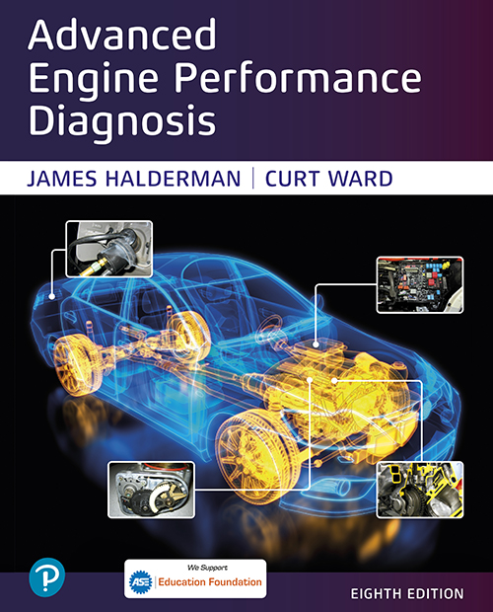

Advanced Engine Performance Diagnosis
Eighth Edition
Chapter 15
Variable Valve Timing and Displacement Systems
Copyright © 2025 Pearson Education, Inc. All Rights Reserved
Notes:
If this PowerPoint presentation contains mathematical equations, you may need to check that your computer has the following installed:
1) Math Type Plugin
2) Math Player (free versions available)
3) NVDA Reader (free versions available)
INSTRUCTOR NOTE: This presentation includes text explanation notes, you can use to teach the course. When in SLIDE SHOW mode, you RIGHT CLICK and select SHOW PRESENTER VIEW, to use the notes.

Slide 2
Learning Objectives
15.1 Explain the purpose and function of variable valve timing (V V T).
15.2 List the steps involved when diagnosing a V V T system.
15.3 Describe how a variable valve timing and lift electronic control (V T E C) system works.
15.4 Explain the operation of variable displacement systems.
15.5 Explain the diagnosis of variable displacement systems.

Slide 3
Variable Valve Timing
Changes the camshaft specifications during different operating modes
The general types of variable valve timing include:
Intake valve timing only
Exhaust valve timing only
Both intake and exhaust valve timing
Operation
The camshaft position actuator oil control valve (O C V) directs oil from the oil feed in the head to the appropriate camshaft position actuator oil passages.

Slide 4
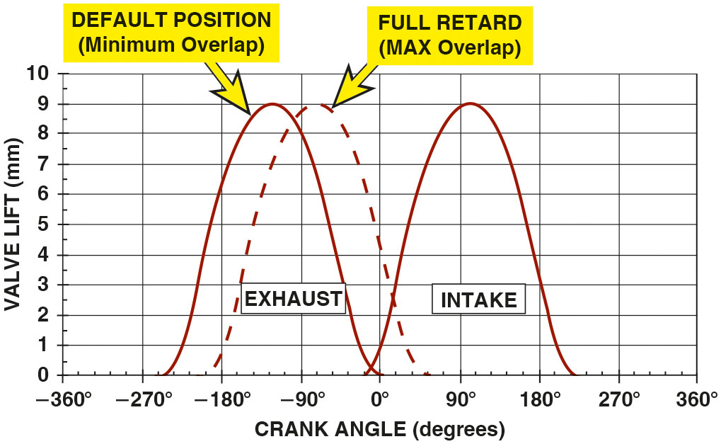
Figure 15.1
Exhaust-Only Timing
The exhaust-only variable cam timing systems allow the overlap period where both valves are open to be changed. The at-rest position provides little valve overlap, whereas the maximum
overlap allows for internal E G R needed to reduce
exhaust
emissions.
Notes:
Exhaust only. An engine that uses V V T on the exhaust only is used to create an E G R affect, thereby eliminating the need for an exhaust gas recirculation (E G R) valve. In this system, the exhaust valve is retarded when the engine is operating at part throttle. This delays the closing of the exhaust valves, which allows exhaust gases to be trapped in the combustion chamber.
Long Description:
The graph has crank angle in degrees from negative 360 to 360 along the x-axis and valve lift in millimeters from 0 to 10 along the y-axis. The curve for exhaust in default position with minimum overlap starts at (negative 250, 0), peaks to (negative 120, 9), and then drops to (0, 0). The curve for exhaust in full retard with maximum overlap starts at (negative 200, 0), peaks to (negative 80, 9), and then drops to (50, 0). The curve for intake starts at (negative 10, 0), peaks to (100, 9), and then drops to (210, 0). All data are approximate.

Slide 5
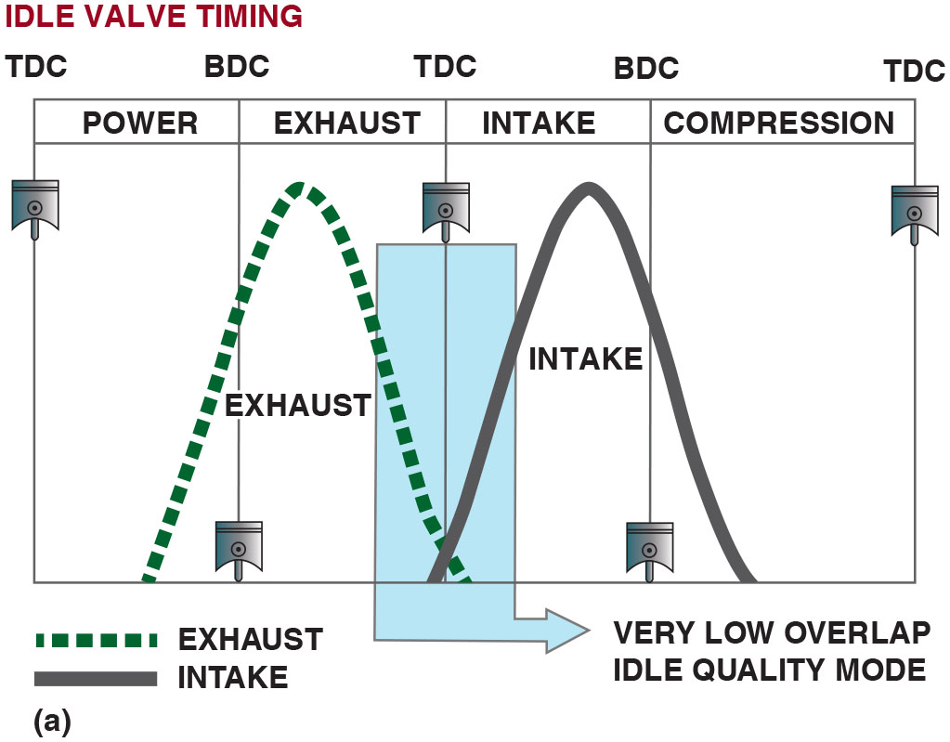
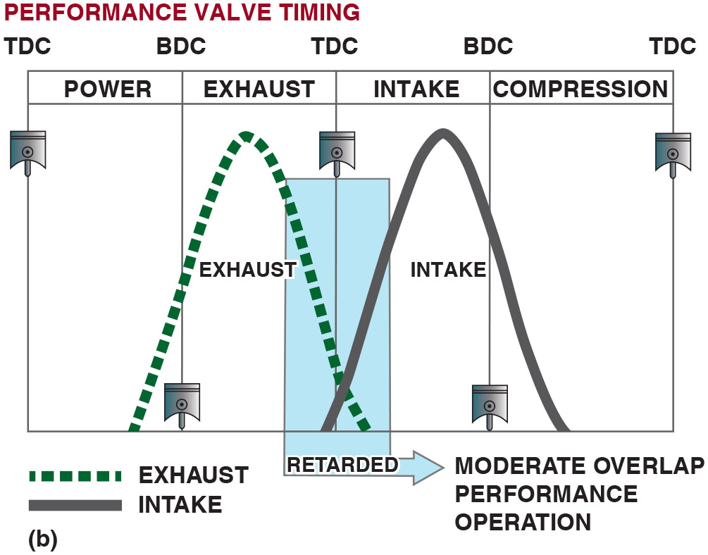
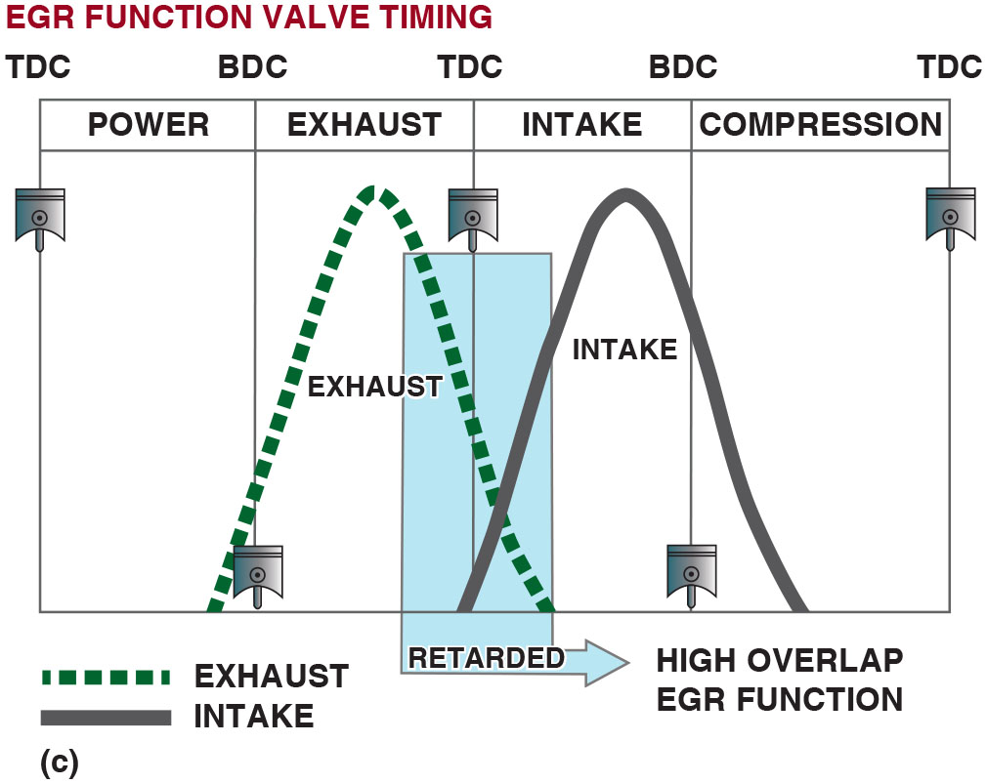
Figure 15.2
No E G R Valve Timing
(a) At engine start, the camshaft timing has little valve overlap, which improves idle quality. (b) During acceleration, the valve overlap is increased to improve engine performance. (c) To reduce
emissions, the valve
timing is changed to trap some of the exhaust gases in the combustion chamber, thereby eliminating the needs for an E G R valve.
Notes:
Long Description 1:
The graph is divided into the following segments, from left to right: Power from T D C to B D C, exhaust from B D C to T D C, intake from T D C to B D C, and compression from B D C to T D C. The exhaust curve starts from power segment, peaks at exhaust segment, and then drops at the start of intake segment. The intake curve starts from the end of exhaust segment, peaks at intake segment, and then drops at compression segment. Both curves show very low overlap in idle quality mode.
Long Description 2:
The graph is divided into the following segments, from left to right: Power from T D C to B D C, exhaust from B D C to T D C, intake from T D C to B D C, and compression from B D C to T D C. The exhaust curve starts from power segment, peaks at exhaust segment, and then drops at the start of intake segment. The intake curve starts from the end of exhaust segment, peaks at intake segment, and then drops at compression segment. Both curves show moderate overlap in performance operation.
Long Description 3:
The graph is divided into the following segments, from left to right: Power from T D C to B D C, exhaust from B D C to T D C, intake from T D C to B D C, and compression from B D C to T D C. The exhaust curve starts from power segment, peaks at exhaust segment, and then drops at the start of intake segment. The intake curve starts from the end of exhaust segment, peaks at intake segment, and then drops at compression segment. Both curves show high overlap in E G R function.

Slide 6
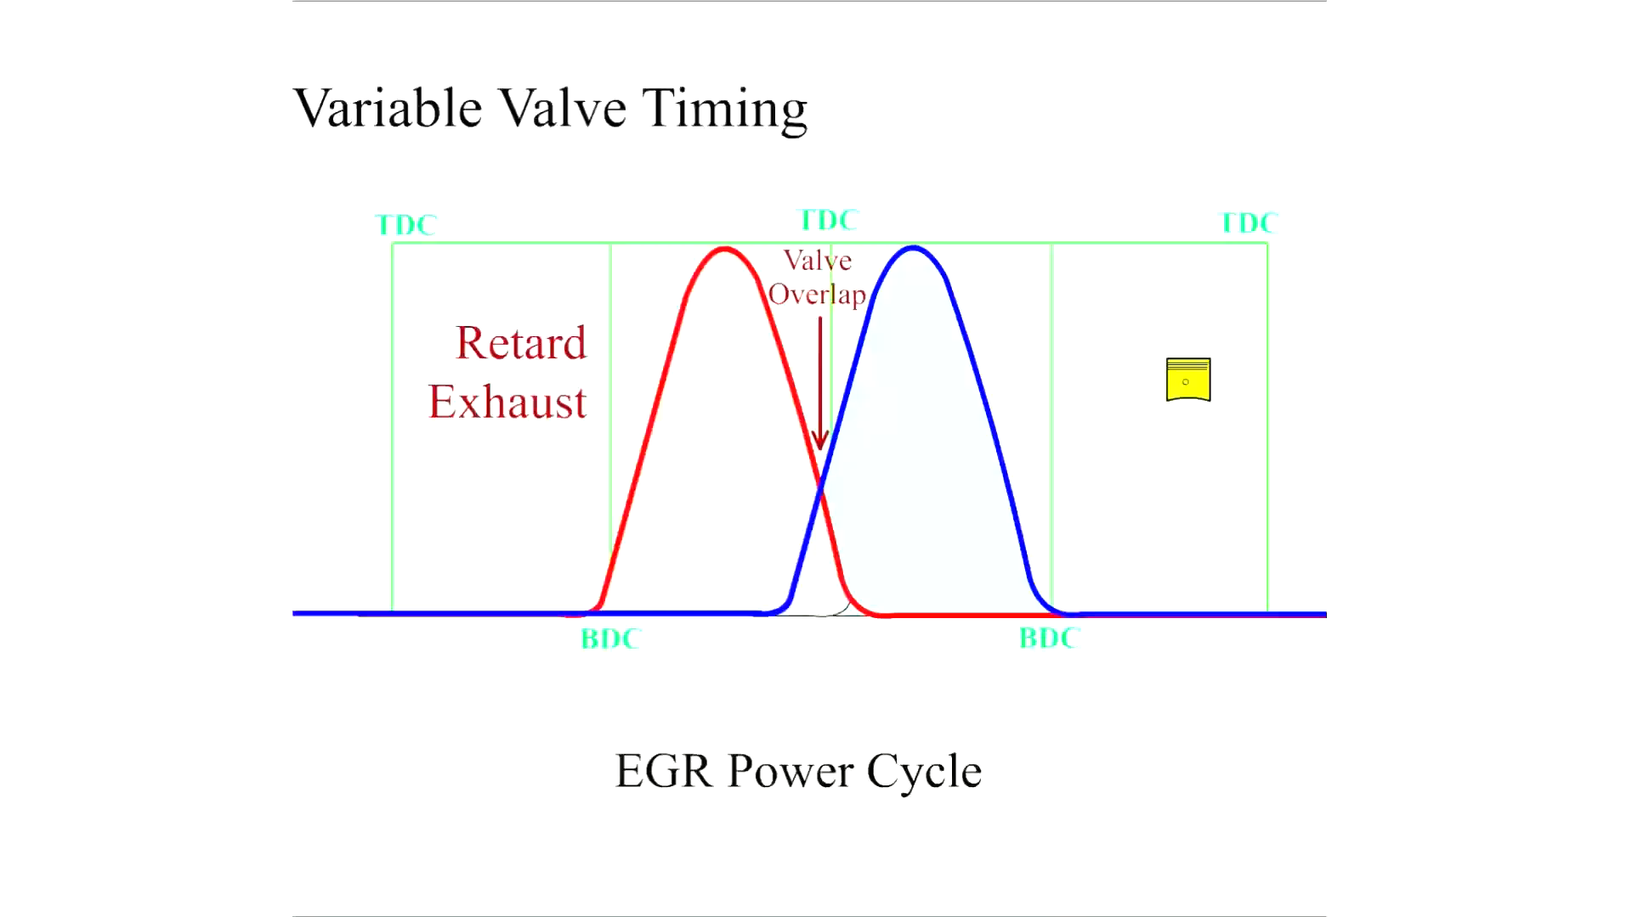
Animation: Variable Valve Timing

Slide 7
Chart 15.1
Intake/Exhaust Phasing
Camshaft Phasing Changed | Purpose
Exhaust cam phasing | Reduces N O subscript x exhaust emissions
Exhaust cam phasing | Increases fuel economy (reduced pumping losses)
Intake cam phasing | Increases low-speed torque
Intake cam phasing | Increases high-speed power
Notes:
By varying the intake camshaft timing, engine performance is improved. By varying the exhaust camshaft timing, the exhaust emissions and fuel consumption are reduced.

Slide 8
Frequently Asked Question: What Are the Various Names Used for Variable Valve Timing Systems?
? Frequently Asked Question
What Are the Various Names Used for Variable Valve Timing Systems? B M W—V A N O S (Variable Nockenwellen Steuerung), Ford—V V T (Variable Valve Timing), G M—D C V C P (Double Continuous Variable Cam Phasing), if used for both intake and exhaust camshafts, Honda—V T E C (Variable valve Timing and lift Electronic Control), Hyundai—M P I C V V T (Multiport Injection Continuously Variable Valve Timing), Mazda—S-V T (Sequential Valve Timing), Mitsubishi—M I V E C C (Mitsubishi Innovative Valve timing Electronic Control system), Nissan—N-V C T T (Nissan Variable Control Timing), Nissan—V V L (Variable Valve Lift), Porsche—Variocam (Variable camshaft timing), Suzuki—V V T (Variable Valve Timing), Subaru—A V C S (Active Valve Control System), Toyota—V V T-i (Variable Valve Timing-intelligent), Toyota—V V T L-i (Variable Valve Timing and Lift-intelligent), Volkswagen—V V T (Variable Valve Timing), and Volvo—V V T (Variable Valve Timing).

Slide 9
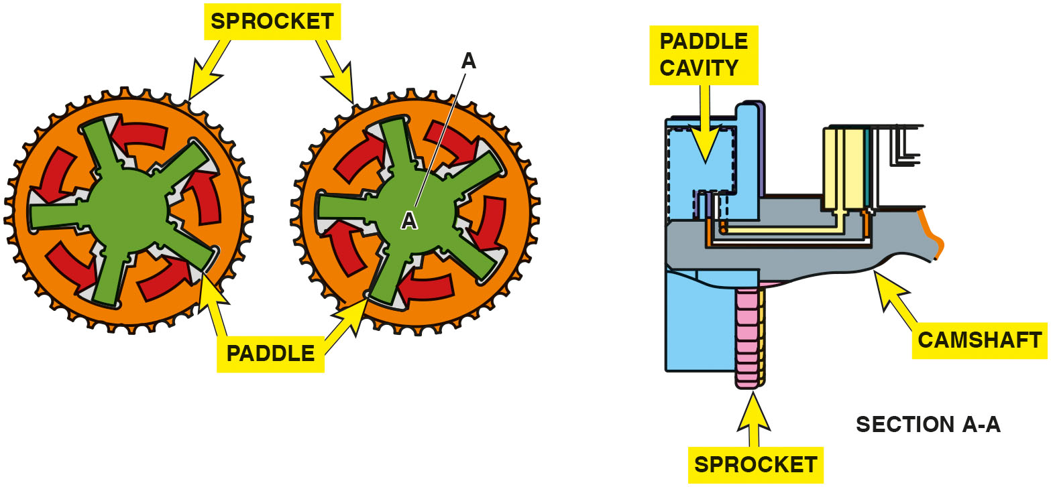
Figure 15.3
Retard and Advance
Camshaft rotation during advance and retard.
Notes:
Long Description:
The illustration shows two sprockets with many teeth and five paddles each; the first sprocket rotates in anti-clockwise direction and the second sprocket rotates in clockwise direction. Section A-A along the radius of a sprocket shows the alignment of paddle cavity, camshaft with two oil passages, and sprocket.

Slide 10
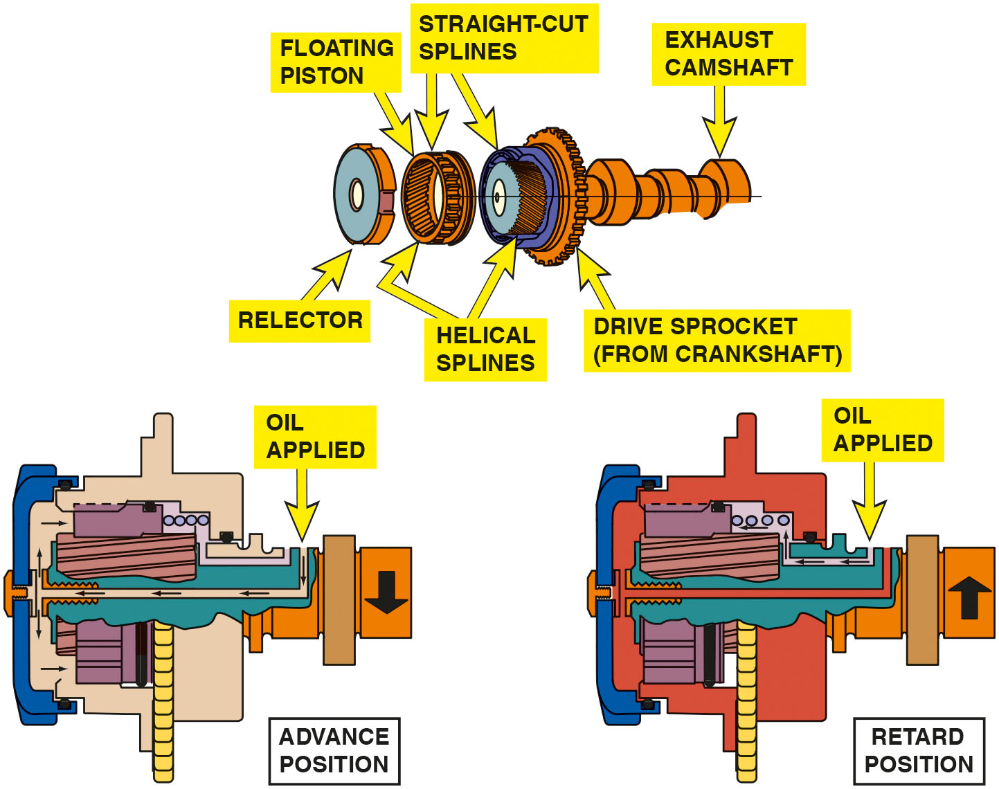
Figure 15.4
Spline Cam Phaser
Notes:
Long Description:
The illustration shows the following parts, from left to right: Reflector, floating piston and drive sprocket from crankshaft with straight-cut and helical splines, and exhaust camshaft. A section of this assembly in advance position shows the camshaft rotating in anticlockwise direction; oil is applied in the external passage, which exerts pressure on the reflector and pushes the floating piston to the drive sprocket. A section this assembly shows the camshaft rotating in clockwise direction; Oil is applied in the internal passage, which pulls the floating piston away from the drive sprocket.

Slide 11
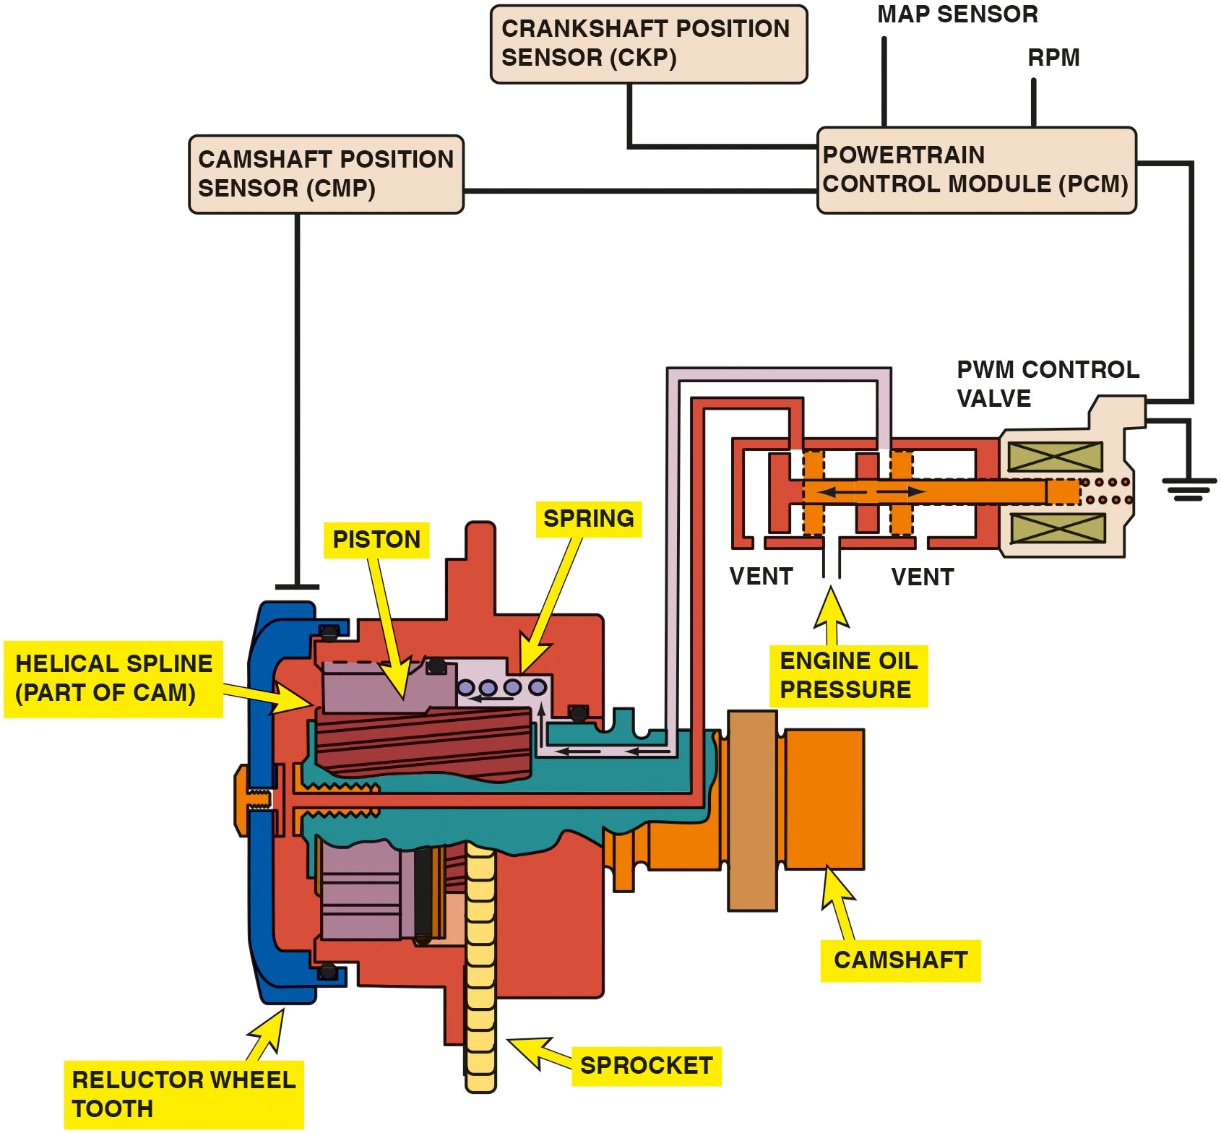
Figure 15.5
Control Valve
A spline phaser showing the control valve and how it works internally. Note that the P C M uses the engine speed (R P M), crankshaft position (C K P) sensor, and the camshaft position (C M P) sensor to monitor and command the camshaft for maximum power and lowest possible exhaust emissions.
Notes:
Long Description:
The spline phaser houses a piston connected to a spring, a helical spline as a part of cam, reflector wheel tooth, and a sprocket that is connected to the camshaft. The spline phaser has a P W M control valve with vent to regulate engine oil pressure, which is further connected to poer train control module or P C M with map sensor and R P M, crankshaft position sensor or C K P, and camshaft position sensor or C M P.

Slide 12
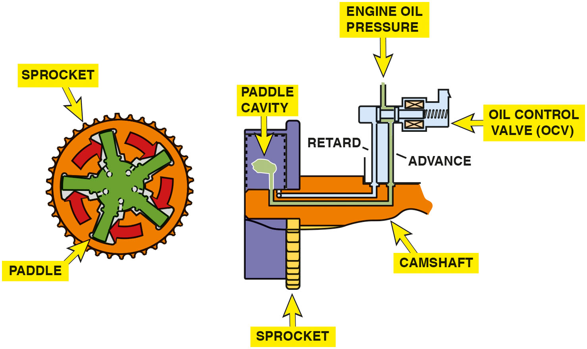
Figure 15.6
Vane Phaser
A vane phaser is used to move the camshaft using changes of oil pressure from the oil control valve.
Notes:
Long Description:
The first illustration shows a sprocket with many teeth and five paddles rotating in clockwise direction. The second illustration shows a vane phaser having a sprocket, paddle cavity, camshaft, oil control valve or O C V to regulate engine oil pressure. In advance position, oil is applied in the outer passage, which enters the paddle cavity. In retard position, oil is applied in the inner passage.

Slide 13
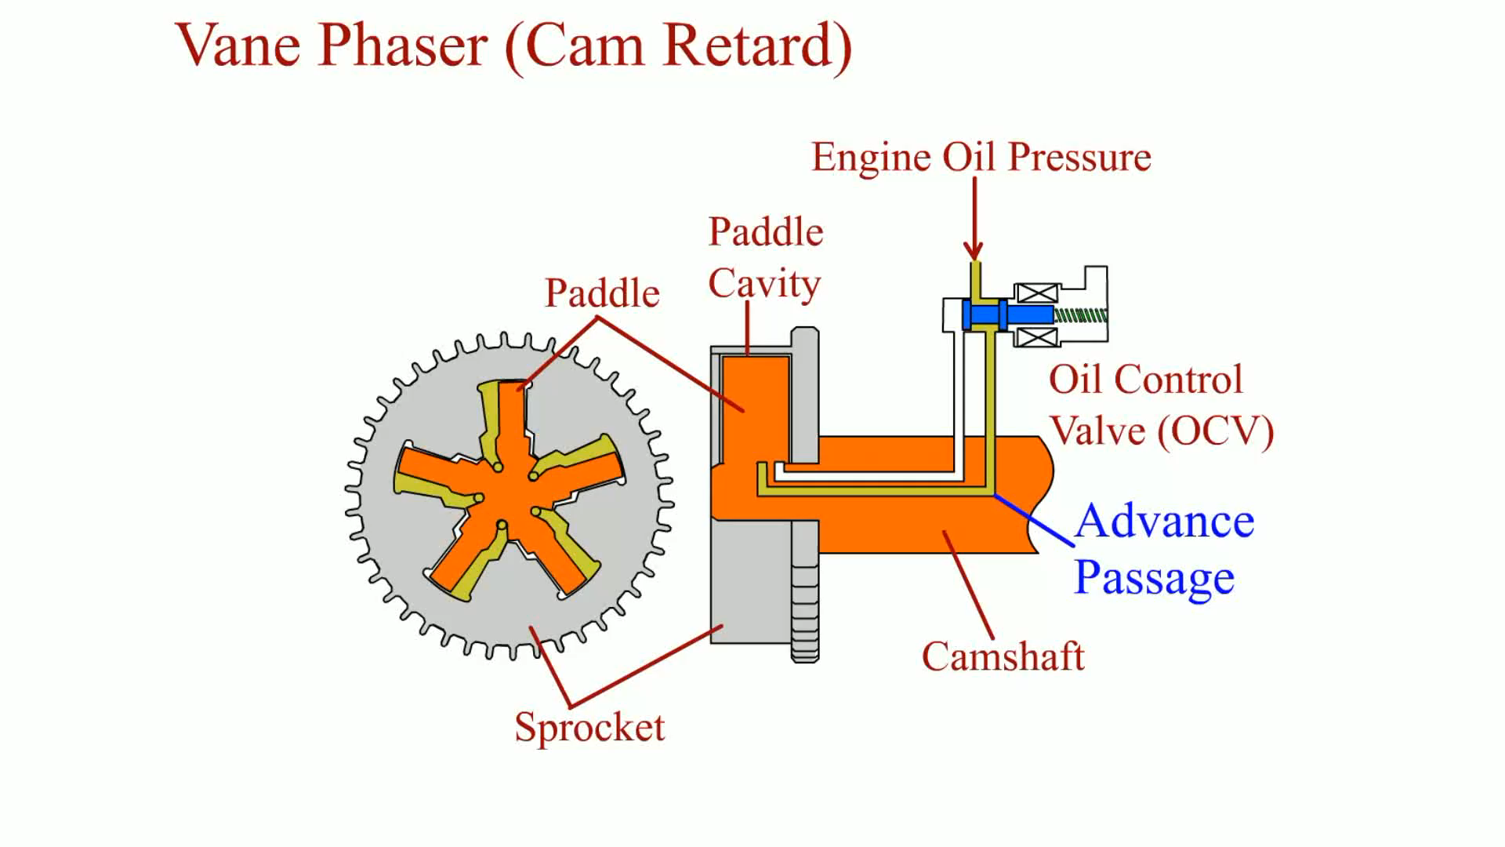
Animation: Vane Phaser (Cam Retard)

Slide 14
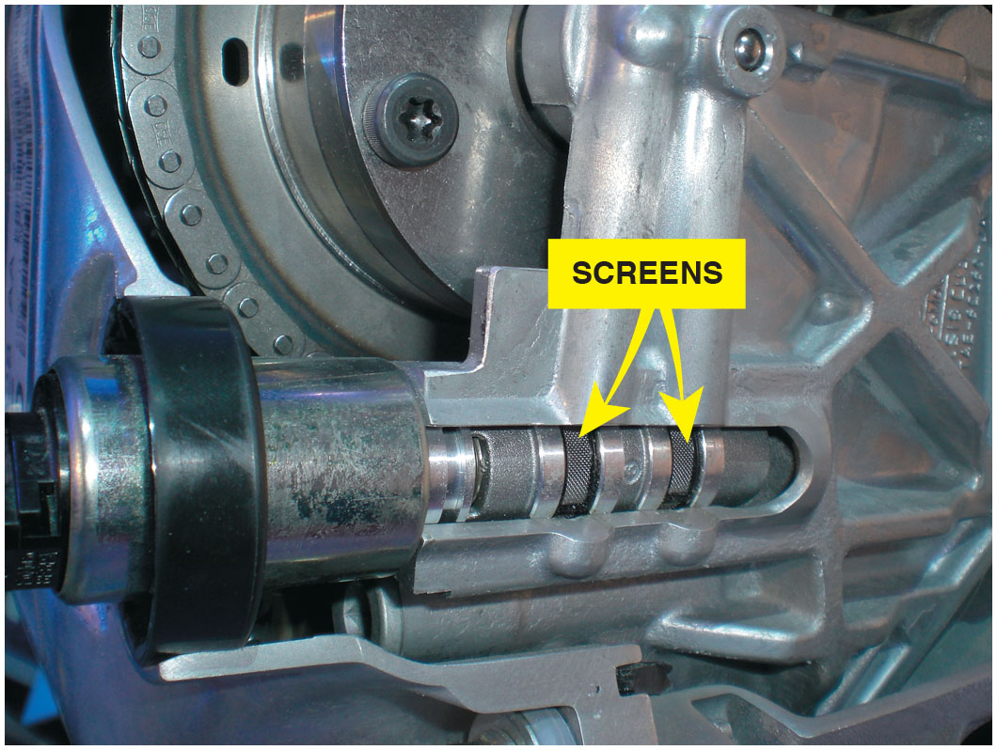
Figure 15.7
Screens
The screen(s) protects the solenoid valve from dirt and debris that can cause the valve to stick. This fault can set a P0017 diagnostic trouble code (crankshaft position–camshaft position correlation error).
Notes:
TECH TIP: Check the Screen on the Control Valve If There Are Problems: If a N O x emission failure at a state inspection occurs or a diagnostic trouble code is set related to the cam timing, remove the control valve and check for a clogged oil screen. A lack of regular oil changes can cause the screen to become clogged, thereby preventing proper operation. A rough idle is a common complaint because the spring may not be able to return the camshaft to the idle position after a long highway trip. ● See Figure 15.7.

Slide 15
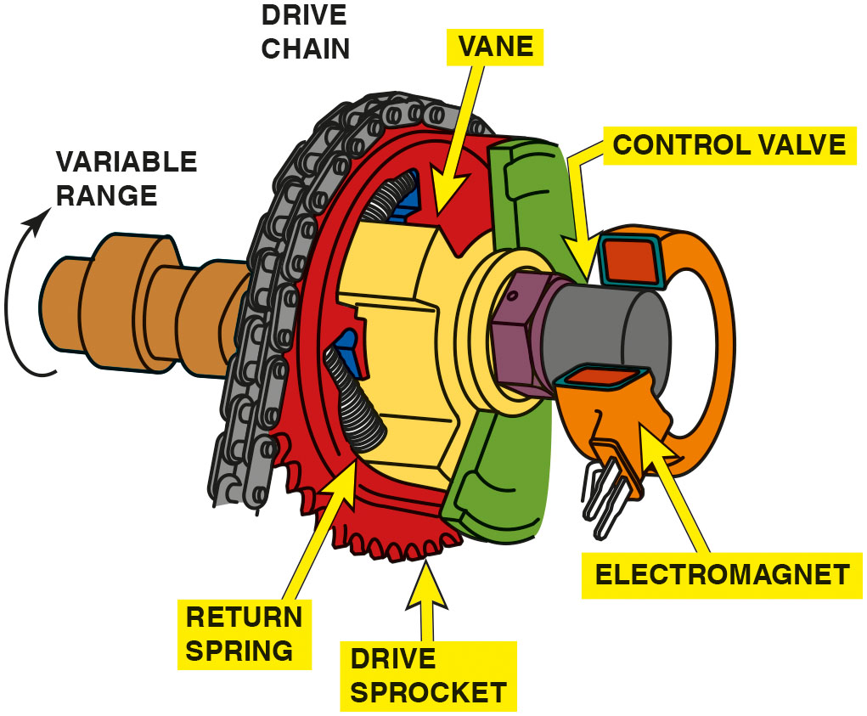
Figure 15.8
Magnetically Controlled
A magnetically controlled vane phaser.
Notes:
The following occurs when the pulse width is changed:
■ 0% pulse width. The oil is directed to the advance chamber of the exhaust camshaft actuator and retard chamber of the intake camshaft activator.
■ 50% pulse width. The P C M is holding the cam in the calculated position based on engine R P M and load. At 50% pulse width, the oil flow through the phaser drops to zero.
● See Figure 15.9.
■ 100% pulse width. The oil is directed to the retard chamber of the exhaust camshaft actuator and the advance chamber of the intake camshaft actuator.
Long Description:
The illustration shows a drive sprocket attached to a return spring and vane. The vane has an electromagnet installed around a control valve. A drive chain circumscribes the sprocket which ia attached to a variable range of rotating camshaft.

Slide 16
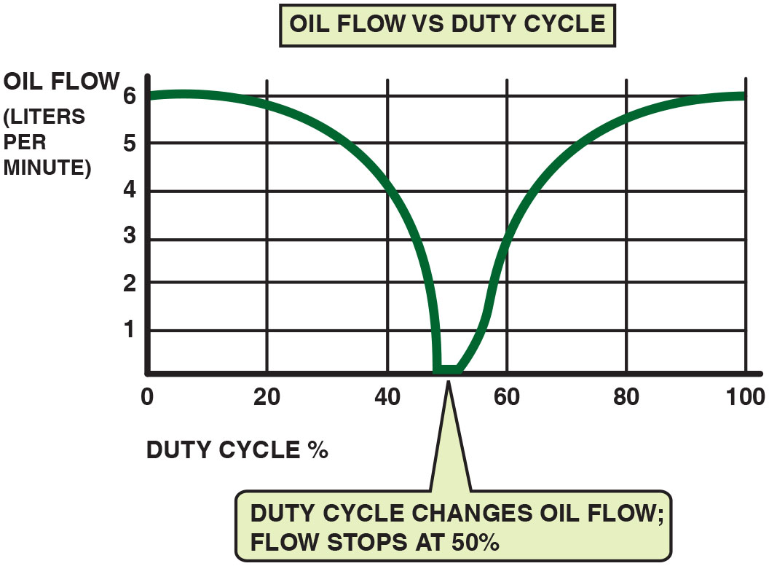
Figure 15.9
50% Duty Cycle
When the P C M commands 50% duty cycle, the oil flow through the phaser drops to zero.
Notes:
Long Description:
The graph of oil flow versus duty cycle has duty cycle in percentage from 0 to 100 along the x-axis and oil flow in liters per minute from 0 to 6 along the y-axis. A curve starts at (0, 6), drops to (50, 0), and then rises again to (100, 6). The graph implies that duty cycle changes oil flow and the flow stops at 50 percent.

Slide 17
Frequently Asked Question: What Happens When the Engine Stops?
? Frequently Asked Question
What Happens When the Engine Stops? When the engine stops, the oil pressure drops to zero and a spring-loaded locking pin is used to keep the camshaft locked to prevent noise at engine start. When the engine starts, oil pressure releases the locking pin.

Slide 18
Diagnostic Steps
STEP 1 Verify customer concern.
STEP 2 Perform a thorough visual inspection.
STEP 3 Check for stored D T C s.
STEP 4 Use a scan tool and check for duty cycle.
STEP 5 Check solenoid for proper resistance.
STEP 6 Check for proper engine oil pressure.
Notes:
DIAGNOSTIC STEPS
The diagnostic procedure as specified by most vehicle manufacturers usually includes the following steps:
STEP 1 Verify the customer concern. This will usually be a “check engine light” (malfunction indicator light or M I L), as the engine performance effects would be minor under most operating conditions.
STEP 2 Perform a thorough visual inspection including checking the oil for proper level and condition.
STEP 3 Check for stored diagnostic trouble codes (D T C s). Typical V V T-related D T C s include the following:
P0011—Intake cam position is over advanced bank 1 P0012—Intake cam position is over retarded bank 1 P0013—Exhaust camshaft position actuator P0014—Exhaust camshaft too far advanced P0021—Intake cam position is over advanced bank 2 P0022—Intake cam position is over retarded bank 2
STEP 4 Use a scan tool and check for duty cycle on the cam phase solenoid while operating the vehicle at a steady road speed. The commanded pulse width should be 50%. If the pulse width is not 50%, the P C M is trying to move the phaser to its commanded position and the phaser has not reacted properly. A P W M signal of higher or lower than 50% usually indicates a stuck phaser assembly.
STEP 5 Check the solenoid for proper resistance. If a scan tool with bidirectional control is available, connect an am- meter and measure the current as the solenoid is being commanded on by the scan tool.
STEP 6 Check for proper engine oil pressure. Low oil pressure or restricted flow to the cam phaser can be the cause of
many D T C s.

Slide 19
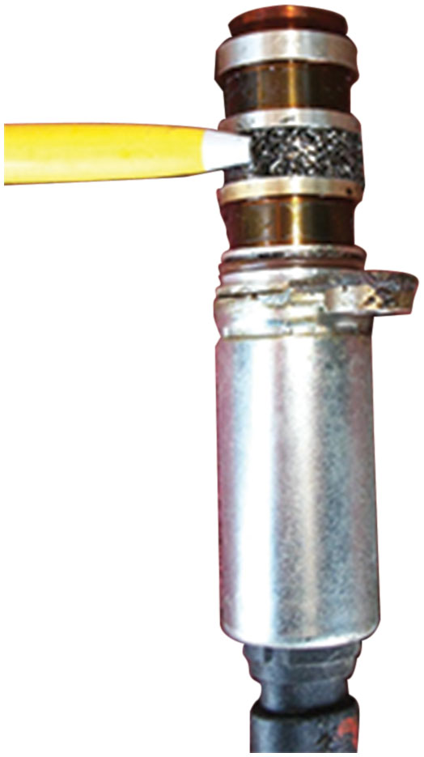
Figure 15.10
Case Study
The exhaust camshaft actuator solenoid taken from a Chevrolet 2.4-liter four-cylinder showing the filter screen clogged with metal shavings.
Notes:
CASE STUDY: The Case of the Chevrolet Equinox
The owner of a Chevrolet Equinox complained that the engine was making noise and the “check engine” light on the dash was on. The service technician used a scan tool and retrieved two diagnostic trouble codes:
P0014—Exhaust cam position sensor system performance
P0013—Camshaft position actuator circuit open
The service technician removed the exhaust cam actuator solenoid and found that the filter screen was covered with metal shavings. ● Figure 15.9.
The technician recommended replacing the engine due to the amount of metal shavings and a new camshaft actuator solenoid. The customer approved the repair, and this solved both the engine noise and eliminated the check engine light after the installation of the replacement engine, and after that the D T C s were cleared.
Summary:
Complaint—The owner complained of a noisy engine and the “check engine” light on the dash was on.
Cause—Major engine wear caused the noise and the wear metal caused the exhaust camshaft actuator solenoid filter screen to become clogged, setting a diagnostic trouble code and lighting the check engine light.
Correction—The engine was replaced and the trouble code cleared.

Slide 20
Variable Lift and Cylinder Deactivation Systems
Variable Lift
This system uses two different camshafts for low and high R P M.
Engine oil controlled
Cylinder Deactivation
Some engines are designed to operate on four of eight cylinders, or three of six cylinders, during low load conditions to improve fuel economy.
The system uses two-stage hydraulic valve lifters.
Notes:
Variable camshafts such as the system used by Honda/Acura are called variable valve timing and lift electronic control (V T E C). This system uses two different camshafts for low and high R P M. When the engine is operating at idle and speeds below about 4000 R P M, the valves are opened by cam- shafts that are optimized by maximum torque and fuel economy. When engine speed reaches a predetermined speed, depending on the exact make and model, the computer turns on a solenoid, which opens a spool valve. When the spool valve opens, the engine oil pressure pushes against pins that lock the three intake rocker arms together. With the rocker arms lashed, the valves must follow the profile of the high R P M cam lobe in the center. This process of switching from the low-speed camshaft profile to the high-speed profile takes about 100 milliseconds (0.1 sec). ● See Figures 15.11 and 15.12.

Slide 21
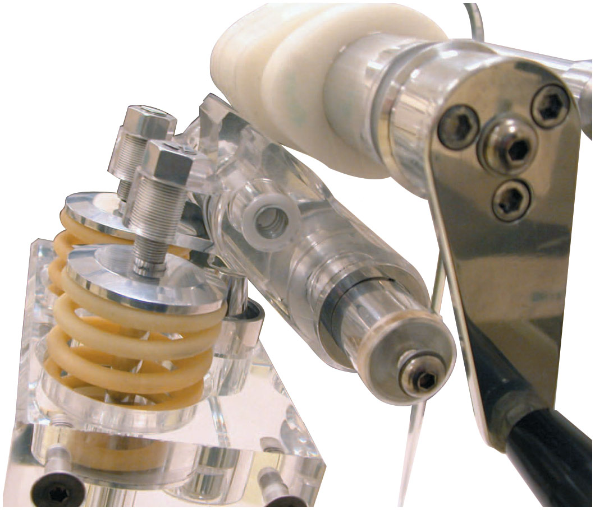
Figure 15.11
Honda V T E C
A plastic mock-up of a Honda V T E C system that uses two different camshaft profiles: one for low-speed engine operation and the other for high-speed operation.

Slide 22
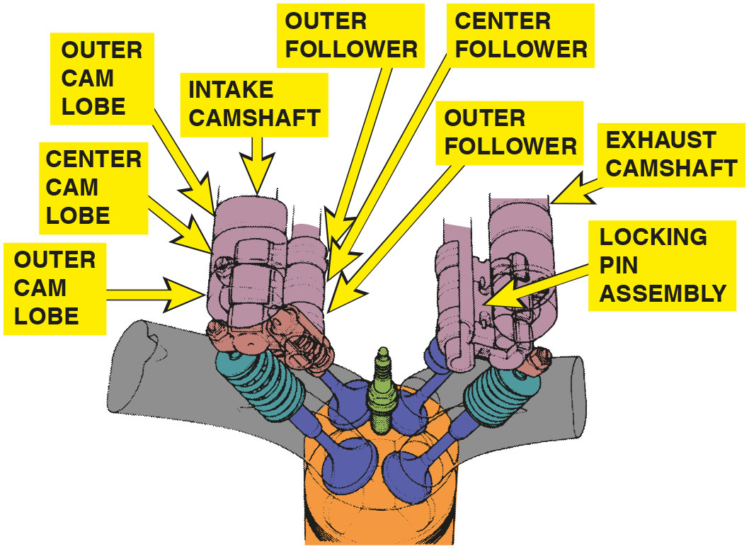
Figure 15.12
Honda V T E C
Engine oil pressure is used to switch cam lobes on a V T E C system.
Notes:
Long Description:
The intake camshaft consists of a center cam lobe flanked above and below by outer cam lobe and a center follower flanked above and below by outer follower. The exhaust camshaft has a similar setup with locking pin assembly.

Slide 23
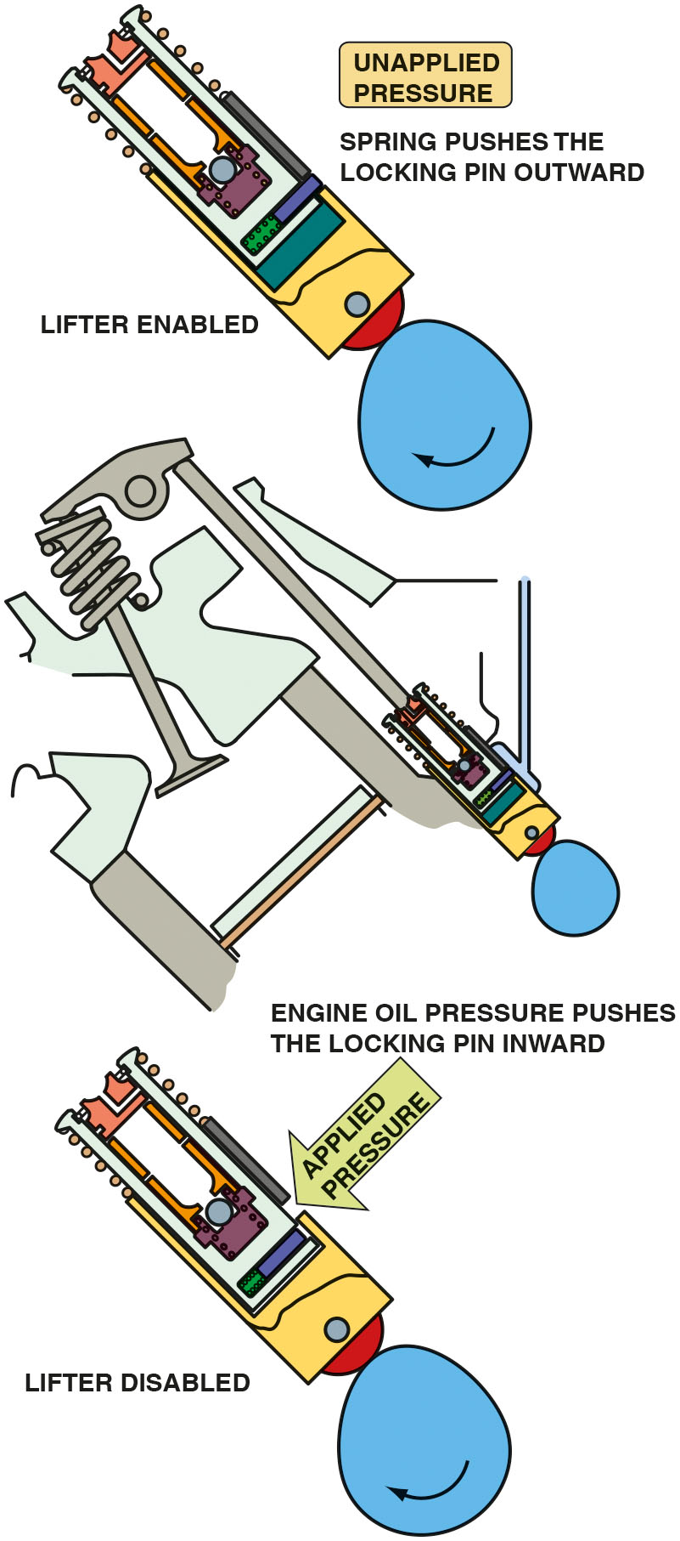
Figure 15.13
Oil Pressure
Oil pressure applied to the locking pin causes the inside of the lifter to freely move inside the outer shell of the lifter, thereby keeping the valve closed.
Notes:
CASE STUDY The Case of the Wrong Oil
A Dodge Durango was in the shop for routine service, including a tire rotation and an oil change.
Shortly after, the customer returned and stated that the “check engine” light was on. A scan tool was used to retrieve any diagnostic trouble codes. A P0521, “oil pressure not reaching specified value at 1250 R P M” was set. A check of service information showed that this code could be set if the incorrect viscosity engine oil was used. The shop had used S A E 10W-30, but the 5.7-liter Hemi V-8 with multiple displacement system (M D S) required S A E 5W-20 oil. The correct oil was installed and the D T C cleared.
A thorough test-drive confirmed that the fault had been corrected and the shop learned that the proper viscosity oil is important to use in all vehicles.
Summary:
Complaint—The check engine light was on after an oil change.
Cause—Incorrect viscosity oil was used.
Correction—The oil was replaced with the specified viscosity and the D T C was cleared.
Long Description:
The illustration shows an engine with a hydraulic valve lifter operated by a cam. Under unapplied pressure, spring pushes the locking pin outward and lifter is enabled. Under applied pressure, the locking pin is pushed inward and lifter is disabled.

Slide 24
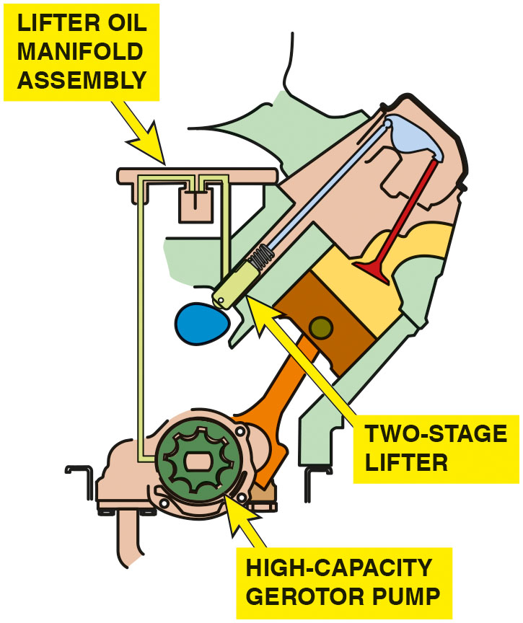
Figure 15.14
Fuel Management
Active fuel management includes many different components and changes to the oiling system, which makes routine oil changes even more important on engines equipped with this system.

Slide 25
Question 1
How does variable valve timing help improve engine operation and reduce emissions?

Slide 26
Answer 1
By changing the timing of the opening and closing of the intake and exhaust valves, the level of N O x emissions can be lowered.

Slide 27
Summary (1 of 2)
Variable valve timing used to improve engine performance and reduce exhaust emissions.
Intake cam phasing is used to improve low-speed torque and high-speed power.
Exhaust cam phasing used to reduce exhaust emissions and increase fuel economy by reducing pumping losses.
Variable valve timing on overhead valve, cam-in-block engines used to reduce NOx emissions.
Variable valve timing faults are often result of extended oil change intervals, which can clog the screen on cam phaser.
As a result of clogged screen, oil cannot flow to and adjust valve timing, thereby setting valve-timing-related D T C s.

Slide 28
Summary (2 of 2)
Oil flow to phasers is controlled by P C M. If a 50% duty cycle is shown on a scan tool, the phaser has reached the commanded position.
If cycle is other than 50%, there is a fault in system because cam phaser not able to reach position.
Variable valve timing and lift electronic control (V T E C) is used on Honda/Acura vehicles to improve performance.
Control of variable valve timing (V V T) solenoid can be either ground side switching or power side switching.
Common variable valve timing diagnostic trouble codes include P0011, P0021, P0012, and P0022.
Cylinder deactivation systems improve fuel economy by disabling half of the cylinders during certain driving conditions, such as steady speed cruising.

Slide 29
Animation and Video Library Links (Must have an internet connection and active Haldeman subscription)
Animation Library: (A8) Engine Performance Animations
Video Library: (A8) Engine Performance Videos

Slide 30

Copyright
This work is protected by United States copyright laws and is provided solely for the use of instructors in teaching their courses and assessing student learning. Dissemination or sale of any part of this work (including on the World Wide Web) will destroy the integrity of the work and is not permitted. The work and materials from it should never be made available to students except by instructors using the accompanying text in their classes. All recipients of this work are expected to abide by these restrictions and to honor the intended pedagogical purposes and the needs of other instructors who rely on these materials.

