Slide 1


Advanced Engine Performance Diagnosis
Eighth Edition
Chapter 14
Engine and Misfire Diagnosis
Copyright © 2025 Pearson Education, Inc. All Rights Reserved
Notes:
If this PowerPoint presentation contains mathematical equations, you may need to check that your computer has the following installed:
1) Math Type Plugin
2) Math Player (free versions available)
3) NVDA Reader (free versions available)
INSTRUCTOR NOTE: This presentation includes text explanation notes, you can use to teach the course. When in SLIDE SHOW mode, you RIGHT CLICK and select SHOW PRESENTER VIEW, to use the notes.

Slide 2
Objectives (1 of 2)
14.1 List typical engine mechanical-related complaints.
14.2 Discuss how to diagnose engine operation problems using visual checks, engine noise, engine smoke, and oil pressure testing.
14.3 Describe how to perform visual inspections.
14.4 Explain how to perform engine noise diagnosis.
14.5 Explain how to perform an oil pressure test.
14.6 List the possible causes of an engine misfire.
14.7 Describe how to perform a cylinder power balance, cylinder contribution test, and cylinder pressure testing.

Slide 3
Objectives (2 of 2)
14.8 Describe how to perform dry, wet, and running compression tests.
14.9 Explain how to perform a cylinder leakage test.
14.10 Discuss vacuum testing to determine engine condition.
14.11 Explain how to interpret vacuum waveforms.
14.12 Describe how to test for excessive exhaust system back pressure.
14.13 Explain how to diagnose head gasket failure.
14.14 Describe how to diagnose a head gasket failure.

Slide 4
Engine-Related Complaints
Excessive oil consumption
Engine misfiring
Loss of power
Smoke from the engine or exhaust
Engine noise

Slide 5
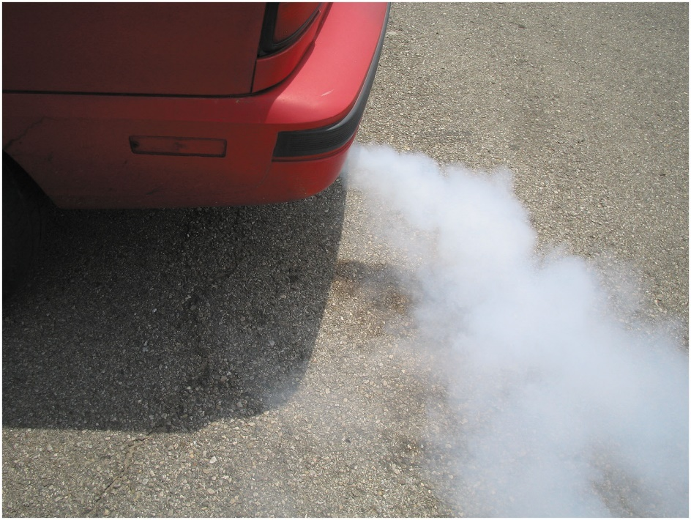
Figure 14.1
Blown or Defective Cylinder Head Gasket
White steam is usually an indication of a blown (defective) cylinder head gasket that allows engine coolant to flow into the combustion chamber where it is turned to steam.

Slide 6
Visual Checks (1 of 3)
Oil Level and Condition
Oil should be to the proper level.
Oil condition (check for abnormal color or odor).

Slide 7
Visual Checks (2 of 3)
Coolant Level and Condition
The coolant level in coolant recovery container should be within limits indicated on overflow bottle. If this level is too low or coolant recovery container is empty, check level of coolant in radiator (only when cool) and also check operation of the pressure cap.
Coolant checked with a hydrometer or refractometer for boiling and freezing temperatures. This test indicates if concentration of antifreeze is sufficient for proper protection.

Slide 8
Visual Checks (3 of 3)
Coolant Level and Condition
Pressure-test cooling system and look for leakage. Coolant leakage can often be seen around hoses or cooling system components because it will often cause:
a. Grayish white stain
b. Rusty stain
c. Dye stains from antifreeze (red, orange, green, or yellow depending on the type of coolant)
Check for cool areas of radiator indicating clogged sections.
Check operation and condition of fan clutch, electric fan, and coolant pump drive belt.

Slide 9
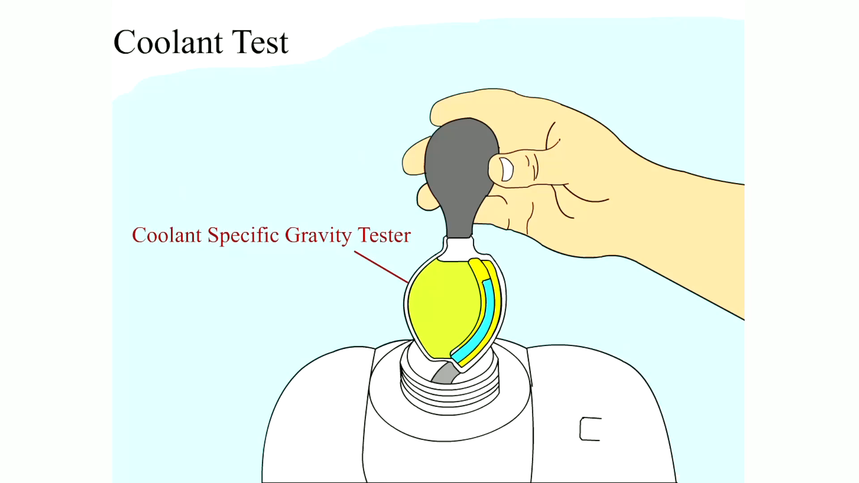
Animation: Coolant Test

Slide 10
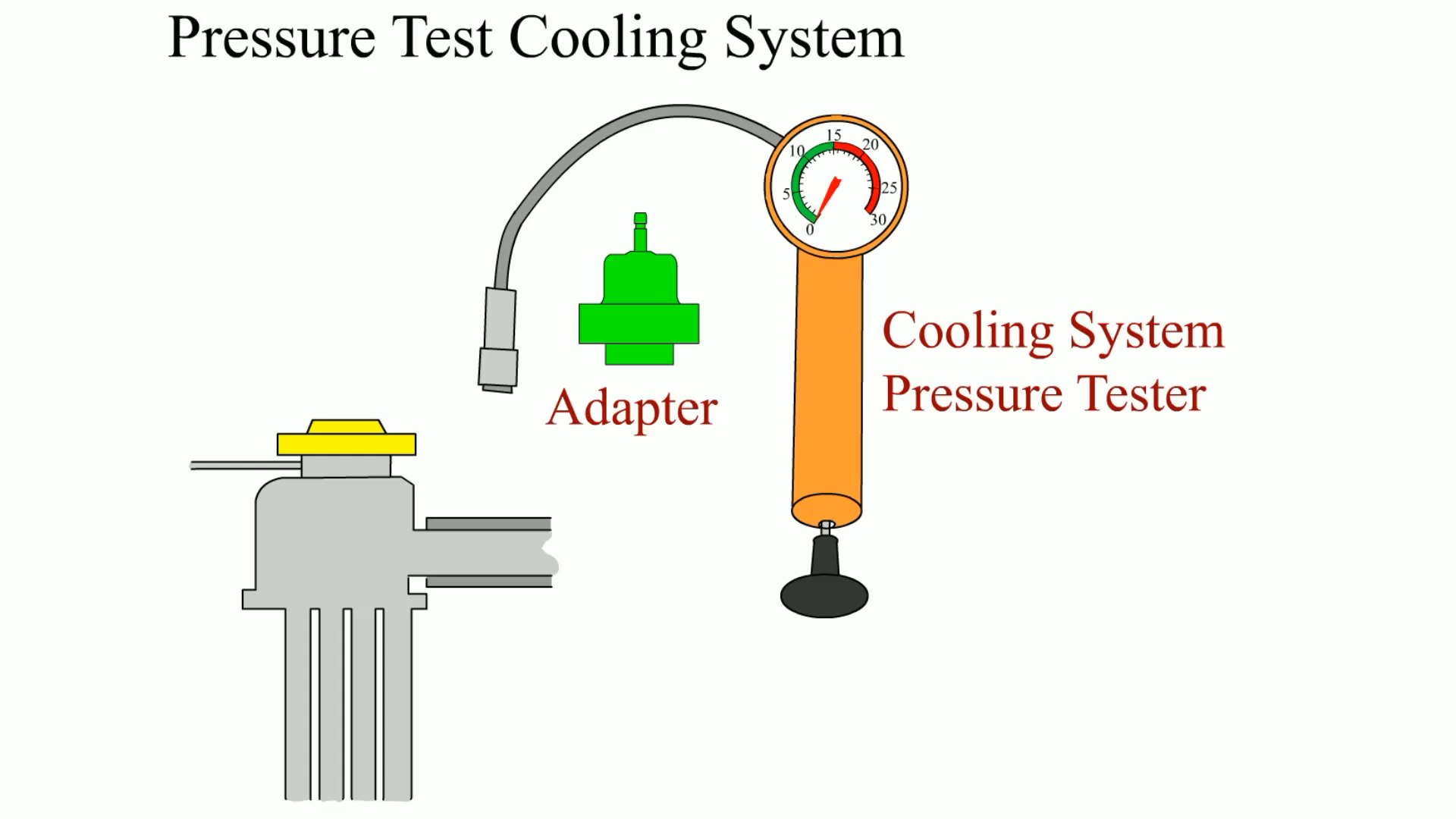
Animation: Pressure Test Cooling System

Slide 11
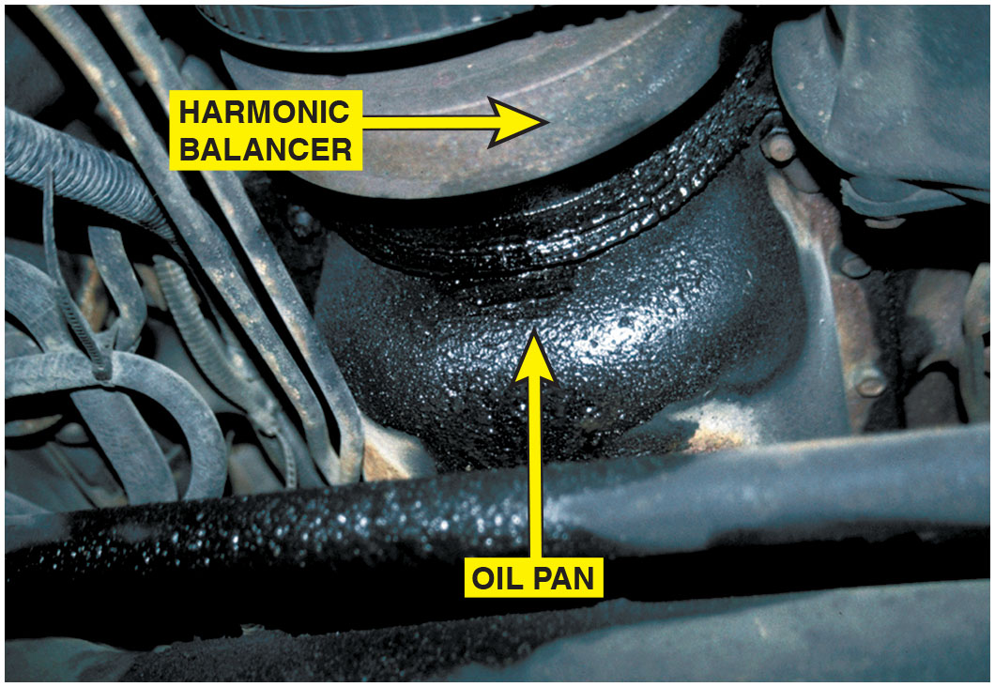
Figure 14.2
Oil Leaks
What looks like an oil pan gasket leak can be a valve or cam cover gasket leak. Always look for the highest most forward place that looks wet as oil always tends to move downward due to gravity and rearward due to vehicle movement.
Notes:
Oil leaks can lead to severe engine damage if the resulting low oil level is not corrected. Besides causing an oily mess where the vehicle is parked, the oil leak can cause blue smoke to occur under the hood as leaking oil drips on the exhaust system.

Slide 12
Engine Noise Diagnosis (1 of 3)
Valves clicking. lack of oil to the lifters. The noise is most noticeable at idle when oil pressure is the lowest. It can also be due to a fault in valve train.
Torque converter. attaching bolts or nuts may be loose on flex plate and cause a deep knocking noise that is often thought to be main or rod bearing-related. This noise is most noticeable at idle or when there is no load
Cracked flex plate. noise of a cracked flex plate is often mistaken for a rod or main bearing noise.
Loose or defective drive belts or tensioners. If an accessory drive belt is loose or defective, flopping noise often sounds similar to a bearing knock.

Slide 13
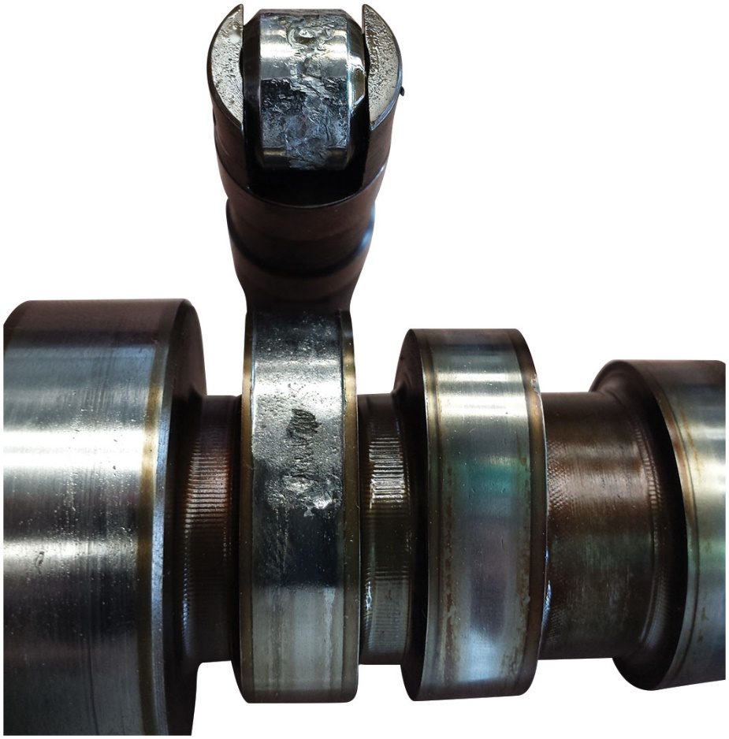
Figure 14.3
Engine Noise Roller Lifter
The weird sounding engine noise was finally found to be a damaged roller lifter and camshaft.

Slide 14
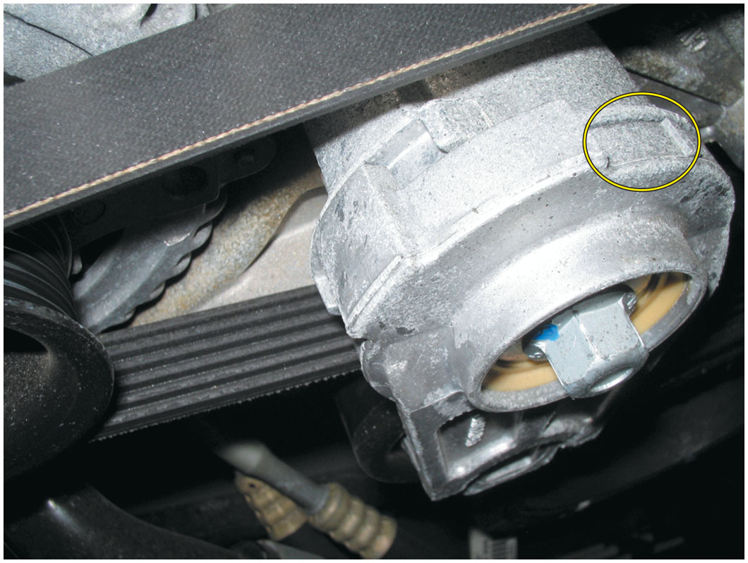
Figure 14.4
Belt Tensioner Noise
An accessory belt tensioner. Most tensioners have a mark that indicates normal operating location. If the belt has stretched, this indicator mark will be outside of the normal range. Anything wrong with the belt or tensioner can cause noise.

Slide 15
Engine Noise Diagnosis (2 of 3)
Piston pin knock. not affected by load on the cylinder. If clearance is too great, a double knock noise is heard when engine idles. If disabling cylinders one at a time does not change sound, then a defective piston pin could be the cause.
Piston slap. A piston slap is usually caused by an undersized or improperly shaped piston or oversized cylinder bore. A piston slap is most noticeable when engine is cold and tends to decrease or stop making noise as piston expands during engine operation.
Timing chain noise. excessively loose timing chain can cause a severe knocking noise when chain hits timing chain cover. This noise can often sound like a rod bearing knock.

Slide 16
Engine Noise Diagnosis (3 of 3)
Rod bearing noise. defective rod bearing is usually load sensitive and changes in intensity as load increases and decreases. Detected by grounding out spark plugs one cylinder at a time. If knocking noise decreases or is eliminated when a particular cylinder is grounded (disabled), then grounded cylinder is one from which noise is originating.
Main bearing knock. main bearing knock often cannot be isolated to a particular cylinder. The sound can vary in intensity and may disappear at times depending on engine load.
Regardless of type of loud knocking noise, after external causes of knocking noise have been eliminated, the engine should be disassembled and carefully inspected to determine cause.

Slide 17
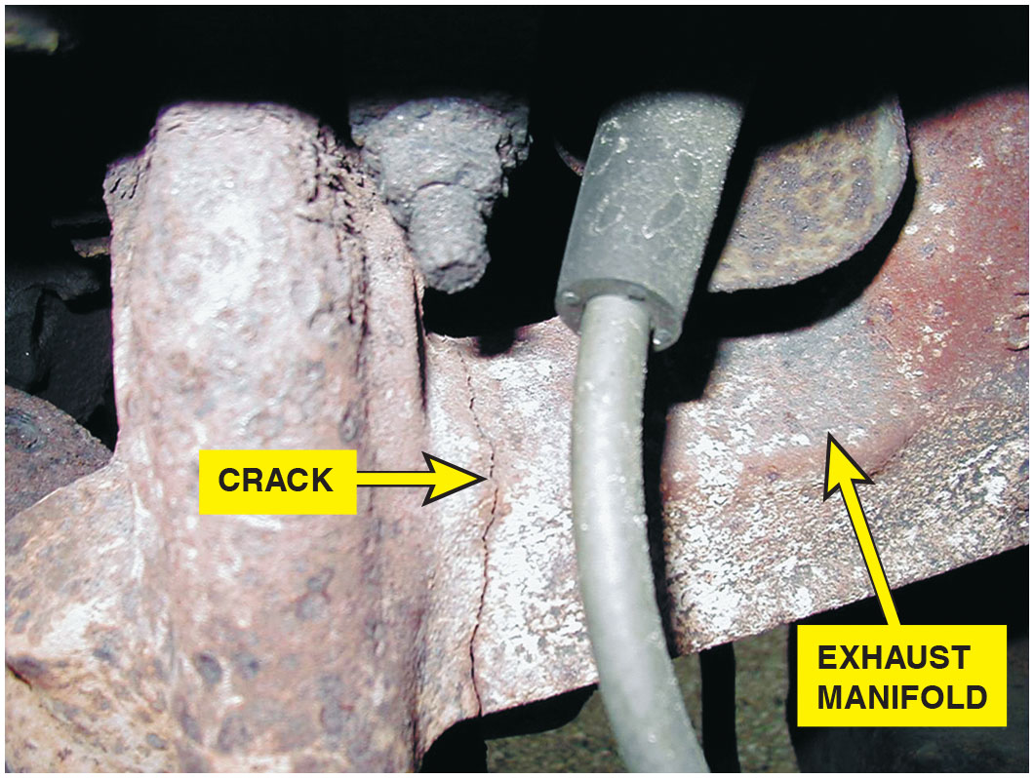
Figure 14.5
Clicking Sound
A cracked exhaust manifold can make a clicking sound that is often difficult to find.

Slide 18
Oil Pressure Testing (1 of 2)
Test Procedure
STEP 1: Operate engine until normal operating temperature
STEP 2: engine off, remove oil pressure sending unit or sender, usually located near the oil filter. Thread an oil pressure gauge into the threaded hole.
STEP 3: Start engine, observe gauge. Record oil pressure at idle speed and 2500 R P M
Most recommend a minimum oil pressure of 10 P S I per 1000 R P M. At 2500 R P M, oil pressure should be at least 25 P S I
Always compare test results with specs. Besides engine bearing wear, other possible causes for low oil pressure include:
Low oil level
Diluted oil
Worn oil pump or stuck oil pressure relief valve
Restricted oil pump pickup screen

Slide 19
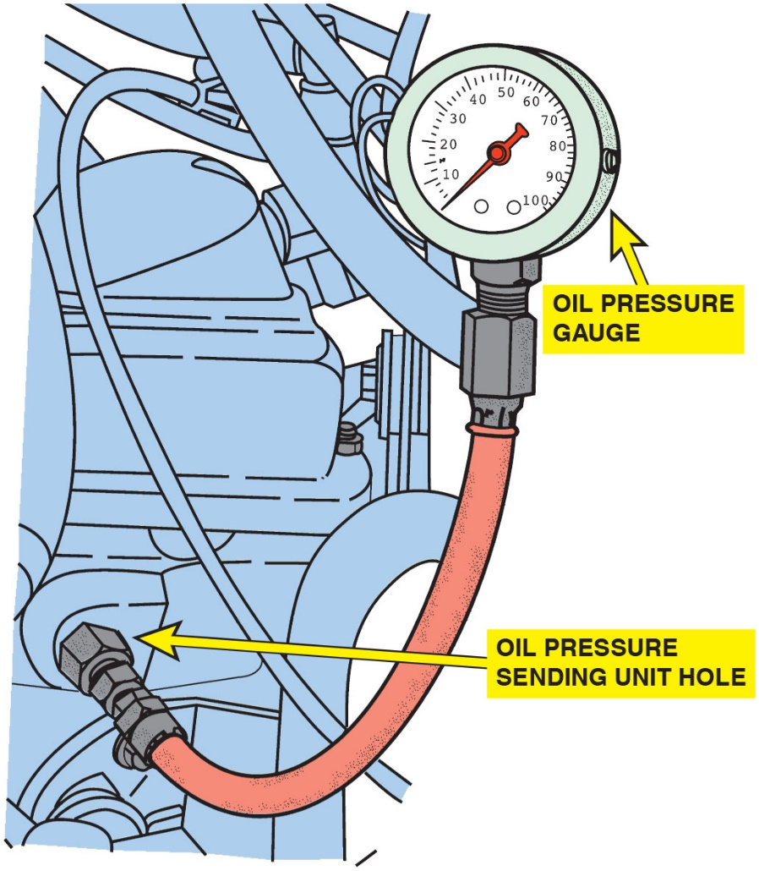
Figure 14.6
Measuring Engine Oil Pressure
To measure engine oil pressure, remove the oil pressure sending (sender) unit usually located near the oil filter. Screw the pressure gauge into the oil pressure sending unit hole.

Slide 20
Oil Pressure Testing (2 of 2)
Oil Pressure Warning Lamp
Red oil pressure warning lamp in dash usually lights when oil pressure is < 4 to 7 P S I, depending on vehicle and engine.
Oil Light Should Not Be On During Driving. If oil warning lamp is on, stop engine immediately.
Always confirm oil pressure with a reliable mechanical gauge before performing engine repairs.
The sending unit or circuit may be defective.

Slide 21
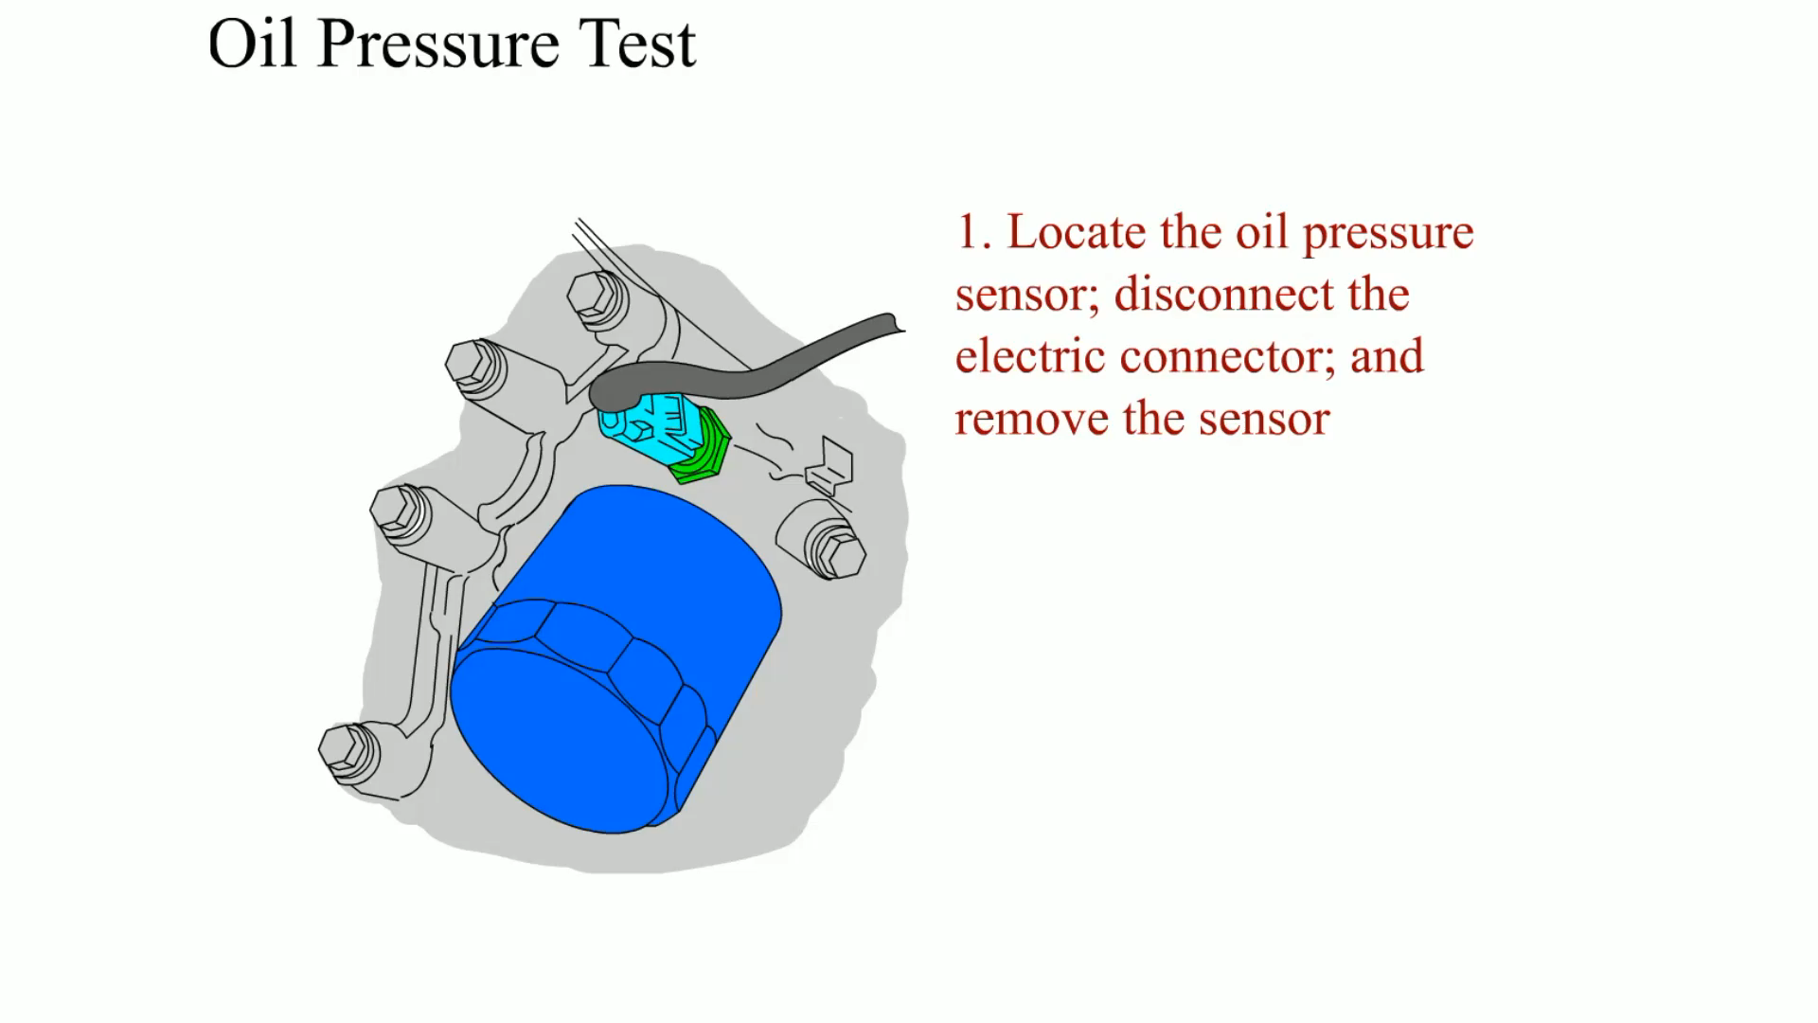
Animation: Oil Pressure Test

Slide 22
Misfire Diagnosis (1 of 4)
Definition of a Misfire
Cylinder does not fire or fire well enough to contribute to the operation of the engine.
Engine running properly, each cylinder contributes equally engine speed is consistent.
Cylinder misfiring, engine speed drops slightly instead of increasing slightly when each cylinder is operating correctly.
Change in engine speed detected by the crankshaft position (C K P) sensor, which indicates to P C M that misfire has occurred.
When misfire is detected, P C M sets a P0300 (random misfire detected) D T C and turns on M I L.
Notes:
Tech Tip: Do Not Clear Codes
When diagnosing an engine misfire, do not clear codes. When the codes are cleared, all the Mode $06 data are also erased. Mode $06 is very helpful to identify which cylinder is causing the misfire and to what degree. Mode $06 can also be used to verify that the repair has been successful in solving the misfire fault. See Chapter 11 for details on Mode $06.

Slide 23
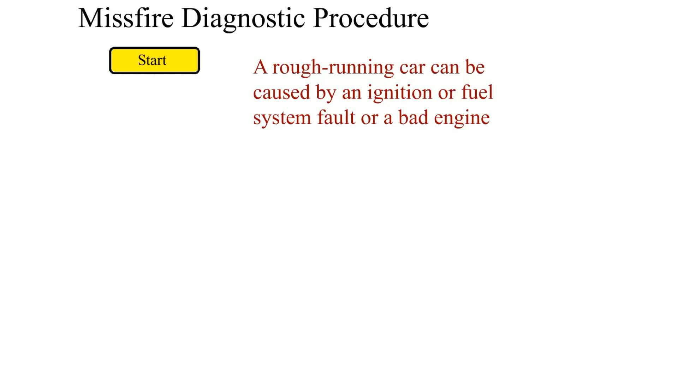
Animation: Misfire Diagnostic Procedure

Slide 24
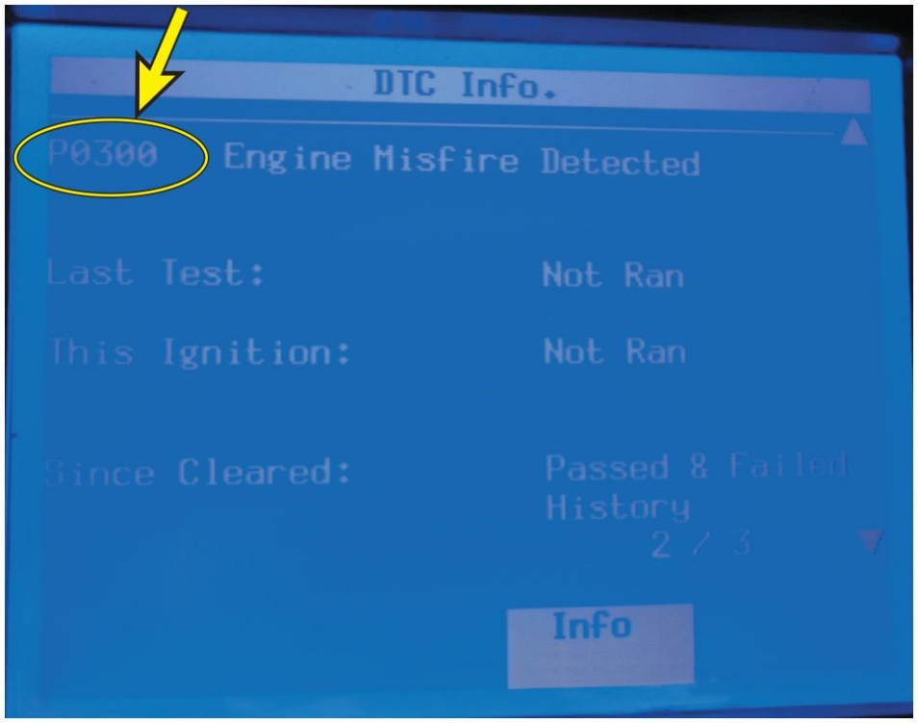
Figure 14.7
General Motors Random Misfire D T C
A General Motor’s Tech 2 scan tool display showing a random misfire D T C has been detected.

Slide 25
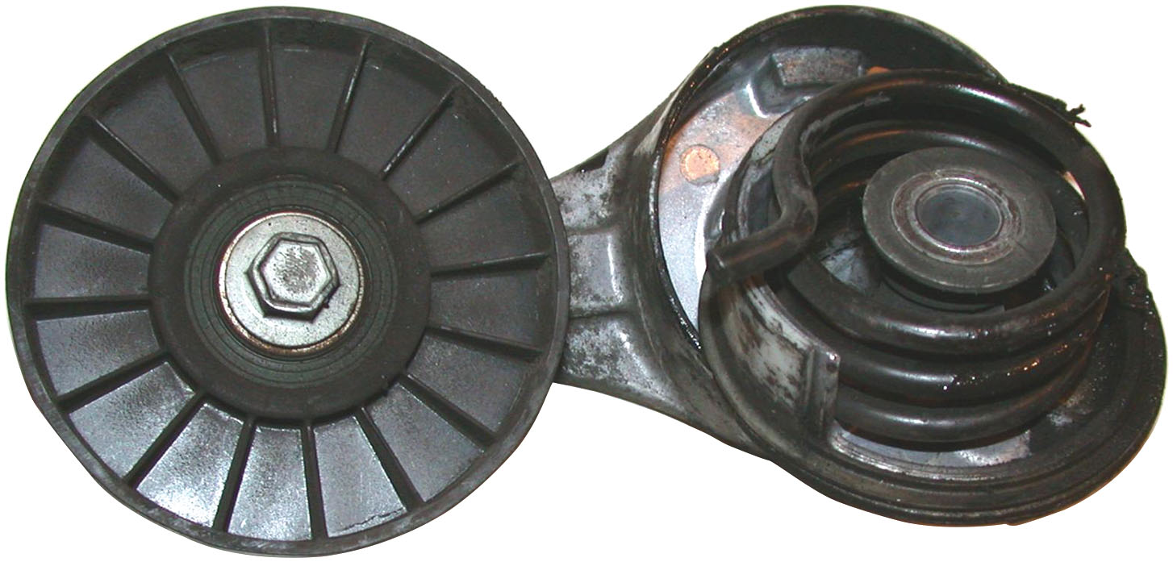
Figure 14.8
Drive Belt Accessory
A broken accessory drive belt tensioner can cause engine speed to vary as belt loosens and then tightens causing what is measured by C K P as uneven engine speed and a possible P0300 random misfire diagnostic trouble code.

Slide 26
Misfire Diagnosis (2 of 4)
Causes of Misfires
Fault with cylinder head or engine block assembly that affects engine compression can be the source of a misfire
Typical causes can include:
Burned valves would cause a lower-than-normal compression and less than normal combustion
Blown head gasket
Valve timing issues, Worn chain or skipped timing belt
Variable valve (cam) timing system
Piston or cylinder wear that causes a lower-than-normal compression will cause a misfire to occur
Defective harmonic balancer or cracked flexplate can be cause of a misfire

Slide 27
Misfire Diagnosis (3 of 4)
Causes of Misfires
Any fault in ignition system can cause an engine to misfire
Typical causes can include:
Ignition coil fault can cause a lack of spark or proper spark to ignite air–fuel mixture under all operating conditions
Spark plug fault, worn or cracked porcelain, can cause a misfire
Faults in secondary ignition circuit wiring, Spark plug wires, can cause a misfire
Ignition timing faults caused by a defective C K P sensor or an engine mechanical fault can cause a misfire

Slide 28
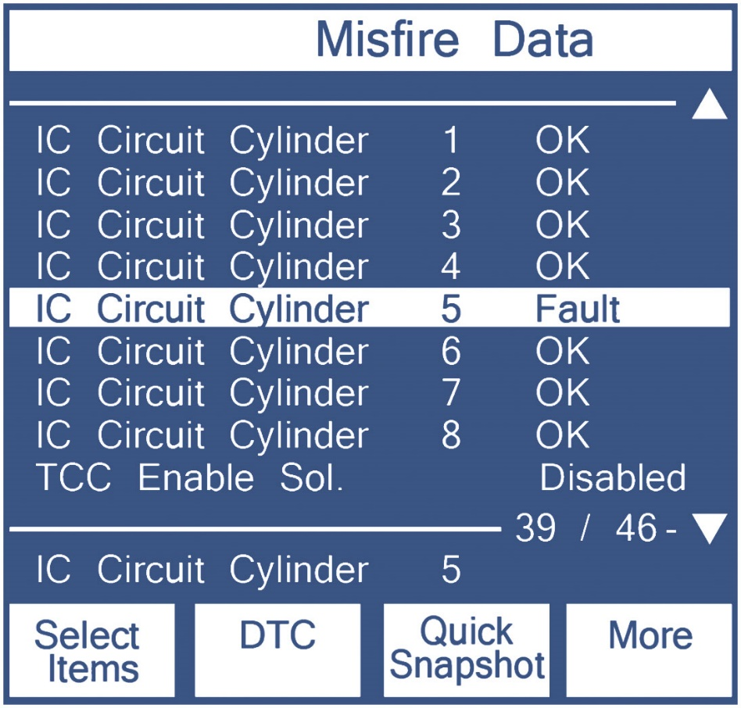
Figure 14.9
Scan Tool Information
A scan tool, such as a Tech 2, can often identify ignition system related faults that can be the cause of a misfire.
Notes:
Long Description:
The misfire data is as follows: I C Circuit cylinder: 1, and ok; IC Circuit cylinder: 2, and ok; I C Circuit cylinder: 3, and ok; I C Circuit cylinder: 4, and ok; I C Circuit cylinder: 5, and Fault - this data is highlighted; I C Circuit cylinder: 6, and ok; I C Circuit cylinder: 7, and ok; I C Circuit cylinder: 8, and ok; and T C C Enable sol.: disabled. A scale with 39 or 46 hyphen down triangle. I C Circuit cylinder: 5. The following buttons are at the bottom: select items, D T C, quick snapshot, and more.

Slide 29
Misfire Diagnosis (4 of 4)
Causes of Misfires
Any fault in fuel system can cause an engine to misfire
Typical causes can include:
Defective or clogged fuel injector(s) can cause a leaner-than-normal air–fuel mixture, can cause an engine misfire
Low fuel pressure caused by weak fuel pump, clogged fuel filter, or some other fault that causes leaner-than-normal air–fuel mixture, causes engine misfire
Faulty emission control system, P C V or E V A P system that causes a leaner-than normal or a richer-than-normal air–fuel mixture, causes engine misfire

Slide 30
Engine-Related Misfire Diagnosis (1 of 6)
Cylinder Contribution Tests
Perform a cylinder contribution test using a scan tool.
Cylinder Contribution Test
Also called injector power balance test
Is an automated test that a scan tool performs
By turning fuel injectors off one cylinder at time and monitors drop, or increase in engine speed

Slide 31
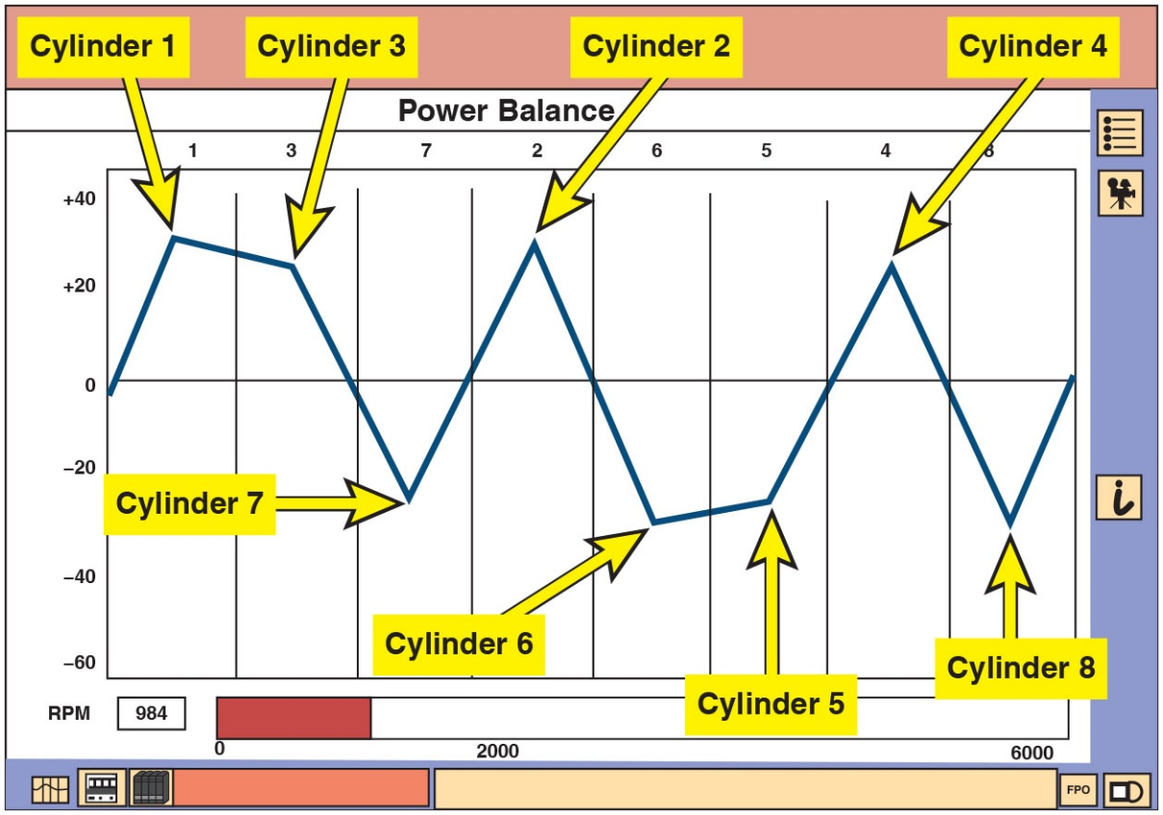
Figure 14.10
Ford I D S Scan Tool
Ford I D S scan tool has a graph function that allows to view data on the cylinder contribution test visually, making diagnosis easier. In this example, cylinders on bank 2 on Ford V-8 (cylinders 7, 6, 5, and 8) were weak and were caused by stuck variable cam solenoid on bank 2.
Notes:
Long Description:
A distorted triangular waveform is shown, with positive and negative peaks indicating different cylinders. The y-axis ranges from minus 60 to plus 40 in increments of 20. The graph is between negative 40 and positive 30. Positive peak 1 is labeled cylinder 1, positive low peak 1 is labeled cylinder 3, negative peak 1 is labeled cylinder 7, positive peak 2 is labeled cylinder 2, negative peak 2 is labeled cylinder 6, negative high peak 2 is labeled cylinder 5, positive peak 3 is labeled cylinder 4, and negative peak 3 is labeled cylinder 8.

Slide 32
Engine-Related Misfire Diagnosis (2 of 6)
Cylinder Balance Test
Most large engine analyzers/scan tools have a cylinder power balance feature
Determine if all cylinders are contributing power equally.
Determined by shorting out (disabling) 1 cylinder at a time
If R P M does not drop as much for one cylinder as for other cylinders of same engine, then shorted cylinder must be weaker than other cylinders.

Slide 33
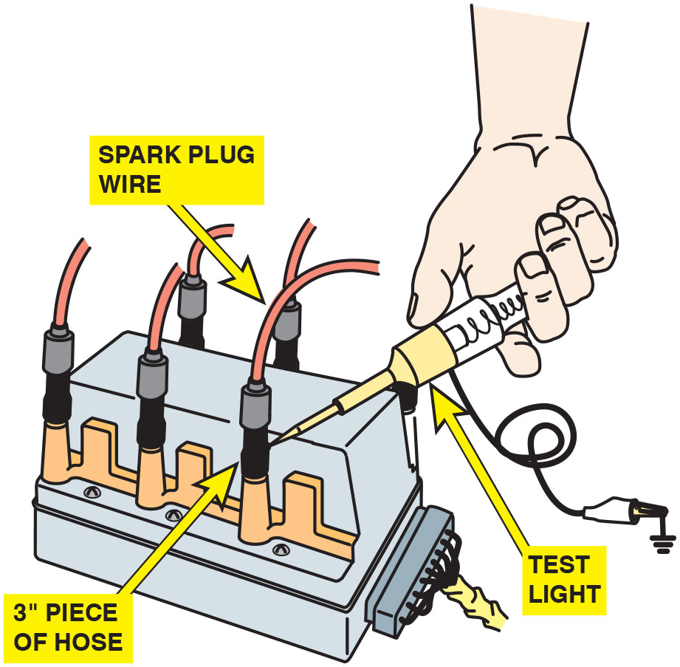
Figure 14.11
Grounding a Cylinder
Using vacuum hose and a test light to ground one cylinder at a time on a waste spark ignition system. Use a standard 12-volt test light. Do not use an L E D test light because high voltage will damage electronics in test light. To avoid possible damage to catalytic converter, do not short out a cylinder for longer than 5 seconds.

Slide 34
Engine-Related Misfire Diagnosis (3 of 6)
Cylinder Balance Test
For example: Cylinder number drop when ignition is shorted (disabled) (R P M)
Cylinder #1-75
Cylinder #2-70
Cylinder #3-15
Cylinder #4-65
Cylinder #5-75
Cylinder #6-70
Cylinder #3 is weak cylinder. Cylinder with the least R P M drop is cylinder not producing its share of power.

Slide 35
Engine-Related Misfire Diagnosis (4 of 6)
Relative Compression Test
D S O & current clamp used to measure change in current that occurs when engine is cranking
Relative compression test uses starter motor current to determine compression values of all cylinders.
No pressure sensors needed to check each individual cylinder and all cylinders can be tested at same time.
High compression, starter motor will draw more current
Lower compression, starter motor will draw less current
Scope software compares highest current draw cylinder and flags that as having a relative compression of 100%
Other cylinders are then displayed as a % of best cylinder.

Slide 36
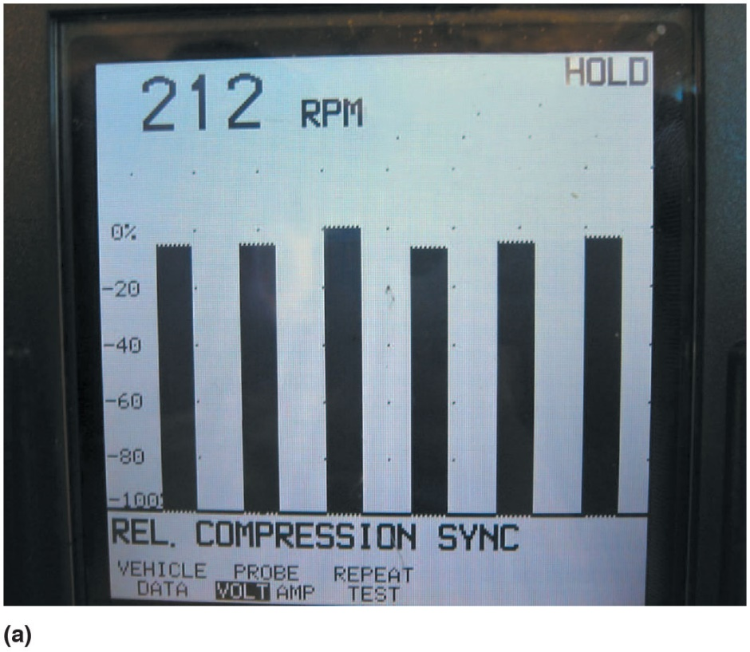
Figure 14.12a
Relative Compression Test
(a) A relative compression test shown on a Fluke scope.
Notes:
Long Description:
The fluke scope screen displays a hold on the top right corner. The reading shows 212 R P M. A bar graph is shown with six bars. The y-axis of the bar graph ranges from minus 100 to 0 percent in increments of 20. The text at the bottom reads: Rel. Compression sync. The vehicle probe repeats. Data volt amp test. Volt is highlighted.

Slide 37
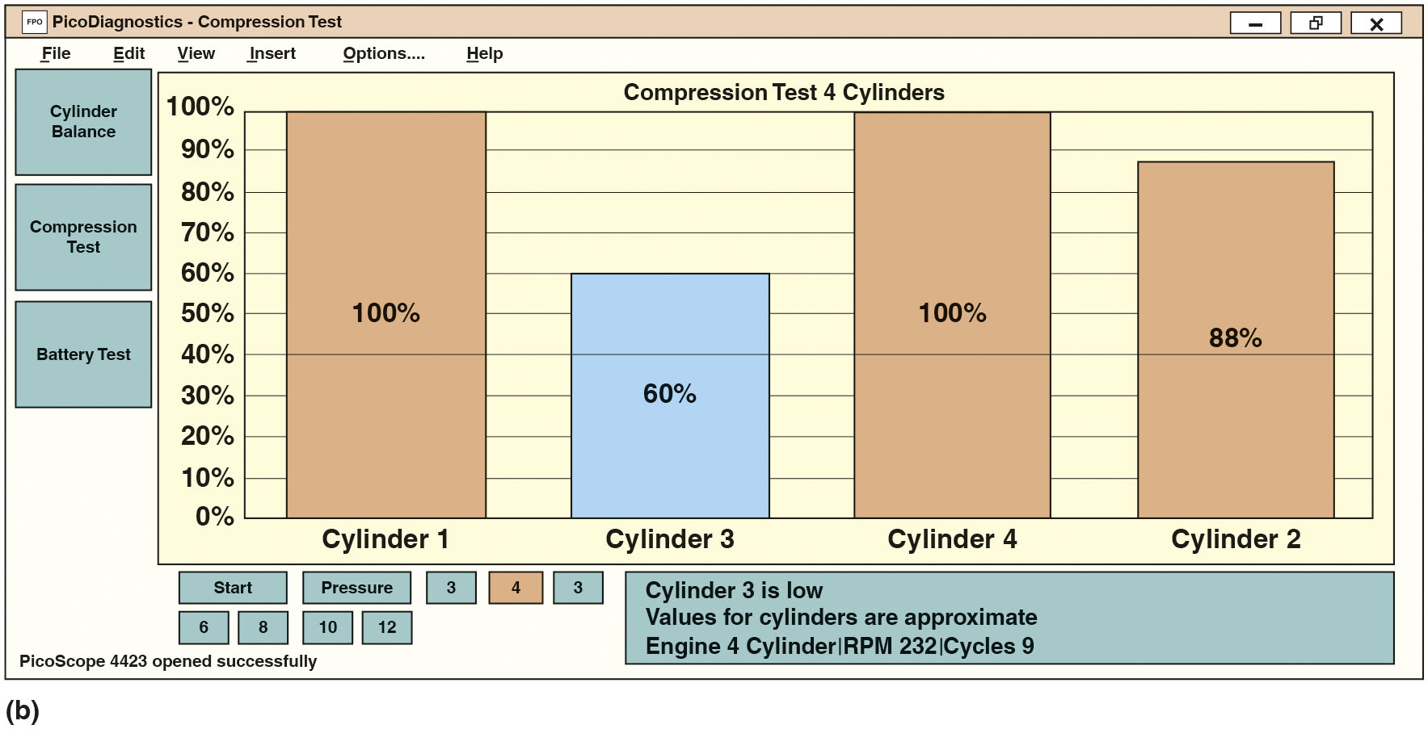
Figure 14.12b
Graph Showing Compression Testing
(a) A relative compression test as shown on a Pico scope.
Notes:
Long Description:
It displays a bar chart of different percentages of compression for four cylinders. The y-axis shows percentages from 0 to 100, with an increment of 10. The data shown are: Cylinder 1 shows 100 percent, Cylinder 3 has 60 percent, Cylinder 4 shows 100 percent, and Cylinder 2 shows 88 percent. The tabs at the top are: file, edit, view, insert, options, and help. On the left of the bar chart are the following panels: cylinder balance, compression test, and battery test. The buttons below are: start, pressure, 3, 4, 3, 6, 8, 10, and 12. The text next to the buttons read: Cylinder 3 is low. The values for cylinders are approximate. Engine 4 cylinder, R P M 232, cyc1es 9. The message PicoScope 4432 opened successfully is at the bottom left corner.

Slide 38
Engine-Related Misfire Diagnosis (5 of 6)
Cylinder Pressure Transducer Testing
Help determine if camshaft timing is correct
Help determine if cylinder pressure (compression) is normal
Help determine if exhaust valves are too tight, or too loose
Verify if there is a problem with valves sealing properly

Slide 39
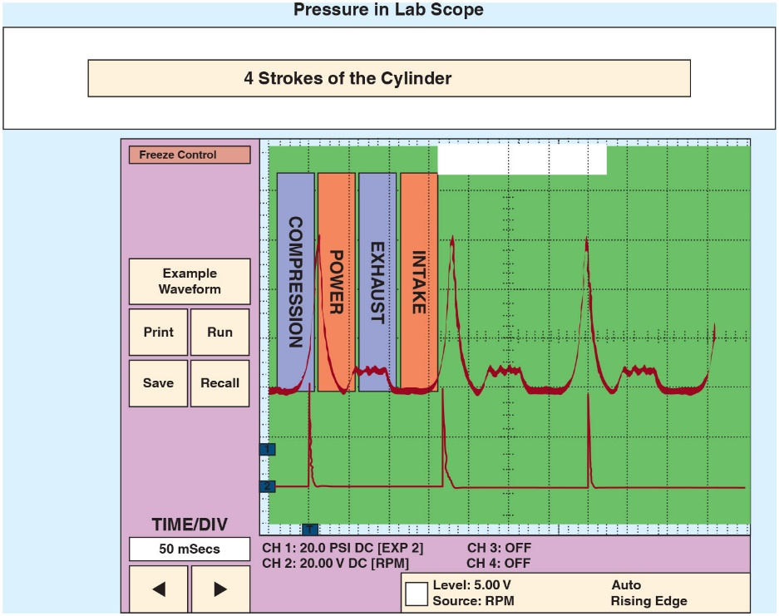
Figure 14.13
Pressure Inside Cylinder
Pressure waveform display showing pressures inside cylinder during engine cranking through all 4 strokes
of crankshaft rotation).
peaks shown on waveform represent the pressure in the cylinder when the engine is on the compression stroke.
Notes:
Long Description:
The title is Pressure in Lab Scope, and the heading is 4 strokes of the cylinder. It shows four tabs compression, power, exhaust, and intake. The tab compression is selected. The waveform shows sharp peaks followed by corrugated pulses, and another waveform shows sharp peaks with a very thin width below the starting of the peaks. The left panel shows the following buttons: freeze control, example waveform, print, run, save, and recall. The time per div is 50 m secs. There are two left and right arrow buttons below it. The texts at the bottom of the screen are as follows: C H 1: 20.0 P S I D C open square bracket E X P 2 close square bracket. C H 2: 20.0 V D C open square bracket R P M 2 close square bracket. C H 3: OFF. C H 4: OFF. Level: 5.00 V Auto. Source: R P M rising edge.

Slide 40
Engine-Related Misfire Diagnosis (6 of 6)
Cylinder Pressure Transducer Testing
To conduct electronic cylinder pressure test, perform steps:
STEP 1 Remove spark plug from cylinder to be tested an connect electronic pressure transducer into spark plug hole and disconnect electrical connector to coil (C O P-type ignition) or ground spark plug wire (waste-spark system).
STEP 2 Connect pressure transducer to a D S O and set to capture a pressure waveform when engine is started.
STEP 3 Start engine and run at idle speed, then capture a cylinder pressure waveform.

Slide 41
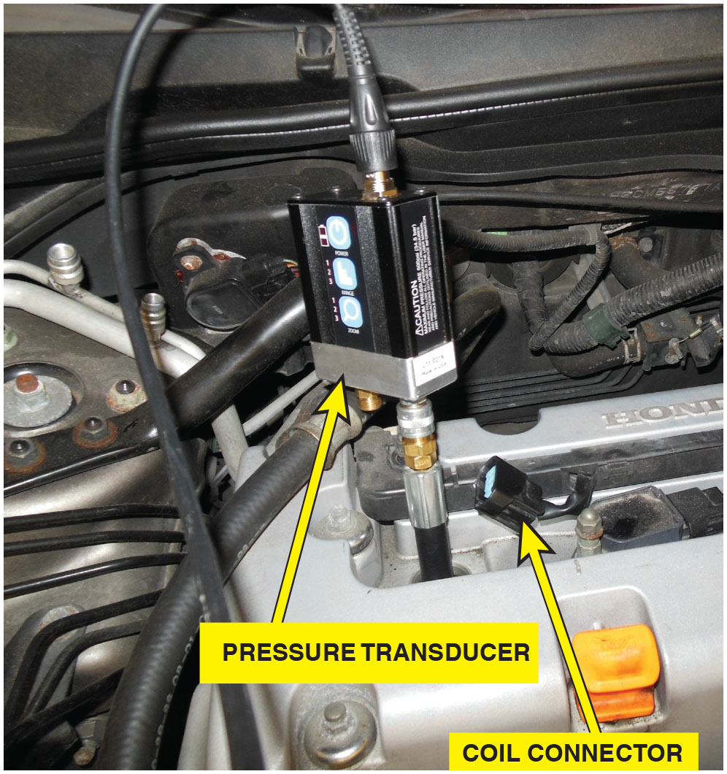
Figure 14.14
Coil-on-Plug and Pico Scope
Coil-on-plug ignition coil and spark plug were removed and the pressure transducer was threaded into the spark plug hole.

Slide 42
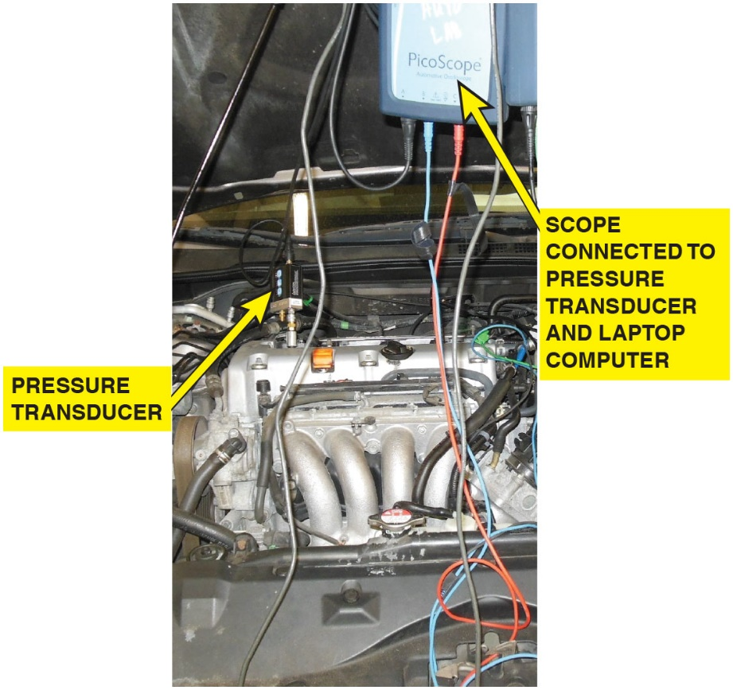
Figure 14.15
Coil-on-Plug and Pico Scope
Pico scope connected to a laptop computer is being used to capture the cylinder pressure waveform.

Slide 43
Compression Test (1 of 6)
Cranking Compression Test
Fundamental engine diagnostic tests
For smooth engine operation
All cylinders must have equal compression.
An engine can lose compression
When air leaks through 1 or more of following 3 routes:
Intake or exhaust valve or seat
Piston rings (or piston, if there is a hole)
Cylinder head gasket

Slide 44
Compression Test (2 of 6)
Cranking Compression Test
Warmed to normal operating temperature before testing
Compression test should be performed as follows:
STEP 1: Remove all spark plugs, allows engine to be cranked to an even speed. Be sure to label all spark plug wires.
STEP 2: Open throttle to permit maximum amount of air to be drawn into engine, which ensures consistent compression test results. If working on E T C system, check service information for exact procedure to follow to safely open throttle without causing harm.
Notes:
CAUTION: Disable the ignition system by disconnecting the primary leads from the ignition coil(s). Also disable the fuel-injection system to prevent the squirting of fuel into the cylinder.

Slide 45
Compression Test (3 of 6)
Cranking Compression Test
STEP 3: Thread a compression gauge into one spark plug hole and crank engine. Continue cranking engine through 4 compression strokes. Each compression stroke make stroke makes a puffing sound, causes gauge needle to pulse.
STEP 4: Record test results for all cylinders and compare results. Most O E M S specify minimum compression reading and maximum allowable variation among cylinders. Most specify maximum difference of 20% between highest and lowest readings.
Notes:
Note: the reading on the compression gauge after the first puff. This reading should be at least one-half the final reading. A low first-puff reading indicates possible weak piston rings or a leaking valve or valve seat. Release the pressure on the gauge and repeat for the other cylinders.
For example:
If the highest reading is 150 P S I, Subtract 20% (–30 P S I)
Lowest allowable compression is 120 P S I s a puffing sound and causes the gauge

Slide 46
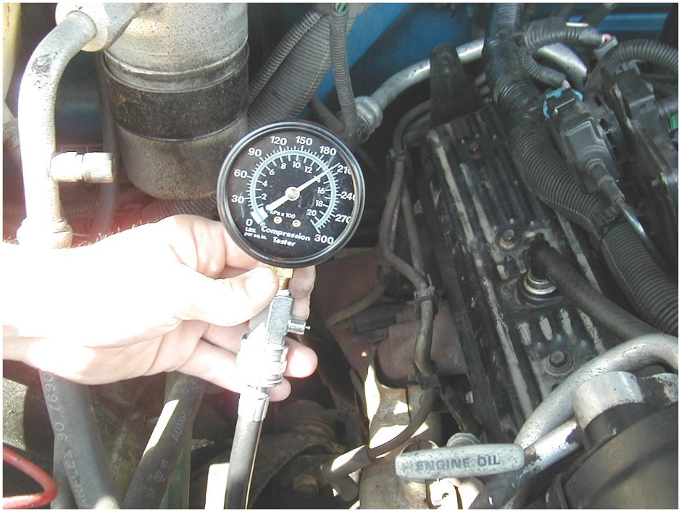
Figure 14.16
Performing Compression Test
It often requires an assistant to perform a compression test: one person watches the first puff reading on the gauge and the other person cranks the engine.
Notes:
Tech Tip
Quick and Easy Math
To make the math quick and easy, think of 10% of 150, which is 15 (move the decimal point to the left by one place). Now double it: 15 ∗ 2 = 30. This represents 20%.

Slide 47
Compression Test (4 of 6)
Wet Compression Test
Compression test reading indicates low compression on one or more cylinders
Add 3 squirts of oil to 3 cylinder and retest
Called wet compression test, because oil used to help seal around piston rings
Perform compression test again and observe results.
If first-puff readings greatly improve and readings are much higher than without oil, cause of low compression is worn or defective piston rings.
If compression readings increase only slightly (or not at all), cause of low compression usually defective valves.
Notes:
NOTE: During both the dry and wet compression tests, be sure that the battery and starting system are capable of cranking the engine at normal cranking speed
CAUTION: Do not use more than three squirts oil from a hand-operated oil squirt can. Too much oil can cause a hydrostatic lock, which can damage or break pistons or connecting rods or even crack a cylinder head.

Slide 48
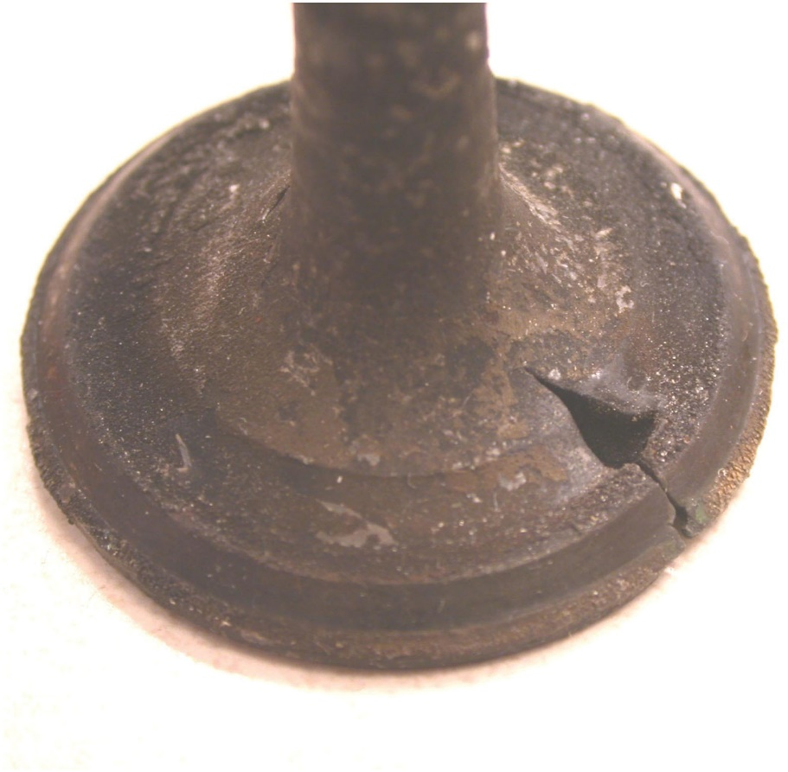
Figure 14.17
Causes of Lower-than-Normal Compression
A leaking valve will cause a lower-than-normal compression reading.

Slide 49
Compression Test (5 of 6)
Running (Dynamic) Compression Test
Help determine engine condition and is usually performed with the engine cranking
What is R P M of a cranking engine?
Engine idles at 600 to 900 R P M, and starter motor obviously cannot crank engine as fast as engine idles.
Check of engine’s compression at cranking speed determines condition of an engine that does not run at such low speeds
Running compression test, also called a dynamic compression test, is used to test the engine for valve train–related faults that do not show up during a cranking compression test.

Slide 50
Compression Test (6 of 6)
Running (Dynamic) Compression Test
To perform a running compression test, perform following steps:
STEP 1: Remove Schrader valve from end of compression tester.
STEP 2: Remove just one spark plug at a time.
STEP 3: With one spark plug removed from the engine, use a jumper wire to ground spark plug wire to a good engine ground or disconnect the primary wire connecter at the coil (C O P system). This prevents possible ignition coil damage.
STEP 4: Start engine, push pressure release on the gauge, and read compression. Increase engine speed to about 2000 R P M and push pressure release on gauge again. Read gauge and record reading.
STEP 5: Stop engine, install spark plug, reattach spark plug wire, and repeat the test for each of the remaining cylinders.
Notes:
Results: Just like the cranking compression test, the running compression test can inform a technician of the relative compression of all the cylinders.

Slide 51
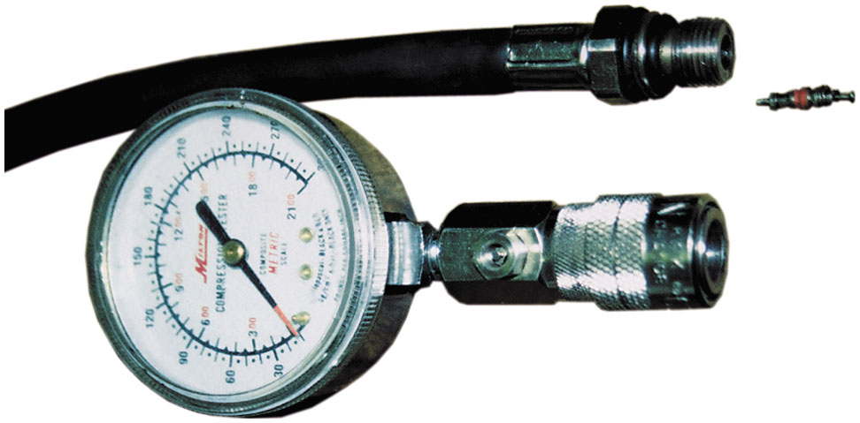
Figure 14.18
Two-Piece Compression Gauge’
A two-piece compression gauge showing Schrader valve removed from the end that is screwed into spark plug hole.

Slide 52
Cylinder Leakage Test
Test Procedure
One of the best tests that can be used to determine engine condition is the cylinder leakage test
This test involves injecting air under pressure into the cylinders one at a time.
The amount and location of any escaping air helps the technician determine the condition of the engine
The air is injected into the cylinder through a cylinder leakage gauge installed in the spark plug hole

Slide 53
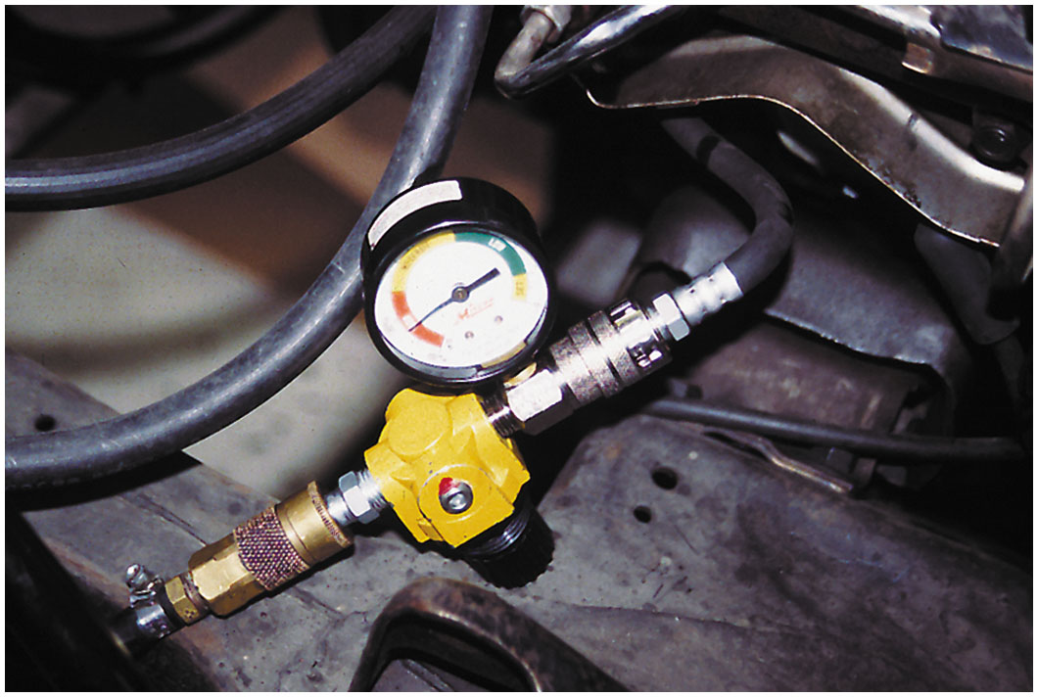
Figure 14.19
Cylinder Leakage Test
A typical handheld cylinder leakage tester.

Slide 54
Cylinder Leakage Test (1 of 2)
Test Procedure
STEP 1: For best results, normal operating temperature (upper radiator hose hot and pressurized)
STEP 2: Cylinder being tested must be at T D C of compression stroke.
STEP 3: Connect tester to shop air not over 100 P S I (700 kPa).
STEP 4: Calibrate cylinder leakage unit as per O E M specs
STEP 5: Inject air into the cylinders one at a time, rotating the engine as necessitated by firing order to test each cylinder at T D C on compression stroke.
Notes:
NOTE: The greatest amount of wear occurs at the top of the cylinder because of the heat generated near the top of the cylinders. The piston ring flex also adds to the wear at the top of the cylinder.

Slide 55
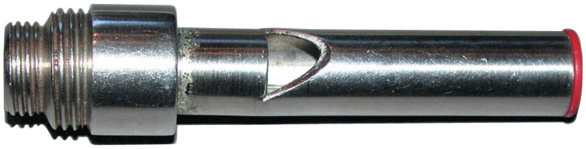
Figure 14.20
Whistle Stop
A whistle stop used to find top dead center. Remove the spark plug and install the whistle stop, then rotate the engine by hand. When the whistle stops making a sound, this means that the piston is at the top.

Slide 56
Cylinder Leakage Test (2 of 2)
Test Procedure
STEP 6: Evaluate the results:
Less than 10% leakage: good
Less than 20% leakage: acceptable
Less than 30% leakage: poor
More than 30% leakage: definite problem
STEP 7: Check source of air leakage
Air heard escaping from oil filler cap, piston rings are worn or broken.
Air observed bubbling out of radiator, possible blown head gasket or cracked cylinder head.
Air heard coming from throttle body, defective intake valve(s).
Air heard coming from tailpipe, defective exhaust valve(s).
Notes:
NOTE: If leakage seems unacceptably high, repeat the test, being certain that it is being performed correctly and that the cylinder being tested is at T D C on the compression stroke.

Slide 57
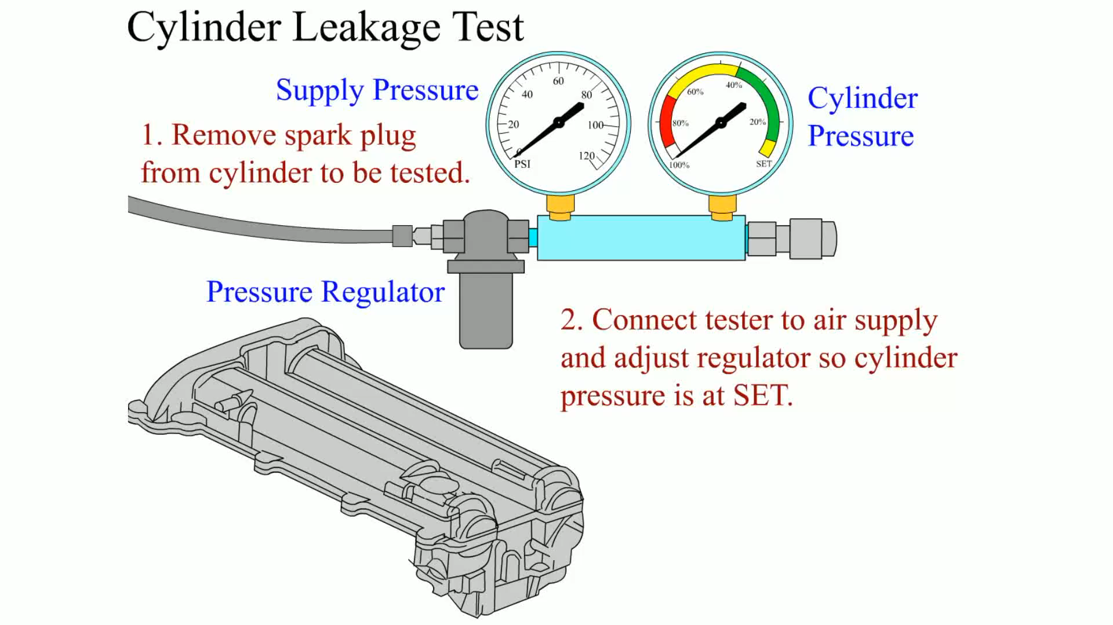
Animation: Cylinder Leakage Test

Slide 58
Vacuum Tests (1 of 2)
Idle Vacuum Test
An engine in proper condition should idle with a steady vacuum between 17 in. Hg and 21 in. Hg.
NOTE: Engine vacuum readings vary with altitude. A reduction of 1 in. Hg per 1,000 ft (300 m) of altitude should be subtracted from the expected values if testing a vehicle above 1,000 ft (300 m).

Slide 59
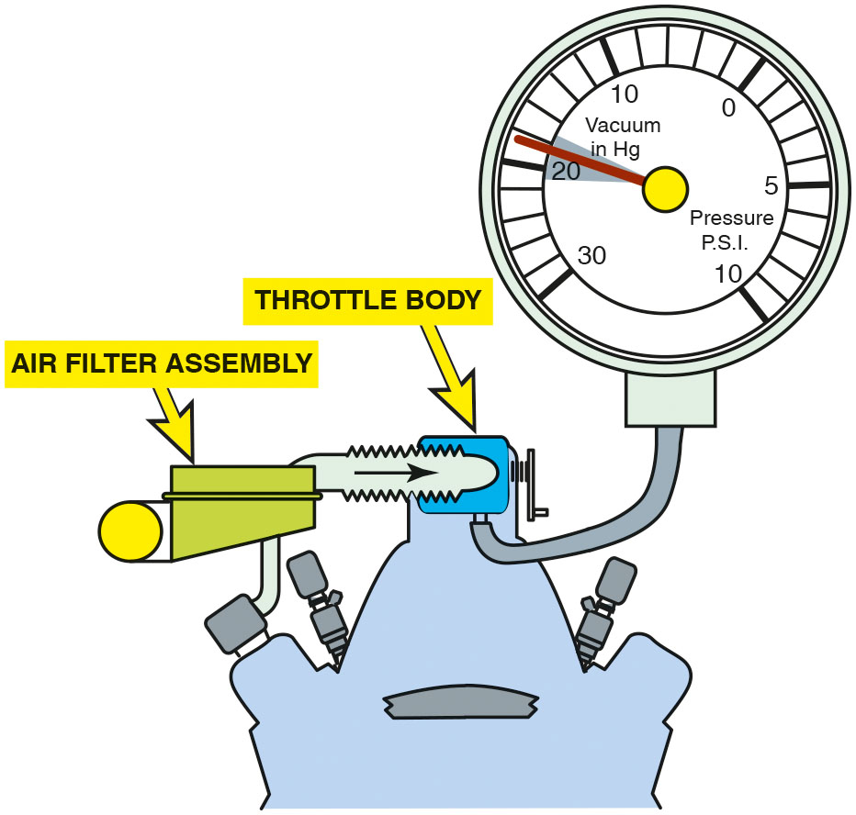
Figure 14.21
Good Engine
An engine in good mechanical condition should produce 17 to 21 in. Hg of vacuum at idle at sea level.

Slide 60
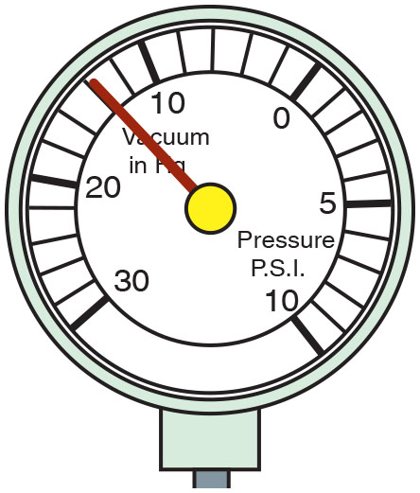
Figure 14.22
Steady Reading
A steady but low reading could indicate retarded valve or ignition timing.
Notes:
If the vacuum is lower than normal, yet the gauge reading is steady, the most common causes include:
■ Retarded cam/ignition timing (Check the timing chain for excessive slack or the timing belt
for proper installation.)
■ Vacuum leaks. • See Figure 14.22.

Slide 61
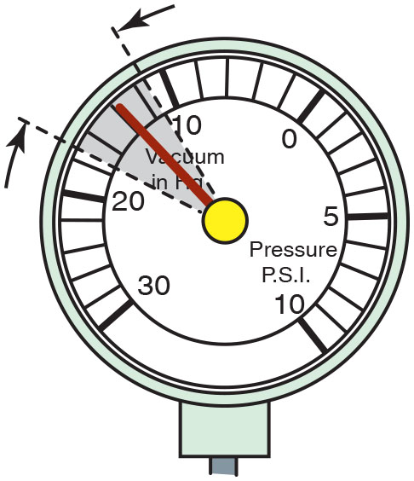
Figure 14.23
Vacuum Leak
A gauge reading with the needle fluctuating 3 to 9 H g below normal often indicates a vacuum leak in the intake system.
Notes:
Fluctuating Vacuum
If the needle drops, then returns to a normal reading, then drops again, and again returns, this indicates a sticking valve. A common cause of sticking valves is lack of lubrication of the valve stems. • See Figures 14.23 through 14.28.

Slide 62
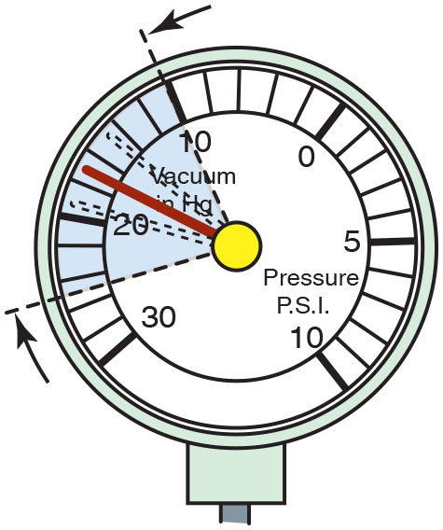
Figure 14.24
Leaking Head Gasket
A leaking head gasket can cause the needle to vibrate as it moves through a range from below to above normal.

Slide 63
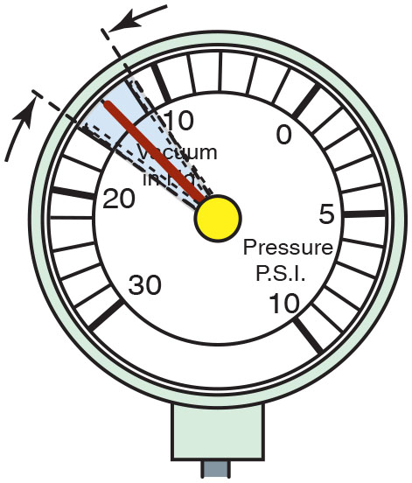
Figure 14.25
Incorrect Air–Fuel Mixture
An oscillating needle 1 or 2 inch Hg below normal could indicate an incorrect air–fuel mixture (either too rich or too lean).

Slide 64
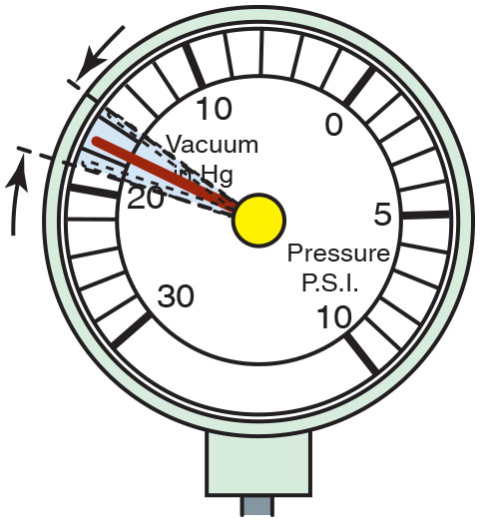
Figure 14.26
Worn Valve Guides
A rapidly vibrating needle at idle that becomes steady as engine speed is increased indicates worn valve guides.

Slide 65
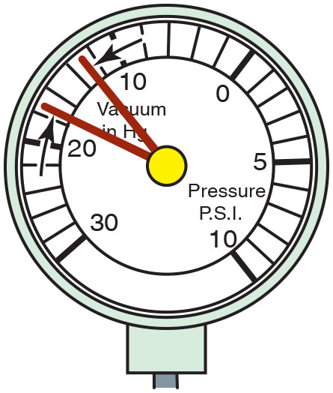
Figure 14.27
Burned Valve
If the needle drops 1 or 2 inch H g from the normal reading, one of the engine valves is burned or not seating properly.

Slide 66
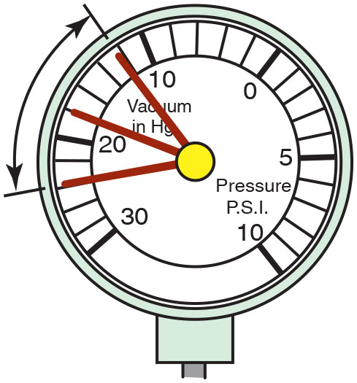
Figure 14.28
Weak Valve Springs
Weak valve springs will produce a normal reading at idle, but as engine speed increases, the needle will fluctuate rapidly between 12 and 24 inch H g.

Slide 67
Vacuum Tests (2 of 2)
Low and Steady Vacuum
Vacuum lower than normal, yet gauge reading is steady, most common causes include:
Retarded cam/ignition timing (Check timing chain for excessive slack or timing belt for proper installation)
Vacuum leaks.
Fluctuating Vacuum
If needle drops, then returns to a normal reading, then drops again, and again returns, this indicates a sticking valve.
Common cause of sticking valves lack of lubrication of valve stems.

Slide 68
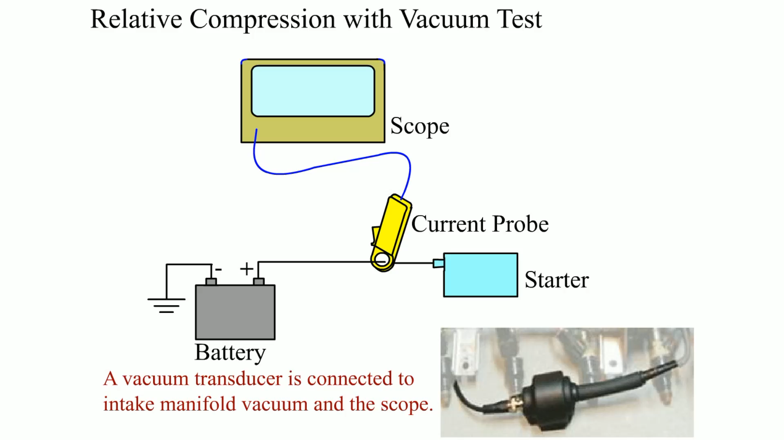
Animation: Relative Compression Test with Vacuum Test

Slide 69
Question 3
What does a fluctuating vacuum gauge indicate?

Slide 70
Answer 3
A vacuum leak in the intake system.

Slide 71
Vacuum Waveforms (1 of 2)
Principles
D S O used to create a vacuum waveform
Vacuum transducer attached to intake manifold vacuum source
Ignition timing or faults in ignition system
Fuel injector faults
Fuel delivery faults
Notes:
A transducer is a device that converts pressure, vacuum, temperature, or other input signals into an electrical signal that will vary with changes in input levels. Vacuum waveform is not affected by any of the following:

Slide 72
Vacuum Waveforms (2 of 2)
Interpreting a Vacuum Waveform
Vacuum waveform display pressure (vacuum) in intake manifold
Lower waveform is, higher the vacuum
Determining which cylinder relates to which waveform using a vacuum waveform can be a challenge
Most scopes or testers that are equipped to display vacuum waveforms also trigger off of cylinder number 1
Vacuum waveform testing is an excellent way to determine engine condition for each cylinder

Slide 73
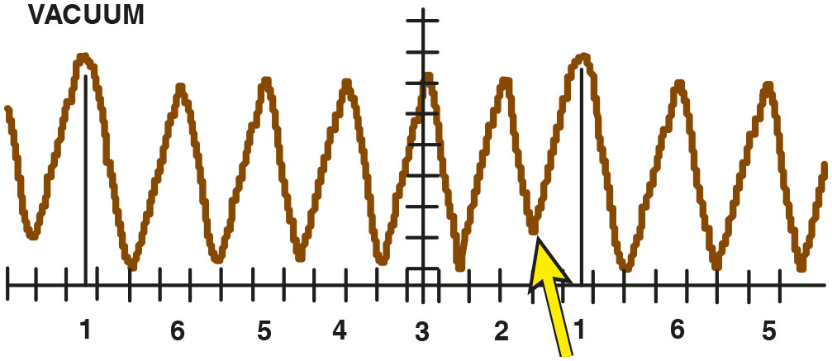
Figure 14.29
Typical Vacuum Waveform
A typical vacuum waveform as displayed on a scope connected to a vacuum transducer and connected to the intake manifold. Notice that the cylinder number 2 vacuum waveform does not go down as low as the others. This indicates that the cylinder is not sealing.
Notes:
A vacuum waveform will display the pressure (vacuum) in the intake manifold. The lower the waveform is, the higher is the vacuum. • See Figure 14.29.

Slide 74
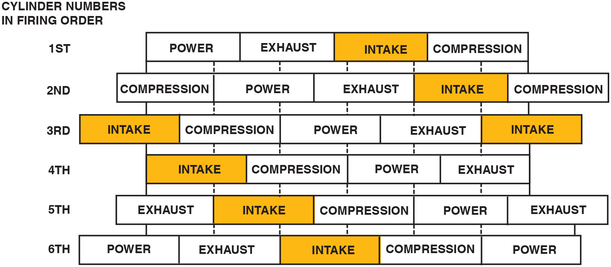
Figure 14.30
Relationship Among Cylinders
The relationship among cylinders showing where the intake stroke occurs in relation to other cylinders.
Notes:
Determining which cylinder relates to which waveform using a vacuum waveform can be a challenge. Most scopes or testers that are equipped to display vacuum waveforms also trigger off cylinder number 1. Vacuum waveform testing is an excellent way to determine engine condition. A diagram that indicates where the highest vacuum (lowest part of the waveform) will be for each cylinder is shown in • Figure 14.30. Always follow the oscilloscope manufacturer’s recommended procedures as found in the instruction manual.
Long Description:
It displays cylinder numbers in firing order. First; power, exhaust, intake, and then compression. Second; Compression, power, exhaust, intake, and then again compression. Third; Intake, compression, power, exhaust, and then again intake. Fourth; Intake, compression, power, and exhaust. Fifth; Exhaust, Intake, compression, power, and then again exhaust. Sixth; Power, exhaust, Intake, compression, and power.

Slide 75
Exhaust Backpressure Testing (1 of 4)
Purpose of Tests
If exhaust system restricted, engine will be low on power
Yet will operate smoothly
Causes of restricted exhaust:
Clogged catalytic converter: Check ignition & fuel-injection systems for faults could cause excessive amounts of unburned fuel to be exhausted.
Excessive unburned fuel can overheat catalytic converter and cause beads or structure of converter to fuse together, creating the restriction.
Clogged or restricted muffler: cause low power. Often a defective catalytic converter will shed particles that clog a muffler. Broken internal baffles can restrict exhaust flow.

Slide 76
Exhaust Backpressure Testing (2 of 4)
Using a Vacuum Gauge
Vacuum gauge used to measure manifold vacuum at a high idle (2000–2500 R P M)
Exhaust system restricted, pressure increases in exhaust system. This is back pressure.
Manifold vacuum will drop gradually if engine is kept at a constant speed if exhaust is restricted.
If exhaust system is NOT restricted, vacuum reading will be the same or higher than reading at idle speed.
Vacuum reading is lower at 2500 R P M than when it was at idle speed, then an exhaust restriction is indicated.

Slide 77
Exhaust Backpressure Testing (3 of 4)
Using a Pressure Gauge
Exhaust system back pressure can be measured directly
Installing a pressure gauge into an exhaust opening
This can be accomplished in one of following methods:
With oxygen sensor:
Use a back pressure gauge and adapter or remove the inside of a discarded oxygen sensor
Thread in adapter to convert to a vacuum or pressure gauge.
Notes:
NOTE: An adapter can be easily made by inserting a metal tube or pipe. A short section of brake line works well, too. The pipe can be brazed to the oxygen sensor housing or it can be glued in with epoxy. An 18 mm compression gauge adapter can also be adapted to fit into the oxygen sensor opening

Slide 78
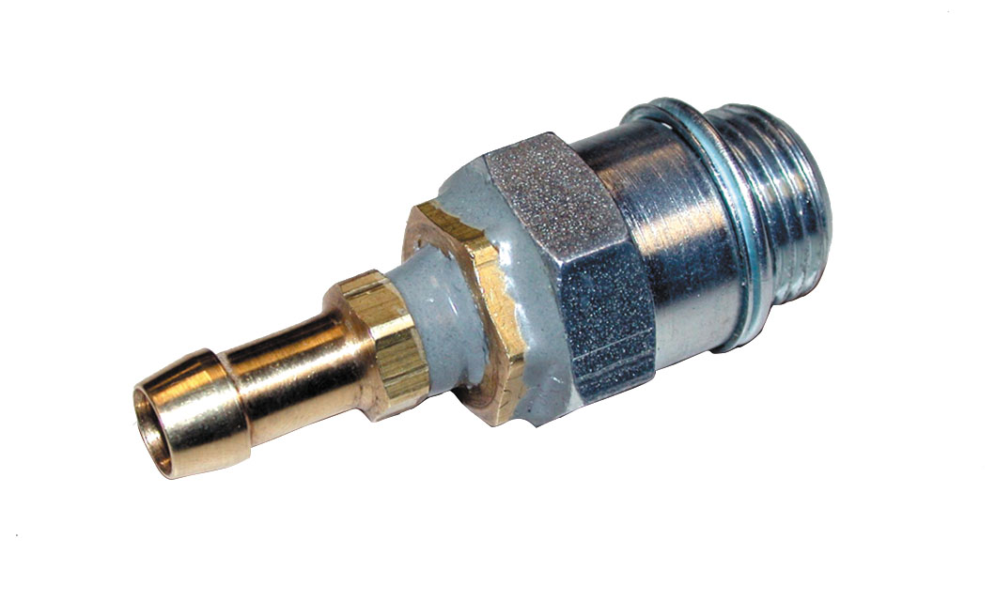
Figure 14.31
Technician-Made Equipment (1 of 2)
A technician-made adapter used to test exhaust system back pressure.

Slide 79
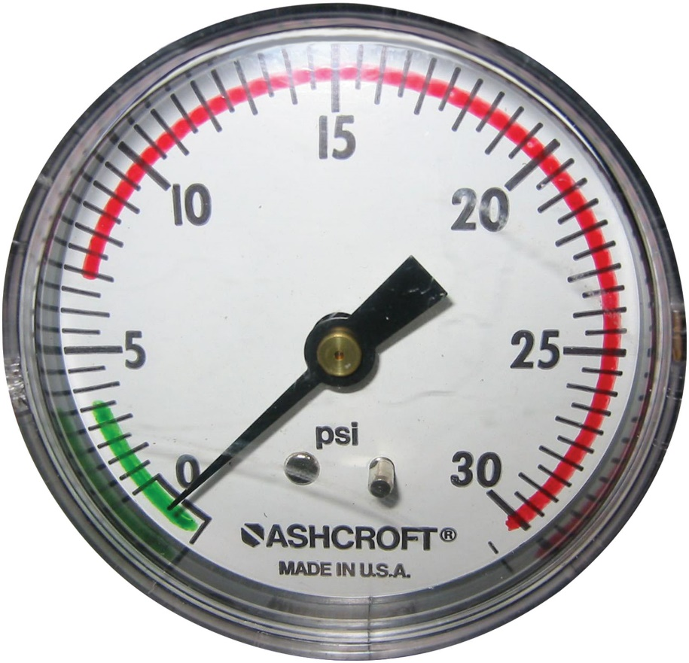
Figure 14.32
Technician-Made Equipment (2 of 2)
A technician marked pressure gauge showing a green line for acceptable backpressure readings and the red line indicating excessive backpressure readings.

Slide 80
Exhaust Backpressure Testing (4 of 4)
Using Pressure Gauge
With E G R valve: Remove E G R valve and fabricate a plate to connect to a pressure gauge.
With air-injection reaction (A I R) check valve: Remove check valve from exhaust tubes leading down to exhaust manifold.
Use rubber cone with a tube inside to seal against the exhaust tube.
Connect tube to a pressure gauge.
At idle, maximum back pressure should be < 0.5 P S I (10 kPa).
Should be < 2.5 P S I (15 kPa) at 2500 R P M.

Slide 81
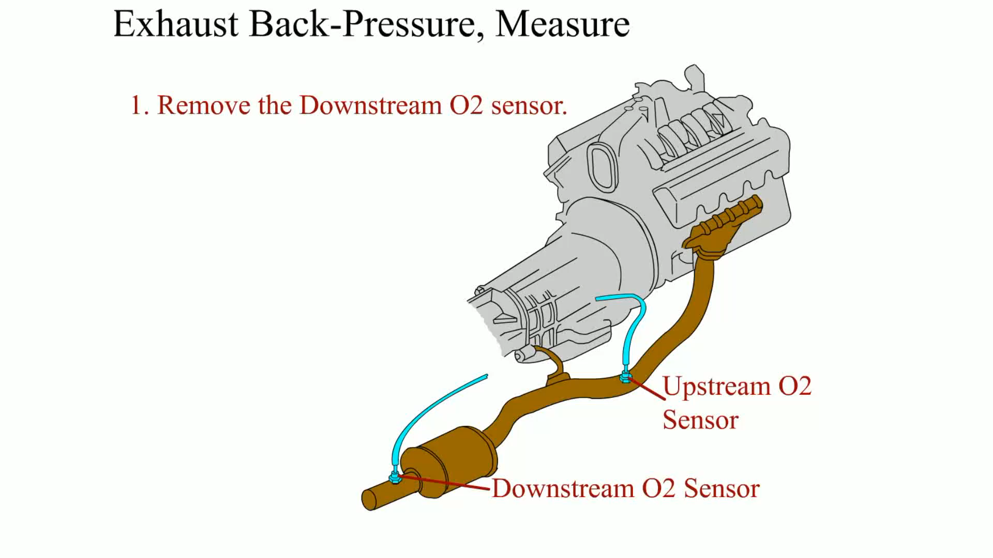
Animation: Exhaust Back-Pressure, Measure

Slide 82
Diagnosing Head Gasket Failure (1 of 2)
Tests and Indications
Exhaust gas analyzer: Radiator cap removed, place probe from exhaust analyzer above radiator filler neck
If hydrocarbon (H C) reading increases, exhaust (unburned fuel) is getting into coolant
Chemical tester using blue liquid is also available
Liquid turns yellow if combustion gases are present
Bubbles in coolant: Remove coolant pump belt to prevent pump operation
Remove radiator cap and start engine
If bubbles appear in coolant before it begins to boil, a defective head gasket or cracked cylinder head is indicated.

Slide 83
Diagnosing Head Gasket Failure (2 of 2)
Excessive water or steam is coming from tailpipe, this means that coolant is getting into combustion chamber from a defective head gasket or a cracked head.
Install pressure gauge to radiator: If head gasket failure is suspected, then increase in cooling system pressure will be detected before coolant becomes hot enough to boil.
If any of preceding indicators of head gasket failure occur, remove cylinder head(s) and check:
Head gasket, for signs of leakage
Sealing surfaces, for warpage
Castings, for cracks

Slide 84
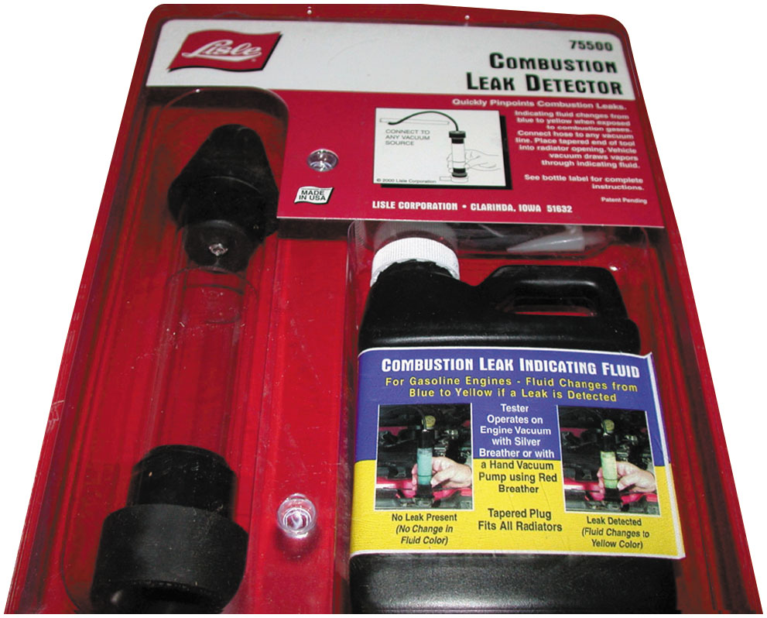
Figure 14.33
Blue Liquid Head Gasket Leak Detector
A tester that uses a blue liquid to check for exhaust gases in the exhaust, which would indicate a head gasket leak problem.

Slide 85
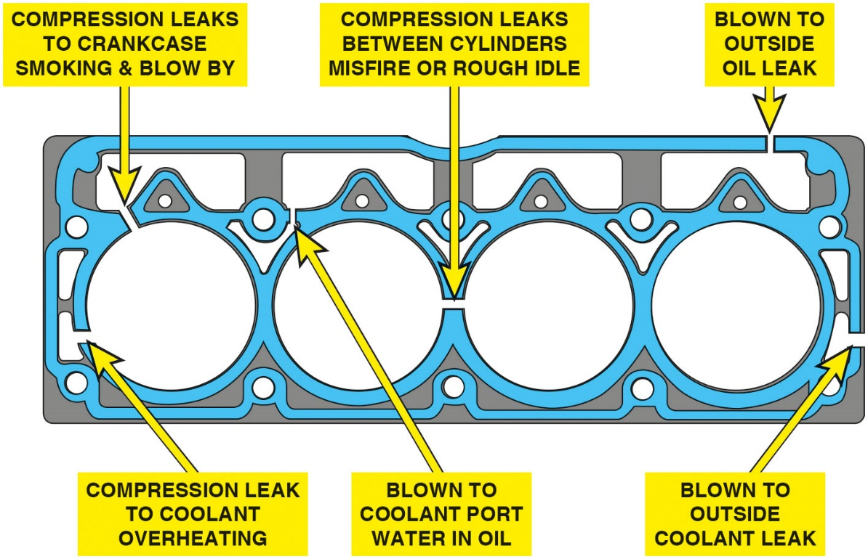
Figure 14.34
Head Gasket Leak Areas
Head gasket can fail in many locations and where it fails results in either a compression loss or an exterior or interior coolant or oil leak.
Notes:
Gasket Failure Locations
A cylinder head gasket can fail in several locations including
Outside of the engine. This type of failure would result in an oil or coolant leak.
Compression leaks. This type of head gasket failure could result in a loss of compression in one or two cylinders that are side-by-side. If the compression leak is from the combustion chamber to the coolant passage, then overheating is likely.
Long Description:
The illustration displays a head gasket with gaps on top and between cylinders. The gaps for the four cylinders are labeled as follows: The top gap in the first cylinder is labelled; Compression leaks to crankcase smoking and blow by. The bottom left gap in the first cylinder is labelled; Compression leak to coolant overheating. Compression leaks between cylinders misfire or rough idle. Blown to coolant port water in oil. Blown to outside oil leak. Blown to outside coolant leak.

Slide 86
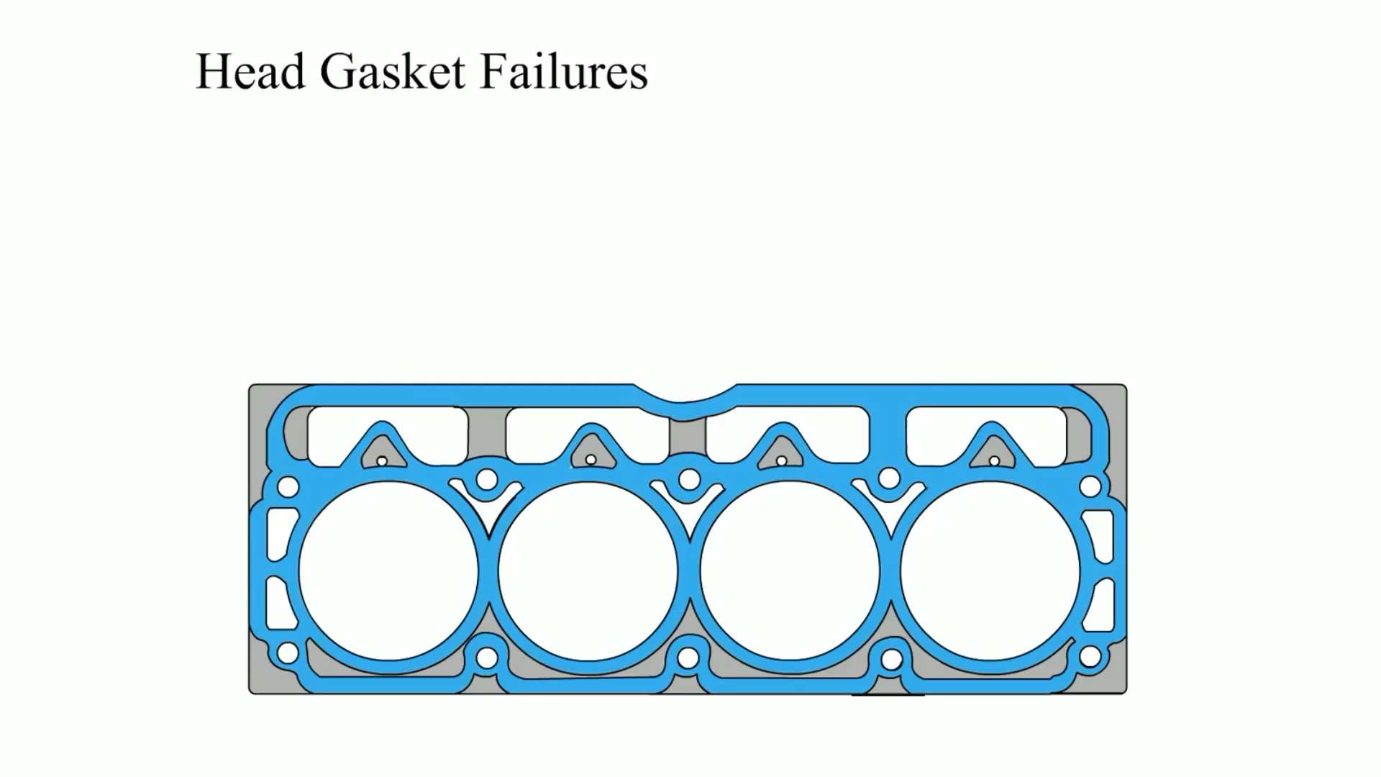
Animation: Head Gasket Failures

Slide 87
Compression Test Step by Step

Slide 88
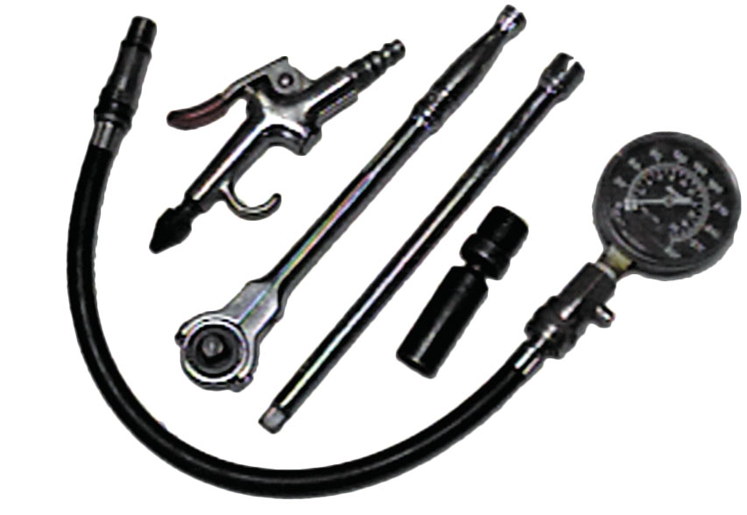
Compression Testing Tools
Notes:
1. The tools and equipment needed to perform a compression test include a compression gauge, an air nozzle, and the socket ratchets and extensions that may be necessary to remove the spark plugs from the engine

Slide 89
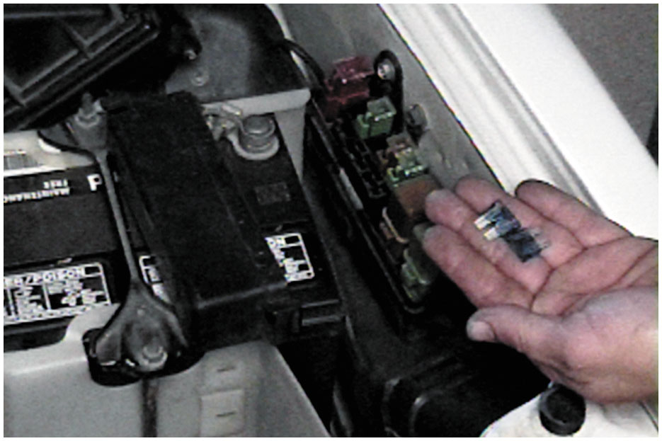
Disable Fuel & Ignition System
Notes:
2. To prevent ignition and fuel-injection operation while the engine is being cranked, remove both the fuel injection fuse and the ignition fuse

Slide 90
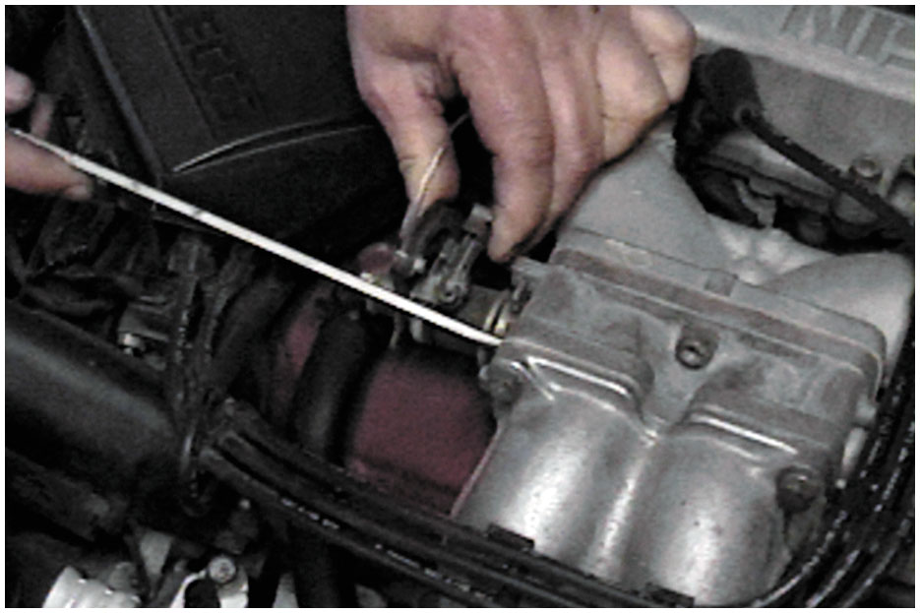
Block Open Throttle
Notes:
3. Block open the throttle (and choke, if the engine is equipped with a carburetor). Keeping the throttle open ensures that enough air will be drawn into the engine so that the compression test results will be accurate

Slide 91
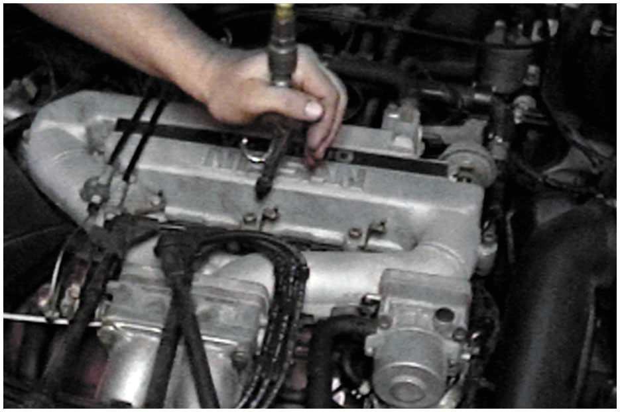
Blow Away Any Dirt
Notes:
4. Before removing the spark plugs, use an air nozzle to blow away any dirt that may be around the spark plug

Slide 92
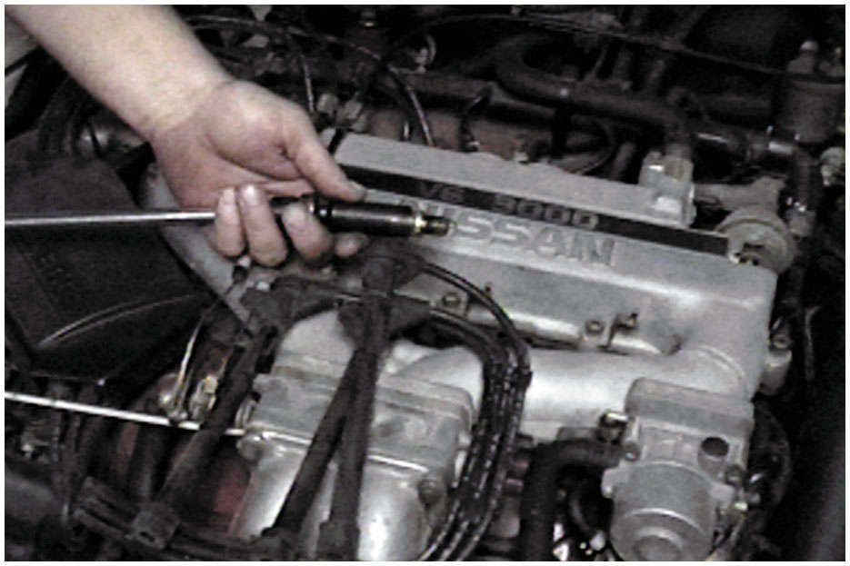
Remove All Spark Plugs
Notes:
5. Remove all of the spark plugs. Be sure to mark the spark plug wires so that they can be reinstalled onto the correct spark plugs after the compression test has been performed

Slide 93
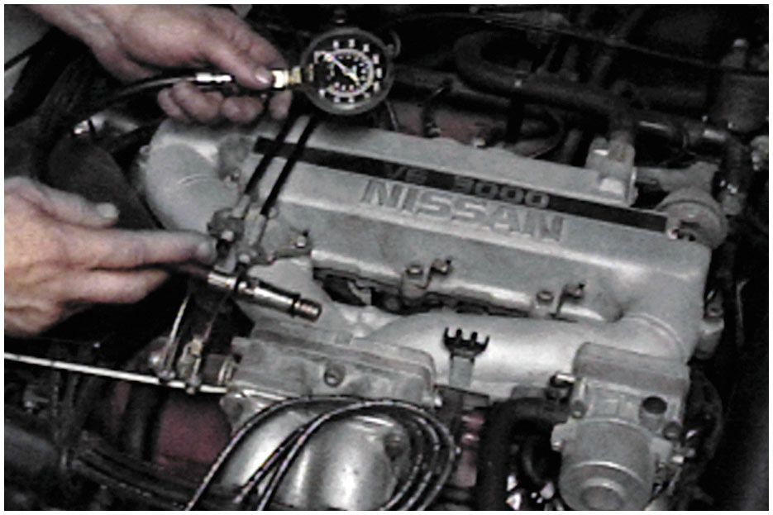
Select Correct Adapter
Notes:
6. Select the proper adapter for the compression gauge. The threads on the adapter should match those on the spark plug

Slide 94
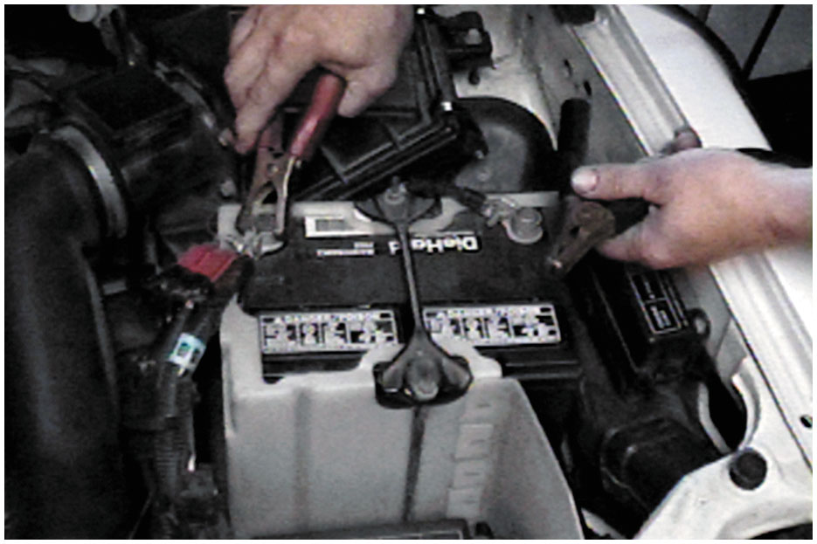
Connect Battery Charger
Notes:
7. If necessary, connect a battery charger to the battery before starting the compression test. It is important that consistent cranking speed be available for each cylinder being tested

Slide 95

Note Reading After 1st Puff
Notes:
8. Make a note of the reading on the gauge after the first “puff,” which indicates the first compression stroke that occurred on that cylinder as the engine was being rotated

Slide 96

Stop Cranking After 4 Puffs
Notes:
9. After the engine has been cranked for four “puffs,” stop cranking the engine and observe the compression gauge

Slide 97

Record 1st Puff & Final Reading
Notes:
10. Record the first puff and this final reading for each cylinder. The final readings should all be within 20% of each other

Slide 98

Squirt 2 Squirts of Engine Oil
Notes:
11. If a cylinder(s) is lower than most of the others, use an oil can and squirt two squirts of engine oil into the cylinder and repeat the compression test

Slide 99

Reading Now Higher: Defective Rings
Notes:
12. If the gauge reading is now much higher than the first test results, then the cause of the low compression is due to worn or defective piston rings

Slide 100
Cylinder Pressure Transducer Waveform Sequence

Slide 101

Step 1
The crankshaft rotates
between the two
peaks, which show the pressure at top dead center (T D C) of the cylinder.
Notes:
Long Description:
The waveform shows sharp peaks followed by corrugated pulses. The ascending end portion of the first peak is labeled compression stroke, the peak of the left peak is labeled T D C, the descending start portion of the first peak is labeled power stroke, the first short peak of the pulse is labeled exhaust stroke, the third short peak of the pulse is labeled intake stroke, and the wavelength between the peaks is labeled 720 degrees.

Slide 102

Step 2
At the beginning of the intake stroke, the pressure inside the cylinder is at atmospheric pressure and then drops as the piston travels downward on the intake stroke.
Notes:
Long Description:
The waveform shows one sharp peak at the center followed by corrugated pulses. The start of the corrugated pulse on the left is labeled intake stroke. The ascending end portion of the peak is labeled compression stroke, the peak is labeled peak compression, the descending start portion of the peak is labeled power stroke, and the first short peak of the pulse is labeled exhaust stroke.

Slide 103

Step 3
The scope is being triggered by the ignition as it fires number one cylinder and the power stroke ends when the piston is near bottom dead center (B D C).
Notes:
Long Description:
The waveform shows a sharp peak followed by corrugated pulses. The peak of the peak is labeled T D C, the descending start portion of the peak is labeled power stroke, a dashed line passes through the end of the power stroke, which is labeled B D C.

Slide 104

Step 4
Waveform showing when the intake and exhaust valves open and close.
Notes:
Long Description:
The waveform shows one sharp peak at the center followed by corrugated pulses. The start of the corrugated pulse on the left is labeled intake stroke. The ascending end portion of the peak is labeled compression stroke, the peak is labeled peak compression, the descending start portion of the peak is labeled power stroke, and the first short peak of the pulse is labeled exhaust stroke.

Slide 105

Step 5
A waveform pattern showing a cylinder with excessive exhaust valve clearance.

Slide 106

Step 6
A waveform showing a pattern on an engine with a worn intake cam lobe.
Notes:
Long Description:
The waveform shows sharp peaks on the left and center, followed by corrugated pulses. The peak of the center peak is labeled T D C. The small peak in the corrugated pulses on the right of the peak is labeled pressure rise, and the descending start portion of the pulse is labeled slopping intake stroke.

Slide 107
Summary
The first step in diagnosing engine condition is to perform a thorough visual inspection, including a check of oil and coolant levels and their condition.
Many engine-related problems make a characteristic noise.
A compression test can be used to test the condition of valves and piston rings.
A cylinder leakage test fills the cylinder with compressed air, and the gauge indicates the percentage of leakage.

Slide 108
Animation and Video Library Links (Must have an internet connection and active Haldeman subscription)
Animation Library: (A8) Engine Performance Animations
Video Library: (A8) Engine Performance Videos

Slide 109

Copyright
This work is protected by United States copyright laws and is provided solely for the use of instructors in teaching their courses and assessing student learning. Dissemination or sale of any part of this work (including on the World Wide Web) will destroy the integrity of the work and is not permitted. The work and materials from it should never be made available to students except by instructors using the accompanying text in their classes. All recipients of this work are expected to abide by these restrictions and to honor the intended pedagogical purposes and the needs of other instructors who rely on these materials.

