Slide 1
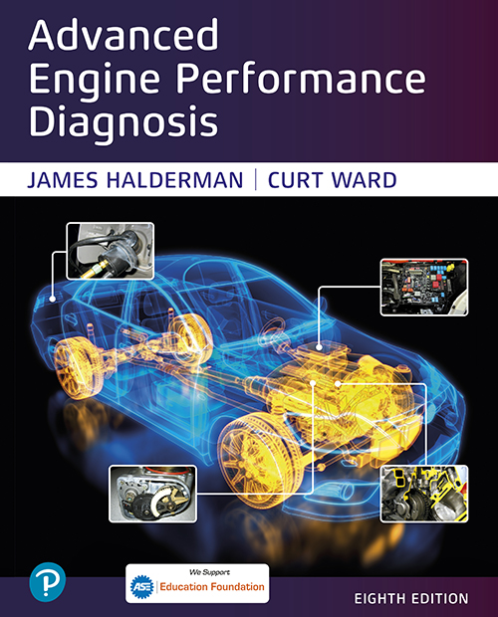

Advanced Engine Performance Diagnosis
Eighth Edition
Chapter 13
Ignition System Operation, Diagnosis, and Service
Copyright © 2025 Pearson Education, Inc. All Rights Reserved
Notes:
If this PowerPoint presentation contains mathematical equations, you may need to check that your computer has the following installed:
1) Math Type Plugin
2) Math Player (free versions available)
3) NVDA Reader (free versions available)
INSTRUCTOR NOTE: This presentation includes text explanation notes, you can use to teach the course. When in SLIDE SHOW mode, you RIGHT CLICK and select SHOW PRESENTER VIEW, to use the notes.

Slide 2
Objectives (1 of 2)
13.1 Describe the purpose and function of the ignition system.
13.2 Discuss ignition switching and triggering.
13.3 Explain the purpose and function of distributor ignition systems.
13.4 Discuss waste-spark ignition systems and coil-on- plug ignition systems.
13.5 Describe the advantages of coil-on-plug ignition systems.
13.6 Discuss the purpose and function of knock sensors.
13.7 Explain ignition system diagnosis.

Slide 3
Objectives (2 of 2)
13.8 List the steps to perform a current ramp test of the ignition coils.
13.9 Explain spark plug construction, service, and how to conduct a spark plug wire inspection.
13.10 Describe the different types of spark plugs.
13.11 Explain ignition timing and scope testing and discuss the symptoms of a faulty ignition system.
13.12 Explain how to test an ignition system using a scope.
13.13 Explain how to scope test a waste-spark ignition system.
13.14 Explain how to scope test a coil-on-plug ignition system.
13.15 Describe the possible causes and solutions for ignition system problems.

Slide 4
Ignition Systems
Purpose and Function
The ignition system includes components and wiring necessary to create and distribute a high voltage (up to 40,000 volts or more) and send to the spark plug.
Background
Before the mid-1970s, ignition systems used a mechanically opened set of contact points to make and break the electrical connection to ground.
Since the mid-1970s, ignition systems have used sensors, such as a pickup coil and reluctor (trigger wheel), to trigger or signal an electronic module.

Slide 5
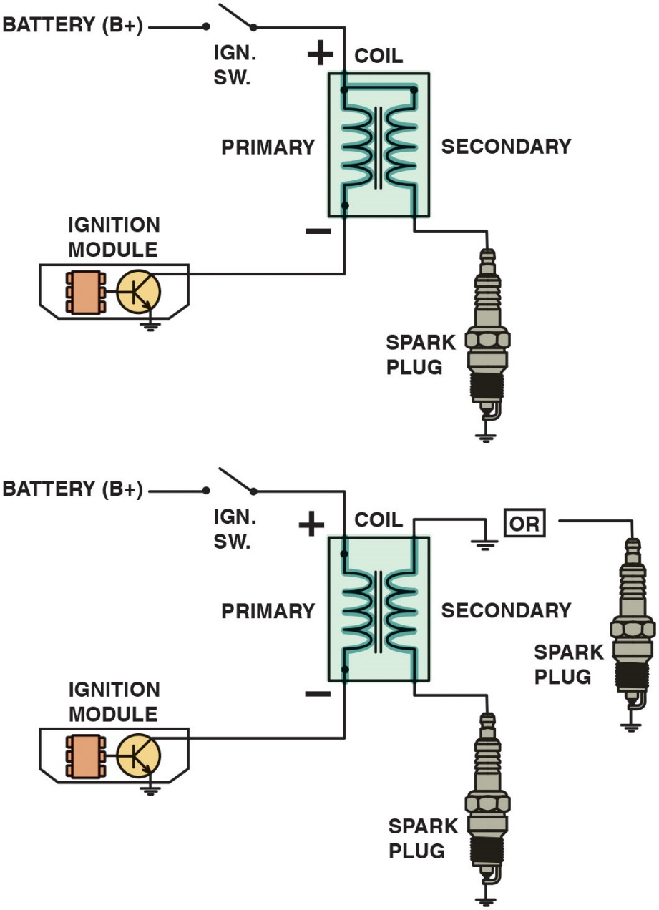
Figure 13.1
Married Coil
Some ignition coils are electrically connected, called married (top figure), whereas others use separate primary and secondary windings, called divorced (lower figure). The polarity (positive or negative) of a coil is determined by the direction in which the coil is wound.
Notes:
Ignition Coil Construction
The heart of any ignition system is the ignition coil. When the coil negative lead is grounded, the primary (low voltage) circuit of the coil is complete and a magnetic field is created around the coil windings. When the circuit is opened, the magnetic field collapses and induces a high voltage in the secondary winding of the ignition coil. The coil creates a high-voltage spark by electromagnetic induction. Many ignition coils contain two separate but electrically connected windings of copper wire. Other coils are true transformers in which the primary and secondary windings are not electrically connected. • See Figure 13.1.
Long Description:
The first one is the married ignition coil, with the top terminals of the primary and secondary coils connected together. The top primary terminal is the positive terminal connected to an open I.G.N.S.W. with a battery (B plus). The bottom primary terminal is the negative terminal connected to the ignition module. The bottom secondary terminal is connected to a spark plug. The second one is the divorced ignition coil with the same settings except that the top terminal of the secondary is not connected to the top terminal of the primary. Instead, it is either grounded or connected to another spark plug.

Slide 6
Ignition System Operation
All ignition systems apply voltage close to battery voltage (12 volts) to positive side of ignition coil and pulse negative side to ground.
When coil negative lead is grounded, primary (low-voltage) circuit of coil is complete and a magnetic field is created around coil windings.
When circuit is opened, magnetic field collapses and induces a high-voltage spark in secondary winding of ignition coil.

Slide 7
Ignition Coils (1 of 4)
Purpose and Function
The coil creates a high-voltage spark by electromagnetic induction.
Coil Construction
The center of an ignition coil contains a core of laminated soft iron (thin strips of soft iron).
Surrounding the laminated core are the secondary windings.
Surrounding the secondary windings are the primary windings.

Slide 8
Ignition Coils (2 of 4)
Self-Induction
When current starts to flow into a coil, an opposing current is created in the windings of the coil. This opposing current generation is caused by self-induction and is called inductive reactance.
Mutual Induction
The current flowing in one coil winding induces a voltage in the adjacent coil winding when a change occurs.

Slide 9
Ignition Coils (3 of 4)
How Ignition Coils Create 40,000 Volts
All ignition systems use electromagnetic induction to produce a high-voltage spark.
Magnetic field in an ignition coil produced by current flowing through primary windings
When primary coil winding ground return path connection is opened, magnetic field collapses and induces a voltage of 250 to 400 volts in primary winding of the coil
High-voltage (20,000 to 40,000 volts) low-amperage (20 to 80 m A) current in the secondary coil windings.

Slide 10
Ignition Coils (4 of 4)
Primary Ignition Circuit
Battery, ignition switch
Primary windings of coil
Pickup coil ( cranks sensor)
Ignition module (igniter)
P C M
Secondary Ignition Circuit
Secondary windings of coil
Distributor cap and rotor (if the vehicle is so equipped)
Spark plug wires and spark plugs
Notes:
Electronic ignition. Since the mid-1970s, ignition systems have used sensors, such as a pickup coil and reluctor (trigger wheel), to trigger or signal an electronic module that switches the primary ground circuit of the ignition coil. Distributor ignition (DI) is the term specified by the Society of Automotive Engineers (SAE) for an ignition system that uses a distributor. Electronic ignition (EI) is the term specified by the SAE for an ignition system that does not use a distributor. Electronic ignition system types include:
1. Waste-spark system. This type of system uses one ignition coil to fire the spark plugs for two cylinders at the same time.
2. Coil-on-plug system (COP). This type of system uses a single ignition coil for each cylinder with the coil placed above or near the spark plug.

Slide 11
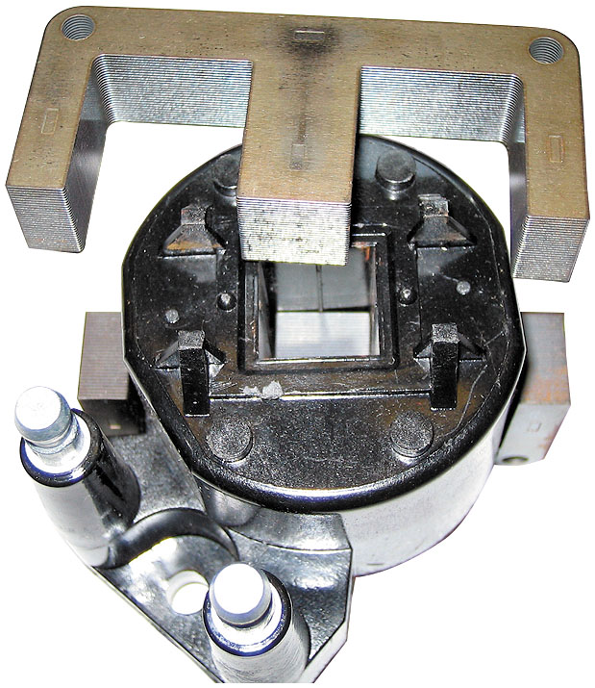
Figure 13.2
E Coil
The steel lamination used in an E coil helps increase the magnetic field strength, which helps the coil produce higher energy output for a more complete combustion in the cylinders.
Notes:
In older coils, these windings are surrounded with a thin metal shield and insulating paper and placed into a metal container filled with transformer oil to help cool the coil windings. Other coil designs use an air-cooled, epoxy-sealed E coil. The E coil is so named because the laminated, soft iron core is E shaped, with the coil wire turns wrapped around the center “finger” of the E and the primary winding wrapped inside the secondary winding. • See Figures 13.2 and 13.3.

Slide 12
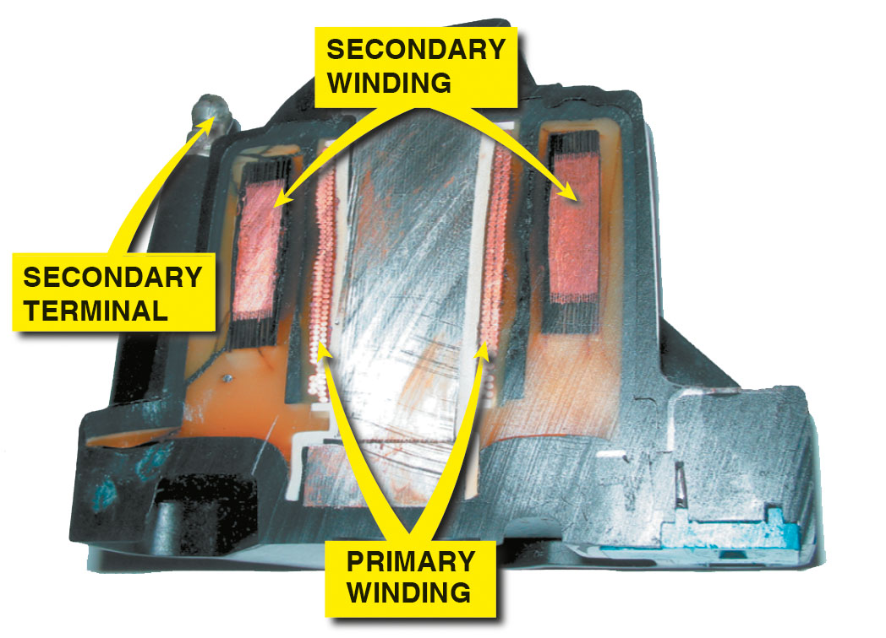
Figure 13.3
Primary Inside Secondary
The primary windings are inside the secondary windings on this General Motors coil.

Slide 13
Question 1
What are the components of the secondary ignition circuit?
Notes:
The ignition components that regulate the current in the coil primary winding by turning it on and off are known collectively as the primary ignition circuit. When the primary circuit is carrying current, the secondary circuit is off. When the primary circuit is turned off, the secondary circuit has high voltage. The components necessary to create and distribute the high voltage produced in the secondary windings of the coil are called the secondary ignition circuit. • See Figure 13.4.

Slide 14
Answer 1
The secondary side of the coil, the cap and rotor (if used), the spark plug wires, and the spark plugs.

Slide 15
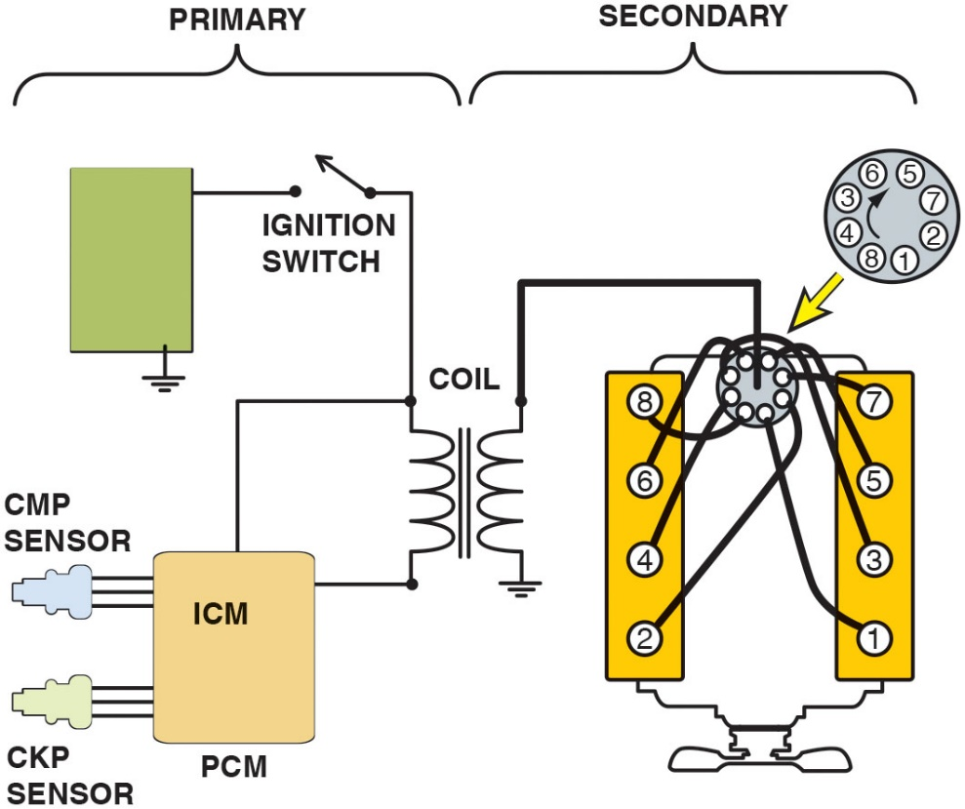
Figure 13.4
Ignition Circuit
The primary ignition system is used to trigger, and therefore create the secondary (high-voltage) spark from the ignition coil.
Notes:
Ignition Coil Operation
All ignition systems use electromagnetic induction to produce a high-voltage spark from the ignition coil. Electromagnetic induction (EMI) means that a current can be created in a conductor (coil winding) by a moving magnetic field. The magnetic field in an ignition coil is produced by current flowing through the primary winding of the coil. An ignition coil can increase battery voltage to 40,000 volts or more in the following way.
Battery voltage is applied to primary winding.
A ground is provided to the primary winding by ignition control module (ICM), igniter, or PCM.
Current (approximately 2 to 6 amperes) flows in primary coil creating a magnetic field.
When ground is opened by ICM, built-up magnetic field collapses.
The movement of the collapsing magnetic field induces a voltage of 250 to 400 volts in the primary winding and 20,000 to 40,000 volts or more in the secondary winding with a current of 0.020 to 0.080 ampere
The high voltage created in the secondary winding is high enough to jump the air gap at the spark plug.
The electrical arc at the spark plug ignites the air–fuel mixture in the combustion chamber of the engine.
For each spark that occurs, the coil must be charged with a magnetic field and then discharged
Long Description:
The primary of the ignition coil is connected to an open ignition switch from the module and to I C M. The secondary is connected to the center of the distribution rotor. The rotor has the following pins in clockwise direction: 5, 7, 2, 1, 8, 4, 3, 6. The pins on the secondary ignition system have 8, 6, 4, 2 on the left and 7, 5, 3, 1 on the right. Each labeled pin on the ignition system is connected to the corresponding labeled pin of the rotor (that is, 8-8, 6-6, 4-4, e t c.). I C M and P C M are in the same block. I C M has C M P sensor as input and P C M has C K P sensor as input. The second terminal of the secondary of the coil is grounded. The other end of the module is grounded.

Slide 16
Ignition Switch and Triggering
Turning on/off of primary circuit is called switching.
Unit that does switching is electronic switch, such as a power transistor.
Power transistor can be located in:
In powertrain control module (P C M)
In I C M
Part of the coil-on-plug assembly

Slide 17
Primary Circuit Operation
These are used as crankshaft position (C K P) sensors or camshaft position (C M P) sensors:
Hall-effect switch uses a stationary sensor and rotating trigger wheel (shutter).
Magnetic sensor uses changing strength of magnetic field surrounding a coil of wire to signal module and computer.

Slide 18
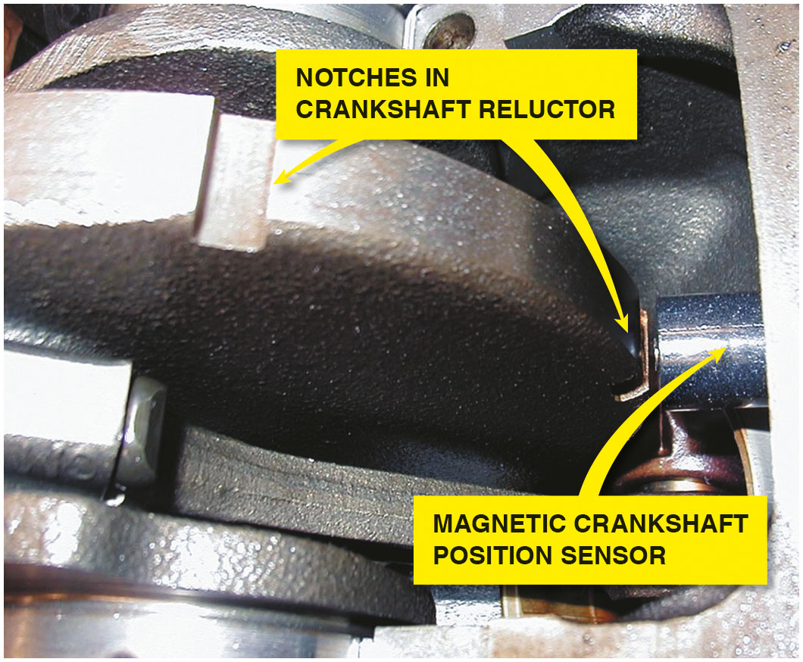
Figure 13.5
C K P Sensor
A typical magnetic crankshaft position sensor.

Slide 19
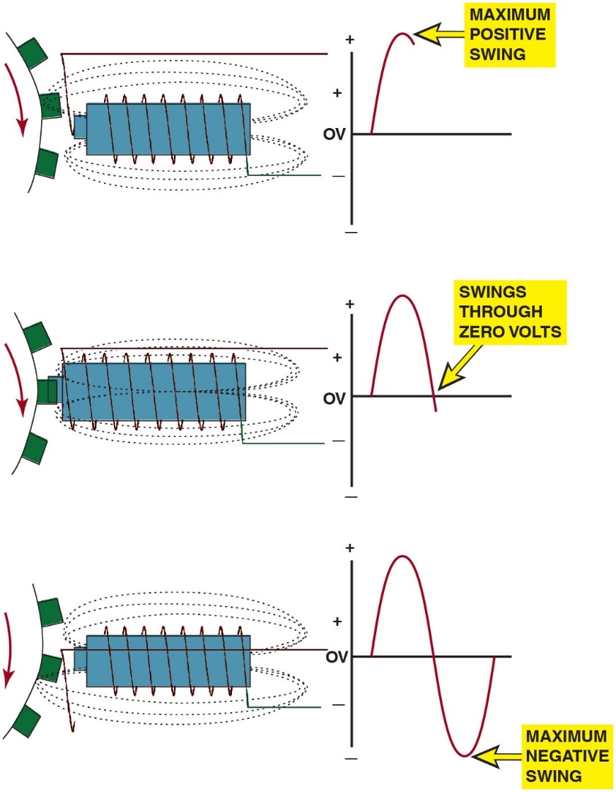
Figure 13.6
Magnetic Sensor
A magnetic sensor uses a permanent magnet surrounded by a coil of wire. The notches of the crankshaft (or camshaft) create a variable magnetic field strength around the coil. When a metallic section is close to the sensor, the magnetic field is stronger because metal is a better conductor of magnetic lines of force than air.
Notes:
Long Description:
Stage 1: A tooth approaches the sensor – this creates a maximum positive swing. Stage 2: A tooth is aligned with the sensor – this brings the voltage in the coil back to 0. Stage 2: A tooth moves away from the sensor – This creates a maximum negative swing of voltage. The whole cycle creates a complete sine wave in the voltage graph.

Slide 20
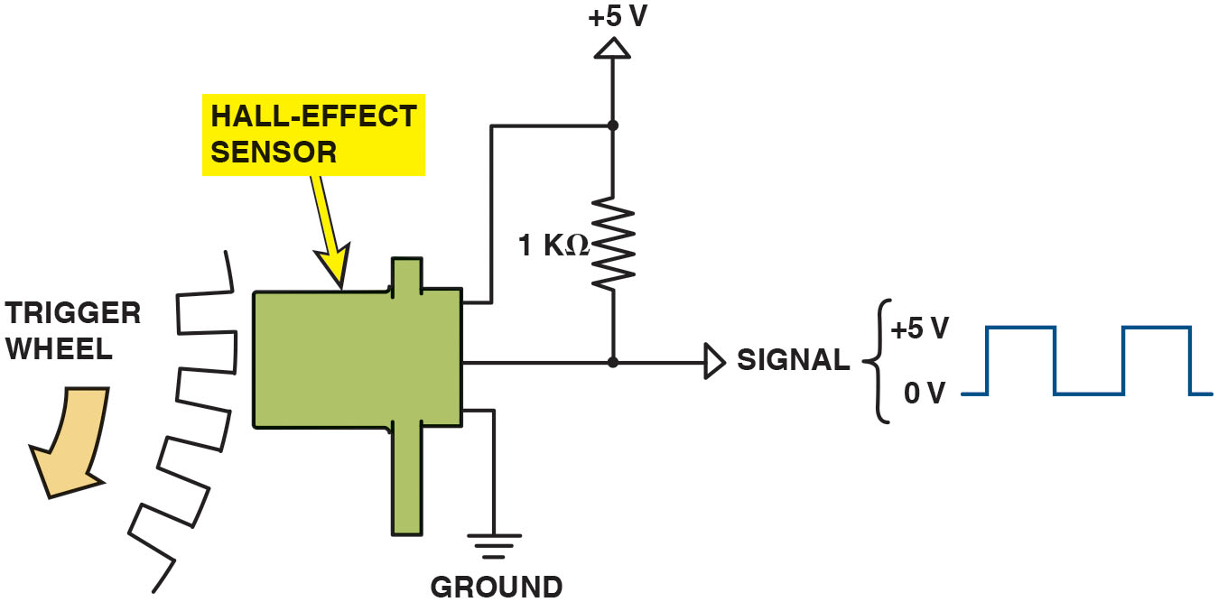
Figure 13.7
Hall-Effect Switch
A Hall-effect sensor produces a digital on-off voltage signal whether it is used with a blade or a notched wheel.
Notes:
Long Description:
Hall-effect switch. This switch also uses a stationary sensor and rotating trigger wheel (shutter). Unlike the magnetic pulse the Hall-effect switch requires a small input voltage to generate an output or signal voltage. Hall effect can generate a voltage signal in semiconductor material (gallium arsenate crystal) by passing current through it in one direction and applying a magnetic field to it at a right angle to its surface. If the input current is held steady and the magnetic field fluctuates, an output voltage is produced that changes in proportion to field strength. Most Hall-effect switches in distributors have the following:
Hall element or device.
Permanent magnet
Rotating ring of metal blades (shutters) like a trigger wheel (Another method uses a stationary sensor with a rotating magnet.) • See Figure 13.7.
Long Description:
The hall-effect sensor is a rectangular structure with pipe-like extensions at top right and bottom right. The middle terminal of the sensor has a signal of 0 V to plus 5 V. The waveform shows two pulses. A 1 k ohm resistor is connected from the signal to a positive 5 V. The top terminal of the sensor is connected to the resistor at a positive 5 V. The bottom terminal is connected to the ground. The sensor is used with a trigger wheel that rotates in an anticlockwise direction.

Slide 21
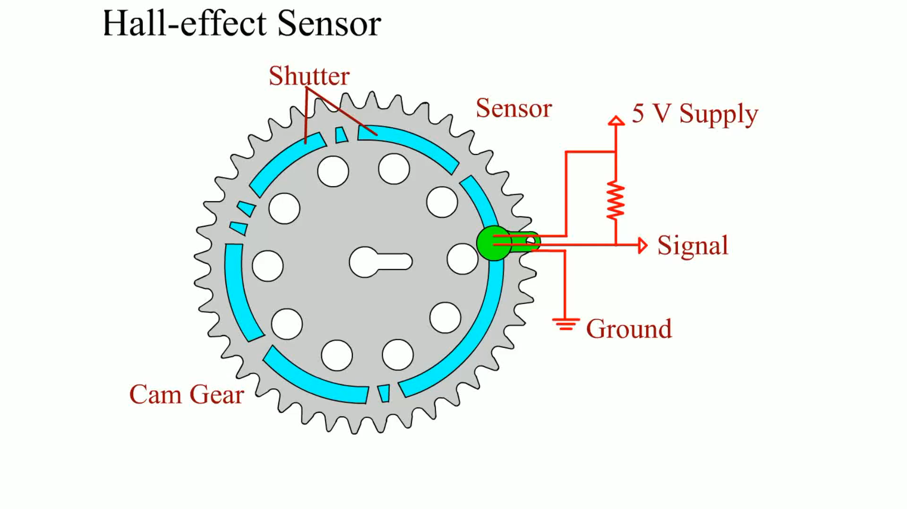
Animation: Hall-Effect Sensor

Slide 22
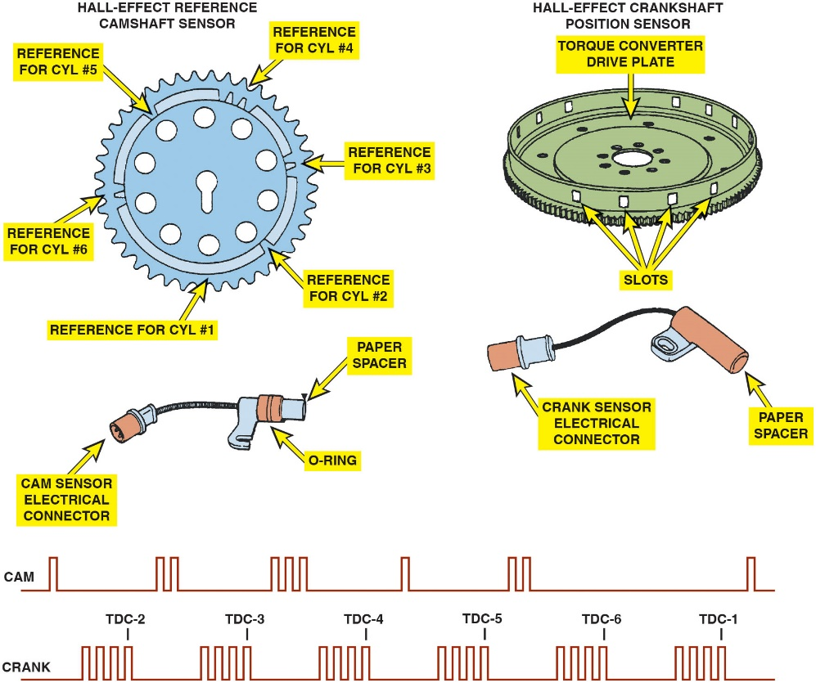
Figure 13.8
Hall-Effect Sensor
Some Hall-effect sensors look like magnetic sensors. This Hall-effect camshaft reference sensor and crankshaft position sensor have an electronic circuit built in that creates a 0-to-5 volt signal as shown at the bottom. These Hall-effect sensors have three wires: a power supply (8 volts) from the computer (controller); a signal (0 to 5 volts); and a signal ground.
Notes:
TECH TIP: The Tachometer Trick
When diagnosing a no-start or intermittent misfire condition, check the operation of the tachometer. If the tachometer does not indicate engine speed (no-start condition) or drops toward zero (engine misfire), the problem is due to a defect in the primary ignition circuit. The tachometer gets its signal from the pulsing of the primary winding of the ignition coil or the crankshaft position (C K P) sensor. The following components in the primary circuit could cause the tachometer to not work when the engine is cranking:
Pickup coil
Crankshaft position sensor
Ignition module (igniter)
Coil primary wiring
If the vehicle is not equipped with a tachometer, connect a scan tool and monitor engine R P M. Remember the following:
No tachometer reading means the problem is in the primary ignition circuit.
Tachometer reading okay means the problem is in the secondary ignition circuit or is a fuel-related problem.
Long Description:
Hall-effect reference camshaft sensor: structure: A saw-tooth edged wheel is with the following positions: top right: reference for cyl hash 4; center right: reference for cyl hash 3; bottom right: reference for cyl hash 2; bottom center: reference for cyl hash 1; center left: reference for cyl hash 6; top left: reference for cyl hash 5. Cable diagram: a gun-like structure with O ring in the middle and paper spacer at the end is connected through a cable to a pipe-like structure containing a cam sensor electrical connector. Output voltage waveform: CAM: the pulse waveform has six segments: One pulse; two pulses; three pulses; one pulse; two pulses; one pulse.
Hall-effect crankshaft position sensor: structure: a disc with corrugated bottom and slots along the side and a torque converter drive plate inside. Cable diagram: a gun-like structure with paper spacer at the end of the long tube is connected through a cable to a pipe-like structure containing a crank sensor electrical connector. Output voltage waveform: Four pulses correspond to the middle of the segments of the camshaft sensor. The last pulses of the segments are labeled as follows: T D C-2; T D C-3; T D C-4; T D C-5; T D C-6; T D C-1.

Slide 23
Question 2
What are the two type of crankshaft sensors?

Slide 24
Answer 2
Hall-effect and magnetic sensors.

Slide 25
Distributor Ignition Systems (1 of 2)
Purpose and Function
To distribute the high-voltage spark from the ignition coil to the spark plugs located at each cylinder
To provide a method for switching the primary ignition circuit, first using mechanical points and later using a sensor
The distributor is driven by a gear from the end of the camshaft inside the engine that rotates at the same speed as the camshaft, which is half crankshaft speed.

Slide 26
Distributor Ignition Systems (2 of 2)
Distributor Cap and Rotor
The high-voltage pulse from the ignition coil enters the distributor cap and is sent to the individual spark plug wires by the rotating rotor.
Firing Order
Firing order means the order that the spark is distributed to the correct spark plug at the right time.

Slide 27
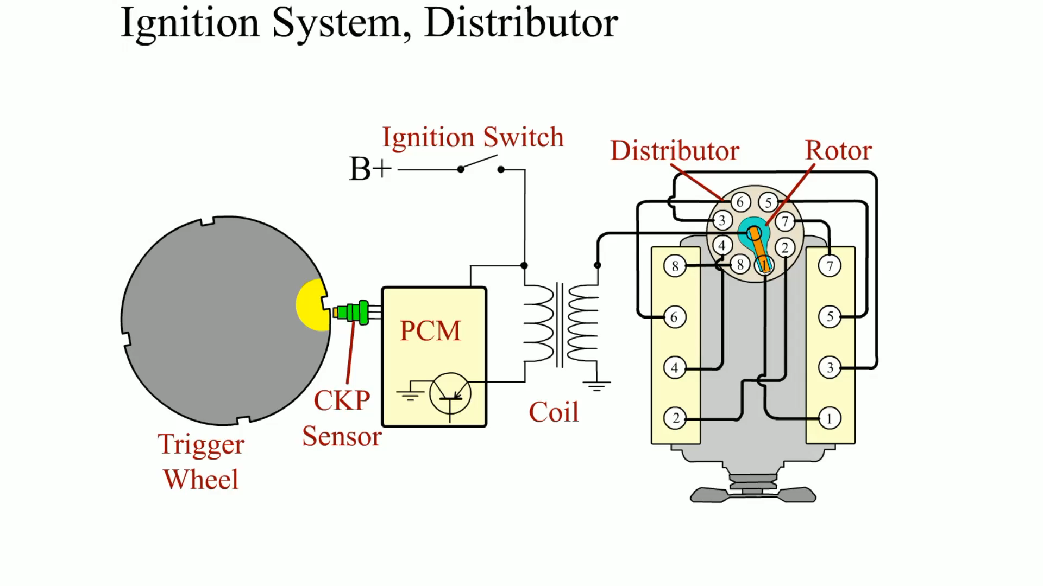
Animation: Ignition System, Distributor

Slide 28
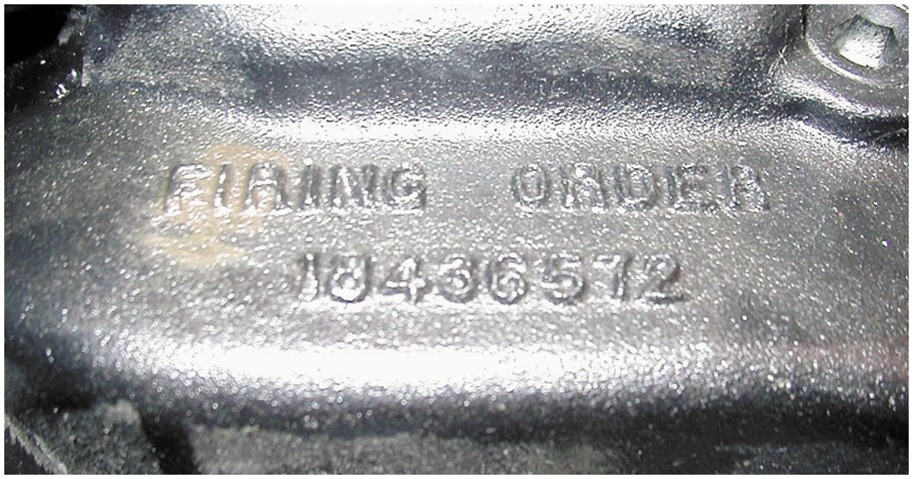
Figure 13.9
Firing Order
The firing order is cast or stamped on the intake manifold on most engines that have a distributor ignition.
Notes:
Firing order means the order that the spark is distributed to the correct spark plug at the right time. The firing order of an engine is determined by crankshaft and camshaft design. The firing order is determined by the location of the spark plug wires in the distributor cap of an engine equipped with a distributor. The firing order is often cast into the intake manifold for easy reference. • See Figure 13.9.
CAUTION: Ford V-8s use two different firing orders depending on whether the engine is high output (HO) or standard. Using the incorrect firing order can cause the engine to backfire and could cause engine damage or personal injury. General Motors V-6 engines use different firing orders and different locations for cylinder 1 between the 60-degree V-6 and the 90-degree V-6. Using the incorrect firing order or cylinder number location chart could result in poor engine operation or a no start. The firing order is also important for waste-spark-type ignition systems. The spark plug wire can often be installed on the wrong coil pack, which can create a no-start condition or poor engine operation.

Slide 29
Waste-Spark Ignition Systems
Waste-spark ignition is another name for distributorless ignition system (D I S) or electronic ignition (E I).
Each end of the secondary winding is connected to a cylinder exactly opposite the other in the firing order, which is called a companion (paired) cylinder.
This means that both spark plugs fire at the same time (within nanoseconds of each other).

Slide 30
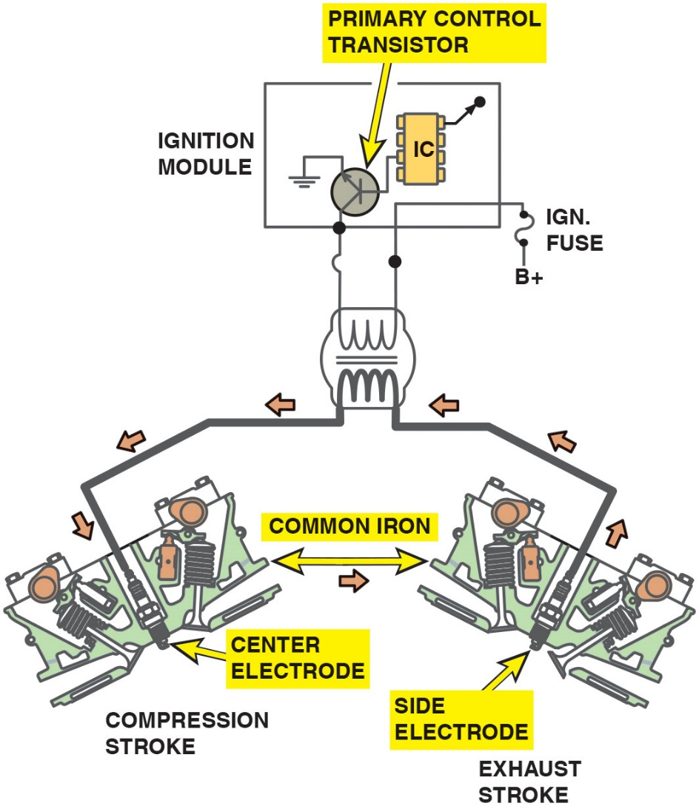
Figure 13.10
Waste Spark
Waste-spark system fires one cylinder while its piston is on the compression stroke and into paired or companion cylinders while it is on the exhaust stroke. In a typical engine, it requires only about 2 to 3 k V to fire the cylinder on the exhaust strokes. The remaining coil energy is available to fire the spark plug under compression (typically about 8 to 12 k V).
Notes:
TECH TIP: Odds Fire Straight
Waste-spark ignition systems fire two spark plugs at the same time. Most vehicle manufacturers use a waste-spark system that fires the odd-numbered
cylinders (1, 3, and 5) by straight polarity (current flow from the top of the spark plug through the gap and to the ground electrode). The even-numbered -cylinders (2, 4, and 6) are fired reverse polarity, meaning that the spark jumps from the side electrode to the -center electrode. Some vehicle manufacturers equip their vehicles with platinum plugs with the expansive -platinum alloy only on one electrode as follows:
On odd-numbered cylinders (1, 3, 5), the platinum is on the center electrode.
On even-numbered cylinders (2, 4, 6), the platinum is on the ground electrode.
Replacement spark plugs use platinum on both electrodes (double platinum) and can, therefore, be placed in any cylinder location.
Long Description:
The ignition module has a primary control transistor and an I C. The collector of the transistor is connected to the first terminal of the primary of a coil. The second terminal of the primary is connected through the ignition module to I G N. fuse with B positive terminal. The secondary is connected to the center electrode a little away from the compression stroke from a common iron rod and the side electrode a little away from the exhaust stroke from the rod. Arrows flow from the side electrode to the center electrode and back to the side electrode. The ends of the common iron rod are indicated by a double-headed arrow.

Slide 31
Frequently Asked Question: How Can You Determine Companion Cylinder?
? Frequently Asked Question
How Can You Determine Companion Cylinder? Companion cylinders are two cylinders in same engine that both reach T D C at the same time.
One cylinder is on compression stroke.
Other cylinder is on exhaust stroke
To determine which two cylinders are companion cylinders in the engine, follow these steps:
STEP 1 Determine firing order (such as 165432 for a typical V-6 engine).
STEP 2 Write firing order and then place second half under first half.
STEP 3 The cylinder numbers above and below each other are companion or paired cylinders.
In this case 1 and 4, 6 and 3, and 5 and 2 are companion cylinders.
Notes:
Replacement spark plugs use platinum on both electrodes (double platinum) and, therefore, can be placed in any cylinder location
Cylinder 1 Always fires straight polarity (from the center electrode to the ground electrode), one time requiring 10 to 12 kV and one time requiring 3 to 4 kV.
Cylinder 4 Always fires reverse polarity (from the ground electrode to the center electrode), one time requiring 10 to 12 kV and one time requiring 3 to 4 kV

Slide 32
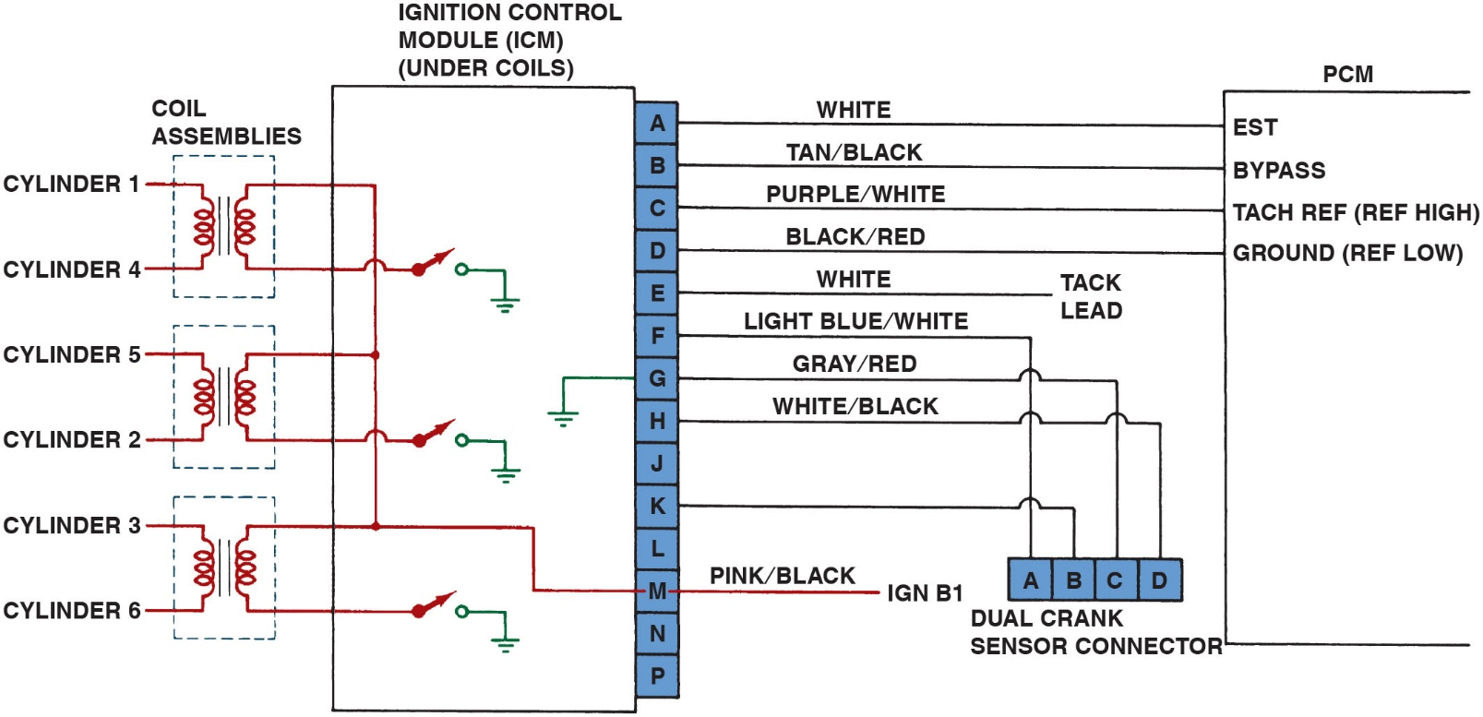
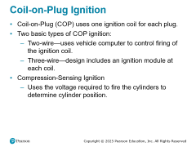
Figure 13.11
Waste Spark
Typical wiring diagram of a V-6 waste-spark ignition system. P C M uses input data from all the engine sensors and determines the optimum ignition timing, then triggers the primary ignition circuit to fire the spark plug or sends the trigger signal to the I C M, if equipped.
Notes:
The crankshaft sensor cannot be moved to adjust ignition timing because ignition timing is not adjustable. The slight adjustment of the crankshaft sensor is designed to position the sensor exactly in the middle of the rotating metal disc for maximum clearance.
Long Description:
There are three sets of coil assemblies. Set 1 is with cylinder 1, cylinder 4; set 2 is with cylinder 5, cylinder 2; set 3 is with cylinder 3, cylinder 6. The sets are connected such that all the top terminals are each connected together and the bottom terminals are each connected to a switch and grounded. These two connections are within ignition control module (I C M) (under coils). The top output terminal on the secondary of set 3 is connected to pin M of I C M. Dual crank sensor connector has four pins A to D. Output pins A to P with O not present are for I C M. The output connections are as follows: Pin A through a white conductor to E S T of P C M; pin B through a tan or black conductor to bypass of P C M; pin C through a purple or white conductor to tach ref (ref high) of P C M; pin D through a black or red conductor to ground (ref low) of P C M; pin E through a white conductor to tack lead; pin F through a light blue or white conductor to pin A of dual crank sensor connector; pin G through a gray or red conductor to pin C of the connector; pin H through a white or black conductor to pin D of the connector; pin K through a conductor to pin B of the connector; pin M through a pink or black conductor to I G N B superscript 1. Pin G of I C M is grounded inside the module.

Slide 33
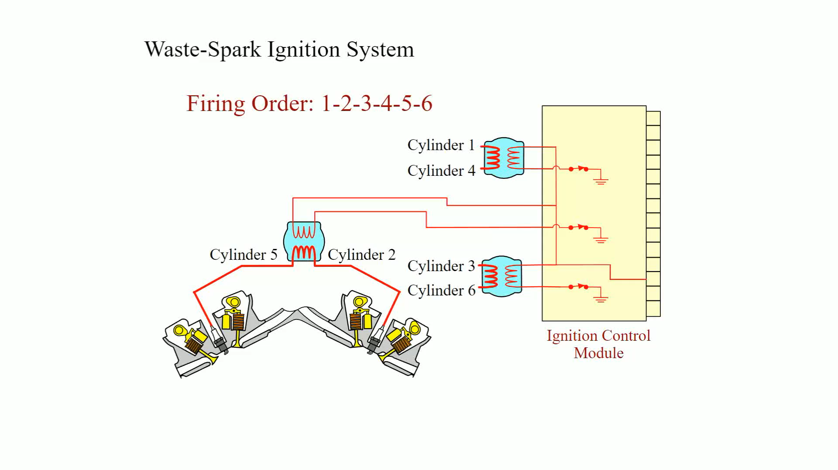
Animation: Waste-Spark Ignition System

Slide 34
Coil-on-Plug Ignition
Coil-on-Plug (C O P) uses one ignition coil for each plug.
Two basic types of C O P ignition:
Two-wire—uses vehicle computer to control firing of the ignition coil.
Three-wire—design includes an ignition module at each coil.
Compression-Sensing Ignition
Uses the voltage required to fire the cylinders to determine cylinder position.

Slide 35
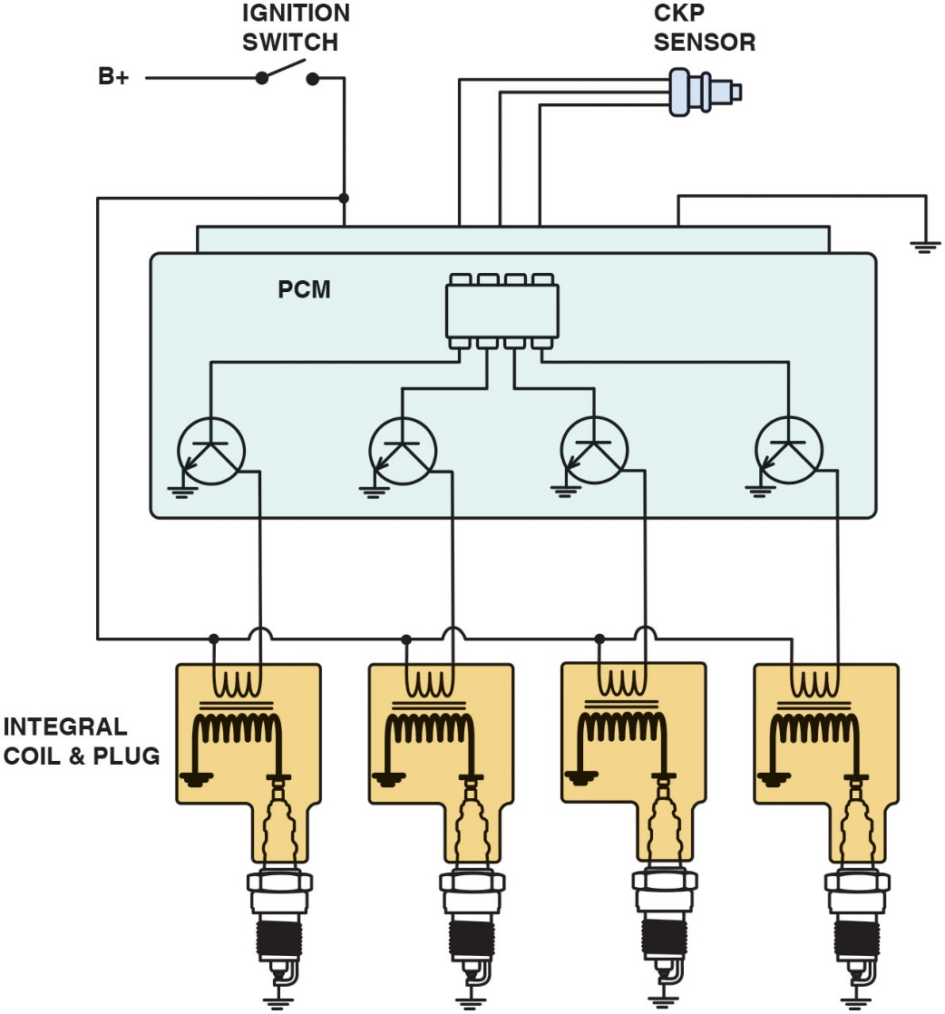
Figure 13.12
Two-Wire C O P
A typical two-wire coil-on-plug ignition system showing the triggering and the switching being performed by the P C M from input from the crankshaft position sensor.
Notes:
Long Description:
Each spark plug has its own set of primary and secondary coil. The primary coil is connected to the ignition switch on one end and collectors of the transistors in P C M on the other. Secondary coils are connected to spark plugs and ground. Transistors are controlled by I C in P C M. P C M is also connected to C K P sensor.

Slide 36
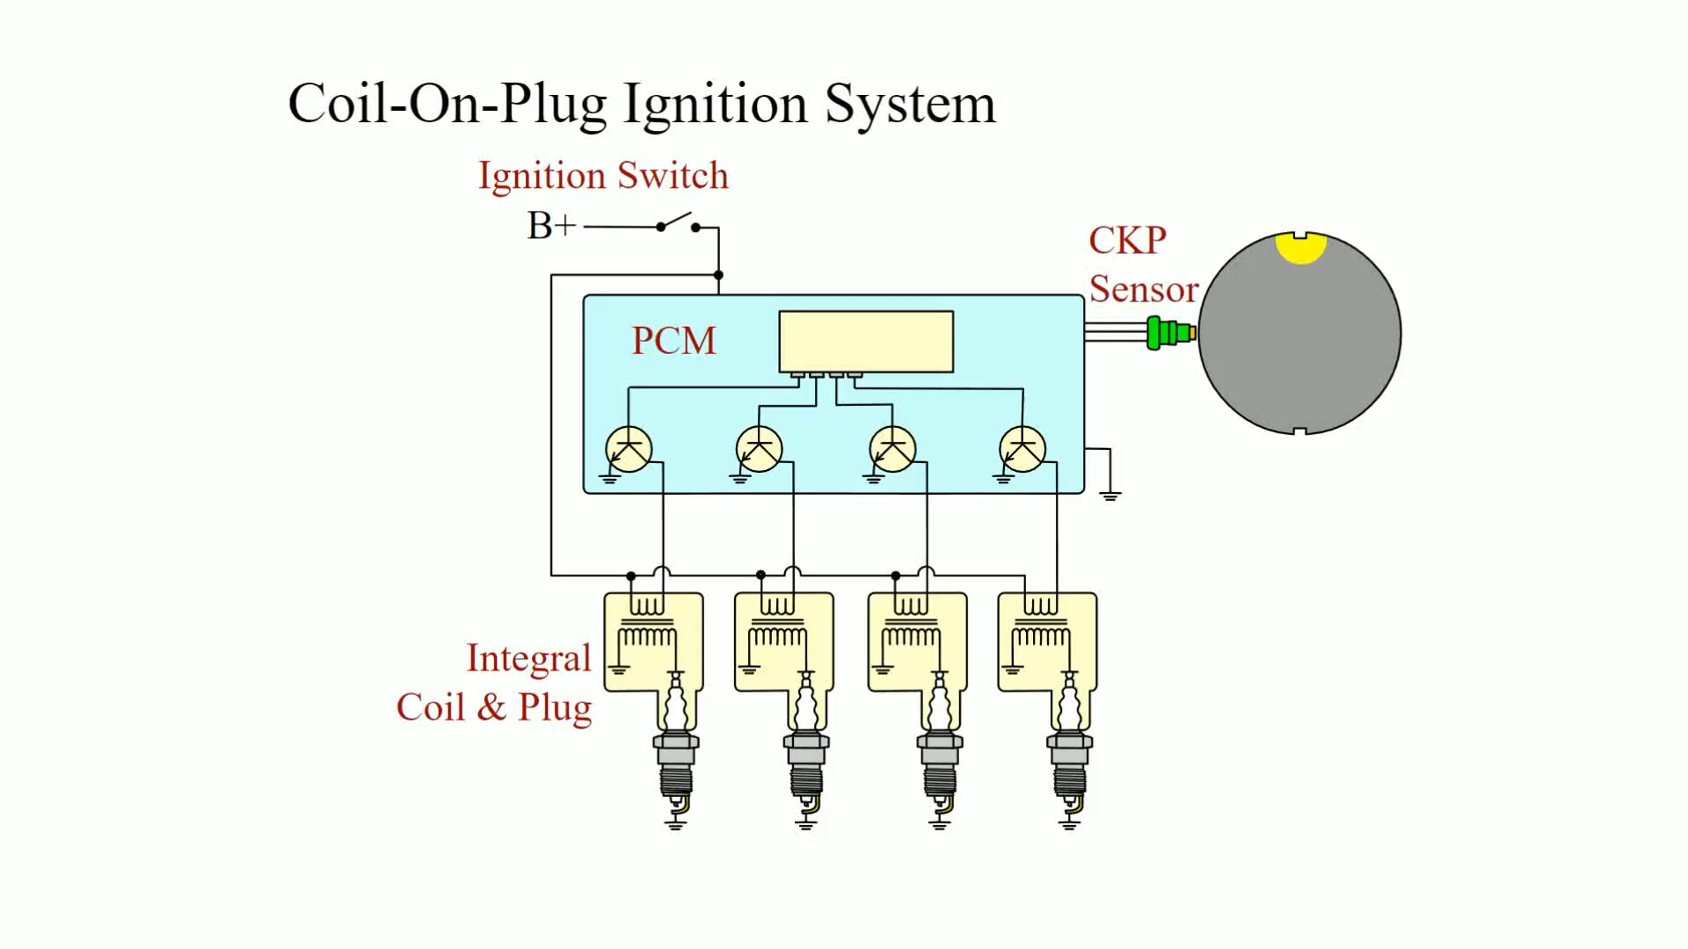
Animation: Coil-On-Plug Ignition System

Slide 37
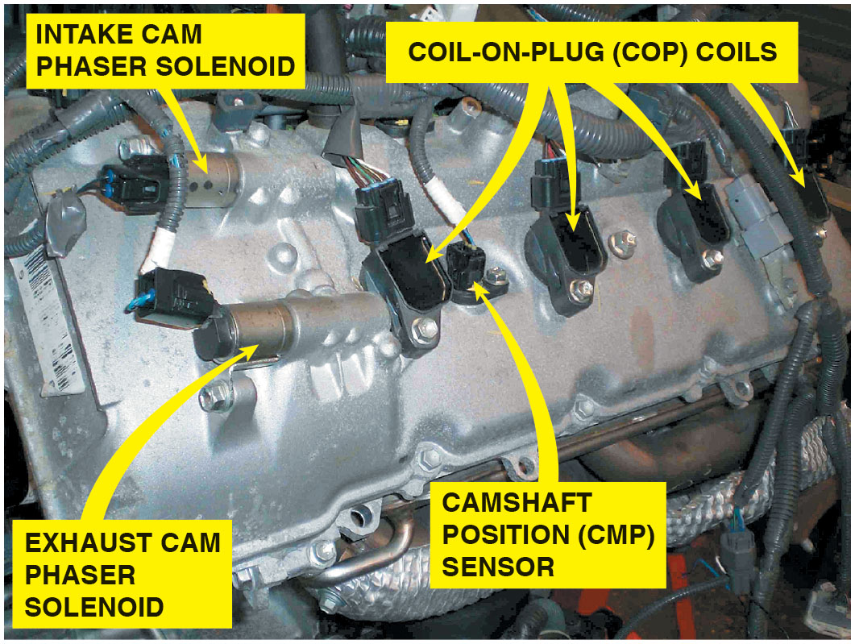
Figure 13.13
C O P with V V T
An overhead camshaft engine equipped with variable valve timing on both the intake and exhaust camshafts and coil-on-plug ignition.
Notes:
Many General Motors V-8 engines use a coil-near-plug system with individual coils and modules for each individual cylinder that are placed on the valve covers. Short secondary ignition spark plug wires are used to connect the output terminal of the ignition coil to the spark plug, and therefore this system is called a coil-near-plug system.

Slide 38
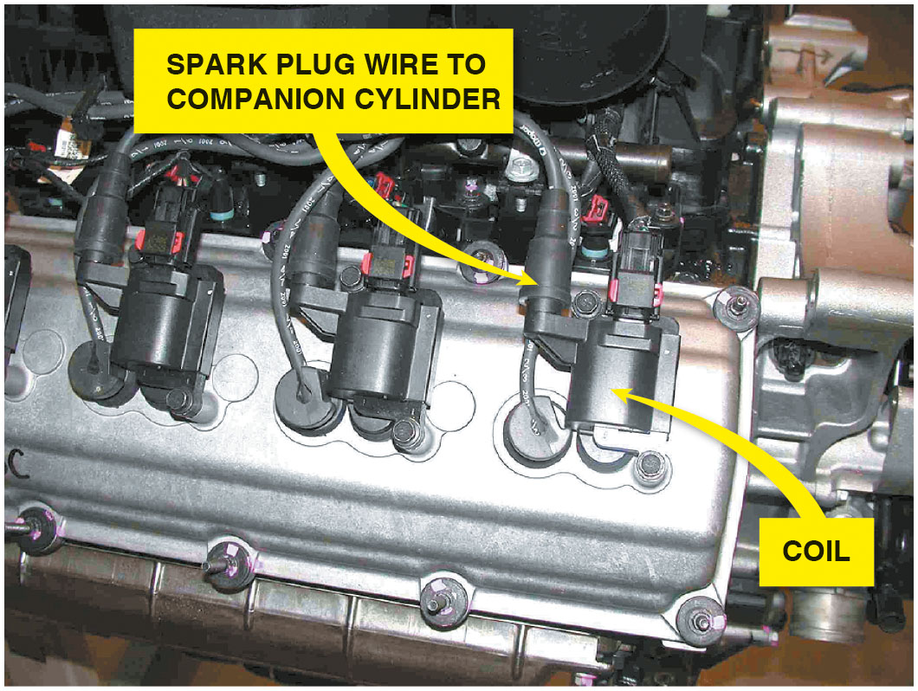
Figure 13.14
Hemi-Engine
Chrysler Hemi V-8 that has two spark plugs per cylinder. The coil on top of one spark fires that plug plus, through a spark plug wire, fires a plug in the companion cylinder.
Notes:
WARNING Never Disconnect a Spark Plug Wire When the Engine Is Running!
Ignition systems produce a high-voltage pulse necessary to ignite a lean air–fuel mixture. If you disconnect a spark plug wire when the engine is running, this high-voltage spark could cause personal injury or damage to the ignition coil and/or ignition module.
Long Description:
Chrysler Hemi V-8 has two spark plugs per cylinder. The coil on top of one spark fires that plug plus, through a spark plug wire, fires a plug in the companion cylinder.

Slide 39
Knock Sensors
Knock sensors are used to detect abnormal combustion.
Inside the knock sensor is a piezoelectric element that generates a voltage when pressure or a vibration is applied to the unit.
Diagnosing the Knock Sensor
A scan tool is used to read diagnostic trouble codes and check the functionality of the knock sensor.

Slide 40
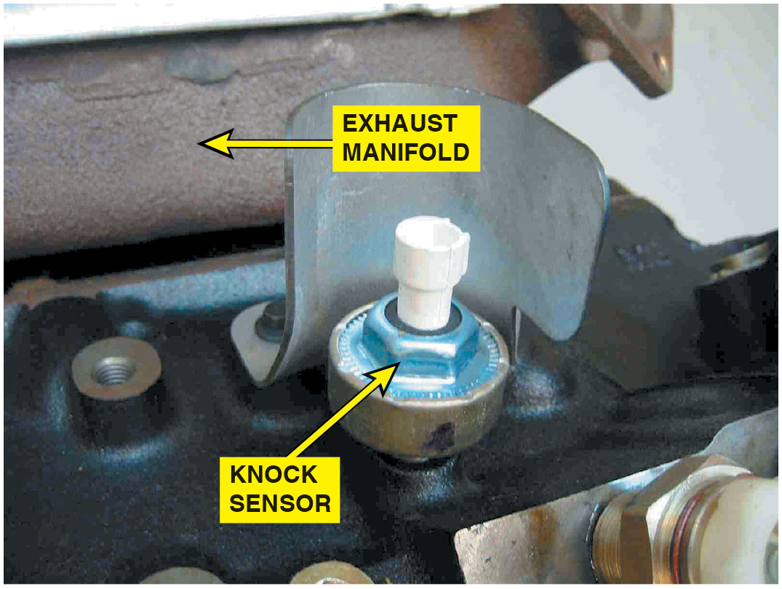
Figure 13.15
Knock Sensor
A typical knock sensor on the side of the block. Some are located in the “V” of a V-type engine and are not noticeable until the intake manifold has been removed.
Notes:
Diagnosing the Knock Sensor
If a knock sensor diagnostic trouble code (DTC) is present, follow the specified testing procedure in the service information. A scan tool can be used to check the operation of the knock sensor, using the following procedure
STEP 1 Start the engine and connect a scan tool to monitor ignition timing and/or knock sensor activity.
STEP 2 Create a simulated engine knocking sound by tapping on the engine block or cylinder head with a soft-faced mallet.
STEP 3 Observe the scan tool display. The vibration from the tapping should have been interpreted by the knock sensor as a knock, resulting in a knock sensor signal and a reduction in the spark advance.

Slide 41
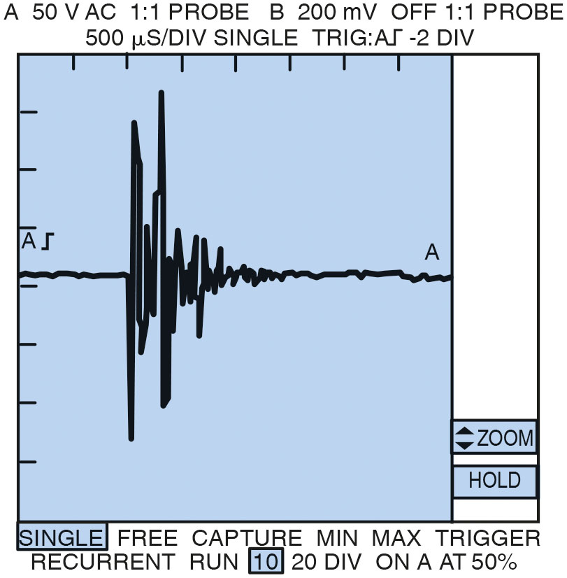
Figure 13.16
Knock Waveform
A typical waveform from a knock sensor during a spark knock event. This signal is sent to the computer which in turn retards the ignition timing. This timing retard is accomplished by an output command from the computer to either a spark advance control unit or directly to the ignition module.
Notes:
A knock sensor also can be tested using a digital storage oscilloscope. • See Figure 13.16.
CASE STUDY: The Low-Power Toyota
A technician talked about the driver of a Toyota who complained about poor performance and low fuel economy. The technician checked everything, and even replaced all secondary ignition components. Then the technician connected a scan tool and noticed that the knock sensor was commanding the timing to be retarded. Careful visual inspection revealed a “chunk” missing from the serpentine belt which caused a “noise” like a spark knock. Apparently, the knock sensor was “hearing” the accessory drive belt noise and kept retarding the ignition timing. After replacing the accessory drive belt, a test drive confirmed that normal engine power was restored.
Summary
Concern—Driver complained of low performance and reduced fuel economy.
Cause—The accessory drive belt had a fault that caused the knock sensor to signal the PCM to retard ignition timing.
Correction—Replacing the accessory drive belt restored proper engine operation
Long Description:
It shows A is 50 V AC 1 isto 1 probe and B is 200 mV off 1 isto 1 probe. 500 mu S per div. The amplitude of the wave increases suddenly and then slowly damps down before coming to 0. Single-free capture min-max trigger recurrent run 10-20 div on A at 50 percent.

Slide 42
Question 3
What is the purpose of the knock sensor?

Slide 43
Answer 3
To detect abnormal combustion.

Slide 44
Checking for Spark
In event of a no-start condition, check for secondary voltage out of ignition coil or to the spark plugs.
Install a spark tester, and crank engine.
Typical causes of a no-spark (intermittent spark) condition include the following:
Weak ignition coil, low or no voltage to coil, open coil wire or plug, defective pickup coil, and defective module.
Notes:
Checking for Spark
In the event of a no-start condition, the first step should be to check for secondary voltage out of the ignition coil or to the spark plugs. If the engine is equipped with a separate ignition coil, remove the coil wire from the center of the distributor cap, install a spark tester, and crank the engine. See the Tech Tip, “Always Use a Spark Tester.” A good coil and ignition system should produce a blue spark at the spark tester. • See Figures 13.17 and 13.18.

Slide 45
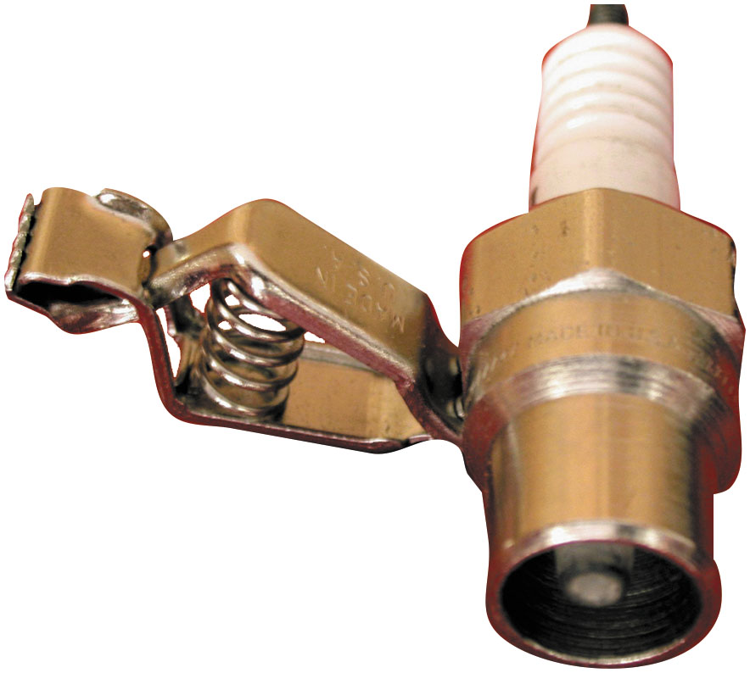
Figure 13.17
Testing for Spark
A spark tester looks like a regular spark plug with an alligator clip attached to the shell. This tester has a specified gap that requires at least 25,000 volts (25 kV) to fire.
Notes:
TECH TIP: Always Use a Spark Tester
A spark tester looks like a spark plug except it has a recessed center electrode and no side electrode. The tester commonly has an alligator clip attached to the shell so that it can be clamped on a good ground connection on the engine. A good ignition system should be able to cause a spark to jump this wide gap at atmospheric pressure. Without a spark tester, a technician might assume that the ignition system is okay, because it can spark across a normal, grounded spark plug. The voltage required to fire a standard spark plug when it is out of the engine and not under pressure is about 3,000 volts or less. An electronic ignition spark tester requires a minimum of 25,000 volts to jump the 3/4-inch gap. Therefore, never assume that the ignition system is okay because it fires a spark plug—always use a spark tester. Remember that an intermittent spark across a spark tester should be interpreted as a no-spark condition.

Slide 46
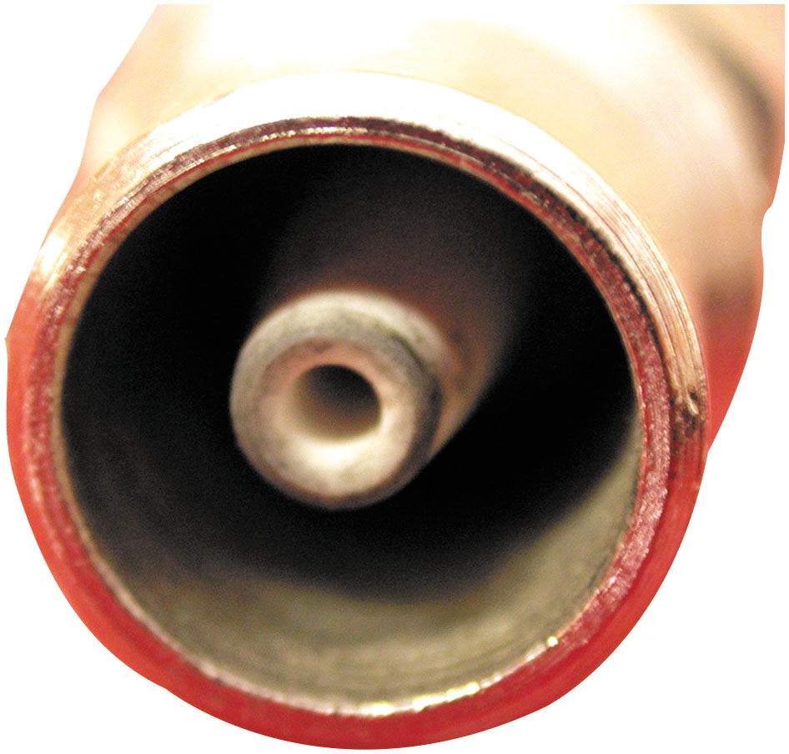
Figure 13.18
Spark Tester
A close-up showing the recessed center electrode on a spark tester. It is recessed 3/8 inch into the shell and the spark must then jump another 3/8 inch to the shell for a total gap of 3/4 inch.
Notes:
Typical causes of a no-spark (intermittent spark) condition include the following:
Weak ignition coil
Low or no voltage to the primary (positive) side of the coil
High resistances, open coil wire, or spark plug wire
Negative side of the coil not being pulsed by the ignition module
Defective pickup coil or crankshaft position sensor
Defective ignition control module (ICM)
Defective main relay (can be labeled Main, EFI, ASD on Chrysler products, EEC on Ford vehicle relays)

Slide 47
Question 4
Why should a spark tester be used to check for spark, rather than a standard spark plug?

Slide 48
Answer 4
The spark must jump across a larger gap to more effectively test the system.

Slide 49
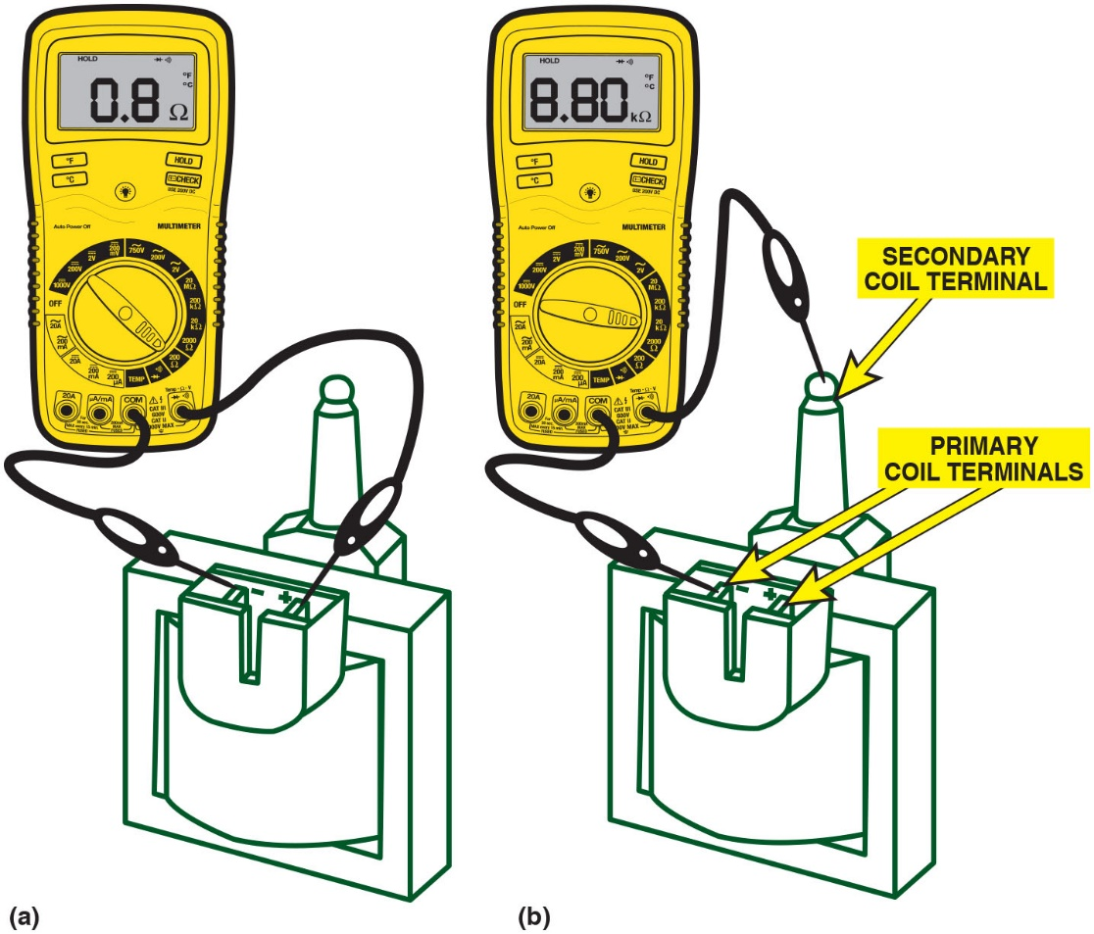
Figure 13.19
Coil Testing
(a) Set the digital meter to read Ohms and measure between the two primary terminals of the coil. Most coils are less than 1 ohm. (b) To measure the secondary winding, connect 1 meter lead to one of the primary terminals and the other to the secondary terminal.
Notes:
Long Description:
a. The leads of the ohmmeter are placed on the primary coil terminals. The reading on the digital display of the ohmmeter is 0.8 ohms. b. One lead of the ohmmeter is placed on one of the primary coil terminals, and the other lead of the ohmmeter is placed on the secondary coil terminal. The reading on the digital display of the ohmmeter is 8.80 kiloohms.

Slide 50
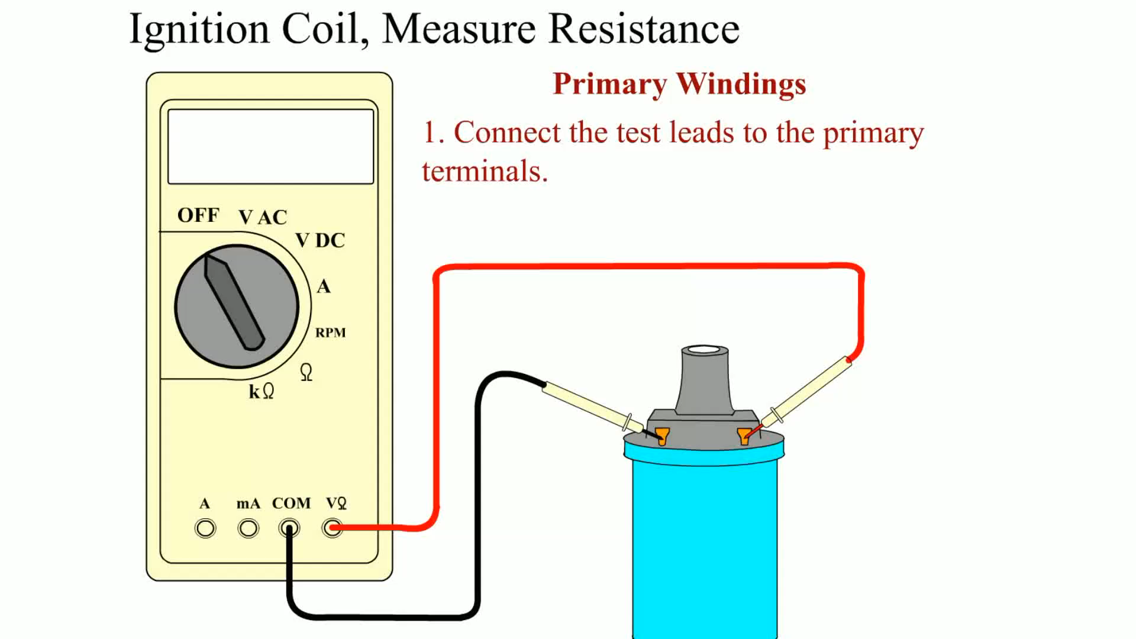
Animation: Ignition Coil, Measure Resistance

Slide 51
Current Ramping Ignition Coils (1 of 3)
Using the digital storage oscilloscope and a current probe
Quick check made of overall primary condition of
Two most important parameters of the ignition circuit
Module current limits and charging rise time of circuit
Actual circuit operation of the primary current control
Precise element in total ignition function and output

Slide 52
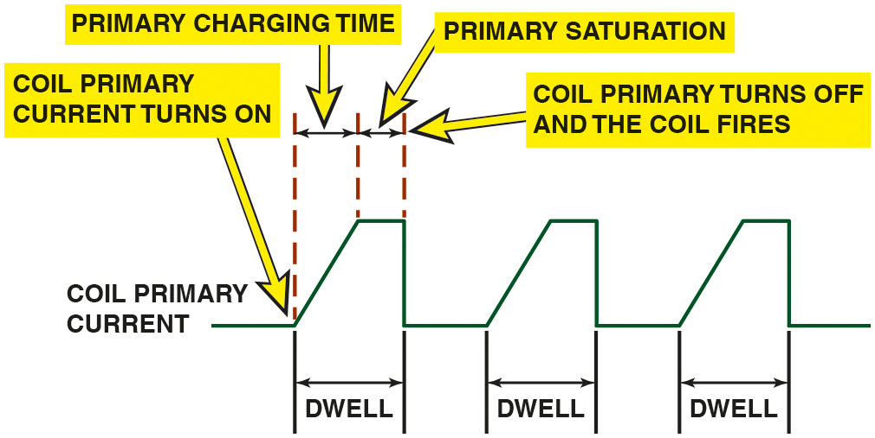
Figure 13.20
Primary Current Waveform
A waveform showing the primary current flow through the primary windings of an ignition coil.
Notes:
Testing an ignition coil for resistance does not always find a coil problem that occurs under actual heat and loads. However, by using a digital storage oscilloscope and a low-current probe, the ignition system can be checked for module current limits and the charging rise time.
Ignition coil operation begins with the ignition control module (ICM) completing the primary circuit through the ignition coil winding. The module allows primary current to ramp upward (primary charging time) to a preset limit. Once ramped to the preset limit, the coil remains on for a set period of time (primary saturation), known as the dwell period. Coil current is then turned off (open circuit) allowing the magnetic field built up through the dwell cycle to collapse inward, cutting across many turns of secondary coil windings, inducing a higher output voltage to fire the coil. The ignition systems used today must provide voltages of at least 25,000 volts and maintain spark duration of over 2 ms to assure good ignition over extended service intervals. Using the digital storage oscilloscope and a current probe, a quick check can be made of the overall primary condition of the two most important parameters of the ignition circuit, the module current limits and the charging rise time of the circuit. Actual circuit operation of the primary current control is a precise element in total ignition function and output. • See Figure 13.20.
Long Description:
The waveform starts with a small horizontal line labeled as coil primary current. An arrow is pointed at the end of the line labeled as coil primary current turns on. It then shows a rising slant during primary charging time, and then during primary saturation, it maintains a horizontal line. An arrow pointed at the end of primary saturation is labeled as coil primary turns off and the coil fires. The primary charging time and the primary saturation time are labeled as dwell. The waveform repeats a similar pattern thereafter twice.

Slide 53
Current Ramping Ignition Coils (2 of 3)
Current Ramp Test Procedure
To perform a current ramp test of the ignition coil(s), take the following steps:
STEP 1 Every ignition system has a power feed circuit to the ignition coil(s).
To perform current probe testing on system, first locate feed wire, make it current probe accessible.
This will serve as a common point on all ignition.

Slide 54
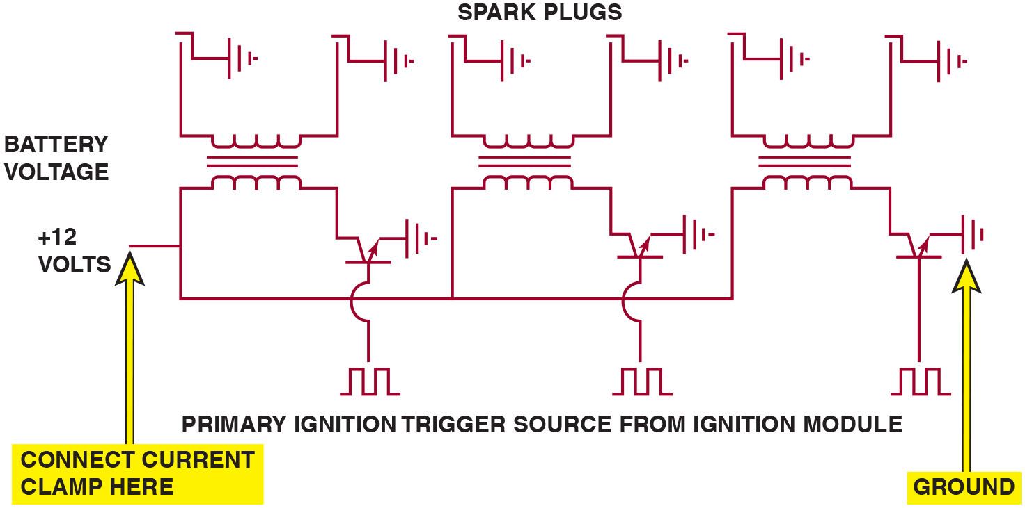
Figure 13.21
Waste Spark Schematic
Schematic of a typical waste-spark ignition system showing the location for the power feed and grounds.
Notes:
Long Description:
The figure shows three transformers, where the secondary is connected to ground through spark plugs. Battery voltage is given to them. The first terminal of the primary of each is connected to plus 12 volts and the second terminal of each is connected to a transistor representing the primary ignition trigger source from the ignition module. Each emitter is connected to the ground. The input waveform has two pulses. An arrow pointing to plus 12 volts is labeled connect current clamp here.

Slide 55
Current Ramping Ignition Coils (3 of 3)
STEP 2 Set up scope to read approximately 100 mV per division and 2 ms per division.
May be adjusted to the waveform, but will give an initial reference point.

Slide 56
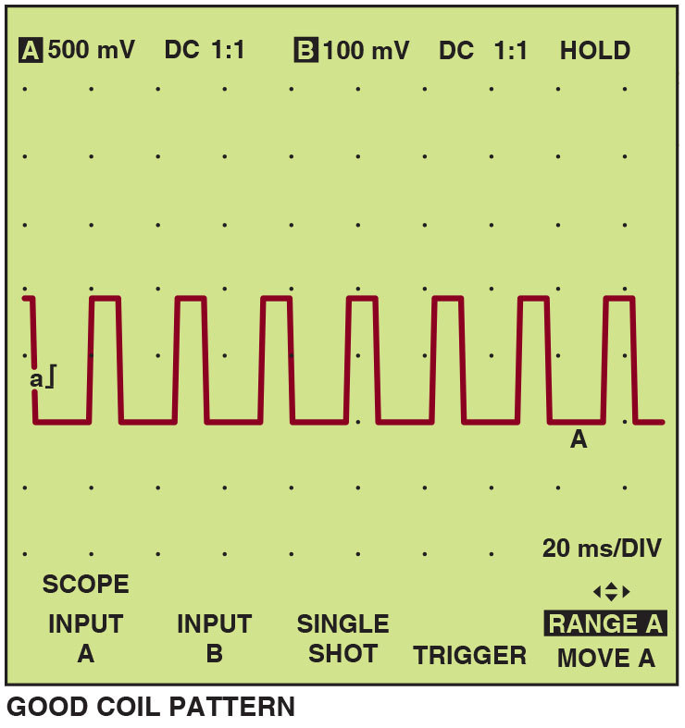
Figure 13.22
Good Coil Current Flow Waveform Pattern
An example of a good coil current flow waveform pattern. Note the regular shape of the rise time and slope. Duration of the waveform may change as the module adjusts the dwell. The dwell is usually increased as the engine speed is increased.
Notes:
Long Description:
The display shows a regular pulse waveform A of 20 m s per DIV with equal amplitude and equal width. The amplitude is a integral symbol. The top of the screen shows the following: A: 500 m V, D C 1 is to 1, B: 100 m V, D C 1 is to 1, and hold. The bottom shows the following: scope input: A, input: B, single shot, trigger, range A: move A.

Slide 57
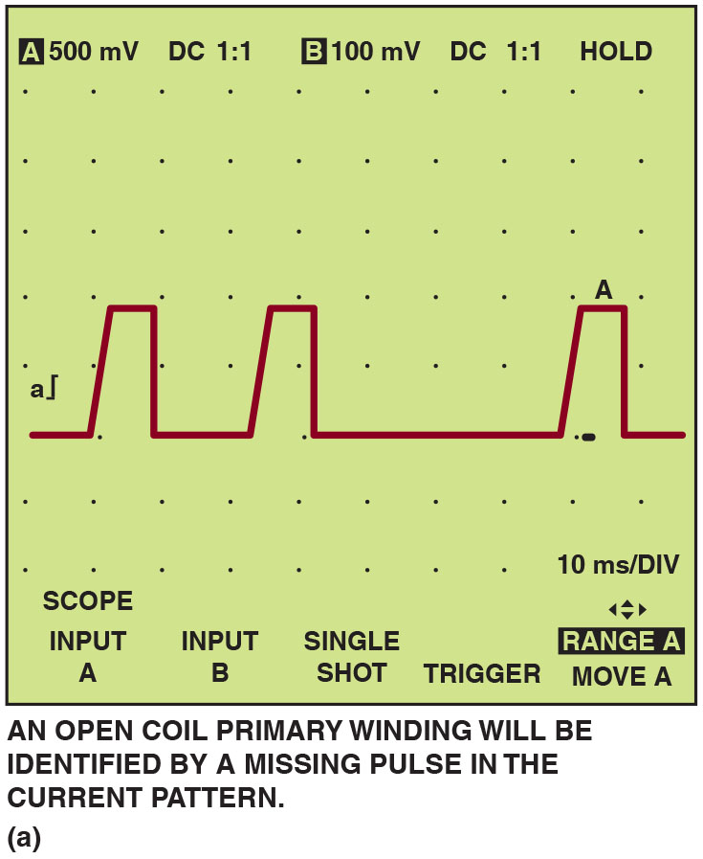
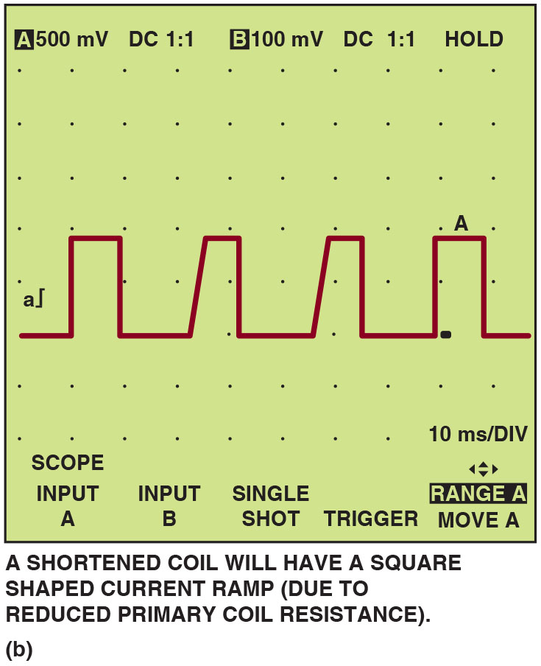
Figure 13.23
Some Faults That Current Waveform Can Detect:
(a) A waveform pattern showing an open in the coil primary (b) A shorted coil pattern waveform.
Notes:
Long Description 1:
An open primary winding will be identified by a missing pulse in the current pattern. The waveform of 10 m s per DIV shows a series of slanting pulses with the first two of amplitude a integral symbol arranged away from the third of width A. The top of the screen reads, A: 500 m V, D C 1 is to 1, B: 100 m V, D C 1 is to 1, hold. The bottom reads, scope input A, input B, single shot, trigger, range A: move A.
Long Description 2:
A shortened coil will have a square sharped current ramp (due to reduced primary coil resistance). The top of the screen reads, A: 500 m V, D C 1 is to 1, B: 100 m V, D C 1 is to 1, hold. The bottom reads, scope input A, input B, single shot, trigger, range A: move A. The waveform shows a straight square pulse of amplitude a integral followed by slant pulses and a straight pulse of width A.

Slide 58
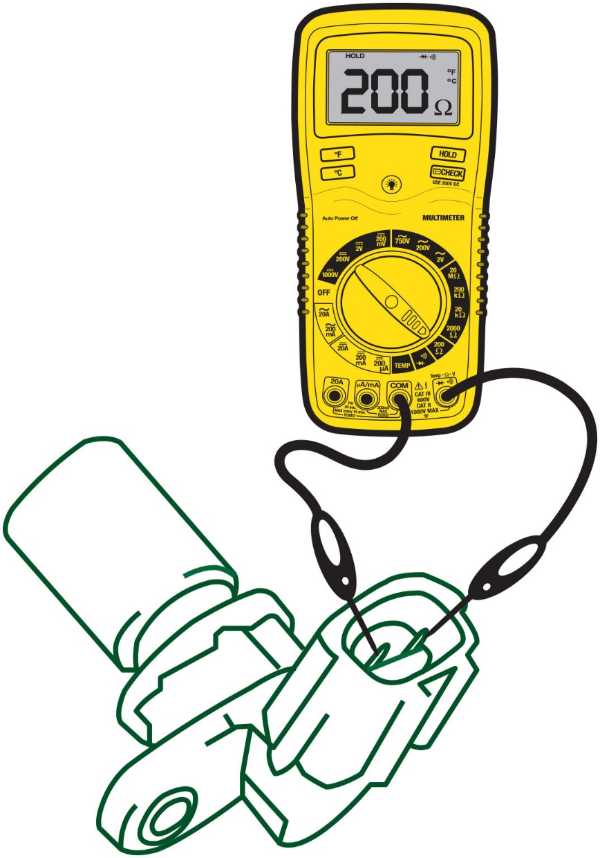
Figure 13.24
C K P Sensor Testing
Measuring the resistance of an magnetic crankshaft position (C K P) sensor using an ohmmeter.
Notes:
Magnetic Sensor Testing
The pickup coil, located under the distributor cap on many electronic ignition engines, can cause a no-spark condition if defective. The pickup coil must generate an AC voltage pulse to the ignition module so that the module can pulse the ignition coil. A pickup coil contains a coil of wire, and the resistance of this coil should be within the range specified by the manufacturer. Some common tests for pickup coils and magnetic crankshaft position sensors include:
■ Resistance. Usually between 150 and 1,500 ohms, but check service information for the exact specifications. • See Figure 13.24.

Slide 59
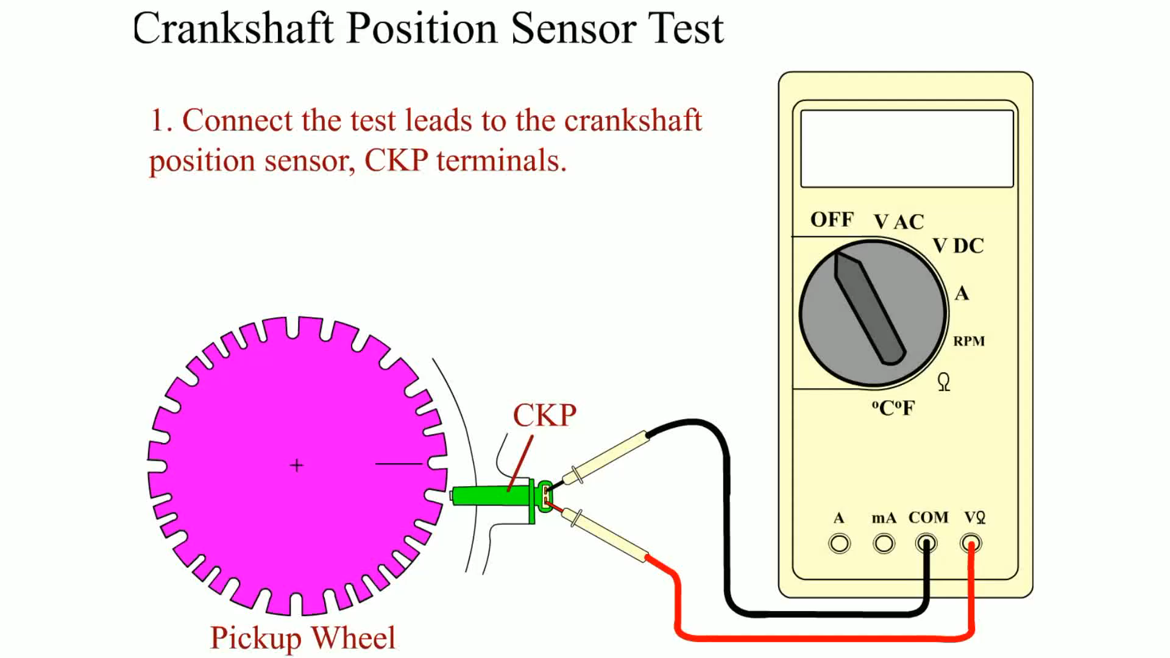
Animation: Crankshaft Position Sensor Test

Slide 60
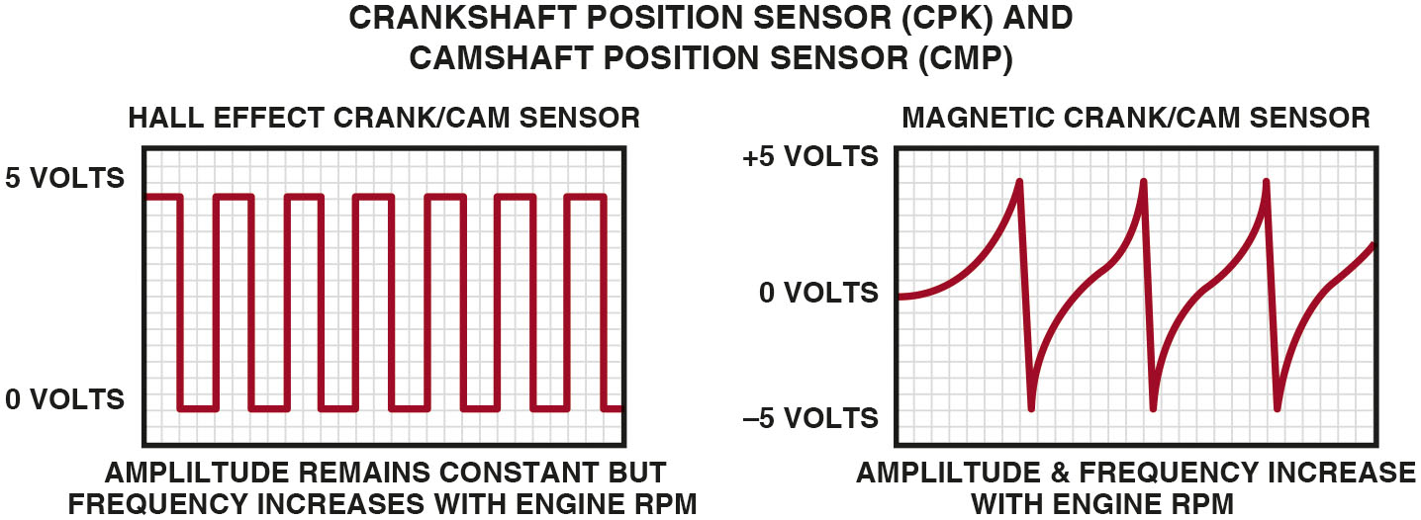
Figure 13.25
Hall-Effect Testing
A Hall-effect sensor produces a square waveform, whereas a magnetic sensor produces an analog waveform when viewed on the scope.
Notes:
Long Description:
Hall Effect sensor generates a box type wave with low of 0 volt and high of 5 volts. Amplitude of the wave remains constant but frequency increases with engine R P. Magnetic crank and Cam sensor generates a spiky wave which increases like a log curve and then suddenly drops. Amplitude and frequency of the wave increases with engine R P M

Slide 61
Animation: Hall-Effect Sensor

Slide 62
Electronic Ignition Troubleshooting Procedure
Turn the ignition on (engine off) and, using either a voltmeter or a test light, test for battery voltage available at the positive terminal of the ignition coil.
Connect the voltmeter or test light to the negative side of the coil and crank the engine. The voltmeter should fluctuate or the test light should blink, indicating that the primary coil current is being turned on and off.

Slide 63
Ignition Coil Testing Using an Ohmmeter
To test the primary coil winding resistance:
Set the meter to read low ohms.
Measure the resistance between the positive terminal and the negative terminal of the ignition coil.
To test the secondary coil winding resistance:
Set the meter to read kilohms
Measure the resistance between either primary terminal and the secondary coil tower.

Slide 64
Testing Magnetic Sensors
Magnetic sensors must be tested to see if they stick to iron or steel, indicating that the magnetic strength of the sensors is okay.
Sensor can be tested using D M set to read A C volts.

Slide 65
Question 5
How is a magnetic sensor tested for resistance and A C voltage output?

Slide 66
Answer 5
A digital multimeter can be used to measure resistance of the sensor and the A C voltage output.

Slide 67
Testing Hall-Effect Sensors
Using a D M M, check for the presence of changing voltage (pulsed on/off or digital D C) when engine is being cranked.
Best test is to use oscilloscope and observe waveform.

Slide 68
Ignition System Diagnosis Using Visual Inspection
Check all spark plug wires for proper routing.
Check that all spark plug wires are securely attached.
Check that all spark plug wires are clean
Free from excessive dirt or oil
Remove distributor cap and carefully check cap and distributor rotor for faults.
Remove spark plugs and check for excessive wear or other visible faults.

Slide 69
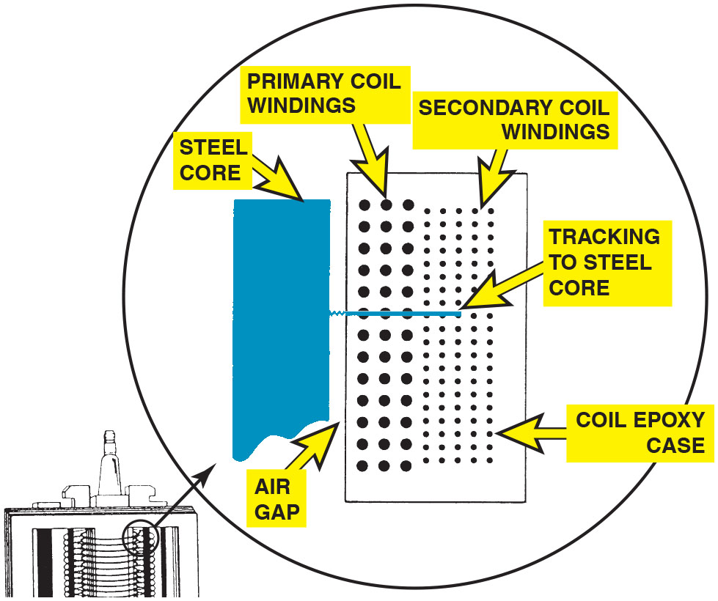
Figure 13.26
Coil Track
A track inside an ignition coil is not a short, but rather it is a low-resistance path or hole that has been burned through from the secondary wiring to the steel core.
Notes:
TECH TIP: Bad Wire? Replace the Coil!
When performing engine testing (such as a compression test), always ground the coil wire. Never allow the coil to discharge without a path to ground for the spark. High-energy electronic ignition systems can produce 40,000 volts or more of electrical pressure. If the spark cannot arc to ground, the coil energy can (and usually does) arc inside the coil itself, creating a low-resistance path to the primary windings or the steel laminations of the coil. See Figure 13.26
This low-resistance path is called a track and could cause an engine misfire under load even though all of the remaining component parts of the ignition system are functioning correctly. Often these tracks do not show up on any coil test, including most scopes. Because the track is a lower-resistance path to ground than normal, it requires that the ignition system be put under a load for it to be detected, and even then, the problem (engine misfire) may be intermittent.
Therefore, when disabling an ignition system, perform one of the following procedures to prevent possible ignition coil damage:
Remove the power source wire from the ignition system to prevent any ignition operation.
On distributor-equipped engines, remove the secondary coil wire from the center of the distributor cap and connect a jumper wire between the disconnected coil wire and a good engine ground. This ensures that the secondary will be safely grounded and prevents high-voltage coil damage.

Slide 70
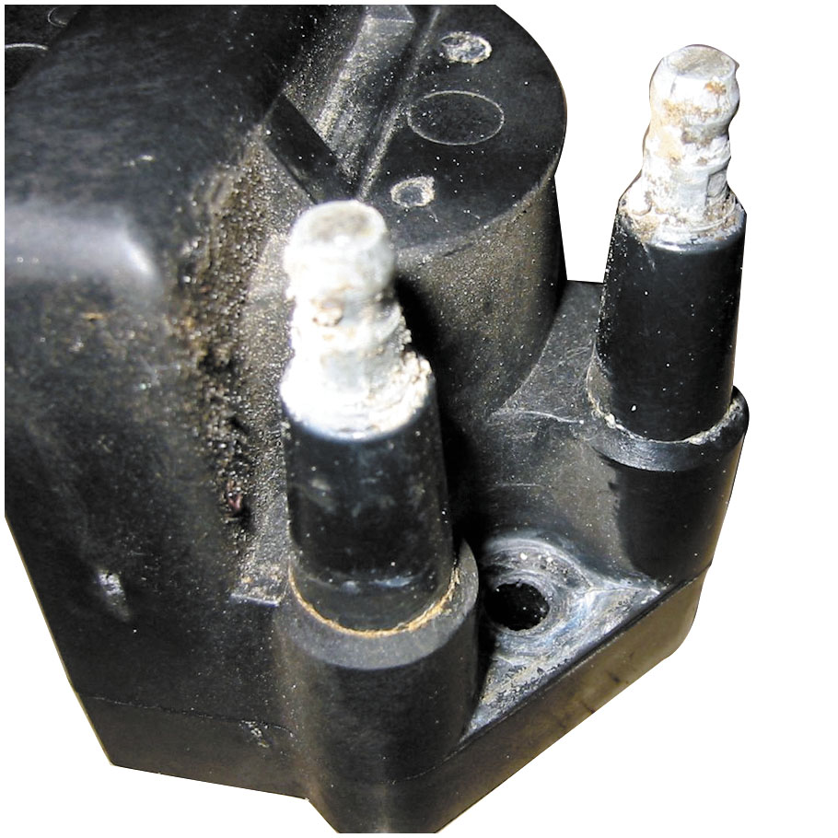
Figure 13.27
Corroded Terminals
Corroded terminals on a waste-spark coil can cause misfire diagnostic trouble codes to be set.
Notes:
Carefully check the cap and distributor rotor for faults or coil secondary terminal on waste-spark coils. • See Figure 13.27.

Slide 71
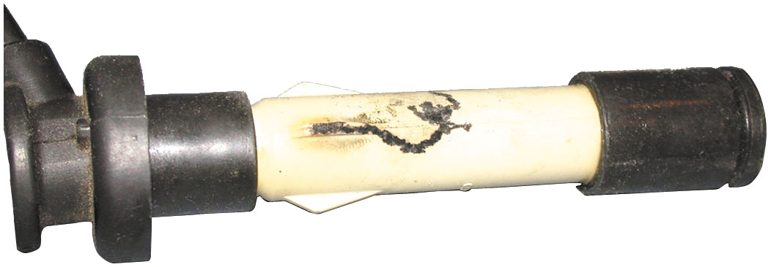
Figure 13.28
Misfire Cause
This spark plug boot on an overhead camshaft engine has been arcing to the valve cover causing a misfire to occur.
Notes:
Visually check the wires and boots for damage. • See Figure 13.28.

Slide 72
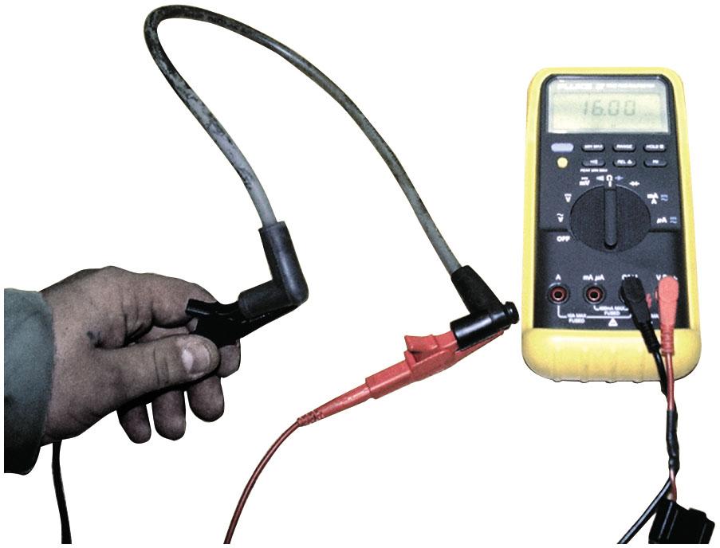
Figure 13.29
Wire Resistance
Measuring the resistance of a spark plug wire with a multimeter set to the ohms
position. The reading of
kΩ (16,030 ohms) is okay because the wire is about 2 ft long. Maximum allowable resistance for a spark plug wire this long would be 20 kΩ (20,000 ohms).
Notes:
Check all spark plug wires with an ohmmeter for proper resistance. Good spark plug wires should
measure less than 10,000 ohms per foot of length. • See Figure 13.29.

Slide 73
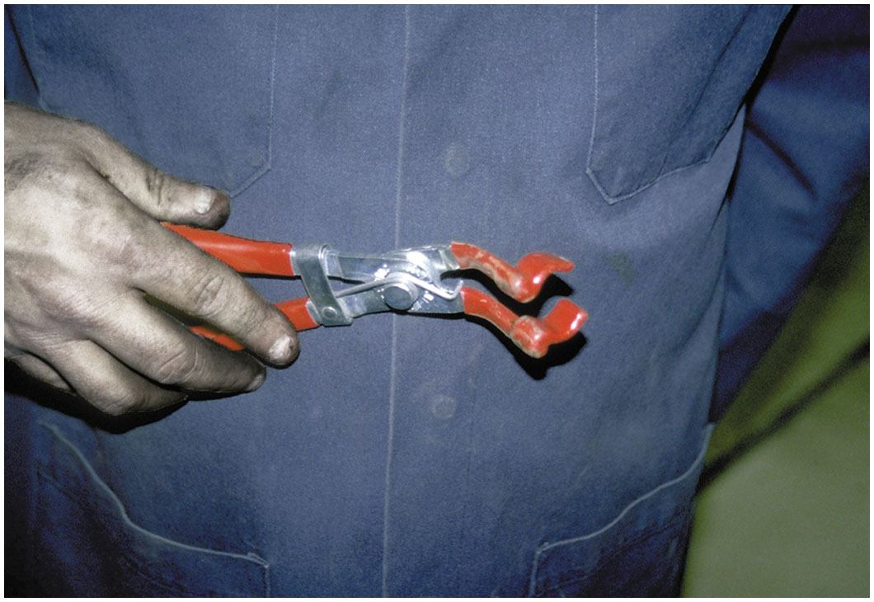
Figure 13.30
Boot Pliers
Spark plug wire boot pliers are a handy addition to any tool box.
Notes:
TECH TIP: Spark Plug Wire Pliers Are a Good Investment Spark plug wires are often difficult to remove. Using a good-quality spark plug wire plier, such as shown in ● See Figure 13.30, saves time and reduces the chance of harming the wire during removal.

Slide 74
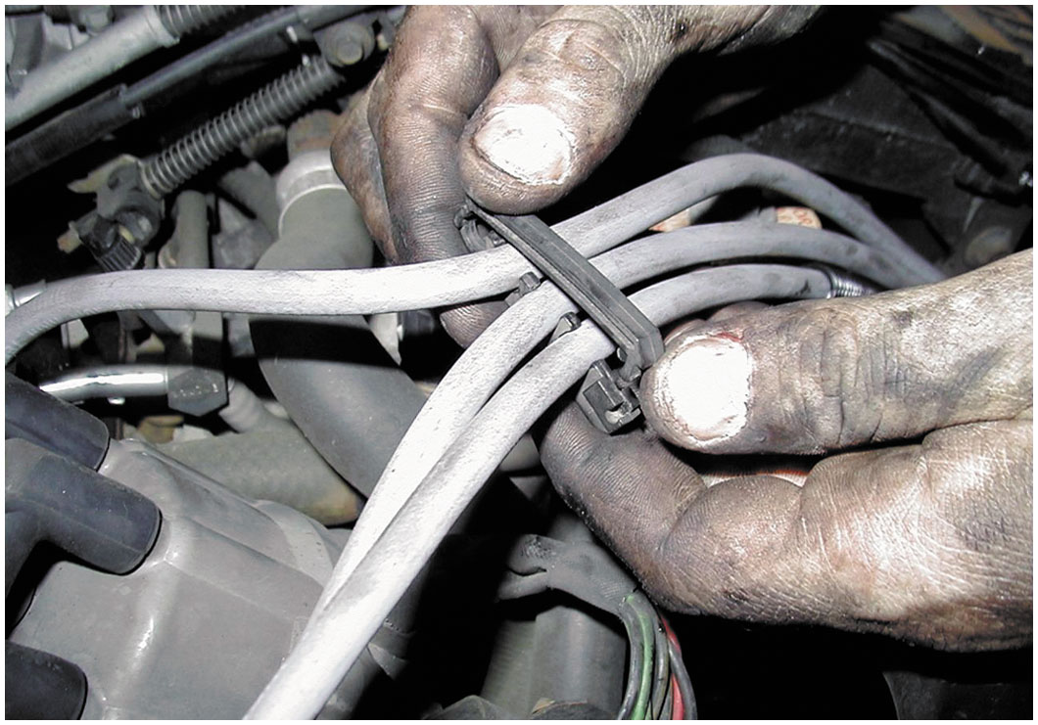
Figure 13.31
Plug Wire Comb
Always take the time to install spark plug wires back into the original holding brackets (wiring combs).
Notes:
TECH TIP: Route the Wires Right!
High voltage is present through spark plug wires when the engine is running. Surrounding the spark plugs in a magnetic field that can affect other circuits or components of the vehicle. For example, if a spark plug wire is routed too closely to the signal wire from a mass airflow (MAF) sensor, the induced signal from the ignition wire could create a false MAF signal to the computer. The computer, not able to detect that the signal was false, would act on the MAF signal and command the appropriate amount of fuel based on the false MAF signal. To prevent any problems associated with high- voltage spark plug wires, be sure to route them as manufactured, using all the factory holding brackets and wiring combs. ● See Figure 30.15. If the factory method is unknown, most factory service information shows the correct routing.

Slide 75
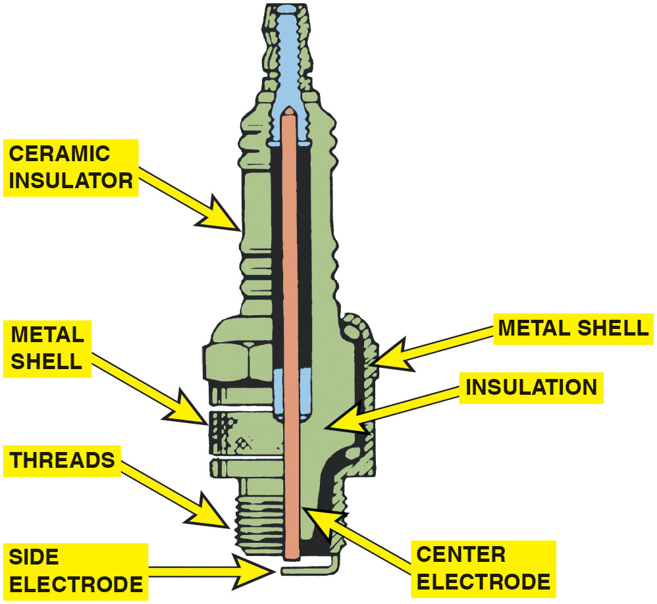
Figure 13.32
Spark Plug
Parts of a typical spark plug.
Notes:
Spark Plug Construction
Spark plugs are manufactured from ceramic insulators inside a steel shell. The threads of the shell
are rolled, and a seat is formed to create a gas-tight seal with the cylinder head. • See Figure
13.32.

Slide 76
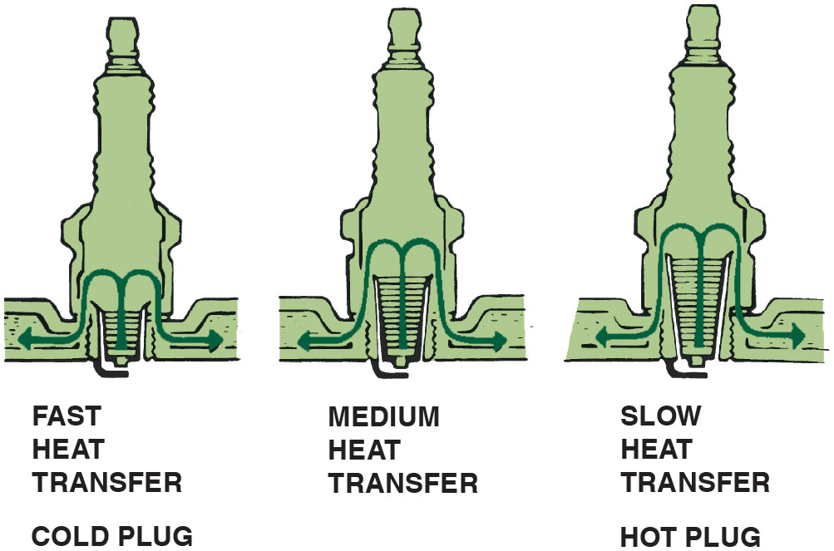
Figure 13.33
Heat Range
The heat range of a spark plug is determined by the distance the heat has to flow from the tip to the cylinder head.
Notes:
Long Description:
Fast heat transfer spark plugs have small threads and are also called cold plugs. Medium heat transfer spark plugs have medium threads. Slow heat transfer spark plugs have the tallest threads and are also called hot plugs.

Slide 77
Spark Plugs
Spark plugs classified by reach, heat range, type of seat.
Resistor Spark Plugs
Includes a resistor in the center electrode, which helps to reduce electromagnetic noise.
Platinum Spark Plugs
Small amount of the precious metal platinum welded onto each electrode.
Iridium Spark Plugs
Small amount of iridium welded onto the tip of a small center electrode.

Slide 78
Spark Plug Service
The Need for Service
Spark plugs should be inspected and replaced every 20,000 to 100,000 miles depending on the vehicle.
Spark Plug Inspection
Carbon fouling
Oil fouling
White coolant deposits
When installing spark plugs, always use correct torque.
Notes:
Used spark plugs should not be cleaned and reused unless absolutely necessary. The labor required to remove and replace (R & R) spark plugs is the same whether the spark plugs are replaced or cleaned. Although cleaning spark plugs often restores proper engine operation, the service life of cleaned spark plugs is shorter than that of new spark plugs. Platinum-tipped spark plugs should not be regapped! Using a gapping tool can break the platinum after it has been used in an engine.
Check service information regarding the recommended type of spark plugs and the specified service procedures.
Spark Plug Service
When replacing spark plugs, perform the following steps.
STEP 1 Check service information. Check for the exact spark plug to use and the specified instructions and/or technical service bulletins that affect the number of plug to be used or a revised replacement procedure.
STEP 2 Allow the engine to cool before removing spark plugs. This is true especially on engines with aluminum cylinder heads.
STEP 3 Use compressed air or a brush to remove dirt from around the spark plug before removal. This step helps prevent dirt from getting into the cylinder of an engine while removing a spark.
STEP 4 Check the spark plug gap and correct as needed. Be careful not to damage the tip on the center electrode if adjusting a platinum or iridium type of spark plug.
STEP 5 Install the spark plugs by hand. After tightening by hand, use a torque wrench and tighten the spark plugs to factory specifications. • See Figures 13.34 and 13.35.

Slide 79
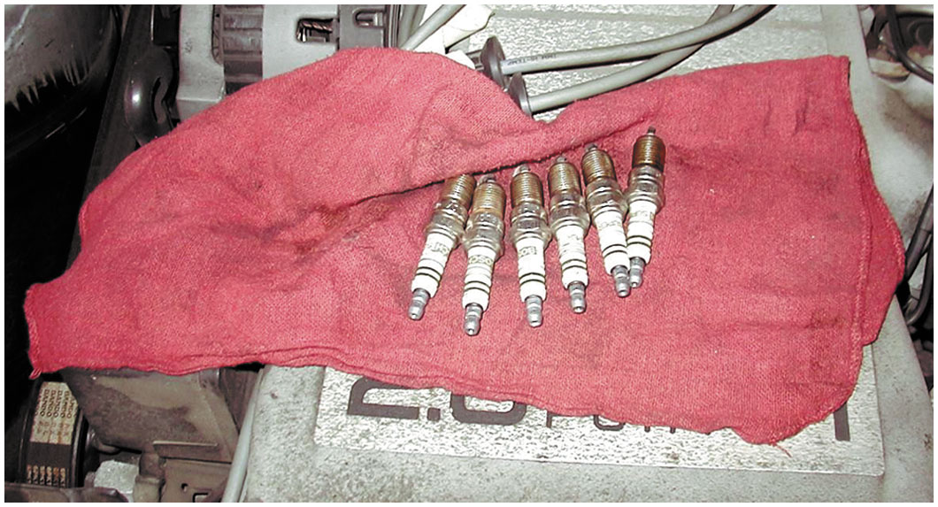
Figure 13.34
Spark Plug Service
When removing spark plugs, it is wise to arrange them so that they can be compared and any problem can be identified with a particular cylinder.
Notes:
TECH TIP: Use Original Equipment Manufacturer’s Spark Plugs
A technician at an independent service center replaced the spark plugs in a Buick with new Champion brand spark plugs of the correct size, reach, and heat range. When the customer returned to pay the bill, he inquired as to the brand name of the replacement parts used for the tune-up. When told that Champion spark plugs were used, he stopped signing his name on the check he was writing. He said that he owned 1,000 shares
of General Motors stock and he owned two General Motors vehicles and he expected to have General Motors parts used in his General Motors vehicles. The service manager had the technician replace the spark plugs with A C brand spark plugs because this brand was used in the engine when the vehicle was new. Even though most spark plug manufacturers produce spark plugs that are correct for use, many customers prefer that original equipment manufacturer (O E M) spark plugs be used in their engines.
Tech Tip: Two-Finger Trick
To help prevent overtightening a spark plug when a torque wrench is not available, simply use two fingers on the ratchet handle. Even the strongest service technician cannot overtighten a spark plug by using two fingers.

Slide 80
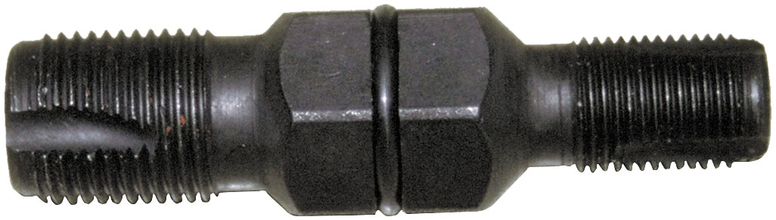
Figure 13.35
Thread Chaser
A spark plug thread chaser is a low-cost tool that hopefully will not be used often, but is necessary to use to clean the threads before new spark plugs are installed.

Slide 81
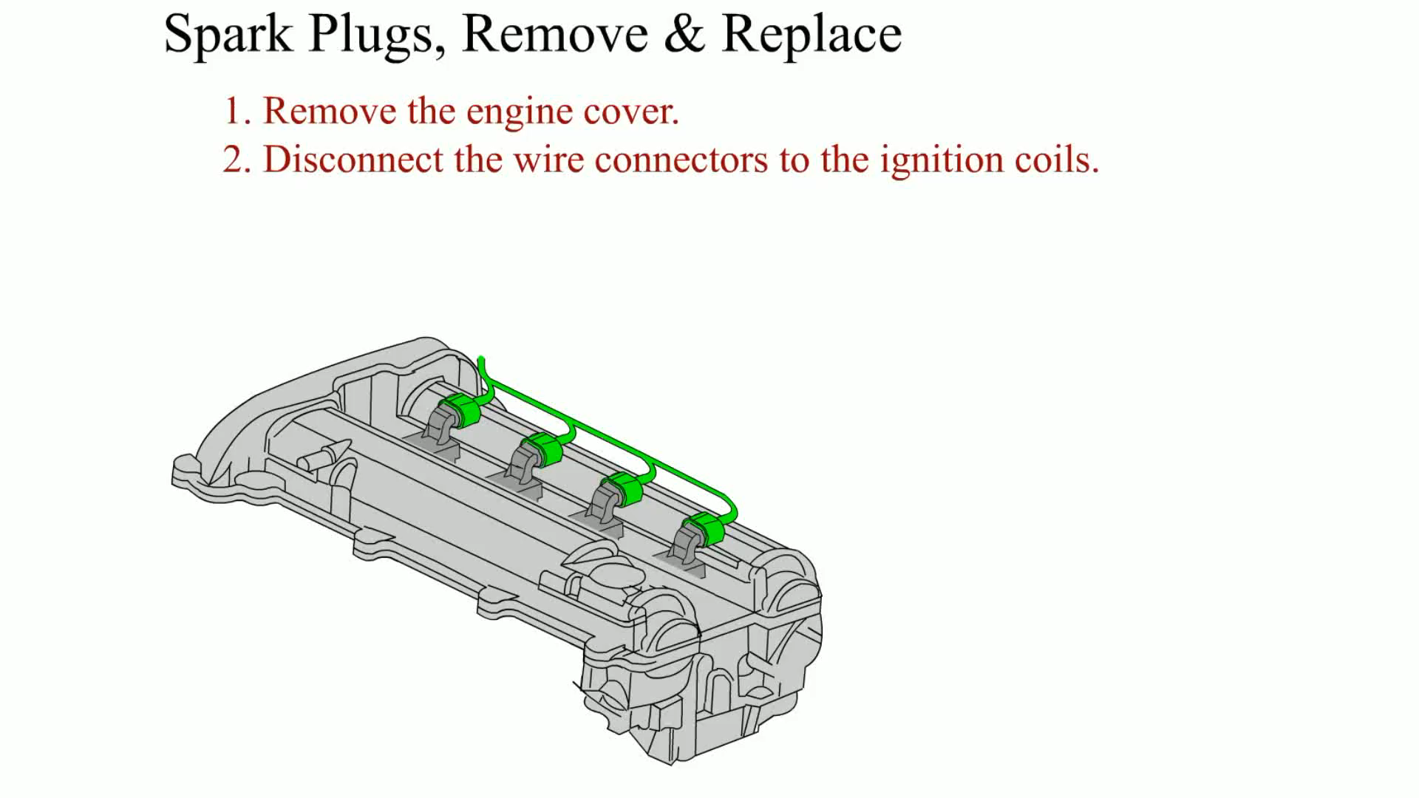
Animation: Spark Plugs, Remove and Replace

Slide 82
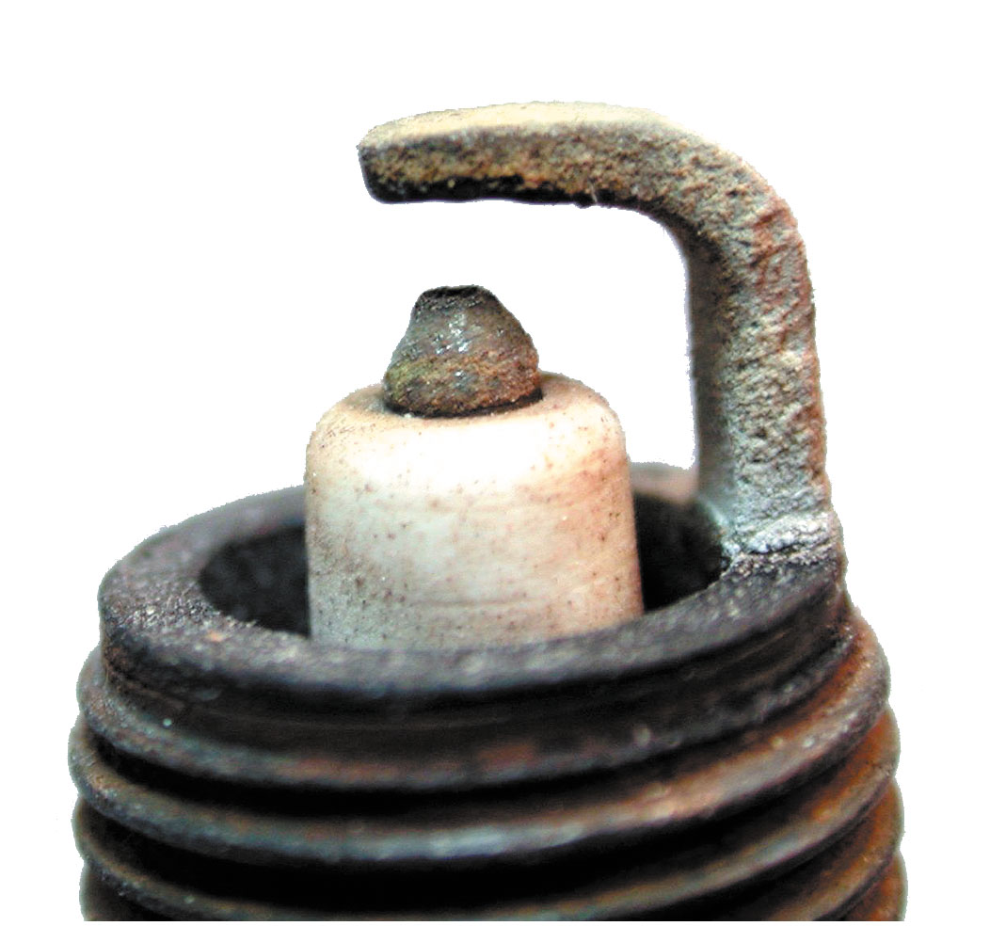
Figure 13.36
Normal Plug Wear
A normally worn spark plug that has a tapered platinum-tipped center electrode.
Notes:
When removing spark plugs, place them in order so that they can be inspected to check for engine problems that might affect one or more cylinders. All spark plugs should be in the same condition, and the color of the center insulator should be light tan or gray. If all the spark plugs are black or dark, the engine should be checked for conditions that could cause an overly rich air–fuel mixture or possible oil burning. If only one or a few spark plugs are black, check those cylinders for proper firing (possible defective spark plug wire) or an engine condition affecting only those cylinders. • See Figures 13.36 through 13.39

Slide 83
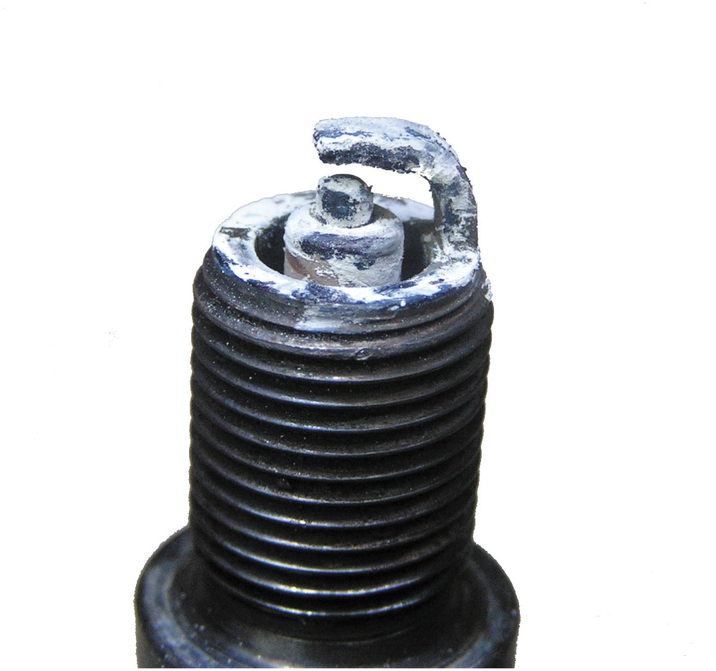
Figure 13.37
Blown Head Gasket
A spark plug from an engine that had a blown head gasket. The white deposits could be from the additives in the coolant.

Slide 84
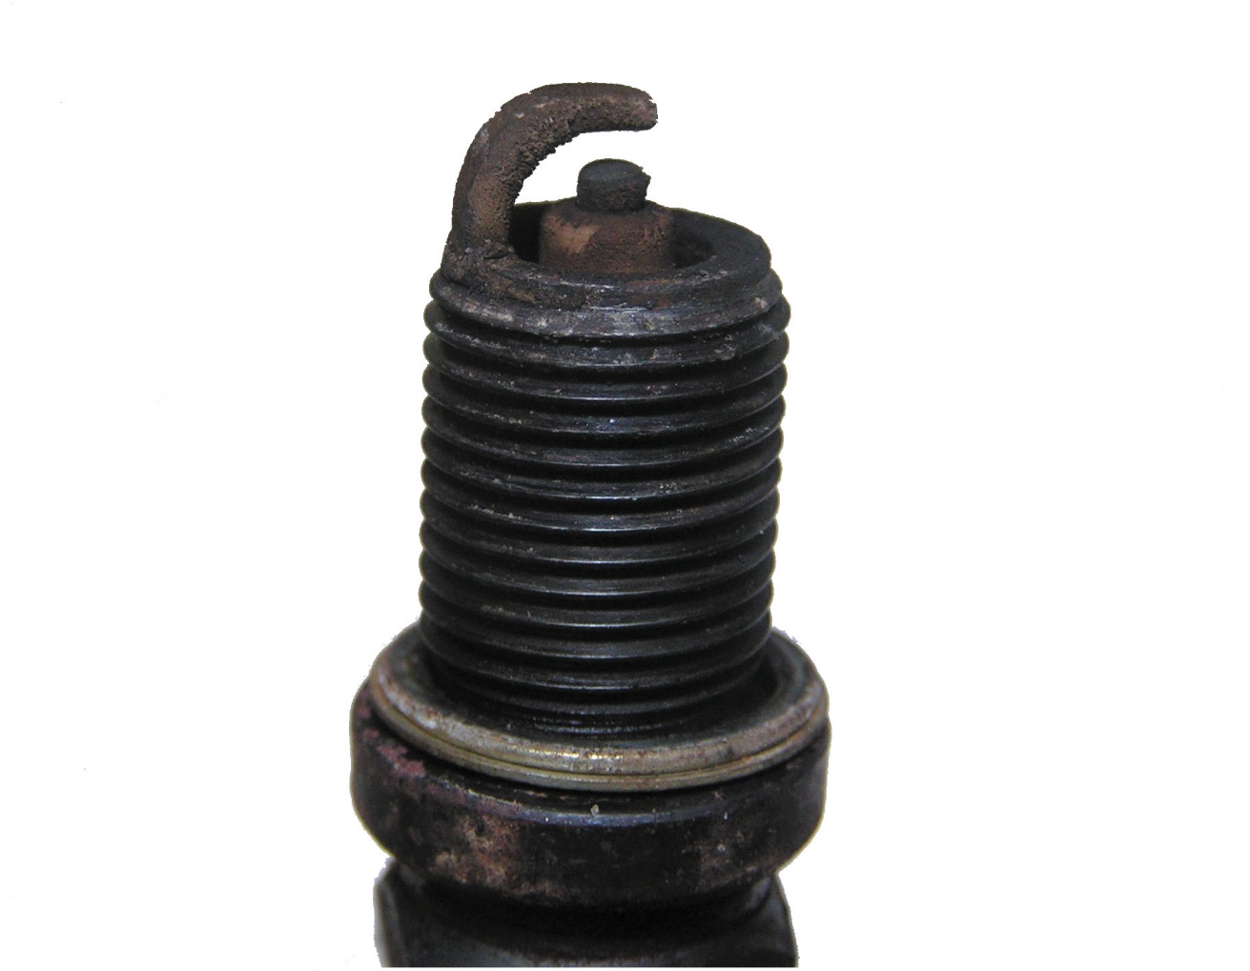
Figure 13.38
Oil Fouled
A worn spark plug showing fuel and/or oil deposits.

Slide 85
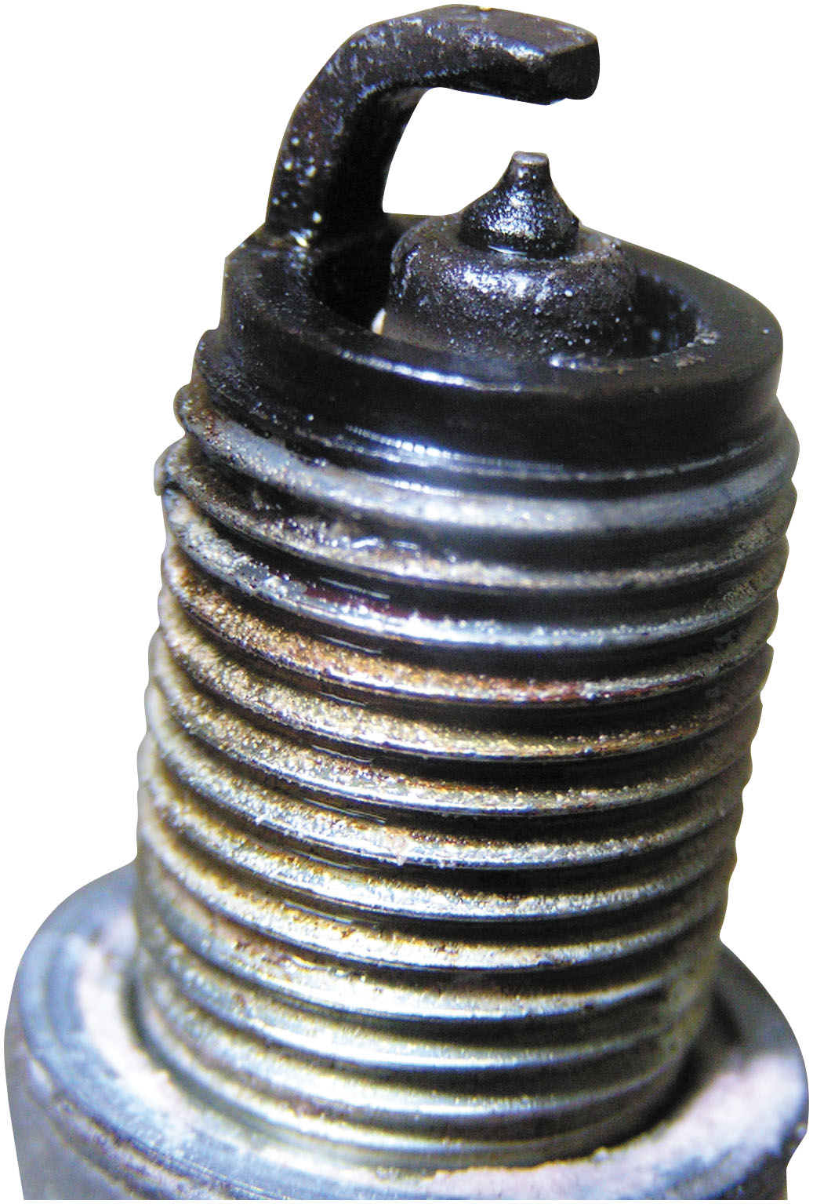
Figure 13.39
Fuel Soaked
A platinum-tipped spark plug that is fuel soaked indicating a fault with the fuel system or the ignition system causing the spark plug to not fire.
Notes:
Note
The engine computer “senses” rich or lean air-fuel ratios by means of input from the oxygen sensor(s). If one cylinder is lean, the PCM may make all other cylinders richer to compensate.
Note
General Motors does not recommend the use of antiseize compound on the threads of spark plugs being installed in an aluminum cylinder head, because the spark plug will be overtightened. This excessive tightening torque places the threaded portion of the spark plug too far into the combustion chamber where carbon can accumulate and result in the spark plugs being difficult to remove. If antiseize compound is used on spark plug threads, reduce the tightening torque by 40%. Always follow the vehicle manufacturer’s recommendations.
Review Chart 13.1 on page 366: The table has three columns: spark plug, torque with torque wrench, pound-foot, and torque without torque wrench, turns. The second and third columns have two sub-columns each: cast-iron head and aluminum head. The table has two sections. Row entries for the first section corresponding to the gasket spark plug are as follows. Row 1: 14 millimeters; 26 to 30; 18 to 22; one-fourth; one-fourth. Row 2: 18 millimeters; 32 to 38; 28 to 34; one-fourth; one-fourth. Row entries for the second section corresponding to the tapered seat spark plug are as follows. Row 1: 14 millimeters; 7 to 15; 7 to 15; 1 over 16, snug; 1 over 16, snug. Row 2: 18 millimeters; 15 to 20; 15 to 20; 1 over 16, snug; 1 over 16, snug

Slide 86
Ignition Timing
The Need for Spark Advance
Ignition timing refers to when spark plug fires in relation to piston position.
As engine rotates faster, spark plug firing event must occur sooner.
Initial Timing
If engine is equipped with a distributor, it may be possible to adjust base or the initial timing.
Ignition timing does change as timing chain or gear wears.
Notes:
Ignition timing refers to when the spark plug fires in relation to piston position. The time when the spark occurs depends on engine speed and, therefore, must be advanced (spark plugs fire sooner) as the engine rotates faster. The ignition in the cylinder takes a certain amount of time, usually 30 milliseconds (30/1, 000 of a second) and remains constant regardless of engine speed. Therefore, to maintain the most efficient combustion, the ignition sequence has to occur sooner as the engine speed increases. For maximum efficiency from the expanding gases inside the combustion chamber, the burning of the air–fuel mixture should end by about 10 degrees after top dead center (ATDC). If the burning of the mixture is still occurring after that point, the expanding gases do not exert
much force on the piston because the gases are “chasing” the piston as it moves downward. Therefore, to achieve the goal of having the air–fuel mixture completely burned by the time the piston reaches 10 degrees after top dead center, the spark must be advanced (occur sooner) as the
engine speed increases. This timing advance is determined and controlled by the PCM on most vehicles. • See Figures 13.40 and 13.41.

Slide 87
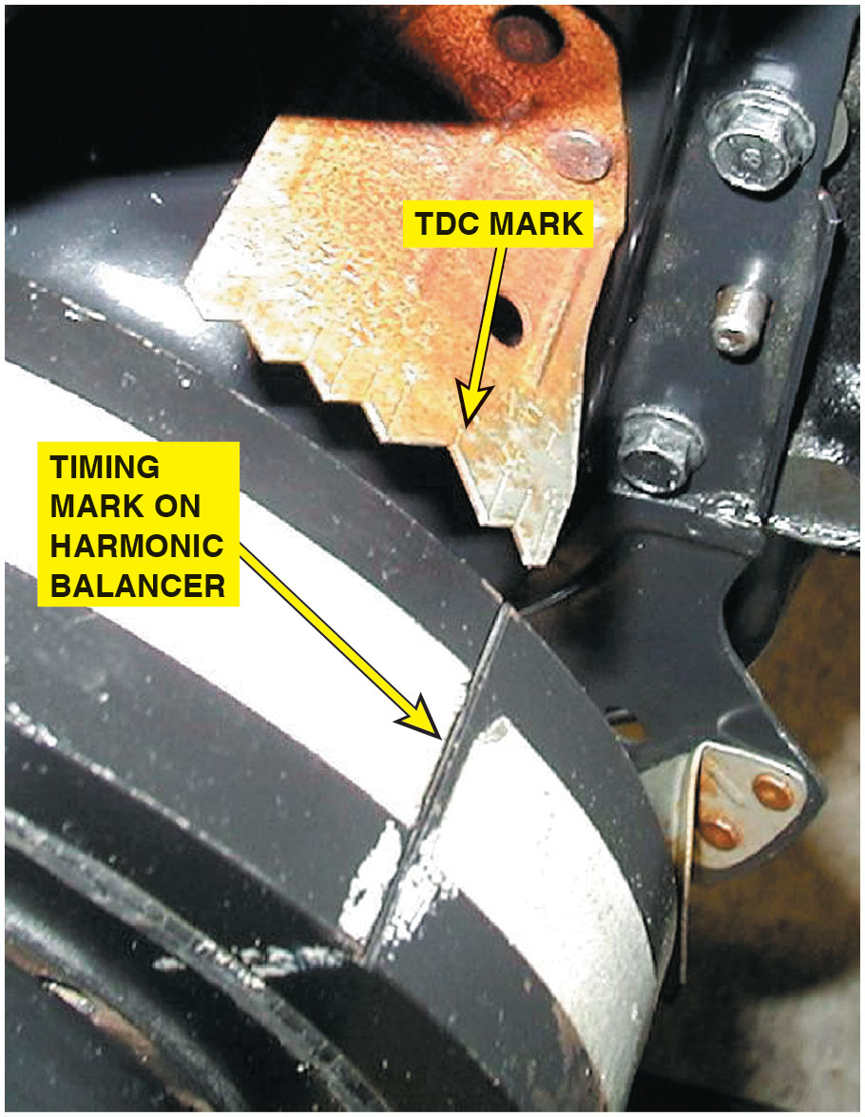
Figure 13.40
Timing Marks
Ignition timing marks are found on the harmonic balancers that are equipped with distributor ignition.

Slide 88

Figure 13.41
Initial Timing
The initial timing is where the spark plug fires at idle speed. The computer then advances the timing based on engine speed and other factors.
Notes:
Long Description:
During 0 to 1000 r p m Advance is below 10 degrees. During 1000 to 3000 r p m advance is linearly increasing to reach approx. 21 to 22 degrees. During 3000 to 5000 r p m advance is linearly increasing to reach approx. 26 to 27 degrees. After 5000 r p m advance is constant at about 28 degrees.

Slide 89

Figure 13.42
Ignition Scope Testing
Typical engine analyzer hookup that includes a scope display. (1) Coil wire on top of the distributor cap if integral type of coil; (2) number 1 spark plug connection; (3) negative side of the ignition coil; (4) ground (negative) connection of the battery.
Notes:
Terminology
All ignition systems must charge and discharge an ignition coil. With the engine off, ignition scopes will display a horizontal line. With the engine running, this horizontal (zero) line is changed to a pattern that will have sections both above and below the zero line. Sections of this pattern that are
above the zero line indicate that the ignition coil is discharging. Sections of the scope pattern below the zero line indicate charging of the ignition coil. The height of the scope pattern indicates voltage. The length (from left to right) of the scope pattern indicates time. • See Figures 13.42 and
13.43 for typical scope hookups.
Long Description:
The illustration displays a secondary pickup connected to the negative side of the primary pickup with a coil wire. The secondary pickup leads to the scope on the right, and to the left it is connected to the ground clamp, which is connected to the engine ground. The top of the primary pickup is connected to the top of the engine, and the negative side of the primary pickup is connected to the body of the engine. The top of the engine is also connected to the top of the number 1 spark plug. The trigger pickup leads to the scope on its right.

Slide 90

Figure 13.43
Clip-On Adapters
Clip-on adapters are used with an ignition system that uses an integral ignition coil.
Notes:
Terminology
All ignition systems must charge and discharge an ignition coil. With the engine off, ignition scopes will display a horizontal line. With the engine running, this horizontal (zero) line is changed to a pattern that will have sections both above and below the zero line. Sections of this pattern that are
above the zero line indicate that the ignition coil is discharging. Sections of the scope pattern below the zero line indicate charging of the ignition coil. The height of the scope pattern indicates voltage. The length (from left to right) of the scope pattern indicates time. • See Figures 13.42 and
13.43 for typical scope hookups.

Slide 91

Figure 13.44
Scope-Testing
Typical secondary ignition oscilloscope pattern.
Notes:
Long Description:
The x-axis ranges from 0 to 5 m S in unit increment. The left y-axis ranges from 0 K V to 20 K V in increments of 5 K V. The right y-axis ranges from 0 K V per V to 40 K V per V in increments of 10 K V per V. A sharp line labeled firing line is from (0, 0.5 K V) to (0, 11.8 K V). It continues as an irregular square pulse labeled spark line (spark duration) with decreasing high oscillating minute curves. Then it has two decreasing sine curves and two wide square pulses. Intermediate section is from the sine curves to the end of the first wide square pulse along 3 K V. Dwell section is from the end of the first wide square pulse to the end of the second square wave.

Slide 92

Figure 13.45
Secondary Patterns
A single cylinder is shown at the top and a four-cylinder engine at the bottom.
Notes:
Long Description:
Secondary conventional (single): The waveform starts as a short vertical line with an arrow pointing to the terminating point reading, points close or transistor turns on. It then becomes a flat U curve with a short spike near the center. An arrow pointing to the ending point of the U curve reads, points open or transistor turns off. A sharp tall peak then follows and is labeled firing line (beginning of spark). It then becomes a short inverted U-curve labeled spark line. The end point of the inverted U-curve is labeled spark ends. It suddenly slopes down as a vertical line and follows an irregular flat U-curve. Dwell section is the width of the flat U-curve section. Firing section is the width of the inverted U-curve. Intermediate section is the width of the irregular flat U-curve. Secondary conventional (parade): The waveform is a continuous short irregular square pulses with sharp lines at the end of two pulses. The corresponding texts read as follows: Firing lines should be equal. A short line indicates low resistance in the wire. A high line indicates high resistance in the wire; Available voltage should be about 10 K V on conventional ignition system and even greater with an electronic system; spark lines can be viewed side-by-side for ease of comparison; cylinders are displayed in firing order.

Slide 93

Figure 13.46
Ignition Secondary Pattern
Drawing shows what is occurring electrically at each part of the scope pattern.
Notes:
Long Description:
The waveform starts as a short horizontal line and then shows a sharp spike labeled spark. It then becomes a flat U curve with short spike labeled spark ends. It then shows a sharp dip followed by a gradual increase to a region with multiple minor fluctuations labeled coil oscillations. An arrow pointing to the middle point of the coil oscillation reads, transistor on. An arrow pointing to the ending point of the coil oscillation reads, transistor off. A sharp, tall peak then follows and is labeled firing line for the next cylinder in firing order.

Slide 94

Figure 13.47
Superimposed Pattern
Typical secondary ignition pattern. Note the lack of firing lines on the superimposed pattern.
Notes:
Superimposed. This superimposed position is used to look at differences in patterns between cylinders in all areas except the firing line. There are no firing lines illustrated in
superimposed positions. • See Figure 13.47.

Slide 95

Figure 13.48
Raster Pattern
Raster is best scope position to view spark lines of all the cylinders to check for differences. Most scopes display cylinder 1 at bottom. The other cylinders are positioned by firing order above cylinder 1.
Notes:
2. Raster (stacked). Cylinder 1 appears at the bottom of the screen and all other cylinder patterns are displayed upward in the engine’s firing order. Use the raster (stacked) position
to look at the spark line length and transistor-on point. The raster pattern shows all areas of the scope pattern except the firing lines. • See Figure 13.48.

Slide 96

Figure 13.49
Display (Parade) Pattern
Display is the only position to view the firing lines of all cylinders. Cylinder 1 is displayed on the left (except for its firing line, which is shown on the right). The cylinders are displayed from left to right by firing order.
Notes:
Display (parade). Display (parade) is the only position in which firing lines are visible and the cylinders are displayed on the screen from left to right in the engine’s firing order. This
selection is used to compare the height of firing lines among all cylinders. • See Figure 13.49.

Slide 97
Scope-Testing Ignition System (1 of 6)
Any automotive scope with the correct probes or adapters show an ignition system pattern.
Firing Line
The leftmost vertical (upward) line is called the firing line.
Spark Line
The spark line is a short horizontal line immediately after the firing line.

Slide 98
Scope-Testing Ignition System (2 of 6)
Intermediate Oscillations
The intermediate oscillations follow the spark line, and are also called the “ringing” of the coil as it is pulsed.
Transistor-on Point
When the transistor turns on an electronic system, the coil is being charged.
Dwell Section
Dwell is the amount of time that the current is charging the coil from the transistor-on point to the transistor-off point.

Slide 99
Scope-Testing Ignition System (3 of 6)
Pattern Selection
Superimposed
Raster (stacked)
Display (parade)
Reading the Scope on Display (Parade)
The firing lines should all be 5 to15 k V in height and be within 3 k V of each other.

Slide 100
Scope-Testing Ignition System (4 of 6)
Reading the Spark Lines
The spark lines should be level and one-fourth as high as the firing lines (1.5 to 2.5 k V, but usually less than 2 k V).
Spark Line Slope
An upward-sloping spark line can indicate a lean air–fuel mixture.
A downward sloping spark line is finding ground through deposits.

Slide 101

Figure 13.50
Downward-Sloping Spark Line
A downward-sloping spark line usually indicates high secondary ignition system resistance or an excessively rich air–fuel mixture.
Notes:
Spark Line Slope
Downward-sloping spark lines indicate that the voltage required to maintain the spark duration is decreasing during the firing of the spark plug. Although it is normal for the spark line to angle downward slightly, a steep slope indicates that the spark energy is finding ground through spark plug deposits (the plug is fouled) or other ignition problems. • See Figure 13.50.

Slide 102

Figure 13.51
Upward-Sloping Spark Line
An upward-sloping spark line usually indicates a mechanical engine problem or a lean air–fuel mixture.
Notes:
An upward-sloping spark line usually indicates a mechanical engine problem. A defective piston ring or valve would tend to seal better in the increasing pressures of combustion. As the spark plug fires, the effective increase in pressures increases the voltage required to maintain the spark, and the height of the spark line rises during the duration of the spark. • See Figure 13.51.

Slide 103

Figure 13.52
Rope Length
The relationship between the height of the firing line and length of the spark line can be illustrated using a rope. Because energy cannot be destroyed, the stored energy in an ignition coil must dissipate totally, regardless of engine operating conditions.
Notes:
Long Description:
By bending the rope, it divides into 2 lines 1 representing firing line and other spark line. When firing line is long spark line is small and when firing line is small the spark line is long. Same length of rope, energy, if high voltage is required to ionize spark plug cap, less energy is available for spark duration. A lean cylinder is an example of where higher voltage is required to fire with a shorter-than-normal duration. If low voltage is required to fire the spark plug (low firing line), more of the coil's energy is available to provide a long-duration spark line. (A fouled spark plug is an example of low voltage to fire, with a longer-then-normal duration.)

Slide 104
Scope-Testing Ignition System (5 of 6)
Reading the Intermediate Section
The intermediate section should have three or more oscillations (bumps) for a correctly operating ignition system.
Electronic Ignition and the Dwell Section
Many E I systems also produce a “hump” in the dwell section, which reflects a current-limiting circuit in the control module.
Dwell Variation (Electronic Ignition)
Typically caused by a worn mechanical component

Slide 105
Scope-Testing Ignition System (6 of 6)
Coil Polarity
If the pattern is upside down, the primary wires on the coil may be reversed, causing the coil polarity to be reversed.
Acceleration Check
All firing lines should rise evenly
If the firing lines on one or more cylinders fail to rise, this indicates fouled spark plugs.
Rotor Gap Voltage
The normal rotor gap voltage is 3 to 7 k V.
Notes:
Rotor Gap Voltage (DI Systems)
The rotor gap voltage test measures the voltage required to jump the gap (0.03 to 0.05 inches, or 0.8 to 1.3 mm) between the rotor and the inserts (segments) of the distributor cap. Select the display (parade) scope pattern and remove a spark plug wire (at the spark plug end), then using a jumper connected to a good ground, insert the jumper into the spark plug boot making sure it contacts the plug wire terminal. Start the engine and observe the height of the firing line for the cylinder being tested. Because the spark plug wire is connected directly to ground, the firing line height on the scope will indicate the voltage required to jump the air gap between the rotor and the distributor cap insert. The normal rotor gap voltage is 3 to 7 kV, and the voltage should not exceed 8 kV. If
the rotor gap voltage indicated is near or above 8 kV, inspect and replace the distributor cap and/or rotor as required.

Slide 106
Scope Testing a Waste-Spark Ignition System
A handheld digital storage oscilloscope can be used to check the pattern of each individual cylinder.
Some larger scopes are able to display both power and waste-spark waveforms.
Because the waste spark does not require as high a voltage level as the cylinder on the power stroke, the waste form is normally lower.

Slide 107

Figure 13.53
Dual-Trace D S O
A dual trace scope pattern showing both the power and the waste spark from the same coil (cylinders 1 and 6). Note that the firing line is higher on the cylinder that is under compression (power); otherwise, both patterns are almost identical.
Notes:
A handheld digital storage oscilloscope can be used to check the pattern of individual cylinders. Some larger scopes can be connected to all spark plug wires and therefore are able to display both power and waste-spark waveforms. • See Figure 13.53.

Slide 108
Scope-Testing Coil-on-Plug Ignition
Each individual coil can be shown on a scope and, using the proper cables and adapters.
Always follow the scope equipment manufacturer’s instructions.
Normal ignition patterns may vary based on manufacturer system designs.

Slide 109

Figure 13.54
Three Sparks
A secondary waveform of a Ford 4.6 liter V-8, showing three sparks occurring at idle speed.
Notes:
In a coil-on-plug type of ignition system, each individual coil can be shown on a scope. By using a multichannel scope and the proper cables and adapters, the waveform for all of the cylinders can be viewed at the same time. Always follow the scope equipment manufacturer’s instructions. • See Figure 13.54.

Slide 110

Figure 13.55
Advanced Ignition Diagnosis
An inductive paddle being used on engine equipped with a coil-on-plug ignition to get a scope pattern on laptop computer using a Pico scope.
Notes:
Advanced Ignition Diagnosis
As the use of coil-on-plug ignition systems has increased, so has the need for newer and more innovative technology to effectively diagnose misfire conditions. The inductive paddle and the oscilloscope is one of the newest and most efficient methods of diagnosing secondary ignition problems. • See Figure 13.55.

Slide 111

Figure 13.56
Inductive Paddle
The inductive paddle used with a Pico scope created the pattern showing normal ignition and engine operation.
Notes:
The inductive paddle is placed on the portion of the coil that gives the best pattern. The pattern typically will show when the coil is turned on, the inductive kick as well as the extra energy after the spark event. • See Figure 13.56.

Slide 112
Question 6
What are the sections of a secondary ignition scope pattern?

Slide 113
Answer 6
Firing line, spark line, intermediate section, and dwell section.

Slide 114
Summary (1 of 3)
A thorough visual inspection should be performed on all ignition components when diagnosing an engine performance problem.
Platinum spark plugs should not be regapped after use in an engine.
A secondary ignition scope pattern includes a firing line, spark line, intermediate oscillations, and transistor-on and transistor-off points.
The slope of the spark line can indicate incorrect air–fuel ratio or other engine problems.

Slide 115
Summary (2 of 3)
All inductive ignition systems supply battery voltage to the positive side of the ignition coil and pulse the negative side of the coil on and off to ground to create a high-voltage spark.
If an ignition system uses a distributor, it is a distributor ignition (D I) system.
If an ignition system does not use a distributor, it is an electronic ignition (E I) system.
A waste-spark ignition system fires two spark plugs at the same time.
A coil-on-plug ignition system uses an ignition coil for each spark plug.

Slide 116
Summary (3 of 3)
A thorough visual inspection should be performed on all ignition components when diagnosing an engine performance problem.
Platinum spark plugs should not be regapped after use in an engine.

Slide 117
Animation and Video Library Links (Must have an internet connection and active Haldeman subscription)
Animation Library: (A8) Engine Performance Animations
Animation Library: (A6) Electrical/Electronic Systems Animations
Video Library: (A8) Engine Performance Videos
Video Library: (A6) Electrical/Electronic Systems Videos

Slide 118

Copyright
This work is protected by United States copyright laws and is provided solely for the use of instructors in teaching their courses and assessing student learning. Dissemination or sale of any part of this work (including on the World Wide Web) will destroy the integrity of the work and is not permitted. The work and materials from it should never be made available to students except by instructors using the accompanying text in their classes. All recipients of this work are expected to abide by these restrictions and to honor the intended pedagogical purposes and the needs of other instructors who rely on these materials.

