Slide 1
The Gale Halderman Story
Jim Halderman
Jimmy Dinsmore

Slide 2
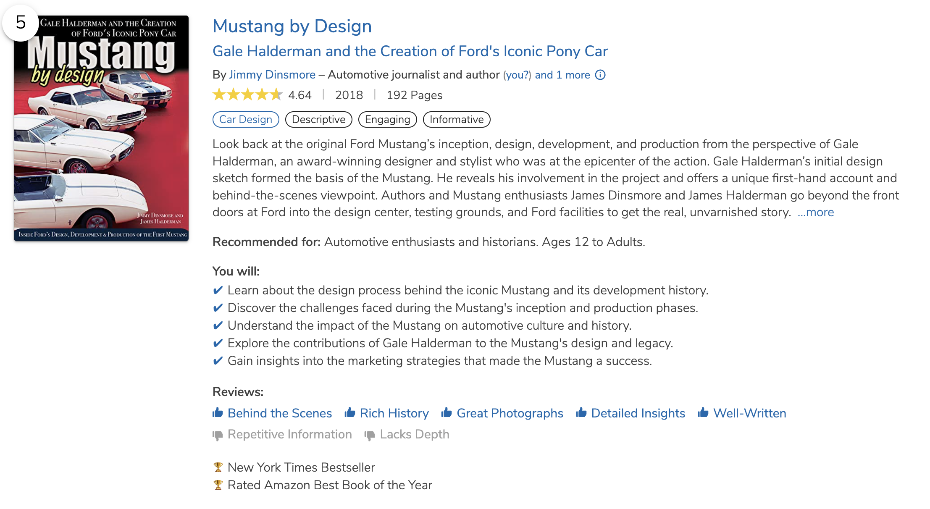
Mustang By Design
• BookAuthority's best Car Design books of all time!
• New York Times best-seller (for its category)
• Available now on Amazon, or for sale out in the vendor area (come see me for an autographed copy)

Slide 3
Meet the Authors
Jim Halderman
jim@jameshalderman.com
• Retired Automotive Instructor – Sinclair Community College
• Author of many automotive textbooks, all published by Pearson Education
• ASE certified Master Automotive Technician (A1-A9) plus Advanced Engine Performance (L1), L3 and L4.
Jimmy Dinsmore
jimmydinsmore@yahoo.com
• Automotive Journalist reviewing cars and covering the industry for 15 years
• Syndicated Driver’s Side column

Slide 4
Right place, right time
“Luck is what happens when preparation meets opportunity.”

Slide 5
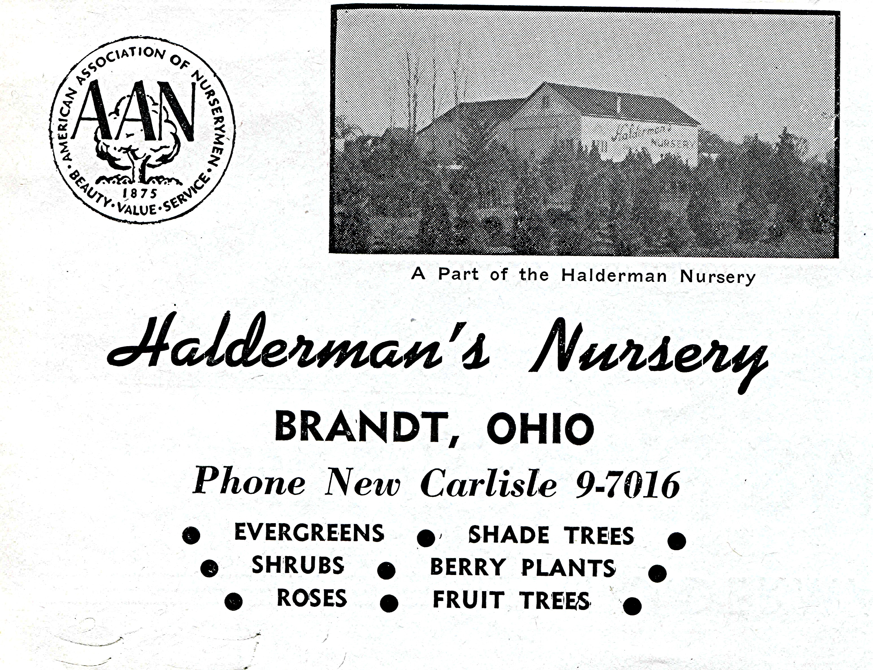
Gale Halderman
Born in 1932
“The farm Boy From Ohio”

Slide 6
Attended the Dayton Art Institute

Slide 7
A Young Gale and his Father/Uncle

Slide 8
Gale was Hired by Ford Based on His Portfolio alone

Slide 9
Gale helped Joe Oros with the design of the 1957 Ford in 1954

Slide 10
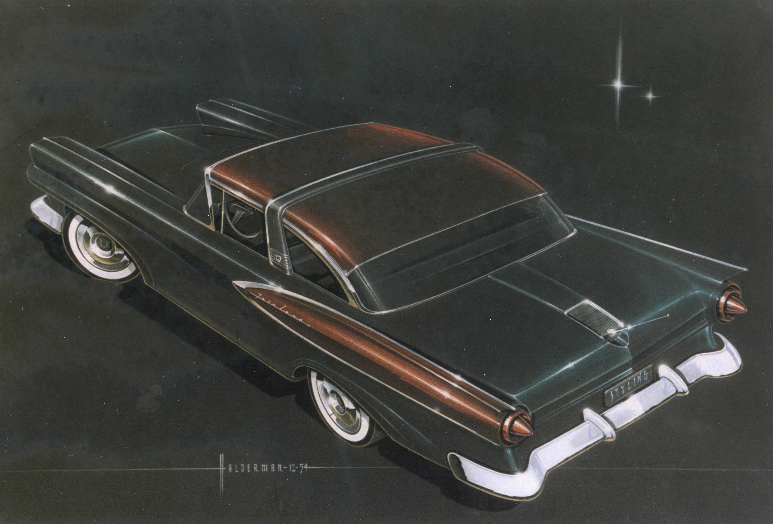
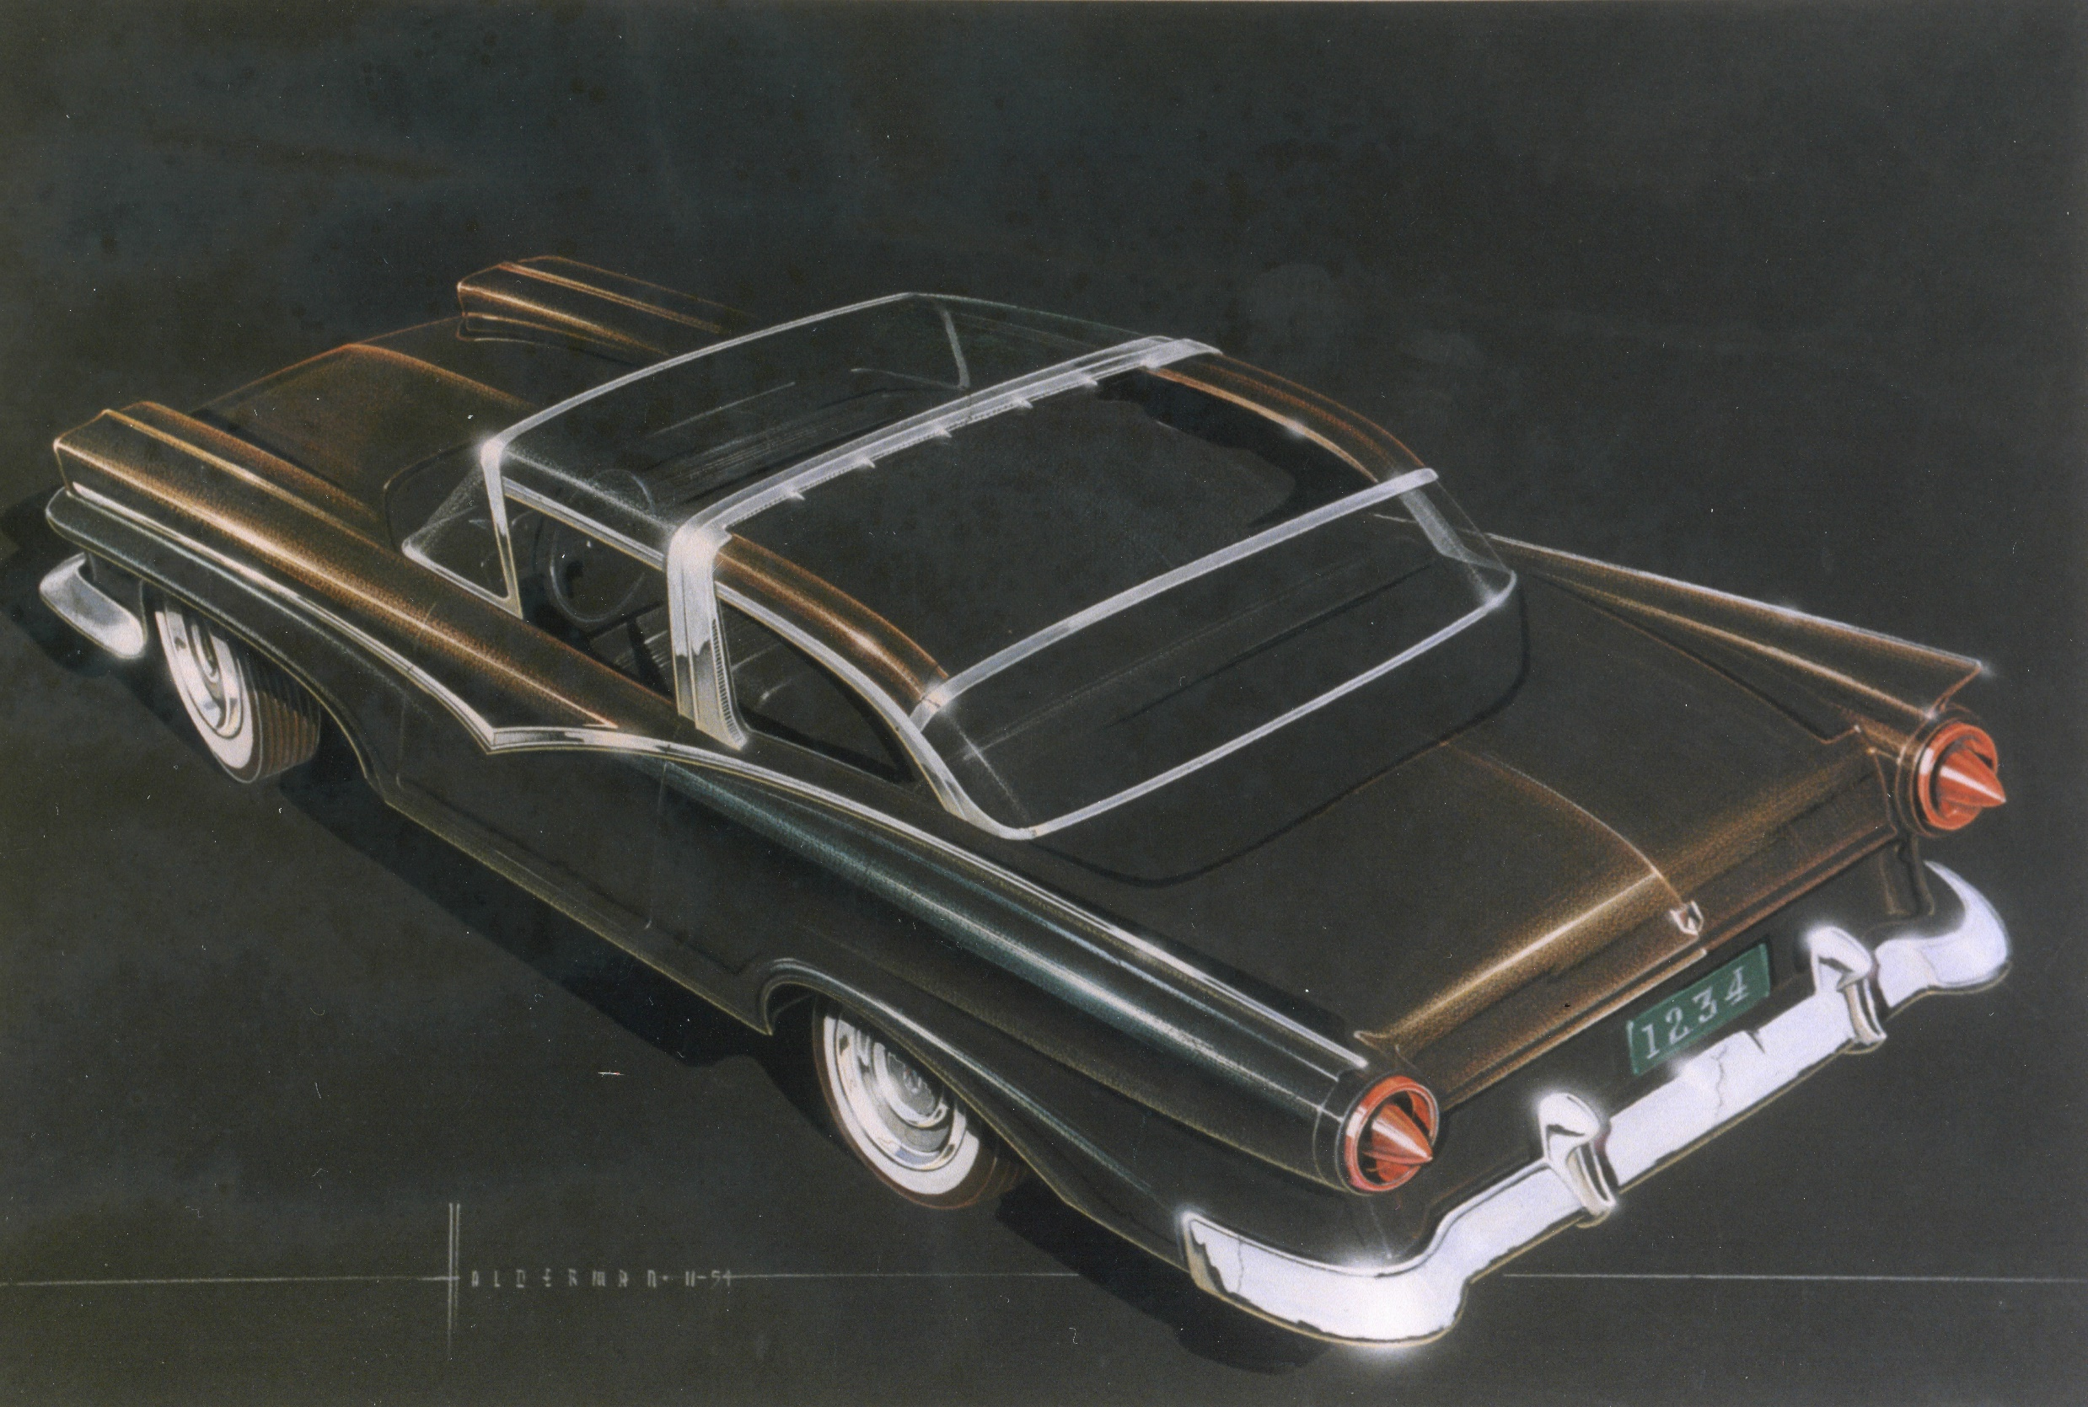
Gale’s first job was to get his ideas for “extra chrome” on the 1957s

Slide 11
Gale’s Sketch of the “Special Falcon” was selected by Lee Lacocca in 1962

Slide 12
The Horse
Charles Keresztes clay modeled the newly-decided Mustang logo for the car. Kereszstes was Hungarian and had a fondness for horses. He designed the iconic Mustang emblem to be housed within the predesigned corral space of the Cougar. It was decided that it would always run to the left. Throughout the car’s history, little has changed to the emblem.

Slide 13
Using a Grease Pencil
Gale learned to sketch freehand and to enhance the creative process he was taught to sketch quickly and loosely.
He was instructed to use a grease pencil, which was conducive to the artistic process.
Gale used this method throughout his schooling and also took it with him to the Ford Motor Company, a practice some found bizarre.

Slide 14
Hal Sperlich
Certainly, the idea for this new car was Lee Iacocca’s and he’s rightfully credited with being the “Father of the Mustang.” But, without the work of another visionary, Hal Sperlich, the Mustang would’ve never happened.

Slide 15
Parts of the Mustang

Slide 16
Early Promotion
“I worked with Joe Oros, for many years and while designing the Mustang. I helped Joe design the 1957 Ford Galaxie.
Because of the great sales, Joe was promoted to chief designer of Ford Studio.
He immediately promoted me to a design manager. I had only been with Ford several weeks.”

Slide 17
Gale’s Offices

Slide 18
“Gills”
Used to transition between the headlight and grille.
The same design feature is still used today.

Slide 19
Three Section Tail Lights

Slide 20
Mustang Design Features
Outside mirror was not standard.
Most were dealer installed.
Therefore , there were many different designs seen.
A right-side mirror was almost never seen in the mid-1960s.

Slide 21
Backup lights-Optional
The lights could be purchased from the dealer.
A hole saw was needed to make the needed opening for the lights.
The wiring was already there, so all that was needed was to plug them into the wiring harness.

Slide 22
Gas Cap was Loose
Early Mustangs did not have a cable to keep them attached to the vehicle
Many gas caps were lost or stolen.
Later, a cable was used to keep the gas cap attached to the car.

Slide 23
Plastic Lock Button
The interior lock button was plastic.
Looked and felt cheap.
This was later improved after the car proved to be a success.

Slide 24
Falcon Dash
The dash was right out of the Ford Falcon.
Just one turn signal light was on the dash and flashed for either left or right.
There was only one light instead or two to save costs.
The “Rally Pack” was an option and already wired for it.

Slide 25
Spinner Hubcaps
Spinner-type wheel covers were available but only on 14-inch wheels (13-inch wheels were standard).
These were outlawed because they created a potential hazard to pedestrians.

Slide 26
Passenger Side Seat Did Not Adjust
The passenger seat was bolted to the floor.
It was positioned in the most likely used position.
Most customers did not notice or care that it was not able to be moved forwarded or rearward.

Slide 27
Getting the Cost Out
First: Sound and thermal insulation was reduced.
It required a lot of labor to install at the factory.
The insulation added to the weight of the vehicle.
The cost of the insulation itself was a big factor.
Few people could tell the difference.

Slide 28
Getting the Cost Out - #2
Second: The quality of the interior fabric used on the seat(s), door panels, and headliner (inside roof fabric) was reduced to save costs. While all fabric was tested to ensure long life and wear, using a lighter weight fabric often resulted in huge savings.

Slide 29
Getting the Cost Out - #3
Third: The carpet thickness was reduced to reduce vehicle weight and cost.

Slide 30
Gale Also Designed Trucks
Gale said that designing trucks was hard.
The shape/form always stayed the same.
A truck is “just four corners.”
Not much else to change.

Slide 31
Ford F-Series Trucks
We also wrote this book, published by Car Tech Books.
14 Chapters-14 generations of F-Series Trucks (1948-Present).
We interviewed Gale many times and Hal Sperlich to learn about designing Ford Trucks.
Also available to purchase on Amazon or our vendor booth

Slide 32
Retirement-1994 (after 40 years) (Presented models of the first and last car he designed-1957 Ford and 1990 Lincoln)

Slide 33
Indy Mecum Auction-2019

Slide 34
Halderman Barn Museum

Slide 35
Halderman Barn Museum 6476 US-40 Tipp City, OH 45371 www.haldermanmustang.com www.facebook.com/Haldermanbarn

