Slide 1
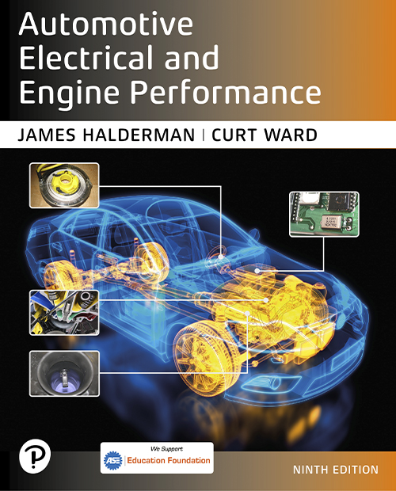
Automotive Electrical and Engine Performance
Ninth Edition
Chapter 44
On-Board Diagnosis
Copyright © 2025 Pearson Education, Inc. All Rights Reserved
Notes:
If this PowerPoint presentation contains mathematical equations, you may need to check that your computer has the following installed:
1) Math Type Plugin
2) Math Player (free versions available)
3) NVDA Reader (free versions available)
INSTRUCTOR NOTE: This presentation includes text explanation notes, you can use to teach the course. When in SLIDE SHOW mode, you RIGHT CLICK and select SHOW PRESENTER VIEW, to use the notes.

Slide 2
Learning Objectives (1 of 2)
44.1 Explain the purpose and function of O B D systems.
44.2 Discuss the diagnostic executive.
44.3 List the various continuous and noncontinuous monitors
44.4 Discuss
monitor information.
44.5 Explain enabling criteria.
44.6 Explain the numbering designation of
diagnostic
trouble codes.

Slide 3
Learning Objectives (2 of 2)
44.7 Explain the information captured by freeze-frame.
44.8 Describe the criteria to enable an O B D monitor.
44.9 Describe P C M tests related to O B D systems.
44.10 List the operation modes of a global scan tool.
44.11 Describe mode six diagnosis.

Slide 4
On-Board Diagnostics Generation-roman numeral two open parenthesis O B D hyphen roman number two close parenthesis Systems (1 of 2)
Purpose and Function
All light-duty vehicles (less than 8,500 pounds) sold in North America since 1996, as well as medium-duty vehicles (8,500–14,000 pounds) beginning in 2005, and heavy-duty vehicles (greater than 14,000 pounds) beginning in 2010, are required to support diagnostics, using a standardized data link connector.

Slide 5
On-Board Diagnostics Generation-roman numeral two open parenthesis O B D hyphen roman number two close parenthesis Systems (2 of 2)
Objectives
Detect component degradation or a faulty emission-related system that prevents compliance with federal emission standards.
Alert the driver of needed emission-related repair or maintenance.
Use standardized D T C s accept a generic scan tool.

Slide 6
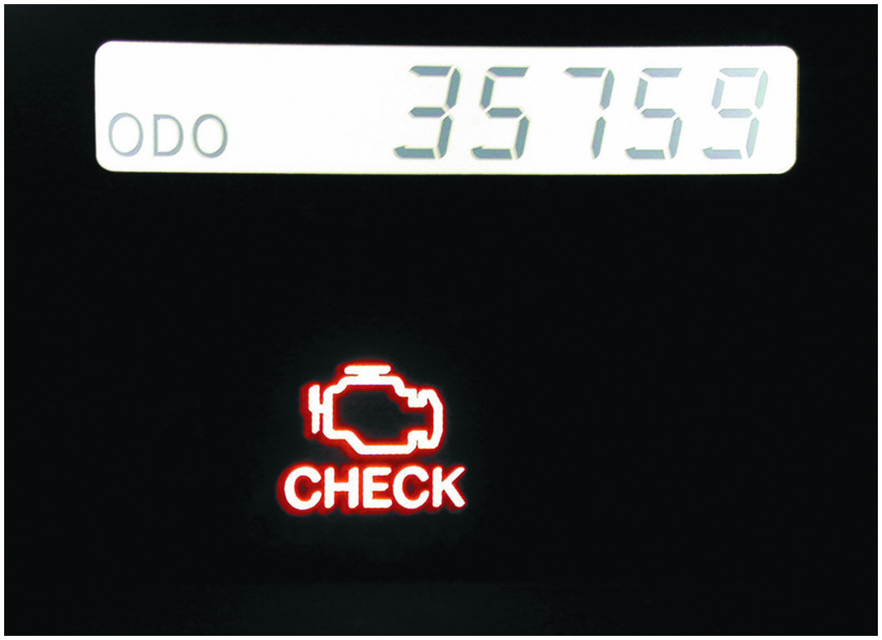
Figure 44.1
M I L Check Engine Light
A typical malfunction indicator lamp (M I L) often labeled “check engine” or “service engine soon” (S E S).

Slide 7
Diagnostic Executive and Task Manager
A software program designed to manage operation of all
monitors by controlling the sequence of steps
necessary to execute diagnostic tests and monitors.
Ford/G M systems, software called diagnostic executive.
Chrysler systems, called the task manager.

Slide 8
Monitors (1 of 2)
Purpose and Function
A monitor is an organized method of testing a specific part of the system.
Continuous Monitors
Comprehensive component monitor (C C M)
Misfire monitor
Misfire type A
Misfire type B
Fuel trim monitor

Slide 9
Monitors (2 of 2)
Noncontinuous Monitors
O 2 S monitor
O 2 S heater monitor
Catalyst monitor
E G R monitor
E V A P monitor
Secondary A I R monitor
Transmission monitor
P C V system monitor
Thermostat monitor

Slide 10
O B D hyphen roman number two Monitor Information (1 of 2)
Comprehensive Component Monitor
Inputs and outputs are to be checked electrically.
Inputs to the P C M are tested for rationality.
Outputs from the P C M be tested for functionality
Monitor runs continuously
Continuous Running Monitors
Continuous monitors run continuously and only stop if they fail and include:
Fuel system: rich/lean
Misfire: catalyst damaging/F T P

Slide 11
O B D hyphen roman number two Monitor Information (2 of 2)
Once per Trip Monitors
Monitor runs once per trip, pass or fail
response,
heaters, E G R, purge flow E V A P
leak, secondary air, catalyst
Exponentially Weighted Moving Average (E W M A) Monitors
A mathematical method used to determine performance.
Some Catalyst and E G R monitors

Slide 12
Enabling Criteria (1 of 3)
Purpose and Function
Each monitor has enabling criteria. These criteria are a set of conditions that must be met before the task manager gives the go-ahead for each monitor to run.
Trip
Key-on condition that contains necessary conditions for a particular test to be performed, followed by a key-off.

Slide 13
Enabling Criteria (2 of 3)
Warm-Up Cycle
Defined as a trip with an engine temperature increase
of at least
and where engine temperature
reaches at least
M I L Condition: Off
Indicates that P C M has not detected any faults in an emissions-related component or system, or that M I L circuit is not working.

Slide 14
Enabling Criteria (3 of 3)
M I L Condition: On Steady
Indicates a fault in an emissions-related component or system that could affect the vehicle emission levels.
M I L Condition: Flashing
Indicates a misfire or fuel control system fault that could damage the catalytic converter.
M I L: Off
When the codes are cleared, the battery is connected on the monitor, which passes three consecutive trips.

Slide 15
O B D hyphen Roman number two Numbering Designation (1 of 4)
D T C s are grouped into major categories, depending on the location of the fault on the system involved.
Pxxx—powertrain D T C s
Bxxx—Body D T C s
Cxxx—Chassis D T C s
Uxxx—Network D T C s

Slide 16
O B D hyphen Roman number two Numbering Designation (2 of 4)
D T C Numbering Explanation
P0100—Air metering and fuel system fault
P0200—Fuel system (fuel injector only) fault
P0300—Ignition system or misfire fault
P0400—Emission control system fault
P0500—Idle speed control, vehicle speed (V S) sensor fault
P0600—Computer output circuit (relay, solenoid, etc.) fault
P0700—Transaxle, transmission faults

Slide 17
O B D hyphen Roman number two Numbering Designation (3 of 4)
Types of D T C s
TYPE A CODES. Emission-related and causes the M I L to be turned on the first trip if the computer has detected a problem.
TYPE B CODES. Stored and M I L is turned on during second consecutive trip, alerting the driver to the fact that a diagnostic test was performed and failed.
TYPE C AND D CODES. For use with non-emission-related diagnostic tests

Slide 18
O B D hyphen Roman number two Numbering Designation (4 of 4)
Diagnostic Trouble Code Priority
C A R B mandated that all diagnostic trouble codes (D T C s) Freeze Frame be stored according to individual priority.
Priority 0—Non-emission-related codes
Priority 1—One-trip failure of two-trip fault for non-fuel, non-misfire codes
Priority 2—One-trip failure of two-trip fault for fuel or misfire codes
Priority 3—Two-trip failure or matured fault of non-fuel, non-misfire codes
Priority 4—Two-trip failure or matured fault for fuel or misfire codes

Slide 19
Question 1
What is the difference between a Type A and a Type B D T C?

Slide 20
Answer 1
Type A D T C illuminates the M I L after one trip. Type B D T C requires two trips to illuminate the M I L.

Slide 21
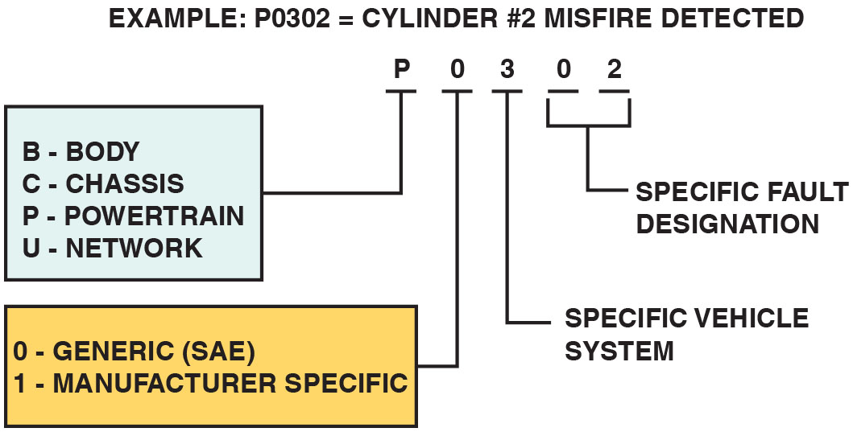
Figure 44.2
D T C
D T C identification format.
Notes:
Long Description:
The illustration depicting an O B D-II D T C identification format. It is a 5-digit alphanumeric key displays a block showing B for body, C for Chassis, P for Powertrain and U for Network. It is connected to P. The block below it has 0 for Generic (S A E) or 1 for Manufacturer specific. Third digit is specific vehicle system. The digits 0 and 2 is specific fault designation.

Slide 22
Animation: Diagnostic Trouble Code, DTC

Slide 23
Frequently Asked Question: What Is a Drive Cycle?
? Frequently Asked Question
What Is a Drive Cycle? vehicle being driven under specified speed and times that allows all monitors to run. P C M is looking at a series of data points representing speed and time and determines from these data points when the conditions are right to perform a monitor or a test of a component. These data points and, therefore, drive cycle are vehicle- specific and are not the same for each vehicle. Some conditions for a drive cycle to successfully run all of the monitors include Cold start with intake air temperature (I A T) and engine coolant temperature (E C T) close to each other, indicating that the engine has cooled to the temperature of the surrounding air temperature. Fuel level within a certain range, between 15% and 85%. Vehicle speed 4 to 12 minutes. Stop and idle for a certain time. SEE NOTES SECTION FOR BALANCE OF THE TEXT.
Notes:
Frequently Asked Question: What Is a Drive Cycle?
A drive cycle is a vehicle being driven under specified speed and times that allows all monitors to run. In other words, the P C M is looking at a series of data points representing speed and time and determines from these data points when the conditions are right to perform a monitor or a test of a component. These data points and, therefore, the drive cycle are vehicle- specific and are not the same for each vehicle. Some common conditions for a drive cycle to successfully run all of the monitors include Cold start with intake air temperature (I A T) and engine coolant temperature (E C T) close to each other, indicating that the engine has cooled to the temperature of the surrounding air temperature. Fuel level within a certain range, usually between 15% and 85%. Vehicle speed within a certain speed range for certain amount of time, usually 4 to 12 minutes. Stop and idle for a certain time. Each monitor requires its own set of parameters needed to run the test, and sometimes these conditions cannot be met. For example, some evaporate emissions control (E V A P) systems require a temperature that may not be possible in winter months in a cold climatic area.
A typical universal drive cycle that works for many vehicles includes the following steps.
MIL must be off. No D T C s present. Fuel fill between 15% and 85%.
Cold start—Preferred = 8-hour soak at 68°F to 86°F. Alternative = E C T below 86°F.
STEP 1 With the ignition off, connect scan tool.
STEP 2 Start engine and drive between 20 and 30 mph for 22 minutes, allowing speed to vary.
STEP 3 Stop and idle for 40 seconds, gradually accelerate to 55 mph.
STEP 4 Maintain 55 mph for 4 minutes using a steady throttle input.
STEP 5 Stop and idle for 30 seconds, then accelerate to 30 mph.
STEP 6 Maintain 30 mph for 12 minutes.
STEP 7 Repeat steps 4 and 5 four times.
Using scan tool, check readiness. Always check service information for the exact drive cycle conditions for the vehicle being serviced for best results.

Slide 24
Chart 44.1 (1 of 2)
Faults
MONITOR NAME | MONITOR TYPE (HOW OFTEN IT COMPLETES) | NUMBER OF FAULTS ON SEPARATE TRIPS TO SET A PENDING D T C | NUMBER OF SEPARATE CONSECUTIVE TRIPS TO LIGHT M I L, STORE A D T C | NUMBER OF TRIPS WITH NO FAULTS TO ERASE A M ATURING D T C | NUMBER OF TRIPS WITH NO FAULT TO TURN THE M I L OFF | NUMBER OF WARM-UP CYCLES TO ERASE D T C AFTER MIL IS TURNED OFF
C C M | Continuous (trip conditions allow it) | 1 | 2 | 1–Trip | 3–Trips | 40
Catalyst | Once per drive cycle | 1 | 3 | 1–Trip | 3–O B D hyphen roman numeral two drive cycle | 40
Misfire Type A | Continuous | 1 | 1 | 1–Trip | 3–Similar conditions | 80
Misfire Type B | Continuous | 1 | 2 | 1–Trip | 3–Similar conditions | 80
Fuel System | Continuous | 1 | 2 | 1–Trip | 3–Similar conditions | 80

Slide 25
Chart 44.1 (2 of 2)
Faults
MONITOR NAME | MONITOR TYPE (HOW OFTEN IT COMPLETES) | NUMBER OF FAULTS ON SEPARATE TRIPS TO SET A PENDING D T C | NUMBER OF SEPARATE CONSECUTIVE TRIPS TO LIGHT M I L, STORE A D T C | NUMBER OF TRIPS WITH NO FAULTS TO ERASE A M ATURING D T C | NUMBER OF TRIPS WITH NO FAULT TO TURN THE M I L OFF | NUMBER OF WARM-UP CYCLES TO ERASE D T C AFTER MIL IS TURNED OFF
Oxygen Sensor | Once per trip | 1 | 2 | 1–Trip | 3–Trips | 40
E G R | Once per trip | 1 | 2 | 1–Trip | 3–Trips | 40
E V A P | Once per trip | 1 | 1 | 1–Trip | 3–Trips | 40
A I R | Once per trip | 1 | 2 | 1–Trip | 3–Trips | 40
P C M Determination of faults chart.

Slide 26
O B D hyphen Roman number two Freeze Frame
Purpose and Function
To assist the service technician, O B D
requires the
computer to take a “snapshot” or freeze-frame of all data at the instant an emission-related D T C is set.
Freeze-Frame Items Include:
Calculated load value, engine speed (R P M), short-term and long-term fuel trim percent, fuel system pressure (on some vehicles), vehicle speed (m p h), engine coolant temperature, intake manifold pressure, closed-open-loop status, and the fault code that triggered the freeze-frame.

Slide 27
Frequently Asked Question: What Are Pending Codes?
? Frequently Asked Question
What Are Pending Codes? Pending codes are set when operating conditions are met and the component or circuit is not within the normal range, yet the conditions have not yet been met to set a D T C. For example, a sensor may require two consecutive faults before a D T C is set. If a scan tool displays a pending code or a failure, a driveability concern could also be present. The pending code can help the technician to determine the root cause before the customer complains of a check engine light indication.

Slide 28
Enabling Conditions
Global Disable Conditions:
Pending:
Under some situations, the P C M does not run a monitor if the M I L is illuminated and a fault is stored from another monitor.
Conflict:
There are also situations when the P C M does not run a monitor if another monitor is in progress.
Suspend:
Occasionally, the P C M may not allow a two-trip fault to mature.

Slide 29
P C M Tests
Rationality Test
This means that the input signal is compared against other inputs and information to see if it makes sense under the current conditions.
Functionality Test
A functionality test refers to using P C M inputs checking the operation of the outputs.
Electrical Test
Refers to the P C M check of both input and outputs for open circuits, shorts to ground and shorts to voltage.

Slide 30
Global O B D hyphen Roman number two
All
vehicles must be able to display data on a
global (called generic) scan tool under nine different modes of operation.
Mode 1: Current powertrain data
Mode 2: Freeze-frame data
Mode 3: D T C s
Mode 4: Clear and reset D T C s
Mode 5: Oxygen sensor results
Mode 6: Once per trip monitor results
Mode 7: Continuous monitor results
Mode 8: Bidirectional control of onboard systems
Mode 9: Module Identification

Slide 31
Frequently Asked Question: How Can You Tell Generic from Factory?
? Frequently Asked Question
How Can You Tell Generic from Factory? When using
using a scan tool on an
-equipped vehicle, if
the display asks for make, model, and year, then the factory or enhanced part of the P C M is being accessed. If the generic or global part of the P C M is being scanned, then there is no need to know the vehicle identification details.

Slide 32
Diagnosing Problems Using Mode Six
Mode six information can be used to diagnose faults by following three steps:
Check the monitor status before starting repairs. This step shows how the system failed.
Look at the component or parameter that triggered the fault. This step helps pin down the root cause of the failure.
Look to the monitor enable criteria, which shows what it takes to fail or pass the monitor.

Slide 33
Question 2
What is a rationality test?

Slide 34
Answer 2
A comparison of the input to other inputs to see if it makes sense under the current conditions.

Slide 35
Summary
If the M I L is on, retrieve the D T C and follow the manufacturer’s recommended procedure to find the root cause of the problem.
All monitors must have the enable criteria achieved before a test is performed.
vehicles use common generic D T C s.
includes generic (S A E) as well as vehicle
manufacturer- specific D T C s and data display.

Slide 36
Animations and Video Links (Halderman website subscription and web access needed to view)
(A8) Engine Performance Animations
(A8) Engine Performance Videos

Slide 37
Copyright
This work is protected by United States copyright laws and is provided solely for the use of instructors in teaching their courses and assessing student learning. Dissemination or sale of any part of this work (including on the World Wide Web) will destroy the integrity of the work and is not permitted. The work and materials from it should never be made available to students except by instructors using the accompanying text in their classes. All recipients of this work are expected to abide by these restrictions and to honor the intended pedagogical purposes and the needs of other instructors who rely on these materials.

