Slide 1
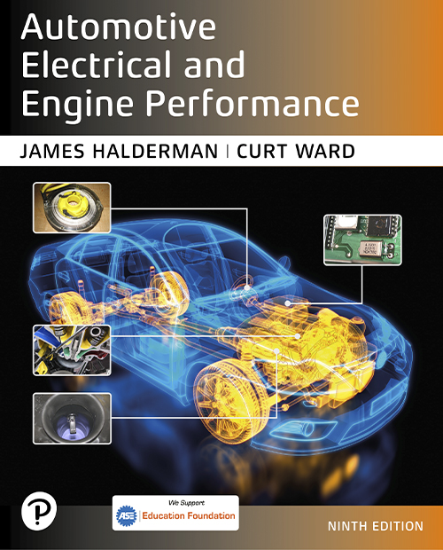
Automotive Electrical and Engine Performance
Ninth Edition
Chapter 43
Catalytic Converters
Copyright © 2025 Pearson Education, Inc. All Rights Reserved
Notes:
If this PowerPoint presentation contains mathematical equations, you may need to check that your computer has the following installed:
1) Math Type Plugin
2) Math Player (free versions available)
3) NVDA Reader (free versions available)
INSTRUCTOR NOTE: This presentation includes text explanation notes, you can use to teach the course. When in SLIDE SHOW mode, you RIGHT CLICK and select SHOW PRESENTER VIEW, to use the notes.

Slide 2
Learning Objectives
43.1 Explain the purpose, function, construction, and operation of catalytic converters.
43.2 Describe catalytic converter performance in
vehicles.
43.3 Discuss the diagnosis of catalytic converters.
43.4 Discuss the replacement of catalytic converters.

Slide 3
Catalytic Converters (1 of 3)
Purpose and Function
After-treatment device used to reduce exhaust emissions outside of the engine.
Catalytic Converter Construction
Most catalytic converters are constructed of a ceramic material in a honeycomb shape with square openings for the exhaust gases.
Substrate is then coated with a porous aluminum material called the washcoat.
Catalytic materials are then applied on top of the washcoat.

Slide 4
Catalytic Converters (2 of 3)
Catalytic Converter Operation
Substrate contains small amounts of rhodium, palladium, and platinum.
Elements act as catalysts.
Converter should have a
air–fuel ratio, but can
use a mixture that varies slightly.
Converter Light-Off Temperature
Must be heated to its light-off temperature of close to
before it begins working.

Slide 5
Catalytic Converters (3 of 3)
Converter Usage
A catalytic converter must be located as close as possible to the exhaust manifold to work effectively.
Some vehicles have used a small, quick heating oxidation converter, called a preconverter or a pup (mini) converter, that connects directly to the exhaust manifold outlet.
Catalytic Converter Performance
The P C M determines if the catalytic converter is ready for testing based on specific conditions, which may vary by vehicle make, model, and year.

Slide 6
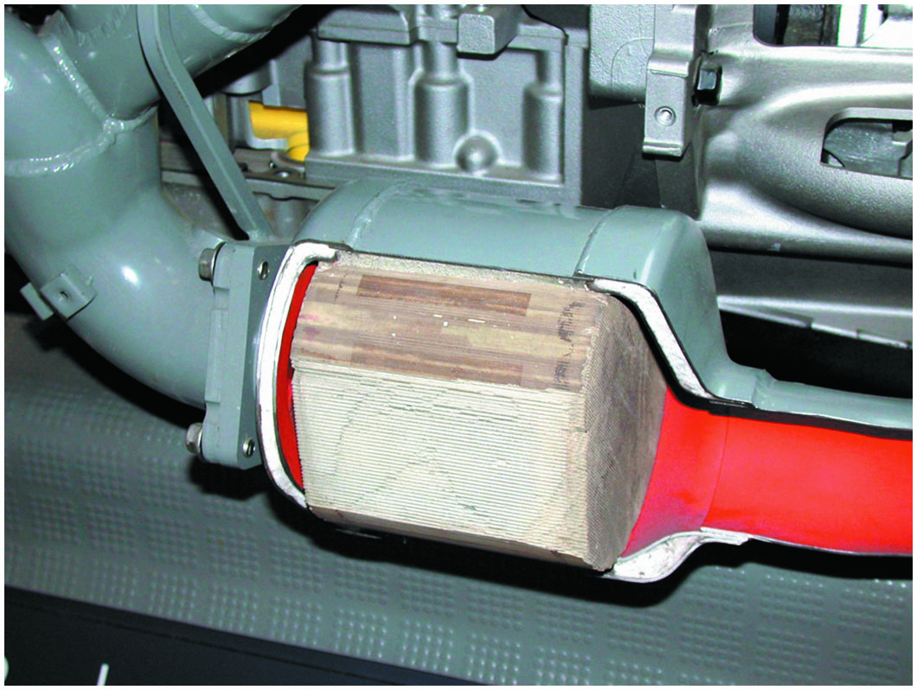
Figure 43.1
Catalytic Converter
Most catalytic converters are located as close to the exhaust manifold as possible, as seen in this display of a Chevrolet Corvette.
Notes:
TECH TIP: Catalytic Converters
Catalytic converters start a chemical reaction, but do not enter into the chemical reaction. Therefore, catalytic converters neither wear out nor die of old age. If a catalytic converter is found to be defective (nonfunctioning or clogged), look for the root cause. Items that should be checked when a defective catalytic converter is discovered include all components of the ignition and fuel systems. Excessive unburned fuel can cause the catalytic converter to overheat and fail. The oxygen sensor must be working and fluctuating from 0.5 to 5 H z (times per second) to provide the necessary air–fuel mixture variations for maximum catalytic converter efficiency.

Slide 7
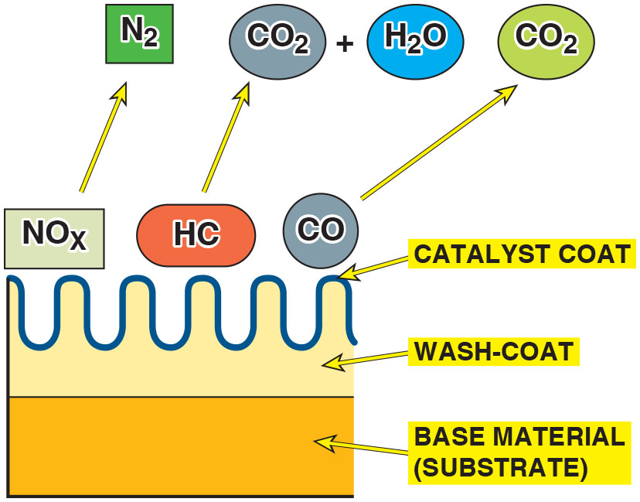
Figure 43.2
Base Materials
The base material, called the substrate, is used to support the wash coat, which is a porous material that is used to hold the catalyst materials.
Notes:
Long Description:
The illustration depicting a base material displays a comb-like wash-coat over it and catalyst coated over the comb. Exhaust gases like N O subscript x, H C, and C O come in contact with the catalyst and break down into N subscript 2, C O subscript 2 and H subscript 2 O.

Slide 8
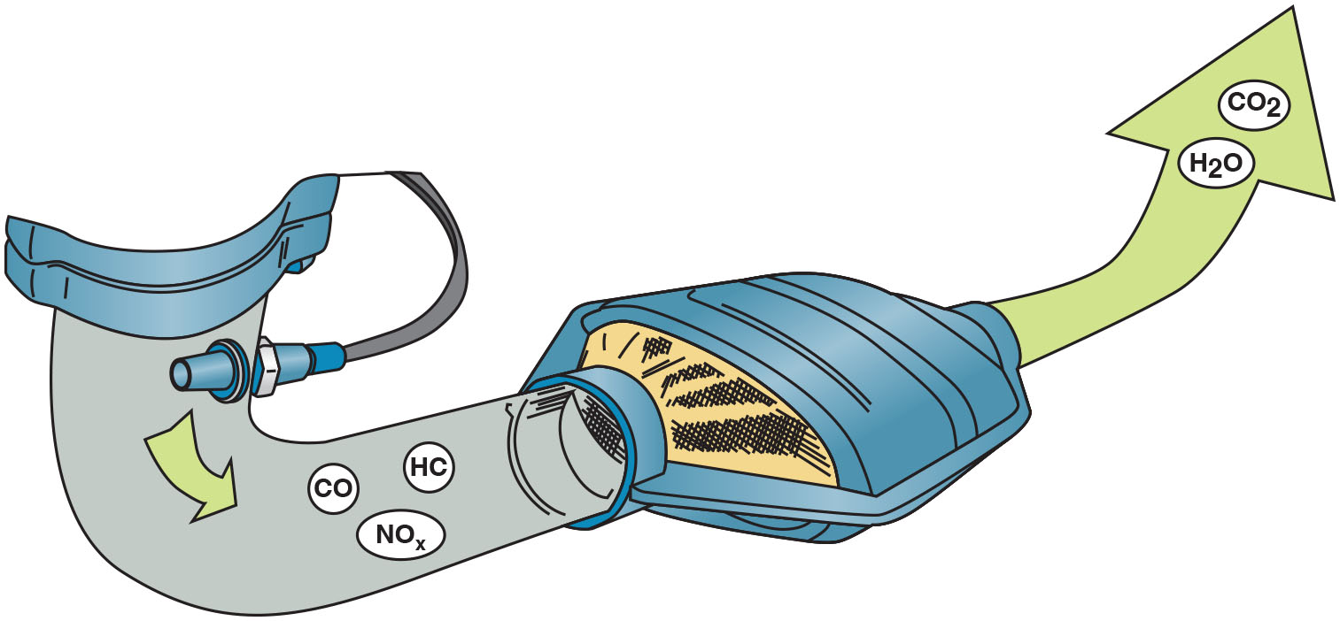
Figure 43.3
Operation
The three-way catalytic converter first separates the N O x into nitrogen and oxygen and then converts the H C and C O into harmless water
and carbon dioxide
The nitrogen (N) passes through the
converter and exits the tailpipe and enters the atmosphere, which is about 78% nitrogen.

Slide 9
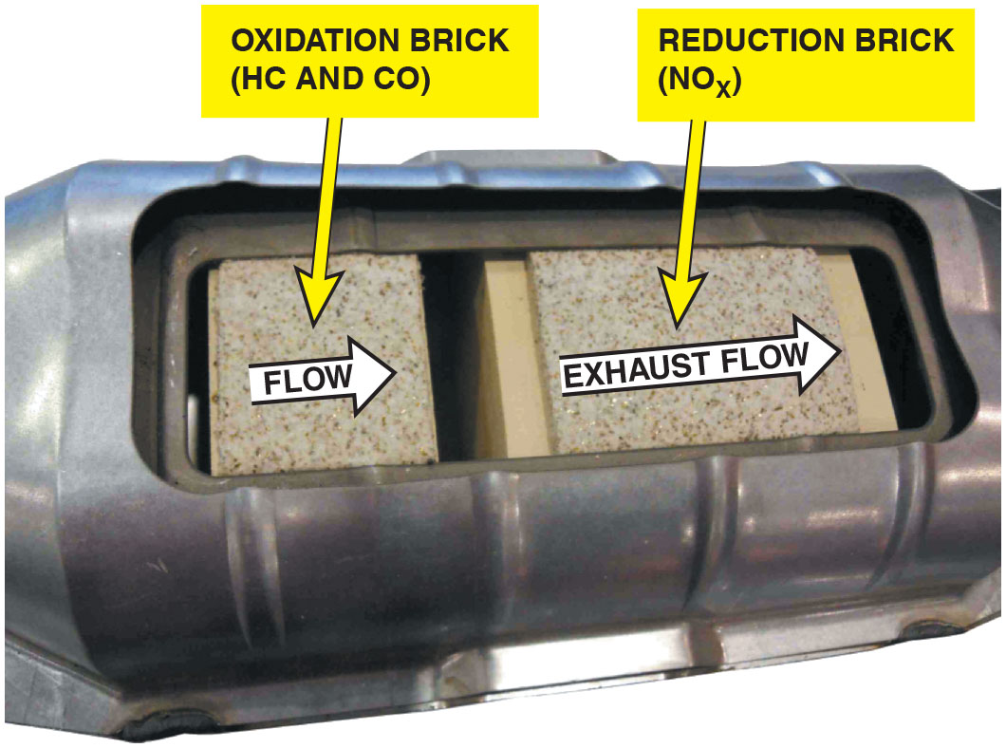
Figure 43.4
Converter Sections
The small oxidation section of the converter helps build heat for the reduction section to reduce N O x emissions in the rear brick on most newer vehicles. Older catalytic converters had the reduction brick first then the oxidation brick. Since about 2007, the allowable N O x levels were greatly reduced, and engines became more efficient at controlling H C and C O and that was when the position of the bricks were changed.

Slide 10
Animation: Catalytic Converter

Slide 11
O B D hyphen roman numeral two Catalytic Converter Performance
When the three-way converter (T W C) is operating as it should, the post-converter H O2S is less active than the pre-converter sensor
Converter Damaging Conditions
Contamination
Excessive temperatures
Improper air–fuel mixtures

Slide 12
Question 1
What is the function of the catalytic converter?

Slide 13
Answer 1
The function of the catalytic converter is to reduce exhaust emissions outside the engine.

Slide 14
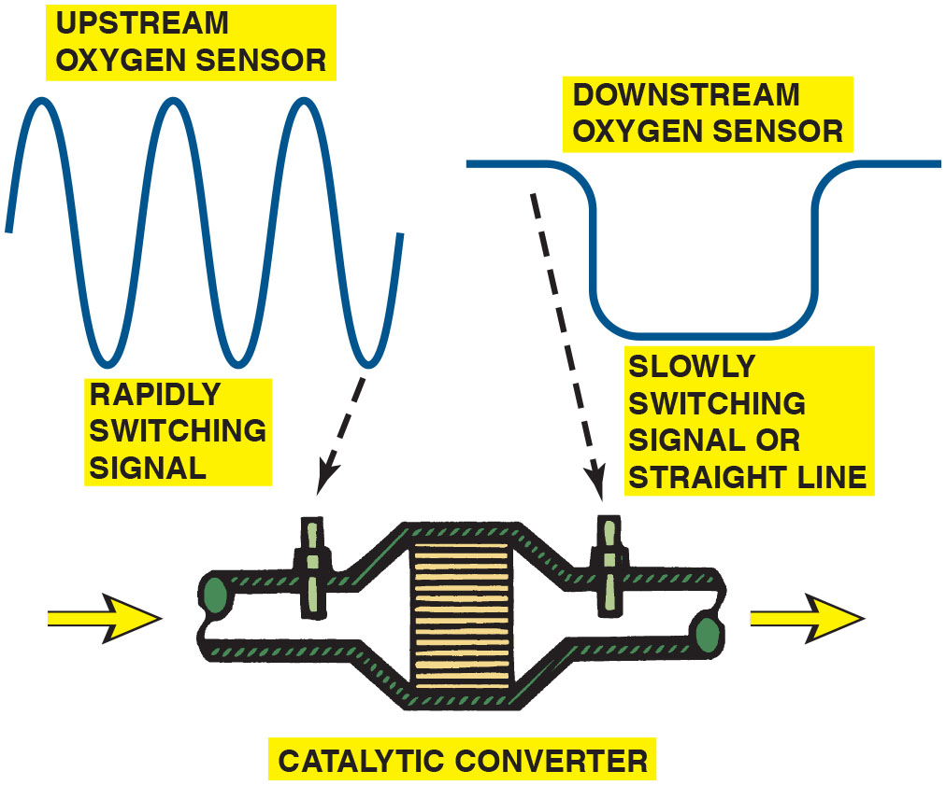
Figure 43.5
Upstream/Downstream
The
catalytic
converter monitor compares the signals of upstream and downstream oxygen sensors to determine converter efficiency.

Slide 15
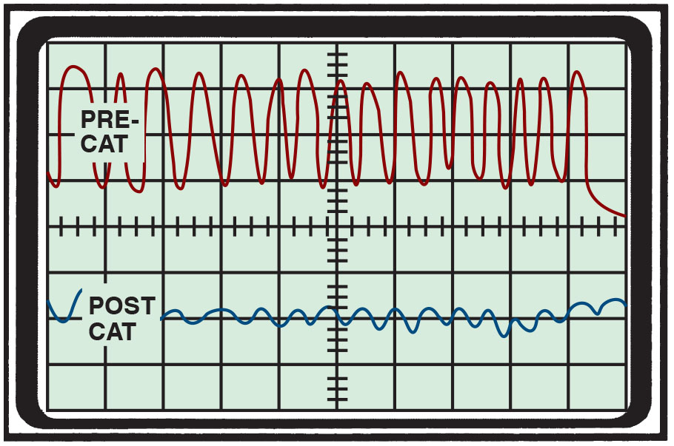
Figure 43.6
Waveform
The waveform of a downstream O2S sensor from a properly functioning converter shows little, if any, activity.

Slide 16
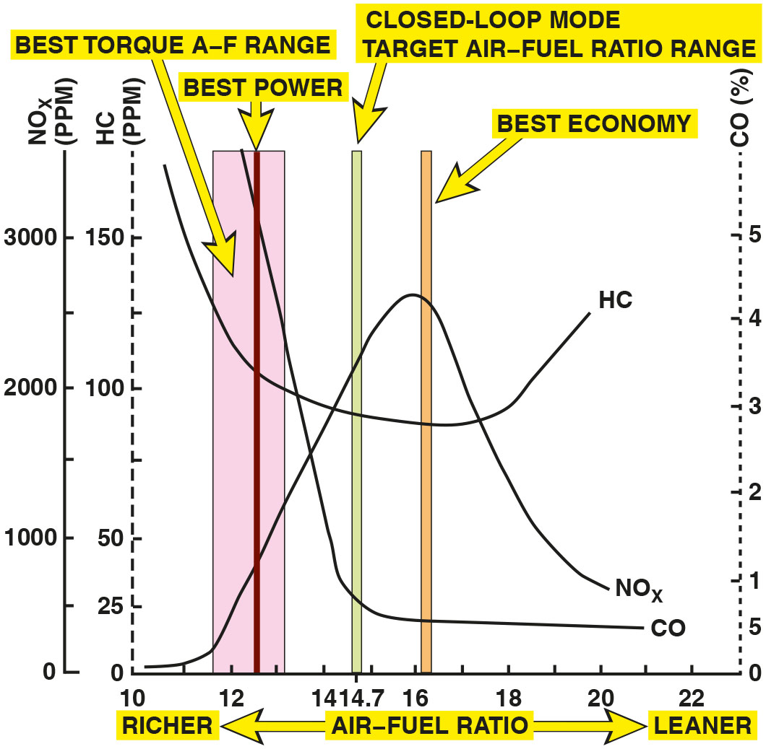
Figure 43.7
Stoichiometric Ratio
The highest catalytic converter efficiency occurs when the air–fuel mixture is about 14.7∶1.
Notes:
Long Description:
The line graph between various exhaust gasses and Air-fuel ratio. The x-axis contains Air fuel ratio from 10 to 22 and y-axis representing gasses N O subscript x and H C. It shows the best power is achieved at 12.6 is to 1 ratio. Best torque is achieved between 11.7 is to 1 and 13.1 is to 1. Closed-Loop mode is achieved at target AF ratio of 14.7 is to 1. At this ratio efficiency of catalytic converter is highest. Best economy is achieved at 16.2 is to 1. Graph with C O; C O is the highest value of 6 percentages at 12 Air-Fuel ratio. It drops linearly to 1 percentage at Air-Fuel ratio of 14. Then slowly becomes constant at 0.5percenntage till 21 is to 1 Air-Fuel ratio. Graph with H C; H C has the highest value of 170 P P M at 10.5 is to 1 Air-Fuel ratio. It drops linearly to 112.5 at Air-Fuel of 12 is to 1. Then it drops slowly to 85.5 at Air-Fuel ratio of 18 is to 1. It then increases to 125 at Air-Fuel ratio of 20 is to 1. Graph with N O subscript x; N O subscript x has the lowest value of almost 0 at 10.25 is to 1 Air-Fuel ratio. Then it increases slowly to 10 at Air-Fuel ratio of 11.5 is to 1. Then it linearly increases to 125 at Air-Fuel ratio of 16 is to 1. Then it linearly decreases to 25 at Air-Fuel of 20 is to 1.

Slide 17
Frequently Asked Question: Can a Catalytic Converter Be Defective Without Being Clogged?
? Frequently Asked Question
Can a Catalytic Converter Be Defective Without Being Clogged? Yes. Catalytic converters can fail by being chemically damaged or poisoned without being mechanically clogged. Therefore, the catalytic converter should be tested not only for physical damage (clogging) by performing a back pressure or vacuum test and a rattle test, but also for temperature rise, usually with a pyrometer or propane test, to check the efficiency of the converter.

Slide 18
Question 2
How does the engine control module monitor the performance of the catalytic converter?

Slide 19
Answer 2
By monitoring the switch rate of the downstream oxygen sensor as compared to the switch rate of the upstream oxygen sensor.

Slide 20
Diagnosis Catalytic Converters (1 of 3)
Tap Test
If the substrate inside the converter is broken, the converter rattles when hit. If the converter rattles, a replacement converter is required.
Testing Back Pressure with a Gauge
Exhaust system back pressure can be measured directly by installing a pressure gauge in an exhaust opening.

Slide 21
Diagnosis Catalytic Converters (2 of 3)
Testing for Back Pressure Using a Vacuum Gauge
An exhaust restriction can be tested indirectly by checking the intake manifold vacuum with the engine operating at a fast idle speed (about 2,500 R P M).
Testing a Catalytic Converter for Temperature Rise
To test the converter, operate the engine at 2,500 R P M for at least two minutes to fully warm the converter. Measure the inlet and the outlet temperatures using an infrared pyrometer.

Slide 22
Diagnosis Catalytic Converters (3 of 3)
Catalytic Converter Efficiency Test
Efficiency of catalytic converter
Determined using an exhaust gas analyzer.

Slide 23
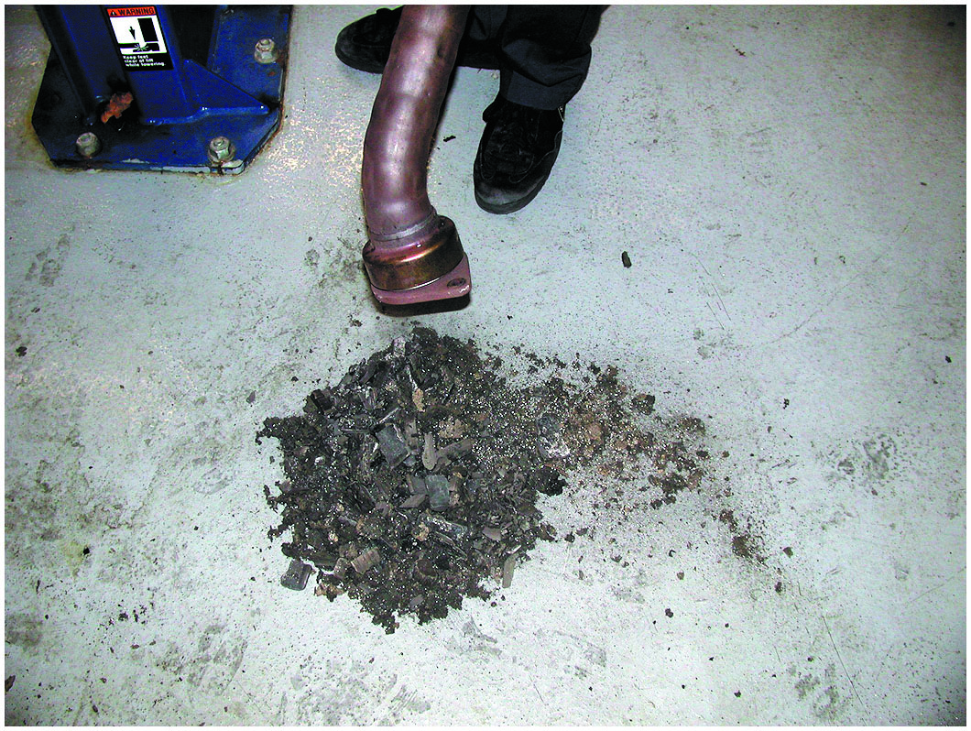
Figure 43.8
Failed Substrate
A catalytic converter that rattles when tapped was removed, and the substrate, or what was left of it, fell out. This converter has to be replaced and the root cause of why it failed found and corrected.

Slide 24
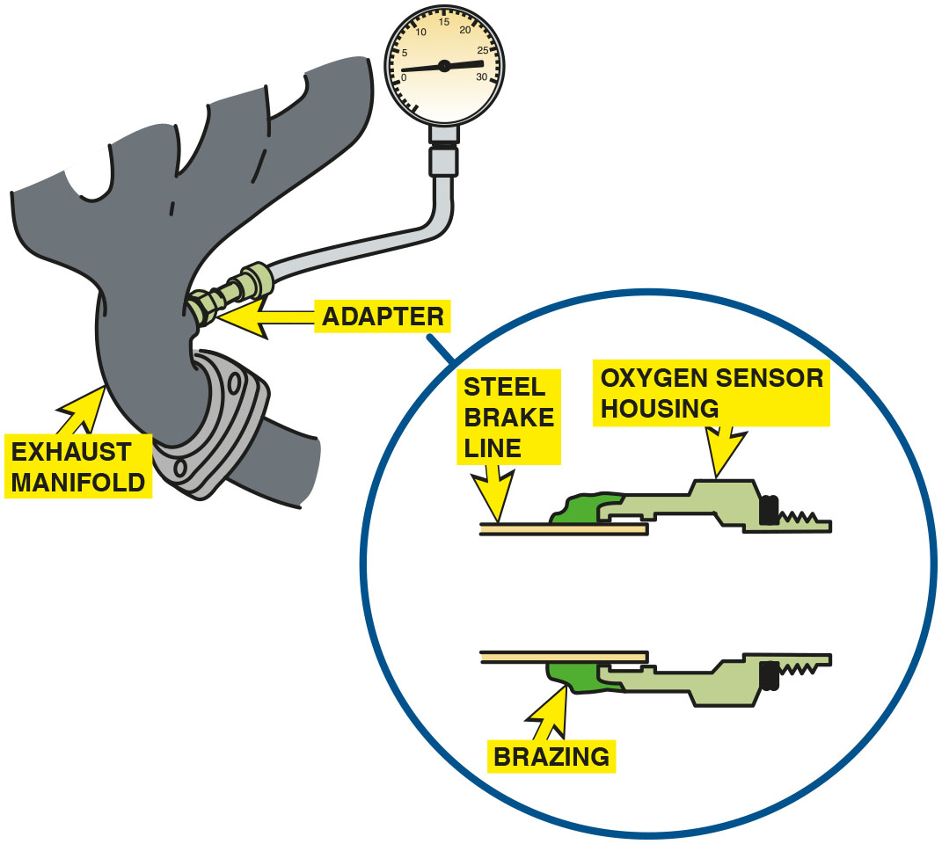
Figure 43.9
Back Pressure Tool
A back pressure tool can be made by using an oxygen sensor housing and epoxy or braze to hold the tube to the housing.

Slide 25
Animation: Exhaust Back-Pressure, Measure

Slide 26
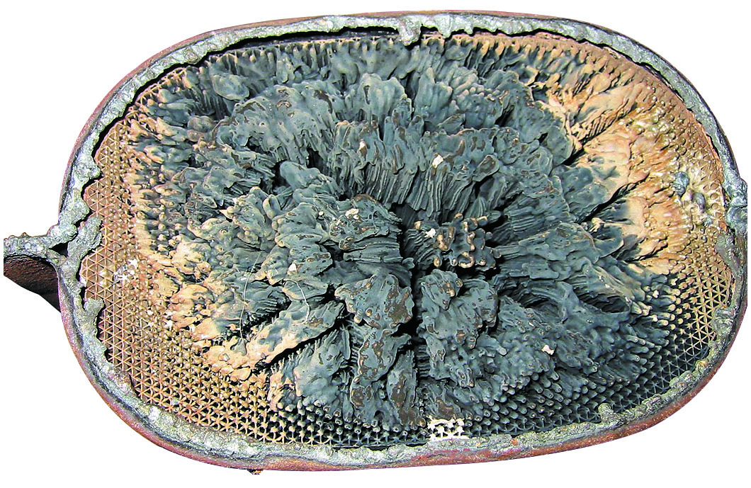
Figure 43.10
Melted Converter
This partially melted catalytic converter tested okay at idle, but had excessive back pressure at higher engine speeds.

Slide 27
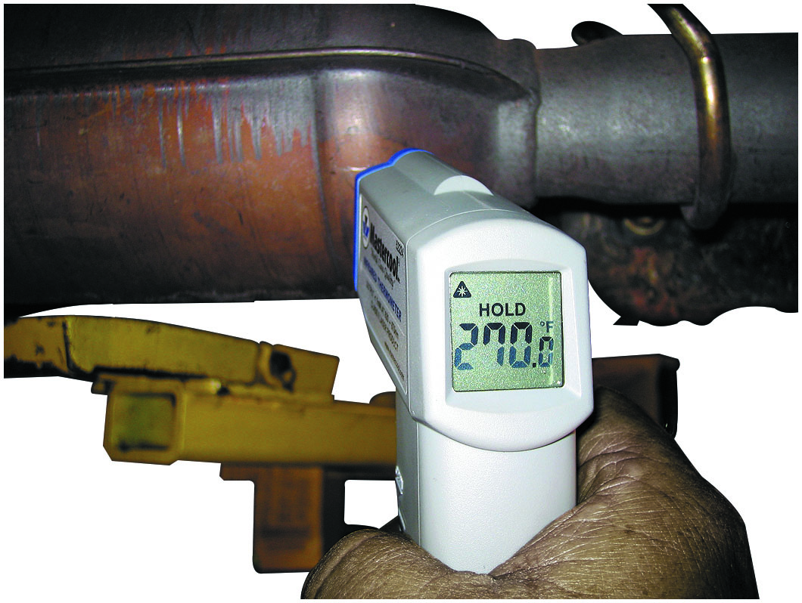
Figure 43.11
Temperature Difference
The temperature of the outlet should be at least 10% hotter than the temperature of the inlet. If a converter is not working, the inlet temperature is hotter than the outlet temperature.

Slide 28
Question 3
How can a catalytic converter be diagnosed?

Slide 29
Answer 3
A tap test, a pressure test, a vacuum test, a temperature test, and an efficiency test.

Slide 30
Figure 43.12
Replacing Converter
Whenever replacing a catalytic converter with a universal unit, first measure the distance between the rear brick and the center of the rear oxygen sensor. Be sure that the replacement unit is installed to the same dimension.
Notes:
TECH TIP: Aftermarket Catalytic Converters
Some replacement aftermarket (non-factory) catalytic converters do not contain the same amount of cerium as the original part. Cerium is the element that is used in catalytic converters to store oxygen. As a result of the lack of cerium, the correlation between the oxygen storage and the conversion efficiency may be affected enough to set a false diagnostic trouble code (P0422).
NOTE: If an aftermarket converter is being installed, be sure that the distance between the rear of the catalyst block is the same distance from the rear oxygen sensor as the factory converter to be ensured of proper operation. Always follow the instructions that come with the replacement converter. ● See Figure 43.12.
Long Description:
The illustration depicting replacing a catalytic converter with a universal unit displays a replacement converter at the center. C O, N O subscript x, and H C enter the front exhaust pipe on the left. O subscript 2, H subscript 2 O and C O subscript 2 exits through the outlet pipe on the right. A rear (post) O subscript 2 sensor is connected at a specific distance from the replacement converter.

Slide 31
Catalytic Converter Replacement Guidelines
If a converter is replaced on a vehicle with less than 80,000 miles or eight years, depending on the year of the vehicle, an original equipment catalytic converter must be used as a replacement.
Notes:
Tech Tip: Catalytic Converters
Catalytic converters start a chemical reaction, but do not enter the chemical reaction. Therefore, catalytic converters neither wear out nor die of old age. If a catalytic converter is found to be defective (nonfunctioning or clogged), look for the root cause. Items that should be checked when a defective catalytic converter is discovered include all components of the ignition and fuel systems. Excessive unburned fuel can cause the catalytic converter to overheat and fail. The oxygen sensor must be working and fluctuating from 0.5 to 5 Hz (times per second) to provide the necessary air–fuel mixture variations for maximum catalytic converter efficiency.

Slide 32
Catalytic Converter-Related Diagnostic Trouble Code
Diagnostic Trouble Code | Description | Possible Causes
P0422 | Catalytic converter efficiency failure | Engine mechanical fault Exhaust leaks Fuel contaminations, such as engine oil, coolant, or sulfur

Slide 33
Summary
Catalytic converter is after-treatment device that reduces exhaust emissions outside of the engine. Catalyst is an element that starts a chemical reaction but not consumed in the process.
Catalyst material used in a catalytic converter includes rhodium, palladium, and platinum.
system monitor compares relative activity of a rear
oxygen sensor to pre-catalytic oxygen sensor to efficiency.
Catalytic converter can be tested for excessive back pressure using a vacuum gauge.
Replacement of the catalytic converter must conform to E P A guidelines.

Slide 34
Animations and Video Links (Halderman website subscription and web access needed to view)
(A8) Engine Performance Animations
(A8) Engine Performance Videos

Slide 35
Copyright
This work is protected by United States copyright laws and is provided solely for the use of instructors in teaching their courses and assessing student learning. Dissemination or sale of any part of this work (including on the World Wide Web) will destroy the integrity of the work and is not permitted. The work and materials from it should never be made available to students except by instructors using the accompanying text in their classes. All recipients of this work are expected to abide by these restrictions and to honor the intended pedagogical purposes and the needs of other instructors who rely on these materials.

