Slide 1
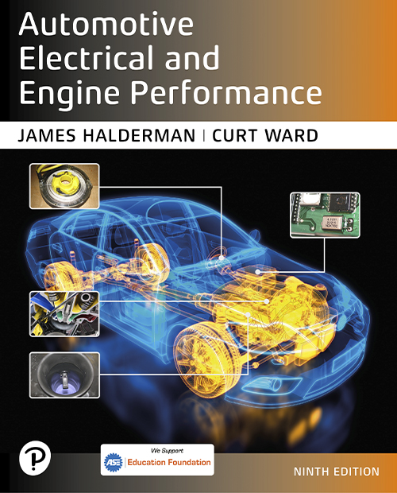
Automotive Electrical and Engine Performance
Ninth Edition
Chapter 42
P C V and S A I Systems
Copyright © 2025 Pearson Education, Inc. All Rights Reserved
Notes:
If this PowerPoint presentation contains mathematical equations, you may need to check that your computer has the following installed:
1) Math Type Plugin
2) Math Player (free versions available)
3) NVDA Reader (free versions available)
INSTRUCTOR NOTE: This presentation includes text explanation notes, you can use to teach the course. When in SLIDE SHOW mode, you RIGHT CLICK and select SHOW PRESENTER VIEW, to use the notes.

Slide 2
Learning Objectives
42.1 Describe the purpose and function of the positive crankcase ventilation (P C V) system.
42.2 Discuss P C V system diagnosis.
42.3 Explain the purpose and function of the secondary air-injection (S A I) system.
42.4 Explain how to diagnose faults in the secondary air-Injection system.

Slide 3
Crankcase Ventilation (1 of 2)
Purpose and Function
P C V systems were developed to ventilate the crankcase and recirculate the vapors to induction system so they can be burned in the cylinders.
P C V Valves
P C V valve in most systems is a one-way valve containing a spring-operated plunger that controls valve flow rate.

Slide 4
Crankcase Ventilation (2 of 2)
Orifice-Controlled Systems
Closed P C V system used on some 4-cylinder engines contains a calibrated orifice instead of a P C V valve.
Separator Systems
Turbocharged and many fuel-injected engines use an oil/vapor or oil/water separator and a calibrated orifice instead of a P C V valve.

Slide 5
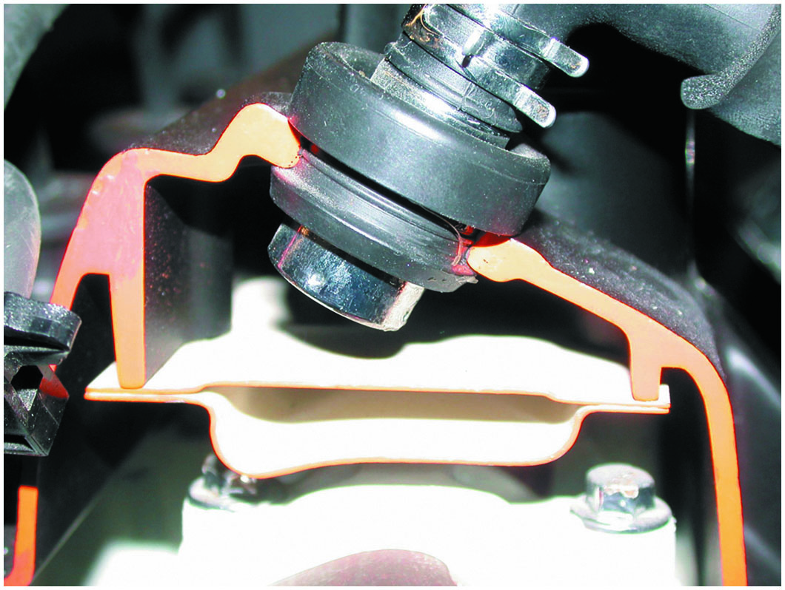
Figure 42.1
Vent Type P C V
A P C V valve in a cutaway valve cover, showing the baffles that prevent liquid oil from being drawn into the intake manifold.
Notes:
CASE STUDY: The Whistling Engine
An older vehicle was being diagnosed for a whistling sound whenever the engine was running, especially at idle. It was finally discovered that the breather in the valve cover was plugged and caused high vacuum in the crankcase. The engine was sucking air from what was likely the rear main seal lip, making the “whistle” noise. After replacing the breather and P C V, the noise stopped.
Summary:
Complaint—The customer stated that the engine made a whistling sound when it was running.
Cause—A clogged P C V breather was found to be the cause of air being drawn into the engine through the rear main seal.
Correction—The P C V breather and check valve were replaced, which corrected the whistling noise concern.

Slide 6
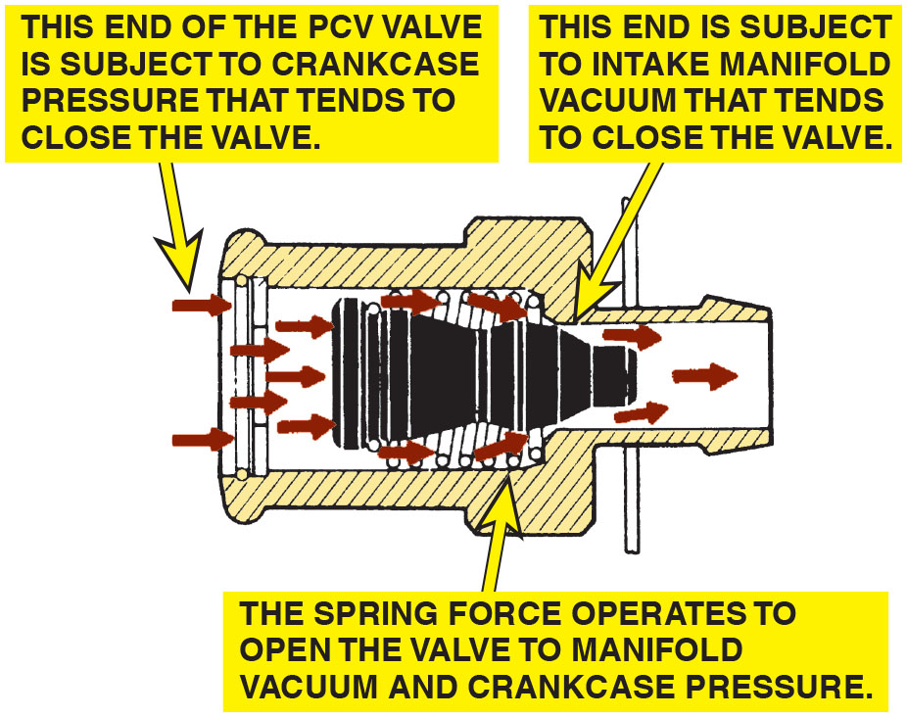
Figure 42.2
P C V Flow
Spring force, crankcase pressure, and intake manifold vacuum work together to regulate the flow rate through the P C V valve.
Notes:
Long Description:
The illustration depicting working of a P C V valve displays several rightward arrows around the valve. The left end is subject to intake manifold vacuum that tends to close the valve. The right end of the P C V valve is subject to crankcase pressure that tends to close the valve. The spring force operates to open the valve to manifold vacuum and crankcase pressure.

Slide 7
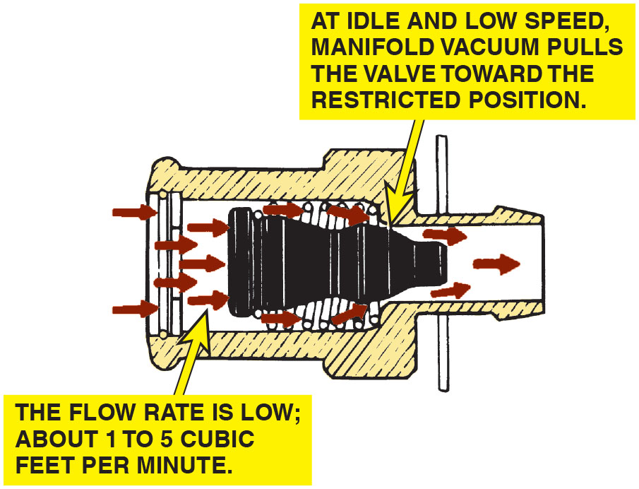
Figure 42.3
Idle
Air flows through the P C V valve during idle, cruising, and light-load conditions.

Slide 8
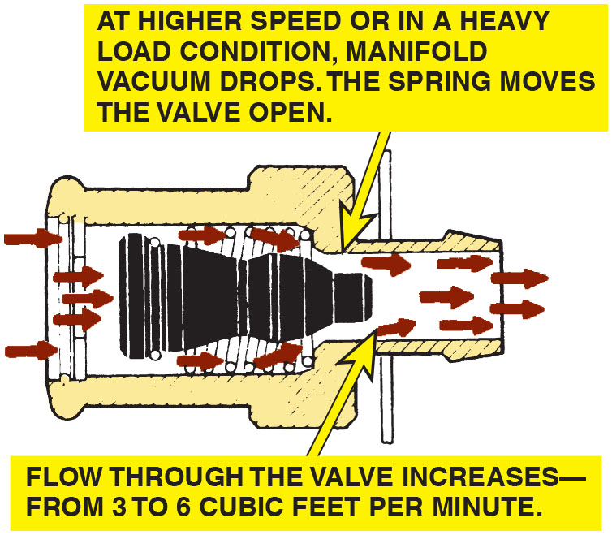
Figure 42.4
Acceleration
Air flows through the P C V valve during acceleration and when the engine is under a heavy load.

Slide 9
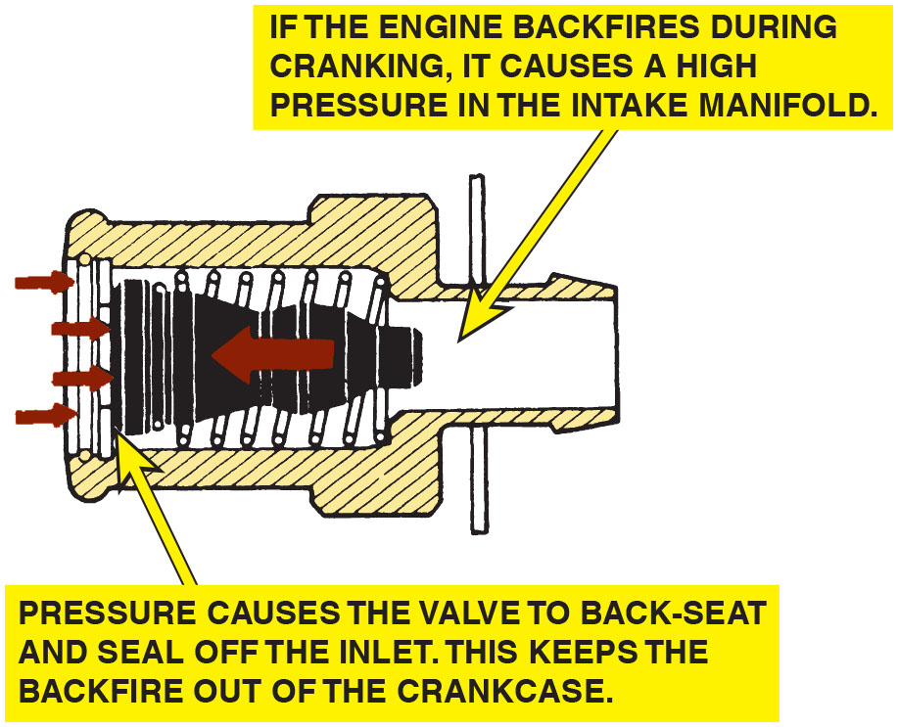
Figure 42.5
Backfire
P C V valve operation in the event of a backfire.

Slide 10
P C V System Diagnosis (1 of 3)
Symptoms
Rough or unstable idle
Excessive oil consumption
Oil in the air filter housing
Oil leaks due to excessive crankcase pressure
P C V System Performance Test
A slight vacuum is created in the crankcase (usually less than 1 i n. H g if measured at the dipstick) and is also applied to other areas of the engine.
Notes:
TECH TIP: Check for Oil Leaks with the Engine Off
The owner of an older vehicle equipped with a V-6 engine complained to their technician that they smelled burning oil, but only after shutting off the engine. The technician found that the rocker cover gaskets were leaking. But why did the owner only notice the smell of hot oil when the engine was shut off? Because of the P C V system, engine vacuum tends to draw oil away from gasket surfaces. When the engine stops, however, engine vacuum disappears, and the oil remaining in the upper regions of the engine tend to flow down and out through any opening. Therefore, a good technician should check an engine for oil leaks, not only with the engine running, but also shortly after shutdown.

Slide 11
P C V System Diagnosis (2 of 3)
Rattle Test
If the P C V valve does not rattle, it is definitely defective and must be replaced.
The
Card Test
Remove the oil-fill cap (where oil is added to the engine) and start the engine.
Hold a
card over the opening (a dollar bill or any
other piece of paper can be used for this test):
If the P C V system, including the valve and hoses, is functioning correctly, the card should be held down on the oil-fill opening by the slight vacuum inside the crankcase.

Slide 12
P C V System Diagnosis (3 of 3)
Snap-Back Test
The proper operation of the P C V valve can be checked by placing a finger over the inlet hole in the valve when the engine is running and removing the finger rapidly.
Crankcase Vacuum Test
The P C V system can be checked by testing for a weak vacuum at the oil dipstick tube using an inches-of-water manometer or gauge.
P C V Monitor
Starting with 2004 and newer vehicles, all vehicle P C M s monitor the P C V system for proper operation as part
of the
system.

Slide 13
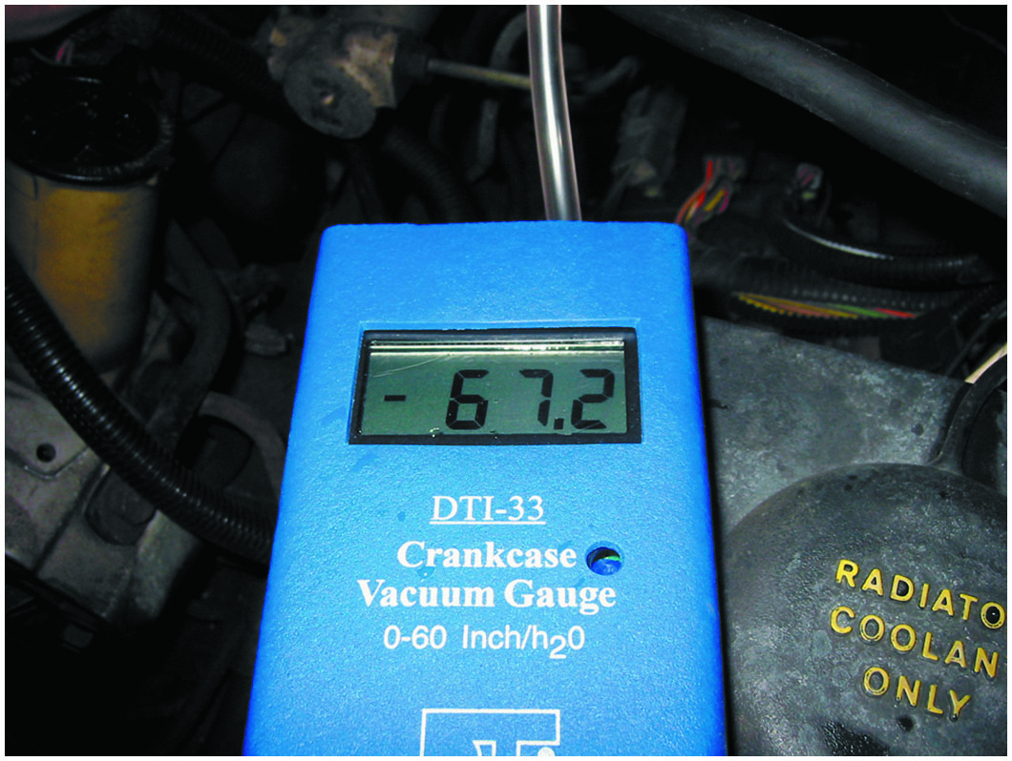
Figure 42.6
Vacuum Gauge
Using a gauge that measures vacuum in units of inches of water to test the vacuum at the dipstick tube, being sure that the P C V system is capable of drawing a vacuum on the crankcase
(28 inches
= 1 P S I, or
about 2 in. Hg of vacuum).

Slide 14
Animation: Positive Crankcase Ventilation System Test

Slide 15
Frequently Asked Question: What Are the Wires for at the P C V Valve?
? Frequently Asked Question
What Are the Wires for at the P C V Valve? Ford uses an electric heater to prevent ice from forming inside the P C V valve and causing blockage. Water is a by-product of combustion, and resulting moisture can freeze when the outside air temperature is low. General Motors and others clip a heater hose to the P C V hose to provide the heat needed to prevent an ice blockage.

Slide 16
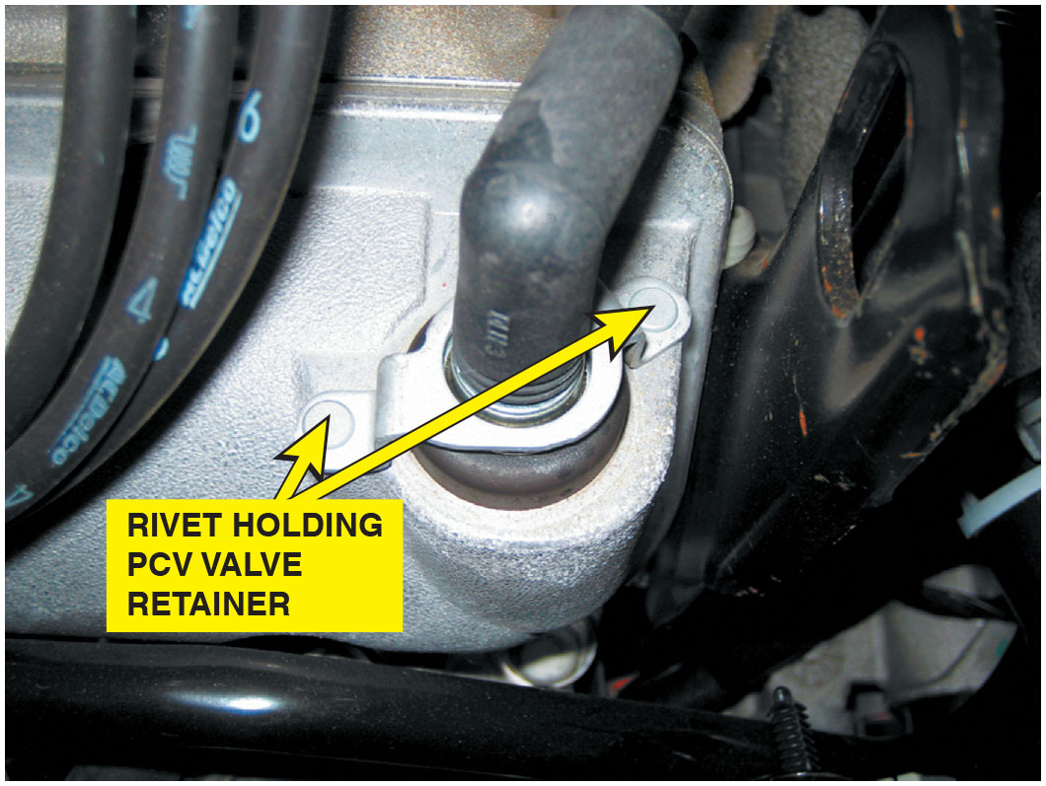
Figure 42.7
P C V Fasteners
Most P C V valves used on newer vehicles are secured with fasteners, making it more difficult to disconnect, and thereby less likely to increase emissions.

Slide 17
P C V-Related Diagnostic Trouble Codes
Diagnostic Trouble Code | Description | Possible Causes
P0101 | M A F or airflow circuit range problem | Defective P C V valve or hose/connections or M A F circuit fault
P0505 | Idle control system problem | Defective P C V valve or hose/connections

Slide 18
Question 1
What emissions does a P C V valve control?

Slide 19
Answer 1
Excessive crankcase hydrocarbons (H C).

Slide 20
Secondary Air-Injection System (1 of 3)
Purpose and Function
The secondary air-injection (S A I) system provides the air necessary for the oxidizing process either at the exhaust manifold or inside the catalytic converter.
Parts and Operation
The system pulls fresh air in through an external filter and pumps the air under slight pressure to each exhaust port through connecting hoses or a manifold.

Slide 21
Secondary Air-Injection System (2 of 3)
Air Distribution Manifolds and Nozzles
Air delivered to exhaust system in one of two ways:
An external air manifold, or manifolds, distributes the air through injection tubes with stainless steel nozzles.
An internal air manifold distributes air to exhaust ports near each exhaust valve through passages cast in the cylinder head or the exhaust manifold.

Slide 22
Secondary Air-Injection System (3 of 3)
Exhaust Check Valves
All air-injection systems use one or more one-way check valves to protect the air pump and other components from reverse exhaust flow.
Belt-Driven Air Pumps
Belt-driven air pump uses a centrifugal filter just behind the drive pulley.
Electric Motor-Driven Air Pumps
Generally used only during cold engine operation and is computer controlled.

Slide 23
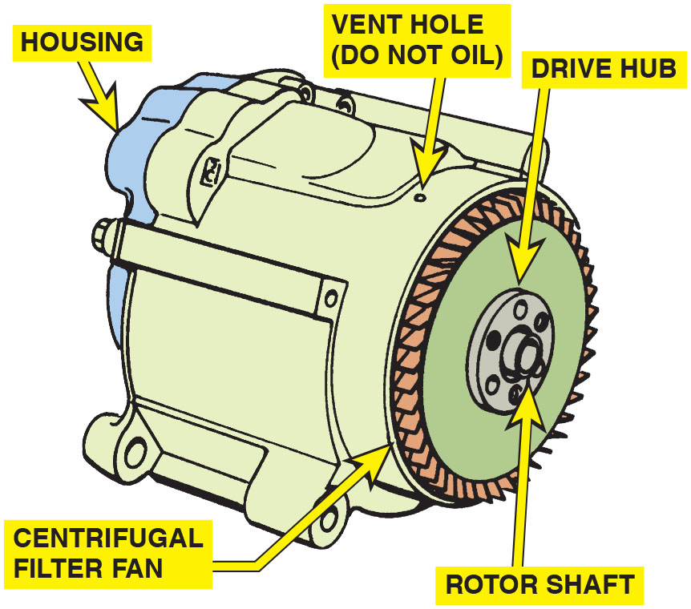
Figure 42.8
Air Pump
A typical belt-driven AIR pump. Air enters through the revolving fins behind the drive pulley. The fins act as an air filter because dirt is heavier than air and, therefore, the dirt is deflected off of the fins at the same time air is being drawn into the pump.

Slide 24
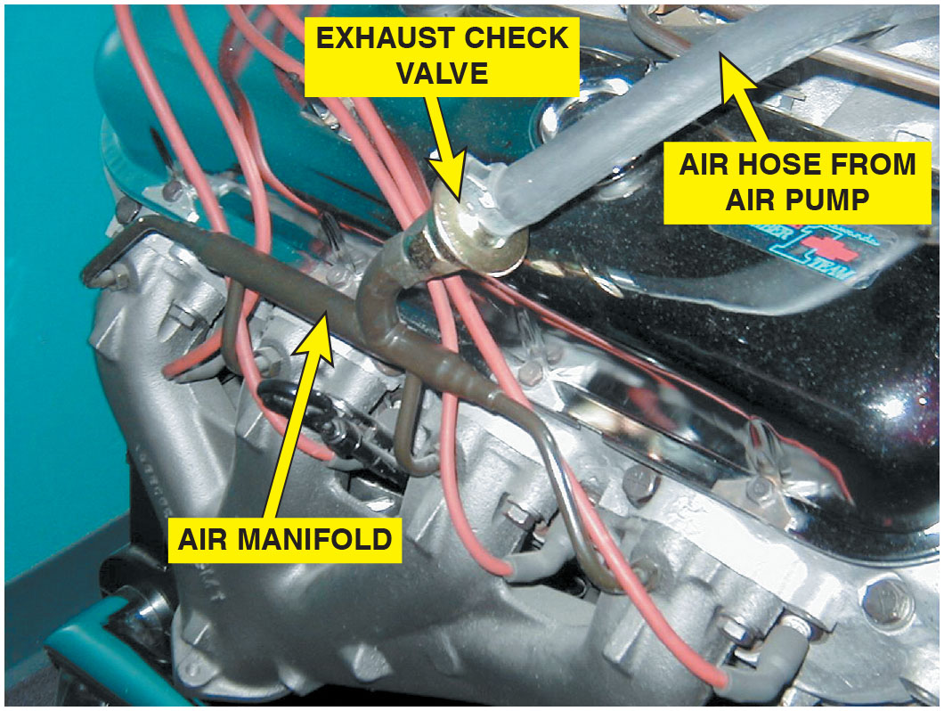
Figure 42.9
Exhaust Check Valve
The external air manifold and exhaust check valve on a restored muscle car engine.

Slide 25
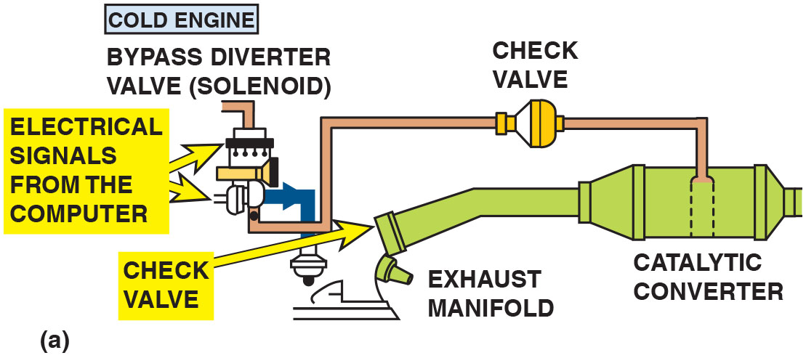
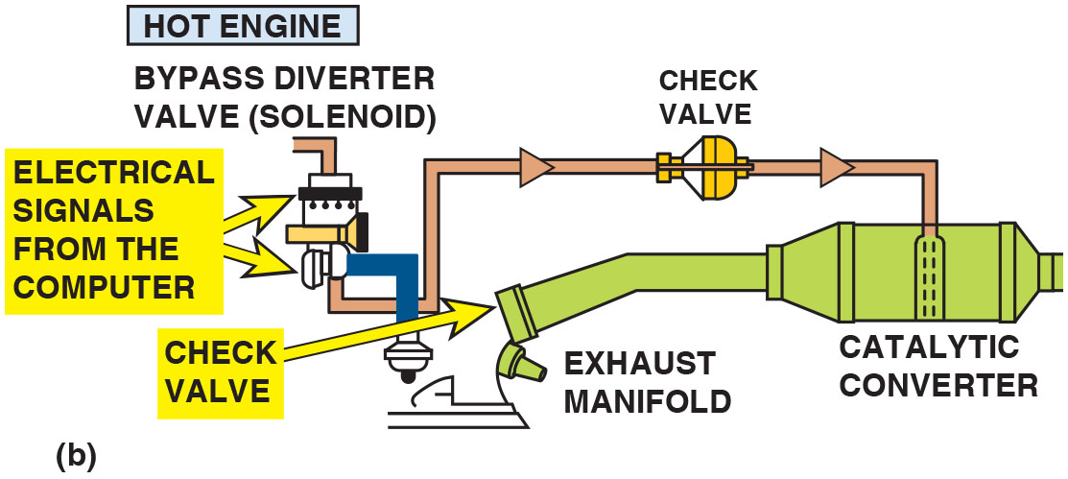
Figure 42.10
A I R Operation
(a) When the engine is cold and before the oxygen sensor is hot enough to achieve closed loop, the airflow from the air pump is directed to the exhaust manifold(s) through the one-way check valves, which keep the exhaust gases from entering the switching solenoids and the pump itself. (b) When the engine achieves closed loop, the air is directed to the catalytic converter.
Notes:
Long Description 1:
The illustration displays 2 actuators connected to the computer, it has 1 inlet and 2 outlets, one outlet goes to exhaust manifold and the other goes to catalytic converter via a check valve above it. When the engine is cold and before the oxygen sensor is hot enough to achieve closed loop, the airflow from the air pump is directed to the exhaust manifold through the one-way check valves, which keep the exhaust gases from entering the switching solenoids and the pump itself. Electric signals from the computer are fed to the bypass diverted valve (solenoid) and the air pump.
Long Description 2:
The illustration displays 2 actuators connected to the computer, it has 1 inlet and 2 outlets, one outlet goes to exhaust manifold and the other goes to catalytic converter via a check valve above it. When the engine achieves closed loop, the air is directed from the bypass diverter valve (solenoid) to the catalytic converter through the check valve above it. Electric signals from the computer are fed to the bypass diverted valve (solenoid) and the air pump.

Slide 26
Animation: Secondary Air-Injection

Slide 27
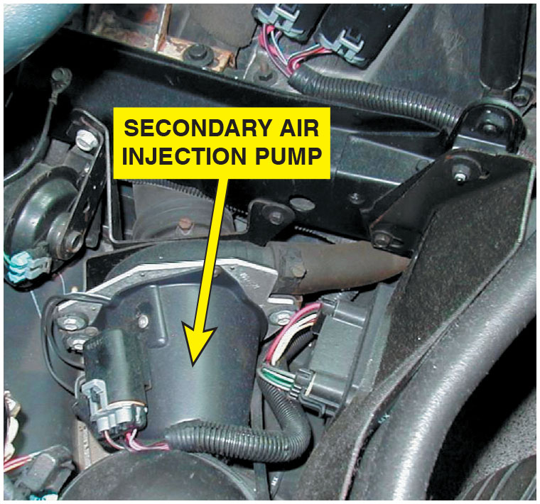
Figure 42.11
S A I Pump
A typical electric motor-driven S A I pump. This unit is on a Chevrolet Corvette and only works when the engine is cold.

Slide 28
Secondary Air-Injection System Diagnosis (1 of 2)
Symptoms
The air pump system should be inspected if an exhaust emissions test failure occurs.

Slide 29
Secondary Air-Injection System Diagnosis (2 of 2)
Visual Inspection
Carefully inspect all parts of the S A I system for holes or other physical damage.
Four-Gas Exhaust Analysis
A S A I system can be tested using an exhaust gas analyzer.
Verify
values as the system is enabled and disabled.

Slide 30
S A I-Related Diagnostic Trouble Code
Diagnostic Trouble Code | Description | Possible Causes
P0410 | S A I solenoid circuit fault | Defective S A I solenoid Loose or corroded electrical connections Loose, missing, or defective rubber hose(s)
P0411 | Secondary air injection system incorrect flow detected | Malfunctioning air pump, Check valve stuck closed or clogged

Slide 31
Question 2
What is the purpose of the air-injection pump?

Slide 32
Answer 2
The secondary air-injection (S A I) system provides the air necessary for the oxidizing process either at the exhaust manifold or inside the catalytic converter.

Slide 33
Summary
P C V systems use a valve or a fixed orifice to transfer and control the fumes from crankcase back into intake system.
P C V valve regulates the flow of fumes depending on engine vacuum and seals the crankcase vent in the event of a backfire.
30% of air needed by engine at idle speed flows through P C V system.
AIR system forces air at low pressure into the exhaust to reduce C O and H C exhaust emissions.
P C M controls electric motor style S A I system pump and solenoids to regulate air flow in the system.
Secondary air system monitored by P C M and turn on M I L.

Slide 34
Animations and Video Links (Halderman website subscription and web access needed to view)
(A8) Engine Performance Animations
(A8) Engine Performance Videos

Slide 35
Copyright
This work is protected by United States copyright laws and is provided solely for the use of instructors in teaching their courses and assessing student learning. Dissemination or sale of any part of this work (including on the World Wide Web) will destroy the integrity of the work and is not permitted. The work and materials from it should never be made available to students except by instructors using the accompanying text in their classes. All recipients of this work are expected to abide by these restrictions and to honor the intended pedagogical purposes and the needs of other instructors who rely on these materials.

