Slide 1
Automotive Electrical and Engine Performance
Ninth Edition
Chapter 41
E V A P and E G R Systems
Copyright © 2025 Pearson Education, Inc. All Rights Reserved
Notes:
If this PowerPoint presentation contains mathematical equations, you may need to check that your computer has the following installed:
1) Math Type Plugin
2) Math Player (free versions available)
3) NVDA Reader (free versions available)
INSTRUCTOR NOTE: This presentation includes text explanation notes, you can use to teach the course. When in SLIDE SHOW mode, you RIGHT CLICK and select SHOW PRESENTER VIEW, to use the notes.

Slide 2
Learning Objectives (1 of 2)
41.1 Explain the operation of an evaporative emission control (E V A P) system.
41.2 Discuss enhanced evaporative control systems.
41.3 Discuss leak detection pump systems.
41.4 Discuss onboard refueling vapor recovery.
41.5 Explain how to diagnose the E V A P system.
41.6 Discuss the functions of an evaporative system monitor.
41.7 Discuss the purpose and function of exhaust gas recirculation (E G R) systems.

Slide 3
Learning Objectives (2 of 2)
41.8 Explain the strategies to monitor on-board diagnostics
generation
exhaust gas recirculation (E G R)
systems.
41.9 Explain how to diagnose a defective E G R system.

Slide 4
Evaporative Emission Control System (1 of 2)
Purpose and Function
The purpose of the evaporative emission control system is to trap and hold gasoline vapors, also called volatile organic compounds (V O C s).
Common Components
Most E V A P fuel tank filler caps have a built-in pressure-vacuum relief valve.

Slide 5
Evaporative Emission Control System (2 of 2)
E V A P System Operation
The canister is filled with activated charcoal granules that can hold up to one-third of their own weight in fuel vapors.
During engine operation, stored vapors are drawn from the canister into the engine through a hose connected to the throttle body.
The P C M controls when the canister purges on most engines.

Slide 6
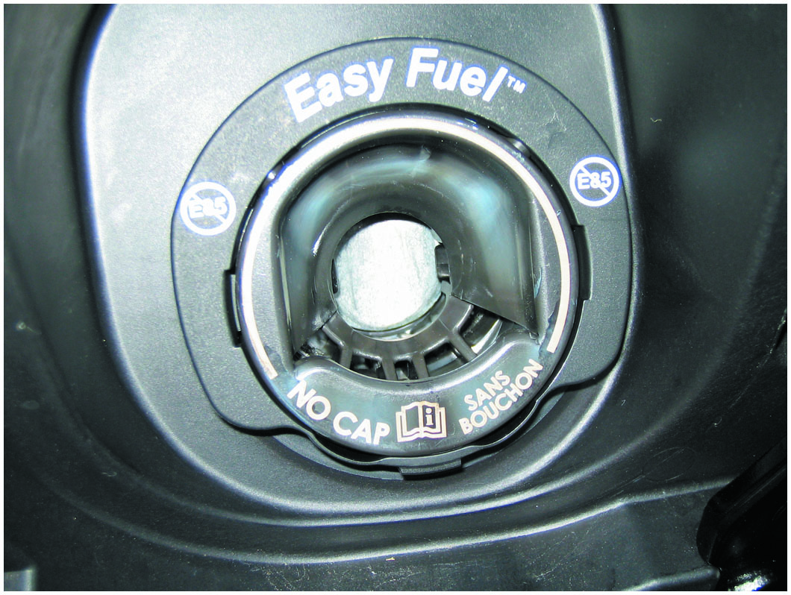
Figure 41.1
Capless Fuel Fill
A capless system from a Ford does not use a replaceable cap; instead, it is spring-loaded closed.

Slide 7
Frequently Asked Question: Why Should I Stop When Pump Clicks Off?
? Frequently Asked Question
When Filling My Fuel Tank, Why Should I Stop When the Pump Clicks Off? Every fuel tank has an upper volume chamber that allows for expansion of the fuel when hot. The volume of the chamber is between 10% and 20% of the volume of the tank. For example, if a fuel tank has a capacity of 20 gallons, the expansion chamber volume is from 2 to 4 gallons. A hose is attached at the top of the chamber and vented to the charcoal canister. If extra fuel is forced into this expansion volume, liquid gasoline can be drawn into the charcoal canister. This liquid fuel can saturate the canister and create an overly rich air–fuel mixture when the canister purge valve is opened during normal vehicle operation. This extra-rich air–fuel mixture can cause the vehicle to fail an exhaust emissions test, reduce fuel economy, and possibly damage the catalytic converter. To avoid problems, simply add fuel to the next dime’s worth after the nozzle clicks off. This ensures that the tank is full, yet not overfilled.

Slide 8
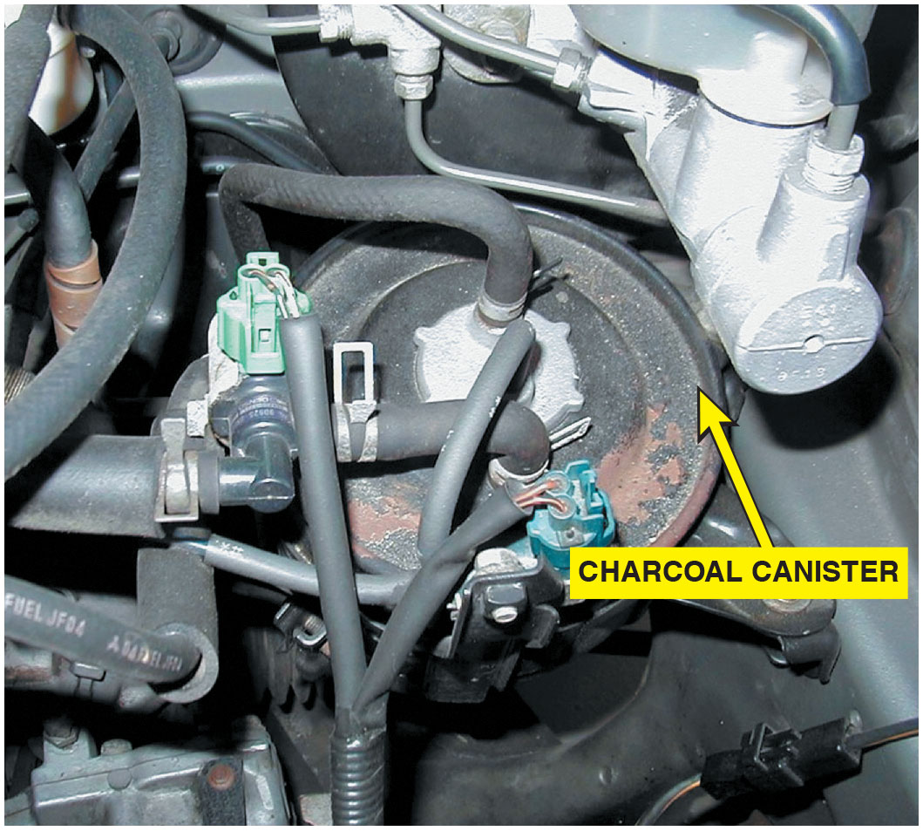
Figure 41.2
Charcoal Canister
A charcoal canister can be located under the hood or underneath the vehicle.

Slide 9
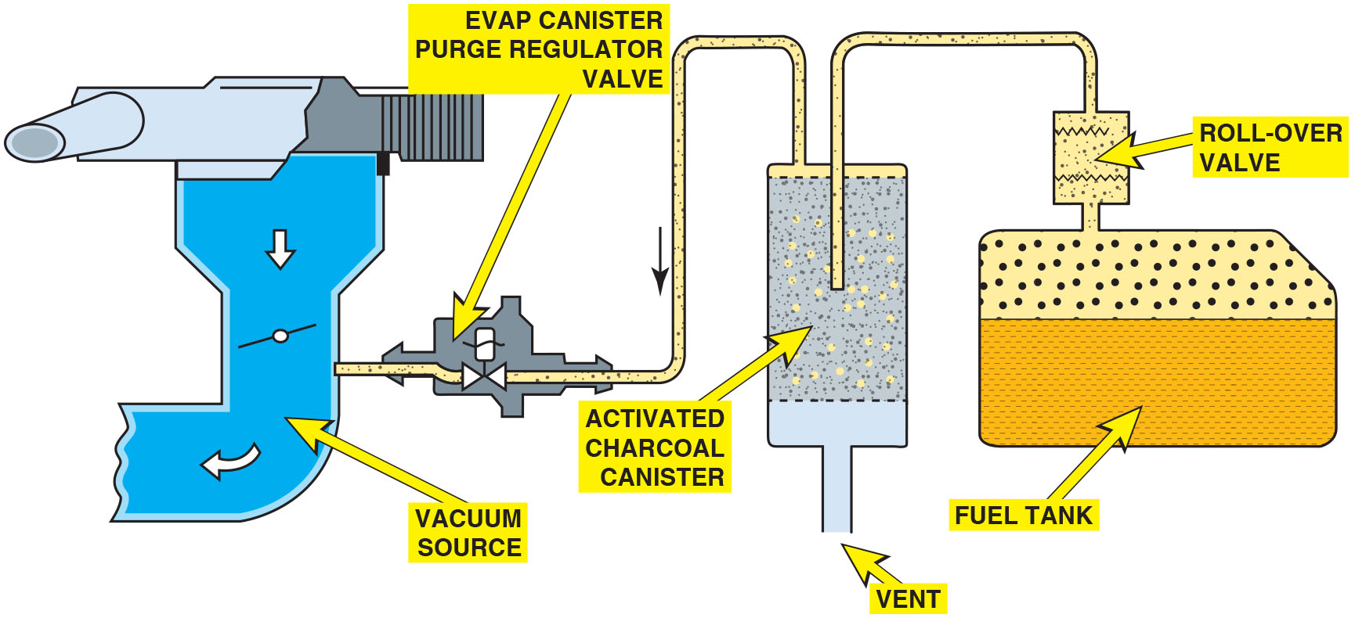
Figure 41.3
E V A P System
The E V A P system includes all of the lines, hoses, and valves, plus the charcoal canister.
Notes:
Long Description:
A roll-over valve is connected to the fuel tank. A line from the roll-over valve connects to an activated charcoal canister, which in turn is connected to an E V A P canister purge regulator valve through a pipe. A vent is at the bottom of the canister. The E V A P canister purge regulator valve empties inside a vacuum source near the throttle valve.

Slide 10
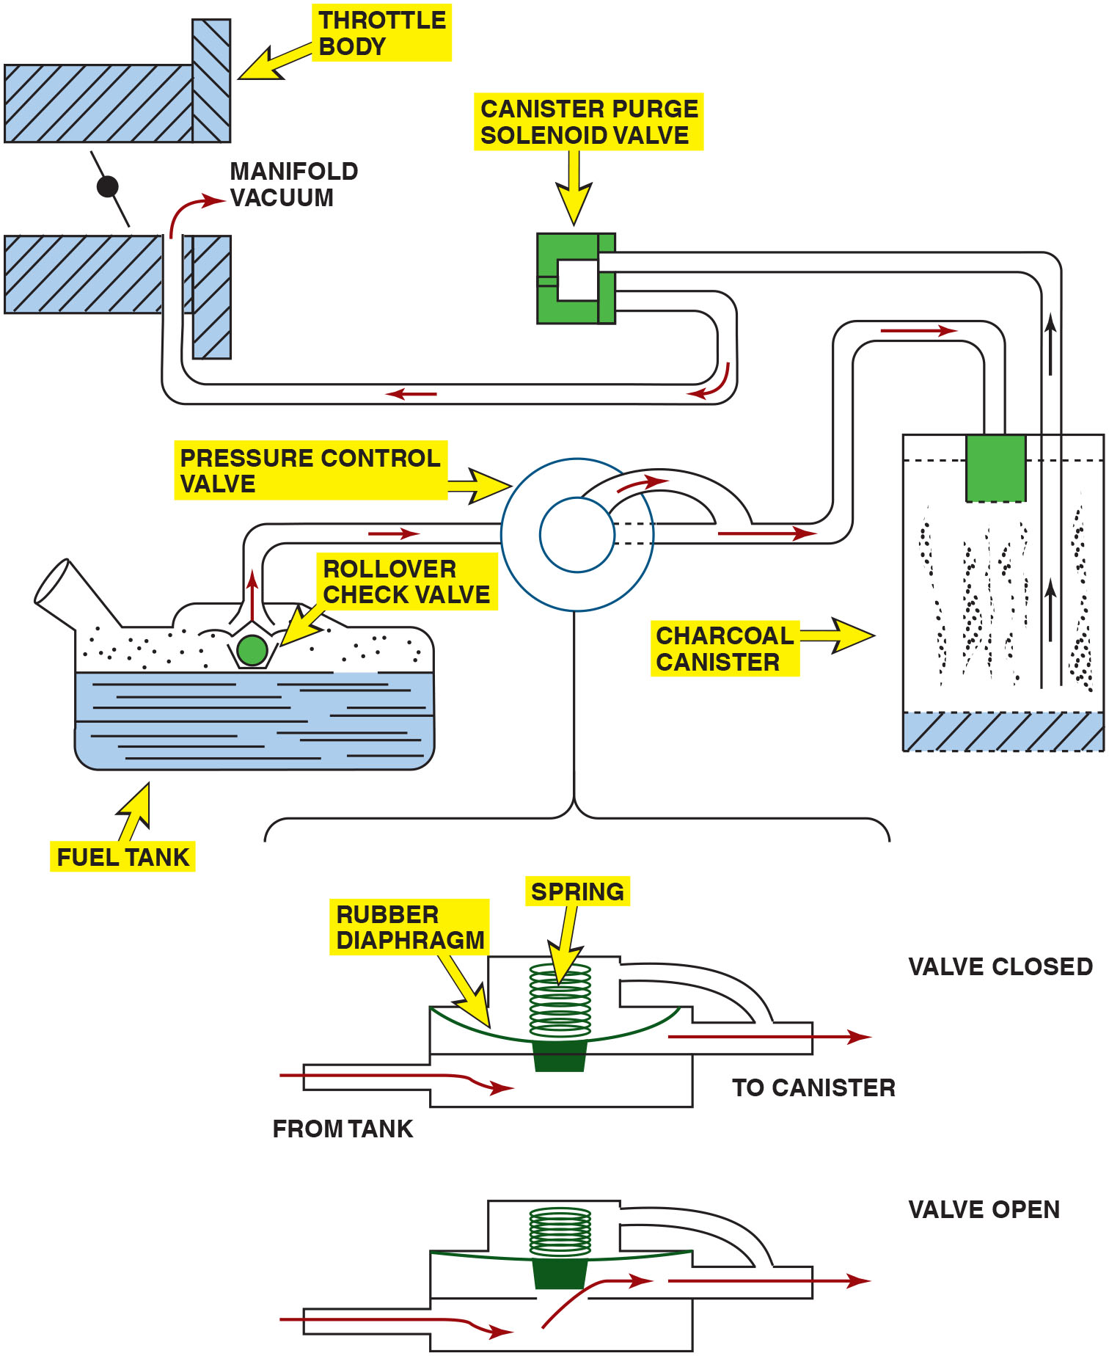
Figure 41.4
E V A P Operation
A typical E V A P system. Note that when the computer turns on the canister purge solenoid valve, manifold vacuum draws any stored vapors from the canister into the engine. Manifold vacuum also is applied to the pressure control valve. When this valve opens, fumes from the fuel tank are drawn into the charcoal canister and eventually into the engine. When the solenoid valve is turned off (or the engine stops and there is no manifold vacuum), the pressure control valve is spring-loaded shut to keep vapors inside the fuel tank from escaping to the atmosphere.
Notes:
Long Description:
A canister purge solenoid valve sucks the fuel vapor from a charcoal canister and sends it to the vacuum manifold in a throttle body. Fuel vapor is regulated by a pressure control valve from the fuel tank. A rollover check valve is located in the pipe of the fuel tank. An enlarge view shows the operation of pressure control valve. The valve consists of a spring connected to a diaphragm. When the valve is open, the spring is compressed and vapor fumes from the fuel tank are drawn into the charcoal canister. When the valve is closed, the spring is loaded and keeps the valve closed.

Slide 11
Animation: Evaporative Emission Control System

Slide 12
Question 1
What is the purpose of the evaporative system?

Slide 13
Answer 1
To trap and hold gasoline vapors.

Slide 14
Nonenhanced Evaporative Control Systems
This term refers to evaporative systems that had limited diagnostic capabilities.
This system does not check for leaks.
The P C M also has the capability of monitoring the integrity of the purge solenoid and circuit.
Nonenhanced E V A P systems use either a canister purge solenoid or a vapor management valve to control purge vapor.

Slide 15
Enhanced Evaporative Control Systems (1 of 2)
Background
Produced between 1996 and 2000 must be able to
a leak as small as detect
inches in diameter.
Beginning in 2000, enhanced systems started a
phase-in of
diameter leak detection.
All vehicles built after 1995 have enhanced E V A P systems with the ability to detect purge flow and system leakage.

Slide 16
Enhanced Evaporative Control Systems (2 of 2)
Vent Valve
Canister vent valve is a normally open valve and is closed only when commanded by the P C M during testing of the system.
Purge Valve
Canister purge valve, also called canister purge (C A N P) solenoid, is normally closed and is pulsed open by the P C M during purging.

Slide 17
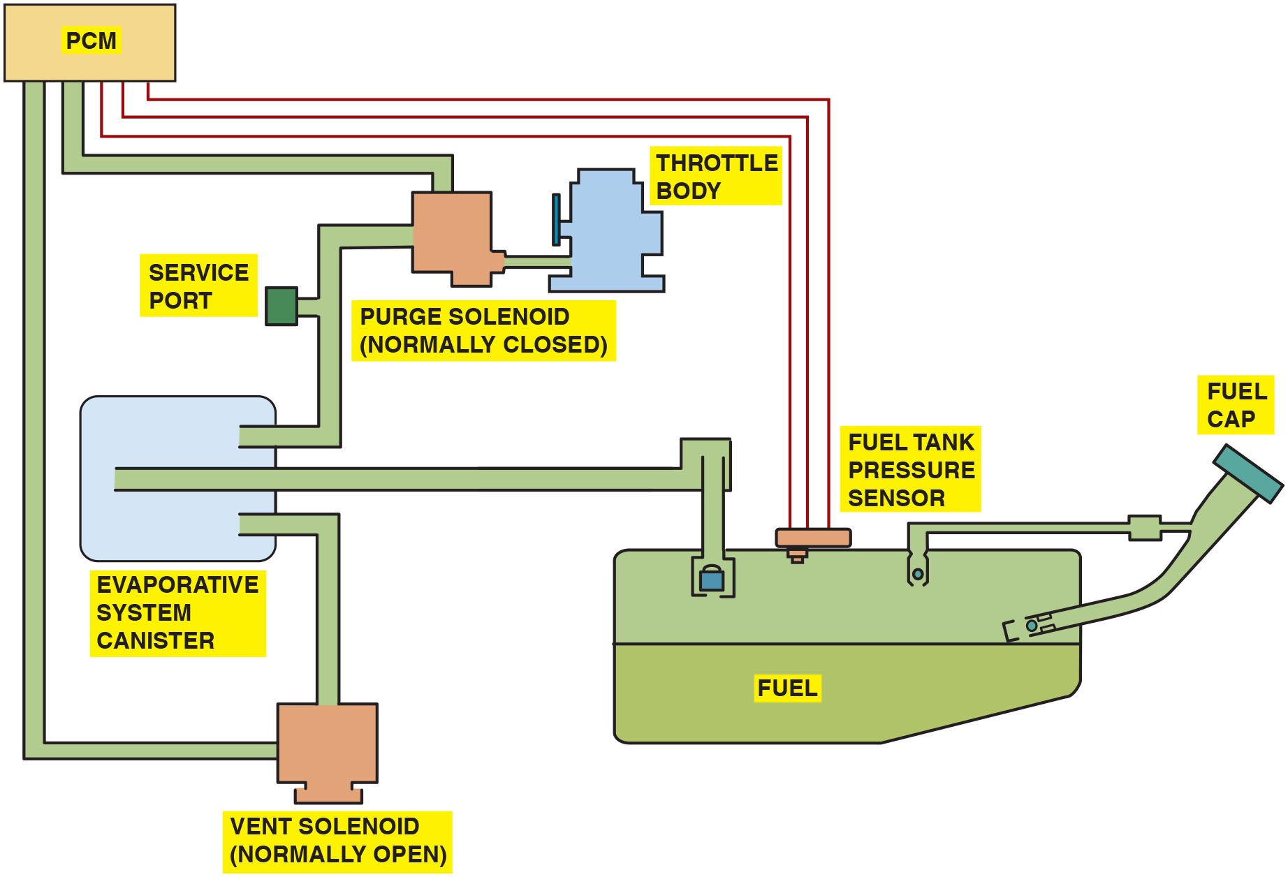
Figure 41.5
Enhanced E V A P
An enhanced E V A P system is able to perform system and leak detection diagnosis.
Notes:
TECH TIP: Problems after Refueling? Check the Purge Valve: The purge valve is normally closed and open only when the PCM is commanding the system to purge. If the purge solenoid becomes stuck in the open position, gasoline fumes are allowed to flow directly from the gas tank to the intake manifold. When refueling, this results in a lot of fumes being forced into the intake manifold and, as a result, causes a hard-to-start condition after refueling. This also results in a rich exhaust, and likely black exhaust, when first starting the engine after refueling. While the purge solenoid is usually located under the hood of most vehicles and is less subject to rust and corrosion, as with the vent valve, it can still fail.
Long Description:
The evaporative system canister is connected to a fuel tank that houses a fuel tank pressure sensor and a fuel cap. One pipe from the evaporative system canister connects to the throttle body through a service port and a normally closed purge solenoid. Another pipe from the evaporative system canister connects to the P C M through a normally open vent solenoid. The P C M is also connected to the fuel tank pressure sensor.

Slide 18
Leak Detection Pump
Operation
Purge solenoid is normally closed.
Vent valve in the l d p is normally open. Filtered fresh air is drawn through the L D P to the canister.
L D P uses a spring attached to a diaphragm to apply
pressure (7.5 in.
to the fuel tank (during pump
period).
P C M monitors the L D P switch that is triggered if the pressure drops in the fuel tank.
Shorter pump period, larger the leak. The longer the pump period, the smaller the leak.

Slide 19
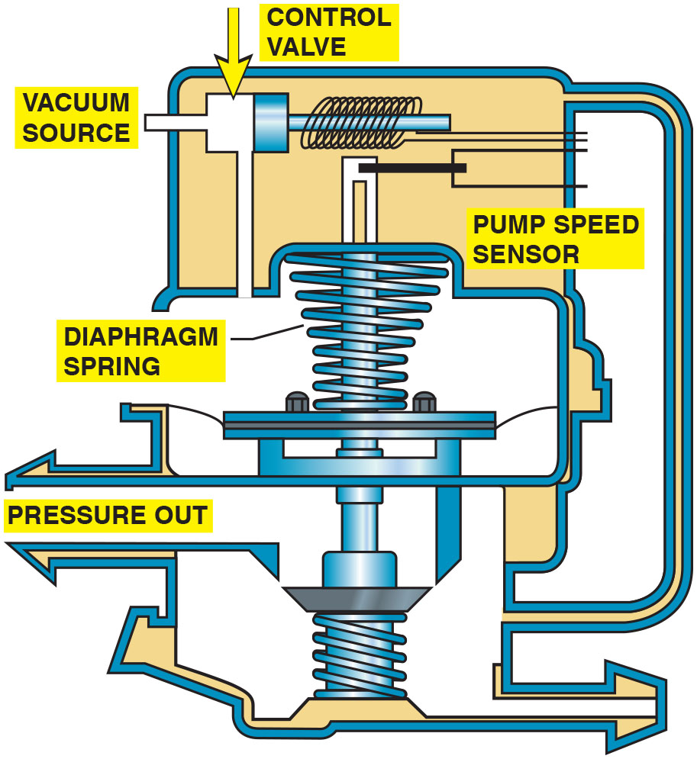
Figure 41.6
Leak Detection Pump
A leak detection pump (L D P) used on some Chrysler and other vehicles to pressurize (slightly) the fuel system to check for leaks.
Notes:
Long Description:
It has the following components: a control valve controls the vacuum source and has a pump sensor installed to the right. It has a spring attached to a diaphragm that is connected to a port from the fuel tank. Pressure out is labeled in the outlet passing through the valve that separates the spring from the diaphragm and the spring at the bottom leading to the inlet.

Slide 20
Onboard Refueling Vapor Recovery
Purpose and Function (O R V R)
Prevent fuel vapors from escaping to atmosphere during refueling.
Operation
Reduced-size filler tube creates an aspiration effect, which tends to draw outside air into the filler tube.
During refueling, fuel tank is vented to charcoal canister.

Slide 21
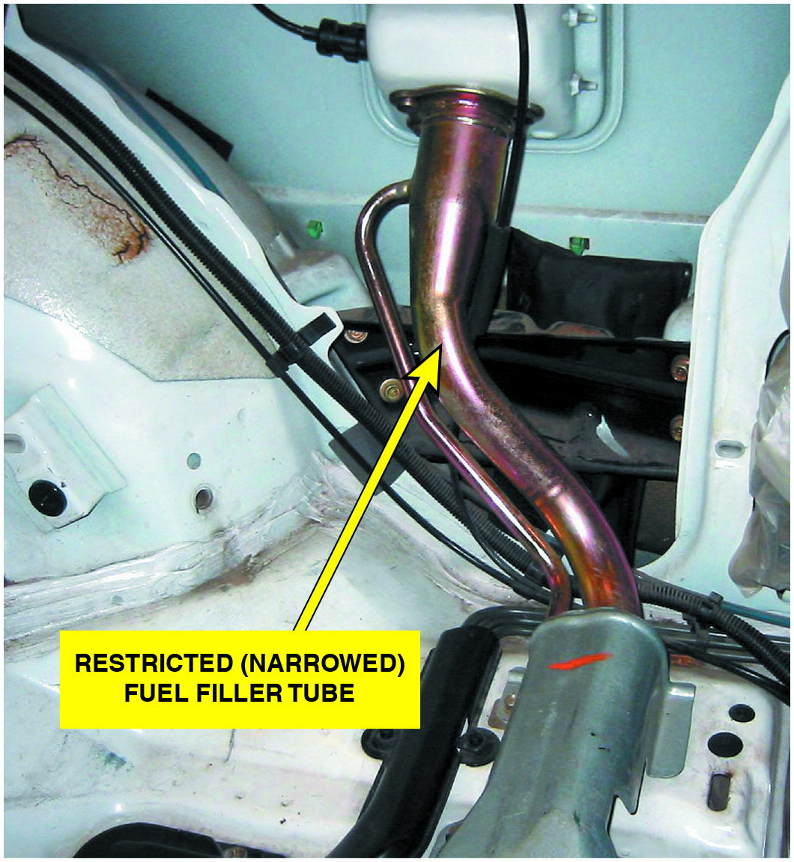
Figure 41.7
Restricted Fuel Fill
A restricted fuel fill pipe shown on vehicle with the interior removed.

Slide 22
Question 2
What is the purpose of the O R V R system?

Slide 23
Answer 2
To prevent gasoline vapors from escaping to the atmosphere during refueling.

Slide 24
Diagnosing E V A P System
Symptoms
Common engine performance problems that can be caused by a fault in this system include the following:
Poor fuel economy
Poor performance
Locating Leaks in the System
Smoke machine testing
Nitrogen gas pressurization

Slide 25
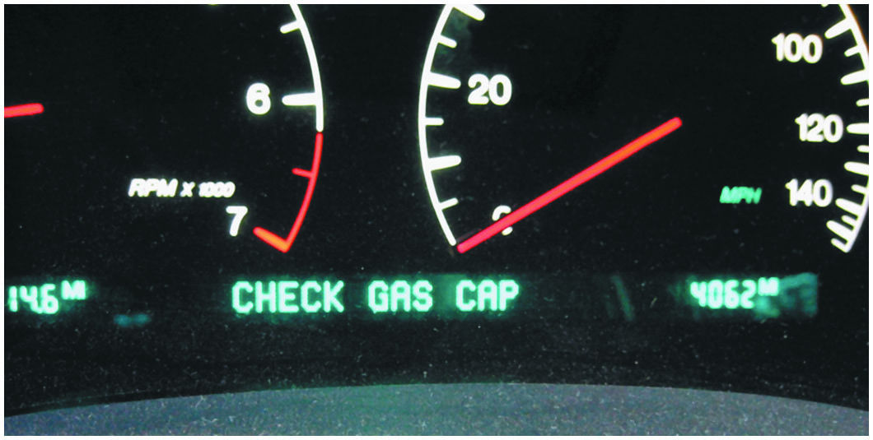
Figure 41.8
Leak Message
Some vehicles display a message if an evaporative control system leak is detected that could be the result of a loose gas cap.

Slide 26
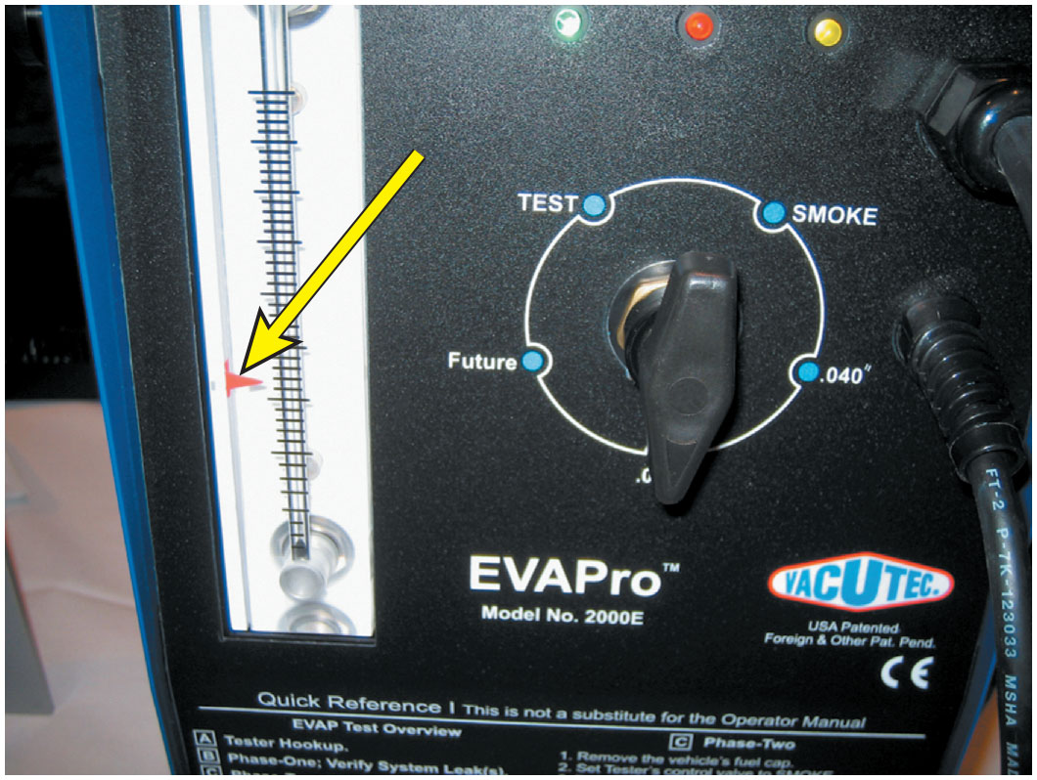
Figure 41.9
Leak Testing
To test for a leak, this tester was
set to the
hole and
turned on. The ball rose in the scale on the left, and the red arrow was moved to that location. If, when testing the system for leaks, the ball rises higher than the arrow, then the leak is larger
than
inch. If the ball does
not rise to level of the arrow, leak
is smaller than
inch.

Slide 27
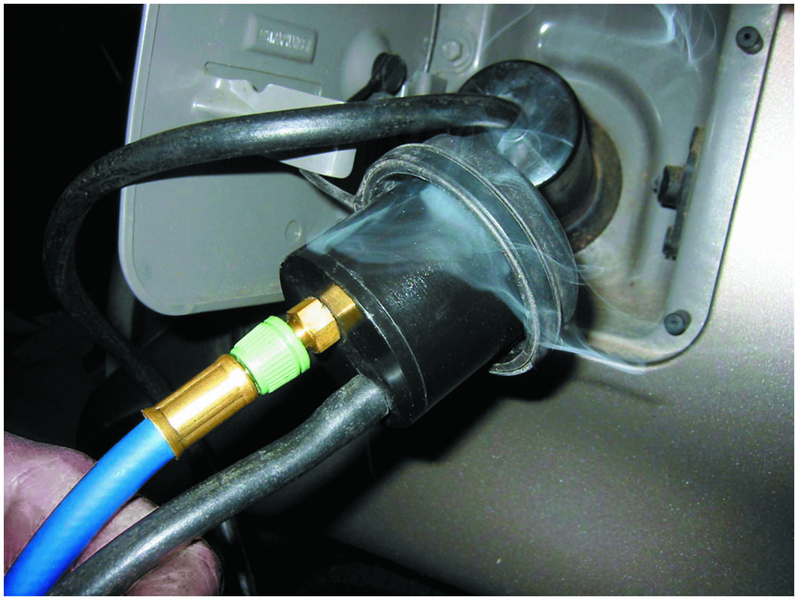
Figure 41.10
Smoke Testing
This unit is applying smoke to the fuel tank through an adapter, and the leak was easily found to be the gas cap seal.

Slide 28
Animation: Evaporative Emissions Control System Test

Slide 29
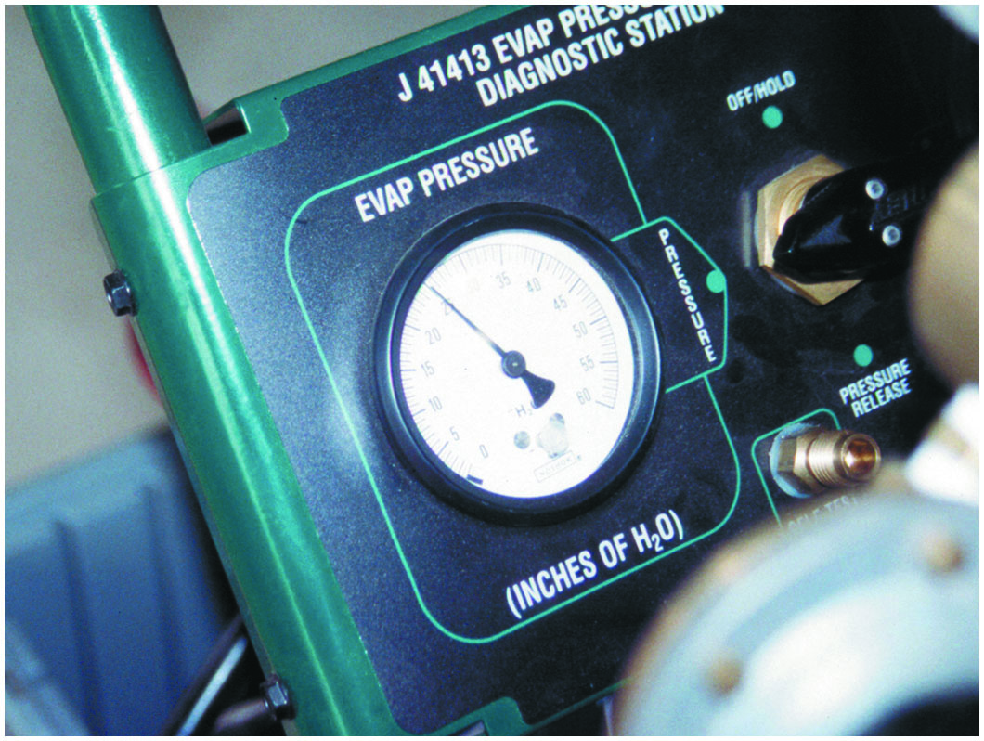
Figure 41.11
Emission Tester
An emission tester that uses nitrogen to pressurize the fuel system.

Slide 30
Evaporative System Monitor
Requirements
not only detect faults, but also periodically
various systems and alert the driver before emissions-related components are harmed by system faults.
Pressurized Test Method
Pressure in the system is monitored by a fuel tank pressure sensor when the monitor is in progress.
Engine-Off Natural Vacuum Test Method
Sealed system will draw into a slight vacuum as the tank cools.
P C M monitors change after vehicle has been shut off.

Slide 31
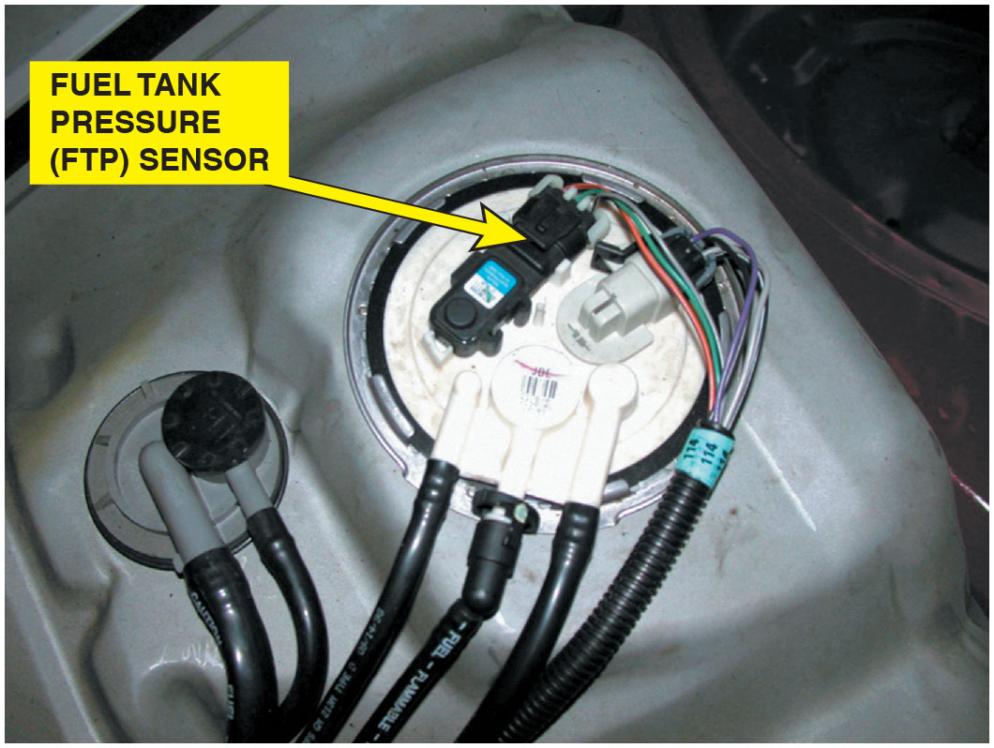
Figure 41.12
Tank Pressure Sensor
The fuel tank pressure sensor (black unit with three wires) looks like a M A P sensor and is usually located on top of the fuel pump module (white unit).

Slide 32
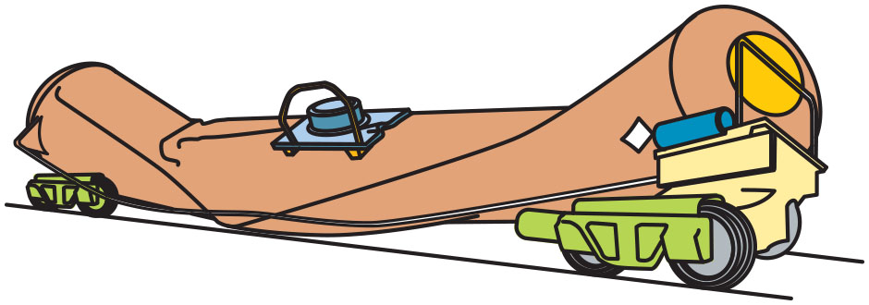
Figure 41.13
Tank Collapse
A tank car was cleaned using steam, and then both the bottom drain and the top vent were closed. The next day, the tank had collapsed because of the air pressure difference when the inside cooled. The higher outside air pressure caused the tank to collapse.

Slide 33
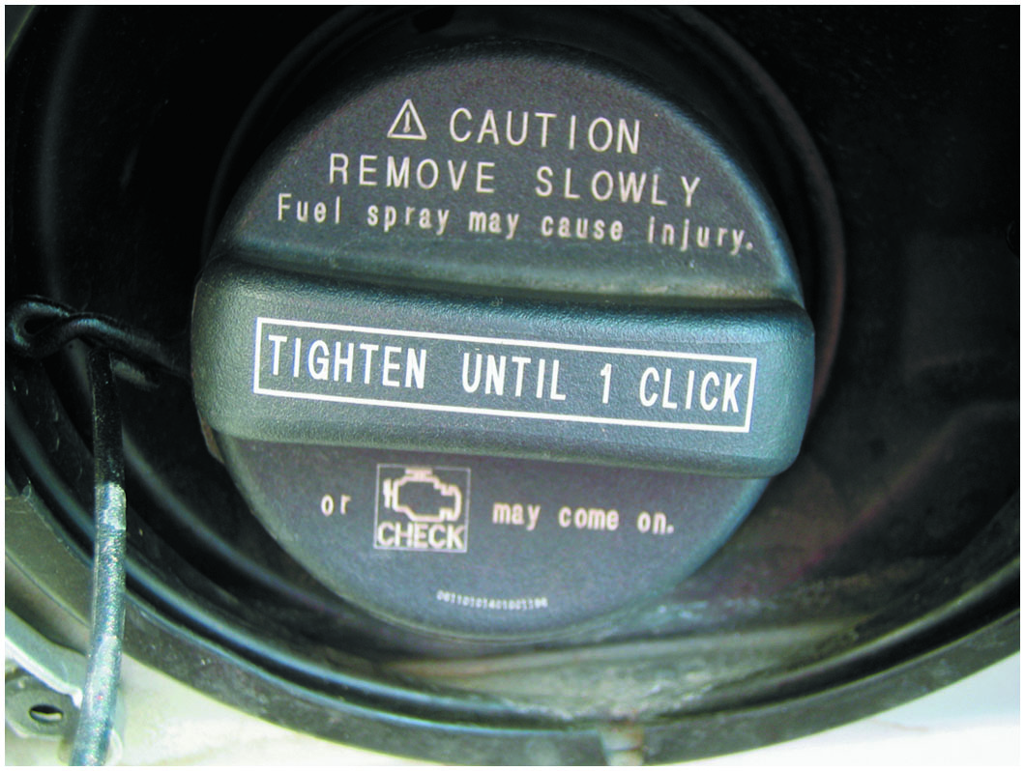
Figure 41.14
Cap Message
This Toyota cap warns that the check engine light comes on if not tightened until one click.
Notes:
TECH TIP: Always Tighten the Cap Correctly
Many D T C s are set because the gas cap has not been properly installed. To be sure that a screw-type gas cap is properly sealed, tighten it until you hear three clicks. The clicking is a ratchet device, and the clicking does not harm the cap. Therefore, if a P0440 or similar D T C is set, check the cap. ● See Figure 41.14.

Slide 34
Typical E V A P Monitor (1 of 2)
P C M runs E V A P monitor when enable criteria are met:
Barometric pressure (B A R O) > 70 kPa (20.7 in. Hg or 10.2 P S I)
I A T and E C T between
and
to
at engine start-up
E C T and I A T within
of each other at engine start-up
Fuel level within 15% to 85%
Throttle position (T P) sensor between 9% and 35%

Slide 35
Typical E V A P Monitor (2 of 2)
Running E V A P Monitor
Four tests are performed during a typical E V A P monitor. A D T C is assigned to each test:
Weak vacuum test (P0440–large leak)
No flow during purging (P0441–no flow during purging)
Small leak test (P0442–small leak)
Excess vacuum test (P0446)

Slide 36
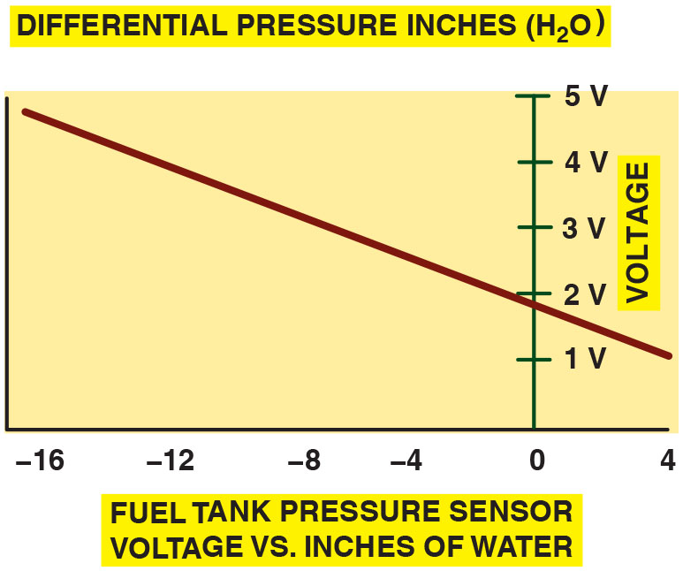
Figure 41.15
Tank Pressure
To easily check the fuel tank pressure sensor, remove the cap, and the sensor should read about 1.7 volts.
Notes:
Long Description:
The graph depicts differential pressure inches on the x axis from negative 16 to 4 in the increments of 4 and voltage on the y axis from 0 to 5 in the increments of 1 volt. The curve follows a downward-sloping line from (negative 16, 5) to (4, 1).

Slide 37
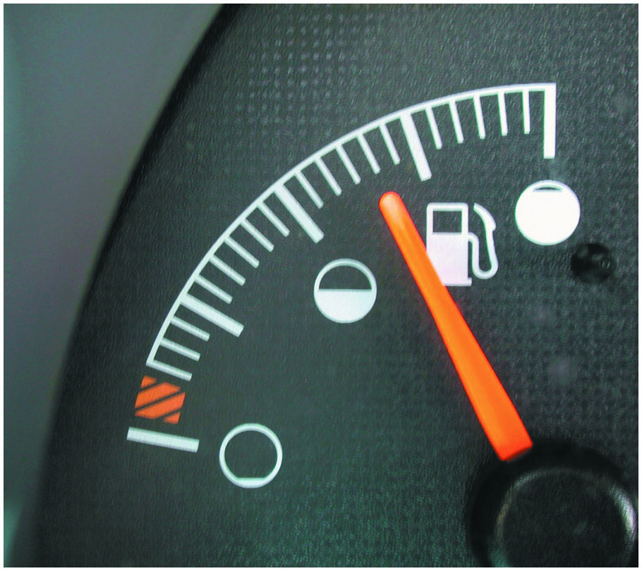
Figure 41.16
Fuel Level
The fuel level must be above 15% and below 85% before the E V A P monitor runs on most vehicles.
Notes:
TECH TIP: Keep the Fuel Tank Properly Filled
Most evaporative system monitors do not run unless the fuel level is between 15% and 85%. In other words, if a driver always runs with close to an empty tank or always tries to keep the tank full, the E V A P monitor may not run. ● See Figure 41.16.

Slide 38
Question 3
What are the two
test methods used when testing
evaporative systems?

Slide 39
Answer 3
A pressurized test and engine-off natural vacuum.

Slide 40
Exhaust Gas Recirculation Systems (1 of 5)
Introduction
E G R is an emission control system that lowers the amount
of nitrogen oxides
formed during combustion.
Formation
Nitrogen
and oxygen
molecules bond to form
(N O,
when combustion flame front temperatures
exceed

Slide 41
Exhaust Gas Recirculation Systems (2 of 5)
Controlling
The E G R system routes small quantities, usually between 6% and 10%, of exhaust gas into the intake manifold.
The result is a lower peak combustion temperature.
E G R System Operation
Typically only used when the engine is above idle.
Not used at idle, during warm-up, and at wide-open throttle.

Slide 42
Exhaust Gas Recirculation Systems (3 of 5)
Positive and Negative Back Pressure E G R Valves
Positive back pressure E G R valves require a positive back pressure in the exhaust system.
Negative back pressure E G R valves react to a low-pressure pulse created by the exhaust valve, by closing a small internal valve, which allows the E G R valve to be opened by vacuum.
Computer-Controlled E G R Systems
Most vehicles today use the powertrain control module (P C M) to operate the E G R system.

Slide 43
Exhaust Gas Recirculation Systems (4 of 5)
E G R Valve Position Sensors
A linear potentiometer on the top of the E G R valve stem indicates valve position to the P C M.
Digital E G R Valves
The digital E G R valve consists of three solenoids controlled by the powertrain control module (P C M).
Each solenoid controls a different size orifice in the base.
It can produce any of seven different flow rates.

Slide 44
Exhaust Gas Recirculation Systems (5 of 5)
Linear E G R
A linear E G R valve contains a pulse-width modulated solenoid to precisely regulate exhaust gas flow and a feedback potentiometer that signals the P C M regarding the actual position of the valve.

Slide 45
Figure 41.17
Red Brown Haze
Nitrogen oxides
create a red-brown haze that often hangs over major cities.

Slide 46
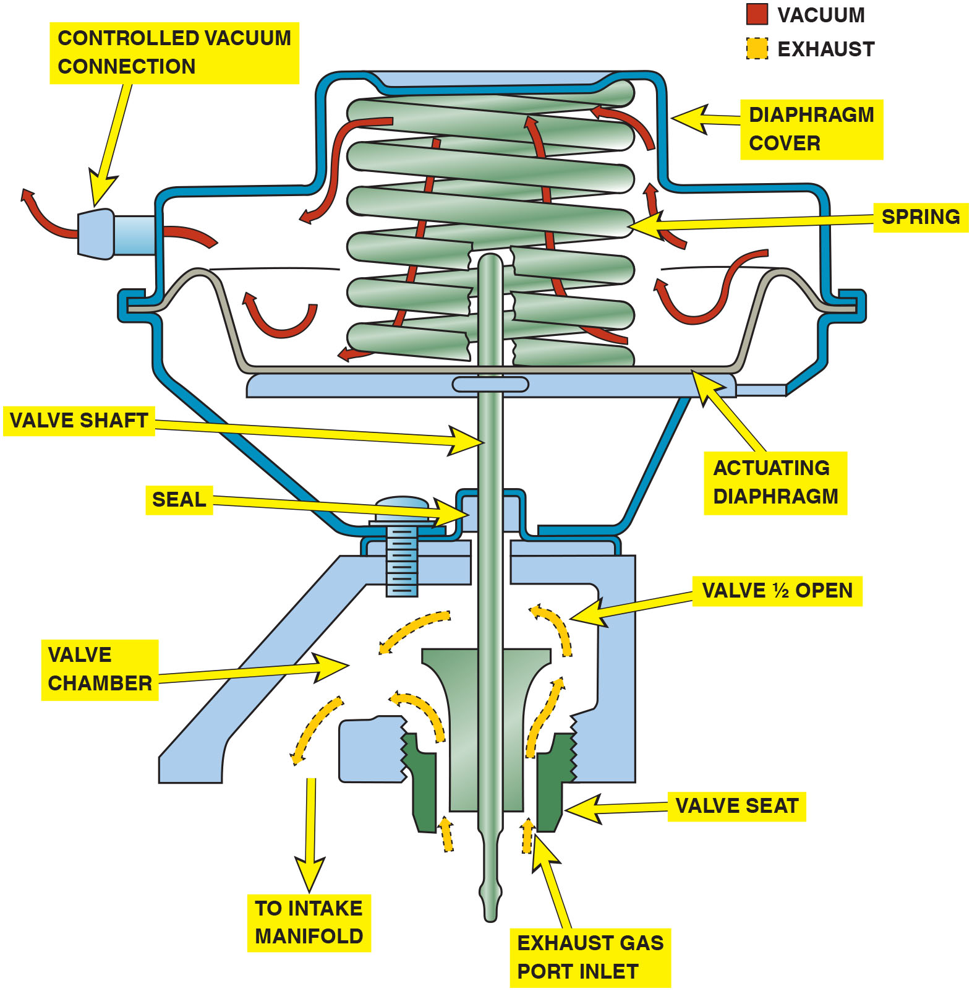
Figure 41.18
E G R Valve
When the E G R valve opens, the exhaust gases flow through the valve and into passages in the intake manifold.
Notes:
Long Description:
The mechanism is primarily divided into two chambers vacuum chamber and valve chamber. Vacuum chamber has an outer shell known as diaphragm cover with a diaphragm at the bottom and a spring pushing the diaphragm at place. When vacuum is generated by engine the diaphragm is pulled upwards against the spring. The diaphragm is connected to valve in valve chamber via valve shaft. Both the chambers are attached by a bolt and seal surrounding valve shaft. Valve chamber is threaded to engine. When valve shaft moves upwards it opens Exhaust gas port inlet and the exhaust cases enter through the port and go to intake manifold.

Slide 47
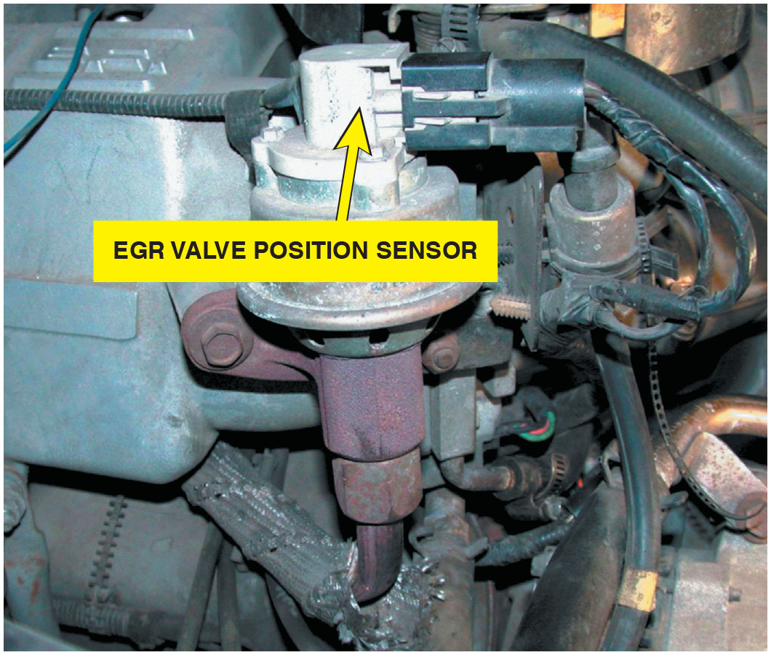
Figure 41.19
E G R Position Sensor
An E G R valve position sensor on top of an E G R valve.

Slide 48
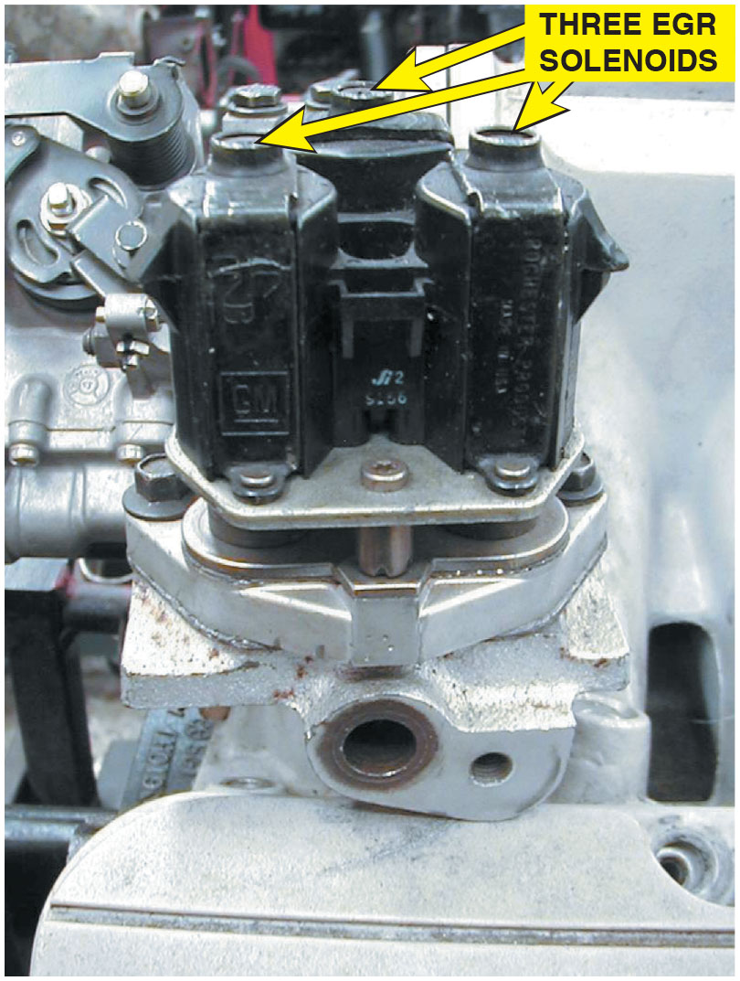
Figure 41.20
Digital E G R Valve
Digital E G R valve as used on some older General Motors engines.

Slide 49
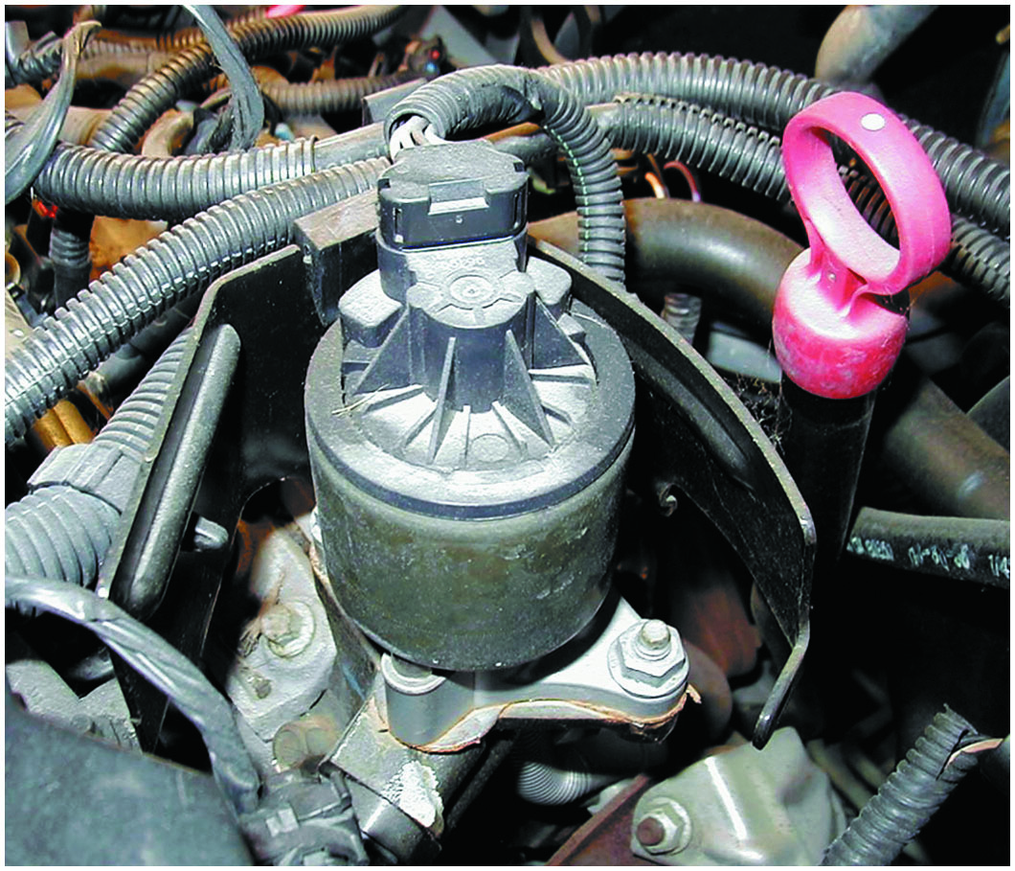
Figure 41.21
G M Linear E G R
A General Motors linear E G R valve.

Slide 50
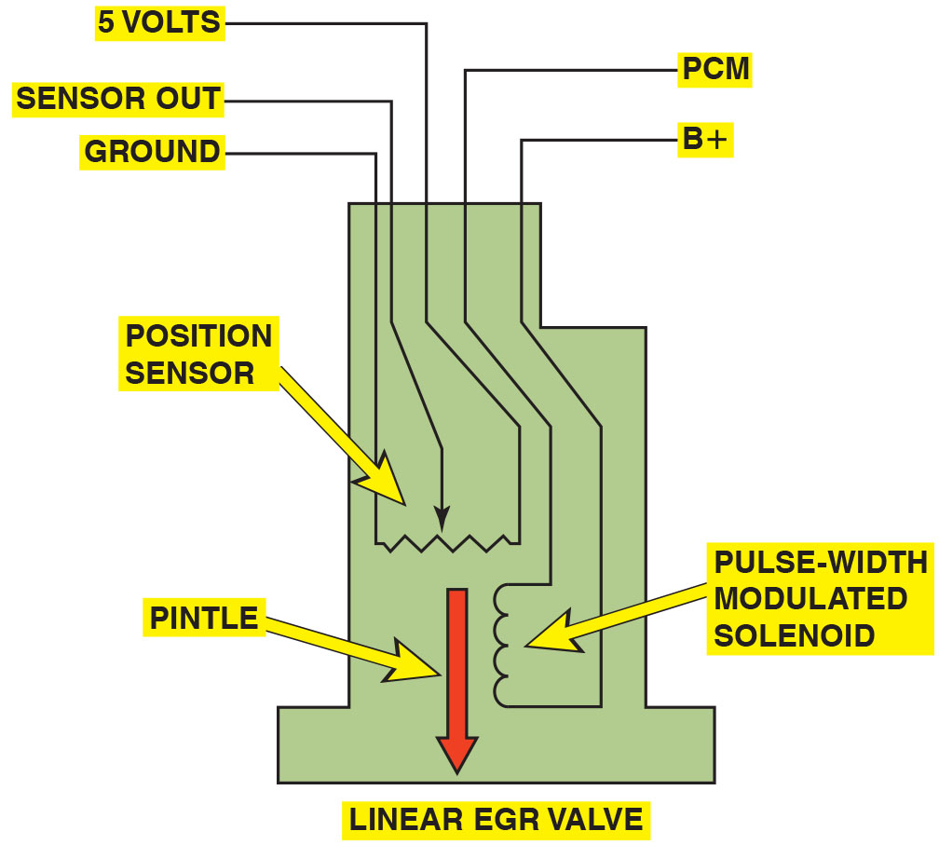
Figure 41.22
E G R Operation
The E G R valve pintle is pulse-width modulated and a three-wire potentiometer provides pintle-position information back to the P C M.
Notes:
TECH TIP: Find the Root Cause
Excessive back pressure, such as that caused by a partially clogged exhaust system, could cause the plastic sensors on the E G R valve to melt. Always check for a restricted exhaust whenever replacing a failed E G R valve sensor.
Long Description:
The two sides of coil of solenoid are connected to P C M and B plus and the three wires of position sensor are connected to 5 volts, ground, and the movable part to sensor out.

Slide 51
Question 4
What is the purpose of an E G R system?

Slide 52
Answer 4
To reduce combustion temperatures and lower
tailpipe emissions.

Slide 53
O B D hyphen Roman number two E G R Monitoring Strategies
Purpose and Function
P C M monitors system and alerts the driver and the technician if an emission system is malfunctioning.
Monitoring Strategies
Some manufacturers, such as Chrysler, monitor the difference in the exhaust oxygen sensor’s voltage activity as the E G R valve opens and closes.
Most Fords use an E G R monitor test sensor called a delta pressure feedback E G R (D P F E) sensor.
Many vehicle manufacturers use the manifold absolute pressure (M A P) sensor as the E G R monitor on some applications.

Slide 54
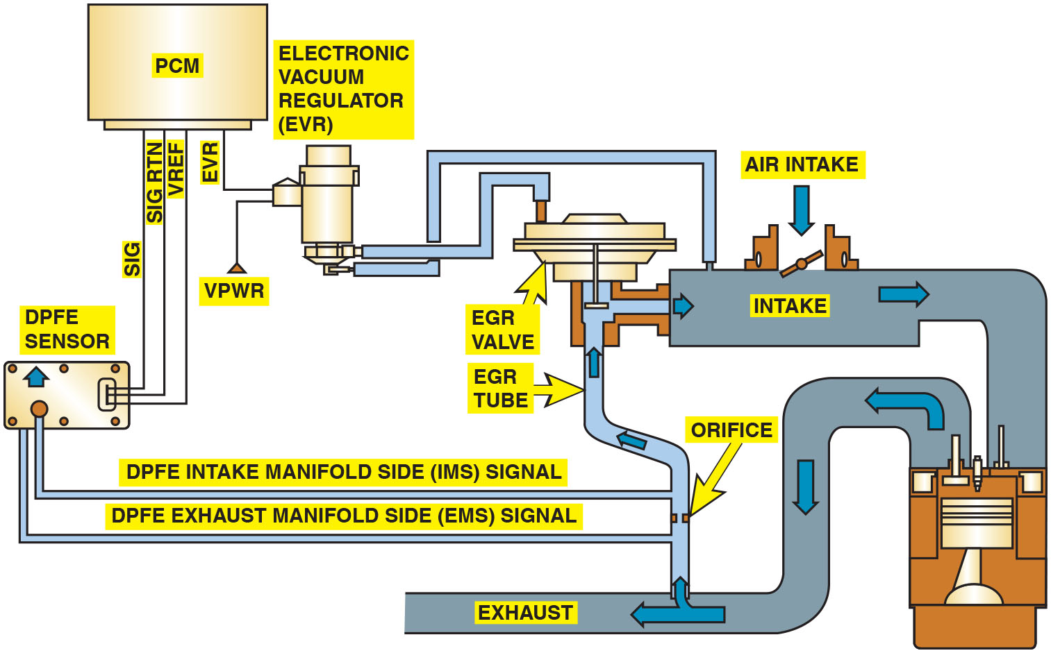
Figure 41.23
Ford D P F E
A typical Ford D P F E sensor and related components.
Notes:
Long Description:
Movement of air: Air enters the engine via butterfly valve in air intake and goes to the engine where it is converted to exhaust. The exhaust then moves out and is divided into two parts one goes out and other towards the intake via a E G R tube and E G R valve. Two small tubes are connected to D P F E sensor one before the orifice in E G R tube and one after it. The one after the orifice is called D P F E intake manifold side (I M S) signal and one before the orifice is called D P F E intake manifold side (I M S) signal. Two tubes are connected electronic vacuum regulator (E V R). One goes to E G R valve and other to intake. Control system – The D P F E sensor is connected to PCM via S I G, S I G R T N (signal return) and V R E F (voltage reference) pins. P C M is connected to the E V R via E V R pin. E V R controls the flow of vacuum from intake to E G R vacuum chamber.

Slide 55
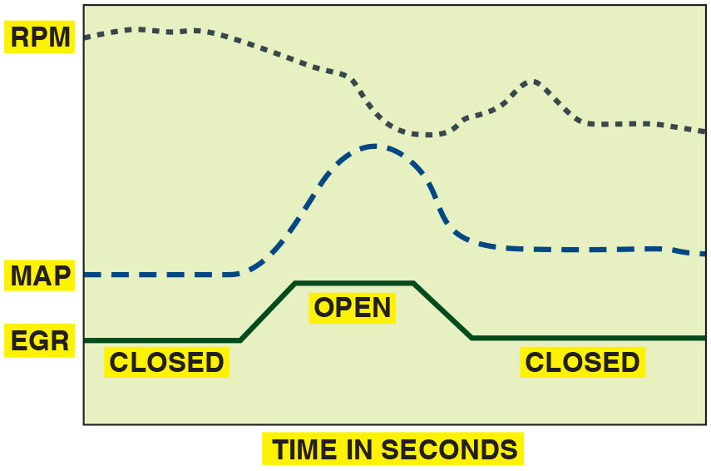
Figure 41.24
Active Test
An
active test. The P C M opens the E G R valve and
then monitors the MAP sensor and/or engine speed (R P M) to verify that it meets acceptable values.

Slide 56
Diagnosing a Defective E G R System (1 of 2)
Symptoms
Detonation (spark knock or ping) during acceleration or during cruise (steady-speed driving)
Excessive oxides of nitrogen
exhaust emissions
Rough idle or frequent stalling
Poor performance/low power, especially at low engine speed

Slide 57
Diagnosing a Defective E G R System (2 of 2)
E G R Testing Procedures
Check the vacuum diaphragm of the E G R valve to see if it can hold vacuum.
Apply vacuum from a hand-operated vacuum pump and check for proper operation.
Monitor engine vacuum drop.

Slide 58
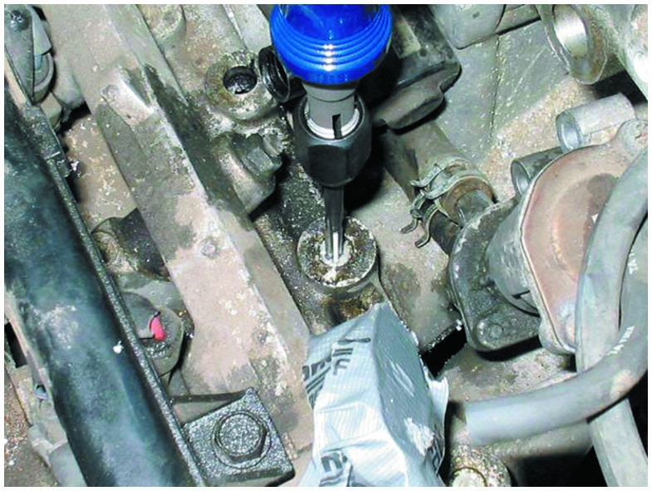
Figure 41.25
Honda Passage Plugs
Removing the E G R passage plugs from the intake manifold on a Honda.
Notes:
TECH TIP: Watch Out for Carbon Balls!
E G R valves can get stuck partially open by a chunk of carbon, and the valve or solenoid tests as defective. When the valve (or solenoid) is removed, small chunks or balls of carbon often fall into the exhaust manifold passage. When the replacement valve is installed, the carbon balls can be drawn into the new valve again, causing the engine to idle roughly or stall. To help prevent this problem, start the engine with the E G R valve or solenoid removed. Any balls or chunks of carbon are blown out of the passage by the exhaust. Stop the engine and install the replacement E G R valve or solenoid.
TECH TIP: The Snake Trick
The E G R passages on many intake manifolds become clogged with carbon, which reduces the flow of exhaust and the amount of exhaust gases in the cylinders. This reduction can cause spark knock (detonation) and increased emissions of oxides of nitrogen (N O x) (especially important in areas with enhanced exhaust emissions testing). To quickly and easily remove carbon from exhaust passages, cut an approximately 1-foot (30-cm) length from stranded wire, such as garage door guide wire or an old speedometer cable. Flare the end and place the end of the wire into the passage. Set your drill on reverse and turn it on, and the wire pulls its way through the passage, cleaning the carbon as it goes, just like a snake in a drainpipe. Some vehicles, such as Hondas, require that plugs be drilled out to gain access to the E G R passages. ● See Figure 41.25.

Slide 59
E G R-Related O B D hyphen Roman number two Diagnostic Trouble Codes
Diagnostic Trouble Code | Description | Possible Causes
P0400 | Exhaust gas recirculation flow problems | E G R valve E G R valve hose or electrical connection Defective P C M
P0401 | Exhaust gas recirculation flow insufficient | E G R valve Clogged E G R ports or passages
P0402 | Exhaust gas recirculation flow excessive | Stuck-open E G R valve Vacuum hose(s) misrouted Electrical wiring shorted

Slide 60
Animation: EGR System Tests

Slide 61
Question 5
What are the symptoms of a defective E G R system?

Slide 62
Answer 5
Rough idle, spark knock, poor performance, and frequent stalling.

Slide 63
Summary (1 of 2)
The purpose of the evaporative emission (E V A P) control system is to reduce the release of volatile organic compounds (V O C s) into the atmosphere.
A carbon (charcoal) canister is used to trap and hold gasoline vapors until they can be purged and run into the engine to be burned.
regulation requires that the evaporative emission
control system be checked for leakage and proper purge flow rates.
External leaks can best be located by pressurizing the fuel system with low-pressure smoke.

Slide 64
Summary (2 of 2)
Recirculating 6% to 10% inert exhaust gases back into the intake system reduces peak temperature inside the combustion chamber and reduces N O x exhaust emissions.
E G R is usually not needed at idle, at wide-open throttle, or when the engine is cold.
Many E G R systems use a feedback potentiometer to signal the P C M the position of the E G R valve pintle.
regulation requires that the flow rate be tested and
then is achieved by opening E G R valve and observing the reaction of the MAP sensor.

Slide 65
Animations and Video Links (Halderman website subscription and web access needed to view)
(A8) Engine Performance Animations
(A8) Engine Performance Videos

Slide 66
Copyright
This work is protected by United States copyright laws and is provided solely for the use of instructors in teaching their courses and assessing student learning. Dissemination or sale of any part of this work (including on the World Wide Web) will destroy the integrity of the work and is not permitted. The work and materials from it should never be made available to students except by instructors using the accompanying text in their classes. All recipients of this work are expected to abide by these restrictions and to honor the intended pedagogical purposes and the needs of other instructors who rely on these materials.

