Slide 1
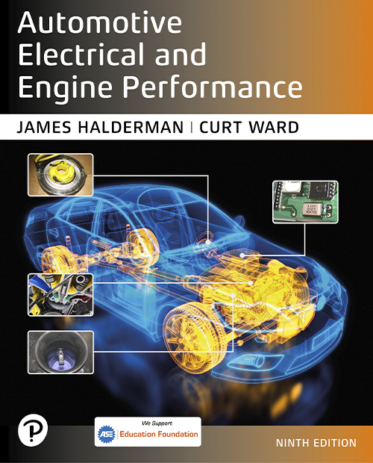

Automotive Electrical and Engine Performance
Ninth Edition
Chapter 40
Vehicle Emission Standards and Testing
Copyright © 2025 Pearson Education, Inc. All Rights Reserved
Notes:
If this PowerPoint presentation contains mathematical equations, you may need to check that your computer has the following installed:
1) Math Type Plugin
2) Math Player (free versions available)
3) NVDA Reader (free versions available)
INSTRUCTOR NOTE: This presentation includes text explanation notes, you can use to teach the course. When in SLIDE SHOW mode, you RIGHT CLICK and select SHOW PRESENTER VIEW, to use the notes.

Slide 2
Learning Objectives
40.1 Discuss normal engine combustion.
40.2 Discuss exhaust analysis and combustion efficiency.
40.3 Discuss the catalytic converter.
40.4 Explain diagnosis using exhaust analysis.
40.5 Explain engine fault possibilities.
40.6 Discuss U S and European emission standards.
40.7 Explain vehicle emission testing.

Slide 3
Normal Engine Combustion
Entering engine combustion chamber is fuel (H C) plus air
(nitrogen
is 78% and oxygen
is 21% of the air).
During combustion, H C combines with air to form water
and carbon dioxide
plus nitrogen
and some other non-desirable gases.
  Carbon monoxide (C O)
  Oxides of nitrogen
  Unburned hydrocarbons (H C)

Slide 4
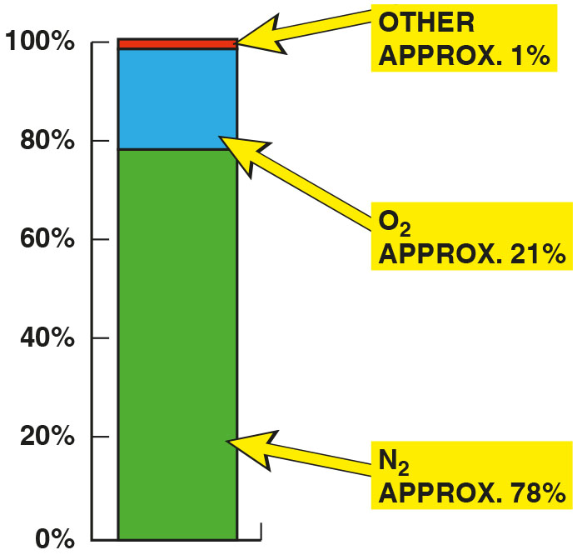
Figure 40.1
Air Composition
The air entering the engine consists of mostly nitrogen (78%) with about 21% oxygen and about 1% other gases.

Slide 5
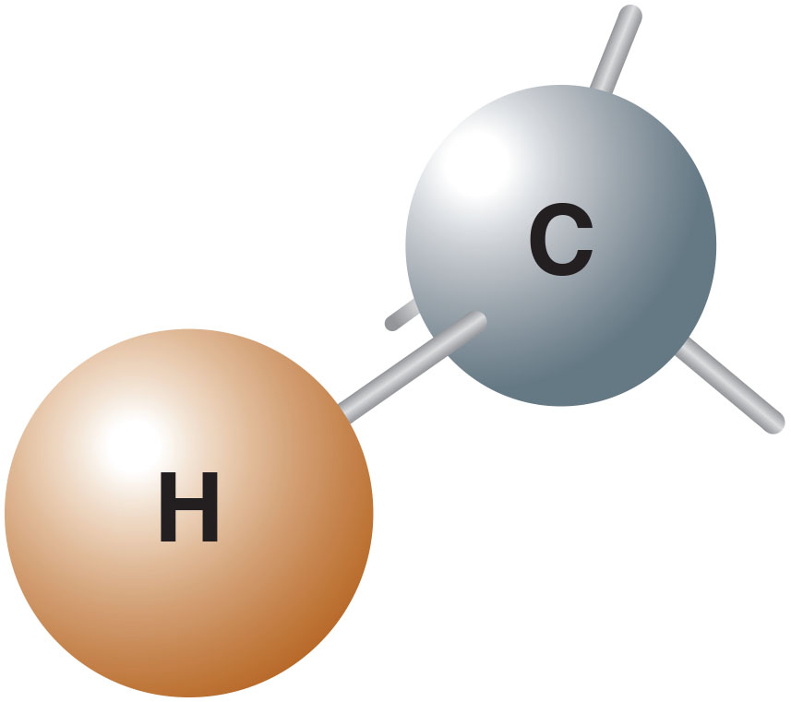
Figure 40.2
Hydrocarbons
Hydrocarbons can include many combinations of hydrogen and carbon.

Slide 6
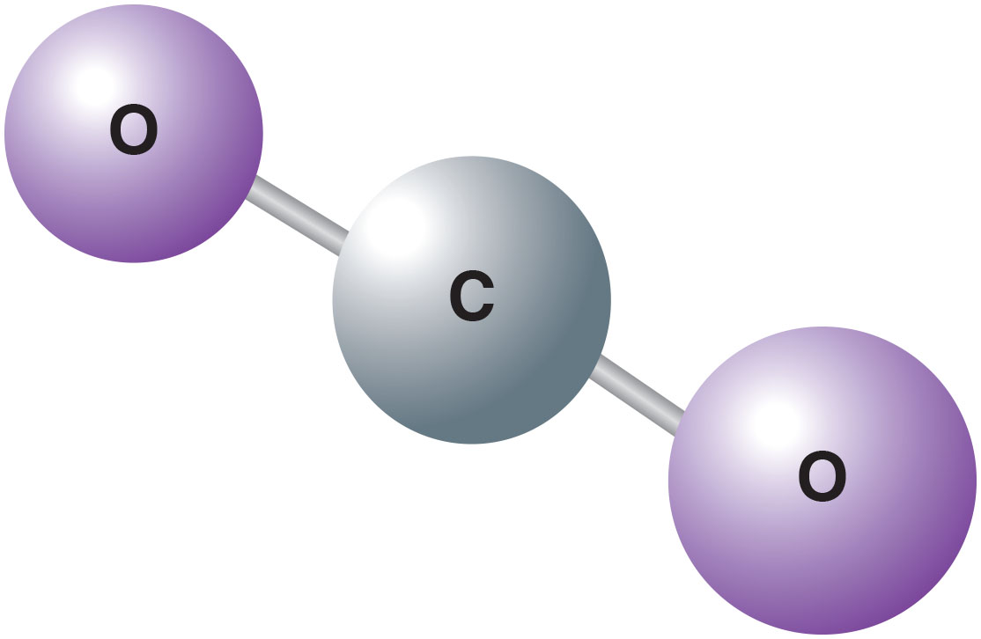
Figure 40.3
Carbon Dioxide
Carbon dioxide has two oxygen atoms attached to the one carbon atom and is a stable molecule.

Slide 7
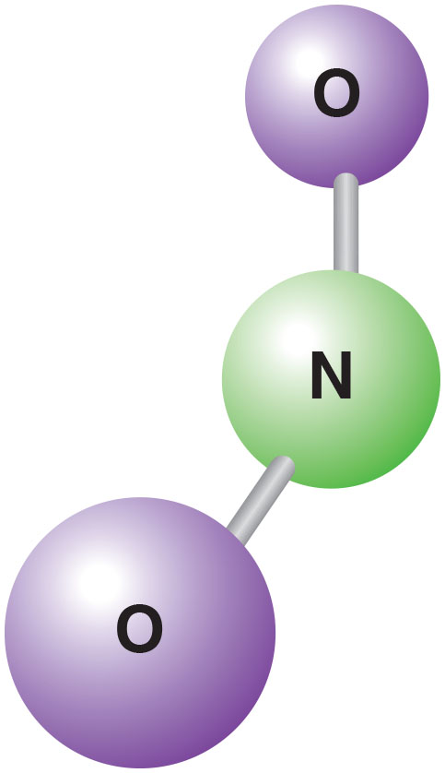
Figure 40.4
N O x
N O and
shown together are
referred to as

Slide 8
Frequently Asked Question: Why Is Steam Seen from the Tailpipe When Cold Outside, But Not Always?
? Frequently Asked Question
Why Is Steam Seen from the Tailpipe When Cold Outside, But Not Always? Steam is water vapor and is invisible. However, when an engine is cold, the water vapor created by combustion partially condenses into small droplets of water that are visible as “steam” from the tailpipe of vehicle when the engine is cold. After the exhaust system has been heated, the water vapor no longer condenses in the exhaust system, so it is not visible after the engine is warm. See Figure 40.5.

Slide 9
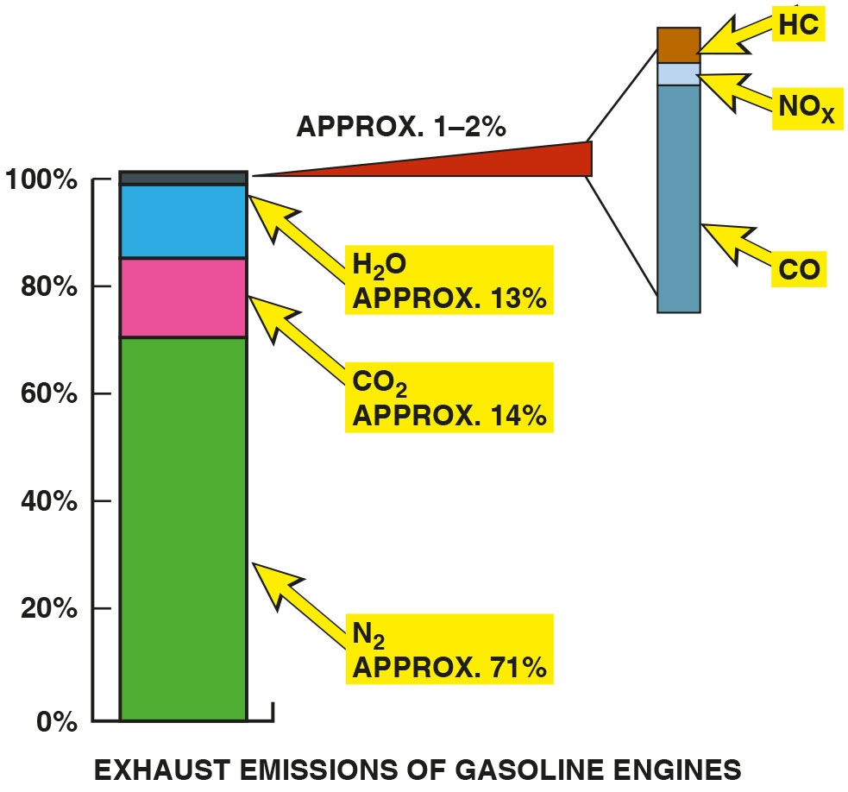
Figure 40.5
A chart showing that about 13% of the exhaust
emissions is water
in the form of steam.
Notes:
Long Description:
Nitrogen is approximately 71 percent, Carbon dioxide is 14 percent, and water is about 13 percent. Hydrocarbons, oxides of nitrogen, and carbon monoxide are approximately 1 to 2 percent.

Slide 10
Question 1
What are the five exhaust gases?

Slide 11
Answer 1
Oxygen, carbon monoxide, carbon dioxide, hydrocarbons, and oxides of nitrogen.

Slide 12
Exhaust Analysis and Combustion Efficiency (1 of 2)
Hydrocarbons (H C)
  Unburned gasoline measured in parts per million (p p m).
Carbon Monoxide (C O)
  An unstable poisonous gas created by partially burned gasoline that easily combines with any oxygen.
Carbon Dioxide
  Oxygen in engine combining with carbon of gasoline.

Slide 13
Exhaust Analysis and Combustion Efficiency (2 of 2)
Oxygen
  21% oxygen in the atmosphere, and most of this oxygen should be “used up” during combustion process.
Oxides of Nitrogen
  Oxide of nitrogen (N O) is a colorless, tasteless,
odorless gas that mixes with oxygen to create
is reddish-brown and has an acid and pungent smell.

Slide 14
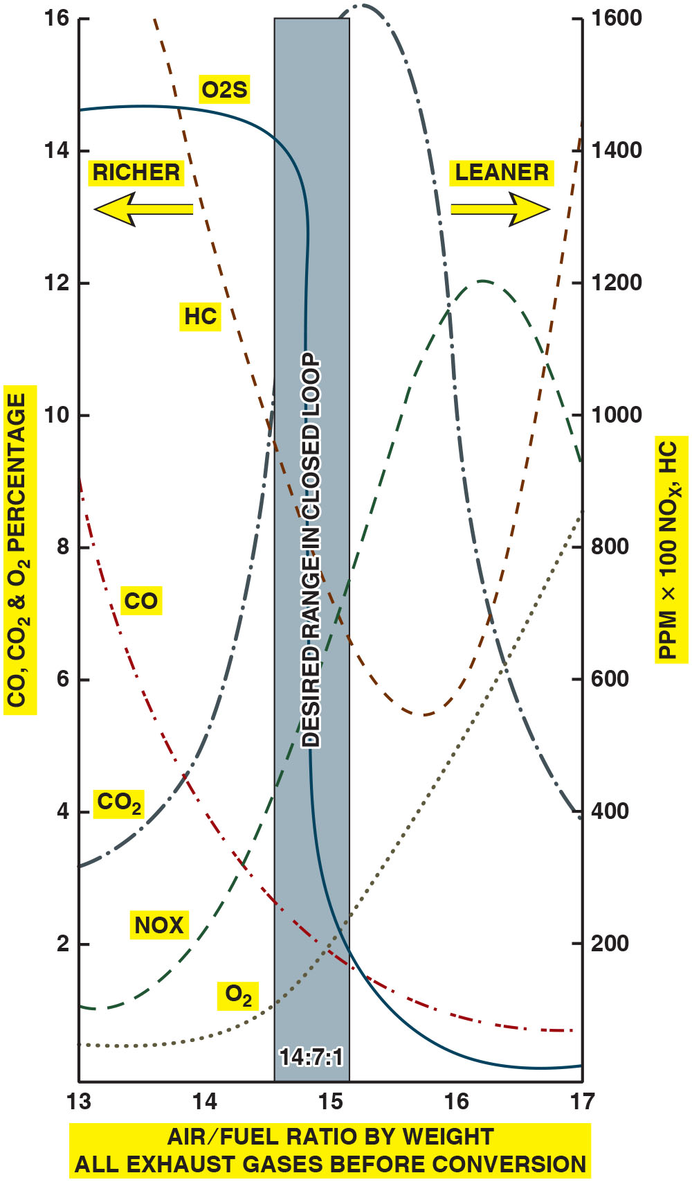
Figure 40.6
Emissions
Exhaust emissions are very complex. When the air–fuel mixture becomes richer, some exhaust emissions are reduced, while others increase.
Notes:
Long Description:
The graph depicts the air fuel ratio by weight on the x axis from 13 to 17 in the increments of 1, percentage of carbon monoxide, carbon dioxide, and oxygen emission on the left y axis from 0 to 16 in the increments of 2 percent, and percentage of hydrocarbon and nitrous oxide emission on the right y axis from 0 to 1600 in the increments of 200 p p m per 100: The desired air fuel ratio range in closed loop is 14.7 is to 1 and a mixture below this value is riche and a mixture above this value is lean. The curve for carbon monoxide emission starts at (13, 9) and falls sharply to (17, 1). The curve for carbon dioxide emission starts at (13, 3), rises to (15.5, 16), and falls to (17, 4). The curve for oxygen emission starts at (13, 0.5) and rises sharply to (17, 8). The curve for O 2 S starts at (13, 14.5), falls gradually to (14.7, 13), falls sharply to (14.7, 2), and falls gradually to (17, 0.1). The curve for nitrous dioxide emission starts at (13,100), rises to (16,1200), and falls to (17,900). The curve for hydrocarbon emission starts at (14,1600), falls to (16, 600), and rises to (17,1400).

Slide 15
Catalytic Converter
Used to help reduce exhaust emissions by helping the oxygen in exhaust to oxidize H C/C O in exhaust stream to
form harmless water
and carbon dioxide
It also is used to separate nitrogen from the oxygen in
to produce just nitrogen
and oxygen

Slide 16
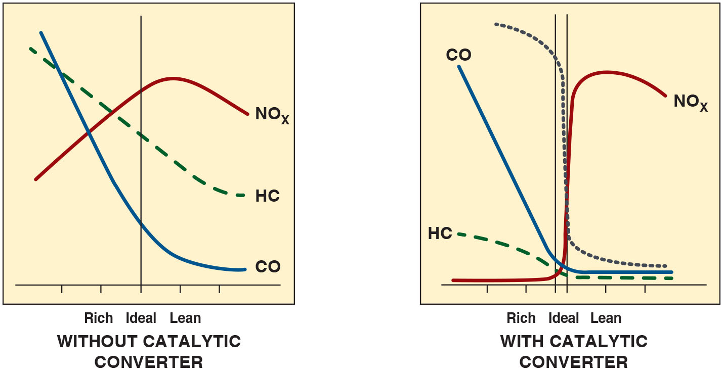
Figure 40.7
Catalytic Converter
The image on the left shows exhaust gases existing in an engine without a catalytic converter with rich exhaust being toward the left of the vertical line and lean exhaust to the right of the line. The image on the right shows the exhaust after it has been treated by the catalytic converter.
Notes:
Long Description:
Without a catalytic converter, N O x, H C, and C O emission are high for rich, lean, and ideal mixtures. With a catalytic converter, N O x, H C, and C O emission are reduced for rich, lean, and ideal mixtures.

Slide 17
Chart 40.1
Gases
EXHAUST GAS | TYPICAL SPECIFICATIONS
Unburned hydrocarbons (H C) | 2 point 30–50 p p m or less
Carbon Monoxide (C O) | 0.3%–0.5% or less
Oxygen Left parenthesis O subscript 2 right parenthesis. | 0%–2%
Carbon Dioxide Left parenthesis C O subscript 2 right parenthesis. | 12%–15% or higher
Oxides of Nitrogen Left parenthesis N O subscript X right parenthesis. | Less than 100 p p m at idle and less than 1,000 p p m at wide-open throttle (W O T)
Typical specifications for gases for a vehicle equipped with a catalytic converter.

Slide 18
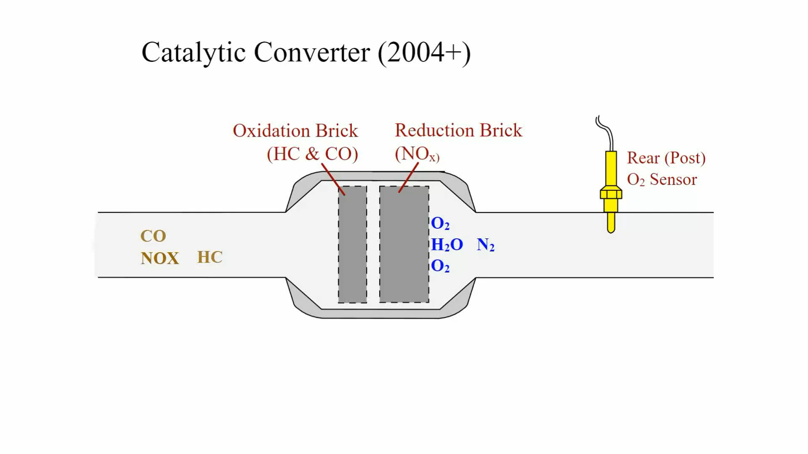
Animation: Catalytic Converter

Slide 19
Question 2
What is the function of a catalytic converter?

Slide 20
Answer 2
Oxidize hydrocarbons and carbon monoxide and reduce oxides of nitrogen.

Slide 21
Exhaust Analysis Diagnostic Tool
Rich or Lean Exhaust
  C O is high, exhaust rich, C O is called “rich indicator.”
  is high, exhaust lean,
  is called “lean indicator.”
Therefore, if the C O reading is the same as the
reading, then the engine is operating correctly.

Slide 22
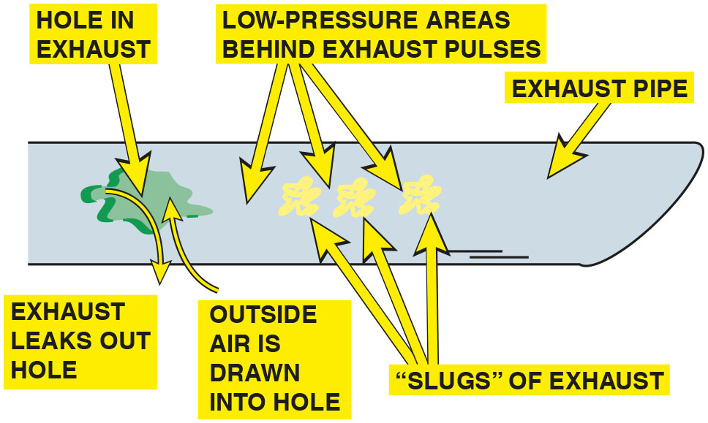
Figure 40.8
Hole in Exhaust
A hole in the exhaust system can cause outside air (containing oxygen) to be drawn into the exhaust system. This extra oxygen can be confusing to a service technician
because the extra
in the exhaust stream could be
misinterpreted as a too-lean air–fuel mixture.
Notes:
TECH TIP: How to Find a Leak in the Exhaust System
A hole in the exhaust system can dilute the exhaust gases with additional oxygen (O2 ) .
● See Figure 40.8.
This additional O2 in the exhaust can lead the
service technician to believe that the air–fuel mixture
is too lean. To help identify an exhaust leak, perform an exhaust analysis at idle and at 2,500 R P M
(fast idle) and compare with the following:
• If the O2 is high at idle and at 2,500 R P M, the mixture is lean at both idle and at 2,500 R P M.
• If the O2 is low at idle and high at 2,500 R P M, this usually means the vehicle is equipped with a
working AIR pump.
• If the O2 is high at idle, but okay at 2,500 R P M, a hole in the exhaust or a small vacuum leak
that is
“covered up” at higher speed is indicated.

Slide 23
Chart 40.2
Gas Readings
CARBON MONOXIDE (C O) | CARBON DIOXIDE open parenthesis C O subscript 2 close parenthesis. | HC | O subscript 2 | POSSIBLE ISSUES
Low | High | Low | Low | Normal readings. No issues
High | Low | High | High | Rich exhaust and misfire
Low | Low | High | High | Lean exhaust and misfire
High | High | High | High | Catalytic converter not working as designed plus possible other air–fuel ratio issues
High | Low | High | High | Rich exhaust
High | Low | High | Low | Possible defective thermostat
Possible issues based on the relative readings of the four exhaust gases.
Notes:
CASE STUDY: The Case of the Retarded Exhaust Camshaft
A Toyota equipped with a double overhead camshaft (D O H C) six-cylinder engine failed the state-mandated enhanced exhaust emissions test for N O x. The engine ran perfectly without spark knocking (ping), which is usually a major reason for excessive N O X emissions. The technician checked the following: The cylinders, which were decarbonized using top engine cleaner The E G R valve, which was inspected and the E G R passages cleaned After all the items were completed, the vehicle was returned to the inspection station where the Vehicle again failed for excessive N O X emissions (better, but still over the maximum allowable limit). After additional hours of troubleshooting, the technician decided to go back to basics and start over again. A check of the vehicle history with the owner indicated that the only previous work performed on the engine was a replacement timing belt over a year before. The technician discovered that the exhaust cam timing was retarded by two teeth, resulting in late closing of the exhaust valve. The proper exhaust valve timing resulted in a slight amount of exhaust gas being retained in the cylinder. This extra exhaust was helped reduce N O X emissions. After repositioning the timing belt, the vehicle passed the emissions test well within the limits.
Summary:
Complaint—Customer stated that the vehicle failed an emission test due to excessive N O X exhaust emissions.
Cause—exhaust cam was discovered to be retarded by two teeth as a result of the timing belt being incorrectly installed during a previous repair.
Correction—timing belt was properly aligned and vehicle passed the emission test.

Slide 24
Engine Fault Possibilities (1 of 2)
H C too High
  High H C exhaust emissions are usually caused by an engine misfire.
C O too High
  Excessive carbon monoxide is an indication of too rich an air–fuel mixture.
  Fuel pressure may be too high, injector may be malfunctioning, or the air intake is restricted.
Notes:
TECH TIP: Your Nose Knows
Using the nose, a technician can often identify a major problem without having to connect the vehicle to an exhaust analyzer. For example, The strong smell of exhaust is due to excessive unburned hydrocarbon (H C) emissions. Look for an ignition system fault that could prevent the proper burning of the fuel. If your eyes start to burn or water, suspect excessive oxides of nitrogen (N O _{X} ) emissions. The N O X combine with the moisture in the eyes to form a mild solution of nitric acid. The acid formation causes the eyes to burn and water. Excessive N O X exhaust emissions can be caused by a lack of proper amount of exhaust gas recirculation (E G R) or a variable valve timing issue. (This is usually noticed above idle on most vehicles.) Dizzy feeling or headache. This is commonly caused by excessive carbon monoxide (C O) exhaust emissions. Get into fresh air as soon as possible. A probable cause of high levels of C O is an excessively rich air–fuel mixture.

Slide 25
Engine Fault Possibilities (2 of 2)
and
Relationships
  Higher
  level, leaner the exhaust. Oxygen, therefore,
  is lean indicator. Acceptable levels of
  are 0% to 2%.
  is a measure of efficiency. higher level of
  in exhaust stream, more efficiently the engine is operating. Levels of 12% to 17% are considered to be acceptable.
S M O G and
  contributes to formation of photochemical smog
  when sunlight reacts chemically with
  and
  unburned H C.
Notes:
CASE STUDY: O₂S Shows Rich, But Pulse Width Is Low
A service technician was attempting to solve a driveability problem. The powertrain control module (P C M) did not indicate any diagnostic trouble codes (D T C s). A check of the oxygen sensor voltage indicated a higher-than-normal reading almost all the time. The
pulse width to the port injectors was lower than normal. The lower-than-normal pulse width indicates that the P C M is attempting to reduce fuel flow into the engine by decreasing the amount of on-time for all the injectors. What could cause a rich mixture if the injectors were being commanded to deliver a lean mixture?
Finally, the technician shut off the engine and took a careful look at the entire fuel-injection system. When the vacuum hose was removed from the fuel-pressure regulator, fuel was found dripping from the vacuum hose. The problem was a defective fuel-pressure regulator that allowed an uncontrolled amount of
fuel to be drawn by the intake manifold vacuum into the cylinders. While the P C M tried to reduce fuel by reducing the pulse width signal to the injectors, the extra fuel being drawn directly from the fuel rail caused the engine to operate with too rich an air–fuel mixture.
Summary:
Complaint—Customer stated that the engine did not perform correctly.
Cause—No stored diagnostic trouble codes (D T C s) were found but the oxygen sensor reading was higher than normal indicating that the exhaust air–fuel mixture was too rich.
Correction—The fuel pressure regulator was found to be leaking causing fuel to be drawn into the intake causing the richer-then-normal air–fuel mixture. Replacing the fuel pressure regulator solved the driveability complaint.

Slide 26
Emission Standards (1 of 2)
Tier 1 and Tier 2
  All vehicles sold in U S must meet Tier 1 standards that went into effect in 1994 and are the least stringent.
  Tier 2 standards have been optional since 2001, and fully adopted by 2009.
Federal E P A Bin Number
  Tier 2 only.
  The lower the bin number, the cleaner the vehicle.

Slide 27
Emission Standards (2 of 2)
S M O G Emission Information
  New vehicles are equipped with a sticker that shows the relative level of smog causing emissions created by the vehicle compared to others on the market.
California Standards
  The California Air Resources Board (C A R B) standards
  since January 1, 2004, are known as
  Within that rating system, there are three primary ratings: L E V, U L E V, and S U L E V.
  Includes maintaining the reduced emissions for 150,000 miles.

Slide 28
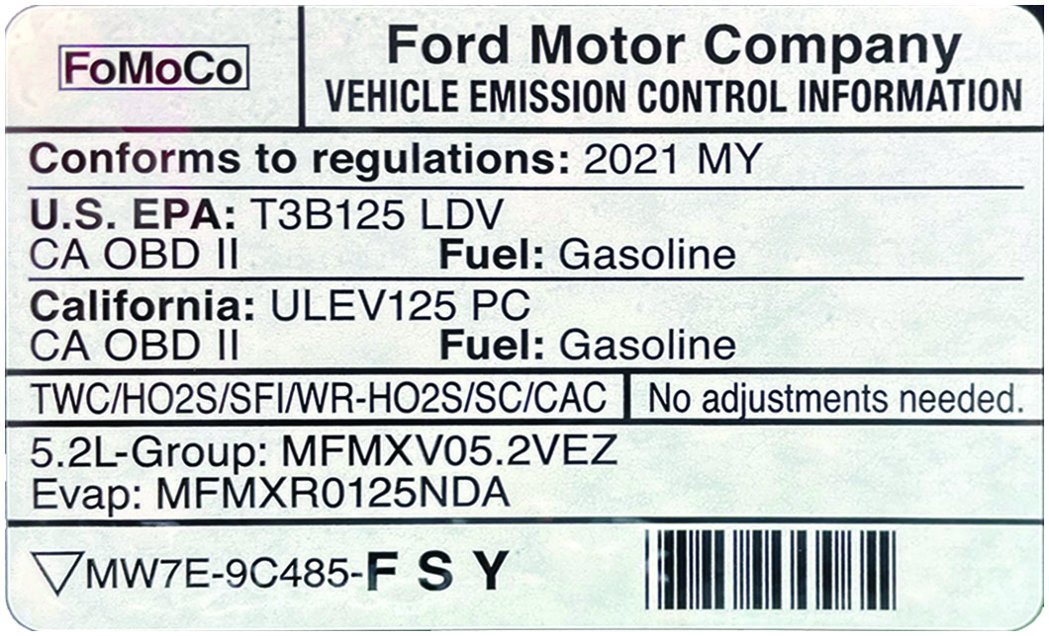
Figure 40.9
V E C I Sticker
This vehicle emission control information (V E C I) decal indicates this vehicle meets both national E P A Tier 3. Bin 125 (T3B125) and California U L E V125 P C (passenger car) standard.

Slide 29
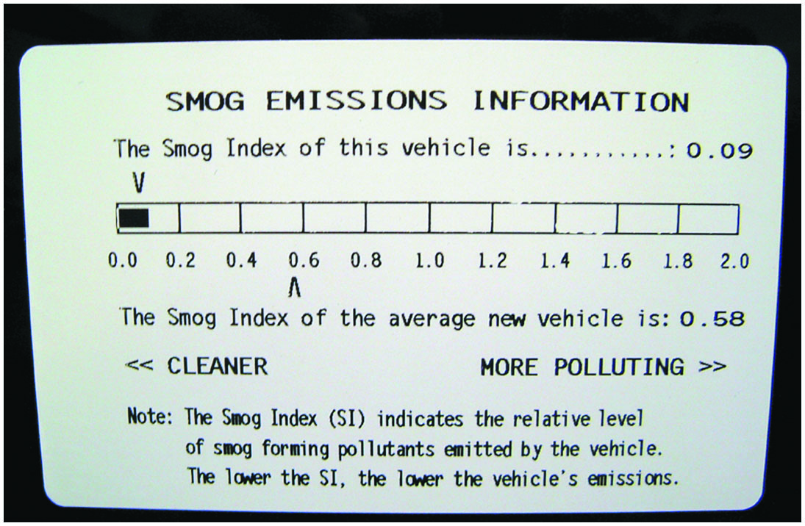
Figure 40.10
S M O G Levels
This label on a Toyota Camry hybrid shows the relative smog-producing emissions, but this does not
include
which may
increase global warming.

Slide 30
European Standards
Exhaust emissions of
total hydrocarbon (T H C), non-
methane hydrocarbons (N M H C), C O, and P M are regulated for most vehicle types, including cars and trucks in the European Union (E U).
E U also sets limits for
emission in units of grams per
kilometer.

Slide 31
Vehicle Emission Testing
Testing
  system is designed to illuminate M I L and
  store trouble codes any time a malfunction exists that
  causes the vehicle emissions to exceed 1
  times the Federal Test Procedure (F T P) limits.
Remote Sensing
  In highly enhanced areas, states perform on-the-road testing of vehicle emissions.
Random Roadside Testing
  Visual checks of the emission control devices to detect tampering.

Slide 32
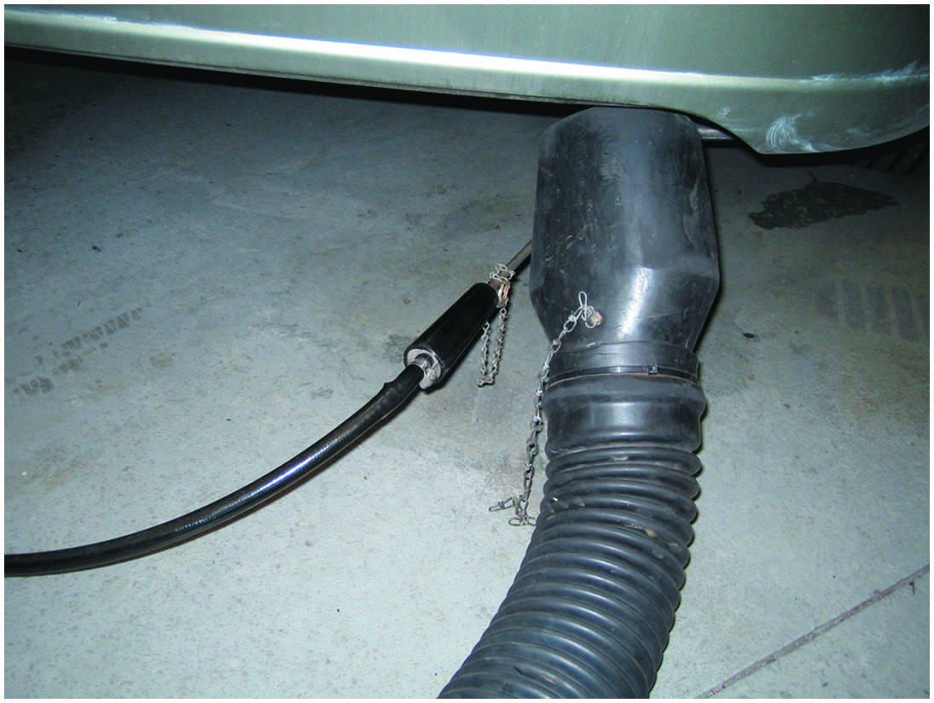
Figure 40.11
Stream Sampling
A partial stream sampling exhaust probe being used to measure exhaust gases in parts per million (p p m) or percent (%).

Slide 33
Question 3
What are three types of vehicle emission testing?

Slide 34
Answer 3
remote sensing, and random roadside testing.

Slide 35
Summary
Excessive hydrocarbon (H C) exhaust emissions created by a lack of proper combustion, fault in ignition system, too lean air–fuel mixture, too-cold engine.
Excessive carbon monoxide (C O) exhaust emissions created by a rich air–fuel mixture.
Excessive oxides of nitrogen (N O x) exhaust emissions are created by excessive heat in combustion chamber or a lack of exhaust gas recirculation (E G R).
levels indicate efficiency. The higher
more efficient
engine operation.
Oxygen
indicates leanness. Higher
leaner air–fuel
mixture.
Vehicle driven about 20 miles, to allow engine to be fully warm before an enhanced emissions test.

Slide 36
Animations and Video Links
(Halderman website subscription and web access needed to view)
(A8) Engine Performance Animations
(A8) Engine Performance Videos

Slide 37

Copyright
This work is protected by United States copyright laws and is provided solely for the use of instructors in teaching their courses and assessing student learning. Dissemination or sale of any part of this work (including on the World Wide Web) will destroy the integrity of the work and is not permitted. The work and materials from it should never be made available to students except by instructors using the accompanying text in their classes. All recipients of this work are expected to abide by these restrictions and to honor the intended pedagogical purposes and the needs of other instructors who rely on these materials.

