Slide 1
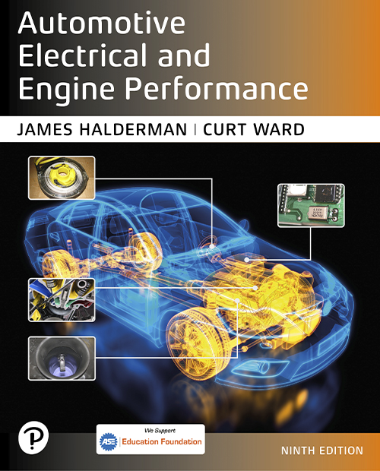
Automotive Electrical and Engine Performance
Ninth Edition
Chapter 39
Turbocharging and Supercharging
Copyright © 2025 Pearson Education, Inc. All Rights Reserved
Notes:
If this PowerPoint presentation contains mathematical equations, you may need to check that your computer has the following installed:
1) Math Type Plugin
2) Math Player (free versions available)
3) NVDA Reader (free versions available)
INSTRUCTOR NOTE: This presentation includes text explanation notes, you can use to teach the course. When in SLIDE SHOW mode, you RIGHT CLICK and select SHOW PRESENTER VIEW, to use the notes.

Slide 2
Learning Objectives
39.1 Discuss airflow requirements and volumetric efficiency of engines.
39.2 Explain forced induction principles.
39.3 Discuss superchargers.
39.4 Discuss turbochargers.
39.5 Discuss turbocharger failures.
39.6 Explain boost control.

Slide 3
Introduction
Airflow Requirements
Calculate engine airflow requirements using three factors.
Engine displacement
Engine revolutions per minute (R P M)
Volumetric efficiency
Volumetric Efficiency
A measure of how well an engine breathes.
A new engine is about 85% efficient.
Turbochargers or superchargers can increase volumetric efficiency to over 100%.

Slide 4
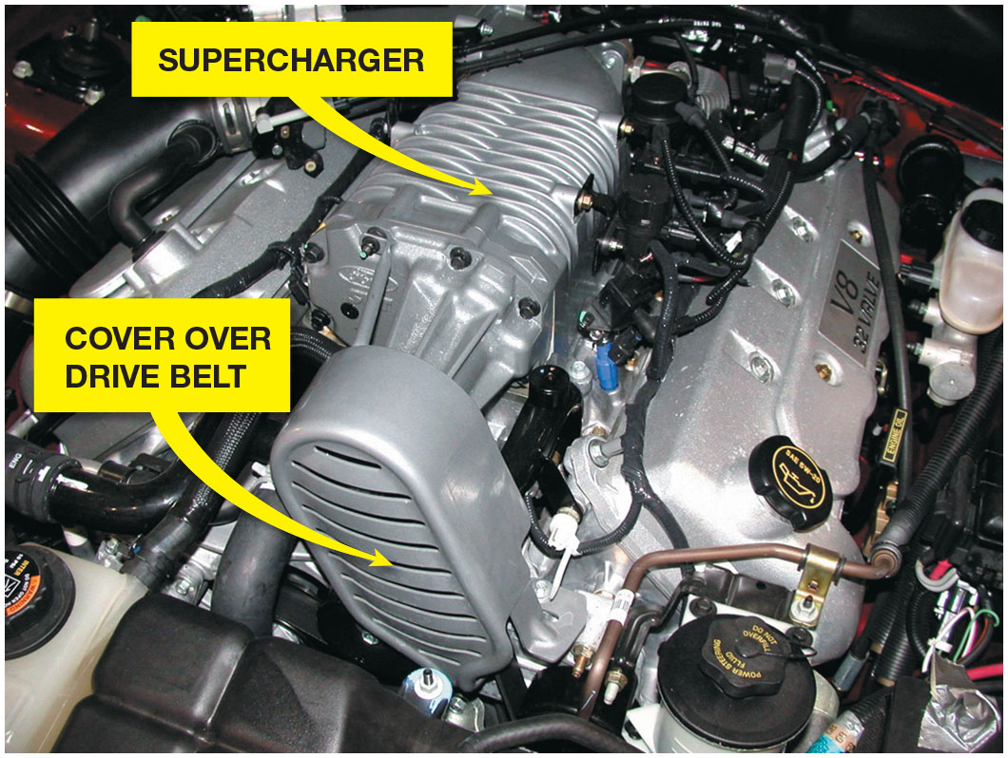
Figure 39.1
Supercharger
A supercharger on a Ford

Slide 5
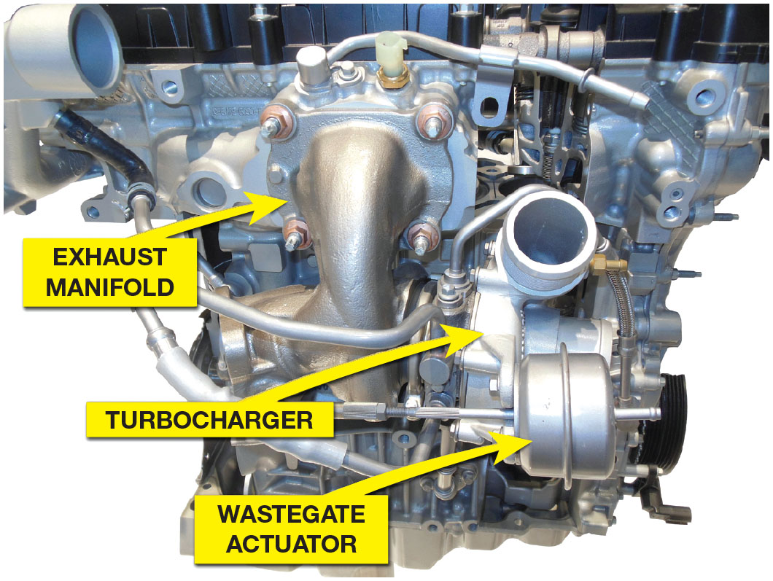
Figure 39.2
Eco Boost Engine
A turbocharged Ford three-cylinder
liter Eco Boost engine.

Slide 6
Question 1
What is volumetric efficiency?

Slide 7
Answer 1
A measure of how well an engine breathes.

Slide 8
Forced Induction Principles (1 of 2)
Charge density is a term used to define the amount of the air–fuel charge introduced into the cylinders.
When air is pumped into the cylinder, the combustion chamber receives an increase of air pressure known as boost.
Boost can be measured in:
Pounds per square inch (P S I)
Atmospheres (A T M) (1 atmosphere is 14.7 P S I)
Bars (1 bar is 14.7 P S I)

Slide 9
Forced Induction Principles (2 of 2)
Forced induction systems use an air pump to pack a denser air–fuel charge into the cylinders.
The weight of the air–fuel charge is higher.
Power is increased because it is directly related to the weight of an air–fuel charge consumed within a given time period.
Atmospheric pressure drops as altitude increases, but boost pressure remains the same.
Boost increases the amount of air drawn into the cylinder during the intake stroke.

Slide 10
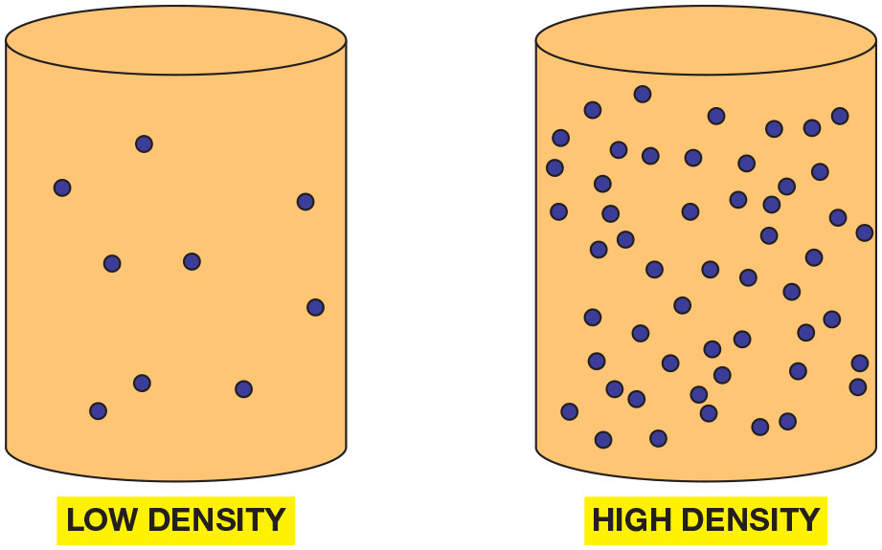
Figure 39.3
Air Density
The more air and fuel that can be packed in a cylinder, the greater the density of the air–fuel charge.

Slide 11
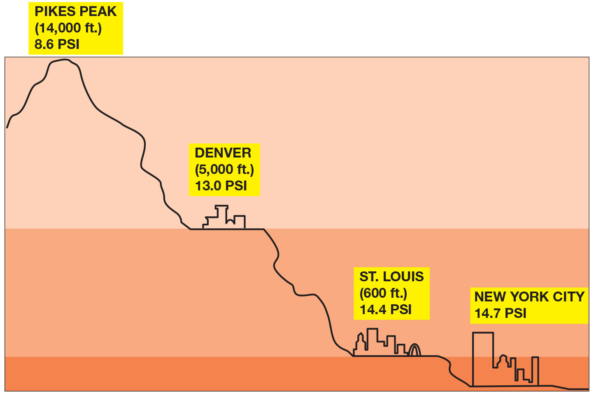
Figure 39.4
Atmosphere
Atmospheric pressure decreases with increases in altitude.
Notes:
Long Description:
The figure depicts the following atmospheric pressures across different altitudes: Pikes peak is at 14,000 feet and has an atmospheric pressure of 8.6 P S I. Denver is at 5,000 feet and has an atmospheric pressure of 13.0 P S I. Saint Louis is at 6,00 feet and has an atmospheric pressure of 14.4 P S I. New York city is below Saint Louis and has an atmospheric pressure of 14.7 P S I.

Slide 12
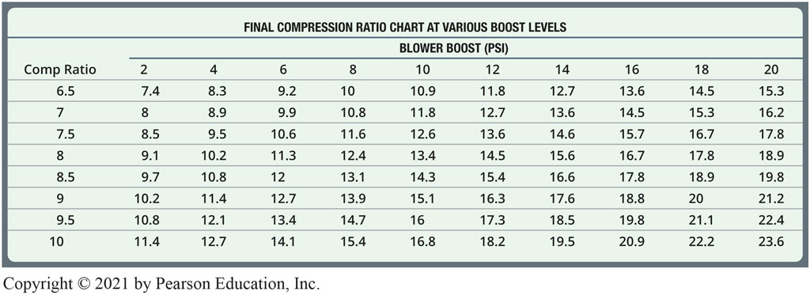
Chart 39.1
Compression Ratio
The effective compression ratio compared to the boost pressure.
Notes:
Long Description:
The table shows two column headers: comp ratio and blower boost (P S I). The column blower boost (P S I) is divided into the following: 2; 4; 6; 8; 10; 12; 14; 16; 18; 20. The data are as follows: Row 1: 6.5; 7.4; 8.3; 9.2; 10; 10.9; 11.8; 12.7; 13.6; 14.5; 15.3. Row 2: 7; 8; 8.9; 9.9; 10.8; 11.8; 12.7; 13.6; 14.5; 15.3; 16.2. Row 3: 7.5; 8.5; 9.5; 10.6; 11.6; 12.6; 13.6; 14.6; 15.7; 16.7; 17.8. Row 4: 8; 9.1; 10.2; 11.3; 12.4; 13.4; 14.5; 15.6; 16.7; 17.8; 18.9. Row 5: 8.5; 9.7; 10.8; 12; 13.1; 14.3; 15.4; 16.6; 17.8; 18.9; 19.8. Row 6: 9; 10.2; 11.4; 12.7; 13.9; 15.1; 16.3; 17.6; 18.8; 20; 21.2. Row 7: 9.5; 10.8; 12.1; 13.4; 14.7; 16; 17.3; 18.5; 19.8; 21.1; 22.4. Row 8: 10; 11.4; 12.7; 14.1; 15.4; 16.8; 18.2; 19.5; 20.9; 22.2; 23.6.

Slide 13
Superchargers
A supercharger is an engine-driven air pump that supplies more than the normal amount of air into the intake manifold, and boosts engine torque and power.
The roots type of supercharger is positive displacement design, because all of the air that enters is forced through the unit.
A centrifugal supercharger is not a positive displacement pump and all of the air that enters is not forced through the unit.
A bypass valve allows intake air to flow directly into the intake manifold.

Slide 14
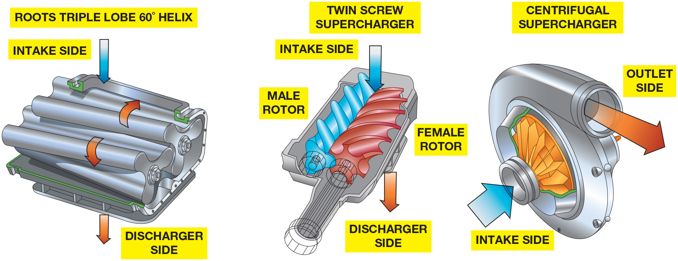
Figure 39.5
Superchargers
A Roots-type supercharger (left) compared to a twin screw type in the center and a centrifugal type on the right.
Notes:
Long Description:
Roots-type supercharger: It consists of two roots triple lobe 60 degrees helixes rotating in opposite directions. The intake and discharge sides are at the top and bottom, respectively. Twin screw supercharger: It comprises a male rotor and a female rotor. The rotors are placed adjacent to each other. The intake and discharge sides are at the top and bottom, respectively. Centrifugal supercharger: The intake side is on the left, and the intake is at the center. The outlet side is on the top.

Slide 15
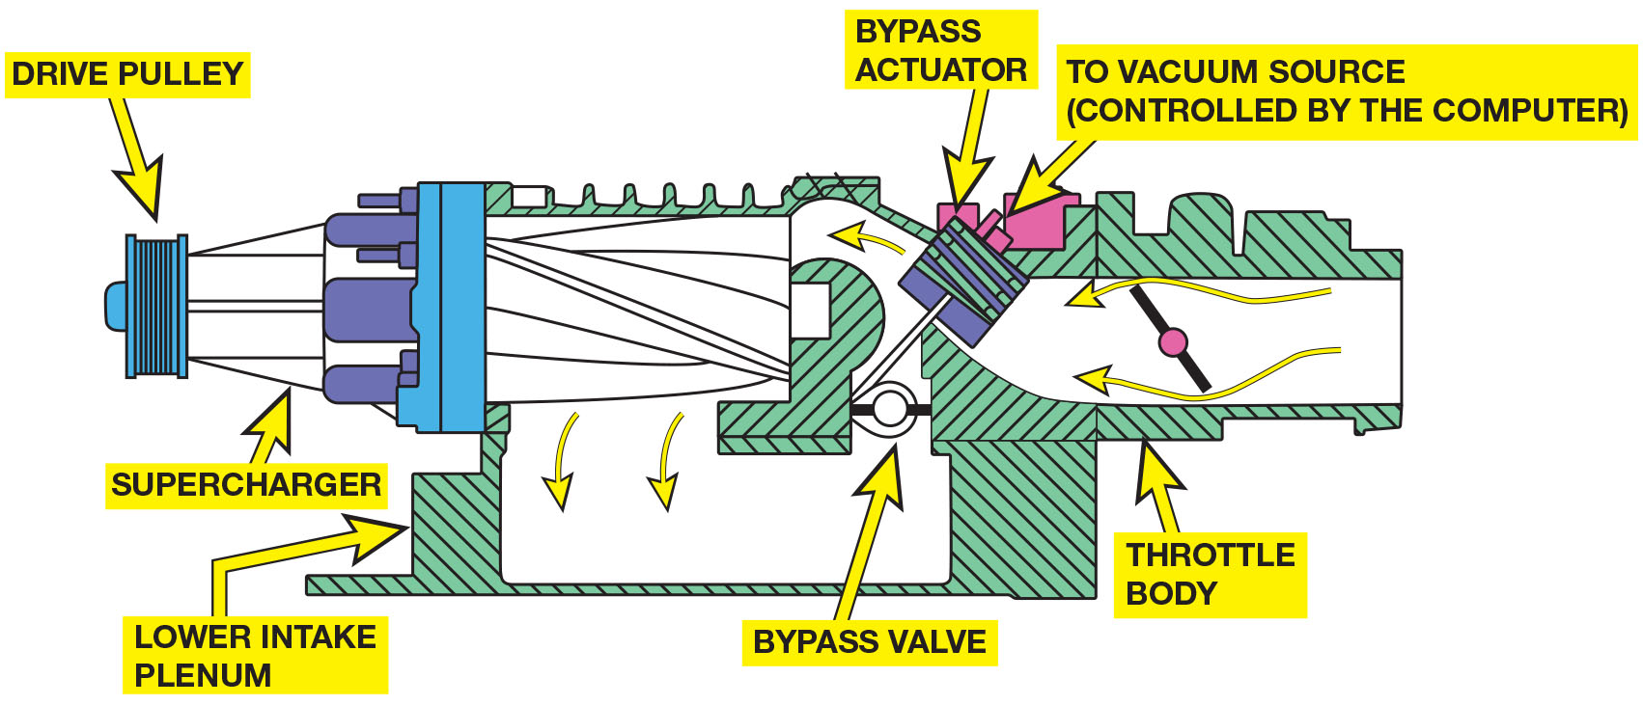
Figure 39.6
Bypass Valve
The bypass actuator opens the bypass valve to control boost pressure.
Notes:
Long Description:
The figure depicts the following details: A supercharger driven by a drive pulley is connected to the lower intake plenum. A bypass actuator is placed between the throttle body and the supercharger. The bypass actuator is connected to a vacuum source at the top that is controlled by a computer. A bypass valve below the actuator allows airflow to be directed around the supercharger under certain conditions.

Slide 16
Animation: Supercharger Bypass

Slide 17
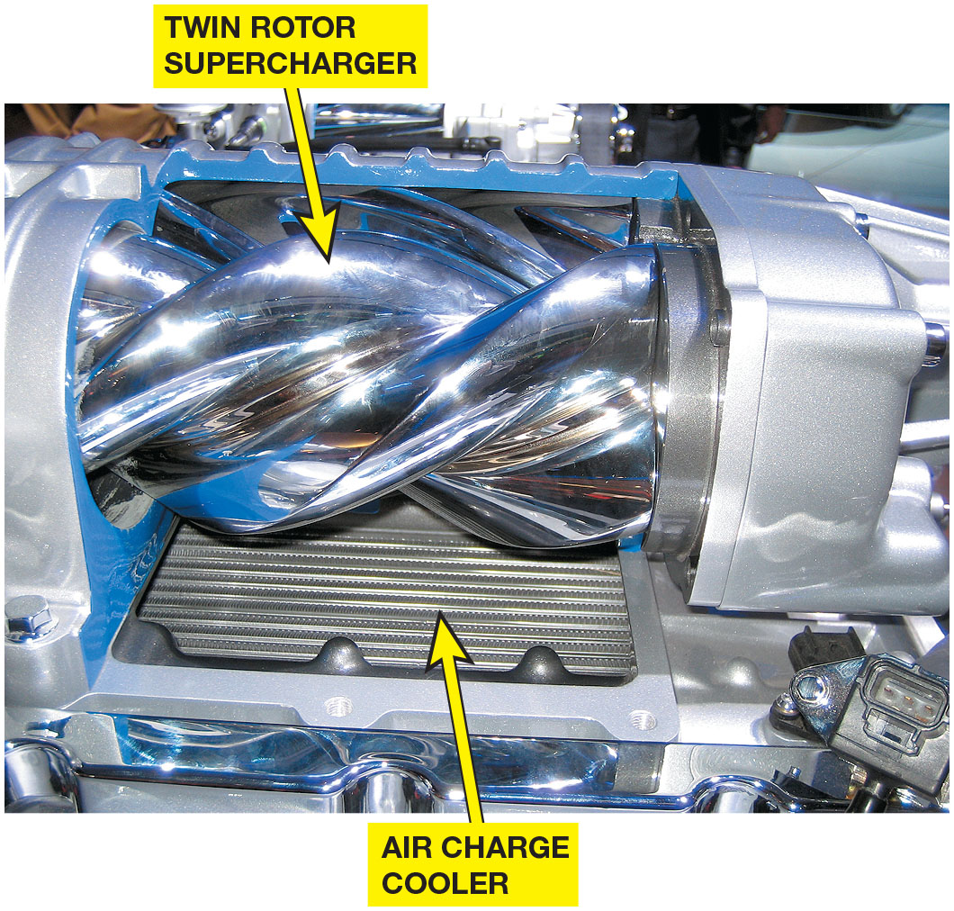
Figure 39.7
Cutaway
A Ford supercharger cutaway display showing the Roots-type blower and air charge cooler (intercooler). The air charge cooler is used to reduce the temperature of the compressed air before it enters the engine to increase the air charge density.
Notes:
TECH TIP: Faster Moves More Air
One of the high-performance measures that can be used to increase horsepower on a supercharged engine is to install a smaller diameter pulley.
The smaller the pulley diameter, the faster the supercharger will rotate and the higher the potential boost pressure will be. The change will require a shorter belt, and the extra boost could cause serious engine damage.

Slide 18
Turbochargers
A turbocharger uses the heat of the exhaust to power a turbine wheel and, therefore, does not directly reduce engine power.
The turbine wheel turns an impeller (compressor) wheel which is connected by a shaft in the center housing.
The delay between acceleration and turbo boost is called turbo lag.

Slide 19
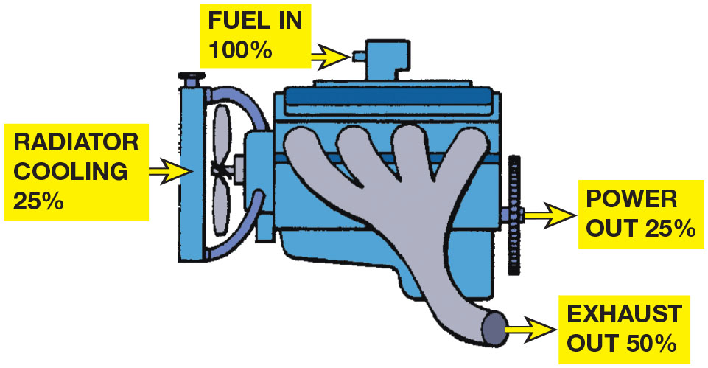
Figure 39.8
Turbocharger
A turbocharger uses some of the heat energy that would normally be wasted.

Slide 20
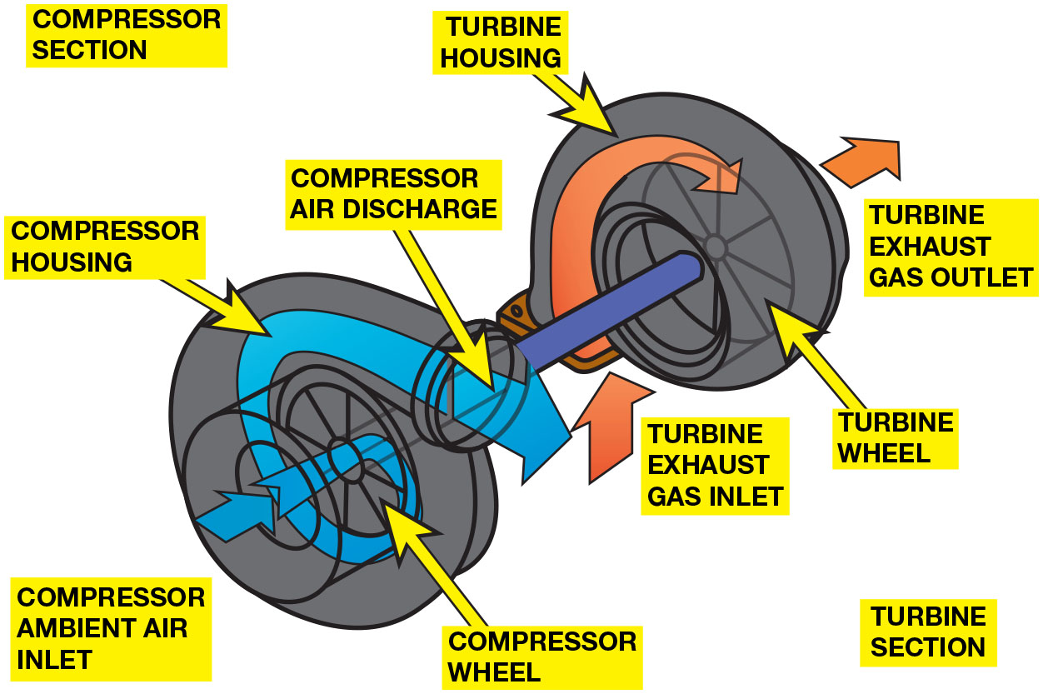
Figure 39.9
Turbo Operation
A turbine wheel is turned by the expanding exhaust gases.
Notes:
Long Description:
The compressor and turbine sections are marked on opposite sides. The compressor housing and turbine housing enclose the compressor wheel and turbine wheel, respectively. The compressor and turbine are connected by a shaft. Air enters through the compressor ambient air inlet on the side and moves around the compressor wheel. Air exits through the compressor air discharge on the top. The exhaust gases enter the turbine through the turbine exhaust gas inlet at the bottom. The gases move around the turbine wheel and exit through the turbine exhaust gas outlet on the side.

Slide 21
Animation: Turbocharger

Slide 22
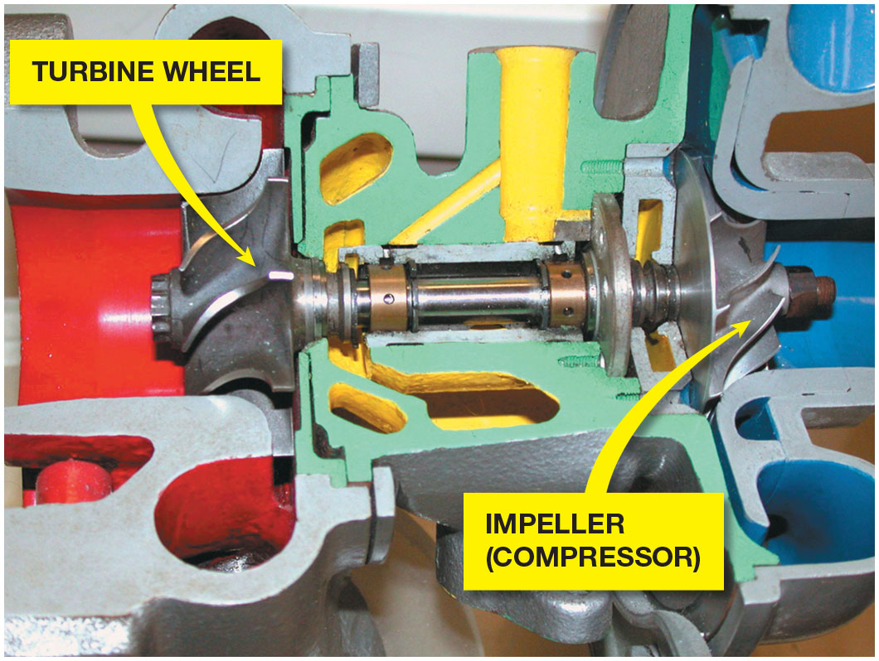
Figure 39.10
C H R A
The exhaust drives the turbine wheel on the left, which is connected to the impeller wheel on the right through a shaft. The bushings that support the shaft are lubricated with engine oil under pressure.

Slide 23
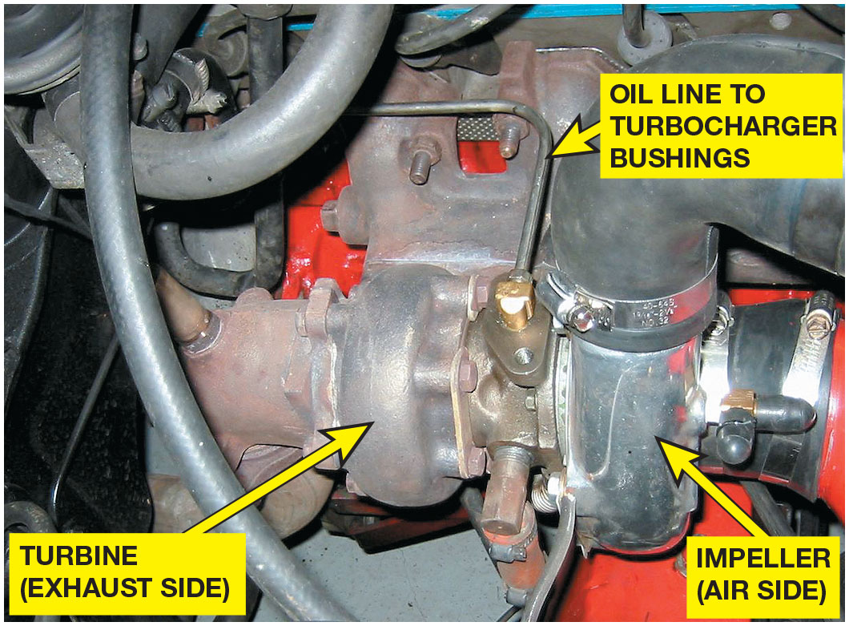
Figure 39.11
Oil Feed
Engine oil is fed to the center of the turbocharger to lubricate the bushings and returns to the oil pan through a return line.
Notes:
Long Description:
The turbine at the exhaust side is connected to an air side impeller through a central housing. An oil line is connected to the center of the turbocharger to lubricate the bushings and returns to the oil pan through a return line.

Slide 24
Turbocharger Failures
Creates a noticeable drop in power.
Bearing failure is the most common cause.
Excessive oil consumption due to wear.
Most failures are preventable by performing regular maintenance.

Slide 25
Question 2
What is a common cause of turbocharger failures?

Slide 26
Answer 2
Bearing failures.

Slide 27
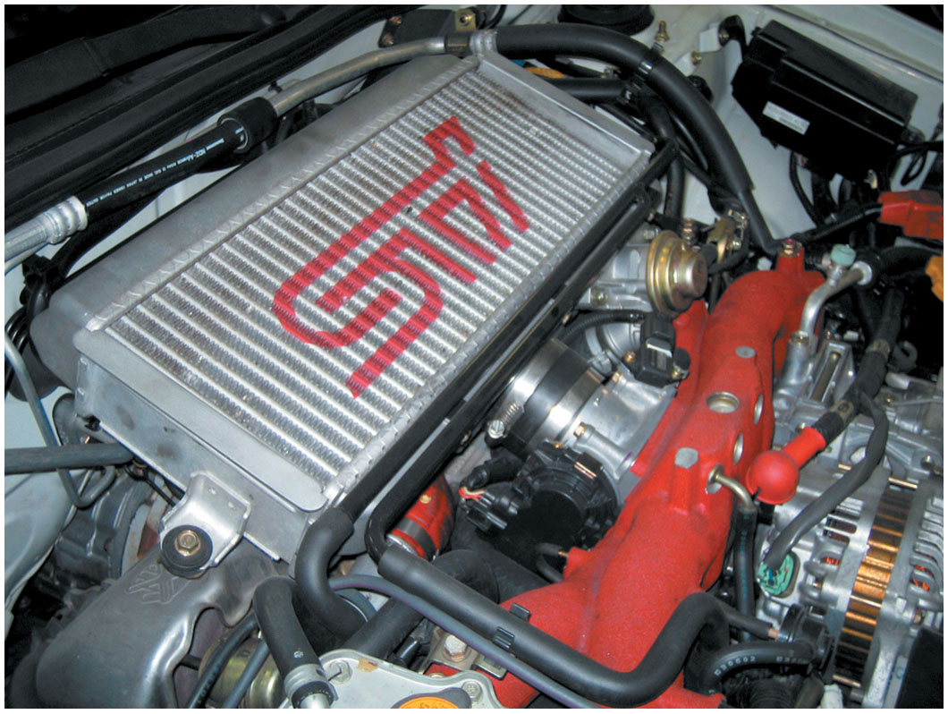
Figure 39.12
Intercooler
The unit on top of this Subaru that looks like a radiator is the intercooler, which cools the air after it has been compressed by the turbocharger.

Slide 28
Boost Control
Wastegate: It is a bypass valve at the exhaust inlet to the turbine, which allows all or part of the exhaust gas to enter the turbine.
Relief Valves: It vents pressurized air from the connecting pipe between the outlet of the turbocharger and the throttle.
Two types of relief valves:
Compressor bypass valve (C B V)
Blow-off valve (B O V)

Slide 29
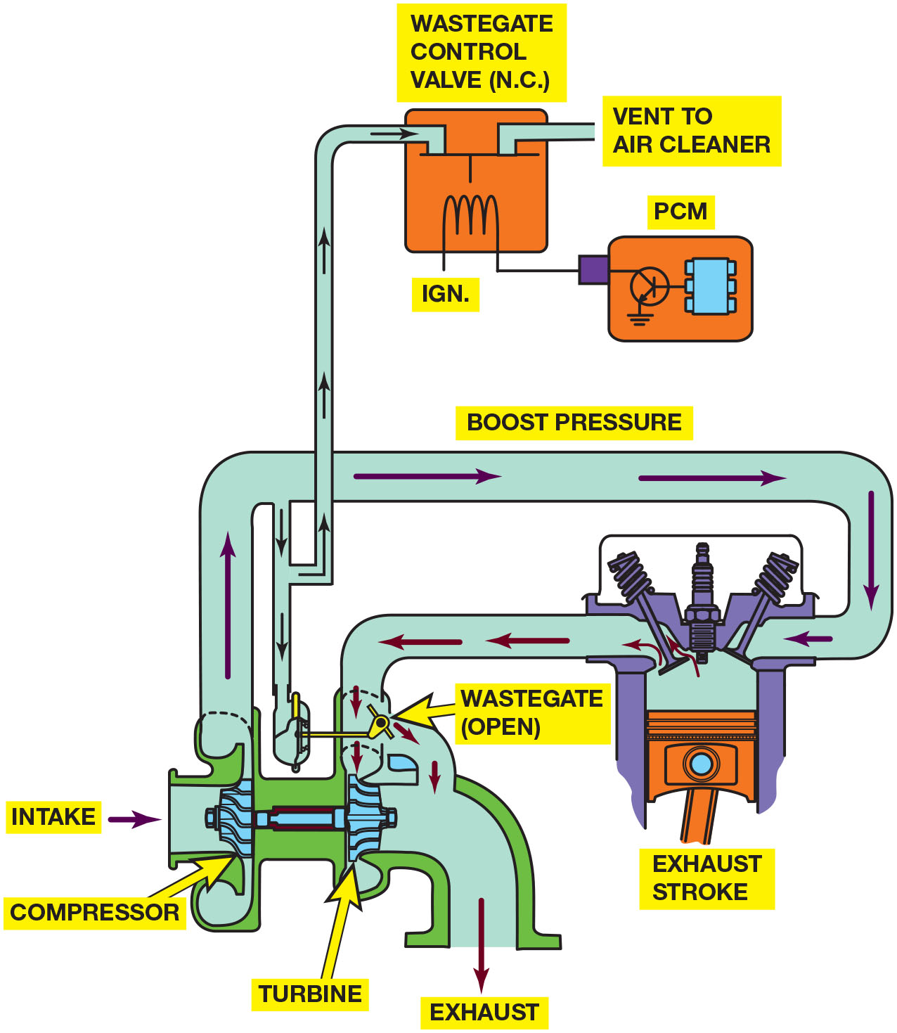
Figure 39.13
Wastegate
A wastegate is used on many turbocharged engines to control maximum boost pressure. The wastegate is controlled by a computer-controlled valve.
Notes:
TECH TIP: Boost Is the Result of Restriction
The boost pressure of a turbocharger (or supercharger) is commonly measured in pounds per square inch. If a cylinder head is restricted because of small valves and ports, the turbocharger will quickly provide boost. Boost results when the air being forced into the cylinder heads cannot flow into the cylinders fast enough and “piles up” in the intake manifold, increasing boost pressure. If an engine had large valves and ports, the turbocharger could provide a much greater amount of air into the engine at the same boost pressure as an identical engine with smaller valves and ports. Therefore, by increasing the size of the valves, a turbocharged or supercharged engine will be capable of producing much greater power.
Long Description:
The figure depicts the following: Wastegate control valve is controlled by means of an ignition coil by a P C M and is connected to a vent that leads to air cleaner and another vent that is connected to wastegate. Wastegate is connected to the turbocharger that houses a compressor wheel and turbine wheel. When the wastegate is open, most of the exhaust gas from the cylinder flows directly out of the exhaust and less amount of exhaust drives the turbine, causing a reduction in boost pressure.

Slide 30
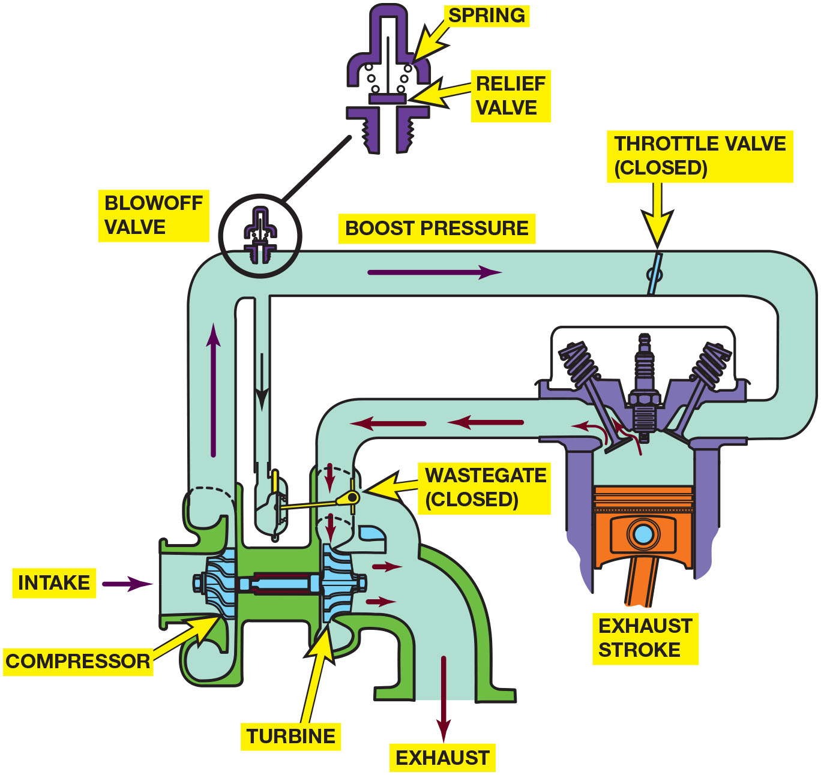
Figure 39.14
Blow-Off Valve
A blow-off valve is used in some turbocharged systems to relieve boost pressure during deceleration.
Notes:
Long Description:
The figure depicts the following details: The intake port of an engine is connected to the compressor side of the supercharger and the exhaust port of the engine is connected to the turbine side of the supercharger. A wastegate is positioned over the turbine side of the supercharger. When the wastegate is closed, all the exhaust from the engine is forced through the turbine. A blow-off valve is placed on the intake line of the engine. An enlarged view of the blow-off valve shows a spring controlled relief valve.

Slide 31
Animation: Turbocharger Wastegate

Slide 32
Question 3
What is the purpose of an intercooler?

Slide 33
Answer 3
Reduce the temperature of the air entering the engine.

Slide 34
Summary
Volumetric efficiency is comparison of actual volume of air–fuel mixture drawn into the engine to theoretical maximum volume that can be drawn into the cylinder.
Supercharger operates from the engine by a drive belt and, while it does consume some engine power, it forces a greater amount of air into the cylinders for even more power.
Turbocharger uses normally wasted heat energy of exhaust to turn an impeller at high speed. The impeller is linked to a turbine wheel on the same shaft and is used to force air into the engine.
Three types of superchargers: roots-type, twin screw, and centrifugal.
Bypass valve is used to control the boost pressure.
Intercooler used on many turbocharged and some supercharged engines to reduce the temperature of air entering the engine for increased power.
Wastegate used to limit and control boost pressures, & keep the speed of the turbine wheel from slowing down during engine deceleration.

Slide 35
Animations and Video Links (Halderman website subscription and web access needed to view)
(A8) Engine Performance Animations
(A8) Engine Performance Videos

Slide 36
Copyright
This work is protected by United States copyright laws and is provided solely for the use of instructors in teaching their courses and assessing student learning. Dissemination or sale of any part of this work (including on the World Wide Web) will destroy the integrity of the work and is not permitted. The work and materials from it should never be made available to students except by instructors using the accompanying text in their classes. All recipients of this work are expected to abide by these restrictions and to honor the intended pedagogical purposes and the needs of other instructors who rely on these materials.

