Slide 1
Automotive Electrical and Engine Performance
Ninth Edition
Chapter 38
Fuel-Injection System Diagnosis and Service
Copyright © 2025 Pearson Education, Inc. All Rights Reserved
Notes:
If this PowerPoint presentation contains mathematical equations, you may need to check that your computer has the following installed:
1) Math Type Plugin
2) Math Player (free versions available)
3) NVDA Reader (free versions available)
INSTRUCTOR NOTE: This presentation includes text explanation notes, you can use to teach the course. When in SLIDE SHOW mode, you RIGHT CLICK and select SHOW PRESENTER VIEW, to use the notes.

Slide 2
Learning Objectives
38.1 Explain fuel-injection system diagnosis including scan tool diagnosis.
38.2 Describe how to test for an injector pulse.
38.3 Describe how to check fuel-injection resistance.
38.4 Describe the pressure-drop balance test.
38.5 Describe injection voltage-drop tests.
38.6 Describe scope-testing fuel injectors.
38.7 Describe how to service the fuel-injection system.

Slide 3
Port Fuel-Injection Pressure Regulator Diagnosis
Connect a fuel-pressure gauge to monitor the fuel pressure.
Locate the fuel-pressure regulator and disconnect the vacuum hose from the regulator.
With the engine running at idle speed, reconnect the vacuum hose to the fuel-pressure regulator while watching the fuel pressure gauge.
Using a hand-operated vacuum pump, apply vacuum (20 inches Hg) to the regulator.

Slide 4
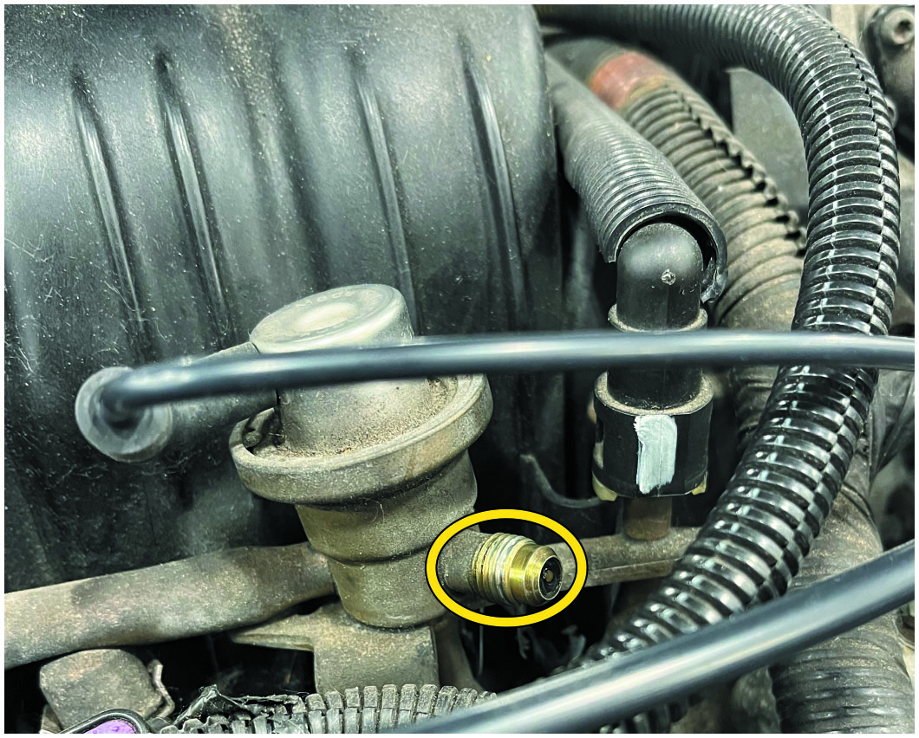
Figure 38.1
Fuel Pressure Port
A fuel pressure gauge can be connected to many older fuel injection systems at the threaded port on the fuel rail.

Slide 5
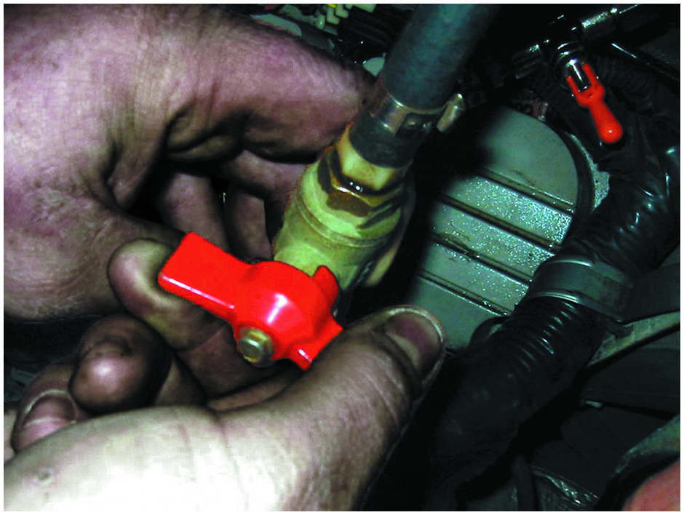
Figure 38.2
Shutoff Valve
Shutoff valves must be used on vehicles equipped with plastic fuel lines to isolate the cause of a pressure drop in the fuel system.

Slide 6
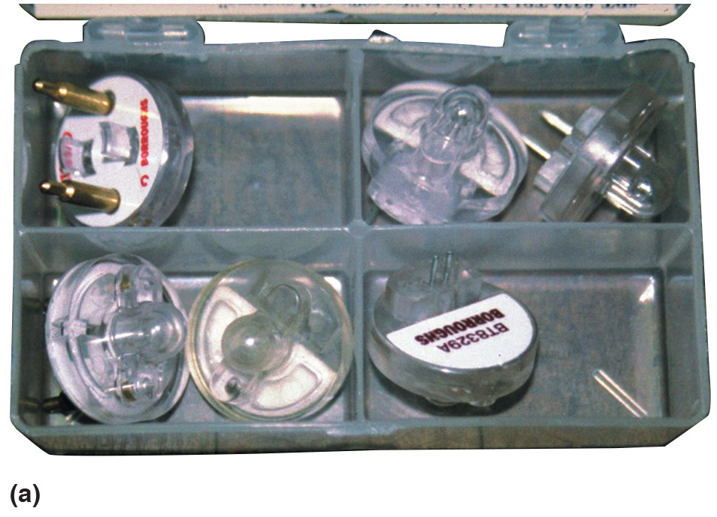
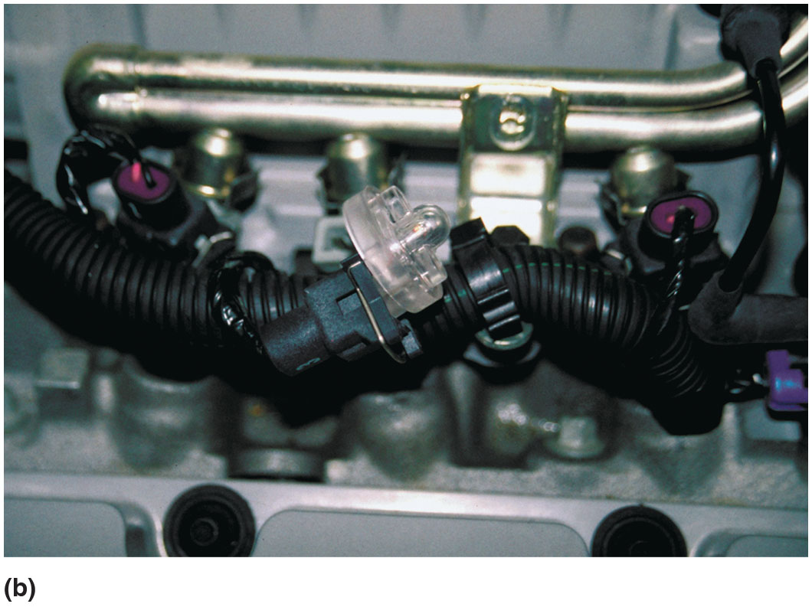
Figure 38.3
Noid Lights
(a) Noid lights are usually purchased as an assortment so that one is available for any type or size of injector wiring connector. (b) The connector is unplugged from the injector and a noid light is plugged into the injector connector. The noid light should flash when the engine is being cranked if the power circuit and the pulsing to ground by the computer are functioning okay.

Slide 7
Testing for an Injector Pulse
A noid light is designed to electrically replace the injector in the circuit and to flash if the injector circuit is working correctly.
Possible noid light problems and causes include the following:
The light is off and does not flash.
The noid light flashes dimly.
The noid light is on and does not flash.

Slide 8
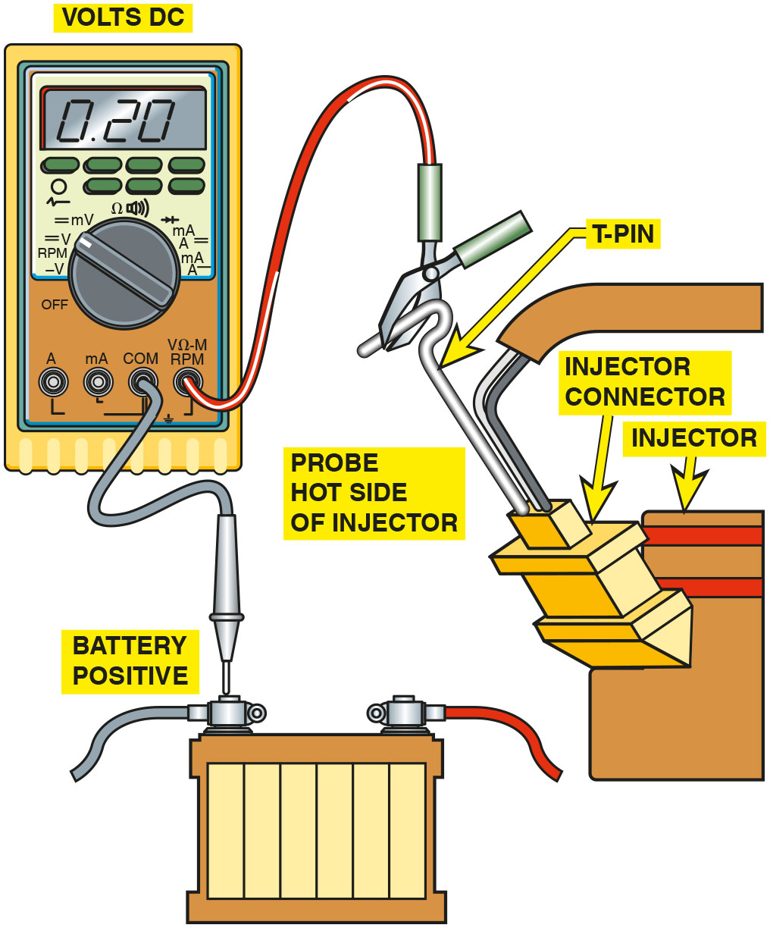
Figure 38.4
Injector Voltage Drop
Use a D M M set to read D C volts to check the voltage drop of the positive circuit to the fuel injector. A reading of 0.5 volt or less is generally considered to be acceptable.

Slide 9
Animation: Check Injector Pulse

Slide 10
Question 1
What is the purpose of a noid light?

Slide 11
Answer 1
To replace the injector in the circuit for the purpose of testing.

Slide 12
Injector Voltage-Drop Tests
Another test of injectors involves pulsing the injector and measuring the voltage drop across the windings as current is flowing.
The voltage drop across each injector should be within 0.1 volt of each other.

Slide 13
Checking Fuel-Injector Resistance
With ohmmeter, measure resistance across injector terminals.
Typical resistance values:
Low-resistance injectors:
Higher-resistance injectors: 12–16 ohms

Slide 14
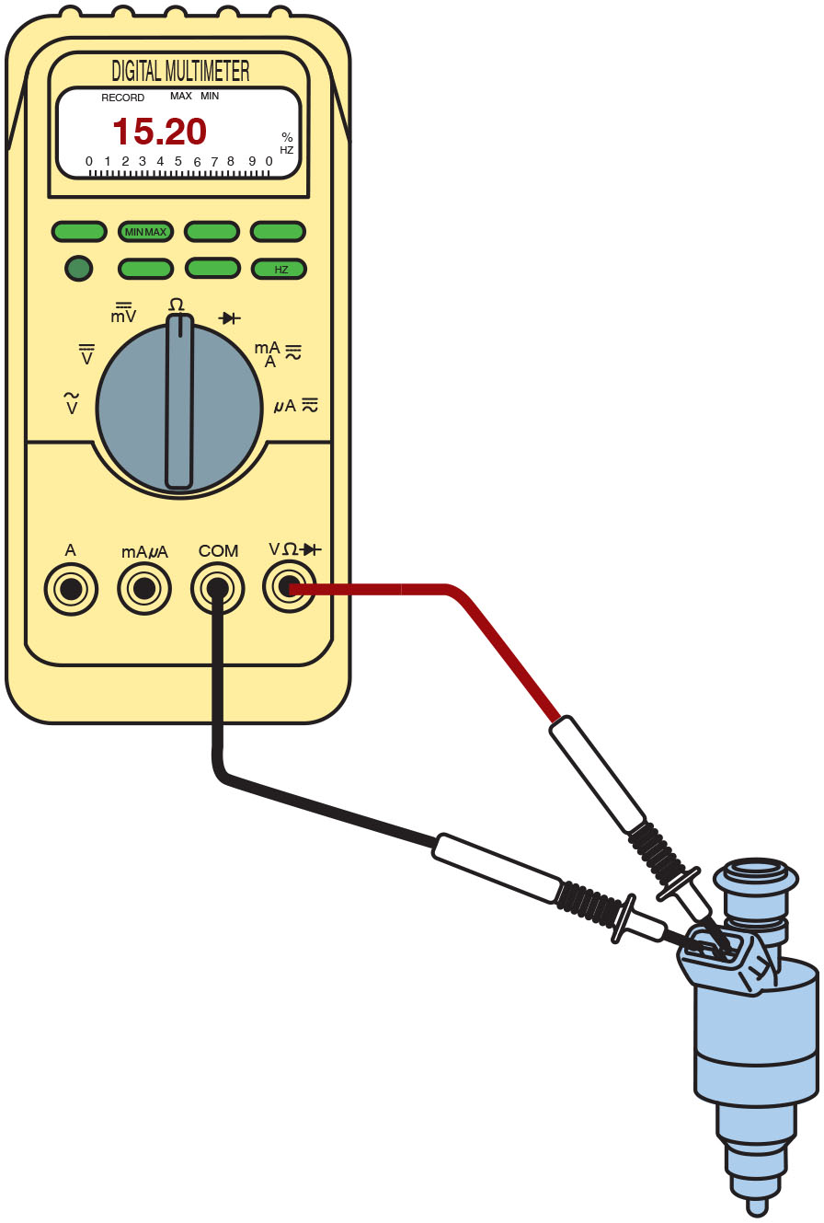
Figure 38.5
Injector Resistance
Connections and settings necessary to measure fuel-injector resistance.

Slide 15
Animation: Test Injector Resistance

Slide 16
Pressure-Drop Balance Test
The purpose of running this injector balance test is to determine which injector is restricted, inoperative, or delivering fuel differently.
The pressure balance test involves using an electrical timing device to pulse the fuel injectors on for a given amount of time, usually 500 milliseconds or 0.5 seconds, and observing the drop in pressure that accompanies the pulse.

Slide 17
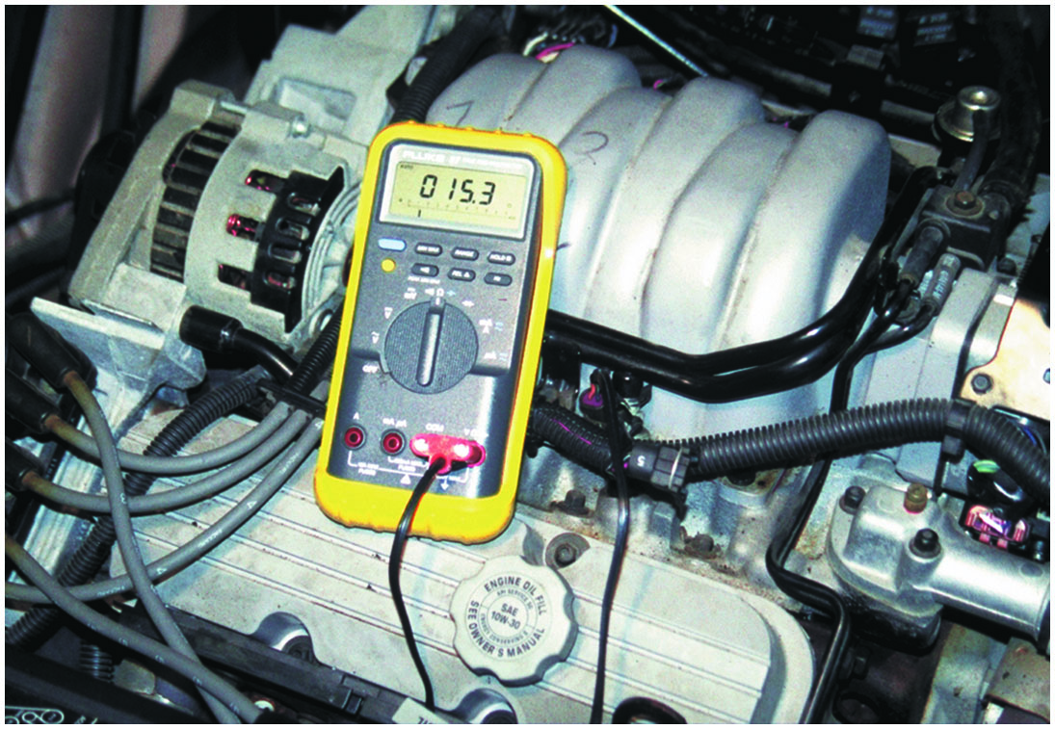
Figure 38.6
Fuel-Injector Resistance
To measure fuel-injector resistance, a technician constructed a short wiring harness with a double banana plug that fits into the V and C O M terminals of the meter and an injector connector at the other end. This setup makes checking resistance of fuel injectors quick and easy.

Slide 18
Diagnosing Electronic Fuel-Injection Problems Using Visual Inspection
Check air filter and replace as needed.
Check air induction system for obstructions.
Check conditions of all vacuum hoses.
Check P C V for proper operation.
Check all fuel-injection electrical connections.

Slide 19
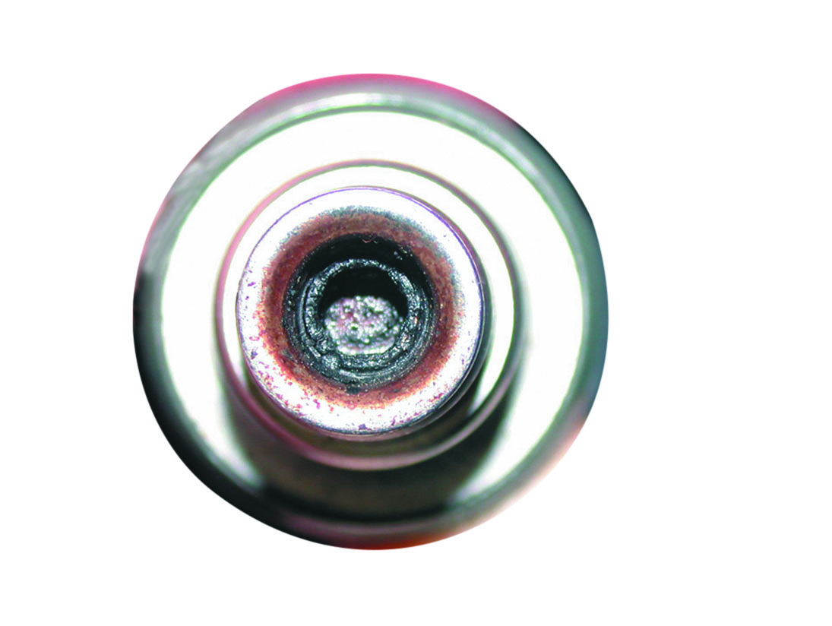
Figure 38.7
Clogged Injector
If an injector has the specified resistance, this does not mean that it is okay. This injector had the specified resistance, yet it did not deliver the correct amount of fuel because it was clogged.
Notes:
TECH TIP: Equal Resistance Test
All fuel injectors should measure the specified resistance. However, the specification often indicates the temperature of the injectors be at room temperature and of course will vary according to the temperature. Rather than waiting for all of the injectors to achieve room temperature, measure the resistance and check that they are all within 0.4 ohm of each other. To determine the difference, record the resistance of each injector and subtract the lowest resistance reading from the highest resistance reading to get the difference. If more than 0.4 ohm, then further testing will be needed to verify defective injector(s). • See Figure 38.7.

Slide 20
Port Fuel-Injection System Diagnosis
Attach fuel-pressure gauge to Schrader valve on fuel rail.
Turn ignition key on or start the engine to build up the fuel pump pressure (to about 35 to 45 P S I).
Wait 20 minutes and observe fuel pressure retained in the fuel rail.

Slide 21
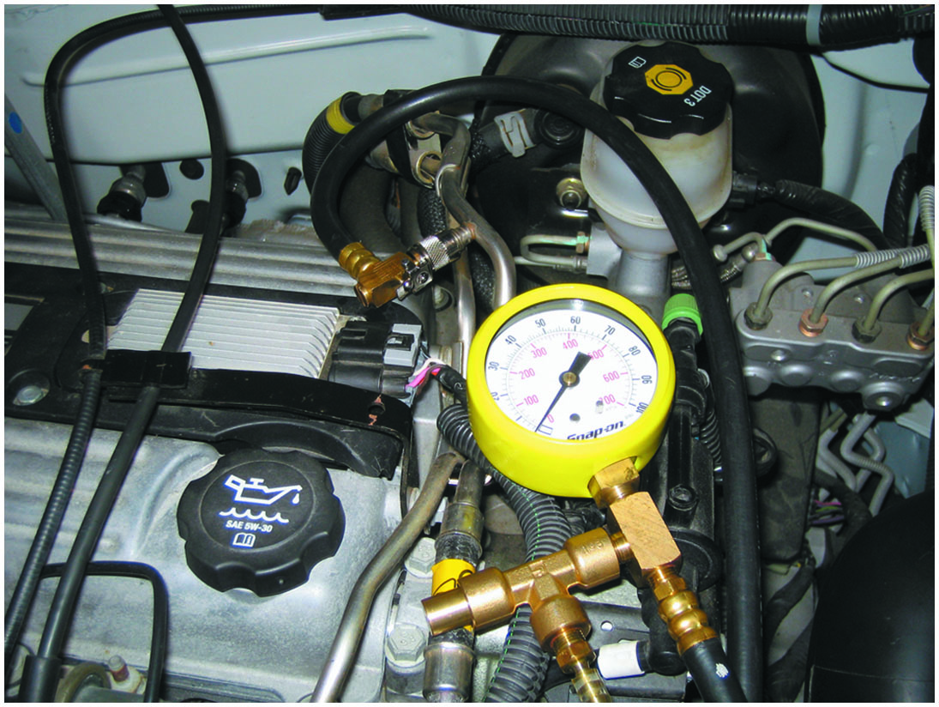
Figure 38.8
Checking Fuel Pressure
Connect a fuel-pressure gauge to the fuel rail at the Schrader valve.

Slide 22
Animation: Injector Pulse Balance Test

Slide 23
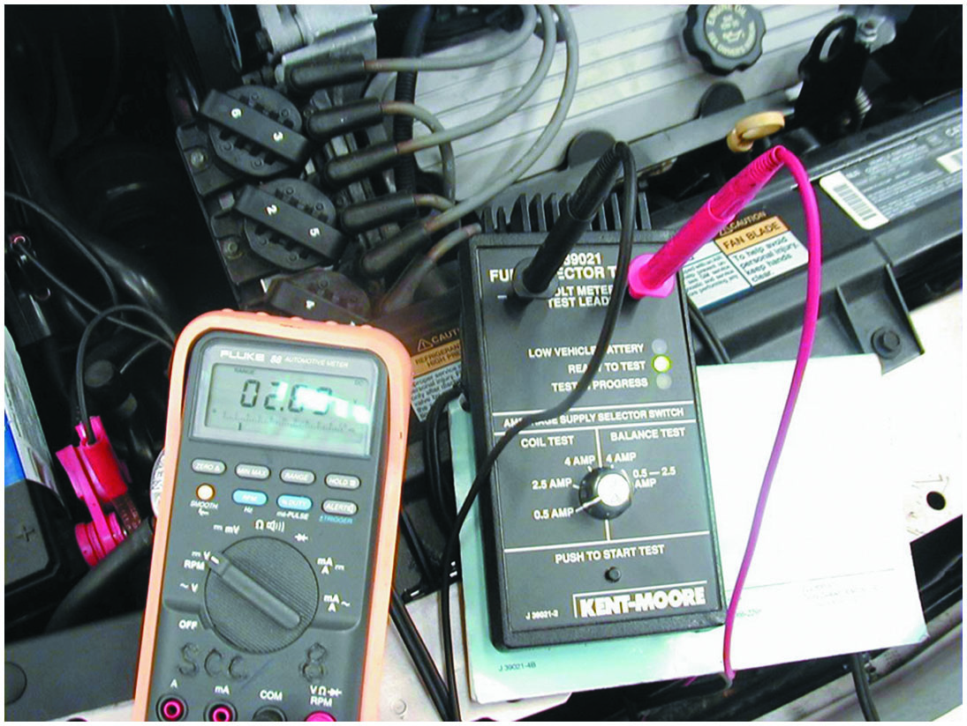
Figure 38.9
Injector Tester
An injector tester being used to check the voltage drop through the injector while the tester is sending current through the injectors. This test is used to check the coil inside the injector. This same tester can be used to check for equal pressure drop of each injector by pulsing the injector on for 500 m s.

Slide 24
Scope-Testing Fuel Injectors
There are three types of injector drive circuits and each type of circuit has its own characteristic pattern.
Saturated switch type
Peak and hold type
Pulse-width modulated type

Slide 25
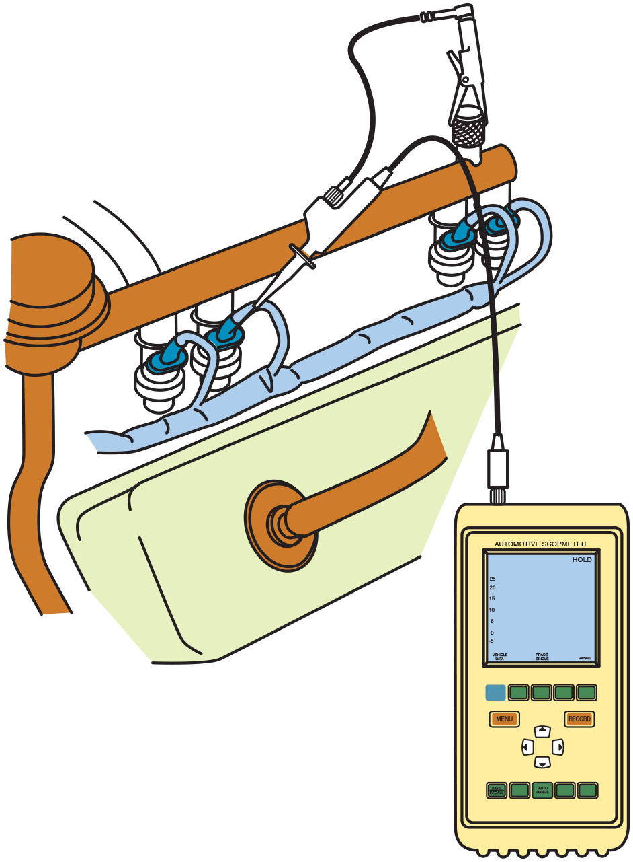
Figure 38.10
D S O Injector Test
A D S O can be easily connected to an injector by carefully back-probing the electrical connector.

Slide 26
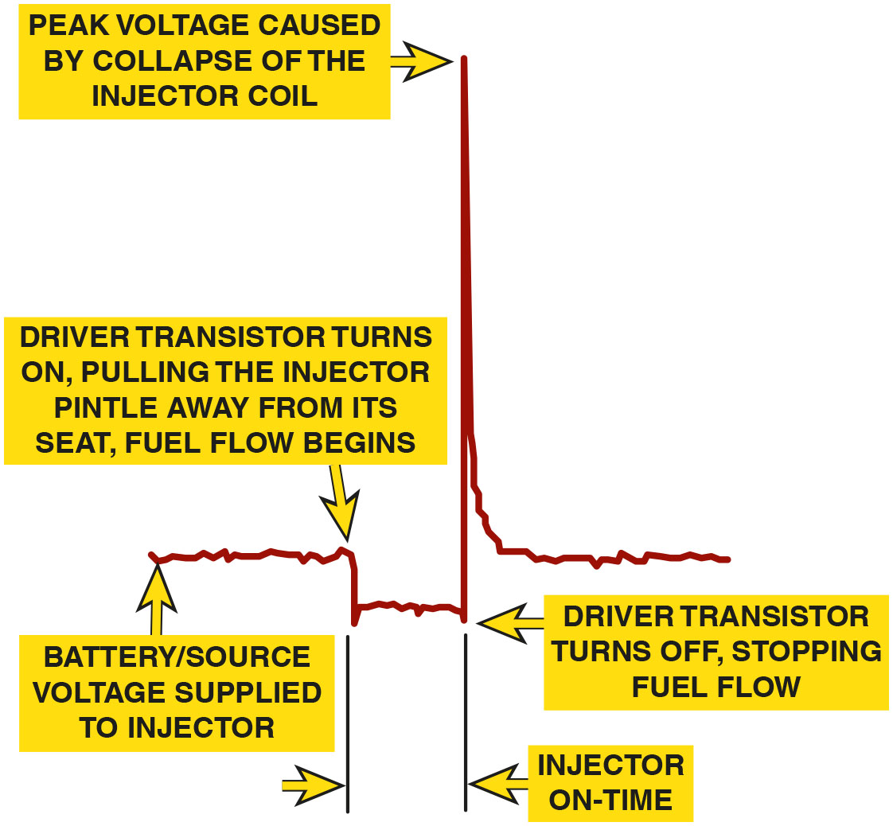
Figure 38.11
Injector Pulse Width
The injector on-time is called the pulse width.
Notes:
Long Description:
The waveform lies close to the horizontal line when source voltage is applied to the injector. As the driver transistor turns on, pulling the injector pintle away from its seat, fuel flow begins and the waveform falls sharply. The waveform rises sharply due to peak voltage caused by the collapse of injector coil and falls sharply as current is reduced enough to keep hold-in winding activated. The waveform lies close to the horizontal line and rises and falls sharply again. The distance between the second rise and driver transistor turning on is labeled injector on-time.

Slide 27
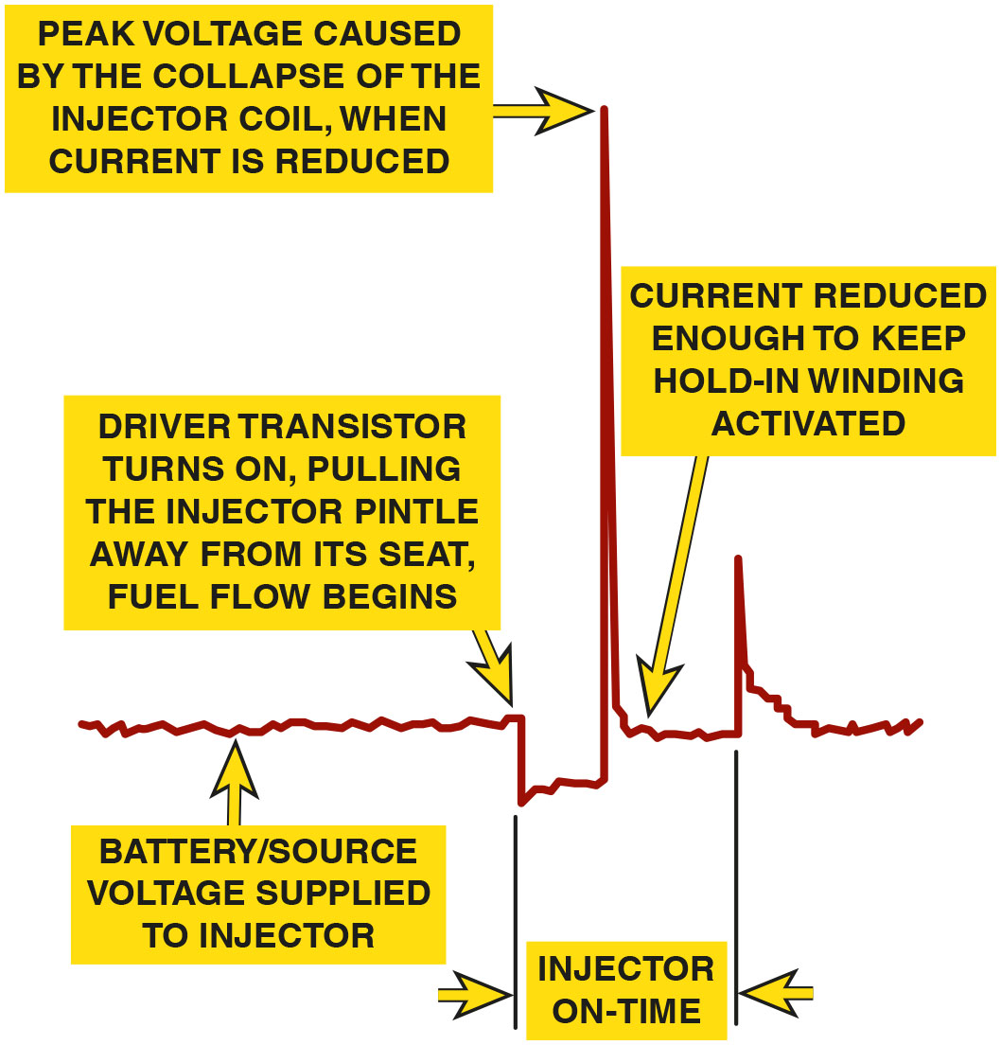
Figure 38.12
Peak & Hold Injector
A typical peak-and-hold fuel-injector wave form. Most fuel injectors that measure less than 6 ohms will usually display a similar waveform.
Notes:
Long Description:
The waveform lies close to the horizontal line when source voltage is applied to the injector. As the driver transistor turns on, pulling the injector pintle away from its seat, fuel flow begins and the waveform falls sharply. The waveform lies close to the horizontal line and rises sharply due to peak voltage caused by the collapse of injector coil and falls sharply. The distance between the peak and driver transistor turning on is labeled injector on-time.

Slide 28
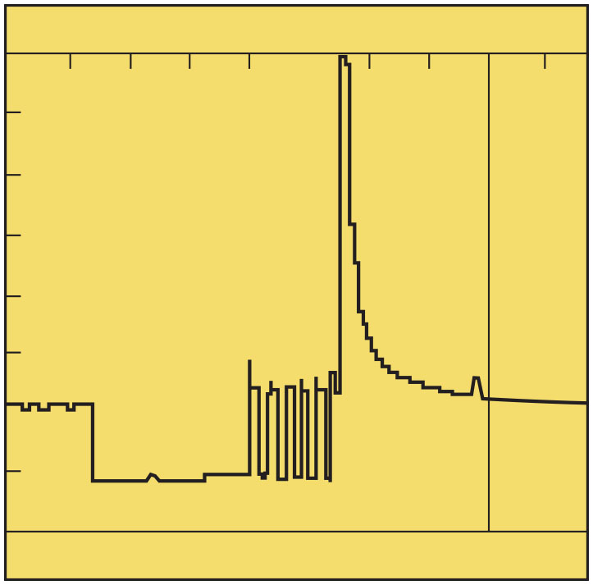
Figure 38.13
P W M Waveform
A waveform of a pulse-width modulated fuel injector. At the end, when the voltage is removed, there is an inductive spike created similar to the spike created but other types of injectors.

Slide 29
Frequently Asked Question: If 3 of 6 Injectors Are Defective, Should I Also Replace the Other 3?
? Frequently Asked Question
If Three of Six Injectors Are Defective, Should I Also Replace the Other Three? Many service technicians “recommend” that the three good injectors be replaced along with the other three that tested as being defective. The reasons given by these technicians include the following: All six injectors have been operating under the same fuel, engine, and weather conditions. The labor required to replace all six is just about the same as replacing only the three defective injectors. Replacing all six at the same time helps ensure that all of the injectors are flowing the same amount of fuel so that the engine is operating most efficiently. With these ideas in mind, the customer should be informed and offered the choice. Complete sets of injectors, such as those in Figure 38.14 can be purchased at a reasonable cost.

Slide 30
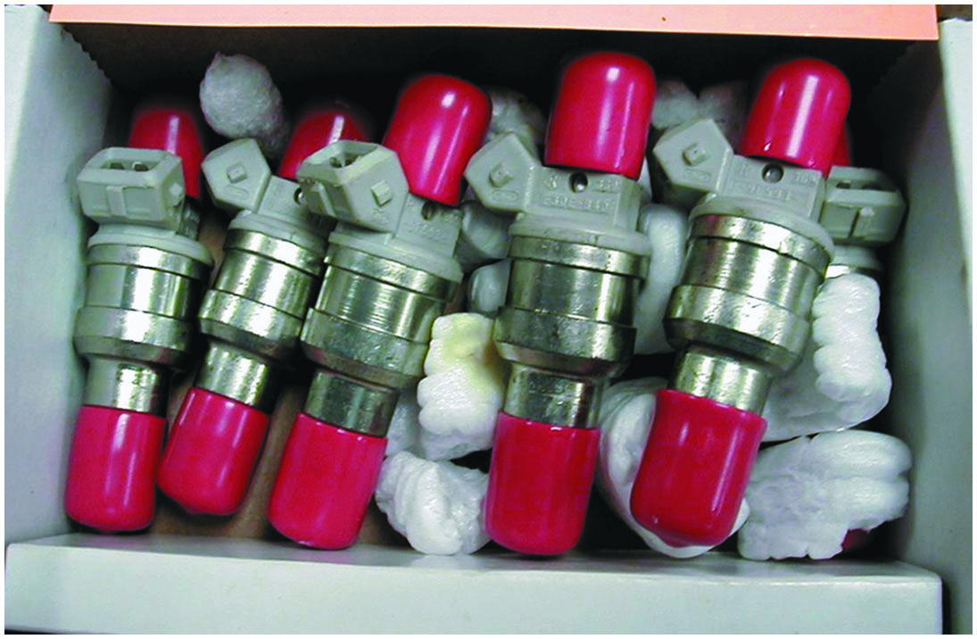
Figure 38.14
Reconditioned Injectors
A set of six reconditioned injectors. The sixth injector is barely visible at the far right.

Slide 31
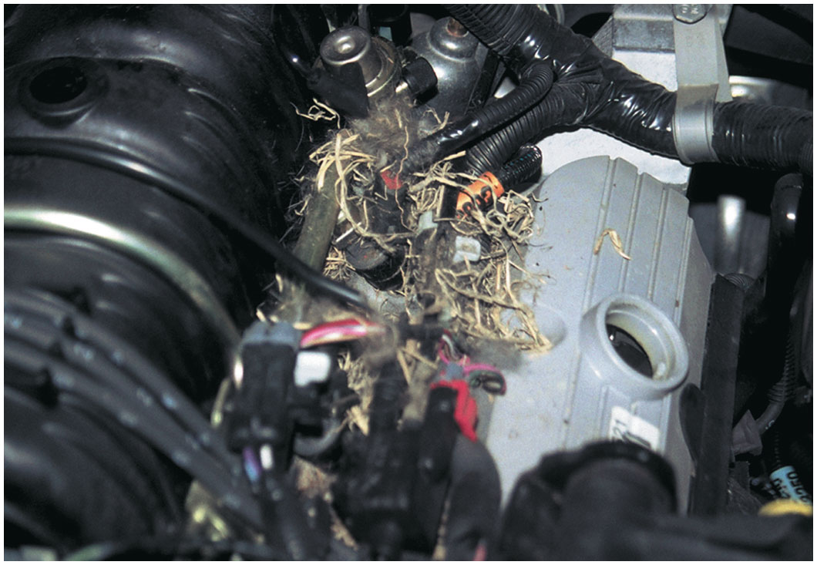
Figure 38.15
Harness Damage
When the cover is removed from the top of the engine, a mouse or some other animal nest is visible. The animal had already eaten through a couple of injector wires. At least the cause of the intermittent misfire was discovered.
Notes:
CASE STUDY: There Is No Substitute for a Thorough Visual Inspection
An intermittent “check engine” light and a random-misfire diagnostic trouble code (D T C) P0300 was being diagnosed. A scan tool did not provide any help because all systems seemed to be functioning normally. Finally, the technician removed the engine cover and discovered a mouse nest. • See Figure 38.15.
Summary:
Complaint—Customer stated that the “Check Engine” light was on.
Cause—Stored P0300 DTC was stored indicating a random misfire had been detected caused by an animal that had partially eaten some fuel-injector wires.
Correction—The mouse nest was removed and the wiring was repaired.

Slide 32
Question 2
How can an injector be tested?

Slide 33
Answer 2
With a multimeter, a scan tool, pressure gauge, or an oscilloscope.

Slide 34
Fuel-Injection Service
Check fuel-pump operating pressure and volume.
Test the fuel-pressure regulator for operation and leakage.
Flush the entire fuel rail and upper fuel-injector screens, including the fuel-pressure regulator.
Decarbon the engine assembly.
Clean the throttle plate and idle air control passages.
Relearn the onboard computer.

Slide 35
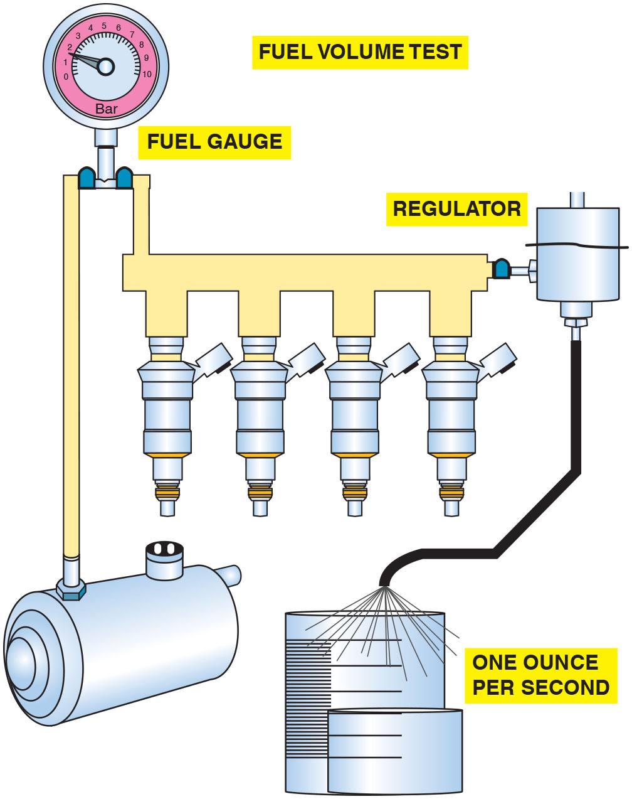
Figure 38.16
Fuel-Pump Volume
Checking fuel-pump volume using a hose from the outlet of the fuel-pressure regulator into a calibrated container.

Slide 36
Idle Air Speed Control Diagnosis
An electronic stepper motor or pulse-width-modulated solenoid is used to maintain the correct idle speed.
When the engine stops, most I A C units retract outward to get ready for the next engine start.
As the engine gets warmer, the computer reduces engine idle speed gradually by reducing the number of counts or steps commanded by the I A C.
If the engine speed does not flare at start, then the I A C may not be working (it may be stuck in one position).

Slide 37
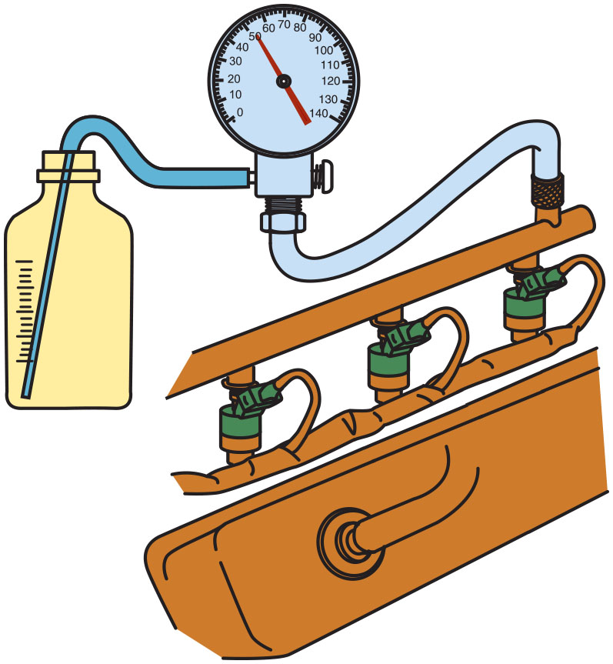
Figure 38.17
Fuel-Pump Volume Test
Testing fuel-pump volume using a fuel-pressure gauge with a bleed hose inserted into a suitable container. The engine is running during this test.

Slide 38
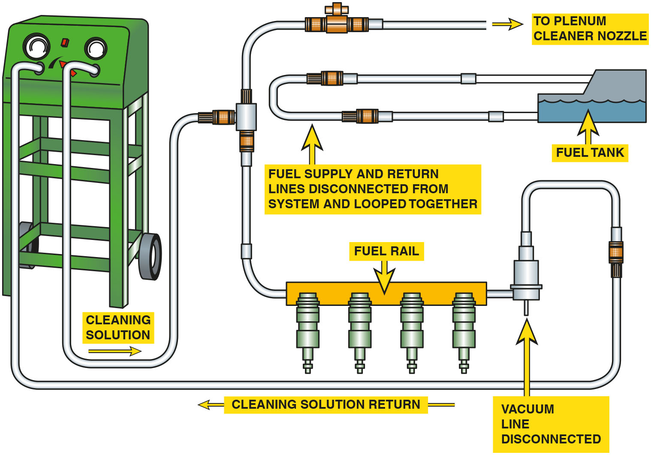
Figure 38.18
Cleaning Machine
A typical two-line cleaning machine hookup, showing an extension hose that can be used to squirt a cleaning solution into the throttle body while the engine is running on the cleaning solution and gasoline mixture.
Notes:
Long Description:
It shows the following components: cleaning solution from the cleaning machine passes through a pipe to the fuel rail and plenum cleaner nozzle. The furl rail connects back to the cleaning machine and provides the return for cleaning solution. The fuel and supply lines from the fuel tank are disconnected and looped together. The vacuum line from the fuel line is disconnected.

Slide 39
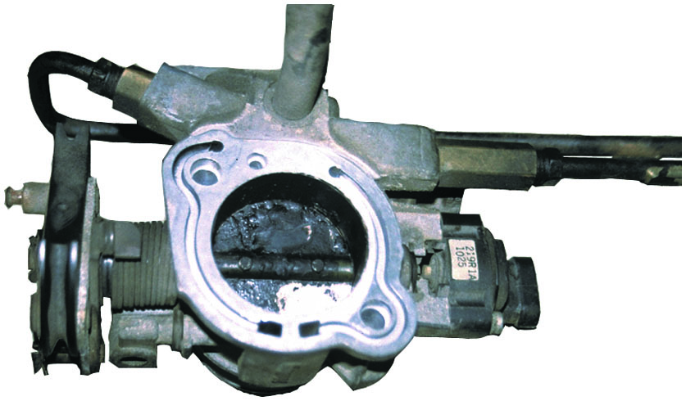
Figure 38.19
Removed Throttle Body
To thoroughly clean a throttle body, it is sometimes best to remove it from the vehicle. The throttle plate may need to be cleaned if the engine tends to stall, hesitate or has a rough idle.

Slide 40
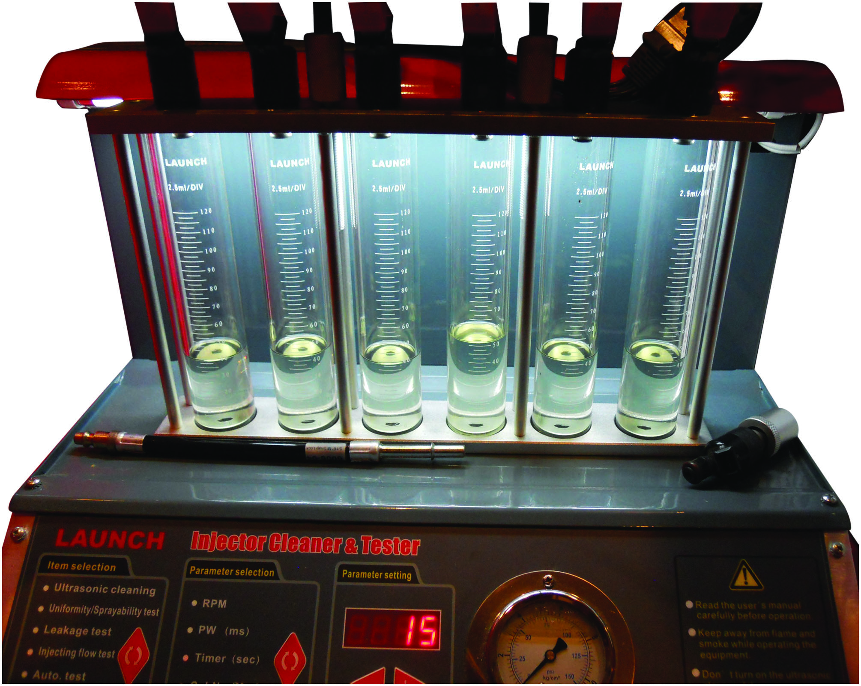
Figure 38.20
Injector Volume
The amount each injector is able to flow is displayed in glass cylinders are each injector for a quick visual check.
Notes:
TECH TIP: Use an Injector Tester
The best way to check injectors is to remove them all from the engine and test them using an injector tester. A typical injector tester uses a special nonflammable test fluid that has the same viscosity as gasoline. The tester pulses the injectors, and the amount of fuel delivered, as well as the spray pattern can be seen. Many testers are capable of varying the frequency of the pulse, as well as the duration that helps find intermittent injector faults. • See Figure 38.20.

Slide 41
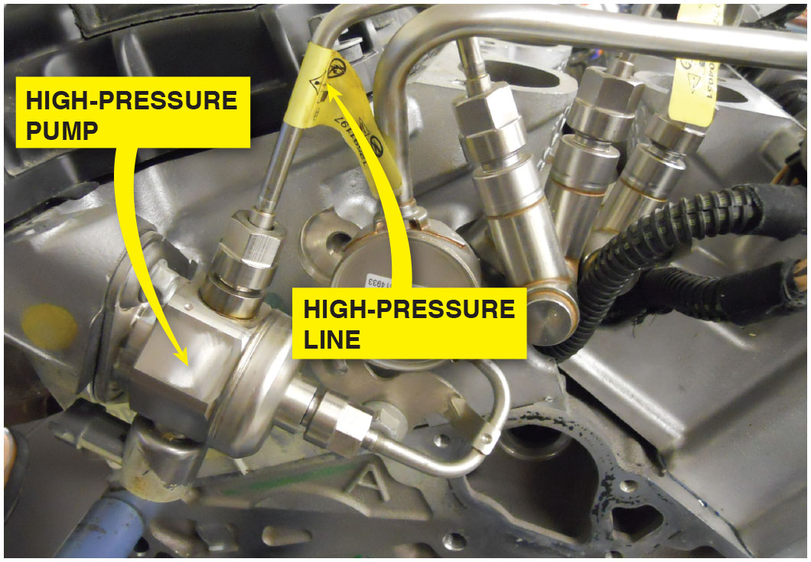
Figure 38.21
Line Identification
The line that has the yellow tag is a high-pressure line and this line must be replaced with a new part if removed even for a few minutes to gain access to another part.
Notes:
WARNING: Before opening any part of the high-pressure section of a gasoline direct injection (G D I ) system,
the pressure must be bled off. The high pressures of this fuel system can cause injury or death. If any of the high-pressure lines are removed, even temporarily, they MUST be replaced because the ends use a ball-fitting that deforms to create the high-pressure seal. Once this seal has been opened, a new ball end must be used to insure a proper seal. • See Figure 38.21. Always check service information for the exact procedures to follow for the vehicle being serviced.

Slide 42
Question 3
Why do injectors need to be serviced?

Slide 43
Answer 3
To remove the accumulation of carbon and other additives that are restricting the fuel flow.

Slide 44
Fuel-System Scan Tool Diagnostics
By observing the long-term fuel trim and the short-term fuel trim, we can determine how the fuel system is performing.

Slide 45
Fuel-Pump Relay Circuit Diagnosis

Slide 46
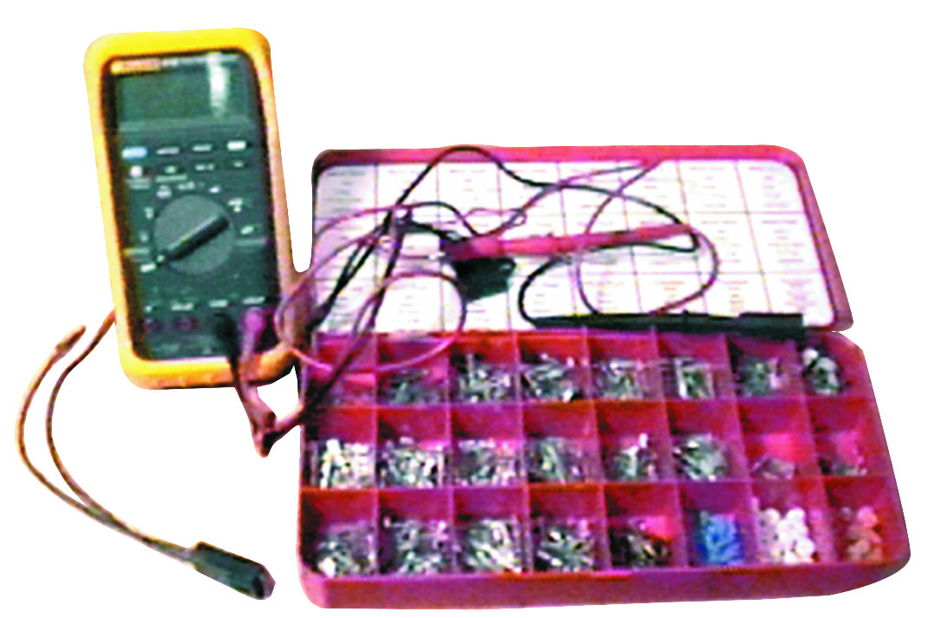
1. Tools
The tools needed to diagnose a circuit containing a relay include a digital multimeter (D M M), a fused jumper wire, and an assortment of wiring terminals.

Slide 47
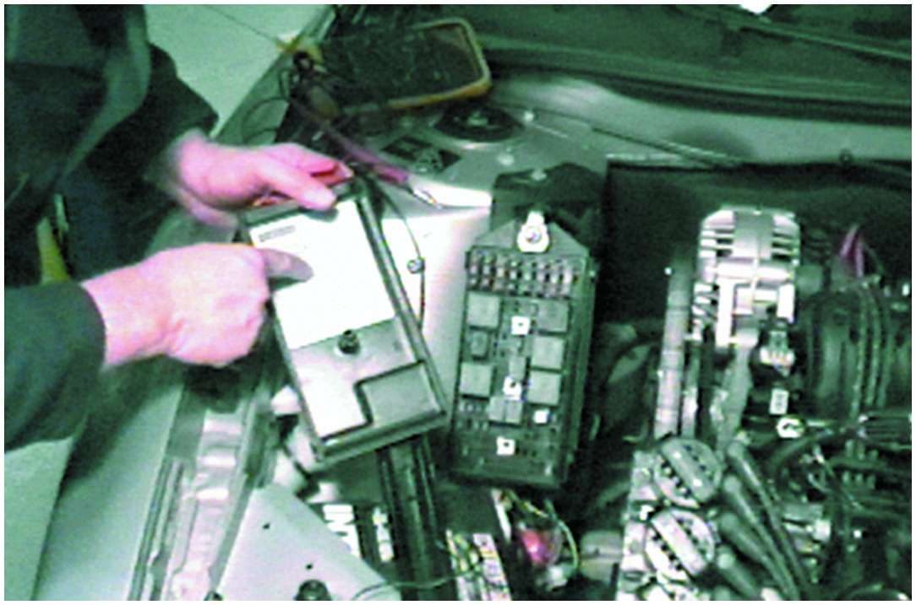
2. Relay Center
Start the diagnosis by locating the relay center. It is under the hood on this General Motors vehicle, so access is easy. Not all vehicles are this easy.

Slide 48
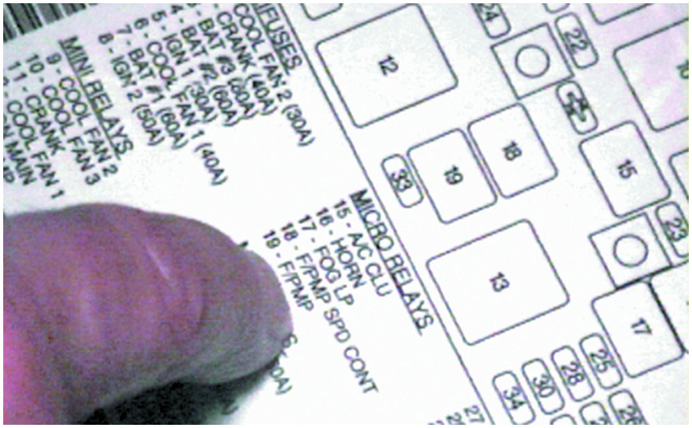
3. Relay Fuse Locations
The chart under the cover for the relay center indicates the location of the relay that controls the electric fuel pump.

Slide 49
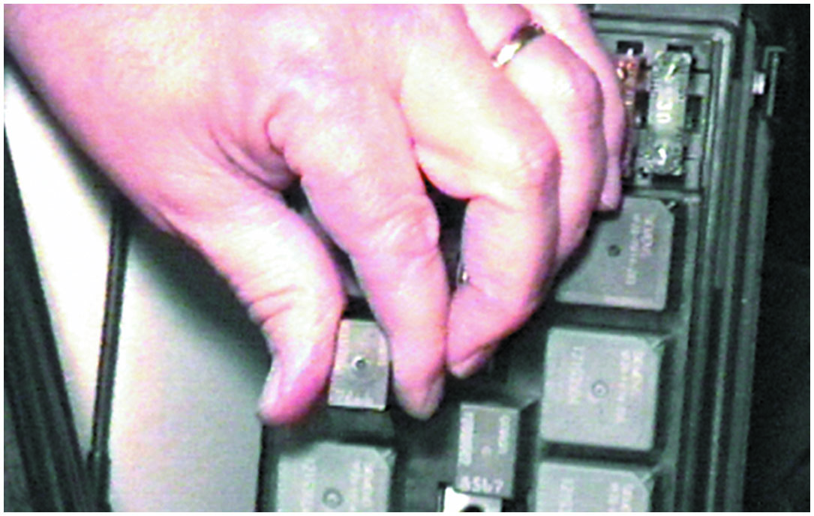
4. Pump Relay
Locate the fuel-pump relay and remove it by using a puller if necessary. Try to avoid rocking or twisting the relay to prevent causing damage to the relay terminals or the relay itself.

Slide 50
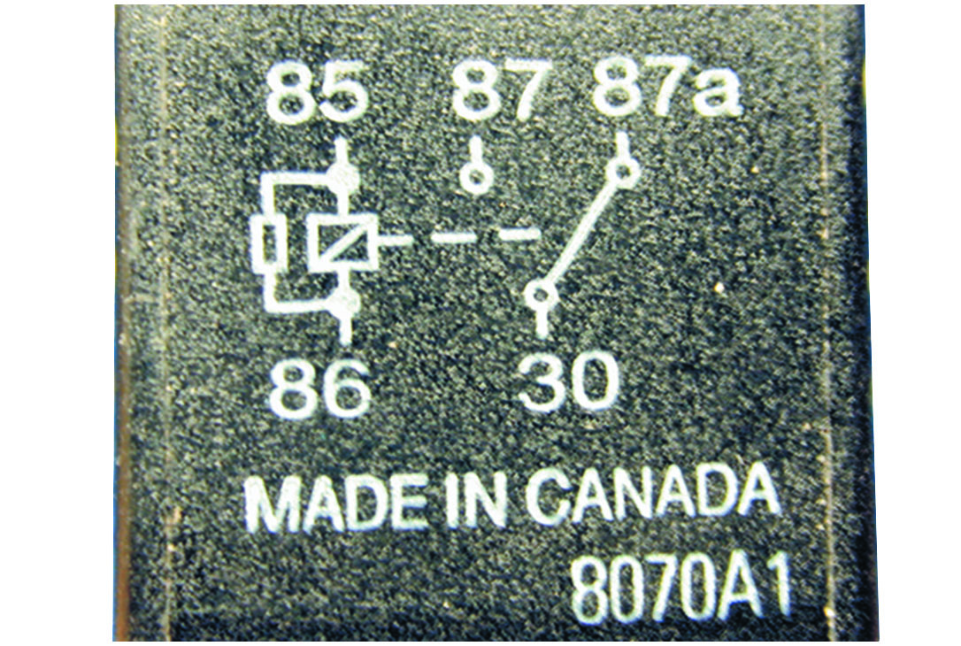
5. Terminals 85 and 86
Terminals 85 and 86 represent the coil inside the relay. Terminal 30 is the power terminal, 87a is the normally closed contact, and 87 is the normally open contact.

Slide 51
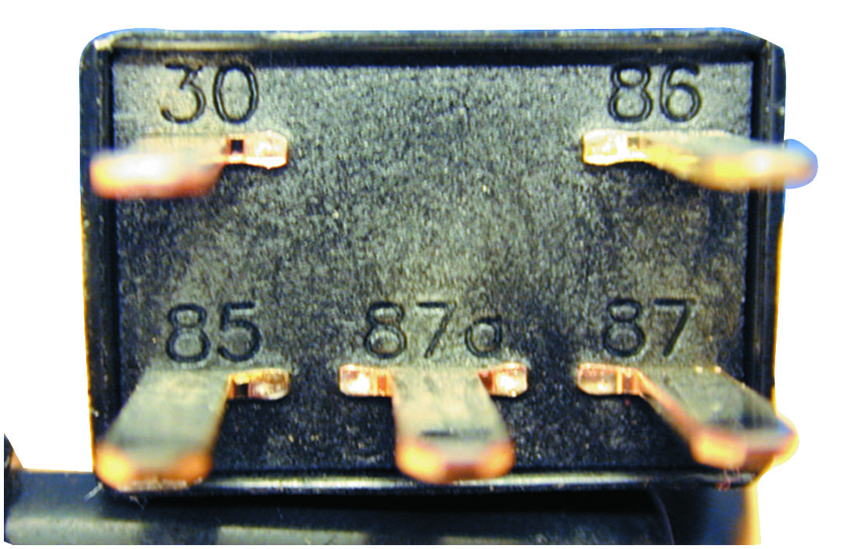
6. Terminals Labels on Relay
The terminals are also labeled on most relays.

Slide 52
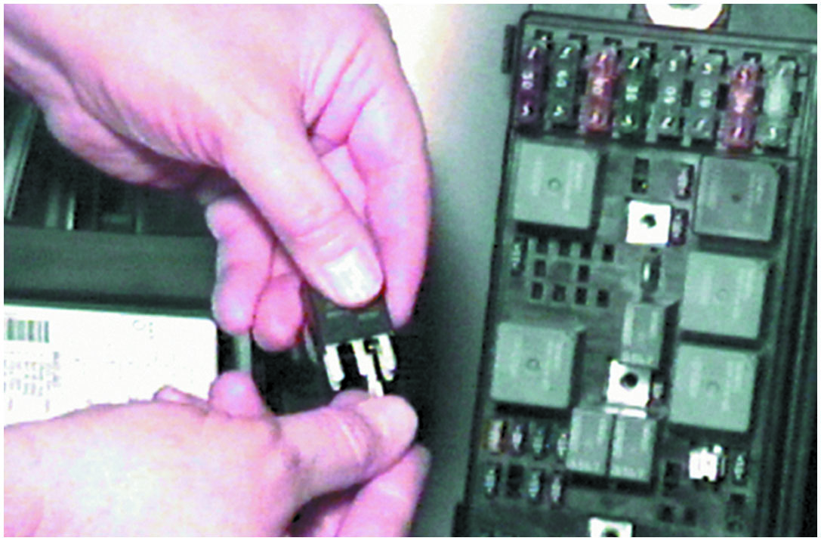
7. Select Right Terminal
To help make good electrical contact with the terminals without doing any harm, select the proper-size terminal from the terminal assortment.

Slide 53
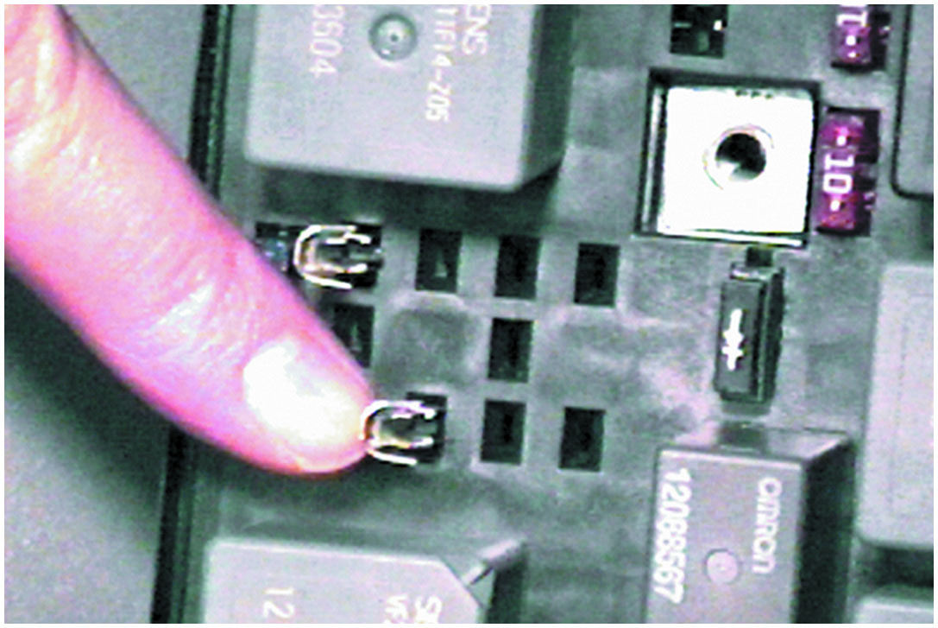
8. Insert Terminals
Insert the terminals into the relay socket in 30 and 87.

Slide 54
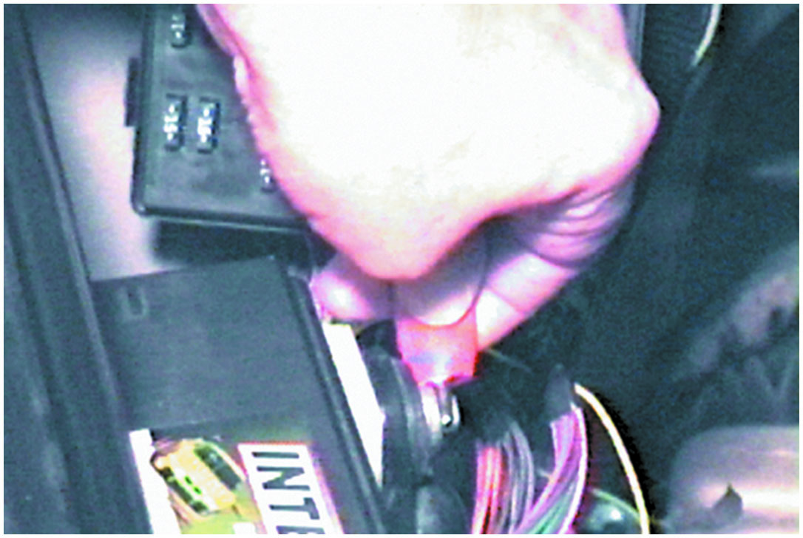
9. Voltage Check
To check for voltage at terminal 30, use a test light or a voltmeter. Start by connecting the alligator clip of the test light to the positive (1) terminal of the battery.

Slide 55
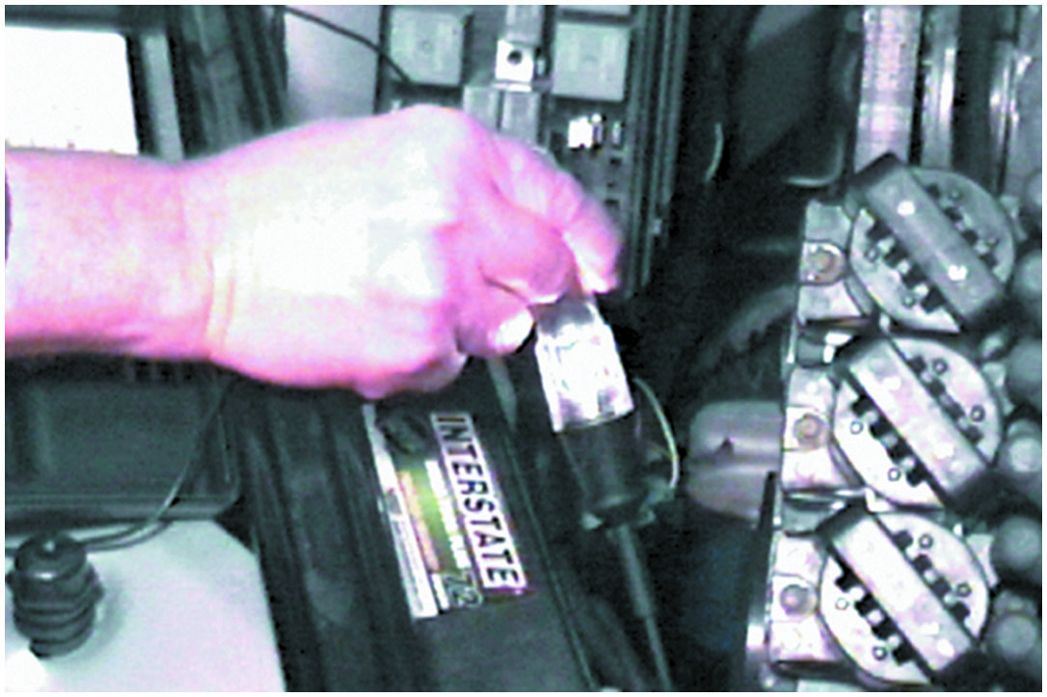
10. Test Light to Ground
Touch the test light to the negative (−) terminal of the battery or a good engine ground to check the test light.

Slide 56
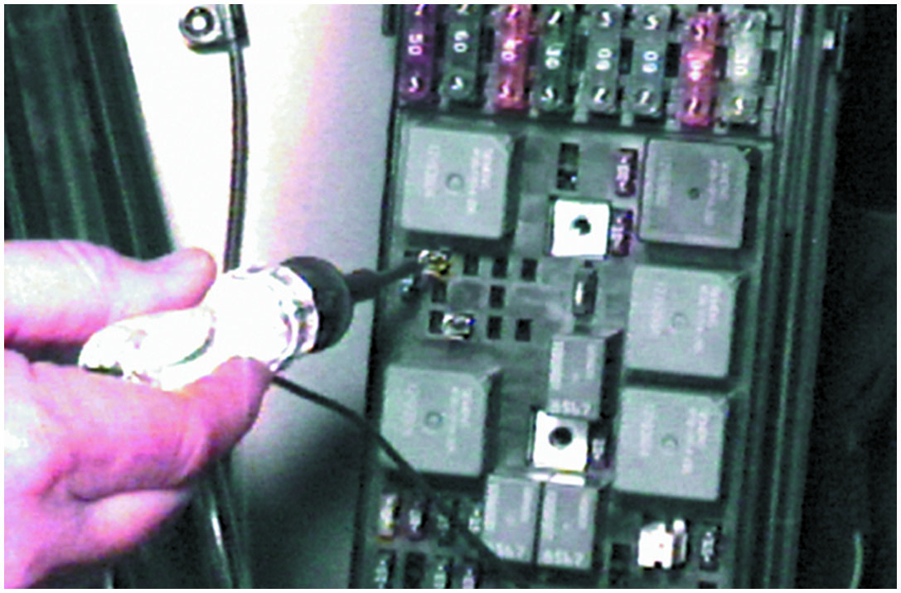
11. Voltage at Terminal 30
Use the test light to check for voltage at terminal 30 of the relay. The ignition may have to be in the on (run) position.

Slide 57
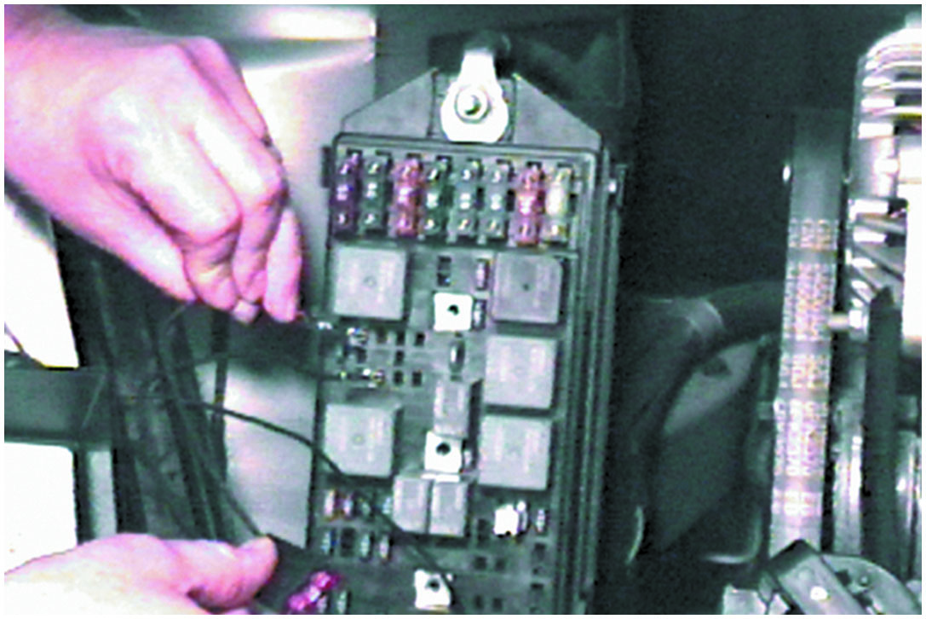
12. Jumper 30 to 87
To check to see if the electric fuel pump can be operated from the relay contacts, use a fused jumper wire and touch the relay contacts that correspond to terminals 30 and 87 of the relay.

Slide 58
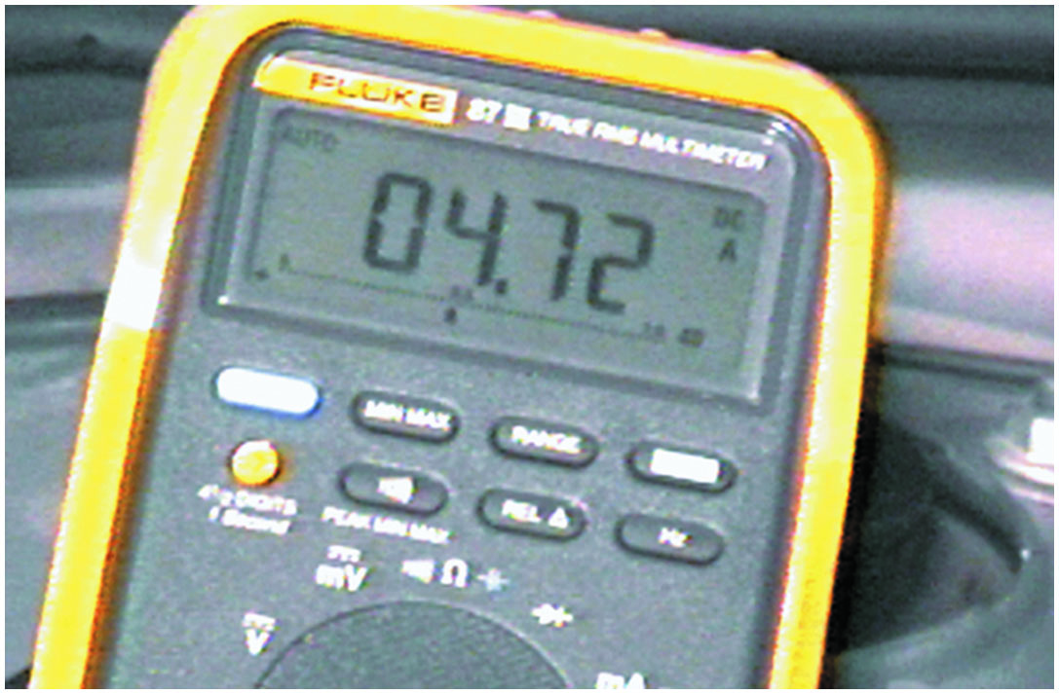
13. 4 to 8 Amperes
Connect the leads of the meter to contacts 30 and 87 of the relay socket. The reading of 4.7 amperes is okay because the specification is 4 to 8 amperes.

Slide 59
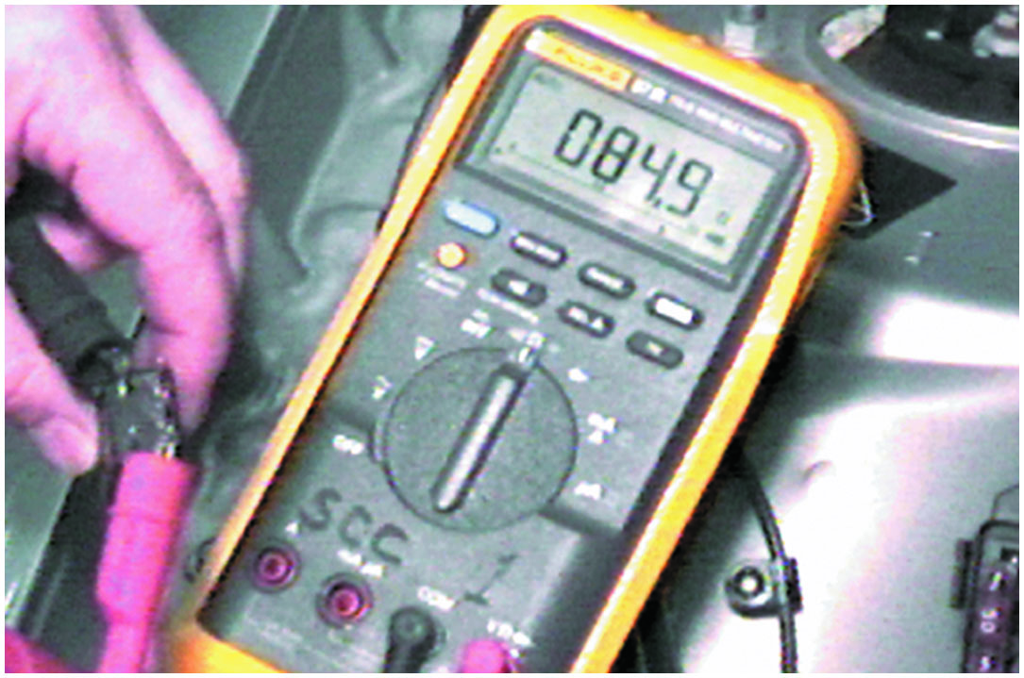
14. 60 to 100 Ohms
Set the meter to read ohms
and measure the
resistance of the relay coil. The usual reading for most relays is between 60 and 100 ohms.

Slide 60
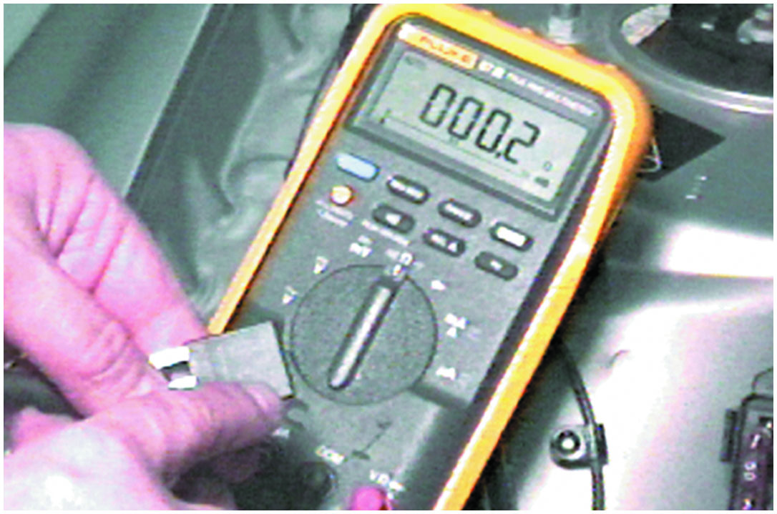
15. Measure Ohms 30 to 87a
Measure between terminal 30 and 87a. Terminal 87a is the normally closed contact, and there should be little, if any, resistance between these two terminals, as shown.

Slide 61
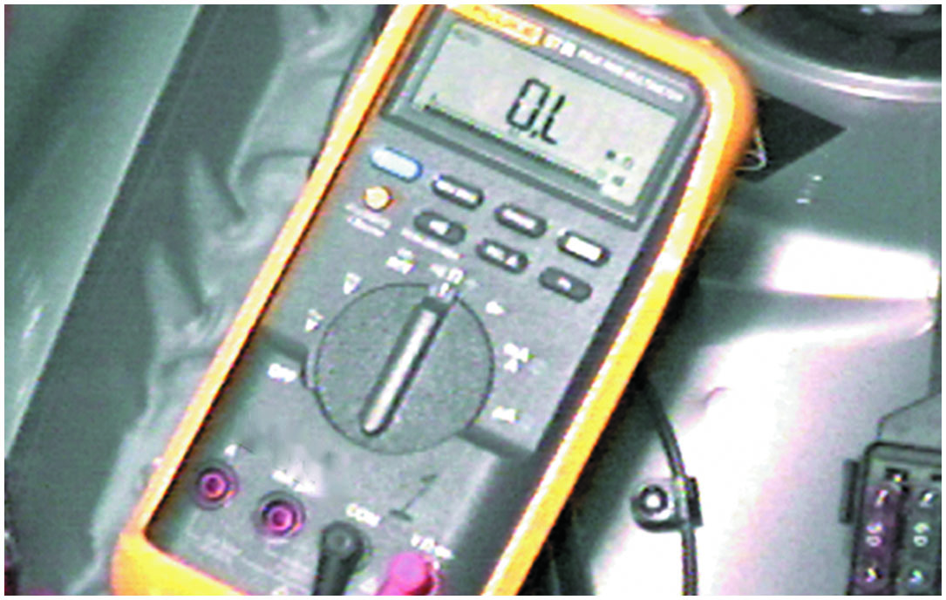
16. Should Show O L
To test the normally open contacts, connect one meter lead to terminal 30 and the other lead to terminal 87. The ohmmeter should show an open circuit by displaying O L.

Slide 62
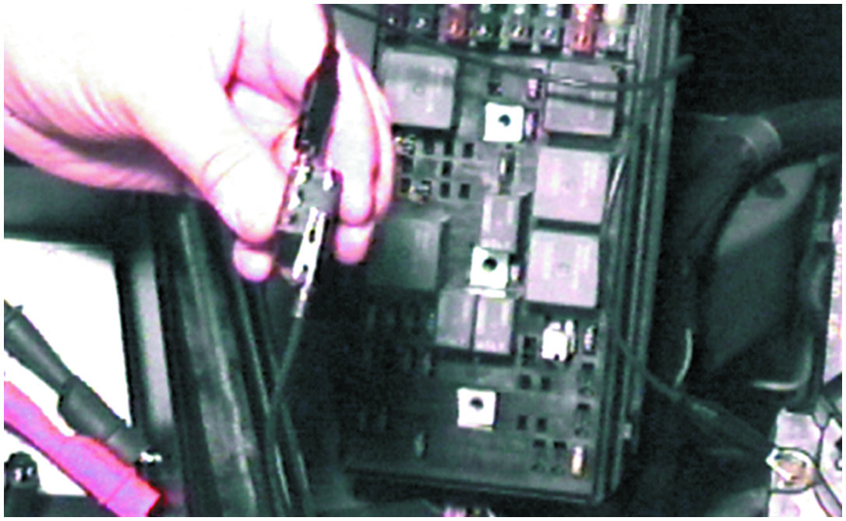
17. 12 Volts to 86, Ground 85
Connect a fused jumper wire to supply 12 volts to terminal 86 and a ground to terminal 85 of the relay. If the relay clicks, then the relay coil is able to move the armature (movable arm) of the relay.

Slide 63
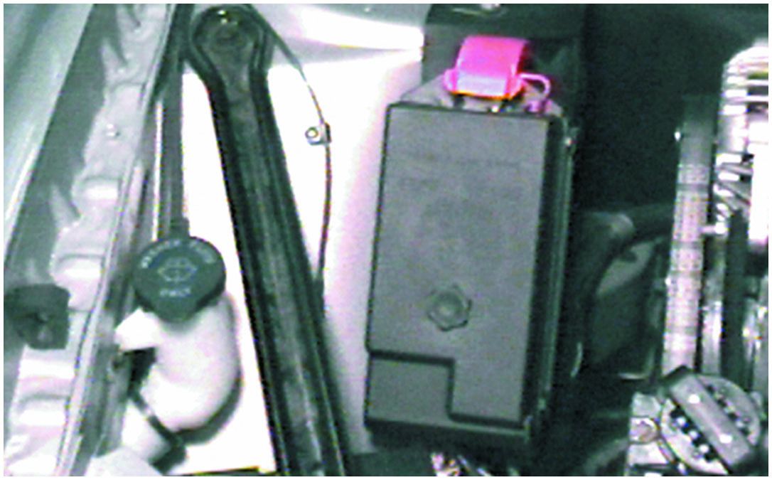
18. Install Relay Cover
After testing, be sure to reinstall the relay and the relay cover.

Slide 64
Fuel Injector Cleaning

Slide 65
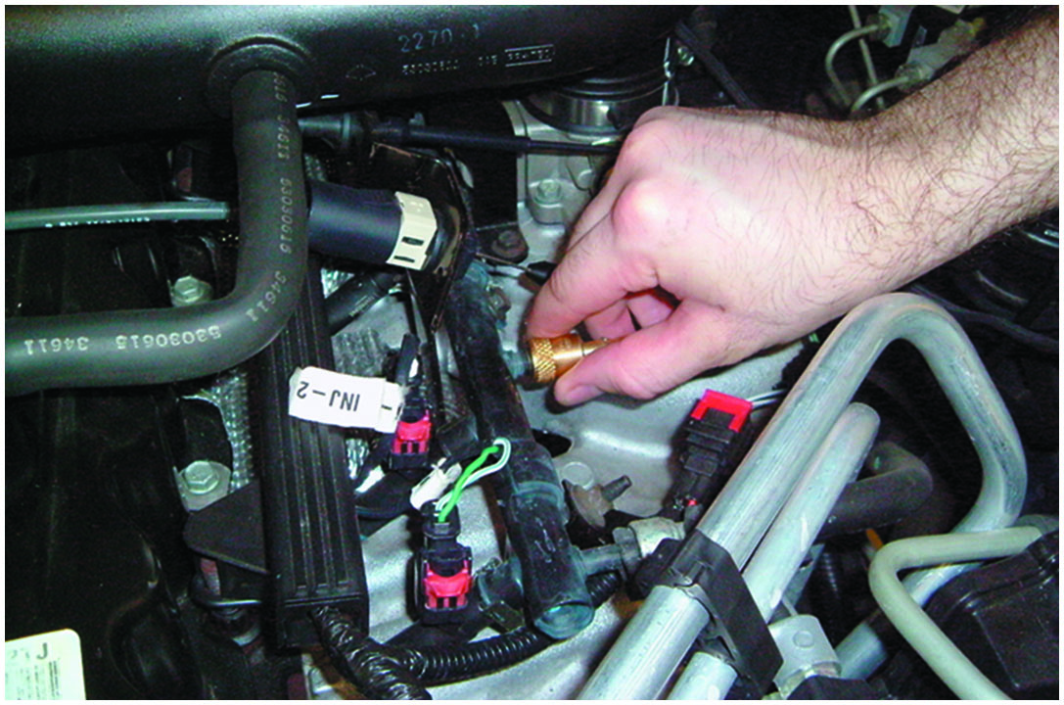
1. Operating Temperature
Start the fuel injector cleaning process by bringing the vehicle’s engine up to operating temperature. Shut off the engine, remove the cap from the fuel rail test port, and install the appropriate adapter.

Slide 66
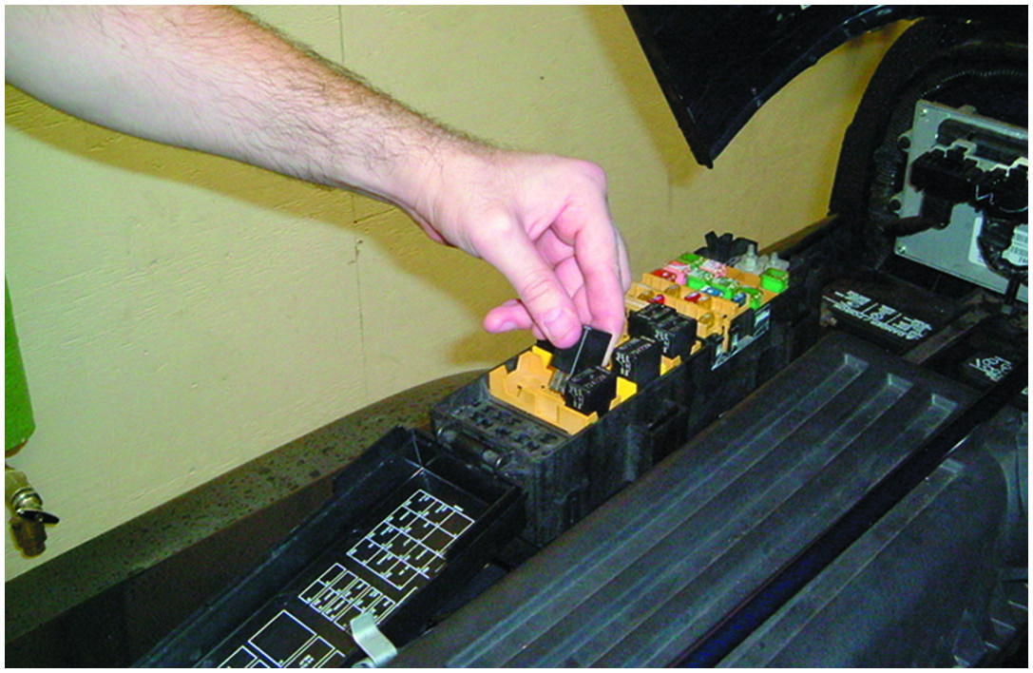
2. Disable Fuel Pump
The vehicle’s fuel pump is disabled by removing its relay or fuse. In some cases, it may be necessary to disconnect the fuel pump at the tank if the relay or fuse powers more than just the pump.

Slide 67
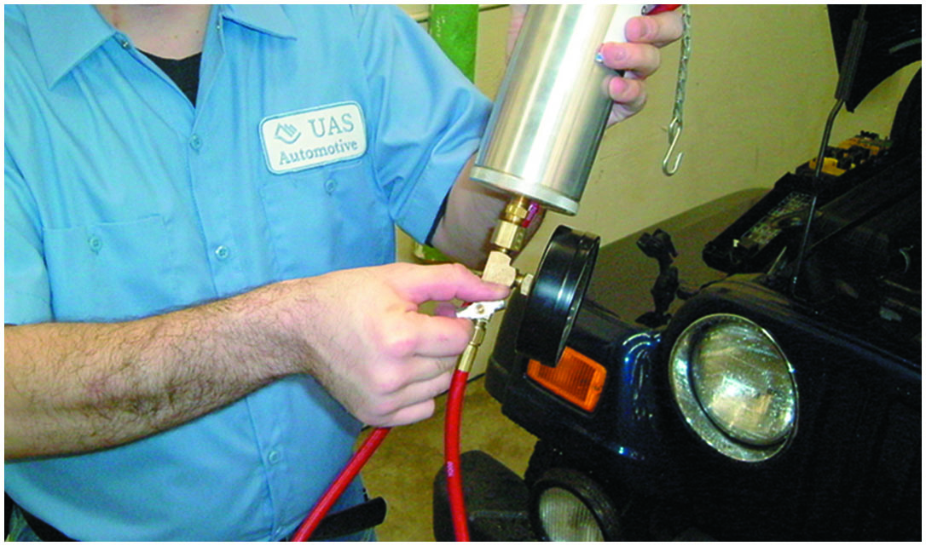
3. Outlet Valve Off
Turn the outlet valve of the canister to the OFF or CLOSED position.

Slide 68
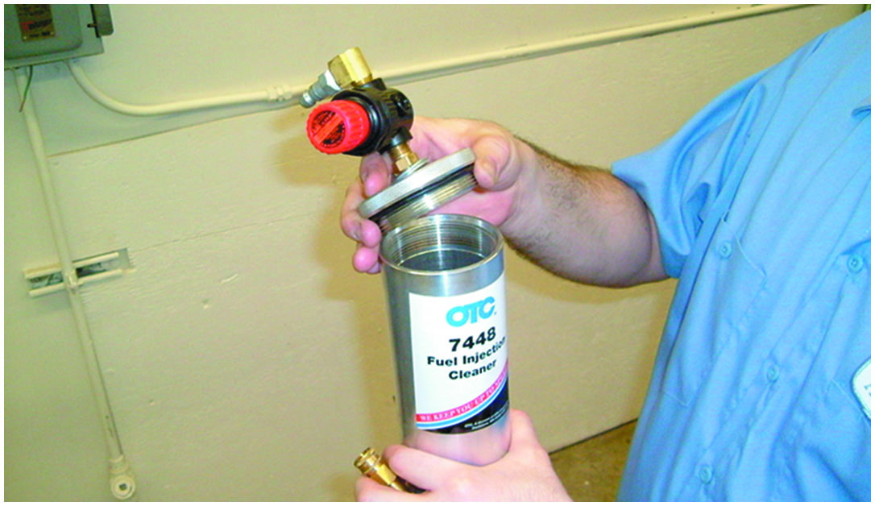
4. Remove Cleaner Top
Remove the fuel injector cleaning canister’s top and regulator assembly. Note that there is an O-ring seal located here that must be in place for the canister’s top to seal properly.

Slide 69
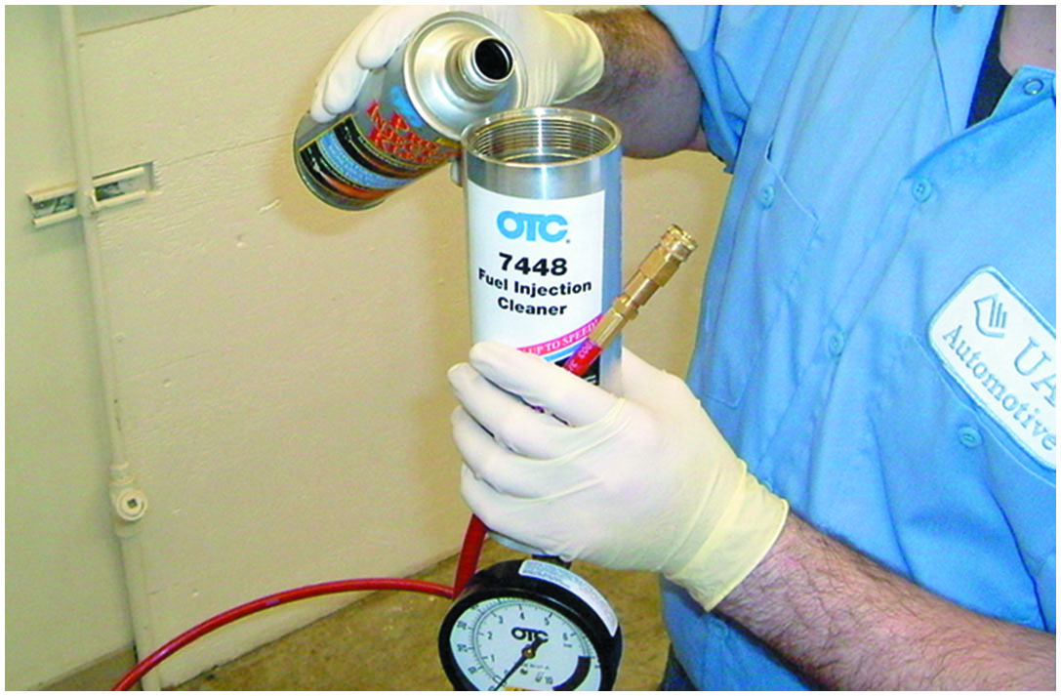
5. Pour in Cleaner
Pour the injection system cleaning fluid into the open canister. Rubber gloves are highly recommended for this step as the fluid is toxic.

Slide 70
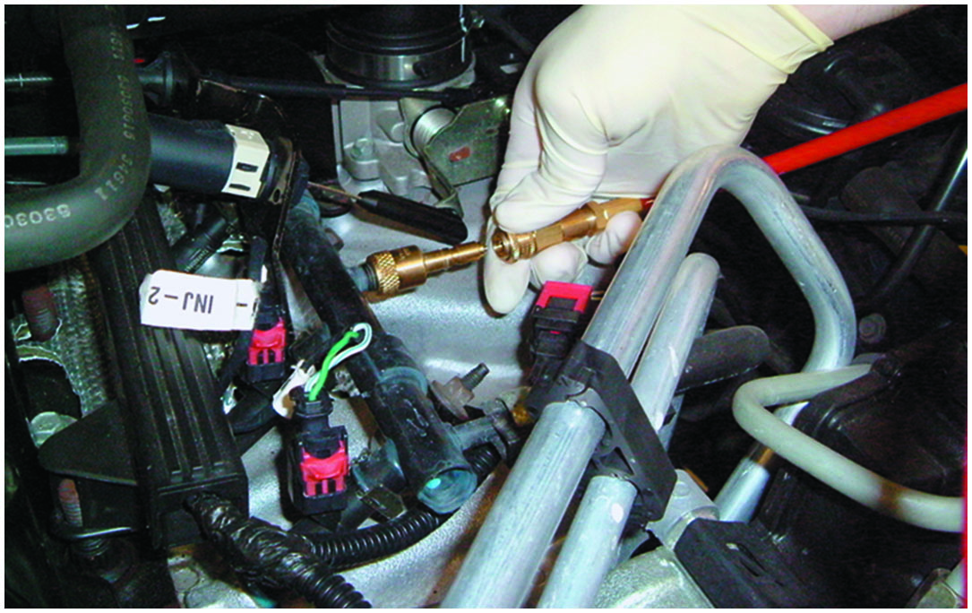
6. Connect Canister to Fuel Rail
Replace the canister’s top (making sure it is tight) and connect its hose to the fuel rail adapter. Be sure that the hose is routed away from exhaust manifolds and other hazards.

Slide 71
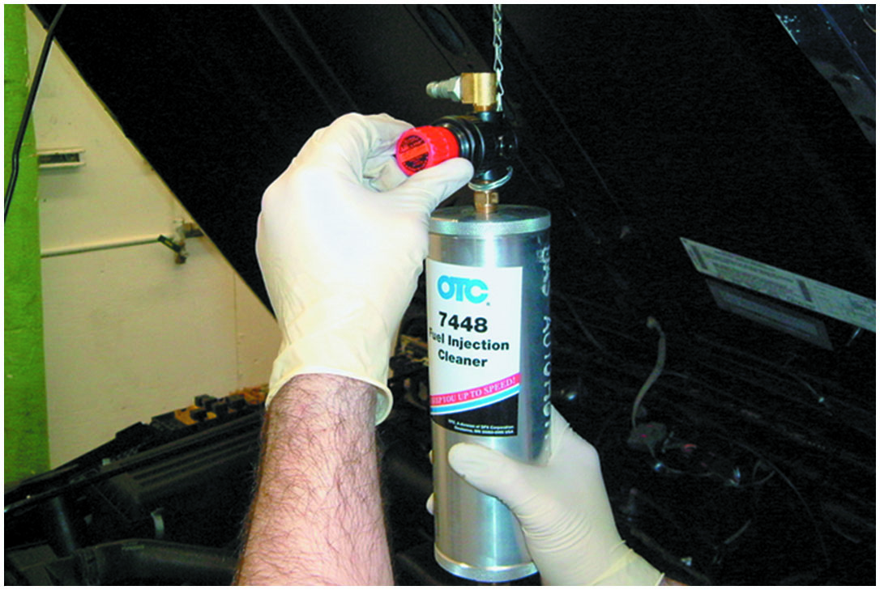
7. Adjust Air Pressure to Full Open
Hang the canister from the vehicle’s hood and adjust the air pressure regulator to full OPEN position (C C W).

Slide 72
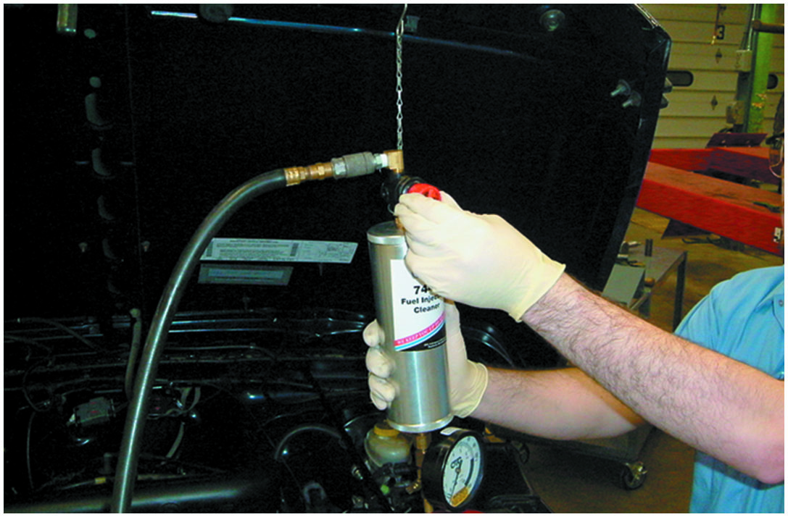
8. Connect Shop Air
Connect shop air to the canister and adjust the air pressure regulator to the desired setting. Canister pressure can be read directly from the gauge.

Slide 73
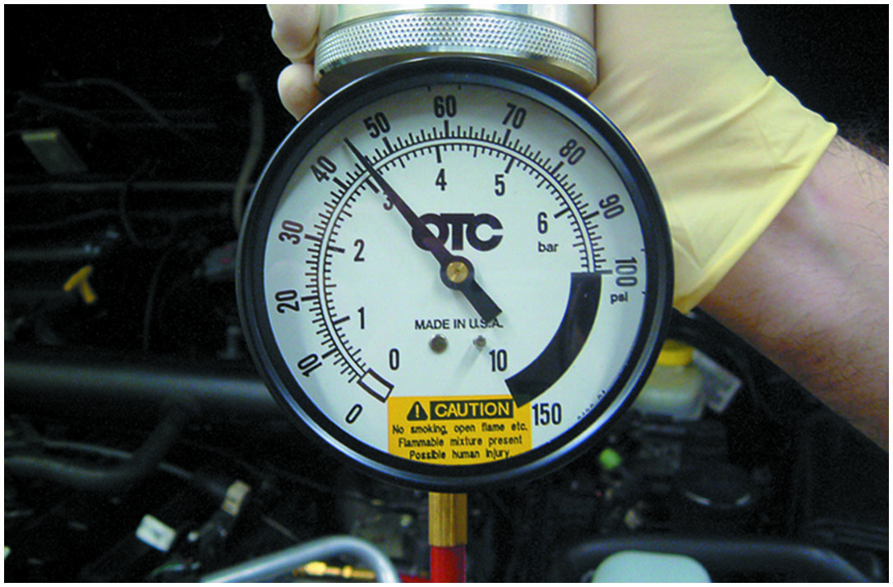
9. Pressure 5 P S I Below Fuel Pres.
Canister pressure should be adjusted to 5 P S I below system fuel pressure. An alternative for return-type systems is to block the fuel return line to the tank.

Slide 74
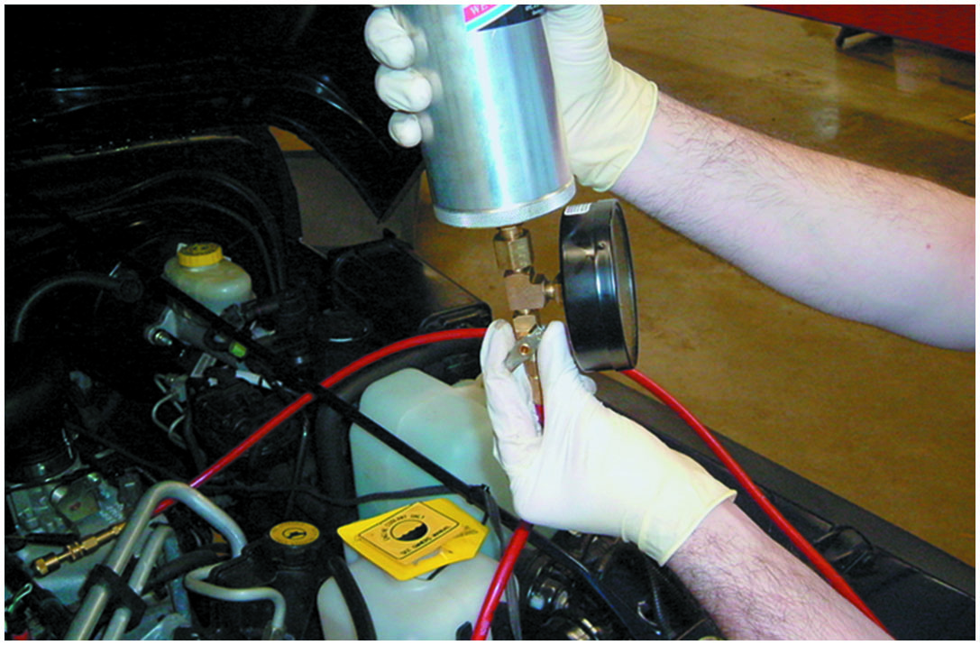
10. Open Outlet Valve
Open the outlet valve on the canister.

Slide 75
11. Run at 1,000 to 1,500 R P M
Start the vehicle’s engine and let run at 1,000–1,500 R P M. The engine is now running on fuel injector cleaning fluid provided by the canister.

Slide 76
12. Check for Leaks
Continue the process until the canister is empty and the engine stalls. Remove the cleaning equipment, enable the vehicle’s fuel pump, and run the engine to check for leaks.

Slide 77
Summary
A typical port fuel-injection system uses an individual fuel injector for each cylinder and squirts fuel directly into the intake manifold about 3 inches (80 mm) from the intake valve.
A typical fuel-injection system fuel pressure should not drop more than 20 P S I in 20 minutes.
A noid light can be used to check for the presence of an injector pulse.
Injectors can be tested for resistance and should be within 0.3 to 0.4 ohms of each other.
Different designs of injectors have a different scope waveform, depending on how the computer pulses the injector on and off.
An idle air control unit controls idle speed and can be tested for proper operation using a scan tool or scope.

Slide 78
Animations and Video Links (Halderman website subscription and web access needed to view)
(A8) Engine Performance Animations
(A8) Engine Performance Videos

Slide 79
Copyright
This work is protected by United States copyright laws and is provided solely for the use of instructors in teaching their courses and assessing student learning. Dissemination or sale of any part of this work (including on the World Wide Web) will destroy the integrity of the work and is not permitted. The work and materials from it should never be made available to students except by instructors using the accompanying text in their classes. All recipients of this work are expected to abide by these restrictions and to honor the intended pedagogical purposes and the needs of other instructors who rely on these materials.

