Slide 1
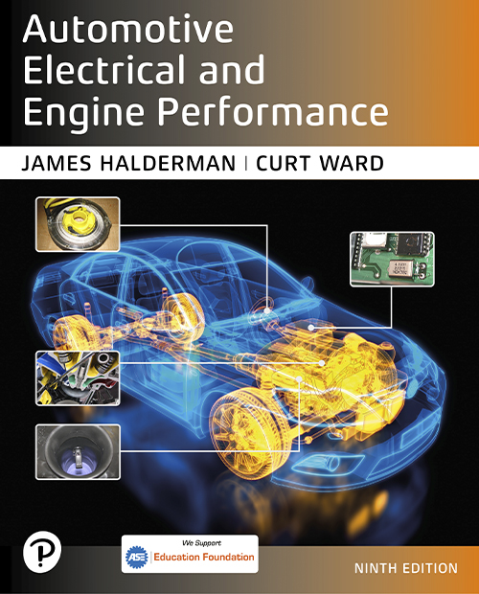
Automotive Electrical and Engine Performance
Ninth Edition
Chapter 37
Electronic Throttle Control System
Copyright © 2025 Pearson Education, Inc. All Rights Reserved
Notes:
If this PowerPoint presentation contains mathematical equations, you may need to check that your computer has the following installed:
1) Math Type Plugin
2) Math Player (free versions available)
3) NVDA Reader (free versions available)
INSTRUCTOR NOTE: This presentation includes text explanation notes, you can use to teach the course. When in SLIDE SHOW mode, you RIGHT CLICK and select SHOW PRESENTER VIEW, to use the notes.

Slide 2
Learning Objectives
37.1 Describe electronic throttle control systems.
37.2 Explain how an electronic throttle control system works.
37.3 Describe the A P P sensor.
37.4 Describe the throttle body assembly.
37.5 Describe T P sensors.
37.6 Describe how to diagnose faults in an electronic throttle control system.
37.7 Explain how to service an electronic throttle system.

Slide 3
Electronic Throttle Control (E T C) System
Advantages of E T C
Eliminates mechanical throttle cable.
Eliminates need for cruise control actuators and controllers.
Helps reduce engine power for traction control (T C) and electronic stability control (E S C) systems.
Eliminates need for an idle air control valve.
Parts Involved
Accelerator pedal position sensor (A P P S), throttle position sensor (T P S), servo motor, and control unit.

Slide 4
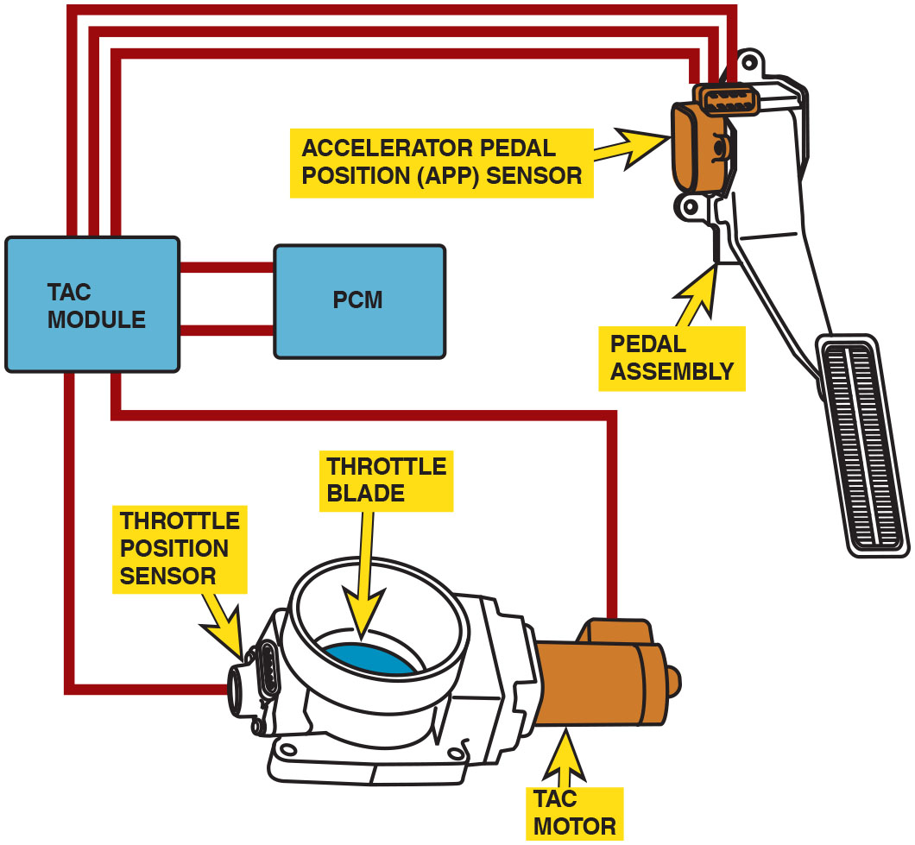
Figure 37.1
E T C
The throttle pedal is connected to the A P P sensor. The electronic throttle body includes a throttle position sensor to provide throttle angle feedback to the vehicle computer. Some systems use a throttle actuator control (T A C) module to operate the throttle blade (plate).
Notes:
Long Description:
The electronic throttle body consists of a throttle blade that runs by a motor and contains a throttle position sensor. The throttle body is connected to the accelerating pedal position sensor and a pedal assembly through a T A C module, which is in turn connected to a P C M.

Slide 5
Question 1
What parts can be deleted if an engine uses an electronic throttle control (E T C) system instead of a conventional accelerator pedal and cable to operate the throttle valve?

Slide 6
Answer 1
Accelerator cable, cruise actuator, idle air control valve.

Slide 7
Normal Operation of E T C System
These normal conditions include the following:
The engine may not increase above idle speed when depressing the accelerator pedal when the gear selector is in P A R K or N E U T R A L.
While accelerating rapidly, there is often a slight delay before the engine responds.
While at cruise speed, the accelerator pedal may or may not cause the engine speed to increase if the accelerator pedal is moved slightly.

Slide 8
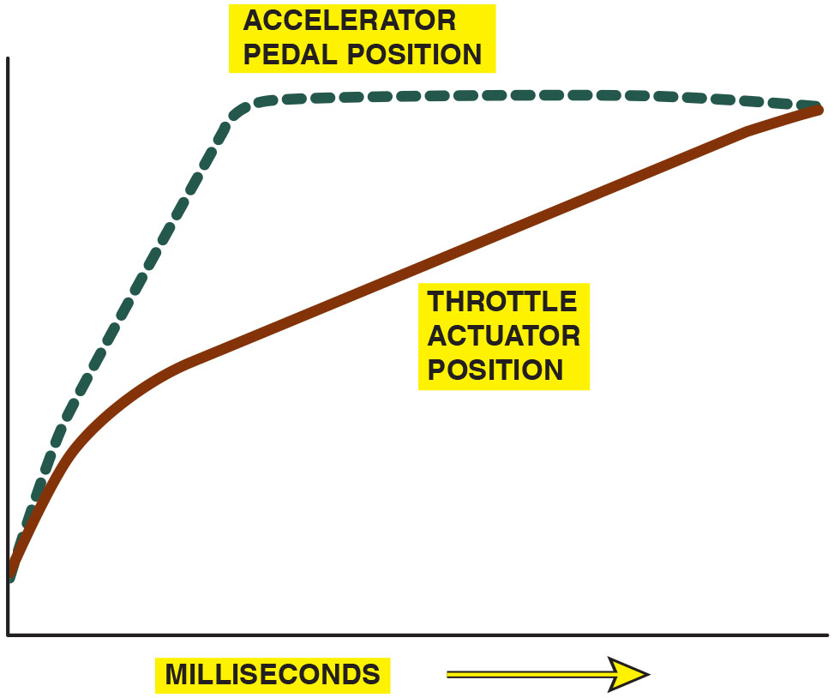
Figure 37.2
Throttle Valve Opening
The opening of the throttle plate can be delayed as long as 30 milliseconds
sec) to allow time
for the amount of fuel needed to catch up to the opening of the throttle plate.
Notes:
Long Description:
The curves for accelerator pedal position and throttle actuator position follow and upward sloping curve. The curve for throttle actuator position lies below the curve accelerator pedal position curve.

Slide 9
Accelerator Pedal Position Sensor
Cable-Operated System
Uses a cable attached to the accelerator pedal to operate the A P P sensor located under the hood.
Two Sensors
The accelerator pedal position sensor (on pedal assembly) uses two sometimes three separate sensors, which act together to give accurate accelerator pedal position information to the controller, but also are used to check that the sensor is working properly.

Slide 10
Frequently Asked Question: What Is Meant By “Pumping Losses?”
? Frequently Asked Question
What Is Meant By “Pumping Losses?” Pumping loss in an internal combustion engine that has a throttle body to control the speed of engine by controlling the amount of air delivered to the cylinders. The engine is an air pump, so by limiting the air flow with the throttle plate, the engine must work harder. When at idle or part load, the plate is almost closed, and vacuum (negative pressure) is built in the intake manifold, so the pressure above the piston on the intake stroke is very low usually below 10 p s i. The smaller the throttle opening the lower the manifold pressure, the greater the pumping loss. • See Figure 37.3. Electronic throttle control system is used to reduce pumping losses by opening the throttle and at the same time the P C M is controlling engine speed by: Adjusting the variable valve timing, Commanding more E G R, Reducing ignition timing.

Slide 11
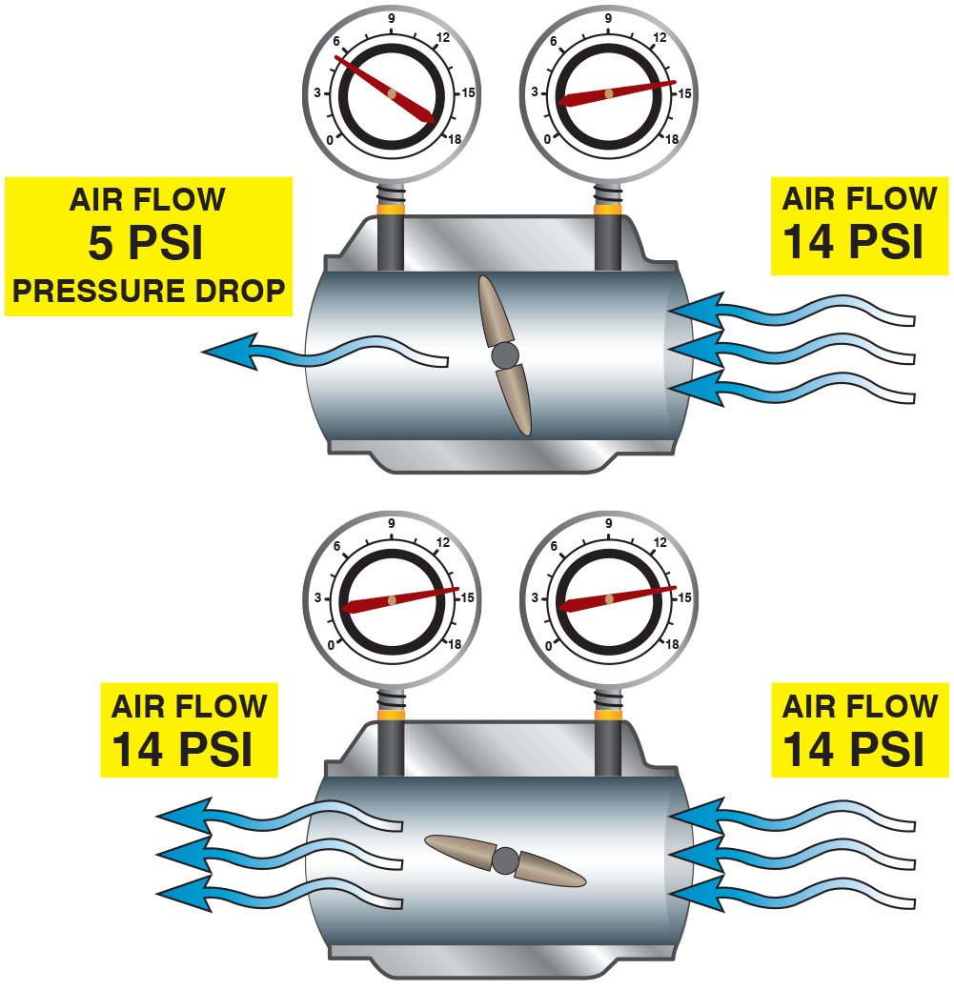
Figure 37.3
Pumping Losses
The gauges show the differences in pumping losses with the upper figure without E T C and the lower figure with E C T.
Notes:
Long Description:
In the first measurement, air flow is 14 P S I at the inlet and air flow is 5 P S I pressure drop at the outlet. The knob is tilted slightly to the left. In the second measurement, air flow is 14 P S I at the inlet and it is the same at the outlet. The knob is titled such that the left is slightly up and the right is slightly down, which are both slightly away from the horizontal position.

Slide 12
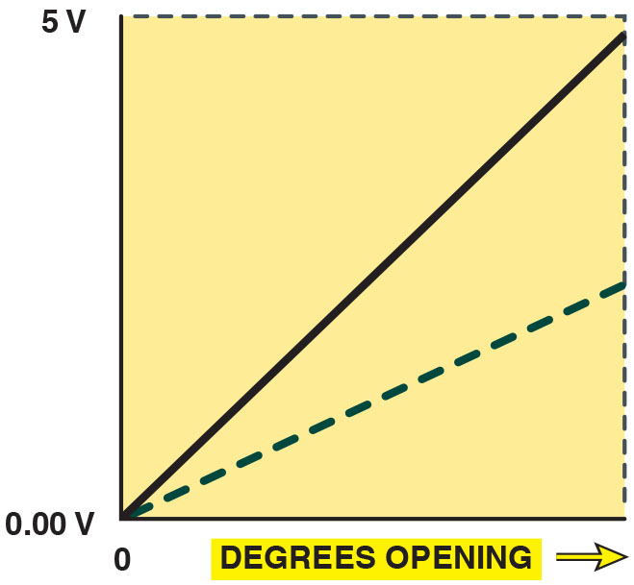
Figure 37.4
A P P Sensor
A typical A P P sensor, showing two different output voltage signals that are used by the P C M to determine accelerator pedal position. Two (or three in some applications) are used as a double check because this is a safety-related sensor.
Notes:
Long Description:
The graph depicts voltage on the vertical axis from 0 to 5 volts and degrees of opening on the horizontal axis. The curve for one of the output signal follows an upward-sloping line from 0 to 5 volts. The curve for the second output signal follows an upward-sloping line from 0 to 2 volts.

Slide 13
Throttle Body Assembly
Throttle Plate and Spring
Throttle plate held slightly open by a concentric clock spring.
Electronic Throttle Body Motor
Throttle plate held slightly open by a concentric clock spring.
Throttle plate motor driven by a bidirectional pulse-width modulated (P W M) signal from P C M or electronic throttle control module using H-bridge circuit.

Slide 14
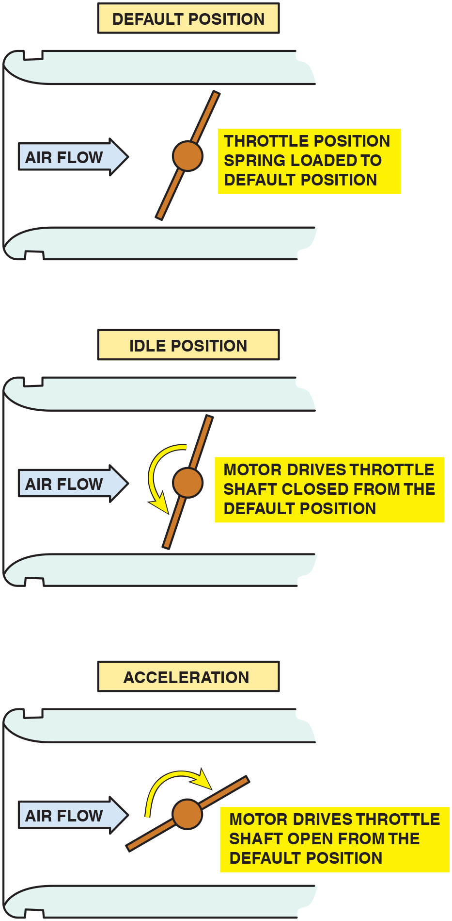
Figure 37.5
Throttle Positions
The default position for the throttle plate is in slightly open position. The servomotor then is used to close it for idle and open it during acceleration.
Notes:
Long Description:
Default position: The spring-loaded position is in the default position. Idle position: Throttle shaft is closed from the default position. Acceleration: Throttle shaft is open from the default position and rotates in clockwise direction.

Slide 15
Animation: Electronic Throttle Control

Slide 16
Frequently Asked Question: What Is the “Spring Test”?
? Frequently Asked Question
What Is the “Spring Test”? The spring test is a self-test performed by the P C M whenever the engine is started. The P C M operates the throttle to check if it can react to the command and return to the default (home) position. This self-test is used by the P C M to determine that the spring and motor are working correctly and may be noticed by some vehicle owners by the following factors: A slight delay in the operation of the starter motor. It is when the ignition is turned to the on position that the P C M performs the test. While it takes just a short time to perform the test, it can be sensed by the driver that there could be a fault in the ignition switch or starter motor circuits. A slight “clicking” sound may also be heard coming from under the hood when the ignition is turned on. This is normal and is related to the self-test on the throttle as it opens and closes.

Slide 17
Frequently Asked Question: Why Not Use a Stepper Motor for E T C?
? Frequently Asked Question
Why Not Use a Stepper Motor for E T C? A stepper motor is a type of motor that has multiple windings and is pulsed by a computer to rotate a certain number of degrees when pulsed. The disadvantage is that a stepper motor is too slow to react compared with a conventional D C electric motor and is the reason a stepper motor is not used in E T C systems.

Slide 18
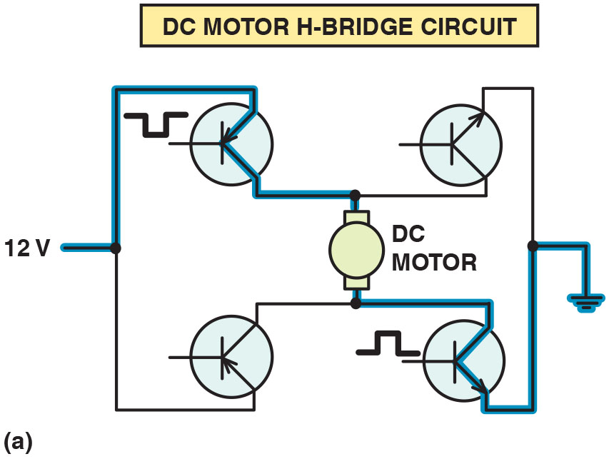
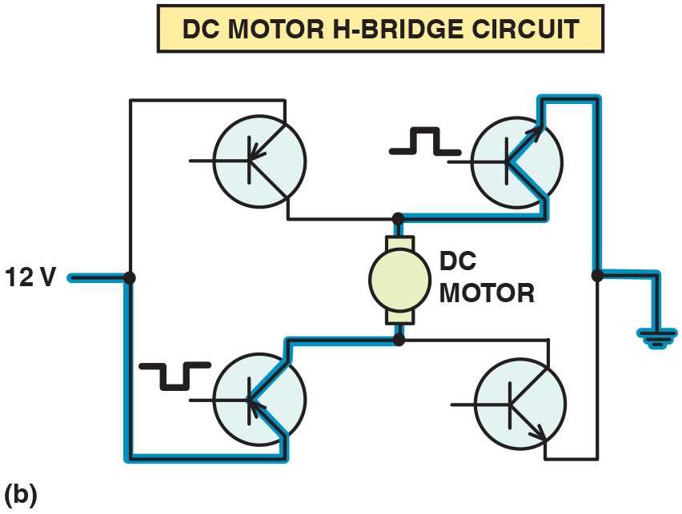
Figure 37.6
H-Bridge Control
(a) An H-bridge circuit is used to control the direction of the D C electric motor of the E T C unit. (b) To reverse the direction of operation, the polarity of the current through the motor is reversed.
Notes:
Long Description 1:
The circuit depicts four transistors connected to a D C motor with 12 volts power on one end and ground on the other end. To control the direction of the D C electric motor of the electronic throttle control unit, 12 volts current flows through the top left transistor, D C motor, the bottom right transistor, and then to the ground.
Long Description 2:
The circuit depicts four transistors connected to a D C motor with 12 volts power on one end and ground on the other end. To reverse the current flow, 12 volts current flows through the bottom left transistor, D C motor, the top right transistor, and then to the ground.

Slide 19
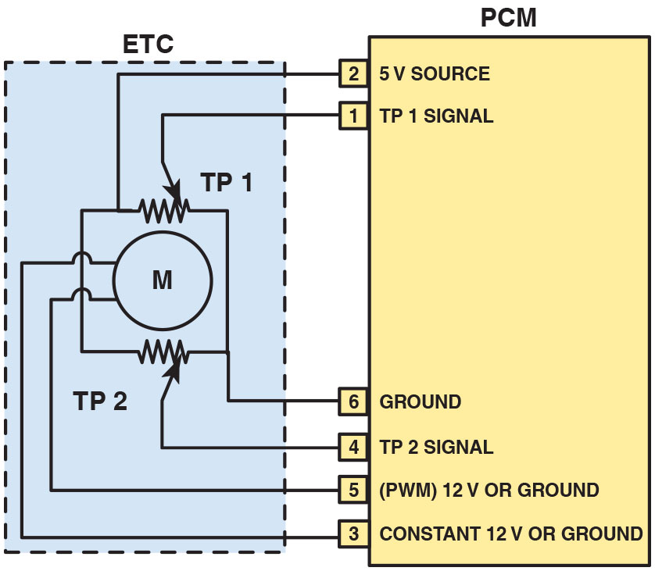
Figure 37.7
Schematic
Schematic of a typical E T C system. Note that terminal #5 is always P W M and that terminal #3 is always constant, but both power and ground are switched to change the direction of the motor.
Notes:
Long Description:
The following terminals of the P C M are connected to the electronic throttle control: Terminal 1 is signal for throttle position 1. Terminal 2 is a voltage source. Terminal 3 is constant or ground. Terminal 4 is signal for throttle position 1. Terminal 5 is pulse width modulated. Terminal 6 is ground.

Slide 20
Throttle Position (T P) Sensor
Two T P sensors are used in the throttle body assembly to provide T P signals to the P C M.
Two sensors are used as fail-safe measure and for diagnosis.
There are two types of T P sensors used in electronic throttle control systems:
Potentiometers
Hall-effect

Slide 21
Question 2
What two types of throttle position sensors are used?

Slide 22
Answer 2
Potentiometer and Hall-effect.

Slide 23
Diagnosis of Electronic Throttle Control Systems (1 of 3)
Fault Mode
Limp home mode also called “fail-safe mode” indicates following actions performed by P C M:
Engine speed limited to default speed (1,200–1,600 R P M)
There is slow or no response when accelerator pedal is depressed.
Cruise control system is disabled.
Diagnostic trouble code (D T C) is set.
E T C warning lamp on the dash lights.

Slide 24
Diagnosis of Electronic Throttle Control Systems (2 of 3)
Vacuum Leaks
E T C system simply moves throttle, as needed, to achieve proper idle speed to compensate for leak.
Diagnostic Procedure
If a fault occurs in E T C system, check service information for specified procedure to follow.

Slide 25
Diagnosis of Electronic Throttle Control Systems (3 of 3)
Scan Tool Data
A P P-indicated angle
T P-desired angle
T P-indicated angle
T P sensors 1 and 2

Slide 26
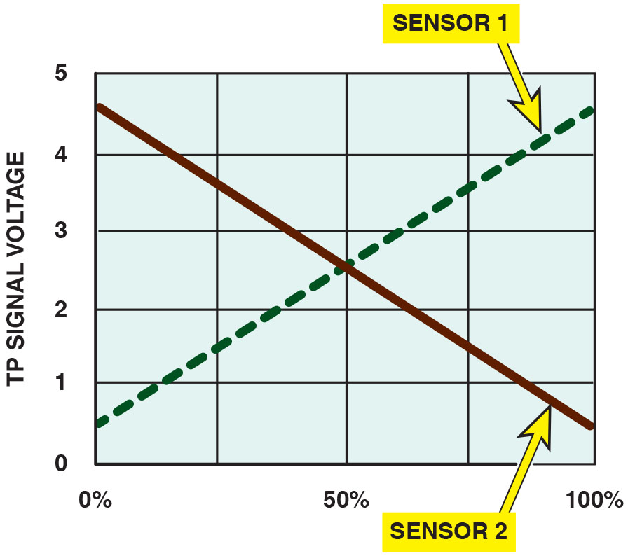
Figure 37.8
T P Sensors
The two T P sensors used on the throttle body of an electronic throttle body assembly produce opposite voltage signals as the throttle is opened. The total voltage of both combined at any throttle plate position is 5 volts.
Notes:
Long Description:
The graph depicts percentage on the x axis from 0 to 100 in the increments of 25 percent and T P signal voltage on the y axis from 0 to 5 in the increments of 1. The curve for sensor 1 follows an upward-sloping curve from (0, 0.5) to (100, 4.5). The curve for sensor 2 follows a downward-sloping curve from (0, 4.5) to (100, 0.5).

Slide 27
Animation: Throttle Position Sensor (TPS)

Slide 28
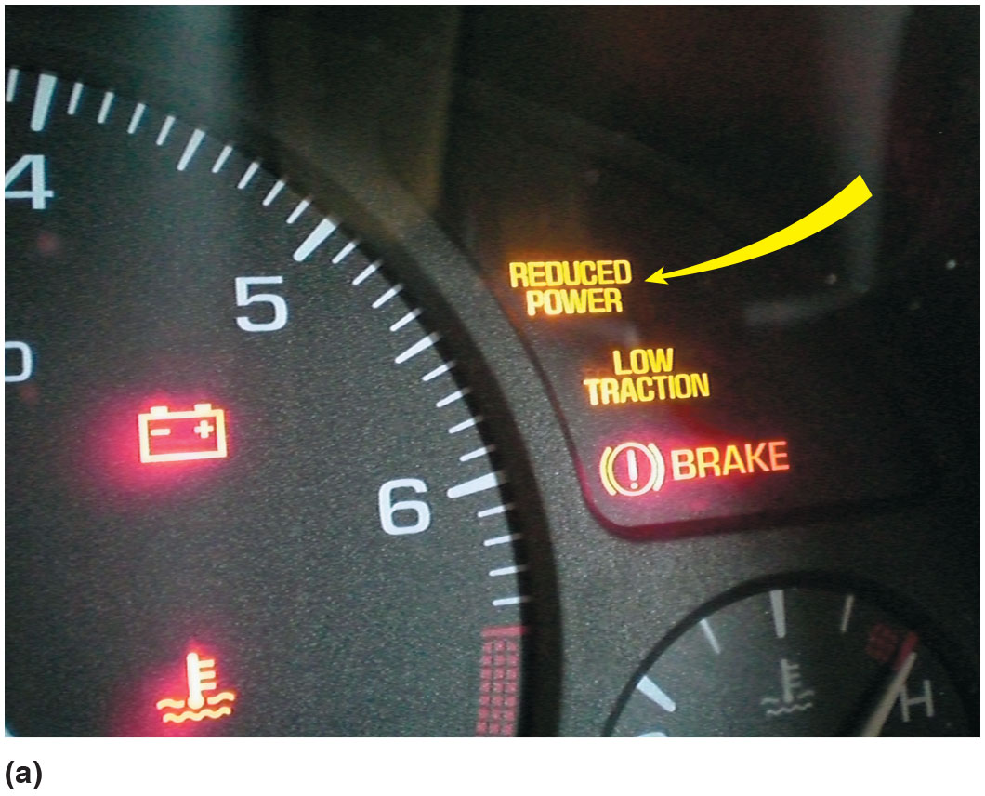
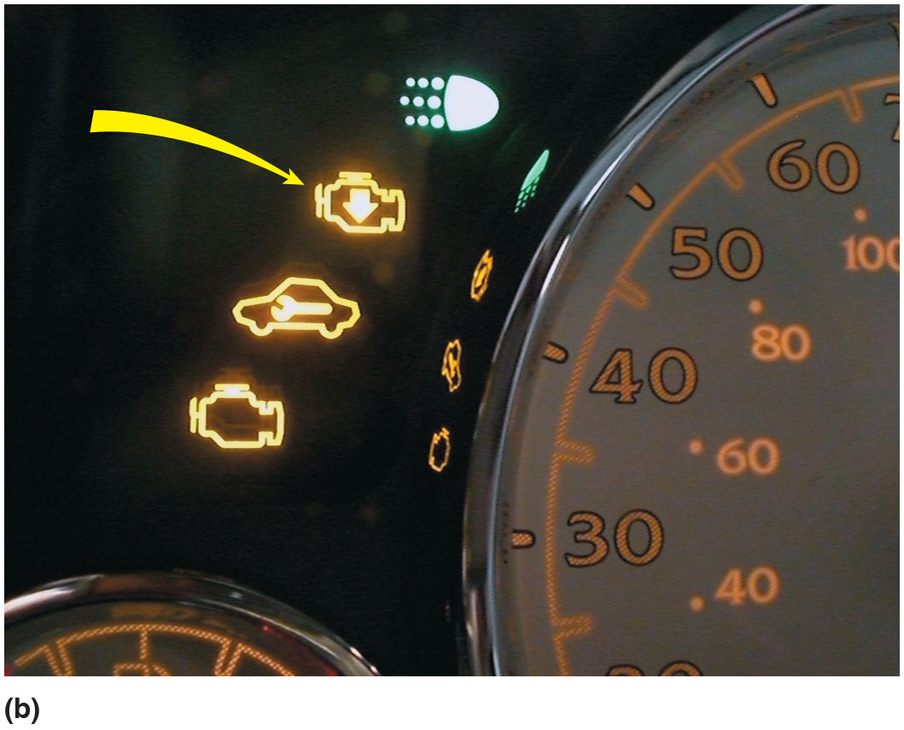
Figure 37.9
E T C Fault Indicators
(a) A “reduced power” warning light indicates a fault with the E T C system on some General Motors vehicles. (b) A symbol showing an engine with an arrow pointing down is used on some General Motors vehicles to indicate a fault with the E T C system.

Slide 29
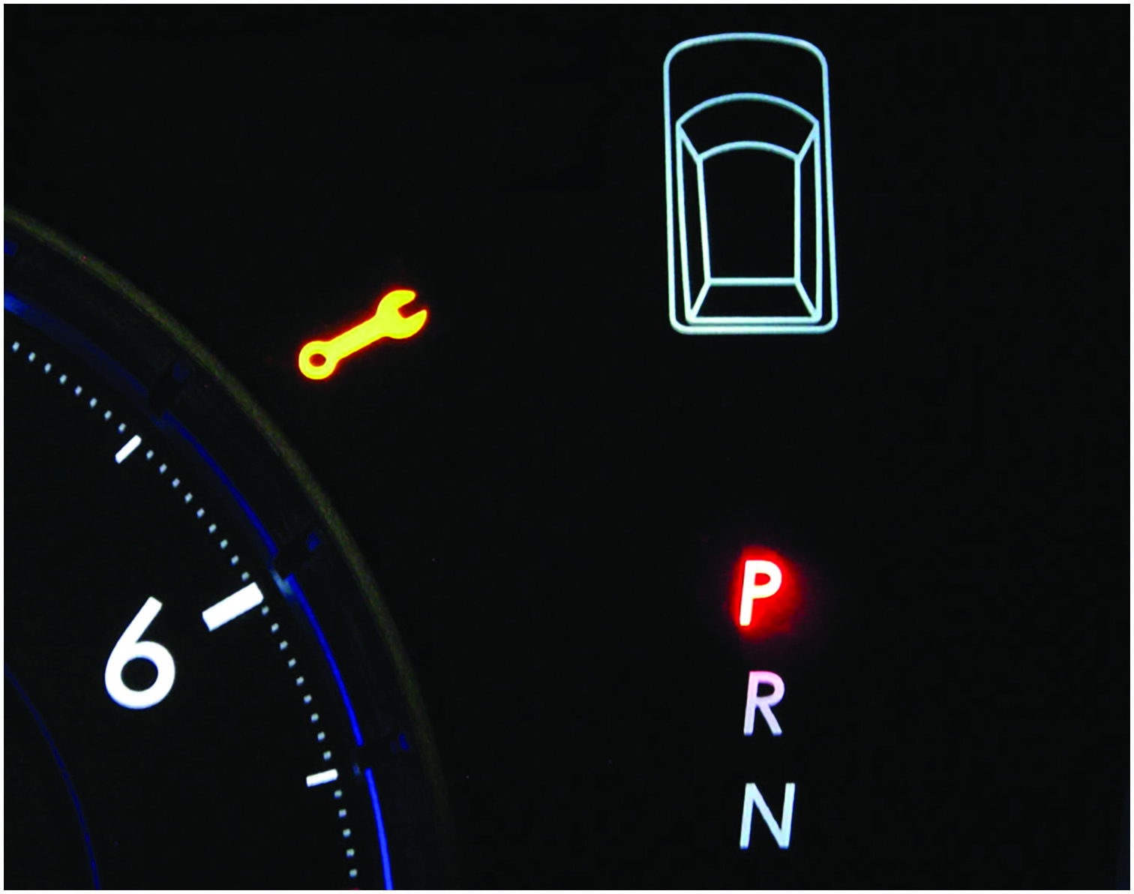
Figure 37.10
Ford Wrench Symbol
A wrench symbol warning lamp on a Ford vehicle. The symbol can also be green.

Slide 30
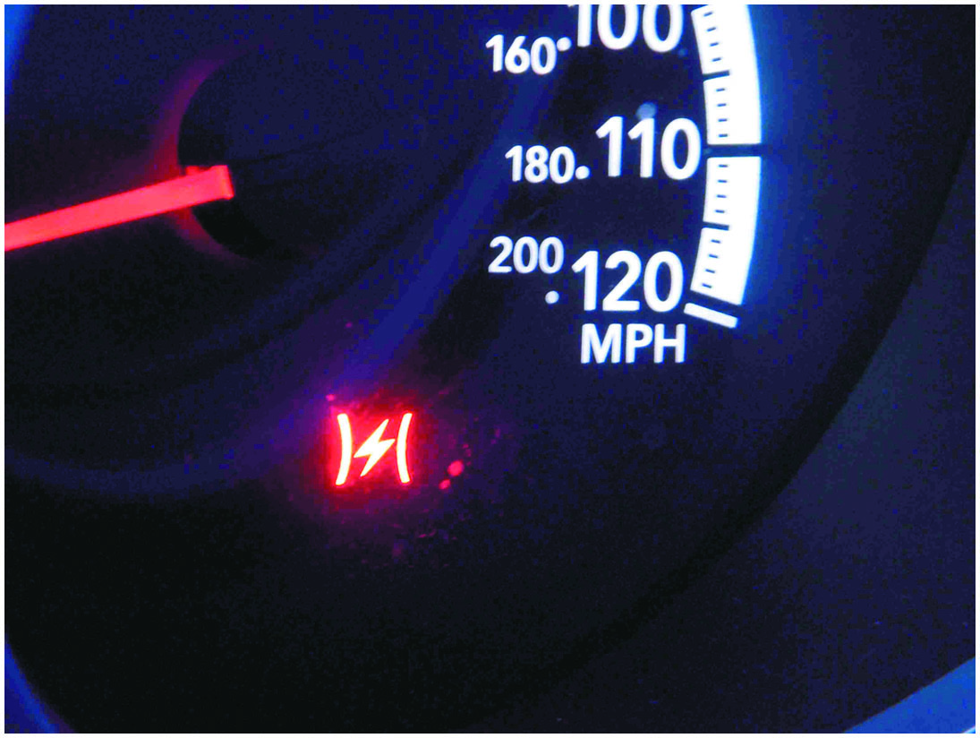
Figure 37.11
Chrysler Fault Symbol
A symbol used on a Chrysler vehicle indicating a fault with the E T C.

Slide 31
Frequently Asked Question: How Do You Calibrate a New A P P Sensor?
? Frequently Asked Question
How Do You Calibrate a New A P P Sensor? Whenever an A P P sensor is replaced, it should be calibrated before it will work correctly. Always check service information for the exact procedure to follow after A P P sensor replacement. Here is a typical example of the procedure:
STEP 1 Make sure the accelerator pedal is fully released.
STEP 2 Turn the ignition switch on (engine off) and wait at least 2 seconds.
STEP 3 Turn the ignition switch off and wait at least 10 seconds.
STEP 4 Turn the ignition switch on (engine on) and wait at least 2 seconds.
STEP 5 Turn the ignition switch off and wait at least 10 seconds.

Slide 32
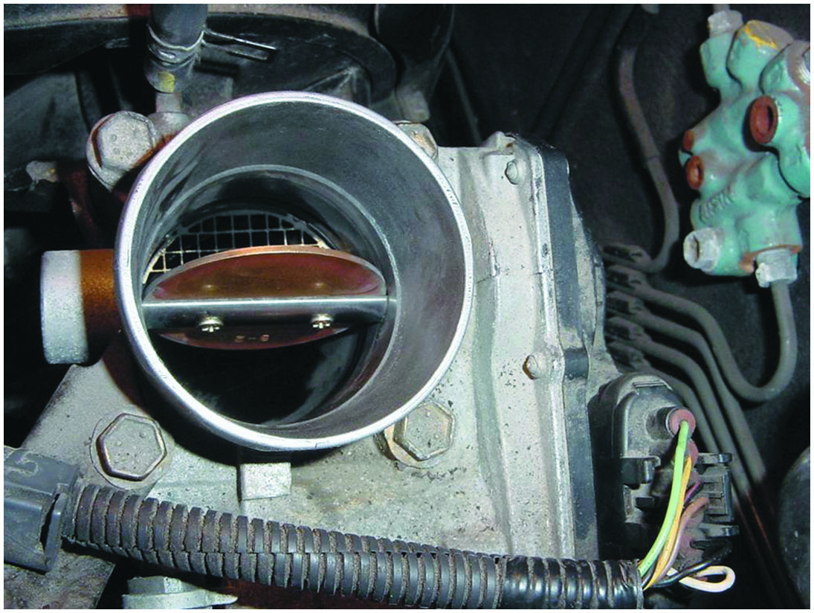
Figure 37.12
Stuck Throttle Valve
The throttle plate stayed where it was moved, which indicates that there is a problem with the electronic throttle body control assembly.

Slide 33
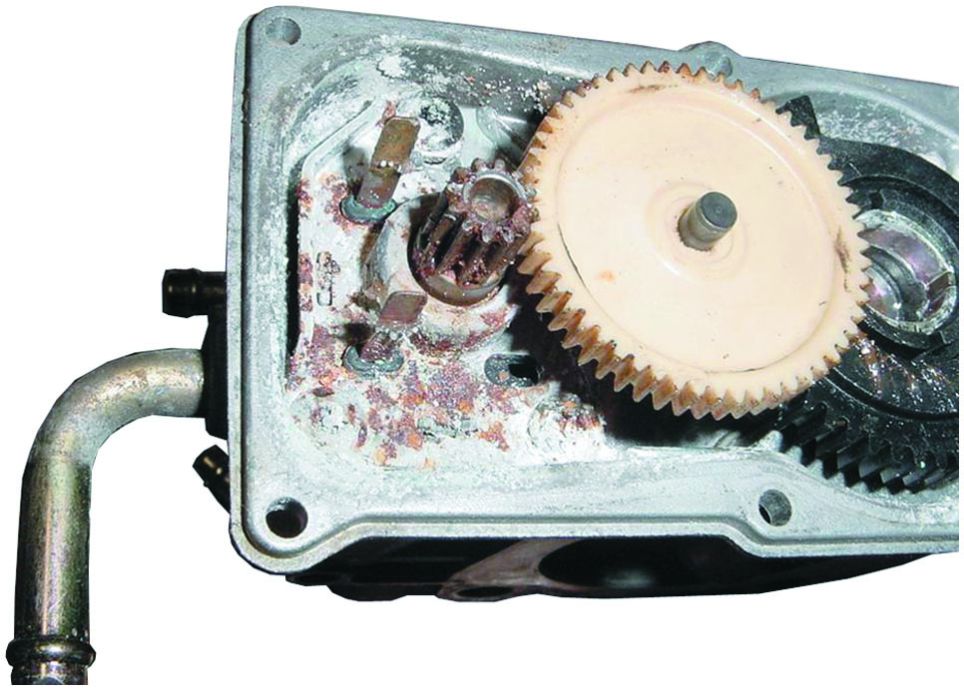
Figure 37.13
Corroded E T C
A corroded E T C assembly shown with the cover removed.
Notes:
CASE STUDY: The High Idle Toyota
The owner of a Toyota Camry complained that the engine would idle at over 1,200 RPM compared with a normal 600 to 700 RPM. The vehicle would also not accelerate. Using a scan tool, a check for DTCs showed one code: P2101—“TAC motor circuit low.”
Checking service information led to the inspection of the ETC throttle body assembly. With the ignition key out of the ignition and the inlet air duct off the throttle body, the technician used a screwdriver to see if the throttle plate worked.
Normal operation—The throttle plate should move and then spring back quickly to the default position. Abnormal operation—If the throttle plate stays where it is moved or does not return to the default position, there is a fault with the throttle body assembly. • See Figure 37.12. The technician replaced the throttle body assembly with an updated version and proper engine operation was restored. The technician disassembled the old throttle body and found it was corroded inside due to moisture entering the unit through the vent hose.• See Figure 37.13.
Summary:
Complaint—Customer stated that the engine would idle at over 2,000 RPM.
Cause—A stored P2101 DTC was stored indicating a fault with the throttle body assembly.
Correction—The throttle body was replaced with an improved version that placed the vent tube in a different position to help avoid water getting into the assembly.

Slide 34
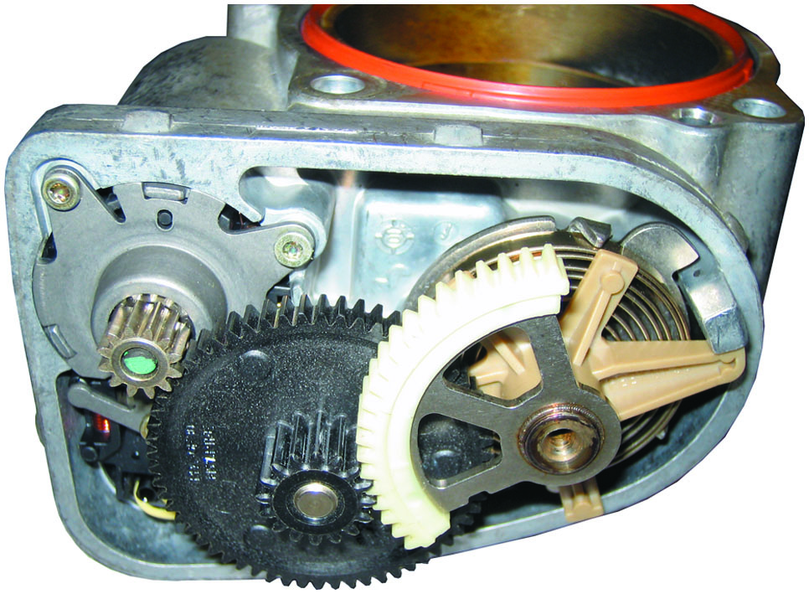
Figure 37.14
E T C Motor Drive
Notice the small motor gear on the left drives a larger plastic gear (black), which then drives the small gear in mesh with the section of a gear attached to the throttle plate. This results in a huge torque increase from the small motor and helps explain why it could be dangerous to insert a finger into the throttle body assembly.

Slide 35
E T C Throttle Follower Test
Test can be performed on some Chrysler vehicles.
To perform this test, use the “throttle follower test” procedure as shown on the scan tool. An assistant is needed to check that the throttle plate is moving as the accelerator pedal is depressed.

Slide 36
Servicing Electronic Throttle Systems (1 of 2)
E T C-Related Performance Issues
Lower than normal idle speed.
Rough idle.
Engine stalls when coming to a stop (called a coast-down stall).
Throttle Body Cleaning Procedure
Remove the air inlet hose from throttle body.
Spray throttle body cleaner onto a shop cloth.
Use shop cloth to remove varnish and carbon deposits from the throttle body housing and throttle plate.

Slide 37
Servicing Electronic Throttle Systems (2 of 2)
Throttle Body Relearn Procedure
A typical throttle body relearn procedure includes:
Turn the ignition on (engine off) for 30 seconds.
Turn the ignition off and wait 30 seconds.
Start the engine and the idle learn procedure should cause the engine to idle at the correct speed.
Other vehicles may require the use of a scan tool.

Slide 38
Question 3
What three E C T performance-related conditions might indicate a need for throttle body cleaning?

Slide 39
Answer 3
Rough idle, lower than normal idle speed, and engine stalling.

Slide 40
Summary
Using an electronic throttle control (E T C) system on an engine has many advantages over a conventional method that uses a mechanical cable between the accelerator pedal and the throttle valve.
The major components of an E T C system include the following:
Accelerator pedal position (A P P) sensor
E T C actuator motor and spring
Throttle position (T P) sensor
Electronic control unit
The T P sensor is actually two sensors that share the 5-volt reference from the P C M and produce opposite signals as a redundant check.
Limp-in mode is commanded if there is a major fault in the system, which can allow the vehicle to be driven enough to be pulled off the road to safety.
The diagnostic procedure for the E T C system includes verifying the customer concern, using a scan tool to check for D T C s, and checking the value of the T P and A P P sensors.

Slide 41
Animations and Video Links (Halderman website subscription and web access needed to view)
(A8) Engine Performance Animations
(A8) Engine Performance Videos

Slide 42
Copyright
This work is protected by United States copyright laws and is provided solely for the use of instructors in teaching their courses and assessing student learning. Dissemination or sale of any part of this work (including on the World Wide Web) will destroy the integrity of the work and is not permitted. The work and materials from it should never be made available to students except by instructors using the accompanying text in their classes. All recipients of this work are expected to abide by these restrictions and to honor the intended pedagogical purposes and the needs of other instructors who rely on these materials.

