Slide 1
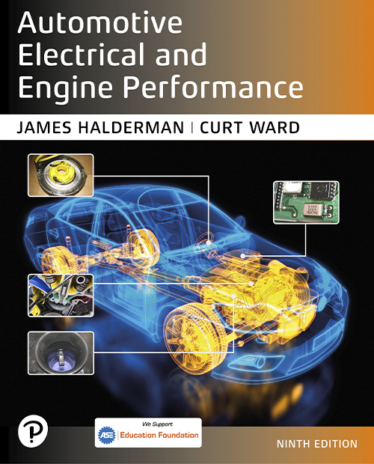

Automotive Electrical and Engine Performance
Ninth Edition
Chapter 35
Fuel-Injection Parts and Operation
Copyright © 2025 Pearson Education, Inc. All Rights Reserved
Notes:
If this PowerPoint presentation contains mathematical equations, you may need to check that your computer has the following installed:
1) Math Type Plugin
2) Math Player (free versions available)
3) NVDA Reader (free versions available)
INSTRUCTOR NOTE: This presentation includes text explanation notes, you can use to teach the course. When in SLIDE SHOW mode, you RIGHT CLICK and select SHOW PRESENTER VIEW, to use the notes.

Slide 2
Learning Objectives
35.1 Describe how electronic fuel injection works.
35.2 Describe types of fuel injection.
35.3 Explain the different methods used to regulate fuel pressure.
35.4 Discuss fuel injectors.
35.5 Discuss fuel-injection modes of operation.
35.6 Describe idle control systems.

Slide 3
Electronic Fuel-Injection Operation (1 of 2)
Electronic fuel-injection systems use the computer to control the following operation of fuel injectors.
Most electronic fuel-injection systems share the following:
  Electric fuel pump
  Fuel-pump relay
  Fuel-pressure regulator
  Fuel-injector nozzle or nozzles

Slide 4
Electronic Fuel-Injection Operation (2 of 2)
Most electronic fuel-injection systems use the P C M to control the following aspects of their operation:
  Pulsing the fuel injectors on and off
  Operating the fuel-pump relay circuit
There are two types of electronic fuel-injection systems:
  Throttle-body-injection (T B I) type
  Port fuel-injection type

Slide 5
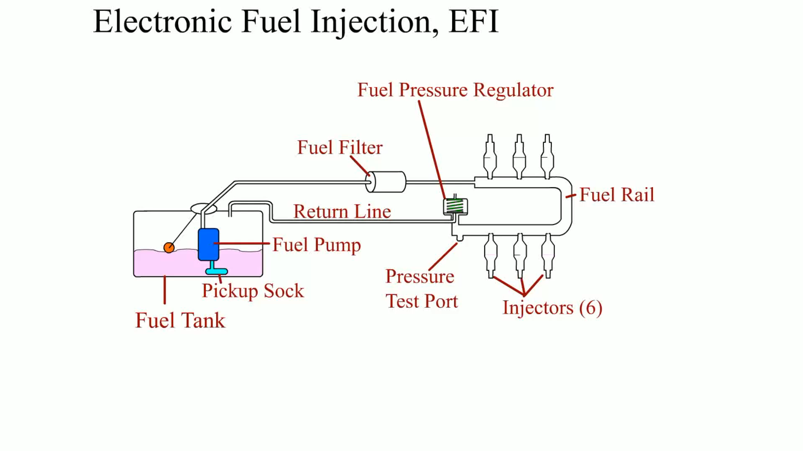
Animation: Electronic Fuel Injection, EFI

Slide 6
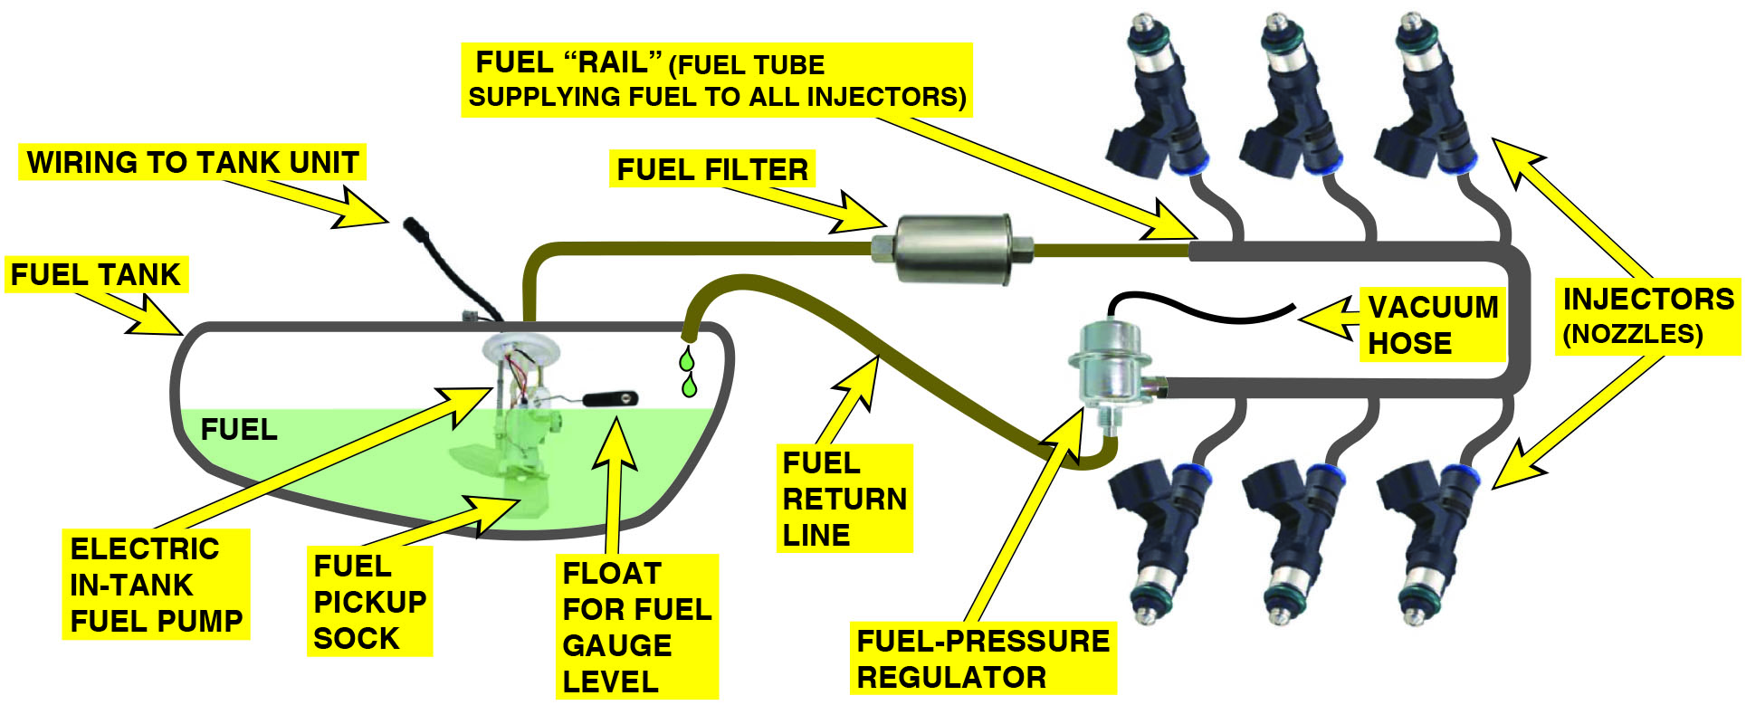
Figure 35.1
Port Fuel Injection
Typical port fuel-injection system, indicating the location of various components. Notice that the fuel-pressure regulator is located on the fuel return side of the system. The computer does not control fuel pressure, but does control the operation of the electric fuel pump (on most systems) and the pulsing on and off of the injectors.
Notes:
Long Description:
The various parts of the fuel injection system. The system has a half-filled fuel tank. There’s an electric in-tank fuel pump, a fuel pickup sock, and a float for fuel gauge level inside the tank. Wiring to the tank unit can be seen attached at the fuel pump. The fuel tank is also connected to the fuel rail that supplies fuel to the injectors. A fuel filter is added to the fuel line before the fuel rail. The fuel tube is in a U-shape with the injector arrangement suggesting the fuel system is for a V 6 engine. At the end of the fuel rail, a fuel-pressure regulator is added to the system. A vacuum hose connects the fuel-pressure regulator on the top and the bottom of the regulator is connected back to the fuel tank through fuel return line.

Slide 7
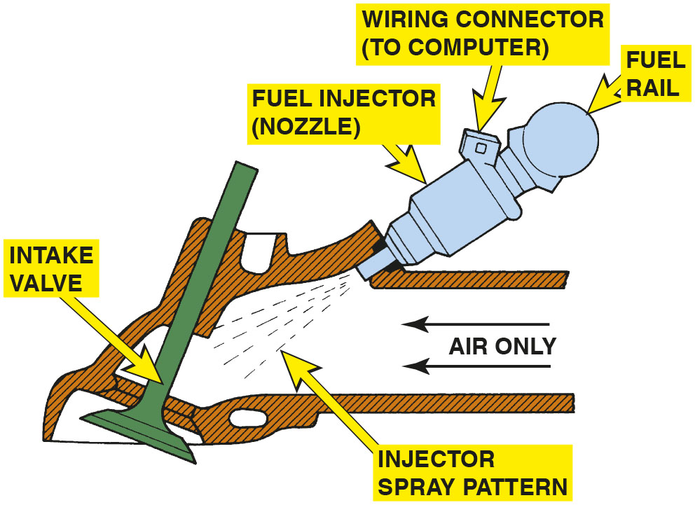
Figure 35.2
Indirect Port Injection
A typical port fuel-injection system squirts fuel into the low pressure (vacuum) of the intake manifold, about 3 inch (70 to 100 m m) from the intake valve.
Notes:
Long Description:
A fuel injector nozzle injector with a wiring connector which connects it to the computer. The sprayer squirts in a pattern into the intake manifold is shown with air passing through it. The fuel spray is directed to the intake valve in the system.

Slide 8
Speed-Density Fuel-Injection System
The speed-density method calculates the amount of fuel required by the sensors, such as the following:
  M A P sensor
  Throttle position (T P) sensor
  Temperature sensors (coolant and intake air)
  Oxygen sensor voltage (O2S)
  Adaptive memory

Slide 9
Mass Airflow Fuel-Injection Systems
The formula used by fuel-injection systems that use a mass airflow (M A F) sensor to calculate the injection base pulse width is:
  Injector pulse width = airflow/R P M
The formula is modified by other sensor values, such as:
  Throttle position
  Engine coolant temperature
  Barometric pressure
  Adaptive memory

Slide 10
Question 1
What are the two basic methods used for measuring the amount of air the engine is breathing in?

Slide 11
Answer 1
Mass airflow and speed density.

Slide 12
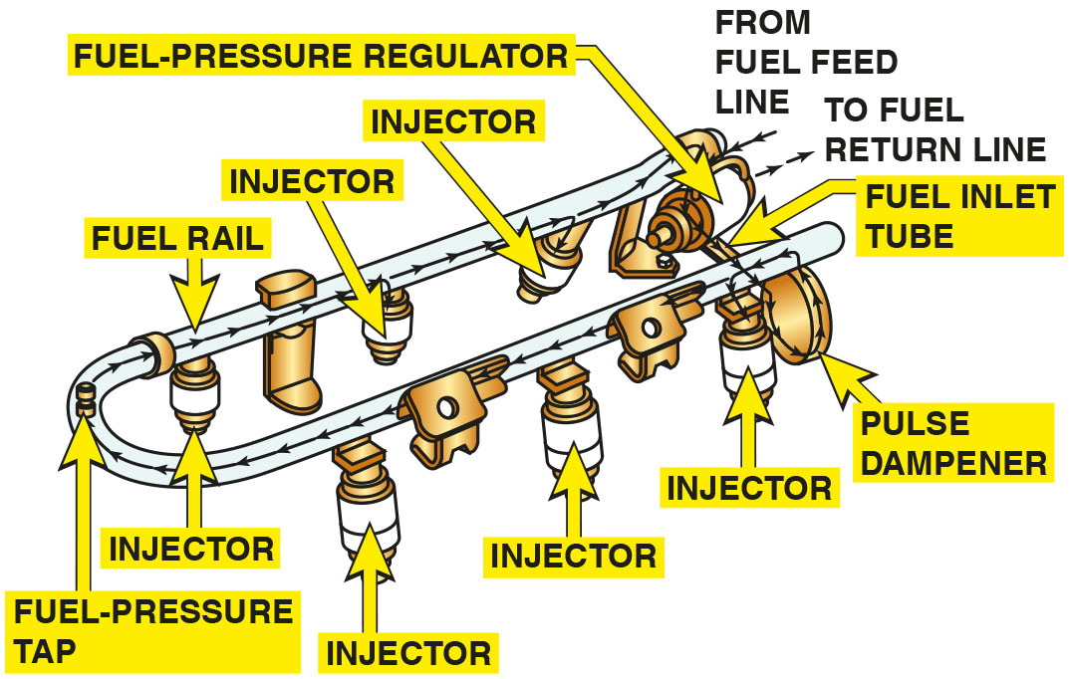
Figure 35.3
Fuel Rail
The injectors receive fuel and are supported by the fuel rail.
Notes:
Long Description:
It shows a fuel line which connects the fuel feed line with the fuel injectors. Fuel from the feed line goes into the fuel inlet tube and then to the pulse dampener. After passing through these parts, the fuel enters the rail which has injectors connected to it. The fuel rail is in a U-shape and has 3 injectors connected in between the inlet and outlet. After three injectors, a fuel-pressure tap can be located. At the end of the fuel rail, a fuel-pressure regulator is connected. A fuel return line is connected to the fuel-pressure regulator.

Slide 13
Port-Fuel Injection (1 of 2)
The advantages of port-fuel injection design are also related to characteristics of intake manifolds.
  Fuel distribution is equal to all cylinders because each cylinder has its own injector.
  The fuel is injected almost directly into the combustion chamber.
  The intake manifold can be sized and shaped to achieve specific engine performance characteristics.

Slide 14
Port-Fuel Injection (2 of 2)
Domestic systems use one of three ways to trigger the injectors:
  Grouped double fire
    Two equalized groups of injectors
  Simultaneous double fire
    All injectors are fired at the same time
  Sequential
    The firing of the injectors is according to engine firing order

Slide 15
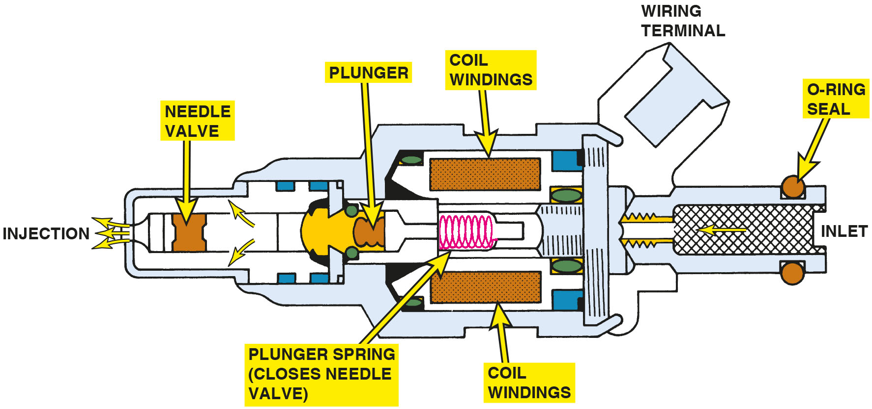
Figure 35.4
Fuel Injector
Cross section of a typical port fuel-injection nozzle assembly. These injectors are serviced as an assembly only; no part replacement or service is possible except for replacement of external O-ring seals.
Notes:
Long Description:
The port fuel-injection nozzle with a cylindrical body with varying diameters from start to end of the injection nozzle. The injector has an inlet at the start with O-ring seal. After the inlet, a wiring terminal connects the body of the nozzle. The nozzle body has coiled windings inside it. The nozzle has a plunger spring arrangement between the coiled windings and a needle valve at the outlet.

Slide 16
Frequently Asked Question: How Do the Sensors Affect the Pulse Width?
? Frequently Asked Question
How Do the Sensors Affect the Pulse Width? The base pulse width of a fuel-injection system is primarily determined by the value of the M A F or M A P sensor and engine speed (R P M). However, the P C M relies on the input from many other sensors, such as the following, to modify the base pulse width as needed: See NOTES SECTION.
Notes:
How Do the Sensors Affect the Pulse Width?
The base pulse width of a fuel-injection system is primarily determined by the value of the MAF or MAP sensor and engine speed (RPM). However, the PCM relies on the input from many other sensors, such as the following, to modify the base pulse width as needed:
• TP Sensor. This sensor causes the P C M to command up to 500% (five times) the base pulse width if the accelerator pedal is depressed rapidly to the floor. It can also reduce the pulse width by about 70% if the throttle is rapidly closed.
• ECT. The value of this sensor determines the temperature of the engine coolant, helps determine the base pulse width, and can account for up to 60% of the determining factors.
• BARO. The BARO sensor compensates for altitude and adds up to about 10% under high-pressure conditions and subtracts as much as 50% from the base pulse width at high altitudes.
• IAT. The intake air temperature is used to modify the base pulse width based on the temperature of the air entering the engine. It is usually capable of adding as much as 20% if very cold air is entering the engine or reducing the pulse width by up to 20% if very hot air is entering the engine.
• O2S. This is one of the main modifiers to the base pulse width and can add or subtract up to about 20% to 25% or more, depending on the oxygen sensor activity.

Slide 17
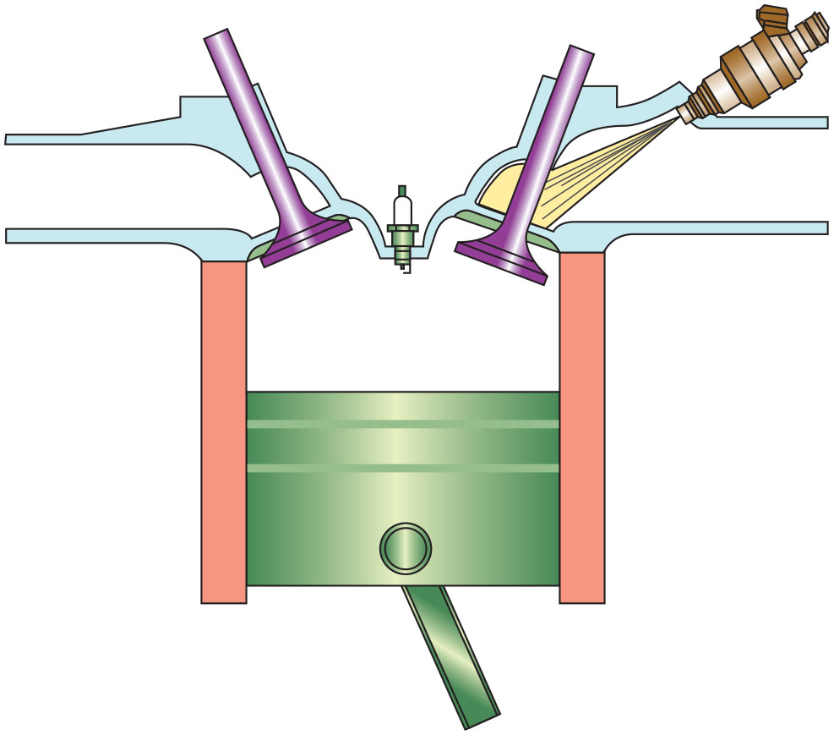
Figure 35.5
Fuel Spray
Port fuel injectors spray atomized fuel into the intake manifold about 3 inches (75 m m) from the intake valve.

Slide 18
Fuel-Pressure Regulator
Purpose and Function
  The pressure regulator and fuel pump work together to maintain the required pressure drop at the injector tips.
Operation
  The fuel pressure is modulated by a combination of spring pressure and manifold vacuum acting on the diaphragm.

Slide 19
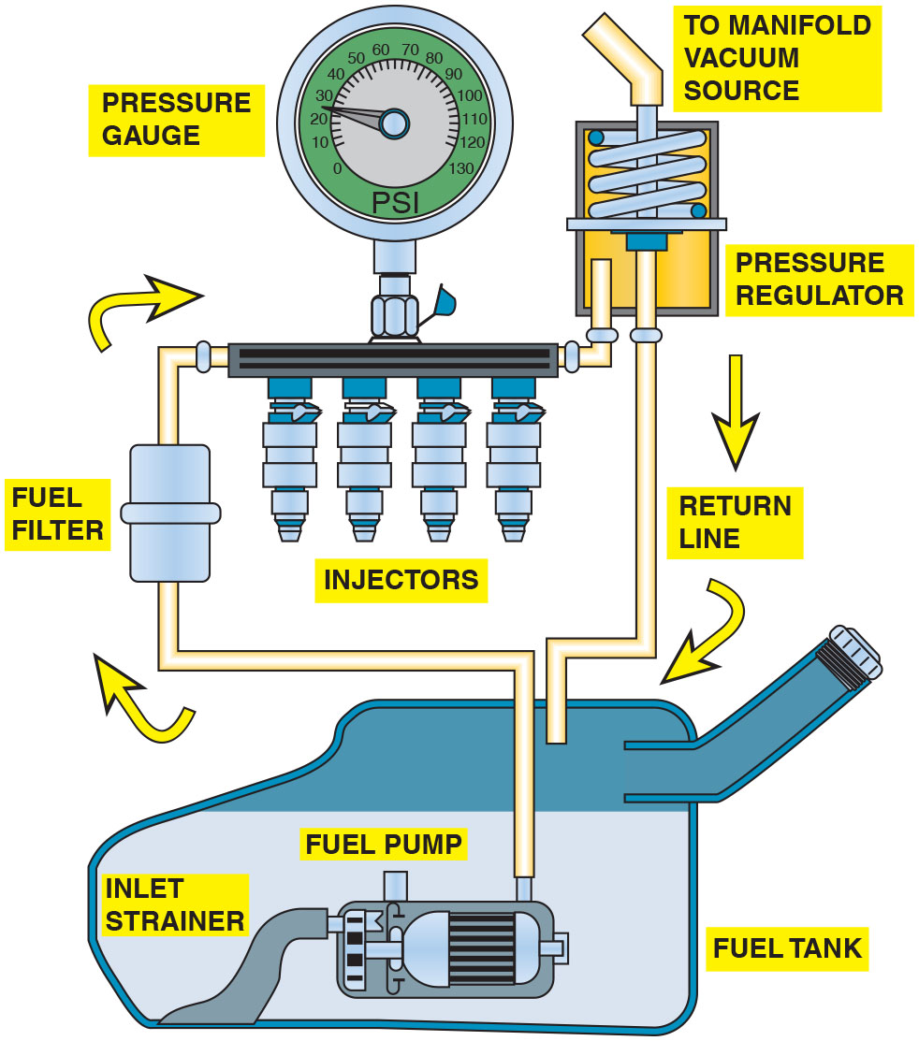
Figure 35.6
P F I Vacuum Regulator
A typical port fuel-injected system showing a vacuum-controlled fuel-pressure regulator.
Notes:
Long Description:
A fuel tank is connected to an injector rail through fuel lines. The fuel lines have a fuel filter before the fuel enters the fuel rail and a pressure regulator at the end of the fuel rail. A return line from the pressure regulator connects the pressure regulator to the fuel tank. Inside the fuel tank, there’s a fuel pump and an inlet strainer dipped inside fuel. The fuel is shown to travel along the above described fuel lines. A pressure gauge is connected to the injector rail and the pressure regulator is connected to manifold vacuum source.

Slide 20
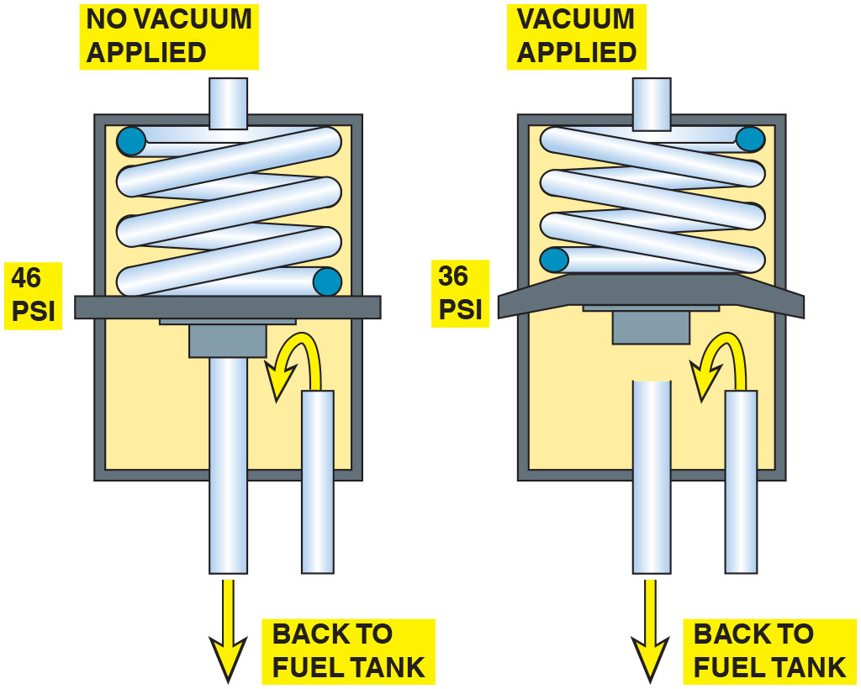
Figure 35.7
Regulator Operation
A typical fuel-pressure regulator that has a spring that exerts 46 pounds of force against the fuel. If 20 inches of vacuum are applied above the spring, the vacuum reduces the force exerted by the spring on the fuel, allowing the fuel to return to the tank at a lower pressure.
Notes:
Long Description:
The fuel pressure regulator is made of a cylindrical chamber with a spring actuated valve seat in the top half and a fuel line from the injector rail connected to the bottom half. The bottom half also has the fuel return line. A vacuum line connects to the top half of the regulator. The first regulator with no vacuum applied shows a spring exerting 46 pounds of force on the fuel. The second regulator with vacuum applied shows a spring exerting 36 pounds of force on the fuel.

Slide 21
Vacuum-Biased Fuel-Pressure Regulator
The primary reason why many port fuel-injected systems use a vacuum-controlled fuel-pressure regulator is to ensure that there is a constant pressure drop across the injectors.

Slide 22
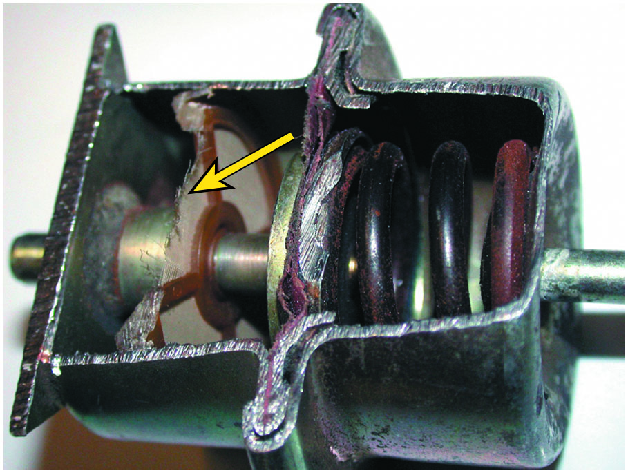
Figure 35.8
Regulator Filter Screen
A lack of fuel flow could be due to a restricted fuel-pressure regulator. Notice the fine screen filter. If this filter were to become clogged, higher than normal fuel pressure would occur.
Notes:
TECH TIP: Don’t Forget the Regulator
Some fuel-pressure regulators contain a 10-micron filter. If this filter becomes clogged, a lack of fuel flow
would result. ● See Figure 35.8.

Slide 23
Question 2
What is the purpose of the vacuum-controlled (biased) fuel pressure regulator?

Slide 24
Answer 2
Adjust fuel pressure so there is a constant pressure drop across the injectors.

Slide 25
Electronic Returnless Fuel System
Power driver contains a high-current transistor that controls the pump speed using pulse width modulation (P W M).
Fuel pressure at rail is sensed by a pressure transducer.

Slide 26
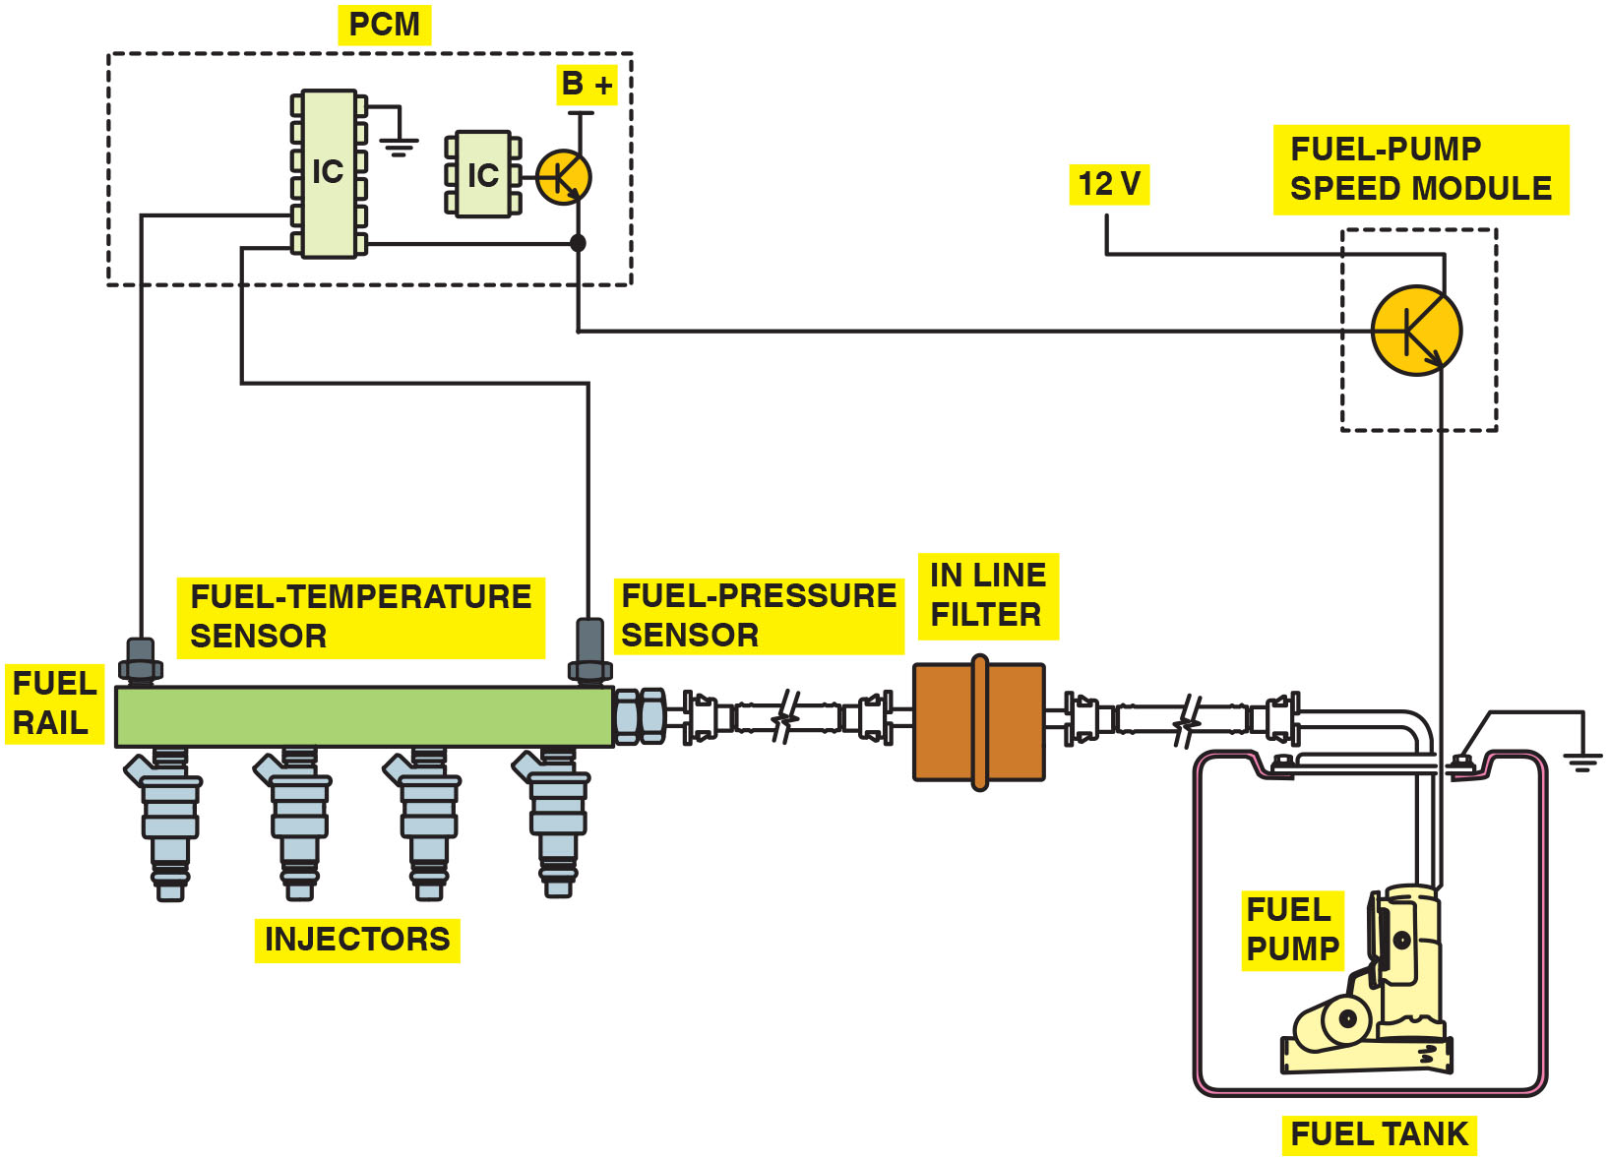
Figure 35.9
Fuel-Pressure Sensor
The fuel-pressure sensor and fuel-temperature sensor are often constructed together in one assembly to help give the P C M the needed data to control the fuel-pump speed.
Notes:
Long Description:
A fuel tank is connected to a fuel-pump speed module. The speed module looks like a transistor with one terminal connected to 12 volts and one terminal connected to the P C M. The control terminal is connected to the fuel pump. The fuel pump is connected through fuel lines to the fuel rail. An inline filter is connected between the fuel rail and fuel pump. A fuel-pressure sensor is connected at the start of the fuel rail and a fuel temperature sensor is connected at the end of the fuel rail. The fuel rail has 4 injectors. The sensors are connected to an I C in the P C M. The output of this I C is connected to another I C through a transistor which goes as the input to the fuel-pump speed module’s transistor.

Slide 27
Mechanical Returnless Fuel System
This system has a bypass regulator to control rail pressure that is located in close proximity to the fuel tank.
Fuel is sent by the in-tank pump to a chassis-mounted inline filter with excess fuel returning to the tank through a short return line.
The system employs a constant rail pressure.

Slide 28
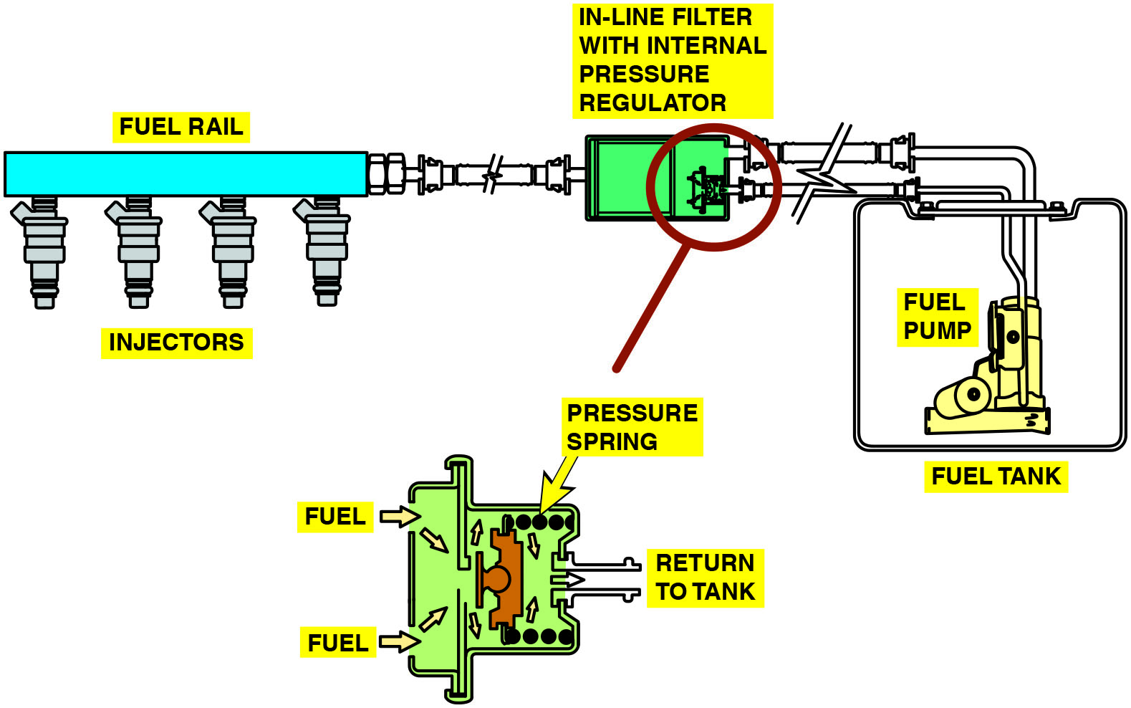
Figure 35.10
Returnless Fuel System
A mechanical returnless fuel system. The bypass regulator in the fuel tank controls fuel line pressure.
Notes:
Long Description:
The fuel pump inside the fuel tank is connected to the fuel rail through fuel lines. Between the connection of fuel pump and fuel rail, there is an in-line filter with internal pressure regulator. The internal pressure regulator has a pressure spring and a return line connected back to the fuel tank.

Slide 29
Demand Delivery System (D D S)
A fuel pump and a low-cost, high-performance bypass regulator are used within the appropriate fuel sender.
The system provides a precise quantity of fuel into the rail as consumed by the engine.

Slide 30
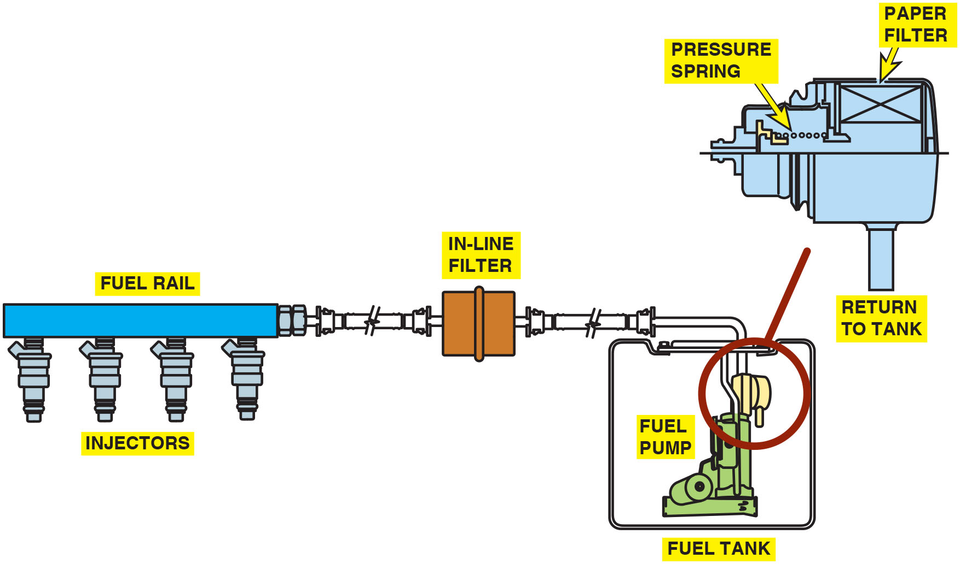
Figure 35.11
Demand Delivery
A demand delivery system uses a fuel-pressure regulator attached to the fuel pump assembly inside the fuel tank.

Slide 31
Frequently Asked Question: Why Some Fuel Rails Are Rectangular Shaped?
? Frequently Asked Question
Why Some Fuel Rails Are Rectangular Shaped? A port fuel-injection system uses a pipe or tubes to deliver fuel from the fuel line to the intended fuel injectors. This pipe or tube is called the fuel rail. Some manufacturers construct the fuel rail in a rectangular cross section. ● See Figure 35.12. The sides of the fuel rail are able to move in and out slightly, thereby acting as a fuel pulsator evening out the pressure pulses created by the opening and closing of the injectors to reduce under hood noise. A round cross-sectional fuel rail is not able to deform and, as a result, some manufacturers have had to use a separate dampener.

Slide 32
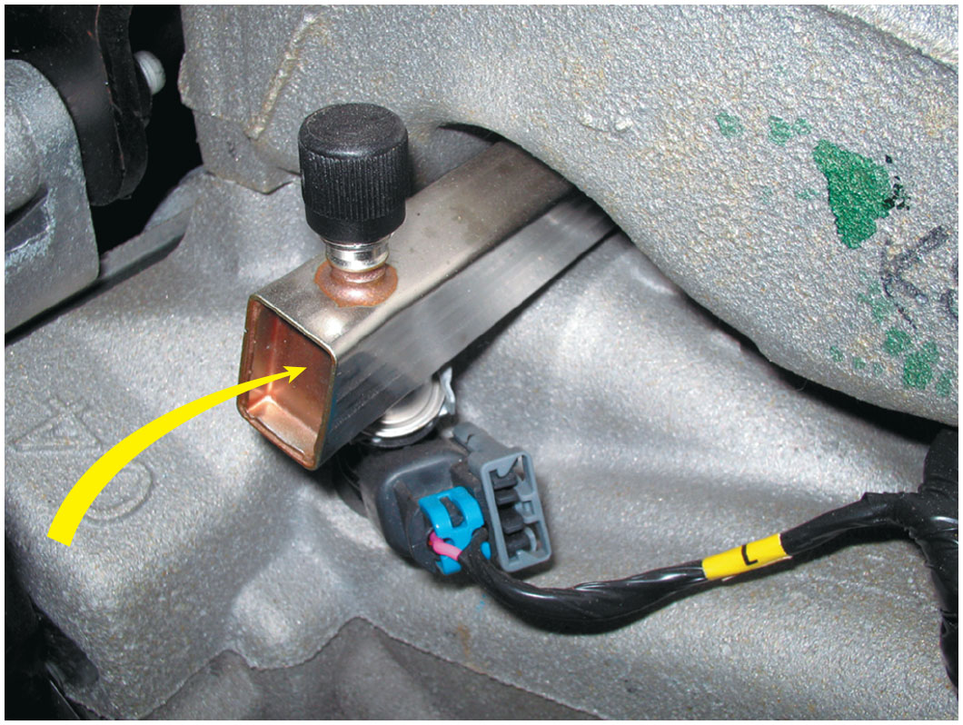
Figure 35.12
Rectangular Fuel Rail
A rectangular-shaped fuel rail is used to help dampen fuel system pulsations and noise caused by the injectors opening and closing.

Slide 33
Fuel Injectors
This electromagnetic device contains an armature and a spring-loaded needle valve or ball valve assembly.
The injector opens the same amount each time it is energized.
The amount of fuel injected depends on the length of time the injector remains open.

Slide 34
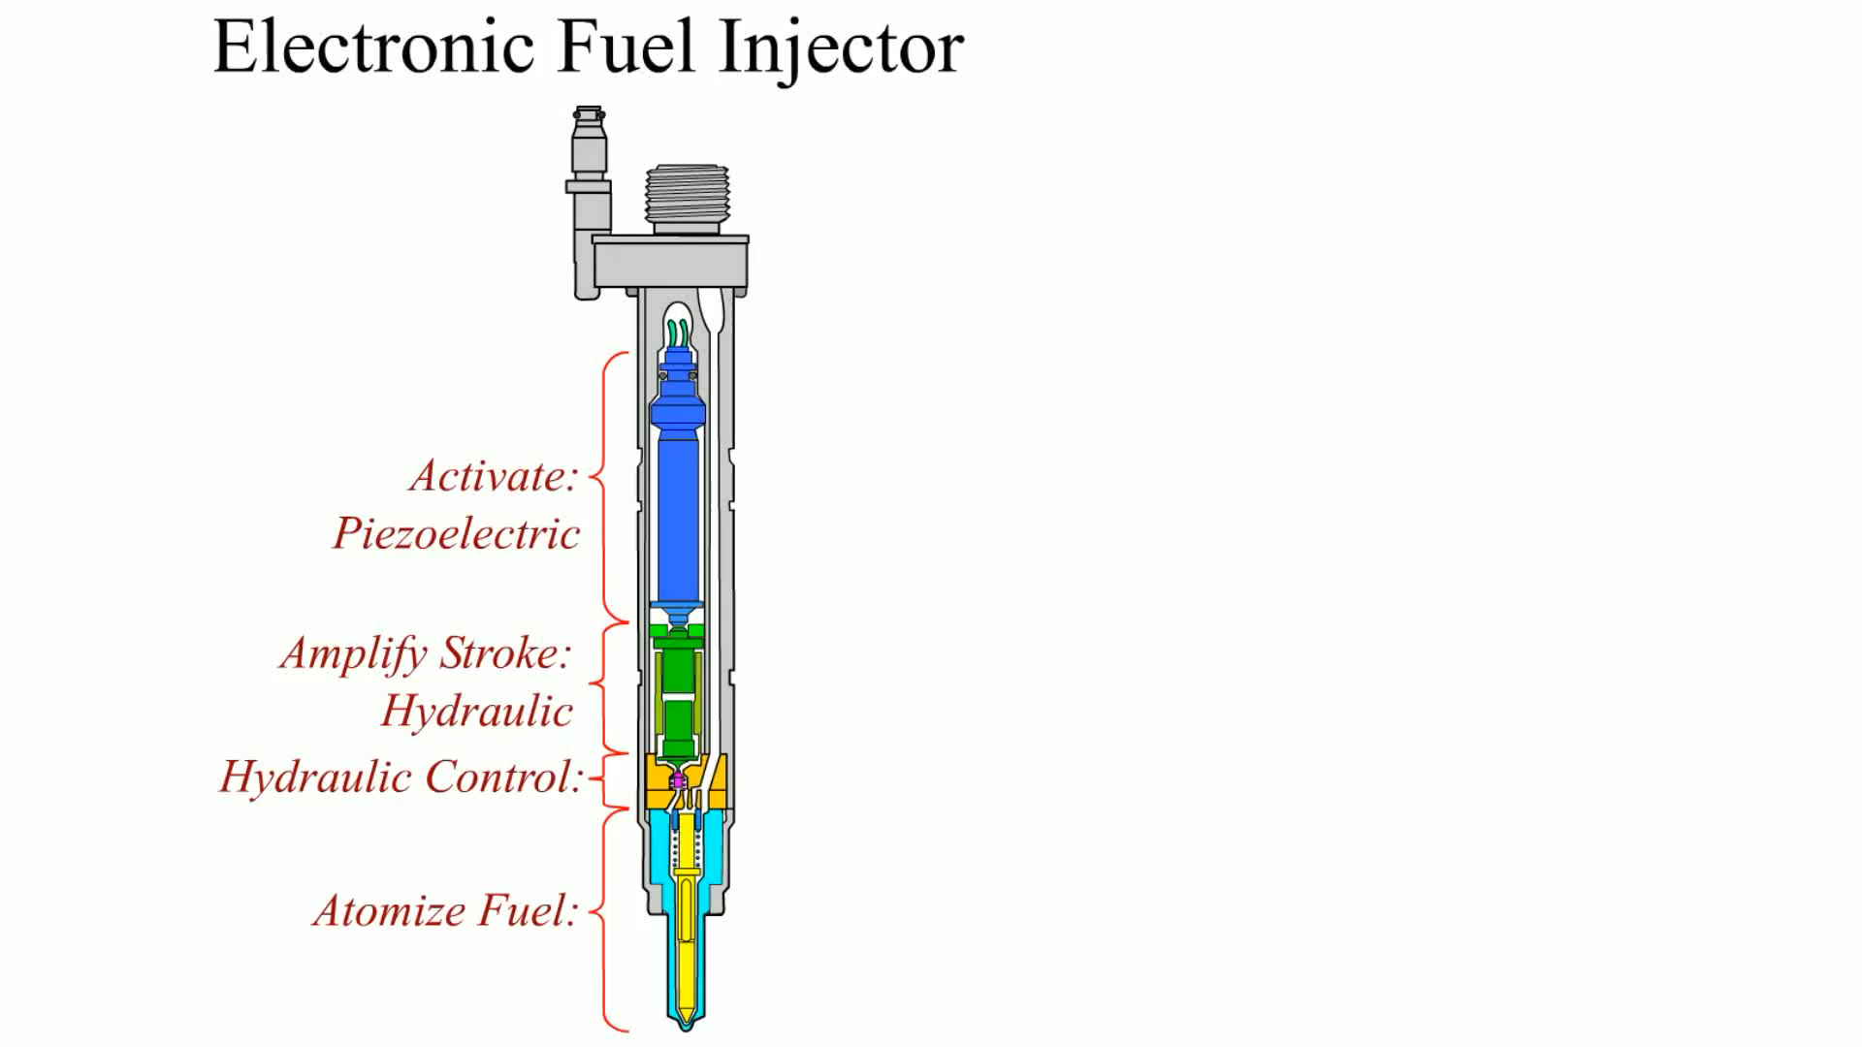
Animation: Electronic Fuel Injector

Slide 35
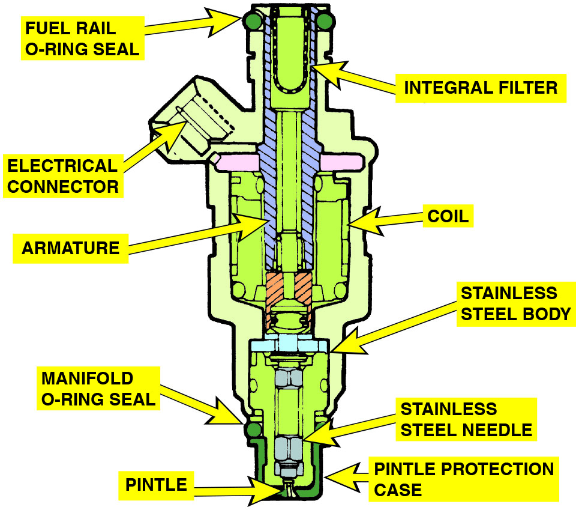
Figure 35.13
Multiport Fuel Injector
A multiport fuel injector. Notice that the fuel flows straight through and does not come in contact with the coil windings.
Notes:
Long Description:
The multiport fuel injector depicts a cylindrical body with varying diameters from start to end of the injection nozzle. The fuel injector has a pintle and pintle protection case with a manifold O-ring seal. The injector contains an armature and a spring loaded needle valve. A stainless steel needle can be seen in the drawing. The armature has a coil around it and an electrical connector on the side. There is an integral filter at the inlet of the injector and a fuel-rail O-ring seal on the top.

Slide 36
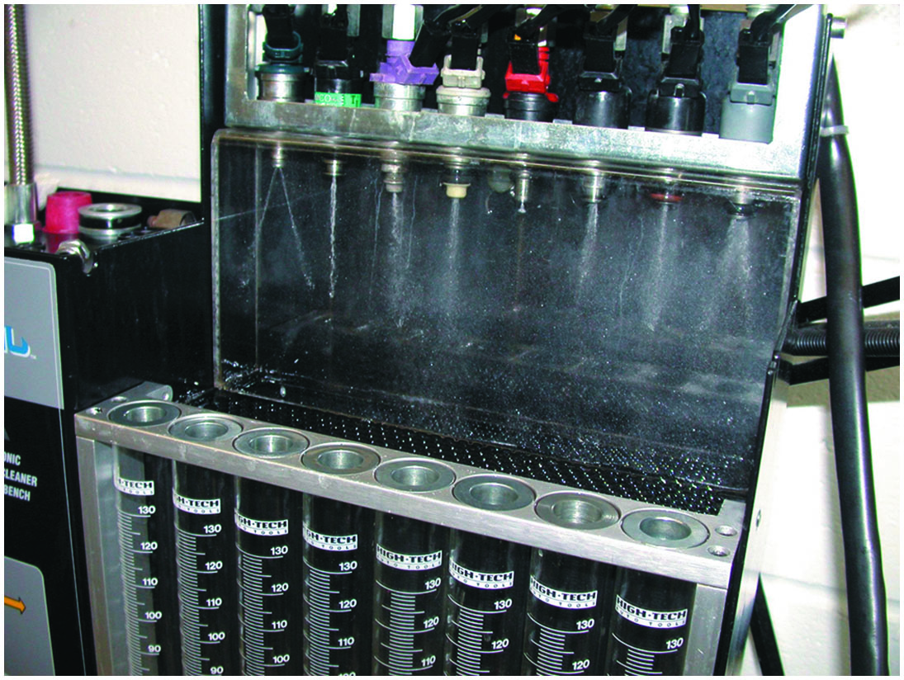
Figure 35.14
Spray Pattern
Each of the eight injectors shown are producing a correct spray pattern for the applications. While all throttle-body injectors spray a conical pattern, most port fuel injections do not.

Slide 37
Fuel-Injection Modes of Operation (1 of 4)
All fuel-injection systems are designed to supply the correct amount of fuel under a wide range of engine operating conditions.
Starting Mode
  When the ignition is turned to the start (on) position, the engine cranks and the P C M energizes the fuel-pump relay and pulses the injectors based on engine speed and coolant temperature.

Slide 38
Fuel-Injection Modes of Operation (2 of 4)
Clear Flood Mode
  When the P C M detects that the engine speed is low (usually below 600 R P M) and the throttle-position (T P) sensor voltage is high (W O T), the injector pulse width is greatly reduced or even shut off entirely, depending on the vehicle.
Open-Loop Mode
  The P C M determines injector pulse width without feedback from the oxygen sensor.

Slide 39
Fuel-Injection Modes of Operation (3 of 4)
Closed-Loop Mode
  Is used to modify the base injector pulse width as determined by feedback from the oxygen sensor.
Acceleration Enrichment Mode
  The P C M then supplies a longer injector pulse width and may even supply extra pulses to supply the needed fuel for acceleration.

Slide 40
Fuel-Injection Modes of Operation (4 of 4)
Deceleration Enleanment Mode
  The injector may be shut off entirely for a short time and then pulsed on enough to keep the engine running.
Fuel Shutoff Mode
  Besides shutting off fuel entirely during periods of rapid deceleration, P C M also shuts off the injector when the ignition is turned off to prevent the engine from continuing to run.

Slide 41
Idle Control
Purpose and Function
  In a nonelectronic throttle control system, the idle speed is controlled by using an air bypass control unit.
The I A C is computer-controlled and is either a solenoid-operated valve or a stepper motor that regulates the airflow around the throttle.
Stepper Motor Operation
  Stepper motors are direct-current motors that move in fixed steps or increments from de-energized (no voltage) to fully energized (full voltage).

Slide 42
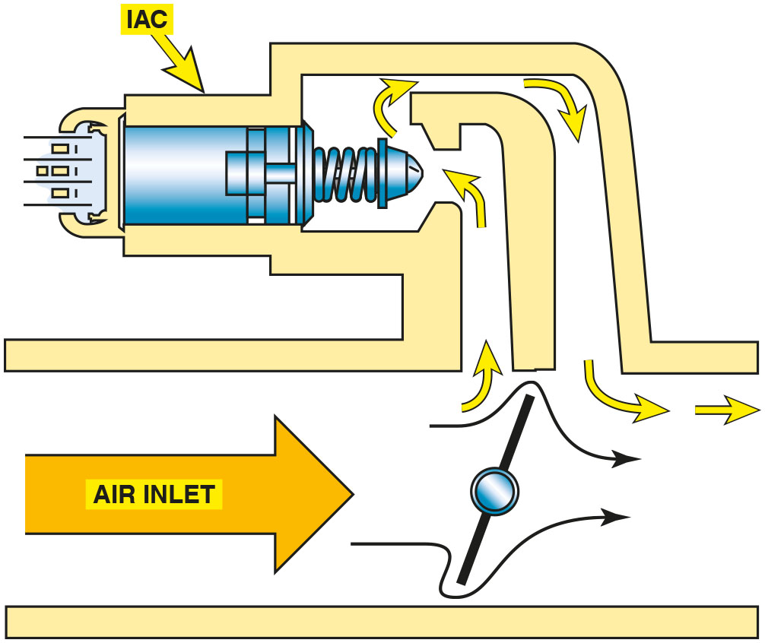
Figure 35.15
I A C
The small arrows indicate the air bypassing the throttle plate in the closed throttle position. This air is called minimum air. The air flowing through the I A C is the airflow that determines the idle speed.
Notes:
Long Description:
The bypass control unit with a throttle plate and an idle air control (I A C) motor. The air inlet is connected to the throttle chamber, where a bypass is present before the throttle plate. The bypass has a bigger path for the air to pass through. This figure shows the throttle plate in the closed throttle position and the air passing through the bypass and the I A C motor and then flowing back into the throttle chamber.

Slide 43
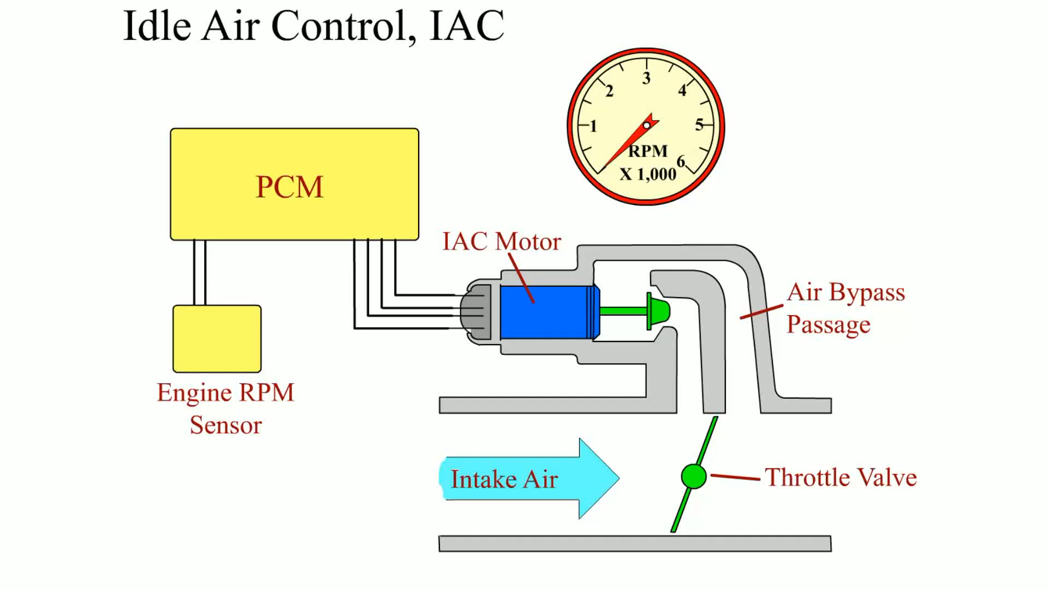
Animation: Idle Air Control, IAC

Slide 44
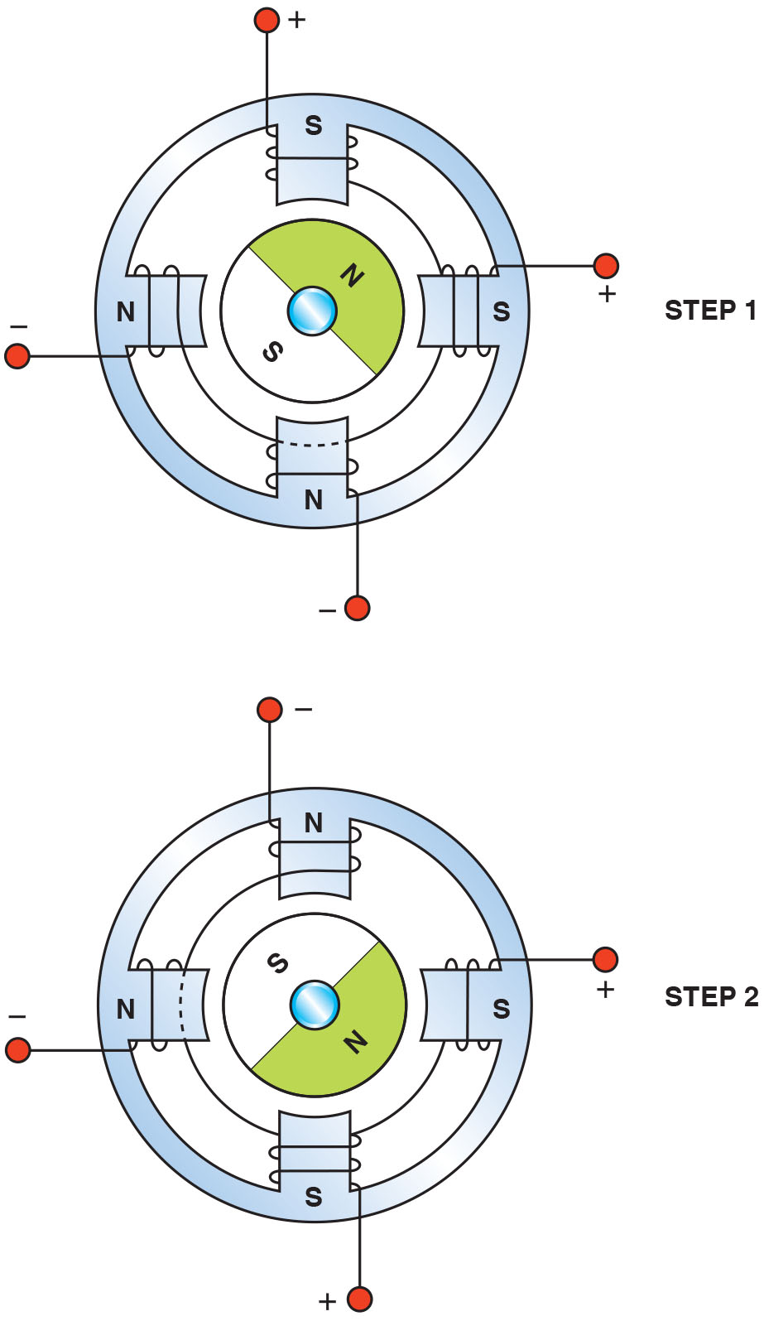
Figure 35.16
I A C Stepper Motor
Most stepper motors use four wires, which are pulsed by the computer to rotate the armature in steps.
Notes:
Long Description:
A circular permanent magnet in the middle and two electromagnets. The permanent magnet forms the armature of the motor. There are four poles of the electromagnets around the armature. Each pole has a winding and is connected to separate wires. In step one, two of the electromagnet poles are south and two of them are north. This makes the armature north attract towards the south poles (top and right) and armature south attract towards the north poles (bottom and left). This forms position one in step one. In step two, consecutive poles are magnetized and the armature rotates 90 degrees.

Slide 45
Question 3
What are the two types of I A C motors?

Slide 46
Answer 3
Solenoid and stepper motor.

Slide 47
Summary (1 of 2)
A fuel-injection system includes the electric fuel pump and fuel-pump relay, fuel-pressure regulator, and fuel injectors (nozzles).
The two types of fuel-injection systems are the throttle body design and the port fuel-injection design.
The two methods of fuel-injection control are the speed density system, which uses the M A P to measure the load on the engine, and the mass airflow, which uses the M A F sensor to directly measure the amount of air entering the engine.
The amount of fuel supplied by fuel injectors is determined by how long they are kept open. This opening time is called the pulse width and is measured in milliseconds.

Slide 48
Summary (2 of 2)
The fuel-pressure regulator is usually located on the fuel return on return-type fuel-injection systems.
T B I-type fuel-injection systems do not use a vacuum controlled fuel-pressure regulator, whereas many port fuel-injection systems use a vacuum-controlled regulator to monitor equal pressure drop across the injectors.
Other fuel designs include the electronic returnless, the mechanical returnless, and the demand delivery systems.

Slide 49
Animations and Video Links
(Halderman website subscription and web access needed to view)
(A8) Engine Performance Animations
(A8) Engine Performance Videos

Slide 50

Copyright
This work is protected by United States copyright laws and is provided solely for the use of instructors in teaching their courses and assessing student learning. Dissemination or sale of any part of this work (including on the World Wide Web) will destroy the integrity of the work and is not permitted. The work and materials from it should never be made available to students except by instructors using the accompanying text in their classes. All recipients of this work are expected to abide by these restrictions and to honor the intended pedagogical purposes and the needs of other instructors who rely on these materials.

