Slide 1
Automotive Electrical and Engine Performance
Ninth Edition
Chapter 33
Narrow and Wide-Band Oxygen Sensors
Copyright © 2025 Pearson Education, Inc. All Rights Reserved
Notes:
If this PowerPoint presentation contains mathematical equations, you may need to check that your computer has the following installed:
1) Math Type Plugin
2) Math Player (free versions available)
3) NVDA Reader (free versions available)
INSTRUCTOR NOTE: This presentation includes text explanation notes, you can use to teach the course. When in SLIDE SHOW mode, you RIGHT CLICK and select SHOW PRESENTER VIEW, to use the notes.

Slide 2
Learning Objectives (1 of 2)
33.1 Discuss how O2S sensors work.
33.2 Discuss P C M uses of the oxygen sensor.
33.3 Discuss oxygen sensor diagnosis.
33.4 Discuss post-catalytic converter O2S testing.
33.5 Explain the operation of wide-band oxygen sensors.
33.6 Describe dual cell planar wide-band sensor operation.

Slide 3
Learning Objectives (2 of 2)
33.7 Discuss dual cell diagnosis.
33.8 Describe single cell wide-band oxygen sensors.
33.9 Interpret oxygen sensor-related diagnostic trouble codes.
33.10 Discuss P C M use of fuel trim to maintain stoichiometric fuel efficiency.
33.11 Describe the operation of short-term and long-term fuel trim.

Slide 4
Oxygen Sensors (1 of 3)
Purpose and Function
Automotive computer systems use an oxygen sensor in the exhaust system to measure the oxygen content of the exhaust.
Narrow Band
A conventional zirconia oxygen sensor (O2S) is only able to detect if the exhaust is richer or leaner than

Slide 5
Oxygen Sensors (2 of 3)
Construction
A typical zirconia oxygen sensor has the sensing element in the shape of a thimble; therefore, it is often referred to as one of the following: thimble design, cup design, or finger design.
Operation
When the concentration of oxygen on the exhaust side
of the thimble is low, a high voltage
to
is generated between the electrodes. As the oxygen concentration on the exhaust side increases, the
voltage generated drops
to

Slide 6
Oxygen Sensors (3 of 3)
There are several different designs of oxygen sensors, including the following:
One-wire oxygen sensor
Two-wire oxygen sensor
Three-wire oxygen sensor
Four-wire oxygen sensor
Heater Circuits
Conventional
O2 sensors require 0.8 to
amperes
at about
Wide-band O2 sensors require 8 to 10 amperes at
to

Slide 7
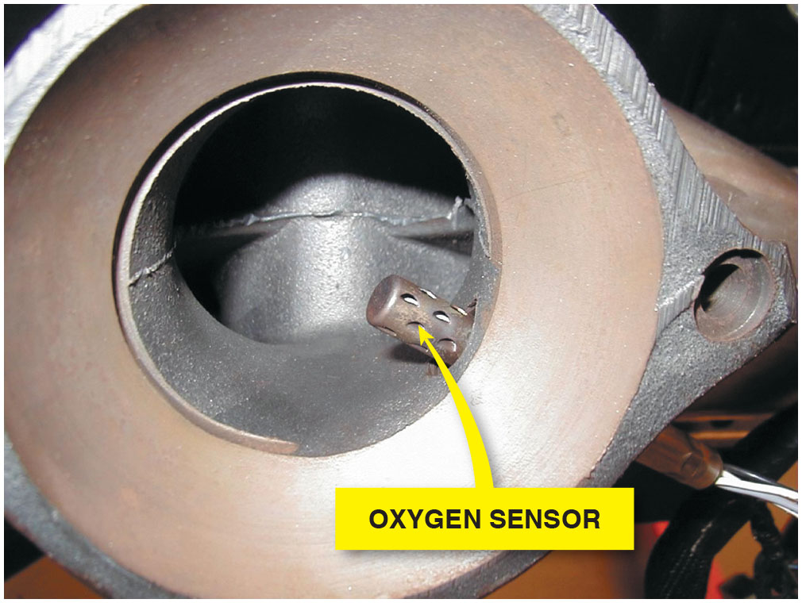
Figure 33.1
Oxygen Sensor
Many oxygen sensors are located in the exhaust manifold near its outlet so that the sensor can detect the air–fuel mixture in the exhaust stream for all cylinders that feed into the manifold.

Slide 8
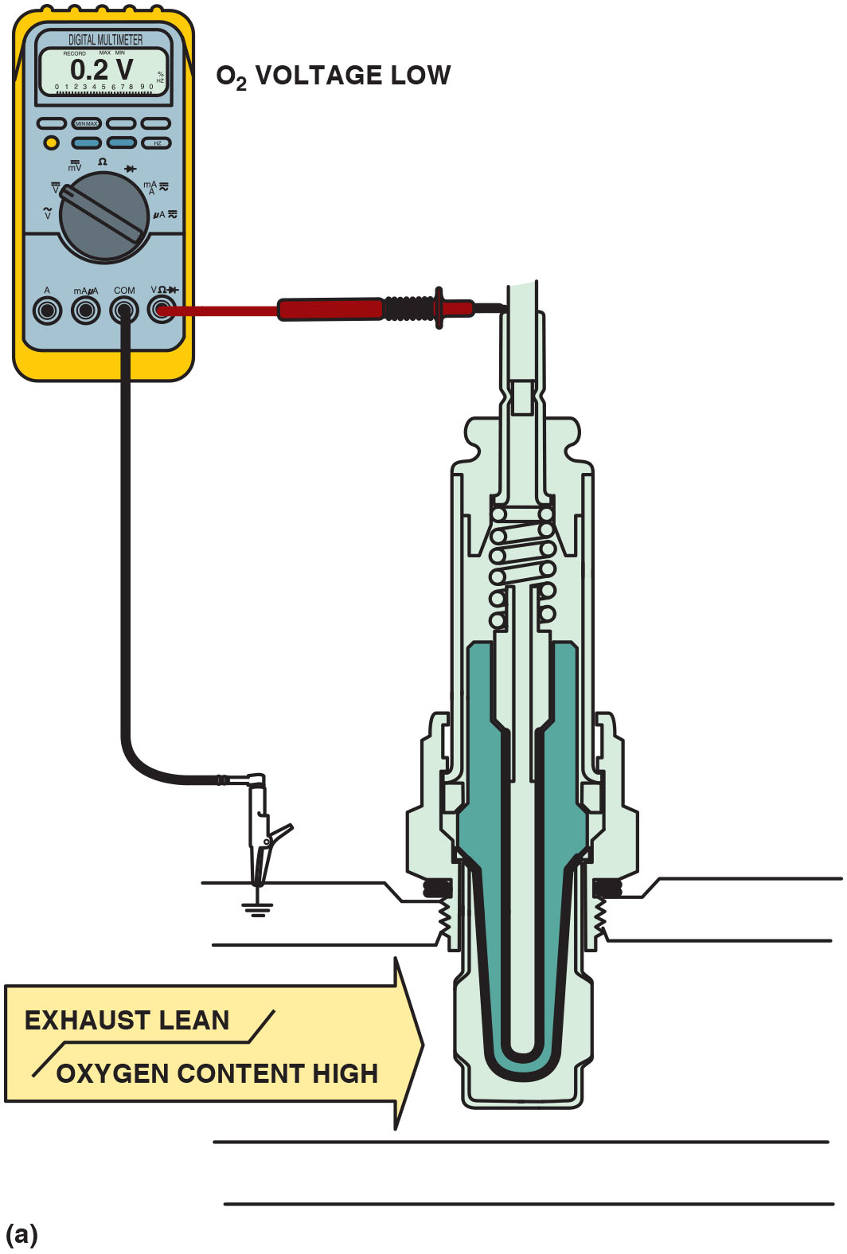
Figure 33.2
Sensor Operation
(a) When the exhaust is lean, the output of a zirconia oxygen sensor is below 450 m V. (b) When the exhaust is rich, the output of a zirconia oxygen sensor is above 450 m V.
Notes:
Long Description 1:
The figure depicts the red test lead attached to the tip of the sensor and the black test lead connected to ground. Exhaust flowing through the sensor is tipped to be lean and with high oxygen content. The O subscript 2 voltage shown on the multi-meter is 0.2 volts.
Long Description 2:
The figure depicts the red test lead attached to the tip of the sensor and the black test lead connected to ground. Exhaust flowing through the sensor is tipped to be rich and with low oxygen content. The O 2 voltage shown on the multimeter is 0.8 volts.

Slide 9
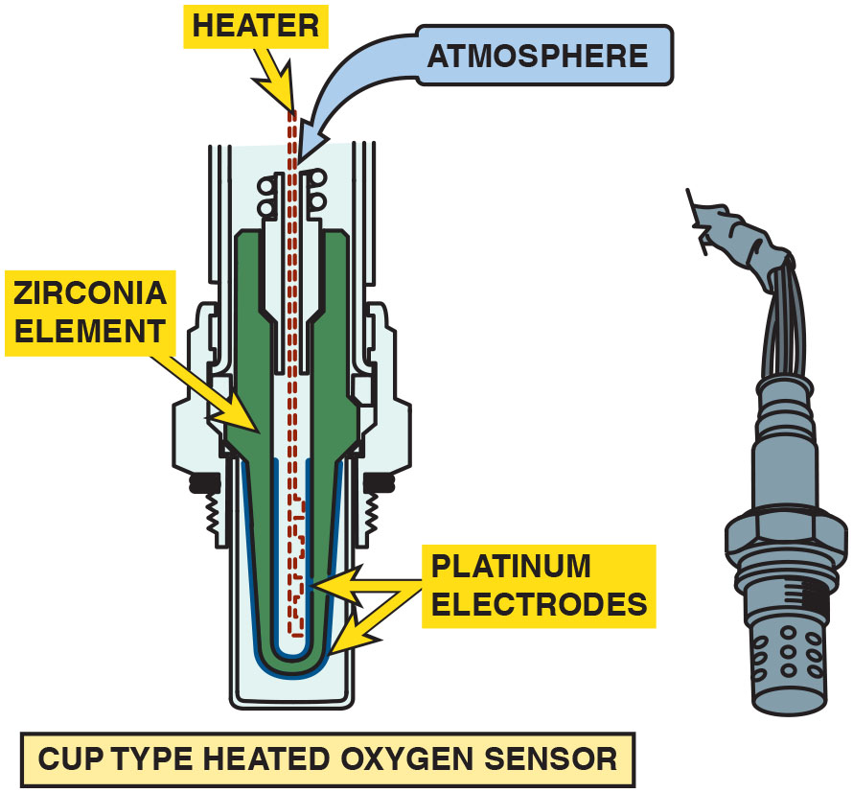
Figure 33.3
Zirconia Element
Most conventional zirconia oxygen sensors and some wide-band oxygen sensors use the cup (finger) type of design.
Notes:
Long Description:
The figure depicts a finger-type design with the sensing element in the shape of a thimble on one end. The housing of the sensor holds a u-shaped Zirconia element covered with porous platinum electrodes. A heater element is inside the thimble-shaped sensing element of the sensor. Atmospheric air enters from the other end of the sensor.

Slide 10
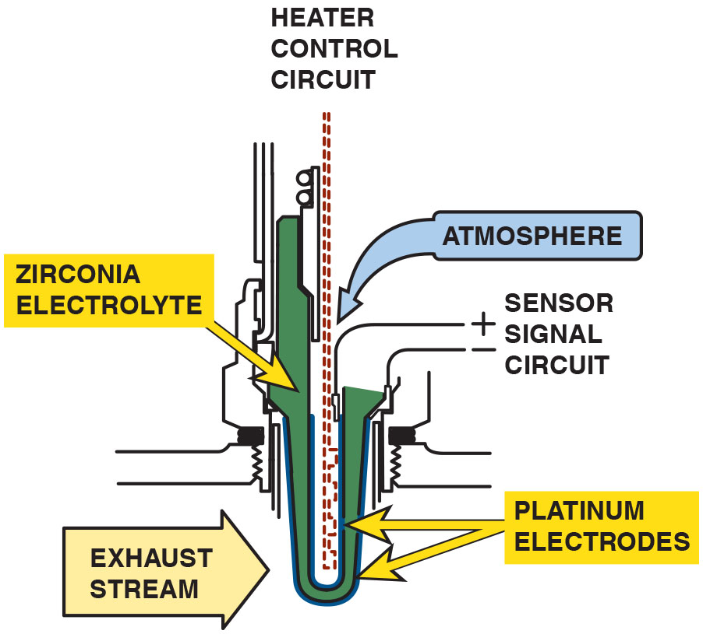
Figure 33.4
Heated Oxygen Sensor
A typical heated zirconia oxygen sensor, showing the sensor signal circuit that uses the outer (exhaust) electrode as the negative and the ambient air side electrode as the positive.
Notes:
Long Description:
The figure depicts a finger type design with the sensing element in the shape of a thimble at one end. The thimble end is in contact with exhaust stream. The other end has the atmospheric air entering the sensor. A sensor signal circuit connected to the sensor uses the exhaust side electrode as the negative and the ambient-air electrode as the positive. A heater control circuit is kept inside the thimble along the positive side electrode. Platinum electrodes are connected to the exhaust side electrode, while the zirconia electrode is on the other side of the heater control circuit.

Slide 11
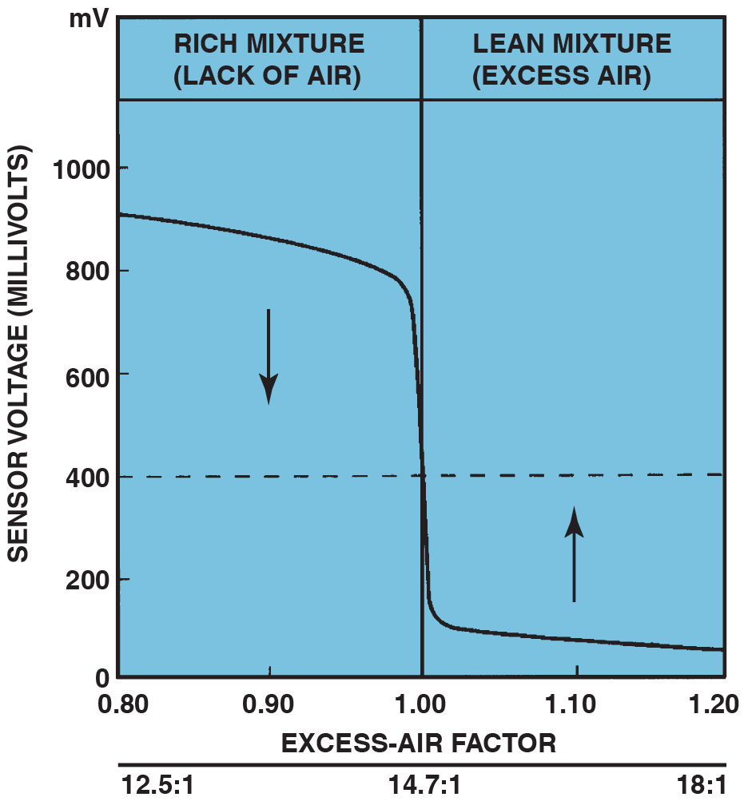
Figure 33.5
Stoichiometric 14.7∶1
The oxygen sensor provides a quick response at the stoichiometric air–fuel ratio of 14.7∶1.
Notes:
Case Study The Chevrolet Pickup Truck Story
The owner of a Chevrolet pickup truck complained that the engine ran terribly. It would hesitate and surge, yet there were no diagnostic trouble codes (D T Cs ). After hours of troubleshooting, the technician discovered while talking to the owner that the problem started after the transmission had been repaired. However,
the transmission shop said that the problem was an engine problem and not related to the transmission. A thorough visual inspection revealed that the
front and rear oxygen sensor connectors had been switched. The P C M was trying to compensate for an air fuel mixture condition that did not exist. Reversing the O2S connectors restored proper operation of the truck.
Summary:
Complaint—Vehicle owner complained that the pickup truck ran terribly.
Cause—During a previous repair, the upstream and downstream oxygen sensor connectors were reversed.
Correction—The connectors were moved to their correct locations, which restored proper engine operation.
Long Description:
The graph has sensor voltage in millivolts on the vertical axis and the excess air factor on the horizontal axis. The vertical axis has values from 0 millivolts to 1000 millivolts in intervals of 200 millivolts. The horizontal axis has excess-air factor values from 0.80 to 1.20 in intervals of 0.1. The graph is divided into two sections, rich mixture (lack of air) from 0.80 excess-air factor to 1.00 and lean mixture (excess air) from 1.00 excess-air factor to 1.20. An air fuel ratio of 12.5 to 1 is shown at an excess-air factor of 0.80, 14.7 to 1 at 1.00 excess-air factor and 18 to 1 at 1.20 excess-air factor. The graph shows a gradual decrease in a voltage and a sudden drop when the mixture changes and again a gradual decrease.

Slide 12
Question 1
How does an oxygen sensor report the level of oxygen in the exhaust?

Slide 13
Answer 1
When the oxygen level is low, the sensor generates a voltage above 450 m V. When the oxygen level is high, the oxygen sensor generates a voltage below 450 m V.

Slide 14
Titania Oxygen Sensor
The titania (titanium dioxide) oxygen sensor does not produce a voltage, but rather changes resistance due to the presence of oxygen in the exhaust.
As with a zirconia oxygen sensor, the voltage signal is above 450 mV when the exhaust is rich and low (below 450 mV) when the exhaust is lean.

Slide 15
Frequently Asked Question: Where Is H O2S1?
? Frequently Asked Question
Where Is H O2S1? Oxygen sensors are numbered according to their location in the engine. On a V-type engine, heated oxygen sensor number 1 (H O2S1) is located in the exhaust system upstream of the catalytic converter on the side of the engine where cylinder 1 is located. ● See Figure 33.6.

Slide 16
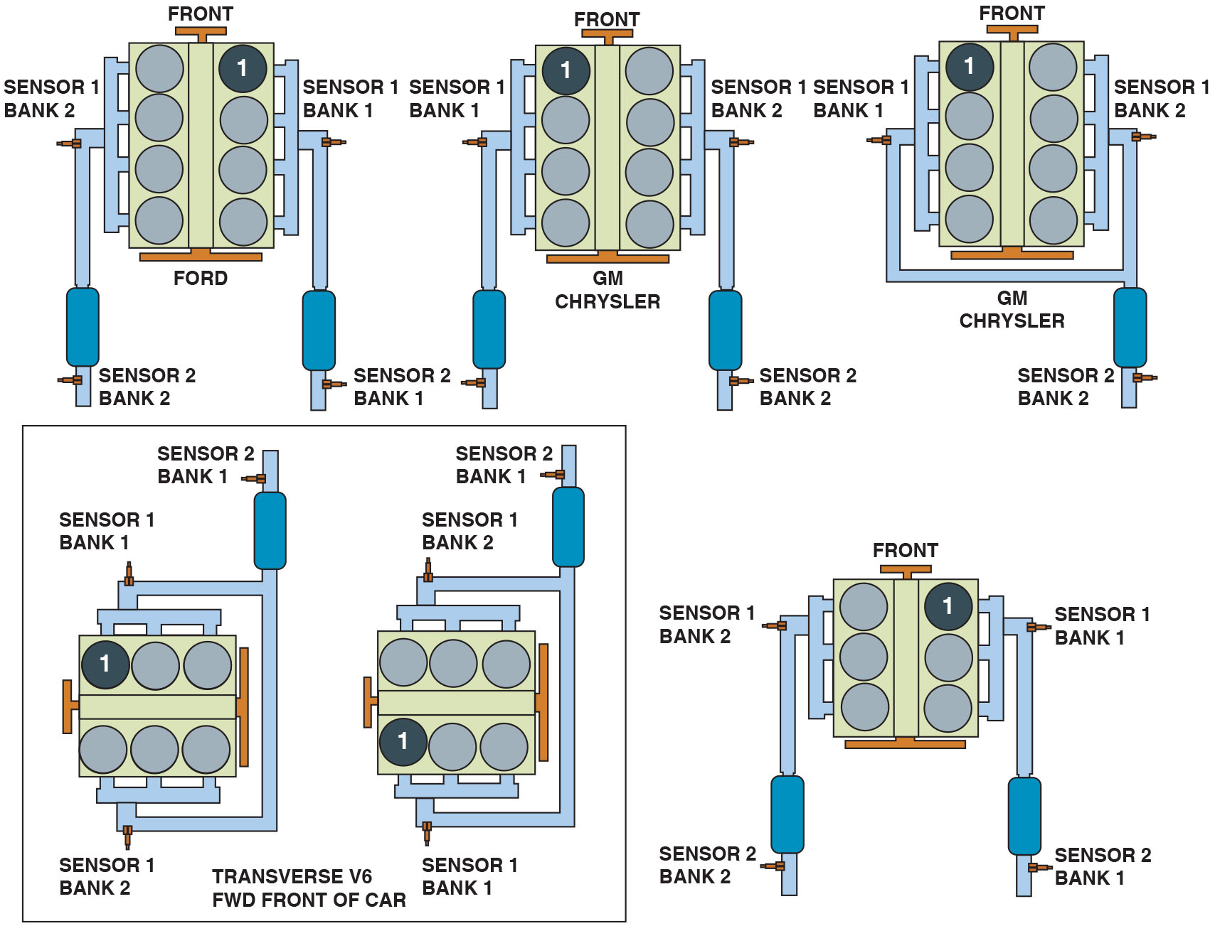
Figure 33.6
Oxygen Sensor Locations
Number and label designations for oxygen sensors. Bank 1 is the bank where cylinder 1 is located.
Notes:
Long Description:
The figure depicts six engine blocks divided into two halves, each half with equal number of cylinders. From the six engine blocks shown in the figure, three of them have two separate catalytic converters for their exhaust manifolds and the other three of them have a single catalytic converter for their exhaust manifolds. For every engine block, whether it is transverse or F W D, there is a bank of two sensors. Sensor banks located near the half where cylinder 1 is located is labeled as sensor bank 1 for every engine.

Slide 17
P C M Uses of Oxygen Sensor
Fuel Control
The upstream oxygen sensors are among the high-authority sensors used for fuel control while operating in closed loop.
Fuel Trim
The fuel trim numbers are determined from the signals by the oxygen sensor(s).
Fuel trim can be negative (subtracting fuel) or positive (adding fuel).

Slide 18
Oxygen Sensor Diagnosis (1 of 2)
P C M System Tests
The P C M uses the oxygen sensor to test the E G R system, the catalytic converter, and the fuel system.
Visual Inspection
Black sooty deposits usually indicate a rich air–fuel mixture.
White chalky deposits are characteristic of silica contamination.
White sandy or gritty deposits are characteristic of antifreeze (ethylene glycol) contamination.

Slide 19
Oxygen Sensor Diagnosis (2 of 2)
Digital Voltmeter Testing
Oxygen sensor can be checked for proper operation using a digital high-impedance voltmeter.
Min/Max Testing
Digital meter set on D C volts can be used to record the minimum and maximum voltage with the engine running.
Scan Tool Testing
Using a scan tool, observe oxygen sensor voltages.
Scope Testing
Voltage signal of sensor constantly changing.

Slide 20
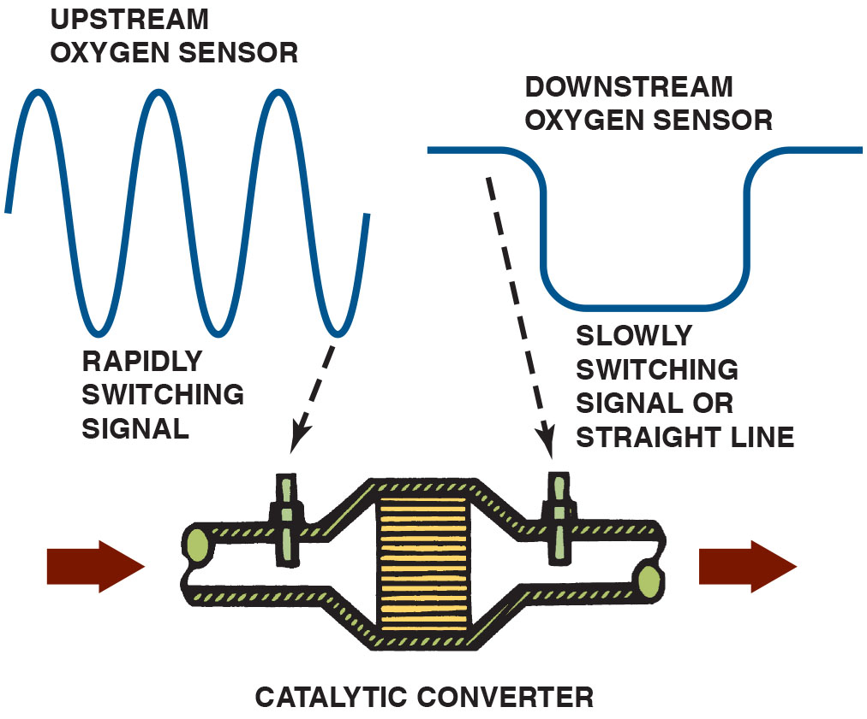
Figure 33.7
Upstream/Downstream
The
catalytic converter monitor compares the
signals of the upstream and downstream oxygen sensor to determine converter efficiency.
Notes:
Long Description:
The figure also depicts signals from the upstream and downstream oxygen sensors as shown on an O B D-2 catalytic converter monitor. The upstream signal shows a rapidly switching signal, with the curve of the signal similar to a sine wave. The downstream signal shows a slowly switching signal or a straight line signal, with the curve of the signal similar to a rectangular pulse with rounded edges.

Slide 21
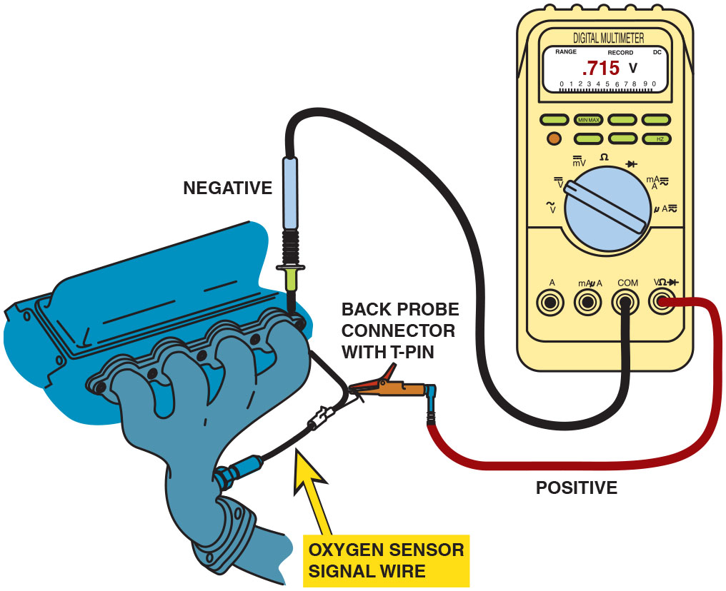
Figure 33.8
D M M Testing
Testing an oxygen sensor using a D M M set on D C volts. With the engine operating in closed loop, the oxygen voltage should read over 800 m V and lower than 200 m V and be constantly fluctuating.
Notes:
Long Description:
The figure depicts the red test lead connected to the oxygen sensor signal wire and the black test lead connected to the engine ground. The display on the multi-meter reads .715 volts.

Slide 22
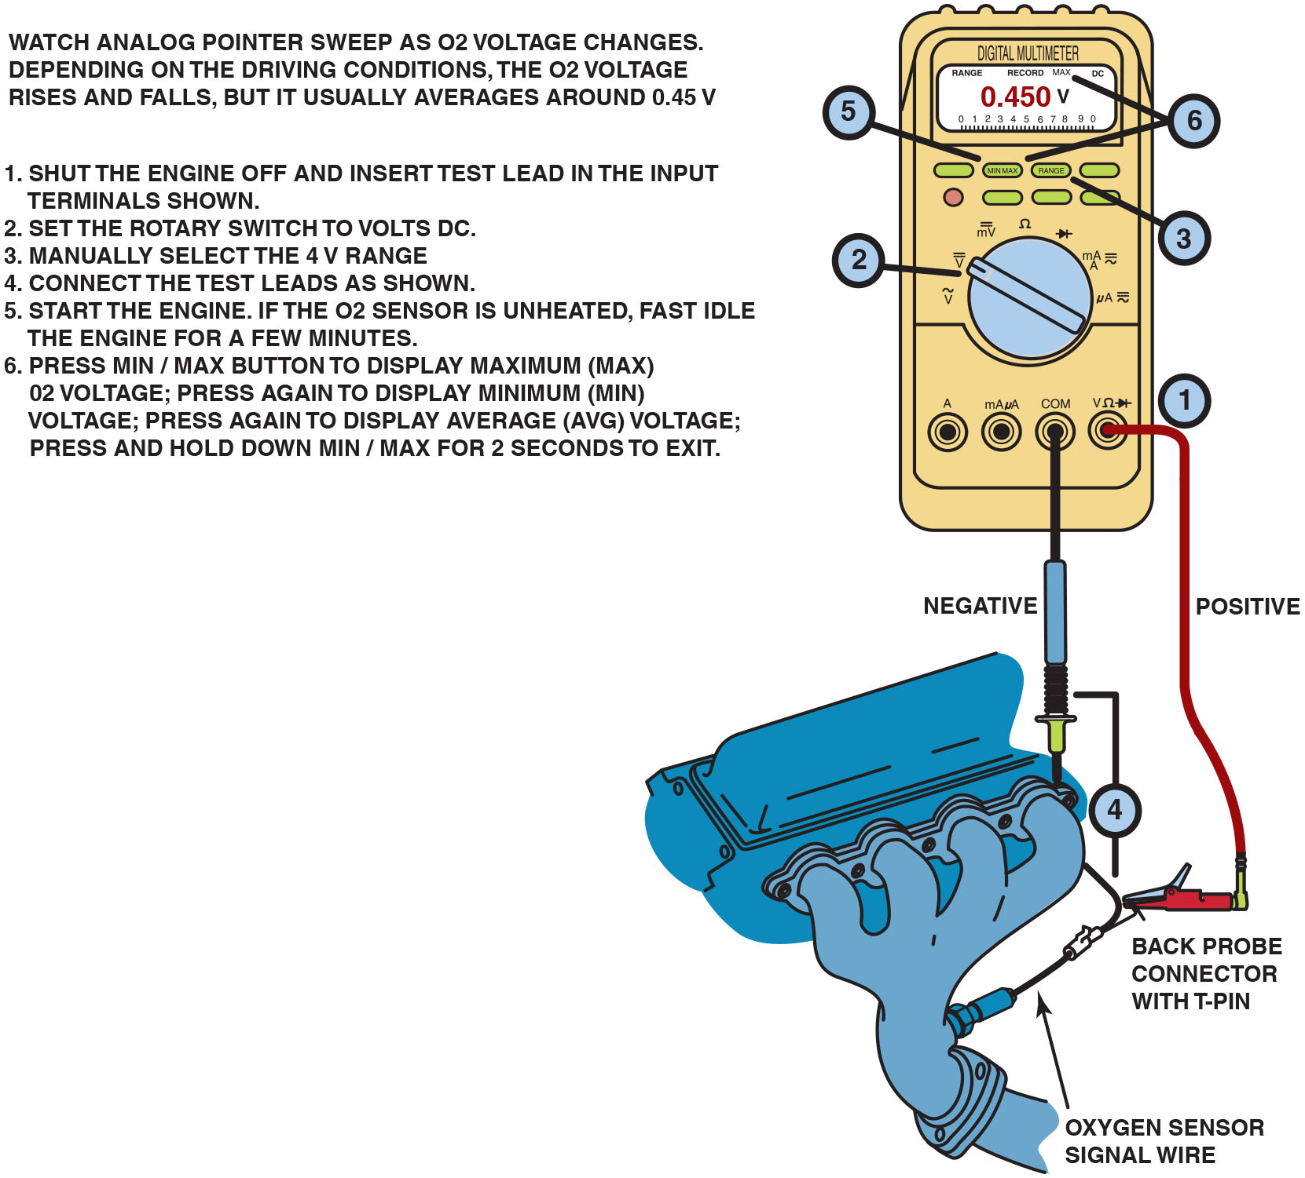
Figure 33.9
D M M M I N/M A X Testing
Using a digital multimeter to test an oxygen sensor using the M I N/M A X record function of the meter.
Notes:
TECH TIP Do Not Solder Oxygen Sensor Wires: Oxygen sensors must have outside oxygen to compare with the oxygen content in the exhaust.
Most oxygen sensors breathe through the signal wire and, if soldered, would block the flow of outside air to the sensor. If a replacement oxygen sensor is used, always use the factory replacement, using the original connectors or a crimp-and-seal connector that will seal out any moisture and still allow air to flow through the connector.
Long Description:
The figure depicts the red test lead connected to the oxygen sensor signal wire and the black test lead connected to the engine ground. Numbering from 1 to 6 can be seen on the figure. Number 1 is shown near the input terminals of test leads. Number 2 is shown at the rotary switch. Number 3 is shown at the range button on the multi-meter. Number 4 is shown at the test leads connected to engine and the oxygen sensor. Number 5 is shown the minimum and maximum button and number 6 is shown pointing the minimum and maximum button and the display screen of the multi-meter. Instructions for using the multi-meter are shown in the figure and can be read as below. Watch analog pointer sweep as O 2 voltage chances. Depending on the driving conditions, the O 2 voltage rises and falls, but it usually averages around 0.45 volts. 1. Shut the engine off and insert test lead in the input terminals as shown. 2. Set the rotary switch to volts D C. 3. Manually select the 4 volts range. 4. Connect the test leads as shown. 5. Start the engine. If the O 2 sensor is unheated, fast idle the engine for a few minutes. 6. Press minimum and maximum button to display maximum (maximum) O 2 voltage; press again to display minimum (minimum) voltage; press again to display average (average) voltage; press and hold down minimum and maximum for 2 seconds to exit.

Slide 23
Animation: O2 Sensor, Voltage Checks

Slide 24
Frequently Asked Question: Why Does the Oxygen Sensor Voltage Read 5 Volts on Many Chrysler Vehicles?
? Frequently Asked Question
Why Does the Oxygen Sensor Voltage Read 5 Volts on Many Chrysler Vehicles? Many Chrysler vehicles apply a 5-volt reference to the signal wire of the oxygen sensor. The purpose of this voltage is to allow the P C M to detect if the oxygen sensor signal circuit is open or grounded. If the voltage on the signal wire is 4.5 volts or more, the P C M assumes that the sensor is open. If the voltage on the signal wire is zero, the P C M assumes that the sensor is shorted-to-ground. If either condition exists, the P C M can set a D T C.
Notes:
TECH TIP The Key On, Engine Off Oxygen Sensor Test
This test works on General Motors vehicles and may work on others if the P C M applies a bias voltage to the oxygen sensors. Zirconia oxygen sensors become
more electrically conductive as they get hot. To perform this test, be sure that the vehicle has not run for several hours.
STEP 1 Connect a scan tool and get the display ready to show oxygen sensor data.
STEP 2 Key the engine on without starting the engine. The heater in the oxygen sensor will start heating the sensor.
STEP 3 Observe the voltage of the oxygen sensor. The applied bias voltage of 450 m V should slowly decrease for all oxygen sensors as they become more electrically conductive as the bias voltage is flowing to ground.
STEP 4 A good oxygen sensor should indicate a voltage of less than 100 m V after three minutes. Any sensor that displays a higher than usual voltage
or seems to stay higher longer than the others could be defective or skewed high.

Slide 25
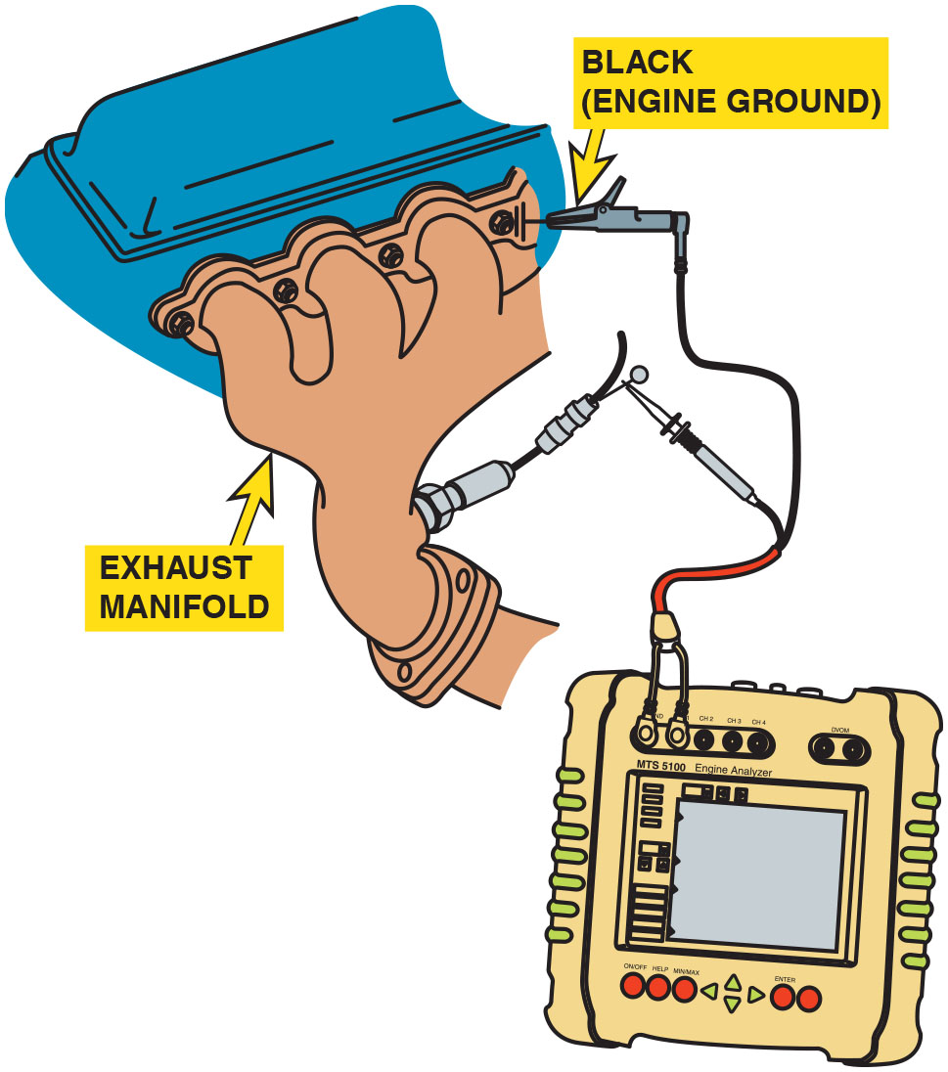
Figure 33.10
D S O O2 Testing
Connecting a handheld digital storage oscilloscope to an oxygen sensor signal wire. Check the instructions for the scope as some require the use of a filter to be installed in the test lead to reduce electromagnetic interference that can affect the oxygen sensor waveform.
Notes:
CASE STUDY: The Oxygen Sensor Is Lying to You
A technician was trying to solve a driveability problem with an older V-6 passenger car. The car idled roughly, hesitated, and accelerated poorly. A thorough visual inspection did not indicate problems and there were no diagnostic trouble codes stored. The technician checked the oxygen sensor activity using a D M M. The voltage stayed above 600 m V most of the time. If the technician removed a large vacuum hose, the oxygen sensor voltage would temporarily drop to below 450 m V and then return to a reading of over 600 m V. Remember:
• High O2S readings=rich exhaust (low O2 content in the exhaust)
• Low O2S readings=lean exhaust (high O2 content in the exhaust)
As part of a thorough visual inspection, the technician removed and inspected the spark plugs. All the spark plugs were white, indicating a lean mixture, not the rich mixture that the oxygen sensor was indicating. The high O2S reading signaled the P C M to reduce the amount of fuel, resulting in an excessively
lean operation.
After replacing the oxygen sensor, the engine ran great. But what killed the oxygen sensor? The technician finally learned from the owner that the head gasket had been replaced over a year ago. The silicate and phosphate additives in the antifreeze coolant had coated the oxygen sensor. Because the oxygen sensor was coated, the oxygen content of the exhaust could not be detected, resulting in a false rich signal from the oxygen sensor.
Summary:
Complaint—Vehicle owner complained that the car equipped with a V-6 engine ran terribly.
Cause—The oxygen sensor was contaminated by the additives in the coolant caused by a previously repaired head gasket failure.
Correction—Replacing the oxygen sensors restored proper engine operation.

Slide 26
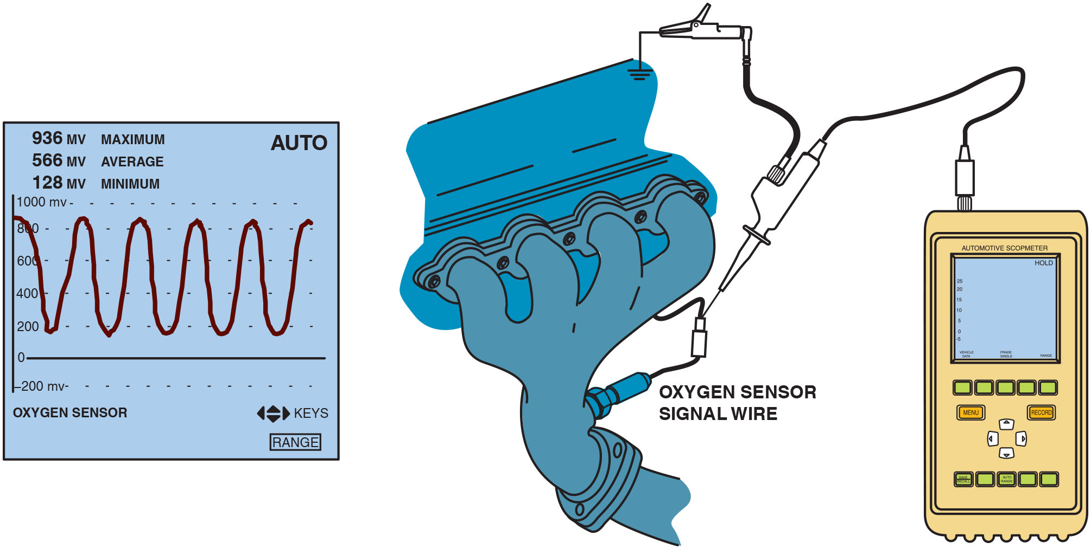
Figure 33.11
O2 Waveform
The waveform of a good oxygen sensor as displayed on a digital storage oscilloscope (D S O). Note that the maximum reading is above 800 mV and the minimum reading is less than 200 mV.
Notes:
Long Description:
The D S O screen shows a waveform similar to a sine wave. The waveform is measured for voltages and it is seen on a graph with voltage on the vertical axis. The waveform oscillates between a maximum value of 936 millivolts and a minimum voltage of 128 millivolts.

Slide 27
Animation: Wide Band Oxygen Sensor Tests

Slide 28
Question 2
What are the three ways to test an oxygen sensor?

Slide 29
Answer 2
With a multimeter, a scan tool, or an oscilloscope.

Slide 30
Post-Catalytic Converter Oxygen Sensor Testing
Oxygen sensor located behind the catalytic converter is
used on
vehicles to monitor converter efficiency.
If converter is working correctly, the oxygen content after the converter should be fairly constant.
Post catalytic converter oxygen sensor also is used to modify the amount of fuel delivered to the engine to allow the converter to work efficiently.

Slide 31
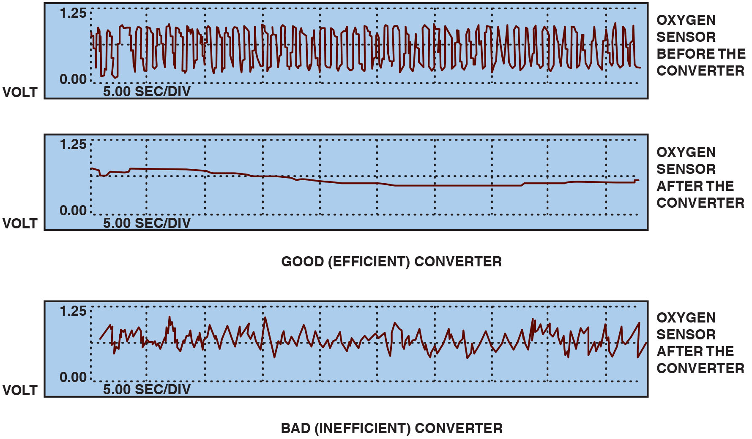
Figure 33.12
Oxygen Sensor Waveforms
The post-catalytic converter oxygen sensor should display very little activity if the catalytic converter is efficient.
Notes:
TECH TIP The Propane Oxygen Sensor Test
Adding propane to the air inlet of a running engine is an excellent way to check if the oxygen sensor is able to react to changes in air–fuel mixture. Follow these
steps in performing the propane trick:
1. Connect a digital storage oscilloscope to the oxygen sensor signal wire.
2. Start and operate the engine until it reaches operating temperature and is in closed-loop fuel control.
3. While watching the scope display, add some propane to the air inlet. The scope display should read full rich (over 800 m V).
4. Shut off the propane. The waveform should drop to less than 200 m V (0.2 V).
5. Quickly add some propane while the oxygen sensor is reading low and watch for a rapid transition to rich. The transition should occur in <100 milliseconds (ms).
Long Description:
The figure shows three graphs measured for oxygen content in the post catalytic converter sensor. The graph is displayed on a 2 by 10 display with voltage on the two vertical divisions and a time of 5 seconds per division on the horizontal divisions. The first graph for oxygen sensor before the converter shows a waveform that oscillates between zero and one volt (approximately) and is closely spaced. The second graph for oxygen sensor after the converter shows a waveform with a line that starts in the second grid and ends in the first grid but remains close to a voltage of 0.625 volts. This graph shows that the converter is efficient. The third graph for oxygen sensor after the converter shows a waveform that is distorted and doesn’t follow a specific curve. The waveform oscillates between 1 and 0.4 (approximately).

Slide 32
Frequently Asked Question: How Could Using Silicone Sealer on a Valve Cover Gasket Affect the Oxygen Sensor?
? Frequently Asked Question
How Could Using Silicone Sealer on a Valve Cover Gasket Affect the Oxygen Sensor? The wrong type of silicone room temperature vulcanization (R T V) sealer on a valve cover gasket gives off harmful silica fumes during curing process. These fumes enter the crankcase area by way of the oil drain back holes in the cylinder head, as well as through pushrod openings and other passages in the engine. During engine operation, these fumes are drawn into the intake manifold through the positive crankcase ventilation (P C V) system and are burned in the engine. The harmful silica then exits through the exhaust system, where the contamination affects the oxygen sensor.

Slide 33
Wide-Band Oxygen Sensors (1 of 2)
Terminology
Wide-band oxygen sensors have various names, depending on the vehicle and/or oxygen sensor manufacturer, including: broadband, wide-band, air–fuel sensor, lean air–fuel sensor.
Introduction
The need for more stringent exhaust emission standards require more accurate fuel control than can be provided by a traditional oxygen sensor.

Slide 34
Wide-Band Oxygen Sensors (2 of 2)
Purpose and Function
A wide-band oxygen sensor is capable of supplying air–fuel ratio information to the P C M over a much broader range.
Planar Design
A wide-band oxygen sensor that is flat and thin (1.5
mm or
The thin design makes it easier to heat and allows closed-loop operation in less than 10 seconds.

Slide 35
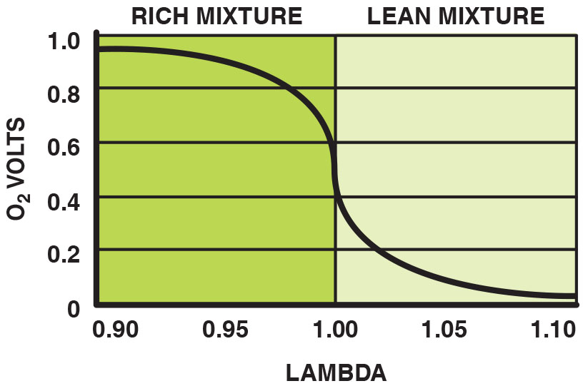
Figure 33.13
Zirconia Sensor
A conventional zirconia oxygen sensor can only reset to
exhaust mixtures that are richer or leaner than
(lambda
Notes:
Long Description:
The graph depicts voltage on the vertical axis and lambda values on the horizontal axis. Lambda 1.00 is equal to an air-fuel ratio of 14.7 to 1. Values of rich mixture extend from .90 lambda to 1 on the horizontal axis and values of lean mixture extend from 1 to 1.10 on the same axis. The graph decreases gradually from 1 volt to 0.6 when the mixture is rich, drops steeply from 0.6 to 0.4 volts at air-fuel ratio of 14.7 to 1 and again decreases gradually from 0.4 to 0 volts when the mixture is lean.

Slide 36
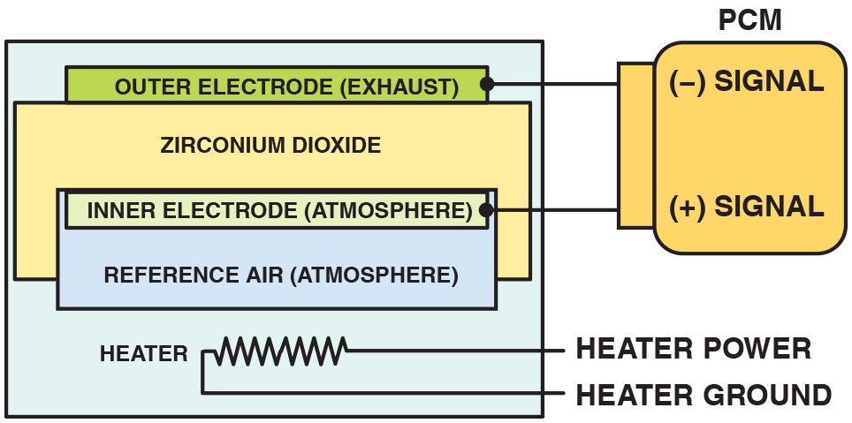
Figure 33.14
Wide-Band Sensor
A planar design zirconia oxygen sensor places all of the elements together, which allows the sensor to reach operating temperature quickly.
Notes:
Long Description:
The figure depicts a planar stack with a heater at the bottom. The heater is connected to power and ground terminals. Above the heater, a zirconium dioxide electrolyte is placed. The inner electrode and the reference air are sandwiched into the zirconia electrolyte. At the top of the zirconia electrolyte, an outer exhaust electrode is stacked. The outer electrode is connected to the negative P C M signal and the inner electrode is connected to the positive P C M signal.

Slide 37
Frequently Asked Question: How Quickly Can Wide-Band Oxygen Sensor Achieve Closed Loop?
? Frequently Asked Question
How Quickly Can a Wide-Band Oxygen Sensor Achieve Closed Loop? In a Toyota Highlander hybrid electric vehicle, operation of the gasoline engine is delayed for a short time when the vehicle is first driven. During this time of electric operation, the oxygen sensor heaters are turned on in readiness for the gasoline engine starting. The gasoline engine often achieves closed-loop operation during cranking because the oxygen sensors are fully warm and ready to go at the same time the engine is started. Having the gasoline engine achieve closed loop quickly, allows it to meet the stringent S U L E V standards.

Slide 38
Dual Cell Planar Wide-Band Sensor Operation (1 of 2)
Construction
A dual cell, planar-type, wide-band oxygen sensor is made like a conventional planar O2S, or Nernst cell. Above the Nernst cell is another zirconia layer with two electrodes, called the pump cell.
Operation
Oxygen sensors do not measure the quantity of free oxygen in the exhaust. Instead, oxygen sensors produce a voltage that is based on the ion flow between the platinum electrodes of the sensor to maintain a stoichiometric balance.

Slide 39
Dual Cell Planar Wide-Band Sensor Operation (2 of 2)
Stoichiometric
When the exhaust is at stoichiometric
air–fuel
ratio), the voltage of the Nernst cell is 450 m V (0.45 V).
The voltage between the diffusion chamber and the air reference chamber changes from 0.45 V. This voltage is:
Higher if the exhaust is rich
Lower if the exhaust is lean
The reference voltage remains constant, but varies by vehicle.

Slide 40
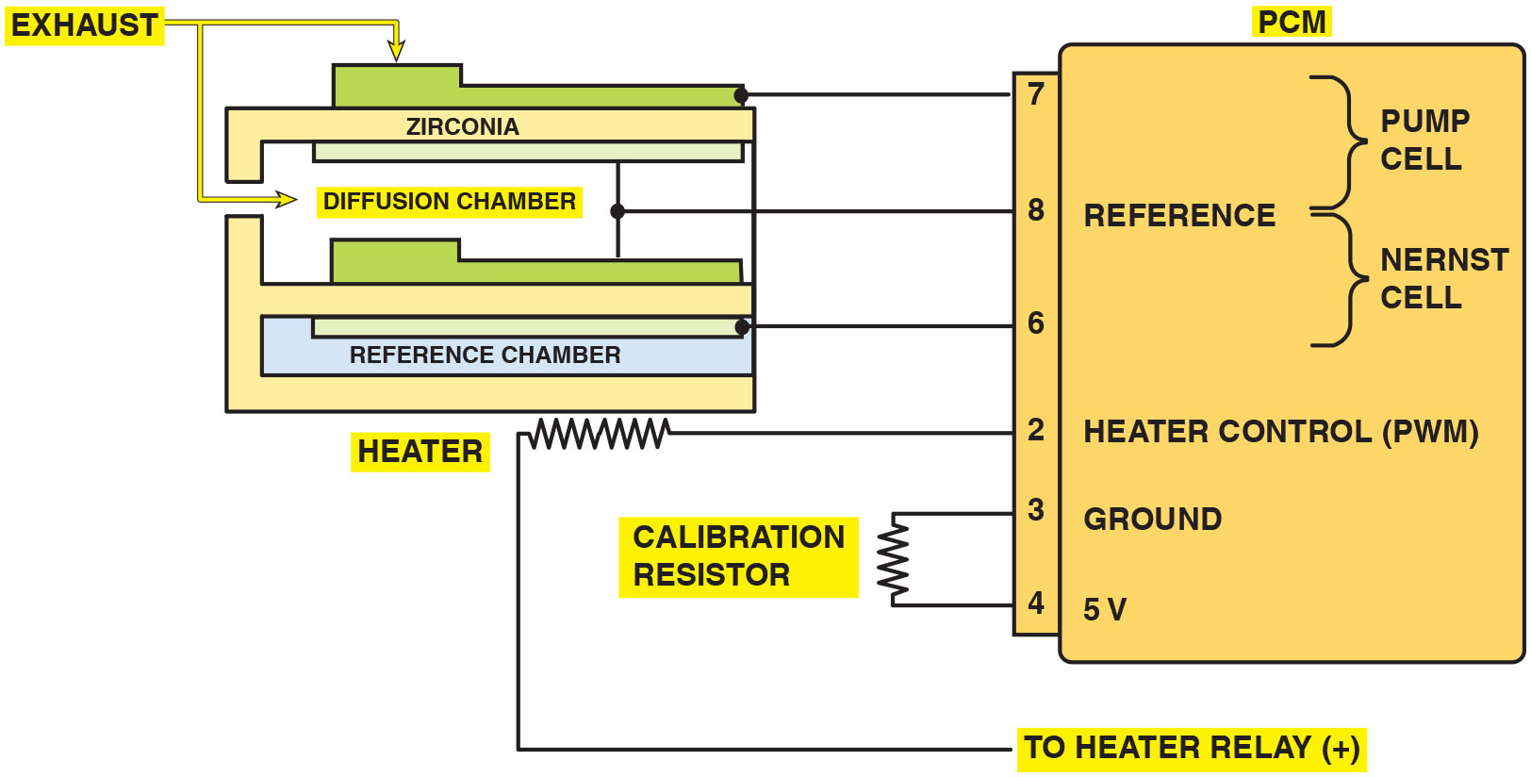
Figure 33.15
Wide-Band Nernst Cell
The reference electrodes are shared by the Nernst cell and the pump cell.
Notes:
Long Description:
The figure depicts a dual-cell planar design made of two cells, a conventional planar O 2 S or the Nernst cell and another layer of zirconia layer with two electrodes, called the pump cell. The conventional cell is on the bottom and a second layer of zirconia of the pump cell is at the top. There’s a diffusion chamber between the two cells and the cells share a common ground, called the reference. The diffusion chamber is exposed to exhaust gases. P C M terminals 3 and 4, ground and 5 volts are connected to a calibration resistor. A heater coil placed below the Nernst cell has one terminal connected to P C M terminal 2 and other terminal is connected to the positive terminal of heater relay. The P C M terminal 2 has a P W M heater control. P C M terminal 6 is connected to the inner electrode of Nernst cell. The reference is connected to the common reference for pump cell and Nernst cell at P C M terminal 8. Exhaust electrode of pump cell is connected to P C M terminal 7.

Slide 41
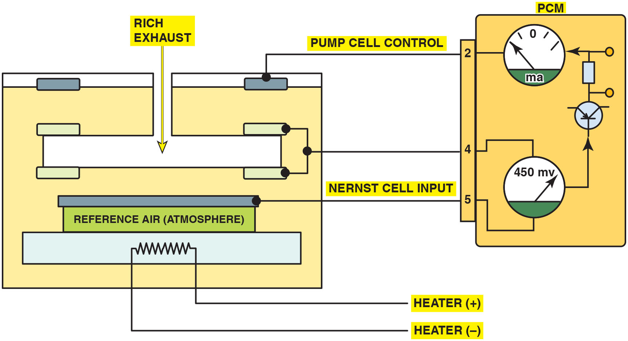
Figure 33.16
Exhaust Rich
When the exhaust is rich, the P C M applies a negative current into the pump cell.
Notes:
Long Description:
The figure depicts a dual cell sensor with a P C M connected to it. A heater coil connected to heater positive and negative terminals is stacked at the bottom of the cell. A Nernst cell is connected to a voltmeter in a P C M. The Nernst cell electrode is connected to input terminal 5 of P C M and the common reference electrode is connected to the terminal 4 of P C M. The voltmeter is connected to an ammeter in the P C M through a circuitry made of electrical components. The ammeter connects to the pump cell electrode through terminal 2 of P C M.

Slide 42
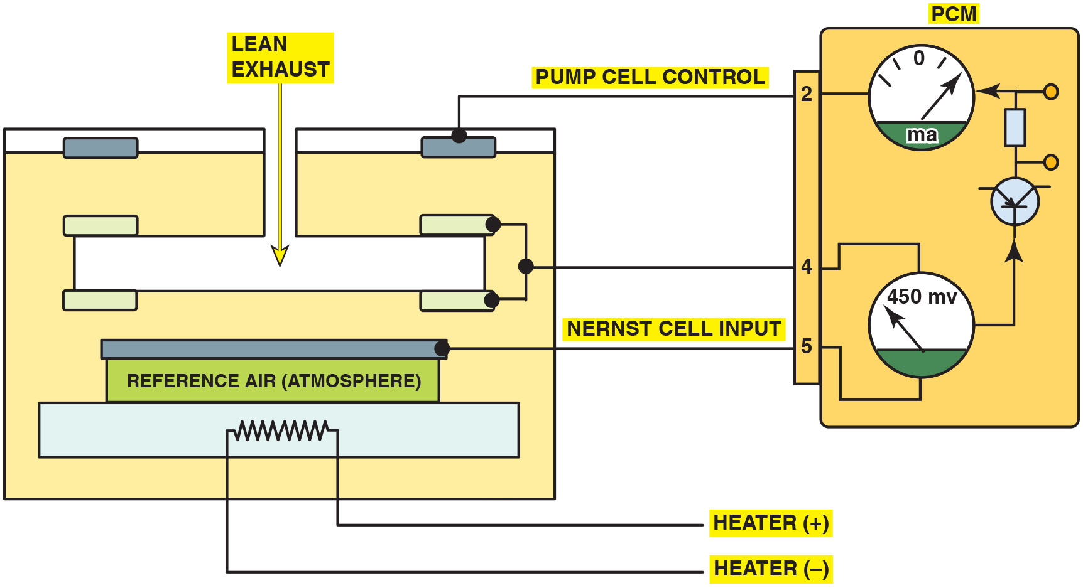
Figure 33.17
Exhaust Lean
When the exhaust is lean, the P C M applies a positive current into the pump cell.
Notes:
Long Description:
The figure depicts a dual cell sensor with a P C M connected to it. A heater coil connected to heater positive and negative terminals is stacked at the bottom of the cell. A Nernst cell is connected to a voltmeter in a P C M. The Nernst cell electrode is connected to input terminal 5 of P C M and the common reference electrode is connected to the terminal 4 of P C M. The voltmeter is connected to an ammeter in the P C M through a circuitry made of electrical components. The ammeter connects to the pump cell electrode through terminal 2 of P C M.

Slide 43
Dual Cell Diagnosis
Scan Tool Diagnosis
Most service information specifies that a scan tool be used to check the wide-band oxygen sensor, because the P C M performs tests of the unit and can identify faults.
Digital Meter Testing
Check service information and determine the circuit and connector terminal identification.
Measure the calibration resistor for opens and shorts.

Slide 44
Animation: Dual Cell 02 Sensor Voltage Check

Slide 45
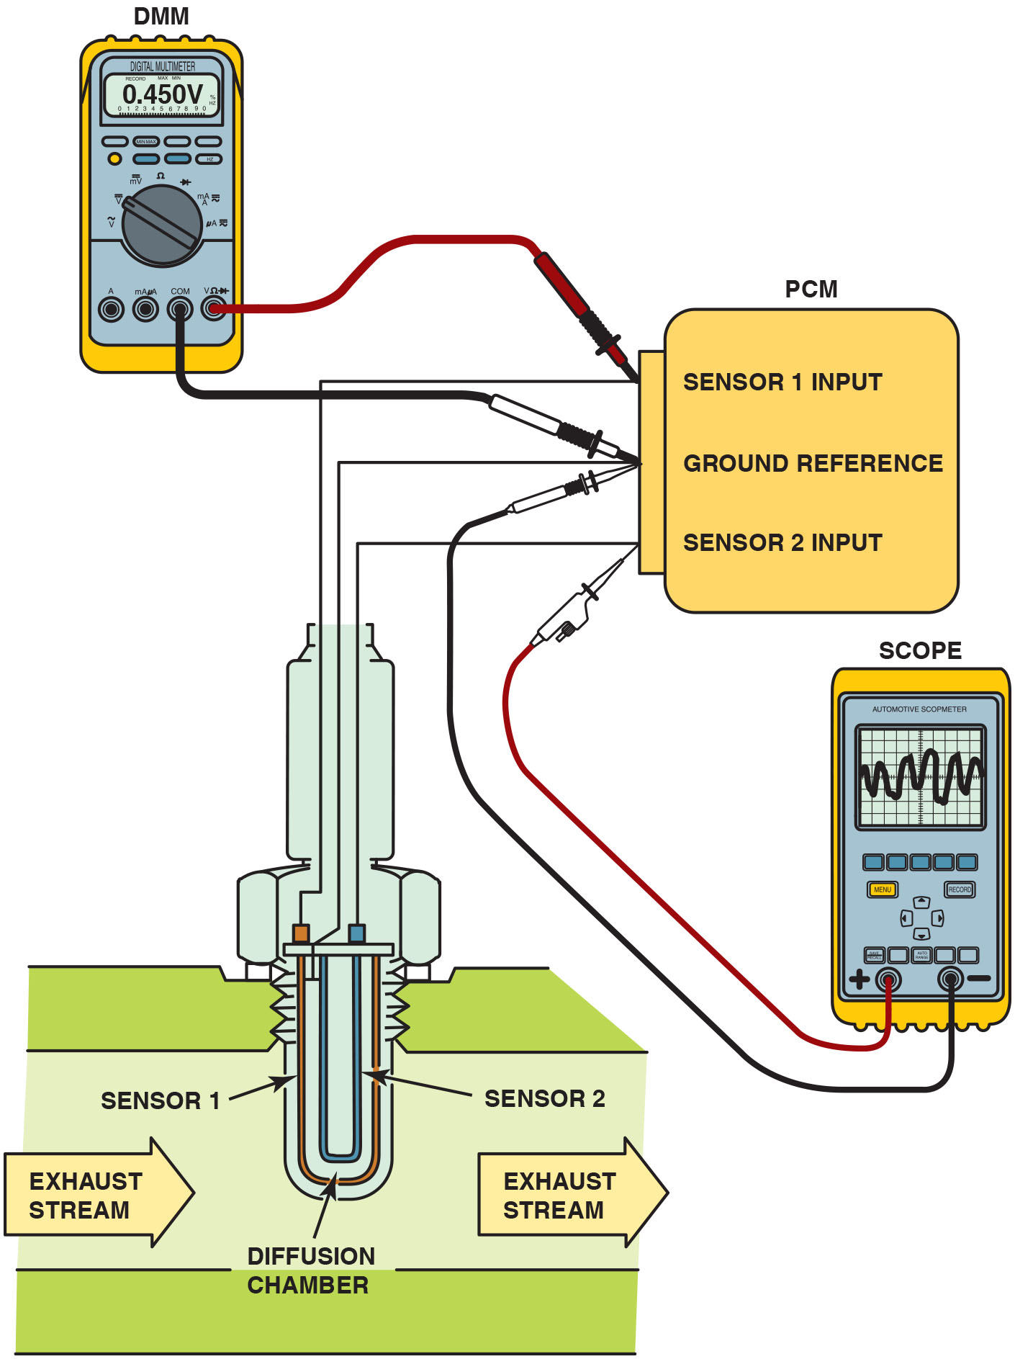
Figure 33.18
Testing Wide Band
Testing a dual cell wide-band oxygen sensor can be done using a voltmeter or a scope. The meter reading is attached to the Nernst cell and should read stoichiometric (450 mV) at all times. The scope is showing activity to the pump cell with commands from the P C M to keep the Nernst cell at 14.7∶1 air–fuel ratio.
Notes:
Long Description:
The figure shows the sensors connected to the P C M. The Nernst cell is connected to the sensor 1 input and the ground reference of the P C M. To the same P C M terminals, a voltmeter is also connected. The pump cell is connected to the sensor 2 input and the ground reference. To the same terminals, a scope is also connected. The voltmeter display reads 0.450 volts and the scope display shows a waveform.

Slide 46
Single Cell Wide-Band Oxygen Sensors
Construction
A typical single cell wide-band oxygen sensor looks similar to a conventional four-wire zirconia oxygen sensor and is referred to as an air–fuel sensor.
Milliammeter Testing
Zero (0 m A) represents lambda or stoichiometric air–
fuel ratio of
+10 m A indicates a lean condition
−10 m A indicates a rich condition
Scan Tool Testing
Scan tool displays voltage, but varies by vehicle.

Slide 47
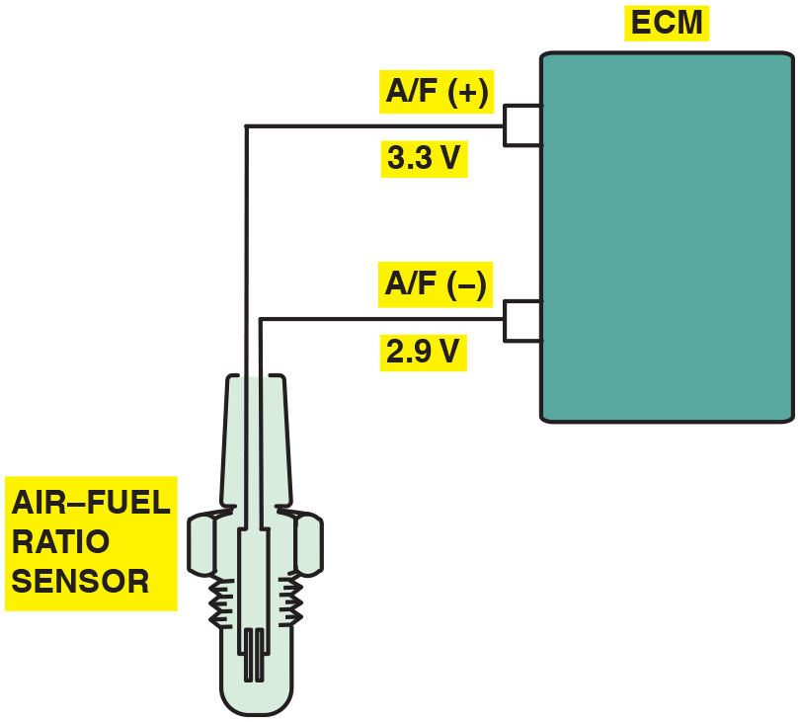
Figure 33.19
Single Cell
A single cell wide-band oxygen sensor has four wires with two for the heater and two for the sensor itself. The voltage applied to the sensor is 0.4 volts (3.3 − 2.9 = 0.4) across the 2 leads of the sensor.

Slide 48
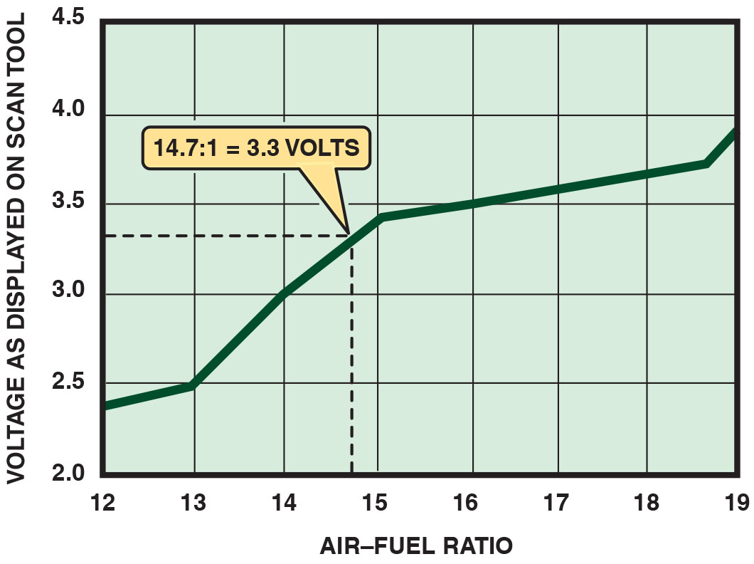
Figure 33.20
Scan Tool Testing
A scan tool can display various voltages but will often show 3.3 V because the P C M is controlling the sensor through applying a low current to the sensor to achieve balance.

Slide 49
Wide-Band Oxygen Sensor Pattern Failures
Most of the failures cause a D T C to set, usually causing the malfunction indicator (check engine) lamp to light.
However, one type of failure may not set a D T C, such as when the following occur.
Voltage from the heater circuit bleeds into the Nernst cell.
This voltage causes the engine to operate extremely lean and may or may not set a D T C.

Slide 50
Oxygen Sensor–Related Diagnostic Trouble Codes
P0131 Upstream H O2S grounded
Exhaust leak upstream of H O2S (bank 1)
Extremely lean air–fuel mixture
H O2S defective or contaminated
H O2S signal wire shorted-to-ground
P0132 Upstream H O2S shorted Upstream H O2S (bank 1) shorted
Defective H O2S
Fuel-contaminated H O2S
P0133 Upstream H O2S slow response
Open or short in heater circuit
Defective or fuel-contaminated H O2S
E G R or fuel system fault
Notes:
Oxygen Sensor–related Diagnostic Trouble Codes
Learning Objective: Interpret oxygen sensor-related diagnostic trouble codes.
Diagnostic trouble codes (D T C s) associated with the oxygen sensor include the following:
P0131 Upstream H O2S grounded
Exhaust leak upstream of HO2S (bank 1)
Extremely lean air–fuel mixture
H O2S defective or contaminated
H O2S signal wire shorted-to-ground
P0132 Upstream H O2S shorted Upstream H O2S (bank 1) shorted
Defective H O2S
Fuel-contaminated H O2S
P0133 Upstream H O2S slow response
Open or short in heater circuit
Defective or fuel-contaminated H O2S
E G R or fuel system fault

Slide 51
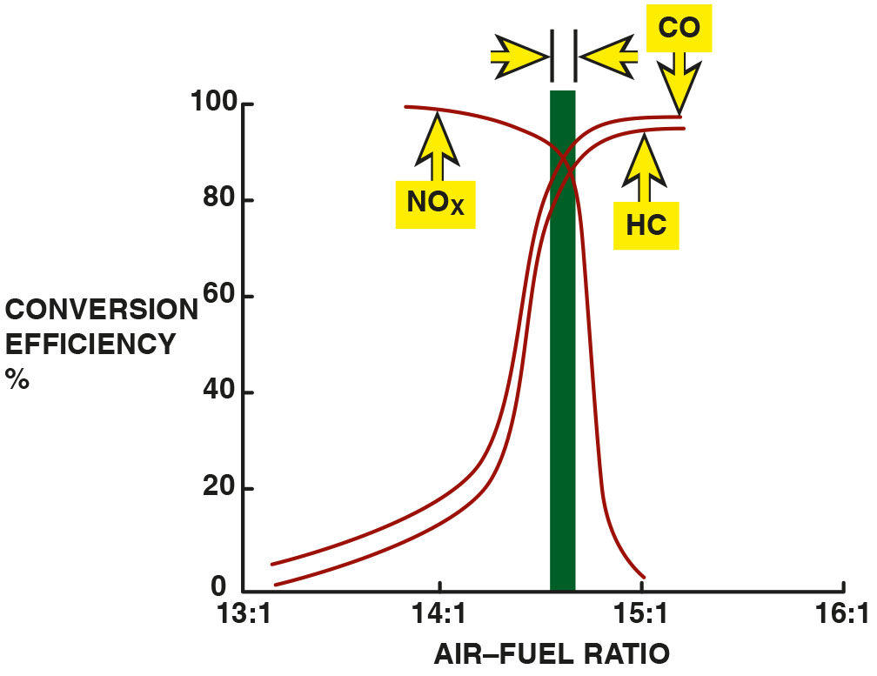
Figure 33.21
Fuel Trim
The catalytic converter is most efficient when the exhaust ratio is closest to 14.7∶1.
Notes:
Fuel Trim
The Powertrain Control Module (P C M) does not measure or check the air–fuel mixture entering the cylinders. Instead, the P C M measures the air mass, and then calculates the amount of fuel needed. Fuel trim provides a method that can change the amount of fuel
delivered to the engine based on feedback from the oxygen sensors. The primary purpose of the fuel trim is to keep the air–fuel mixture as close to 14.7:1 as possible. When the air–fuel ratio is kept at 14.7:1, the efficiency of the catalytic converter is the highest, which results in the lowest possible exhaust emissions. • See Figure 33.21.
Lambda is a Greek letter used to represent ratio, as in air–fuel ratio. If an engine is operating at exactly 14.7:1, the air–fuel ratio on gasoline, the ratio is called stoichiometric and is assigned a lambda of 1.0. Air–fuel ratios lower than 1.0 indicate a rich mixture. Air–fuel ratios higher than 1.0 indicate a lean mixture.
To determine the air–fuel ratio if lambda is given, multiply lambda times 14.7.
Long Description:
The x-axis ranges from 13 is to 1 to 16 is to 1 in increments of 1 is to 1. The y-axis ranges from 0 to 100 in increments of 20. Two S-curves and an inverted S-curve overlapping on top are shown. The first S-curve for H C extends from (13 is to 1, 0) to (15 is to 1, 97). The second S-curve for C O extends from (13 is to 1, 6) to (15 is to 1, 98). The inverted curve for N O subscript x extends from (13 is to 1, 98) to (15 is to 1, 0). A bar is placed along the intersecting point, where it starts from above 100 to a region before 15 is to 1 on the x-axis. The width of the bar is indicated by a right arrow and a left arrow.

Slide 52
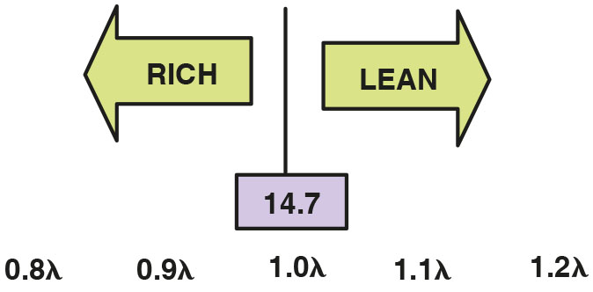
Figure 33.22
Equivalence Ratio
Shown is lambda. The equivalence ratio is opposite lambda.
Notes:
Equivalence Ratio
The equivalence ratio (E R) is the inverse of lambda, with 1.0 equal to 1.0 lambda; however, 0.9 E R is equal to 1.1 lambda. Equivalence ratio (E R) = 1/λ (lambda), which is the inverse of lambda. Therefore, a rich air–fuel mixture has an equivalence ratio of greater than 1 and a lean mixture less than 1. • See Figure 33.22.
Long Description:
The optimum range is 14.7, indicated in the center by a line separating two arrows. There is a horizontal scale below with values 0.9 lambda and 0.9 lambda on the left, 1.0 lambda in the center, and 1.1 lambda and 1.2 lambda on the right. A left arrow labeled rich is from a value before 1.0 lambda to a value before the first 0.9 lambda. A right arrow labeled lean is from a value beyond 1.0 lambda to a value before 1.2 lambda.

Slide 53
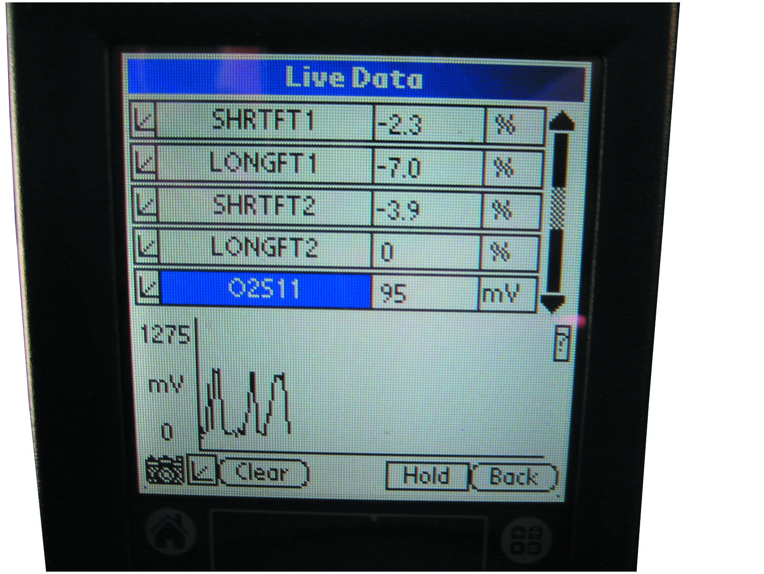
Figure 33.23
Fuel Trim Live Data
A scan tool display showing both long-term and short-term fuel trim. Both LTFT and STFT should be less than 10%.
Notes:
Need for Fuel Trim
The purpose of fuel trim is to provide the catalytic converter with a stoichiometric air–fuel mixture, which it needs to reduce N O x exhaust emissions and to help oxidize H C and C O into harmless carbon dioxide (C O₂) and water (H₂O) vapor. If the exhaust is always rich,
the catalytic converter cannot reduce C O and H C emissions. If the exhaust is always lean, the catalytic converter cannot reduce N O x emissions; therefore, the air–fuel mixture must alternate between rich and lean. The computer is therefore designed to provide as close to a 14.7:1 mixture as possible by using the oxygen sensor, as well as the short-term and long-term fuel trim program, to accomplish this feat. • See Figure 33.23.
Case Study: The Red Pickup Truck Story
A 4-cylinder 2.2-liter engine was replaced due to excessive oil consumption. The replacement engine never ran correctly, especially at idle and low speeds. The scan tool data showed a −25% long-term fuel trim, indicating that the oxygen sensor was measuring a very rich (low oxygen content) exhaust stream. Because the engine was operating so badly, the service technician believed the oxygen sensor was indicating a false rich condition. The service technician then checked the following:
Poor oxygen sensor ground (this can cause a higher-than-normal oxygen sensor voltage)
Oxygen sensor wiring shorted to voltage or near a spark plug wire
A contaminated (coated) oxygen sensor that will read higher than normal
None of the false rich conditions was found. Remembering that the engine ran terribly even when
cold and the problem started after the engine was replaced, the technician started to look for
faults that could have occurred when parts were switched from the original engine to the
replacement engine. The technician found an incorrect E G R gasket. This caused exhaust gases to
flow into the cylinders all the time. The exhaust gases also displaced the oxygen that normally
would be in the cylinder, thereby reducing the amount of oxygen measured by the oxygen sensor.
Replacing the E G R gasket restored proper engine operation.
Summary
Concern—A replacement engine never ran correctly after being installed into the pickup truck.
Cause—The incorrect E G R base gasket had been installed allowing exhaust gases to enter
cylinders at all times.
Correction—The correct E G R base gasket was installed which corrected the poor engine
operation.
Long Description:
The display shows the following data in three columns: S H T F T 1; negative 2.3; percent. LONG F T 1; negative 7.0; percent. S H T F T 2; negative 3.9; percent. LONG F T 2; 0; percent. O 2 S 11; 95; m V. A graph below shows an irregular positive sine wave with 0 to 1275 m V on the y-axis. A camera icon and three buttons, namely, clear, hold, and back, are at the bottom of the screen.

Slide 54
Fuel Trim
Short-Term Fuel Trim (STFT)
Percentage measurement of amount computer is adding or subtracting from a calculated value
O2S signal modifies preprogrammed fuel delivery
Short-term fuel trim of +20% indicates that 20% additional fuel added to achieve proper air–fuel mixture
Long-Term Fuel Trim
Add/subtract fuel for a longer amount of time than short-term fuel trim
Keep short-term fuel trim as close to zero as possible
Notes:
Short-Term Fuel Trim
Short-term fuel trim (S T F T) is a percentage measurement of the amount the computer is adding or subtracting from a calculated value. Electronic fuel-injector systems use the oxygen sensor (O2S) to determine whether the exhaust is rich or lean. Without the O2S, fuel delivery is controlled by the computer alone using the programmed pulse width commands based on other sensor inputs, such as engine coolant temperature (E C T), throttle position (T P), and engine load (M A P). When the engine is operating in closed loop, the O2S signal can modify or change the preprogrammed fuel delivery. Fuel trim is expressed as a percentage (%), either positive (+) or negative (−), and represents the amount of fuel different from the anticipated amount. For example, if a small vacuum leak occurs, the O2S produces a lower voltage signal, which is interpreted by the computer as meaning the air–fuel mixture is too lean. As a result, the pulse width is increased slightly to compensate for this slight vacuum leak. The amount of this additional fuel is seen on a scan tool as a positive short-term fuel trim.
A short-term fuel trim of +20% indicates that 20% additional fuel had to be added to achieve the proper air–fuel mixture. A −20% short-term fuel trim indicates that fuel had to be removed by shortening the injector pulse width to achieve the proper air–fuel mixture.
Short-term fuel trim represents actions by the computer over a relatively short time. The purpose of the S T F T is to provide a varying air–fuel mixture so that the catalytic converter can eﬀiciently reduce H C, C O, and N O_{x} exhaust emissions. If, for example, a large vacuum leak was to occur, then the fuel delivery would have to be increased even more and for a longer time. Therefore, electronic fuel-injection system computers also incorporate a long-term fuel trim program.
Long-Term Fuel Trim
Long-term fuel trim (L T F T) is designed to add or subtract fuel for a longer amount of time than short-term fuel trim. For this reason, LTFT should be looked at by the service technician as a guide to whether the computer has been adding or subtracting fuel in order to achieve the proper air–fuel mixture. For example, if a vacuum hose splits open, the engine will be leaner than normal. Short-term fuel trim will attempt to add fuel right away to adjust. If the resulting air (vacuum) leak remains for longer than a few seconds to a minute, the computer will revise the long-term fuel trim to compensate for the leak over a larger period of time. When the L T F T makes an adjustment, the S T F T can still make short and quick changes in the air–fuel mixture needed to provide the catalytic converter with an lean, then rich exhaust. The purpose of long-term fuel trim is to keep short-term fuel trim as close to zero as possible.

Slide 55
Question 3
How are diagnostics performed on a wide-band dual cell oxygen sensor?

Slide 56
Answer 3
Diagnostics are performed with a scan tool or a multimeter.

Slide 57
Summary
The E C T sensor is a high-authority sensor at engine startup and is used for closed-loop control, as well as idle speed.
All temperature sensors decrease in resistance as the temperature increases. This is called negative temperature coefficient (N T C).
The E C T and I A T sensors can be tested visually, as well as by using a digital multimeter or a scan tool.
Some vehicle manufacturers use a stepped E C T circuit inside the P C M to broaden the accuracy of the sensor.
Other temperature sensors include transmission fluid temperature (T F T), engine fuel temperature (E F T), exhaust gas recirculation (E G R) temperature, and engine oil temperature.

Slide 58
Animations and Video Links (Halderman website subscription and web access needed to view)
(A8) Engine Performance Animations
(A6) Electrical/Electronic Systems Animations
(A8) Engine Performance Videos
(A6) Electrical/Electronic Systems Videos

Slide 59
Copyright
This work is protected by United States copyright laws and is provided solely for the use of instructors in teaching their courses and assessing student learning. Dissemination or sale of any part of this work (including on the World Wide Web) will destroy the integrity of the work and is not permitted. The work and materials from it should never be made available to students except by instructors using the accompanying text in their classes. All recipients of this work are expected to abide by these restrictions and to honor the intended pedagogical purposes and the needs of other instructors who rely on these materials.

