Slide 1
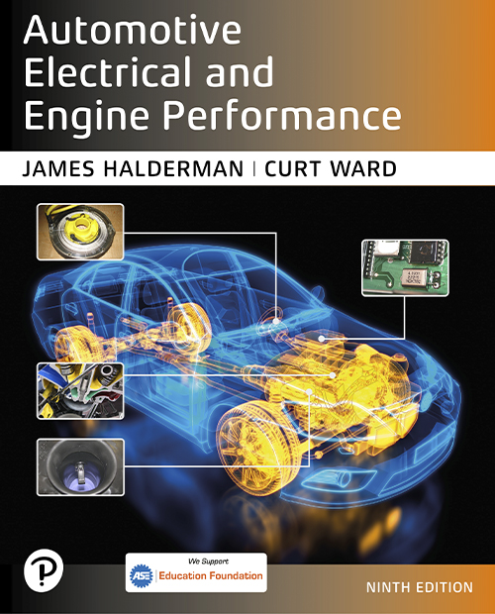
Automotive Electrical and Engine Performance
Ninth Edition
Chapter 30
Ignition System Diagnosis and Service
Copyright © 2025 Pearson Education, Inc. All Rights Reserved
Notes:
If this PowerPoint presentation contains mathematical equations, you may need to check that your computer has the following installed:
1) Math Type Plugin
2) Math Player (free versions available)
3) NVDA Reader (free versions available)
INSTRUCTOR NOTE: This presentation includes text explanation notes, you can use to teach the course. When in SLIDE SHOW mode, you RIGHT CLICK and select SHOW PRESENTER VIEW, to use the notes.

Slide 2
Learning Objectives (1 of 3)
30.1 Describe the procedure used to check for spark.
30.2 Describe the electronic ignition troubleshooting procedure.
30.3 Describe ignition coil testing using an ohmmeter.
30.4 Describe how to test magnetic sensors.
30.5 Describe how to test Hall-effect sensors.
30.6 Discuss visual inspection of the ignition system.
30.7 Explain how to test for poor performance.

Slide 3
Learning Objectives (2 of 3)
30.8 Explain how to test for a no-start condition.
30.9 Inspect and test ignition system secondary circuits.
30.10 Describe spark plug service.
30.11 Describe secondary ignition tests.
30.12 Describe how to test the ignition system using an oscilloscope.
30.13 Describe how to scope-test a waste-spark ignition system.

Slide 4
Learning Objectives (3 of 3)
30.14 Describe how to scope-test a coil-on-plug ignition system.
30.15 Diagnose ignition system-related problems.

Slide 5
Checking for Spark
In event of a no-start condition, check for secondary voltage out of ignition coil or to the spark plugs.
Install a spark tester, and crank engine.
Typical causes of a no-spark (intermittent spark) condition include the following:
Weak ignition coil, low or no voltage to coil, open coil wire or plug, defective pickup coil, and defective module.

Slide 6
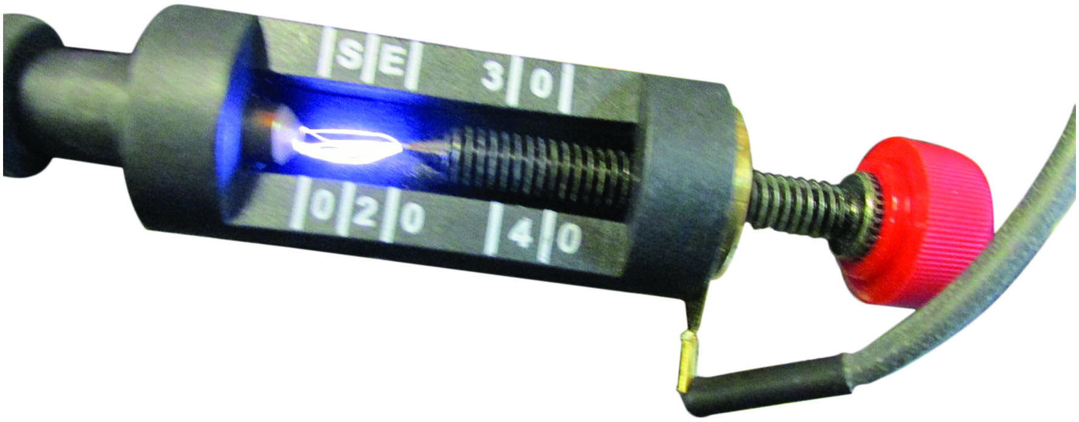
Figure 30.1
Testing for Spark
An adjustable spark tester that can be adjusted and should be set to at least 25,000 volts. The tester is connected to a disconnected spark plug wire or coil and the pigtail clipped to a good chassis ground. Cranking the engine should cause a spark to be seen from the spark tester.

Slide 7
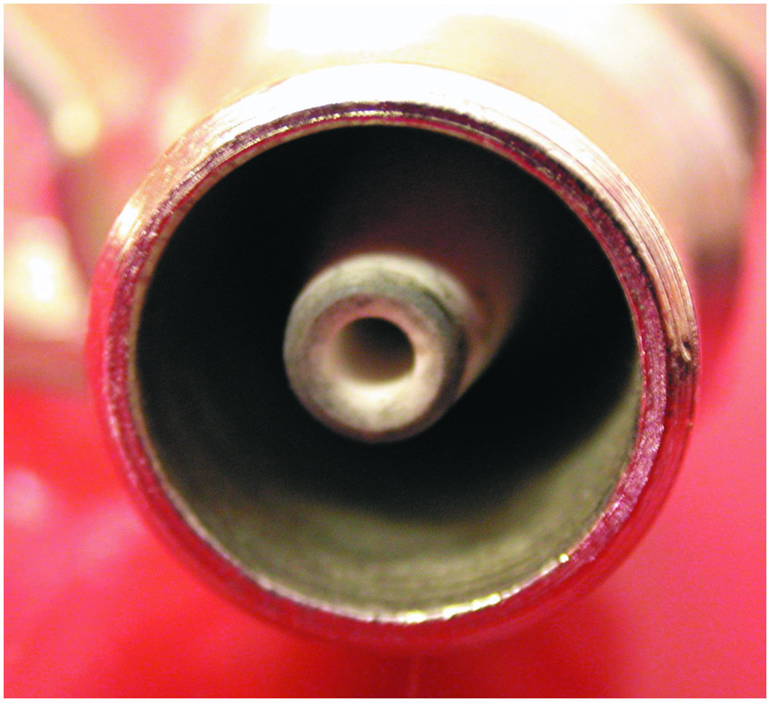
Figure 30.2
Spark Tester
A close-up showing the recessed center electrode on a spark tester. It is recessed 3/8 inch into the shell and the spark must then jump another 3/8 inch to the shell for a total gap of 3/4 inch.

Slide 8
Question 1
Why should a spark tester be used to check for spark, rather than a standard spark plug?

Slide 9
Answer 1
The spark must jump across a larger gap to more effectively test the system.

Slide 10
Electronic Ignition Troubleshooting Procedure
Turn the ignition on (engine off) and, using either a voltmeter or a test light, test for battery voltage available at the positive terminal of the ignition coil.
Connect the voltmeter or test light to the negative side of the coil and crank the engine. The voltmeter should fluctuate or the test light should blink, indicating that the primary coil current is being turned on and off.

Slide 11
Ignition Coil Testing Using an Ohmmeter
To test the primary coil winding resistance:
Set the meter to read low ohms.
Measure the resistance between the positive terminal and the negative terminal of the ignition coil.
To test the secondary coil winding resistance:
Set the meter to read kilohms
Measure the resistance between either primary terminal and the secondary coil tower.

Slide 12
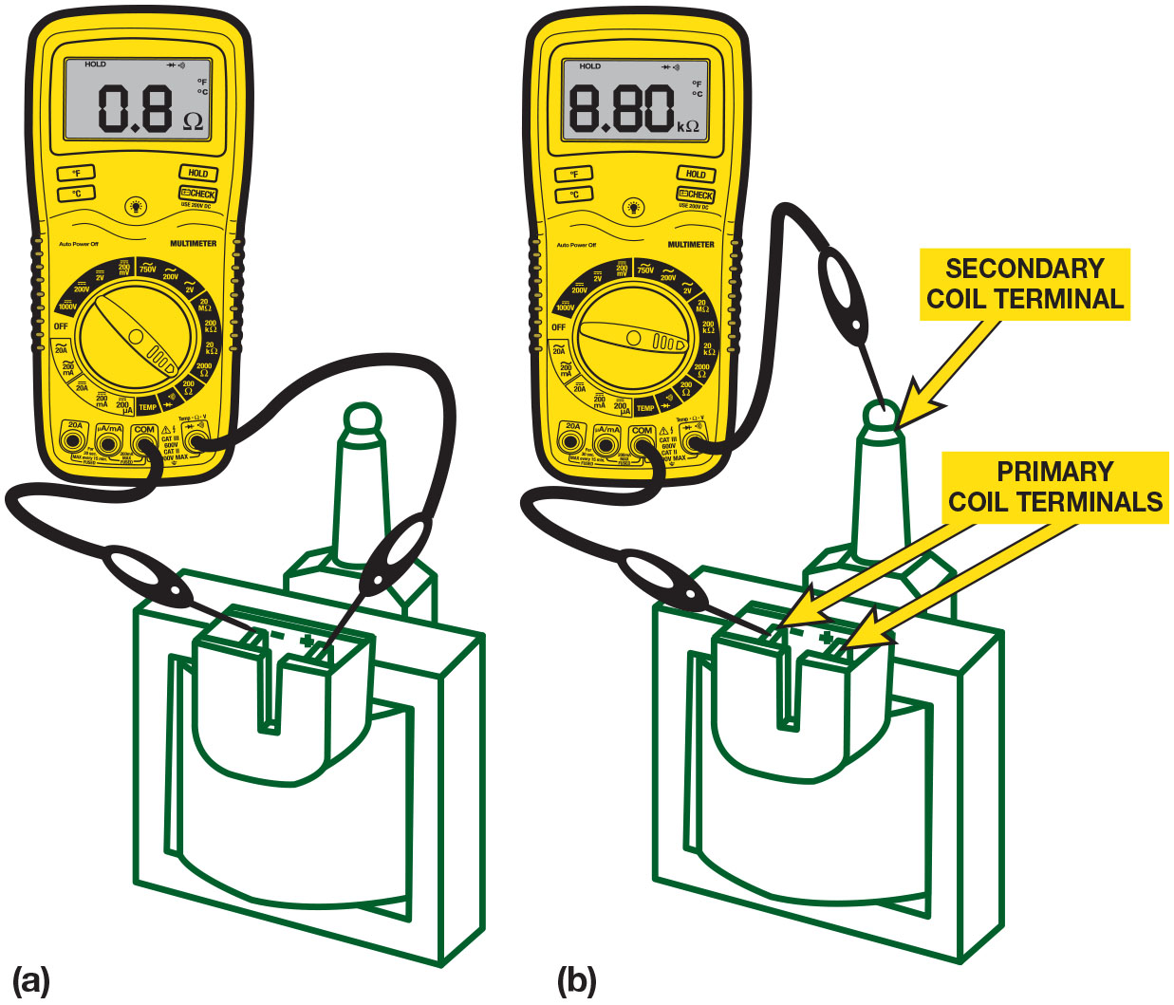
Figure 30.3
Coil Testing
(a) Set the digital meter to read Ohms and measure between the two primary terminals of the coil. Most coils are less than 1 ohm. (b) To measure the secondary winding, connect 1 meter lead to one of the primary terminals and the other to the secondary terminal.
Notes:
Long Description:
a. The leads of the ohmmeter are placed on the primary coil terminals. The reading on the digital display of the ohmmeter is 0.8 ohms. b. One lead of the ohmmeter is placed on one of the primary coil terminals, and the other lead of the ohmmeter is placed on the secondary coil terminal. The reading on the digital display of the ohmmeter is 8.80 kiloohms.

Slide 13
Animation: Ignition Coil, Measure Resistance

Slide 14
Testing Magnetic Sensors
Magnetic sensors must be tested to see if they stick to iron or steel, indicating that the magnetic strength of the sensors is okay.
Sensor can be tested using D M set to read A C volts.

Slide 15
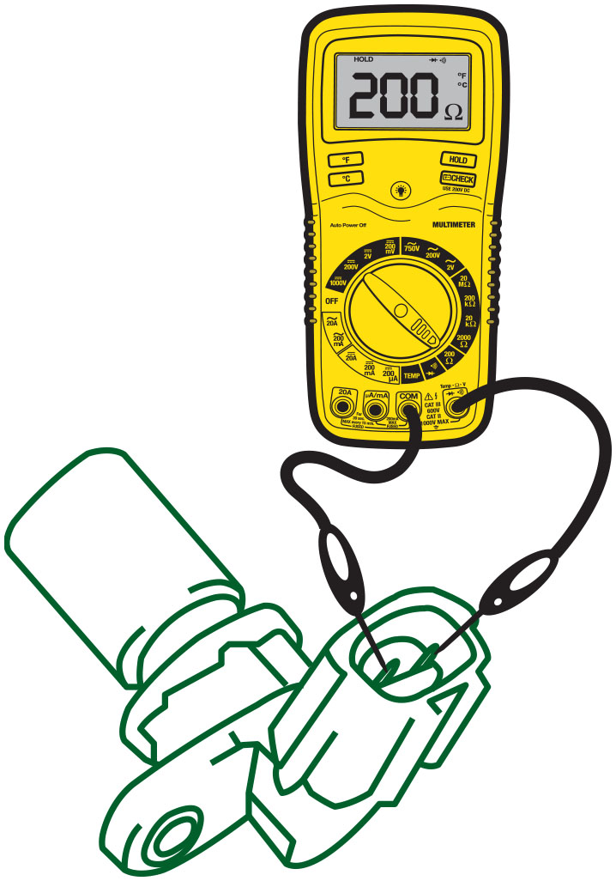
Figure 30.4
C K P Sensor Testing
Measuring the resistance of an magnetic crankshaft position (C K P) sensor using an ohmmeter.

Slide 16
Question 2
How is a magnetic sensor tested for resistance and A C voltage output?

Slide 17
Answer 2
A digital multimeter can be used to measure resistance of the sensor and the A C voltage output.

Slide 18
Testing Hall-Effect Sensors
Using a digital voltmeter, check for the presence of changing voltage (pulsed on/off or digital D C) when engine is being cranked.
Best test is to use oscilloscope and observe waveform.

Slide 19
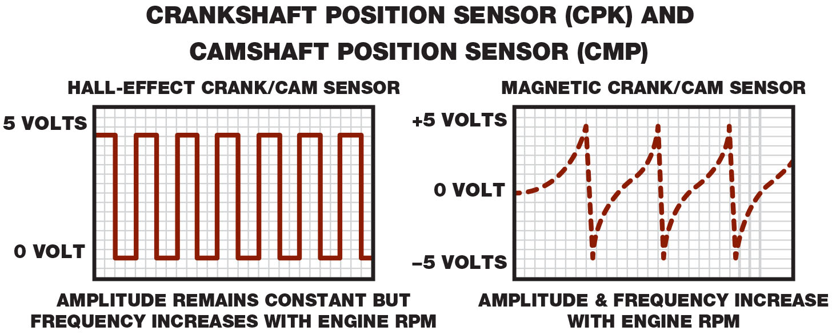
Figure 30.5
Hall-Effect Testing
A Hall-effect sensor produces a square waveform, whereas a magnetic sensor produces an analog waveform when viewed on the scope.
Notes:
Long Description:
Hall Effect sensor generates a box type wave with low of 0 volt and high of 5 volts. Amplitude of the wave remains constant but frequency increases with engine R P. Magnetic crank and Cam sensor generates a spiky wave which increases like a log curve and then suddenly drops. Amplitude and frequency of the wave increases with engine R P M

Slide 20
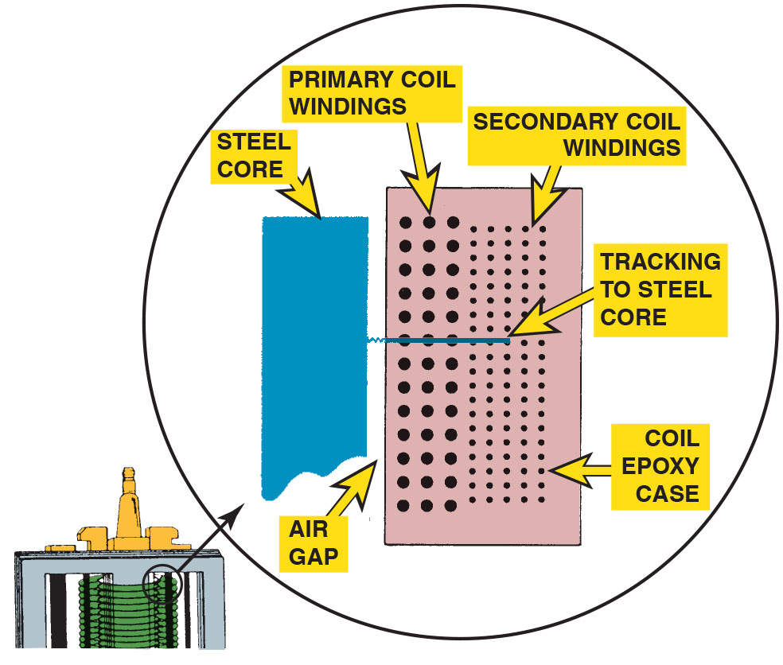
Figure 30.6
Coil Track
A track inside an ignition coil is not a short, but rather it is a low-resistance path or hole that has been burned through from the secondary wiring to the steel core.
Notes:
TECH TIP: Bad Wire? Replace the Coil!
When performing engine testing (such as a compression test), always ground the coil wire. Never allow the coil to discharge without a path to ground for the spark. High-energy electronic ignition systems can produce 40,000 volts or more of electrical pressure.
If the spark cannot arc to ground, the coil energy can (and usually does) arc inside the coil itself, creating a low-resistance path to the primary windings or the steel laminations of the coil. • See Figure 30.6. This low-resistance path is called a track and could cause an engine misfire under load even though all of the remaining component parts of the ignition system are functioning correctly. Often these tracks do not show up on any coil test, including most scopes.
Because the track is a lower-resistance path to ground than normal, it requires that the ignition system be put under a load for it to be detected, and even then, the problem (engine misfire) may be intermittent.
Therefore, when disabling an ignition system, perform one of the following procedures to prevent possible ignition coil damage:
Remove the power source wire from the ignition system to prevent any ignition operation.
On distributor-equipped engines, remove the secondary coil wire from the center of the distributor cap and connect a jumper wire between the disconnected coil wire and a good engine ground. This ensures that the secondary will be safely grounded and prevents high-voltage coil damage.

Slide 21
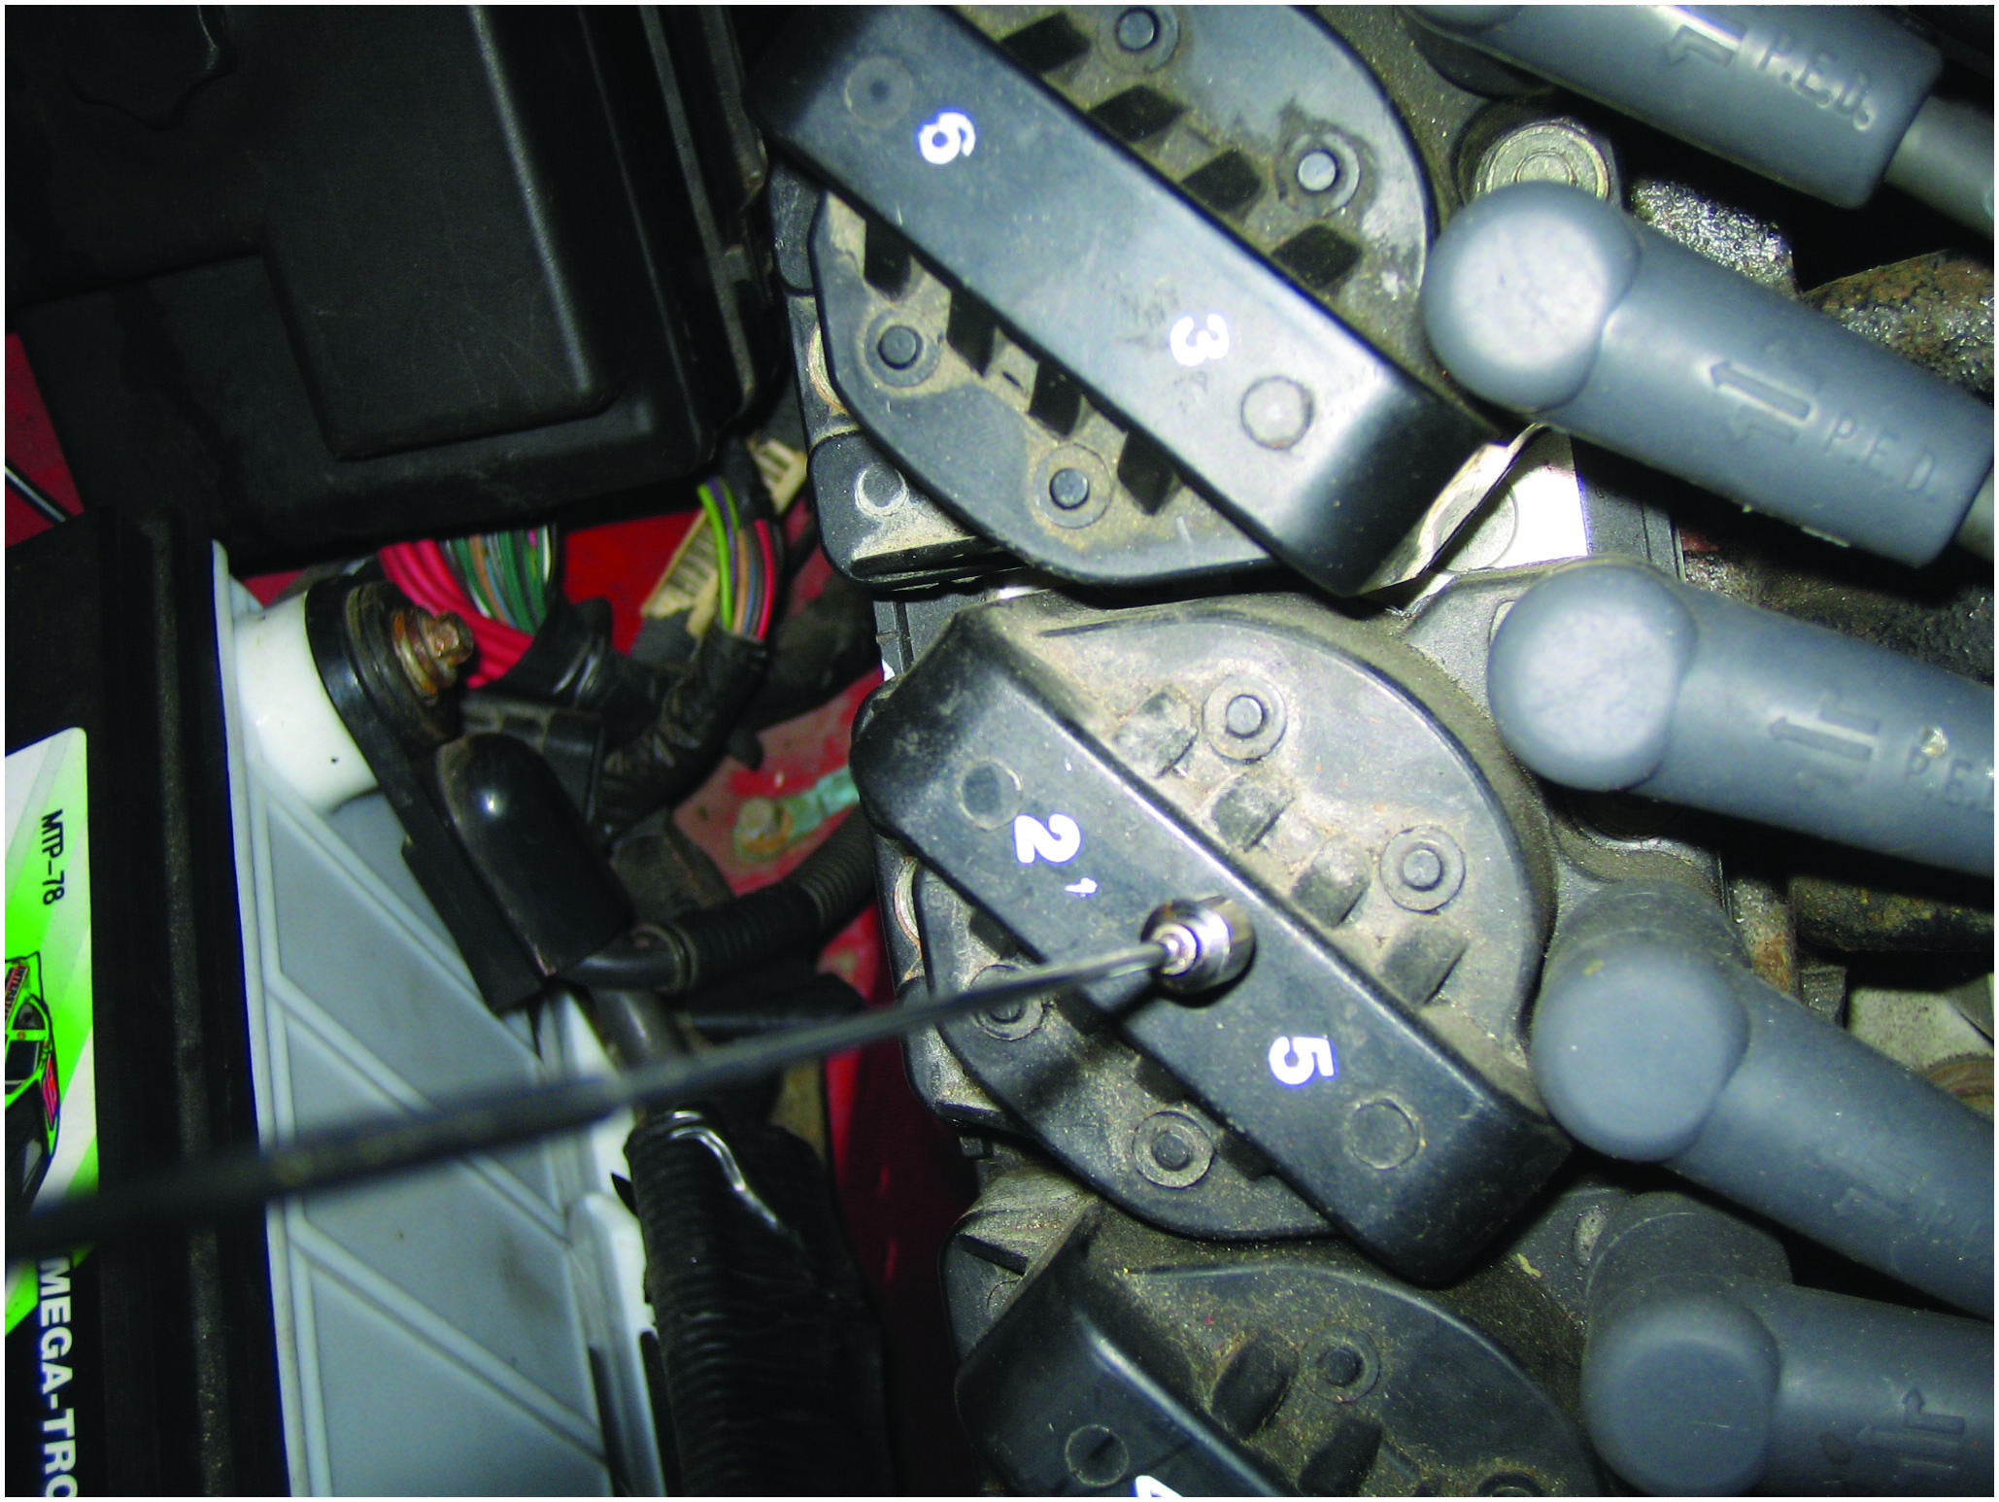
Figure 30.7
Tech Tip
If the coil is working, the end of the magnetic pickup tool will move with the changes in the magnetic field around the coil.
Notes:
TECH TIP: The Magnetic Pickup Tool Test
All ignition coils are pulsed on and off by the ignition control module or P C M. When the coil charges and discharges, the magnetic field around the coil changes. This pulsing of the coil can be observed by holding the magnetic end of a pickup tool near an operating ignition coil. The magnet at the end of the pickup tool will move as the magnetic field around the coil changes. • See Figure 30.7.

Slide 22
Ignition System Diagnosis Using Visual Inspection
Check all spark plug wires for proper routing.
Check that all spark plug wires are securely attached.
Check that all spark plug wires are clean.
Free from excessive dirt or oil.
Remove distributor cap and carefully check cap and distributor rotor for faults.
Remove spark plugs and check for excessive wear or other visible faults.

Slide 23
Testing for Poor Performance
Many diagnostic equipment manufacturers offer methods for testing distributorless ignition systems on an oscilloscope.
A simple method of testing distributorless (waste-spark systems) ignition with the engine off involves removing the spark plug wires (or connectors) from the spark plugs (or coils or distributor cap) and installing short lengths (2 inches) of rubber vacuum hose in series.

Slide 24
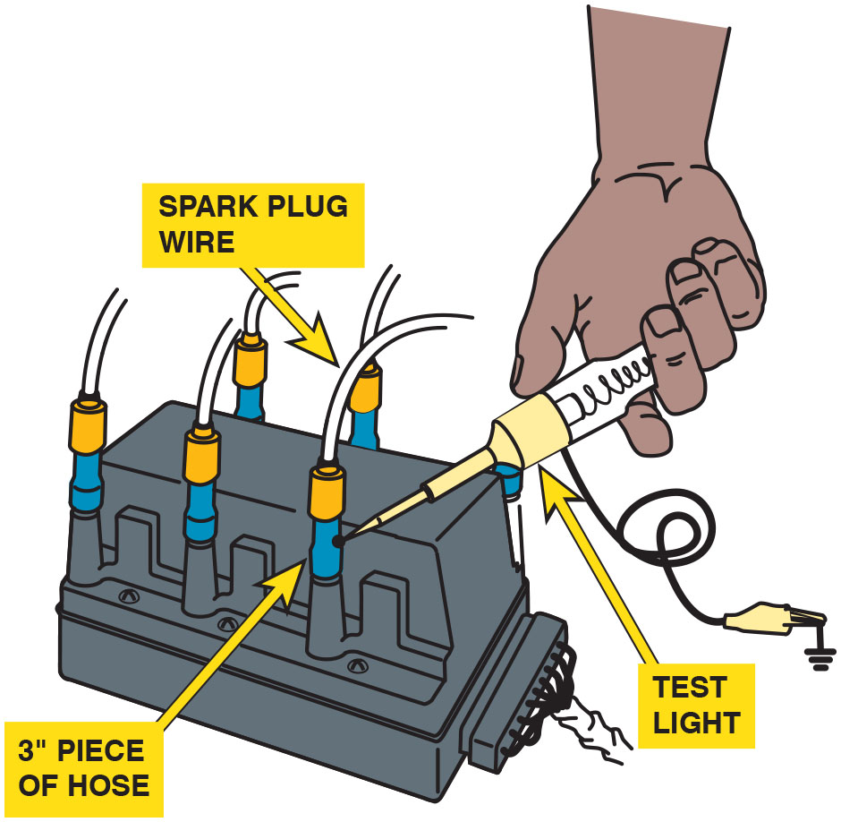
Figure 30.8
D I S Testing
Using a vacuum hose and a grounded test light to ground one cylinder at a time on a D I S. This works on all types of ignition systems and provides a method for grounding out one cylinder at a time without fear of damaging any component. Use a standard 12-volt test light that uses a bulb because if an L E D test light is used, the high-voltage with harm the electronic circuit inside the test light.

Slide 25
Secondary Ignition Inspection
Distributor Cap and Rotor
Inspect a distributor cap for cracks, carbon tracks, and corrosion.
C O P and Waste Spark Inspection
Look for evidence of carbon track or heat-related faults to the plug boot.
Spark Plug Wire Inspection
Spark plug wires should be visually inspected for cuts or defective insulation and checked for resistance with an ohmmeter.

Slide 26
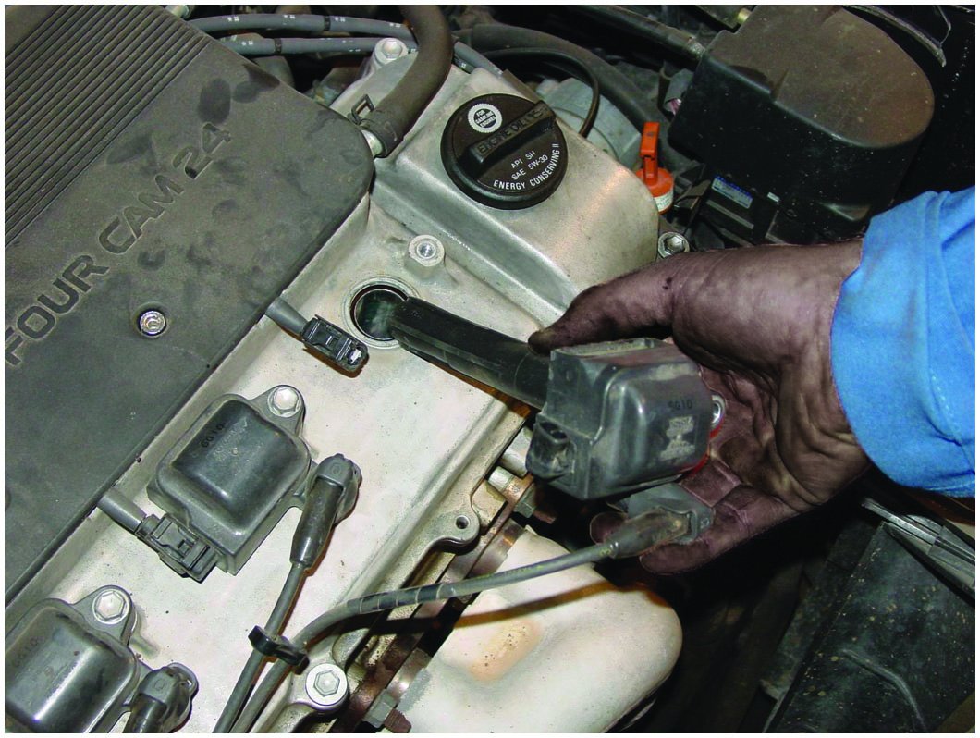
Figure 30.9
C O P Inspection
When checking a coil-on-plug (C O P) assembly, check that the primary and secondary wiring looks normal and that the coil is not discolored from arcing or corrosion.

Slide 27
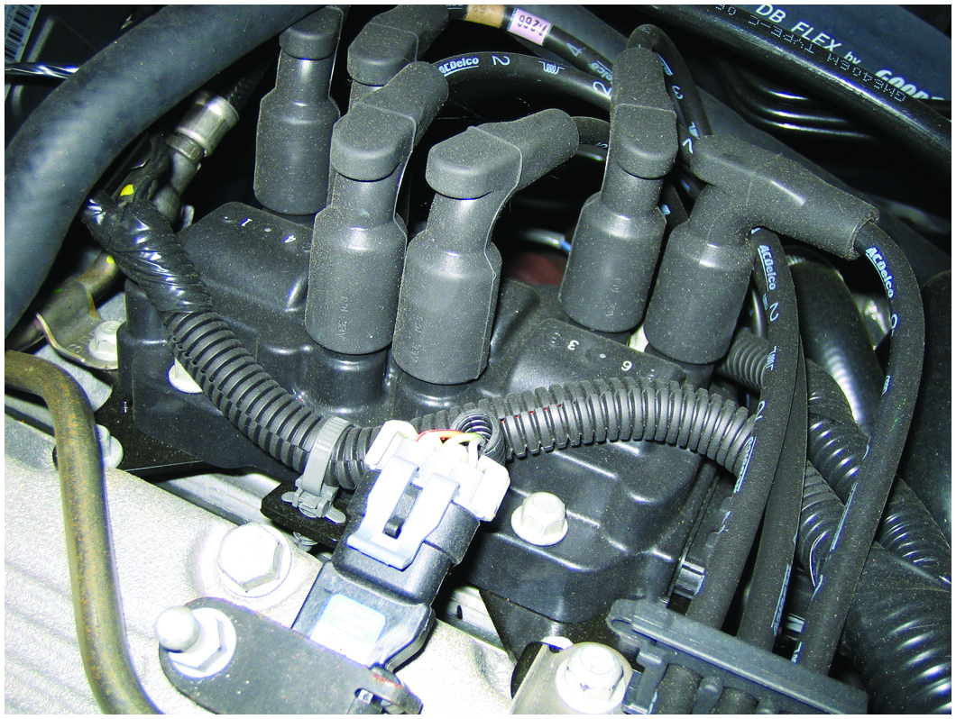
Figure 30.10
Waste Spark Inspection
When checking a waste spark-type ignition system, check that the secondary wires are attached to the correct coil terminal and that the wiring is correctly routed to help avoid cross-fire.

Slide 28
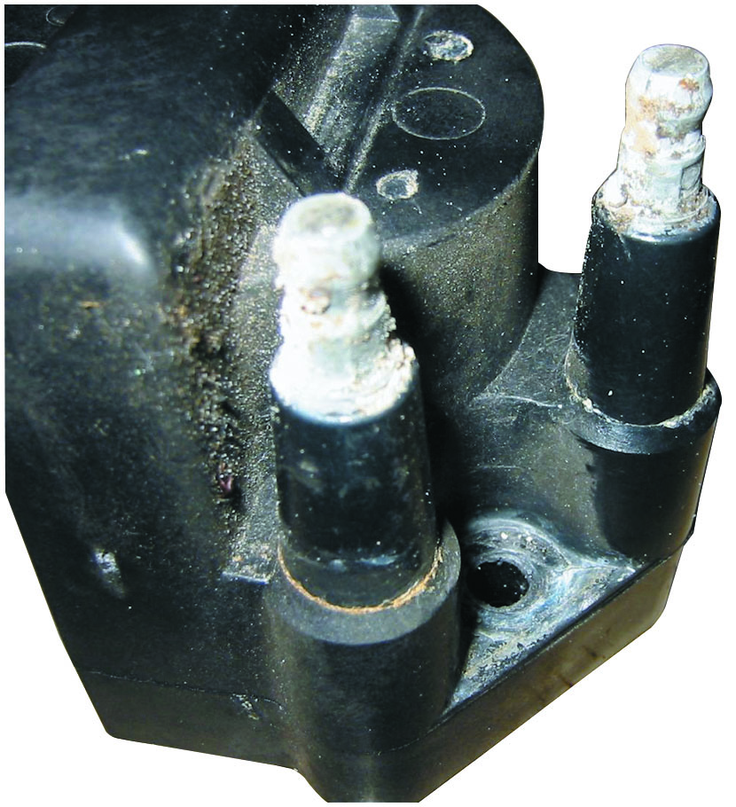
Figure 30.11
Corroded Terminals
Corroded terminals on a waste-spark coil can cause misfire diagnostic trouble codes to be set.

Slide 29
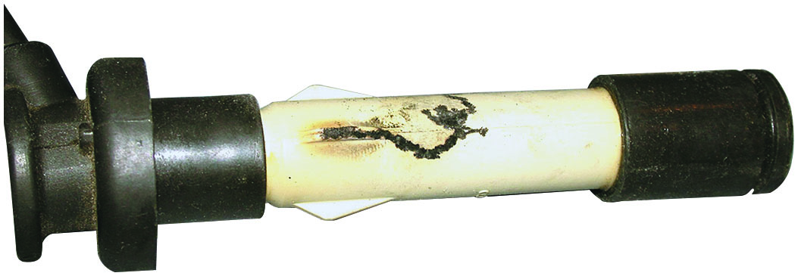
Figure 30.12
Misfire Cause
This spark plug boot on an overhead camshaft engine has been arcing to the valve cover causing a misfire to occur.

Slide 30
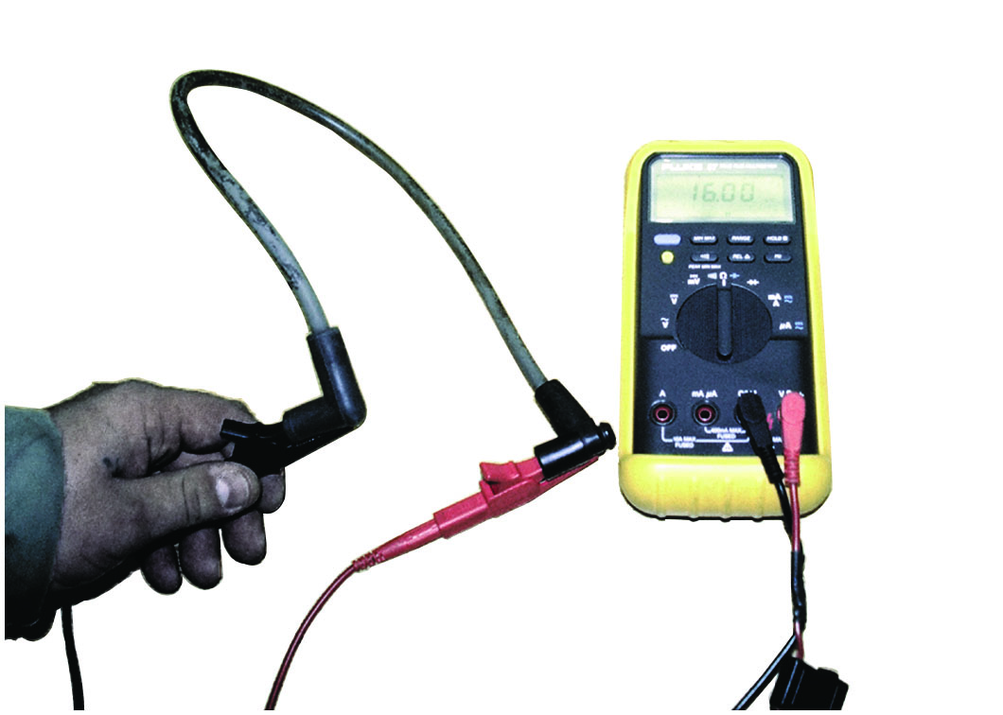
Figure 30.13
Wire Resistance
Measuring the resistance of a spark plug wire with a multimeter set to the
ohms position. The reading of
(16,030 ohms) is okay because
the wire is about 2 feet long. Maximum allowable resistance for a spark plug wire this long would be 20
(20,000 ohms). High resistance
spark plug wires can cause an engine misfire especially during acceleration.

Slide 31
Animation: Test Spark Plug Wire

Slide 32
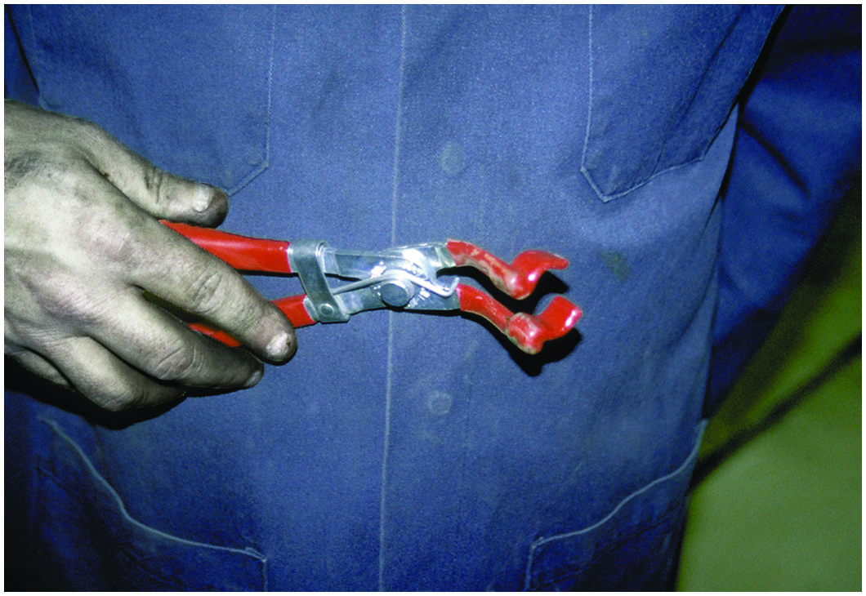
Figure 30.14
Boot Pliers
Spark plug wire boot pliers are a handy addition to any tool box.
Notes:
TECH TIP: Spark Plug Wire Pliers Are a Good Investment
Spark plug wires are often difficult to remove. Using a good-quality spark plug wire plier, such as shown in • See Figure 30.14, saves time and reduces the chance of harming the wire during removal.

Slide 33
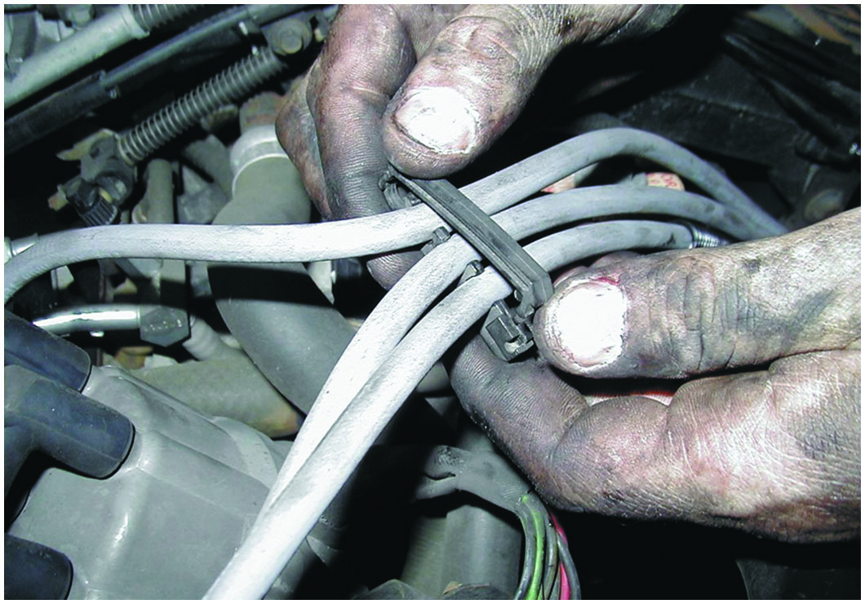
Figure 30.15
Plug Wire Comb
Always take the time to install spark plug wires back into the original holding brackets (wiring combs).
Notes:
TECH TIP: Route the Wires Right!
High voltage is present through spark plug wires when the engine is running. Surrounding the spark plugs in a magnetic field that can affect other circuits or components of the vehicle. For example, if a spark plug wire is routed too closely to the signal wire from a mass airflow (M A F) sensor, the induced signal from the ignition wire could create a false M A F signal to the computer. The computer, not able to detect that the signal was false, would act on the M A F signal and command the appropriate amount of fuel based on the false M A F signal. To prevent any problems associated with high-voltage spark plug wires, be sure to route them as manufactured, using all the factory holding brackets and wiring combs. ● See Figure 30.15. If the factory method is unknown, most factory service information shows the correct routing.

Slide 34
Spark Plug Service
The Need for Service
Spark plugs should be inspected and replaced every 20,000 to 100,000 miles depending on the vehicle.
Spark Plug Inspection
Carbon fouling
Oil fouling
White coolant deposits
When installing spark plugs, always use correct torque.

Slide 35
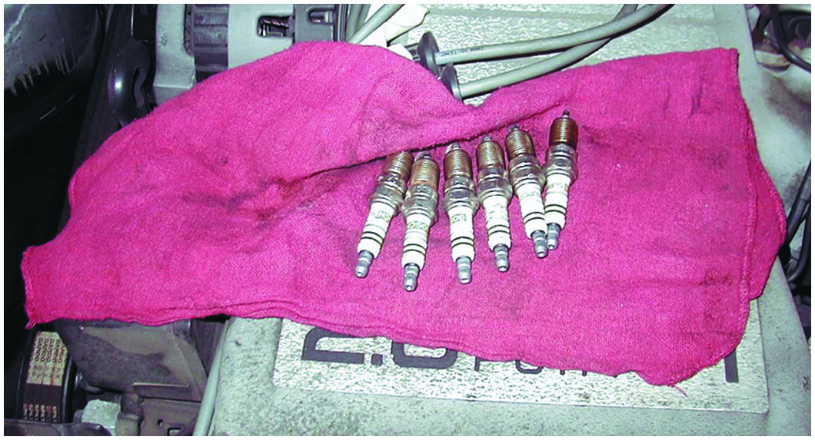
Figure 30.16
Spark Plug Service
When removing spark plugs, it is wise to arrange them so that they can be compared, and any problem can be identified with a particular cylinder.
Notes:
TECH TIP: Use Original Equipment Manufacturer’s Spark Plugs
A technician at an independent service center replaced the spark plugs in a Buick with new Champion brand spark plugs of the correct size, reach, and heat range. When the customer returned to pay the bill, he inquired as to the brand name of the replacement parts used for the tune-up. When told that Champion spark plugs were used, he stopped signing his name on the check he was writing. He said that he owned 1,000 shares
of General Motors stock and he owned two General Motors vehicles and he expected to have General Motors parts used in his General Motors vehicles. The service manager had the technician replace the spark plugs with A C brand spark plugs because this brand was used in the engine when the vehicle was new. Even though most spark plug manufacturers produce spark plugs that are correct for use, many customers prefer that original equipment manufacturer (O E M) spark plugs be used in their engines.

Slide 36
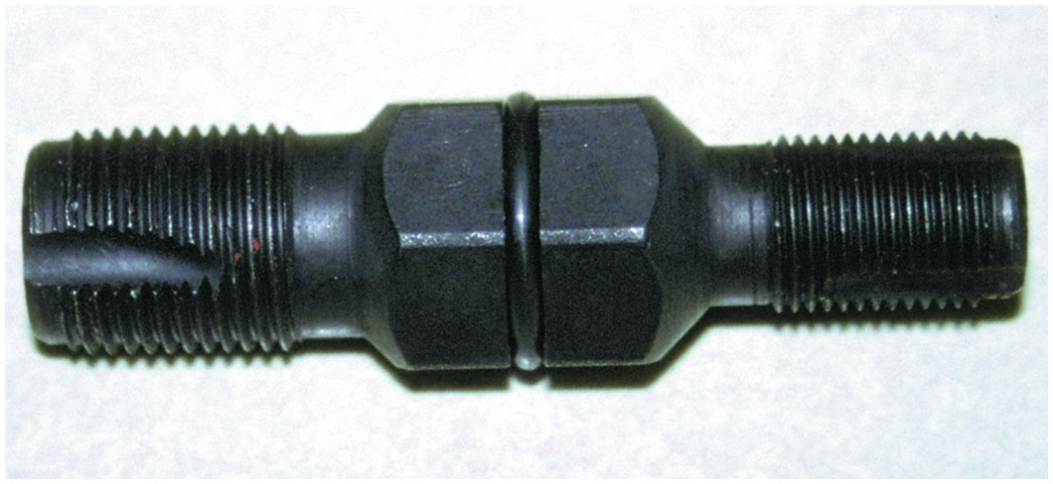
Figure 30.17
Thread Chaser
A spark plug thread chaser is a low-cost tool that hopefully will not be used often, but is necessary to use to clean the threads before new spark plugs are installed.

Slide 37
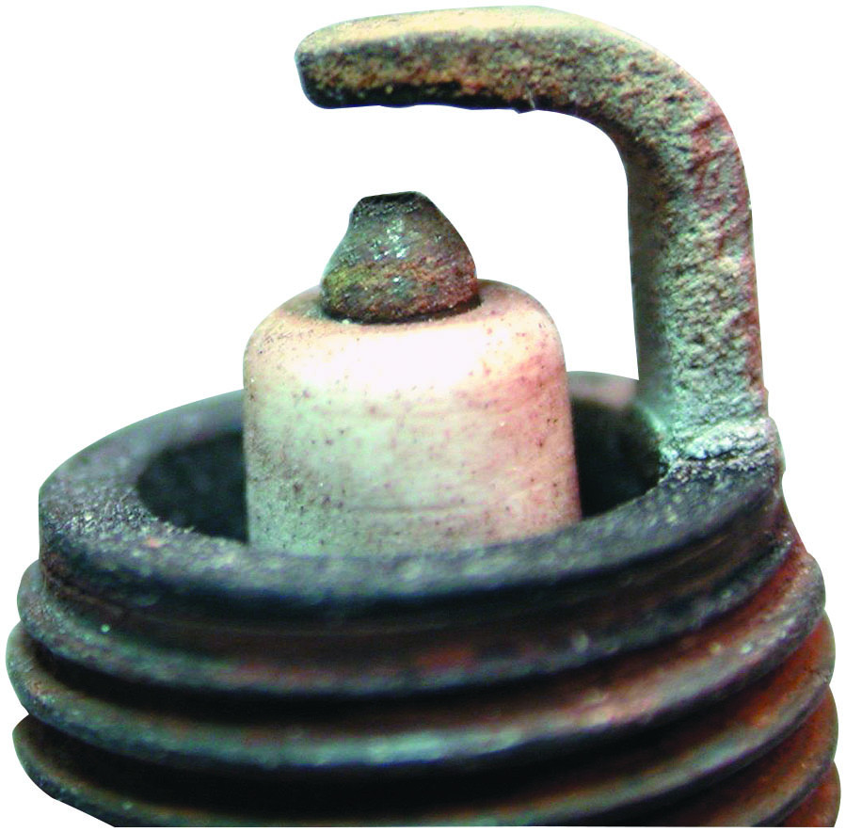
Figure 30.18
Normal Plug Wear
A normally worn spark plug that has a tapered platinum-tipped center electrode.

Slide 38
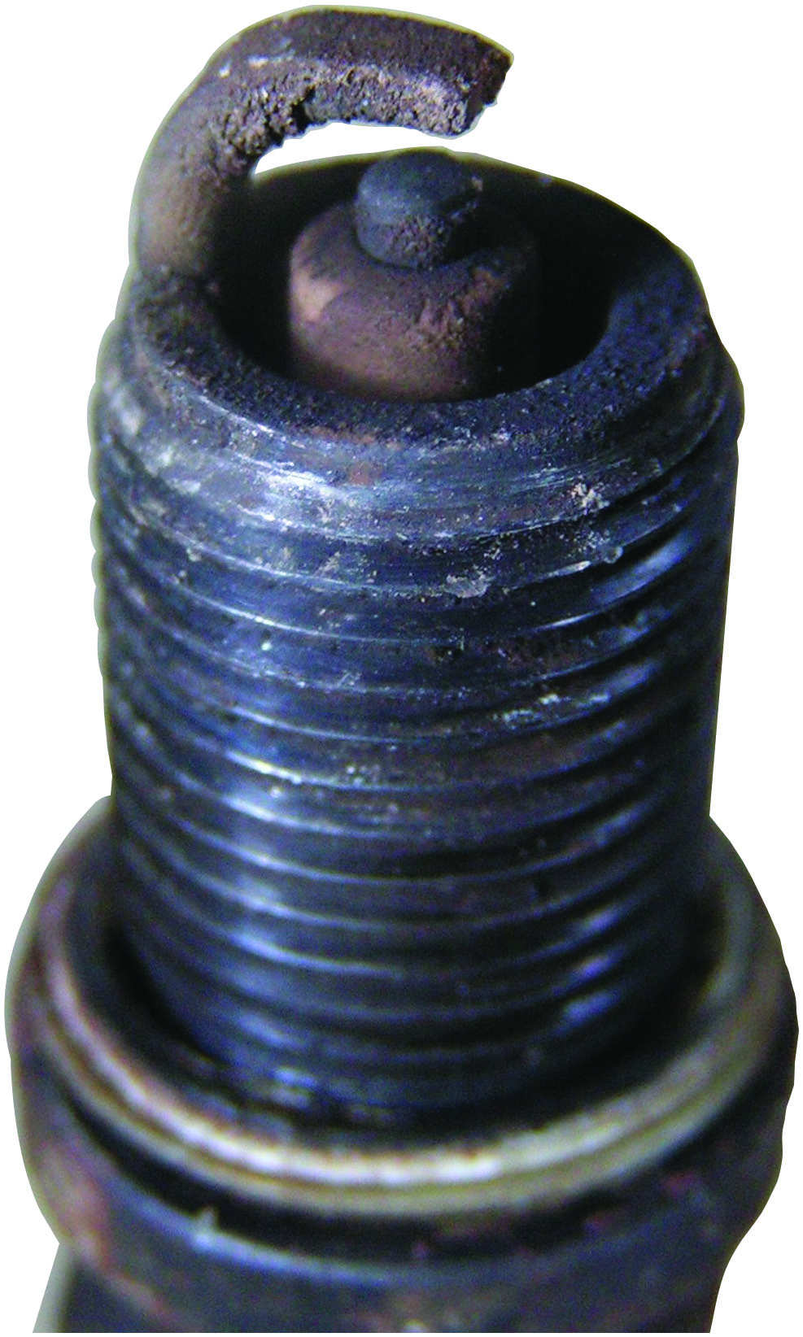
Figure 30.19
Oil Fouled
A worn spark plug showing fuel and/or oil deposits.

Slide 39
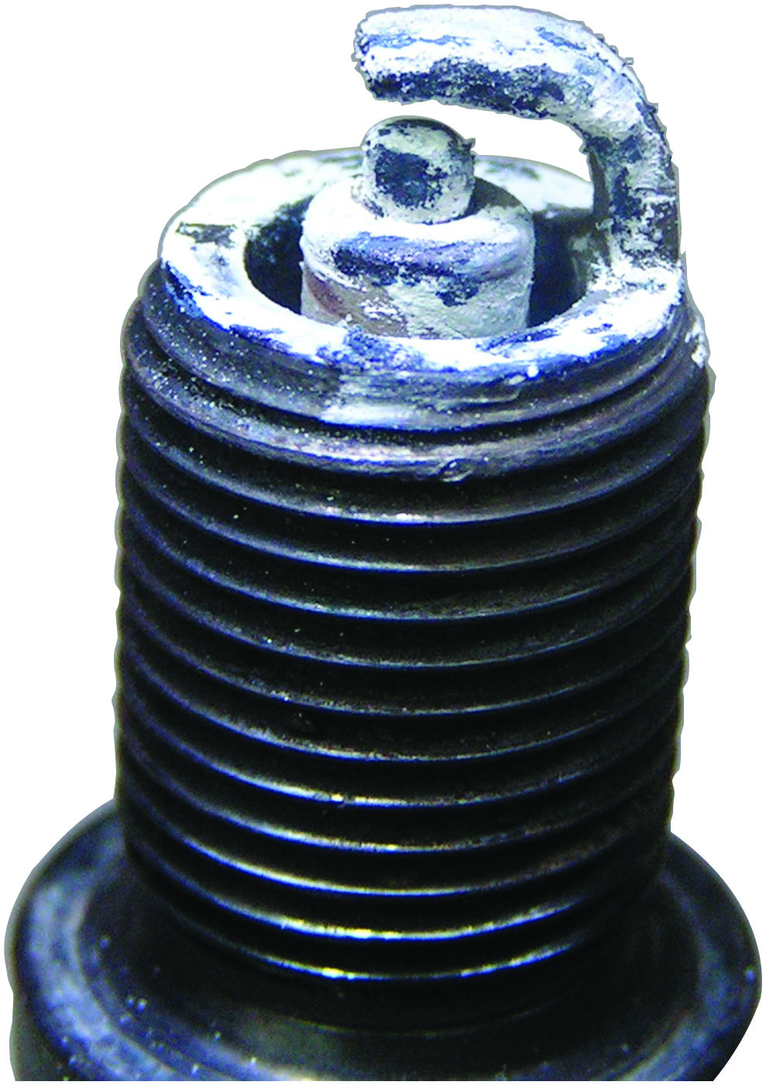
Figure 30.20
Blown Head Gasket
A spark plug from an engine that had a blown head gasket. The white deposits could be from the additives in the coolant.

Slide 40
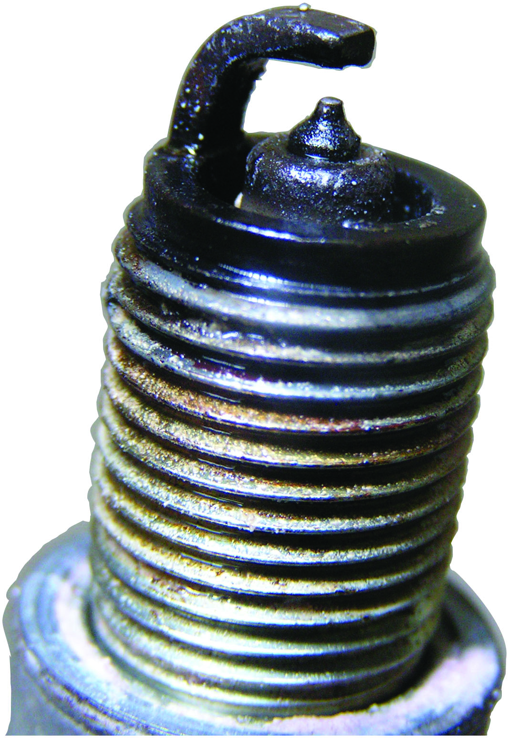
Figure 30.21
Fuel Soaked
A platinum tipped spark plug that is fuel soaked indicating a fault with the fuel system or the ignition system causing the spark plug to not fire.

Slide 41
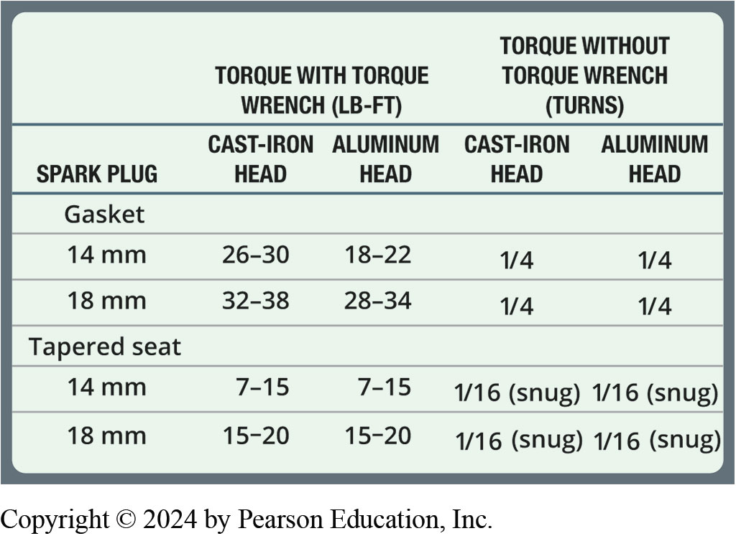
Chart 30.1
Tightening Torque
Typical spark plug tightening torque based on type of spark plug and the cylinder head material.
Notes:
Long Description:
The table has three columns: spark plug, torque with torque wrench, pound-foot, and torque without torque wrench, turns. The second and third columns have two sub-columns each: cast-iron head and aluminum head. The table has two sections. Row entries for the first section corresponding to the gasket spark plug are as follows. Row 1: 14 millimeters; 26 to 30; 18 to 22; one-fourth; one-fourth. Row 2: 18 millimeters; 32 to 38; 28 to 34; one-fourth; one-fourth. Row entries for the second section corresponding to the tapered seat spark plug are as follows. Row 1: 14 millimeters; 7 to 15; 7 to 15; 1 over 16, snug; 1 over 16, snug. Row 2: 18 millimeters; 15 to 20; 15 to 20; 1 over 16, snug; 1 over 16, snug.

Slide 42
Quick/Easy Secondary Ignition Tests
The following are some quick and easy secondary ignition tests:
If any spark is visible or a “snapping” sound is heard, the location should be closely inspected and the defective parts replaced.
For intermittent problems, use a spray bottle to apply a water mist to the spark plugs, distributor cap, and spark plug wires.

Slide 43
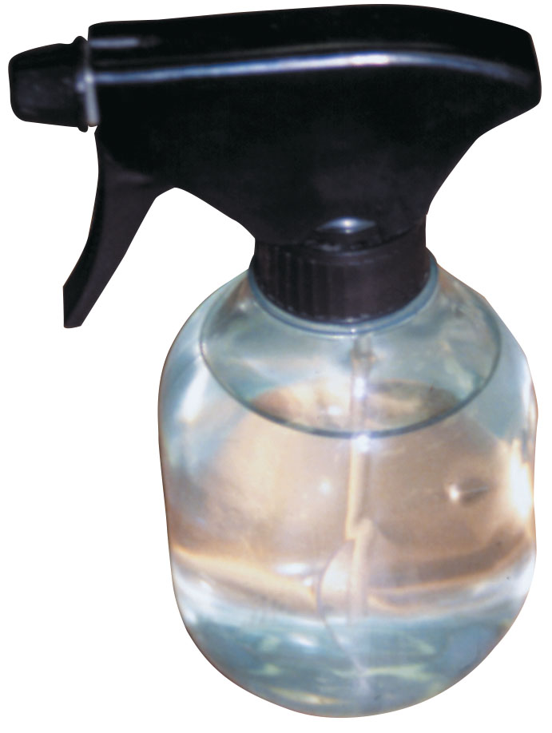
Figure 30.22
Water Spray Test
A water spray bottle is an excellent diagnostic tool to help find an intermittent engine misfire caused by a break in a secondary ignition circuit component.

Slide 44
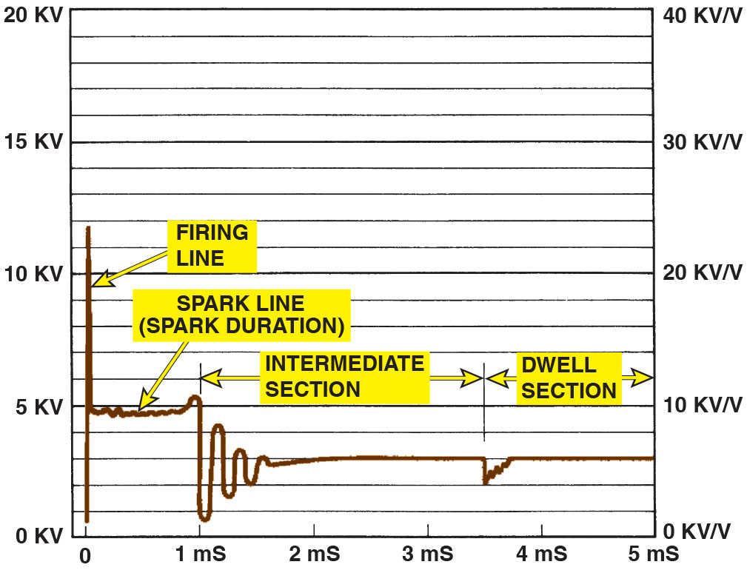
Figure 30.23
Scope-Testing
Typical secondary ignition oscilloscope pattern.
Notes:
Long Description:
The graph depicts the following: At 0 m S, there is an instantaneous voltage of 12 K V called firing line. Then it drops down to 5 K V between 0 to 1 m S. This is called spark line or spark duration. Between 1 and 1.5 m S voltage shows dapped oscillation with maximum point at 5 K V and minimum at 0.5 K V before dampening down to 3 K V. Between 1.5 to 3.5 m S the voltage remains constant at 3 K V. The region between 1 to 3.5 m S is known as intermediate section. Between 3.5 to 5 m S the voltage drops suddenly once only to rise and stabilize at 3 K V. The region is known as dwell section.

Slide 45
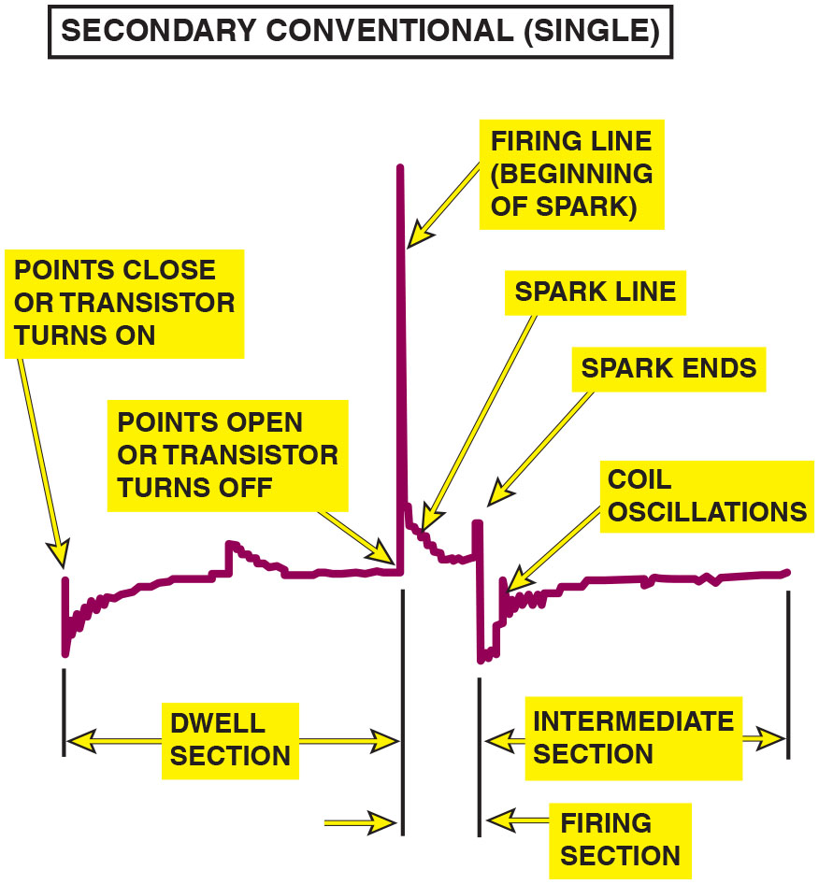
Figure 30.24
C O P Ignition
The scope shows one cylinder at a time on a C O P-type ignition system.
Notes:
Long Description:
A spike at the beginning of the fluctuating line is labeled points close or transistor turns on. The dwell section with multiple minor fluctuations follows the spike at the beginning, and the line gradually increases in the dwell section. The end of the dwell section is labeled points open or transistor turns off. The next section of the line is the firing section. The firing section starts by peaking to a sharp spike labeled firing line, beginning of spark. At the end of the sharp spike, the line decreases gradually with minor fluctuations in the region labeled spark line. The spark ends with a small spike. The intermediate section follows the firing section. The intermediate section starts with a sharp dip followed by a gradual increase to a region with multiple minor fluctuations labeled coil oscillations. The line then remains constant with multiple minor dips.

Slide 46
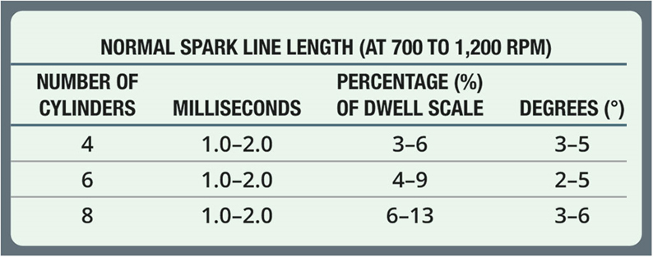
Chart 30.2
Spark Line
Spark line length depends on the number of cylinders and the engine speed.
Notes:
Long Description:
The table has four columns: number of cylinders, milliseconds, percentage of dwell scale, and degrees. Row entries are as follows. Row 1: 4, 1.0 to 2.0, 3 to 6, 3 to 5. Row 2: 6, 1.0 to 2.0, 4 to 9, 2 to 5. Row 3: 8, 1.0 to 2.0, 6 to 13, 3 to 6.

Slide 47
Scope-Testing Ignition System (1 of 6)
Any automotive scope with the correct probes or adapters show an ignition system pattern.
Firing Line
The leftmost vertical (upward) line is called the firing line.
Spark Line
The spark line is a short horizontal line immediately after the firing line.

Slide 48
Scope-Testing Ignition System (2 of 6)
Intermediate Oscillations
The intermediate oscillations follow the spark line, and are also called the “ringing” of the coil as it is pulsed.
Transistor-On Point
When the transistor turns on an electronic system, the coil is being charged.
Dwell Section
Dwell is the amount of time that the current is charging the coil from the transistor-on point to the transistor-off point.

Slide 49
Scope-Testing Ignition System (3 of 6)
Pattern Selection
Superimposed
Raster (stacked)
Display (parade)
Reading the Scope on Display (Parade)
The firing lines should all be 5 to 15 k V in height and be within 3 k V of each other.

Slide 50
Scope-Testing Ignition System (4 of 6)
Reading the Spark Lines
The spark lines should be level and one-fourth as high as the firing lines (1.5 to 2.5 k V, but usually less than 2 k V).
Spark Line Slope
An upward-sloping spark line can indicate a lean air–fuel mixture.
A downward sloping spark line is finding ground through deposits.

Slide 51
Scope-Testing Ignition System (5 of 6)
Reading the Intermediate Section
The intermediate section should have three or more oscillations (bumps) for a correctly operating ignition system.
Electronic Ignition and the Dwell Section
Many E I systems also produce a “hump” in the dwell section, which reflects a current-limiting circuit in the control module.
Dwell Variation (Electronic Ignition)
Typically caused by a worn mechanical component.

Slide 52
Scope-Testing Ignition System (6 of 6)
Coil Polarity
If the pattern is upside down, the primary wires on the coil may be reversed, causing the coil polarity to be reversed.
Acceleration Check
All firing lines should rise evenly.
If the firing lines on one or more cylinders fail to rise, this indicates fouled spark plugs.
Rotor Gap Voltage
The normal rotor gap voltage is 3 to 7 k V.

Slide 53
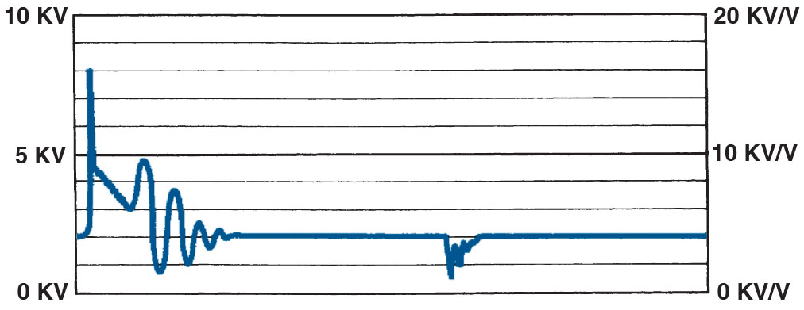
Figure 30.25
Downward Spark Line
A downward-sloping spark line usually indicates high secondary ignition system resistance or an excessively rich air–fuel mixture.

Slide 54
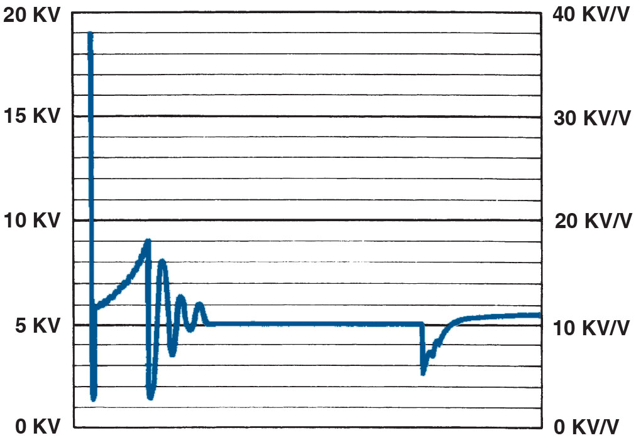
Figure 30.26
Upward Slop Spark Line
An upward-sloping spark line usually indicates a mechanical engine problem or a lean air–fuel mixture.

Slide 55
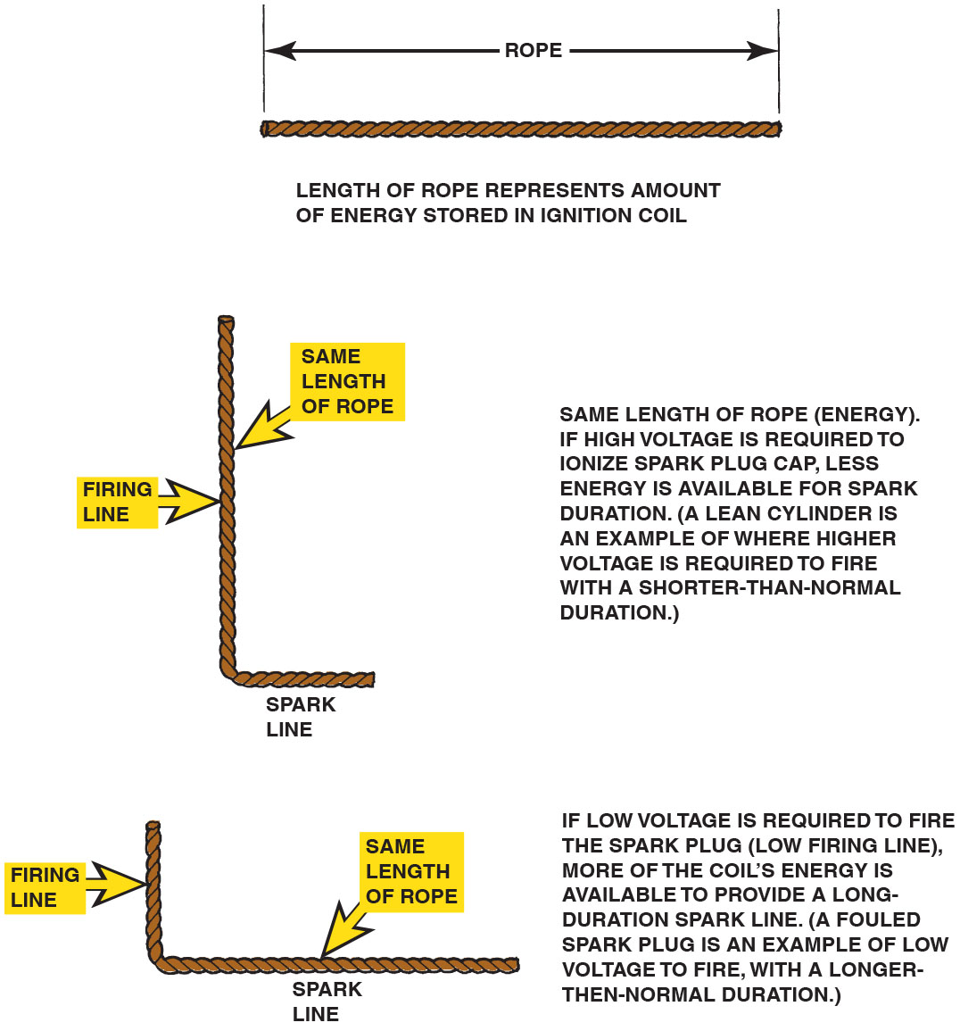
Figure 30.27
Rope Length
The relationship between the height of the firing line and length of the spark line can be illustrated using a rope. Because energy cannot be destroyed, the stored energy in an ignition coil must dissipate totally, regardless of engine operating conditions.
Notes:
Long Description:
By bending the rope, it divides into 2 lines 1 representing firing line and other spark line. When firing line is long spark line is small and when firing line is small the spark line is long. Same length of rope, energy, if high voltage is required to ionize spark plug cap, less energy is available for spark duration. A lean cylinder is an example of where higher voltage is required to fire with a shorter-than-normal duration. If low voltage is required to fire the spark plug (low firing line), more of the coil's energy is available to provide a long-duration spark line. (A fouled spark plug is an example of low voltage to fire, with a longer-then-normal duration.)

Slide 56
Scope-Testing a Waste-Spark Ignition System
A handheld digital storage oscilloscope can be used to check the pattern of each individual cylinder.
Some larger scopes are able to display both power and waste-spark waveforms.
Because the waste spark does not require as high a voltage level as the cylinder on the power stroke, the waste form is normally lower.

Slide 57
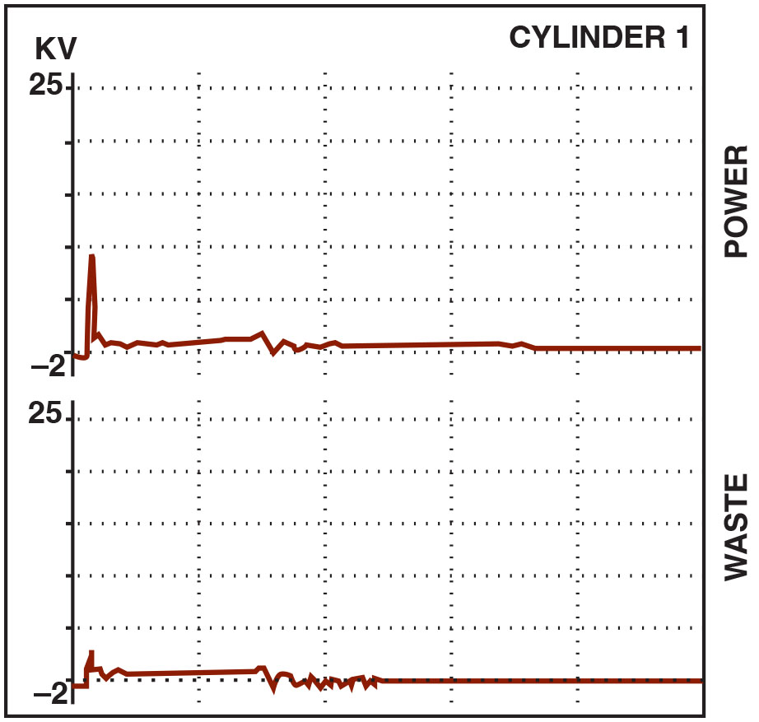
Figure 30.28
Dual-Trace D S O
A dual-trace scope pattern showing both the power and the waste spark from the same coil (cylinders 1 and 6). Note that the firing line is higher on the cylinder that is under compression (power); otherwise, both patterns are almost identical.

Slide 58
Scope-Testing a Coil-on-Plug Ignition System
Each individual coil can be shown on a scope and using the proper cables and adapters.
Always follow the scope equipment manufacturer’s instructions.
Normal ignition patterns may vary based on manufacturer system designs.

Slide 59
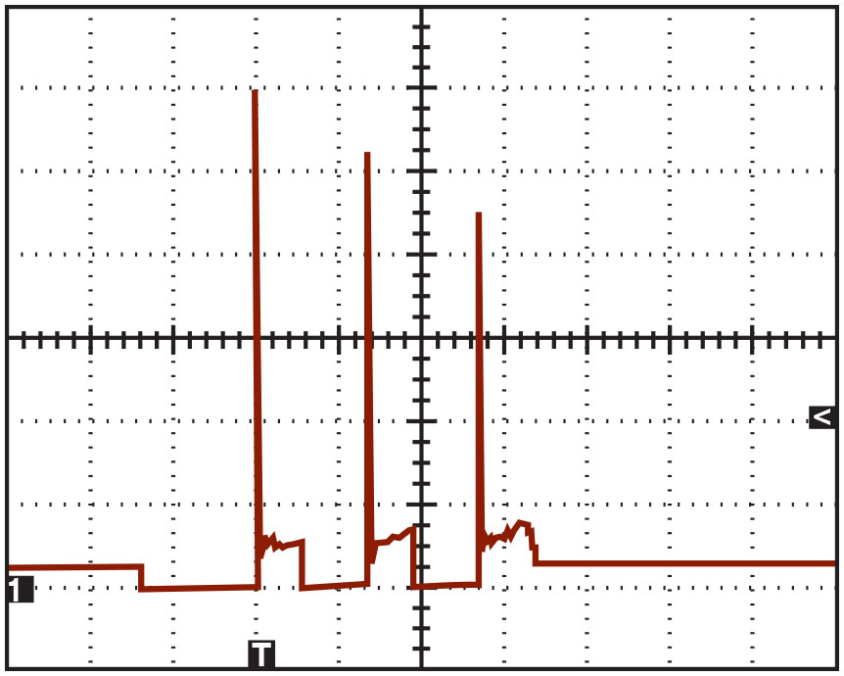
Figure 30.29
Three Sparks
A secondary waveform of a Ford 4.6-liter V-8, showing three sparks occurring at idle speed.
Notes:
In a coil-on-plug type of ignition system, each individual coil can be shown on a scope. By using a multichannel scope and the proper cables and adapters, the waveform for all of the cylinders can be viewed at the same time. Always follow the scope equipment manufacturer’s instructions. ● See Figure 30.29.

Slide 60
Ignition System Symptom Guide
PROBLEM | POSSIBLE CAUSES AND/OR SOLUTIONS
No spark out of the coil | Possible open in the ignition switch circuit Possible defective ignition module (if electronic ignition coil) Possible defective pickup coil or Hall- effect switch (if electronic ignition) Possible shorted condenser
Weak spark out of the coil | Possible high-resistance coil wire or spark plug wire Possible poor ground between the distributor or module and the engine block
Engine misfire | Possible defective (open) spark plug wire Possible worn or fouled spark plugs Possible defective pickup coil Possible defective module Possible poor electrical connections at the pickup coil and/or module

Slide 61
Question 3
What are the sections of a secondary ignition scope pattern?

Slide 62
Answer 3
Firing line, spark line, intermediate section, and dwell section.

Slide 63
Summary
A thorough visual inspection should be performed on all ignition components when diagnosing an engine performance problem.
Platinum spark plugs should not be regapped after use in an engine.
A secondary ignition scope pattern includes a firing line, spark line, intermediate oscillations, and transistor-on and transistor-off points.
The slope of the spark line can indicate incorrect air–fuel ratio or other engine problems.

Slide 64
Animations and Video Links (Halderman website subscription and web access needed to view)
(A8) Engine Performance Animations
(A8) Engine Performance Videos

Slide 65
Copyright
This work is protected by United States copyright laws and is provided solely for the use of instructors in teaching their courses and assessing student learning. Dissemination or sale of any part of this work (including on the World Wide Web) will destroy the integrity of the work and is not permitted. The work and materials from it should never be made available to students except by instructors using the accompanying text in their classes. All recipients of this work are expected to abide by these restrictions and to honor the intended pedagogical purposes and the needs of other instructors who rely on these materials.

