Slide 1
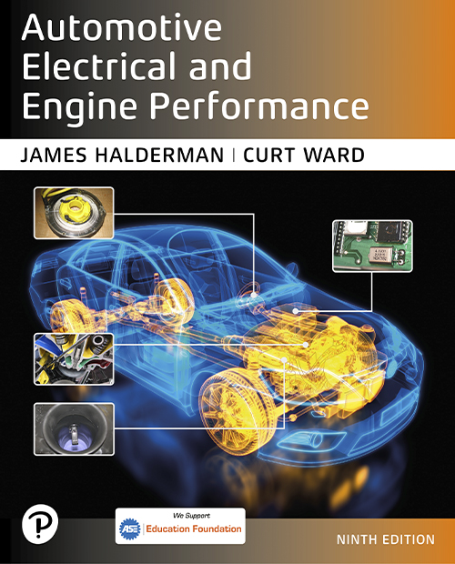
Automotive Electrical and Engine Performance
Ninth Edition
Chapter 29
Ignition System Parts and Operation
Copyright © 2025 Pearson Education, Inc. All Rights Reserved
Notes:
If this PowerPoint presentation contains mathematical equations, you may need to check that your computer has the following installed:
1) Math Type Plugin
2) Math Player (free versions available)
3) NVDA Reader (free versions available)
INSTRUCTOR NOTE: This presentation includes text explanation notes, you can use to teach the course. When in SLIDE SHOW mode, you RIGHT CLICK and select SHOW PRESENTER VIEW, to use the notes.

Slide 2
Learning Objectives (1 of 2)
29.1 Discuss ignition systems.
29.2 Discuss ignition coils.
29.3 Discuss ignition switching and triggering.
29.4 Describe ignition system operation.
29.5 Describe the operation of waste-spark ignition systems.
29.6 Describe the operation of coil-on-plug ignition systems.
29.7 Discuss ignition timing.

Slide 3
Learning Objectives (2 of 2)
29.8 Discuss knock sensors.
29.9 Describe the different types of spark plugs.

Slide 4
Ignition System
Purpose and Function
The ignition system includes components and wiring necessary to create and distribute a high voltage (up to 40,000 volts or more) and send to the spark plug.
Background
Before the mid-1970s, ignition systems used a mechanically opened set of contact points to make and break the electrical connection to ground.
Since the mid-1970s, ignition systems have used sensors, such as a pickup coil and reluctor (trigger wheel), to trigger or signal an electronic module.

Slide 5
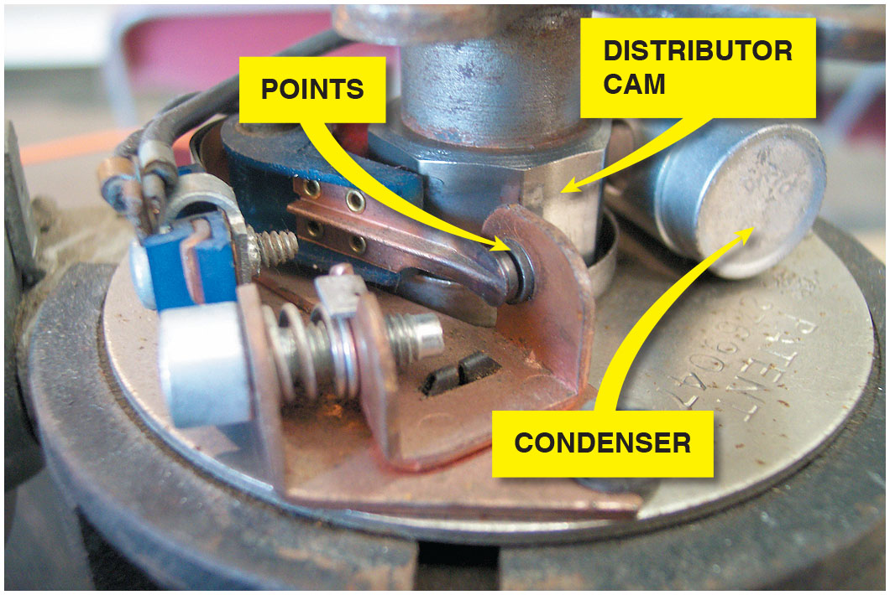
Figure 29.1
Point-Type Ignition
A point-type ignition system showing the distributor cam which opens the points.

Slide 6
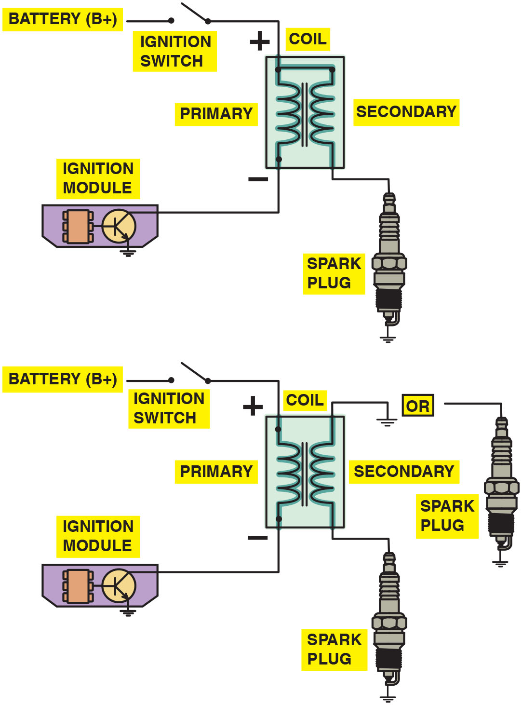
Figure 29.2
Married Coil
Some ignition coils are electrically connected, called married (top figure), whereas others use separate primary and secondary windings, called divorced (lower figure). The polarity (positive or negative) of a coil is determined by the direction in which the coil is wound.
Notes:
Long Description:
In both the circuits positive of the primary coil is connected to battery via ignition switch and negative is connected to Ignition module while one end of the secondary coil is connected to spark plug. In an electrically connected winding or married winding other end of secondary coil is connected to positive is primary coil where as in electrically isolated windings the other end of secondary coil is either connected to ground or a sparkplug.

Slide 7
Ignition System Operation
All ignition systems apply voltage close to battery voltage (12 volts) to positive side of ignition coil and pulse negative side to ground.
When coil negative lead is grounded, primary (low-voltage) circuit of coil is complete and a magnetic field is created around coil windings.
When circuit is opened, magnetic field collapses and induces a high-voltage spark in secondary winding of ignition coil.

Slide 8
Ignition Coils (1 of 4)
Purpose and Function
The coil creates a high-voltage spark by electromagnetic induction.
Coil Construction
The center of an ignition coil contains a core of laminated soft iron (thin strips of soft iron).
Surrounding the laminated core are the secondary windings.
Surrounding the secondary windings are the primary windings.

Slide 9
Ignition Coils (2 of 4)
Self-Induction
When current starts to flow into a coil, an opposing current is created in the windings of the coil. This opposing current generation is caused by self-induction and is called inductive reactance.
Mutual Induction
The current flowing in one coil winding induces a voltage in the adjacent coil winding when a change occurs.

Slide 10
Ignition Coils (3 of 4)
How Ignition Coils Create 40,000 Volts
All ignition systems use electromagnetic induction to produce a high-voltage spark.
Magnetic field in an ignition coil produced by current flowing through primary windings.
When primary coil winding ground return path connection is opened, magnetic field collapses and induces a voltage of 250 to 400 volts in primary winding of the coil .
High-voltage (20,000 to 40,000 volts) low-amperage (20 to 80 m A) current in the secondary coil windings.

Slide 11
Ignition Coils (4 of 4)
Primary Ignition Circuit
Battery, ignition switch
Primary windings of coil
Pickup coil (cranks sensor)
Ignition module (igniter)
P C M
Secondary Ignition Circuit
Secondary windings of coil
Distributor cap and rotor (if the vehicle is so equipped)
Spark plug wires and spark plugs

Slide 12
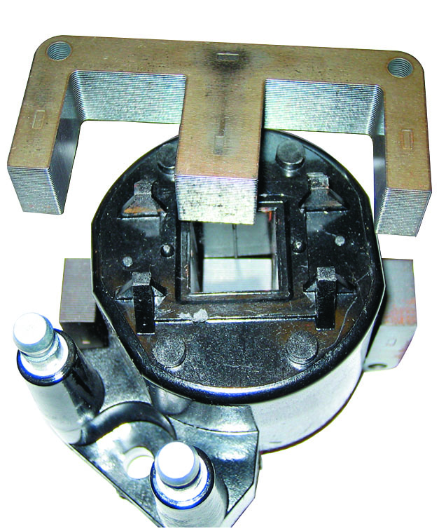
Figure 29.3
E Coil
The steel lamination used in an E coil helps increase the magnetic field strength, which helps the coil produce higher energy output for a more complete combustion in the cylinders.

Slide 13
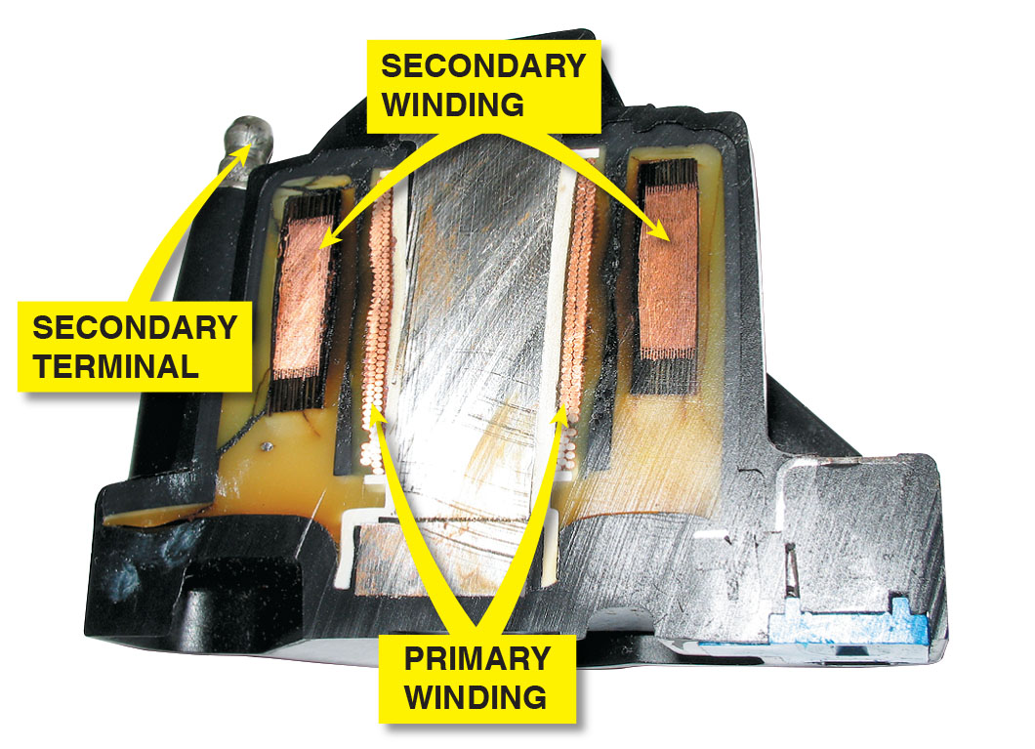
Figure 29.4
Primary Inside Secondary
The primary windings are inside the secondary windings on this General Motors coil.

Slide 14
Frequently Asked Question: How Does the Computer Control the Ignition?
? Frequently Asked Question
How Does the Computer Control the Ignition? The P C M is the final functioning of the ignition circuits. P C M receives signals from all of the sensors and uses an algorithm to determine the best time to fire spark plugs. For example, sensors that affect when the spark occurs include E C T sensor—colder the engine, the more spark advance may be needed. Throttle position (T P) sensor—determine where accelerator position is located but also at what rate it is changing. If the accelerator pedal rapidly being depressed, spark timing may be delayed (retarded slightly) to help prevent spark knock. M A P sensor is used to detect engine load. During a heavy load, less spark advance is needed to help prevent spark knock, whereas more spark advance is needed under light load conditions for the engine to achieve maximum fuel economy and the lowest possible exhaust emissions.

Slide 15
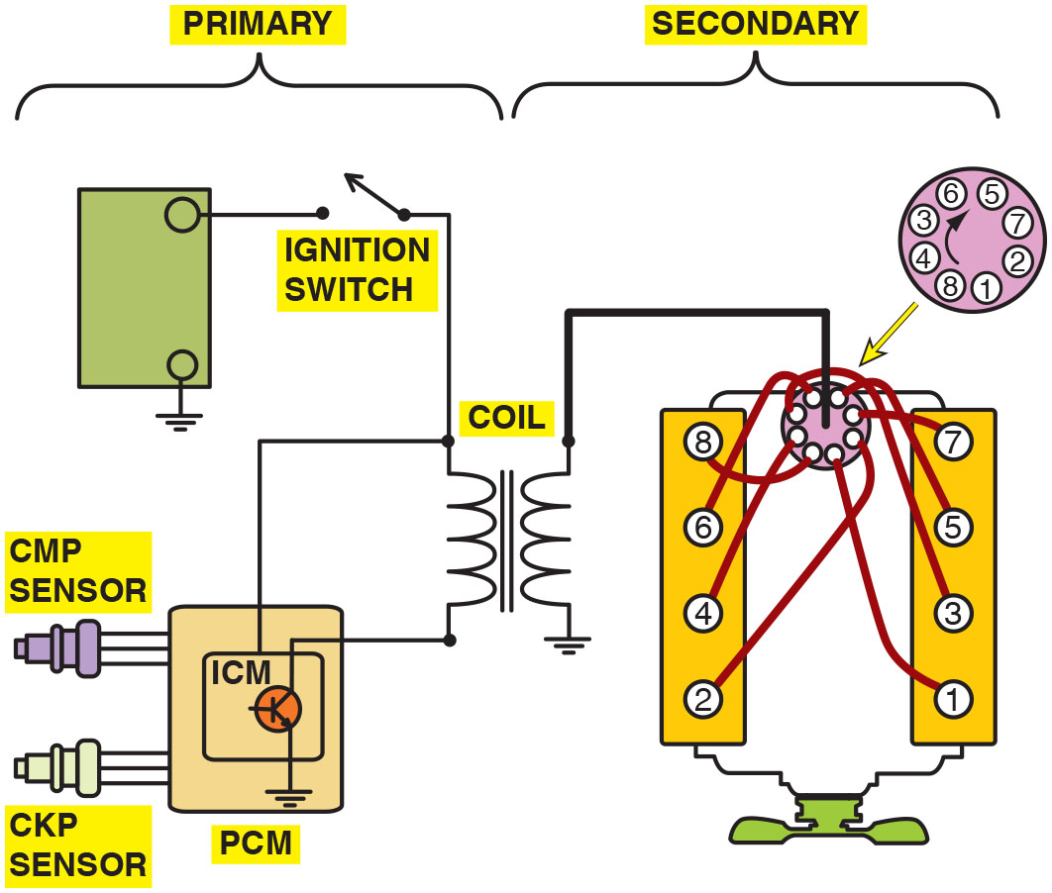
Figure 29.5
Ignition Circuit
The primary ignition system is used to trigger, and therefore create, the secondary (high-voltage) spark from the ignition coil.
Notes:
Long Description:
Primary circuit: 1. Battery 2. Ignition switch. 3. Primary coil. 4. I C M (this module consists of transistor with second side of coil connected to the collector). 5. P C M (this module is connected to the emitter of the transistor). 6. I C M and P C M are connected to C M P and C K P sensors. Secondary circuit: 1. Secondary coil. 2. Distributer, shown as a dial with 1, 2, 3, 4, 5, 6,7and 8 written over it. 3. Eight spark plugs of a V 8 engine.

Slide 16
Question 1
What are the components of the secondary ignition circuit?

Slide 17
Answer 1
The secondary side of the coil, the cap and rotor (if used), the spark plug wires, and the spark plugs.

Slide 18
Ignition Switch and Triggering
Turning on/off of primary circuit is called switching.
Unit that does switching is electronic switch, such as a power transistor.
Power transistor can be located in:
In the powertrain control module (P C M)
In the I C M
Part of the coil-on-plug assembly

Slide 19
Primary Circuit Operation
These are used as crankshaft position (C K P) sensors or camshaft position (C M P) sensors:
Hall-effect switch uses a stationary sensor and rotating trigger wheel (shutter).
Magnetic sensor uses changing strength of magnetic field surrounding a coil of wire to signal module and computer.

Slide 20
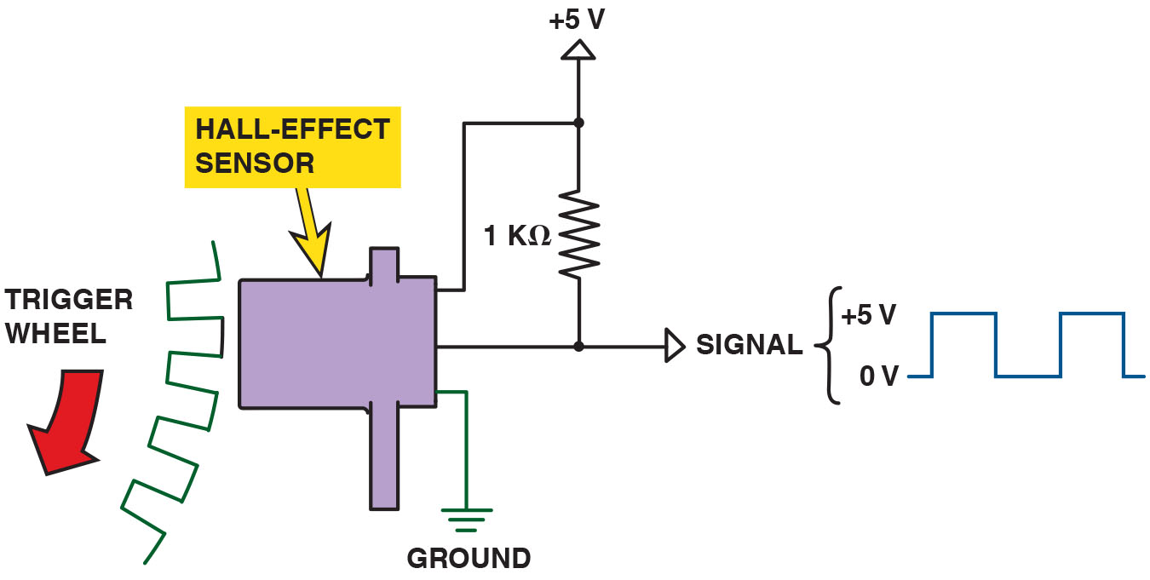
Figure 29.6
Hall-Effect Switch
A Hall-effect sensor produces a digital on-off voltage signal whether it is used with a blade or a notched wheel.
Notes:
Long Description:
The Sensor has 3 pins: First is connected to power of plus 5 volts. Second is signal out. It is also connected to power pin with a 1000 ohms resister. Third pin is ground.

Slide 21
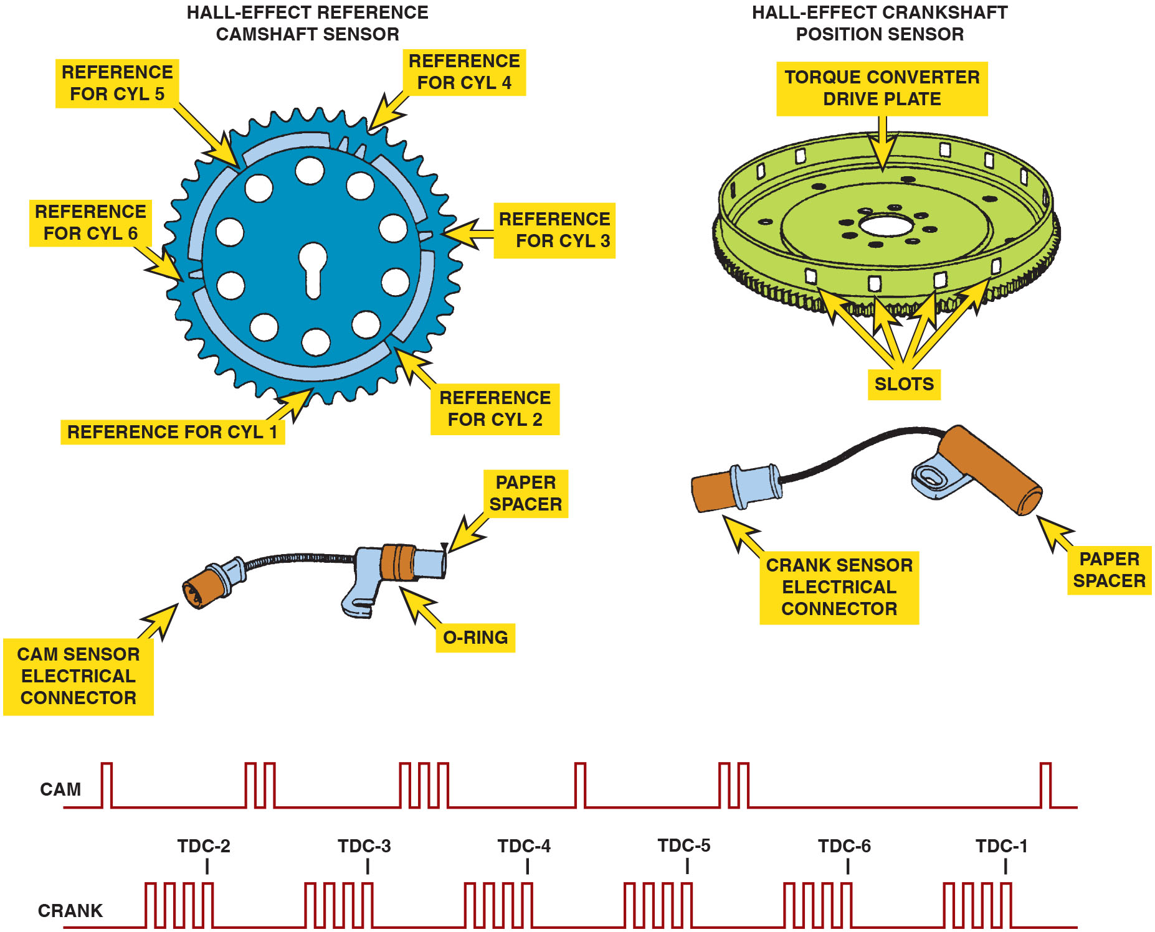
Figure 29.7
Hall-Effect Sensor
Some Hall-effect sensors look like magnetic sensors. This Hall-effect camshaft reference sensor and crankshaft position sensor have an electronic circuit built in that creates a 0 to 5 volt signal as shown at the bottom. These Hall-effect sensors have three wires: a power supply (8 volts) from the computer (controller); a signal (0 to 5 volts); and a signal ground.
Notes:
TECH TIP: The Tachometer Trick
When diagnosing a no-start or intermittent misfire condition, check the operation of the tachometer. If the tachometer does not indicate engine speed (no-start condition) or drops toward zero (engine misfire), the problem is due to a defect in the primary ignition circuit. The tachometer gets its signal from the pulsing of the primary winding of the ignition coil or the crankshaft position (C K P) sensor. The following components in the primary circuit could cause the tachometer to not work when the engine is cranking:
Pickup coil
Crankshaft position sensor
Ignition module (igniter)
Coil primary wiring
If the vehicle is not equipped with a tachometer, connect a scan tool and monitor engine R P M. Remember the following:
No tachometer reading means the problem is in the primary ignition circuit.
Tachometer reading okay means the problem is in the secondary ignition circuit or is a fuel-related problem.
Long Description:
Hall Effect reference camshaft sensor has notches in the gear, defined as 1. Reference for cylinder 1: no notch. 2. Reference for cylinder 2: 1 notch. 3. Reference for cylinder 3: 2 notch. 4. Reference for cylinder 4: 3 notch. 5. Reference for cylinder 5: 1 notch. 6. Reference for cylinder 6: 2 notch. Hall Effect reference Crankshaft sensor has slots in the side face of torque converter drive plate, defined as 4 slots for each cylinder. A graph also shows the wave output for both the sensors. The wave output shows a high value only at slots or notches.

Slide 22
Animation: Hall Effect Sensor

Slide 23
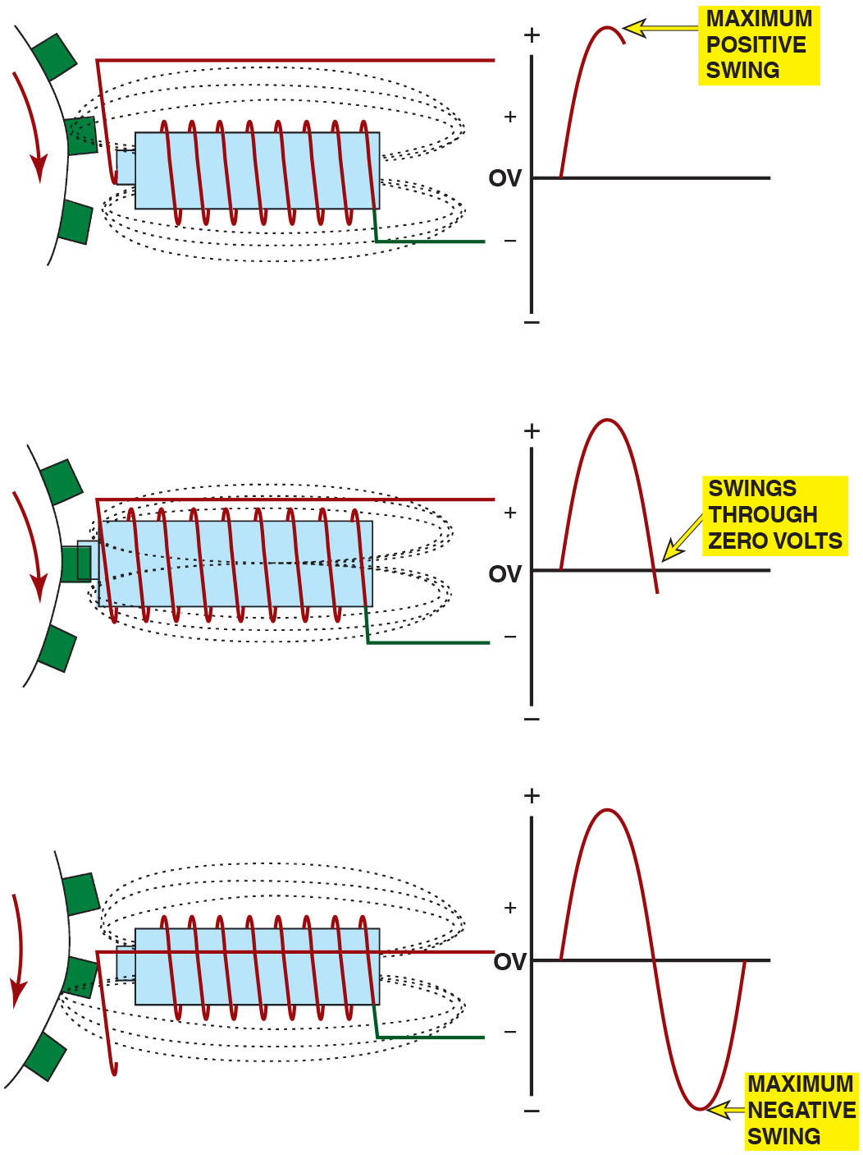
Figure 29.8
Magnetic Sensor
A magnetic sensor uses a permanent magnet surrounded by a coil of wire. The notches of the crankshaft (or camshaft) create a variable magnetic field strength around the coil. When a metallic section is close to the sensor, the magnetic field is stronger because metal is a better conductor of magnetic lines of force than air.
Notes:
Long Description:
Stage 1: A tooth approaches the sensor – this creates a maximum positive swing. Stage 2: A tooth is aligned with the sensor – this brings the voltage in the coil back to 0. Stage 2: A tooth moves away from the sensor – This creates a maximum negative swing of voltage. The whole cycle creates a complete sine wave in the voltage graph.

Slide 24
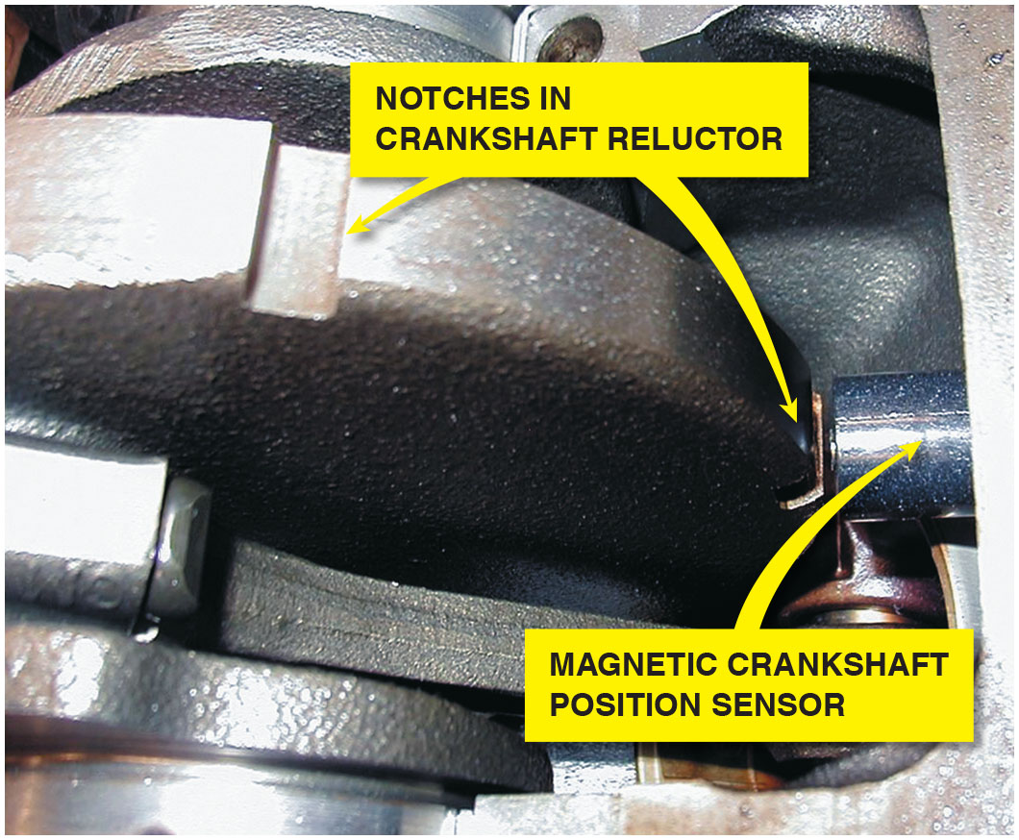
Figure 29.9
C K P Sensor
A typical magnetic crankshaft position sensor.

Slide 25
Question 2
What are the two type of crankshaft sensors?

Slide 26
Answer 2
Hall-effect and magnetic sensors.

Slide 27
Distributor Ignition Systems (1 of 2)
Purpose and Function
To distribute the high-voltage spark from the ignition coil to the spark plugs located at each cylinder.
To provide a method for switching the primary ignition circuit, first using mechanical points and later using a sensor.
The distributor is driven by a gear from the end of the camshaft inside the engine that rotates at the same speed as the camshaft, which is half crankshaft speed.

Slide 28
Distributor Ignition Systems (2 of 2)
Distributor Cap and Rotor
The high-voltage pulse from the ignition coil enters the distributor cap and is sent to the individual spark plug wires by the rotating rotor.
Firing Order
Firing order means the order that the spark is distributed to the correct spark plug at the right time.

Slide 29
Animation: Ignition System, Distributor

Slide 30
Frequently Asked Question: What Is Meant by the Firing Order?
? Frequently Asked Question
What Is Meant by the Firing Order? Firing order means the order that the spark is distributed to the correct spark plug at the right time. The firing order of an engine is determined by crankshaft and camshaft design. The firing order is determined by the location of the spark plug wires in the distributor cap of an engine equipped with a distributor. The firing order is often cast into the intake manifold for easy reference. • See Figure 29.10.

Slide 31
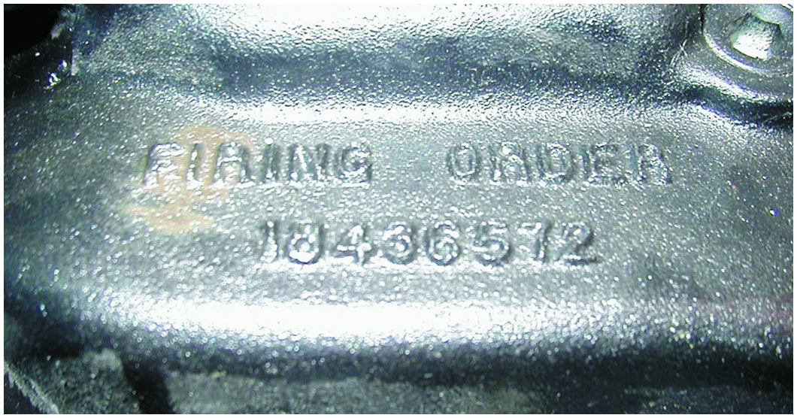
Figure 29.10
Firing Order
The firing order is cast or stamped on the intake manifold on most engines that have a distributor ignition.

Slide 32
Waste-Spark Ignition Systems
Waste-spark ignition is another name for distributorless-ignition system (D I S) or electronic ignition (E I).
Each end of the secondary winding is connected to a cylinder exactly opposite the other in the firing order, which is called a companion (paired) cylinder.
This means that both spark plugs fire at the same time (within nanoseconds of each other).

Slide 33
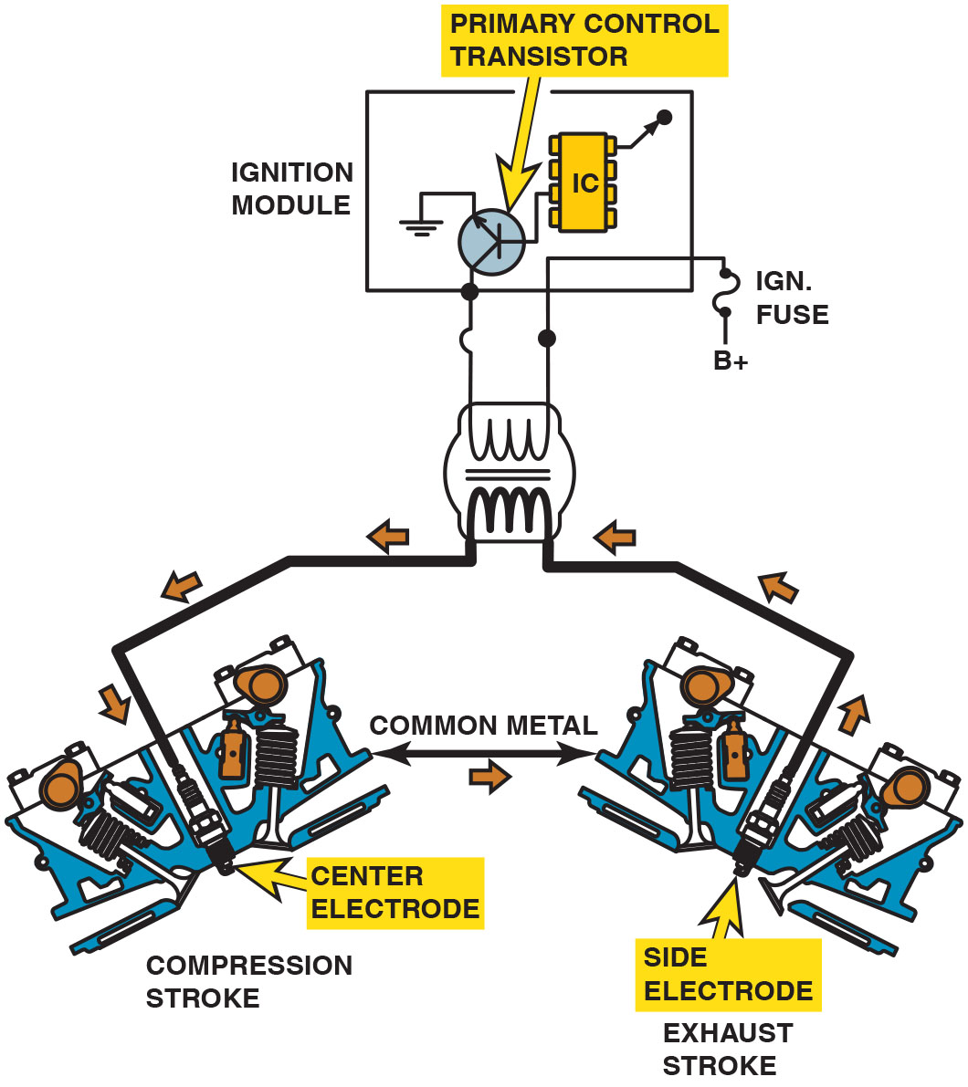
Figure 29.11
Waste Spark
A waste-spark system fires one cylinder while its piston is on the compression stroke and into paired or companion cylinders while it is on the exhaust stroke. In a typical engine, it requires only about 2 to 3 k V to fire the cylinder on the exhaust strokes. The remaining coil energy is available to fire the spark plug under compression (typically about 8 to 12 k V).
Notes:
TECH TIP: Odds Fire Straight
Waste-spark ignition systems fire two spark plugs at the same time. Most vehicle manufacturers use a waste-spark system that fires the odd-numbered
cylinders (1, 3, and 5) by straight polarity (current flow from the top of the spark plug through the gap and to the ground electrode). The even-numbered cylinders (2, 4, and 6) are fired reverse polarity, meaning that the spark jumps from the side electrode to the center electrode. Some vehicle manufacturers equip their vehicles with platinum plugs with the expansive platinum alloy only on one electrode as follows:
On odd-numbered cylinders (1, 3, 5), the platinum is on the center electrode.
On even-numbered cylinders (2, 4, 6), the platinum is on the ground electrode.
Replacement spark plugs use platinum on both electrodes (double platinum) and can, therefore, be placed in any cylinder location.
Long Description:
The secondary coil is connected to 2 spark plugs, one at each end. The current flows through the Centre electrode which is the spark plug in compression stroke. Moves through common iron and enters side electrode and goes back to the secondary coil effectively completing the circuit.

Slide 34
Animation: Waste-Spark Ignition System

Slide 35
Coil-on-Plug Ignition
Coil-on-Plug (C O P) uses one ignition coil for each plug.
Two basic types of C O P ignition:
Two-wire—uses vehicle computer to control firing of the ignition coil.
Three-wire—design includes an ignition module at each coil.
Compression-Sensing Ignition
Uses the voltage required to fire the cylinders to determine cylinder position.

Slide 36
Animation: Coil-On-Plug Ignition System

Slide 37
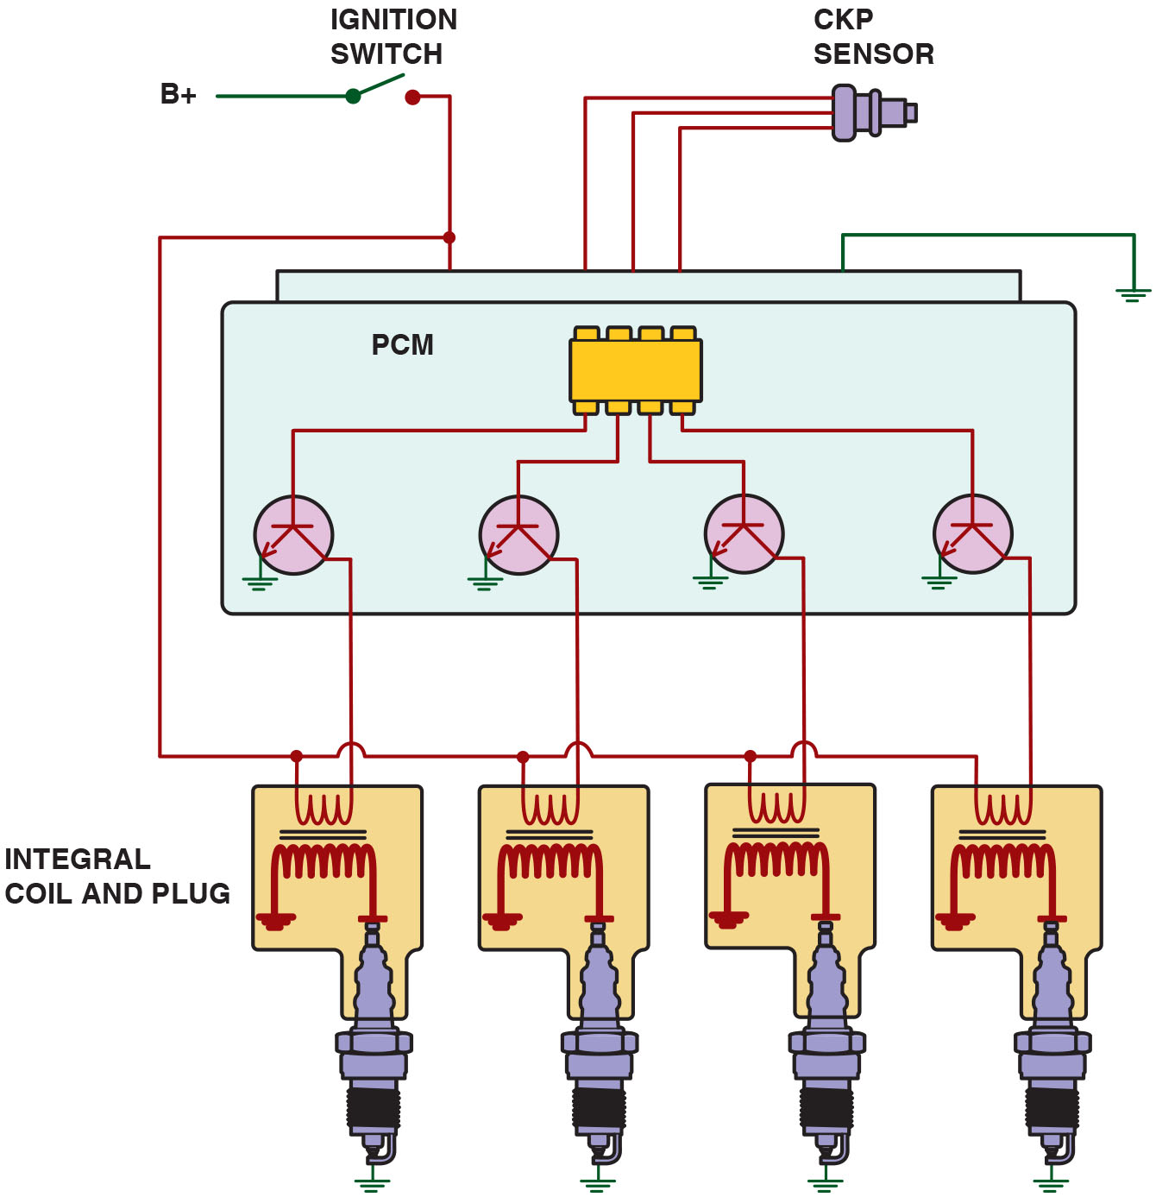
Figure 29.12
Two-Wire C O P
A typical two-wire coil-on-plug ignition system showing the triggering and the switching being performed by the P C M from input from the crankshaft position sensor.
Notes:
Long Description:
Each spark plug has its own set of primary and secondary coil. The primary coil is connected to the ignition switch on one end and collectors of the transistors in P C M on the other. Secondary coils are connected to spark plugs and ground. Transistors are controlled by I C in P C M. P C M is also connected to C K P sensor.

Slide 38
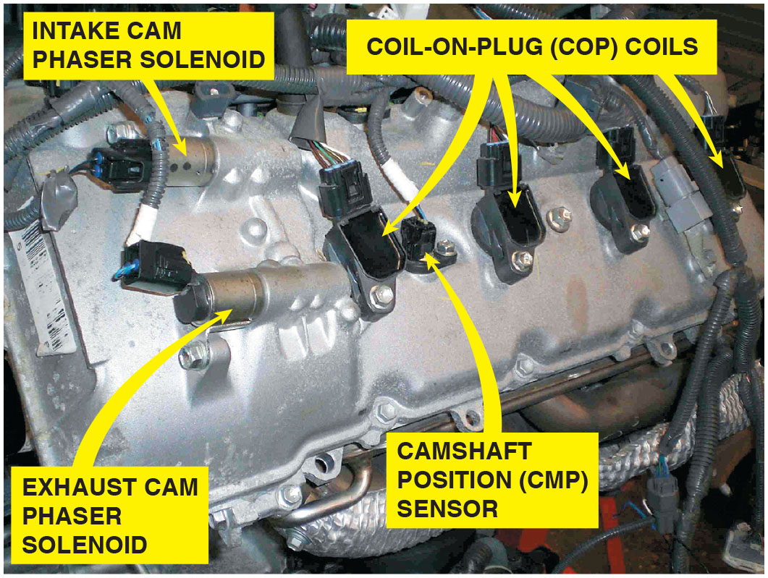
Figure 29.13
C O P with V V T
An overhead camshaft engine equipped with variable valve timing on both the intake and exhaust camshafts and coil-on-plug ignition.

Slide 39
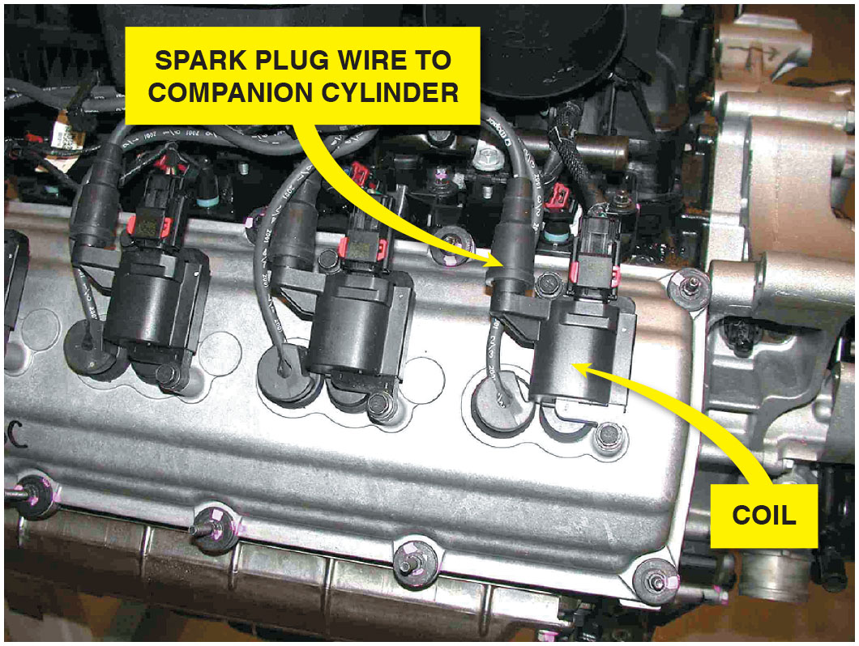
Figure 29.14
Hemi Engine
Chrysler Hemi V-8 that has two spark plugs per cylinder. The coil on top of one spark fires that plug plus, through a spark plug wire, fires a plug in the companion cylinder.
Notes:
WARNING Never Disconnect a Spark Plug Wire When the Engine Is Running!
Ignition systems produce a high-voltage pulse necessary to ignite a lean air–fuel mixture. If you disconnect a spark plug wire when the engine is running, this high-voltage spark could cause personal injury or damage to the ignition coil and/or ignition module.
Long Description:
Chrysler Hemi V-8 has two spark plugs per cylinder. The coil on top of one spark fires that plug plus, through a spark plug wire, fires a plug in the companion cylinder.

Slide 40
Ignition Timing
The Need for Spark Advance
Ignition timing refers to when spark plug fires in relation to piston position.
As engine rotates faster, spark plug firing event must occur sooner.
Initial Timing
If engine is equipped with a distributor, it may be possible to adjust base or the initial timing.
Ignition timing does change as timing chain or gear wears.

Slide 41
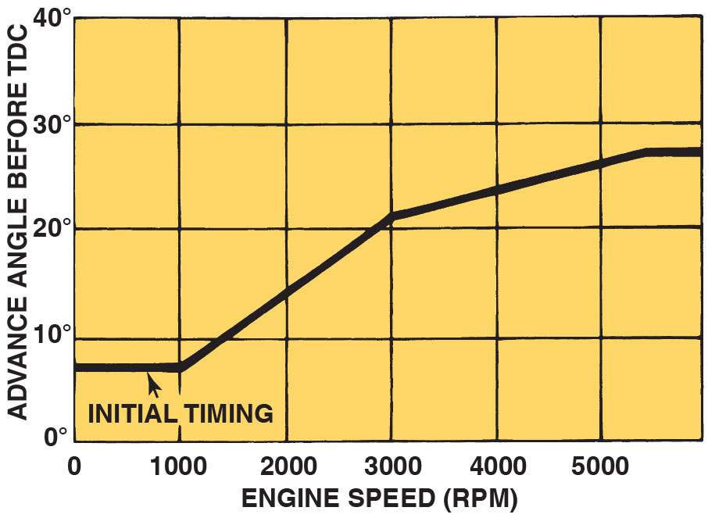
Figure 29.15
Initial Timing
The initial timing is where the spark plug fires at idle speed. The computer then advances the timing based on engine speed and other factors.
Notes:
Long Description:
During 0 to 1000 r p m Advance is below 10 degrees. During 1000 to 3000 r p m advance is linearly increasing to reach approx. 21 to 22 degrees. During 3000 to 5000 r p m advance is linearly increasing to reach approx. 26 to 27 degrees. After 5000 r p m advance is constant at about 28 degrees.

Slide 42
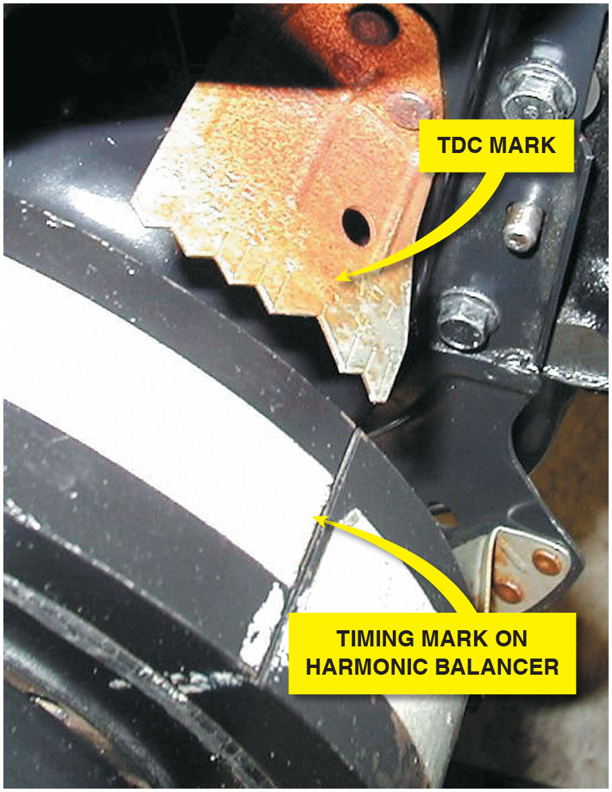
Figure 29.16
Timing Marks
Ignition timing marks are found on the harmonic balancers that are equipped with distributor ignition.

Slide 43
Knock Sensors
Knock sensors are used to detect abnormal combustion.
Inside the knock sensor is a piezoelectric element that generates a voltage when pressure or a vibration is applied to the unit.
Diagnosing the Knock Sensor
A scan tool is used to read diagnostic trouble codes and check the functionality of the knock sensor.

Slide 44
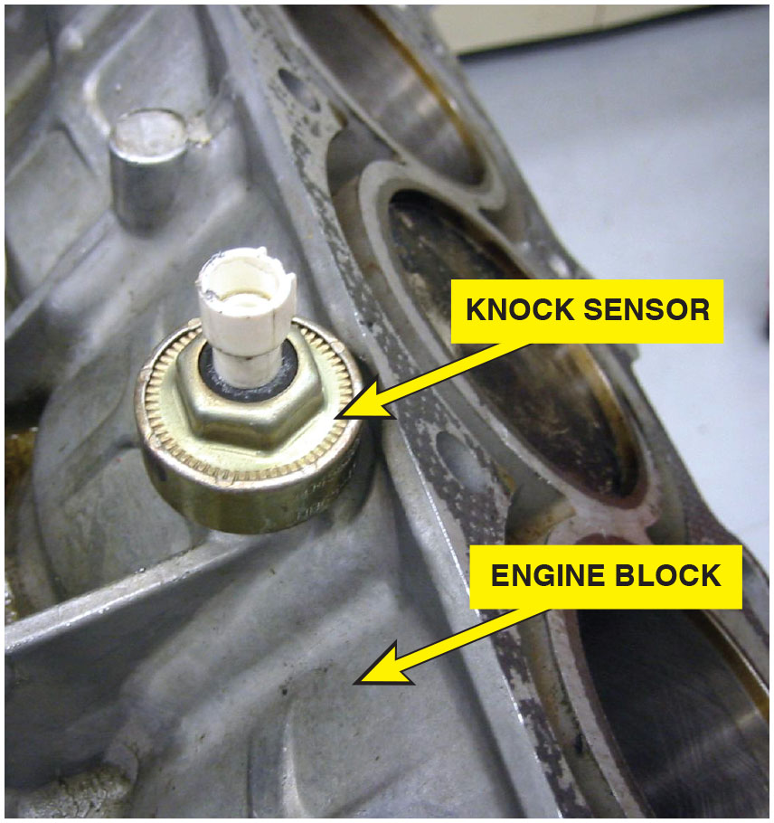
Figure 29.17
Knock Sensor
A knock sensor which is used by the powertrain control module (P C M) to detect engine detonation.

Slide 45
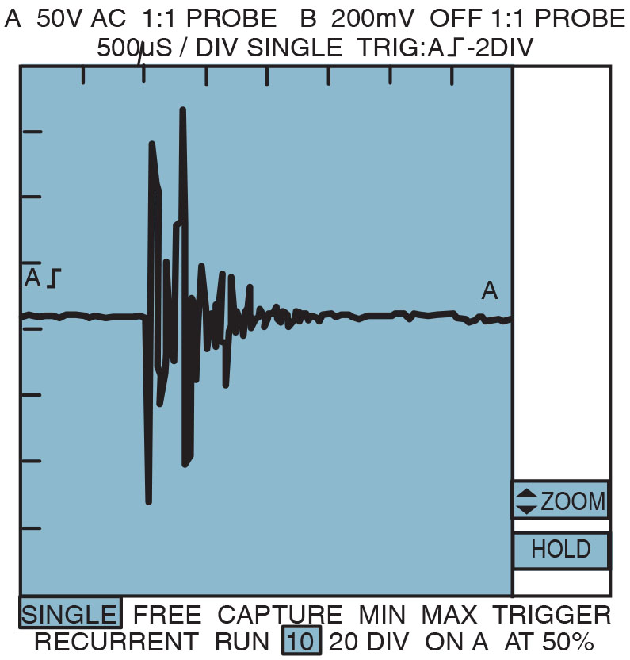
Figure 29.18
Knock Waveform
A typical waveform from a knock sensor during a spark knock event. This signal is sent to the computer which in turn retards the ignition timing. This timing retard is accomplished by an output command from the computer to either a spark advance control unit or directly to the ignition module.

Slide 46
Question 3
What is the purpose of the knock sensor?

Slide 47
Answer 3
To detect abnormal combustion.

Slide 48
Spark Plugs
Spark plugs classified by reach, heat range, type of seat.
Resistor Spark Plugs
Includes a resistor in the center electrode, which helps to reduce electromagnetic noise.
Platinum Spark Plugs
Small amount of the precious metal platinum welded onto each electrode.
Iridium Spark Plugs
Small amount of iridium welded onto the tip of a small center electrode.

Slide 49
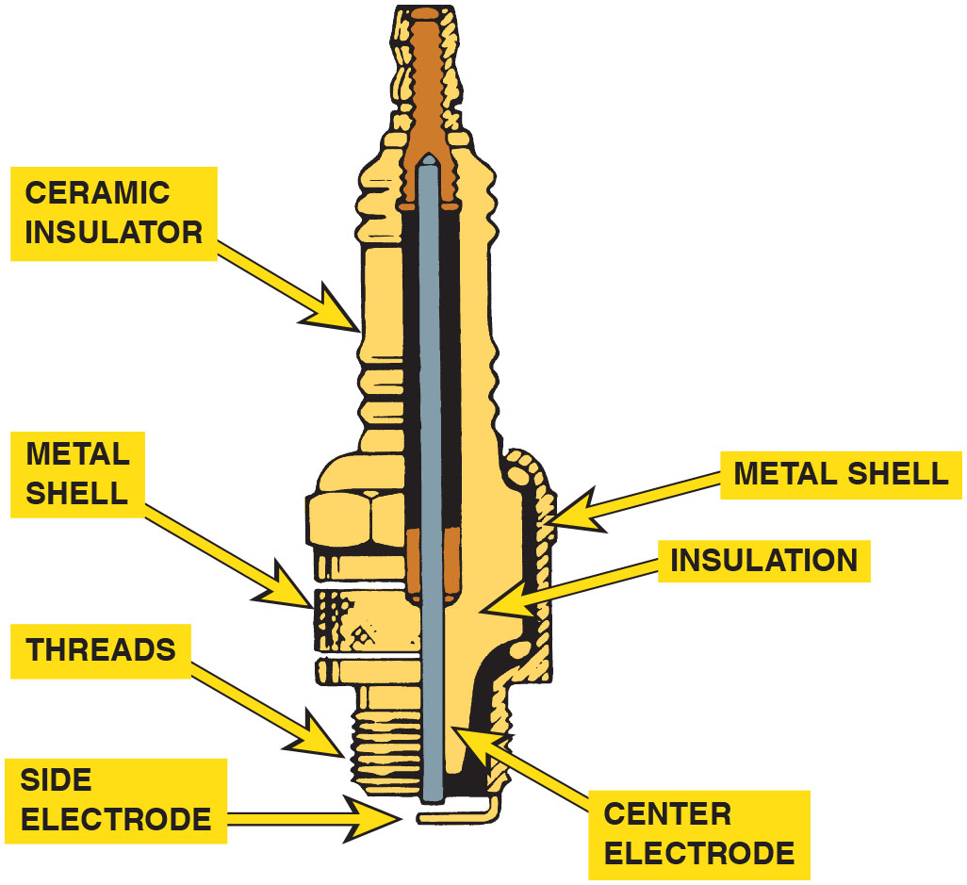
Figure 29.19
Spark Plug
Parts of a typical spark plug.

Slide 50
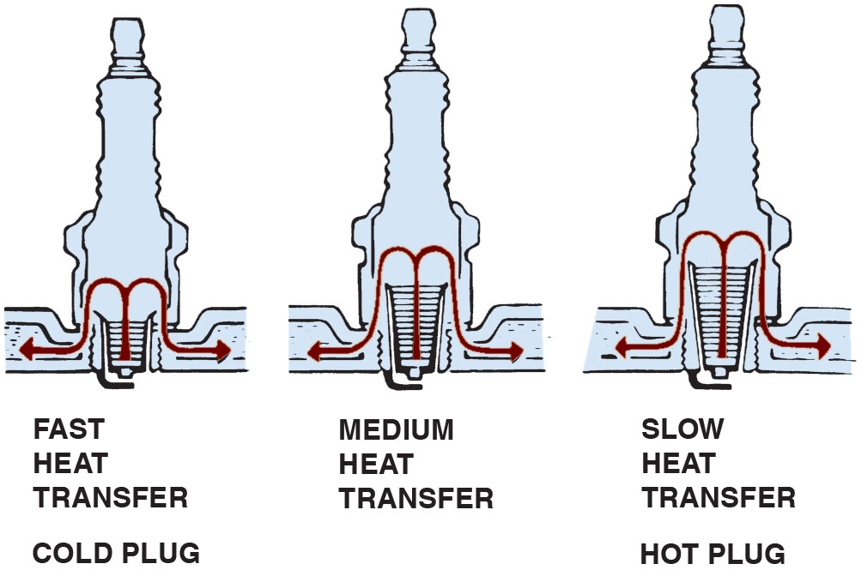
Figure 29.20
Heat Range
The heat range of a spark plug is determined by the distance the heat has to flow from the tip to the cylinder head.
Notes:
Long Description:
Fast heat transfer spark plugs have small threads and are also called cold plugs. Medium heat transfer spark plugs have medium threads. Slow heat transfer spark plugs have the tallest threads and are also called hot plugs.

Slide 51
Summary
All inductive ignition systems supply battery voltage to the positive side of the ignition coil and pulse the negative side of the coil on and off to ground to create a high voltage spark.
If an ignition system uses a distributor, it is a distributor ignition (D I) system.
If an ignition system does not use a distributor, it is called an electronic ignition (E I) system.
A waste-spark ignition system fires two spark plugs at the same time.
Coil-on-plug ignition system uses an ignition coil for each spark plug.

Slide 52
Animations and Video Links (Halderman website subscription and web access needed to view)
(A8) Engine Performance Animations
(A8) Engine Performance Videos

Slide 53
Copyright
This work is protected by United States copyright laws and is provided solely for the use of instructors in teaching their courses and assessing student learning. Dissemination or sale of any part of this work (including on the World Wide Web) will destroy the integrity of the work and is not permitted. The work and materials from it should never be made available to students except by instructors using the accompanying text in their classes. All recipients of this work are expected to abide by these restrictions and to honor the intended pedagogical purposes and the needs of other instructors who rely on these materials.

