Slide 1


Automotive Electrical and Engine Performance
Ninth Edition
Chapter 27
Gasoline, Diesel, and Alternative Fuels
Copyright © 2025 Pearson Education, Inc. All Rights Reserved
Notes:
If this PowerPoint presentation contains mathematical equations, you may need to check that your computer has the following installed:
1) Math Type Plugin
2) Math Player (free versions available)
3) NVDA Reader (free versions available)
INSTRUCTOR NOTE: This presentation includes text explanation notes, you can use to teach the course. When in SLIDE SHOW mode, you RIGHT CLICK and select SHOW PRESENTER VIEW, to use the notes.

Slide 2
Learning Objectives (1 of 2)
27.1 Discuss characteristics of gasoline and refining of gasoline.
27.2 Discuss the volatility of gasoline.
27.3 Explain air–fuel ratios.
27.4 Explain normal and abnormal combustion.
27.5 Explain octane rating.
27.6 Discuss gasoline additives.
27.7 Discuss testing gasoline for alcohol content.

Slide 3
Learning Objectives (2 of 2)
27.8 Discuss general gasoline recommendations.
27.9 Discuss E85.
27.10 Discuss alternative fuel vehicles.
27.11 Discuss propane.
27.12 Discuss compressed natural gas fuels.
27.13 Discuss diesel fuel.
27.14 Discuss biodiesel.

Slide 4
Gasoline
Definition
  Gasoline describes a complex mixture of various hydrocarbons refined from crude petroleum oil for use as a fuel in engines.
Chemical Composition
  Methane, ethane, propane, butane, pentane, hexane, heptane, octane; depending on the number of carbon atoms.

Slide 5
Refining (1 of 2)
Types of Crude Oil
  Thin crude oil—called high-gravity crude
  Thick crude oil—called low-gravity crude
  Low-sulfur crude—called sweet crude
  High-sulfur crude—called sour crude
Distillation
  The crude is separated into different products by boiling.

Slide 6
Refining (2 of 2)
Cracking
  Hydrocarbons with higher boiling points cracked into lower boiling hydrocarbons by treating them to very high temperatures.
  Instead of high heat, today cracking is performed using a catalyst and is called catalytic cracking.
  Hydrocracking similar to catalytic cracking in that it uses a catalyst, but the catalyst is in a hydrogen atmosphere.

Slide 7
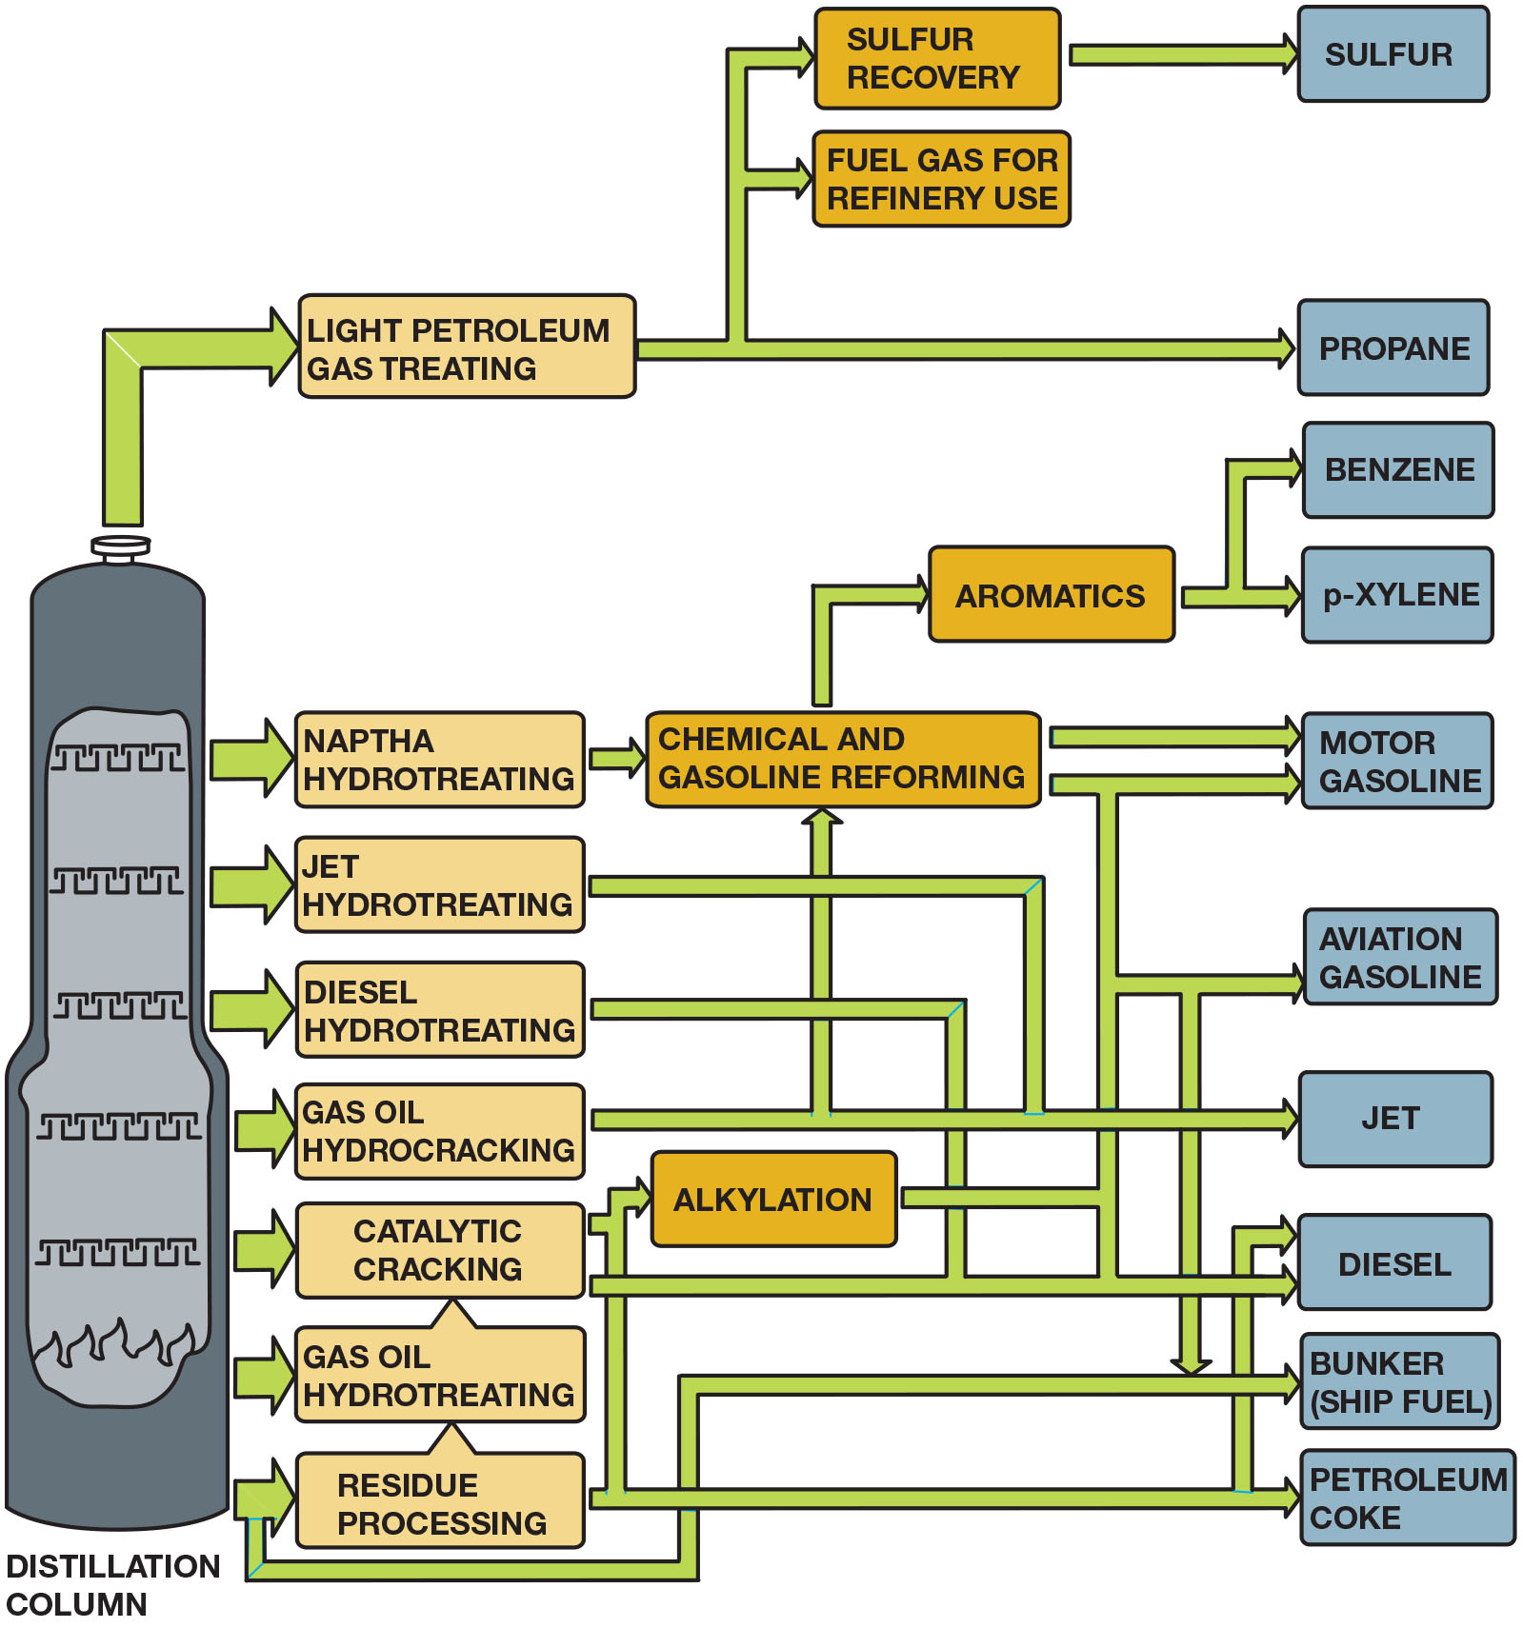
Figure 27.1
Oil Refining
The crude oil refining process showing most of the major steps and processes.
Notes:
Long Description:
The steps in the flowchart are as follows: Distillation column leads to light petroleum gas treating, naptha hydrotreating, jet hydrotreating, diesel hydrotreating, gas oil hydrocracking, catalytic cracking, gas oil hydrotreating, residue processing. Light petroleum gas treating leads to sulphur recovery and fuel gas for refinery use to form sulfur and propane. The other hydro treating and cracking methods individually or combinedly lead to aromatics, chemical and gasoline reforming, and alkylation to form benzene, p-xylene, motor gasoline, aviation gasoline, jet, diesel, bunker or ship fuel, and petroleum coke.

Slide 8
Volatility (1 of 2)
Definition of Volatility
  Volatility describes how easily the gasoline evaporates (forms a vapor).
Reid Vapor Pressure (R V P)
  Reid vapor pressure (R V P) is the pressure of the
  vapor above the fuel when the fuel is at
Seasonal Blending
  The adjustment of the R V P according to the season to match the vaporization rate with the temperature and improve starting.

Slide 9
Volatility (2 of 2)
Distillation Curve
  Another method of classifying gasoline volatility is the distillation curve.
Driveability Index
  To predict cold weather driveability, an index was created called the driveability index, also called the distillation index (D I).
Volatility-Related Problems
  Incorrect R V P can cause rough idle, stalling, hesitation on acceleration, and surging.

Slide 10
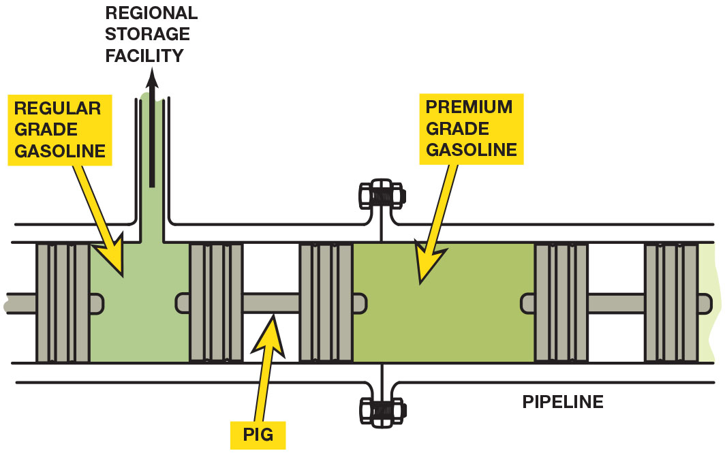
Figure 27.2
Pig
A pig is a plug-like device that is placed in a pipeline to separate two types or grades of fuel.
Notes:
Long Description:
The illustration of a pipeline shows separate chambers for the storage of regular grade gasoline and premium grade gasoline. Regular grade gasoline is transferred to the regional storage facility. The different grades of gasoline are separated by pig or pipeline inspection gauge.

Slide 11
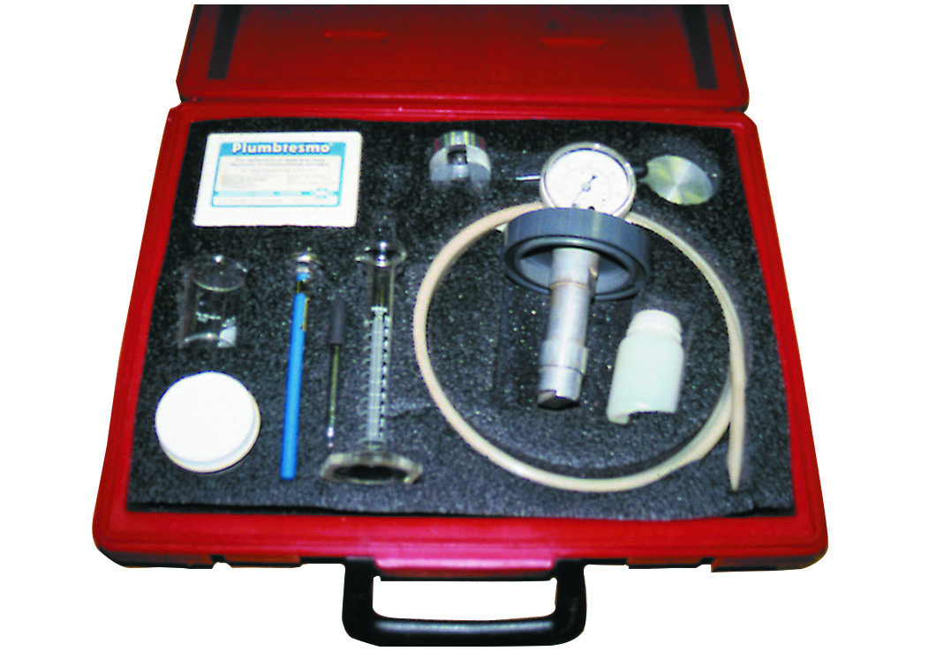
Figure 27.3
R V P Kit
A gasoline testing kit, including an insulated container where water at
is used to heat
a container holding a small sample of gasoline. The reading on the pressure gauge is the Reid vapor pressure (R V P).
Notes:
Long Description:
The test kit with a sticker of Plumbtesmo includes: container box, thermometer, density hydrometer, measures, filter paper, flameproof torch, seals with plier, earthing clip, oil and water finding paste, oil pump, dip rod., and pressure gauge to measure reid vapor pressure.

Slide 12
Frequently Asked Question: Why Do I Get Lower Gas Mileage in the Winter?
? Frequently Asked Question
Why Do I Get Lower Gas Mileage in the Winter? Several factors cause the engine to use more fuel in the winter than in the summer: Gasoline that is blended for use in cold climates is designed for ease of starting and contains fewer heavy molecules, which contribute to fuel economy. The heat content of winter gasoline is lower than summer-blend gasoline. In cold temperatures, all lubricants are stiff, causing more resistance. These lubricants include the engine oil, as well as the transmission and differential gear lubricants. Heat from the engine is radiated into the outside air more rapidly when the temperature is cold, resulting in longer run time until the engine has reached normal operating temperature. Road conditions, such as ice and snow, can cause tire slippage or additional drag on the vehicle.

Slide 13
Question 1
What is Reid vapor pressure?

Slide 14
Answer 1
Reid vapor pressure (R V P) is the pressure of the vapor
above the fuel when the fuel is at

Slide 15
Gasoline Combustion Process (1 of 2)
Chemical Reactions
  Combustion involves chemical combination of oxygen
  from air (about 21% of the atmosphere) with
  hydrogen and carbon from fuel.
Heat Energy
  Heat produced by combustion process measured in British thermal units (B T Us). One B T U is the amount of
heat required to raise one pound of water

Slide 16
Gasoline Combustion Process (2 of 2)
Air–Fuel Ratios
  Air–fuel ratio is proportion by weight of air and gasoline that injection system mixes, as needed, for engine combustion.
Stoichiometric Air–Fuel Ratio
  Ideal mixture or ratio (14.7 to 1) at which all of fuel combines with all of the oxygen in air and burns completely is called stoichiometric ratio, a chemically perfect combination.

Slide 17
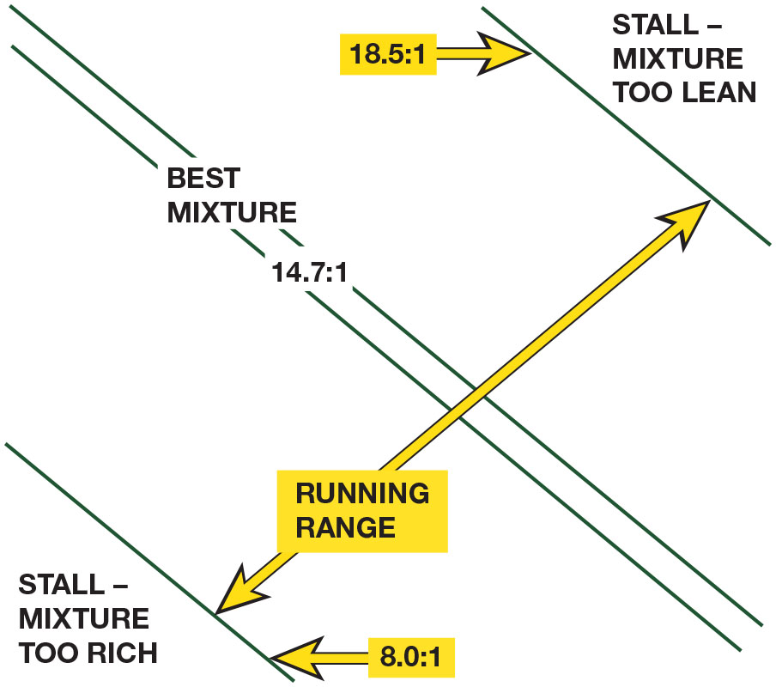
Figure 27.4
Stoichiometric Ratio
An engine will not run if the air–fuel mixture is either too rich or too lean.
Notes:
The ideal mixture or ratio at which all the fuel combines with all the oxygen in the air and burns
completely is called the stoichiometric ratio, a chemically perfect combination. In theory, this
ratio for gasoline is an air–fuel mixture of 14.7:1. The stoichiometric ratio is a compromise between
maximum power and maximum economy. • See Figure 27.5.

Slide 18
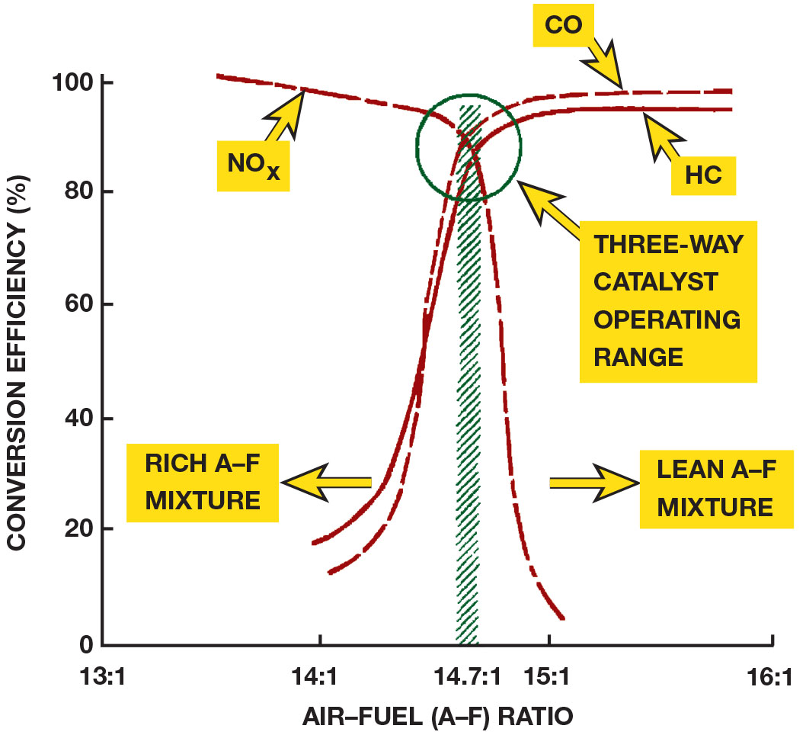
Figure 27.5
Three-Way Catalyst
With a three-way catalytic converter, emission control is
most efficient with an air–fuel ratio between
and
Notes:
Long Description:
The graph has air-fuel or A-F ratio of 13 is to 1, 14 is to 1, 14.7 is to 1, 15 is to 1, and 16 is to 1 along the horizontal axis, and percentage of conversion efficiency from 0 to 100 in increments of 20 along the vertical axis. Curve for N O subscript x starts at 100 and drops to 3. Curve for C O starts at 10 and rises to 100. Curve for H C starts at 15 and rises to 100. Rich A-F mixture is toward left and lean A-F mixture is toward right. The point of intersection of the three curves at about (14.7 is to 1, 90) denotes three-way catalyst operating range. All data are approximate.

Slide 19
Question 2
What is stoichiometric ratio?

Slide 20
Answer 2
An air–fuel mixture of approximately

Slide 21
Normal and Abnormal Combustion
Normal Combustion
  Normal combustion occurs smoothly and progresses across combustion chamber from point of ignition.
Abnormal Combustion
  Engine knock (detonation, spark knock, or ping) is a metallic noise an engine makes, usually during acceleration, resulting from abnormal or uncontrolled combustion inside the cylinder.

Slide 22
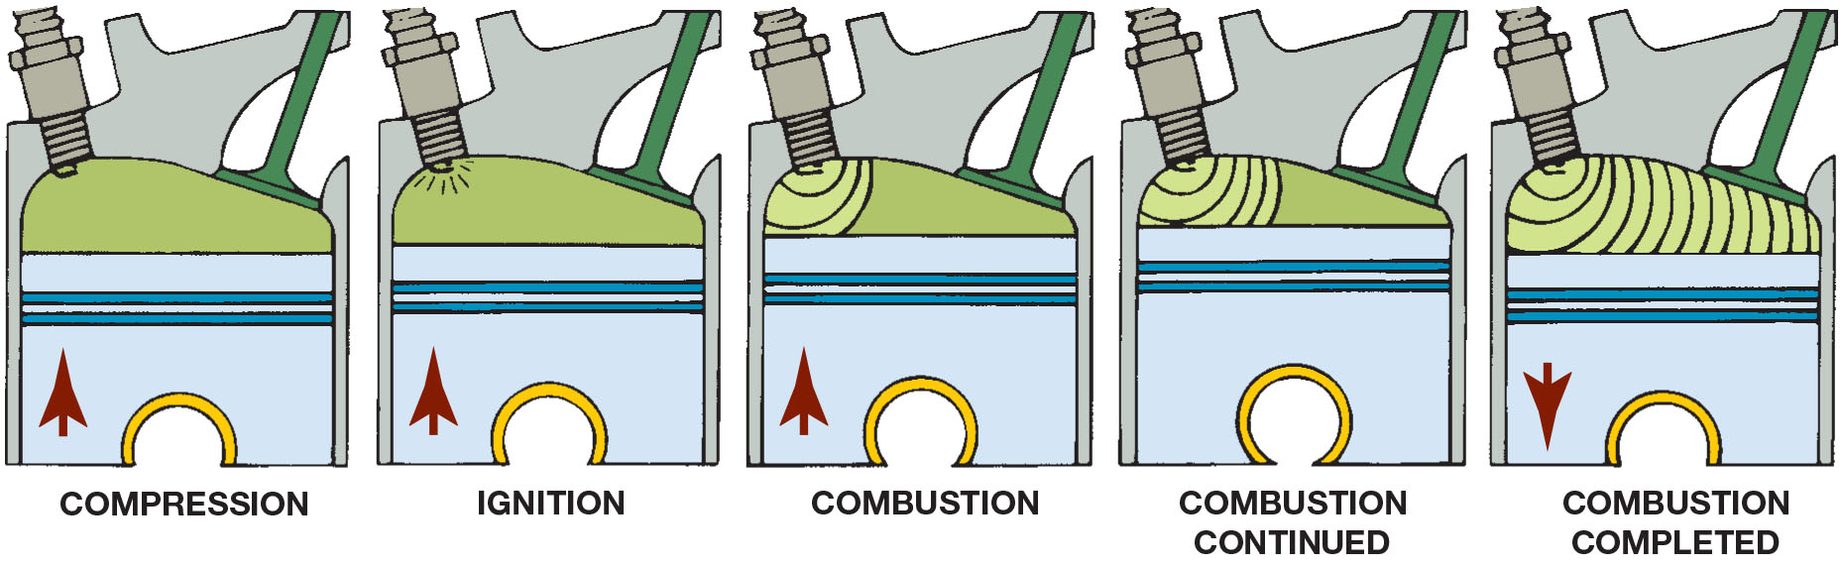
Figure 27.6
Normal Combustion
Normal combustion is a smooth, controlled burning of the air–fuel mixture.

Slide 23
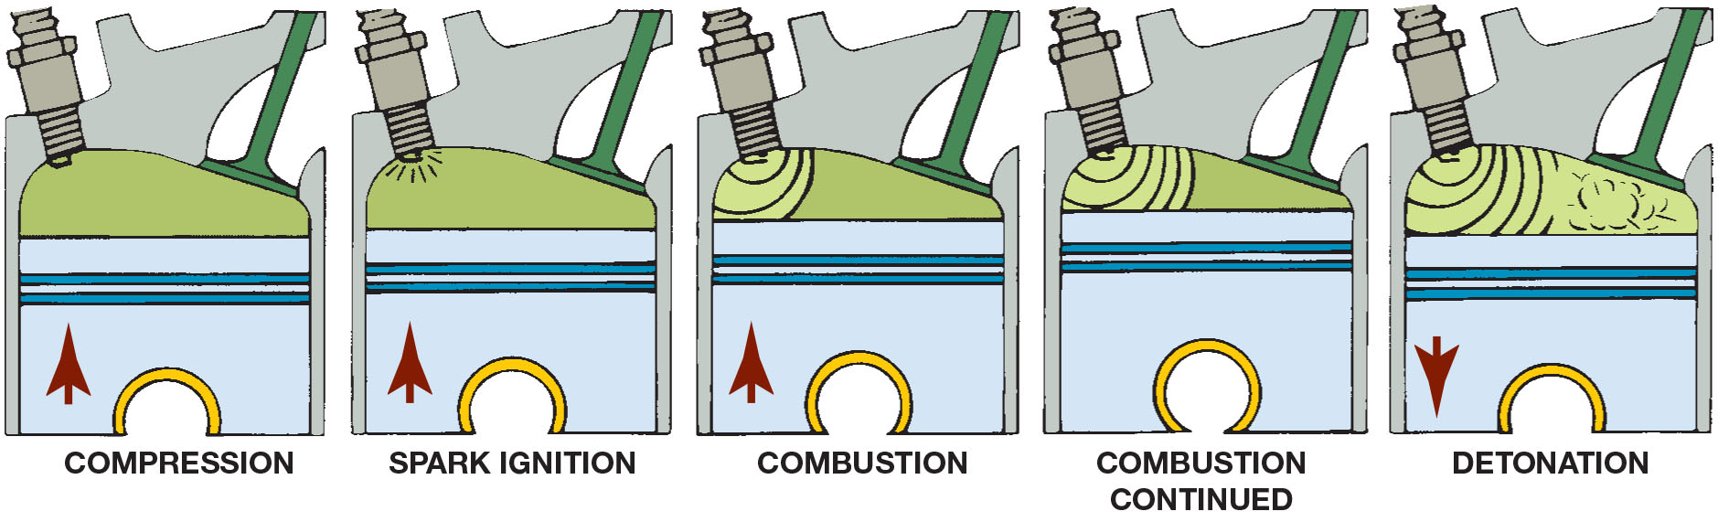
Figure 27.7
Detonation
Detonation is a secondary ignition of the air–fuel mixture. It is also called spark knock or pinging.
Notes:
Controlling Spark Knock
Spark knock was commonly heard in older engines, especially when under load and in warm weather
temperatures. Most engines built since the 1990s are equipped with a knock sensor that is used to
signal the powertrain control module (P C M) to retard the ignition timing if knock is detected. Using
the proper octane fuel helps to ensure that spark knock does not occur

Slide 24
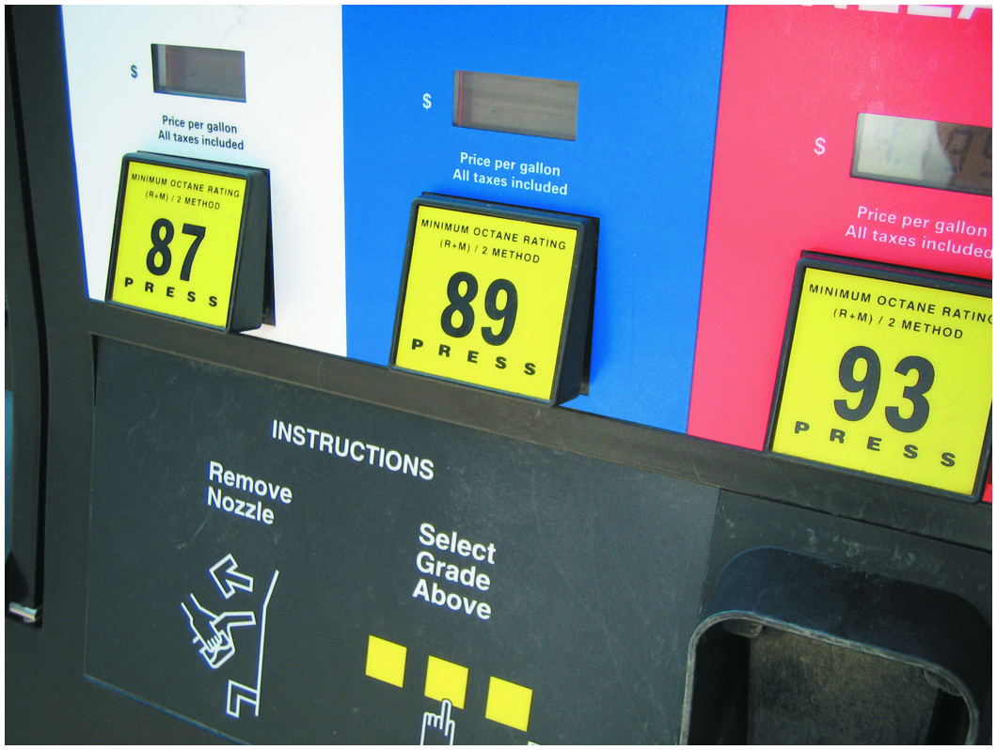
Figure 27.8
Octane Ratings on Pump
A pump showing regular with a pump octane of 87, plus rated at 89, and premium rated at 93. These ratings can vary with brand, as well as in different parts of the country.
Notes:
Long Description:
The pump shows the instructions to remove nozzle and select grade above. Three press buttons numbered as 87, 89, and 93 denotes minimum octane rating, left parenthesis R plus M right parenthesis divided by 2 method. The display screen above each button indicates the price per gallon in U S dollars, with all taxes included.

Slide 25
Octane Ratings
The two basic methods used to rate gasoline for antiknock properties (octane rating) are the research method and the motor method.
Octane rating posted on pumps in U S is the average of the
two methods and is referred to as

Slide 26
Chart 27.1
Octane Rating
GRADES | OCTANE RATING
Regular | 87
Midgrade (also called Plus) | 89
Premium | 91 or higher
The octane rating displayed on the fuel pumps can vary depending on climate.

Slide 27
Frequently Asked Question: What Grade of Gasoline Does the E P A Use When Testing Engines?
? Frequently Asked Question
What Grade of Gasoline Does the E P A Use When Testing Engines? Due to the various grades and additives used in commercial fuel, the government (E P A) uses a liquid called indolene, which has a research method octane number of 96.5 and a motor method octane rating of 88, resulting in a
rating of 92,25.
Notes:
TECH TIP: Horsepower and Fuel Flow
To produce 1 h p, the engine must be supplied with 0.50 l b of fuel per hour (l b/h r). Fuel injectors are rated in pounds per hour. For example, a V-8 engine equipped with 25 l b/h r fuel injectors could produce 50 h p per cylinder (per injector) or 400 h p. Even if the cylinder head or block is modified to produce more
horsepower, the limiting factor may be the injector flow rate.
The following are flow rates and resulting horsepower for a V-8 engine:
30 l b/h r: 60 h p per cylinder, or 480 h p
35 l b/h r: 70 h p per cylinder, or 560 h p
40 l b/h r: 80 h p per cylinder, or 640 h p
Of course, injector flow rate is only one of many variables that affect power output. Installing larger injectors without other major engine modifications could decrease engine output and drastically increase exhaust emissions.

Slide 28
High-Altitude Octane Requirements
The octane rating of fuel does not need to be as high because the engine cannot take in as much air.
In mountainous areas, gasoline
octane ratings
are two or more numbers lower than normal (according to the S A E, about one octane number lower per 1,000 feet or 300 meters in altitude).

Slide 29
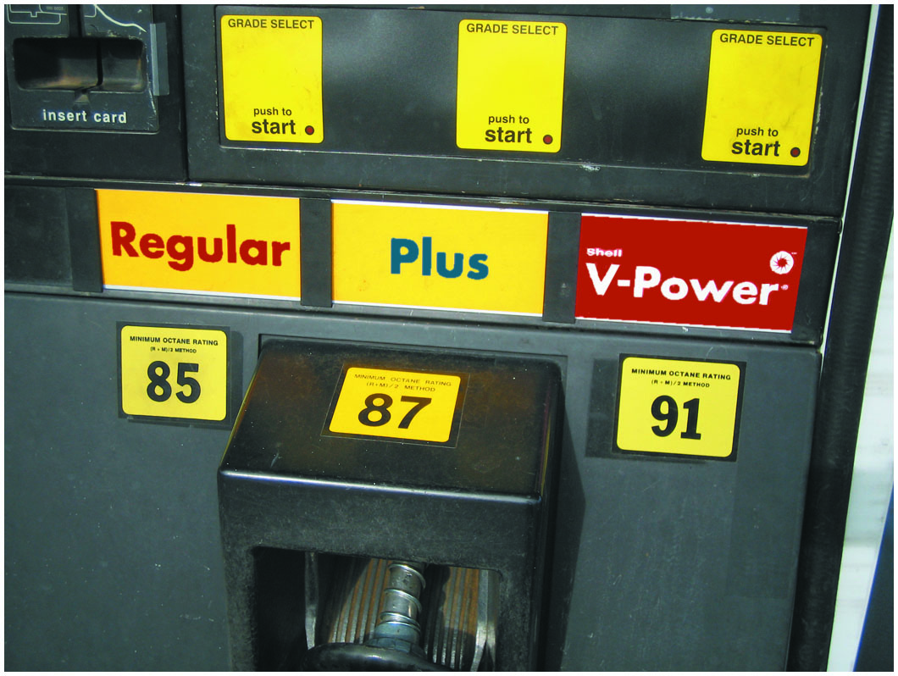
Figure 27.9
High Altitude
The posted octane rating in most high-altitude areas shows regular at 85 instead of the usual 87.

Slide 30
Question 3
Why does the octane level in gasoline vary with altitude?

Slide 31
Answer 3
At higher altitude, the air is less dense.

Slide 32
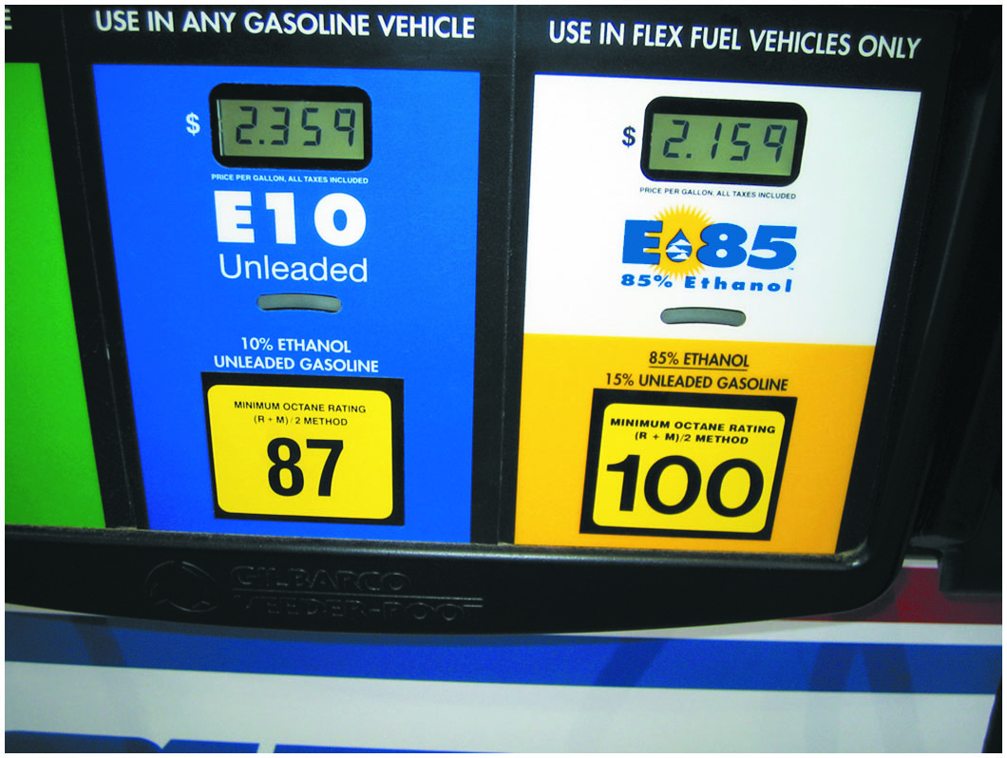
Figure 27.10
Ethanol Blend
This fuel pump indicates that the gasoline is blended with 10% ethanol (ethyl alcohol) and can be used in any gasoline vehicle. E85 contains 85% ethanol and can only be used in vehicles specifically designed to use it.
Notes:
Long Description:
The first part of the pump is labeled as E 10 unleaded and numbered as 87. It has 10 percent ethanol and unleaded gasoline, for use in any gasoline vehicle. The second part of the pump is labeled as E 85 and numbered as 100. It has 85 percent ethanol and 15 percent unleaded gasoline, for use in flex fuel vehicles only.

Slide 33
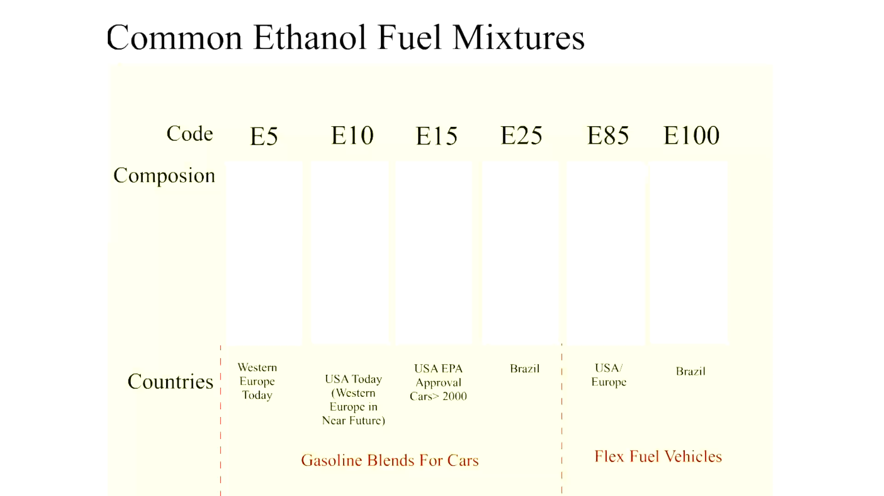
Animation: Common Ethanol Fuel Mixtures

Slide 34
Gasoline Additives (1 of 2)
Dye
  Dye is usually added to gasoline at the distributor to help identify the grade and/or brand of fuel.
Octane Improver Additives
  Aromatic hydrocarbons (hydrocarbons containing the benzene ring), such as xylene and toluene
  Alcohols, such as ethanol (ethyl alcohol), methanol (methyl alcohol), and tertiary butyl alcohol (T B A)
  Metallic compounds, such as methylcyclopentadienyl manganese tricarbonyl (M M T)

Slide 35
Gasoline Additives (2 of 2)
Oxygenated Fuel Additives
  Methyl tertiary butyl (M T B E)—Now phased out due to health concerns
  Tertiary-amyl methyl ether (T A M E)—An oxygen atom bonded to two carbon atoms and is added to gasoline to provide oxygen to the fuel
  Ethanol (ethyl alcohol)—The addition of ethanol at a rate of 10% adds 3.5% oxygen by weight

Slide 36
Frequently Asked Question: What Is Meant by “Phase Separation”?
? Frequently Asked Question
What Is Meant by “Phase Separation”? All alcohols absorb water, and the alcohol–water mixture can separate from the gasoline and sink to the bottom of the fuel tank. This process is called phase separation. To help avoid engine performance problems, try to keep at least a quarter tank of fuel at all times, especially during seasons when there is a wide temperature span between daytime highs and nighttime lows. These conditions can cause moisture to accumulate in the fuel tank as a result of condensation of the moisture in the air. Keeping the fuel tank full reduces the amount of air and moisture in the tank. • See Figure 27.11.

Slide 37
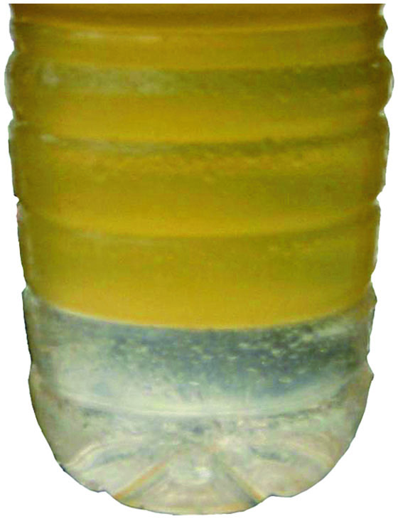
Figure 27.11
Phase Separation
A container with gasoline containing water and alcohol. Notice the separation line where the alcohol–water mixture separated from the gasoline and sank to the bottom.

Slide 38
Gasoline Blending
Inline Blending: Gasoline and ethanol are mixed in a storage tank or in the tank of a transport truck while it is being filled.
Sequential Blending: At the terminal a measured amount of ethanol is added to the tank truck followed by a measured amount of gasoline.
Splash Blending: Splash blending can be done at the retail outlet or distributor and involves separate purchases of ethanol and gasoline.

Slide 39
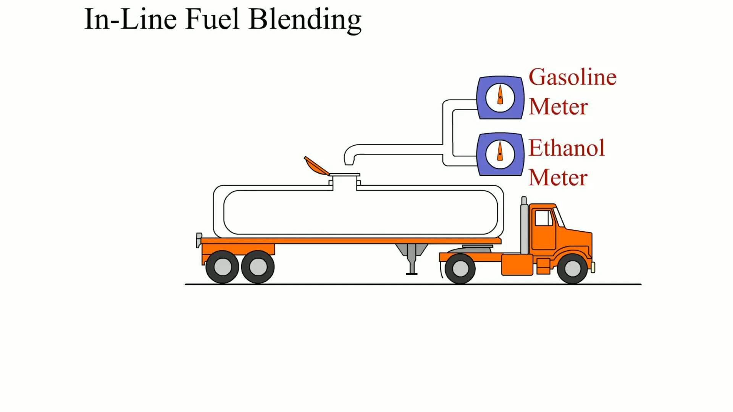
Animation: In-Line Fuel Blending

Slide 40
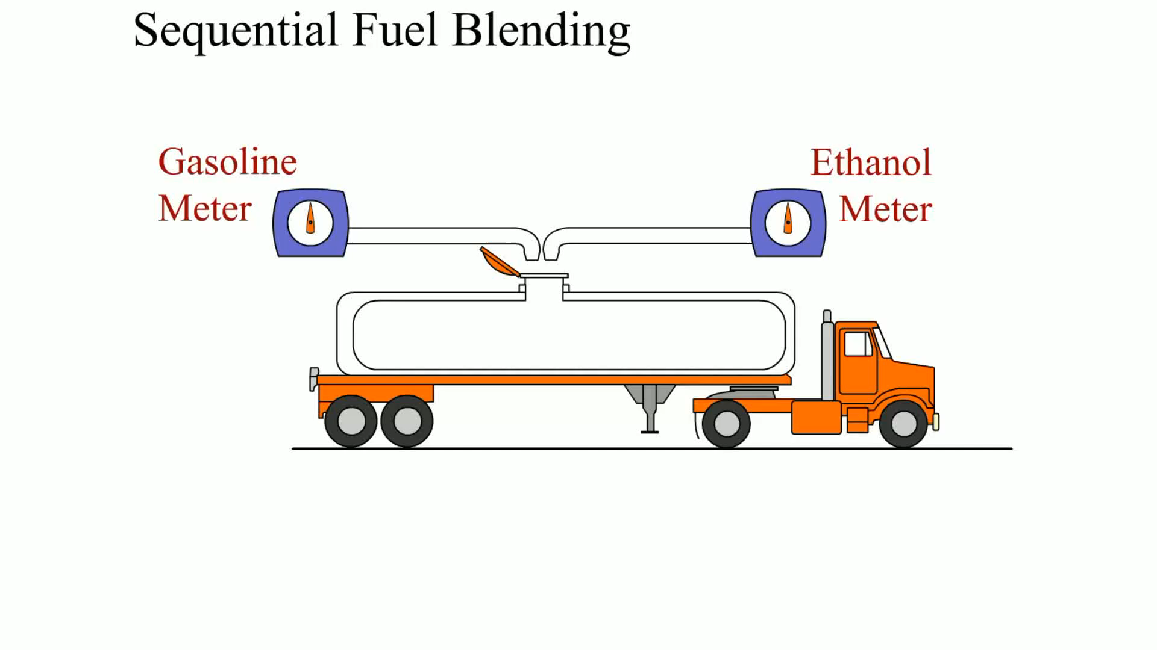
Animation: Sequential Fuel Blending

Slide 41
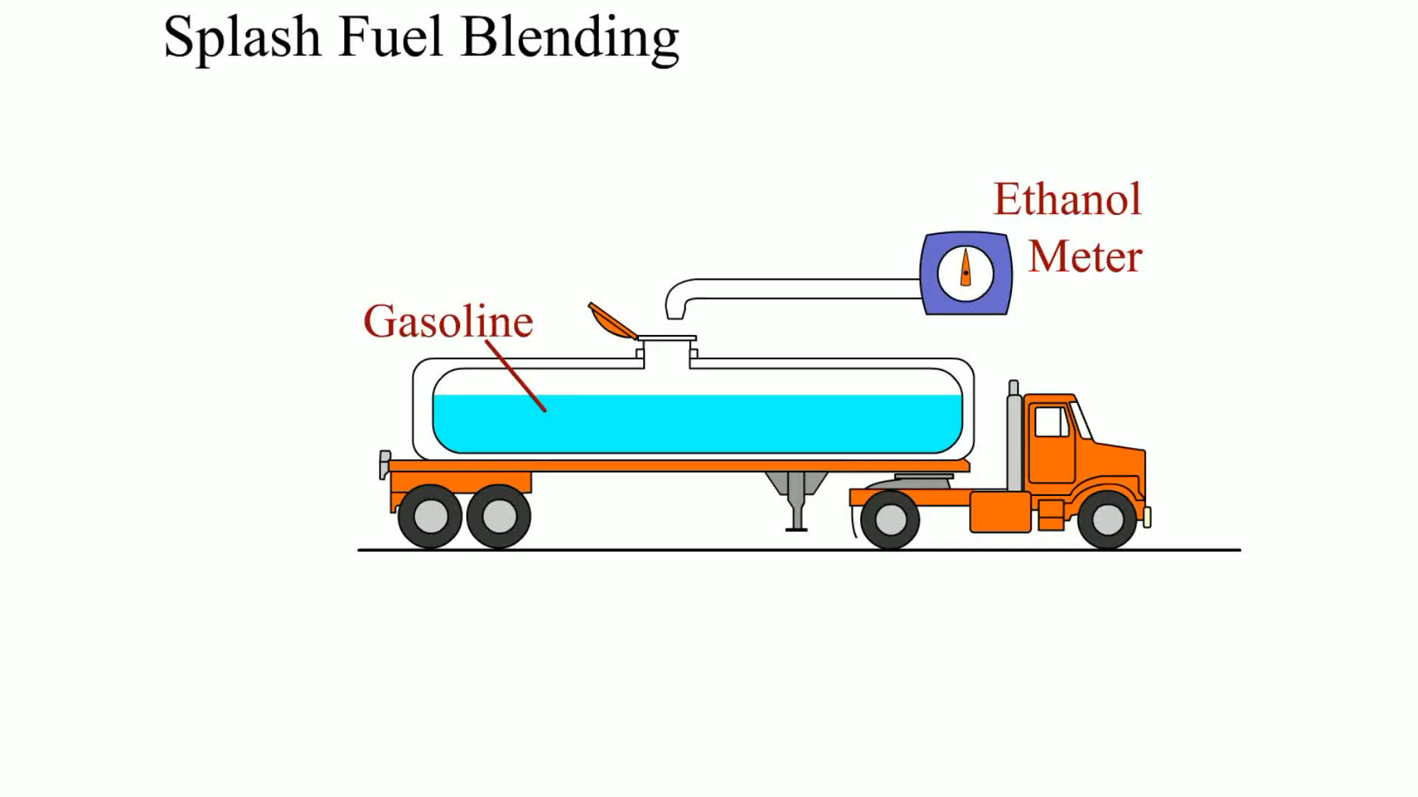
Animation: Splash Fuel Blending

Slide 42
Reformulated Gasoline
Reformulated gasoline (R F G) is manufactured to help reduce emissions.
  The additives contain at least 2% oxygen by weight and the additive benzene is reduced to a maximum of 1% by volume.
  Reduce light compounds such as butane and propane.
  Refineries eliminate heavy compounds with high boiling points, such as aromatics and olefins.

Slide 43
Testing Gasoline for Alcohol Content
Pour suspect gasoline into a graduated cylinder.
Fill the graduated cylinder to the 90 m L mark.
Add 10 m L of water to the graduated cylinder.
Shake vigorously the cylinder for one minute.
Let it stand for two minutes.
Take a reading at the boundary between the two liquids.
For percent of alcohol in gasoline, subtract 10 m L from the reading.

Slide 44
Frequently Asked Question: Is Water Heavier than Gasoline?
? Frequently Asked Question
Is Water Heavier than Gasoline? Yes. Water weighs about 8 l b per gallon, whereas gasoline weighs about 6 l b per gallon. The density as measured by specific gravity includes
the following: Water
(the baseline for specific gravity)
Gasoline
to
This means that any water that
gets into the fuel tank will sink to the bottom.

Slide 45
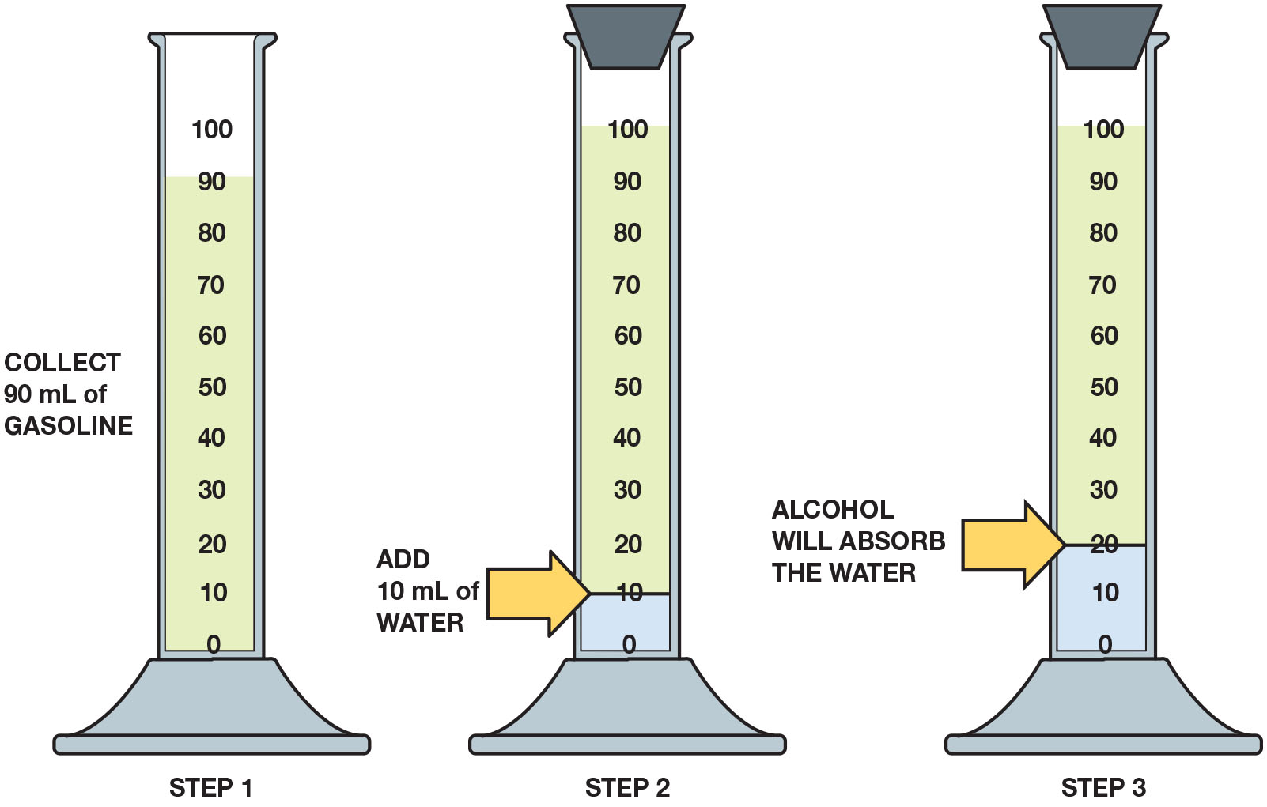
Figure 27.12
Alcohol Testing
Checking gasoline for alcohol involves using a graduated cylinder and adding water to check if the alcohol absorbs the water.
Notes:
Long Description:
The experiment illustrates the following steps. Step 1: Collect 90 milliliters of gasoline in a measuring cylinder graduated from 0 to 100 in increments of 10. Step 2: Add 10 milliliters of water and close the mouth of the cylinder with a cork. The water settles at the bottom of the cylinder till 10 m l. Step 3: Alcohol will absorb the water. The mixture of water and alcohol settles at the bottom of the cylinder till 20 m l.

Slide 46
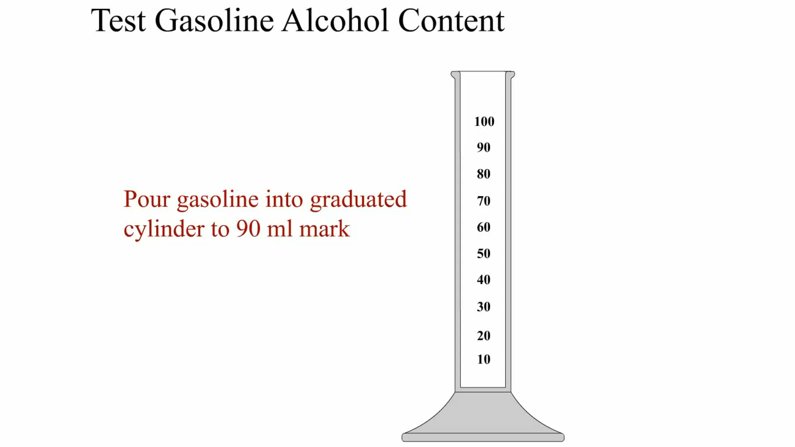
Animation: Test Gasoline Alcohol Content

Slide 47
Frequently Asked Question: What Is “Top-Tier” Gasoline?
? Frequently Asked Question
What Is “Top-Tier” Gasoline? Top-tier gasoline has specific standards for quality, including enough detergent to keep all intake valves clean. Four automobile manufacturers (B M W, General Motors, Honda, and Toyota) developed the standards. Top-tier gasoline exceeds the quality standards developed by the World Wide Fuel Charter (W W F C) in 2002 by vehicle and engine manufacturers. The gasoline companies that agreed to make fuel that matches or exceeds the standards as a top-tier fuel include ChevronTexaco, Shell, and ConocoPhillips. • See Figure 27.13.

Slide 48
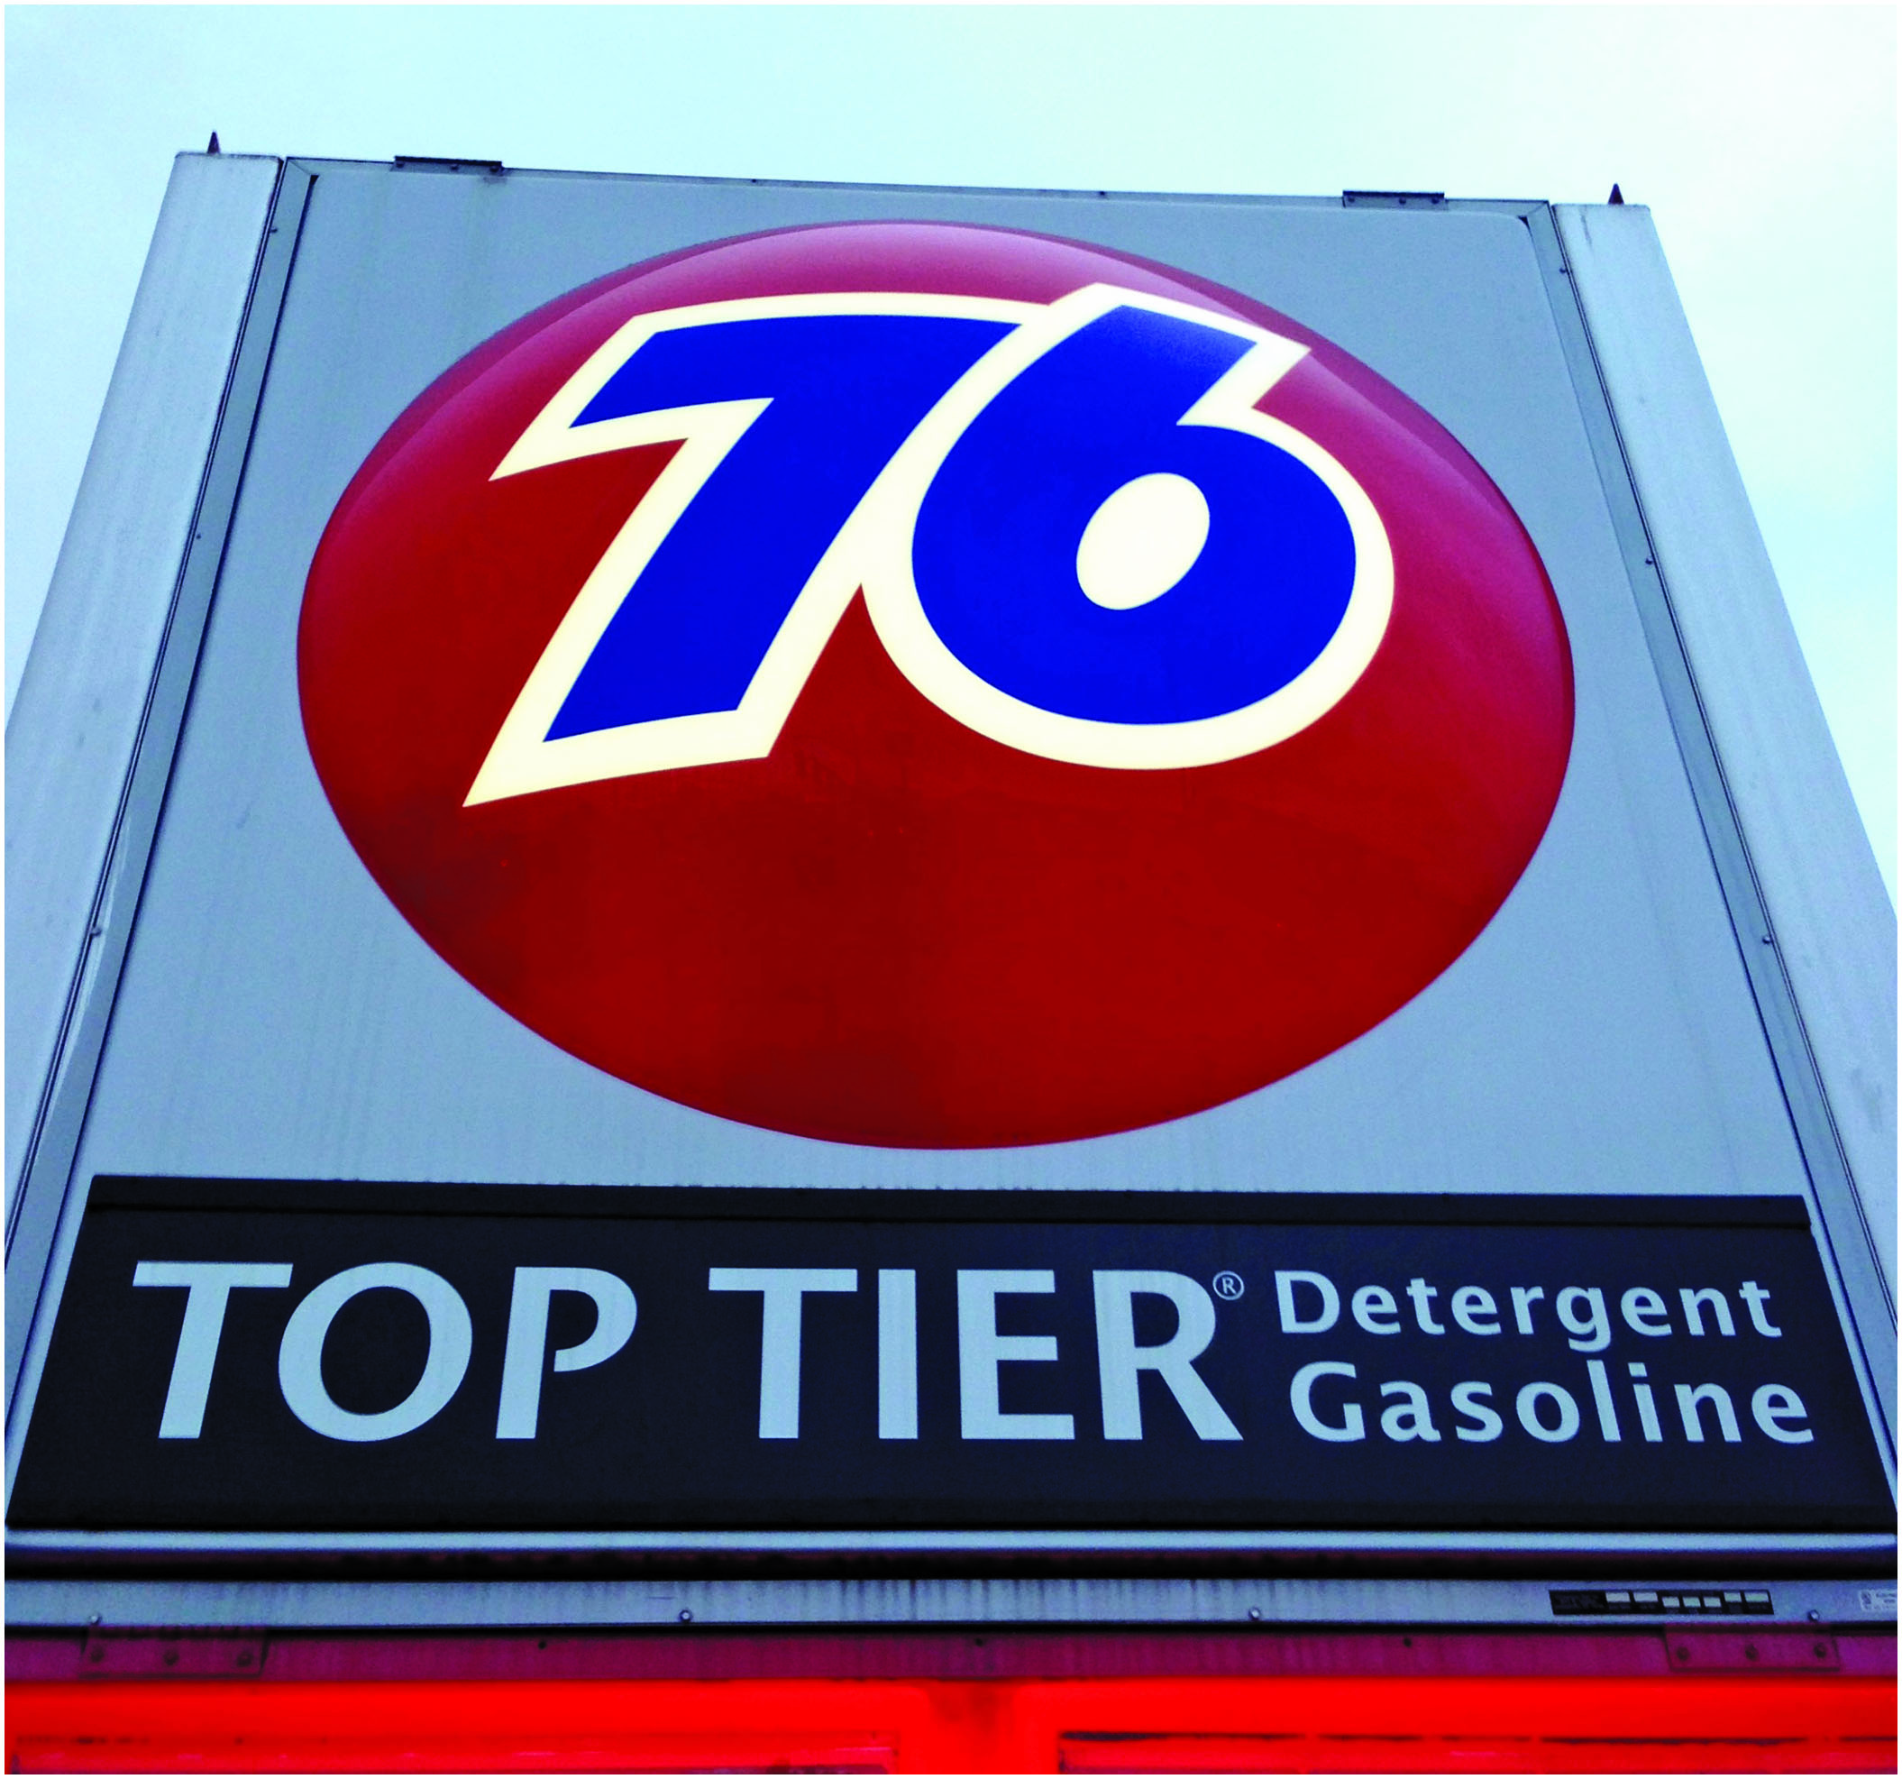
Figure 27.13
Top-Tier Gasoline
Not all top-tier gas stations mention that they are top-tier like this station.
Notes:
TECH TIP: The Sniff Test
Problems can occur with stale gasoline from which the lighter parts of the gasoline have evaporated. Stale gasoline usually results in a no-start situation. If stale gasoline is suspected, sniff it. If it smells rancid, replace it with fresh gasoline.
NOTE: If storing a vehicle, boat, or lawnmower over the winter, put some gasoline stabilizer into the gasoline to reduce the evaporation and separation that can occur during storage. Gasoline stabilizer is frequently available at most automotive parts stores.

Slide 49
General Gasoline Recommendations
Purchase fuel from a busy station.
Keep the fuel tank above one-quarter full.
Do not purchase fuel with a higher octane rating than is necessary.
Do not overfill the gas tank.
Be careful when filling gasoline containers.

Slide 50
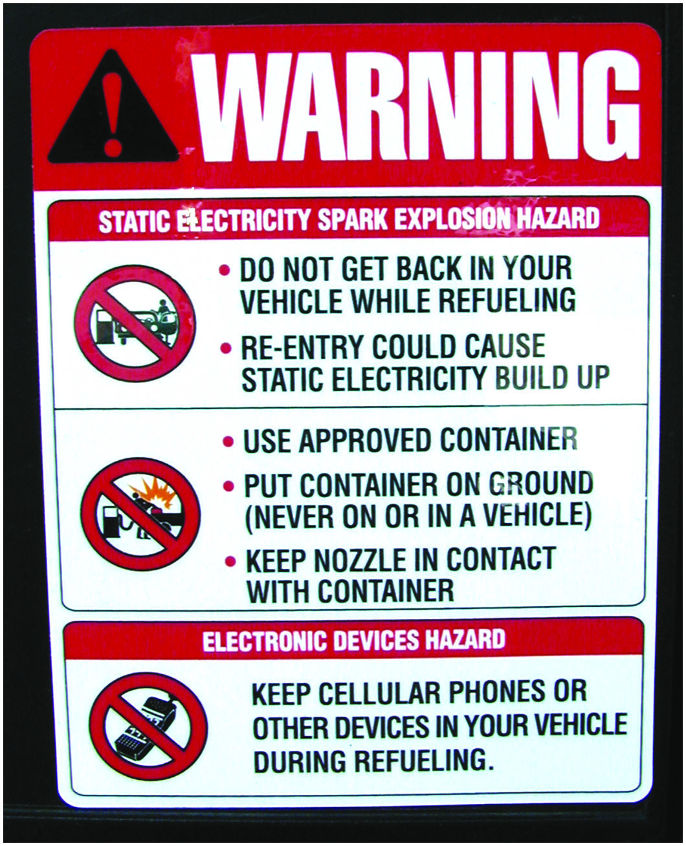
Figure 27.14
Warnings
Many service stations have signs posted warning customers to place plastic fuel containers on the ground while filling. If placed in a trunk or pickup truck bed equipped with a plastic liner, static electricity could buildup during fueling and discharge from the container to the metal nozzle, creating a spark and possible explosion. Some service stations have warning signs not to use cell phones while fueling to help avoid the possibility of an accidental spark creating a fire hazard.
Notes:
Long Description:
The signboard with appropriate icons reads: Warning. Static electricity spark explosion hazard: Do not get back in your vehicle while refuelling; Re-entry could cause static electricity build up. Use approved container; Put container on ground and never on or in a vehicle; Keep nozzle in contact with container. Electronic devices hazard: Keep cellular phones or other devices in your vehicle during refueling.

Slide 51
Frequently Asked Question: Why Should I Keep Fuel Gauge Above One-Quarter Tank?
? Frequently Asked Question
Why Should I Keep the Fuel Gauge Above One-Quarter Tank? fuel pickup inside fuel tank can help keep water from being drawn into fuel system unless water is all that is left at bottom of tank. Moisture inside fuel tank can condense, causing liquid water to drop to bottom of fuel tank. (Water heavier than gas, 8 pound per gallon for water, 6 pound per gallon for gasoline.) If alcohol- blended gasoline used, alcohol can absorb water and alcohol–water combination can be burned. When fuel level is low, fuel pump will draw from this alcohol/water. Alcohol and water do not burn as well as gasoline, driveability problems can occur such as stalling, rough idle, hard starting, and missing.
Notes:
TECH TIP: Do Not Overfill the Fuel Tank
Gasoline fuel tanks have an expansion volume area at the top. The volume of this expansion area is equal to 10% to 15% of the volume of the tank. This area is normally not filled with gasoline, but rather is designed to provide a place for the gasoline to expand into, if the vehicle is parked in the hot sun and the gasoline expands. This prevents raw gasoline from escaping from the fuel system. Valves in the evaporative system control how much vapor is sent to the charcoal canister. This volume area could be filled with gasoline if the fuel is slowly pumped into the tank. Since it can hold an extra 10% (2 gallons in a 20 gallon tank), some people deliberately try to fill the tank completely. When this expansion volume is filled, liquid fuel (rather than vapors) can be drawn into the charcoal canister. When the purge valve opens, liquid fuel can be drawn into the engine, causing an excessively rich air–fuel mixture. Not only can this liquid fuel harm vapor recovery parts, but overfilling the gas tank could also cause the vehicle to fail an exhaust emission test, particularly during an enhanced test when the tank could be purged while on the rollers.

Slide 52
Ethanol
Ethanol Terminology
  Ethanol is also called ethyl alcohol or grain alcohol, because it is usually made from grain.
Ethanol Production
  Conventional ethanol is derived from grains, such as corn, wheat, or soybeans.
  Ethanol can be made by the dry mill process, in which the starch portion of the corn is fermented into sugar and then distilled into alcohol.

Slide 53
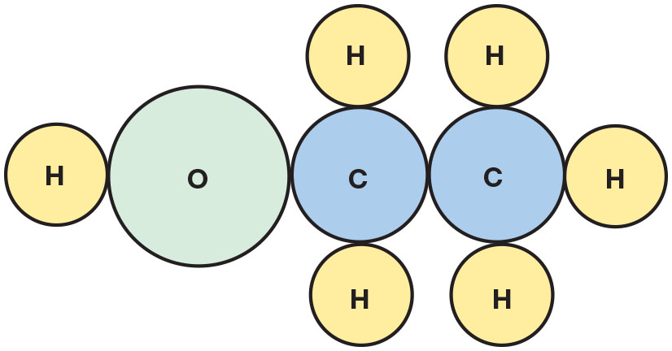
Figure 27.15
Ethanol Molecule
The ethanol molecule showing two carbon atoms, six hydrogen atoms, and one oxygen atom.
Notes:
Long Description:
The model of ethanol shows the spatial arrangement of its atoms. It has two carbon atoms bonded to each other. The first C is further bonded to H above, H below, and O H to the left. The second C is further bonded to H above, H below, and H to the right.

Slide 54
Cellulose Ethanol
Terminology
  Cellulose ethanol can be produced from a wide variety of cellulose biomass feedstock, including:
    Agricultural plant wastes (corn stalks, cereal straws)
    Plant wastes from industrial processes (sawdust, paper pulp)
    Energy crops grown specifically for fuel production
Refining Cellulose Biomass
  Involves extracting fermentable sugars from the feedstock

Slide 55
E85
What Is E85?
  E85 is composed of 85% ethanol and 15% gasoline.
  E85 has an octane rating of about 100 to 105.
Heat Energy of E85
  E85 has less heat energy than gasoline.
  Gasoline = 114,000 B T U s per gallon
  E85 = 87,000 B T U s per gallon

Slide 56
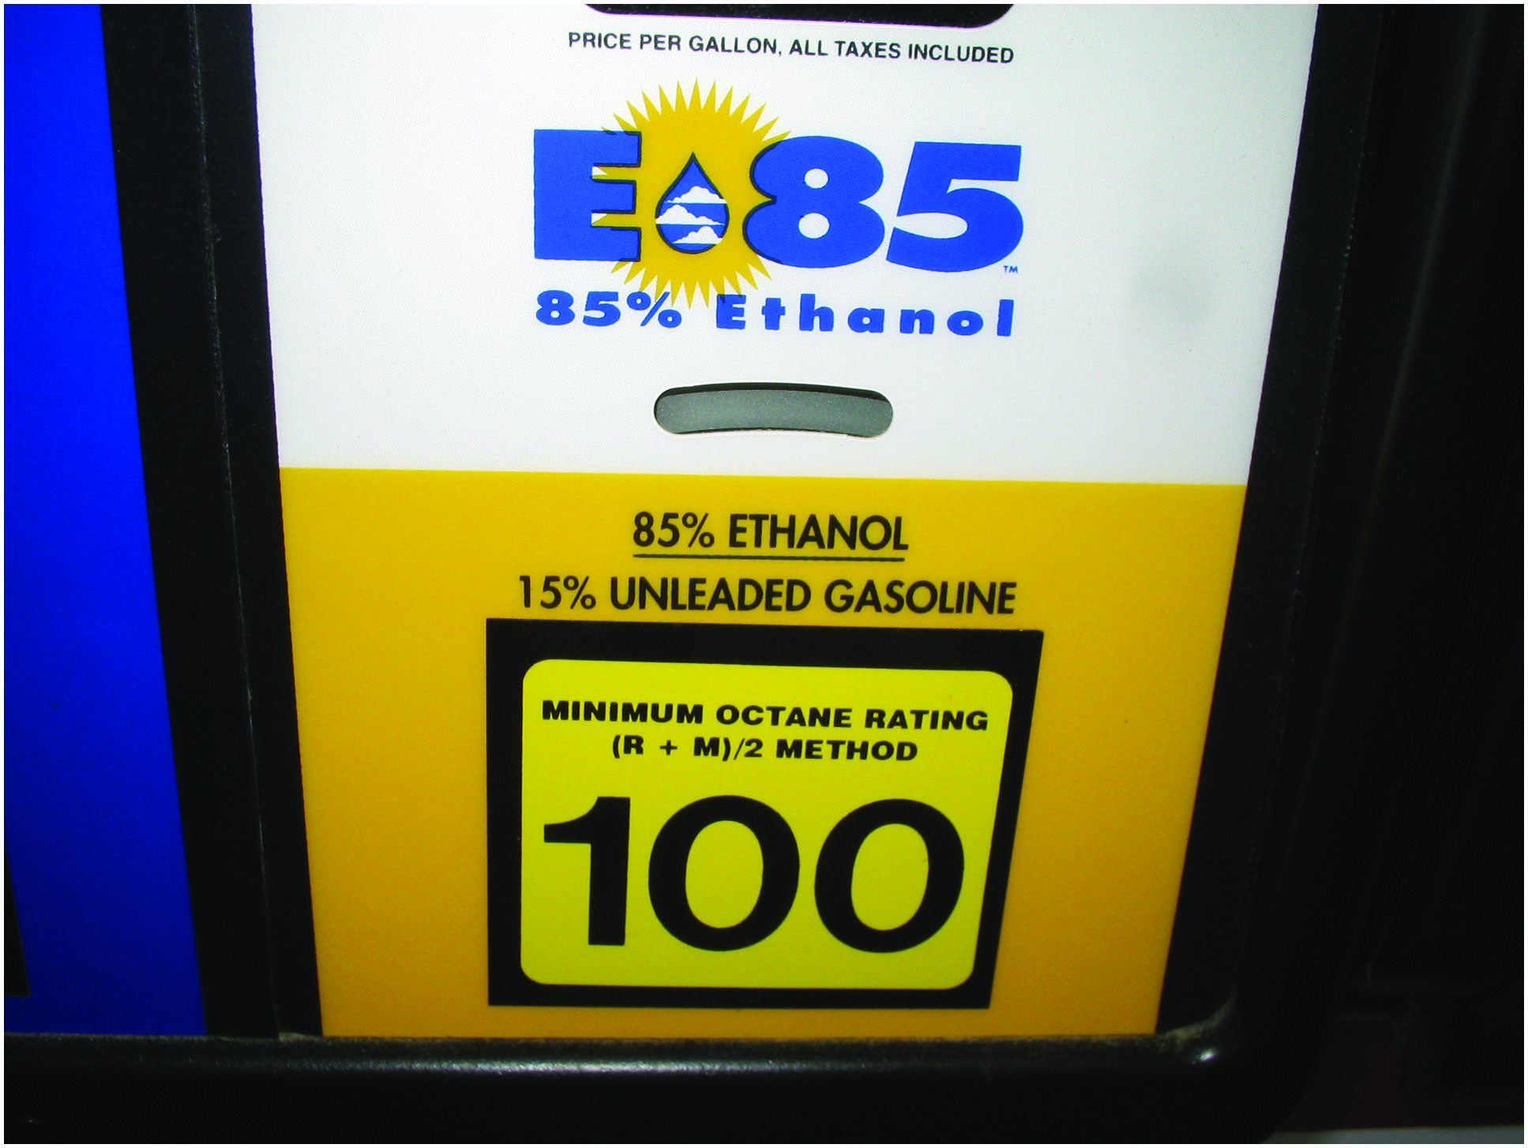
Figure 27.16
E85
E85 has 85% ethanol mixed with 15% gasoline.
Notes:
TECH TIP: Purchase a Flex Fuel Vehicle
If purchasing a new or used vehicle, try to find a flex fuel vehicle. Even though you may not want to use E85, a flex fuel vehicle has a more robust fuel system than a conventional fuel system designed for gasoline or E10. The enhanced fuel system components and materials usually include Stainless steel fuel rail Graphite commutator bars instead of copper in the fuel pump motor (ethanol can oxidize into acetic acid, which can corrode copper) Diamond like carbon (D L C) corrosion-resistant fuel injectors Alcohol resistant O-rings and hoses. The cost of a flex fuel vehicle compared with the same vehicle designed to operate on gasoline is a no-cost or a low-cost option.
Long Description:
The pump is labeled as E 85 and numbered as 100. It has 85 percent ethanol and 15 percent unleaded gasoline. Minimum octane rating is 100, based on left parenthesis R plus M right parenthesis divided by 2 method. The display screen indicates the price per gallon, with all taxes included.

Slide 57
Question 4
What is E85?

Slide 58
Answer 4
85% gasoline and 15% ethanol.

Slide 59
Alternative Fuel Vehicles (1 of 2)
Vehicles equipped with this capability are commonly referred to as alternative fuel vehicles (A F Vs), flex fuels, and flexible fuel vehicles (F F Vs).
E85 Fuel System Requirements
  Fuel compensation sensor that measures both the percentage of ethanol blend and the temperature of the fuel.
  Sensorless flex fuel systems rely on feedback from the oxygen sensor to detect lean condition.

Slide 60
Alternative Fuel Vehicles (2 of 2)
Flex Fuel Vehicle Identification
  Emblems on the side, front, and/or rear of the vehicle
  Yellow fuel cap showing E85/gasoline
  Vehicle Emission Control Information (V E C I) label
  Vehicle identification number (V I N)
Notes:
See Chart 27.2 on page 981: The characteristics of alternative fuels compared to regular unleaded gasoline show that all have advantages and disadvantages.

Slide 61
Safety Procedures When Working with Alternative Fuels
Safety glasses and/or face shield
Protective gloves
Long-sleeved shirt and pants
If any fuel gets on skin, area should be washed
If fuel spills on clothing, change into clean clothing
If fuel spills on a painted surface, flush surface with water and air dry
Always vent the exhaust to the outside

Slide 62
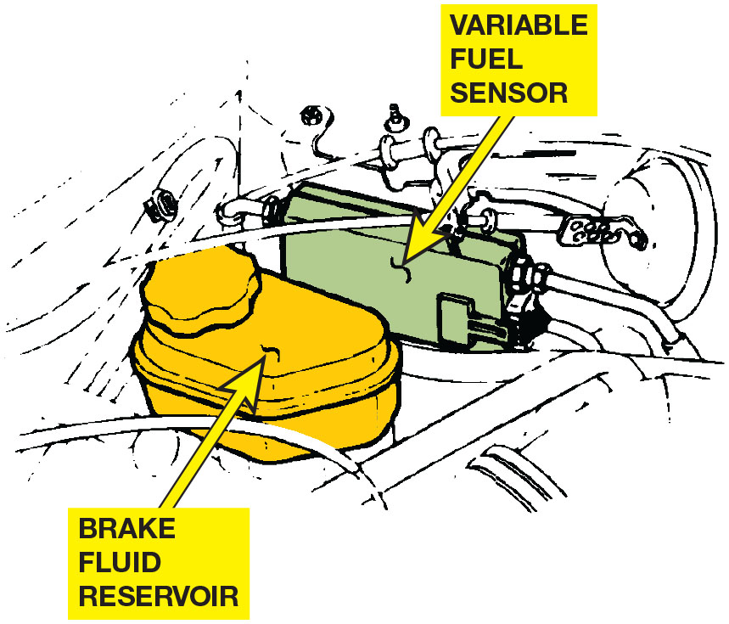
Figure 27.17
Variable Fuel Sensor
The location of the variable fuel sensor can vary, depending on the make and model of vehicle, but it is always in the fuel line between the fuel tank and the fuel injectors.

Slide 63
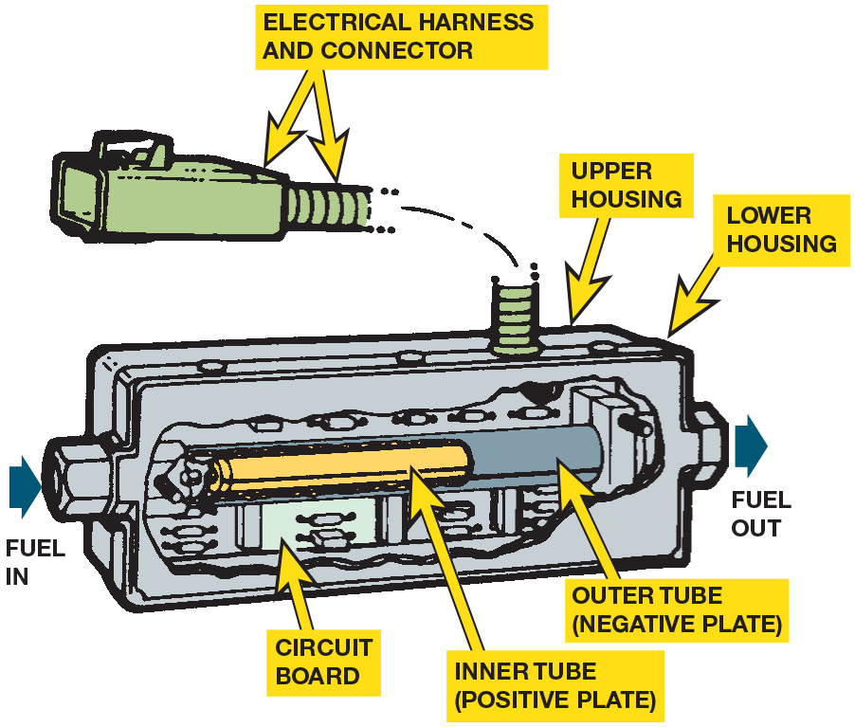
Figure 27.18
Cutaway Fuel Sensor
A cutaway view of a typical variable fuel sensor.
Notes:
Long Description:
The sensor is made of the following components: Inlet and outlet for fuel; circuit board; inner tube, positive plate; outer tube, negative plate; upper housing; lower housing; electrical harness and connector.

Slide 64
Frequently Asked Question: How Does a Sensorless Flex Fuel System Work?
? Frequently Asked Question
How Does a Sensorless Flex Fuel System Work? Many G M flex fuel vehicles do not use a fuel compensation sensor and instead use the oxygen sensor to detect the presence of the lean mixture and the extra oxygen in the fuel. The P C M then adjusts the injector pulse width and the ignition timing to optimize engine operation to use of E85. Called a virtual flexible fuel vehicle (V-F F V). It can operate on pure gasoline or blends up to 85% ethanol.

Slide 65
Frequently Asked Question: How Long Can Oxygenated Fuel Be Stored Before All of the Oxygen Escapes?
? Frequently Asked Question
How Long Can Oxygenated Fuel Be Stored Before All of the Oxygen Escapes? The oxygen in oxygenated fuels,
such as E10 and E85, is not in a gaseous state like the
in soft drinks. The oxygen is part of the molecule of ethanol or other oxygenates and does not bubble out of the fuel. Oxygenated fuels, like any fuel, have a shelf life of about 90 days.

Slide 66
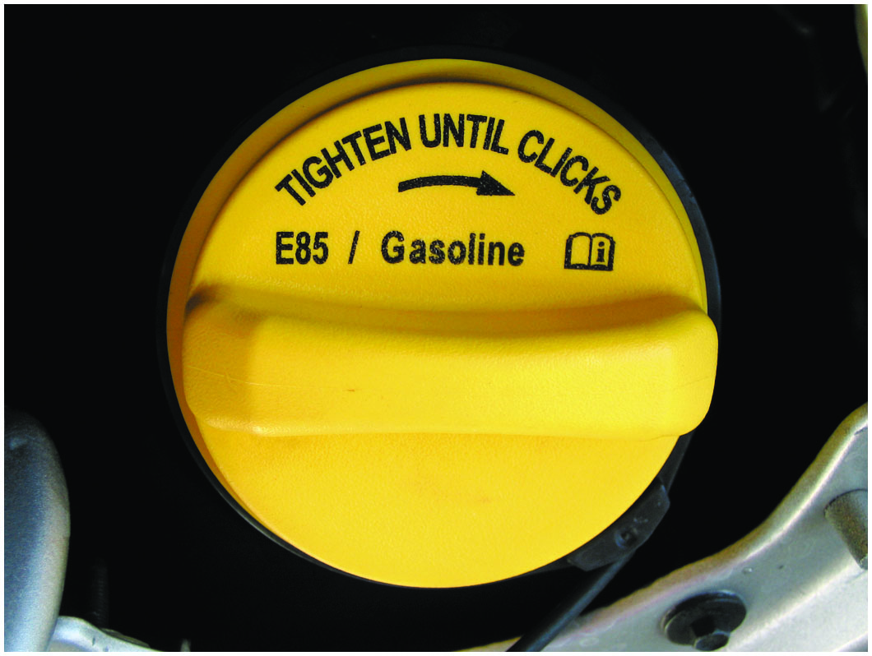
Figure 27.19
Yellow Fuel Cap
A flex fuel vehicle often has a yellow gas cap, which is labeled E85/gasoline.

Slide 67
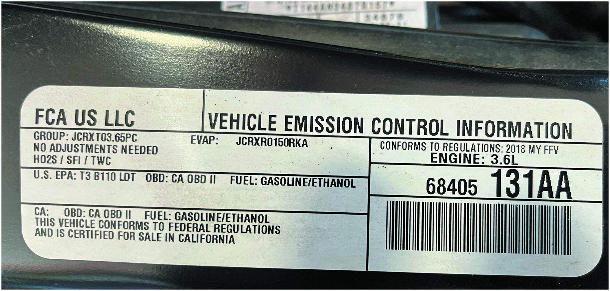
Figure 27.20
F F V V E C I Sticker
This flexible fuel vehicle (F F V) vehicle emission control information (V E C I) sticker located under the hood indicates that it can operate on either gasoline or ethanol.
Notes:
Long Description:
The sticker reads: F-C-A U-S L-L-C. Group: J C R X T 03.65 P C; E VAP: J C R X R 0 1 5 0 R K A. No adjustments needed. H O 2 S, S F I, T W C. U-S E-P-A: T-3 B-110 L D T; O B D: C-A O-B-D 2; Fuel: Gasoline, ethanol. Conforms to regulations: 2018 MY F F V; Engine: 3.6 L. Bar code: 68405 131 A A. C A; O B D: C-A O-B-D 2; Fuel: Gasoline, ethanol. This vehicle conforms to federal regulations and is certified for sale in California.

Slide 68
Question 5
How is a flexible fuel vehicle identified?

Slide 69
Answer 5
The vehicle can be identified by the fuel cap, the V I N number, the emissions sticker, or the badging on the sides.

Slide 70
Propane
When sold as a fuel, it is also known as liquefied petroleum gas (L P G) or L P gas.
Advantages of Propane
  Reduced emissions, low cost, improved cold start ability, and lower maintenance costs
Disadvantages of Propane
  Required space for storage tanks, fewer B T U s per gallon than gasoline, higher initial costs, and limited refueling stations

Slide 71
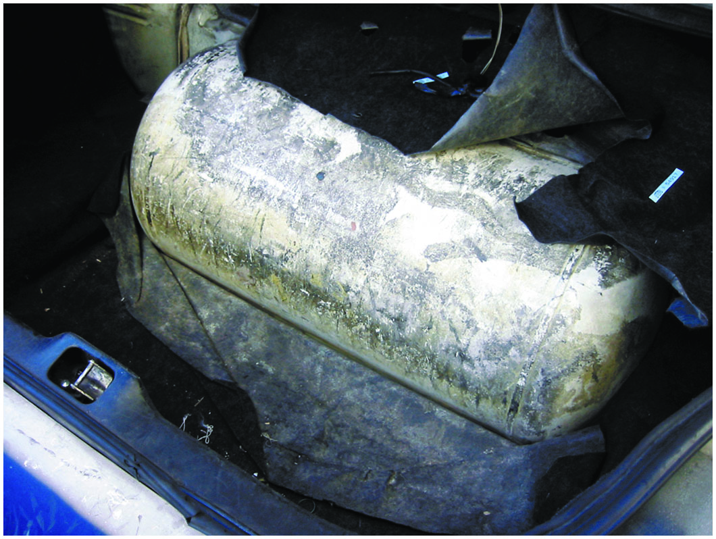
Figure 27.21
Propane Tank
Propane fuel storage tank in the trunk of a Ford taxi.

Slide 72
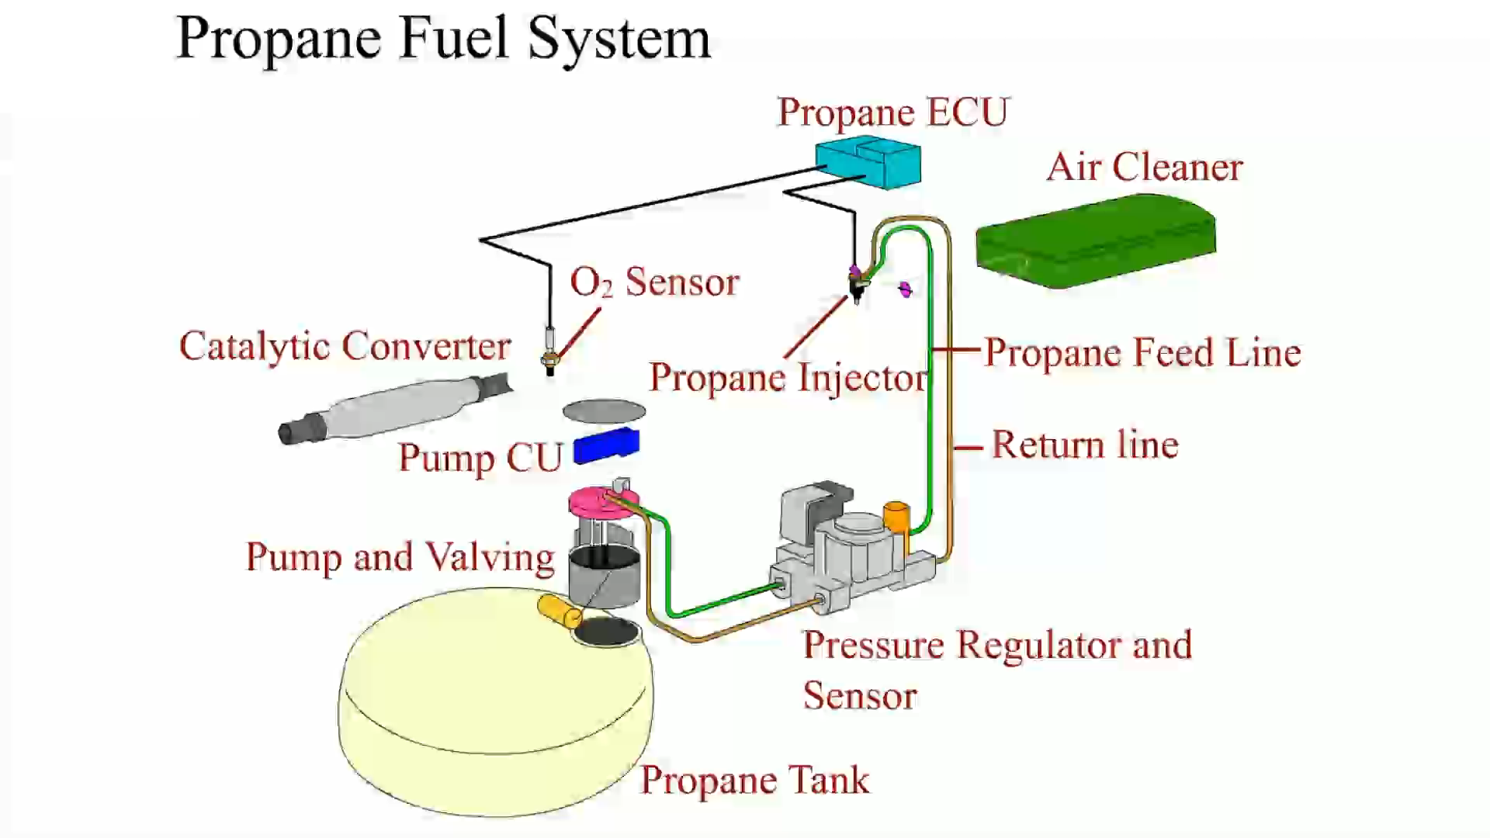
Animation: Propane Fuel System

Slide 73
Compressed Natural Gas (C N G) (1 of 2)
C N G Vehicle Design
  Vehicles using this fuel are often referred to as natural gas vehicles (N G Vs).
  Natural gas has to be compressed to about 3,000 P S I (20,000 k P a).
  Weight and cost of storage container is a major factor when it comes to preparing vehicle to run on C N G.

Slide 74
Compressed Natural Gas (C N G) (2 of 2)
C N G Composition
  Compressed natural gas is made of methane, propane, ethane, n-butane, carbon dioxide, and nitrogen.
  Once it is processed, it is at least 93% methane.
C N G Fuel Systems
  C N G tank has 3,600 P S I of pressure in tank.
  High-pressure regulator reduces high-pressure C N G to approximately 170 P S I.
  Two-stage regulator first reduces pressure to 4 to 6 P S I in the first stage and then to 4.5 to 7 inches of water in the second stage.

Slide 75
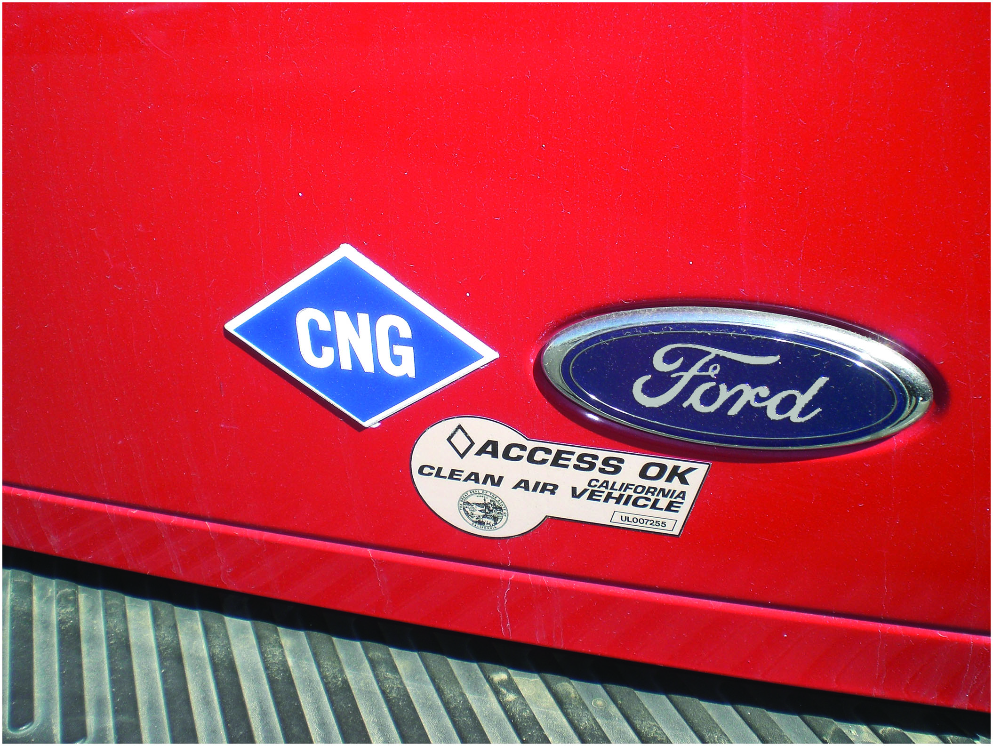
Figure 27.22
Blue C N G Sticker
The blue sticker on the rear of this vehicle indicates that it is designed to use compressed natural gas. This Ford truck also has a sticker that allows it to be driven in the high occupancy vehicle (H O V) lane, even if there is just the driver because it is a C N G vehicle.

Slide 76
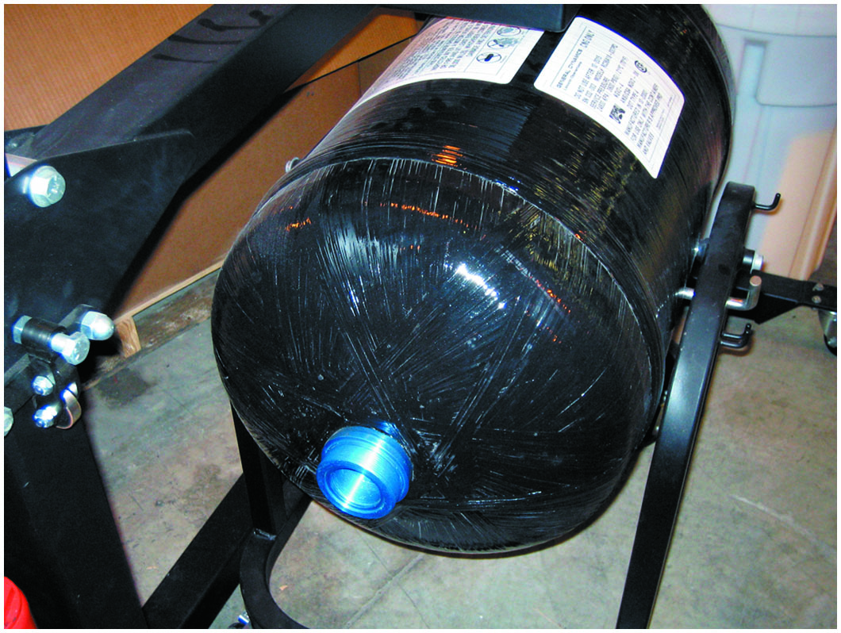
Figure 27.23
C N G Storage Tank
A C N G storage tank from a Honda Civic G X shown with the fixture used to support it while it is being removed or installed in the vehicle. Honda specifies that three technicians be used to remove or install the tank through the rear door of the vehicle due to the size and weight of the tank.

Slide 77
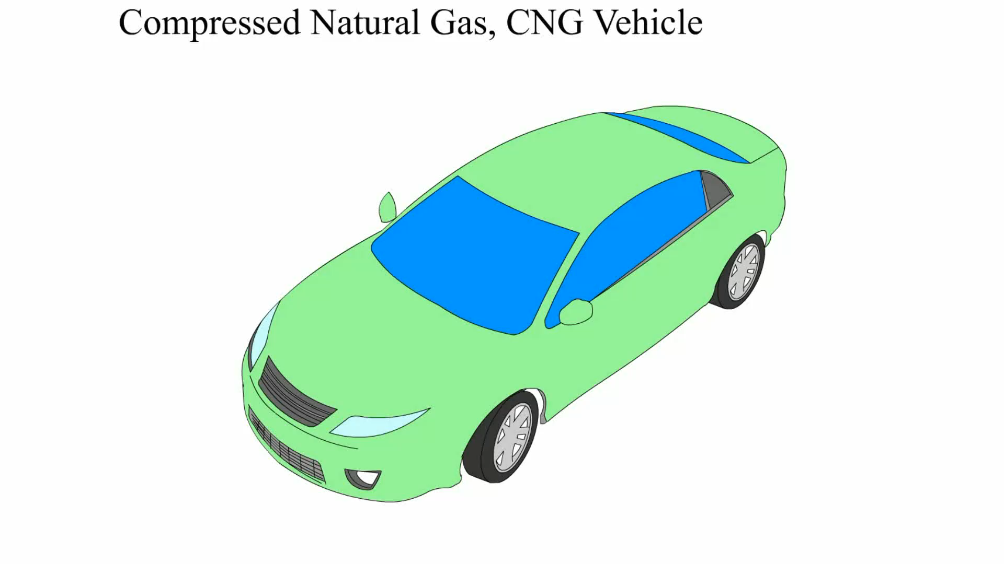
Animation: Compressed Natural Gas, CNG Vehicle

Slide 78
Frequently Asked Question: What Is the Amount of C N G Equal to in Gasoline?
? Frequently Asked Question
What Is the Amount of C N G Equal to in Gasoline? To achieve the amount of energy of 1 gallon of gasoline, 122 f t 3 of compressed natural gas (C N G) is needed. While the octane rating of C N G is much higher than gasoline (130 octane), using C N G instead of gasoline in the same engine would result in a 10% to 20% reduction of power due to the lower heat energy that is released when C N G is burned in engine.

Slide 79
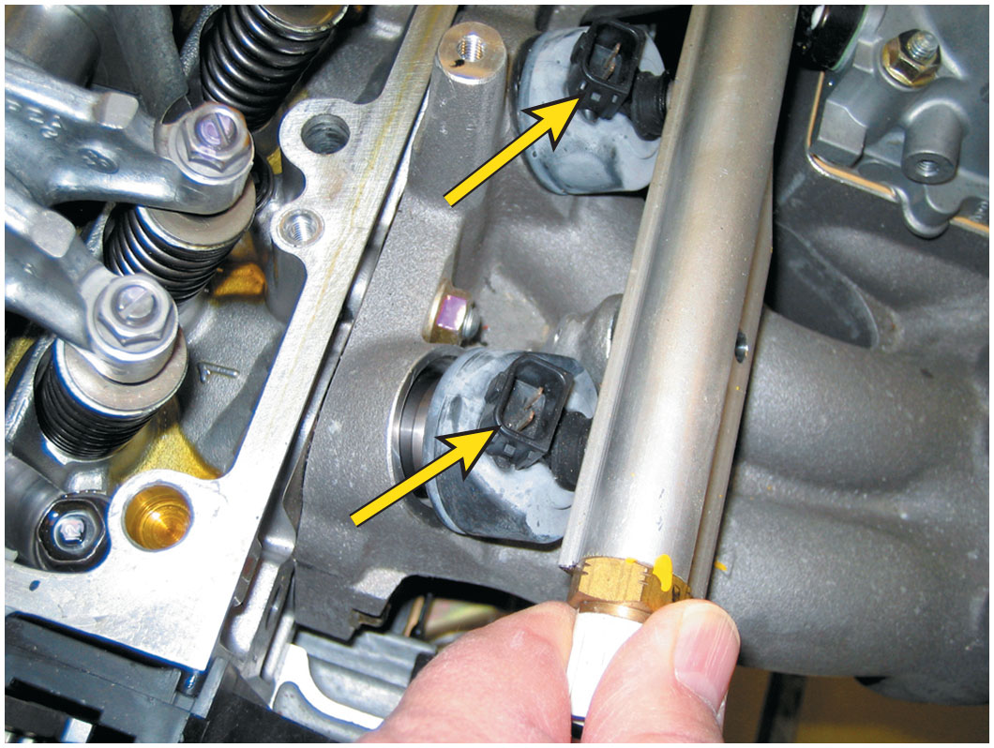
Figure 27.24
C N G Injectors
The fuel injectors used on this Honda Civic G X C N G engine are designed to flow gaseous fuel instead of liquid fuel and cannot be interchanged with any other type of injector.

Slide 80
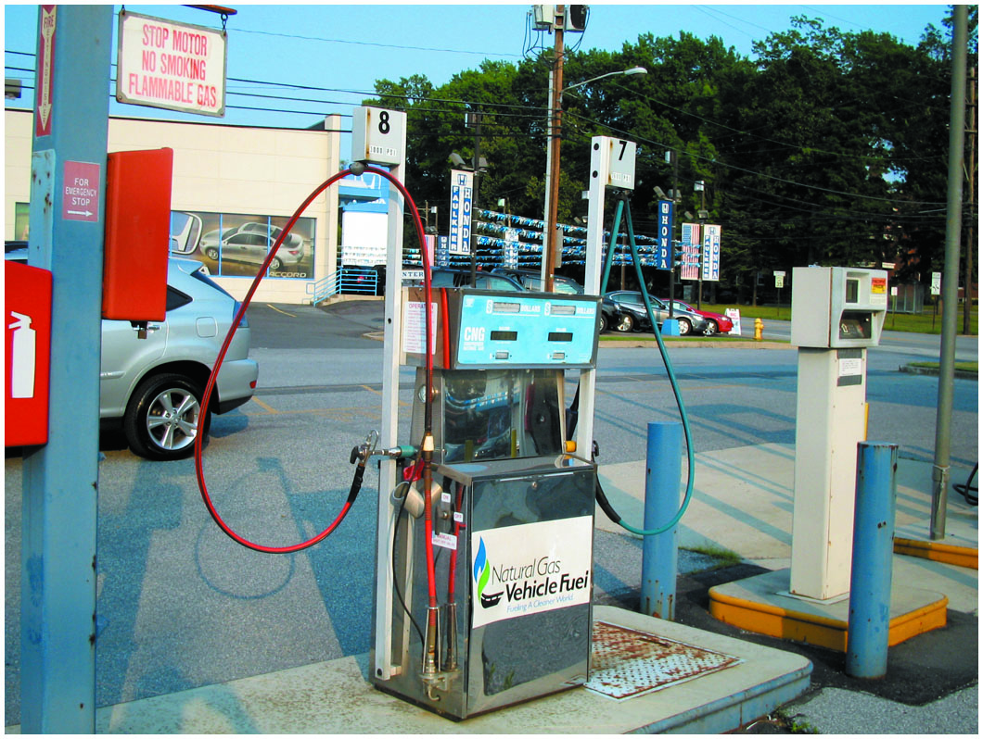
Figure 27.25
C N G Pump
This C N G pump is capable of supplying compressed natural gas at either 3,000 P S I or 3,600 P S I. The price per gallon is higher for the higher pressure.

Slide 81
Diesel Fuel (1 of 4)
Features of Diesel Fuel
  Diesel fuel contains 12% more heat energy than the same amount of gasoline.
  Fuel in diesel engine is not ignited with a spark but is ignited by heat generated by high compression.
Diesel Fuel Requirements
  Cleanliness
  Low-temperature fluidity
  Cloud point

Slide 82
Diesel Fuel (2 of 4)
Cetane Number
  Measure of ease with which the fuel can be ignited.
  Should be between 45 and 50.
Sulfur Content
  Federal regulations on sulfur content require less than 15 parts per million (P P M).
Diesel Fuel Color
  Used to identify on-road versus off-road use

Slide 83
Diesel Fuel (3 of 4)
Grades of Diesel Fuel
  Grade #1: lowest boiling point and the lowest cloud and pour points, as well as a lower B T U content.
  Grade #2: higher boiling point, cloud point, and pour point as compared with grade #1. Commonly used.
Diesel Fuel Specific Gravity Testing
  The density or specific gravity of diesel fuel is measured in units of A P I gravity.

Slide 84
Diesel Fuel (4 of 4)
Diesel Fuel Heaters
  Diesel fuel heaters, either coolant or electric, help prevent power loss and stalling in cold weather.
  Heater is placed in fuel line between tank and primary filter to keep the fuel from gelling.
Ultra-Low-Sulfur Diesel Fuel
  Diesel engines manufactured to 2007 or newer standards must use ultra-low-sulfur diesel fuel (U L S D) containing less than 15 P P M of sulfur compared to the older, low sulfur specification of 500 P P M.

Slide 85
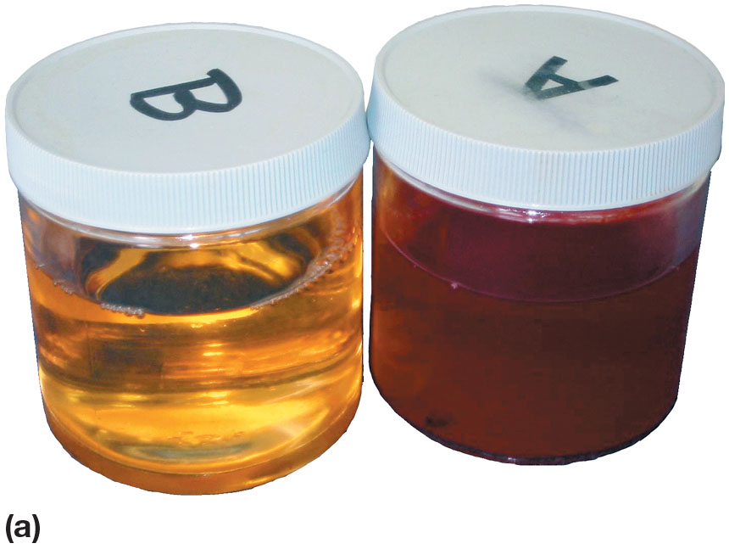
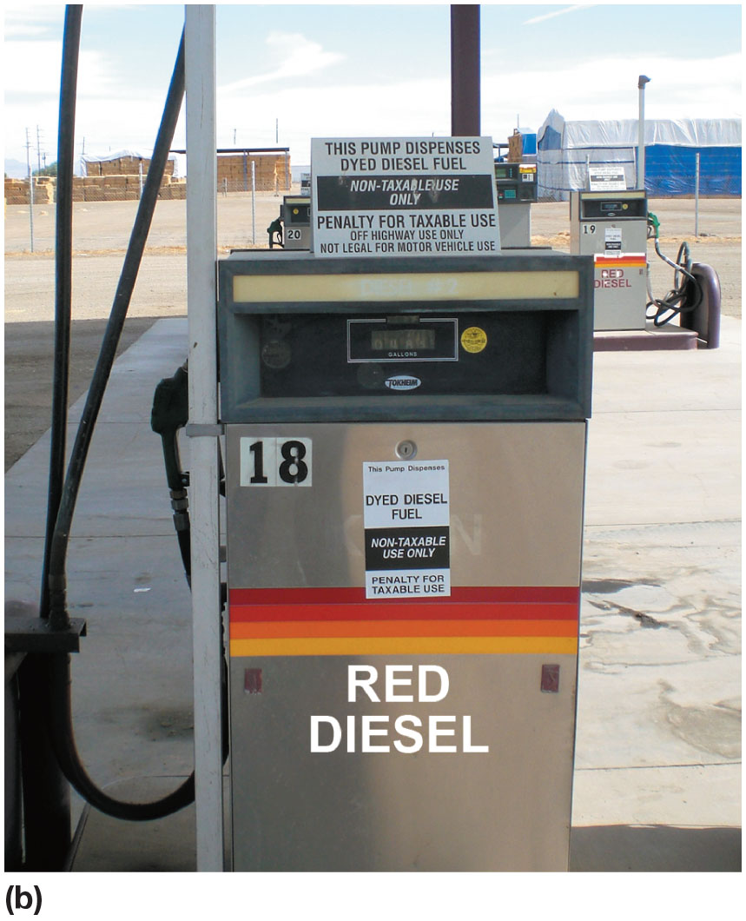
Figure 27.26
Diesel Fuels
(a) Regular diesel fuel on the left has a clear or greenish tint, whereas fuel for off-road use is tinted red for identification. (b) This fuel pump in a farming area clearly states the red diesel fuel is for off-road use only because it is not taxed.

Slide 86
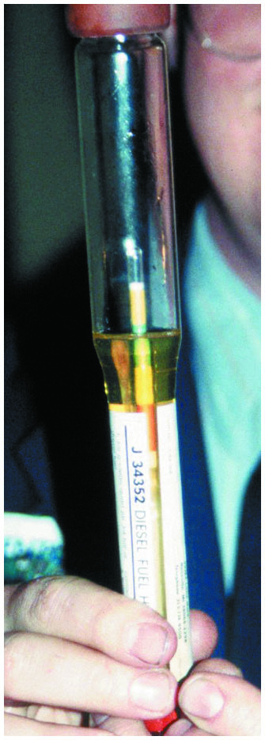
Figure 27.27
Diesel Fuel Hydrometer
Testing the A P I viscosity of a diesel fuel sample using a hydrometer.

Slide 87
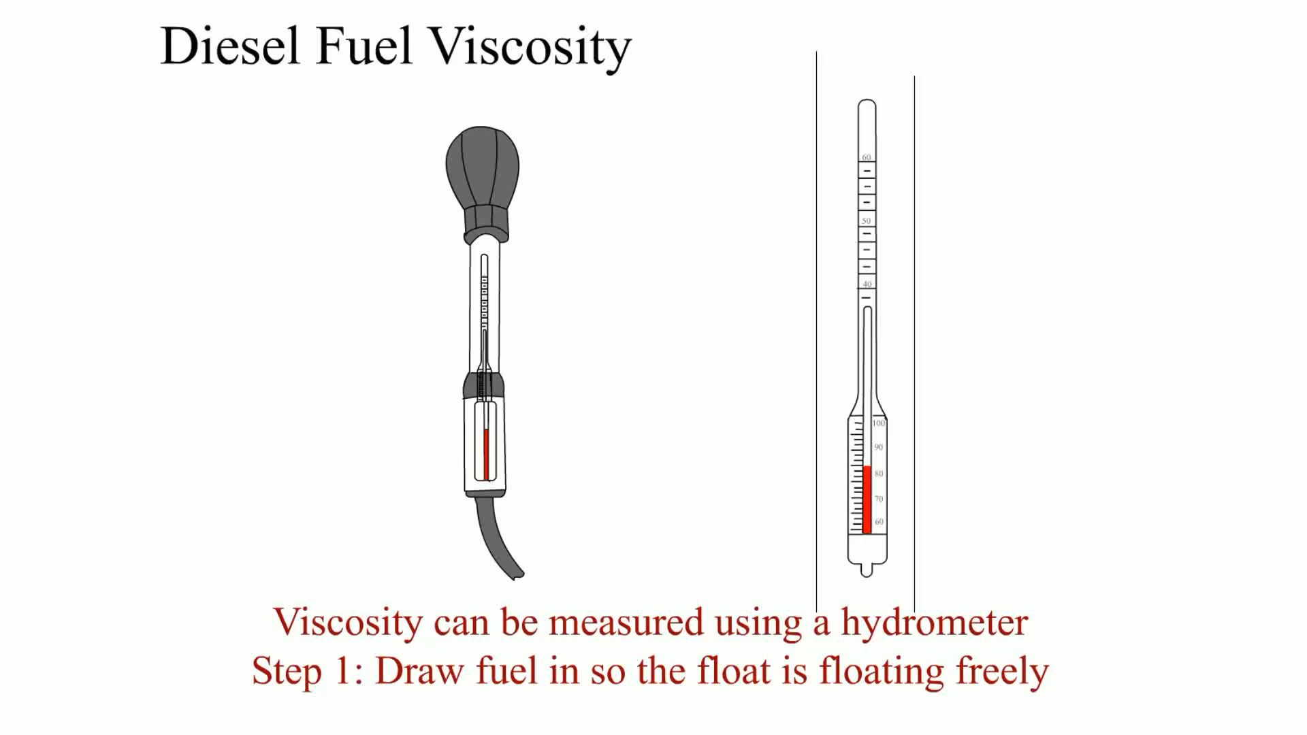
Animation: Diesel Fuel Viscosity

Slide 88
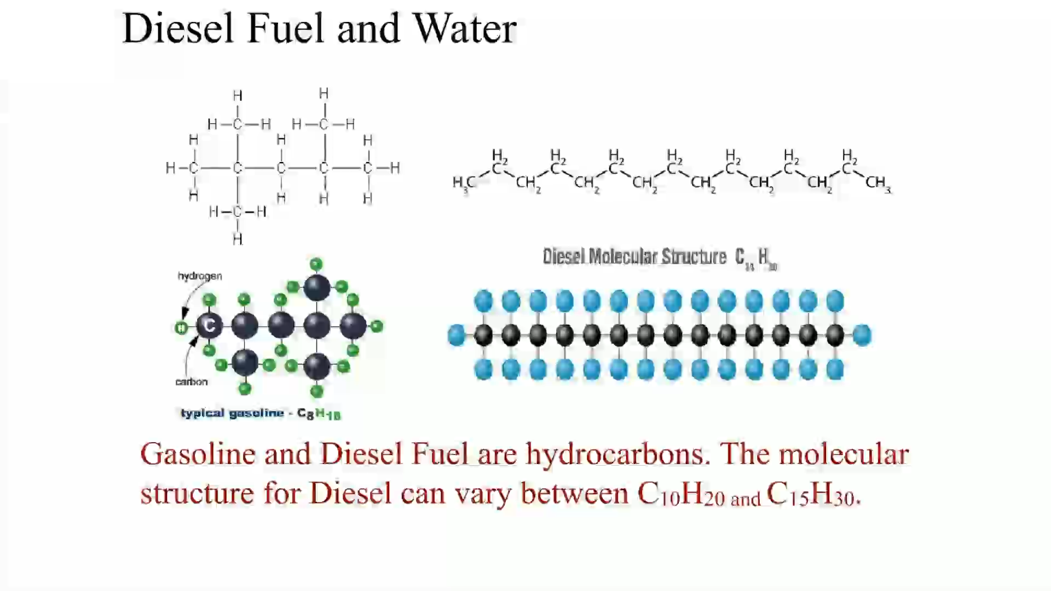
Animation: Diesel Fuel and Water

Slide 89
Question 6
What is cetane number?

Slide 90
Answer 6
Cetane number is a measure of the ease with which the fuel can be ignited.

Slide 91
Biodiesel
Definition of Biodiesel
  Biodiesel defined as mono-alkyl esters of long-chain fatty acids derived from vegetable oils or animal fats
  Conform to A S T M D6751 specifications for use in diesel engines.
Biodiesel Blends
  Biodiesel blends are denoted as “B X X” with “X X,” representing the percentage of biodiesel contained in the blend (i.e., B20 is 20% biodiesel, 80% petroleum diesel).

Slide 92
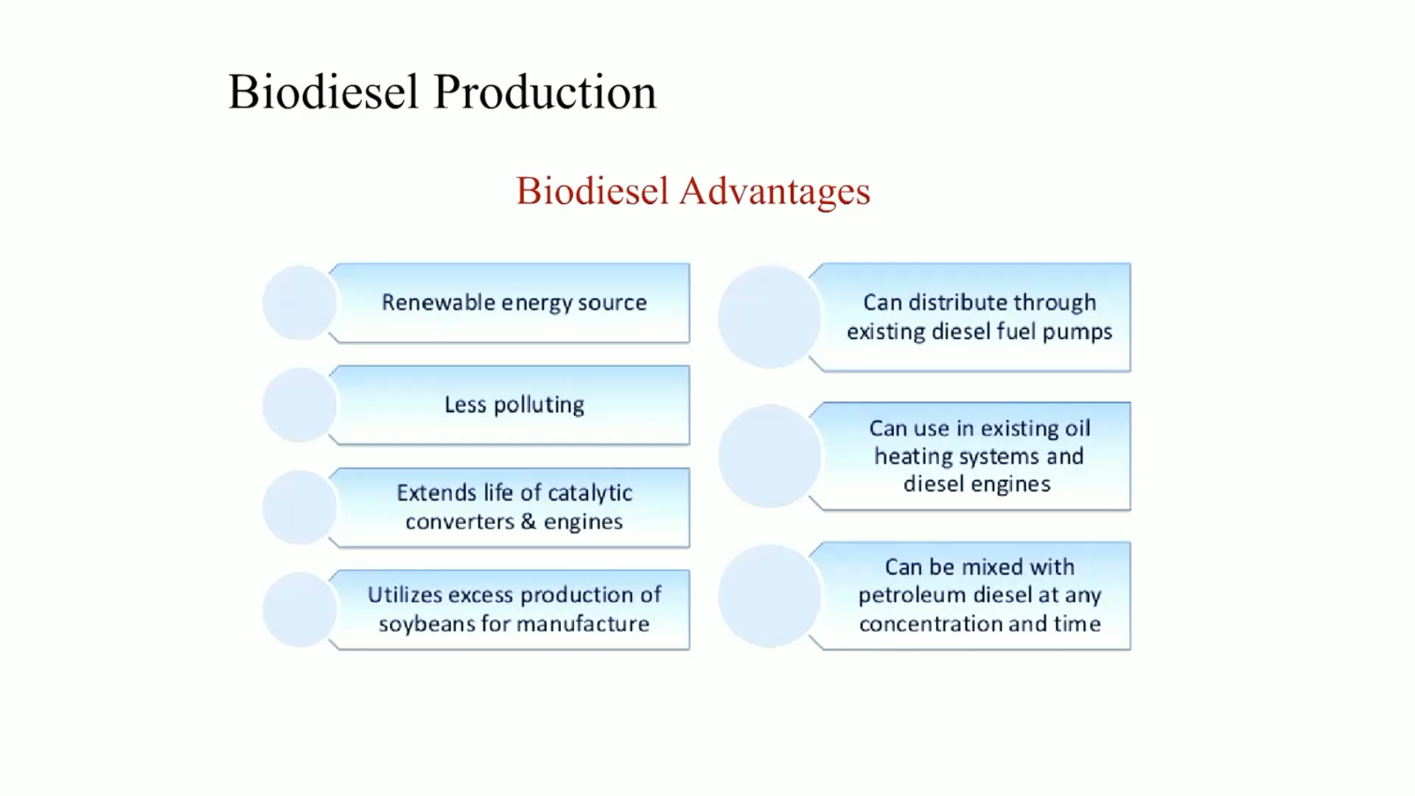
Animation: Biodiesel Production

Slide 93
Frequently Asked Question: What Are the Pump Nozzle Sizes?
? Frequently Asked Question
What Are the Pump Nozzle Sizes? Unleaded gasoline nozzles are smaller than those used for diesel fuel to help prevent fueling errors. However, it is still possible to fuel a diesel vehicle with gasoline. • See Chart 27.3 for the sizes and colors used for fuel pump nozzles.

Slide 94
Chart 27.3
Pump Nozzle Sizes
FUEL | NOZZLE DIAMETER | PUMP HANDLE COLOR (VARIES–NO ESTABLISHED STANDARD)
Gasoline | 13/16 inch (21m m) | Black, red, white, green, or blue
E10 | 13/16 inch (21m m) | Black, red, white, green, or blue
E85 | 13/16 inch (21m m) | Yellow or black
Diesel fuel | 15/16 inch (24 m m) | Yellow, green, or black
Biodiesel | 15/16 inch (24 m m) | Green
Truckstop diesel | 11/4 or 11/2 inch (32 or 38 m m) | Varies
Fuel pump nozzle size is standardized except for use by over-the-road truck stops where high fuel volumes and speedy refills require larger nozzle sizes compared to passenger vehicle filling station nozzles.

Slide 95
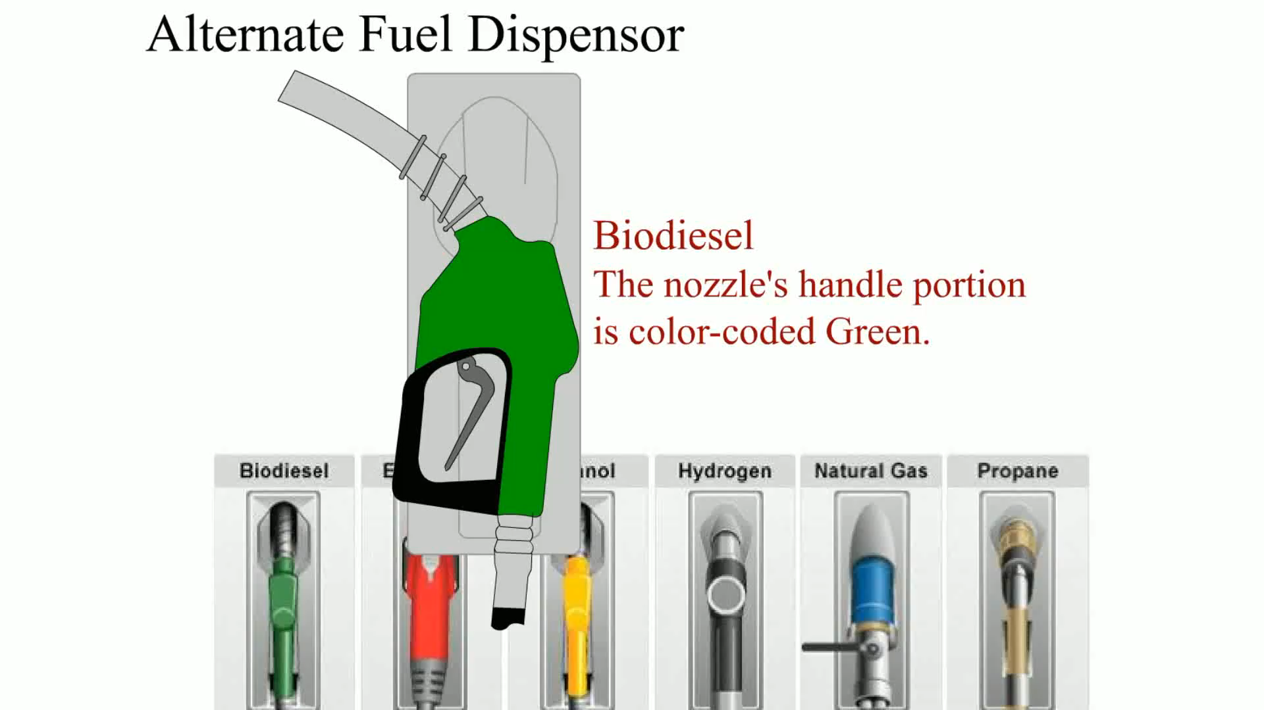
Animation: Alternative Fuel Dispenser

Slide 96
Frequently Asked Question: I Thought Biodiesel Was Vegetable Oil?
? Frequently Asked Question
I Thought Biodiesel Was Vegetable Oil? Biodiesel is vegetable oil with the glycerin component removed by means of reacting the vegetable oil with a catalyst. The resulting hydrocarbon esters are 16 to 18 carbon atoms in length, almost identical to the petroleum diesel fuel atoms. Many vehicle and diesel engine fuel system suppliers permit the use of biodiesel fuel that is certified as meeting testing standards. None permit the use of vegetable oil in its natural state.
Complete Text In Notes Section
Notes:
I Thought Biodiesel Was Vegetable Oil?
Biodiesel is vegetable oil with the glycerin component removed by means of reacting the vegetable oil with a catalyst. The resulting hydrocarbon esters are 16 to 18 carbon atoms in length, almost identical to the petroleum diesel fuel atoms. This allows the use of biodiesel fuel in a diesel engine with no modifications needed. Biodiesel-powered vehicles do not need a second fuel tank, whereas vehicles powered with vegetable oil do.
There are three main types of fuel used in diesel engines:
■ Petroleum diesel, a fossil hydrocarbon with a carbon chain length of about 16 carbon atoms
■ Biodiesel, a hydrocarbon with a carbon chain length of 16 to 18 carbon atoms
■ Vegetable oil, a triglyceride with a glycerin component joining three hydrocarbon chains of 16 to 18 carbon atoms each, called straight vegetable oil (S V O)
Other terms used when describing vegetable oil include the following:
■ Pure plant oil (P P O), a term most often used in Europe to describe S V O
■ Waste vegetable oil (W V O), which could include animal or fish oils from cooking
■ Used cooking oil (U C O), a term used when the oil may or may not be pure vegetable oil Vegetable oil is not liquid enough at common ambient temperatures for use in a diesel engine fuel delivery system designed for the lower viscosity petroleum diesel fuel. Vegetable oil needs to be
heated to obtain a similar viscosity to biodiesel and petroleum diesel. This means a heat source needs to be provided before the fuel can be used in a diesel engine. This is achieved by starting on petroleum diesel or biodiesel fuel until the engine heat can be used to sufficiently warm a tank containing the vegetable oil. It also requires purging the fuel system of vegetable oil with petroleum diesel or biodiesel fuel prior to stopping the engine to avoid the vegetable oil thickening and solidifying in the fuel system away from the heated tank. The use of vegetable oil in its natural state does, however, eliminate the need to remove the glycerin component. Many vehicle and diesel engine fuel system suppliers permit the use of biodiesel fuel that is certified as meeting testing standards. None permit the use of vegetable oil in its natural state.

Slide 97
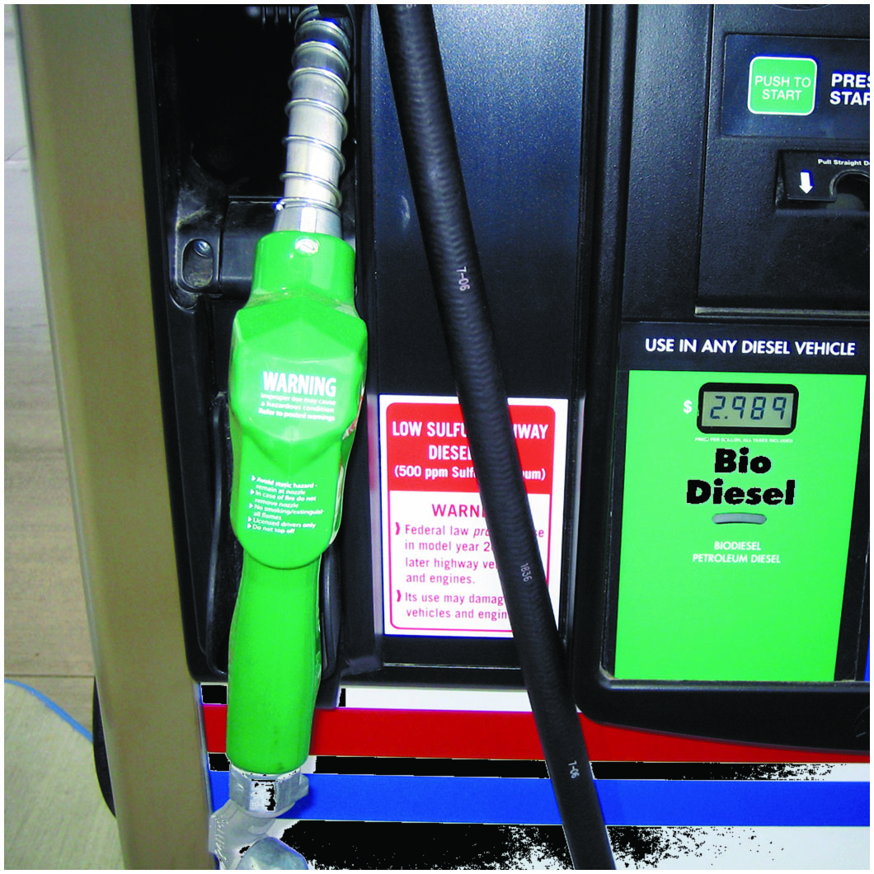
Figure 27.28
Biodiesel Pump
A biodiesel pump decal.

Slide 98
Testing for Alcohol Content in Gasoline

Slide 99
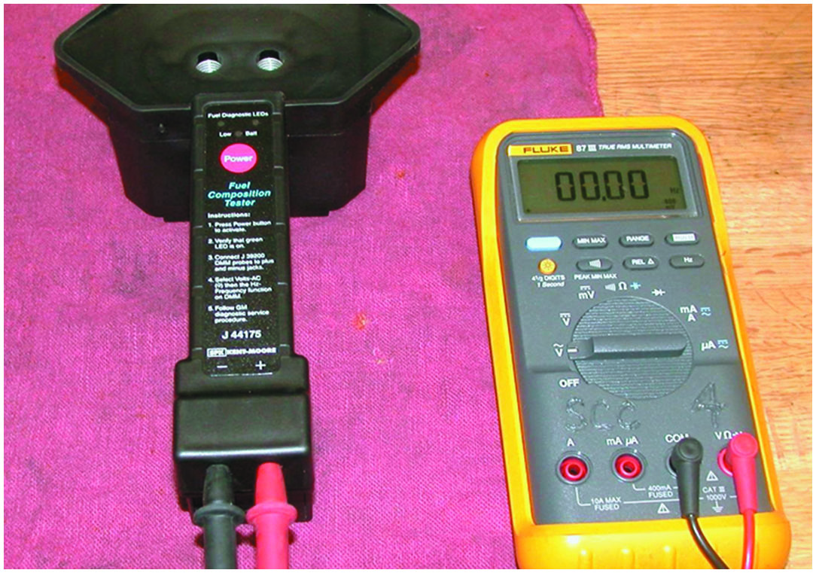
Special Tool
Notes:
1. A fuel composition tester (S P X Kent-Moore J-44175) is the recommended tool to use to test the alcohol content of gasoline.

Slide 100
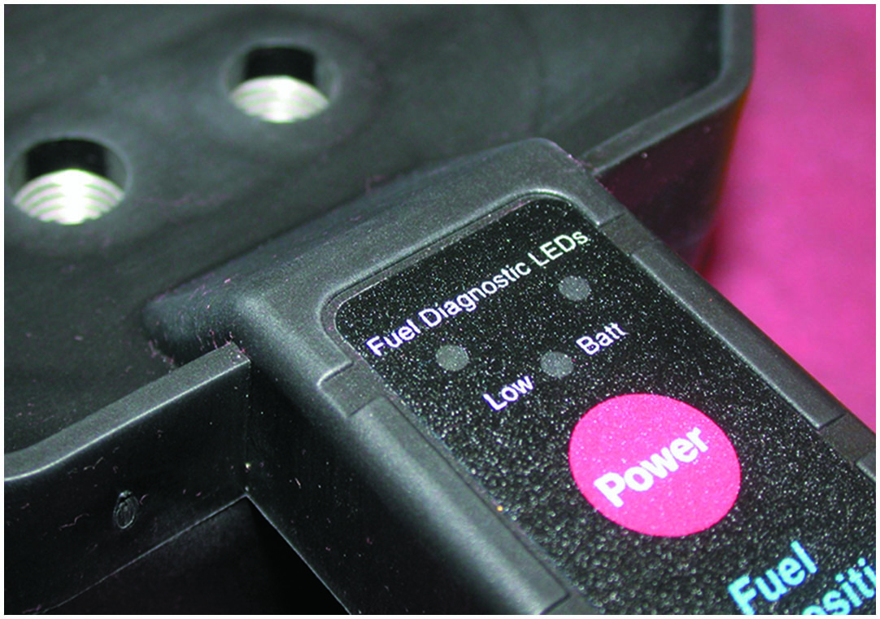
Battery-Powered Tester
Notes:
2. This battery-powered tester uses light-emitting diodes (L E Ds), meter lead terminals, and two small openings for the fuel sample.

Slide 101
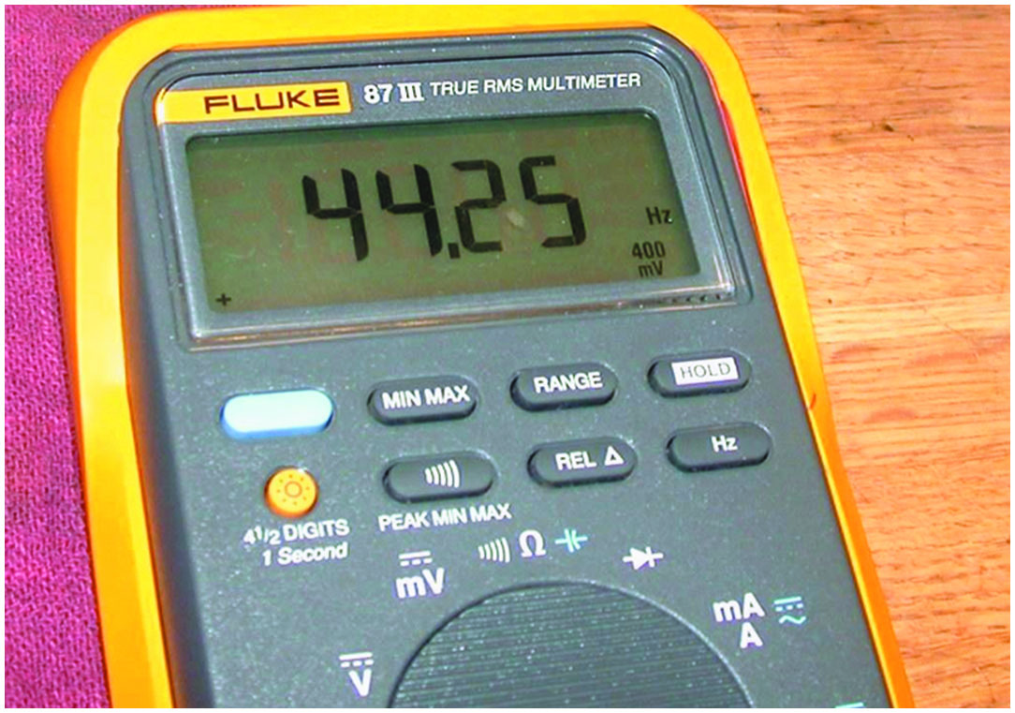
Measuring Air Frequency
Notes:
3. The first step is to verify the proper operation of the tester by measuring the air frequency by selecting A C hertz on the meter. The air frequency should be between 35 H z and 48 H z.

Slide 102
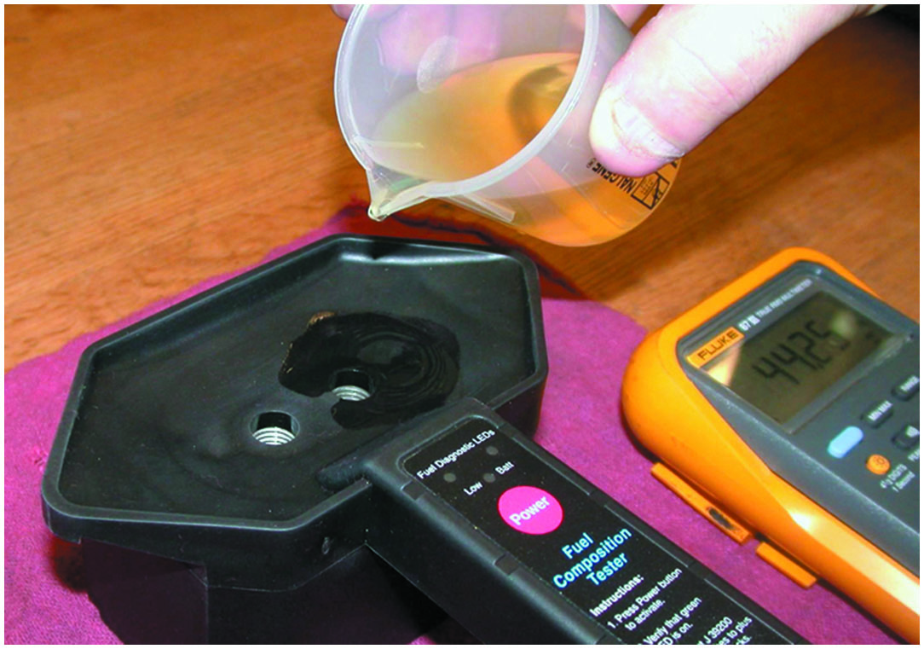
Pour in Gasoline
Notes:
4. After verifying that the tester is capable of correctly reading the air frequency, gasoline is poured into the testing cell of the tool.

Slide 103
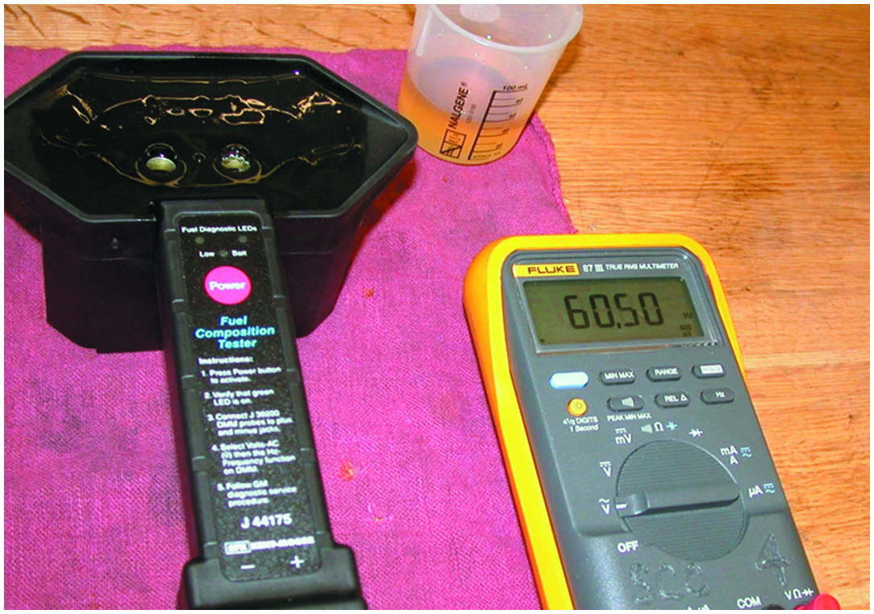
Record A C Frequency
Notes:
5. Record the A C frequency as shown on the meter and subtract 50 from the reading (e.g., 60.50 − 50.00 = 10.5 ). This number (10.5) is the percentage of alcohol in the gasoline sample.

Slide 104
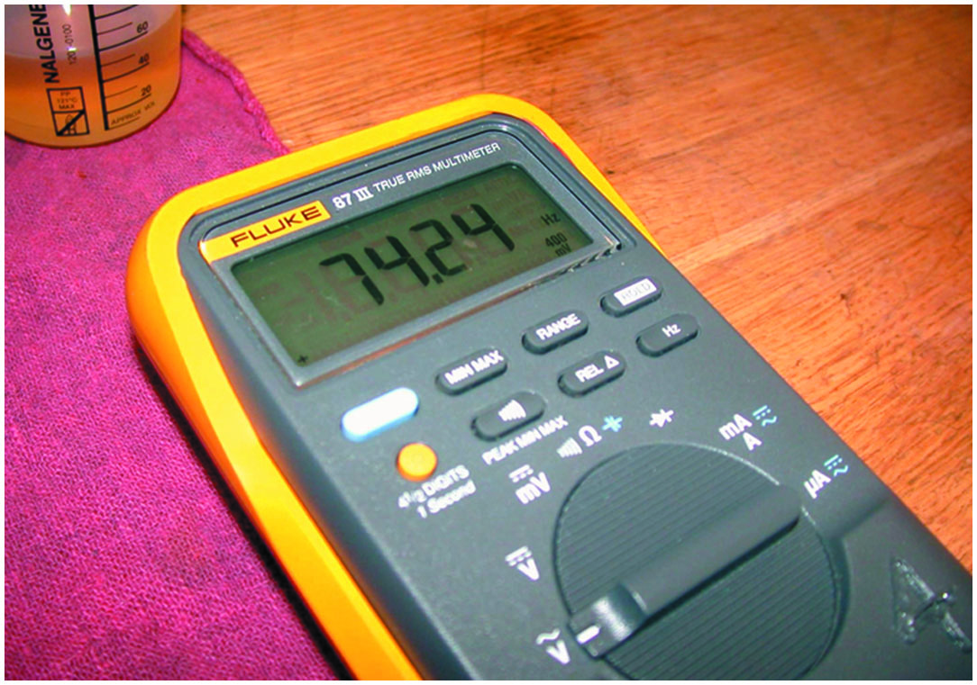
Reading Increases
Notes:
6. Adding additional amounts of ethyl alcohol (ethanol) increases the frequency reading.

Slide 105
Summary (1 of 2)
Gasoline is a complex blend of hydrocarbons blended for seasonal usage to achieve the correct volatility for easy starting and maximum fuel economy under all driving conditions.
Winter-blend fuel used during warm weather can cause a rough idle and stalling because of higher Reid vapor pressure (R V P).
Abnormal combustion (also called detonation or spark knock) increases both the temperature and the pressure inside the combustion chamber.
Most regular grade gasoline today, using the (R + M) , 2 rating method, is 87 octane; midgrade (plus) is 89 and premium grade is 91 or higher.
Oxygenated fuels contain oxygen to lower C O exhaust emissions.
Flexible fuel vehicles (F F Vs) are designed to operate on gasoline or gasoline-ethanol blends up to 85% ethanol (E85).
E85 has fewer B T Us of energy per gallon compared with gasoline and will therefore provide lower fuel economy.

Slide 106
Summary (2 of 2)
Methanol, methyl alcohol or wood alcohol and, can be made from wood, is mostly made from natural gas.
Propane is a widely used fuel, also called liquefied petroleum gas (L P G).
C N G available for refilling in several pressures: 2,400 P S I, 3,000 P S I, and 3,600 P S I.
Safety procedures when working around alternative fuel include wearing P P E.
Diesel fuel requirements: cleanliness, low temperature fluidity, and proper cetane rating.
Emission control devices used on 2007 and newer engines require the use of ultra-low-sulfur diesel (U L S D).
Biodiesel is a blend of vegetable-based liquid with regular diesel fuel.

Slide 107
Animations and Video Links
(Halderman website subscription and web access needed to view)
(A8) Engine Performance Animations
(A8) Engine Performance Videos

Slide 108

Copyright
This work is protected by United States copyright laws and is provided solely for the use of instructors in teaching their courses and assessing student learning. Dissemination or sale of any part of this work (including on the World Wide Web) will destroy the integrity of the work and is not permitted. The work and materials from it should never be made available to students except by instructors using the accompanying text in their classes. All recipients of this work are expected to abide by these restrictions and to honor the intended pedagogical purposes and the needs of other instructors who rely on these materials.

