Slide 1
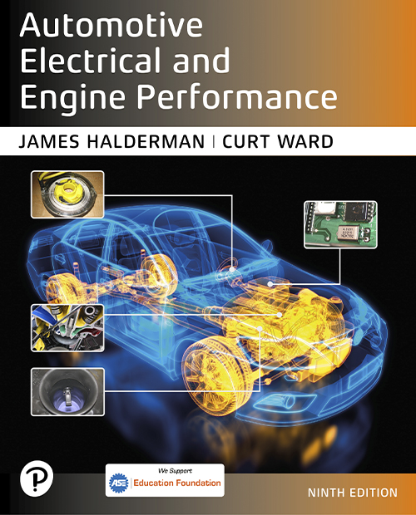
Automotive Electrical and Engine Performance
Ninth Edition
Chapter 26
Engine Condition Diagnosis
Copyright © 2025 Pearson Education, Inc. All Rights Reserved
Notes:
If this PowerPoint presentation contains mathematical equations, you may need to check that your computer has the following installed:
1) Math Type Plugin
2) Math Player (free versions available)
3) NVDA Reader (free versions available)
INSTRUCTOR NOTE: This presentation includes text explanation notes, you can use to teach the course. When in SLIDE SHOW mode, you RIGHT CLICK and select SHOW PRESENTER VIEW, to use the notes.

Slide 2
Learning Objectives (1 of 3)
26.1 Discuss typical engine-related complaints.
26.2 Discuss engine smoke diagnosis.
26.3 Discuss importance of driver’s description.
26.4 Discuss visual checks.
26.5 Discuss engine noise diagnosis.
26.6 Explain oil pressure testing and the purpose of oil pressure warning lamps.
26.7 Describe the cylinder contribution test.

Slide 3
Learning Objectives (2 of 3)
26.8 Describe the relative compression test.
26.9 Describe compression testing.
26.10 Describe wet compression tests.
26.11 Describe running compression tests.
26.12 Describe the cylinder leakage test.
26.13 Describe the cylinder power balance test.
26.14 Explain vacuum tests.

Slide 4
Learning Objectives (3 of 3)
26.15 Explain how to test back pressure with a vacuum gauge and a pressure gauge.
26.16 Explain how to diagnose head gasket failure.
26.17 Discuss the operation of dash warning lights.

Slide 5
Typical Engine-Related Complaints
Excessive oil consumption
Engine misfiring
Loss of power
Smoke from the engine or exhaust
Engine noise

Slide 6
Engine Smoke Diagnosis
Blue: Indicates the engine is burning oil.
Black: Indicates excessive fuel in the combustion chamber.
White (steam): Indicates water (coolant) in the combustion chamber.

Slide 7
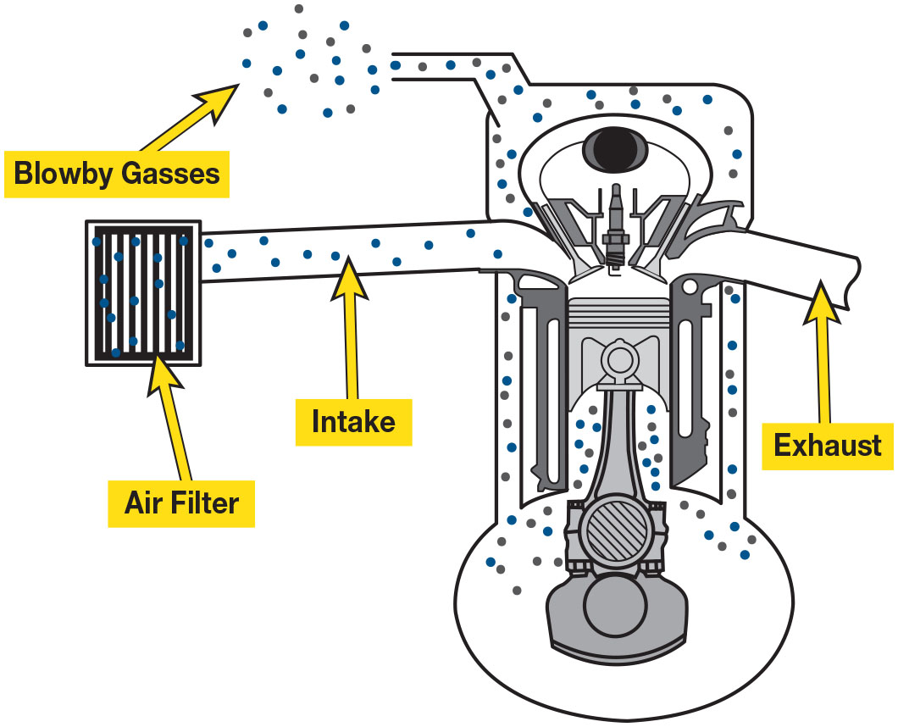
Figure 26.1
Blow-by Gases
Blow-by is created by combustion gases leaking past the piston rings. These gases are recirculated into the intake system through the positive crankcase ventilation (P C V) system. Excessive blow-by indicates worn piston rings.
Notes:
Long Description:
The intake and exhaust are on either side. The intake is connected to an air filter. Air from the air filter enters the system through the intake. The air mixed with combustion gases circulates the system. The blowby gases exit the system through an opening at the top.

Slide 8
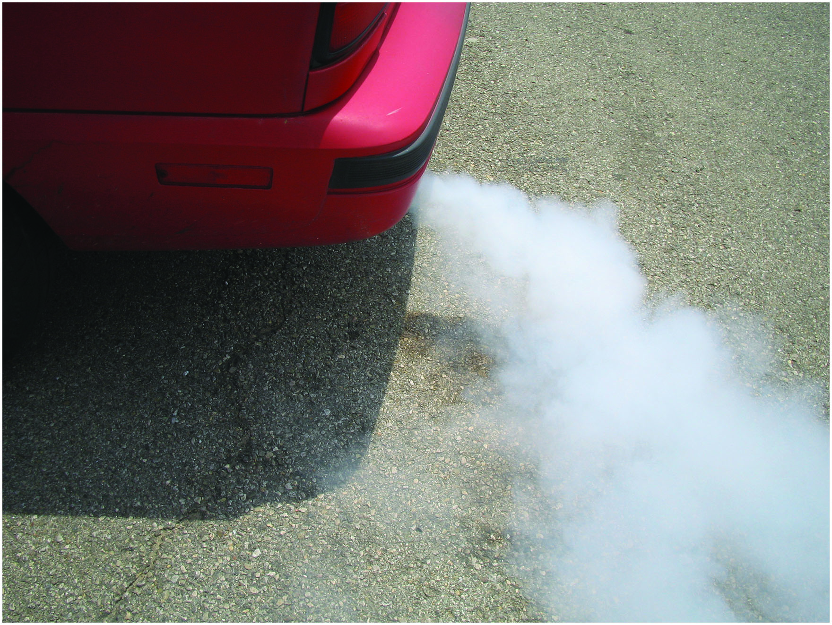
Figure 26.2
White Smoke
White steam is usually an indication of a blown (defective) cylinder head gasket that allows engine coolant to flow into the combustion chamber where it is turned into steam.
Notes:
TECH TIP: Your Nose Knows
Whenever diagnosing any vehicle, try to use all senses including smell. Some smells and their cause include
• Gasoline. If the exhaust smells like gasoline or unburned fuel, a fault with the ignition system is a likely cause. Unburned fuel due to lean air–fuel mixture, causing a lean misfire is also possible.
• Sweet smell. A coolant leak often gives off a sweet smell, especially if the leaking coolant flows onto the hot exhaust.
• Exhaust smell. Check for an exhaust leak, including a possible cracked exhaust manifold, which can be difficult to find because it often does not make noise.

Slide 9
Question 1
What does blue exhaust smoke indicate?

Slide 10
Answer 1
The engine has an oil consumption concern.

Slide 11
The Driver Is Your Best Resource
Ask the following questions:
When did the problem first occur?
Under what conditions does it occur?
Cold or hot?
Acceleration, cruise, or deceleration?
How far was it driven?
What recent repairs have been performed?

Slide 12
Visual Checks
Oil level and condition
Coolant level and condition
Oil leaks
Notes:
WARNING: Check the coolant level in the radiator only if the radiator is cool. If the radiator is hot and the radiator cap is removed, the drop in pressure above the coolant will cause the coolant to boil immediately and can cause severe burns when the coolant explosively expands upward and outward from the radiator opening.
TECH TIP: What’s Leaking?
The color of the leaks observed under a vehicle can help the technician determine and correct the cause. Some leaks, such as condensate (water) from the air- conditioning system, are normal, whereas a brake fluid leak is very dangerous. The following are colors of common leaks.
Color What’s Leaking
Sooty black: Engine Oil
Yellow, green, blue, or orange Antifreeze (coolant)
Red: Automatic transmission fluid
Murky brown: Brake or power steering fluid or very neglected antifreeze (coolant)
Clear: Air-conditioning condensate (water) (normal)

Slide 13
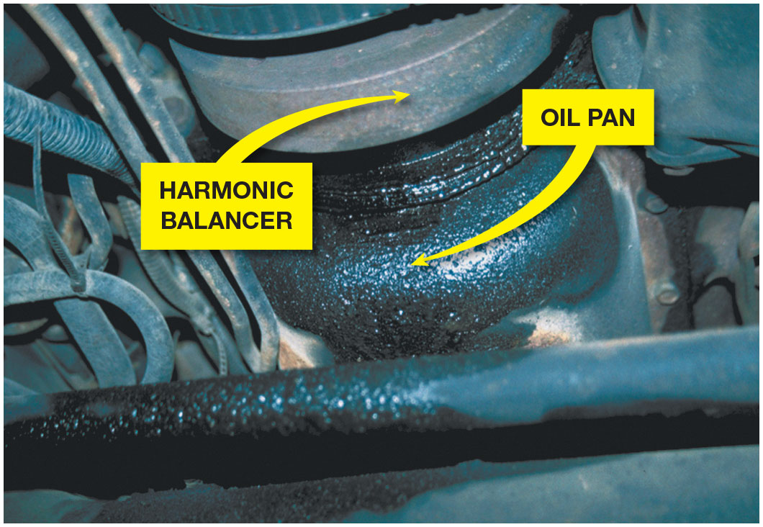
Figure 26.3
Oil Leaks
What looks like an oil pan gasket leak can be a rocker cover gasket leak. Always look for the highest and most forward place you see oil leaking; that should be repaired first.

Slide 14
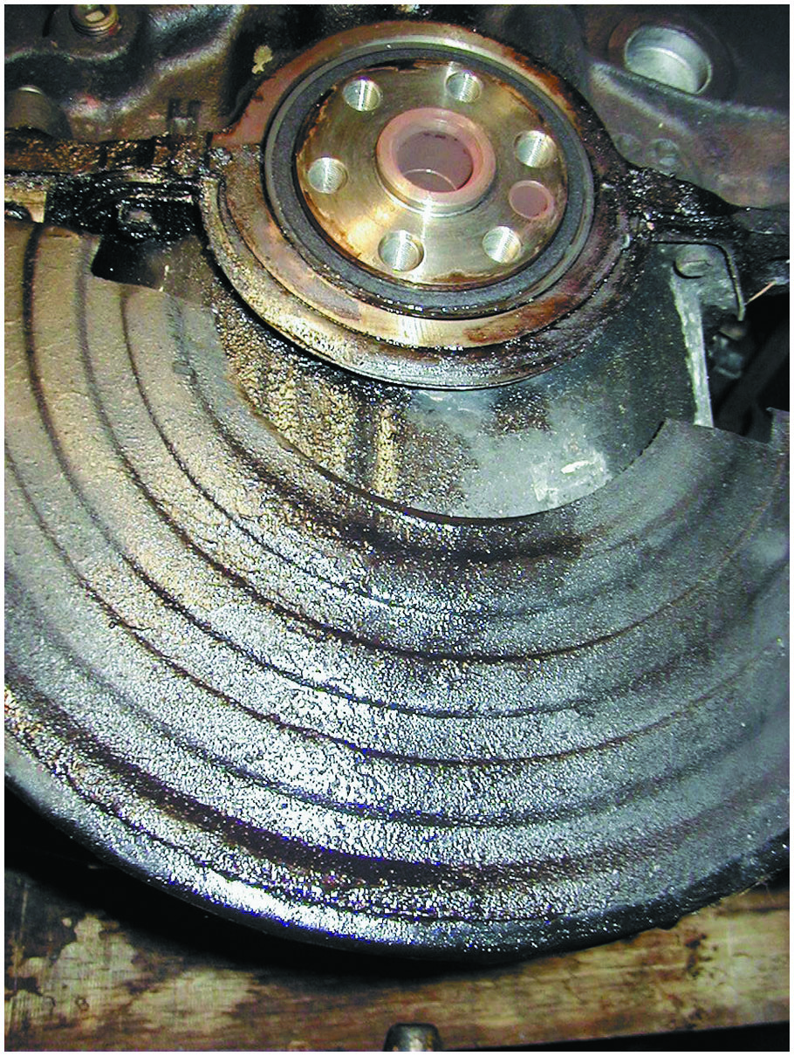
Figure 26.4
Oil Leak Checking
The transmission and flexplate (flywheel) were removed to check the exact location of this oil leak. The rear main seal and/or the oil pan gasket could be the cause of this leak.

Slide 15
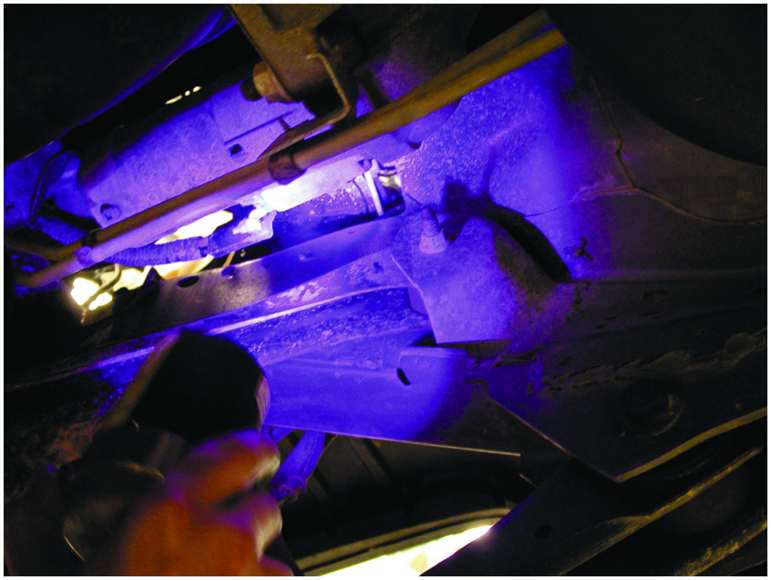
Figure 26.5
Black Light and Dye
Using a black light to spot leaks after adding dye to the oil.
Notes:
TECH TIP: The Foot Powder Spray Trick
The source of an oil or other fluid leak is often difficult to determine. A quick and easy method that works is the following. First, clean the entire area. This can best be done by using a commercially available degreaser to spray the entire area. Let it soak to loosen all accumulated oil and greasy dirt. Clean off the degreaser with a water hose. Let the area dry. Start the engine, and using spray foot powder or other aerosol powder product, spray the entire area. The leak will turn the white powder dark. The exact location of any leak can be quickly located.
NOTE: Most oil leaks appear at the bottom of the engine due to gravity. Look for the highest, most forward location for the source of the leak.

Slide 16
Engine Noise Diagnosis
Engine noises are often difficult to diagnose. Several items that can cause an engine noise include:
Valves clicking
Torque converter
Cracked flex plate
Loose or defective drive belts or tensioners
Piston pin knock
Timing chain noise
Rod or main bearing noise
Notes:
TECH TIP Engine Noise and Cost
A light ticking noise often heard at one-half engine speed and associated with valve train noise is a less serious problem than many deep-sounding knocking noises. Generally, the deeper the sound of the engine noise, the more the owner will have to pay for repairs. A light “tick tick tick,” though often not cheap, is usually far less expensive than a deep “knock knock knock” from the engine.

Slide 17
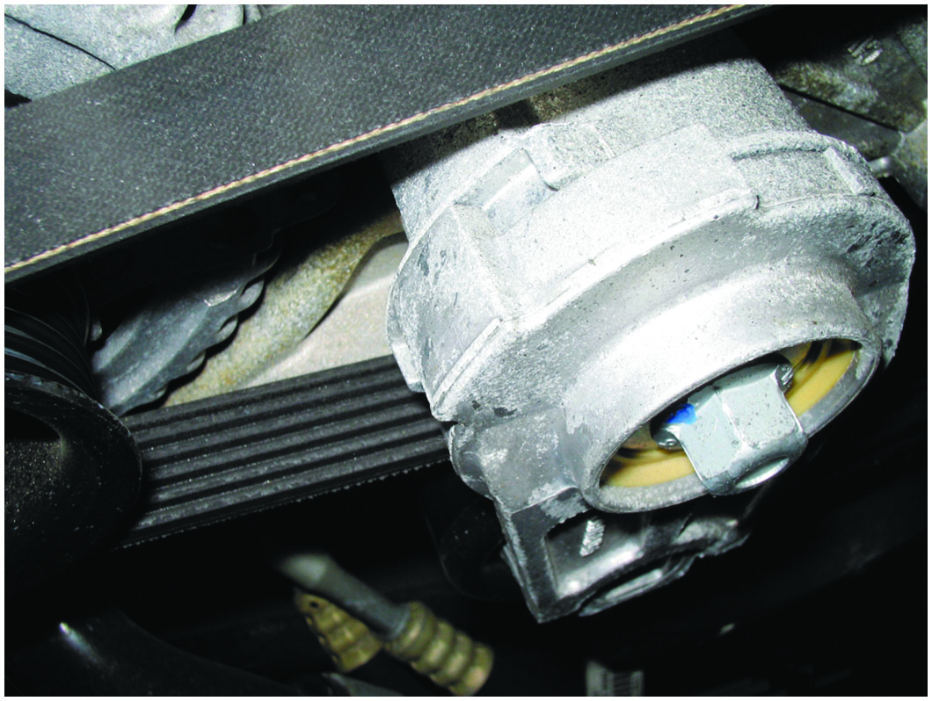
Figure 26.6
Belt Tensioner
An accessory belt tensioner. Anything wrong with the belt or tensioner can cause noise.

Slide 18
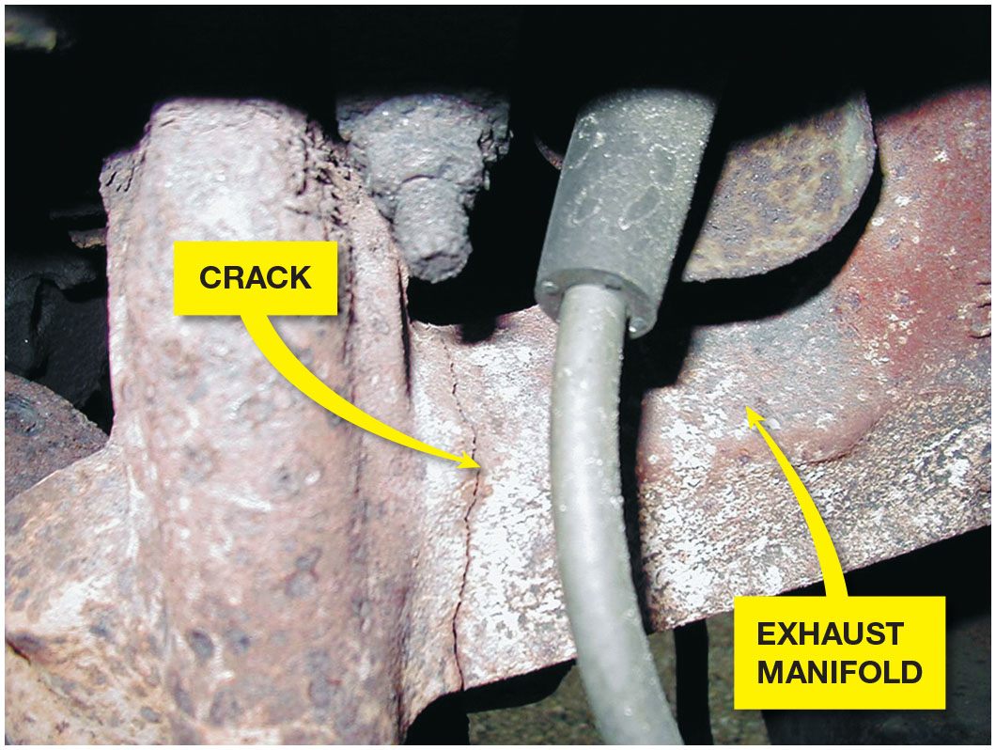
Figure 26.7
Cracked Exhaust
A cracked exhaust manifold on a Ford V-8.

Slide 19
Oil Pressure Testing
Proper oil pressure is very important for the operation of any engine.
Low oil pressure can cause engine wear, and engine wear can cause low oil pressure.
Other issues include:
Low oil level
Diluted oil
Stuck oil pressure relief valve
The oil pressure warning lamp will illuminate when pressures drop below 4–7 P S I.

Slide 20
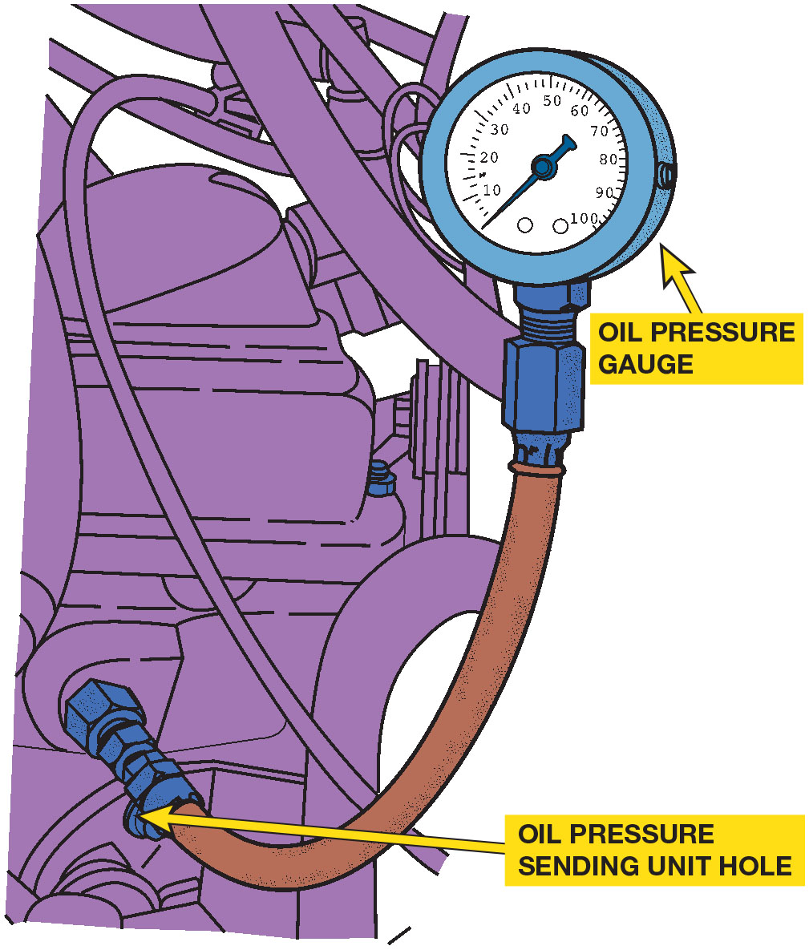
Figure 26.8
Oil Pressure Test
To measure engine oil pressure, remove the oil pressure sending (sender) unit usually located near the oil filter. Screw the pressure gauge into the oil pressure sending unit hole.

Slide 21
Animation: Oil Pressure Test

Slide 22
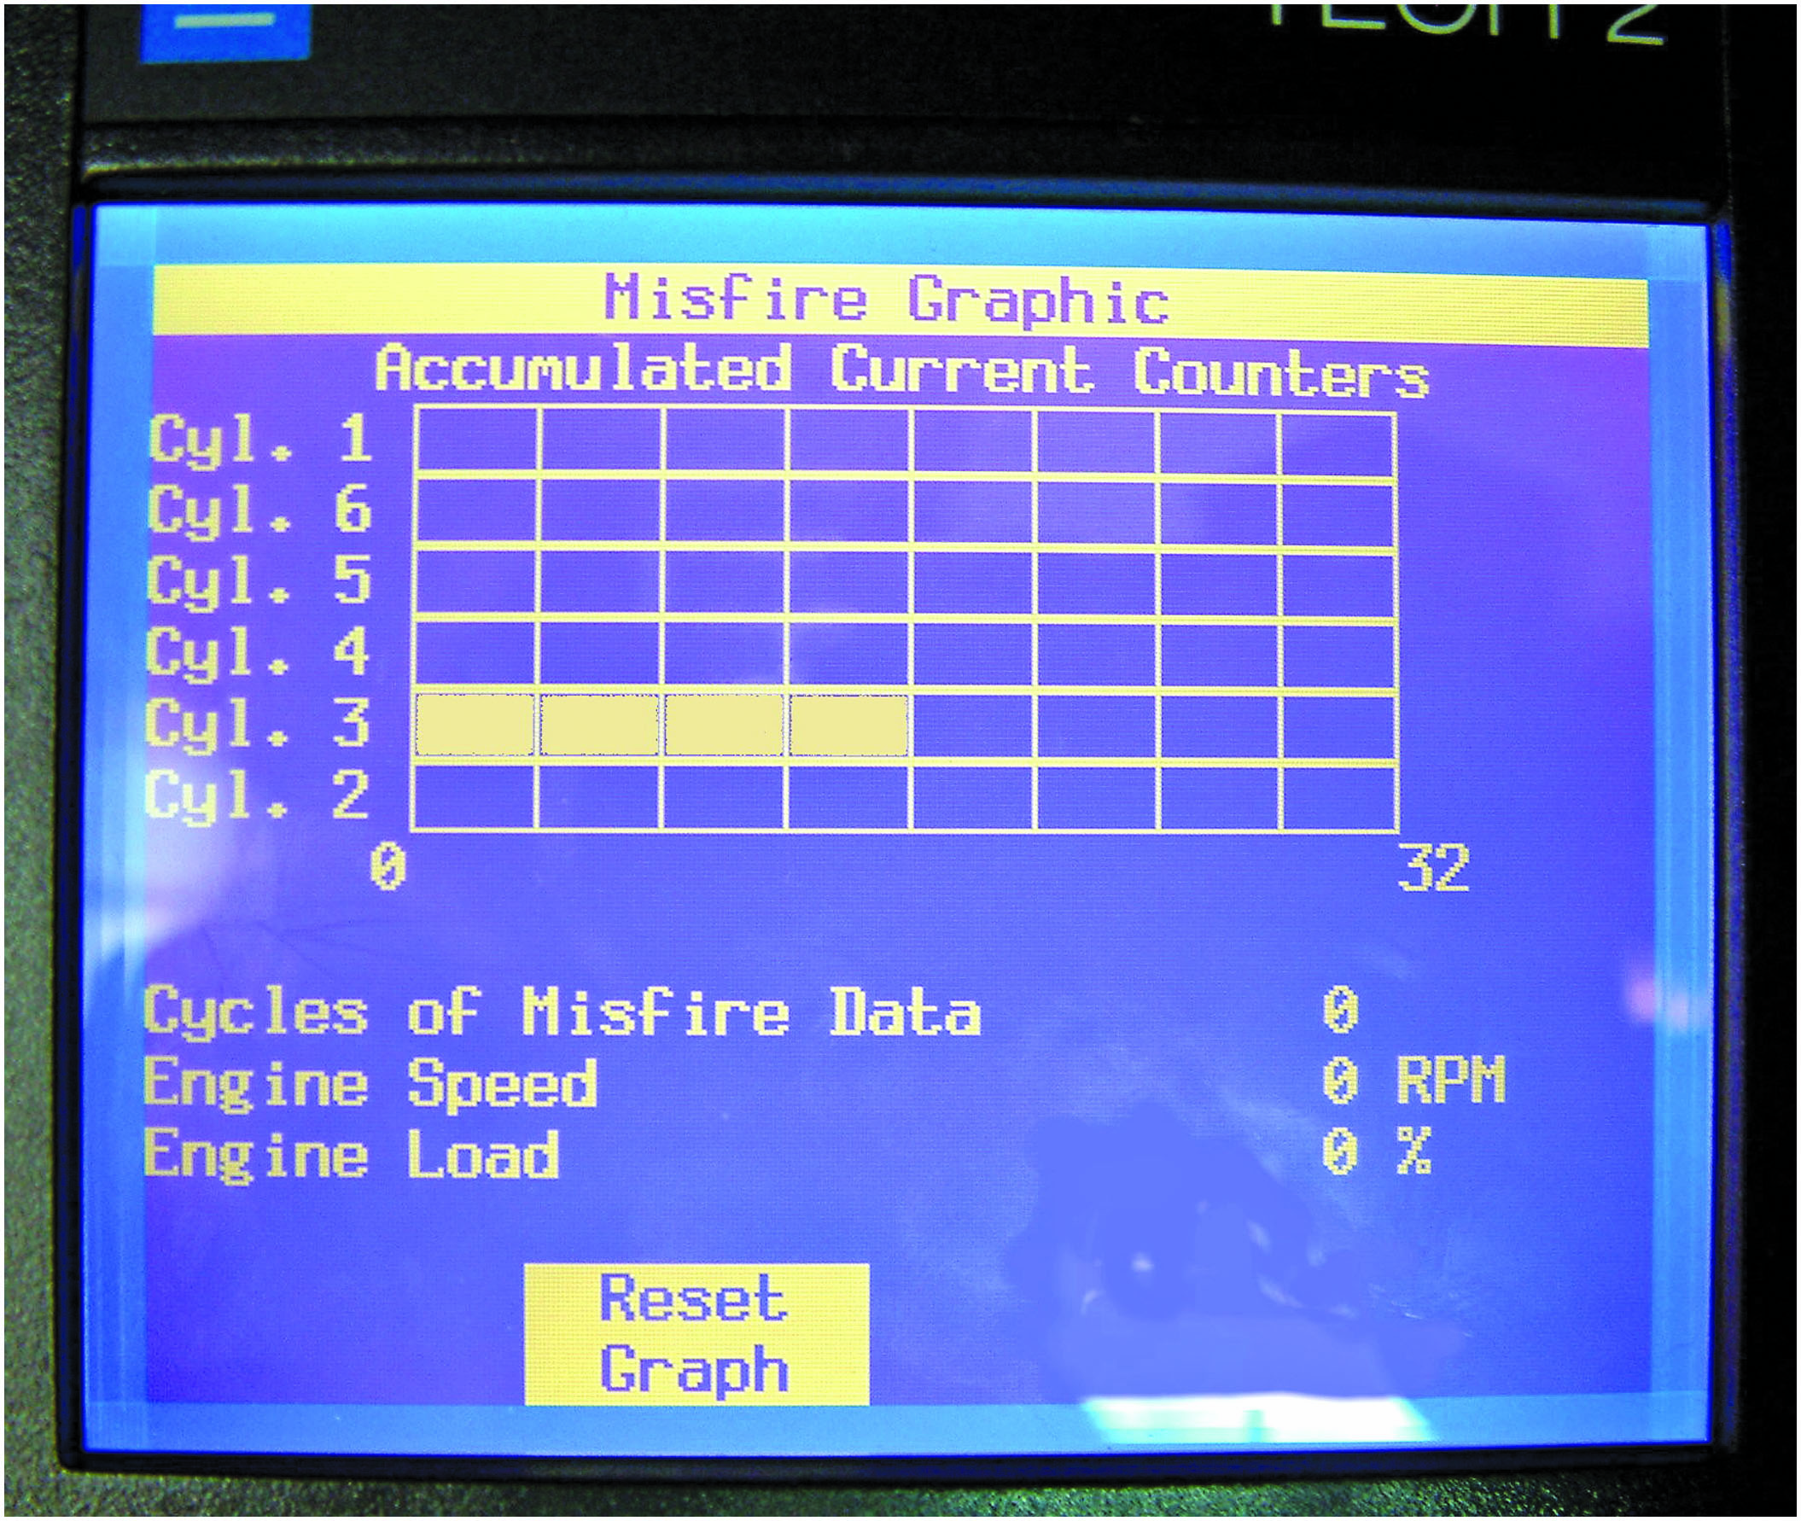
Figure 26.9
Scan Tool
A Tech 2 scan tool display showing a fault with cylinder 3. Once the cylinder has been identified, then more detailed tests can be performed to determine the root cause, which could be an ignition, fuel or mechanical issue.
Notes:
TECH TIP Use a Scan Tool to Check for Misfires
Many factory or factory-level scan tools can display cylinder misfire data. The wise service technician checks for misfire codes and misfire counter information using a scan tool before
checking the engine using labor intensive procedures, such as compression testing or cylinder leakage tests. These can be done on just the cylinder or cylinders that the P C M has detected as Being at fault. See Figure 26.9.

Slide 23
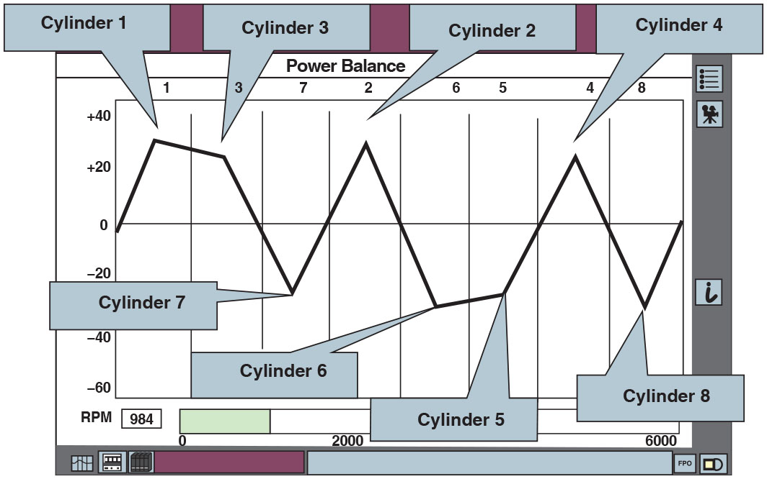
Figure 26.10
Ford Data
The Ford I D S scan tool has a graph function that allows the technician to view the data on the cylinder contribution test visually, making diagnosis easier. In this example, the
cylinders on bank 2 on a Ford
(cylinders 7, 6, 5, and 8)
are weak.
Notes:
Long Description:
A distorted triangular waveform is shown, with positive and negative peaks indicating different cylinders. The y-axis ranges from minus 60 to plus 40 in increments of 20. The graph is between negative 40 and positive 30. Positive peak 1 is labeled cylinder 1, positive low peak 1 is labeled cylinder 3, negative peak 1 is labeled cylinder 7, positive peak 2 is labeled cylinder 2, negative peak 2 is labeled cylinder 6, negative high peak 2 is labeled cylinder 5, positive peak 3 is labeled cylinder 4, and negative peak 3 is labeled cylinder 8.

Slide 24
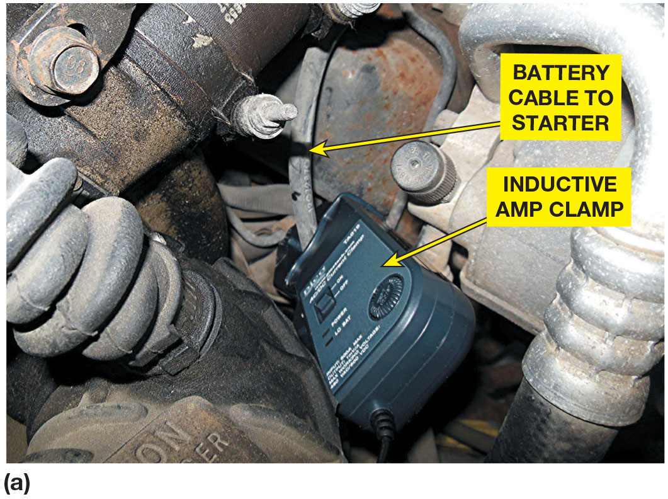
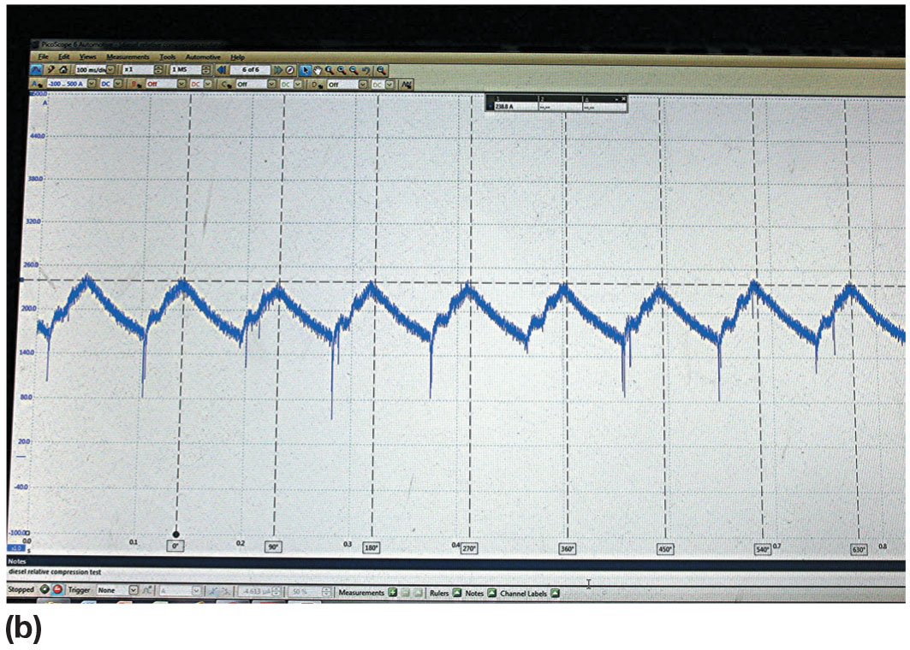
Figure 26.11
Relative Compression
(a) A relative compression test using an amp clamp around the starter motor power cable and a Pico scope. (b) The result is a waveform that displays the current needed for each cylinder under compression. This test indicates that all cylinders are requiring the same current to rotate the starter motor which indicates that all cylinders have the same relative compression.

Slide 25
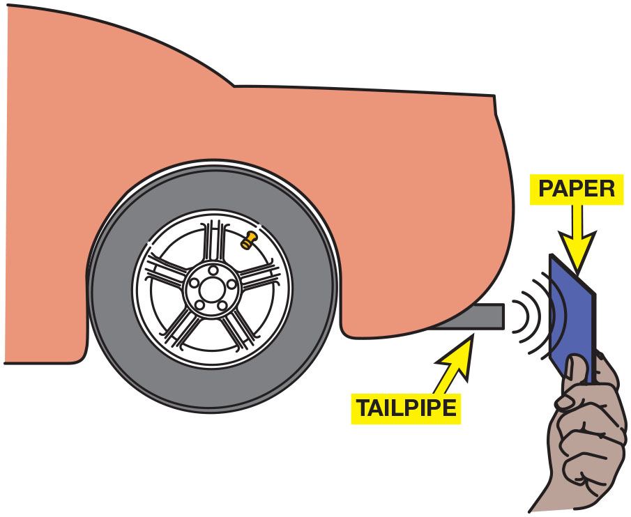
Figure 26.12
Paper Test
The paper test involves holding a piece of paper near the tailpipe of an idling engine. A good engine should produce even, outward puffs of exhaust. If the paper is sucked in toward the tailpipe, a burned valve is a possibility.
Notes:
TECH TIP: The Paper Test
A soundly running engine should produce even and steady exhaust at the tailpipe. You can test this with the paper test. Hold a piece of paper or a 3" × 5" index card (even a dollar bill works)
within 1 inch (25 m m) of the tailpipe with the engine running at idle.● See Figure 23.12.
The paper should blow out evenly without “puffing.” If the paper is drawn toward the tailpipe at times, the exhaust valves in one or more cylinders could be burned. Other reasons why the paper might be sucked toward the tailpipe include the following:
1. The engine could be misfiring because of a lean condition that could occur normally when the engine is cold.
2. Pulsing of the paper toward the tailpipe could also be caused by a hole in the exhaust system. If exhaust escapes through a hole in the exhaust system, air could be drawn in during the intervals
between the exhaust puffs from the tailpipe to the hole in the exhaust, causing the paper to be drawn toward the tailpipe.
3. Ignition fault causing misfire.

Slide 26
Compression Test (1 of 2)
Cranking compression test
Dry
Wet
Running (dynamic) compression test
Relative compression test
Cylinder leakage test

Slide 27
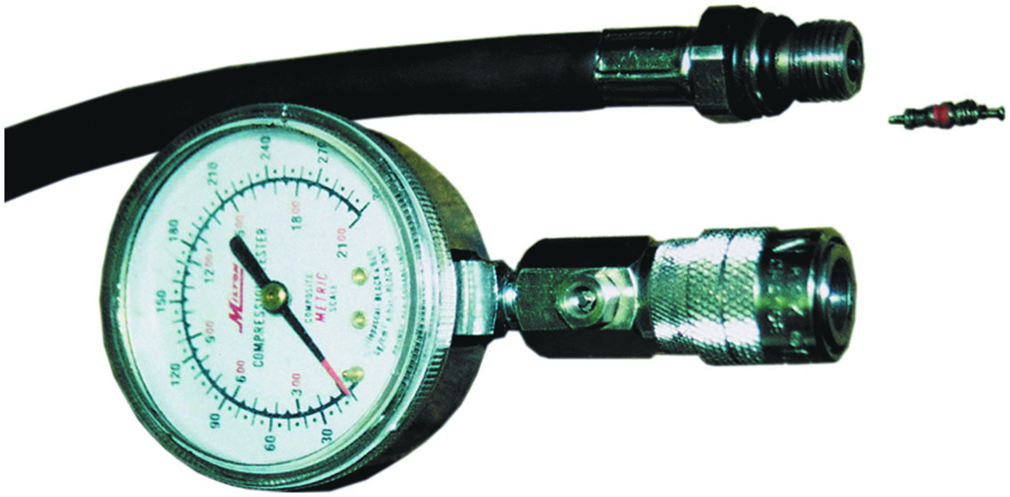
Figure 26.13
Compression Gauge
A two-piece compression gauge set. The threaded hose is screwed into the spark plug hole after removing the spark plug. The gauge part is then snapped onto the end of the hose.

Slide 28
Animation: Relative Compression with Vacuum Test

Slide 29
Animation: Relative Cranking Compression Test

Slide 30
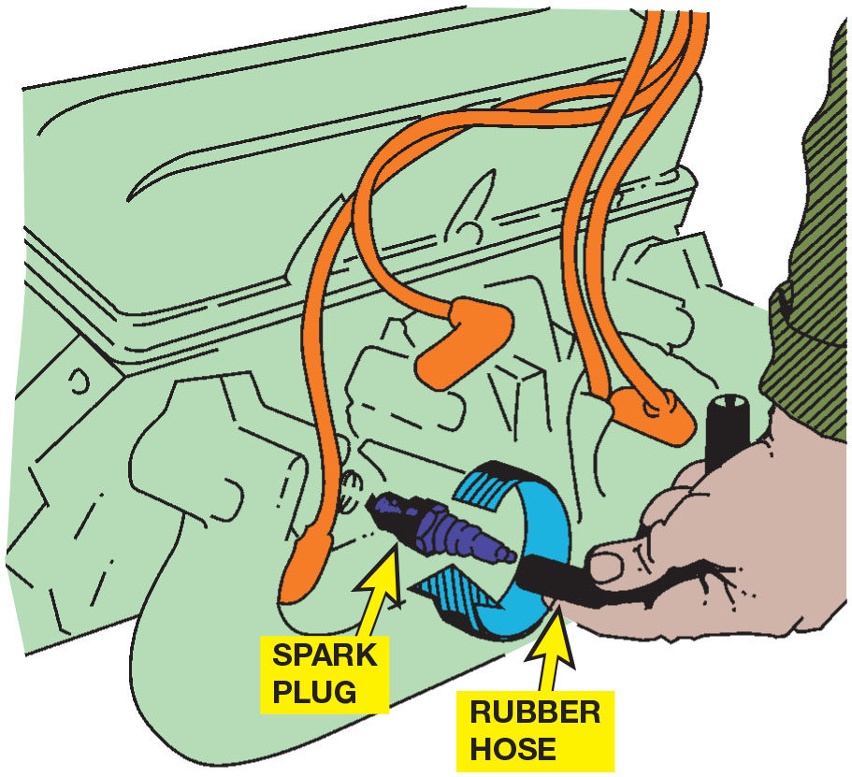
Figure 26.14
Installing Plugs
Use a vacuum or fuel line hose over the spark plug to install it without danger of cross-threading the cylinder head.
Notes:
TECH TIP: The Hose Trick
Installing spark plugs can be made easier by using a rubber hose on the end of the spark plug. The hose can be a vacuum hose, fuel line, or even an old spark plug wire end. ● See Figure 26.14.
The hose makes it easy to start the threads of the spark plug into the cylinder head. After
starting the threads, continue to thread the spark plug for several turns. Using the hose
eliminates the chance of cross threading the plug. This is especially important when installing
spark plugs in aluminum cylinder heads.

Slide 31
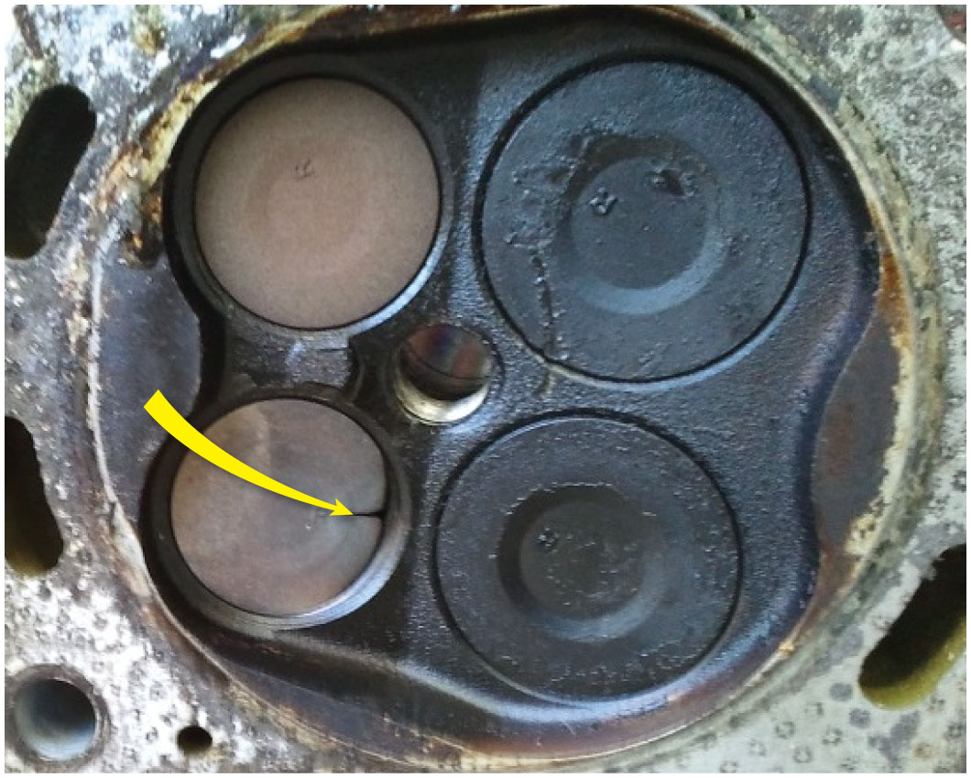
Figure 26.15
Burnt Exhaust Valve
Badly burned exhaust valve. A compression test could have detected a problem, and a cylinder leakage test (leak down test) could have been used to determine the exact problem.

Slide 32
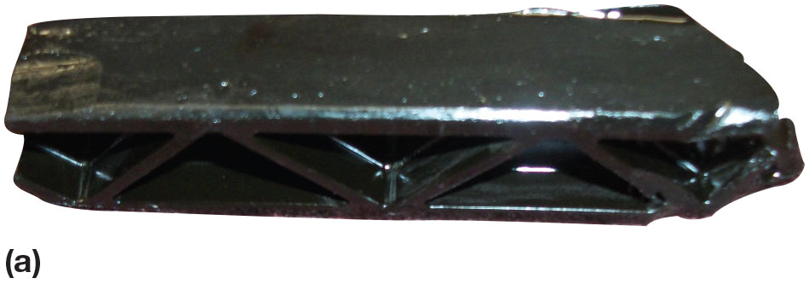
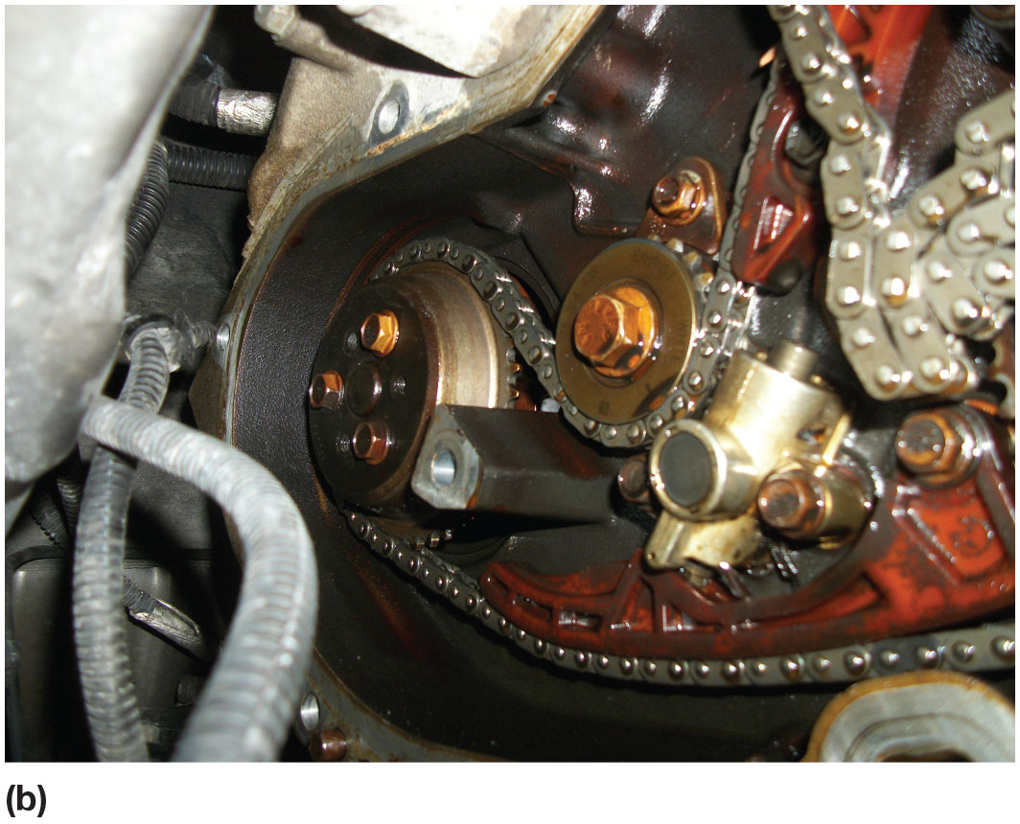
Figure 26.16
Case Study
(a) The broken guide caused the chain to fall off of the crankshaft sprocket. (b) A new timing chain and guide was needed to fix this engine.
Notes:
CASE STUDY: The Case of the Chevrolet Equinox 2.4L
A Chevrolet Equinox equipped with a 2.4-liter four- cylinder engine was towed to shop because it would not start. The technician verified that the engine would crank very rapidly and would not start. Because of the rapid cranking speed, the technician thought that the engine did not have any compression. The technician performed a compression test and discovered that all cylinders had very low compression. The technician then checked for cam rotation and it was found not to be turning when the engine was cranked. When the front cover was removed, it was observed that
The smaller cam chain guide had broken and the chain had fallen off the sprockets. ● See Figure 26.16(a).
The timing chain and guides were replaced and the engine checked for interference between the pistons and valves. No damage to valves this time. See Figure 26.16(b).
Summary:
Complaint—Customer complained that the engine would not start.
Cause—The smaller cam chain guide had broken and the chain fell off the sprockets.
Correction—Replaced the timing chain and guides and checked for interference between the pistons and valves. No damage was done to the valves this time.

Slide 33
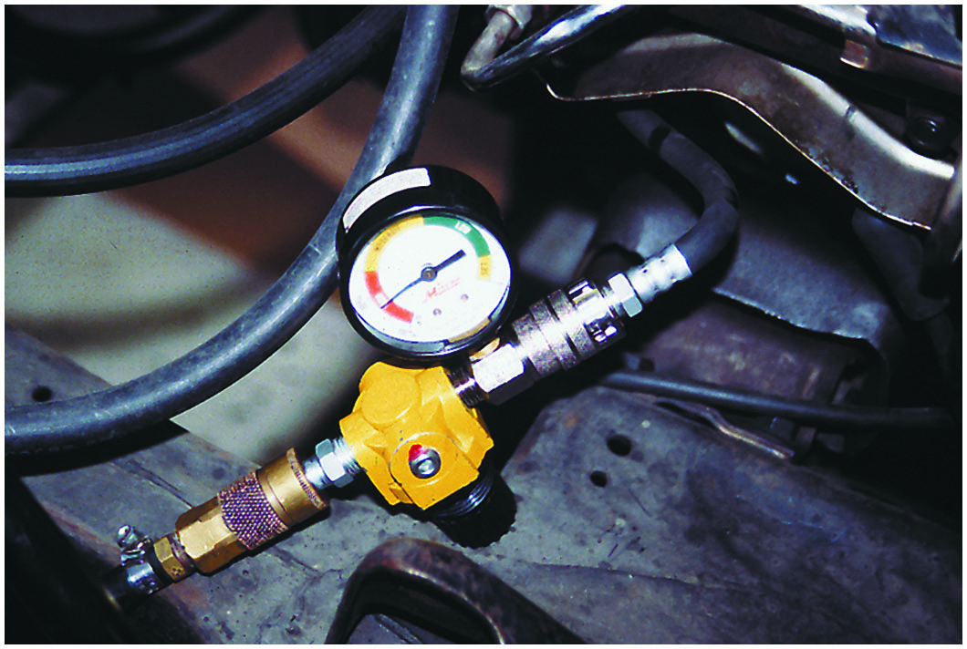
Figure 26.17
Leakage Tester
A typical handheld cylinder leakage tester.

Slide 34
Animation: Cylinder Leakage Test

Slide 35
Figure 26.18
Compression Whistle
A whistle stop used to find top dead center. Remove the spark plug and install the whistle stop, then rotate the engine by hand. When the whistle stops making a sound, the piston is at the top.

Slide 36
Question 2
What are the three types of compression test?

Slide 37
Answer 2
Cranking, running, and relative compression tests.

Slide 38
Cylinder Power Balance Test
The purpose of a cylinder power balance test is to determine if all cylinders are contributing power equally.
The acceptable method of canceling cylinders, which will work on all types of ignition systems, including distributorless, is to ground the secondary current for each cylinder.

Slide 39
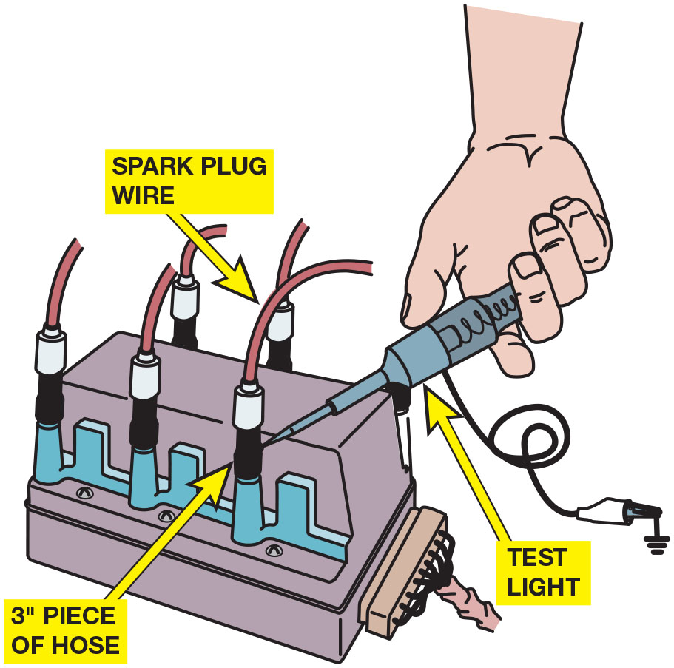
Figure 26.19
Cylinder Balance
Using short lengths of vacuum hose and a test light to ground one cylinder at a time on a distributorless ignition system. This works on all types of ignition systems and provides a method for grounding out one cylinder at a time without fear of damaging any component. To avoid possible damage to the catalytic converter, do not short out a cylinder for longer than five seconds. Use a standard light bulb-type test light. An electronic test light will be destroyed by the high voltage.

Slide 40
Vacuum Tests
Vacuum is pressure below atmospheric pressure and is measured in inches (or millimeters) of mercury (H g).
Cranking Vacuum Test
Idle Vacuum Test
Low and Steady Vacuum
Fluctuating Vacuum

Slide 41
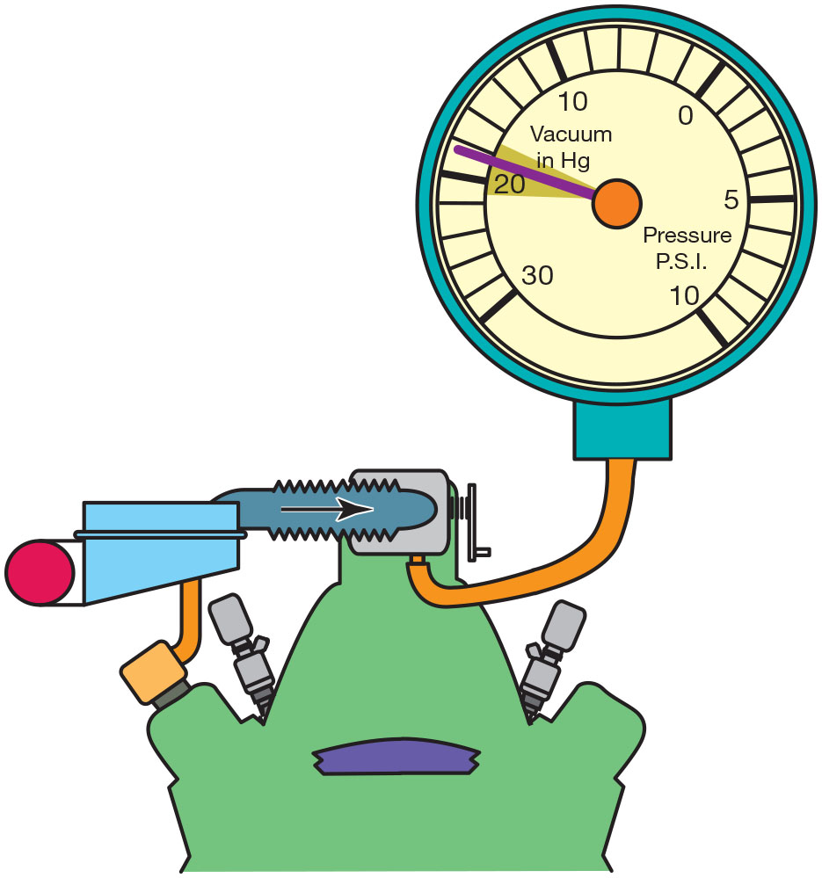
Figure 26.20
Good Engine
An engine in good mechanical condition should produce 17 to 21 inch H g of vacuum at idle at sea level.

Slide 42
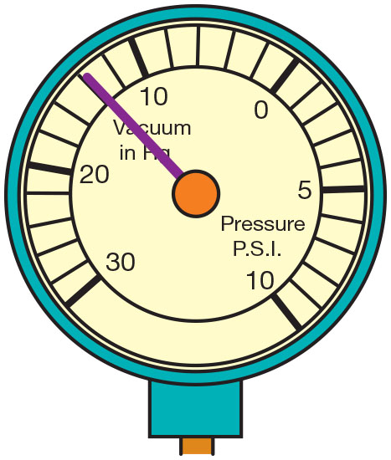
Figure 26.21
Steady Reading
A steady but low reading could indicate retarded valve or ignition timing.

Slide 43
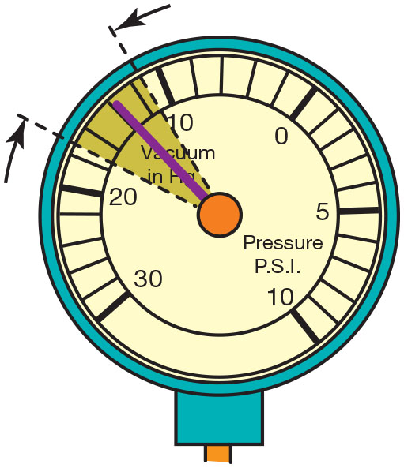
Figure 26.22
Vacuum Leak
A gauge reading with the needle fluctuating 3 to 9 H g below normal often indicates a vacuum leak in the intake system.

Slide 44
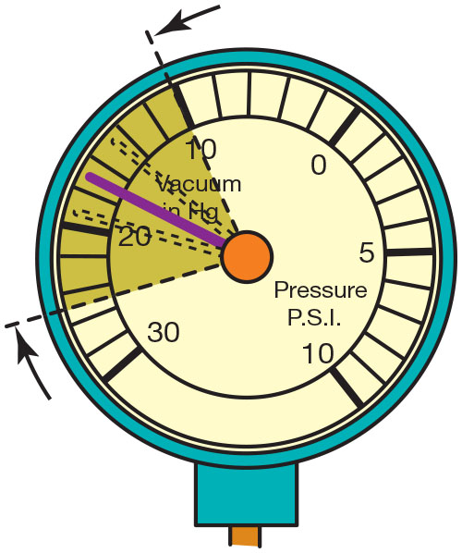
Figure 26.23
Leaking Head Gasket
A leaking head gasket can cause the needle to vibrate as it moves through a range from below to above normal.

Slide 45
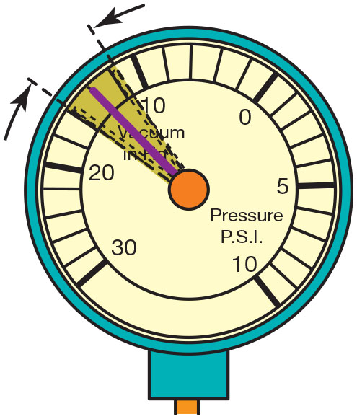
Figure 26.24
Incorrect Air–Fuel Mixture
An oscillating needle 1 or 2 inch Hg below normal could indicate an incorrect air–fuel mixture (either too rich or too lean).

Slide 46
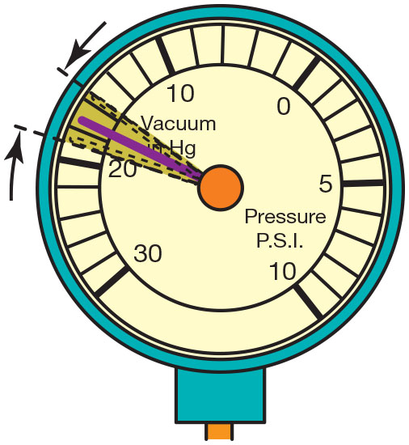
Figure 26.25
Worn Valve Guides
A rapidly vibrating needle at idle that becomes steady as engine speed is increased indicates worn valve guides.

Slide 47
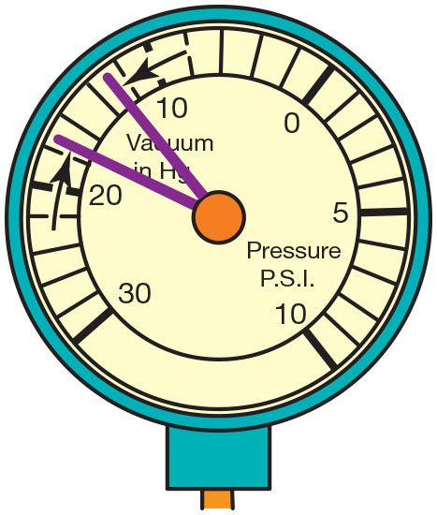
Figure 26.26
Burned Valve
If the needle drops 1 or 2 inch H g from the normal reading, one of the engine valves is burned or not seating properly.

Slide 48
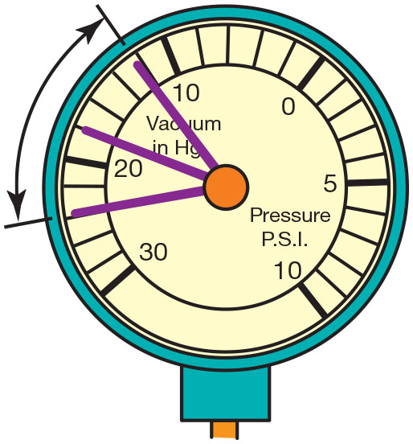
Figure 26.27
Weak Valve Springs
Weak valve springs will produce a normal reading at idle, but as engine speed increases, the needle will fluctuate rapidly between 12 and 24 inch H g.

Slide 49
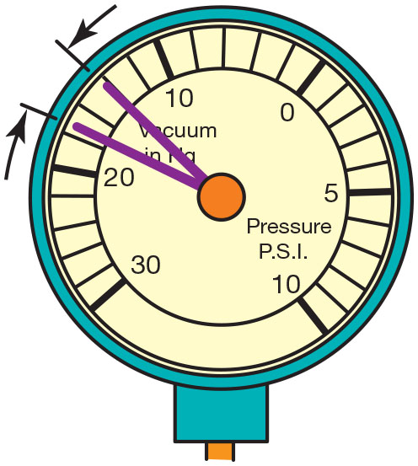
Figure 26.28
Retarded Ignition
A steady needle reading that drops 2 or 3 inch H g when the engine speed is increased slightly above idle indicates that the ignition timing is retarded.

Slide 50
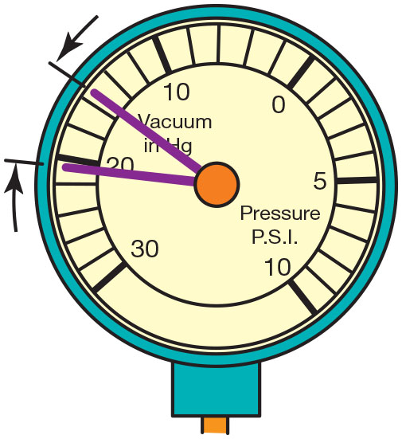
Figure 26.29
Advanced Ignition
A steady needle reading that rises 2 or 3 inch H g when the engine speed is increased slightly above idle indicates that the ignition timing is advanced.

Slide 51
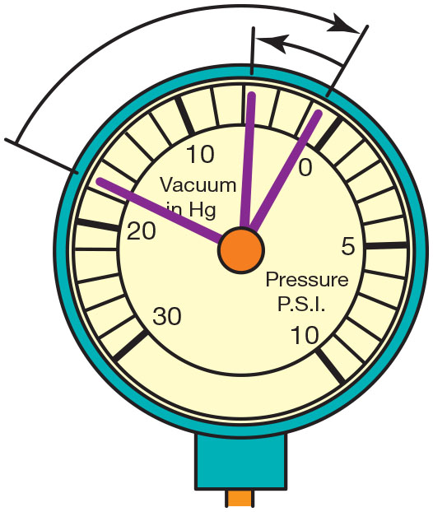
Figure 26.30
Exhaust Restriction
A needle that drops to near zero when the engine is accelerated rapidly and then rises slightly to a reading below normal indicates an exhaust restriction.

Slide 52
Question 3
What does a fluctuating vacuum gauge indicate?

Slide 53
Answer 3
A vacuum leak in the intake system.

Slide 54
Exhaust Restriction Test
Common causes of restricted exhaust include:
Clogged catalytic converter
Clogged or restricted muffler
Damaged or defective piping
Test back pressure:
With a vacuum gauge
With a pressure gauge

Slide 55
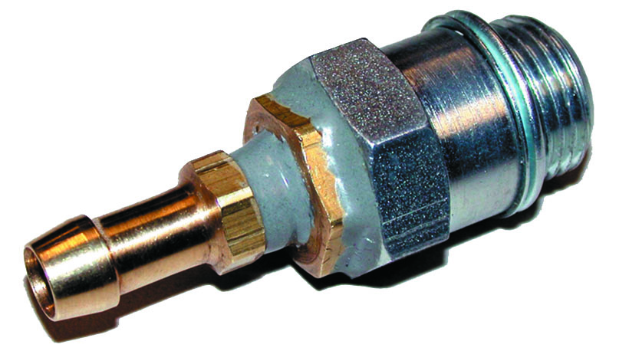
Figure 26.31
Testing Back Pressure
A technician-made adapter used to test exhaust system back pressure.

Slide 56
Animation: Exhaust Back-Pressure, Measure

Slide 57
Diagnosing Head Gasket Failure
Items can be used to help diagnose a head gasket failure.
Exhaust gas analyzer
Chemical test
Bubbles in coolant
Excessive exhaust steam

Slide 58
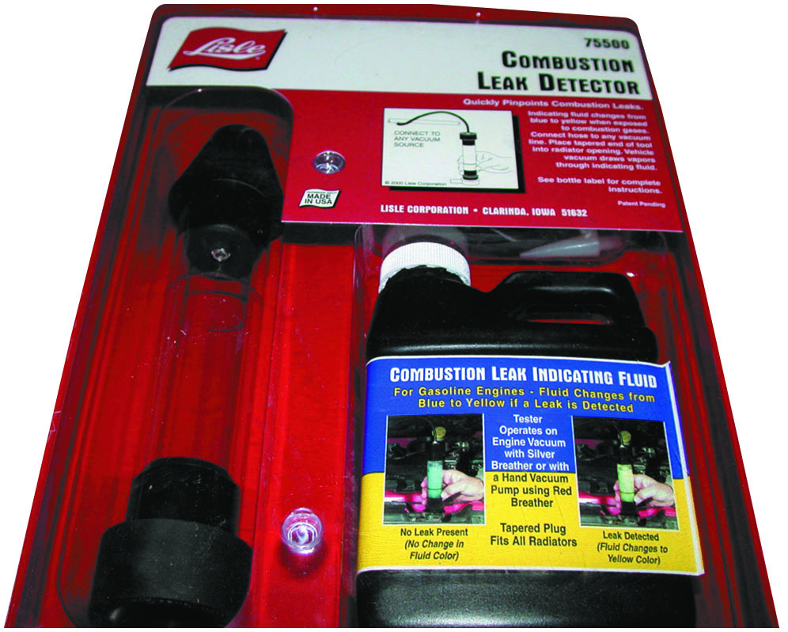
Figure 26.32
Blue Liquid
A tester that uses a blue liquid to check for exhaust gases in the exhaust, which would indicate a head gasket leak problem.

Slide 59
Figure 26.33
Warning Lights
Red dash symbols are used to warn the driver of a fault requiring immediate action.
Notes:
Most vehicles are equipped with several dash warning lights often called “telltale” lights. These lights are often the only warning a driver receives that there may be engine problems.
Long Description:
The following symbols are depicted. 1. Air suspension warning. 2. Airbag warning. 3. Battery or alternator warning. 4. Brake fluid low. 5. Brake warning. 6. Catalytic converter warning. 7. Chassis system warning. 8. Distance warning. 9. Drivetrain trouble indicator. 10. Electronic throttle control. 11. Engine fault stop. 12. Handbrake warning. 13. Hydraulic brake fault. 14. Ignition switch warning. 15. Key fob battery low. 16. Low coolant level warning. 17. Master warning. 18. Mechanical fault warning. 19. Night vision warning. 20. Oil level low. 21. Oil pressure low. 22. Parking brake light. 23. Pedestrian warning. 24. Power steering warning. 25. Seat belt not on. 26. Steering lock warning. 27. Suspension fault detected. 28. Temperature warning. 29. Theft deterrent fault. 30. Trailer tow hitch warning. 31. Transmission fault do not shift. 32. Transmission fluid t e m p warning.

Slide 60
Compression Test Step by Step

Slide 61
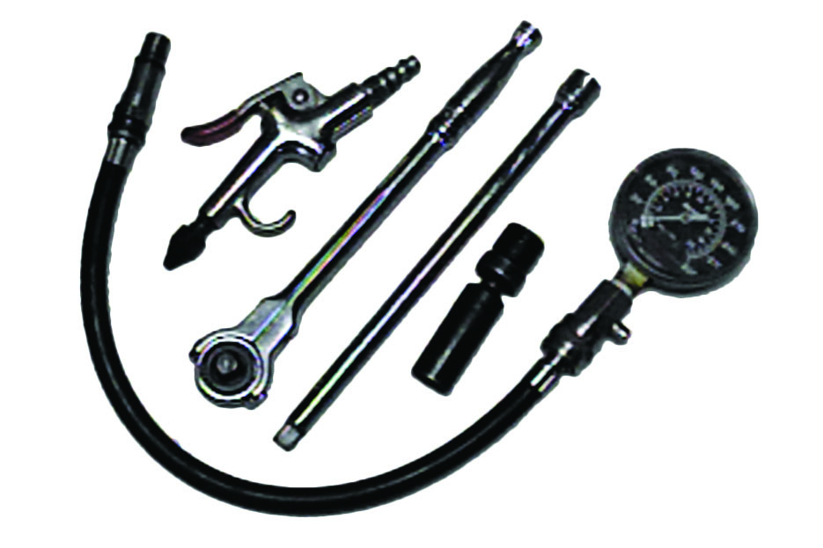
Compression Testing Tools
Notes:
1. The tools and equipment needed to perform a compression test include a compression gauge, an air nozzle, and the socket ratchets and extensions that may be necessary to remove the spark plugs from the engine

Slide 62
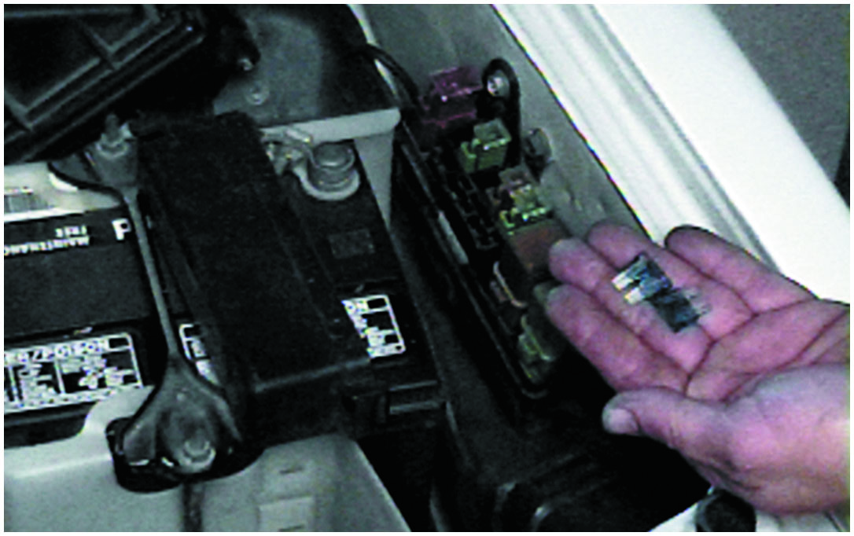
Disable Fuel and Ignition System
Notes:
2. To prevent ignition and fuel-injection operation while the engine is being cranked, remove both the fuel injection fuse and the ignition fuse

Slide 63
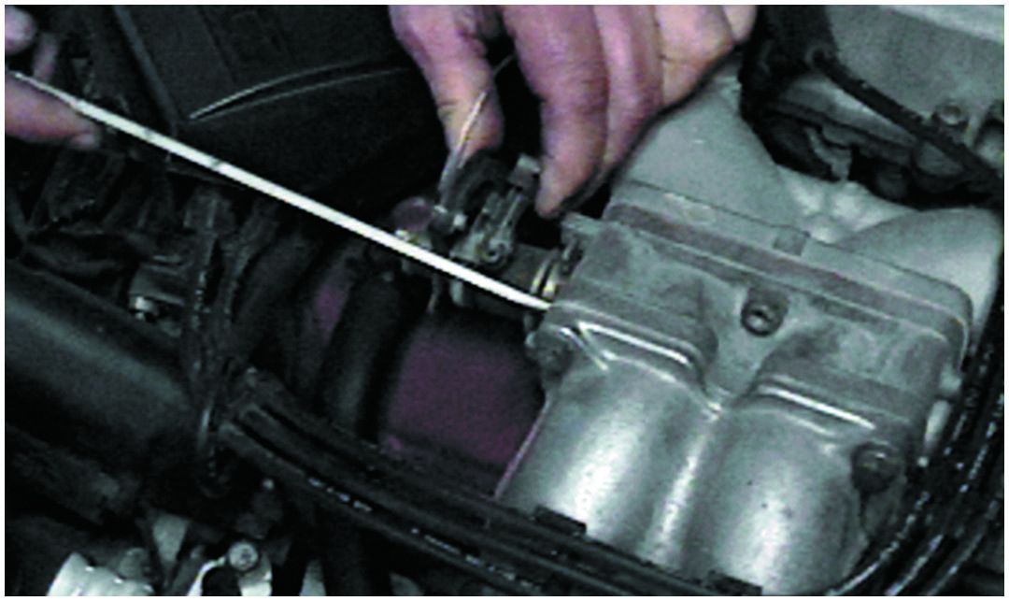
Block Open Throttle
Notes:
3. Block open the throttle (and choke, if the engine is equipped with a carburetor). Keeping the throttle open ensures that enough air will be drawn into the engine so that the compression test results will be accurate

Slide 64
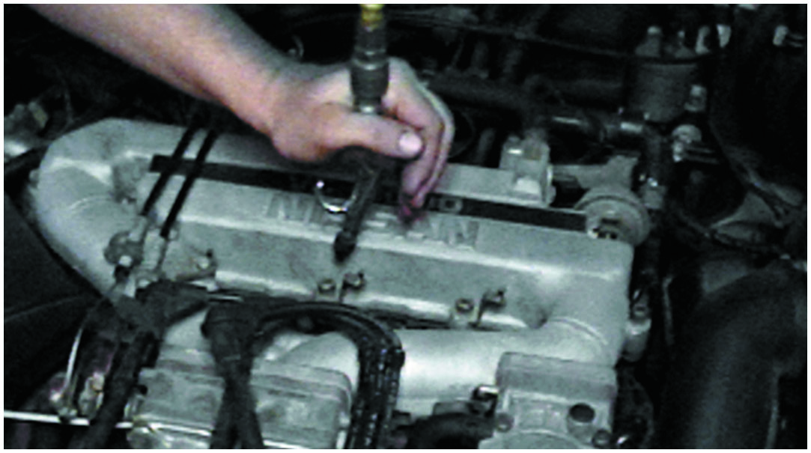
Blow Away Any Dirt
Notes:
4. Before removing the spark plugs, use an air nozzle to blow away any dirt that may be around the spark plug

Slide 65
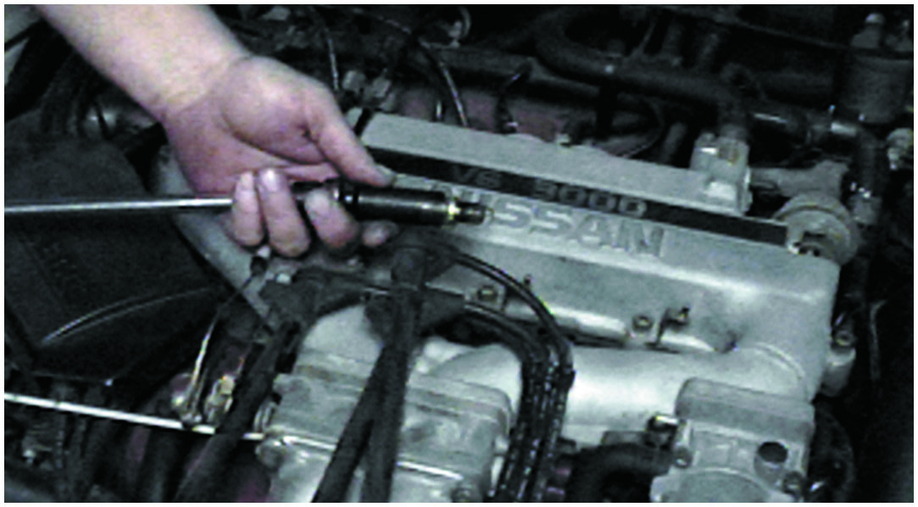
Remove All Spark Plugs
Notes:
5. Remove all of the spark plugs. Be sure to mark the spark plug wires so that they can be reinstalled onto the correct spark plugs after the compression test has been performed

Slide 66
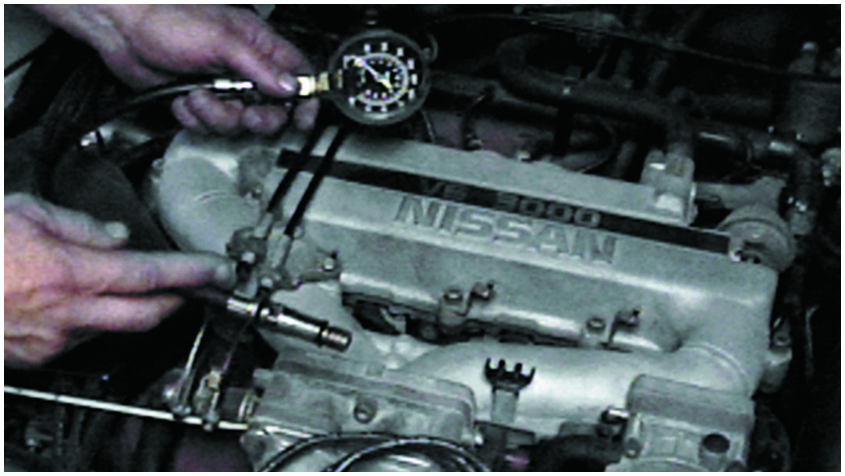
Select Correct Adapter
Notes:
6. Select the proper adapter for the compression gauge. The threads on the adapter should match those on the spark plug

Slide 67
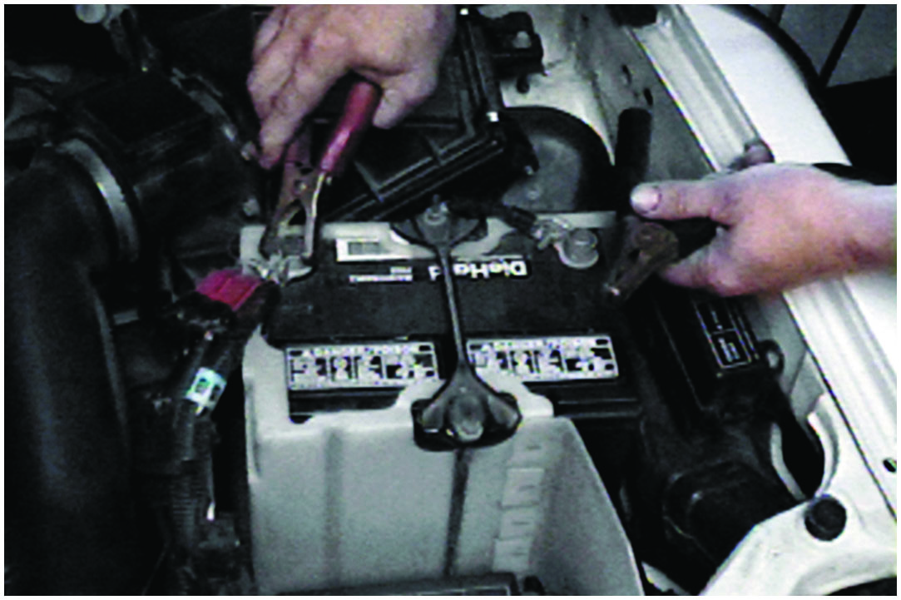
Connect Battery Charger
Notes:
7. If necessary, connect a battery charger to the battery before starting the compression test. It is important that consistent cranking speed be available for each cylinder being tested

Slide 68
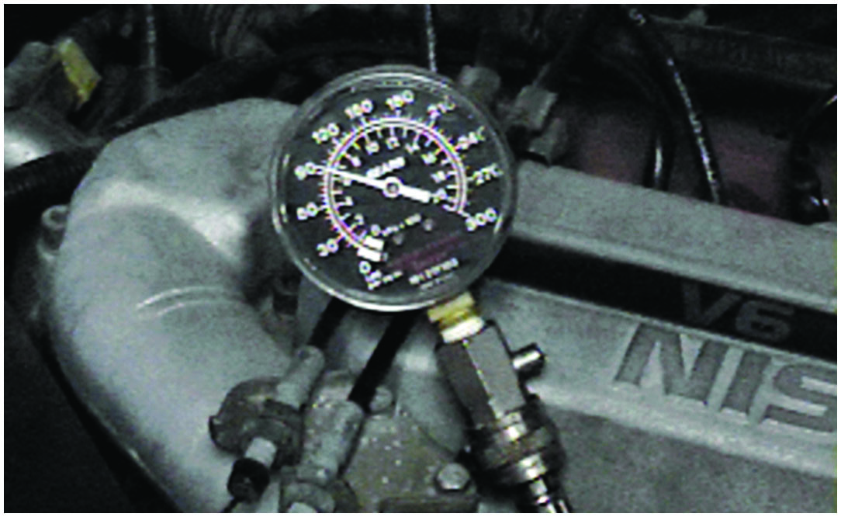
Note Reading After First Puff
Notes:
8. Make a note of the reading on the gauge after the first “puff,” which indicates the first compression stroke that occurred on that cylinder as the engine was being rotated

Slide 69
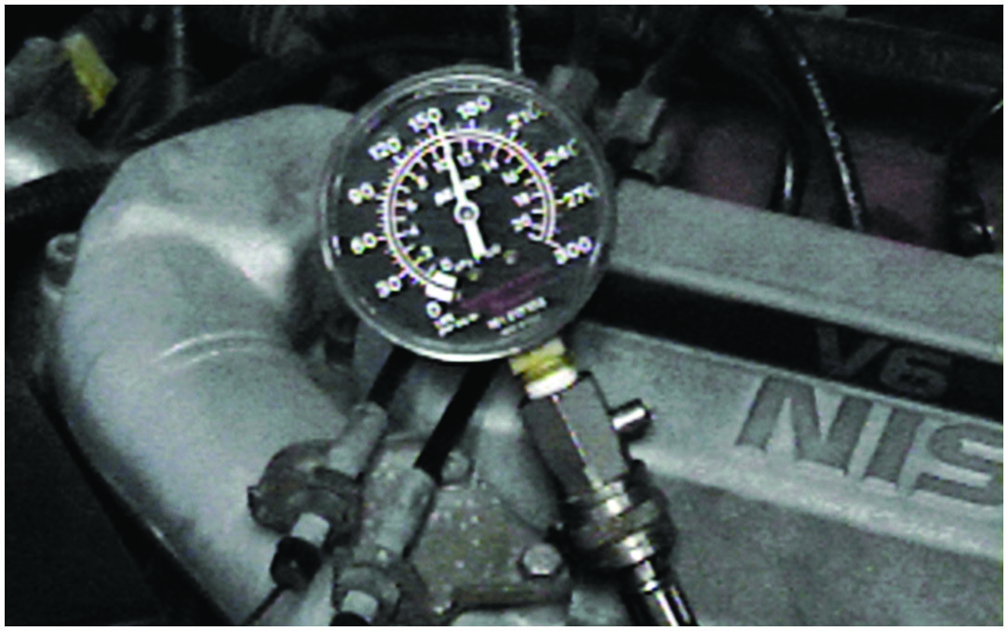
Stop Cranking After Four Puffs
Notes:
9. After the engine has been cranked for four “puffs,” stop cranking the engine and observe the compression gauge

Slide 70
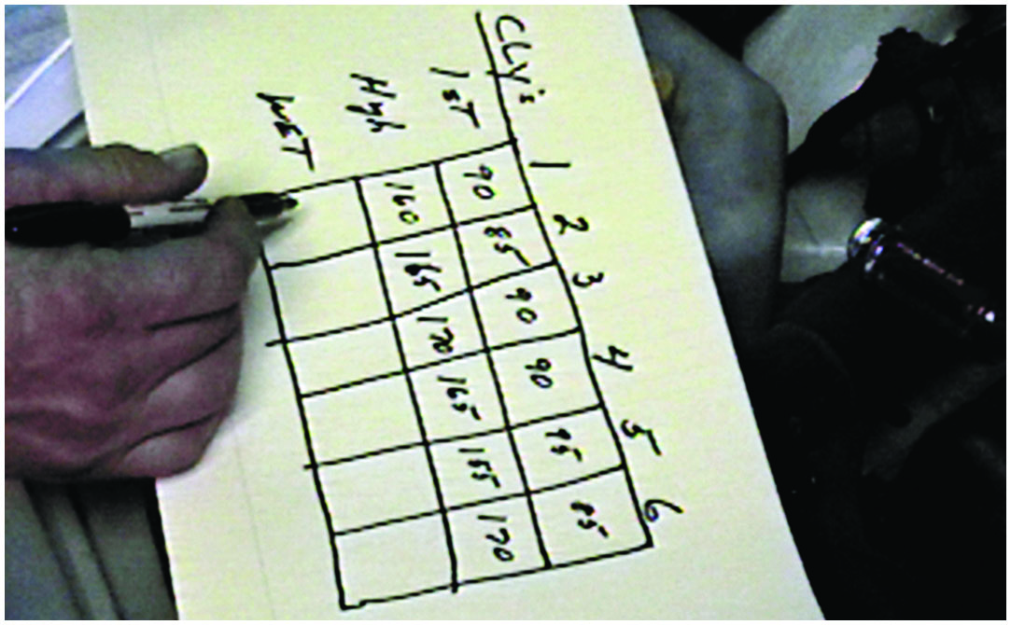
Record First Puff and Final Reading
Notes:
10. Record the first puff and this final reading for each cylinder. The final readings should all be within 20% of each other

Slide 71
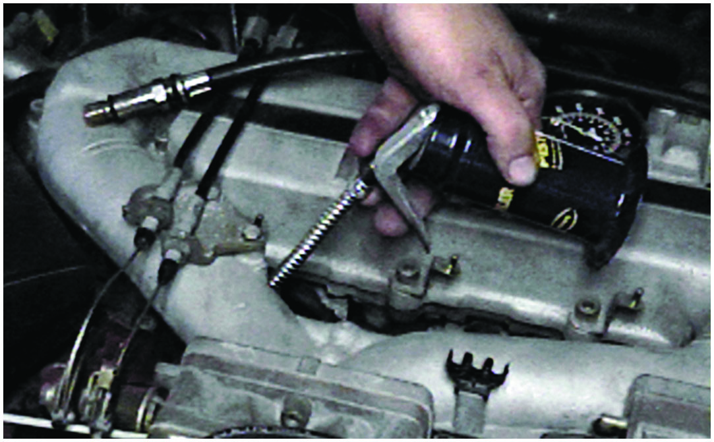
Squirt Two Squirts of Engine Oil
Notes:
11. If a cylinder(s) is lower than most of the others, use an oil can and squirt two squirts of engine oil into the cylinder and repeat the compression test

Slide 72
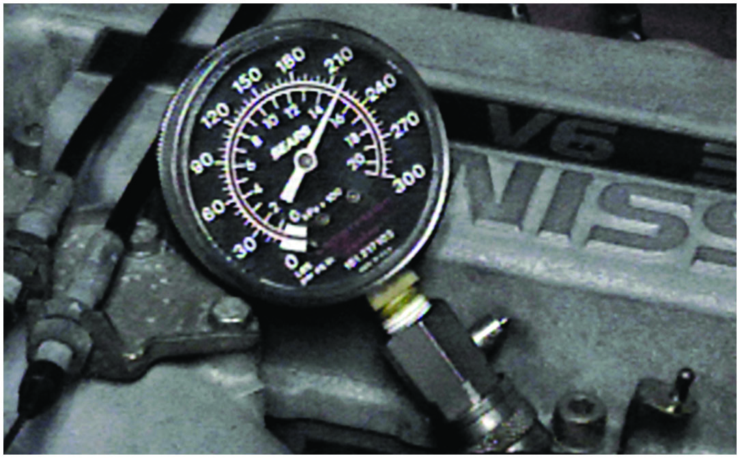
Reading Now Higher: Defective Rings
Notes:
12. If the gauge reading is now much higher than the first test results, then the cause of the low compression is due to worn or defective piston rings

Slide 73
Summary
The first step in diagnosing engine condition is to perform a thorough visual inspection.
Oil leaks can be found using white powder or a fluorescent dye and a black light.
Engine-related problems make a characteristic noise.
Oil analysis can reveal engine problems by measuring amount of dissolved metals in the oil.
Compression test to test the valves and piston rings.
Cylinder leakage test fills the cylinder with compressed air, and the gauge indicates percentage of leakage.
Cylinder balance test indicates whether all cylinders are working okay.
Testing engine vacuum can help determine condition.

Slide 74
Animations and Video Links (Halderman website subscription and web access needed to view)
(A8) Engine Performance Animations
(A8) Engine Performance Videos

Slide 75
Copyright
This work is protected by United States copyright laws and is provided solely for the use of instructors in teaching their courses and assessing student learning. Dissemination or sale of any part of this work (including on the World Wide Web) will destroy the integrity of the work and is not permitted. The work and materials from it should never be made available to students except by instructors using the accompanying text in their classes. All recipients of this work are expected to abide by these restrictions and to honor the intended pedagogical purposes and the needs of other instructors who rely on these materials.

