Slide 1
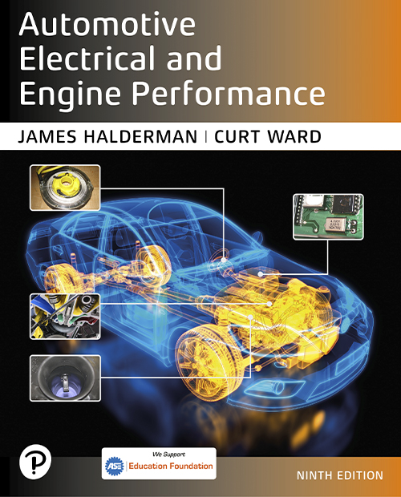
Automotive Electrical and Engine Performance
Ninth Edition
Chapter 25
Hybrid and Electric Vehicle Safety
Copyright © 2025 Pearson Education, Inc. All Rights Reserved
Notes:
If this PowerPoint presentation contains mathematical equations, you may need to check that your computer has the following installed:
1) Math Type Plugin
2) Math Player (free versions available)
3) NVDA Reader (free versions available)
INSTRUCTOR NOTE: This presentation includes text explanation notes, you can use to teach the course. When in SLIDE SHOW mode, you RIGHT CLICK and select SHOW PRESENTER VIEW, to use the notes.

Slide 2
Learning Objectives (1 of 2)
25.1 Discuss high-voltage safety, electric shock potential, and E V/H E V service areas.
25.2 Discuss electric shock potential.
25.3 Discuss E V/H E V service areas.
25.4 Describe the personal protective equipment (P P E) recommended for working on E V/H E V systems.
25.5 Explain the tools and equipment needed for working on high-voltage electrical systems.

Slide 3
Learning Objectives (2 of 2)
25.6 Explain the purpose of the safety interlock system.
25.7 Describe the process for depowering the high-voltage system.
25.8 Discuss precautions that are needed when hoisting an E V/H E V in the shop.
25.9 Discuss precautions that are needed when moving an E V/H E V in the shop.

Slide 4
High-Voltage Safety (1 of 2)
Need for Caution
Hybrid electric vehicles and all electric vehicles use high-voltage (H V) circuits that, if touched with an unprotected hand, could cause serious burns, or even death.
Identifying High-Voltage Circuits
Blue or yellow—42 volts (not a shock hazard but an arc is maintained if a circuit is opened)
Orange—60 to 600 volts or higher

Slide 5
High-Voltage Safety (2 of 2)
It is possible to be seriously injured or electrocuted (killed) if proper safety procedures are not followed.
Precautions for Electronic Medical Devices
Technicians who rely on cardiac pacemakers should not service or repair electric or hybrid electric vehicles because of strong magnetic fields.
Check with the manufacturer of the device before being in or around a charging vehicle.

Slide 6
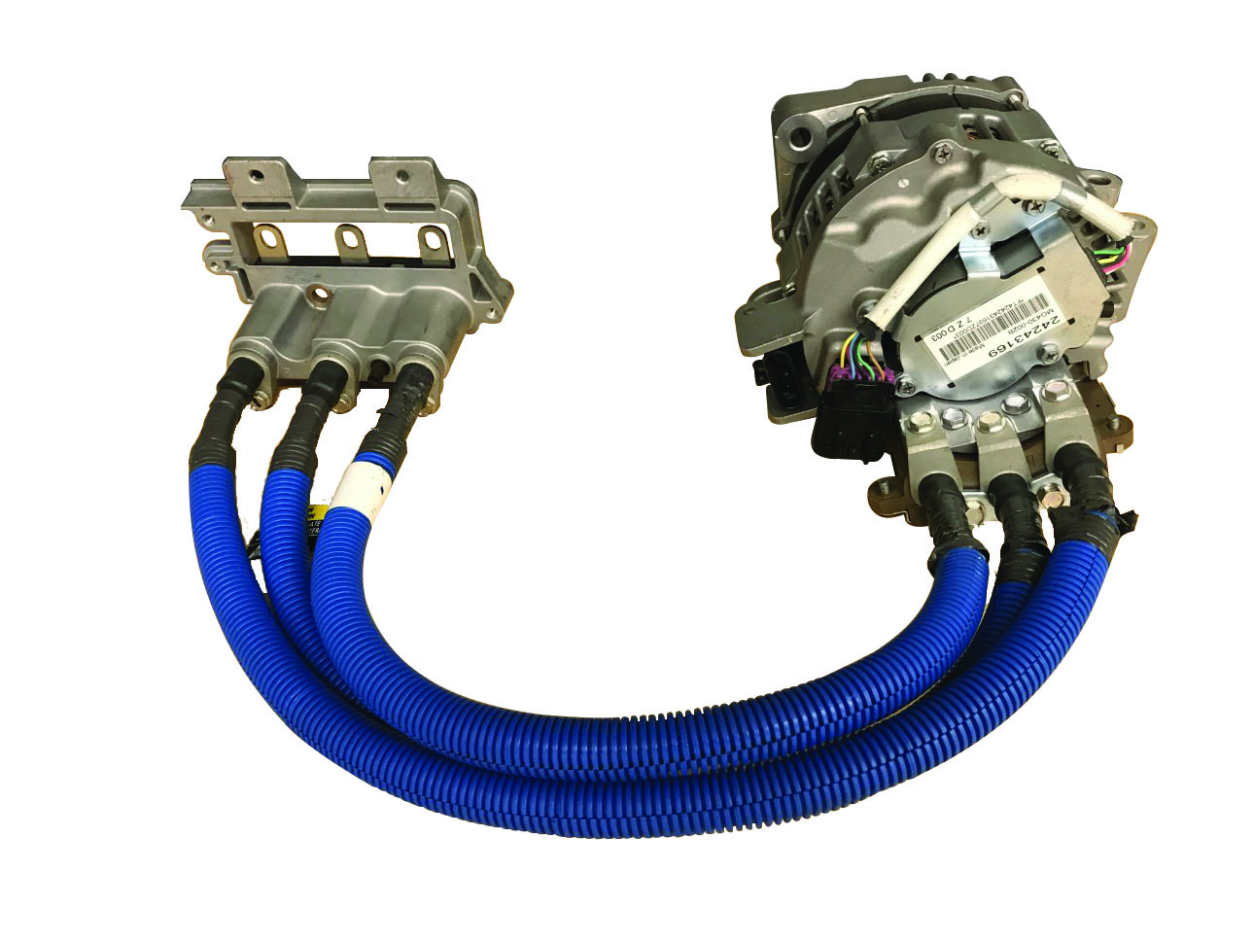
Figure 25.1A
Blue Conduits
When the belt starter alternator assembly is installed, the three blue cables run between the inverter assembly and the alternator.

Slide 7
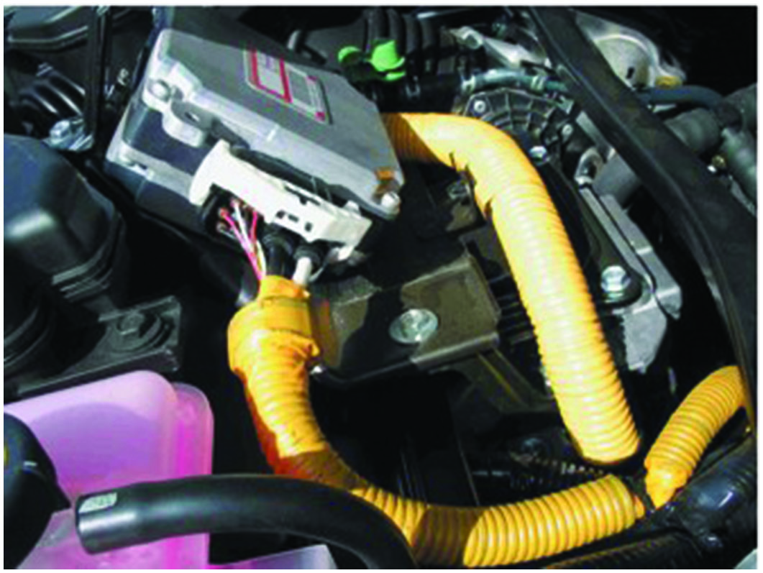
Figure 25.1B
Yellow Conduits
The yellow cable is part of the electric power steering system on a Toyota/Lexus vehicle.

Slide 8
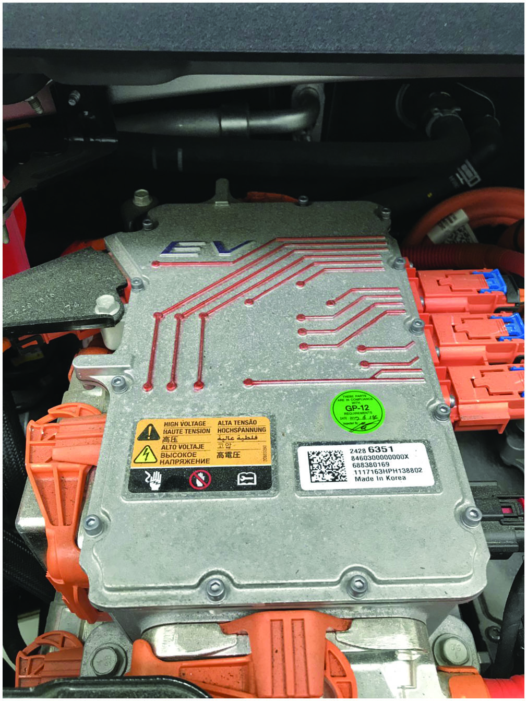
Figure 25.2
Orange Conduits
The orange cables connect to the high power distribution module (H P D M) on the Chevrolet Bolt.

Slide 9
Frequently Asked Question: How Much Current Is Too Much?
? Frequently Asked Question
How Much Current Is Too Much? Low voltage, such as the 12–14 volts used in conventional vehicles, does not represent a shock hazard and it is safe to handle. The only concern would be a possible burn could occur if a 12-volt wire were to touch ground causing the wiring to overheat. Voltages between 14 and 60 volts do not present a shock hazard, but an arc can occur if a connector carrying current is opened. High voltage, over 60 volts, does create a shock hazard and all precautions must be adhered to prevent personal injury. Typical current and how it affects the body are given as follows: SEE NOTES SECTION FOR THE REST OF THIS QUESTION
Notes:
Frequently Asked Question: How Much Current Is Too Much?
Low voltage, such as the 12–14 volts used in conventional vehicles, does not represent a shock hazard and it is safe to handle. The only concern would be a possible burn could occur if a 12-volt wire were to touch ground causing the wiring to overheat. Voltages between 14 and 60 volts do not present a shock hazard, but an arc can occur if a connector carrying current is opened. High voltage, over 60 volts, does create a shock hazard and all precautions must be adhered to prevent personal injury. Typical current and how it affects the body are given as follows:
1 milliamp—May be noticeable as a slight tingle.
2–5 milliamps—May be noticeable as a light shock forcing the technician to let go.
6–25 milliamps—Noticed by pain and the technician cannot let go of the wires or component.
26–150 milliamps—Severe pain and possibly fatal.
1,000 milliamps—One ampere across the heart can stop the heart (fatal).
Also, always wear H V gloves for protection whenever working on or near a potential H V circuit or component. To help prevent an electric current from flowing through the body, always place one hand in a pocket and use only one hand when measuring a potential H V circuit or disconnecting a potential H V circuit.

Slide 10
Electric Shock Potential (1 of 2)
Receiving an electric shock from a hybrid vehicle is highly unlikely because of the following:
Contact with the battery module or other components inside the battery box can occur only if the box is damaged and the contents are exposed, or the box is opened without following proper precautions.
Contact with the electric motor can occur only after one or more components are removed.
The H V cables can be easily identified by their distinctive orange color, and contact with them can be avoided.

Slide 11
Electric Shock Potential (2 of 2)
The system main relays (S M R s) or contactors disconnect power from the cables the moment the ignition is turned off.

Slide 12
Electric Vehicles in Service Area
For a safe working environment:
Be sure the work area is clean and dry.
Care should be taken that H V warnings and safety cones are posted.
Additional precautions, such as a roof cone or warning tape, are also recommended.

Slide 13
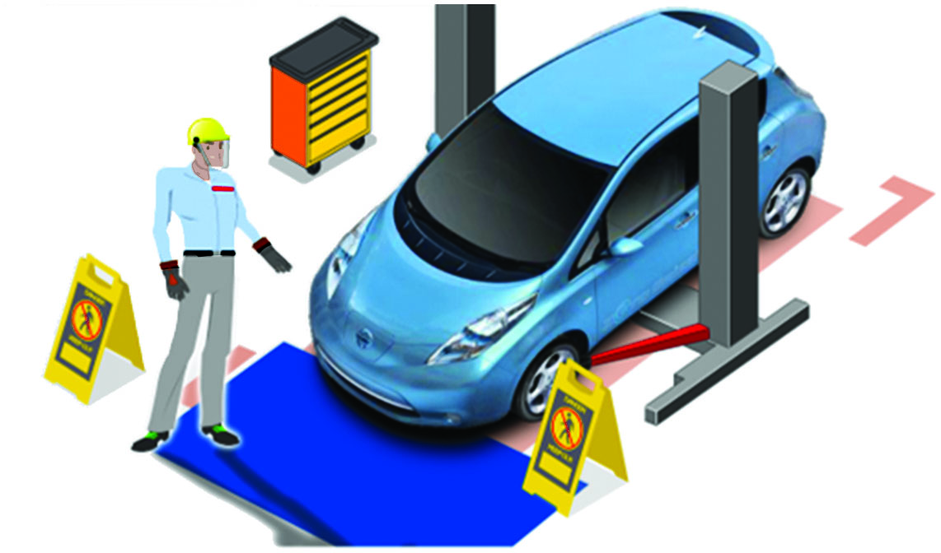
Figure 25.3
H E V/E V Workspace
A clearly defined safety zone needs to be established in the area where a hybrid or electric vehicle is being repaired.

Slide 14
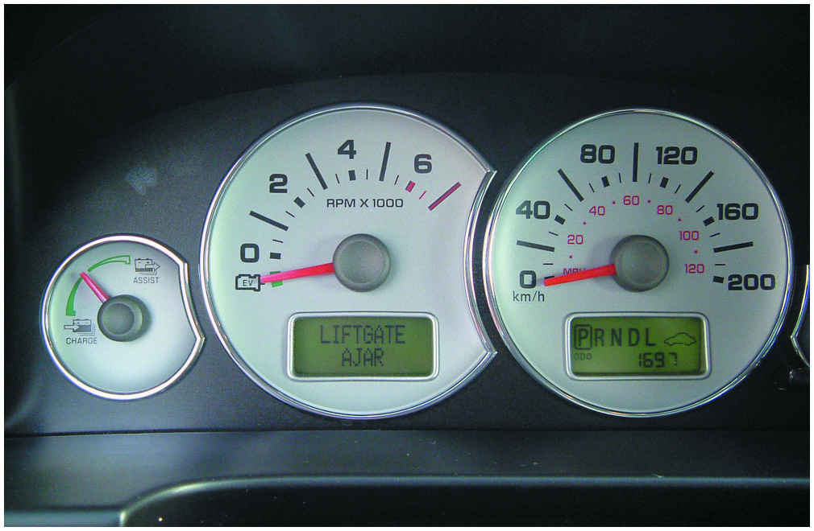
Figure 25.4
E V Instead of 0 R P M
The Ford Escape Hybrid instrument panel showing the vehicle in park and the tachometer on “E V” instead of 0 R P M. This means the gasoline engine could start at any time depending on the state of charge of the H V battery and other factors.
Notes:
TECH TIP: Silence Is NOT Golden
Never assume the vehicle is shut off just because the engine is off. When working with a hybrid electric vehicle, always look for the READY indicator status on the dash display. The vehicle is shut off when the READY indicator is off.
The vehicle may be powered by
The electric motor only.
The gasoline engine only.
A combination of both the electric motor and the gasoline engine.
The vehicle computer determines the mode in which the vehicle operates to improve fuel economy and reduce emissions. The driver cannot manually select the mode. • See Figure 25.4.

Slide 15
Personal Protective Equipment (P P E)
Eye Protection
Plastic frames (Avoid metal frames as these are conductive and could cause a shock hazard.)
Side shields
Meet the standard A N S I Z87.1
High-Voltage Gloves
H V lineman’s gloves
Ensure that the gloves are rated at least 1,000 volts and class “0” by A N S I /A S T M

Slide 16
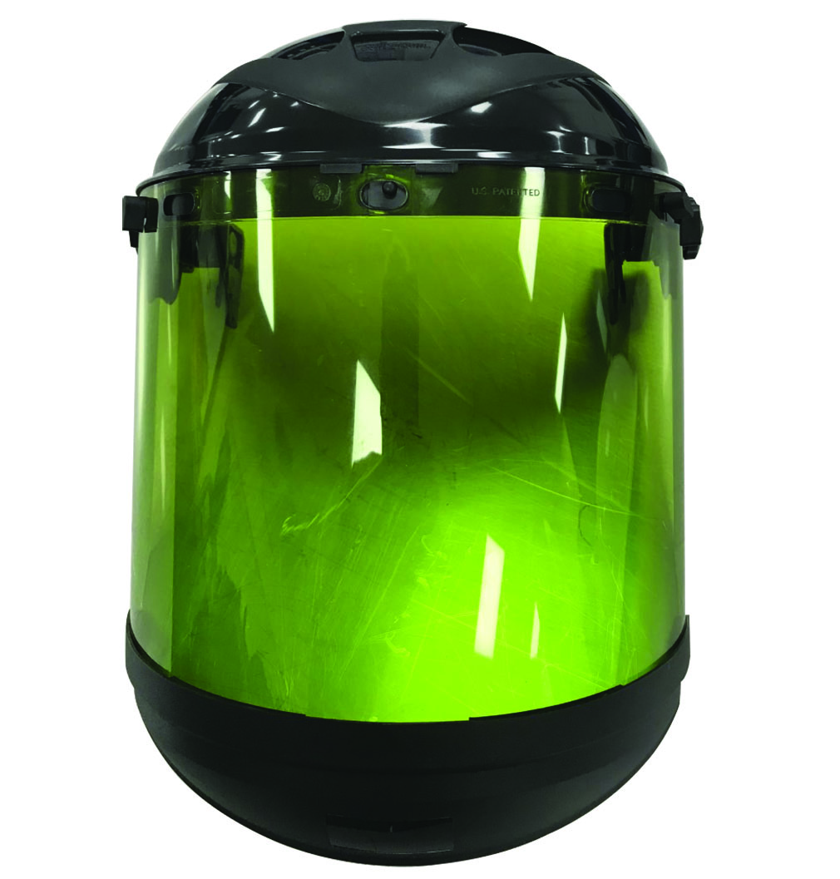
Figure 25.5
Full-Face Shield
Safety glasses or a full-face shield similar to the items depicted must be worn when testing for the presence of high voltage.

Slide 17
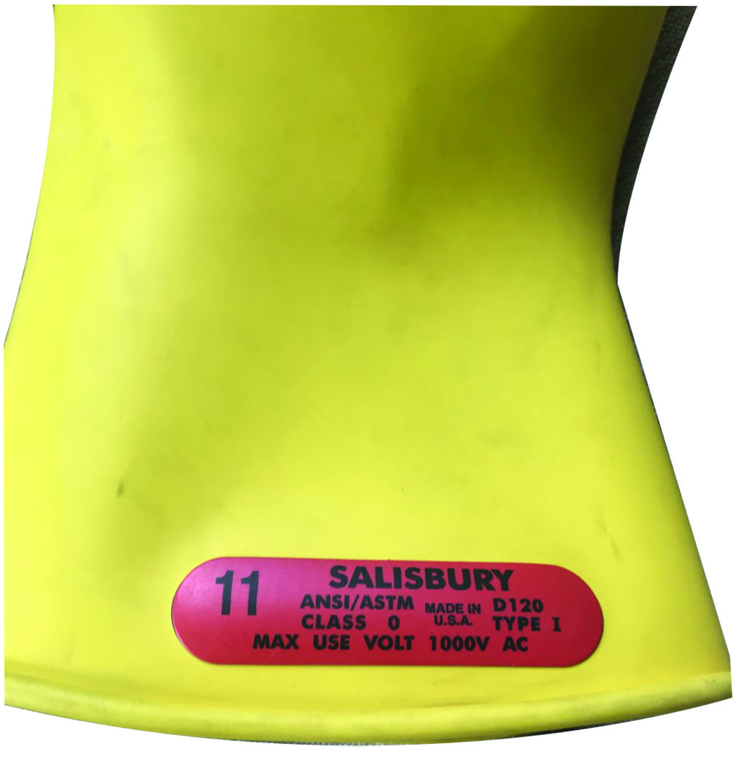
Figure 25.6
Glove Rating
The gloves should be clearly marked indicating that they are class “0” and rated for 1,000 volts.

Slide 18
Figure 25.7
Glove Leaks
The glove is rolled up on the open end to check for air pressure and any air leakage.
Notes:
WARNING: Do not use shop air to test H V gloves. The high air pressure will damage the gloves and lead to a lack of personal protection against high voltage.

Slide 19
Figure 25.8
Glove Inflator
An electric glove inflator similar to this may be used for testing.

Slide 20
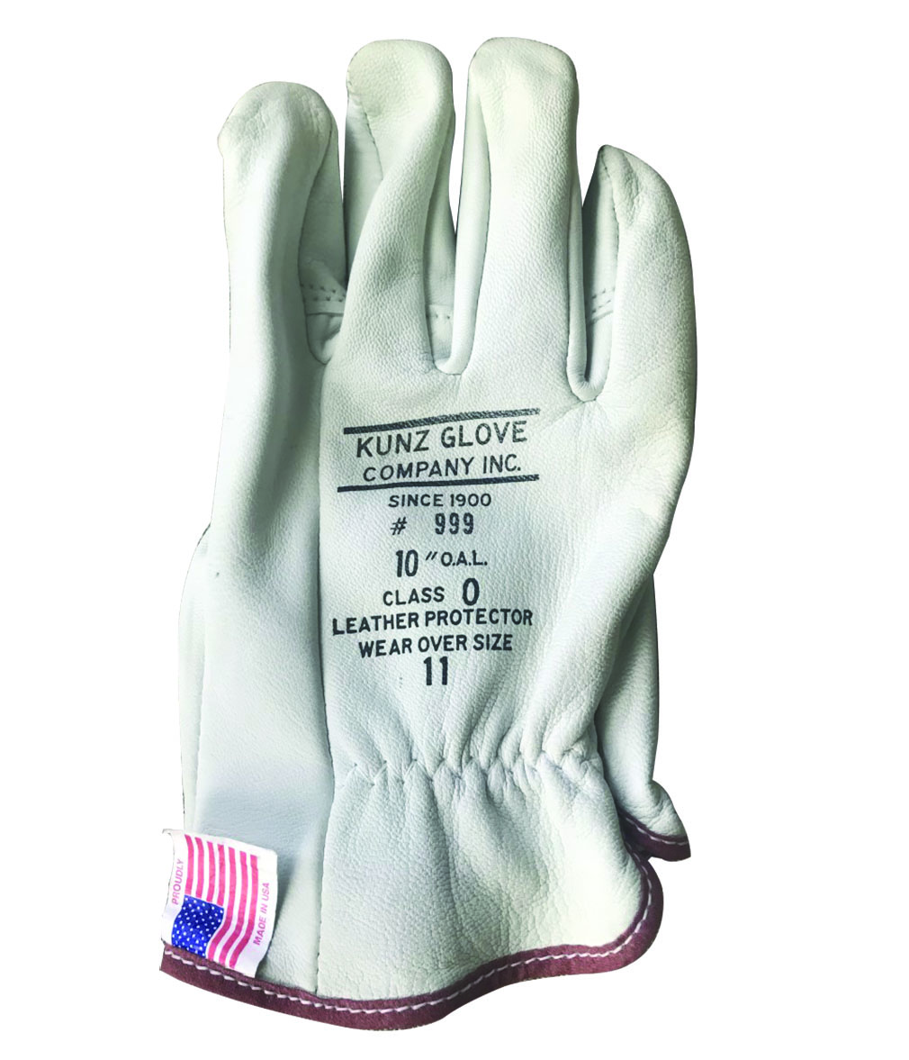
Figure 25.9
Leather Gloves
Clean leather gloves must be used to protect the H V rubber gloves.

Slide 21
Question 1
What should be the rating of the rubber gloves?

Slide 22
Answer 1
Class “0” and 1,000 volts.

Slide 23
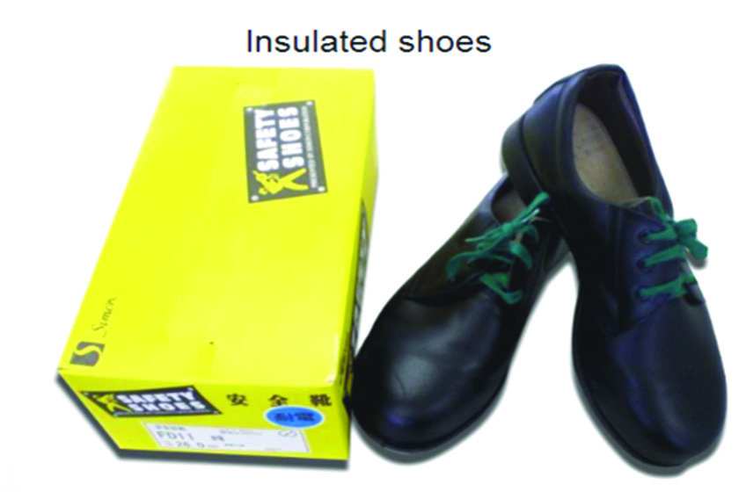
Figure 25.10
Safety Shoes
The sole of this shoe is designed to prevent the transfer of electrical current.

Slide 24
Figure 25.11
Rubber Mat
Some work locations require the use of insulated rubber mats in the work area.

Slide 25
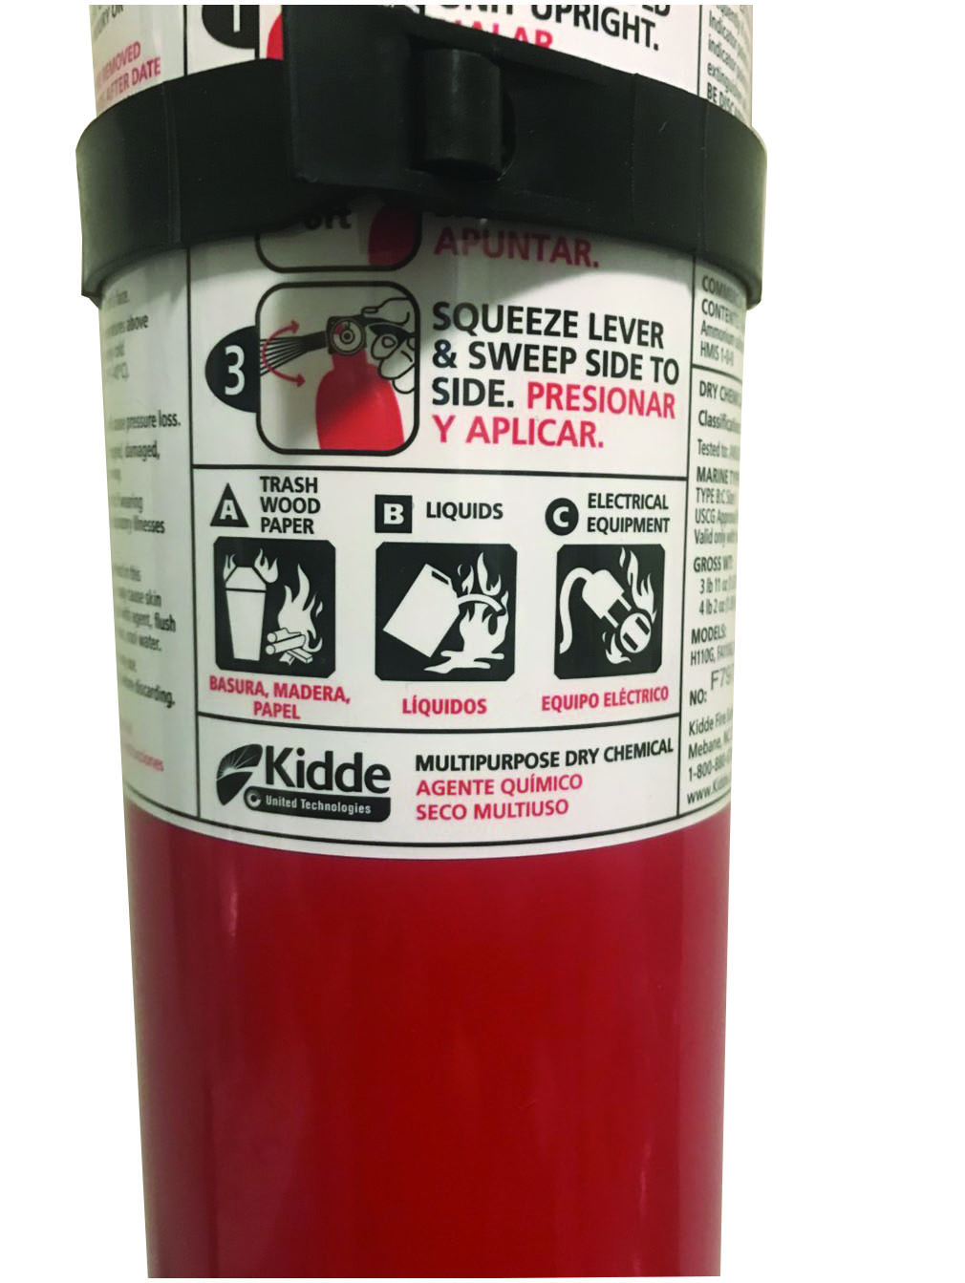
Figure 25.12
Fire Extinguisher
Make sure a proper fire extinguisher is available in the work area.

Slide 26
Frequently Asked Question: Is the Radiation from a Hybrid Dangerous?
? Frequently Asked Question
Is the Radiation from a Hybrid Dangerous? No. While there is a changing magnetic field surrounding any wire carrying an electrical current, the amount of electromagnetic radiation is very low. ● See Figure 25.13.

Slide 27
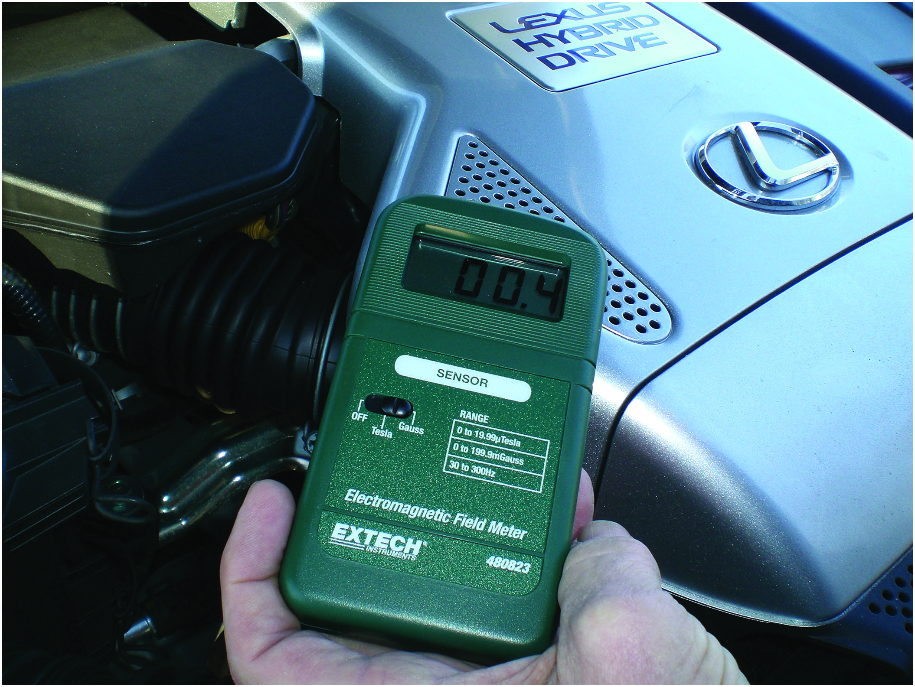
Figure 25.13
Measure Radiation
The radiation emitted from a hybrid electric vehicle is very low and is being measured in units of milligauss.

Slide 28
High-Voltage Tools and Equipment
C A T
Rated Digital Multimeter
Megohmmeter (Insulation Tester)
Insulated Hand Tools

Slide 29
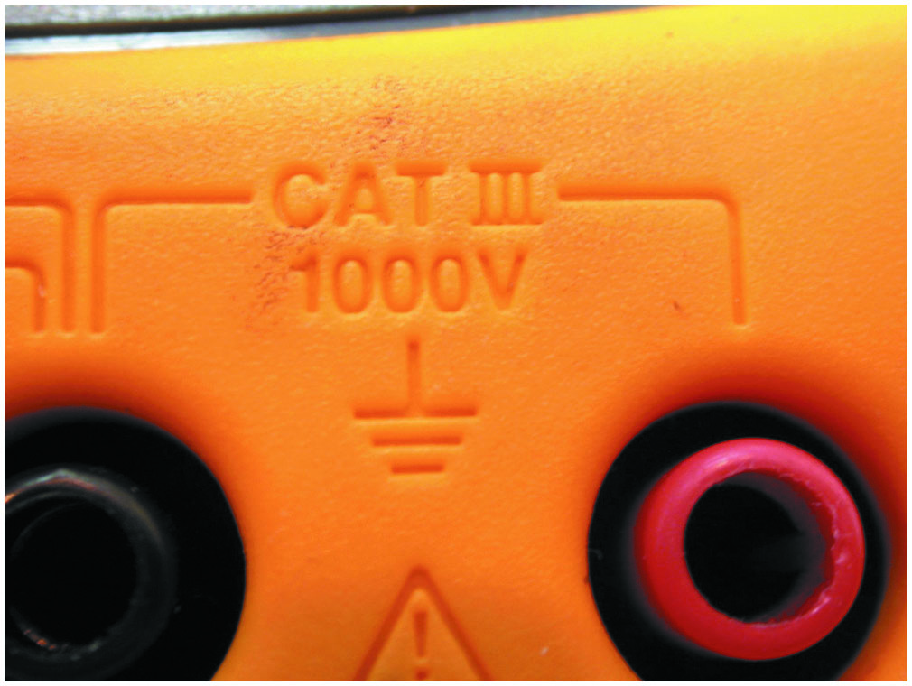
Figure 25.14
D M M C A T
Rated
Use only a meter that is
C A T
rated when making
electrical measurements on an electric or hybrid electric vehicle.

Slide 30
Figure 25.15
D M M Leads
The meter leads should also be C A T
-rated when
checking voltages on a hybrid electric vehicle.

Slide 31
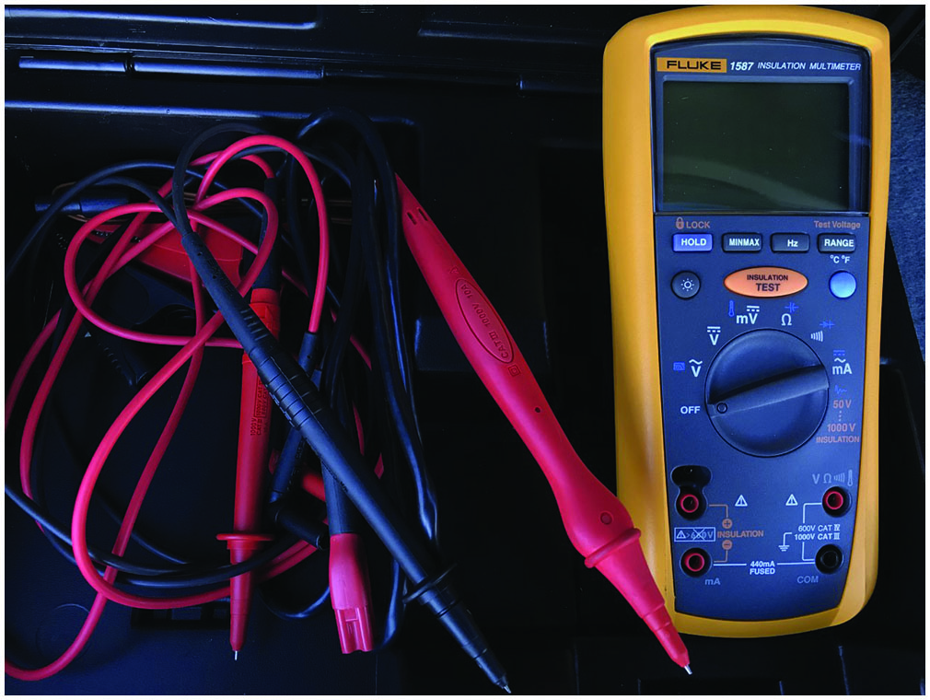
Figure 25.16
Fluke 1587 Megger
The Fluke 1587 is an example of an insulation tester that is able to test the H V circuit insulation to 1,000 volts. The resistance between the H V circuit and ground should be
higher than one million ohms
Notes:
A Megohmmeter or insulation tester is used to check for continuity between the H V cables and the vehicle chassis. It contains an internal D C–D C converter that allows for the continuity test to occur at a much higher voltage than a conventional ohmmeter. ● See Figure 25.16.

Slide 32
Loss of Isolation Test
Purpose
The H V circuits do not use a common ground.
When the ground fault system detects H V leaking to ground, it sets a D T C that includes the location of the fault.
Test Procedure
Disable the H V system.
Use D T Cs and schematics to identify problem areas.
Connect the isolation tester to the circuit, perform the test and record the results.

Slide 33
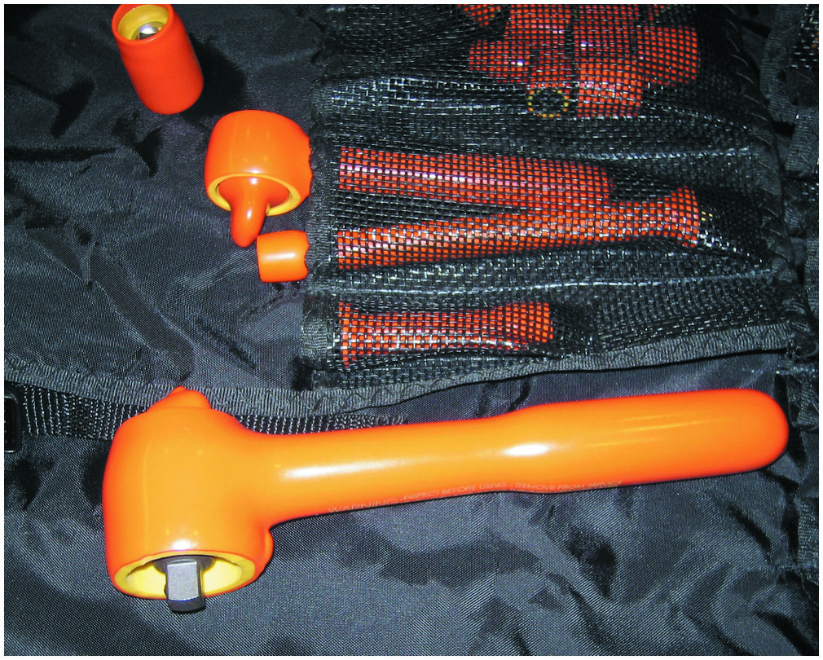
Figure 25.17
Insulated Tools
Insulated tools, such as this socket set, provide an additional margin of safety to the service technician when working around H V components and systems.
Notes:
Although they are not required by all manufacturers, insulated tools such as a ratchets, extensions, sockets, pliers, and screwdrivers provide an additional margin of safety to the service technician when working around H V components and systems. • See Figure 25.17.

Slide 34
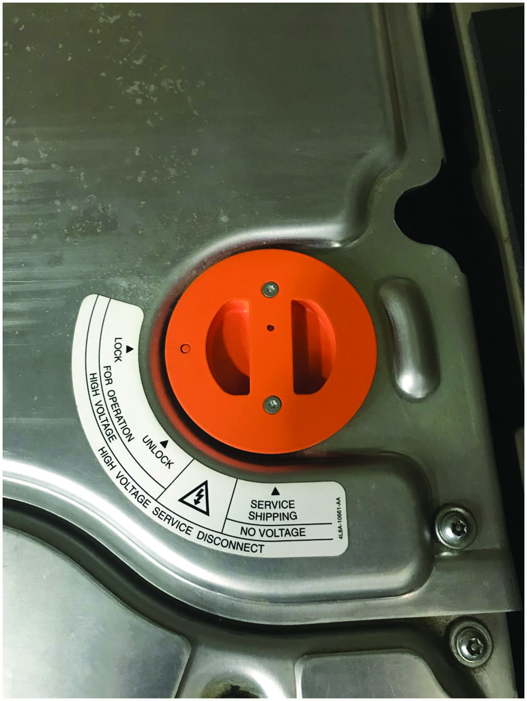
Figure 25.18
Manual Disconnect
The manual disconnect on this Ford battery contains a fuse and safety interlock.

Slide 35
Safety Interlock System (1 of 2)
With an open detected, the H V controller does the following to keep the vehicle safe (continued):
If the hybrid vehicle is not moving, it will disable the I C E immediately.
The H V system will be depowered on an electric vehicle.

Slide 36
Safety Interlock System (2 of 2)
Local Interlock
A local interlock is a low voltage (L V) circuit that uses separate switches and contacts to detect when there has been an open in L V circuits or components that are associated with the H V system.
Detect the removal of items such as covers, battery disconnects, air-conditioning compressors, or any other component.

Slide 37
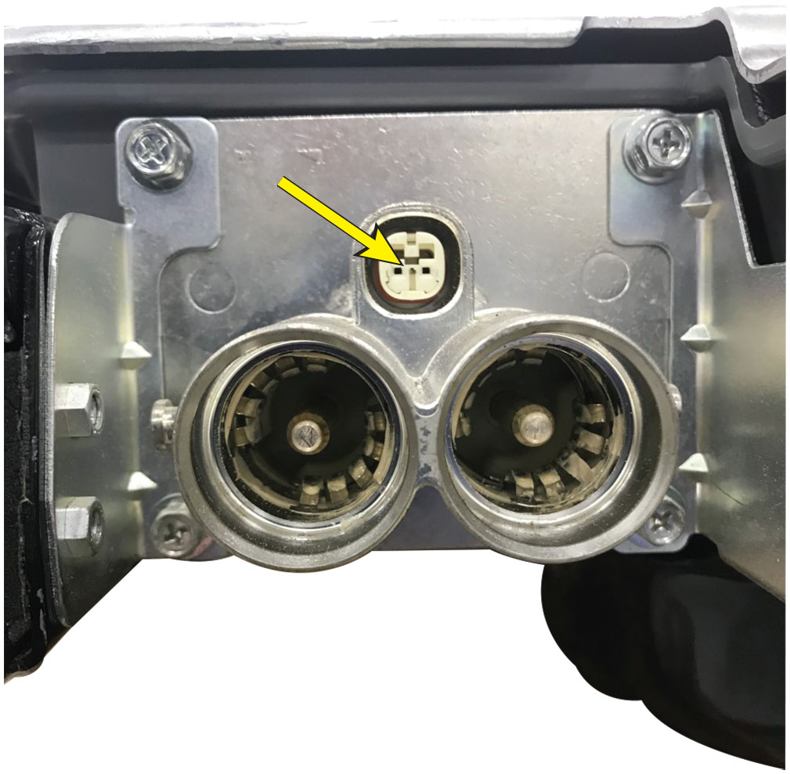
Figure 25.19
Interlock
The small white connector is the local interlock on the H V connection to the battery.

Slide 38
Electric Shock Potential
Locations Where Shock Can Occur
Contact with the battery module
Contact with the electric motor
The H V cables
The system main relays (S M Rs)

Slide 39
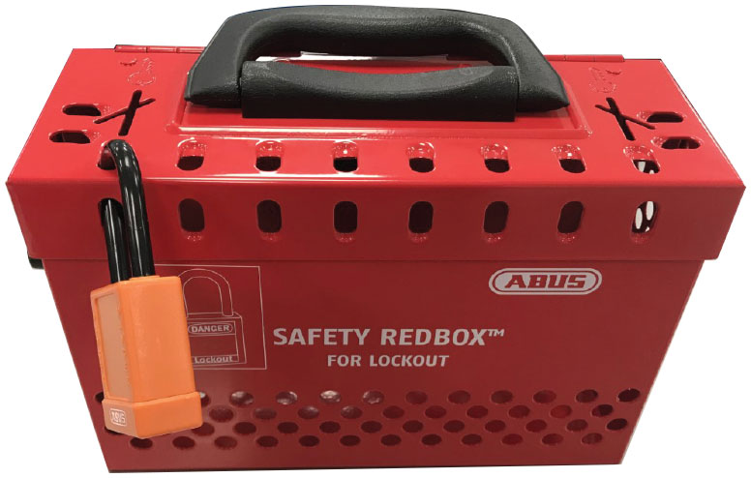
Figure 25.20
Lock Box
A lock box is a safe location to keep the ignition keys of a hybrid or electric vehicle while it is being worked on.

Slide 40
Depowering the High-Voltage System (1 of 3)
If work is going to be performed on any of the following components, service information procedures must be followed to prevent possible electrical shock and personal injury.
The H V battery pack
Any of the electronic controllers that use orange cables, such as the inverter and converters
The air-conditioning compressor, if electrically driven, and has orange cables attached

Slide 41
Depowering the High-Voltage System (2 of 3)
STEP 1
Turn the ignition off and remove the key (if equipped) from the ignition and store it in a lock box to prevent accidental starting.
STEP 2
Remove the 12-volt power source to the H V controller and wait 10 minutes for all capacitors to discharge.
This step could involve:
Removing a fuse or a relay
Disconnecting the negative battery cable from the auxiliary 12-volt battery

Slide 42
Depowering the High-Voltage System (3 of 3)
STEP 3
Remove the H V fuse or service plug or switch.
STEP 4
Confirm there is no H V power present before beginning the repair.

Slide 43
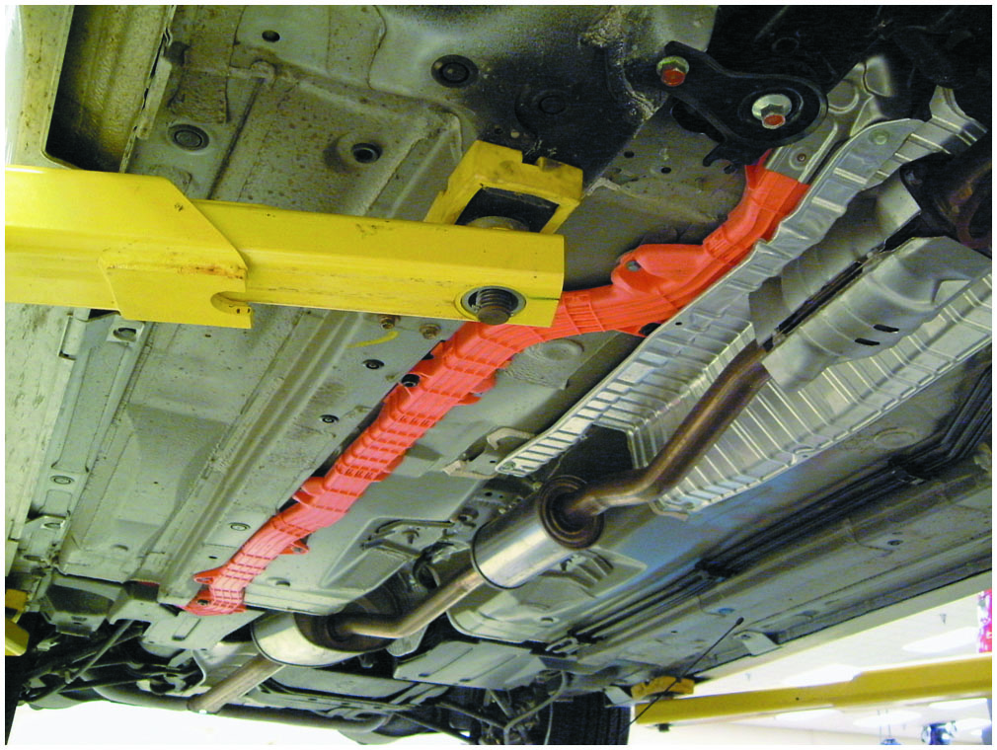
Figure 25.21
Orange High Voltage
The H V wiring on this Honda hybrid is colored orange for easy identification.

Slide 44
Hoisting a Hybrid or Electric Vehicle
Refer to the manufacturer’s service information for proper lift points.
Orange cables run under the vehicle just inside the frame rails on most hybrid and electric vehicles.
Many electric vehicles use coolant or refrigerant to maintain the temperature of the battery. Caution should be used to avoid damaging these lines.
The cables are not repairable and are expensive.

Slide 45
Animation: Hybrid Vehicle Safety

Slide 46
Frequently Asked Question: What Is That Sound?
? Frequently Asked Question
What Is That Sound? E V s and most H E V s emit a sound through a speaker in the front at low speeds to warn pedestrians that a moving vehicle is near. It is called acoustic vehicle alerting system (A V A S). It creates sound whenever the vehicle is traveling at low speed. N H T S A requires device to emit warning sounds when travelling at speeds less than 19 M P H. While easily heard from outside the vehicle, it is usually not heard inside the vehicle unless the windows are down. Some customers ask their service technician to disable this system, but it is a safety device and could help prevent personal injury if someone were to step in front or back of a moving vehicle that is almost silent.

Slide 47
H V Glove Use

Slide 48
1. Glove Cuff
The cuff of the rubber glove should extend at
least
beyond
the cuff of the leather protector.

Slide 49
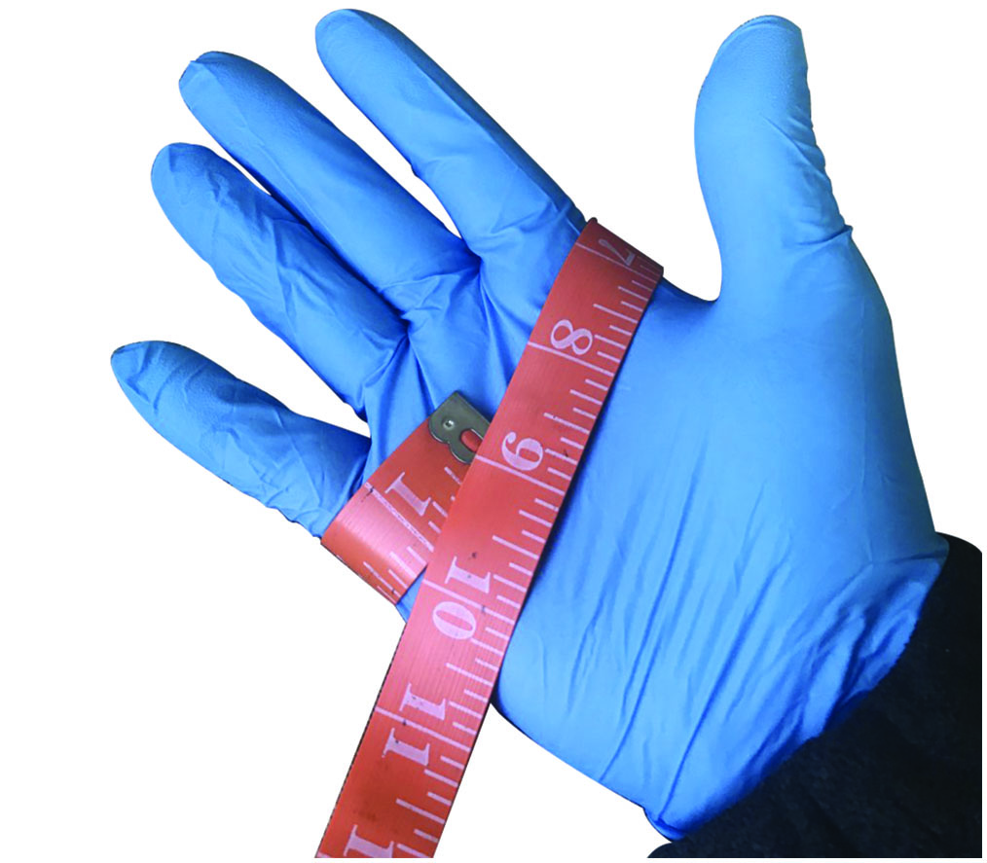
2. Glove Size
To determine the correct glove size, use a soft tape measure around the palm of the hand. A measurement of 9 inches would correspond with a glove size of 9.

Slide 50
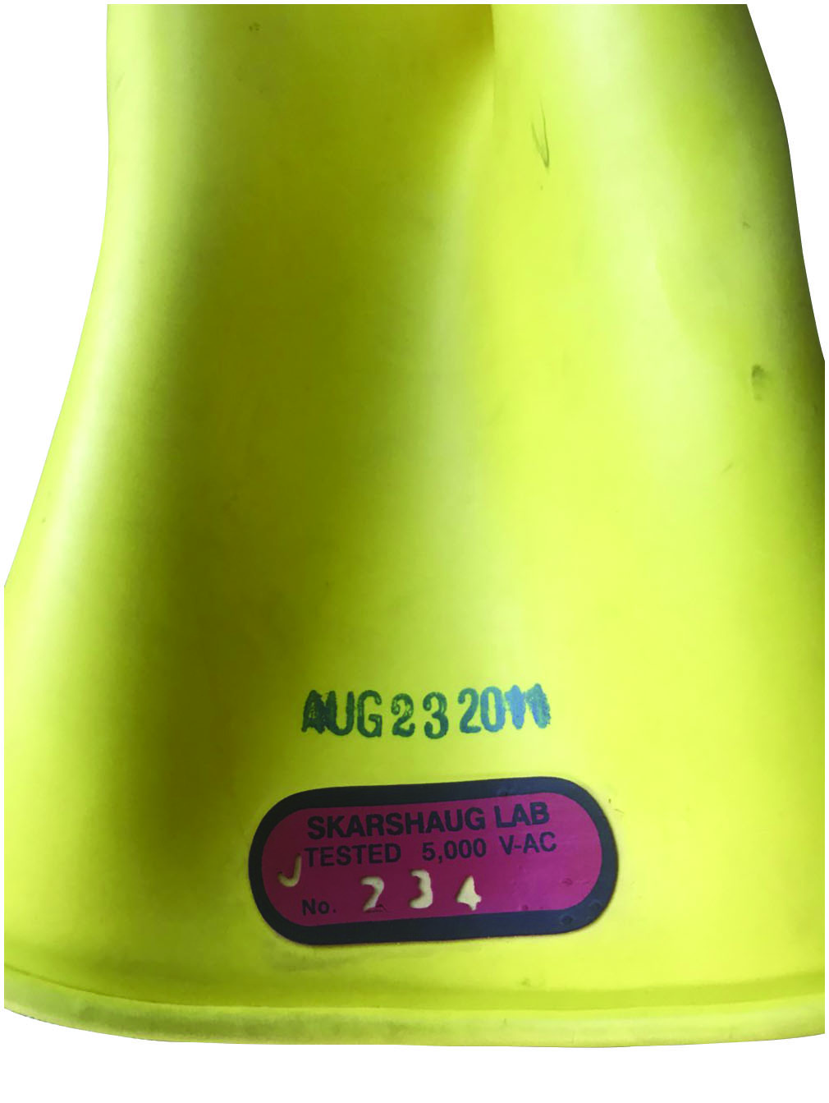
3. Glove Rating
The glove rating and the date of the last test should be stamped on the glove cuff.

Slide 51
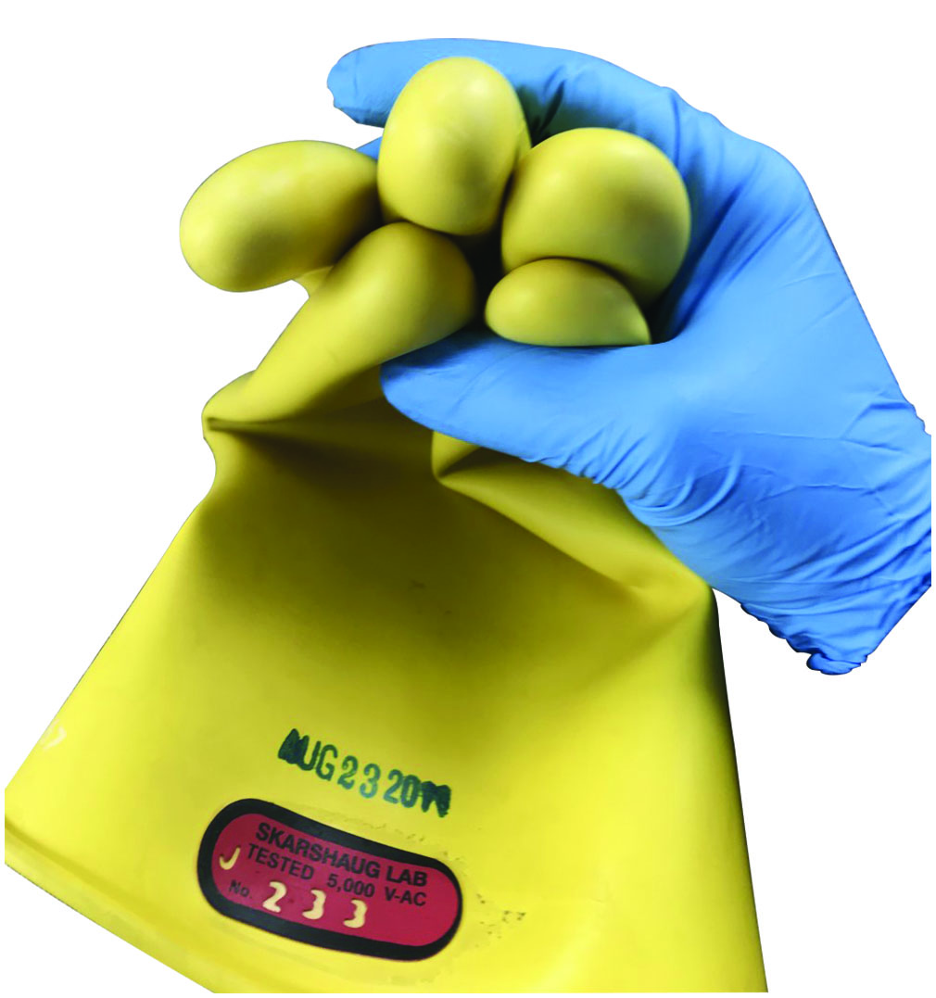
4. Visual Inspection
Start a visual inspection of the glove fingertips, making sure that no cuts or other damages are present.

Slide 52
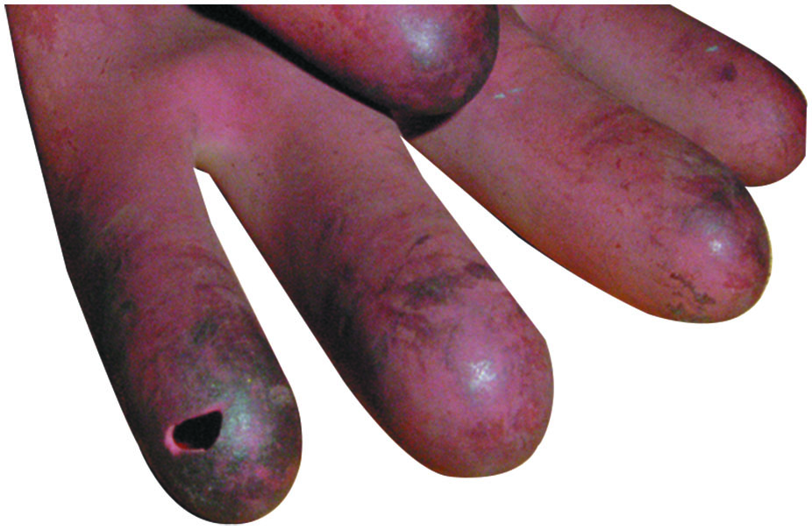
5. Glove Damage
The damage on this glove was easily detected with a simple visual inspection. Note that the rubber glove material can be damaged by petroleum products, detergents, certain hand soaps, and talcum powder.

Slide 53
6. Inflate Glove
Manually inflate the glove to inspect for pinhole leaks. Starting at the cuff, roll up the glove and trap air in the finger end. Listen and carefully watch for deflation of the glove. If a leak is detected, the glove must be discarded.

Slide 54
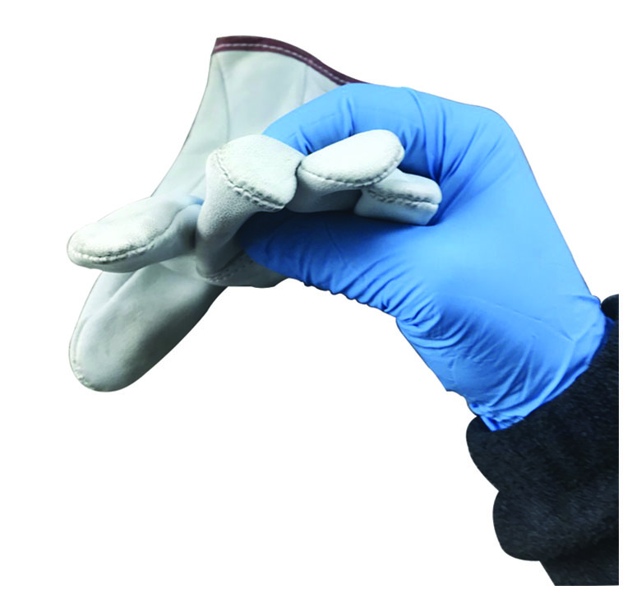
7. Petroleum Damages Rubber Glove
Petroleum on the leather protector’s surface will damage the rubber glove underneath.

Slide 55
8. Glove Dust
Glove powder (glove dust) should be used to absorb moisture and reduce friction.

Slide 56
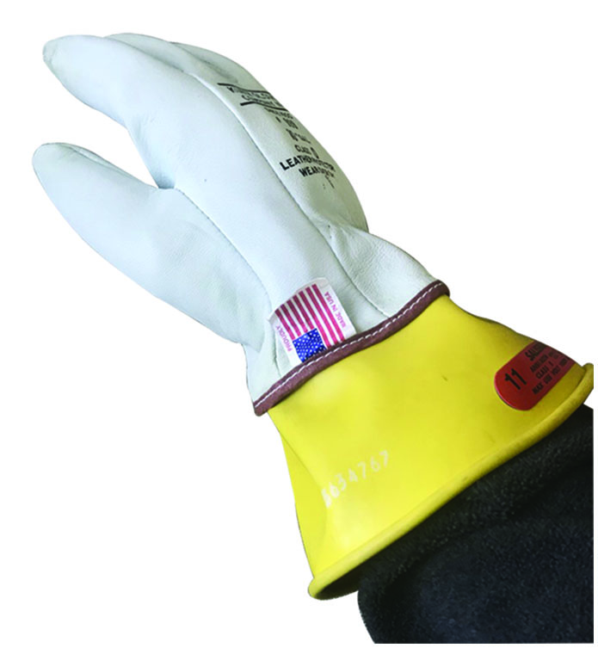
9. Tighten Gloves
Put on the gloves and tighten the straps on the back of the leather protectors (if equipped).

Slide 57
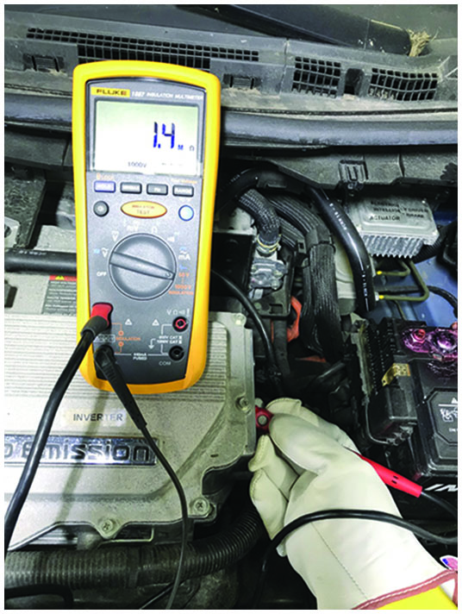
10. Must Wear Gloves
Technicians M U S T wear H V gloves whenever working around the H V areas of a hybrid or electric vehicle.

Slide 58
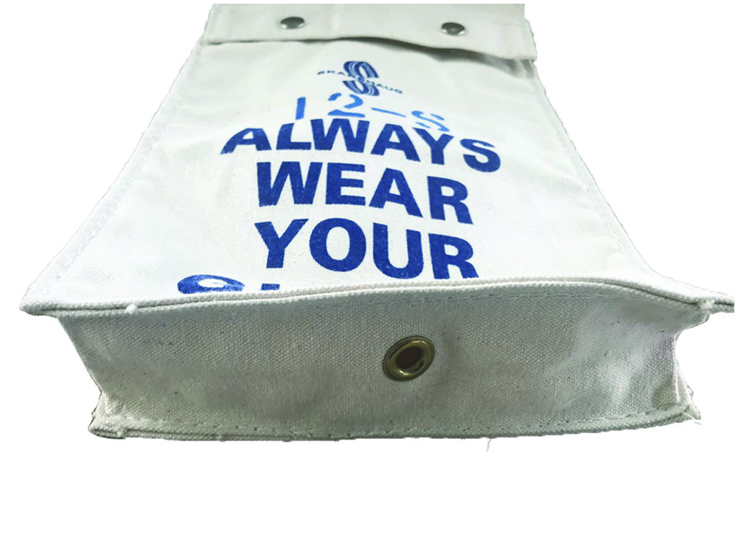
11. Canvas Storage Bag
H V gloves should be placed in a canvas storage bag when not in use. Note the ventilation hole at the bottom of this bag.

Slide 59
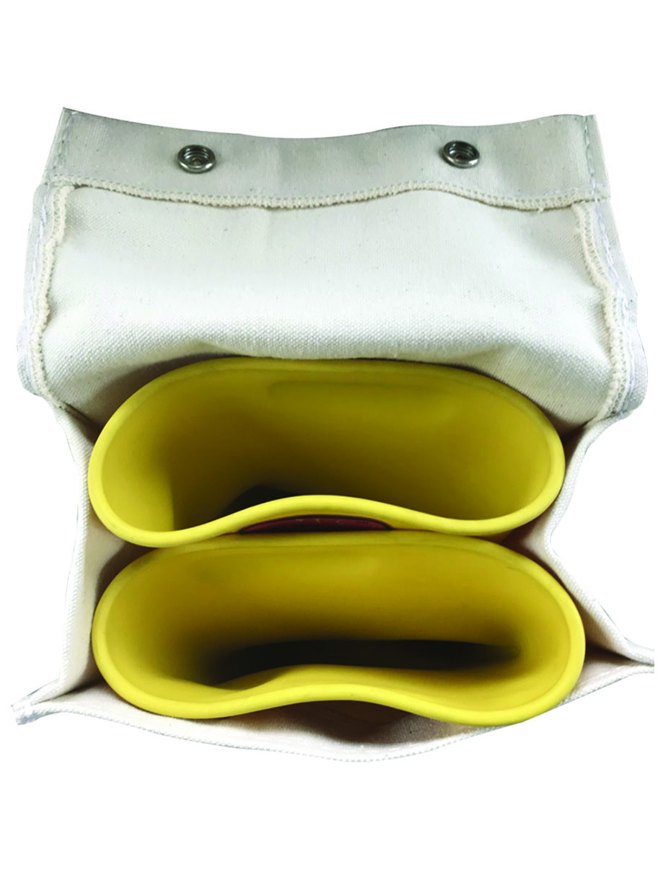
12. Gloves Not Folded
Make sure the rubber gloves are not folded when placed in the canvas bag. Folding increases mechanical stress on the rubber and can lead to premature failure of the glove material.

Slide 60
Summary (1 of 2)
High-voltage circuits covered in orange plastic conduit.
Be sure the work area is clean and dry.
High-voltage warnings and safety cones are posted
Eye protection should be used
Before working on the high-voltage system of a hybrid electric vehicle, ensure that high-voltage lineman’s gloves are available. Gloves rated at least 1,000 volts and class “0” by A N S I/A S T M.
Hybrid and electric vehicles are equipped with electrical systems whose voltages can exceed 600 volts D C.
Category three (C A T
certified digital multimeter (D M M)
is required for making measurements on these high-voltage systems.

Slide 61
Summary (2 of 2)
Local interlock is low-voltage circuit that uses separate switches and contacts to detect when there has been an open in low-voltage circuits associated with high-voltage. The local interlock can detect the removal of items such as covers, battery disconnects, air-conditioning compressors.
Service information procedures must be followed to prevent possible electrical shock and personal injury.
When hoisting or using a floor jack, refer to the manufacturer’s service information for proper lift points.
Electric vehicles and most hybrid electric vehicles emit a sound through speaker in front at low speeds to warn pedestrians that moving vehicle is nearby. This system is called acoustic vehicle alerting system (A V A S).

Slide 62
Animations and Video Links (Halderman website subscription and web access needed to view)
(A6) Electrical/Electronic Systems Animations
(L3) Light Duty Hybrid Electric Animations
(A6) Electrical/Electronic Systems Videos
(L3) Light Duty Hybrid Electric Videos

Slide 63
Copyright
This work is protected by United States copyright laws and is provided solely for the use of instructors in teaching their courses and assessing student learning. Dissemination or sale of any part of this work (including on the World Wide Web) will destroy the integrity of the work and is not permitted. The work and materials from it should never be made available to students except by instructors using the accompanying text in their classes. All recipients of this work are expected to abide by these restrictions and to honor the intended pedagogical purposes and the needs of other instructors who rely on these materials.

