Slide 1
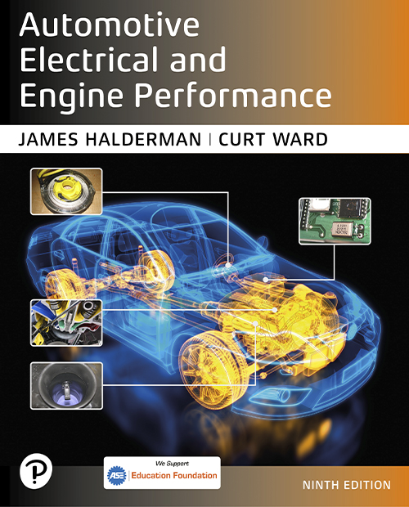
Automotive Electrical and Engine Performance
Ninth Edition
Chapter 18
Driver Information and Navigation Systems
Copyright © 2025 Pearson Education, Inc. All Rights Reserved
Notes:
If this PowerPoint presentation contains mathematical equations, you may need to check that your computer has the following installed:
1) Math Type Plugin
2) Math Player (free versions available)
3) NVDA Reader (free versions available)
INSTRUCTOR NOTE: This presentation includes text explanation notes, you can use to teach the course. When in SLIDE SHOW mode, you RIGHT CLICK and select SHOW PRESENTER VIEW, to use the notes.

Slide 2
Learning Objectives (1 of 3)
18.1 Identify the meaning of dash warning symbols.
18.2 Describe steering wheel controls.
18.3 Describe voice activation.
18.4 Describe maintenance indicators.
18.5 Describe analog and digital displays.

Slide 3
Learning Objectives (2 of 3)
18.6 Discuss the operation of a head-up display.
18.7 Discuss the operation of night vision systems.
18.8 Discuss the operation of electronic displays.
18.9 Discuss the operation of virtual displays.

Slide 4
Learning Objectives (3 of 3)
18.10 Discuss the operation of touch screens.
18.11 Describe how speedometers and odometers work.
18.12 Discuss the diagnosis of oil pressure lamp, temperature lamp, brake warning lamp, and other analog dash instruments.
18.13 Describe how a navigation system works.
18.14 Explain the operation and diagnosis of Telematics systems.
18.15 Explain the operation of a backup camera.

Slide 5
Dash Warning Symbols (1 of 2)
Purpose and Function
Symbols are used instead of words because they are universal in a global vehicle market.
Bulb Test
All of warning lights come on as part of a self-test, and to help driver or technician spot any warning light that may be burned out or not operating.

Slide 6
Dash Warning Symbols (2 of 2)
Green or White Symbols
Used to notify the driver that certain functions are working.
Amber Symbols
A fault or an issue has occurred that may require attention soon.
Red Warning Symbols
Red symbols mean that a serious fault has been detected and that immediate attention is required.

Slide 7
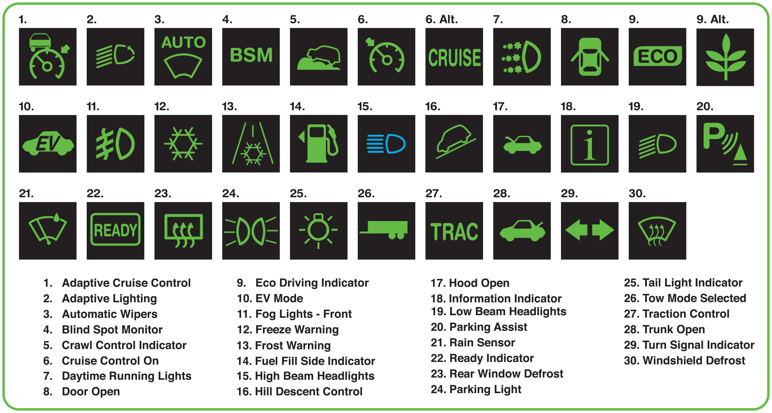
Figure 18.1
Green and Blue Symbols
Green and blue symbols are used to inform the driver what is in operation.
Notes:
Long Description:
All the symbols are displayed as green icons except symbol 15 which is displayed as a blue icon. Details of the operation and the icons are as follows. 1. Adaptive cruise control, a speedometer with a vehicle on top. 2. Adaptive lighting, five sloping lines by the side of an oval shape that has a forward arrow on its side. 3. Automatic wipers, windshield. 4. Blind spot monitor, text reading B S M. 5. Crawl control indicator, a car moving up a bumpy road. 6. Cruise control on, an arrow pointing to a speedometer or alternatively, a text reading cruise. 7. Daytime running lights, three lines radiating from an oval shape. 8. Door open, doors of a car open. 9. Eco driving indicator, text reading E C O, and alternatively, a plant icon. 10, E V mode, text reading E V on a car. 11. Fog lights, front, a vertical line runs through three parallel lines beside an oval shape. 12. Freeze warning, six arrows pointing to the sides of a hexagon. 13. Frost warning, six arrows pointing to the sides of a hexagon on a road. 14. Fuel fill side indicator, a petrol bunk symbol. 15. high beam headlights, an icon in blue showing five parallel lines to the left of an oval shape. 16. Hill descent control, a car over a sloping line. 17. Hood open, car with its hood open. 18. Information indicator, the letter i within a square. 19. Low beam headlights, five sloping lines running parallel beside an oval shape. 20. parking assist, a Wi-Fi symbol before upper case b placed diagonally above a triangle with a line below. 21. Rain sensor, a water droplet symbol falling on a windshield wiper. 22. Ready indicator, text ready within a rectangle. 23. Rear window defrost, three curved arrows flow into a rectangle. 24. Parking lot, Lines radiating from two oval shapes. 25. Taillight indicator, lines radiating from a circle that has a small bar on the top. 26. Tow mode selected, a trailer truck. 27. Traction control, text reading T R A C. 28. Trunk open, car with its trunk open. 29. Turn signal indicator, left and right arrows. 30. Windshield defrost, three curved arrows entering a windshield symbol.

Slide 8
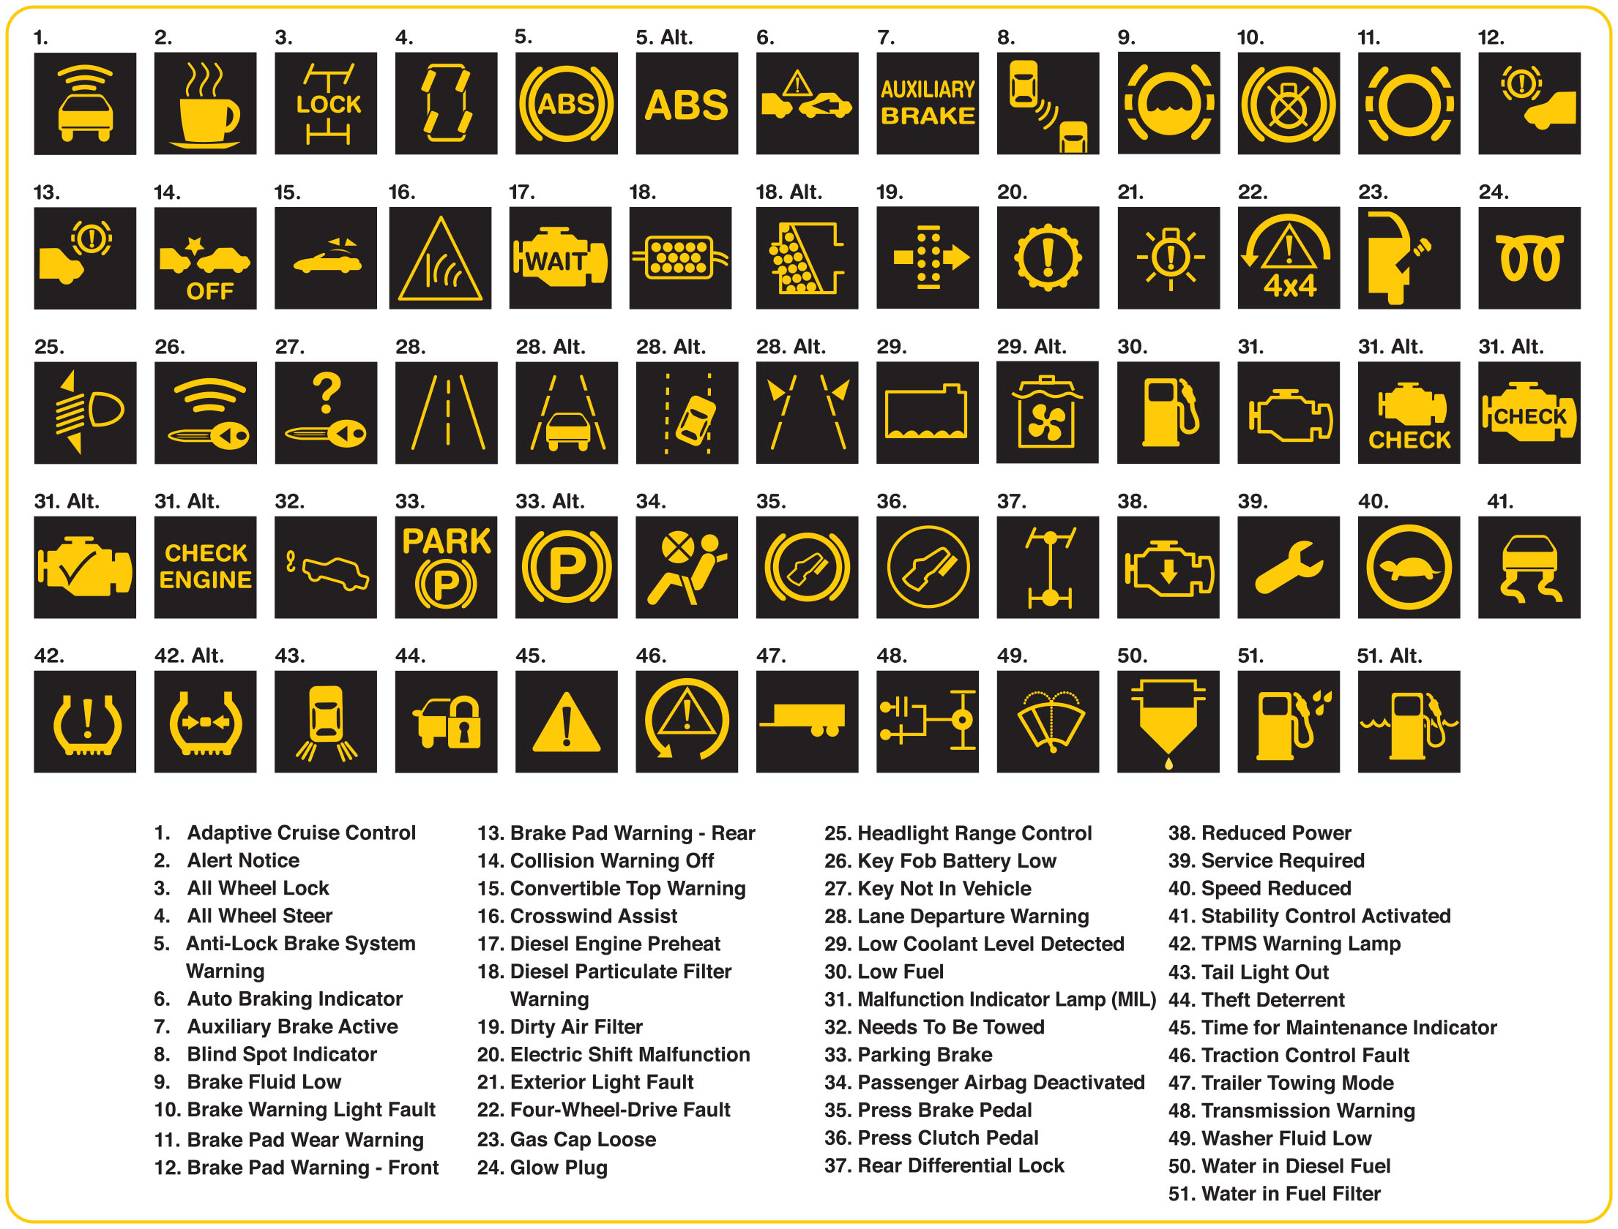
Figure 18.2
Amber Symbols
Amber warning symbols inform the driver of a potential concern.
Notes:
Long Description:
The details of the indications are as follows. 1. Adaptive cruise control. 2. Alert notice. 3. All wheel lock. 4. All wheel steer. 5. Anti-lock brake system warning. 6. Auto braking indicator. 7. Auxiliary brake active. 8. Blind spot indicator. 9. Brake fluid low. 10. Brake warning light fault. 11. brake pad wear warning. 12. Brake pad warning, front. 13. Brake pad warning, rear. 14. Collision warning off. 15. Convertible top warning. 16. Crosswind assist. 17. Diesel engine preheat. 18. Diesel particulate filter warning. 19. Dirty air filter. 20. Electric shift malfunction. 21. Exterior light fault. 22. Four-wheel-drive fault. 23. Gas cap loose. 24. Glow plug. 25. Headlight range control. 26. Key Fob battery low. 27. Key not in vehicle. 28. Lane departure warning. 29. Low coolant level detected. 30. Low fuel. 31. Malfunction indicator lamp, M I L. 32. Needs to be towed. 33. Parking brake. 34. Passenger airbag deactivated. 35. Press brake pedal. 36. Press clutch pedal. 37. Rear differential lock. 38. Reduced power. 39. Service required. 40. Speed reduced. 41. Stability control activated. 42. T P M S warning lamp. 43. Tail light out. 44. Theft deterrent. 45. Time for maintenance indicator. 46. Traction control fault. 47. Trailer towing mode. 48. Transmission warning. 49. Washer fluid low. 50. Water in diesel fuel. 51. Water in fuel filter.

Slide 9
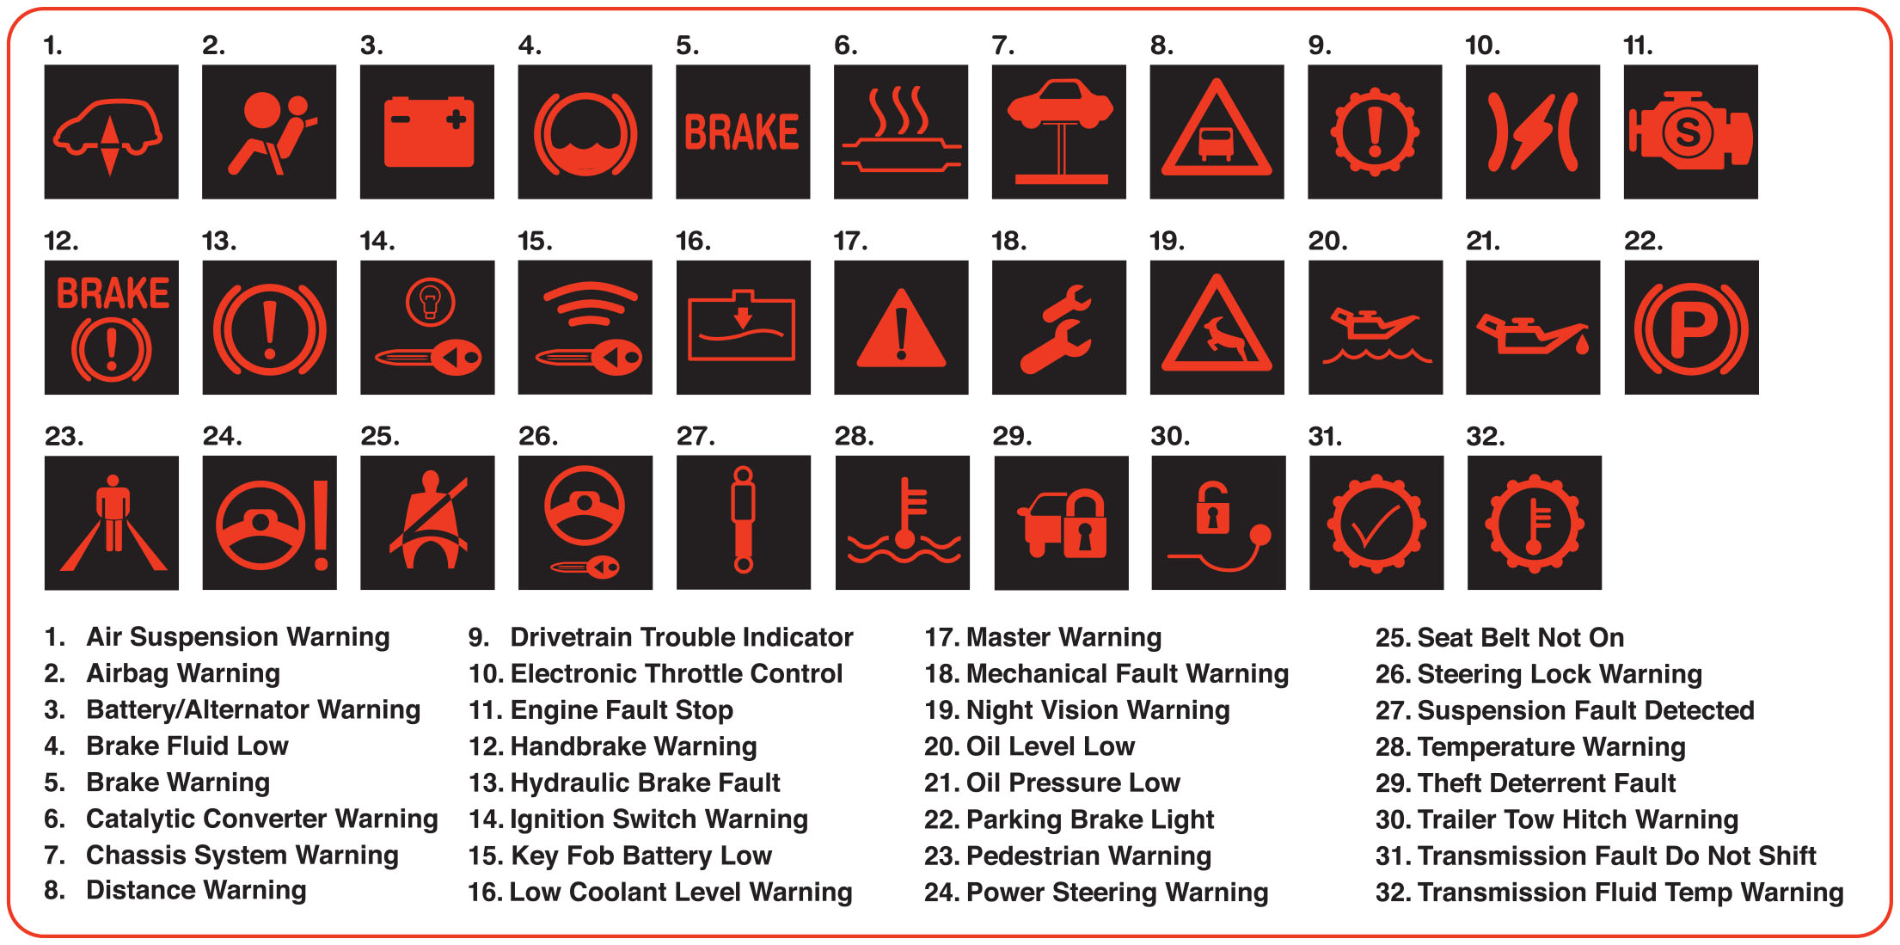
Figure 18.3
Red Dash Symbols
Red dash symbols are used to warn the driver of a fault requiring immediate action.
Notes:
Long Description:
The details of the indications are as follows. 1. Air suspension warning. 2. Airbag warning. 3. Battery or alternator warning. 4. Brake fluid low. 5. Brake warning. 6. Catalytic converter warning. 7. Chassis system warning. 8. Distance warning. 9. Drivetrain trouble indicator. 10. Electronic throttle control. 11. Engine fault stop. 12. Handbrake warning. 13, Hydraulic brake fault. 14. Ignition switch warning. 15. Key fob battery low. 16. Low coolant level warning. 17. Master warning. 18. Mechanical fault warning. 19. Night vision warning. 20. Oil level low. 21. Oil pressure low. 22. Parking brake light. 23. Pedestrian warning. 24. Power steering warning. 25. Seat belt not on. 26. Steering lock warning. 27. Suspension fault detected. 28. Temperature warning. 29. Theft deterrent fault. 30. Trailer tow hitch warning. 31. Transmission fault do not shift. 32. Transmission fluid temperature warning.

Slide 10
Frequently Asked Question: How to Rest Maintenance Indicators?
? Frequently Asked Question
How to Rest Maintenance Indicators? In most cases, the maintenance required indicators symbols are used only as a reminder that routine maintenance is needed, such as an oil change. For most vehicles, the resetting procedure is often easily done such as: “Depress the accelerator pedal three times to the floor, in less than 10 seconds.” Then when the ignition is turned off, and the light will go out, resetting the indicator. Check service information the owner's manual or perform an Internet search to find the exact procedure to follow for the vehicle being serviced.

Slide 11
Question 1
What do the colors of the dash symbols mean?

Slide 12
Answer 1
Green or blue indicate something is working, amber indicates something will need attention soon and red indicates that attention is needed immediately.

Slide 13
Steering Wheel Controls
Purpose
Allow driver to keep their hands on wheel and their eyes on the road at all times.
Function
Radio controls
Cruise control
Telephone answering and calls
Voice commands

Slide 14
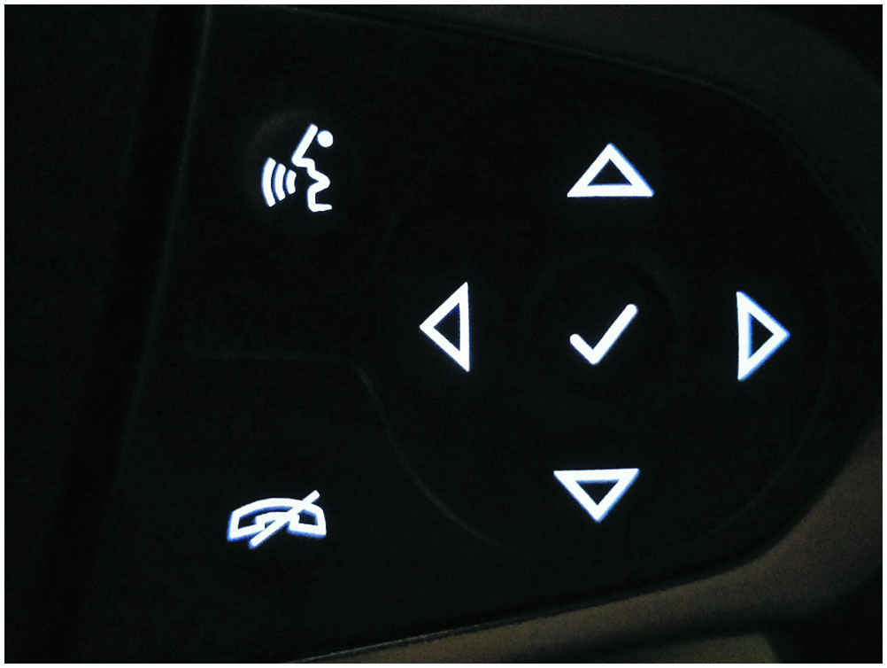
Figure 18.4
Steering Wheel Controls
Steering wheel controls allow the driver to select a function while keeping their hands on the wheel and their eyes on the road.

Slide 15
Voice Activation
Purpose
Perform various functions or settings in the vehicle.
Functions
Phone calls
Text messages
Climate-control settings
Source of audio
Navigation system

Slide 16
Maintenance Indicators
Purpose and Function
Inform the driver that routine maintenance is needed.
Reset Maintenance Indicators
Refer to service information or owners manual for procedure.

Slide 17
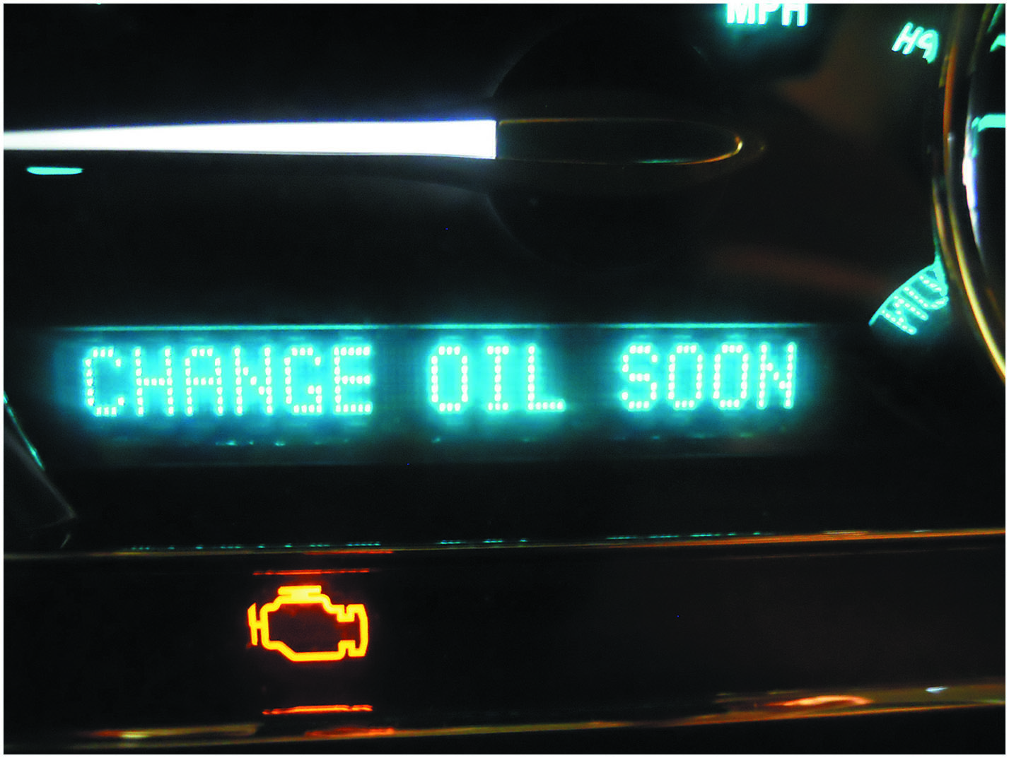
Figure 18.5
Maintenance Reminders
Maintenance reminders are often messages displayed on the instrument panel informing the driver of needed service, such as the need to change the engine oil.

Slide 18
Analog and Digital Displays
Terminology
Analog display uses a needle to show values.
Digital display uses numbers to indicate values.
Stepper Motor Analog Gauges
Most analog dash displays use a stepper motor to move the needle.
Network Communication
Data is shared digitally with the instrument cluster from various modules.

Slide 19
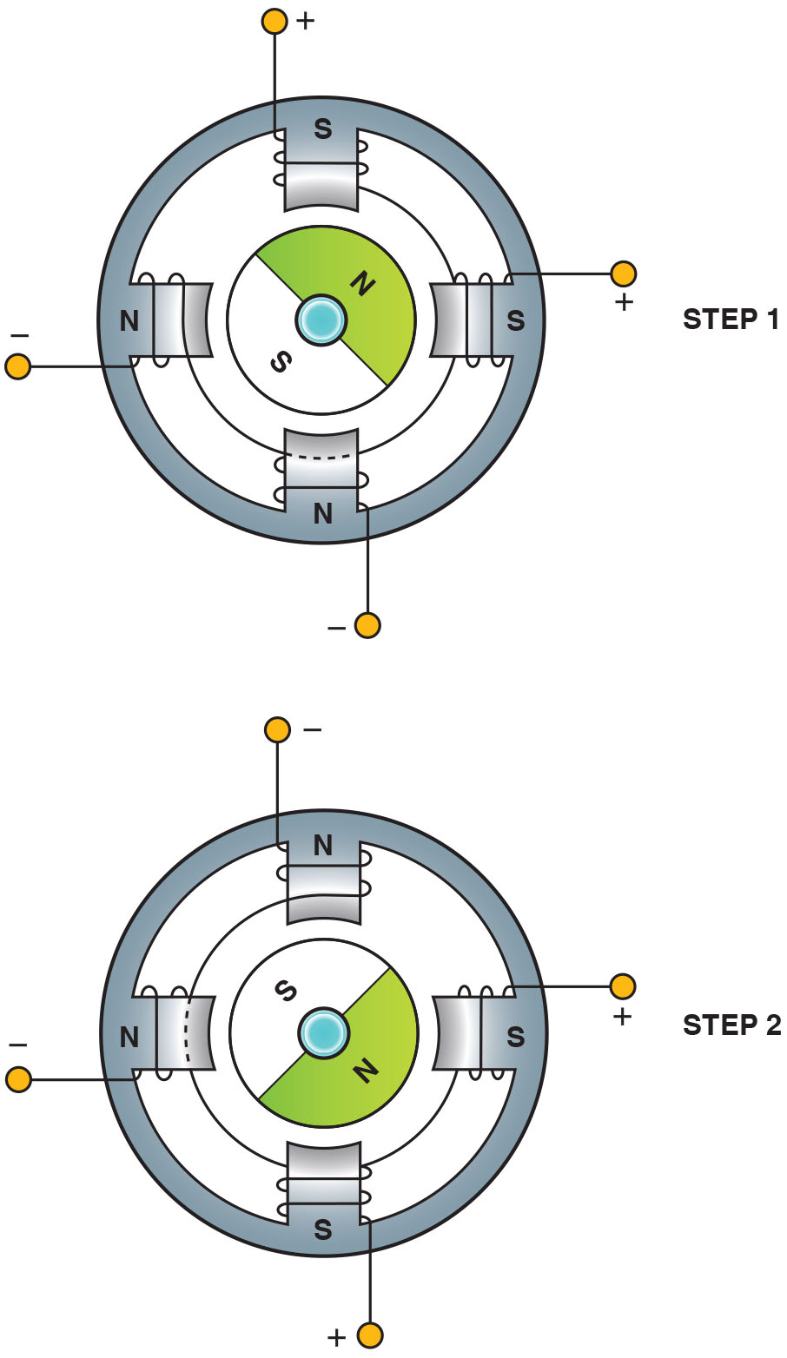
Figure 18.6
Stepper Motor
Most stepper motors use four wires that are pulsed by the computer to rotate the armature in steps.
Notes:
Long Description:
The stepper motor has a circular body with 4 equally placed stator poles at top, bottom, left and right. Step 1 has positive connected to armature of top and right poles showing both as positive and magnetic south and step 2 has positive connected to armature of right and bottom poles showing both as positive and magnetic south. The magnetic north of the rotor is aligned between the magnetic south poles.

Slide 20
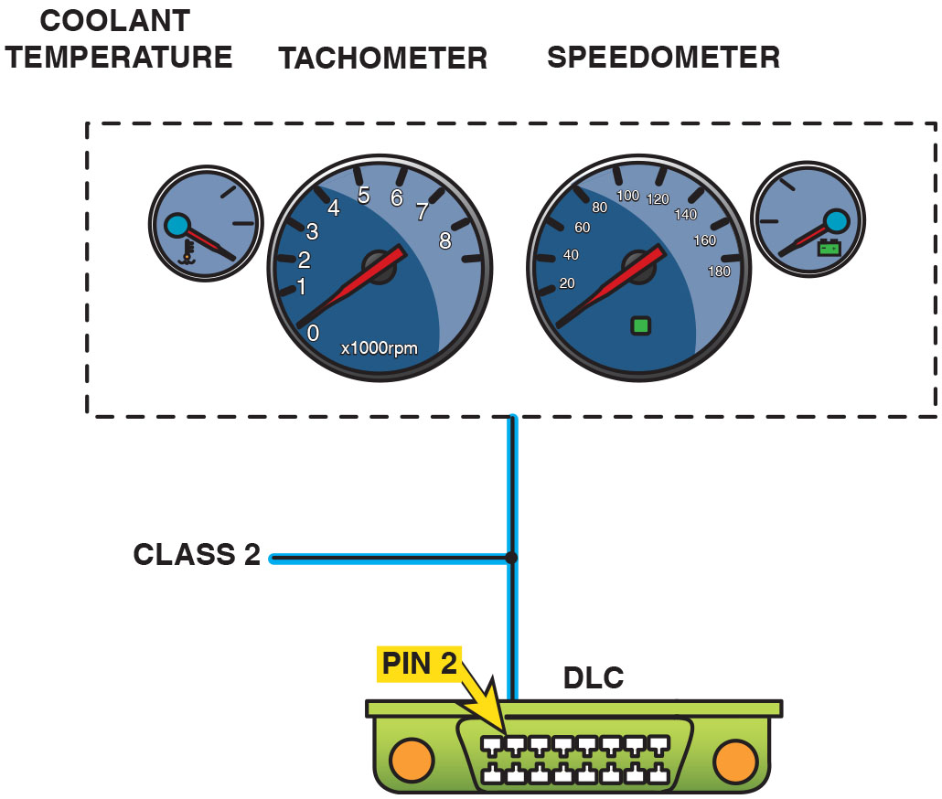
Figure 18.7
Instrument Display D L C
A typical instrument display uses data from the sensors over serial data lines to the individual gauges.

Slide 21
Head-Up Display
Purpose
Supplemental display that projects the vehicle speed and sometimes other data, such as turn-signal information, onto the windshield.
Operation
H U D unit is installed in instrument panel (I P) and uses a mirror to project vehicle information onto the inside surface of the windshield.

Slide 22
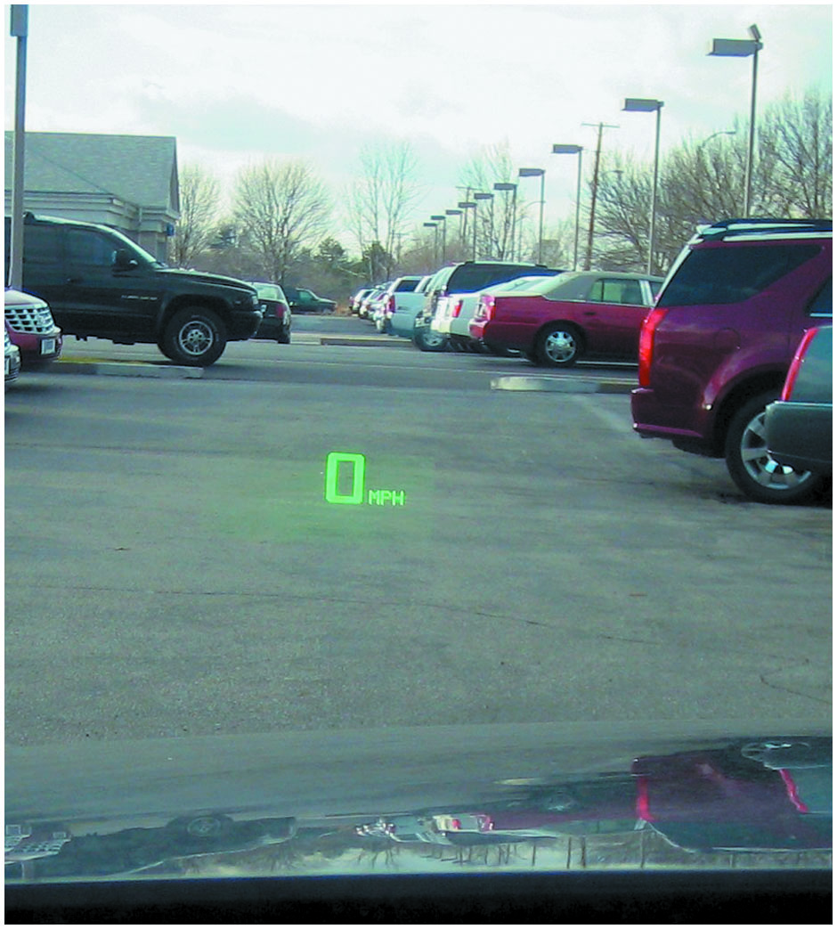
Figure 18.8
H U D
A typical head-up display showing zero miles per hour, which is actually projected on the windshield from the head-up display in the dash.

Slide 23
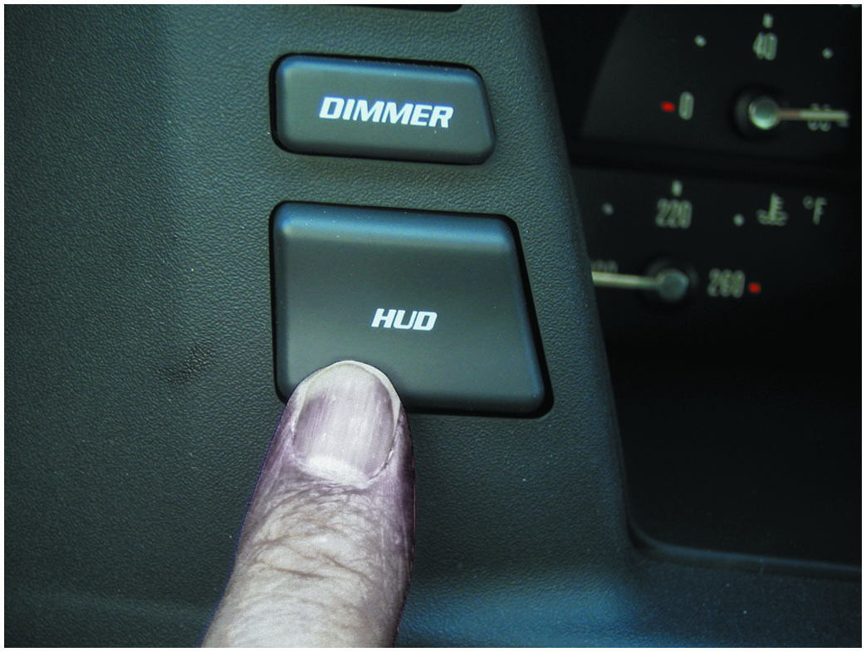
Figure 18.9
H U D Control
The dash-mounted control for the head-up display on this Cadillac allows the driver to move the image up and down on the windshield for best viewing.

Slide 24
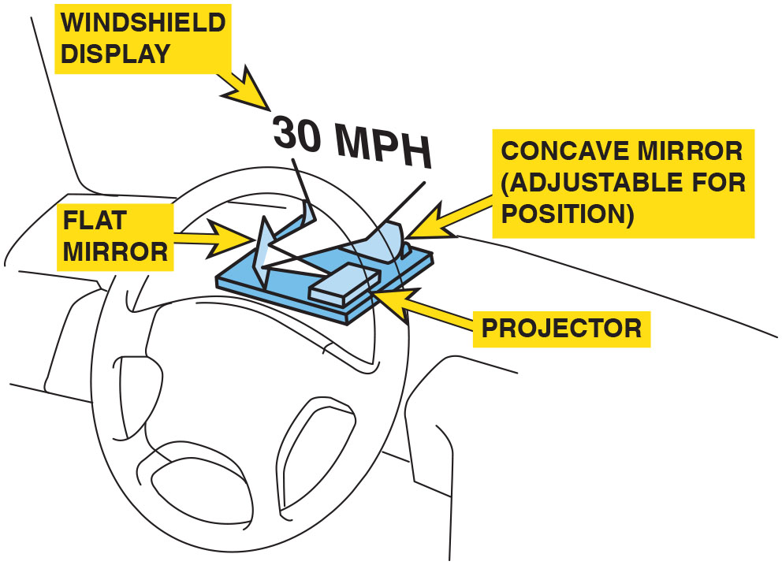
Figure 18.10
H U D Display Unit
A typical head-up display (H U D) unit.

Slide 25
Night Vision
Purpose and Function
Uses a camera that is capable of observing objects in the dark to assist the driver while driving at night.
Operation
Camera creates pictures based on the heat energy emitted by objects, rather than from light reflected on an object, as in a normal optical camera.
Diagnosis and Service
Follow the manufacturer’s recommended testing and service procedures.

Slide 26
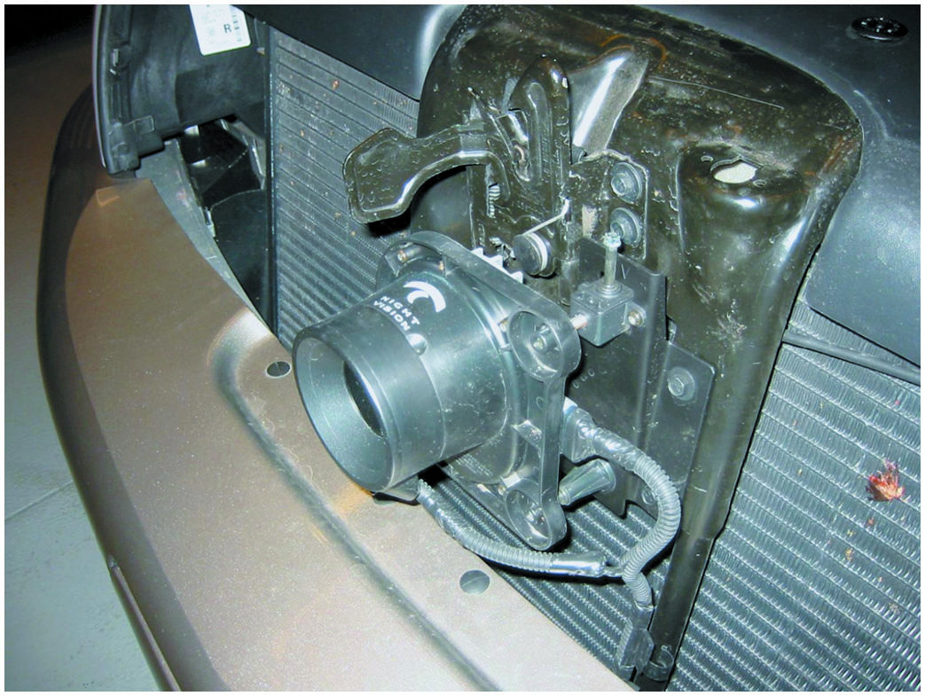
Figure 18.11
Night Vision
A night vision camera behind the grille of a Cadillac.

Slide 27
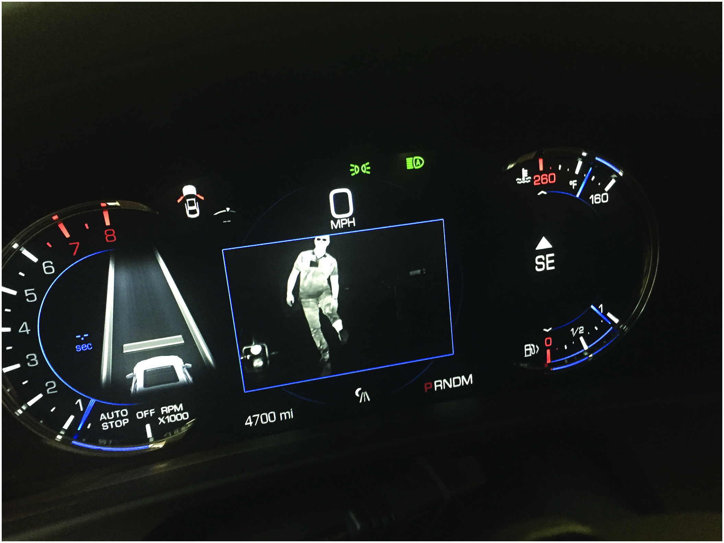
Figure 18.12
Night Vision Image
A view of a person walking in front of a Cadillac equipped with night vision.

Slide 28
Question 2
Night vision is used to detect what type of objects?

Slide 29
Answer 2
People or objects that emit heat energy that cannot be seen in the darkness.

Slide 30
Electronic Displays (1 of 2)
Light-Emitting Diode (L E D)
Light-emitting diode (L E D) is a semiconductor that is constructed to release energy in the form of light.
Vacuum Tube Fluorescent Displays
V T F display generates its bright light in a manner similar to that of a T V screen, where a chemical-coated light-emitting element called phosphor is hit with high-speed electrons.

Slide 31
Electronic Displays (2 of 2)
Liquid Crystal Displays
L C D construction consists of a special fluid sandwiched between two sheets of polarized glass.
A small voltage is applied to the fluid through a conductive film laminated to the glass plates.
W O W Display
When a vehicle equipped with a digital dash is started, all segments of the electronic display are turned on at full brilliance for 1 or 2 seconds.

Slide 32
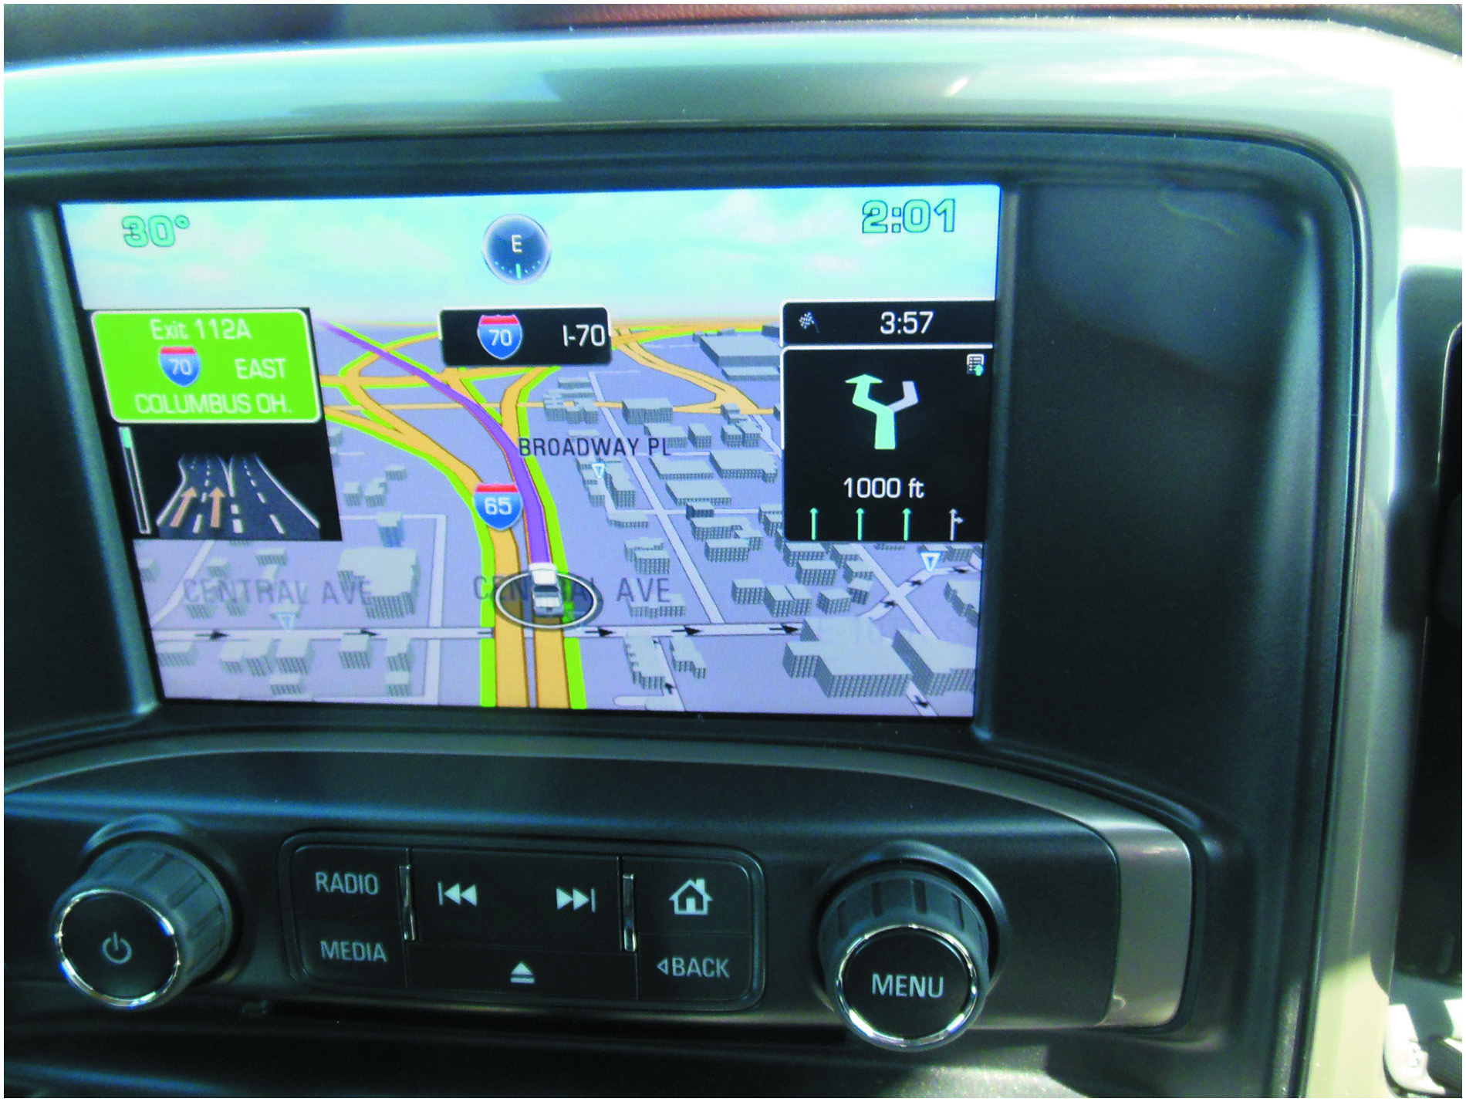
Figure 18.13
Navigation System
A typical L C D navigation system display.

Slide 33
Frequently Asked Question: What Is the W O W Display?
? Frequently Asked Question
What Is the W O W Display? When a vehicle equipped with a digital dash is started, all segments of the electronic display are turned on at full brilliance for 1 or 2 seconds. This is commonly called the W O W display and is used to show off the brilliance of the display. If numbers are part of the display, the number 8 is shown, because this number uses all segments of a number display. Technicians can also use the W O W display to determine if all segments of the electronic display are functioning correctly.

Slide 34
Virtual Display
Purpose and Function
Virtual display is a dash that allows the driver to select what data is being displayed.
Operation
Dash display is all that is really different because all the data comes to the I P C on the data bus.
Display can be changed to meet the needs of driver.

Slide 35
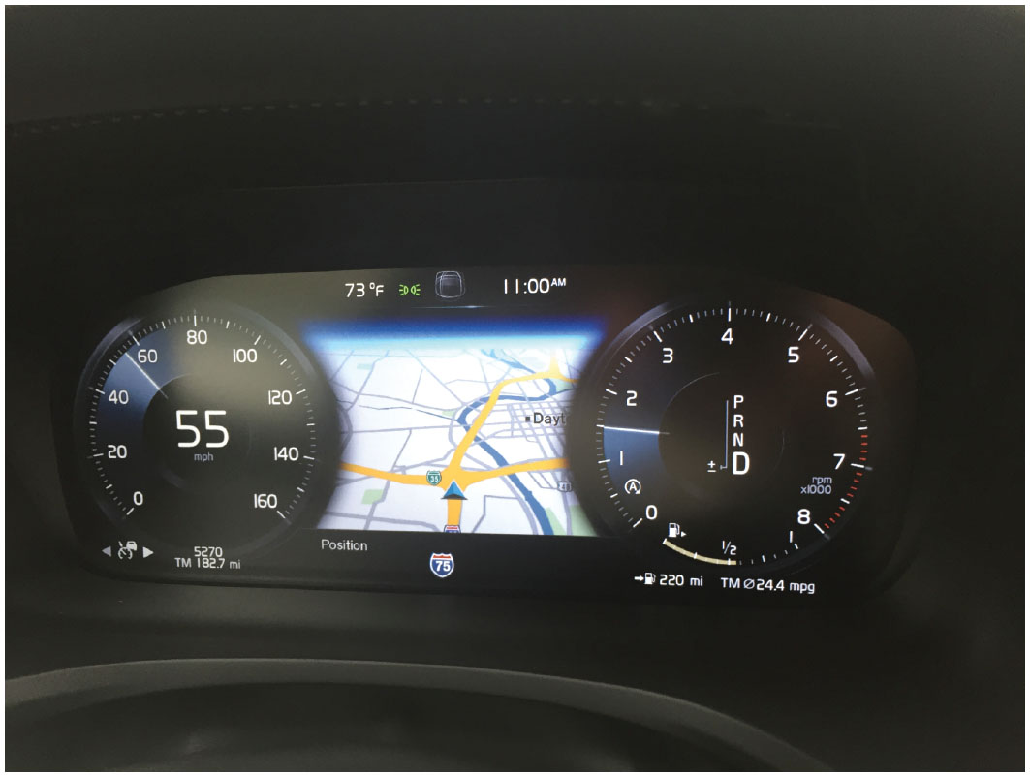
Figure 18.14
Virtual Dash
A virtual dash on this Volvo is able to display a speedometer (left) in both analog (needle-type) and digital (number) as well as a tachometer on the right. In the center of the display, this virtual dash is displaying the navigation screen. What is displayed can be changed by the driver to match what is important to them.

Slide 36
Touch Screens
Purpose
Allow driver to use a finger to perform functions displayed on the screen.
Operation
Capacitive touchscreen panel reacts to the human touch. The touch location is sent to the controller for processing.
Touch Screen Feedback
Haptic response (beep or vibration) improves the experience by providing feedback.

Slide 37
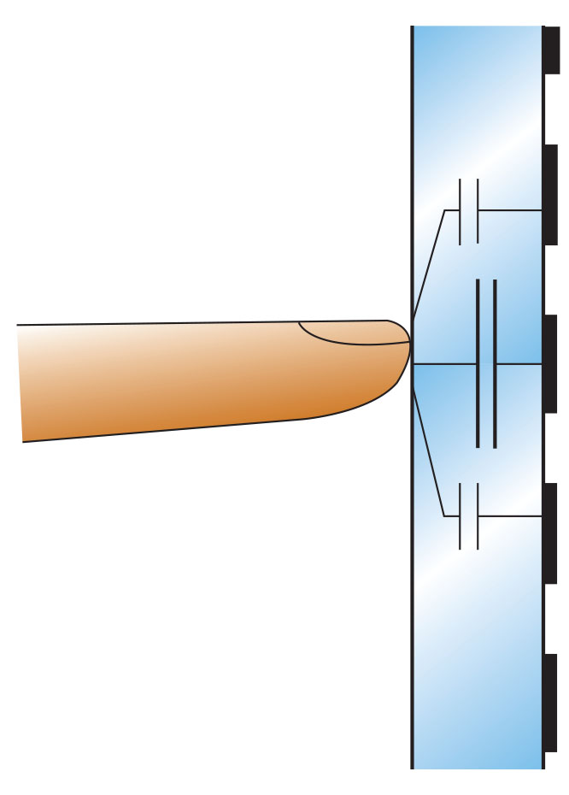
Figure 18.15
Touchscreen
Schematic of a capacitive touchscreen.
Notes:
TECH TIP: Touch Screen Tip
Most vehicle navigation systems use a touch screen for use by the driver (or passenger) to input information or other on-screen prompts. Most touch screens use a change in capacitance at the surface of the screen to determine when and where some action is being performed. Do not push harder on the display if the unit does not respond, or the display unit may be damaged. If no response is detected when lightly touching the screen, rotate the finger to cause the capacitance area to increase so it can be easily detected.

Slide 38
Speedometers/Odometers
Operation
Dash displays use an electric vehicle speed sensor on the output of the transmission or from the input from the wheel speed sensors (W S S).
Odometers
Odometer is a dash display that indicates the total miles traveled by the vehicle.
Uses either an electrically driven mechanical odometer or a digital display odometer to indicate miles traveled.

Slide 39
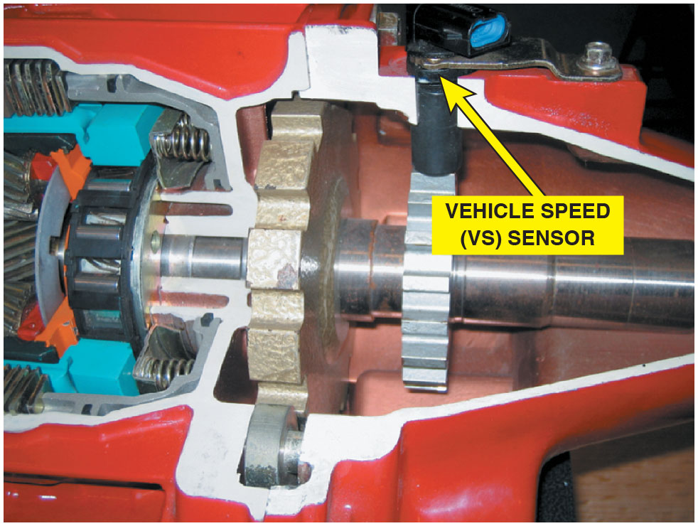
Figure 18.16
V S S
A vehicle speed sensor located in the extension housing of the transmission. Some vehicles use the wheel speed sensors for vehicle speed information.

Slide 40
Animation: Wheel Speed Sensor

Slide 41
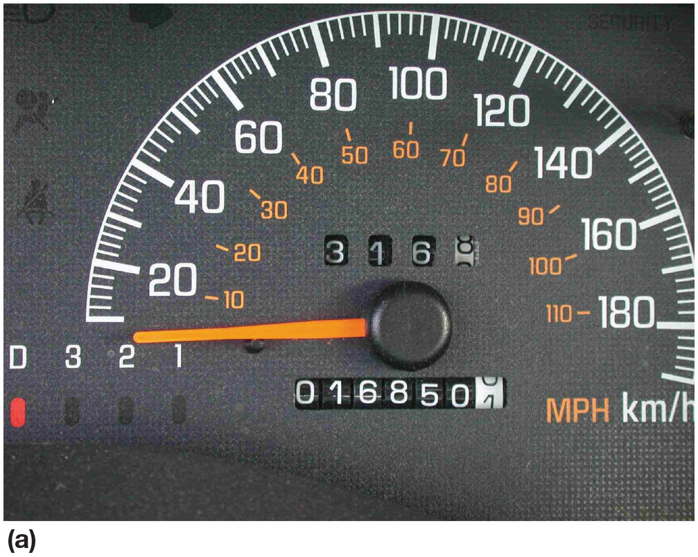
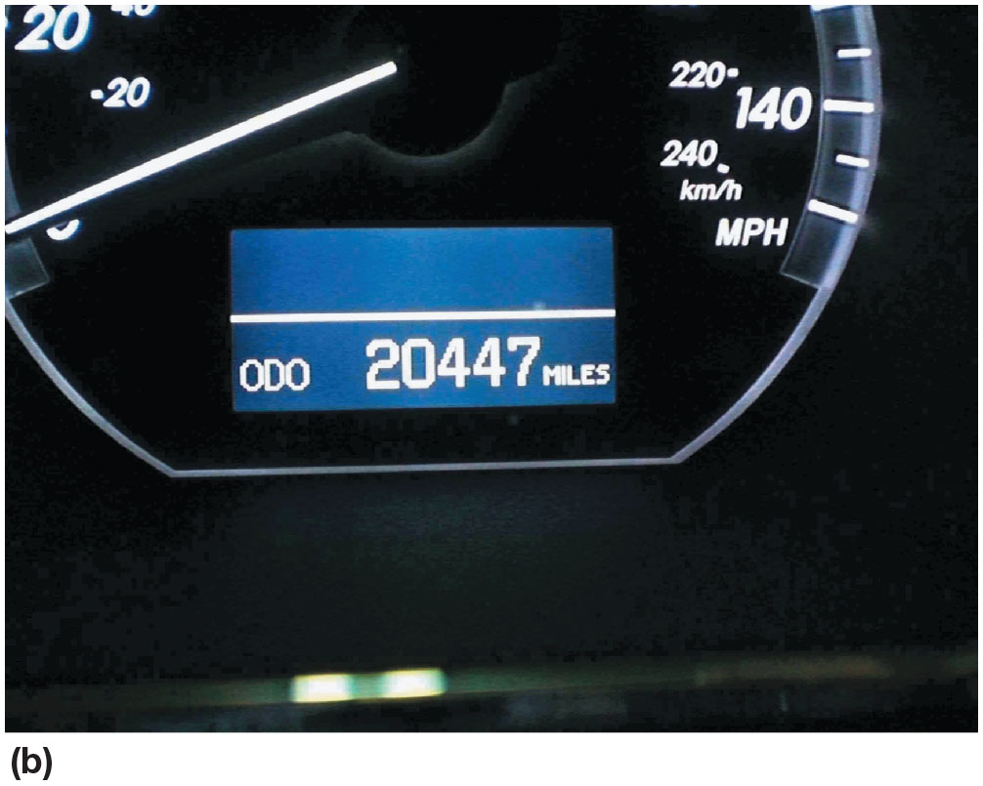
Figure 18.17
Odometers
(a) Some odometers are mechanical and are operated by a stepper motor. (b) Many vehicles are equipped with an electronic odometer.
Notes:
TECH TIP: Keep the Same Overall Tire Diameter
Whenever larger (or smaller) wheels or tires are installed, the speedometer and odometer calibration are thrown off. This can be summarized as follows:
Larger diameter tires. The speed showing on the speedometer is slower than the actual speed. The odometer reading shows fewer miles than actual.
Smaller diameter tires. The speed showing on the speedometer is faster than the actual speed. The odometer reading shows more miles than actual.
To avoid speedometer and odometer issues, select a wheel/tire combination that has the same outside diameter (O D) of the original wheel/tire
combination. Many newer vehicles can use the scan tool to change the tire size (from a select group of sizes) to minimize the effects of tires size change on odometer and speedometer readings. To determine the exact effects of a replacement size wheel or tire, perform an Internet search for a tire
size comparison chart.
CASE STUDY: The Speedometer Works As If It Is a Tachometer: The owner of a Ford F-150 pickup truck complained that all of a sudden the speedometer needle went up and down with engine speed, rather than vehicle speed. In fact, the speedometer needle went up and down with engine speed, even though the gear selector was in “park” and the vehicle was not moving. After hours of troubleshooting, the service technician went back and started checking the basics and discovered that the alternator had a bad diode. The technician measured over 1 volt A C and over 10 ampere A C ripple current using a clamp-on A C/D C ammeter. Replacing the alternator restored the proper operation of the speedometer.
Summary:
Complaint—Customer stated that the speedometer moves in relation to engine speed and not vehicle speed.
Cause—Tests confirmed that the alternator was producing excessive A C voltage due to a bad diode.
Correction—Replacing the alternator restored proper operation of the speedometer.

Slide 42
Dash Gauges (1 of 2)
Fuel Level
Fuel level gauges use a fuel tank sending unit that consists of a float attached to a variable resistor.
As the resistance of the tank unit changes, the dash-mounted gauge also changes to show the level of the fuel in the tank.
Oil Pressure
The oil pressure lamp operates through use of an oil pressure sending unit, which is a switch screwed into the engine block, and grounds the electrical circuit.

Slide 43
Dash Gauges (2 of 2)
Coolant Temperature
Most vehicles use the engine coolant temperature (E C T) sensor for engine temperature gauge operation.
Dash Instrument Diagnosis
Use factory or factory-level scan tool to check for codes.
Use bidirectional control features on scan tool to actuate dash display.
Always follow the specified testing and diagnostic procedures found in service information for the vehicle being tested.

Slide 44
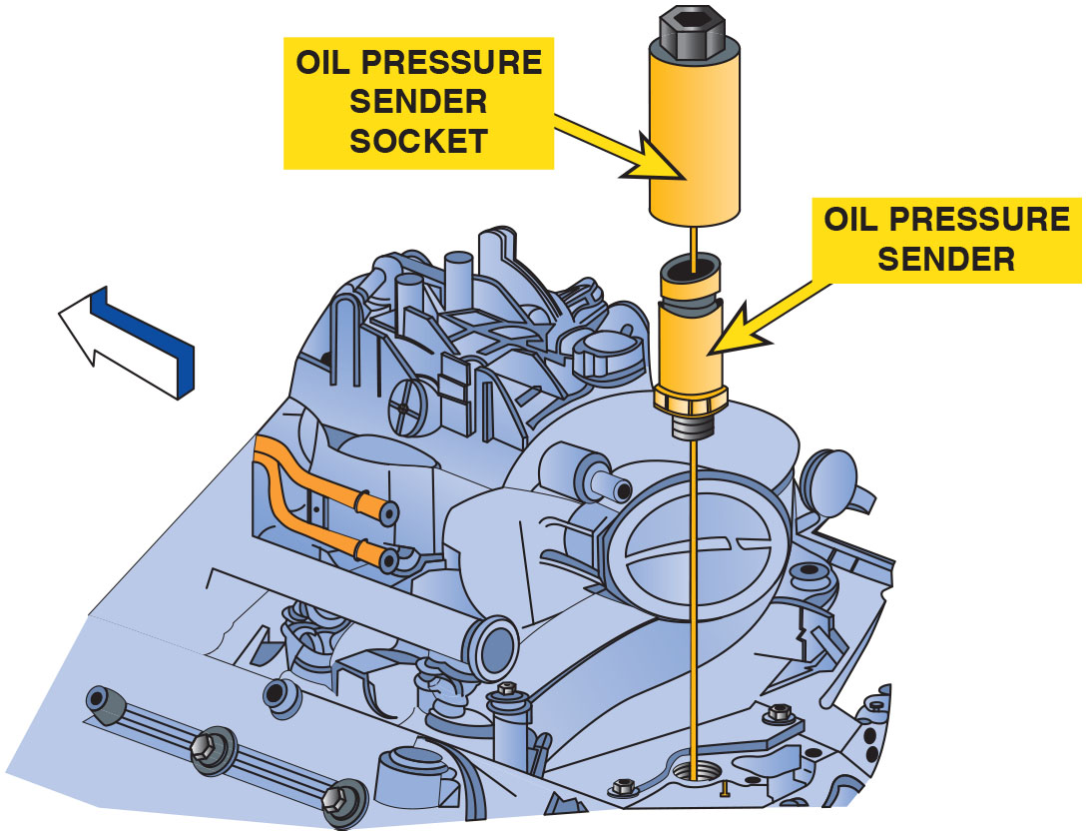
Figure 18.18
Sending Unit
A sending unit socket being used to remove an oil pressure sender unit.
Notes:
CASE STUDY: Electronic Devices Cannot Swim
The owner of a Dodge minivan complained that after the vehicle was cleaned inside and outside, the temperature gauge, fuel gauge, and speedometer stopped working. The vehicle speed sensor was checked and found to be supplying a square wave signal that changed with vehicle speed. A scan tool
indicated a speed, yet the speedometer displayed zero all the time. Finally, the service technician checked
the body control module (B C M) to the right of the accelerator pedal and noticed that it had been wet, from the interior cleaning. Drying the B C M did not fix the problem, but a replacement B C M fixed all the problems. The owner discovered that electronic
devices do not like water and that computers cannot swim.
Summary:
Complaint—Customer complained that many gauges stopped working after the vehicle was cleaned.
Cause—The body control module (B C M) was found to be wet from interior cleaning.
Correction—Replacing the B C M fixed all the problems.

Slide 45
Frequently Asked Question: What Does the Arrow Mean?
? Frequently Asked Question
What Does the Arrow Mean? Many fuel gauges have an arrow next the symbol of a fuel pump. The arrow points to the side where the fill cap is located. This is very helpful if using a rental vehicle as it indicates which side to pull up to a filling station pump. ● See Figure 18.19.

Slide 46
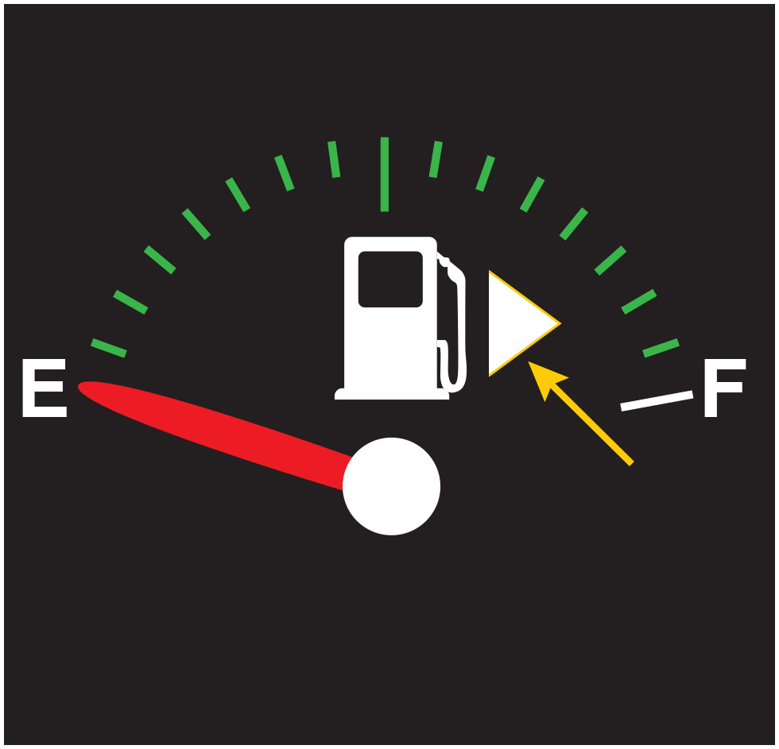
Figure 18.19
Fuel Cap Location
The arrow next to the fuel pump symbol shows which side of the vehicle the fuel cap is located.

Slide 47
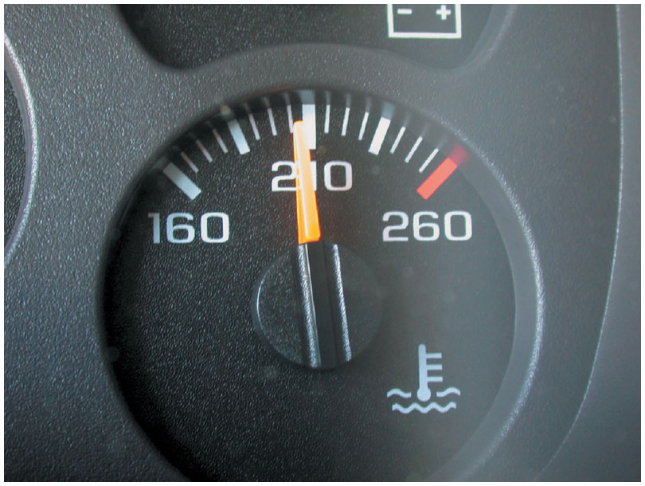
Figure 18.20
Temp Gauge
A temperature gauge showing normal operating
temperature between
and
depending on the
specific vehicle and engine.

Slide 48
Navigation and G P S
Purpose and Function
The global positioning system (G P S) uses 24 satellites in orbit around the earth to provide signals for navigation devices.
Navigation System Parts and Operation
G P S satellite signals
Y A W sensor
Vehicle speed sensor
Audio input/output

Slide 49
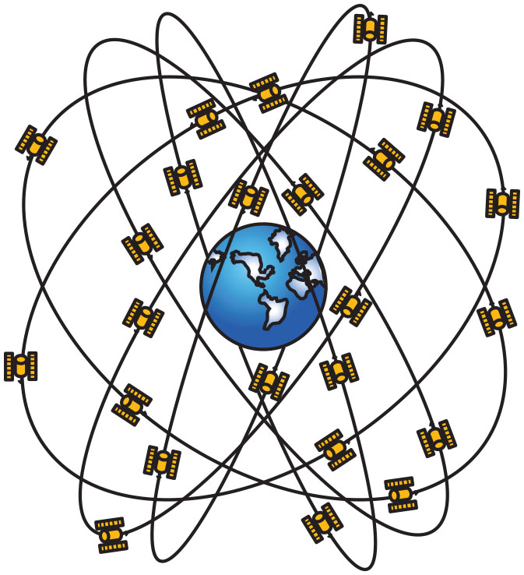
Figure 18.21
G P S
Global positioning systems use 24 satellites in high earth orbit whose signals are picked up by navigation systems. The navigation system computer then calculates the location based on the position of the satellite overhead.

Slide 50
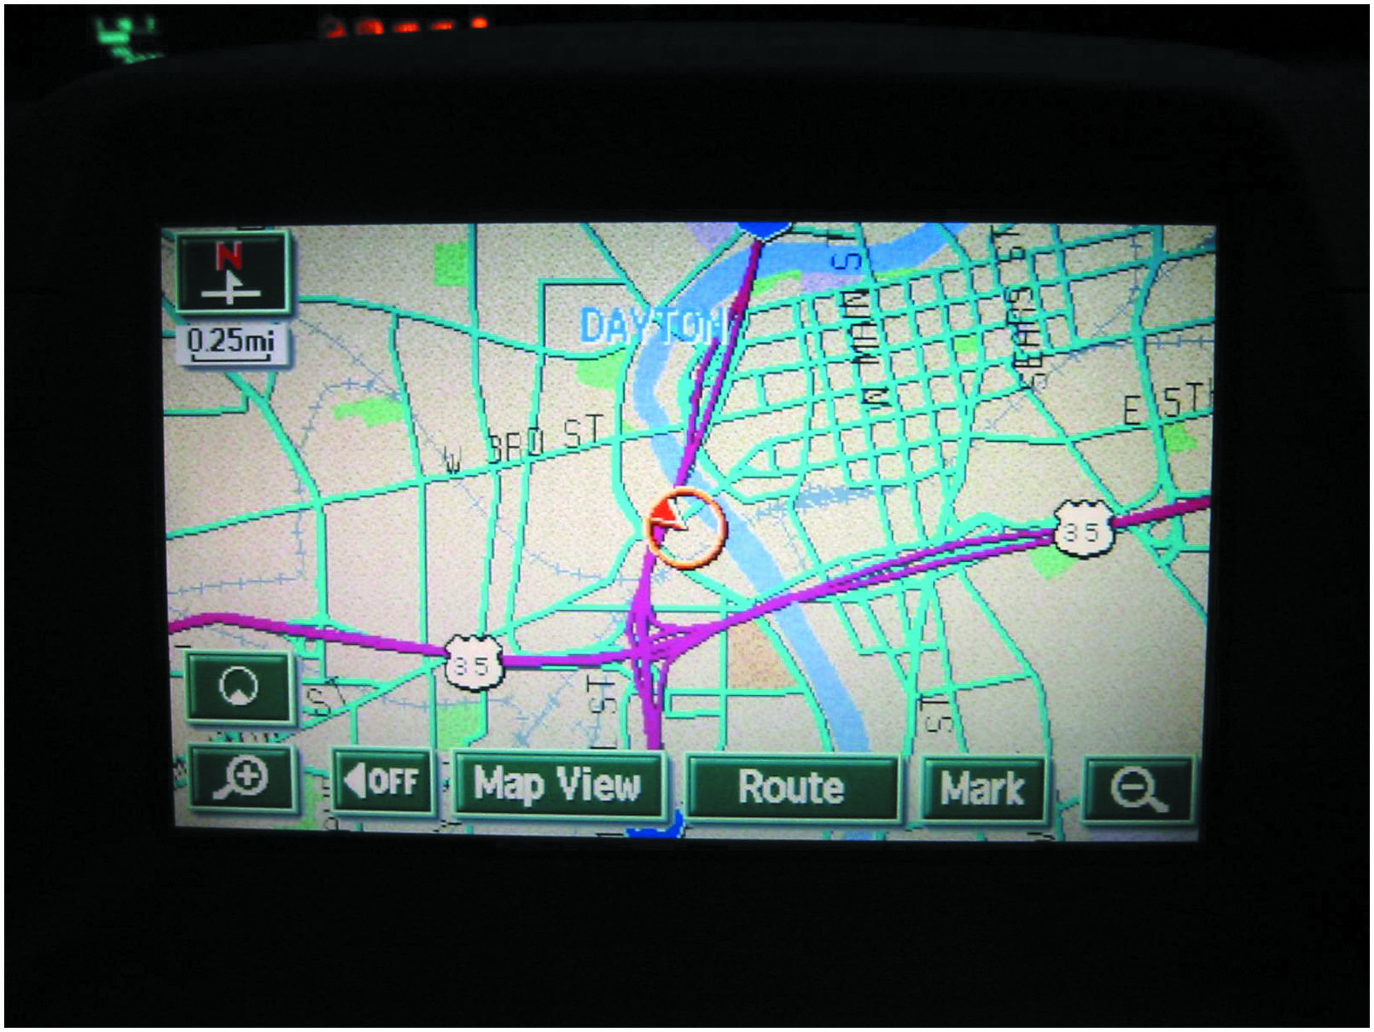
Figure 18.22
G P S Display
A typical G P S display screen showing the location of the vehicle.

Slide 51
Frequently Asked Question: What Is Navigation-Enhanced Climate Control?
? Frequently Asked Question
What Is Navigation-Enhanced Climate Control? Some vehicles use data from navigation system to help control the automatic climate control system. Data about the location of the vehicle includes Time and date. This information allows the automatic climate control system to determine where sun is located. Direction of travel. The navigation system can also help the climate control system determine the direction of travel. As a result of input from navigation system, the automatic climate control system can control cabin temperature, in addition to various other sensors in the vehicle. For example, if vehicle is traveling south in the late afternoon in July, the climate control system could assume that the passenger side of the vehicle is warmed more by the sun than the driver’s side, and could increase the airflow to the passenger side to help compensate for the additional solar heating.

Slide 52
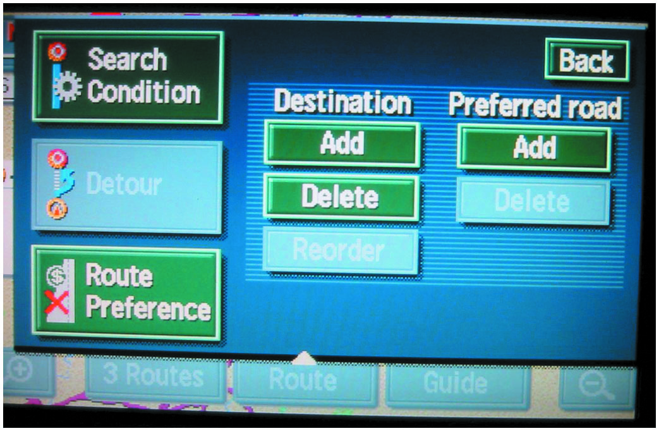
Figure 18.23
Navigation Display
A typical navigation display showing various options. Some systems do not allow access to these if the vehicle is in gear and/or moving.

Slide 53
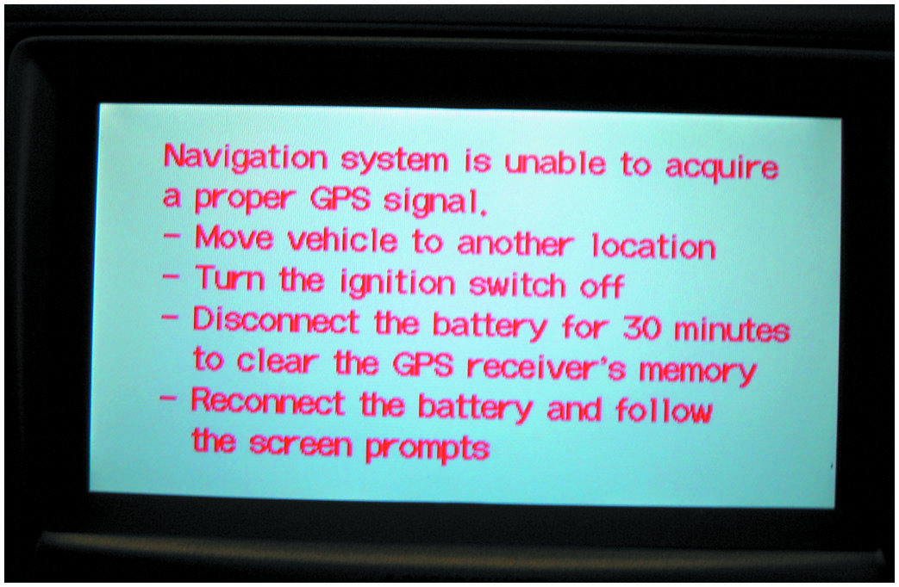
Figure 18.24
No G P S Signal
A screen display of a navigation system that is unable to acquire usable signals from G P S satellites.
Notes:
Long Description:
Text on the display reads, navigation system is unable to acquire a proper G P S signal. Move vehicle to another location. Turn the ignition switch off. Disconnect the battery for 30 minutes to clear the G P S receiver's memory. Reconnect the battery and follow the screen prompts.

Slide 54
Question 3
How does a navigation system determine the location of the vehicle?

Slide 55
Answer 3
G P S satellites.

Slide 56
Telematics
What Is Telematics?
Telematics: interconnected system that combines telecommunications (cellular systems) and G P S navigation satellite system technology.
Parts and Operation
Automatic notification of airbag deployment.
Emergency services.
Stolen vehicle location assistance.
Remote door unlock.
Roadside assistance.

Slide 57
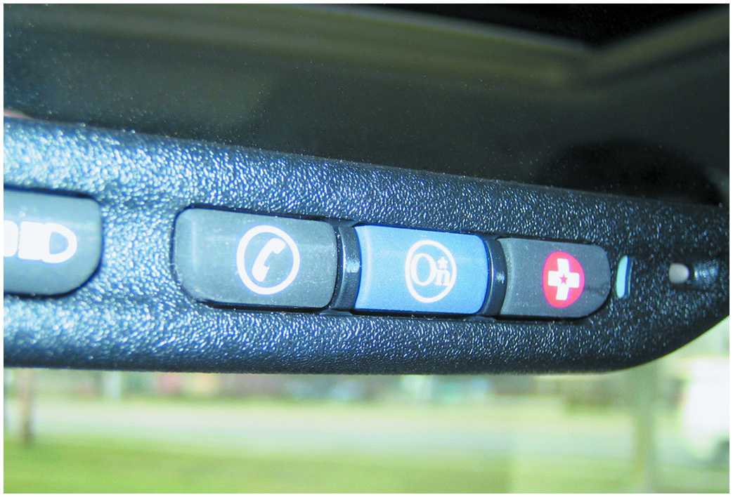
Figure 18.25
OnStar Telematics
The three-button OnStar control is located on the inside rearview mirror. The left button (telephone handset icon) is pushed if a hands-free cellular call is to be made. The center button is depressed to contact an OnStar advisor and the right emergency button is used to request that help be sent to the vehicle’s location.
Notes:
Long Description:
The left button, telephone handset icon, is pushed if a hands-free cellular call is to be made. The center button is depressed to contact an OnStar advisor and the right emergency button is used to request that help be sent to the vehicle’s location.

Slide 58
Backup Camera
Parts and Operation
Used to display area at rear of vehicle in a screen display on dash, or in the inside rear-view mirror when gear selector is placed in reverse.
Rear Camera Image Issues
Dark conditions
Physical damage
Dirt, mud, ice, snow
Excessive temperatures
Glare

Slide 59
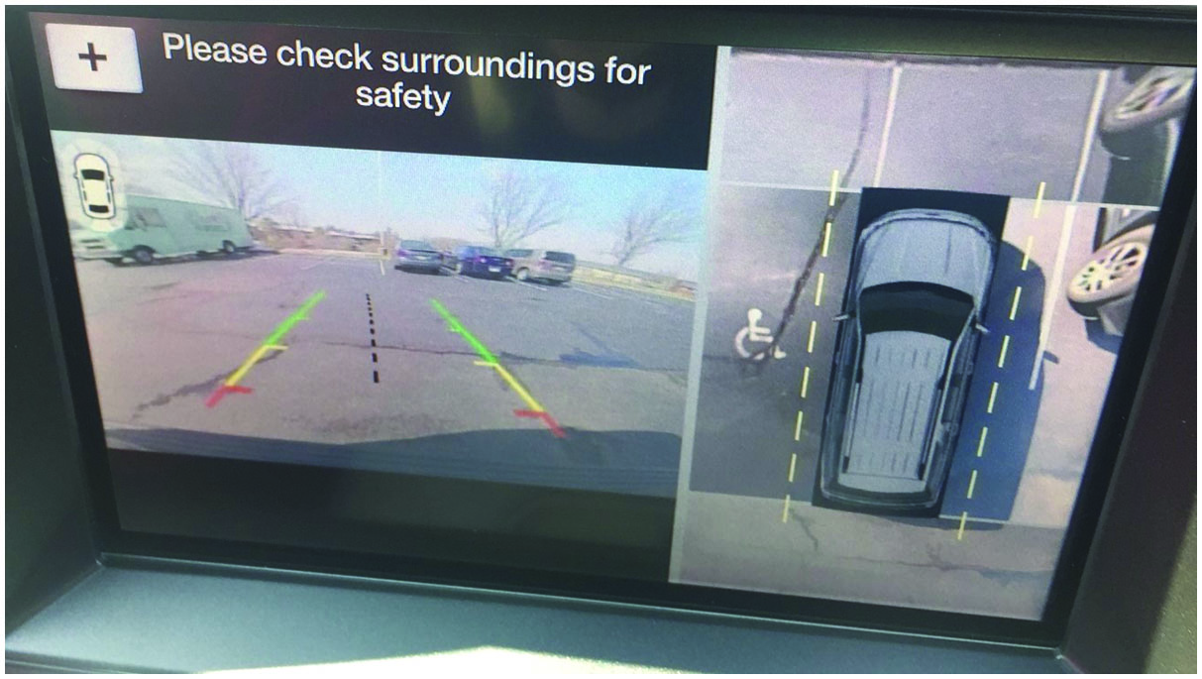
Figure 18.26
Backup Camera
A dash display on a Ford F-150 pickup truck showing the backup camera image on the left side of the screen and a bird’s eye view on the right side showing the vehicle next to the truck on the right and the handicap parking stop on the left. The bird’s eye view is created by combining the images from the front, side mirror, and rear cameras together to create the virtual image.

Slide 60
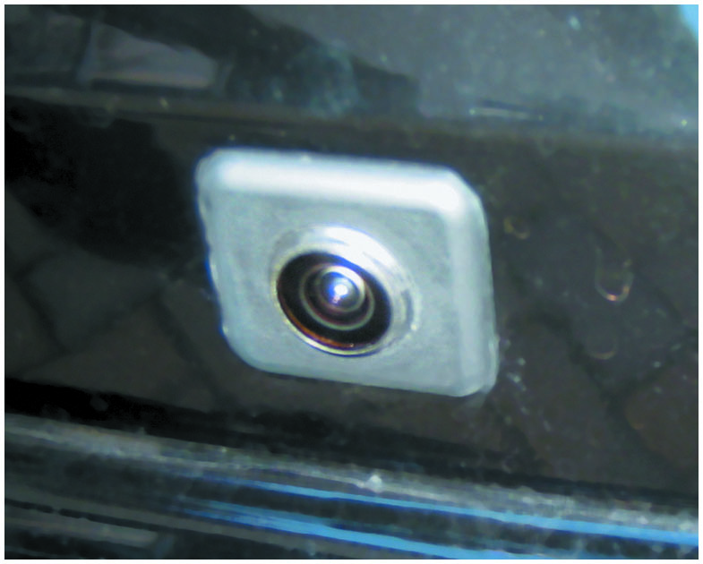
Figure 18.27
Backup Camera
A typical fisheye-type backup camera usually located near the center on the rear of the vehicle near the license plate.

Slide 61
Frequently Asked Question How Do I Test the U S B Port?
? Frequently Asked Question
How Do I Test the U S B Port? U S B (Universal Serial Bus) ports have been used in vehicles since about 2006. They are used for everything from streaming music to simply providing power to a cell phone or other electronic devices. If the outlet does not function, begin by making sure the fuse is not blown. A U S B multimeter can be used to safely measure the port voltage and current output. (• See Figure 18.28.) Additionally, the U S B port pins can be tested individually for continuity with a cable tester and the entire circuit can be load tested using a U S B load tester. Caution should be exercised when load testing a U S B port as U S B
and U S B
are only rated for 500 milliamperes.
Notes:
How Do I Test the USB Port?

Slide 62
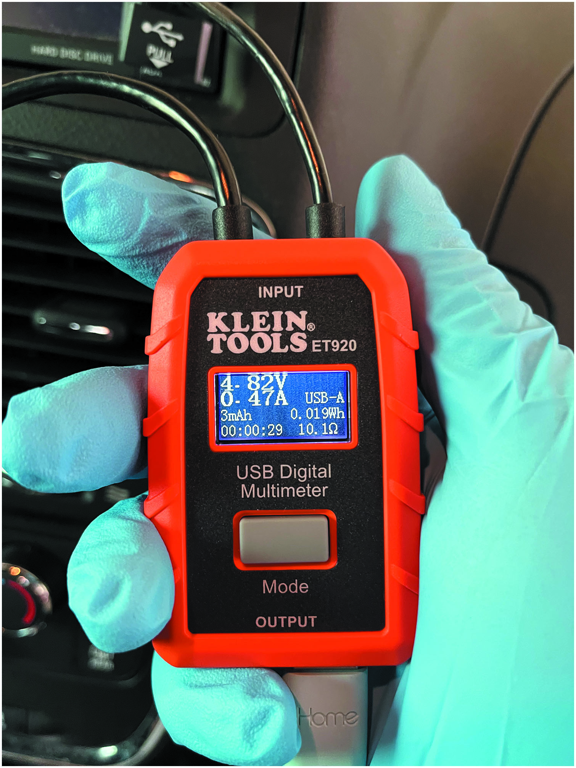
Figure 18.28
Backup Camera
The U S B multimeter is plugged into the U S B port and a cell phone is plugged into the output side of the meter. The meter shows the U S B port is outputting 4.82 volts and the cell phone is drawing 0.47 amperes.

Slide 63
Parking Assist
Components
Ultrasonic object sensors
Electromagnetic parking sensors (E P S)
Blind spot monitor
Operation
The system is active from the time the engine is started until the vehicle exceeds a speed of approximately 6 M P H (10 k m/h).
Also active when the vehicle is backing up.

Slide 64
Lane Departure Warning
Parts and Operation
Uses cameras to detect if the vehicle is crossing over lane marking lines on the pavement.
Some systems use two cameras, one mounted on each outside rearview mirror.
Some systems use infrared sensors located under the front bumper.
Diagnosis and Service
After a visual inspection, follow the vehicle manufacturer’s recommended diagnosis procedures to locate and repair the fault in the system.

Slide 65
Animation: ADAS Lane Departure Warning

Slide 66
Summary (1 of 3)
Green or white symbols are used to notify the driver that certain functions are working.
Amber-colored symbols mean that a fault or an issue has occurred that may require attention soon. Red symbols mean that a serious fault has been detected and that immediate attention is required.
Most recent vehicles include voice commands, commonly called voice activation that can be used to perform various functions or settings in the vehicle.
The purpose of the maintenance reminders is to inform the driver that routine maintenance is needed.

Slide 67
Summary (2 of 3)
The head-up display (H U D), also called a heads-up display, is a supplemental display that projects the vehicle speed and sometimes other data, such as turn signal information onto the windshield.
Night vision systems use a camera that can observe objects in the dark to assist the driver while driving at night.
Touch screen is a dash display, usually L C D, which allows the driver or passenger to use a finger to perform functions that are displayed on the screen.
Dash displays use an electric vehicle speed sensor on the output of the transmission or from the input from the wheel speed sensors (W S S).

Slide 68
Summary (3 of 3)
Fuel level gauges use a fuel tank sending unit that consists of a float attached to a variable resistor.
The global positioning system (G P S) uses 24 satellites in orbit around the earth to provide signals for navigation devices.
Telematics is an interconnected system that combines telecommunications (cellular systems) and global position system (G P S) navigation satellite system technology.
A backup camera is used to display the area at the rear of the vehicle in a display when the gear selector is placed in reverse.

Slide 69
Animations and Video Links (Halderman website subscription and web access needed to view)
(A6) Electrical/Electronic Systems Animations
(A6) Electrical/Electronic Systems Videos

Slide 70
Copyright
This work is protected by United States copyright laws and is provided solely for the use of instructors in teaching their courses and assessing student learning. Dissemination or sale of any part of this work (including on the World Wide Web) will destroy the integrity of the work and is not permitted. The work and materials from it should never be made available to students except by instructors using the accompanying text in their classes. All recipients of this work are expected to abide by these restrictions and to honor the intended pedagogical purposes and the needs of other instructors who rely on these materials.

