Slide 1
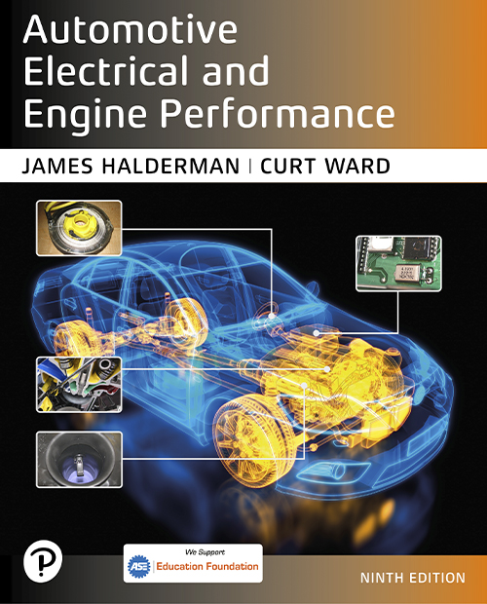
Automotive Electrical and Engine Performance
Ninth Edition
Chapter 17
Lighting and Signaling Circuits
Copyright © 2025 Pearson Education, Inc. All Rights Reserved
Notes:
If this PowerPoint presentation contains mathematical equations, you may need to check that your computer has the following installed:
1) Math Type Plugin
2) Math Player (free versions available)
3) NVDA Reader (free versions available)
INSTRUCTOR NOTE: This presentation includes text explanation notes, you can use to teach the course. When in SLIDE SHOW mode, you RIGHT CLICK and select SHOW PRESENTER VIEW, to use the notes.

Slide 2
Learning Objectives (1 of 3)
17.1 Explain lighting systems in an automobile.
17.2 List the advantages of using L E D lights.
17.3 Read and interpret a bulb chart.
17.4 Discuss the operation of brake lights.
17.5 Discuss the operation of turn signals.
17.6 Describe daytime running lights.
17.7 Describe headlights.

Slide 3
Learning Objectives (2 of 3)
17.8 Describe high-intensity discharge headlights.
17.9 Describe L E D headlights.
17.10 Describe adaptive front lighting systems.
17.11 Describe automatic headlights.
17.12 Describe the headlight high-/low-beam switch.
17.13 Describe auto-dimming headlights.
17.14 Describe how to aim headlights.

Slide 4
Learning Objectives (3 of 3)
17.15 Describe fog lights and driving lights.
17.16 Describe automatic dimming mirrors.
17.17 Describe courtesy lights.
17.18 Describe illuminated entry.
17.19 Explain the procedures to inspect and troubleshoot headlight system.
17.20 Explain the procedures to diagnose the lighting and signaling system.

Slide 5
Lighting Systems (1 of 2)
Non-Computer-Controlled Lighting
Older vehicles used the headlight switch to operate all the lights, including:
Headlights
Taillights
Side-marker lights
Front parking lights
Dash lights
Interior (dome) light(s)

Slide 6
Lighting Systems (2 of 2)
Body Control Module-Controlled Lighting
Body Control Module (B C M) is referred to as a central organizational module.
Benefits include:
Monitors current flow through circuit and turns on a warning light if there is a failure.
Modules turn off the lights after a time delay to prevent the battery from being drained.
In a failsafe mode, all exterior lights default to on for safety.

Slide 7
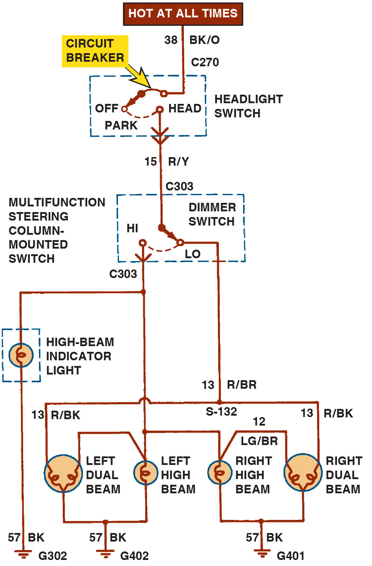
Figure 17.1
Headlight Circuit
A typical headlight circuit diagram on an older vehicle that does not use a controller, such as the body control module (B C M) to control the operation of the lights. Note that the headlight switch is represented by a dotted outline indicating that other circuits (such as dash lights) also operate from the switch.
Notes:
Long Description:
Power supply which is hot at all the times is connected to headlight switch connected to following circuit 1. H I a. High beam indicator light b. Left Dual beam c. Left high beam d. Right high beam e. Right dual beam 2. LOW a. Left Dual beam b. Right dual beam.

Slide 8
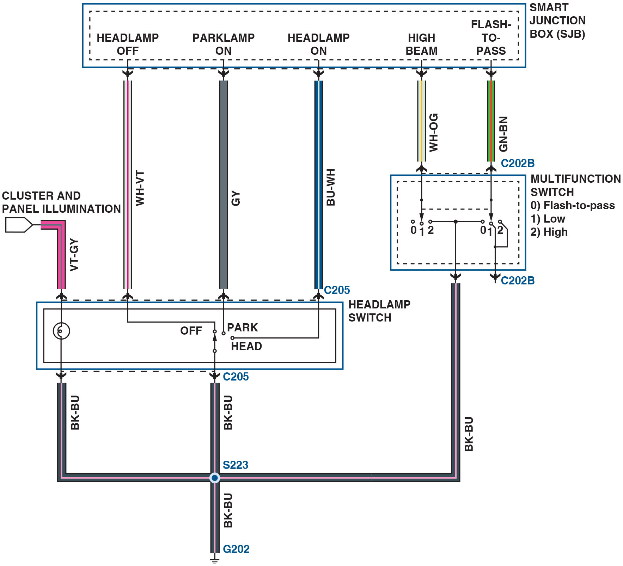
Figure 17.2
Schematic
A schematic showing the inputs from the multifunction switch and the headlight switch to the smart junction box (S J B). The S J B then uses the body control module (B C M) to operate the lights.
Notes:
Long Description:
The cluster and panel illumination connect to a bulb in the headlamp switch. The off, park, and head terminals of the headlamp switch connect to the headlamp off, parklamp on, and headlamp on terminals of the S J B, respectively. The movable contact of the headlamp switch connects to the off terminal of the headlamp switch. The movable contacts of the multifunction switch connect to two terminals labeled 1 in the headlamp switch and to the high beam and flash-to-pass terminals in the S J B. Two terminals of the multifunction switch are labeled 2, and two other terminals are labeled 0. Terminals 0, 1, and 2 correspond to flash-to-pass, low, and high, respectively. Terminal 2 on the left is connected to terminal 0 on the right and both terminals are connected to a splice point. Terminals 1 and 2 on the right are connected to a connector. The bulb and the movable contact of the headlamp switch are connected to the splice point, which connects to the ground. The color specifications of the wires, the specifications of the connectors, and the name of the ground are provided.

Slide 9
Animation: Headlight Circuit, Parking Lights

Slide 10
L E D Lighting
Parts and Operation
An L E D is a P–N junction diode that emits light when a suitable voltage is applied to the leads.
L E D Features
Faster Illumination
Longer Service Life
Lower Current Draw
Testing Bulbs
The bulbs can be visually inspected or tested using an ohm meter.

Slide 11
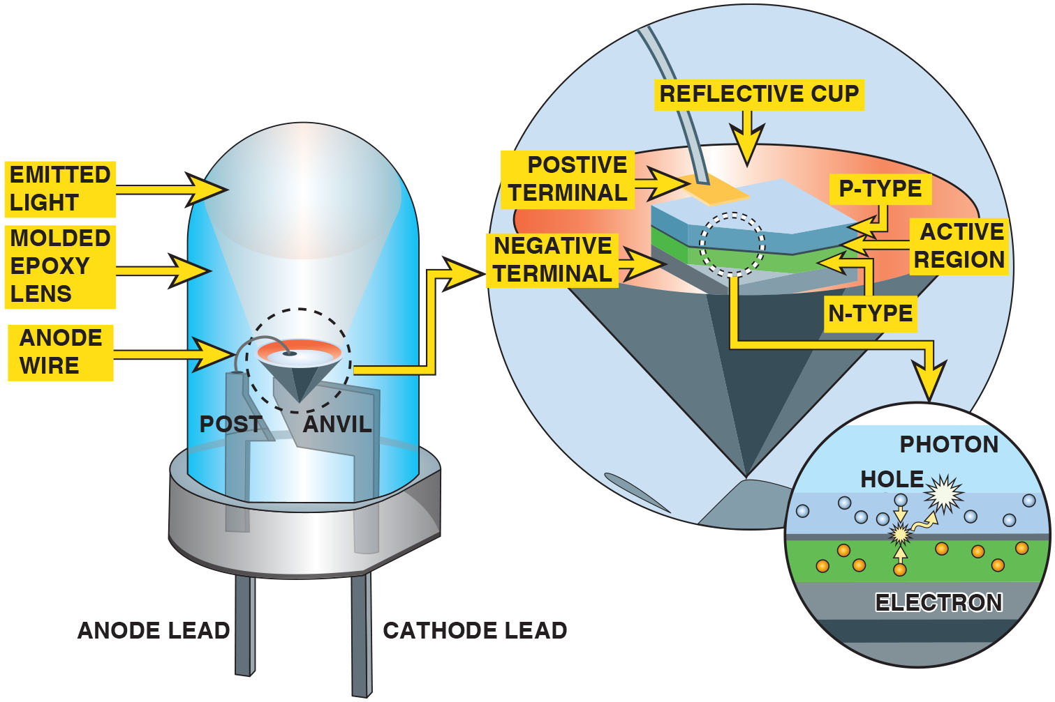
Figure 17.3
L E D
An L E D emits light when a photon is released at the P–N junction.
Notes:
Long Description:
The illustration shows the post and anvil terminals surrounded by the molded epoxy lens. The anode wire from the post terminal connects to a component inside a reflective cup. The emitted light from the reflective cup in the L E D is directed upward. The anode and cathode leads are at the bottom. A magnified view of the reflective cup shows the positive and negative terminals attached to the P-type and N-type regions enclosed by the cup. The junction between the P-type and N-type regions is the active region. A magnified view of the P-N junction shows a hole and an electron interacting at the P-N junction to release a photon.

Slide 12
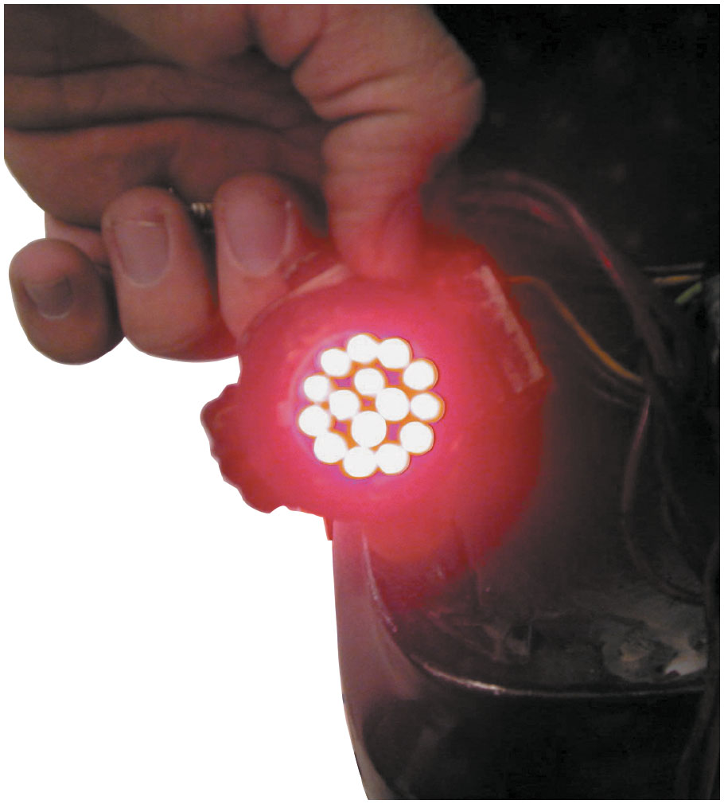
Figure 17.4
Replacement L E D
A replacement L E D taillight bulb is constructed of many small, individual light-emitting diodes.

Slide 13
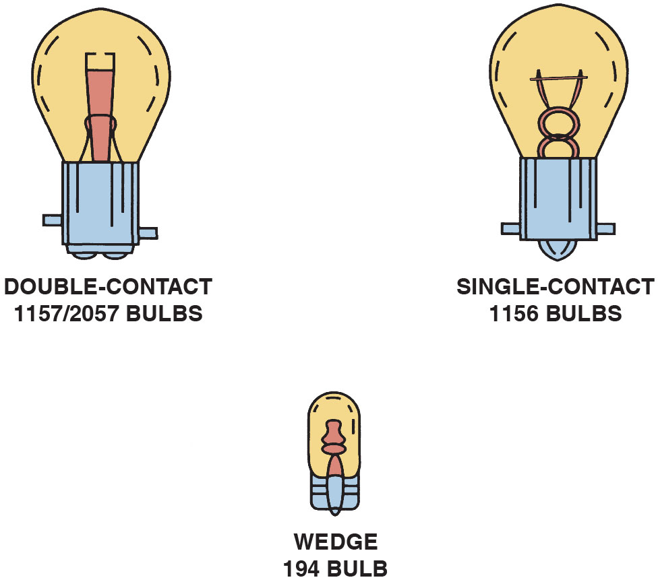
Figure 17.5
Dual-Filament Bulb
Dual-filament (double-contact) bulbs contain both a low-intensity filament for taillights or parking lights, and a high-intensity filament for brake lights and turn signals. Bulbs come in a variety of shapes and sizes. The numbers shown are the trade numbers.

Slide 14
Bulb Numbers
Trade Number
The number used on automotive bulbs is called the bulb trade number, as recorded with the American National Standards Institute (A N S I).
Bulb Number Suffixes
A–amber (painted glass)
B–blue
H D–heavy duty
N A–natural amber (amber glass)
Q–quartz halogen

Slide 15
Chart 17.1 (1 of 2)
Bulb Numbers
BULB NUMBER | FILAMENTS | AMPERAGE | WATTAGE
1156 | 1 | 2.1 | 26.9
1157 | 2 | 0.6/2/1 | 8.3/26.9
2057 | 2 | 0.5/2.1 | 6.9/26.9
3057 | 2 | 0.5/2.1 | 6.7/26.9
4157 | 2 | 0.6/2/1 | 8.3/26.9
7440 | 1 | 1.8 | 21 point 0
7443 | 2 | 0.4/1.8 | 5 point 0 over 21 point 0
67 | 1 | 0.6 | 8 point 0
161 | 1 | 0.2 | 2.7
168 | 1 | 0.4 | 4.9
192 | 1 | 0.3 | 4.3
194 | 1 | 0.3 | 3.8
585 | 1 | 0 point 0 4 | 1.1

Slide 16
Chart 17.1 (2 of 2)
BULB NUMBER | FILAMENTS | AMPERAGE | WATTAGE
921 | 1 | 1.4 | 18
9003 | 2 | 4 point 6 over 5 point 0 | 55 point 0 over 60 point 0
9006 | 1 | 4.3 | 55 point 0
Some automotive bulb trade numbers with their amperage and wattage rating. Check service information for the exact bulb to use.

Slide 17
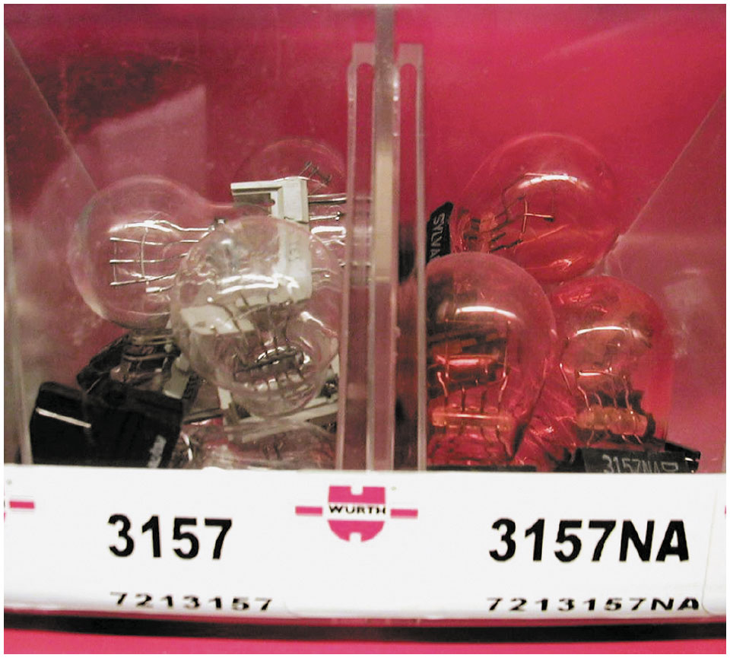
Figure 17.6
Bulb Markings
Bulbs that have the same trade number have the same operating voltage and wattage. N A means that the bulb uses a natural amber glass ampoule with clear turn-signal lenses.

Slide 18
Question 1
Why should the exact same trade number of bulb be used as a replacement?

Slide 19
Answer 1
To ensure the bulb emits the correct lumens.

Slide 20
Brake Lights (1 of 2)
Terminology
Brake lights, also called stop lights, use high-intensity filament of a double-filament bulb or L E Ds.
One Filament Stop/Turn Bulbs
Stop/turn signals are both provided by one filament.
Two Filament Stop/Turn Bulbs
Separate filaments for the stop and turn lamps, the brake and turn signal switches are not connected.

Slide 21
Brake Lights (2 of 2)
B C M-Controlled Brake Lights
Input from brake pedal switch or sensor is used by other systems in vehicle as an input signal for:
Shift interlock
Push-button start
Cruise control
Antilock braking system (A B S)

Slide 22
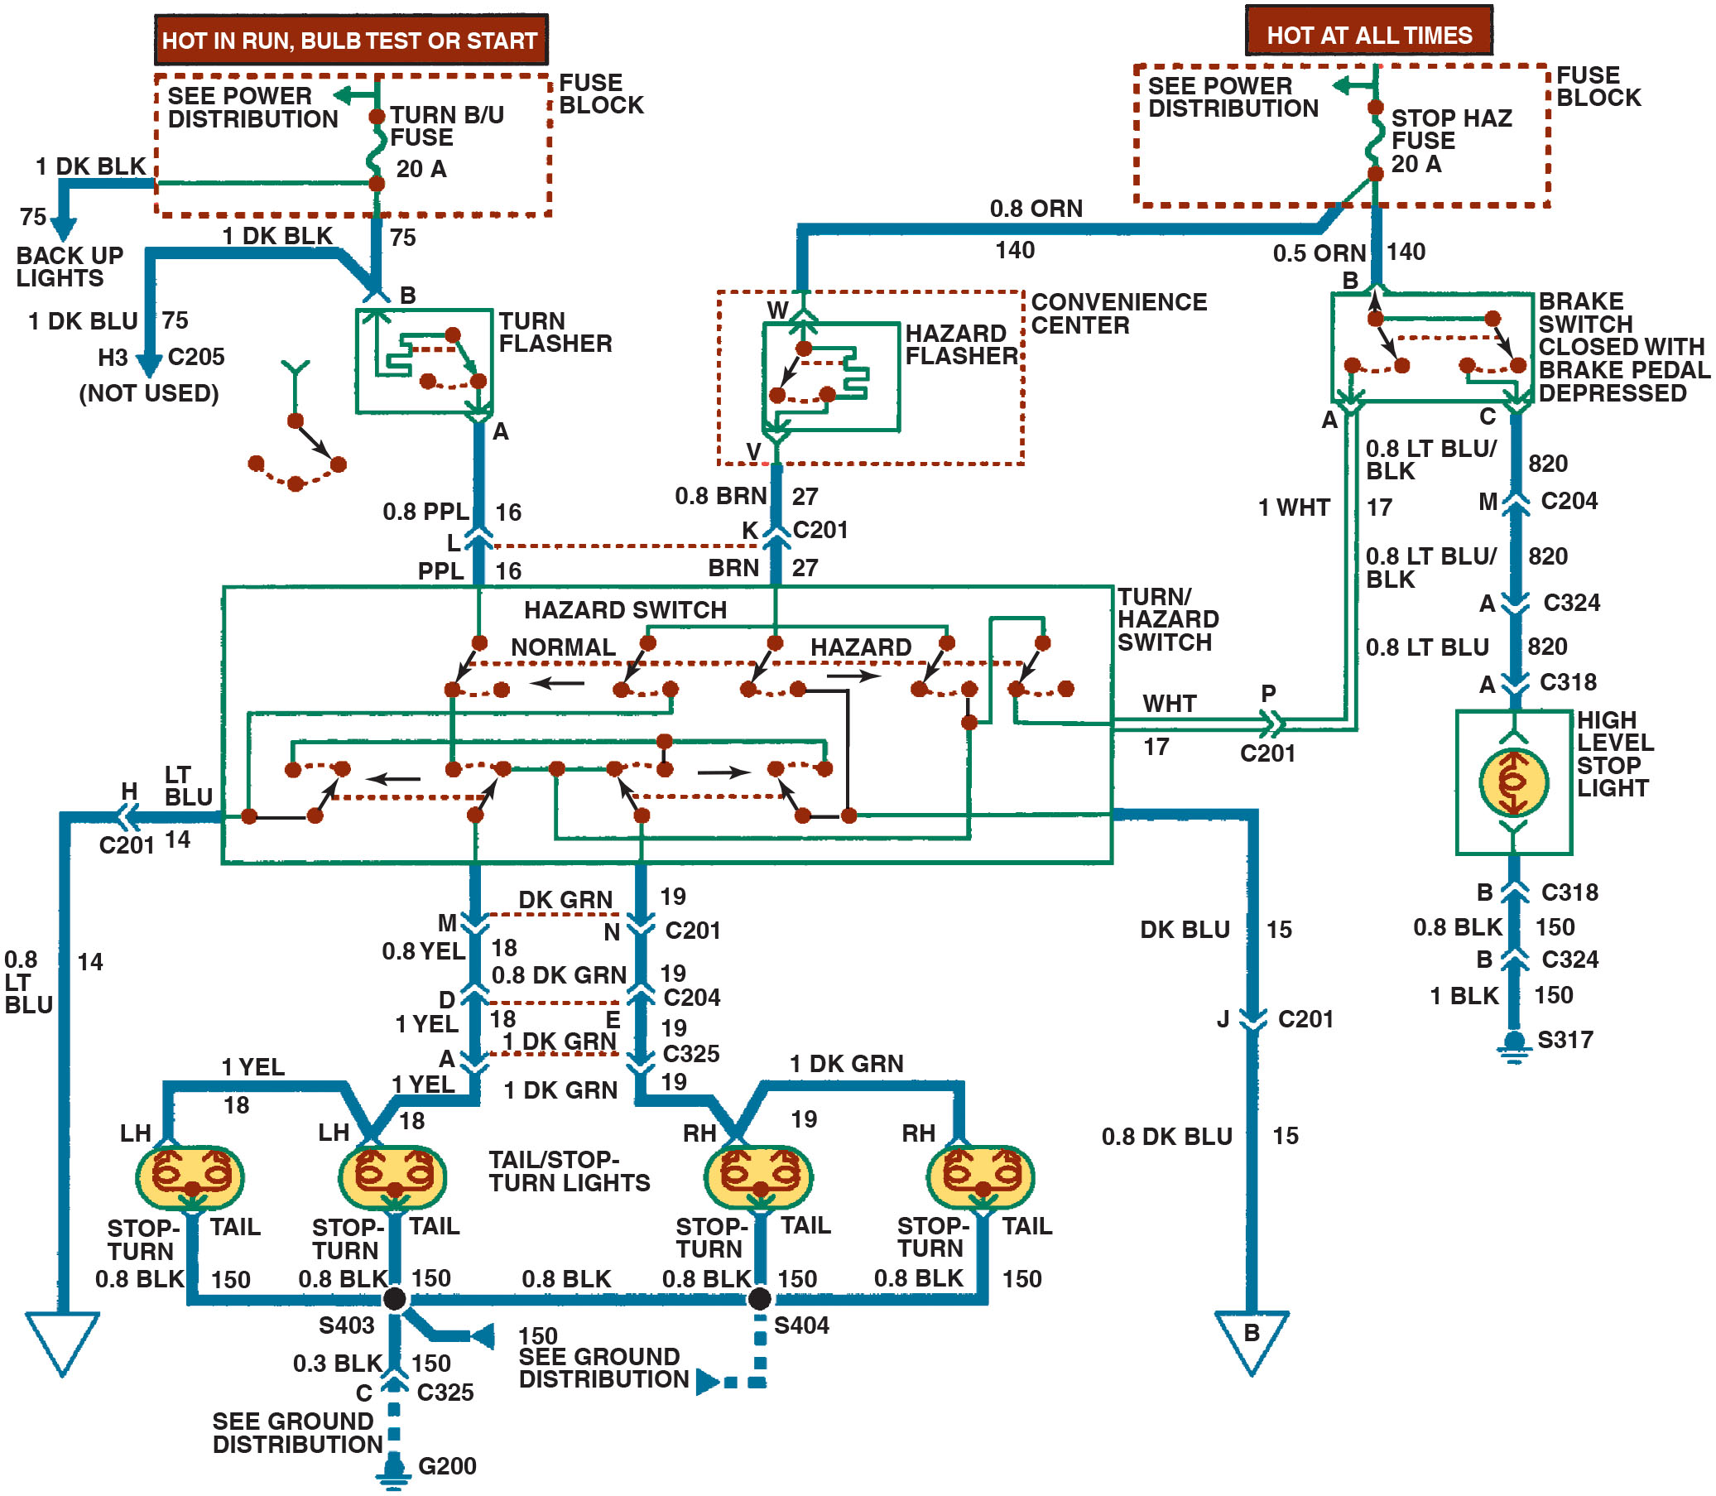
Figure 17.7
Brake Light Circuit
A typical older-type brake light circuit showing the brake switch and all of the related circuit components.
Notes:
Long Description:
The circuit diagram depicts a hot in run, bulb test, or start fuse block connected to a turn flasher, turn or hazard switch, and tail or stop turn lights. A hot at all times fuse block is also connected to the turn or hazard switch, but through a convenience center. The hot at all times fuse block is connected to a high level stop switch through a brake switch that closes when the brake pedal is depressed.

Slide 23
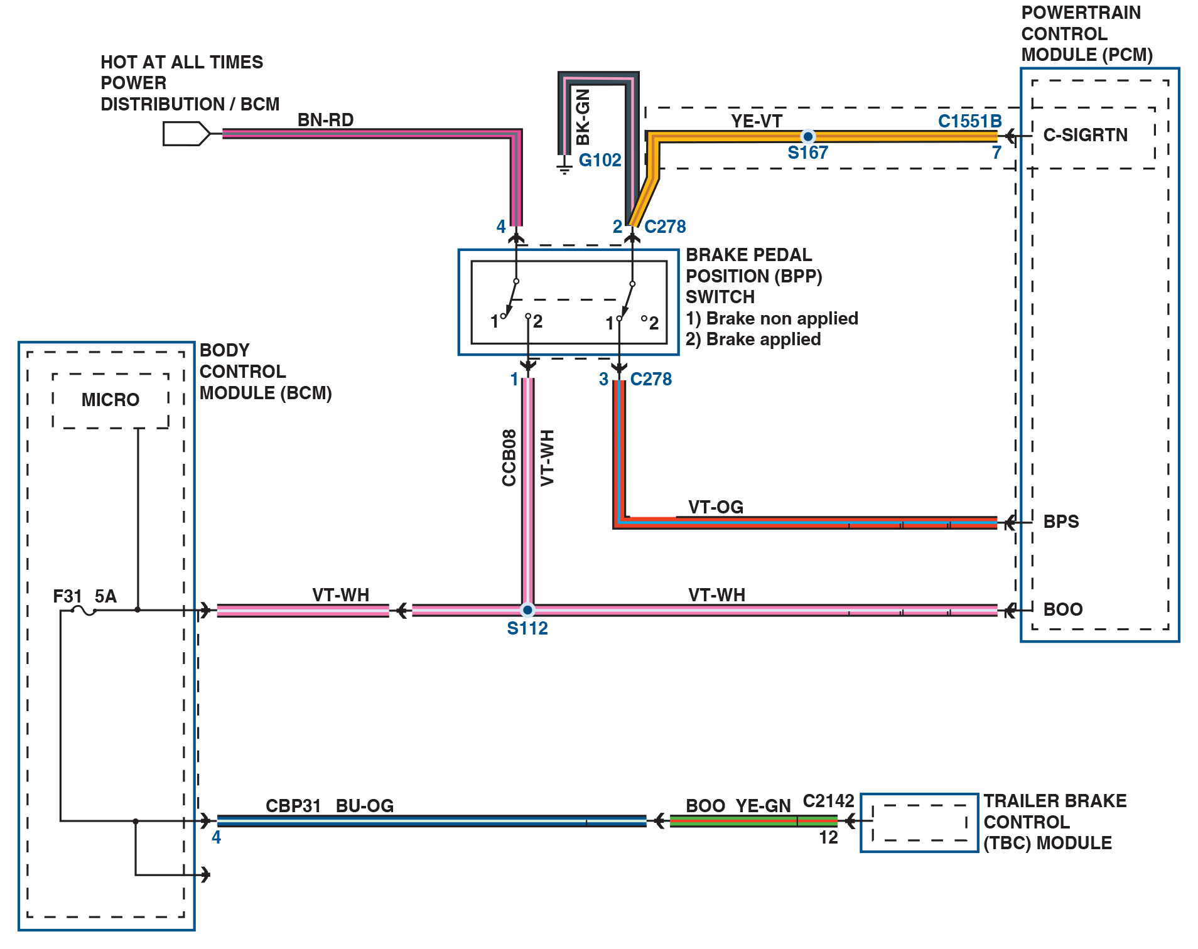
Figure 17.8
B C M Controlled
A schematic of the B C M-controlled brake light circuit that includes the brake pedal position (B P P) switch, which creates signals to the powertrain control module (P C M) with inputs labeled B P S (brake pedal position) and B O O (brake on-off).
Notes:
Long Description:
The B C M is connected to the T B C module through two wires and multiple connectors. Another branch from the line in the B C M is connected to a connector. The lines in the B C M are connected to a 5 amperes fuse, which connects to the component labeled micro in the B C M. The B C M is connected to splice point S 112. The power distribution or B C M, hot at all times, is connected to a movable contact of the B P P switch. The other movable contact connects to ground G 102 and splice point S 167. S 167 connects to C-S I G R T N of the P C M. The B P P switch has two terminals labeled 1 and two terminals labeled 2. 1 and 2 correspond to brake non applied and brake applied, respectively. The movable contacts connect to the terminals labeled 1. Terminal 2 on the left connects to S 112, which is connected to the input line for B O O in the P C M. Terminal 1 on the right connects to the input line for B P S in the P C M. All connections use connectors and wires. The color specifications of the wires and the specifications of the connectors are marked.

Slide 24
Animation: Stop Lights

Slide 25
Turn Signals (1 of 2)
Mechanical System Operation
In older systems, the turn signal circuit is supplied power from the ignition switch and operated by a lever and a switch.
B C M-Controlled Turn Signals
The B C M sends a signal through the data lines to the lighting module(s) to flash the lights.

Slide 26
Turn Signals (2 of 2)
Bulb Outage Warning
Lighting module, usually the B C M, monitors the current flow though all of the lights.
Hazard Warning Lights
Hazard warning, also called 4-way flashers, is a device installed in a vehicle lighting system with the primary function of causing both the left and right turn signal lamps to flash when the hazard warning switch is activated.

Slide 27
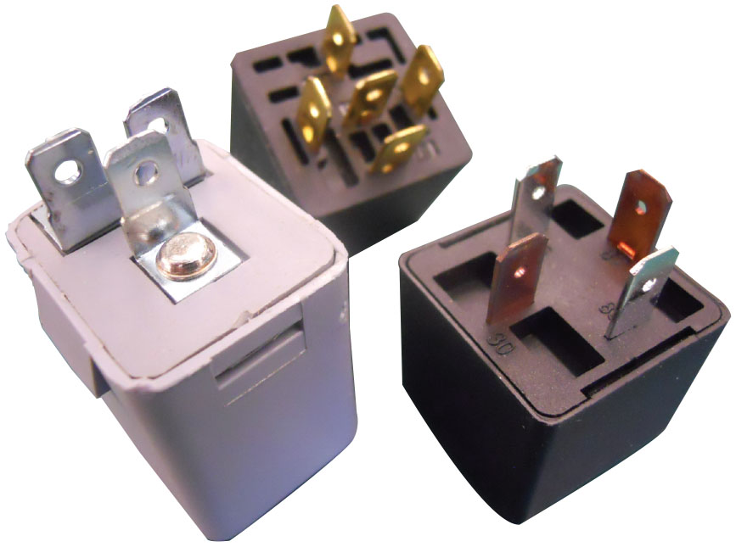
Figure 17.9
Flashers
Three styles of flasher units.

Slide 28
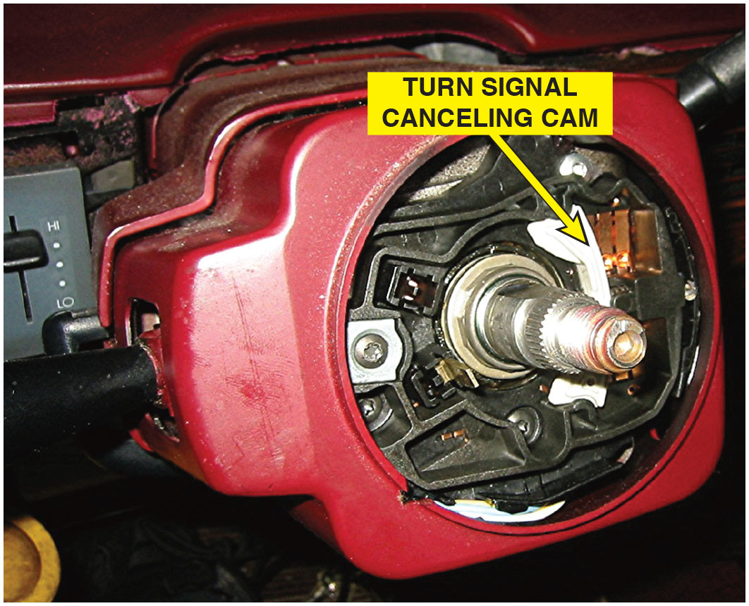
Figure 17.10
Steering Column
A steering column with the steering wheel removed, showing the turn signal canceling cam used to return the lever to the neutral position after a turn. The switches are an input to the body control module for left and right turn-signal operation.

Slide 29
Animation: Turn and Stop Lights

Slide 30
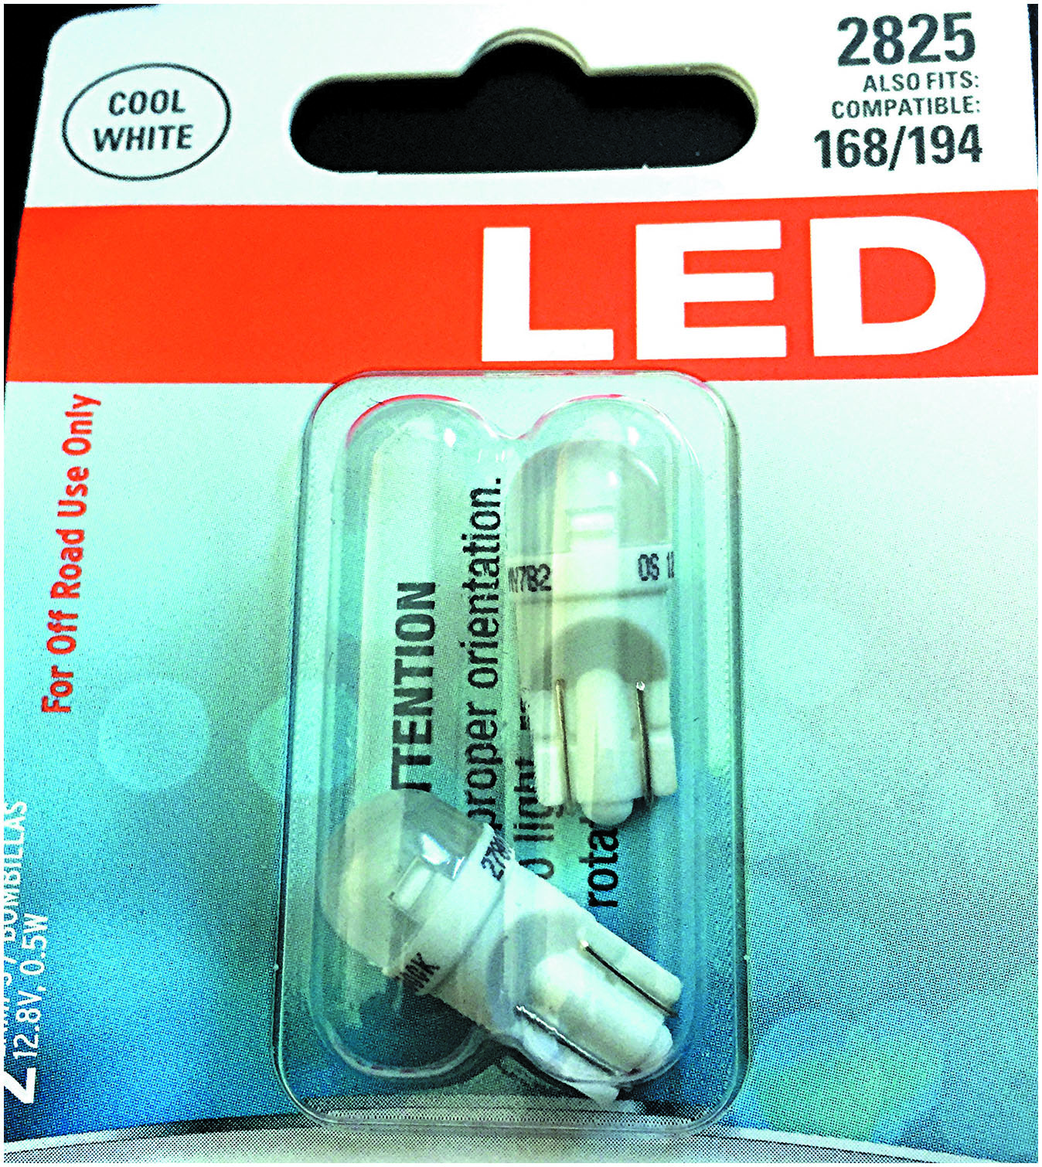
Figure 17.11
Replacement L E D
Replacement side marker L E D lamps that could be used to replace standard bulbs. However, the current draw is lower and using these bulbs could cause the lamp outage warning lamp to be turned on.

Slide 31
Daytime Running Lights
Purpose and Function
Daytime running lights (D R Ls) are lights at the front of the vehicle that are on all the time the engine is running, unless they are turned off, or when the headlights are on.
D R Ls involve operation of the following:
Front parking lights
Separate D R L lamps
Headlights (at a reduced current)

Slide 32
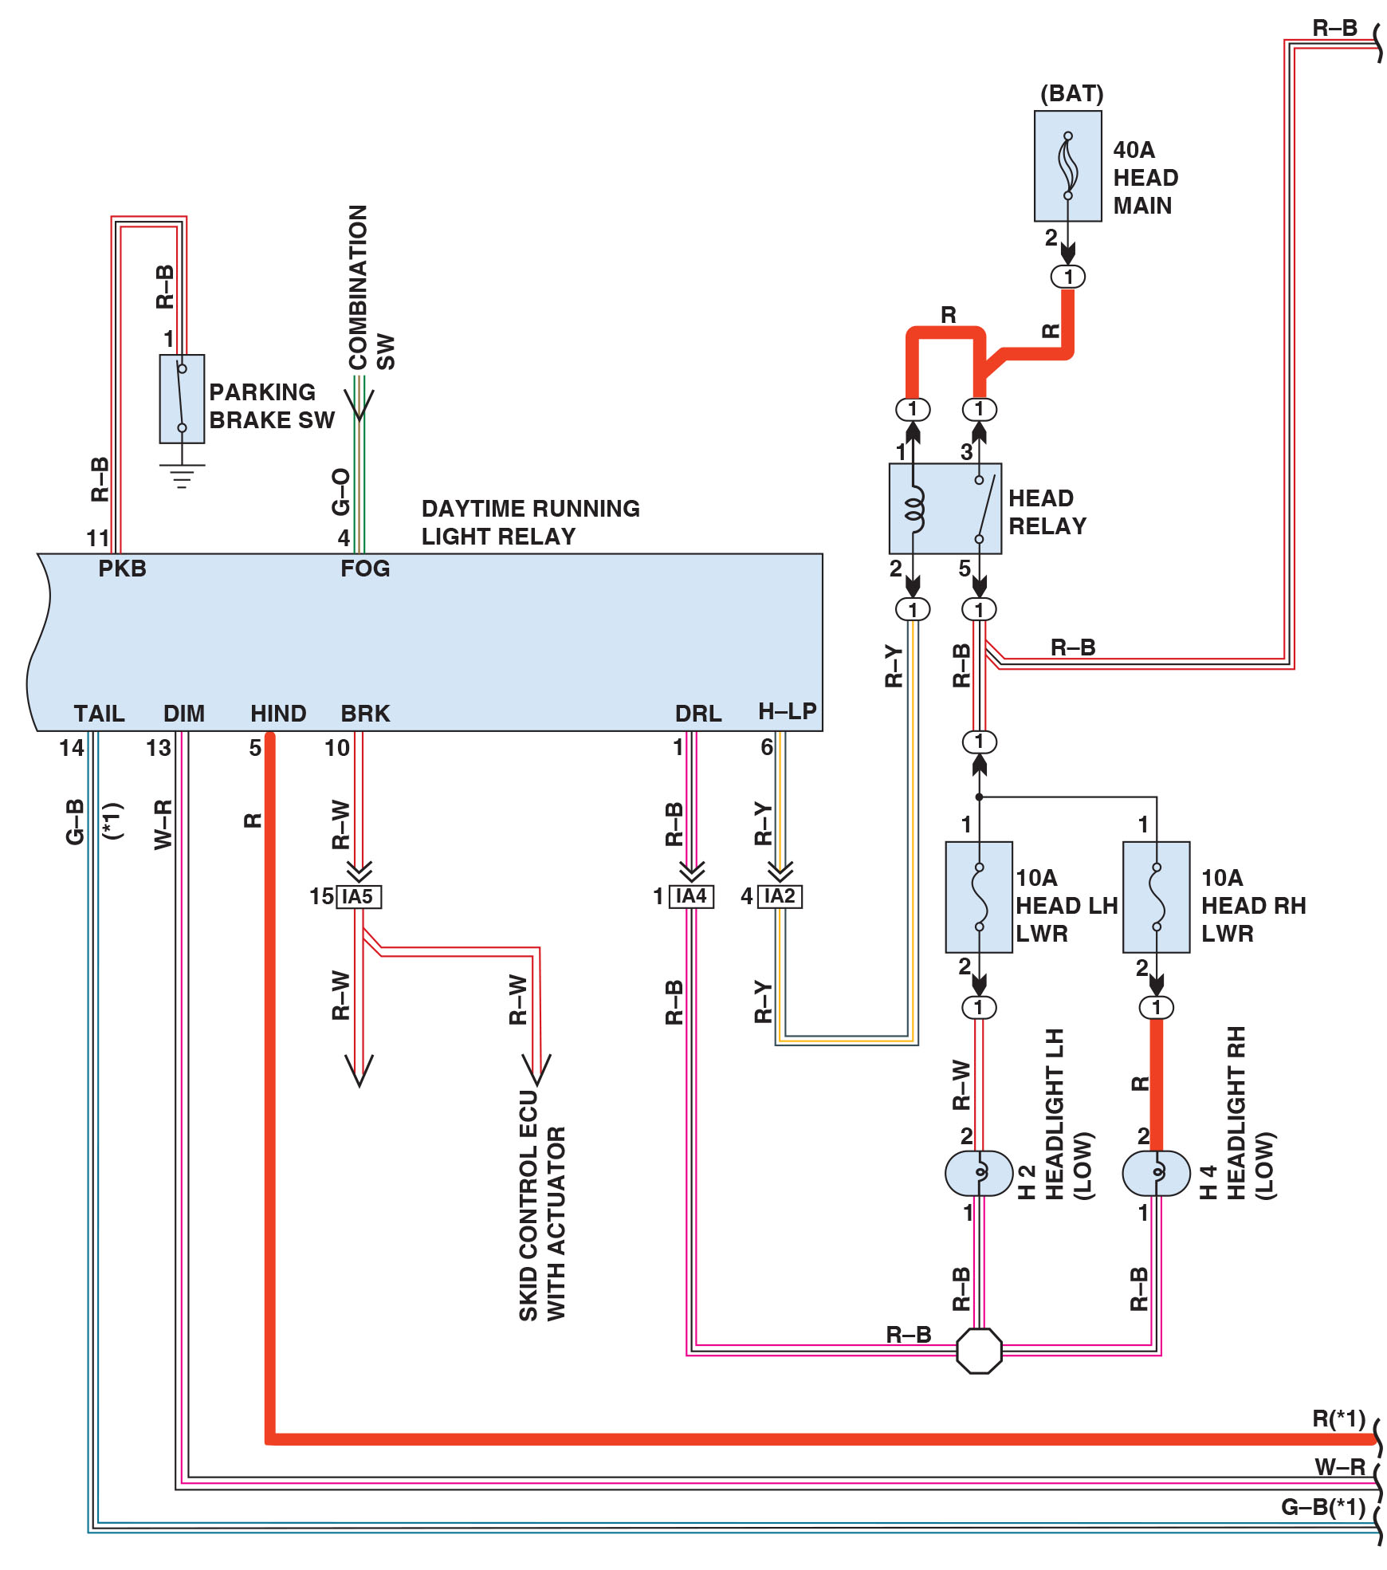
Figure 17.12
D R L Schematic
A schematic showing a D R L circuit that uses the headlights. Also notice that each headlight has its own fuse to protect the circuit. Check service information for how the D R Ls operate on the vehicle being serviced.
Notes:
Long Description:
The terminals of the daytime running light relay and the corresponding connections are as follows. The P K B terminal is connected to the closed parking brake switch. The F O G terminal is connected to the combination S W. The connections to the tail, dim, and hind terminals are also depicted. The B R K terminal is connected to the skid control E C U with actuator. The D R L terminal is connected to headlights L H, low, and R H, low through a splice point. Each headlight is connected to a 10 amperes fuse. The fuses are connected to the head relay. The H-L P terminal is connected to the windings of the head relay. The head relay is connected to the 40 amperes head main. The specifications of the connectors and the color specifications of the wires used in the connections are provided.

Slide 33
Headlights (1 of 2)
Headlight Switches
Older vehicles use the headlight switch to operate the exterior and interior lights.
Composite Headlights
Composite headlights are constructed using a replaceable bulb and a fixed lens cover that is part of the vehicle.

Slide 34
Headlights (2 of 2)
Bulb Faults
Gray color. Low voltage to the bulb (check for corroded socket or connector)
White (cloudy) color. Indication of an air leak
Broken filament. Usually caused by excessive vibration
Blistered glass. Indication that someone has touched the glass
Cloudy Headlight Restoration
The process of restoring the surface of a composite headlight assembly

Slide 35
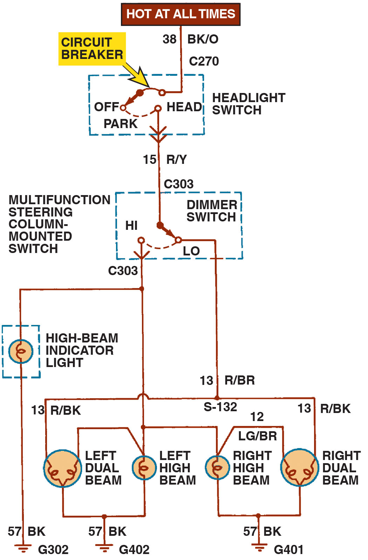
Figure 17.13
Headlight Circuit
A Typical headlight circuit diagram on an older vehicle that does not use a controller, such as the B C M, to control the operation of the lights. Note that the headlight switch is represented by a dotted outline, indicating that other circuits (such as dash lights) also operate from the switch.
Notes:
Long Description:
Power supply which is hot at all the times is connected to headlight switch connected to following circuit 1. H I a. High beam indicator light b. Left Dual beam c. Left high beam d. Right high beam e. Right dual beam 2. LOW a. Left Dual beam b. Right dual beam.

Slide 36
Animation: Headlight Circuit, Parking Lights

Slide 37
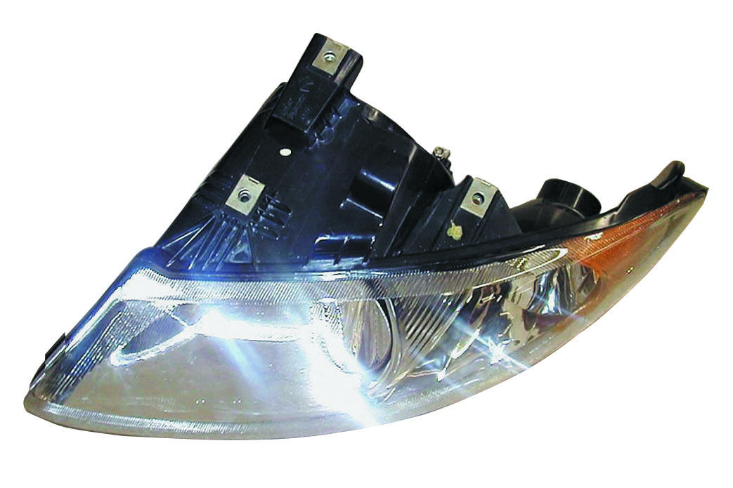
Figure 17.14
Composite Lamp
A typical composite headlamp assembly. The lens, housing, and bulb sockets are usually included as a complete assembly.

Slide 38
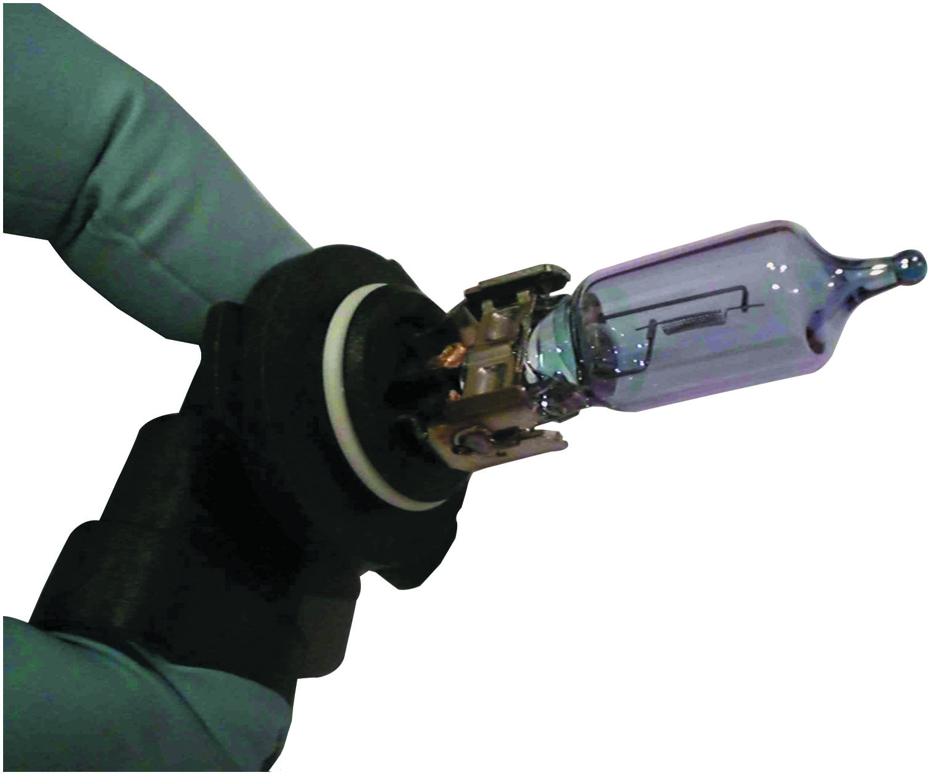
Figure 17.15
Halogen Handling
Handle a halogen bulb by the base to prevent the skin’s oil from getting on the glass.

Slide 39
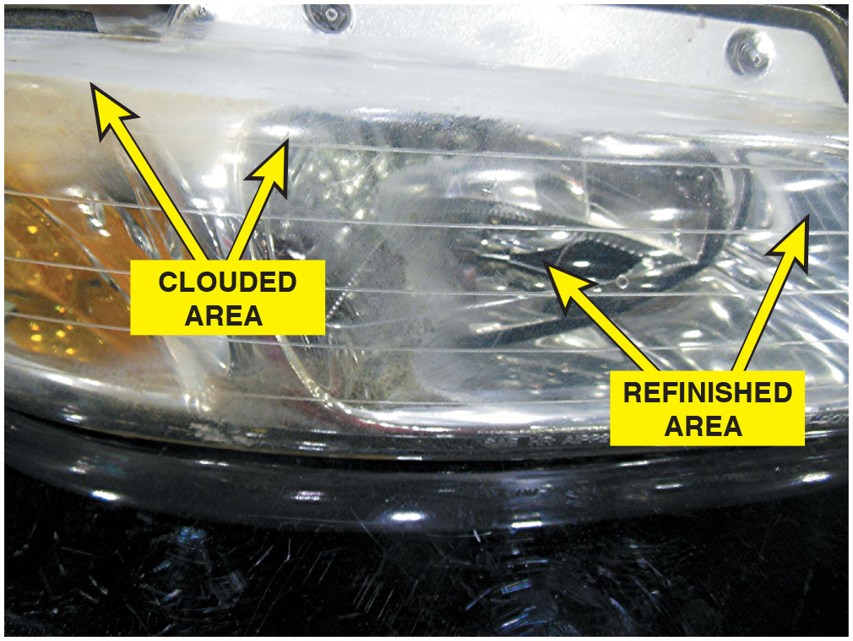
Figure 17.16
Cloudy Lens
The right side of this headlight assembly has been restored, but still needs to be polished. The left side is cloudy and not yet restored.

Slide 40
Question 2
Why is it important to avoid touching a halogen bulb with your fingers?

Slide 41
Answer 2
To prevent the bulb from failing prematurely.

Slide 42
High-Intensity Discharge Headlights (1 of 2)
Parts and Operation
High-intensity discharge (H I D) headlights produce light that is crisper, clearer, and brighter than light produced by a halogen headlight.
Stages of H I D Headlamp Operation
Start-up or stroke state
Run-up state
Steady state

Slide 43
High-Intensity Discharge Headlights (2 of 2)
Bi-Xenon Headlights
Uses a shutter to block some of the light during low-beam operation, and then mechanically move to expose more of the light from the bulb for high-beam operation.
H I D Headlight Failure Symptoms
A light flickers
Lights go out (caused when the ballast assembly detects repeated bulb restrikes)
Color changes to a dim pink glow

Slide 44
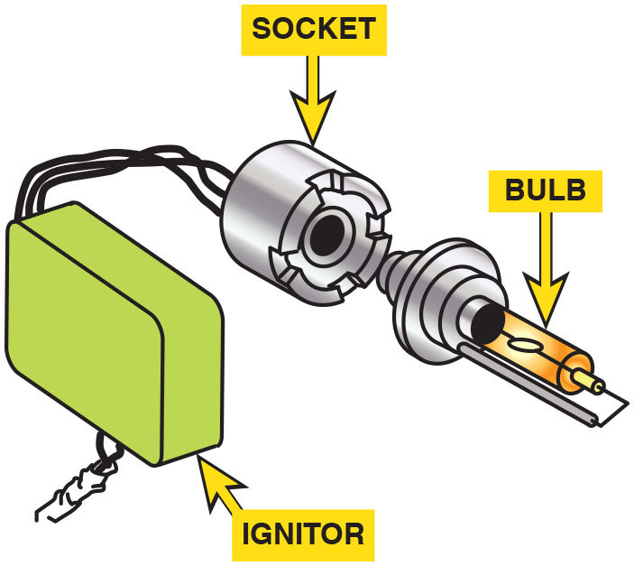
Figure 17.17
H I D Igniter
The igniter contains the ballast and transformer needed to provide high-voltage pulses to the arc-tube bulb.

Slide 45
Frequently Asked Question: What Is the Difference Between the Temperature of the Light and the Brightness of the Light?
? Frequently Asked Question
What Is the Difference Between the Temperature of the Light and the Brightness of the Light? The temperature of the light indicates the color of the light. The brightness of the light is measured in lumens. A standard 100 watt incandescent light bulb emits about 1,700 lumens. A typical halogen headlight bulb produces about 2,000 lumens, and a typical H I D bulb produces about 2,800 lumens.

Slide 46
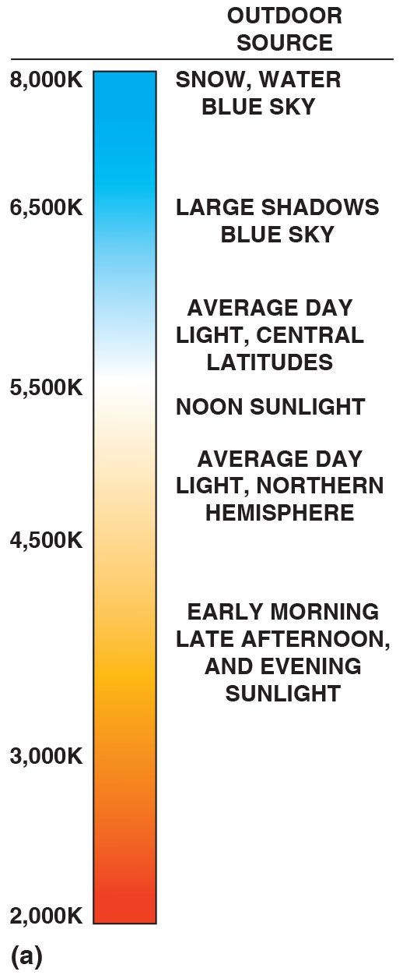
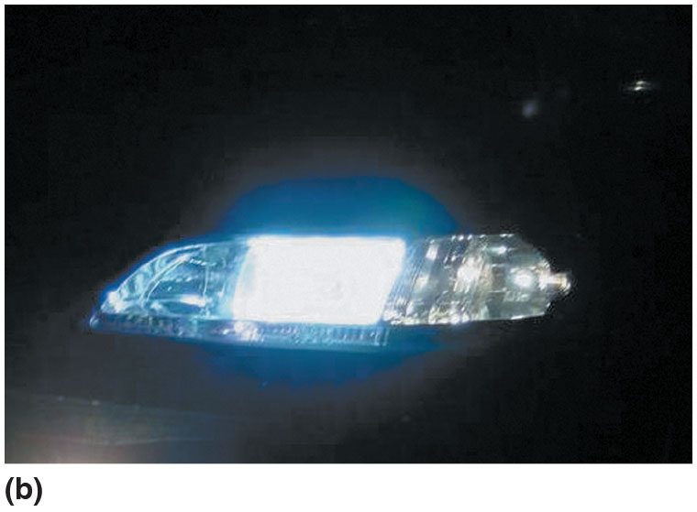
Figure 17.18
H I D Color
(a) The color of light is measured in degrees Kevin (K). The higher the temperature of the light, the bluer the appearance. (b) H I D (xenon) headlights emit a whiter light than halogen headlights and usually look blue compared to halogen bulbs.
Notes:
Long Description:
The approximate data for different colors of light are as follows. The temperature values are in Kelvin. Red to orange. Temperature: 2,000 to 3,000. Varying shades of orange. Temperature: 3,000 to 4,500. Outdoor source: early morning, late afternoon, and evening sunlight. Light orange to peach. Temperature: 4,500 to 5,000. Outdoor source: average day light, northern hemisphere. Peach to white. Temperature: 5,000 to 5,500. Outdoor source: noon sunlight. White to lighter shades of blue. Temperature: 5,500 to 6,000. Outdoor source: average day light, central latitudes. Blue. Temperature: 6,500. Outdoor source: large shadows, blue sky. Dark blue. Temperature: 8,000. Outdoor source: snow, water, blue sky.

Slide 47
L E D Headlights
The advantages of L E D headlights compared to other types include:
Long service life
Reduced electrical power required
The disadvantages of L E D headlights include:
Higher cost
Many small L E D s are required to create the necessary light output

Slide 48
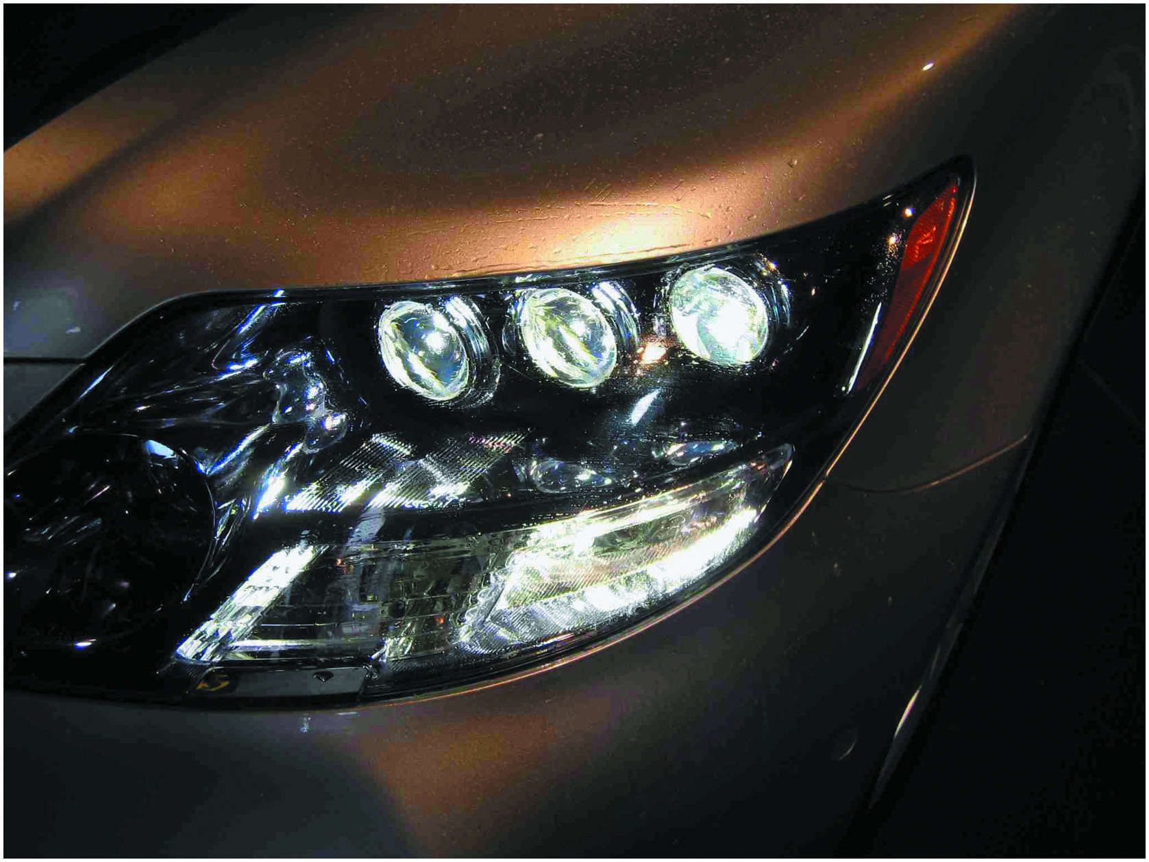
Figure 17.19
L E D Headlights
L E D headlights usually require multiple units to provide the needed light, as seen on this Lexus L S600h.

Slide 49
Question 3
What are the advantages of L E D lights?

Slide 50
Answer 3
Long service life and reduced power consumption.

Slide 51
Adaptive Front Lighting System (1 of 2)
Purpose and Function
Adaptive (advanced) front lighting system, or A F S, is a system that mechanically moves the headlights to follow the direction of the front wheels.
Parts and Operation
The vehicle has to be moving above a predetermined speed. Self leveling motors are used to keep the lights properly aligned.

Slide 52
Adaptive Front Lighting System (2 of 2)
Diagnosis and Service
Start by checking that A F S is switched on.
Check that system performs a self-test during start-up.
Verify that both low-beam and high-beam lights function correctly.
Use a scan tool to test for any A F S-related diagnostic trouble codes.

Slide 53
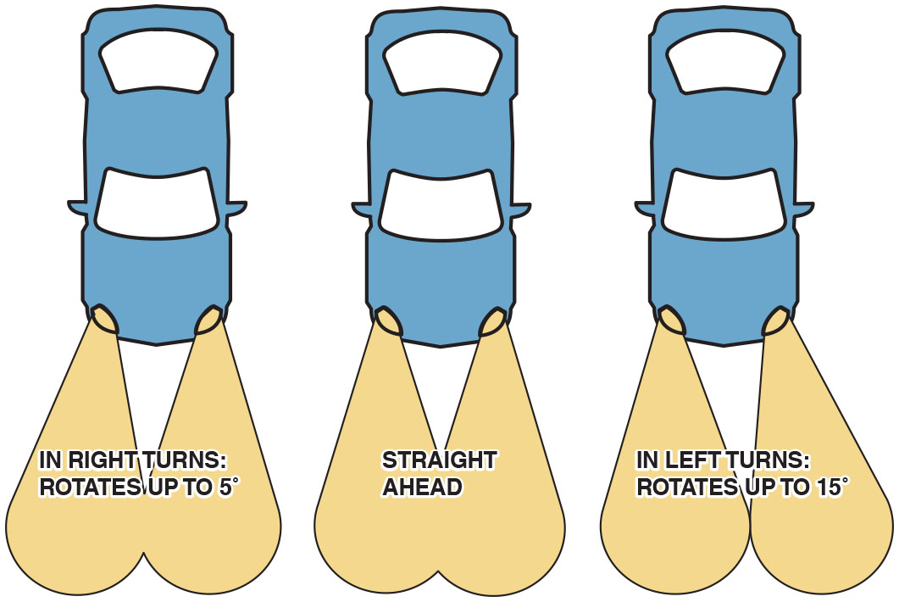
Figure 17.20
Adaptive Headlights
Adaptive front lighting systems rotate the low-beam headlight in the direction of travel.
Notes:
Long Description:
When car has to turn right the light rotates towards right upto 5 degrees. When car moves straight forward the lights are also straight. When the car has to move left the lights rotate left upto 15 degrees.

Slide 54
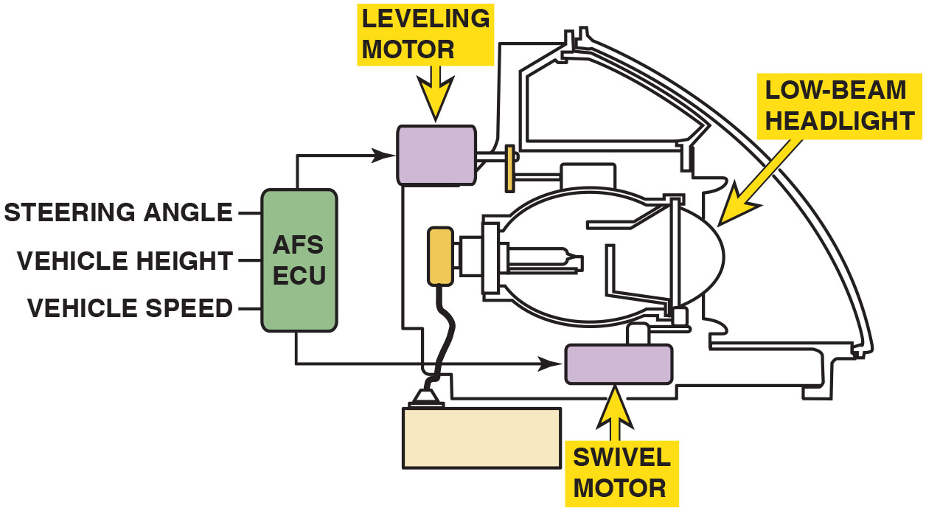
Figure 17.21
A F S Motors
A typical adaptive front lighting system uses two motors: one for the up-and-down movement and the other for rotating the low-beam headlight to the left and right.
Notes:
Long Description:
Two motors are connected to bulb housing with a low-beam headlight, a swivel motor, and a level motor, both the motors are connected to A F S E C U, which takes steering angle, vehicle height, and vehicle speed into consideration.

Slide 55
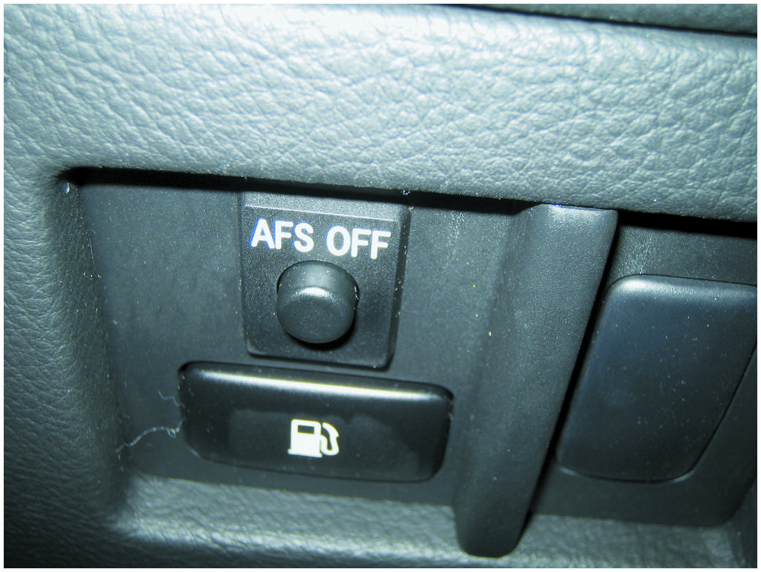
Figure 17.22
A F S Button
Typical dash-mounted switch that allows the driver to turn off the front lighting system.

Slide 56
Automatic Headlights
Purpose and Function
Turn on the headlights when the light sensor detects low ambient light level.
Controls
Most vehicles allow the driver to select the headlights in the “AUTO” position or turn them on and off manually.

Slide 57
Figure 17.23
Automatic Headlights
A dash symbol used to inform the driver that the automatic headlights are on.

Slide 58
Headlight High-/Low-Beam Switch
Dimmer Switch
The switch used to switch between the two circuits is often called the dimmer switch or the high/low switch.
The dimmer switch is usually hand-operated by a lever on the steering column.

Slide 59
Auto Dimming Headlights
Purpose and Function
A system that causes the headlights to switch from high-intensity beams to low-intensity beams when the system detects the headlights from an approaching vehicle.
Types of Systems
Photo resistor-based system
Camera-based systems

Slide 60
Headlight Aiming
According to U.S. federal law, all headlights, regardless of shape, must be able to be aimed using headlight-aiming equipment.
The headlights are equipped with adjusting screws that can be used to aim the headlights.

Slide 61
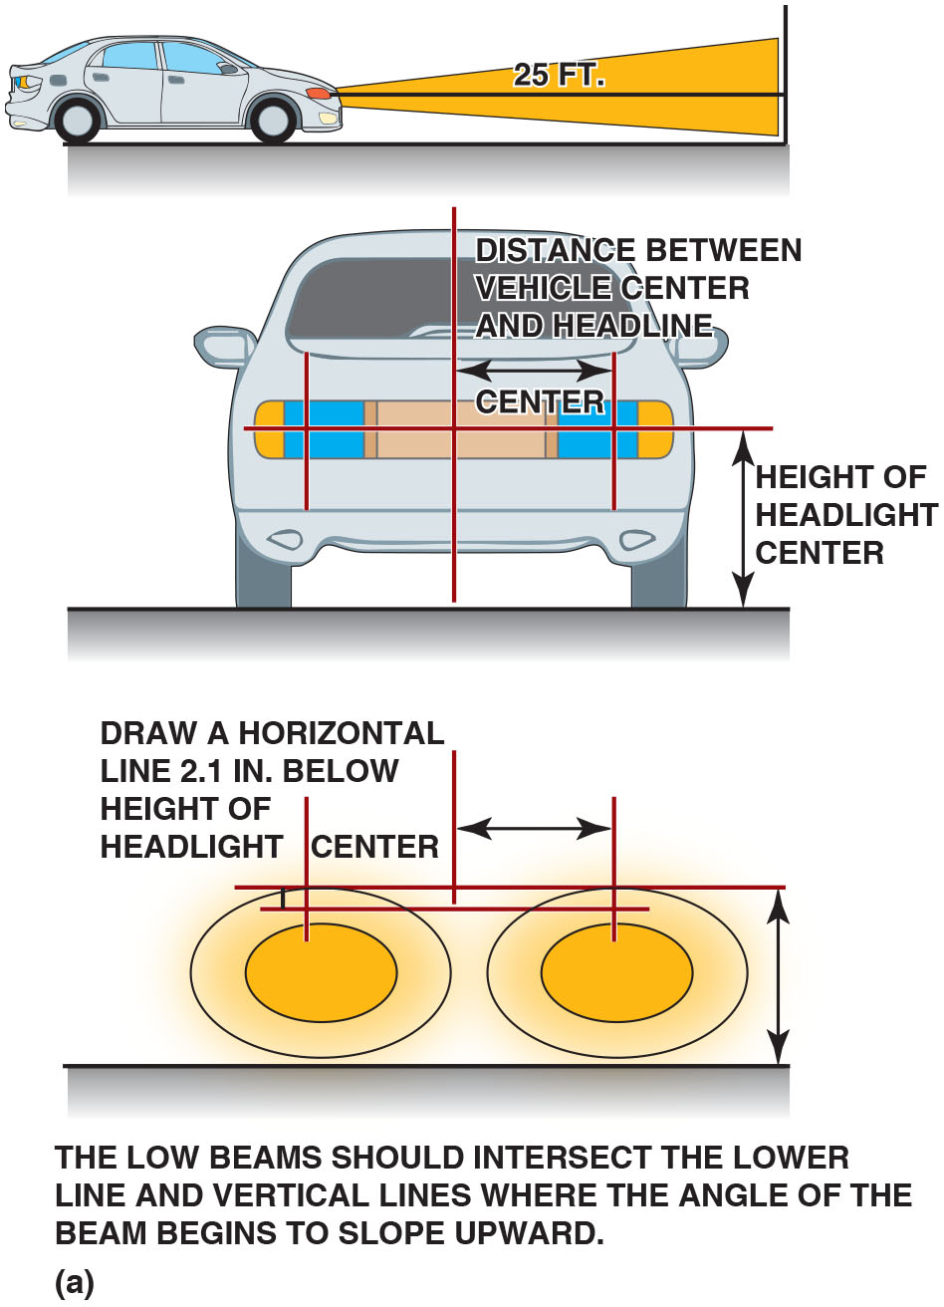
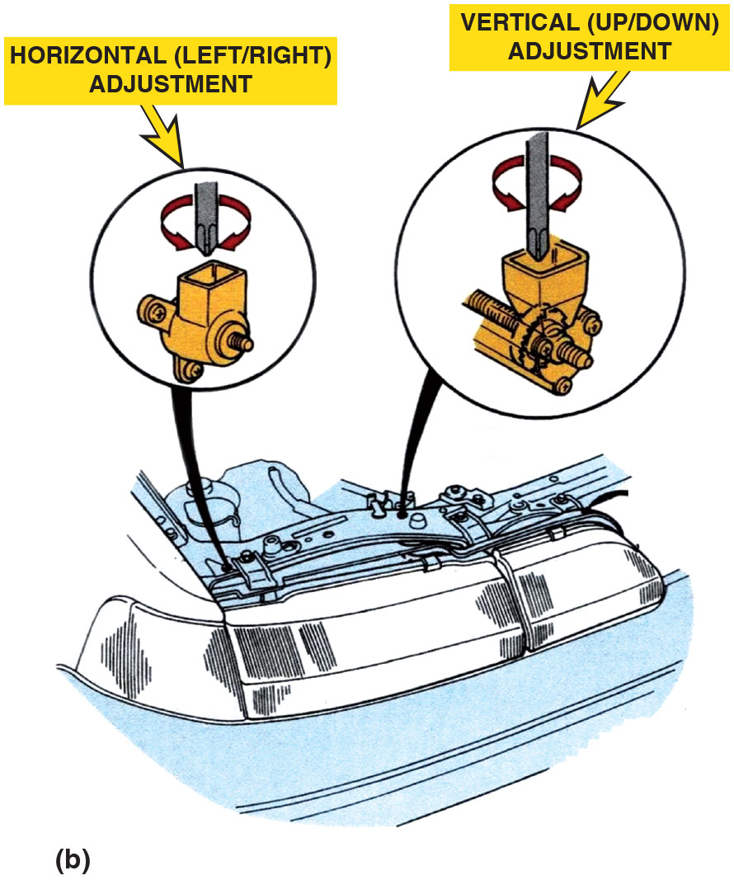
Figure 17.24
Headlight Aiming
(a) A typical headlight-aiming diagram as found in service information. (b) Adjustments to move the headlight-aiming point left or right or up and down are usually made using a screwdriver to move the headlight housing.
Notes:
Long Description:
A side view of a car shows the beams from the headlights aimed at an object 25 feet in front of the car. The front view of a car shows vertical lines passing through the centers of the headlines and the center of the vehicle. A horizontal line passes through the vehicle center and headlight center. The horizontal distance between the vertical line at the center and the vertical line on the side is labeled distance between vehicle center and headlight center. The vertical distance between the ground and the horizontal line is labeled height of headlight center. The view below shows beams from the headlights with the vertical and horizontal lines passing through the centers and the dimensions marked. Text reads, Draw a horizontal line 2.1 inches below height of headlight center. The low beams should intersect the lower line and vertical lines where the angle of the beam begins to slope upward.

Slide 62
Fog Lights and Driving Lights
Fog Lights
Fog lights have a unique beam that is flat and wide, and positioned low on vehicle, usually near front bumper.
Driving Lights
Driving lights are designed to send powerful beams far ahead, illuminating the next stretch of road.

Slide 63
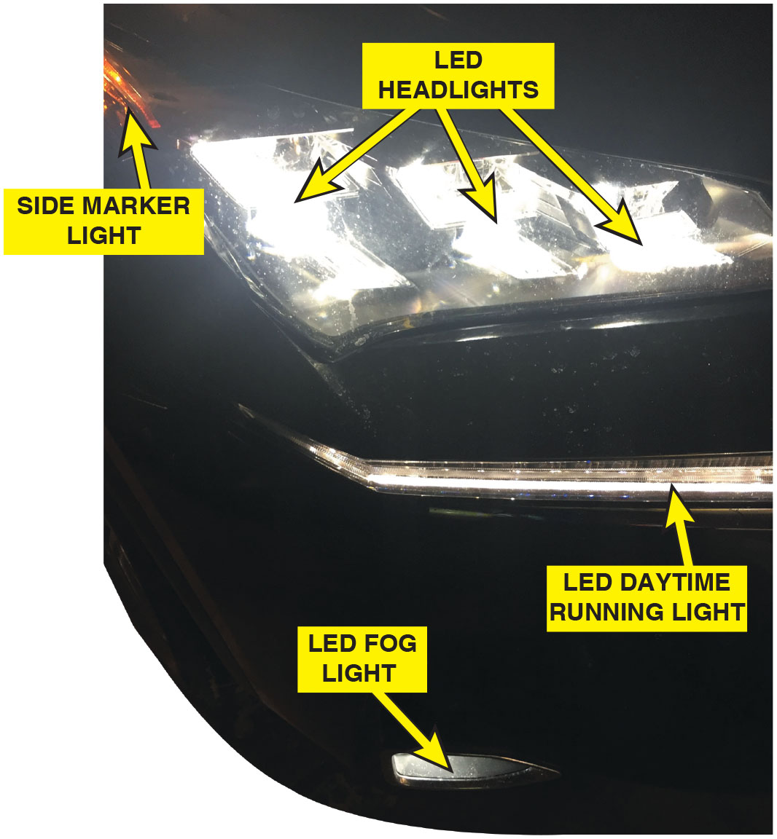
Figure 17.25
Fog Lights
Fog lights are often included on many vehicles, such as these on a Lexus S U V.

Slide 64
Frequently Asked Question: What Are Rear Fog Lights?
? Frequently Asked Question
What Are Rear Fog Lights? Some vehicles, usually European vehicles, are equipped with rear (red) fog lights. These are used so that drivers behind can see the vehicle in front. These could be on whenever the fog lights are turned on, or they could be on a separate switch. These rear fog lights are sometimes confused with brake lights being on because they are often as bright as brake lights. Check the owner’s manual or service information if a fault is reported about the rear fog lights.

Slide 65
Frequently Asked Question: What Is the Troxler Effect?
? Frequently Asked Question
What Is the Troxler Effect? The Troxler effect, also called Troxler fading, is a visual effect where an image remains on the retina of the eye for a short time after the image has been removed. The effect was discovered in 1804 by Ignaz Paul Vital Troxler (1780–1866), a Swiss physician. Because of the Troxler effect, headlight glare can remain on the retina of the eye and create a blind spot. At night, this fading away of the bright light from the vehicle in the rear reflected by the rearview mirror can cause a hazard.

Slide 66
Automatic Dimming Mirrors
Parts and Operation
Automatic dimming mirrors use electrochromic technology to dim the mirror in proportion to the amount of headlight glare from other vehicles at the rear.
Diagnosis and Service
Check for power and ground
Confirm the operation of the forward facing sensor
In most cases the mirror is replaced as an assembly

Slide 67
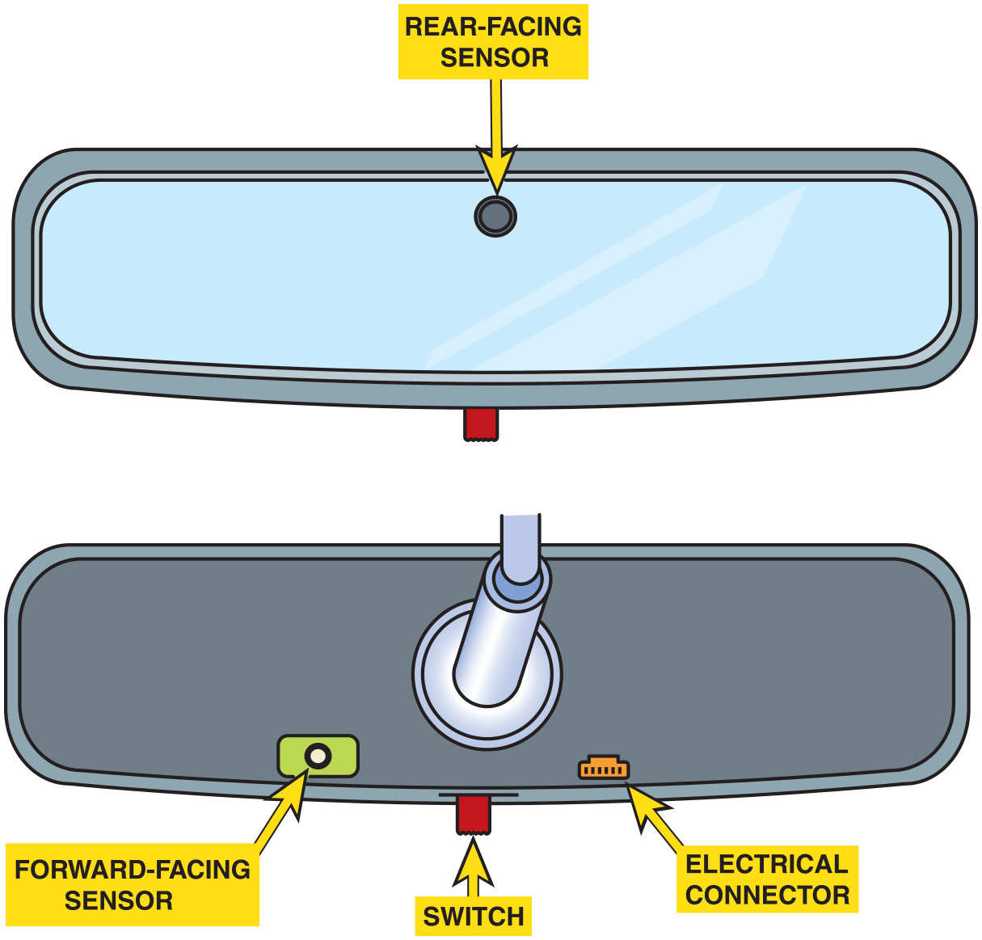
Figure 17.26
Dimming Mirror
An automatic dimming mirror compares the amount of light toward the front of the vehicle to the rear of the vehicle and allows a voltage to cause the gel to darken the mirror.

Slide 68
Courtesy Lights
Courtesy lights are a generic term primarily used for interior lights, including overhead (dome) and under-the-dash (courtesy) lights.
Many newer vehicles operate the interior lights through the B C M or through an electronic module.

Slide 69
Illuminated Entry
The interior lights are turned on for a given amount of time when the outside door handle or remote keyless entry (R K E) fob is operated while the doors are locked.

Slide 70
Animation: Courtesy Lights

Slide 71
Lighting System Diagnosis
STEP 1 Verify the customer concern.
STEP 2 Perform a visual inspection.
STEP 3 Connect a factory or enhanced scan tool with bidirectional control of the control modules to check for proper operation of the affected lighting circuit.
STEP 4 Follow the diagnostic procedure, as found in service information, to determine the root cause of the problem.
Notes:
TECH TIP: The Weirder the Problem, the More Likely It Is a Poor Ground Connection
Bad grounds are often the cause for feedback or lamps operating at full or partial brilliance. At
first, the problem looks weird, because often the switch for the lights that are on dimly is not
even turned on. When an electrical device is operating, and it lacks a proper ground connection,
the current tries to find ground and often causes other circuits to work. Check all
grounds before replacing parts.

Slide 72
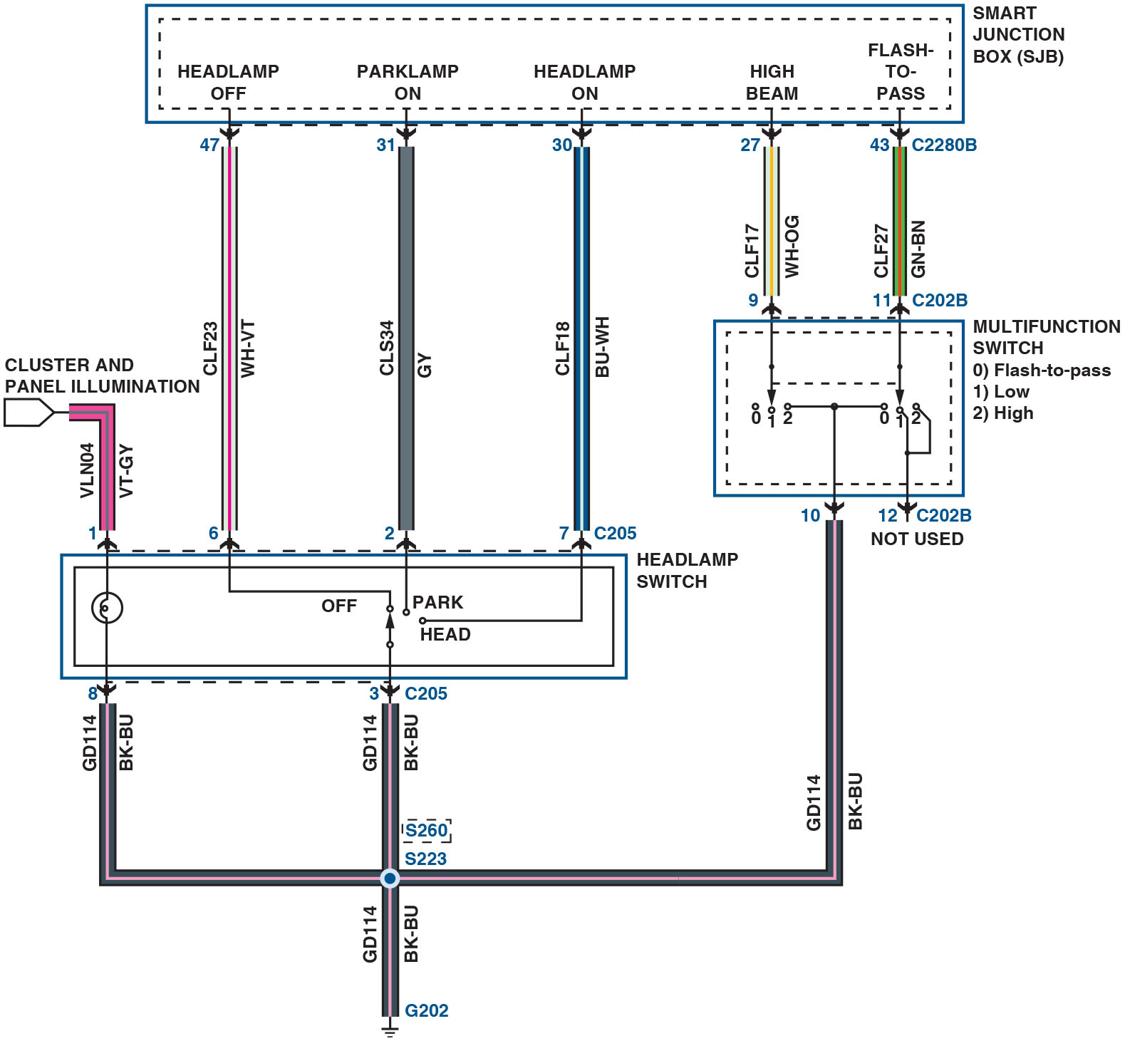
Figure 17.27
Headlight Diagnosis
A Ford headlight circuit showing the control of the power side of the circuit comes from the smart junction box (S J B).
Notes:
Long Description:
The cluster and panel illumination connect to a bulb in the headlamp switch. The off, park, and head terminals of the headlamp switch connect to the headlamp off, parklamp on, and headlamp on terminals of the S J B, respectively. The movable contact of the headlamp switch connects to the off terminal of the headlamp switch. The movable contacts of the multifunction switch connect to two terminals labeled 1 in the headlamp switch and to the high beam and flash-to-pass terminals in the S J B. Two terminals of the multifunction switch are labeled 2, and two other terminals are labeled 0. Terminals 0, 1, and 2 correspond to flash-to-pass, low, and high, respectively. Terminal 2 on the left is connected to terminal 0 on the right and both terminals are connected to a splice point. Terminals 1 and 2 on the right are connected to a connector, which is not used. The bulb and the movable contact of the headlamp switch are connected to the splice point, which connects to the ground. The color specifications of the wires, the specifications of the connectors, and the name of the ground are provided.

Slide 73
Taillight Bulb Replacement

Slide 74
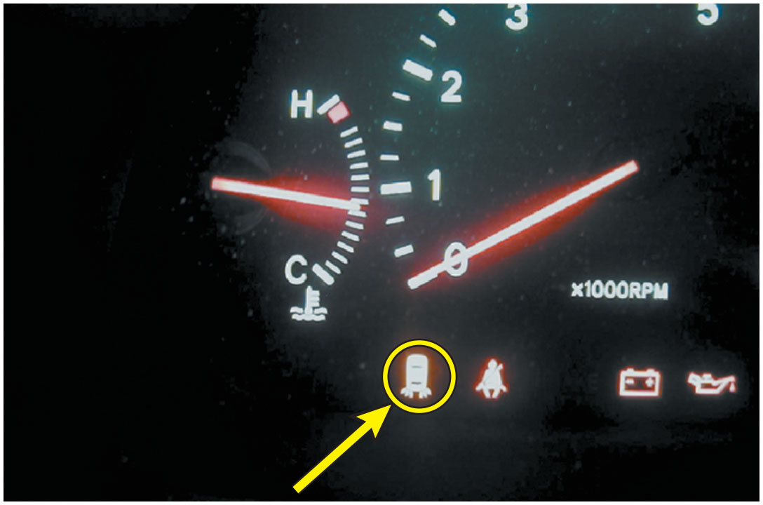
Taillight Fault Indicator
Notes:
1. The driver noticed that the taillight fault indicator (icon) on the dash was on any time the lights were on.

Slide 75
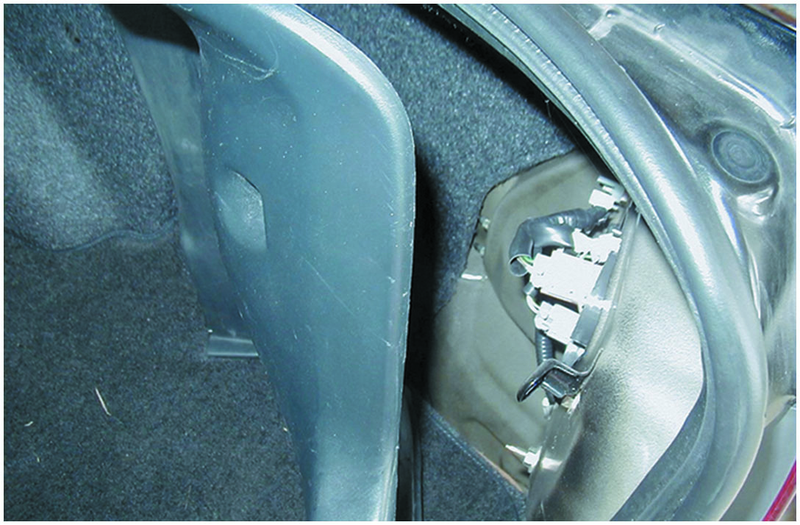
Visual Inspection
Notes:
2. A visual inspection at the rear of the vehicle indicated that the right rear taillight bulb did not light. Removing a few screws from the plastic cover revealed the taillight assembly.

Slide 76
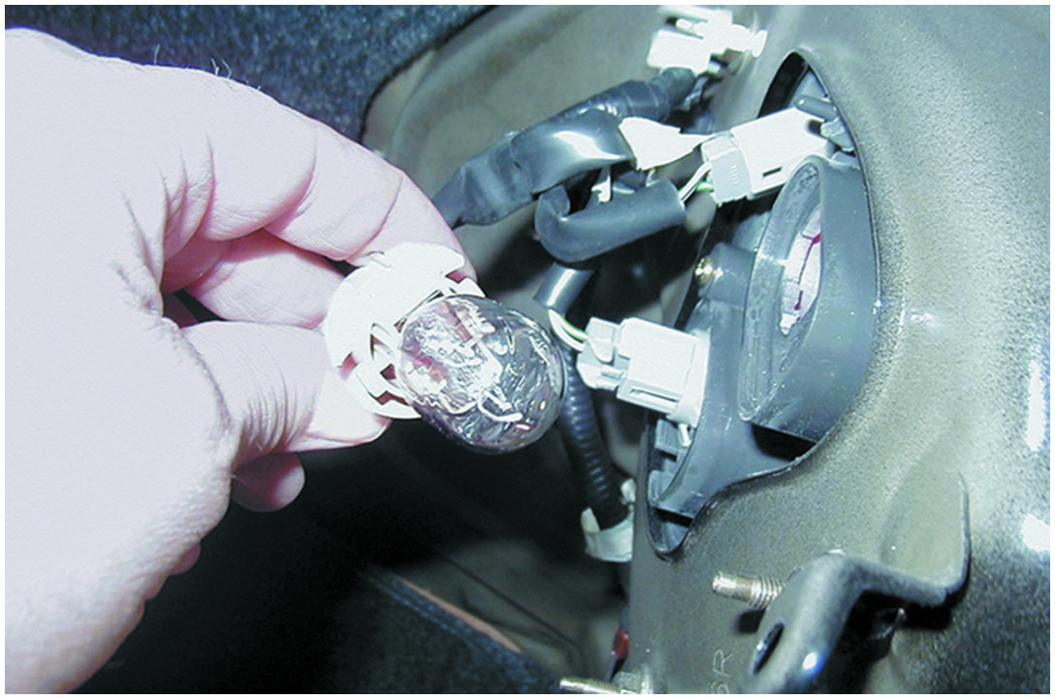
Bulb Socket Is Removed
Notes:
3. The bulb socket is removed from the taillight assembly by gently twisting the base of the bulb counterclockwise.

Slide 77
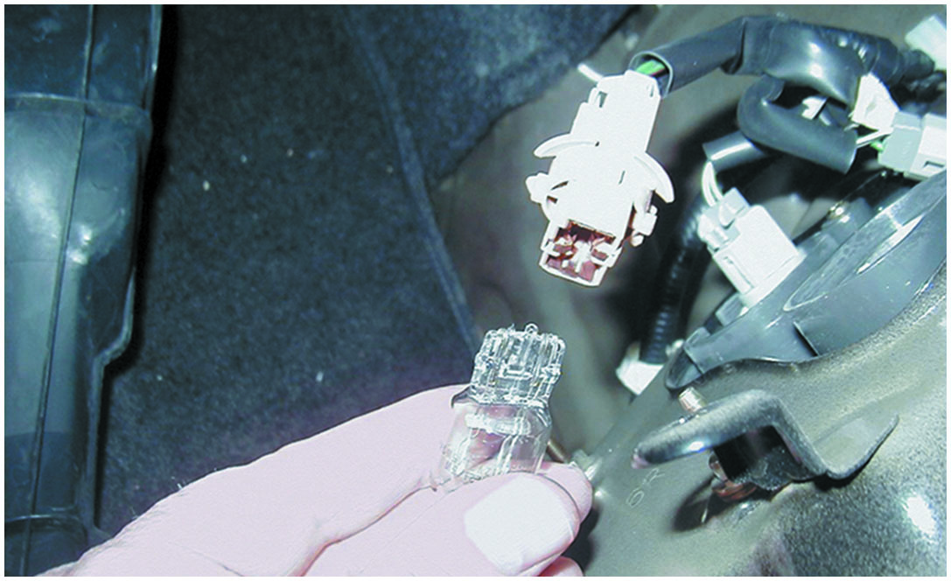
Bulb Removed from Socket
Notes:
4. The bulb is removed from the socket by gently grasping the bulb and pulling the bulb straight out of the socket. Many bulbs required that you rotate the bulb 90 degrees (1/4 turn) to release the retaining bulbs.

Slide 78
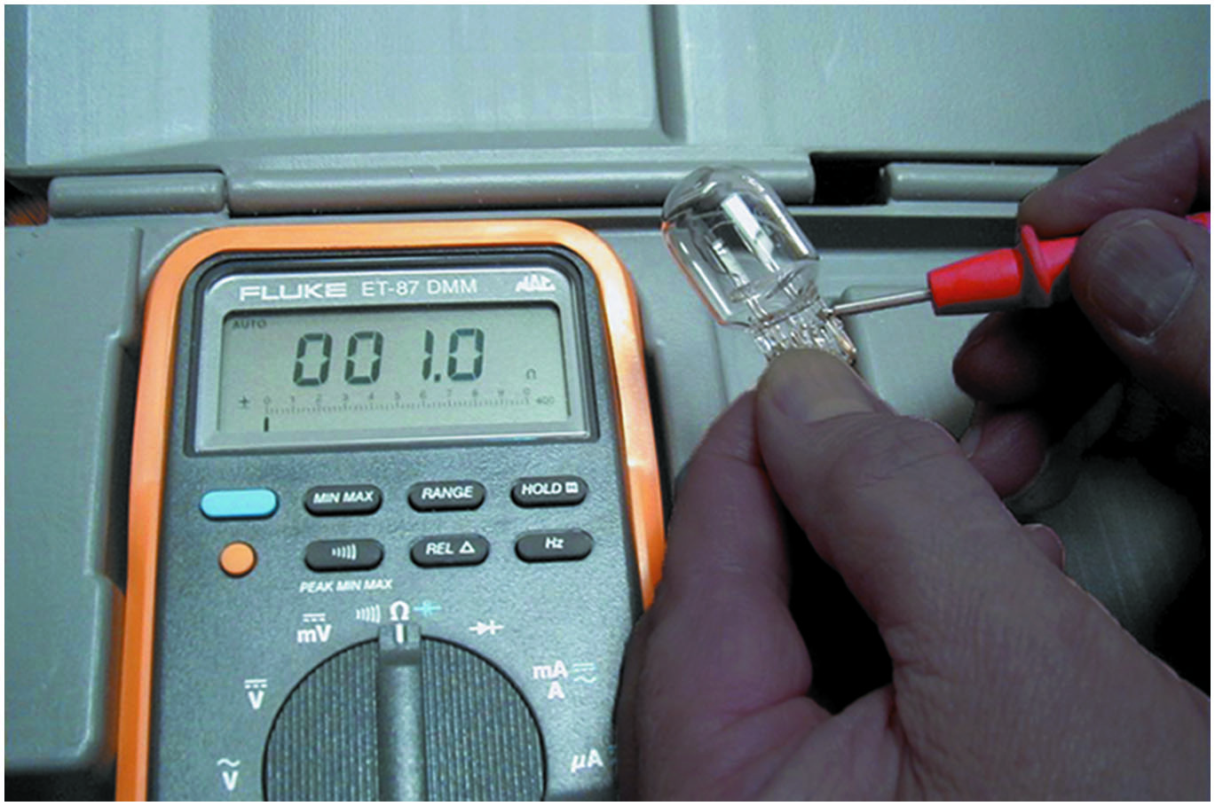
Bulb Tested
Notes:
5. The new 7443 replacement bulb is being checked with an ohmmeter to be sure that it is okay before it is installed in the vehicle.

Slide 79
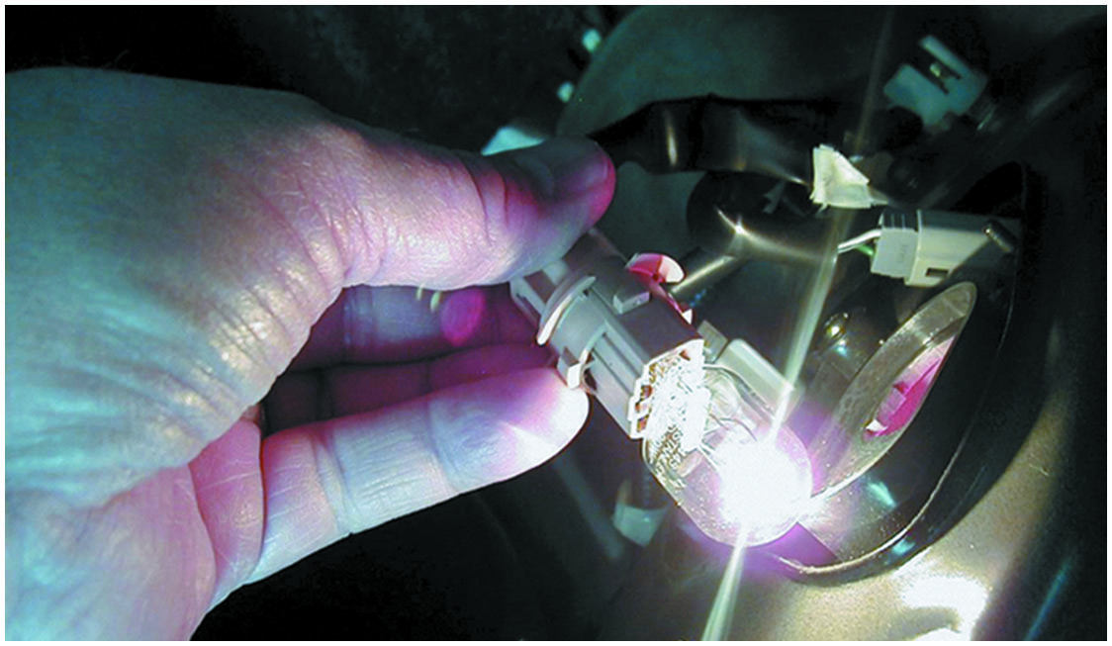
Bulb Works
Notes:
6. The replacement bulb is inserted into the taillight socket and the lights are turned on to verify proper operation before putting the components back together.

Slide 80
Summary (1 of 3)
Lighting systems used in older vehicles are not controlled by a computer, but usually by the body control module (B C M) as are most of the lighting systems on newer vehicles.
The number used on automotive bulbs is called the bulb trade number, as recorded with the American National Standards Institute (A N S I). The number is the same regardless of the manufacturer.
L E D s are used in newer vehicles because they light faster, have a longer service life, draw lower amount of current.

Slide 81
Summary (2 of 3)
Turn signals can be operated through a flasher unit or the B C M depending on the make, model, and year of the vehicle.
Daytime running lights (D R L s) are lights at the front of the vehicle that are on all the time if the engine is running, unless they are turned off.
High-intensity discharge (H I D) headlights produce light that is crisper, clearer, and brighter than light produced by a halogen headlight.

Slide 82
Summary (3 of 3)
An adaptive (or advanced) front lighting system or A F S is a system that mechanically moves the headlights to follow the direction of the front wheels.
Automatic headlights will automatically turn on the headlights when the light sensor detects low ambient light level.
Automatic dimming mirrors use electrochromic technology to dim the mirror in proportion to the amount of headlight glare from other vehicles at the rear.

Slide 83
Animations and Video Links (Halderman website subscription and web access needed to view)
(A6) Electrical/Electronic Systems Animations
(A6) Electrical/Electronic Systems Videos

Slide 84
Copyright
This work is protected by United States copyright laws and is provided solely for the use of instructors in teaching their courses and assessing student learning. Dissemination or sale of any part of this work (including on the World Wide Web) will destroy the integrity of the work and is not permitted. The work and materials from it should never be made available to students except by instructors using the accompanying text in their classes. All recipients of this work are expected to abide by these restrictions and to honor the intended pedagogical purposes and the needs of other instructors who rely on these materials.

