Slide 1
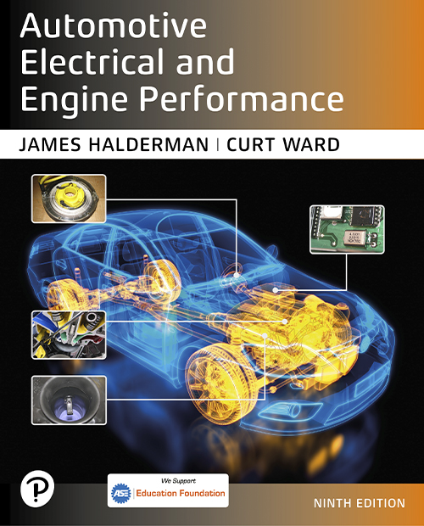
Automotive Electrical and Engine Performance
Ninth Edition
Chapter 15
Charging Systems Parts and Operation
Copyright © 2025 Pearson Education, Inc. All Rights Reserved
Notes:
If this PowerPoint presentation contains mathematical equations, you may need to check that your computer has the following installed:
1) Math Type Plugin
2) Math Player (free versions available)
3) NVDA Reader (free versions available)
INSTRUCTOR NOTE: This presentation includes text explanation notes, you can use to teach the course. When in SLIDE SHOW mode, you RIGHT CLICK and select SHOW PRESENTER VIEW, to use the notes.

Slide 2
Learning Objectives (1 of 2)
15.1 Explain why an alternator generates an A C and changes it to D C.
15.2 Describe an alternator’s construction, including overrunning pulleys.
15.3 Describe the components and operation of an alternator.
15.4 Discuss how an alternator works.

Slide 3
Learning Objectives (2 of 2)
15.5 List the factors determining an alternator’s output voltage and current.
15.6 Explain how the voltage of an alternator is regulated.
15.7 Explain how the heat produced by an alternator is regulated.
15.8 Discuss computer-controlled alternators.

Slide 4
Principle of Alternator Operation
Terminology
S A E term for unit that generates electricity is generator.
Alternator is most commonly used
Amount of current generated can be increased by:
Increasing speed of conductors through magnetic field
Increasing number of conductors passing through magnetic field
Increasing strength of magnetic field

Slide 5
Alternator Construction
Housing
An alternator is constructed using a two-piece cast aluminum housing
A front ball bearing is pressed into the front housing, called the drive-end (D E) housing
The rear housing, or the slip-ring-end (S R E) housing, usually contains either a roller bearing or ball bearing

Slide 6
Question 1
How can the amount of current an alternator generates increase?

Slide 7
Answer 1
Increase the speed of the conductors, increase the number of conductors, and increase the strength of the magnetic field.

Slide 8
Alternator Overrunning Pulleys
Purpose and Function
The purpose of this pulley is to help eliminate noise and vibration in the accessory drive belt system.
May use a dampener spring inside, plus a one-way clutch.
Manufacturer Specific System Names
Isolating Decoupler Pulley (I D P)
Active Alternator Pulley (A A P)
Alternator Decoupler Pulley (A D P)
Alternator Overrunning Decoupler Pulley
Overrunning Alternator Dampener (O A D) (most common term)

Slide 9
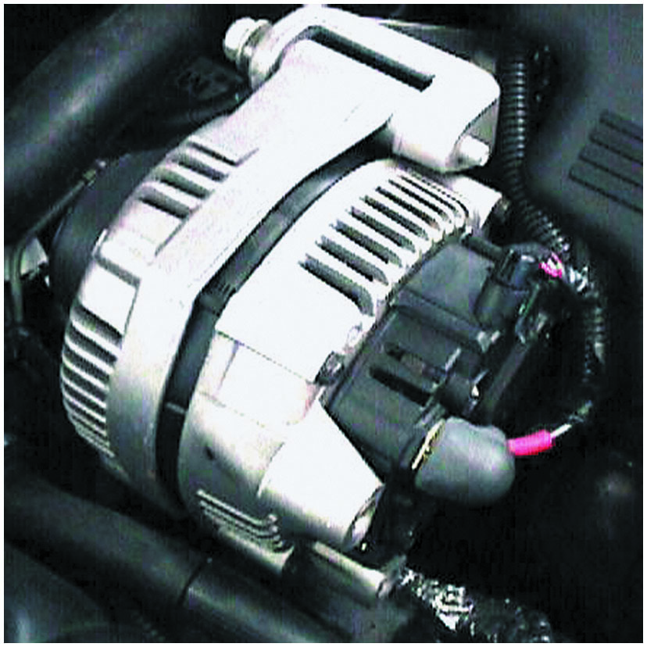
Figure 15.1
Alternator
A typical alternator on a Chevrolet V-8 engine that is driven by the accessory drive belt at the front of the engine.
Notes:
TECH TIP: Alternator Horsepower and Engine Operation
Many technicians are asked how much power certain accessories require. A 100 ampere alternator requires about 2 horsepower from the engine.
One horsepower is equal to 746 watts. Watts are calculated by multiplying amperes times volts.
Power in watts = 100 A × 14.5 V = 1,450 W
1 h p = 746 W
Therefore, 1,450 watts is about 2 horsepower.
Allowing about 20% for mechanical and electrical losses adds another 0.4 horsepower. Therefore, when someone asks how much power it takes to produce
100 amperes from an alternator, the answer is 2.4 horsepower.
Many alternators delay the electrical load to prevent the engine from stumbling when a heavy electrical load is applied. The voltage regulator or vehicle computer is capable of gradually increasing the output of the alternator over a period of several minutes. Even though 2 horsepower does not sound like much, a sudden demand for 2 horsepower from an idling engine can cause the engine to run rough or stall. The difference in part numbers of various alternators is often an indication of the time interval over which the load is applied. Therefore, using the wrong replacement alternator could cause the engine to stall!

Slide 10
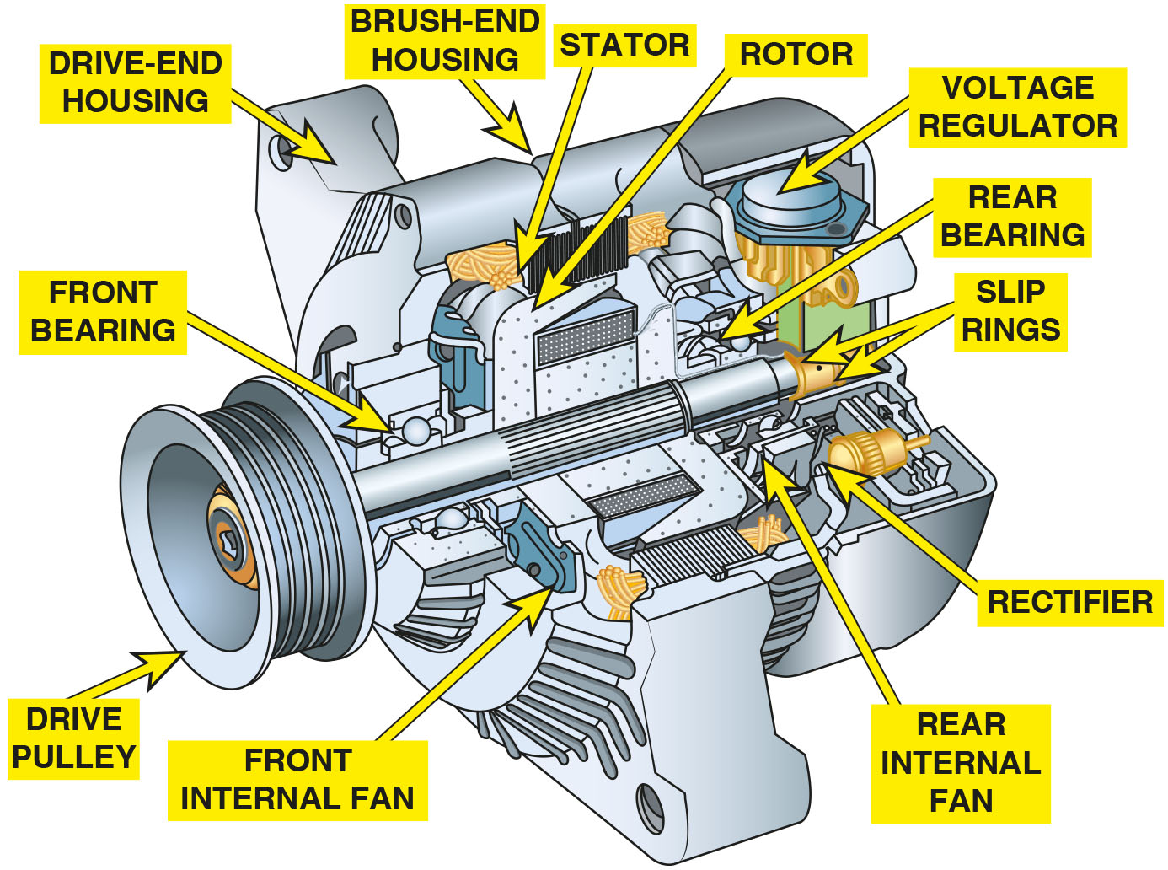
Figure 15.2
Frame
The end frame toward the drive belt is called the drive-end housing and the rear section is called the slip-ring-end housing.
Notes:
Long Description:
The components are as follows. The drive pulley is attached to a shaft. The drive-end housing houses the front bearing, front internal fan, stator, and rotor. The brush-end housing houses the rear bearing, voltage regulator, slip rings, rectifier, and rear internal fan. The stator and rotor are located close to each other. The voltage regulator is located behind and above the rear bearing. The rear internal fan and rectifier are located close to each other. The front and rear bearings are located on one side of the shaft, and the front internal fan and rear internal fan are located on the other side.

Slide 11
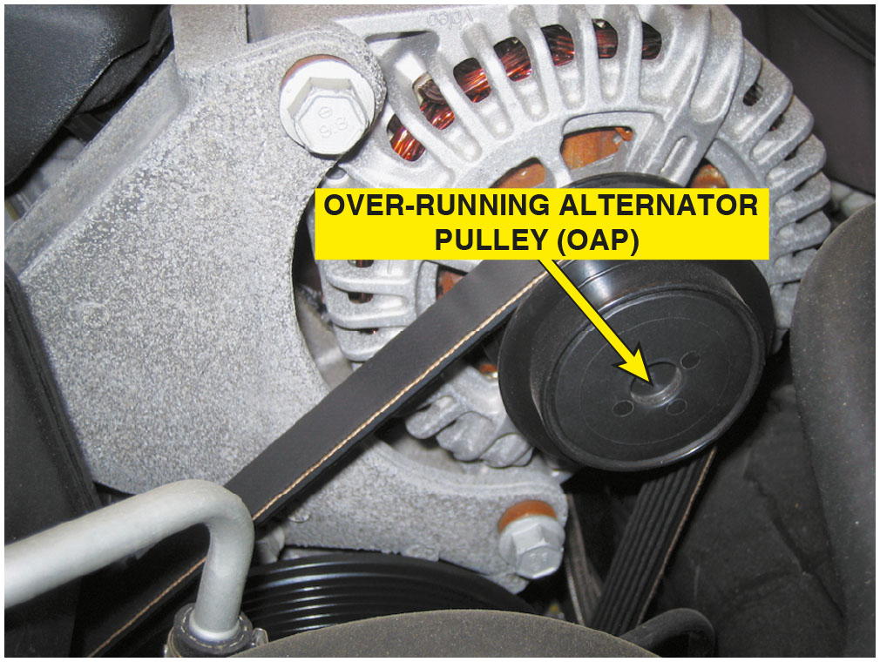
Figure 15.3
O A P
An O A P on a Chevrolet Corvette alternator.

Slide 12
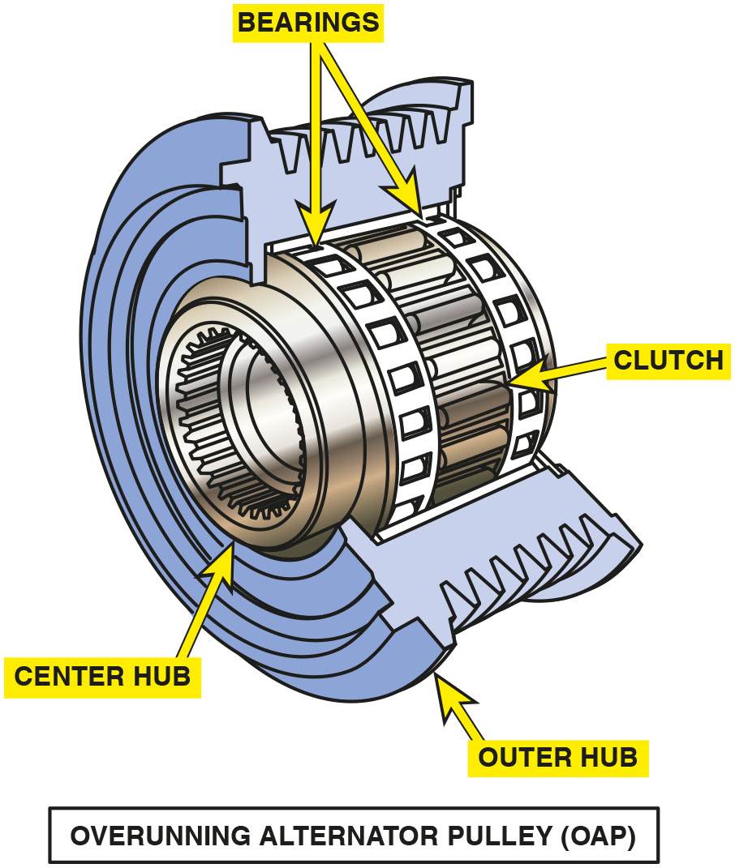
Figure 15.4
O A P Exploded View
An exploded view of an overrunning alternator pulley showing all of the internal parts.

Slide 13
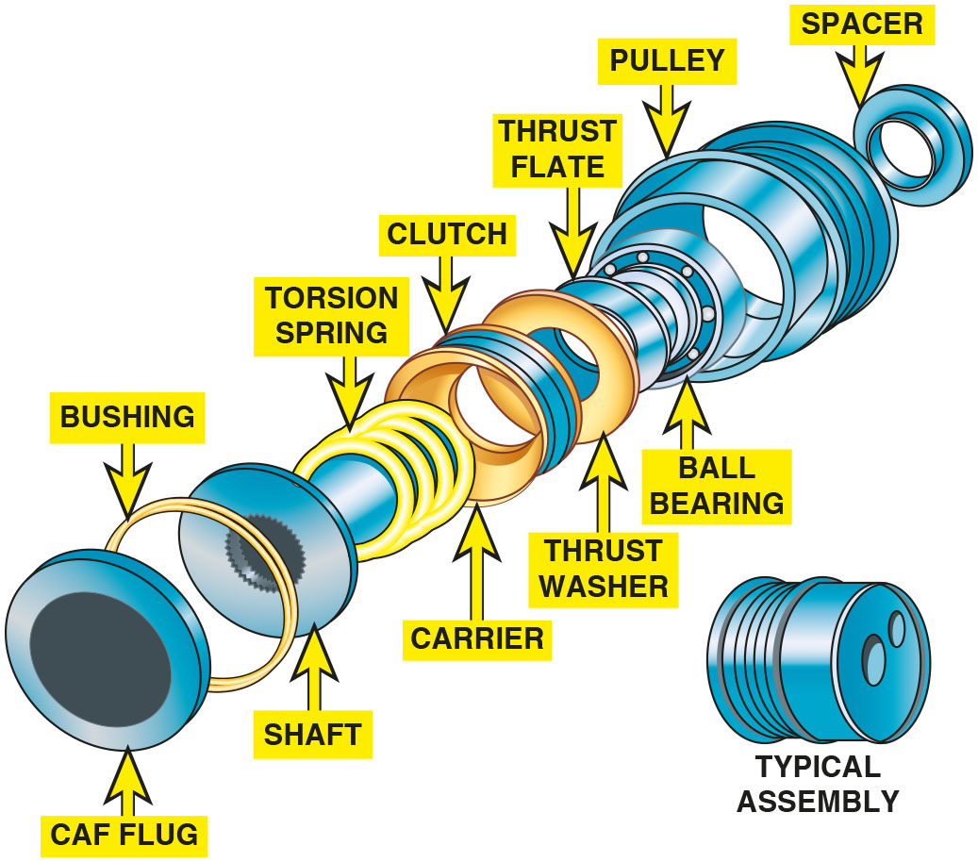
Figure 15.5
O A D
An overrunning alternator damper (O A D) is engineered to dampen noises and vibrations in the front accessory drive belt system.
Notes:
Long Description:
The typical assembly shows a cylindrical device, and the exploded view shows the relationship between the parts in the assembly. The parts in the exploded view, moving from the front to the back, are as follows: cap plug, bushing, shaft, torsion spring, carrier, clutch, thrust washer, thrust plate, ball bearing, pulley, and spacer.

Slide 14
Frequently Asked Question: Can I Install an O A P or an O A D to My Alternator?
? Frequently Asked Question
Can I Install an O A P or an O A D to My Alternator? Usually, no. An alternator needs to be equipped with the proper shaft to allow the installation of an O A P or O A D. This also means that a conventional pulley often cannot be used to replace a defective overrunning alternator pulley or dampener. Check service information for the exact procedure to follow.

Slide 15
Question 2
What is the purpose of an O A P or O A D?

Slide 16
Answer 2
Reduce noise and vibration.

Slide 17
Alternator Components and Operation (1 of 2)
Rotor Construction
Rotor constructed of many turns of copper wire coated with a varnish insulation wound over an iron core.
How Rotors Create Magnetic Fields
Current through slip rings causes “fingers” of rotor to become alternating north and south magnetic poles.

Slide 18
Alternator Components and Operation (2 of 2)
Rotor Current
Maximum rated alternator output in amperes depends on the number and gauge of the rotor windings.
Stator Construction
Stator consists of stationary coil windings inside alternator.
Diodes
Semiconductor that operate as a one-way electrical check valve.

Slide 19
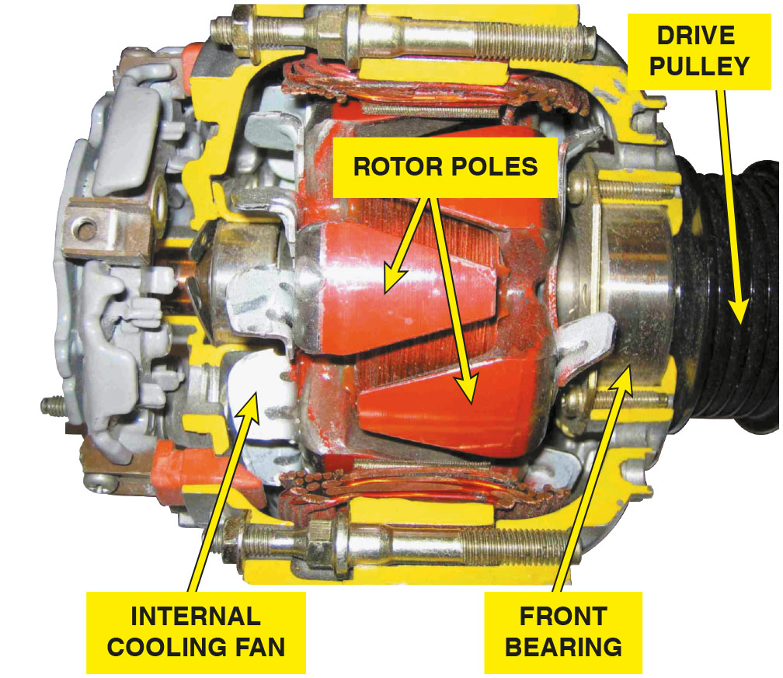
Figure 15.6
Cutaway
A cutaway of an alternator, showing the rotor and cooling fan that is used to force air through the unit to remove the heat created when it is charging the battery and supplying electrical power for the vehicle.
Notes:
Long Description:
A housing made of aluminum and the drive pulley of the alternator attached to the front end. Inside the housing, two bearings on each end support the shaft with rotor poles and internal cooling fan. Heavy metal plates in the shape of a triangle can be seen over the iron core which forms the rotor poles.

Slide 20
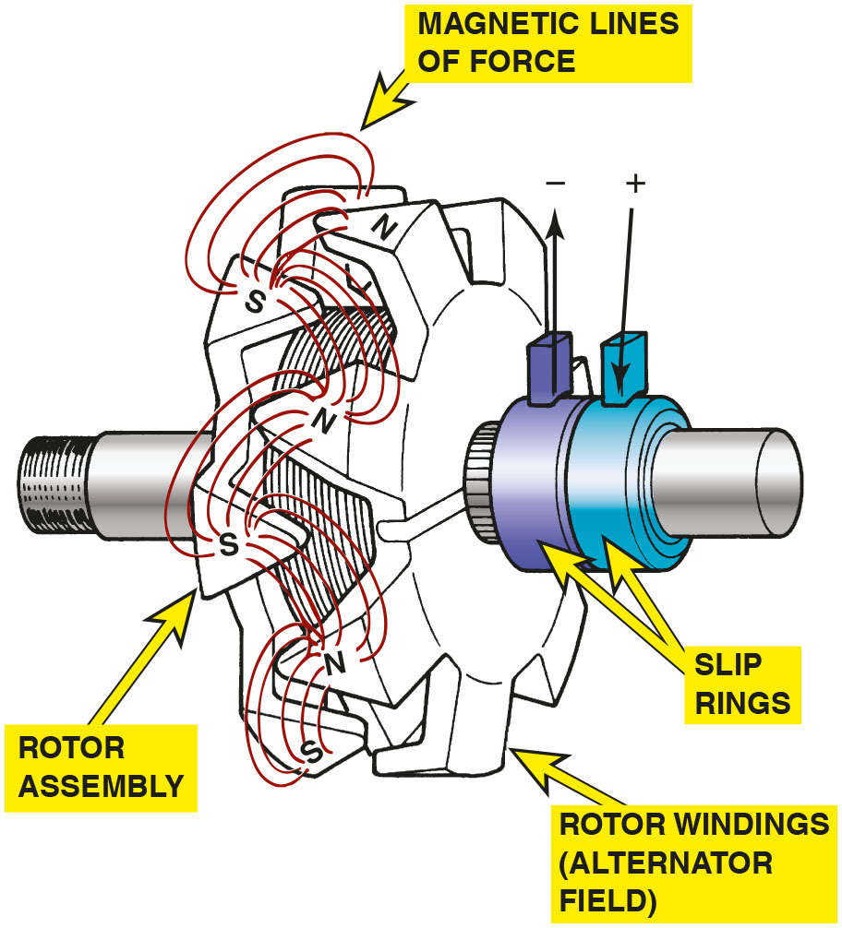
Figure 15.7
Rotor Flux
Rotor assembly of a typical alternator. Current through the slip rings causes the “fingers” of the rotor to become alternating north and south magnetic poles. As the rotor revolves, these magnetic lines of force induce a current in the stator windings.
Notes:
Long Description:
A rotor with wire wound over the iron core and finger claw rotor poles on the end of the iron core. The rotor assembly fits on a shaft and the shaft has two slip rings in the end, market as negative and positive. Alternate finger claw rotor poles are named S, south and N, north, and magnetic lines of force can be seen on the stator windings.

Slide 21
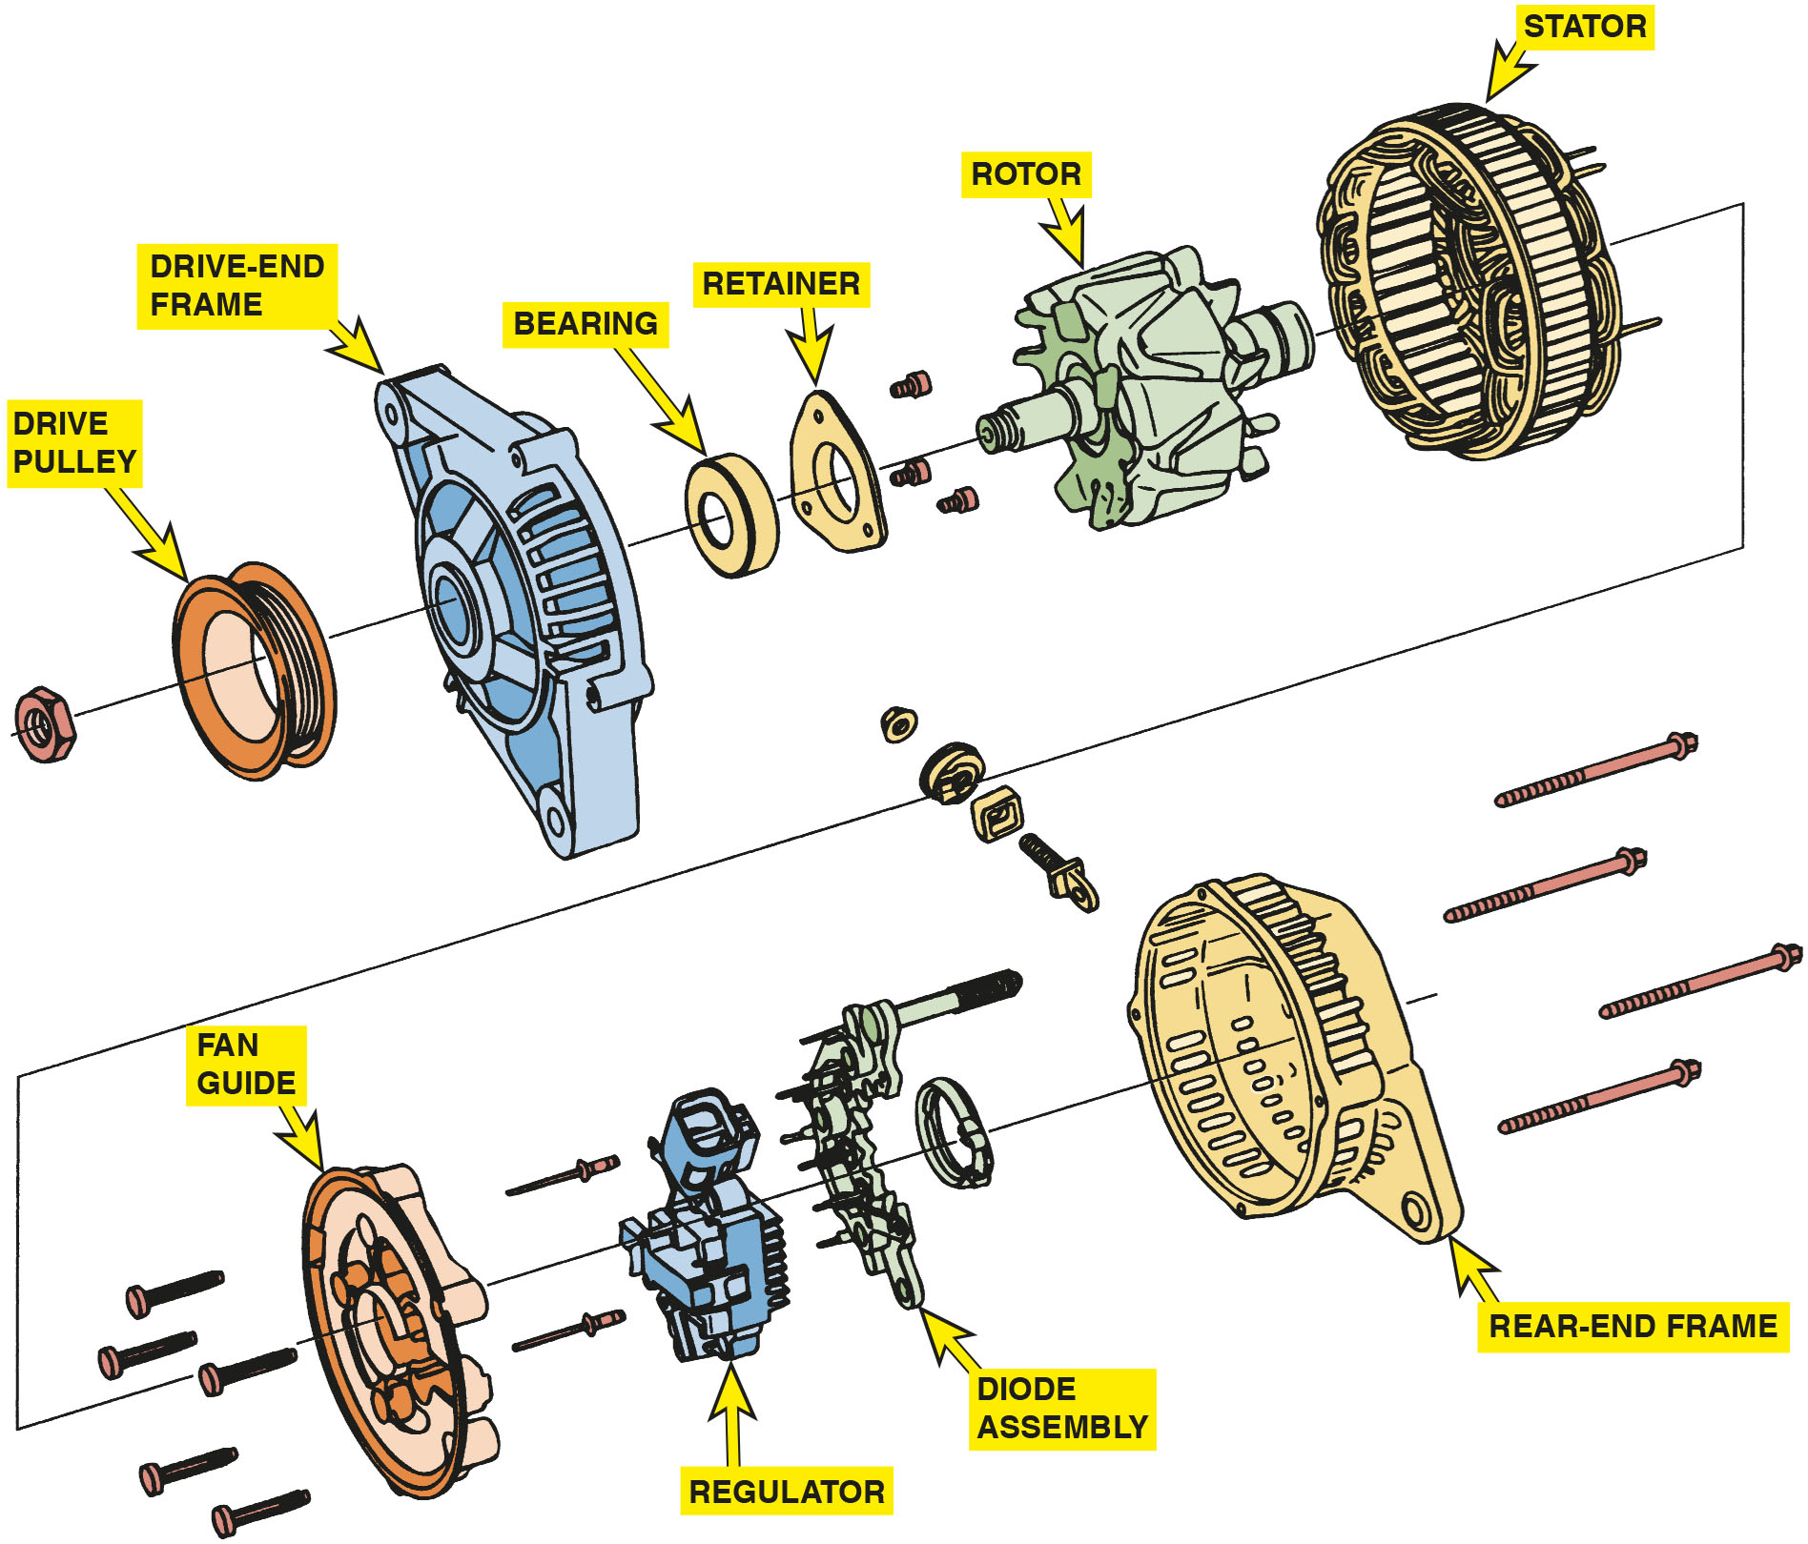
Figure 15.8
Exploded View
An exploded view of a typical alternator showing all of its internal parts including the stator windings.
Notes:
Long Description:
The different parts of an alternator that are connected to each other as follows: A nut, a drive pulley, drive frame end, a bearing, a retainer, 3 small bolts, a rotor, a stator, four bolts, a fan guide, two support pins, a regulator, diode assembly, rear end frame and 4 half threaded bolts.

Slide 22
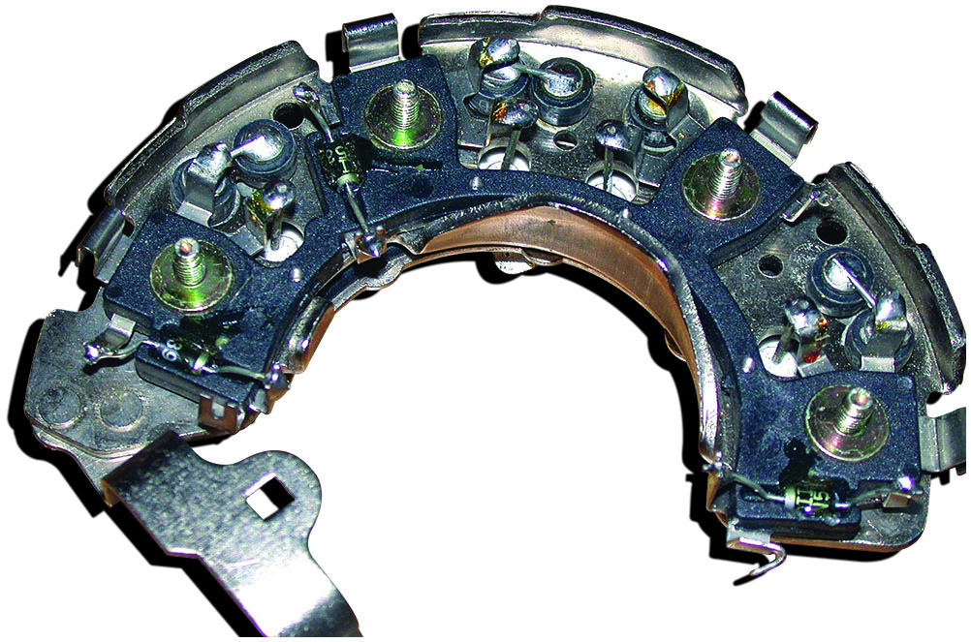
Figure 15.9
Rectifier
A rectifier usually includes six diodes in one assembly and is used to rectify A C voltage from the stator windings into D C voltage suitable for use by the battery and electrical devices in the vehicle.

Slide 23
How an Alternator Works (1 of 2)
Field Current Is Produced
Magnetic field of rotor generates a current in stator windings by electromagnetic induction.
Current Induced in Stator
Induced current in stator windings is alternating current because of alternating magnetic field of rotor.

Slide 24
How an Alternator Works (2 of 2)
Wye-Connected Stators
In wye-type stator connection, the currents must combine because two windings are always connected in series.
Delta-Connected Stators
Current induced in each winding flows to diodes in a parallel circuit.

Slide 25
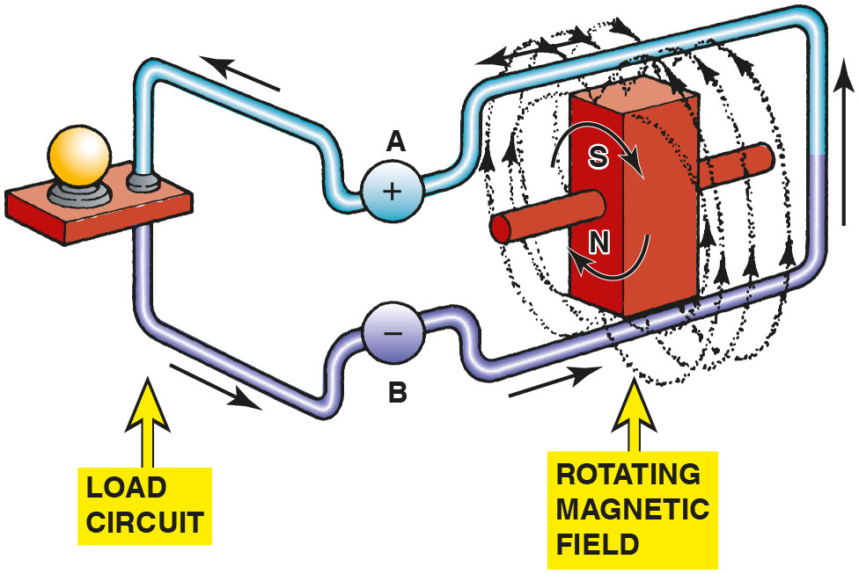
Figure 15.10
Magnetic Line of Force
Magnetic lines of force cutting across a conductor induce a voltage and current in the conductor.
Notes:
Long Description:
A load circuit with a bulb in the middle and a conductor passing over a rotor. The conductor on the top is connected to a positive terminal A. The conductor on the bottom is connected to negative terminal B. The rotor has south pole on the top and north pole at the bottom and is shown with a rotating magnetic field around it. Voltage and current pass through the positive terminal to the negative terminal along the whole circuit.

Slide 26
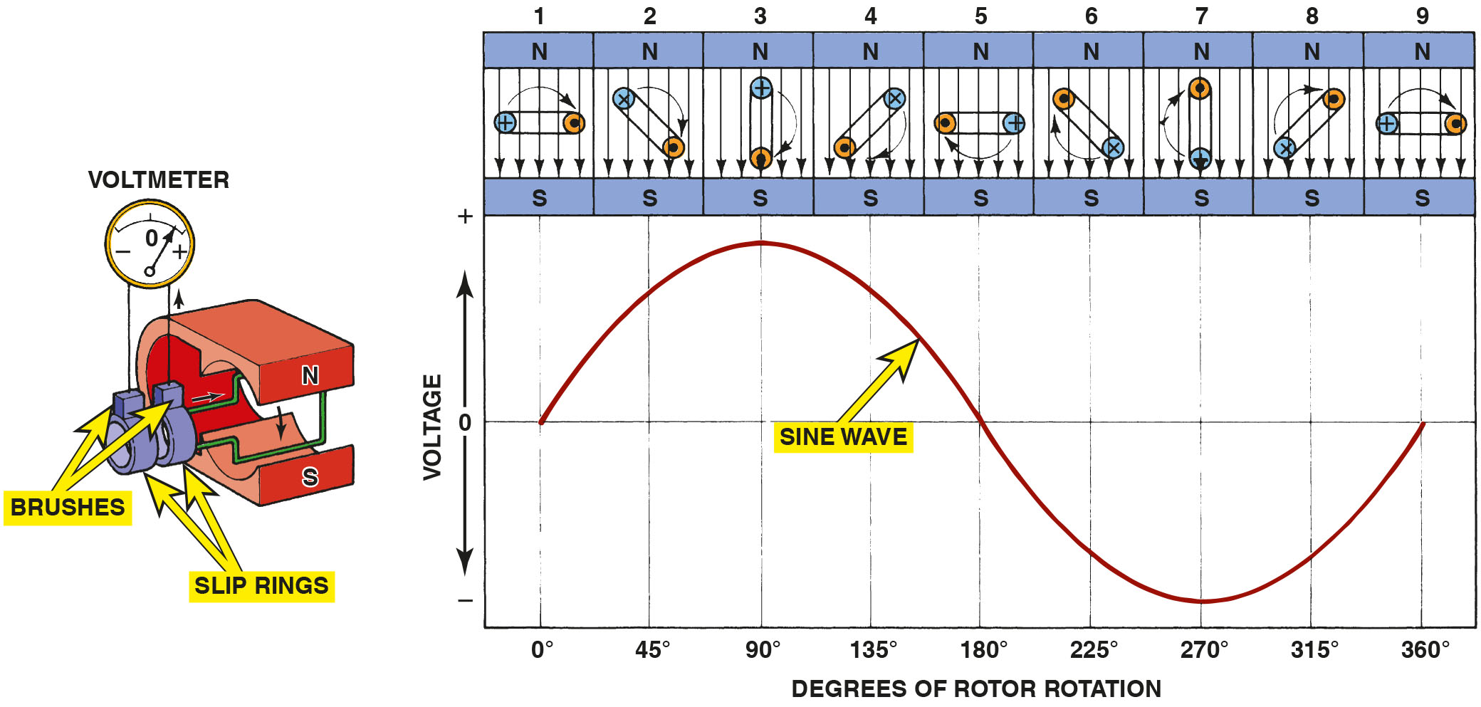
Figure 15.11
Sine Wave
A sine wave (shaped like the letter S on its side) voltage curve is created by one revolution of a winding as it rotates in a magnetic field.
Notes:
Long Description:
A rotor with two slip rings and brushes connected to a voltmeter. The rotor winding is placed between two magnetic poles, north at the top and south at the bottom. The voltage curve created by one revolution of a winding can be described as below. The voltage curve is drawn across a graph. The graph has degrees of rotor rotation on the horizontal axis and voltage on the vertical axis. Positive and negative voltages are shown on the graph. The voltage curve is in the shape of a sine wave. The sine curve begins from zero degree of rotation where the winding is horizontal. The winding rotates clockwise in increments of 45 degrees and completes a revolution after 360 degrees. From zero degree to 180 degrees, the voltage curve moves only above the horizontal zero line. It begins at zero voltage at zero degrees, peaks at positive voltage at 90 degrees, and ends at zero voltage again at 180 degrees. The 180 degrees to 360 degrees, the voltage curve moves only below the horizontal zero line. It continues at zero voltage at 180 degrees, peaks at negative voltage at 270 degrees and ends at zero voltage again at 360 degrees. The sine curve is created by one revolution of a winding between the north and south poles.

Slide 27
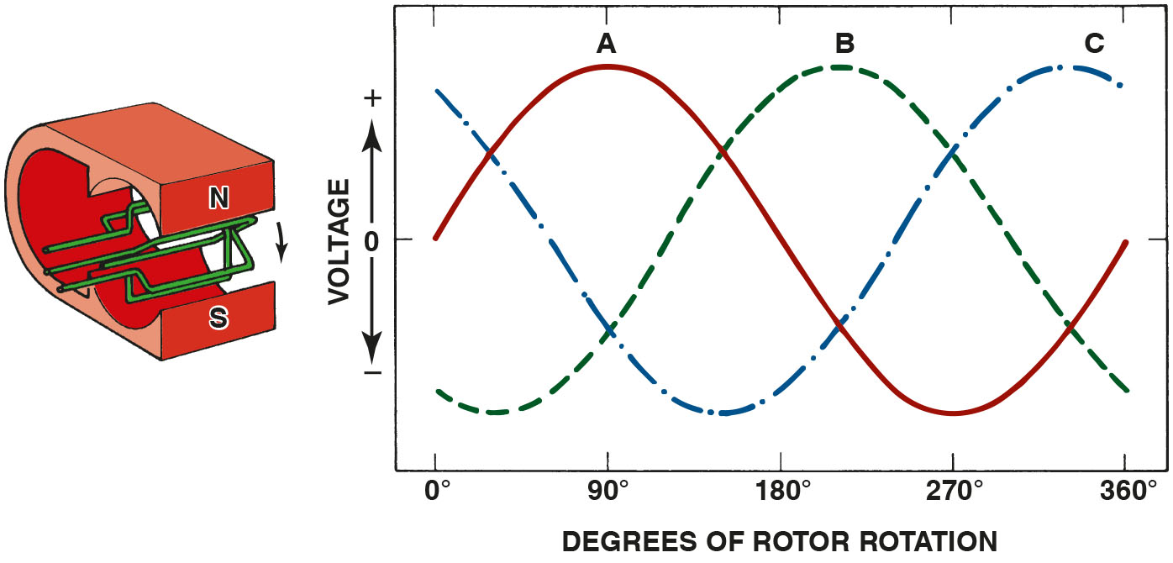
Figure 15.12
Three Windings Wave
When three windings (A, B, and C) are present in a stator, the resulting current generation is represented by the three sine waves. The voltages are 120 degrees out of phase. The connection of the individual phases produces a three-phase alternating voltage.
Notes:
Long Description:
Three windings rotating clockwise in between south and north magnetic poles. The current created by the three windings are presented in the form of sine waves in the graph. The graph has degrees of rotation on the horizontal axis and voltage on the vertical axis. The waves oscillate between peak positive and peak negative every 180 degrees and the three curves named A, B, and C can be seen 120 degrees out of phase from each other.

Slide 28
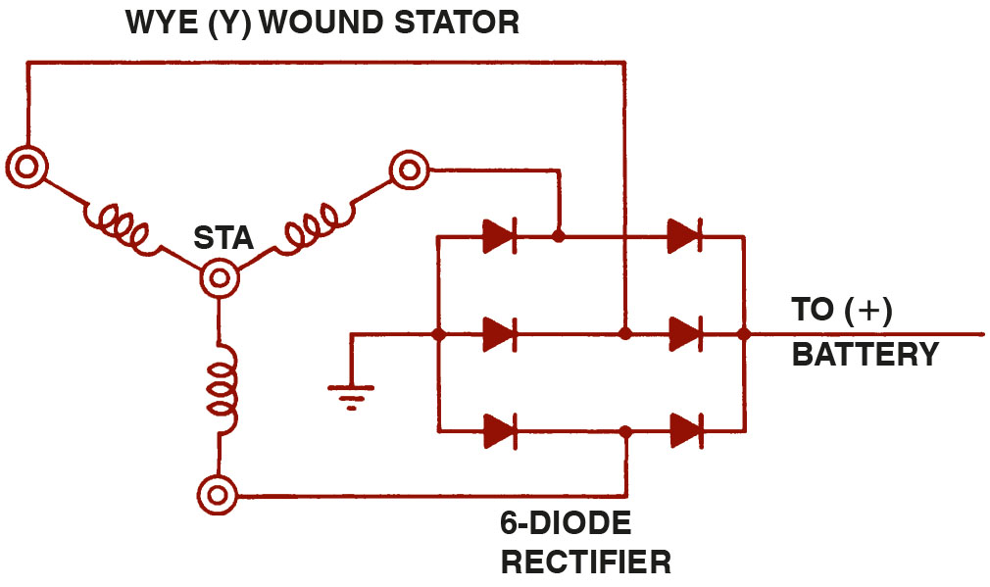
Figure 15.13
Wye Stator
Wye-connected stator winding.
Notes:
Long Description:
The three windings are connected in the shape of Y and each of the stator is connected to a leg of a 6-diode rectifier that is connected at one end to the positive terminal of a battery and to ground on the other end.

Slide 29
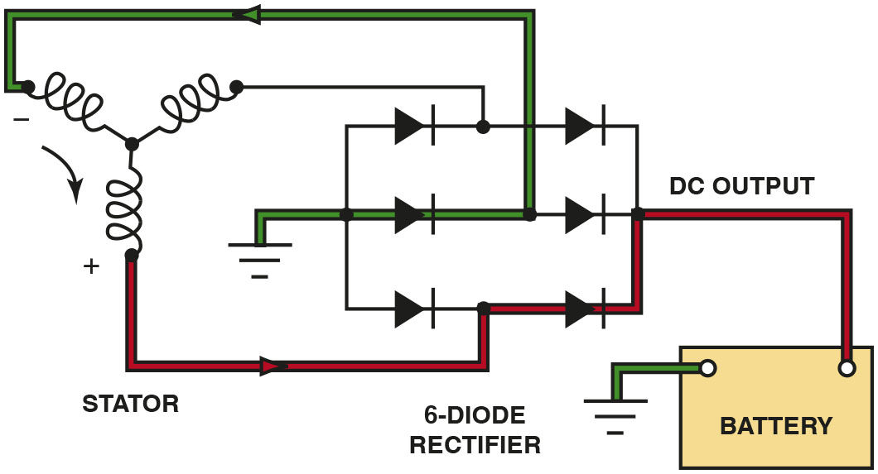
Figure 15.14
Wye Stator Operation
As the magnetic field, created in the rotor, cuts across the windings of the stator, a current is induced. Notice that the current path includes passing through one positive (+) diode on the way to the battery and one negative (−) diode as a complete circuit is completed through the rectifier and stator. It is the flow of current through the diodes that converts the A C voltage produced in the stator windings to D C voltage available at the output terminal of the alternator.
Notes:
Long Description:
The circuit diagram depicts the rectifier bridge is connected to ground on one end and the battery positive terminal on the other. One stator winding has a positive current induced and the second winding has a negative current induced. The third winding is inactive. The positive current from first winding passes through one positive diode and reaches the battery positive. The negative current from the second winding passes through one negative diode and reaches the ground.

Slide 30
Animation: Wye Windings

Slide 31
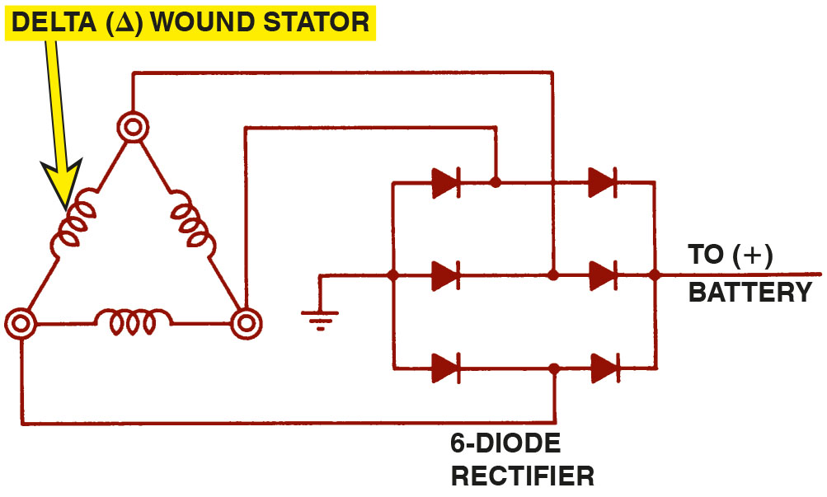
Figure 15.15
Delta Wound
Delta-connected stator winding.
Notes:
Long Description:
The three windings are connected in a triangular shape and each of the stator is connected to a leg of a 6-diode rectifier that is connected at one end to the positive terminal of a battery and to ground on the other end.

Slide 32
Alternator Output Factors
The output voltage and current of an alternator depend on the following factors.
Speed of rotation
Number of conductors
Strength of the magnetic field

Slide 33
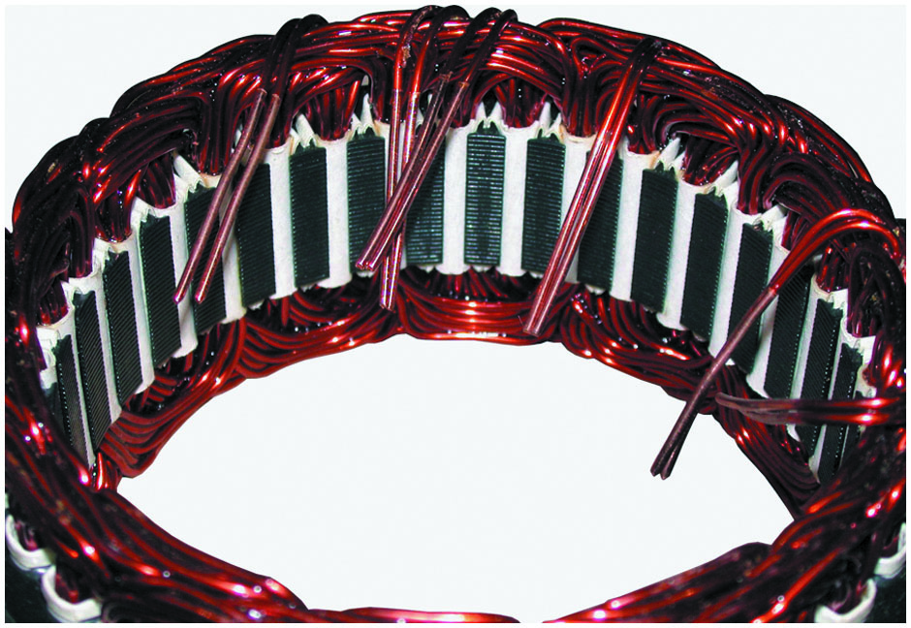
Figure 15.16
Stator Windings
A stator assembly with six, rather than the normal three, windings.

Slide 34
Alternator Voltage Regulation
Regulator Operation
Control of field current is accomplished by opening and closing ground side of field circuit through rotor on most alternators.
Zener diode is a major electronic component that makes voltage regulation possible.
Battery Condition and Charging Voltage
The alternator may supply the needed current but may not reach maximum charging voltage.
Voltage regulators compensate for temperature.

Slide 35
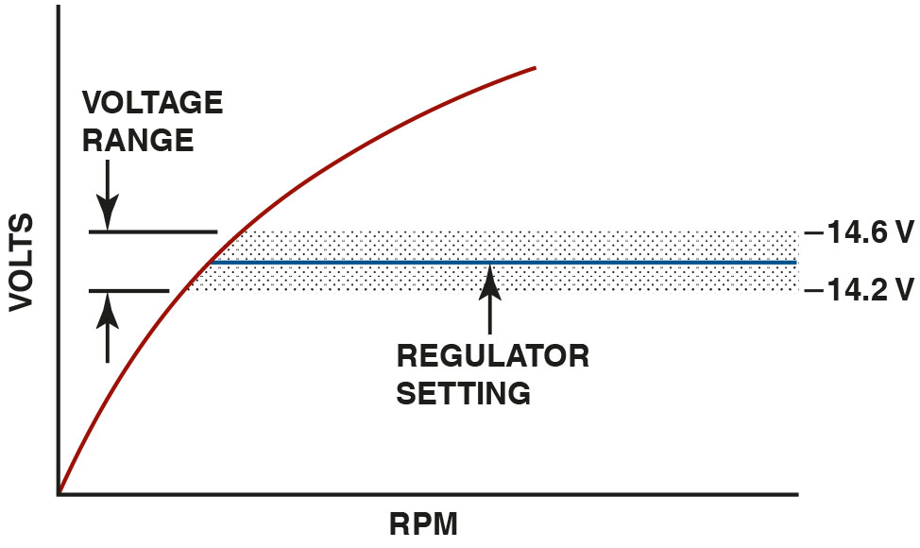
Figure 15.17
Voltage Regulator
Typical voltage regulator range.

Slide 36
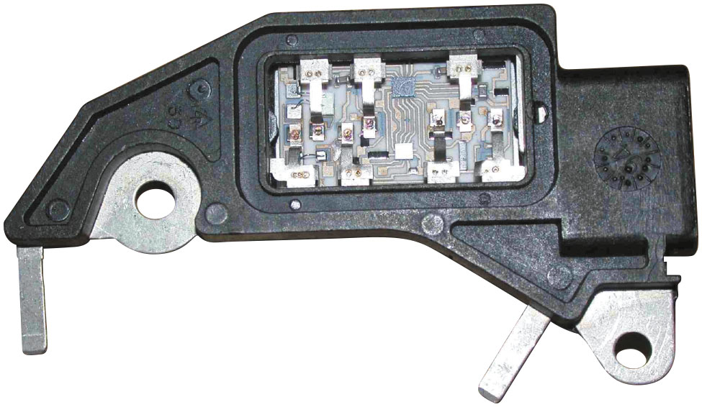
Figure 15.18
Electronic Regulator
A typical electronic voltage regulator with the cover removed showing the circuits inside.

Slide 37
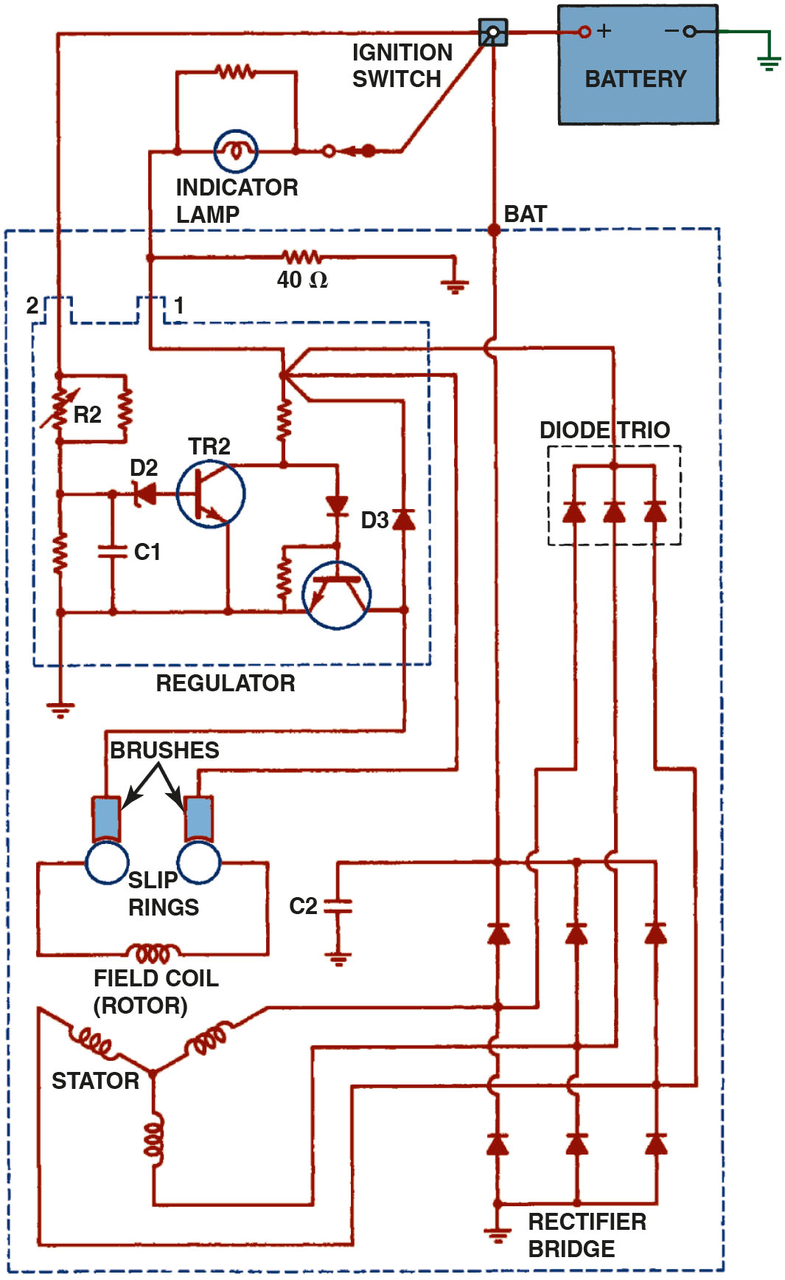
Figure 15.19
G M S I Regulator
Typical General Motors S I-style alternator with an integral voltage regulator. Voltage present at terminal 2 is used to reverse bias the zener diode (D2) that controls T R2. The positive brush is fed by the ignition current (terminal 1) plus current from the diode trio.
Notes:
Long Description:
The circuit has different electrical components like a stator, a battery, diode Rectifier Bridge, a Zener diode, a thermistor, a transistor, a rotor and slip rings with brushes. The zener diode is connected in series to T R 2 and is housed in a regulator. A diode trio connects to the regulator and to a rectifier bridge, which in turn is connected to field coil and stator.

Slide 38
Alternator Cooling
The types of cooling include the following:
External fan
Internal fan(s)
Both an external fan and an internal fan
Coolant cooled

Slide 39
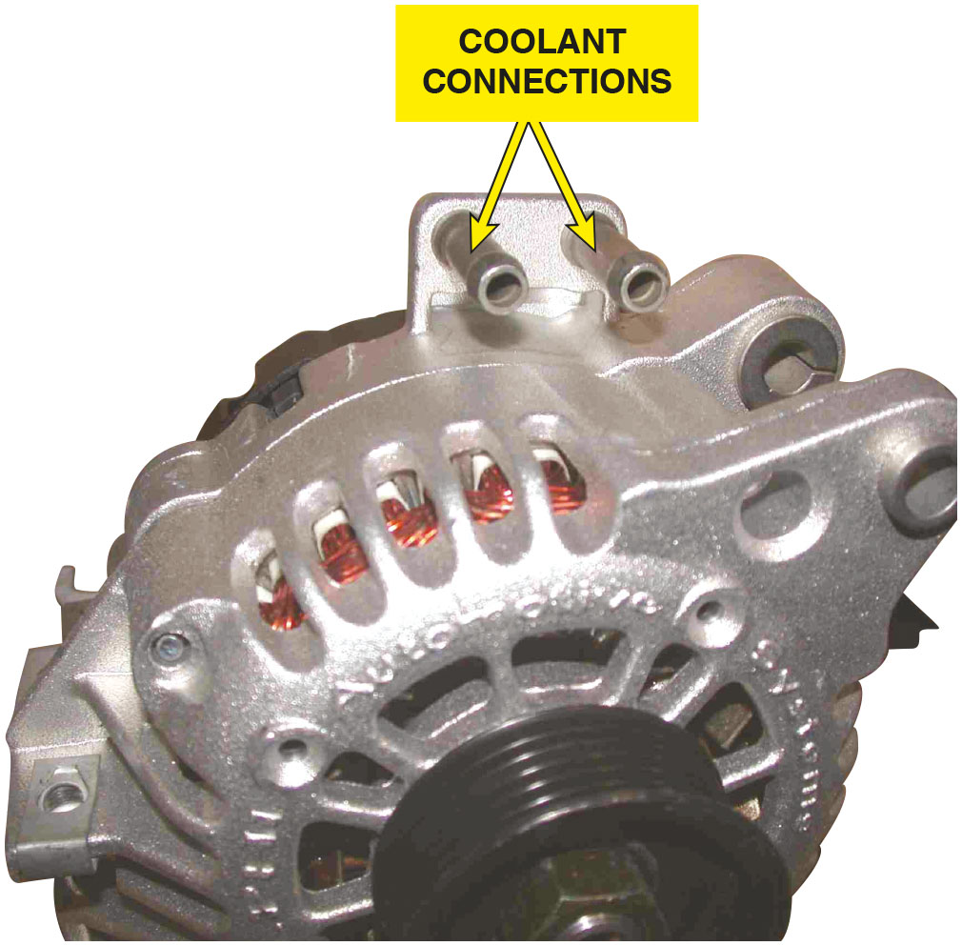
Figure 15.20
Coolant Cooled
A coolant-cooled alternator showing the hose connections where coolant from the engine flows through the rear frame of the alternator.

Slide 40
Question 3
How can an alternator be cooled?

Slide 41
Answer 3
How can an alternator be cooled?

Slide 42
Computer-Controlled Alternators
Computers can interface with charging system in three ways.
Computer can activate charging system by turning on and off field current to rotor.
Computer can monitor operation of alternator and increase engine speed.
Computer can control alternator by controlling alternator output to match needs of system.

Slide 43
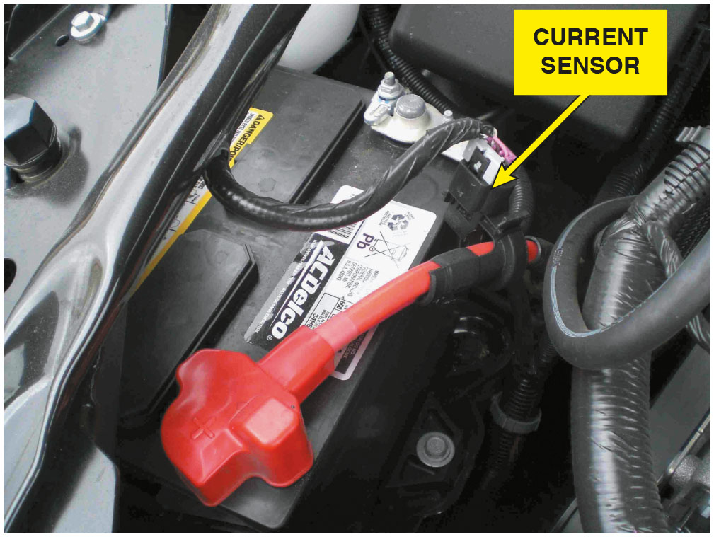
Figure 15.21
Hall-Effect Sensor
A Hall-effect current sensor attached to the positive battery cable is used as part of the E P M system.

Slide 44
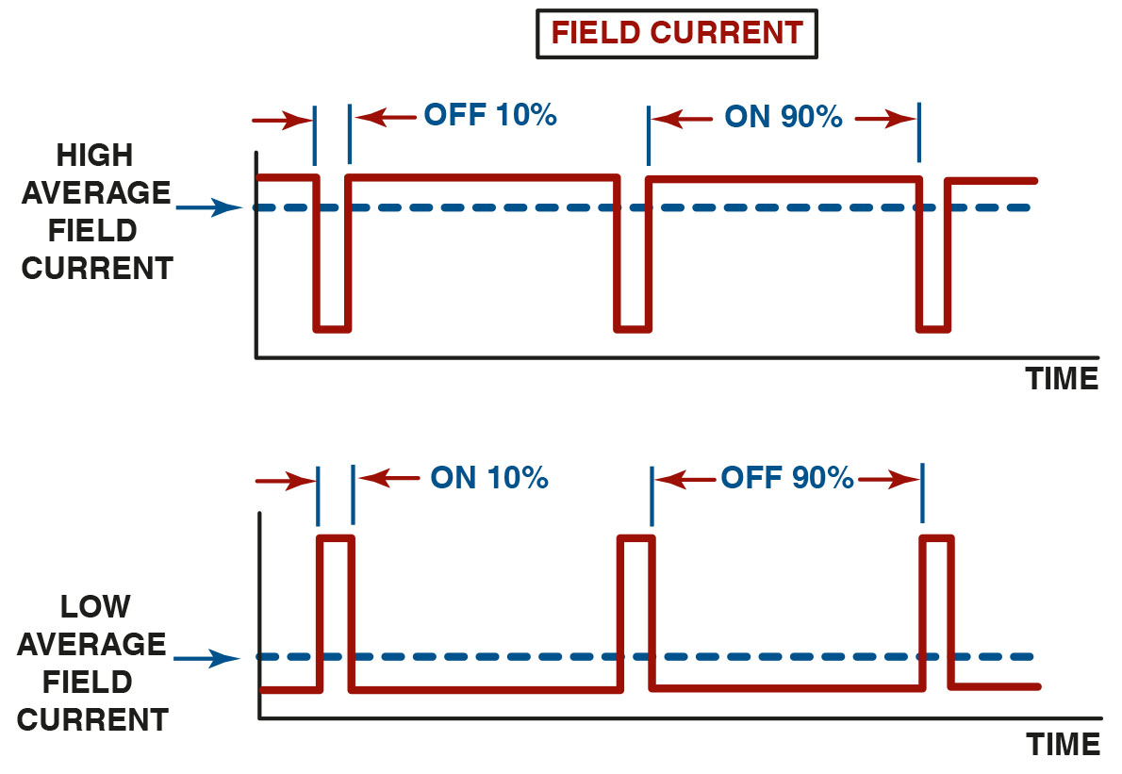
Figure 15.22
Computer Control
The amount of time current flowing through the field (rotor) determines the alternator output.
Notes:
Long Description:
The graph depicts time on the horizontal axis and the current flowing through the rotor on the vertical axis. The graph resembles square waves. The first graph has high average field current line with a pulse that shows that current flow remains off for 10 percent of the time and remains on for 90 percent of the time. The current is above high average field current when on and below it when off. The second graph has low average field current line with a pulse shows that current flow remains on for 10 percent of the time and remains off for 90 percent of the time. The current is below low average field current when off and above it when on.

Slide 45
Chart 15.1
Output Voltage
COMMAND DUTY CYCLE | ALTERNATOR OUTPUT VOLTAGE
10% | 11 point 0 V
20% | 11.6 V
30% | 12.1 V
40% | 12.7 V
50% | 13.3 V
60% | 13.8 V
70% | 14.4 V
80% | 14.9 V
90% | 15.5 V
The output voltage is controlled by varying the duty cycle as controlled by the P C M.

Slide 46
Animation: A Modern 3-Wire Connector Alternator

Slide 47
Summary
Alternator output is increased if the speed of the alternator is increased.
The parts of a typical alternator include the drive-end (D E) housing, slip-ring-end (S R E) housing, rotor assembly, stator, rectifier bridge, brushes, and voltage regulator.
The magnetic field is created in the rotor.
The alternator output current is created in the stator windings.
The voltage regulator controls the current flow through the rotor winding.

Slide 48
Animations and Video Links (Halderman website subscription and web access needed to view)
(A6) Electrical/Electronic Systems Animations
(A6) Electrical/Electronic Systems Videos

Slide 49
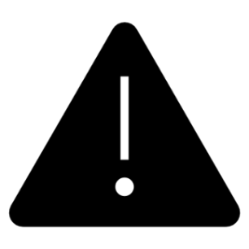
Copyright
This work is protected by United States copyright laws and is provided solely for the use of instructors in teaching their courses and assessing student learning. Dissemination or sale of any part of this work (including on the World Wide Web) will destroy the integrity of the work and is not permitted. The work and materials from it should never be made available to students except by instructors using the accompanying text in their classes. All recipients of this work are expected to abide by these restrictions and to honor the intended pedagogical purposes and the needs of other instructors who rely on these materials.

