Slide 1
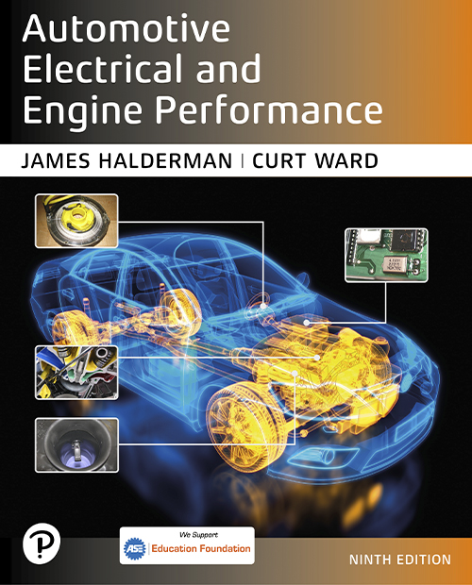
Automotive Electrical and Engine Performance
Ninth Edition
Chapter 13
Starting System Parts and Operation
Copyright © 2025 Pearson Education, Inc. All Rights Reserved
Notes:
If this PowerPoint presentation contains mathematical equations, you may need to check that your computer has the following installed:
1) Math Type Plugin
2) Math Player (free versions available)
3) NVDA Reader (free versions available)
INSTRUCTOR NOTE: This presentation includes text explanation notes, you can use to teach the course. When in SLIDE SHOW mode, you RIGHT CLICK and select SHOW PRESENTER VIEW, to use the notes.

Slide 2
Learning Objectives
13.1 Describe the parts and operation of a cranking circuit.
13.2 Explain push button starting.
13.3 Discuss starter motor operation.
13.4 Explain the components of a starter motor.
13.5 Describe gear reduction starters.
13.6 Describe the function of starter drives.
13.7 Describe the function of solenoids.
13.8 Discuss stop-start system operation.

Slide 3
Cranking Circuit
Parts Involved
Starter motor
Battery
Starter solenoid or relay
Starter drive
Ignition switch
Control Circuit Parts and Operation
The ignition switch does not operate the starter unless the automatic transmission is in neutral or park, or the clutch pedal is depressed on manual transmission/transaxle vehicles.

Slide 4
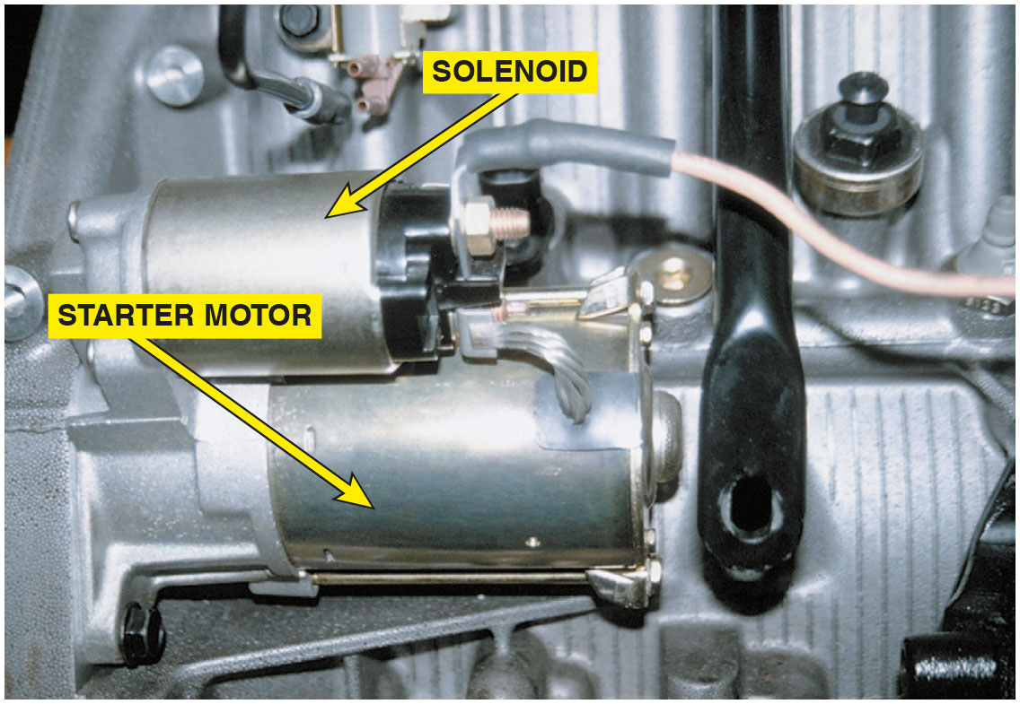
Figure 13.1
Solenoid Starter
A typical solenoid-operated starter.

Slide 5
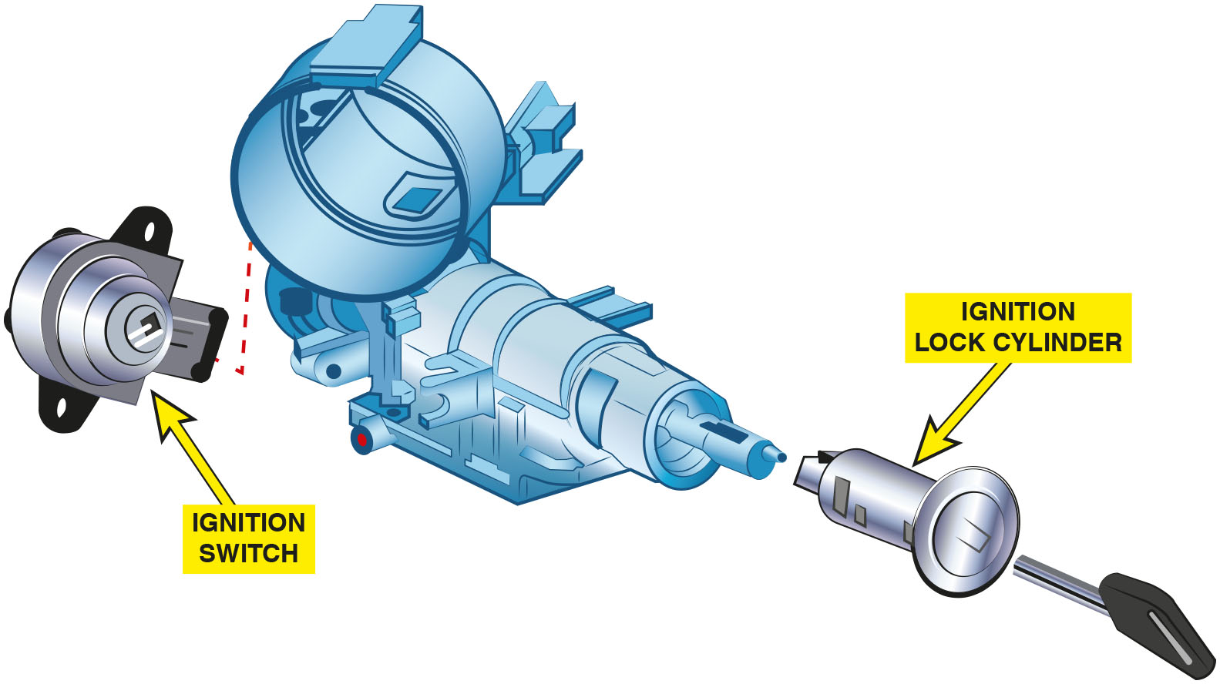
Figure 13.2
Lock Cylinder
The lock cylinder is often a separate part from the electrical ignition switch and operates it directly or uses a link between two components.

Slide 6
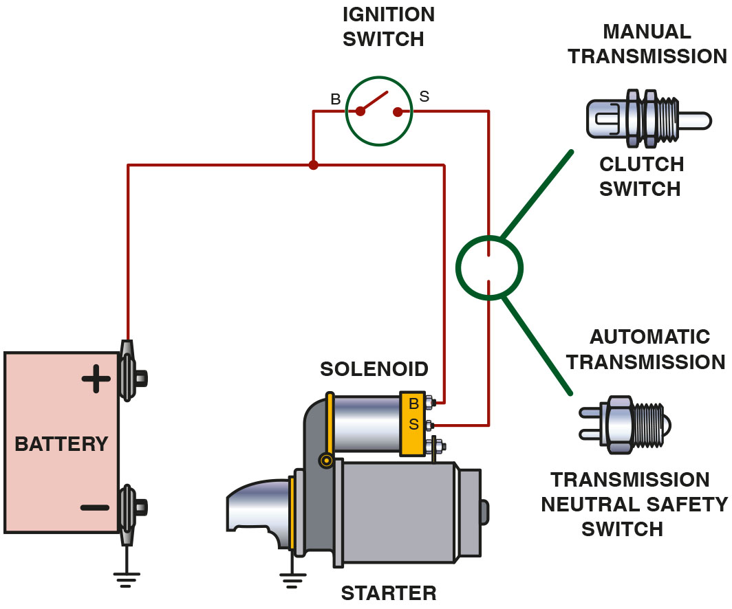
Figure 13.3
Cranking Control
To prevent the engine from cranking, an electrical switch is usually installed to open the circuit between the ignition switch and the starter solenoid. The control circuit includes the small wiring and components needed to control the solenoid. The starter solenoid controls the electrical current flow through the large battery cables of the power circuit that operates the starter motor.
Notes:
Long Description:
A clutch switch in the case of manual transmission or a transmission neutral safety switch in the case of automatic transmission is installed between the ignition switch and the starter solenoid.

Slide 7
Question 1
What are the parts in a typical cranking circuit?

Slide 8
Answer 1
Starter motor, battery, starter solenoid or relay, starter drive, and ignition switch.

Slide 9
Computer-Controlled Starting
Operation
The ignition switch start position on the push-to-start button is used as an input signal to the powertrain control module (P C M).
Remote Starting
Allows the driver to start the engine of the vehicle from a distance of about 200 fee t (65 m).
The doors remain locked to reduce the possibility of theft.

Slide 10
Animation: Starter Circuit, ECU Controlled

Slide 11
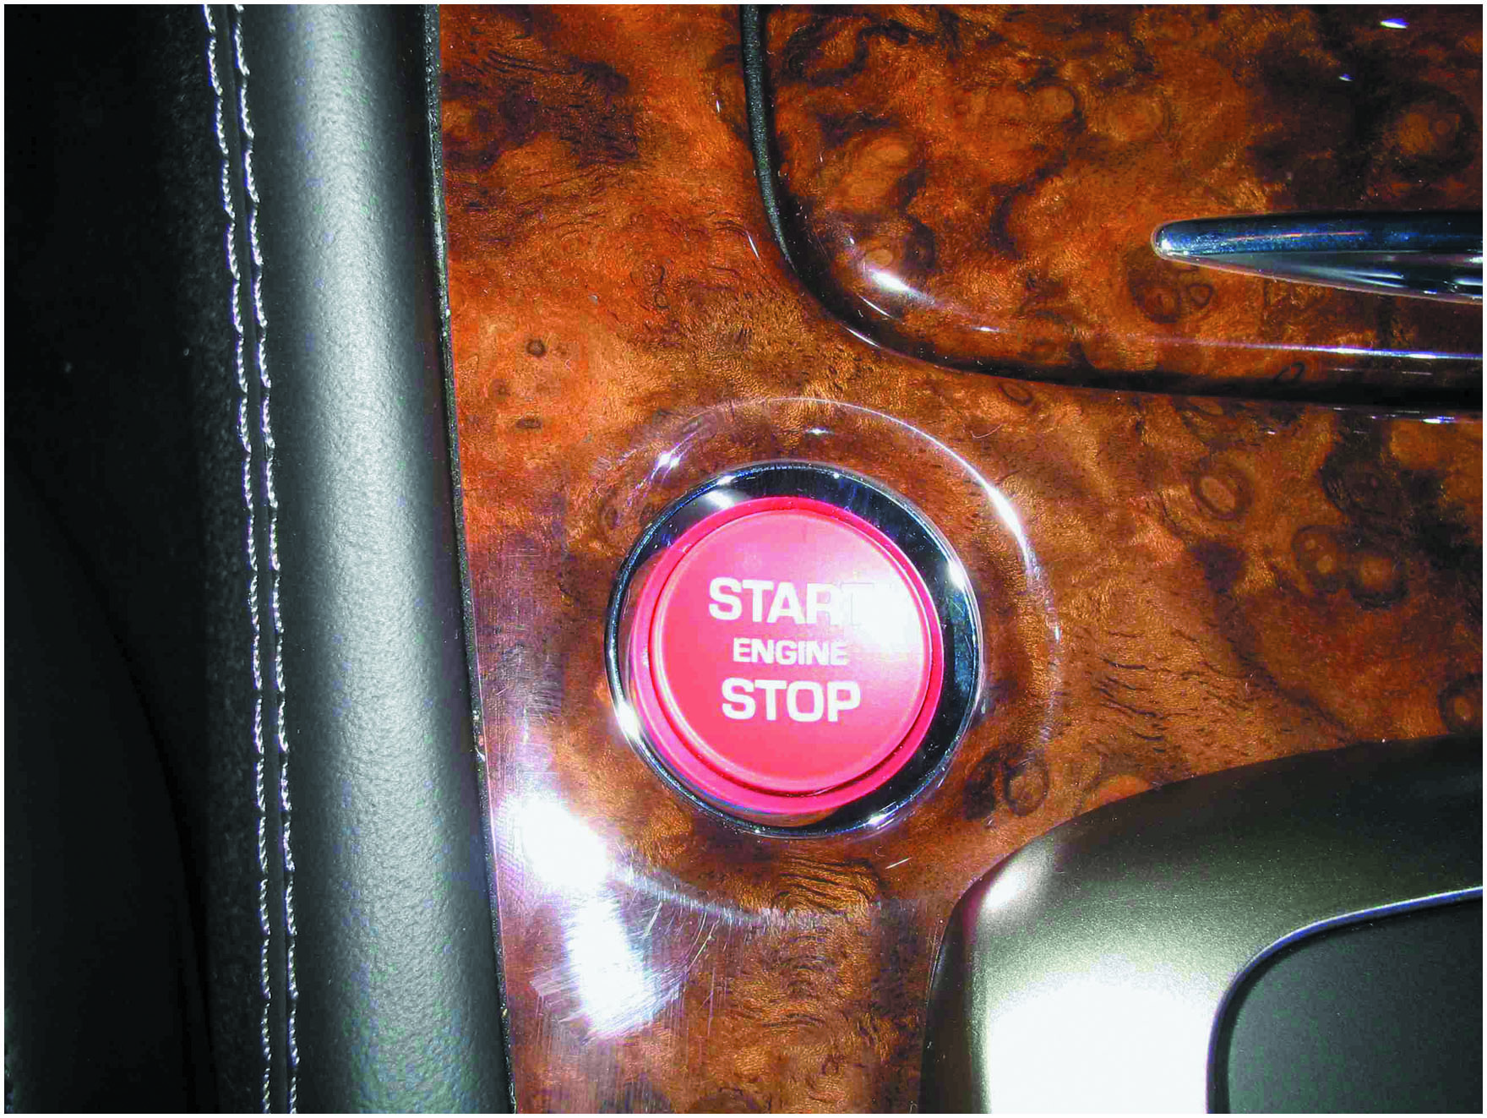
Figure 13.4
Start Button
Instead of using an ignition key to start the engine, some vehicles are using a start button, which is also used to stop the engine, as shown on this Jaguar.

Slide 12
Figure 13.5
Remote Start
The top button on this key fob is the remote start button.

Slide 13
Starter Motor Operation (1 of 2)
Principles
A starter motor uses electromagnetic principles to convert electrical energy from the battery (up to 300 amperes) to mechanical power (up to 8 horse power [6 kilowatts]) to crank the engine.
Series Motors
A series motor develops its maximum torque at the initial start (0 R P M) and develops less torque as the speed increases.

Slide 14
Starter Motor Operation (2 of 2)
Shunt Motors
Shunt-type electric motors have the field coils in parallel (or shunt) across the armature.
Permanent Magnet Motors
Permanent magnet starters use gear reduction to multiply starter motor torque.
Compound Motors
Some of the field coils are connected to the armature in series and some are connected directly to the battery in parallel (shunt) with the armature.

Slide 15
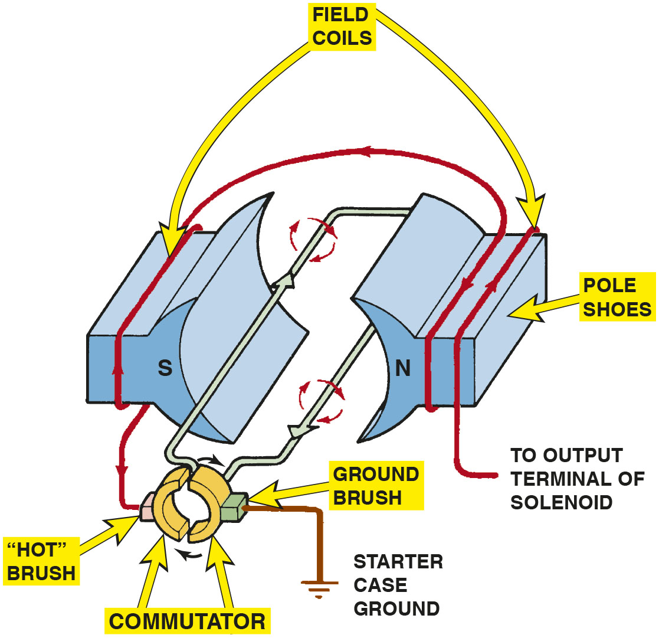
Figure 13.6
Series-Wound Motor
This series-wound electric motor shows the basic operation with only two brushes: one hot brush and one ground brush. The current flows through both field coils, then through the hot brush and the loop winding of the armature, before reaching ground through the ground brush.
Notes:
Long Description:
The figure depicts a commutator, an armature, stator in the form of two pole shoes and two brushes, hot brush and ground brush, connected to the commutator. The ground brush is connected to the starter case ground. A field coil is shown flowing from the output terminal through the pole shoes to the hot brush. The commutator is rotating clockwise in the figure.

Slide 16
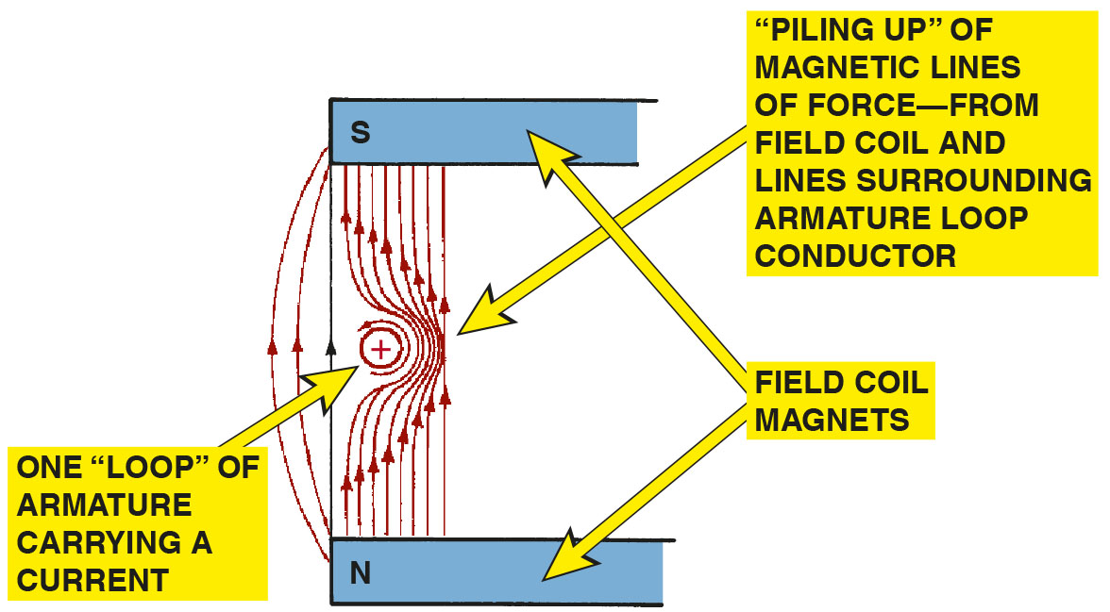
Figure 13.7
Magnetic Fields
The interaction of the magnetic fields of the armature loops and field coils creates a stronger magnetic field on the right side of the conductor, causing the armature loop to move toward the left.

Slide 17
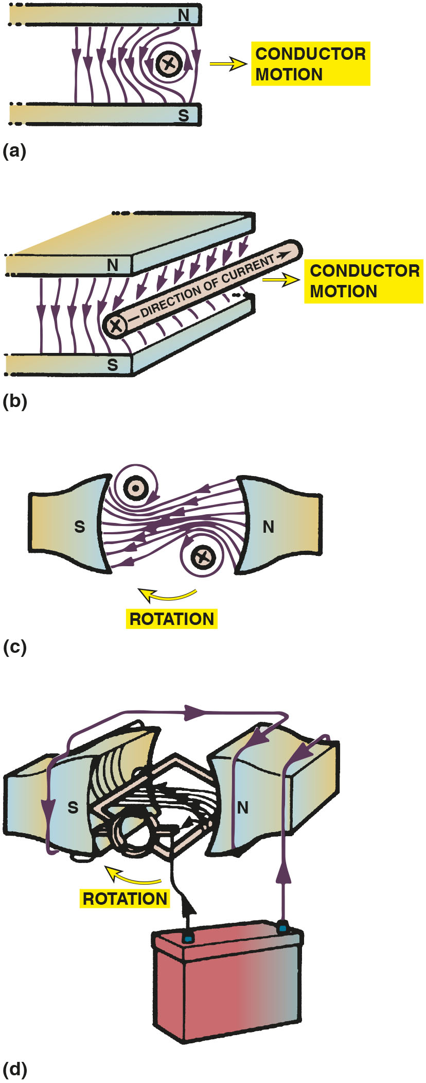
Figure 13.8
Armature Loops
The armature loops rotate due to the difference in the strength of the magnetic field. The loops move from a strong magnetic field strength toward a weaker magnetic field strength.
Notes:
Long Description:
a. The illustration shows two field magnets with magnetic lines of force extending from the north pole on the top to the south pole at the bottom. The magnetic lines of force surround a conductor carrying current. The direction of the conductor motion is toward the right. b. The illustration shows a conductor rod placed in a magnetic field created by two field magnets. The magnetic lines of force extend from the north pole on the top to the south pole at the bottom. The current in the conductor flows into the plane of the page. The direction of the conductor motion is toward the right. c. The illustration shows two loops placed in a magnetic field created by two magnets. The magnetic lines of force are directed from the north pole on the right toward the south pole on the left. The magnetic lines of force surround the loops in opposite directions. The current in one of the loops flows into the plane of the page, while the current in the other loop flows out of the plane of the page. The rotation is in a clockwise direction. d. An armature is placed in a magnetic field created by field coil magnets. The magnetic lines of force extend from the north pole on the right to the south pole on the left. The terminals of a battery are connected to the brush of a commutator and one end of the field coil. The direction of current flow in the field coils is indicated through arrows. The armature rotates in a clockwise direction.

Slide 18
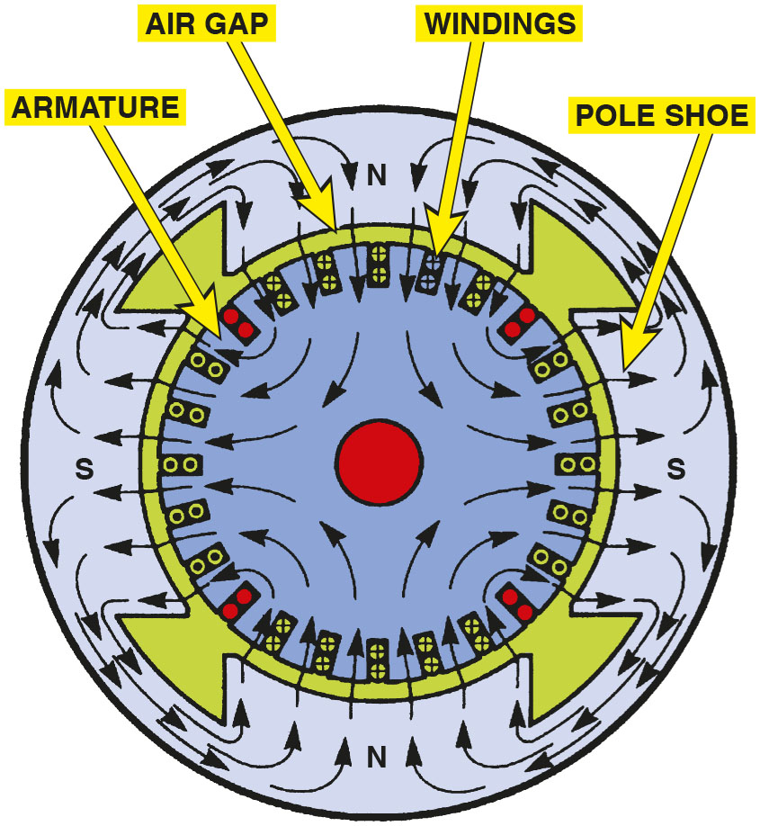
Figure 13.9
Lines of Force
Magnetic lines of force in a four-pole motor.

Slide 19
Animation: Permanent Magnet Motor

Slide 20
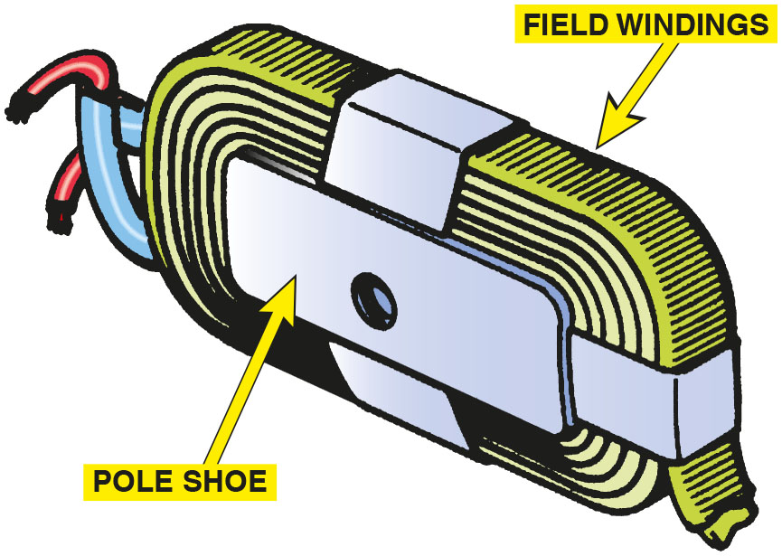
Figure 13.10
Pole Shoe/Field Winding
A pole shoe and field winding.

Slide 21
Figure 13.11
Series-Wound Motor
This wiring diagram illustrates the construction of a series-wound electric motor. Notice that all current flows through the field coils, then through the armature (in series) before reaching ground.

Slide 22
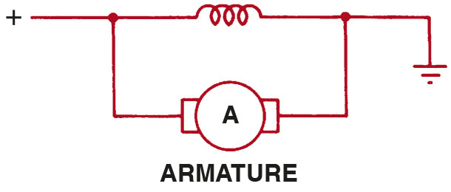
Figure 13.12
Shunt-Type Motor
This wiring diagram illustrates the construction of a shunt-type electric motor and shows the field coils in parallel (or shunt) across the armature.

Slide 23
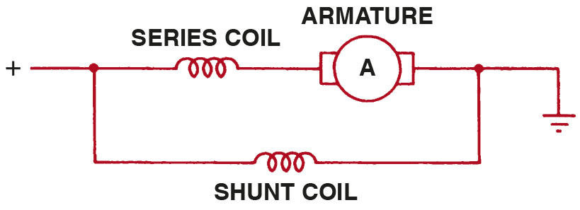
Figure 13.13
Compound Motor
A compound motor is a combination of series and shunt types, using part of the field coils connected electrically in series with the armature and part in parallel (shunt).

Slide 24
How the Starter Motor Works
Parts Involved
Field coils
Armature
Field housing
Starter Brushes
To supply the proper current to the armature, a four-pole motor must have four brushes riding on the commutator.
Permanent Magnet Fields
Used in place of the electromagnetic field coils.

Slide 25
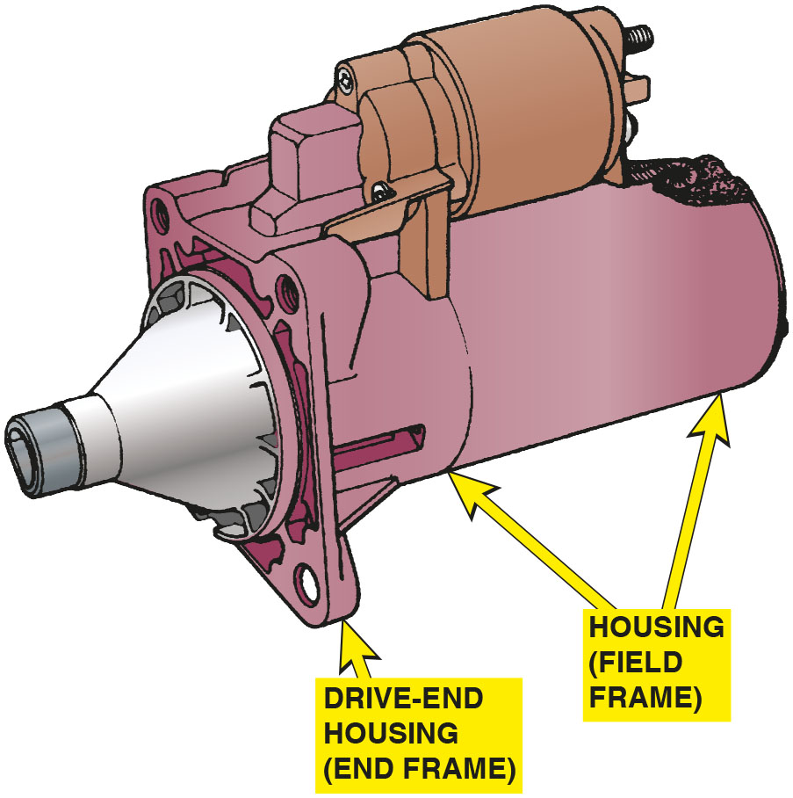
Figure 13.14
Starter Motor
A typical starter motor showing the drive-end housing.

Slide 26
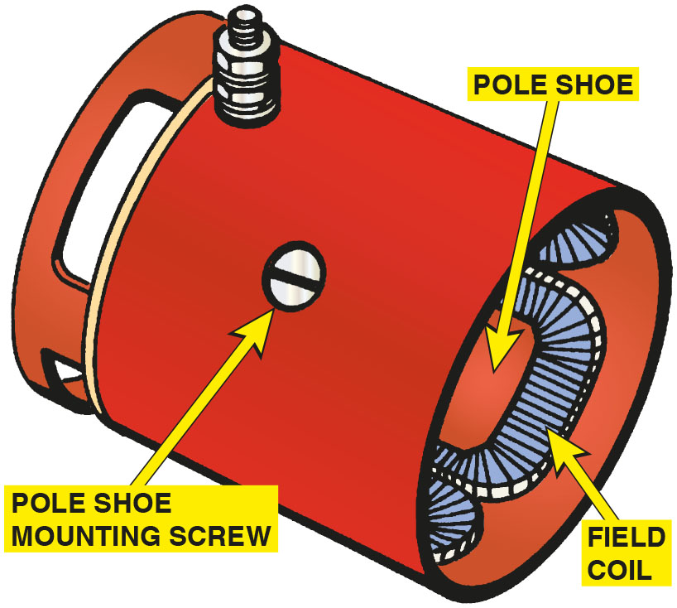
Figure 13.15
Pole Shoes
Pole shoes and field windings installed in the housing.

Slide 27
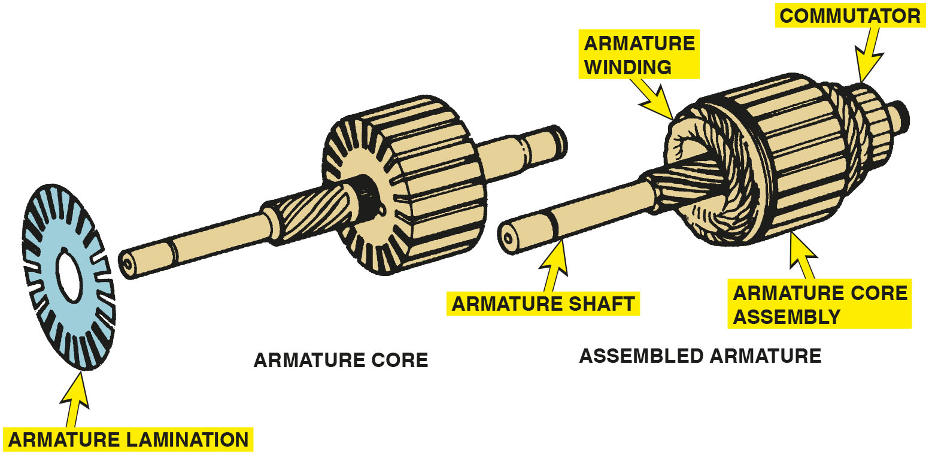
Figure 13.16
Armature
A typical starter motor armature. The armature core is made from thin sheet metal sections assembled on the armature shaft, which is used to increase the magnetic field strength.
Notes:
Long Description:
The figure depicts an armature lamination made of thin circular disk of steel. An armature core has multiple armature lamination wound together lengthwise. The armature core has a shaft passing thought it. An assembled armature has an armature core with armature windings on both ends. A commutator sits at the end of the armature core assembly.

Slide 28
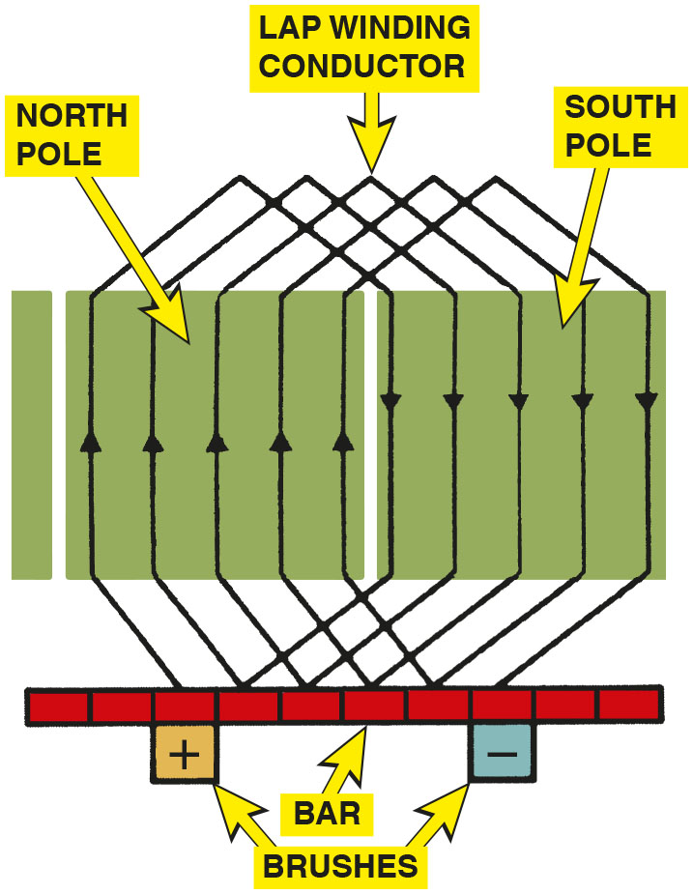
Figure 13.17
Armature Loops
An armature showing how its copper wire loops are connected to the commutator.

Slide 29
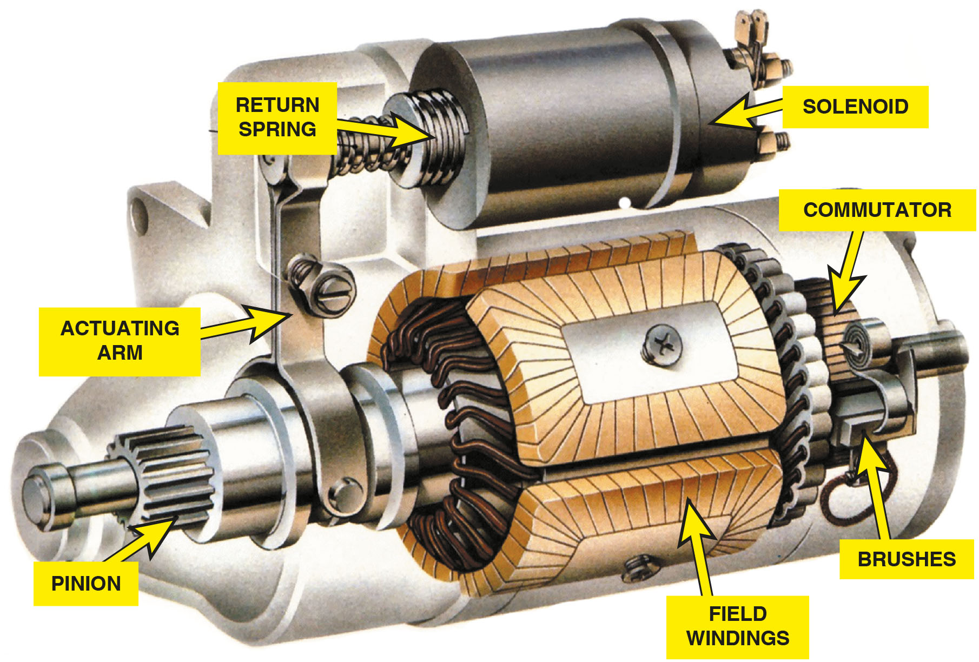
Figure 13.18
Starter Cutaway
A cutaway of a typical starter motor showing the commutator, brushes, and brush spring.
Notes:
Long Description:
The figure depicts a solenoid connected to the armature shaft through a return-spring controlled actuating arm. The armature shaft has a pinion gear at the front end. Screw mounted pole shoes field windings surround the armature core. The commutator along with brushes are at the rear end of the motor.

Slide 30
Animation: Starter Circuit, Neutral Safety Switch

Slide 31
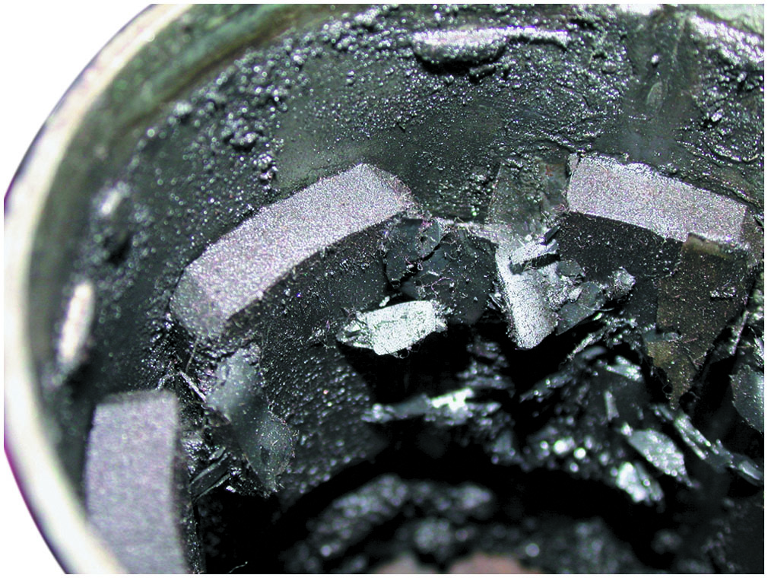
Figure 13.19
Damaged Magnet
This starter permanent magnet field housing was ruined when someone used a hammer on the field housing in an attempt to “fix” a starter that did not work. A total replacement is the only solution in this case.
Notes:
TECH TIP: Don’t Hit That Starter!
In the past, it was common to see service technicians hitting a starter in their effort to diagnose a no-crank condition. Often the shock of the blow to the starter aligned or moved the brushes, armature, and bushings. Many times, the starter functioned after being hit, even if only for a short time.
However, most starters today use permanent magnet fields, and the magnets can be easily broken if hit. A magnet that is broken becomes two weaker magnets. Some early permanent magnet starters used magnets that were glued or bonded to the field housing. If struck with a heavy tool, the magnets could be broken with parts of the magnet falling onto the armature and into the bearing pockets, making the starter impossible to repair or rebuild. ● See Figure 13.19.

Slide 32
Gear-Reduction Starters
Purpose and Function
Gear reduction purpose
is to increase
starter motor speed and provide torque multiplication necessary to crank an engine.
Produces necessary cranking power with reduced starter amperage requirements.
Uses a planetary gear set to provide necessary torque for starting.

Slide 33
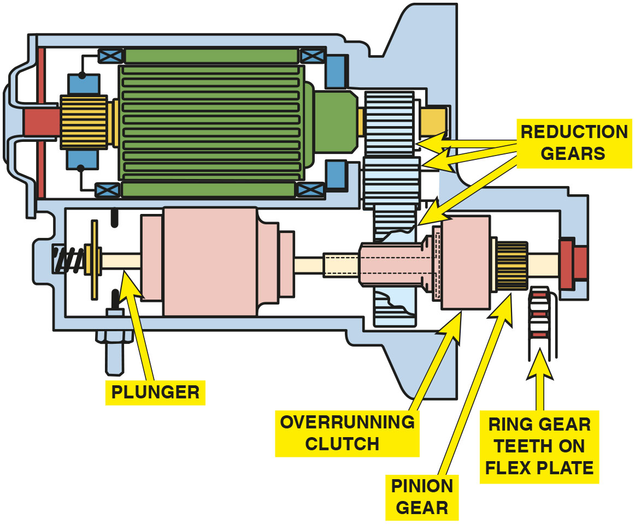
Figure 13.20
Gear-Reduction Starter
A typical gear-reduction starter.
Notes:
Long Description:
The figure depicts reduction gears connected to the pinion end of the starter motor. A plunger and an overrunning clutch in a housing below the motor housing are connected to a shaft having the pinion gear that mates with the ring gear on flex plate. The final reduction gear rotates this shaft.

Slide 34
Starter Drives (1 of 2)
Purpose and Function
Includes small pinion gears that mesh with and rotate the larger gear on the engine flywheel or flex plate for starting.
Starter Drive Gear Ratio
The engine ring gear to starter pinion ratio is between

Slide 35
Starter Drives (2 of 2)
Starter Drive Operation
Uses a type of one-way clutch that allows the starter to rotate the engine, but then turns freely if the engine speed is greater than the starter motor speed.
Failure Mode
The major wear occurs in the overrunning clutch section of the starter drive unit.
The entire starter drive is replaced as a unit.

Slide 36
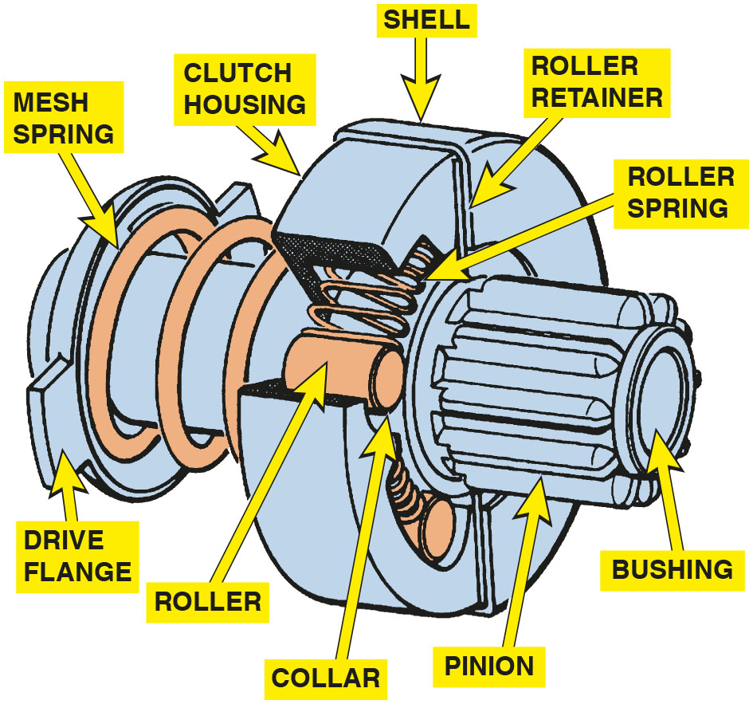
Figure 13.21
Starter Drive
A cutaway of a typical starter drive showing all of the internal parts.
Notes:
Long Description:
The figure depicts a pinion with a bushing on end of the drive and a drive flange on the other end. The shell that has an overrunning clutch rests on drive flange through a mesh spring. The shell of the starter drive has rollers inside, cylindrically resting on the pinion’s collar. The shell walls have roller retainer and the multiple rollers are separated by roller springs inside the cylindrical shell housing.

Slide 37
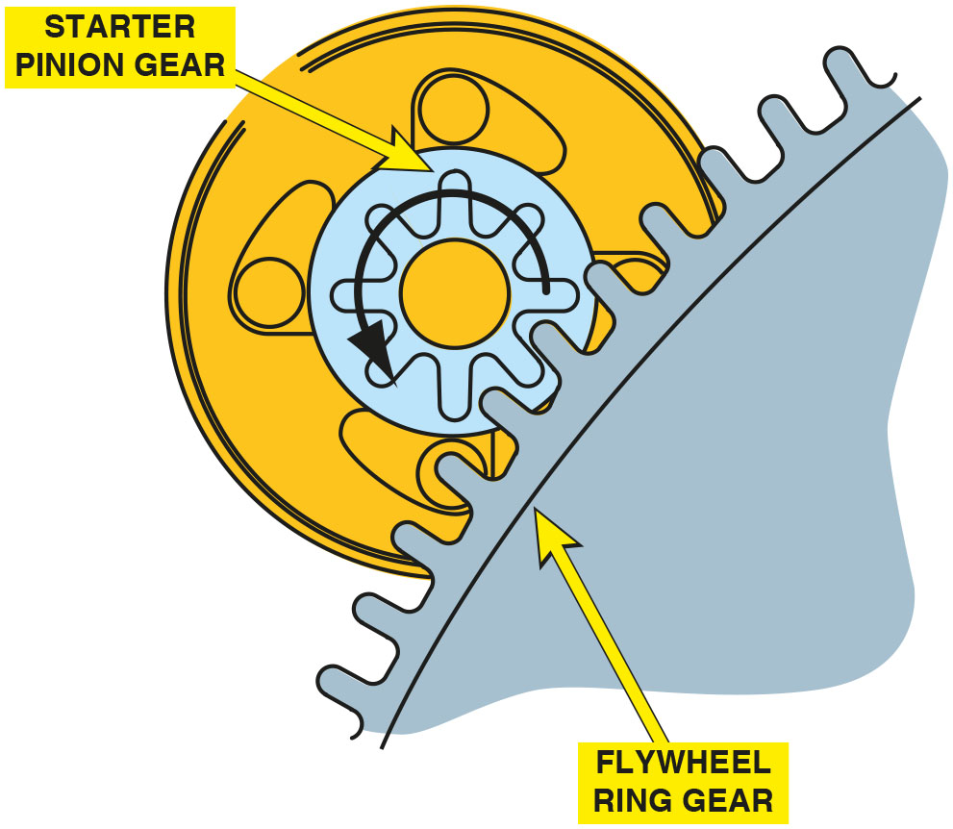
Figure 13.22
Gear Ratio
The ring gear to pinion gear ratio is usually

Slide 38
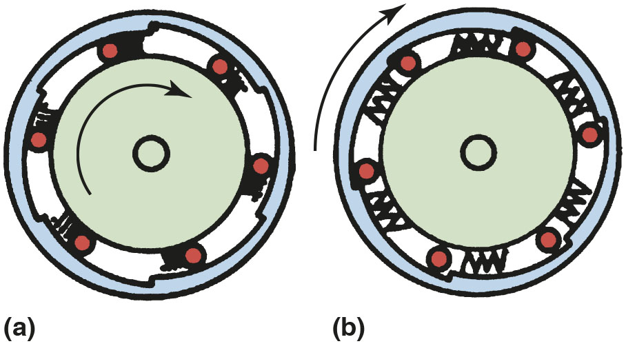
Figure 13.23
Drive Operation
Operation of the overrunning clutch. (a) Starter motor is driving the starter pinion and cranking the engine. The rollers are wedged against spring force into their slots. (b) The engine has started and is rotating faster than the starter armature. Spring force pushes the rollers so they can rotate freely.
Notes:
Long Description:
a. The rollers are forced tightly into their respective notches by the spring, and the pinion rotates in a clockwise direction. b. The rollers are forced out of their respective notches, leading to free rotation in a clockwise direction.

Slide 39
Frequently Asked Question: What Is a Bendix?
? Frequently Asked Question
What Is a Bendix? Older-model starters often used a Bendix drive mechanism, which used inertia to engage the starter pinion with the engine flywheel gear. Inertia is the tendency of a stationary object to remain stationary, because of its weight, unless forced to move. On these older-model starters, the small starter pinion gear was attached to a shaft with threads, and the weight of this gear caused it to be spun along the threaded shaft and mesh with the flywheel whenever the starter motor spun. If the engine speed was greater than the starter speed, the pinion gear was forced back along the threaded shaft and out of mesh with the flywheel gear. The Bendix drive mechanism has generally not been used since the early 1960s, but some technicians use this term when describing a starter drive.

Slide 40
Question 2
What is the typical engine ring rear to starter pinion ratio?

Slide 41
Answer 2
The typical engine ring rear to starter pinion ratio

Slide 42
Starter Solenoids
Solenoid Operation
A starter solenoid is an electromagnetic switch containing two separate, but connected, electromagnetic windings.
Solenoid Windings
The two internal windings contain approximately the same number of turns but are made from different-gauge wire.

Slide 43
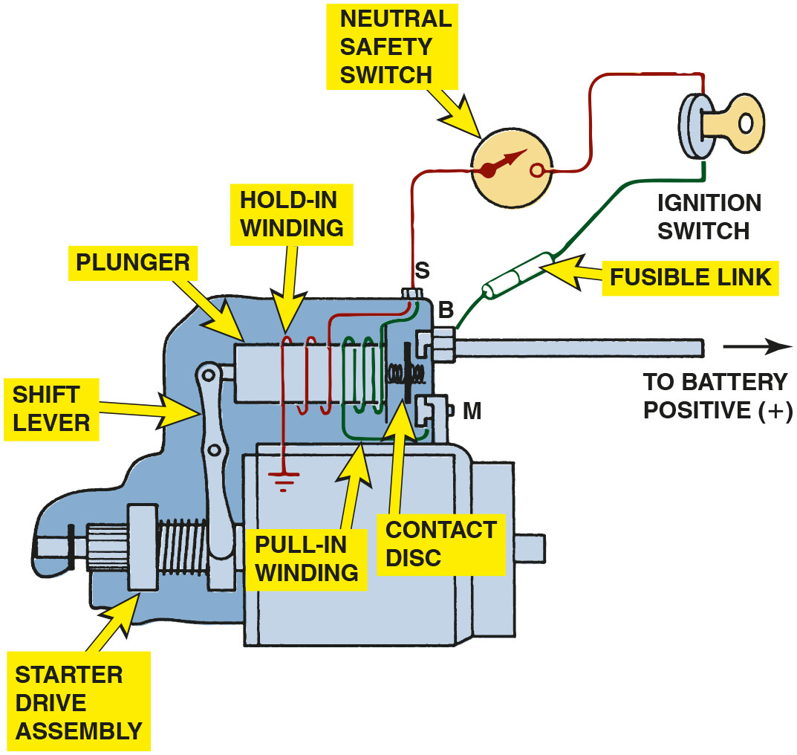
Figure 13.24
Solenoid Operation
Wiring diagram of a typical starter solenoid. Notice that both the pull-in winding and the hold-in winding are energized when the ignition switch is first turned to the “start” position. As soon as the solenoid contact disc makes electrical contact with both the B and M terminals, the battery current is conducted to the starter motor and electrically neutralizes the pull-in winding.
Notes:
Long Description:
The ignition switch is connected to B terminal through a fusible link. The B terminal is connected to the positive terminal of the battery. A spring actuated contact disk connects a plunger to terminals S, B, and M. The plunger of the solenoid is encased by hold-in and pull-in windings. One end of the hold-in winding is connected to the ignition switch through a neutral safety switch, while the other end is grounded. One end of the pull-in windings is connected to terminal S, while the other is connected to terminal M. A starter drive assembly activates the plunger through a pivoted shift lever.

Slide 44
Frequently Asked Question: How Are Starters Made So Small?
? Frequently Asked Question
How Are Starters Made So Small? Starters and most components in a vehicle are made as small and as light in weight as possible to help increase vehicle performance. A starter can be constructed smaller due to the use of gear reduction and permanent magnets to achieve the same cranking torque as a straight drive starter, but using much smaller components. ● See Figure 13.25 for an example of an automotive starter armature that is palm size.

Slide 45
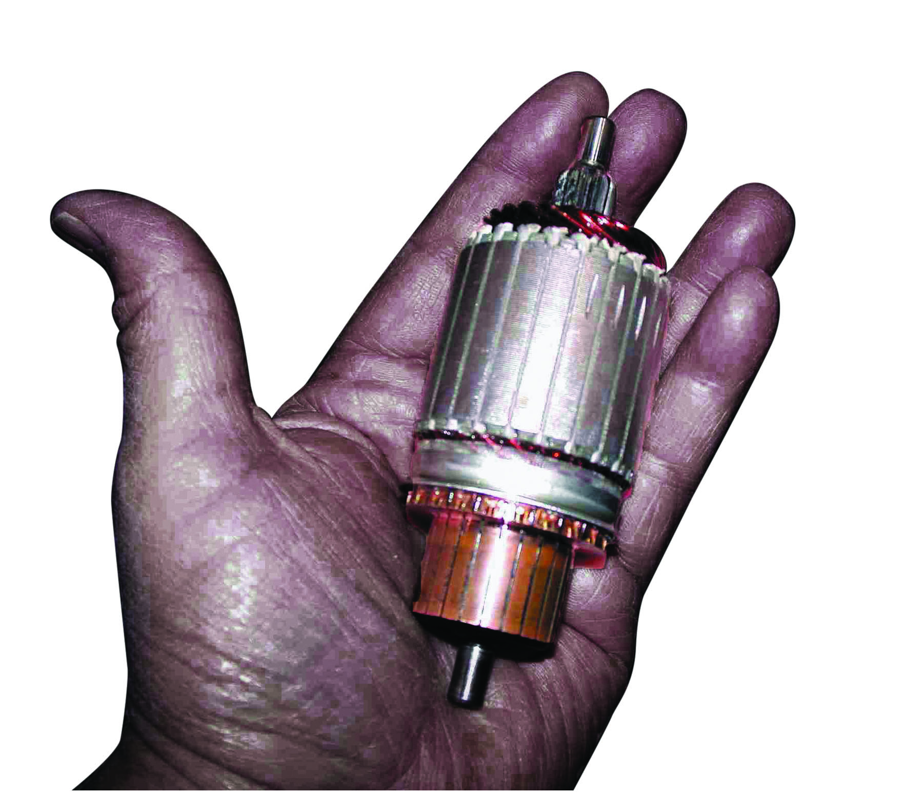
Figure 13.25
Palm-Size Starter Armature
A palm-size starter armature.

Slide 46
Start-Stop Systems (1 of 2)
Purpose and Function
Stop-start systems are designed to increase fuel economy and reduce exhaust emissions.
Conditions for Start-Stop to Occur
Accelerator pedal not depressed
Vehicle speed is low or zero
Battery state-of-charge above threshold
Hood is closed

Slide 47
Start-Stop Systems (2 of 2)
Start-Stop System Components
An A G M or E L A battery
Battery sensor
Low engine speed
Hood switch
H V A C control unit
Starter Motor Designs
Advanced engagement (A E) starter
Tandem solenoid (T S) starter

Slide 48
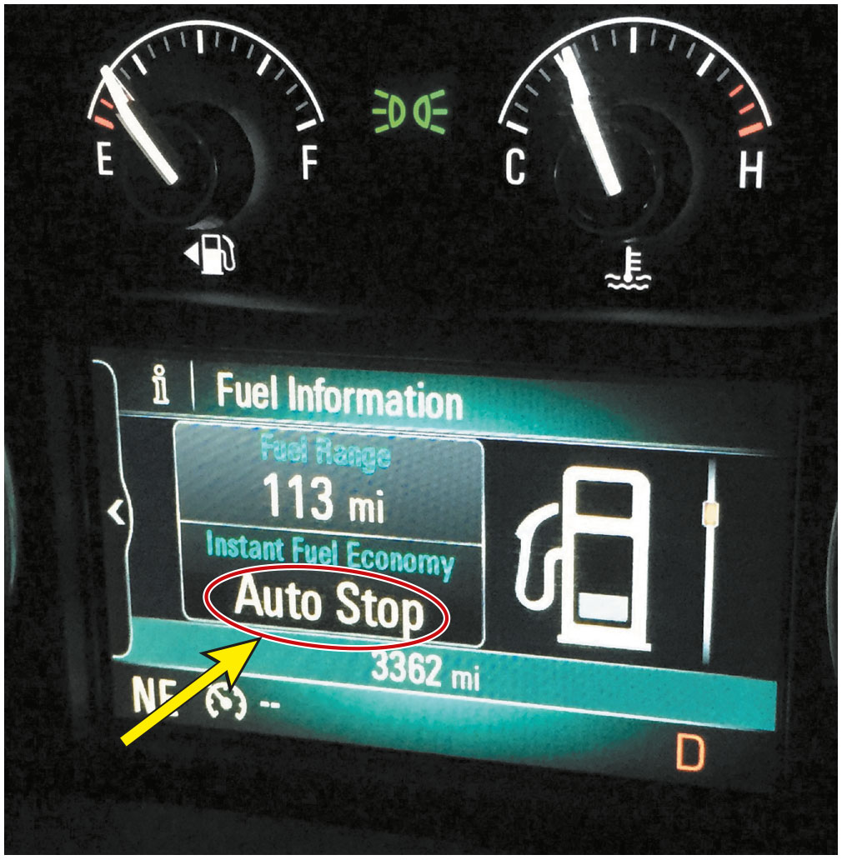
Figure 13.26
Auto-Stop
A Buick Auto Stop system lets the driver know when the engine is stopped.

Slide 49
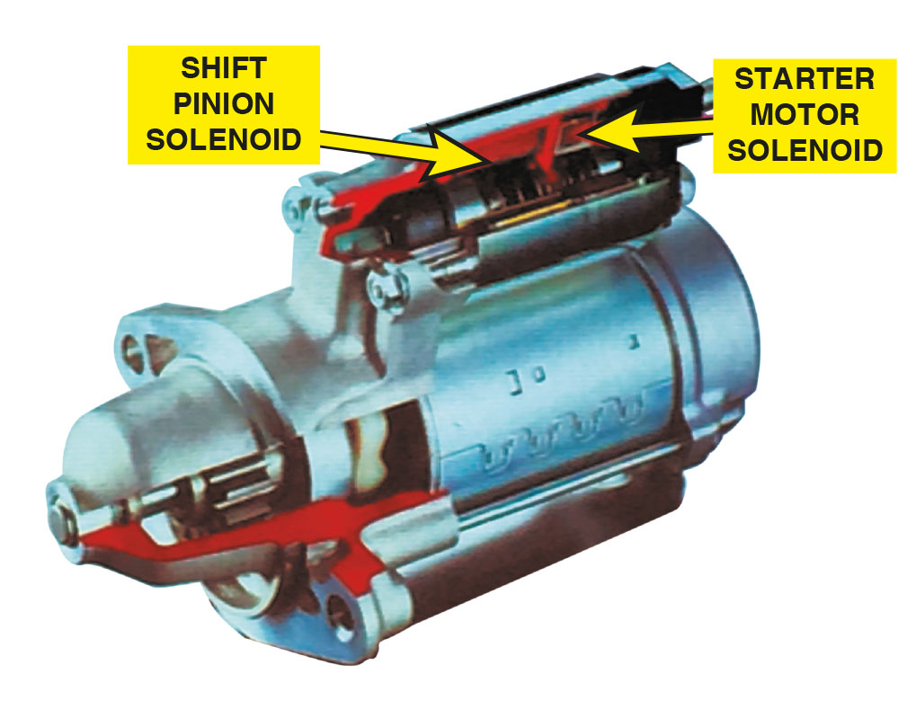
Figure 13.27
Two Solenoids
Using two solenoids allows independent control of the pinion gear and motor energization.

Slide 50
Frequently Asked Question: Can a Stop-Start System Be Turned Off?
? Frequently Asked Question
Can a Stop-Start System Be Turned Off? Sometimes. Some vehicles equipped with a stop-start system can be turned off using a button on the dash or center stack. ●See Figure 13.28.

Slide 51
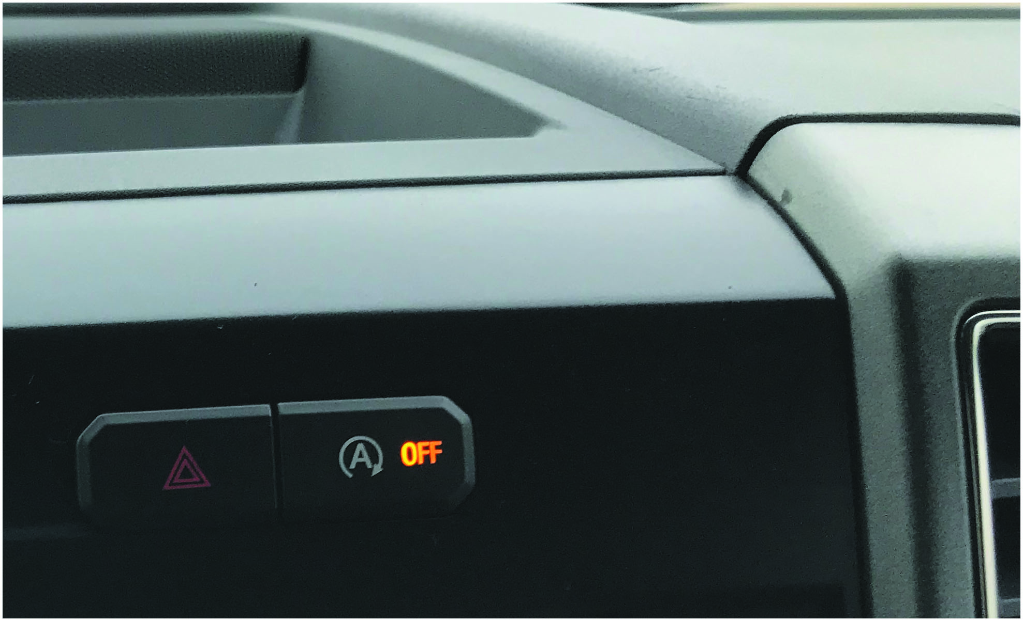
Figure 13.28
Auto-Stop Off Switch
The stop-start system on this Ford F-150 pickup truck can be turned off using a switch on the dash.

Slide 52
Question 3
Can the Stop Start system be turned off on every vehicle equipped with the system?

Slide 53
Answer 3
No, Some vehicles equipped with a stop-start system can be turned off using a button on the dash or console. For example you cannot turn it off on a Chevrolet Cruze, if equipped.

Slide 54
Summary
All starter motors use the principle of magnetic interaction between the field coils attached to the housing and the magnetic field of the armature.
The control circuit includes ignition switch, neutral safety (clutch) switch, and solenoid.
Push-button starting systems use P C M and a relay to energize the starter solenoid.
Power circuit includes: battery, cables, solenoid, and starter motor.
Parts of a typical starter include the main field housing, commutator-end (or brush-end) housing, drive-end housing, brushes, armature, and starter drive.
Stop-start systems designed to increase fuel economy and reduce exhaust emissions.

Slide 55
Animations and Video Links (Halderman website subscription and web access needed to view)
(A6) Electrical/Electronic Systems Animations
(A6) Electrical/Electronic Systems Videos

Slide 56
Copyright
This work is protected by United States copyright laws and is provided solely for the use of instructors in teaching their courses and assessing student learning. Dissemination or sale of any part of this work (including on the World Wide Web) will destroy the integrity of the work and is not permitted. The work and materials from it should never be made available to students except by instructors using the accompanying text in their classes. All recipients of this work are expected to abide by these restrictions and to honor the intended pedagogical purposes and the needs of other instructors who rely on these materials.

