Slide 1
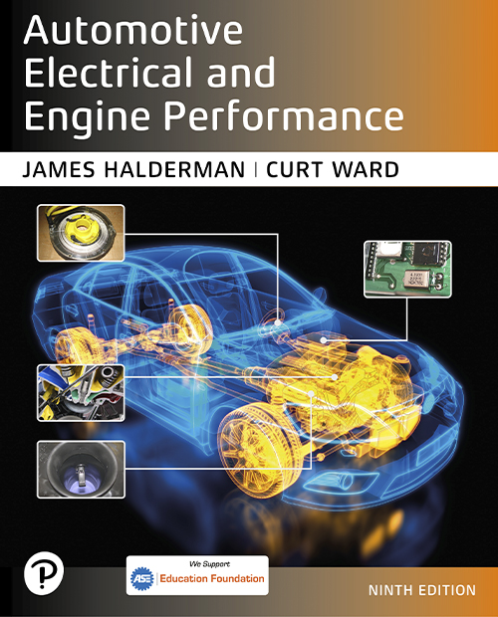
Automotive Electrical and Engine Performance
Ninth Edition
Chapter 8
Wiring Schematics and Circuit Testing
Copyright © 2025 Pearson Education, Inc. All Rights Reserved
Notes:
If this PowerPoint presentation contains mathematical equations, you may need to check that your computer has the following installed:
1) Math Type Plugin
2) Math Player (free versions available)
3) NVDA Reader (free versions available)
INSTRUCTOR NOTE: This presentation includes text explanation notes, you can use to teach the course. When in SLIDE SHOW mode, you RIGHT CLICK and select SHOW PRESENTER VIEW, to use the notes.

Slide 2
Learning Objectives
8.1 Describe what information wiring schematics include.
8.2 Interpret wiring schematics.
8.3 Explain the procedure to identify relay terminals.
8.4 Explain how to locate an open circuit.
8.5 Describe how to check for common power or ground.
8.6 Discuss circuit troubleshooting.
8.7 Explain the different methods to locate a short circuit.
8.8 Explain the procedure to troubleshoot an electrical problem.

Slide 3
Wiring Schematics and Symbols (1 of 2)
Terminology
A wiring schematic, sometimes called a diagram, shows electrical components and wiring using symbols and lines to represent components and wires.
All circuit schematics or diagrams include:
Power-side of wiring, splices, connectors, wire size, wire color, trace color, circuit number, electrical components, ground path returns, fuses and switches

Slide 4
Wiring Schematics and Symbols (2 of 2)
Circuit Information
The first color or color abbreviation is the color of the wire insulation.
The second color (if mentioned) is the color of the stripe or tracer on the base color.
Wire Size
Wire size is shown on all schematics.
Metric wire gauge size in square millimeters
Standard wire using the A W G standard

Slide 5
Figure 8.1 Wire Color
The center wire is a solid color wire, meaning that the wire has no other identifying tracer or stripe color. The two end wires could be labeled “B L U/W H T,” indicating a blue wire with a white tracer or stripe.

Slide 6
Chart 8.1 Wire Colors
ABBREVIATION | COLOR
B R N | Brown
B L K | Black
G R N | Green
W H T | White
P P L | Purple
P N K | Pink
T A N | Tan
B L U | Blue
Y E L | Yellow
O R N | Orange
D K B L U | Dark blue
L T B L U | Light blue
D K G R N | Dark green
L T G R N | Light green
R E D | Red
G R Y | Gray
V I O | Violet

Slide 7
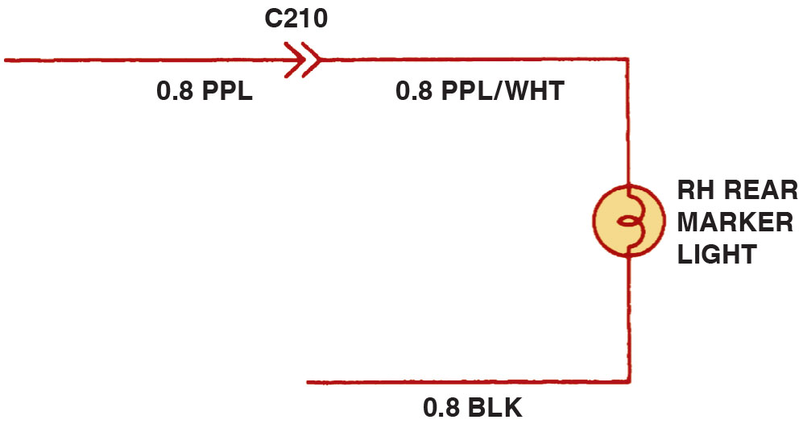
Figure 8.2 Wiring Diagram
Typical section of a wiring diagram. Notice that the wire color changes at connection C210. The “0.8” represents the metric wire size in square millimeters.
Notes:
Long Description:
The diagram depicts a circuit in which wire of different color and sizes are attached to a bulb. A solid wire of 0.8 P P L is connected to one end of the connector numbered C 210. The other end of the connector is connected to a wire labeled 0.8 P P L/White. This wire is connected to a rear marker bulb and the bulb is grounded using a 0.8 B L K wire.

Slide 8
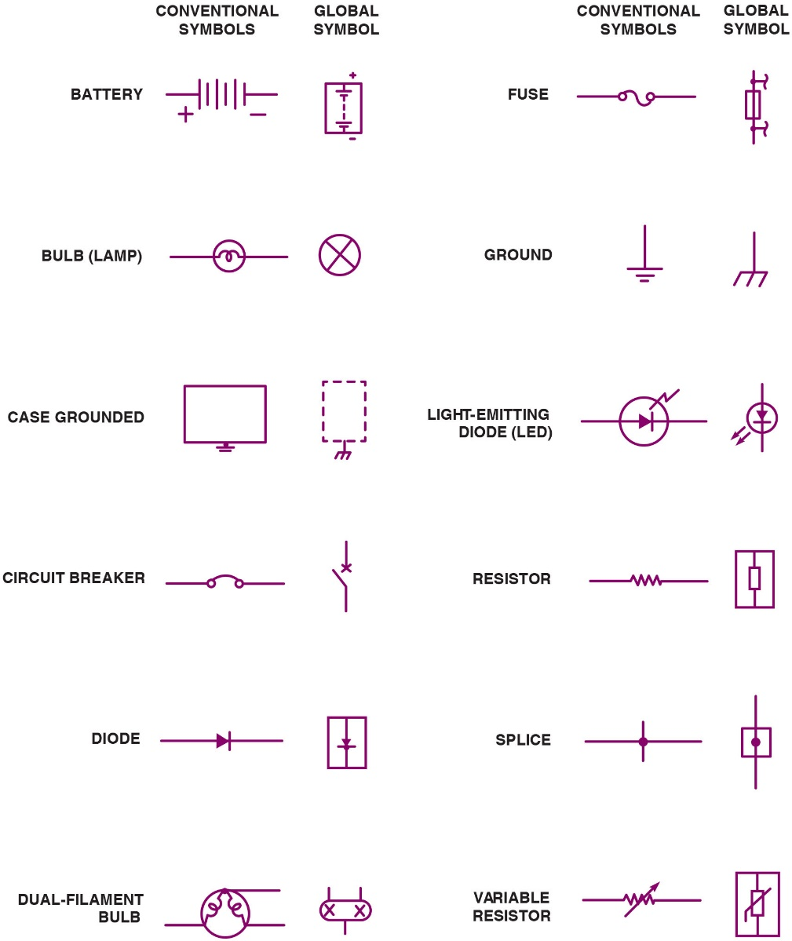
Figure 8.3 Symbols
Typical electrical and electronic symbols used in automotive wiring and circuit diagrams. Both the conventional and the global symbols are shown side-by-side to make reading schematics easier.
Notes:
Long Description:
Battery: Conventional symbol is represented by a collection of long and short parallel lines with the positive symbol on the left and negative symbol on the right. Global symbol is represented by a two long and short parallel lines placed vertically in a vertical rectangle box with the positive symbol at the top and negative symbol at the bottom. Bulb (Lamp): Conventional symbol is represented by a looped wire inside a circle. Global symbol is represented by an X mark inside a circle. Case grounded: Conventional symbol is represented by a rectangular box with a long and short line at the bottom. Global symbol is represented by a dashed rectangle placed vertically with three vertical line placed at the bottom represented by the letter E facing downward. Circuit breaker: Conventional symbol is represented by two points connected together by a small hump. Global symbol is represented by an X mark on a vertical line with an open switch. Diode: Conventional symbol is represented by a right facing arrow pointing at a vertical line. Global symbol is represented by a downward facing arrow pointing at a horizontal line placed inside a vertical rectangle. Dual-filament bulb: Conventional symbol is represented by two looped lines connected to each other to form an inverted V shape inside a circle. All the three tips of the line are connected with horizontal lines. Global symbol is represented by two X marks placed inside a filleted rectangle with two vertical lines at the top and a single vertical line at the bottom center. Fuse: Conventional symbol is represented by two points connected by the letter S placed horizontally. Global symbol is represented by a vertical rectangle placed between two points on a vertical line. An inverted S is connected to each point to the right with a horizontal line. Ground: Conventional symbol is represented by a vertical line connected to three parallel lines in descending sizes. Global symbol is represented by a vertical line connected to the letter E placed horizontally. Light-emitting diode (L E D): Conventional symbol is represented by a right facing arrow pointing at a vertical line inside a circle. An inverted letter S with flat ends is placed at the top right of the circle. Global symbol is represented by a downward facing arrow pointing at a horizontal line placed inside a circle. Two downward-sloping arrows points to left at the bottom of the circle. Resistor: Conventional symbol is represented by zig-zag lines on a horizontal line. Global symbol is represented by vertical rectangle inside a box with vertical line at both ends of the rectangle. Splice: Conventional symbol is represented by a vertical line that intersects a horizontal line with a point placed at the intersection. Global symbol is represented by a square with a vertical line running through it and a point placed at the center of the square. Variable resistor: Conventional symbol is represented by zig-zag lines on a horizontal line. An upward-sloping arrow points to the right through the zig-zag lines. Global symbol is represented by vertical rectangle inside a box with vertical line at both ends of the rectangle. An upward-sloping line connected to a vertical line at the left bottom points to the right through the rectangle.

Slide 9
Question 1
What are the two ways the wire size may be displayed on the schematic?

Slide 10
Answer 1
or A W G standard.

Slide 11
Schematic Symbols (1 of 4)
Battery
The plates of a battery are represented by long and short lines.
Wiring
Electrical wiring is shown as straight lines and with a few numbers and/or letters to indicate the wire size, circuit number, wire color, splices, connectors, and location.

Slide 12
Schematic Symbols (2 of 4)
Electrical Components
Most electrical components have their own unique symbol that shows the basic function or parts.
Electric Motors
Electric motor symbol shows a circle with the letter M in the center and two electrical connections, one at the top and the other at the bottom.

Slide 13
Schematic Symbols (3 of 4)
Resistors
A resistor symbol is a jagged line representing resistance to current flow.
Capacitors
If one of the lines is curved, this indicates that the capacitor being used has a polarity.
Electrically Heated Unit
The grid-like symbol represents an electrically heated element.

Slide 14
Schematic Symbols (4 of 4)
Boxed Components
A solid line, the box is the entire component.
Dashed lines, it represents part of a component.
Switches
Normally open
Normally closed
Momentary contact

Slide 15
Figure 8.4 Typical Connector
In this typical connector, note that the positive terminal is usually a female connector.
Notes:
TECH TIP: Read the Arrows
Wiring diagrams indicate connections by symbols that look like arrows. ● See Figure 8.4.
Do not read these “arrows” as pointers showing the direction of current flow. Also observe that the
power side (positive side) of the circuit is usually the female end of the connector. If a
connector becomes disconnected, it is difficult for the circuit to become shorted to ground or to
another circuit because the wire is recessed inside the connector.

Slide 16
Figure 8.5 Battery Symbol
The symbol for a battery. The positive plate of a battery is represented by the longer line and the negative plate by the shorter line.

Slide 17
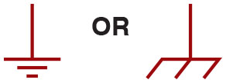
Figure 8.6 Ground Symbol
The ground symbol on the left represents an earth ground. The ground symbol on the right represents a chassis ground.

Slide 18
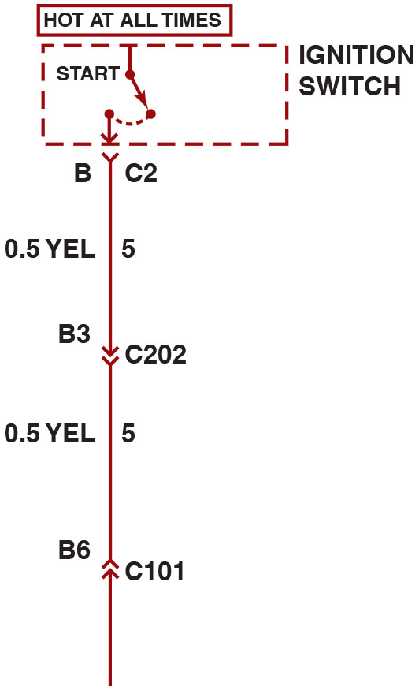
Figure 8.7 From + to -
Starting at the top, the wire from the ignition switch is attached to terminal B of connector C2, the wire is
0.5
(20-gauge A W G),
and is yellow. The circuit number is 5. The wire enters connector C202 At terminal B3.
Notes:
Long Description:
The wiring schematic shows an ignition switch at the top with an indication of hot at all times. The wire from the ignition switch is attached to terminal B of connector C 2. The wire is yellow in color and is 0.5 millimeters squared in size. The circuit to which it is connected is circuit number 5. The wire enters connector C 202 at terminal B 3. Again, the color and size of wire is same as before. This wire is connected to circuit number 5 and there is another wire connected to terminal B 6 coming from connector C 101 connected to the circuit number 5.

Slide 19
Figure 8.8 Terminal I D
The electrical terminals are usually labeled with a letter or number.

Slide 20
Figure 8.9 Splice
Two wires that cross at the dot indicate that the two are electrically connected.

Slide 21
Figure 8.10 Wires That Cross
Wires that cross, but do not electrically contact each other, are shown with one wire bridging over the other.

Slide 22
Figure 8.11 C, G, S Location
Connectors (C), grounds (G), and splices (S) are followed by a number, generally indicating the location in the vehicle. G209 is under the dash.

Slide 23
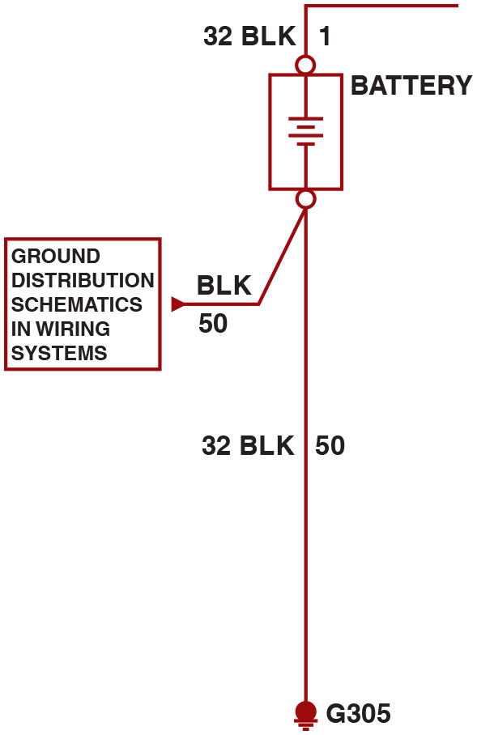
Figure 8.12 Ground G305
The ground for the battery is labeled G305, indicating the ground connector is located in the passenger compartment of the vehicle.
Notes:
Long Description:
The diagram depicts a black solid colored wire of 32 millimeter squared size connected to the positive terminal of the battery. The wire is also connected to circuit number 1. The negative terminal is connected to two wires, one black solid colored wire of 50 millimeter squared size and another of 32 millimeter squared size. The wire of 50 mm squared size is connected to a ground distribution schematic in wiring system. The other wire of 32 millimeter squared size is connected to the battery ground which is labeled as G 305 and the circuit number 50. G 305 denotes that the ground connector is located in the passenger compartment of the vehicle.

Slide 24
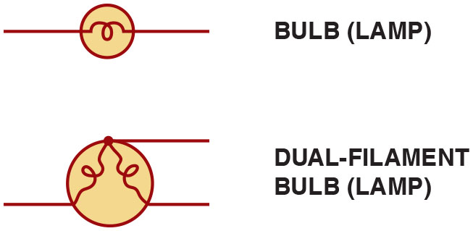
Figure 8.13 Lightbulb Symbol
The symbol for lightbulbs shows the filament inside a circle, which represents the glass ampoule of the bulb.

Slide 25
Figure 8.14 Motor Symbol
An electric motor symbol shows a circle with the letter M in the center and two black sections that represent the brushes of the motor.

Slide 26
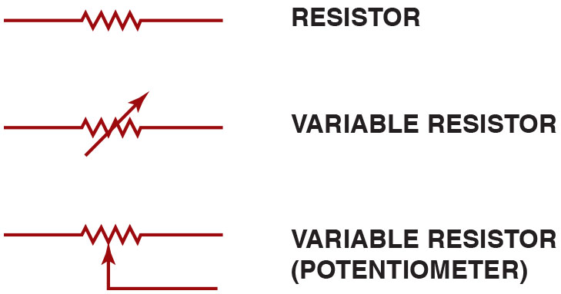
Figure 8.15 Resistor Symbol
Resistor symbols vary, depending on the type of resistor.
Notes:
Long Description:
The diagram shows three symbols and their description is as follows. A resistor symbol is a jagged line represents resistance to current flow in any wiring diagram. A thermistor or a variable resistor symbol has an arrow running through the symbol of a fixed resistor. A potentiometer is a three-wire variable resistor shown with an arrow pointing toward the resistance part of a fixed resistor.

Slide 27
Figure 8.16 Rheostat
Rheostat uses only two wires—one is connected to a voltage source and the other is attached to the movable arm.

Slide 28
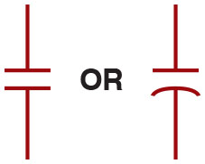
Figure 8.17 Capacitors
Symbols used to represent capacitors. If one of the lines is curved, this indicates that the capacitor being used has a polarity.

Slide 29
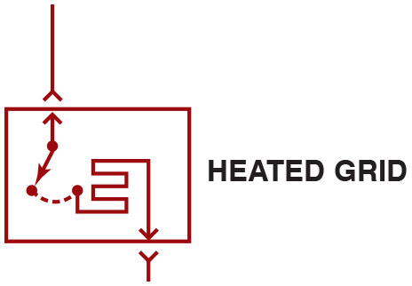
Figure 8.18 Heated Grid
The grid-like symbol represents an electrically heated element.

Slide 30
Figure 8.19 Dotted Box Part
A dashed outline represents a portion (part) of a component.

Slide 31
Figure 8.20 Solid Box Component
Solid box represents an entire component.

Slide 32
Figure 8.21 Grounded Case
This symbol represents a component that is case grounded.

Slide 33
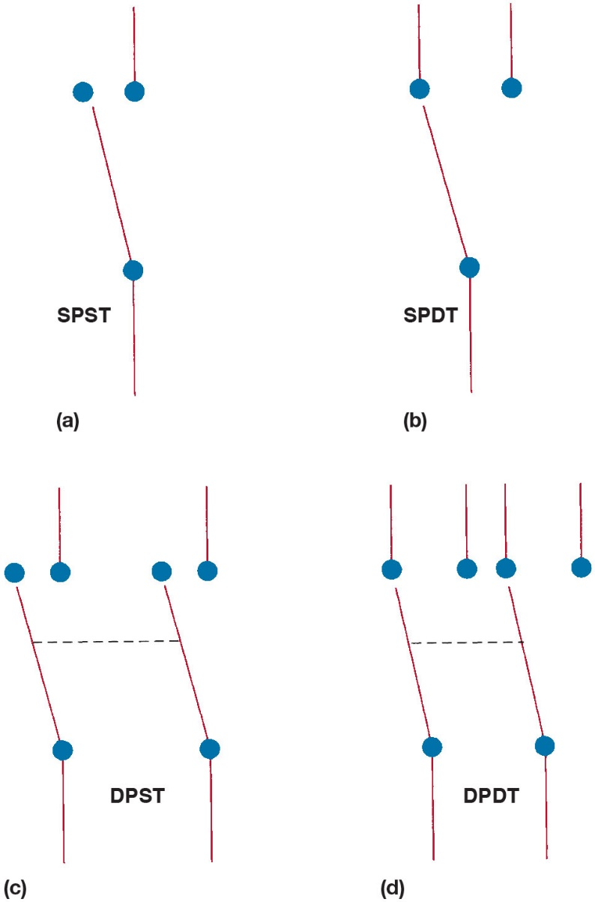
Figure 8.22 Switch Symbols
(a) A symbol for a single-pole, single-throw (S P S T) switch. This type of switch is normally open (N.O.) because nothing is connected to terminal that switch is contacting in its normal position. (b) A single-pole, double-throw (S P D T) switch has 3 terminals. (c) A double-pole, single-throw (D P S T) switch has 2 positions (off/on) and can control 2 separate circuits. (d) A double-pole, double-throw (D P D T) switch has 6 terminals—3 for each pole. Note: Both (c) and (d) also show a dotted line between the 2 arms indicating that they are mechanically connected, called a “ganged switch.”
Notes:
Long Description:
The details of the switches are as follows. S P S T. This has two wires one wire in and one wire out. The first wire that comes in has a dot at the center and a dot closer to its tip. The second wire that goes out has a dot at the tip. S P D T. This has three wires. The first wire that goes in has a dot at the center. The other two wires that go out have a dot at the tip. D P S T. This has two pairs of wires whose arms are connected by a dashed line. Both the pairs have a wire that comes in having a dot at the center and a dot closer to its tip and another wire that goes out having a dot at its tip. D P D T. This has two wires flowing in which are connected and four out wires. The wires that flow in have dots at the center. The wires that flow out have dots at the tips. Here, the arms of the two wires flowing in are connected by a dashed line which includes the first three fires that flow out.

Slide 34
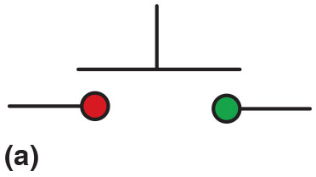
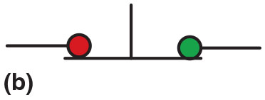
Figure 8.23 Momentary Switch
(a) A symbol for a normally open (N.O.) momentary switch. (b) A symbol for a normally closed (N.C.) momentary switch.

Slide 35
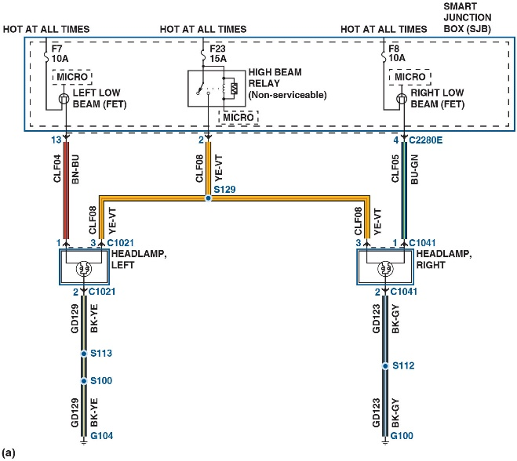
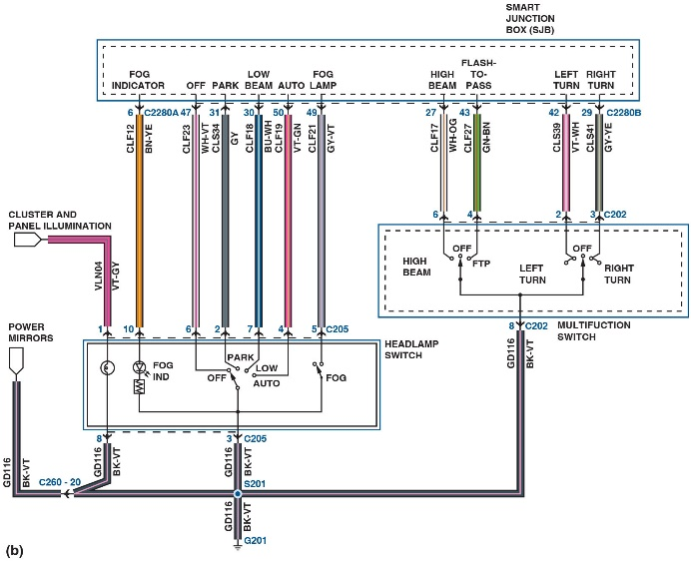
Figure 8.24 Headlight Switch
(a) A typical headlight circuit showing the colors of the wires. (b) A more complex circuit using colored pencils to indicate where there is voltage in the circuit will help diagnose the system if there is a fault.
Notes:
TECH TIP: Color-Coding Is Key to Understanding
Whenever diagnosing an electrical problem, it is common practice to print out the schematic of the circuit and take it to the vehicle. A meter is then used to check for voltage at various parts of the circuit to help determine whether there is a fault. The diagnosis can be made easier if the parts of the circuit are first color-coded using markers or color pencils.
The colors represent voltage conditions in various parts of a circuit. Once the circuit has been color- coded, it can be tested using the factory wire colors as a guide. See 8-24.
TECH TIP: Divide the Circuit in Half
When diagnosing any circuit that has a relay, start testing at the relay and divide the circuit in half.
High-current portion: Remove the relay and check that there are 12 volts at the terminal 30 socket. If there is, the power side is okay. Use an ohmmeter and check between terminal 87 socket and ground. If the load circuit has continuity, there should be some resistance. If O L, the circuit is electrically open. Control circuit (low current): With the relay
removed from the socket, check that there are 12 volts to terminal 86 with the ignition on and the control switch on. If not, check service information to see if power should be applied to terminal 86, and continue troubleshooting the switch power and related circuit.
Check the relay itself: Use an ohmmeter and mea- sure for continuity and resistance.
Between terminals 85 and 86 (coil), there should be 60 to 100 ohms. If not, replace the relay.
Between terminals 30 and 87 (high-amperage switch controls), there should be continuity (low ohms) when there is power applied to terminal 85 and a ground applied to terminal 86 that operates the relay. If OL is displayed on the meter set to read ohms, the circuit is open, which requires that the relay be replaced.
Between terminals 30 and 87a (if equipped), with the relay turned off, there should be low resistance (less than 5 ohms).
Long Description 1:
The left headlamp has two grounded cables having black and yellow wires (B K Y E). The right headlamp has two grounded cables having black and gray wires (B K G Y). Both the headlamps are connected by a cable having yellow and violet wires (Y E V T). The circuit has a smart junction box, S J B which is hot at all times. A cable from the left headlamp having brown and blue (B N B U) is connected to the junction box on the left. Another cable from the right headlamp having blue and green wires (B Y G N) is connected to the junction box on the right. The other end of the Y E V T cable connecting both the headlamps is connected to the junction box in the center.
Long Description 2:
The circuit has a smart junction box, S J B that has a fog indicator, off cable, park cable, low beam cable, auto cable, and a cable for fog lamp on the left and high beam cable, flash to pass cable, left turn cable, and right turn cable. The cables on the left of the smart junction box are colored B N Y E, W H V T, G Y, B U W H, V T G N, and G Y V T, respectively. These cables are connected to a headlamp switch. Additionally, a cluster and panel illumination is connected to the headlamp switch by a V T G Y cable. The four cables on the right from the smart junction box are colored W H O G, G N B N, V T W H, and G Y Y E. These cables are connected to a multifunction switch. Power mirrors are connected to the headlamp switch and the multifunction switch using a long B K V T cable which is grounded.

Slide 36
Question 2
How is an electrical motor identified on a schematic?

Slide 37
Answer 2
An electric motor symbol shows a circle with the letter M in the center and two black sections that represent the brushes of the motor.

Slide 38
Relay Terminal Identification
A relay is a magnetic switch that uses a movable armature to control a high-amperage circuit by using a low amperage electrical switch.
I S O Relay Terminal Identification
Coil (Terminals 85 and 86)
Load (Terminals 30, 87 and 87a)
Relay Spike Control
To reduce the induced voltage, some relays contain a diode connected across the coil.

Slide 39
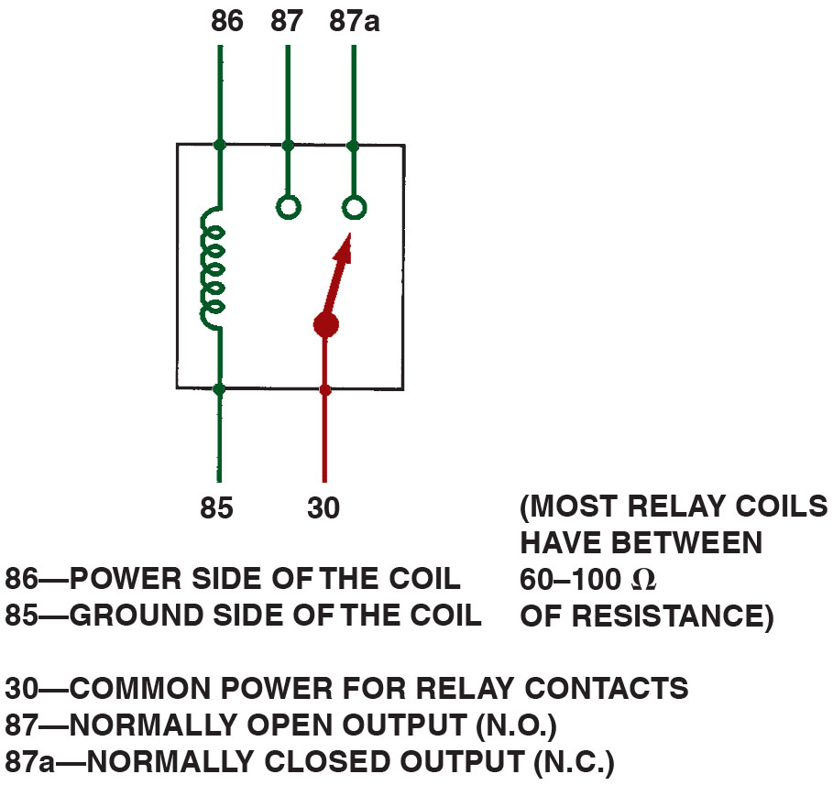
Figure 8.25 Relay Contacts
A relay uses a movable arm to complete a circuit whenever there is a power at terminal 86 and a ground at terminal 85.
Notes:
Long Description:
The diagram depicts the components of a relay, a coil with two terminals 85 and 86, a movable arm connected to terminal 30 and outputs normally open, N. O. at 87 and normally closed N. C. at 87. Relay coils have 60 to100 ohms of resistance. Terminal 85 is the ground side of the coil and terminal 86 is the power side of the coil. Power is usually applied to terminal 30.

Slide 40
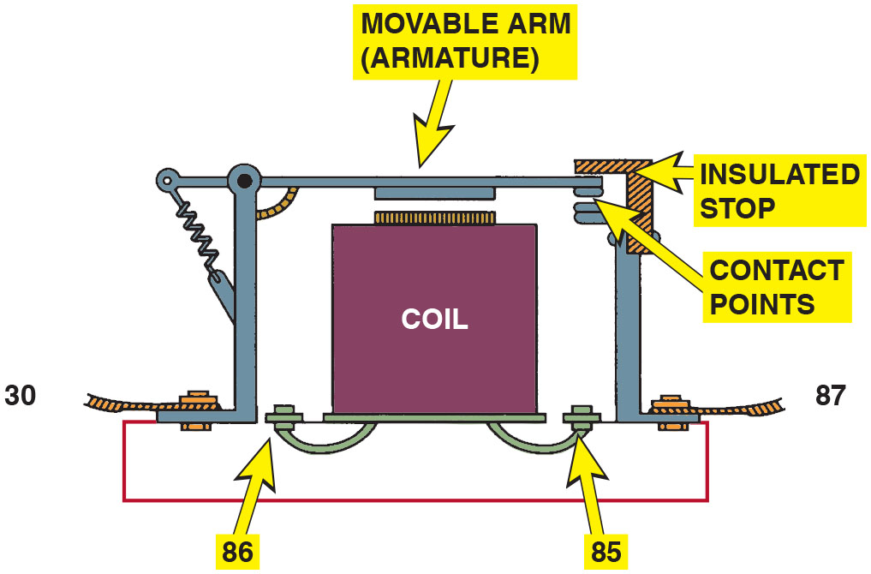
Figure 8.26 Four-Terminal Relay
A cross-sectional view of a typical four-terminal relay. Current flowing through the coil (terminals 86 And 85) causes the movable arm (called the armature) to be drawn toward the coil magnet.
Notes:
Long Description:
It shows a coil with two terminals 85 and 86 and a movable arm connected to terminal 30. There is an insulated stop for the movable arm and contact point for the movable arm and terminal 87. It also has a coil which represents the control circuit inside the relay.

Slide 41
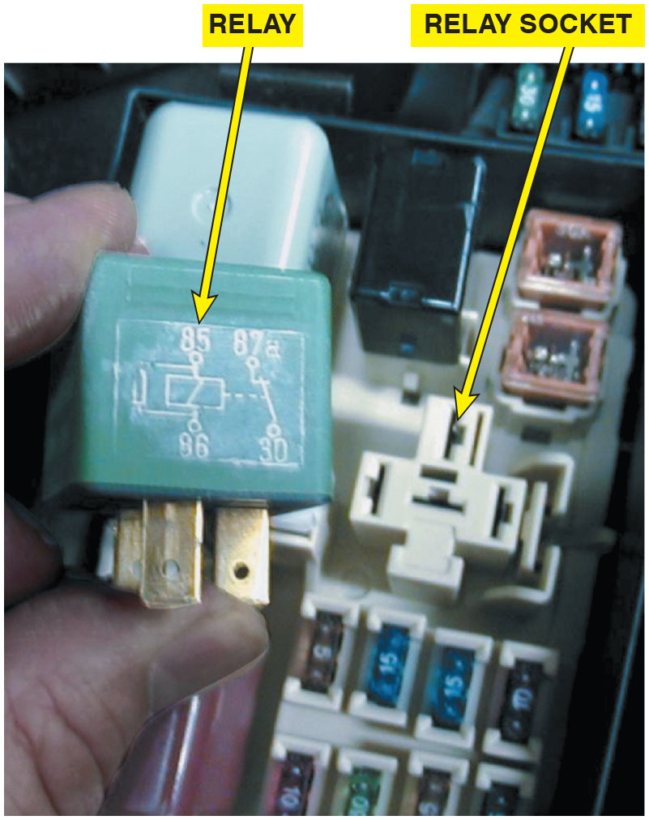
Figure 8.27 Typical Relay
A typical relay showing the schematic of the wiring in the relay.
Notes:
Long Description:
The diagram shows a coil with two terminals 85 and 86 and a movable arm connected to terminal 30. There is an insulated stop for the movable arm and a contact point for the movable arm and terminal 87. The diagram also depicts a coil that represents the control circuit inside the relay.

Slide 42
Animation: Relay

Slide 43
Frequently Asked Question: What Is the Difference Between a Relay and a Solenoid
? Frequently Asked Question
What Is the Difference Between a Relay and a Solenoid? Often, these terms are used differently among vehicle manufacturers, which can lead to some confusion. Relay: A relay is an electromagnetic switch that uses a movable arm. Because a relay uses a movable arm, it is generally limited to current flow not exceeding 30 amperes. Solenoid: A solenoid is an electromagnetic switch that uses a movable core. Because of this type of design, a solenoid is capable of handling 200 amperes or more. It is used in the starter motor circuit and other high-amperage applications, such as in the glow plug circuit of diesel engines.

Slide 44
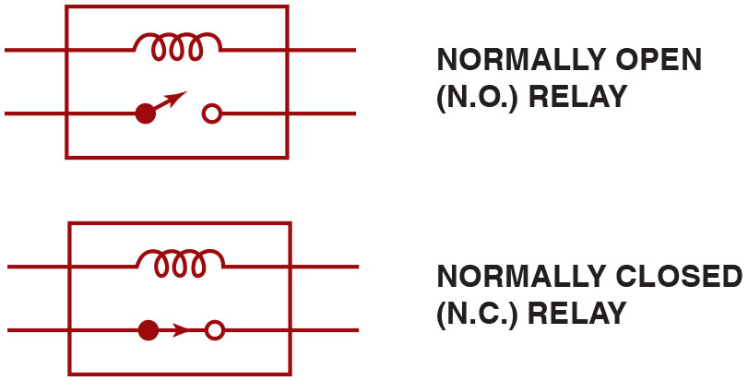
Figure 8.28 Relay Positions
All schematics are shown in their normal, Non-energized position.
Notes:
Long Description:
The symbol has a coil in parallel with a switch inside a rectangular box. In normally open relay, the switch is in open position. In normally closed relay, the switch is in closed position.

Slide 45
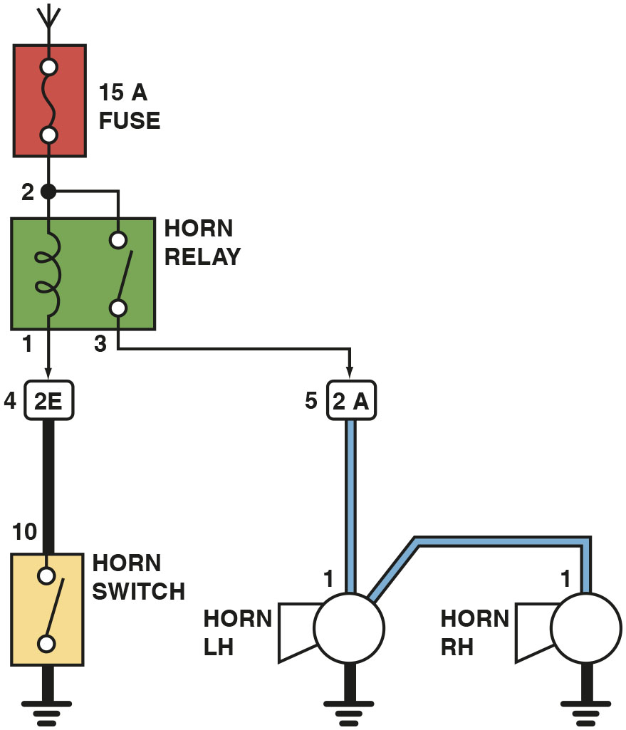
Figure 8.29 Horn Circuit
A horn circuit. Note that the relay contacts supply the heavy current to operate the horn when the horn switch simply completes a low-current circuit to ground, causing the relay contacts to close.
Notes:
Long Description:
There are 4 main parts in a horn circuit, a 15 ampere fuse, a horn relay, a horn switch and the horn. The 15 ampere fuse is connected to the horn relay at the junction at terminal 2. There is a relay coil between terminal 2 and terminal 1 and a movable arm between terminal 2 and terminal 3. Terminal 1 is further connected to the horn switch via two terminals, 4 and 10. Two horns, one on the left hand and other on the right hand are connected to terminal 3 via terminal 5.

Slide 46
Figure 8.30 Solid-State Control
When the relay or solenoid coil current is turned off, the stored energy in the coil flows through the clamping diode and effectively reduces voltage spike.
Notes:
Long Description:
The open switch is connected to the base of the transistor and the solenoid coil to the source of the transistor. The other end of the coil has B positive voltage. The clamping diode has the positive connected to the left of the coil and the negative to the right of the coil. An arrow in anticlockwise direction is in the shaded region between the coil and the diode.

Slide 47
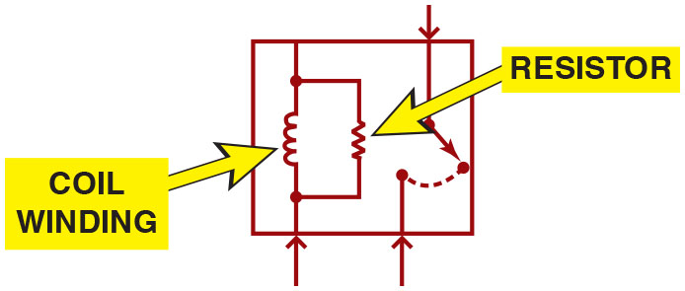
Figure 8.31 Spike Reduction
A resistor used in parallel with the coil windings is a common spike reduction method used in many relays.
Notes:
Long Description:
The switch has a top contact closed to the bottom right contact. All these components are enclosed in a block. An up arrow flows from the bottom to the circuit of coil winding and resistor and from the bottom to the bottom left contact of the 3-way switch. A down arrow flows to the top contact from the top of the block.

Slide 48
Locating an Open Circuit
The typical procedure for locating an open circuit involves the following steps.
Perform a thorough visual inspection.
Print out the schematic.
Check everything that does and does not work.
Check for voltage.

Slide 49
Common Power or Ground
When diagnosing an electrical problem that affects more than one component or system, check the electrical schematic for a common power source or a common ground.
Example:
Under-hood light
Inside lighted mirrors
Dome light
Left-side courtesy light
Right-side courtesy light

Slide 50
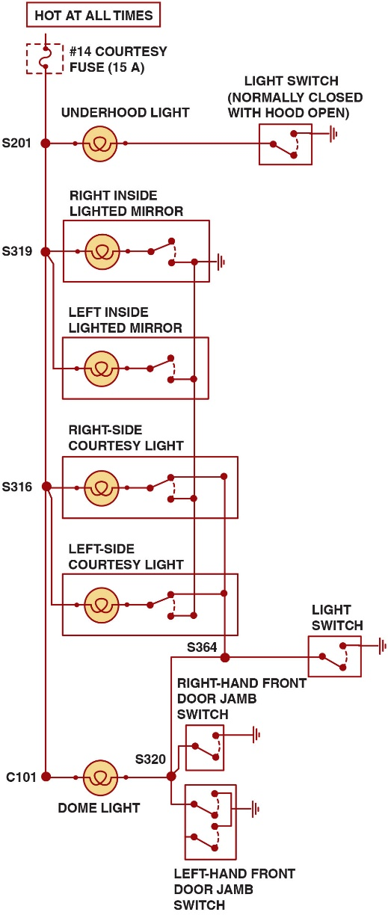
Figure 8.32 One Fuse Power
A typical wiring diagram showing multiple switches and bulbs powered by one fuse.
Notes:
Long Description:
The wiring diagram has a single courtesy fuse of 15 amperes which powers six lights. All the bulbs are connected electrically through wire splices connected to a long strip of wire and each switch is earth grounded. First light connected to the fuse is the underhood light which has a light switch that turns on when the hood is open. It is connected through splice number 201. Second and third lights connected to the fuse are the right inside lighted mirror and the left inside lighted mirror. They are connected through splice number 319. Fourth and fifth lights connected to the fuse are right-side courtesy light and left-side courtesy light. They are connected through splice number 316. All these four switches have common ground. Inside mirror lights can be activated individually but courtesy lights are connected to a common light switch. A Dome light is connected to the fuse through connector number 101. A splice between courtesy lights and dome light occurs at splice number 364 and splice number 320 which has light switches connected to them. Whenever the light switch is turned on, both courtesy lights and dome light can be turned on according to the wiring diagram. Two switches connected at splice number 320 turn on the dome light if turned on. These two switches are right-hand front door jamb switch and left hand-front door jamb switch. The right door jamb switch is a S P S T whereas the left door jamb switch is a D P S T. All switches are in off position.

Slide 51
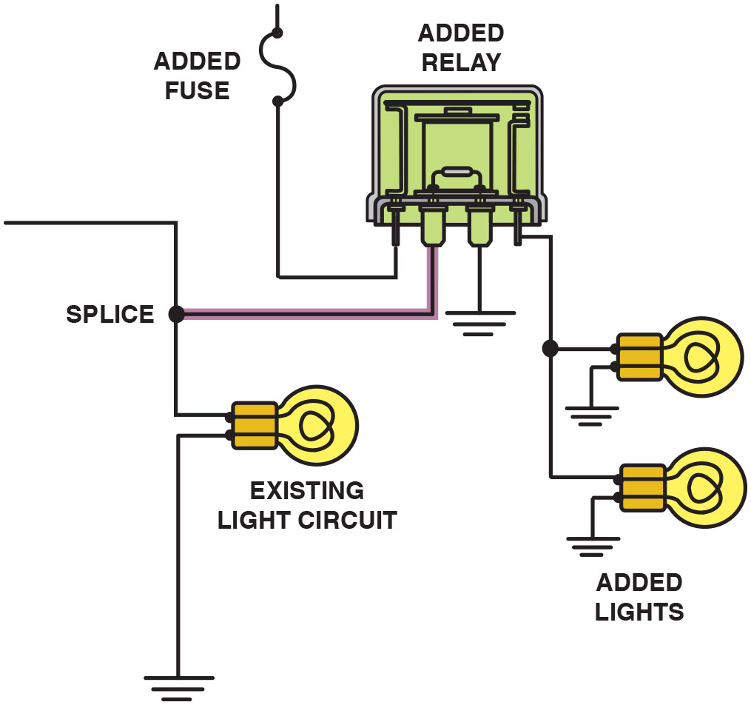
Figure 8.33 Add a Relay
To add additional lighting, simply tap into an existing light wire and connect a relay. Whenever the existing light is turned on, the coil of the relay is energized.
Notes:
TECH TIP: Do It Right—Install a Relay
Often the owners of vehicles, especially owners of pickup trucks and sport utility vehicles (S U V s), want to add additional electrical accessories or lighting. It is tempting in these cases to simply splice into an existing circuit. However, when another circuit or component is added, the current that flows through the newly added component is also added to the current for the original component. This additional current can easily overload the fuse and wiring. Do not simply install a larger amperage fuse; the wire gauge size was not engineered for the additional current and could overheat. The solution is to install a relay, which uses a small coil to create a magnetic field that causes a movable arm to switch on a higher current circuit. The typical relay coil has 50 to 150 ohms (usually 60 to 100 ohms) of resistance and requires just 0.24 to 0.08 ampere when connected to a 12 volt source. This small additional current is not enough to overload the existing circuit. See Figure 8.33 for how additional lighting can be added.

Slide 52
Circuit Troubleshooting Procedure
Example: Backup lights are inoperative
Verify the malfunction
Check for everything else that does not operate correctly
Check fuse for backup lights
Check for voltage at the backup light socket

Slide 53
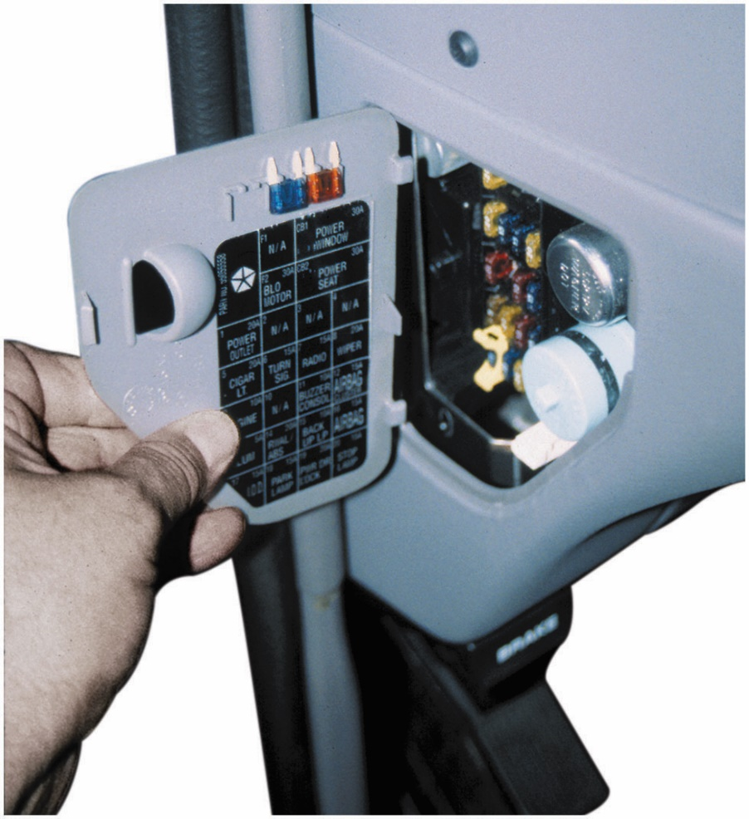
Figure 8.34 Check the Fuse First
Always check the simple things first. Check the fuse for the circuit you are testing.
Notes:
CASE STUDY: The Electric Mirror Fault Story
A customer noticed that the electric mirrors stopped working. The service technician checked all electrical components in the vehicle and discovered that the interior lights were also not working. The interior lights were not mentioned by the customer as being a problem most likely because the driver only used the vehicle in daylight hours.
The service technician found the interior light and power accessory fuse blown. Replacing the fuse restored the proper operation of the electric outside mirror and the interior lights. However, what caused the fuse to blow? A visual inspection of the dome light, next to the electric sunroof, showed an area where a wire was bare. Evidence showed the bare wire had touched the metal roof, which could cause the fuse to blow. The technician covered the bare wire with a section of vacuum hose and then taped the hose with electrical tape to complete the repair.
Summary:
Complaint—The electric power mirrors stopped working.
Cause—A blown fuse due to a fault in the wiring at the dome light.
Correction—Repaired the wiring at the dome light, which restored the proper operation of the electric mirrors that shared the same fuse as the dome light.

Slide 54
Locating a Short Circuit (1 Of 3)
Definition
A short circuit is an electrical connection to another wire or to ground before the current flows through some or all of the resistance in the circuit.
Fuse Replacement Method
Disconnect one component at a time and then replace the fuse. Not the preferred method.
Circuit Breaker Method
The circuit breaker alternately opens and closes the circuit, protecting the wiring from overheating.

Slide 55
Locating a Short Circuit (2 Of 3)
Test Light Method
Remove the blown fuse and connect a test light to the terminals of the fuse holder (polarity does not matter).
Buzzer Method
The buzzer method is similar to the test light method, but uses a buzzer to replace a fuse and act as an electrical load.
Ohmmeter Method
Remove power from the circuit and measure continuity to ground.

Slide 56
Locating a Short Circuit (3 Of 3)
Gauss Method
A Gauss gauge is a handheld meter that responds to weak magnetic fields.
Circuit Tracer
The tone is generated as long as there is a continuous electrical path along the circuit.

Slide 57
Animation: Test Light Checks

Slide 58
Frequently Asked Question: Where to Start?
? Frequently Asked Question
Where to Start? Where does a technician start the troubleshooting when using a wiring diagram? HINT 1 If the circuit contains a relay, start your diagnosis at the relay. The entire circuit can be tested at the terminals of the relay. HINT 2 The easiest first step is to locate the unit on the schematic that is not working or not working correctly. (a) Trace where the unit gets its ground connection. (b) Trace where the unit gets its power connection. Often a ground is used by more than one component. Therefore, ensure that everything else is working correctly. If not, the fault may lie at the common ground (or power) connection. HINT 3 Divide circuit in half by locating a connector or a part of the circuit that can be accessed easily. Heck for power and ground at this midpoint. This step could save you time. HINT 4 Use fused jumper wire to substitute a ground or a power source to place a suspected switch or section of wire.

Slide 59
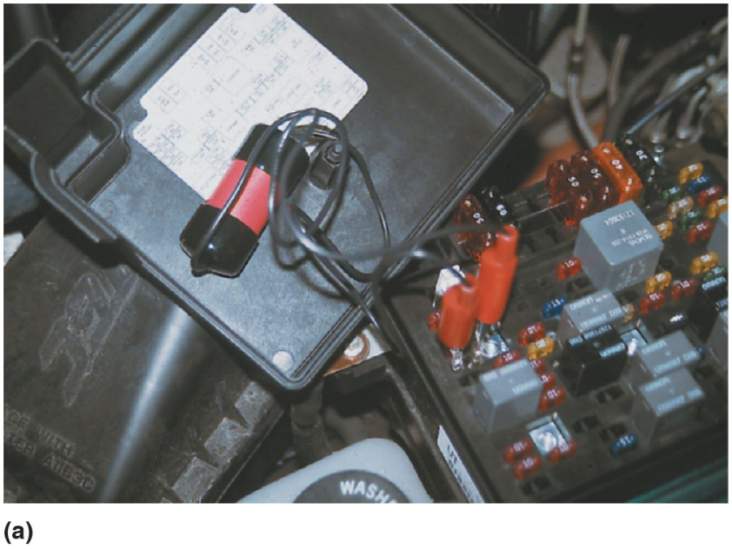
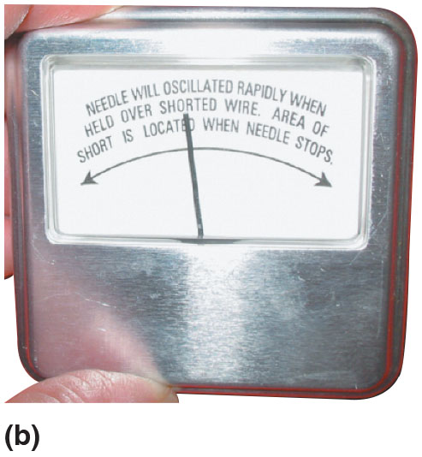
Figure 8.35 Gauss Gauge
(a) After removing the blown fuse, a pulsing circuit breaker is connected to the terminals of the fuse. (b) The circuit breaker causes current to flow, then stop, then flow again, through the circuit up to the point of the short-to-ground. By observing the Gauss gauge, the location of the short is indicated near where the needle stops moving due to the magnetic field created by the flow of current through the wire.
Notes:
GAUSS GAGE METHOD
If a short circuit blows a fuse, a special pulsing circuit breaker (similar to a flasher unit) can be installed in the circuit in place of the fuse. Current flows through the circuit until the circuit breaker opens the circuit. As soon as the circuit breaker opens the circuit, it closes again. This on-and-off current flow creates a pulsing magnetic field around the wire carrying the current. A Gauss gauge is a handheld meter that responds to weak magnetic fields. It is used to observe this pulsing magetic field, which is indicated on the gauge as needle movement. This pulsing magnetic field registers on the Gauss gauge, even through the metal body of the vehicle. A needle-type compass
can also be used to observe the pulsing magnetic field.
Figures 8.35 and 8.36.

Slide 60
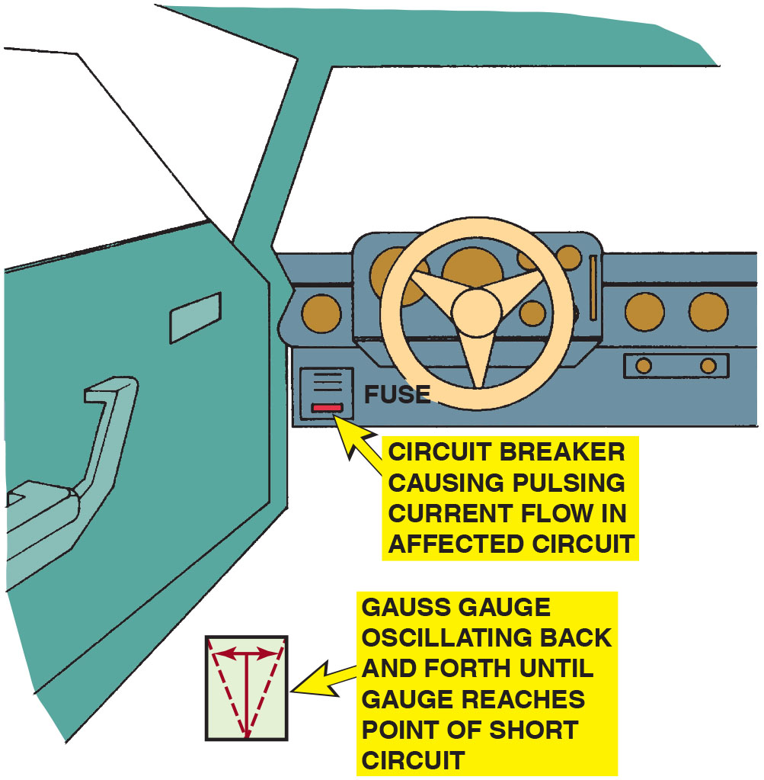
Figure 8.36 Gauss Gauge Method
Gauss gauge can be used to determine the location of a short circuit even behind a metal panel.
Notes:
Long Description:
A circuit breaker in the fuse can cause pulsing current flow in the affected circuit. A Gauss gauge oscillates back and forth to detect a point of short circuit.

Slide 61
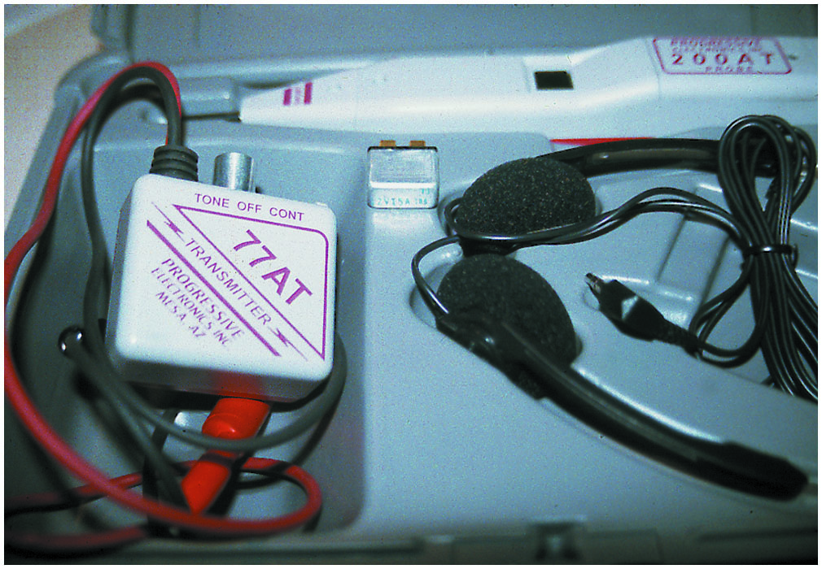
Figure 8.37 Tone Generator
A tone generator–type tester used to locate open circuits and circuits that are shorted-to-ground.
Notes:
TECH TIP: Heat or Movement
Electrical shorts are commonly caused either by movement, which causes the insulation around the wiring to be worn away, or by heat melting the insulation. When checking for a short circuit, first check the wiring that is susceptible to heat, movement, and damage. Heat. Wiring near heat sources, such as the exhaust system, cigarette lighter, or alternator
Wire movement. Wiring that moves, such as in areas near the doors, trunk, or hood Damage. Wiring subject to mechanical injury, such as in the trunk, where heavy objects can move around and damaged wiring can also occur as a result of an accident or a previous repair

Slide 62
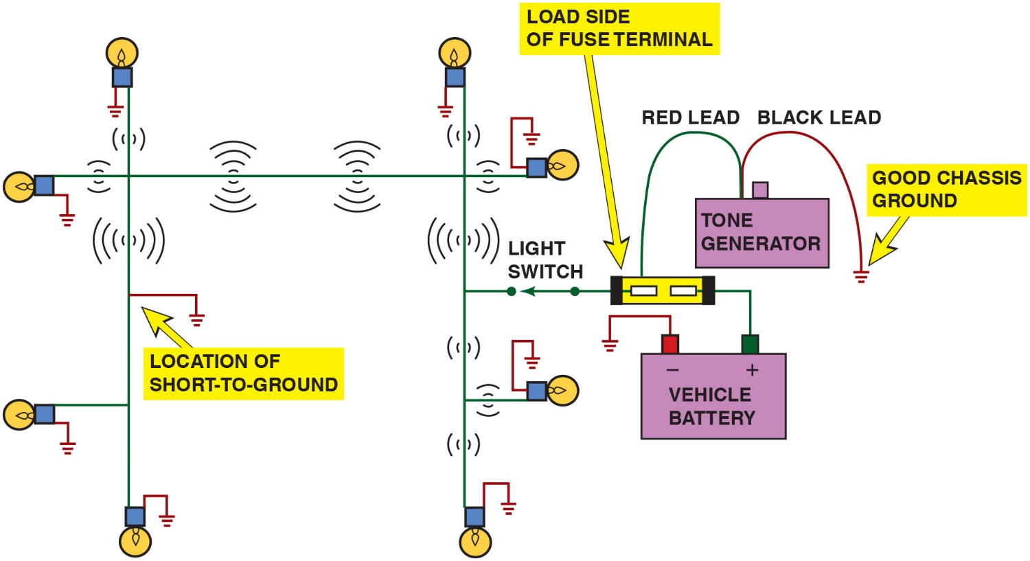
Figure 8.38 Tone Generator Method
To check for a short-to-ground using a tone generator, connect the black transmitter lead to a good chassis ground and the red lead to the load side of the fuse terminal.
Notes:
Long Description:
An array of bulbs is connected to a light switch in a circuit connected to a fuse and in turn to vehicle battery. A tone generator’s black lead is connected to the ground chassis and red lead is connected to the load side of the fuse terminal. The color of the wire in the circuit is green. All short to grounds are in red color. The transmitter of the tone generator is turned on and tone signals with various strengths are shown in the diagram.

Slide 63
Animation: Tone Generator

Slide 64
Question 3
How can a tone generator be used to locate a short circuit?

Slide 65
Answer 3
When the circuit is shorted the generator will emit a tone.

Slide 66
Electrical Troubleshooting Guide
When troubleshooting any electrical component, remember the following hints to identify the problem faster and more easily.
For a device to work, it must have power and ground.
If there is no power to a device, an open power side (e.g., blown fuse) is indicated.
If there is power on both sides of a device, an open ground is indicated.
If a fuse blows immediately, a grounded power-side wire is indicated.
Notes:
TECH TIP: Electrical Troubleshooting Guide
When troubleshooting any electrical component, remember the following hints to identify the problem faster and more easily:
For a device to work, it must have two things: power and ground. Often more than one circuit shares a single ground connector.
If there is no power to a device, an open power side (blown fuse, etc.) is indicated. Often more than one circuit is being protected by each fuse.
If there is power on both sides of a device, an open ground is indicated. If a fuse blows immediately, a grounded power-side wire is indicated. Most electrical faults result from heat or movement. Most non computer–controlled devices operate by opening and closing the power side of the circuit (power-side switch). Most computer-controlled devices operate by opening closing the ground side of the circuit (ground-side switch).

Slide 67
Step-by-Step Troubleshooting
Determine the customer concern
Verify the customer’s concern
Perform a thorough visual inspection
Check for technical service bulletins (T S B s)
Locate the wiring schematic
Check the factory service information
Determine the root cause and repair the vehicle
Verify the repair

Slide 68
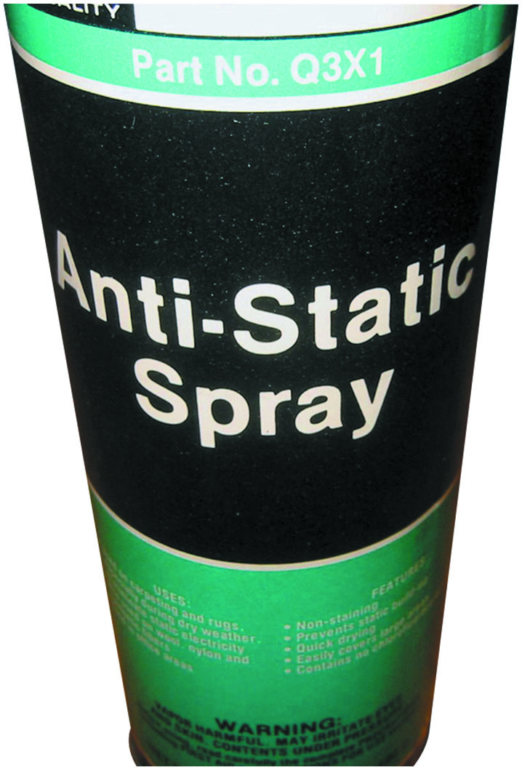
Figure 8.39 Anti-Static Spray
Anti-static spray can be used by customers to prevent being shocked when they touch a metal object like the door handle.
Notes:
TECH TIP: Wiggle Test
Intermittent electrical problems are common, yet difficult to locate. To help locate these hard-to-find problems, try operating the circuit and start wiggling the wires and connections that control the circuit. If in doubt where the wiring goes, try moving all the wiring starting at the battery. Pay particular attention to wiring running near the battery or the windshield washer container. Corrosion can cause wiring to fail, and battery acid fumes and alcohol-based windshield washer fluid can start or contribute to the problem. If you notice any change in the operation of the device being tested while wiggling the wiring, look closer in the area you were wiggling until you locate and correct
the actual problem.
CASE STUDY: Shocking Experience
A customer complained that after driving for a while, they got a shock whenever they grabbed the door handle when exiting the vehicle. The customer thought that there must be an electrical fault and that the shock was coming from the vehicle itself. In a way, the shock was caused by the vehicle, but it was not a fault.
The service technician sprayed the cloth seats with an antistatic spray and the problem did not reoccur. Obviously, a static charge was being created by the movement of the driver’s clothing on the seats and then discharged when the driver touched the metal
door handle. Figure 8.39.
Summary:
Complaint—Vehicle owner complained that they got shocked when the door handle was touched.
Cause—Static electricity was found to be the cause, not a fault with the vehicle.
Correction—The seats and carpet were sprayed with an antistatic spray and this corrected the concern.

Slide 69
Summary
Most wiring diagrams include the wire color, circuit number, and wire gauge.
The number used to identify connectors, grounds, and splices usually indicates where they are located in the vehicle.
All switches and relays on a schematic are shown in their normal position either normally closed (N . C.) or normally open (N . O.).
A typical relay uses a small current through a coil (terminals 85 and 86) to operate the higher current part (terminals 30 and 87).
A short-to-voltage affects the power side of the circuit and usually involves more than one circuit.
A short-to-ground usually causes the fuse to blow and usually affects only one circuit.
Most electrical faults are a result of heat or movement.

Slide 70
Animations and Video Links (Halderman website subscription and web access needed to view)
(A6) Electrical/Electronic Systems Animations
Schematics Library
(A6) Electrical/Electronic Systems Videos

Slide 71
Copyright
This work is protected by United States copyright laws and is provided solely for the use of instructors in teaching their courses and assessing student learning. Dissemination or sale of any part of this work (including on the World Wide Web) will destroy the integrity of the work and is not permitted. The work and materials from it should never be made available to students except by instructors using the accompanying text in their classes. All recipients of this work are expected to abide by these restrictions and to honor the intended pedagogical purposes and the needs of other instructors who rely on these materials.

