Slide 1
Advanced Engine Performance Diagnosis
Eighth Edition
Chapter 28
Module Reprogramming
Copyright © 2025 Pearson Education, Inc. All Rights Reserved
Notes:
If this PowerPoint presentation contains mathematical equations, you may need to check that your computer has the following installed:
1) Math Type Plugin
2) Math Player (free versions available)
3) NVDA Reader (free versions available)
INSTRUCTOR NOTE: This presentation includes text explanation notes, you can use to teach the course. When in SLIDE SHOW mode, you RIGHT CLICK and select SHOW PRESENTER VIEW, to use the notes.

Slide 2
Learning Objectives (1 of 2)
28.1 List the benefits of module reprogramming over previous methods of update.
28.2 Describe the regulatory requirements of J2534.
28.3 List the hardware used for programming.
28.4 List the software used for programming.
28.5 Describe the methods of module reprogramming.
28.6 Explain the need for a battery maintainer during reprogramming.

Slide 3
Learning Objectives (2 of 2)
28.7 Describe the concerns of programming in the shop.
28.8 Describe aftermarket reprogramming.

Slide 4
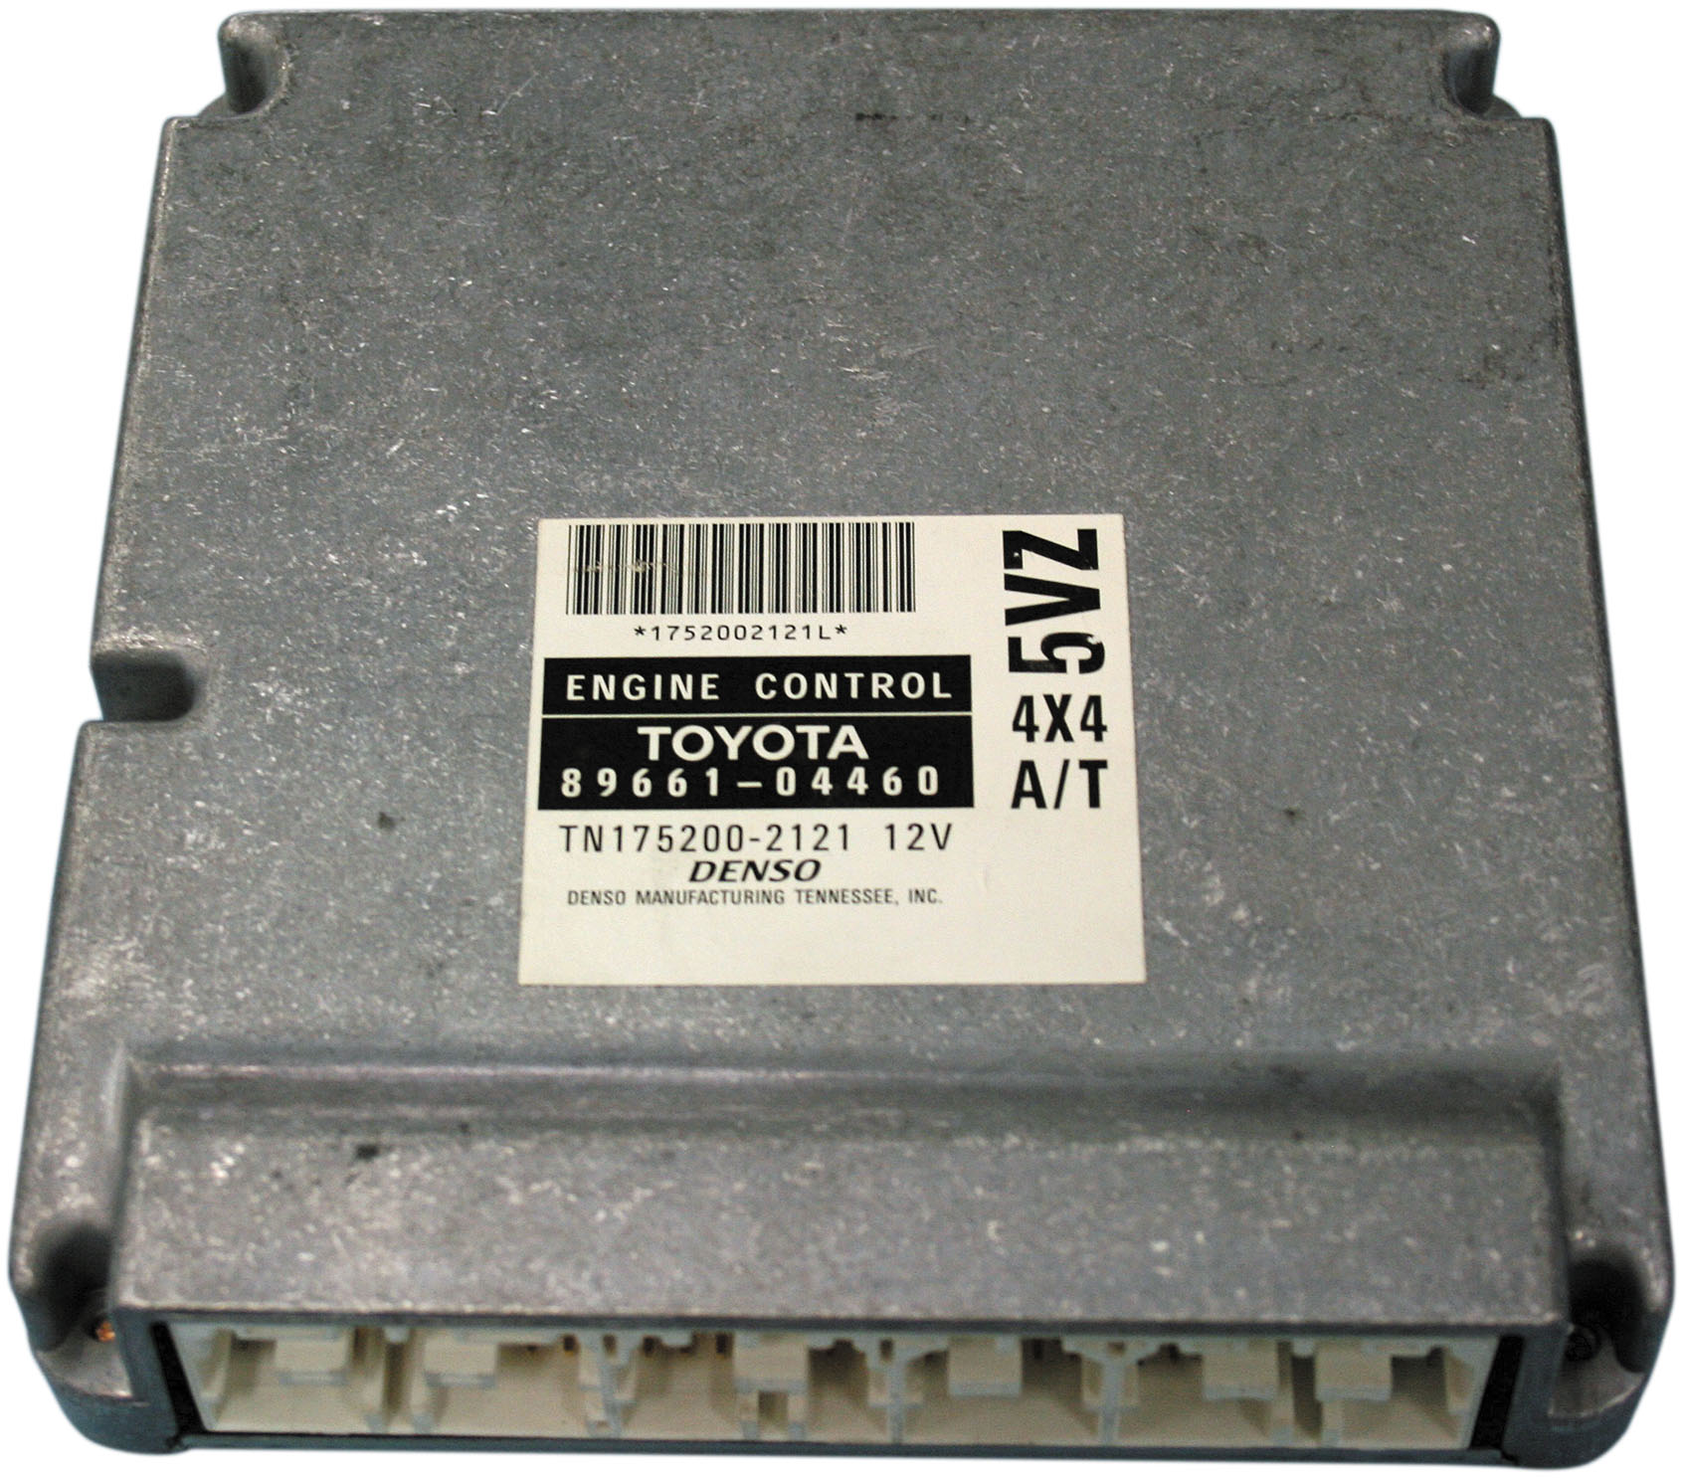
Figure 28.1
Control Module
The Toyota engine control module pictured in the figure is an example of a module that must be replaced to update the programming memory.
Notes:
Software programming has been used by the engine control module to meet air quality and emission standards since fuel injection replaced carburetors. The method of updating the software calibration has changed as technology has evolved. On early fuel-injected vehicles, it was necessary to change the computer when the calibration needed to be updated. As shown in Figure 28.1. In the early 1980s, the replacement P R O M M (programmable read only memory) was introduced. Instead of replacing the entire module, the technician would remove the P R O M and install a replacement chip. Several versions of replaceable P R O M s were used. ● See Figures 28.2 and 28.2b. In 1990, G M introduced flash reprogramming. This process allowed the technician to download the replacement software calibration from the manufacturer and to install it in the vehicles computer E E P R O M (electronically erasable programmable read only memory). This eliminated the need to stock any parts which decreased the cost and the time needed for the repair.

Slide 5
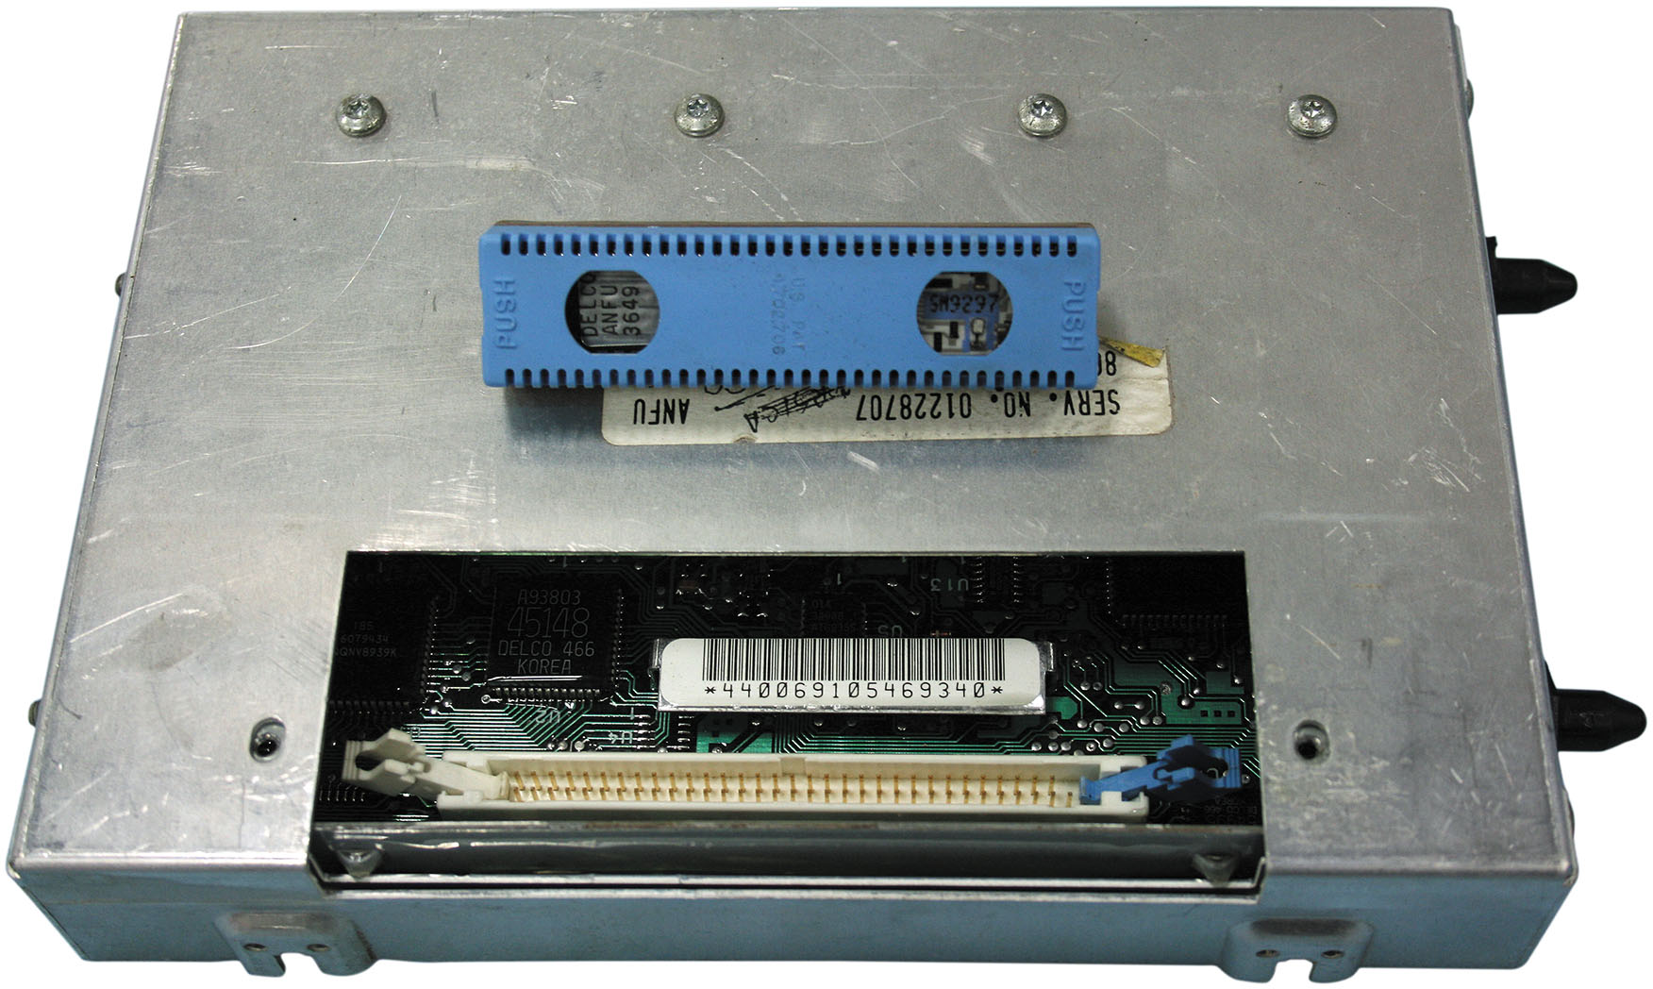
Figure 28.2A
G M P R O M E C M
The two General Motors engine control modules above are examples of two styles of removable P R O M s used to update programmable memory.

Slide 6
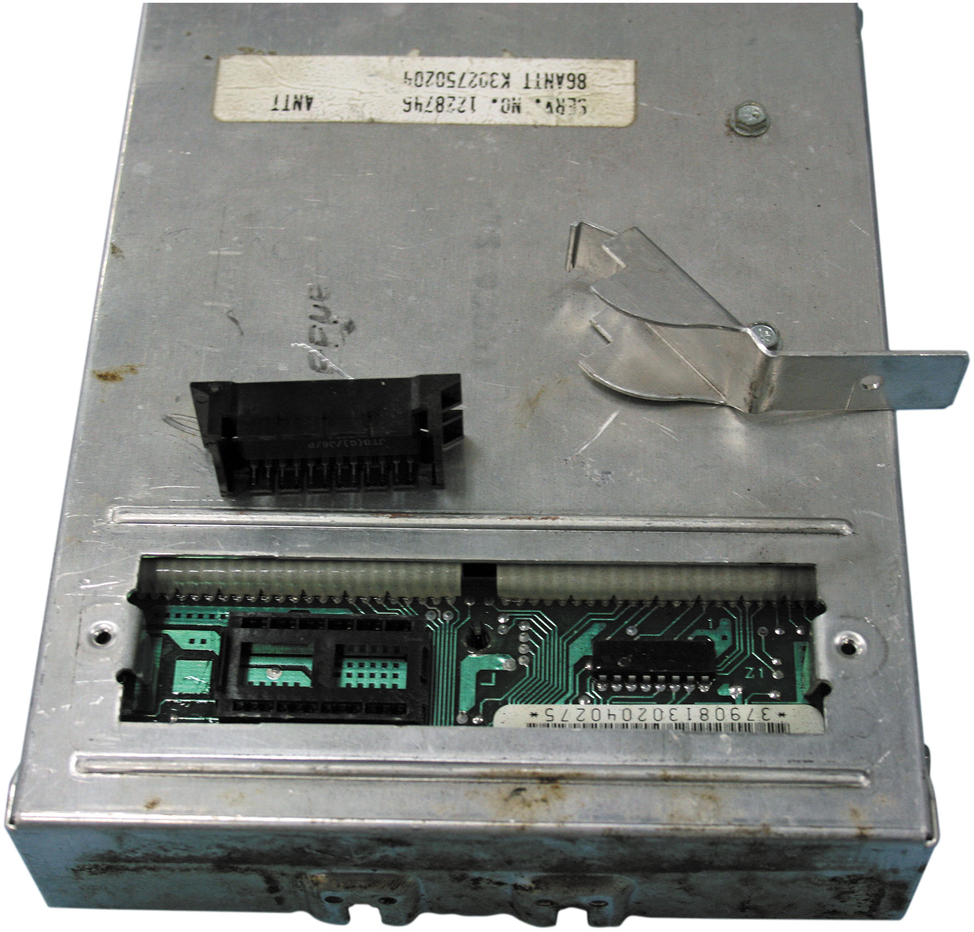
Figure 28.2B
G M E C M P R O M
The two General Motors engine control modules above are examples of two styles of removable P R O M s used to update programmable memory.

Slide 7
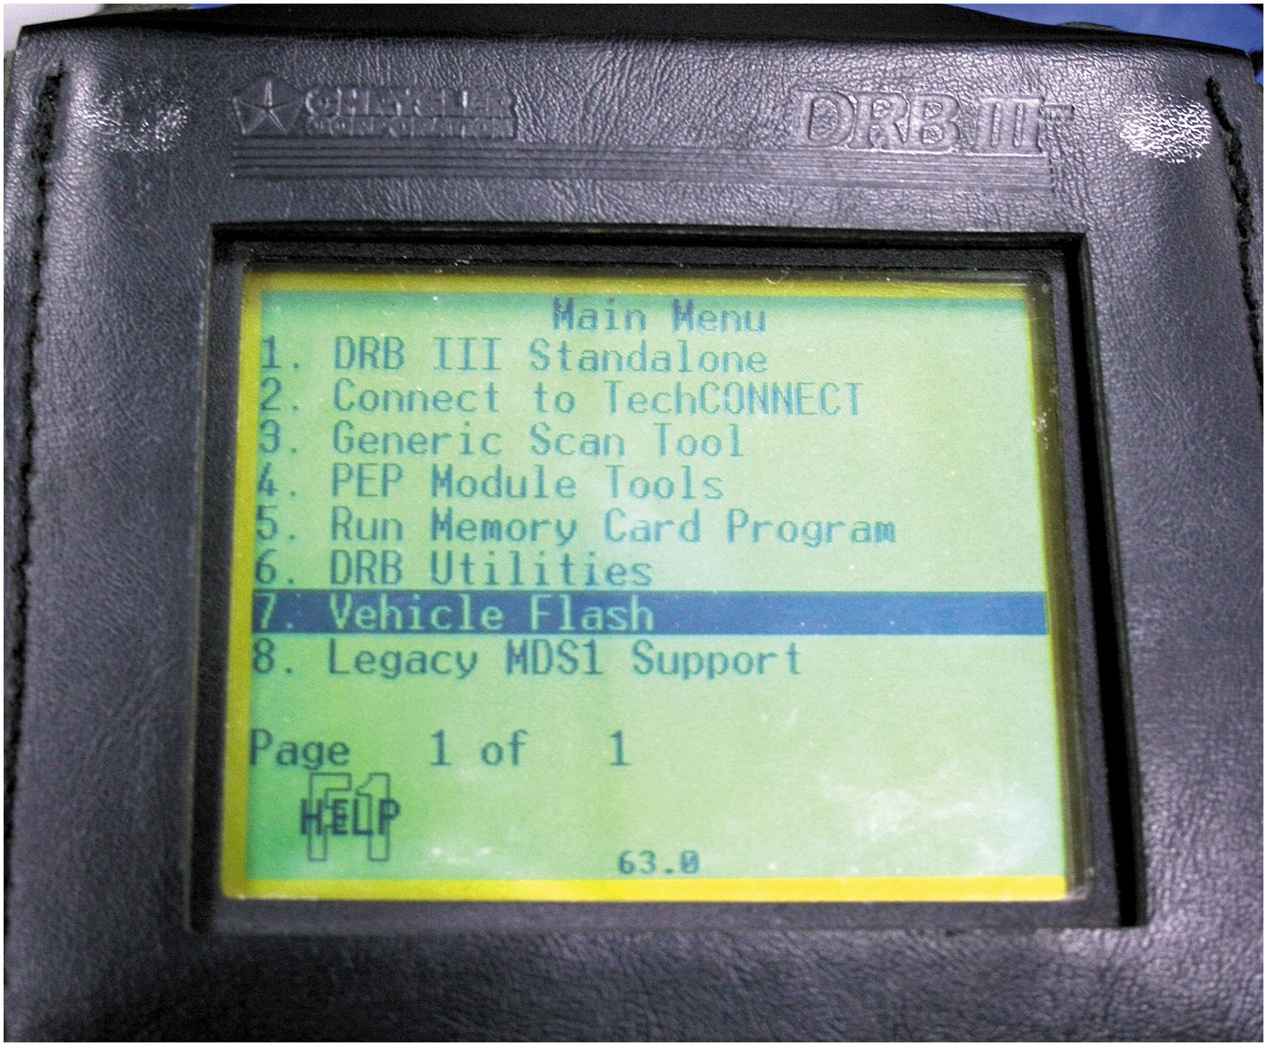
Figure 28.3
Scan Tool Programming
The manufacturer scan tool is being used to reprogram the engine control module via the data link connector.

Slide 8
S A E Standards J2534 & J2534-1/2
S A E J2534: communications between computer and vehicle
E P A/C A R B regulations require all automakers
Provide a J2534 service to everyone in U S
For reflashing emission-related controllers
4 Versions J2534, J2534-1, J2534-2, and J2534-5
J2534-5 Latest improved D L C Communications
Notes:
S A E created the standard S A E J2534 for communications between a computer and a vehicle. The original standard was introduced in February of 2002, and was identified as version 02.02. The E PA and C A R B regulations require all automakers to provide a J2534 service to everyone in the United States for re- flashing emission-related controllers. If the technician has a S A E J2534 pass-through device, they can re-flash and, in some cases, diagnose vehicles with factory functionality. The E P A documentation requires O E M s to comply with S A E J2534 for pass-through reprogramming beginning with model year 2004. Reprogramming information also had to be made available within three months of vehicle introduction for new models. The original version of the standard was found to have some errors.
This original standard was updated in December of 2004. The new standard was identified as version 04.04 or more commonly as S A E J2534-1. The changes in the second version of the standard supported specific requirements of Ford and Chrysler that were not addressed in the first standard that related to J1850 class 2 communication protocols. It also defined specifics for the design of the vehicle communication interface device. The standard was updated again and referred to as S A E J2534-2. These changes addressed issues related to single wire C A N B U S communication and issues related to the G M U A R T communication protocol. The new standard also provided a method for manufacturers to add optional features in a uniform way. An example of this is the ability to flash program modules that were not emission related.
The current standard is referred to as S E J2534 version 5.00. The newest standard includes all the changes required in the previous updates and serves to improve the communication through the J1962 connector. It is important to have the most current equipment to ensure that that the flash reprogramming process will be completed without any malfunctions.

Slide 9
Programming Hardware
O E M pass-through devices
G M M D I and Ford V C I
Generic Devices like Car D A Q-Plus
Notes:
Each manufacturer has developed their own J2534 pass-through device or application programming interface (A P I) that is specific to the brands the manufacturer sells. A pass-through device or API serves as a connection point that makes all the hardware look the same, and allows the computer with the reprogramming software to communicate with the vehicles control module through the data link connector (D L C). Generally, these tools are not designed with the functionality to support competitive brands. In many cases, these pass-through devices are designed to support the manufacturer scan tool in addition to providing reprogramming capabilities. The G M M D I and Ford V C I are both examples of this type of technology. ● See Figure 28.4.
The generic J2534 pass-through device is designed to support multiple manufacturers. These tools typically do not have the same level of scan tool diagnostics as a manufacturer-specific tool. These tools are more often found outside of the dealership environment in the independent repair facilities. The Drew Technologies Car D A Q-Plus series of J2534 pass-through devices is an example of a generic tool.

Slide 10
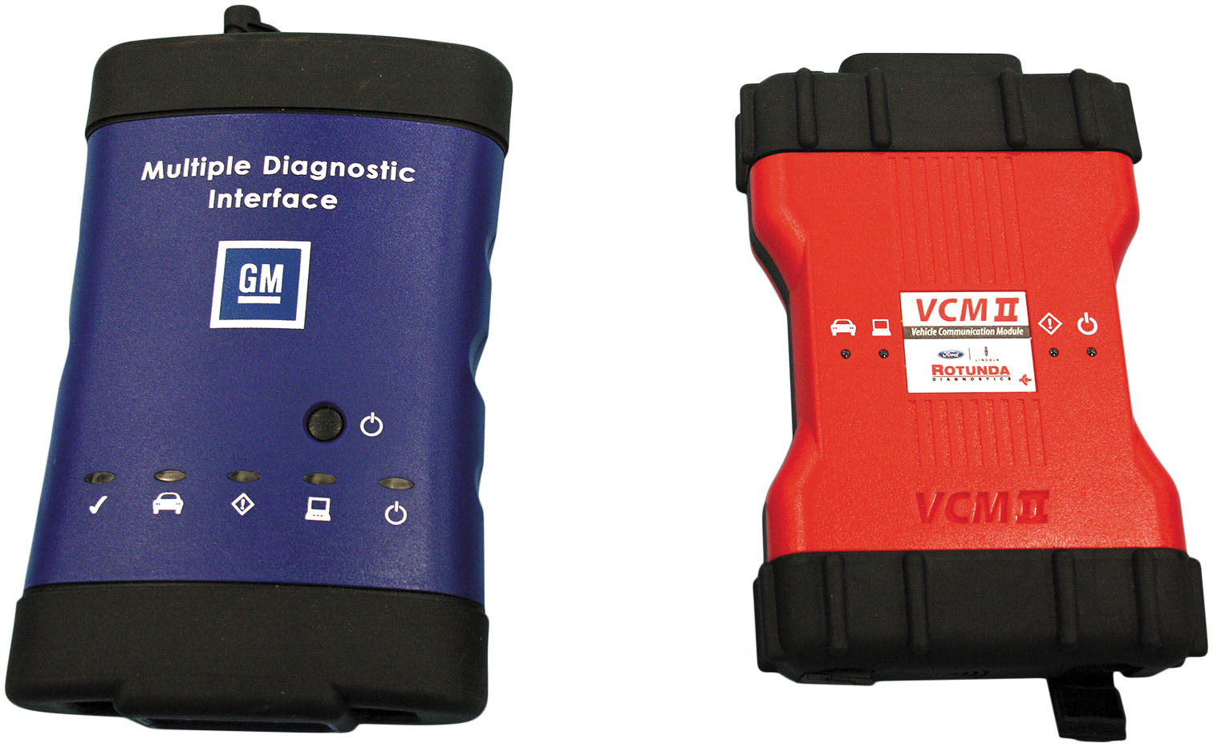
Figure 28.4
G M M D I Ford V C I
The G M M D I and Ford V C I are examples of manufacturer-specific pass-through devices.

Slide 11
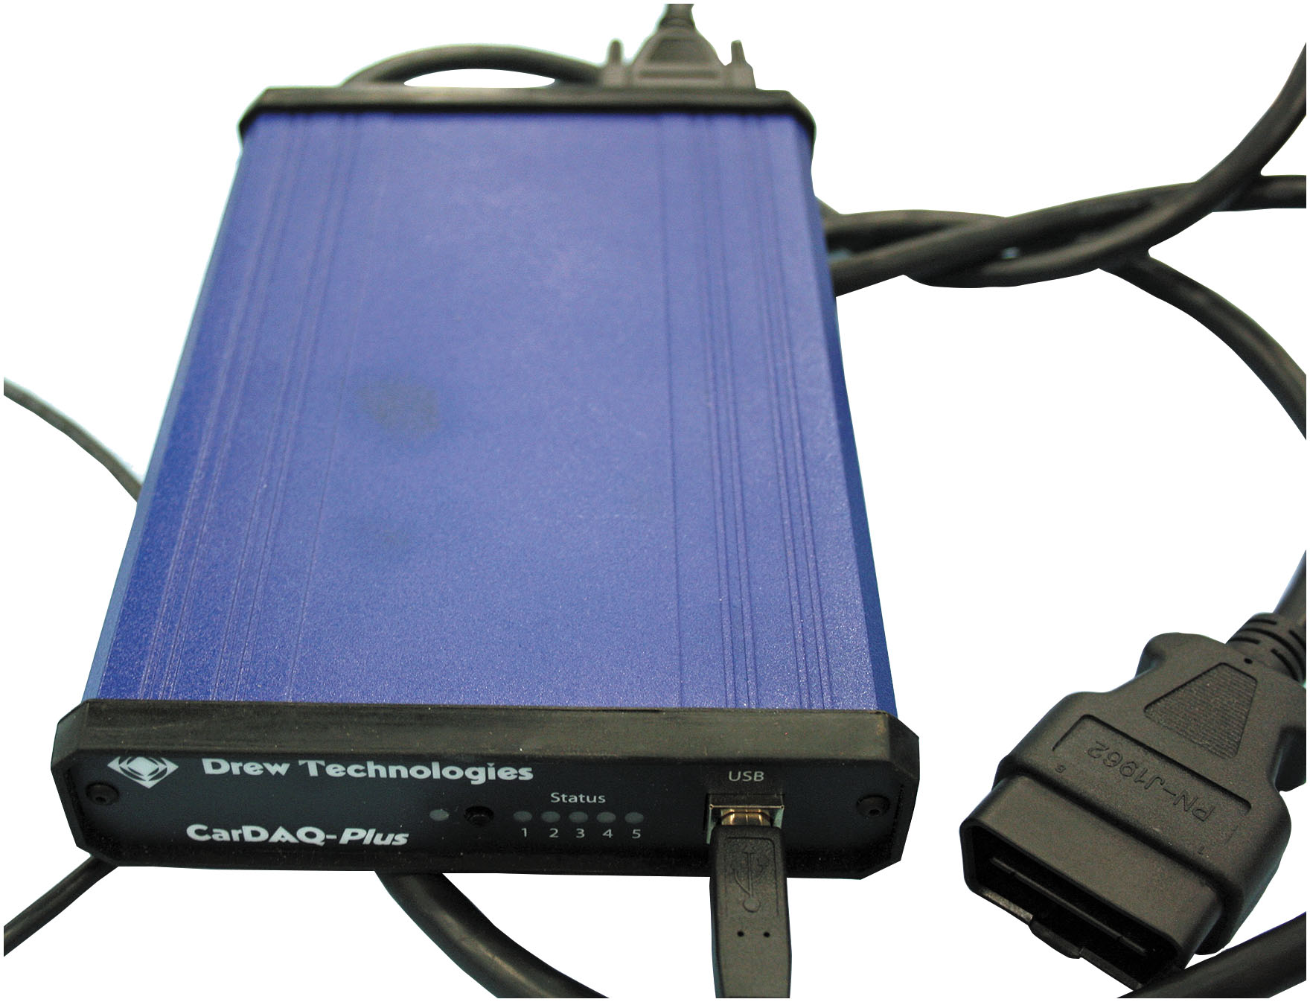
Figure 28.5
Generic Device
The Car D A Q Plus is a generic pass-through device.

Slide 12
Programming Software
N A S T F (National Automotive Service Task Force)
Tool industry, O E M ensures access to information, training, and tools needed for diagnosis and repair
N A S T F created a portal to access reprogramming information.
Includes where to access information, tools needed, and in many cases a short video on how to complete the task
O E M Dealers have a factory system
Notes:
N A S T F (NATIONAL AUTOMOTIVE SERVICE TASK FORCE) is a cooperative effort of the automotive service industry, the tool industry, and the original equipment manufacturers to ensure that automotive professionals employed outside of the O E M s have all the information, training, and tools they need to diagnose and repair modern automobiles. The N A S T F has created a portal for all automotive service professionals to access manufacturer-specific reprogramming information. This includes where to access the information, the tools needed, and in many cases a short video on how to complete the task. ● See Figure 28.5.
VEHICLE SECURITY PROFESSIONAL – LOCKSMITH I D Many
times when a module must be reprogrammed or programmed upon replacement, the security codes or key specific information must be re-entered during the process. In order to obtain this information, the shop or service technician must be a registered vehicle security professional and have a locksmith I D number. The National Automotive Service Task Force (N A S T F), in conjunction with automotive manufacturers, insurance industry, independent repair, and law enforcement communities, has developed this system to allow the aftermarket repair industry to access to this sensitive data. The forms and instructions needed to apply for this identification number can be found on the N A S T F website (www.nasft.org) under Locksmith/Vehicle Security. ● See Figure 28.7.

Slide 13
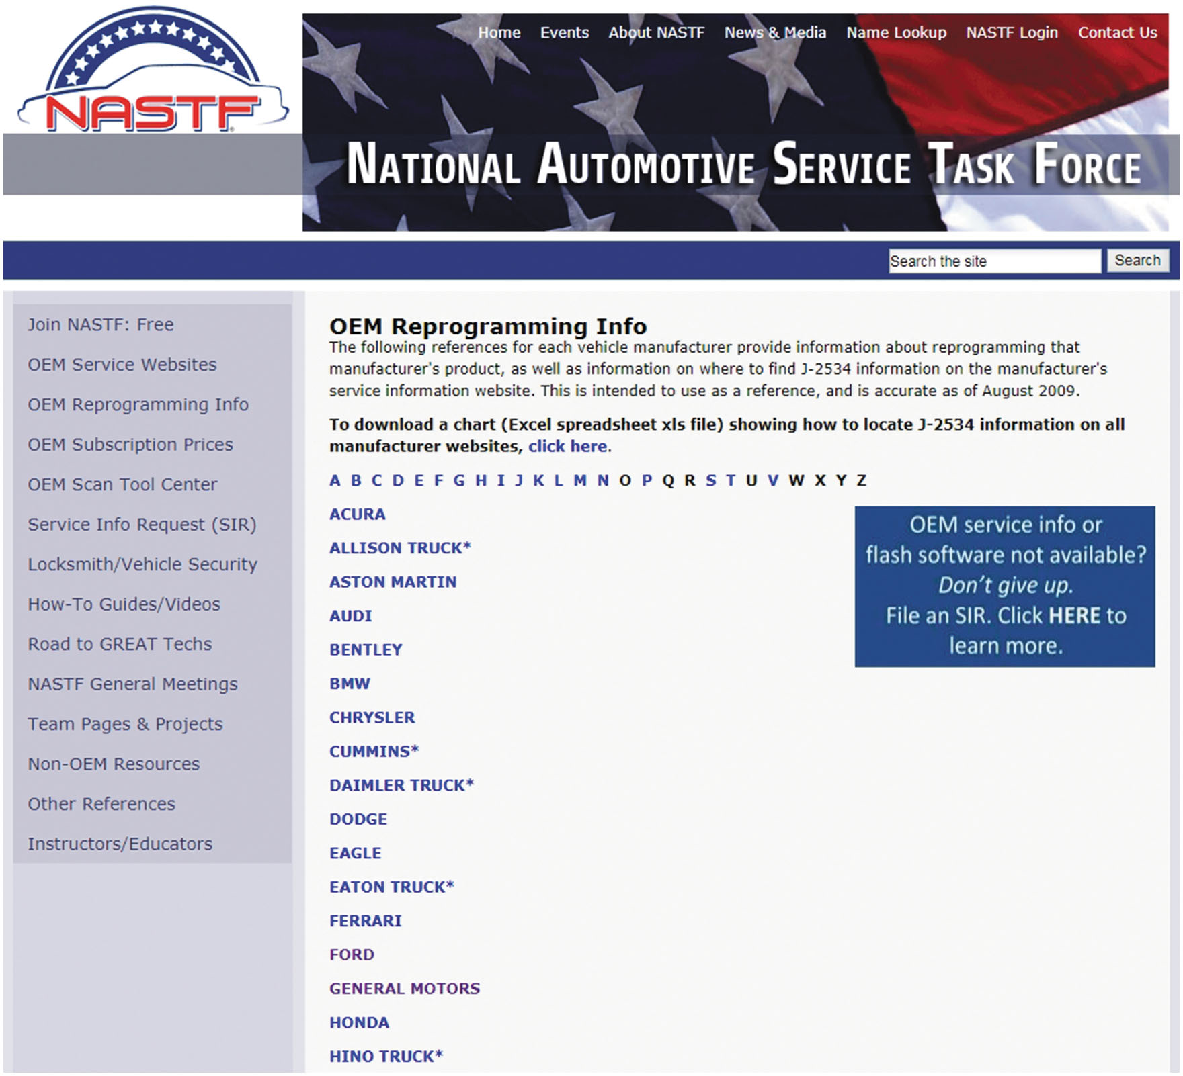
Figure 28.6
Locksmith I D
The screenshot of the N A S T F website provides an access point for the aftermarket automotive professional to obtain the needed reprogramming information.

Slide 14
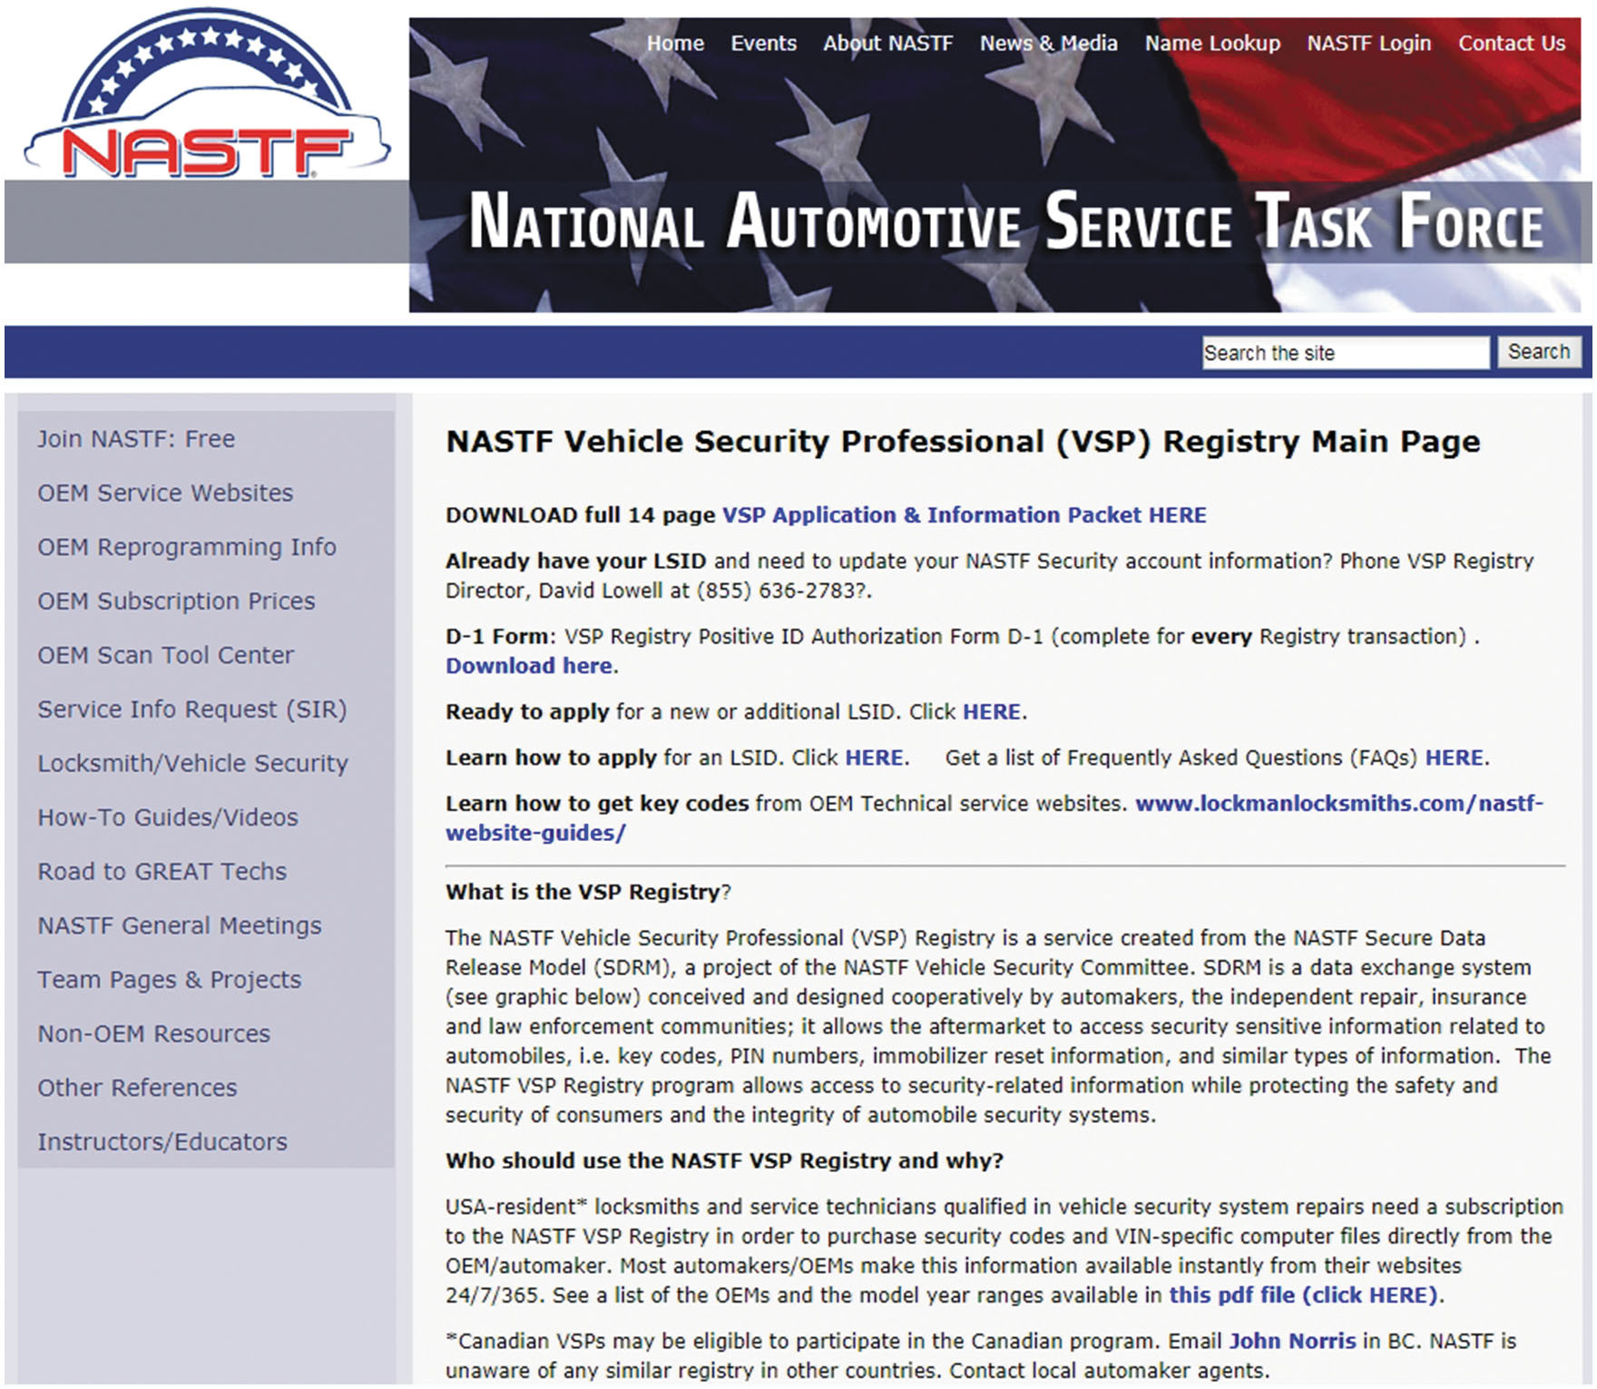
Figure 28.7
N A S T F Website
The screenshot from the N A S T F website provides the resources for the technician to apply for a locksmith I D.
Notes:
Many times when a module must be reprogrammed or programmed upon replacement, the security codes or key specific information must be re-entered during the process. In order to obtain this information, the shop or service technician must be a registered vehicle security professional and have a locksmith I D number. The National Automotive Service Task Force (N A S T F), in conjunction with automotive manufacturers, insurance industry, independent repair, and law enforcement communities, has developed this system to allow the aftermarket repair industry to access to this sensitive data. The forms and instructions needed to apply for this identification number can be found on the N A S T F website (www.nasft.org) under Locksmith/Vehicle Security. • See Figure 28.7.

Slide 15
Reprogramming (1 of 2)
Module connected to vehicle during process
Module uses its normal connection points
Provide power, ground, communication links
Involves Scan tool, Computer, Internet, Interface
Notes:
On-board reprogramming of the controller is defined as having the module connected to the vehicle during the process. The module uses its normal connection points to provide the power, ground, communication links, and any other needed support. This is the type of programming that typically occurs in a service facility. ● See Figure 28.8.

Slide 16
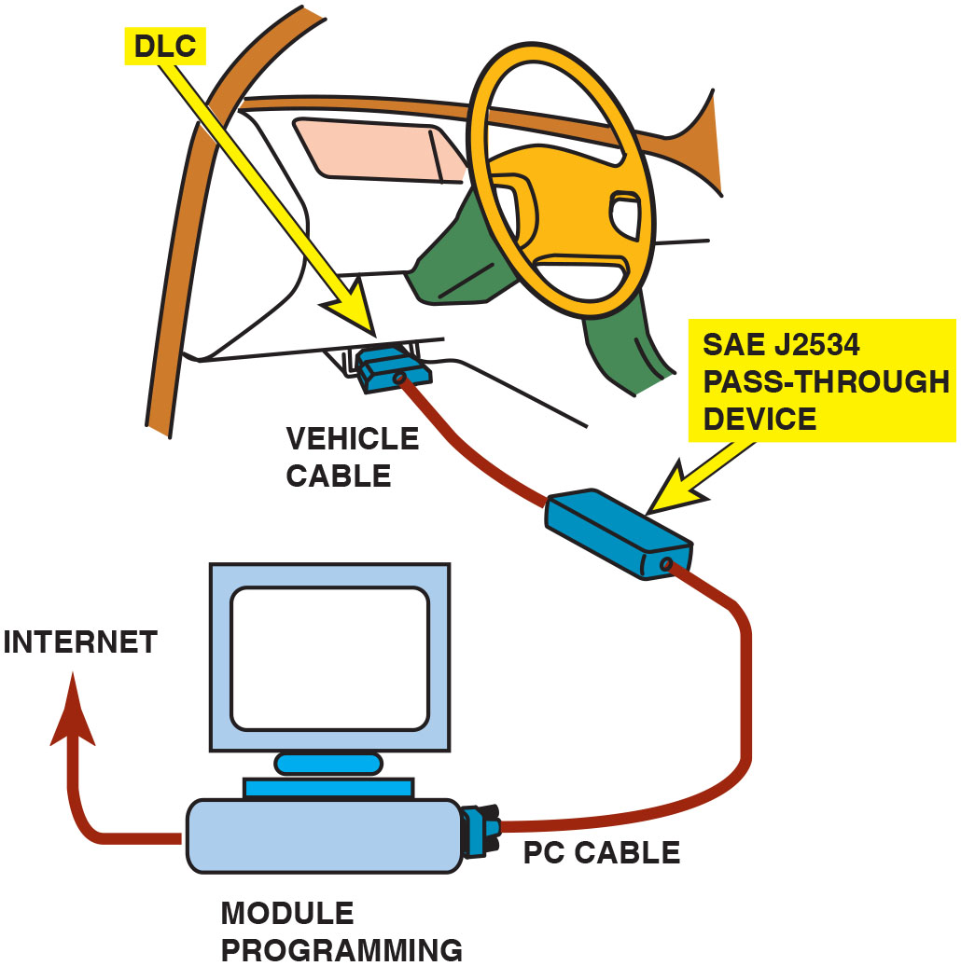
Figure 28.8
J2534 Device
The J2534 device is being used to program the engine control module through the D L C.

Slide 17
Reprogramming (2 of 2)
Off-board programming of controller
Module programmed someplace other than in vehicle
Sometimes done at local parts store
Remote Programming shop simply plugs in equipment and follows the instructions of someone who is at a distant location
Notes:
Off-board programming of the controller is defined as having the module programmed someplace other than in the vehicle. This could be anywhere that there is a computer and the needed power, ground and communication links. The purchase and programming of a module at a local parts store is an example of off-board programming. ● See Figure 28.9. Remote programming is a relatively new process. The servicing facility does not perform the reprogramming of the vehicle. Instead, the shop simply plugs in the equipment and follows the instructions of someone who is at a distant location. This process still requires an Internet connection and equipment. However, it relies on a third party who has the manufacturer subscription for the software. This option has become increasingly popular for shops that perform very few reprogramming events or lack the technical expertise to complete the task. ● See Figure 28.10.

Slide 18
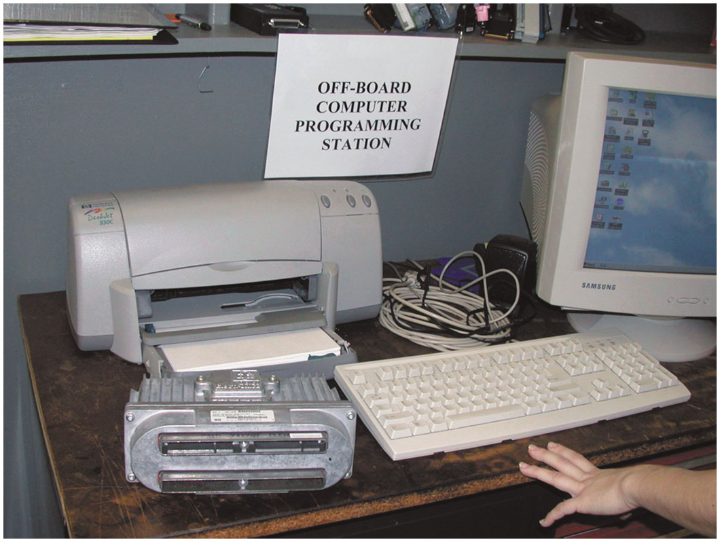
Figure 28.9
Off-Board Programming
The engine control module can be programmed at an off-board location.

Slide 19
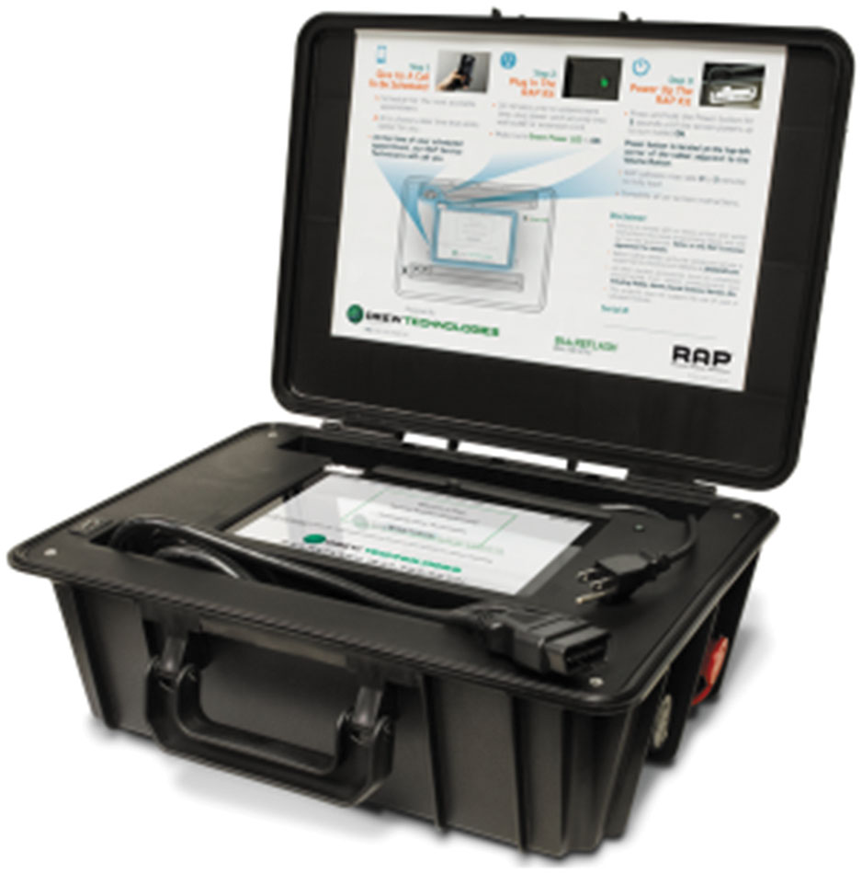
Figure 28.10
Remote Programmer
The Drew Technologies remote programming tool is an example of a tool that is connected to the vehicle and used remotely.
Notes:
Remote
Remote programming is a relatively new process. The servicing facility does not perform the reprogramming of the vehicle. Instead, the shop simply plugs in the equipment and follows the instructions of someone who is at a distant location. This process still requires an Internet connection and equipment. However, it relies on a third party who has the manufacturer subscription for the software. This option has become increasingly popular for shops that perform very few reprogramming events or lack the technical expertise to complete the task. • See Figure 28.10.

Slide 20
Battery Voltage
Provide a stable vehicle voltage
Use battery maintainer connected during repair
Hold vehicle at specific voltage for duration of repair.
No wide fluctuations in voltage or amperage.
Recommended that the maintainer be only used
For voltage stabilization during a reprogramming
Not be used for any other general shop
Notes:
In order to provide a stable vehicle voltage throughout the reprogramming process, it is recommended that a battery maintainer be connected to the vehicle during the repair. A battery maintainer is designed to hold the vehicle at a specific voltage throughout the duration of the repair. A unique feature of the battery maintainer is that it accomplishes this task without wide fluctuations in voltage or amperage. ● See Figures 28.11 and 28.12. Currently there are very few battery maintainers in the marketplace and they are more expensive than a battery charger. It is recommended that the maintainer be only used for the purpose of voltage stabilization during a reprogramming event, and they not be used for any other general shop use to ensure their proper operation.

Slide 21
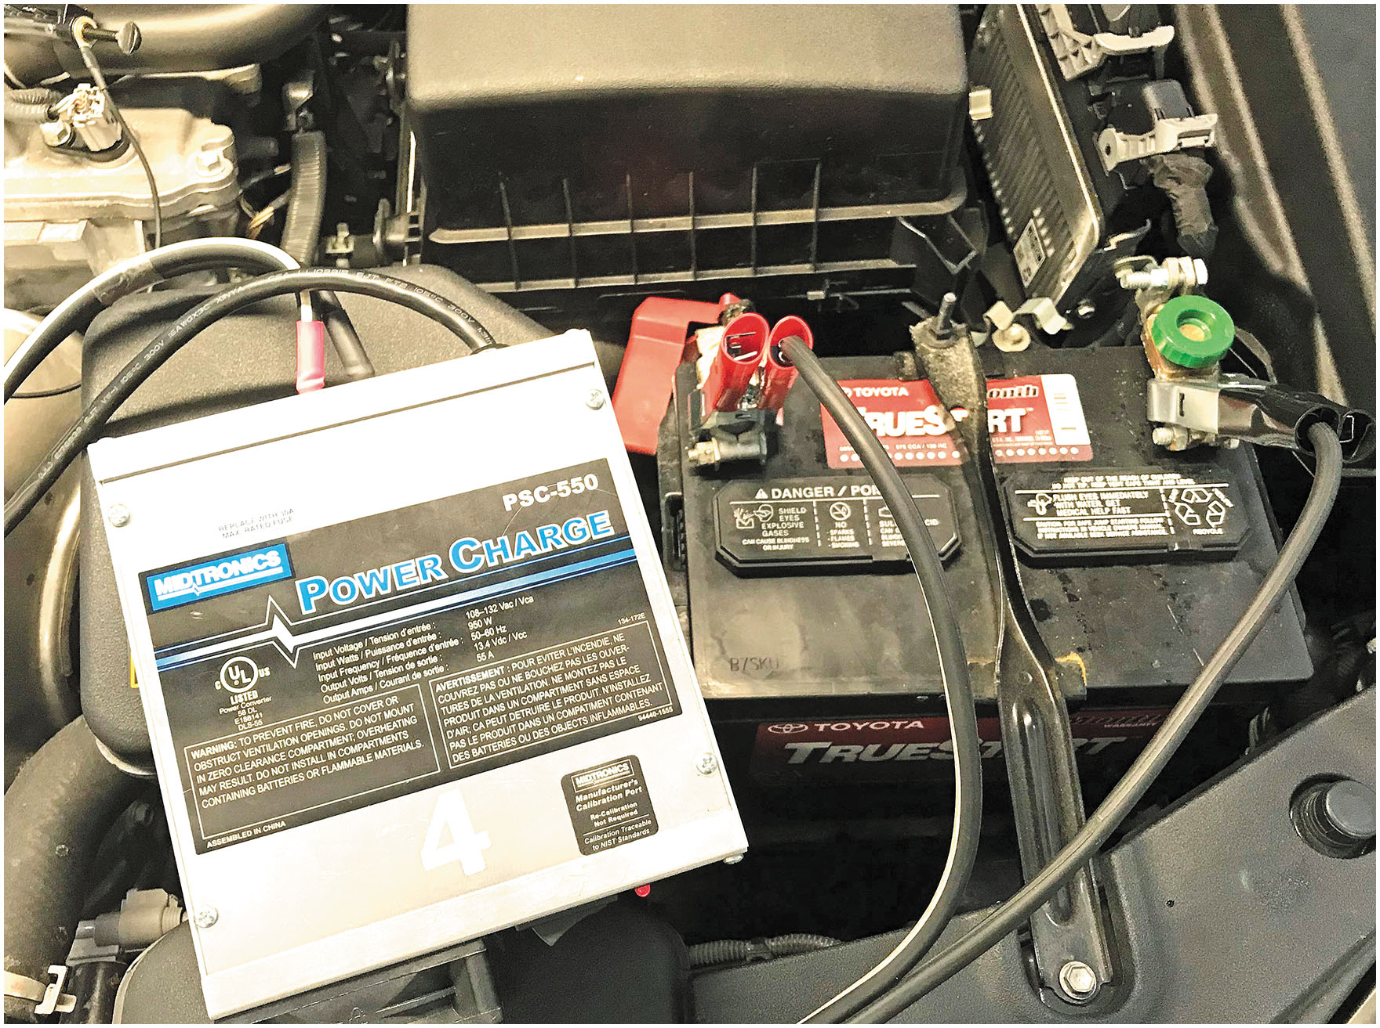
Figure 28.11
Battery Maintainer
The Midtronics P S C-550 is an example of battery maintainer that meets the voltage and current requirements for reprogramming.

Slide 22
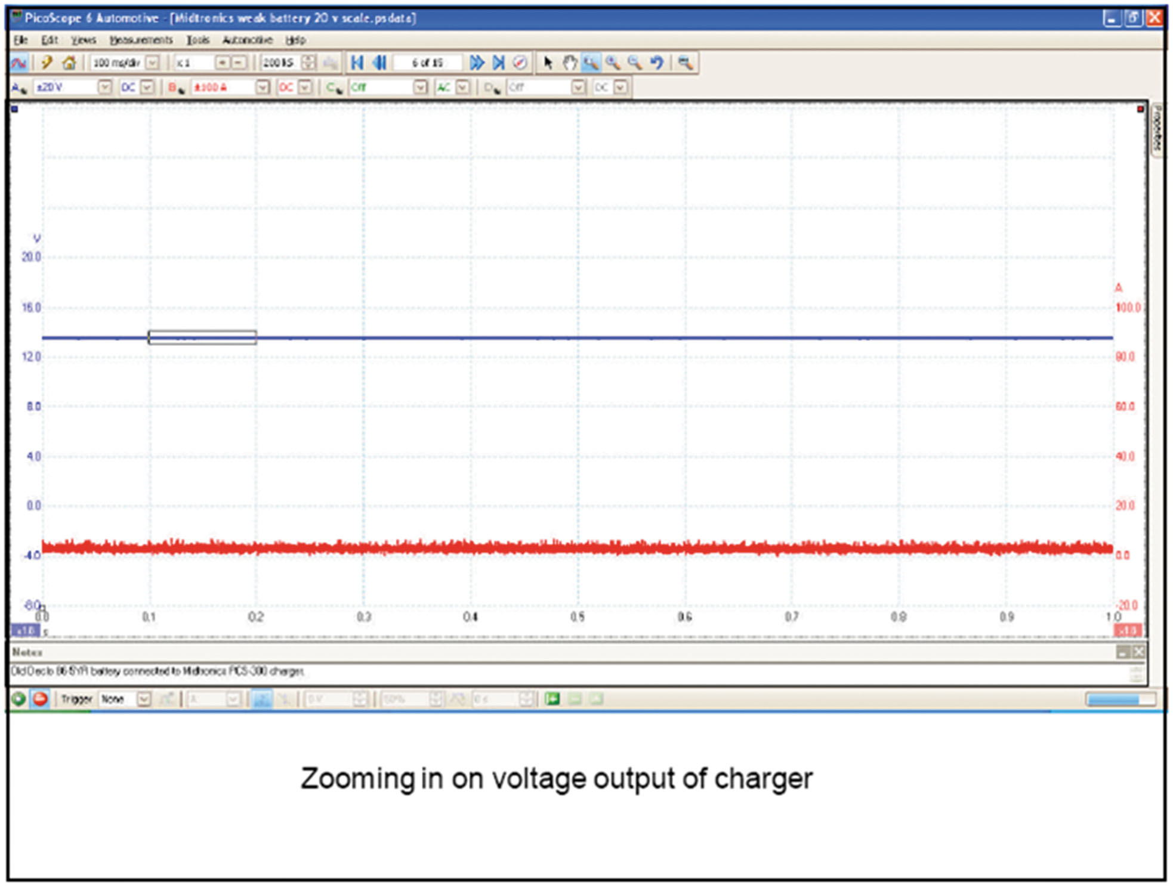
Figure 28.12
D S O Pattern
The scope patterns show stable voltage and current traces.
Notes:
The reprogramming of computers is relatively new to the automotive industry, and, as a result, there are many concerns related to the failure of the process and the damaging of the vehicle’s module. The items listed below are some of the reasons some shops are hesitant to perform this type of repair.

Slide 23
Aftermarket Reprogramming
Tuners increase torque and horsepower or defeat emissions
Take vehicle out of emission compliance
They do not meet E P A/C A R B requirements
Illegal for on- or off-road use
Change in torque and horsepower will lead to physical failures of the powertrain
Changes in software may also lead to a failure at the emission test lane due to monitor failures or omissions
Notes:
There are many aftermarket programmers or “tuners” available in the marketplace today. The primary purpose of the programs is to increase torque and horsepower or to defeat emission control devices. These programs take the vehicle out of emission compliance because they do not meet the E P A/C A R B requirements and are therefore illegal for on- or off-road use. It is likely that the change in torque and horsepower will lead to physical failures of the powertrain due to the increased numbers. The changes in software may also lead to a failure at the emission test lane due to monitor failures or omissions. ● See Figure 28.13.

Slide 24
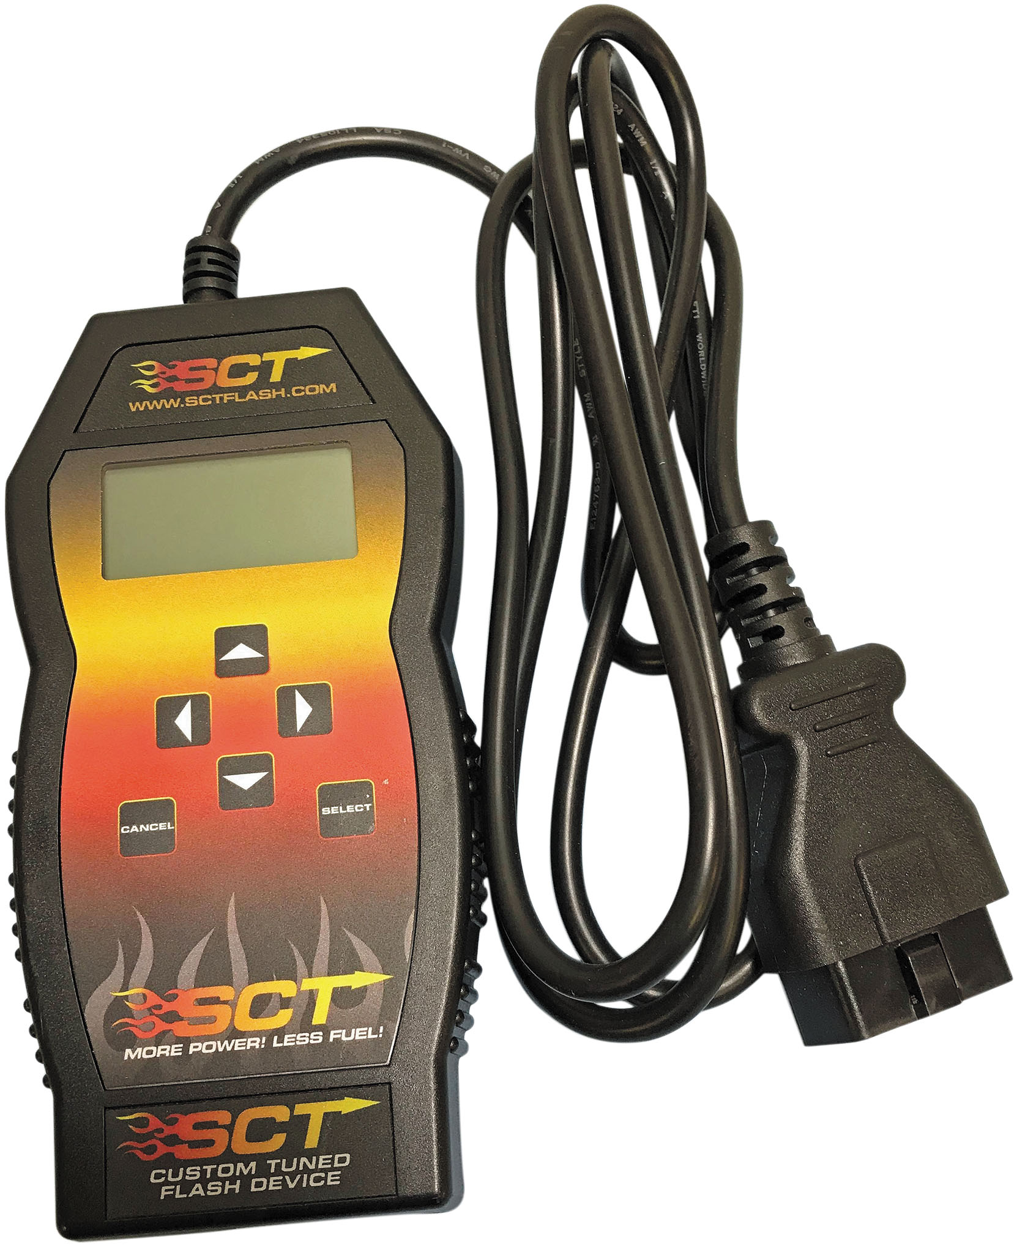
Figure 28.13
S C T Tuner
The S C T aftermarket tuner is an example of device that takes the vehicle out of compliance when reprogramming the module.

Slide 25
Frequently Asked Question: How Does Over-the-Air Software Update Work?
? Frequently Asked Question
How Does Over-the-Air Software Update Work? Over-the-air (O T A) updates refers to the process of updating the software wirelessly by the manufacturer, eliminating the need to take the vehicle to the dealership. The vehicle is connected to the Internet via onboard cellular equipment (either 4G or 5G) or by Wi-Fi (if the owner allows access to their home Internet). The software is downloaded when the vehicle is updated while parked during a period of non-use. The process allows the manufacturer to update many vehicles in a very short period. ● See Figure 28.14.

Slide 26
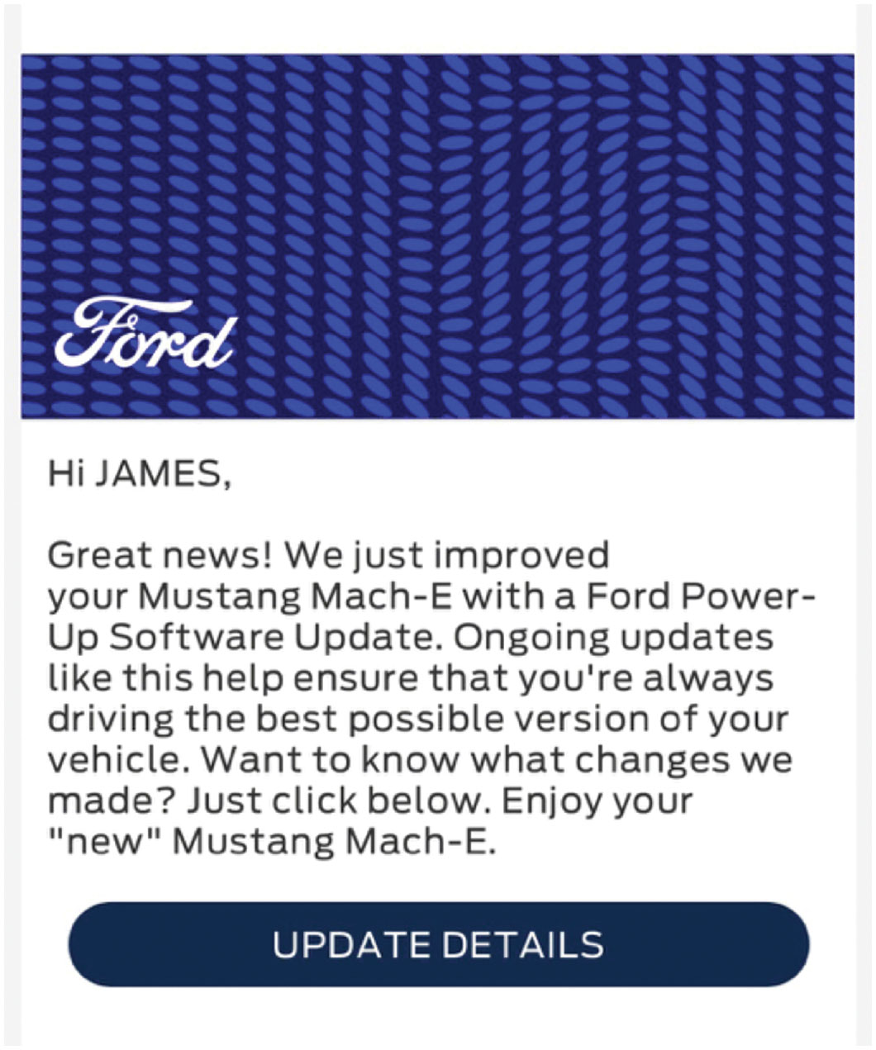
Figure 28.14
Software Message
The vehicle owner receives a message from the manufacturer acknowledging the software update.

Slide 27
Question 1
Technician A says that reprogramming an engine control module using the J2534 system requires a factory scan tool. Technician B says that reprogramming an engine control module using the J2534 system requires Internet access. Which technician is correct?
a. Technician A only
b. Technician B only
c. Both Technicians A and B
d. Neither Technician A nor B

Slide 28
Answer 1
Technician A says that reprogramming an engine control module using the J2534 system requires a factory scan tool. Technician B says that reprogramming an engine control module using the J2534 system requires Internet access. Which technician is correct?
b. Technician B only X

Slide 29
Summary
Programming of electronically erasable programmable read only
memory was a requirement for
J2534 standard supports programming of E E P R O M in modules responsible for emission control with a pass-through device on all vehicles 2004 and newer.
E E P R O M programming performed on-board the vehicle, off-board, or remotely with the proper equipment.
When reprogramming a module, use a battery maintainer, so the vehicle’s system voltage does not drop below the minimum level.
Many aftermarket programmers or “tuners” are designed to take the vehicle out of emission compliance and therefore are illegal for on- or off-road use.

Slide 30
Animation and Video Library Links (Must have an internet connection and active Haldeman subscription)
Animation Library: (A8) Engine Performance Animations
Video Library: (A8) Engine Performance Videos

Slide 31
Copyright
This work is protected by United States copyright laws and is provided solely for the use of instructors in teaching their courses and assessing student learning. Dissemination or sale of any part of this work (including on the World Wide Web) will destroy the integrity of the work and is not permitted. The work and materials from it should never be made available to students except by instructors using the accompanying text in their classes. All recipients of this work are expected to abide by these restrictions and to honor the intended pedagogical purposes and the needs of other instructors who rely on these materials.

