Slide 1
Advanced Engine Performance Diagnosis
Eighth Edition
Chapter 27
Emission Control Devices Operation and Diagnosis
Copyright © 2025 Pearson Education, Inc. All Rights Reserved
Notes:
If this PowerPoint presentation contains mathematical equations, you may need to check that your computer has the following installed:
1) Math Type Plugin
2) Math Player (free versions available)
3) NVDA Reader (free versions available)
INSTRUCTOR NOTE: This presentation includes text explanation notes, you can use to teach the course. When in SLIDE SHOW mode, you RIGHT CLICK and select SHOW PRESENTER VIEW, to use the notes.

Slide 2
Objectives (1 of 3)
27.1 Describe the purpose of emission control devices.
27.2 Explain how smog is created.
27.3 Explain exhaust gas recirculation systems.
27.4 Discuss
E G R monitoring strategies, diagnosing
a defective E G R system, and E G R trouble codes.
27.5 Explain how a defective E G R system is diagnosed.
27.6 Discuss crankcase ventilation, P C V system diagnosis, and P C V-related trouble codes.
27.7 Explain how to diagnose the P C V system.

Slide 3
Objectives (2 of 3)
27.8 Explain the secondary air-injection system and its diagnosis.
27.9 Describe the process for diagnosing a secondary air-injection system.
27.10 Explain the purpose and function of catalytic converters, their diagnosis, and guidelines to replace them.
27.11 Explain how to diagnose a catalytic converter.
27.12 Explain evaporative emission control system, and compare enhanced and nonenhanced evaporative control systems.

Slide 4
Objectives (3 of 3)
27.13 Discuss the leak detection pump system and onboard refueling vapor recovery.
27.14 Discuss the diagnosis of the E V A P system and state inspection E V A P tests.

Slide 5
Introduction (1 of 2)
Most of major advances in engines are direct result of need to improve fuel economy and reduce exhaust emissions.
Engine changes to meet latest emission standards include:
More efficient combustion chambers
Low friction engine components
More precise ignition timing with C O P ignition systems
Change ignition timing on individual cylinders
Closer engine tolerances to reduce unburned fuel emissions
Variable valve timing systems used to increase engine power and reduce exhaust emissions

Slide 6
Introduction (2 of 2)
It has been said that engine changes are due to the need to reduce three things.
Emissions
Emissions
Emissions

Slide 7
Smog (1 of 2)
Definition and Terminology
Term to describe air pollution is smog
Combines two words: smoke and fog.
Smog formed in atmosphere when sunlight combines with unburned H C
Oxides of nitrogen
produced during the combustion
process inside the cylinders of an engine.
Carbon monoxide (C O) is a poisonous gas
Smog is ozone
a strong irritant to the lungs and eyes.
Ozone is located in two places:
Upper-atmospheric ozone is desirable because it blocks out harmful ultraviolet rays from the sun.
Ground-level ozone considered to be unhealthy smog.
Notes:
Smog is formed in the atmosphere when sunlight combines with unburned fuel (hydrocarbon, or H C) and oxides of nitrogen (N O_{x}) produced during the combustion process inside the cylinders of an engine. Carbon monoxide (C O) is a poisonous gas. Smog is ozone (O₃), a strong irritant to the lungs and eyes.

Slide 8
Figure 27.1
Red-Brown Haze
Notice the red-brown haze which is often over many major cities. This haze is the result of oxides or nitrogen in the atmosphere.
Notes:
Emissions that are controlled include:
H C (unburned hydrocarbons). Excessive H C emissions (unburned fuel) are controlled by the evaporative system (charcoal canister), the positive crankcase ventilation (P C V) system, the secondary air-injection (S A I) system, and the catalytic converter.
C O (carbon monoxide). Excessive C O emissions are controlled by the positive crankcase ventilation (P C V) system, the secondary air-injection (S A I) system, and the catalytic converter.
N O_{x} (oxides of nitrogen). Excessive N O_{x} emissions are controlled by the exhaust gas recirculation (E G R) system and the catalytic converter. An oxide of nitrogen (N O) is a colorless, tasteless, and odorless gas when it leaves the engine, but as soon as it reaches the atmosphere and mixes with more oxygen, nitrogen oxides (N O₂) are formed, which appear as red-brown emissions. • See Figure 27.1.

Slide 9
Smog (2 of 2)
H C (unburned hydrocarbons).
C O (Carbon Monoxide).
C O controlled by Positive Crankcase Ventilation (P C V) system, secondary air-injection (S A I) system, and the catalytic converter.
(oxides of nitrogen).
Controlled by exhaust gas recirculation (E G R) system and catalytic converter.
Notes:
H C (unburned hydrocarbons). Excessive H C emissions (unburned fuel) are controlled by the evaporative system (charcoal canister), the positive crankcase ventilation (P C V) system, the secondary air-injection (S A I) system, and the catalytic converter.
C O (carbon monoxide). Excessive C O emissions are controlled by the positive crankcase ventilation (P C V) system, the secondary air-injection (S A I) system, and the catalytic converter.
N O_{x} (oxides of nitrogen). Excessive NOx emissions are controlled by the exhaust gas recirculation (E G R) system and the catalytic converter.
An oxide of nitrogen (N O) is a colorless, tasteless, and odorless gas when it leaves the engine, but as soon as it reaches the atmosphere and mixes with more oxygen, nitrogen oxides (N O₂) are formed, which appear as red-brown emissions

Slide 10
Exhaust Gas Recirculation Systems (1 of 14)
Exhaust gas recirculation (E G R) is an emission control
system that lowers amount of nitrogen oxides
formed during combustion.
In presence of sunlight,
reacts with hydrocarbons in
the atmosphere to form ozone
or photochemical
smog, an air pollutant.

Slide 11
Exhaust Gas Recirculation Systems (2 of 14)
Formation
Nitrogen
and oxygen
molecules are separated
into individual atoms of nitrogen and oxygen during the combustion process.
These molecules then bond to form
When combustion flame front temperatures exceed
is formed inside the cylinders,
which is then discharged into the atmosphere from the tailpipe.

Slide 12
Exhaust Gas Recirculation Systems (3 of 14)
Controlling
To handle
generated above
Most efficient method to meet
emissions, without
significantly affecting engine performance, fuel economy, and other exhaust emissions, is to use exhaust gas recirculation (E G R).
E G R system routes small quantities, usually between 6% and 10%, of exhaust gas into the intake manifold.

Slide 13
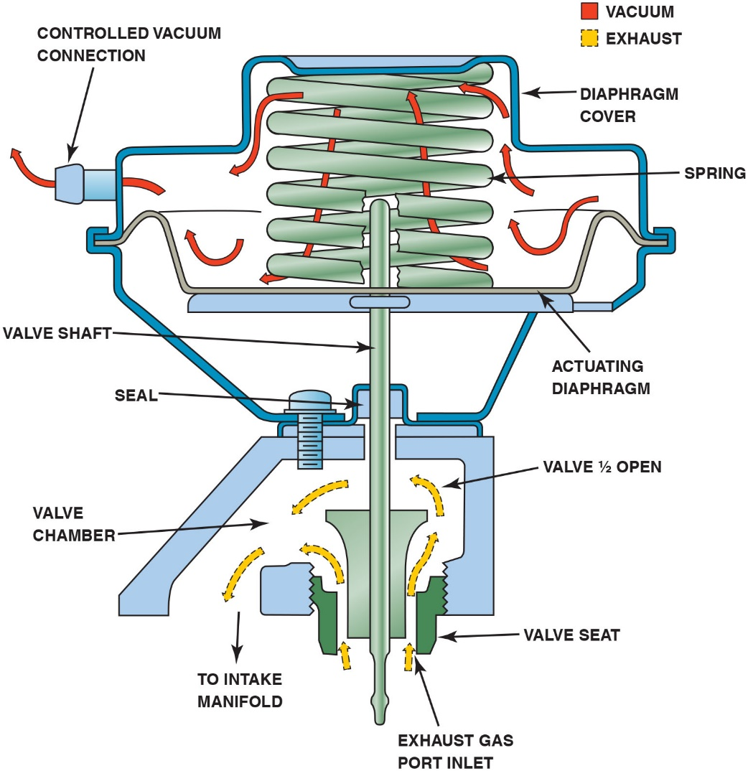
Figure 27.2
E G R Valve
When the E G R valve opens, the exhaust gases flow through the valve and into passages in the intake manifold.
Notes:
Long Description:
A spring is over the valve shaft. The diaphragm cover is in the form of a hat over a V-shaped component split on the bottom. The spring sits on a diaphragm plate. The actuating diaphragm is in the form of a container with its ends connected to the edges of the hat-shaped portion of the diaphragm cover. A controlled vacuum connection is fit to the diaphragm cover. A seal tightly secures the valve with a V-shaped engine. Valve seats are fixed on either side of the valve shaft with one to the end of the V-shaped engine edge and the other to an outlet with an arrow labeled to intake manifold. Red arrows indicating vacuum flow from the right bottom end above the actuating diaphragm to up, then from the right bottom spring turn to the top turn and top turn to the left bottom turn, and from the top spring to above the left diaphragm to controlled vacuum connection. Yellow arrows indicating exhaust flow from the right bottom side of the vacuum shaft to the other side and yellow arrows also flow from the outlet to intake manifold. The V-shaped engine edge is labeled valve chamber. The other end of the valve is labeled valve half open. The space where the yellow arrow enters the right bottom side of the vacuum shaft is labeled exhaust gas port inlet.

Slide 14
Animation: Exhaust Gas Recirculation, EGR

Slide 15
Exhaust Gas Recirculation Systems (4 of 14)
E G R system interconnects exhaust and intake manifolds.
E G R valve controls flow of exhaust gases through interconnecting passages.
On V-type engines, intake manifold crossover is used as a source of exhaust gas for E G R system.
Cast passage connects exhaust crossover to E G R valve
Exhaust gas is sent from E G R valve to openings in manifold.

Slide 16
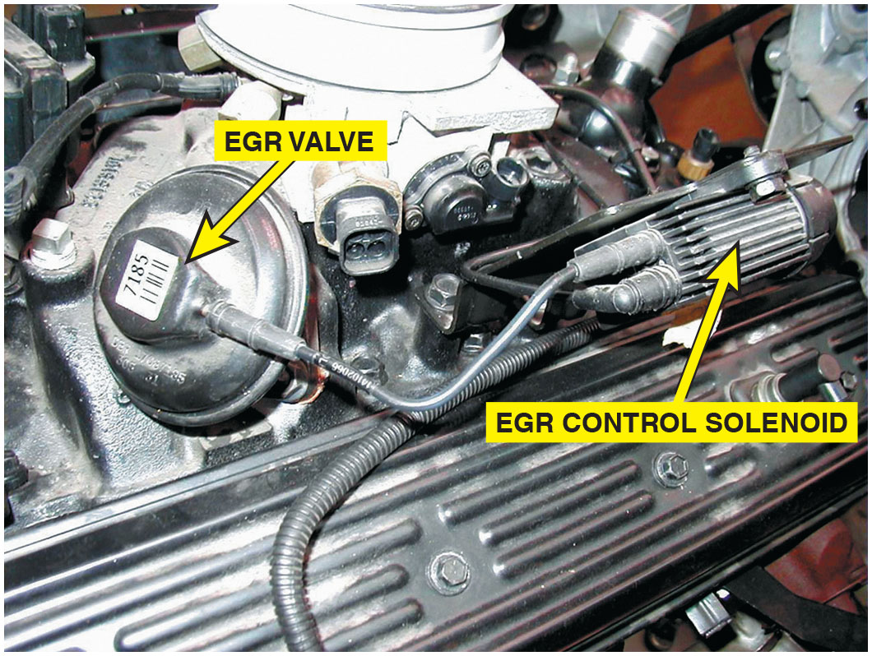
Figure 27.3
Vacuum-Operated E G R Valve
A vacuum-operated E G R valve. The vacuum to the E G R valve is computer controlled by the E G R valve control solenoid.

Slide 17
Exhaust Gas Recirculation Systems (5 of 14)
On inline-type engines, an external tube is used to carry exhaust gas to E G R valve.
Designed to be long so that exhaust gas is cooled before it enters E G R valve.

Slide 18
Exhaust Gas Recirculation Systems (6 of 14)
E G R System Operation
Needed to lower peak combustion temperatures.
not required during conditions because combustion temperatures low:
Idle speed
When engine is cold
At W O T (not allowing E G R allows engine to provide extra power
when demanded. While
formation is high during these times,
overall effect of not using E G R during W O T is minor
emission changes according to speed, temperature, and load.
E G R is not used at W O T because it would reduce engine performance and engine does not operate under these conditions for a long period of time.

Slide 19
Exhaust Gas Recirculation Systems (7 of 14)
E G R Benefits
In addition to lowering
levels, the E G R system also
helps control detonation.
Detonation, also called spark knock or ping, occurs when high pressure and heat cause air–fuel mixture to ignite.
Uncontrolled combustion can severely damage the engine.
Using E G R system allows for greater ignition timing advance and for advance to occur sooner without detonation problems, which increases power and efficiency.

Slide 20
Exhaust Gas Recirculation Systems (8 of 14)
Positive and Negative Backpressure E G R Valves
Vacuum-operated E G R valves used on older engines
Have small valve inside that bleeds off any applied vacuum and prevents valve from opening.
Positive Backpressure.
Require positive backpressure in exhaust system.
At low engine speeds and light engine loads, the E G R system is not needed.
Without sufficient backpressure E G R valve does not open even though vacuum may be present at E G R valve.

Slide 21
Exhaust Gas Recirculation Systems (9 of 14)
Negative Backpressure.
On each exhaust stroke, engine emits an exhaust “pulse.”
Each pulse represents a positive pressure.
Behind each pulse is a small area of low pressure.
Some E G R valves react to this low-pressure area by closing a small internal valve which allows E G R valve to be opened by vacuum.
Notes:
Note
Installing a high-performance exhaust system could prevent a backpressure vacuum-operated E G R valve from opening. If this occurs, excessive combustion chamber temperature leads to severe spark knock, piston damage, or a blown head gasket.

Slide 22
Exhaust Gas Recirculation Systems (10 of 14)
Computer-Controlled E G R Systems
E G R systems have one or more solenoids controlling E G R vacuum.
Computer controls a solenoid to shut off vacuum to E G R valve at cold engine temperatures, idle speed, and wide-open throttle operation.
If two solenoids are used, one acts as an off-on control of supply vacuum.
Second solenoid vents vacuum when E G R flow is not desired or needs to be reduced.
Notes:
The second solenoid is used to control a vacuum air bleed, allowing atmospheric pressure in to modulate E G R flow according to vehicle operating conditions.

Slide 23
Exhaust Gas Recirculation Systems (11 of 14)
E G R Valve Position Sensors
Computer controlled E G R systems use a sensor to indicate E G R operation.
E G R system monitors require E G R sensor to
verify valve opened.
Linear potentiometer on top of E G R valve stem indicates valve position
Called an E G R valve position (E V P) sensor.
Some later-model Ford E G R systems, however, use a feedback signal provided by E G R exhaust backpressure sensor converts exhaust backpressure to a voltage signal.
Called a pressure feedback E G R (P F E) sensor.

Slide 24
Exhaust Gas Recirculation Systems (12 of 14)
On some E G R systems, the top of valve contains a vacuum regulator and E G R pintle-position sensor in one assembly.
Pintle-position sensor provides a voltage output to P C M.
Increases as duty cycle increases, allowing P C M to monitor valve operation.

Slide 25
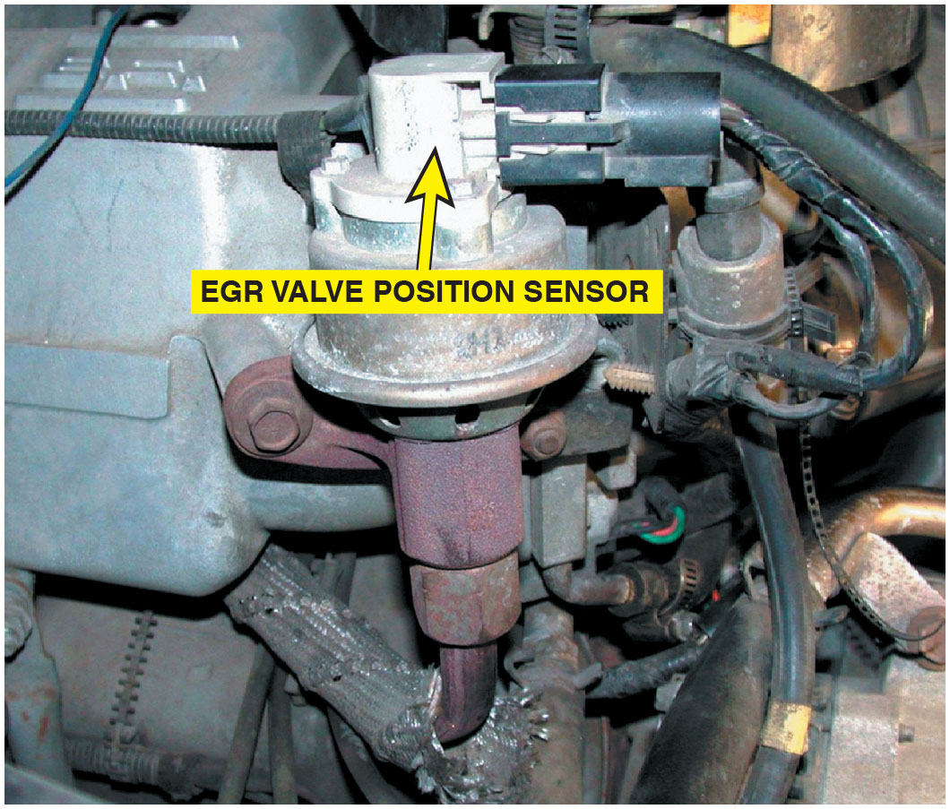
Figure 27.4
E G R Valve Position Sensor
An E G R valve position sensor on top of an E G R valve.

Slide 26
Exhaust Gas Recirculation Systems (13 of 14)
Digital E G R Valves
G M introduced digital E G R valve design on some engines.
Consists of three solenoids controlled by P C M
Each solenoid controls a different size orifice in the base—small, medium, and large.
P C M controls ground circuit of each solenoids individually.
It can produce any of seven different flow rates, using solenoids to open the three valves in different combinations.
Offers precise control, and using a swivel pintle design helps prevent carbon deposit problems.

Slide 27
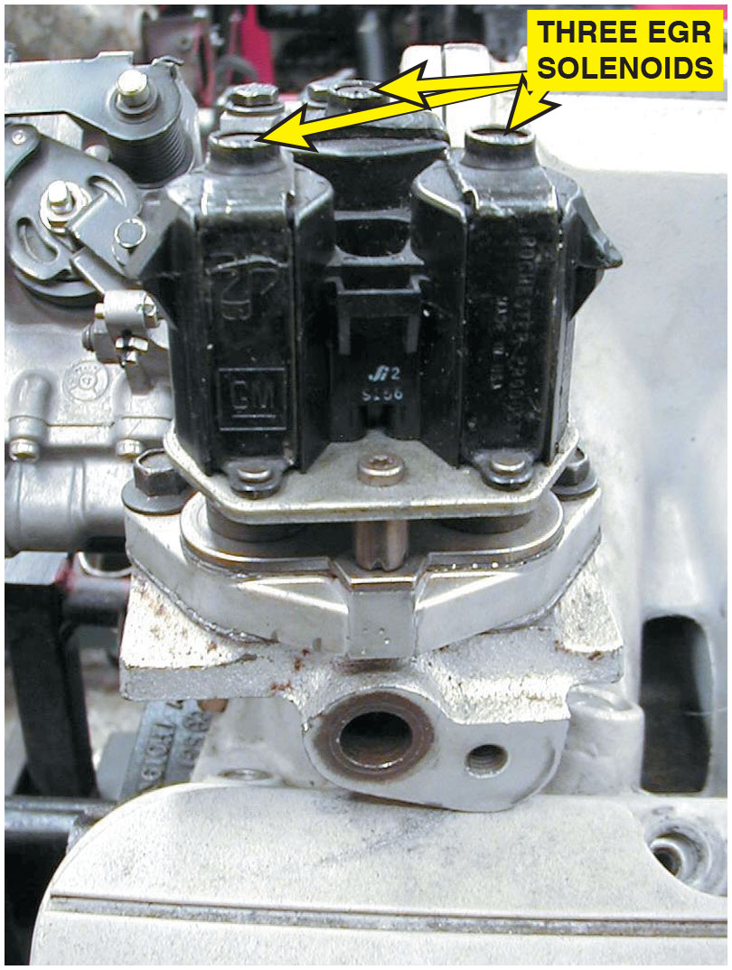
Figure 27.5
Digital E G R Valve
Digital E G R valve.

Slide 28
Exhaust Gas Recirculation Systems (14 of 14)
Linear E G R
Most G M and many other vehicles use a linear E G R
Contains a P W M solenoid to precisely regulate exhaust gas flow and a feedback potentiometer.
Signals computer regarding actual position of the valve.

Slide 29
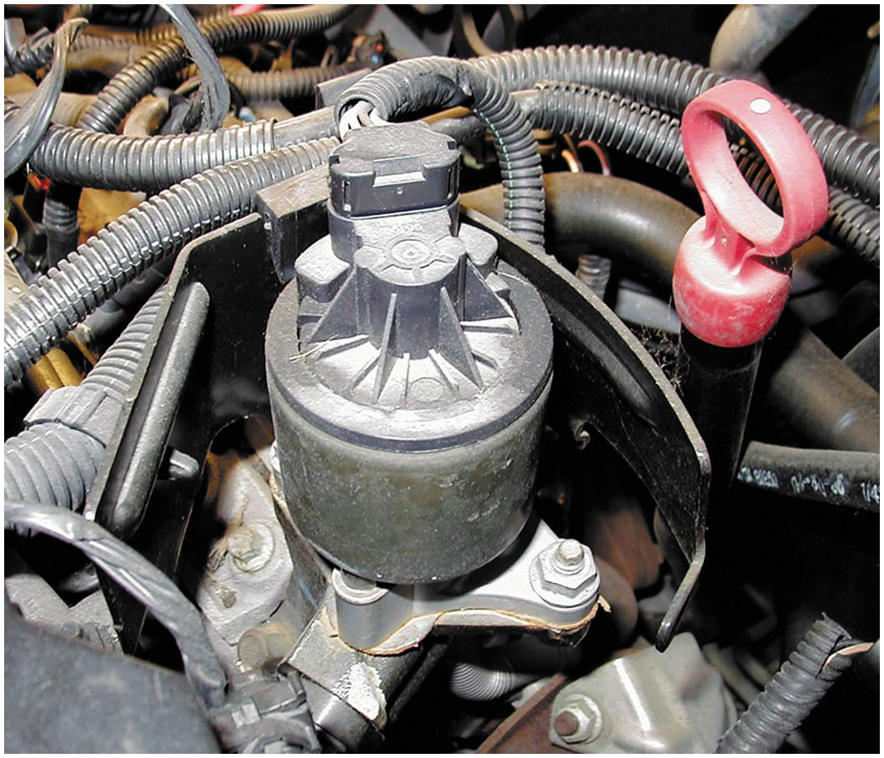
Figure 27.6
Linear E G R Valve
General Motors linear E G R valve.

Slide 30
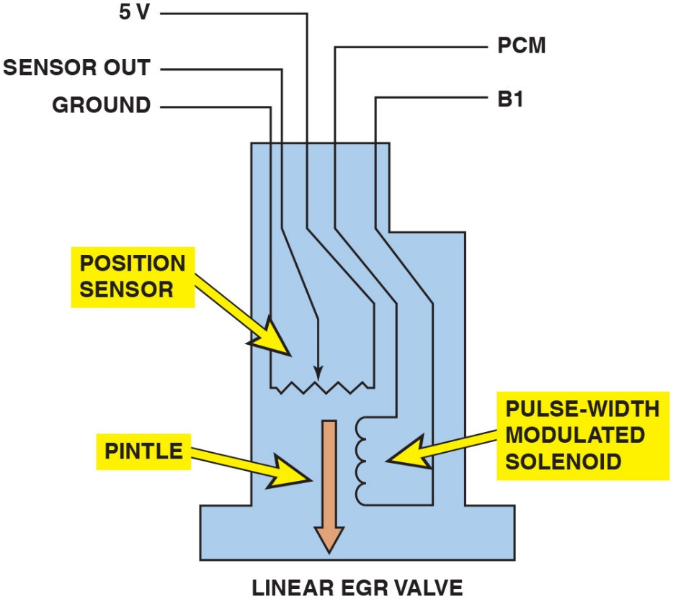
Figure 27.7
E G R Valve Pintle Schematic
The E G R valve pintle is pulse-width modulated and a three-wire potentiometer provides pintle-position information back to the P C M.
Notes:
Long Description:
It displays a flat rectangular base with a rectangular structure having an L-shaped edge on top right, labeled as a linear E G R valve. A P C M and B 1 from the top lead inside the linear E G R valve are connected to the terminals of a pulse-width modulated solenoid. Ground and 5 V from the top left enter inside the linear E G R valve and connected to the left terminal and center tap of a position sensor. A downward arrow pointing at the triangular edges represents the direction of the sensor out. A downward arrow touches the base of a linear E G R valve labeled as a pintle.

Slide 31
O B D hyphen Roman number 2 E G R Monitoring Strategies (1 of 4)
Purpose and Function
In 1996, E P A began requiring
systems
Includes emissions system monitors that alert driver and technician if emissions system is malfunctioning.
performs test by opening and closing E G R valve.
P C M monitors an E G R function sensor for a change in signal voltage. If E G R system fails, a D T C sets.
System fails two consecutive times, M I L is lit.

Slide 32
O B D hyphen Roman number 2 E G R Monitoring Strategies (2 of 4)
Monitoring Strategies
E G R monitoring strategies include:
Monitor difference in the exhaust oxygen sensor voltage activity as E G R valve opens and closes.
Oxygen in exhaust decreases when E G R valve is open and increases when E G R valve is closed.
P C M sets a D T C if sensor signal does not change.

Slide 33
O B D hyphen Roman number 2 E G R Monitoring Strategies (3 of 4)
Most Fords use an E G R monitor test sensor called a delta pressure feedback E G R (D P F E) sensor.
Measures pressure differential between two sides of a metered orifice positioned just below E G R valve’s exhaust side.
Pressure between orifice and E G R valve decreases when E G R opens because it becomes exposed to lower pressure in intake.
D P F E sensor recognizes this pressure drop, compares it to relatively higher pressure on exhaust side of orifice, and signals value of pressure difference to P C M.

Slide 34
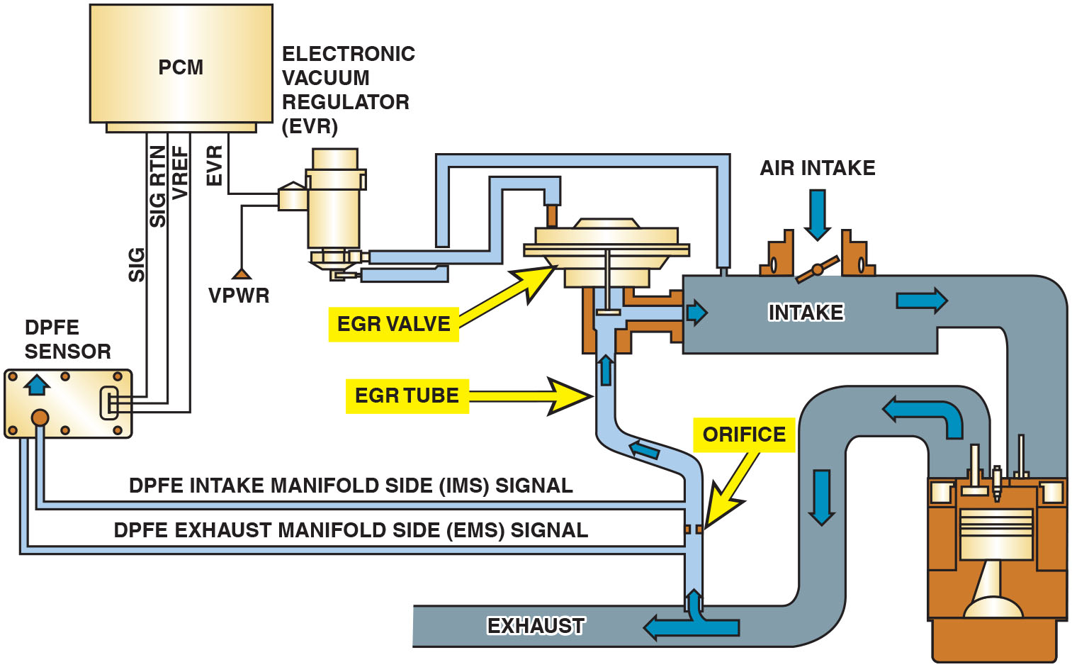
Figure 27.8
D P F E Sensor and Related Components
A D P F E sensor and related components.
Notes:
Long Description:
Input signals such as S I G, S I G R T N, and V REF from the D P F E sensor are fed to the P C M. E V R from the P C M is fed to an electronic vacuum regulator (E V R), where the other signal to it from below is V P W R. Two outlet pipes are from E V R: one to the E G R valve and the other to the intake manifold. The intake manifold is fed to an air recirculation system. From the E G R valve, a E G R tube passes to the exhaust from the recirculation system. There is an intake manifold pipe with the signal labeled D P F E intake manifold side (I M S) signal from the D P F E sensor to the E G R tube. There are orifices in the tube below. There is an exhaust manifold pipe with the signal labeled D P F E exhaust manifold side (E M S) signal. Air intake is to the intake valve over the intake manifold. The air flow is from the right of the E G R tube to intake, to the recirculation system and from it to the exhaust and to the E G R tube.

Slide 35
Frequently Asked Question: Where Is the E G R Valve?
? Frequently Asked Question
Where Is the E G R Valve? Most newer vehicles that are equipped with variable valve timing (V V T) use the valve overlap to keep some exhaust gases in the combustion chamber. As a result, most newer engines do not use an E G R valve.

Slide 36
O B D hyphen Roman number 2 E G R Monitoring Strategies (4 of 4)
Many manufacturers use M A P sensor as E G R monitor on some applications.
After meeting enable criteria (operating condition requirements), E G R monitor is run.
P C M monitors M A P sensor while it commands E G R valve to open.
M A P sensor signal should change in response to sudden change in manifold pressure or fuel trim changes created by a change in oxygen sensor voltage.
If E G R fails on two consecutive trips, P C M lights M I L.

Slide 37
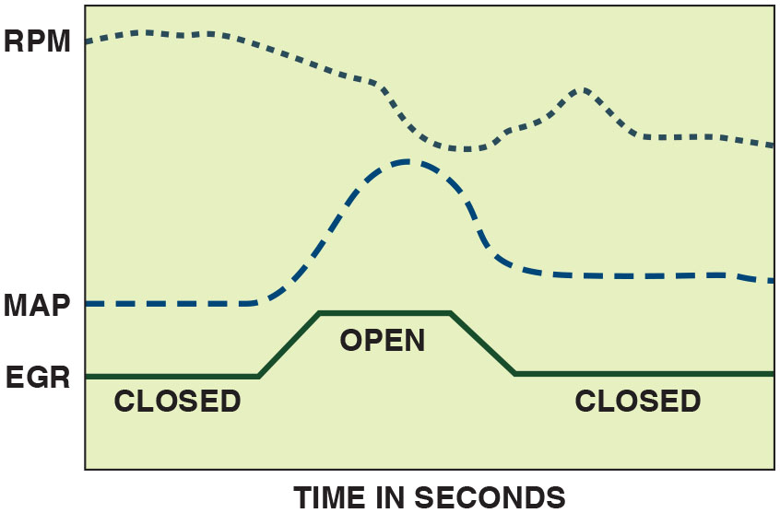
Figure 27.9
Active Test
An
active test. P C M opens the E G R valve and then
monitors the M A P sensor and/or engine speed (R P M) to verify that it meets acceptable values.
Notes:
Long Description:
The illustration displays time in seconds. E G R begins with a straight line labeled as closed. It then shows a steep increase, continues as a straight line, and then shows a decline; this segment is labeled as open. It then continues as a straight line until the end, labeled as closed. A dashed line represents M A P, which goes straight and then witnesses a wave followed by a straight path. R P M is a smaller dashed line with an irregular path; it shows gradual decline, then shows a U-shaped curve, followed by gradual decline.

Slide 38
Diagnosing a Defective E G R System (1 of 3)
Symptoms
If E G R valve is not opening or flow of exhaust gas is restricted, following symptoms are likely.
Detonation (spark knock or ping) during acceleration or during cruise (steady-speed driving)
Excessive
exhaust emissions If E G R valve is stuck
open or partially open, following symptoms are likely.
Rough idle or frequent stalling
Poor performance/low power, especially at low engine speed

Slide 39
Diagnosing a Defective E G R System (2 of 3)
E G R Testing Procedures
First step is to perform thorough visual inspection.
To check for proper operation of vacuum-operated E G R valve, follow these steps.
Notes:
Tech Tip: Watch Out for Carbon Balls!
Exhaust gas recirculation (E G R) valves can get stuck partially open by a chunk of carbon. The E G R valve or solenoid will test as defective. When the valve (or solenoid) is removed, small chunks or balls of carbon often fall into the exhaust manifold passage. When the replacement valve is installed, the carbon balls can be drawn into the new valve again, causing the engine to idle roughly or stall. To help prevent this problem, start the engine with the E G R valve or solenoid removed. Any balls or chunks of carbon will be blown out of the passage by the exhaust. Stop the engine and install the replacement E G R valve or solenoid.

Slide 40
Diagnosing a Defective E G R System (3 of 3)
STEP 1: Check vacuum diaphragm of E G R valve to see if it can hold vacuum. Because many E G R valves require exhaust backpressure to function correctly, engine should be running at a fast idle during this test. Always follow the specified testing procedures.
STEP 2: Apply vacuum from a hand-operated vacuum pump and check for proper operation. Valve itself should move when vacuum is applied, and engine operation should be affected. E G R valve should be able to hold vacuum that was applied. If vacuum drops off, then valve is likely to be defective.
STEP 3: Monitor engine vacuum drop. Connect vacuum gauge to an intake manifold vacuum source and monitor engine vacuum at idle (17–21 inch Hg at sea level). Raise speed of engine to 2,500 R P M and note vacuum reading (17–21 inch Hg or higher).

Slide 41
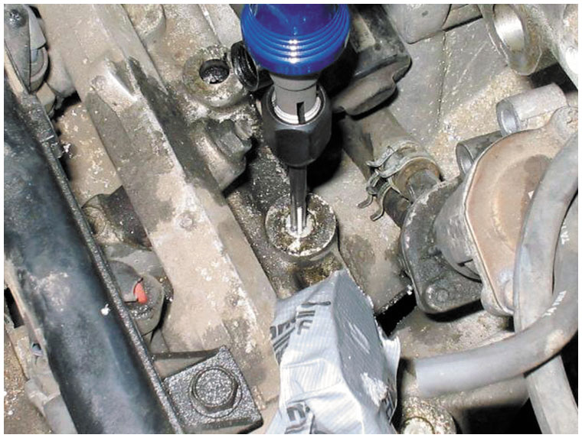
Figure 27.10
Honda E G R Passage Plug Removal
Removing the E G R passage plugs from intake manifold on a Honda.
Notes:
Tech Tip: The Snake Trick
The E G R passages on many intake manifolds become clogged with carbon, which reduces the flow of exhaust and the amount of exhaust gases in the cylinders. This reduction can cause spark knock (detonation) and increased emissions of oxides of nitrogen (N O_{x}) (especially important in areas with enhanced exhaust emissions testing). To quickly and easily remove carbon from exhaust passages, cut an approximately 1 foot (30 c m) length from stranded wire, such as garage door guide wire or an old speedometer cable. Flare the end and place the end of the wire into the passage. Set your drill on reverse, turn it on, and the wire will pull its way through the passage, cleaning the carbon as it goes, just like a snake in a drain pipe. Some vehicles, such as Hondas, require that plugs be drilled out to gain access to the E G R passages, as shown in • See Figure 27.10.

Slide 42
E G R-Related O B D hyphen Roman number 2 Diagnostic Trouble Codes
Diagnostic Trouble Code | Description | Possible Causes
P0400 | Exhaust gas recirculation flow problems | E G R valve E G R valve hose or electrical connection Defective P C M
P0401 | Exhaust gas recirculation flow insufficient | E G R valve Clogged E G R ports or passages
P0402 | Exhaust gas recirculation flow excessive | Stuck-open E G R valve Vacuum hose(s) misrouted Electrical wiring shorted
Notes:
Case Study: The Blazer Story
The owner of a Chevrolet Blazer equipped with a 4.3-liter V-6 engine complained that the engine would stumble and hesitate at times. Everything seemed to be functioning correctly, except that the service technician discovered a weak vacuum going to the E G R valve at idle. This vehicle was equipped with an E G R valve-control solenoid, called an electronic vacuum regulator valve (E V R V) by General Motors Corporation. The computer pulses the solenoid to control the vacuum that regulates the operation of
the E G R valve. The technician checked the service manual for details on how the system worked. The technician discovered that vacuum should be present at the E G R valve only when the gear selector indicates a drive gear (drive, low, reverse). Because the technician discovered the vacuum at the solenoid to be leaking, the solenoid was obviously defective and required replacement. After replacement of the solenoid (E V R V), the hesitation problem was solved.
Summary
Concern—Vehicle owner complained that the engine would stumble and hesitate at times.
Cause—The E G R vacuum solenoid was found to be leaking.
Correction—The E G R solenoid was replaced which restored proper engine operation.

Slide 43
Crankcase Ventilation (1 of 7)
Purpose and Function
No piston ring, new or old, can provide a perfect seal between piston and cylinder wall.
Engine running, pressure of combustion forces piston downward.
This same pressure also forces gases and unburned fuel from the combustion chamber, past the piston rings, and into the crankcase.
Blowby term used to describe when combustion gases are forced past piston rings and into crankcase.

Slide 44
Crankcase Ventilation (2 of 7)
Blowby, must be ventilated from crankcase.
Crankcase cannot be vented directly to atmosphere, because the hydrocarbon vapors add to air pollution.
Positive Crankcase Ventilation (P C V)
Developed to ventilate crankcase.
Recirculate vapors to engine’s induction system so they can be burned in the cylinders.
P C V systems help reduce H C and C O emissions.

Slide 45
Crankcase Ventilation (3 of 7)
All systems use following:
P C V valve, calibrated orifice, or orifice and separator
P C V inlet air filter plus all connecting hoses
Oil/vapor or oil/water separator is used in some systems instead of a valve or orifice, with turbocharged and fuel-injected engines.
Oil/vapor separator lets oil condense and drain back into crankcase.
Oil/water separator accumulates moisture and prevents it from freezing during cold engine starts.

Slide 46
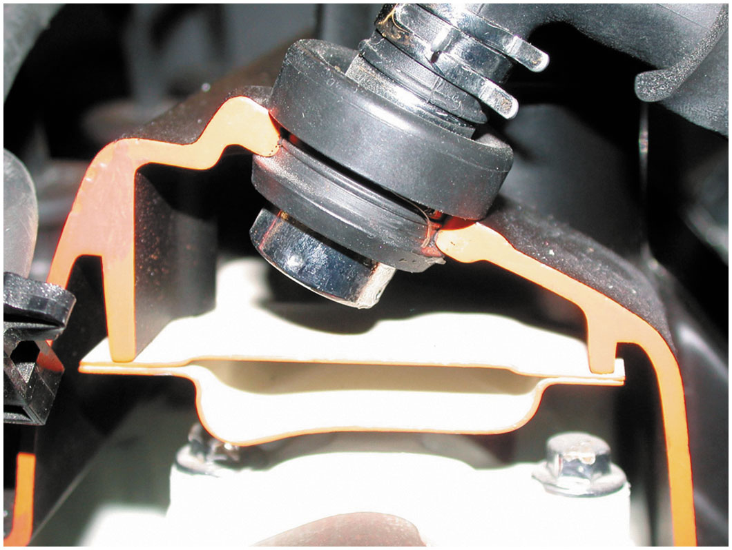
Figure 27.11
Crankcase Ventilation
P C V valve in a cutaway valve cover, showing the baffles that prevent liquid oil from being drawn into the intake manifold.

Slide 47
Animation: Positive Crankcase Ventilation (PCV)

Slide 48
Crankcase Ventilation (4 of 7)
Air for P C V system is drawn after air cleaner filter, which acts as a P C V filter.
P C V valve in most systems is a one-way valve containing a spring-operated plunger that controls valve flow rate.
Flow rate is established for each engine and a valve for a different engine should not be substituted.
Flow rate is determined by size of plunger and holes inside valve.
P C V valves located in valve cover or intake manifold
Notes:
NOTE: Some older designs drew from the dirty side of the air cleaner, where a separate crankcase ventilation filter was used.

Slide 49
Crankcase Ventilation (5 of 7)
P C V valve regulates airflow through the crankcase under all driving conditions and speeds.
Manifold vacuum is high (at idle, cruising, and light-load operation), P C V valve restricts airflow to maintain a balanced air–fuel ratio.
It also prevents high intake manifold vacuum from pulling oil out of the crankcase and into the intake manifold.
Under high speed or heavy loads, the valve opens and allows maximum airflow.
If engine backfires, valve will close instantly to prevent a crankcase explosion.

Slide 50
Crankcase Ventilation (6 of 7)
Orifice-Controlled Systems
Closed P C V system used on four-cylinder engines
Contains calibrated orifice instead of P C V valve.
Located in valve cover or intake manifold
Hose connected between valve cover, air cleaner, and intake manifold.
While most orifice flow control systems work same as a P C V valve system.
They may not use fresh air scavenging of crankcase.
Notes:
Crankcase vapors are drawn into the intake manifold in calibrated amounts, depending on manifold pressure and the orifice size.
If vapor availability is low, as during idle, air is drawn in with the vapors.
During off-idle operation, excess vapors are sent to the air cleaner.
At idle, P C V flow is controlled by a 0.05 inch (1.3 m m) orifice.
As engine moves off idle, ported vacuum pulls a spring-loaded valve off of its seat, allowing P C V flow to pass through a 0.09 inch (2.3 mm) orifice.

Slide 51
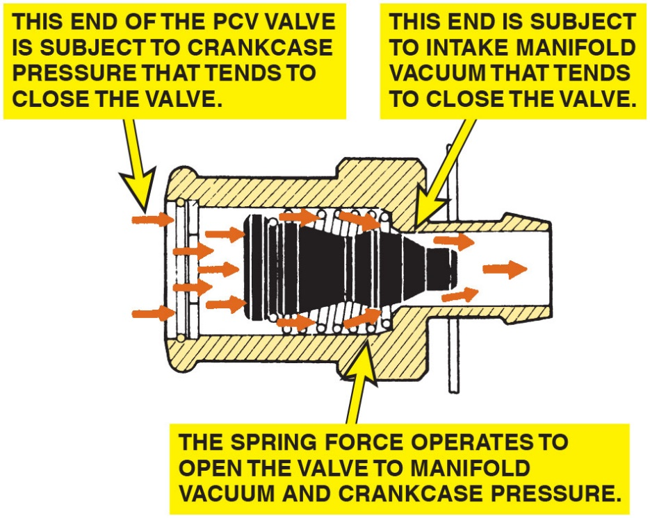
Figure 27.12
P C V Valve Cutaway
P C V valve in a cutaway valve cover, showing the baffles that prevent liquid oil from being drawn into the intake manifold.
Notes:
P C V Valves
The P C V valve in most systems is a one-way valve containing a spring-operated plunger that controls valve flow rate. • See Figure 27.12.
Long Description:
The left end of the P C V valve is subject to crankcase pressure that tends to close the valve. Several rightward arrows indicate the flow. The spring force operates to open the valve to manifold vacuum and crankcase pressure. The right end is subject to an intake manifold vacuum that tends to close the valve.

Slide 52
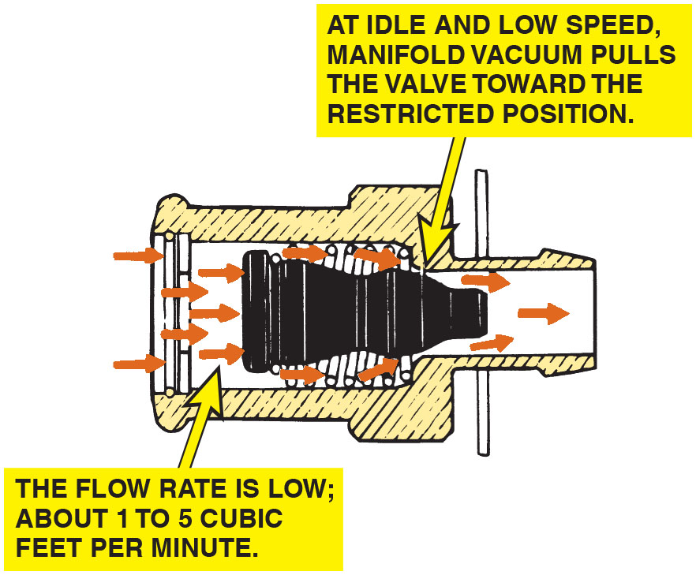
Figure 27.14
P C V Flow During Acceleration
Air flows through the P C V valve during acceleration and when the engine is under a heavy load.

Slide 53
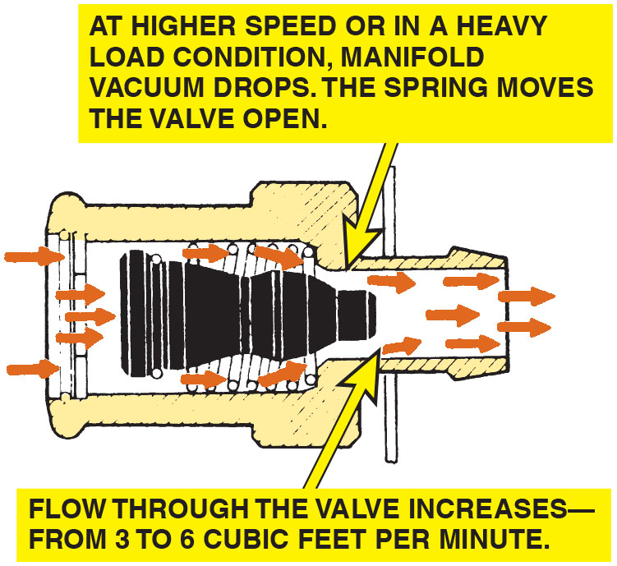
Figure 27.13
P C V Flow, Idle Light Loads
Air flows through the P C V valve during idle, cruising, and light-load conditions.
Notes:
A flow rate is established for each engine and a valve for a different engine should not be substituted. The flow rate is determined by the size of the plunger and the holes inside the valve. P C V valves usually are located in the valve cover or intake manifold. The P C V valve regulates airflow through the crankcase under all driving conditions and speeds. When manifold vacuum is high (at idle, cruising, and light-load operation), the P C V valve restricts the airflow to maintain a balanced air–fuel ratio. • See Figure 27.13.

Slide 54
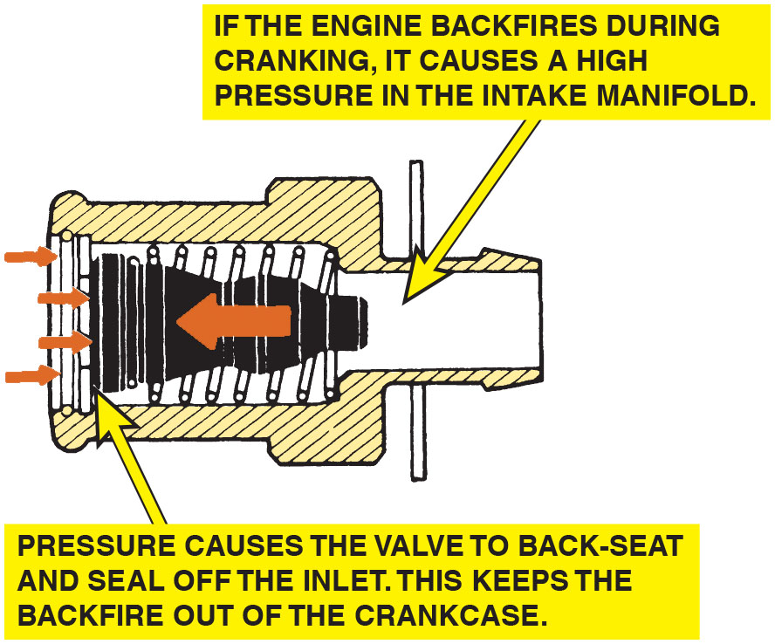
Figure 27.15
P C V During Backfire
P C V valve operation in the event of a backfire.
Notes:
Long Description:
It displays several rightward arrows, which indicate the flow. Pressure causes the valve to back-seat and seal off the inlet. This keeps the backfire out of the crankcase. If the engine backfires during cranking, it causes high pressure in the intake manifold. A leftward arrow at the center indicates the flow of backfire.

Slide 55
Crankcase Ventilation (7 of 7)
Separator Systems
Turbocharged and many fuel-injected engines.
Use an oil/vapor or oil/water separator.
Calibrated orifice instead of a P C V valve.
Air intake throttle body acts as source for crankcase ventilation vacuum.
Calibrated orifice acts as metering device.
Notes:
Case Study: The Whistling Engine
An older vehicle was being diagnosed for a whistling sound whenever the engine was running, especially at idle. It was finally discovered that the breather in the valve cover was plugged and caused high vacuum in the crankcase. The engine was sucking air from what was likely the rear main seal lip, making the “whistle” noise. After replacing the breather and PCV, the noise stopped.
Summary
Concern—Vehicle owner complained that the engine would make a whistling noise.
Cause—The crankcase breather was clogged.
Correction—The breather and the P C V valve were both replaced, which stopped the whistling noise
when the engine was running.

Slide 56
P C V System Diagnosis (1 of 7)
Symptoms
If P C V valve or orifice is not clogged
Intake air flows freely and the P C V system functions properly.
Engine design includes the air and vapor flow as a calibrated part of the air–fuel mixture.
In fact, some engines receive as much as 30% of the idle air through P C V system.
For this reason, a flow problem in the P C V system results in drivability problems.
Notes:
A blocked or plugged P C V system can cause:
Rough or unstable idle
Excessive oil consumption
Oil in the air filter housing
Oil leaks due to excessive crankcase pressure Before expensive engine repairs are attempted, check the condition of the P C V system.
Tech Tip: Check for Oil Leaks with the Engine Off
The owner of an older vehicle equipped with a V-6 engine complained to his technician that he smelled burning oil, but only after shutting off the engine. The technician found that the rocker cover gaskets were leaking. But why did the owner only notice the smell of hot oil when the engine was shut off? Because of the positive crankcase ventilation (P C V) system, engine vacuum tends to draw oil away from gasket surfaces. But when the engine stops, the engine vacuum disappears and the oil remaining in the upper
regions of the engine will tend to flow down and out through any opening. Therefore, a good technician should check an engine for oil leaks not only with the engine running, but also shortly after shutdown.

Slide 57
P C V System Diagnosis (2 of 7)
P C V System Performance Check
Properly operating positive crankcase ventilation system able to draw vapors from crankcase and into intake manifold.
If pipes, hoses, and P C V valve itself are not restricted, vacuum is applied to crankcase.
A slight vacuum is created in crankcase (usually less than 1 inch H g if measured at dipstick) and applied to other areas of engine.
Notes:
Oil drain back holes provide a path for oil to drain back into the oil pan.
These holes also allow crankcase vacuum to be applied under the rocker covers and in the valley area of most V-type engines.
Case Study: The Oil Burning Chevrolet Van
An automotive instructor was driving a Chevrolet van to Fairbanks, Alaska, in January. It was pretty cold out, somewhere around −32◦F (−36◦C). As he pulled into Fairbanks and stopped at a traffic light, he smelled burning oil. When he stopped at the hotel, he still smelled burning oil. He looked under the van and discovered a large pool of oil. After checking the oil and finding very little left, he called a local shop and was told to bring it in. The technician looked over the situation and said, “You need to put some
cardboard across the grill to stop the P C V valve from freezing up.” Apparently the P C V valve froze, which then caused the normal blowby gases to force several quarts out the dipstick tube. After he installed the cardboard, he did not have any further problems.
Summary
Concern—Vehicle owner experienced oil burning when extremely cold outside.
Cause—The P C V valve was frozen causing pressure to build up in the crankcase.

Slide 58
P C V System Diagnosis (3 of 7)
Rattle Test
Removing P C V valve and shaking it in your hand.
P C V valve does not rattle, defective and must be replaced.
If P C V valve does rattle, it does not necessarily mean that P C V valve is good.
All P C V valves contain springs that can become weaker with age and with heating and cooling cycles.
Replace any P C V valve with the exact replacement according to recommended intervals, usually every 3 years or 36,000 miles (60,000 k m).

Slide 59
P C V System Diagnosis (4 of 7)
3 × 5 Card Test
Remove oil-fill cap and start engine.
Hold a 3 × 5 card over the opening (dollar bill or any other piece of paper can be used for this test).
If P C V system, including the valve and hoses, is functioning correctly, card should be held down on oil-fill opening by the slight vacuum inside crankcase.
If card will not stay, carefully inspect P C V valve, hose(s), and manifold vacuum port for carbon buildup (restriction).
Clean or replace as necessary.
Notes:
NOTE: Use care on some overhead camshaft engines. With the engine running, oil may be sprayed from the open oil-fill opening.
NOTE: On some four-cylinder engines, the 3 × 5 card may vibrate on the oil-fill opening when the engine is running at idle speed. This is normal because of the time intervals between intake strokes on a four-cylinder engine.

Slide 60
P C V System Diagnosis (5 of 7)
Snap-Back Test
P C V valve can be checked by placing a finger over inlet hole in valve when engine is running
Removing finger rapidly.
Repeat several times.
Valve should “Snap Back.”
If valve does not snap back, replace valve.

Slide 61
Frequently Asked Question: Why Are There Wires at the P C V Valve?
? Frequently Asked Question
Why Are There Wires at the P C V Valve? Ford uses an electric heater to prevent ice from forming inside the P C V valve causing blockage. Water is a by-product of combustion and resulting moisture can freeze when the outside air temperature is low. General Motors and others clip a heater hose to the P C V hose to provide the heat needed to prevent an ice blockage.

Slide 62
P C V System Diagnosis (6 of 7)
Crankcase Vacuum Test
Testing for Tweak vacuum at the oil dipstick tube
Using an inches-of-water manometer or gauge, as follows:
STEP 1: Remove oil-fill cap or vent P C V opening and cover the opening.
STEP 2: Remove oil dipstick (oil level indicator).
STEP 3: Connect water manometer or gauge to dipstick tube.
STEP 4: Start engine and observe gauge at idle and at 2,500 R P M.
Gauge should show some vacuum.
If not, carefully inspect P C V system for blockages or other faults.

Slide 63
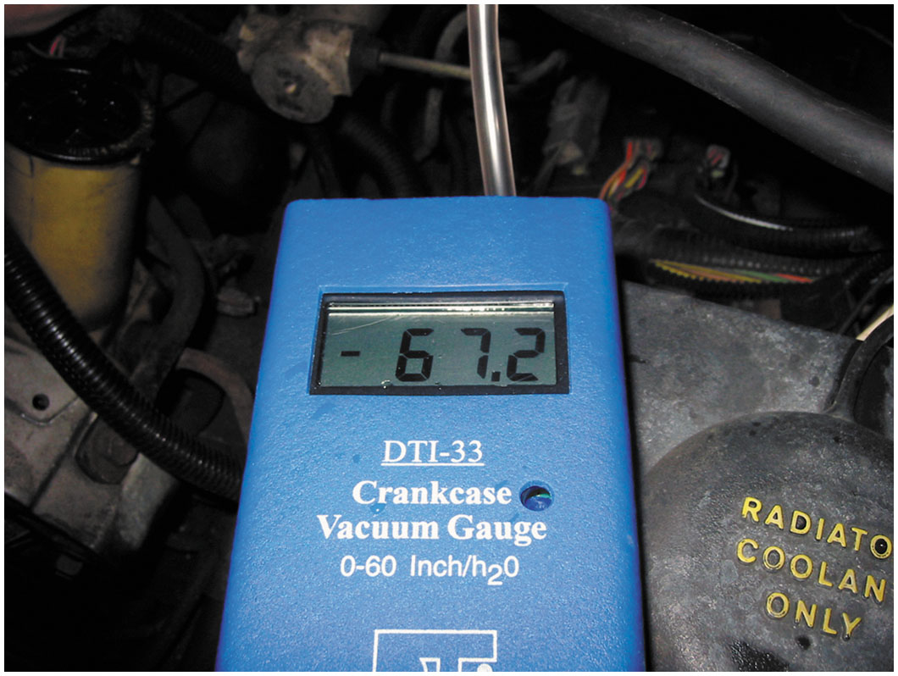
Figure 27.16
Crankcase Vacuum Gauge
Using a gauge that measures vacuum in units of inches of water to test the vacuum at the dipstick tube, being sure that the P C V system can draw a vacuum on the crankcase. Note that 28 inches of water equals 1 P S I, or about 2 inches of mercury (inch H g) of vacuum.

Slide 64
P C V System Diagnosis (7 of 7)
P C V Monitor
Starting with 2004 and newer vehicles, all vehicle P C Ms
monitor P C V system for proper operation as part of
system.
P C V monitor will fail if the P C M detects an opening between crankcase and P C V valve or between P C V valve and intake manifold.

Slide 65
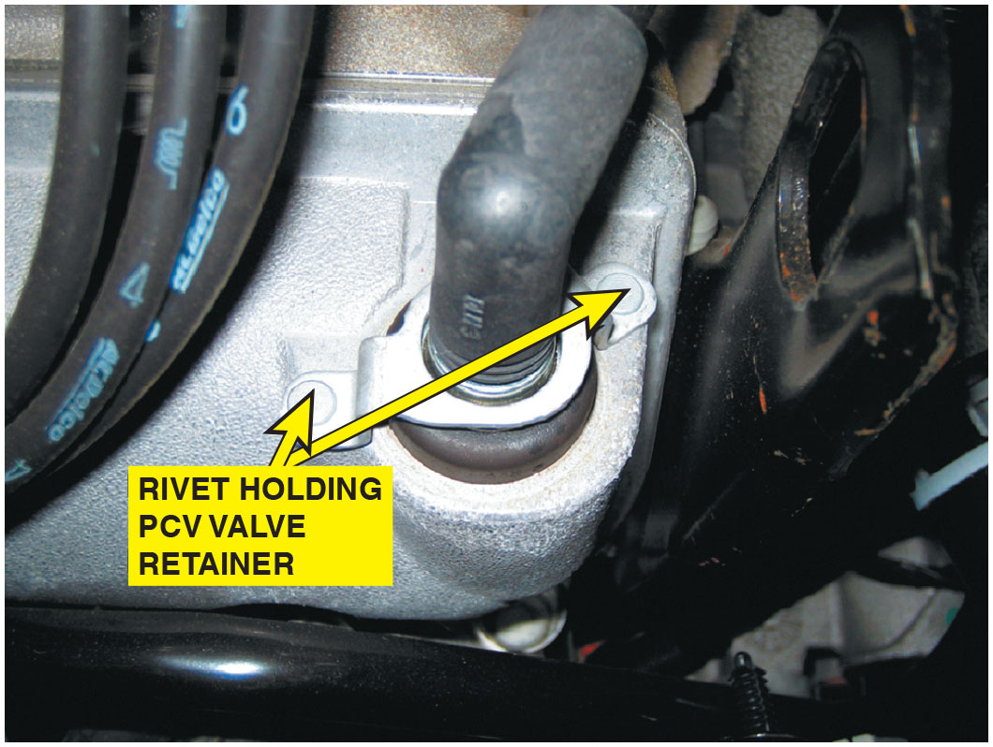
Figure 27.17
P C V Secured with Fastener
Most P C V valves used on newer vehicles are secured with fasteners, which makes it more difficult to disconnect, and therefore, less likely to increase emissions.

Slide 66
P C V Related D T C s
Diagnostic Trouble Code | Description | Possible Causes
P0101 | M A F or airflow circuit range problem | Defective P C V valve, hose/connections, or MAF circuit fault
P0505 | Idle control system problem | Defective P C V valve or hose/Connections

Slide 67
Secondary Air-Injection System (1 of 9)
Purpose and Function
Secondary Air-Injection (S A I)
Provides air necessary for oxidizing process
At exhaust manifold
Inside catalytic converter
Notes:
NOTE: This system is commonly called AIR, meaning air-injection reaction. Therefore, an AIR pump does pump air.

Slide 68
Secondary Air-Injection System (2 of 9)
S A I Pump
AIR pump, smog pump, or thermactor pump, mounted at front of the engine and driven by a belt from the crankshaft pulley.
It pulls fresh air in through an external filter
Pumps air under slight pressure to each exhaust port through connecting hoses or a manifold.
Notes:
S A I system includes the following components:
A belt-driven pump with inlet air filter (older models) An electronic air pump (newer models)
One or more air distribution manifolds and nozzles
One or more exhaust check valves
Connecting hoses for air distribution
Air management valves and solenoids on all newer applications

Slide 69
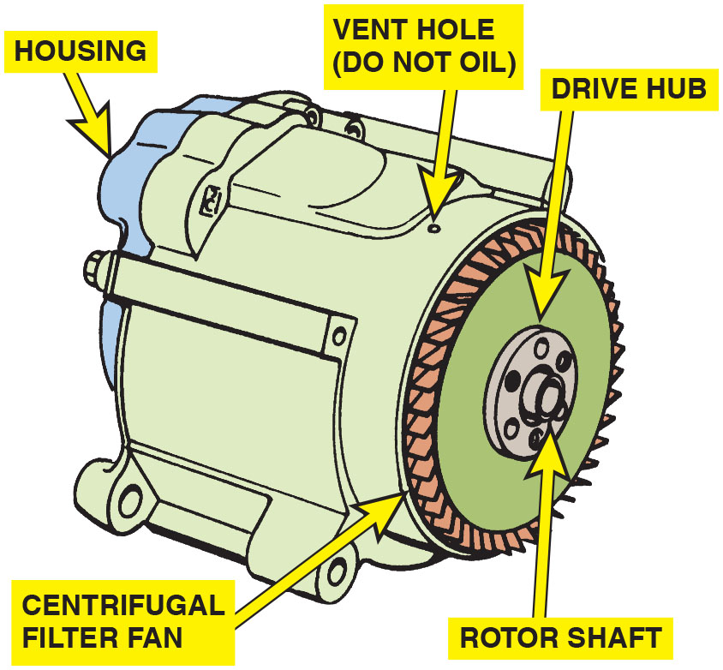
Figure 27.18
AIR Pump
A typical belt-driven AIR pump. Air enters through the revolving fins behind the drive pulley. The fins act as an air filter because dirt is heavier than air, and therefore, the dirt is deflected off of the fins at the same time air is being drawn into the pump.
Notes:
Long Description:
It displays a small cylindrical structure with a centrifugal filter fan at the front. It is connected to a circular structure labeled as a drive hub. A small hole on top is labeled a vent hole (do not use oil). The drive hub is attached to a rotor shaft. The housing is on the back side

Slide 70
Secondary Air-Injection System (3 of 9)
With introduction of N Ox reduction converters (also called dual-bed, three-way converters, or T W C)
S A I pump output is sent to the center of converter where extra air can help oxidize unburned H C, C O into water vapor and carbon dioxide.
Computer controls the airflow from the pump by switching on and off various solenoid valves.

Slide 71
Secondary Air-Injection System (4 of 9)
Air Distribution Manifolds and Nozzles
S A I sends air from pump to nozzle installed near each exhaust port in cylinder head.
This provides equal air injection for the exhaust.
Makes it available at a point in system where exhaust gases are the hottest.
Notes:
Air is delivered to the exhaust system in one of two ways:
An external air manifold, or manifolds, distributes the air through injection tubes with stainless steel nozzles. The nozzles are threaded into the cylinder heads or exhaust manifolds close to each exhaust valve. This method is used primarily with smaller engines.
An internal air manifold distributes the air to the exhaust ports near each exhaust valve through passages cast in the cylinder head or the exhaust manifold. This method is used mainly with larger engines.

Slide 72
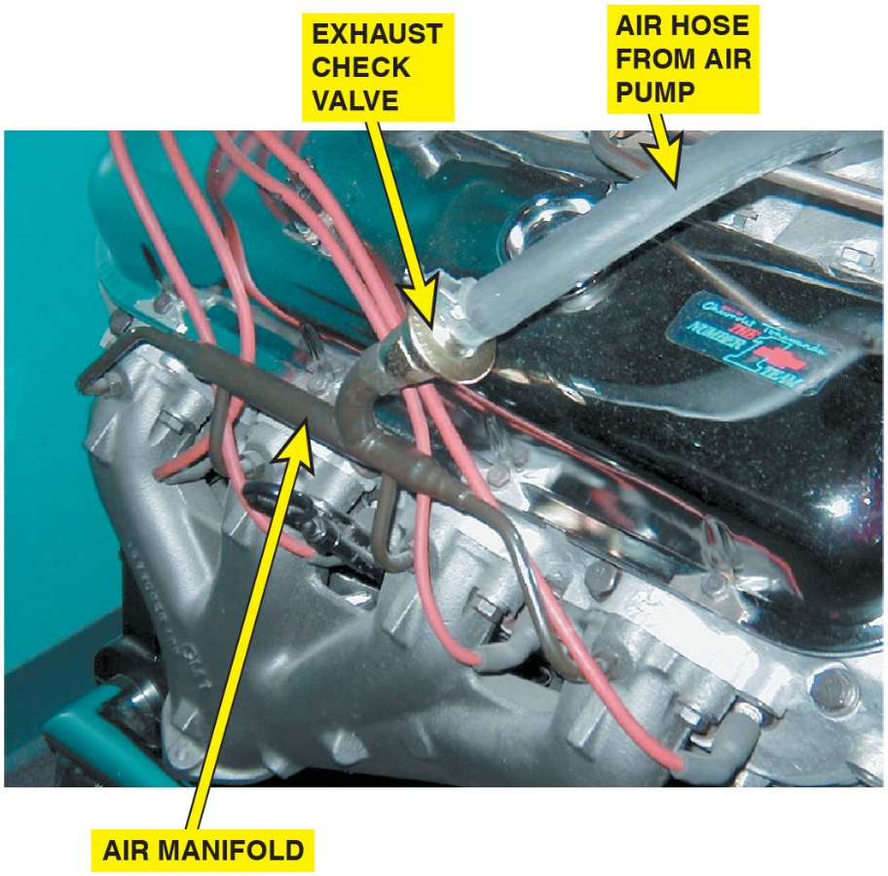
Figure 27.19
External Air Manifold and Exhaust Check Valve
The external air manifold and exhaust check valve on a restored muscle car engine.

Slide 73
Secondary Air-Injection System (5 of 9)
Exhaust Check Valves
Use one or more one-way check valves to protect air pump and other components from reverse exhaust flow.
Check valve contains a spring-type metallic disc or reed that closes under exhaust backpressure located between the air manifold and switching valve(s).
If exhaust pressure exceeds injection pressure air pump fails, check valve spring closes valve to prevent reverse exhaust flow.
Notes:
NOTE: These check valves commonly fail, resulting in excessive exhaust emissions (C O especially). When the check valve fails, hot exhaust can travel up to and destroy the switching valve(s) and air pump itself.

Slide 74
Secondary Air-Injection System (6 of 9)
Belt-Driven Air Pumps
Uses a centrifugal filter just behind the drive pulley.
Pump rotates, underhood air is drawn into pump and slightly compressed.
Vacuum/solenoid-controlled diverter valves direct air:
Exhaust manifold when engine is cold to help oxidize C O and unburned H C into carbon dioxide and water vapor.
Catalytic converter provides extra oxygen needed
for the efficient conversion of C O and H C into
and
Air cleaner during deceleration or wide-open throttle (W O T) engine operation.

Slide 75
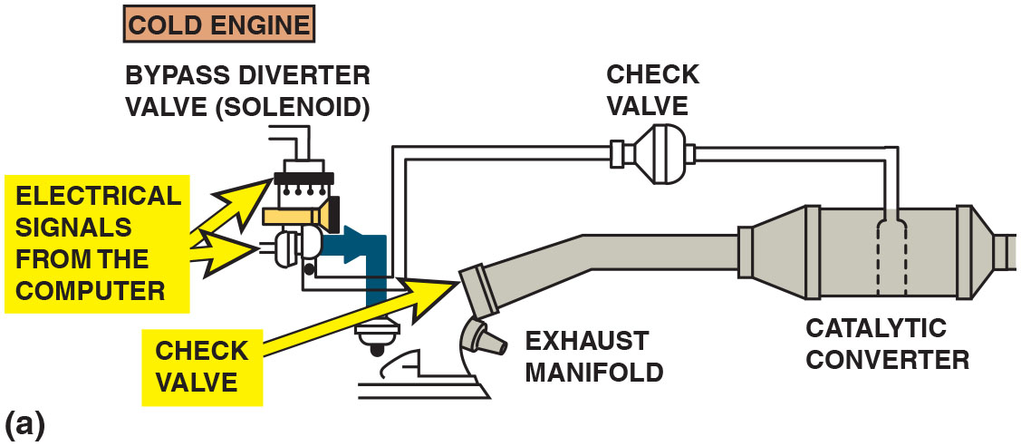
Figure 27.20a
Cold Engine, Open Loop Operation.
(a) When the engine is cold and before the oxygen sensor is hot enough to achieve closed loop, the airflow from the air pump is directed to the exhaust manifold(s) through the one-way check valves which keep the exhaust gases from entering the switching solenoids and the pump itself.
Notes:
Belt-Driven Air Pumps
The belt-driven air pump uses a centrifugal filter just behind the drive pulley. As the pump rotates, underhood air is drawn into the pump and slightly compressed. The system uses either vacuum- or solenoid-controlled diverter valves to direct air to the following:
■ Exhaust manifold when the engine is cold to help oxidize carbon monoxide (C O) and unburned hydrocarbons (H C) into carbon dioxide (C O₂) and water vapor (H₂O)
■ Catalytic converter on many models to help provide the extra oxygen needed for the efficient conversion of C O and H C into C O₂ and H₂O.
■ Air cleaner during deceleration or wide-open throttle (W O T) engine operation • See Figure 27.20.
Long Description:
It displays a bypass diverter valve (solenoid) that emits electrical signals from the computer, which pass through a pipe and reach the check valve on top. The check valve is attached to the catalytic converter with a pipe. The catalytic converter is attached to a cylindrical structure bending in the middle and is labeled exhaust manifold. An arrow pointing at the end of the exhaust manifold is labeled a check valve. The air flow is from the air pump to the bottom check valve and isolates the exhaust manifold and the catalytic converter.

Slide 76
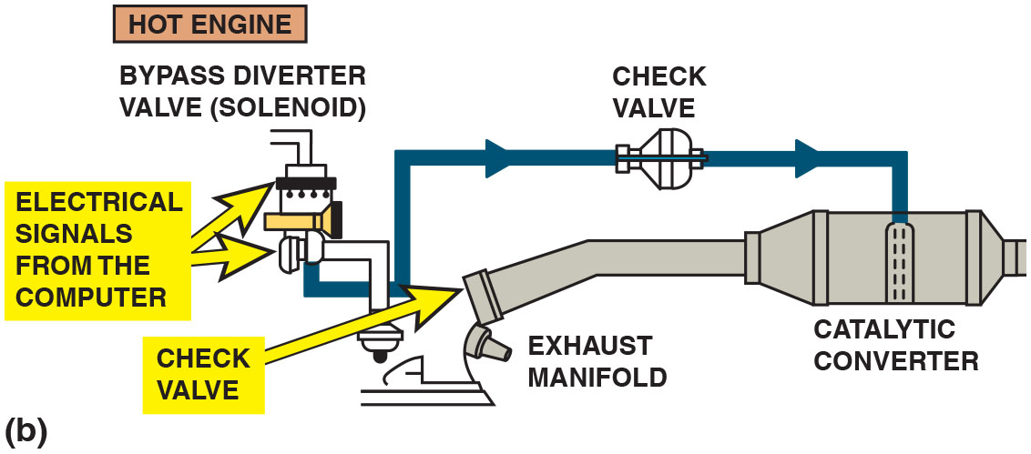
Figure 27.20b
Closed Loop Operation
(b) When the engine achieves closed loop, the air is directed to the catalytic converter.
Notes:
Long Description:
It displays a bypass diverter valve (solenoid) that emits electrical signals from the computer, which pass through a pipe and reach the check valve on top. The check valve is attached to the catalytic converter with a pipe. The catalytic converter is attached to a cylindrical structure bending in the middle and is labeled exhaust manifold. An arrow pointing at the end of the exhaust manifold is labeled a check valve. The air flow is from the solenoid through the top check valve to the catalytic converter.

Slide 77
Animation: Secondary Air-Injection

Slide 78
Secondary Air-Injection System (7 of 9)
Electric Motor-Driven Air Pumps
Used only during cold engine operation and computer controlled.
S A I system helps reduce (H C) and C O
It also helps to warm three-way catalytic converters
quickly on engine start-up so conversion of exhaust gases may occur sooner.
S A I pump solenoids controlled by P C M.
P C M turns on pump by providing ground to complete circuit which energizes S A I pump solenoid relay.
P C M turns on S A I pump during start-up any time engine
coolant temperature is above
system enters
closed-loop operation.

Slide 79
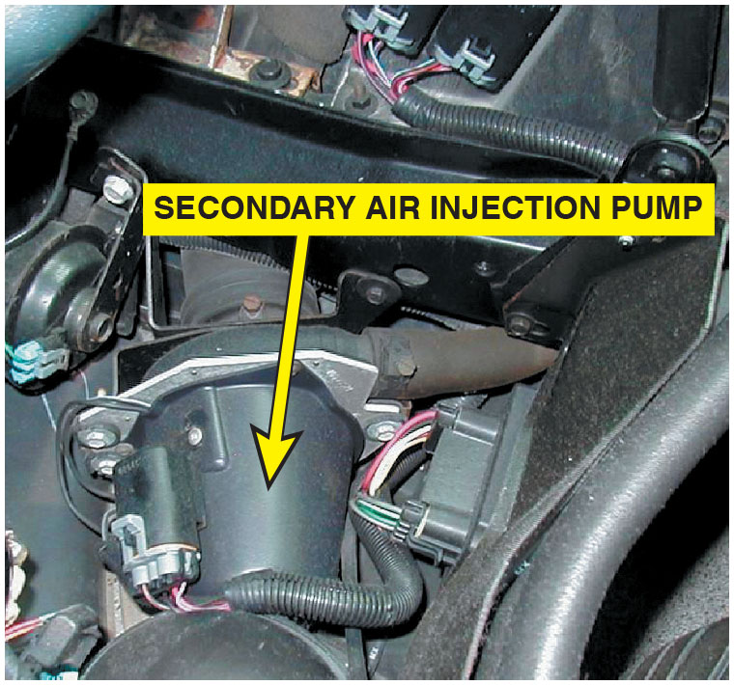
Figure 27.21
Electric Secondary Air-Injection Pump
A typical electric motor-driven S A I pump. This unit is on a Chevrolet Corvette and only works when the engine is cold.

Slide 80
Secondary Air-Injection System Diagnosis
Symptoms
Air pump system should be inspected if an exhaust emissions test failure occurs.
Exhaust will enter the air cleaner assembly resulting in a horribly running engine
Extra exhaust displaces oxygen needed for proper combustion.
With the engine running, check for normal operation.
Notes:
Symptoms
The air pump system should be inspected if an exhaust emissions test failure occurs. In severe cases, the exhaust will enter the air cleaner assembly, resulting in a horribly running engine because the extra exhaust displaces the oxygen needed for proper combustion. With the engine running, check for normal operation. • See Chart 27.1, page 724 (textbook).

Slide 81
Secondary Air-Injection System (8 of 9)
Visual Inspection
Carefully inspect all secondary-air-injection (S A I) systems, including:
Any hoses or pipes that have holes and leak air or exhaust, which require replacement
Check valve(s), when a pump has become inoperative
Exhaust gases that may have gotten past the check valve and damaged the pump. (Look for signs of overheated areas upstream from the check valves. In severe cases, the exhaust can enter the air cleaner assembly and destroy the air filter and greatly reduce engine power.)
Drive belt on an engine-driven pump, for wear and proper tension. (If the belt is worn or damaged, check that the AIR pump rotates.)

Slide 82
Secondary Air-Injection System (9 of 9)
Four-Gas Exhaust Analysis
S A I system tested using exhaust gas analyzer:
STEP 1: Start engine and allow it to normal operating temperature is achieved.
STEP 2: Connect analyzer probe to tailpipe and observe exhaust readings for H C and C O.
STEP 3: Using appropriate pinch-off pliers, shut off airflow from S A I system. Observe H C and C O readings. If S A I system is working correctly, H C and C O should increase when S A I system is shut off.
STEP 4: Record
reading with S A I system still inoperative. Unclamp
pliers and watch
readings. If system is functioning correctly,
level should increase by 1%–4%.

Slide 83
S A I-Related Diagnostic Trouble Code
Diagnostic Trouble Code | Description | Possible Causes | Diagnostic Trouble Code
P0410 | S A I solenoid circuit fault | Defective S A I solenoid Loose or corroded electrical connections Loose, missing, or defective rubber hose(s) | P0410

Slide 84
Catalytic Converters (1 of 14)
Purpose and Function
Aftertreatment device used to reduce exhaust emissions outside of engine.
Uses catalyst, which is a chemical that helps start a chemical reaction but does not enter into chemical reaction.
Catalyst materials on surface of material inside converter help create a chemical reaction.
Changes harmful exhaust emissions into nonharmful exhaust emissions.
Converts harmful exhaust gases into water vapor
and carbon dioxide

Slide 85
Catalytic Converters (2 of 14)
Purpose and Function
Installed in exhaust system between exhaust manifold and muffler.
Converter location is important.
Since as much of exhaust heat as possible must be retained for effective operation.
Nearer it is to engine, the better.

Slide 86
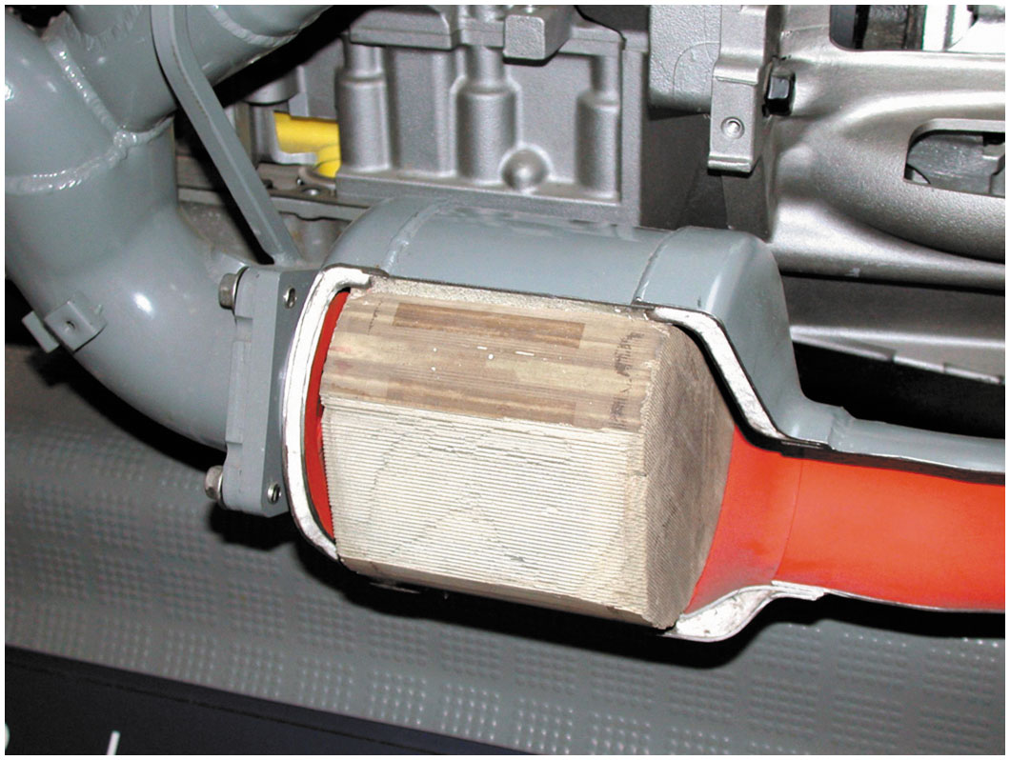
Figure 27.22
Catalytic Convert Cutaway
Most catalytic converters are located as close to the exhaust manifold as possible, as seen in this display of a Chevrolet Corvette.

Slide 87
Catalytic Converters (3 of 14)
Catalytic Converter Construction
Constructed of ceramic material in honeycomb shape with square openings for exhaust gases.
400 openings per square inch (62 openings per square
centimeter), wall thickness is about
inch (1.5 mm).
Substrate coated with a porous aluminum material called washcoat, which makes surface rough.
Catalytic materials are then applied on top of washcoat
Substrate contained within a round or oval shell made by welding together two stamped pieces of stainless steel.

Slide 88
Catalytic Converters (4 of 14)
Ceramic substrate in monolithic converters
Not restrictive; however, converter can be broken
Exposed to shock or severe jolts.
Monolithic converters can be serviced only as a unit.
Exhaust pipe connected to manifold or header to carry gases through catalytic converter and to muffler
V-type engines can use dual converters
Or route exhaust into one catalytic converter using Y-exhaust pipe.

Slide 89
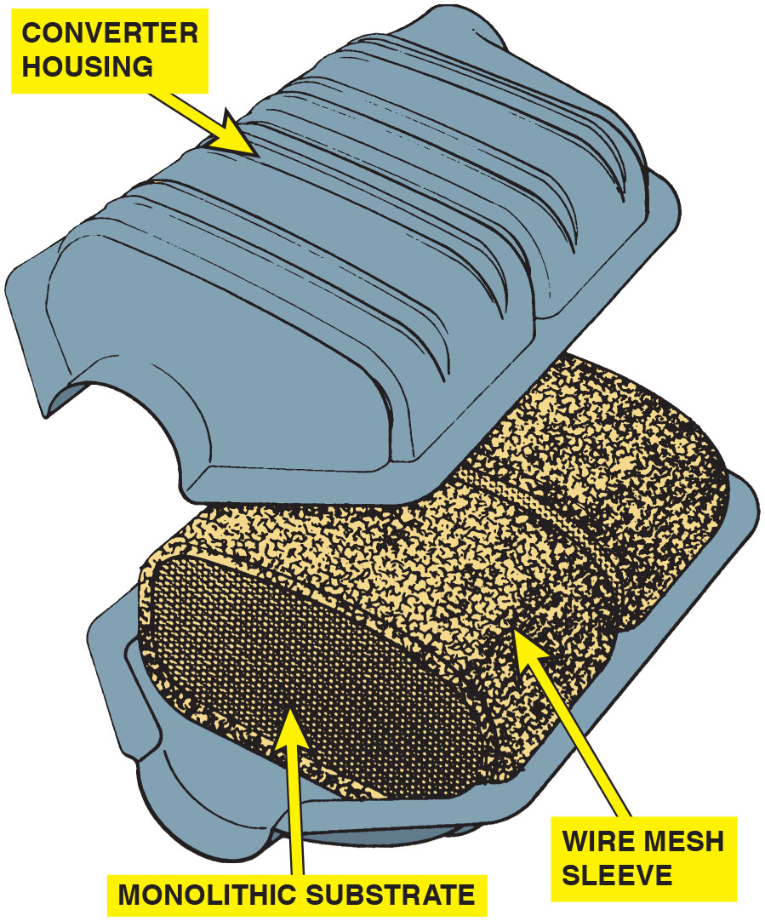
Figure 27.23
Catalytic Converter with a Monolithic Substrate
A typical catalytic converter with a monolithic substrate.

Slide 90
Animation: Catalytic Converter

Slide 91
Catalytic Converters (5 of 14)
Catalytic Converter Operation
Substrate contains rhodium, palladium, and platinum.
Act as Catalysts, which start chemical reaction without becoming part of, or being consumed in, process.
In the first section of three-way catalytic converter (T W C)
Emissions
H C, and C O) converted to
and
As exhaust gas passes through catalyst,
chemically reduced (i.e., nitrogen and oxygen separated) in first section.
In the second section of converter, most of H C and C O
remaining in exhaust gas oxidized to form harmless
and

Slide 92
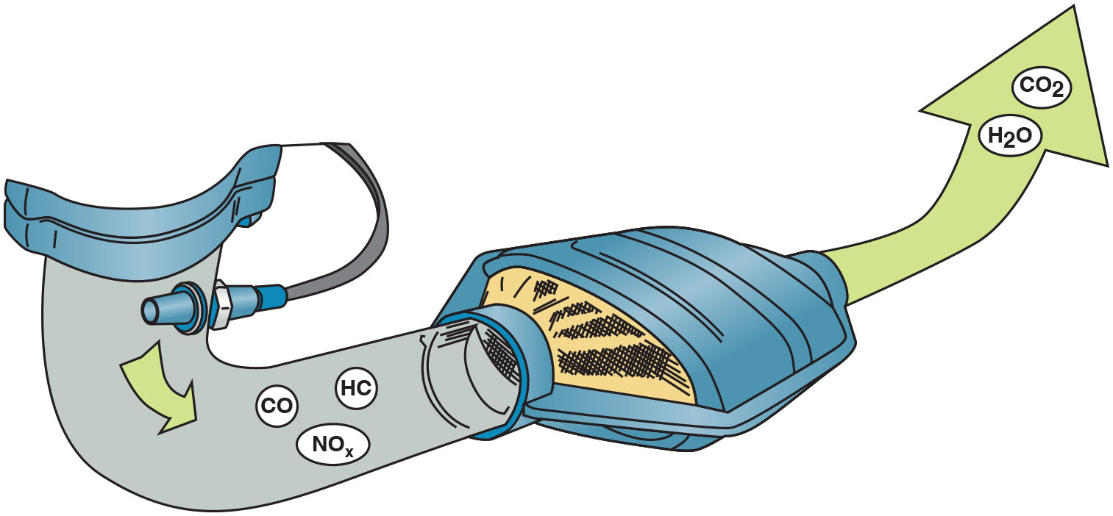
Figure 27.24
Three-Way Catalytic Converter
Three-way catalytic converter first separates
into
nitrogen and oxygen and then converts the H C and C O
into harmless water
and carbon dioxide

Slide 93
Catalytic Converters (6 of 14)
Since 1990s, converters also contain cerium, element that can store oxygen.
Cerium provides oxygen to oxidation bed of converter when exhaust is rich and lacks enough oxygen for oxidation.
When exhaust is lean, cerium absorbs extra oxygen.
Converter should have a 14.7∶1 air–fuel ratio.
Rich exhaust required for reduction—
from N in
Lean exhaust provides oxygen to oxidize H C and C O
(combining oxygen with H C and C O to form
and
If catalytic converter is not functioning correctly, check that air–fuel mixture being supplied to engine is correct and that ignition system is free of defects.

Slide 94
Catalytic Converters (7 of 14)
Converter Light-off Temperature
Converter does not work cold, it must be heated to its light-off temperature of close to 500F before it works
When fully effective, converter reaches temperature range
of
to
to
Because of extreme heat converter remains hot long after engine is shut off.
Most vehicles use a series of heat shields to protect passenger compartment and other parts of the chassis from excessive heat.
Vehicles have been known to start fires because of the hot converter causing tall grass.

Slide 95
Catalytic Converters (8 of 14)
Converter Usage
Located as close as possible to exhaust manifold.
Farther back converter is positioned in exhaust system, more exhaust gases cool before they reach converter since positioning in the exhaust system affects the oxidation process.
Cars that use only an oxidation converter generally locate it underneath front of passenger compartment.

Slide 96
Catalytic Converters (9 of 14)
Some vehicles have used a small, quick heating oxidation converter called preconverter, pup converter, or mini converter.
Connects directly to exhaust manifold outlet.
These have a small catalyst surface area close to the engine that heats up rapidly to start oxidation process more quickly during cold engine warm-up.
For this reason, they were often called light-off converters (L O Cs).
Main converter, under passenger compartment, completes the oxidation reaction started in the L O C.

Slide 97
Catalytic Converters (10 of 14)
Catalytic Converter Performance
With
converter performance monitored by a
heated oxygen sensor (H O 2 S), both before and after converter.
Converters have what is known as oxygen storage capacity (O S C).
O S C is due mostly to cerium coating in catalyst rather than precious metals used.
When T W C is operating as it should, postconverter H O 2 S is far less active than the preconverter sensor.
Converter stores, then releases, oxygen during normal reduction and oxidation of exhaust gases, smoothing out
the variations in

Slide 98
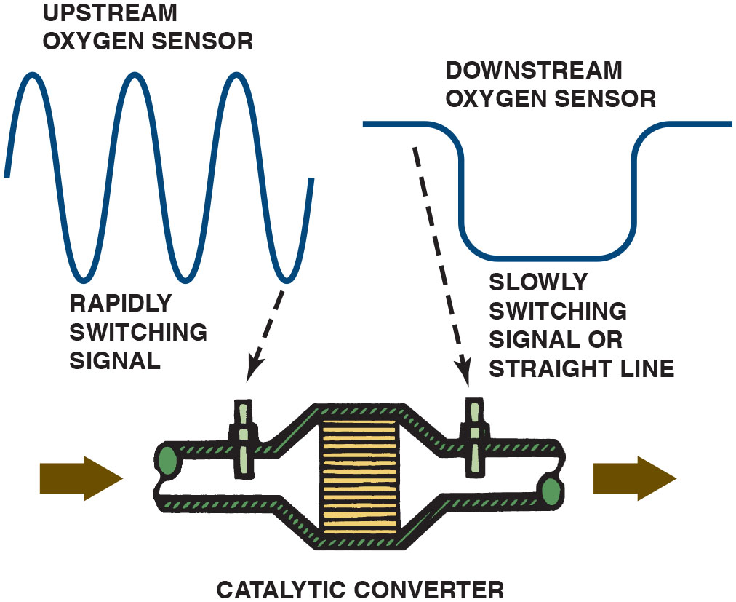
Figure 27.25
Upstream and Downstream Oxygen Sensors
catalytic
converter monitor compares the signals of the upstream and downstream H O2 S to determine converter efficiency.
Notes:
Where a cycling sensor voltage output is expected before the converter, because of the converter action, the postconverter H O2S should read a steady signal without much fluctuation.
Long Description:
It shows a sine wave from the upstream oxygen sensor fed to the left pipe of the catalytic converter and a round-edged pulse wave fed to the right pipe of the converter. The air flow is from the left to the right of the converter. A leftward and rightward arrow are shown on both sides of the converter.

Slide 99
Animation: Wide Band Oxygen Sensor Test

Slide 100
Catalytic Converters (11 of 14)
Converter-Damaging Conditions
Since converters have no moving parts
Require no periodic service.
Under federal law, catalyst effectiveness
Warranted for 80,000 miles or 8 years.
3 main causes of premature converter failure:
Contamination
Excessive temperatures
Improper air–fuel mixtures
Notes:
Contamination
Substances that can destroy the converter include exhaust that contains excess engine oil, antifreeze, sulfur (from poor fuel), and various other chemical substances.

Slide 101
Catalytic Converters (12 of 14)
Excessive Temperatures
Destroyed by excessive temperatures.
Too much unburned fuel enters converter.
Excessively lean mixtures.
Long idling periods on some vehicles, since more heat develops at those times than normal highway speeds.
Cause converter to melt down.
Leading to internal parts breaking apart and either clogging converter or moving downstream to plug muffler.
Restricted exhaust flow severely reduces engine power.

Slide 102
Catalytic Converters (13 of 14)
Improper Air–Fuel Mixtures
Rich mixtures or raw fuel in exhaust can be caused by misfiring, or an excessively rich air–fuel mixture resulting from a defective coolant temp sensor or defective fuel injectors.
Lean mixtures commonly caused by intake manifold leaks.
Converter can become a catalytic furnace causing high temperatures

Slide 103
Catalytic Converters (14 of 14)
To avoid excessive catalyst temperatures and the possibility of fuel vapors reaching converter rules:
Do not use fuel additives or cleaners that are not converter safe.
Do not crank an engine for more than 40 seconds when it is flooded or misfiring.
Do not turn off ignition switch when vehicle is in motion.
Do not disconnect a spark plug wire for more than 30 seconds.
Repair engine problems such as dieseling, misfiring, or stumbling as soon as possible.

Slide 104
Diagnosing Catalytic Converters (1 of 10)
Tap Test
Tap test involves tapping (not pounding) on catalytic converter using rubber mallet.
If substrate inside converter is broken, converter will rattle when hit.
If converter rattles, a replacement converter is required.

Slide 105
Diagnosing Catalytic Converters (2 of 10)
Testing Backpressure with Pressure Gauge
Measure: Exhaust backpressure can be measured by installing pressure gauge in exhaust opening.
To test backpressure, remove inside of discarded oxygen sensor, thread in adapter to convert it to vacuum or pressure gauge.
To test exhaust backpressure at E G R valve, remove E G R valve, fabricate plate equipped with fitting.
To test at S A I check valve, remove check valve from exhaust tubes leading to exhaust manifold. Use a rubber cone with tube inside to seal against exhaust tube. Connect tube to a pressure gauge.
Notes:
NOTE: An adapter can be easily made by inserting a metal tube or pipe into an old oxygen sensor housing. A short section of brake line works great. The pipe can be brazed to the oxygen sensor housing or it can be glued with epoxy. An 18 mm compression gauge adapter can also be adapted to fit into the oxygen sensor opening. ● See Figure 27.26.

Slide 106
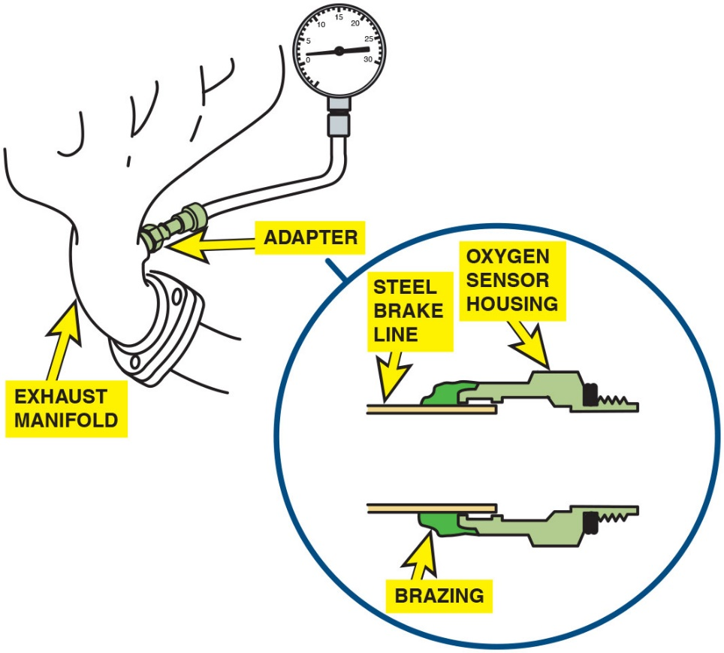
Figure 27.26
Backpressure
A backpressure tool can be made by using an oxygen sensor housing and epoxy or braze to hold the tube to the housing.

Slide 107
Diagnosing Catalytic Converters (3 of 10)
At idle, max backpressure should be < 1.5 P S I (10 k P a).
Should be <2.5 P S I (15 kPa) at 2,500 R P M.
Pressure readings higher than these indicate exhaust system restricted.
Further testing needed to determine location of restriction.

Slide 108
Diagnosing Catalytic Converters (4 of 10)
Testing for Backpressure Using Vacuum Gauge
Checking intake vacuum with engine operating at a fast idle speed (2,500 R P M).
If exhaust restricted, some exhaust can pass and effect may not be noticeable when the engine is at idle speed.
However, when engine is operating at higher speed, exhaust gases can build up behind restriction and eventually will be unable to leave combustion chamber.
When some of exhaust is left behind at end of exhaust stroke, resulting pressure in combustion chamber reduces engine vacuum.

Slide 109
Diagnosing Catalytic Converters (5 of 10)
Testing for exhaust restriction using a vacuum gauge:
STEP 1: Attach vacuum gauge to an intake manifold vacuum source.
STEP 2: Start engine. Record the engine manifold vacuum reading. Should read 17–21 inch Hg at idle speed.
STEP 3: Increase engine speed to 2,500 R P M and hold that speed for 60 seconds while looking at vacuum gauge.

Slide 110
Diagnosing Catalytic Converters (6 of 10)
Results
If vacuum reading is equal to or higher than vacuum reading when engine was at idle speed, the exhaust system is not restricted.
If vacuum reading is lower than vacuum reading when the engine was at idle speed, then exhaust is restricted.
Further testing needed to determine location of restriction.

Slide 111
Diagnosing Catalytic Converters (7 of 10)
Testing Catalytic Converter for Temperature Rise
Able to reduce
exhaust emissions into N, and
Oxidize unburned H C and C O into harmless
and
During these chemical processes, catalytic converter should increase in temperature at least 10% if converter is working properly.
To test converter, operate engine at 2,500 R P M for at least 2 minutes to fully warm up converter.
Measure inlet and outlet temperatures using an infrared thermometer (pyrometer), as shown in Figure 27.27.

Slide 112
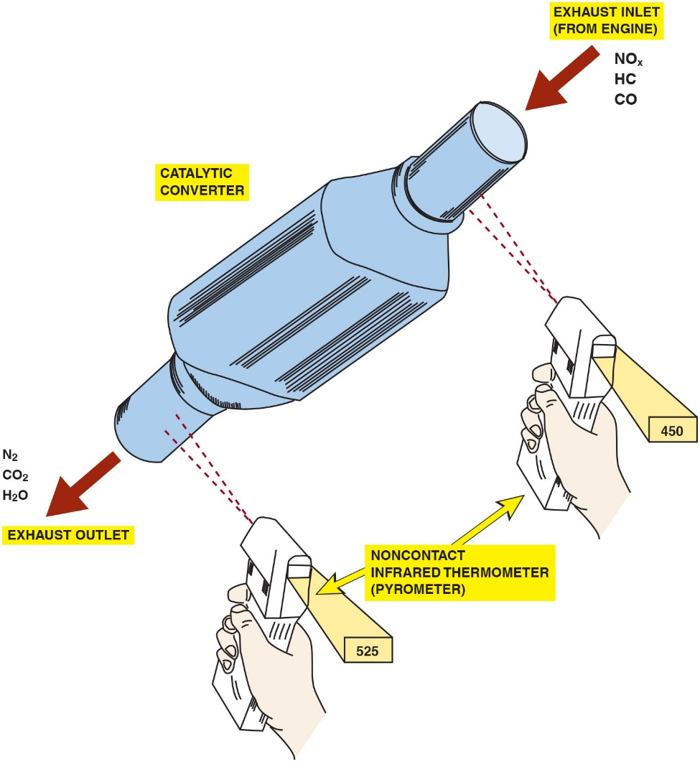
Figure 27.27
Exhaust Temperature
The temperature of the outlet should be at least 10% hotter than the temperature of the inlet. If a converter is not working, the inlet temperature will be hotter than the outlet temperature.
Notes:
Long Description:
It displays a rolling pin-like structure labeled catalytic converter. The exhaust inlet (from the engine) gases are N O subscript x, H C, and C O. The exhaust outlet gases are N subscript 2, C O subscript 2, and H subscript 2 O. Two leftward arrows indicate the flow. A pair of hands are holding pyrometers near the two ends of the converter. The pyrometer is labeled a noncontact infrared thermometer. The temperature detected by the pyrometer is 450 at the inlet, and it is 525 at the outlet.

Slide 113
Diagnosing Catalytic Converters (8 of 10)
NOTE: If engine is extremely efficient, converter may not have any excessive unburned hydrocarbons or carbon monoxide to convert! In this case, a spark plug wire could be grounded out using a vacuum hose and a test light to create some unburned hydrocarbon in the exhaust. Do not ground out a cylinder for longer than 10 seconds or the excessive amount of unburned hydrocarbon could overheat and damage the converter.

Slide 114
Diagnosing Catalytic Converters (9 of 10)
Catalytic Converter Efficiency Tests
Converter efficiency determined using exhaust gas analyzer.
Oxygen level test. Warm in closed loop, check
and C O
levels.
Good converter should be able to oxidize extra H C caused by rapid acceleration.
If
is zero, go to snap-throttle test.
If
is > zero, check C O level.
If C O is > than zero, converter is not functioning correctly.

Slide 115
Diagnosing Catalytic Converters (10 of 10)
Catalytic Converter Efficiency Tests
Snap-throttle test. With engine warm and in closed loop, snap throttle to W O T in park or neutral and observe oxygen reading.
reading should not exceed 1.2%; if it does, converter is
not working.
If
rises to 1.2%, the converter may have low efficiency.
If
remains below 1.2%, then the converter is okay.
Notes:
Tech Tip: Aftermarket Catalytic Converters
Some replacement aftermarket (nonfactory) catalytic converters do not contain the same amount of cerium as the original part. Cerium is the element that is used in catalytic converters to store oxygen. As a result of the lack of cerium, the correlation between the oxygen storage and the conversion efficiency may be affected enough to set a false diagnostic trouble code (P0422).

Slide 116
Figure 27.28
Replacing Catalytic Converter
Whenever replacing a catalytic converter with a universal unit, first measure the distance between the rear brick and the center of the rear oxygen sensor. Be sure that the replacement unit is installed to the same dimension.
Notes:
Catalytic Converter Replacement Guidelines
Because a catalytic converter is a major exhaust gas emission control device, the Environmental Protection Agency (E P A) has strict guidelines for its replacement, including:
If a converter is replaced on a vehicle with less than 80,000 miles or eight years, depending on the year of the vehicle, an original equipment catalytic converter must be used as a replacement.
The replacement converter must be of the same design as the original. If the original had an air pump fitting, so must the replacement.
The old converter must be kept for possible inspection by the authorities for 60 days.
A form must be completed and signed by both the vehicle owner and a representative from the service facility. This form must state the cause of the converter failure and must remain on file for 2 years.
Note
When an aftermarket converter is being installed, to be assured of proper operation, ensure that its distance from the rear of the catalyst block is the same as the distance between the rear oxygen sensor and the factory converter. Always follow the instructions that come with the replacement converter. • See Figure 27.28.
Long Description:
It displays the front exhaust pipe in front of the replacement converter and the rear (post) O subscript 2 sensor at the rear of the converter. The flow of gases such as carbon monoxide, N O subscript x, and H C is in the form of sine waves. The flow of gases to the converter is indicated by a right arrow entering the converter and the flow from the converter to the rear O subscript 2 sensor is indicated by a right arrow exiting the converter. The gases coming out of the converter are O subscript 2, H subscript 2, O, N subscript 2, carbon monoxide, and C O subscript 2. There are two bricks, and the gap between the rear brick and the center of the rear oxygen sensor is labeled to keep this distance.

Slide 117
Catalytic Converter-Related Diagnostic Trouble Code
Diagnostic Trouble Code | Description | Possible Causes
P0420 | Catalytic converter efficiency failure | Engine mechanical fault Exhaust leaks Fuel contaminants, such as engine oil, coolant, or sulfur

Slide 118
Evaporative Emission Control System (1 of 6)
Purpose and Function
E V A P traps and holds gasoline vapors, also called volatile organic compounds, or V O Cs.
Includes charcoal canister, hoses, and valves.
Vapors are routed into a charcoal canister, then into intake airflow where they are burned in engine instead of being released into atmosphere.

Slide 119
Evaporative Emission Control System (2 of 6)
Common Components
Fuel tank filler caps used with modern E V A P systems
E V A P fuel tank filler caps have pressure-vacuum relief built into them.
Pressure/vacuum exceeds calibrated value, valve opens.
Once pressure or vacuum has been relieved, valve closes.
If sealed cap used on an E V A P system that requires a pressure-vacuum relief design, vacuum lock may develop in fuel system.
Fuel tank damaged by fuel expansion or contraction.

Slide 120
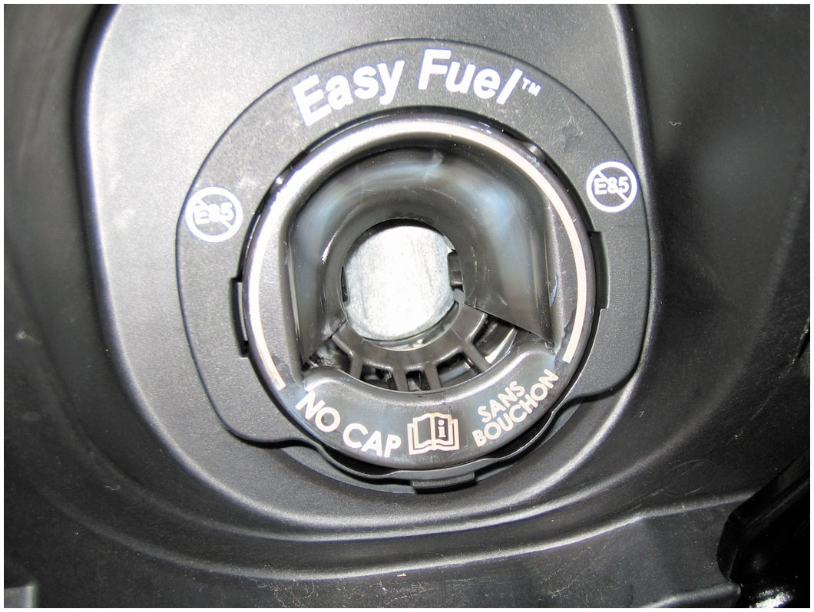
Figure 27.29
Fuel Tank Filler Caps
A capless system from a Ford does not use a replaceable cap; instead, it has a spring-loaded closure.

Slide 121
Evaporative Emission Control System (3 of 6)
Evaporative Control System Operation
Canister is located under hood or underneath the vehicle filled with activated charcoal granules.
Hold up to one-third of their own weight in fuel vapors.
Note: some vehicles with large or dual fuel tanks may have dual canisters.

Slide 122
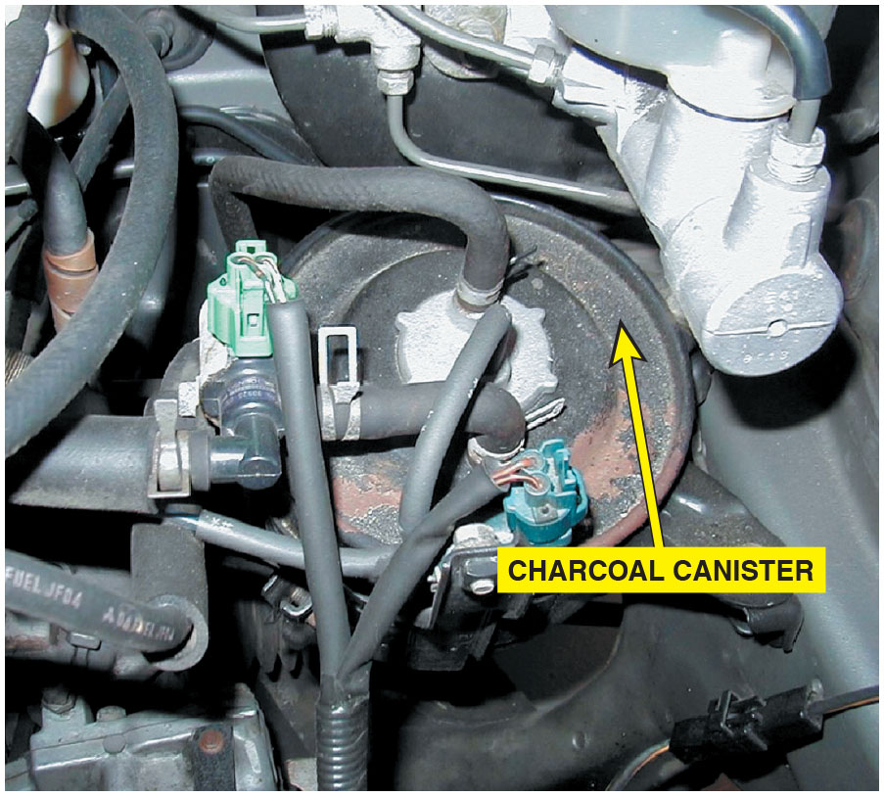
Figure 27.30
Charcoal Canister
A charcoal canister can be located under the hood or underneath the vehicle.

Slide 123
Evaporative Emission Control System (4 of 6)
Activated charcoal is effective vapor trap because of surface area.
Each gram of activated charcoal
Has surface area of 1,100
Hold either 300 or 625 grams of charcoal
Using adsorption
Fuel vapor molecules adhere to carbon surface.
System purges vapor molecules quite simply.
By sending fresh airflow through charcoal.
Notes:
Vapor Purging
During engine operation, stored vapors are drawn from the canister into the engine through a hose connected to the throttle body or the air cleaner.
This “purging” process mixes H C vapors from the canister with the existing air–fuel charge.

Slide 124
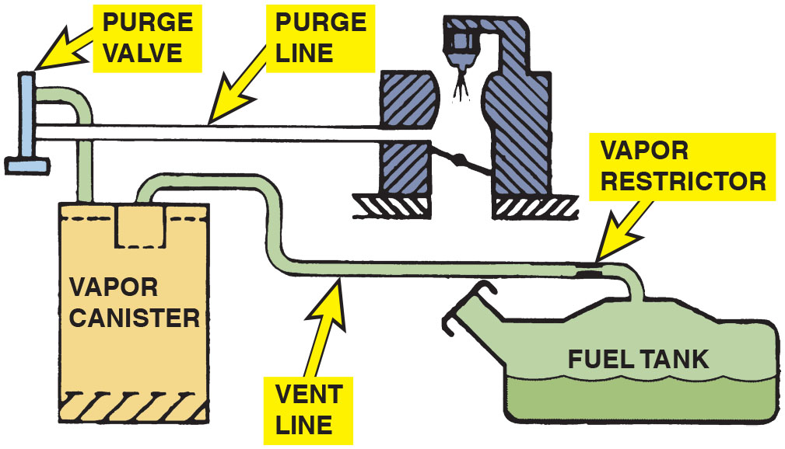
Figure 27.31
Evaporative Emission Control System
The evaporative emission control system includes all of the lines, hoses, and valves, plus the charcoal canister.
Notes:
Long Description:
It displays an inverted T-shaped structure at the top left labeled purge valve. A purge line from the purge valve leads to the throttle body. A pipe from the purge valve is inserted into a vapor canister through a pipe. A pipe labeled vent line from the vapor canister leads to a fuel tank. A tube adapter labeled vapor restrictor is at the end of the vent line above the fuel tank.

Slide 125
Animation: Evaporative Emission Control System

Slide 126
Frequently Asked Question: When Filling My Fuel Tank, Why Should I Stop When the Pump Clicks Off?
? Frequently Asked Question
When Filling My Fuel Tank, Why Should I Stop When the Pump Clicks Off? Every fuel tank has an upper volume chamber that allows for expansion of fuel when hot. The volume of chamber is between 10% and 20% of volume of tank. For example, if a fuel tank had a capacity of 20 gallons, expansion chamber volume would be from 2 to 4 gallons. A hose is attached at top of chamber and vented to charcoal canister. If extra fuel is forced into this expansion volume, liquid gasoline can be drawn into charcoal canister. This liquid fuel can saturate canister and create an overly rich air–fuel mixture when canister purge valve is opened during normal vehicle operation. This extra-rich air–fuel mixture can cause vehicle to fail an exhaust emissions test, reduce fuel economy, and possibly damage the catalytic converter. To avoid problems, simply add fuel to the next dime’s worth after the nozzle clicks off. This will ensure that the tank is full, yet not overfilled.

Slide 127
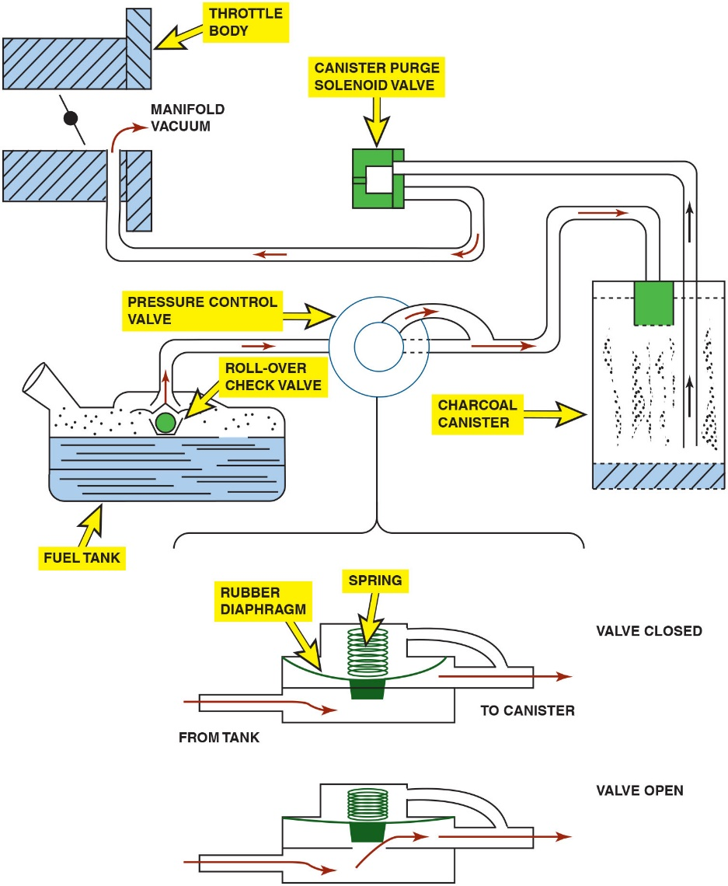
Figure 27.32
Evaporate Emission Control System
A typical evaporative emission control system. Note that when the computer turns on the canister purge solenoid valve, manifold vacuum draws any stored vapors from the canister into the engine. Manifold vacuum also is applied to the pressure control valve. When this valve opens, fumes from the fuel tank are drawn into the charcoal canister and eventually into the engine. When the solenoid valve is turned off (or the engine stops and there is no manifold vacuum), the pressure control valve is spring-loaded shut to keep vapors inside the fuel tank from escaping to the atmosphere.
Notes:
Long Description:
A fuel tank has an outlet pipe from a roll-over check valve above the liquid level. The outlet leads to a round-shaped pressure control valve. A manifold from the control valve is fed to a charcoal canister. An outlet tube is from the canister to a canister purge solenoid valve. The outlet is from the solenoid valve to manifold vacuum between two throttle bodies. The pressure control valve has a spring with a rubber diaphragm is between the pipe from the tank and the pipe to the canister. The valve closed condition is achieved with the spring in original position and the valve open condition is with the spring in compressed position.

Slide 128
Evaporative Emission Control System (5 of 6)
Computer-Controlled Purge
P C M controls when canister purges on most engines.
Done by electric vacuum solenoid, and one or more purge valves.
Under normal conditions, most engine control systems permit purging only during closed-loop operation at cruising speeds.
During other engine operation conditions, such as open-loop mode, idle, deceleration, or wide-open throttle, the P C M prevents canister purging.

Slide 129
Evaporative Emission Control System (6 of 6)
Pressures can build inside fuel system and measured in units of inches of water (28 inches of water equals 1 P S I).
Some scan tools display other units of measure for E V A P system that make understanding system difficult.
Pressure buildup in E V A P system can be caused by:
Fuel evaporation rates (volatility)
Gas tank size (fuel surface area and volume)
Fuel level (liquid versus vapor)
Fuel slosh (driving conditions)
Hot temperatures (ambient, in-tank, close to the tank)
Returned fuel from the rail

Slide 130
Non Enhanced Evaporative Control System
Prior to 1996, Referred to as nonenhanced E V A P) control systems.
Limited diagnostic capabilities.
Limited to their ability to detect if purge has occurred.
Many systems have a diagnostic switch that could sense
Purge is occurring and set a code if no purge is detected.
This system does not check for leaks.
P C M has capability of monitoring integrity of purge solenoid and circuit.
These systems’ limitations are their ability to check the integrity of the evaporative system on the vehicle.

Slide 131
Enhanced Evaporative Control System (1 of 5)
Beginning in 1996,
manufacturers required to install
systems that detect both purge flow and evaporative system leakage.
Systems on models produced between 1996 and 2000 must be
able to detect a leak as small as
inch diameter.
Beginning in model year 2000, the enhanced systems started a
phase-in of
inch diameter leak detection.
Vehicles built after 1995 have enhanced evaporative systems.
Ability to detect purge flow and system leakage.
If either of these two functions fails, system sets D T C.
Turn on M I L light to warn driver of failure.

Slide 132
Enhanced Evaporative Control System (2 of 5)
Canister Vent Valve
Canister vent valve is a NO valve and is only closed when commanded by P C M during testing of system.
Vent valve only closed during testing by P C M as part of
mandated
standards.
Vent solenoid located under vehicle in most cases.
Exposed to the environment, making this valve subject to rust and corrosion.

Slide 133
Enhanced Evaporative Control System (3 of 5)
Canister Purge Valve
Purge valve or Canister Purge (C A N P) solenoid is normally closed and is pulsed open by P C M during purging.
Purge valve connected to intake manifold vacuum.
Line is used to draw gasoline vapors from charcoal canister into engine when purge valve is commanded open.
Notes:
Tech Tip: Problems after Refueling? Check the Purge Valve
The purge valve is normally closed and open only when the P C M is commanding the system to purge. If the purge solenoid were to become stuck in the open position, gasoline fumes would be allowed to flow directly from the gas tank to the intake manifold. When refueling, this would result in a lot of fumes being forced into the intake manifold; and as a result, would cause a hard-to-start condition after refueling. This would also result in a rich exhaust (likely black) when first starting the engine after refueling. Although the purge solenoid is usually located under the hood of most vehicles and less subject to rust and corrosion, as with the vent valve, it can still fail.

Slide 134
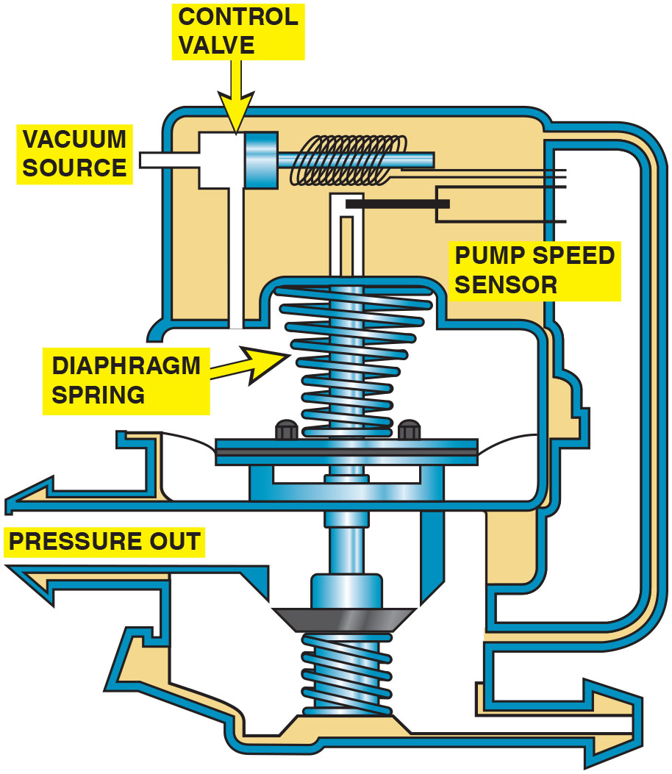
Figure 27.33
Leak Detection Pump (L D P)
A leak detection pump (L D P) used on some Chrysler vehicles to pressurize (slightly) the fuel system to check for leaks.
Notes:
Long Description:
A control valve at the end of the vacuum source is attached to a pump speed sensor through a piston and coil arrangement. The control valve is indicated by a down arrow. A diaphragm from the pump speed sensor leads to a diaphragm plate, where a diaphragm spring is above it and a thread adapter is below it. The left vent to the side of the thread below the diaphragm plate is labeled pressure out.

Slide 135
Enhanced Evaporative Control System (4 of 5)
Operation
The system works to test for leaks as follows:
Purge solenoid is normally closed.
Vent valve in L D P is normally open.
Filtered fresh air is drawn through L D P to canister.
L D P uses a spring attached to a diaphragm to apply
pressure (7.5 inches
to fuel tank.
P C M monitors L D P switch that is triggered if pressure drops in fuel tank.

Slide 136
Enhanced Evaporative Control System (5 of 5)
Time between L D P solenoid off and L D P switch close is called pump period.
Time period is inversely proportional to size of leak.
Shorter pump period, larger leak.
Longer pump period, smaller leak.
E V A P large leak (>
inches): < 0.9 second
E V A P medium leak
to
inches): 0.9 to 1.2
seconds
E V A P small leak
to
inches): 1.2 to 6 seconds

Slide 137
Onboard Refueling Vapor Recovery
Purpose and Function
Onboard Refueling Vapor Recovery (O R V R) system .
First introduced on some 1998 vehicles.
Previously designed E V A P systems.
Allowed fuel vapor to escape to atmosphere during refueling.

Slide 138
Enhanced Evaporative Control System
Operation
Primary feature of most O R V R systems is restricted tank filler tube, which is about 1 inch (25 mm) in diameter.
Reduced size filler tube creates aspiration effect, which tends to draw outside air into filler tube.
During refueling, fuel tank vented to charcoal canister.
Captures the gas fumes; and with air flowing into the filler tube, no vapors can escape to the atmosphere.

Slide 139
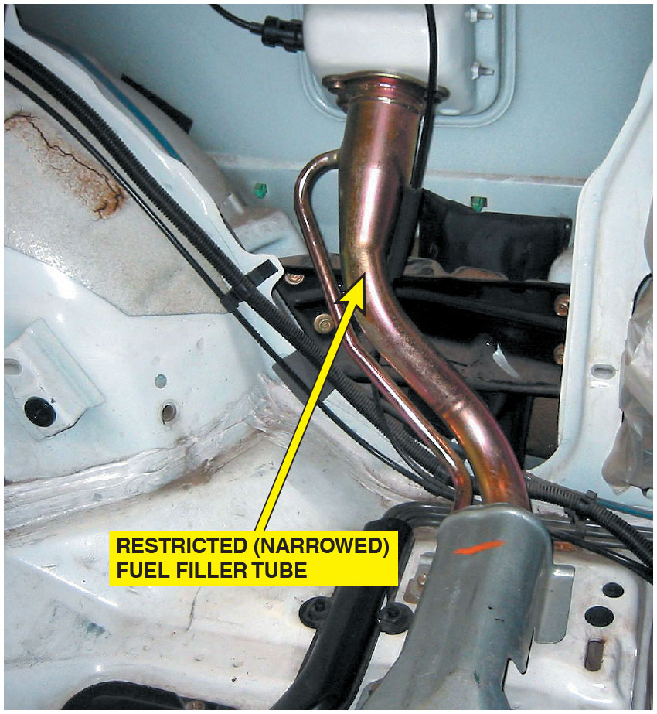
Figure 27.34
Onboard Refueling Vapor Recovery
A restricted fuel fill pipe shown on a vehicle with the interior removed.

Slide 140
State Inspection E V A P Tests (1 of 2)
Periodic inspection and test of fuel system mandated.
includes tests on vehicle before and during dynamometer test.
Before test, fuel tank and cap, fuel lines, canister, and other fuel system components inspected and tested to ensure.
Not leaking gasoline vapors into atmosphere.
First, fuel tank cap is tested to ensure that it is sealing properly and holds pressure within specs.
Next, cap is installed on vehicle, and using a special adapter, E V A P system is pressurized to approximately 0.5 P S I and monitored for 2 minutes.
Pressure in tank/lines should not drop below approximately 0.3 P S I.

Slide 141
State Inspection E V A P Tests (2 of 2)
If cap or system leaks, hydrocarbon emissions are likely being released, and vehicle fails test.
If system leaks, ultrasonic leak detector may be used to find leak.
Finally, with engine warmed up and running at a moderate speed, canister purge line is tested for adequate flow using a special flow meter inserted into system.

Slide 142
Diagnosing E V A P System (1 of 6)
Symptoms
Before vehicle emissions testing began in many parts of the country, little service work was done on the evaporative emission system.
Common engine-performance problems:
Poor fuel economy
Poor performance
Notes:
Poor fuel economy. A leak in a vacuum-valve diaphragm can result in engine vacuum drawing in a constant flow of gasoline vapors from the fuel tank. This usually results in a drop in fuel economy of 2 to 4 miles per gallon (mpg). Use a hand-operated vacuum pump to check that the vacuum diaphragm can hold vacuum.
Poor performance. A vacuum leak in the manifold or ported vacuum section of vacuum hose in the system can cause the engine to run rough. Age, heat, and time all contribute to the deterioration of rubber hoses.

Slide 143
Diagnosing E V A P System (2 of 6)
Enhanced exhaust emissions (I/M-240) testing tests
Evaporative emission system.
Leak in system tested by pressurizing entire fuel system to a level below 1 pounds per s q. in. or 1 P S I (about 14
inches
Pressurized with nitrogen, a nonflammable gas that makes up 78% of our atmosphere.
Pressure in system is then shut off and monitored.
If pressure drops below a set standard, vehicle fails test.
Test determines if there is a leak in system.
Notes:
NOTE: To help pass the evaporative section of an enhanced emissions test, arrive at the test site with less than one-half tank of fuel. This means that the rest of the volume of the fuel tank is filled with air. It takes longer for the pressure to drop from a small leak when the volume of the air is greater compared to when the tank is full and the volume of air remaining in the tank is small.

Slide 144
Diagnosing E V A P System (3 of 6)
Locating Leaks in System
Leaks in evaporative emission control system.
Cause malfunction check gas cap indication lamp to light on some vehicles.

Slide 145
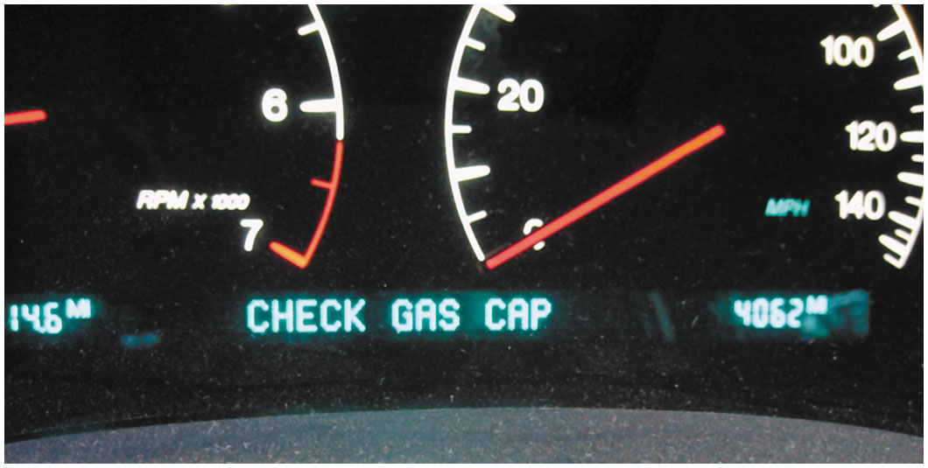
Figure 27.35
Loose Gas Cap
Some vehicles will display a message if an evaporative control system leak is detected that could be the result of a loose gas cap.

Slide 146
Diagnosing E V A P System (4 of 6)
Leak will also cause a gas smell.
Most noticeable if vehicle were parked in an enclosed garage.
First step is to determine if there is leak in system by
setting E V A P tester to rate system, either a
inch or a
inch hole size leak.

Slide 147
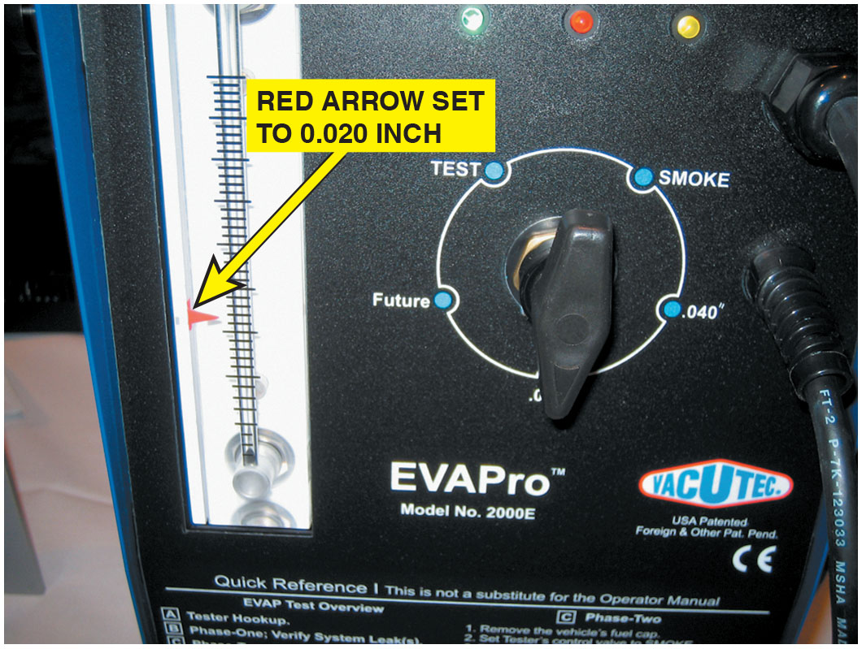
Figure 27.36
E V A P Leak Testing
To test for a leak, this tester
was set to
inch hole
and turned on. The ball rose in scale on left and red arrow was moved to that location. When testing the system for leaks, if ball rises higher than arrow,
leak is larger than
inch.
If the ball does not rise to the level of the arrow, the leak is
smaller than
inch.
Notes:
Long Description:
It has a knob with the options test, smoke, future, and .040 degree. The company name is V A C U T E C, U S A, a patented foreign and other pat. pend. There are three small lights on the top. The colors are yellow, red, and green. The green light is on. The text at the bottom reads quick reference, this is not a substitute for the operator manual. The E V A P test overview comprises: A. Tester hookup. B. Phase-one: verify system leak(s). C. Phase-two.

Slide 148
Diagnosing E V A P System (5 of 6)
After it has been determined that a leak exists
Larger than specified
Two methods used to check for leaks in evaporative system:
Smoke Machine Testing
Most efficient method of leak detection.
Introduce smoke under low pressure.
From a machine specifically designed for this purpose.

Slide 149
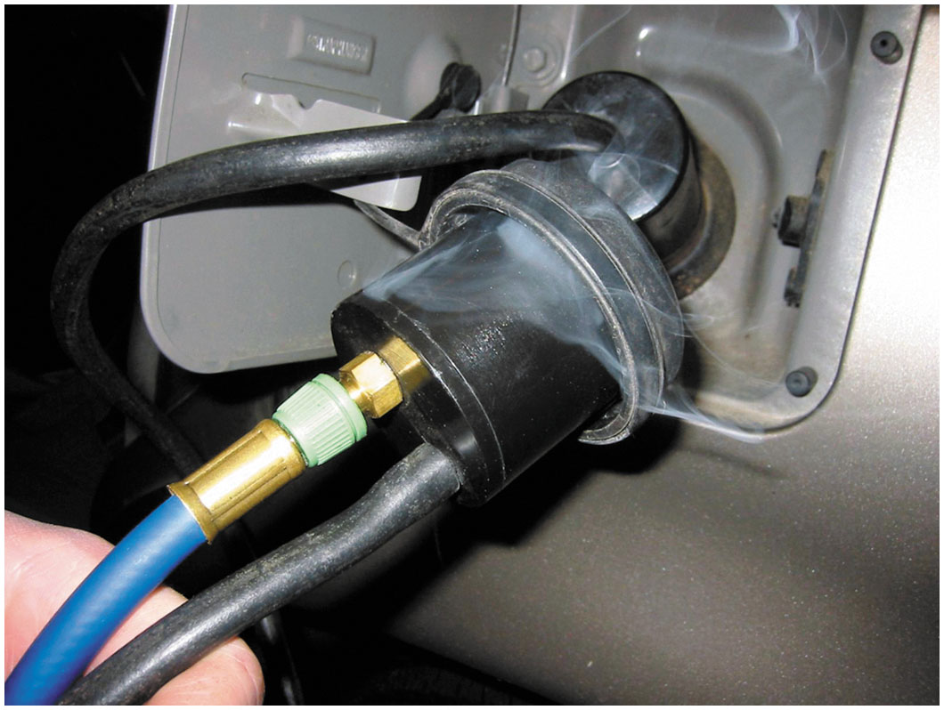
Figure 27.37
Tank Leak Tester
This unit is applying smoke to the fuel tank through an adapter and the leak was easily found to be the gas cap seal.

Slide 150
Diagnosing E V A P System (6 of 6)
Nitrogen Gas Pressurization
This method uses nitrogen gas under a very low pressure (lower than 1 P S I) in fuel system.
Listens for escaping air, using amplified headphones.

Slide 151
Animation: Evaporative Emission Control System Test

Slide 152
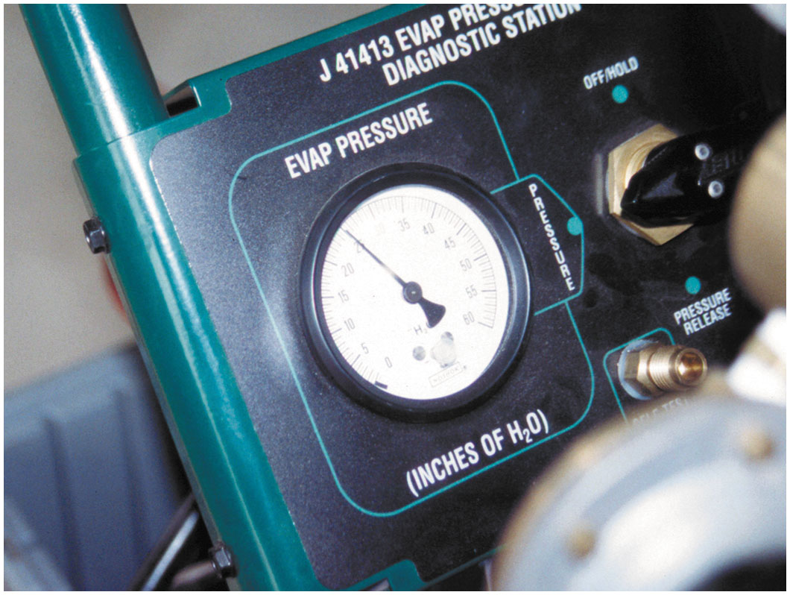
Figure 27.38
Testing with Nitrogen Gas
An emission tester that uses nitrogen to pressurize the fuel system.
Notes:
Long Description:
The emission tester has the following text on the top: J 41413 E V A P pressure diagnostic station. There is a knob with the following options: off or mold, pressure release, and pressure. There is a dial to measure the E V A P pressure in inches of H subscript 2 O.

Slide 153
Evaporative System Monitor (1 of 5)
Requirements
Not only detect faults.
Periodically test various systems and alert driver before emissions-related components are harmed by system faults.
Serious faults cause blinking M I L or even engine shutdown.
Less serious faults simply store D T C not illuminate M I L.
Notes:
O B D-II requirements did not affect fuel system design. However, one new component, a fuel evaporative canister purge line pressure sensor, was added for monitoring purge line pressure during tests.
The O B D-II requirements state that vehicle fuel systems are to be routinely tested while underway by the P C M.

Slide 154
Evaporative System Monitor (2 of 5)
vehicles perform a canister purge system pressure
test, as commanded by P C M.
While vehicle is being driven, vapor line between canister and purge valve monitored for pressure changes.
Canister purge solenoid open, line should be under a vacuum since vapors must be drawn from canister into intake system.
However, when purge solenoid is closed, there should be no vacuum in line.
Pressure sensor detects if vacuum present, and information is compared to command given to solenoid.

Slide 155
Evaporative System Monitor (3 of 5)
If, during canister purge cycle, no vacuum exists in canister purge line, D T C set indicating a possible fault,
Could be caused by inoperative or clogged solenoid or a blocked or leaking canister purge fuel line.
If vacuum exists when no command for purge is given, a stuck solenoid is evident, and a code is set.
E V A P system monitor tests for purge volume and leaks.

Slide 156
Evaporative System Monitor (4 of 5)
E V A P monitor first closes off the system to atmospheric pressure.
Opens purge valve during cruise operation.
Fuel Tank Pressure (F T P) sensor then monitors the rate with which vacuum increases in the system.
Monitor uses this information to determine purge volume flow rate.
Notes:
To test for leaks, the E V A P monitor closes the purge valve, creating a completely closed system.
The fuel tank pressure sensor then monitors the leak-down rate.
If the rate exceeds P C M-stored values, a leak greater than or equal to the O B D-II standard of 0.040 inch (1 m m) or 0.020 inch (0.5 m m) exists. After two consecutive failed trips testing either purge volume or the presence of a leak, the P C M lights the M I L and sets a D T C.

Slide 157
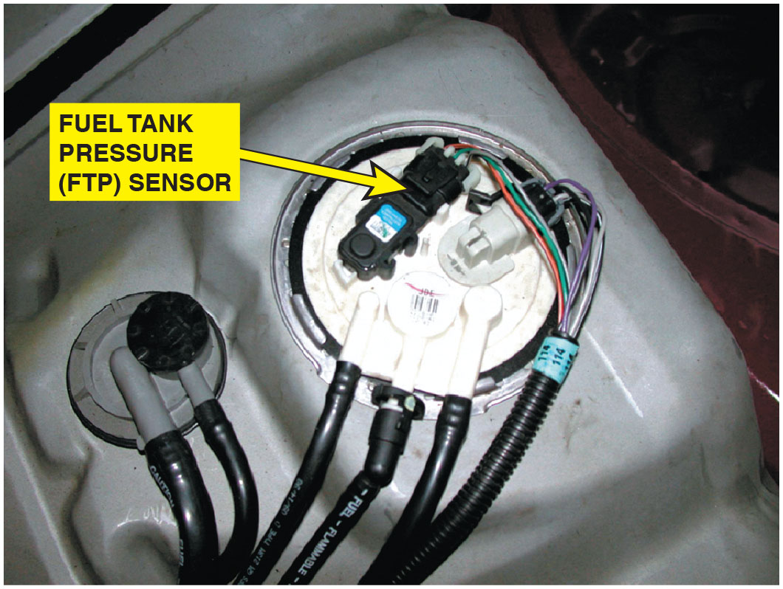
Figure 27.39
Fuel Tank Pressure (F T P) Sensor
The fuel tank pressure sensor (black unit with three wires) looks like a M A P sensor and is usually located on top of the fuel pump module (white unit).

Slide 158
Evaporative System Monitor (5 of 5)
Engine-Off Natural Vacuum
System integrity (leakage) can also be checked after the engine is shut off.
Premise is that a warm evaporative system will cool down after engine is shut off and vehicle is stable.
Slight vacuum created in tank during this cooling period.
If a specific level of vacuum is reached and maintained, the system is said to have integrity (no leakage).

Slide 159
Typical E V A P Monitor (1 of 3)
P C M run E V A P monitor when following criteria are met:
Cold start
Barometric pressure (B A R O) > 70 kPa (20.7 inches Hg or 10.2 P S I)
I A T between
and
at engine start-up
E C T between
and
at engine start-up
E C T and I A T within 39F of each other at engine start-up
Fuel level within 15% to 85%
Throttle position (T P) sensor between 9% and 35%

Slide 160
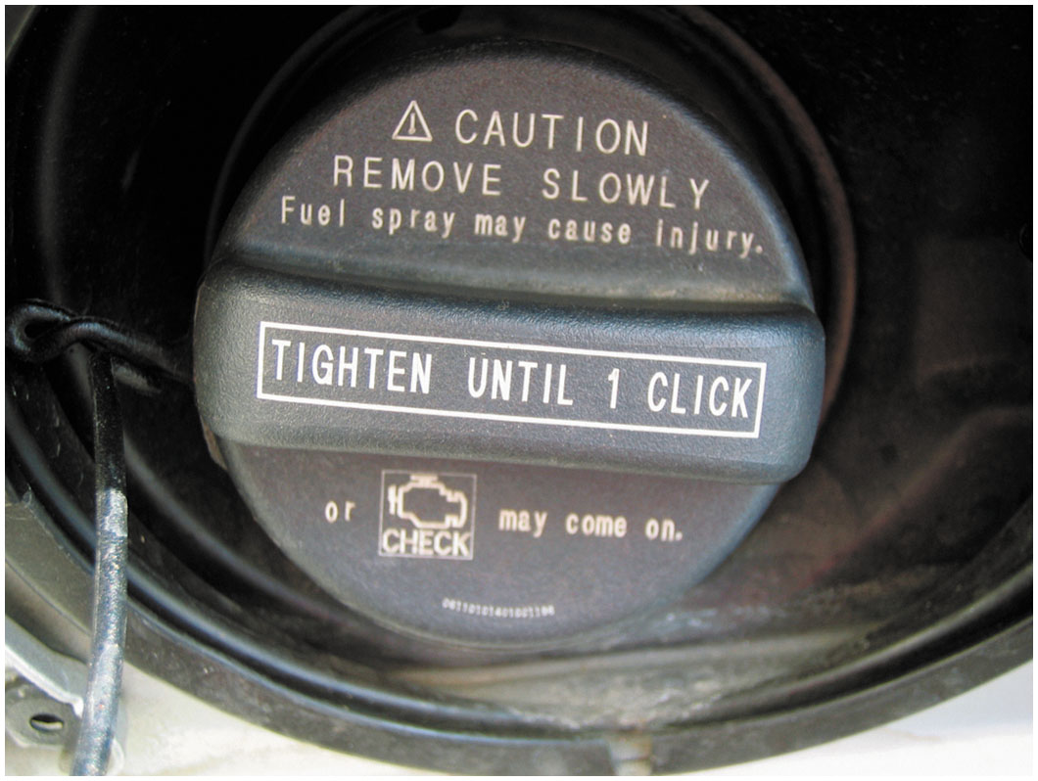
Figure 27.40
Toyota Fuel Cap
This Toyota cap has a warning. The check engine light will come on if not tightened until one click.
Notes:
Tech Tip: Always Tighten the Cap Correctly
Many diagnostic trouble codes (D T C s) are set because the gas cap has not been properly installed. To be sure that a screw-type gas cap is properly sealed, it may need to be tightened until it clicks three times. The clicking is a ratchet device and the clicking does not harm the cap. Therefore, if a P0440 or similar D T C is set, check the cap. • See Figure 27.40.

Slide 161
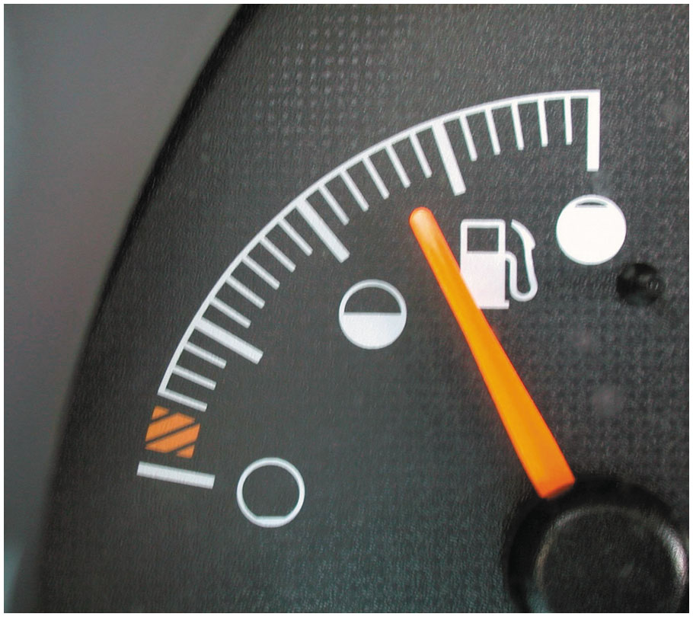
Figure 27.41
Fuel Gauge
The fuel level must be between 15% and 85% before the E V A P monitor will run on most vehicles.
Notes:
Tech Tip: Keep the Fuel Tank Properly Filled
Most evaporative system monitors will not run unless the fuel level is between 15% and 85%. In other words, if a driver always operates with close to an empty tank or always tries to keep the tank full, the E V A P monitor may not run. • See Figure 27.41.

Slide 162
Typical E V A P Monitor (2 of 3)
Running E V A P Monitor
Three tests performed during a E V A P monitor. D T C assigned to each test.
1. Weak vacuum test (P0440—large leak). This test identifies gross leaks. During the monitor, the vent solenoid is closed and the purge solenoid is duty cycled. The fuel tank pressure (F T P) should indicate a vacuum of
approximately 6 to 10 inches
2. Small leak test (P0442—small leak). After the large leak test passes, the P C M checks for a small leak by keeping the vent solenoid closed and closing the purge solenoid. The system is now sealed. The P C M measures the change in F T P voltage over time.

Slide 163
Typical E V A P Monitor (3 of 3)
3. Excess vacuum test (P0446). This test checks for vent path restrictions. With the vent solenoid open and purge commanded, the P C M should not see excessive vacuum in the E V A P system. Typical E V A P system vacuum with
the vent solenoid open is about 5 to 6 inches

Slide 164
E V A P System-Related Diagnostic Trouble Codes
Diagnostic Trouble Code | Description | Possible Causes
P0440 | Evaporative system fault | Loose gas cap Defective E V A P vent Cracked charcoal canister E V A P vent or purge vapor line problems
P0442 | Small leak Detected | Loose gas cap Defective E V A P vent or purge solenoid E V A P vent or purge line problems
P0446 | E V A P canister vent blocked | E V A P vent or purge solenoid electrical problems Restricted E V A P canister vent line

Slide 165
Summary (1 of 2)
Recirculating 6% to 10% inert exhaust gases back into the intake system by the E G R system reduces peak temperature inside the combustion chamber and reduces N O x exhaust emissions.
E G R not needed at idle, W O T, or when engine is cold.
E G R systems use a feedback potentiometer to signal P C M position of E G R valve pintle.
requires that flow rate be tested and then is achieved by opening E G R
valve and observing the reaction of the M A P sensor.
P C V systems use a valve or a fixed orifice to control and direct the fumes from the crankcase back into the intake system.
P C V valve regulates flow of fumes, depending on engine vacuum, and seals the crankcase vent in the event of a backfire.
30% of air needed by the engine at idle speed flows through the P C V system.
S A I system forces air at low pressure into the exhaust to reduce C O and H C exhaust emissions.

Slide 166
Summary (2 of 2)
A catalytic converter is aftertreatment device that reduces exhaust emissions outside of engine. A catalyst is an element that starts a chemical reaction, but is not consumed in the process.
Catalyst material used in a catalytic converter includes rhodium, palladium, and platinum.
O b d-ii system monitor compares the relative activity of a rear oxygen sensor to the precatalytic oxygen sensor to determine catalytic converter efficiency.
Purpose of E V A P system to reduce the release of volatile organic compounds (V O C S) into the atmosphere.
Carbon (charcoal) canister is used to trap and hold gasoline vapors until they can be purged and run into the engine to be burned.
regulation requires that the evaporative emission control system be
checked for leakage and proper purge flow rates.
External leaks can best be located by pressurizing the fuel system with low-pressure smoke.

Slide 167
Animation and Video Library Links (Must have an internet connection and active Haldeman subscription)
Animation Library: (A8) Engine Performance Animations
Video Library: (A8) Engine Performance Videos

Slide 168
Copyright
This work is protected by United States copyright laws and is provided solely for the use of instructors in teaching their courses and assessing student learning. Dissemination or sale of any part of this work (including on the World Wide Web) will destroy the integrity of the work and is not permitted. The work and materials from it should never be made available to students except by instructors using the accompanying text in their classes. All recipients of this work are expected to abide by these restrictions and to honor the intended pedagogical purposes and the needs of other instructors who rely on these materials.

