Slide 1
Advanced Engine Performance Diagnosis
Eighth Edition
Chapter 25
Electronic Transmission Controls
Copyright © 2025 Pearson Education, Inc. All Rights Reserved
Notes:
If this PowerPoint presentation contains mathematical equations, you may need to check that your computer has the following installed:
1) Math Type Plugin
2) Math Player (free versions available)
3) NVDA Reader (free versions available)
INSTRUCTOR NOTE: This presentation includes text explanation notes, you can use to teach the course. When in SLIDE SHOW mode, you RIGHT CLICK and select SHOW PRESENTER VIEW, to use the notes.

Slide 2
Learning Objectives
25.1 Explain how the automatic transmissions/transaxles are controlled electronically.
25.2 Explain the function of sensors and switches for electronic control of transmission.
25.3 Identify the types of transmission solenoids.
25.4 Discuss adaptive strategies and controls for electronically controlled automatic transmissions/transaxles.

Slide 3
Transmission Control Module
Electronic controls are used for more accurate automatic
Operation of transmission.
Design is often called Control Solenoid Valve Assembly
Mechatronic, & Solenoid Body.
It reduces number of wires entering transmission.

Slide 4
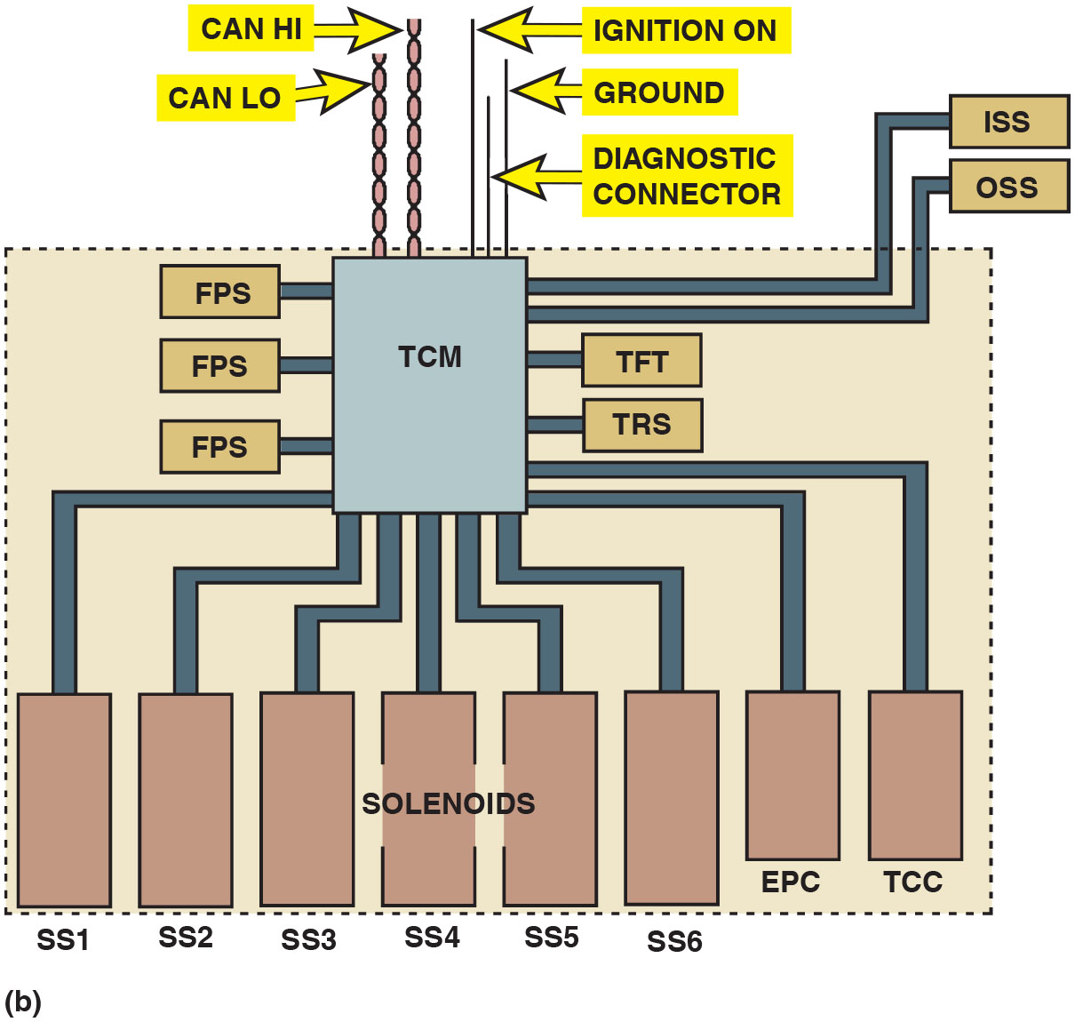
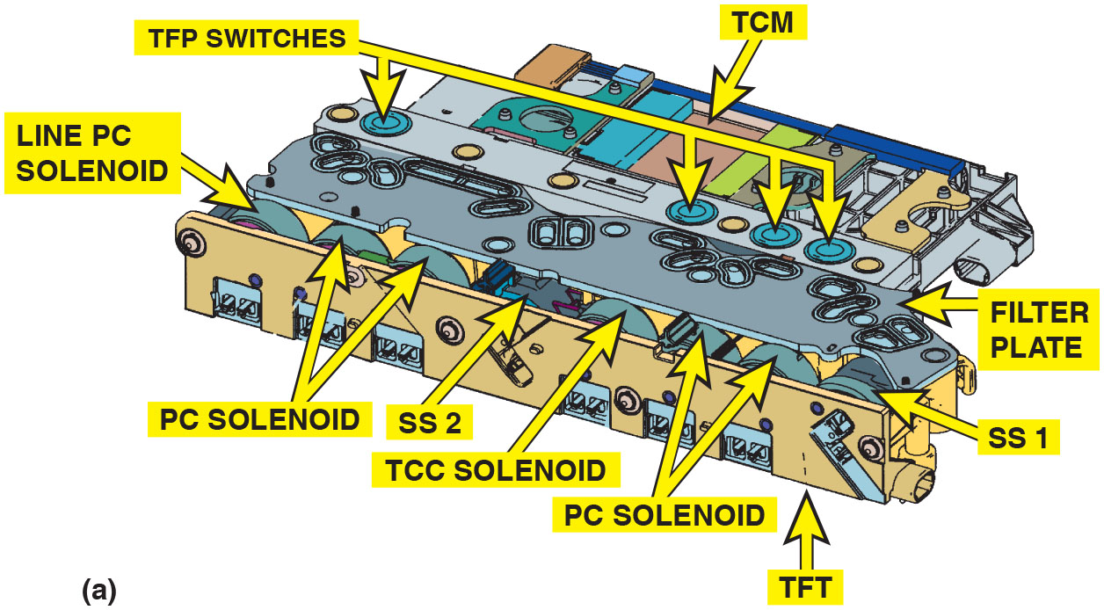
Figure 25.1
Control Solenoid Assembly
(a) This control solenoid assembly contains 4 transmission fluid pressure (T F P) switches, line pressure control (P C) solenoid, 4 pressure control (P C) solenoids, 2 shift solenoids (S S), a torque converter clutch (T C C) solenoid, a transmission fluid temperature (T F T) sensor, & transmission control module (T C M). It also has a vehicle harness connector with connections to the shift position switch and input and output speed sensors. (b) A simplified view is also shown.
Notes:
Long Description 1:
The illustration the following parts of the control solenoid valve assembly: transmission control module (T C M), transmission fluid pressure (T F P) switches, line P C solenoid, pressure control (P C) solenoid, shift solenoid 2 (S S 2), torque converter clutch (T C C) solenoid, P C solenoid, transmission fluid temperature (T F T), S S 1, and filter plate.
Long Description 2:
Transmission control module (T C M) is connected from the bottom to eight solenoids: S S 1 to S S 6, electronic pressure control (E P C), and torque converter clutch (T C C). T C M is connected to three fluid pressure sensors (F P Ss) on the left, an input shaft speed sensor (I S S), an output shaft speed sensor (O S S), a transmission fluid temperature (T F T) sensor, and a transmission range sensor (T R S) on the right. Twisted wires CAN Hi and CAN LO are connected on top left. The other wires ignition on, diagnostic connection, and ground are connected on top right.

Slide 5
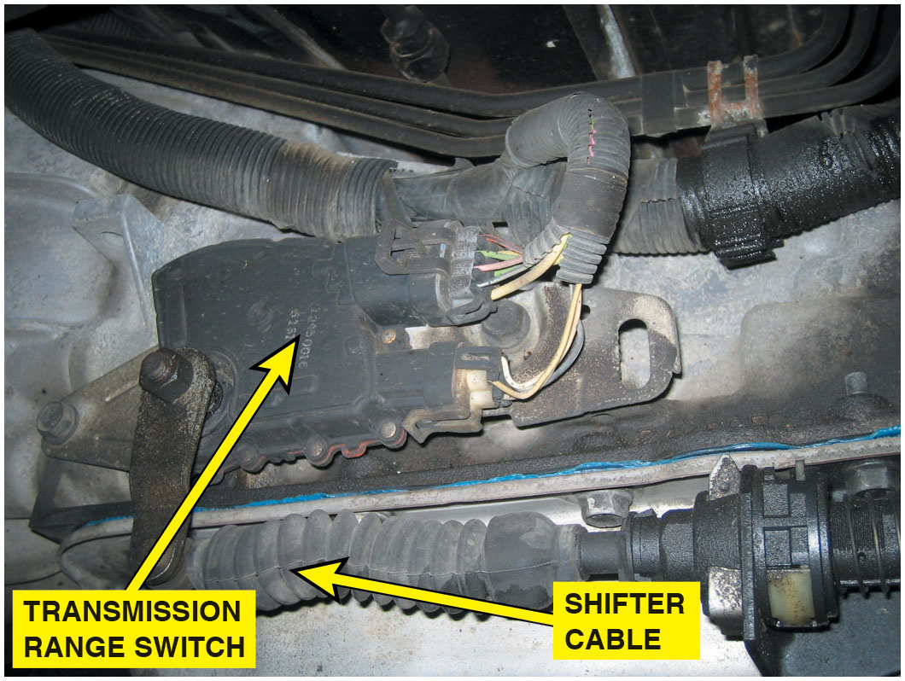
Figure 25.2
Range Switch
The transmission range switch is usually located on the case where the shifter cable attaches to the manual valve lever. The switch also includes the switch for the backup lights and the park/neutral switch, which is used to prevent the start being engaged unless the shifter is in park or neutral.

Slide 6
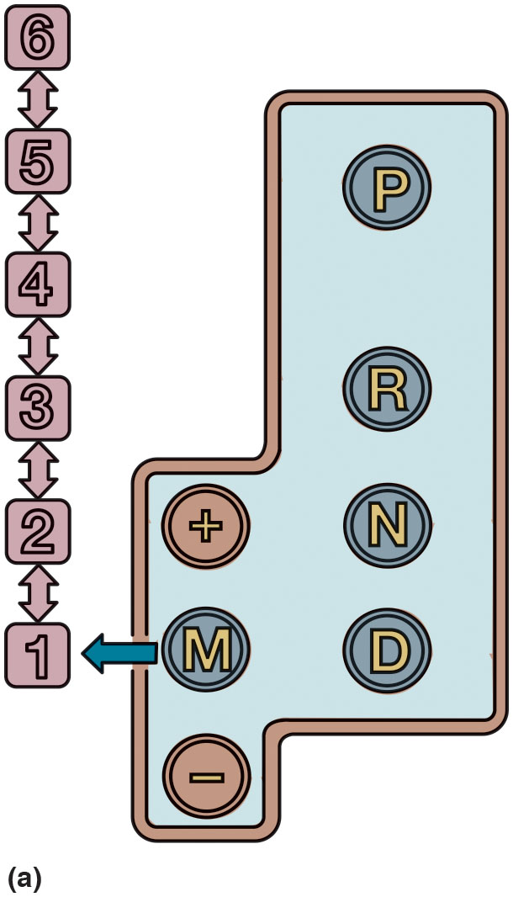
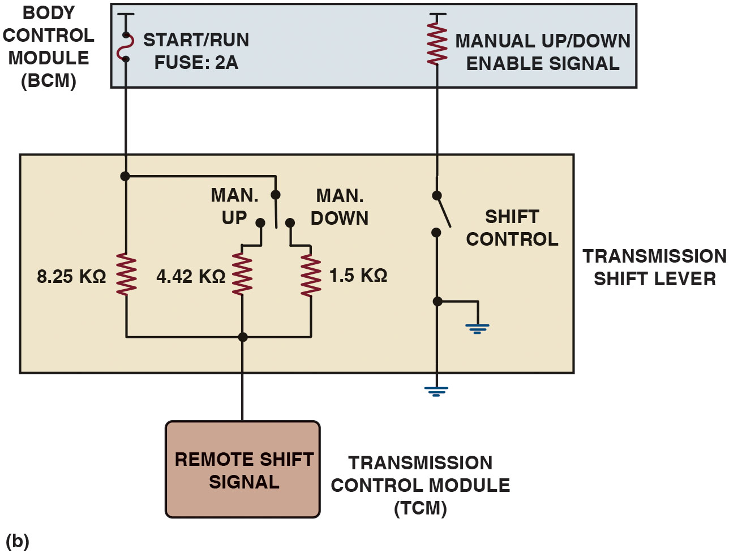
Figure 25.3
Manual Shift Control
(a) Moving shift lever to M (manual) position (a) activates the up/down, +/− switches that will cause an upshift or downshift. (b) internal schematic of shift lever.
Notes:
Long Description 1:
The block diagram shows the following buttons inside the lever from top left to bottom right: plus; manual or M; minus; P; R; N; D. An arrow points to a series of number buttons 1 to 6 with a double arrow between consecutive ones.
Long Description 2:
The circuit diagram shows a transmission shift lever connected to the body control module (B C M) and transmission control module (T C M). Two resistors in the transmission shift lever, 4.42 kiloohms and 1.5 kiloohms, are connected in parallel to 8.25 kiloohms, which leads to a start or run fuse of 2 A in the B C M. One end of the resistor 4.42 kiloohms is connected to a manual up or down open switch and the other end to the remote shift signal in the T C M. Another open switch labeled shift control in the shift lever is connected to the manual or down enable signal in the B C M. The other end of the shift control is grounded.

Slide 7
Sensors
Various Sensor Types (organized by type of electrical signal):
Frequency generators (ac signal with frequency relative to speed)
Voltage generator (voltage signal that is relative to speed)
Potentiometer or variable resistor (alters voltage or resistance)

Slide 8
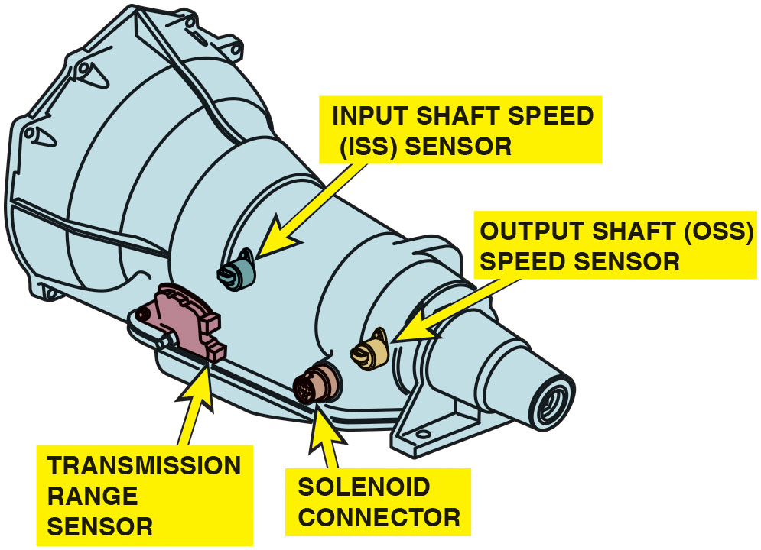
Figure 25.4
Sensors
Speed sensors are used by the P C M or T C M to control shifts and detect faults such as slippage when the 2 speeds do not match the predetermined ratio for each gear commanded.
Notes:
Switches (an on–off signal)
Thermistor (changes resistance relative to temperature)
Transducer (changes resistance relative to pressure)
Serial data (an on–off signal coming from another control module
Speed sensors measure the speeds of the input and output shafts or sometimes of other shaft speeds in the automatic transmission or transaxle. The output shaft speed sensor is often used to provide vehicle speed information to the P C M and for adaptive learning. • See Figure 25.4.
Speed sensor design includes the following:
Magnetic—Most speed sensors use a coil of wire that is wrapped around a magnetic core. This sensor is mounted next to a toothed ring or wheel. As the toothed ring revolves, an alternating voltage is produced in the sensor. • See Figure 25.5.
Hall-Effect—Some speed sensors are Hall-Effect and create an on–off square wave signal that is used directly by the P C M/T C M for speed detection.
Long Description:
The sensor is horn shaped. An input shaft speed (I S S) sensor is on the input side and an output shaft speed (O S S) sensor on the output side. A transmission range sensor is to the side of the I S S sensor and a solenoid connector to the side of the O S S sensor.

Slide 9
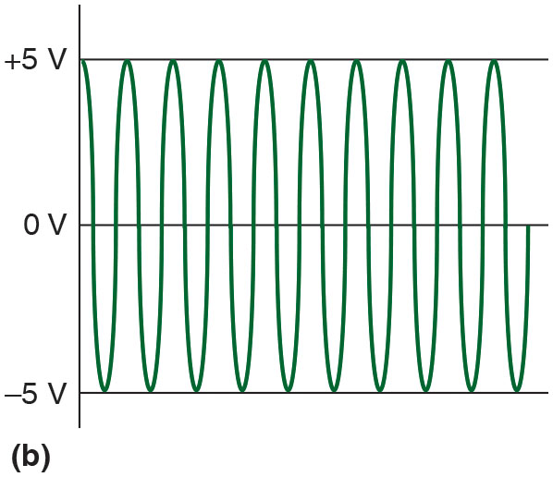
Figure 25.5
Speed Sensor
(a) The speed sensor switch will close as the magnet moves past it. It will generate a sine wave signal, which is converted inside the P C M/T C M to a digital signal. (b) The frequency of the signal is used to measure the speed.
Notes:
Long Description 1:
The illustration shows the generation of 0, positive 5, and negative 5 volts as magnetic lines of flux around the coil are at rest, being pulled into the core, and being pulled out from the core, respectively.
Long Description 2:
The illustration shows a sine wave with evenly spaced peaks and troughs of positive 5 volts and negative 5 volts, respectively.

Slide 10
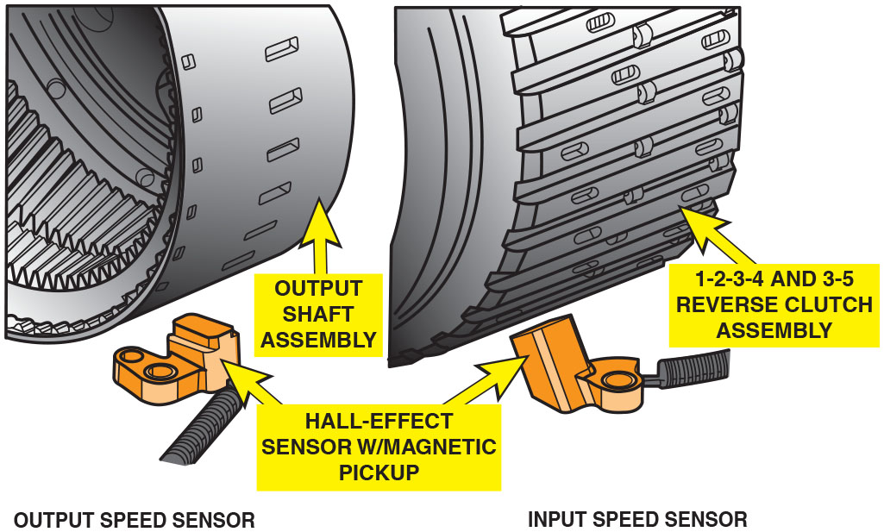
Figure 25.6
Speed Sensors
Input and output speed sensors are mounted so that notches in rotating assembly are used to measure speed (R P M), which is used by P C M/T C M for shift control and diagnostic information.
Notes:
Speed Sensor Locations
Speed sensors are used to detect the speeds of the input and output shafts on automatic transmissions/transaxles. Input speed sensor (I S S) measures the speed of the input shaft, which is the same or almost the same as the engine speed. This is also called turbine speed sensor (T S S) because it is used to determine the speed of the turbine shaft.
The output speed sensor (O S S) is also called the vehicle speed sensor (V S) and is used by the P C M for speedometer and cruise control operation as well as for transmission/transaxle operation and shift-related fault detection. • See Figure 25.6.

Slide 11
Animation: Wheel Speed Sensor

Slide 12
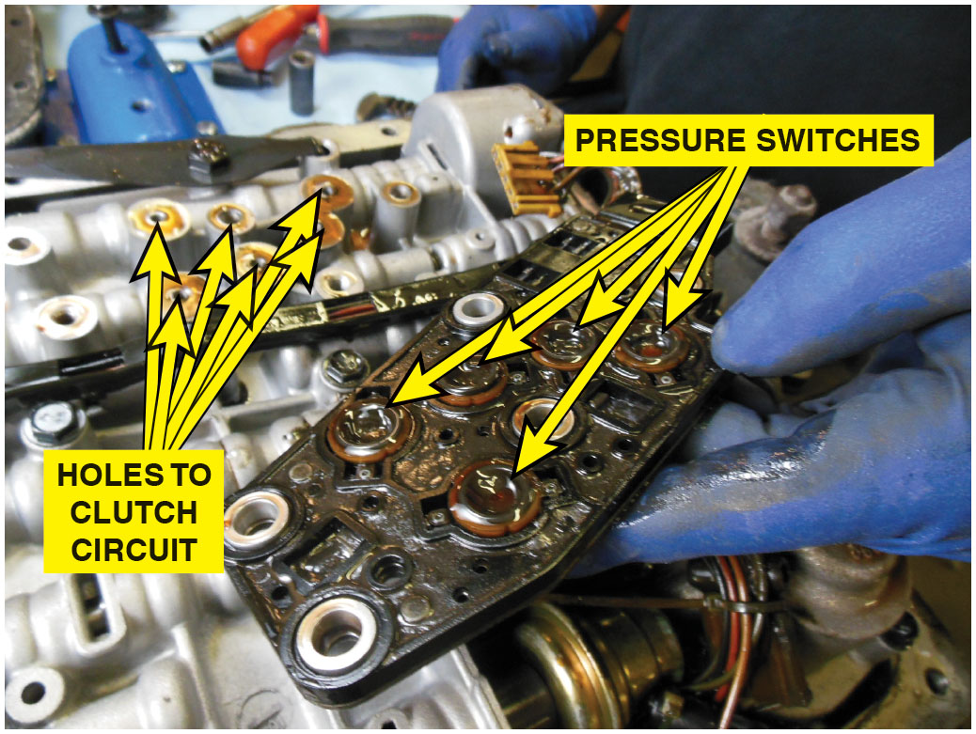
Figure 25.7
Pressure Switch Manifold (P S M)
Pressure switch manifold (P S M) used in a G M 4L60-E consists of diaphragm switches with seals around each one that are bolted to the valve body over holes for each clutch circuit.

Slide 13
Transmission Solenoids (1 of 2)
Hydraulic operation of transmission controlled by solenoids.
Switched to redirect pressurized fluid to move shift valves
Change operational pressures
P C M/T C M receives signals from sensors
Operates solenoids to produce upshifts & downshifts at proper speed

Slide 14
Transmission Solenoids (2 of 2)
Types of Solenoids
On-off
Can be normally open to fluid flow or
Normally closed to block fluid flow.
Linear
This solenoid can be varied by changing amount
Time to precisely control fluid flow
Through solenoid valve.

Slide 15
Frequently Asked Question: What Is Pressure Logic?
? Frequently Asked Question
What Is Pressure Logic? Pressure switches are used to monitor which clutch has pressure but the P C M/T C M can use the information from the switches to verify which gear the transmission/transaxle is operating. Some pressure switches are normally open (N.O.) and others are normally closed (N.C.) and the gear that the unit is operating in can be determined by the switch positions. An open circuit is represented by a binary code “1” and measures 12 volts while a grounded circuit binary code is “0” and measures 0 volts. Depending on the position of the manual valve, fluid is routed to the pressure switch manifold (P S M). The P C M/T C M uses information from the on/off positioning of the switches to adjust line pressure, torque converter clutch (T C M) apply, and to control shift solenoid operation. • See Figure 25.8.

Slide 16
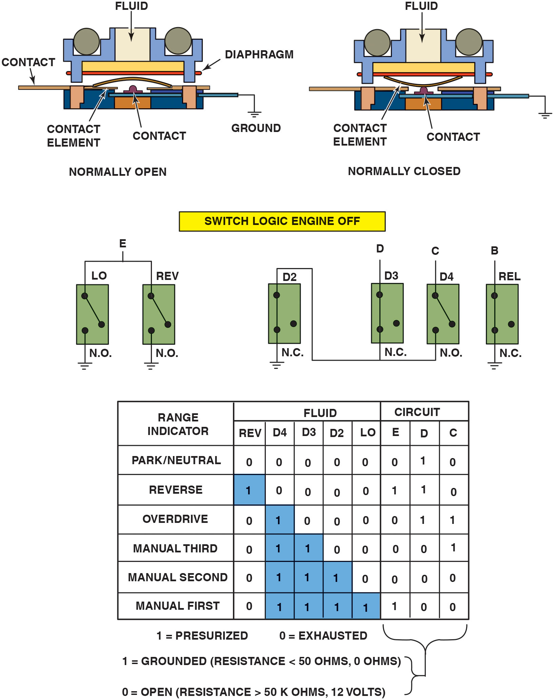
Figure 25.8
Switches
Some switches are electrically normally open (N.O.) and others are normally closed (N.C.) and are used to provide gear selection information to the P C M/T C M.
Notes:
Long Description:
The first part shows fluid in the center of a rectangular stair-like structure with the edges holding a bar labeled diaphragm and a rectangular base containing bars on either side with a U-shaped or an inverted U-shaped element and a hat-like structure labeled contact. In the normally open schematic, the contact element is with a U-shaped element not touching the contact. In the normally closed schematic, it is with an inverting U-shaped element touching the contact. The second part labeled switch logic engine off shows positions E, D, C, and B for logic circuits. Two normally open (N. O.) switches at L O and REV positions are grounded with the top terminal of each connected for E position. A(n) normally closed (N. C.) switch at D 2 position with the top terminal connected to the bottom terminal of an N. C. at D position and the bottom terminal of an N. O. of an N. O. at C position. An N. C. switch at REL position or B position is grounded. The third part shows a table of 6 rows and three columns. The column headers are range indicator, fluid, and circuit. The fluid column is divided into five columns: REV, D 4, D 3, D 2, and L O. The circuit column is divided into three columns: E, D, and C. The data are as follows: Row 1: range indicator: peak or neutral; REV: 0; D 4: 0; D 3: 0; D2: 0; L O: 0; E: 0; D: 1; C: 0. Row 2: range indicator: reverse; REV: 1; D 4: 0; D 3: 0; D 2: 0; L O: 0; E: 1; D: 1; C: 0. Row 3: range indicator: overdrive; R E V: 0; D 4: 1; D 3: 0; D 2: 0; L O: 0; E: 0; D: 1; C: 1. Row 4: range indicator: manual third; REV: 0; D 4: 1; D 3: 1; D 2: 0; L O: 0; E: 0; D: 0; C: 1. Row 5: range indicator: manual second; REV: 0; D 4: 1; D 3: 1; D 2: 1; L O: 0; E: 0; D: 0; C: 0. Row 6: range indicator: manual first; R E V: 0; D 4: 1; D 3: 1; D 2: 1; L O: 1; E: 1; D: 0; C: 0. Logic 1 under the fluid column is highlighted. An angular bracket is placed under the E, D, and C columns. The legend reads as follows: 1 equals presurized and 0 equals exhausted; 1 equals grounded (resistance is less than 50 ohms, 0 ohms); 0 equals open (resistance is greater than 50 kiloohms, 12 volts).

Slide 17
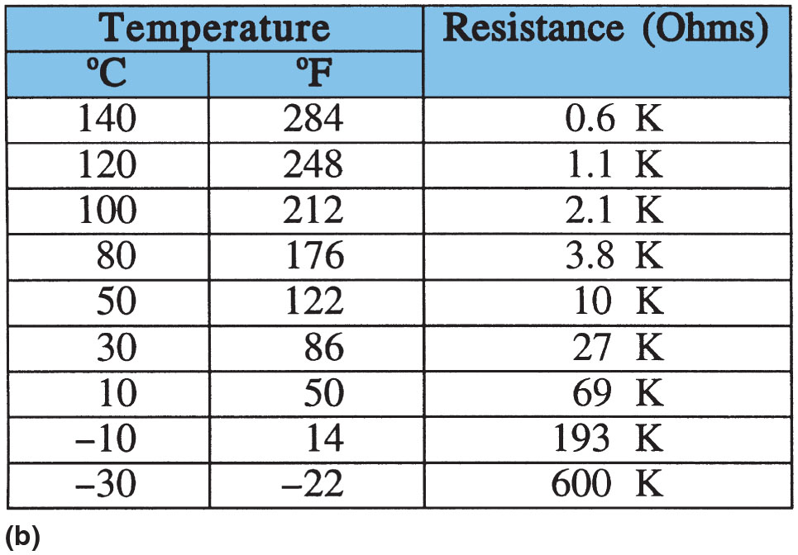
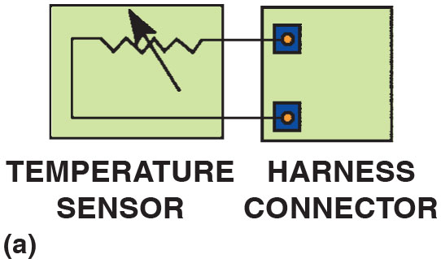
Figure 25.9
Transmission Fluid Temperature Sensor
(a) A transmission fluid temperature sensor can be checked by connecting an ohmmeter to the harness connector terminals. (b) The resistance should change as the temperature changes.
Notes:
The transmission fluid temperature (T F T) sensor can also be called a transmission oil temperature
(T O T) sensor. Most temperature sensors are thermistors, a type of variable resistor that changes electrical resistance relative to temperature. These are called negative temperature coefficient (N T C) thermistors. The signal from a thermistor is the inverse of the temperature because it has high resistance at low temperatures and a low resistance at high temperatures. For example, a particular transmission fluid temperature sensor has a resistance of 37 to 100 ohms (Ω) at 32°F to 58°F (0°C to 20°C) and 1,500 to 2,700 ohms (Ω) at 195°F to 230°F (91°C to 110°C). • See Figure 25.9.
This sensor is used by the P C M or T C M to detect the temperature of the automatic transmission fluid. This signal is used to determine the best shift points and to regulate line pressure. It will cause the P C M or the T C M to engage the torque converter clutch (T C C) sooner and disable overdrive, to help reduce fluid temperature if it reaches higher than normal.
Long Description 1:
A resistor with an arrow in the temperature sensor is connected to the terminals of the harness connector.
Long Description 2:
There are two subcolumns under the temperature column: degrees Celsius and degrees Fahrenheit. The data are as follows: Row 1: 140; 284; 0.6 K. Row 2: 120; 248; 1.1 K. Row 3: 100; 212; 2.1 K. Row 4: 80; 176; 3.8 K. Row 5: 50; 122; 10 K. Row 6: 30; 86; 27 K. Row 7: 30; 86; 27 K. Row 8: 10; 50; 69 K. Row 9: negative 10; 14; 193 K. Row 10: negative 30; negative 22; 600 K.

Slide 18
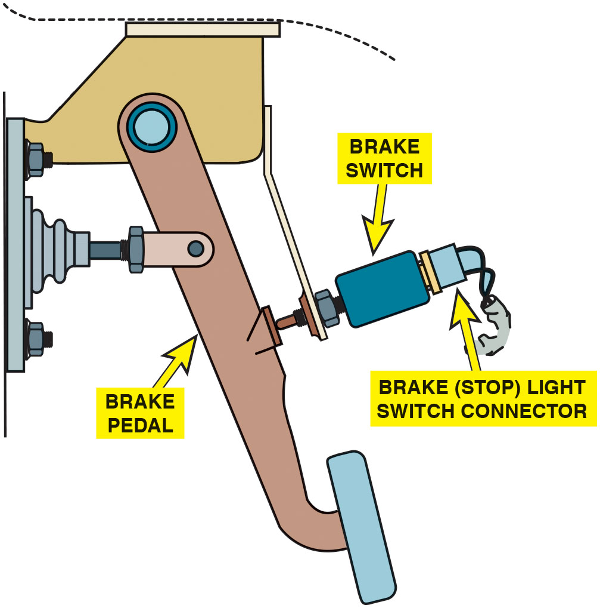
Figure 25.10
Brake (Stop Light) Switch
The brake (stop light) switch is mounted at the brake pedal. It provides a brake-apply signal to the T C M.

Slide 19
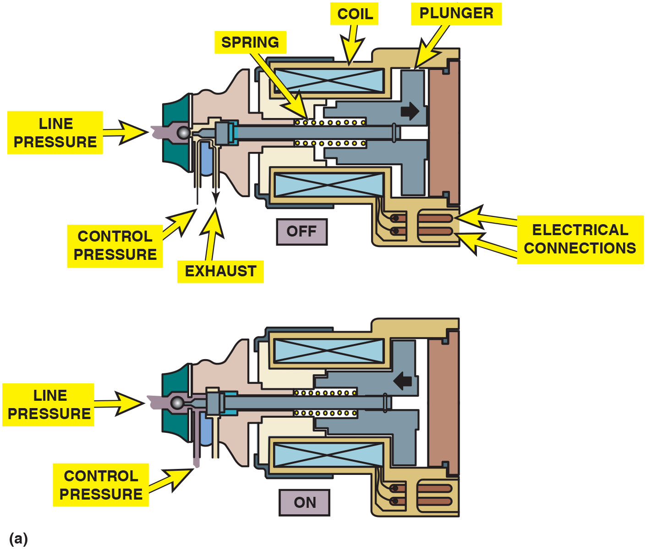
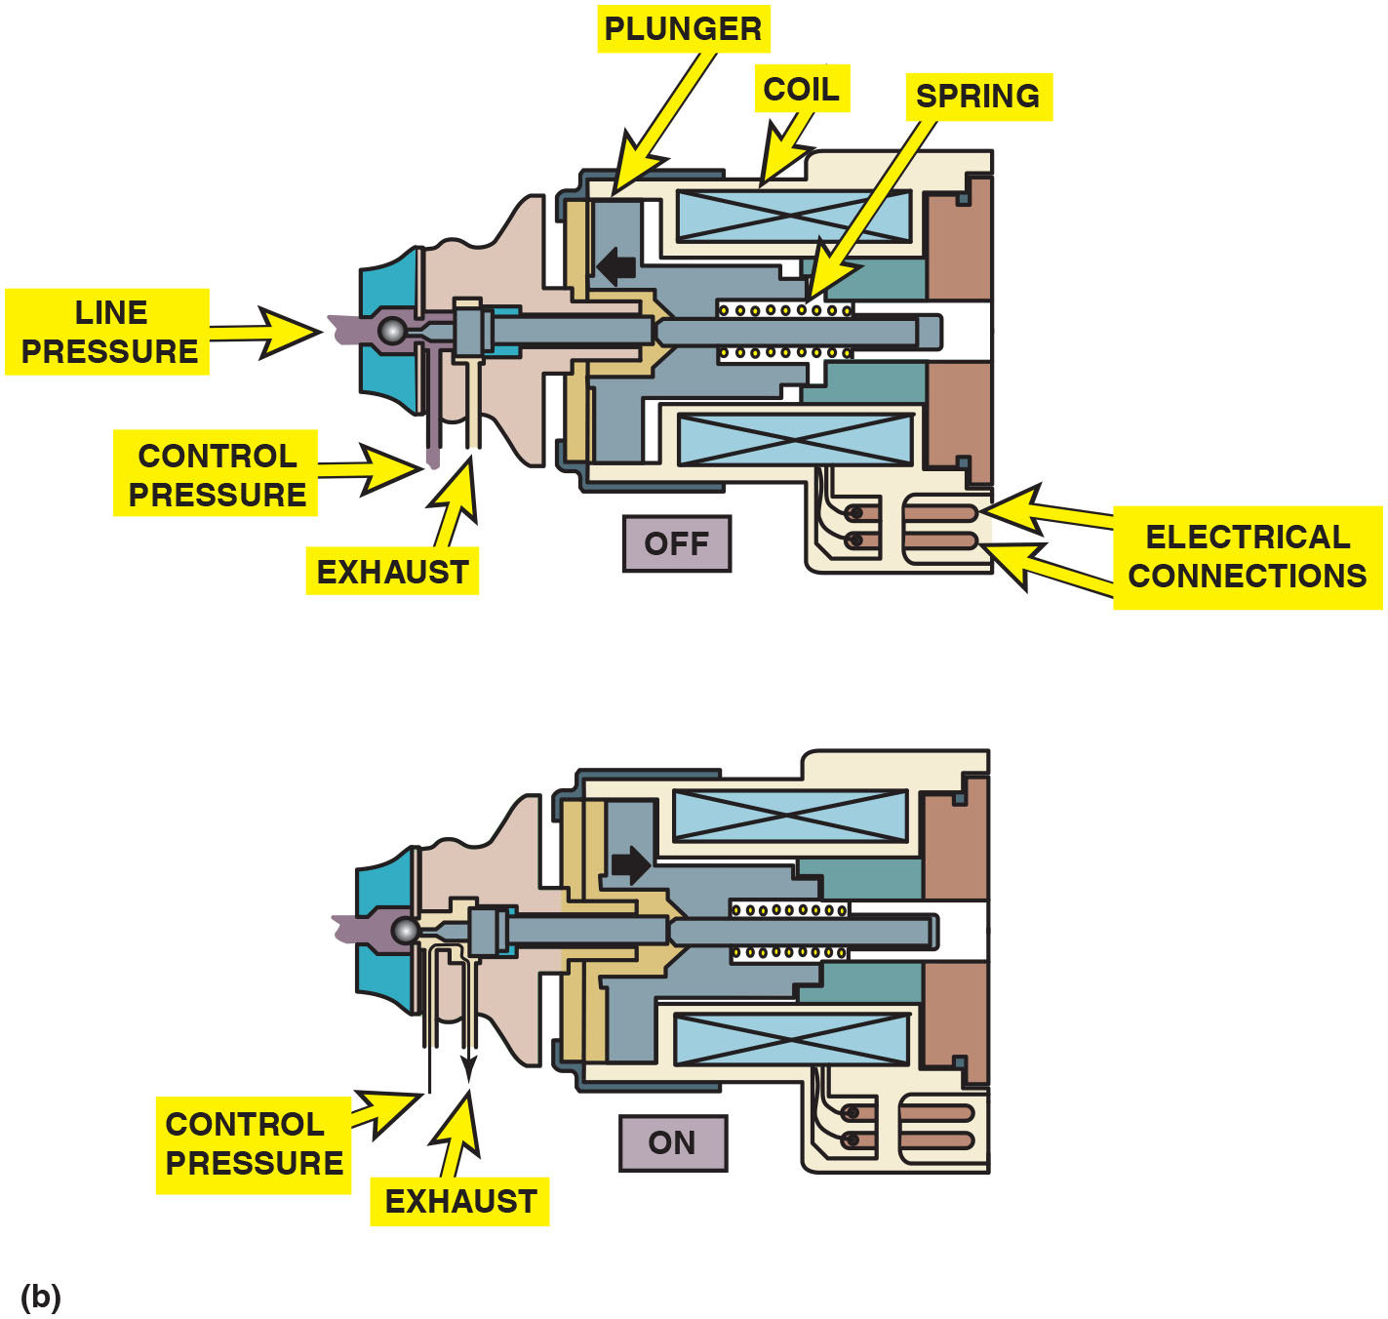
Figure 25.11
Shift Solenoids
(a) The normally closed solenoid blocks fluid flow when it is off while opening the exhaust; and when it is on, it opens the valve. (b) The normally open solenoid allows fluid flow when it is off; and when it is on, it closes the valve while opening the exhaust.
Notes:
Figure 25.11 (a) normally closed solenoid blocks fluid flow when off while opening exhaust; when on, opens valve. (b) normally open solenoid allows fluid flow when it is off; and when it is on, it closes the valve while opening the exhaust.
Types Of Solenoids An electronic transmission controls the shift points by turning a solenoid(s) on and off. The solenoids in turn control the hydraulic pressure that moves the shift valves or operates the torque converter clutch. Solenoids used in electronically controlled automatic transmissions/transaxles are as follows:
On–off solenoids. These can be normally open to fluid flow or normally closed to block fluid flow. Shift solenoids control the pressure force which in turn controls the position of the shift valve. They are commanded on or off by the P C M or T C M. The resistance of most on–off shift solenoids is 10 to 15 ohms. ● See Figure 25.11.
Linear solenoids. This type of solenoid can be varied by changing the amount of on time to precisely control the fluid flow through the solenoid valve. The variable power or ground applied to the linear solenoids is pulse-width modulated (P W M) and allows the P C M precise control over the shifting and the fluid pressure. The resistance of most linear (P W M) shift solenoids is about half of the on–off type and range from 4 to 6 ohms. ● See Figure 25.12.
A P W M signal is a digital signal, usually 0 volts and 12 volts, which is cycling at a fixed frequency. Varying the length of time that the signal is on provides a signal that can vary the on and off time of an output. The ratio of on time relative to the period of the cycle is referred to as duty cycle. The torque converter Clutch (T C C), Pressure Control Solenoids (P C S), And Some Shift Ids Are Pulse-width Modulated-type Solenoids. ● See Figure 25.13.
Long Description 1:
The illustration shows a pump-like structure leftward in which there is an opening on top labeled line pressure followed by tube-like elements labeled control pressure and exhaust, a spring above a rod fixed, a cylinder with a cross labeled coil above and below the spring, an L-shaped element above the spring labeled plunger, and a set of two bars from the coil labeled electrical connections. Here, the normally closed solenoid has the plunger to the right of the spring, where a right arrow in the off position indicates that it is closed and a left arrow in the on position indicates that it is open.
Long Description 2:
The illustration shows a pump-like structure leftward in which there is an opening on top labeled line pressure followed by tube-like elements labeled control pressure and exhaust, a spring above a rod fixed, a cylinder with a cross labeled coil above and below the spring, an L-shaped element above the spring labeled plunger, and a set of two bars from the coil labeled electrical connections. Here, the normally closed solenoid has the plunger to the left of the spring, where a left arrow in the off position indicates that it is closed and a right arrow in the on position indicates that it is open.

Slide 20
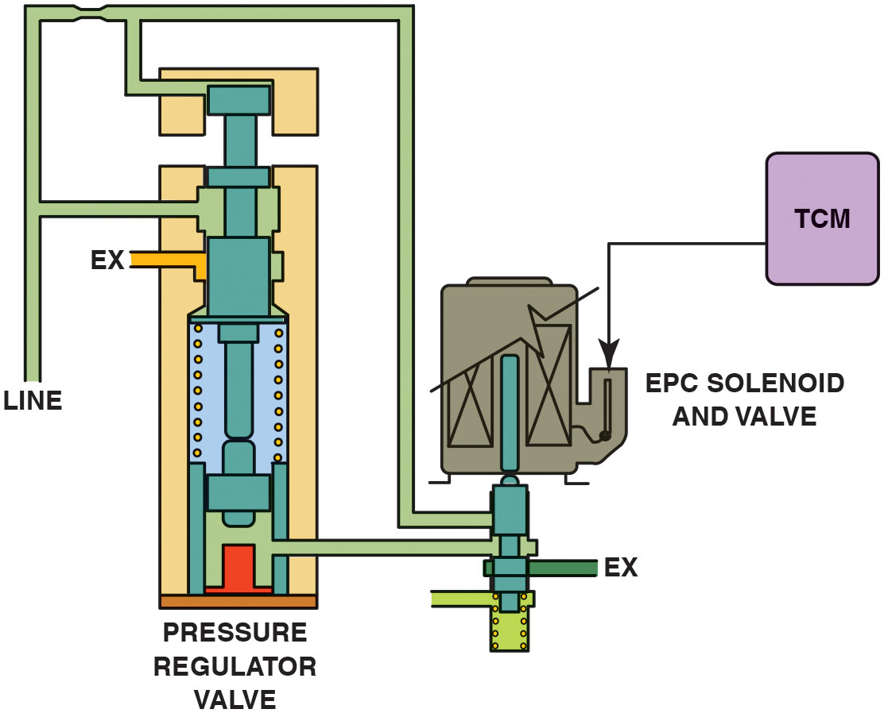
Figure 25.12
E P C Solenoid
The signal from the T C M can cause the to change the pressure regulator valve to adjust line pressure.
Notes:
Long Description:
The circuit diagram of the solenoid resembles a hand pump where there are inlets labeled line and ex, a valve at the bottom labeled pressure regulator valve, a rectangular shaped solenoid with a valve labeled electronic pressure control (E P C) solenoid and valve, and the transmission control module (T C M). The line is attached to the E P C solenoid through a pipe to which there is an outlet labeled ex. A pipe from the pressure regulator valve is attached to the pipe from the E P C solenoid. A signal is passed from the T C M to the E P C solenoid.

Slide 21
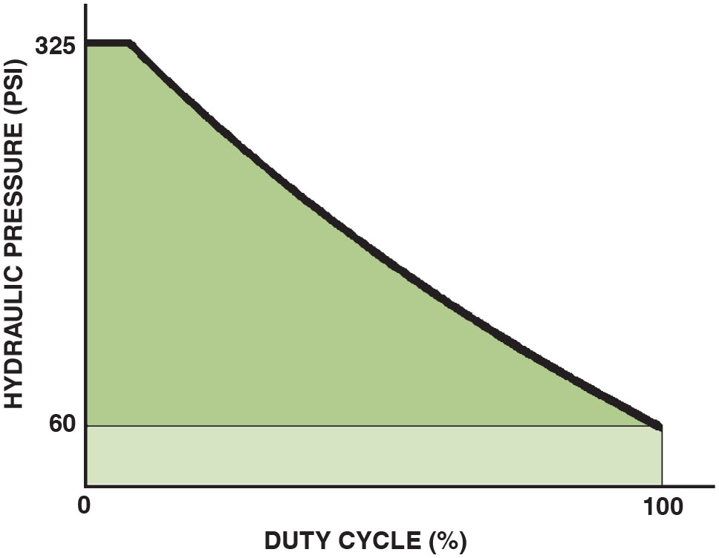
Figure 25.13
Line Pressure Curve
Line pressure increases as the duty cycle of the E P C solenoid decreases.

Slide 22
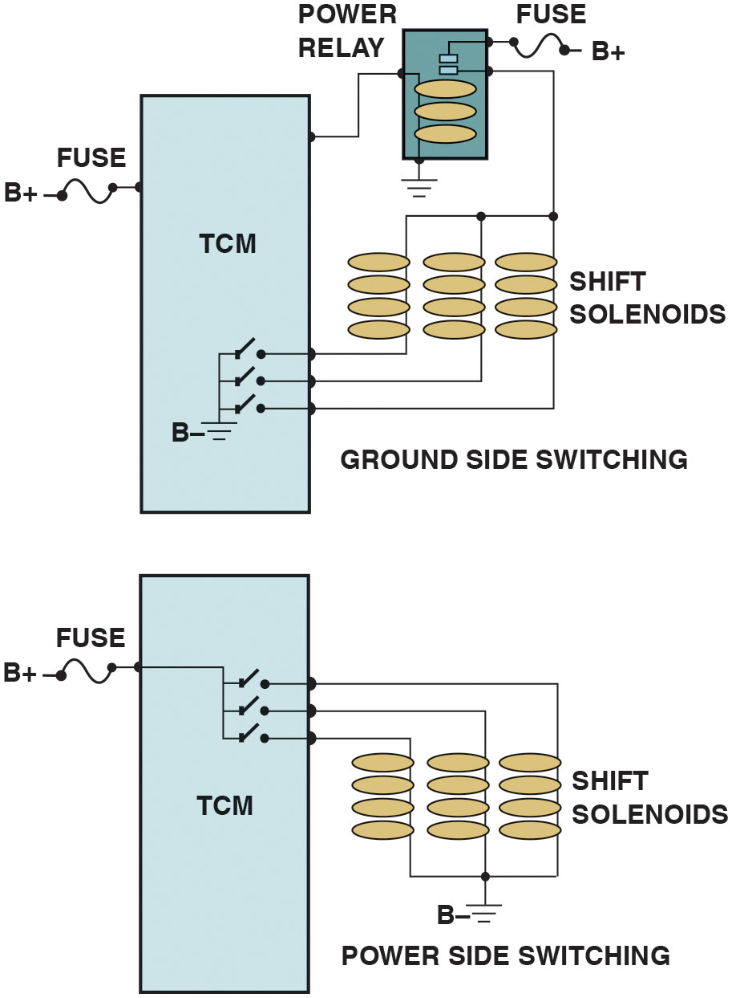
Figure 25.14
Solenoid Control
Solenoid control occurs when P C M/T C M completes circuit to ground (top) or switches on B+ (bottom). Ground connection is also B−.
Notes:
Long Description:
In the first part, a B plus fuse on the left and a power relay on the right with three shift solenoids along with B plus fuse are connected to the T C M. The switches in the T C M are grounded. This connection is labeled ground side switching. In the second part, B plus fuse on the left is connected to the switches in the T C M. The shift solenoids are grounded with B minus terminal. This connection is labeled power side switching.

Slide 23
Chart 25.1
E P C Amperes
E P C AMPERES | PRESSURE P S I (K P a)
0 point 0 | 169–195 P S I (1,165–1,345 k P a)
0.1 | 167–194 P S I (1,151–1,338 k P a)
0.2 | 161–190 P S I (1,110–1,310 k P a)
0.3 | 155–186 P S I (1,069–1,282 k P a)
0.4 | 144–177 P S I (993–1,220 k P a)
0.5 | 133–167 P S I (917–1,151 k P a)
0.6 | 120–153 P S I (827–1,055 k P a)
0.7 | 102–138 P S I (703–952 k P a)
0.8 | 83–119 P S I (572–821 k P a)
0.9 | 62–97 P S I (427–669 k P a)
1 point 0 | 53–69 P S I (365–476 k P a)

Slide 24
Adaptive Strategies (1 of 2)
Adaptive control, or adaptive learning, keeps shift duration within a certain time period as determined by the driver's habits.
G M call their adaptive control
Transmission Adapt Pressure system.
Manages oil pressure to control clutch fill rates.

Slide 25
Adaptive Strategies (2 of 2)
Chrysler refers to the adaptive control as the clutch volume index (C V I).
Honda calls it clutch fill volume index which is shown on a scan tool as a number..

Slide 26
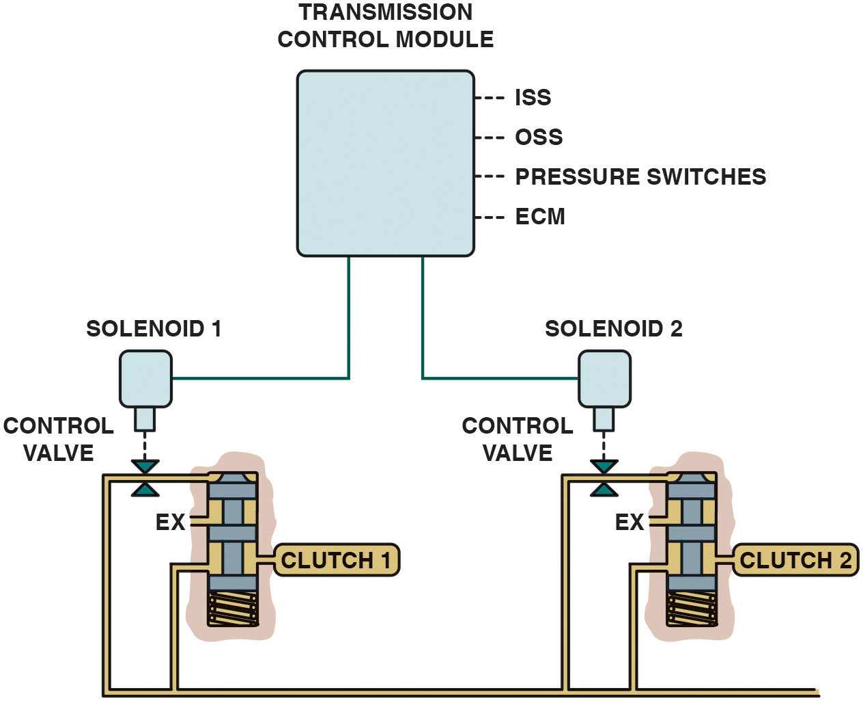
Figure 25.15
Solenoid Control
Using data from sensors, T C M can apply or release clutches. During upshift, solenoid 1 can control how fast clutch 1 releases as solenoid 2 controls how fast clutch 2 applies to keep the shift time at the proper speed.
Notes:
Long Description:
The following labels to the transmission control module block are connections depicted as dashed lines: I S S, O S S, pressure switches, and E C M. Both solenoids are inverted bottle shaped and lead to a control valve each, represented by two inverted triangles. Both clutches are hand pump shaped with ex inlets. Pipes from the top and the side of the clutches are connected to each other.

Slide 27
How It All Works
Electronic
T C M uses information from the various
Engine and transmission/ transaxle sensors and then commands
Shift solenoids to operate, which controls the timing of the shifts.
Hydraulic
Solenoid can be cycled (pulsed on and off).

Slide 28
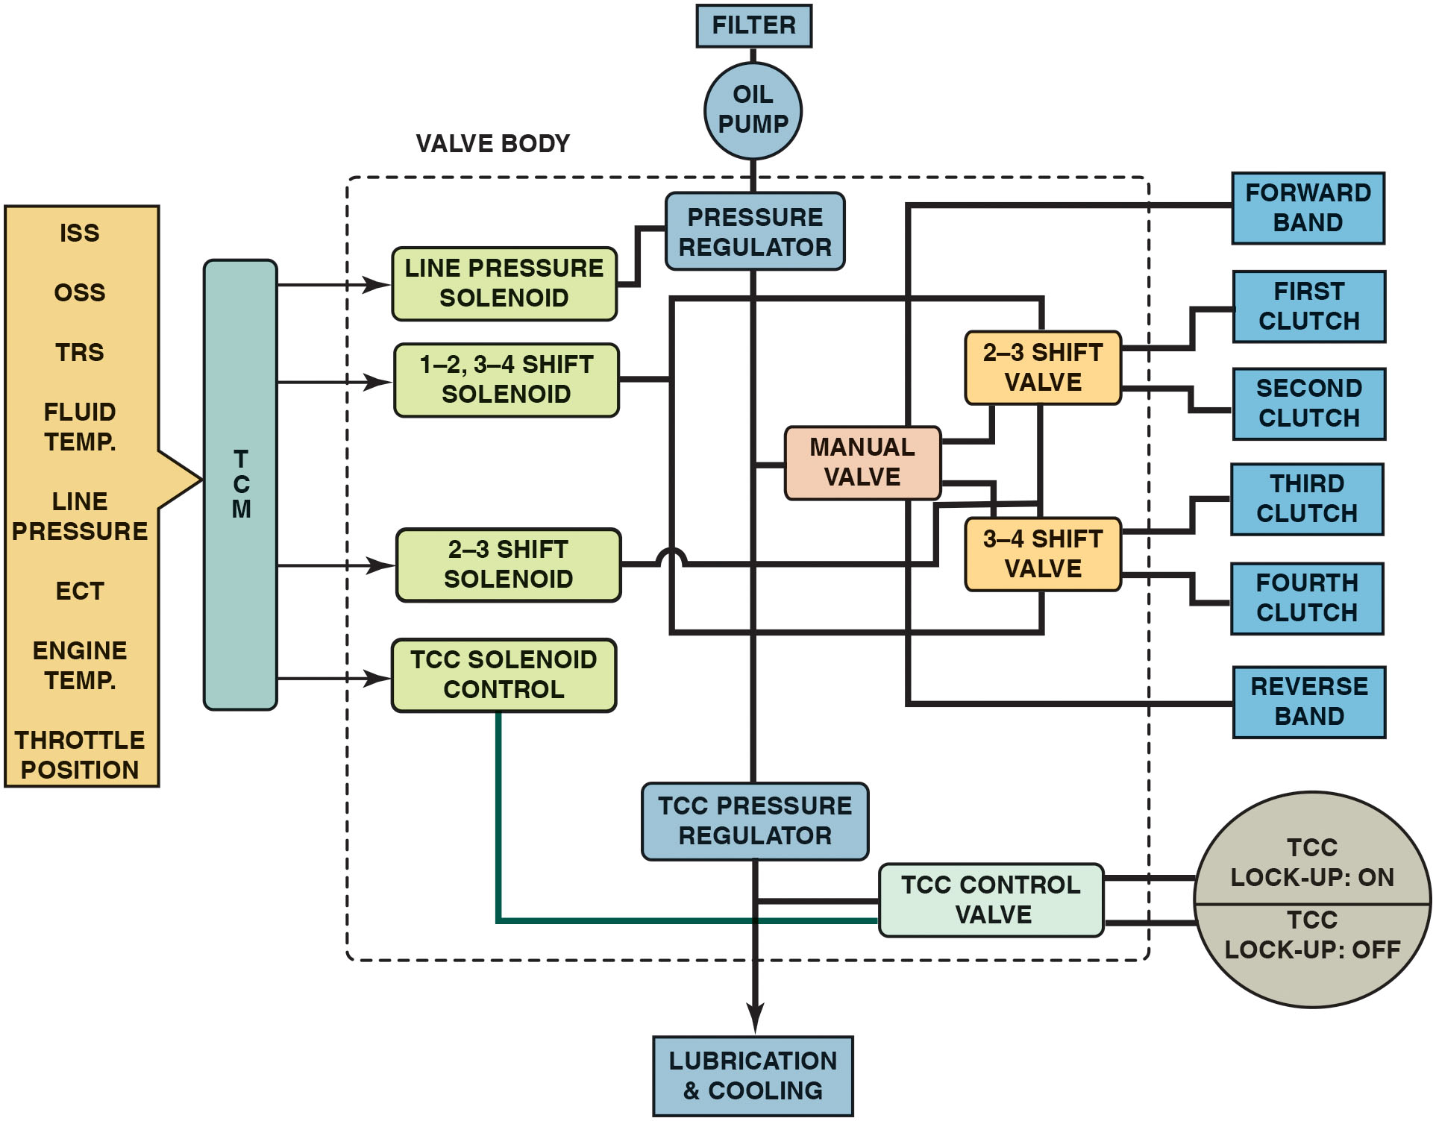
Figure 25.16
Electronic/Hydraulic Controls
Diagram showing relationship between electronic and hydraulic controls.
Notes:
Long Description:
The inputs to the T C M are I S S, O S S, T R S, fluid temperature, line pressure, E C T, engine temperature, and throttle position. The flow from left to right is as follows: T C M is vertically connected to line pressure solenoid, 1-2, 3-4 shift solenoid, 2-3 shift solenoid, and a T C C solenoid control. Components linearly connected from top to bottom are filter, oil, pressure regulator, T C C pressure regulator, and lubrication and cooling. Line pressure solenoid leads to pressure regulator. Components connected in a closed loop are 1-2, 3-4 shift solenoid, 2-3 shift valve, and 3-4 shift valve. From pressure regulator, manual valve leads to 2-3 shift valve and 3-4 shift valve. It also leads to forward band and reverse band. 2-3 shift valve leads to first clutch and second clutch. 3-4 shift valve leads to third clutch and fourth clutch. 2-3 shift solenoid is connected to 3-4 shift valve. From T C C pressure regulator, T C C control valve leads to T C C lock-up: on in one half of a circular block. From T C C solenoid control, T C C control valve leads to T C C lock-up: off in the second half of the circular block. All the components starting from the T C M except forward band, clutches, reverse band, T C C lock-up, filter, oil pump, and lubrication and cooling are connected by a dashed block and labeled valve body.

Slide 29
Frequently Asked Question: What Is Torque Control ?
? Frequently Asked Question
What Is Torque Control? Accurate control of shift timing and quality provides a smoother driving experience. In addition to improving shift quality, altering the ignition timing during the shift decreases the load on the transmission and increases transmission life. This is called torque management or torque reduction and is controlled by the P C M/T C M. • See Figure 25.17.

Slide 30
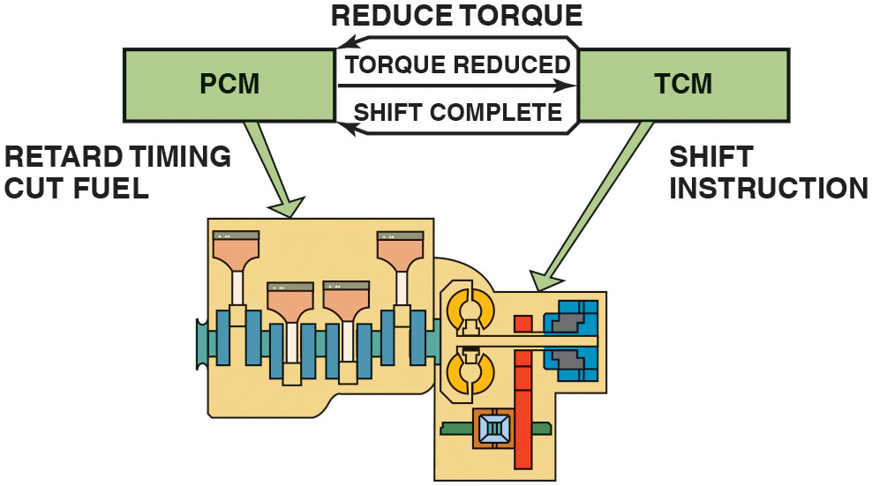
Figure 25.17
Torque Control
When transmission control module (T C M) is ready to begin an upshift, it signals the powertrain control module (P C M) to reduce engine torque. This produces a smoother shift with less wear in the transmission.
Notes:
Figure 25.17 When the transmission control module (T C M) is ready to begin an upshift, it signals the powertrain control module (P C M) to reduce engine torque. This produces a smoother shift with less wear in the transmission.
Frequently Asked Questions: What Is Torque Control? Accurate control of shift timing and quality provides a smoother driving experience. In addition to improving shift quality, altering the ignition timing during the shift decreases the load on the transmission and increases transmission life. This is called torque management or torque reduction and is controlled by the P C M/T C M. • See Figure 25.17.
Long Description:
Arrows from T C M to P C M are labeled reduce torque and shift complete. An arrow from P C M to T C M is labeled torque reduced. An arrow from P C M labeled retard timing cut fuel points to a train block containing a chain of vertical rectangular components with down-arrowhead-like structures. An arrow from T C M labeled shift instruction leads to the adjacent block containing tire-like structures with gaps on top and bottom connected to a horizontal bar in between intersecting a vertical bar and a vertical rectangular block with a handle-like structure on its left. The vertical bar makes L shape with a horizontal bar containing a square block.

Slide 31
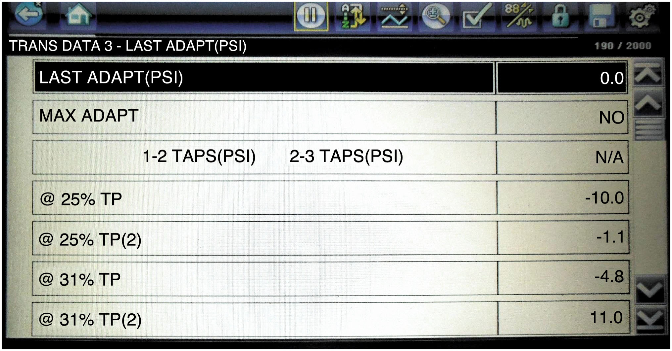
Figure 25.18
Adaptive Pressure Changes
A scan tool display showing the adaptive (T A P) pressure changes at various throttle positions.
Notes:
Long Description:
The table is titled trans data 3-last adapt (P S I). The data are as follows: Row 1: last adapt (P S I); 0.0. Row 2: MAX A D A P T; NO. Row 3: 1-2 T A P S (P S I) 2-3 T A P S (P S I); N/A. Row 4: at 25 percent T P; negative 10.0. Row 5: at 25 percent T P (2); negative 1.1. Row 6: at 31 percent T P; negative 4.8. Row 7: at 31 percent T P(2); 11.0.

Slide 32
Frequently Asked Question: What Is Fuzzy Logic ?
? Frequently Asked Question
What Is Fuzzy Logic? A method used to improve shift timing is through process called fuzzy logic. In most situations, shifts simply match vehicle speed and throttle position. Fuzzy logic adapts shifts to driving conditions such as mountains, upgrades and downgrades, and while turning corners. Shifts will be delayed and firmer because of increased load and multiple changes in throttle position. Fuzzy logic and advanced electronics allow improved shifts for many different situations. • See Figure 25.19.

Slide 33
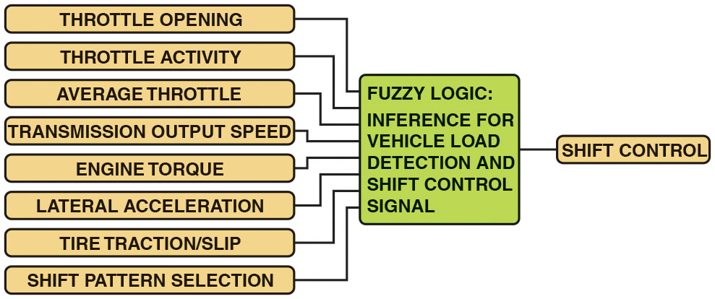
Figure 25.19
Fuzzy Logic
Fuzzy logic part of T M C receives input signals, compares what the driver is doing with the throttle and what the vehicle is doing with normal operation, adapts shift timing.
Notes:
Long Description:
The following are the inputs to the fuzzy logic block: throttle opening, throttle activity, average throttle, transmission output speed, engine torque, lateral acceleration, tire traction/slip, and slip pattern selection. The fuzzy logic block is labeled fuzzy logic: interference for vehicle load detection and shift control signal.

Slide 34
Chart 25.2
General Motors 4T60-E (Front-Wheel-Drive Transaxle)
Gear Range | Solenoid A | Solenoid B
First Gear | ON | OFF
Second Gear | OFF | OFF
Third gear | OFF | ON
Fourth gear | ON | ON
Vehicle would start out remain in 3rd gear if there was a fault with computer or wiring.

Slide 35
Chart 25.3
General Motors 4l80-E (Rear-Wheel-Drive Transmission)
Gear Range | Solenoid A | Solenoid B
First Gear | ON | OFF
Second Gear | OFF | OFF
Third gear | OFF | ON
Fourth gear | ON | ON
Vehicle would start out remain in 2nd gear if there was fault with computer or wiring.
Notes:
Depending on the exact make and model of the transmission or transaxle, the default gear can be second, third, or fourth gear. ● See Charts 25.2 and 25.3 for examples of two General Motors transmissions.

Slide 36
Question 1
What type of sensor is the transmission fluid temperature (T F T) sensor?
a. Negative temperature coefficient (N T C) thermistor
b. Potentiometer
c. Rheostat
d. Transducer

Slide 37
Answer 1
What type of sensor is the transmission fluid temperature (T F T) sensor?
a. Negative temperature coefficient (N T C) thermistor.

Slide 38
Summary (1 of 2)
Electronic controls used for more accurate automatic operation
Electronic controls use sensors to monitor various operational inputs
Will be used to control the operation of the transmission.

Slide 39
Summary (2 of 2)
Hydraulic operation of the transmission is controlled by solenoids
Switched to redirect pressurized fluid to move shift valves
Change the operational pressures.
P C M/T C M receives signals from the sensors and operates solenoids.
Produce upshifts and downshifts at the proper speed.

Slide 40
Animation and Video Library Links (Must have an internet connection and active Haldeman subscription)
Animation Library: (A8) Engine Performance Animations
Video Library: (A8) Engine Performance Videos

Slide 41
Copyright
This work is protected by United States copyright laws and is provided solely for the use of instructors in teaching their courses and assessing student learning. Dissemination or sale of any part of this work (including on the World Wide Web) will destroy the integrity of the work and is not permitted. The work and materials from it should never be made available to students except by instructors using the accompanying text in their classes. All recipients of this work are expected to abide by these restrictions and to honor the intended pedagogical purposes and the needs of other instructors who rely on these materials.

