Slide 1
Advanced Engine Performance Diagnosis
Eighth Edition
Chapter 23
Gasoline Direct-Injection (G D I) Systems
Copyright © 2025 Pearson Education, Inc. All Rights Reserved
Notes:
If this PowerPoint presentation contains mathematical equations, you may need to check that your computer has the following installed:
1) Math Type Plugin
2) Math Player (free versions available)
3) NVDA Reader (free versions available)
INSTRUCTOR NOTE: This presentation includes text explanation notes, you can use to teach the course. When in SLIDE SHOW mode, you RIGHT CLICK and select SHOW PRESENTER VIEW, to use the notes.

Slide 2
Learning Objectives
23.1 Explain how a direct fuel-injection system works.
23.2 Describe the direct-injection fuel delivery system.
23.3 Describe modes of operation.
23.4 Discuss G D I piston designs.
23.5 Discuss port/direct injection systems.
23.6 Discuss engine start systems.
23.7 Discuss G D I service issues..

Slide 3
Direct Fuel Injection (1 of 2)
Port Injection v s. Direct Injection
In G D I system, fuel is squirted directly into combustion chamber.
In a port fuel-injection system, there is constant fuel pressure but variable injector pulse width.
In a G D I, there is almost constant injector pulse width with varying fuel pressure.
Parts and Operation
A direct-injection system sprays high-pressure fuel, up to 2,900 P S I, into the combustion chamber.

Slide 4
Direct Fuel Injection (2 of 2)
Advantages of Gasoline Direct Injection
Improved fuel economy and lower emissions
Higher compression ratio for higher engine efficiency
Use of lower-octane gasoline
Higher volumetric efficiency
Disadvantages of Gasoline Direct Injection
Higher cost due to high-pressure pump and injectors
More components compared with port fuel injection
Higher
emissions

Slide 5
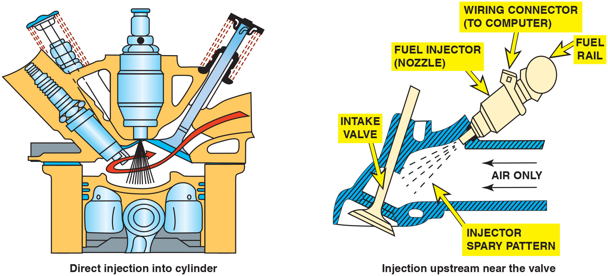
Figure 23.1
P F I Compared to G D I
A comparison of a port fuel injection system (right) to a gasoline direct injection (G D I) system on the left.
Notes:
Long Description:
In a direct injection system, fuel is sprayed directly into the combustion chamber by an injector. In a spray type fuel injection system, fuel is sprayed by a fuel injector upstream near the valve and air mixes with the fuel above the intake valve. The fuel injector is connected to a wiring connector and the fuel rail.

Slide 6
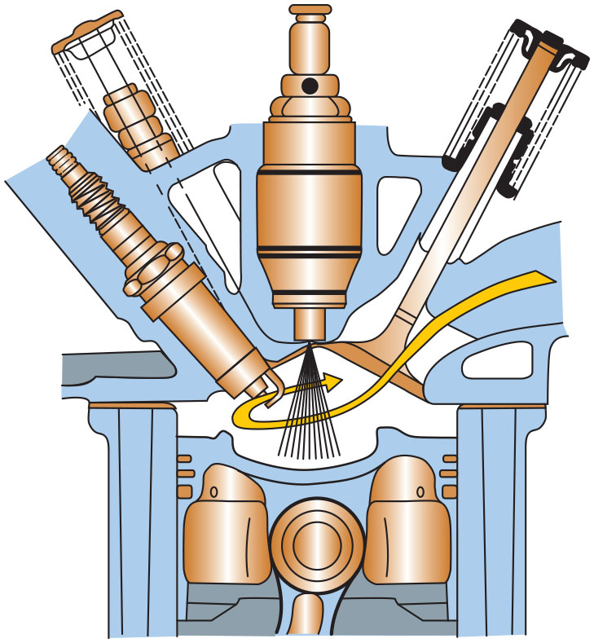
Figure 23.2
G D I Injection
A gasoline direct-injection system injects fuel under high pressure directly into the combustion chamber.

Slide 7
Question 1
What are two advantages of gasoline direct injection compared with port fuel injection?

Slide 8
Answer 1
Better fuel economy and lower emissions.

Slide 9
Direct-Injection Fuel Delivery System (1 of 2)
Low-Pressure Supply Pump
The fuel pump in the fuel tank supplies fuel to the high-pressure fuel pump at a pressure of approximately 60 P S I.
High-Pressure Pump
A typical G D I high-pressure pump has a range of between 500 P S I (3,440 k P a) and 2,900 P S I (15,200 k P a) during engine operation.

Slide 10
Direct-Injection Fuel Delivery System (2 of 2)
Fuel Rail
The fuel rail stores the fuel from the high-pressure pump and stores high-pressure fuel for use to each injector.
Fuel Pressure Regulator
An electric pressure-control valve is installed between the pump inlet and outlet valves.

Slide 11
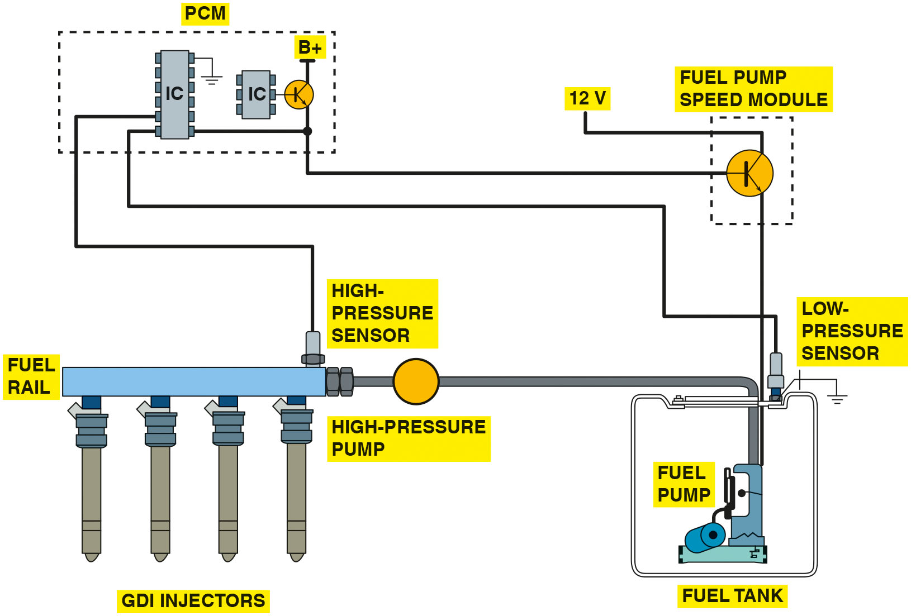
Figure 23.3
Low-Pressure Pump
A G D I system uses a low-pressure pump in the gas tank similar to other types of fuel-injection systems. The P C M controls the pressure of the high-pressure pump using sensor inputs.
Notes:
Long Description:
A fuel pump sucks fuel from the fuel tank and a low-pressure is connected to the tank. The fuel pump is controlled by a fuel pump speed module. A high-pressure pump is connected to a fuel rail, which in turn has four G D I injectors connected to it. A P C M controls both the sensors and the speed module.

Slide 12
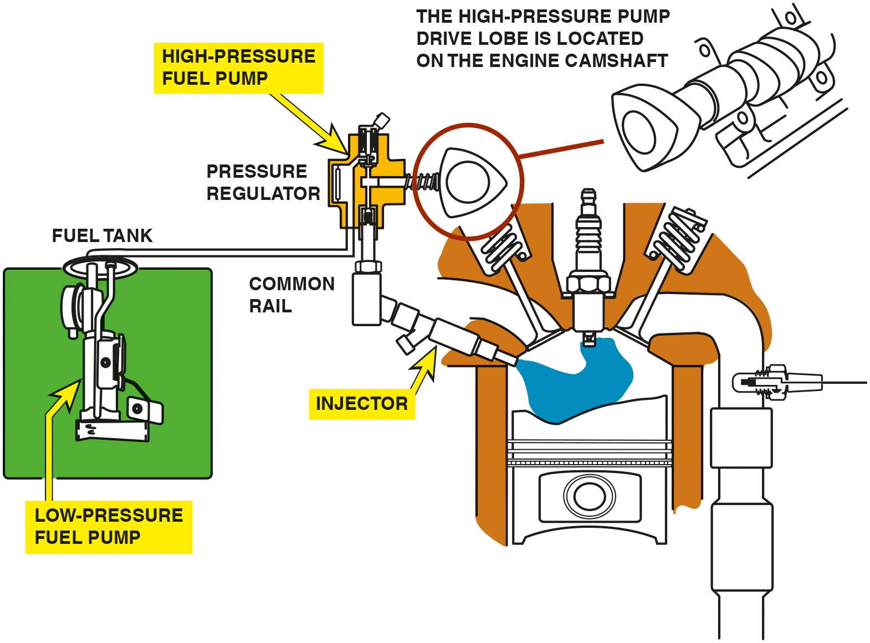
Figure 23.4
G D I Uses 2 Fuel Pumps
A typical direct-injection system uses two pumps-one-low-pressure electric pump in the fuel tank and the other a high-pressure pump driven by the camshaft. The high-pressure fuel system operates at a pressure as low as 500 P S I during light load conditions and as high as 2,900 P S I under heavy loads.
Notes:
Long Description:
A low-pressure fuel pump is installed inside a fuel tank and is connected to a pressure regulator. The pressure regulator houses a high-pressure fuel pump and is connected to a common rail. A high-pressure pump drive lobe is located on the engine camshaft and drives the high-pressure pump. An injector is connected to the common rail.

Slide 13
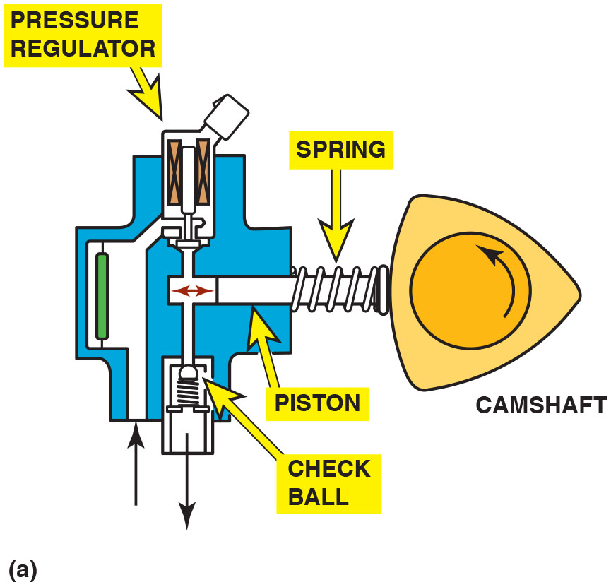
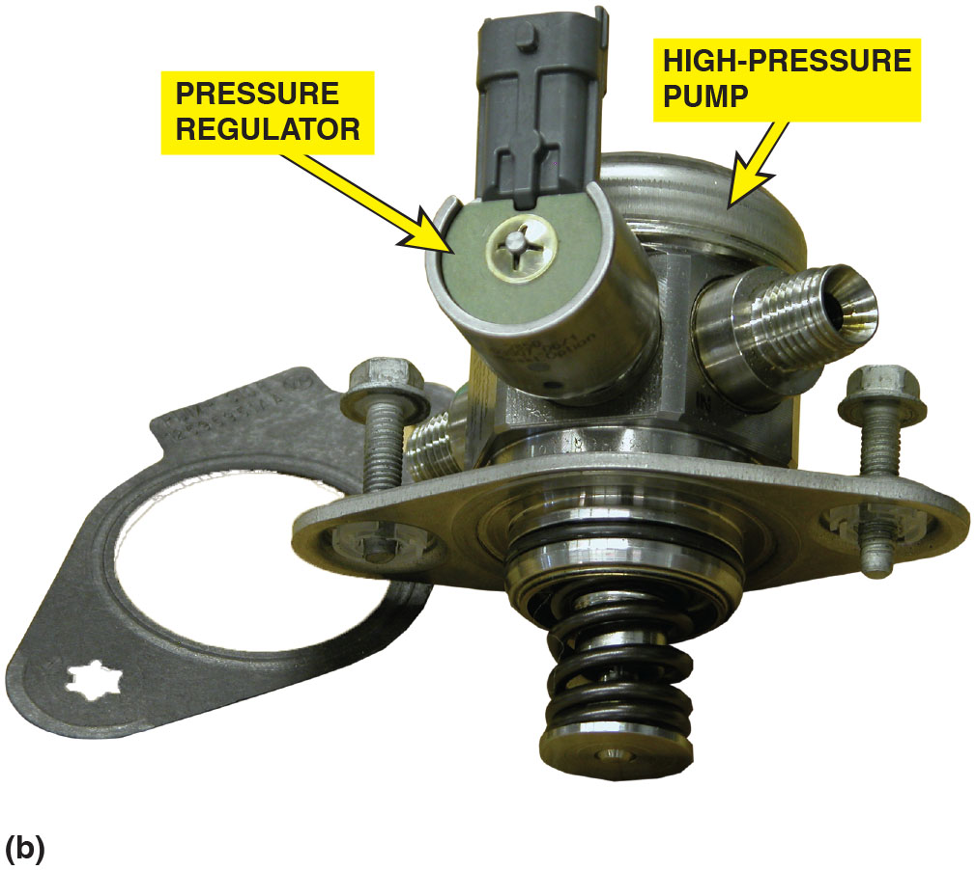
Figure 23.5
High-Pressure Pump
(a) A typical camshaft-driven high-pressure pump used to increase fuel pressure to 2,000 P S I or higher. (b) The high-pressure pump assembly removed from the engine. Many G D I engines use a roller where the high-pressure pump rides against the cam lobes to help reduce friction and wear.

Slide 14
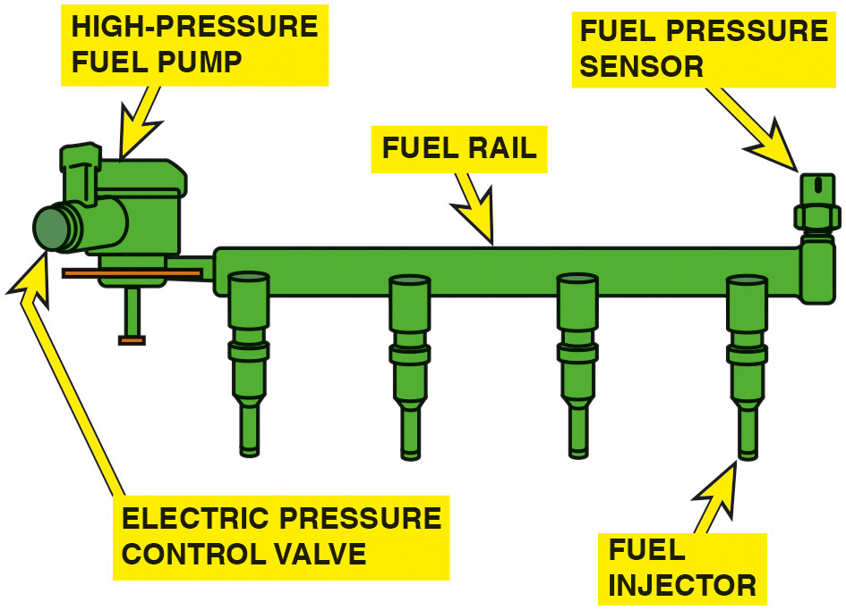
Figure 23.6
G D I Fuel Rail
A G D I fuel rail and pump assembly with the electric pressure control valve.

Slide 15
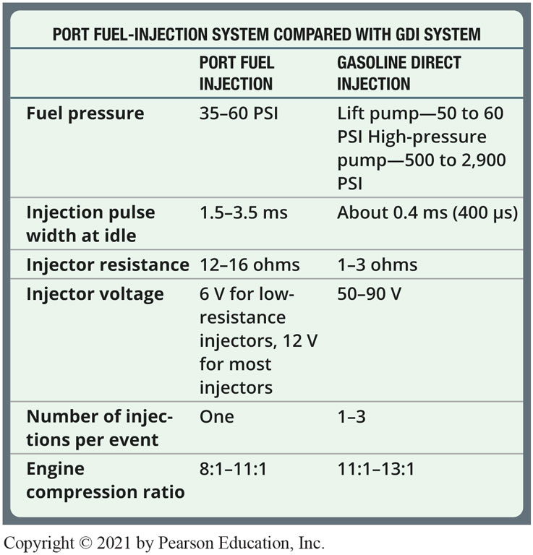
Chart 23.1
P F I v s G D I
A comparison chart showing the major differences between a port fuel-injection system and a G D I system.
Notes:
Long Description:
The table is titled port fuel-injection system compared with G D I system. The table has two columns: port fuel injection and gasoline direct injection. Row entries are as follows. Fuel pressure. Port fuel injection: 35 to 60 pounds per square inch. Gasoline direct injection: Lift pump, 50 to 60 pounds per square inch. High-pressure pump, 500 to 2,900 pounds per square inch. Injection pulse width at idle. Port fuel injection: 1.5 to 3.5 milliseconds. Gasoline direct injection: About 0.4 milliseconds, 400 microseconds. Injector resistance. Port fuel injection: 12 to 16 ohms. Gasoline direct injection: 1 to 3 ohms. Injector voltage. Port fuel injection: 6 volts for low-resistance injectors, 12 volts for most injectors. Gasoline direct injection: 50 to 90 volts. Number of injections per event. Port fuel injection: one. Gasoline direct injection: 1 to 3. Engine compression ratio. Port fuel injection: ratio of 8 to 1 to ratio of 11 to 1. Gasoline direct injection: ratio of 11 to 1 to ratio of 13 to 1.

Slide 16
Gasoline Direct-Injection Fuel Injectors
Each high-pressure fuel injector assembly is an electrically magnetic injector mounted in the cylinder head.
The P C M controls each fuel injector with 50 to 90 volts (usually 60 to 70 volts), depending on the system, which is created by a boost capacitor in the P C M.

Slide 17
Modes of Operation (1 of 2)
Stratified Mode
In this mode of operation, the air–fuel mixture is richer around the spark plug than it is in the rest of the cylinder.
Homogeneous Mode
In this mode of operation, the air–fuel mixture is the same throughout the cylinder.

Slide 18
Modes of Operation (2 of 2)
There are variations of these modes that can be used to fine-tune the air–fuel mixture inside the cylinder.
Homogeneous lean mode
Homogeneous stratified mode
Homogeneous knock protection mode
Stratified catalyst heating mode

Slide 19
Piston Top Designs
Three of the most commonly used designs include:
Spray-guided combustion
Swirl combustion
Tumble combustion

Slide 20
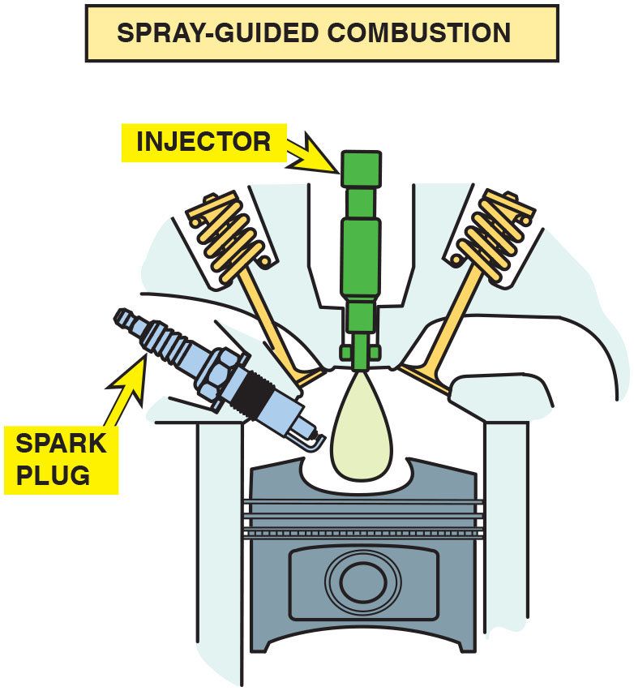
Figure 23.7
Injector at Top
In this design, the fuel injector is at the top of the cylinder and sprays fuel into the cavity of the piston.

Slide 21
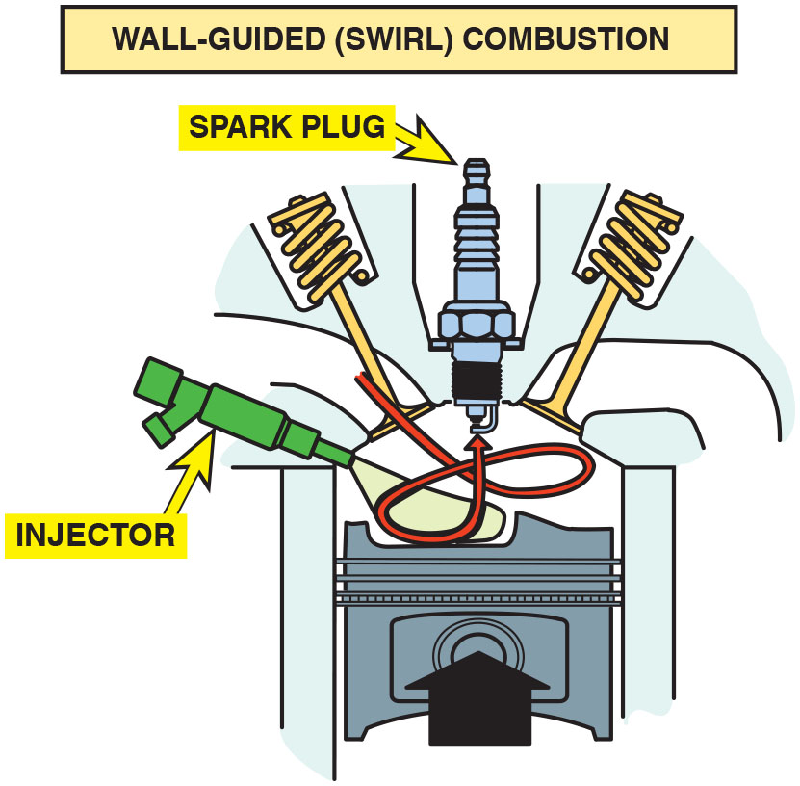
Figure 23.8
Swirl Combustion
The side injector combines with the shape of the piston to create a swirl as the piston moves up on the compression stroke.

Slide 22
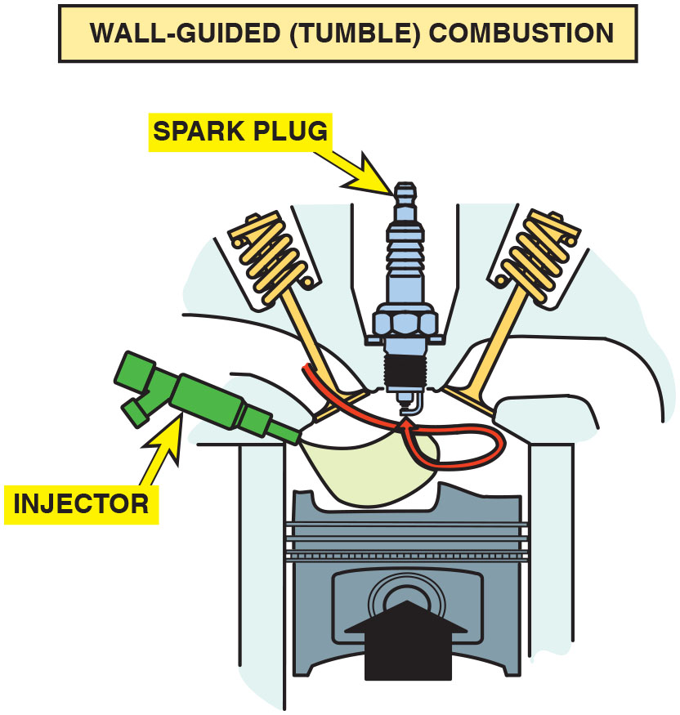
Figure 23.9
Tumbling Force
The piston creates a tumbling force as it moves upward.

Slide 23
Question 2
What are the two primary modes of operation?

Slide 24
Answer 2
Stratified and homogeneous mode.

Slide 25
Port- and Direct-Injection Systems
Overview
This system combines direct-injection injectors located in the combustion chamber with port fuel-injectors in the intake manifold near the intake valve.
Cold-Start Warm-Up
To help reduce exhaust emissions after a cold start, the fuel system uses a stratified change mode.
The catalytic converter rapidly reaches operating temperature, which reduces exhaust emissions.

Slide 26
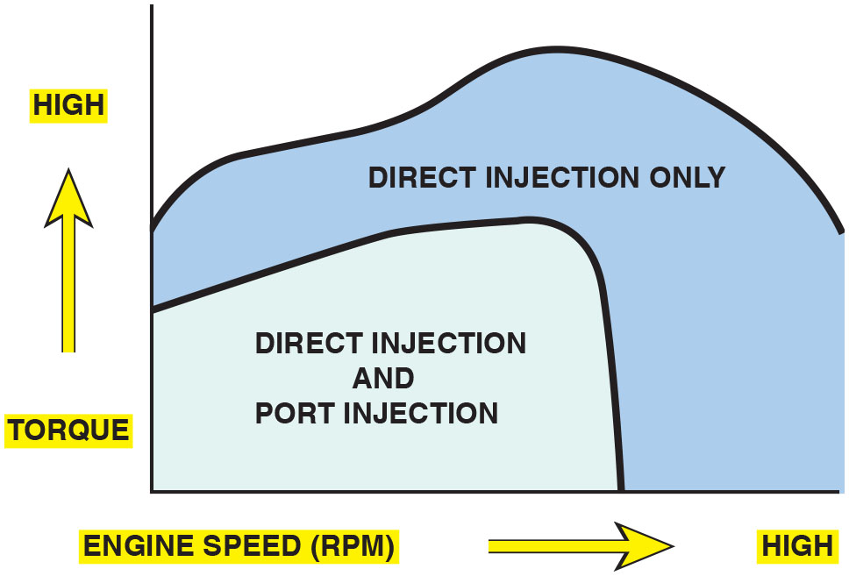
Figure 23.10
Notice that there are conditions when the port fuel injector, located in the intake manifold, and the gasoline direct injector, located in the cylinder, both operate to provide the proper air–fuel mixture.

Slide 27
Gasoline Direct-Injection Issues
Noise Issues
Injectors can often be heard with the engine running and the hood open. (Likely a normal condition)
Carbon Issues
Carbon can accumulate on the tip of the injector.
Carbon can accumulate on the back side of the intake valve.

Slide 28
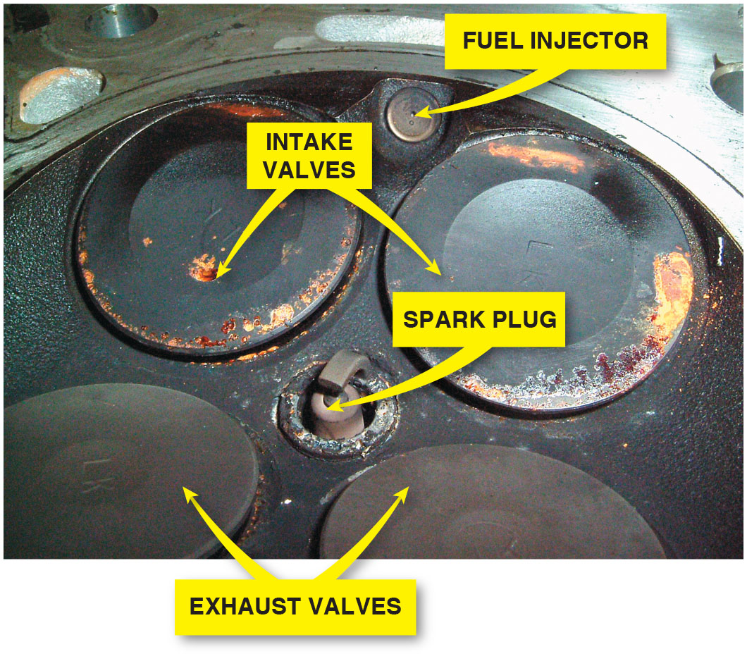
Figure 23.11
Drivability Issue
There may become a driveability issue because the G D I injector is exposed to combustion carbon and fuel residue.

Slide 29
G D I Service
Carbon Prevention
Dispersant every six months or every 6,000 miles has proven to help prevent injector and intake valve deposits.
Service Precautions
Don’t reuse high-pressure lines.
Always use a torque wrench when tightening fuel line fittings.
Do not loosen any fuel fittings with the engine cranking or running.
Always replace the Teflon seal whenever replacing or reinstalling a G D I injector.

Slide 30
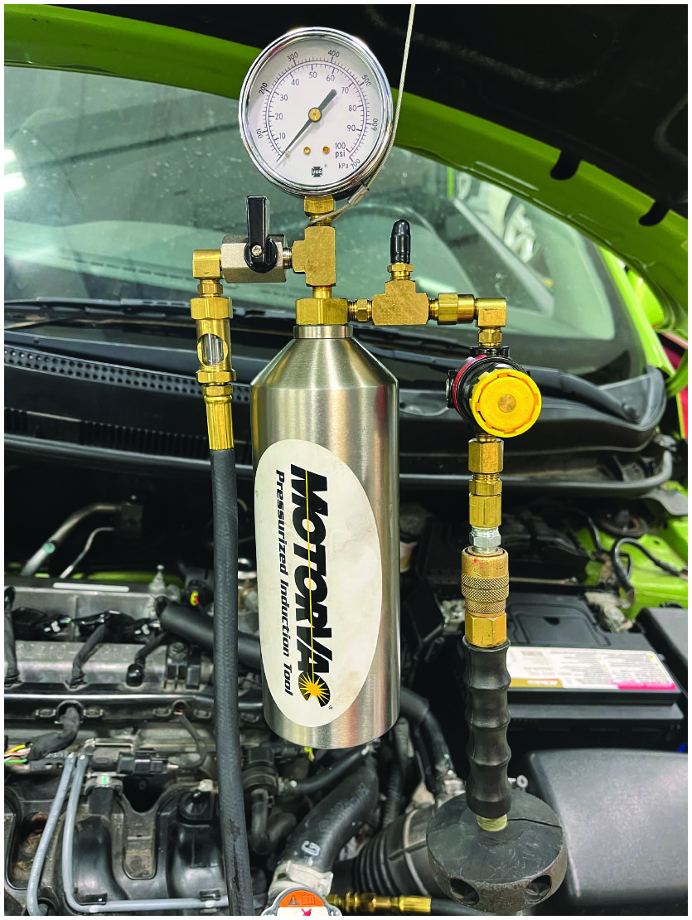
Figure 23.12
Carbon Prevention
Carbon cleaning.
Notes:
Carbon Prevention
Most experts recommend the use of Techronő a fuel system dispersant, to help keep carbon from accumulating. The use of a dispersant every six months or every 6,000 miles has proven to help prevent injector and intake valve deposits. The use of Top Tier fuel is also recommended to help reduce the deposits on intake valves and injectors. Top Tier fuel contains a higher level of detergent than standard fuels. Visit https://www.toptiergas.com to identify what brands sell Top Tier fuel and where stations that sell the fuel are located.
If the lack of power is discovered and there are no stored diagnostic trouble codes, a conventional carbon cleaning procedure will likely restore power if the intake valves are coated. Cleaning tools can be as simple as a wire brush and solvent. More sophisticated
cleaning methods include pressurized induction tools that provide a mist of dispersant through the air intake system and media blasters that use a pressurized abrasive to remove the carbon. • See Figure 23.12.

Slide 31
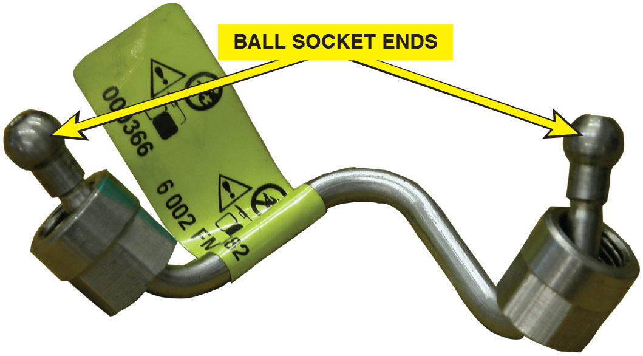
Figure 23.13
Ball and Socket
The high-pressure lines use a ball and socket connection. The ball end deforms when the line is tightened and must be replaced with a new part whenever it is removed.

Slide 32
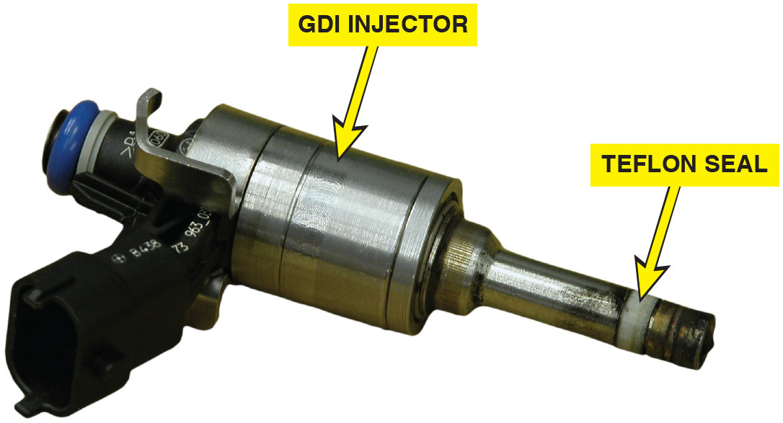
Figure 23.14
G D I Injector
Whenever a G D I fuel injector is removed, a new Teflon seal must be installed to ensure a leak-free connection in the combustion chamber.

Slide 33
Question 3
What should be replaced any time a high-pressure injector is serviced?

Slide 34
Answer 3
The Teflon seal.

Slide 35
Summary
G D I system uses a fuel injector that delivers a short squirt of fuel directly into the combustion chamber rather than in the intake manifold, near the intake valve on a port fuel-injection system.
Advantages of using gasoline direct injection:
Improved fuel economy
Reduced exhaust emissions
Greater engine power
Some of the disadvantages of G D I:
Higher cost
The need for N O x storage catalyst in some applications
More components
The operating pressure can vary from as low as 500 P S I during some low-demand conditions to as high as 2,900 P S I.

Slide 36
Animation and Video Library Links (Must have an internet connection and active Haldeman subscription)
Animation Library: (A8) Engine Performance Animations
Video Library: (A8) Engine Performance Videos

Slide 37
Copyright
This work is protected by United States copyright laws and is provided solely for the use of instructors in teaching their courses and assessing student learning. Dissemination or sale of any part of this work (including on the World Wide Web) will destroy the integrity of the work and is not permitted. The work and materials from it should never be made available to students except by instructors using the accompanying text in their classes. All recipients of this work are expected to abide by these restrictions and to honor the intended pedagogical purposes and the needs of other instructors who rely on these materials.

