Slide 1


Advanced Engine Performance Diagnosis
Eighth Edition
Chapter 21
Fuel Pumps, Lines, and Filters
Copyright © 2025 Pearson Education, Inc. All Rights Reserved
Notes:
If this PowerPoint presentation contains mathematical equations, you may need to check that your computer has the following installed:
1) Math Type Plugin
2) Math Player (free versions available)
3) NVDA Reader (free versions available)
INSTRUCTOR NOTE: This presentation includes text explanation notes, you can use to teach the course. When in SLIDE SHOW mode, you RIGHT CLICK and select SHOW PRESENTER VIEW, to use the notes.

Slide 2
Learning Objectives
21.1 Discuss the fuel delivery system, including fuel tanks and rollover leak protection.
21.2 Discuss the different types of fuel lines.
21.3 Explain the different types of electric fuel pumps.
21.4 Describe fuel filters.
21.5 Describe how to test fuel pumps.
21.6 Describe how to replace fuel pumps.

Slide 3
Fuel Delivery System
Fuel delivery (and return) systems use many if not all of the following components:
  Fuel storage tank, filler neck, and gas cap
  Fuel tank pressure sensor
  Fuel pump
  Fuel filter(s)
  Fuel delivery lines and fuel rail
  Fuel-pressure regulator
  Fuel return line (if equipped with a return-type fuel delivery system)

Slide 4
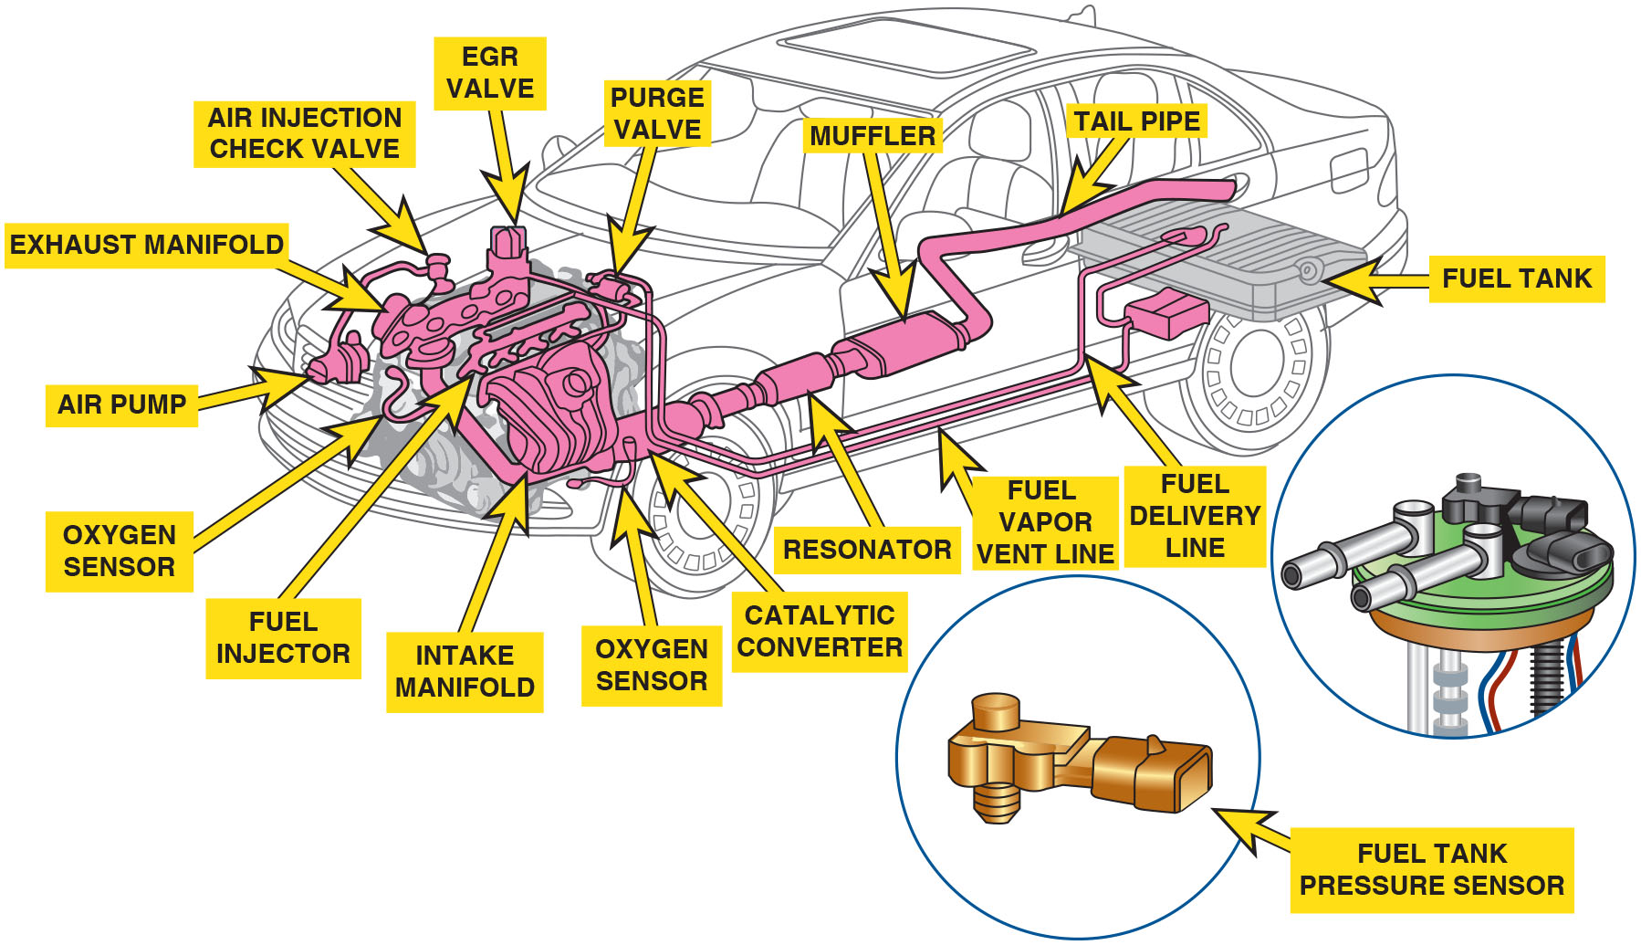
Figure 21.1
Fuel System
The fuel system includes many separate parts and components, including the fuel tank, fuel pump and lines, as well as the fuel tank pressure sensor used to measure the pressure inside the fuel tanks used by the evaporative fuel control system.
Notes:
Long Description:
The figure depicts various parts of the fuel system of a car. A fuel tank is show in the rear end of the car with a fuel delivery line and a fuel vapor vent line connected to it. The fuel lines end at an E G R valve and purge valve near the engine. The engine block shown is connected to the air injection check valve, air pump, fuel injectors and the intake manifold. The exhaust system is also neatly laid out with an exhaust manifold connected to the tail pipe of the car through various other parts – oxygen sensor, catalytic converter, resonator and a muffler.

Slide 5
Fuel Tanks (1 of 3)
A vehicle fuel tank is made of corrosion-resistant steel or polyethylene plastic.
Regardless of size and shape, all fuel tanks incorporate most, if not all, of the following features:
  Inlet or filler tube through which fuel enters the tank
  Filler cap with pressure holding and relief features
  An outlet to the fuel line leading to the fuel pump or fuel injector
  Fuel pump mounted within the tank
  Tank vent system
  Fuel pickup tube and fuel level sending unit

Slide 6
Fuel Tanks (2 of 3)
Tank Location and Mounting
  Most vehicles use a horizontally suspended fuel tank.
  Fuel tanks located there so that frame rails and body components protect the tank in the event of a crash.
Filler Tubes
  Fuel enters tank through a large tube extending from the tank to an opening on the outside of the vehicle.
  Onboard refueling vapor recovery (O R V R) systems were added to the filler neck to reduce evaporative emissions.

Slide 7
Fuel Tanks (3 of 3)
Pressure-Vacuum Filler Cap
  Safety cap must seal system and release excess pressure or excess vacuum.
Fuel Pickup Tube
  Fuel pickup tube is usually a part of the fuel sender assembly or the electric fuel pump assembly and contains the tank sock.
Tank Venting Requirements
  E V A P system vents gasoline vapors from the fuel tank directly to a charcoal-filled vapor storage canister.

Slide 8
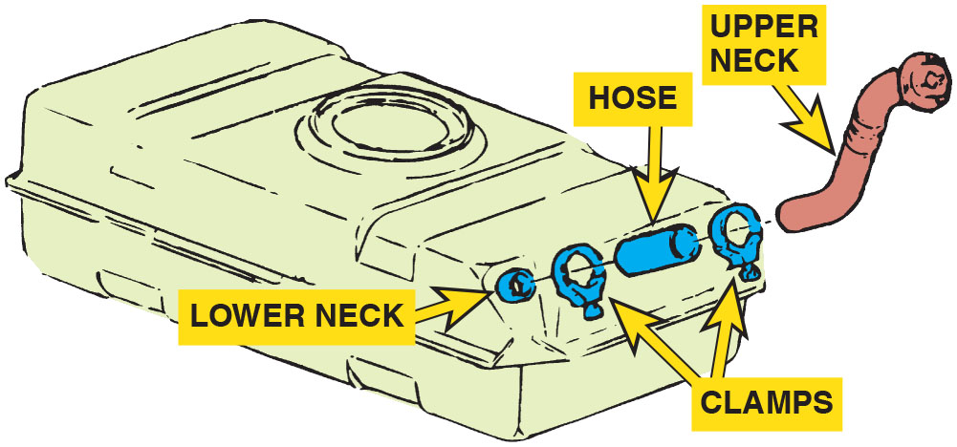
Figure 21.2
Fuel Tank
A three-piece filler tube assembly.

Slide 9
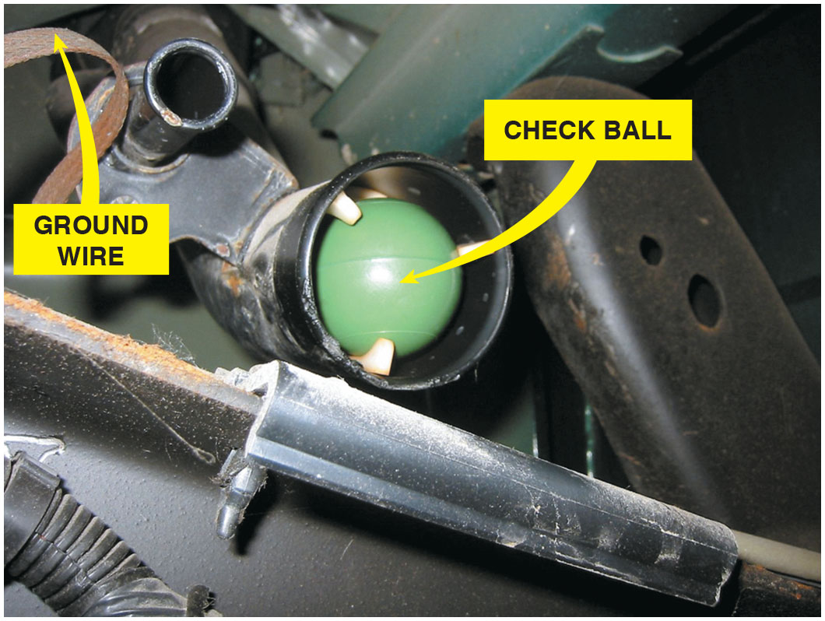
Figure 21.3
Filler Tube
A view of a typical filler tube with the fuel tank removed. Notice the ground strap used to help prevent the buildup of static electricity as the fuel flows into the plastic tank. The check ball looks like a ping-pong ball.

Slide 10
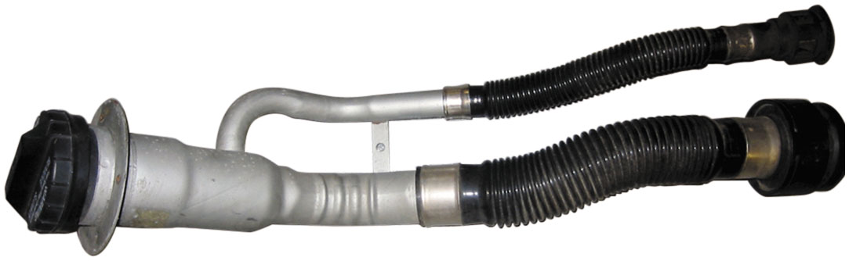
Figure 21.4
Vapor Recovery
Vehicles equipped with onboard refueling vapor recovery usually have a reduced-size fill tube.

Slide 11
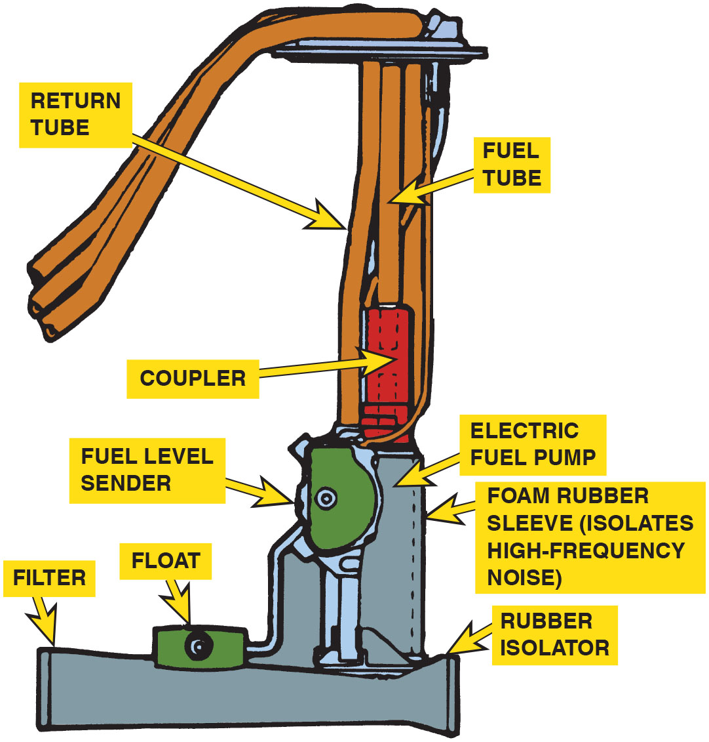
Figure 21.5
Fuel Pickup
The fuel pickup tube is part of the fuel sender and pump assembly.
Notes:
Long Description:
The figure depicts the fuel tube and return tubes connected to the fuel level sender and electric fuel pump assembly. The fuel tube is connected to a coupler above the fuel level sender. The assembly has a foam rubber sleeve to isolate high-frequency noise, a rubber isolator with a filter at the bottom end, and a float attached to the fuel level sender.

Slide 12
Rollover Leakage Protection
All vehicles have one or more devices to prevent fuel leaks in case of vehicle rollover or a collision in which fuel may spill.
A basic one-way check valve may be installed in any number of places between the fuel tank and the engine.
Some vehicles use devices to ensure that the fuel pump shuts off when an accident occurs.

Slide 13
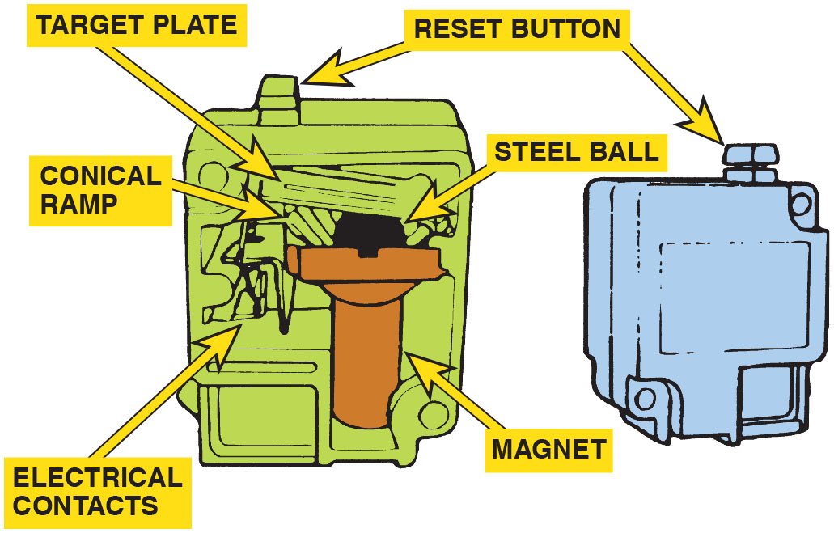
Figure 21.6
Ford Inertia Switch
Ford uses an inertia switch to turn off the electric fuel pump in case of an accident.
Notes:
Long Description:
The figure depicts a steel ball in conical ramp, with a magnet at the end of the ramp. Electrical contacts next to the magnet and a target plate can be seen resting over the steel ball can be seen. A reset button is at the top of the switch.

Slide 14
Fuel Lines (1 of 3)
Fuel and vapor lines made of steel, nylon tubing, or fuel-resistant rubber hoses connect the parts of the fuel system.
Depending on their function, fuel and vapor lines may be either rigid or flexible.
The design of the line is dependent on the pressure it must carry.

Slide 15
Fuel Lines (2 of 3)
Rigid Lines
  All fuel lines fastened to the body, frame, or engine are made of seamless steel tubing.
Flexible Lines
  Most fuel systems use synthetic rubber hose sections where flexibility is needed.
Fuel Line Mounting
  Fuel supply lines from the tank to a throttle body or fuel rail are routed to follow the frame along the underbody of the vehicle.

Slide 16
Fuel Lines (3 of 3)
Fuel-Injection Lines
  Hoses used for fuel-injection systems are made of materials with high resistance to oxidation and deterioration.
Fuel-Injection Fittings and Nylon Lines
  Because of their operating pressures, fuel-injection systems often use special kinds of fittings to ensure leak proof connections.
  Unlocking the special fittings typically requires special tools.

Slide 17
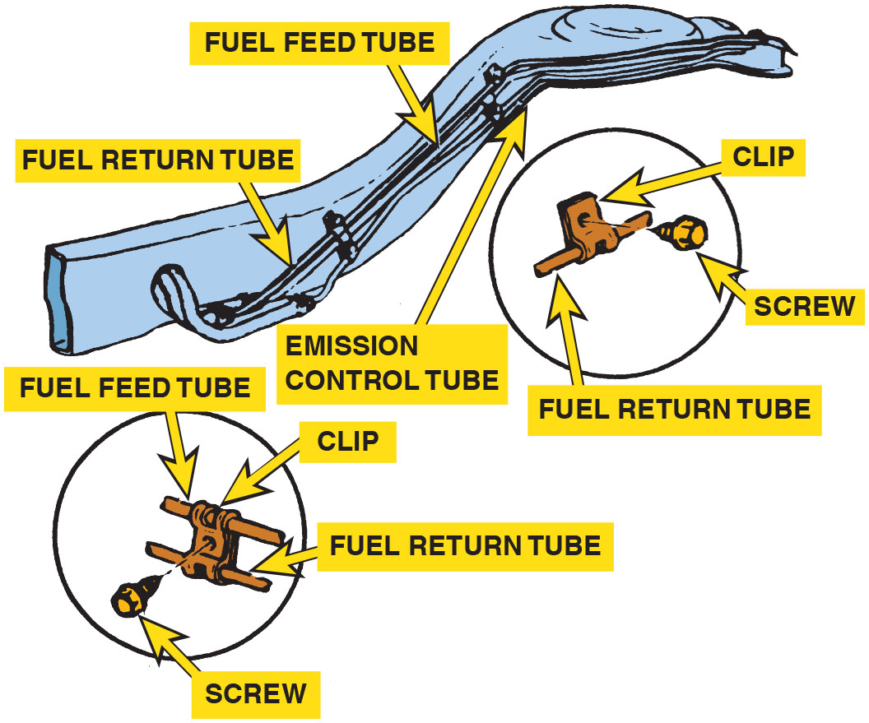
Figure 21.7
Fuel Lines
Fuel lines are routed along the frame or body and secured with clips.

Slide 18
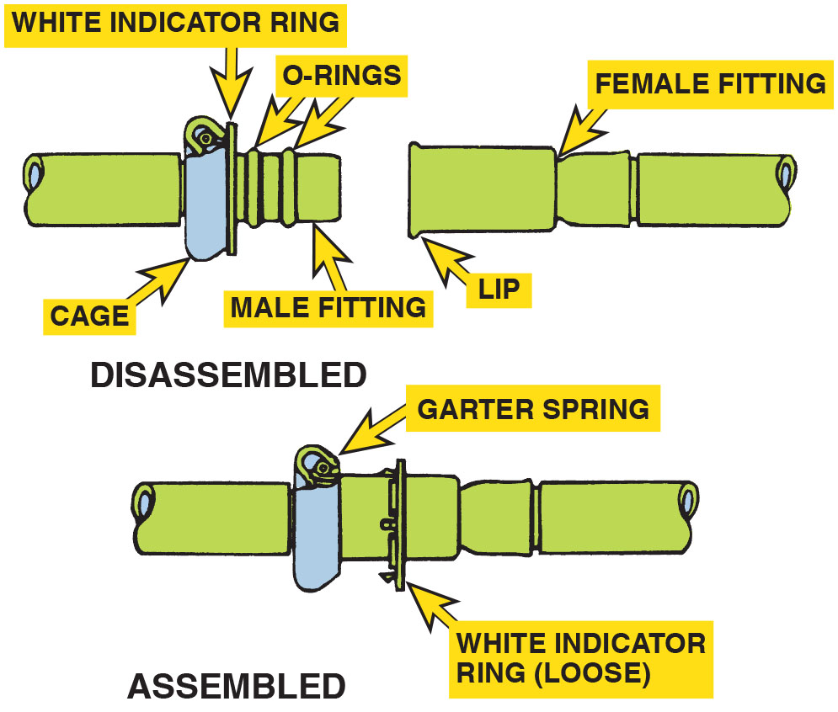
Figure 21.8
Spring-Lock Connectors
Some Ford metal line connections use springlocks and O-rings.
Notes:
Long Description:
The figure has a male and a female fitting tubing in the disassembled state. There are O-rings on the male end and a flared female end. The spring connector has a garter spring inside a cage. The female end lip is inside the spring-lock connector in the assembled state and a single steel tubing is obtained.

Slide 19
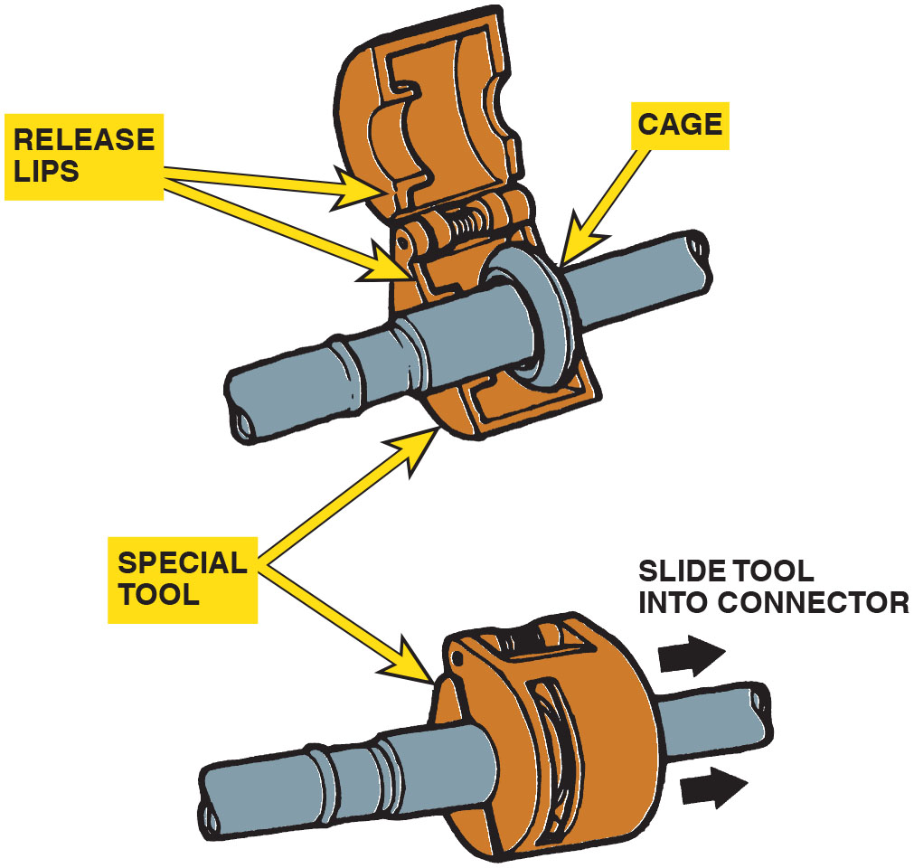
Figure 21.9
Spring-Lock Tool
Ford spring-lock connectors require a special tool for disassembly.

Slide 20
Frequently Asked Question: Just How Much Fuel Is Recirculated?
? Frequently Asked Question
Just How Much Fuel Is Recirculated? Approximately 80% of the available fuel-pump volume is released to the fuel tank through the fuel-pressure regulator at idle speed. For example, a passenger vehicle cruising down the road at 60 m p h gets 30 m p g. With a typical return-style fuel system pumping about 30 gallons per hour from the tank, it would therefore burn 2 gallons per hour, and return about 28 gallons per hour to the tank!

Slide 21
Frequently Asked Question: How Can an Electric Pump Work Inside a Gas Tank and Not Cause a Fire?
? Frequently Asked Question
How Can an Electric Pump Work Inside a Gas Tank and Not Cause a Fire? Even though fuel fills the entire pump, no burnable mixture exists inside the pump because there is no air and no danger of commutator brush arcing, igniting the fuel.

Slide 22
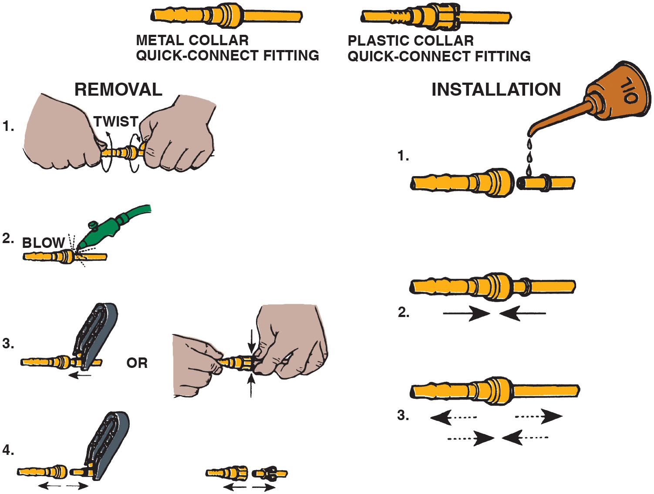
Figure 21.10
Quick-Connector Steps
Typical quick-connect steps.
Notes:
Long Description:
The figure shows two types of quick-connect fittings, a metal collar quick-connect fitting, and a plastic collar quick-connect fitting. The following are the steps for installation of the quick-connect: 1. The female fitting and male fitting are brought together in a straight line and the female fitting is oiled. 2. The female fitting and male fittings are pushed into each other. 3. The joined tubing is checked for fitment by pulling the fittings out once and then pushing them in. The following are the steps for removal of the quick-connect: 1. The fitted tubing is held in hand and twisted. 2. Air is blown into the quick-connector. 3. A clamp or hands are used to pinch the male fitting. 4. The male fitting and female fittings are pulled out.

Slide 23
Electric Fuel Pumps (1 of 4)
Positive Displacement Pump
  A positive displacement pump is a design that forces everything that enters the pump to leave the pump.
  When the maximum volume has been reached, the supply port closes and the discharge opens.
  A fuel outlet check valve closes to maintain fuel pressure when the pump shuts off.

Slide 24
Electric Fuel Pumps (2 of 4)
Hydrokinetic Flow Pump Design
  This design of pump rapidly moves the fuel to create pressure.
  A turbine pump is the most common.
  These units use an impeller that accelerates the fuel particles before actually discharging.
  A typical electric fuel pump used on a fuel-injection system delivers about 40 to 50 gallons per hour or 0.6 to 0.8 gallons per minute at a pressure of 70 to 90 P S I.

Slide 25
Electric Fuel Pumps (3 of 4)
Modular Fuel Sender Assembly
  The modular fuel sender consists of a fuel level sensor, a turbine pump, and a jet pump.
  The reservoir dampens fuel slosh to maintain a constant fuel level available to the pump.
Electric Pump Control Circuits
  Fuel-pump circuits are typically controlled by the fuel-pump relay.
  The pump is energized at key on and then again once a “tach” signal is received.

Slide 26
Electric Fuel Pumps (4 of 4)
Pump Pulsation Dampening
  An accumulator in the system to reduce pressure pulses and noise.
Variable Speed Pumps
  Pump speed and pressure can be regulated by controlling the voltage supplied to the pump with a resistor switched into the circuit, or by using a separate fuel pump driver module to supply a pulse-width modulated (P W M) voltage to the pump.

Slide 27
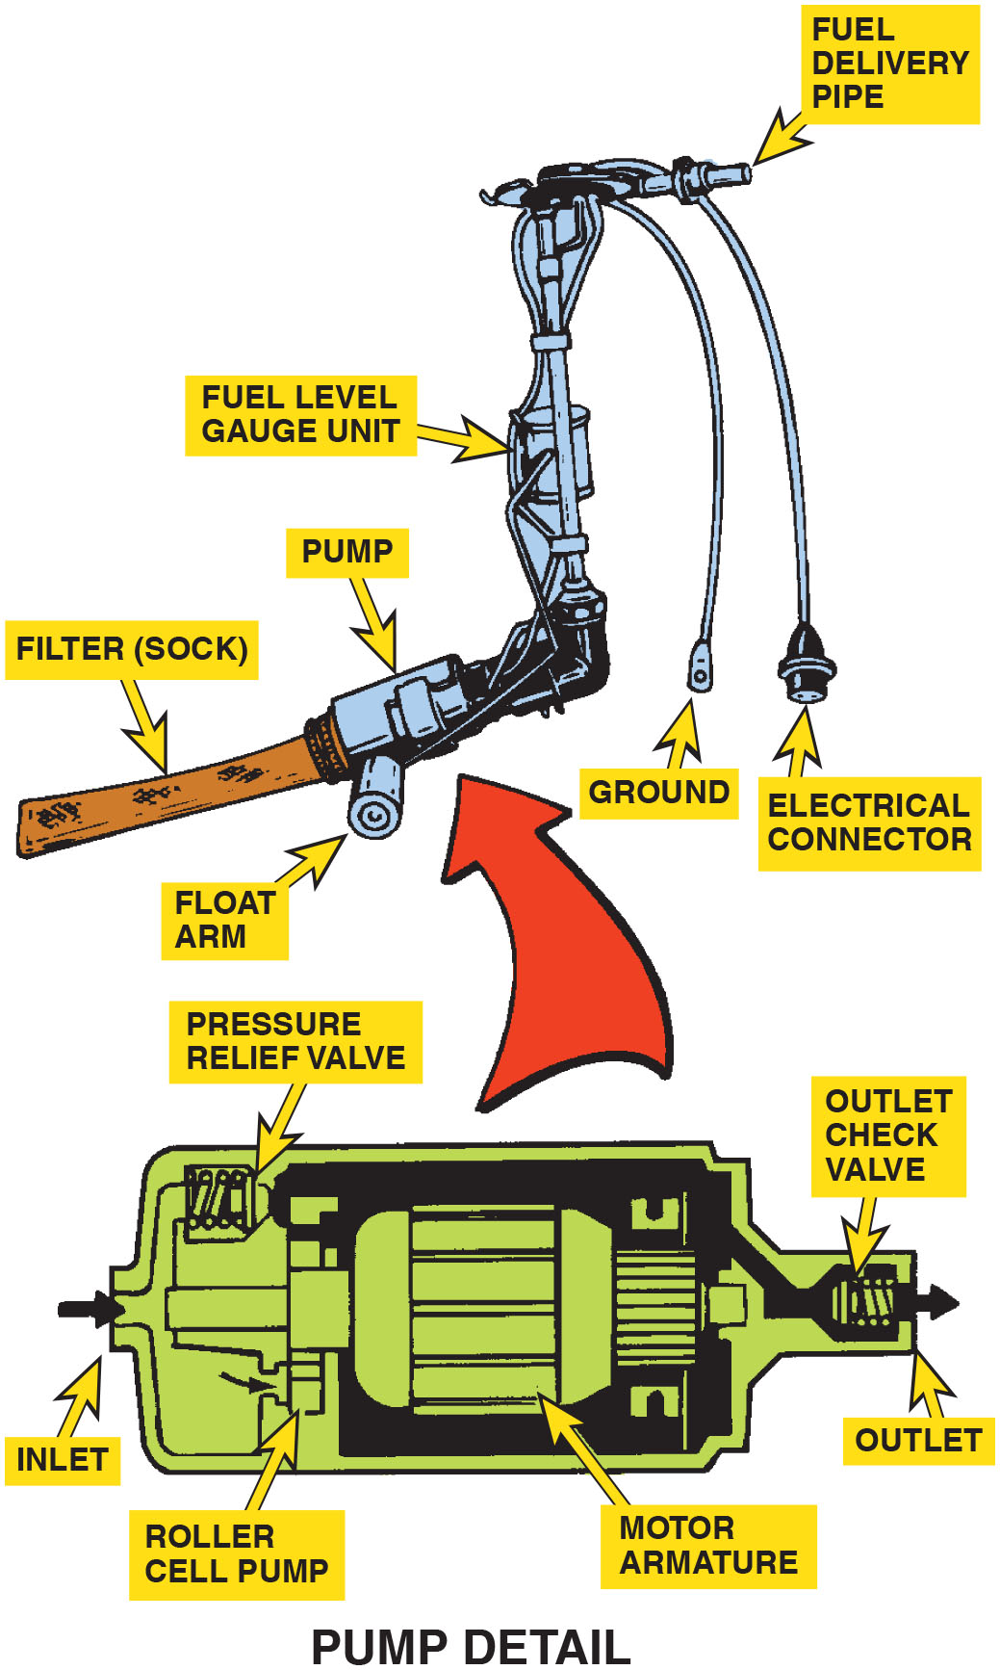
Figure 21.11
Roller Pump
A roller cell-type electric fuel pump.
Notes:
Long Description:
The cutaway pump depicts a chamber inside the pump with a motor armature resting on two bearings. The motor armature has a rotor plate on one end with rollers on it. The pump has an inlet and outlet valve with an outlet check valve. The oil flow is showed to enter the pump through the inlet and pass through the roller cells. A pressure relief valve is present near the inlet. The assembly of fuel delivery system shows a pump connected to a fuel level gauge unit which has a fuel delivery pipe connected to it. A wired ground and a wire electrical connector are seen at the end of fuel delivery pipe. The pump has a floater arm beside it and a filter sock behind it.

Slide 28
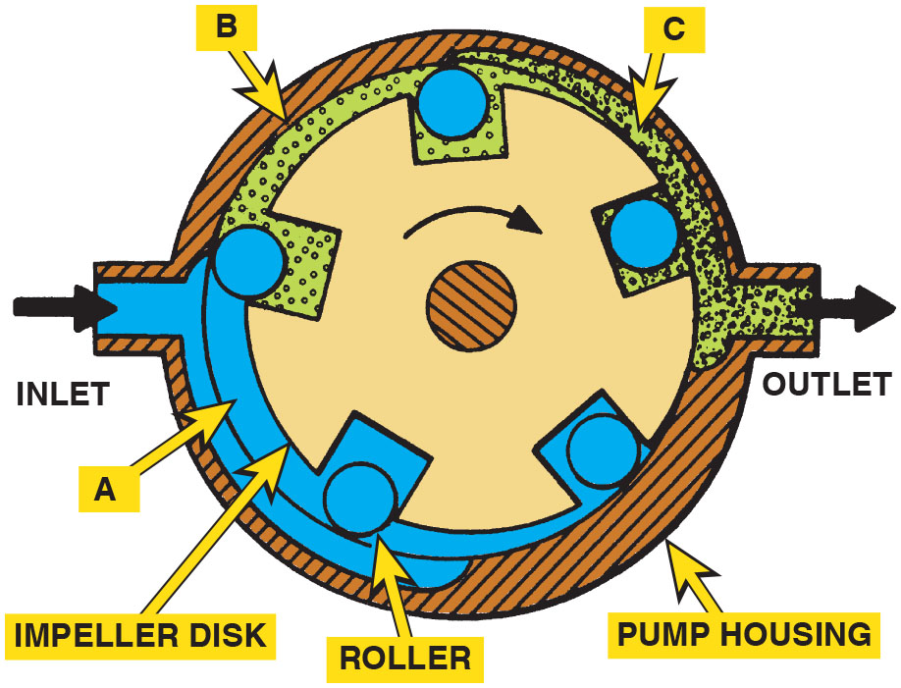
Figure 21.12
Rotary Vane Pump
The pumping action of an impeller or rotary vane pump.
Notes:
Long Description:
The figure depicts portions of the pump and housing through which the oil flows. Fuel enters from the inlet to portion A where it fills the space between the rollers. As the impeller rotates and due to the eccentricity of the pump housing, the fuel gets trapped between the impeller and housing which is marked as portion B. The impeller and the housing are the closest to each other at portion C where the fuel gets squeezed out through the outlet.

Slide 29
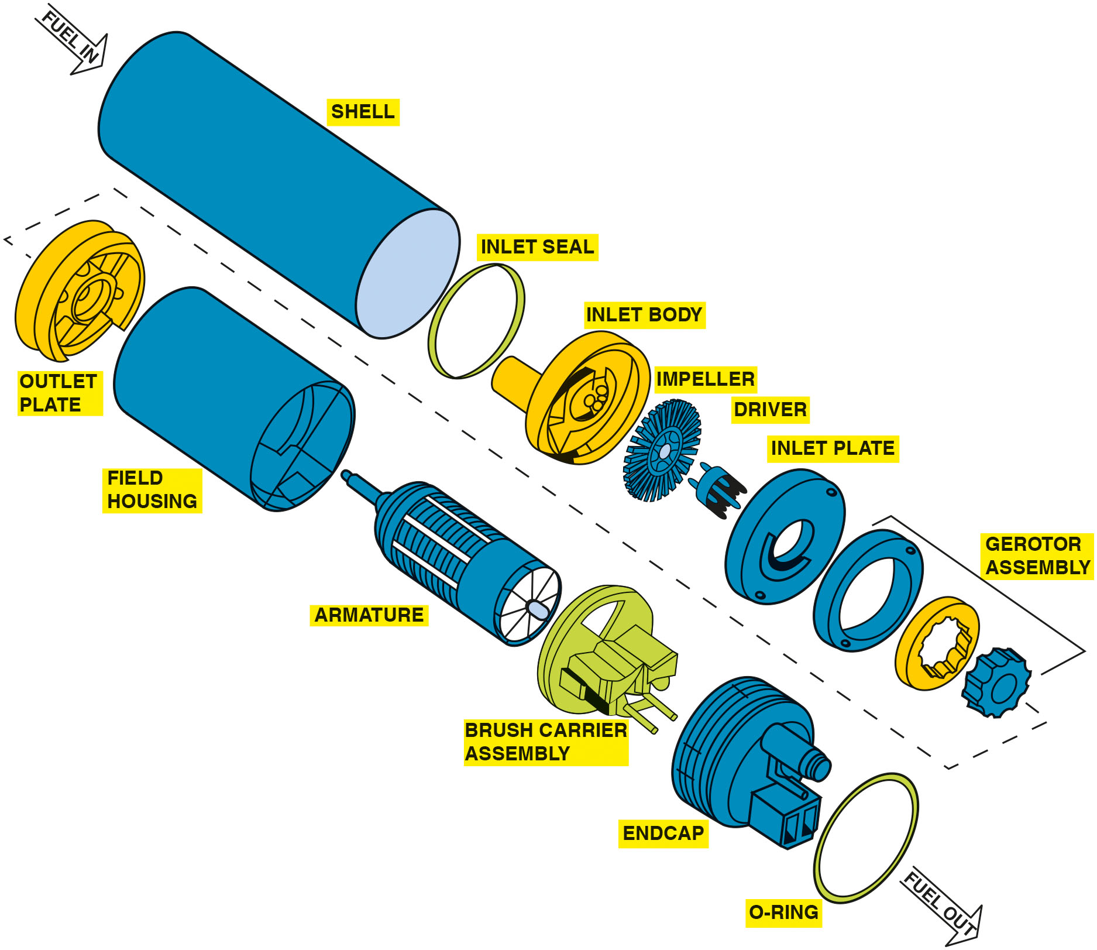
Figure 21.13
Exploded View
An exploded view of a gerotor electric fuel pump.
Notes:
Long Description:
The exploded view depicts the inlet and outlet of fuel along the shell of the pump which includes the following parts inside it, in order of their assembly inside the shell. An inlet seal, the inlet body, an impeller, a driver, an inlet plate, the gerotor assembly, an outlet plate, the field housing, an armature, a brush carrier assembly, an endcap, and an O-ring.

Slide 30
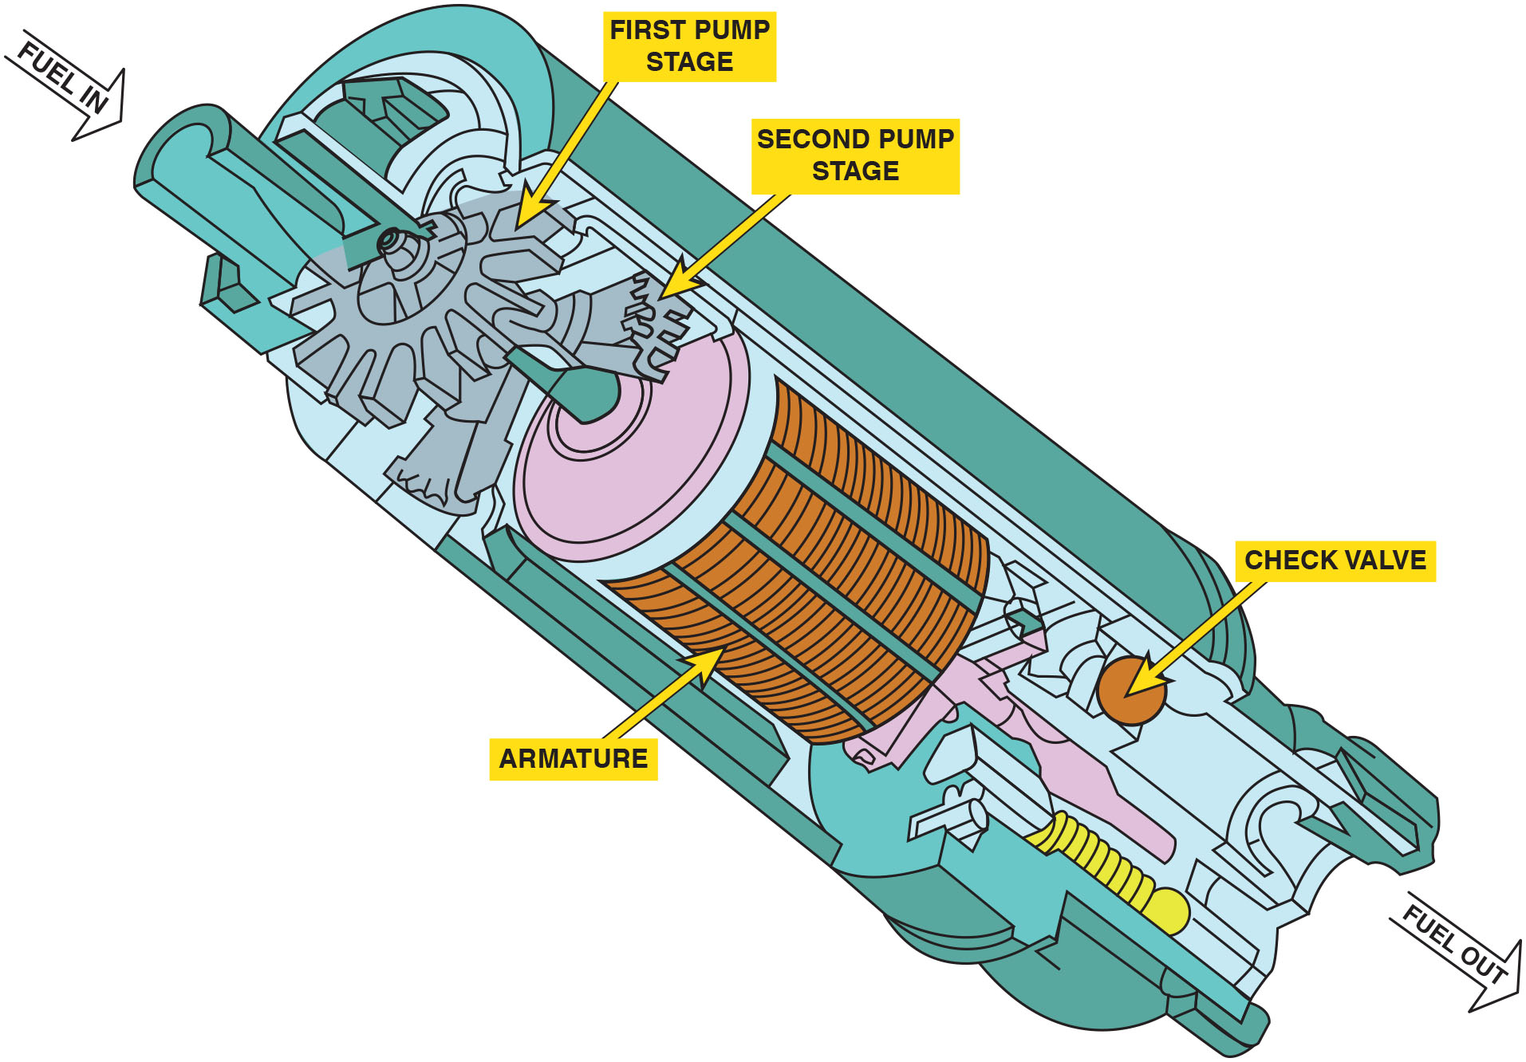
Figure 21.14
Two Stage Pump
A cutaway view of a typical two-stage turbine electric fuel pump.
Notes:
Long Description:
A down arrow pointing to the fuel inlet is labeled fuel in. The fuel inlet directs the fuel to the two pump stages: first pump stage and second pump stage. The armature is a cylindrical component fixed to the blades. The check valve indicated by a sphere attached to a cylindrical body is in the end cap below the armature. A down arrow pointing away from the fuel outlet is labeled fuel out.

Slide 31
Frequently Asked Question: Why Are Many Fuel-Pump Modules Spring-Loaded?
? Frequently Asked Question
Why Are Many Fuel-Pump Modules Spring-Loaded? Fuel modules that contain the fuel pickup sock, fuel pump, and fuel level sensor are often spring-loaded when fitted to a plastic fuel tank. The plastic material shrinks when cold and expands when hot, so having fuel module spring-loaded ensures that the fuel pickup sock will always be the same distance from the bottom of the tank. ● See Figure 21.15.

Slide 32
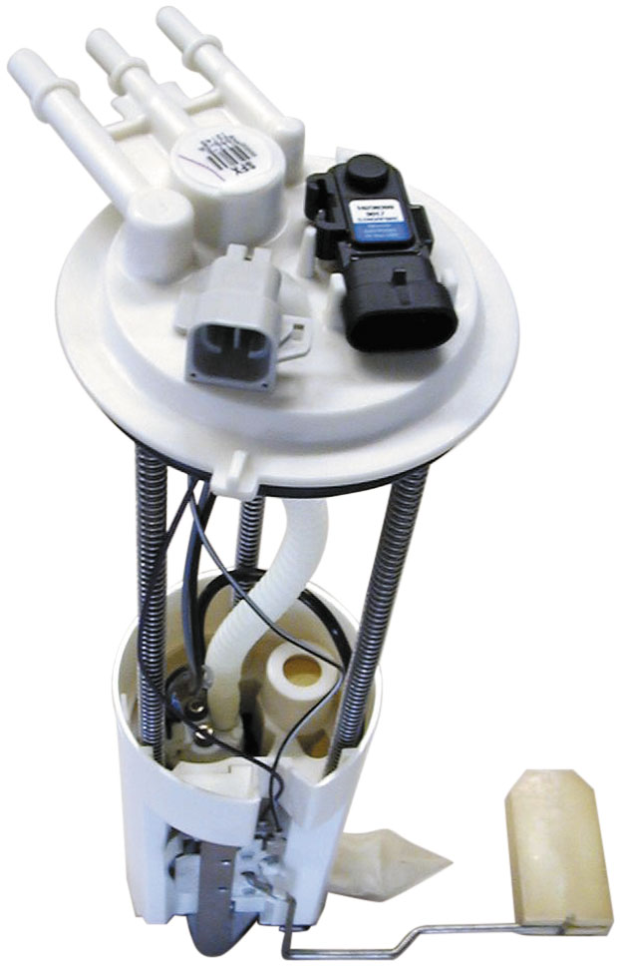
Figure 21.15
Two-Stage Pump
A typical fuel-pump module assembly, which includes the pickup strainer and fuel pump, as well as the fuel pressure sensor and fuel level sensing unit.

Slide 33
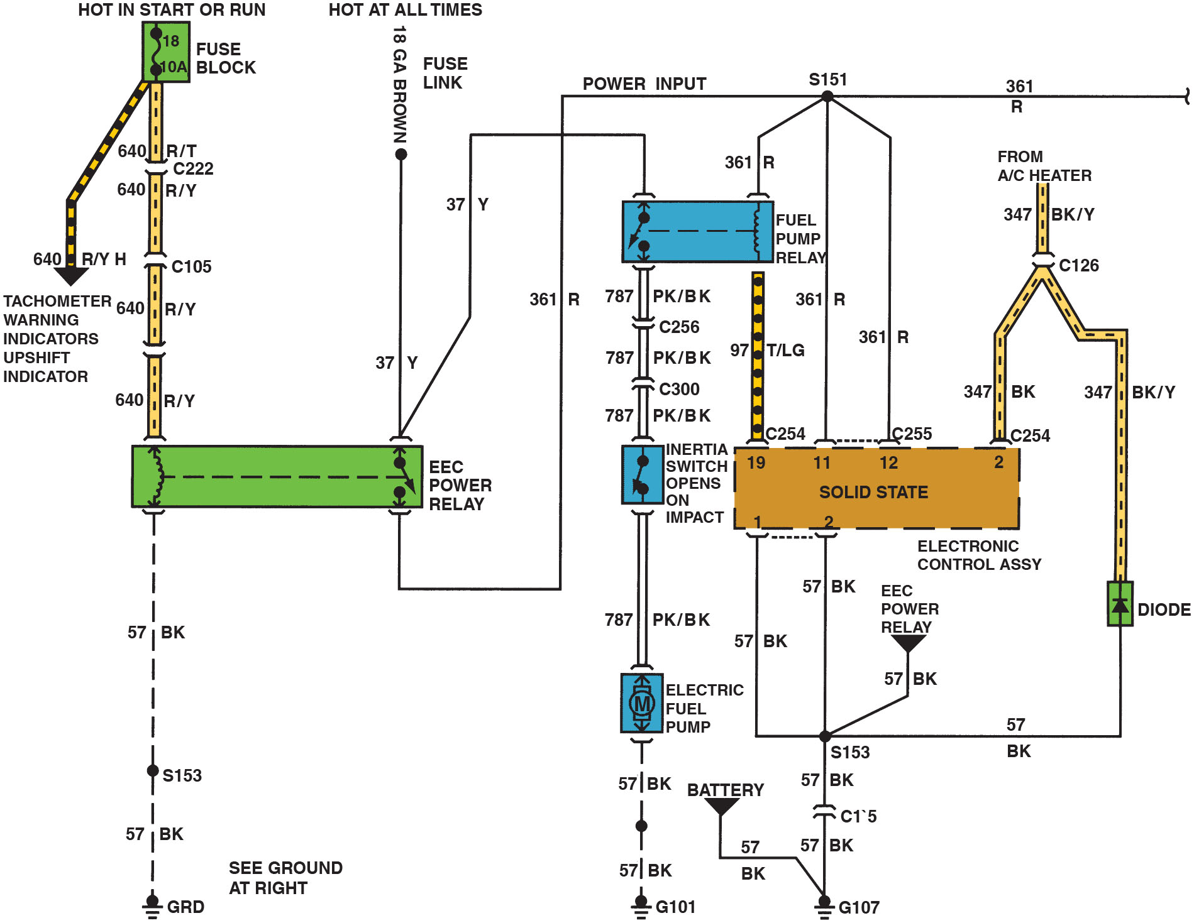
Figure 21.16
Circuit
A schematic showing that an inertia switch is connected in series between the fuel-pump relay and the fuel pump.
Notes:
Long Description:
The circuit diagram depicts the following: A hot in start or run fuse block and a hot at all times fuse link are connected to a E E C power relay, which in turn connected to a fuel pump relay. The fuel pump relay connects to an inertia switch that opens on impact and a solid state. The inertia switch is connected to ground through an electric fuel pump. The solid state is also connected to a heater and battery.

Slide 34
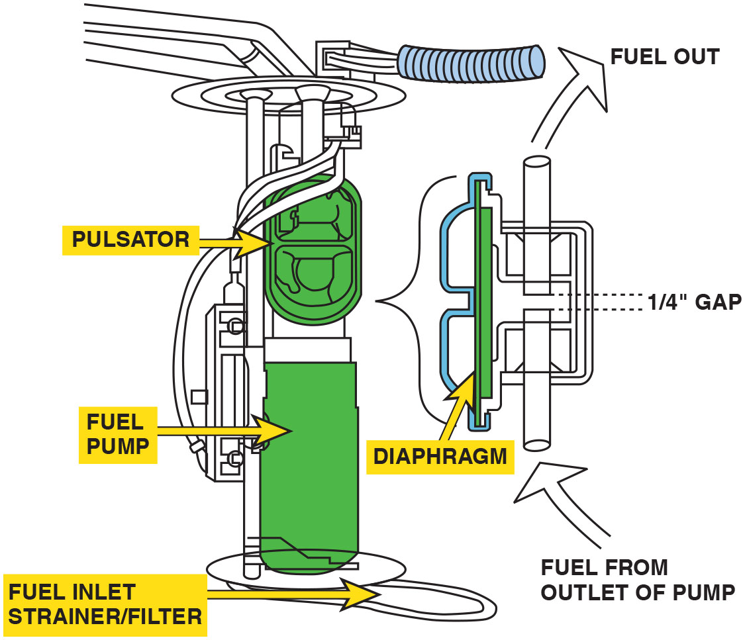
Figure 21.17
Fuel Pulsator
A typical fuel pulsator used mostly with roller vane-type pumps to help even out the pulsation in pressure that can cause noise.
Notes:
Long Description:
The figure depicts a pulsator with a diaphragm attached to the pump at its outlet. The diaphragm covers two pipes assembled in a straight line with a gap of 1 by 4 inch between them. The pipe assembly is connected to the outlet of the pump. The fuel from outlet of the pump enters the pipe assembly and comes out of the second pipe after the gap to go out through the fuel outlet.

Slide 35
Question 1
What are the two most common types of electric fuel pumps?

Slide 36
Answer 1
Positive displacement and hydrokinetic flow.

Slide 37
Fuel Filters
Fuel filters remove dirt, rust, water, and other contamination from the gasoline before it can reach the fuel injectors.
Fuel filters should be replaced according to the vehicle manufacturer’s recommendations.
Returnless-type fuel-injection system usually use filters that are part of the fuel pump assembly and do not have any specified service interval.

Slide 38
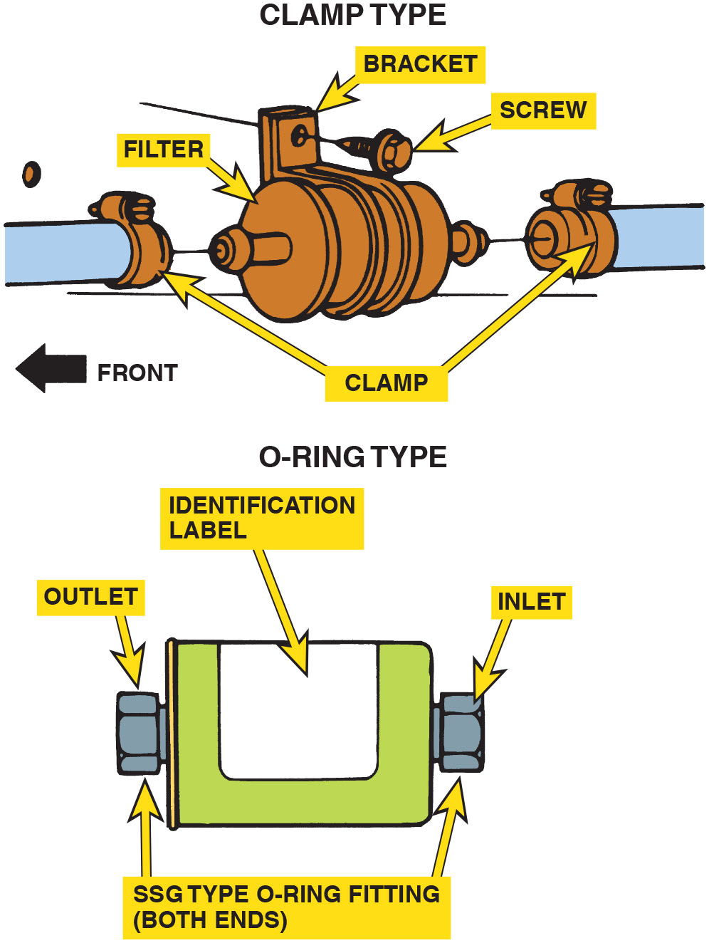
Figure 21.18
Older Fuel Filter
Inline fuel filters are usually attached to the fuel line with screw clamps or threaded connections. The fuel filter must be installed in the proper direction or a restricted fuel flow can result.
Notes:
Long Description:
A clamp type filter has a bracket and screw for fitments and two clamps on both the ends of the fuel line for fitting the filter ends to it. An O-ring type fuel filter has an identification label and is cylindrical in shape. The inlet and outlet to the filter have a S S G type fittings.

Slide 39
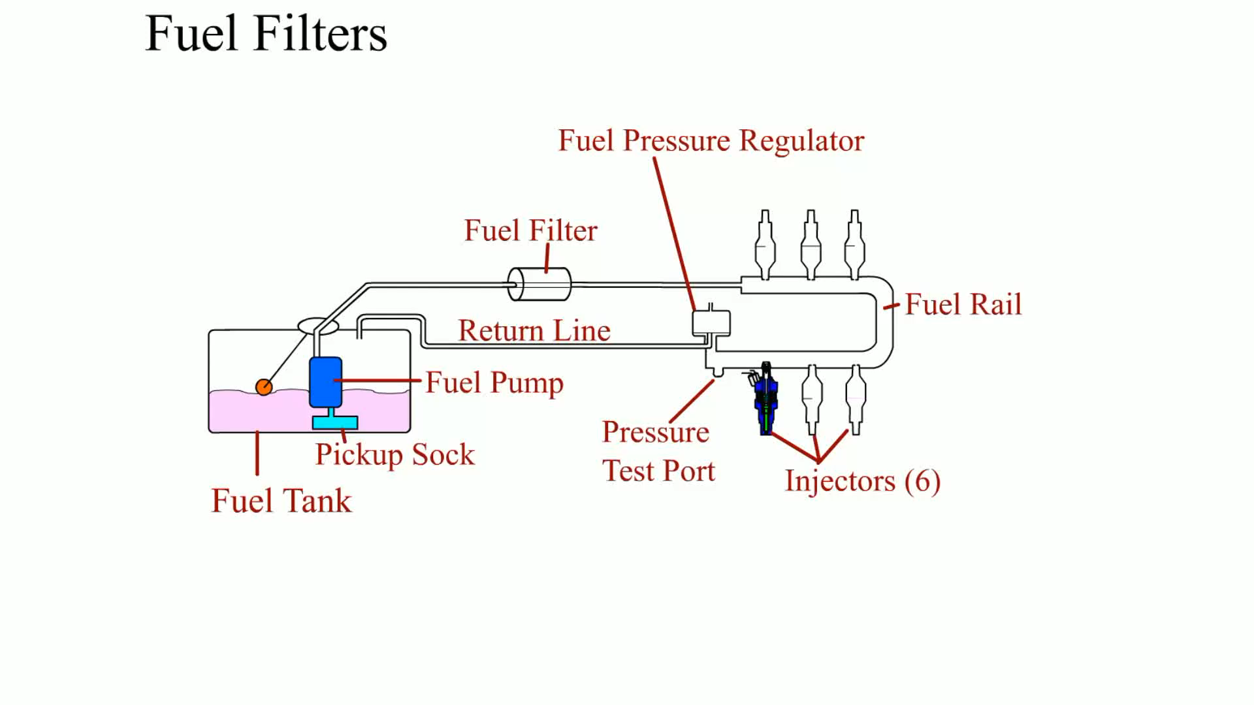
Animation:
Fuel Filters

Slide 40
Question 2
Where are fuel filters typically located in the system?

Slide 41
Answer 2
In the fuel tank and in-line.

Slide 42
Fuel-Pump Testing (1 of 2)
Testing Fuel Pump Pressure
  To measure fuel-pump pressure, locate the Schrader valve and attach a fuel-pressure gauge.
  Cycle the key to on to actuate the fuel pump.
Rest Pressure Test
  If the fuel pressure is acceptable, then check the system for leakdown.
  The pressure should not drop for five minutes.

Slide 43
Fuel-Pump Testing (2 of 2)
Dynamic Pressure Test
  To test the pressure dynamically, start the engine.
  If the pressure is vacuum referenced, then the pressure should change when the throttle is cycled.
Testing Fuel-Pump Volume
  Sufficient fuel capacity (flow) should be at least 2 pints (1 liter) every 30 seconds or 1 pint in 15 seconds.

Slide 44
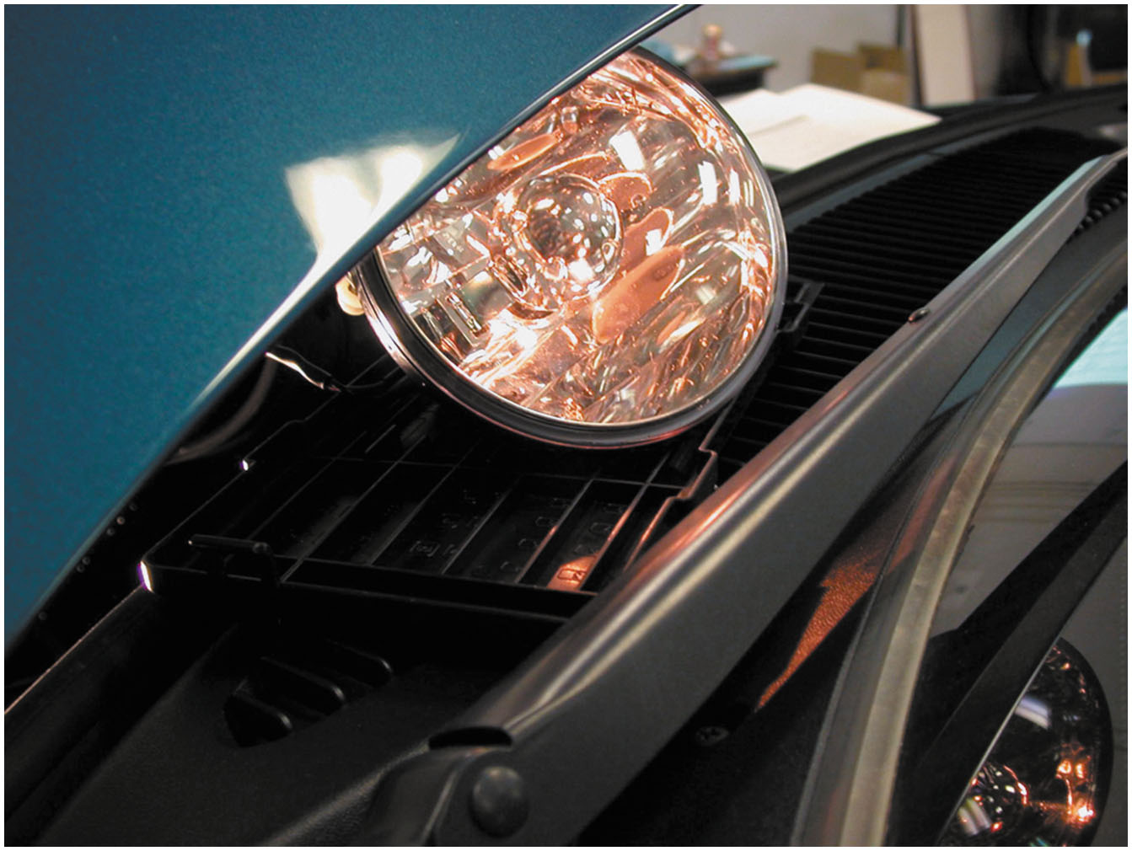
Figure 21.19
Dim Headlight
A dim headlight indicates excessive resistance in fuel pump circuit.
Notes:
TECH TIP Use a Headlight to Test for Power and Ground
When replacing a fuel pump, always check for proper power and ground. If the supply voltage is low due to resistance in the circuit or the ground connection is poor, the lower available voltage to the pump will result in lower pump output and could also reduce the life of the pump. While a voltage drop test can be preformed, a quick and easy test is to use a headlight connected to the circuit. If the headlight is bright, then both the power side and the ground side of the pump circuit are normal. If the headlight is dim, then more testing will be needed to find the source of the resistance in the circuit(s). ● See Figure 21.19.

Slide 45
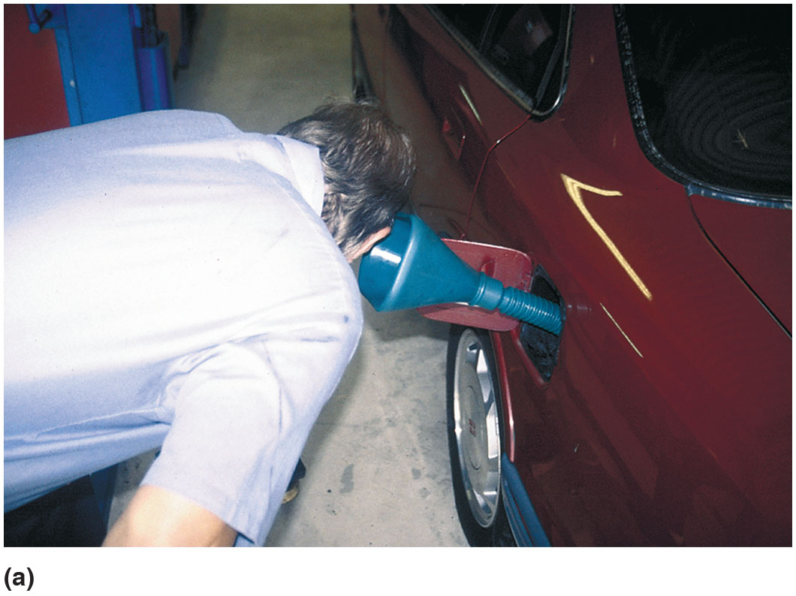
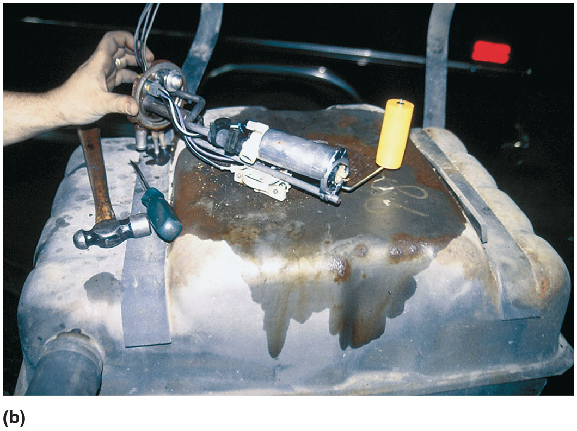
Figure 21.20
Pump Running Test
(a) A funnel helps in hearing if the electric fuel pump inside the gas tank is working. (b) If the pump is not running, check the wiring and current flow before going through the process of dropping the fuel tank to remove the pump.

Slide 46
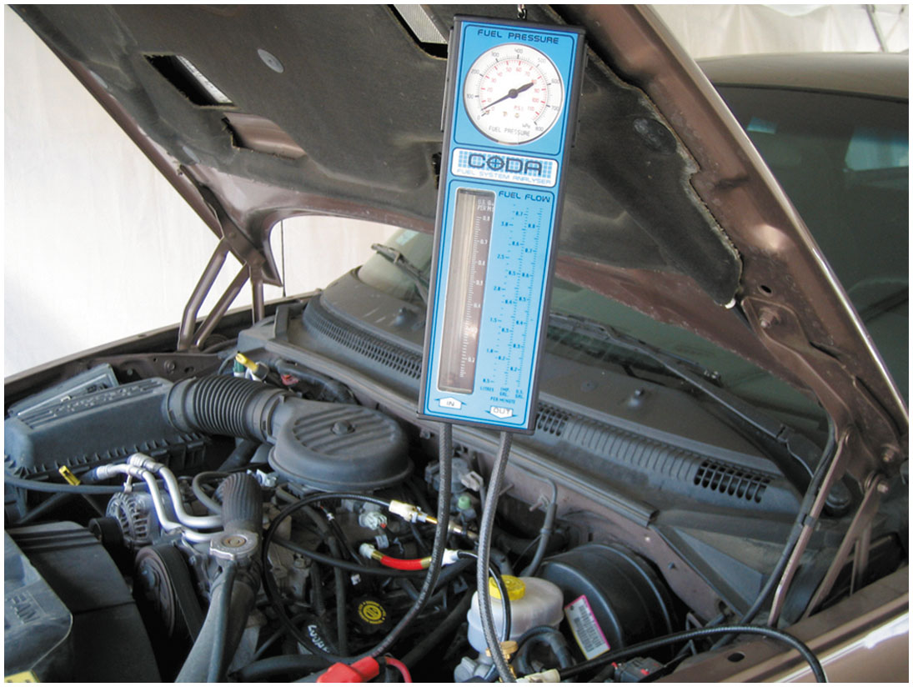
Figure 21.21
Fuel System Tester
A fuel system tester connected in series in the fuel system so all of the fuel used flows through the meter, which displays the rate of flow and the fuel pressure.

Slide 47
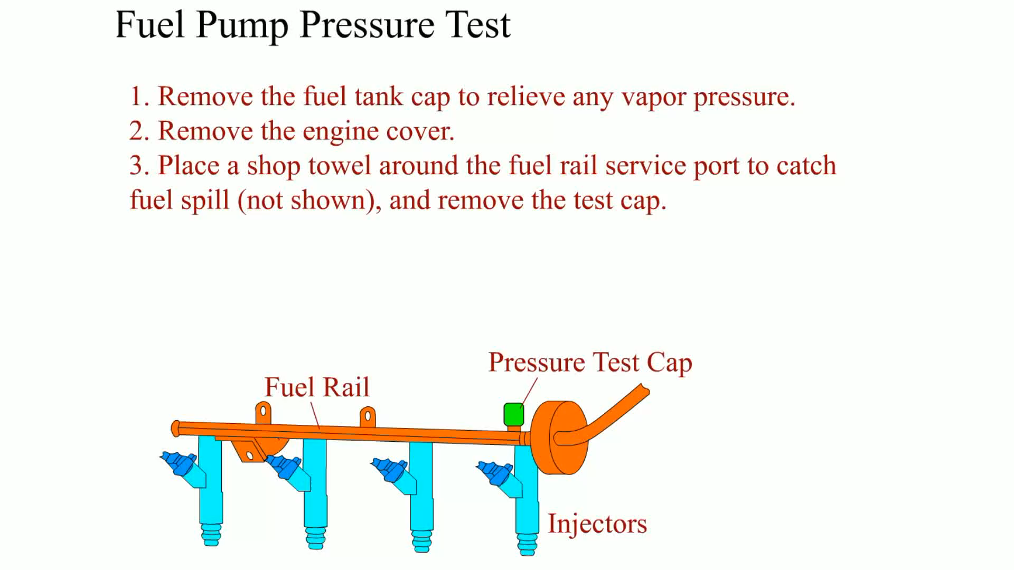
Animation:
Fuel Pump Pressure Test

Slide 48
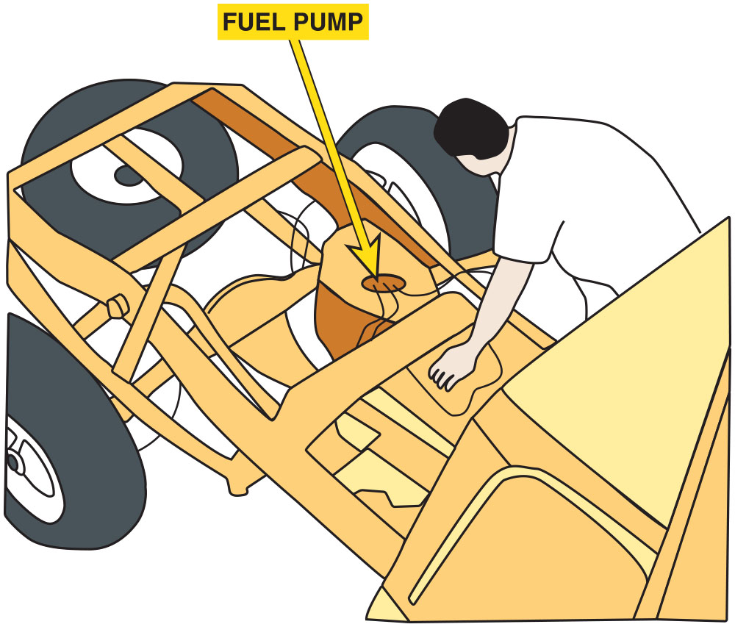
Figure 21.22
Truck Bed
Removing the bed from a pickup truck makes gaining access to the fuel pump a lot easier.
Notes:
TECH TIP Remove the Bed to Save Time?
The electric fuel pump is easier to replace on many General Motors pickup trucks if the bed is removed.
Access to the top of the fuel tank, where the access hole is located, for the removal of the fuel tank sender
unit and pump is restricted by the bottom of the pickup truck bed. It would take several people (usually
other technicians in the shop) to lift the truck bed from the frame after removing only a few fasteners. ● See Figure 21.22.

Slide 49
Fuel-Pump Current Draw Test
This test is most often performed by connecting a digital multimeter set to read D C amperes and test the current draw.
Compare the reading to factory specifications.

Slide 50
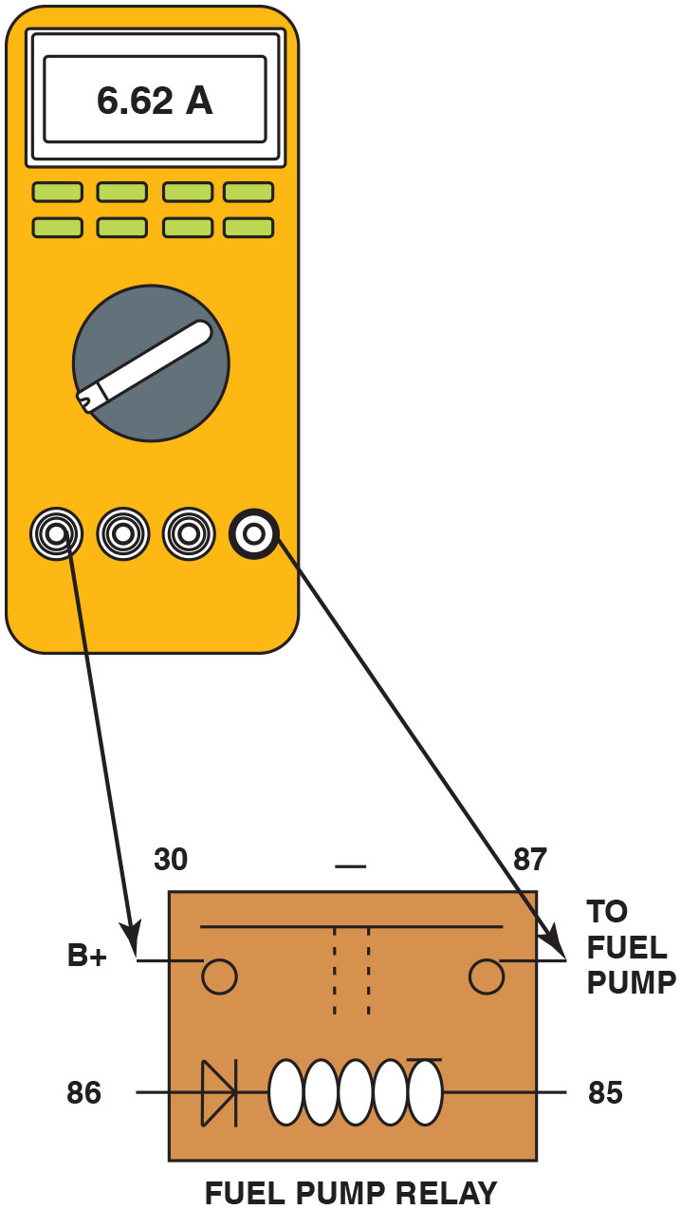
Figure 21.23
Relay Test
Hookup for testing fuel-pump current draw on any vehicle equipped with a fuel-pump relay.
Notes:
CAUTION: Be sure to clean around the fuel pump opening so that dirt or debris does not enter the tank
when the fuel pump is removed.

Slide 51
Question 3
What are three ways to test the fuel pump.

Slide 52
Answer 3
Rest pressure test, dynamic pressure test, and volume test.

Slide 53
Fuel Pump Replacement
The following recommendations should be followed whenever replacing an electric fuel pump:
  The fuel-pump strainer (sock) should be replaced with the new pump.
  If the original pump had a deflector shield, it should always be reinstalled.
  Always check the interior of the fuel tank for evidence of contamination or dirt.
  Check that the wiring and electrical connectors are clean and tight.

Slide 54
Summary (1 of 2)
The fuel delivery system includes the following items:
  Fuel tank
  Fuel pump
  Fuel filter(s)
  Fuel lines
A fuel tank is either constructed of steel with a tin plating for corrosion resistance or polyethylene plastic.
Fuel tank filler tubes contain an anti-siphoning device.
Accident and rollover protection devices include check valves and inertia switches.
Most fuel lines are made of nylon plastic.
Electric fuel-pump types include roller cell, gerotor, and turbine.

Slide 55
Summary (2 of 2)
Fuel filters remove particles that are 10 to 20 microns or larger in size and should be replaced regularly.
Fuel pumps can be tested by checking:
  Pressure
  Volume
  Specified current draw

Slide 56
Animation and Video Library Links
(Must have an internet connection and active Haldeman subscription)
Animation Library: (A8) Engine Performance Animations
Video Library: (A8) Engine Performance Videos

Slide 57

Copyright
This work is protected by United States copyright laws and is provided solely for the use of instructors in teaching their courses and assessing student learning. Dissemination or sale of any part of this work (including on the World Wide Web) will destroy the integrity of the work and is not permitted. The work and materials from it should never be made available to students except by instructors using the accompanying text in their classes. All recipients of this work are expected to abide by these restrictions and to honor the intended pedagogical purposes and the needs of other instructors who rely on these materials.

