Slide 1
Advanced Engine Performance Diagnosis
Eighth Edition
Chapter 20
Fuel Trim Diagnosis
Copyright © 2025 Pearson Education, Inc. All Rights Reserved
Notes:
If this PowerPoint presentation contains mathematical equations, you may need to check that your computer has the following installed:
1) Math Type Plugin
2) Math Player (free versions available)
3) NVDA Reader (free versions available)
INSTRUCTOR NOTE: This presentation includes text explanation notes, you can use to teach the course. When in SLIDE SHOW mode, you RIGHT CLICK and select SHOW PRESENTER VIEW, to use the notes.

Slide 2
Objectives (1 of 2)
20.1 Explain the purpose and function of fuel trim.
20.2 Discuss the difference between speed density and mass airflow fuel control.
20.3 Explain how the P C M determines the base injector pulse width.
20.4 Compare short-term and long-term fuel trim.
20.5 Explain how fuel trim can aid in diagnosis.
20.6 Explain the purpose of fuel trim cells.
20.7 Describe how to diagnose fuel trim concerns.

Slide 3
Objectives (2 of 2)
20.8 List factors that can affect the accuracy of the mass airflow sensor.
20.9 Describe how knowing volumetric efficiency of engine can help diagnose engine performance concerns.

Slide 4
Fuel Trim (1 of 5)
Purpose and Function
P C M does not measure or check air–fuel mixture entering cylinders.
Instead, P C M measures air mass, and then calculates amount of fuel needed.
Fuel trim provides a method that is capable of changing amount of fuel delivered to engine based on feedback from oxygen sensors.
Primary purpose of fuel trim is to keep the air–fuel
mixture as close to
as possible.

Slide 5
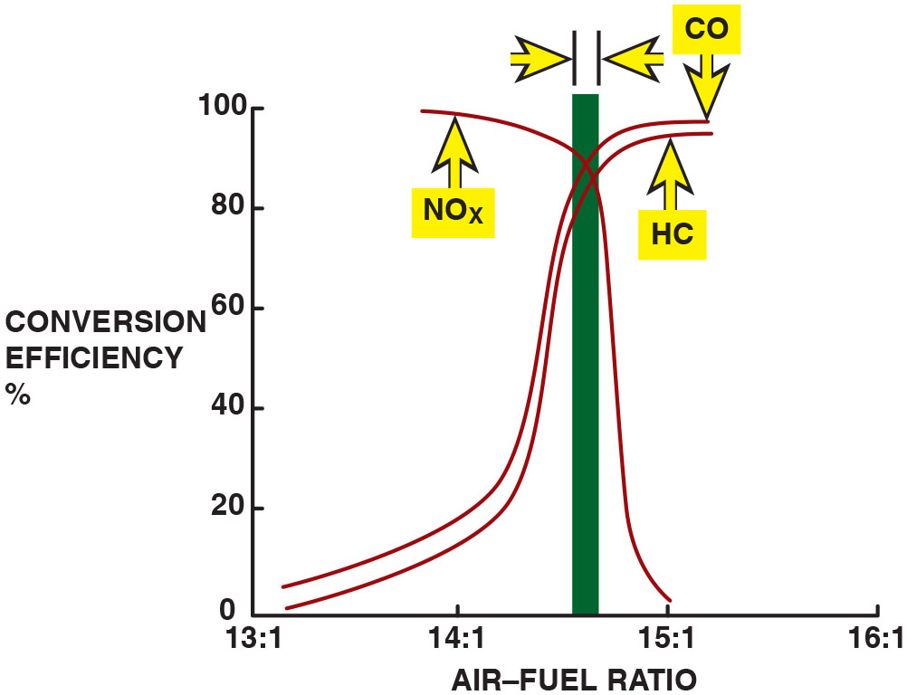
Figure 20.1
Catalytic Converter
The catalytic converter is most efficient when the exhaust ratio is
closest to
Notes:
Fuel Trim
The Powertrain Control Module (P C M) does not measure or check the air–fuel mixture entering the cylinders. Instead, the P C M measures the air mass, and then calculates the amount of fuel needed. Fuel trim provides a method that can change the amount of fuel delivered to the engine based on feedback from the oxygen sensors. The primary purpose of the fuel trim is to keep the air–fuel mixture as close to 14.7:1 as possible. When the air–fuel ratio is kept at 14.7:1, the efficiency of the catalytic converter is the highest, which results in the lowest possible exhaust emissions. • See Figure 20.1. Lambda is a Greek letter used to represent ratio, as in air–fuel ratio. If an engine is operating at exactly 14.7:1, the air–fuel ratio on gasoline, the ratio is called stoichiometric and is assigned a lambda of 1.0. Air–fuel ratios lower than 1.0 indicate a rich mixture. Air–fuel ratios higher than 1.0 indicate a lean mixture.
To determine the air–fuel ratio if lambda is given, multiply lambda times 14.7.
Long Description:
The x-axis ranges from 13 is to 1 to 16 is to 1 in increments of 1 is to 1. The y-axis ranges from 0 to 100 in increments of 20. Two S-curves and an inverted S-curve overlapping on top are shown. The first S-curve for H C extends from (13 is to 1, 0) to (15 is to 1, 97). The second S-curve for C O extends from (13 is to 1, 6) to (15 is to 1, 98). The inverted curve for N O subscript x extends from (13 is to 1, 98) to (15 is to 1, 0). A bar is placed along the intersecting point, where it starts from above 100 to a region before 15 is to 1 on the x-axis. The width of the bar is indicated by a right arrow and a left arrow.

Slide 6
Fuel Trim (2 of 5)
Lambda
Lambda is Greek letter used to represent ratio, as in air–fuel ratio.
If engine is operating at exactly
, air–fuel ratio on
gasoline, ratio is called stoichiometric and is assigned a
lambda of
Air–fuel ratios lower than
indicate a rich mixture.
Air–fuel ratios higher than
indicate a lean mixture.

Slide 7
Fuel Trim (3 of 5)
To determine the air–fuel ratio if lambda is given, multiply lambda times 14.7.
Example 1: lambda of
means that engine is operating 5%
lean and has an air–fuel mixture of
Example 2: lambda of 0.97 means that engine is operating 3%
rich and has an air–fuel mixture of
Usual lambda limits include:
0.9 lambda
is 10% rich and results in maximum power.
1.15 lambda
is 15% lean; in this case, a lean misfire is likely
to occur
Most new vehicles are designed to operate between 0.98 and
lambda or, stated another way, within 2% of stoichiometric.

Slide 8
Fuel Trim (4 of 5)
Equivalence Ratio
The equivalence ratio (E R) is the inverse of lambda, with
equal to
lambda; however, 0.9 E R is equal to 1.1
lambda.
Equivalence ratio 1E R2 = 1/l (lambda), which is the inverse of lambda.
Therefore, a rich air–fuel mixture has an equivalence ratio of greater than 1 and a lean mixture less than 1.
NOTE: Engineers and many technical articles of fuel trim use equivalence ratios instead of lambda.

Slide 9
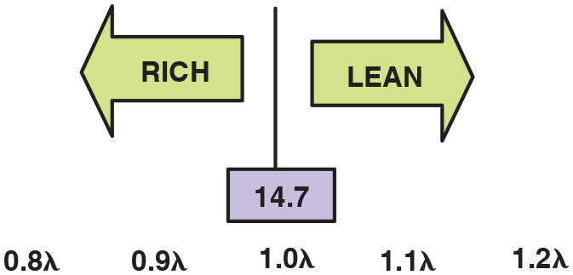
Figure 20.2
Equivalence Ratio
Shown is lambda. The equivalence ratio is opposite lambda.
Notes:
Equivalence Ratio
The equivalence ratio (E R) is the inverse of lambda, with 1.0 equal to 1.0 lambda; however, 0.9 ER is equal to 1.1 lambda. Equivalence ratio (E R) = 1/λ (lambda), which is the inverse of lambda. Therefore, a rich air–fuel mixture has an equivalence ratio of greater than 1 and a lean mixture less than 1. • See Figure 20.2.
Note: Engineers and many technical articles of fuel trim use equivalence ratios instead of lambda.
Long Description:
The optimum range is 14.7, indicated in the center by a line separating two arrows. There is a horizontal scale below with values 0.9 lambda and 0.9 lambda on the left, 1.0 lambda in the center, and 1.1 lambda and 1.2 lambda on the right. A left arrow labeled rich is from a value before 1.0 lambda to a value before the first 0.9 lambda. A right arrow labeled lean is from a value beyond 1.0 lambda to a value before 1.2 lambda.

Slide 10
Base Pulse Width (1 of 4)
Purpose & Function
Base pulse width is injector pulse width calculated by P C M using information from sensors before oxygen sensor(s) is operating.
P C M uses information from following sensors to determine base pulse width for fuel injectors:
R P M (engine speed)
Manifold absolute pressure (M A P) or mass airflow (M A F)
B A R O (altitude)
Throttle position (T P S)
Engine coolant temperature (E C T) (used mostly when the engine is cold)
Intake air temperature (I A T)
Battery voltage B+
Amount of exhaust gas (E G R) or (V V T)
Canister purge flow amount
Notes:
A general formula for the calculation is:
((R P M × M A P or M A F/B A R O) × (E C T × T P S) × (I A T × B+)) × O₂ × (S T F T × L I F T)
The cam and crank sensors are used to determine how fast the engine is turning (R P M). The barometer reading (B A R O) and the manifold absolute pressure (M A P) sensor or the mass airflow (M A F) sensors are used to determine the amount and the density of air entering the engine. These values together generate a base load calculation. The engine coolant temperature (E C T) sensor and the throttle position sensor (T P S) are major modifiers to the base load calculation. The intake air temperature (I A T) and battery voltage (B+) are minor modifiers to the base load calculation. Other factors, such as purge flow and exhaust gasses, are considered. The fuel is injected into the cylinder. After the combustion process, the oxygen sensor (O₂) is used to determine how much oxygen is left in the exhaust stream. The P C M uses the feedback from the O₂ sensor to adjust short-term fuel trim (S T F T) and long-term fuel trim (L T F T) values to achieve the stoichiometric ratio target.

Slide 11
Base Pulse Width (2 of 4)
Speed Density Modifier
Besides M A P sensor, other sensors are used to fine-tune or modify mathematical calculations needed to determine injector pulse width.
input sensors that affect fuel trim in a speed density system include:
B A R O. The B A R O sensor or M A P sensor reading at key on determines the atmospheric pressure.
I A T. The intake air temperature (I A T) sensor measures the temperature of the air entering the engine. The P C M uses this information to calculate the density of the air.
R P M. All speed density calculations need the speed of the engine to calculate injector pulse width.

Slide 12
Base Pulse Width (3 of 4)
Speed Density Modifier
E G R
P C M needs to determine amount of exhaust gases being recirculated into intake manifold to make an accurate measurement of air mass entering cylinders.
Various designs used for this calculation and include:
E G R valve pintle position
E G R passage temperature sensor
Pressure differential in the E G R passage
E C T
Engine coolant temperature used to add fuel when engine is cold, but has little effect on fuel trim after engine has been run for a while
T P sensor
P C M uses position of the throttle in three places to determine basic calculations.

Slide 13
Base Pulse Width (4 of 4)
Mass Airflow Modifiers
Using a M A F sensor provides P C M with a direct reading of volume of air entering engine.
M A F-equipped engines are able to provide a more accurate air–fuel ratio under all conditions.
M A F system has following advantages compared with a speed density system:
Measures actual mass of air entering engine.
Altitude and temperature corrections not needed.
Amount of E G R does not need to be calculated.

Slide 14
Measuring Pulse Width
P C M determines base injector pulse width based on reading from sensors and calculations from lookup tables stored in read-only memory.
Base pulse width is best guess as to correct amount of fuel that engine needs.
Pulse width is measured in milliseconds (m s) and represents amount of time fuel injectors commanded on.
A typical engine at idle speed will have a pulse width of about 2 to 5 m s, depending on the size of the engine.

Slide 15
Frequently Asked Question: Does the Air–Fuel Ratio Have to Vary from Rich to Lean?
? Frequently Asked Question
Does the Air–Fuel Ratio Have to Vary from Rich to Lean? No. The
catalytic converter is most efficient when air–fuel Mixture is at
(stoichiometric). However, when carburetors were used for fuel control,
they were not capable of providing exactly
and did fluctuate rich
and lean within about 5% of stoichiometric. Older fuel-injection systems (multiport or gang-fired systems) were capable of providing an air–fuel mixture within about 2% of stoichiometric. Vehicles equipped with
sequential port fuel injectors can be kept within 1% of
which
greatly increases the efficiency of the catalytic converter.

Slide 16
Frequently Asked Question: Is There Less Oxygen in the Air at High Altitude?
? Frequently Asked Question
Is There Less Oxygen in the Air at High Altitude? No. At altitudes above sea level, the atmospheric pressure and air density are lower, but the amount of oxygen (21%) remains the same at all altitudes. Three basic altitude-related factors are:
Physical altitude. This is the altitude measured above sea level.
Pressure altitude. This is the atmospheric pressure corrected to sea level according to the International Standard Atmosphere (I S A). Pressure altitude is primarily used for airplane performance calculations using 101 k P a as the standard for atmospheric pressure at sea level. See the chart on pages 547–548 (textbook).
Notes:
Density altitude. This altitude factor is important for engine operation. Density altitude is the number of oxygen molecules that are entering the engine. The density is affected by temperature. Therefore, the use of the intake air temperature sensor data is important in determining air density.
TECH TIP: One Millisecond per Liter: A rule-of-thumb that usually works to determine if the pulse width is within reason is to remember that the size of the engine does affect the amount of fuel needed. While injector flow rates are higher for larger engines, it is generally true that, at idle on a warm engine, the injector pulse width will be about 1 millisecond per liter of displacement.
2 liters = 2 milliseconds
3 liters = 3 milliseconds
4 liters = 4 milliseconds
5 liters = 5 milliseconds
6 liters = 6 milliseconds
Therefore, if the injector pulse width is far from being normal, determine if the engine has a vacuum leak (if numbers are too high) or if the purge valve is stuck open (if the numbers are too low).

Slide 17
Fuel Trip Operation
Need for Fuel Trim
Provide converter with stoichiometric air–fuel mixture, to
reduce
emissions & help oxidize H C and C O into
carbon dioxide
and water
vapor.
Exhaust always rich, catalytic converter cannot reduce C O/H C emissions.
Exhaust always lean, catalytic converter cannot reduce N O X emissions; therefore, air–fuel mixture must alternate between rich and lean.
Computer provides as close to
mixture as possible
by using oxygen sensor, & short-term and long-term fuel trim program.
Notes:
NOTE: On some vehicles, while operating under full load, the oxygen sensor data is ignored and the P C M commands the richer-than-normal air–fuel mixture needed for maximum power based on inputs from the other sensors.

Slide 18
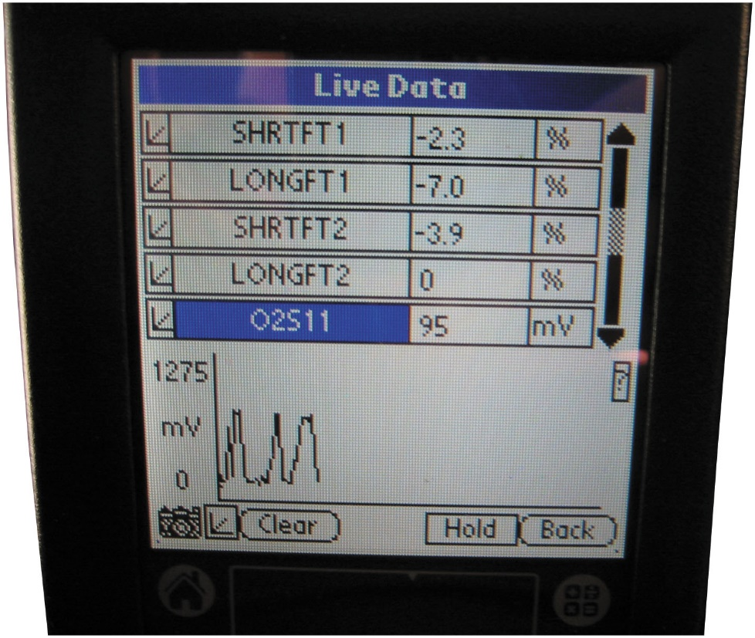
Figure 20.3
Fuel Trim Live Data
A scan tool display showing both long-term and short-term fuel trim. Both L T F T and S T F T should be less than 10%.
Notes:
Need for Fuel Trim
The purpose of fuel trim is to provide the catalytic converter with a stoichiometric air–fuel mixture, which it needs to reduce N O_{x} exhaust emissions and to help oxidize H C and C O into harmless carbon dioxide (C O₂) and water (H₂O) vapor. If the exhaust is always rich, the catalytic converter cannot reduce C O and H C emissions. If the exhaust is always lean, the catalytic converter cannot reduce N O_{x} emissions; therefore, the air–fuel mixture must alternate between rich and lean. The computer is therefore designed to provide as close to a 14.7:1 mixture as possible by using the oxygen sensor, as well as the short-term and long-term fuel trim program, to accomplish this feat. • See Figure 20.3.
Case Study: The Red Pickup Truck Story
A four-cylinder 2.2-liter engine was replaced due to excessive oil consumption. The replacement engine never ran correctly, especially at idle and low speeds. The scan tool data showed a −25% long-term fuel trim, indicating that the oxygen sensor was measuring a very rich (low oxygen content) exhaust stream. Because the engine was operating so badly, the service technician believed the oxygen sensor was indicating a false rich condition. The service technician then checked the following:
Poor oxygen sensor ground (this can cause a higher-than-normal oxygen sensor voltage)
Oxygen sensor wiring shorted to voltage or near a spark plug wire
A contaminated (coated) oxygen sensor that will read higher than normal
None of the false rich conditions was found. Remembering that the engine ran terribly even when
cold and the problem started after the engine was replaced, the technician started to look for
faults that could have occurred when parts were switched from the original engine to the
replacement engine. The technician found an incorrect E G R gasket. This caused exhaust gases to
flow into the cylinders all the time. The exhaust gases also displaced the oxygen that normally
would be in the cylinder, thereby reducing the amount of oxygen measured by the oxygen sensor.
Replacing the E G R gasket restored proper engine operation.
Summary
Concern—A replacement engine never ran correctly after being installed into the pickup truck.
Cause—The incorrect EGR base gasket had been installed allowing exhaust gases to enter
cylinders at all times.
Correction—The correct E G R base gasket was installed which corrected the poor engine
operation.
Long Description:
The display shows the following data in three columns: S H T F T 1; negative 2.3; percent. LONG F T 1; negative 7.0; percent. S H T F T 2; negative 3.9; percent. LONG F T 2; 0; percent. O 2 S 11; 95; m V. A graph below shows an irregular positive sine wave with 0 to 1275 m V on the y-axis. A camera icon and three buttons, namely, clear, hold, and back, are at the bottom of the screen.

Slide 19
Fuel Trim (5 of 5)
Short-Term Fuel Trim (S T F T)
Percentage measurement of amount computer is adding or subtracting from a calculated value
signal modifies preprogrammed fuel delivery
Short-term fuel trim of +20% indicates that 20% additional fuel added to achieve proper air–fuel mixture
Long-Term Fuel Trim
Add/subtract fuel for a longer amount of time than short-term fuel trim
keep -term fuel trim as close to zero as possible
Notes:
Short-Term Fuel Trim
Short-term fuel trim (S T F T) is a percentage measurement of the amount the computer is adding or subtracting from a calculated value. Electronic fuel-injector systems use the oxygen sensor (O₂S) to determine whether the exhaust is rich or lean. Without the O2S, fuel delivery is controlled by the computer alone using the programmed pulse width commands based on other sensor inputs, such as engine coolant temperature (E C T), throttle position (T P), and engine load (M A P). When the engine is operating in closed loop, the O₂S signal can modify or change the preprogrammed fuel delivery. Fuel trim is expressed as a percentage (%), either positive (+) or negative (−), and represents the amount of fuel different from the anticipated amount. For example, if a small vacuum leak occurs, the O2S produces a lower voltage signal, which is interpreted by the computer as meaning the air–fuel mixture is too lean. As a result, the pulse width is increased slightly to compensate for this slight vacuum leak. The amount of this additional fuel is seen on a scan tool as a positive short-term fuel trim.
A short-term fuel trim of +20% indicates that 20% additional fuel had to be added to achieve the proper air–fuel mixture. A −20% short-term fuel trim indicates that fuel had to be removed by shortening the injector pulse width to achieve the proper air–fuel mixture.
Short-term fuel trim represents actions by the computer over a relatively short time. The purpose of the S T F T is to provide a varying air–fuel mixture so that the catalytic converter can eﬀiciently reduce H C, C O, and NO_{x} exhaust emissions. If, for example, a large vacuum leak was to occur, then the fuel delivery would have to be increased even more and for a longer time. Therefore, electronic fuel-injection system computers also incorporate a long-term fuel trim program.
Long-Term Fuel Trim
Long-term fuel trim (L T F T) is designed to add or subtract fuel for a longer amount of time than short-term fuel trim. For this reason, L T F T should be looked at by the service technician as a guide to whether the computer has been adding or subtracting fuel in order to achieve the proper air–fuel mixture. For example, if a vacuum hose splits open, the engine will be leaner than normal. Short-term fuel trim will attempt to add fuel right away to adjust. If the resulting air (vacuum) leak remains for longer than a few seconds to a minute, the computer will revise the long-term fuel trim to compensate for the leak over a larger period of time. When the L T F T makes an adjustment, the S T F T can still make short and quick changes in the air–fuel mixture needed to provide the catalytic converter with an lean, then rich exhaust. The purpose of long-term fuel trim is to keep -term fuel trim as close to zero as possible.

Slide 20
Fuel Trim Cells
Both S T F T s and L T F T s react to oxygen sensor voltage
To modify fuel delivery.
Most vehicles set aside different fuel trim cells for each combination of engine speed (R P M) and load.
Computer can then correct for slight differences in fuel mixture separately for each cell.
G M uses 16 cells plus 2 for deceleration and 2 for idle only.
Notes:
Tech Tip: Think of a Small Faucet and a Large Faucet:
The purpose of fuel trim is to add or subtract fuel as needed to maintain the proper air–fuel mixture so the catalytic converter can operate properly. S T F T is fast but can add or subtract only a small amount of fuel. This can be visualized as being similar to a small water faucet adding water to a sink. For example, if a small vacuum hose becomes disconnected, the S T F T will add a little extra fuel to compensate for the added amount of air being drawn into the engine. If a large hose becomes disconnected, the S T F T cannot supply the needed fuel required; therefore, the L T F T is needed to supply additional fuel to overcome the large air leak. This can be visualized as being similar to a large water faucet adding a greater amount of water to a sink. Because the L T FT indicates a larger amount of fuel being added or subtracted than S T F T, many service technicians simply ignore the S T F T readings and use the L T F T numbers to see if they are within 10%. If L T F T is greater than 10%, either positive (+) or negative (−), then a fault should be corrected. The maximum value for STFT and L T F T depends on the exact make, model, and year of manufacture of vehicle but is usually limited to 25% to 30% for either.

Slide 21
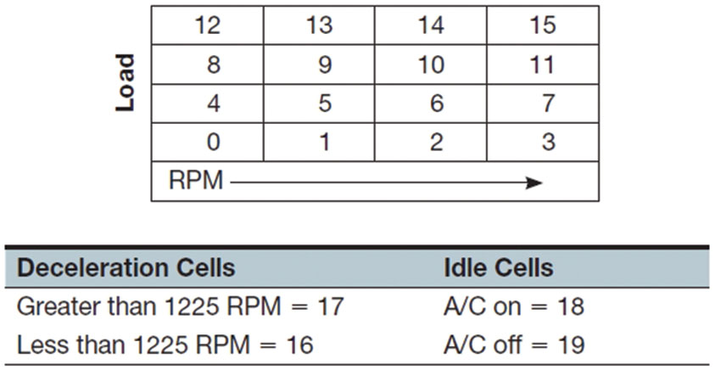
Figure 20.4
An Example of a Fuel Cell Map.
An example of a fuel cell map.
Notes:
Both S T F T s and L T F T s react to oxygen sensor voltage to modify fuel delivery. Most vehicles set aside different fuel trim cells for each combination of engine speed (R P M) and load. The computer can then correct for slight differences in fuel mixture separately for each cell. For example, G M uses 16 cells plus 2 for deceleration and 2 for idle only. • See Figure 20.4.
Tech Tip Movie Mode Diagnosis
A scan tool will display fuel trim values, but only those in the cell where the engine is operating. For example, if an engine lacks power while towing a trailer up a hill, looking at the fuel trim values at idle in the shop will show the values in the cell or cells that the engine is operating. To observe the true fuel trim values, the vehicle will have to be operated under similar conditions and the data recorded on the scan tool. Use snap-shot or movie mode during the test drive, scroll through the recorded values, and look for the fuel trim cell and the L T F T and S T F T values to help determine if there is a fuel delivery or other fuel-trim-related problem.
Long Description:
It shows a four by four matrix with load labeled on the left and R P M at the bottom with a rightward arrow indicating its direction. The data of the matrix are as follows: Row 1; 12, 13, 14, and 15. Row 2; 8, 9, 10, and 11. Row 3; 4, 5, 6, and 7. Row 4; 0, 1, 2, and 3. It then shows a table with the column headings deceleration cells and Idle cells. The values from the rows for the respective columns are row 1; Greater than 1225 R P M equals 17, and A slash C on equals 18. Row 2; Less than 1225 R P M equals 16, and A slash C off equals 19.

Slide 22
Fuel Cell Diagnosis
To use fuel trim as a diagnostic aid
Data observed during same condition as concern
For example, two cells for idle—one with A/C on and one with A/C off
If problem only occurs when the A/C is on
Observe fuel trim numbers at idle and with A/C on.
Looking at fuel trim in the service bay (stall)
With engine at idle will not find a concern at 55 M P H
Vehicle must be driven under similar conditions to best duplicate the condition when concern occurs.
Notes:
Fuel trim values can only be observed with a scan tool. A scan tool will display both short-term and long-term fuel trim. For system diagnosis, refer to the long-term fuel trim because it represents a longer amount of time (history) and a greater amount of mixture correction.
NOTE: The object of S T F T and L T F T is to be able to make corrections to the amount of fuel delivered to the engine to achieve the proper air–fuel mixture. For example, a reading of +30% L T F T will indicate the computer must deliver 30% more than the calibrated amount of fuel to achieve the proper air–fuel mixture. This also means that the engine is now operating with the correct air–fuel mixture. The L T F T number simply tells the technician what the computer had to do to achieve the proper mixture.

Slide 23
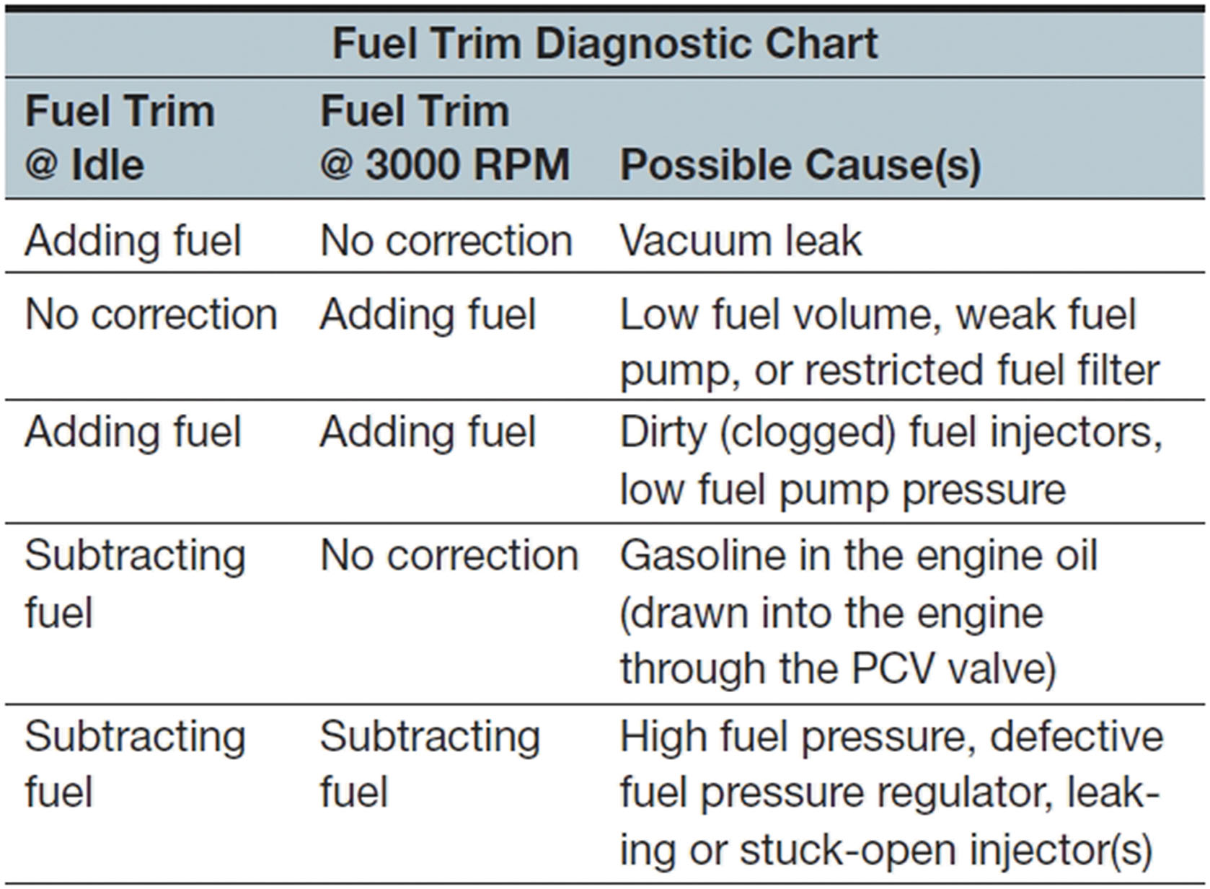
Figure 20.5
Fuel Trim Diagnostic Chart Example.
A fuel trim diagnostic chart example.
Notes:
SEE PAGE 552 FOR THREE EXAMPLES OF FUEL TRIM
Long Description:
The data from the rows for the column headings Fuel Trim at the rate Idle, Fuel Trim at the rate 3000 R P M, and Possible Cause(s) respectively are as follows: row 1; Adding fuel, No correction, and Vacuum leak. Row 2; No correction, Adding fuel, and Low fuel volume, weak fuel pump, or restricted fuel filter. Row 3; Adding fuel, Adding fuel, and Dirty (clogged) fuel injectors, low fuel pump pressure. Row 4; Subtracting fuel, No correction, and Gasoline in the engine oil (drawn into the engine through the P C V valve). Row 5; Subtracting fuel, Subtracting fuel, and High fuel pressure, defective fuel pressure regulator, leaking or stuck-open injector(s).

Slide 24
Using Fuel Trim as a Diagnostic Aid
Fuel trim values observed with scan tool.
Scan tool displays both short-term and long-term fuel trim.
For system diagnosis
Refer to long-term fuel trim
Represents a longer amount of time (history)
Greater amount of mixture correction.
Notes:
NOTE: The object of S T F T and L T F T is to be able to make corrections to the amount of fuel delivered to the engine to achieve the proper air–fuel mixture.
For example, a reading of +30, L T F T will indicate the computer must deliver 30% more than the calibrated amount of fuel to achieve the proper air–fuel mixture. This also means that the engine is now operating with the correct air–fuel mixture. The L T F T number simply tells the technician what the computer had to do to achieve the proper mixture.

Slide 25
Mass Airflow Accuracy (1 of 2)
With M A F sensor, accuracy of sensor is critical for P C M to provide current pulse width command to fuel injectors.
Factors affecting M A F sensor readings include:
Vacuum leaks. Represents air entering combustion chambers not measured by M A F sensor, and affects air–fuel mixture mostly at idle. Above idle, effects reduced.
False air. False or unmeasured air is air that is entering the intake system after M A F sensor. This false air can have a great effect on air–fuel mixture at idle and, like a vacuum leak, tends to have less of an effect at higher engine speeds.

Slide 26
Mass Airflow Accuracy (2 of 2)
Factors affecting M A F sensor readings include:
P C V airflow. Airflow through P C V system is not measured by M A F sensor. Therefore, all openings to crankcase must be sealed to prevent unmeasured air from entering.
Airflow disturbance (disruption). If incorrect air filter is installed or air inlet system is modified, airflow through M A F sensor may not be straight.
If air turbulence passes through M A F sensor, the accuracy of the amount of airflow will not be correct.

Slide 27
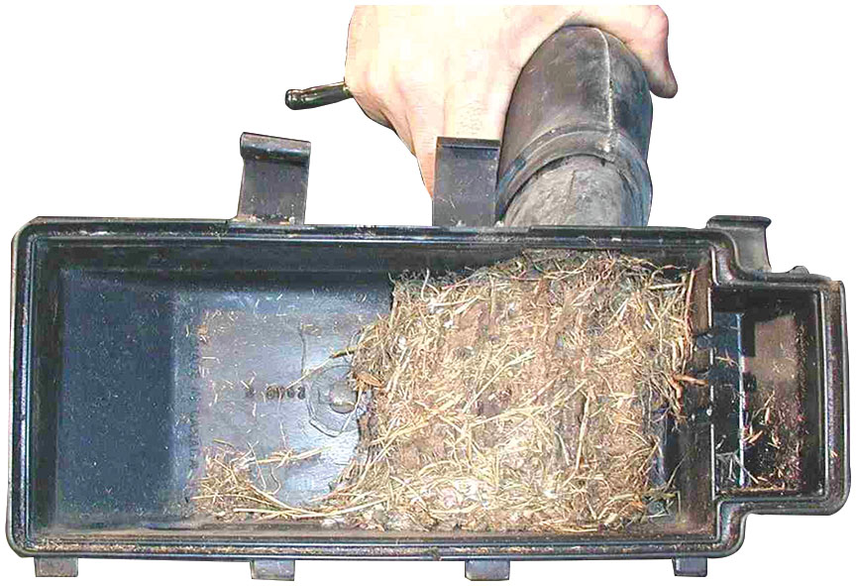
Figure 20.6
Dirty Air Cleaner Assembly
Any fault in air cleaner assembly can disrupt airflow through the M A F sensor.

Slide 28
Frequently Asked Question: What Is the Alpha P I D?
? Frequently Asked Question
What Is the Alpha P I D? Alpha is the air–fuel ratio parameter displayed on Nissan/Infiniti vehicles.
100 =
higher than 100 = P C M is adding fuel
Lower than 100 = P C M is subtracting fuel
Alpha used as a single parameter that replaces both long-term fuel trim and short-term fuel trim.
Notes:
Density altitude. This altitude factor is important for engine operation. Density altitude is the number of oxygen molecules that are entering the engine. The density is affected by temperature. Therefore, the use of the intake air temperature sensor data is important in determining air density.
TECH TIP: One Millisecond per Liter: A rule-of-thumb that usually works to determine if the pulse width is within reason is to remember that the size of the engine does affect the amount of fuel needed. While injector flow rates are higher for larger engines, it is generally true that, at idle on a warm engine, the injector pulse width will be about 1 millisecond per liter of displacement.
2 liters = 2 milliseconds
3 liters = 3 milliseconds
4 liters = 4 milliseconds
5 liters = 5 milliseconds
6 liters = 6 milliseconds
Therefore, if the injector pulse width is far from being normal, determine if the engine has a vacuum leak (if numbers are too high) or if the purge valve is stuck open (if the numbers are too low).

Slide 29
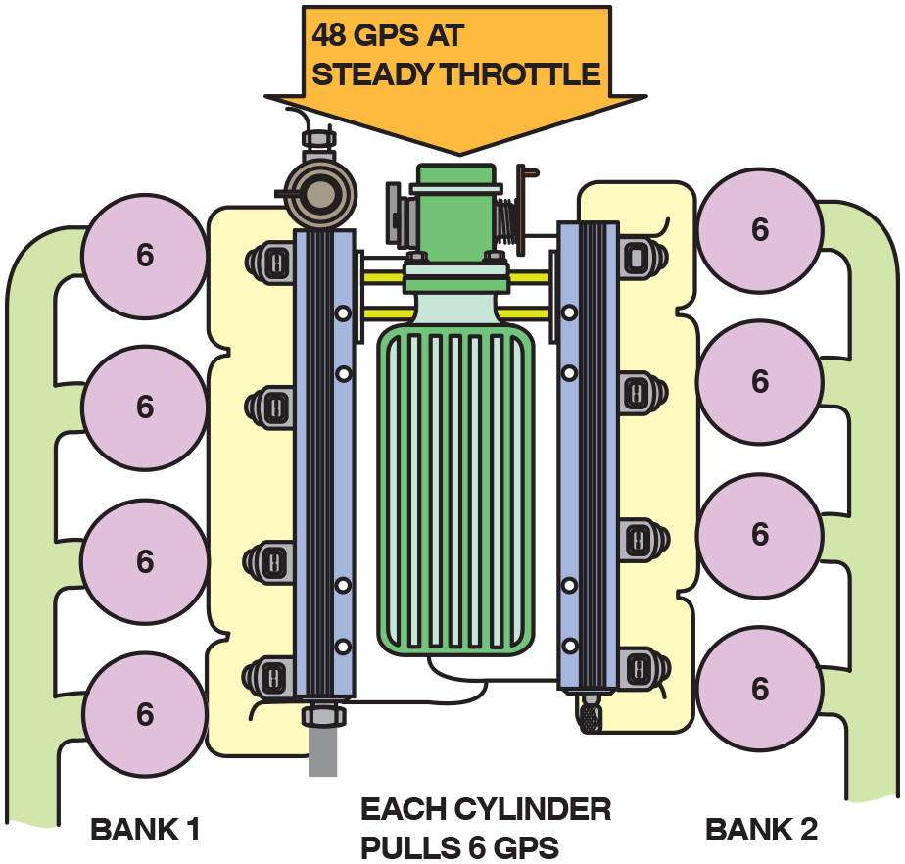
Figure 20.7
48 G P S at Steady Throttle.
This properly operating engine is drawing in 48 grams per second of air for all eight cylinders. This indicates that each cylinder will be receiving 6 grams per second (G P S).
Notes:
Case Study: Negative Fuel Trim Bank #1; Positive Fuel Trim Bank #2
The owner of a Chevrolet Camaro V-8 complained that the engine seemed to lack the power it used to have. The service technician found that, while there were no diagnostic trouble codes, the left bank (bank #1) had a negative total fuel trim, whereas the right bank had a positive total fuel trim. If one bank of a V-8 engine has a restricted exhaust on one bank, the fuel trim numbers will be negative on the bank that is restricted and positive on the bank that is not restricted. A restricted converter was found to be the root cause as the substrate had cracked and the broken sections restricted the flow of exhaust. • See Figures 20.7 through 20.10.
Long Description:
The illustration displays a top view of a throttle at the center with four cylinders connected to it on the left and right, respectively. The cylinders on the left are labeled bank 1 and the cylinders on the right are labeled bank 2. A downward arrow into the throttle indicates 48 g p s at steady throttle. Text below reads, Each cylinder pulls 6 G P S.

Slide 30
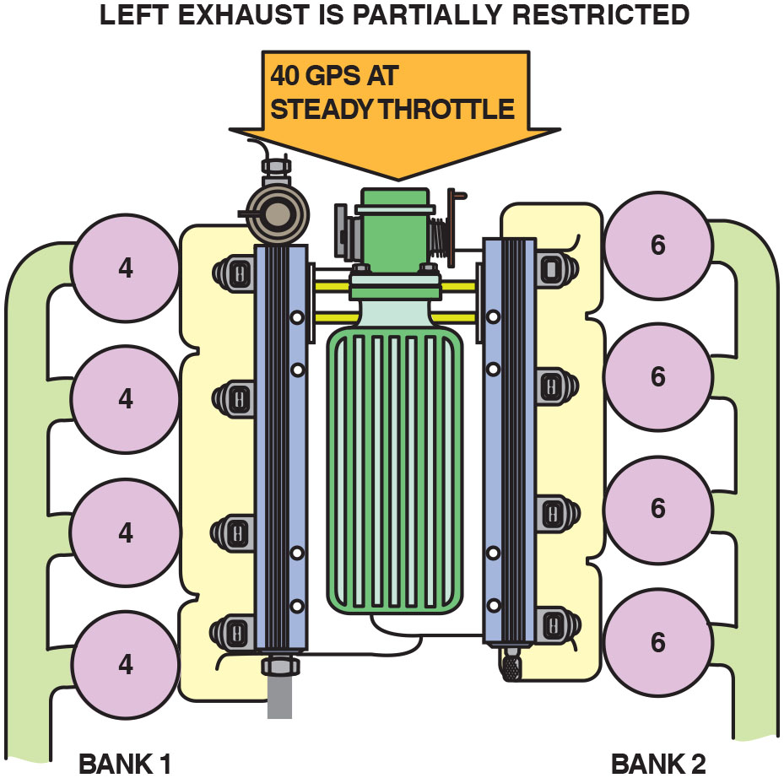
Figure 20.8
40 G P S at Steady Throttle.
If exhaust system on left bank (bank #1) were to become restricted, total airflow through the M A F sensor would also decrease. The cylinders on right Bank (bank #2) would draw same 6 G P S as before and cylinders on bank #1, which have a restricted exhaust, would draw just 4 G P S.
Notes:
Case Study: Negative Fuel Trim Bank #1; Positive Fuel Trim Bank #2
The owner of a Chevrolet Camaro V-8 complained that the engine seemed to lack the power it used to have. The service technician found that, while there were no diagnostic trouble codes, the left bank (bank #1) had a negative total fuel trim, whereas the right bank had a positive total fuel trim. If one bank of a
V-8 engine has a restricted exhaust on one bank, the fuel trim numbers will be negative on the bank that is restricted and positive on the bank that is not restricted. A restricted converter was found to be the root cause as the substrate had cracked and the broken sections restricted the flow of exhaust. • See Figures 20.7 through 20.10.
Long Description:
The illustration displays a top view of a throttle at the center with four cylinders connected to it on the left and right, respectively. The cylinders on the left are labeled bank 1, and the cylinders on the right are labeled bank 2. The cylinders on the left pull 4 and the ones on the right pull 6. A downward arrow into the throttle indicates 40 g p s at steady throttle. The text above reads, Left exhaust is partially restricted.

Slide 31
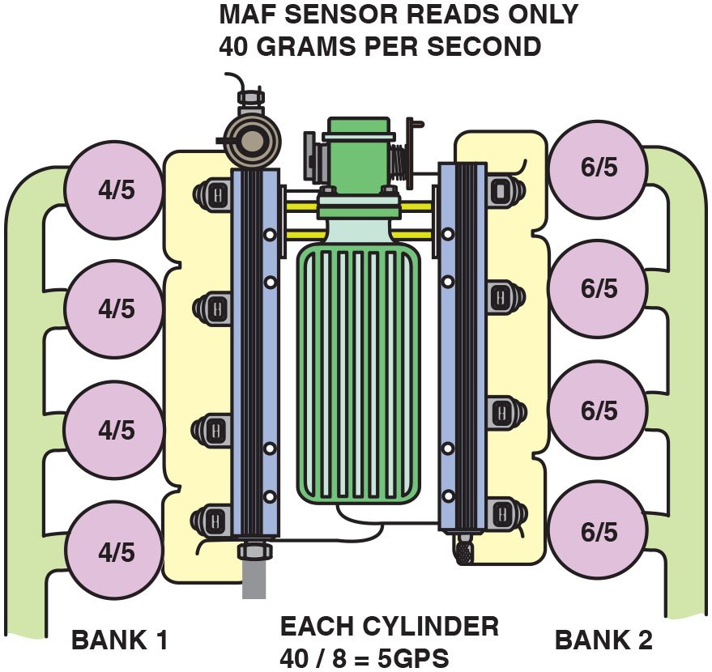
Figure 20.9
A F Sensor Reads Only 40 G P S
If all cylinders were equal and showed 40 grams per second, each cylinder will be drawing 5 grams per second
cylinders = 40 G P S 2 .
Bank #1 being supplied 4/5ths of air needed, whereas bank #2 is being supplied 6/5ths of air needed causing bank #1 to operate too rich and bank # 2 to operate too lean.
Notes:
Case Study: Negative Fuel Trim Bank #1; Positive Fuel Trim Bank #2
The owner of a Chevrolet Camaro V-8 complained that the engine seemed to lack the power it used to have. The service technician found that, while there were no diagnostic trouble codes, the left bank (bank #1) had a negative total fuel trim, whereas the right bank had a positive total fuel trim. If one bank of a
V-8 engine has a restricted exhaust on one bank, the fuel trim numbers will be negative on the bank that is restricted and positive on the bank that is not restricted. A restricted converter was found to be the root cause as the substrate had cracked and the broken sections restricted the flow of exhaust. • See Figures 20.7 through 20.10.
Long Description:
The illustration displays a top view of a throttle at the center with four cylinders connected to it on the left and right, respectively. The cylinders on the left are labeled bank 1 and the cylinders on the right are labeled bank 2. The cylinders on the left pull 4 over 5 and on the right pull 6 over 5. Text corresponding to the M A F sensor above bank 1 reads, M A F sensor reads only 40 grams per second. Text below the throttle reads, Each cylinder 40 over 8 equals 5 G P S.

Slide 32
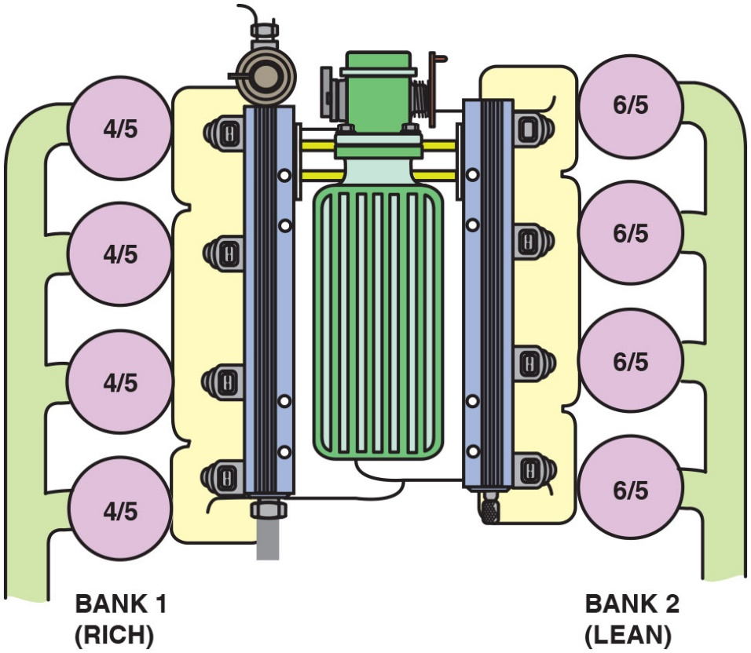
Figure 20.10
Restricted Exhaust and Running Rich.
As a result of the restricted exhaust on bank #1, the restricted bank will operate too rich and bank #2 will operate too lean. The long-term fuel trim will be negative for bank #1 and positive for bank #2.
Notes:
Case Study: Negative Fuel Trim Bank #1; Positive Fuel Trim Bank #2
The owner of a Chevrolet Camaro V-8 complained that the engine seemed to lack the power it used to have. The service technician found that, while there were no diagnostic trouble codes, the left bank (bank #1) had a negative total fuel trim, whereas the right bank had a positive total fuel trim. If one bank of a
V-8 engine has a restricted exhaust on one bank, the fuel trim numbers will be negative on the bank that is restricted and positive on the bank that is not restricted. A restricted converter was found to be the root cause as the substrate had cracked and the broken sections restricted the flow of exhaust. • See Figures 20.7 through 20.10.
As a result of the restricted exhaust on bank #1, the restricted bank will operate too rich and bank #2 will operate too lean. The long-term fuel trim will be negative for bank #1 and positive for bank #2.
Summary
Concern—The customer complained of a lack of power.
Cause—A restricted exhaust on the left bank due to a broken substrate inside the catalytic converter.
Correction—The catalytic converter was replaced, which restored normal engine power delivery.
Long Description:
The illustration displays a top view of a throttle at the center with four cylinders connected to it on the left and right, respectively. The cylinders on the left are labeled bank 1 (rich) and the cylinders on the right are labeled bank 2 (lean). The cylinders on the left pull 4 over 5 and on the right pull 6 over 5.

Slide 33
Volumetric Deficiency
Definition of Volumetric Efficiency (V E)
Percentage of air entering engine compared to theoretical airflow.
Normally aspirated engines will test having a V E of 75% to 90%.
Older two-valve cylinder head engines will test lower than newer engines equipped with four valves per cylinder.
Percentages above 100% possible on supercharged or turbocharged
Test should be conducted in a safe location away from traffic and does not need to be performed at high vehicle speeds.
Data needed:
Engine size in cubic inches
Engine speed (R P M)
M A F (grams per second)
Intake air temperature (I A T)

Slide 34
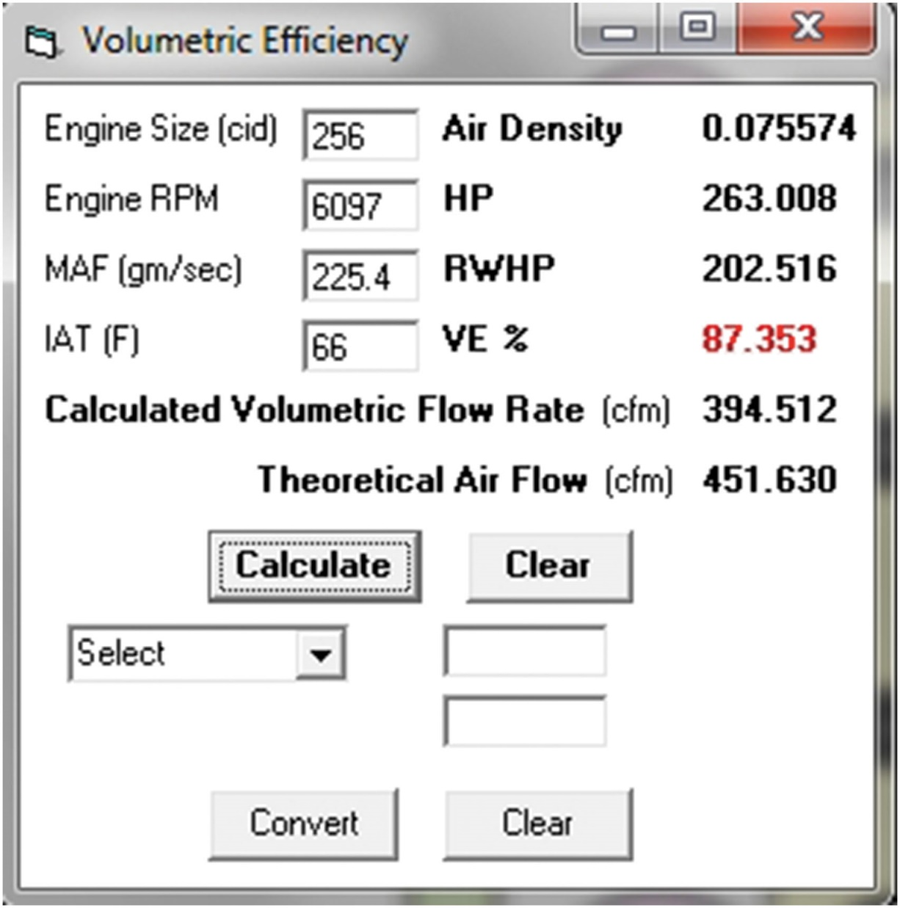
Figure 20.11
V E Example 1
The data shows a normally operating engine.
Notes:
Example 1
A Chevrolet Trailblazer equipped with a 4.2-liter 6-cylinder engine is tested using the following information and results:
Engine size = 256 c u. i n. (4.2 liters)
Engine R P M = 6097
M A F (g m/s) = 225.4
I A T (◦F) = 66
The calculated airflow through the engine is 395 c u. f t per sec. The theoretical airflow through the engine is 451 c u. f t per second. The V E is 87%. This result indicates that the M A F sensor is accurately measuring the airflow and the engine is in good mechanical condition. • See Figure 20.11.
Long Description:
The data shown is as follows: Engine size (c i d); 256, Engine R P M; 6097, M A F in g m per second; 225.4, I A T (F); 66, Air density; 0.075574, H P; 263.008, R W H P; 202.516, V E percent; 87.353 which is highlighted in red, calculated volumetric flow rate (c f m); 394.512, theoretical air flow (c f m); 451.630. There are two buttons calculate and clear below it. The two buttons at the bottom are convert and clear.

Slide 35
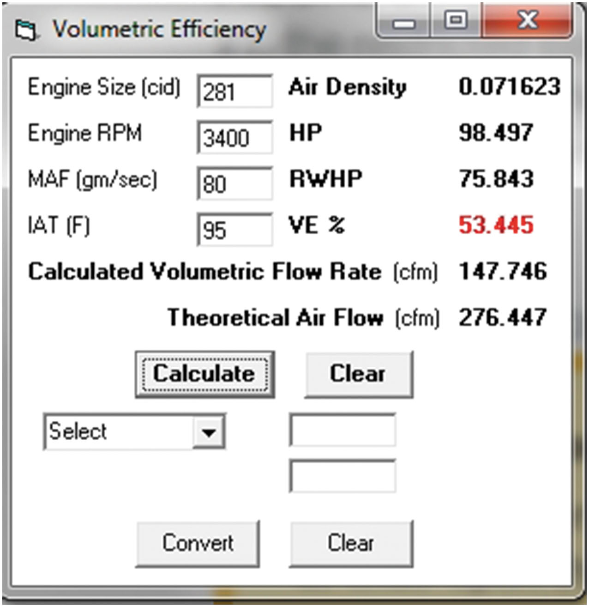
Figure 20.12
V E Example 2
The data indicates a restriction.
Notes:
Example 2
A Cadillac Deville is equipped with a 4.6-liter V-8. The customer’s concern is poor performance. Fuel trim numbers are within ±2% from idle to cruise. A check of the V E indicates the following:
Engine size = 281 c u. i n. (4.6 liters)
Engine R P M = 3400
M A F (gm/s) = 80
I A T (◦F) = 95
The calculated volumetric efficiency is 53%. A clogged catalytic converter is discovered to be the cause. • See Figure 20.12.
Tech Tip MAF Sensor or Airflow Problem? If a M A F sensor reading is lower than normal, such as at wide-open throttle, it could be an engine
breathing problem or a defective/contaminated M A F sensor. To determine which the case is, check the following:
■ If the fuel trim numbers follow the airflow, there is an airflow measurement error (M A F-sensor-related problem).
■ If the fuel trim numbers are okay, the M A F is okay.
■ If the B A R O reading is lower than normal, there is an engine breathing issue, such as a restricted intake or exhaust.
Tech Tip: Possible Restricted Exhaust? Check the I A T.
If the exhaust system is restricted, all the exhaust will be unable to exit the engine, especially at wide-open throttle. Using a scan tool, look at the values displayed for the intake air temperature (I A T) sensor. The I A T should decrease slightly at W O T normally due to the increased airflow. If the I A T reading increases, this is an indication of a restricted exhaust.
Long Description:
The data shown is as follows: Engine size (c i d); 281, Engine R P M; 3400, M A F in g m per second; 80, I A T (F); 95, Air density; 0.071623, H P; 98.497, R W H P; 75.843, V E percent; 53.445 which is highlighted in red, calculated volumetric flow rate (c f m); 147.746, theoretical air flow (c f m); 276.447. There are two buttons calculate and clear below it. The two buttons at the bottom are convert and clear.

Slide 36
Summary (1 of 2)
Lambda is a Greek letter used to represent air–fuel ratio.
Lambda of
is equal to an air–fuel rate of
Equivalence ratio is the inverse of lambda.
Base pulse width is determined by the P C M based on input from many sensors.
Speed density fuel control uses calculations based on the input from various sensors, such as the T P and M A P sensor to determine the amount of fuel needed.
Mass airflow systems use a mass airflow sensor to measure the mass of the air entering the engine directly.

Slide 37
Summary (2 of 2)
Fuel trim uses the oxygen sensor data to fine-tune the air–fuel mixture to ensure lowest emissions.
Short-term fuel trim (S T F T) is capable of quickly adding or subtracting fuel, but only a limited amount.
Long-term fuel trim (L T F T) is capable of adding or subtracting more fuel than S T F T, but is slower to react.
Volumetric efficiency is the percentage of air entering the engine compared to the theoretical airflow.

Slide 38
Animation and Video Library Links (Must have an internet connection and active Haldeman subscription)
Animation Library: (A8) Engine Performance Animations
Video Library: (A8) Engine Performance Videos

Slide 39
Copyright
This work is protected by United States copyright laws and is provided solely for the use of instructors in teaching their courses and assessing student learning. Dissemination or sale of any part of this work (including on the World Wide Web) will destroy the integrity of the work and is not permitted. The work and materials from it should never be made available to students except by instructors using the accompanying text in their classes. All recipients of this work are expected to abide by these restrictions and to honor the intended pedagogical purposes and the needs of other instructors who rely on these materials.

