Slide 1
Advanced Engine Performance Diagnosis
Eighth Edition
Chapter 19
Narrow and Wide-Band Oxygen Sensors
Copyright © 2025 Pearson Education, Inc. All Rights Reserved
Notes:
If this PowerPoint presentation contains mathematical equations, you may need to check that your computer has the following installed:
1) Math Type Plugin
2) Math Player (free versions available)
3) NVDA Reader (free versions available)
INSTRUCTOR NOTE: This presentation includes text explanation notes, you can use to teach the course. When in SLIDE SHOW mode, you RIGHT CLICK and select SHOW PRESENTER VIEW, to use the notes.

Slide 2
Learning Objectives (1 of 2)
19.1 Discuss how O2S sensors work
19.2 Discuss P C M uses of the oxygen sensor.
19.3 Discuss oxygen sensor diagnosis.
19.4 Discuss post-catalytic converter O2S testing.
19.5 Explain the operation of wide-band oxygen sensors.
19.6 Describe dual cell planar wide-band sensor operation.

Slide 3
Learning Objectives (2 of 2)
19.7 Discuss dual cell diagnosis.
19.8 Describe single cell wide-band oxygen sensors.
19.9 Interpret oxygen sensor-related diagnostic trouble codes.

Slide 4
Oxygen Sensors (1 of 3)
Purpose and Function
Automotive computer systems use an oxygen sensor in the exhaust system to measure the oxygen content of the exhaust.
Narrow Band
Conventional zirconia oxygen sensor (O2S) is only a able to detect if the exhaust is richer or leaner than

Slide 5
Oxygen Sensors (2 of 3)
Construction
Zirconia oxygen sensor has sensing element in shape of a thimble; therefore, it is often referred to as one of the following: thimble design, cup design, or finger design.
Operation
When concentration of oxygen on exhaust side
of the thimble is low, a high voltage
to
is generated between the electrodes. As the oxygen concentration on the exhaust side increases, the
voltage generated drops
to

Slide 6
Oxygen Sensors (3 of 3)
There are several different designs of oxygen sensors, including the following:
One-wire oxygen sensor
Two-wire oxygen sensor
Three-wire oxygen sensor
Four-wire oxygen sensor
Heater Circuits
Conventional
sensors require 0.8 to
amperes
at about
Wide-band
sensors require 8 to 10 amperes at
to

Slide 7
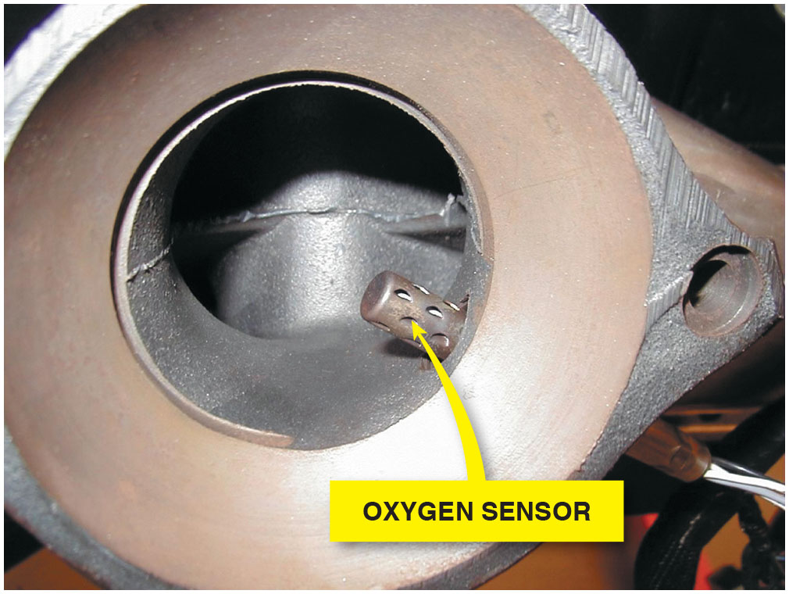
Figure 19.1
Oxygen Sensor
Many oxygen sensors are located in the exhaust manifold near its outlet so that the sensor can detect the air–fuel mixture in the exhaust stream for all cylinders that feed into the manifold.

Slide 8
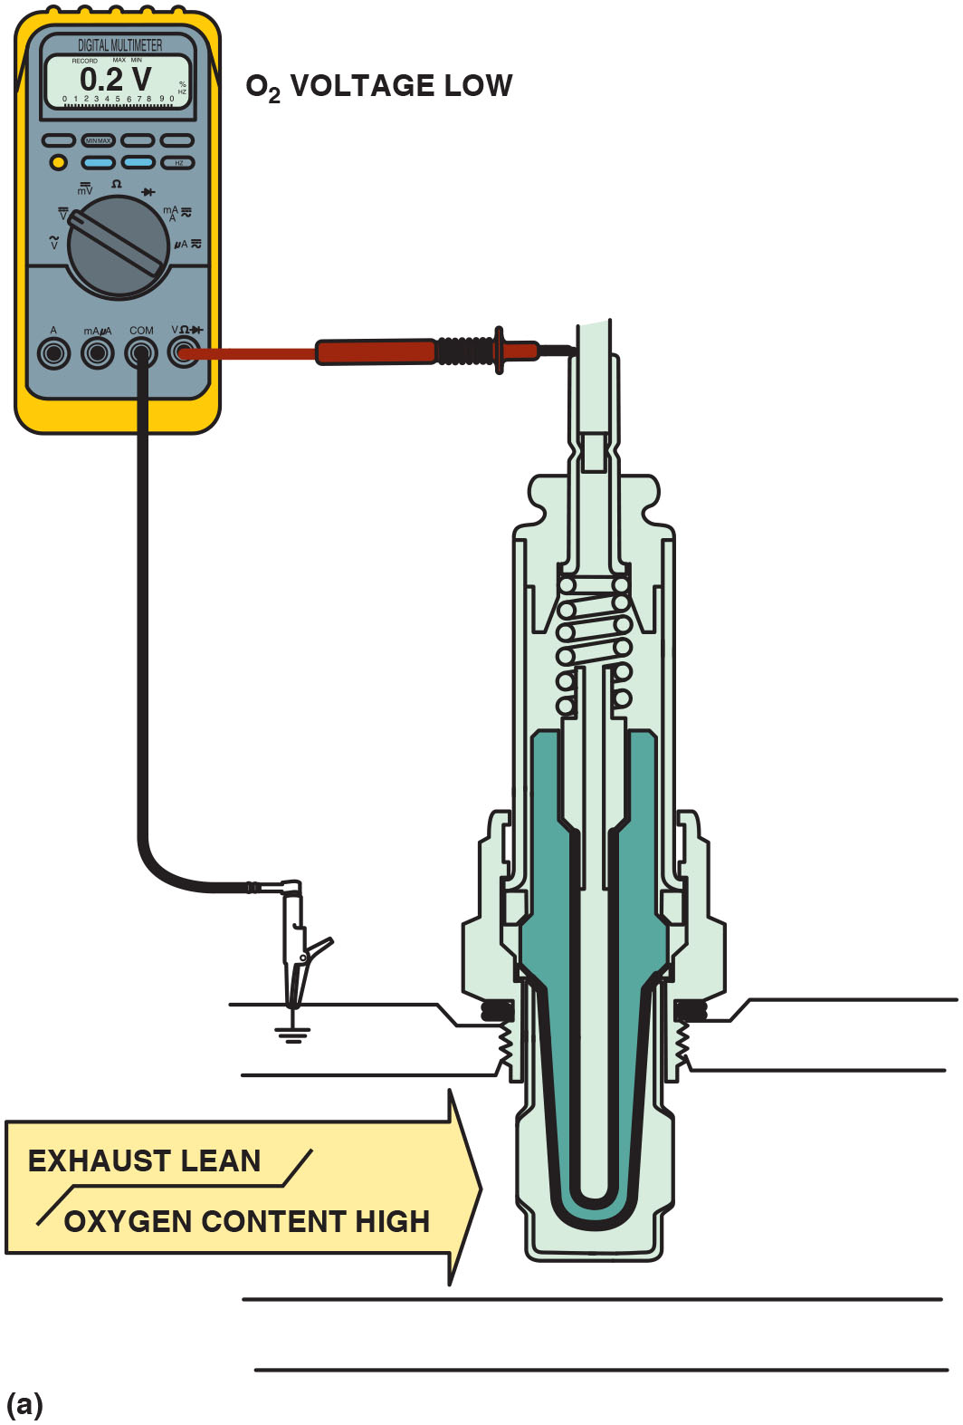
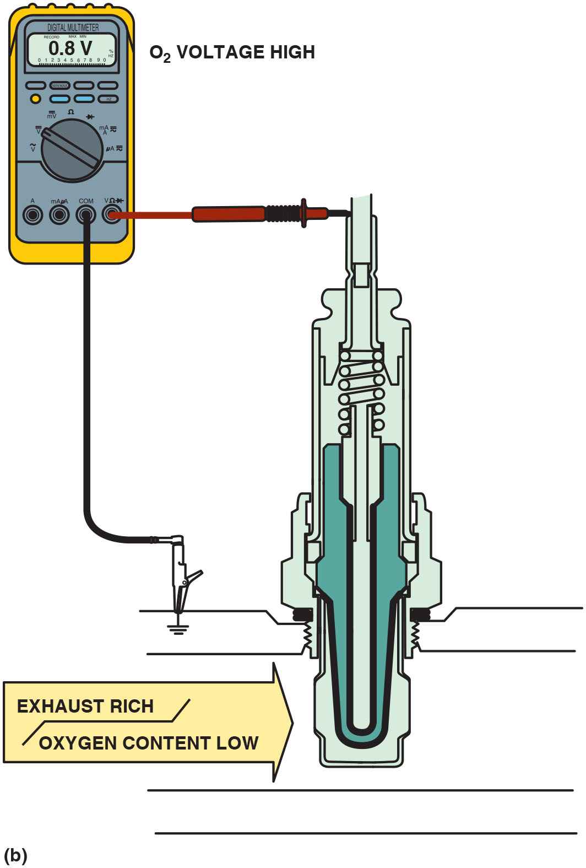
Figure 19.2
Sensor Operation
(a) When the exhaust is lean, the output of a zirconia oxygen sensor is below 450 m V. (b) When the exhaust is rich, the output of a zirconia oxygen sensor is above 450 m V.
Notes:
Long Description 1:
The figure depicts the red test lead attached to the tip of the sensor and the black test lead connected to ground. Exhaust flowing through the sensor is tipped to be lean and with high oxygen content. The O subscript 2 voltage shown on the multi-meter is 0.2 volts.
Long Description 2:
The figure depicts the red test lead attached to the tip of the sensor and the black test lead connected to ground. Exhaust flowing through the sensor is tipped to be rich and with low oxygen content. The O 2 voltage shown on the multimeter is 0.8 volts.

Slide 9
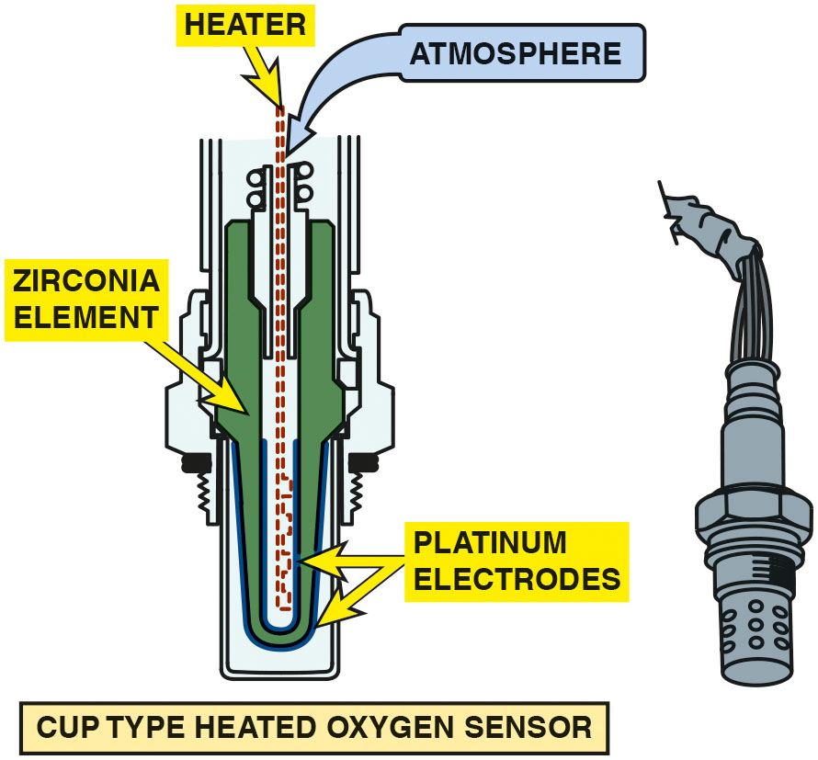
Figure 19.3
Zirconia Element
Most conventional zirconia oxygen sensors and some wide-band oxygen sensors use the cup (finger) type of design.
Notes:
Long Description:
The figure depicts a finger-type design with the sensing element in the shape of a thimble on one end. The housing of the sensor holds a u-shaped Zirconia element covered with porous platinum electrodes. A heater element is inside the thimble-shaped sensing element of the sensor. Atmospheric air enters from the other end of the sensor.

Slide 10
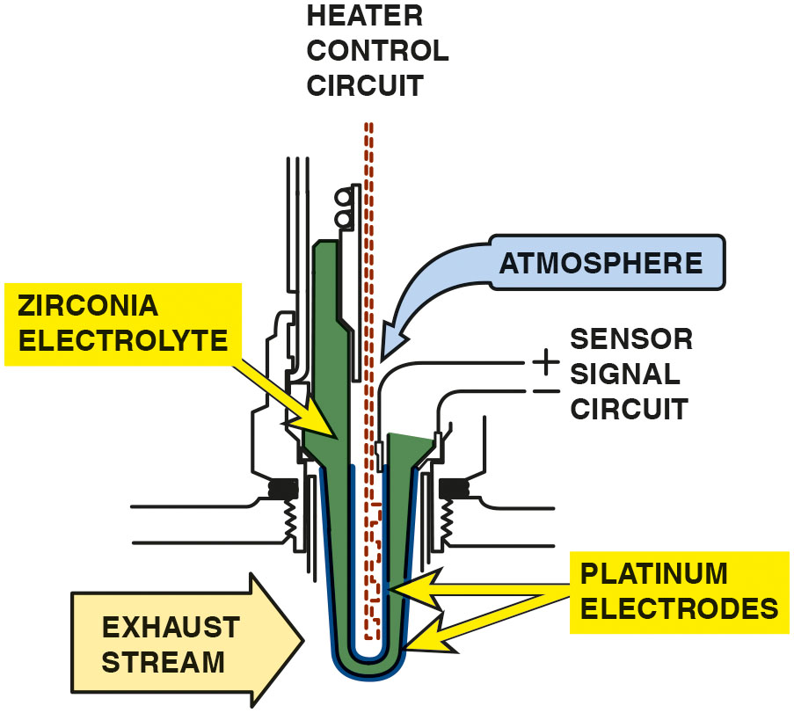
Figure 19.4
Heated
Sensor
A typical heated zirconia oxygen sensor, showing the sensor signal circuit that uses the outer (exhaust) electrode as the negative and the ambient air side electrode as the positive.
Notes:
Long Description:
The figure depicts a finger type design with the sensing element in the shape of a thimble on one end. The thimble end is in contact with exhaust stream. The other end has the atmospheric air entering the sensor. A sensor signal circuitry connected to the sensor uses the exhaust side electrode as the negative and the ambient-air electrode as the positive.

Slide 11
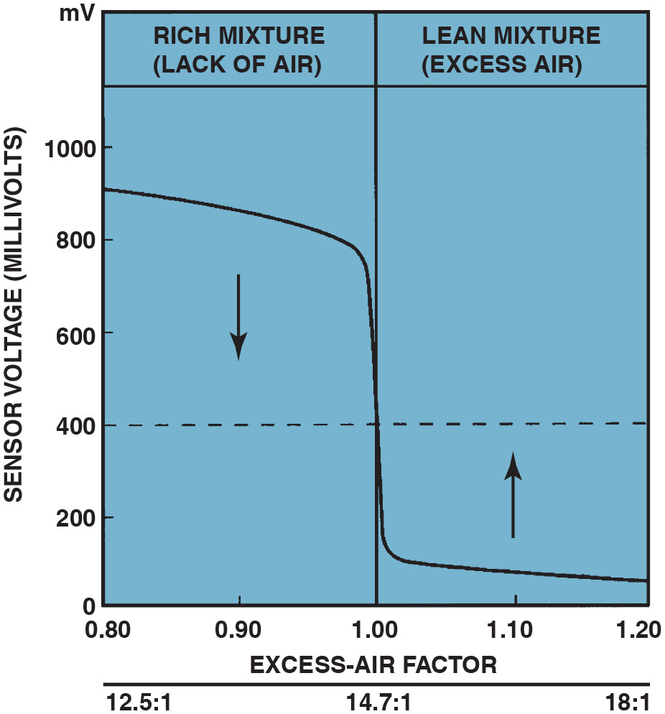
Figure 19.5
Stoichiometric
The oxygen sensor provides a quick response at the stoichiometric air–fuel ratio of
Notes:
Case Study The Chevrolet Pickup Truck Story
The owner of a Chevrolet pickup truck complained that the engine ran terribly. It would hesitate and surge, yet there were no diagnostic trouble codes (D T C s). After hours of troubleshooting, the technician discovered while talking to the owner that the problem started after the transmission had been repaired. However,
the transmission shop said that the problem was an engine problem and not related to the transmission. A thorough visual inspection revealed that the
front and rear oxygen sensor connectors had been switched. The P C M was trying to compensate for an air fuel mixture condition that did not exist. Reversing the O2S connectors restored proper operation of the truck.
Summary:
Complaint—Vehicle owner complained that the pickup truck ran terribly.
Cause—During a previous repair, the upstream and downstream oxygen sensor connectors were reversed.
Correction—The connectors were moved to their correct locations, which restored proper engine operation.
Long Description:
The graph has sensor voltage in millivolts on the vertical axis and the excess air factor on the horizontal axis. The vertical axis has values from 0 millivolts to 1000 millivolts in intervals of 200 millivolts. The horizontal axis has excess-air factor values from 0.80 to 1.20 in intervals of 0.2. The graph is divided into two sections, rich mixture (lack of air) from 0.80 excess-air factor to 1.00 and lean mixture (excess air) from 1.00 excess-air factor to 1.20. An air fuel ratio of 12.5 to 1 is shown at an excess-air factor of 0.80, 14.7 to 1 at 1.00 excess-air factor and 18 to 1 at 1.20 excess-air factor. The graph shows a gradual decrease in a voltage and a sudden drop when the mixture changes and again a gradual decrease.

Slide 12
Question 1
How does an oxygen sensor report the level of oxygen in the exhaust?

Slide 13
Answer 1
When the oxygen level is low, the sensor generates a voltage above 450 m V. When the oxygen level is high, the oxygen sensor generates a voltage below 450 m V.

Slide 14
Titania Oxygen Sensor
Titania (titanium dioxide) oxygen sensor does not produce a voltage, but rather changes resistance due to the presence of oxygen in the exhaust.
As with a zirconia oxygen sensor, the voltage signal is above 450 m V when the exhaust is rich and low (below 450 m V) when the exhaust is lean.

Slide 15
Frequently Asked Question: Where Is H O2S1?
? Frequently Asked Question
Where Is H O2S1? Oxygen sensors are numbered according to their location in the engine. On a V-type engine, heated oxygen sensor number 1 (H O2S1) is located in the exhaust system upstream of the catalytic converter on the side of the engine where cylinder 1 is located. ● See Figure 19.6.

Slide 16
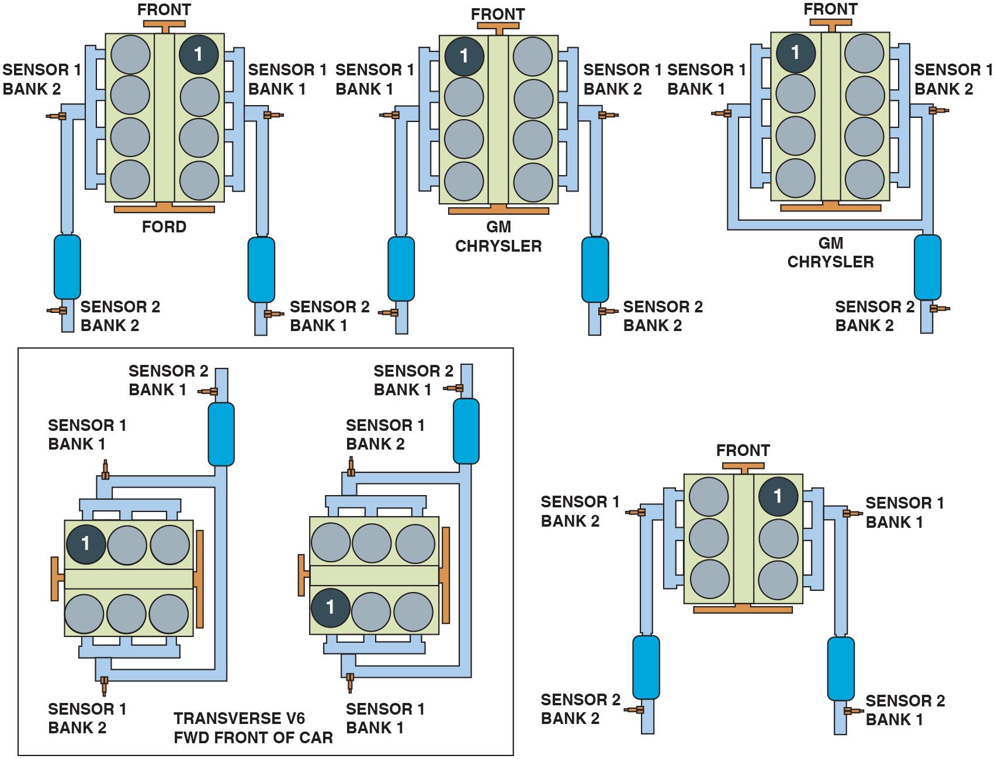
Figure 19.6
Sensor Locations
Number and label designations for oxygen sensors. Bank 1 is the bank where cylinder 1 is located.
Notes:
Long Description:
The figure depicts six engine blocks divided into two halves, each half with equal number of cylinders. From the six engine blocks shown in the figure, three of them have two separate catalytic converters for their exhaust manifolds and the other three of them have a single catalytic converter for their exhaust manifolds. For every engine block, whether it is transverse or F W D, there is a bank of two sensors. Sensor banks located near the half where cylinder 1 is located is labeled as sensor bank 1 for every engine.

Slide 17
P C M Uses of Oxygen Sensor
Fuel Control
The upstream oxygen sensors are among the high-authority sensors used for fuel control while operating in closed loop.
Fuel Trim
The fuel trim numbers are determined from the signals by the oxygen sensor(s).
Fuel trim can be negative (subtracting fuel) or positive (adding fuel).

Slide 18
Oxygen Sensor Diagnosis (1 of 2)
P C M System Tests
The P C M uses the oxygen sensor to test the E G R system, the catalytic converter, and the fuel system.
Visual Inspection
Black sooty deposits usually indicate a rich air–fuel mixture.
White chalky deposits are characteristic of silica contamination.
White sandy or gritty deposits are characteristic of antifreeze (ethylene glycol) contamination.

Slide 19
Oxygen Sensor Diagnosis (2 of 2)
Digital Voltmeter Testing
Oxygen sensor can be checked for proper operation using a digital high-impedance voltmeter.
Min/Max Testing
Digital meter set on D C volts can be used to record the minimum and maximum voltage with the engine running.
Scan Tool Testing
Using a scan tool, observe oxygen sensor voltages.
Scope Testing
Voltage signal of sensor constantly changing.

Slide 20
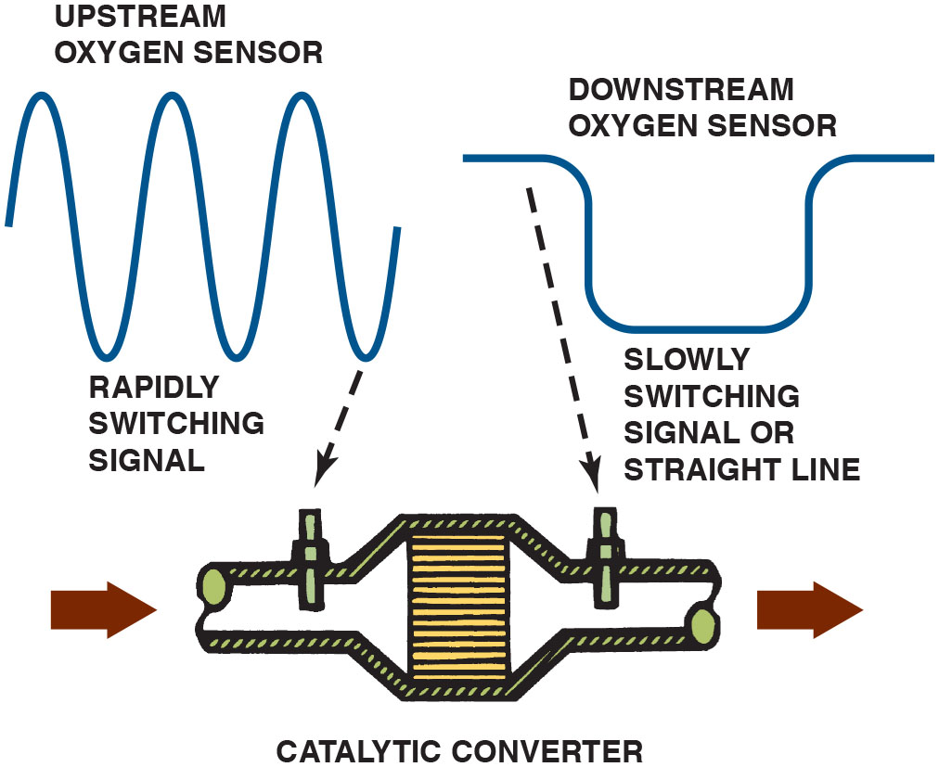
Figure 19.7
Upstream/Downstream
The
catalytic converter monitor compares the
signals of the upstream and downstream oxygen sensor to determine converter efficiency.
Notes:
Long Description:
The figure also depicts signals from the upstream and downstream oxygen sensors as shown on an O B D-2 catalytic converter monitor. The upstream signal shows a rapidly switching signal, with the curve of the signal similar to a sine wave. The downstream signal shows a slowly switching signal or a straight line signal, with the curve of the signal similar to a rectangular pulse with rounded edges.

Slide 21
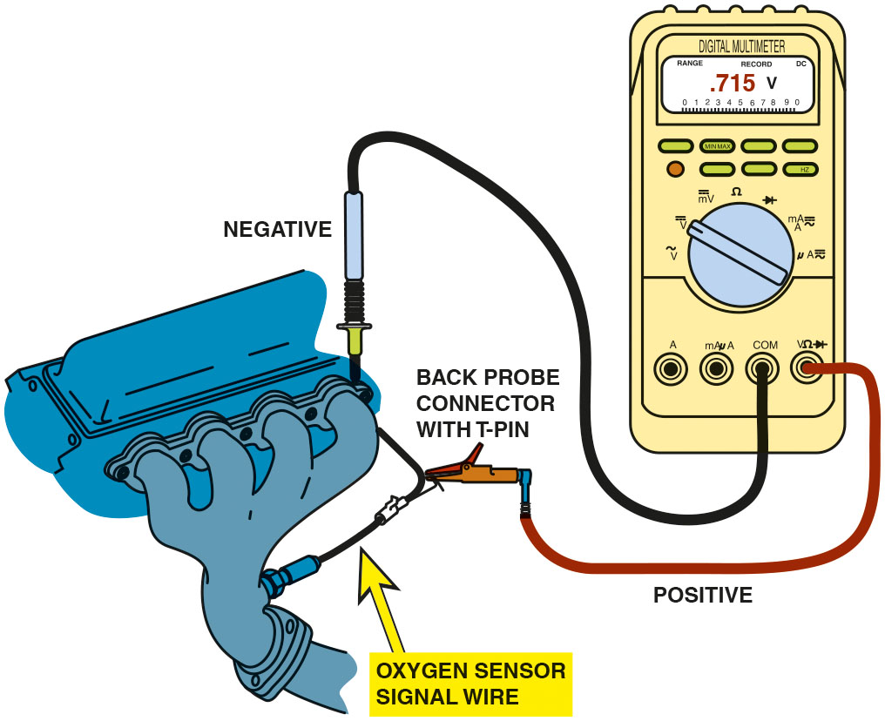
Figure 19.8
D M M Testing
Testing an oxygen sensor using a D M M set on D C volts. With the engine operating in closed loop, the oxygen voltage should read over 800 m V and lower than 200 m V and be constantly fluctuating.
Notes:
Long Description:
The figure depicts the red test lead connected to the oxygen sensor signal wire and the black test lead connected to the engine ground. The display on the multi-meter reads .715 volts.

Slide 22
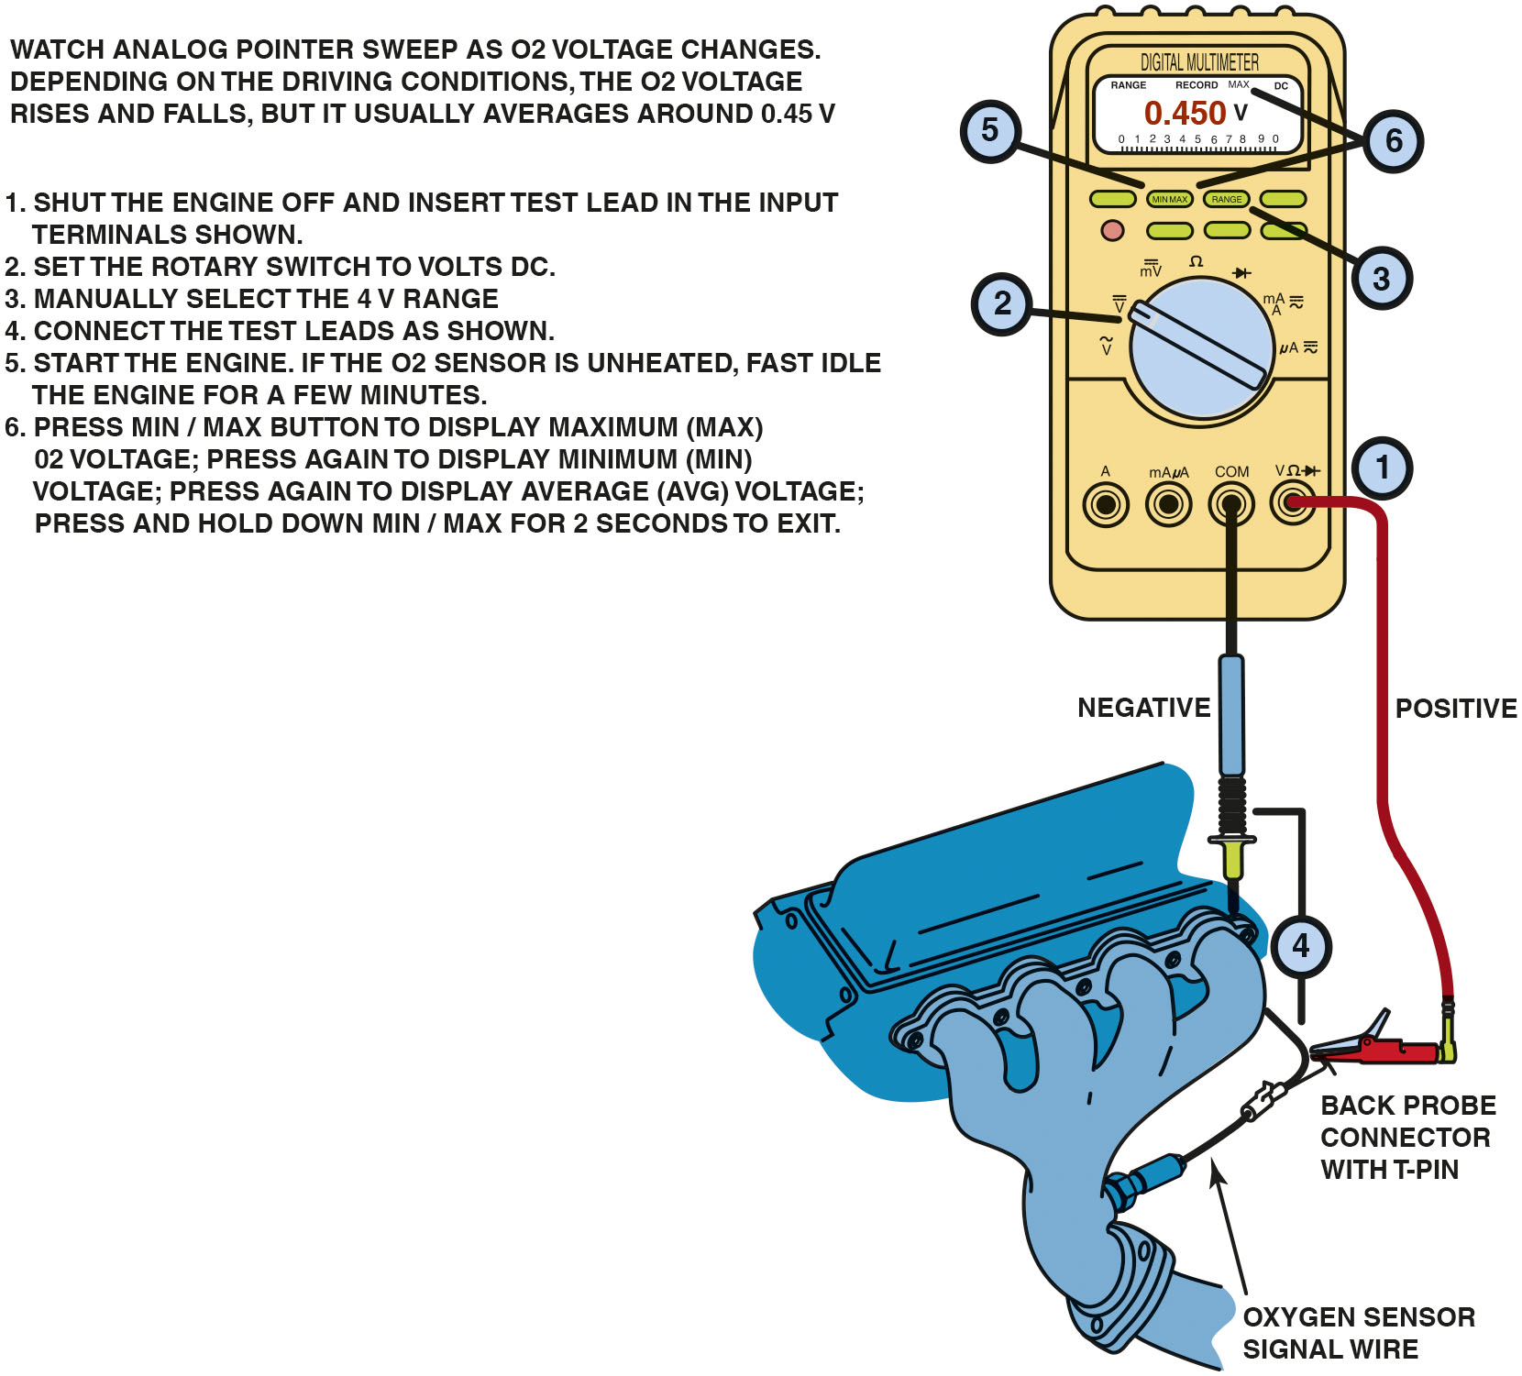
Figure 19.9
D M M M I N/M A X Testing
Using a digital multimeter to test an oxygen sensor using the M I N/M A X record function of the meter.
Notes:
TECH TIP Do Not Solder Oxygen Sensor Wires: Oxygen sensors must have outside oxygen to compare with the oxygen content in the exhaust.
Most oxygen sensors breathe through the signal wire and, if soldered, would block the flow of outside air to the sensor. If a replacement oxygen sensor is used,
always use the factory replacement, using the original connectors or a crimp-and-seal connector that will seal out any moisture and still allow air to flow through the connector.
Long Description:
The figure depicts the red test lead connected to the oxygen sensor signal wire and the black test lead connected to the engine ground. Numbering from 1 to 6 can be seen on the figure. Number 1 is shown near the input terminals of test leads. Number 2 is shown at the rotary switch. Number 3 is shown at the range button on the multi-meter. Number 4 is shown at the test leads connected to engine and the oxygen sensor. Number 5 is shown the minimum and maximum button and number 6 is shown pointing the minimum and maximum button and the display screen of the multi-meter. Instructions for using the multi-meter are shown in the figure and can be read as below. Watch analog pointer sweep as O 2 voltage chances. Depending on the driving conditions, the O 2 voltage rises and falls, but it usually averages around 0.45 volts. 1. Shut the engine off and insert test lead in the input terminals as shown. 2. Set the rotary switch to volts D C. 3. Manually select the 4 volts range. 4. Connect the test leads as shown. 5. Start the engine. If the O 2 sensor is unheated, fast idle the engine for a few minutes. 6. Press minimum and maximum button to display maximum (maximum) O 2 voltage; press again to display minimum (minimum) voltage; press again to display average (average) voltage; press and hold down minimum and maximum for 2 seconds to exit.

Slide 23
Frequently Asked Question: Why Does the Oxygen Sensor Voltage Read 5 Volts on Many Chrysler Vehicles?
? Frequently Asked Question
Why Does the Oxygen Sensor Voltage Read 5 Volts on Many Chrysler Vehicles? Many Chrysler vehicles apply a 5-volt reference to the signal wire of the oxygen sensor. The purpose of this voltage is to allow the P C M to detect if the oxygen sensor signal circuit is open or grounded. If the voltage on the signal wire is 4.5 volts or more, the P C M assumes that the sensor is open. If the voltage on the signal wire is zero, the P C M assumes that the sensor is shorted-to-ground. If either condition exists, the P C M can set a D T C.
Notes:
TECH TIP The Key On, Engine Off Oxygen Sensor Test
This test works on General Motors vehicles and may work on others if the P C M applies a bias voltage to the oxygen sensors. Zirconia oxygen sensors become
more electrically conductive as they get hot. To perform this test, be sure that the vehicle has not run for several hours.
STEP 1 Connect a scan tool and get the display ready to show oxygen sensor data.
STEP 2 Key the engine on without starting the engine. The heater in the oxygen sensor will start heating the sensor.
STEP 3 Observe the voltage of the oxygen sensor. The applied bias voltage of 450 m V should slowly decrease for all oxygen sensors as they become more electrically conductive as the bias voltage is flowing to ground.
STEP 4 A good oxygen sensor should indicate a voltage of less than 100 m V after three minutes. Any sensor that displays a higher than usual voltage.
or seems to stay higher longer than the others could be defective or skewed high.

Slide 24
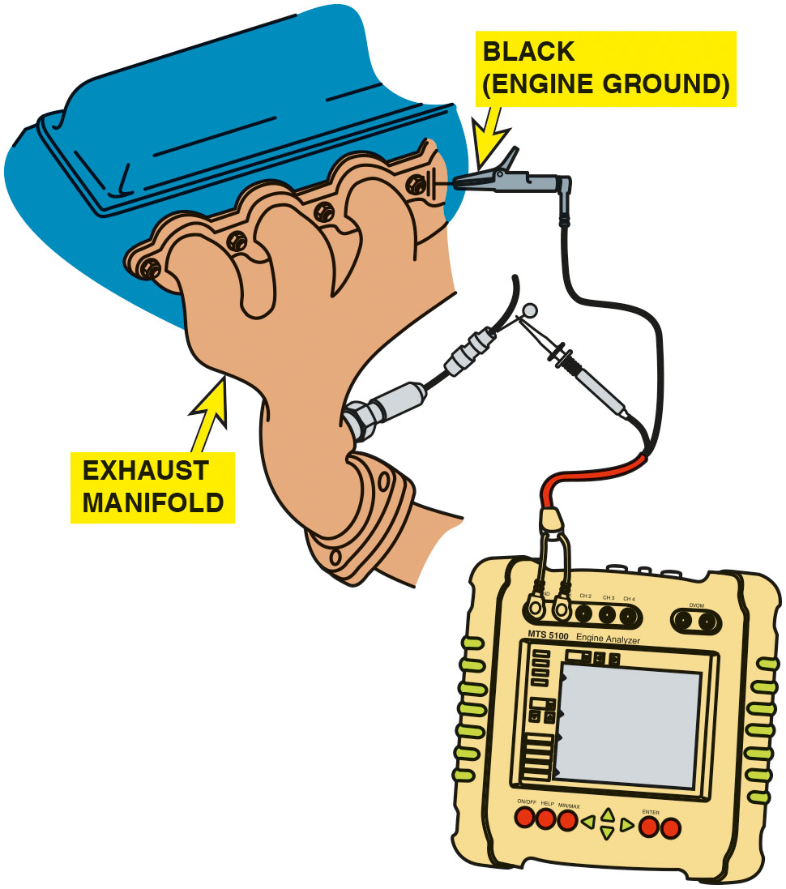
Figure 19.10
D S O
Testing
Connecting a handheld digital storage oscilloscope to an oxygen sensor signal wire. Check the instructions for the scope as some require the use of a filter to be installed in the test lead to reduce electromagnetic interference that can affect the oxygen sensor waveform.
Notes:
CASE STUDY The Oxygen Sensor Is Lying to You
A technician was trying to solve a driveability problem with an older V-6 passenger car. The car idled roughly, hesitated, and accelerated poorly. A thorough visual inspection did not indicate problems and there were no diagnostic trouble codes stored. The technician checked the oxygen sensor activity
using a D M M. The voltage stayed above 600 m V most of the time. If the technician removed a large vacuum hose, the oxygen sensor voltage would temporarily
drop to below 450 m V and then return to a reading of over 600 m V. Remember:
• High O2S readings=rich exhaust (low O₂ content in the exhaust)
• Low O2S readings=lean exhaust (high O₂ content in the exhaust)
As part of a thorough visual inspection, the technician removed and inspected the spark plugs. All the spark plugs were white, indicating a lean mixture, not the rich mixture that the oxygen sensor was indicating. The high O₂S reading signaled the P C M to reduce the amount of fuel, resulting in an excessively
lean operation.
After replacing the oxygen sensor, the engine ran great. But what killed the oxygen sensor? The technician finally learned from the owner that the head gasket had been replaced over a year ago. The silicate and phosphate additives in the antifreeze coolant had coated the oxygen sensor. Because the oxygen sensor was coated, the oxygen content of the exhaust could not be detected, resulting in a false rich signal from the oxygen sensor.
Summary:
Complaint—Vehicle owner complained that the car equipped with a V-6 engine ran terribly.
Cause—The oxygen sensor was contaminated by the additives in the coolant caused by a previously repaired head gasket failure.
Correction—Replacing the oxygen sensors restored proper engine operation.

Slide 25
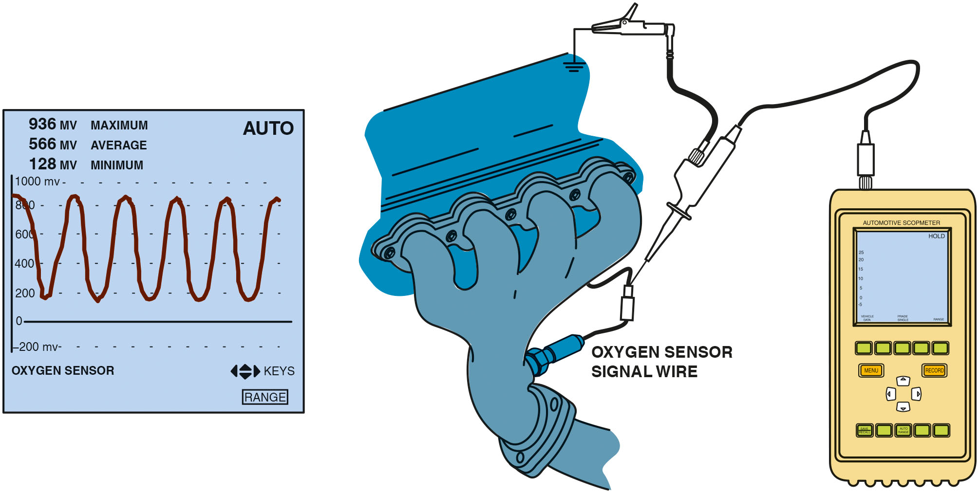
Figure 19.11
Waveform
The waveform of a good oxygen sensor as displayed on a digital storage oscilloscope (D S O). Note that the maximum reading is above 800 m V and the minimum reading is less than 200 m V.
Notes:
Long Description:
The D S O screen shows a waveform similar to a sine wave. The waveform is measured for voltages and it is seen on a graph with voltage on the vertical axis. The waveform oscillates between a maximum value of 936 millivolts and a minimum voltage of 128 millivolts.

Slide 26
Animation: Wide Band Oxygen Sensor Test

Slide 27
Question 2
What are the three ways to test an oxygen sensor?

Slide 28
Answer 2
With a multimeter, a scan tool, or an oscilloscope.

Slide 29
Post-Catalytic Converter Oxygen Sensor Testing
Oxygen sensor located behind the catalytic converter is
used on
vehicles to monitor converter efficiency.
If converter is working correctly, the oxygen content after the converter should be fairly constant.
Post catalytic converter oxygen sensor also is used to modify the amount of fuel delivered to the engine to allow the converter to work efficiently.

Slide 30
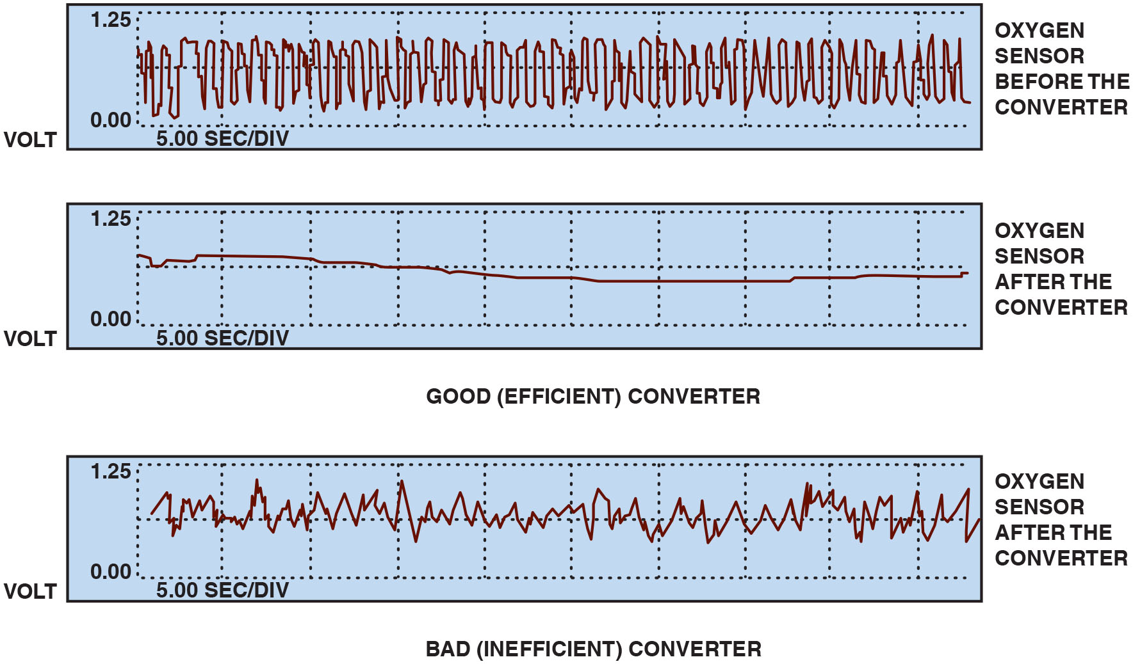
Figure 19.12
Sensor Waveforms
The post-catalytic converter oxygen sensor should display very little activity if the catalytic converter is efficient.
Notes:
TECH TIP The Propane Oxygen Sensor Test
Adding propane to the air inlet of a running engine is an excellent way to check if the oxygen sensor is able to react to changes in air–fuel mixture. Follow these
steps in performing the propane trick:
1. Connect a digital storage oscilloscope to the oxygen sensor signal wire.
2. Start and operate the engine until it reaches operating temperature and is in closed-loop fuel control.
3. While watching the scope display, add some propane to the air inlet. The scope display should read full rich (over 800 m V).
4. Shut off the propane. The waveform should drop to less than 200 m V (0.2 V).
5. Quickly add some propane while the oxygen sensor is reading low and watch for a rapid transition to rich. The transition should occur in <100 milliseconds (m s).
Long Description:
For all the three graphs, The X-axis is labeled 5.00 sec per div but without values. The Y-axis labeled volt shows values 0.00 and 1.25. The first graph labeled oxygen sensor voltage before the converter shows a distorted high-frequency square pulse wave. The second graph labeled oxygen sensor after the converter: good (efficient) converter shows a steady line starting from above the midline between 0.00 and 1.25 and ends below the midline. The third graph labeled oxygen sensor after the converter: bad (inefficient) converter shows a highly oscillating irregular triangular wave that remains constant along the midline.

Slide 31
Frequently Asked Question: How Could Using Silicone Sealer on a Valve Cover Gasket Affect the Oxygen Sensor?
? Frequently Asked Question
How Could Using Silicone Sealer on a Valve Cover Gasket Affect the Oxygen Sensor? The wrong type of silicone R T V on a valve cover gasket gives off harmful silica fumes during curing process. These fumes enter the crankcase area by way of the oil drain back holes in the cylinder head, as well as through pushrod openings and other passages in the engine. During engine operation, these fumes are drawn into the intake manifold through the P C V system and are burned in the engine. The harmful silica then exits through the exhaust system, where the contamination affects the oxygen sensor.

Slide 32
Wide-Band Oxygen Sensors (1 of 2)
Terminology
Wide-band oxygen sensors have various names, depending on the vehicle and/or oxygen sensor manufacturer, including: broadband, wide-band, air–fuel sensor, lean air–fuel sensor.
Introduction
The need for more stringent exhaust emission standards require more accurate fuel control than can be provided by a traditional oxygen sensor.

Slide 33
Wide-Band Oxygen Sensors (2 of 2)
Purpose and Function
A wide-band oxygen sensor is capable of supplying air–fuel ratio information to the P C M over a much broader range.
Planar Design
A wide-band oxygen sensor that is flat and thin (1.5
mm or
The thin design makes it easier to heat and allows closed-loop operation in less than 10 seconds.

Slide 34
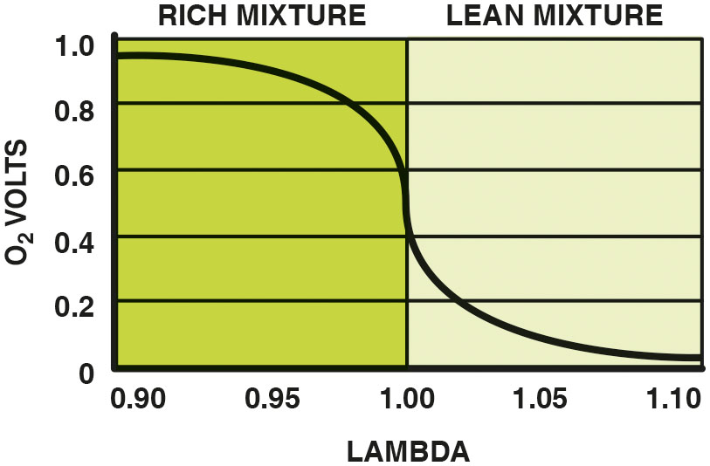
Figure 19.13
Zirconia Sensor
A conventional zirconia oxygen sensor can only reset to
exhaust mixtures that are richer or leaner than
(lambda
Notes:
Long Description:
The graph depicts voltage on the vertical axis and lambda values on the horizontal axis. Lambda 1.00 is equal to an air-fuel ratio of 14.7 to 1. Values of rich mixture extend from .90 lambda to 1 on the horizontal axis and values of lean mixture extend from 1 to 1.10 on the same axis. The graph decreases gradually from 1 volt to 0.6 when the mixture is rich, drops steeply from 0.6 to 0.4 volts at air-fuel ratio of 14.7 to 1 and again decreases gradually from 0.4 to 0 volts when the mixture is lean.

Slide 35
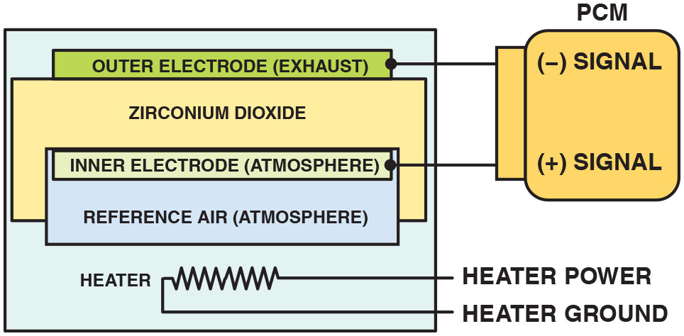
Figure 19.14
Wide-Band Sensor
A planar design zirconia oxygen sensor places all of the elements together, which allows the sensor to reach operating temperature quickly.
Notes:
Long Description:
The figure depicts a planar stack with a heater at the bottom. The heater is connected to power and ground terminals. Above the heater, a zirconium dioxide electrolyte is placed. The inner electrode and the reference air are sandwiched into the zirconia electrolyte. At the top of the zirconia electrolyte, an outer exhaust electrode is stacked. The outer electrode is connected to the negative P C M signal and the inner electrode is connected to the positive P C M signal.

Slide 36
Frequently Asked Question: How Quickly Can Wide-Band Oxygen Sensor Achieve Closed Loop?
? Frequently Asked Question
How Quickly Can a Wide-Band Oxygen Sensor Achieve Closed Loop? In a Toyota Highlander hybrid electric vehicle, operation of the gasoline engine is delayed for a short time when the vehicle is first driven. During this time of electric operation, the oxygen sensor heaters are turned on in readiness for the gasoline engine starting. The gasoline engine often achieves closed-loop operation during cranking because the oxygen sensors are fully warm and ready to go at the same time the engine is started. Having the gasoline engine achieve closed loop quickly, allows it to meet the stringent S U L E V standards.

Slide 37
Dual-Cell Planar Wide-Band Sensor Operation (1 of 2)
Construction
A dual-cell, planar-type, wide-band oxygen sensor is made like a conventional planar O2S, or Nernst cell. Above the Nernst cell is another zirconia layer with two electrodes, called the pump cell.
Operation
Oxygen sensors do not measure the quantity of free oxygen in the exhaust. Instead, oxygen sensors produce a voltage that is based on the ion flow between the platinum electrodes of the sensor to maintain a stoichiometric balance.

Slide 38
Dual-Cell Planar Wide-Band Sensor Operation (2 of 2)
Stoichiometric
When the exhaust is at stoichiometric
air–fuel
ratio), the voltage of the Nernst cell is 450 m V (0.45 V).
The voltage between the diffusion chamber and the air reference chamber changes from 0.45 V. This voltage is:
Higher if the exhaust is rich
Lower if the exhaust is lean
The reference voltage remains constant, but varies by vehicle.

Slide 39
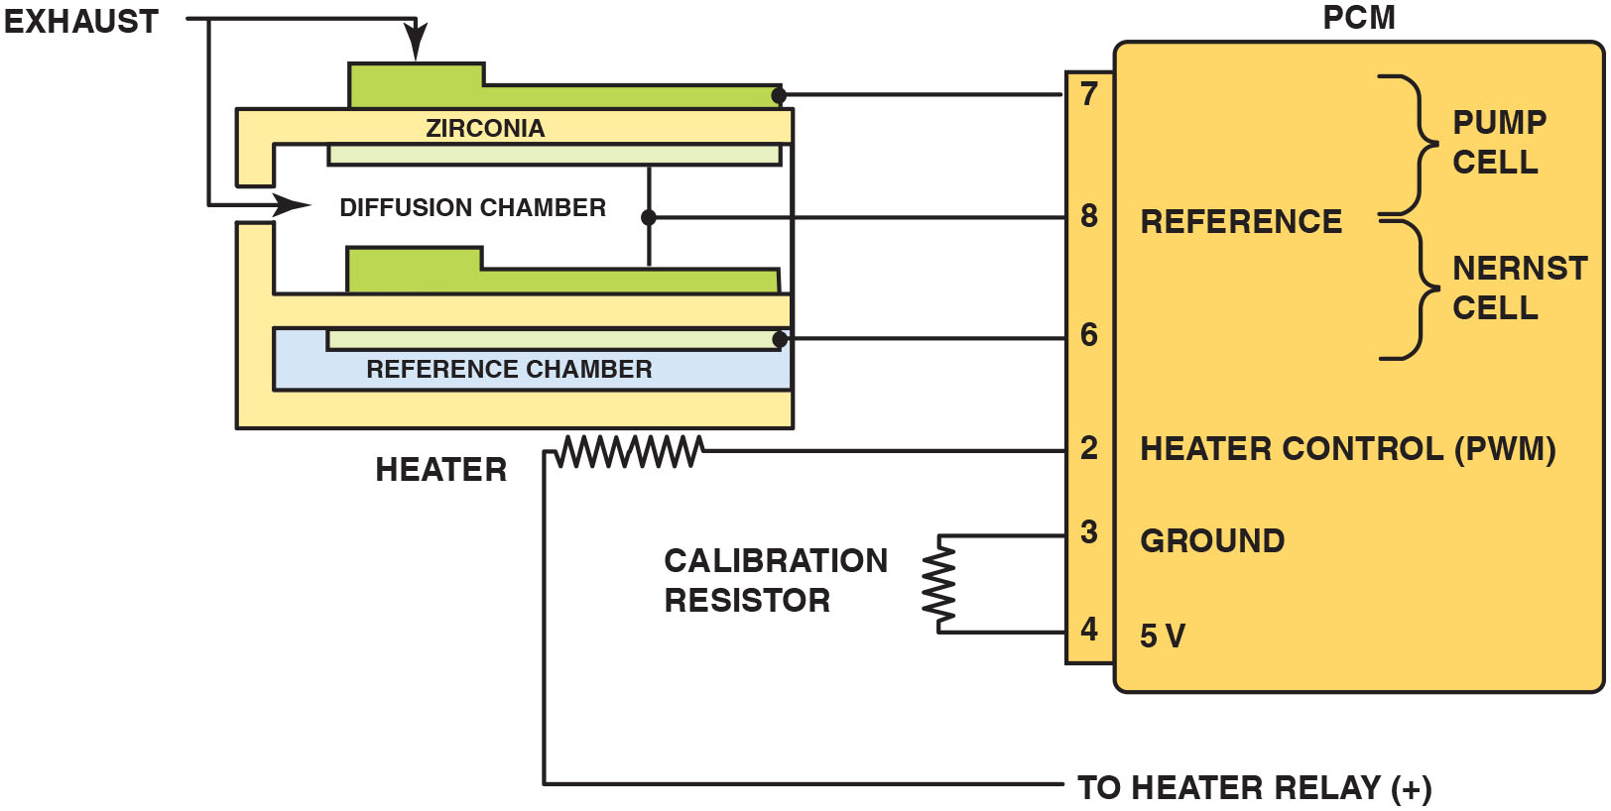
Figure 19.15
Wide-Band Nernst Cell
The reference electrodes are shared by the Nernst cell and the pump cell.
Notes:
Long Description:
The figure depicts a dual-cell planar design made of two cells, a conventional planar O 2 S or the Nernst cell and another layer of zirconia layer with two electrodes, called the pump cell. The conventional cell is on the bottom and a second layer of zirconia of the pump cell is at the top. There’s a diffusion chamber between the two cells and the cells share a common ground, called the reference. The diffusion chamber is exposed to exhaust gases. P C M terminals 3 and 4, ground and 5 volts are connected to a calibration resistor. A heater coil placed below the Nernst cell has one terminal connected to P C M terminal 2 and other terminal is connected to the positive terminal of heater relay. The P C M terminal 2 has a P W M heater control. P C M terminal 6 is connected to the inner electrode of Nernst cell. The reference is connected to the common reference for pump cell and Nernst cell at P C M terminal 8. Exhaust electrode of pump cell is connected to P C M terminal 7.

Slide 40
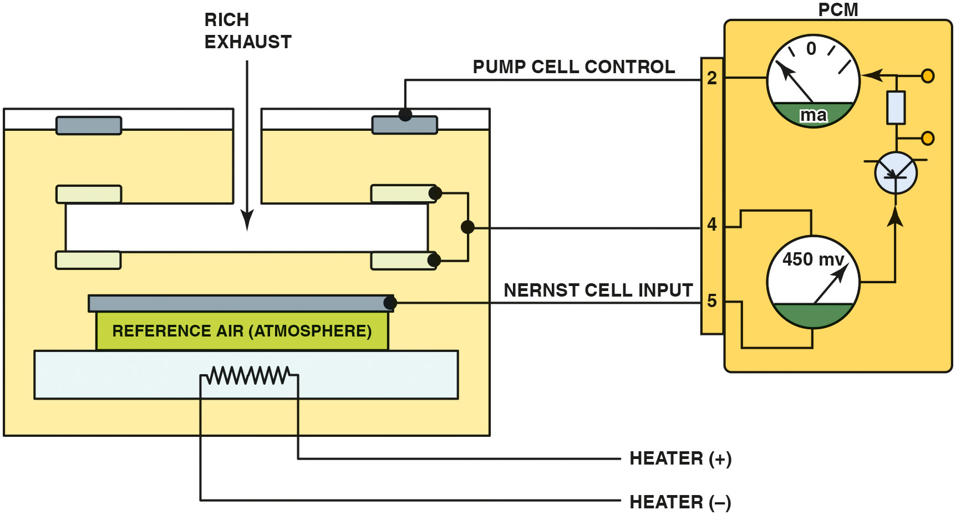
Figure 19.16
Exhaust Rich
When the exhaust is rich, the P C M applies a negative current into the pump cell.
Notes:
Long Description:
The figure depicts a dual cell sensor with a P C M connected to it. A heater coil connected to heater positive and negative terminals is stacked at the bottom of the cell. A Nernst cell is connected to a voltmeter in a P C M. The Nernst cell electrode is connected to input terminal 5 of P C M and the common reference electrode is connected to the terminal 4 of P C M. The voltmeter is connected to an ammeter in the P C M through a circuitry made of electrical components. The ammeter connects to the pump cell electrode through terminal 2 of P C M.

Slide 41
Figure 19.17
Exhaust Lean
When the exhaust is lean, the P C M applies a positive current into the pump cell.
Notes:
Long Description:
The figure depicts a dual cell sensor with a P C M connected to it. A heater coil connected to heater positive and negative terminals is stacked at the bottom of the cell. A Nernst cell is connected to a voltmeter in a P C M. The Nernst cell electrode is connected to input terminal 5 of P C M and the common reference electrode is connected to the terminal 4 of P C M. The voltmeter is connected to an ammeter in the P C M through a circuitry made of electrical components. The ammeter connects to the pump cell electrode through terminal 2 of P C M.

Slide 42
Dual-Cell Diagnosis
Scan Tool Diagnosis
Most service information specifies that a scan tool be used to check the wide-band oxygen sensor, because the P C M performs tests of the unit and can identify faults.
Digital Meter Testing
Check service information and determine the circuit and connector terminal identification.
Measure the calibration resistor for opens and shorts.

Slide 43
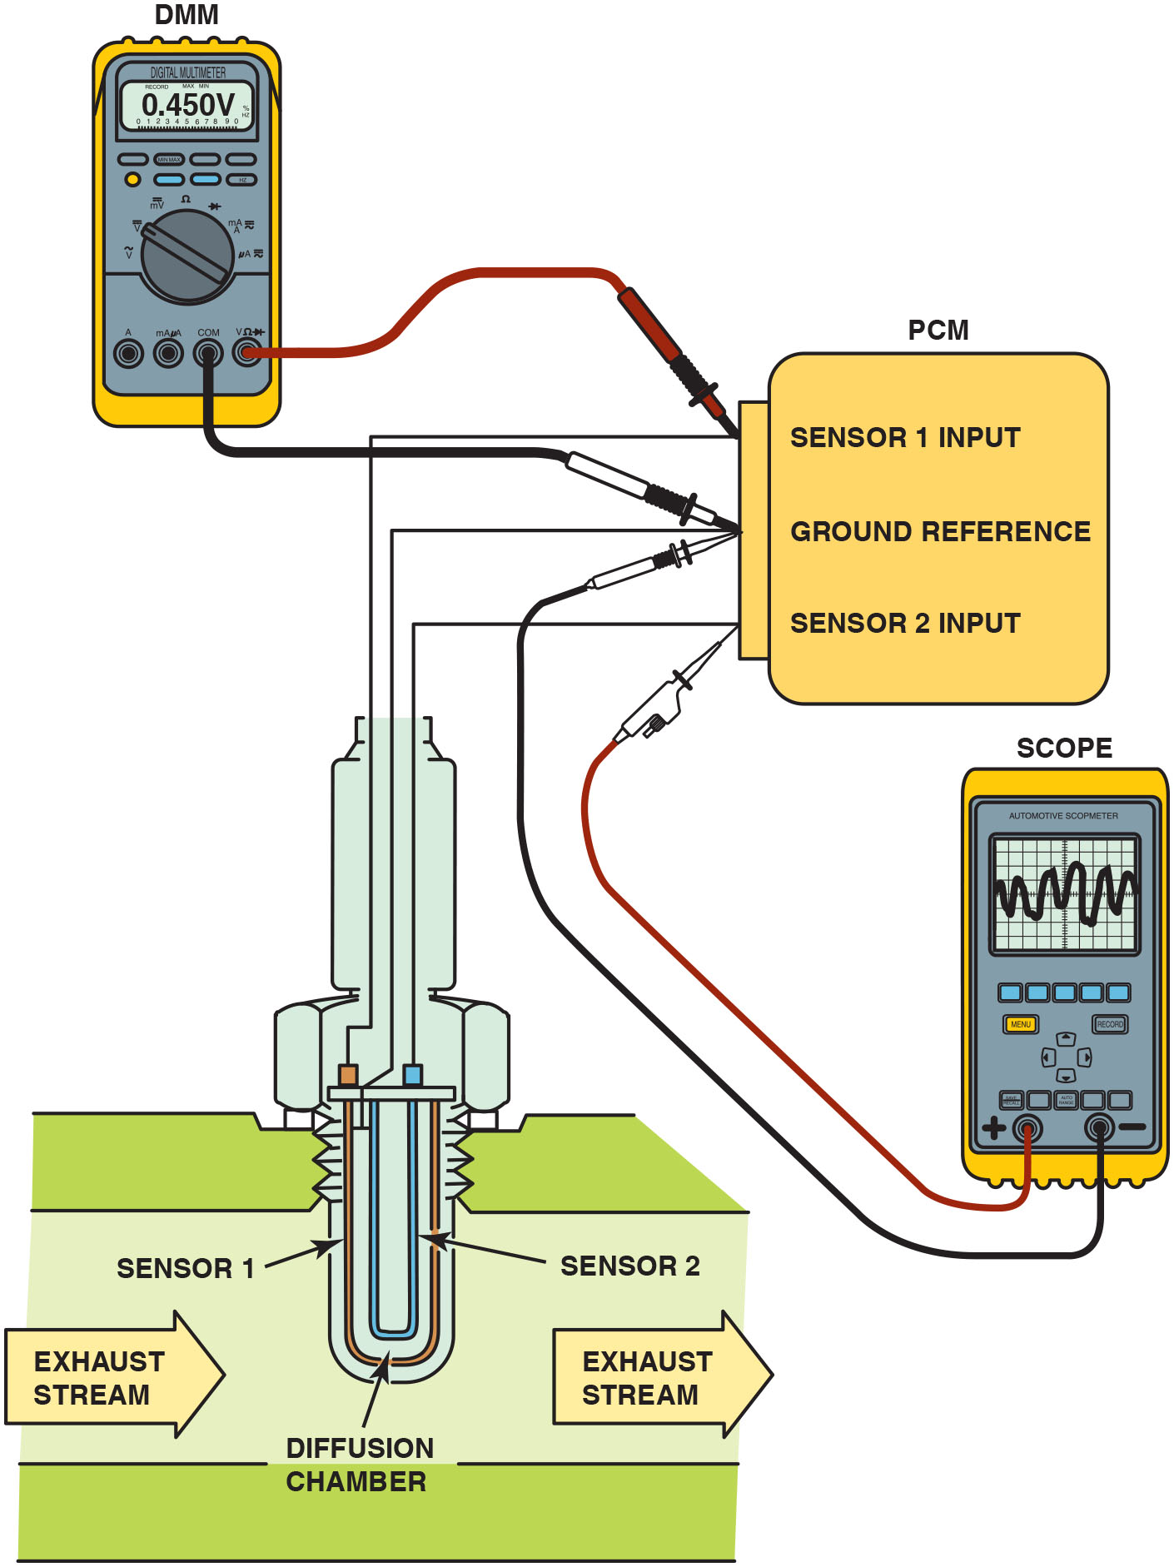
Figure 19.18
Testing Wide Band
Testing a dual cell wide-band oxygen sensor can be done using a voltmeter or a scope. The meter reading is attached to the Nernst cell and should read stoichiometric (450 m V) at all times. The scope is showing activity to the pump cell with commands from the P C M to keep the Nernst cell at
air–fuel ratio.
Notes:
Long Description:
The figure shows the sensors connected to the P C M. The Nernst cell is connected to the sensor 1 input and the ground reference of the P C M. To the same P C M terminals, a voltmeter is also connected. The pump cell is connected to the sensor 2 input and the ground reference. To the same terminals, a scope is also connected. The voltmeter display reads 0.450 volts and the scope display shows a waveform.

Slide 44
Single-Cell Wide-Band Oxygen Sensors
Construction
A typical single-cell wide-band oxygen sensor looks similar to a conventional four-wire zirconia oxygen sensor and is referred to as an air–fuel sensor.
Milliammeter Testing
Zero (0 m A) represents lambda or stoichiometric air–
fuel ratio of
+10 m A indicates a lean condition
− 10 m A indicates a rich condition
Scan Tool Testing
Scan tool displays voltage, but varies by vehicle.

Slide 45
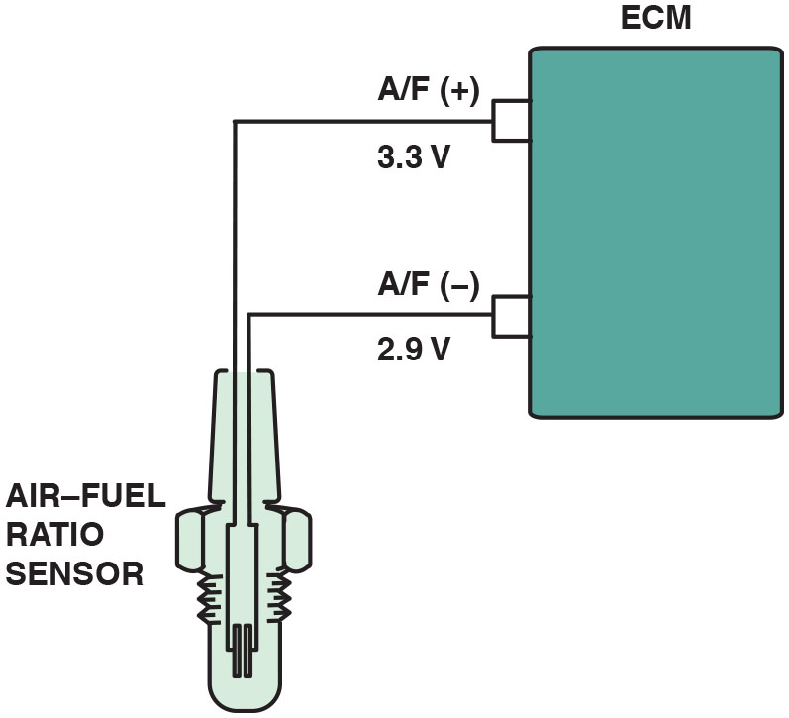
Figure 19.19
Single Cell
A single cell wide-band oxygen sensor has four wires with two for the heater and two for the sensor itself. The voltage applied to the sensor is 0.4 volts (3.3 − 2.9 = 0.4) across the two leads of the sensor.

Slide 46
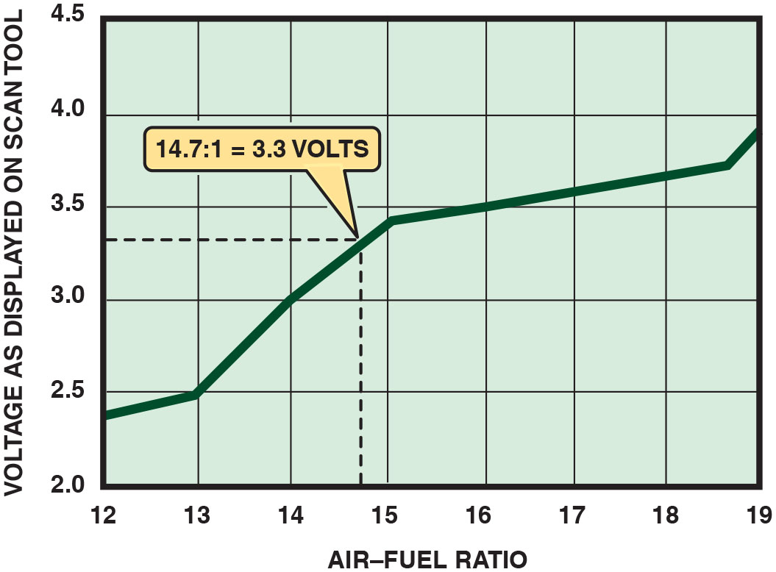
Figure 19.20
Scan Tool Testing
A scan tool can display various voltages but will often show 3.3 V because the P C M is controlling the sensor through applying a low current to the sensor to achieve balance.

Slide 47
Wide-Band Oxygen Sensor Pattern Failures
Most of the failures cause a D T C to set, usually causing the malfunction indicator (check engine) lamp to light.
However, one type of failure may not set a D T C, such as when the following occur.
Voltage from the heater circuit bleeds into the Nernst cell.
This voltage causes the engine to operate extremely lean and may or may not set a D T C.

Slide 48
Oxygen Sensor–Related Diagnostic Trouble Codes
P0131 Upstream H O2S grounded
Exhaust leak upstream of H O2S (bank 1)
Extremely lean air–fuel mixture
H O2S defective or contaminated
H O2S signal wire shorted-to-ground
P0132 Upstream H O2S shorted Upstream H O2S (bank 1) shorted
Defective H O2S
Fuel-contaminated H O2S
P0133 Upstream H O2S slow response
Open or short in heater circuit
Defective or fuel-contaminated H O2S
E G R or fuel system fault
Notes:
Oxygen Sensor–Related Diagnostic Trouble Codes
Learning Objective: Interpret oxygen sensor-related diagnostic trouble codes.
Diagnostic trouble codes (D T C s) associated with the oxygen sensor include the following:
P0131 Upstream H O2S grounded
Exhaust leak upstream of H O2S (bank 1)
Extremely lean air–fuel mixture
H O2S defective or contaminated
H O2S signal wire shorted-to-ground
P0132 Upstream H O2S shorted Upstream H O2S (bank 1) shorted
Defective H O2S
Fuel-contaminated H O2S
1054 AUTOMOTIVE ELECTRICAL AND ENGINE PERFORMANCE
P0133 Upstream H O2S slow response
Open or short in heater circuit
Defective or fuel-contaminated H O2S
E G R or fuel system fault

Slide 49
Question 3
How are diagnostics performed on a wide-band dual-cell oxygen sensor?

Slide 50
Answer 3
Diagnostics are performed with a scan tool or a multimeter.

Slide 51
Summary
The E C T sensor is a high-authority sensor at engine startup and is used for closed-loop control, as well as idle speed.
All temperature sensors decrease in resistance as the temperature increases. This is called negative temperature coefficient (N T C).
The E C T and I A T sensors can be tested visually, as well as by using a digital multimeter or a scan tool.
Some vehicle manufacturers use a stepped E C T circuit inside the P C M to broaden the accuracy of the sensor.
Other temperature sensors include transmission fluid temperature (T F T), engine fuel temperature (E F T), exhaust gas recirculation (E G R) temperature, and engine oil temperature.

Slide 52
Animation and Video Library Links (Must have an internet connection and active Haldeman subscription)
Animation Library: (A8) Engine Performance Animations
Animation Library: (A6) Electrical/Electronic Systems Animations
Video Library: (A8) Engine Performance Videos
Video Library: (A6) Electrical/Electronic Systems Videos

Slide 53
Copyright
This work is protected by United States copyright laws and is provided solely for the use of instructors in teaching their courses and assessing student learning. Dissemination or sale of any part of this work (including on the World Wide Web) will destroy the integrity of the work and is not permitted. The work and materials from it should never be made available to students except by instructors using the accompanying text in their classes. All recipients of this work are expected to abide by these restrictions and to honor the intended pedagogical purposes and the needs of other instructors who rely on these materials.

