Slide 1
Advanced Engine Performance Diagnosis
Eighth Edition
Chapter 17
M A P and M A F Sensors
Copyright © 2025 Pearson Education, Inc. All Rights Reserved
Notes:
If this PowerPoint presentation contains mathematical equations, you may need to check that your computer has the following installed:
1) Math Type Plugin
2) Math Player (free versions available)
3) NVDA Reader (free versions available)
INSTRUCTOR NOTE: This presentation includes text explanation notes, you can use to teach the course. When in SLIDE SHOW mode, you RIGHT CLICK and select SHOW PRESENTER VIEW, to use the notes.

Slide 2
Learning Objectives (1 of 2)
17.1 Discuss the variations in pressure that can occur within an engine.
17.2 Describe principles of pressure sensors.
17.3 Discuss how M A P sensors work.
17.4 Discuss the P C M uses of the M A P sensor.
17.5 Describe how the B A R O sensor is used to test altitude.
17.6 List the methods that can be used to test M A P sensors.
17.7 Discuss M A F sensor types.

Slide 3
Learning Objectives (2 of 2)
17.8 Discuss the P C M uses for the M A F sensor.
17.9 List the methods that can be used to test M A F sensors.
17.10 List the methods that can be used to test M A F sensor contamination.

Slide 4
Air Pressure—High and Low
Think of an internal combustion engine as a big air pump.
As a piston moves down on an intake stroke, it lowers the air pressure within the engine.
The low pressure within the engine is called vacuum.
The difference in pressure between the two areas is called a pressure differential.

Slide 5
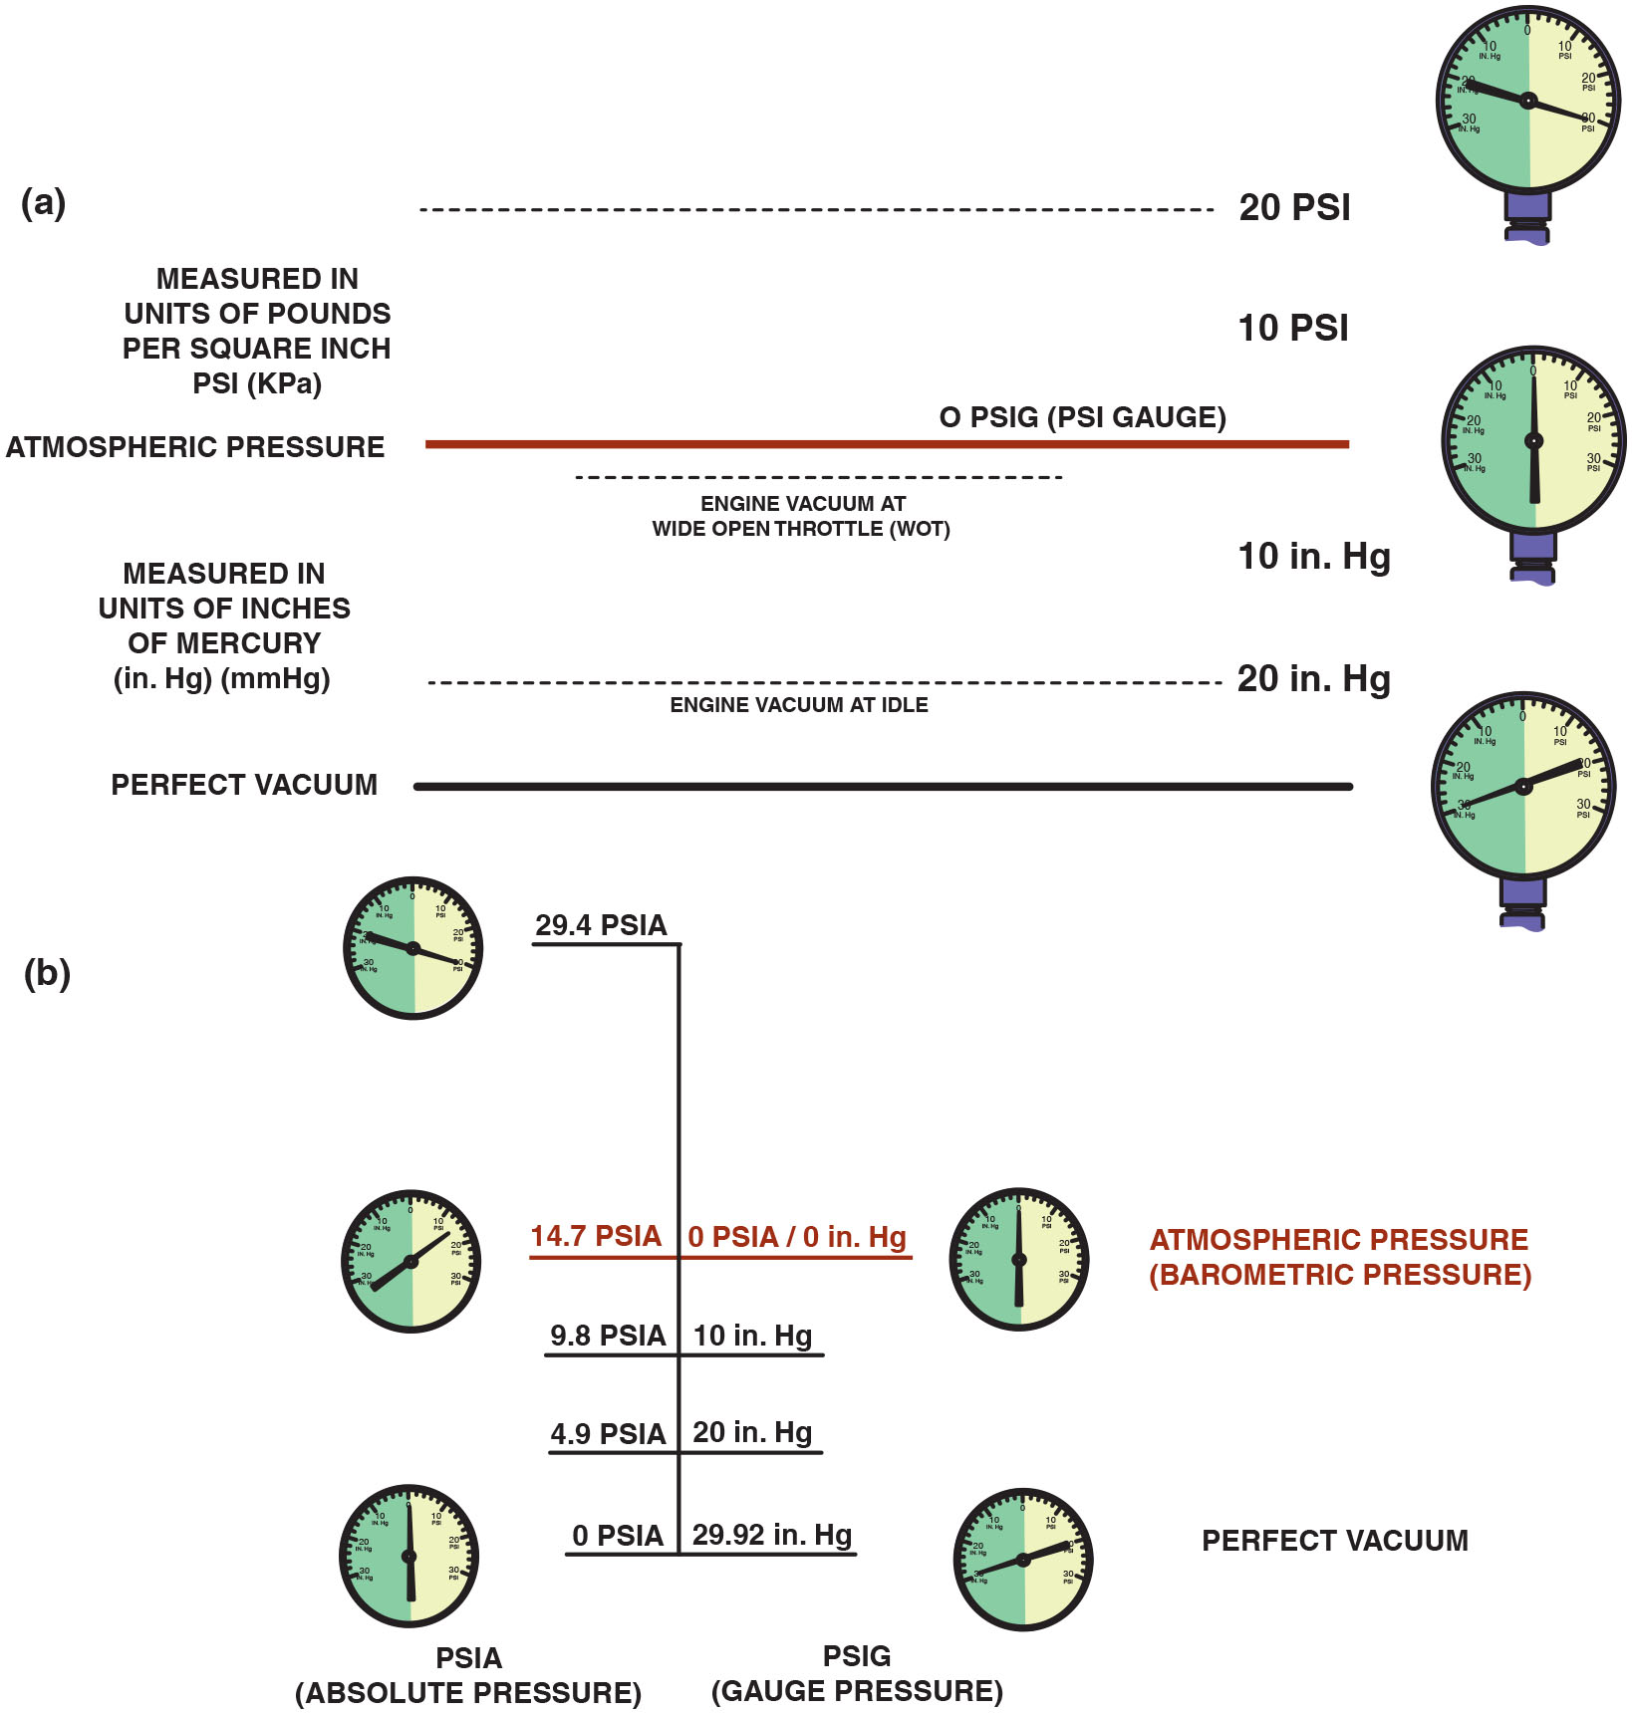
Figure 17.1
M A P Sensor
(a) As an engine is accelerated under a load, the engine vacuum drops. This drop in vacuum is actually an increase in absolute pressure in the intake manifold. A M A P sensor senses all pressures greater than that of a perfect vacuum. (b) The relationship between absolute pressure, vacuum, and gauge pressure.
Notes:
Long Description:
The figure depicts the following information in two sections: Section a: Shows a dial indicator calibrated from 30-inch H g to 0 on the left side of the dial and 0 to 30 P S I on the right side of the indicator. The scale of each calibration is in the multiples of 10. The indicator needle on the right displays pressure measured in units of pounds per square inch (P S I) and on the left displays pressure measured in units of inches of mercury (inches of H g). Atmospheric pressure and engine vacuum at wide open throttle (W O T) are indicated at 0 P S I Gauge. The engine vacuum at idle is indicated at 20 inches H g and perfect vacuum at 30 inches of H g. Section b: Shows a dial indicator with values of pressure in terms of absolute pressure and gauge pressure. Prefect vacuum is shown at 0 P S I A or 29.92 inches of H g gauge pressure. The value of 14.7 P S I A and 0 inches of H g gauge pressure is considered the Atmospheric or Barometric pressure. Similarly, 9.8 P S I A corresponds to 10 inches of H g gauge pressure and 4.9 P S I A corresponds to 20 inches of H g gauge pressure.

Slide 6
Principles of Pressure Sensors
To provide computer with changing airflow information, a fuel-injection system may use:
Manifold absolute pressure (M A P) sensor
Manifold absolute pressure sensor plus barometric absolute pressure (B A R O) sensor
Barometric and manifold absolute pressure sensors combined (B M A P)

Slide 7
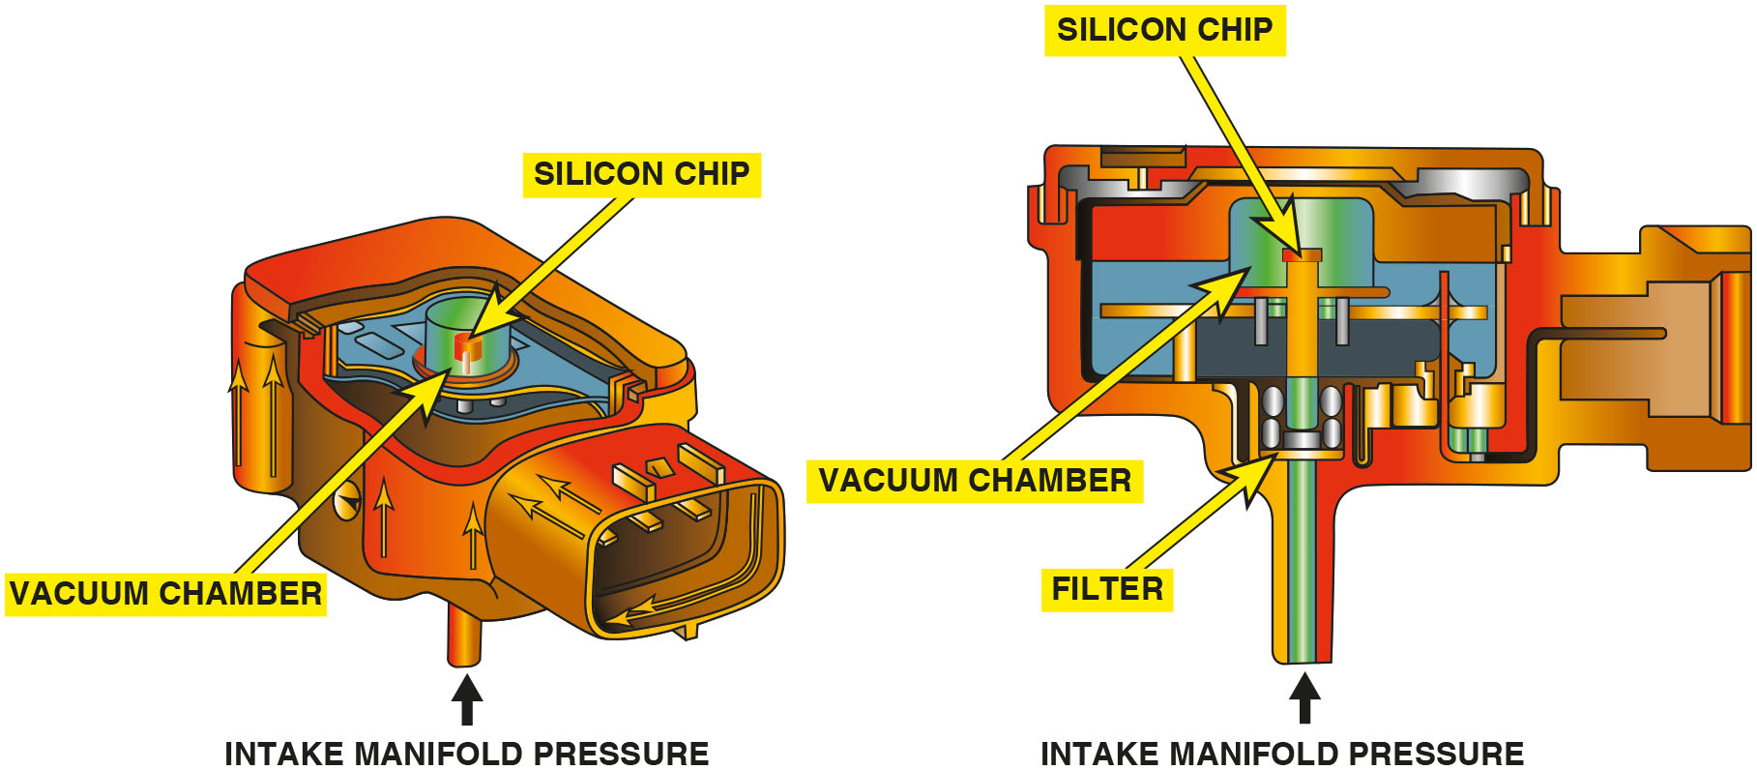
Figure 17.2
M A P Sensor Operation
A M A P sensor compares the absolute pressure in the intake manifold to a perfect vacuum. The deflection of the silicon chip is converted to an absolute pressure reading by the electronics in the sensor itself.
Notes:
Long Description:
The figure depicts the M A P sensor housing with an intake manifold, a filter for the intake, and a silicon chip placed inside a vacuum chamber. A signal conditioning circuit is connected to the silicon chip and vacuum chamber unit inside the housing.

Slide 8
Construction of Manifold Absolute Pressure Sensors
Purpose and Function
The manifold absolute pressure sensor is used by the engine computer to sense engine load.
Silicon-Diaphragm Strain Gauge M A P Sensor
There are four resistors attached to the silicon wafer, which changes in resistance when strain is applied. This is a piezoresistive sensor.
Ceramic Disc M A P Sensor
This type of sensor converts manifold pressure into a capacitance discharge.

Slide 9
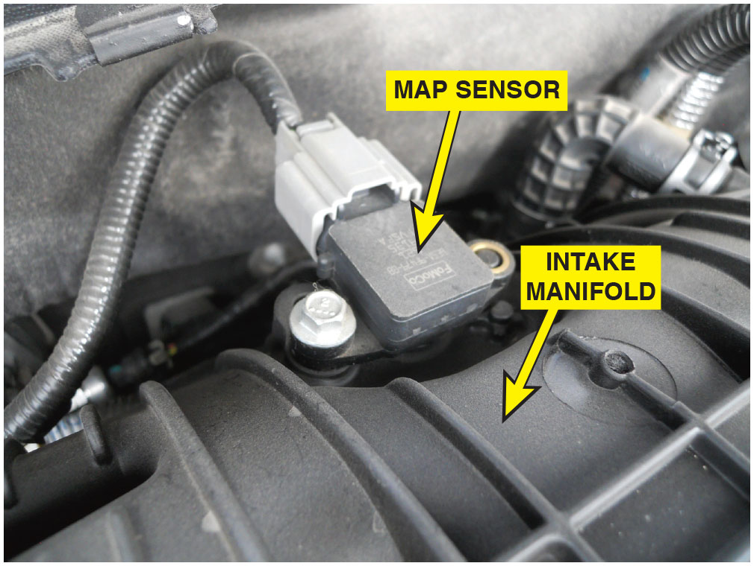
Figure 17.3
M A P Sensor in Engine
A typical M A P sensor installed in the intake manifold.

Slide 10
Chart 17.1
M A P and Engine Load
ENGINE LOAD | MANIFOLD VACUUM | MANIFOLD ABSOLUTE PRESSURE | M A P SENSOR VOLT SIGNAL
Heavy (W O T) | Low (almost 0 inch H g) | High (almost atmospheric) | High (4.6–4.8 V)
Light (idle) | High (17–21 inch H g) | Low (lower than atmospheric) | Low (0.8–1.6 V)
Engine load and how it is related to engine vacuum, and M A P sensor reading.

Slide 11
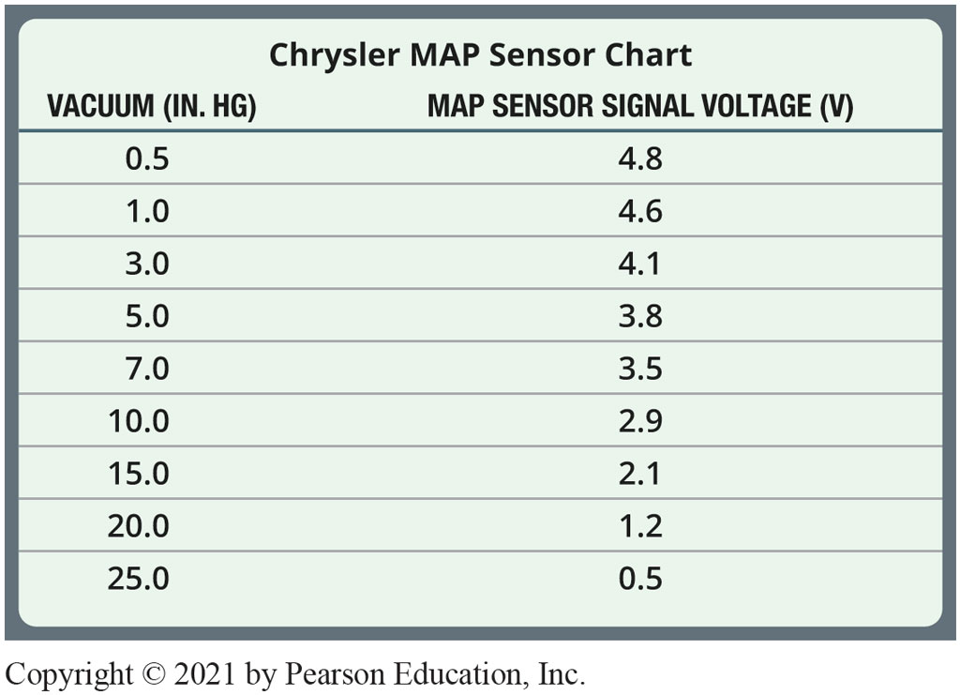
Chart 17.2
M A P Sensor Chart
Chrysler M A P sensor values compared to engine vacuum.
Notes:
TECH TIP: If It’s Green, It’s a Signal Wire
Ford-built vehicles usually use a green wire as the signal wire back to the computer from the sensors. It may not be a solid green, but if there is green somewhere on the wire, then it is the signal wire. The other wires are the power and ground wires to the sensor.
Long Description:
The table is titled Chrysler M A P sensor chart. The table has two columns: vacuum, inches of mercury, and M A P sensor signal voltage, volts. Row entries are as follows. Row 1: 0.5, 4.8. Row 2: 1.0, 4.6. Row 3: 3.0, 4.1. Row 4: 5.0, 3.8. Row 5: 7.0, 3.5. Row 6: 10.0, 2.9. Row 7: 15.0, 2.1. Row 8: 20.0, 1.2. Row 9: 25.0, 0.5.

Slide 12
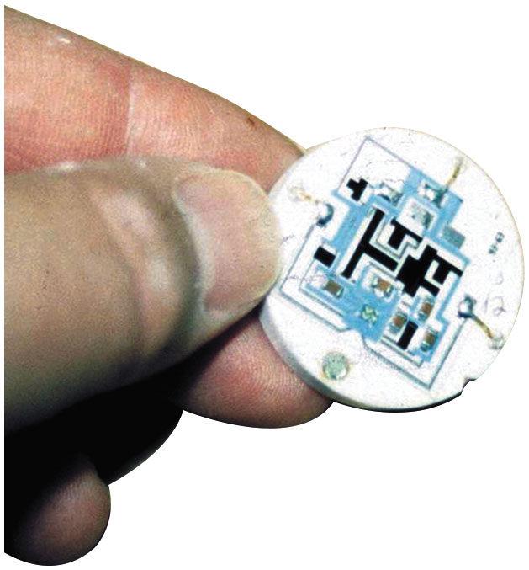
Figure 17.4
Ceramic Disc Type
Shown is the electronic circuit inside a ceramic disc M A P sensor used on many Chrysler engines. The black areas are carbon resistors that are applied to the ceramic, and lasers are used to cut lines into these resistors during testing to achieve the proper operating calibration.

Slide 13
Question 1
What are two types (construction) of M A P sensors?

Slide 14
Answer 1
Silicon-diaphragm strain gauge M A P sensor and ceramic disc M A P sensor.

Slide 15
P C M M A P Sensor Uses
P C M uses the M A P sensor to determine the following:
The load on the engine
Altitude, fuel, and spark control calculations
E G R system operation
Detect deceleration (vacuum increases)
Monitor engine condition
Load detection for returnless-type fuel injection
Altitude and M A P sensor values

Slide 16
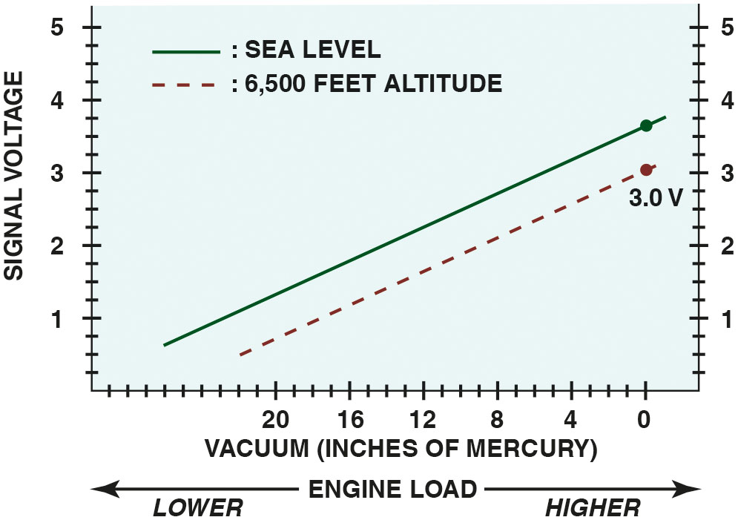
Figure 17.5
Altitude Effects
Altitude affects the M A P sensor voltage.
Notes:
Long Description:
The graph depicts signal voltage on the vertical axis and vacuum in inches of mercury on the horizontal axis. The engine load during particular vacuum values are also shown as lower value of engine load towards higher vacuum values and higher engine load towards lower vacuum values. The graph shows two graph lines, one measured at sea level with a solid line and other measured at 6500 altitude with a dotted dash line. Both the graph lines are upward-sloping straight lines.

Slide 17
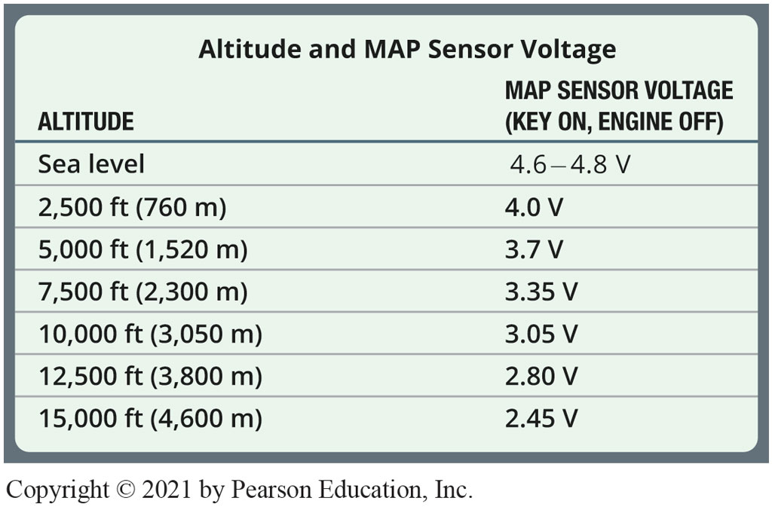
Chart 17.3
Altitude and M A P
Comparison between M A P sensor voltage and altitude.
Notes:
TECH TIP: Use the M A P Sensor as a Vacuum Gauge
A M A P sensor measures the pressure inside the intake manifold compared with absolute zero (perfect vacuum). For example, an idling engine that has 20 inches of mercury (inch H g) of vacuum has a lower pressure inside the intake manifold than when the engine is under a load and the vacuum is at 10 inch H g. A decrease in engine vacuum results in an increase in manifold pressure. A normal engine should produce between 17 and 21 inch H g at idle. Comparing the vacuum reading with the voltage reading output of the M A P sensor indicates that the reading should be between 1.62 and 0.88 volt. Therefore, a digital multimeter (D M M), scan tool, or scope can be used to measure the M A P sensor voltage and be used instead of a vacuum gauge.
NOTE: This chart was developed by testing a M A P sensor at a location about 600 feet above sea level. For best results, a chart based on your altitude should be made by applying a known vacuum, and reading the voltage of a known-good M A P sensor. Vacuum usually drops about 1 inch per 1,000 feet of altitude. See page 858 for chart.
Long Description:
The table is titled Altitude and M A P sensor voltage. The table has two columns: altitude and M A P sensor voltage, key on, engine off. Row entries are as follows. Row 1: Sea level; 4.6 to 4.8 volts. Row 2: 2,500 feet, 760 meters; 4.0 volts. Row 3: 5,000 feet, 1,520 meters; 3.7 volts. Row 4: 7,500 feet, 2,300 meters; 3.35 volts. Row 5: 10,000 feet, 3,050 meters; 3.05 volts. Row 6: 12,500 feet, 3,800 meters; 2.80 volts. Row 7: 15,000 feet, 4,600 meters; 2.45 volts.

Slide 18
Barometric Pressure Sensor
A barometric pressure (B A R O) sensor is similar in design, but senses more subtle changes in barometric absolute pressure (atmospheric air pressure).
It is vented directly to the atmosphere.
Is the primary sensor used to determine altitude.

Slide 19
Question 2
What is the primary purpose of a barometric pressure sensor?

Slide 20
Answer 2
Determine the altitude.

Slide 21
Testing the M A P Sensor
Three different types of test instruments can be used to test a pressure sensor:
A Digital Voltmeter with three test leads connected in series
Scope connected to sensor output, power, and ground
Scan tool or a specific tool recommended by vehicle manufacturer
Notes:
CASE STUDY The Case of the No-Start Lexus
The owner of a Lexus I S250 had the car towed to a shop as a no-start. The technician discovered that the “check engine” light would not come on even with key on, engine off (K O E O). A scan tool would not communicate either. Checking the resources on www.iatn.net, the technician read of a similar case where the fuel pressure sensor was shorted, which disabled all serial data communications. The technician disconnected the fuel pressure sensor located on the backside of the engine and the communications were restored and the engine started. The fuel pressure sensor was replaced and returned to the happy owner.
Summary:
Complaint—The vehicle owner stated that the engine would not start.
Cause—A shorted fuel pressure sensor was found as per a previous similar case.
Correction—The fuel pressure sensor was replaced and this corrected the serial data fault that caused the
no-start condition.

Slide 22
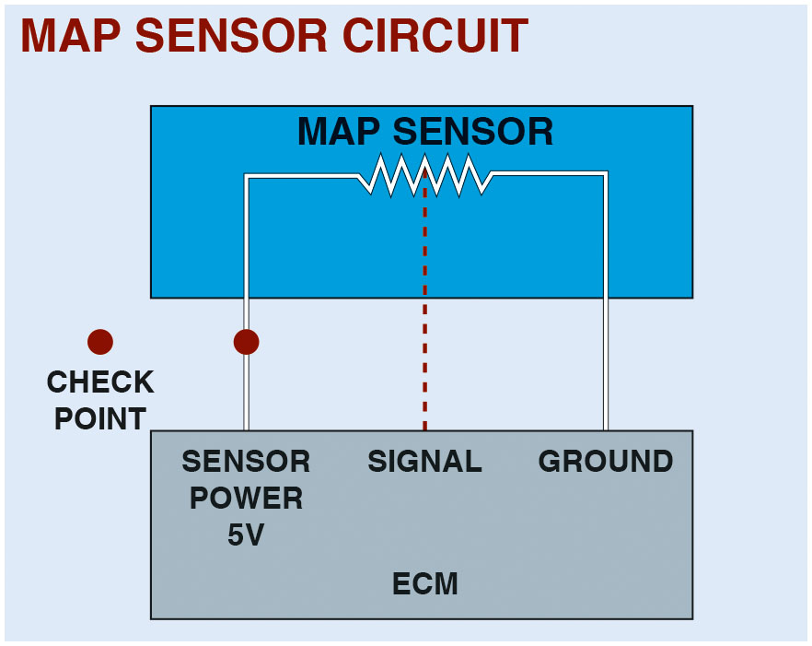
Figure 17.6
Checking M A P Sensor
When checking a M A P sensor, first verify that the sensor is receiving a 5-volt reference voltage and then check for the output (signal) voltage.

Slide 23
Animation: MAP Sensor Reference Voltage Check

Slide 24
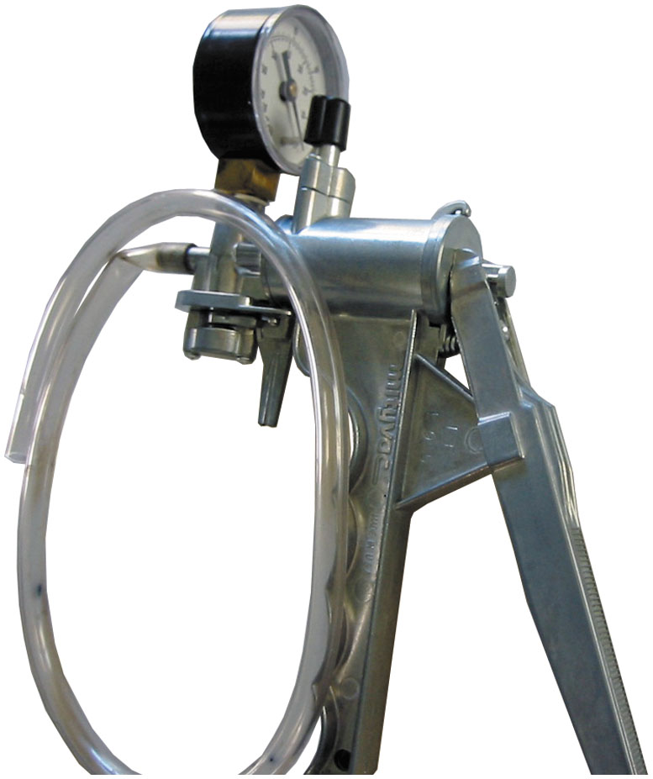
Figure 17.7
Vacuum Pump
A typical hand-operated vacuum pump.
Notes:
TECH TIP: Visual Check of the M A P Sensor
A defective vacuum hose to a M A P sensor can cause a variety of driveability problems including poor fuel economy, hesitation, stalling, and rough idle. A small air leak (vacuum leak) around the sensor can cause these symptoms and often set a trouble code in the vehicle computer. When checking the M A P sensor, if anything comes out of the sensor itself, it should be replaced. This includes water, gasoline, or any other substance.

Slide 25
Question 3
What are three ways to test a M A P sensor?

Slide 26
Answer 3
A multimeter, a scan tool, and an oscilloscope.

Slide 27
Mass Airflow Sensor Types
Purpose and Function
Purpose and function of mass airflow sensors is to measure amount of air entering engine.
Hot Film Sensor
Uses a temperature-sensing resistor (thermistor) to measure the temperature of the incoming air.
Hot Wire Sensor
Uses a hot wire to sense the mass air flow.

Slide 28
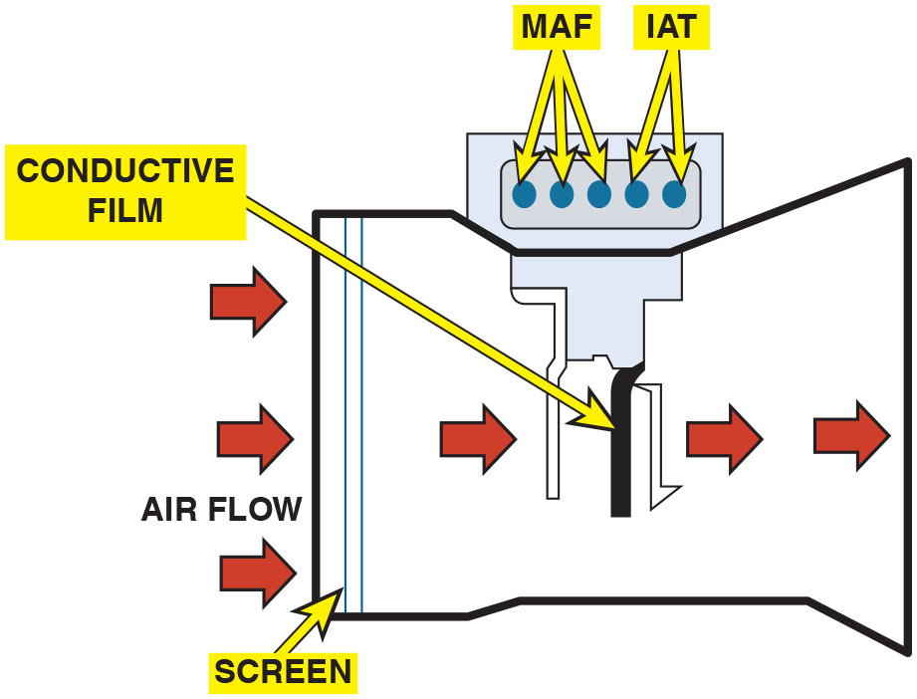
Figure 17.8
M A F
This five-wire mass air flow sensor consists of a metal foil sensing unit, an intake air temperature (I A T) sensor, and the electronic module.
Notes:
Long Description:
A mass air flow, M A F sensor is connected at the middle of the duct with a hot wire sensing unit. The sensor module also has an intake air temperature sensor (I A T).

Slide 29
Animation: Mass Air Flow, (VAF) Sensor

Slide 30
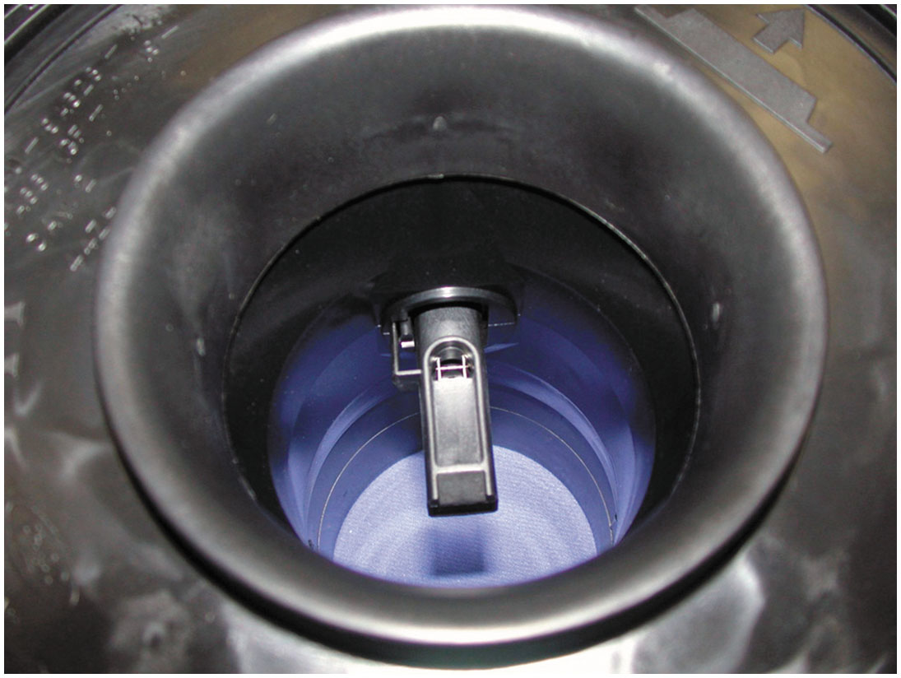
Figure 17.9
M A F Sensing Wire
The sensing wire in a typical hot wire mass air flow sensor.
Notes:
CASE STUDY: The Dirty M A F Sensor Story
The owner of a Buick Park Avenue equipped with a 3,800 V-6 engine complained that the engine would hesitate during acceleration, showed lack of power, and seemed to surge or miss at times. A visual inspection found everything to be like new, including a new air filter. There were no stored diagnostic trouble codes (D T C s). A look at the scan data showed airflow to be within the recommended 3–7 grams per second. A check of the frequency output showed the problem. Idle frequency = 2.177 k H z (2,177 H z)
Normal frequency at idle speed should be 2.37–2.52 kHz. Cleaning the hot wire of the M A F sensor restored proper operation. The sensor wire was covered with what looked like fine fibers, possibly from the replacement air filter.
Summary:
Complaint—Customer stated that the engine hesitated when accelerating.
Cause—Tests confirmed that the M A F sensor was operating correctly but the frequency output at idle was not within the normal range.
Correction—Cleaning the M A F sensor restored proper operation of the sensor and the engine now accelerates normally.

Slide 31
Frequently Asked Question: What Is Meant by a “High-Authority Sensor”?
? Frequently Asked Question
What Is Meant by a “High-Authority Sensor”? A high-authority sensor is a sensor that has a major influence over the amount of fuel being delivered to the engine. For example, at engine start-up, the engine coolant temperature (E C T) sensor is a high-authority sensor and the oxygen
sensor
is a low-authority sensor. However, as the
engine reaches operating temperature, the oxygen sensor becomes a high-authority sensor and can greatly affect the amount of fuel being supplied to the engine. See the chart on next slide:

Slide 32
Frequently Asked Question Chart
High-Authority Sensors | Low-Authority Sensors
E C T (especially when the engine starts and is warming up) | I A T (intake air temperature) sensors modify and back up the E C T
O2S (after the engine reaches closed-loop operation) | T F T (transmission fluid temperature)
M A P | P R N D L (shift position sensor)
M A F | K S (knock sensor)
T P (high authority during acceleration and deceleration) | E F T (engine fuel temperature)

Slide 33
Question 4
What are the two most common types of mass airflow sensors?

Slide 34
Answer 4
Hot wire and hot film.

Slide 35
Frequently Asked Question: What Is False Air?
? Frequently Asked Question
What Is False Air? Airflow sensors and mass airflow (M A F) sensors are designed to measure all the air entering the engine. If an air inlet hose was loose or had a hole, extra air could enter the engine without being measured. This extra air is often called false air. ● See Figure 17.10. NOTE: If the engine runs well in reverse, yet runs terrible in any forward gear, carefully look at the inlet hose for air leaks that would open when the engine torque moves the engine slightly on its mounts.

Slide 36
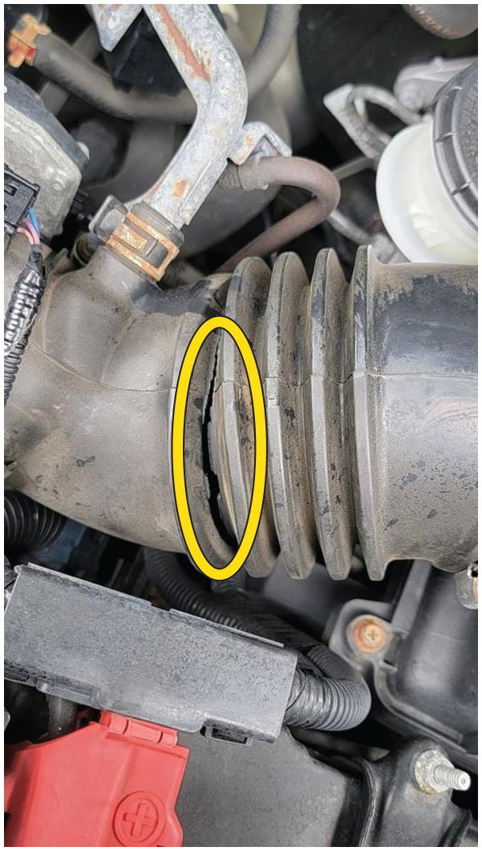
Figure 17.10
Cracked Hose
Carefully check the hose between the M A F sensor and the throttle plate for cracks or splits that could create extra (false) air into the engine that is not measured by the M A F sensor.

Slide 37
P C M Uses for Airflow Sensors
The P C M uses the information from the airflow sensor for the following purposes:
Airflow sensors are used mostly to determine the amount of fuel needed and base pulse-width numbers.
Airflow sensors back up the T P sensor in the event of a loss of signal or an inaccurate throttle position sensor signal.

Slide 38
Testing Mass Airflow Sensors
Visual Inspection
M A F Sensor Output Test
Tap Test
Digital Meter Test of an M A F Sensor

Slide 39
Question 5
What are four ways to test an M A F sensor?

Slide 40
Answer 5
Visual inspection, M A F sensor output test, tap test, and a digital meter.

Slide 41
M A F Sensor Contamination
Dirt, oil, silicon, or even spider webs can coat the sensing wire.
It tends to insulate the sensing wire at low air flow rates.
Creates an incorrect estimate of air entering the engine.

Slide 42
M A F Sensor Scope Testing
A digital storage oscilloscope (D S O) can be used to monitor the operation of an M A F sensor.
Connect the test leads to the signal wire and the sensor ground.
Look for a consistent pattern that changes in frequency as the engine speed is increased.

Slide 43
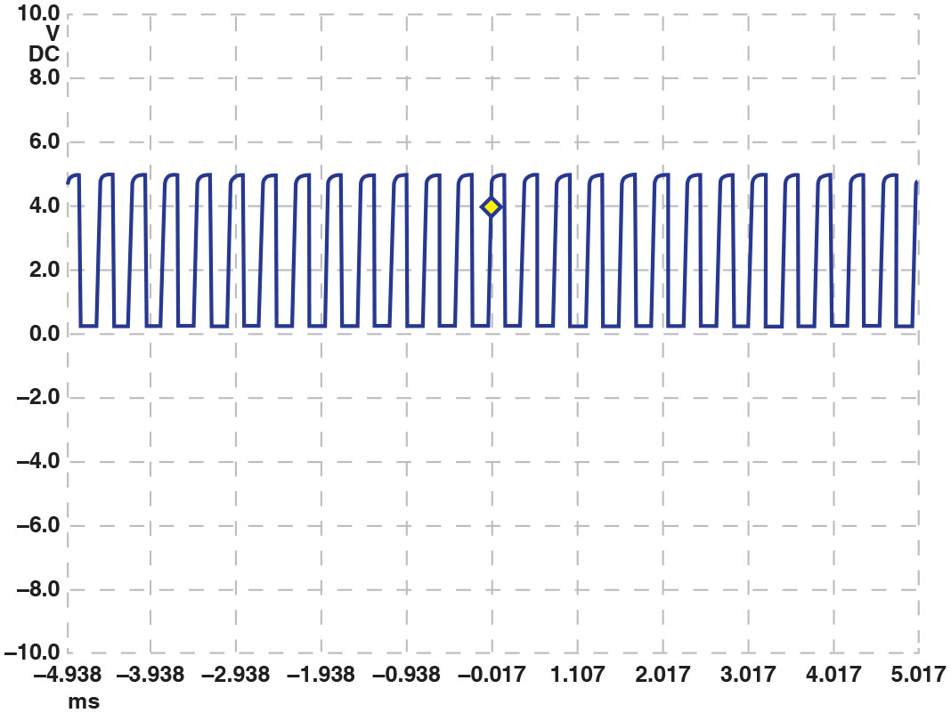
Figure 17.11
M A F D S O Waveform
A scope display showing a normal Chevrolet Equinox M A F sensor at idle speed, the frequency is 2,600 Hz (2.6 k H z).
Notes:
Tech Tip: The Unplug It Test
If a sensor is defective yet produces a signal to the computer, the computer will often accept the
reading and make the required changes in fuel delivery and spark advance. If, however, the sensor
is not reading correctly, the computer will process this wrong information and perform an action
assuming that information being supplied is accurate. “If in doubt, take it out.”
If the engine operates better with a sensor unplugged, then suspect that the sensor is defective. A
sensor that is not supplying the correct information is said to be skewed. The computer will not
set a diagnostic trouble code for this condition because the computer can often not detect that
the sensor is supplying wrong information.
Long Description:
The graph has two axes with voltage on the vertical axis and time across the horizontal axis. The curve range between minus 4.938 millisecond to 5.017 millisecond, and oscillates between 0 and 5-volts D C. The graph resembles cycles of rectangular waves with a curved top edge.

Slide 44
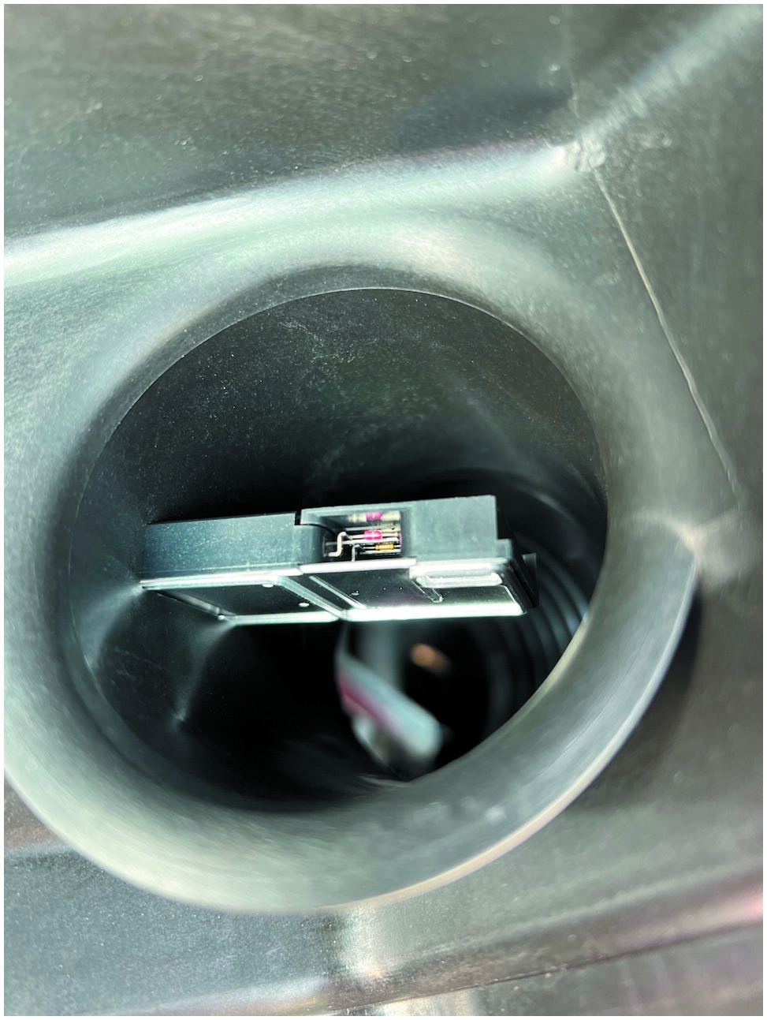
Figure 17.12
M A F Cleaned
The cleaned M A F sensor looks like new.
Notes:
Case Study: The Case of the Surging Chevrolet
The owner of a Chevrolet Malibu (122,000 miles) complained to a service advisor that the idle
would surge and that the tachometer would fluctuate up and down at times when idling at a
traffic light. The shop was able to verify that the idle speed was unsteady at times. The service
technician performed a visual inspection and did not find anything wrong. The vehicle appeared
to be well maintained with a clean air filter and clean engine oil. With the owner’s permission, the
shop cleaned the throttle plate (E T C system), and replaced the spark plugs which were original.
The fluctuating idle still was happening. The technician then removed the M A F sensor and
cleaned it using a spray M A F sensor cleaner. After installing the sensor, the engine idled perfectly.
• See Figure 17.12.
Summary
Concern—The idle would surge and that the tachometer would fluctuate up and down at times.
Cause—A dirty M A F sensor.
Correction—Cleaning the M A F sensor fixed the idle surging problem.

Slide 45
Question 6
What will be the result of a contaminated M A F sensor?

Slide 46
Answer 6
An incorrect estimate of the air entering the engine.

Slide 47
Summary (1 of 2)
Pressure below atmospheric pressure is called vacuum and is measured in inches of mercury.
A manifold absolute pressure sensor uses a perfect vacuum (zero absolute pressure) in the sensor to determine the pressure.
Three types of M A P sensors include:
Silicon-diaphragm strain gauge
Capacitor-capsule design
Ceramic disc design

Slide 48
Summary (2 of 2)
A mass airflow sensor actually measures the density and amount of air flowing into the engine, which results in accurate engine control.
An air vane sensor measures the volume of the air, and the intake air temperature sensor is used by the P C M to calculate the mass of the air entering the engine.
A hot wire M A F sensor uses the electronics in the sensor
itself to heat a wire
above the temperature of the air
entering the engine.

Slide 49
Animation and Video Library Links (Must have an internet connection and active Haldeman subscription)
Animation Library: (A8) Engine Performance Animations
Animation Library: (A6) Electrical/Electronic Systems Animations
Video Library: (A8) Engine Performance Videos
Video Library: (A6) Electrical/Electronic Systems Videos

Slide 50
Copyright
This work is protected by United States copyright laws and is provided solely for the use of instructors in teaching their courses and assessing student learning. Dissemination or sale of any part of this work (including on the World Wide Web) will destroy the integrity of the work and is not permitted. The work and materials from it should never be made available to students except by instructors using the accompanying text in their classes. All recipients of this work are expected to abide by these restrictions and to honor the intended pedagogical purposes and the needs of other instructors who rely on these materials.

