Slide 1
Advanced Engine Performance Diagnosis
Eighth Edition
Chapter 16
Temperature and Throttle Position Sensors
Copyright © 2025 Pearson Education, Inc. All Rights Reserved
Notes:
If this PowerPoint presentation contains mathematical equations, you may need to check that your computer has the following installed:
1) Math Type Plugin
2) Math Player (free versions available)
3) NVDA Reader (free versions available)
INSTRUCTOR NOTE: This presentation includes text explanation notes, you can use to teach the course. When in SLIDE SHOW mode, you RIGHT CLICK and select SHOW PRESENTER VIEW, to use the notes.

Slide 2
Learning Objectives (1 of 2)
16.1 Describe the purpose and function of engine coolant temperature sensors.
16.2 Describe how to inspect and test temperature sensors.
16.3 Explain the function and testing of intake air temperature sensors, including sensor D T Cs.
16.4 Discuss the other temperature sensors that may be found on vehicles.
16.5 Describe the construction and function of a T P sensor.

Slide 3
Learning Objectives (2 of 2)
16.6 Discuss T P sensor input.
16.7 Discuss the P C M uses for the T P sensor.
16.8 Describe how to test the T P sensor, including sensor D T Cs.

Slide 4
Engine Coolant Temperature Sensors (1 of 2)
Purpose and Function
A computer-equipped vehicle uses the coolant temperature sensor to adjust fuel delivery, adjust ignition timing, and to adjust target idle.
E C T Sensor Construction
Engine coolant temperature sensors are constructed of a semiconductor material that decreases in resistance as the temperature of the sensor increases.

Slide 5
Engine Coolant Temperature Sensors (2 of 2)
Stepped E C T Circuits
Some vehicle manufacturers use a step-up resistor to effectively broaden the range of the E C T sensor.
When the temperature is low, usually below
the E C T sensor voltage is applied through a
high-value resistor inside the P C M.
When the temperature is high, usually above
the E C T sensor voltage is applied through a
much lower resistance value inside the P C M.

Slide 6
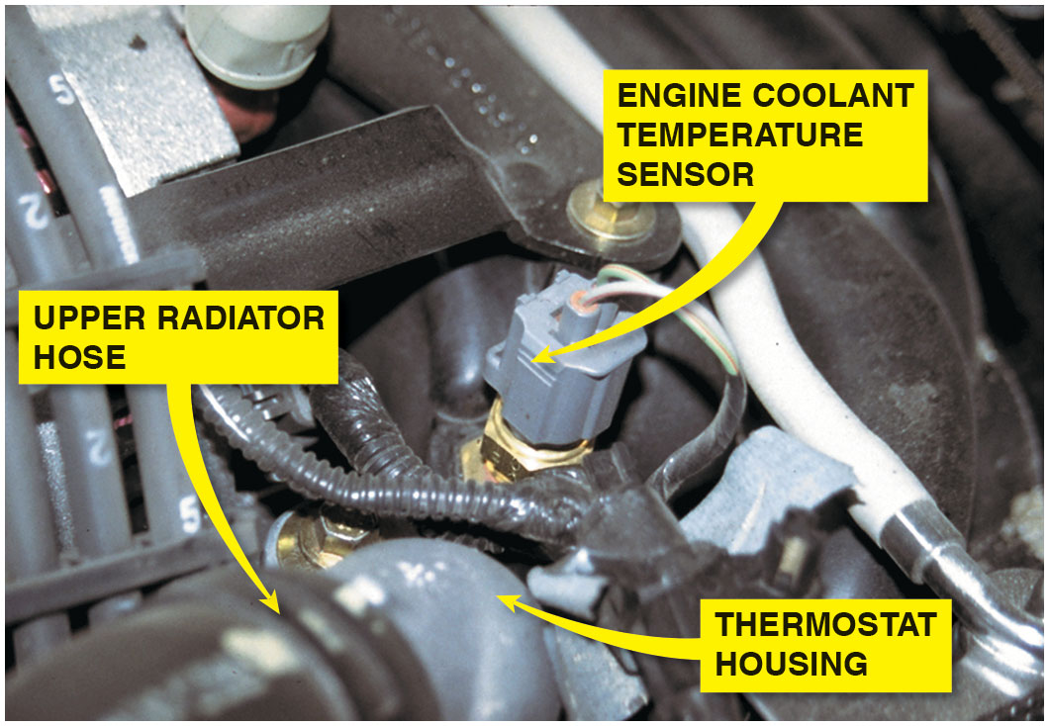
Figure 16.1
E C T Sensor
A typical engine coolant temperature (E C T) sensor. E C T sensors are located near the thermostat housing on most engines.

Slide 7
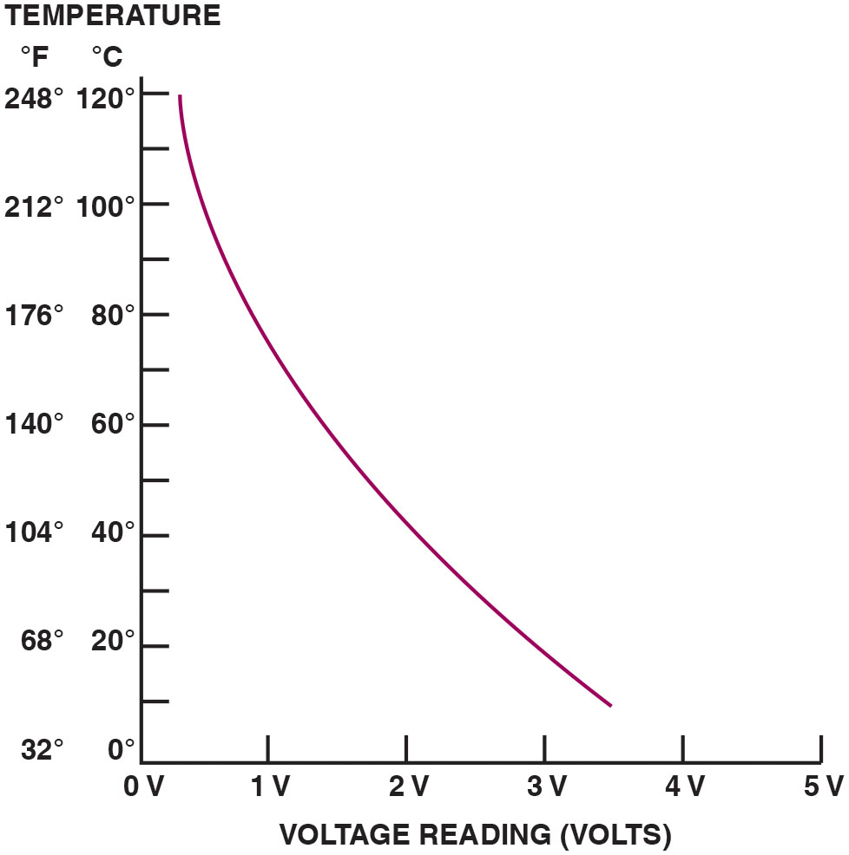
Figure 16.2
E C T Voltage Curve
A typical E C T sensor temperature versus voltage curve.
Notes:
Long Description:
The x-axis labeled voltage reading (volts) ranges from 0 V to 5 V in increments of 1 V. The y-axis labeled temperature ranges from 0 degrees Celsius to 120 degrees Celsius in increments of 20 degrees Celsius and from 32 degrees Fahrenheit to 248 degrees Fahrenheit in increments of 36 degrees Fahrenheit. The curve extends from (0.4 V, 120 degrees Celsius or 248 degrees Fahrenheit) to (3.5 V, 10 degrees Celsius or 48 degrees Fahrenheit).

Slide 8
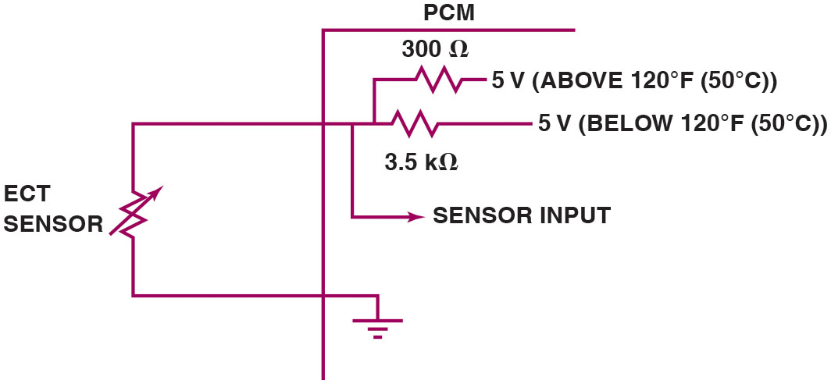
Figure 16.3
E C T Circuit
A typical two-step E C T circuit showing that when the coolant temperature is low, the P C M applies a 5-volt reference voltage to the E C T sensor through a higher resistance compared to when the temperature is higher.
Notes:
Long Description:
Above 120-degree Fahrenheit 5 volts is applied via 300 Ohms resistance. Below 120-degree Fahrenheit 5 volts is applied via 3.5 Kilohms resistance.

Slide 9
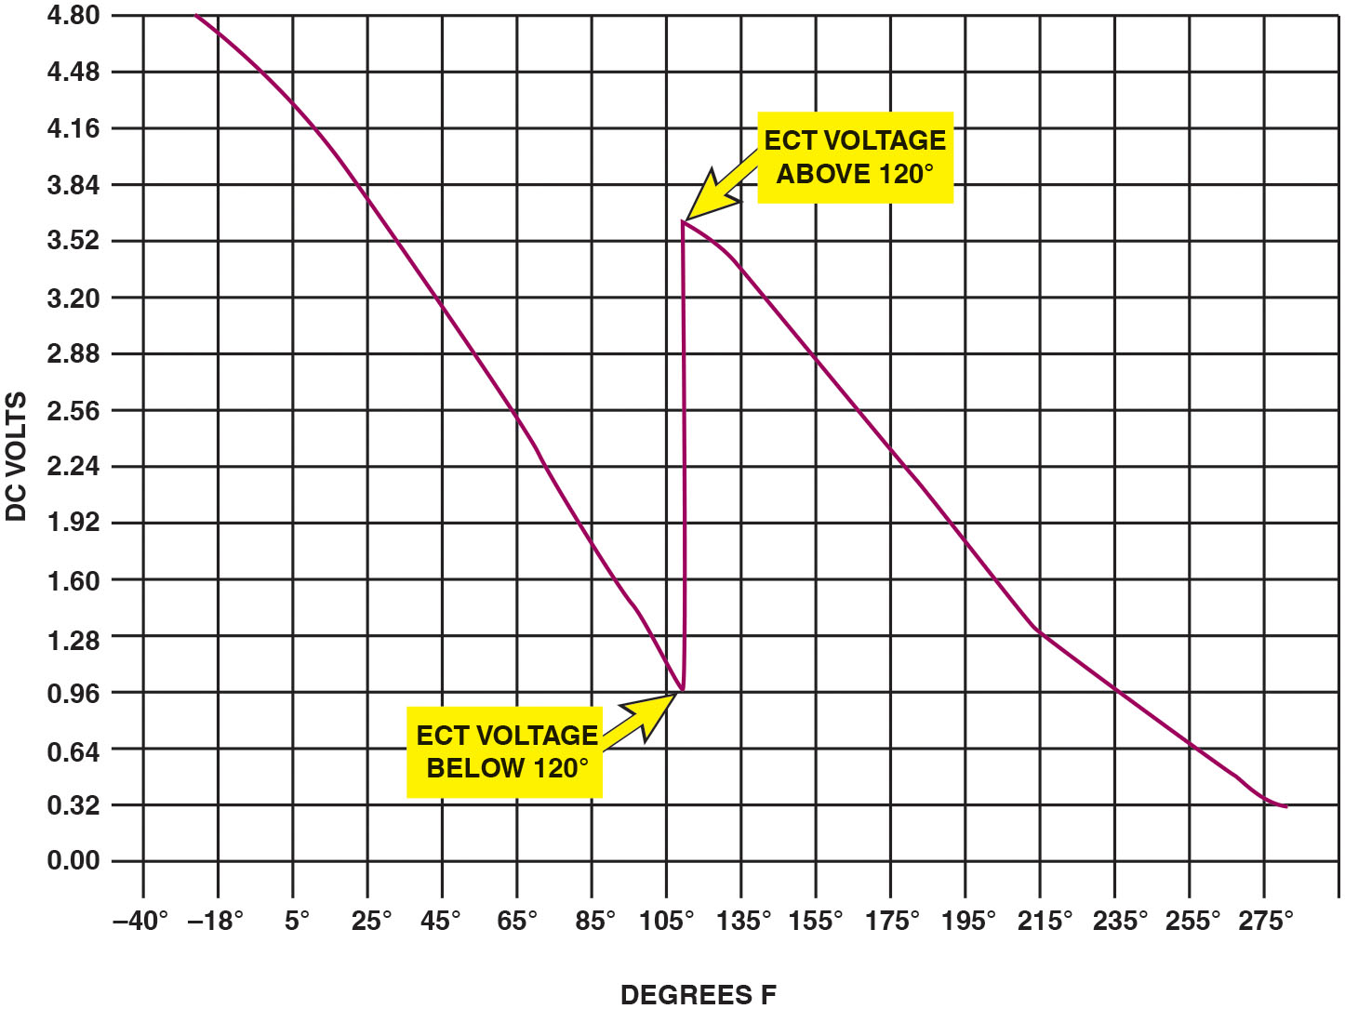
Figure 16.4
E C T Voltage
The transition between steps usually occurs at a temperature that would not interfere with cold engine starts or the cooling fan operation. In this example, the transition occurs when the sensor voltage is about 1 volt and rises to about 3.6 volts.
Notes:
Long Description:
The x-axis labeled degrees F shows the values negative 40 degrees, negative 18 degrees, 5 degrees, 25 degrees, 45 degrees, 65 degrees, 85 degrees, 105 degrees, 135 degrees, 155 degrees, 175 degrees, 195 degrees, 215 degrees, 235 degrees, 255 degrees, and 275 degrees. The y-axis labeled D C volts ranges from 0.00 to 4.80 in increments of 0.32. A wave follows the following pattern: The D C voltage starts at 4.8 volts at little less than negative 18 degrees. The voltage drops almost linearly to reach a value of 0.96 below 120 degrees. This point is labeled E C T voltage below 120 degrees. The voltage then suddenly increases to a little over 3.52 above 120 degrees. This point is labeled E C T voltage above 120 degrees. The voltage then drops till 0.32 volts beyond 275 degrees.

Slide 10
Question 1
What is the purpose of a stepped E C T circuit?

Slide 11
Answer 1
To broaden the range of the coolant temperature sensor.

Slide 12
Testing E C T Sensor
Testing E C T by Visual Inspection
Properly filled cooling system
Proper pressure maintained by the radiator cap
Proper antifreeze-water mix
Proper operation of the cooling fan
Testing E C T Using D M M
Measure resistance and compare to a chart.
Testing E C T Sensor Using a Scan Tool
Compare displayed temperature with the actual temperature of the engine.

Slide 13
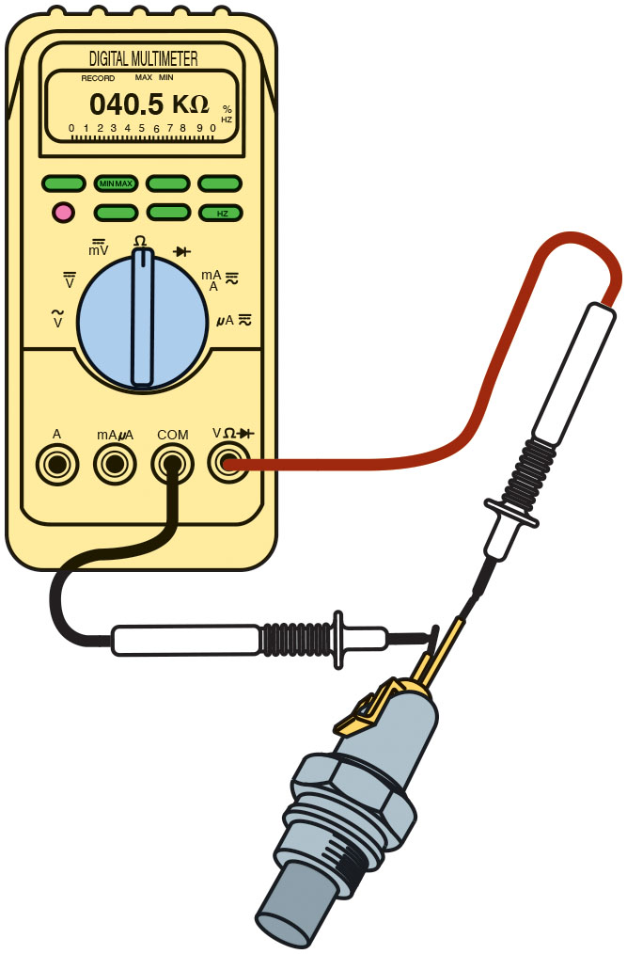
Figure 16.5
E C T Resistance
Measuring the resistance of the E C T sensor. The resistance measurement can then be compared with specifications. (Courtesy of Fluke Corporation)

Slide 14
Animation: Test Engine Coolant Temperature, ECT, Sensor

Slide 15
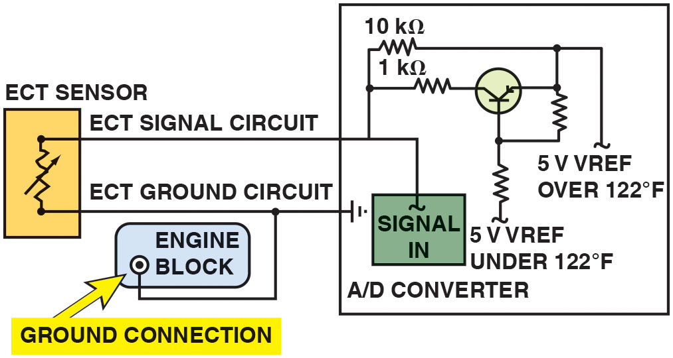
Figure 16.6
E C T Voltage Drop
When voltage drop reaches
volts, P C M turns on a transistor.
Transistor connects 1 kΩ resistor in parallel with 10 kΩ resistor. Total circuit resistance now drops to 909 ohms. This function allows the P C M to
have full binary control at cold temperatures up to approximately
and a second full binary control at temperatures greater than
Notes:
CASE STUDY: The Case of the Hot Audi
The owner of Audi A3 Quattro took the vehicle to a shop and mentioned that the engine temperature gauge was indicting that the engine was running hot. A check engine light was also on. A scan tool was used to retrieve a D T C P0116 (Engine Coolant Temperature (E C T) Sensor 1 Circuit Range/Performance). Another shop had replaced the thermostat, water pump, and E C T sensor (at the radiator outlet), which did not fix the overheat problem.
The service technician looked at the scan tool data and noticed that the E C T was showing a temperature of over 240° (112°C), yet the upper radiator hose was not hot. Checking service information, the technician discovered that this engine has two E C T sensors, one in the radiator outlet and another one located on the engine block. The D T C was referencing the E C T located on the engine block, designated G62 in service information. The technician checked the resistance of G62 and found it to be out of specifications. Replacing this E C T sensor resulted in both E C T sensors reading the same temperature with key on, engine off (K O E O). The D T C was cleared and the vehicle was driven, which confirmed that the root cause had been found.
Summary:
Complaint—The temperature gauge was showing that the engine was overheating and the check engine light was on.
Cause—One of the two E C T sensors was out of specification causing both the incorrect dash temperature reading and a stored diagnostic trouble code.
Correction—Replacing the E C T sensor located on the engine block (G62) corrected both issues.
Long Description:
When the voltage drop reaches approximately 1.20 volts, the P C M turns on a transistor. The transistor connects a 1-kilo ohms resistor in parallel with the 10- kilo ohms resistor. Total circuit resistance now drops to around 909 ohms. This function allows the P C M to have full binary control at cold temperatures up to approximately 122 degrees Fahrenheit (50 degrees Celsius), and a second full binary control at temperatures greater than 122 degrees Fahrenheit (50 degrees Celsius).

Slide 16
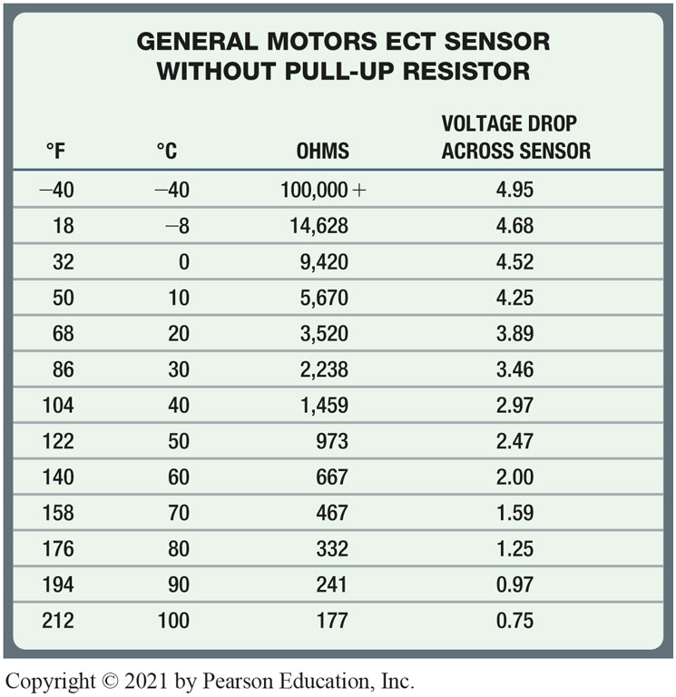
Chart 16.1
E C T Temps
Notes:
Long Description:
The table has four columns: degrees Fahrenheit, degrees Celsius, ohms, and voltage drop across sensor. Row entries are as follows. Row 1: negative 40, negative 40, 100,000 plus, 4.95. Row 2: 18, negative 8, 14,628, 4.68. Row 3: 32, 0, 9,420, 4.52. Row 4: 50, 10, 5,670, 4.25. Row 5: 68, 20, 3,520, 3.89. Row 6: 86, 30, 2,238, 3.46. Row 7: 104, 40, 1,459, 2.97. Row 8: 122, 50, 973, 2.47. Row 9: 140, 60, 667, 2.00. Row 10: 158, 70, 467, 1.59. Row 11: 176, 80, 332, 1.25. Row 12: 194, 90, 241, 0.97. Row 13: 212, 100, 177, 0.75.

Slide 17
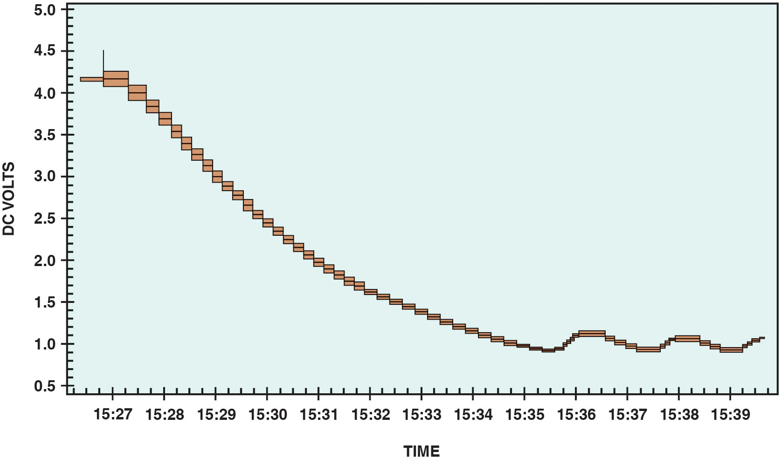
Figure 16.7
E C T Testing
An E C T sensor being tested using a digital meter set to D C volts. A chart showing the voltage decrease of the E C T sensor as the temperature increases from a cold start. The bumps at the bottom of the waveform represent temperature decreases when the thermostat opens and is controlling coolant temperature.
Notes:
TECH TIP: Quick and Easy E C T Test
To check that the wiring and the computer are functioning, regarding the ECT sensor, connect a scan tool and look at the E C T temperature display.
STEP 1 Unplug the connector from the E C T sensor. The temperature displayed on the scan tool should read about −40°C
NOTE: −40° Celsius is also −40° Fahrenheit. This is the point where both temperature scales meet.
STEP 2 With the connector still removed from the E C T sensor, use a fused jumper lead and connect the two terminals of the connector together. The scan tool should display about 285°F (140°C). This same test procedure will work for the I A T and other temperature sensors.

Slide 18
Question 2
What are three ways to test an engine coolant temperature sensor?

Slide 19
Answer 2
A visual inspection, with a multimeter, and with a scan tool.

Slide 20
Intake Air Temperature (I A T) Sensor
Purpose and Function
I A T sensor is negative temperature coefficient (N T C) thermistor that decreases in resistance as the temperature of the sensor increases.
I A T sensor used as an input sensor by P C M to control many functions, including:
Fuel delivery
Spark timing

Slide 21
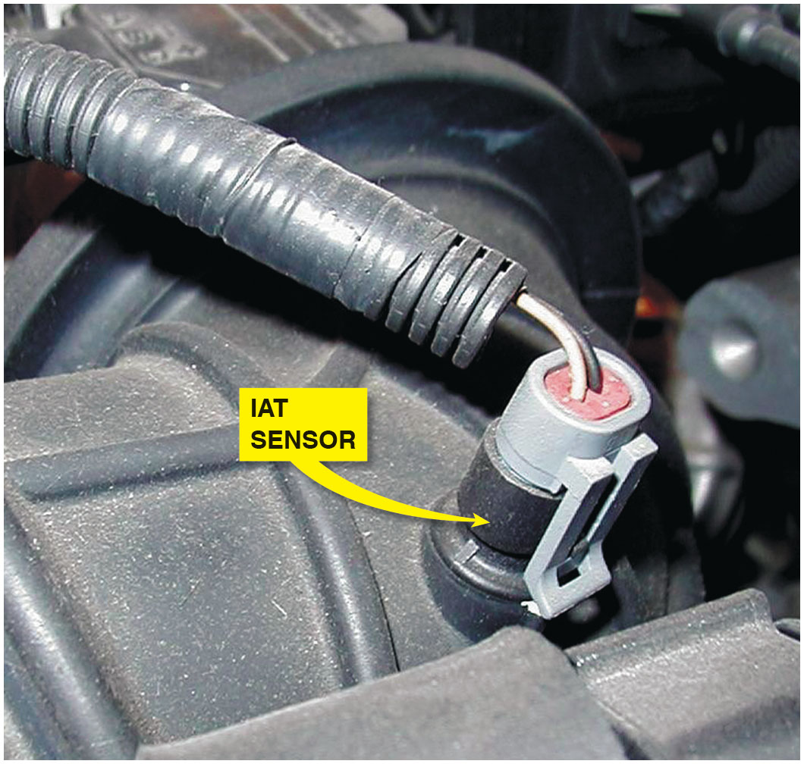
Figure 16.8
I A T Sensor
The I A T sensor on this General Motors 3800 V-6 engine is in the air passage duct between the air cleaner housing and the throttle body.

Slide 22
Testing Intake Air Temperature Sensor
To diagnose I A T sensor, follow these steps:
Perform visual inspection of sensor and wiring.
After vehicle has been allowed to cool for several hours, use a scan tool, observe I A T, and compare it to engine coolant temperature. The two temperatures
should be within
of each other.
Check voltage and compare to service specifications.

Slide 23
Frequently Asked Question: What Exactly Is an N T C Sensor?
? Frequently Asked Question
What Exactly Is an N T C Sensor? A negative temperature coefficient (N T C) thermistor is a semiconductor whose resistance decreases as the temperature increases. In other words, the sensor becomes more electrically conductive as the temperature increases. Therefore, when a voltage is applied, typically 5 volts, the signal voltage is high when the sensor is cold because the sensor has a high resistance and little current flows through to ground. ● See Figure 16.9. However, when the temperature increases, the sensor becomes more electrically conductive and takes more of the 5 volts to ground, resulting in a lower signal voltage as the sensor warms.

Slide 24
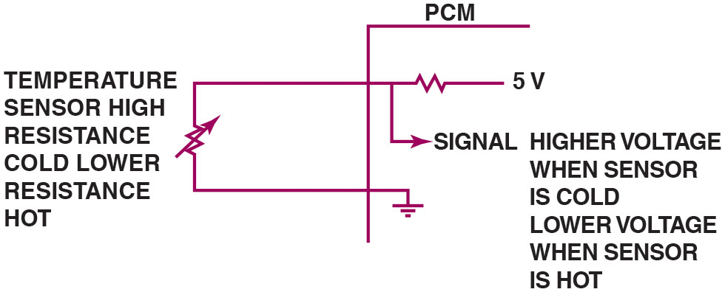
Figure 16.9
N T C Sensor
A typical temperature sensor circuit.
Notes:
Long Description:
The variable resistance sensor is connected to P C M and 5 volts supply via resistance. The temperature sensor shows high resistance at cold temperatures and low resistance at high temperatures.

Slide 25
Transmission Fluid Temperature Sensor
The transmission fluid temperature signal is used by P C M to perform certain strategies based on temperature of the automatic transmission fluid.
Shift points may be delayed and the torque converter clutch may be inhibited in low temperatures.
In high temperatures, overdrive may be inhibited and the torque converter clutch may be engaged to dissipate heat.

Slide 26
Cylinder Head Temperature Sensor
Some vehicles may use a cylinder head temperature sensor instead of, or in addition too, the engine coolant temperature sensor.
When both sensors are used, a calculation between the two is used to determine engine temperature.

Slide 27
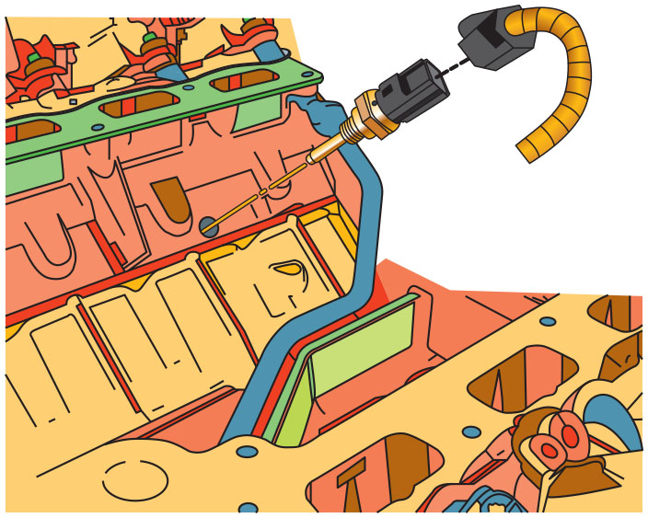
Figure 16.10
C H T Sensor
Some engines are equipped with a cylinder head temperature (C H T) sensor, which is used by the P C M along with the E C T to determine the temperature of the engine.

Slide 28
Engine Fuel Temperature (E F T) Sensor
Some vehicles that are equipped with an electronic returnless type of fuel injection, use an engine fuel temperature (E F T) sensor to give the P C M information regarding the temperature and, therefore, the density of the fuel.
Check service information for the exact location, if equipped, and how to test and service the sensor.

Slide 29
Exhaust Gas Recirculation (E G R) Temperature Sensor
Some engines (Toyota) equipped with exhaust gas recirculation (E G R) temperature sensors.
P C M monitors temperature in exhaust passage between E G R valve and intake manifold.
If temperature increases when E G R is commanded on, the P C M can determine that valve or related components are functioning.

Slide 30
Engine Oil Temperature Sensor
Engine oil temperature sensors used on many G M vehicles and used as an input to oil life monitoring system.
Computer program inside P C M calculates engine oil life based on run time, engine R P M, and oil temperature.

Slide 31
Chart 16.2
Temp Sensors
DIAGNOSTIC TROUBLE CODE | DESCRIPTION | POSSIBLE CAUSES
P0112 | I A T sensor low voltage | I A T sensor internally shorted-to-ground I A T sensor wiring shorted-to-ground I A T sensor damaged by backfire (usually associated with I A T sensors that are mounted in the intake manifold) Possible defective P C M
P0113 | I A T sensor high voltage | I A T sensor internally (electrically) open I A T sensor signal, circuit, or ground circuit open Possible defective P C M
P0117 | E C T sensor low voltage | E C T sensor internally shorted-to-ground The E C T sensor circuit wiring shorted-to-ground Possible defective P C M
P0118 | E C T sensor high voltage | E C T sensor internally (electrically) open E C T sensor signal, circuit, or ground circuit open Engine operating in an overheated condition Possible defective P C M
Selected temperature sensor-related diagnostic trouble codes.
Notes:
Selected temperature sensor-related diagnostic trouble codes

Slide 32
Question 3
What is the purpose of an engine oil temperature sensor?

Slide 33
Answer 3
The sensor is used as an input to determine engine oil life.

Slide 34
Throttle Position Sensor Construction
Potentiometers
Variable-resistance sensor with three terminals
Typical sensor has three wires:
A 5-volt reference feed wire from the computer
Signal return (ground wire back to computer)
Voltage signal wire back to computer; as throttle is opened, voltage to computer changes

Slide 35
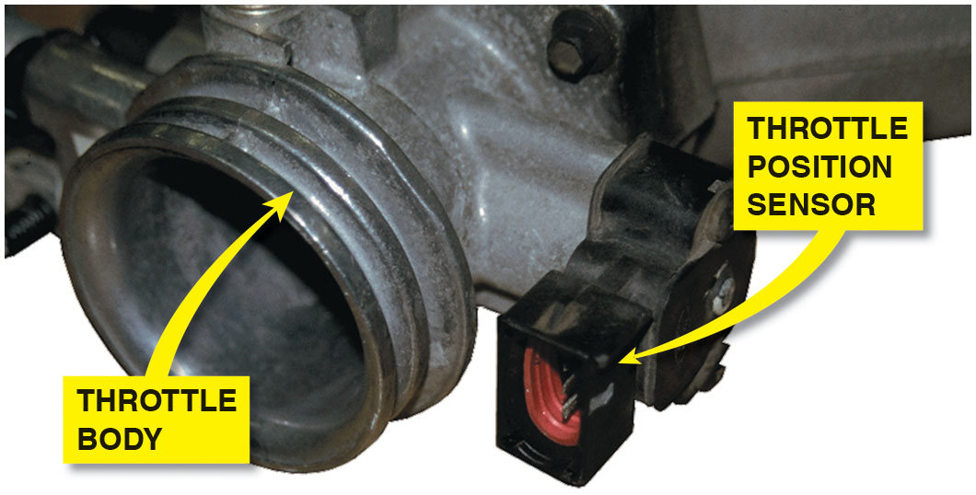
Figure 16.11
T P Sensor
A typical T P sensor mounted on the throttle body of this port-injected engine.

Slide 36
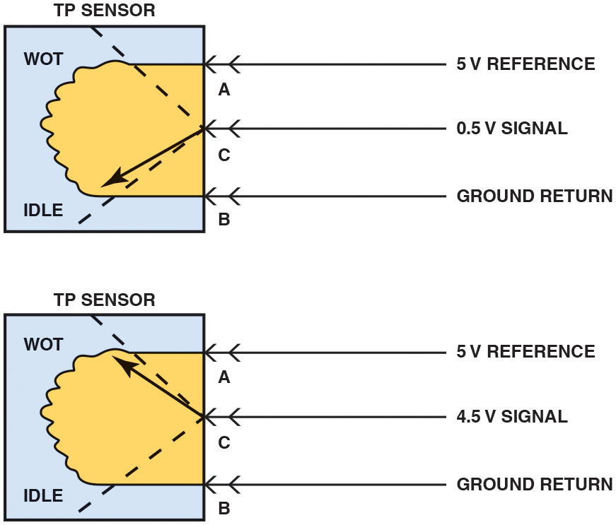
Figure 16.12
T P Sensor Operation
The signal voltage from a throttle position increases as the throttle is opened because the wiper arm is closer to the 5-volt reference. At idle, the resistance of the sensor winding effectively reduces the signal voltage output to the computer.

Slide 37
Animation: Throttle Position Sensor (TPS)

Slide 38
Question 4
What is the purpose of each of the three wires on a typical T P sensor?

Slide 39
Answer 4
5-volt feed, ground (signal return), and signal voltage.

Slide 40
T P Sensor Computer Input Functions
Computer senses any change in throttle position and changes the fuel mixture and ignition timing.
Throttle position sensor signals P C M to pulse additional fuel from the injectors when the throttle is depressed.

Slide 41
P C M Uses for T P Sensor
T P sensor used by P C M for the following:
Clear flood mode
Torque converter clutch engagement and release
Rationality testing for M A P and M A F sensors
Automatic transmission shift points
Target idle speed (idle control strategy)
Air-conditioning compressor operation
Backs up other sensors

Slide 42
Testing Throttle Position Sensor
T P sensor can be tested using the following tools:
A Digital Voltmeter with three test leads connected in series
Scan tool or a specific tool recommended by the vehicle manufacturer
D S O

Slide 43
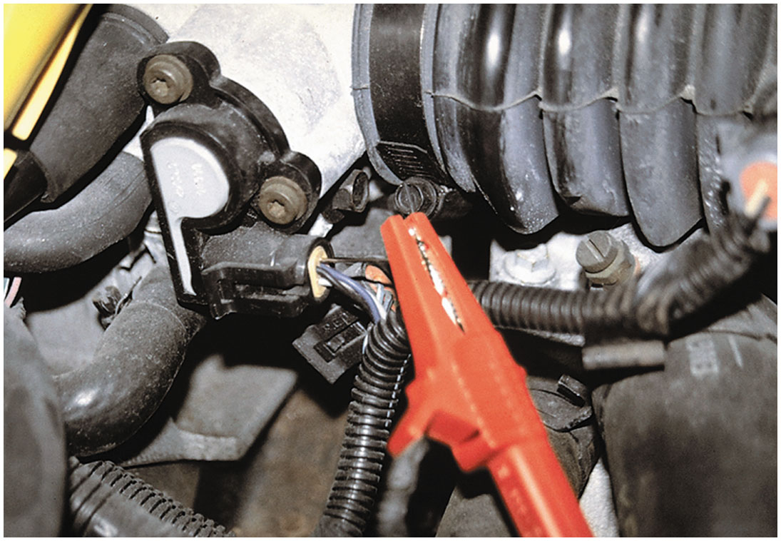
Figure 16.13
T P Sensor Testing
A meter lead connected to a T-pin that was gently pushed along the signal wire of the T P sensor until the point of the pin touched the metal terminal inside the plastic connector.

Slide 44
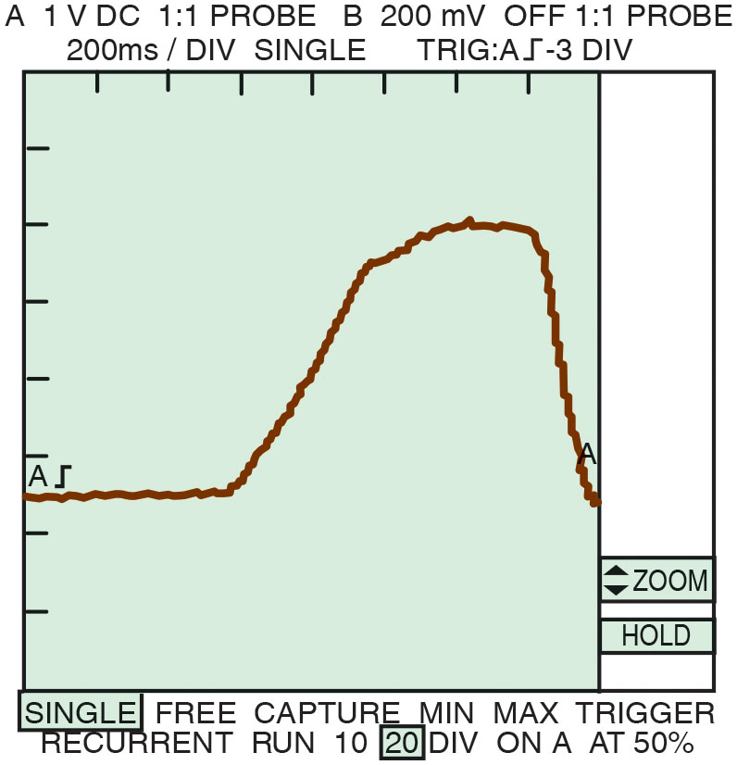
Figure 16.14
T P Sensor Waveform
A typical waveform of a T P sensor signal as recorded on a D S O when the accelerator pedal was depressed with the ignition switch on (engine off). Clean transitions and the lack of any glitches in this waveform indicate a good sensor.
Notes:
Long Description:
Clean transitions and the lack of any glitches in this waveform indicate a good sensor. The wave starts a constant value then smoothly increases then plateaus before falling to initial value.

Slide 45
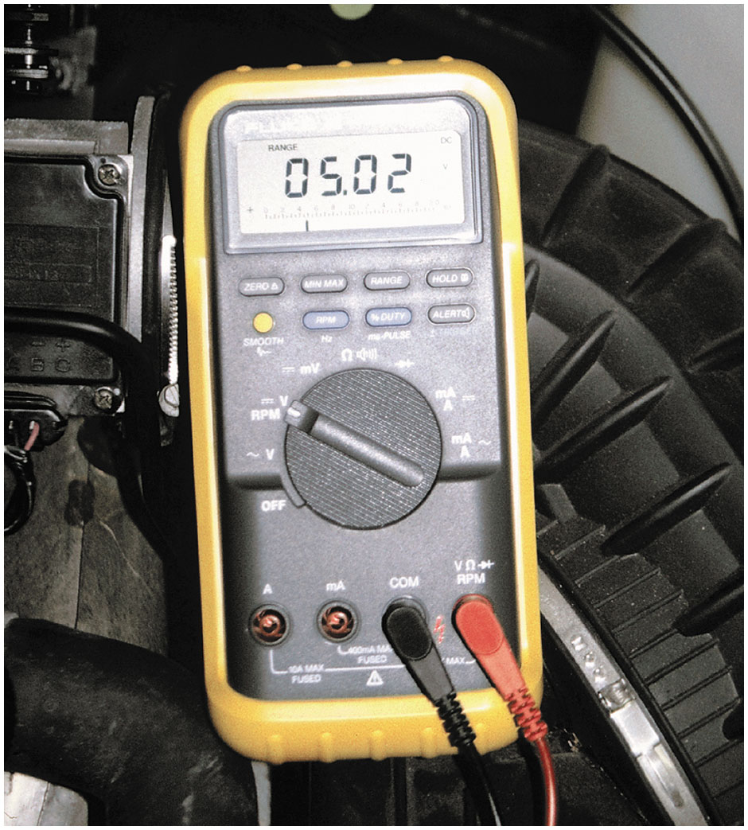
Figure 16.15
T P D M M Testing
Checking the 5-volt reference from the computer being applied to the T P sensor with the ignition switch on (engine off).

Slide 46
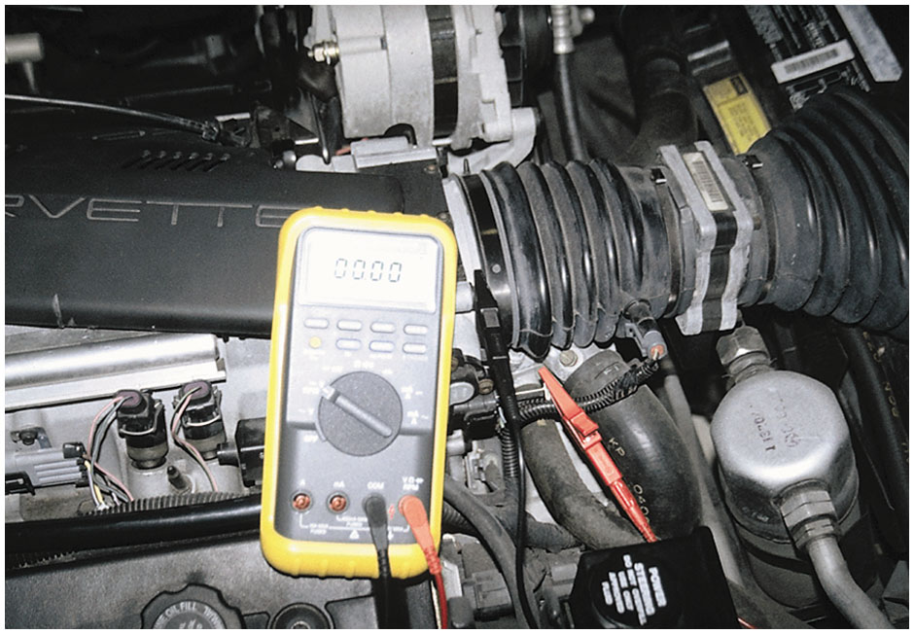
Figure 16.16
T P Voltage Drop
Checking the voltage drop between the T P sensor ground and a good engine ground with the ignition on (engine off). A reading of greater than 0.2 volt (200 mV) represents a bad computer ground.
Notes:
TECH TIP: Check Power and Ground before Condemning a Bad Sensor
Most engine sensors use a 5-volt reference and a ground. If the 5 volts to the sensor is too high
(shorted to voltage) or too low (high resistance), the sensor output will be skewed or out of range. Before replacing the sensor that did not read correctly, measure both the 5-volt reference and ground. To measure the ground, simply turn the ignition on (engine off) and touch one test lead of a D M M set to read D C volts to the sensor ground and the other to the negative terminal of the battery. Any reading higher than 0.2 volt (200 mV) represents a poor ground.

Slide 47
Animation: TP Sensor Volt Check, Reference Signal

Slide 48
Question 5
What are three ways to test a T P sensor?

Slide 49
Answer 5
A multimeter, a scan tool, and an oscilloscope.

Slide 50
Testing T P Sensor Using M I N/M A X Function
Many digital multimeters are capable of recording voltage readings over time and then displaying the minimum, maximum, and average readings.
To perform a M I N/M A X test of T P sensor, manually set the meter to read higher than 4 volts.

Slide 51
Testing T P Sensor Using Scan Tool
With key on, engine off, T P sensor voltage display should be about 0.5 volt.
Check scan tool display for percentage of throttle opening.
The idle air control (I A C) counts should increase as the throttle is opened and decrease as the throttle is closed.
Shut off and restart the engine. The percentage of throttle opening should return to 0%.

Slide 52
Summary
The E C T sensor is a high-authority sensor at engine start-up and is used for closed-loop control, as well as idle speed.
All temperature sensors decrease in resistance as the temperature increases. This is called negative temperature coefficient (N T C).
The E C T and I A T sensors can be tested visually, as well as by using a digital multimeter or a scan tool.
Some vehicle manufacturers use a stepped E C T circuit inside the P C M to broaden the accuracy of the sensor.
Other temperature sensors include transmission fluid temperature (T F T), engine fuel temperature (E F T), exhaust gas recirculation (E G R) temperature, and engine oil temperature.

Slide 53
Animation and Video Library Links (Must have an internet connection and active Haldeman subscription)
Animation Library: (A8) Engine Performance Animations
Video Library: (A8) Engine Performance Videos

Slide 54
Copyright
This work is protected by United States copyright laws and is provided solely for the use of instructors in teaching their courses and assessing student learning. Dissemination or sale of any part of this work (including on the World Wide Web) will destroy the integrity of the work and is not permitted. The work and materials from it should never be made available to students except by instructors using the accompanying text in their classes. All recipients of this work are expected to abide by these restrictions and to honor the intended pedagogical purposes and the needs of other instructors who rely on these materials.

