Slide 1
Advanced Engine Performance Diagnosis
Eighth Edition
Chapter 10
Global O B D hyphen Roman number 2 and Mode $06
Copyright © 2025 Pearson Education, Inc. All Rights Reserved
Notes:
If this PowerPoint presentation contains mathematical equations, you may need to check that your computer has the following installed:
1) Math Type Plugin
2) Math Player (free versions available)
3) NVDA Reader (free versions available)
INSTRUCTOR NOTE: This presentation includes text explanation notes, you can use to teach the course. When in SLIDE SHOW mode, you RIGHT CLICK and select SHOW PRESENTER VIEW, to use the notes.

Slide 2
Learning Objectives
10.1 Explain Global
and its modes of operation.
10.2 List the steps for diagnosing problems using mode $06.
10.3 Access global
on a scan tool.
10.4 Describe how mode $06 can be used to identify a problem.
10.5 Explain how to convert raw numbers to usable data for various types of mode $06 tests.
10.6 Describe permanent fault codes and how to clear them.
10.7 State where mode $06 information can be obtained.

Slide 3
What Is Global O B D hyphen Roman number 2 question mark (1 of 2)
Purposes and Functions
The purposes and functions of Global
include:
It can check P C M to determine what it has detected about a failure.
It can be used by service technicians to verify a repair.
It can check test results performed by P C M to see if the results are close to a failure level.
Information will show what is at fault even though no D T C s are set.
Since data displayed is very technical, it often need to be converted to give service technician usable information.

Slide 4
What Is Global O B D hyphen Roman number 2 question mark (2 of 2)
Purposes and Functions include:
An estimated 80% of P C M D T Cs can be diagnosed using
the global
function of scan tool.
All global
functions are standardized, which is not
case when looking at O E M data.
Some D T C s may be displayed using the global
scan tool function that is not displayed on an O E M, or by
using enhanced mode
function of the scan tool.

Slide 5
Global O B D hyphen Roman number 2 Modes
All
vehicles must be able to display data on a global (generic) scan tool
under 10 different modes of operation:
Mode One Current data (parameter identification display or P I D)
Mode Two Freeze-frame data
Mode Three Diagnostic trouble codes
Mode Four Clear and reset D T C s, freeze-frame data, and readiness status monitors for noncontinuous monitors only
Mode Five Oxygen sensor monitor test results
Mode Six O B D monitoring of test results for noncontinuous monitored systems
Mode Seven O B D monitoring of test results for continuously monitored systems
Mode Eight Bidirectional control of onboard systems
Mode Nine Module identification
Mode Ten ($0A) Permanent diagnostic trouble codes (D T C s)

Slide 6
Frequently Asked Question: How Can You Tell Global from Factory?
? Frequently Asked Question
How Can You Tell Global from Factory? When using a
scan tool on an
equipped vehicle, if the display asks
for make, model, and year of manufacture, then the factory or enhanced part of the P C M is being accessed. This is true
for most scan tools except the Chrysler D R B
and Star
Scans being used on a Chrysler vehicle. These scan tools can determine vehicle information from the P C M and do not need to be entered by the service technician. If the global or generic part of the P C M is being scanned, then there is no need to know the vehicle details.

Slide 7
Global O B D hyphen Roman number 2 Modes (1 of 2)
Chart 10.1 Hexadecimal Numbers
Generic (global) data is used by most state emission programs.
Decimal Number | Hexadecimal Code
0 | $0
1 | $1
2 | $2
3 | $3
4 | $4
5 | $5
6 | $6
7 | $7
8 | $8
9 | $9
10 | $A
11 | $B
12 | $C
13 | $D
14 | $E
15 | $F
Generic
displays often
use hexadecimal numbers, which use 16 numbers instead of 10. Numbers 0 to 9 (zero counts as a number) make up first 10 and then capital letters A to F complete 16 numbers.
To help identify number as being in a hexadecimal format, a dollar sign ($) is used in front of the number or letter. See following conversion chart:

Slide 8
Global O B D hyphen Roman number 2 Modes (2 of 2)
Hexadecimal Numbers
Hexadecimal coding is also used to identify tests (Test Identification [T I D] and Component Identification [C I D]). C A N-equipped vehicles use monitor identification (M I D) and T I D.
Decimal Number | Hexadecimal Code
0 | $0
1 | $1
2 | $2
3 | $3
4 | $4
5 | $5
6 | $6
7 | $7
8 | $8
9 | $9
10 | $A
11 | $B
12 | $C
13 | $D
14 | $E
15 | $F

Slide 9
Diagnosing Problems Using Modes $06
Mode $06 information can be used to diagnose faults by following 3 steps:
STEP 1: Check monitor status before starting repairs. This step will show how the system failed.
STEP 2: Look at component or parameter that triggered fault. This step will help pin down root cause of failure.
STEP 3: Look to monitor enable criteria, which will show what it takes to fail or pass monitor.

Slide 10
Accessing Global O B D hyphen Roman number 2 (1 of 4)
Global
Global (generic)
used by inspectors where
emission testing is performed.
Aftermarket scan tools designed to retrieve global
Some O E M Scan tools, like Tech 2 are not able to retrieve information without special software.
Global
is accessible using I S O-9141-2, K W P
2000, J1850 P W M, J1850 V P W, and C A N.

Slide 11
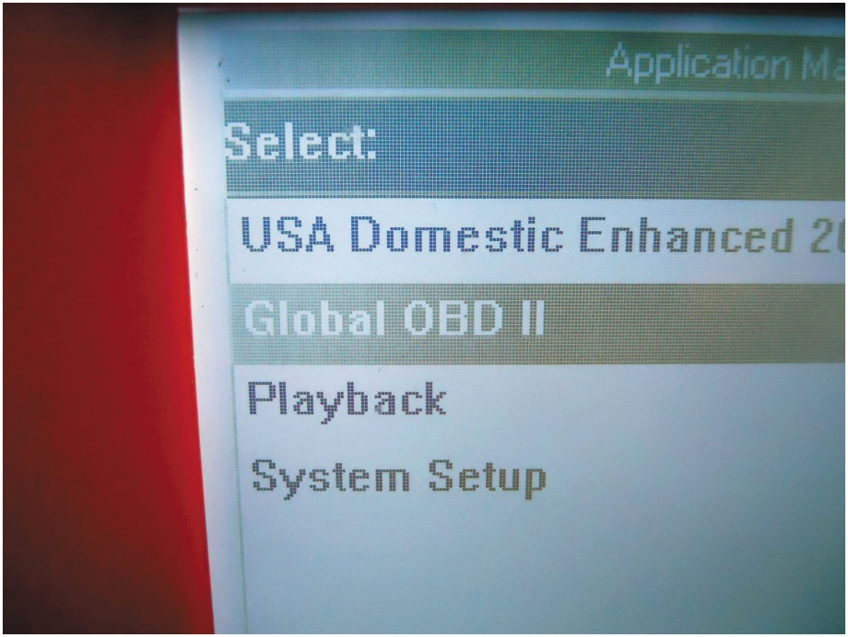
Figure 10.1
Global
Global
can be
accessed from the main menu on all aftermarket and some original equipment scan tools.

Slide 12
Accessing Global O B D hyphen Roman number 2 (2 of 4)
Snap-On 2500
An older Snap-on scan tool, often called “the brick” that was used in the aftermarket for many year.
Snap-On Solus
From main menu select “Generic
Follow the on-screen instructions to select the desired test.

Slide 13
Frequently Asked Question: What Is E O B D?
? Frequently Asked Question
What Is E O B D? E O B D stands for European on-board diagnostics. It is like the U.S. version and meets the standard specified for generic O B D data.

Slide 14
Accessing Global O B D hyphen Roman number 2 (3 of 4)
Snap-On Modis
Select scanner using down arrow key and then select
“Global
Follow on-screen instructions to get to “start communication” and then to the list of options to view.
O T C Genisys
From main menu select “Global
and then follow
the on-screen instructions.
Select “special tests” to get access to mode $06 information and parameters.

Slide 15
Accessing Global O B D hyphen Roman number 2 (4 of 4)
Master Tech
From main menu, select “Global
At next screen, select “
functions,” then “system
tests,” and then “other results” to obtain mode $06 data.

Slide 16
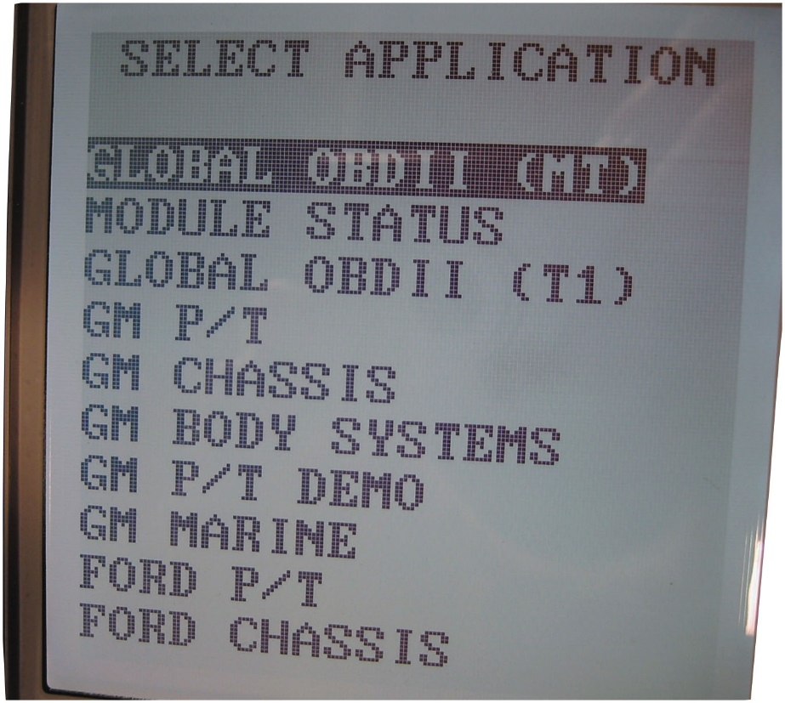
Figure 10.2
Master Tech display
A photo of a Master Tech display, showing where to
select global
from the
menu.

Slide 17
Animation: Scan Tools, OBD II

Slide 18
Mode $06 (1 of 6)
Mode $06 is used by service technicians to monitor the P C M test results of various systems.
While other modes are used for monitoring other functions, mode $06 is used to maintain all noncontinuous monitors and pending D T Cs.
The continuous monitors include fuel system monitors, misfire monitors, and comprehensive component monitors (C C M).
The noncontinuous monitors include catalyst efficiency, E G R, E V A P, oxygen sensor monitors, oxygen sensor heater, secondary air injection (S A I), and thermostats.

Slide 19
Mode $06 (2 of 6)
Using Mode $06
Mode $06 is used to monitor all of the tests of the system and components.
Mode $06 allows the service technician to view what the computer is doing and see the results of all of the tests that are being performed.

Slide 20
Mode $06 (3 of 6)
Mode $06 can be used for:
See test results that are close to failing. This means that a D T C may be set in future because results of test are close to set limit, & cause D T C to set.
Looking at mode $06 data, technician can be warned of a problem
Verify a repair. By looking at mode $06 test results,
Determine whether or not the repair that caused M I L to come on was in fact repaired correctly.
If test results are close to upper or lower limit allowed, repair was not completed successfully.
If, however, test results are far from upper or lower limit, repair was successful and vehicle can be returned to the owner
Knowing that the M I L will not come on again due to same concern.

Slide 21
Mode $06 (4 of 6)
Reading Mode $06 Data
Some scan tools translate raw hexadecimal data into
English, such as Auto Enginuity scan tool software
However, data is difficult to read.
In addition, data from Ford vehicles needs to be multiplied by a conversion factor to achieve a usable value.

Slide 22
Mode $06 (5 of 6)
Select Monitor
The first step is to select monitor (fuel trim, misfire, catalyst, etc.). There could be three results:
Incomplete. means computer has not yet completed test for selected monitor.
Pass. means that monitor was tested to completion and that test passed. Pass could have been close to failing; looking at test results will indicate how close it came to failing.
Fail. monitor test failed. Checking test results will help determine why it failed and by how much, which will help in diagnosing root cause.

Slide 23
Mode $06 (6 of 6)
Data Display
Test data displayed often includes upper limit and/or lower limit (often not both), test results, and units.
The “unit” may be just a number
However, by looking at upper and lower limits, you can judge how close test results were to failing test.
Many scan tools display component and test information in plain English
While others just display the hexadecimal number

Slide 24
Oxygen Sensor Heater Mode $06 Test (General Motors) (1 of 2)
Can set a P0141 D T C for bank 1, sensor 1 (B1S1).
Checking service information indicates the following enable criteria for the code to set:
Cold engine start
Engine at idle speed
Engine operating temperature below

Slide 25
Oxygen Sensor Heater Mode $06 Test (General Motors) (2 of 2)
Following Monitors Suspended:
E V A P
Oxygen sensor performance
Catalyst
Mode $06 data for B1S1 heater circuit in T I D-06, C I D-41:
The maximum limit = 186
Measure value = 33
Minimum limit = -----
Result = passed
Notes:
Note that the technician cannot determine what is being measured nor what the number 186 indicates. Also note that there is no minimum limit and the measured value of 33 is far below the maximum limit of 186. This means that the oxygen sensor heater test easily passed.

Slide 26
Engine Misfire Tests (Ford) (1 of 4)
A misfire fault can set a random misfire D T C of P0300 or one or more individual misfire D T C s P0301 through P0310 for cylinders one through 10.
Enable criteria for these codes to set include:
Time since engine start 5 seconds
Engine coolant temperature
to
R P M range from idle to redline or fuel cutoff
Fuel level 15% minimum
Test I D is used to identify several related tests, including:
$50—Total engine misfire (updated every 1,000 revolutions)
$53—Cylinder-specific misfire

Slide 27
Engine Misfire Tests (Ford) (2 of 4)
Ford being checked using mode $06 for T I D-50 had following results:
Maximum limit = 1,180
Measured value = 0
Minimum value = -----
Result = passed
What is percentage of misfire allowed?
Value shown for maximum has to be converted to get actual percentage.
According to service information, to get actual percentage of misfire
value has to be multiplied by
So, raw value for maximum
misfire was
which equals 1.7%. Maximum allowable
misfire before a D T C is set is 1.7%. By looking at mode $06 data, you can determine how close engine is to failing misfire monitor.

Slide 28
Engine Misfire Tests (Ford) (3 of 4)
For individual cylinder misfires, check test I D $53.
For example, if a value of 17,482 is displayed, test failed. Multiplying test results (17,482) by conversion
factor
shows a misfire of 26%.
Type A misfire codes: those that can cause damage to catalytic converter. Misfire usually ranges from 40% at idle to about 4% at high engine speeds.
Type B misfire codes set if the misfire exceeds 2% to 4%, depending on engine, make, model, and year.

Slide 29
Engine Misfire Tests (Ford) (4 of 4)
Ford and other companies have many tests performed on oxygen sensor, including voltage amplitude.
Ford T I D $01, C I D $21 for H O 2 S 1 shows:
Minimum value = 512
Maximum value = N/A
Current value = 794
According to Ford, numbers have to be converted into
volts by multiplying value by
So, current value is
0.778 volts, which is above minimum allowable voltage of

Slide 30
G M C A N Oxygen Sensor Mode $06 Test (1 of 2)
One of oxygen sensor tests performed on a G M vehicles equipped with C A N (G M C A N) is rich-to-lean sensor switch time.
Typical test results show:
Monitor I D (M I D) $01
Test I D $05
Maximum limit = 0.155 sec.
Measured value
Minimum value
Result = passed

Slide 31
G M C A N Oxygen Sensor Mode $06 Test (2 of 2)
This mode $06 test shows oxygen sensor is able to reset very quickly to a change in air–fuel mixture from rich to
lean by reacting in 30 ms
Normally this information only be determined using a scope of waveform who forces system lean and watches the reaction time on scope display.
Using mode $06 and a scan tool, especially on C A N, is a fast and easy way to determine oxygen sensor health without having to do time-consuming tests.
Notes:
Tech TIP: Mode $06 Replaces a Scope
Mode $06 data, especially when used on C A N-equipped vehicles, reduces the need to use an oscilloscope to view oxygen sensor reaction time in milliseconds. In the past, the only way to test an oxygen sensor for reaction time was to force the sensor lean or rich while viewing the reaction on a scope. Then, the reaction time could be determined using the cursors. Mode $06 data now includes oxygen sensor reaction time so that all that is needed to determine oxygen sensor condition is a scan tool and mode $06 data.

Slide 32
Ford E G R Tests (1 of 3)
Ford checks E G R system, including flow testing and tests of the sensor used to check the flow of exhaust gases.
Duty cycle of E G R solenoid checked using mode $06 by looking at the following:
T I D $4B
C I D $30
Maximum limit = 26,214
Measured value = 14,358
Minimum value = -----
Test results = passed

Slide 33
Ford E G R Tests (2 of 3)
These results at limits
Converted to give usable values
Multiply measured set limit value by
to get duty
cycle as a percentage (%).
Maximum limit
Measured value

Slide 34
Ford E G R Tests (3 of 3)
Ford Delta Pressure for E G R Flow Test
Following occurred on a test vehicle:
T I D $4A
C I D $30
Maximum limit =
Measured value = 2,226
Minimum limit = 768
Result = passed
The values shown need to be compared and corrected as follows:
If value is > 32,767, the value is negative.
If the value < 32,767, the value is positive.
Multiply value by
to get inches of water.
Notes:
The value was 2,226 × 0.0078 = 17.7 inches of water (in. H2O) of vacuum (negative pressure).

Slide 35
G M Catalyst Efficiency Test (1 of 2)
Scan tool displays data that do not need to be converted, although the units are often unknown. You can see how close test results come to either maximum or minimum limits.
G M idle catalyst efficiency test could have following results:
T I D $0C
C I D $60
Maximum limit = 33,234
Measured value = 17,708
Minimum limit = -----
Result = passed

Slide 36
G M Catalyst Efficiency Test (2 of 2)
What do the numbers represent?
Numbers are created as a result of the test and cannot be determined by the technician.
It is clear by the reading and the maximum limit that the catalyst efficiency test easily passed.
This is an excellent test to check if the efficiency of the catalytic converter needs to be determined.

Slide 37
G M E V A P Test (C A N)
One of evaporative (E V A P) system tests that can be monitored using a scan tool and mode $06 data is engine off, natural vacuum test.
An example of a typical result includes:
M I D E V A P
T I D 201
Minimum value
Maximum value
Current value
Notes:
The values do not need to be converted, although the units are unknown. However, it is clear from the test results that the current value is not even close to the maximum limit, which means that the E V A P system being tested by the natural vacuum method is free from faults.

Slide 38
Permanent Codes (1 of 2)
Definition
Starting in 2010 all vehicles support “permanent fault codes,” which are stored in nonvolatile R A M and cannot be cleared when the battery is disconnected and only go away when the problem is fixed.
There are three different types of
codes defined
under the S A E J1979 standard:
Mode $03 “confirmed” trouble codes
Mode $07 “pending” trouble codes
Mode $0A “permanent” trouble codes

Slide 39
Permanent Codes (2 of 2)
Permanent trouble codes cannot be simply “cleared” by any tool, even factory scan tools.
These codes can only be cleared by P C M once it has determined that the malfunction is no longer present.
Usually requires that vehicle be driven enough so it can pass the self tests.

Slide 40
Where to Get Mode $06 Information
Many scan tools display all of the parameters and information needed so that additional mode $06 data is not needed.
Many O E M s post mode $06 information on service information websites.
This information is often free, unlike other service information.
Refer to National Automotive Service Task Force (N A S T F) website for website address of all O E M service information sites
(
www.NASTF.org
)
Notes:
Two examples include:
http://service.gm.com (free access to mode $06 information)
www.motorcraftservice.com (search for mode $06 free access)

Slide 41
Summary (1 of 2)
Global
can be used by a service technician to do the
following:
Check the P C M regarding what it has detected as a fault
Verify a repair
Check if the test results are close to failure, which could trigger the M I L
Global
has 10 modes, each covering a certain aspect of the
diagnostic system.
Mode $06 is the most commonly used mode of global
because it includes data on the noncontinuous monitored system.

Slide 42
Summary (2 of 2)
Most aftermarket scan tools and some original equipment
scan tools can access global
data.
Many Ford mode $06 data requires that the displayed number be converted to show usable values.

Slide 43
Animation and Video Library Links (Must have an internet connection and active Haldeman subscription)
Animation Library: (A8) Engine Performance Animations
Animation Library: (A6) Electrical/Electronic Systems Animations
Video Library: (A8) Engine Performance Videos
Video Library: (A6) Electrical/Electronic Systems Videos

Slide 44
Copyright
This work is protected by United States copyright laws and is provided solely for the use of instructors in teaching their courses and assessing student learning. Dissemination or sale of any part of this work (including on the World Wide Web) will destroy the integrity of the work and is not permitted. The work and materials from it should never be made available to students except by instructors using the accompanying text in their classes. All recipients of this work are expected to abide by these restrictions and to honor the intended pedagogical purposes and the needs of other instructors who rely on these materials.

