Slide 1
Advanced Engine Performance Diagnosis
Eighth Edition
Chapter 9
On-Board Diagnosis
Copyright © 2025 Pearson Education, Inc. All Rights Reserved
Notes:
If this PowerPoint presentation contains mathematical equations, you may need to check that your computer has the following installed:
1) Math Type Plugin
2) Math Player (free versions available)
3) NVDA Reader (free versions available)
INSTRUCTOR NOTE: This presentation includes text explanation notes, you can use to teach the course. When in SLIDE SHOW mode, you RIGHT CLICK and select SHOW PRESENTER VIEW, to use the notes.

Slide 2
Learning Objectives
9.1 Explain the purpose and function of O B D systems.
9.2 Understand the purpose and function of on-board
diagnostics
systems.
9.3 Discuss the numbering designation of
diagnostic
trouble codes.
9.4 List the types of information obtained from a freeze-frame.
9.5 Understand the information obtained from an O B D monitor and the criteria to enable an O B D monitor.
9.6 List the continuous monitors.
9.7 List the noncontinuous monitors.

Slide 3
On-Board Diagnostics Generation hyphen roman numeral two (O B D hyphen roman numeral two) Systems (1 of 6)
PURPOSE AND FUNCTION OF
Early diagnostic systems reduce emissions and speed up vehicle repair.
Systems called On-Board Diagnostics (O B D s).
California Air Resources Board (C A R B) developed the first regulation requiring manufacturers selling vehicles in that state to install O B D.
O B D Generation
applies to all vehicles sold in California
beginning with the 1988 model year.

Slide 4
On-Board Diagnostics Generation hyphen roman numeral two (O B D hyphen roman numeral two) Systems (2 of 6) Specs:
Instrument panel warning lamp alerts certain system failures, now called a malfunction indicator lamp (M I L).
System’s ability to record and transmit diagnostic trouble codes (D T C s) for emission-related failures.
Electronic system monitoring of H O 2 S, E G R valve, and evaporative purge solenoid.
Notes:
By failing to monitor the catalytic converter, the evaporative system for leaks, and the presence of engine misfire, O B D-I did not do enough to lower automotive emissions. This led the CARB and the EPA to develop O B D Generation-II (O B D-II).

Slide 5
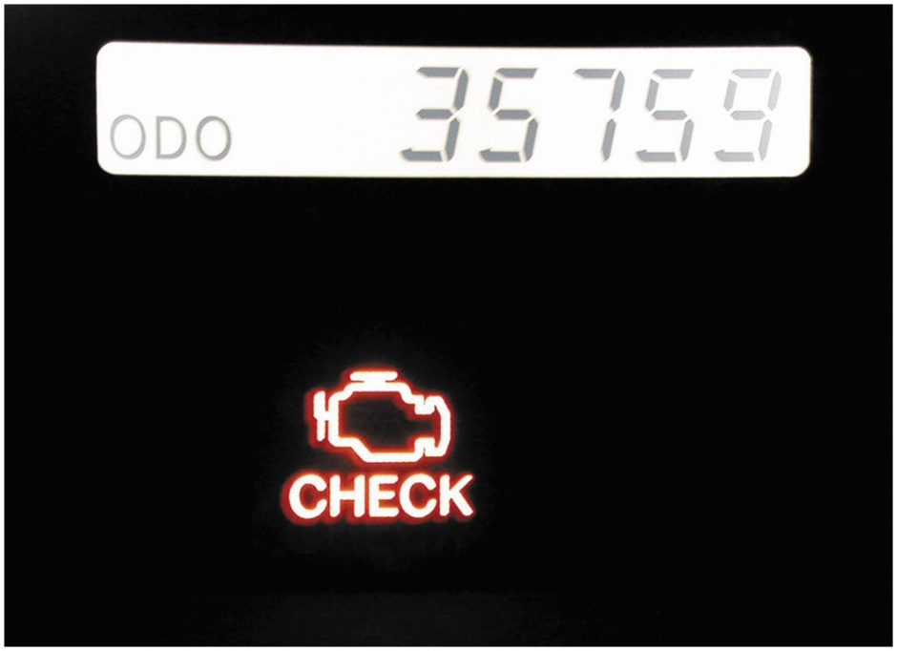
Figure 9.1
M I L
A typical malfunction indicator lamp (M I L) often labeled “check engine” or “service engine soon” (S E S).

Slide 6
On-Board Diagnostics Generation hyphen roman numeral two (O B D hyphen roman numeral two) Systems (3 of 6)
Objectives
C A R B defines
vehicle by its ability to:
Detect component degradation or a faulty emission related system that prevents compliance with federal emission standards.
Alert the driver of needed emission-related repair or maintenance.
Use standardized D T C s and accept a generic scan tool.
Notes:
These requirements apply to all 1996 and later model light-duty vehicles. O B D-Ⅱ regulations require that not only sensors but also all exhaust emission control devices be tested, and that they are verified for proper operation.

Slide 7
On-Board Diagnostics Generation hyphen roman numeral two (O B D hyphen roman numeral two) Systems (4 of 6)
All new vehicles must pass Federal Test Procedure (F T P) for exhaust emissions while being tested for 1874 seconds on dynamometer rollers that simulate urban drive cycle
The regulations for
vehicles state that the vehicle
computer must be capable of testing for, and determining
If the exhaust emissions are within 1.5 times the F T P limits

Slide 8
On-Board Diagnostics Generation hyphen roman numeral two (O B D hyphen roman numeral two) Systems (5 of 6)
The regulations for
vehicles state that the vehicle
computer must be capable of testing for, and determining, if the exhaust emissions are within 1.5 times the F T P limits.
Computer must:
Test all exhaust emission system components for correct operation.
Actively operate system and measure the results.
Continuously monitor all aspects of the engine operation to be certain that the exhaust emissions do not exceed 1.5 times the F T P limit.

Slide 9
On-Board Diagnostics Generation hyphen roman numeral two (O B D hyphen roman numeral two) Systems (6 of 6)
Check engine operation for a misfire.
Turn on the M I L (check engine) if the computer senses a fault in a circuit or system.
Record a freeze-frame, which is a snapshot of all key engine data at the time the D T C was set.
Flash the M I L if an engine misfire occurs that could damage the catalytic converter.

Slide 10
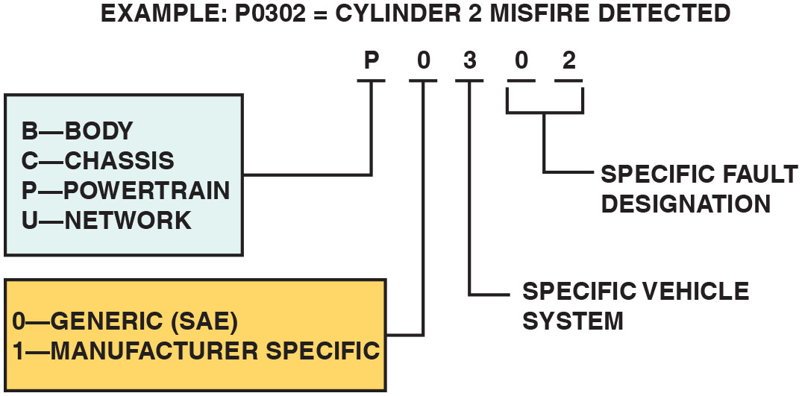
Figure 9.2
D T C
D T C identification format
Notes:
Long Description:
The illustration displays an example: P0302 equals cylinder 2 misfire detected. P represents BCPU; B: Body, C: Chassis, P: Powertrain, and U: Network. 0 represents Generic (SAE) or 1 represents manufacturer specific. 3 represents specific vehicle system. 0 and 2 represents specific fault designation.

Slide 11
O B D hyphen roman numeral two D T C Numbering Designation (1 of 4)
D T C s are grouped into major categories, depending on the location of the fault on the system involved.
Pxxx—powertrain D T C s
Bxxx—Body D T C s
Cxxx—Chassis D T C s
Uxxx—Network D T C s

Slide 12
Animation: Diagnostic Trouble Code, DTC

Slide 13
O B D hyphen roman numeral two D T C Numbering Designation (2 of 4)
D T C Numbering Explanation
P0100—Air metering and fuel system fault
P0200—Fuel system (fuel injector only) fault
P0300—Ignition system or misfire fault
P0400—Emission control system fault
P0500—Idle speed control, vehicle speed (V S) sensor fault
P0600—Computer output circuit (relay, solenoid, etc.) fault
P0700—Transaxle, transmission faults

Slide 14
O B D hyphen roman numeral two D T C Numbering Designation (3 of 4)
Types of D T C s
Type A Codes. Emission-related and causes the M I L to be turned on the first trip if the computer has detected a problem.
Type B Codes. Stored and M I L is turned on during second consecutive trip, alerting the driver to the fact that a diagnostic test was performed and failed.
Type C and D Codes. For use with non-emission-related diagnostic tests.

Slide 15
Frequently Asked Question: What Are Pending Codes?
? Frequently Asked Question
What Are Pending Codes? Pending codes are set when operating conditions are met and the component or circuit is not within the normal range, yet the conditions have not yet been met to set a D T C. For example, a sensor may require two consecutive faults before a D T C is set. If a scan tool displays a pending code or a failure, a driveability concern could also be present. The pending code can help the technician to determine the root cause before the customer complains of a check engine light indication.

Slide 16
O B D hyphen roman numeral two D T C Numbering Designation (4 of 4)
Diagnostic Trouble Code Priority
C A R B mandated that all diagnostic trouble codes (D T C s) Freeze Frame be stored according to individual priority.
Priority 0—Non-emission-related codes
Priority 1—One-trip failure of two-trip fault for non-fuel, non-misfire codes
Priority 2—One-trip failure of two-trip fault for fuel or misfire codes
Priority 3—Two-trip failure or matured fault of non-fuel, non-misfire codes
Priority 4—Two-trip failure or matured fault for fuel or misfire codes

Slide 17
Question 1
What is the difference between a Type A and a Type B D T C?

Slide 18
Answer 1
Type A D T C illuminates the M I L after one trip. Type B D T C requires two trips to illuminate the M I L.

Slide 19
O B D hyphen roman numeral two Freeze-Frame (1 of 3)
requires computer to take a “snapshot” or freeze-
frame of all data
At the instant an emission-related D T C is set.
Scan tool is required to retrieve this data.
Notes:
NOTE: Although O B D-Ⅱ requires that just one freeze-frame of data be stored, the instant an emission-related DTC is set, vehicle manufacturers usually provide expanded data about the DTC beyond that required, such as General Motor’s failure recorders. However, retrieving this enhanced data usually requires the use of the vehicle-specific scan tool.

Slide 20
O B D hyphen roman numeral two Freeze-Frame (2 of 3)
Freeze-frame items include the following:
Calculated load value
Engine speed (R P M)
Short-term and long-term fuel trim percent
Fuel system pressure (on some vehicles)
Vehicle speed (mph)
Engine coolant temperature
Intake manifold pressure
Closed-open-loop status
Fault code that triggered the freeze-frame
If a misfire code is set, identify which cylinder is misfiring

Slide 21
O B D hyphen roman numeral two Freeze-Frame (3 of 3)
D T C should not be cleared from the vehicle computer memory unless the fault has been corrected, and technician directed by procedure.
If problem that caused the D T C to be set has been corrected
Computer will automatically clear D T C after 40 consecutive warm-up cycles with no further faults detected
Disconnecting battery may not erase D T C s or freeze-frame data.
Most vehicle manufacturers recommend using scan tool to erase D T C rather than disconnecting the battery

Slide 22
Chart 9.1
Faults
MONITOR NAME | MONITOR TYPE (HOW OFTEN IT COMPLETES) | NUMBER OF FAULTS ON SEPARATE TRIPS TO SET A PENDING D T C | NUMBER OF SEPARATE CONSECUTIVE TRIPS TO LIGHT M I L, STORE A D T C | NUMBER OF TRIPS WITH NO FAULTS TO ERASE A M ATURING D T C | NUMBER OF TRIPS WITH NO FAULT TO TURN THE M I L OFF | NUMBER OF WARM-UP CYCLES TO ERASE D T C AFTER M I L IS TURNED OFF
C C M | Continuous (trip conditions allow it) | 1 | 2 | 1–Trip | 3–Trips | 40
Catalyst | Once per drive cycle | 1 | 3 | 1–Trip | 3–OBD-roman numeral two drive cycle | 40
Misfire Type A | Continuous |  | 1 |  | 3–Similar conditions | 80
Misfire Type B | Continuous | 1 | 2 | 1–Trip | 3–Similar conditions | 80
Fuel System | Continuous | 1 | 2 | 1–Trip | 3–Similar conditions | 80
Oxygen Sensor | Once per trip | 1 | 2 | 1–Trip | 3–Trips | 40
E G R | Once per trip | 1 | 2 | 1–Trip | 3–Trips | 40
E V A P | Once per trip | 1 | 1 | 1–Trip | 3–Trips | 40
A I R | Once per trip | 1 | 2 | 1–Trip | 3–Trips | 40
P C M Determination of faults chart.

Slide 23
Diagnostic Executive or Task Manager (1 of 11)
Purpose
P C M uses software to perform needed tasks
Ford/G M call software diagnostic executive
Chrysler systems, calls it the task manager.
Manage operation of all
monitors
By controlling sequence of steps necessary
To execute diagnostic tests and monitors.

Slide 24
Diagnostic Executive or Task Manager (2 of 11)
Enabling Criteria
P C M needs an internal director to keep track of when each monitor should run
Each monitor has enabling criteria
Conditions that must be met before task manager will give go-ahead for each monitor to run.
Most enabling criteria follow simple logic, such as:
Not authorize start of O2S monitor until engine has reached operating temperature and the system has entered closed loop.
Not authorize start of E G R monitor when engine at idle because E G R is closed

Slide 25
Diagnostic Executive or Task Manager (3 of 11)
Enabling criteria can differ from one monitor to the next
Task manager decides when each monitor should run, and in what order, to avoid confusion.
Monitor may be classified as pending if a failed sensor or other system fault is keeping it from running on schedule.
Task manager may suspend a monitor if conditions are not correct to continue.
For example, if the catalyst monitor is running during a road test, P C M detects a misfire, catalyst monitor will be suspended for duration of misfire.

Slide 26
Diagnostic Executive or Task Manager (4 of 11)
Global Disable
Monitors can be globally disabled for certain defined parameters because of potential for false failures during the test.
Not all global disablers apply to every monitor.
Conditions that could disable a monitor include:
New catalyst Bank 2
New catalyst Bank 1
Very low battery voltage
High ethanol content
Power Take Off (P T O) Engage
Low fuel level
High fuel level
High altitude
Low battery voltage
High battery voltage
Low ambient temperature
Very low ambient temperature

Slide 27
Diagnostic Executive or Task Manager (5 of 11)
Pending
Under some situations P C M will not run a monitor
M I L is ON and a fault is stored from another monitor
P C M postpones monitors, pending a resolution of original fault.
P C M does not run test until problem is remedied.
M I L is illuminated for an oxygen sensor fault
P C M does not run catalyst monitor until oxygen sensor fault is remedied.

Slide 28
Diagnostic Executive or Task Manager (6 of 11)
Conflict
Situations when P C M does not run a monitor if another monitor is in progress.
Effects of another monitor running could result in a failure.
If this conflict is present, monitor is not run until conflicting condition passes.
Monitor will run later after the conflicting monitor has passed.
For example, if fuel system monitor is in progress, P C M does not run E G R monitor. Since both tests monitor changes in air–fuel ratio and adaptive fuel compensation, monitors conflict with each other.

Slide 29
Diagnostic Executive or Task Manager (7 of 11)
Suspend
P C M may not allow a two-trip fault to mature.
P C M will suspend maturing fault if a condition exists that may induce erroneous failure.
Prevents illuminating M I L for wrong fault and allows more precise diagnosis.
For example, if P C M is storing a one-trip fault for oxygen sensor and E G R monitor, P C M may still run E G R monitor, but will suspend results until oxygen sensor monitor either passes or fails.
P C M can determine if E G R system is actually failing or if an oxygen sensor is failing.

Slide 30
Diagnostic Executive or Task Manager (8 of 11)
Trip
Key-on condition that contains necessary conditions for a particular test to be performed followed by a key-off.
Conditions are called enable criteria.
For example E G R test to be performed,
Engine must be at normal operating temperature and decelerating for a minimum amount of time.
Some tests are performed when the engine is cold, whereas others require that the vehicle be cruising at a steady highway speed.
Warm-Up Cycle
A trip with an engine temperature increase of at least
and where
engine temperature reaches at least

Slide 31
Diagnostic Executive or Task Manager (9 of 11)
M I L Condition: Off
P C M has not detected any faults in an emissions-related component or system or that M I L circuit is not working.
M I L Condition: On Steady
This condition indicates a fault in an emissions-related component or system that could affect vehicle emissions.
M I L Condition: Flashing
This condition indicates a misfire or fuel control system fault that could damage the catalytic converter.
Notes:
NOTE: In a misfire condition with the M I L on steady, if the driver reaches a vehicle speed and load condition with the engine misfiring at a level that could cause catalyst damage, the M I L would start flashing. It would continue to flash until engine speed and load conditions caused the level of misfire to subside. Then, the M I L would go back to the on-steady condition. This situation might result in a customer complaint of a M I L with an intermittent flash

Slide 32
Diagnostic Executive or Task Manager (10 of 11)
M I L Off
P C M will turn off M I L if any of following occurs:
Codes are cleared with scan tool.
Power to P C M is removed at battery or with P C M power fuse for an extended period of time (may be up to several hours or longer).
Vehicle is driven on 3 consecutive trips with a warm-up cycle and meets all code set conditions without P C M detecting faults.
P C M will set a code if a fault is detected that could cause tailpipe emissions to exceed 1.5 times F T P standard.
However, P C M will not deactivate M I L until vehicle has been driven on 3 consecutive trips with vehicle conditions similar to actual conditions present when the fault was detected.
Notes:
This is not merely three vehicle start-ups and trips. It means three trips during which certain engine operating conditions are met so that the O B D-Ⅱ monitor that found the fault can run again and pass the diagnostic testing condition.

Slide 33
Diagnostic Executive or Task Manager (11 of 11)
Exponentially Weighted Moving Average (E W M A) Monitors
Mathematical method used to determine performance.
Smooths out variables in readings over time and results in a running average.
Some O E M S use this strategy to test a system multiple times during a single drive cycle.
Method is used by some O E M S for 2 monitors.
Catalyst monitor
E G R monitor

Slide 34
Monitors (1 of 11)
Monitor is organized method of testing a specific part of system.
Tests computer performs to evaluate components and systems
Component/System failure is detected
D T C will be stored and M I L illuminated during 2 trip.
Two types of monitors are
Continuous & Noncontinuous (once-per-trip)
Continuous Monitors
Run after required enabling conditions are met
Run for remainder of vehicle drive cycle

Slide 35
Frequently Asked Question: What Is a Drive Cycle?
? Frequently Asked Question
What Is a Drive Cycle? Vehicle being driven under specified speed and times that allows all monitors to run. P C M is looking at a series of data points representing speed and time and determines from these data points when the conditions are right to perform a monitor or a test of a component. These data points and, therefore, drive cycle are vehicle- specific and are not the same for each vehicle. Some conditions for a drive cycle to successfully run all of the monitors include Cold start with intake air temperature (I A T) and engine coolant temperature (E C T) close to each other, indicating that the engine has cooled to the temperature of the surrounding air temperature. Fuel level within a certain range, between 15% and 85%. Vehicle speed 4 to 12 minutes. Stop and idle for a certain time. SEE NOTES SECTION FOR BALANCE OF TEXT
Notes:
Frequently Asked Question: What Is a Drive Cycle?
A drive cycle is a vehicle being driven under specified speed and times that allows all monitors to run. In other words, the P C M is looking at a series of data points representing speed and time and determines from these data points when the conditions are right to perform a monitor or a test of a component. These data points and, therefore, the drive cycle are vehicle- specific and are not the same for each vehicle. Some common conditions for a drive cycle to successfully run all of the monitors include Cold start with intake air temperature (I A T) and engine coolant temperature (E C T) close to each other, indicating that the engine has cooled to the temperature of the surrounding air temperature. Fuel level within a certain range, usually between 15% and 85%. Vehicle speed within a certain speed range for certain amount of time, usually 4 to 12 minutes. Stop and idle for a certain time.
Each monitor requires its own set of parameters needed to run the test, and sometimes these conditions cannot be met. For example, some evaporate emissions control (E V A P) systems require a temperature that may not be possible in winter months in a cold climatic area.
A typical universal drive cycle that works for many vehicles includes the following steps.
M I L must be off. No D T Cs present. Fuel fill between 15% and 85%.
Cold start—Preferred = 8-hour soak at 68°F to 86°F. Alternative = E C T below 86°F.
STEP 1 With the ignition off, connect scan tool.
STEP 2 Start engine and drive between 20 and 30 mph for 22 minutes, allowing speed to vary.
STEP 3 Stop and idle for 40 seconds, gradually accelerate to 55 mph.
STEP 4 Maintain 55 mph for 4 minutes using a steady throttle input.
STEP 5 Stop and idle for 30 seconds, then accelerate to 30 mph.
STEP 6 Maintain 30 mph for 12 minutes.
STEP 7 Repeat steps 4 and 5 four times.
Using scan tool, check readiness. Always check service information for the exact drive cycle conditions for the vehicle being serviced for best results.

Slide 36
Monitors (2 of 11)
Comprehensive Component Monitor (C C M)
Watches sensors and actuators
Sensor values are constantly compared with known-good values
Designed to monitor failure in any electronic component or circuit (including emission-related and non–emission related circuits)
Many P C M sensors and output devices are tested at key-on or immediately after engine start-up.
However, some devices are tested by C C M only after engine meets certain engine conditions.
Components tested by the C C M include the following:
NEXT SLIDE

Slide 37
Monitors (3 of 11)
The components tested by the C C M include the following:
Four-wheel-drive low switch
Brake switch
Camshaft (C M P) and crankshaft (C K P) sensors
Clutch switch (manual transmissions/transaxles only)
Cruise servo switch
Engine coolant temperature (E C T) sensor
E V A P purge sensor or switch
Fuel composition sensor
Intake air temperature (I A T) sensor
Knock sensor (K S)
Manifold absolute pressure (M A P) sensor
Mass airflow (M A F) sensor
Throttle-position (T P) sensor
Transmission temperature sensor
Transmission turbine speed sensor
Vacuum sensor
Vehicle speed (V S) sensor
E V A P canister purge and E V A P purge vent solenoid
Idle air control (I A C)
Ignition control system
Transmission torque converter clutch solenoid
Transmission shift solenoids

Slide 38
Monitors (4 of 11)
Electrical Test
P C M check of both input and outputs for the following:
Open circuits
Shorts to voltage
Shorts to ground
For example: E C T Shorted high (input to P C M) above capable voltage; that is, a 5-volt sensor with 12-volt input to P C M would indicate a short to voltage.

Slide 39
Monitors (5 of 11)
Rationality Test
Test applied by P C M and constantly being monitored for rationality. Input signal compared against other inputs and information to see if it makes sense under the current conditions.
Functionality Test
Test refers to P C M inputs checking the operation of the outputs to see that they are functioning as designed:
Example:
P C M commands I A C to increase engine speed
P C M monitors engine R P M
Functionality test fails if engine speed does not increase

Slide 40
Monitors (6 of 11)
Misfire Monitor
Looks at engine misfire.
P C M uses information received from C K P Sensor
To calculate time between edges of reluctor, as well as rotational speed and acceleration.
Misfire Type A. Upon detection of a misfire type A (200 revolutions), which would cause catalyst damage, M I L will blink once per second during actual misfire, and D T C stored.

Slide 41
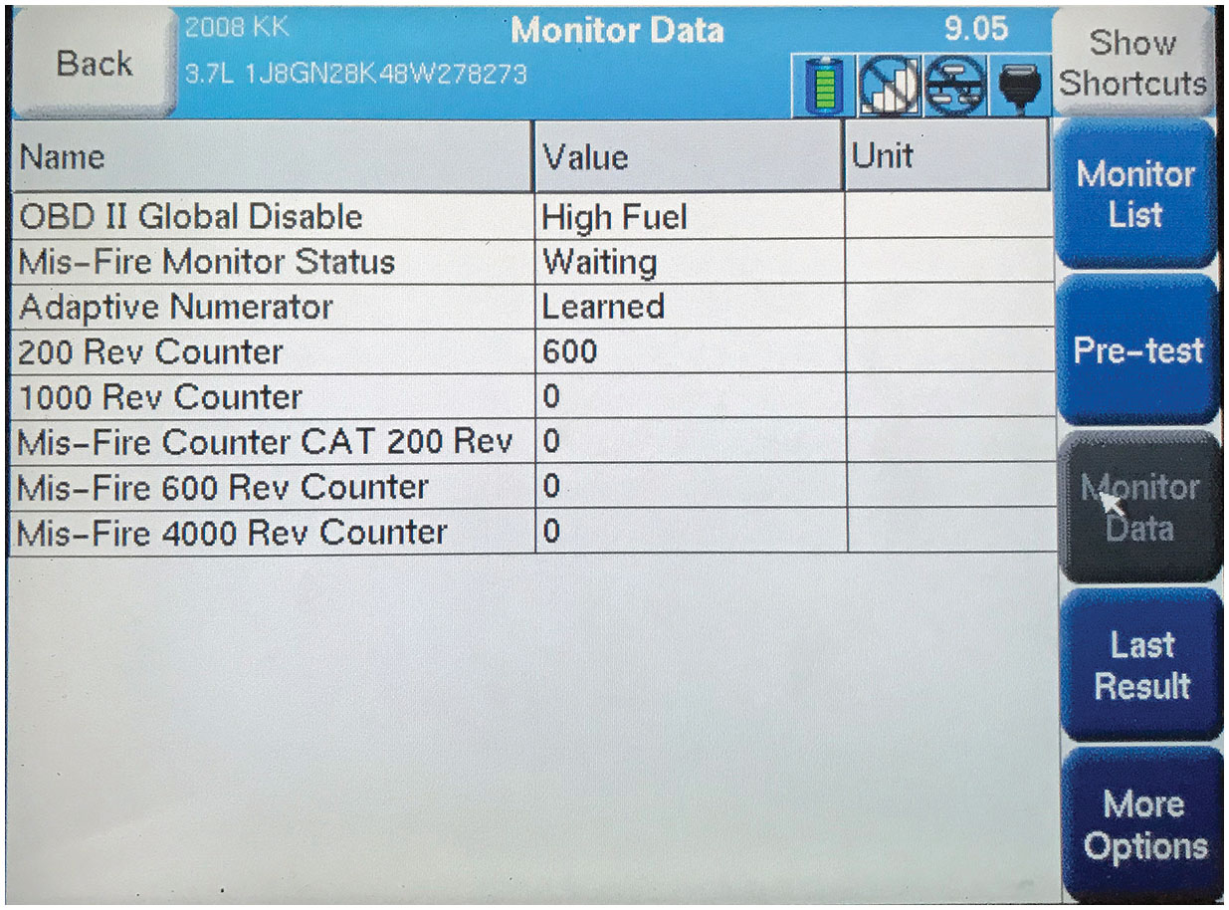
Figure 9.3
Misfire Monitor
A screen capture of a misfire on a scan tool.
Notes:
Long Description:
The back option is at the top-left corner. On the right, the following options are one below the other: show shortcuts, monitor list, pre-test, monitor data, last result, and more options. The monitor data option is selected. The monitor data for 2008 K K 3.7 L 1 J 8 G N 28 K 48 W 278273 is shown in a table. The data from the rows for the column headings name, value, and unit, respectively, are as follows: Row 1: O B D Roman number 2 Global Disable; High Fuel; blank. Row 2: Mis-Fire Monitor Status; Waiting; blank. Row 3: Adaptive Numerator; Learned; blank. Row 4: 200 Rev Counter; 600; blank. Row 5: 1000 Rev Counter; 0; blank. Row 6: Mis-Fire Counter C A T 200 Rev; 0; blank. Row 7: Mis-Fire 600 Rev Counter; 0; blank. Row 8: Mis-Fire 4000 Rev Counter; 0; blank.

Slide 42
Monitors (7 of 11)
Misfire Monitor Type B
Misfire Type B. Upon detection of a misfire type B (1000 revolutions), which will exceed 1.5 times the E P A federal test procedure (F T P) standard or cause vehicle to fail an inspection and maintenance tailpipe emissions test, M I L will illuminate and a D T C will be stored.

Slide 43
Monitors (8 of 11)
Misfire codes can be set for a variety of failures. Systems that can cause a misfire code to set include ignition, fuel, air induction, and engine mechanical.
Once repairs have been completed, it is helpful to complete a misfire monitor good trip to ensure problem has been resolved.
D T C associated with multiple cylinder misfire for a type A or type B misfire is D T C P0300.
D T Cs associated with an individual cylinder misfire for a type A or type B misfire are D T Cs P0301, P0302, P0303, P0304, P0305, P0306, P0307, P0308, P0309, and P0310.

Slide 44
Monitors (9 of 11)
Fuel Trim Monitor
P C M uses fuel trim monitor to continuously monitor short- and long-term fuel trim. Constantly updated adaptive fuel tables are stored in long-term memory (K A M) and used by P C M for compensation due to wear and aging of fuel system components.
Fuel trim monitors fail because of fuel delivery or air induction concerns.
After failure is corrected, it is helpful to pass a fuel trim monitor to ensure the problem has been corrected.
Fuel trim monitors typically have to pass under the same conditions in which they failed.

Slide 45
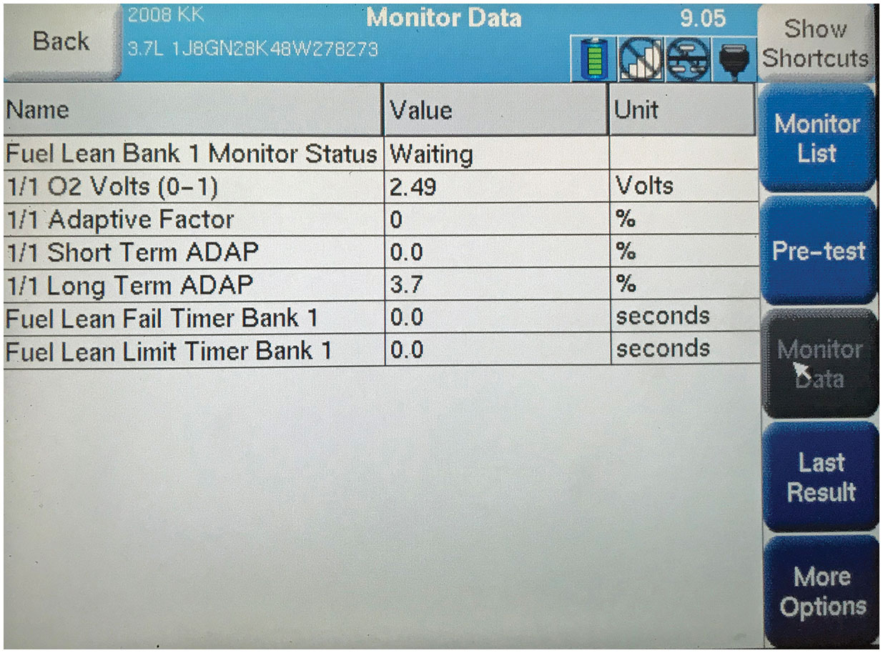
Monitors (10 of 11)
Figure 9.4 A Chrysler fuel trim monitor.
Notes:
Long Description:
The back option is at the top-left corner. On the right, the following options are one below the other: show shortcuts, monitor list, pre-test, monitor data, last result, and more options. The monitor data option is selected. The monitor data for 2008 K K 3.7 L 1 J 8 G N 28 K 48 W 278273 is shown in a table. The data from the rows for the column headings name, value, and unit, respectively, are as follows: Row 1: Fuel Lean Bank 1 Monitor Status; Waiting; blank. Row 2: 1 slash 1 O2 Volts (0-1); 2.49; Volts. Row 3: 1 slash 1 Adaptive Factor; 0; percentage. Row 4: 1 slash 1 Short Term ADAP; 0.0; percentage. Row 5: 1 slash 1 Lon Term ADAP; 3.7; percentage. Row 6: Fuel Lean Fail Timer Bank 1; 0.0; seconds. Row 7: Fuel Lean Limit Timer Bank 1; 0.0; seconds.

Slide 46
Monitors (11 of 11)
The codes associated with a fuel trim monitor include:
P0171—Fuel Trim Lean Bank 1
P0174—Fuel Trim Lean Bank 2
P0172—Fuel Trim Rich Bank 1
P0175—Fuel Trim Rich Bank 2

Slide 47
Noncontinuous (Once-per-Trip) Monitors (1 of 15)
Data applies to all non-continuous or once-per-trip monitors:
Monitor runs once per trip, pass or fail
Two-trip D T C s
M I L, D T C, freeze-frame after two consecutive faults
Freeze-frame is priority 1 on first trip
Freeze-frame is priority 3 on maturing trip
3 consecutive good trips are used to extinguish M I L
40 warm-up cycles used to erase D T C and freeze-frame

Slide 48
Noncontinuous (Once-per-Trip) Monitors (2 of 15)
Oxygen Sensor Monitor
Once-per-trip monitor that tests performance of both upstream and downstream oxygen sensors.
Tests ability of sensors to switch fast enough and that voltage can change far enough.
To enable monitor to run, P C M will ensure engine, exhaust system, and oxygen sensor have reached a minimum temperature.

Slide 49
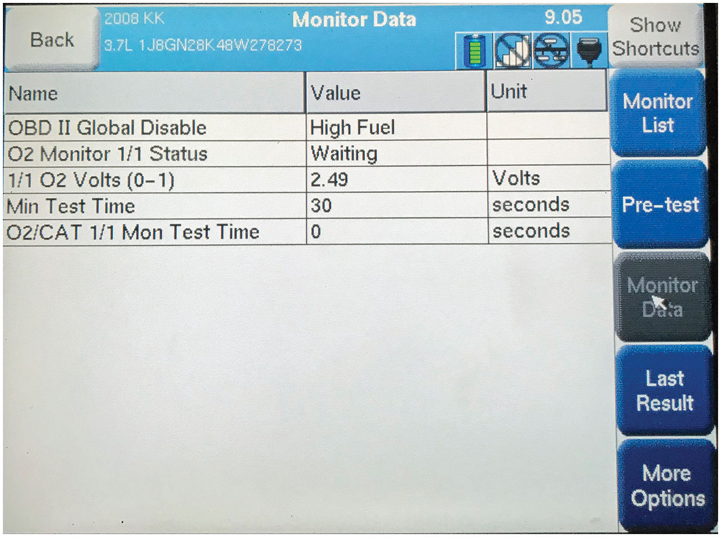
Figure 9.5
Oxygen Sensor Monitor
An example of an upstream oxygen sensor monitor as displayed on a scan tool.
Notes:
Long Description:
The back option is at top left corner. On the right the following options are one below the other; show shortcuts, monitor list, pre-test, monitor data, last result, and more options. The monitor data option is selected. The monitor data for 2008 KK 3.7L 1J8GN28K48W278273 is shown in a table. The data from the rows for the column headings name, value, and unit respectively are as follows: row 1; O B D II Global Disable, and High Fuel. Row 2; O2 Monitor 1 slash 1 Status, and Waiting. Row 3; 1 slash 1 O2 Volts (0-1), 2.49, and Volts. Row 4; Min Test Time, 30, and seconds. Row 5; O2 slash C A T 1 slash 1 Mon Test Time, 0, and seconds.

Slide 50
Noncontinuous (Once-per-Trip) Monitors (3 of 15)
Once monitor is ready to run under specific operating conditions, P C M will monitor signal generated by oxygen sensor.
Criteria for an upstream oxygen sensor are different from downstream oxygen sensor because of catalytic converter.
Failed oxygen sensor performance monitor is a result of an older oxygen sensor that has deteriorated over time.
Make sure exhaust system is in good condition and not leaking before condemning the sensor.
Leaking exhaust system will allow unmonitored oxygen into the exhaust stream and may cause a false failure.

Slide 51
Noncontinuous (Once-per-Trip) Monitors (4 of 15)
After failure has been corrected the vehicle should be driven in a manner that will allow the oxygen sensor to run to completion. If system passes monitor, it is likely the vehicle has been correctly repaired. If the system fails monitor, it is likely other problems are still present. The codes associated with a failed oxygen sensor monitor are:
P1131 H O2S lack of switching
P0132 H O2S over voltage
P0133 H O2S slow response

Slide 52
Noncontinuous (Once-per-Trip) Monitors (5 of 15)
Oxygen Sensor Heater Monitor
Tests oxygen sensor heater separately from sensor output of the oxygen sensor. It is a once-per-trip monitor and is typically tested on a cold start. All oxygen sensor heaters are tested at the same time
P C M can control ground side or power side of circuit. P C M can also control voltage to a heater using a high-side driver on a sensor that is always grounded.

Slide 53
Noncontinuous (Once-per-Trip) Monitors (6 of 15)
Typically, only enabling criteria for this monitor are that the engine is cold and the battery voltage is above a minimum level.
A failed oxygen sensor heater monitor is most generally associated with a failed heater. An easy way to test circuit is to unplug sensor and connect a test light across heater circuit in connector. Start vehicle and if test light illuminates P C M and the circuits are both good, this leaves the heater to be the only possible bad component.
Codes associated with a failed oxygen sensor heater are:
P0135—Upstream O2 Sensor Heater Malfunction
P0141—Downstream O2 Sensor Heater Malfunction

Slide 54
Noncontinuous (Once-per-Trip) Monitors (7 of 15)
Catalyst Monitor
Once-per-trip monitor that monitors efficiency of catalytic converter.
Catalytic converter efficiency monitored using upstream and downstream oxygen sensor.
Under specific operating conditions, switch rate of 2 sensors monitored and compared.
During normal operating conditions, upstream oxygen sensor will be switching between a low voltage (0.2 V) and high voltage (0.8 V) as it keeps vehicle in normal fuel control.
Notes:
If the catalyst is good, the downstream oxygen sensor will show very little activity. As the catalyst begins to fail, the switch rate of the downstream oxygen sensor will begin to approach the switch rate of the upstream oxygen sensor.

Slide 55
Noncontinuous (Once-per-Trip) Monitors (8 of 15)
E W M A (Exponentially Weighted Catalyst Moving Average)
To enable a monitor to operate, specific criteria must be met. Criteria focuses on operating temperature, vehicle speed, and throttle angle.
Generally, fuel level must be above 15% and engine must be in closed loop fuel control.
Normal operating temperature and the vehicle speed and throttle angle must indicate the engine is under enough load to get the exhaust system hot enough to test.

Slide 56
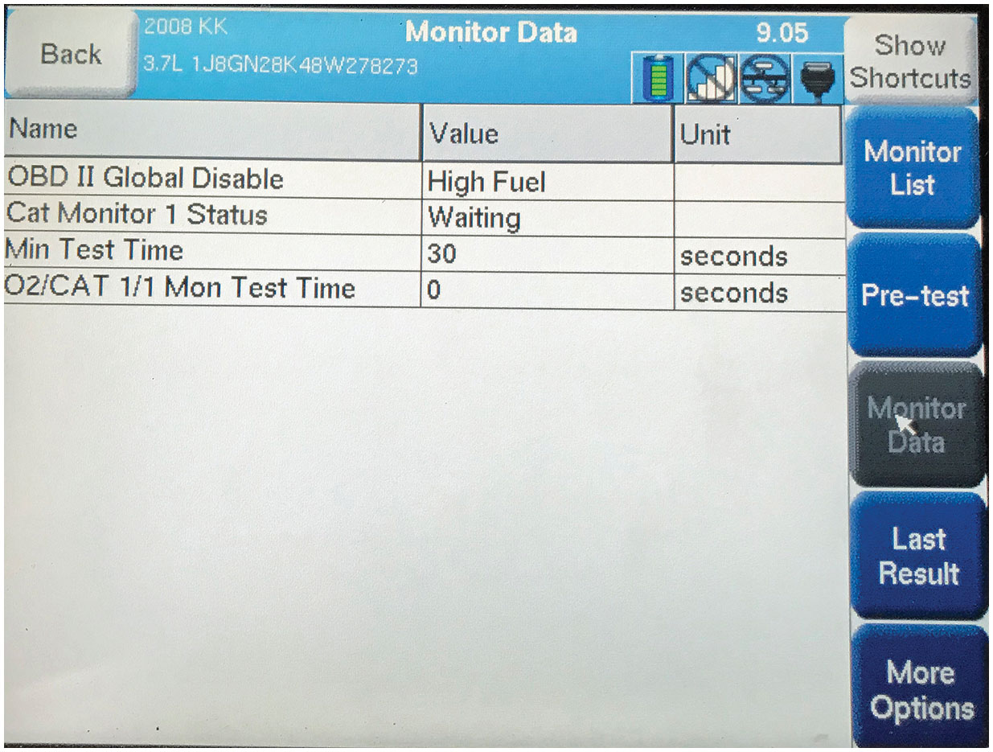
Figure 9.6
E W M A catalyst monitor
E W M A (Exponentially Weighted Catalyst Moving Average)
catalyst monitor on a scan tool.
Notes:
Long Description:
The back option is at top left corner. On the right the following options are one below the other; show shortcuts, monitor list, pre-test, monitor data, last result, and more options. The monitor data option is selected. The monitor data for 2008 KK 3.7L 1J8GN28K48W278273 is shown in a table. The data from the rows for the column headings name, value, and unit respectively are as follows: row 1; OBD II Global Disable, and High Fuel. Row 2; Cat Monitor 1 Status, and Waiting. Row 3; Min Test Time, 30, and seconds. Row 4; 02 slash CAT 1 slash 1 Mon Test Time, 0, and seconds.

Slide 57
Noncontinuous (Once-per-trip) Monitors (9 of 15)
Before condemning a catalyst, check the fuel trims and integrity of exhaust system.
Fuel system that is adding or subtracting more than 10% of fuel, or an exhaust system that leaks, may create a false failure and set an erroneous code.
Codes associated with a catalyst monitor failure include:
P0420—Catalyst Efficiency below Threshold (Bank 1)
P0430—Catalyst Efficiency below Threshold (Bank 2)

Slide 58
Noncontinuous (Once-per-Trip) Monitors (10 of 15)
Evaporative Emissions Monitor
Ensure evaporative emissions system flows properly and does not leak unburned hydrocarbons (H C S) to atmosphere.
Divided into 2 categories: pressure based and vacuum based. Because of these differences, monitors are not the same.
Regardless of style of the evaporative system, enabling criteria to get monitor ready to run are very similar.
Engine must cold soak & ambient temperature between
Fuel level must be between 15% and 85%
Intake air temperature/coolant temperature within 10°of each other.

Slide 59
Noncontinuous (Once-per-Trip) Monitors (11 of 15)
Vacuum-Style Evaporative System
Monitor runs on a cold start.
The vent solenoid is energized closing the valve. The purge solenoid is energized allowing the system to flow. This operation will pull the evaporative system into a vacuum. The pressure level is monitored for a specific amount of time to determine if the system is leaking and flowing properly.

Slide 60
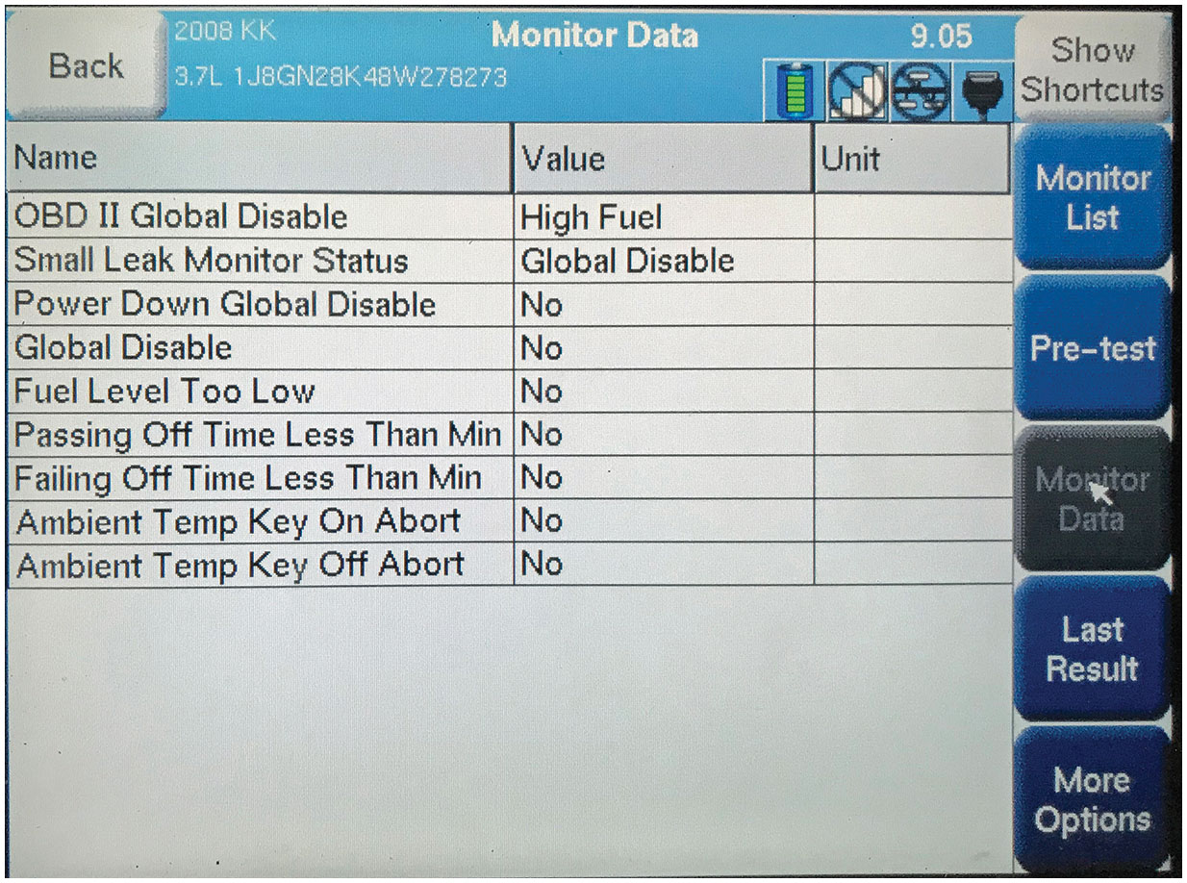
Figure 9.7
Vacuum-Style Evaporative System
An evaporative emissions monitor on a pressure type (L D P) system on a Chrysler.
Notes:
Long Description:
The back option is at top left corner. On the right the following options are one below the other; show shortcuts, monitor list, pre-test, monitor data, last result, and more options. The monitor data option is selected. The monitor data for 2008 KK 3.7L 1J8GN28K48W278273 is shown in a table. The data from the rows for the column headings name, value, and unit respectively are as follows: row 1; OBD II Global Disable, and High Fuel. Row 2; Small Leak Monitor Status, and Global Disable. Row 3; Power Down Global Disable, and No. Row 4; Global Disable, and No. Row 5; Fuel Level Too Low, and No. Row 6; Passing Off Time Less Than Min, and No. Row 7; Failing Off Time Less Than Min, and No. Row 8; Ambient Temp Key On Abort, and No. Row 9; Ambient Temp Key Off Abort, and No.

Slide 61
Noncontinuous (Once-per-Trip) Monitors (12 of 15)
Vacuum-Style Evaporative System
Pressure-style system also runs on a cold start using a leak detection pump.
Purge valve de-energized, sealing system, and pump is energized to pressurize system.
System pressure monitored for a specific amount of time.

Slide 62
Noncontinuous (Once-per-Trip) Monitors (13 of 15)
System failures for leaks are common.
Failures of components, such as vent solenoids, deterioration of lines, and loose gas caps, are common causes of failure.
Scan data and smoke machines help to identify these failures.
Monitor is very difficult to operate after a repair has been completed because of the cold soak requirement.
Codes associated with an evaporative emission failure are:
P0456—Evaporative Emission System Small Leak Detected
P0457—Evaporative Emission System Large Leak Detected

Slide 63
Noncontinuous (Once-per-Trip) Monitors (14 of 15)
Exhaust G A S Recirculation (E G R) Monitor
Once-per-trip monitor measures flow of exhaust gases back into engine.
E G R system designed to displace oxygen in combustion chamber with exhaust gases to lower combustion temperatures and the level of oxides of nitrogen (N O x).
Monitor ensures that flow is not too low or too high.
Some systems will monitor intake manifold pressure during change while others will monitor exhaust oxygen level change. Engine must be at operating condition with the fuel system in closed loop.

Slide 64
Noncontinuous (Once-per-Trip) Monitors (15 of 15)
Failures for insufficient flow & excessive flow are common.
E G R valve failures are common, but it is important to inspect system for presence of carbon. Carbon buildup is a common source of E R G system failures.
It may restrict system flow and cause a failure for insufficient flow, or it may not allow a valve to close creating an excessive flow failure.
Failures associated with E G R monitor failures include:
P0401—E G R Insufficient Flow Detected
P0402—E G R Excessive Flow Detected

Slide 65
Summary
If the M I L is on, retrieve the D T C and follow the manufacturer’s recommended procedure to find the root cause of the problem.
All monitors must have the enable criteria achieved before a test is performed.
vehicles use common generic D T C s.
includes generic (S A E) as well as vehicle
manufacturer-specific D T C s and data display.
monitors can be divided into two categories:
continuous and noncontinuous (once-per-trip).

Slide 66
Animation and Video Library Links (Must have an internet connection and active Haldeman subscription)
Animation Library: (A8) Engine Performance Animations
Animation Library: (A6) Electrical/Electronic Systems Animations
Video Library: (A8) Engine Performance Videos
Video Library: (A6) Electrical/Electronic Systems Videos

Slide 67
Copyright
This work is protected by United States copyright laws and is provided solely for the use of instructors in teaching their courses and assessing student learning. Dissemination or sale of any part of this work (including on the World Wide Web) will destroy the integrity of the work and is not permitted. The work and materials from it should never be made available to students except by instructors using the accompanying text in their classes. All recipients of this work are expected to abide by these restrictions and to honor the intended pedagogical purposes and the needs of other instructors who rely on these materials.

