Slide 1
Advanced Engine Performance Diagnosis
Eighth Edition
Chapter 6
Scan Tools
Copyright © 2025 Pearson Education, Inc. All Rights Reserved
Notes:
If this PowerPoint presentation contains mathematical equations, you may need to check that your computer has the following installed:
1) Math Type Plugin
2) Math Player (free versions available)
3) NVDA Reader (free versions available)
INSTRUCTOR NOTE: This presentation includes text explanation notes, you can use to teach the course. When in SLIDE SHOW mode, you RIGHT CLICK and select SHOW PRESENTER VIEW, to use the notes.

Slide 2
Learning Objectives
6.1 Discuss the operation of the malfunction indicator lamp (M I L).
6.2 Explain the location and terminals of the data link connector (D L C).
6.3 Describe the function and types of a scan tools.
6.4 Explain how to use a scan tool.
6.5 Describe diagnostic trouble codes (D T C s) and freeze frame data.
6.6 Explain why pre- and post-scans are needed.

Slide 3
Malfunction Indicator Lamp (M I L)
M I L, also called the check engine light (C E L)
Dash warning light that is orange/yellow
Notify driver of malfunction that affects emissions
Depending on faults, there are several possible modes of operation:
On—A fault affecting emissions has been detected and confirmed by the P C M. Vehicle can be driven
Flashing—A fault that can cause damage to the catalytic converter has been detected.
Off—No fault affecting emissions detected
Notes:
Malfunction Indicator Lamp (M I L), also called the check engine light (C E L), is a dash warning light that is orange/yellow specified by I S O 2575. The light is used to notify the driver of a possible malfunction that affects emissions. Depending on the faults, there are several possible modes of operation:
On—A fault affecting emissions has been detected and confirmed by the P C M. The vehicle can continue to be driven but the cause of the warning light being on should be determined and corrected as soon as possible.
Flashing—A fault that can cause damage to the catalytic converter has been detected. The vehicle should not be driven until the fault has been diagnosed and corrected.
Off—No fault affecting emissions has been detected but this does not necessarily mean that a fault is not present. • See Figure 6.1.

Slide 4
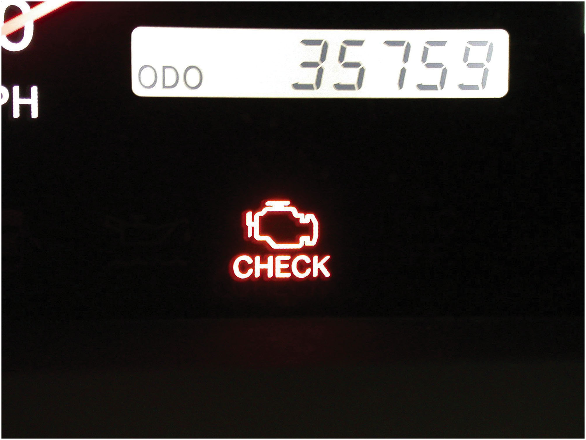
Figure 6.1
M I L
Malfunction Indicator Light (M I L) is often referred to as the “Check Engine” light.

Slide 5
Data Link Connector (D L C)
16-pin data link connector
Adheres to S A E J1962 standard
Located on driver’s side
On all vehicles sold in North America
Starting with model year (M Y) 1996
Notes:
DATA LINK CONNECTOR (DLC)
Learning Objective: Explain the location and terminals of the data link connector (DLC).
Sixteen Pin
The 16-pin data link connector adheres to the S A E J1962 standard. It is located on the driver’s side
on all vehicles sold in North America, starting with model year (MY) 1996.
■ Pin 16 is 12-volt battery
■ Pin #4 is chassis ground
■ Pin #5 is the computer ground
■ Pins #6 and 14 are CAN C (high speed) terminals on all 2008 and newer vehicles. • See Figure 6.2.

Slide 6
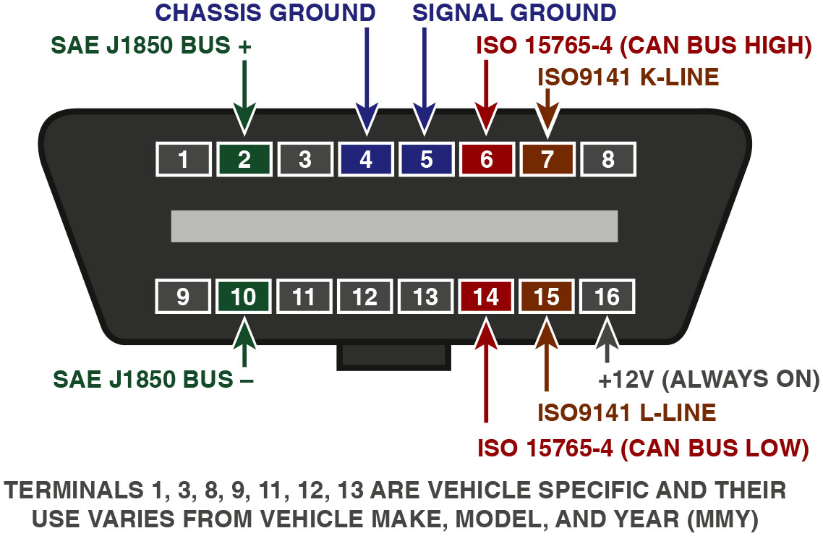
Figure 6.2
D L C (Data Link Connector)
D L C with the terminals identified.
Notes:
Long Description:
The illustration displays a rhombus structure with rounded corners displaying the digits 1 to 8 at the top and 9 to 16 at the bottom. The digit 2 is highlighted in green and labelled S A E J1850 BUS plus. The digits 4 and 5 are highlighted in blue and labelled chassis ground and signal ground, respectively. The digit 6 is highlighted in red and labelled I S O 15765-4 (can bus high). The digit 7 is highlighted in brown and labelled I S O9141 K-Line. The digit 10 is highlighted in green and labelled S A E J1850 BUS minus. The digit 14 is highlighted in red and labelled I S O 15765-4 (can bus low). The digit 15 is highlighted in brown and labelled I S O9141 L-Line. The digit 16 is highlighted in grey and labelled plus 12 V (always on).

Slide 7
D L C Location
D L C is often near the steering wheel
Underneath the dash
Some
vehicles have the port
Somewhere around the center console
Check vehicle owner’s or service information manual
Notes:
Location of the O B D-II DLC
The data link connector (DLC) is often near the steering wheel, underneath the dash. A few
O B D-II vehicles have the port somewhere around the center console. Check the vehicle owner’s or
service information manual for specific details. • See Figure 6.3.

Slide 8
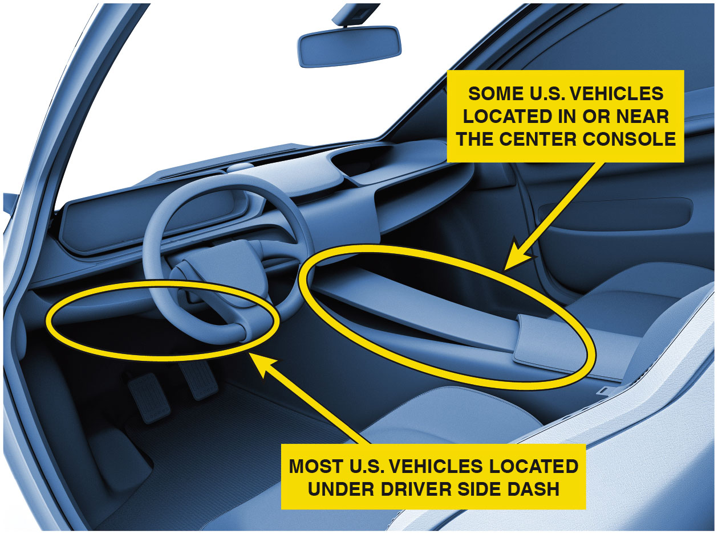
Figure 6.3
D L C Location
The data link connector can be located under the dash on the driver’s side in most vehicles. If the D L C is covered the cover must be easily removed without using any tools.

Slide 9
Animation: Scan Tools

Slide 10
Scan Tools
Scan tool term refers to any tool
Used to access data from the vehicle
Determine what is wrong with vehicle
Can be low-cost unit that just reads D T C s or an expensive factory-level scan tool
Code Readers/Low-cost scan tool
Display only global (generic) D T C S
Generic scan tools provide only emissions-based limited to P C M or engine data including:
Read D T C s
Clear D T C s
Check and possibly reset readiness monitors
Notes:
24.3: SCAN TOOLS
Learning Objective: Describe the function and types of a scan tools.
Purpose and Function
The term scan tool commonly refers to any tool that is used to access data from the vehicle in an
attempt to determine what if, anything, is wrong with the vehicle. A scan tool can be a low-cost
unit that just reads diagnostic trouble codes (D T C s) or a factory or factory-level scan tools
that can cost thousands of dollars.
Code Readers
A code reader is a low-cost scan tool that can display only global (generic) trouble codes. Generic
scan tools provide only emissions-based information on the vehicle and is limited to P C M or engine
data including:
■ Read D T C s
■ Clear D T C s
■ Check and possibly reset readiness monitors. • See Figure 6.4.

Slide 11
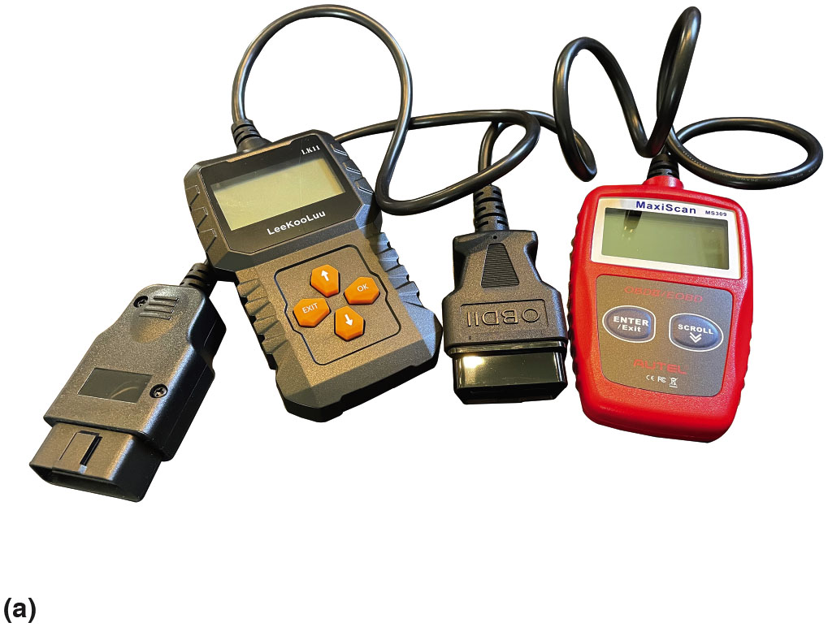
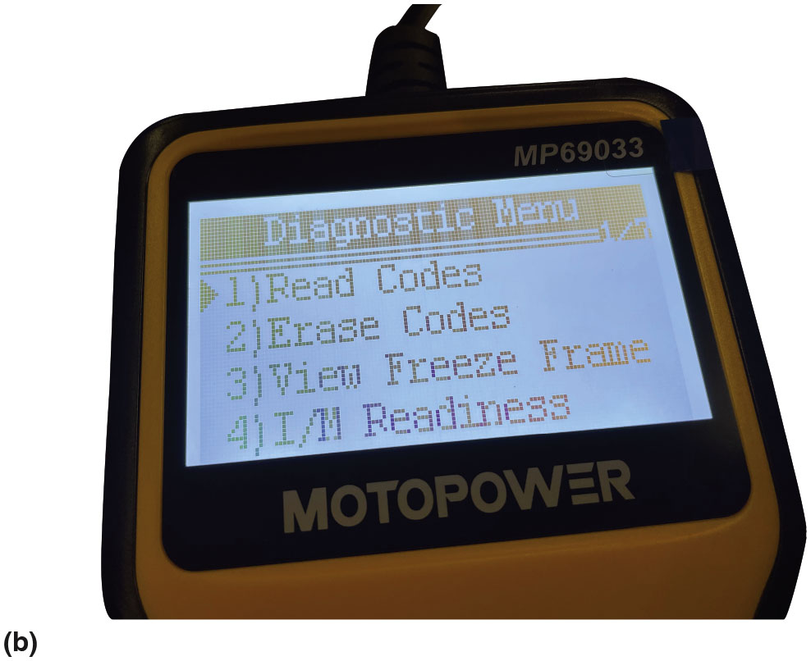
Figure 6.4
Low Cost Scan Tools
(a) A couple of low-cost code readers that can be used to retrieve and clear engine-related diagnostic trouble codes. (b) The main menus of a low-cost scan tool, commonly called a code reader even though it can display and clear more than just trouble codes.
Notes:
To use a code reader, perform the following steps:
Step 1 Be sure that ignition is off before plugging the code reader into the data link connector (DLC).
Step 2 Turn the ignition on or possibly start the engine.
Step 3 Follow the instructions and messages on the display of the code reader.
Step 4 Record any diagnostic trouble codes and research their meaning and possible causes.
Note
Avoid clearing the codes until they have been written down. When the codes are cleared, this also resets the readiness monitors and clears freeze frame data. Most emissions and smog testing facilities will not pass a vehicle if the readiness monitors have not run and passed.

Slide 12
Question 1
Can a Code Reader Read All Diagnostic Trouble Codes?

Slide 13
Answer 1
No, code readers/low-cost scan tool. Display only global (generic) D T C S. Generic scan tools provide only emissions-based limited to P C M or engine data including:
Read D T C s
Clear D T C s
Check and possibly reset readiness monitors

Slide 14
Frequently Asked Question: Can a Code Reader Read All Diagnostic Trouble Codes? (1 of 2)
? Frequently Asked Question
Can a Code Reader Read All Diagnostic Trouble Codes? No. Code readers are designed to read only emission-related diagnostic trouble codes referred to powertrain-related codes starting with the capital letter P. An aftermarket scan tool or a factory scan tool is required to read the diagnostic trouble codes from the other systems.

Slide 15
Smart Phone App Scan Tools
Plugs into the D L C and transmits data via Bluetooth
To a smart phone-equipped app.
Able to display both generic and O E-specific codes
Notes:
Smart Phone App Scan Tools
The smart phone scan tool is a device that plugs into the DLC and transmits data via Bluetooth to a smart phone equipped app. These units are often able to display both generic and OE-specific codes. See Figure 6.5.

Slide 16
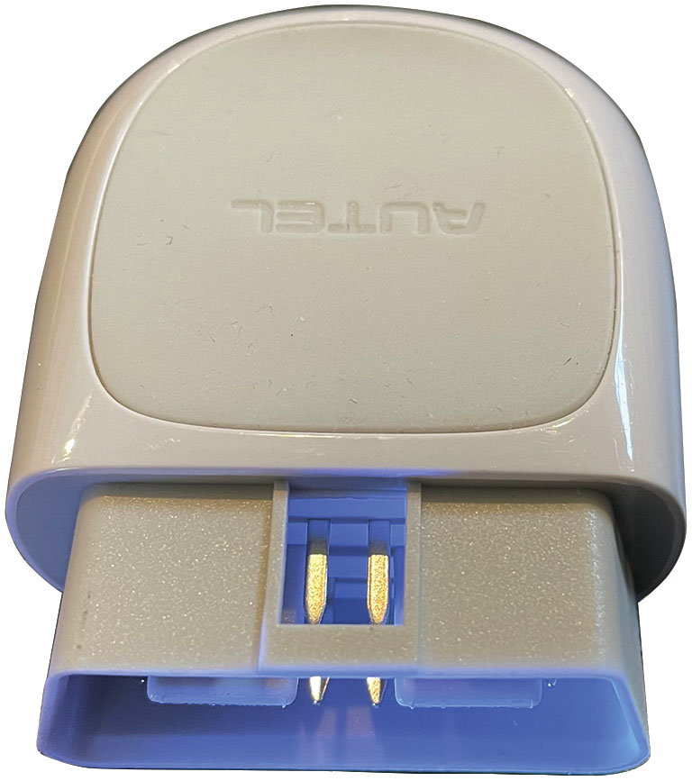
Figure 6.5
Smart Phone Scan Tool
A typical smart phone scan tool that plugs into the D L C and then communicates with the smart phone using Bluetooth.
Notes:
Most smart phone app scanners can clear DTCs and display global (generic) information:
Global (generic) and vehicle-specific trouble codes
Current sensor data including:
Engine RPM
Calculated Load Value
Engine Coolant Temperature (ECT)
Fuel System Status
Vehicle Speed
Short-Term Fuel Trim
Long-Term Fuel Trim
Intake Manifold Pressure (MAP)
Intake Air Temperature (IAT)
Air Flow Rate (MAF)
Throttle Position (TP)
Oxygen Sensor (O₂S) Voltage
Some smart phone app scan tools can read and clear ABS, Airbag (SRS), and TPMS codes.

Slide 17
Aftermarket Scan Tools
Aftermarket diagnostic scan tools
From many manufacturers
Use Data licensed from each O E M
Most aftermarket scan tools
Can connect to the global side of P C M
As well as original equipment (O E) section of P C M
Notes:
Aftermarket Scan Tools
Aftermarket diagnostic scan tools are manufactured by many manufacturers and use the data licensed from each original equipment manufacturer (O E M). Most aftermarket scan tools can connect to the global side of the P C M as well as the original equipment (O E) section of the P C M. Examples of aftermarket scan tools include:
Snap-on (various models including the Solus and Vantage Ultra, Modis, Zeus) O T C/Bosch (various models including Genisys E V O, Task Master Evo and Evolve, Bosch A D S 625)
A T S E Scan
Launch X431
Top Don Phoenix
Autel (various models) • See Figure 6.6.

Slide 18
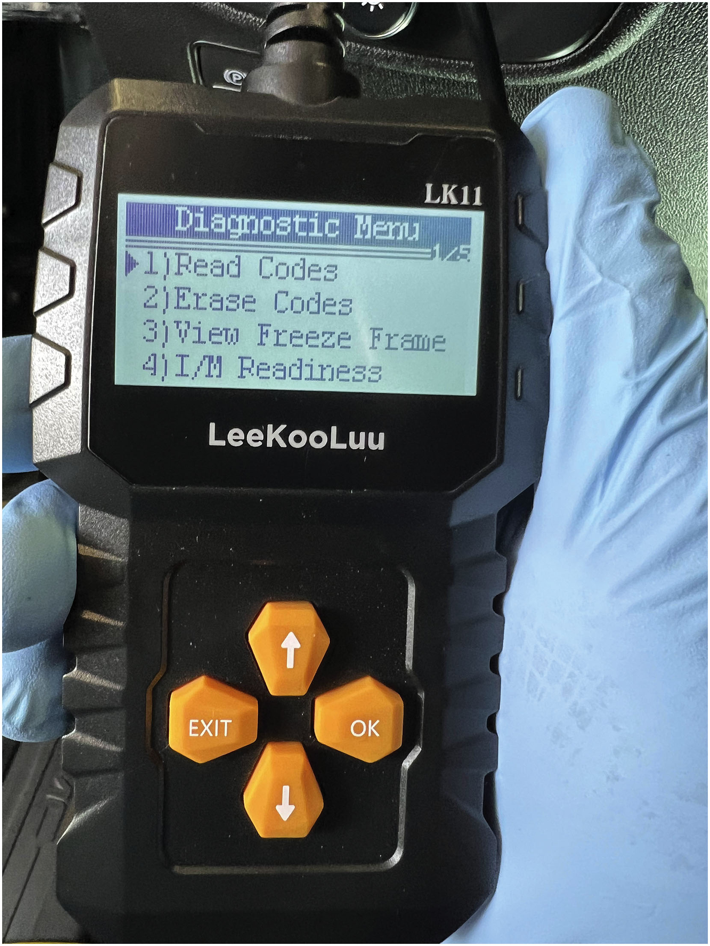
Figure 6.6
Aftermarket Scan Tool
An aftermarket scan tool being used to diagnose an engine performance issue. While many aftermarket scan tools can display most, if not all, the parameters of the factory scan tool, there can be a difference when trying to troubleshoot some faults.

Slide 19
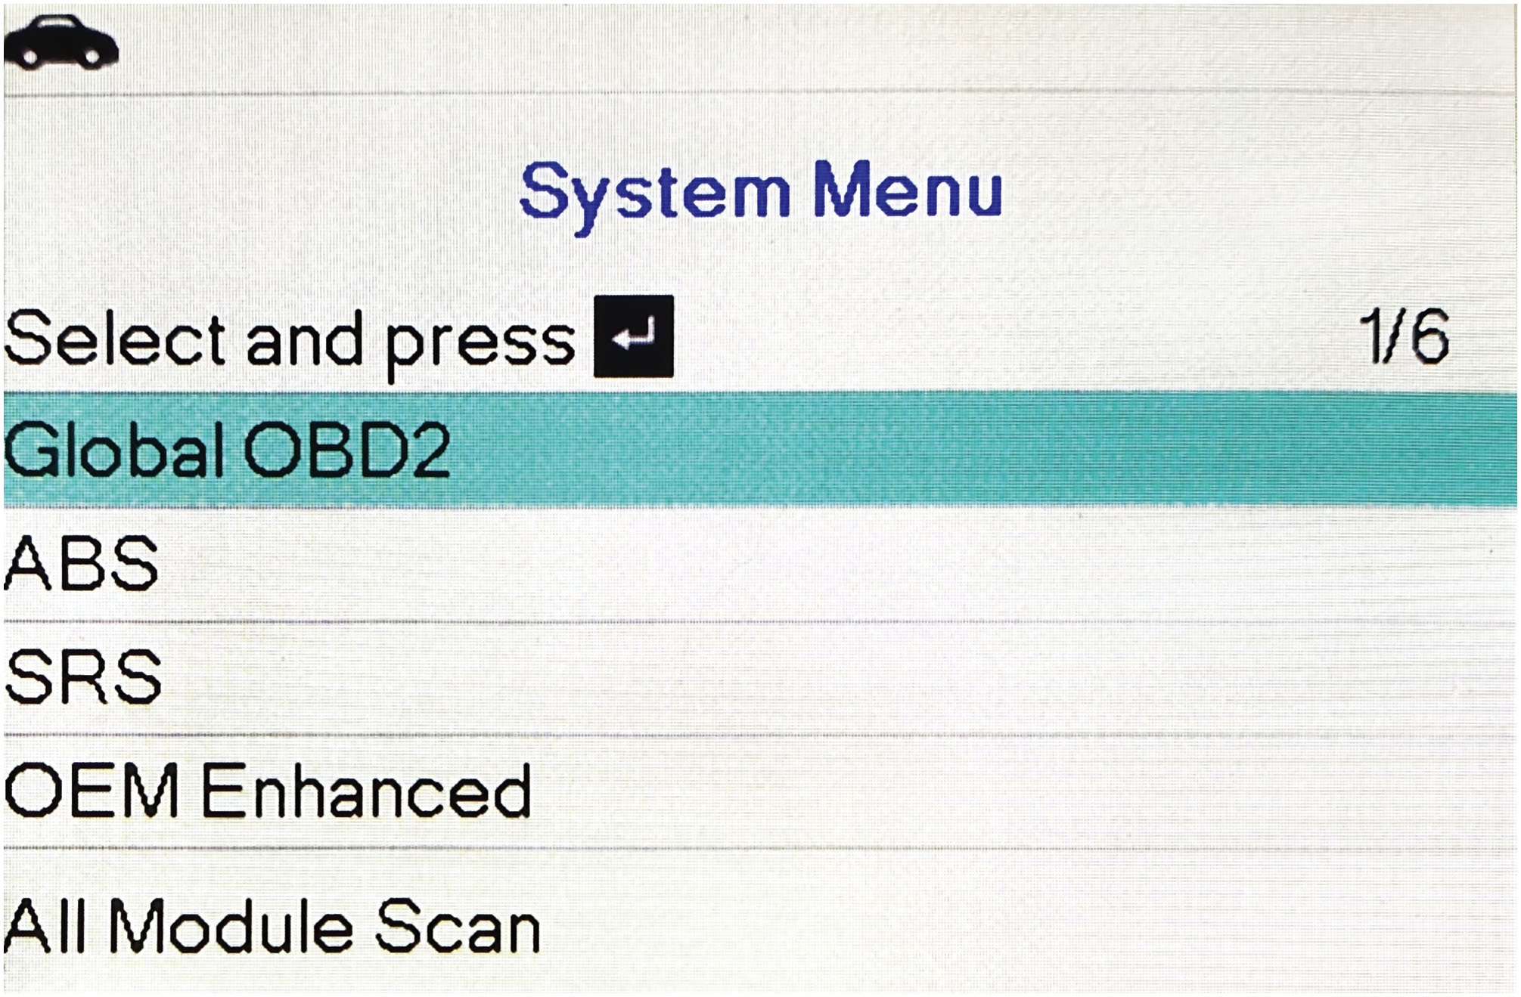
Figure 6.7
Global
from Menu
Most scan tools have the option to select global
from
the main menu.
Notes:
Tech Tip: Start with the Global Side First
When using an aftermarket scan tool, check for codes and data using the global (generic) functions first.
The vehicle P C M does two diagnostic functions:
It tests and reports anything wrong with the emission control system and will set a P0xxx diagnostic trouble code for anything that it determined is out of range which could affect emissions and will set a P0xxx D T C.
The original equipment manufacturer (O E M) uses their own programming to determine whether a sensor or system is out of compliance and will set a P1xxx D T C.
Before using an aftermarket scan tool that uses the vehicle identification number (V I N) or the make, model, year, and engine, to start the diagnosis use the generic functions of the scan tool that does not require the vehicle information. Record any D T C s and then go back and check for any faults using the enhanced side of the P C M by using the V I N, self-identification, or the vehicle information inputted by the technician. Often the generic side of the P C M will indicate a problem and set a D T C before the OE section of the P C M recognizes that there is a problem. For best results, always use both the generic and the OE sections and start with the generic. • See Figure 6.7.

Slide 20
Enhanced O E P C M Section
Enhanced O E section of P C M Access
Requires vehicle be identified:
Enter vehicle identification number (V I N).
Select make, model, and year (M M Y). Then select the engine and transmission, etc.
Many scan tools can automatically select vehicle:
Most enhanced scan tools can access:
Transmission
A B S
S R S (airbags)
H V A C and more
Notes:
To get access to the enhanced OE section of the P C M, the vehicle must be identified. This could be
done several ways such as:
■ Enter the vehicle identification number (V I N).
■ Select the make, model, and year (M M Y). Then select the engine and transmission and other options as shown on the scan tool display.
■ Many scan tools can automatically select the vehicle using the V I N. Most aftermarket enhanced scan tools can access systems other than the engine, such as:
■ Transmission
■ ABS
■ SRS (airbags)
■ HVAC and more
An O B D-II enhanced aftermarket scan tool also may have some or all the same functionalities of an O B D-II generic tool, while also providing access to O E M-specific information.

Slide 21
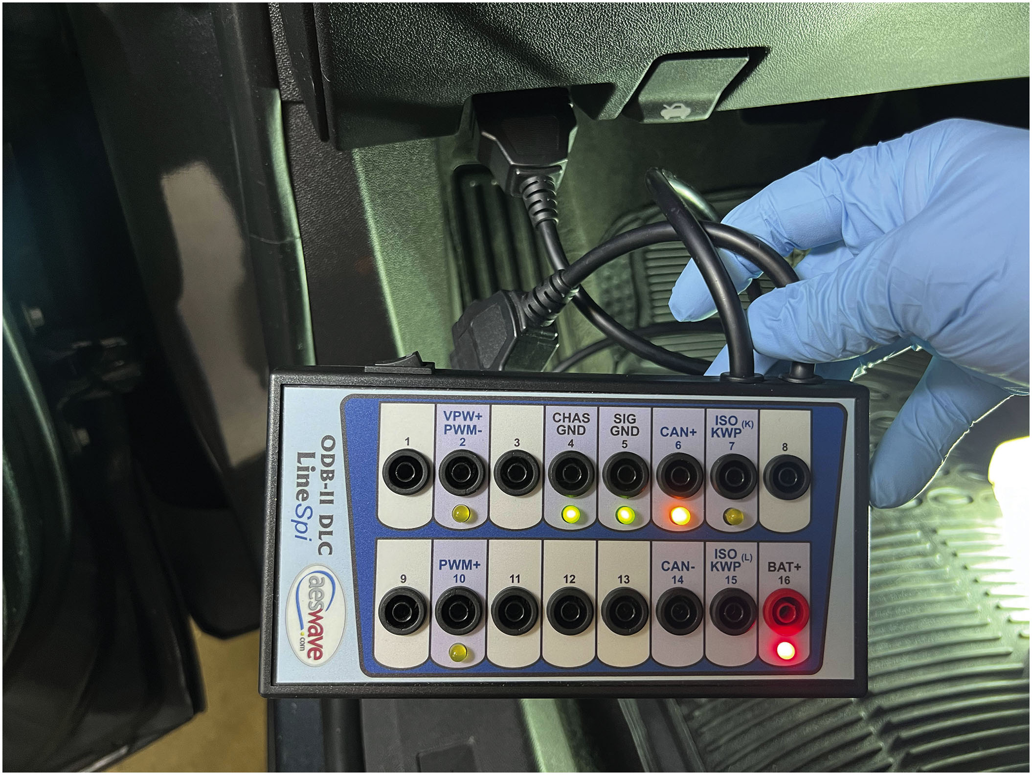
Figure 6.8
D L C Breakout Box
A typical breakout box is used to extend the D L C and give ready access to the terminals.
Notes:
Tech Tip: Use a Breakout Box
To make it easier to plug in a scan tool as well as giving access to all the terminals of data link connector (DLC), use a breakout box. Many breakout boxes include LEDs that light or flash showing that data is being transmitted on the data terminals as well as indication of proper power (pin #16) and chassis ground (pin #4). See Figure 6.8.

Slide 22
Question 2
Where is the diagnostic link connector located?

Slide 23
Answer 2
Under the dash on the left side of the steering wheel.

Slide 24
O E M Factory Scan Tools
Factory scan tools are the scan tools
Required by all dealers sell and service brand of vehicle.
Examples of factory scan tools (oldest to newest) include the following:
G M—Tech 2, M D I (Multiple Diagnostic Interface), M D I 2, or G D S2 (Global Diagnostic System 2)
Ford—New Generation Star (N G S) and I D S (Integrated Diagnostic Software), V C M, V C M2, or V C M3, F D R S
Chrysler—
Star Scan, wiTECH, or wiTECH 2
Honda—Master Tech, Honda Diagnostic System (H D S)
Toyota—Master Tech or Tech Stream
Notes:
O E M Factory Scan Tools
Factory scan tools are the scan tools required by all dealers that sell and service the brand of vehicle.
Examples of factory scan tools (oldest to newest) include the following:
General Motors—Tech 2, MDI (Multiple Diagnostic Interface), MDI 2, or GDS2 (global
diagnostic system 2). • See Figure 6.9.
Ford—New Generation Star (NGS) and IDS (Integrated Diagnostic Software), VCM, VCM2,
or VCM3, FDRS
Chrysler—DRB-III, Star Scan, wiTECH, or wiTECH 2
Honda—Master Tech, Honda Diagnostic System (HDS)
Toyota—Master Tech or Tech Stream
All factory scan tools are designed to provide bi-directional capability, which allows the service
technician the opportunity to operate components using the scan tool, thereby confirming that the
component can work when commanded. Also, all factory scan tools can display all factory parameters.

Slide 25
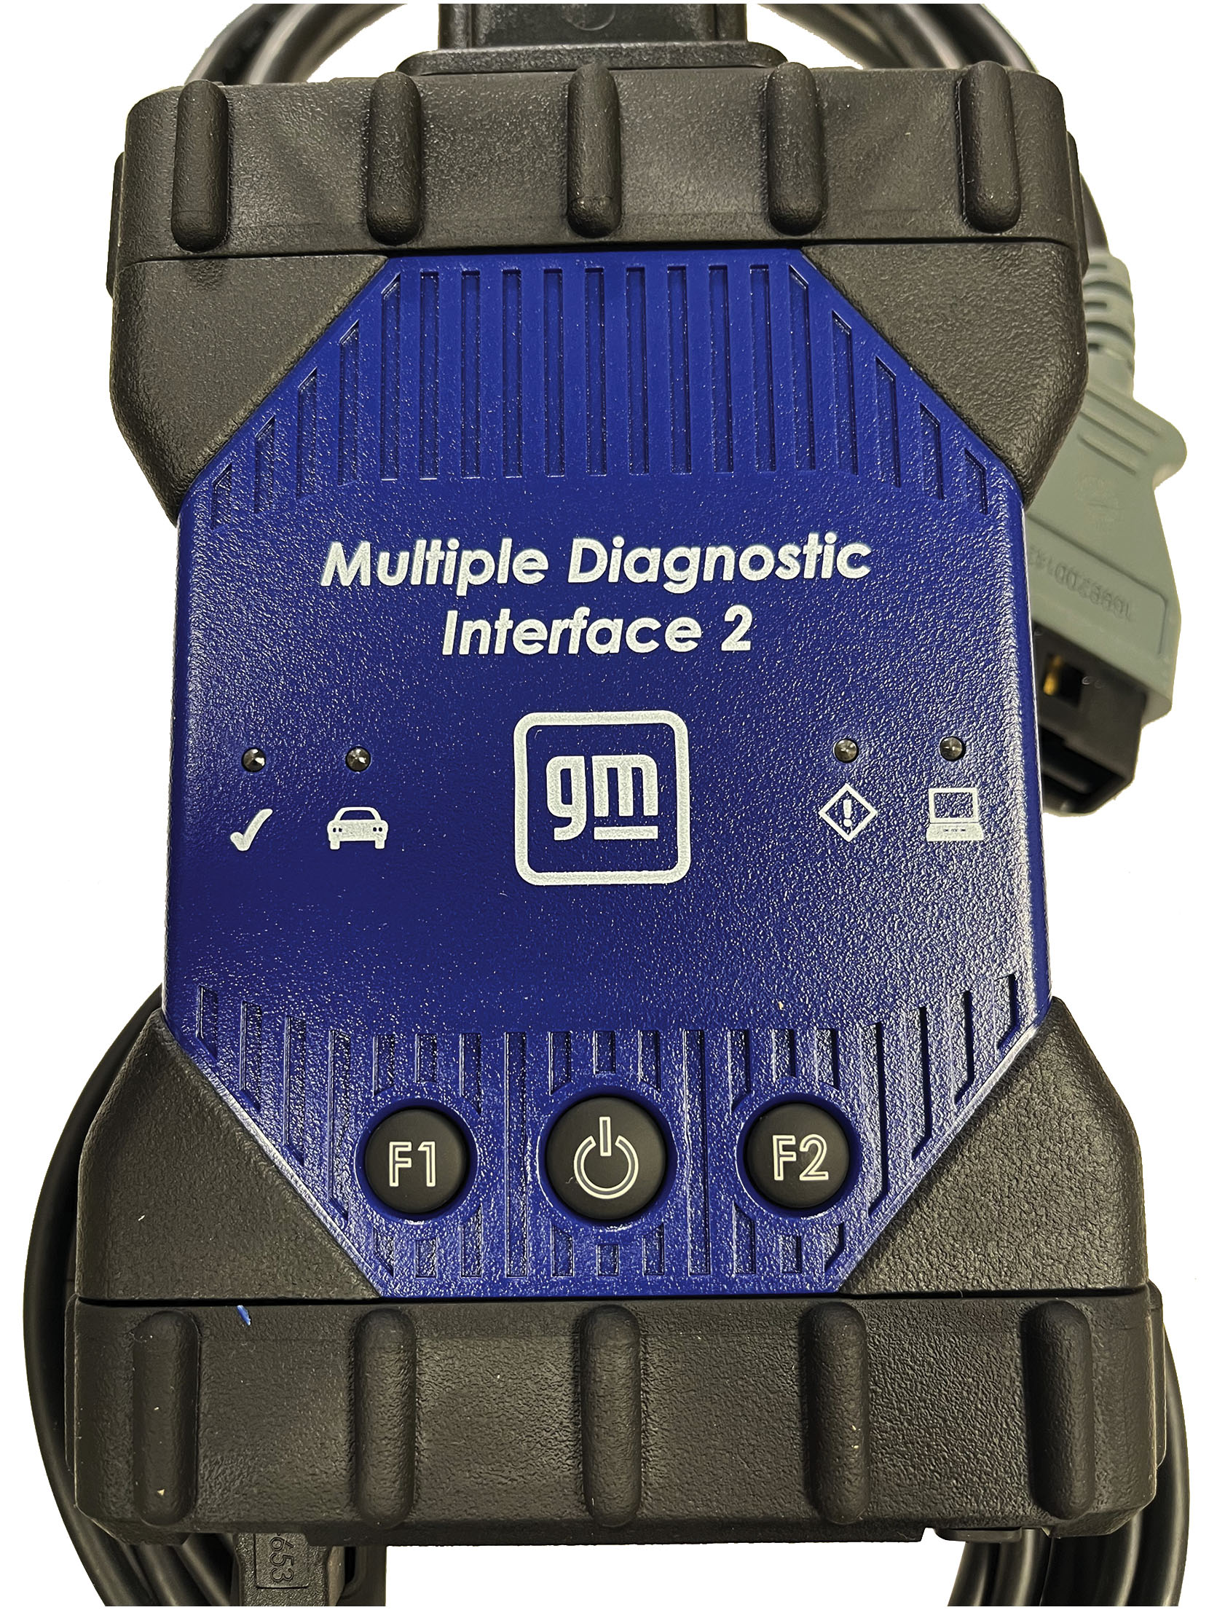
Figure 6.9
M D I Multiple Diagnostic Interface
A G M scan tool that plugs into the D L C and uses a laptop computer for the display.
Notes:
Ford—New Generation Star (NGS) and IDS (Integrated Diagnostic Software), VCM, VCM2, or VCM3, FDRS
Chrysler—DRB-III, Star Scan, wiTECH, or wiTECH 2
Honda—Master Tech, Honda Diagnostic System (HDS)
Toyota—Master Tech or Tech Stream
All factory scan tools are designed to provide bi-directional capability, which allows the service
e scan tool, thereby confirming that the Also, all factory scan tools can display all factory parameters.

Slide 26
Frequently Asked Question: Can a Code Reader Read All Diagnostic Trouble Codes? (2 of 2)
? Frequently Asked Question
Can a Code Reader Read All Diagnostic Trouble Codes? No. Code readers are designed to read only emission-related diagnostic trouble codes referred to powertrain-related codes starting with the capital letter P. An aftermarket scan tool or a factory scan tool is required to read the diagnostic trouble codes from the other systems.

Slide 27
Using Scan Tool
Diagnostic Process Using D T C s
Determines problems or symptoms associated with D T C s
Find root cause of customer concern
Process starts with an all-module scan
Checking service information, pin-point testing
Performing a visual inspection
Resetting vehicle systems
Bi-directional Testing
Reprogramming: J2534 reflashing
Scan Tools Graphing
Notes:
USING A SCAN TOOL
Learning Objective: Explain how to use a scan tool.
Diagnostic Process Using D T C s
The diagnostic process determines what problems or symptoms are associated with the stored D T C s
that need to be identified and addressed to find the root cause of the customer concern. The
process starts with an all-module scan and includes checking service information, pin-point
testing, and performing a visual inspection of the systems and components.
Resetting Systems
Most aftermarket and all factory scan tools can perform resets of the following systems:
■ Oil life monitor
■ Reset the steering angle sensor (SAS) to zero
■ Electric parking brake reset
■ ABS brake fluid bleeding
■ Reset diesel particulate filter (DPF)
■ Write new injector code into the P C M for correct cylinder injection quantity.
■ Diesel exhaust fluid (DEF) reset
■ Tire size reset when tires of a replacement size tires are installed
■ Crankshaft position relearn
■ Immobilizer system to learn new keys
■ Suspension Reset to adjust height sensor for level calibration
■ Plus, many more depending on the vehicle and the scan tool being used.
Bi-directional Testing
Most aftermarket scan tools are also capable of performing bi-directional testing including actu-
ator tests and adjustments. Bi-directional control can be used to turn on and off certain compo-
nents/functions. Bi-directional actuator tests allow the technician to check the condition of items
that are controlled by a module such as turning on headlights or sounding the horn.
Reprogramming
Another function of some enhanced scan tools includes the capability of reprogramming, also known
as J2534 reflashing. J2534 programming is an S A E standard that permits the automotive service
technician to reprogram the P C M if the vehicle concern can be corrected by changes to the
calibration of the P C M software.
Scan Tools Graphing
Many aftermarket scan tools can display the voltages from sensors as a graph instead of just
numbers. This is a great feature because the numbers are often heard to read as the values
constantly change such as the oxygen sensor voltage. • See Figure 6.10.

Slide 28
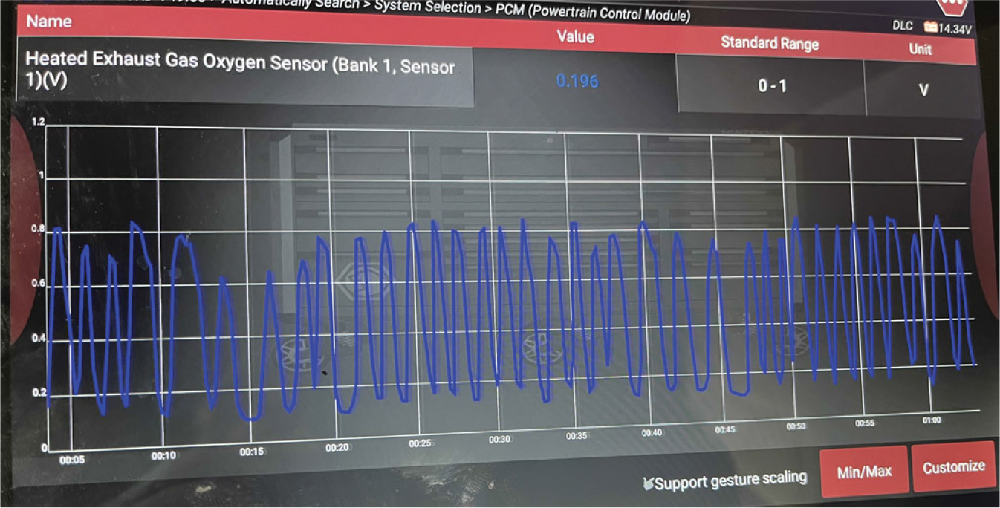
Figure 6.10
Scan Tool-Generated Waveform
The graph of an oxygen sensor as displayed on a scan tool.
Notes:
Scan Tools Graphing
Many aftermarket scan tools can display the voltages from sensors as a graph instead of just numbers. This is a great feature because the numbers are often heard to read as the values constantly change such as the oxygen sensor voltage. See Figure 6.10.
Looking at Scan Tool Data
The best way to look at scan data is in a definite sequence and with specific, selected bits of data that can tell the most about the operation of the engine. Some examples are:
With the key on, engine off (K O E O):
Engine coolant temperature (E C T) is the same as intake air temperature (I A T) after the vehicle sits for several hours.
With the key on, engine running (K O E R), the upstream conventional zirconia oxygen sensor should switch rapidly within 200 m V and 800 m V.
Long Description:
The powertrain control module screen displays a single-row table above the waveform. The table reads as follows: Name: heated exhaust gas oxygen sensor (bank 1, sensor 1) (V); Value: 0.196; standard range: 0-1; unit: V. The x-axis ranges from 00.10 to 00.60 in increments of 00.05. The y-axis ranges from 0 to 1.2 in increments of 0.2. The waveform shows a sine wave with short pulses between large and wide pulses. The Min or Max and Customize buttons are at the bottom behind the text Support gesture scaling.

Slide 29
Generic vs O E D T C s
P0xxx indicates generic (S A E) D T C s
P1xxx indicates O E M-specific D T C s.
Tens/ones numbers indicate part of system at fault.
Some O E M S use their own descriptors
Permanent Code
Starting in 2010 all vehicles support “permanent fault codes,” stored in nonvolatile R A M and cannot be cleared when battery disconnected and only go away when problem fixed.
Permanent codes cannot be simply “cleared” by any tool, even factory scan tools.
Can only be cleared by P C M once malfunction is gone
Notes:
DIAGNOSTIC INFORMATION
Learning Objective: Describe diagnostic trouble codes (D T C s) and freeze frame data.
Generic vs OE D T C s
P0xxx indicates generic (S A E) D T C s and P1xxx indicates manufacturer-specific D T C s. The tens
and ones numbers indicate the part of the system at fault. Some vehicle manufacturers also use their
own descriptors in addition to the S A E standardized formatting.
Permanent Code
Starting in 2010 all vehicles support “permanent fault codes,” which are stored in nonvolatile RAM
and cannot be cleared when the battery is disconnected and only go away when the problem is fixed.
Permanent codes cannot be simply “cleared” by any tool, even factory scan tools. These codes
can only be cleared by the P C M once it has determined that the malfunction is no longer present.
This usually requires that the vehicle be driven enough so it can pass the self-tests.
Note: Some shops and dealers will not return the vehicle to the customer until the permanent D T C
has self-cleared itself. This often requires that the vehicle be driven under a variety of speeds
and traffic conditions, so the P C M conducts self-tests and clears the code.

Slide 30
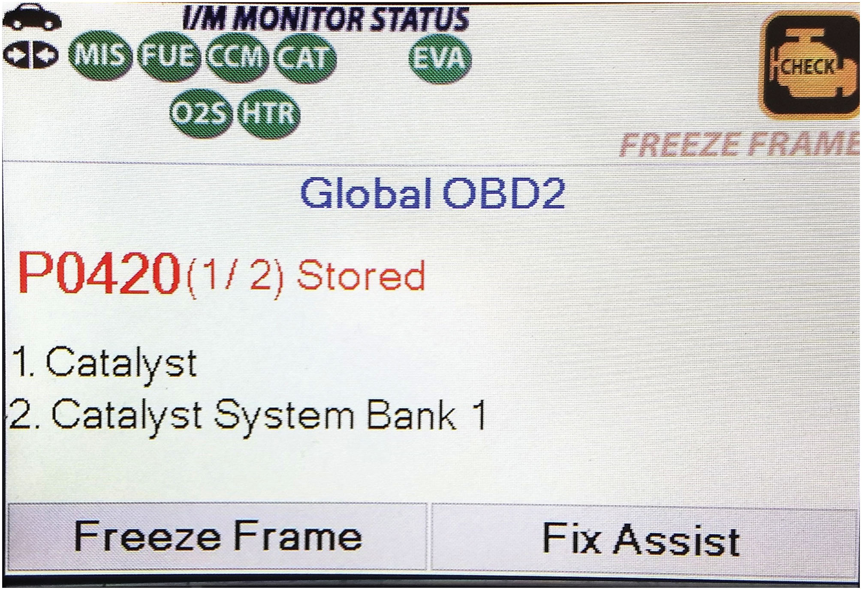
Figure 6.11
D T C Freeze Frame
Whenever a D T C has been set (P0420 in this case), a freeze frame is also captured allowing the service technician to view under what conditions were occurring when the code was set.
Notes:
Freeze Frame
To assist the service technician, O B D-II requires the P C M to take a “snapshot” or freeze-frame of all data at the instant an emission-related D T C is set. A D T C should not be cleared from the vehicle computer memory unless the fault has been corrected, and the technician is so directed by the diagnostic procedure. If the problem that caused the D T C to be set has been corrected, the computer will automatically clear the D T C after 40 consecutive warm-up cycles with no further
faults detected. (Misfire and excessively rich or lean condition codes require 80 warm-up cycles.) The codes can also be erased by using a scan tool. • See Figure 6.11.
Long Description:
It displays a check symbol on the top right corner. The text 'Freeze Frame' is below it. There is an illustration of a car in the top left corner. A leftward and rightward arrow facing each other is below the illustration. M I S, F U E, C C M, C A T, E V A, O2S, and H T R are next to the arrows. The heading Global O B D2 comprises the following content: P0420 (1 slash 2) stored. 1. Catalyst. 2. Catalyst system bank 1. The buttons for freeze frame and fix assist are at the bottom.

Slide 31
Pre- and Post-Scans
Pre-Scan
Record all stored D T C S before any work
Learn D T C s are stored
Help reduce surprises and repair supplements
Main reason why a pre-scan is needed
Fault found in one system root cause of another situation
Post-Scan
Confirms all issues related to the repair have been corrected
Post-scan should become part of the work order
Notes:
PRE- AND POST-SCANS
Learning Objective: Explain why pre- and post-scanning is needed.
Purpose of a Pre-Scan
All professional automotive repair facilities should perform an all-module scan and record all stored
diagnostic trouble codes before any work is performed on the vehicle. A pre-scan must be done to
learn what D T C s are stored in the vehicle. This becomes part of the estimate and repair plans and
might help reduce surprises and repair supplements. The main reason why a pre-scan is needed is
because a fault that is found in one system may be the root cause of another situation that the
vehicle owner may or may not be aware of.
Post-Scan
A post-repair scan confirms that all issues related to the repair have been corrected, including those
D T C s that might have been set during the repair process. The results of both the pre- and the
post-scan should become part of the work order.

Slide 32
Frequently Asked Question: What Is a P I D?
? Frequently Asked Question
What Is a P I D? Scan data information regarding sensors or systems are referred to as parameter identification, often abbreviated P I D. Each sensor and data value such as engine speed (R P M) is displayed on aftermarket and factory scan tools. Check service information for specific range for each sensor when performing a scan tool diagnostic procedure.

Slide 33
Question 3
Why should a technician perform both a pre- and a post-scan of the vehicle before and after a repair?

Slide 34
Answer 3
Help reduce surprises and repair supplements.

Slide 35
Using a Scan Tool Step by Step

Slide 36
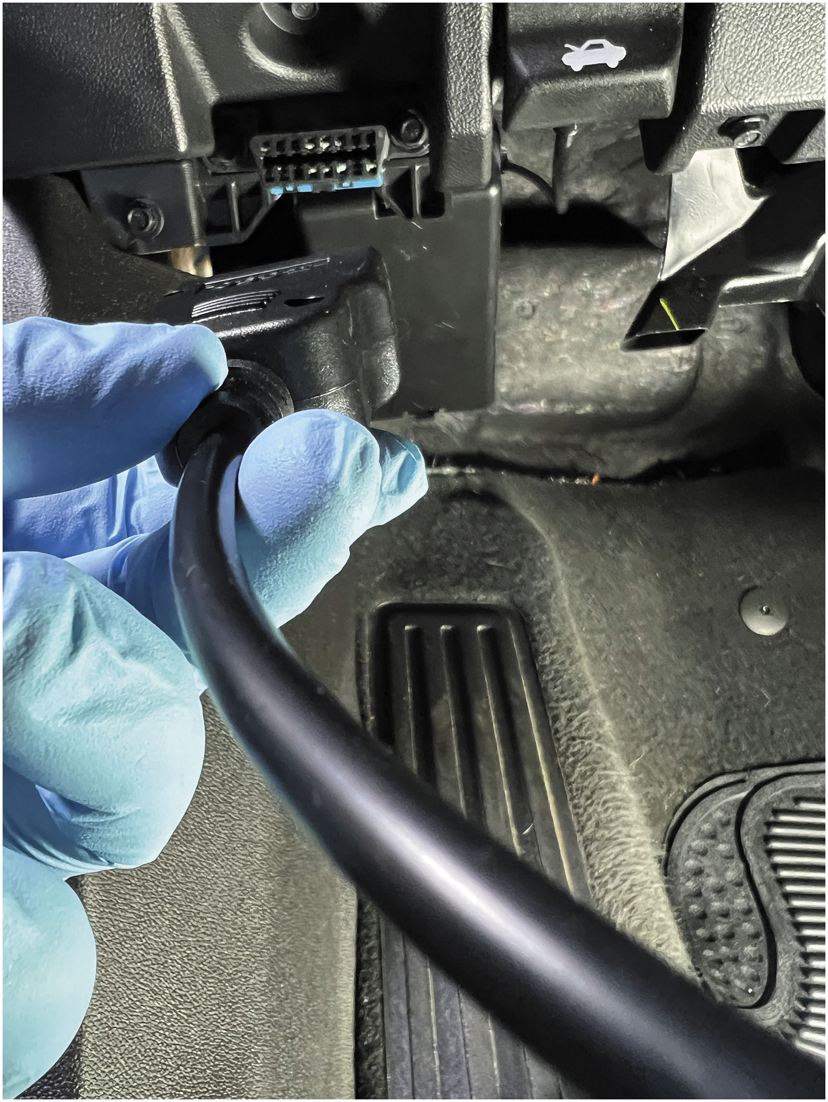
P S1
1. Locate the data link connector (D L C) usually located under the dash on the driver’s side.

Slide 37
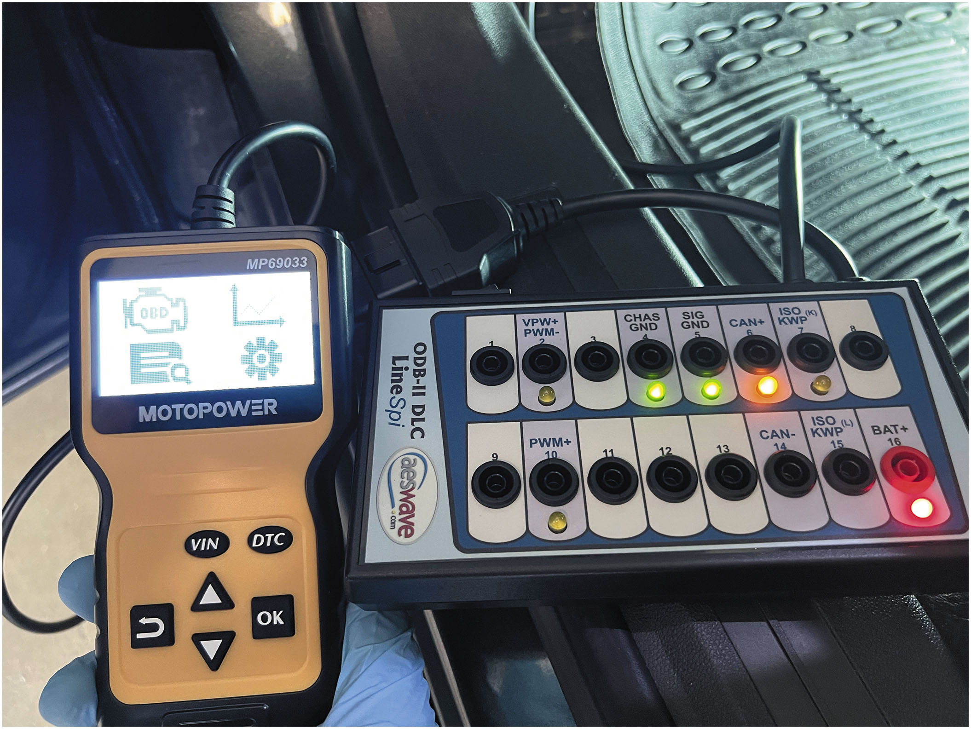
P S2
2. Many technicians use a breakout box (B O B) connected to the D L C and then plug the scan tool into the B O B. This allows easy access to the plug and the technician can monitor that there are module communications occurring.
Notes:
Long Description:
The car battery tester shows V I N, D T C, and O K buttons and arrow buttons. The D L C shows 1 to 16 ports for different controls: V P W P W M negative, CHAS G N D, DIG G N D, CAN positive, I S O K W P (K), P W M positive, CAN negative, I S O K W P (L), and BAT positive.

Slide 38
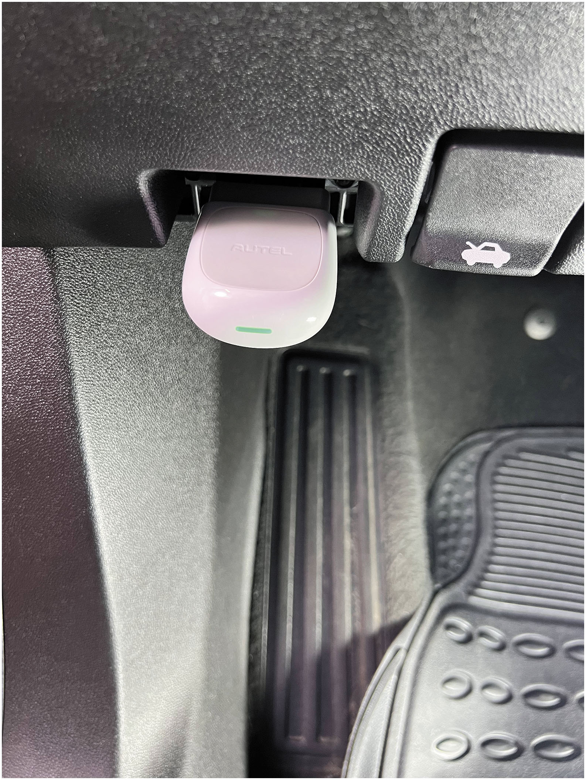
P S3
3. A smart phone scan tool pulled into the D L C which also requires the designated smart phone app to display the data.

Slide 39
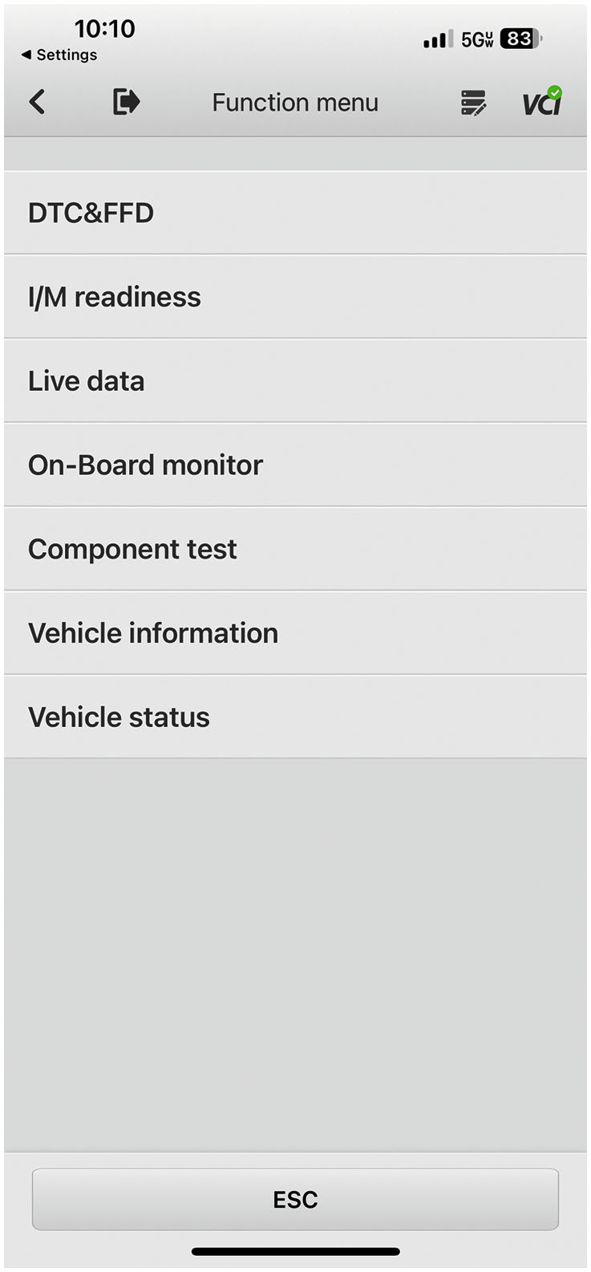
P S4
4. One of the first screens shown on an iPhone screen using the smart phone scan tool.

Slide 40
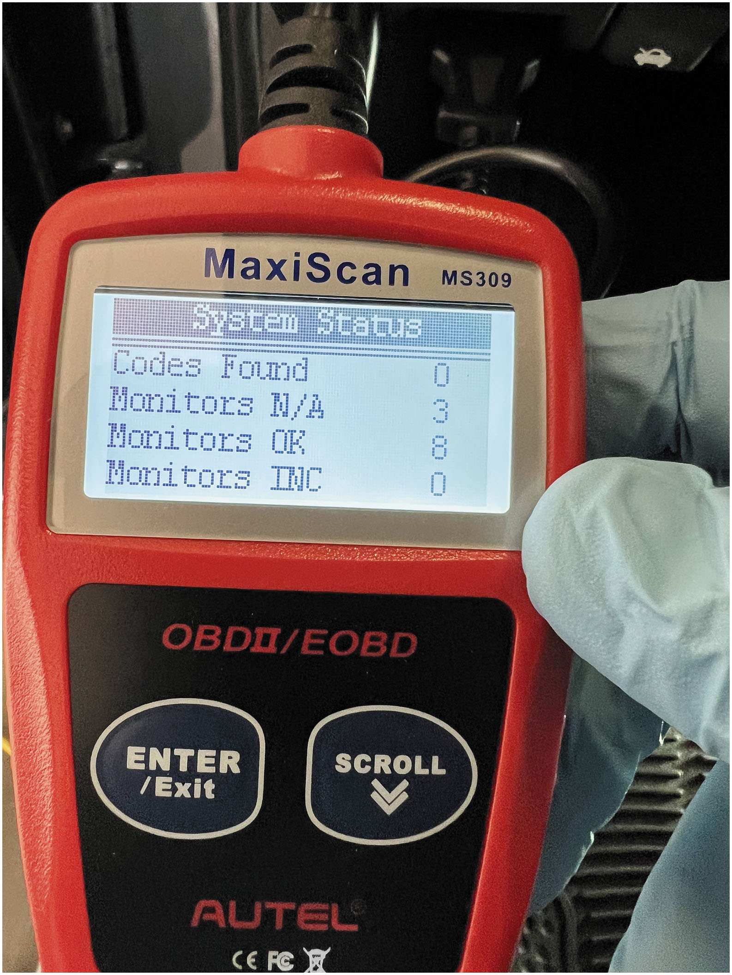
P S5
5. A code reader displaying that there are no stored D T C s and eight monitors that have run and are OK.

Slide 41
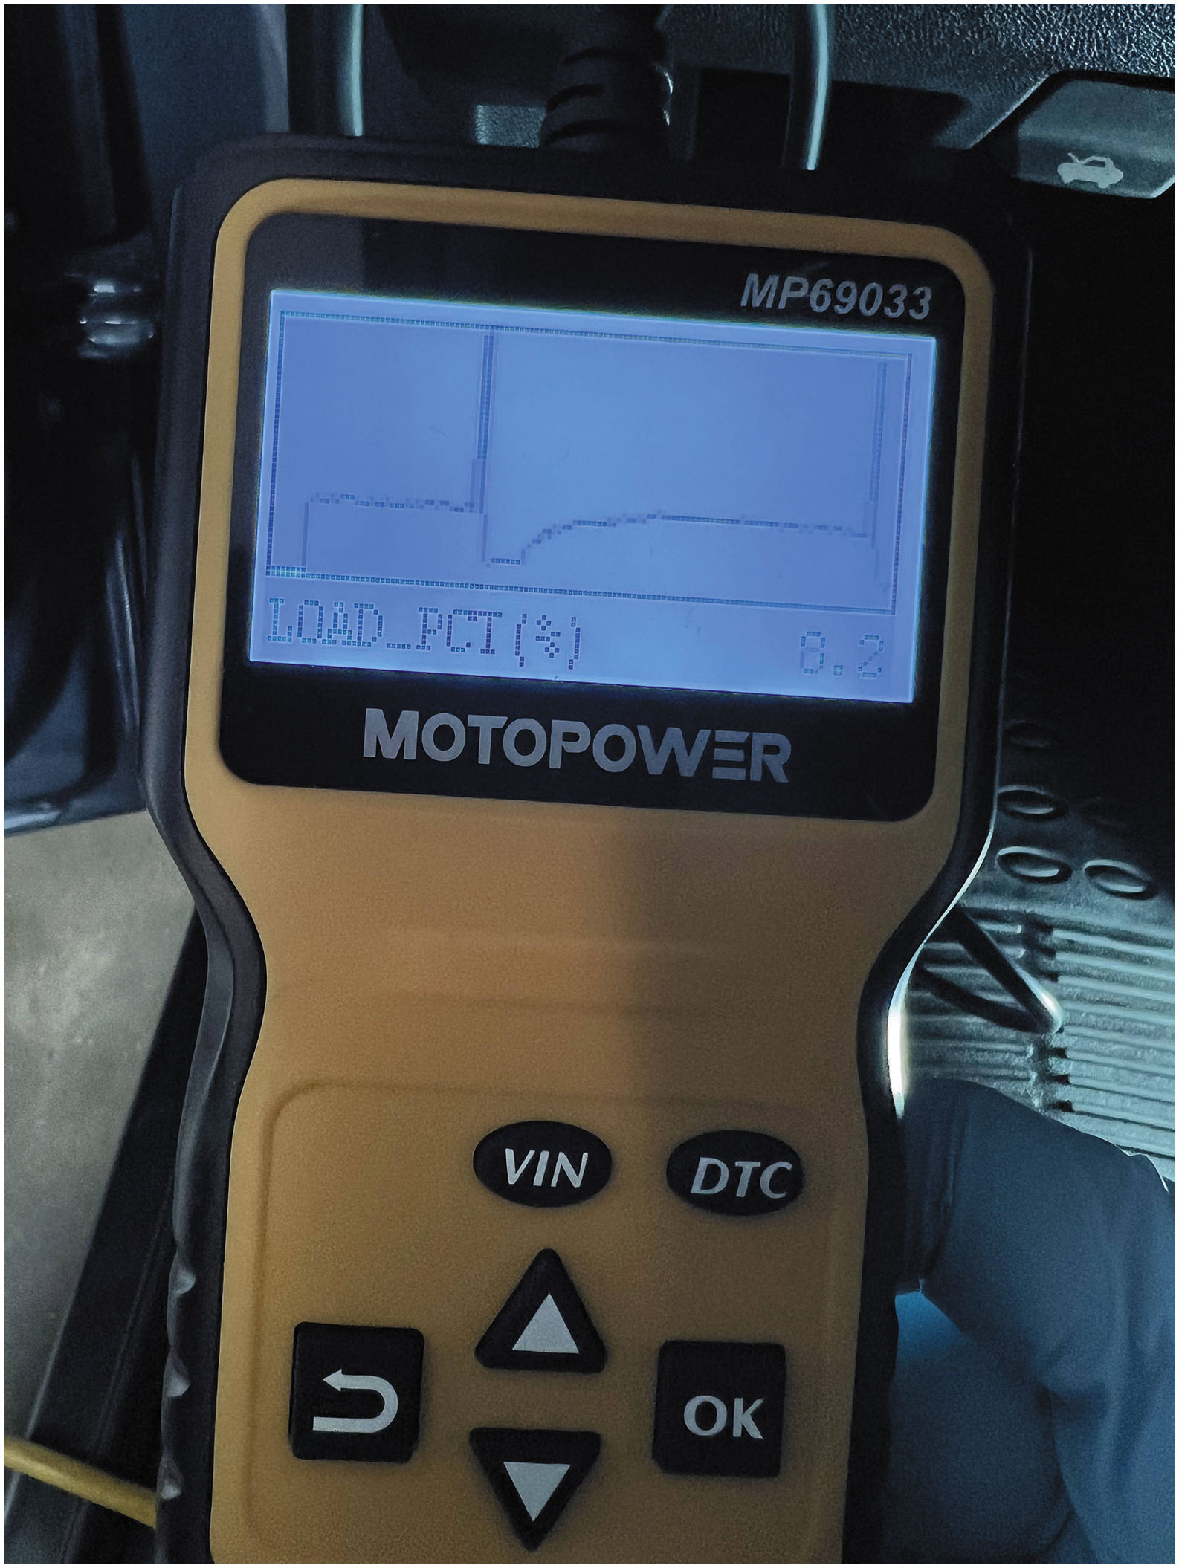
P S6
6. Some scan tools are able to graph data such as this graph of a fuel injector waveform.

Slide 42
Summary (1 of 2)
The Malfunction Indicator Lamp (M I L), also called the check engine light (C E L), is a dash warning light that is orange/yellow specified by I S O 2575.
16-pin data link connector adheres to S A E J1962 standard. It is located on the driver’s side on all vehicles sold in North America, model year (M Y) 1996 and newer.
A code reader is a low-cost scan tool that can display only global (generic) trouble codes.
A smart phone app scan tool is a device that plugs into the D L C and transmits data via Bluetooth to a smart phone equipped with a scan tool app.
An aftermarket diagnostic scan tool is manufactured by many manufacturers and uses the data licensed through each original equipment manufacturer O E M.

Slide 43
Summary (2 of 2)
Factory scan tools are the scan tools required by all dealers that sell and service the brand of vehicle.
D T C s are grouped into major categories, depending on the
location of the fault on the system involved.
Permanent trouble codes cannot be cleared by any tool, even factory scan tools. Codes can only be cleared by the P C M once it has determined that the malfunction is no longer present.
All professional automotive repair facilities should perform an all-module scan and record all stored diagnostic trouble codes before any work is performed on the vehicle.

Slide 44
Animation and Video Library Links (Must have an internet connection and active Haldeman subscription)
Animation Library: (A8) Engine Performance Animations
Animation Library: (A6) Electrical/Electronic Systems Animations
Video Library: (A8) Engine Performance Videos
Video Library: (A6) Electrical/Electronic Systems Videos

Slide 45
Copyright
This work is protected by United States copyright laws and is provided solely for the use of instructors in teaching their courses and assessing student learning. Dissemination or sale of any part of this work (including on the World Wide Web) will destroy the integrity of the work and is not permitted. The work and materials from it should never be made available to students except by instructors using the accompanying text in their classes. All recipients of this work are expected to abide by these restrictions and to honor the intended pedagogical purposes and the needs of other instructors who rely on these materials.

