Slide 1
Advanced Engine Performance Diagnosis
Eighth Edition
Chapter 2
Strategy-Based Diagnosis
Copyright © 2025 Pearson Education, Inc. All Rights Reserved
Notes:
If this PowerPoint presentation contains mathematical equations, you may need to check that your computer has the following installed:
1) Math Type Plugin
2) Math Player (free versions available)
3) NVDA Reader (free versions available)
INSTRUCTOR NOTE: This presentation includes text explanation notes, you can use to teach the course. When in SLIDE SHOW mode, you RIGHT CLICK and select SHOW PRESENTER VIEW, to use the notes.

Slide 2
Learning Objectives
2.1 List the steps of the diagnostic process.
2.2 Discuss the types of scan tools that are used to assess vehicle components.
2.3 Explain how to retrieve diagnostic information and how to use D T C s.
2.4 Explain the troubleshooting procedures to follow if a diagnostic trouble code has been set.
2.5 Explain manufacturer's diagnostic routines.
2.6 Discuss completing system repairs, including resetting the P C M and road test (drive cycle).

Slide 3
The Eight-Step Diagnostic Procedure (1 of 6)
Step 1—Verify the Problem (Concern)
Before a minute is spent on diagnosis, be certain that a problem exists.
Step 2—Perform a Thorough Visual Inspection and Basic Tests
Check for obvious problems (basics, basics, basics).
Check everything that does and does not work.
Look for evidence of previous repairs.
Check oil level and condition.
Check coolant level and condition.

Slide 4
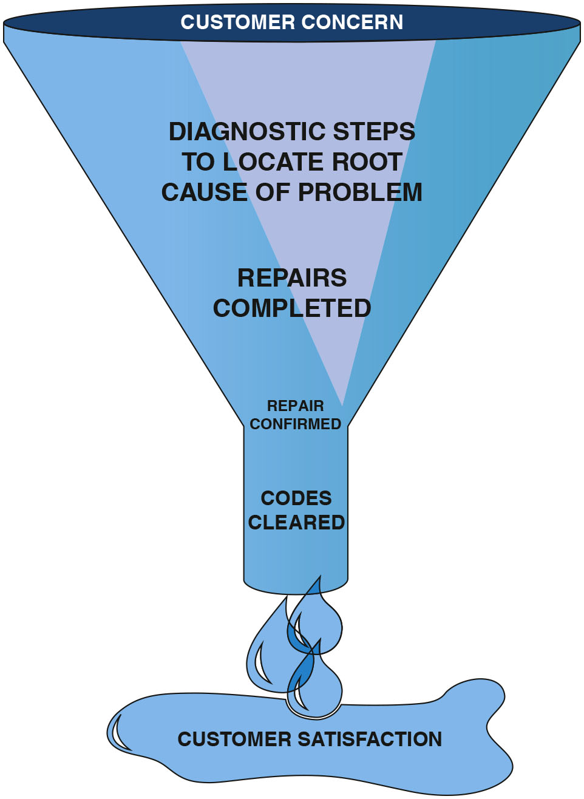
Figure 2.1
Funnel Analogy
A funnel is one way to visualize the diagnostic process. The purpose is to narrow the possible causes of a concern until the root cause is determined and corrected.
Notes:
The diagnostic process is a strategy that eliminates known good components or systems in order to find the root cause of automotive engine performance problems. All vehicle manufacturers recommend a diagnostic procedure, and the plan suggested in this chapter combines most of the features of these plans plus additional steps developed over years of real-world problem solving. Many different things can cause an engine performance problem or concern. The service technician must narrow the possibilities to find the cause of the problem and correct it. A funnel is a way of visualizing a diagnostic procedure. • SEE FIGURE 2.1.

Slide 5
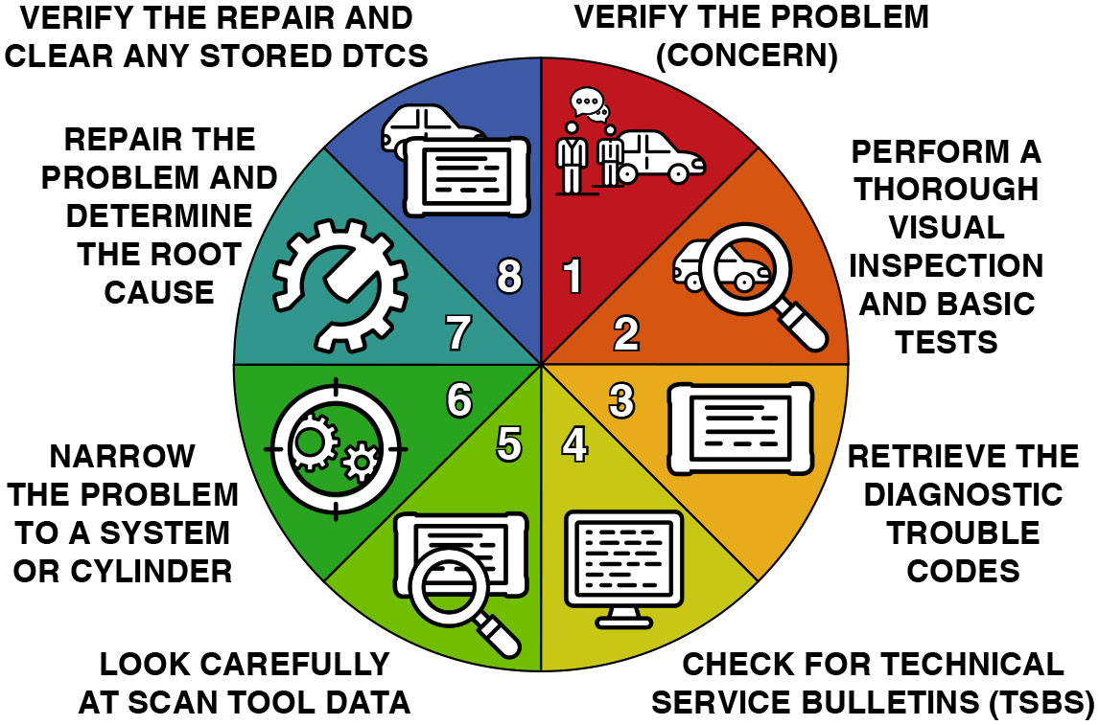
Figure 2.2
Circle Visual
Another way to visualize the diagnostic process is in a circle.
Notes:
Step 1 is to verify the customer concern or problem. If the problem cannot be verified, then the repair cannot be performed
TECH TIP “Original Equipment” Is Not a Four-Letter Word
To many service technicians, an original-equipment part is considered to be only marginal, and to get the really “good stuff” an aftermarket (renewal market) part has to be purchased. However, many problems can be traced to the use of an aftermarket part that has failed early in its service life. Technicians who work at dealerships usually go immediately to an aftermarket part that is observed during a visual inspection. It has been their experience that simply replacing the aftermarket part with the factory original-equipment (O E) part often solves the problem. Original equipment parts are required to pass quality and durability standards and tests at a level not required of aftermarket parts. The technician should be aware that the presence of a new part does not necessarily mean that the part is good.
Long Description:
The illustration depicting a circle displays verify the problem (concern), perform a thorough visual inspection and basic tests, retrieve the diagnostic trouble codes, check for technical service bulletins (t s b s), look carefully at scan tool data, narrow the problem to a system or cylinder, repair the problem and determine the root cause, and verify the repair and clear any stored d t c s.

Slide 6
Animation: Diagnostic Steps

Slide 7
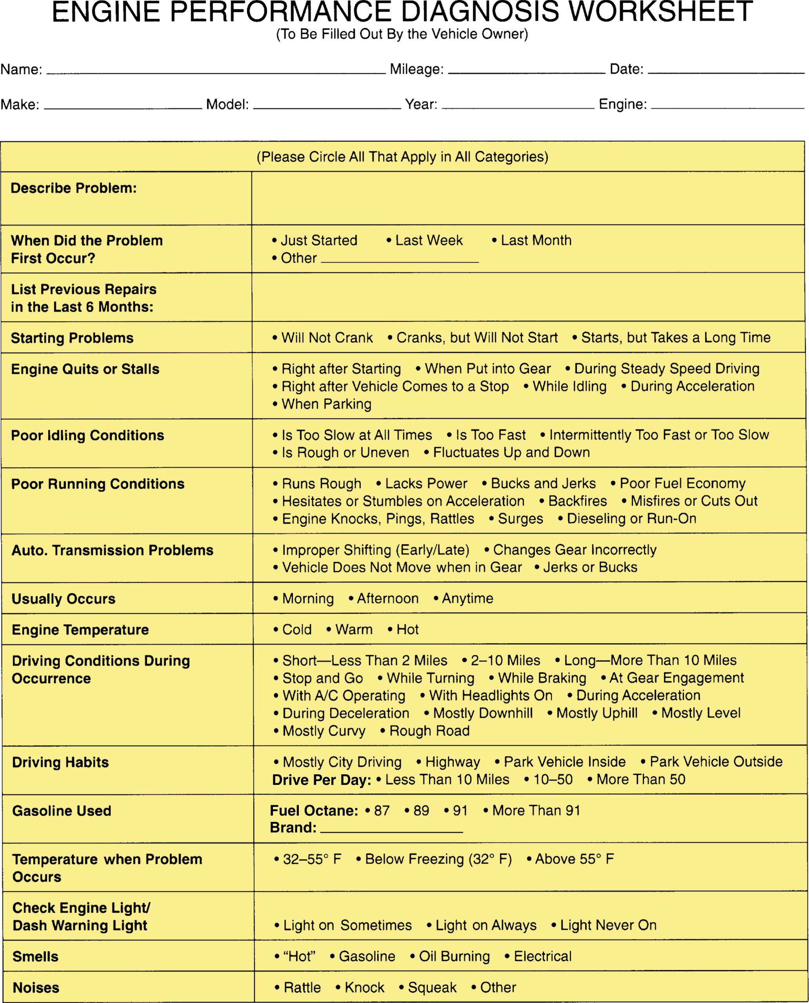
Figure 2.3
Diagnostic Worksheet
A form that the customer should fill out if there is a driveablilty concern to help the service technician more quickly find the root cause.

Slide 8
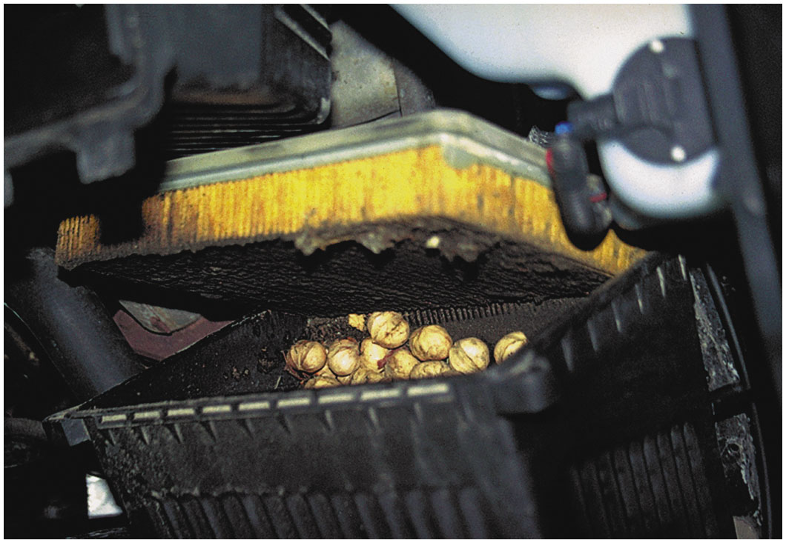
Figure 2.4
Step 2—Visual Check
This is what was found when removing an air filter from a vehicle that had a lack-of-power concern. Obviously, the nuts were deposited by squirrels or some other animal, blocking a lot of the airflow into the engine.

Slide 9
Figure 2.5
Rodent Damage
A technician spotted a mouse crawling across a seat. This discovery prompted the technician to inspect further for rodent damage.
Notes:
TECH TIP: Keep Pet Food Away from Vehicles
A service technician was servicing a Toyota Highlander when the technician noticed something moving inside the vehicle and took a photo using their smartphone. A mouse was apparently
living somewhere in the vehicle, and while there was apparently not any damage done yet to the vehicle, the technician recommended that the customer keep any pet food away from where the
vehicle is parked. The customer admitted to keeping cat food near the vehicle in the garage. • SEE FIGURE 2.5.

Slide 10
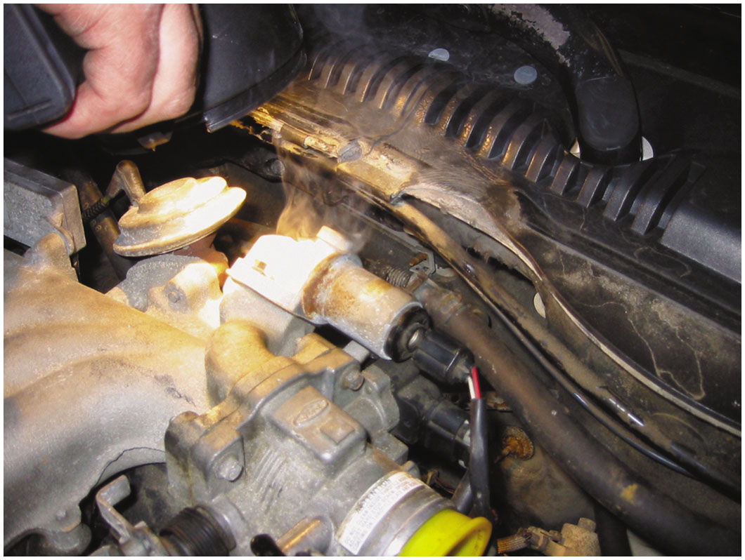
Figure 2.6
Step 2—Using Bright Light
Using a bright light makes seeing where the smoke is coming from easier. In this case, smoke was added to the intake manifold with the inlet blocked with a yellow plastic cap and smoke was seen escaping past a gasket at the idle air control.
Notes:
TECH TIP: Smoke Machine Testing Vacuum (air) leaks can cause a variety of driveability problems and are often difficult to locate. One good method is to use a machine that generates a stream of smoke. Connecting the outlet of the smoke machine to the hose that was removed from the vacuum brake booster allows smoke to enter the intake manifold. Any vacuum leaks will be spotted by observing smoke coming out of the leak. SEE FIGURE 2.6.

Slide 11
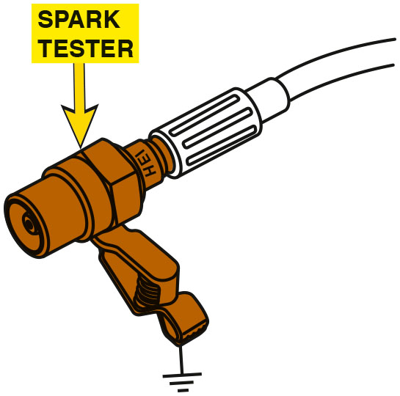
Figure 2.7
Spark Tester
A spark tester connected to a spark plug wire or coil output. A typical spark tester will fire only if at least 25,000 volts is available from the coil, making a spark tester a useful tool. Do not use one that just lights when a spark is present, because it does not require more than about 2,000 volts to light.
Notes:
NOTE: Do not use a standard spark plug to check for proper ignition system voltage. An electronic ignition spark tester is designed to force the spark to jump about 0.75 inch (19 m m). This amount of gap requires between 25,000 and 30,000 volts (25 to 30 k V) at atmospheric pressure, which is enough voltage to ensure that a spark can occur under compression inside an engine.

Slide 12
The Eight-Step Diagnostic Procedure (2 of 6)
Step 3—Retrieve the Diagnostic Trouble Codes (D T C s)
If a diagnostic trouble code (D T C) is present in the computer memory, it may be signaled by illuminating a malfunction indicator lamp (M I L), commonly labeled “check engine” or “service engine soon.”

Slide 13
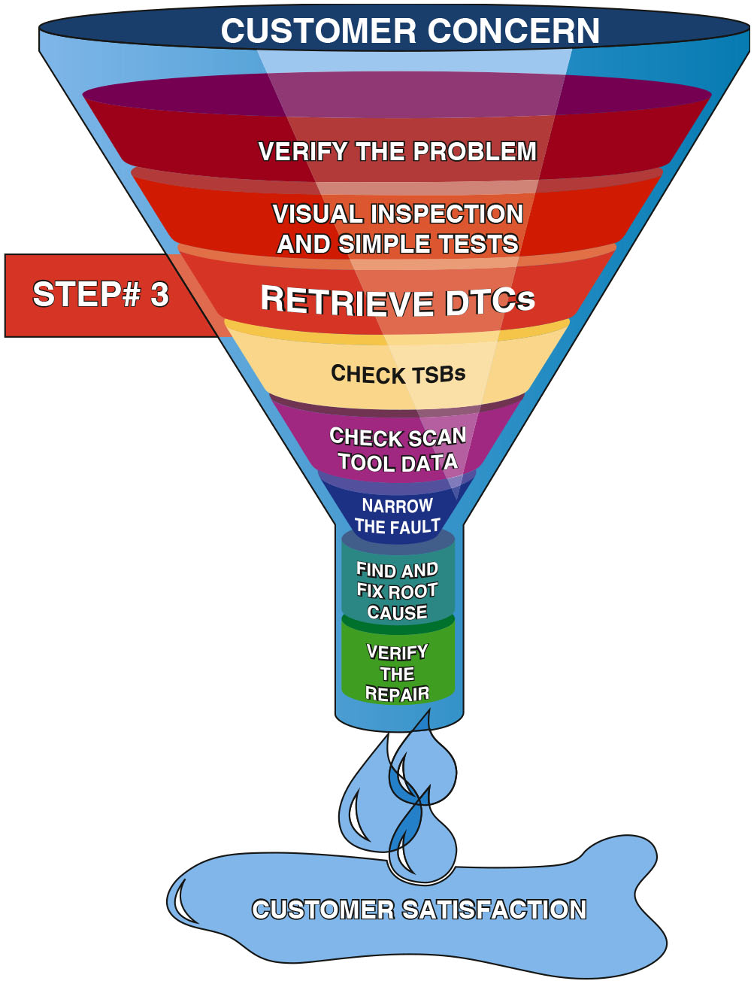
Figure 2.8
Step 3
Step 3 in the diagnostic process is to retrieve any stored diagnostic trouble codes.
Notes:
Long Description:
The illustration depicting a funnel showing step 3 displays Verify the problem, Visual inspection and simple tests, Retrieve D T C, Check T S B s, Check scan tool data, Narrow the fault, Find and fix root cause, Verify the repair, and Customer satisfaction as an outcome from top to bottom.

Slide 14
The Eight-Step Diagnostic Procedure (3 of 6)
Step 4—Check for Technical Service Bulletins
Check for corrections in technical service bulletins (T S B s) that match the symptoms.
As many as 30% of vehicles can be repaired following the information, suggestions, or replacement parts found in a service bulletin.

Slide 15
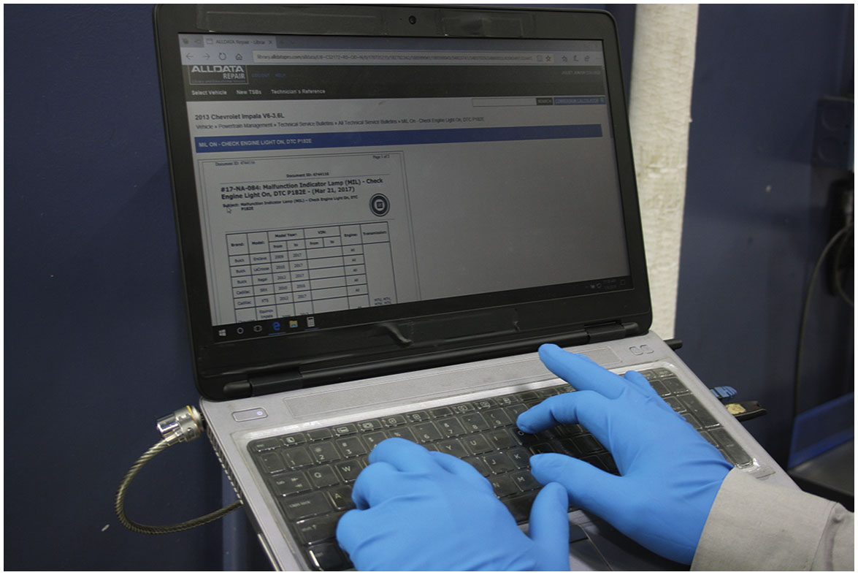
Figure 2.9
Step 4 — Check for T S B s
After checking for stored diagnostic trouble codes (D T C s), the wise technician checks service information for any technical service bulletins that may relate to the vehicle being serviced.

Slide 16
The Eight-Step Diagnostic Procedure (4 of 6)
Step 5—Look Carefully at Scan Tool Data
Vehicle manufacturers have been giving the technician more and more data on a scan tool connected to the data link connector (D L C).
The best way to look at scan data is in a definite sequence and with specific, selected bits of data that can tell the most about the operation of the engine.

Slide 17
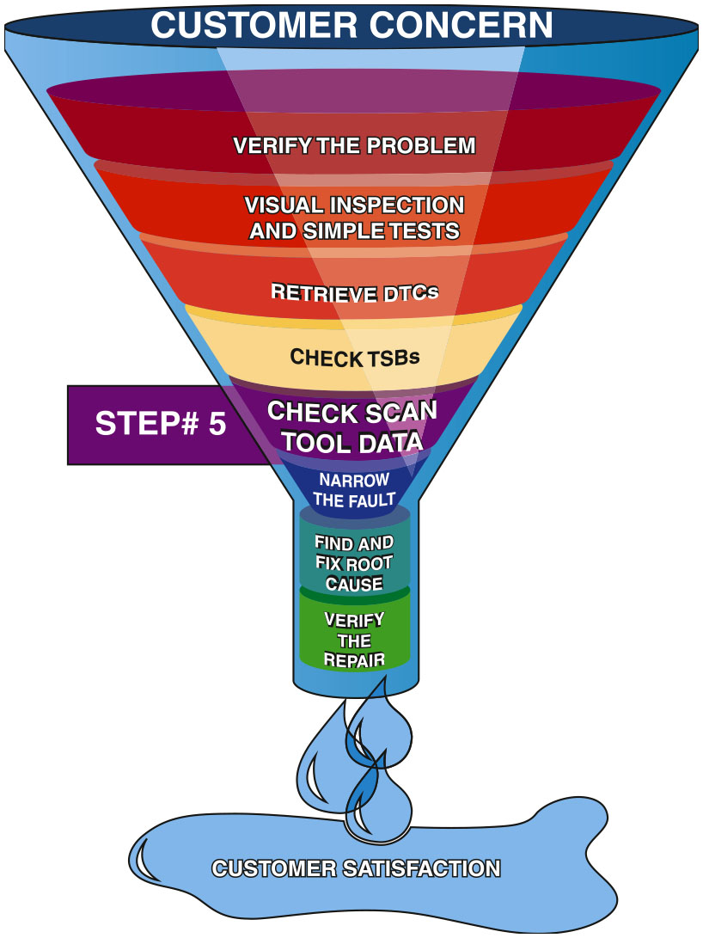
Figure 2.10
Step 5—Scan Tool Data
Looking carefully at the scan tool data is very helpful in locating the source of a problem.
Notes:
TECH TIP: Look at the Freeze Frame
Whenever a D T C is set, a freeze frame is stored. The freeze frame includes data showing how the engine was being operated at the time the code was set. The wise service technician saves the freeze frame information to help determine not only what might have caused the code to set but also to allow the technician to drive the vehicle under similar conditions to verify that the problem has been corrected.
Long Description:
The illustration depicting a funnel showing step 5 displays Verify the problem, Visual inspection and simple tests, Retrieve D T C, Check T S B s, Check scan tool data, Narrow the fault, Find and fix root cause, Verify the repair, and Customer satisfaction as an outcome from top to bottom.

Slide 18
The Eight-Step Diagnostic Procedure (5 of 6)
Step 6—Narrow the Problem to a System or Cylinder
Narrowing the focus to a system or individual cylinder is the hardest part of the entire diagnostic process.
Perform specific tests such as a power balance test, a compression test, or a cylinder leakage test.
Step 7—Repair Problem and Determine Root Cause
The repair or part replacement must be performed following vehicle manufacturer’s recommendations.

Slide 19
The Eight-Step Diagnostic Procedure (6 of 6)
Step 8—Verify the Repair and Clear any Stored D T C s
Test-drive to verify that the original problem (concern) is fixed.
Verify that no additional problems have occurred during the repair process.
Check for and then clear all D T C s.

Slide 20
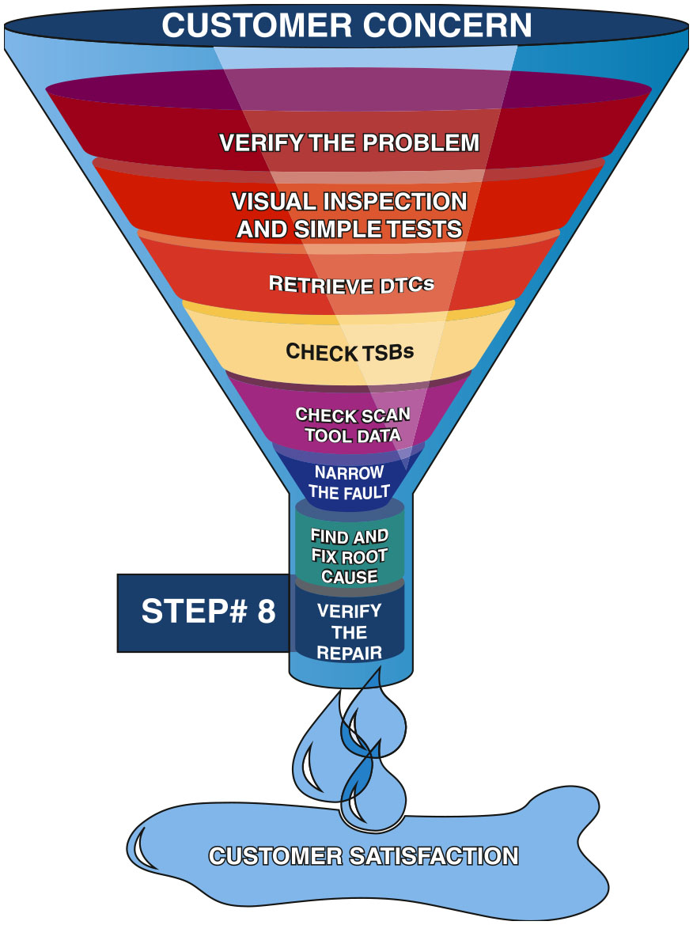
Figure 2.11
Step 8—Verify Repair
Step 8 is very important. Be sure that the customer’s concern has been corrected.
Notes:
TECH TIP: One Test Is Worth 1,000 “Expert” Opinions
Whenever any vehicle has an engine performance or driveability concern, certain people always say:
“Sounds like it’s a bad injector.”
“I’ll bet you it’s a bad computer.”
“I had a problem just like yours yesterday and it was a bad E G R valve.”
Regardless of the skills and talents of those people, it is still more accurate to perform tests on
the vehicle than to rely on feelings or opinions of others who have not even seen the vehicle. Even
your own opinion should not sway your thinking. Follow a plan, perform
tests, and the test results will lead to the root cause.
Long Description:
The illustration depicting a funnel showing step 8 displays Verify the problem, Visual inspection and simple tests, Retrieve D T C, Check T S B s, Check scan tool data, Narrow the fault, Find and fix root cause, Verify the repair, and Customer satisfaction as an outcome from top to bottom.

Slide 21
Chart 2.1
Short-Term Fuel Trim
TOTAL FUEL TRIM (LTFT + S T F T) AT IDLE | 2,500 RPM FUEL TRIM | LOADED FUEL TRIM | DRIVABILITY SYMPTOMS | POSSIBLE CAUSES
0–5% | 0–5% | 0–5% | No issues | Preferred fuel trim values
6–10% | 6–10% | 6–10% | No issues | Acceptable fuel trim valves
Negative 10 plus. percentage | Negative 10 plus percentage | Negative 10 plus percentage | Poor fuel economy | P C M is reducing fuel do to faults in the fuel system over-fueling the engine
Plus 10 percentage plus. | Plus 10 percentage plus. | Plus 10 percentage plus. | Low power, possible hesitation on acceleration | P C M is increasing fuel delivery do to faults in the air induction system
Normal short-term fuel trim (S T F T) and long-term fuel trim (L T F T) are considered to be less than +/−10%.

Slide 22
Question 1
What is the purpose of the eight-step diagnostic process?

Slide 23
Answer 1
To ensure the concern is properly identified and fixed correctly on the first visit.

Slide 24
Scan Tools
Scan tools divided into two groups:
Factory Scan Tools
Factory scan tools designed to provide bidirectional capability
Factory scan tools capable of displaying all factory parameters.
Aftermarket Scan Tools
While many aftermarket scan tools can display most, if not all, of the parameters of the factory scan tool, there can be a difference when trying to troubleshoot some faults.
Notes:
SCAN TOOLS
Learning Objective: Discuss the types of scan tools that are used to assess vehicle components.
Scan tools are the workhorse for any diagnostic work on all vehicles. Scan tools can be divided into two basic groups
1. Factory scan tools. These are the scan tools required by all dealers that sell and service the brand of vehicle. Examples of factory scan tools include
General Motors—Tech 2, M D I (Multiple Diagnostic Interface), M D I 2, or G D S2
(global diagnostic system 2).
Ford—New Generation Star (N G S), I D S (Integrated Diagnostic System), V C M,
V C M2, or V C M3.
Chrysler—D R B-III, Star Scan, wiTECH, or wiTECH 2.
Honda—H D S or Master Tech
Toyota—Master Tech, or Techstream A D V i.

Slide 25
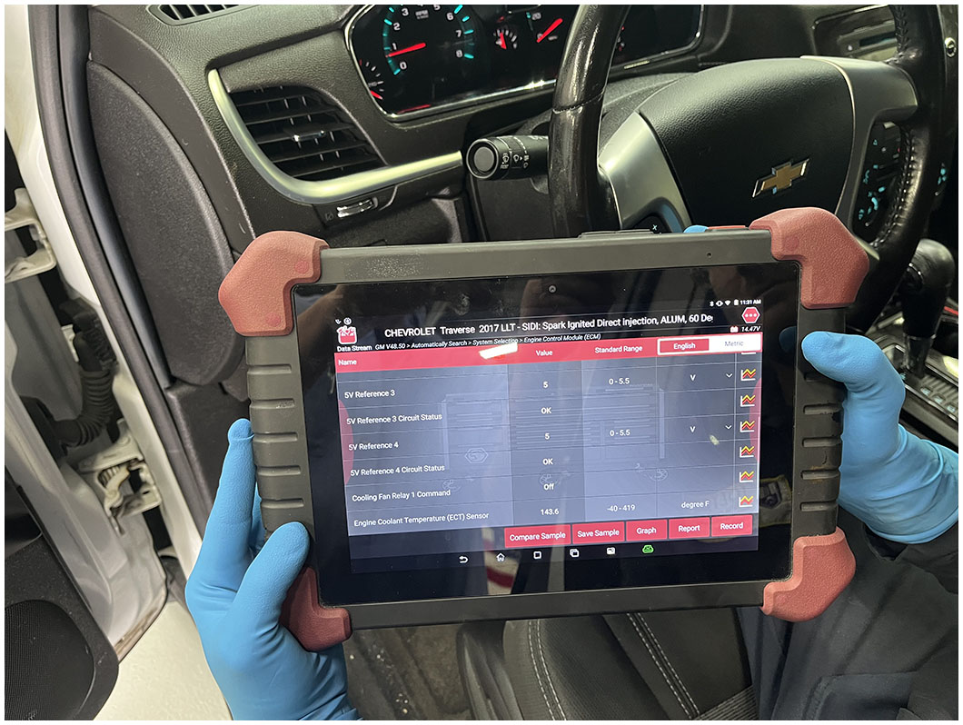
Figure 2.12
Aftermarket Scan Tool
An enhanced aftermarket scan tool being used to diagnose an engine performance issue.
Notes:
Tech Tip
One Test Is Worth 1,000 “Expert” Opinions Whenever any vehicle has an engine performance or driveability concern, certain people always
say:
“Sounds like it’s a bad injector.”
“I’ll bet you it’s a bad computer.”
“I had a problem just like yours yesterday and it was a bad E G R valve.”
Regardless of the skills and talents of those people, it is still more accurate to perform tests on the vehicle than to rely on feelings or opinions of others who have not even seen the vehicle. Even your own opinion should not sway your thinking. Follow a plan, perform tests, and the test results will lead to the root cause.

Slide 26
Question 2
What is the difference between a factory level and an aftermarket scan tool?

Slide 27
Answer 2
The factory scan tool supports a specific brand, whereas an aftermarket scan tool support many brands.

Slide 28
D L C Locations
The data link connector (D L C) is a standardized 16-cavity connector to which a scan tool can be connected to retrieve diagnostic information from the vehicle’s computers.
The normal location is under the dash on the driver’s side of the vehicle.

Slide 29
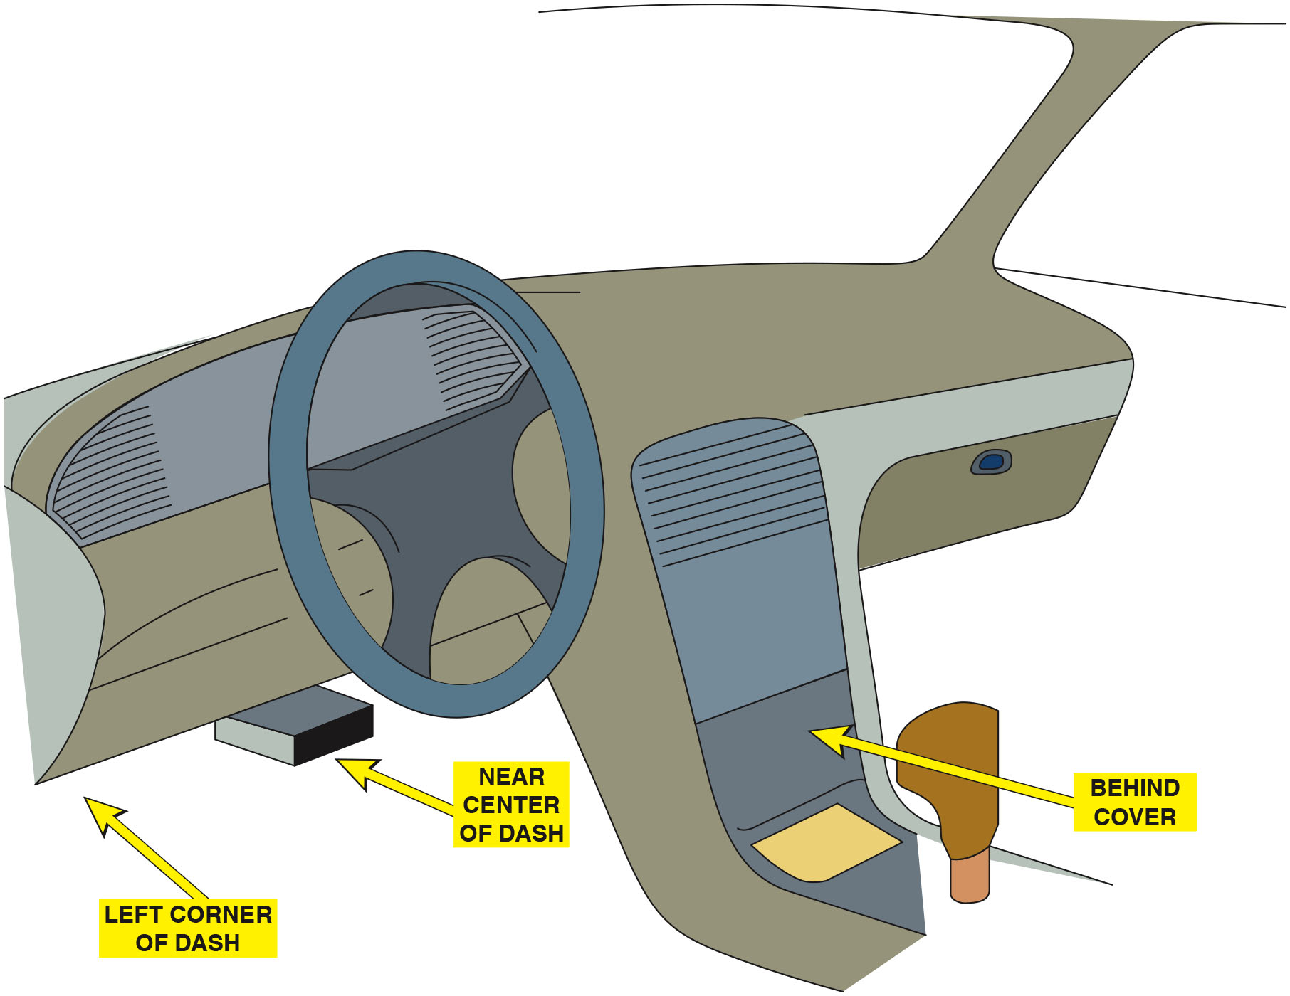
Figure 2.13
D L C Location
The data link connector (D L C) can be located in various locations.

Slide 30
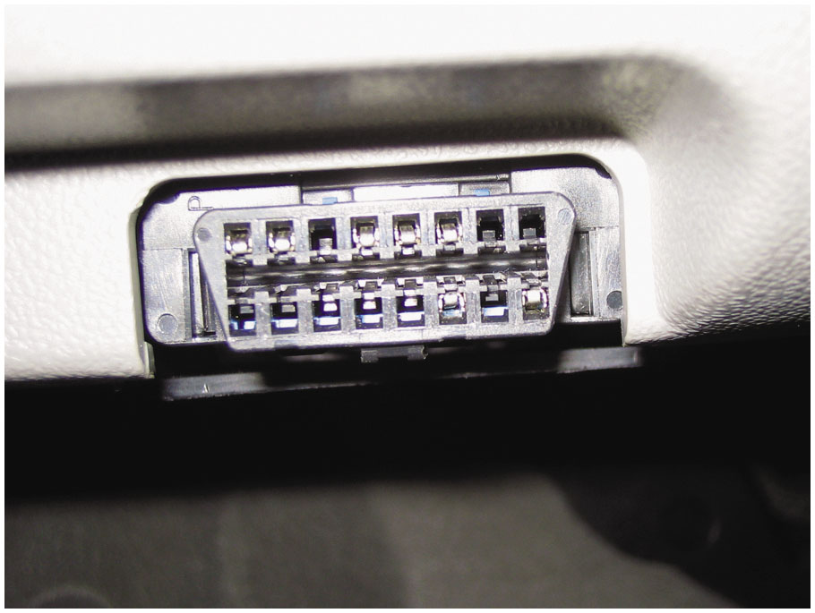
Figure 2.14
D L C
A typical
data link
connector (D L C). The location varies with make and model and may even be covered, but a tool is not needed to gain access. Check service information for the exact location if needed.

Slide 31
O B D roman numeral two Diagnosis
Starting with the 1996 model year, all vehicles sold in the United States must use the same type of 16-pin D L C and must monitor emissions-related components.
Retrieving
Codes
A scan tool is required to retrieve diagnostic trouble
codes from most
vehicles.
Every
scan tool will be able to read all generic
Society of Automotive Engineers (S A E) D T C s from any vehicle.

Slide 32
Animation: Scan Tool

Slide 33
Animation: Scan Tool

Slide 34
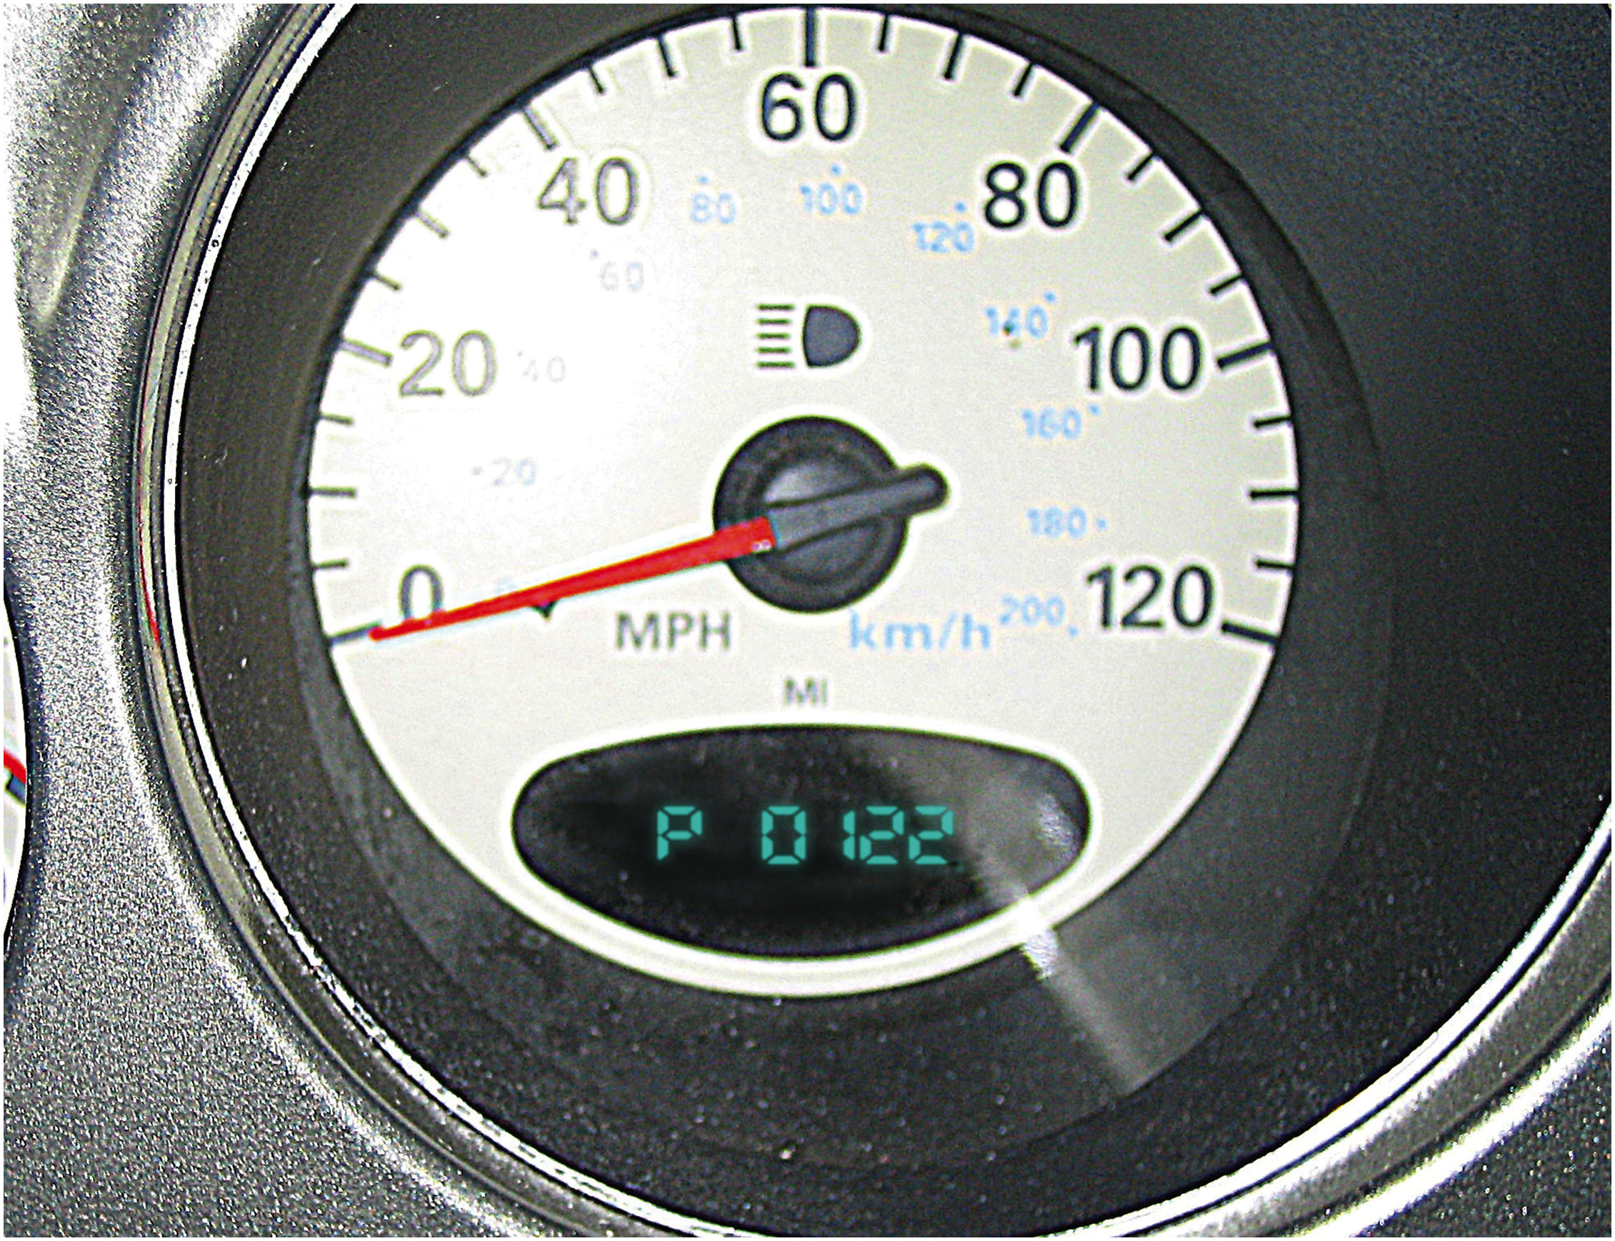
Figure 2.15
Fiat-Chrysler D T C s
Diagnostic trouble codes (D T C s) from Chrysler and Dodge vehicles can be retrieved by turning the ignition switch to on and then off three times.

Slide 35
Retrieval of Diagnostic Information
Locate and gain access to the data link connector (D L C).
Connect the scan tool to the D L C and establish communication.
Follow the on-screen instructions of the scan tool.
Observe the scan data, as well as any D T C s.
Follow the vehicle manufacturer’s instructions if any D T C s are stored.

Slide 36
Troubleshooting Using Diagnostic Trouble Codes
Pinning down causes of the actual problem can be accomplished by trying to set the opposite code.
If the opposite code sets, this indicates that the wiring and connector for the sensor is okay and the sensor itself is defective (open).
If the same code sets, this indicates that the wiring or electrical connection is open (has high resistance) and is the cause of the setting of the D T C.
Methods for Clearing Diagnostic Trouble Codes
Scan tool, remove power from computer, or disconnect the vehicle battery.

Slide 37
Retrieving Codes Prior to 1996
Flash Codes
Most vehicles from the early 1980s through 1995 used some method to retrieve D T C s.
Scan Tool
Special Tester
Fused jumper wire
Test light

Slide 38
O B D hyphen roman numeral two Diagnosis
Starting with the 1996 model year, all vehicles sold in the United States must use the same type of 16-pin D L C and must monitor emissions-related components.
Retrieving
Codes
A scan tool is required to retrieve diagnostic trouble
codes from most
vehicles.
Every
scan tool will be able to read all generic
Society of Automotive Engineers (S A E) D T C s from any vehicle.

Slide 39
Manufacturer’s Diagnostic Routines (1 of 2)
Drive Cycles: vehicle must be driven under a variety
of operating conditions for all active tests to be performed.
Types of
Codes
TYPE A CODES. A type A diagnostic trouble code is emissions related and causes the M I L to be turned on at the first trip if the computer has detected a problem.
TYPE B CODES. A type B code is stored and the M I L is turned on during the second consecutive trip, alerting the driver to the fact that a diagnostic test was performed and failed.

Slide 40
Manufacturer’s Diagnostic Routines (2 of 2)
TYPE C AND D CODES. Type C and type D codes are for use with non-emissions-related diagnostic tests.
Freeze Frame
requires the computer to take a “snapshot” or
freeze-frame of all data at the instant an emissions-related D T C is set.
Diagnosing Intermittent Malfunctions
Determine the conditions when the malfunction occurs, and then try to duplicate those conditions.
Notes:
TECH TIP: The Brake Pedal Trick
If the vehicle manufacturer recommends that battery power be disconnected, first disconnect the negative battery cable and then depress the brake pedal. Because the brake lights are connected to battery power, depressing the brake pedal causes all of the capacitors in the electrical system and computer(s) to discharge through the brake lights.
TECH TIP Drive the Light Out
If working on a vehicle that is subject to state emissions testing, it is best to not clear codes. When diagnostic trouble codes are cleared, all of the monitors have to be rerun and this can be a time-consuming job. Instead of clearing the code, simply drive the vehicle until the P C M clears the code. This will likely take less time compared to trying to drive the vehicle under varying conditions to run all of the monitors.

Slide 41
Animation: Scan Tool, OBD II

Slide 42
Animation: Diagnostic Trouble Code, DTC

Slide 43
Road Test (Drive Cycle)
The vehicle may have to be driven under conditions that allow the P C M to conduct monitor tests. This drive pattern is called a drive cycle.
The drive cycle is different for each vehicle manufacturer, but a universal drive cycle may work. In many cases, performing a universal drive cycle resets most monitors in most vehicles.
Notes:
After the repair has been successfully completed, the vehicle should be driven under similar conditions that caused the original concern. Verify that the problem has been corrected. To per- form this test-drive, it is helpful to have a copy of the freeze-frame parameters that were present when the D T C was set. By driving under similar conditions, the P C M may perform a test of the system and automatically extinguish the MIL. This is the method preferred by most vehicle manufacturers. The D T C can be cleared using a scan tool, but then that means that monitors will have to be run and the vehicle may fail an emissions inspection if driven directly to the testing station.
PROCEDURES FOR RESETTING THE P C M The P C M can be reset or cleared of previously set D T C s and freeze-frame data in the following ways:
1. Driving the Vehicle. Drive the vehicle under similar con present when the fault occurred. If the conditions are similar and the P C M performed the noncontinuous monitor test and it passed three times, then the P C M will extinguish the M I L. This is the method preferred by most vehicle manufacturers; however, this method could be time consuming. If three passes cannot be achieved, the owner of the vehicle will have to be told that even though the check engine light (M I L) is on, the problem has been corrected and the M I L should go out in a few days of normal driving.
Clear D T C s Using a Scan Tool. A scan tool can be used to clear the diagnostic trouble code (D T C), which will also delete all of the freeze-frame data. The advantage of using a scan tool is that the check engine (M I L) will be out and the customer will be happy that the problem (M L on) has been corrected. Do not use a scan tool to clear a D T C if the vehicle is going to be checked soon at a test station for state-mandated emissions tests.
Battery Disconnect. Disconnecting the negative battery cable will clear the D T C s and freeze-frame on many vehicles but not all. Besides clearing the D T C s, disconnecting the battery for about 20 minutes will also erase radio station presets and other memory items in many cases. Most vehicle manufacturers do not recommend that the battery be disconnected to clear D T C s and it may not work on some vehicles.

Slide 44
Summary (1 of 2)
Funnel diagnostics is a visual approach to a diagnostic procedure and involves the following steps:
Step 1 Verify problem (concern)
Step 2 Perform a thorough visual inspection and basic tests
Step 3 Retrieve diagnostic trouble codes (D T C s)
Step 4 Check for technical service bulletins (T S B s)
Step 5 Look carefully at scan tool data
Step 6 Narrow problem to a system or cylinder
Step 7 Repair problem and determine the root cause
Step 8 Verify repair and check for any stored D T C s

Slide 45
Summary (2 of 2)
Care should be taken to not induce high voltage or current around any computer or computer-controlled circuit or sensor.
A thorough visual inspection is important during the diagnosis and troubleshooting of any engine performance problem or electrical malfunction.
If the M I L is on, retrieve the D T C and follow the manufacturer’s recommended procedure to find the root cause of the problem.
vehicles use a 16-pin DLC and common DTCs.

Slide 46
Animation and Video Library Links (Must have an internet connection and active Haldeman subscription)
Animation Library: (A0) Automotive Fundamentals
Animation Library: (A1) Engine Repair Videos
Video Library: (A0) Automotive Fundamentals Videos
Video Library: (A1) Engine Repair Videos

Slide 47
Copyright
This work is protected by United States copyright laws and is provided solely for the use of instructors in teaching their courses and assessing student learning. Dissemination or sale of any part of this work (including on the World Wide Web) will destroy the integrity of the work and is not permitted. The work and materials from it should never be made available to students except by instructors using the accompanying text in their classes. All recipients of this work are expected to abide by these restrictions and to honor the intended pedagogical purposes and the needs of other instructors who rely on these materials.

