Slide 1
Advanced Engine Performance Diagnosis
Eighth Edition
Chapter 1
Service Information, Work Orders, and Vehicle Identification
Copyright © 2025 Pearson Education, Inc. All Rights Reserved
Notes:
If this PowerPoint presentation contains mathematical equations, you may need to check that your computer has the following installed:
1) Math Type Plugin
2) Math Player (free versions available)
3) NVDA Reader (free versions available)
INSTRUCTOR NOTE: This presentation includes text explanation notes, you can use to teach the course. When in SLIDE SHOW mode, you RIGHT CLICK and select SHOW PRESENTER VIEW, to use the notes.

Slide 2
Learning Objectives (1 of 2)
1.1 Discuss the importance of vehicle, owner’s manuals, service records, and service information.
1.2 Explain the different types of service information.
1.3 Discuss the importance of the work order.
1.4 Describe technical service bulletins.
1.5 Describe vehicle recalls and campaigns.
1.6 Explain why service records are important.

Slide 3
Learning Objectives (2 of 2)
1.7 Explain additional information to be obtained from the customer about the vehicle.
1.8 Discuss the parts of a vehicle.
1.9 Differentiate between front-wheel drive and rear-wheel drive.
1.10 Discuss vehicle identification.
1.11 Describe the vehicle safety certification label.
1.12 Describe the V E C I label.

Slide 4
Owner’s Manuals
Most owner’s manuals contain all or most of the following information.
Meaning of dash symbols
How to reset the maintenance reminder light
Specifications of fluids
Tire pressures
Maintenance schedules
Operation of specific features
Tire rotation and T P M S

Slide 5
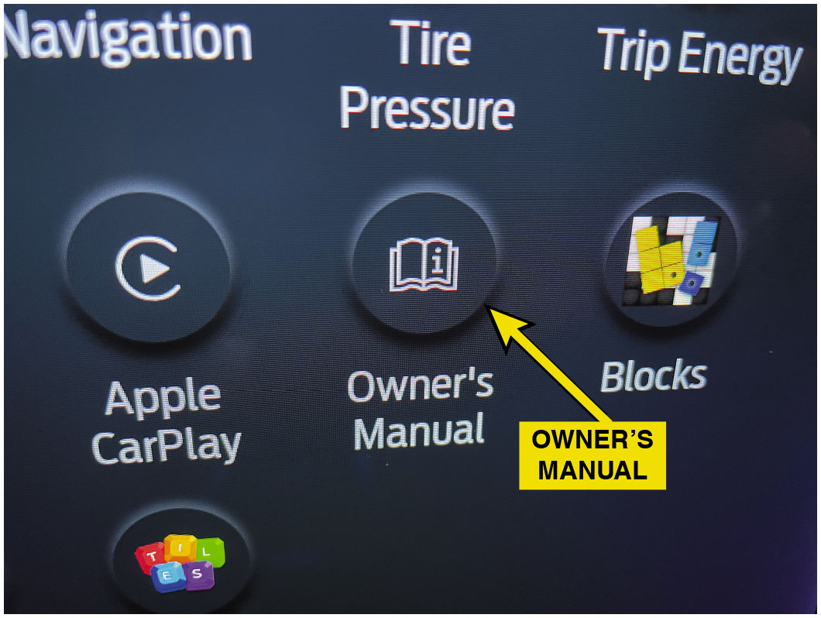
Figure 1.1
Owner’s Manual
The owner’s manual is usually printed and located in the glove compartment. In many newer vehicles, the owner’s manual is accessible on the center control screen.
Notes:
Long Description:
The options are navigation, tire pressure, trip energy, Apple CarPlay accompanied by a play icon, owner’s manual accompanied by a book icon, and blocks accompanied by a blocks’ icon. An arrow points to the owner’s manual, and text reads, owner’s manual.

Slide 6
Service Information (1 of 2)
Purpose of Service Information
Correctly service or repair vehicles
Factory Service Information
Until 1990s service information found in service or shop manuals, now digital
Vehicle manufacturer provides most accurate service information
Notes:
Purpose of Service Information
Service information is needed to correctly service or repair vehicles because it contains all of the specifications, as well as the specified procedures to follow when servicing or repairing a vehicle.
Factory Service Information
Until the 1990s, most service information was found in paper manuals called service manuals or shop manuals.
More recently, the manufacturer provides this information in a digital format.
The most comprehensive and accurate service information is the service information from the vehicle manufacturer.
Tech Tip: Print It Out
It is often a benefit to have the written instructions or schematics (wiring diagrams) at the vehicle while diagnosing or performing a repair. The advantage of electronic service information is that the material can be printed out and taken to the vehicle for easy
access. This also allows the service technician to write or draw on the printed copy, which can be a big help when performing tests, such as electrical system measurements. The schematic can be color-coded to show where there should be voltage and where a ground should be detected. These notes can then be used to document the test results on the work order.

Slide 7
Service Information (2 of 2)
Aftermarket Service Information
Cover multiple years and/or models in one manual.
Paper service manuals disadvantages:
Required storage space
Difficult to use at vehicle or to make copies
Replaced with electronic service information
C D s then D V D s, before becoming available on Internet.
Notes:
Aftermarket Service Information
While factory service manuals cover just one year and one or more models of the same vehicle, most aftermarket service manuals cover multiple years and/or models in one manual.
Paper service manuals had the following disadvantages:
Required a lot of storage space
The pages would become dirty from handling
Difficult to use at the vehicle or to make copies from the thick manuals
Paper service manuals were replaced with electronic service information that came on C D s and then D V D s, before becoming available on the Internet.

Slide 8
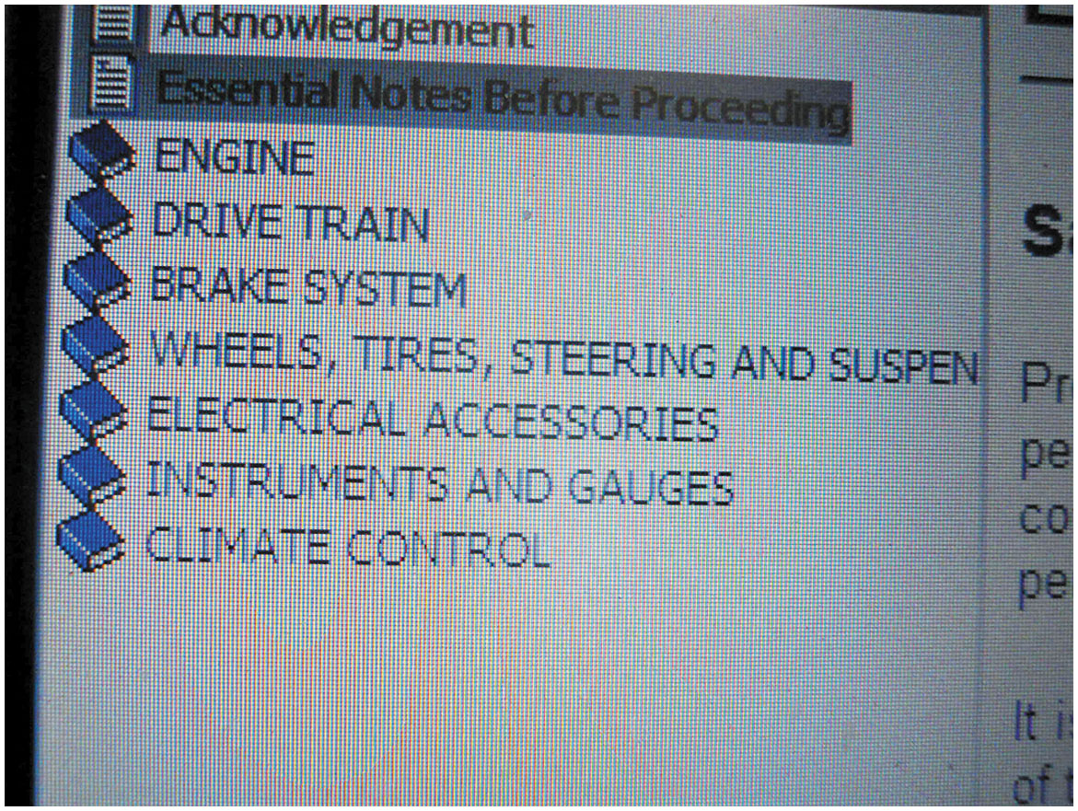
Figure 1.2
Service Info Menu
A main menu showing the major systems of the vehicle. Clicking on one of these major topics opens up another menu showing more detailed information.
Notes:
Long Description:
The menu lists the following systems: engine; drive train; brake system; wheels, tires, steering and suspension; electrical accessories; instruments and gauges; and climate control.

Slide 9
Technical Service Bulletins
Technical Service Bulletins
T S B issued by vehicle manufacturer
Notify of problem or other critical information
Diagnostic procedures/necessary corrective action
Not an authorization for repair
For dealership technicians
Notes:
Technical Service Bulletins
A technical service bulletin (T S B) is issued by the vehicle manufacturer to notify service technicians of a potential problem or other critical information.
The TSB may include diagnostic procedures and the necessary corrective action.
TSB s are not an authorization for repair or a guarantee to correct a concern.
TSB s are designed for dealership technicians, but are republished by aftermarket companies and made available along with other service information to shops and vehicle repair facilities.
Recalls and Campaigns
A campaign is typically issued when a manufacturer wants to improve a product’s performance or increase the customer’s satisfaction.
If the campaign involves a safety or emissions concern, it is considered a recall.
A recall can occur when either the manufacturer or the National Highway Traffic Safety Administration (N H T S A) determines there is a concern.
N H T S A WEB SITE FOR RECALLS: Check for Recalls: Vehicle, Car Seat, Tire, Equipment | NHTSA

Slide 10
Recalls and Campaigns
Recalls and Campaigns
Campaign is issued when a manufacturer wants to improve performance or increase satisfaction
Safety or emissions concern, it is considered a recall
Recall occurs when either manufacturer or N H T S A determines there is a concern
Notes:
Technical Service Bulletins
A technical service bulletin (T S B) is issued by the vehicle manufacturer to notify service technicians of a potential problem or other critical information.
The TSB may include diagnostic procedures and the necessary corrective action.
TSB s are not an authorization for repair or a guarantee to correct a concern.
TSB s are designed for dealership technicians, but are republished by aftermarket companies and made available along with other service information to shops and vehicle repair facilities.
Recalls and Campaigns
A campaign is typically issued when a manufacturer wants to improve a product’s performance or increase the customer’s satisfaction.
If the campaign involves a safety or emissions concern, it is considered a recall.
A recall can occur when either the manufacturer or the National Highway Traffic Safety Administration (N H T S A) determines there is a concern.
N H T S A WEB SITE FOR RECALLS: Check for Recalls: Vehicle, Car Seat, Tire, Equipment | NHTSA

Slide 11
Work Order (1 of 3)
Service Advisor Documentation
Work order or repair order (R O), is a legal document
Signed by vehicle owner or his/her representative
Service advisor completes R O info:
Make, model, year, color, and V I N
Contact information
Date of service and name of person
Estimate amount and list of requested work
Notes:
Service Advisor Documentation
The work order or repair order (R O), is a legal document that is signed by the vehicle owner or his/her representative.
The service advisor or the person designated to complete the work order has to include the following information:
Make, model, and year and other identifying information, such as color and vehicle identification number (V I N)
Name and address of the owner with contact information, such as the cell phone number and email address
Date of service and the name of the person who wrote the service invoice
The miles shown on the odometer
Estimate amount and list of requested work
All professional service facilities and shops use a form that is designed for their purposes and include all of the required information, as specified by the local area and state.

Slide 12
Work Order (2 of 3)
Service Technician Documentation
Technician perform services and repairs
Document work order for accuracy
Service tools were used such as:
Verified customer concern by what means
Looked for stored D T C & note it
Performed a visual inspection of components
Notes:
Service Technician Documentation
The role of the service technician is to not only perform the services and repairs as requested by the vehicle owner, but also to document the work order so that an accurate record of what was performed and the parts used on the work order.
The technician should document the work order by stating not only what was done, but what service tools were used such as:
Verified the customer concern of a rough running engine and the “check engine light” was on by visual inspection.
Looked for stored diagnostic trouble codes using a factory scan tool and noted that a P0300 (random misfire detected) was set.
Performed a visual inspection of the secondary ignition system components.
Found evidence of a coil boot that arced to the cylinder head on cylinders 2 and 3

Slide 13
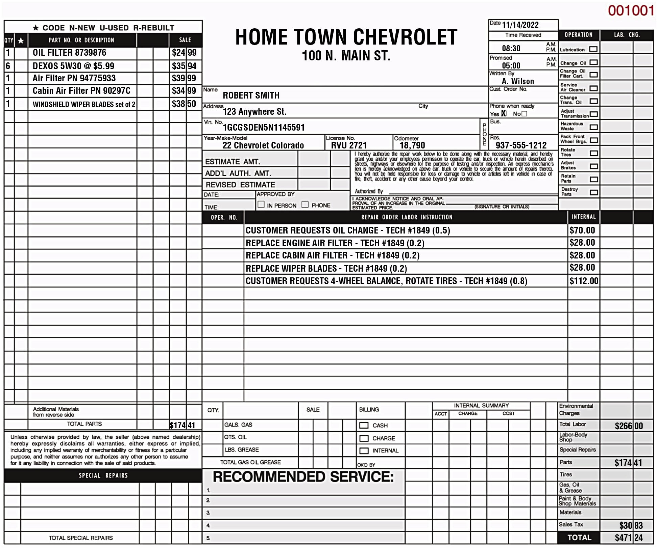
Figure 1.3
Work Order
A typical work order showing the customer concern and what was done to correct the issue. Electronic work orders include all of the same required information.
Notes:
Long Description:
The top middle of the sheet shows the service facility and customer details as follows: Home Town Chevrolet, 100 N. Main S t. Name: Robert Smith; Address: 123 Anywhere S t.; V n N o. 1 G C G S D E N 5 N 1145591; Year-Make-Model: 22 Chevrolet Colorando, License No.: R V U 2721, Odometer: 18,790; phone; estimate a m t.; a d d apostrophe L auth. a m t.; revised estimate; date; time; approved by checkbox in person checkbox phone. An acknowledgement statement is followed by the following: I acknowledge notice and oral approval of an increase in the original estimated price. A line followed by (Signature or initials). Below is a table on the repair order labor instructions, namely, oil change, replacement of air filter and wiper blades, four-wheel balance, and rotate tires, and the cost for each repair work. The column headers are oper. no., repair order labor instruction, and internal. On the left is a reference table listing the part number or description and the cost. The column headers are Q t y, star symbol, part no. or description, and sale. Text corresponding to the star symbol reads, code N-New U-Used R-Rebuilt. On the right is a list of operations followed by a checkbox. On the bottom right are the following cost details: environmental charges, total labor, labor-body shop, special repairs, parts, tires, gas, oil & grease, paint & body materials, materials, sales tax, and total. A table for billing and internal summary is in the bottom middle of the sheet. The table shows the column headers as follows: quantity; a blank column listing type of gas, oil, and grease; sale; billing; internal summary. The billing column shows cash, charge, and internal with a checkbox for each. Placeholders for notes on special repairs and recommended services are at the bottom.

Slide 14
Work Order (3 of 3)
Parts Documentation
Parts used to make repair
Part number(s) and the costs are documented
Notes:
Parts Documentation
Parts are those items used to repair a vehicle or to restore it to useful service.
The part number(s) and the costs are usually documented on the work order by the parts department personnel in larger shops, or the shop owner or service manager in smaller shops.

Slide 15
Work Order Chart 1.1
TENTHS OF AN HOUR | NUMBER 0F MINUTES
0.1 | 6
0.2 | 12
0.3 | 18
0.4 | 24
0.5 | 30
0.6 | 36
0.7 | 42
0.8 | 48
0.9 | 54
1 point 0 | 60
Labor Time Documentation
Labor time, called flat rate, is found in labor guides
Service procedures and time to complete the task
Basis for estimates
Pay technicians
Some T S B s include time
The time that is published for repair and service operations are expressed in tenths of an hour.
Notes:
Labor Time Documentation
The labor time, called flat rate, is found in labor guides, and lists vehicle service procedures and the time it should take an average technician to complete the task.
This flat-rate time is the basis for estimates and the pay for the technicians.
Some T S B s include the time needed to accomplish the task.

Slide 16
Animation: Work Order (Technician Copy)

Slide 17
Animation: Work Order (Customer Copy)

Slide 18
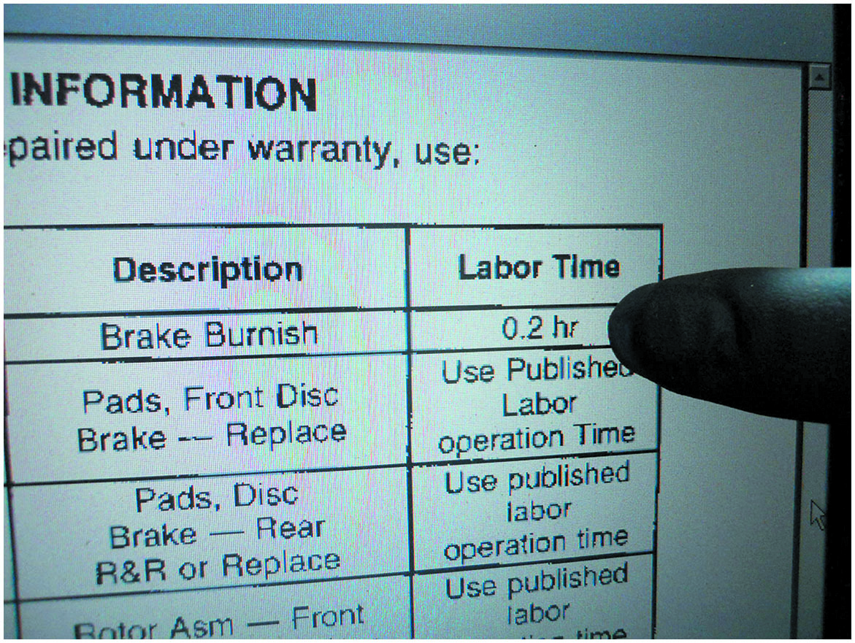
Figure 1.4
T S B s
Some technical service bulletins also include the designated flat-rate time when specifying a repair procedure.

Slide 19
Frequently Asked Question: What Is a Digital Inspection?
? Frequently Asked Question
What Is a Digital Inspection? A digital inspection allows repair shops to perform detailed inspections of a vehicle and generate a report that can be shared with the customer. The report is generated with commercial software that is used in the shop environment on a digital tablet, phone, or other similar electronic devices. • See Figure 1.5.

Slide 20
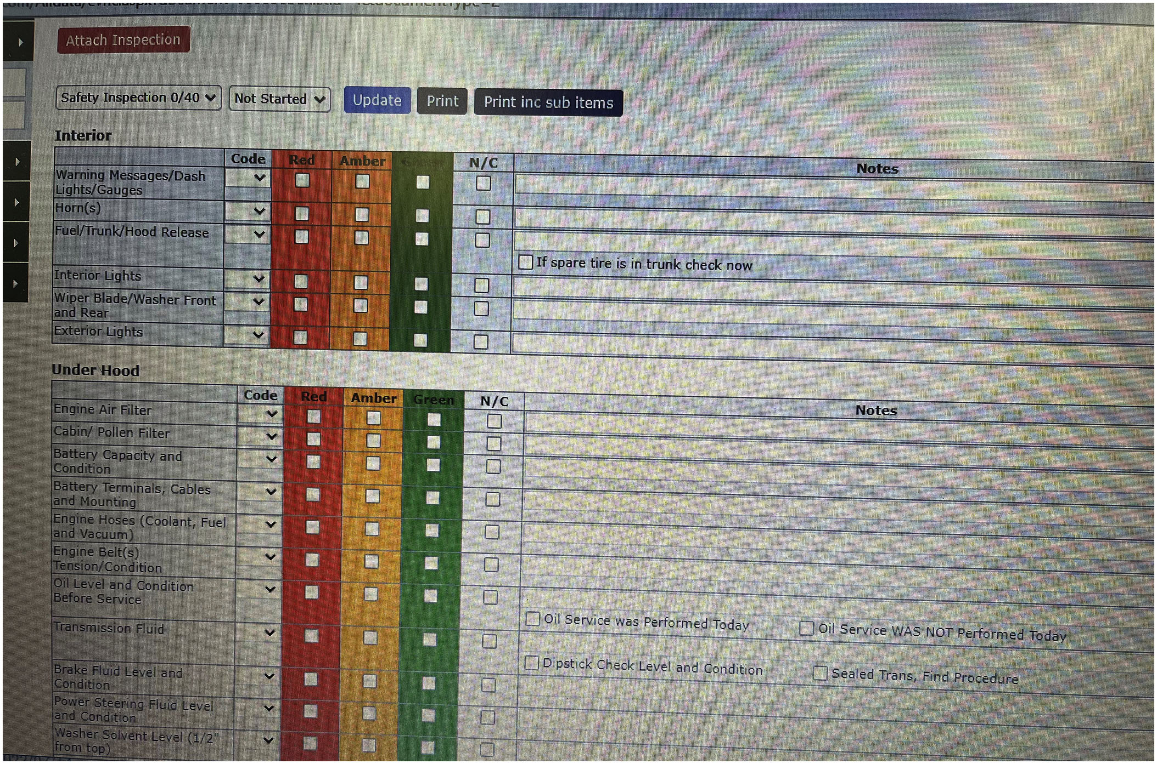
Figure 1.5
Digital Inspection Report
A screen capture of a commercial digital inspection report.
Notes:
The inspection includes checking the condition of the vehicle's tires, brakes, suspension, and other key components that would normally be inspected during a routine service. The technician can use a digital tablet to take photos of any areas of concern, and the software will automatically generate a detailed report based on the inspection that can be shared with the customer. The goal of the digital inspection tools is to help repair shops to improve efficiency, reduce costs, and provide better customer service, ultimately leading to increased customer satisfaction and loyalty.
Long Description:
The report shows two tables titled interior and under hood. Each table shows the following common column headers: blank; code; red; amber; green; N slash C; notes. The column code shows a list box arrow in each cell. Each of the cells red, amber, green, and N slash C shows a check box for each row under it. The first column for Interior reads as follows: Warning Messages or dash lights or gauges; horn(s); fuel or trunk or hood release; interior lights; wiper blade or washer front and rear; exterior lights. Against the row fuel or trunk or hood release, the cell under the column notes reads as follows: check box If spare tire is in trunk check now. The first column for under hood reads as follows: engine air filter; cabin or pollen filter; battery capacity and condition; battery terminals, cables and mounting; engine hoses (coolant, fuel and vacuum); engine belt(s) tension or condition; oil level and condition before service; transmission fluid; brake fluid level and condition; power steering fluid level and condition; washer solvent level (half from top). Against the row transmission fluid, the cell under the column notes reads as follows: check box Oil Service was performed today, check box Oil service was not performed today. Against the row brake fluid level and condition, the cell under the column notes reads as follows: check box Dipstick check level and condition, check box Sealed trans. find procedure. Above the tables, there is a button labeled attach inspection. Below it is a row of the following controls: list box labeled safety inspection 0 or 40; list box labeled not started; buttons such as update, print, and print inc sub items.

Slide 21
Question 1
All of these are required on a Work Order: except:
A. Customer concern
B. Vehicle mileage
C. V I N
D. Engine number

Slide 22
Answer 1
D. Engine number

Slide 23
Service Records
Purpose
History of service work performed on vehicle
Indicate reason for current problem or circuit
Previous collision repair
History of failure in same area as concern
Notes:
Purpose
The purpose of service records is to provide a history of the service work that has been performed on the vehicle in the past.
Often, a previous repair may indicate the reason for the current problem or it could be related to the same circuit or components.
Example #1—A collision could have caused hidden damage that can affect the operation of the vehicle.
Example #2—If the current issue is an error code for an engine misfire and the history of the service work on the vehicle does not show an oil change for several years, this might help the technician to find the root cause

Slide 24
Parts of a Vehicle
Parts of vehicle based on location & purpose of component
Left side of the vehicle—Right side of a vehicle
Front and rear
Front-wheel drive versus rear-wheel drive
Notes:
Parts of Vehicle
The names of the parts of a vehicle are based on the location and purpose of the component.
Left Side of the Vehicle—Right Side of a Vehicle
Both of these terms refer to the left and right as if the driver is sitting behind the steering wheel.
Front and Rear
The proper term for the back portion of any vehicle is rear (e.g., left rear tire).
Front-Wheel Drive Versus Rear-Wheel Drive
Front-wheel drive (F W D) means that the front wheels are being driven by the engine, as well as turned by the steering wheel.
Rear-wheel drive (R W D) means that the rear wheels are driven by the engine.
If the engine is in the front, it can be either front- or rear-wheel drive. In many cases, a front engine vehicle can also drive all four wheels, called four wheel drive (4W D) or all-wheel drive (A W D).
If the engine is located at the rear of the vehicle, it can be rear-wheel drive or four-wheel drive.

Slide 25
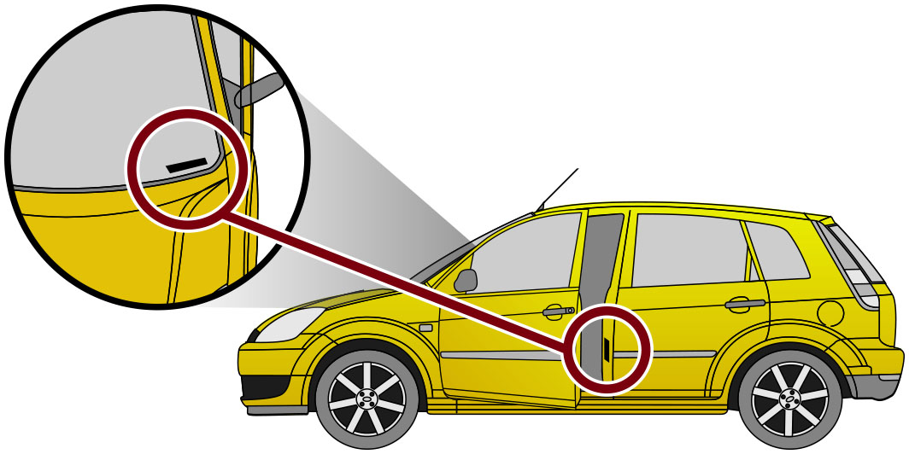
Figure 1.6
Vehicle Identification
Vehicle, engine and accessories, be properly identified
Make, model, and year of the vehicle
New model year (abbreviated M Y)
Why V I N is important
The vehicle identification number (V I N) is visible through the base of the windshield and on a decal inside the driver’s door.
Notes:
All service work requires that the vehicle, including the engine and accessories, be properly identified.
The most common identification is the make, model, and year of the vehicle.
Make: e.g., Chevrolet
Model: e.g., Cruze
Year: e.g., 2014
The year of the vehicle is often difficult to determine exactly.
A model may be introduced as the next year’s model as soon as January of the previous year.
Typically, a new model year (abbreviated M Y) starts in September or October of the year prior to the actual new year, but not always.
This is why the vehicle identification number, usually abbreviated V I N, is so important

Slide 26
Figure 1.7
V I N
Vehicle Identification
Since 1981, 17 characters
Some constants:1st number/letter designates country of origin
A typical V I N showing the information that is represented.
Notes:
Vehicle Identification
Since 1981, all vehicle manufacturers have used a V I N that is 17 characters long.
Although every vehicle manufacturer assigns various letters or numbers within these 17 characters, there are some constants, including:
The first number or letter designates the country of origin
Long Description:
The 17-digit alphanumeric code of the typical V I N indicated from left to right is as follows: 1 G N D S 1 3 S 0 G 2 1 3 8 9 2 6. The code is positioned in order from 1 through 17, and position no. represents the following: 1: Country; 2, 3: World make identifier; 4: Gross vehicle weight rating, G V W R, or brake system; 5, 6: Line chassis series; 7: Body type; 8: Engine type; 9: Check digit; 10: Model year; 11: Plant; 12 through 17: Production sequence number.

Slide 27
Chart 1.2
Country of Origin
1 = United States | J = Japan | T = Czechoslovakia
2 = Canada | K = Korea | U = Romania
3 = Mexico | L = China | V = France
4 = United States | M = India | W = Germany
5 = United States | N = Turkey | X = Russia
6 = Australia | P = Philippines | Y = Sweden
7 = United States | R = Taiwan | Z = Italy
8 = Argentina | S = England
9 = Brazil
The first number or letter designates the country of origin.
Notes:
Vehicle Identification
The first number or letter designates the country of origin. ● SEE CHART 1.2.
The model of the vehicle is commonly the fourth and/or fifth character.
The eighth character is often the engine code. (Some engines cannot be determined by the V I N.)
The tenth character represents the model year (M Y) on all vehicles.

Slide 28
Chart 1.3
Vehicle Year
A | = 1980/2010 | L | = 1990/2020 | Y = 2000/2030
B | = 1981/2011 | M | = 1991/2021 | 1 = 2001/2031
C | = 1982/2012 | N | = 1992/2022 | 2 = 2002/2032
D | = 1983/2013 | P | = 1993/2023 | 3 = 2003/2033
E | = 1984/2014 | R | = 1994/2024 | 4 = 2004/2034
F | = 1985/2015 | S | = 1995/2025 | 5 = 2005/2035
G | = 1986/2016 | T | = 1996/2026 | 6 = 2006/2036
H | = 1987/2017 | V | = 1997/2027 | 7 = 2007/2037
J | = 1988/2018 | W | = 1998/2028 | 8 = 2008/2038
K | = 1989/2019 | X | = 1999/2029 | 9 = 2009/2039
V I N year chart. (The pattern repeats every 30 years.)
Notes:
Vehicle Identification
The tenth character represents the model year (M Y) on all vehicles. ● SEE CHART 1.3.

Slide 29
Animation: Vehicle Identification Number, VIN

Slide 30
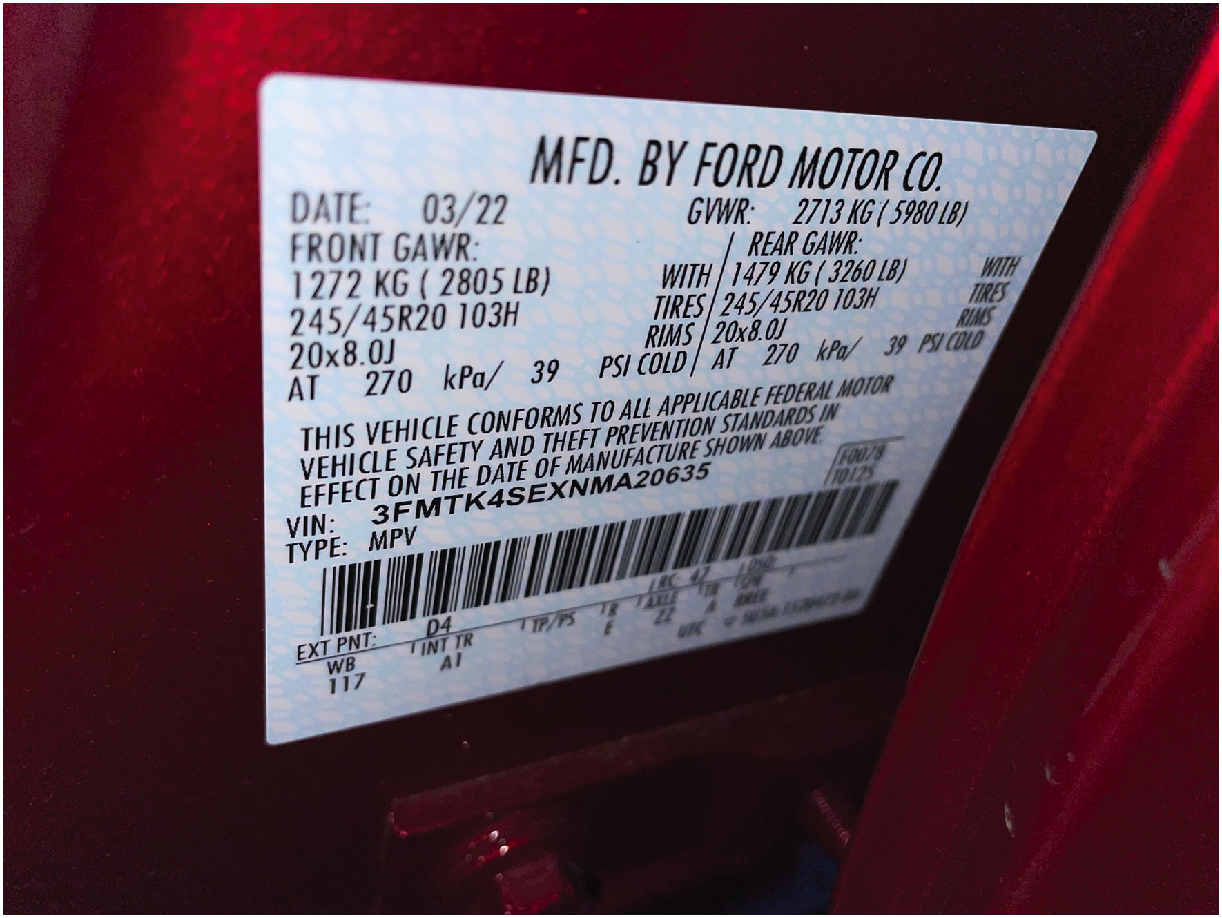
Figure 1.8
Vehicle Safety Certification Label
Vehicle Safety Certification Label
Left side pillar post on rearward-facing section of left front door
Month/year of manufacture, V I N, G V W R & G A W R
A typical vehicle safety certification label which shows the gross vehicle weight, gross axles weight rating, as well as the size and inflation pressure of the tires.
Notes:
A Vehicle Safety Certification Label is attached to the left side pillar post on the rearward-facing section of the left front door.
This label indicates the month and year of manufacture, the (V I N), as well as the G V W R and G A W R.
Gross vehicle weight rating (G V W R)—The maximum (upper limit) weight of a vehicle as specified by the vehicle manufacturer.
This is important to know if hauling a heavy load, such as in a truck or S U V.
Gross axle weight rating (G A W R)—The maximum weight that an axle can support is usually followed by “F R” for front axle and “R R” for rear axle.
Long Description:
The label displays two columns under date followed by G V W R. Date: 03 slash 22; G V W R: 2713 K G (5980 L B). The first column shows front G A W R and the second column shows rear G A W R. Front G A W R: 1272 K G (2805 L B) WITH; 245 or 45 R 20 103 H TIRES; 20 times 8.0 J RIMS; AT 270 k P a or 39 P S I cold. Rear G A W R: 1479 K G (3260 L B) WITH; 245 or 45 R 20 103 H TIRES; 20 times 8.0 J RIMS; AT 270 k P a or 39 P S I cold. Text below reads, This vehicle conforms to all applicable federal motor vehicle safety and theft prevention standards in effect on the date of manufacture shown above. V I N: 3 F M T K 4 S E X N M A 20635, type: M P V; F 0078 T 0125. A scan code is below followed by EXT P N T: D 4, I R C 47, 1050. A line is below with the following data: W B 117, INT T R A 1, T P or P S, R: E, Axle ZZ, T R: A, S slash W R X T E. U T C inverted delta 5 U 5 A--1520472-B A.

Slide 31
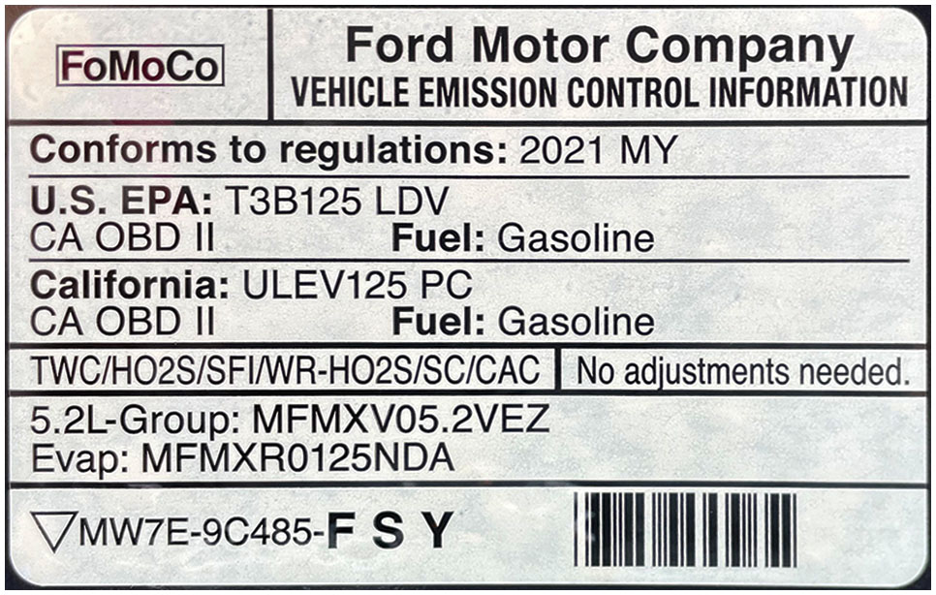
Figure 1.9
V E C I Label
Vehicle Emissions Control Information V E C I label
Under hood
Settings & emission hose routing information
Bottom side of hood, radiator fan shroud, radiator core support, or strut towers
This vehicle emission control information (V E C I) decal indicates this vehicle meets both national E P A Tier 3. Bin 125 (T3B125) and California U L E V125 P C (passenger car) standard.
Notes:
Vehicle Emissions Control Information
The vehicle emissions control information (V E C I) label under the hood of the vehicle shows informative settings and emission hose routing information.
The V E C I label (sticker) can be located on the bottom side of the hood, the radiator fan shroud, the radiator core support, or the strut towers.
Long Description:
The label reads as follows: Conforms to regulations: 2021 M Y; U. S. E P A: T 3 B 125 L D V: C A O B D two, Fuel: gasoline; California: U L E V 125 P C: C A O B D two, Fuel: gasoline; T W C or H O 2 S or S F I or W R-H O 2 S or S C or C A C, no adjustments needed; 5.2 L-Group: M F M X V 05.2 V E Z, Evap: M F M X R 0125 N D A; inverted delta M W 7 E-9 C 485-F S Y, scan code.

Slide 32
Summary (1 of 2)
Service information is needed to correctly service or repair vehicles because it contains all of the specifications, as well as the specified procedures to follow when servicing or repairing a vehicle.
A technical service bulletin (T S B) is issued by the vehicle manufacturer to notify service technicians of a potential problem or other critical information.
A campaign is typically issued when a manufacturer wants to improve a product’s performance or increase the customer’s satisfaction. If the campaign involves a safety or emissions concern, it is considered a recall. A recall can occur when either the manufacturer or the National Highway Safety Administration (N H T S A) determines there is a concern.
The work order, also called a repair order (R O), is a legal document that is signed by the vehicle owner or his/her representative.

Slide 33
Summary (2 of 2)
The purpose of service records is to provide a history of the service work that has been performed on the vehicle in the past.
All vehicle manufacturers use a vehicle identification number (V I N) that is 17 characters long.
The first number or letter designates the country of origin.
The model of the vehicle is commonly the fourth and/or fifth character.
The eighth character is often the engine code.
The tenth character represents the model year (M Y) on all vehicles.
The vehicle emissions control information (V E C I) label under the hood of the vehicle lists emission compliance codes and major emission control systems.

Slide 34
Animation and Video Library Links (Must have an internet connection and active Haldeman subscription)
Animation Library: (A0) Automotive Fundamentals
Animation Library: (A1) Engine Repair Videos
Video Library: (A0) Automotive Fundamentals Videos
Video Library: (A1) Engine Repair Videos

Slide 35
Copyright
This work is protected by United States copyright laws and is provided solely for the use of instructors in teaching their courses and assessing student learning. Dissemination or sale of any part of this work (including on the World Wide Web) will destroy the integrity of the work and is not permitted. The work and materials from it should never be made available to students except by instructors using the accompanying text in their classes. All recipients of this work are expected to abide by these restrictions and to honor the intended pedagogical purposes and the needs of other instructors who rely on these materials.

