Slide 1

Automotive Chassis Systems
Eighth Edition
Chapter 22
Tires and Wheels
Notes:
If this PowerPoint presentation contains mathematical equations, you may need to check that your computer has the following installed:
1) MathType Plugin
2) Math Player (free versions available)
3) NVDA Reader (free versions available)

Slide 2
Objectives
Explain the purpose and functions of tires.
Identify the parts of a tire and describe how it is constructed.
Discuss tire sizes, load index, ratings, specifications, and grading.
Discuss tire conicity and vehicle handling.
Describe spare tires and run-flat tires.
Describe tire selection considerations.
Explain the construction and sizing of steel and alloy wheels and attaching hardware.
  This chapter will help prepare for ASE Suspension and Steering (A4) certification content area “E” (Wheel and Tire Diagnosis and Repair).

Slide 3
Introduction To Tires
PURPOSE- The friction (traction) between the tire and the road determines the handling characteristics of any vehicle.
  The compounding, construction, and condition of tires are some of the most important aspects of the steering, suspension, alignment, and braking systems of any vehicle.
FUNCTION- Tires are mounted on wheels that are bolted to the vehicle to provide:
  1. Shock absorber action when driving over rough surfaces
  2. Friction (traction) between the wheels and the road

Slide 4
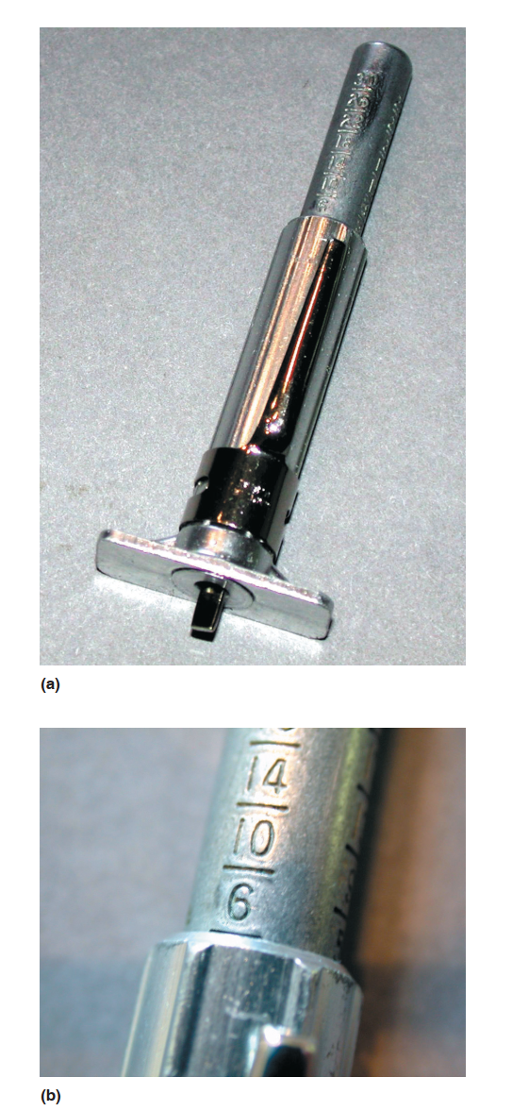
Parts Of A Tire
FIGURE 22–1 (a) A typical tire tread depth gauge. The center movable plunger is pushed down into the groove of the tire. (b) The tread depth is read at the top edge of the sleeve. in this example, the tread depth is 6/32 inch.

Slide 5
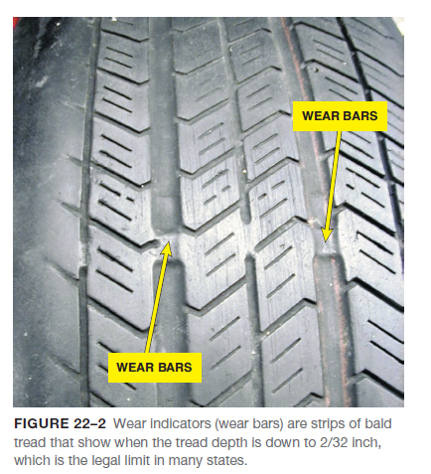
Parts Of A Tire
TREAD- Tread refers to the part of the tire that contacts the ground.
  Tread rubber is chemically different from other rubber parts of a tire and is compounded for a combination of traction and tire wear.
    Tread depth is usually 11/32 inch deep on new tires (this could vary, depending on manufacturer, from 9/32 to 15/32 inch).
SIDEWALL- The sidewall is that part of the tire between the tread and the wheel.
  The sidewall contains all the size and construction details of the tire.

Slide 6
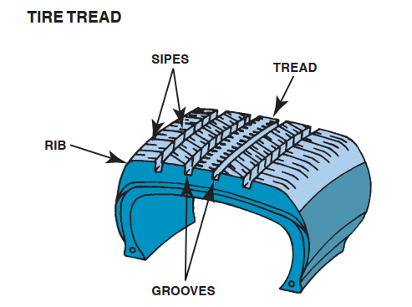
Parts Of A Tire
FIGURE 22–3 The tire tread runs around the circumference of the tire, and its pattern helps maintain traction. The ribs
provide grip, while the grooves direct any water on the road away from the surface. The sipes help the tire grip the road.

Slide 7
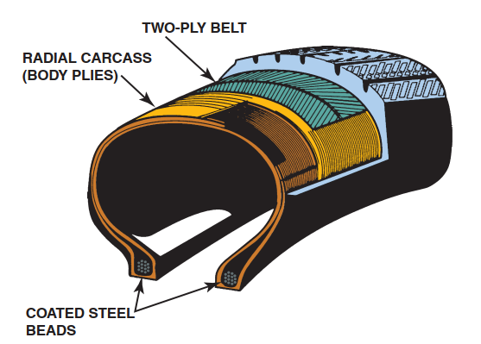
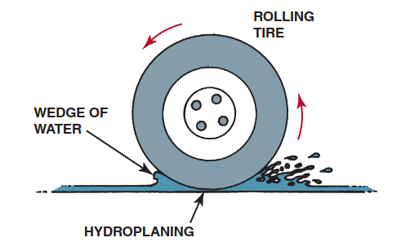
Parts Of A Tire
FIGURE 22–4 Hydroplaning can occur at speeds as low as 30 mph (48 km/h). If the water is deep enough and the tire tread cannot evacuate water through its grooves fast enough, the tire can be lifted off the road surface by a layer of water. Hydroplaning occurs at lower speeds as the tire becomes worn.
FIGURE 22–5 Typical construction of a radial tire. some tires have only one body ply, and some tires use more than two belt plies.

Slide 8
Parts Of A Tire
BEAD- The bead is the foundation of the tire and is located where the tire grips the inside of the wheel rim.
  1. The bead is constructed of many turns of copper- or bronze-coated steel wire.
  2. The main body plies (layers of material) are wrapped around the bead.
  3. Most radial-ply tires and all truck tires wrap the bead with additional material to add strength.
BODY PLY- A tire gets its strength from the layers of material wrapped around both beads under the tread and sidewall rubber.
  This creates the main framework, or “carcass,” of the tire; these body piles are often called carcass piles.

Slide 9
Parts Of A Tire
BELT- A tire belt is two or more layers of material applied over the body plies and under the tread area only to stabilize the tread and increase tread life and handling.
  1. Tire belts can consist of the following materials
    a. Steel mesh
    b. Nylon
    c. Rayon
    d. Fiberglass
    e. Aramid
  2. All radial tires are belted.

Slide 10
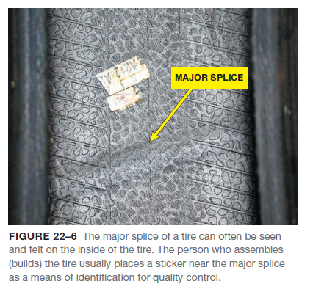
Parts Of A Tire
INNER LINER- The inner liner is the soft rubber lining (usually a butyl rubber compound) on the inside of the tire that protects the body plies and helps provide for self-sealing of small punctures.
MAJOR SPLICE- When the tire is assembled by a craftsperson on a tire-building machine, the body plies, belts, and tread rubber are spliced together.

Slide 11
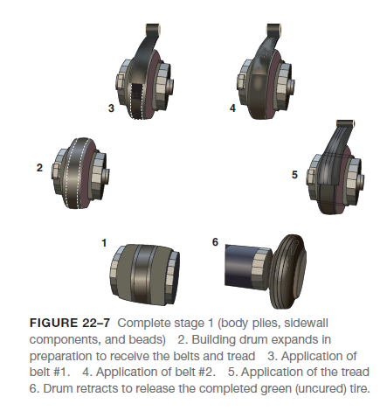
Tire Molding
After the tire has been assembled by the tire building machine, it is called a green tire.
  At this stage in construction, the rubber can be returned and reused because it has not been changed chemically.

Slide 12
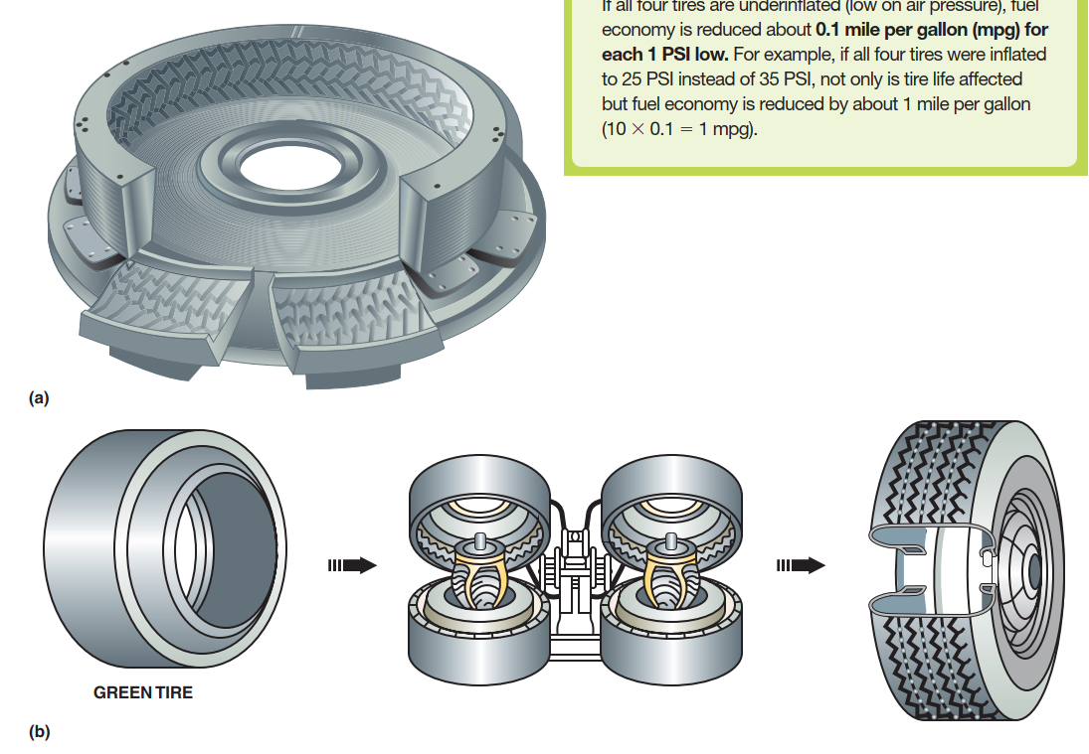
Tire Molding
FIGURE 22–8 After the entire tire has been assembled into a completed “green” tire, it is placed into a tire-molding machine where the tire is molded into shape and the rubber is changed chemically by the heat. This nonreversible chemical reaction is called vulcanization.

Slide 13
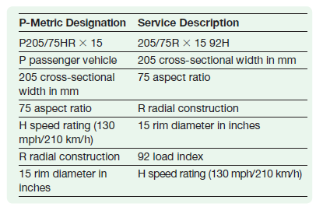
Service Description
Tires built after 1990 use a “service description” method of sidewall information in accordance with ISO 4000 (International Standards Organization) that includes size, load, and speed rating together in one easy-to-read format.

Slide 14
High-Flotation Tire Sizes
High-flotation tires for light trucks are designed to give improved off-road performance on sand, mud, and soft soil and still provide acceptable hard-road surface performance.
LOAD INDEX AND EQUIVALENT LOADS- The load index, is an abbreviated method to indicate the load-carrying capabilities of a tire.
  The weights listed in the chart represent the weight that each tire can safely support.
SPEED RATINGS- Tires are rated according to the maximum sustained speed.
  A vehicle should never be driven faster than the speed rating of the tires.

Slide 15
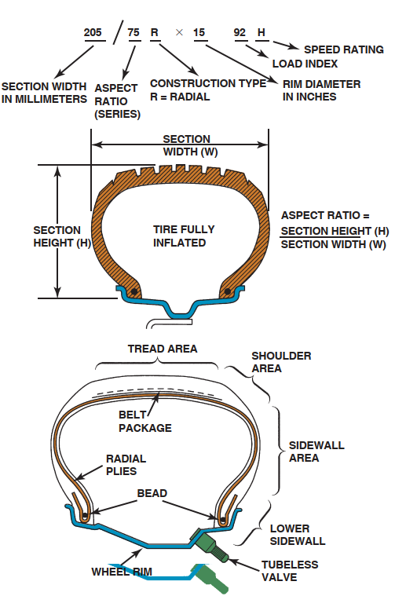
High-Flotation Tire Sizes
FIGURE 22–9 (a) Tire size designation includes cross-sectional width and aspect ratio. The aspect ratio is the proportional relationship between the width and the height of the tire expressed as a percentage. (b) Cross-sectional view of a typical tire showing the terminology.

Slide 16
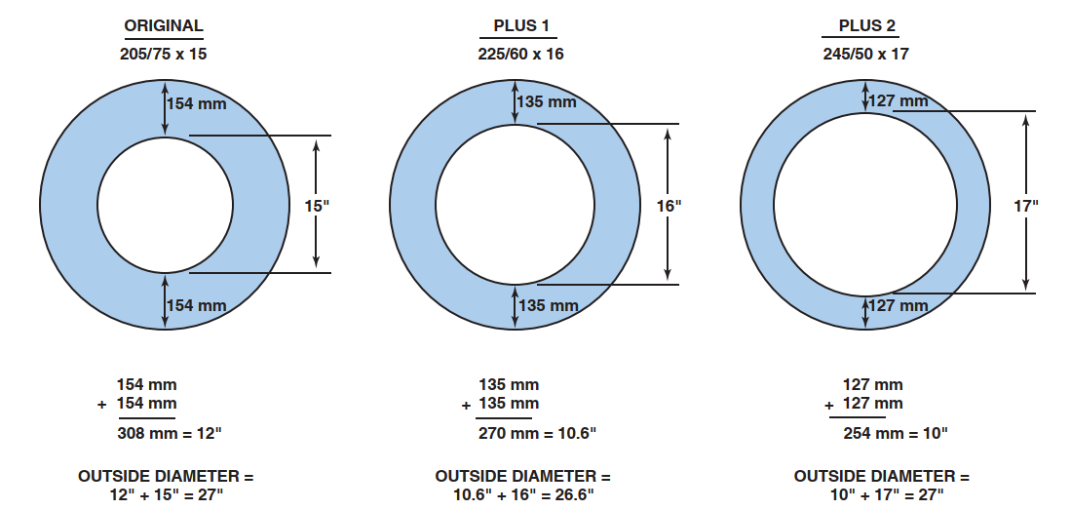
High-Flotation Tire Sizes
FIGURE 22–10 notice that the overall outside diameter of the tire remains almost the same and at the same time the aspect ratio is decreased and the rim diameter is increased.

Slide 17
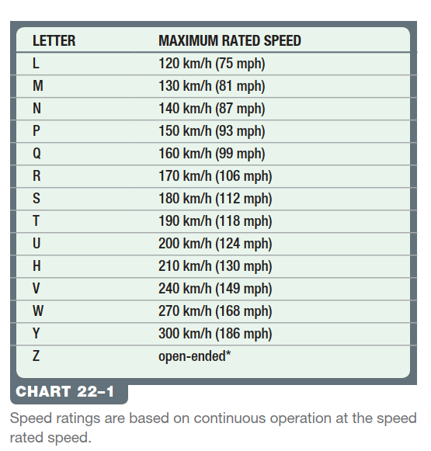
Speed Ratings

Slide 18
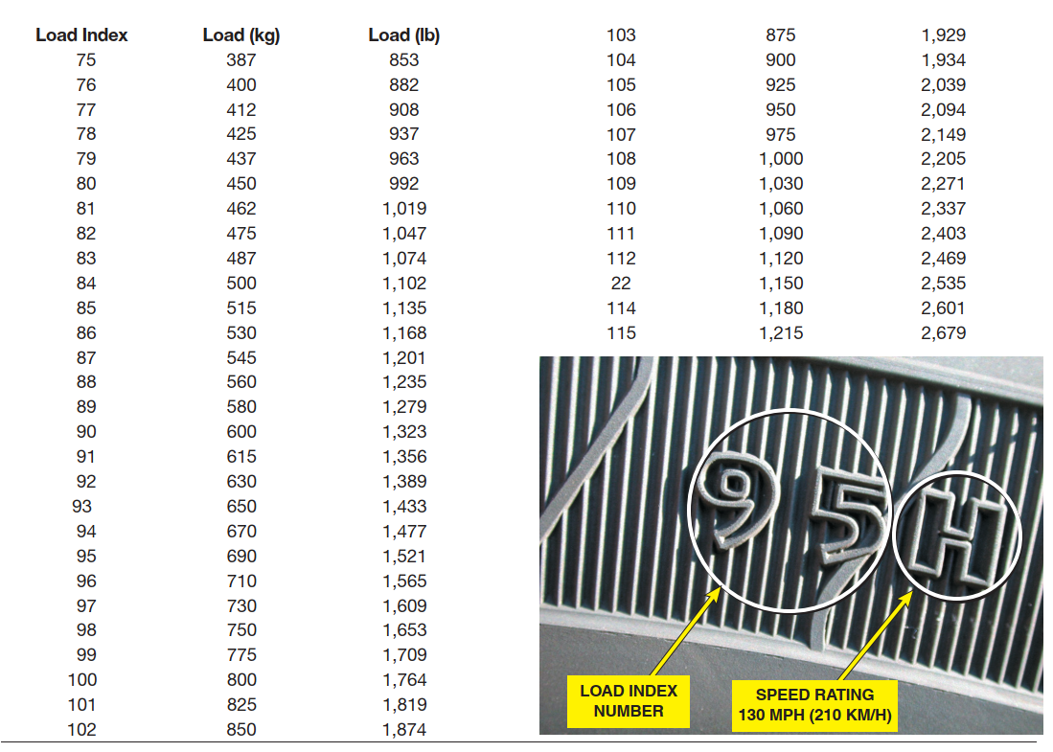
Sidewall Markings
FIGURE 22–11 Typical sidewall markings for load index and speed rating following the tire size.

Slide 19
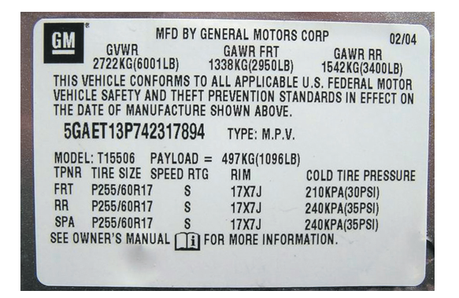
Rim Width and Tire Size
FIGURE 22–12 A typical door placard used on a General Motors vehicle indicating the recommended tire inflation. Note that the information also includes the size and speed rating of the tire as well as the recommended wheel size.

Slide 20
Tire Pressure And Traction
All tires should be inflated to the specifications given by the vehicle manufacturer.
RIM WIDTH AND TIRE SIZE- The rim width is the distance between the tire flanges sometimes called the “flange-to-flange” width.
  As a general rule, for a given rim width it is best not to change tire width more than 10 mm (either wider or narrower).

Slide 21
Uniform Tire Quality Grading System
The U.S. Department of Transportation and the National Highway Traffic Safety Administration developed a system of tire grading, the Uniform Tire Quality Grading System (UTQGS), to help customers better judge the relative performance of tires.
  The three areas of tire performance are tread wear, traction, and temperature resistance.
    TREAD WEAR- The tread wear grade is a comparison rating based on the wear rate of a standardized tire, tested under carefully controlled conditions, which is assigned a value of 100. A tire rated 200 should have a useful life twice as long as the standard tire’s.
    TRACTION- Traction performance is rated by the letters AA,A, B, and C, with AA being the highest.
    TEMPERATURE RESISTANCE- Temperature resistance is rated by the letters A, B, and C, with A being the highest rating

Slide 22
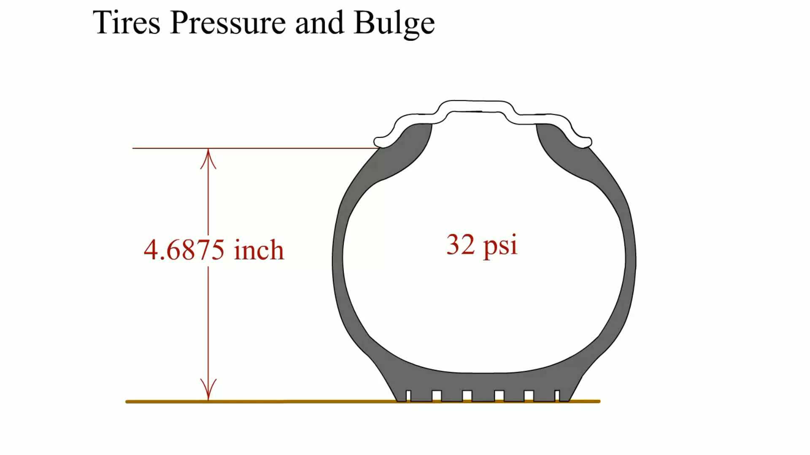
Animation: Tires Pressure and Bulge
(The animation will automatically start in a few seconds)

Slide 23
Types of Tires
ALL-TERRAIN AND PERFORMANCE TIRES All -terrain (A/T) designates a performance category for marketing differentiation, not actual performance rating.
  Other names used by marketing without actual test specifications include:
    Touring-Usually an all-season tire and often include an asymmetrical tread pattern.
    All-season High Performance (AS HP)
    Mud-terrain (M/T) tires. The tire is designed to handle both off and on road driving.
    Highway-terrain (H/T) tires. H/T tires allow a driver to use the same tires for everyday highway driving as well occasional off-road driving.

Slide 24
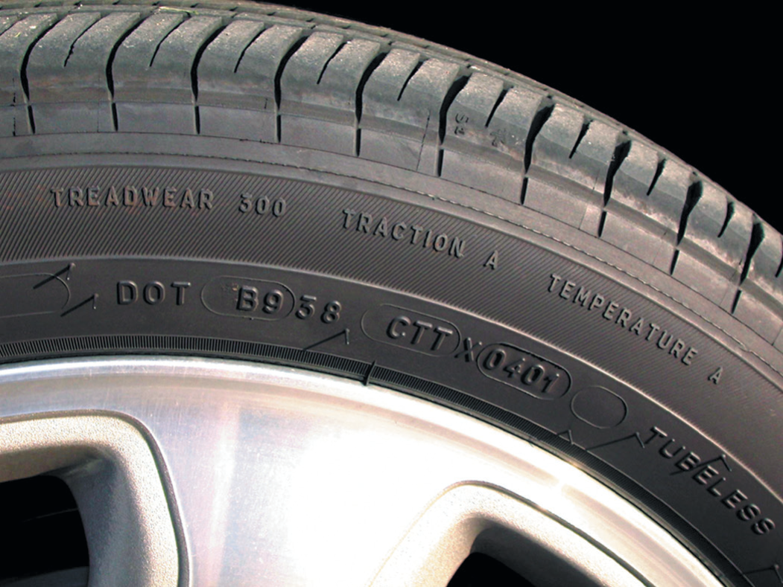
Uniform Tire Quality Grading System
FIGURE 22–13 Typical “Uniform Tire Quality Grading
system” (UTQGs) ratings imprinted on the tire sidewall.

Slide 25
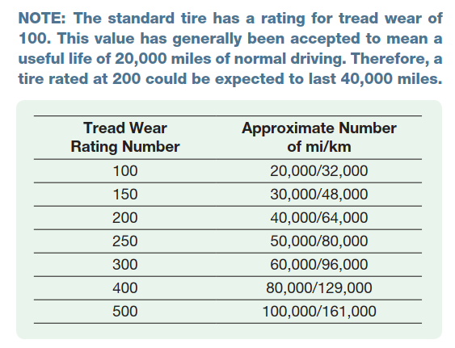
Uniform Tire Quality Grading System

Slide 26
All-Season Tire Designation
M&S RATING Most all-season tires are rated and labeled as M & S, MS, or M + S, and therefore must adhere to general design features as specified by the Rubber Manufacturers Association (RMA).
FOUR SEASONS TIRES- This is a new category created by tire companies.
  Four seasons tires are the same as all-season tires except most of these are also three-peak mountain snowflake (3PMSF) rated.
    They have minimum snow traction ability tested versus an industry standard reference test tire (SRTT)—minimum 110 rating.

Slide 27

All-Season Tire Designation
FIGURE 22–14 The three-mountain peak symbol indicates that the tire is rated with the necessary snow traction to be the specified winter tire required in some states and Canadian provinces for use in the winter months.

Slide 28
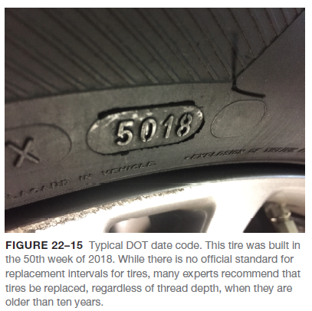
DOT Tire Code
All tires sold in the United States must be approved by the U.S. Federal Department of Transportation (DOT).
  The DOT tire code requirements include resistance to tire damage that could be caused by curbs, chuckholes, and other common occurrences for a tire used on public roads.

Slide 29
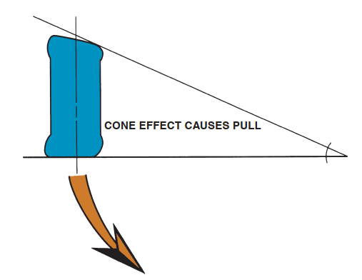
DOT Tire Code
FIGURE 22–16 Conicity is a fault in the tire that can cause the vehicle to pull to one side due to the cone effect (shape) of the tire.

Slide 30
Tire Conicity And Ply Steer
Tire conicity can occur during the construction of any radial or belted tire when the parts of the tire are badly positioned, causing the tire to be smaller in diameter on one side.
VEHICLE HANDLING AND TIRE SLIP ANGLE- The tire surface contact area or tire patch size is about one-half the area of one page of a book. All accelerating, braking, and cornering forces of a vehicle are transferred to the pavement at just four spots.
SPARE TIRES- Most vehicles today come equipped with space-saver spare tires that are smaller than the wheels and tires that are on the vehicle. The reason for the small size is to reduce the size and weight of the entire vehicle and to increase fuel economy by having the entire vehicle weigh less by not carrying a heavy spare tire and wheel around.

Slide 31
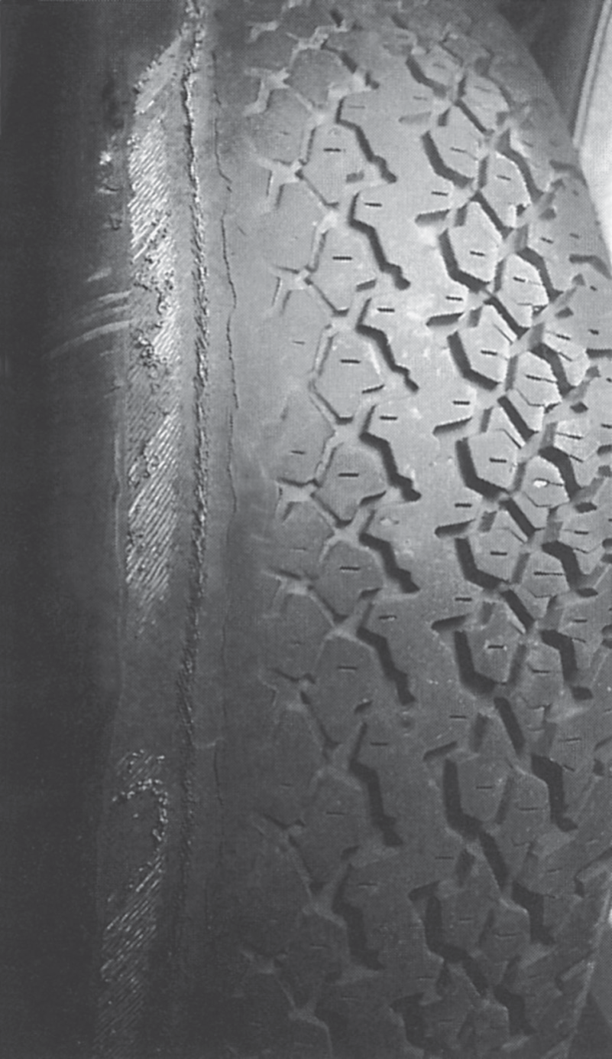
Tire Conicity And Ply Steer
FIGURE 22–17 Notice the angle of the belt material in this worn tire. The angle of the belt fabric can cause a “ply steer” or slight pulling force toward one side of the vehicle.

Slide 32
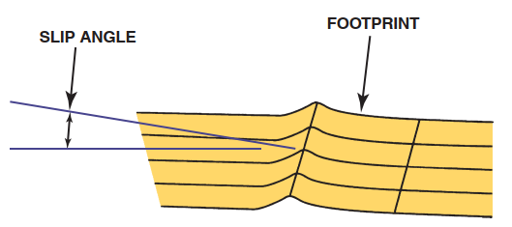
Vehicle Handling and Tire Slip Angle
FIGURE 22–18 Slip angle is the angle between the direction the tire tread is heading and the direction it is pointed.

Slide 33
Run-Flat Tires
Run-flat tires (abbreviated RFT) are designed to operate without any air for a limited distance (usually 50 miles at 55 mph). This feature allows vehicle manufacturers to build vehicles without the extra room and weight of a spare tire and jack assembly.
GENERAL MOTORS TPC RATING- All General Motors original equipment (OE) tires have a rating that identifies the size as well as the tread design, wear, traction, and heat resistance factors.
TIRE SELECTION CONSIDERATIONS- Selecting the proper tire is very important for the proper handling and safety of any vehicle. Do not select a tire by styling or looks alone.
NOISE-REDUCTION TIRES- PURPOSE The purpose of using acoustical foam inside a tire is to reduce a very specific frequency range between 130 and 240 Hz.

Slide 34
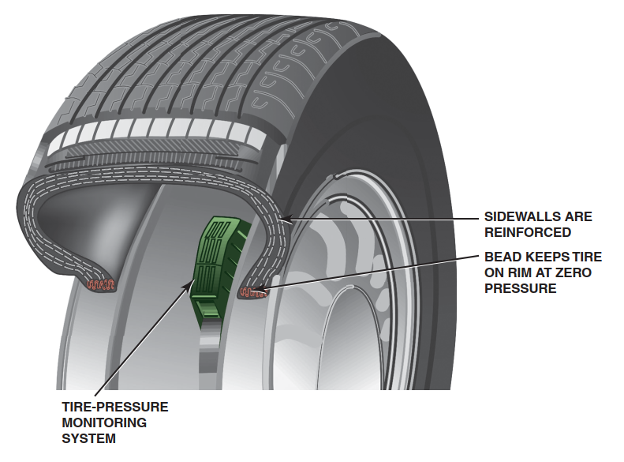
Run-Flat Tires
FIGURE 22–19 Cutaway of a
run-flat tire showing the reinforced sidewalls and the required pressure sensor.

Slide 35
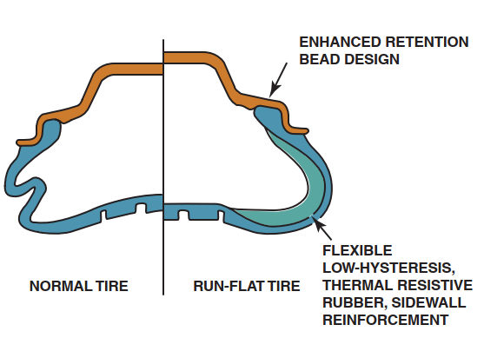
Run-Flat Tires
FIGURE 22–20 A conventional tire on the left and a run-flat tire on the right, showing what happens when there is no air in the tire.

Slide 36
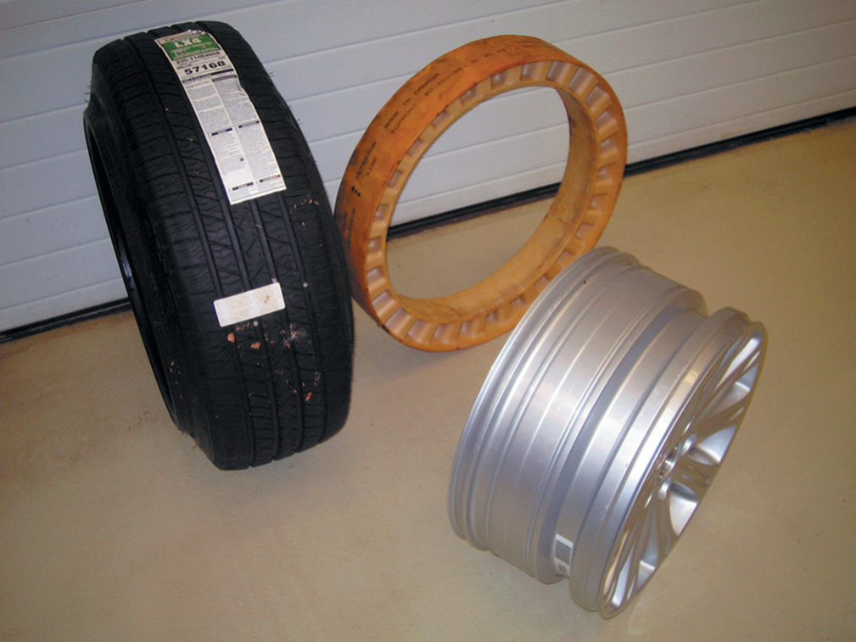
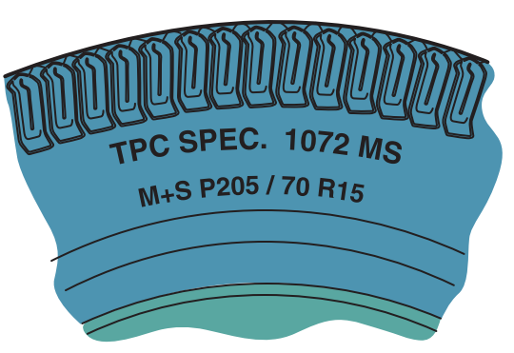
Run-Flat Tires
FIGURE 22–21 The PAX run-flat tire system is composed of three unique components - a special asymmetrical wheel, a urethane support ring, and a special tire.
FIGURE 22–22 The Tire Performance Criteria (TPC)
specification number is imprinted on the sidewall of all tires used on General Motors vehicles from the factory.

Slide 37
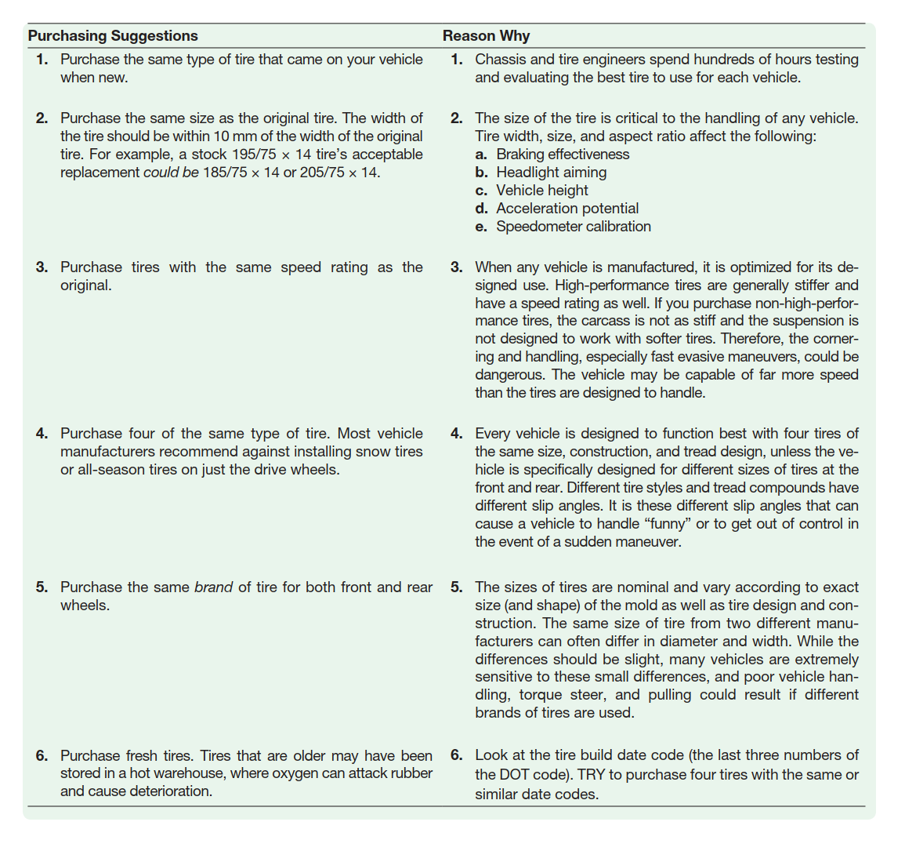
Tire Selection Considerations

Slide 38
Wheels
The concept of a wheel has not changed in the last 5,000 years, but the style and materials used have changed greatly. Today’s wheels are constructed of steel or aluminum alloy.
WHEEL OFFSET- Offset is a very important variable in wheel design. If the center section (spider) is centered on the outer rim, the offset is zero.
POSITIVE OFFSET- The wheel has a positive offset if the center section is outward from the wheel centerline.
NEGATIVE OFFSET- The wheel has a negative offset if the center section is inboard (or “dished”) from the wheel centerline.
BACK SPACING- Back spacing, also called rear spacing or backside setting, is the distance between the back rim edge and the wheel center section mounting pad.
DETERMINING BOLT CIRCLE- On four-lug axles and wheels, the bolt circle measurement is simply taken from center to center on opposite studs or holes,

Slide 39
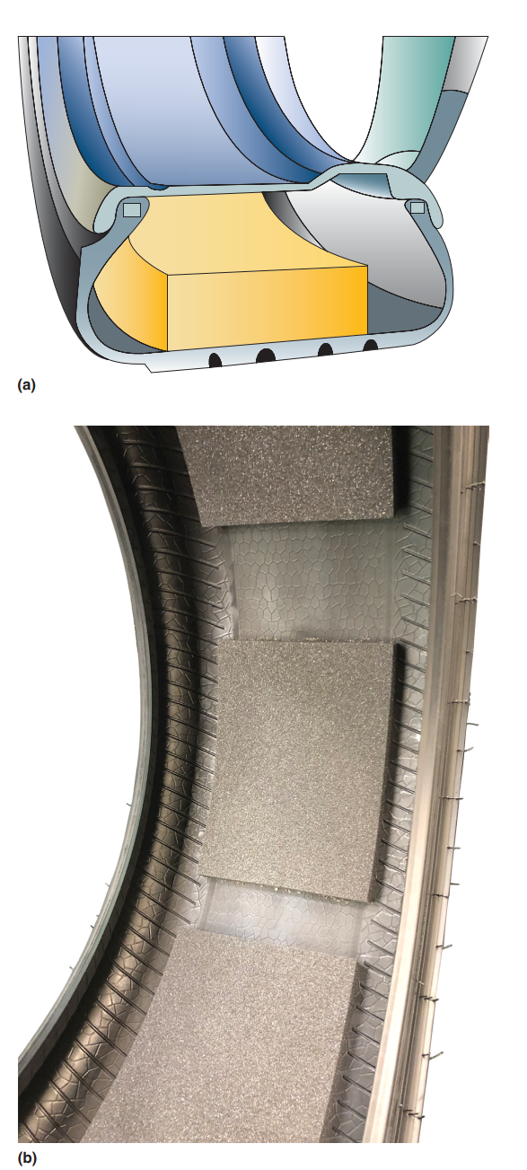
Wheels
FIGURE 22–23 Acoustical foam is placed inside of sound-reducing tires to dampen and prevent the creation of resonance sound that is created inside the structure of the tire itself. The inside of this noise-reducing tire shows blocks of foam whereas other sound-reducing tires may use continuous
strips of foam.

Slide 40
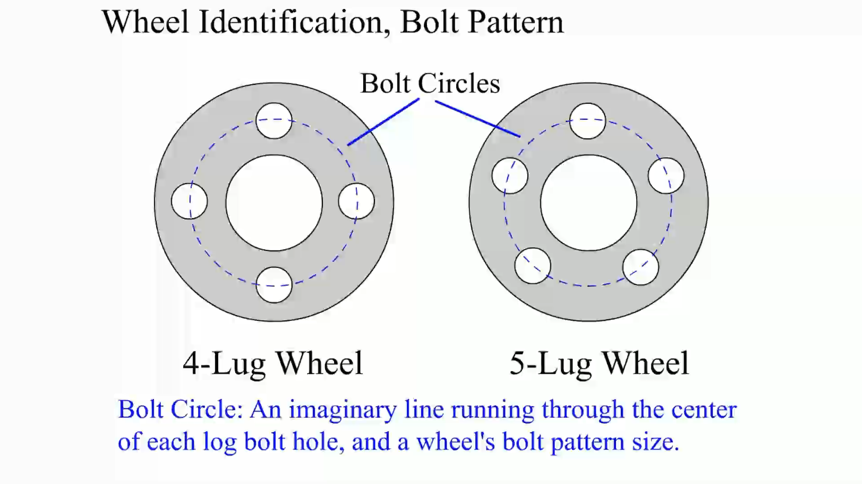
Animation: Wheel Identification, Bolt Pattern
(The animation will automatically start in a few seconds)

Slide 41
Wheels
STEEL WHEELS- Steel is the traditional wheel material. A steel wheel is very strong due to its designed shape and the fact that it is work hardened during manufacturing.
ALUMINUM WHEELS- Forged and cast aluminum wheels are commonly used on cars and trucks. Forged means that the aluminum is hammered or forged under pressure into shape.
CHROME CLAD WHEELS- Chrome clad wheels have become an increasingly popular option on many vehicles. This type of wheel has the following construction features:
  A chrome-plated plastic cladding applied to the front of the wheel.
  The cladding is permanently attached to the aluminum wheel with adhesive foam.
  The foam material is not present near the conical seat area (center) of the wheel.

Slide 42
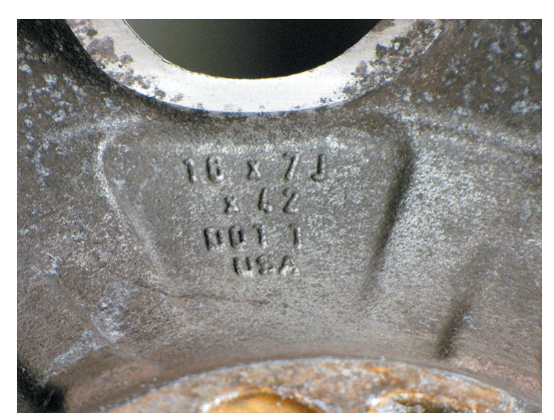
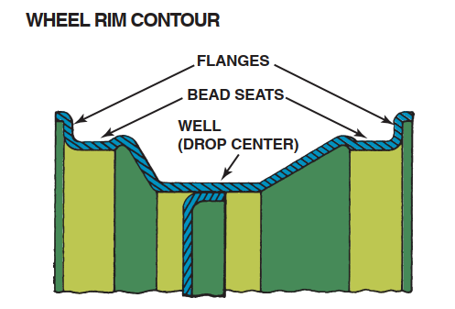

Slide 43
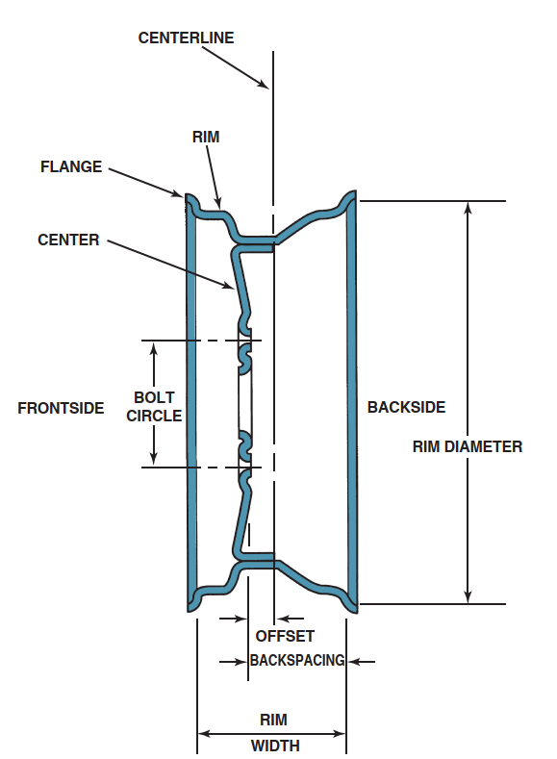
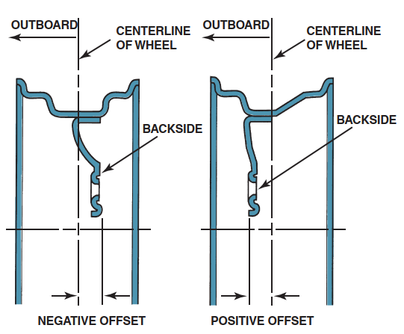
Wheels
FIGURE 22–27 Offset is the distance between the centerline of the wheel and the wheel mounting surface.
FIGURE 22–26 A cross-section of a wheel showing part designations.

Slide 44
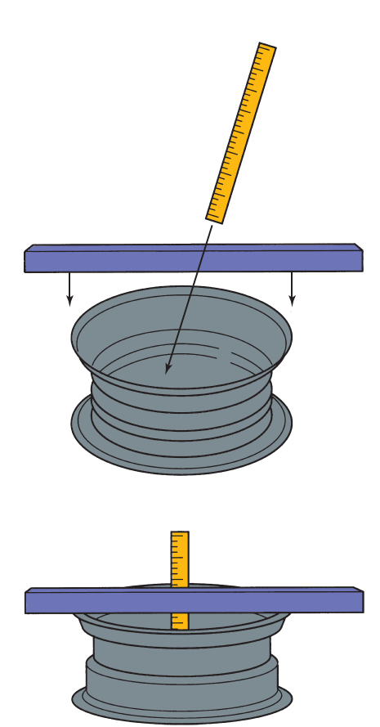
Wheels
FIGURE 22–28 Back spacing (rear spacing) is the distance from the mounting pad to the edge of the rim. Most custom wheels use this measurement method to indicate the location of the mounting pad in relation to the rim.

Slide 45
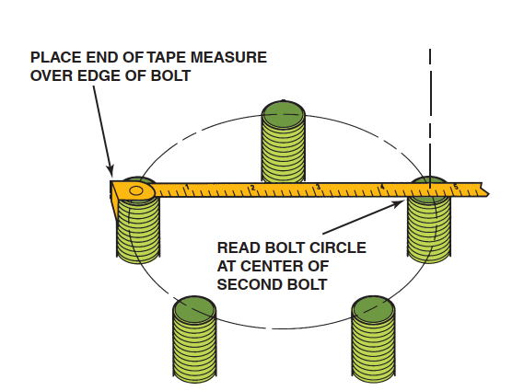
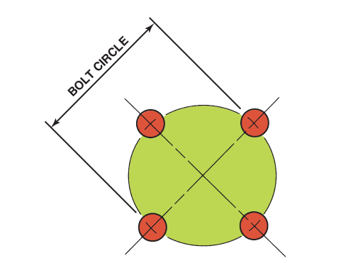
Wheels
FIGURE 22–29 Bolt circle is the diameter of a circle that can be drawn through the center of each lug hole or stud. The bolt circle is sometimes referred to as PCD for pitch circle diameter.
FIGURE 22–30 Measuring the bolt circle on a five-lug wheel is difficult, but a quick and easy way includes measuring as shown to determine the approximate bolt circle of a five-lug wheel.

Slide 46
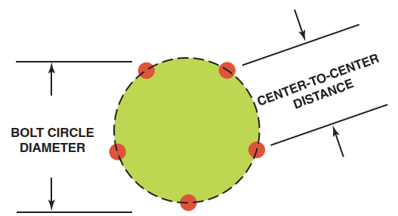
Wheels
FIGURE 22–31 Measure center-to-center distance and compare the distance to the figures in the chart in the text to determine the diameter for a five-lug bolt circle.

Slide 47
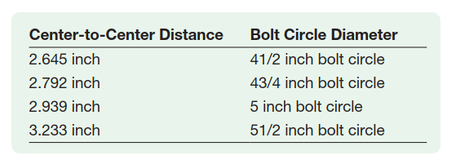
Wheels

Slide 48
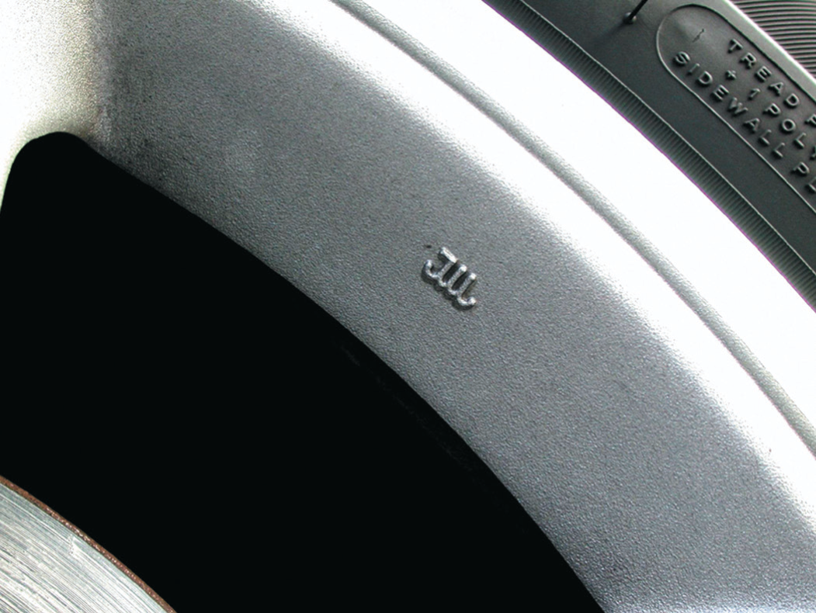
Wheel
FIGURE 22–32 A typical JWl symbol for the Japan Wheel light Metal standard mark.

Slide 49
Tire Valves
All tires use a tire valve, called a Schrader valve, to hold air in the tire.
UNSPRUNG WEIGHT- The lighter the wheel and tire assembly, the faster it can react to bumps and dips in the road surface and thus the better the ride. The chassis and the body of any vehicle are supported by some sort of spring suspension system.
LUG NUTS- Lug nuts are used to hold a wheel to the brake disc, brake drum, or wheel bearing assembly. Most manufacturers use a stud in the brake or bearing assembly with a lug nut to hold the wheel.
SIZE- Lug nuts are sized to the thread size of the stud onto which they screw.
LUG STUDS- Lug studs are usually installed in hubs or drums using a press fit. Serrations on the shoulder of the stud provide support.

Slide 50
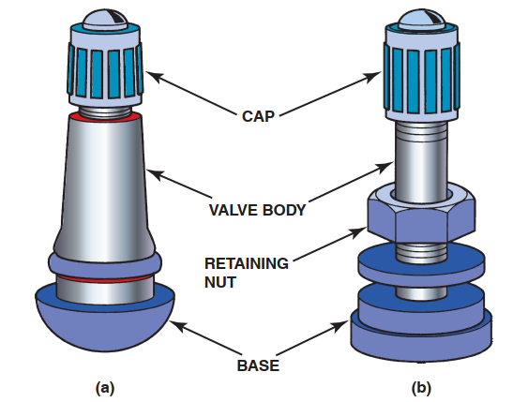
Tire Valves
FIGURE 22–33 (a) A rubber snap-in style tire valve assembly. (b) A metal clamp-type tire valve assembly used on most high-pressure (over 60 PSI) tire applications such as is found on many trucks, RVs, and trailers. The internal Schrader valve threads into the valve itself and can be replaced individually, but most experts recommend replacing the entire valve assembly every time the tires are replaced to help prevent air loss.

Slide 51
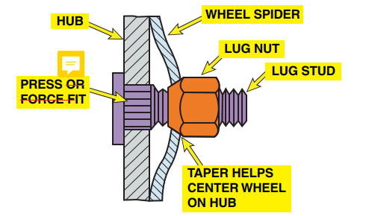
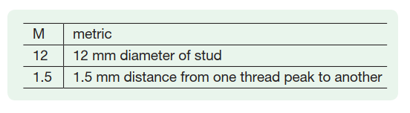
Lug Nuts
FIGURE 22–34 The tapered end of the lug nut is installed toward the wheel so that it wedges into the taper of the wheel hub.

Slide 52
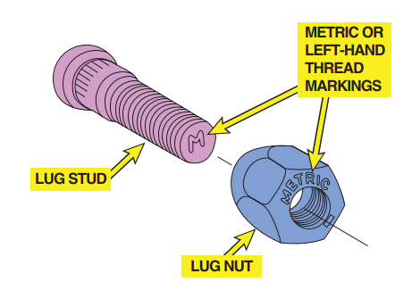
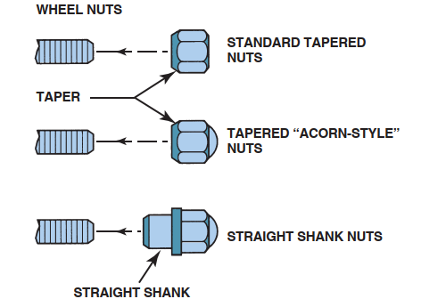
Lug Nuts
FIGURE 22–35 Look carefully on the end of the wheel studs or on the lug nut for metric or left-hand thread marks.
FIGURE 22–36 Various styles of lug nuts.

Slide 53
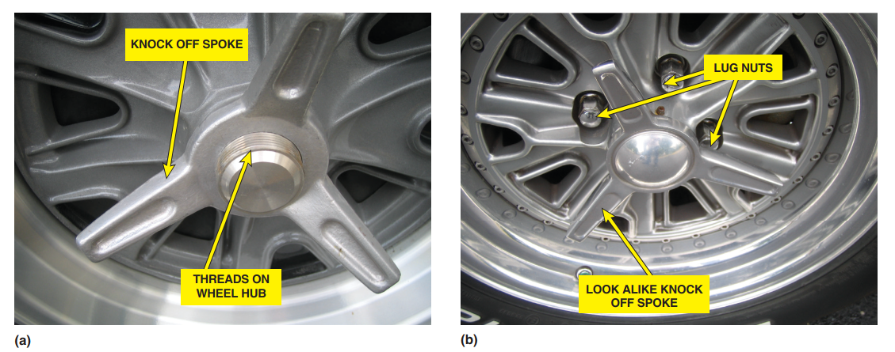
Lug Nuts
FIGURE 22–37 (a) A typical knock-off-type wheel showing the large three prong wing nuts and the threads on the wheel hub. (b) A look-alike knock-off wheel that looks like a knock-off but uses lug nuts.

Slide 54
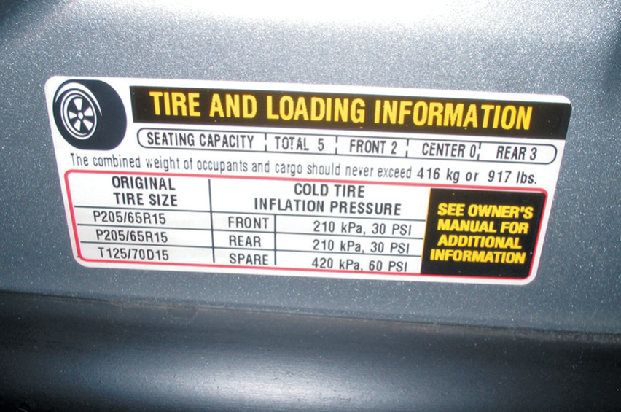
Tire Inspection
Step 1: Check the tire information placard, usually located on the driver’s door or door jamb, for the specified tire size and inflation pressure

Slide 55
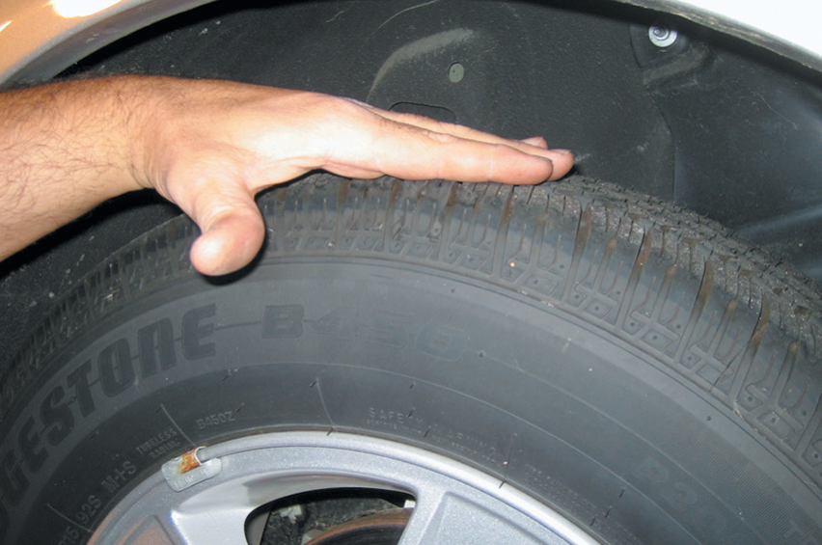
Tire Inspection
Step 2: Visually check the tires for abnormal wear or damage.

Slide 56
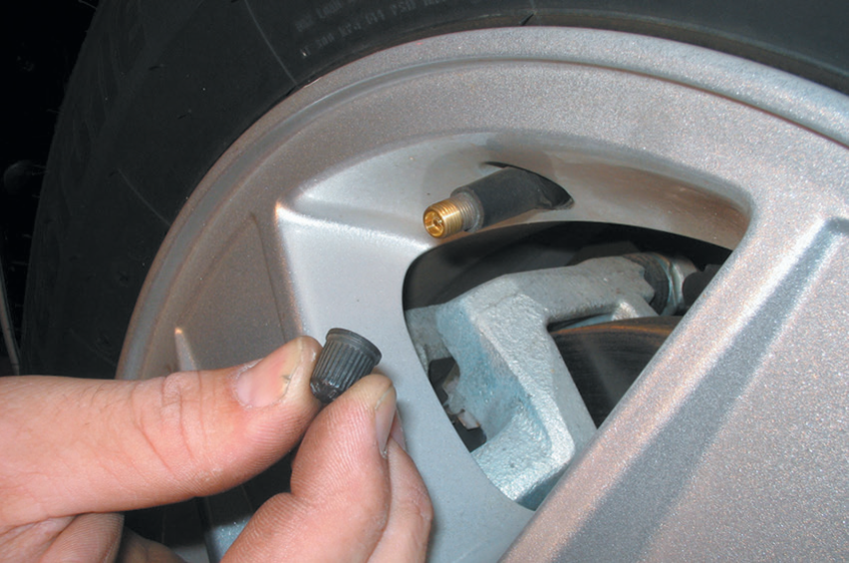
Tire Inspection
Step 3: Remove the tire valve cap and visually check the condition of the valve stem.

Slide 57
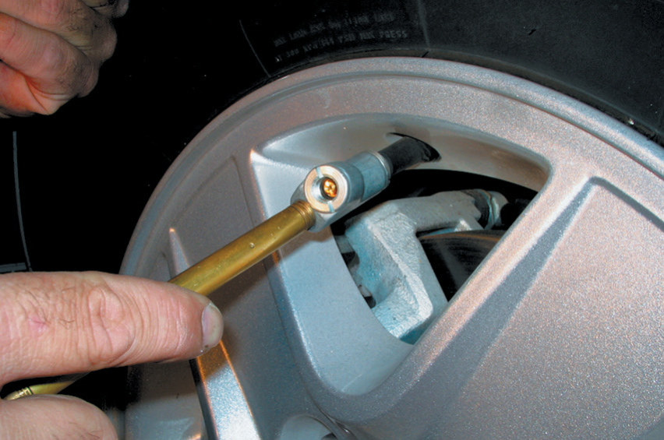
Tire Inspection
Step 4: Check inflation pressure by pushing the tire-pressure gauge straight onto the end of the tire valve. If a “hissing” sound is heard, then the reading will not be accurate.

Slide 58
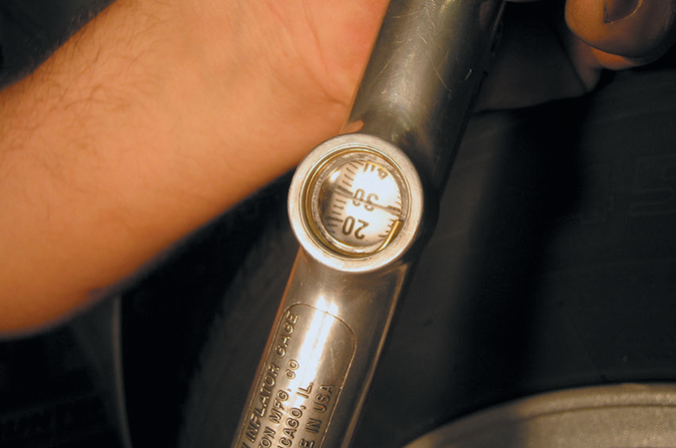
Tire Inspection
Step 5: Read the pressure and compare to the specifications. Use an analog or digital gauge if possible which have been proven to be more accurate than a mechanical pencil-type gauge.

Slide 59
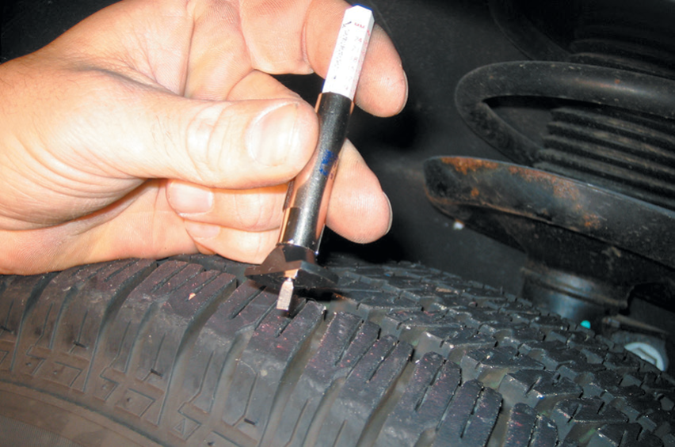
Tire Inspection
Step 6: A typical tire tread depth gauge.

Slide 60
Tire Inspection
Step 7: The blade of the tire tread depth gauge is pushed down into the groove of the tire at the lowest part.

Slide 61

Tire Inspection
Step 8: Remove the gauge from the tire and read the tread depth at the metal housing. Tread depth is usually measured in 1/32’s of an inch.

Slide 62

Tire Inspection
Step 9: If the top of Lincoln’s head is visible, then the tread depth is lower than 2/32 inch, which is the legal limit in many states. Most tire experts recommend replacing tires when they reach 4/32 inch instead of 2/32. To check for this depth, use a quarter instead of a penny and look for the top of Washington’s head.

Slide 63
Summary
The friction (traction) between the tire and the road determines the handling characteristics of any vehicle.
Tread refers to the part of the tire that contacts the ground.
The sidewall is that part of the tire between the tread and the wheel. The sidewall contains all the size and construction details of the tire.
The bead is the foundation of the tire and is located where the tire grips the inside of the wheel rim.
A tire gets its strength from the layers of material wrapped around both beads under the tread and sidewall rubber. This creates the main framework, or “carcass,” of the tire; these body plies are often called carcass plies.
The completed green tire is then placed in a mold where its shape, tread design, and all the sidewall markings are formed.

Slide 64
Summary Cont….
All tires should be inflated to the specifications given by the vehicle manufacturer. Most vehicles have recommended tire inflation figures written in the owner’s manual or on a placard or sticker on the doorpost or glove compartment.
The U.S. Department of Transportation (DOT) and the National Highway Traffic Safety Administration developed a system of tire grading, the Uniform Tire Quality Grading System (UTQGS), to help customers with tire information.
The center section of the wheel that attaches to the hub is called the center section or spider because early wheels used wooden spokes that resembled a spider’s web.
All tires use a tire valve, called a Schrader valve, to hold air in the tire.
Lug nuts are used to hold a wheel to the brake disc, brake drum, or wheel bearing assembly.

Slide 65
Video Links (Internet Access Required)
Wheels (time 10:34)
Wheel manufacturing (time 6:18)
How steel wheels are made (time 5:07)
Wheel bolt circle ID (time 1:23)
Tire siping (time 2:14)
Importance of tire balance (time 3:39)
How to interpret tire ratings (time 1:22)
Tires 101 (time 8:09)
Tire hydroplaning (time 5:46)
Replace a wheel stud (time 2:09)

