Slide 1
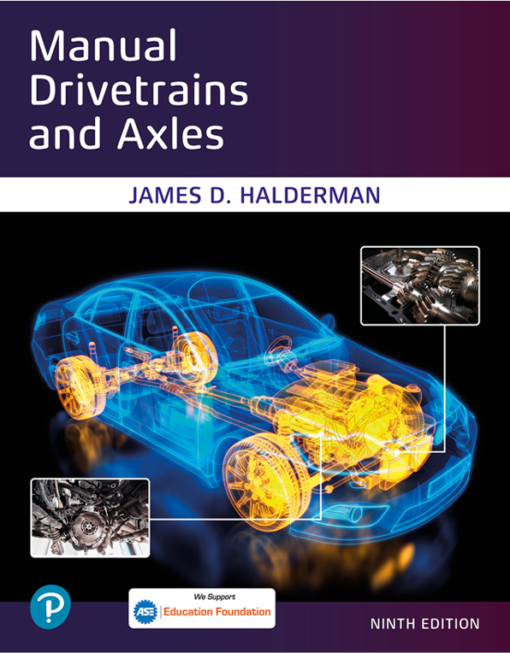
Manual Drivetrains and Axles
Ninth Edition
Chapter 16
Four-wheel Drive Diagnosis and Service
Copyright © 2024, 2018, 2015 Pearson Education, Inc. All Rights Reserved
Notes:
If this PowerPoint presentation contains mathematical equations, you may need to check that your computer has the following installed:
1) Math Type Plugin
2) Math Player (free versions available)
3) NVDA Reader (free versions available)
INSTRUCTOR NOTE: This presentation includes text explanation notes, you can use to teach the course. When in SLIDE SHOW mode, you RIGHT CLICK and select SHOW PRESENTER VIEW, to use the notes.

Slide 2
Learning Objectives
16.1 Diagnose four-wheel-drive-related problems.
16.2 Explain the procedure for diagnosing four-wheel drive and transfer case faults.
16.3 Discuss how to test a four-wheel-drive vehicle using a scan tool.
16.4 Explain the procedure for front hub removal and replacement.
16.5 Explain the procedure for transfer case removal and overhaul.

Slide 3
Four-Wheel-Drive Problem Diagnosis (1 of 2)
Verify Customer Concern.
What does this entail? See Page 255
Perform a visual inspection.
Check for any stored D T C and technical service bulletins.
Check scan tool data for sensor values.
Bidirectional control operation (if available).

Slide 4
Four-Wheel-Drive Problem Diagnosis (2 of 2)
Check electrical switches and actuators using a digital multi-meter.
Follow service information pinpoint tests to determine the root cause.
Perform the needed repair.
Verify the repair.

Slide 5
Visual Inspection (1 of 2)
Always check that all tires are:
Exact same size.
Same brand (different brands even if the same size can vary in the actual diameter and width of the tire).
Same tread depth within
Same inflation pressure within 2 psi for best results.

Slide 6
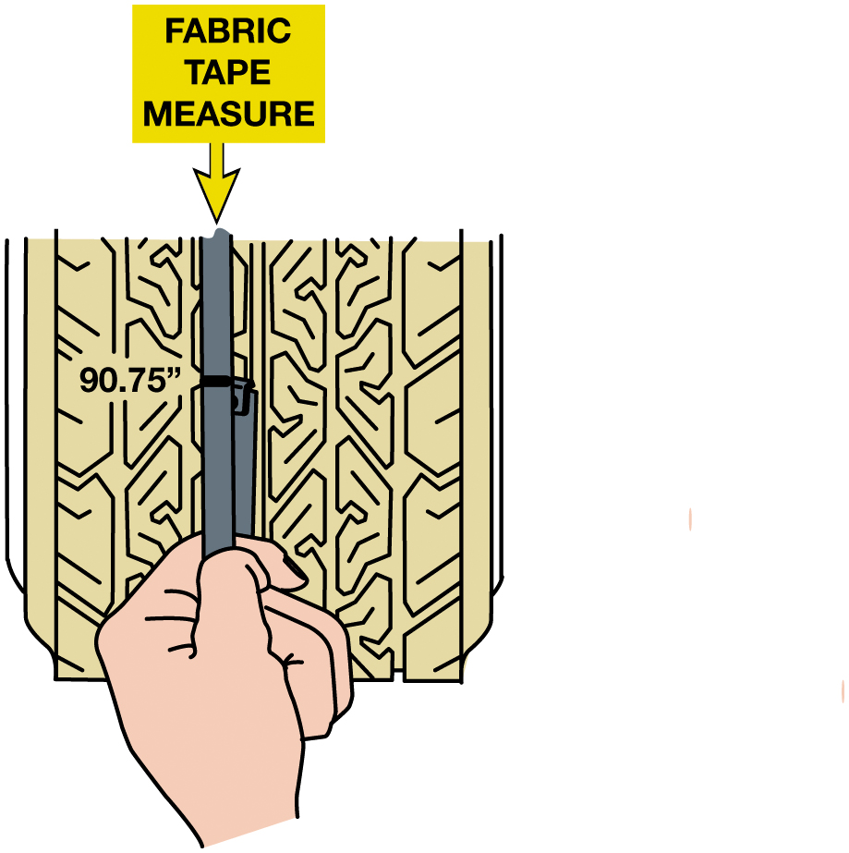
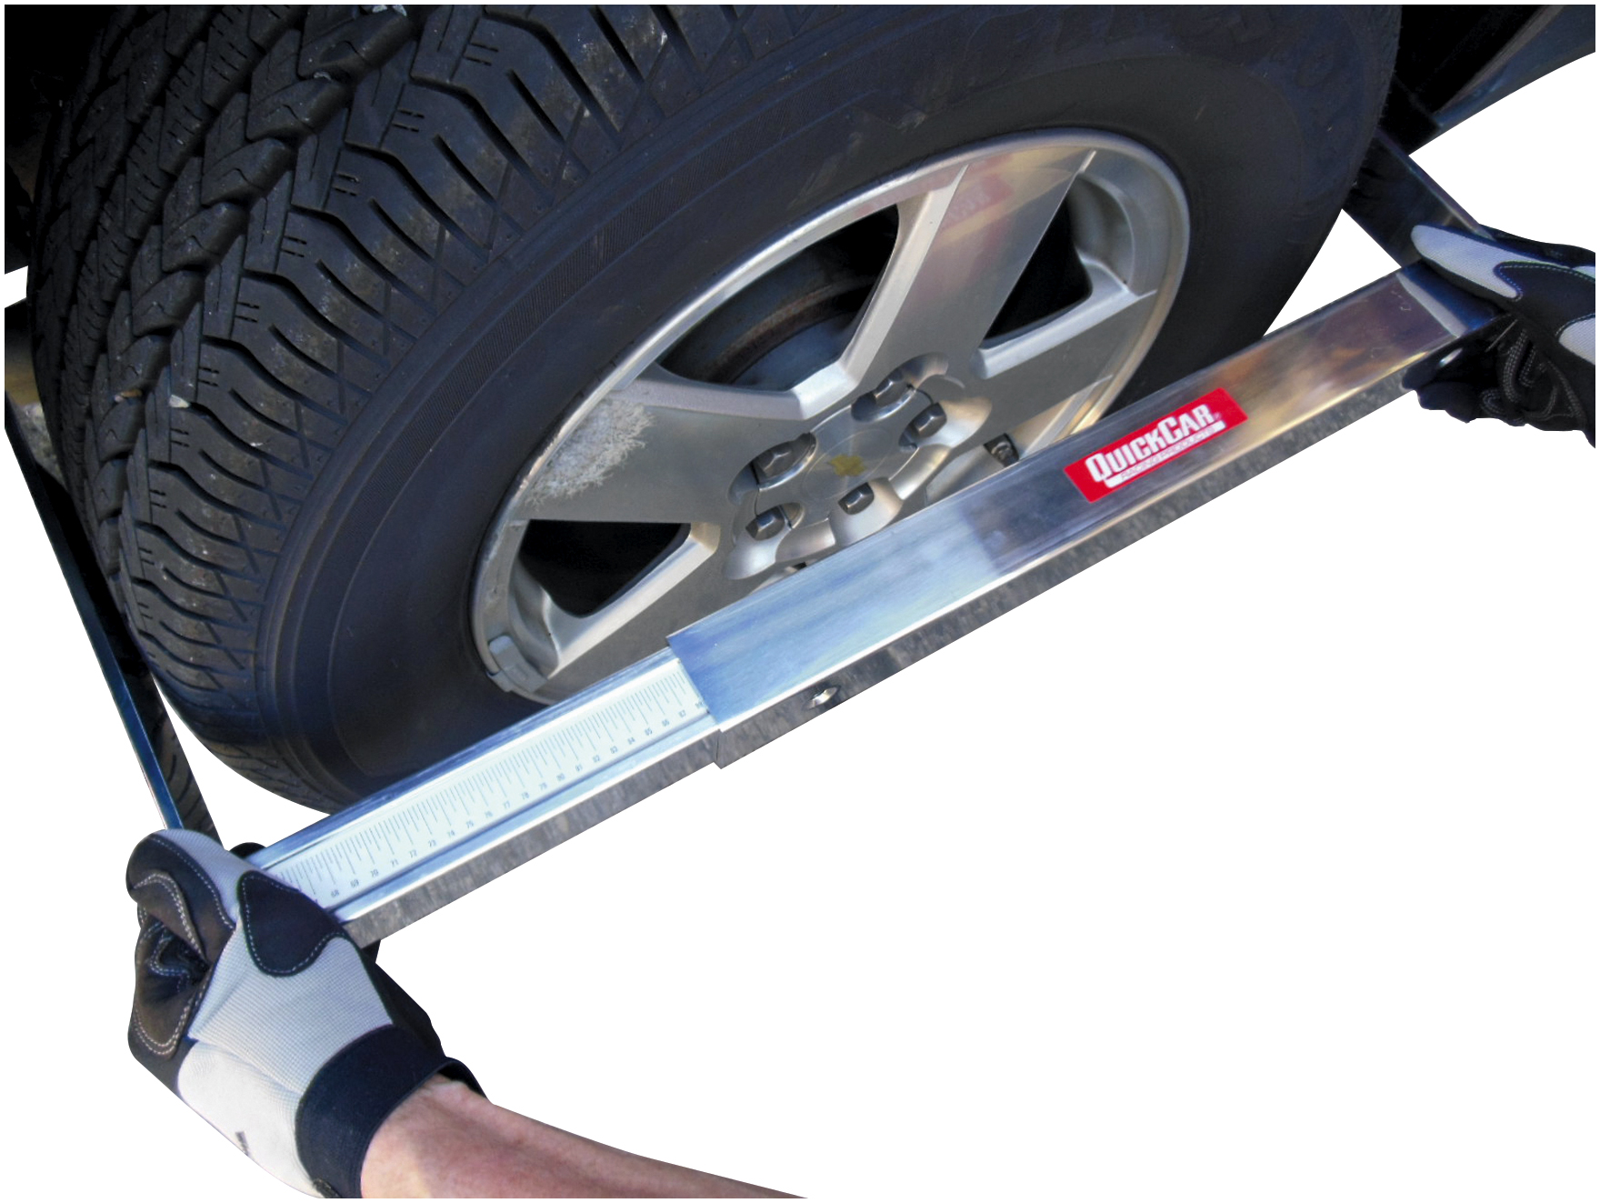
Measuring Tires
Figure 16.1 The measuring tape wrapped around the tire shows the circumference is
Figure 16.2 A stagger gauge, which is commonly used by racing teams to measure the circumference of tires, is a sliding caliper-type tool calibrated to read circumference.
The other three tires
should measure close to the same,
usually within
in circumference.
Notes:
Case Study: The Case of the Noisy Chevrolet Pickup Truck
A G M C pickup (42,000 mi) had a noise in 4 W D and would not shift out of 4 W D until coasting in second
gear. A test using an electronic noise detecting device such as Chassis Ears®, indicated
the whining noise was coming from the transfer case. A careful check of tire size showed 5/32 inch
deeper tread on the rear tires, and a check of tire circumference showed 98 inches at the front and
99 inches at the rear. Replacement of the worn front tires fixed this problem. Apparently, the mix-
matched tire sizes caused the drivetrain to bind, which prevented the transfer case to lock up and
not be able to be shifted correctly.
Summary:
Complaint—Customer was concerned about a noise and not being able to shift out of 4 W D.
Cause—Front tires were worn and smaller than the rear tires.
Correction—Replaced both front tires.

Slide 7
Animation: Measure Tire Circumference (Animation will automatically start)

Slide 8
Visual Inspection (2 of 2)
Measuring tire circumference
Visually check driveline
Gear oil level and condition
Notes:
Equal Size Tires All tires of a full-time four-wheel-drive or all-wheel-drive vehicle must be within a 1/16 inch (1.6 mm) tread depth of each other. Always check that all tires are:
Exact same size;
Same brand (different brands even if the same size can vary in the actual diameter and width Of the tire);
Same tread depth within 2/32 inch (1/16 inch);
Same inflation pressure within 2 P S I for best results;
Measuring Tire Circumference Tire circumference can be checked by wrapping a cloth tape measure
around the tread. ● SEE FIGURE 16.1. A stagger gauge can also be used to measure tire circumference. ● SEE FIGURE 16.2.

Slide 9
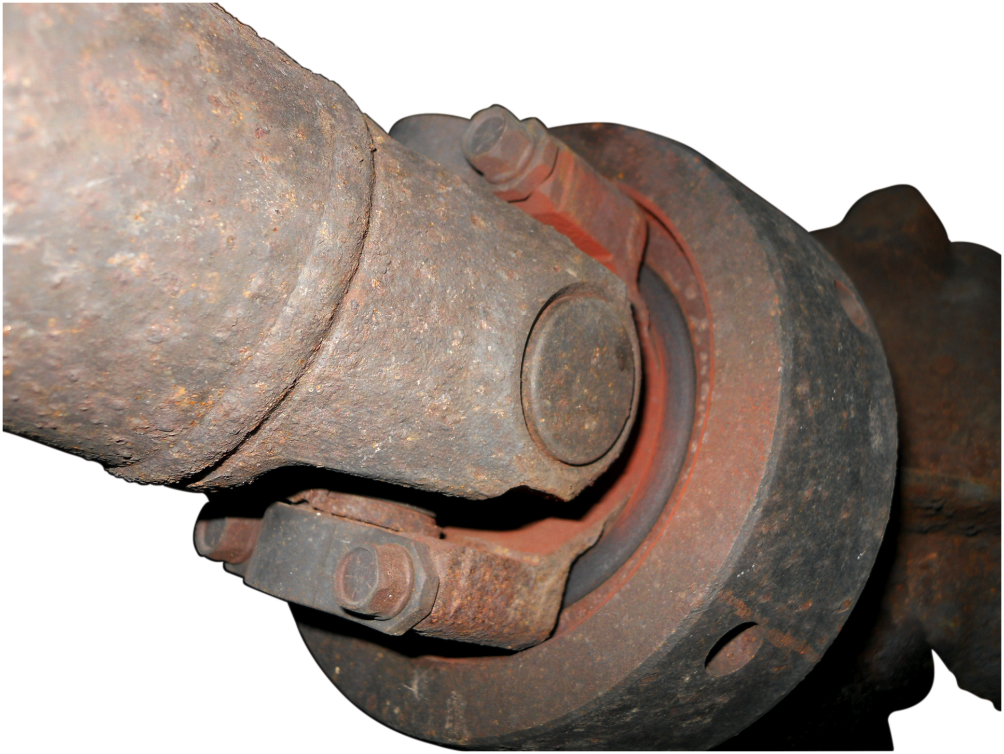
Figure 16.3
Red Rust Stain
Red rust stain is an indication that metal-to-metal contact is occurring and usually indicates that the part is worn and needs to be replaced such as in this U-joint.

Slide 10
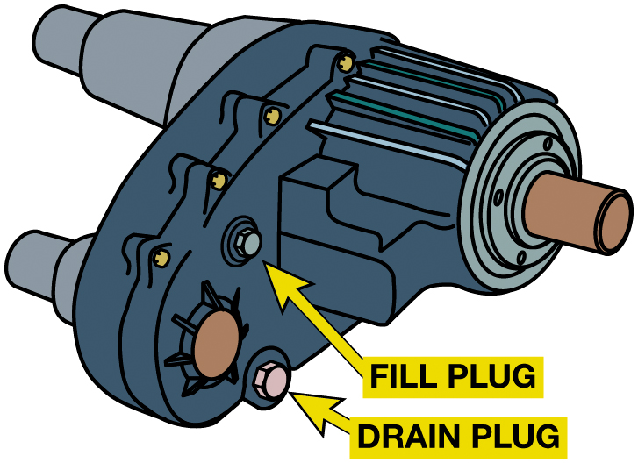
Figure 16.4
Fluid Level Check
Always check the fluid level and condition as one of the first items to check when diagnosing a four-wheel-drive customer concern.

Slide 11
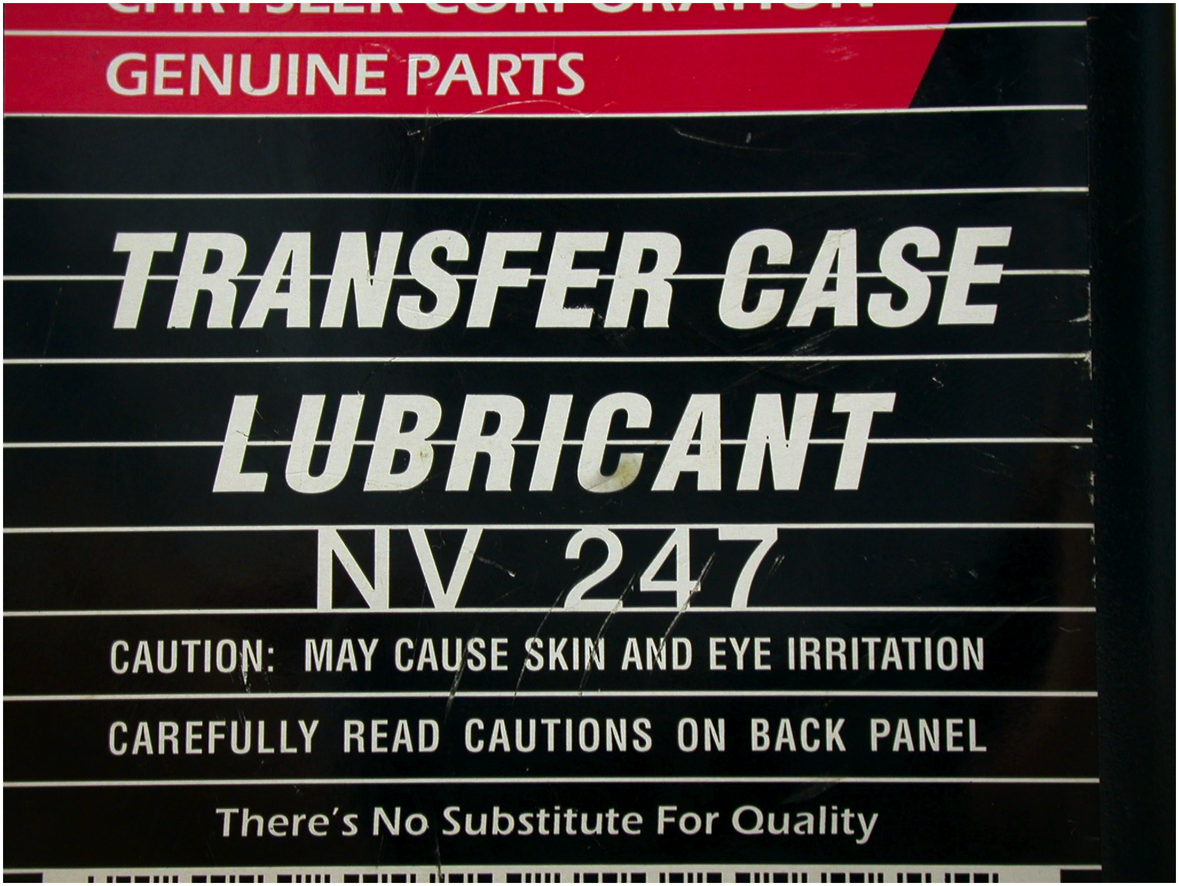
Figure 16.5
Chrysler Fluid
Chrysler recommends the use of a specific transfer case lubricant.
Notes:
Case Study: The Case of the Skipping Chevrolet Minivan
An A W D Chevrolet S U V (38,000 mi) had an odd skip-miss feeling during acceleration. Tire circumferences were checked, and they were within 1/8 of each other. The transfer case was drained and refilled with the proper fluid, but this did not help.
A second transfer case fluid change was recommended, and this fixed the problem. This transfer case can have a stick/slip problem, similar to a limited slip differential. Apparently, the second fluid change caused the clutch plates to work normally.
Summary:
Complaint—Customer was concerned about a skip-miss feeling during acceleration.
Cause—The fluid in the transfer case was causing the sticking/slip issue.
Correction—The transfer case fluid was replaced two times which corrected the customer concern.
Long Description:
The chart reads from top to bottom as follows. Genuine parts; transfer case lubricant; N V 247; caution: may cause skin and eye irritation; carefully read cautions on the pack panel; there is no substitute for quality.

Slide 12
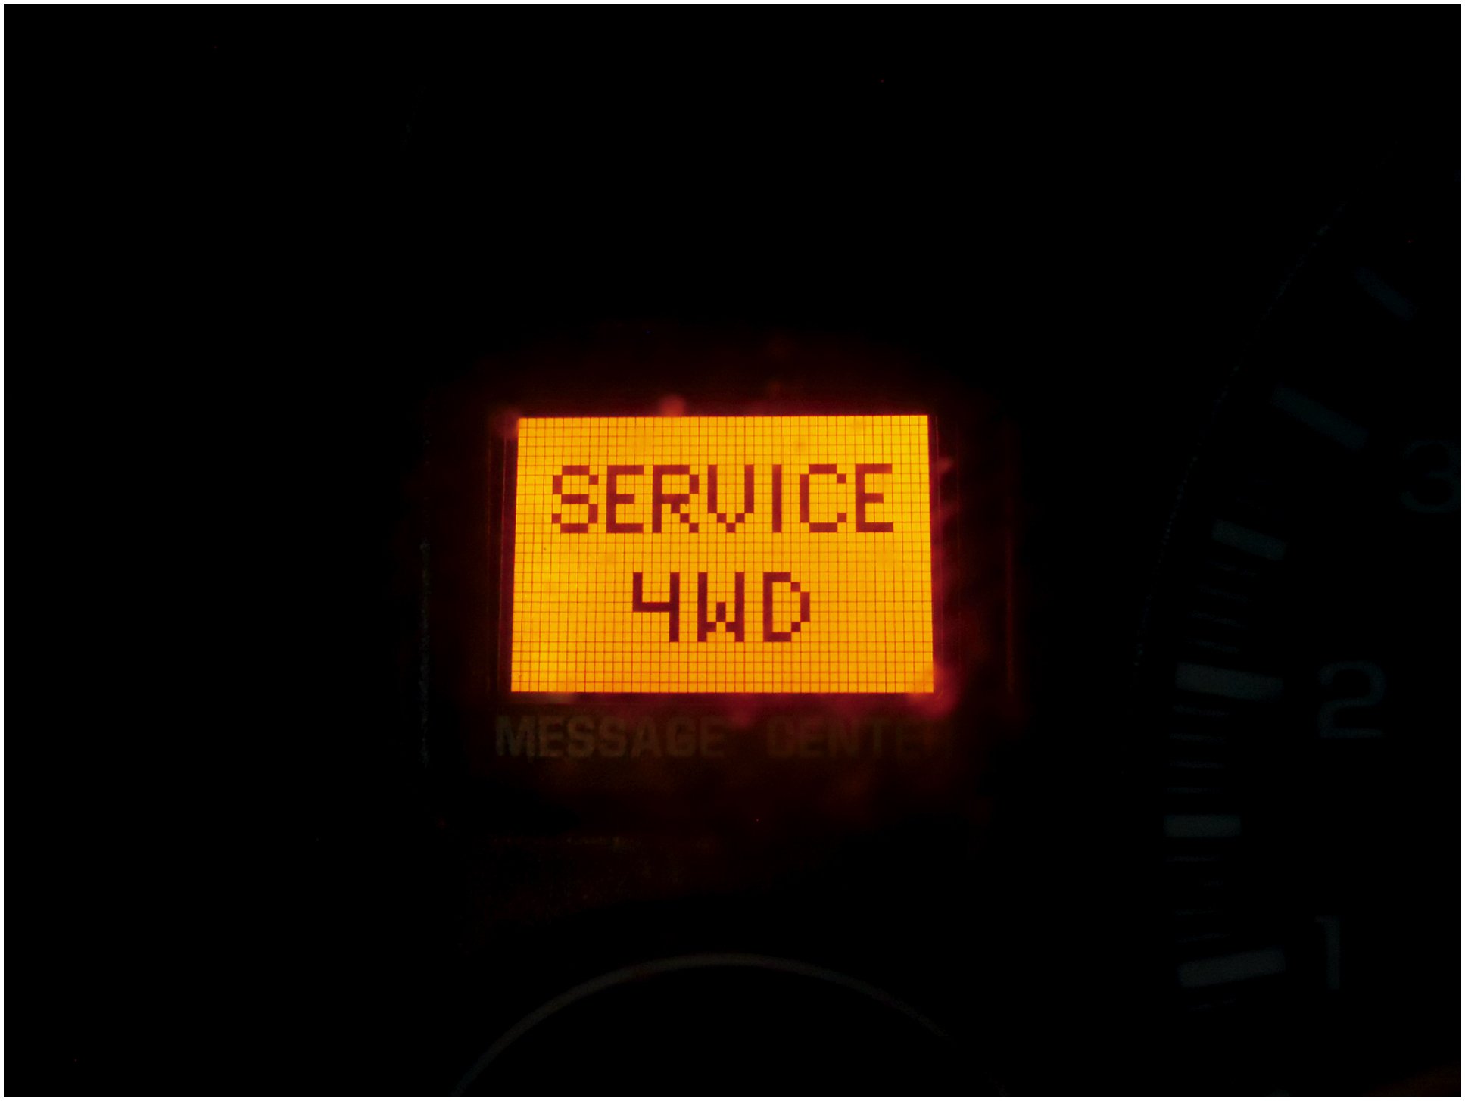
Four-Wheel-Drive Diagnostic Procedures
Warning lights
Scan tools
Most important tools for any diagnostic work on
Factory scan tools
Aftermarket scan tools
Global scan tools
Using a scan tool
Retrieving D T C
Figure 16.6 If the “SERVICE 4 W D” warning light is on, check service information for the exact procedures to follow.
Notes:
Tech Tip: Is the Problem Inside or Outside the Unit?
The purpose of the diagnosis is to determine the cause of the problem.
• Is it due to a fault with the controls (electrical or mechanical)?
• Is it due to the transmission or some other drivetrain component instead of the transfer case?

Slide 13
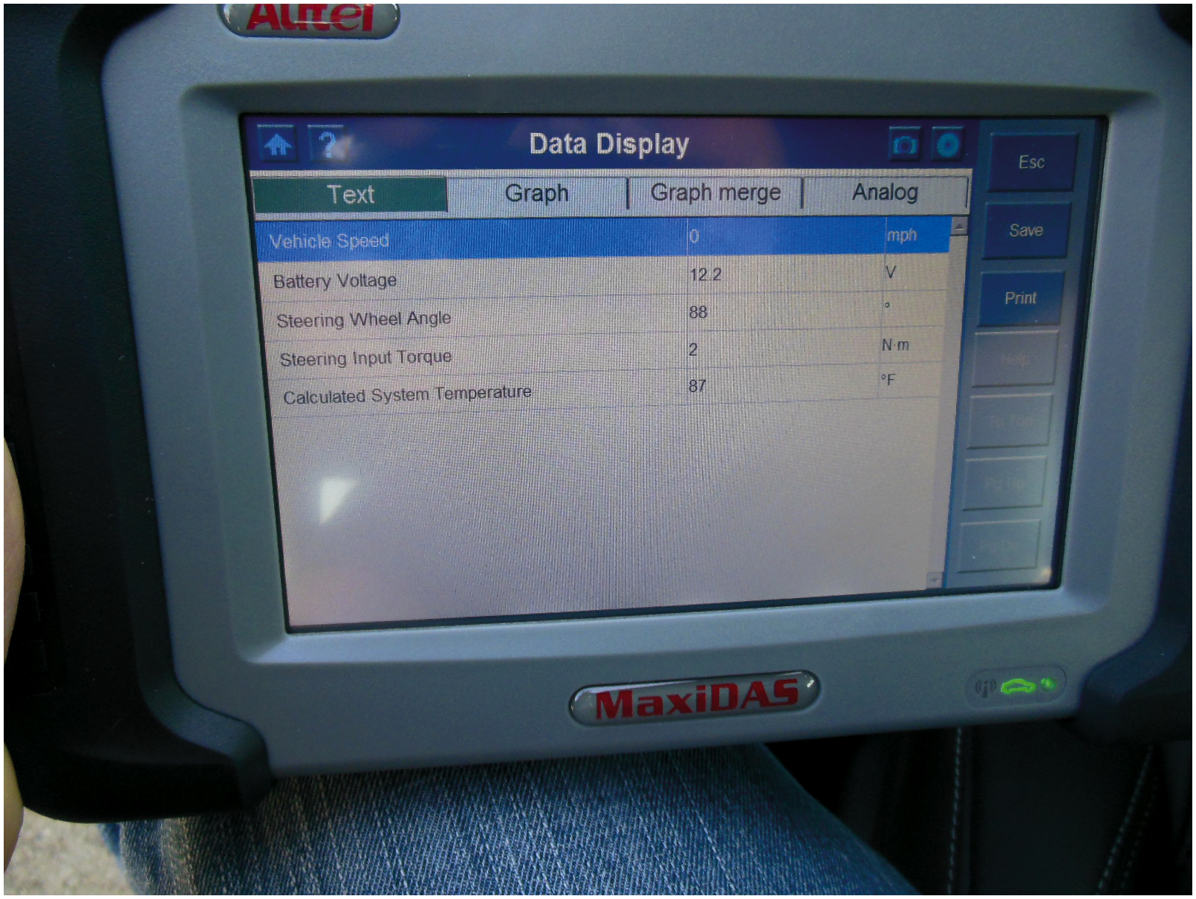
Figure 16.7
An aftermarket factory-level scan tool can be used to diagnose four-wheel-drive and all-wheel-drive concerns.
Codes
Subcodes
Example of a “C” code
Check T S B
Notes:
Long Description:
The table consists of 4 columns and 5 rows. The column headers are text, graph, graph merge, and analog. The row entries are as follows. Row 1: vehicle speed, nil, 0, and m p h. Row 2: battery voltage, nil, 12.2, and V. Row 3: steering wheel angle, nil, 88, and degrees. Row 4: steering input torque, nil, 2, and Newton meter. Row 5: calculated system temperature, nil, 87, and degrees Fahrenheit. The first row is highlighted.

Slide 14
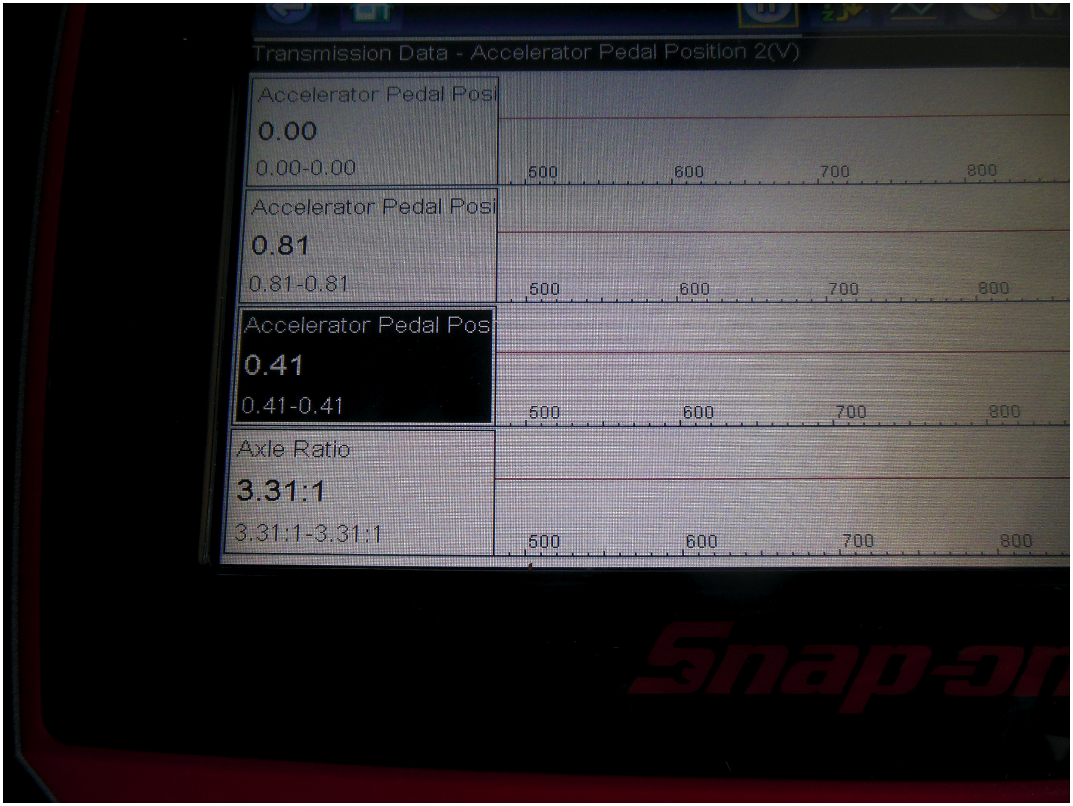
Figure 16.8
Solus Scan Tool
A Snap-on Solus scan tool is being used to troubleshoot a vehicle. This scan tool can be used on most makes and models of vehicles and is capable of diagnosing other computer systems in the vehicles, such as the antilock braking system (A B S) and four-wheel-drive systems.
Notes:
Scan tools are the most important tools for any diagnostic work on all vehicles. Scan tools can be
divided into the following three basic categories:
1. Factory scan tools. These are the scan tools required by all dealers that sell and service a specific brand of vehicle.
Examples of factory scan tools include the following:
■ General Motors—Global Diagnostic System (G D S 2)
■ Ford—W D S (Worldwide Diagnostic System) and I D S (Integrated Diagnostic Software)
■ Chrysler—D R B-III, Star Scan, or WiTECH
■ Honda—H D S or Master Tech
■ Toyota—Master Tech and Tech Stream
All factory scan tools are designed to provide bi-directional capability, which allows the opportunity to operate components using the scan tool, thereby confirming that the component is able to work when commanded. Also, all factory scan tools are capable of displaying
all factory parameters.
2. Aftermarket scan tools. These scan tools are designed to function on more than one brand of vehicle. Examples of aftermarket scan tools include the following:
Snap-on (various models, including the Ethos, Modis, and Solus). SEE FIGURE 16.8. O T C (various models, including Pegasus, Genisys, TOUCH, and Task Master).
AutoEnginuity and other programs that use a laptop or handheld computer for display. While many aftermarket scan tools can display most, if not all, of the parameters of the factory scan tool, there can be a difference when trying to trouble-shoot some faults.
Long Description:
The table consists of 2 columns and 4 rows. The second column has some scale with some values given. The entries are as follows. Row 1: accelerator pedal post, 0.00, 0.00 to 0.00, and the scale has the points 500, 600, 700, and 800 from the left to right. Row 2: accelerator pedal post, 0.81, 0.81 to 0.81, and the scale has the points 500, 600, 700, and 800 from the left to right. Row 3: accelerator pedal post, 0.41, 0.41 to 0.41, and the scale has the points 500, 600, 700, and 800 from the left to right. Row 4: axle ratio, 3.31 ratio 1, 3.31 ratio 1 to 3.31 ratio 1, and the scale has the points 500, 600, 700, and 800 from the left to right.

Slide 15
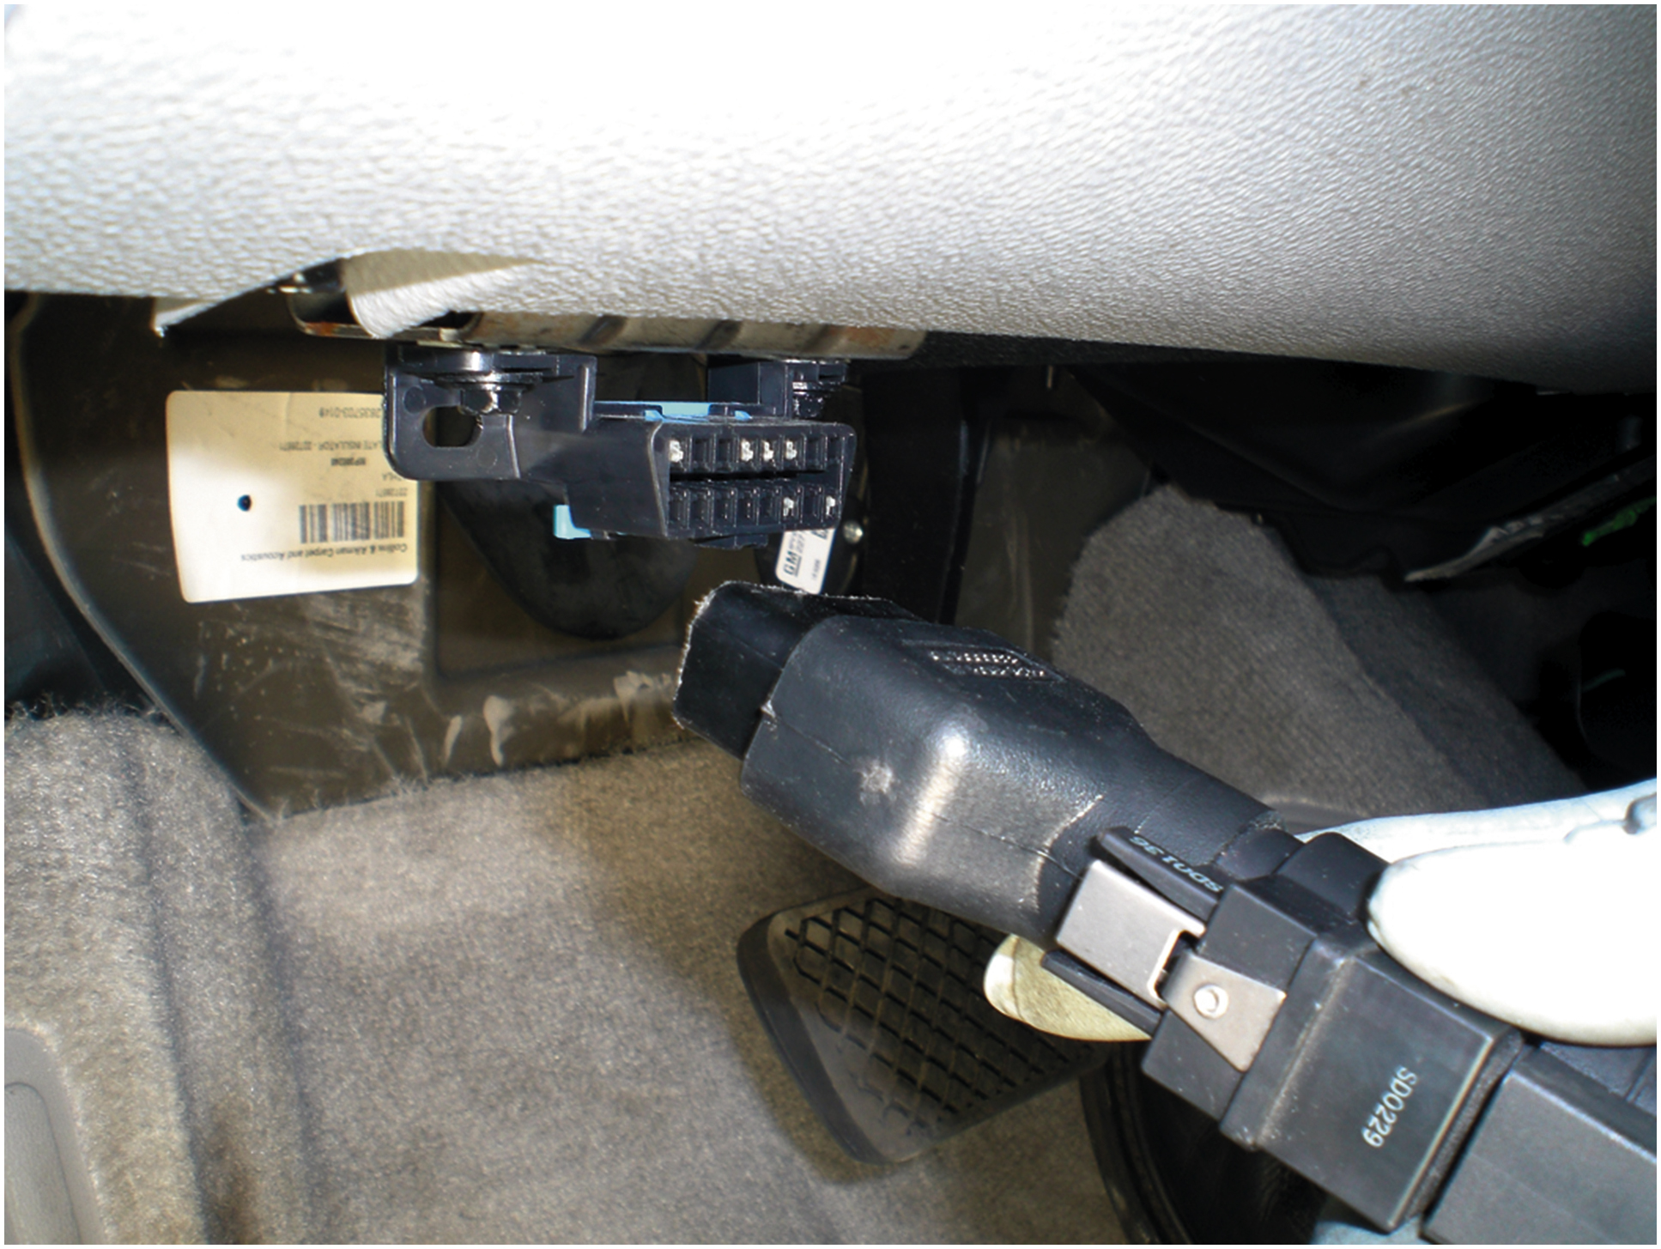
Figure 16.9
Data Link Connector
Connecting a scan tool to the data link connector (D L C) located under the dash on this vehicle.
Notes:
HOW TO USE A SCAN TOOL In order to get the most from a scan tool, the technician should read,
understand, and follow the operating instructions. To use a scan tool perform the following
steps:
STEP 1 Locate the data link connector (D L C). This 16-pin connector is usually located under the
dash on the driver’s side. It can be located in the center console and may be covered by a panel
that can be removed without the use of tools. Check service information for the exact location of
the D L C for the vehicle being serviced.
STEP 2 Connect the scan tool to the D L C. ● SEE FIGURE 16.9. STEP 3 Turn the ignition key on
(engine off). In most cases, the scan tool will come on automatically because the
D L C has power and ground connections for the scan tool.
STEP 4 If using a factory or factory-level scan tool, select the vehicle you are scanning and
enter the information requested on the screen such as the following:
■ Year (tenth character of the V I N)
■ Model (usually the fourth or fifth character of the V I N)
■ Engine (usually the eighth character of the V I N)
■ Any options that may be on the vehicle
STEP 5 Follow the on-screen instructions. Read and record any stored diagnostic trouble codes
(D T Cs). ● SEE FIGURE 16.10.
Long Description:
The text reads as follows. Important: transfer cases with three buttons or rocker switch activation, N V G-233, and N V C-243, do not support TECH 2 diagnostics. Consult proper service manual procedures.

Slide 16
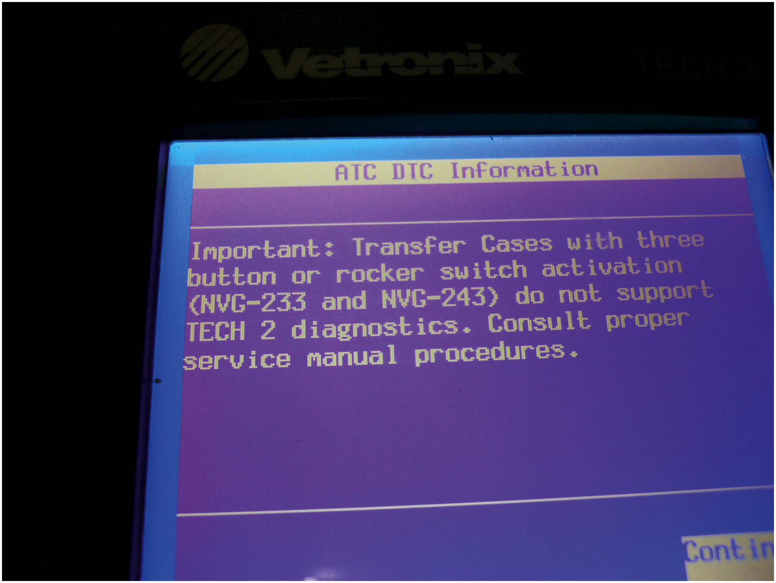
Figure 16.10
Check Procedures
Not all transfer cases are capable of communicating with the scan tool. Check service information for the exact procedures to follow.

Slide 17
Chart 16.1
DTC | DESCRIPTION
C0300 | Rear propeller shaft speed sensor circuit
C0305 | Front propeller shaft speed sensor circuit
C0308 | Motor A/B circuit, short to ground
C0309 | Motor A/B circuit, short to voltage
C0310 | Motor A/B circuit, open circuit
C0315 | Module ground circuit
C0323 | Lock solenoid circuit, open circuit
C0324 | Lock solenoid circuit, shorted to voltage
C0327 | Encoder feed circuit
C0367 | Front axle control circuit, shorted actuator or short to voltage
C0374 | Shift control module unable to control slip
C0376 | Front and rear propeller shaft speeds greater than 20% difference
C0387 | Unable to complete shift as commanded
C0550 | Failed shift control module test
Notes:
Typical C-type D T Cs associated with faults in the transfer case system.

Slide 18
Chart 16.2
DTC | DESCRIPTION
C0306 02 | Motor A or B circuit shorted to ground
C0306 05 | Motor A or B circuit shorted to voltage or open
C0321 01 | Transfer case lock circuit shorted to ground
C0321 04 | Transfer case lock circuit shorted to voltage or open
C0379 01 | Front axle short to voltage
C0379 02 | Front axle short to ground
C0379 04 | Front axle open circuit
Typical D T Cs with sub-codes associated with faults in the transfer case system.
Notes:
Related Diagnostic Trouble Codes

Slide 19
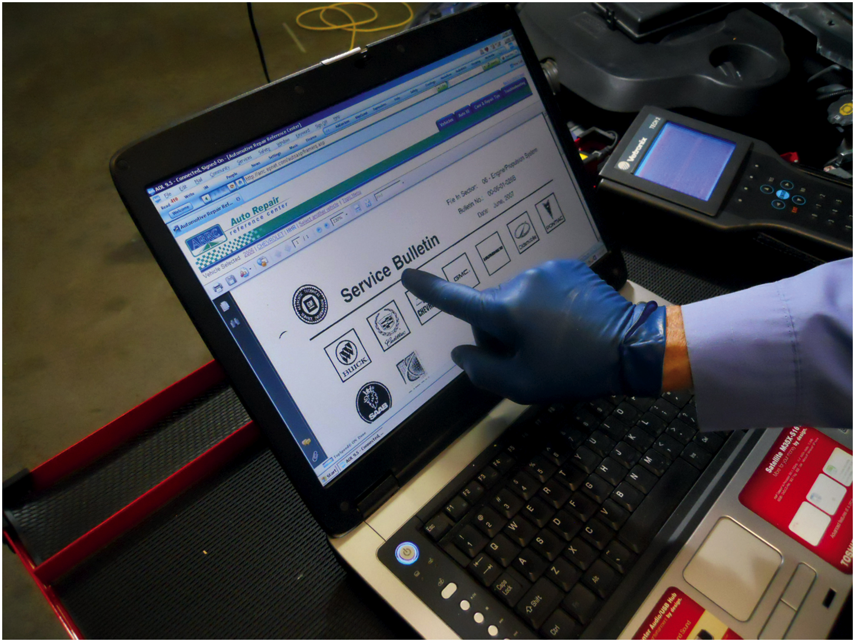
Figure 16.11
T S B
After checking for stored diagnostic trouble codes (D T Cs), the wise technician checks service information for any technical service bulletins that may relate to the vehicle being serviced.
Notes:
Check for Technical Service Bulletins after checking for stored diagnostic trouble codes, technical service bulletins (T S Bs) should be checked to see if there are any faults that are addressed for the codes that have been set. Figure 16.11. According to studies performed by automobile manufacturers, as many as 30% problem vehicles can be repaired following the information, suggestions, or replacement parts found in a service bulletin. D T Cs must be known before searching for service bulletins, because bulletins often include information on solving problems that involve a stored diagnostic trouble code.
Tech Tip: Ask the Driver
A diagnostic trouble code for a fault with the control switch can be set if the driver switches positions rapidly. This is a common situation when the driver is trying to engage four-wheel drive and when it does not go into four-wheel drive immediately, moves the switch back to two-wheel drive and then back into four-wheel drive. Therefore, if there is a diagnostic trouble code set for a fault in the switch and no fault is found, ask the driver if this might be the case.

Slide 20
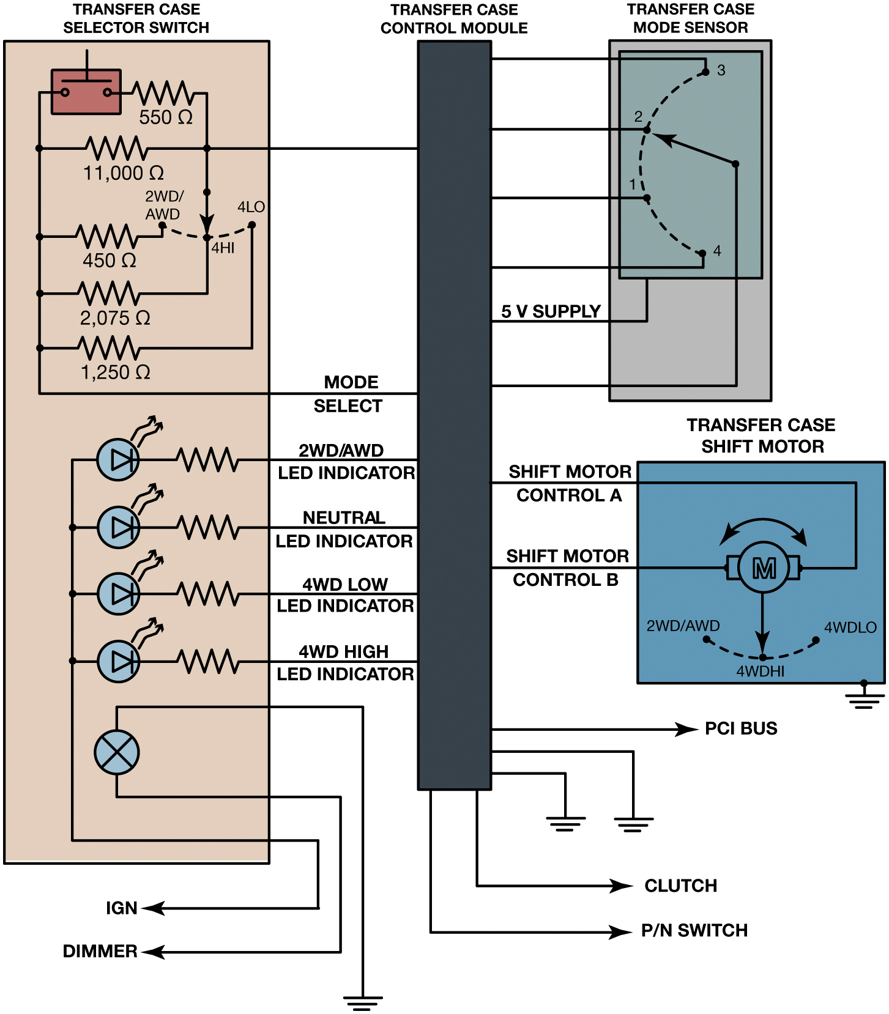
Figure 16.12
Typical Schematic
A typical schematic showing an electronic four-wheel-drive control switch and the wiring connections to the transfer case from the T C C M.
Notes:
Long Description:
The schematic consists of a vertically oriented transfer case selector switch on the left, a vertically oriented transfer case control module on the right of the selector switch, and a small rectangular transfer case mode sensor on the right. A square transfer case shift motor is below the transfer case mode sensor on the right. The resistances on the top of the transfer case selector switch are 550 ohms, 11000 ohms, 450 ohms, 2075 ohms, and 1250 ohms from top to bottom. The transfer case selector switch is connected to the transfer case control module via 11000 ohms and 1250 ohms, mode selection. On the bottom of the transfer case selector switch, four diodes with corresponding resistors in series are connected to the transfer case control module from top to bottom as follows: 2 W D slash A W D, L E D indicator, neutral, L E D indicator, 4 W D low, L E D indicator, and 4 W D high indicator. The top diode is connected downward to I G N. On the bottom, a lamp is connected to the earth's source and dimmer. At the bottom of the transfer case control module, a rightward arrow is for P C I B U S, and 2 rightward arrows at the bottom end are for the clutch and P N switch. The transfer case control module s connected to two earth sources. A 5 volts voltage supply runs in between the transfer case control module and the transfer case mode sensor. The transfer case shift motor has a motor with 2 W D slash A W D, 4 W D H I, AND 4 W D I O labels. The transfer case shift motor is connected to the earth source. The transfer case control module and transfer case shift motor are connected by shift motor control A and shift motor control B.

Slide 21
Check Electrical Components
Checking switches and controls
Typical voltage readings
Checking for power and ground at the motor
Transfer case shift linkage adjustment
Remove shift boot to access gearshift mechanism.
Place the lever in correct position.
Disconnect linkage rod swivel/trunnion from shift lever
See if it slides freely.
Notes:
Case Study The Case of the Broken Jeep
A Jeep Wrangler (73,500 mi) front axle would not engage. An inspection showed broken and brittle vacuum hoses, some falling off their connectors. The vacuum harness to the vacuum hubs was replaced, which did not fix the problem. However, after looking at a vacuum diagram, it was determined that a clogged vent could be the cause. A visual inspection revealed that the vent was plugged with mud. Cleaning this vent fixed this problem.
Summary:
Complaint—Customer was concerned about the front axle not being able to engage.
Cause—Vent port was clogged.
Correction—Replaced the vacuum hoses and lines and cleaned the vent.

Slide 22
Chart 16.3 Voltage Readings
Blank | GM ROTARY SWITCH (5 VOLT) | GM PUSH BUTTON(5 VOLT) | GM PUSH BUTTON (8 VOLT) | FORD ROTARY SWITCH (12 VOLT) | FORD PUSH BUTTON (12 VOLT) | DODGE (RAM) (5 VOLT)
2WD | 4.1 volts | 2 point 0 volts | 3.2 volts | 7.5 volts | NA | 2.1 volts
AUTO 4WD | 3.3 volts | 4.6 volts | 7.5 volts | NA | 1.8 volts | 2.7 volts
4WD High | 2.5 volts | 3 point 0 volts | 4.8 volts | 5.5 volts | 6.4 volts | 3.5 volts
4WD Low | 1.6 volts | 1.5 volts | 2.4 volts | 3.7 volts | 9 point 0 volts | 4.1 volts
Neutral | 0.8 volts | 0.9 volts | 1.2 volts | NA | NA | NA
Notes:
Typical voltage readings that may be measured at the four-wheel-drive control switch with the key on, engine off (K O E O). Always check service information for the exact specifications and testing procedures for the vehicle being serviced.
WARNING: Placing a transfer case into neutral means that the vehicle is able to move even though the
transmission has been placed in “Park.”

Slide 23
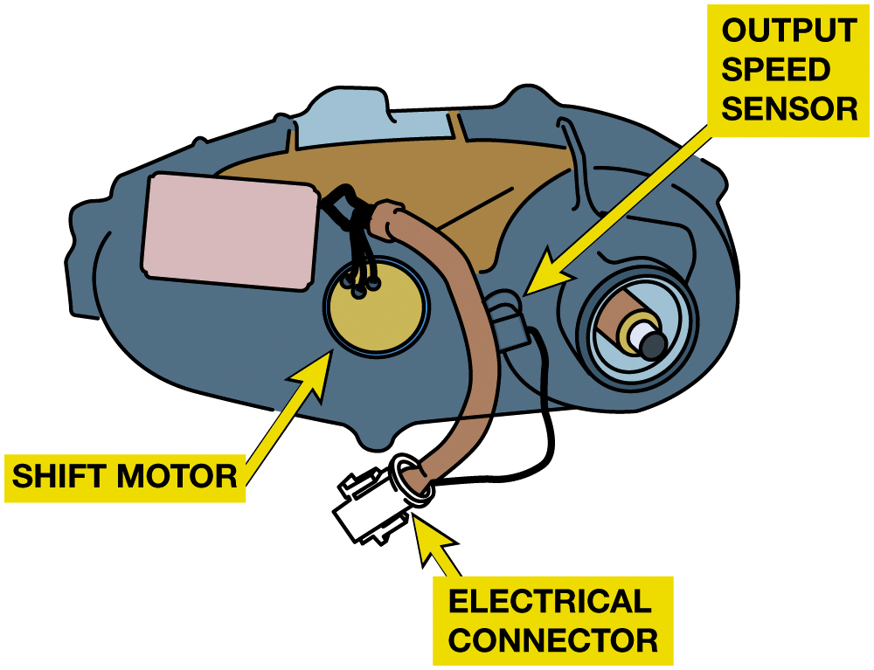
Figure 16.13
Power & Ground
The voltage to the shift motor and the feedback signal voltage signals can often be tested at the electrical connector using a digital meter or by using a scan tool on some models.
Notes:
Checking for Power and Ground at the Motor
The shift control motor operates on 12 volts D C and ground that is routed through the T C C M. To
change direction of the motor, the power and ground are reversed inside the T C C M, causing the motor
to reverse directions. Most motor assemblies also include a feedback sensor that signals the T C C M

Slide 24
Frequently Asked Question: What Is Driveline Windup?
? Frequently Asked Question
What Is Driveline Windup? A condition unique to 4 W D that may be considered a problem by some vehicle owners is driveline windup. This condition, which should be avoided, occurs when a part-time 4 W D vehicle is operated on dry pavement with the transfer case in 4 W D and the front hubs engaged. The different rotating speeds of the front and rear wheels will cause a bind up condition. The result will be a hop, skip, or bounce of the front or rear tires and transfer case locked in gear. This is also called crow hopping. Driveline windup can be removed by lifting a wheel off the ground or, more simply, by driving the vehicle in a circle in a direction opposite to what made the windup. With some electric-shifted transfer cases, windup can cause a delay in shifting out of 4 W D.

Slide 25
Front Hub Removal and Replacement (1 of 2)
Some automatic hubs will not disengage under certain conditions.
Locking front hubs should be cleaned periodically.
Some front hubs are removed by removing the bolts at the wheel hubs.
Sliding them off the axle and hub.
Others have internal snap ring that secures splined inner sleeve to axle.
Notes:
Locking front hubs should be cleaned periodically, especially if the vehicle has been driven under water or in dusty conditions. Most vehicle manufacturers recommend that the hubs be cleaned and lightly coated with grease at the same time the front wheel bearings are serviced. Check the service information for the exact procedure for the vehicle being serviced. Start the inspection of the front hubs by removing the cover plate. Many problems associated with locking hubs can be corrected by cleaning and lubricating the components. If noise is heard from the hubs, carefully inspect the inner components on both sides of the vehicle. A damaged part can cause noise
in the hub on the other side. Service kits are often available for the hubs. These kits contain the gaskets, seals, and retaining rings necessary for installing the hubs correctly after wheel bearing or front brake work has been completed. FIGURE 16.14.

Slide 26
Front Hub Removal and Replacement (2 of 2)
Why and how should locking hubs be serviced?
Pages 262-263
What is the typical procedure for removal?
Pages 262-263

Slide 27
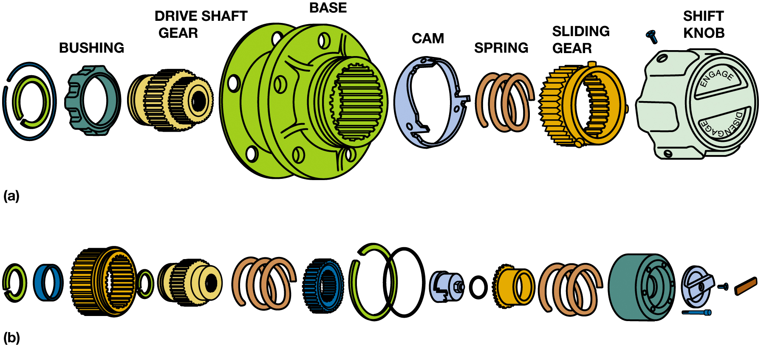
Figure 16.14
Power & Ground
(a) An exploded view of a Dualmatic® manual locking hub. (b) A Warn® manual locking hub.
Notes:
Case study The Case of the Broken Kia
A Kia S U V (63,000 mi) came in with an inoperative 4 W D. This vehicle uses vacuum-operated front
hubs. Rotted flexible front hub vacuum lines and plugged steel vacuum lines were replaced, but this
did not help. New hubs had previously been installed.
The technician found that a seal failure had apparently allowed vacuum to suck all of the grease
out of the wheel bearing. This grease probably caused the plugged and rotted vacuum lines, and the
grease loss caused wheel and spindle bearing failure. Replacement of the wheel bearings, spindle
bearing, spindle, and seal with updated parts fixed this problem.
Summary:
Complaint—Customer was concerned about a lack of 4 W D.
Cause—Front vacuum hub seals were at fault.
Correction—Replaced wheel bearings, spindle, and seal with updated parts.
Long Description:
The illustration on the top and bottom has the following circular structures of the components of the locking hub from the left to right. Bushing, drive shaft gear, base, cam, spring, sliding gear, and shift knob. The components of the manual locking hub on the top are much larger and thicker than the components of the manual locking hub on the bottom.

Slide 28
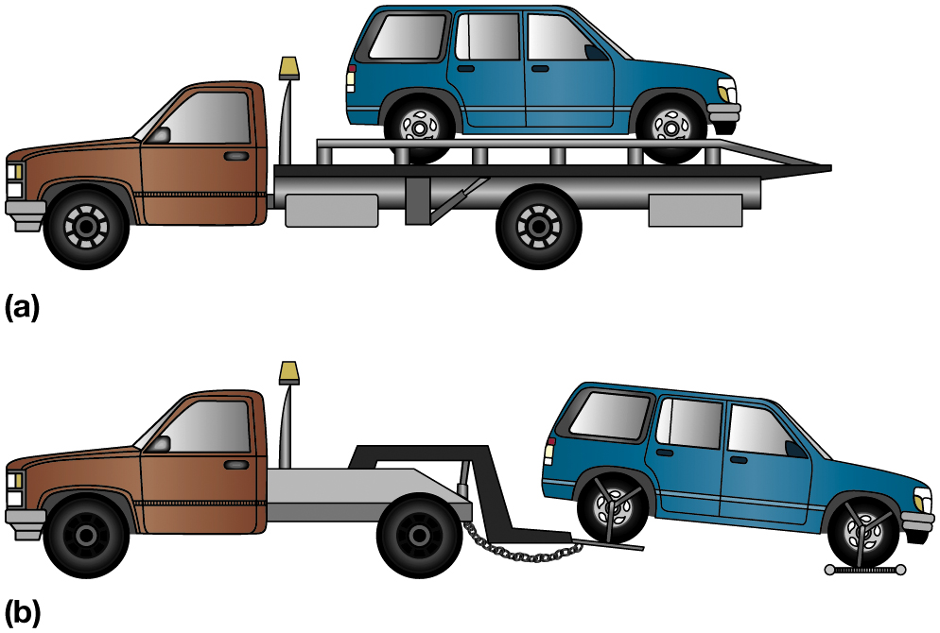
Transfer Case/Unit Removal and Replacement (1 of 2)
Raise and support vehicle securely on a hoist or jack stands
Remove any skid plates and brace rods that block access to transfer case
Disconnect front and rear driveshafts
Disconnect speed sensors and shift connectors and linkage
Figure 16.15 If a four-wheel-drive vehicle must be towed, it should be either on (a) a flatbed truck or (b) a dolly.
Notes:
Tech Tip: How to Tow a Four-Wheel-Drive Vehicle Without Doing Harm
If any of the drive wheels are on the ground, the wheels are turning the axles. Depending on exact type of four-wheel-drive vehicle being towed, this rotation of the wheels can cause severe wear; therefore, most experts suggest the following options:
Placing the vehicle on a flatbed or trailer. This keeps all four wheels off the ground and is the safest method for transporting a four-wheel-drive (or all-wheel-drive) vehicle without doing any harm.
Hoisting the front wheels off the ground and placing the rear wheels on a dolly. This procedure also keeps all wheels off the ground and therefore prevents any damage being done to the powertrain as a result of towing. Always check with vehicle specific information for exact towing procedures. If the transfer case has a neutral position, this will allow the vehicle to be towed with all four wheels on the ground. Always check the owner’s manual or service information for the recommend method to use. Figure 6.15.

Slide 29
Transfer Case/Unit Removal and Replacement (2 of 2)
Support transfer case using a transmission jack
Remove bolts that secure transfer case to transmission
Slide transfer case off rear of transmission, and remove it from vehicle
Replacement or repair decision
Transfer case installation
Notes:
Case Study The Case of the Broken Chevrolet Suburban
The transfer case of a Chevrolet Suburban would jump into neutral when the vehicle hit a large dip
or bump in the road. The vehicle could be shifted back into gear and driven.
After disassembly of the transfer case, it was found that the plastic shift fork inserts had broken
off. Replacement of the shift forks fixed this problem.
Summary:
Complaint—Customer was concerned that the transfer case would go into neutral when driving over
rough or uneven pavement.
Cause—The plastic shift fork inserts had broken off.
Correction—Replaced the transfer case shift forks.

Slide 30
Transfer Case/Unit Overhaul
Overhaul
Disassembly
Gear and bearing inspection
Shift fork clearance and operation
Chain wear check, shaft inspection
Seal replacement
Reassembly with adjustments for gear end float
Bearing clearance or preload
Notes:
See 21 step transfer case overhaul on pages 266-269
Case Study The Case of the Noisy Range Rover
A Land Rover, Range Rover (100,000 mi) has a ratcheting type noise that seems to be coming from the
back seat. The transfer case was removed and disassembled. The chain appeared to be stretched
because the new, replacement chain was about an inch shorter. Replacement of the drive chain fixed
this problem.
Summary:
Complaint—Customer was concerned about a noise coming from the back seat.
Cause—Stretched transfer case chain.
Correction—Replaced transfer case chain.

Slide 31
Question 1
“Rust dust” is a sign of what type of fault?
A. Old contaminated transfer case fluid
B. Worn steel parts such as U-joints
C. High resistance in electrical wiring
D. Worn powertrain mounts

Slide 32
Answer 1
“Rust dust” is a sign of what type of fault?
B. Worn steel parts such as U-joints

Slide 33
Summary
Transfer cases/gear sets must have clean gear oil
Proper level and of the proper type.
Cause of improper 4 W D/A W D operation determined
Using several diagnostic steps.
Transfer case/gear set disassembly/reassembly varies.
Locking hubs need routine service including cleaning and lubricating
Parts must be clean before they can be fully inspected

Slide 34
N V-242 Transfer Case Service Photo Sequence

Slide 35
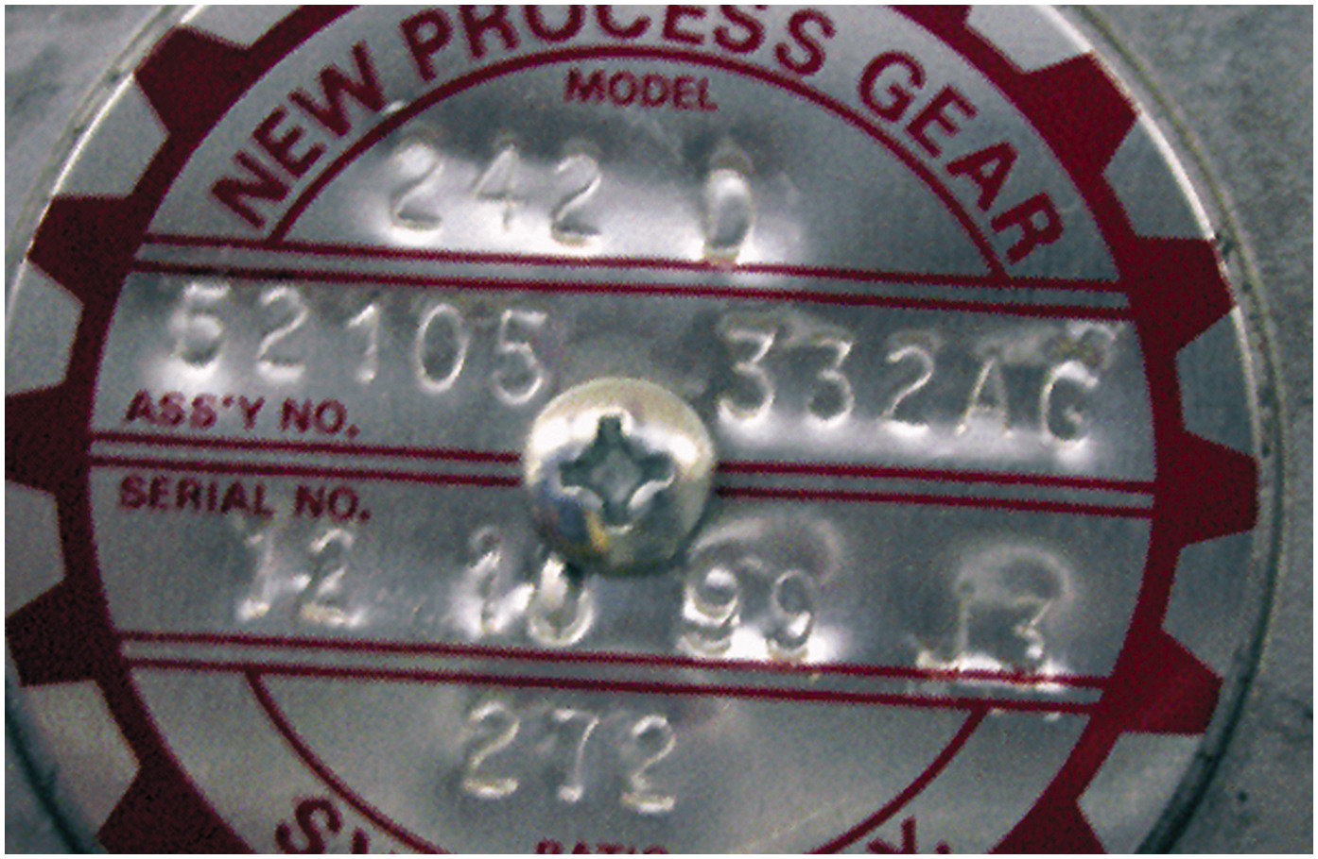
1. The identification plate on the housing indicates the transfer case is a New Venture (New Process) model #242 and has a low-range gear ratio of 2.72.1

Slide 36
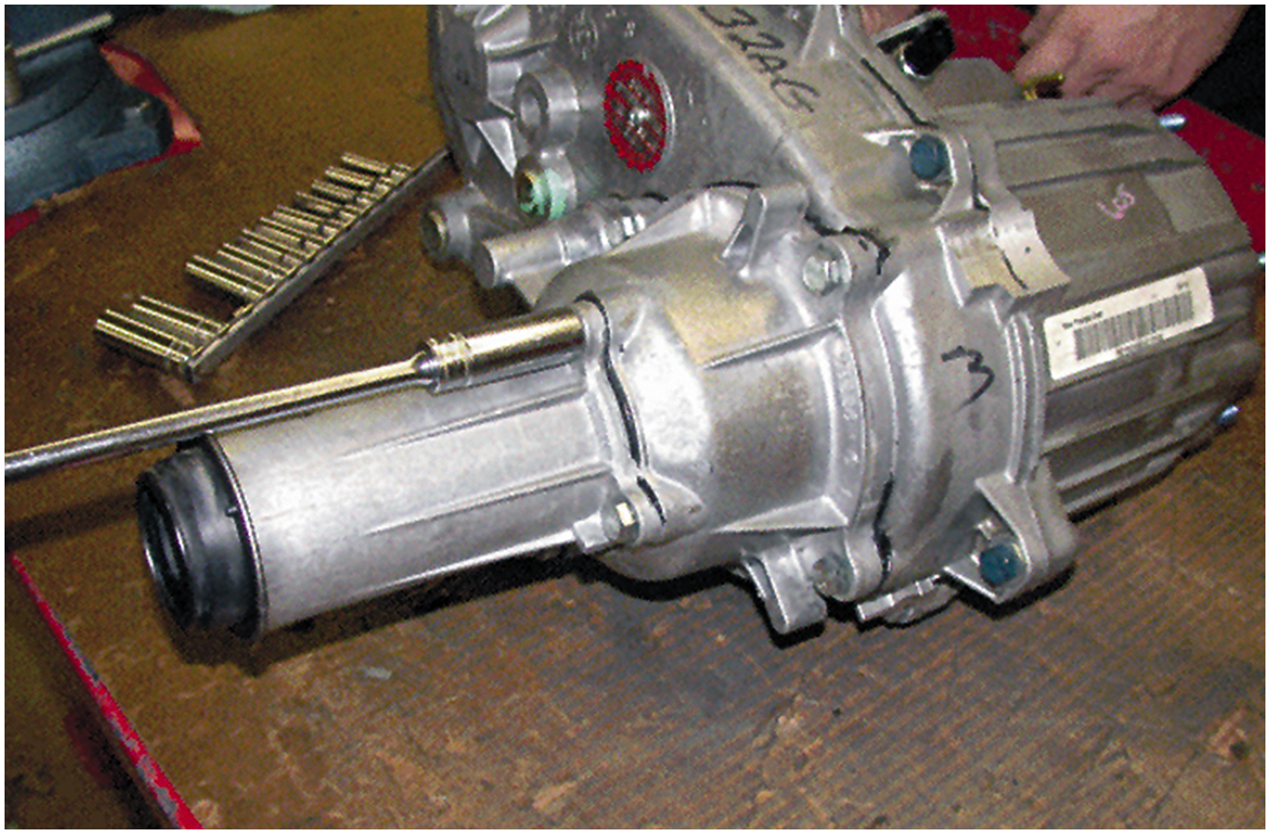
2. Rear output shaft housing being removed

Slide 37
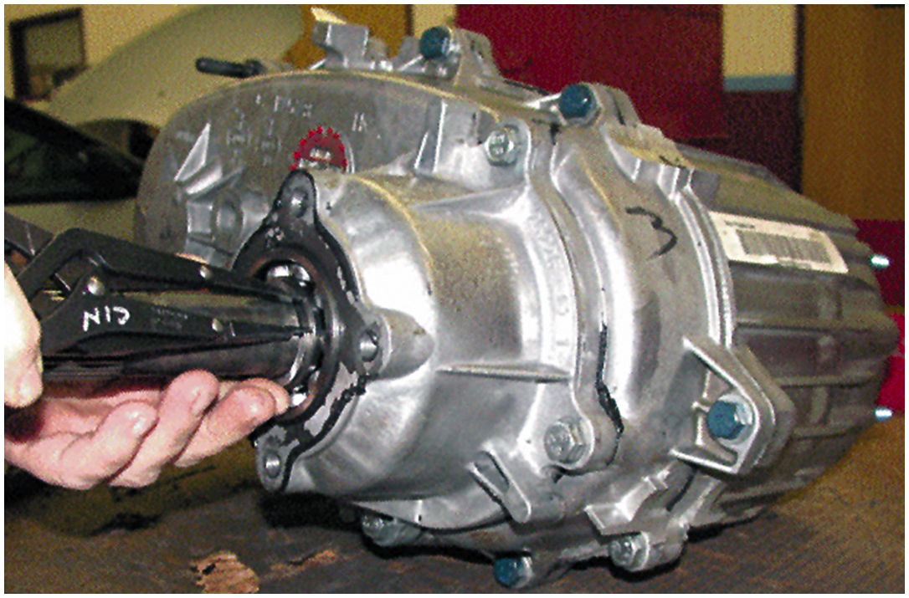
3. Before the case can be separated, the bearing retaining snap ring must be removed using snap-ring pliers

Slide 38
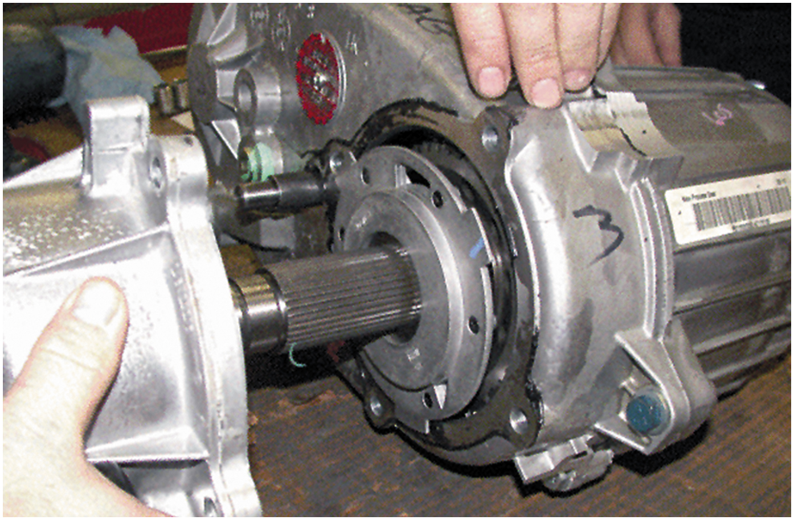
4. The lubricating oil pump is visible after the cover and bearing assembly have been removed

Slide 39
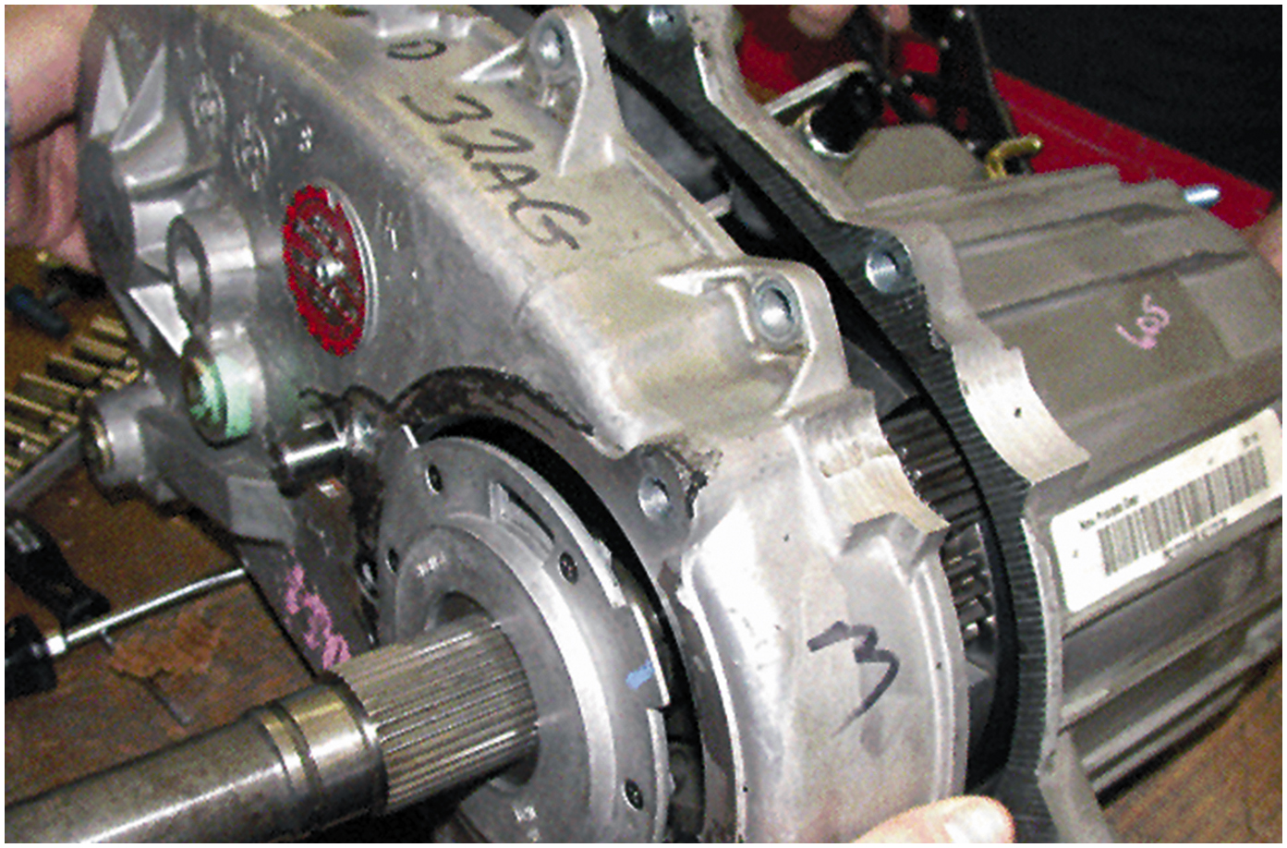
5. The two case halves are being separated

Slide 40
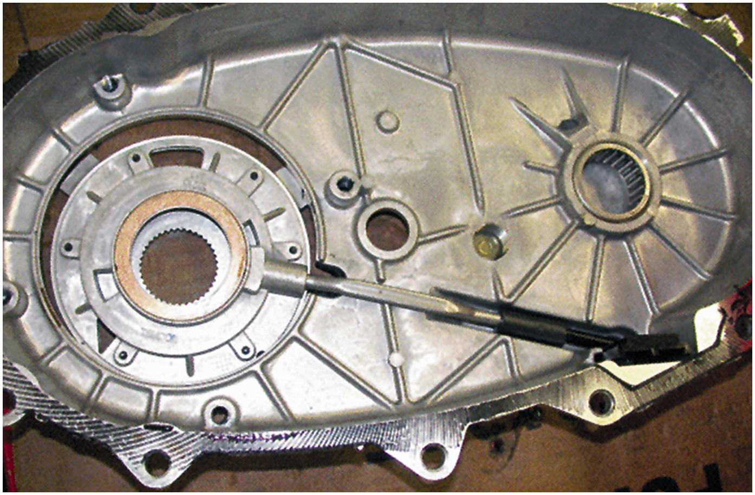
6. The oil pump assembly, pickup screen, and tube are visible on the backside of the case cover

Slide 41
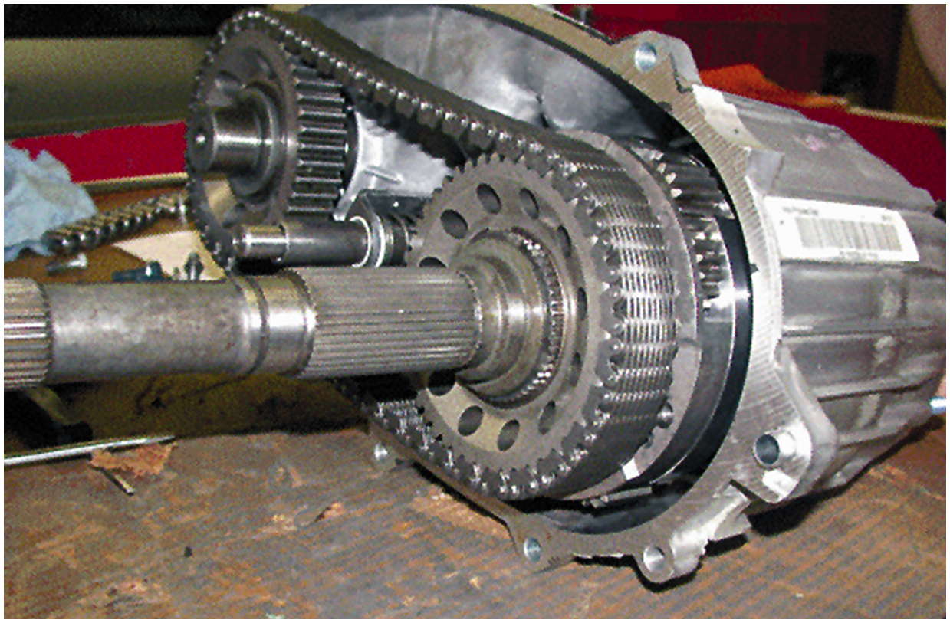
7. The rear output shaft and sprocket are visible on the right. The front output shaft and sprocket are visible on the left connected by the drive chain

Slide 42
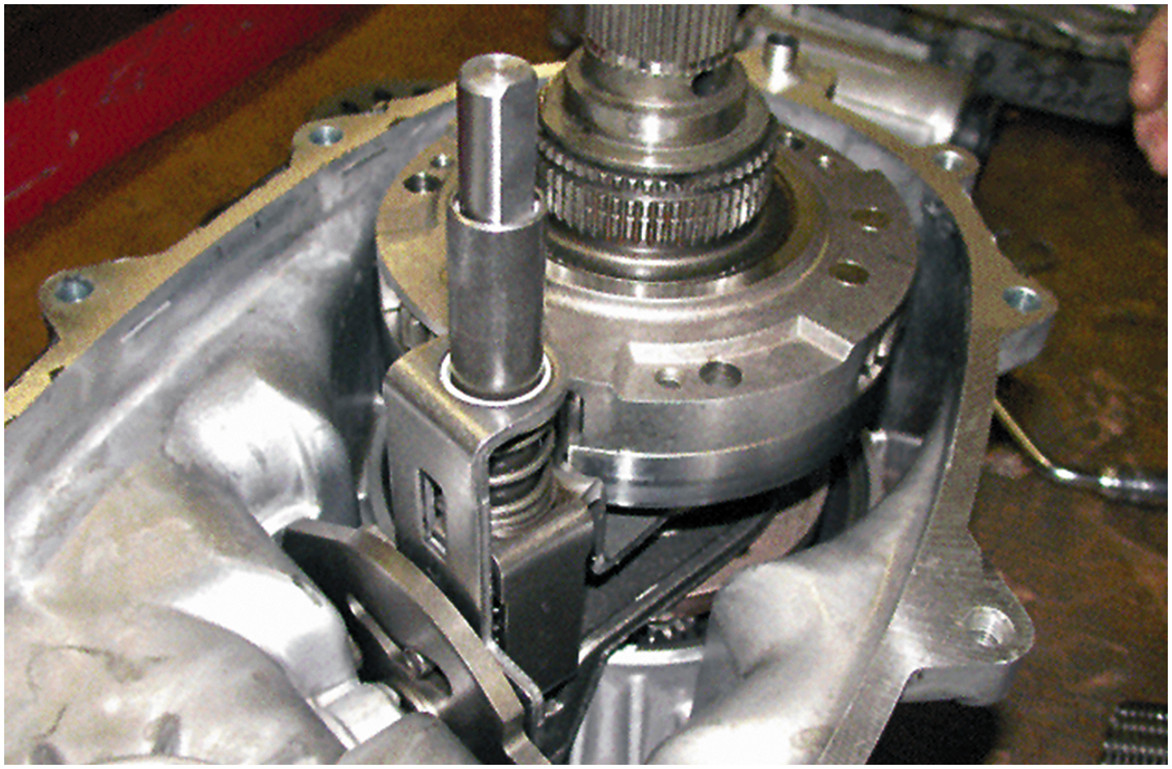
8. View of the shift levers and the center differential after the chain has been removed

Slide 43
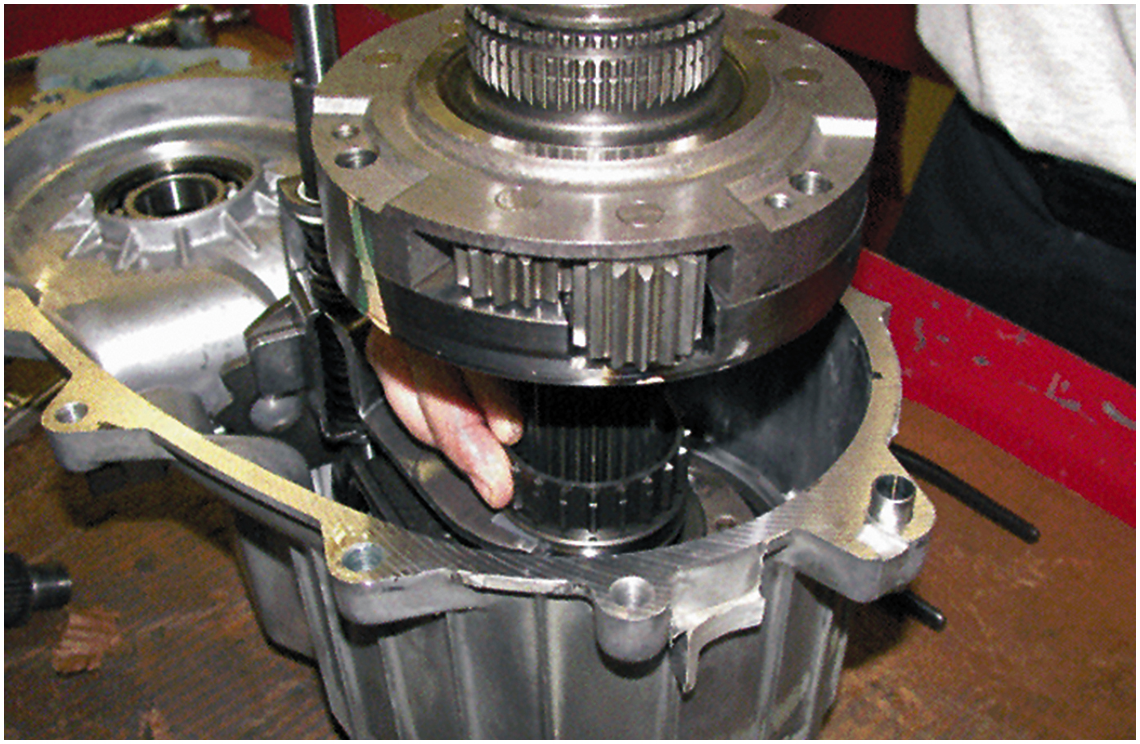
9. Differential being removed

Slide 44
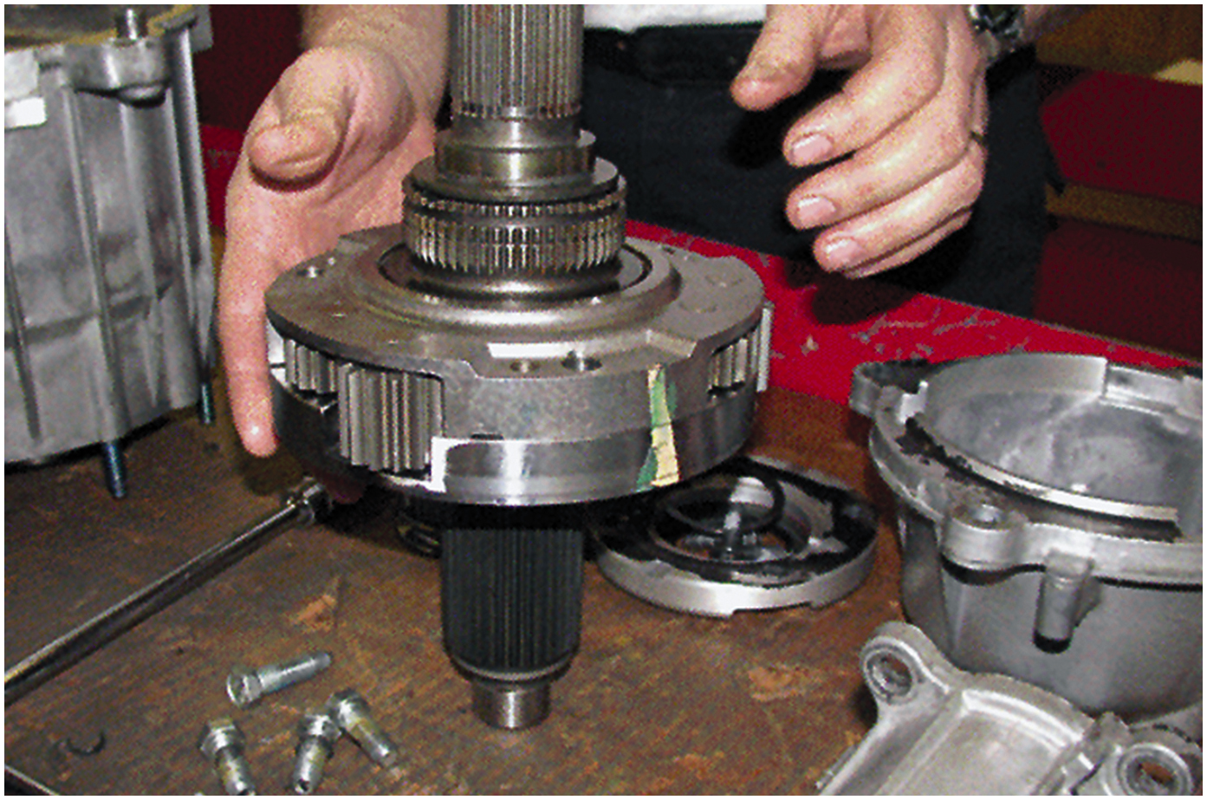
10. Center differential assembly after removal from the transfer case

Slide 45
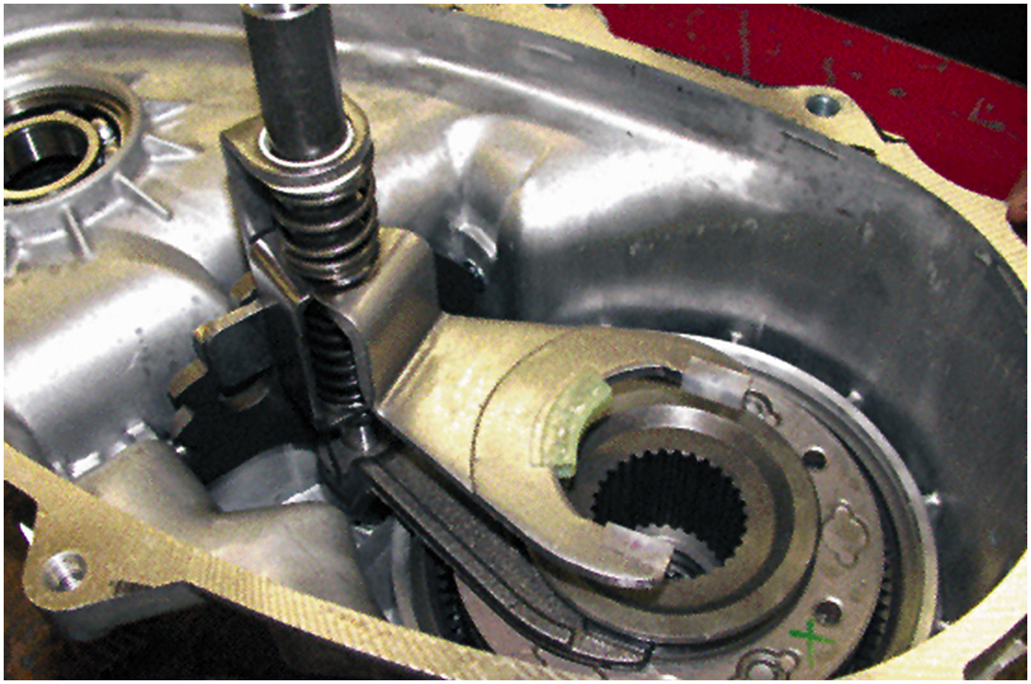
11. Mode shift fork (upper fork) is used to change 2-wheel drive & 4-wheel drive. Fork is attached to range hub, which changes 4-wheel drive high to 4-wheel drive low

Slide 46
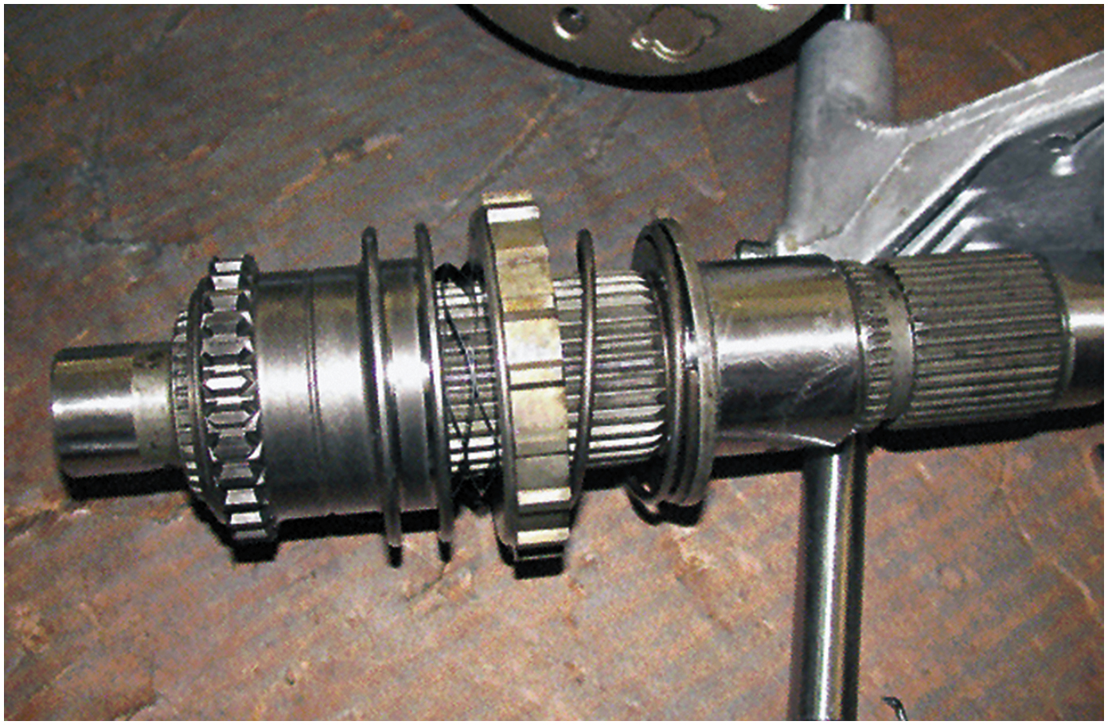
12. Main shaft showing the range hub (left), which changes the transfer case between four-wheel high and four-wheel low

Slide 47
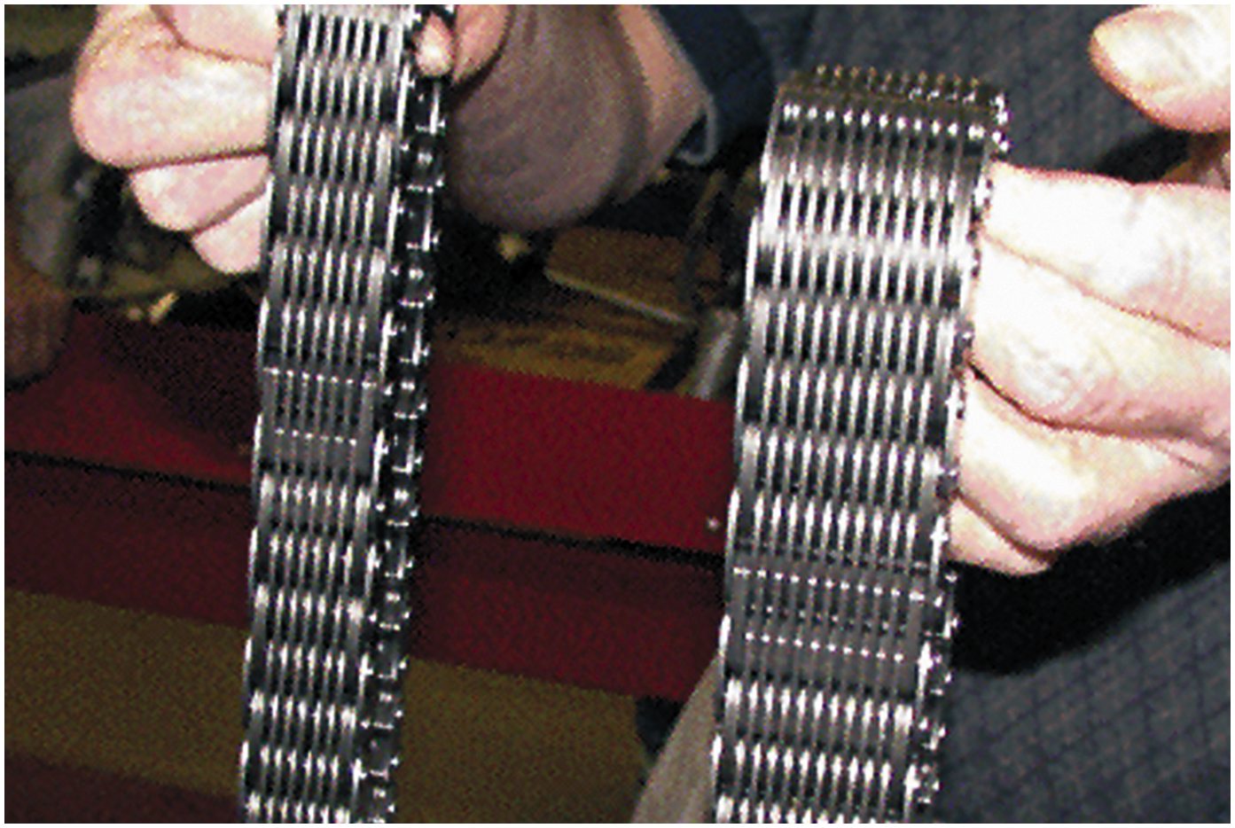
13. The chain used on the NV-242 (right) is larger than the chain used in the smaller version NV-231 (left)

Slide 48
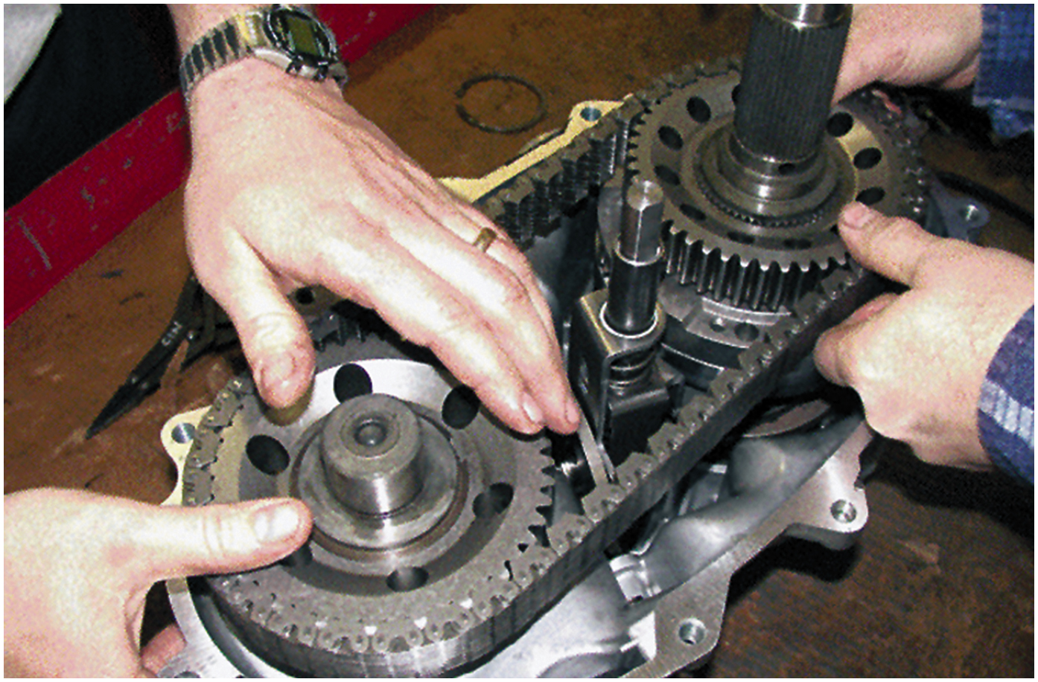
14. Reinstalling the components and the drive chain

Slide 49
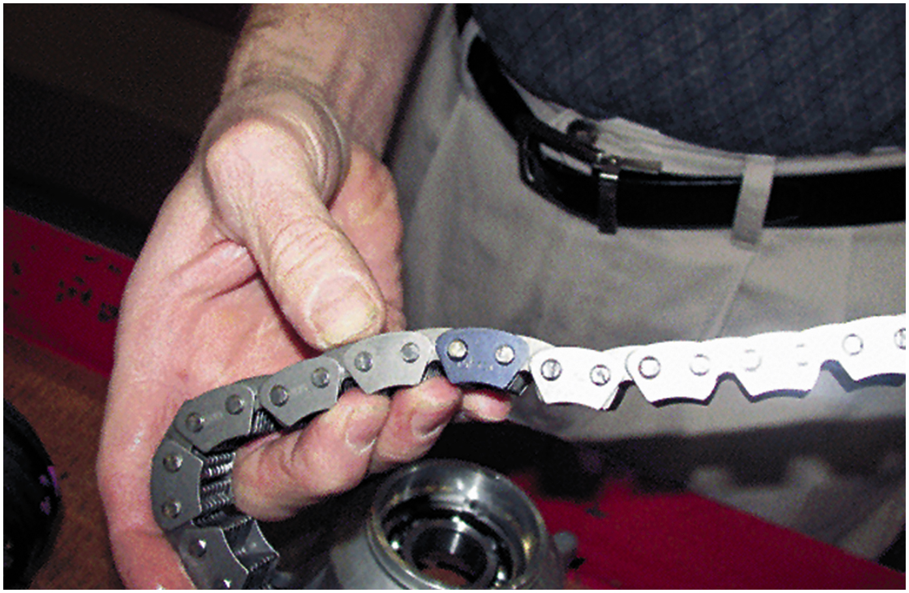
15. The drive chain should be installed with the black (dark) link(s) up

Slide 50
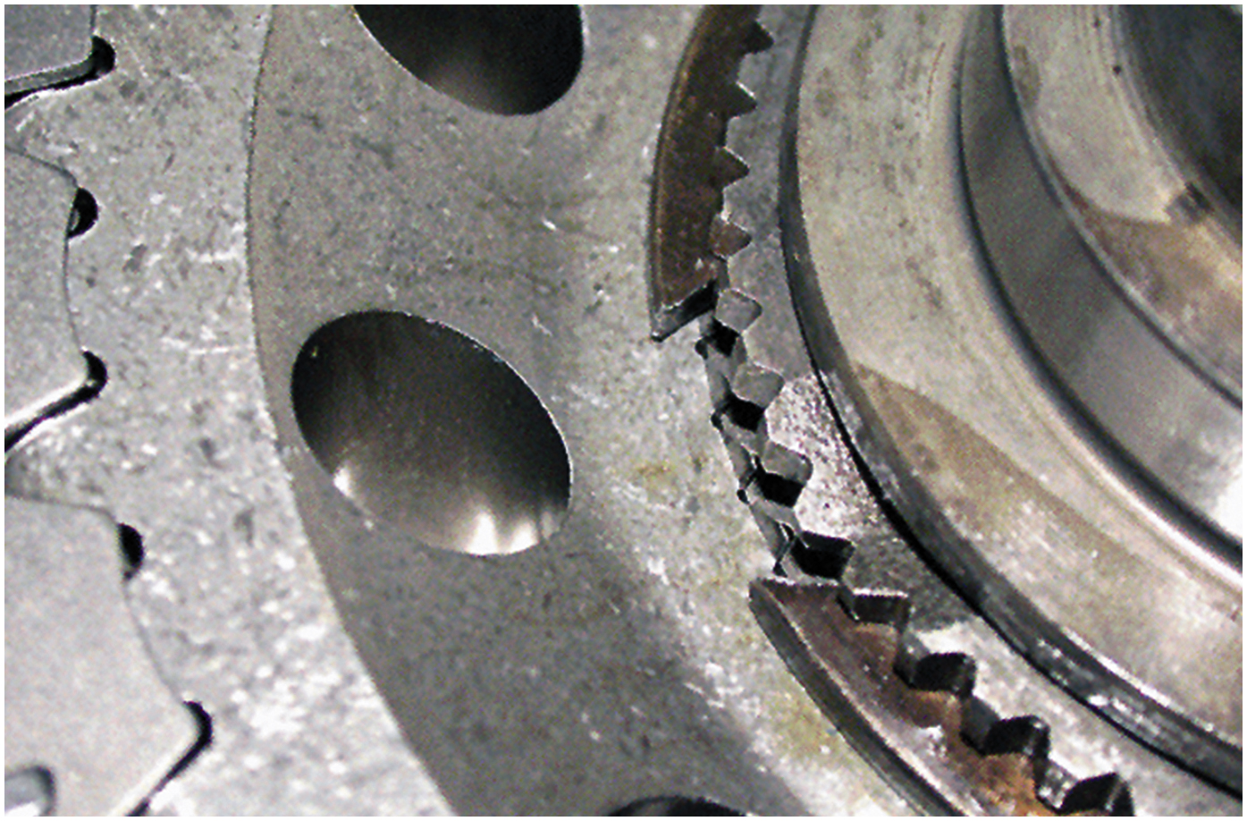
16. Install all snap rings so that the sharpest tips face up so snap-ring pliers can grab onto the tips for easier removal

Slide 51
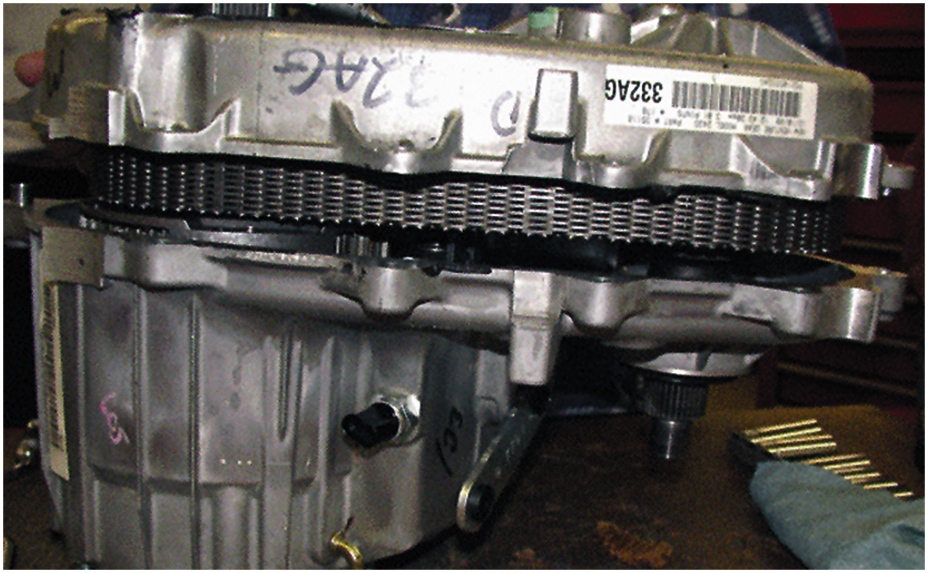
17. Assembling the case halves

Slide 52
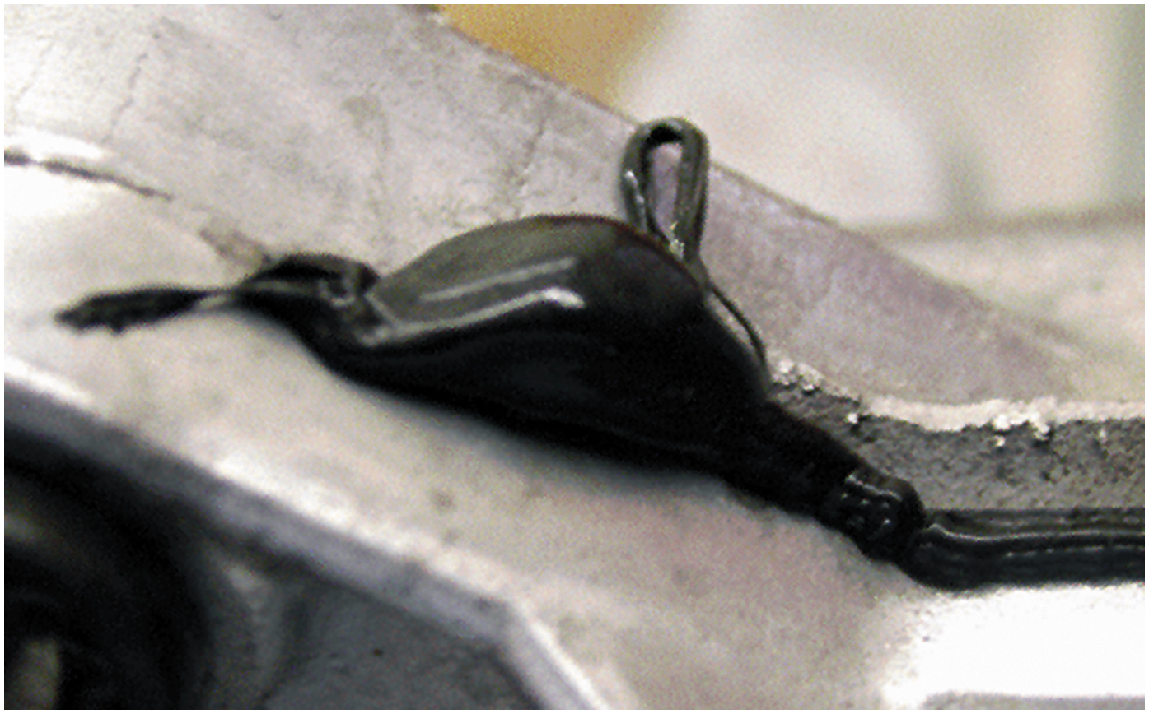
18. The parting surface should be sealed with R T V silicone. Do not use too much or the oil pump screen can become clogged

Slide 53
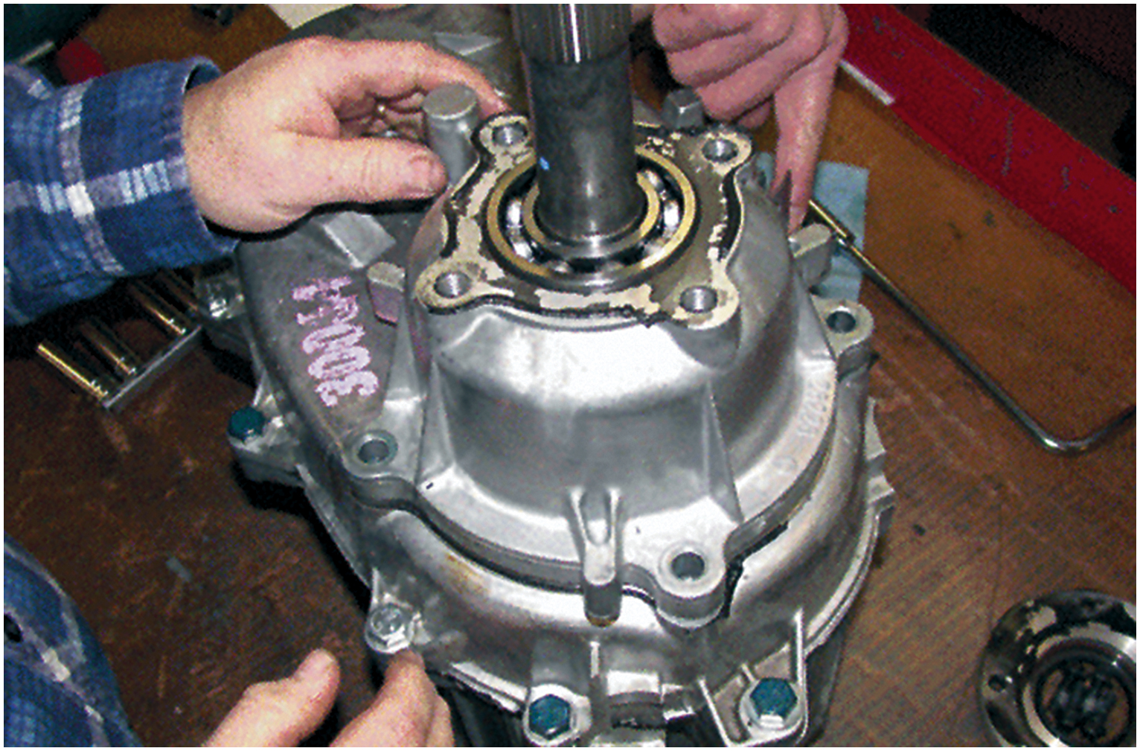
19. After attaching the oil pump and tube, the output shaft housing is installed

Slide 54
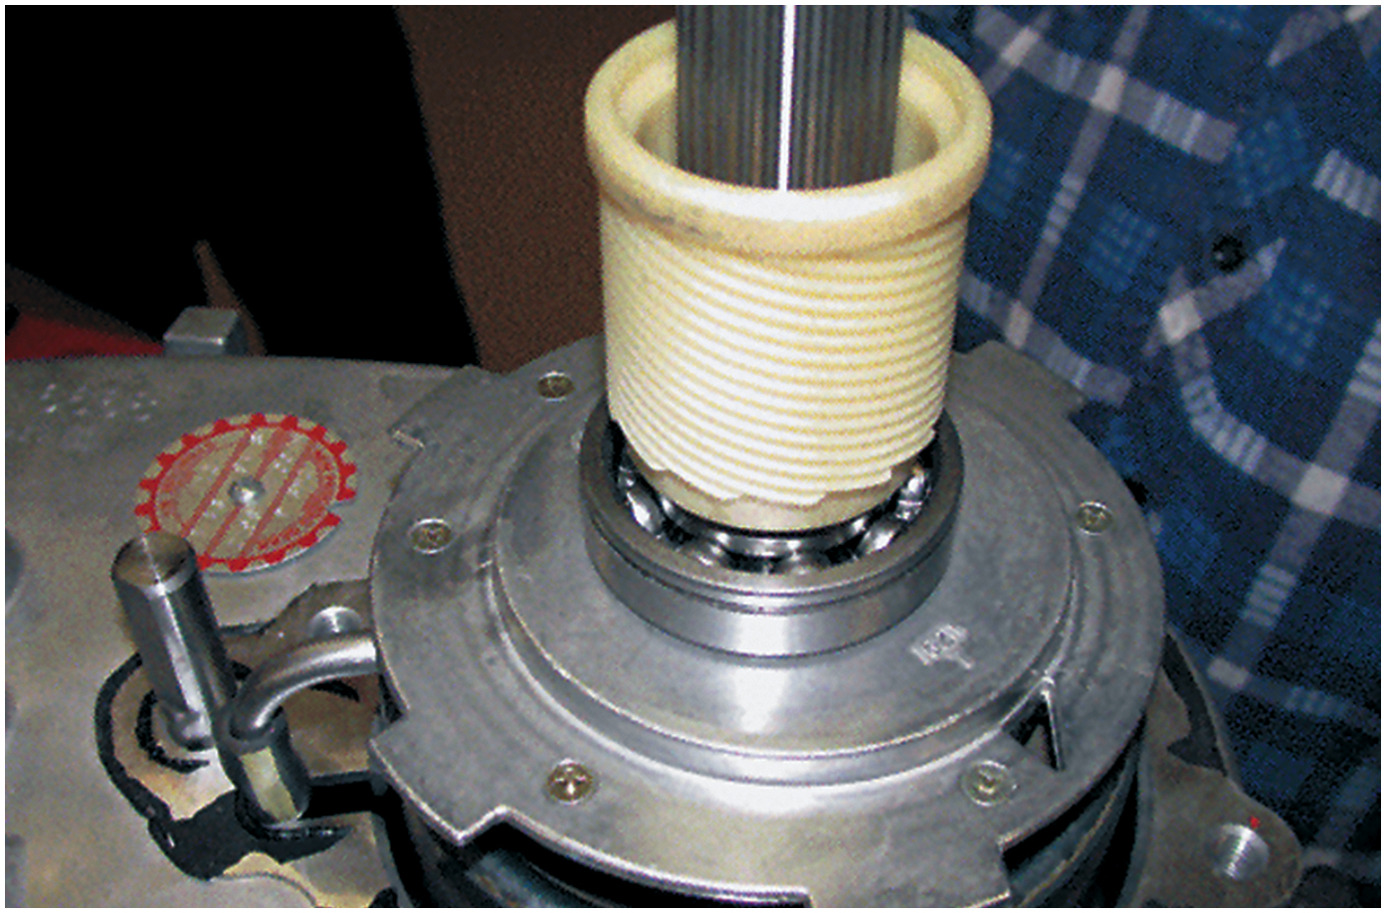
20. The output shaft speed sensor drive gear is correctly installed in this photo. The slip yoke of the drive shaft slips onto the splines and inside nylon gear

Slide 55
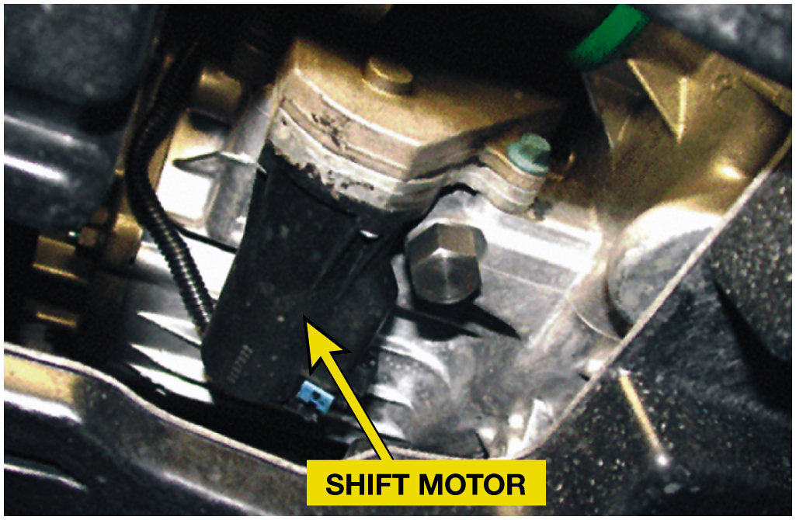
21. The electronically-shifted version of the case is identical except that shifting is achieve an electric motor, shown here installed in a vehicle

Slide 56
Automotive Fundamentals Videos and Animations
Videos Link: (A3) Manual Drive Train Axles Videos
Animations Link: (A3) Manual Drive Train Axles Animations

Slide 57
Copyright
This work is protected by United States copyright laws and is provided solely for the use of instructors in teaching their courses and assessing student learning. Dissemination or sale of any part of this work (including on the World Wide Web) will destroy the integrity of the work and is not permitted. The work and materials from it should never be made available to students except by instructors using the accompanying text in their classes. All recipients of this work are expected to abide by these restrictions and to honor the intended pedagogical purposes and the needs of other instructors who rely on these materials.

