Slide 1
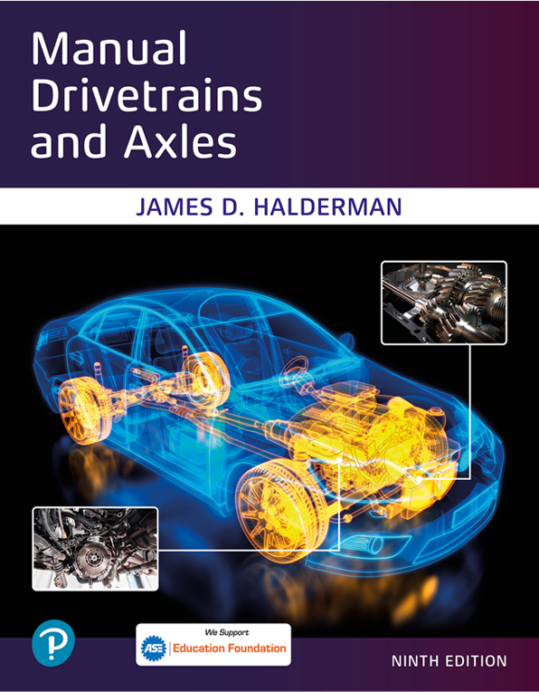
Manual Drivetrains and Axles
Ninth Edition
Chapter 15
Four-Wheel and All-Wheel Drive
Copyright © 2024, 2018, 2015 Pearson Education, Inc. All Rights Reserved
Notes:
If this PowerPoint presentation contains mathematical equations, you may need to check that your computer has the following installed:
1) Math Type Plugin
2) Math Player (free versions available)
3) NVDA Reader (free versions available)
INSTRUCTOR NOTE: This presentation includes text explanation notes, you can use to teach the course. When in SLIDE SHOW mode, you RIGHT CLICK and select SHOW PRESENTER VIEW, to use the notes.

Slide 2
Learning Objectives (1 of 2)
15.1 Explain the characteristics of four-wheel-drive (4W D) vehicles.
15.2 Differentiate between part-time and full-time four-wheel drive vehicles.
15.3 Explain the purpose and function of the central differential and transfer case in a four-wheel-drive vehicle.
15.4 Explain the purpose and function of electronic transfer cases and the power transfer unit of a four-wheel-drive vehicle.

Slide 3
Learning Objectives (2 of 2)
15.5 Explain the purpose and function of couplers and torque bias devices.
15.6 Discuss the operation of front drive axles and drive axle/wheel disconnect systems.

Slide 4
Four-Wheel Drive (1 of 2)
Four-Wheel Drive (4W D)
Steadily evolved from the Jeep of World War
to sport cars and sport-utility vehicles.
What are the issues of powering all four wheels?
Notes:
NOTE: The term 4 × 4 means a four-wheeled vehicle that has engine torque applied to all four wheels
(four-wheel drive). A 4 × 2 means a four-wheeled vehicle that has engine torque applied to only
two wheels (two-wheel drive). The front and the rear wheels of a four-wheel-drive vehicle also travel different distances and
speeds whenever cornering or running over dips or rises in the road. Therefore, a four- wheel-drive
vehicle also needs a center differential to allow the front wheels to travel different distances than the rear wheels.

Slide 5
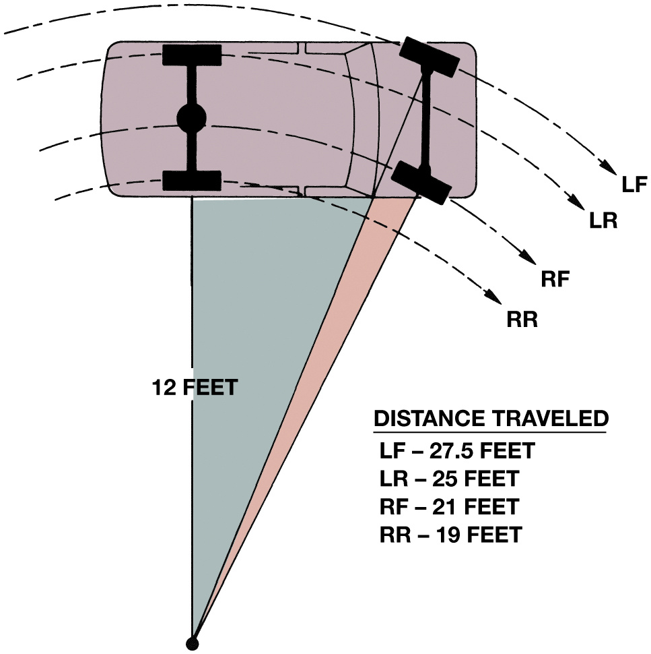
Figure 15.1
Distance Traveled
If a vehicle makes a right-angle turn with an inside rear-wheel radius of 12 feet, the four tires will travel the distances indicated in the same amount of time; the outside front tire will have to go about 70% faster than the inside rear tire.
Notes:
A two-wheel-drive vehicle is able to power both drive wheels through the use of a drive axle and a differential.
Powering all four wheels creates some issues such as:
Not only do the wheels on the outside travel further while turning than the inside wheels, the rear wheels and tires also travel different distances than the front wheels and tires. ● See Figure 15.1
There is a need for a unit, usually a transfer case where the engine torque can be split to either one drive axle or both to provide for four-wheel drive.
Long Description:
The illustration consists of the car at 12 feet from a point and arcs drawn on the path of the wheels. The four arcs from top to bottom are labeled as follows. L F, L R, R F, and R R. The L F arc passes through the left front wheel. L R passes through the left rear wheel. R F passes through the right front wheel. R R passes through the rear right wheel. A table for the distance traveled has the following information. L F 27 point 5 feet. L R 25 feet. R F 21 feet. R R 19 feet.

Slide 6
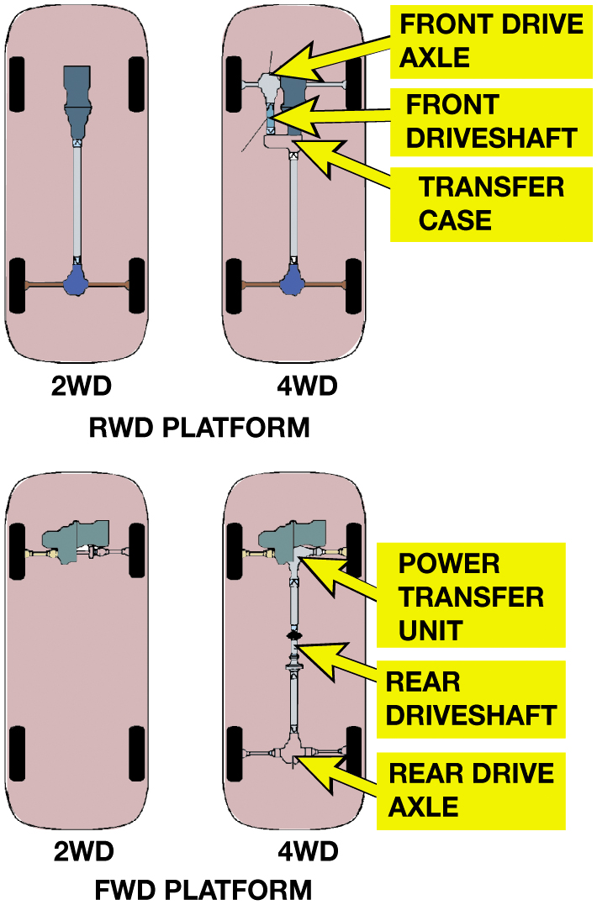
Figure 15.2
Drive Configurations
Four-wheel-drive vehicles can be achieved by using an existing rear-wheel-drive arrangement and adding a transfer case, or a front-wheel-drive arrangement with the addition of rear axle output shaft and center differential assembly.
Notes:
4W D can be based on any drivetrain configuration including:
Front engine–R W D—
Most truck-based four-wheel systems use this arrangement.
Front engine–F W D—
Many passenger vehicles and S U V use this arrangement.
Mid-engine–R W D—
Some sport cars use this arrangement such as some Porsches.
Rear engine–R W D—
Some sport cars use this arrangement such as some Porsches
Long Description:
The first part is titled R W D platform. 2 W D has two rears wheel connected to the axle. 4 W D has all four wheels connected to the straight line in the middle. On the left side of the front wheel, a section is labeled as follows. Front drive axle, front driveshaft, and transfer case. The second part is titled F W D platform. 2 W D has front two wheels connected together. 4 W D has all four wheels connected to the straight line in the middle. The parts on the line from top to bottom are labeled as follows. Power transfer unit, rear driveshaft, and rear drive axle.

Slide 7
Animation: AWD Differentials (Animation will automatically start)

Slide 8
Terminology
Two-wheel drive
Four-wheel drive
Part-time four-wheel drive
Full-time four-wheel drive
On-demand four-wheel drive
Notes:
Two-Wheel Drive. In two-wheel drive, engine torque is sent to either the rear (rear-wheel-drive
vehicle) or to the front (front-wheel-drive vehicle).
Four-Wheel Drive. In four-wheel drive, engine torque is sent to both the front and rear axles.
Part-Time Four-Wheel Drive. In a vehicle equipped with a part-time four-wheel system, both front and rear axles are mechanically connected and locked together. Driving a part-time four-wheel-drive vehicle on dry pavement can cause the drivetrain to bind unless the front wheels are disconnected usually using locking hubs. With the front hubs locked, the vehicle should only be driven on dirt, mud, or snow to avoid damage caused by driveline windup.
Full-Time Four-Wheel Drive. This type of four-wheel- drive system uses a center (interaxle) differential, which allows for both the front and rear axles to rotate at different speeds. A vehicle equipped with a full-time four-wheel-drive system can be safely driven in four- wheel drive on dry pavement and under all driving conditions.
On-Demand Four-Wheel Drive. With an on-demand type four-wheel-drive system, one axle is driven all the time and engine torque is only sent to the other axle when traction has been lost on the primary axle. This type of system is commonly used in front-wheel-drive- based vehicles where the front axle is driven all the time with engine torque only applied to the rear when wheels are starting to slip.

Slide 9
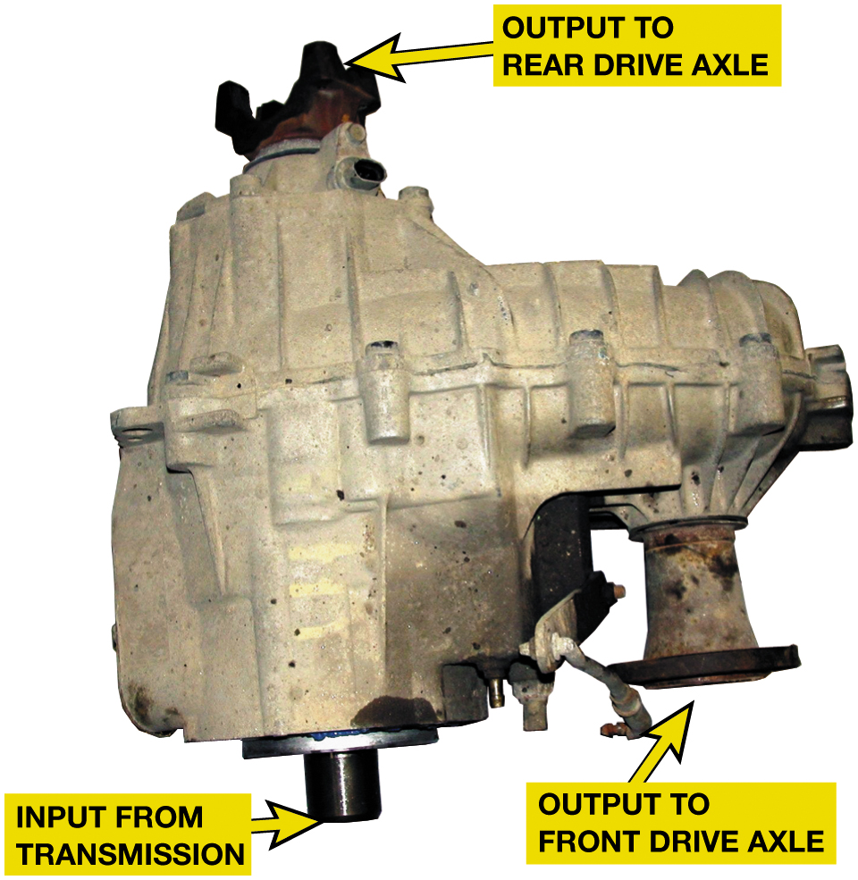
Figure 15.3
Transfer Case
Purpose and function
Types of shifts
Mode
Range
A typical transfer case is attached to the output of the transmission and directs engine torque to the rear or to the front and rear differentials.
Notes:
Transfer Case controls power flow to both the front and rear axles. Many transfer cases also provide gear reduction to increase the torque .
Mode shift. Either two-wheel drive or four-wheel drive may be selected. Many transfer cases also Have a neutral position. The mode shift is achieved by the use of a floor-mounted lever to engage and disengage a clutch inside the transfer case. This shift is usually performed when the vehicle is stopped. However, new designs allow the mode shift to be performed under most driving conditions.
NOTE: The mode shift is not available on all-wheel-drive vehicles.
Range shift. A range shift means either low or high gear ratios. A low range may be selected to deliver high torque at low speeds to the drive wheels. Low range gear ratio varies with application. Commonly used ratios are 2:1, 2.5:1, 2.6:1, and 2.72:1 gear reduction. High range (usually 1:1 ratio) simply transfers engine torque at the through output shaft of the transmission.
Long Description:
The pipes on the transfer case are labeled as follows. On the top right, output to the rear drive axe. On the bottom left, input from the transmission. On the bottom right, output to the front axle.

Slide 10
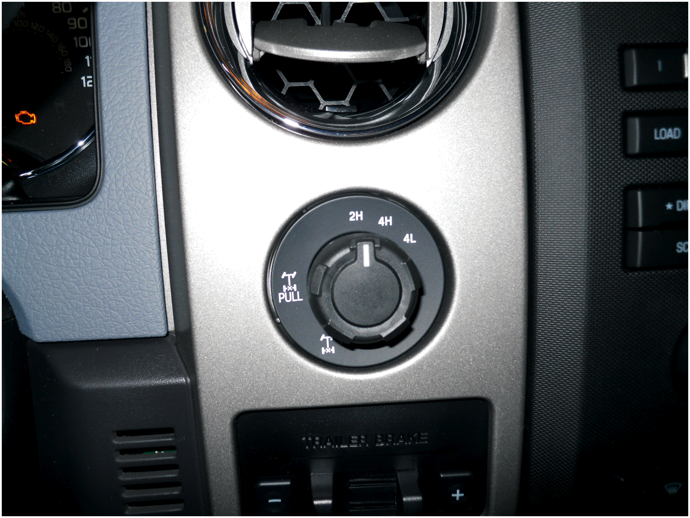
Figure 15.4
Electronic Transfer Case
A typical electronic transfer case control that is used to shift between two-wheel drive and four-wheel drive (mode shift) or from four-wheel high to four-wheel low (range shift).

Slide 11
Part-Time Four-wheel drive
Both front and rear axles mechanically connected and locked together.
Dry pavement can cause drivetrain to bind
Unless front wheels are disconnected usually using locking hubs.
If so, vehicle should only be driven on dirt, mud, or snow.
To avoid damage caused by driveline windup.
Notes:
CAUTION: A part-time four-wheel system does NOT use a center differential. Therefore, the vehicle should only be driven in four-wheel drive when it is on dirt, mud, or snow, where the tires can slip, to avoid driveline binding caused by the different speeds of the four
wheels. The vehicle will likely shake and shutter as wheel torque is applied to the four wheels on dry pavement. The tires will often slip and hop over the pavement as the driveline binds and then the wheels slip and then bind again.

Slide 12
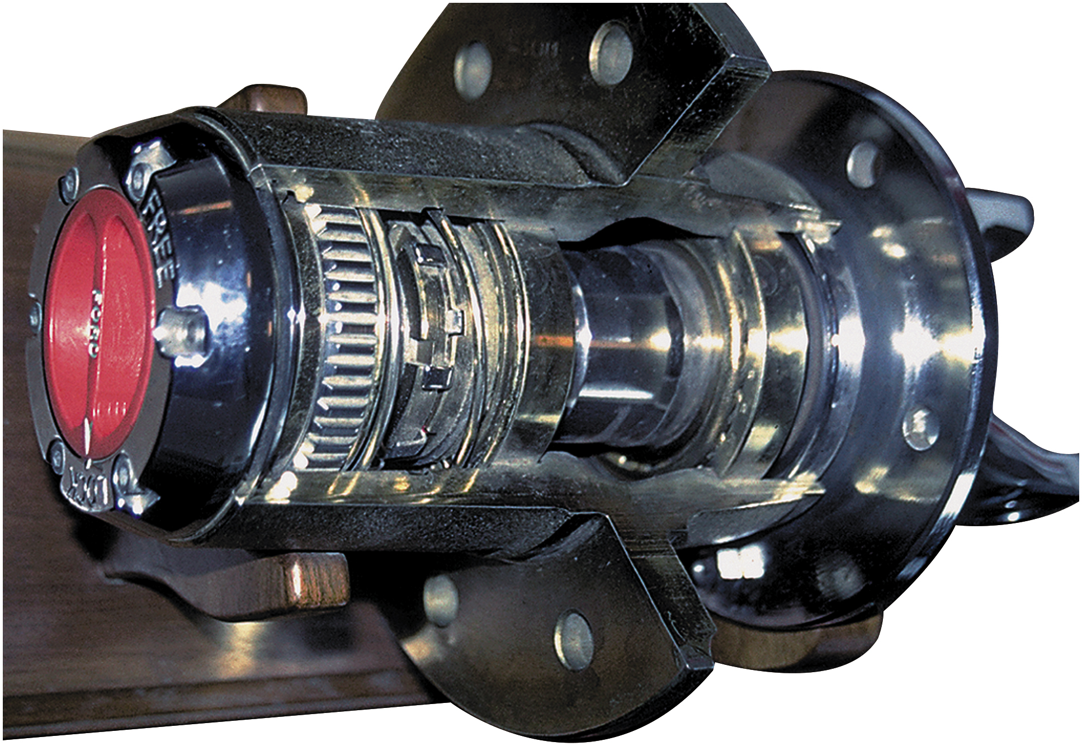
Figure 15.5
Locking Hub
Locking Hub
Connect Power
To Front Wheels
Normally unlocked
Locked in 4W D
Cutaway of a manually operated locking hub.
Notes:
Power is then applied to the front wheels through the drive axles to the locking hubs. In normal 4H driving on hard surfaces, the
front hubs must be in the unlocked position. The front hubs are locked whenever driving on loose road surfaces to absorb and allow for tire slippage due to the different tire speeds front to back. This type of four-wheel-drive system is called part-time four- wheel drive because it can be driven in four-wheel drive only on slippery surfaces. ● SEE FIGURE 15.5.
CAUTION: Failure to unlock the front wheel hubs while driving on a hard road surface can cause serious drive- line vibrations and damage to driveshafts, U-joints, and bearings, as well as to the transfer case, transmission, and even the engine.

Slide 13
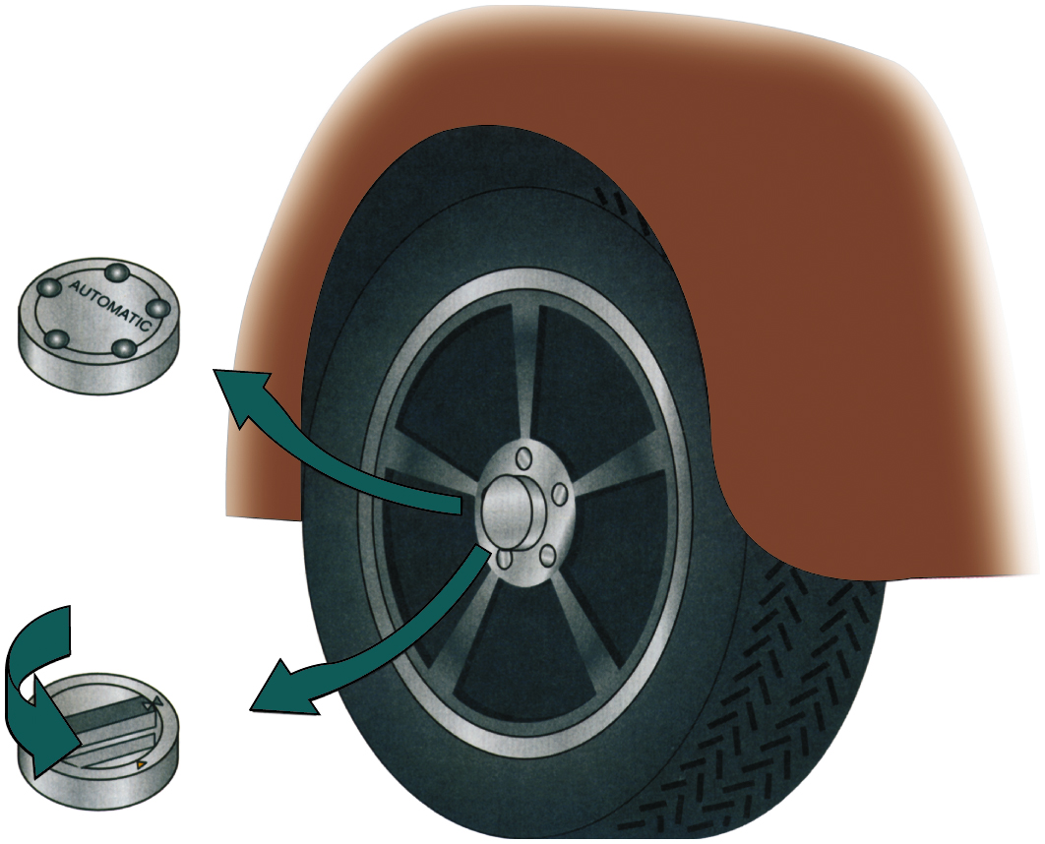
Figure 15.6
Locking Hub
Manual locking hubs require that the hubs be rotated to the locked position by hand to allow torque to be applied to the front wheels. Automatic locking hubs enable the driver to shift into four-wheel drive from inside the vehicle.
Notes:
AUTO LOCKING HUBS Another method of locking the hubs on a part-time four-wheel-drive system is with a clutch arrangement built into the hub assembly. Whenever driving on smooth, hard road surfaces, the hubs “free wheel” and allow the front wheels to rotate at different speeds from the rear wheels. When the speed difference between the wheels and the front drive axle is great, the
hubs will automatically lock and allow engine torque to be applied to the front wheels. Automatic-locking hubs are unlocked by disengaging four-wheel drive at the transfer case and driving for several feet.
Tech Tip: Keep It in Four-Wheel Drive If Driving in Snow or Mud
The disadvantage with automatic locking hubs is that this design requires the vehicle to move some distance (usually a whole wheel turn, often going backwards) after engaging 4 W D, in order for the hubs to engage or disengage. However, if the vehicle gets completely stuck before 4 W D has been engaged, this means that vehicle cannot be placed into four-wheel drive.

Slide 14
Full-Time Four-wheel Drive
Uses a center (interaxle) differential
Allows for both front and rear axles to rotate at different speeds.
Can be safely driven in 4W D on dry pavement
Under all driving conditions.
Notes:
Full-time 4W D is also called all-wheel drive (A W D) or anytime 4W D. A W D vehicles include a transfer case that has center
differential, which allows the front and rear driveshafts to be driven at different speeds to prevent drivetrain binding. A W D transfer cases that deliver power to both driveshafts all of the time are called mechanically active. Some A W D vehicles are passenger car based, using A W D to enhance driving on wet or icy roads, such as the Subaru.

Slide 15
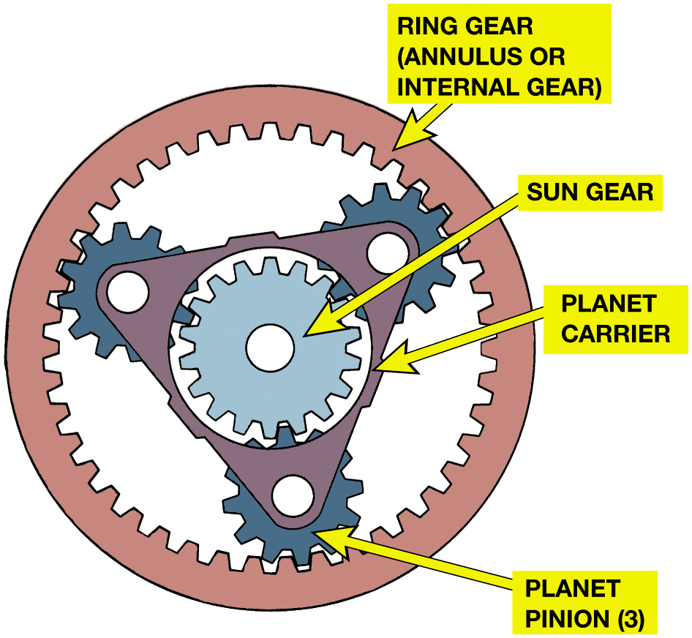
Figure 15.7
A typical planetary gear set used in a transfer case.
Notes:
A planetary gear set includes the following three elements:
Sun gear. This gear is in the center, like the position of the sun is in our solar system.
Planet pinions. The planet pinion gears rotate around the sun gear, like the planets around the sun, and are attached and held in place by a planet carrier.
Ring gear. The outer ring gear has teeth on the inside that mesh with the teeth of the planet pinion gears. The ring gear is also called the annulus gear or internal gear because the gear teeth are on the inside (rather than the outside) portion of the gear.
Long Description:
The gear set consists of the outer ring labeled ring gear or annulus or internal gear. The internal triangular gear is connected to the ring gear by three circular gears labeled planet pinion. The triangular gear is labeled a planet carrier and the gear in the center inside the triangle is labeled as the sun gear.

Slide 16
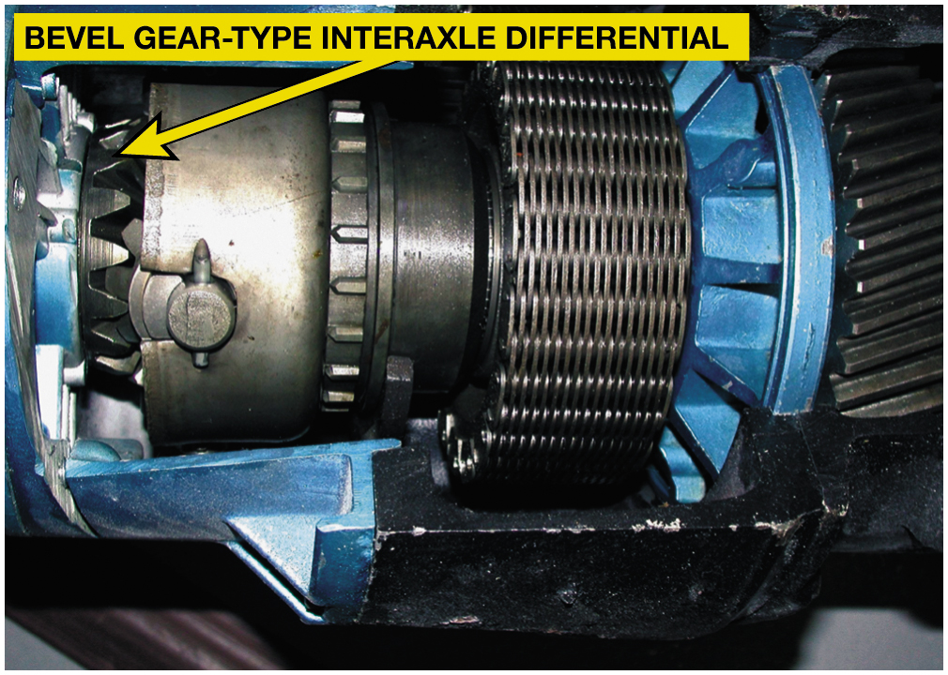
Central Differentials
Center differential, called interaxle differential
Prevent driveline harshness and vibration,
Called driveline windup
Types
Standard Bevel Gear
Planetary Gear
Viscous Coupling
Figure 15.8 A bevel gear-type center (interaxle) differential used inside a transfer case. Bevel gear differentials normally split the torque equally between the front and rear drive axles.

Slide 17
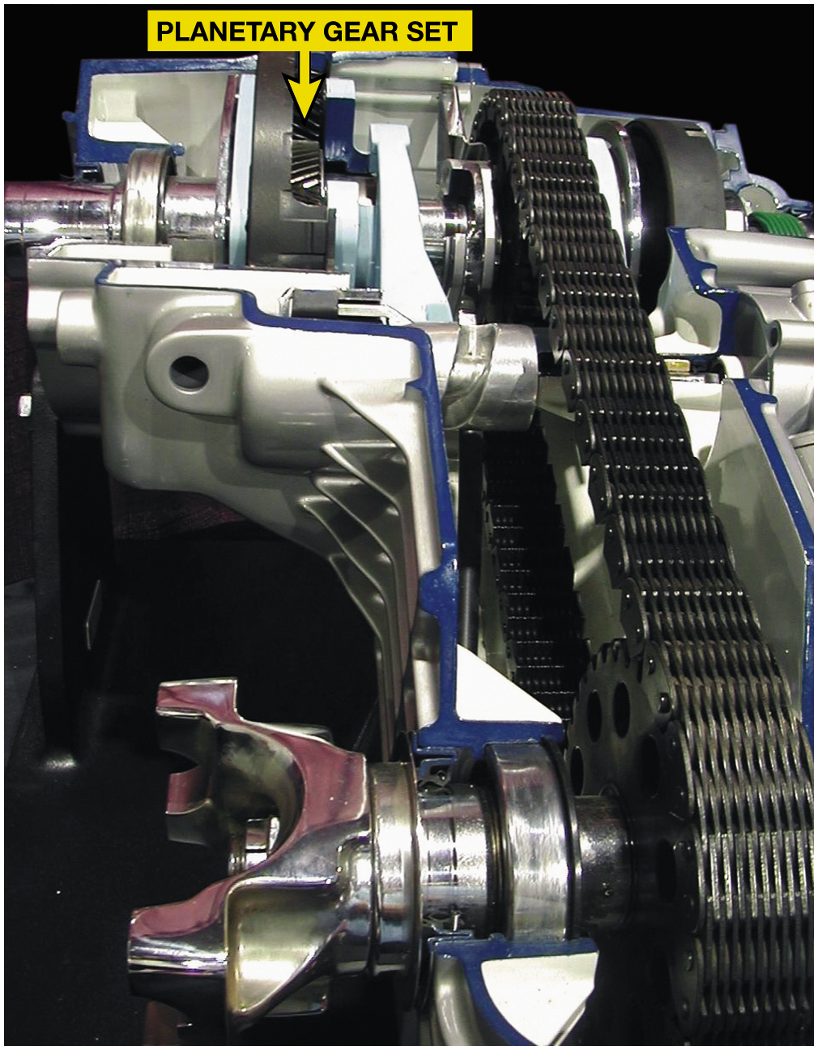
Figure 15.9
Planetary Transfer Case
Cutaway of a planetary gear set transfer case. Planetary gear differentials are designed to split the torque unequally between the front and rear drive axles.
Notes:
Planetary gear differential. A planetary gear set is often incorporated in transfer cases to act as a differential. The torque split can be varied by using a planetary gear set as a center differential by changing the number of teeth on the various elements and how they are interconnected can result in various torque splits front to rear.

Slide 18
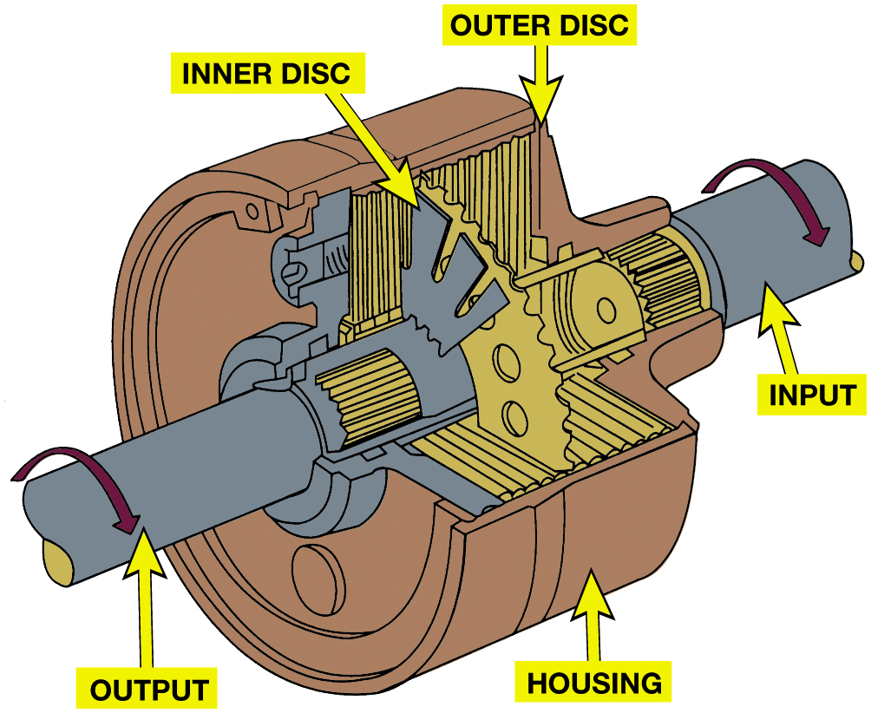
Figure 15.10
Viscous Clutch
A viscous coupling is a sealed unit containing many steel discs. One-half of them are splined to the input shaft, with every other disc splined to the output shaft. Surrounding these discs is a thick (viscous) silicone fluid that expands when hot and effectively locks the discs together.
Notes:
A viscous coupling is a series of steel plates housed in a sealed steel drum. The viscous coupling is not active during equal traction conditions. It actively transfers torque during light to moderate cornering, but there is a certain amount of slippage under these conditions to prevent driveline windup. If there is a significant loss of traction, speed differences between the front and rear axles
increase, and this increase in plate speed heats the silicone fluid in the viscous coupling, causing it to thicken to the point that it transfers more torque to the axle that is losing traction. During a severe loss of traction, the viscous fluid thickens enough to lock the
plates together, dividing engine torque equally 50/50 between the front and rear axles.
Long Description:
The coupling consists of several steek discs, connected to a shaft. The shaft on the right is labeled as input and on the left is marked as output. The shaft rotates in a clockwise direction. The discs are plated in a casing labeled housing. The discs are labeled as inner disc and outer disc.

Slide 19
Animation: Viscous 4WD (Animation will automatically start)

Slide 20
Frequently Asked Question: Can a Four-Wheel-Drive Vehicle Still Get Stuck?
? Frequently Asked Question
Can a Four-Wheel-Drive Vehicle Still Get Stuck? Yes. A 4W D vehicle can get stuck under some conditions depending on type of system and road surface. Figure 15-11. This can occur in following: If front, center, and rear differentials are open type, and if only wheel is on a slippery surface, then other wheels will only get torque required by wheel on slippery surface and vehicle may not be able to move. In case the rear differential is a limited slip-type and both front and center differentials are open type, then if one of rear tires was on a slippery surface, then vehicle could continue to move only if other rear drive wheel was on dry pavement. If one front wheel and one rear wheel were on a slippery surface and rear axle was limited slip, vehicle may not be able to move because center differential is an open type. If vehicle is equipped with a locking center differential and a limited slip differential in rear, then vehicle will be equipped to go under almost every road surface condition. Yet, locking center differential needs to be unlocked at a higher speed to keep the driveline from binding. Current technology allows electronic brake computer to control traction by applying wheel brake on wheel that is spinning to increase amount of torque that is applied to side or end of vehicle with most traction. This means that many systems use open-type differentials instead of limited slip units and rely on the wheel brakes to maintain traction to all drive wheels.

Slide 21
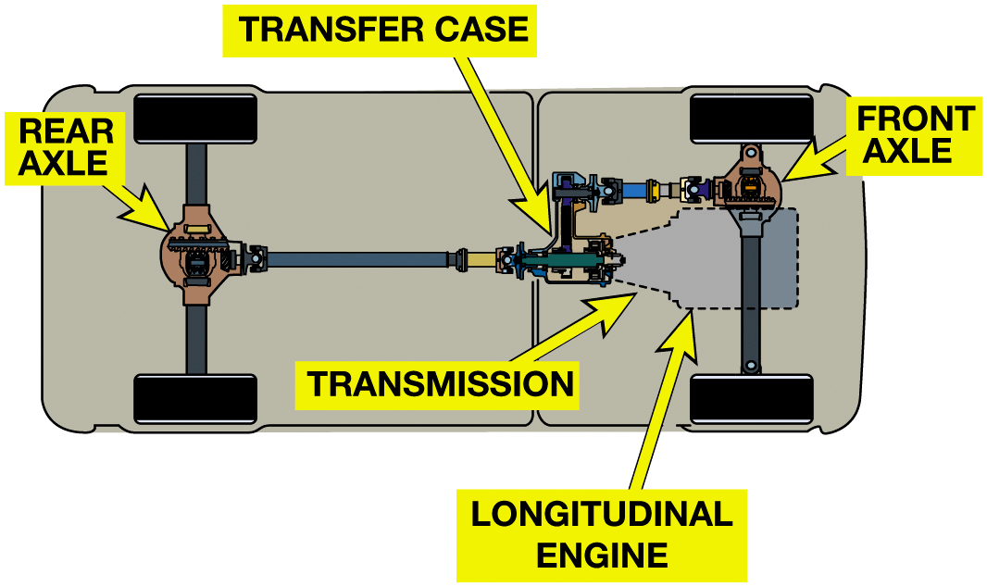
Figure 15.11
Typical 4W D Vehicle
A typical four-wheel-drive vehicle that uses a longitudinal engine and a transfer case to send engine torque to both the front and rear wheel. Even a 4 W D vehicle can get stuck.
Notes:
Long Description:
The front wheel is connected to the front axle and is connected to a transmission and longitudinal engine on the right. The axle is connected to a transfer case and then connected to the rear axle, which is further connected to the rear wheels.

Slide 22
Transfer Cases (1 of 2)
Control power flow to both front and rear axles.
Gear ranges can be engaged in a number of ways, such as:
Manual lever (older vehicles)
Electrical motor (most commonly used)
Vacuum actuators
Connect and disconnect front-drive axle when 2W D selected

Slide 23
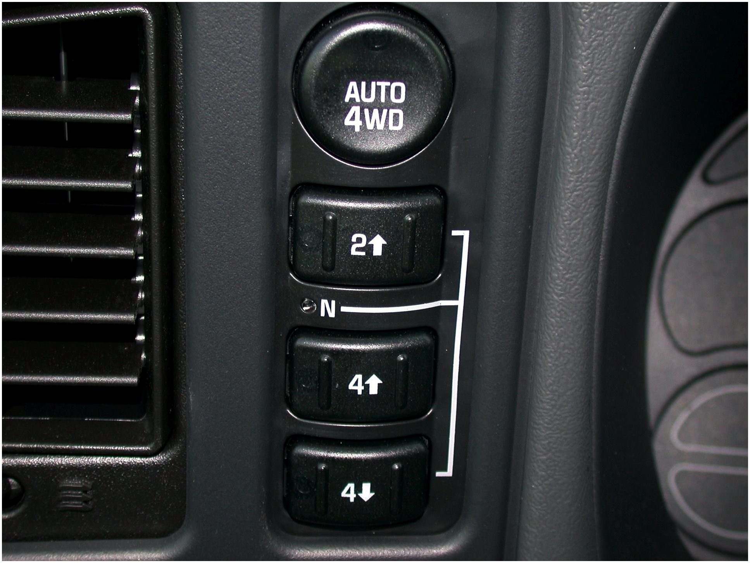
Transfer Cases (2 of 2)
Two-wheel drive operation
Four-wheel drive operation
Oil pump
Manual Shift On-the-Fly Systems
Figure 15.13 Most transfer cases today use an electric motor to make the mode and range changes and use a dial or push button for each position.

Slide 24
Frequently Asked Question: What Is a Gear-to-Gear Transfer Case?
? Frequently Asked Question
What Is a Gear-to-Gear Transfer Case? A gear-to-gear transfer case is simple in design, and is an older design not currently being used. Three gear shafts are in mesh in the transfer case. One gear shaft is attached to the transmission output shaft. The second shaft acts as an idler, and the third shaft is the output to the front axle. Gear-to- gear transfer cases, in most cases, have two speeds. The first four-wheel drive low is a gear reduction that
is usually around two to one
The second gear in the
transfer case is a direct drive. The gears are engaged by sliding collars or synchronizers to lock the gears to the shaft. Neutral is accomplished when neither gear collar is locking a gear in place.

Slide 25
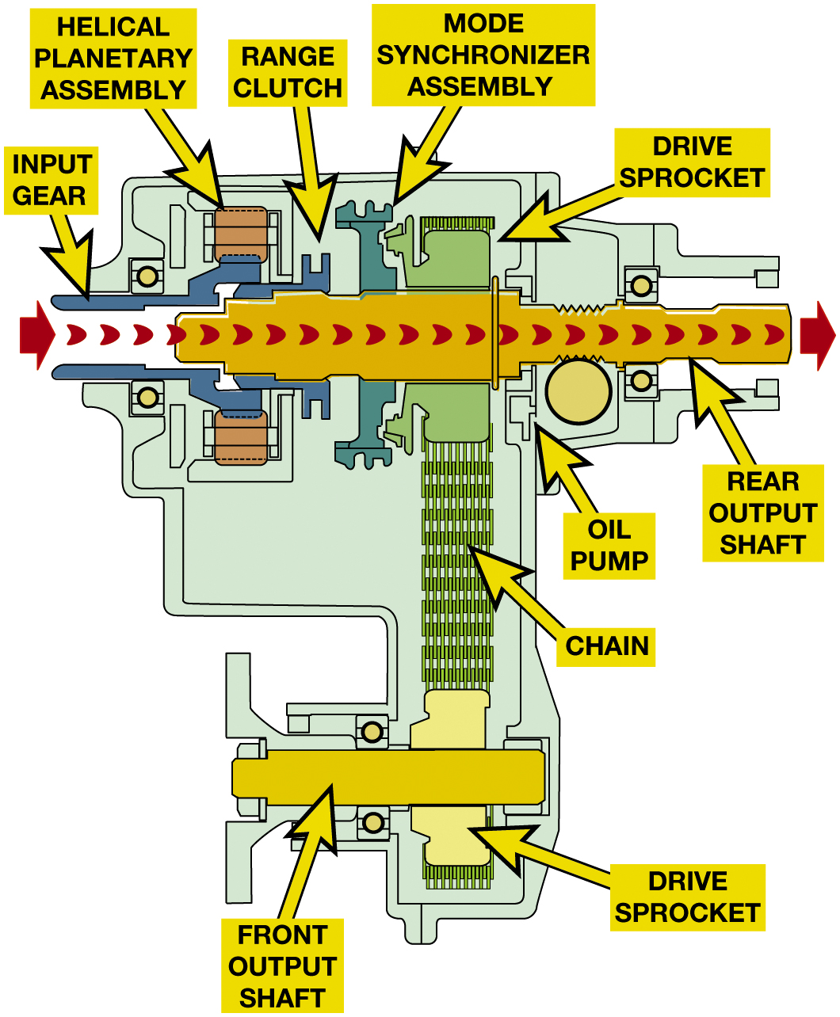
Figure 15.14
Two-wheel-drive/high-range torque flow in a N V231 transfer case. The sliding range clutch is shifted to the forward position by the range lever and fork, which connects the input gear to the output shaft and rear axle. The mode synchronizer sleeve is moved out of engagement from the drive sprocket to remove torque from the front axle.
Notes:
Figure 15.14 Two-wheel-drive/high-range torque flow in a N V231 transfer case. The sliding range
clutch is shifted to the forward position by the range lever and fork, which connects the input
gear to the output shaft and rear axle. The mode synchronizer sleeve is moved out of engagement
from the drive sprocket to remove torque from the front axle.
INSTRUCTOR NOTE: SLIDE WILL ANIMATE BETWEEN 2WD & 4WD
2WD Operation When the transfer case controls are in two-wheel drive, the front differential assembly is disconnected from the transfer case. This disconnection is usually accomplished by disconnecting one of the drive axles. The disconnect mechanism in the front axle and a synchronizer assembly in the transfer case combine to remove torque for the front wheels. 5–14.
Long Description:
The case consists of a pipeline with torque low from left to right entering the input gear and exiting through the rear output shaft. The parts on top of the pipeline from left to right are labeled as follows. Input gear, helical planetary assembly, range clutch, mode synchronizer assembly, and drive S P rocket. The oil pump is labeled below the rear output shaft. Another structure is placed perpendicular to the rear output shaft and connected to the chain. The chain is connected to a rectangular structure labeled as the drive S P rocket. A rectangular structure is placed perpendicular to the drive S P rocket and is labeled as the front output shaft.

Slide 26
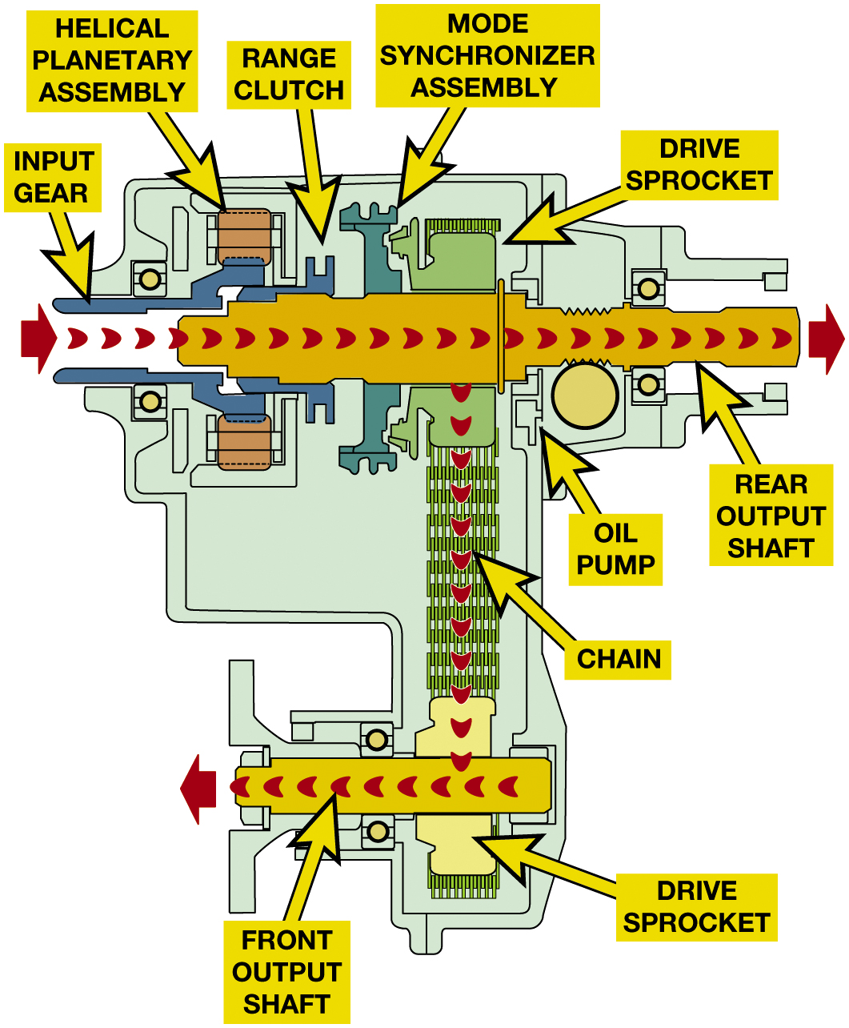
Figure 15.15
Four-wheel-drive/high-range torque flow in a N V231 transfer case. The range clutch position remains the same as in two-wheel drive/high-range, but the synchronizer sleeve is moved rearward and engages the drive sprocket clutch teeth. This action connects the drive sprocket to the rear output shaft, thereby applying equal torque to both front and rear output shafts.
Notes:
Figure 15.15 Four-wheel-drive/high-range torque flow in a N V231 transfer case. The range clutch position remains the same as in two-wheel drive/high-range, but the synchronizer sleeve is moved rearward and engages the drive sprocket clutch teeth. This action connects the drive sprocket to the rear output shaft, thereby applying equal torque to both front and rear output shafts.
4WD Operation: To achieve four-wheel drive, two things must occur.
synchronizer assembly connects the torque from the engine to the front driveshaft in the transfer case.
drive axles must be connected to allow the torque from the front differential.
Full-time 4W D or all-wheel drive (A W D) transfer cases maintain constant power to both the front and rear axles and include a center (interaxle) differential, between the front and rear output shafts.
A chain drive transfer case uses the following parts:
An input shaft, which is connected to the output shaft of the transmission.
In a planetary gear set transfer case, the input shaft is d to the sun gear.
The output shaft to the rear wheels is connected directly to the output shaft through the range clutch if it is in four-wheel drive high range. In low range, the torque flows though the planetary gear set and exits through the ring gear.
In two-wheel drive, engine torque is sent directly to the output shaft and on to the rear drive axle assembly.
In four-wheel drive mode, engine torque is sent through a drive sprocket and a wide chain to the driven sprocket and front output shaft. Figure 5.15.
Long Description:
The case consists of a pipeline with torque low from left to right entering the input gear and exiting through the rear output shaft. The parts on top of the pipeline from left to right are labeled as follows. Input gear, helical planetary assembly, range clutch, mode synchronizer assembly, and drive S P rocket. The oil pump is labeled below the rear output shaft. The torque flows downwards through another structure that is placed perpendicular to the rear output shaft and connected to the chain. The torque flows movies through the chain and is connected to a rectangular structure labeled as the drive S P rocket. Then the flow enters a rectangular structure placed perpendicular to the drive S P rocket, labeled as the front output shaft. The flow exits from the front output shaft.

Slide 27
Frequently Asked Question: What Is a Rocker Pin Chain?
? Frequently Asked Question
What Is a Rocker Pin Chain? The type of chain used in transfer cases is usually assembled from pin links and chain links and is called “rocker pin” type chain. The chain links are what contact the teeth of the sprocket and not the pins as with a roller-type chain. Figure 15-16.

Slide 28
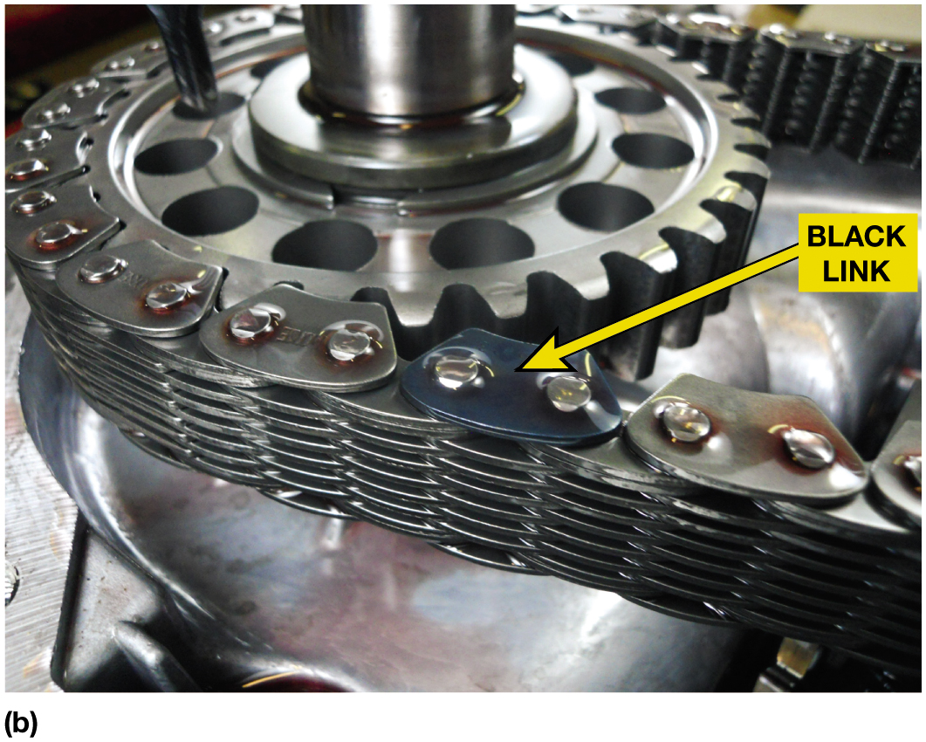
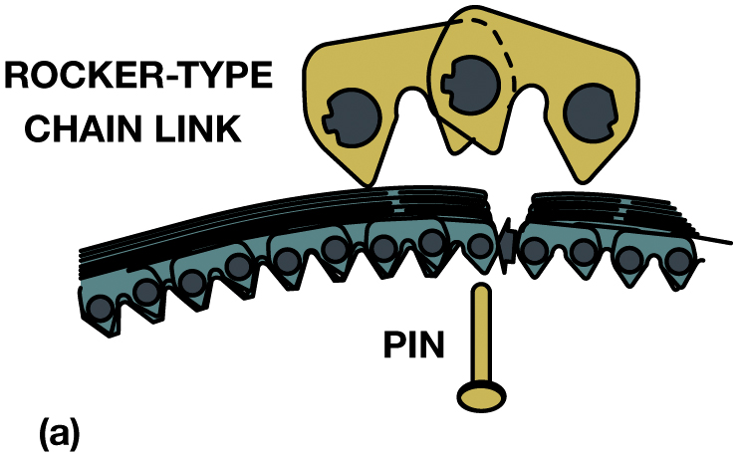
Figure 15.16
(a) A pin and rocker-type chain, which is also called a rocker joint-type chain, is used in transfer cases because of low noise and high efficiency, which improves fuel economy. (b) A rocker pin-type chain used in a transfer case. The black link faces upward and is used as an indicator to the service technician to help insure that the chain is replaced in the same side up when it is reassembled.
Notes:
Figure 15.16 (a) A pin and rocker-type chain, which is also called a rocker joint-type chain, is used in transfer cases because of low noise and high efficiency, which improves fuel economy. (b) A rocker pin-type chain used in a transfer case. The black link faces upward and is used as an indicator to the service technician to help insure that the chain is replaced in the same side up when it is reassembled.
Long Description:
The chain link has a sawtooth link chain on the bottom. A structure with three teeth on top of the chain. Another pin is placed below the chain.

Slide 29
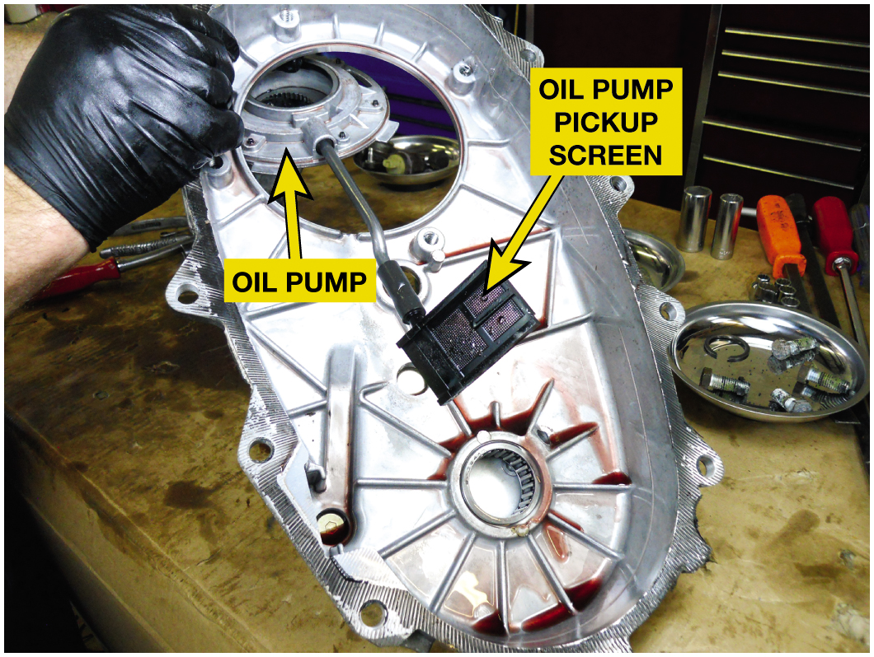
Figure 15.17
Oil Pump
The oil pump is driven by the rear output shaft and is removed with the rear part of the case.
Notes:
Long Description:
The black rectangular box in the middle is labeled as the oil pump pickup screen. A pipe is connected to another circular structure labeled as an oil pump.

Slide 30
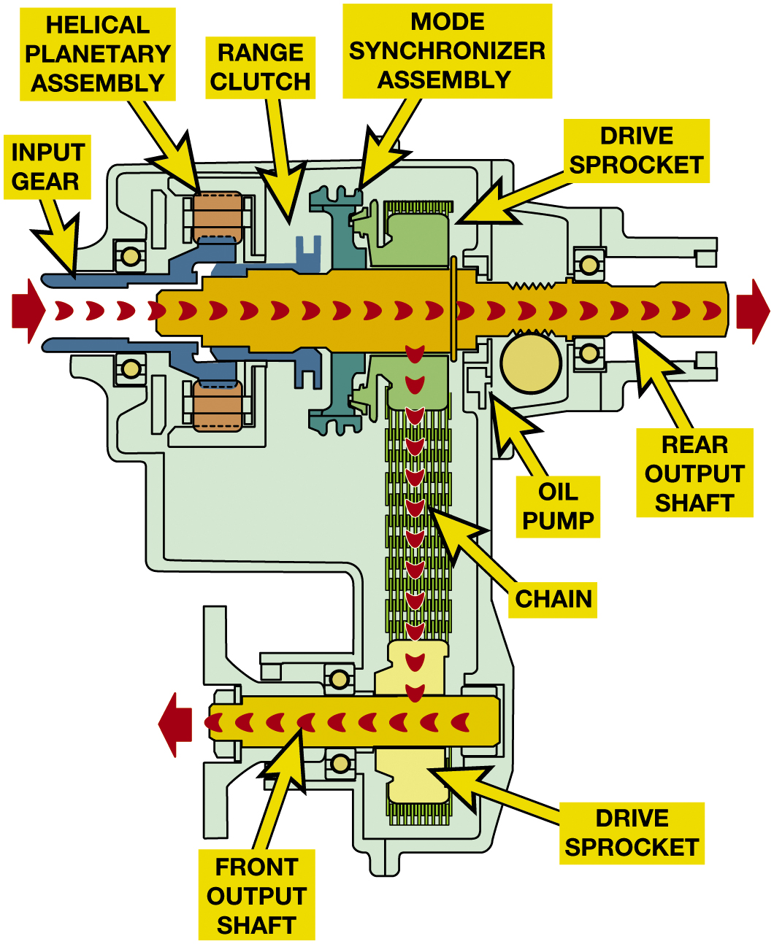
Figure 15.18
Four-wheel-drive/low-range torque flow in a N V231 transfer case. The mode synchronizer assembly remains engaged and the range clutch is moved to the rearward position. The annulus (ring) gear is fixed to the case and the input (sun) gear drives the pinion gears, which walk around the stationary annulus gear and drive the planetary carrier and output shaft at a speed lower than the input gear.
Purpose and Function
Transfer case motor/ encoder assembly is electric motor
Used to shift transfer case from 2W H to 4W H
Can also make a range change between 4W H & 4W L
Motor/Encoder Assembly
Torque Split
Notes:
Figure 15.18 Four-wheel-drive/low-range torque flow in a N V231 transfer case. The mode synchronizer assembly remains engaged and the range clutch is moved to rearward position. The annulus (ring) gear is fixed to the case and the input (sun) gear drives pinion gears, which walk around the stationary annulus gear and drive the planetary carrier and output shaft at a speed lower than the input gear.
Transfer Case Motor/ Encoder Assembly is electric motor used to shift transfer case from two-wheel high (2W H) to four-wheel high (4W H) and can also make a range change between four-wheel high (4W H) and four-wheel low (4W L). These are used on vehicles that feature:
Electronic Shift-on-the-Fly (E S O F) transfer cases. In an electronic transfer case the operation of
the range clutch and mode synchronizer assembly is controlled by the motor/ encoder assembly. ● SEE
Figure 15.18.
Motor/Encoder Assembly Part of the motor assembly is an encoder, which is a position sensor that
sends the actual position of the transfer case shift shaft to the transfer case control module
(T C C M). The T C C M uses the data from the input and output speed sensor to determine when to shift
the transfer case to four-wheel drive. If the rear wheels start to slip, the T C C M commands the
motor/encoder assemble to make the mode shift. The T C C M also sends a signal to the front axle
motor or actuator to engage the front axle when the transfer case is engaging four-wheel high mode.
● SEE FIGURE 15.19.
Torque Split:
Long Description:
The case consists of a pipeline with torque low from left to right entering the input gear and exiting through the rear output shaft. The parts on top of the pipeline from left to right are labeled as follows. Input gear, helical planetary assembly, range clutch, mode synchronizer assembly, and drive S P rocket. The oil pump is labeled below the rear output shaft. The torque flows downwards through another structure that is placed perpendicular to the rear output shaft and connected to the chain. The torque flows movies through the chain and is connected to a rectangular structure labeled as the drive S P rocket. Then the flow enters a rectangular structure placed perpendicular to the drive S P rocket, labeled as the front output shaft. The flow exits from the front output shaft.

Slide 31
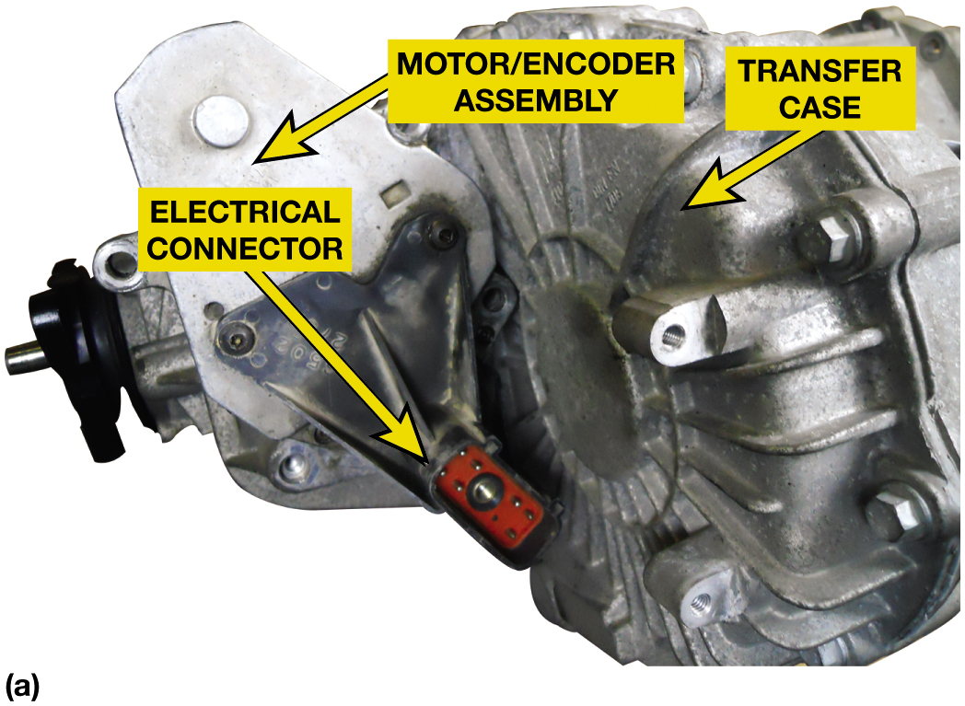
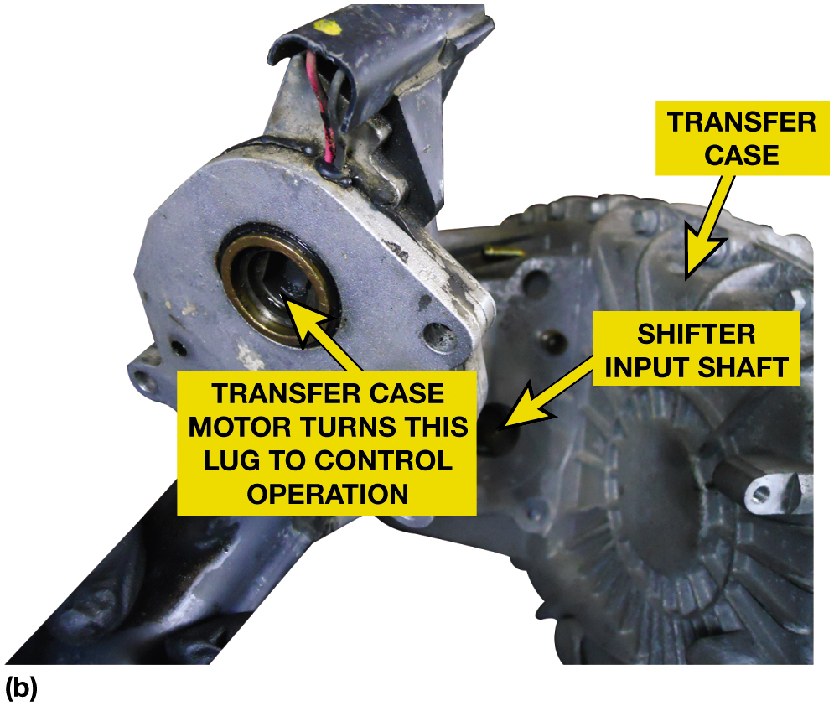
Figure 15.19
Electronic Transfer Case
(a) Electronically controlled transfer cases use an electric motor to make the mode and range shifts. (b) The motor being removed from the transfer case. The assembly includes the D C motor as well as the feedback sensor so the T C C M “knows” the location of the motor.
Notes:
Tech Tip: Equal Tire Sizes: Full-time four-wheel drive (4W D) and A W D vehicles must have four equal-diameter tires. Unequal diameters produce different axle speeds, and this will cause excessive wear at the drive axle or center differential. A viscous coupling at the center differential will not last if it has to operate constantly.
Long Description:
The transfer case is connected to a shifter input shaft which is further connected to a plug. The plug is labeled as follows. The transfer case motor turs this plug to control operation.

Slide 32
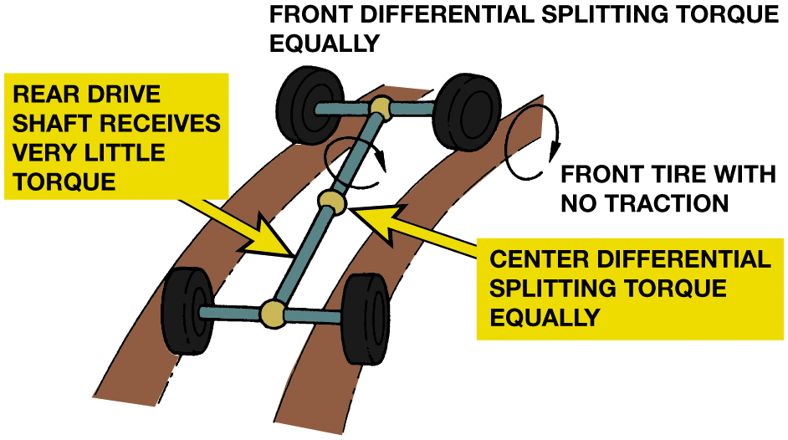
Figure 15.21
Torque Split
If the center and front differential split torque equally, an A W D vehicle can become stuck when one wheel loses traction.
Notes:
Torque Split: Planetary differentials are designed to split torque unevenly so that 35% goes to the front axle and the remaining 65% goes to the rear axle. The exact ratio or torque split depends on the gear ratios in the planetary gear set. This makes the vehicle drive like a rear-wheel-drive vehicle. Some transfer cases use a hydraulically applied internal clutch much like the Quadra-Trac II (Hydra-Lok) limited slip differential to connect the front and rear drive axles. The amount of slip of this clutch determines the torque split.
Some A W D vehicles produced by Audi, Land Rover, Lexus, Toyota, and V W use a Torsen® differential for the center differential. Torsen center differentials are designed with a torque bias ratio of 2.5:1 to 3.5:1. The two driveshafts can operate at different speeds without spin-out problems at the front or rear and smooth turning action. Most non-planetary center differentials, however, split torque equally. It is possible, though, to lift one wheel and not get enough torque to the other three wheels to move the vehicle. Figure 5.21
Power always goes to the wheel with the least amount of traction.
FIGURE 15.20 NOT SHOWN wiring diagram on page 245” The driveshaft (prop shaft) speed sensor signals (upper left) are sent to the transfer case control module (T C C M), which then controls the operation of the front axle actuator.
Long Description:
The system moves along a path. The parts are labeled as follows. In the front, front differential splitting torque equally. Front right wheel, a front tire with no traction. A clockwise arrow indicated the front tire moving forwards. The shaft is divided into two part. In the front part, a clockwise arrow shows the direction of the tun. The middle of the shaft is labeled as center differential splitting torque equally. The bottom shaft is labeled as the rear drive shaft receives very little torque.

Slide 33
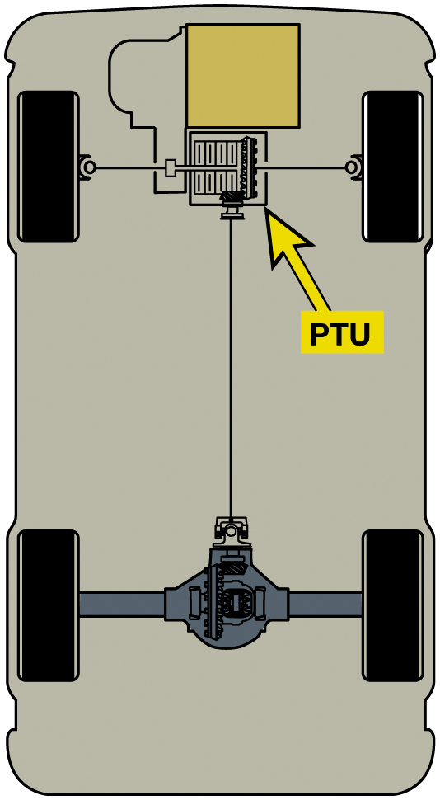
Figure 15.22
A P T U has an interaxle differential that drives the front axle differential and the transfer of torque to the rear driveshaft.
4W D/A W D vehicles that are based on F W D vehicles
Integrate power transfer unit (P T U) into transaxle.
P T U is just a right angle gear set.
Parts and operation Page 244
Notes:
Figure 15.22 P T U has an interaxle differential that drives the front axle differential and the transfer of torque to the rear driveshaft 4W D & A W D vehicles that are based on F W D vehicles integrate a power transfer unit (P T U) into the transaxle. In its simplest
form, a P T U is just a right angle gear set. This gear set is driven by the front differential, and it can drive the rear driveshaft at the same speed as the front wheels. Some P T Us include a sliding gear or multiplate coupling. ● SEE Figure 15.22.
Long Description:
The front wheels are connected to a square box labeled P T U. Another square box is placed on top of the P T U. The rear wheels are connected together. The mid-points of the front and rear wheels connection are then connected by a line.

Slide 34
Frequently Asked Question: What Is Difference Between a Coupler and a Torque Biasing Device?
? Frequently Asked Question
What Is Difference Between a Coupler & Torque Biasing Device? Both of these devices are used in 4W D & A W D vehicles. The major differences include: Couplers are used to control torque between input and output shafts and are connected in series. Figure 15-23. A coupler, such as a viscous coupler, commonly used in rear driveshaft to transmit engine torque to rear drive wheels on a F W D vehicle equipped for A W D operation. Couplers can be located at any of the following locations depending on exact vehicle and application. Transfer case, Power transfer unit, Half shafts: Figure 15-24. A torque biasing device (T B D) is used to control torque between 2 outputs and is connected in parallel. The most commonly used T B Ds are used to control torque in a drive axle to left and right drive wheels. T B D S devices can be located at any of following: At the axle differential between the 2 axle shafts, Figure 15-25. At center differential between front and rear driveshafts. Both devices may use same or similar components but how connected and used in system is what separates them from each other.

Slide 35
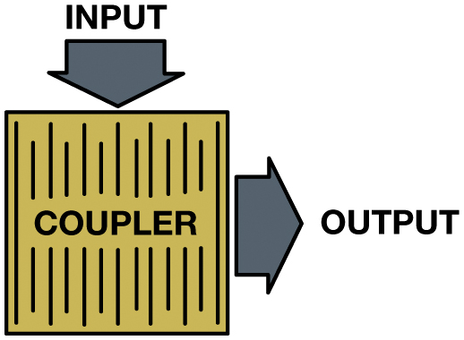
Couplers/Torque Bias Devices
Couplers
Connected in series with other drivetrain members
Transfer torque
Applied When Needed.
Electromagnetic Clutch Coupler
Torque Management
Interactive Torque Management System
Intelligent A W D System
Active Torque Dynamics
Electro-Hydraulic Coupler
Figure 15.23 Coupler is used to transmit engine torque to the drive wheels in series.
Notes:
Long Description:
An arrow pointed towards the box from the top is labeled input. Another arrow pointed outwards from the right side is labeled as output.

Slide 36
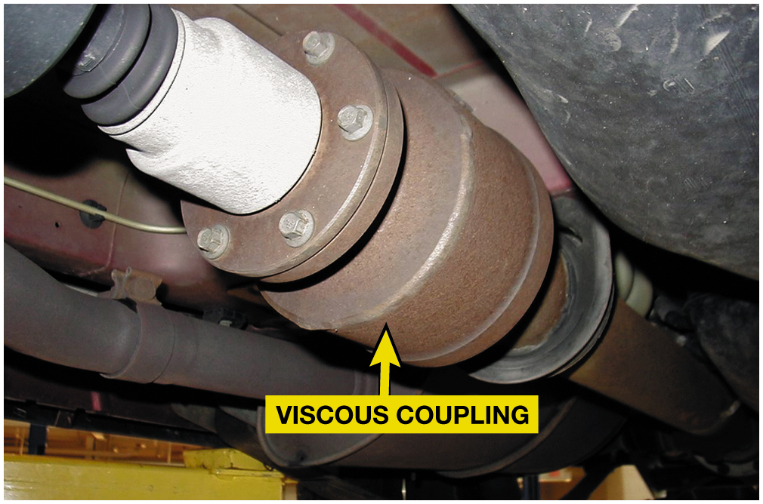
Figure 15.24
Viscous Coupler
A viscous coupling. Note that the unit is attached to the output shaft between the transfer case (or transaxle) and the rear differential. A typical viscous coupling in a sealed unit is serviced as a complete assembly.

Slide 37
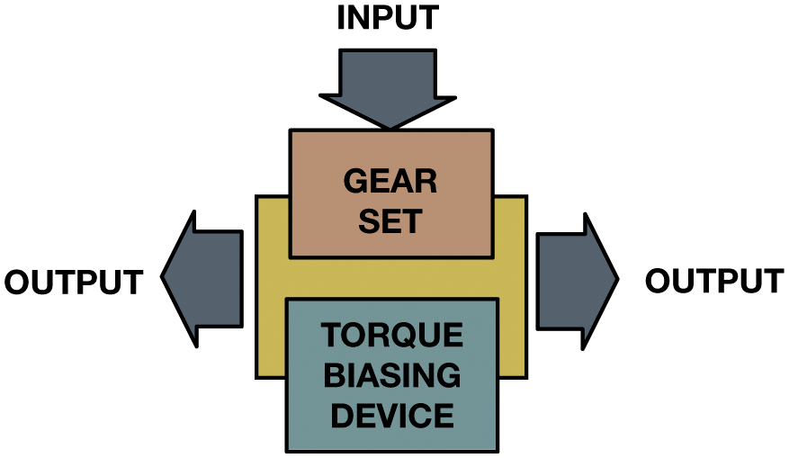
Figure 15.25
A T B D is used to control torque to the drive wheel in parallel.
Notes:
Explanation found in Frequently Asked Question: A torque biasing device (T B D) is used to control torque between two outputs and is connected in parallel. The most commonly used T B Ds are used to control torque in a drive axle to left and right drive wheels. Torque biasing devices can be located at any of following locations depending on the exact vehicle and application: At the axle differential between the two axle shafts, Figure 15.25
Long Description:
The illustration consists of an input arrow towards the gear set from the top. Two arrows pointing outwards from left and right from the base square are labeled as output.

Slide 38
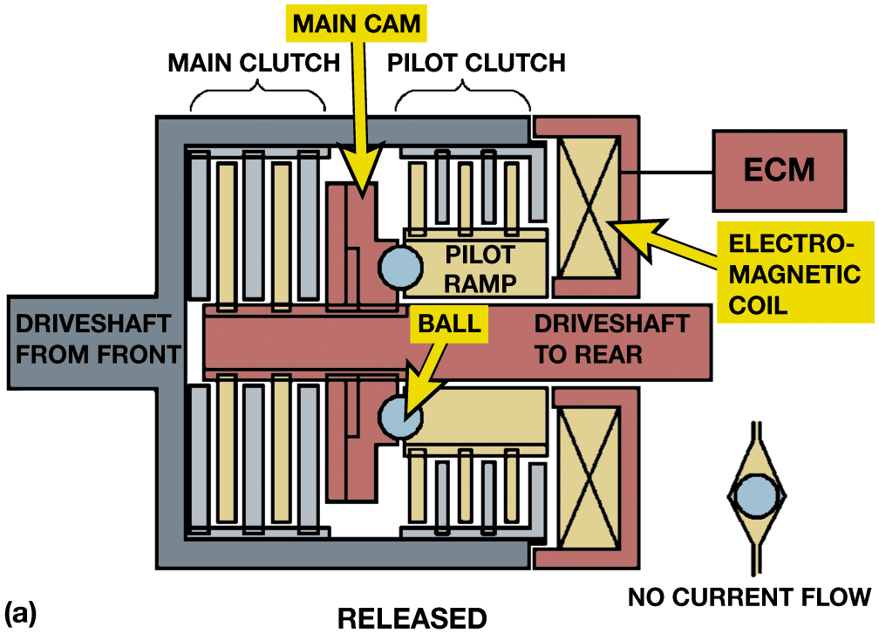
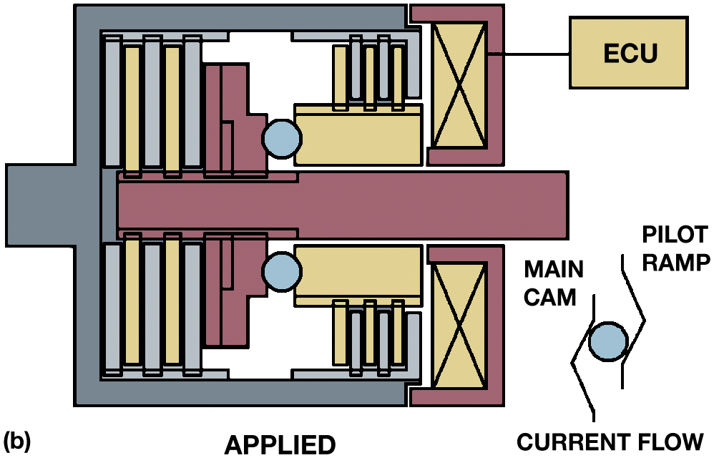
Figure 15.26
Electromagnetic Clutch Coupler
An electromagnetic coupler in a released (a) and applied (b) condition. When the E C U energizes the electromagnet, the pilot clutch applies to cause a speed differential between the pilot ramp and main cam, and this applies the multiplate clutch.
Notes:
Electromagnetic Clutch Coupler: Active couplers used in on-demand systems are dynamic and are applied as needed. These are usually multiplate clutches that are applied by the speed differential between the input and output shafts. In one design, an electromagnetic clutch applies a pilot clutch that in turn applies the main clutch that transfers power. ● SEE FIGURE 15.26.
Another design uses a solenoid to control hydraulic pressure from a gerotor hydraulic pump and the fluid pressure applies the clutch when needed. ● SEE FIGURE 15.27.
These systems are called as in the following list:
■ Torque Management
■ Interactive Torque Management System
■ Intelligent A W D System
■ Active Torque Dynamics
An electromagnetic coil is used to engage a multiplate clutch to transfer torque to the rear drive
axle. Electrical cur- rent to the clutch is controlled by a 4W D electronic control module (E C M)
that uses the wheel speeds sensors. If the front-wheel speed is excessively greater than the
rear-wheel speed, the E C M applies the clutch to drive the rear wheels. The rear wheels are driven
only when necessary to improve traction.
Long Description 1:
The illustration consists of a rectangular structure. A rectangular elongation labeled driveshaft from the front, placed in the same plane on the right is the driveshaft to the rear. A rectangular structure is placed perpendicular to the shaft and labeled as the main cam. The thin rectangular strips on the left of the main cam are labeled as the main clutch. The right side is labeled as the pilot clutch. The pilot clutch consists of thin rectangular strips placed vertically on a box labeled ramp. Another rectangle is placed on the left of the pilot ramp labeled as the electromagnetic coil and a c -shaped structure covers the right labeled as E C M. The same structure is repeated on the lower part. Two circles are placed, one on top and on below the drive shaft. On the bottom left side corner, a circle is enclosed by a diamond shaped curve, labeled as no current flow.
Long Description 2:
The illustration consists of a rectangular structure. A rectangular elongation on the right, placed in the same plane in the middle. A rectangular structure is placed perpendicular to the shaft. The thin rectangular strips on the left and right side. On the right, thin rectangular strips placed vertically on a box. Another rectangle is placed on the left and a c -shaped structure covers the right labeled as E C U. The same structure is repeated on the lower part. Two circles are placed, one on top and one below the drive shaft. On the bottom left-side corner, a circle is enclosed by a main cam on the left and pilot ramp on the right and labeled as current flow.

Slide 39
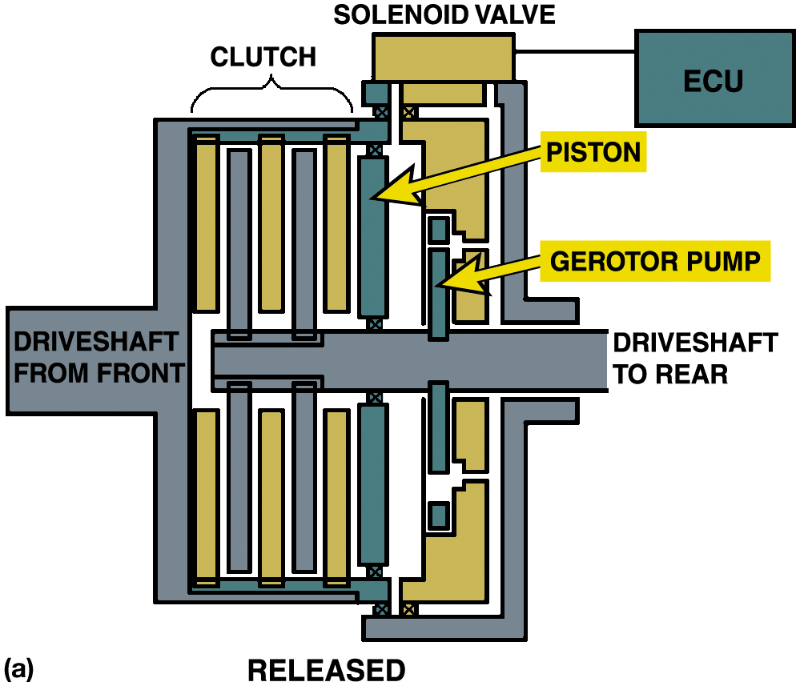
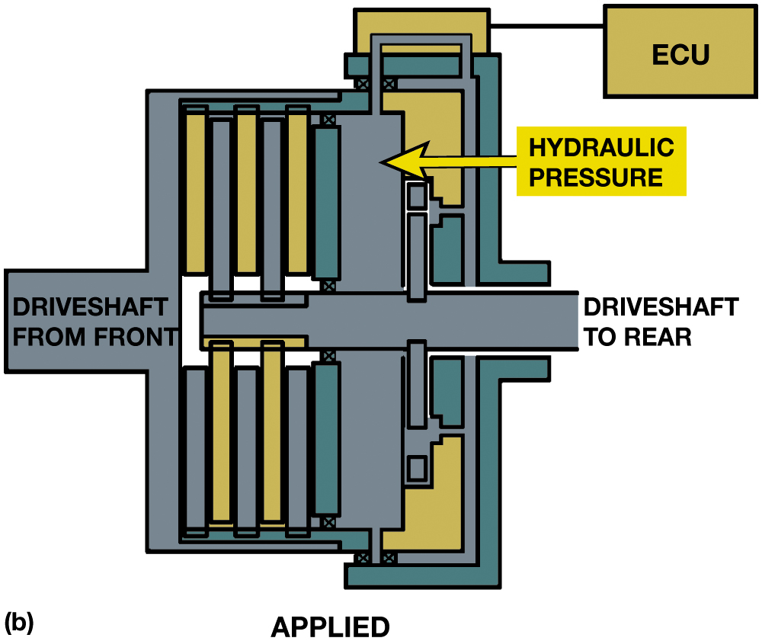
Figure 15.27
Geroter Clutch Coupler
A hydraulic coupler in a released (a) and applied (b) condition. An input shaft–output shaft speed differential will cause the pump to develop hydraulic press, and when the E C U energizes the solenoid valve, the pressure will apply the multiplate clutch.
Notes:
Long Description 1:
The illustration of the coupler consists of the driveshaft from the front elongated towards the left. A rectangular structure inserted from the right side is labeled as a driveshaft to rear. On the top left side of the structure, five vertical rectangular strips are labeled as clutch. Three strips are connected to the top boundary, and two strips are placed on the driveshaft to the rear. A rectangular strip is placed on the right of the clutch labeled piston. On the right, a gerotor pump is placed on the driveshaft. A horizontal rectangular box is placed on top of a gerotor pump, labeled as a solenoid valve. A rectangular box labeled as E C U is connected to the solenoid valve.
Long Description 2:
The illustration of the coupler consists of the driveshaft from the front elongated towards the left. A rectangular structure inserted from the right side is labeled as a driveshaft to the rear. On the top left side of the structure, five vertical rectangular strips. Three strips are connected to the top boundary, and two strips are placed on the driveshaft to the rear. A rectangular box is placed on the right of the strips labeled as hydraulic pressure. A pipe from the top of the hydraulic pressure goes and enters a horizontal box and then is connected to another structure labeled as E C U.

Slide 40
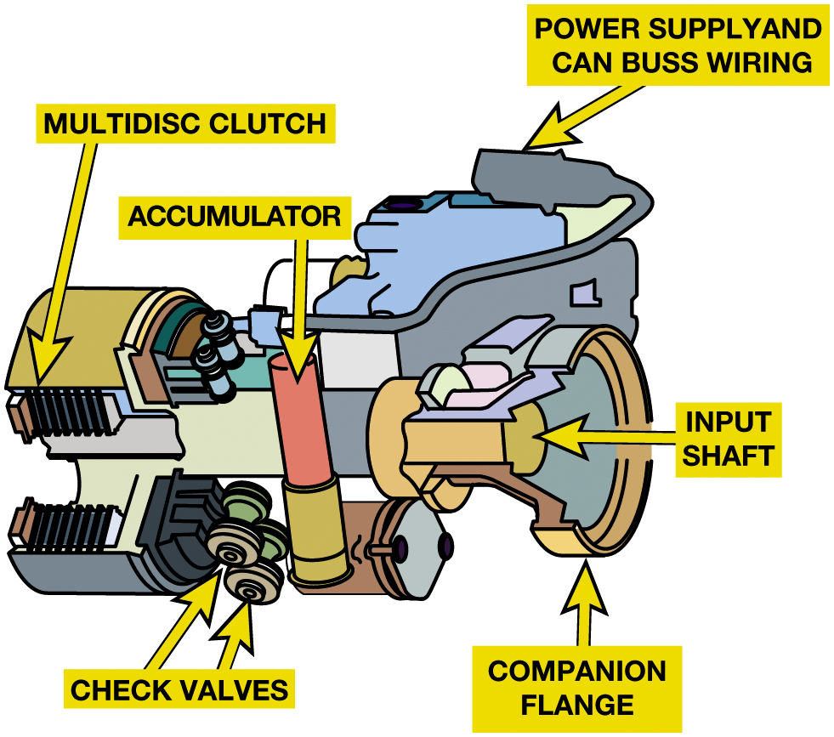
Figure 15.28
Haldex System
The Haldex system uses hydraulic pressure to apply the clutch, which can be created as soon as there is a speed differential between the input and output shafts. Hydraulic pressure and speed at which the clutch will be applied are controlled by the E C U.
Notes:
Long Description:
The parts labeled on the system are as follows. Multidisc clutch, accumulator, check values, power supply and can buss wiring, input shade, and companion flange.

Slide 41
Drive Axles/Wheel Disconnect Systems
Purpose and function
Drive Axles/Wheel Disconnect Systems
Engine intake manifold provides the vacuum
Controlled by the vacuum control valve.
The control valve is controlled by the mode switch.
Continuous Vacuum Locking Hubs
Pulse Vacuum Locking Hubs
Notes:
Continuous Vacuum Locking Hubs A continuous vacuum locking hub system is similar to a conventional manual locking hub except that a vacuum diaphragm applies the force to the clutch ring into engagement. When the transfer case is shifted into 2W D, the vacuum is released from the hub assembly. This then causes the clutch ring to slide out of engagement. This system requires that all of the vacuum seals be leak free so that the hubs receive a continuous vacuum for proper operation. FORD System called IWE Integrated Wheel Ends exclusively used on F150
Pulse Vacuum Locking Hubs Similar to the continuous vacuum system, the pulse vacuum system uses vacuum to engage or disengage the hubs. A continuous supply of vacuum is not required to operate this type of hub disconnect system. Two different levels of vacuum are used to engage and disengage the hubs. The vacuum is applied until the hub gages, and then the vacuum is released. Ford called Wheel Hublocks used on Superduty trucks

Slide 42
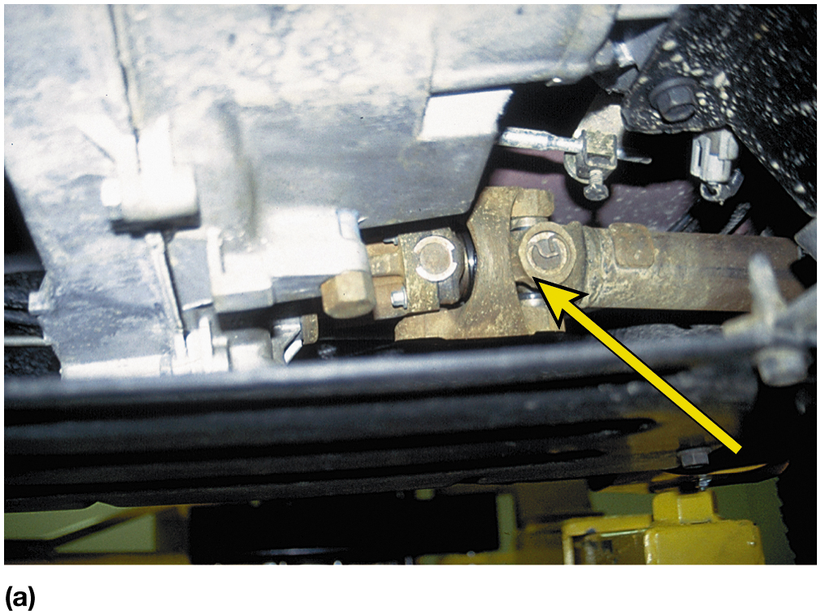
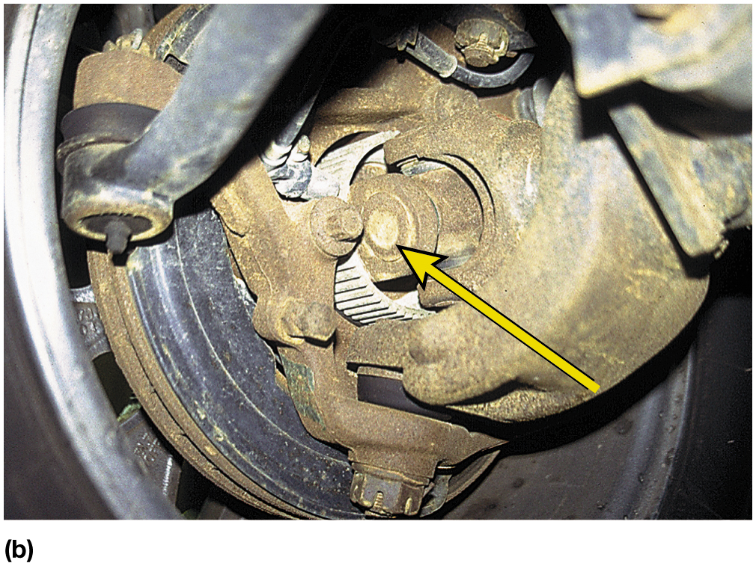
Figure 15.29
Front Drive
(a) A double Cardan U-joint used on the output driveshaft from the transfer case to the front differential assembly. (b) A Cardan-type U-joint at the front drive wheels on a Jeep Wrangler.

Slide 43
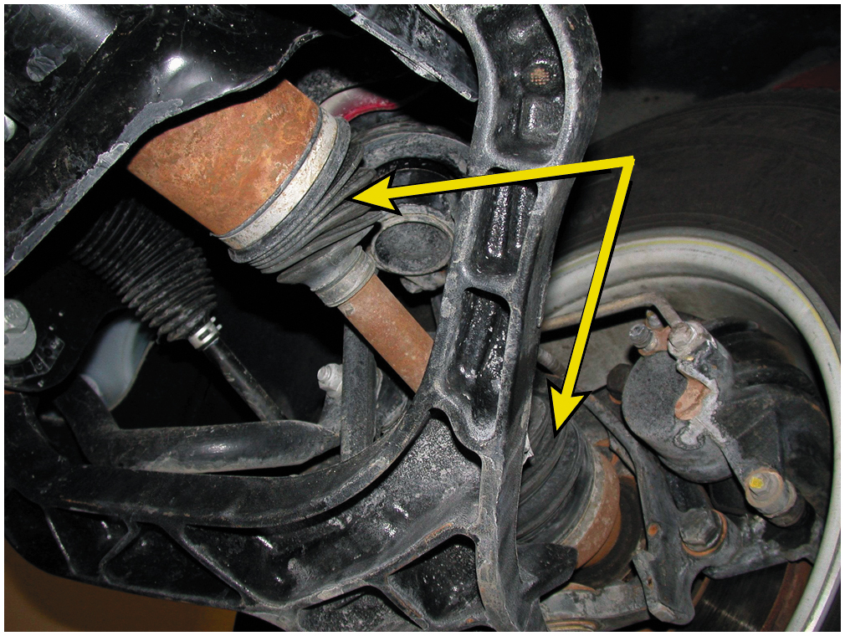
Figure 15.30
Front Drive
Constant velocity (C V) joints are used on the front axles of many four-wheel-drive vehicles like this Chevrolet Blazer.

Slide 44
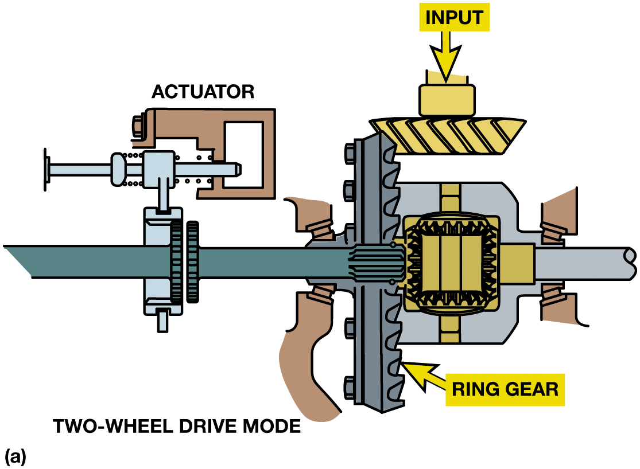
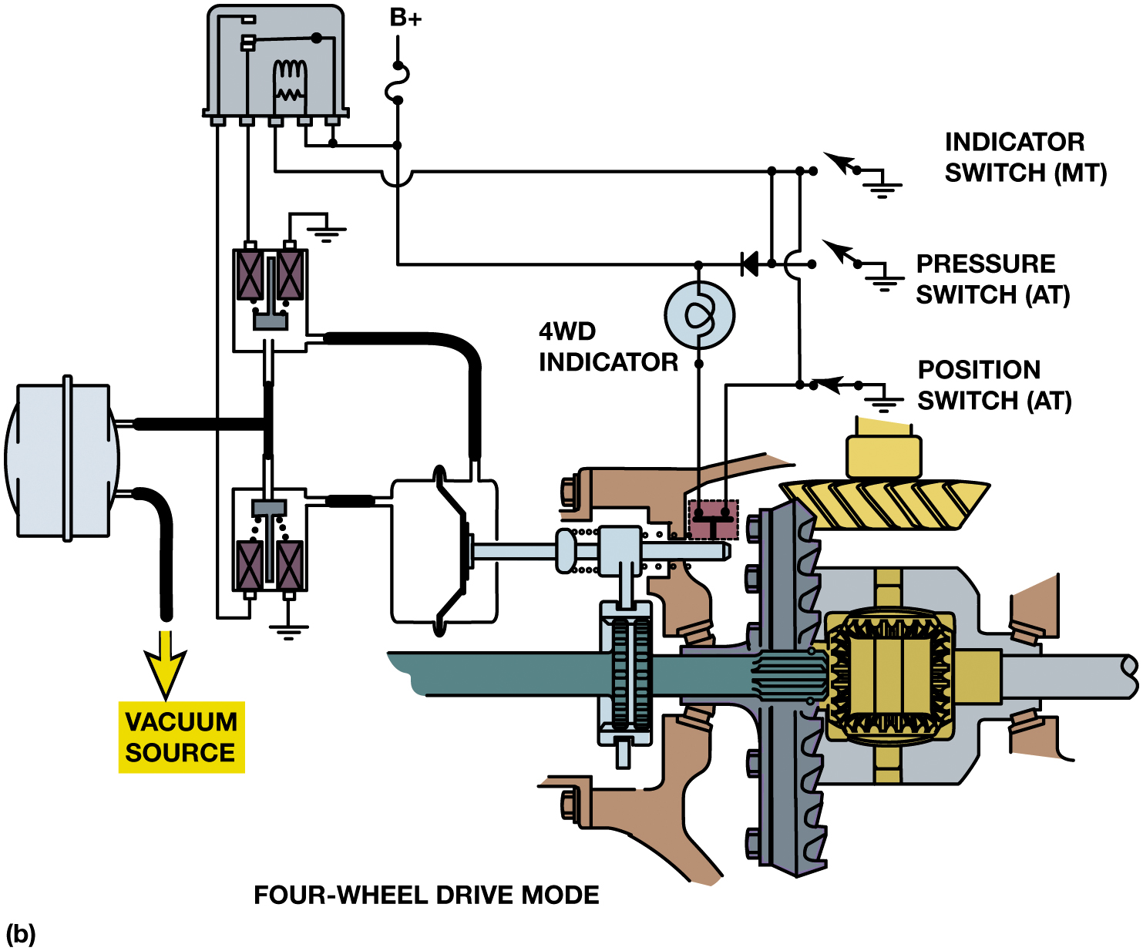
Figure 15.31
Vacuum System
(a) When one axle shaft is disconnected, both front wheels can rotate independently, reducing excessive tire wear. (b) In four-wheel-drive mode, vacuum is applied to the front part and the opposite side is vented to atmospheric pressure retracting the shift motor stem. The shift fork and collar move into engagement with both axle shaft gears. Engine torque from the front differential can now be applied to both front axles.
Notes:
Long Description 1:
The illustration from left to right are as follows. On the top left side of the axle, is an actuator. The axle is then connected to a ring gear, connected to a square structure. A pipe exits from the right of the square structure. Another pipe with a gear on top of the square structure is labeled as an input.
Long Description 2:
The top tight input is connected to the position switch A T connected to the actuator in series and to an indicator switch M T or pressure switch A T in parallel. A 4 W D indicator connected the pressure switch and the actuator. The switches are connected to a rectangular structure with three terminals. The switches are connected to 3 terminals. The fourth and fifth terminals are connected to a box with two rectangles connected to the hub, and one terminal is grounded. The midpoint of the top box is connected to a structure on the left and then a pipe exits downwards and is labeled as a vacuum source.

Slide 45
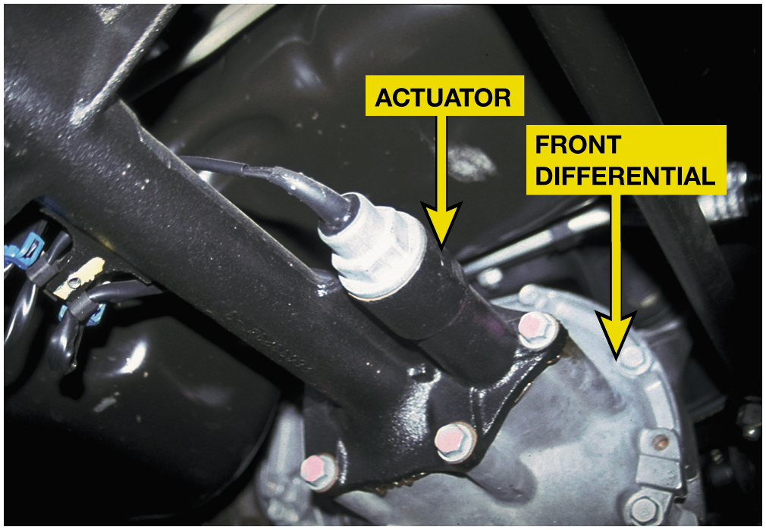
Figure 15.32
A General Motors sport utility vehicle front axle showing the electric axle disconnect actuator.

Slide 46
Question 1
All of these can occur if a part-time four-wheel-drive vehicle is driven on hard pavement in four-wheel drive, EXCEPT:
A. Vehicle will shake and shutter as engine torque is applied to the drive wheels
B. Vehicle will slip and hop over the pavement
C. Vehicle will experience driveline vibrations and damage to driveshafts,
D. Vehicle engine will stall

Slide 47
Answer 1
All of these can occur if a part-time four-wheel-drive vehicle is driven on hard pavement in four-wheel drive, EXCEPT:
D. Vehicle engine will stall

Slide 48
Summary
4W D/A W D vehicles based on front engine F W D vehicles.
A transfer case or power transfer unit drives second axle.
A W D Transfer Cases /P T U can include
Differential, viscous coupler, or electromechanical clutch
Control torque to front and rear drive axles.
Front drive axle has outboard u-joints or cv joints to allow steering.
Front wheel hubs can be disconnected using
Mechanical, automatic, or vacuum operation
Notes:
20 step Ford Vacuum Hub Service found on pages 250-253

Slide 49
Vacuum Hub Service Photo Sequence

Slide 50
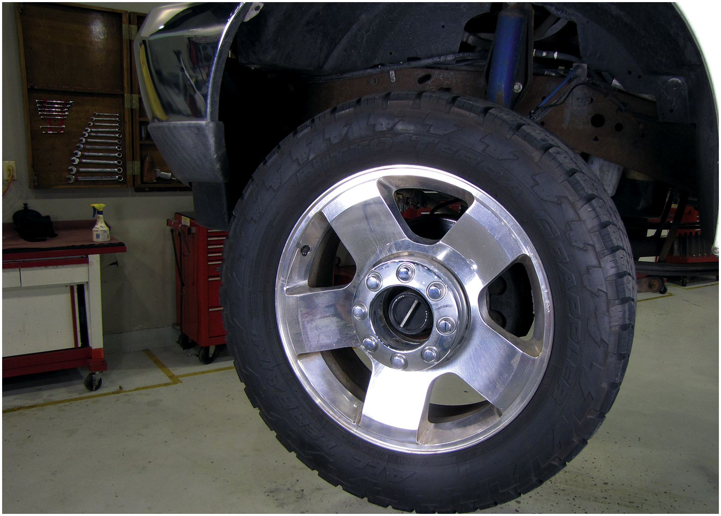
1. The vacuum hubs on this Ford four-wheel-drive truck are leaking and need to be resealed

Slide 51
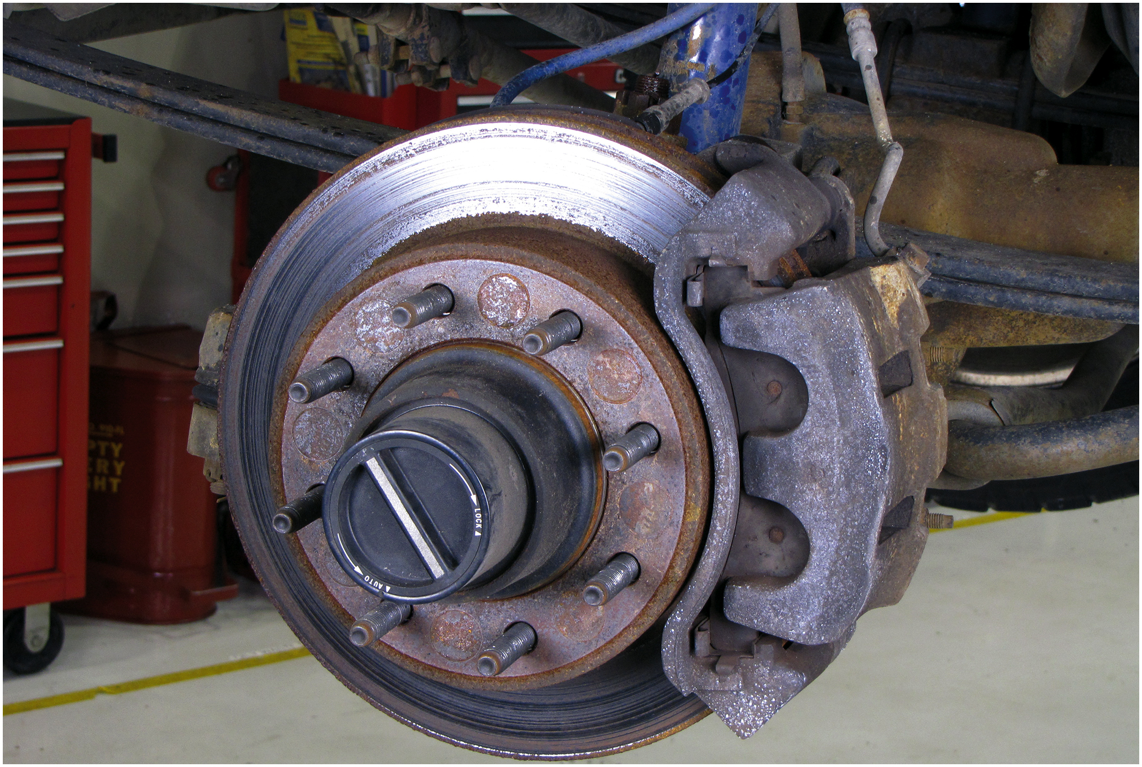
2. View of the hub assembly with the wheel removed

Slide 52
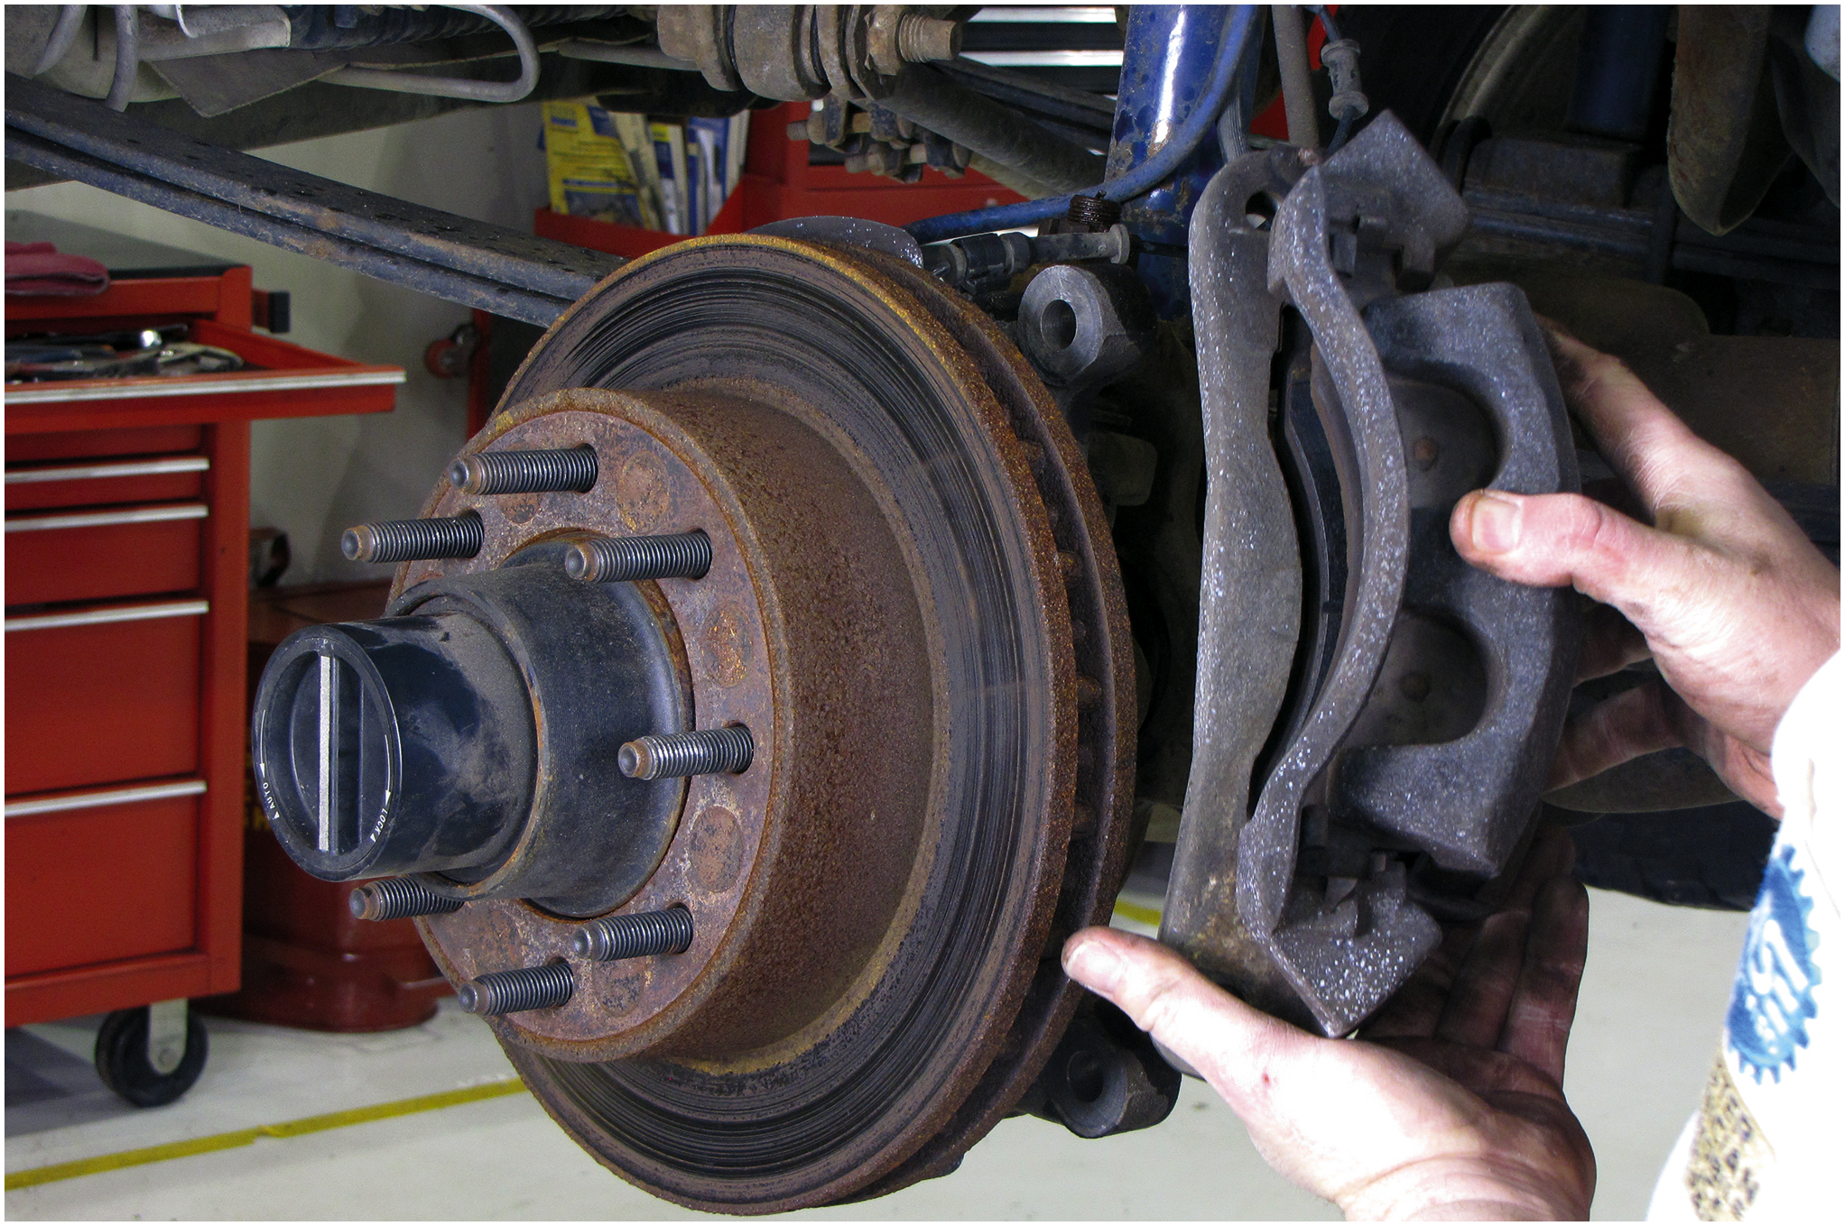
3. The disc brake caliper is removed and supported to prevent causing damage to the brake hose

Slide 53
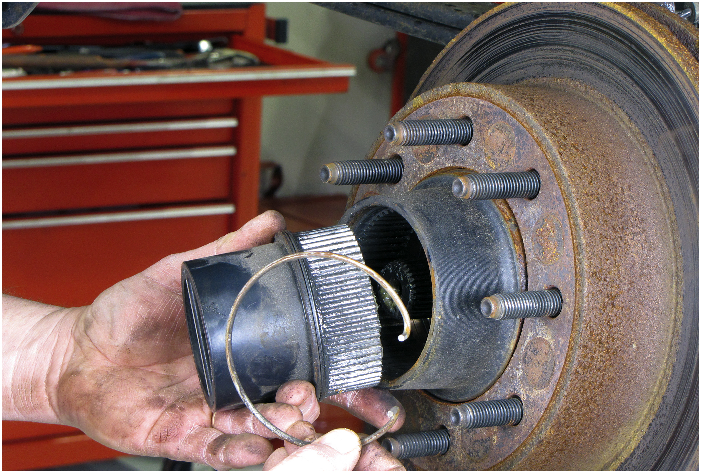
4. The outside hub and hub clip are removed

Slide 54
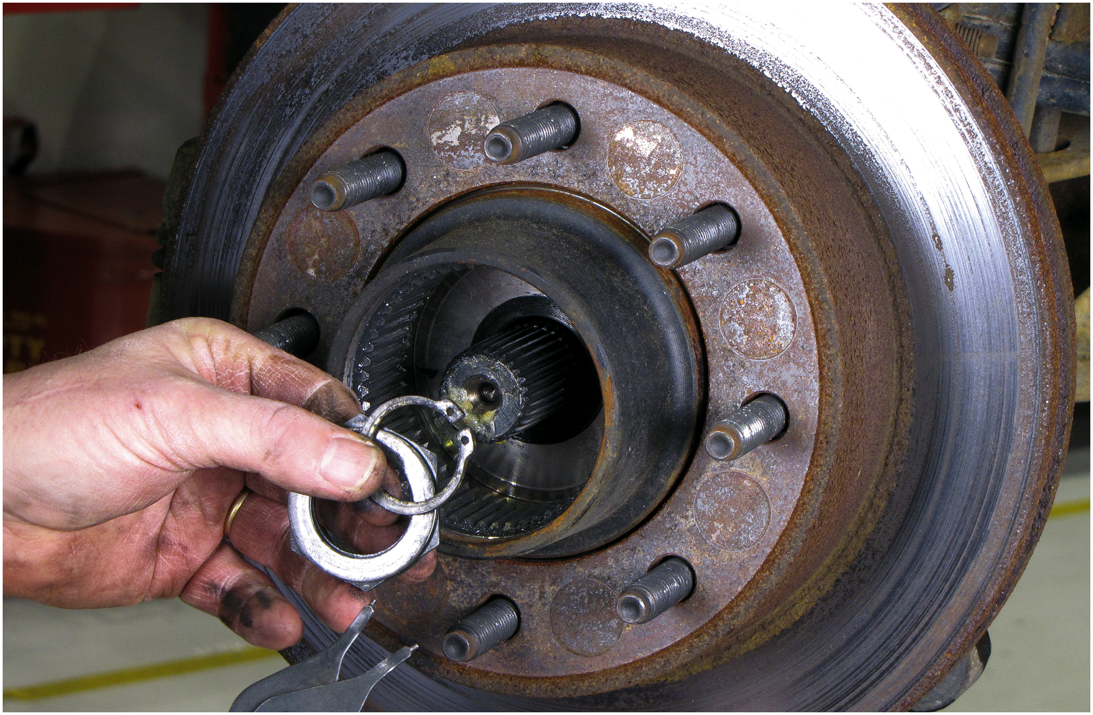
5. The inner clip is removed

Slide 55
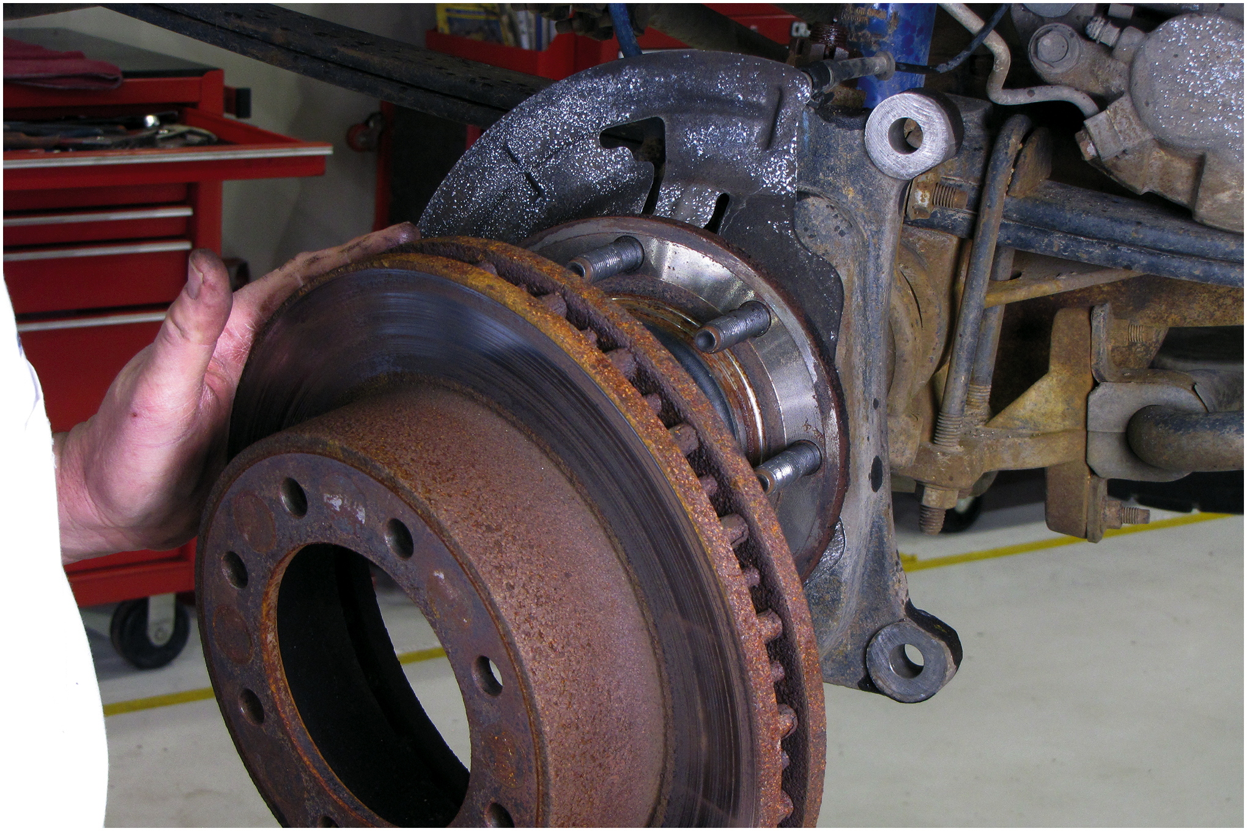
6. The disc brake rotor is removed

Slide 56
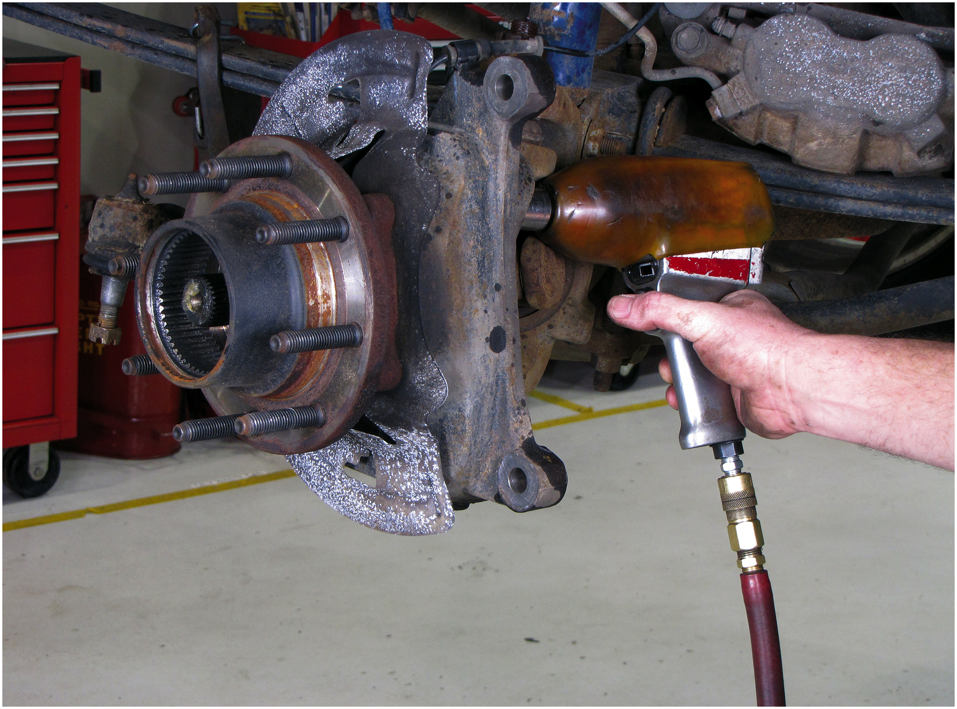
7. The caliper support bracket is being removed

Slide 57
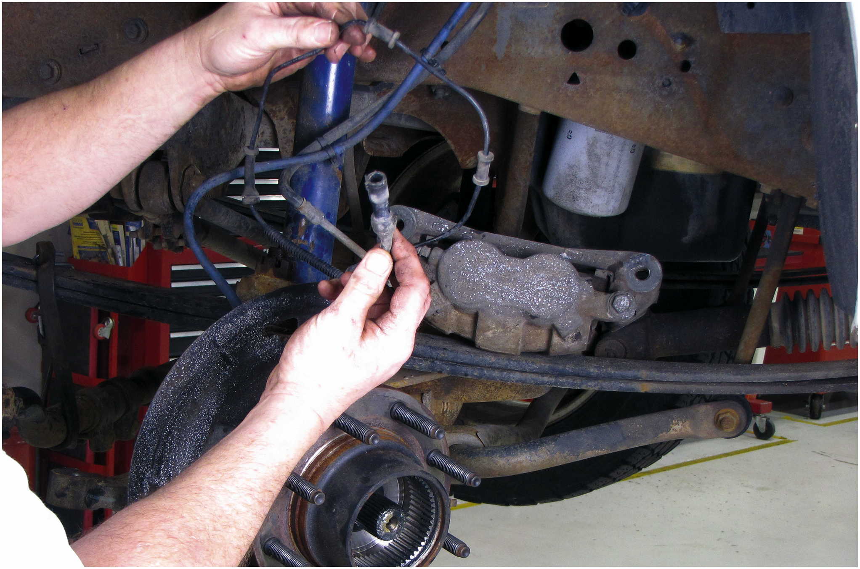
8. The vacuum hose to the wheel hub assembly is disconnected

Slide 58
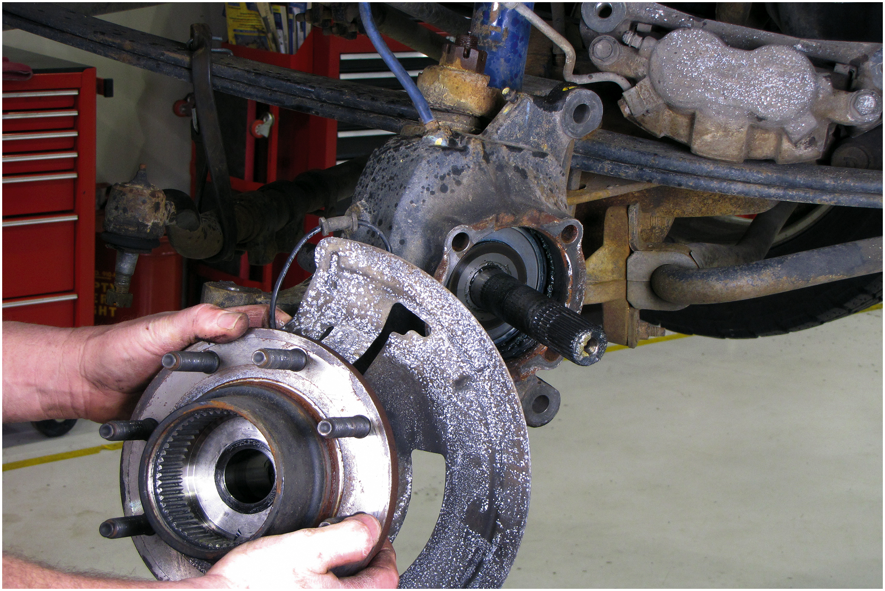
9. The wheel hub assembly is removed and set aside

Slide 59
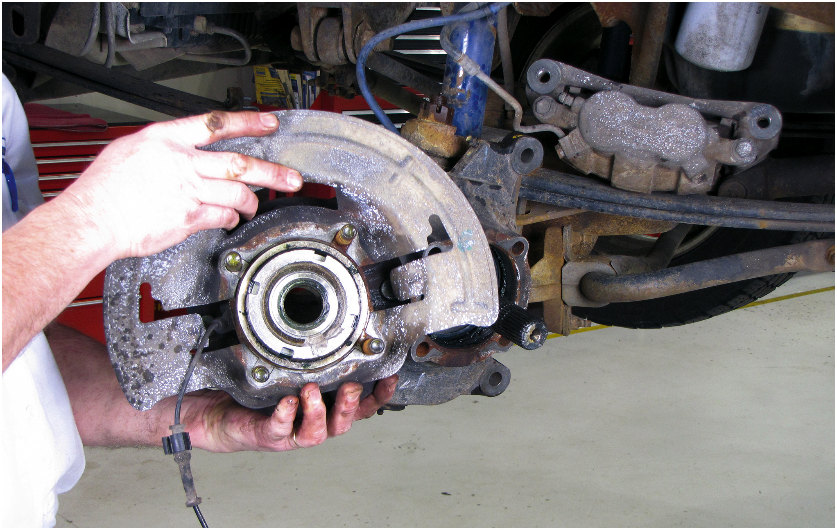
10. The backside view of the hub assembly

Slide 60
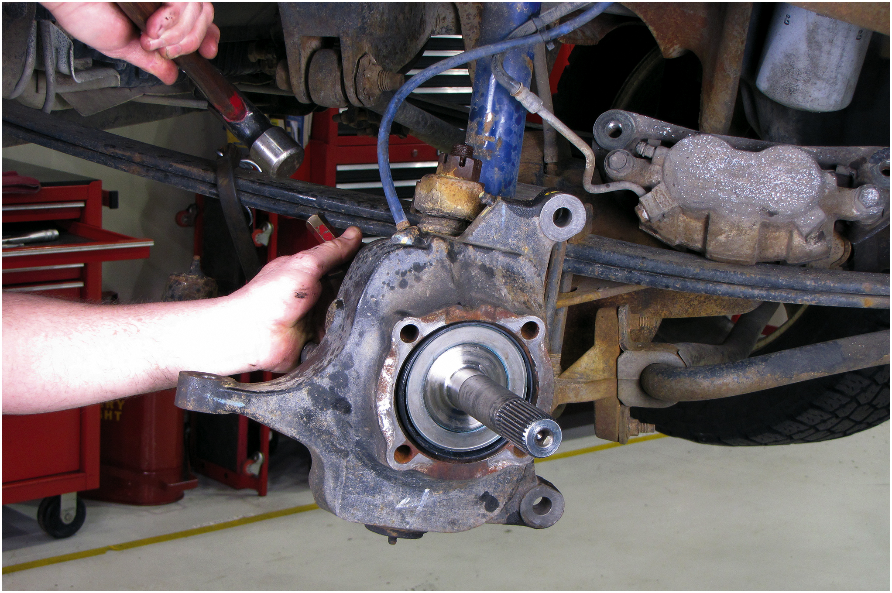
11. The vacuum part of the hub is being driven out from the backside

Slide 61
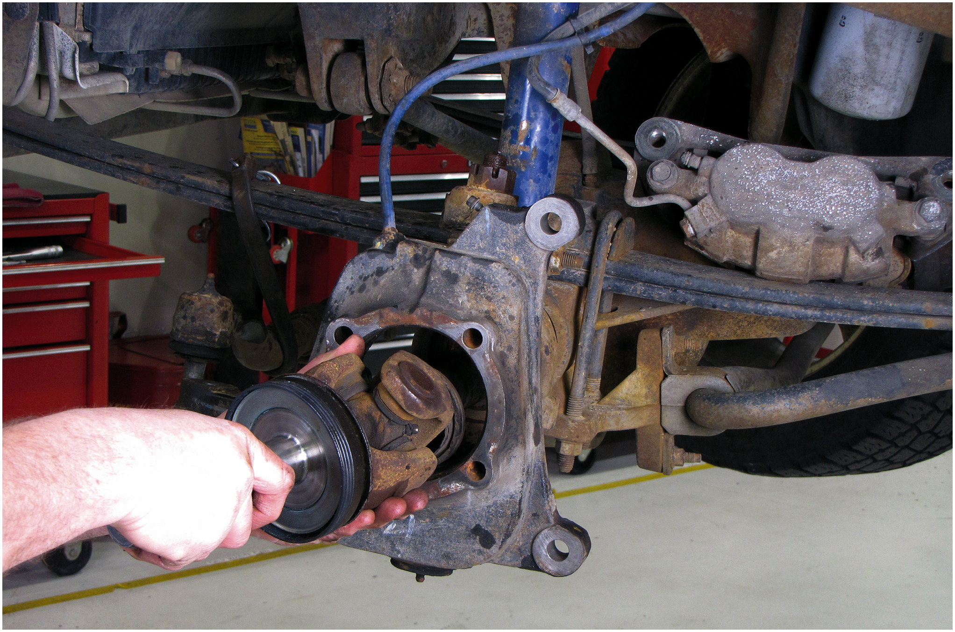
12. The drive axle shaft is removed through the steering knuckle

Slide 62
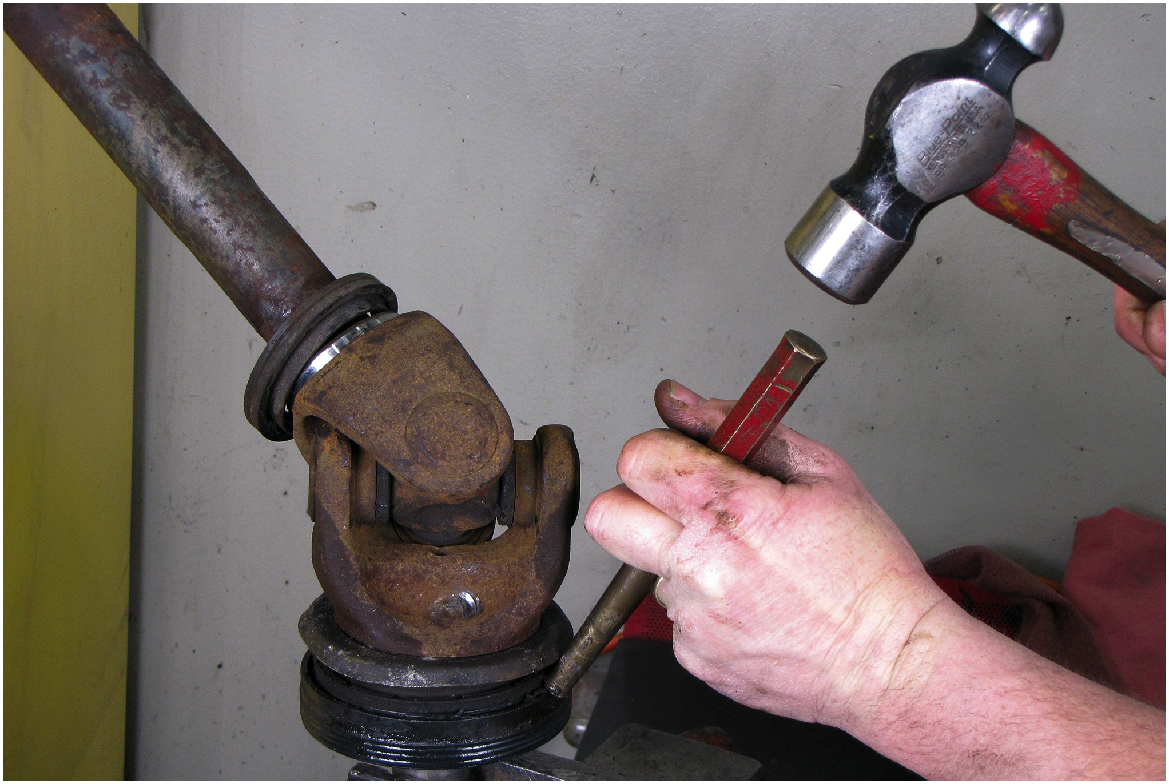
13. The old seal is removed

Slide 63
14. The sealing surfaced is cleaned

Slide 64
15. The new seal and the driver needed to install the seal

Slide 65
16. After lubricating the inner seal, the seal is installed on the axle hub

Slide 66
17. The outer part of the seal is lubricated with engine oil, and then the shaft is reinstalled

Slide 67
18. The hub assembly is installed

Slide 68
19. The caliper mounting bracket is installed and the fasteners torqued to factory specifications

Slide 69
20. Disc brake caliper installed and fasteners are also torqued to specs. After installing wheel/tire assembly and checking for proper operation, this repair has been completed

Slide 70
Automotive Fundamentals Videos and Animations
Videos Link: (A3) Manual Drive Train Axles Videos
Animations Link: (A3) Manual Drive Train Axles Animations

Slide 71
Copyright
This work is protected by United States copyright laws and is provided solely for the use of instructors in teaching their courses and assessing student learning. Dissemination or sale of any part of this work (including on the World Wide Web) will destroy the integrity of the work and is not permitted. The work and materials from it should never be made available to students except by instructors using the accompanying text in their classes. All recipients of this work are expected to abide by these restrictions and to honor the intended pedagogical purposes and the needs of other instructors who rely on these materials.

