Slide 1
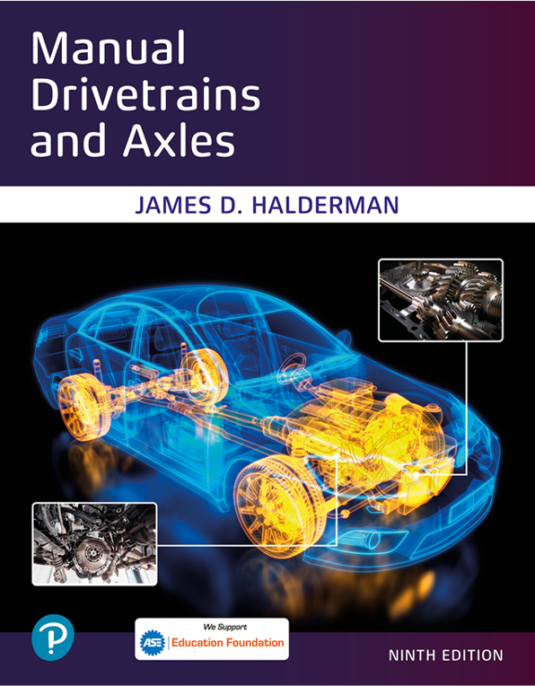
Manual Drivetrains and Axles
Ninth Edition
Chapter 14
Drivetrain Electricity and Electronics
Copyright © 2024, 2018, 2015 Pearson Education, Inc. All Rights Reserved
Notes:
If this PowerPoint presentation contains mathematical equations, you may need to check that your computer has the following installed:
1) Math Type Plugin
2) Math Player (free versions available)
3) NVDA Reader (free versions available)
INSTRUCTOR NOTE: This presentation includes text explanation notes, you can use to teach the course. When in SLIDE SHOW mode, you RIGHT CLICK and select SHOW PRESENTER VIEW, to use the notes.

Slide 2
Learning Objectives (1 of 2)
14.1 Explain the characteristics of electricity.
14.2 Differentiate between conductors, insulators, and semiconductors.
14.3 Explain the units of electrical measurement.
14.4 List the parts of a complete circuit.
14.5 Discuss the types of electrical circuit faults.
14.6 Explain how to detect and measure electrical voltage, current, and resistance.

Slide 3
Learning Objectives (2 of 2)
14.7 Discuss the purpose of terminals, connectors, relays, and switches.
14.8 Explain the operation of speed sensors and throttle position (T P) sensors.
14.9 State the need for networks and discuss network classifications.

Slide 4
Introduction
Electricity may be difficult for some people to learn for the following reasons:
It cannot be seen.
Only the results of electricity can be seen.
It has to be detected and measured.

Slide 5
Electricity (1 of 2)
Electricity: movement of electrons from one atom to another.
Nucleus
Protons, neutrons, and electrons
Automotive electricity uses conventional theory
Electricity flows from positive to negative
Magnets and electrical charge
Electron orbits

Slide 6
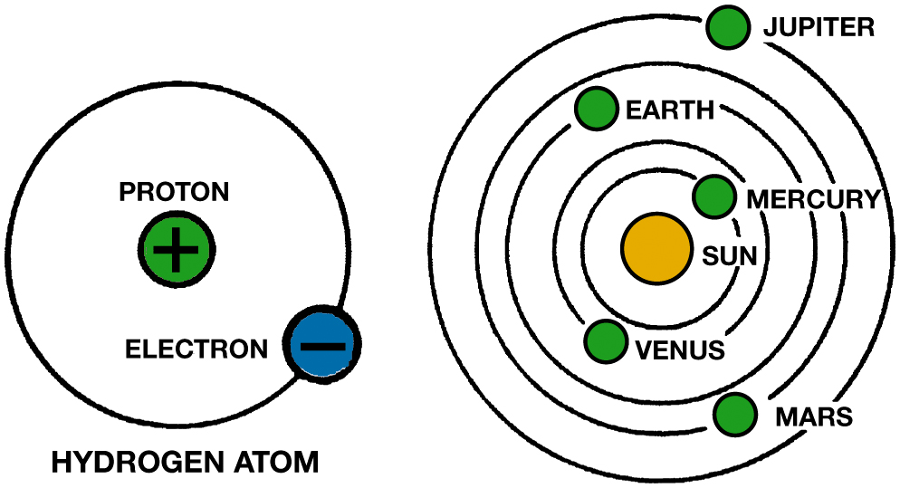
Figure 14.1
In an atom (left), electrons orbit protons in the nucleus just as planets orbit the sun in our solar system (right).
Notes:
The parts of an atom have different charges. The orbiting electrons are negatively charged, while protons are positively charged. Positive charges are indicated by the “plus” sign (+), and negative charges by the “minus” sign (−). These same + and − signs are used to identify parts of an electrical circuit. Neutrons have no charge at all. They are neutral. In a normal or balanced atom, the number of negative particles equals the number of positive particles. That is, there are as many electrons as there are protons.
Long Description:
The illustration on the left has a circle that signifies a hydrogen atom. A proton with a positive sign is inside the circle, and an electron with a negative sign is on the circumference of the circle. The illustration on the right has a circle in the center that signifies the sun. Around the sun are five concentric rings with circles on them that signify planets. Starting from the innermost ring, they are labeled Mercury, Venus, Earth, Mars, and Jupiter.

Slide 7
Electricity (2 of 2)
Conductors
Conductors are materials with fewer than 4 electrons
In their atom’s outer orbit.
Insulators
Insulators are materials with more than 4 electrons
In their atom’s outer orbit.
Semiconductors
Materials with exactly 4 electrons in outer orbit are
Called semiconductors.

Slide 8
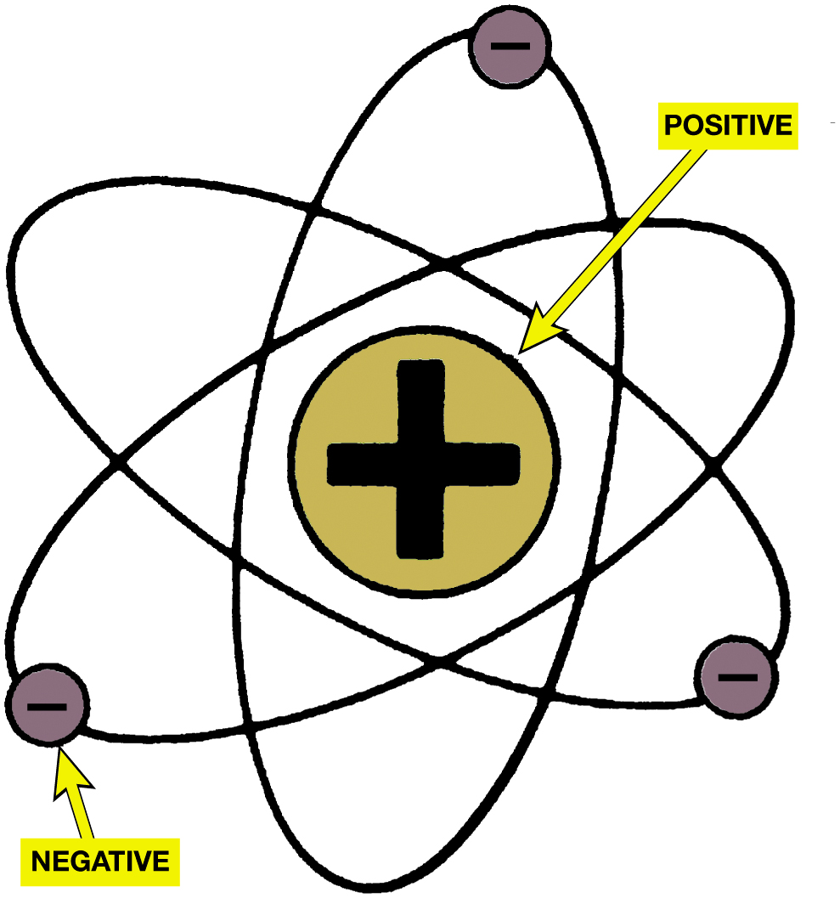
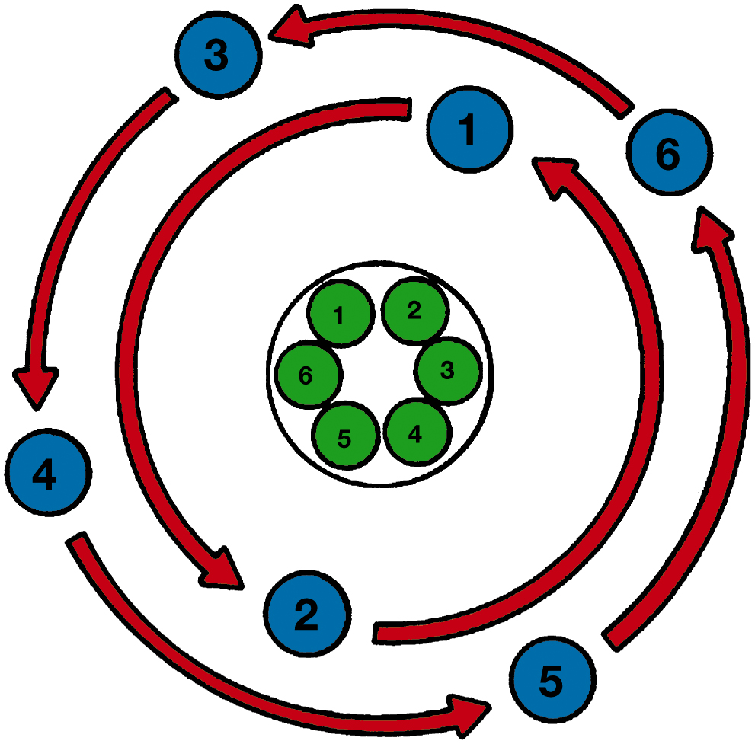
Atom Nucleus & Balanced Atom
Figure 14.2 The nucleus of an atom has a positive (+) charge and the surrounding electrons have a negative (−) charge.
Figure 14.3 This figure shows a balanced atom. The number of electrons is the same as the number of protons in the nucleus.
Notes:
Long Description 1:
The illustration features a circle in the center with a positive symbol. Around the circle are three ellipses with different orientations. Each ellipse has a circle with a negative sign in it
Long Description 2:
The illustration has a ring in the center with 5 circles inside labeled 1, 2, 3, 4, and 5. They represent protons. Around the ring are two concentric counter-clockwise arrows. Each arrow has circles on it. They represent electrons. The circles on the outermost arrow are labelled 3, 4, 5, and 6. The circles on the inner arrow are labelled one and two.

Slide 9
Figure 14.4
Unlike charges attract and like charges repel.
Notes:
Long Description:
The illustration has two tubular magnets placed at some distance. In the magnet on the right, the right and left ends are labeled N and S. In the magnet on the left, the right and left ends are labeled S and N.

Slide 10
Animation: Magnets (Animation will automatically start)

Slide 11
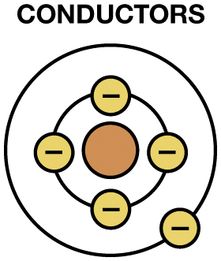
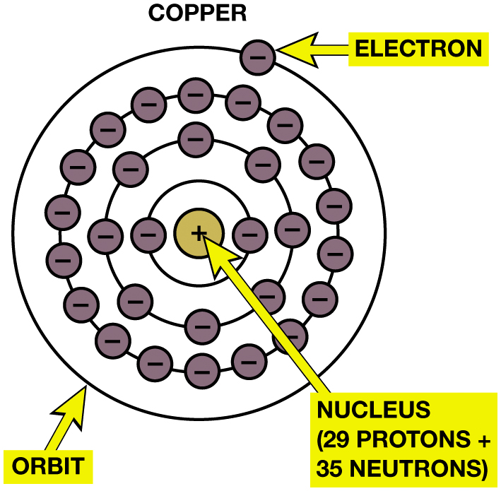
Conductors/Insulators (1 of 2)
Figure 14.6 Copper is an excellent conductor of electricity because it has just one electron in its outer orbit, making it easy to be knocked out of its orbit and flow to other nearby atoms. This causes electron flow, which is the definition of electricity.
Figure 14.5 A conductor is any element that has one to three electrons in its outer orbit.
Notes:
Copper is an excellent conductor because it has only one electron in its outer orbit. This orbit is far enough away from the nucleus of the copper atom that the pull or force holding the outermost electron in orbit is relatively weak.
Copper is the conductor most used in vehicles because the price of copper is reasonable compared to relative cost of other conductors with similar properties. Examples of commonly used conductors include the following materials:
■ Silver
■ Copper
■ Gold
■ Aluminum
■ Steel
■ Cast Iron
Long Description 1:
The illustration is labeled conductors. It has a circle in the center. Around the circle are two concentric rings. The inner ring has four circles with a negative sign inside. The outer ring has one circle with a negative sign inside.
Long Description 2:
The illustration has a circle in the center labeled nucleus. It has a positive sign. The nucleus comprises 29 protons and 35 neutrons. Around the nucleus are four concentric rings that signify orbits. Each orbit has several circles that signify electrons. Each electron has a negative sign. Starting from the innermost orbit there are 2, C 1 A, 1 C 1 A, and 1 electron in the orbits.

Slide 12
Animation: Copper Atom (Animation will automatically start)

Slide 13
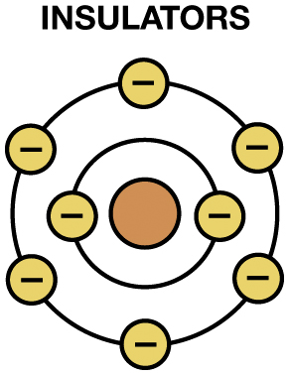
Conductors/Insulators (2 of 2)
Figure 14.7 Insulators are elements with five to eight electrons in the outer orbit.
Notes:
Copper is an excellent conductor because it has only one electron in its outer orbit. This orbit is far enough away from the nucleus of the copper atom that the pull or force holding the outermost electron in orbit is relatively weak.
Copper is the conductor most used in vehicles because the price of copper is reasonable compared to relative cost of other conductors with similar properties. Examples of commonly used conductors include the following materials:
■ Silver
■ Copper
■ Gold
■ Aluminum
■ Steel
■ Cast Iron
Long Description:
The illustration is labeled insulators. It has a circle in the center. Around the circle are two concentric rings. The inner ring has two circles with a negative sign inside. The outer ring has six circles with a negative sign inside.

Slide 14
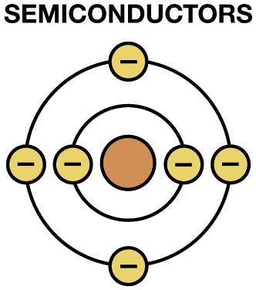
Figure 14.8
Semiconductor
Semiconductor elements contain exactly four electrons in the outer orbit.
Notes:
Long Description:
The illustration is labeled semi-conductors. It has a circle in the center. Around the circle are two concentric rings. The inner ring has two circles with a negative sign inside. The outer ring has four circles with a negative sign inside.

Slide 15
Figure 14.9
Current Flow
Current Flow
What is difference between conventional theory and electron theory? See Pages 211-212
Current electricity is the movement of electrons through a conductor.
Notes:
Current Flow The following events occur if a source of power, such as a battery, is connected to the ends of a conductor—a positive charge (lack of electrons) is placed on one end of the conductor and a negative charge (excess of electrons) is placed on the opposite end of the conductor. For current to flow, there must be an imbalance of excess electrons at one end of the circuit and a
deficiency of electrons at the opposite end. ● SEE FIGURE 9.9.
CONVENTIONAL THEORY VERSUS ELECTRON THEORY
Conventional theory. It was once thought that electricity had only one charge and moved from positive to negative. This theory of the flow conventional theory of current flow. Most automotive applications use the conventional theory. FIGURE 14.10.
Electron theory. The discovery of the electron and its negative charge led to the electron theory, which states that there is electron flow from negative to positive.
Long Description:
The illustration comprises a tubular copper wire. The copper wire consists of several electrons inside. The right end of the copper wire is negatively charged and the left end is positively charged. The negatively charged electrons move from right to left in the copper tube.

Slide 16
Animation: Electron Flow (Animation will automatically start)

Slide 17
Figure 14.11
Units of Electricity
Three fundamentals of electricity-related units include the ampere, volt, and ohm.
Ampere is measure of amount of current flow.
Voltage is unit of electrical pressure.
Ohm is unit of electrical resistance.
One ampere is the movement of 1 coulomb (6.28 billion billion electrons) past a point in 1second.
Notes:
Long Description:
The illustration comprises a tubular copper wire. The right end of the copper wire is negatively charged and the left end is positively charged. Inside the copper wire, 6.2C1A billion billion electrons per second move from the positive end to the negative end of the copper tube.

Slide 18
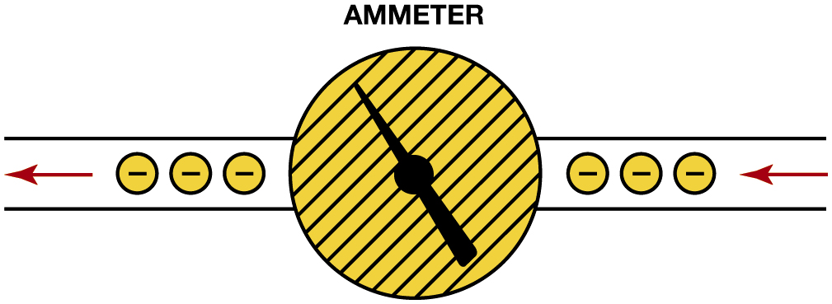
Figure 14.12
Ammeter
An ammeter is installed in the path of the electrons similar to a water meter used to measure the flow of water in gallons per minute. The ammeter displays current flow in amperes.
Notes:
Long Description:
The illustration comprises a path of negatively charged electrons. The electrons flow from left to right. The path has a disc in the center with a needle that points to the north-west

Slide 19
Figure 14.13
Units of Electricity
Voltage is the electrical pressure that causes the electrons to flow through a conductor.
Notes:
Long Description:
The illustration has a narrow tube. The left end of the tube has a torch-like structure. It is labeled voltage. It has a right arrow on the left. On the right of the voltage are several dark circles. The right end of the tube has several narrow nozzles protruding from it. A right arrow is located on the nozzles.

Slide 20
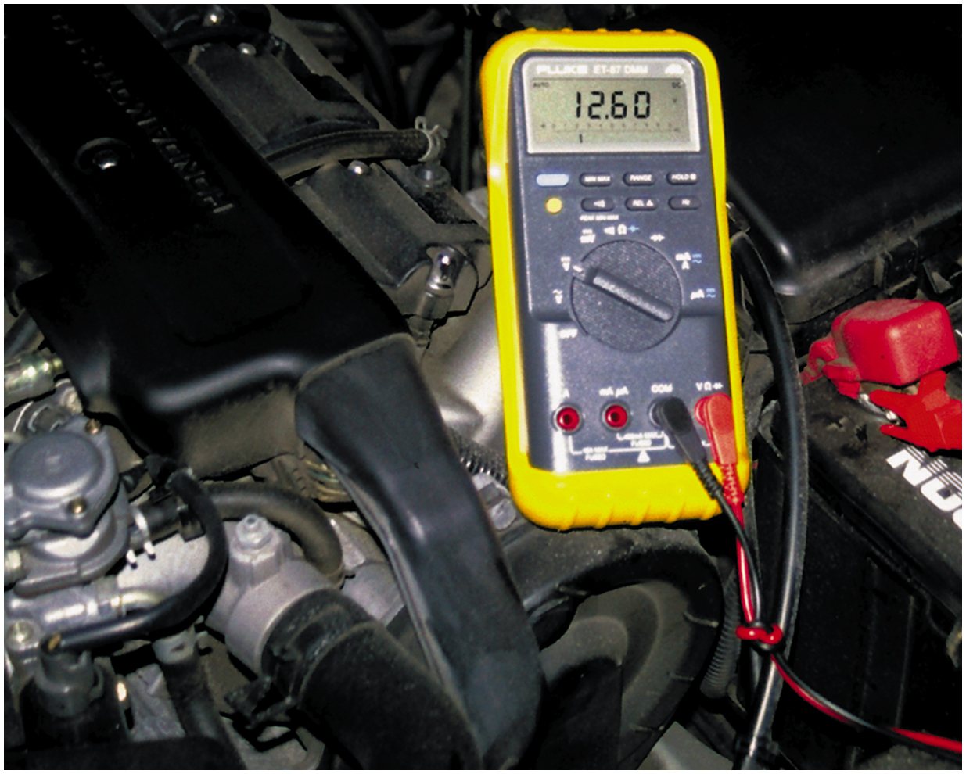
Figure 14.14
This digital multimeter set to read D C volts is being used to test the voltage of a vehicle battery. Most multimeters can also measure resistance (ohms) and current flow (amperes).

Slide 21
Animation: Meter Usage, Battery Volt Check (Animation will automatically start)

Slide 22
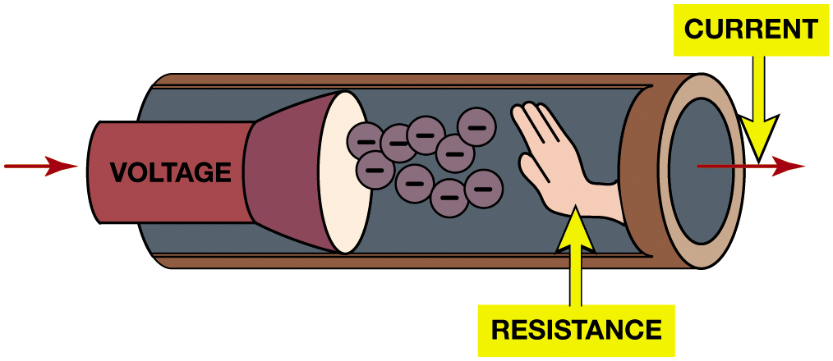
Figure 14.15
Resistance
Resistance to the flow of electrons through a conductor is measured in ohms.
Notes:
Long Description:
The illustration has a narrow tube. The left end of the tube has a torch-like structure. It is labeled voltage. It has a right arrow on the left. On the right of the voltage are several circles with negative signs. On the right of the circles is a human hand labeled resistance. The right end of the tube has a right arrow labeled current

Slide 23
Animation: Voltage and Resistance (Animation will automatically start)

Slide 24
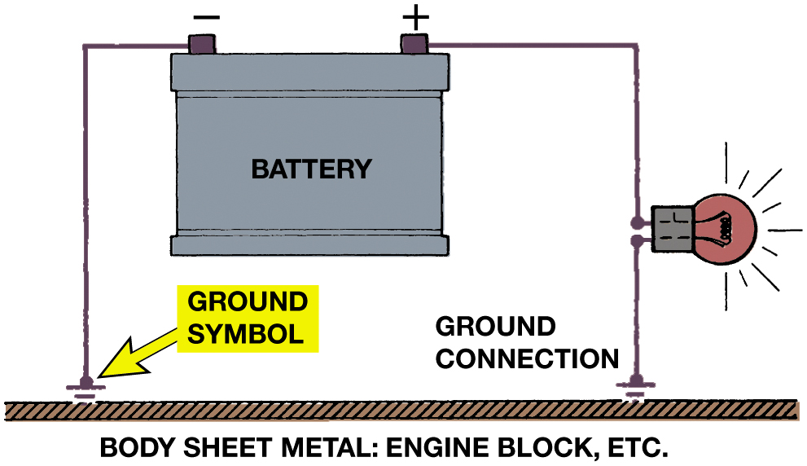
Electrical Circuits
Complete Circuits:
Power source, circuit protection device, power-side wire or path, electrical load, a ground return path, & switch or a control device.
Circuit testers include test lights, fused jumper leads.
Figure 9.16 The return path back to the battery can be any electrical conductor, such as a copper wire or the metal frame or body of the vehicle.
Notes:
Long Description:
The illustration has a battery. The right end of the battery is positively charged and the left end of the battery is negatively charged. An engine block or a metal sheet is located beneath the battery. The negative and positive ends of the battery are connected to the metal sheet by two wires. Their intersection has a ground symbol. A light bulb is attached to the wire on the right.

Slide 25
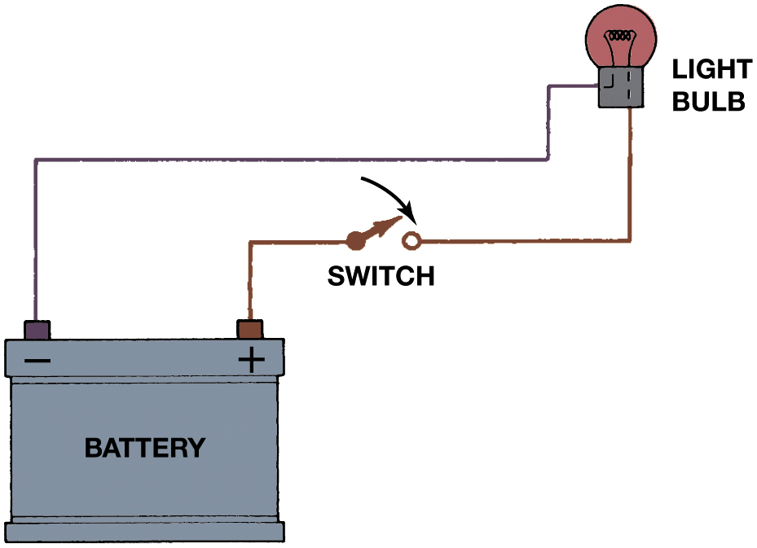
Figure 14.17
Switch
Return path (ground) for electrical current from
Load back to power source so that there is a complete circuit.
Switches and controls turn circuit on and off.
An electrical switch opens the circuit and no current flows. The switch could also be on the return (ground) path wire.
Notes:
Long Description:
The illustration has a battery. The battery is positively charged on the right end and negatively charged on the left. From one of the battery's ends, a wire extends through a bulb and connects to the other. On the right end of the wire, there is an open switch. The switch is open and the circuit is incomplete, no current flows through it. Therefore, the bulb is switched off.

Slide 26
Electrical Schematics (1 of 3)
All circuit schematics or diagrams include:
Power-side wiring of the circuit
All splices
Connectors
Wire size
Wire color
Trace color (if any)
Circuit number
Electrical components
Ground return paths
Fuses and switches

Slide 27
Electrical Schematics (2 of 3)
Circuit Information
Wire size
Open circuits
Short-to-voltage
Short-to-ground
High resistance

Slide 28
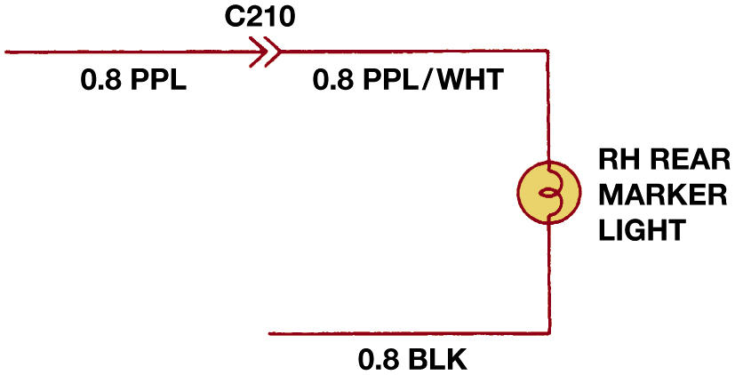
Electrical Schematics (3 of 3)
Figure 14.18 The center wire is a solid color wire, meaning that the wire has no other identifying tracer or stripe color. The two end wires could be labeled “B L U/W H T,” indicating a blue wire with a white tracer or stripe.
Figure 14.19 Typical section of a wiring diagram. Notice that the wire color changes at connection C210. The “.8” represents the metric wire size in square millimeters.
Notes:
Wire size is shown on all schematics. For example, ● FIGURE 9.19 illustrates a rear side-marker bulb circuit diagram where “.8” indicates the metric wire gauge size in square millimeters (mm 2) and “P P L” indicates a solid purple wire. The wire diagram also shows that the color of the wire changes at the number C210. This stands for
“connector #210” and is used for reference purposes. The symbol for the connection can vary
depending on the manufacturer. The color change from purple (P P L) to purple with a white tracer
(P P L/W H T). The ground circuit is the “.8 B L K” wire.
FIGURE 9.20 shows many of the electrical and electronic symbols that are used in wiring and circuit grams.
Long Description 1:
The illustration has a pair of three wires. Each wire has several twisted copper wires protruding from its end. The outer covering of the wires on the left and the right has a stripe and a tracer, respectively.
Long Description 2:
The illustration has an incomplete rectangle. Its top horizontal edge has a double right arrowhead labeled C 210. It divides the edge into two segments. The left segment is labeled 0.C1A P P L and the right segment is labeled 0.C1A P P L slash W H T. The right vertical edge of the rectangle has a bulb symbol labeled R H rear marker light. The horizontal edge on the bottom is labeled 0.C1A B L K.

Slide 29
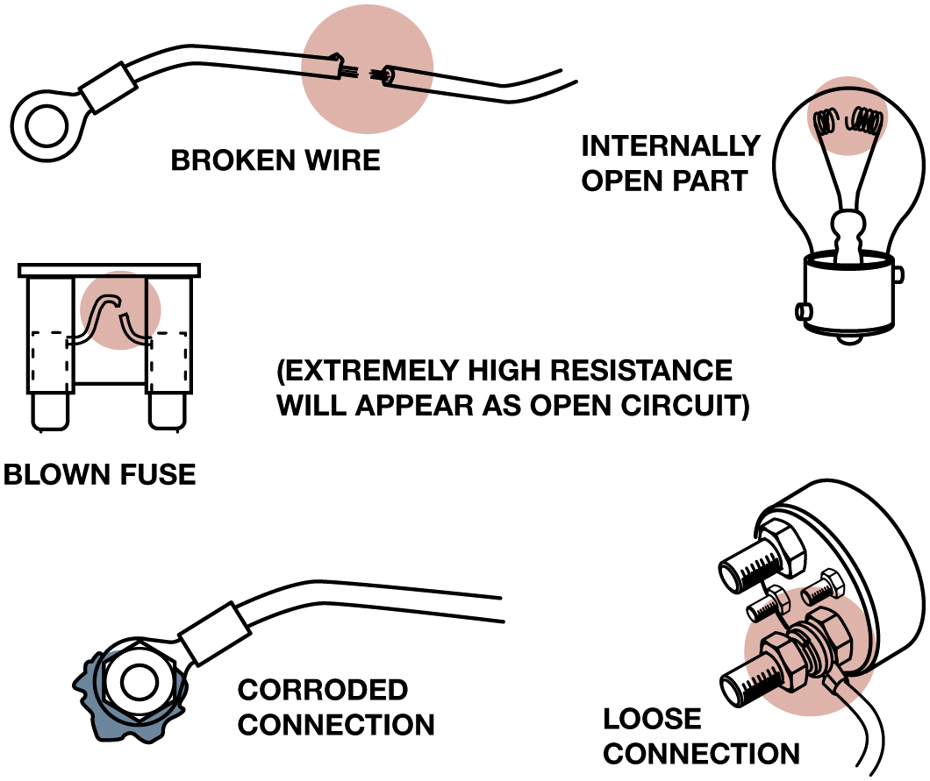
Figure 14.21
Examples of common causes of open circuits. Some of these causes are often difficult to find.
Open Circuit
Circuit that is not complete, or lacks continuity
Such as a broken wire.
Short-to-Voltage
Occurs when power side of one circuit
Electrically connected to power side of another circuit.
Notes:
Open circuit is any circuit that is not complete, or that lacks continuity, such as a broken wire.
Open circuits have the following features:
No current will flow through an open circuit.
An open circuit may be created by a break in the circuit or by a switch that opens (turns off) the circuit and prevents the flow of current.
In any circuit containing a power load and ground, an opening anywhere in the circuit will cause circuit not to work.
A light switch in a home and the headlight switch in a vehicle are examples of devices that open a circuit to control its operation.
NOTE: A blown fuse opens the circuit to prevent damage to the components or wiring in the circuit in the event of an overload caused by a fault in the circuit.
Long Description:
The illustration on the top left is labeled broken wire. It has a wire with an attachment on its left end. The wire is broken in the middle. The illustration on the top right is labeled internally open part. It has a bulb. The filament inside the bulb is broken. The illustration below, on the left, is labeled blown fuse. It has a wide U-shaped structure. A wire connects both vertical ends. The wire is broken in the middle. The text on the right reads extremely high resistance will appear as an open circuit. The illustration on the bottom left is labeled corroded connection. It has a wire with an attachment on its left end. The attachment is damaged. The illustration on the bottom right is labeled loose connection. It has a two-pin plug. One of the pins is loosely connected.

Slide 30
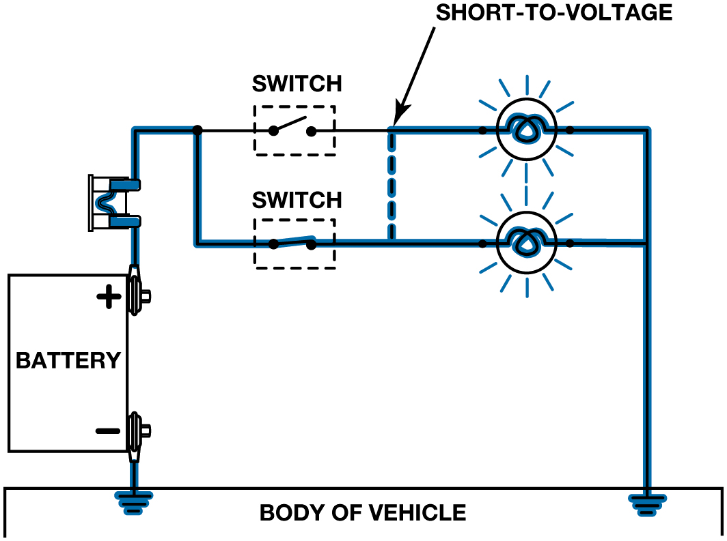
Figure 14.22
A short circuit permits electrical current to bypass some or all of the resistance in the circuit.
Notes:
Short-to-Voltage If a wire (conductor) or component is shorted to voltage, it is commonly referred to as being
shorted. A short-to-voltage occurs when the power side of one circuit is electrically connected to
the power side of another circuit.
A short circuit has the following features:
1. It is a complete circuit in which the current usually bypasses some or all of the resistance in the circuit.
2. It involves the power side of the circuit.
3. It involves a copper-to-copper connection (two power side wires touching together).
4. It is also called a short-to-voltage.
5. It usually affects more than one circuit. In this case, if one circuit is electrically connected to another circuit, one of the circuits may operate when it is not supposed to because it is being supplied power from another circuit.
6. It may or may not blow a fuse.
Long Description:
The illustration has a vehicle body at the bottom. A battery is positioned above it on the left. Its top end is positively charged and its bottom end is negatively charged. A wire connects the negative end of the battery to the vehicle body. Another wire extends from the positive end and connects to a fuse. It extends further and passes through a closed switch and two parallelly placed light bulbs. A dotted line connecting the two bulbs on the left is labeled short to voltage. The wire extends further and connects to the vehicle body.

Slide 31
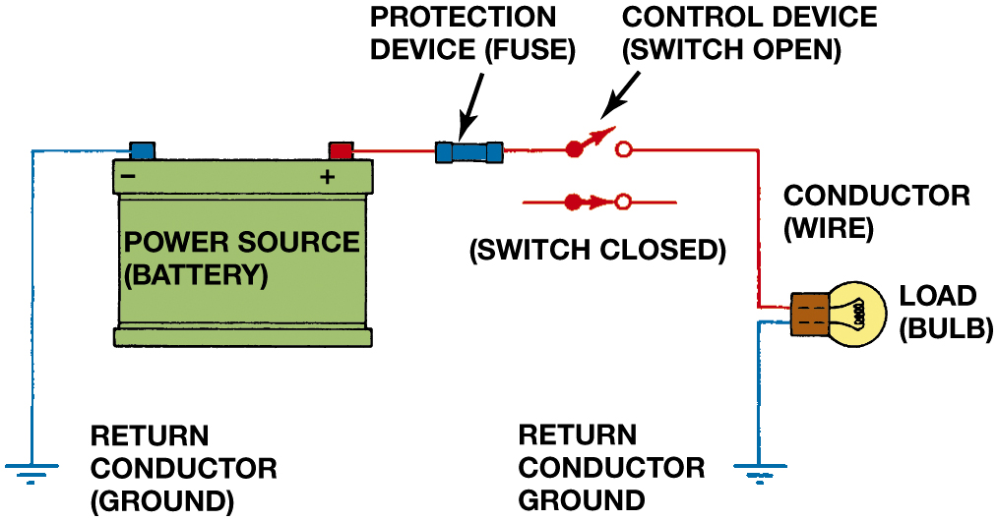
Figure 14.23
A fuse or circuit breaker opens the circuit to prevent possible overheating damage in the event of a short circuit.
Notes:
Long Description:
The illustration has a battery. The battery is positively charged on the right end and negatively charged on the left. A wire extends from the battery's left end to the ground, labeled return conductor. Another conductor wire extends from the battery's right end to the ground, labeled return conductor. The conductor wire connects the protection device, a switch, and a load bulb. In the case of a short circuit, the switch opens and the circuit breaks.

Slide 32
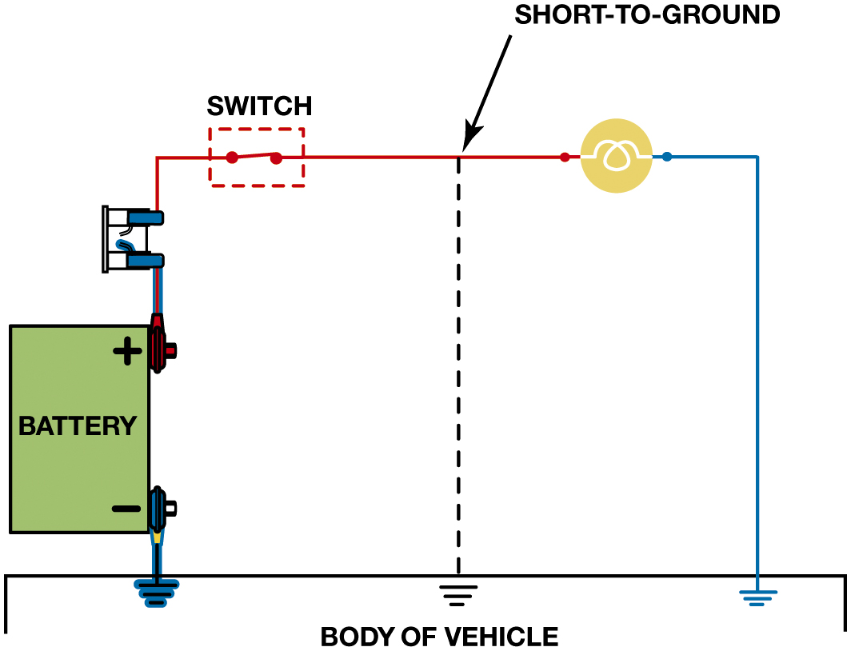
Figure 14.24
Short-To-Ground
A short-to-ground affects the power side of the circuit. Current flows directly to the ground return, bypassing some or all of the electrical loads in the circuit. There is no current in the circuit past the short. A short-to-ground will also cause the fuse to blow.
Notes:
A short-to-ground is a type of short circuit that occurs when the current bypasses part of the nor-
mal circuit and flows directly to ground. A short-to-ground has the following features:
Because the ground return circuit is metal (vehicle frame, engine, or body), it is often identified as having current flowing from copper to steel.
A short-to-ground can occur at any place where a power path wire accidentally touches a return path wire or conductor. ● SEE Figure 9.24.
A defective component or circuit that is shorted to ground is commonly called grounded.
A short-to-ground almost always results in a blown fuse, damaged connectors, or melted wires.
High resistance is resistance higher than normal circuit resistance usually caused by following:
■ Corroded connections or sockets
■ Loose terminals in a connector
■ Loose ground connections
If there is high resistance anywhere in a circuit, it may cause the following problems:
1. Slow operation of a motor-driven unit, such as when the transfer case makes a range change.
2. Dim lights
3. “Clicking” of relays or solenoids
4. No operation of a circuit or electrical component
Long Description:
The illustration has a vehicle body at the bottom. A battery is positioned above it on the left. Its top end is positively charged and its bottom end is negatively charged. The negative terminal of the battery is wired to the body of the vehicle. From the positive end, a wire extends further and is connected to a fuse. It travels on and passes through a switch that is closed. It then extends further, travels through a bulb, and is linked to the vehicle's body. There is a short to the ground between the switch and the lightbulb that prevents current from flowing through it.

Slide 33
Animation: Working with Wiring Diagrams (Animation will automatically start)

Slide 34
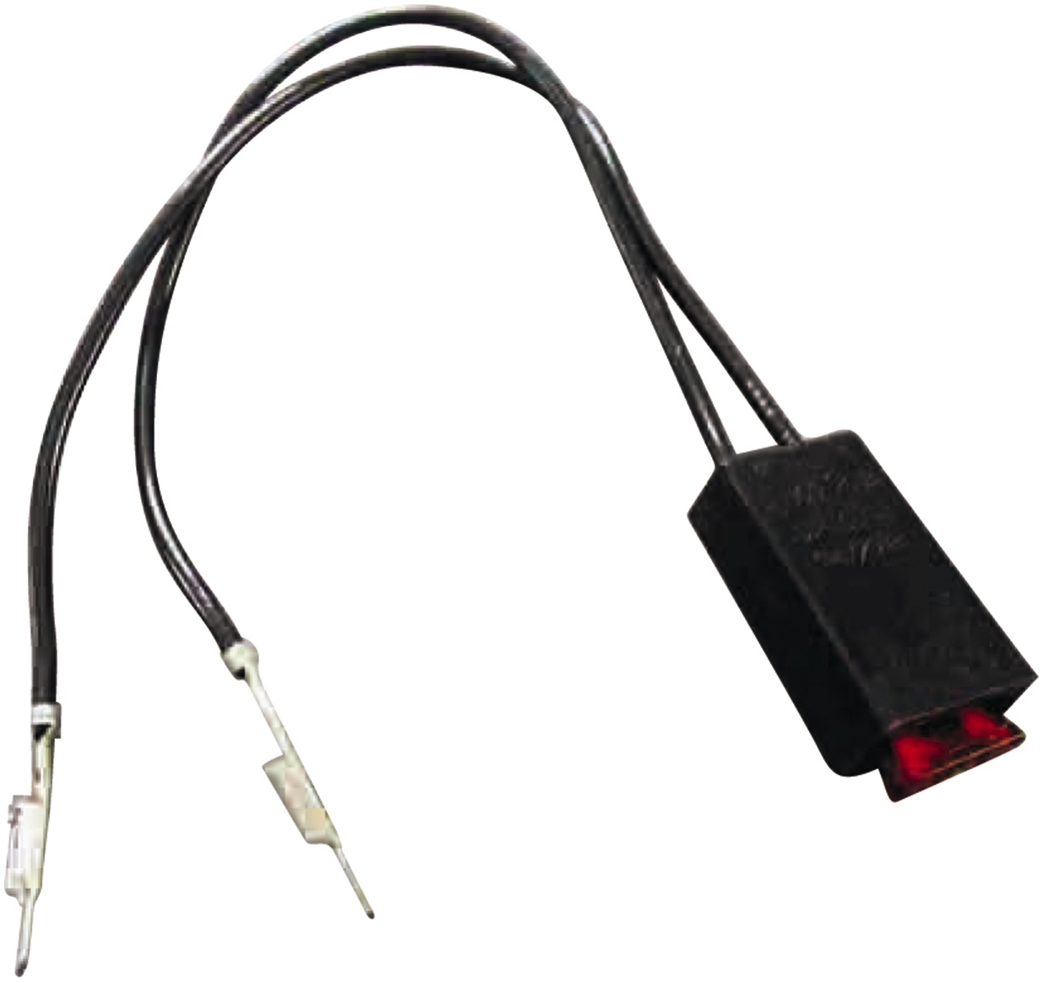
Fused Jumper Wire
Purpose and function
Fuse
Alligator clip ends
Good-quality insulated wire
Figure 14.25 A technician-made fused jumper lead, which is equipped with a red 10-ampere fuse. This fused jumper wire uses terminals for testing circuits at a connector instead of alligator clips.

Slide 35
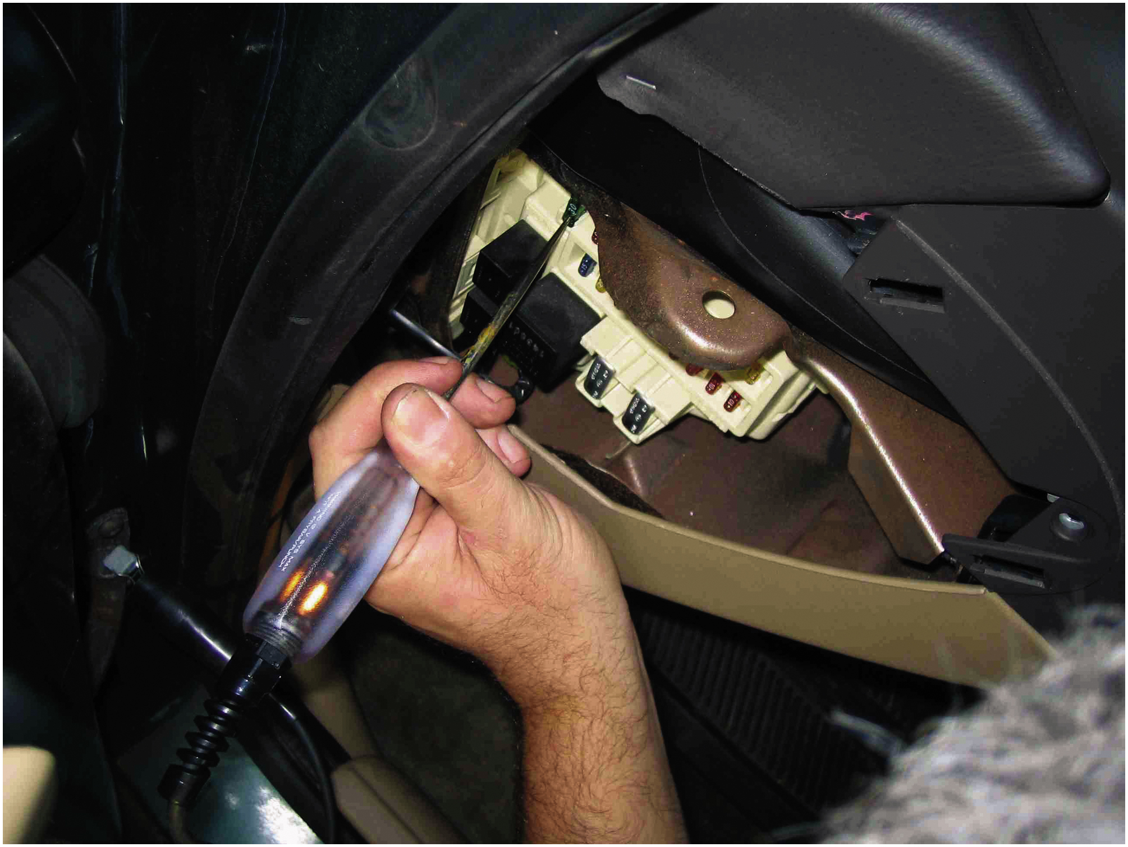
Figure 14.26
Testing a fuse with a test light. If the fuse is good, the test light should light on both sides (power side and load side) of the fuse.
Non-powered Test Light
Use of a 12-volt test light
Electrical power
Grounds

Slide 36
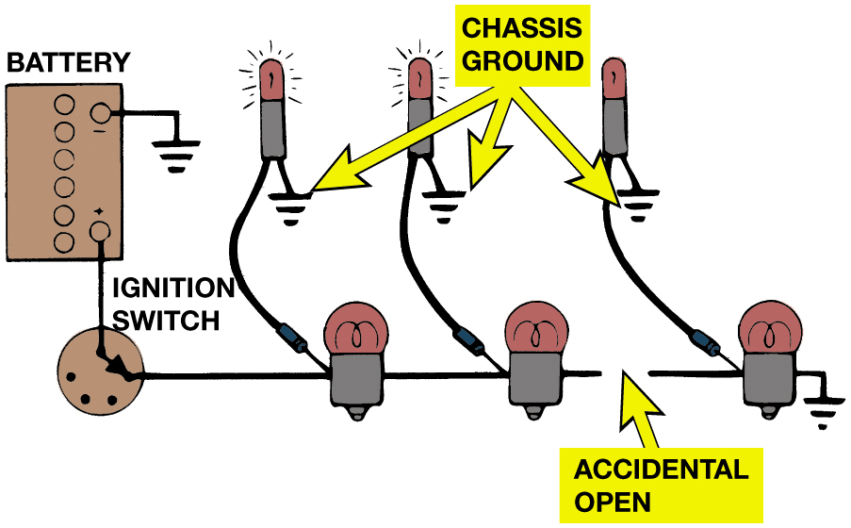
Figure 14.27
Test Light Use
A test light can be used to locate an open in a circuit. Note that the test light is grounded at a different location than the circuit itself.
Notes:
Long Description:
The illustration has a battery. One terminal of the battery is grounded. A wire extends from the battery's other terminal. The wire connects to an ignition switch, which is connected further to a series of three light bulbs. Each of the light bulbs is grounded at different locations labeled chassis ground. The third and second bulbs are connected via a broken wire. It is labeled accidental switch.

Slide 37
Animation: Circuit Test, Test Light (Animation will automatically start)

Slide 38
Animation: Test Light Checks (Animation will automatically start)

Slide 39
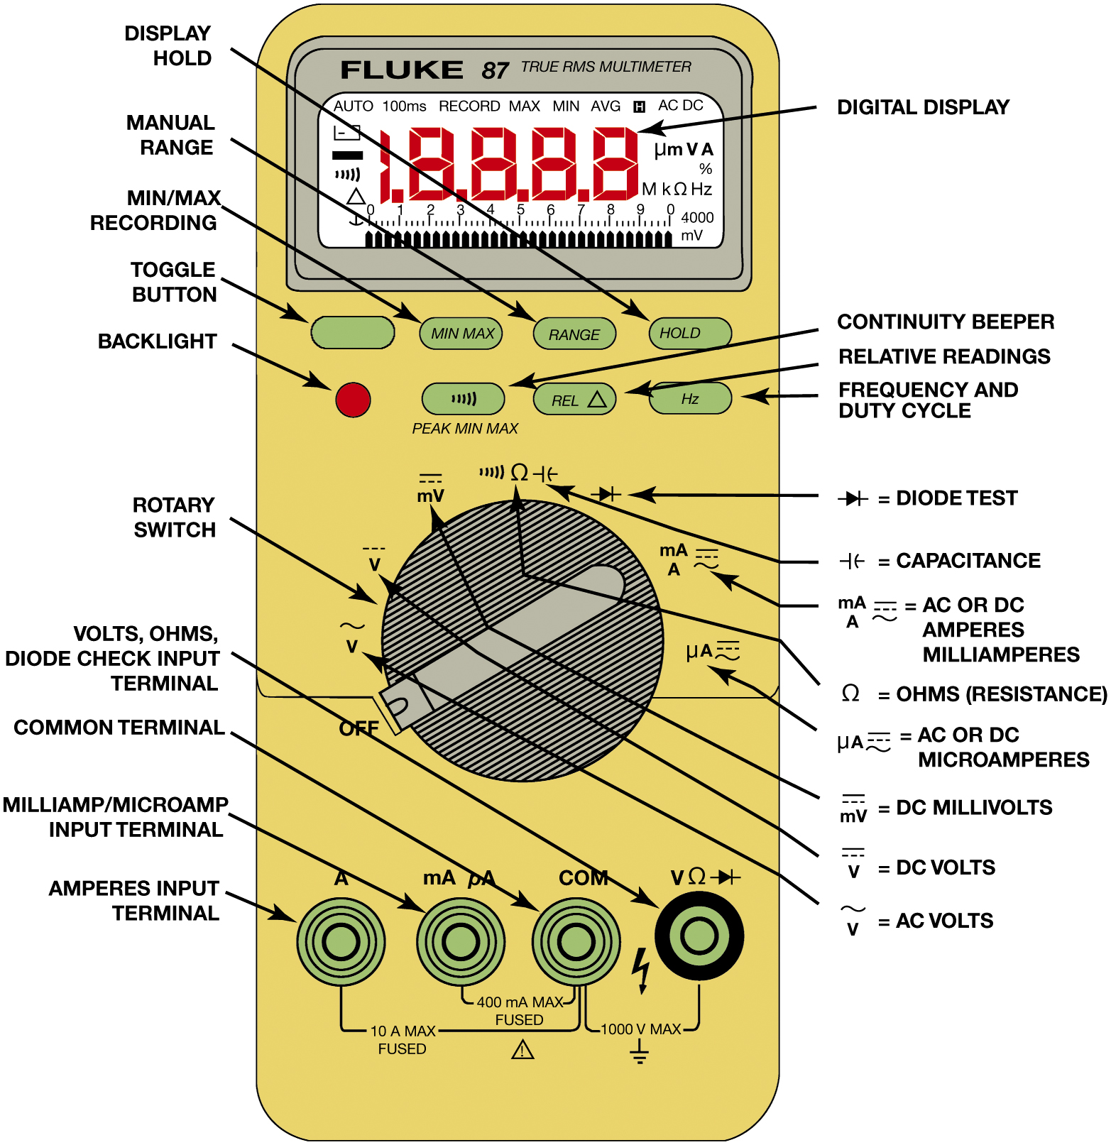
Digital Multimeter (D M M)
Voltmeter measures pressure or potential of electricity in volts.
Ohmmeter measures resistance in ohms of a component or circuit section when no current is flowing
Ammeter measures flow of current through a complete circuit in amperes or milliamperes.
Figure 14.28 Typical digital multimeter. The black meter lead always is placed in the COM terminal. The red meter test lead should be in the volt-ohm terminal except when measuring current in amperes.
Notes:
Long Description:
An illustration of a typical digital multimeter comprises a digital display at the top. Below it are four buttons. From left to right, they are as follows. Toggle button, minimum and maximum recording, manual range, and display hold. Below them is a series of four buttons. From left to right, they are as follows. Backlight, continuity beeper, relative readings, and frequency and duty cycle. Below it is a circular rotatory switch. It has several symbols around it. In a counter clockwise direction, they are as follows. A C or D C microamperes, A C or D C amperes milliamperes, diode test, capacitance, ohm's resistance, D C millivolts, D C volts, A C volts, and off. Below the rotatory switch are four buttons. From left to right, they are as follows. Volts, ohms, diode check input terminal, common terminal, milliampere, microampere input terminal, and amperes input terminal. The ampere's input terminal and common terminal are 10 amperes maximum fused. The milliampere and microampere input terminals and common terminal are 400 milliampere maximum fused. The common terminal and the diode check input terminal are1000 volts maximum.

Slide 40
Chart 14.1
Common symbols and abbreviations used on D M M
SYMBOL | MEANING
A C | Alternating current or voltage
D C | Direct current or voltage
V | Volts
m V | Millivolts (1/1,000 volts)
A | Ampere (amps), current
m A | Milliamperes (1/1,000 amps)
% | Percent (for duty cycle readings only)
ohms | Ohms, resistance
Kilo ohms | Kilohm (1,000 ohms), resistance
Mega ohms | Megohm (1,000,000 ohms), resistance
H z | Hertz (cycles per second), frequency
k H z | Kilohertz (1,000 cycles/sec.), frequency
M s | Milliseconds (1/1,000 sec.) for pulse width measurements

Slide 41
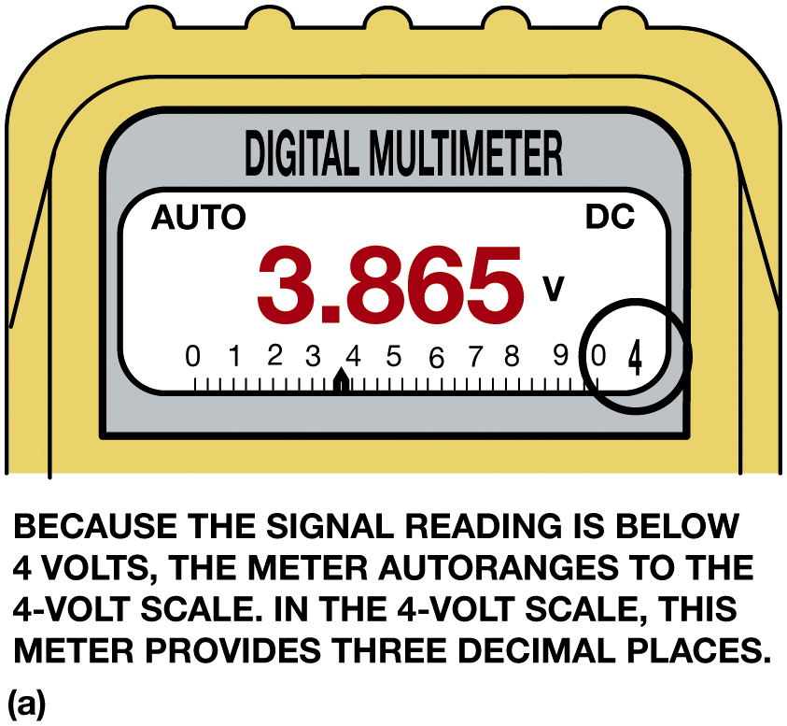
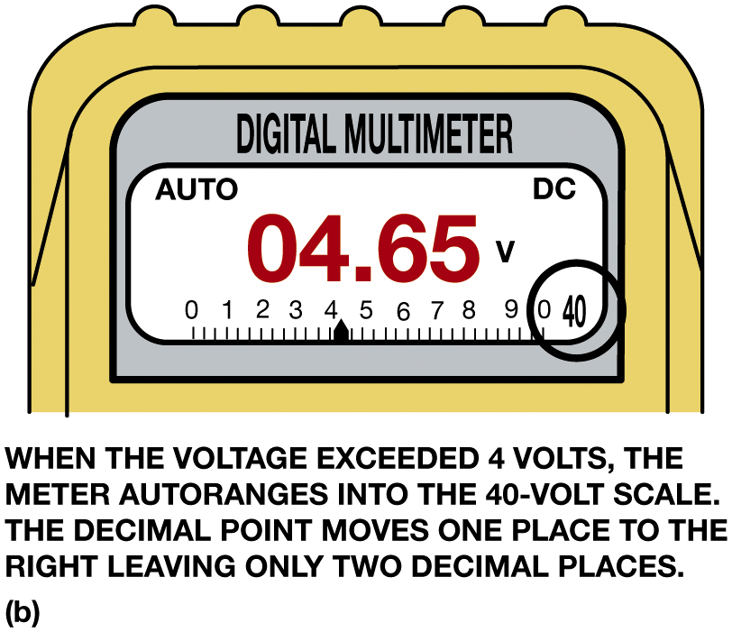
Figure 14.30
A typical autoranging digital multimeter automatically selects the proper scale to read the voltage being tested. The scale selected is usually displayed on the meter face. (a) Note that the display indicates “4,” meaning that this range can read up to 4 volts. (b) The range is now set to the 40-volt scale, meaning that the meter can read up to 40 volts on the scale. Any reading above this level will cause the meter to reset to a higher scale. If not set on autoranging, the meter display would indicate O L if a reading exceeds the limit of the scale selected.
Notes:
Figure 9.30 A typical autoranging digital multimeter automatically selects the proper scale to read the voltage being tested. The scale selected is usually displayed on the meter face. (a) Note that the display indicates “4,” meaning that this range can read up to 4 volts. (b) The range is now set to the 40 volt scale, meaning that the meter can read up to 40 volts on the scale. Any reading above this level will cause the meter to reset to a higher scale. If not set on autoranging, the meter display would indicate O L if a reading exceeds the limit of the scale selected.
D C volts (D C V). This setting is the most common for automotive use. Use this setting to measure
battery voltage and voltage to all lighting and accessory circuits.
A C volts (A C V). This setting is used to check some computer sensors and to check for unwanted A C
voltage from alternators.
Range. The range is automatically set for most meters but can be manually adjusted if needed.
THINK OF MONEY Digital meter displays can often be confusing. The display for a battery measured as 12 1/2 volts would be 12.50 V just as $12.50 is 12 dollars and 50 cents. A 1/2 volt reading on a digital meter will be displayed as 0.50 V, just as $0.50 is half of a dollar. It is more confusing when low values are displayed. E.G. if a voltage reading is 0.063 volt, an auto-ranging meter will display 63 millivolts (63 mV), or 63/1, 000 of a volt, or $63 of $1, 000. (It takes 1,000 mV to equal 1 volt.) Think of millivolts as
one-tenth of a cent, with 1 volt being $1.00. Therefore, 630 millivolts are equal to $0.63 of $1.00 (630 tenths of a cent, or 63 cents). To avoid confusion, try to manually range the meter to read base units (whole volts). If the meter is ranged to base unit volts, 63 millivolts would be displayed as 0.063 or maybe just 0.06, depending ay capabilities of the meter.
Long Description 1:
The illustration is of the upper part of the digital multimeter. The display is labeled a digital multimeter. The top left and right corners of the display reads auto and D C. The reading is 3.865 volts. Below the reading is a scale. It ranges from 0 to 10. The scale has an indicator placed before 4. The digit 4 is encircled on the bottom right. The text below it reads because the signal reading is below 4 volts the meter auto arranges to the 4-volt scale. In, the 4-volt scale, this meter provides three decimal places.
Long Description 2:
The illustration is of the upper part of the digital multimeter. The display is labeled a digital multimeter. The top left and right corners of the display reads auto and D C. The reading is 04.65 volts. Below the reading is a scale. It ranges from 0 to 10. The scale has an indicator placed after 4. The digit 40 is encircled on the bottom right. The text below it reads when the voltage exceeds 4-volt the meter auto arranges into the 40-volt scale. The decimal point moves one place to the right, leaving only two decimal places.

Slide 42
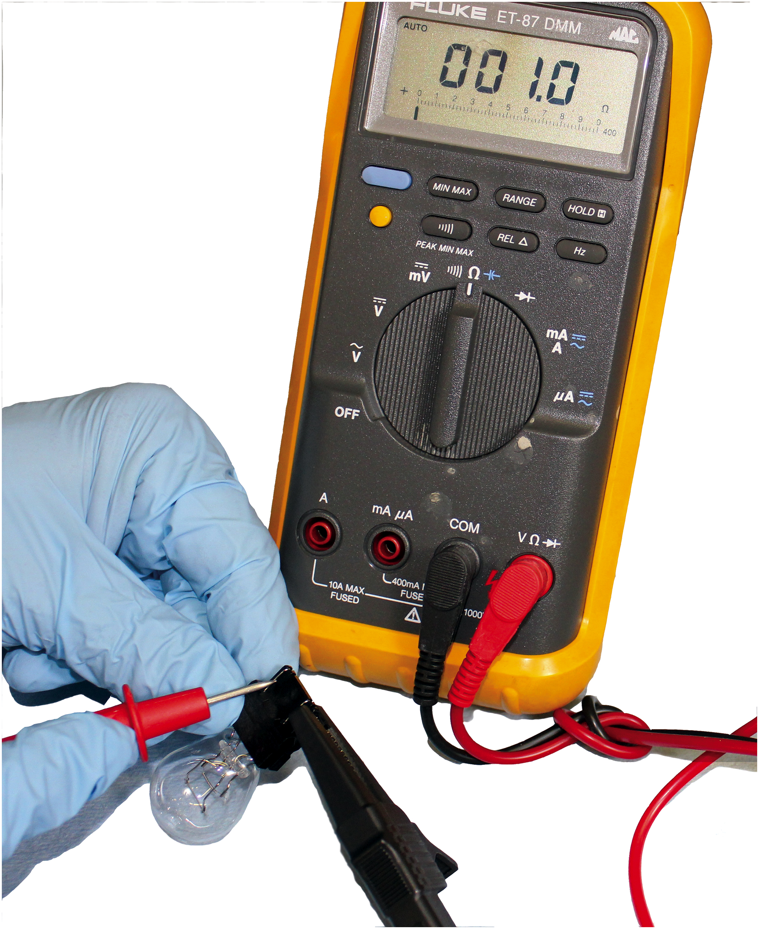
Figure 14.31
Using a digital multimeter set to read ohms
to test this
light bulb. The meter reads the resistance of the filament.
Notes:
Measuring Resistance
An ohmmeter measures resistance in ohms of a component or circuit section when no current is flowing through the
circuit. An ohmmeter contains a battery (or other power source) and is connected in series with the
component or wire being measured.
Zero ohms on the scale means that there is no resistance between the test leads, thus indicating continuity or a continuous path for the current to flow in a closed circuit.
Infinity means no connection, as in an open circuit.
Ohmmeters have no required polarity even though red and black test leads are used for resistance measurement. Different meters have different ways of indicating infinity resistance, or a reading higher than the scale allows. Examples of an over-limit display
include the following:
O L, meaning over limit or overload
Flashing or solid number 1
Flashing or solid number 3 on the left side of the display Check the meter instructions for the exact display used to indicate an open circuit or over-range reading.
To summarize, open and zero readings are as follows:
0.00 Ω = Zero resistance (component or circuit has continuity)
O L = An open circuit (no current flows) or the reading is higher than the scale selected.

Slide 43
Animation: Meter Usage, Measure Ohms (Animation will automatically start)

Slide 44
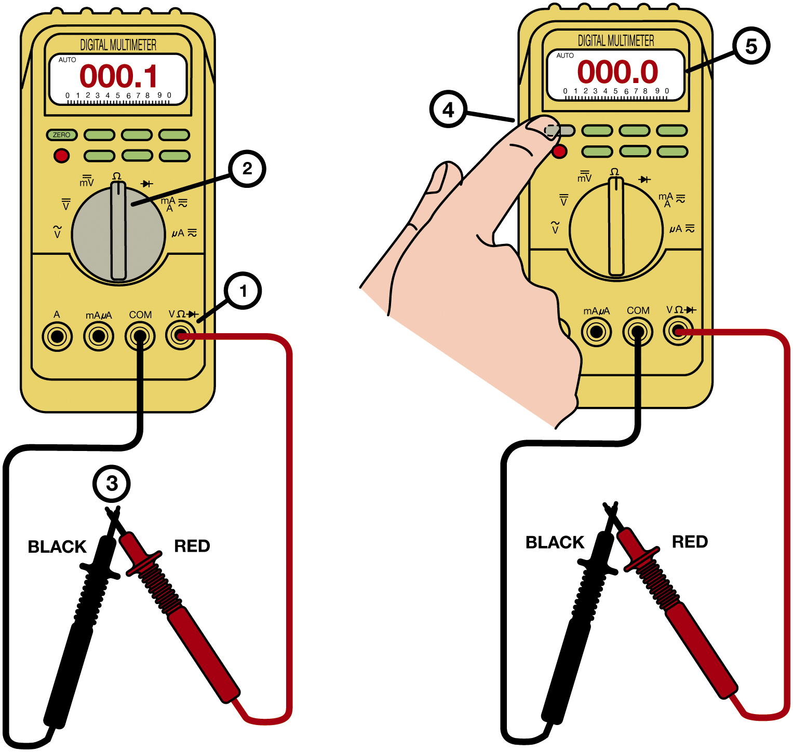
Figure 14.32
Testing Leads
Many digital multimeters can have the display indicate zero to compensate for test lead resistance. (1) Connect leads in the
and C O M meter terminals. (2) Select the
scale. (3) Touch the two
meter leads together. (4) Push the “zero” or “relative” button on the meter. (5) The meter display will now indicate zero ohms of resistance.
Notes:
Figure 9.32 Many digital multimeters can have the display indicate zero to compensate for test lead resistance.
Connect leads in the V Ω and C O M meter terminals.
Select the Ω scale.
Touch the two meter leads together.
(4) Push the “zero” or “relative” button on the meter.
(5) The meter display will now indicate zero ohms of resistance.
Long Description:
The illustration on the left is of a digital multimeter. The display of the multimeter reads 0 0 0 point 1. The steps to indicate zero are as follows. In Step one, a cable with a pointed end is connected to the volt-ohm diode check input terminal. In step 2, the rotating switch is set to ohms. In step 3, the pointed ends of the 2 cables are touched. The illustration on the right is of a digital multimeter. The display of the multimeter reads 0 0 0 point 0. The steps to indicate zero are as follows. In step 4, the toggle button is pushed. In step 5, the metre display indicates zero ohms of resistance.

Slide 45
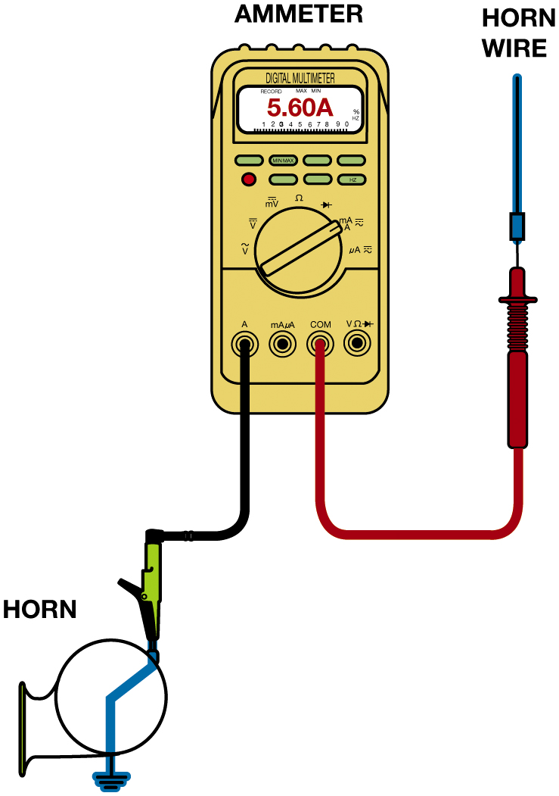
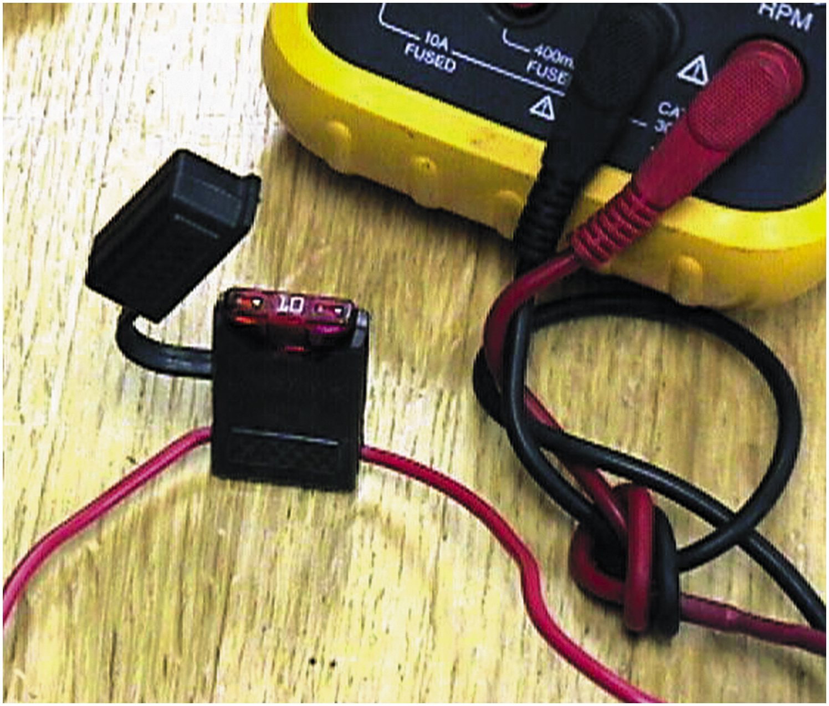
Testing for Current
Figure 14.34 Note the blade-type fuse holder soldered in series with one of the meter leads. A 10-ampere fuse helps protect the internal meter fuse (if equipped) and the meter itself from damage that may result from excessive current flow if accidentally used incorrectly.
Figure 14.33 Measuring the current flow required by a horn requires that the ammeter be connected to the circuit in series and the horn button be depressed by an assistant.
Notes:
Long Description:
The illustration has an ammeter. It is labeled a digital multimeter. A cable with a pointed end is connected to the common terminal. It is further connected to a horn wire. Another cable with a horn clip is connected to the amperes input terminal. It is further connected to an irregular structure labeled horn.

Slide 46
Animation: Meter Usage, Measure Amps (Animation will automatically start)

Slide 47
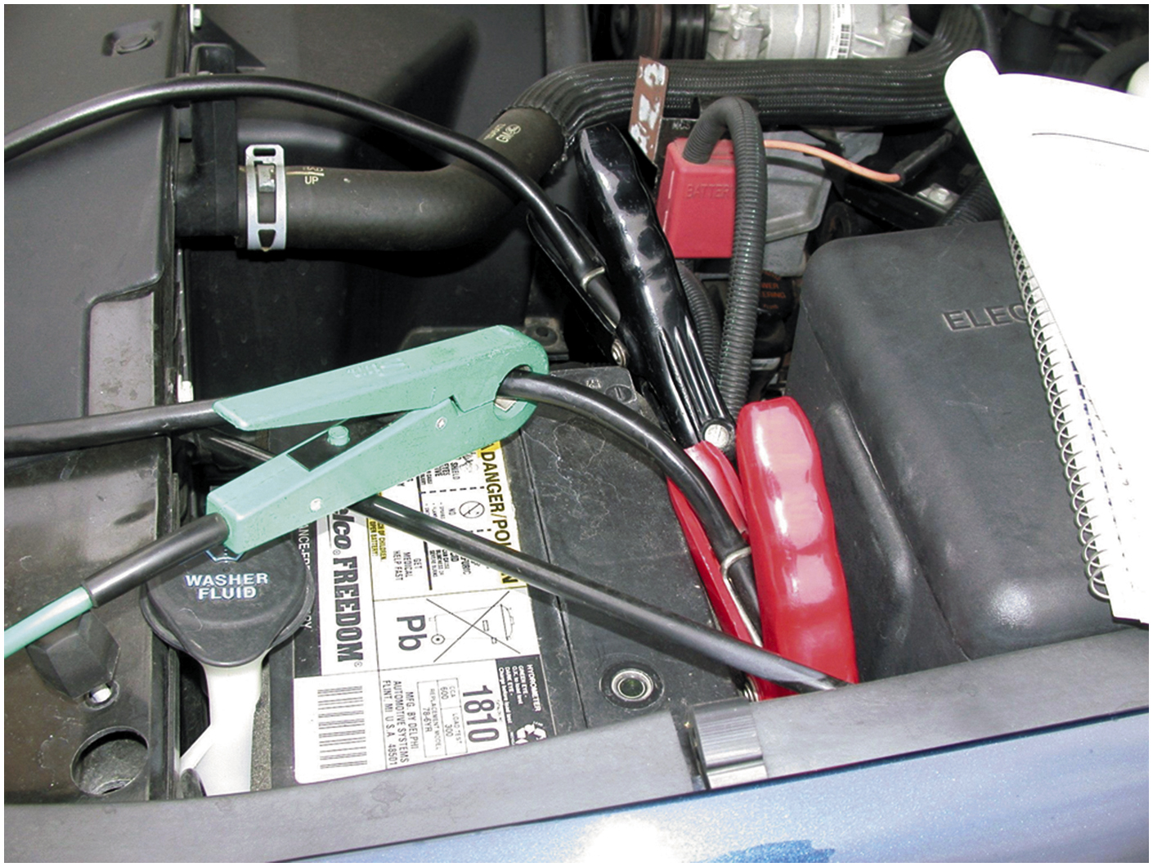
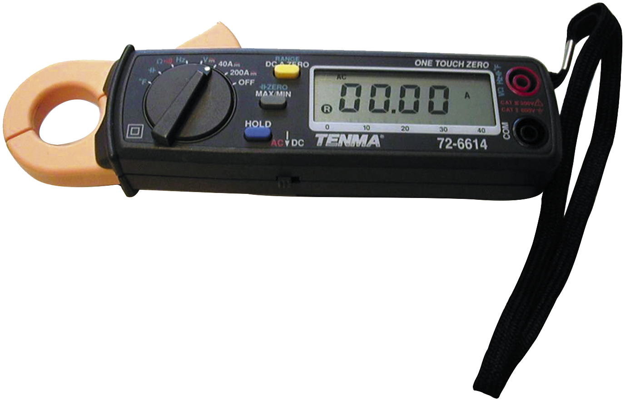
Induction Ammeters
Figure 14.36 A typical mini clamp-on-type digital multimeter. This meter is capable of measuring alternating current (A C) and direct current (D C) without requiring that the circuit be disconnected to install the meter in series. The jaws are simply placed over the wire and current flow through the circuit is displayed.
Figure 14.35 An inductive ammeter clamp is used with all starting and charging testers to measure the current flow through the battery cables.

Slide 48
Animation: Battery Drain Test, Clamp Meter (Animation will automatically start)

Slide 49
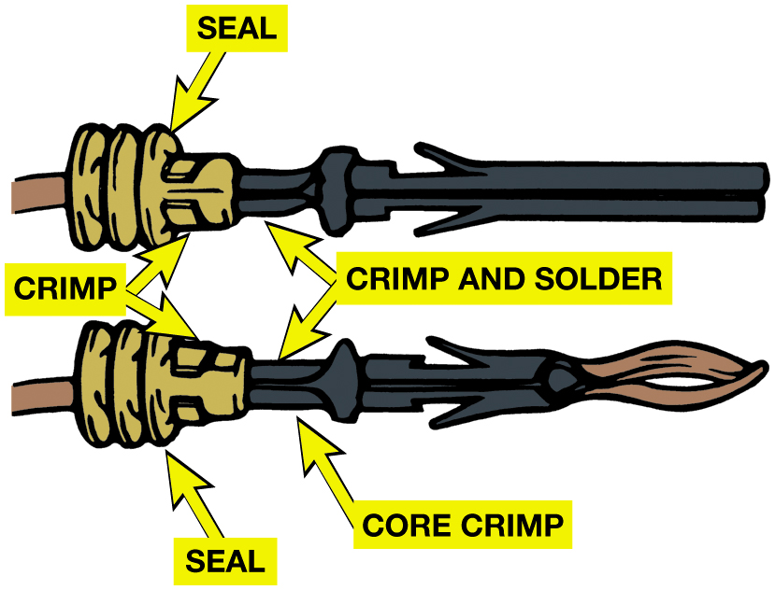
Terminals and Connectors
Terminal
Metal fastener attached
to end of wire
Makes electrical connection.
Connector
plastic portion snaps or connects together
Electrical Connectors exposed to environment use weather-tight seal.
Figure 14.37 Some terminals have seals attached to help seal the electrical connections.
Notes:
Long Description:
The illustration has two rods placed one below the other. The right end of the bottom rod has a pointed structure. The left end of both rods has an irregular tubular structure. The top part of the tabular structure is labeled crimp and the bottom part is labeled seal. The external segment of the rod that connects to the crimp and seal is labeled core crimp. The internal segment of the rod that connects to the crimp and seal is labeled crimp and solder.

Slide 50
Figure 14.38
Separate a connector by opening the lock and pulling the two apart.
Notes:
Long Description:
The illustration has a U-shaped plug like structure on the left. On the right is a separator. The secondary locks on both are closed.

Slide 51
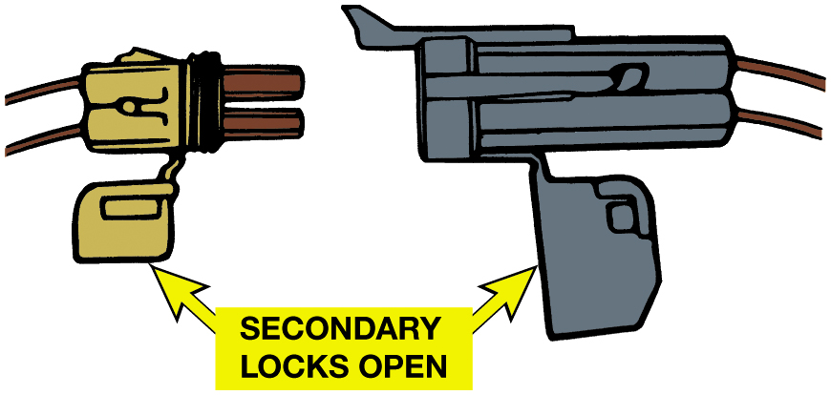
Figure 14.39
The secondary locks help retain the terminals in the connector.
Notes:
Long Description:
The illustration has a U-shaped plug like structure on the left and a rectangular separator on the right. The secondary locks on both are open.

Slide 52
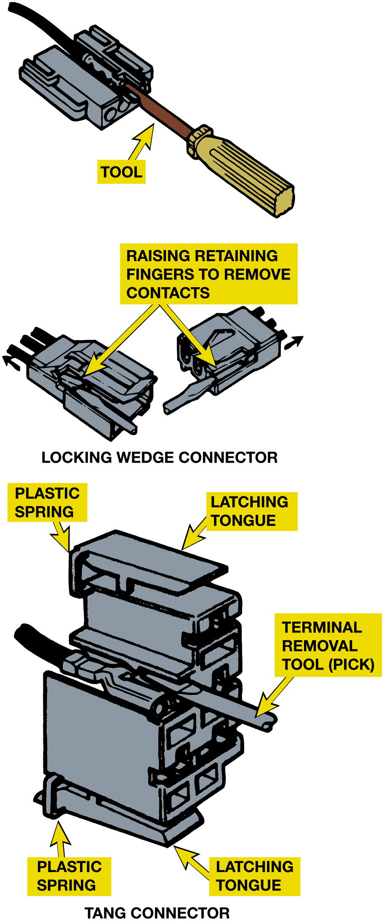
Figure 14.40
Use a small removal tool, sometimes called a pick, to release terminals from the connector.
Notes:
Long Description:
The illustration on the top is labeled as a locking wedge connector. It has a tubular tool fixed inside a rectangular structure. Below are two rectangular structures with three rod-like structures protruding out from one end. It is labeled raising retaining fingers to remove contacts. The illustration on the bottom is labeled as a tang connector. It has a stacked rectangular structure. The top and bottom left are labeled plastic springs. The top and bottom surfaces are labeled latching tongue. A rod-like structure protrudes from the right vertical surface labeled terminal removal tool pick.

Slide 53
Wire Repair
Soldering
Many manufacturers recommend that all wiring repairs be soldered.
Why?
What is the soldering procedure?
Crimping terminals
Heat shrink tubing
Crimp-and-seal connectors
Notes:
Many manufacturers recommend that all wiring repairs be soldered. Solder is an alloy of tin and lead used to make a good electrical contact between two wires or connections in an electrical circuit. However, a flux must be used to help clean the area and to
help make the solder flow. Therefore, solder is made with a resin (rosin) contained in the center, called rosin-core solder.
CAUTION: Never use acid-core solder to repair electrical wiring as the acid will cause corrosion. Figure 9.41.
Solder is available with various percentages of tin and lead in the alloy. Ratios are used to
identify these various types of solder, with the first number denoting the percent- age of tin in
the alloy and the second number giving the percentage of lead. The most commonly used solder is
50/50, which means that 50% of the solder is tin and the other 50% is lead. The percentages of each
alloy primarily determine the melting point of the solder.
■ 60/40 solder (60% tin/40% lead) melts at 361°F (183°C).
■ 50/50 solder (50% tin/50% lead) melts at 421°F (216°C).
■ 40/60 solder (40% tin/60% lead) melts at 460°F (238°C).

Slide 54
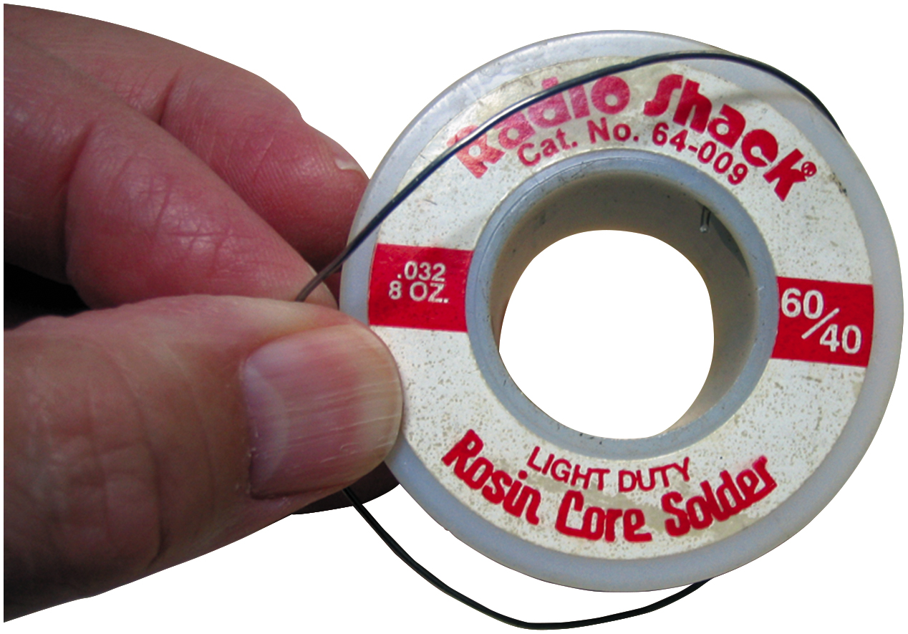
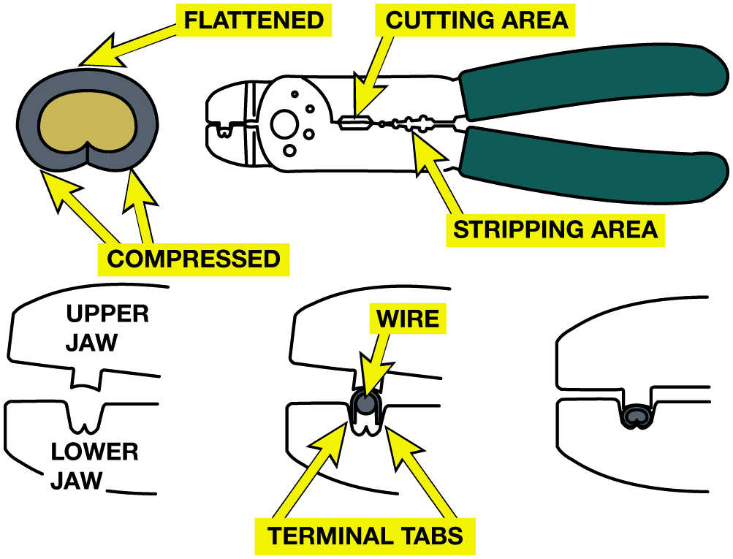
Soldering & Crimping Terminals
Notes:
Figure 9.41 Always use rosin-core solder. Use small-diameter solder for small soldering irons. Use large-diameter solder only for large-diameter (large-gauge) wire and higher-wattage soldering irons (guns).
Figure 9.42 Notice that to create a good crimp, the open part of the terminal is placed in jaws of crimping tool toward the anvil or the W-shape part.
Long Description:
The illustration has a crimping tool with enlarged tool parts all around it. The crimping tool has a V-shaped handle. On its right is a stripping area. A cutting area is on its right. On its right are the two jaws. On the right of the crimping tool is a crimped terminal with a flat top and a compressed bottom. Below the terminal is an enlarged view of the jaws of the crimping tool labeled upper jaw and lower jaw. On its right, a terminal is placed between the upper and lower jaw. On its right is a crimped terminal between the upper and lower jaw.

Slide 55
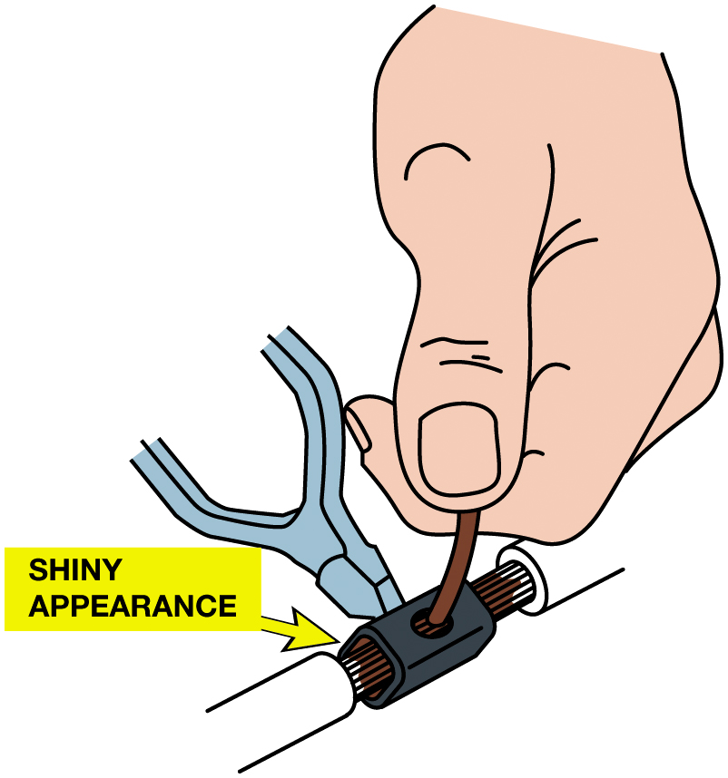
Figure 14.43
All hand-crimped splices or terminals should be soldered to be assured of a good electrical connection.
Notes:
Long Description:
The illustration has a narrow tubular terminal. At the center of the terminal is a hollow cylindrical structure with a shiny appearance and a perforation on top. The terminals are crimped using a splicing tool.

Slide 56
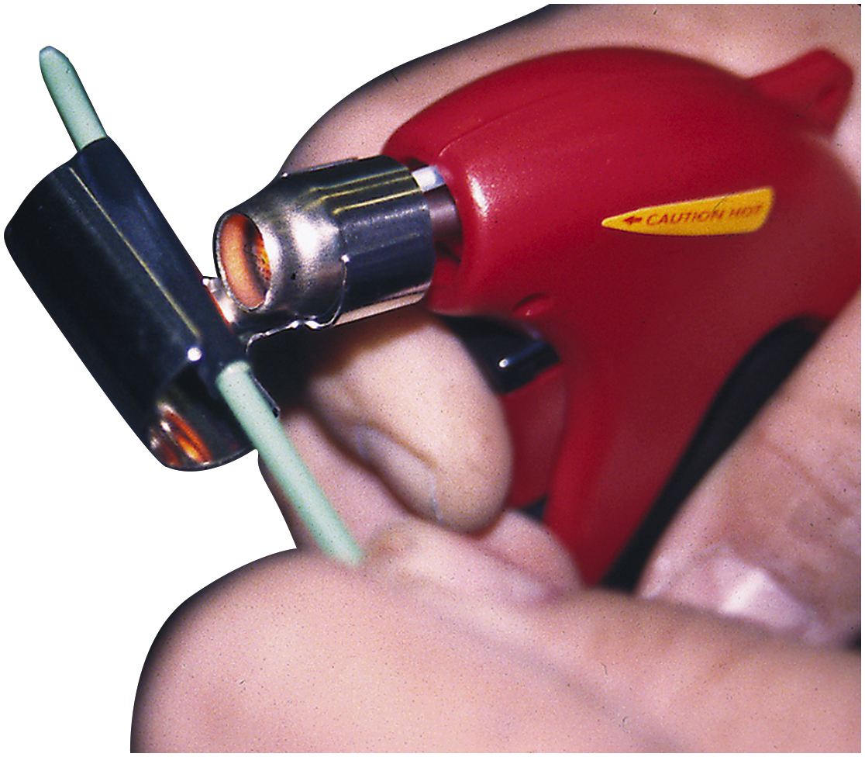
Figure 14.44
A butane torch especially designed for use on heat shrink applies heat without an open flame, which could cause damage.

Slide 57
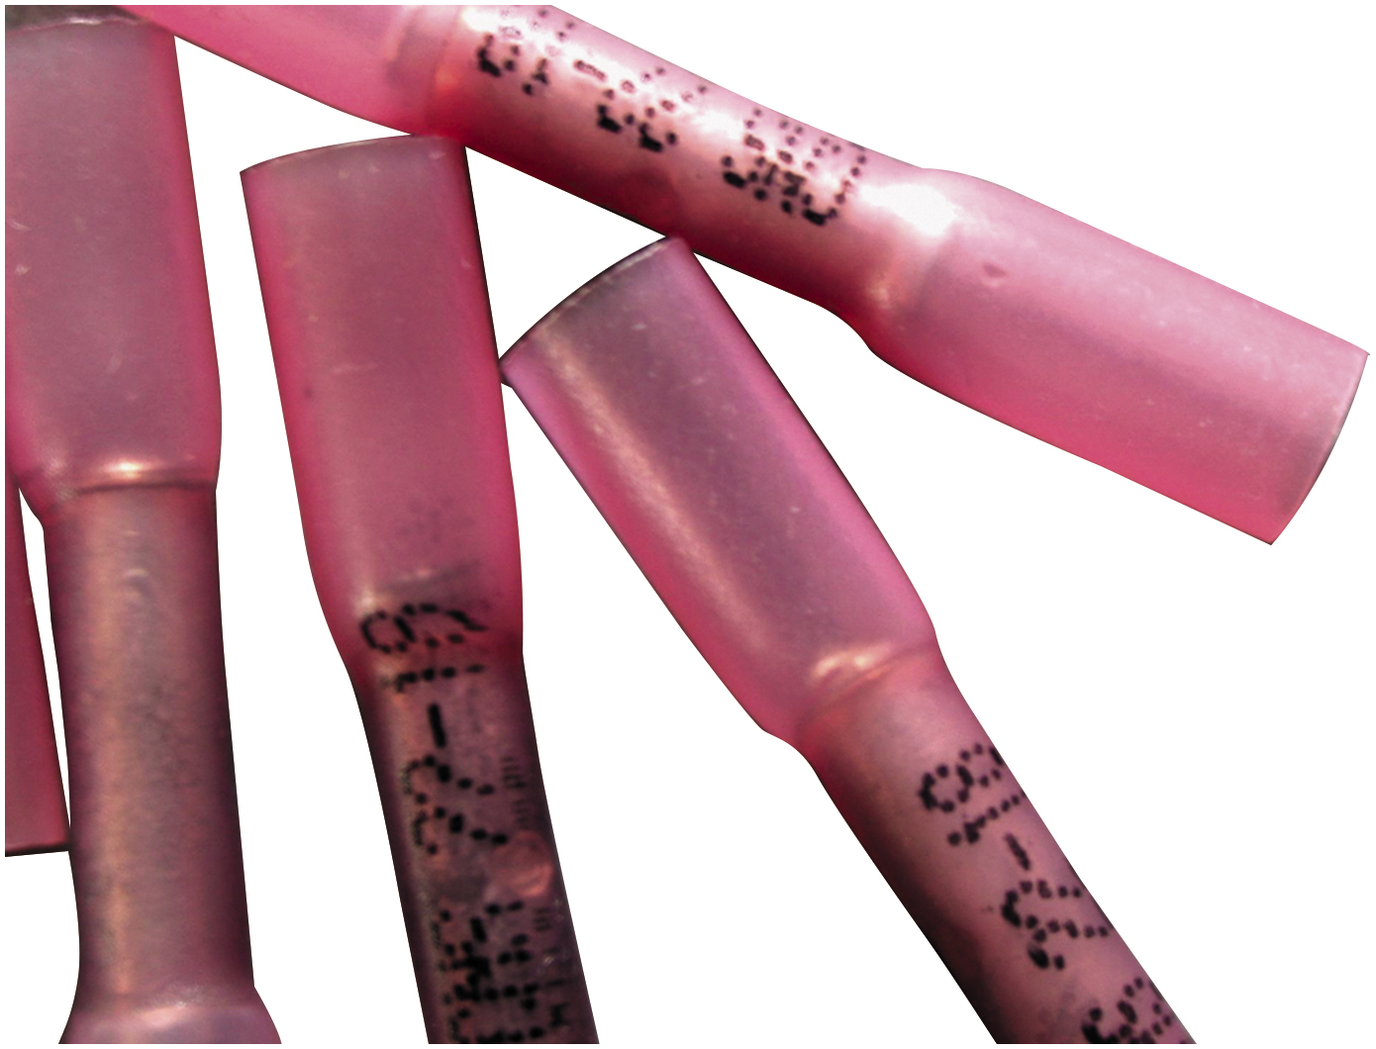
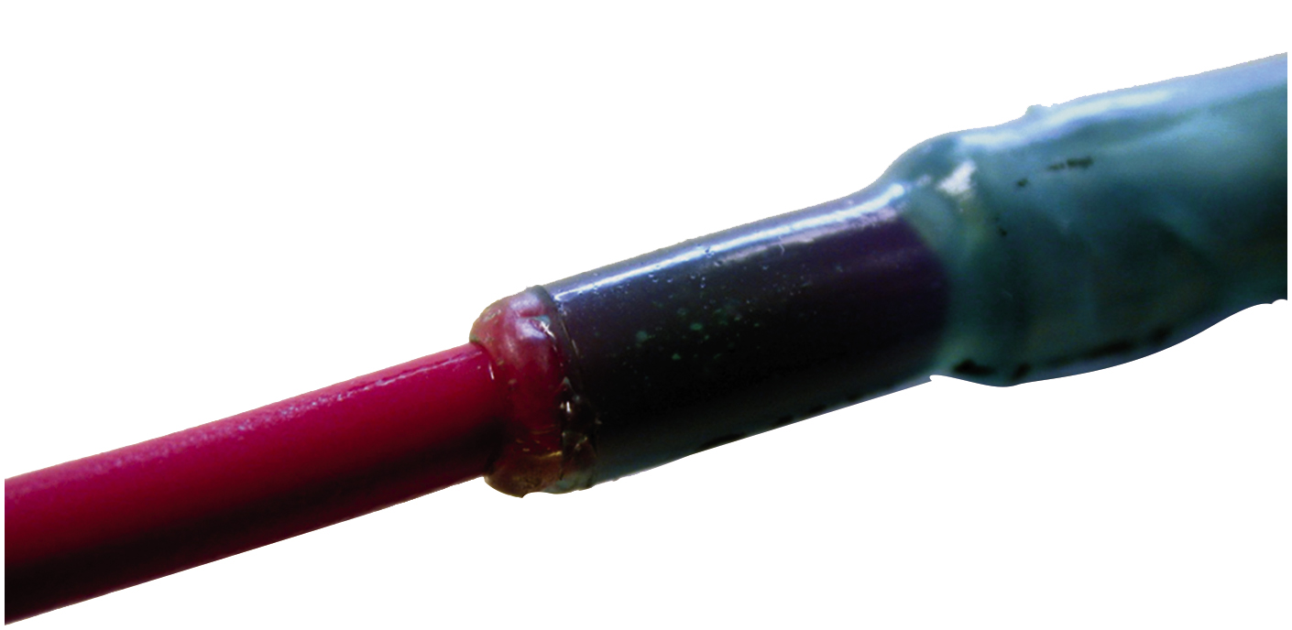
Figure Crimp & Seal Connector
Figure 14.46 Heating the crimp-and-seal connector melts the glue and forms an effective seal against moisture.
Figure 14.45 A typical crimp-and-seal connector. This type of connector is first lightly crimped to retain the ends of the wires and then it is heated. The tubing shrinks around the wire splice, and thermoplastic glue melts on the inside to provide an effective weather-resistant seal.

Slide 58
Animation: Electrical Wire Repair (Animation will automatically start)

Slide 59
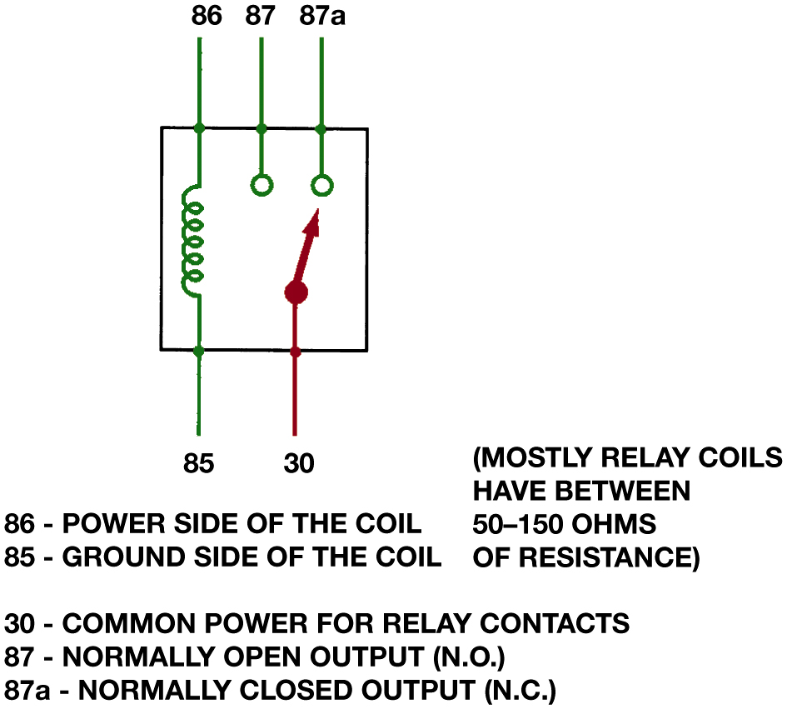
Figure 14.47
Relays
Magnetic Switch
Uses movable armature
Control high-amperage circuit
Using low-amperage switch
Terminal identification
Coil
Other terminals used to control the load current
A relay uses a movable arm to complete a circuit whenever there is a power at terminal 86 and a ground at terminal 85. A typical relay only requires about 1/10 ampere through the relay coil. The movable arm then closes the contacts (#30 to #87) and can often handle 30 amperes or more.
Notes:
Long Description:
The illustration has a square. Four wires are connected to the square. Each of them has a number. At the top left of the square is the power side of the coil (86), and at the bottom left of the square is its ground side (85). They are connected through a wire that has a coil. Adjacent to the power side of the coil is a normally open output (N.O. 87). It is connected to the square. On its right, it's a normally closed output (N.C. 87 a). It is connected to the square. On the bottom left of the square is common power for relay contacts (30). It is connected to the square. The text on the bottom right reads mostly relay coils have between 50- 150 ohms resistance.

Slide 60
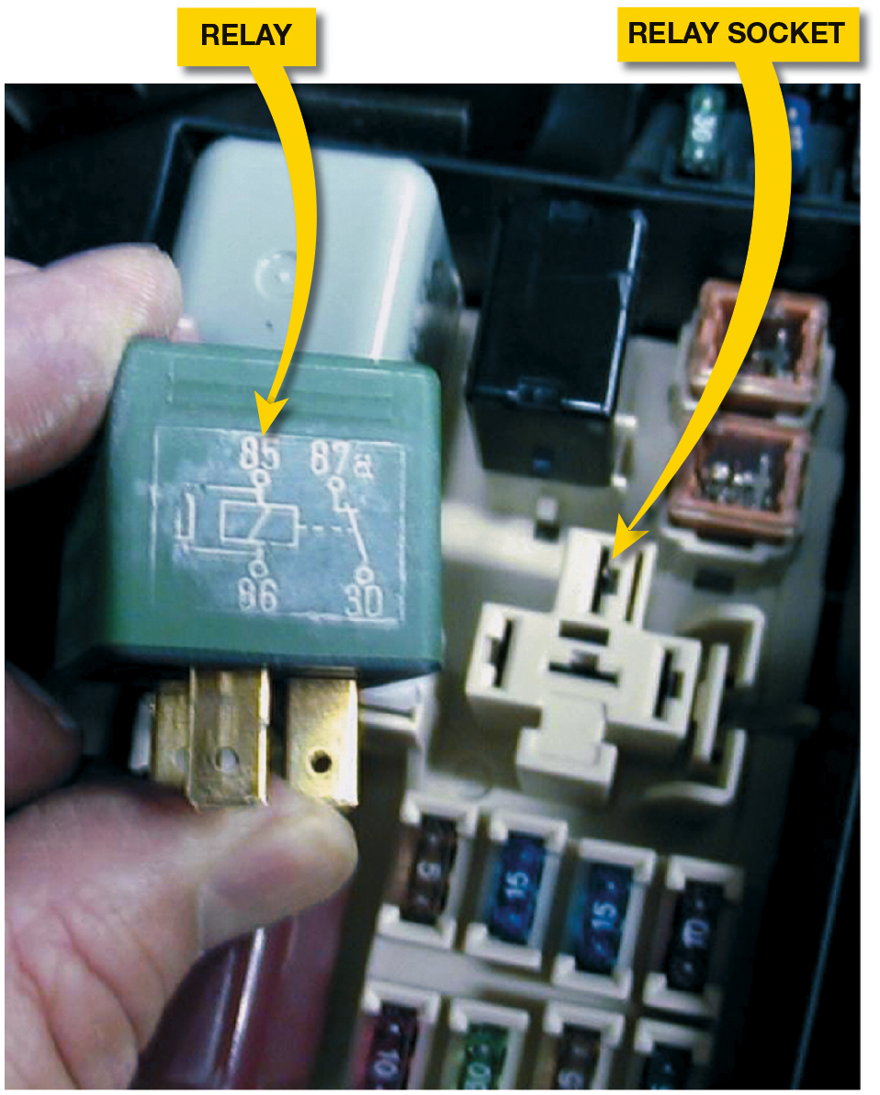
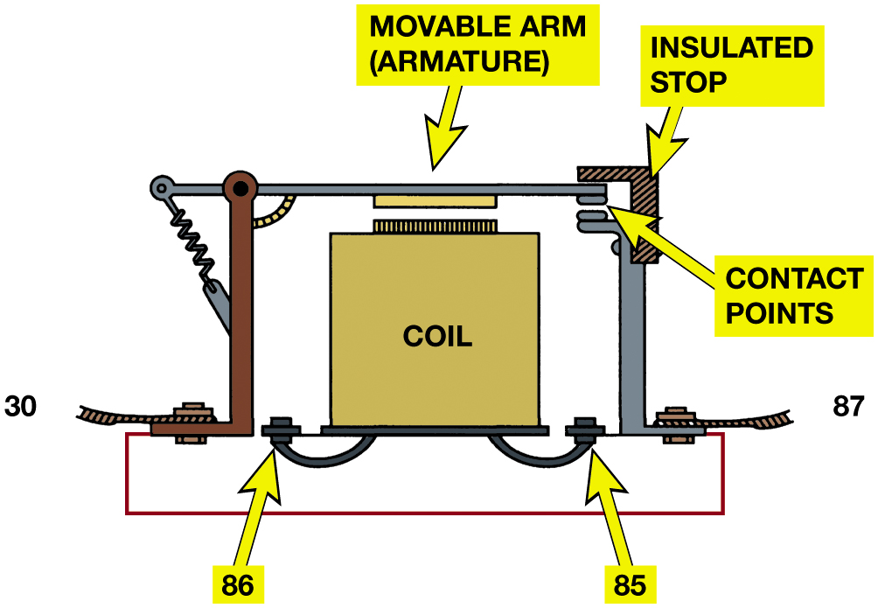
Relays (1 of 2)
Figure 14.48 A cross-sectional view of a typical four terminal relay. Current flowing through the coil (terminals 86 and 85) causes the movable arm (called the armature) to be drawn toward the coil magnet. The contact points complete the electrical circuit connected to terminals 30 and 87.
Figure 14.49 A typical relay showing the schematic of the wiring in the relay.
Notes:
Figure 9.48 cross-sectional view of a typical four-terminal relay. Current flowing through the coil (terminals 86 and 85) causes the movable arm (armature) to be drawn toward the coil magnet. The contact points complete the electrical circuit connected to terminals 30 and 87.
Figure 9.49 A typical relay showing the schematic of the wiring in the relay.
Figure 9.50 All schematics are shown in their normal, non-energized position.
Tech Tip: Divide the Circuit in Half
When diagnosing any circuit that has a relay, start testing at relay and divide circuit in half.
High current portion: Remove the relay and check that there are 12 volts at the terminal 30 socket. If there is, then the power side is okay. Use an ohmmeter and check between terminal 87 socket and ground. If the load circuit has continuity, there should be some resistance. If O L, the circuit is electrically open.
Control circuit (low current): With the relay removed from the socket, check that there is 12 volts to terminal 86 with the ignition on and the control switch on. If not, check service information to see if power should be applied to terminal 86, then continue troubleshooting the switch power and related circuit.
Check the relay itself: Use an ohmmeter and measure for continuity and resistance.
Between terminals 85 and 86 (coil), there should be 60 to 100 ohms. If not, replace the relay.
Between terminals 30 and 87 (high-amperage switch controls), there should be continuity (low ohms) when there is power applied to terminal 85 and a ground applied to terminal 86 that operates the relay. If “O L” is displayed on the meter set to read ohms, the circuit is open which requires that the reply be replaced.
• Between terminals 30 and 87a (if equipped), with the relay turned off, there should be low resistance (less than 5 ohms).
Long Description:
The illustration has a coil in the center. It has two terminals on the left and right, labeled 86 and 85, respectively. On the right is an l-shaped structure. It is labeled movable arm armature. On the right is another bent l-shaped structure. The junction of the movable arm and the bent structure is labeled contact points. Next to the contact point is an l-shaped structure labeled insulated stop. The bottom section of the movable arm and the bent structure are labeled 30 and 87, respectively. They are connected together through a wire. The terminal 85 of the coil and the point 87 are connected, which completes the electrical circuit.

Slide 61
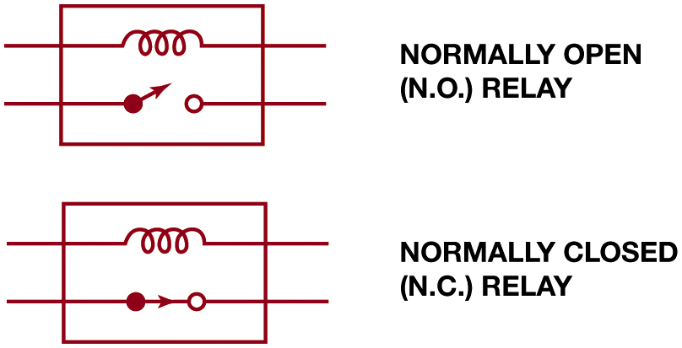
Relays (2 of 2)
Figure 14.50 All schematics are shown in their normal, non-energized position.
Notes:
Figure 9.48 cross-sectional view of a typical four-terminal relay. Current flowing through the coil (terminals 86 and 85) causes the movable arm (armature) to be drawn toward the coil magnet. The contact points complete the electrical circuit connected to terminals 30 and 87.
Figure 9.49 A typical relay showing the schematic of the wiring in the relay.
Figure 9.50 All schematics are shown in their normal, non-energized position.
Tech Tip: Divide the Circuit in Half
When diagnosing any circuit that has a relay, start testing at relay and divide circuit in half.
High current portion: Remove the relay and check that there are 12 volts at the terminal 30 socket. If there is, then the power side is okay. Use an ohmmeter and check between terminal 87 socket and ground. If the load circuit has continuity, there should be some resistance. If O L, the circuit is electrically open.
Control circuit (low current): With the relay removed from the socket, check that there is 12 volts to terminal 86 with the ignition on and the control switch on. If not, check service information to see if power should be applied to terminal 86, then continue troubleshooting the switch power and related circuit.
Check the relay itself: Use an ohmmeter and measure for continuity and resistance.
Between terminals 85 and 86 (coil), there should be 60 to 100 ohms. If not, replace the relay.
Between terminals 30 and 87 (high-amperage switch controls), there should be continuity (low ohms) when there is power applied to terminal 85 and a ground applied to terminal 86 that operates the relay. If “O L” is displayed on the meter set to read ohms, the circuit is open which requires that the reply be replaced.
• Between terminals 30 and 87a (if equipped), with the relay turned off, there should be low resistance (less than 5 ohms).
Long Description:
The schematic at the top comprises a rectangular relay. A coil and an open switch pass through the relay. The schematic at the bottom comprises a rectangular relay. A coil and a closed switch pass through the relay.

Slide 62
Animation: Relay (Animation will automatically start)

Slide 63
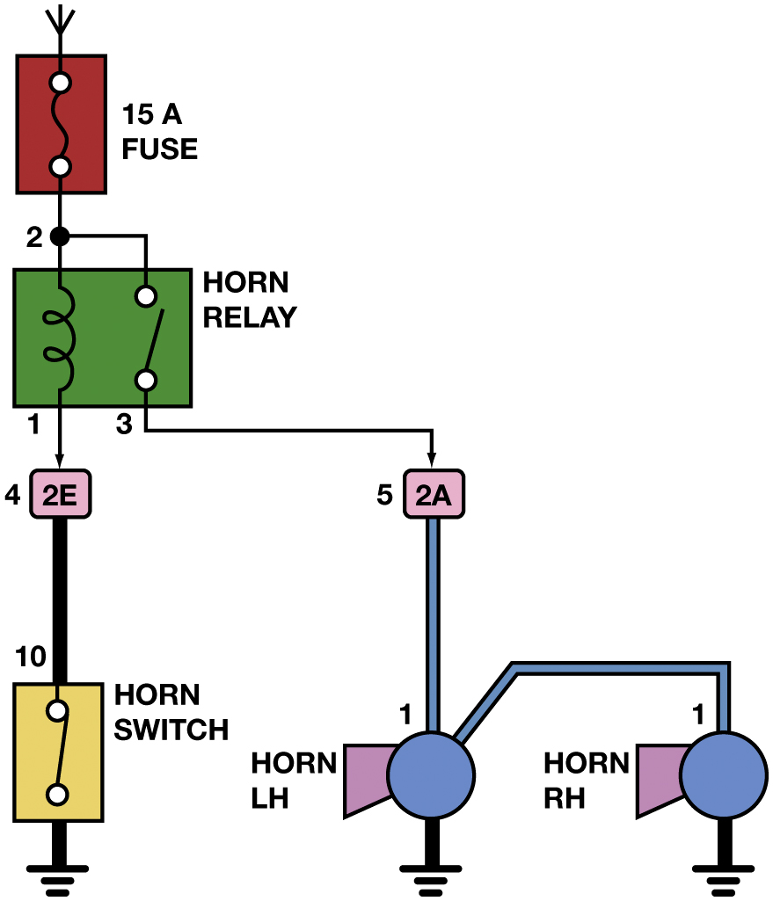
Figure 14.51
Typical Relay Circuit
Typical transmission range switch is also similar to the circuit used for electronic transfer case switches. In this example, power, usually 12 volts, is applied at pin 30 and pin 46 is an input to the P C M. The change in voltage at pin 46 indicates how much resistance the circuit has, which is used to detect the gear selected.
Notes:
Long Description:
The illustration has a 15 amperes fuse on the top. It is connected to a horn relay below. The point of attachment is labeled as 2. The relay has a coil on the left and an open switch on the right. The ends of the coil are labeled 1 and 2. The switch is labeled as 3. They are connected. The coil is connected to a component labeled 2 E (4). The open switch is connected to another component labeled 2 A (5). 2 E is connected to a horn switch (10). 2 A is connected to two horns in a series labeled horn L H (1) and horn R H (1).

Slide 64
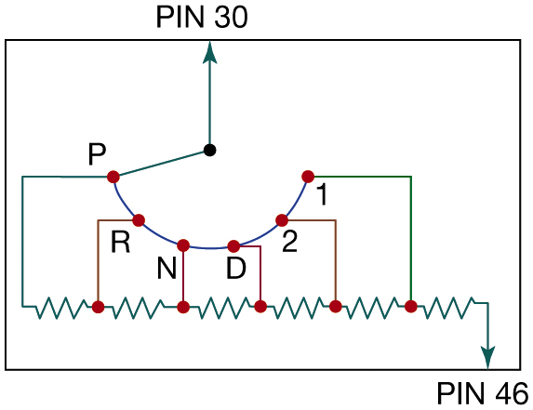
Switches
Electrical Switch
Opens circuit
No current flows.
Switch be on return (ground) path wire.
Ohmmeter checks
Voltmeter checks
Figure 14.52 A typical transmission range switch is also similar to the circuit used for electronic transfer case switches. In this example, power, usually 12 volts, is applied at pin 30 and pin 46 is an input to the P C M. The change in voltage at pin 46 indicates how much resistance the circuit has, which is used to detect the gear selected.
Notes:
Long Description:
The illustration comprises a rectangle. It has a point in the center. Below the point is an arc with six points. From left to right, they are labeled as follows. P, R, N, D, 2, and 1. The point in the center and the point P are connected together. An up arrow extends from the point in the center and touches the periphery of the rectangle. It is labeled pin 30. A wire extends from each of the points on the arc to the bottom. Six resistors are connected to these wires. A down arrow extends from the resistor on the right and touches the periphery of the rectangle. It is labeled pin 46.

Slide 65
Speed Sensors
A magnetic sensor consists of a notched wheel
Coil consisting of an iron core wrapped with fine wire.
The notched wheel causes the magnetic strength
Changes enough to create usable varying A C voltage signal.
Speed sensor tests

Slide 66
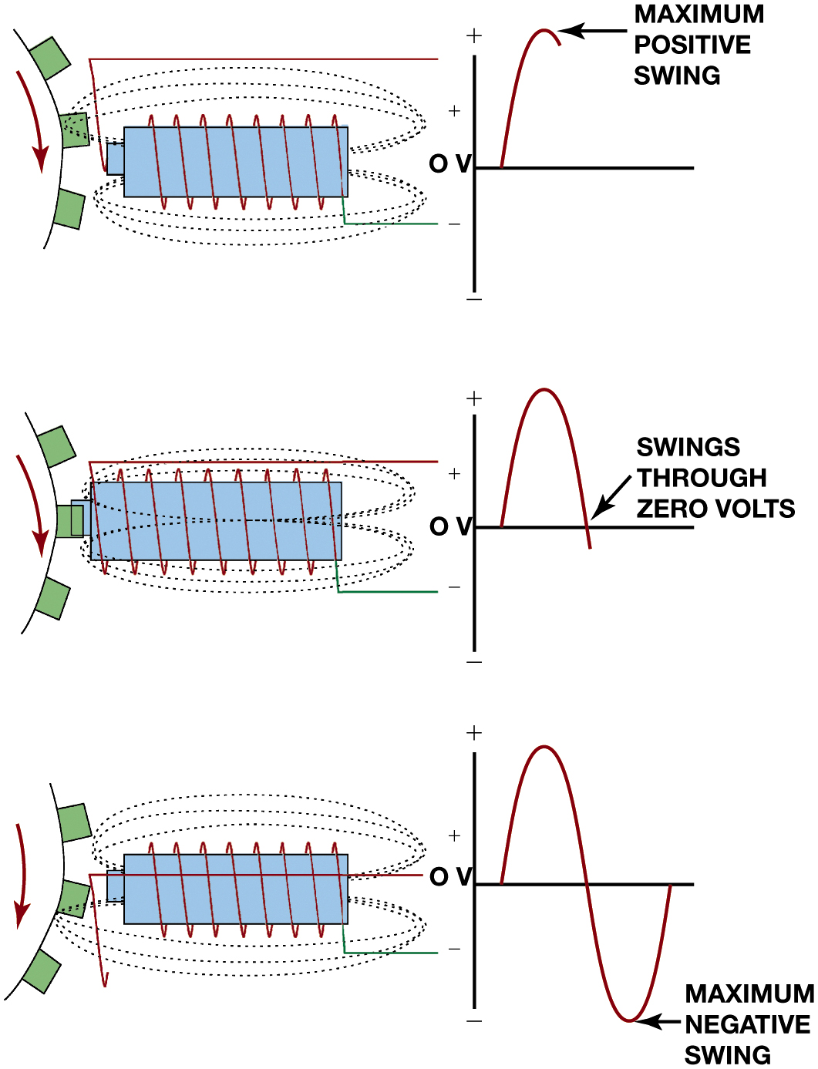
Figure 14.53
Speed Sensor
A magnetic sensor uses a permanent magnet surrounded by a coil of wire. The notches on the rotating shaft create a variable magnetic field strength around the coil. When a metallic section is close to the sensor, the magnetic field is stronger because metal is a better conductor of magnetic lines of force than air.
Notes:
Long Description:
The illustration on the top has a magnet with a coil wrapped around it. On the top and bottom of the magnet are several dotted lines that form an ellipse-like structure. On the left of the magnet is a rotating shaft that moves in a clockwise direction. On its right is a graph. The horizontal axis of the graph is labeled O V. It plots an incomplete mountain curve. The apex of the curve is labeled maximum positive swing. The illustration below has a magnet with a coil wrapped around it. On the top and bottom of the magnet are several dotted lines that form an ellipse-like structure. On the left of the magnet is a rotating shaft that moves in a clockwise direction. On its right is a graph. The horizontal axis of the graph is labeled O V. It plots a mountain curve. The left end of the curve intersects the horizontal axis. It is labeled swings through zero volts. The illustration at the bottom has a magnet with a coil wrapped around it. On the top and bottom of the magnet are several dotted lines that form an ellipse-like structure. On the left of the magnet is a rotating shaft that moves in a clockwise direction. On its right is a graph. The horizontal axis of the graph is labeled O V. It plots a sinusoidal wave. The negative peak of the curve is labeled maximum negative swing.

Slide 67
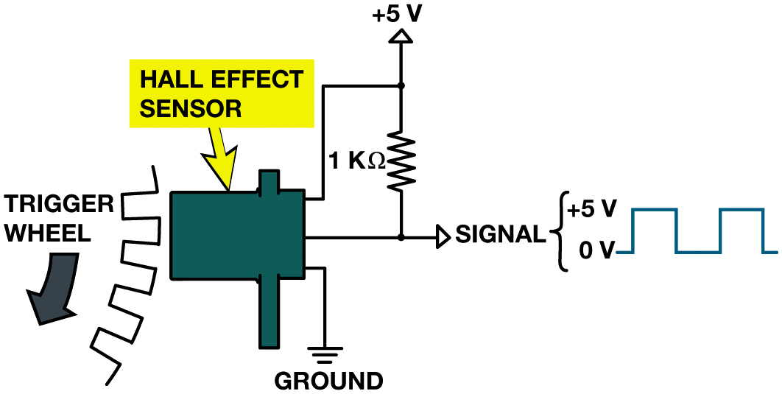
Figure 14.54
A Hall-effect sensor produces an on-off voltage signal whether it is used with a blade or a notched wheel.
Notes:
The illustration has a hall effect sensor. A trigger wheel is on its left. The bottom terminal of the hall effect sensor is grounded. A wire extends from the other terminal to the top and connects to a resistor of 1 kilo Ohm. The resistor is connected to a 5-volt amplifier. A wire extends horizontally from the center of the hall effect sensor. Its right end has an amplifier that produces a signal of zero and five volts. On its right, is an on-off voltage signal.

Slide 68
Animation: Hall-Effect Sensor (Animation will automatically start)

Slide 69
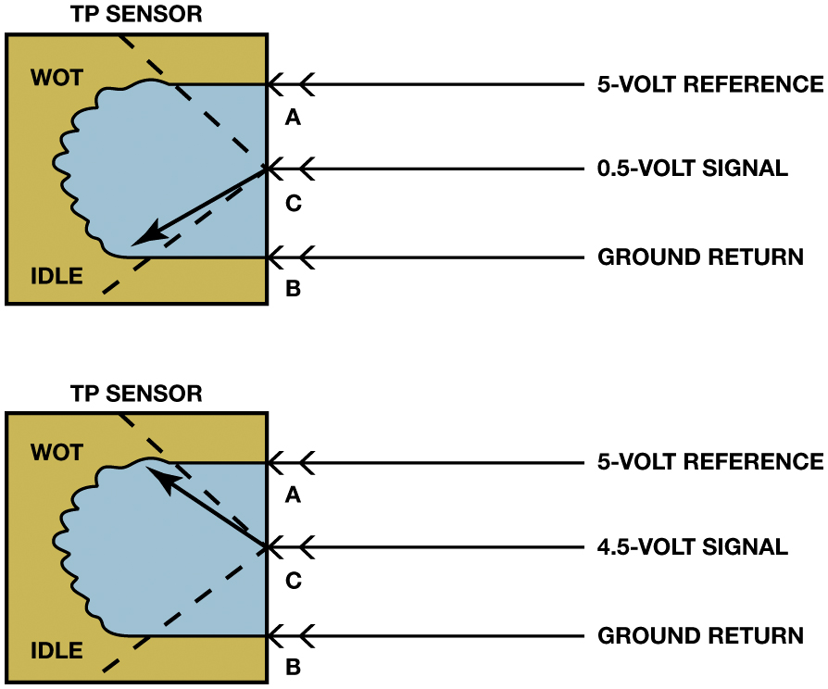
Throttle Position (T P) Sensors
TP Sensor Input
Determine amount of throttle opening and rate of change
Determine shift points
Parts/operation
Page 228
Testing TP Sensor,
Page 228
Figure 14.55 The signal voltage from a throttle position increases as the throttle is opened because the wiper arm is closer to the 5-volt reference. At idle, the resistance of the sensor winding effectively reduces the signal voltage output to the powertrain control module (P C M).
Notes:
Long Description:
The illustration on the top has a rectangular throttle position sensor on the left. It has an irregular, rectangular like structure inside. The top left of the sensor is labeled wot, and the bottom left is labeled idle. Three double-headed arrows extend from the right to the T P sensor. The junction of the arrow and the sensor wall is labeled A, C, and B from top to bottom. The arrow A corresponds to a 5-volt reference. The arrow C corresponds to a 0 point 5-volt signal. The arrow B corresponds to ground return. A dotted line extends from the point C and touches the top and bottom inner surfaces. A diagonal arrow extends from the point C to the idle. The illustration on the bottom has a rectangular throttle position sensor on the left. It has an irregular, rectangular like structure inside. The top left of the sensor is labeled wot, and the bottom left is labeled idle. Three double-headed arrows extend from the right to the T P sensor. The junction of the arrow and the sensor wall is labeled A, C, and B from top to bottom. The arrow A corresponds to a 5-volt reference. The arrow C corresponds to 4 to 5-volt signal. The arrow B corresponds to ground return. A dotted line extends from the point C and touches the top and bottom inner surfaces. A diagonal arrow extends from the point C to the wot.

Slide 70
Animation: Throttle Position (TP) Sensor (Animation will automatically start)

Slide 71
Networks
Need for Network
Modules communicate with each other over data lines or hard wiring.
Use of a network for module communications
Reduces number of wires and connections needed.
Types of Communication
Differential
Parallel
Serial data
Multiplexing

Slide 72
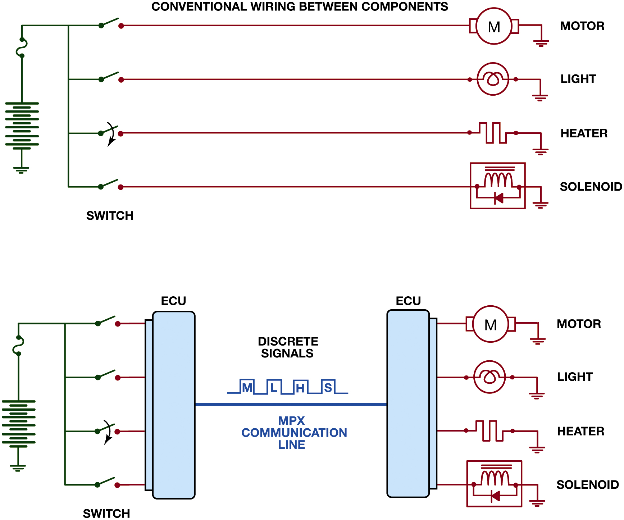
Figure 14.55
A network allows all modules to communicate with other modules
Notes:
Since 1990s, vehicles have used modules to control the operation of most electrical components.
A typical vehicle will have 10 or more modules and they communicate with each other over data lines or hard
wiring, depending on the application.
Long Description:
The illustration at the top is titled conventional wiring between components. On the left is a battery. Four open switches are connected to the battery. Each of the switches is connected to an appliance. From top to bottom, they are as follows. A motor, a light bulb, a heater, and a solenoid. All the appliances are grounded. The illustration at the bottom has a battery on the left. Four open switches are connected to the battery on the right. Each of the switches is connected to the E C U on the right. The E C U is connected to another E C U on its right through a M P X communication line. The communication line has discrete signals on the top. From left to right, they are labeled as follows. M, L, H, and S. Several appliances are connected to the issue on the right. From top to bottom, they are as follows. A motor, a light bulb, a heater, add a solenoid. All the appliances are grounded.

Slide 73
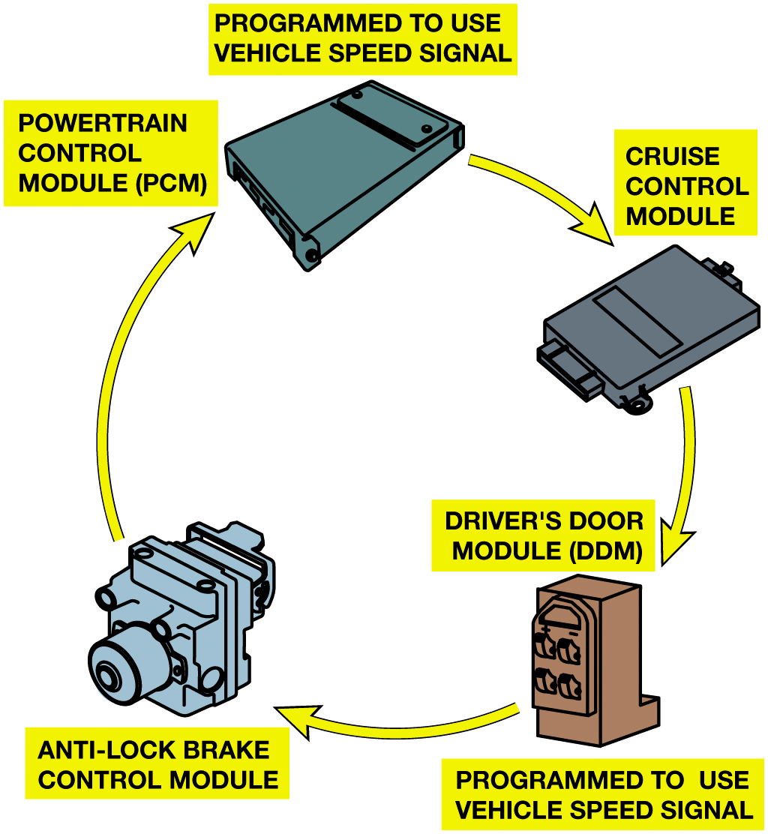
Figure 14.57
A network allows all modules to communicate with other modules.
Robert Bosch
Developed CAN protocol
Called CAN 1.2, in 1993.
What is the CAN?
Page 230
Notes:
Long Description:
The flow of the chart from the top are as follows. A powertrain control module that is programmed to use a vehicle speed signal. It leads to the cruise control module. It leads to the driver's door module, which is programmed to use a vehicle speed signal. It leads to the anti-lock brake control module. It leads to the power train control module.

Slide 74
Figure 14.58
A typical (generic) system showing how the CAN BUS is connected to various electrical accessories and systems in the vehicle.
S A E communication classifications for vehicle communications system.
Class A
Class B
Class C
Notes:
The Society of Automotive Engineers (S A E) standards include the following three categories of in-vehicle network
communications:
■ Class A. Low-speed networks, meaning less than 10,000 bits per second (bps, or 10 Kbs), are generally
used for trip computers, entertainment, and other convenience features.
■ Class B. Medium-speed networks, meaning 10,000 bps to 125,000 bps (10 Kbs to 125 Kbs), are generally
used for information transfer among modules, such as instrument clusters, temperature sensor data, and other general uses.
Class C. High-speed networks, meaning 125,000 bps to 1,000,000 bps, are generally used for real-time powertrain and vehicle dynamic control. High-speed BUS communication systems now use a controller area
network (CAN). ● See Figure 9.58.
Long Description:
The schematic has a vehicle O B D connector on the left with sixteen pins. A fuse is connected to the pin 16. Two cables extend from pins six and fourteen. The cables are coiled together and for a can bus with a positive top surface and a negative bottom surface. The coiled cables extend from the can bus to the immobilizer module below it. The immobilizer module has a transponder key. Another pair of coiled cables extend from the right of the can bus to nodes four and five. Another pair of coiled cables that arises from the top of node four extends to the left and connects to the instrument cluster and node three. Each of the nodes and the instrument cable have a positive and negative terminal on their right end.

Slide 75
Animation: Controller Area Network, CAN (Animation will automatically start)

Slide 76
Figure 14.59
A schematic of a Chevrolet Equinox shows that the vehicle uses a G M L A N B U S (D L C pins 6 and 14), plus a Class 2 (pin 2). A scan tool can therefore communicate to the transmission control module (T C M) through the high-speed network. Pin 1 connects to the low-speed G M L A N network.
Notes:
Figure 9.59 Schematic of a Chevrolet Equinox shows that the vehicle uses a GMLAN BUS (D L C pins 6 and 14), plus a Class 2 (pin 2). A scan tool can therefore communicate to the transmission control module (T C M) through the high-speed network. Pin 1 connects to the low-speed GMLAN network
Long Description:
The schematic has a vehicle O B D connector in the center. It has 16 pins. A radio, a V C I module, and a heads-up display are connected to the pin one on the bottom. The pin one is further connected to a body control module gateway on the top right. The path of connection is labeled low speed G M L A N. An H V A C control module, instrument panel cluster, 4 door modules, sensing diagnostic module, memory seat module, and navigation radio are connected to pin 2 on the left. The path of the connection is labeled Class 2. The transmission control module, electronic brake traction control module, and vehicle communications interface module are connected to pins 6 and 14 on the right. Pin 6 also connects to the body control module gateway. The transmission control module, electronic brake traction control module, and vehicle communications interface module are connected to the powertrain control module through a high-speed G M L A N. The powertrain control module is connected to the throttle actuator through U A R T data 2 and 1.

Slide 77
Animation: CAN Circuit Check (Animation will automatically start)

Slide 78
Frequently Asked Question: What Are U Codes?
? Frequently Asked Question
What Are U Codes? The “U” diagnostic trouble codes were at first “undefined” but are now network-related codes. Use the network codes to help pinpoint the circuit or module that is not working correctly. Some powertrain-related faults are due to network communications errors and therefore can be detected by looking for “U” diagnostic trouble codes (D T Cs).

Slide 79
Question 1
A high-speed CAN BUS communicates with a scan tool through which terminal(s)?
A. 6 and 14
B. 2
C. 7 and 15
D. 4 and 16

Slide 80
Answer 1
A high-speed CAN BUS communicates with a scan tool through which terminal(s)?
A. 6 and 14

Slide 81
Summary (1 of 2)
Electricity is movement of electrons from 1 atom to another.
Automotive uses conventional theory
Electricity flows from + to -
Ampere is measure of amount of current flow.
Voltage is unit of electrical pressure
Ohm is unit of electrical resistance
Complete circuit: power source, a circuit protection device, path, load, ground return path, and a switch or a control device.

Slide 82
Summary (2 of 3)
Circuit testers include test lights and fused jumper leads.
A terminal is metal end of a wire.
Connector is plastic housing for the terminal.
The use of a network for module communications
Reduces number of wires and connections needed.
SAE communication classifications for vehicle communications system:
Class A
Class B
Class C

Slide 83
Automotive Fundamentals Videos and Animations
Videos Link: (A3) Manual Drive Train Axles Videos
Videos Link: (A6) Electrical/Electronic Systems Videos
Animations Link: (A3) Manual Drive Train Axles Animations
Animations Link: (A6) Electrical/Electronic Systems Animations

Slide 84
Copyright
This work is protected by United States copyright laws and is provided solely for the use of instructors in teaching their courses and assessing student learning. Dissemination or sale of any part of this work (including on the World Wide Web) will destroy the integrity of the work and is not permitted. The work and materials from it should never be made available to students except by instructors using the accompanying text in their classes. All recipients of this work are expected to abide by these restrictions and to honor the intended pedagogical purposes and the needs of other instructors who rely on these materials.

