Slide 1
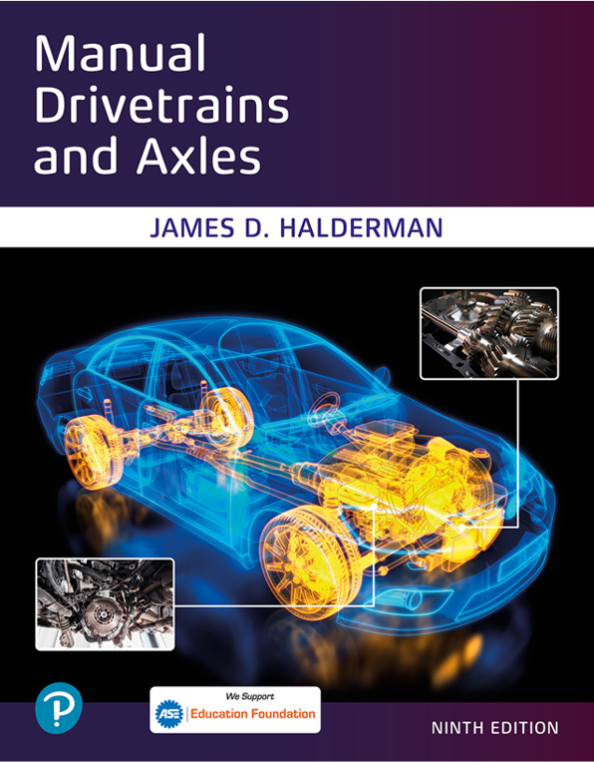
Manual Drivetrains and Axles
Ninth Edition
Chapter 13
Drive Axles & Differential Diagnosis & Service
Copyright © 2024, 2018, 2015 Pearson Education, Inc. All Rights Reserved
Notes:
If this PowerPoint presentation contains mathematical equations, you may need to check that your computer has the following installed:
1) Math Type Plugin
2) Math Player (free versions available)
3) NVDA Reader (free versions available)
INSTRUCTOR NOTE: This presentation includes text explanation notes, you can use to teach the course. When in SLIDE SHOW mode, you RIGHT CLICK and select SHOW PRESENTER VIEW, to use the notes.

Slide 2
Learning Objectives (1 of 2)
13.1 Perform the maintenance needed to keep a drive axle operating properly.
13.2 Describe the steps involved in drive axle service.
13.3 Discuss drive axle lubrication.
13.4 Discuss drive axle diagnosis.
13.5 Discuss the procedures for in-the-shop inspections.
13.6 Explain the on-vehicle service operations.
13.7 Explain the procedure for differential carrier service and differential assembly service.

Slide 3
Learning Objectives (2 of 2)
13.8 Explain the steps to adjust backlash and carrier bearing preload.
13.9 Explain pinion depth shim selection and drive pinion bearing preload adjustment.
13.10 Explain the steps to adjust backlash and carrier bearing preload.

Slide 4
Drive Axle Service (1 of 2)
Cause of improper drive axle operation is determined using several diagnostic steps.
Verify customer complaint
Identify the vehicle, drive axle, and gear ratio
Check vehicle history and T S B s
Hoist the vehicle and remove wheels
Disassembly and inspection

Slide 5
Drive Axle Service (2 of 2)
Test for proper backlash and operation of limited slip unit
Replace components as needed
Test drive vehicle
Some drive axle problems can be repaired on-vehicle.
Gear tooth count
Counting revolutions

Slide 6
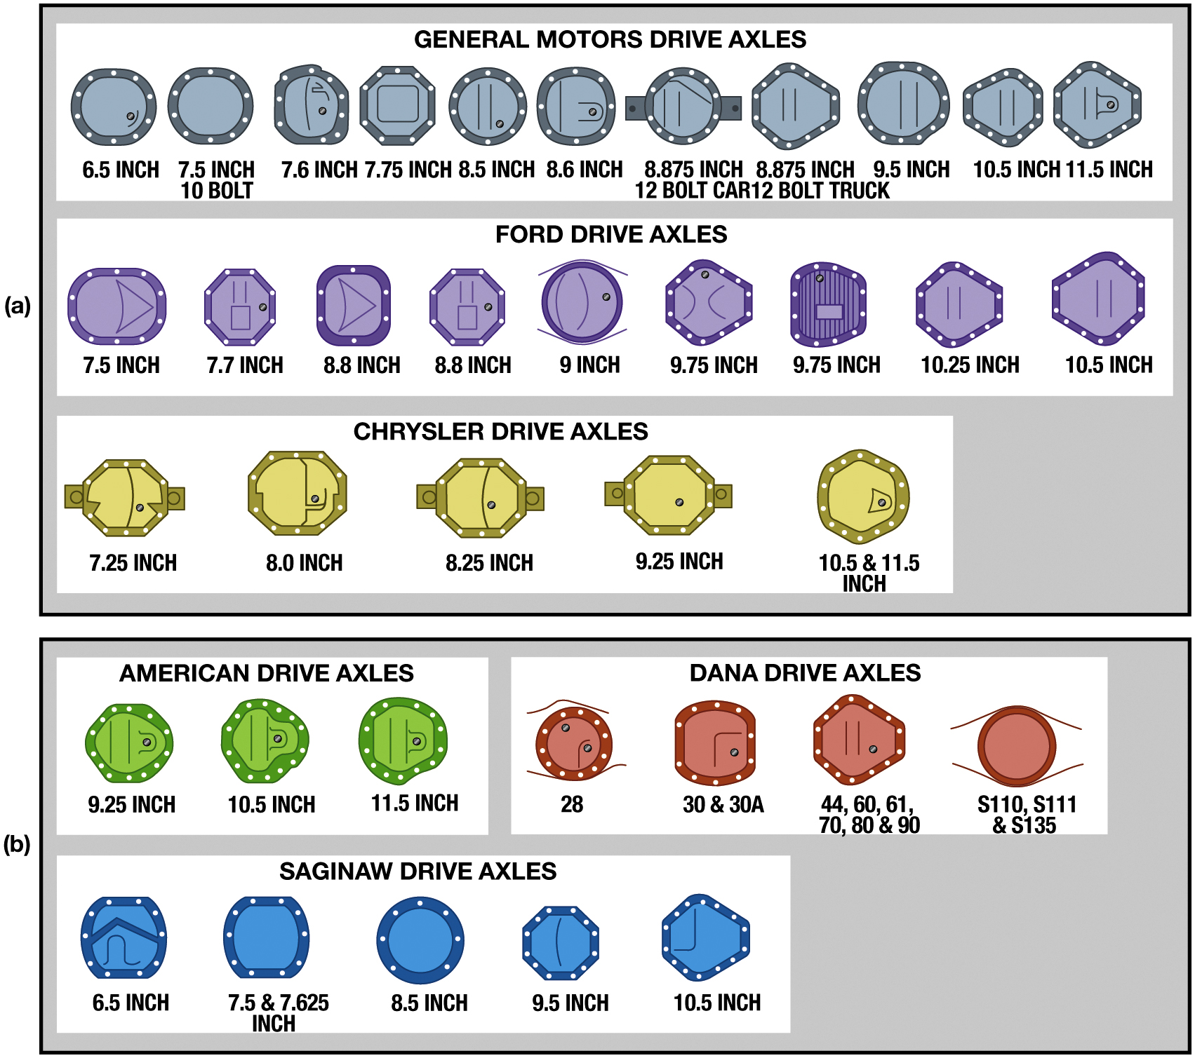
Figure 13.1
Axle Identification
Notes:
Figure 13.1 The drive axle can often be identified using the shape and counting the bolts on the
inspection cover. This is most helpful if trying to locate a heavy duty drive axle at a wrecking
(recycling) yard. (a) Drive axles sorted by the Detroit three vehicle manufacturers. (b) Axles
sorted by axle manufacturers such as American Axle and Manufacturing (A A M), who
supply axles to many vehicle manufacturers.
Long Description:
The first part of the illustration has the drive axles arranged under three headings, namely, general motor drive axles, food drive axles, and Chrysler drive axles. The drive axles are mostly circular, pentagonal, and oval. The general motor drive axles are labeled as follows from left to right according to their sizes. 6. 5 inches, 7.5 inches 10 bolt, 7.6 inches, 7.75 inches, 8.5 inches, 8.6 inches, 8.875 inches 12 bolt car, 8.875 inches, 12 bolt truck, 9.5 inches, 10.5 inches, and 11.5 inches. The food drive axles are labeled as follows from left to right according to their sizes. 7.5 inches, 7.7 inches, 8.8 inches, 9 inches, 9.75 inches, 9.75 inches, 10.25 inches, and 10.5 inches. The Chrysler drive axles are labeled as follows from left to right according to their sizes. 7.25 inches, 8.0 inches, 8.2 inches, 9.25 inches, 10.5, and 11.5 inches. The second part of the illustration has the drive axles arranged under three headings, namely, American drive axles, Dana drive axles, and Saginaw drive axles. The American drive axles are labeled as follows from left to right according to their sizes. 9.25 inches, 10.5 inches, and 11.25 inches. The Dana drive axles are labeled as follows from left to right according to their sizes. 28, 30 and 30 A, 44, 60, 61, 70, 80 and 90, and S 110, S 111, and S 135. The Saginaw drive axles are labeled as follows from left to right according to their sizes. 6.5 inch, 7.25 and 7.625 inch, 8.5 inch, 9.5 inches, and 10.5 inches.

Slide 7
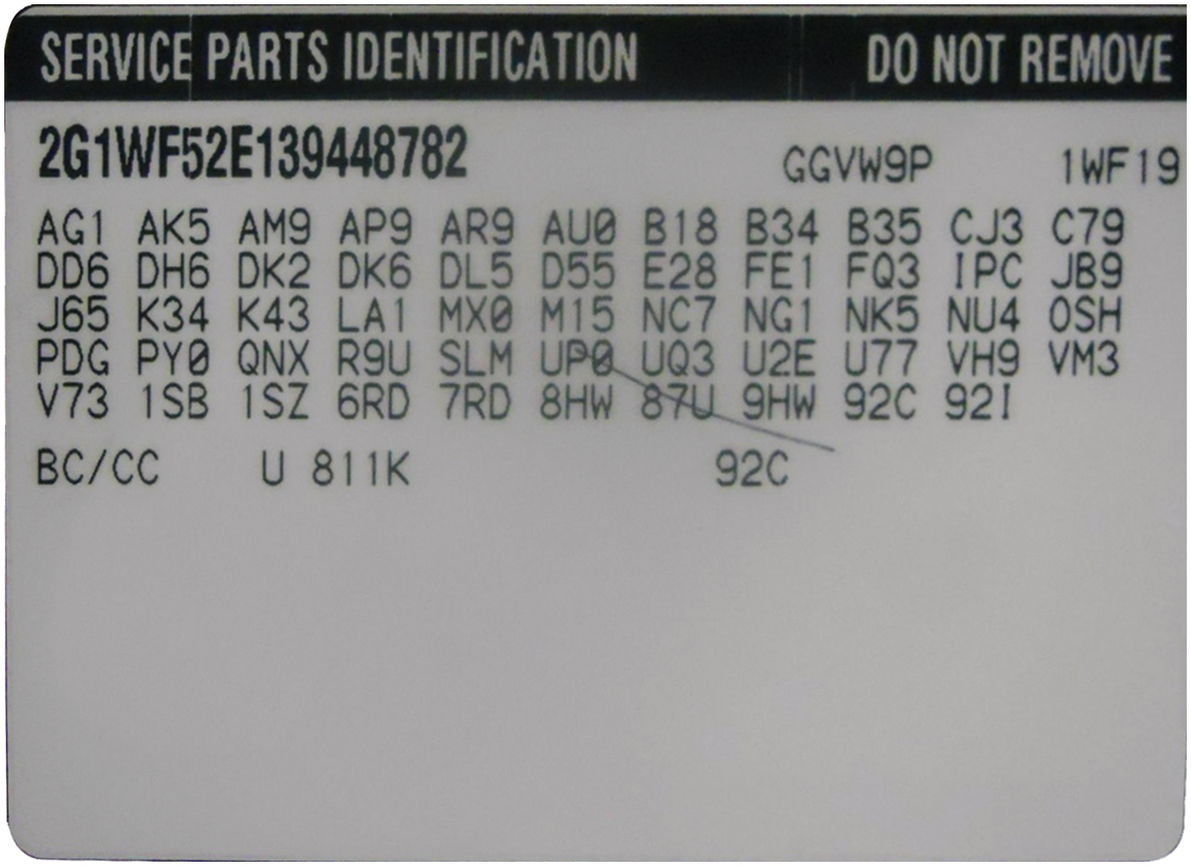
Figure 13.2
Service Parts Identification
The service parts identification sticker includes the codes for major components parts and includes the drive axle ratio and other information needed by the parts department to get the correct parts.
Notes:
Long Description:
The heading of the sticker is service parts identification, do not remove it. The codes included are as follows. 2 G 1 W F 52 E 139448782, G G V W 9 P, and 1 W F 19; A G 1, A K 5, A M 9, A P 9, A R 9, A U O, B 18, B 34, B 35, C J 3, and C79; D D 6, D H 6, D K 2, D K 6, D L 5, D 55, E 28, F E 1, F Q 3, I P C, J B 9; J 65, K 34, K 43, L A 1, M X 0, M 15, N C 7, N G 1, N K 5, N U 4, O S H; P D G, P Y O, Q N X, R 9 U, S L M, U P B, U Q 3, U Z E, U 7 7, V H 9, V M 3; V 7 3, 1 S B, 1 S Z, 6 R D, 7 R D, 8 H W, 8 7 U, 9 H W, 920, 921; B C slash C C, U 81 1 K, and 92 C.

Slide 8
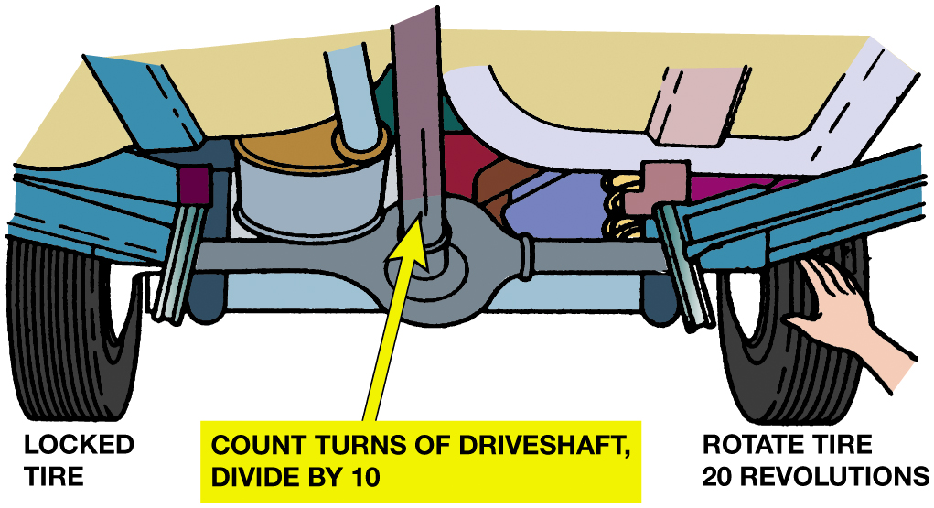
Figure 13.3
Drive Axle Ratio Check
Notes:
FIGURE 13.3 The quickest way to check the drive axle ratio is to rotate one wheel with the other wheel locked and count the number of times the driveshaft rotates. If the driveshaft rotates 37 1/3 turns while the free tire rotates 20 turns, the ratio is 3.73:1.
Counting Revolutions. The axle ratio can be determined by counting the number of revolutions of the
driveshaft that are required to turn the wheels one revolution. The best way of doing this is to
lock one of the tires using the parking brake or a block. Now, turn the driveshaft until the free
tire turns 20 revolutions, and divide the driveshaft revolutions by 10. For example, if there are
23 1/3 turns of the driveshaft to 20 turns of the free tire, the gear ratio is 2.33:1. With one
wheel locked, the differential will cause the other wheel to turn twice as fast. See Figure 13.3.
Long Description:
The illustration of the bottom view of the vehicle consists of two tires connected by the driveshaft. The tire on the left is labeled locked tire, and the tire on the right is labeled rotate tire 20 revolutions. The tire on the right is being rotated manually. A note near the driveshaft reads count turns of the driveshaft, divide by 10.

Slide 9
Drive Axle Lubrication
Drive axles must have clean gear oil at the proper level and of the proper type.
Viscosity of gear oil
A P I gear oil grade
Checking drive axle gear oil level

Slide 10
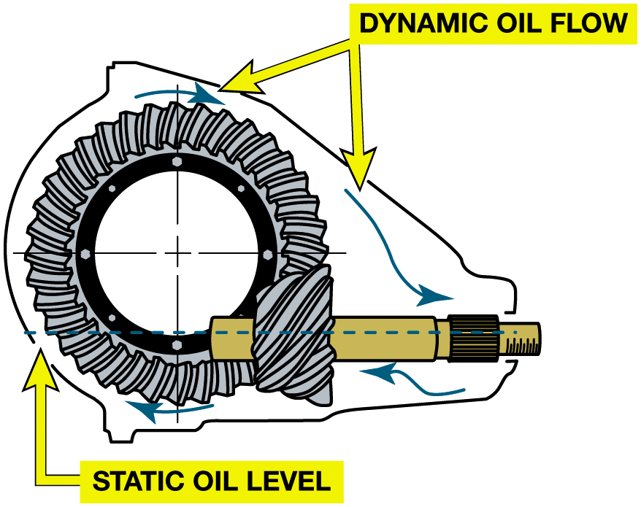
Figure 13.4
Gear Oil Level
In most axles the gear oil level is at the bottom of the filler opening. When the axle operates, the ring gear will produce a dynamic oil flow to lubricate all the parts.
Notes:
S A E 8 5 W-90
S A E 85 W-140
S A E 90
NOTE: Some vehicle manufacturers specify the use of synthetic gear oil of the specified viscosity.
Always check service information for the exact gear lubricant to use.
Because all differentials use hypoid gear sets, a special lubricant is necessary because the gears
both roll and slide between their meshed teeth. Gear oils labeled gear lubricant (G L) are specified
by the American Petroleum Institute (A P I). Drive axles should use hypoid quality G L-5 (meets
military Mil-L 2 1 5 0 B requirements) gear lubricant of the specified viscosity. If the axle has a
limited slip differential, the gear lubricant must meet the requirements for that differential
type. A label is normally located near the filler opening on those axles to indicate the fluid
required.
Long Description:
The illustration consists of gear with a cylindrical filler opening on the bottom right. The static airflow is linear from inside the filler opening to the gear teeth. The dynamic oil flow is clockwise, from the gear to the filler opening.

Slide 11
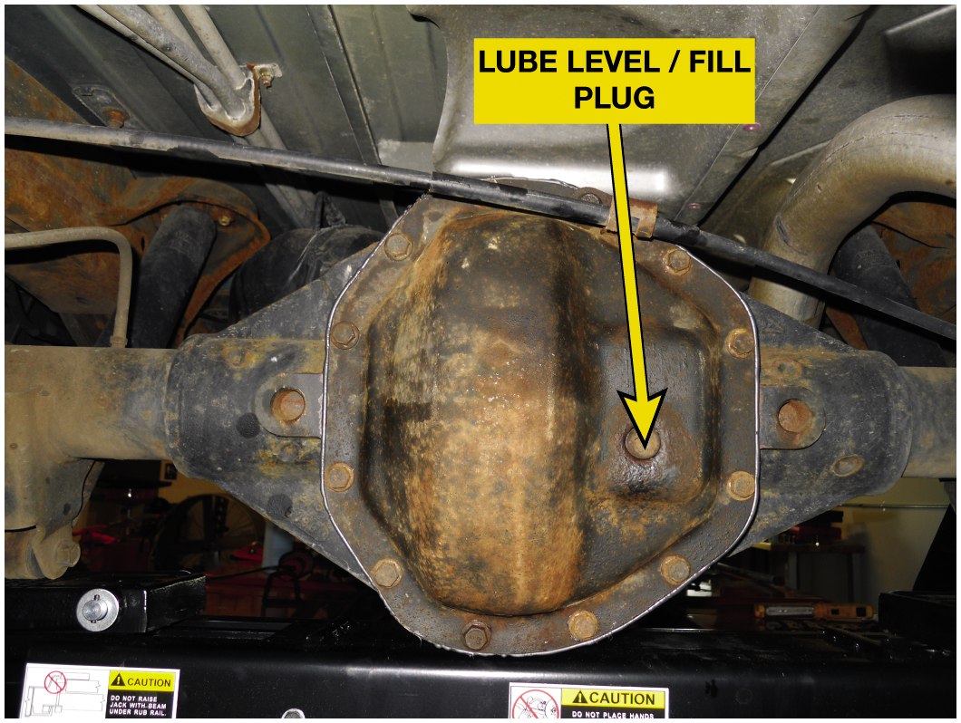
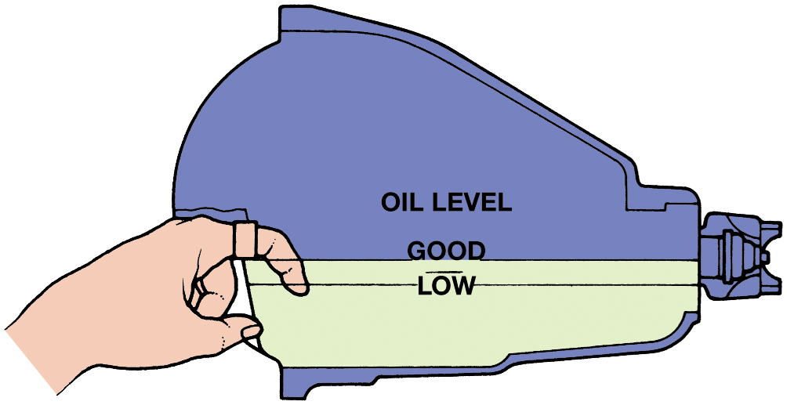
Fill/Level Plug & Oil Level
Figure 13.5 The fill/level plug is often located on the inspection cover but can also be located on the side.
Figure 13.6 The lubricant (oil) level is usually even with the bottom of the fill opening. If necessary, a finger can be used as a dipstick to determine the level.
Notes:
Tech Tip: Chatter and Vibration Fix
If a rear-wheel-drive vehicle has a vibration that feels like a clutch chatter when turning and the
vehicle had an antispin (limited slip) rear axle, consider try adding a friction modifier additive
to the rear axle fluid. This often cures the chatter.
Case Study: The “Steering Problem” That Was a Drive Axle Problem
A Honda C R V (All-wheel-drive) (130,000 m i) had an objectionable noise while turning. The vehicle
owner complained that the problem must be in the power steering system because it only occurred
when turning. An inspection of the power steering showed no problem. On a road test, the noise
seemed to be coming from the rear so the rear driveshaft was removed, and the noise was gone.
The fluid was drained from the rear drive axle and replaced using the recommended oil, and this
fixed this noise problem.
Summary:
Complaint—Driver complained about a nose while turning.
Cause—The rear drive axle was found to be the source of the noise.
Correction—The drive axle fluid was replaced with the specified fluid and the noise concern was corrected.
Long Description:
The illustration consists of a filler opening with demonstrations of the low and good oil levels. The low level of the lubricant is near the bottom and an index finger dipped in the lubricant determines the low level. Just above the low oil level, there is a good oil level.

Slide 12
Drive Axle Diagnosis (1 of 2)
Road Test
Noise Diagnosis
Gear noise
Bearing noise
Clunk
Chuckle
Chatter on corners
Notes:
Most drive axle problems are related to noise, vibration, leaks, and failure to transmit power.
The road test should include the following driving conditions:
■ Drive. Light-to-moderate throttle acceleration
■ Cruise. Enough throttle to maintain a constant speed
■ Float. Just enough throttle to keep engine load off the drivetrain as the vehicle slows
■ Coast. Closed throttle deceleration
■ Coast while in neutral. Isolates transmission noises
Gear noise. Howling or whining and is often torque sensitive but can be continuous.
Bearing noise. Can be a high-pitched, whistle like sound but is usually a rough growl or rumble. Bearings will often make a “wow-wow” type of sound at the speed frequency of the spinning shaft.
Clunk. Heavy metallic slapping noise during reversal of power flow or engagement of power from neutral. This fault is caused by excessive slack or excessive clearances in the drivetrain and can be felt in the drive axle.
Chuckle. A rattling noise, similar to a playing card against spinning bicycle spokes, during deceleration below 40 M P H (64 km/h). This fault is often caused by excessive clearance in the differential.
Chatter on corners. A vibration or noise as the vehicle turns a corner, especially after prolonged straight driving.
This noise is often called chatter, commonly caused by a stick/slip condition at the clutch plates of a limited slip differential. After changing the lubricant in a limited slip differential to cure a chatter problem, drive the vehicle through 10 to 12 figure-8 turns. This procedure will force the new lubricant between the clutch plates.

Slide 13
Drive Axle Diagnosis (2 of 2)
Major internal drive axle problems usually require assembly be removed from vehicle.
Drive axle disassembly and reassembly procedures vary between makes and models.

Slide 14
Chart 13.1
When Noise Occurs | Possible Cause
Under all driving conditions | Road and tires; wheel bearings; incorrect driveline angles
Changes with road surface | Tires
Noise becomes louder during cornering | Differential gears; axle bearings
Howling sound | Ring and pinion gears (incorrect adjustment, worn, or runout issues)
Growling sound | Bearing(s)
Whine noise concern | Check ring gear pattern for incorrect backlash or pinion depth
Clunk on speed change or going from forward to reverse or reverse to forward | Worn U-Joints, differential or driveshaft splines
Continuous low pitched whir | Worn U-joints
Low pitch rumble over 20 M P H (32 k m/h) | Worn carrier bearings
Chatter during cornering | Incorrect gear oil or worn limited slip clutches
Chart showing probable causes of drive axle-related noise concerns.

Slide 15
In-The-Shop Inspections
Checking for…
Internal backlash
Axle shaft endplay
Axle flange runout
Leaks
Limited slip differential

Slide 16
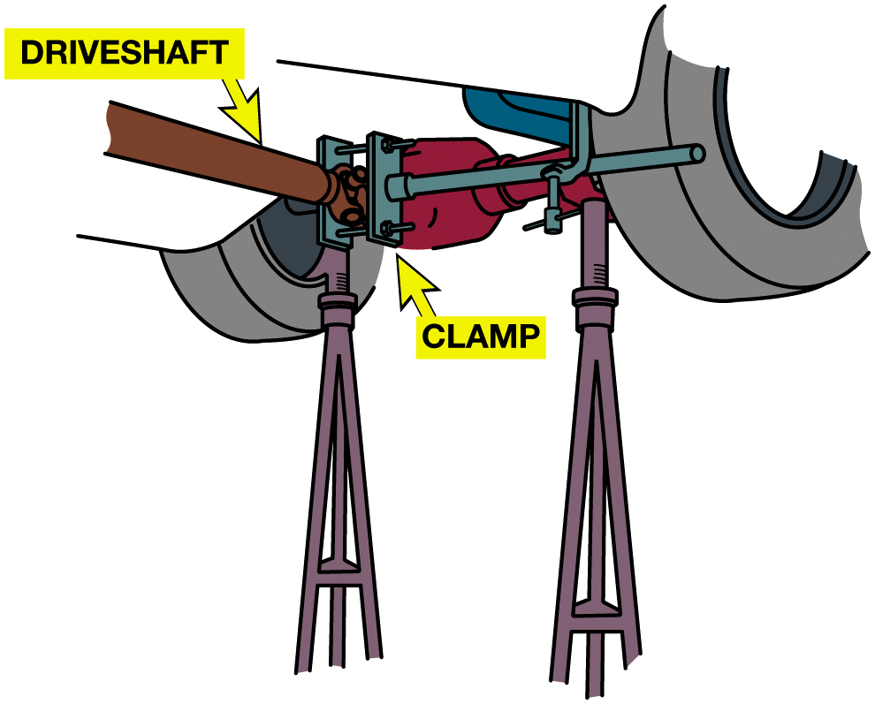
Figure 13.7
Blocking One Wheel
A drive axle can be checked for excessive play in the differential by blocking one drive wheel and the driveshaft.

Slide 17
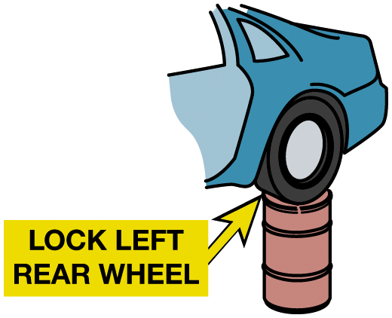
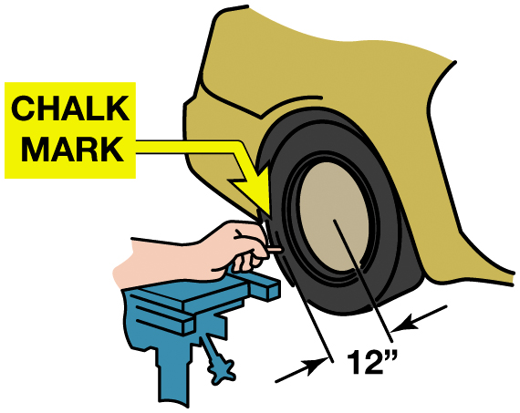
Drive Axle Backlash Check
Figure 13.8 One way to lock one wheel is to lower the vehicle so one tire is resting on a barrel or something similar that will keep the wheel from moving.
Figure 13.9 The mark should be 1 inch or shorter. If the mark is less than 1 inch and there is a clunk in the driveline, the problem is NOT in the drive axle assembly.
Notes:
DRIVE AXLE BACKLASH A drivetrain clunk during a power change can be caused by too much internal
backlash. To quickly determine if the drive axle is the cause of the noise due to backlash, perform
the following steps:
STEP 1 Raise and securely support the vehicle on a hoist or jack stands and the wheels are free to turn.
STEP 2 Lock the driveshaft and drive pinion companion flange by clamping a bar to the companion flange and the body or rear suspension. ● SEE FIGURE 13.7.
STEP 3 Block the left wheel so that it cannot turn. ● SEE FIGURE 13.8.
STEP 4 Turn the right wheel slowly in one direction until it stops, loading the entire lash (clearance) to one side. Using chalk or marking crayon, place a mark on the side of the tire 12 inches (30 c m) from the center of the wheel.
STEP 5 Hold the chalk steady and rotate the tire in the opposite direction until it stops.
STEP 6 Measure the length of the chalk mark; this is the amount of drive axle backlash. More than 1 inch (25 m m) of lash is excessive and indicates that the axle is worn. ● SEE FIGURE 13.9.

Slide 18
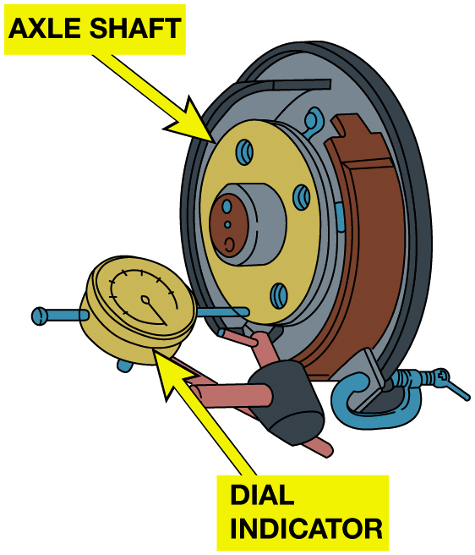
Figure 13.10
Axle End Play
Axle shaft endplay can be checked by mounting a dial indicator on the brake assembly or axle housing with the indicator stylus on the axle. The indicator will measure the endplay as the axle is moved in and out.
Notes:
Case Study: Pinion Bearing Fault
An all-wheel-drive (A W D) Buick Rendezvous (61,000 m i) came into the shop with loud drivetrain howl
and vibration that varied with speed and load. Raising the vehicle on a hoist allowed the
technician to narrow the problem down to the rear drive axle. The rear drive axle gear oil was
clean and at the proper level.
A close inspection of the drive axle revealed rough pinion shaft bearings. The technician was unable to get replacement bearings or a rebuilt assembly so a new axle was installed which fixed the problem.
Summary:
Complaint—Customer complained of a loud howl sound and vibration that varied with speed and load.
Cause—Rough pinion bearings.
Correction—A replacement drive axle solved noise and vibration concern.

Slide 19
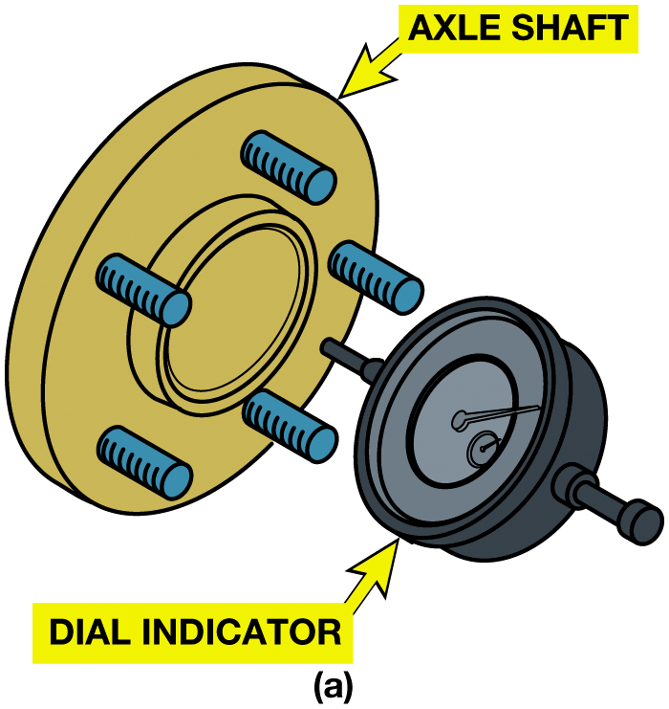
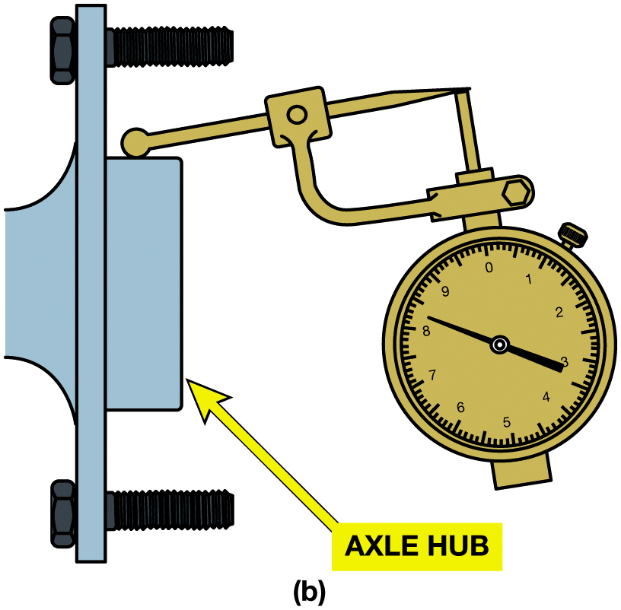
Figure 13.11
Runout Check
(a) This dial indicator is set up to measure axle flange lateral runout, which can cause the wheel to wobble. (b) This dial indicator is set up to measure radial runout of the drum and wheel pilot, which can cause the wheel to run off-center.

Slide 20
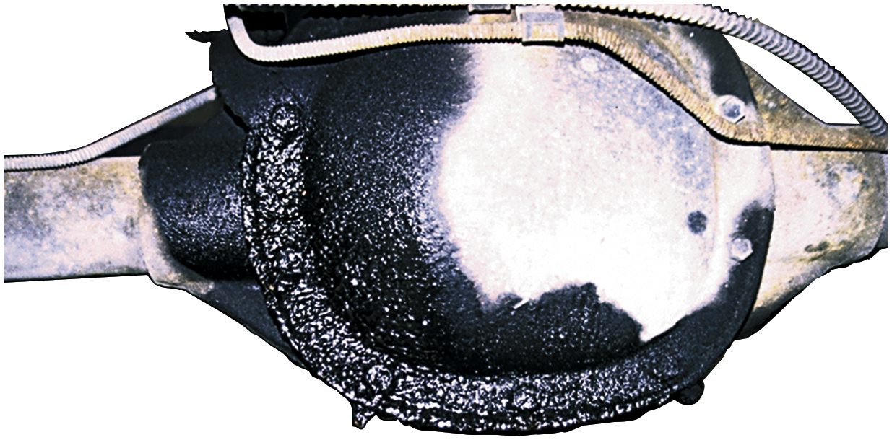
Figure 13.12
Axle Housing Leak
Many leaks are caused by defective gaskets but some axle oil leaks can be caused by a porous casting or cracked welds. A casting problem can be repaired using epoxy sealant, whereas a cracked weld requires housing replacement.

Slide 21
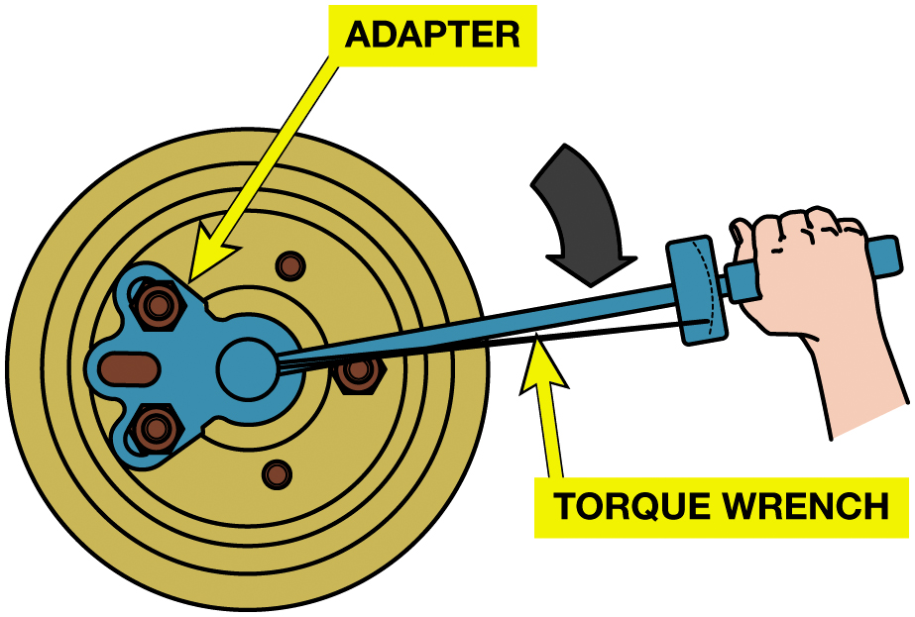
Figure 13.13
Wheel Turning Torque
A special tool has been attached to two wheel studs, allowing a torque wrench to be used to measure the torque required to turn this wheel. The opposite wheel is on the ground with the transmission in neutral. A low reading indicates limited slip differential wear.

Slide 22
On-Vehicle Service Operations
Items That Can Be Serviced Include…
Wheel stud replacement
Axle removal
C-Lock axle seal replacement
Retainer axle bearing and seal removal and replacement

Slide 23
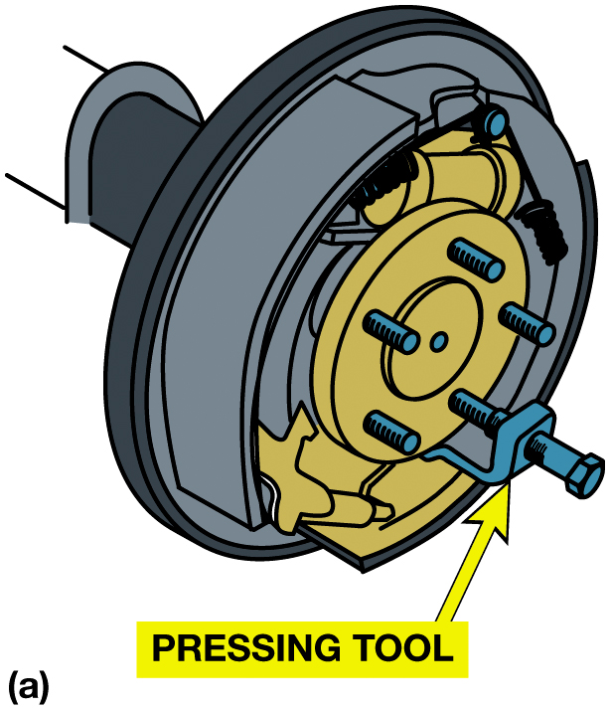
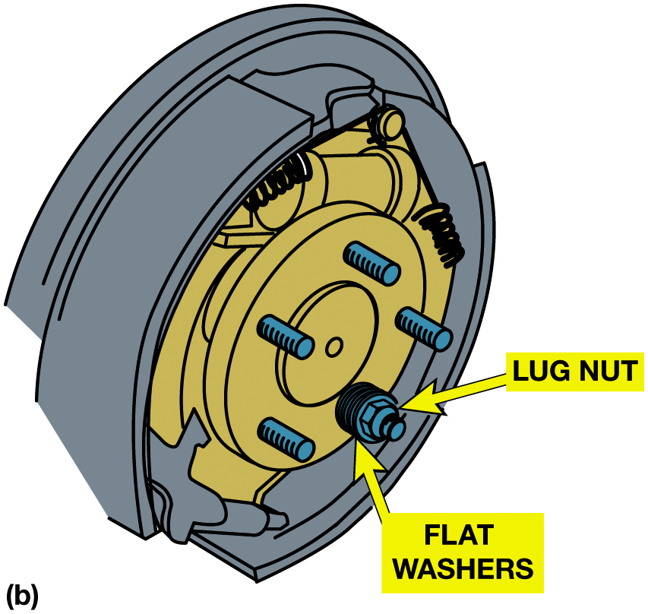
Figure 13.14
Wheel Stud
(a) A tight stud should be removed using a pressing tool so as not to bend the axle flange. (b) A new wheel stud is installed by tightening the lug nut against a stack of flat washers.

Slide 24
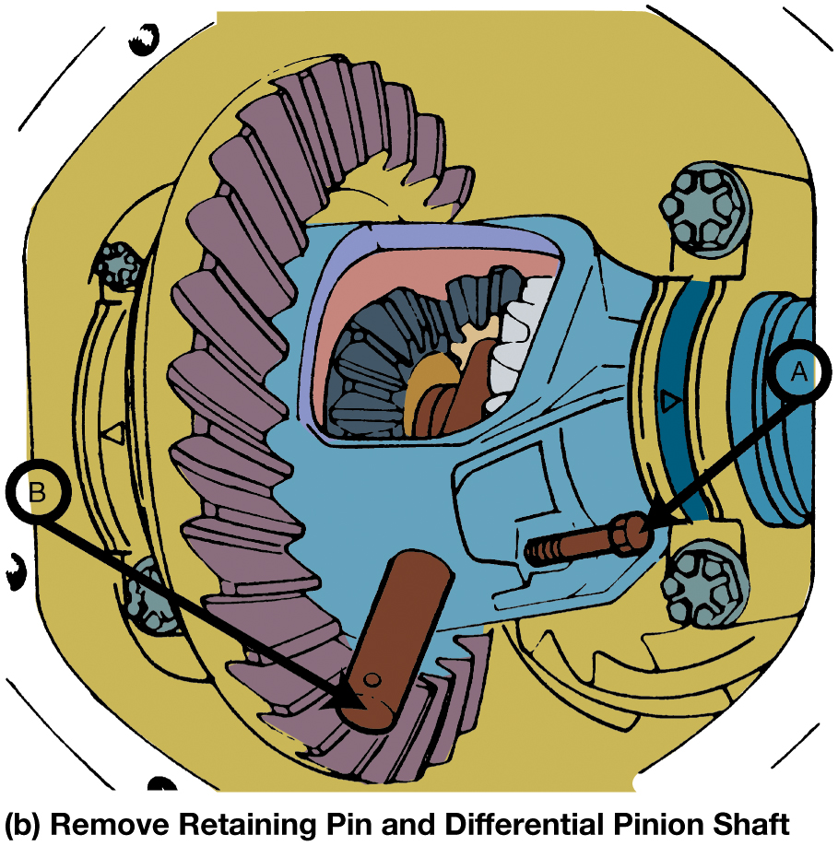
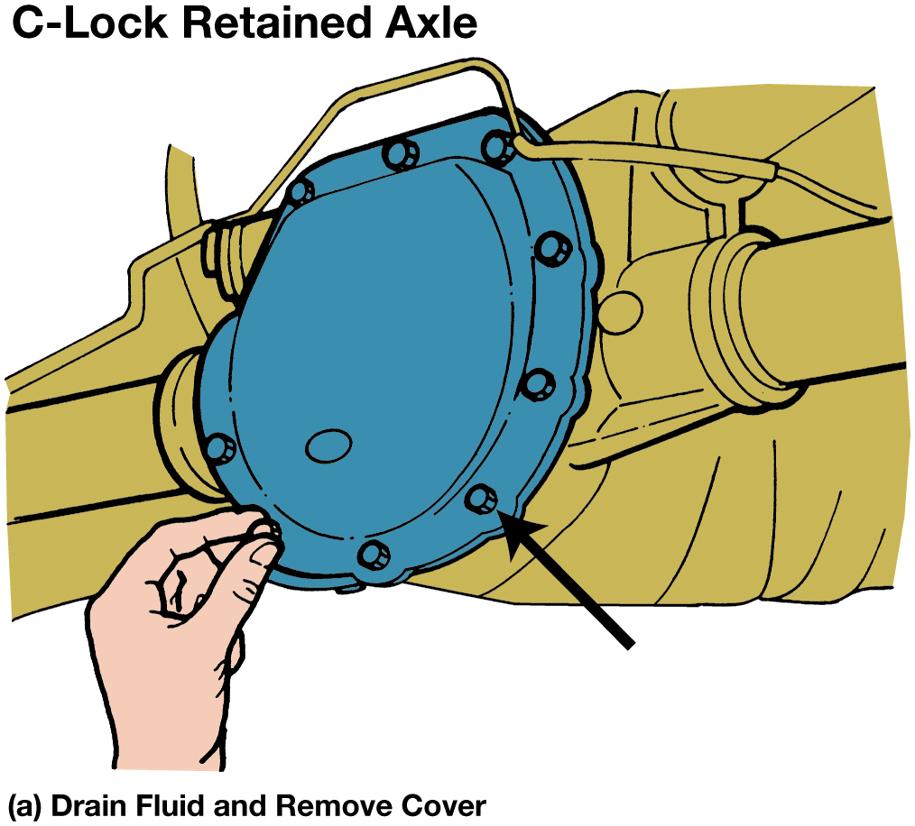
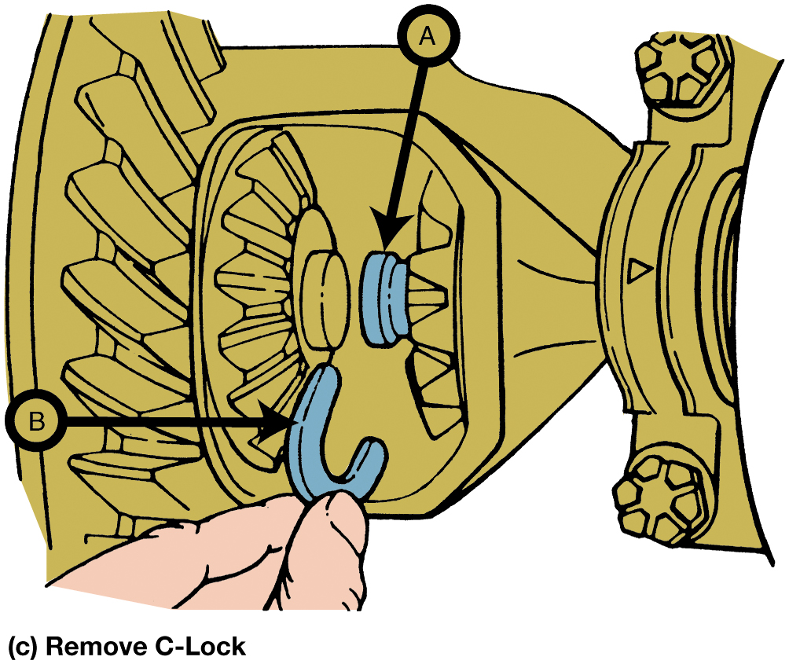
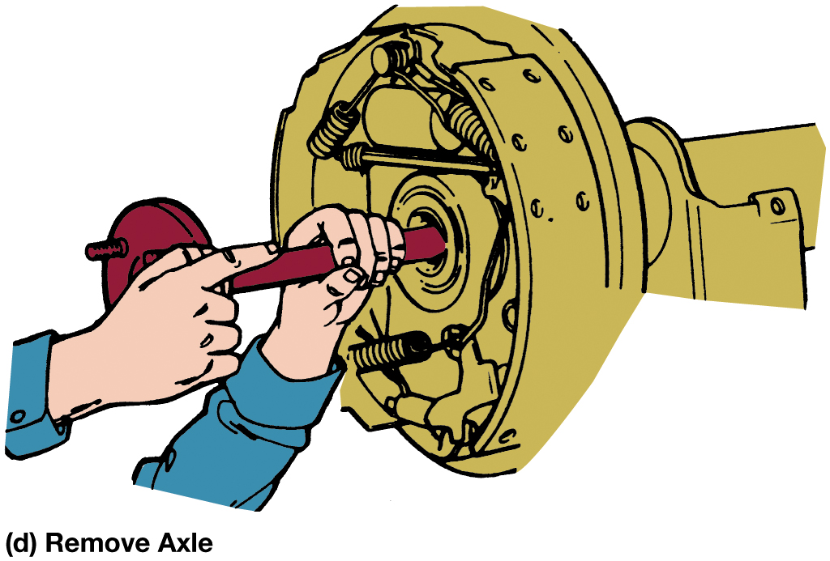
Figure 13.15
C-Lock Axle
Notes:
Figure 13.15 Differential pinion shaft must be removed to allow C-lock and axle to be removed.
Tech Tip: Look for the Hole in the Retainer Plate
Most axle flanges include a hole so that a socket and extension bar can be used to remove and
replace the retainer bolts. If the axle does not have a hole in the retainer plate, then the axle
uses a C-lock-type retaining method.

Slide 25
Animation: Remove and Replace Axle Shaft, C-Lock (Animation will automatically start)

Slide 26
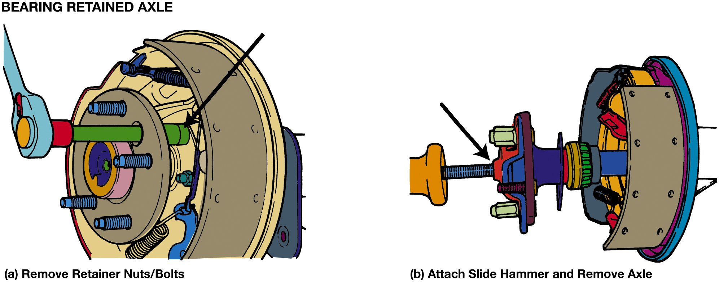
Figure 13.16
Retainer Axle Bearing
The retainer nuts/bolts are removed before sliding the bearing-retained axle from the housing.
Notes:
Tech Tip: Look for the Hole in the Retainer Plate
Most axle flanges include a hole so that a socket and extension bar can be used to remove and
replace the retainer bolts. If the axle does not have a hole in the retainer plate, then the axle
uses a C-lock-type retaining method.
Long Description:
The first step of bearing retained axle involves removing the retainer nuts and bolts by using a wrench. The second step on the right involves removing the axle by attaching the slide hammer to the axle.

Slide 27
Animation: Remove and Replace Axle Shaft, Bearing Retained (Animation will automatically start)

Slide 28
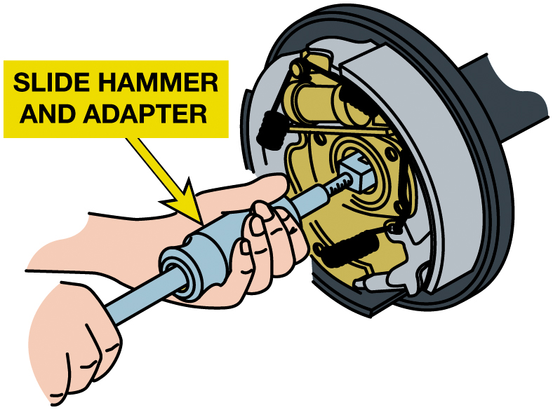
Figure 13.17
Bearing/Seal Removal
The bearing and seal are removed from the housing with a slide hammer and adapter.

Slide 29
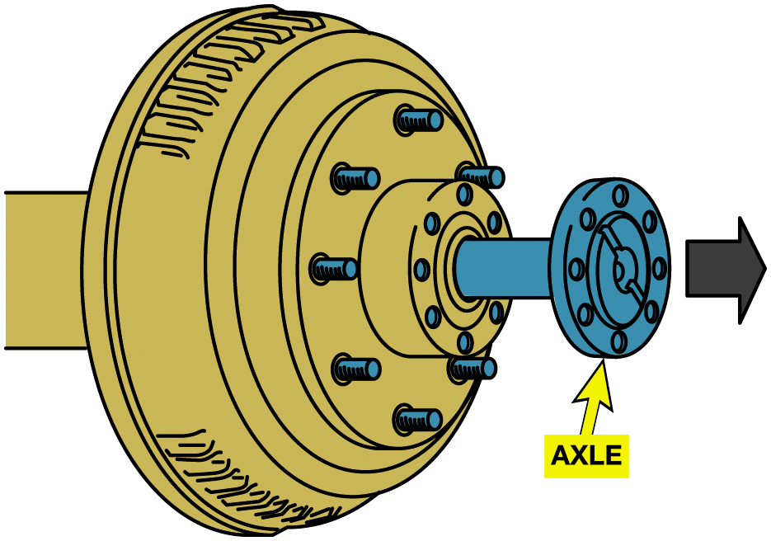
Figure 13.18
Axial Removal
After the axle flange bolts have been removed, a full-floating axle can be slid out of the housing. This permits access to the axle, wheel bearings, and brakes.
Notes:
After the axle flange bolts have been removed, a full-floating axle can be slid out of the housing. This permits access to the axle,
wheel bearings, and brakes.

Slide 30
Frequently Asked Question: How is Axle Removed from a Full-Floating-Type Axle?
? Frequently Asked Question
How Is Axle Removed from a Full-Floating-Type Axle? The full-floating axle is used in medium and heavy-duty trucks and in many larger pickups and vans. Axles are removed to replace the shaft, gain access to the wheel bearings, and allow removal of the hub and brake drum and the carrier. Remove the bolts that attach the axle shaft flange to the hub and mark the location of the axle and hub. Using a soft hammer, strike the axle flange to break the gasket loose. Slide the axle out of the housing. See Figure 13.18.

Slide 31
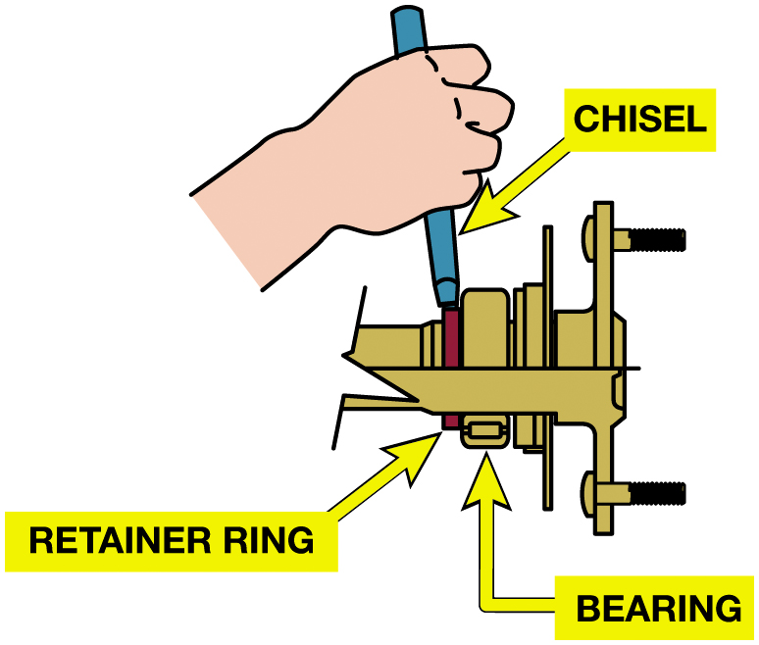
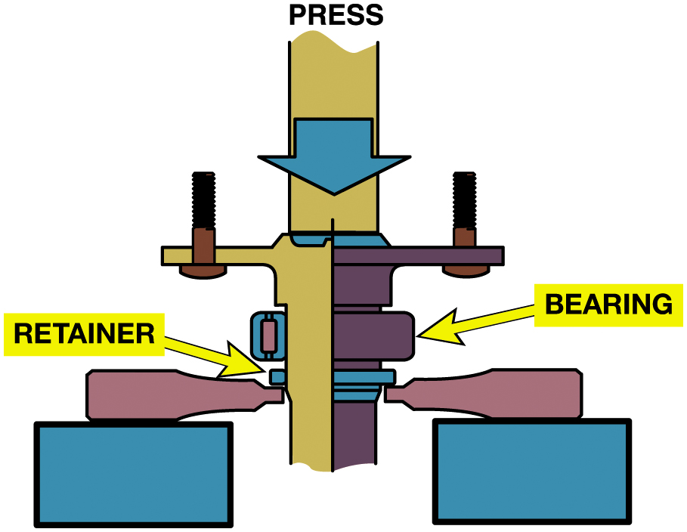
Removing Axle Bearing
Figure 13.19 The axle bearing retainer ring should be cut or stretched using a drill and a chisel to make six to eight blows before trying to press the bearing off the axle.
Figure 13.20 The axle is being pressed into the bearing and retainer plate.

Slide 32
Frequently Asked Question: How are Wheel Studs Replaced?
? Frequently Asked Question
How Are Wheel Studs Replaced? Wheel studs, also known as lug studs, secure the wheel to the axle or hub with lug nuts. Over time, they can rust or break, requiring replacement. Replacing a damaged wheel stud involves the following steps: STEP #1 Use remover over stud and tighten until stud is removed out the back. CAUTION: Do not use a hammer to remove the damaged stud because the hammer blows can damage the axle bearing. STEP #2 Rotate hub until the slot aligns with hole in the hub. Insert new stub into the hub flange. STEP #3 Place a stack of washers over the stud and install a lug nut. Tighten the lug nut to draw the stud into the bearing hub. To prevent future damage to lug studs, always tighten the lug nuts to factory specifications and in the correct order. See Figure 13.21.

Slide 33
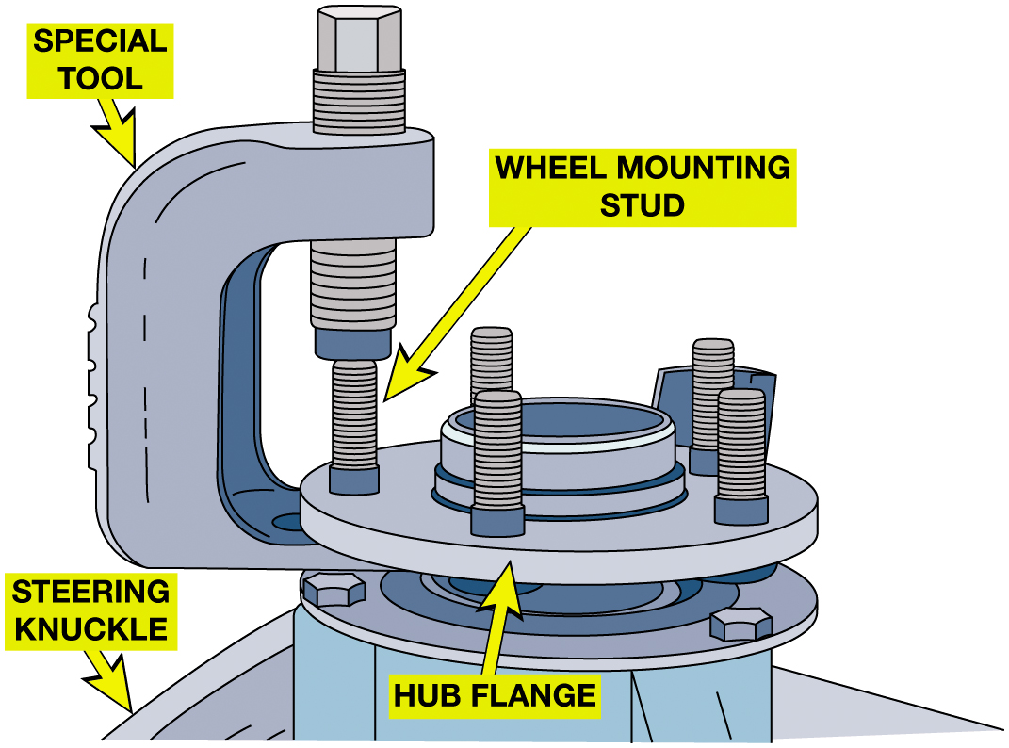
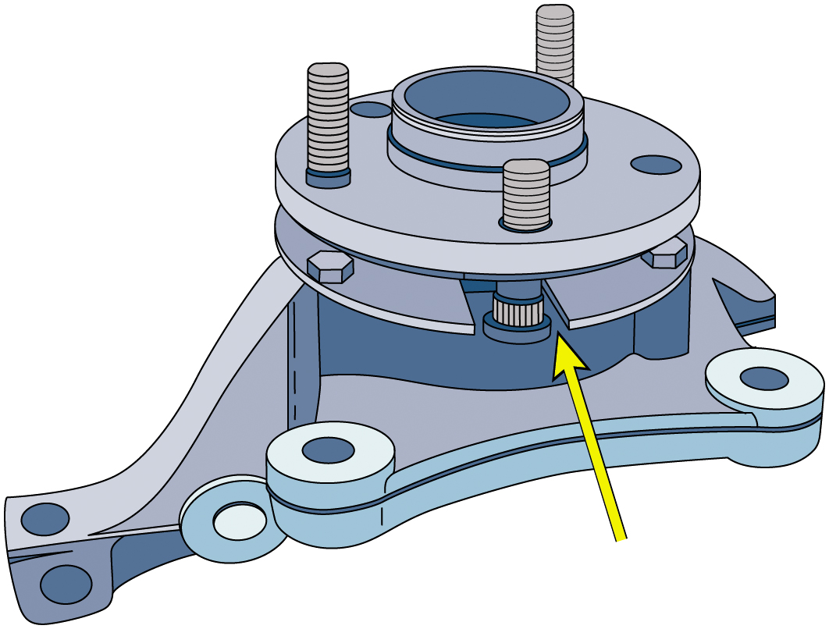
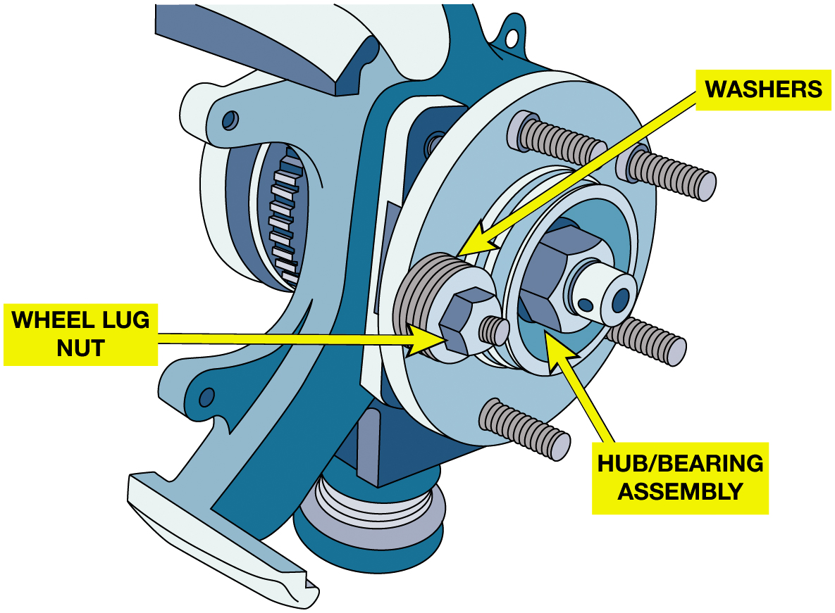
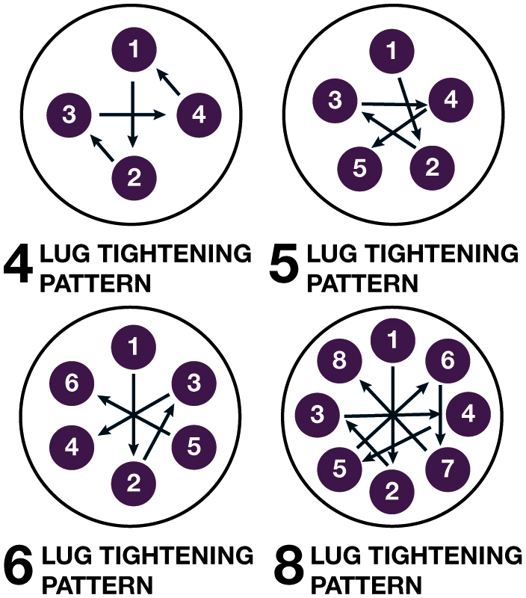
Figure 13.21
Wheel Studs
Notes:
Figure 13.21 (a) A special tool or a tie rod removing tool should be used to remove the damage lug
stud. (b) Align the bearing hub with a slot in the flange and insert the replacement stud. (c)
Install washers and then tighten a lug nit to draw the new stud into the hub flange. (d) To help
prevent future damage to the lug nuts, always tighten to factory specification
and in a crisscross pattern.
Long Description 1:
The illustration has some lug studs attached over the circular hub flange. The hub flange is above a larger circular plate labeled steering knuckle. A special tool is fixed to the hub flange to remove a wheel mounting stud from the flange plate.
Long Description 2:
The illustration has some lug studs attached over the circular hub flange. The hub flange has a hub or bearing assembly in the center. A wheel lug nut of the hub flange has some washers inserted into it.
Long Description 3:
The first illustration labeled 4 lug tightening patterns has numbers 1 to 4 labeled in a circle. The number 1 is at the top, the number 2 is at the bottom, the number 3 is on the left, and the number 4 is on the right. 1 points to 2, 2 points to 3, 3 points to 4, and 4 points to 1. The second illustration labeled 5 lug tightening pattern has numbers 1 to 5 labeled in a circle. Starting from the top, the numbers clockwise are 1, 4, 2, 5, and 3. 1 points to 2, 2 points to 3, 3 points to 4, and 4 points to 5. The third illustration labeled 6 lug tightening pattern has numbers 1 to 6 labeled in a circle. Starting from the top, the numbers clockwise are 1, 3, 5, 2, 4, and 6. 1 points to 2, 2 points to 3, 3 points to 4, 4 points to 5, and 5 points to 6. The fourth illustration labeled 8 lug tightening pattern has numbers 1 to 8 labeled in a circle. Starting from the top, the numbers clockwise are 1, 6, 4, 7, 2, 5, 3, 8, and 1. 1 points to 2, 2 points to 3, 3 points to 4, 4 points to 5, 5 points to 6, 6 points to 7, and 7 points to 8.

Slide 34
Pinion Shaft Seal Replacement (1 of 3)
Disconnect driveshaft from the companion flange.
Support driveshaft so it does not hang from front u-joint.
Measure the torque required to rotate pinion shaft
(pinion and carrier bearing preload)
Using inch-pound torque wrench, record reading
Place index marks on the end of pinion shaft, pinion nut
Companion flange so that flange can be installed back on same spline.

Slide 35
Pinion Shaft Seal Replacement (2 of 3)
Remove drive pinion nut, washer, and companion flange.
Remove pinion seal.
Check bearing pocket for damage and apply gear oil.
Replace companion flange
Install new pinion nut with a washer and tighten nut until the parts align.
Replace the driveshaft.

Slide 36
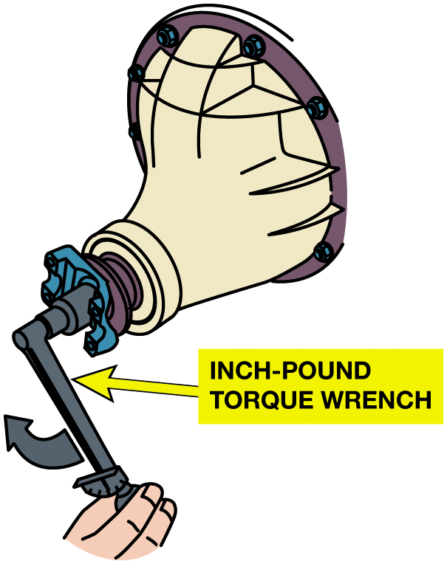
Figure 13.22
Measuring Axle Preload
Notes:
Figure 13.23 A leaky drive pinion seal is repaired by first. After removing the wheels and eliminating any brake drag, use an inch-pound torque wrench to measure the pinion bearing preload. It should be between 17 and 22 inch-pounds or slightly lower in most applications.

Slide 37
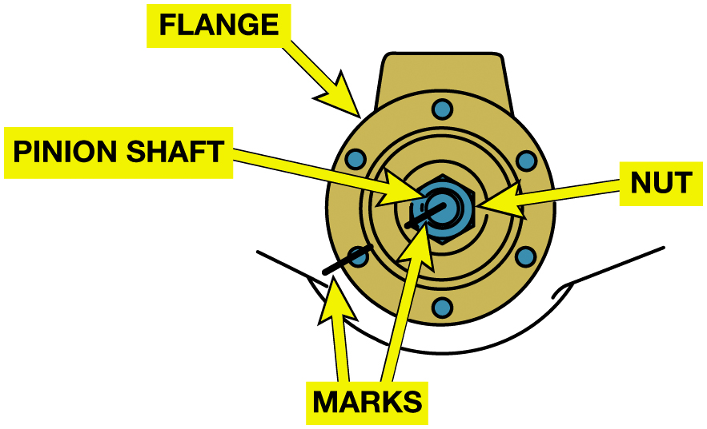
Figure 13.23
Marking Pinion Flange
Mark the pinion flange, pinion nut, and the pinion shaft before removing the pinion nut.

Slide 38
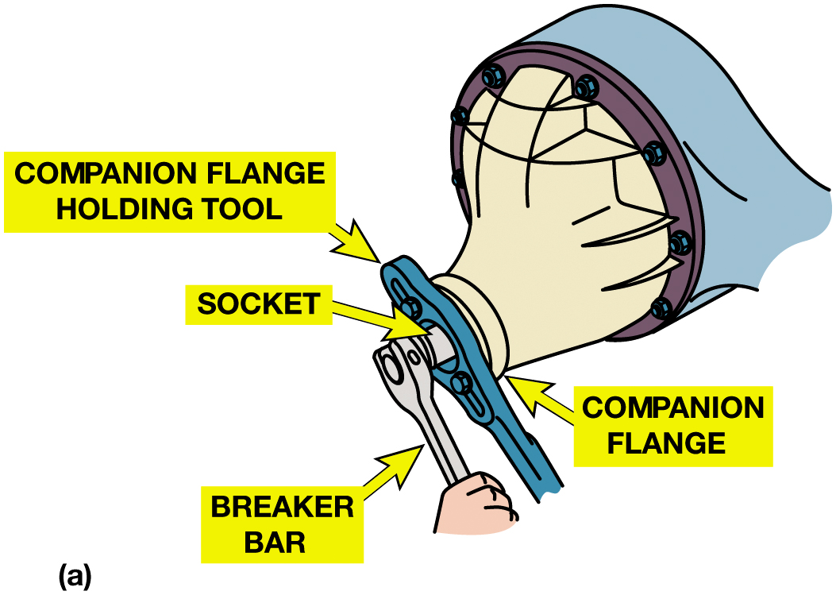
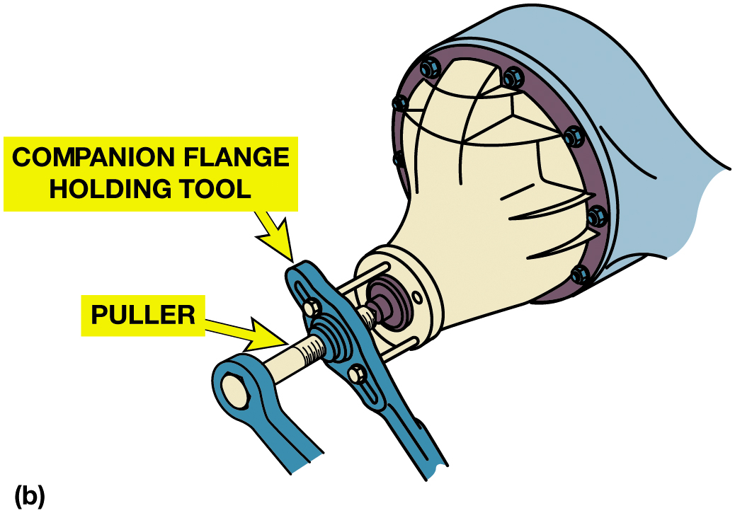
Figure 13.24
Companion Flange
(a) A companion flange holding tool is used to keep the companion flange from rotating as the pinion nut is loosened. (b) After the pinion nut has been removed, a puller is used to remove the companion flange.
Notes:
Long Description 1:
The illustration consists of the companion flange holding tool inserted into the companion flange. The socket of the companion flange visible outside the companion flange holding tool is rotated with the help of a breaking bar.
Long Description 2:
The illustration consists of the companion flange holding tool inserted into the companion flange which is removed from the tool by using a puller and breaking bar.

Slide 39
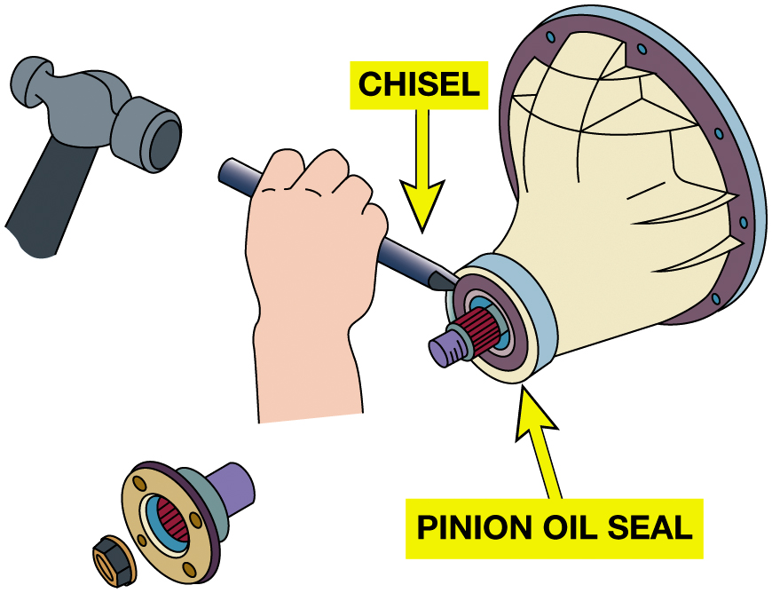
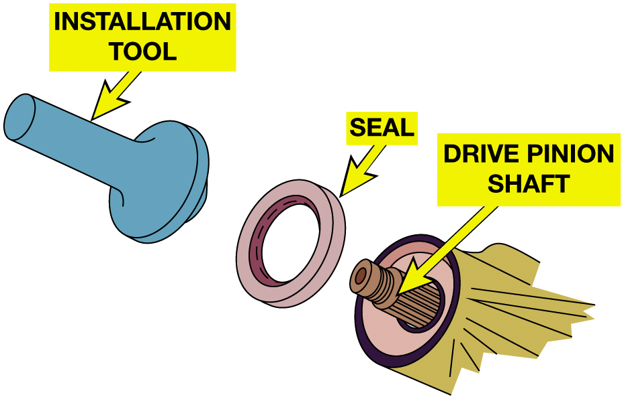
Pinion Shaft Seal Replacement (3 of 3)
Figure 13.25 Use a chisel to separate the seal from the axle housing, then use a seal remover to pry the seal off.
Figure 13.26 Use a seal driver (installation tool) to seat the new seal in the axle housing.
Notes:
Long Description:
The illustration consists of a chisel on the top of the pinion oil seal. Above the chisel, there is a hammer. On the bottom left, there is a removed pinion oil seal.

Slide 40
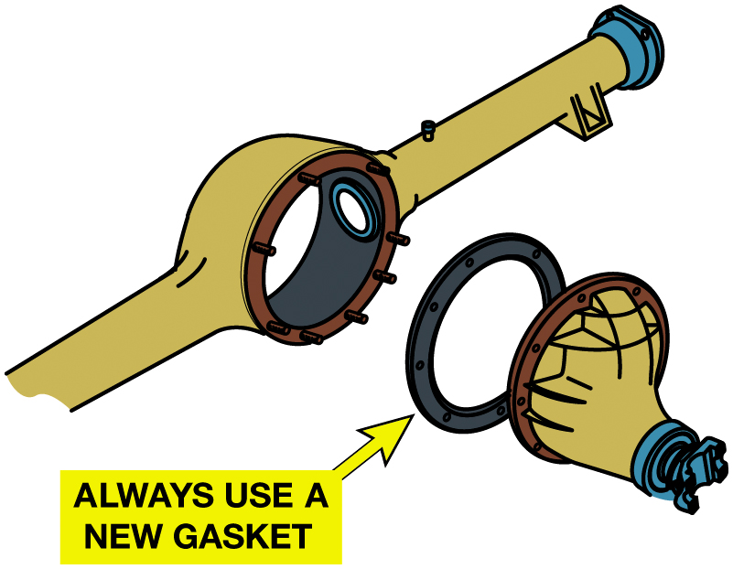
Figure 13.27
Removing Carrier
The carrier (third member) is removed from the drive axle housing by removing the retaining nuts, and then the heavy assembly is carefully removed.
Notes:
Long Description:
The illustration consists of a cylindrical carrier with a circular structure in the center. A gasket is on the right of the carrier. A note reads, always use a new gasket. On the right of the gasket, there is the drive axle housing.

Slide 41
Differential Carrier Service (1 of 2)
Differential carrier service…
An inspection of the gears and bearings before teardown
A check for ring gear runout
Removal and replacement of differential and ring gear
Removal and replacement of the pinion gear
Inspection and repair of the differential

Slide 42
Differential Carrier Service (2 of 2)
Assembly adjustments for pinion depth, pinion bearing preload, backlash, and carrier bearing preload.
Removal carrier removal
Integral carrier removal
Inspection and cleaning

Slide 43
Differential Assembly Service
Differential Assembly Service…
Inspection
Ring gear runout
Ring gear replacement
Pinion gear removal
Pinion bearings
Side bearings
Differential case clearance checks

Slide 44
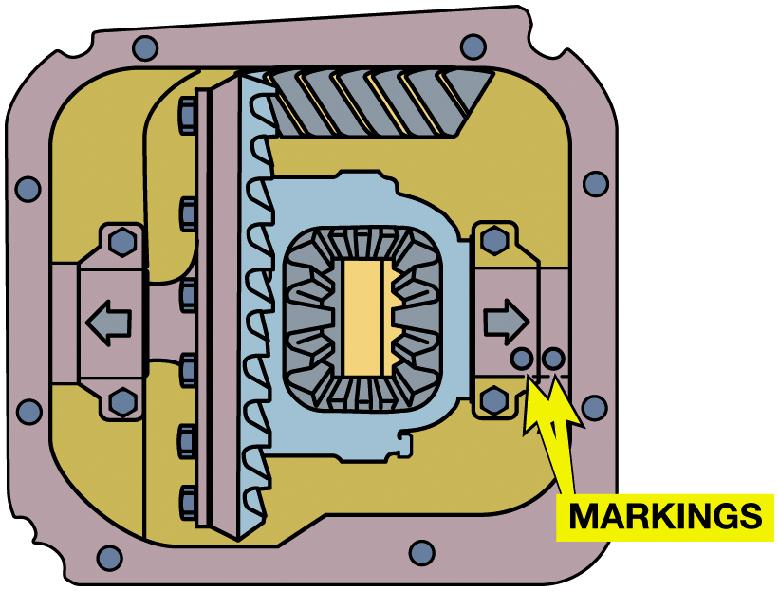
Figure 13.28
Bearing Caps Marked
The bearing caps have to be stamped or marked to make sure that they are installed back in the exact same location. Not only left and right but they also need to be installed with the correct side up, the same as they were installed originally.
Notes:
The bearing caps have to be stamped or marked to make sure that they are installed back in the
exact same location. Not only left and right b they also need to be installed with the correct side up, the same as they were installed originally

Slide 45
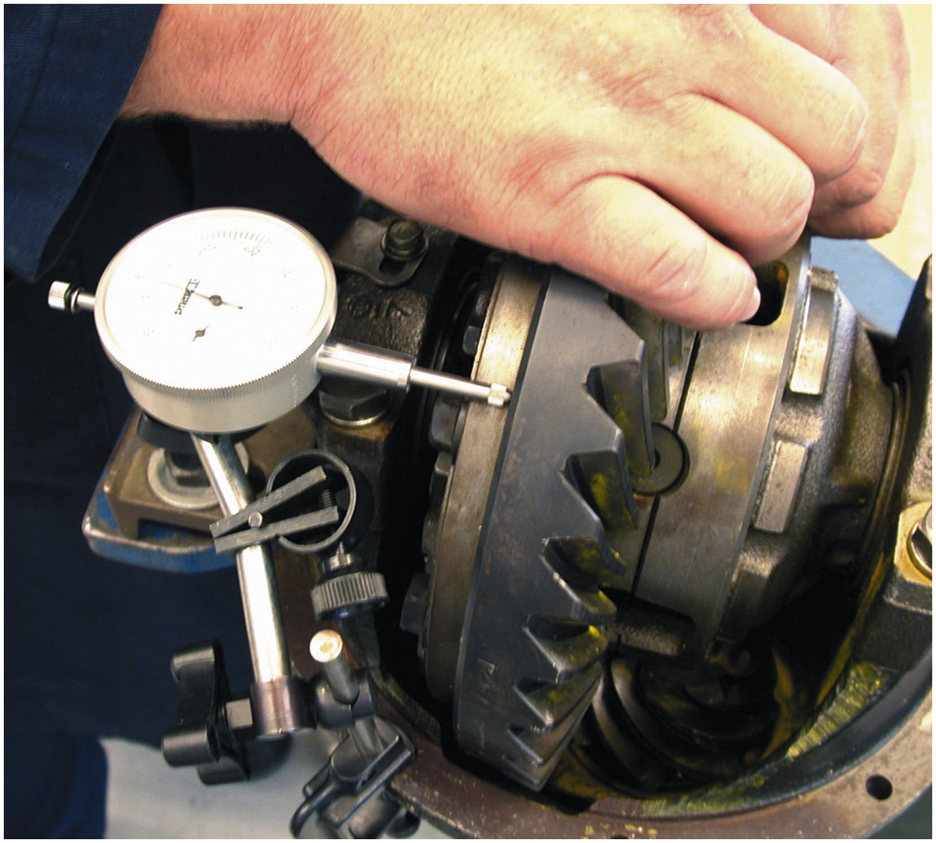
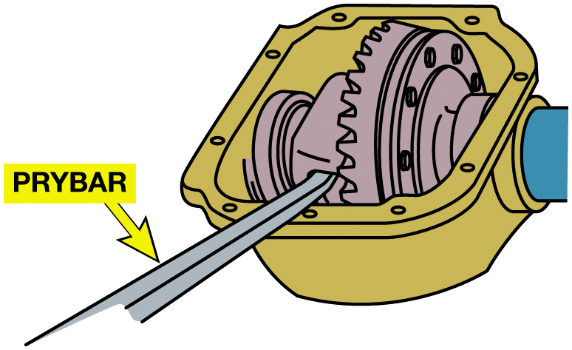
Differential Carrier Service (3 of 3)
Figure 13.29 Use a prybar to gently pry the carrier from the housing.
Figure 13.30 Ring gear runout should be less than 0.002 inch (0.05 mm) as measured by a dial indicator.

Slide 46
Animation: Measure Ring Gear Runout (Animation will automatically start)

Slide 47
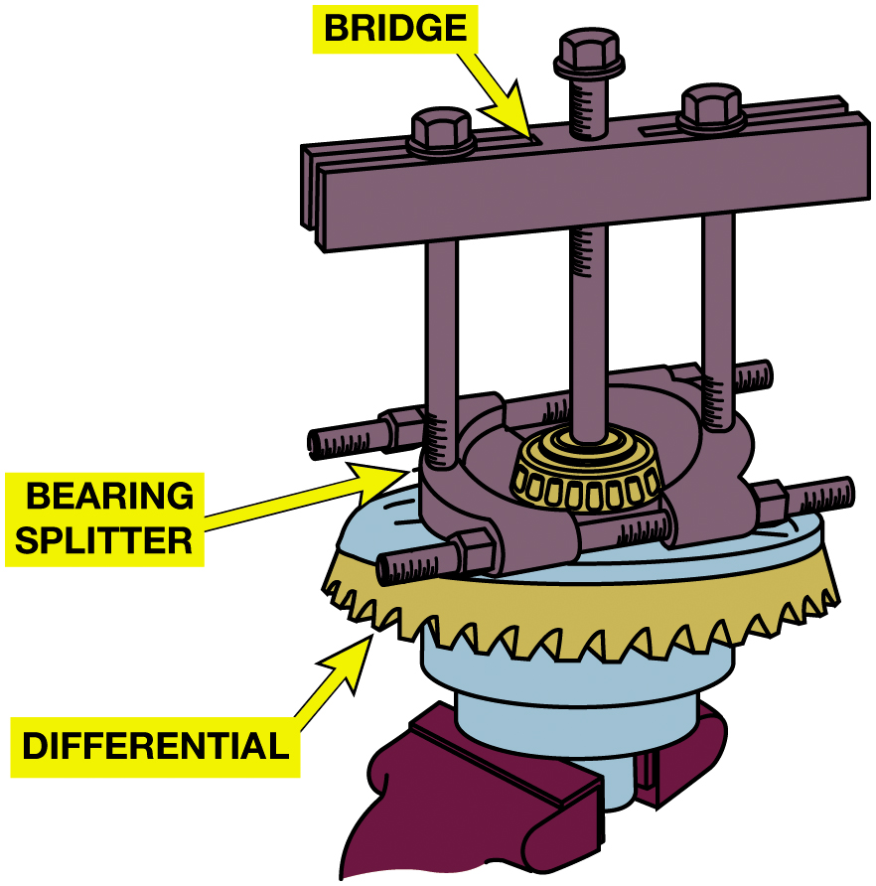
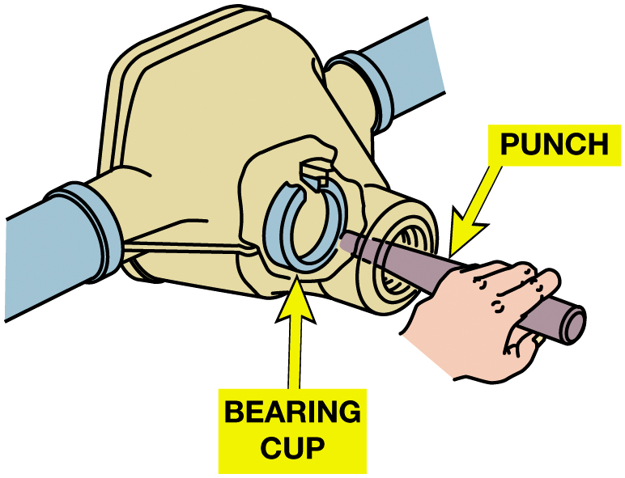
Removing Bearings
Figure 13.31 A damaged bearing cup can be driven out of the housing using a long punch.
Figure 13.32 A puller and bearing splitter are set up to remove the differential side bearing.
Notes:
Ring gear runout is checked if there is evidence of damage to the ring gear. Runout is usually
caused by a faulty or bent differential case or an improper mounting of the ring gear onto the
case. Because gear run- out will cause backlash to change, it is sometimes referred to as backlash
variation. To check ring gear runout, perform the following steps:
Mount a dial indicator with the stylus on the back of the ring gear at 90 degrees to the gear surface. The runout of a differential case can be checked using a similar procedure. ● SEE FIGURE 13–30.
Rotate the ring gear and observe the indicator needle movement. This is the total indicated runout (T I R).
Tech Tip: Loosen Ring Gear Bolts First
An experienced technician will loosen the ring gear mounting bolts before removing the
differential from the differential case. These bolts are normally very tight, and the differential
is hard to hold when it is out of the carrier. While still in the carrier, the differential case
can be held stationary by placing a block of wood between the ring and pinion gears or by placing a
box wrench on one of the ring gear bolts and against the side of the carrier.
Long Description:
The illustration consists of the differential side bearing with a bridge setup above it. The bridge consists of the bearing splitter at the bottom, mounted near the top of the differential side bearing.

Slide 48
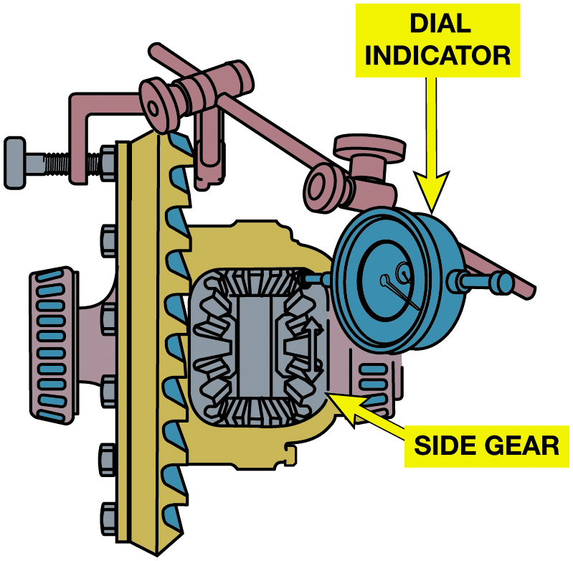
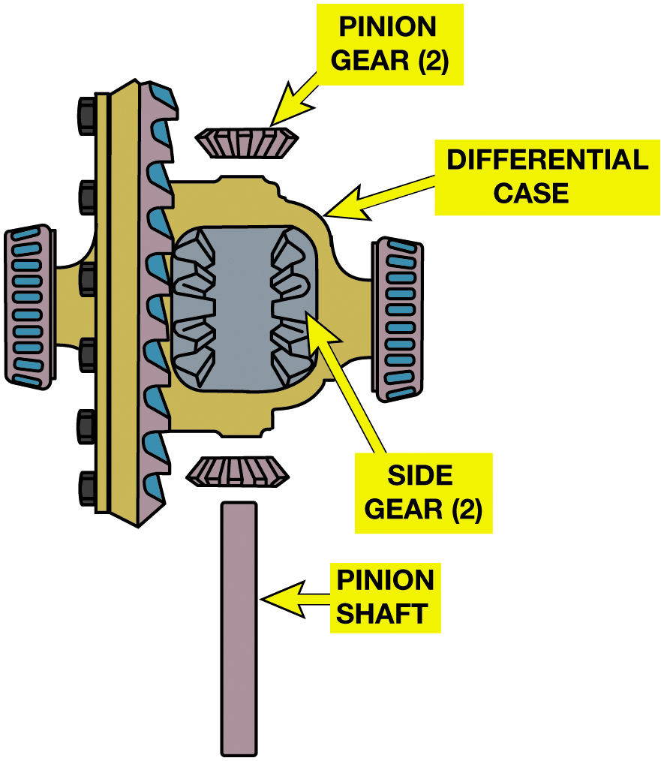
Differential Service
Figure 13.34 With the pinion shaft removed, the pinion gears can be rolled to the case windows and removed; then the side gears can be lifted out of the case.
Figure 13.33 Differential case wear can be checked by measuring the side gear backlash using a dial indicator.
Notes:
NOTE: Excessive clearance in the differential gear set can cause a clunk as the lash is taken up
when either the manual transmission clutch or automatic transmission is engaged. This is especially
noticeable when changing direction, low to reverse, or reverse to low.
Long Description 1:
The illustration consists of the differential side bearing case with a side gear on the top. A dial indicator is on the top right of the side gear.
Long Description 2:
The illustration consists of the differential side bearing case with a side gear on the top. The side gear is labeled side gear 2. The side gear has a pinion gear below it and a pinion gear above it. The pinion gear above the side gear is labeled pinion gear 2. A separate pinion shaft is below the pinion gear at the bottom.

Slide 49
Drive Pinion Shaft
Drive Pinion Depth
Determining pinion depth shim selection
+ or − markings on the pinion gear
Gauge block and fixtures
Contact patterns
Pinion Bearings
Drive pinion bearing preload adjustment
Collapsible spacer
Solid spacer

Slide 50
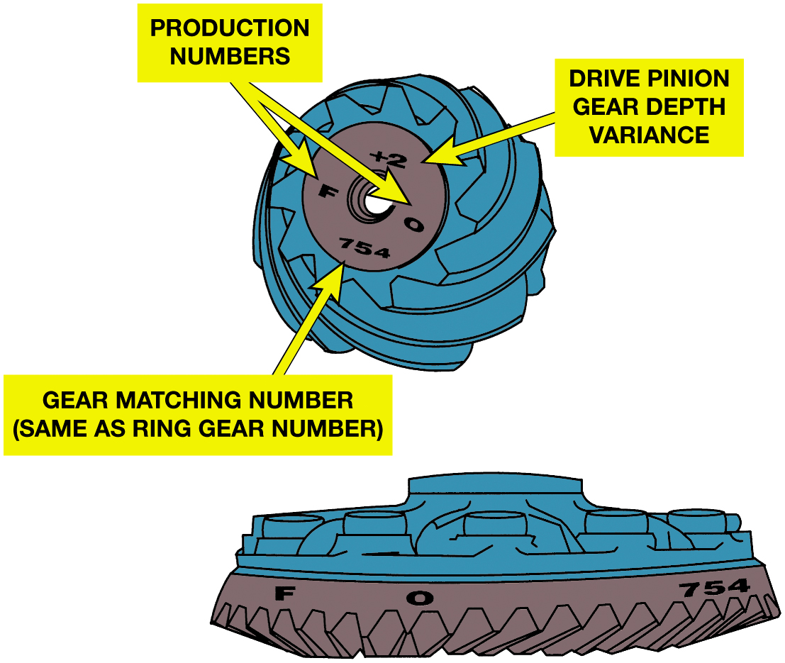
Figure 13.35
Ring Gear Markings
Notes:
Figure 13.35 The ring and pinion gears are a matched set and are marked for correct pinion depth variance.
Pinion depth can be checked using a gauging set and depth micrometer. This is a common method used
to determine the correct shim thickness necessary to provide the proper gear pattern.
Long Description:
The ring gear at the bottom has a mark F, O, 754 on it. The pinion gear on the top has the production numbers F, O, drive pinion gear depth variance plus 2, and gear matching number 754 which is the same as the ring gear number.

Slide 51
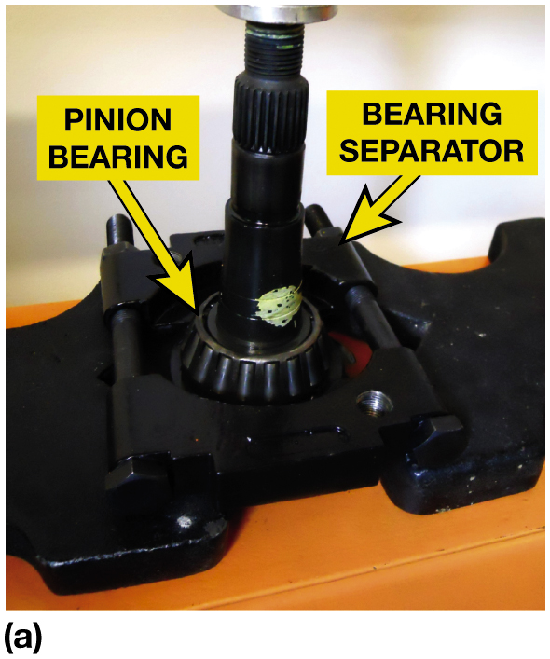
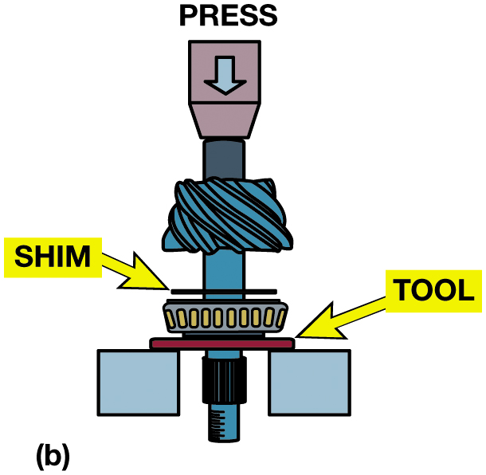
Figure 13.36
Pinion Bearing
Notes:
Figure 13.36 (a) A bearing splitter and a hydraulic press needed to remove the pinion shaft bearing
and get access to the shim. (b) The setup for pressing the bearing onto the pinion shaft with the shim in place.
Long Description:
The illustration consists of the pinion bearing on the bearing separator tool. A thin shim is above the pinion bearing. A hydraulic press is inserted into the shim and pinion bearing from above.

Slide 52
Chart 13.2
Shim Sizes
OLD SHIM MARKING | NEW SHIM MARKING −4 | NEW SHIM MARKING −3 | NEW SHIM MARKING −2 | NEW SHIM MARKING −1 | NEW SHIM MARKING 0 | NEW SHIM MARKING +1 | NEW SHIM MARKING +2 | NEW SHIM MARKING +3 | NEW SHIM MARKING +4
+4 | Plus 0 point 0 0 8 | Plus 0 point 0 0 7 | Plus 0 point 0 0 6 | Plus 0 point 0 0 5 | Plus 0 point 0 0 4 | Plus 0 point 0 0 3 | Plus 0 point 0 0 2 | Plus 0 point 0 0 1 | 0 point 0 0 0
+3 | Plus 0 point 0 0 7+0.007 | Plus 0 point 0 0 6 | Plus 0 point 0 0 5 | Plus 0 point 0 0 4 | Plus 0 point 0 0 3 | Plus 0 point 0 0 2 | Plus 0 point 0 0 1 | 0 point 0 0 0 | Minus 0 point 0 0 1
+2 | Plus 0 point 0 0 6 | Plus 0 point 0 0 5 | Plus 0 point 0 0 4 | Plus 0 point 0 0 3 | Plus 0 point 0 0 2 | Plus 0 point 0 0 1 | 0 point 0 0 0 | Minus 0 point 0 0 1 | Minus 0 point 0 0 2
+1 | Plus 0 point 0 0 5 | Plus 0 point 0 0 4 | Plus 0 point 0 0 3 | Plus 0 point 0 0 2 | Plus 0 point 0 0 1 | 0 point 0 0 0 | Minus 0 point 0 0 1 | Minus 0 point 0 0 2 | Minus 0 point 0 0 3
0 | Plus 0 point 0 0 4 | Plus 0 point 0 0 3 | Plus 0 point 0 0 2 | Plus 0 point 0 0 1 | 0 point 0 0 0 | Minus 0 point 0 0 1 | Minus 0 point 0 0 2 | Minus 0 point 0 0 3 | Minus 0 point 0 0 4
−1 | Plus 0 point 0 0 3 | Plus 0 point 0 0 2 | Plus 0 point 0 0 1 | 0 point 0 0 0 | minus 0 point 0 0 1 | Minus 0 point 0 0 2 | Minus 0 point 0 0 3 | Minus 0 point 0 0 4 | Minus 0 point 0 0 5
−2 | Plus 0 point 0 0 2 | Plus 0 point 0 0 1 | Plus 0 point 0 0 0 | Minus 0 point 0 0 1 | Minus 0 point 0 0 2 | Minus 0 point 0 0 3 | Minus 0 point 0 0 4 | Minus 0 point 0 0 5 | Minus 0 point 0 0 6
−3 | Plus 0 point 0 0 1 | Plus 0 point 0 0 0 | Minus 0 point 0 0 1 | Minus 0 point 0 0 2 | Minus 0 point 0 0 3 | Minus 0 point 0 0 4 | Minus 0 point 0 0 5 | Minus 0 point 0 0 6 | Minus 0 point 0 0 7
−4 | Plus 0 point 0 0 0 | Minus 0 point 0 0 1 | Minus 0 point 0 0 2 | Plus 0 point 0 0 3 | Minus 0 point 0 0 4 | Minus 0 point 0 0 5 | Minus 0 point 0 0 6 | Plus 0 point 0 0 7 | Minus 0 point 0 0 8
A chart can be used to determine the size of the depth shim needed. These markings are no longer used by all manufacturers

Slide 53
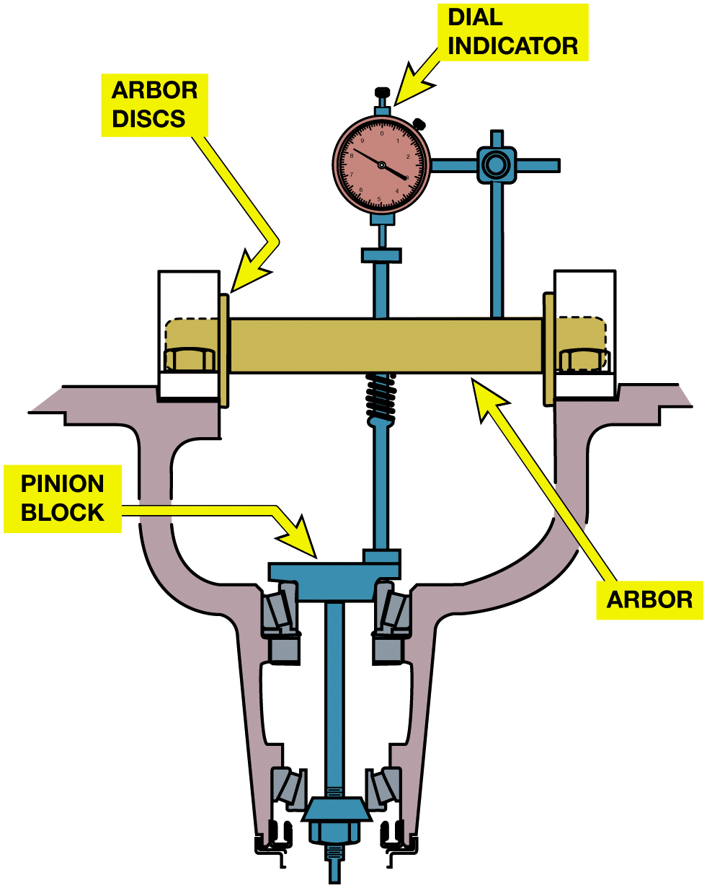
Figure 13.37
Measuring Pinion
Special tool kit used for determining the correct pinion shaft shim thickness.
Notes:
Most vehicle manufacturers use a set of pinion depth gauge blocks to select the correct depth shim. These gauges are installed in the carrier, usually using the rear drive pinion bearing. Universal pinion depth measuring tools are available that can be used to determine the pinion depth.
Long Description:
The illustration consists of a pinion block around a bearing separator tool. A long horizontally oriented rectangular arbor is set on the top of the bearing separator tool. The ends of the arbor have the arbor discs. On the top center of the arbor, a dial indicator is attached to the pinion block via the insertion into the arbor.

Slide 54
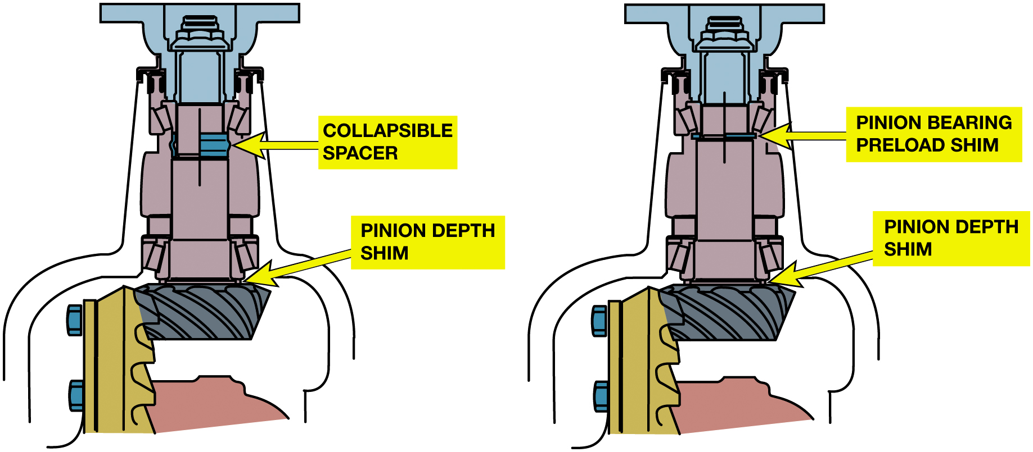
Figure 13.38
Spacer & Shims
The pinion on the left uses a collapsible spacer, and the pinion on the right uses shims to provide the necessary preload to the pinion shaft bearings.
Notes:
Long Description:
The illustration on the left consists of the pinion depth shim just above the pinion block. On the top of the mechanical structure above the shim, there is a collapsible spacer fixed. The illustration on the right consists of the pinion depth shim just above the pinion block. On the top of the mechanical structure above the shim, there is a pinion-bearing preload shim.

Slide 55
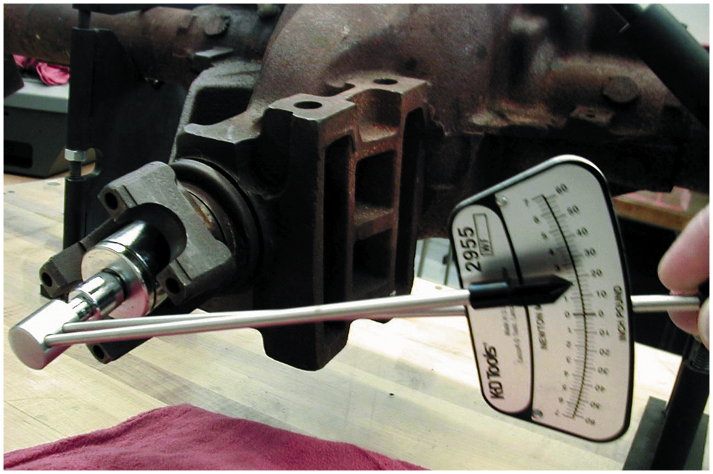
Figure 13.39
Rotating Torque
Using an inch-pound torque wrench to check the rotating torque of the drive pinion. This procedure is very important if the axle uses a collapsible spacer. The drive pinion nut should be gradually tightened and the rotating torque checked to prevent over-tightening the nut. If the rotating torque is higher than specifications, the collapsible spacer will require replacement and the installation procedure must be repeated.

Slide 56
Carrier Assembly and Setup (1 of 3)
Installing ring gear
Installing case into housing
Gear marking compound
Backlash and carrier side bearing preload adjustments
Made ring gear and differential are installed into carrier.
Backlash is adjusted by moving ring gear toward pinion
Reduce backlash and away from pinion to increase backlash.

Slide 57
Carrier Assembly and Setup (2 of 3)
Figure 13.40 Torque the retaining bolts to factory specification and in the order specified in service information.
Figure 13.41 A spreader tool is specified to be used by some vehicle manufacturers when the differential case assembly is being installed in the housing. Always follow the vehicle manufacturer’s recommended procedures.

Slide 58
Carrier Assembly and Setup (3 of 3)
Preload is increased by…
Moving one or both of the carrier bearing cups toward each other
And it is reduced by moving them away from each other
Preload/backlash using shims

Slide 59
Figure 13.43
Backlash Check
(a) Backlash is determined by mounting a dial indicator to the differential housing and placing the button of the gauge against a tooth of the ring gear. Moving the ring gear back and forth will indicate on the dial indicator the amount of backlash. (b) Backlash is the clearance between the drive pinion and the ring gear teeth.
Notes:
Long Description:
The schematic consists of two gear teeth-like structures attached to each other. An inverted tooth-like structure of the gear is inserted into the space between the two structures. The inverted structure almost touches the edge of the tooth-like structure on the left and is at a distance from the edge of the tooth-like structure on the right. The backlash as the space between the inverted tooth-like structure and the structure on the right is labeled 0.008 inches to 0.012 inches.

Slide 60
Figure 13.44
Backlash is adjusted by moving the position of the ring gear.
Notes:
See FIGURE 13.42 Tooth contact pattern on page 200 of the text.
A Tooth Contact Pattern Test is an excellent method for checking proper drive pinion
depth as well as proper backlash between the drive pinion and the ring gear. Gear marking compound
is available from some gear or vehicle manufacturers (G M gear marking compound, for example is part
number 1052351).
Any faults in these areas will be reflected in the pattern. The pattern test involves the following steps:
STEP 1 Clean the gear teeth of the ring gear and the drive pinion.
STEP 2 Using a small brush, apply a light coating of iron oxide compound.
STEP 3 Use a small prybar to apply a load to the ring gear to achieve a more accurate contact
pattern.
STEP 4 Rotate the drive pinion until the ring gear turns one revolution (about three revolutions
of the drive pinion gear).
STEP 5 Repeat rotating the drive pinion in the opposite di- rection. This will create a contact
pattern on both the drive side and the coast side of the ring gear.
NOTE: The drive side is the convex surface of the ring gear teeth. The coast side is the concave
side of the ring gear. This is true except for many differentials used on the front of
four-wheel-drive vehicles. In this case, the drive side in the front differential is the concave
sur- face and the coast side is the convex surface of the ring gear teeth. Always check the service
information for the vehicle being serviced for the correct interpretation of the pattern results.
SEE FIGURE 13.42.
Long Description:
The illustration consists of a differential case with a gear at its center. The right differential shim is on the right of the gear, and the left differential shim is on the left of the gear. A set of pinion-locating shim packs is above the gear with a collapsible spacer over it. A double-headed arrow is on the gear. A note near the arrow reads backlash adjustment. A vertically oriented arrow double-headed arrow is on the collapsible spacer above the pinion locating shim pack, and a note near the arrow reads the pinion depth adjustment. A note below the right differential shim reads, reduces the thickness of the shim to decrease backlash. A note below the left differential shim reads, reduces the thickness of the shim to increase backlash.

Slide 61
Backlash Adjustment
Figure 13.45 Using a dial indicator to adjust backlash using threaded adjusters.
Figure 13.46 Cast iron production shim (O E M use), service spacer, and shim used to adjust backlash and carrier bearing preload.
Notes:
Tech Tip Quick and Easy Shim Trick
An alternative method of adjusting backlash and carrier bearing preload is to start with too small
a shim at the left side and add enough shims to obtain zero bearing clearance and preload. Now,
measure the backlash and adjust the shim packs to correct backlash. Next, increase the size of both
shim packs to adjust the bearing preload.
Long Description:
The illustration consists of a case with a gear at its center. The case is attached to a ring gear on the right of the side gear. The bearings are on both sides of the side gear. The bearings are fixed over the carrier bearings which are attached above the service spacers. The right side shim is near the service spacer on the right of the bearing on the right. The left side shim is near the service spacer on the right of the bearing on the right.

Slide 62
Figure 13.47
Shim Example
Notes:
Figure 13.47 Procedure used to measure and determine the correct shims. Note that in this example,
a special tool ( J-2 2 7 7 9) is used to measure the gap on the left side, while a service spacer, shim, and feeler
gauge are used on the right side.
Long Description:
The illustration consists of the case with a gear at its center. The case is attached to a ring gear on the right of the side gear. The bearings are on both sides of the side gear. The bearings are fixed over the carrier bearings which are attached above the service spacers. A pinion shaft is above the pinion location shim packs over the side gear. The bearing on the left is fixed with a special tool. The bearing on the right is fixed with a feeler gauge. The equations and calculations on the right of the illustrations are as follows. Ring gear side, 0.250 inches, tool. Opposite side: A plus B plus C equals 0.265 inches. Adjust backlash: minus 0.010 over 0.240 inches; plus 0.010 over 0.275 inches. Obtain preload: 0.004 over 0.244 inches, shim required on ring gear side; plus 0.004 over 0.279 inches, shim required on the opposite side.

Slide 63
Frequently Asked Question: Why Should Service Shims Be Used Instead of Factory Shims?
? Frequently Asked Question
Why Should Service Shims Be Used Instead of the Factory Shims? During manufacture of a carrier, the bearings and gears are adjusted using a single, cast iron production shim at each carrier bearing. The sizes of these two shims are carefully selected to provide the proper backlash and carrier bearing preload. The production shims are normally replaced with a fixed-size service spacer and a selective-size shim when the carrier is adjusted. The service shims are made from steel and they can be driven into place. The factory cast iron shims cannot be driven into place and instead should be discarded when assembling the axle. The replacement shims are available in thicknesses needed to readjust the slightly worn bearings and gears. See Figure 13.46.

Slide 64
Installing Carrier with Ring Gear
Figure 13.48 On many axles, it is necessary to use a special tool to install steel spacers (shims) to achieve the specified backlash and side bearing preload.
Figure 13.49 A pattern that changes as it goes around the ring gear is caused by ring gear runout (one pattern change) or pinion gear runout (several pattern changes).
Notes:
Tech Tip” A Quick Check for Ring Gear Runout
Check for a pattern variation. One steady change in pattern indicates ring gear runout. Two or more
changes in pattern indicate pinion gear runout. See Figure 13.49
Long Description 1:
The illustration consists of the carrier within the drive axle housing. A special tool is manually held on the left of the steel spacer shim and a hammer is above the special tool.
Long Description 2:
The ring gear consists of several gear teeth. The ring gear teeth have a drive side as a convex surface on the right and a coast side concave surface on the left. The top part of the drive and coast sides is labeled toe, and the bottom part of the drive and coast side is labeled heel.

Slide 65
Limited Slip Differential Service
Typical Checks
Carefully remove S-shaped preload spring by tapping it through window.
Roll differential pinions around the case windows, and remove them.
Remove side gear and clutch packs as a group
Mark them so that they can be reassembled on same side of differential.
Clean parts.
Check clutch plates or cones.

Slide 66
Question 1
Backlash and carrier side bearing preload adjustments are made by__________.
A. Adding a Shim Behind the Pinion Shaft Bearing
B. Threaded Adjusters or by Changing the Shims
C. Tightening or Loosening Retainer Bolts
D. Using a Case Spreader

Slide 67
Answer 1
Backlash and carrier side bearing preload adjustments are made by__________.
B. Threaded Adjusters or by Changing the Shims

Slide 68
Summary
Drive axles must have clean gear oil at proper level and of proper type.
Cause of improper drive axle operation determined using diagnostic steps.
Some drive axle problems can be repaired on-vehicle.
Major internal drive axle problems usually require
Assembly be removed from the vehicle.
Drive axle disassembly and reassembly procedures
Vary between makes and models
Notes:
18 Step Drive Axle Service found on Pages 205-207

Slide 69
Drive Axle Service Photo Sequence

Slide 70
1. The rear axle fluid is drained by removing all of the inspection cover bolts except for the top one and then the cover is pried loose and the fluid drained into a suitable container

Slide 71
2. The retaining pin is removed which will then allow the pinion shaft to be removed

Slide 72
3. The pinion shaft is removed

Slide 73
4. The axle is pushed inward and the C-lock removed

Slide 74
5. The axle can then be removed

Slide 75
6. The C-lock on the other axle is then removed and the second axle pulled out of the drive axle housing

Slide 76
7. After marking the bearing caps, the retaining bolts are removed, and then the differential case is removed from the drive axle housing

Slide 77
8. The axle bearing and seals are removed and will be replaced as part of the overhaul of this drive axle assembly

Slide 78
9. A long holding tool to keep the pinion flange from rotating as the pinion nut is removed

Slide 79
10. After the pinion shaft has been removed, the pinion bearing is then removed from the front of the housing

Slide 80
11. A hydraulic press is used to press the pinion bearing off the pinion shaft

Slide 81
12. The pinion depth shim is measured and recorded for future reference

Slide 82
13. A special gauging tool is used to determine the proper pinion depth

Slide 83
14. The pinion nut is tightened and the rotating toque checked using an inch-pound torque wrench

Slide 84
15. The differential case is installed into the drive axle housing

Slide 85
16. The pattern is checked and the backlash adjusted to factory specifications using threaded adjusters on this Jeep axle

Slide 86
17. New bearings are installed

Slide 87
18. The drive axle cover is installed using the specified R T V to seal the cover, and then it is filled with the specified gear oil.

Slide 88
Automotive Fundamentals Videos and Animations
Videos Link: (A3) Manual Drive Train Axles Videos
Animations Link: (A3) Manual Drive Train Axles Animations

Slide 89
Copyright
This work is protected by United States copyright laws and is provided solely for the use of instructors in teaching their courses and assessing student learning. Dissemination or sale of any part of this work (including on the World Wide Web) will destroy the integrity of the work and is not permitted. The work and materials from it should never be made available to students except by instructors using the accompanying text in their classes. All recipients of this work are expected to abide by these restrictions and to honor the intended pedagogical purposes and the needs of other instructors who rely on these materials.

