Slide 1
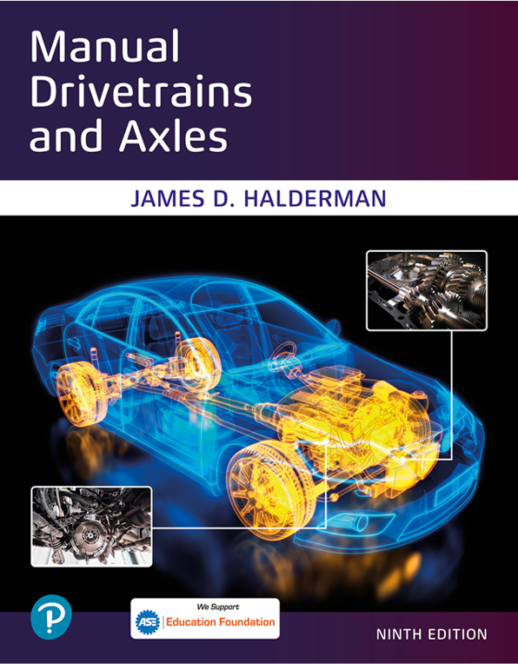
Manual Drivetrains and Axles
Ninth Edition
Chapter 12
Drive Axles & Differentials
Copyright © 2024, 2018, 2015 Pearson Education, Inc. All Rights Reserved
Notes:
If this PowerPoint presentation contains mathematical equations, you may need to check that your computer has the following installed:
1) Math Type Plugin
2) Math Player (free versions available)
3) NVDA Reader (free versions available)
INSTRUCTOR NOTE: This presentation includes text explanation notes, you can use to teach the course. When in SLIDE SHOW mode, you RIGHT CLICK and select SHOW PRESENTER VIEW, to use the notes.

Slide 2
Learning Objectives
12.1 Discuss the different drive axle designs.
12.2 Explain the features of ring and pinion gears.
12.3 Discuss the types of differential carriers.
12.4 State the purpose of differentials and identify the parts of a differential assembly.
12.5 Identify the different types of limited slip differentials.

Slide 3
Drive Axle Terminology
The major parts of a drive axle include:
The ring and pinion gears
Differential
Axle shafts
Notes:
All rear-wheel-drive (R W D) vehicles use a drive axle assembly to transfer power from the
driveshaft to the drive wheels. Because it is powered, it is sometimes called a live axle. Front-
wheel-drive (F W D) vehicles use a dead axle or non-powered rear axle. The major parts of a drive
axle include the following:
■ The ring and pinion gears
■ Differential
■ Axle shafts
Many 4 W D and A W D vehicles use a similar axle at front, the major difference being steerable drive wheels.

Slide 4
Drive Axle Assembly
Purpose and function
Changing the direction of engine torque
Allowing the drive wheels to rotate at different speeds
Support the weight of the vehicle
Drive the wheels through axles

Slide 5
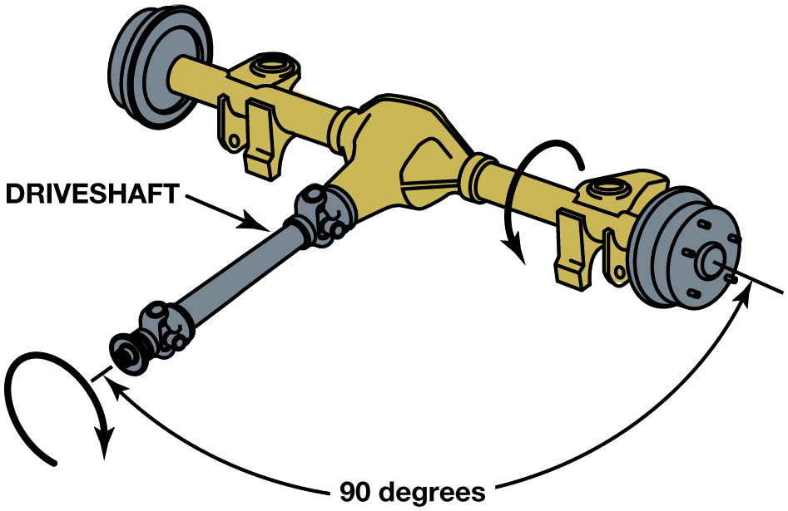
Figure 12.1
The differential assembly changes the direction of engine torque and increases the torque to the drive wheels.
Notes:
Long Description:
The illustration has a rotating driveshaft connected to the axle. The angle formed by the end of the driveshaft near engine and the drive wheels is labeled 90 degrees.

Slide 6
Axle Designs (1 of 2)
Axe Shafts
Transfer the torque from the differential side gears to the drive wheels and support the weight of the vehicle
Semi-Floating Axles
Used by all rear-wheel-drive passenger vehicles
Retainer-plate type
C-lock

Slide 7
Axle Designs (2 of 2)
Full-floating Axles
Used by all heavy trucks
Three-Quarter Axles
Used by some older vehicles

Slide 8
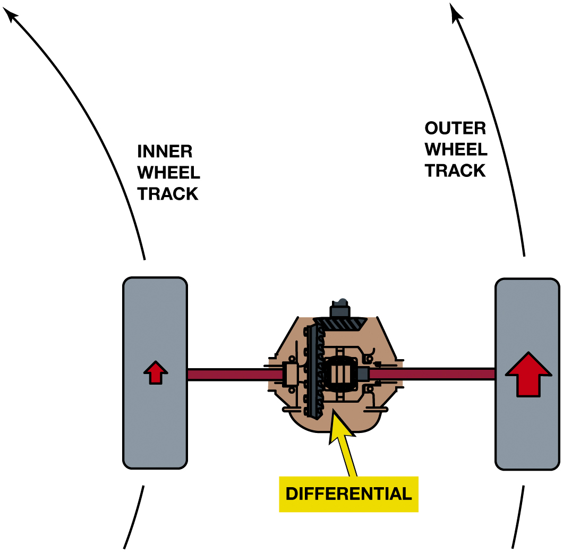
Figure 12.2
The difference between the travel distance of the drive wheels is controlled by the differential.
Notes:
Long Description:
The illustration has the differential in the middle and wheel drives on both the sides. The left wheel has a small upward and the right wheel has a bold upward arrow. An upward extended arrow from the left wheel is labeled inner wheel track and an upward extended arrow from the right wheel is labeled outer wheel track.

Slide 9
Animation: 2WD Differentials (Animation will automatically start)

Slide 10
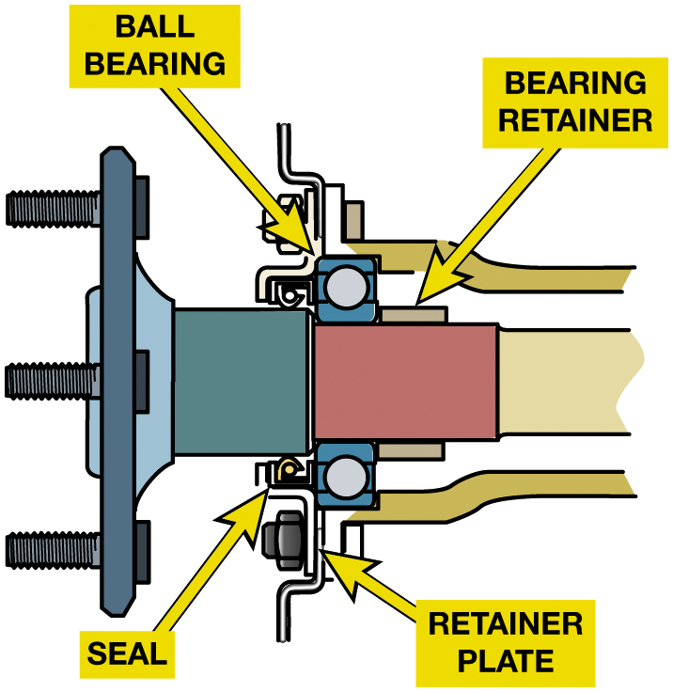
Figure 12.3
Retainer Plate Axle
A typical retainer-plate-type axle, which uses a ball bearing and uses a bearing retainer ring which is a press fit into the axle shaft.
Notes:
Long Description:
The illustration highlights the ball bearing and bearing retainer at the top and seal and retainer plate at the bottom of the axle.

Slide 11
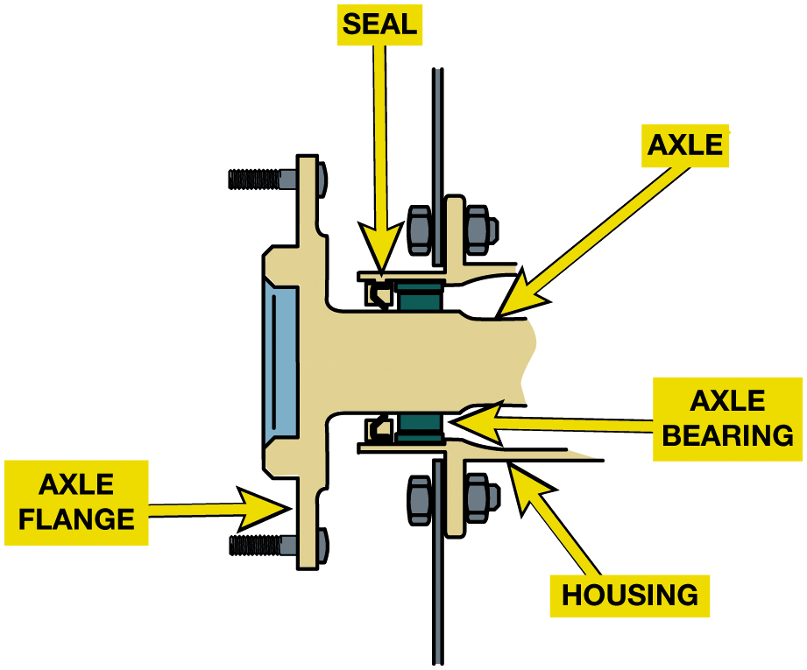
Figure 12.4
A C-lock type axle uses a straight roller bearing which is lubricated by the drive axle lube.
Notes:
Long Description:
The illustration highlights a part of the C-lock axle with the seal, axle, axle bearing, housing, and axle flange.

Slide 12
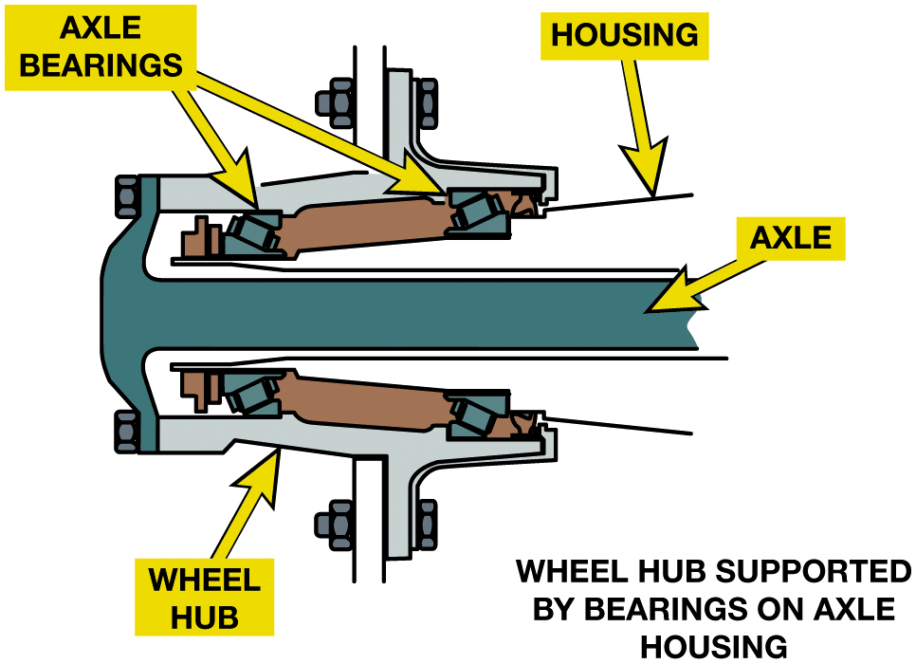
Figure 12.5
Full-Floating Axle
In a full-floating axle the axle itself slides through the center of the wheel hub assembly and does not support the weight of the vehicle.
Notes:
Long Description:
The illustration has axle at its center with axle bearings on both sides. Wheel hub is marked next to it and an extension from axle bearings is labeled housing.

Slide 13
Ring and Pinion Gears (1 of 3)
Ring and pinion gears are the final drive reduction gears.
Ring and pinion gear set is a hypoid type.
After gears have been cut, hardened, and ground to shape,…
Ring and pinion are run against each other in a machine with abrasive compound on their teeth.
Final gear ratio

Slide 14
Ring and Pinion Gears (2 of 3)
How are hypoid gear sets manufactured?
Hypoid gear tooth terms
Pitch line
Face
Flank
Drive side
Backlash
Coast side
Float

Slide 15
Ring and Pinion Gears (3 of 3)
Hunting, non-hunting, and partially non-hunting gear sets
Reverse-cut ring and pinion gears
A B S reluctor wheel
Gear and pinion mounting

Slide 16
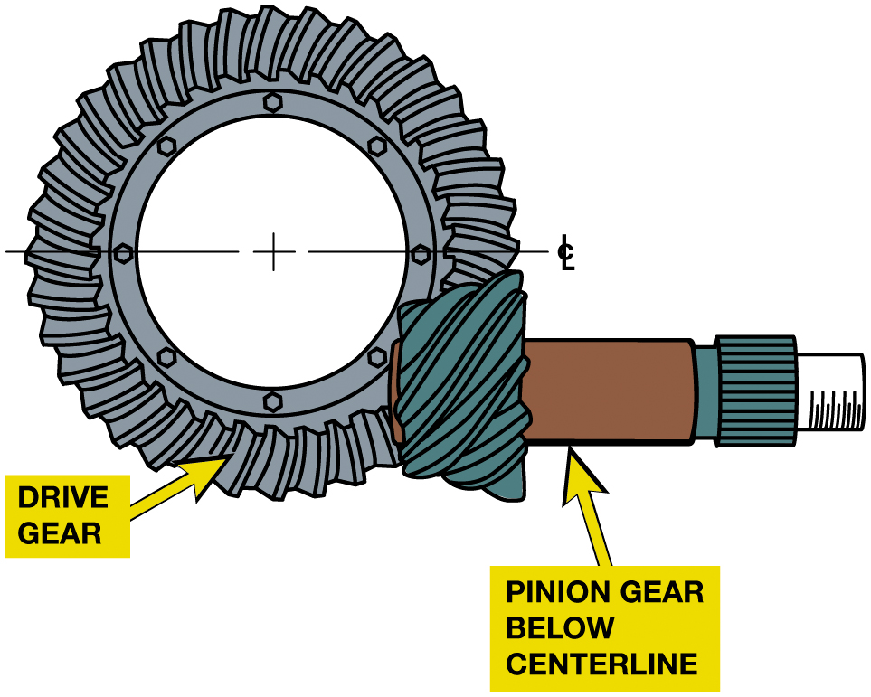
Figure 12.6
Hypoid Gear Set
A hypoid gear set uses a drive pinion that meshes with the ring gear below the center line of the ring gear.
Notes:
Long Description:
The illustration has a gear labeled drive gear with a pinion mounted on it. The shaft connected to the pinion is labeled pinion gear below centerline.

Slide 17
Animation: Hypoid Ring & Pinion Gear Set (Animation will automatically start)

Slide 18
Frequently Asked Question: What Does the 9-Inch Refer to When Describing a Drive Axle?
? Frequently Asked Question
What Does the 9-Inch Refer to When Describing a Drive Axle? 9-inch drive axle actually is referring to the rough diameter of the ring gear. 9-inch gear set is bigger and stronger than an 8-inch gear set. ● See Figure 12.7.

Slide 19
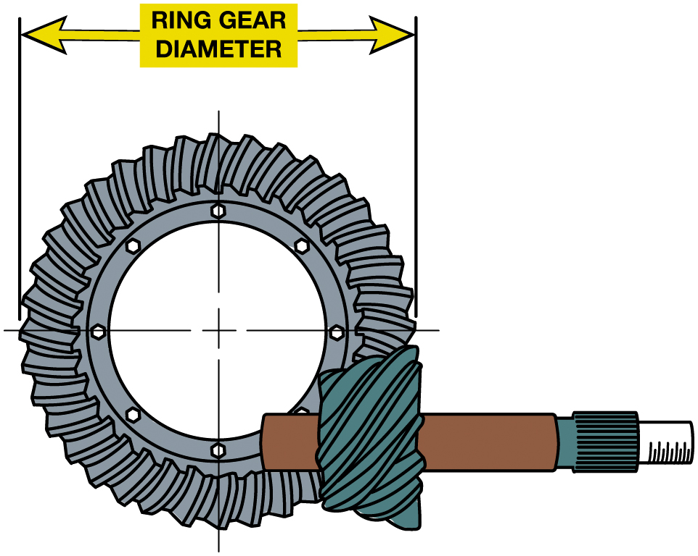
Figure 12.7
Nine Inch Ring Gear
A 9-inch axle has a ring gear with a rough diameter of 9 inches.

Slide 20
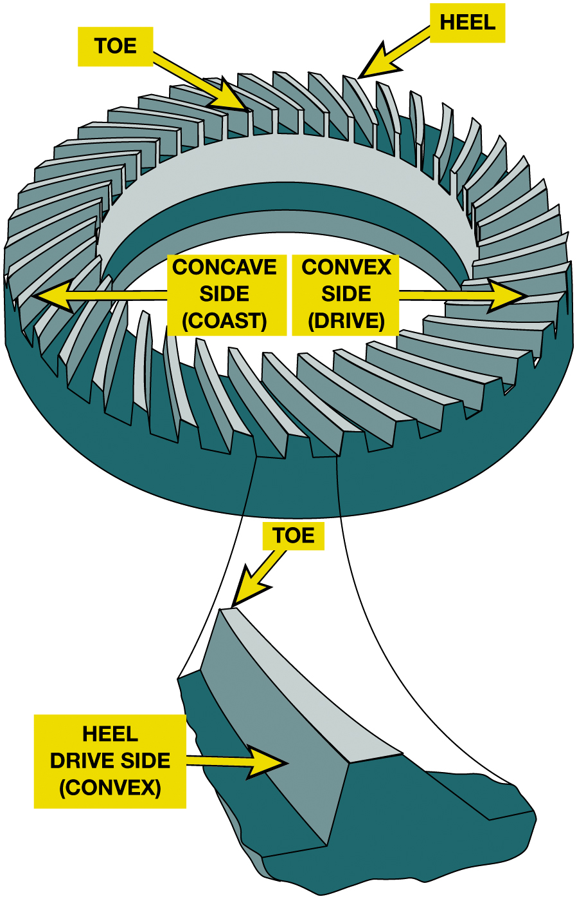
Figure 12.8
Ring Gear Convex Side
The drive side is the convex side of the ring gear except for some front axles used in four-wheel vehicles, and they often use the concave side on the drive side.
Notes:
When a hypoid ring and pinion gear set is adjusted, reference is often made to particular parts of
the gears and their teeth. The outer ends of the ring gear teeth are called the heel and the inner
ends the toe. ● SEE FIGURE 12.8.
The pitch line is the design center of contact between the two gears and is about halfway up the
tooth. The face of the tooth is above the pitch line, and the flank is below it.
The drive side of the ring gear teeth is the vertical, convex side of the tooth. This is the side
of the tooth that contacts the pinion gear while the engine is driving the vehicle forward.
There should be a clearance at the coast side of the tooth which is called backlash. The coast side
of ring gear teeth is the slanted, concave side of the tooth. This surface receives pressure while
the vehicle is coasting and the vehicle is driving the engine. While coasting, the backlash will be
at the drive side of the tooth. The third tooth-load condition is called float.
During float there is no load on the gear teeth, and backlash will be on both sides. ● SEE FIGURE 12.9.
Long Description:
The illustration has a ring gear with the teeth on the left labeled concave side (coast) and the teeth on the right are labeled convex side (drive). The inner end of the tooth is labeled toe and the outer end of the tooth is labeled heel. An enlargement of a section of the teeth from the ring gear highlights the toe on the end of the teeth on the convex side and heel drive side (convex) on the curved side of the teeth.

Slide 21
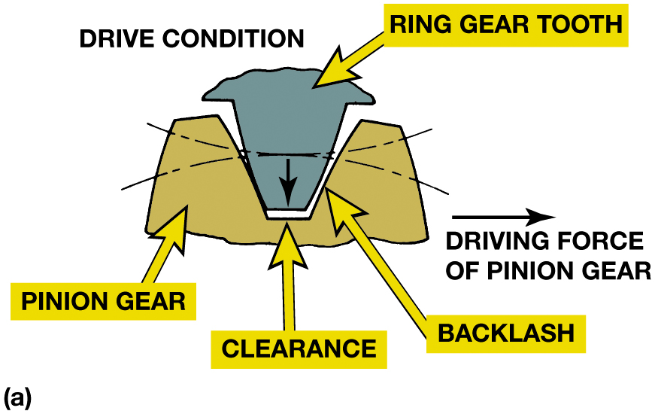
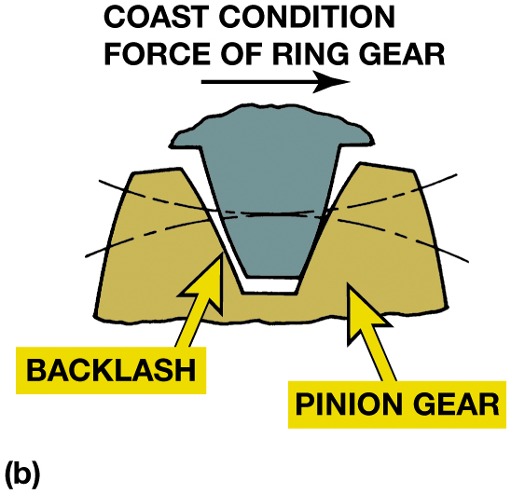
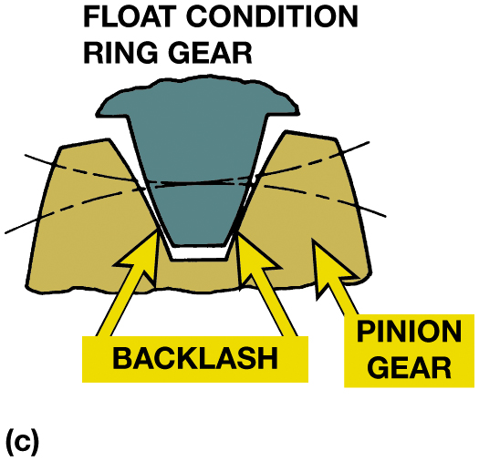
Figure 12.9
Tooth Contact Areas
(a) During a drive condition, the pinion gear is driving the ring gear and there is backlash at the coast side of the ring gear tooth. (b) During a coast condition, this action is reversed. (c) During a float condition, lash is split between both sides of the tooth.
Notes:
HUNTING AND NON-HUNTING GEAR SET
The final drive gear ratio determines how many times a drive pinion tooth will make contact with a
particular ring gear tooth during one revolution. This affects final drive gear set manufacture and
service. Final drive gear sets may be divided into three types, depending on the final drive gear
ratio.
1. Hunting gear sets are gear sets with final drive ratios expressible in a fraction that cannot be
reduced to any lower terms. An example of a hunting gear set is one that has 41 teeth on the ring
gear and 11 teeth on the drive pinion. This combination creates a 3.73:1 axle ratio. This type of
gear set requires no timing marks or alignment during assembly. As the pinion gear drives the ring
gear, each pinion tooth will hunt for, or seek, contact with every ring gear tooth.
2. Non-hunting gear sets are gear sets with final drive ratios expressible as a whole number. An
example of a non-hunting gear set is a differential that uses 39 teeth on the ring gear and 13
teeth on the pinion gear which gives a 3.00:1 gear ratio. Non-hunting gear sets require timing
marks. As the pinion gear drives the ring gear, each pinion tooth contacts only a few ring gear
teeth during each revolution.
3. Partially non-hunting gear sets are gear sets with final drive ratios expressible as a reducible
fraction not equaling a whole number. An example of a partial non-hunting gear set is an axle ratio
of 3.50:1. Partially non-hunting gear sets also require timing marks. During final drive
operation, each pinion tooth contacts only some of the ring pinion teeth. For the pinion teeth to
make contact with the highest number of ring gear teeth, the pinion gear must drive the ring gear
more than one revolution. On non-hunting and partially non- hunting gears, manufacturers lap
(provide a surface finish) the contacting gear teeth to decrease wear. For this reason, these
gear sets are marked to ensure proper alignment during assembly procedures. To preserve the wear
patterns, the gear sets should be reassembled using the same alignment. This prolongs the life of
gear set and decreases operational noise.
Long Description 1:
The illustration labeled is titled drive condition. Pinion gear is on the left, clearance in middle and backlash on the right. The ring gear tooth is marked above the clearance with a downward arrow. A rightward arrow on the right of the backlash is labeled driving force of pinion gear.
Long Description 2:
The illustration labeled has a rightward arrow above the ring gear tooth labeled coast condition force of ring gear. Backlash is on the left, clearance in middle and pinion gear on the right.
Long Description 3:
The illustration is titled float condition ring gear. Pinion gear is on the right and the contact point of pinion gear and ring gear tooth is labeled backlash.

Slide 22
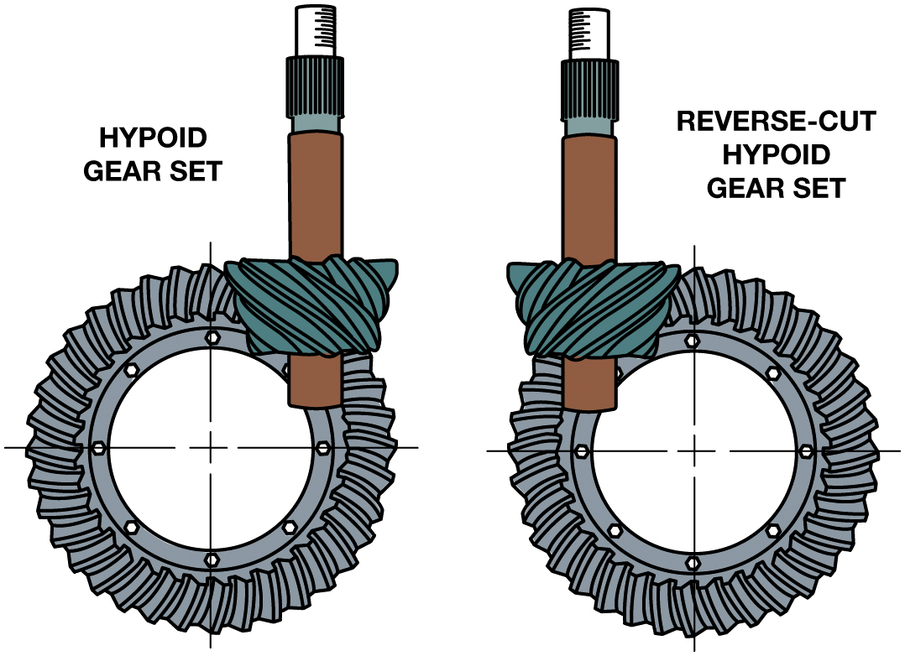
Figure 12.10
Reverse-Cut Gear Set
A reverse-cut gear set is a mirror image of the normal hypoid gear set.
Notes:
Reverse-cut ring and pinion gears were primarily designed for F W D applications to take advantage of their increased strength. The gears have the teeth spirally cut in the opposite direction of standard gears. Some 4 W D vehicles use a standard rear-drive axle that has been turned around for the front, but this arrangement drives on the coast side of the gear tooth which results in a gear that is 15% to 30% weaker. Reverse-cut gears are stronger when used in the front axle and move the drive pinion above the centerline of the ring gear. When the drive pinion is above the centerline of the ring gear (high-mounted), the angle of the driveshaft will be decreased and this is especially useful when the vehicle has been lifted for additional ground clearance. The housing is especially designed with different oiling passages to properly lubricate the gears. Figure 12.11.
Long Description:
The hypoid gear set on the left with teeth in clockwise direction has the pinion gear marked on the top right and the reverse-cut hypoid gear set on the right with teeth in counter clockwise direction has the pinion gear marked on the top left. Centerline is marked on both the gear sets.

Slide 23
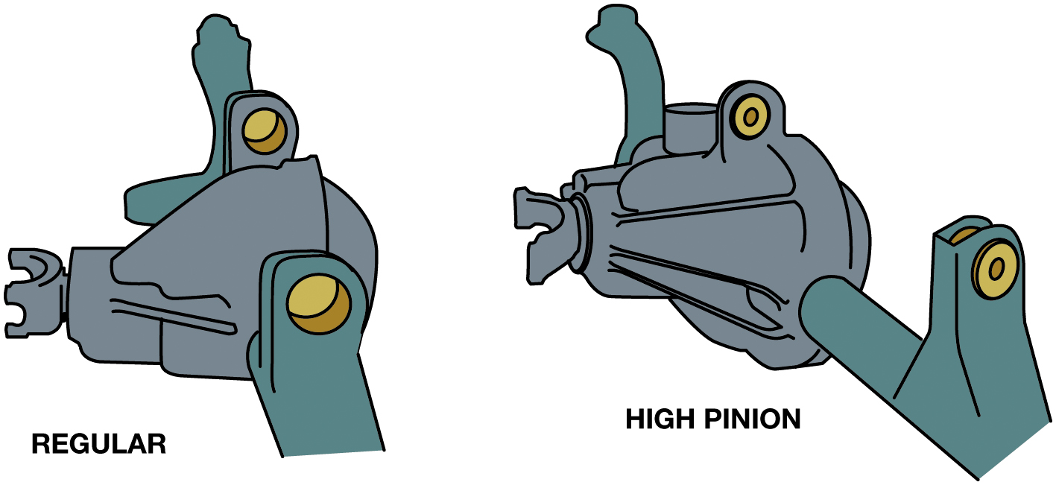
Figure 12.11
Two Front Drive Axles
Two front drive axles. The left one has a standard-cut ring and pinion, whereas the one at the right has high-pinion, reverse-cut ring and pinion gears.

Slide 24
Differential Carriers
What are purpose and function of differential carriers? Page 169-170
Removable Carriers in most early trucks
Integral carriers used by most R W D vehicles
Pinion shafts
Overhung; straddle mounting
Notes:
The differential is responsible for allowing the drive wheels to rotate at different speeds when turning or when the vehicle is
traveling over uneven road surface. The differential carrier is the heavy cast iron portion of the rear axle assembly that provides mounting points for the drive pinion shaft bearings and the carrier bearings. Many carriers have special reinforcing webs to contain
the gear separation forces of the ring and pinion gear set.

Slide 25
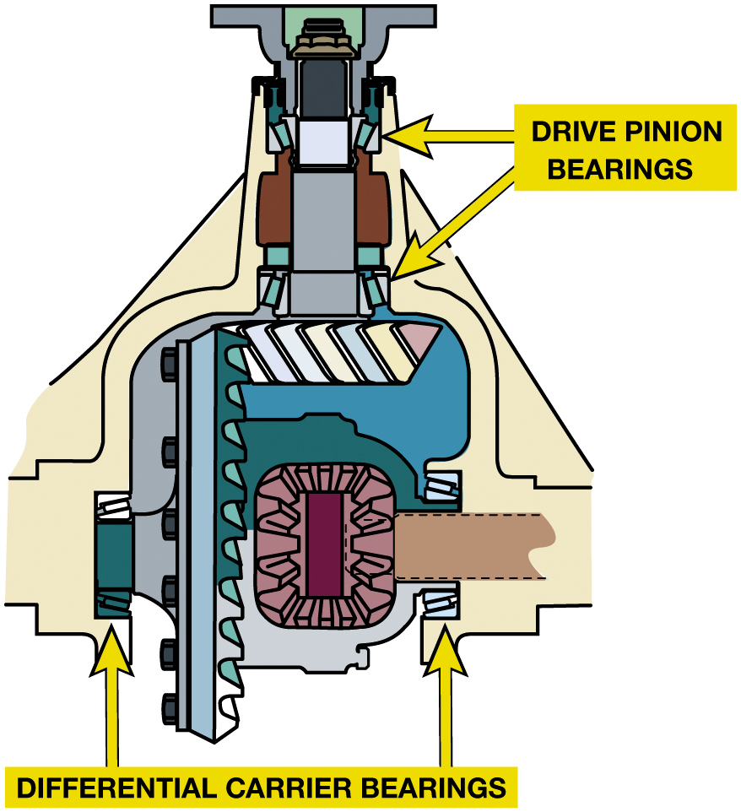
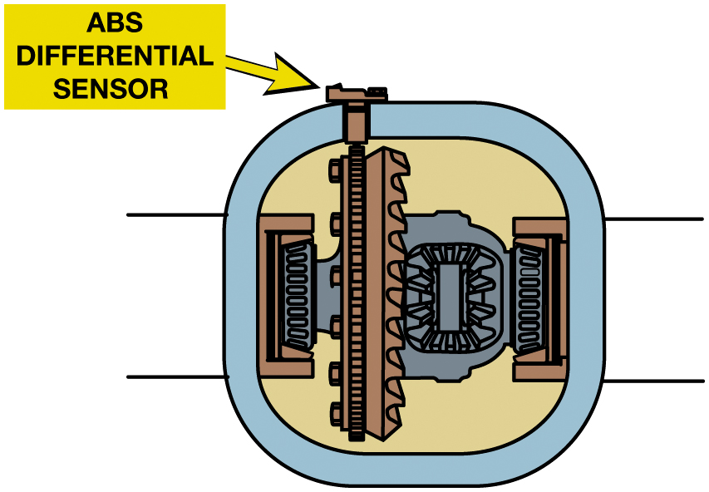
Wheel Speed Sensor/Tapered Roller Bearings
Figure 12.12 Some vehicles with A B S will have a single rear wheel speed sensor at the ring gear or a speed sensor at each axle shaft. Some will use a similar sensor at the drive pinion shaft.
Figure 12.13 A pair of tapered roller bearings called carrier bearings is used to locate the drive pinion gear and the differential case and ring gear. Another pair of bearings locates the drive pinion gear.
Notes:
Long Description:
The illustration highlights the drive pinion bearings at the top and differential carrier bearings on the bottom left and bottom right.

Slide 26
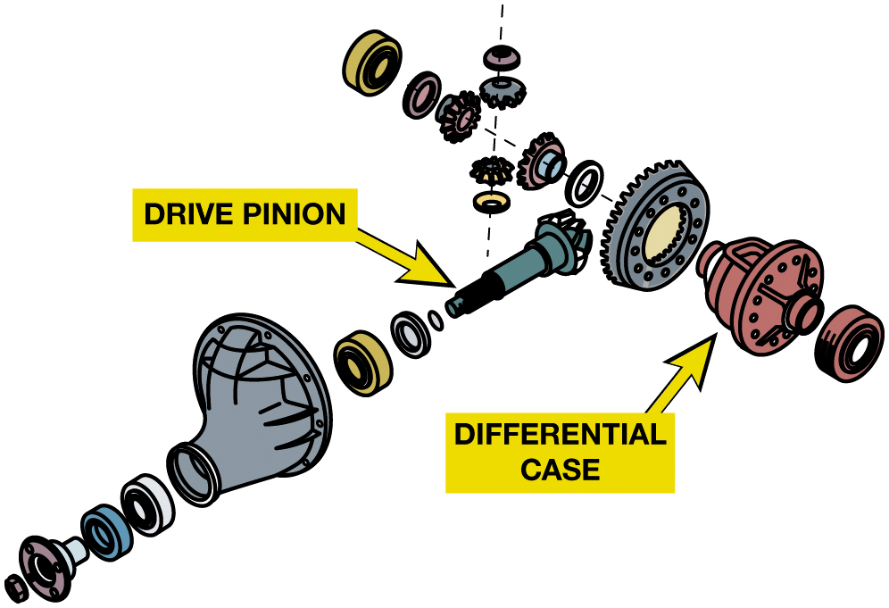
Figure 12.14
Carrier
A removal carrier such as this Ford 9-inch unit. This older design uses an axle housing that is often called a “banjo” because of the shape, which is similar to the musical instrument.

Slide 27
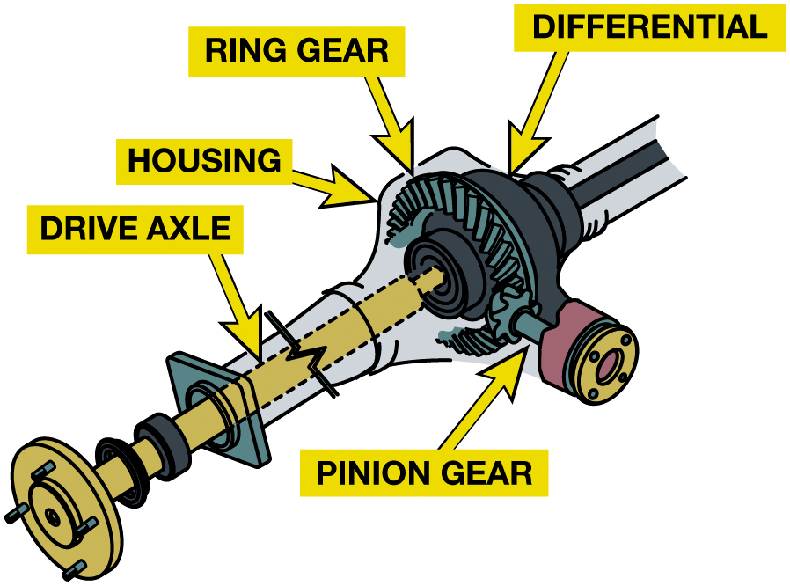
Figure 12.15
A removal carrier such as this Ford 9-inch unit. This older design uses an axle housing that is often called a “banjo” because of the shape, which is similar to the musical instrument.
An integral carrier axle assembly is the most commonly used design of drive axle.
Notes:
Pinion Shafts The pinion shaft is also mounted on a pair of tapered roller bearings. There are two common styles of mounting the shaft and gear. In the first and most common style, called an overhung pinion, the pinion gear hangs over from the rear bearing. The two tapered roller bearings are positioned as far apart as practical to hold the pinion shaft rigid and not allow any movement of the pinion gear as it tries to climb or move away from the ring gear.
In the second style, called straddle mounting, the pinion gear is straddled by two bearings where the rear
Long Description:
The illustration highlights the drive axle near the engine and housing, ring gear, and pinion gear at the differential.

Slide 28
Differentials
Differential…
Splits torque equally to the drive wheels
Allows engine torque to be applied to both drive axles
Parts must include a differential, which includes
two or more differential pinion gears and two side or axle gears.
Types
Open, limited slip, and locked

Slide 29
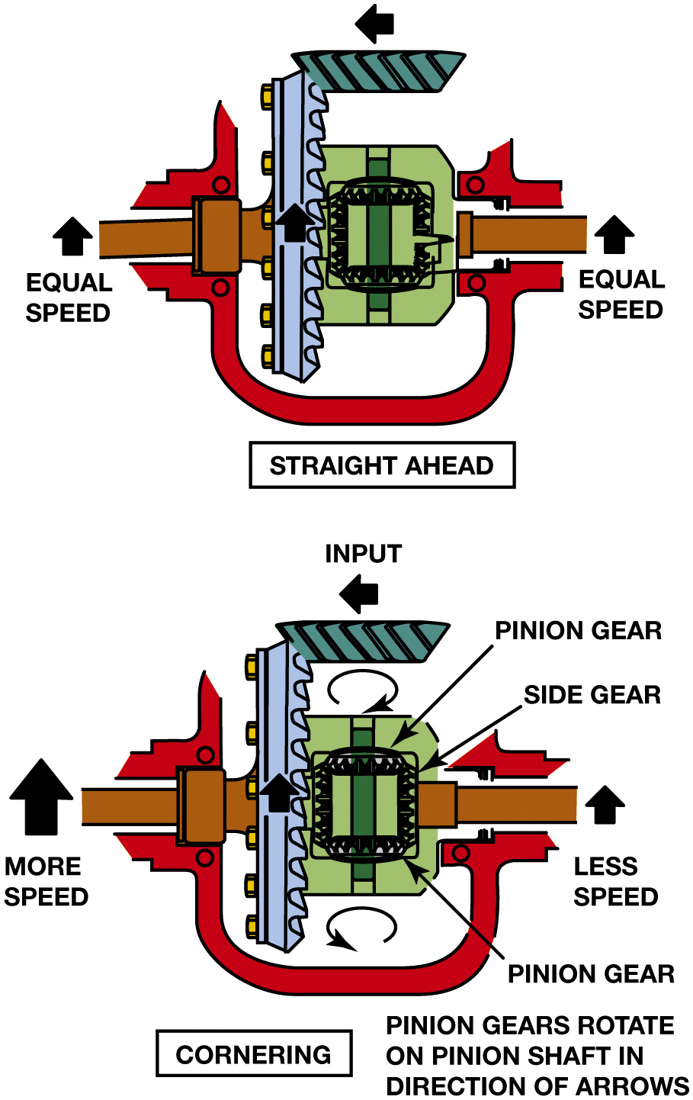
Figure 12.16
Differential
When the vehicle turns a corner, the inner wheel slows and the outer wheel increases in speed to compensate. This difference in rotational speed causes the pinion gears to “walk” around the slower side gear.
Notes:
Long Description:
The illustration labeled straight ahead has a leftward arrow on the pinion and two upward arrows on wheels labeled equal speed. The illustration labeled cornering has a leftward arrow labeled input on the pinion and two upward arrows on wheels of which the left wheel is labeled more speed and the right wheel is labeled less speed. Pinion gear and side gear are marked inside the differential. A clockwise arrow is marked on gear near the input and a counter clockwise arrow is marked on the pinion away from the input. Texts at the bottom right reads pinion gear rotate on pinion shaft in direction of arrows.

Slide 30
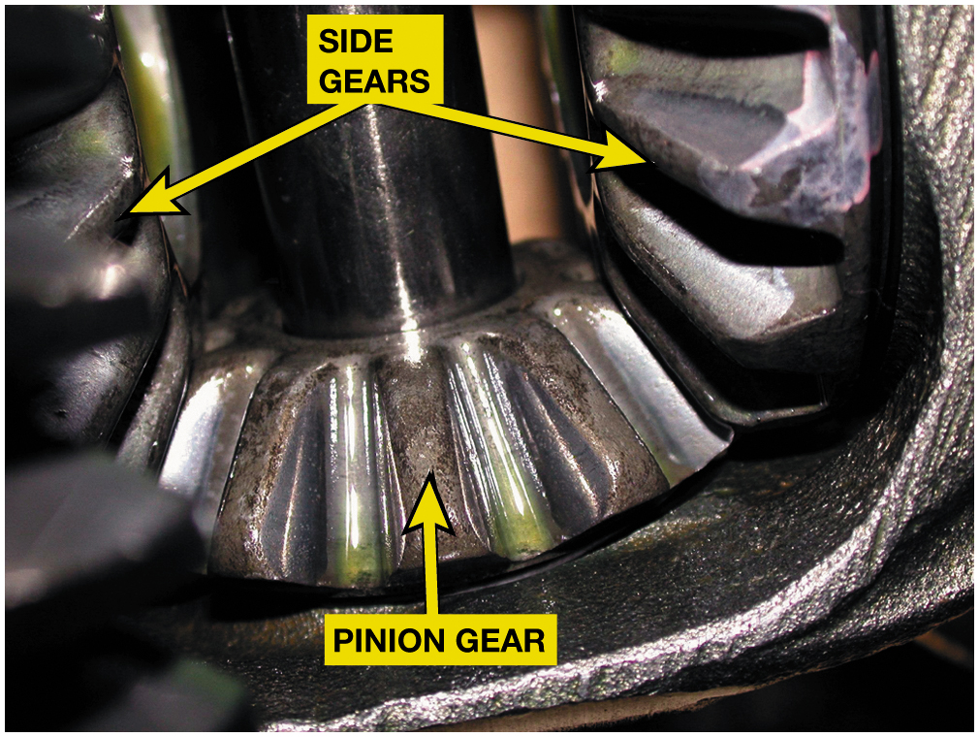
Figure 12.17
Side Gears & Pinion
A close-up view of the side gears and spider (pinion) gear. Note the ridges on the gear teeth. These ridges are manufactured into the gear teeth to help retain lubricant so that no metal-to-metal contact occurs.
Notes:
Note the ridges on the gear teeth. These ridges are manufactured into the gear teeth to help retain lubricant so that no metal-to-metal contact occurs

Slide 31
Frequently Asked Question: Why Does One Wheel Spin When the Other Wheel Is on Dry Pavement?
? Frequently Asked Question
Why Does One Wheel Spin When the Other Wheel Is on Dry Pavement? A standard, called an open differential splits torque equally to the drive wheels. If one tire is on a slippery surface and only 50 pounds-feet of torque can be applied to the road, the other side will also have the same 50 pounds-feet. Even if the tire on the other side from the one on a slippery surface is on dry pavement, the force being sent to the drive wheel (5 pounds) is not enough to propel the vehicle. See Figure 12.18.

Slide 32
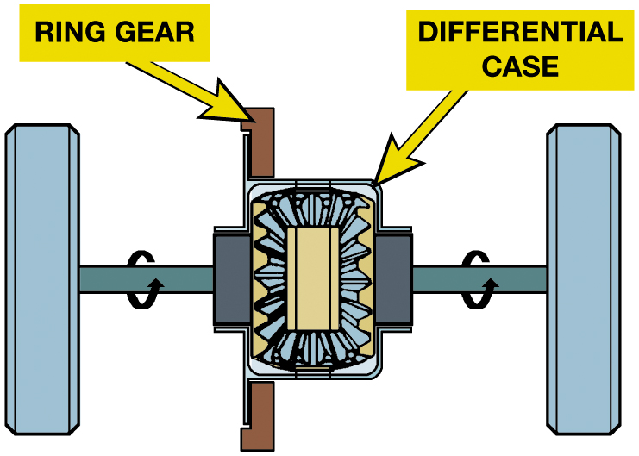
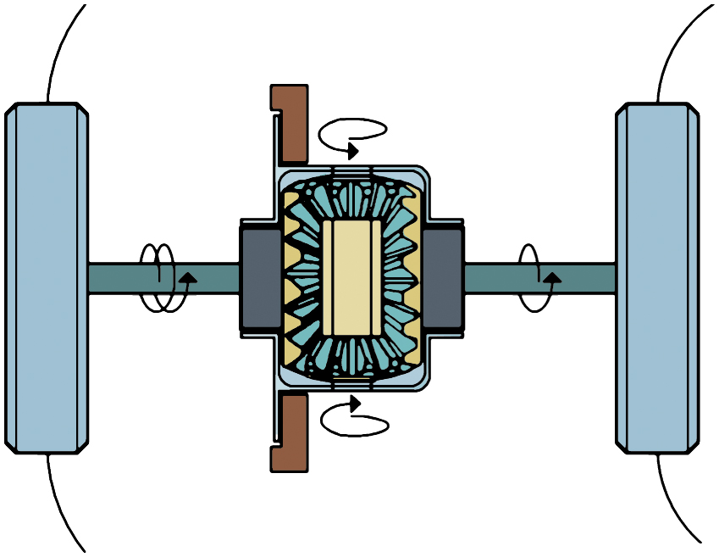
Figure 12.18
Differential Action
Driving straight ahead there is no pinion gear movement (top). When cornering the outer wheel rotates faster and the pinion gears rotate to compensate for the difference (bottom).
Notes:
■ If both side gears are loaded the same and offer the same resistance, the differential pinion
gears remain motionless on their shaft and the entire differential assembly rotates as one unit
with no internal gear movement.
■ When a vehicle goes around a corner, the side gears are equally loaded, but the one connected to
the outer wheel will rotate faster. At this time, the differential pinion gears will rotate on
their shafts to compensate for this change in speed. The outer wheel will speed up relative to the
vehicle and differential, and the inner wheel will slow down the same amount. For example, if the
outer wheel speeds up 20% from 100 RPM to 120 RPM, the inner wheel will slow down by the same
percentage.
Long Description 1:
The illustration has two rotating arrows marked on the wheel drive axles.
Long Description 2:
The illustration has rotating arrows marked on the ring gear, differential case pinion, and the wheel drive axles.

Slide 33
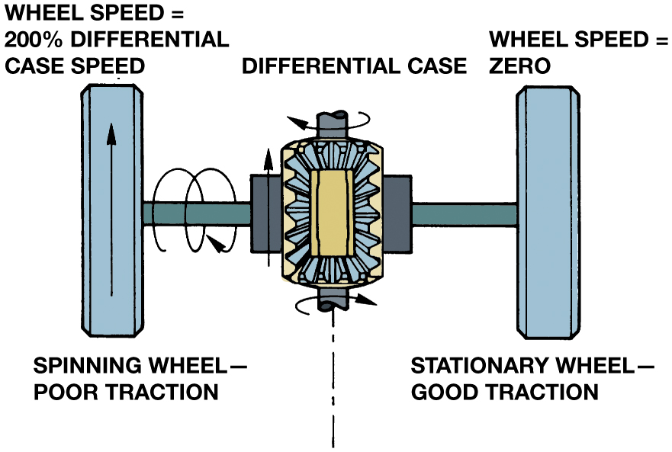
Figure 12.19
Differential
If one tire has poor traction, it will rotate easily, so the differential pinion gears rotate on their shaft and walk around the other side gear, which offers more resistance. The result will be wheel spin on the side with poor traction.
Notes:
The three major types of differentials are as follows:
Open differential This type of differential is used in most passenger vehicles.
Limited Slip differential (L S D) This type of differential can send more torque to the wheel with traction than the wheel with poor traction.
Locked differential This type of differential connects both axle shafts together to eliminate differential action, but is rarely used in original equipment (O E) applications except for vehicles that are designed for off-road travel, and then only at low speeds.
Long Description:
The illustration highlights differential case in the middle with a clockwise arrow at the top and bottom. The left wheel is labeled spinning wheel poor traction and texts above it read wheel speed - 200 percent differential case speed and the right wheel is labeled stationary wheel good traction and texts above it read wheel speed equals zero. An upward arrow is marked on the left wheel.

Slide 34
Animation: Differential Action (Animation will automatically start)

Slide 35
Limited Slip Differentials (1 of 3)
Open Differential Has a Torque Bias Ratio (T B R) of
Limited Slip Types
Preloaded clutches
Self-applying clutches
Viscous couplings
Eaton locker differential
Hydraulic applied clutches
Cone type

Slide 36
Limited Slip Differentials (2 of 3)
What is a Torsen differential?
Electric locking differentials
When the axle shaft or side gear is connected to the differential case, the differential becomes locked.
Electronic torque management
Independent rear suspension drive axles

Slide 37
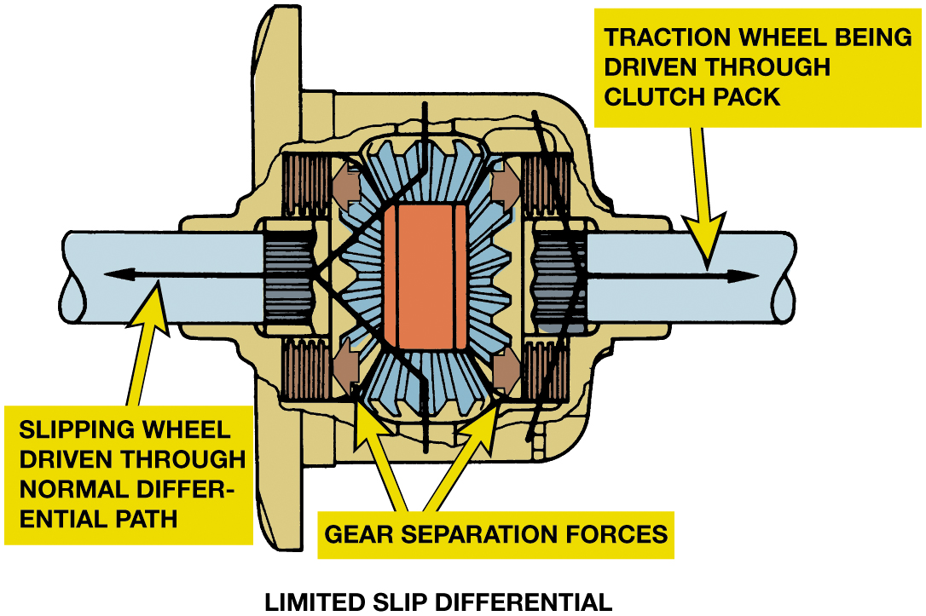
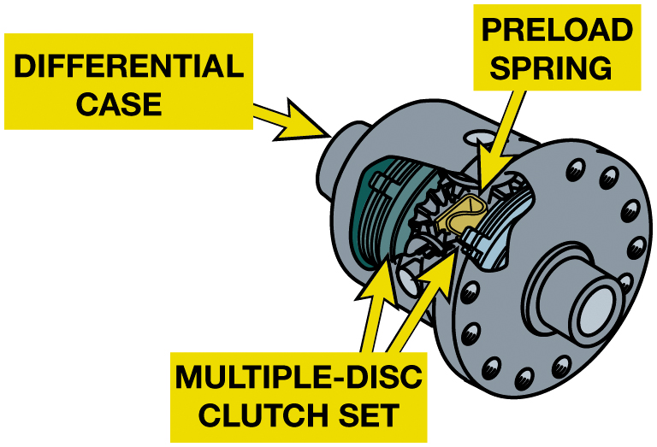
Limited Slip Differentials (3 of 3)
Figure 12.20 Limited slip differentials transfer most of the torque through the pinion shaft and gears like a conventional differential. Some torque is also transferred through the clutch pack going from the case through the clutch to the side gear (right).
Figure 12.21 A limited slip differential showing the preload spring and how the steel plates of the clutch pack are held to the differential case.
Notes:
Figure 12.20 Limited slip differentials transfer most of the torque through the pinion shaft and gears like a conventional differential. Some torque is also transferred through the clutch pack going from the case through the clutch to the side gear (right).
Figure 12.21 A limited slip differential showing the preload spring and how the steel plates of clutch pack are held to the differential case.
Long Description 1:
The illustration highlights the interior of the differential at motion with two outward arrows on the left and right shaft of the pinion. The left arrow is labeled slipping wheel driven through normal differential path and right arrow is labeled traction wheel being driven through clutch pack. Two bold leftward and rightward arrows below wheel axle are labeled gear separation forces.
Long Description 2:
The illustration has two discs on both ends labeled multiple disc clutch set and preload spring is marked in the middle. The right end of the differential is labeled differential case.

Slide 38
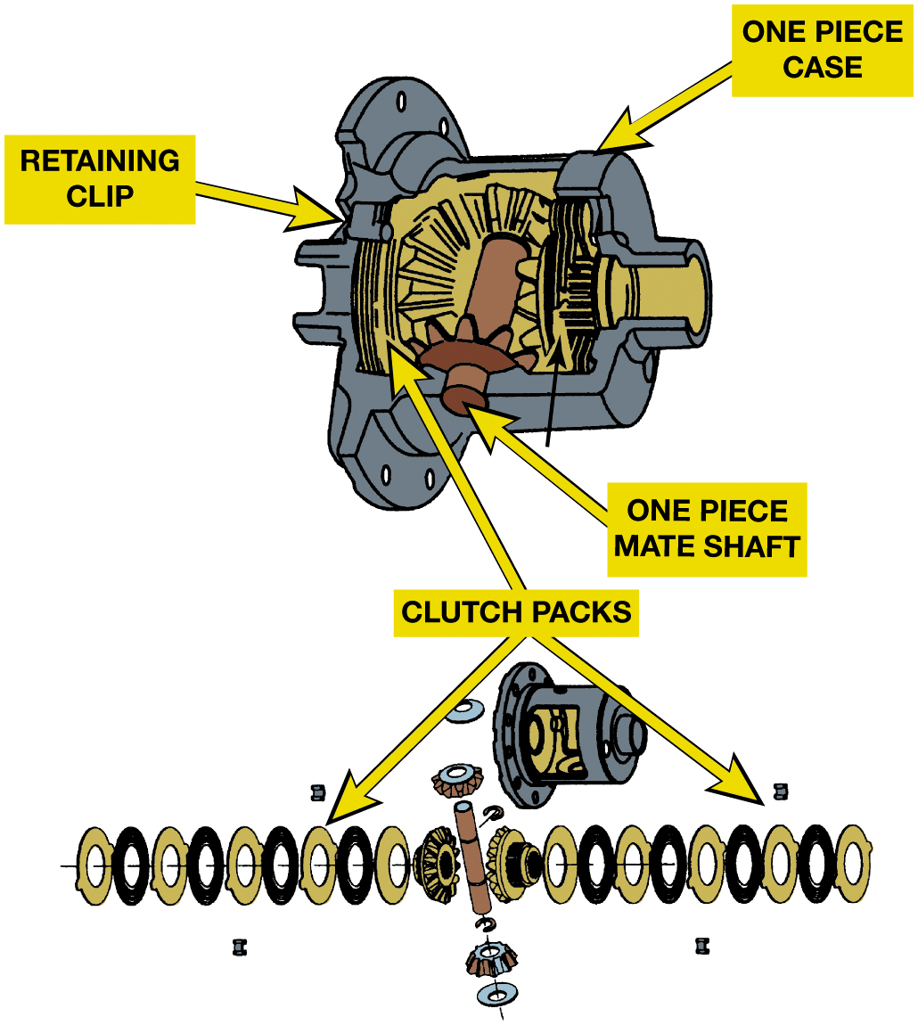
Figure 12.22
Limited Slip Differential
This type of limited slip differential uses the preload force from a spring and the torque generated by the side gears as the two axles rotate at different rates to apply the clutches and limit the amount of difference in the speed of two axles.
Notes:
FIGURE 12.22 This type of limited slip differential uses the preload force from a spring and the
torque generated by the side gears as the two axles rotate at different rates to apply the clutches
and limit the amount of difference in the speed of two axles.
Long Description:
The illustration highlights the retaining clip on the left and a one-piece case on the right. A shaft in the middle is labeled one-piece mate shaft and the discs on its right are labeled clutch packs. Arrows lead towards exploded clutch packs at the bottom.

Slide 39
Figure 12.23
Friction Modifier
A friction additive needs to be added to the gear lube if using a preloaded clutch-type differential.
Notes:
Tech Tip: Friction Modified Additive May Be Added
Lubrication of the clutch plates is critical because the plates have to slip across each other
every time the vehicle turns a corner or rounds a curve. A special friction modifier additive is
required in the gear oil to make it slippery enough for these differentials.
Long Description:
Texts on the bottle reads Mopar, limited slip additive, friction modifier. Caution: eye, skin and respiratory irritation. Read cautions on back panel carefully. A bar code is below it and texts below it read P slash N 04318060A B.

Slide 40
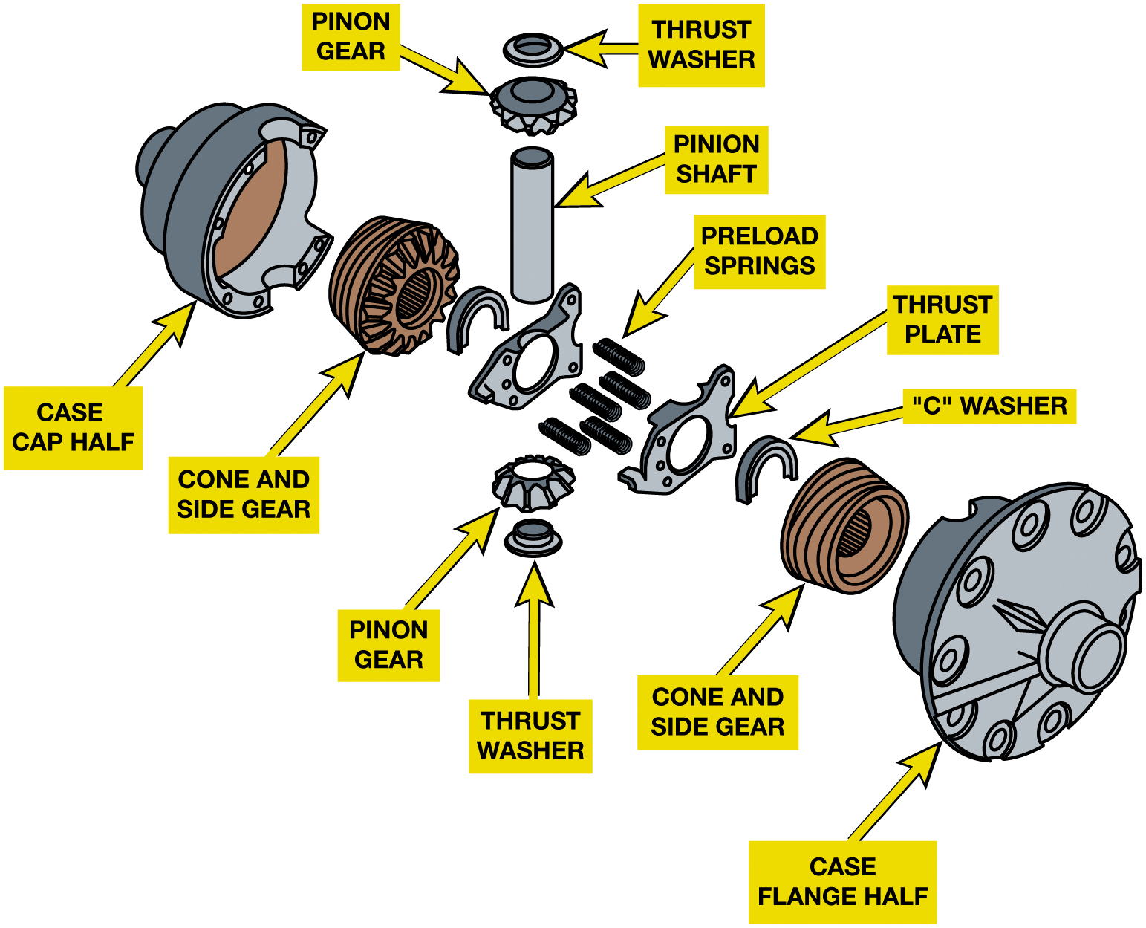
Figure 12.24
Cone Clutch Type
Exploded view of a limited slip differential using cone-type clutches.
Notes:
Some limited slip differentials use a pair of cone clutches in place of the clutch plates. A cone
is splined to each axle shaft, and the differential case is machined to form the mating cone
surface.
Tech Tip: Check Tire Size
A common problem encountered with limited slip differentials is a stick/slip condition in which the
plates stick together, break apart, and stick together instead of sliding smoothly over each
other. This problem shows up as a series of clunks or chuckle sounds as a vehicle rounds a corner.
It is very important to keep the drive tires the same diameter with these differentials. Having
tires of different diameters will cause the clutch stacks to slip continuously, which, in turn,
will cause early failure.
Long Description:
The parts from left to right are as follows: case cap half, cone and side gear, thrust washer, pinion gear, pinion shaft, preload springs, pinion gear, thrust washer, thrust plate, “C” washer, cone and side gear, and case flange half.

Slide 41
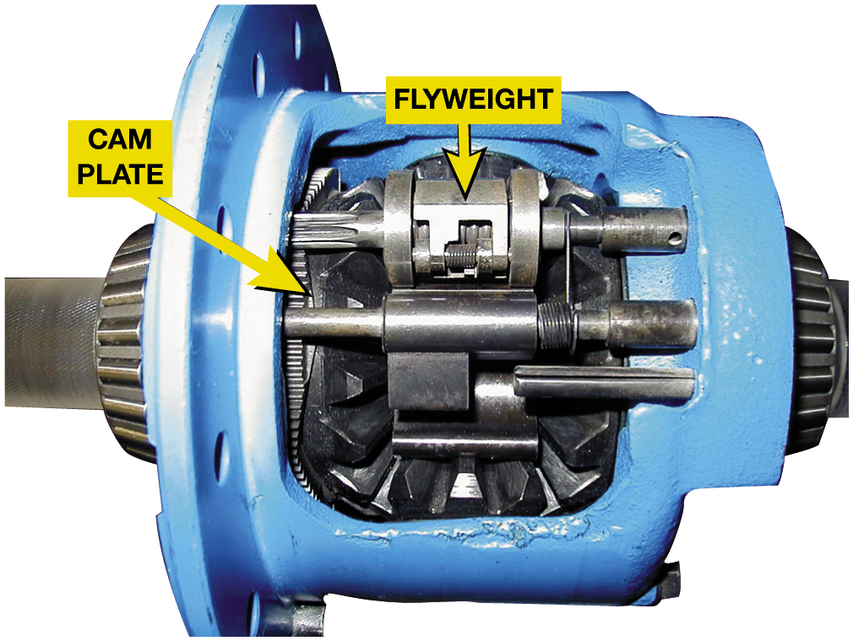
Figure 12.25
Eaton Locker
A locker-type differential operates as a limited slip differential until there is a wheel-to-wheel speed difference of 100 R P M or more. At that point, the governor weights move outward and cause the mechanism to lock the clutch pack.
Notes:
Eaton “locker” differential used in some pickups and light trucks includes a governor,
latching mechanism, and differential cam gear. Normally, this unit will operate as a limited slip
differential, but if a wheel-to-wheel speed difference of 100 R P M or more occurs, the unit will
lock up. Lockup occurs because the spinning cam in the case turns the governor weights fast enough
to fly outward. This, in turn, causes the latching operation, which causes the cam gear to rotate
relative to the cam side gear, and locks up the clutch pack. ●Figure 12.25.

Slide 42
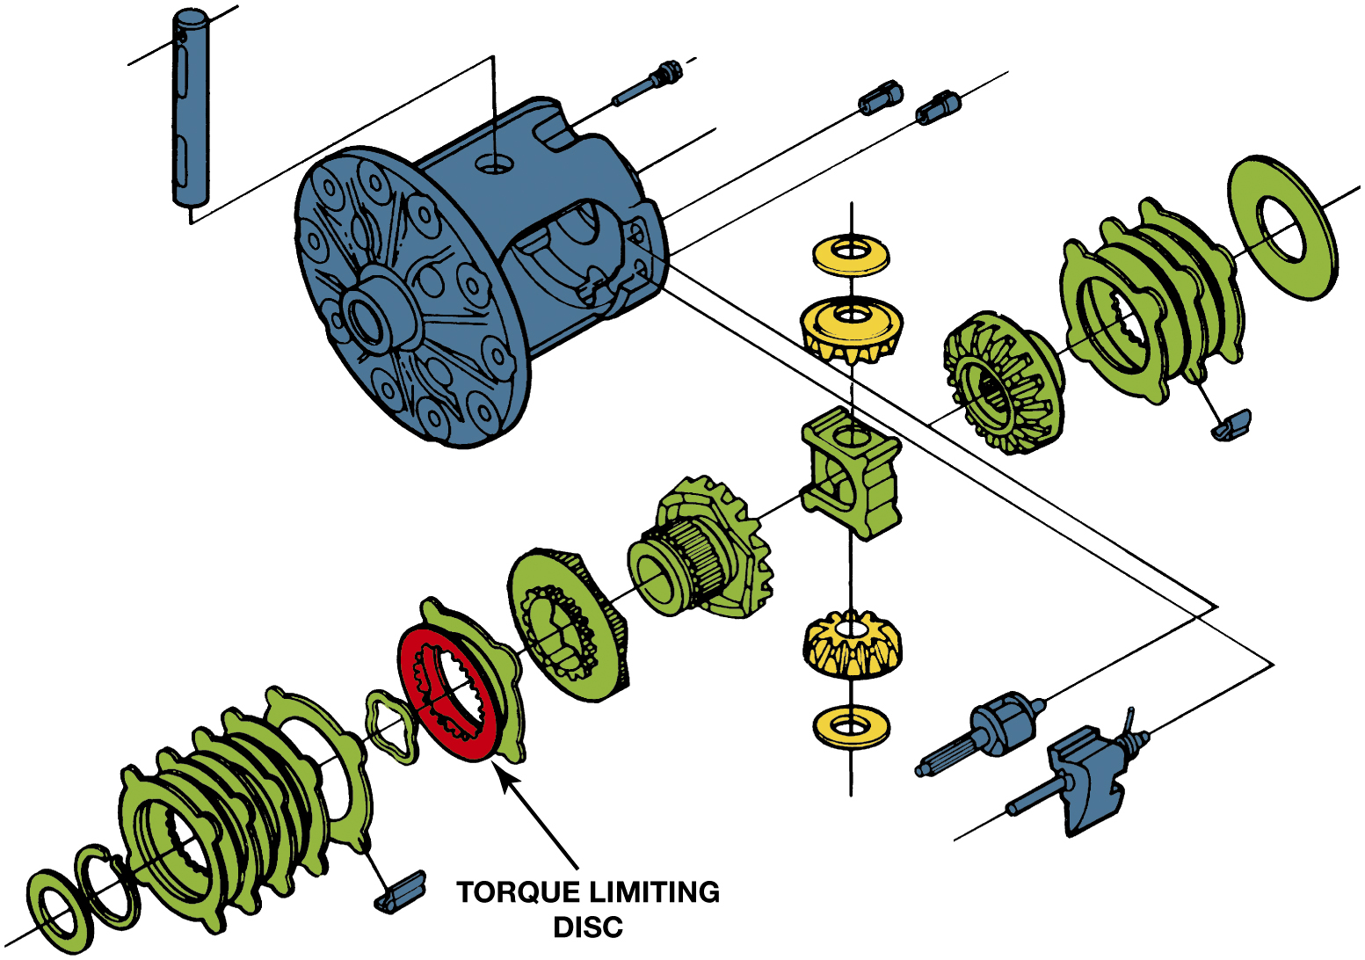
Figure 12.26
Torque Limiting Disc
This Eaton design differential uses a torque-limiting disc to prevent the possibility of breaking an axle in the event of a high-torque demand. When the disc tangs shear, the differential will continue to function but as an open rather than as a limited slip differential.
Notes:
Case Study: I Used to Have a Limited Slip Differential
An owner of a Chevrolet S-10 pickup truck equipped with a V-6 and five-speed manual transmission complained that he used to be able to spin both rear tires on dry pavement, but lately only one tire spins. Many GM pickup trucks are equipped with an Eaton locking differential that uses a torque limiting disc. The teeth of this disc are designed to shear to prevent the possibility of breaking an axle. The service procedure to correct the customer’s concern is to replace the left-hand clutch plates. Usually, the shearing of the torque-linking teeth is associated with a loud bang in the rear axle. The differential will continue to operate normally as
a standard (open) differential. ● SEE FIGURE 12.26 on page 176.
Summary:
Complaint—Driver complained that only one rear wheel would spin when accelerating.
Cause—A torque-limiting disc was sheared.
Correction—The left side clutch plates were replaced and the proper operation of the drive axle was restored to normal operation.
Long Description:
The illustration highlights the components used and their positions in the Eaton design differential. The components are displayed in the sequence of their position with a disc in the middle labeled torque limiting disc.

Slide 43
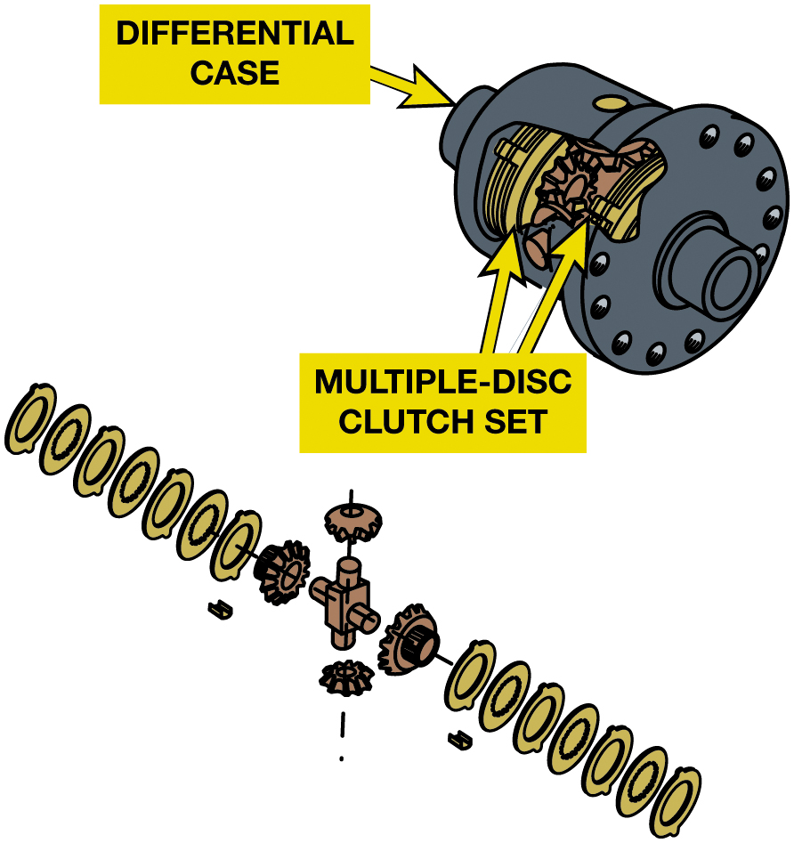
Figure 12.27
Self-Applying Clutch
This limited slip differential uses the action of the pinion mate shafts and ramps in the differential case to apply pressure on the clutch pack and send torque to the wheel with traction.
Notes:
Some limited slip differentials use self-applying clutches. They do not maintain a constant preload
on the clutch packs, so differential action during normal driving is free of clutch drag. These
differentials use a four-pinion differential with two separate differential pinion shafts. The two
shafts called mate shafts are fitted into the case in an opposing manner, with ramp like attachments
to the case.
While going down the road, the two shafts stay centered by pushing toward each other with equal
force because of the equal driving loads and differential gear separation forces. If one wheel
loses traction, the driving load on one of the pinion shafts drops off. The load on the other
pinion shaft causes it to lag behind the differential case and move side- ways because of the case
ramps. This force from the differential pinion gears through the axle gear applies the clutch on
the side with good traction. The result is that this differential applies the clutch needed to
drive the other wheel from the one with poor traction. Figure 12.27.

Slide 44
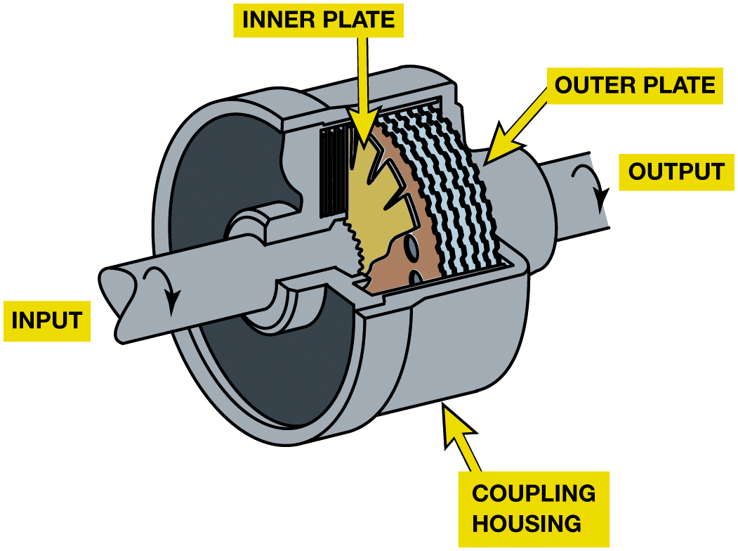
Figure 12.28
Viscous Clutch
In a viscous coupling, silicone fluid is placed between the plates in a seal assembly. When the two axles are moving at different speeds, the fluid becomes hot and expands, which forces the clutch plates to rotate together.
Notes:
Viscous coupling differentials use a stack of intermeshed clutch plates that run in a bath of silicone fluid and are not spring loaded. The thickness of the fluid causes a drag that tries to keep the two sets of plates at the same speed. Slippage between the plates heats the fluid causing it to expand. A unique feature of silicone fluid is that the drag increases as the slip speed of the plates increases. Single-wheel spinning tends to lock up the differential. The plates and silicone fluid must be isolated within a
chamber inside the differential case and must be kept separate from the gear oil in the axle. Figure 12.28.
Long Description:
The illustration has inner and outer plate in the middle covered by coupling housing and the left axle with a clockwise arrow is labeled input and the right axle with a clockwise arrow is labeled output.

Slide 45
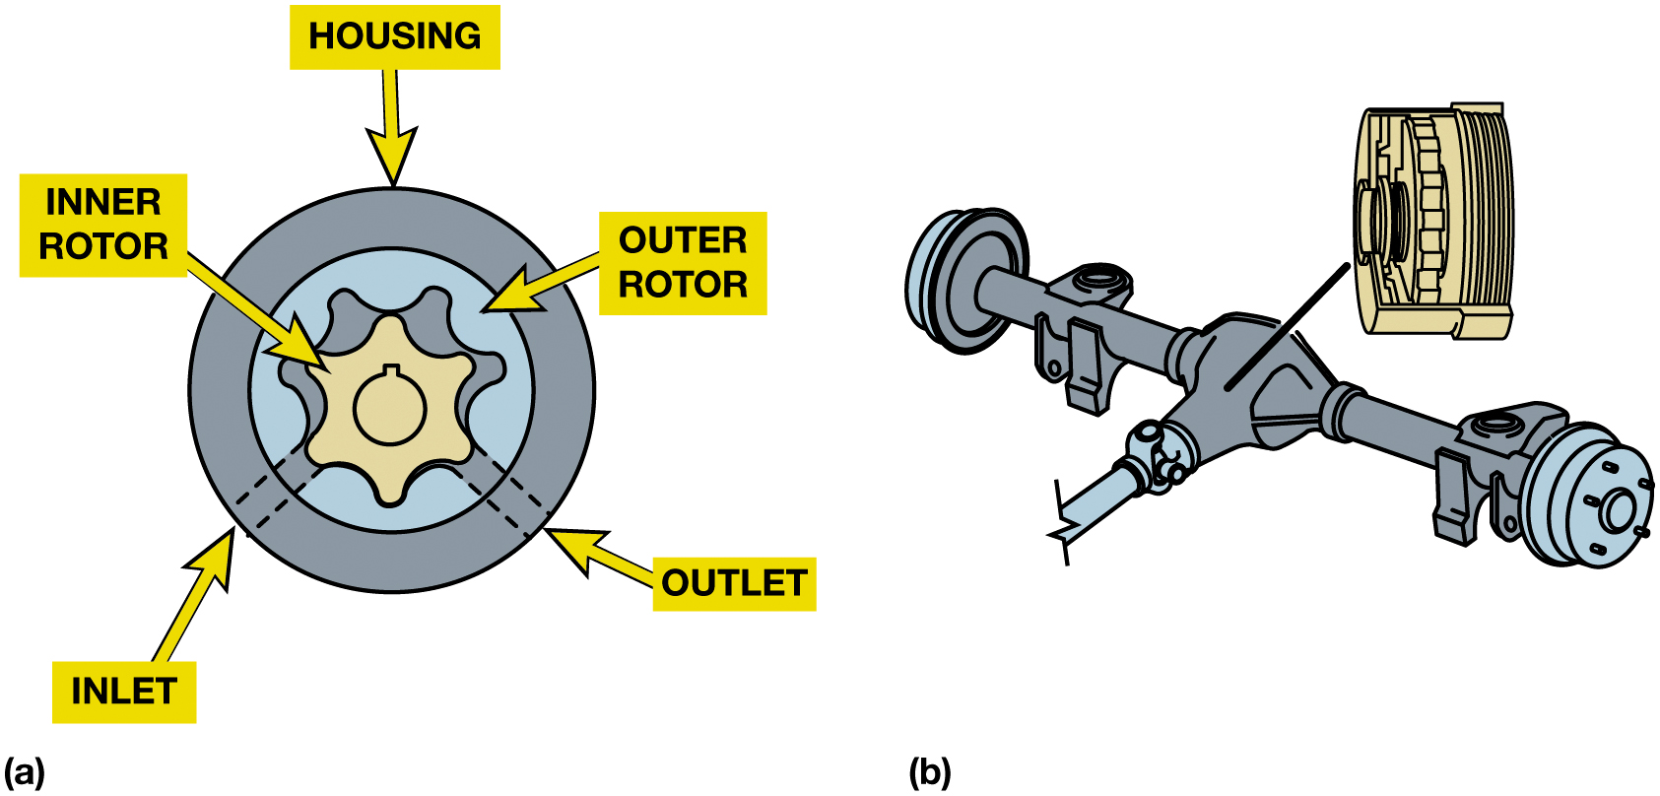
Figure 12.29
Hydraulic Differential
Notes:
Figure 12.29 (a) In hydraulically operated locking differential, if one wheel turns faster than other drive wheel, elements of the fluid pump create fluid pressure which then applies clutch pack. (b) The pump assembly is similar to a type of fluid pump used in many engines or automatic transmissions.
Long Description:
The illustration on the left has outer most layer labeled housing and two rotors in it are labeled inner rotor and outer rotor. Two dotted lines on the bottom left are labeled inlet and two dotted lines on the bottom right are labeled outlet.

Slide 46
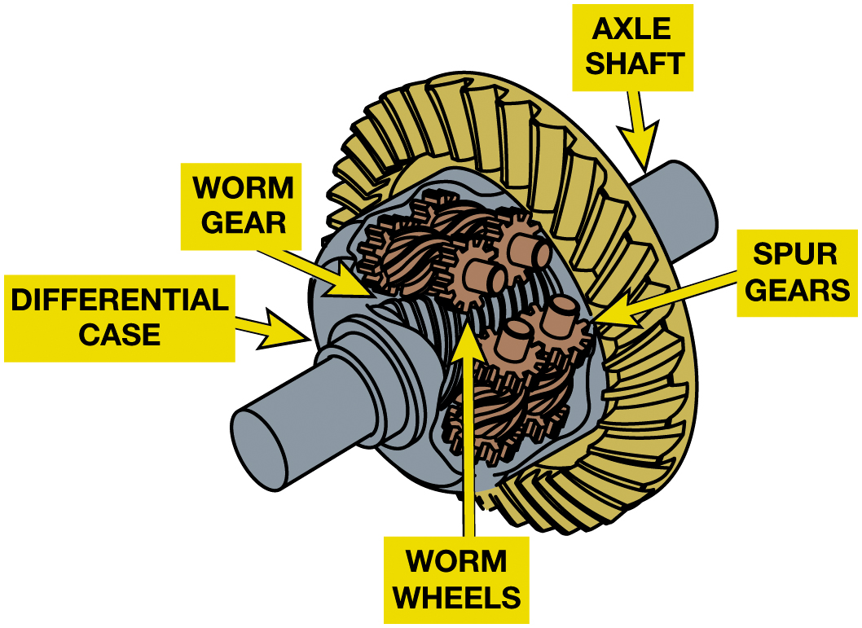
Figure 12.30
Torsen® Differential
A torque sensing differential is used in the front drive axle in front-wheel-drive vehicles as well as in the rear in rear-wheel-drive or all-wheel-drive vehicles.
Notes:
TORSEN® DIFFERENTIAL The Torsen® differential is a pure mechanical worm gear differential. The
name is derived from torque sensing. Two helical gears, called “side gears,” are connected to the
axle shafts. Three pairs of worm gears are mounted in the differential case, and these are called
“element gears.” Each element gear has the worm gear in the center and a spur gear at each end.
The spur gears mesh with the spur gears of the mating element gear. If one of the element gears
rotates in the case, its mate must rotate in the opposite direction. Note that all three pairs of
element gears must rotate at the same time. Gleason, the company that developed Torsen®
differentials, calls the element and side gears Invex gearing. ● SEE FIGURE 12.30.
Long Description:
The illustration highlights the differential case, worm gear, worm wheels, spur gears, and axle shaft.

Slide 47
Frequently Asked Question: What Is Torque Vectoring?
? Frequently Asked Question
Computer-controlled system that controls how much engine torque sent to each drive wheel. Controlling torque allows more grip on slippery surfaces and vehicle can accelerate more quickly without wheel spin. A standard open differential splits torque evenly. If one wheel is on a slippery surface and can only apply 10 l b-f t of torque to road surface, then only 10 l b-f t of torque is applied to other wheel. With such as low amount of torque being applied, the vehicle does not move and the tire on the slippery surface just spins. Torque vectoring achieved in one of the 2 ways: Torque vectoring by braking. Applying one wheel brake creates an increased torque on the tire that is on the slippery surface. This increased torque is then applied to the drive wheel that is on a solid surface. This results in the vehicle being able to move forward even if one tire is on a slippery surface. Differential and clutch-based torque vectoring. Typical differential-based torque vectoring systems use an open differential with multi-plate clutches on either side. The clutches are not always engaged, and are instead electronically or hydraulically actuated. If one (or both) of the clutch packs are active, they are used to multiply or reduce the torque being directed to a wheel. An electronic monitoring system is used to control the clutch pack on either side of the differential. See Figure 12.31.

Slide 48
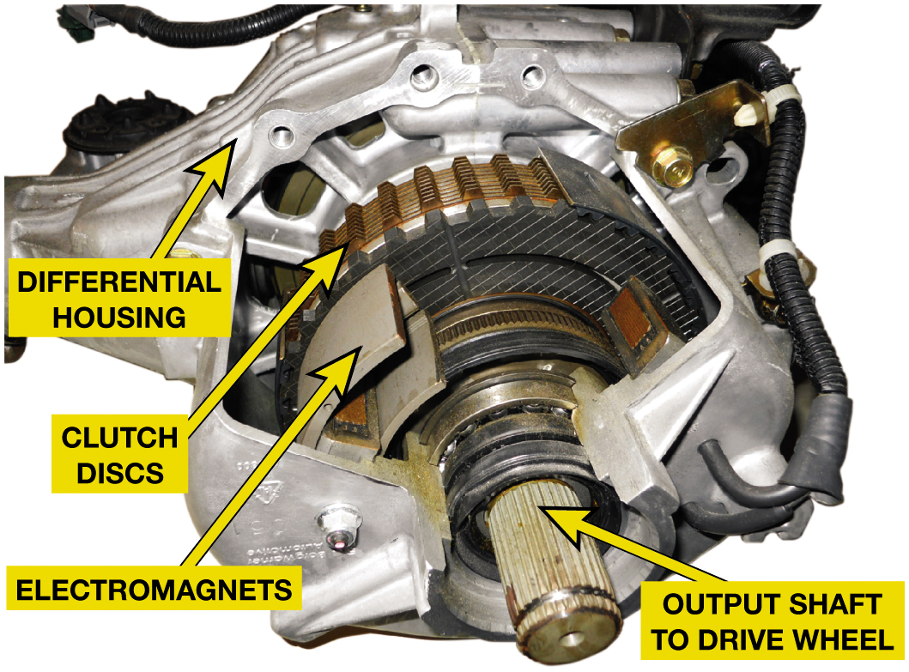
Figure 12.31
Torque Vectoring
A cutaway of a Honda S H-A W D differential showing magnetic clutch assembly to achieve torque vectoring.
Notes:
Electronic Torque Management
Some vehicles are using a variable torque rear drive axle. These are basically front-wheel-drive
vehicles that have a rear drive axle with no differential with the ring gear mounted on a spool to
drive two clutches.
The pair of electronically controlled wet clutch packs is used to send power to the rear axle
shafts. The clutches can be engaged at times of poor traction for A W D or they can be engaged to
provide high-speed vehicle stability. The latter is called automatic yaw control (A Y C) and it
drives one or both rear wheels as needed to keep the vehicle under control. Clutch control comes
from an electronic control module (E C M), which receives signals from front and rear wheel speed sensors and engine speed and load sensors. The Honda Super Handling All Wheel Drive system, S H-A W D, uses a similar rear drive axle that
includes an electronically controlled gear assembly to increase wheel speed. When necessary, A Y C
drives one or both rear wheels as needed to keep the vehicle under control during cornering
maneuvers.
Long Description:
The parts labeled on the photo are differential housing, clutch discs, electromagnets, and output shaft to drive wheels.

Slide 49
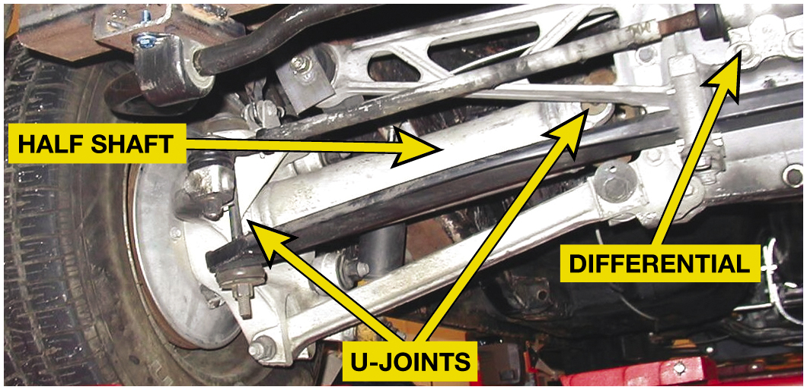
Figure 12.32
An independent rear suspension is used to reduce the amount of weight that the suspension has to carry to improve ride and handling. The differential is attached to the frame of the vehicle and does not move when the rear wheels travel over bumps in the road.
Notes:
Figure 12.32 Independent rear suspension used to reduce amount of weight that suspension has to carry to improve ride and handling. Differential attached to frame of vehicle and does not move when rear wheels travel over bumps in road.
Vehicles with independent rear suspension (I R S) have wheels that are supported by the suspension system and the half shafts that connect them to the axle assembly. The axle housing is very short, slightly bigger than the carrier, and short output shafts are used to connect the axle gears to the U-joint half shaft flanges. Figure 12.32.

Slide 50
Question 1
What is the dimension that is used to identify a 9-inch axle?
A. Distance between side bearings
B. Diameter of the inspection cover
C. Diameter of the ring gear
D. Diameter of the axle tubes

Slide 51
Answer 1
What is the dimension that is used to identify a 9-inch axle?
C. Diameter of the ring gear

Slide 52
Summary
Drive axle combines hypoid final drive gears with differential & 2 axle shafts.
Hypoid ring & pinion gears must be adjusted correctly
Pinion gear and shaft are supported by two pinion bearings.
Ring gear and differential case are supported by two carrier bearings.
Differentials allow 2 wheels to be driven at different speeds.
Limited slip differentials increase torque bias.
Send more torque to the tire with good traction.

Slide 53
Automotive Fundamentals Videos and Animations
Videos Link: (A3) Manual Drive Train Axles Videos
Animations Link: (A3) Manual Drive Train Axles Animations

Slide 54
Copyright
This work is protected by United States copyright laws and is provided solely for the use of instructors in teaching their courses and assessing student learning. Dissemination or sale of any part of this work (including on the World Wide Web) will destroy the integrity of the work and is not permitted. The work and materials from it should never be made available to students except by instructors using the accompanying text in their classes. All recipients of this work are expected to abide by these restrictions and to honor the intended pedagogical purposes and the needs of other instructors who rely on these materials.

