Slide 1
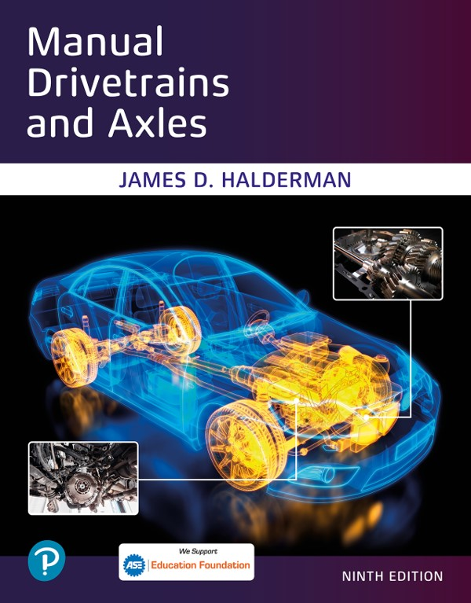
Manual Drivetrains and Axles
Ninth Edition
Chapter 11
Wheel and Axle Bearings
Copyright © 2024, 2018, 2015 Pearson Education, Inc. All Rights Reserved
Notes:
If this PowerPoint presentation contains mathematical equations, you may need to check that your computer has the following installed:
1) Math Type Plugin
2) Math Player (free versions available)
3) NVDA Reader (free versions available)
INSTRUCTOR NOTE: This presentation includes text explanation notes, you can use to teach the course. When in SLIDE SHOW mode, you RIGHT CLICK and select SHOW PRESENTER VIEW, to use the notes.

Slide 2
Learning Objectives
11.1 Describe the types of antifriction bearings, bearing greases, and seals.
11.2 Explain the diagnosis of defective wheel bearings.
11.3 Describe wheel bearing service and sealed bearing replacement.
11.4 Discuss rear drive axle classifications.
11.5 Describe rear axle bearing and seal replacement.
11.6 State the reasons for bearing failure.

Slide 3
Antifriction Bearings
What is purpose and function? Page 146
Ball bearings use hardened steel balls between inner and outer race to reduce friction.
Roller bearings use rollers between inner and outer race to reduce friction.
Most commonly used automotive wheel bearing is the tapered roller bearing.
Notes:
Bearings allow the wheels of a vehicle to rotate and still support the weight of the entire vehicle. Antifriction bearings use
rolling parts inside the bearing to reduce friction. Four styles of rolling contact bearings include ball, roller, needle, and tapered roller bearings, as shown in ● FIGURE 11.1. All four styles convert sliding friction into rolling motion. All of the weight of a vehicle or load on the bearing is transferred through the rolling part.

Slide 4
Figure 11.1
Rolling contact bearings include (left to right) ball, roller, needle, and tapered roller.
Notes:
Long Description:
The text on the top row of the screen from left to right reads as navigation, tire pressure, and trip energy. Below these are the following buttons from left to right: Apple Car Play; Owner’s manual; Blocks. Below the Apple, Car Play button are another button that shows an illustration of five buttons with the letters T, I, L, E, and S on them. The icon of the Apple Car Play button shows a C letter with a triangle in the center. The icon of the Owner’s manual button (pointed by an arrow that reads Owner’s manual) shows an open book symbol with the letter i on the right page. The icon of the blocks button shows a block of various colors in a random arrangement.

Slide 5
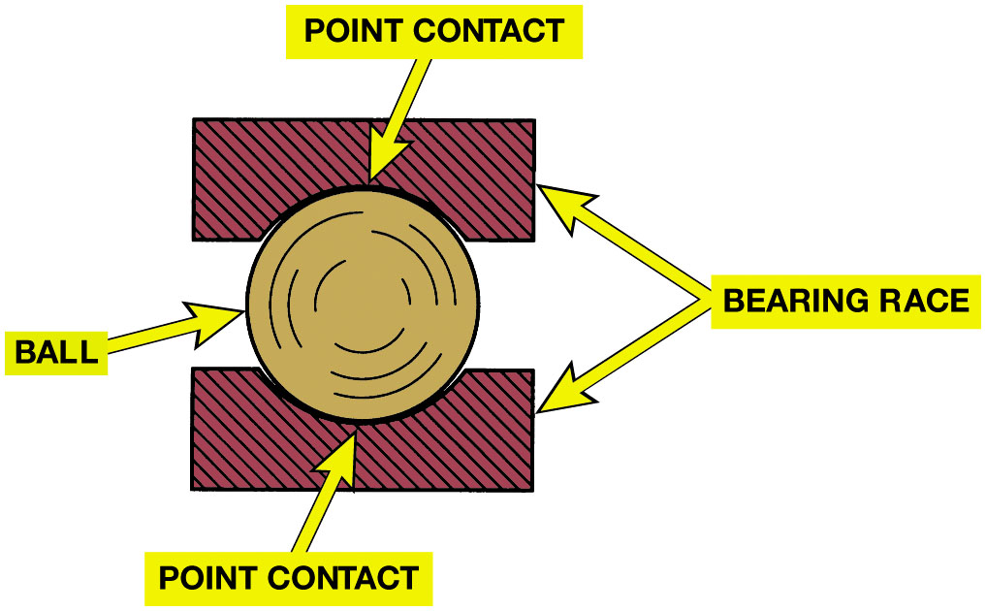
Figure 11.2
Ball Bearing
Many R W D vehicles use inner and outer wheel bearing on front wheels.
Bearings use standard dimensions for inside & outside diameter, & width
F W D vehicles use sealed nonadjustable front wheel bearing.
Ball bearing point contact.
Notes:
Wheel bearings are constructed using friction reducing elements such as steel round balls or steel rollers inside of a housing. The parts involved and their names include:
Inner race—The inner support that provides the rolling surface for the friction-reducing balls or rollers is called a bearing race, also called:
Bearing Cone
Bearing Ring
Bearing Cup
This inner race is located on the spindle or drive axle shaft.
Ball bearings or roller bearings—The purpose and function of the steel balls or steel rollers is to reduce the friction of the rotating parts. Roller bearings can be either straight or tapered. These are the antifriction elements inside a bearing assembly.
Outer race—The outer race, also called the cup or cone, supports the steel balls or steel rollers. The outer race is pressed into the bearing hub or steering knuckle.

Slide 6
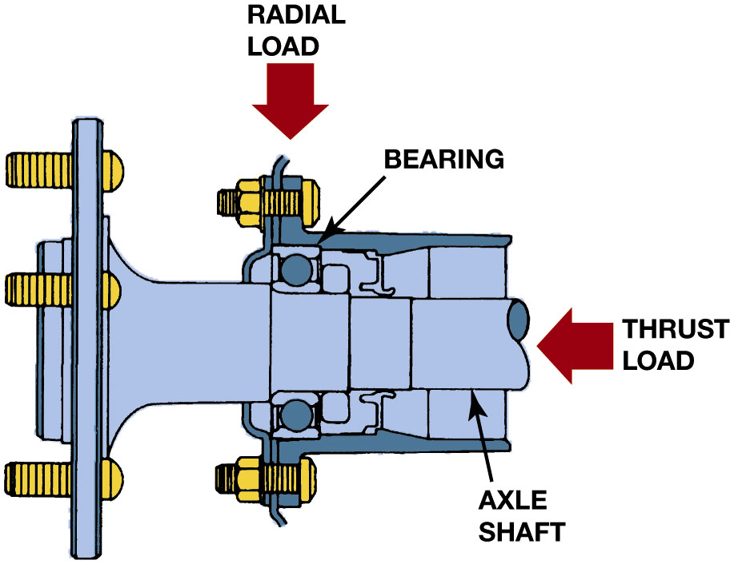
Figure 11.3
Radial/Thrust Load
Radial Load
Vehicle Weight
Thrust Load
Side Force Corning
Radial load is the vehicle weight pressing on the wheels. The thrust load occurs as the chassis components exert a side force during cornering.
Notes:
Long Description:
The illustration comprises a bearing. A downwards arrow indicates a radial load pressing down on the bearing. Another leftwards arrow placed on the right end indicates the thrust load which is a force exerted from the side. An arrow indicates the position of the axle shaft on the lower right end.

Slide 7
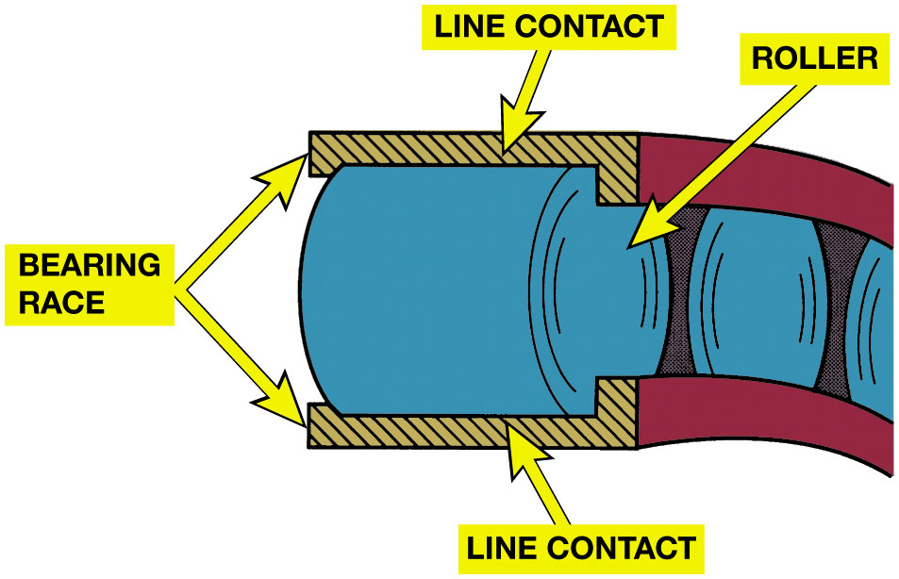
Figure 11.4
Roller Bearings
Roller Bearings
Rollers between
Inner/outer race
Reduce friction
Greater contact area
Support heavier loads
Than ball bearing
Roller bearing line contact.
Notes:
Roller Bearings
Roller bearings use rollers between the inner and outer race to reduce friction. A roller bearing having a greater (longer) contact area can support heavier loads than a ball bearing. ● SEE FIGURE 11.4.
A needle bearing is a type of roller bearing that uses smaller rollers called needle rollers. The clearance between the diameter of the straight roller is manufactured into the bearing to provide the proper radial clearance and is not adjustable.

Slide 8
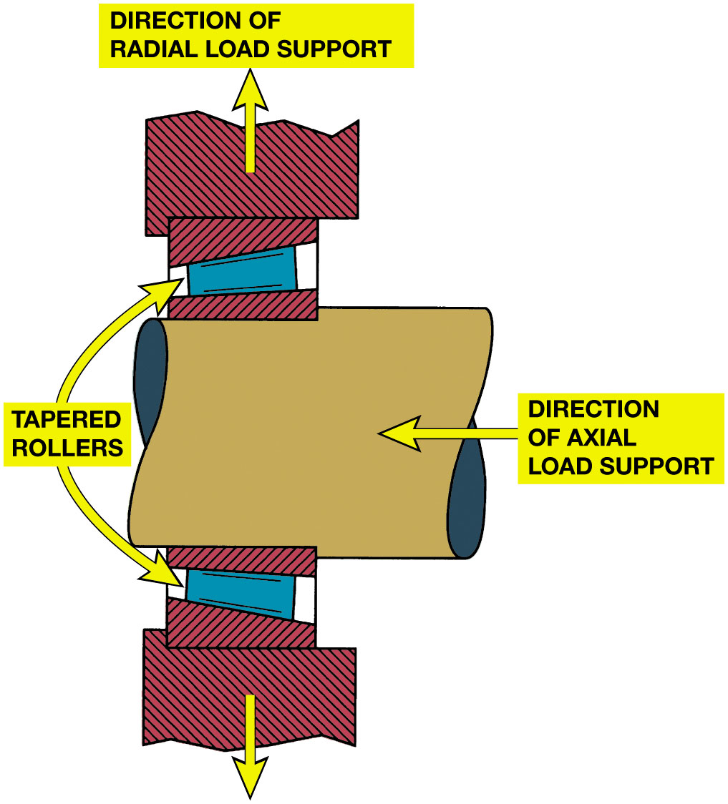
Figure 11.5
Tapered Roller Bearing
Rollers Tapered
Handle Radial & Axial Loads
One Direction
Handle More Weight
A tapered roller bearing will support a radial load and an axial load in only one direction.
Notes:
Tapered Roller Bearings
The most commonly used automotive wheel bearing is the tapered roller bearing. Not only is the bearing itself tapered, but the rollers are also tapered. By design, this type of bearing can withstand radial loads (up and down) as well as axial loads (thrust) in one
direction. ● SEE FIGURE 11.5.
Many non-drive-wheel bearings use tapered roller bearings. The taper allows more weight to be handled by the friction-
reducing bearings because the weight is directed over the entire length of each roller rather than concentrated on a small spot, as with ball bearings. The rollers are held in place by a cage between the inner race (also called the inner ring or cone) and the outer race (also called the outer ring or cup). Tapered roller bearings must be loose in the cage to allow for heat expansion. Tapered roller bearings should always be FIGURES 11.8 AND 11.9. adjusted for a certain amount of free play to allow for heat expansion. On non-drive-axle vehicle wheels, the cup is tightly fitted to the wheel hub and the cone is loosely fitted to wheel spindle. New bearings come packaged with the rollers, cage, and inner race assembled together with the outer race wrapped with moisture-resistant paper. ● SEE FIGURE 11.6.

Slide 9
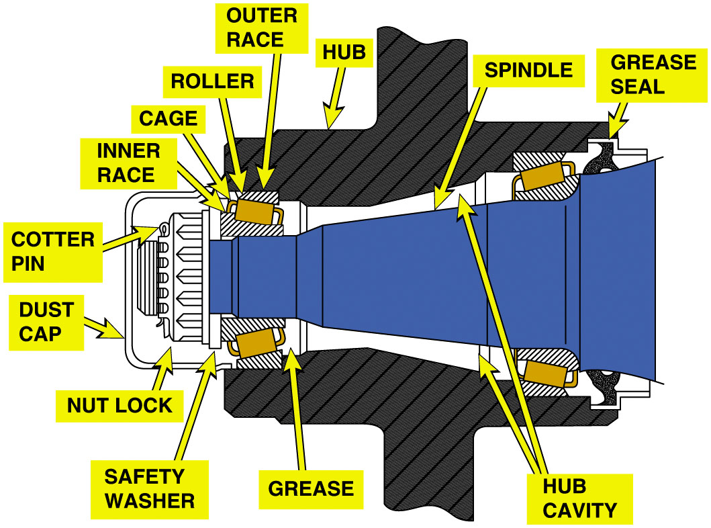
Figure 11.6
Front Wheel Bearing
A cross-sectional view of a typical front wheel bearing showing the larger tapered roller bearing with grease seal on the right and the smaller outer tapered roller bearing on the left.
Notes:
Long Description:
The illustration comprises various parts of the typical front wheel bearing. They are labelled dust cap, cotter pin, inner race, cage, roller, outer race, hub, spindle, grease seal, hub cavity, grease, safety washer, and nut lock.

Slide 10
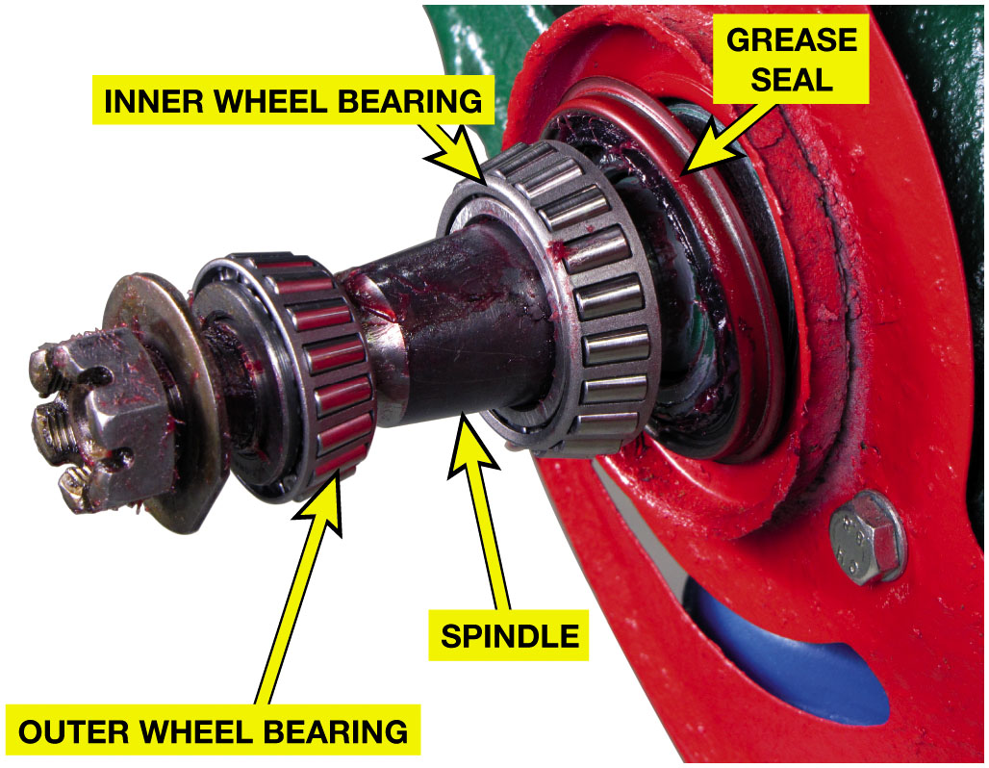
Figure 11.7
Non-Drive Wheel Hub
Non-drive-wheel hub with inner and outer tapered roller bearings. By angling the inner and outer in opposite directions, axial (thrust) loads are supported in both directions.
Notes:
Bearings use standard dimensions for inside diameter, width, and outside diameter. The standardization of bearing sizes helps interchange-ability. The dimensions that are standardized include bearing bore size (inside diameter), bearing series (light to heavy usage), and external dimensions. When replacing a wheel bearing, note the original bearing brand name and number.
Replacement bearing catalogs usually have cross-over charts from one brand to another. The bearing number is usually the same because of the interchangeability and standardization within the wheel bearing industry.

Slide 11
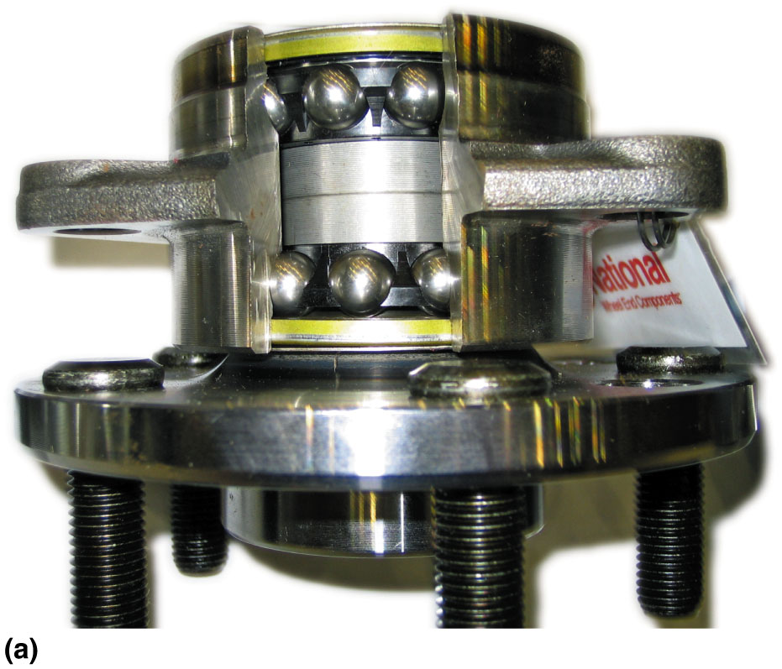
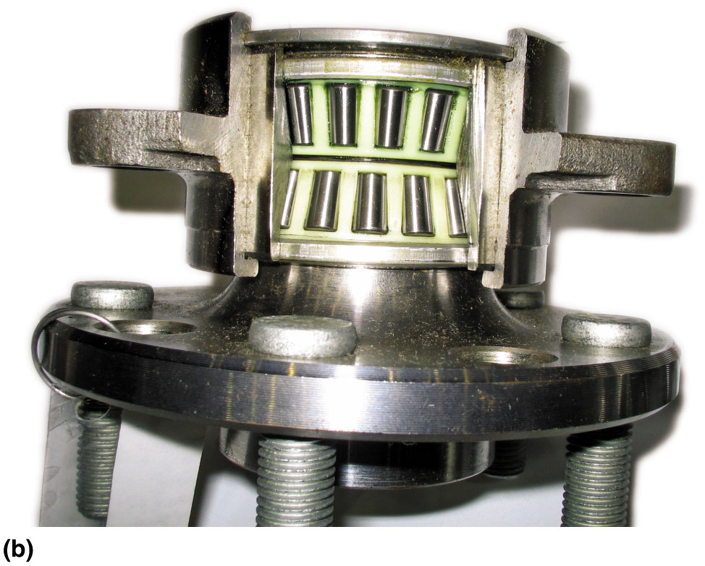
Figure 11.8
Sealed Front Bearing
Sealed bearing and hub assemblies are used on the front and rear wheels of many vehicles. (a) A type using a double row of ball bearings. (b) A type using tapered roller bearings.
Notes:
Most front- wheel-drive vehicles use a sealed nonadjustable front wheel bearing. This type of bearing can include either two pre-loaded tapered roller bearings or a double-row ball bearing. This type of sealed bearing is also used on the rear of many front-wheel-drive vehicles. Double-row ball bearings are often used because of their reduced friction and greater seize resistance.

Slide 12
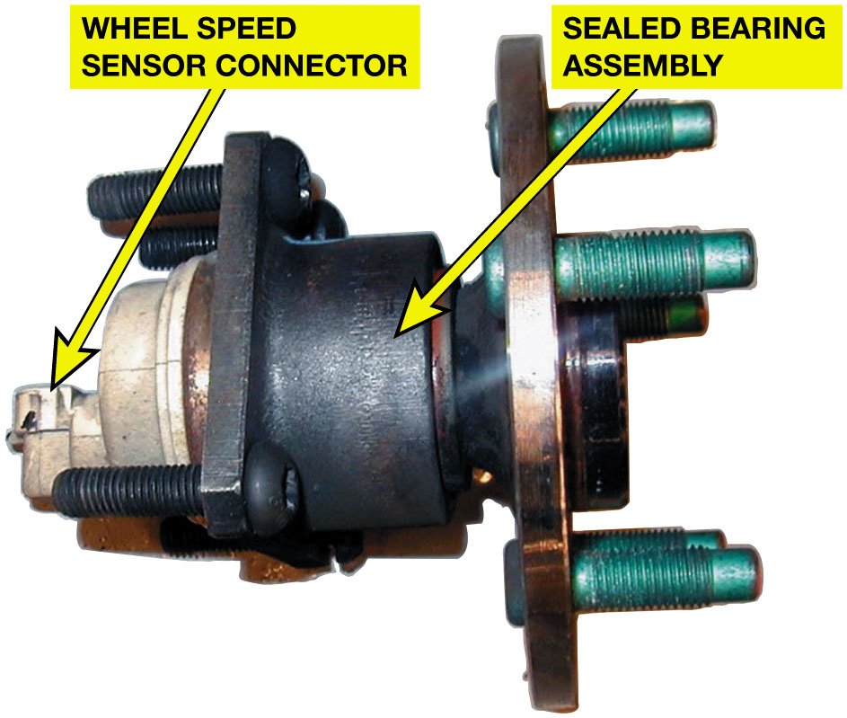
Figure 11.9
Services as Assembly
Sealed bearing and hub assemblies are serviced as a complete unit as shown. This hub assembly includes the wheel speed sensor.

Slide 13
Bearing Greases
N L G I Number | Relative Consistency
000 | Very fluid
00 | Fluid
0 | Semi-fluid
1 | Very soft
2 | Soft (typically used for wheel bearings)
3 | Semi-firm
4 | Firm
5 | Very firm
6 | Hard
What is grease
Why is it important? Page 149
N L G I classification
How is grease classified?
Page 149
Chart on N L G I Numbers
Notes:
Vehicle manufacturers specify the type and consistency of grease for each application. The technician should know what these specifications mean. Grease is oil with a thickening agent to allow it to be installed in places where a liquid lubricant would not stay. Greases are named for their thickening agent, such as aluminum, barium, calcium, lithium, or sodium.
ICATION
The National Lubricating Grease Institute (N L G I) uses the penetration test as a guide to assign the grease a number. Low numbers are very fluid and higher numbers are more firm or hard. Number 2 grease is the most commonly used. See the chart for other numbers.
Grease is also classified according to quality. Wheel bearing classifications include the following:
■ G A—mild duty
■ G B—moderate duty
■ G C—severe duty, high temperature (frequent stop- and-go service) G C indicates the highest quality. Chassis grease, such as that used to lubricate steering and
suspension components, includes the following classifications:
■ L A—mild duty (frequent relubrication)
■ L B—high loads (infrequent relubrication)
L B indicates the highest quality. Most multipurpose greases are labeled with both wheel bearing and chassis grease classifications, such as G C-L B.
More rolling bearings are destroyed by over lubrication than by under lubrication because the heat generated in the bearings cannot be transferred easily to the air through the excessive grease. The cavity between the inner and out bearings should never be filled beyond one-third to one-half of their grease capacity by volume.

Slide 14
Frequently Asked Question: What Do Different Grease Colors Mean?
? Frequently Asked Question
What Do Different Grease Colors Mean? Nothing. According to grease manufacturers, grease is colored for identification, marketing, for consistency of color reasons. Identification. The color is often used to distinguish one type of grease from another within same company. Blue grease from one company may be totally different from blue grease produced or marketed by another company. Marketing. According to grease manufacturers, customers tend to be attracted to a particular color of grease and associate that color with quality. Consistency of color. All greases are produced in batches, and the color of the finished product often varies from one batch to another. By adding color to the grease, the color can be made consistent. Always use the grease recommended for the service being performed.

Slide 15
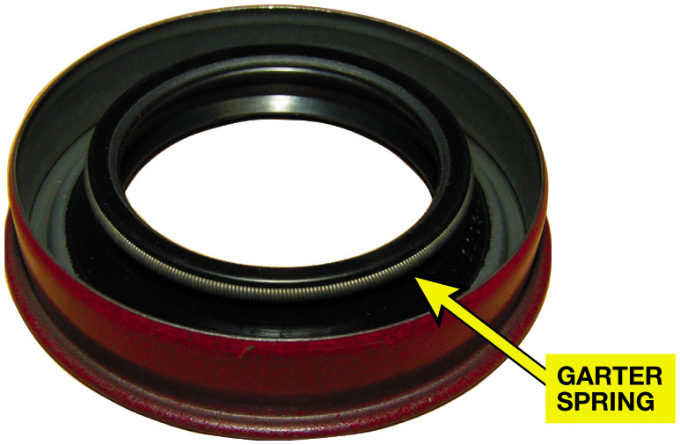
Figure 11.10
Seals
What is purpose and function of seals?
Page 150
Types of seals
Static
Dynamic
Typical lip seal with a garter spring.
Notes:
PURPOSE AND FUNCTION Seals are used in all vehicles to keep lubricant, such as grease, from leaking out and to prevent dirt, dust, or water from getting into the bearing or lubricant.
TYPES OF SEALS Two general applications of seals are static and dynamic.
■ Static seals are used between two surfaces that do not move.
■ Dynamic seals are used to seal between two surfaces that move.
Wheel bearing seals are dynamic-type seals that must seal between rotating axle hubs and the stationary spindles or axle housing. Most dynamic seals use a synthetic rubber lip seal encased in metal. The lip is often held in contact with the moving part with the aid of a garter spring, as seen in ● FIGURE 11.10. The sealing lip should be installed toward the grease or fluid being contained. ●
SEE FIGURE 11.11.

Slide 16
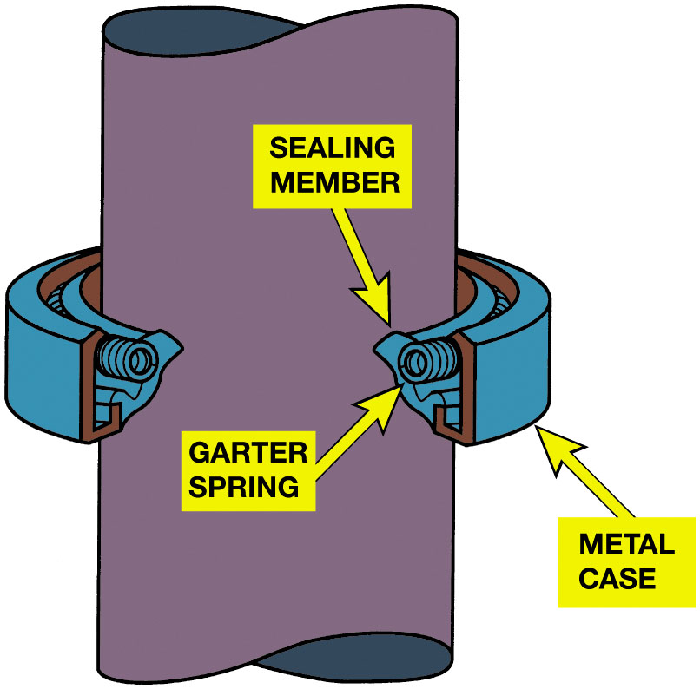
Figure 11.11
Garter Spring
Garter Spring
Keeps Sharp Edge
Against Shaft
A garter spring helps hold the sharp lip edge of the seal tight against the shaft.
Notes:
Safety Tip: Smoking Can Kill You
Some greases contain polymers such as Teflon® that turn to a deadly gas when burned. Always wash your hands thoroughly after handling grease that contains these ingredients before smoking. If some of the grease is on the cigarette paper and is burned, these polymers turn into nitrofluoric acid—a deadly toxin.

Slide 17
Bearing Diagnosis
Wheel bearings control positioning, reduce rolling resistance of wheels.
Bearing fails, wheel may not be kept in position and noise usually heard.
Defective wheel bearings symptoms include:
Hum, Rumbling, Growling Noise Increases With Vehicle Speed.
Roughness Felt In Steering Wheel Changes With Speed/Cornering.
Looseness Excessive Play In Steering Wheel on Rough Roads.
Loud Grinding Noise In Severe Cases,
Indicating A Defective Front Wheel Bearing.
Pulling During Braking
Notes:
Wheel bearings control the positioning and reduce the rolling resistance of vehicle wheels. Whenever a bearing fails, the wheel may not be kept in position and noise is usually heard. Symptoms of defective wheel bearings include the following:
A hum, rumbling, or growling noise that increases with vehicle speed
Roughness felt in the steering wheel that changes with the vehicle speed or cornering
Looseness or excessive play in the steering wheel, especially while driving over rough road
surfaces
loud grinding noise in severe cases, indicating a defective front wheel bearing
Pulling during braking
Determining Bearing Noise From Tire Noise
Defective wheel bearing is often difficult to diagnose because the noise is similar to a noisy winter tire or a severely cupped tire. Customers often request that tires be replaced as a result of the noise when the real problem is a bad wheel bearing. To help determine if the noise is caused by a wheel bearing or a tire, try the following tests:
TEST #1 Drive the vehicle over a variety of road surfaces. If the noise changes with a change in road surface, the noise is caused by a tire(s). If the noise remains the same, then the cause is a defective wheel bearing.
TEST #2 Try temporarily overinflating the tires. If the noise changes, then the tires are cause. If the noise is the same, then defective wheel bearings are the cause.
Testing Wheel Bearing With the vehicle off the ground, rotate the wheel by hand, listening and feeling carefully for bearing roughness. Grasp the wheel at the top and bottom and wiggle it back and forth, checking for bearing looseness.
Tech Tip: Easy Wheel Bearing Looseness Test
Looseness in a front wheel bearing can allow rotor to move whenever the front wheel hits a bump, forcing caliper piston in, which causes brake pedal to kick back and creates feeling that brakes are locking up. Loose wheel bearings are easily diagnosed by removing the cover of the master cylinder reservoir and watching the brake fluid as the front wheels are turned left and right with the steering wheel. If the brake fluid moves while the front wheels are being turned, caliper piston(s) are moving in and out, caused by loose wheel bearing(s). If everything is OK, the brake fluid should not move. Loose wheel bearings can also cause the brake pedal to sink due to movement of the rotor, causing the caliper piston to move. This sinking brake pedal is usually caused by a defective master cylinder. Before replacing a master cylinder, check the wheel bearings.

Slide 18
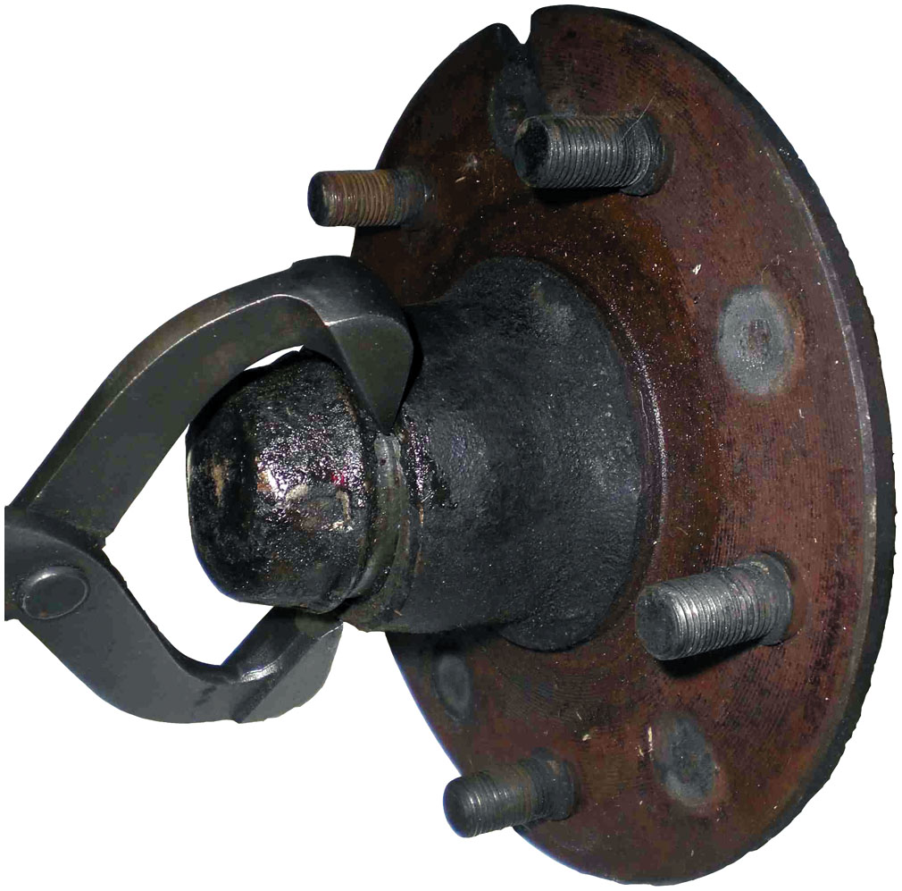
Figure 11.12
Bearing Service
What are steps
Non-drive-wheel bearing inspection?
Page 151
Removing the grease cap with grease cappliers.
Notes:
The steps in a non-drive-wheel bearing inspection include the following:
1. Hoist the vehicle safely.
2. Remove wheel.
3. Remove brake caliper assembly support it with a coat hanger or other suitable hook to avoid allowing caliper to hang by brake hose.
4. Remove the grease cap (dust cap). ● SEE FIGURE 11.12.
5. Remove the old cotter key and discard.
NOTE: The term cotter, as in cotter key or cotter pin, is derived from the Old English verb meaning “to close or fasten.”
6. Remove the spindle nut (castle nut).
7. Remove the washer and the outer wheel bearing.
8. Remove bearing hub from spindle. Inner bearing remains in hub and may be removed (simply lifted out) after grease seal is pried out.
● FIGURE 11.13.
9. Most vehicle and bearing manufacturers recommend cleaning bearing thoroughly in solvent or acetone.
● FIGURE 11.14.
10. Carefully inspect the bearings and the races for the following:
A. Outer race for lines, scratches, or pits.
B. Cage should be round. If round cage has straight sections, this is an indication of an overtightened adjustment or a dropped cage. ● See chart 11.1.

Slide 19
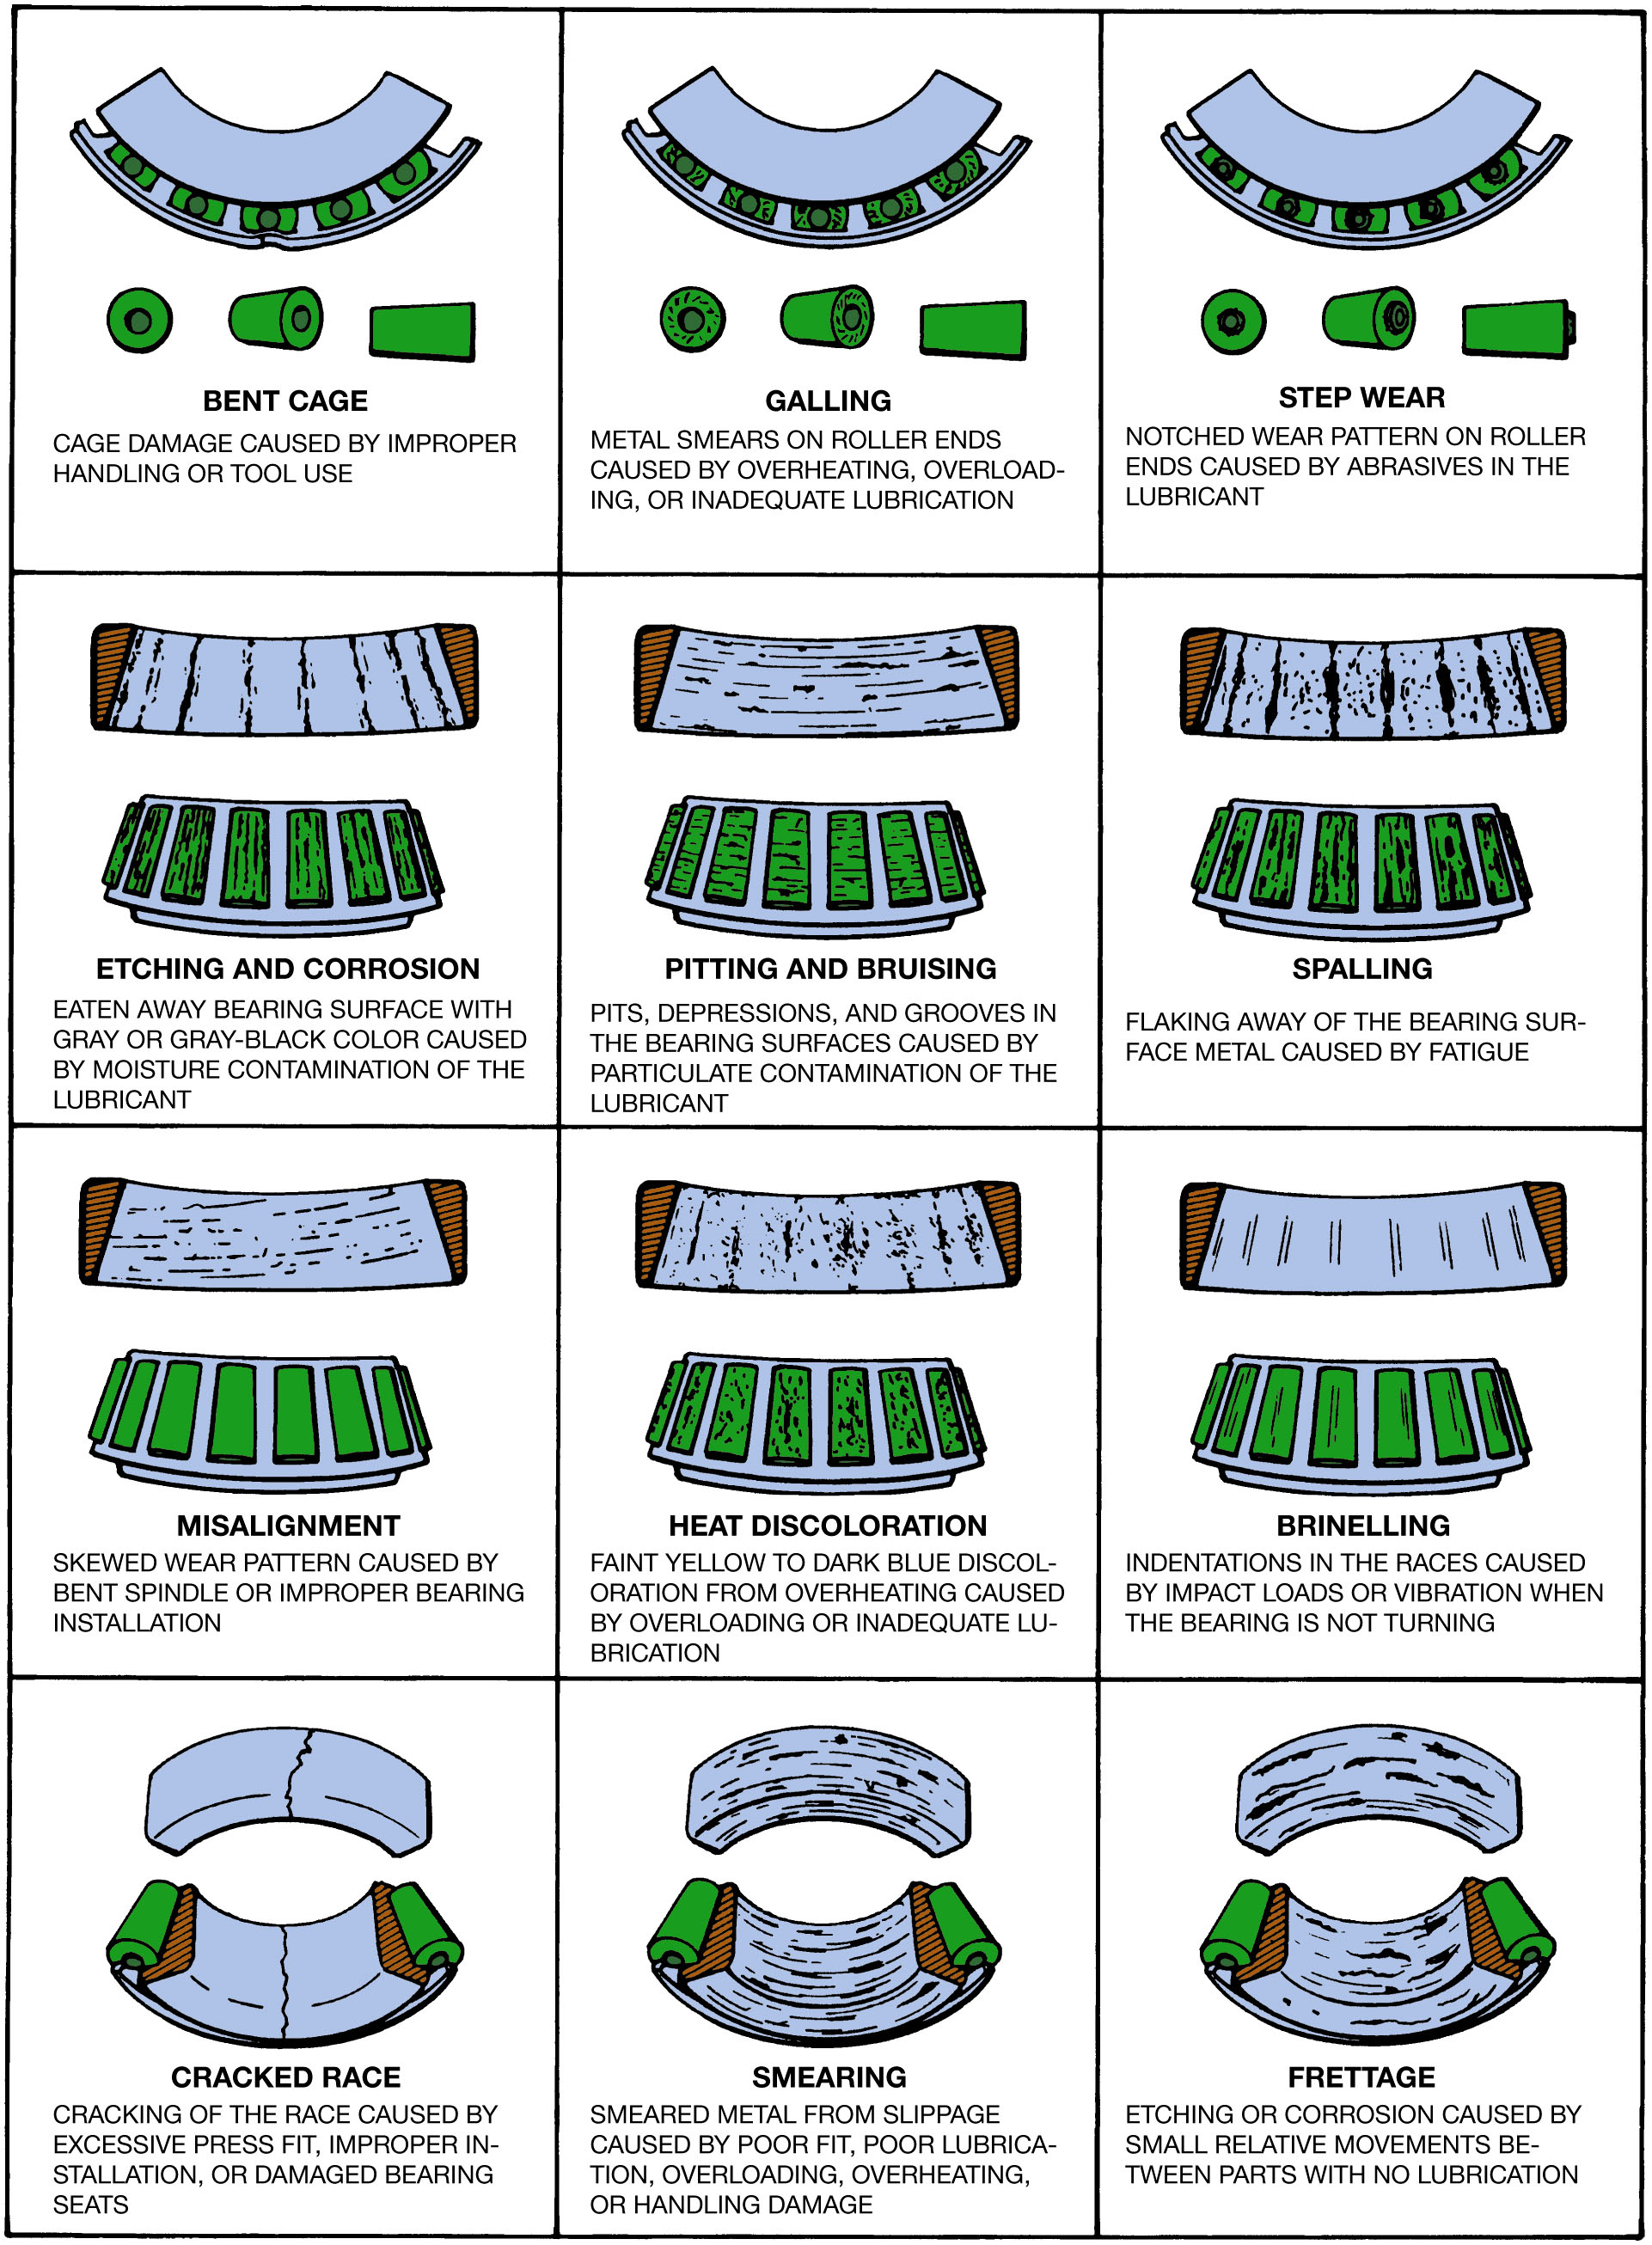
Chart 11.1
Wheel bearing inspection chart. Replace the bearing if it has any of the faults shown.
Notes:
Long Description:
The chart comprises twelve illustrations divided into four rows of three columns each. The data is as follows. Row 1: Bent cage which is cage damage caused by improper handling or tool use; galling which is metal smears on roller ends caused by overheating, overloading, or inadequate lubrication; and step wear which is notched wear pattern on roller ends caused by abrasives in the lubricant. Row 2: Etching and corrosion which is eaten away bearing surface with gray or gray-black color caused by moisture contamination of the lubricant; pitting and bruising which is pits, depressions, and grooves in the bearing caused by particulate contamination of the lubricant; and spalling which is flaking away of the bearing surface metal caused by fatigue. Row 3: Misalignment which is a skewed wear pattern caused by bent spindle or improper bearing installation; heat discoloration which is a faint yellow to dark blue discoloration from overheating caused by overloading or inadequate lubrication; and brinelling which is indentations in the races caused by impact loads or vibration when the bearing is not turning. Row 4: Cracked race which is cracking of the race caused by excessive press fit, improper installation, or damaged bearing seats; smearing which is smeared metal from slippage caused by poor fit, poor lubrication, overloading, overheating, or handling damage; and frettage which is etching or corrosion caused by small relative movements between parts with no lubrication.

Slide 20
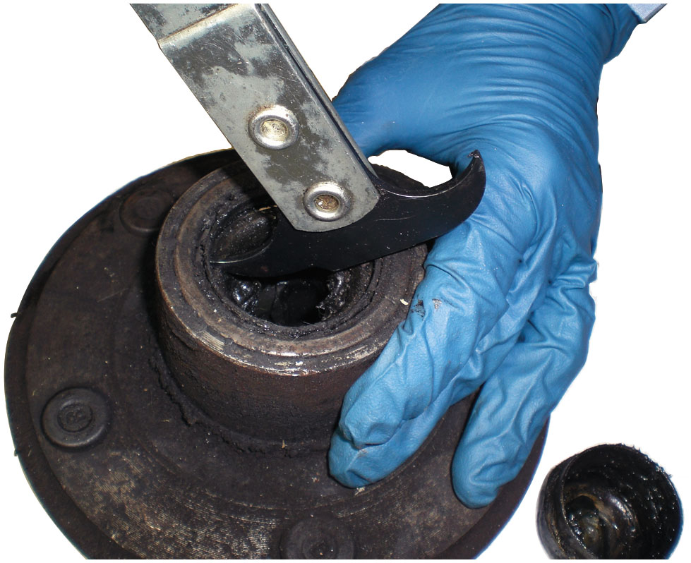
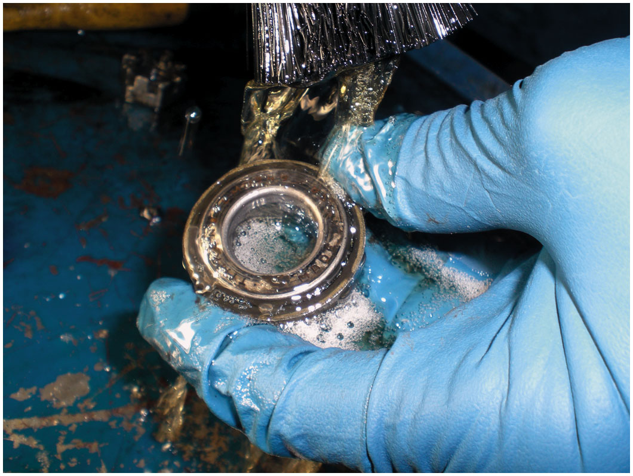
Wheel Bearing Service (1 of 3)
Figure 11.13 Using a seal puller to remove the grease seal.
Figure 11.14 Cleaning a wheel bearing with a parts brush and solvent.

Slide 21
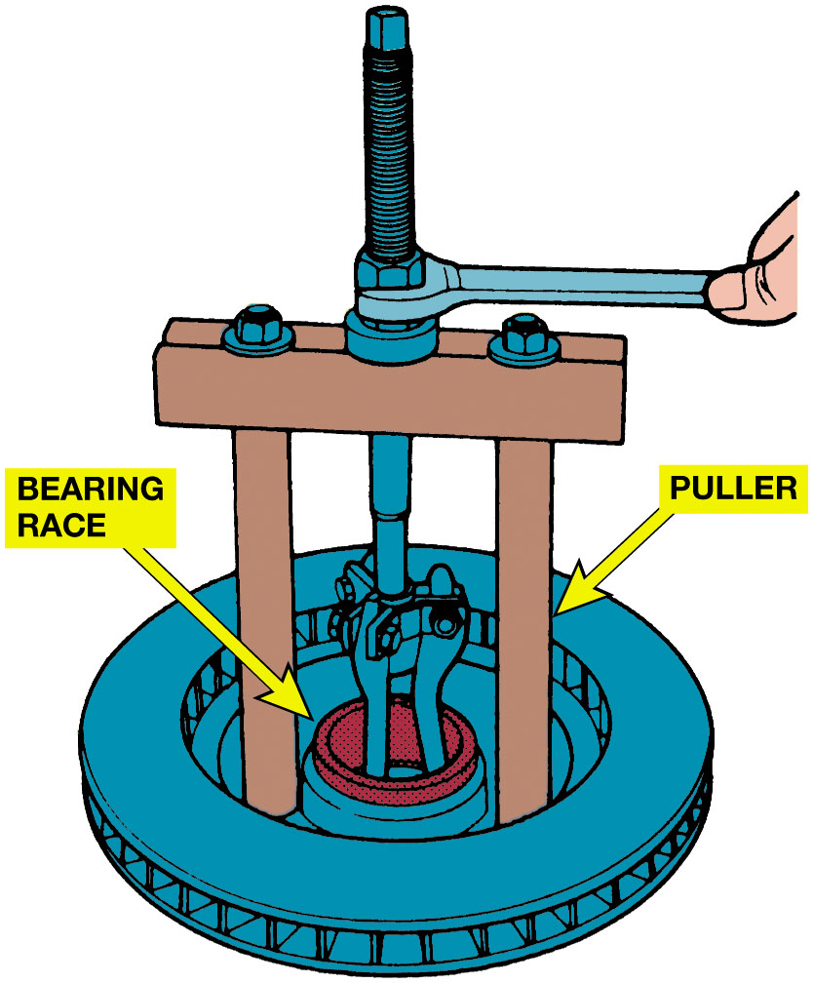
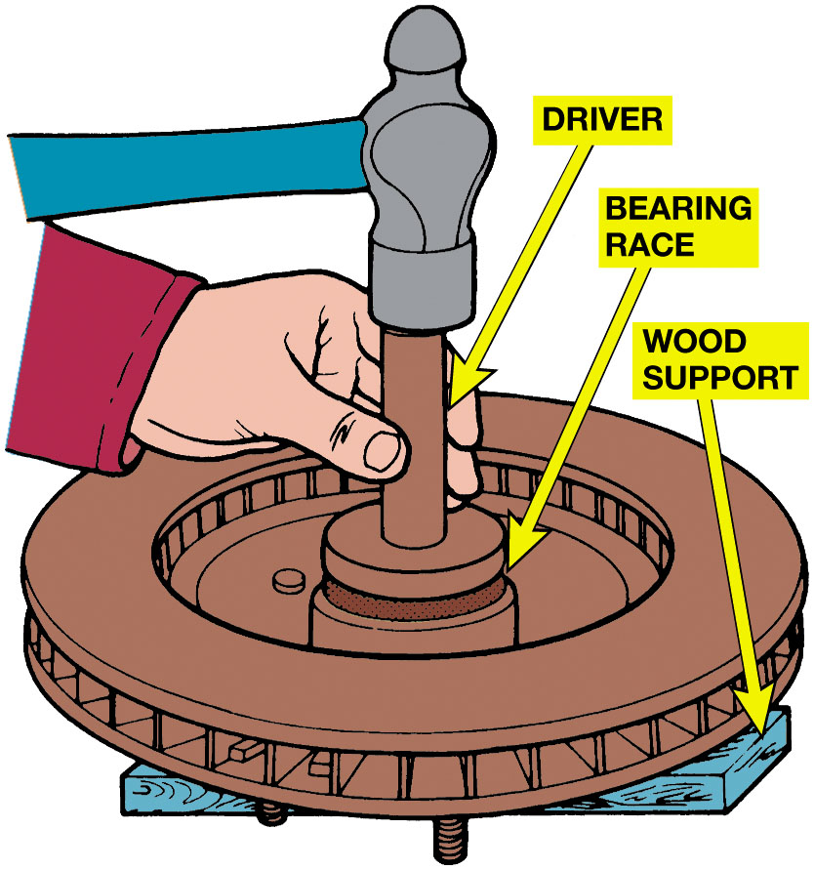
Wheel Bearing Service (2 of 3)
Figure 11.15 A wheel bearing race puller.
Figure 11.16 Installing a bearing race with a driver.

Slide 22
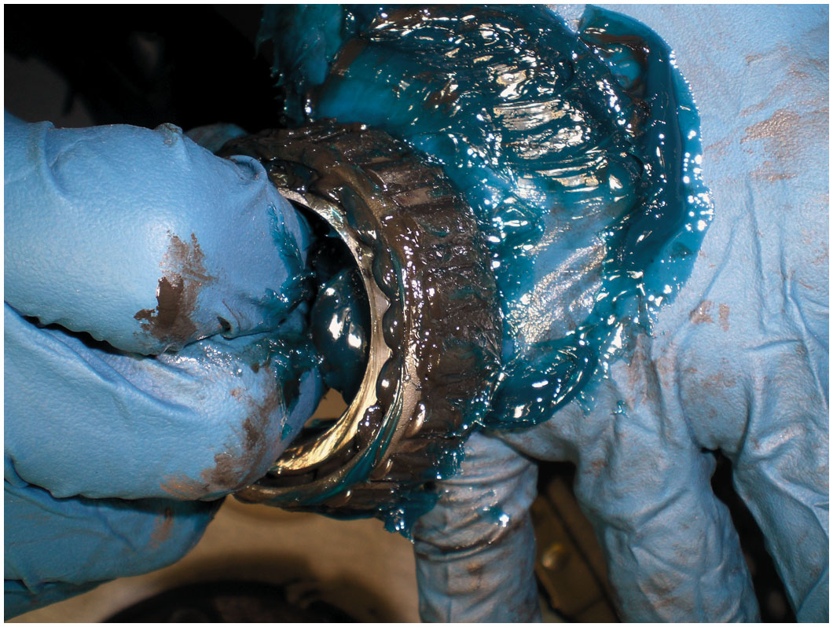
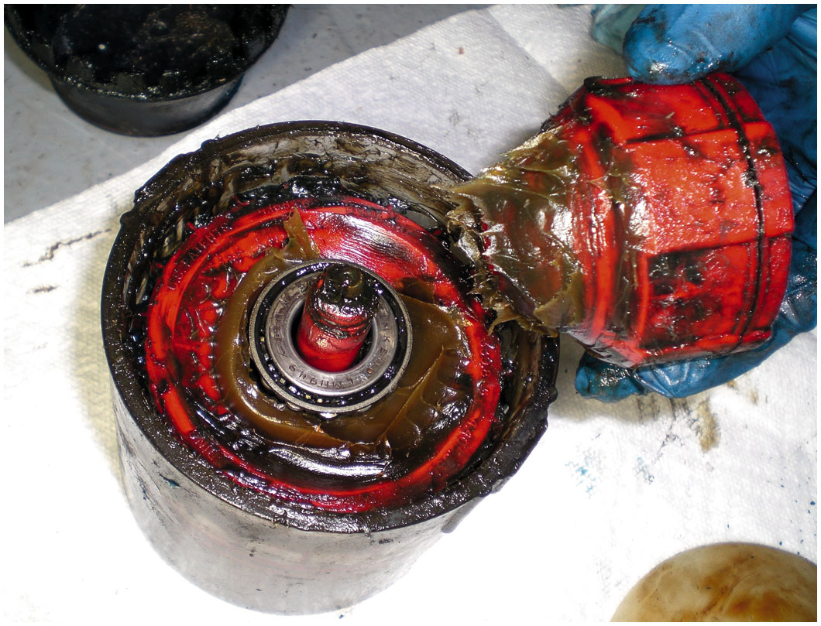
Wheel Bearing Service (3 of 3)
Figure 11.17 Notice the new blue grease has been forced through the bearing.
Figure 11.18 A commonly used hand-operated bearing packer.

Slide 23
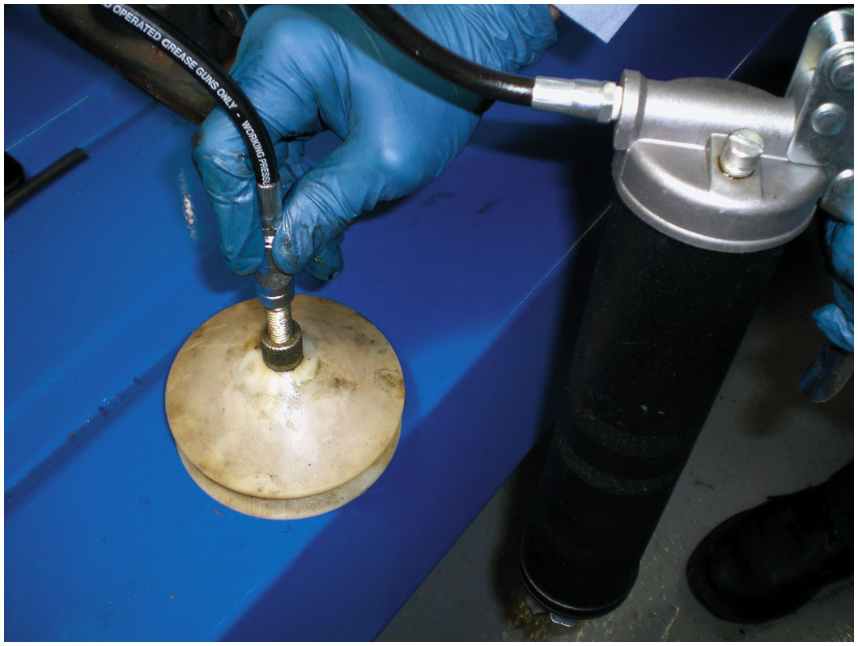
Figure 11.19
Grease-Gun Packer
The wheel bearing is placed between two nylon cones and then a grease gun is used to inject grease into the center of the bearing.
Notes:
Grease gun-type bearing packer. This type of bearing packer uses a grease gun to fill the bearing with grease. The grease gun can be hand-operated or powered by electric or air. Figure 11.19.

Slide 24
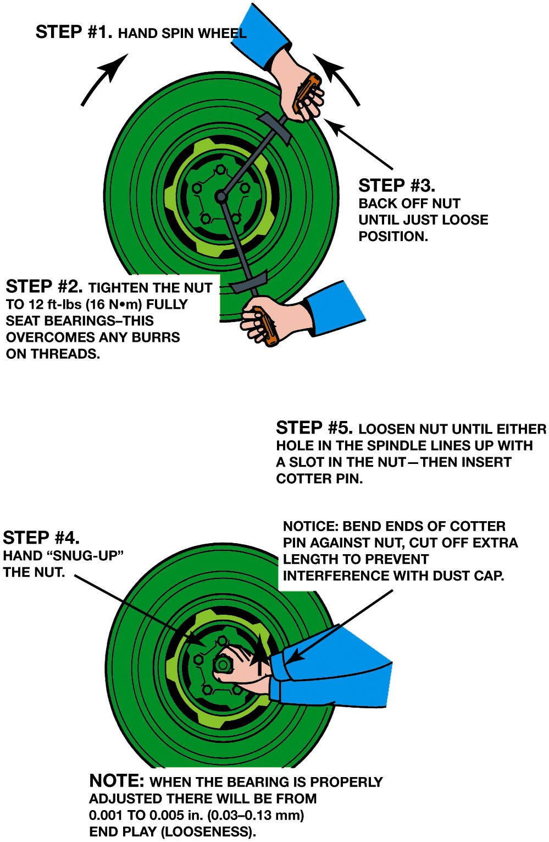
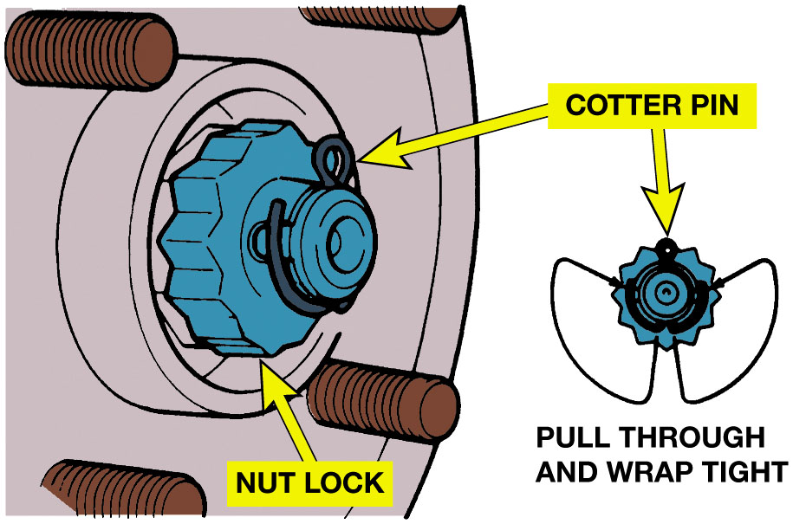
Wheel Bearing Adjustment
Figure 11.21 A properly secured wheel bearing adjust nut.
Figure 11.20 The wheel bearing adjustment procedure as specified for rear-wheel-drive vehicles. Always check service information for the specified procedure to follow.
Notes:
Install the spindle nut and, while rotating the tire assembly, tighten to about 12 to 30 l b-f t with a wrench to “seat” the bearing correctly in the race (cup) and on the spindle. ● SEE FIGURE 11.20.
NOTE: If wheel bearing is properly adjusted, wheel will still have about 0.001−0.005 inch (0.03 to 0.13 m m) end play. To check for proper clearance, grasp wheel at the top and bottom and check for a slight looseness. This looseness is necessary to allow the tapered roller bearing to expand when hot and not bind or cause the wheel to lock up.
Long Description 1:
The illustration is in two parts with a total of five steps to be followed. The first illustration is of a wheel bearing with two wrenches placed at an angle to spin and tighten the nut. The three steps are listed as follows.
Step 1: Hand spin wheel. The arrows indicate a clockwise direction.
Step 2: Tighten the nut to twelve feet pounds, fully seat bearings-this overcomes any burrs on threads.
Step 3: Back off nut until just loose position.
The second illustration is of a wheel bearing with hands pressing on the nut. The steps are as follows.
Step 4: Hand snug up the nut.
Step 5: Loosen nut until either hole in the spindle lines up with a slot in the nut. Then insert cotter pin.
Note: Bend ends of cotter pin against nut, cut off extra length to prevent interference with dust cap.
Note: When the bearing is properly adjusted there will be from 0.001 to 0.005 inch end play.
Long Description 2:
The illustration is a cross-sectional view of a wheel bearing that has a nut lock placed at the center which is secured using a cotter pin. Another smaller illustration of a cotter pin on the right explains how to pull and tightly wrap the cotter pin around the nut lock.

Slide 25
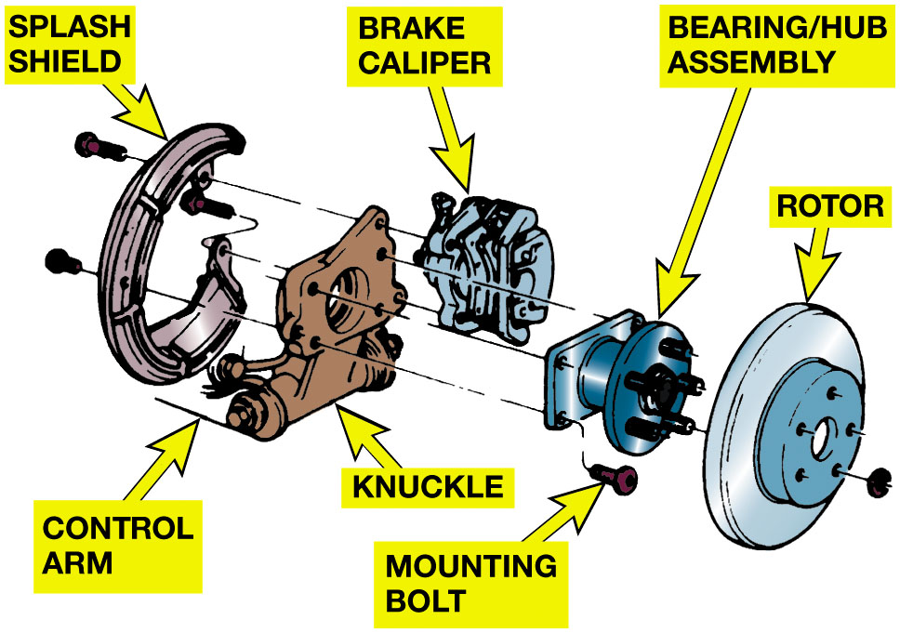
Figure 11.22
Sealed Wheel Bearing
A rear wheel sealed bearing hub assembly.
Notes:
Diagnosing a defective front bearing on a front-wheel-drive vehicle is sometimes confusing. A defective wheel bearing is usually noisy while driving straight, and the noise increases with vehicle speed (wheel speed). A drive axle shaft U-joint (C V joint) can also be the cause of noise on a front-wheel-drive vehicle, but usually makes more noise while turning and accelerating. Most front-wheel-drive vehicles use a sealed bearing assembly that is bolted to the steering knuckle and
supports the drive axle or the rear, as shown in ● FIGURE 11.22.
Many front-wheel-drive vehicles use a bearing that must be pressed off the steering knuckle. Special aftermarket tools are also available to remove many of the bearings without removing the knuckle from the vehicle. Check the service information for the exact procedures to follow for the vehicle being serviced. ● Figure 11–24.
Long Description:
The illustration has parts of the rear wheel pulled apart and placed at a distance. They consist of an incomplete circular ring in C shape that is labelled splash shield, a control arm with a knuckle, a brake caliper, a bearing or hub assembly, and a circular disk that is labelled rotor. There are mounting bolts placed around different parts indicating how to assemble the parts.

Slide 26
Sealed Bearing Replacement
Diagnosing defective front bearing on a F W D vehicle is confusing.
Noisy
Special aftermarket tools are available
Remove many bearings without removing knuckle

Slide 27
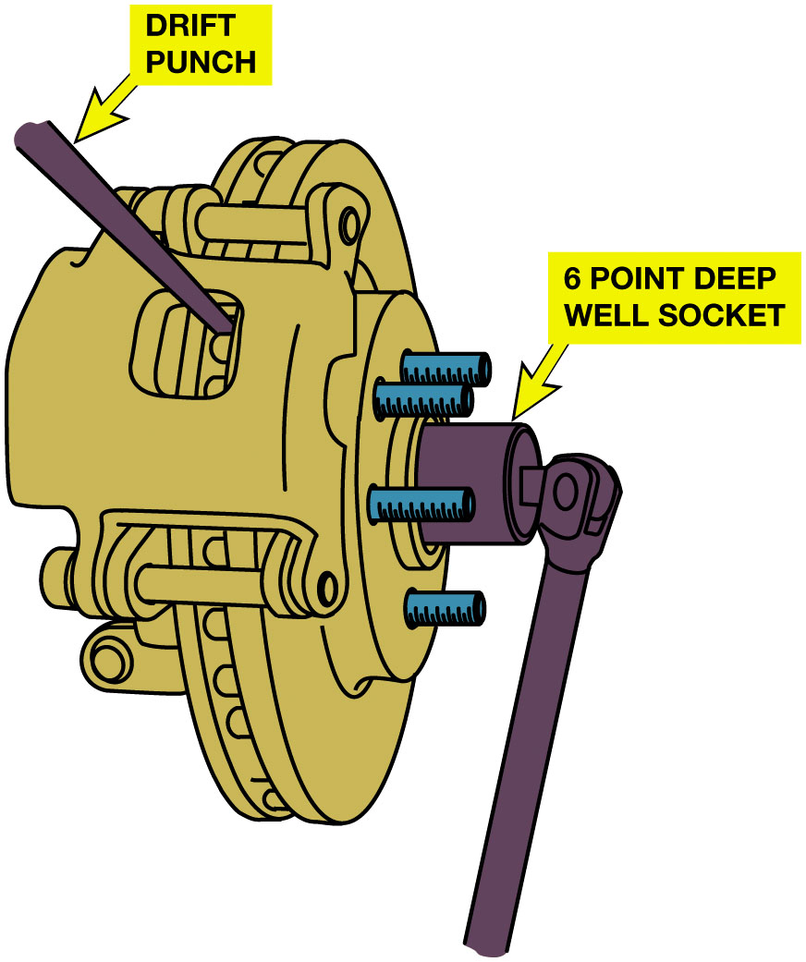
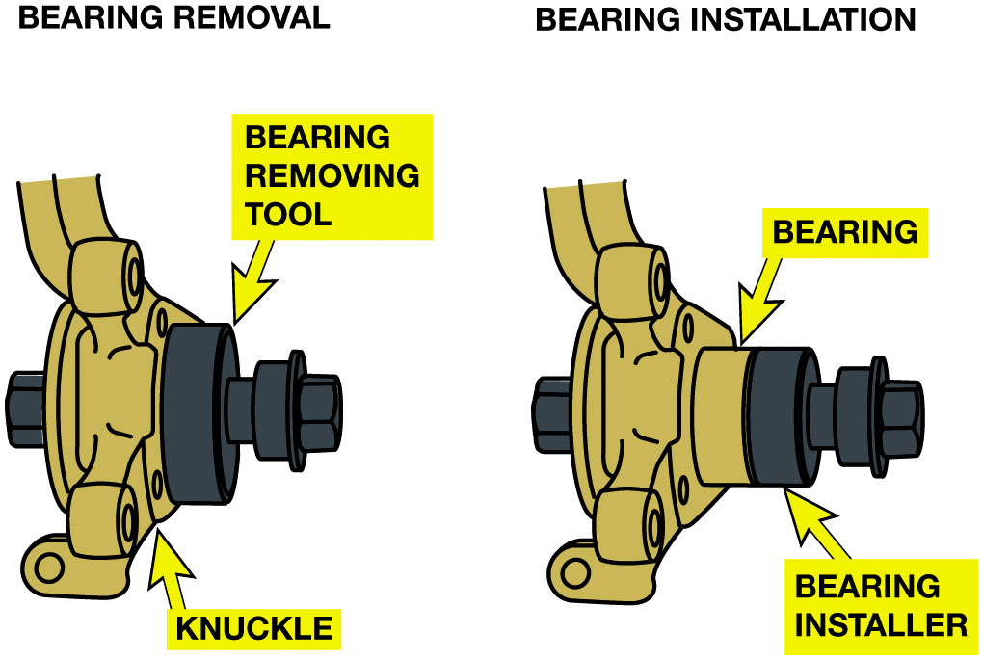
Sealed Wheel Bearings
Figure 11.23 Removing the drive axle shaft hub nut. This nut is usually very tight and the drift (tapered) punch wedged into the cooling fins of the brake rotor keeps the hub from revolving when the nut is loosened. Never use an air impact wrench to loosen or tighten the drive axle shaft nut because the hammering action will damage the bearings.
Figure 11.24 A special puller makes the job of removing the hub bearing from the knuckle easy without damaging any component.
Notes:
Figure 11.23 Removing drive axle shaft hub nut. Nut is tight and drift (tapered) punch wedged into cooling fins of brake rotor keeps hub from revolving when nut is loosened. Never use air impact wrench to loosen or tighten drive axle shaft nut because hammering action damages bearings
Long Description:
The illustration has two parts. The first part is a side-view with an arrow indicating the bearing removing tool placed at the center and a knuckle indicated below it on the side. The second part is also a side-view with arrows indicating the bearing placed at the center and a bearing installer placed on top of it.

Slide 28
Rear Drive Axle Classifications
Full-floating
Bearings are mounted and retained in hub of brake drum or rotor.
Three-quarter-floating
Bearings mounted and retained in brake drum or rotor hub.
Semi-floating
Bearings press onto axle shaft
Installed in outer end of axle housing.

Slide 29
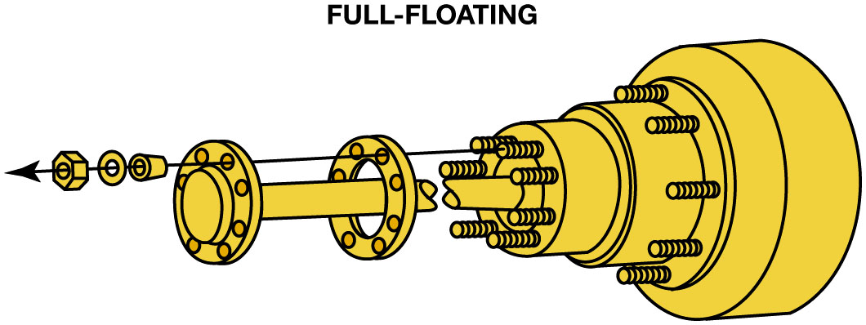
Figure 11.25
Rear Drive Axle Classifications
A typical full-floating rear axle assembly.
Notes:
There are three rear drive axle classifications:
■ Full-floating
■ Three-quarter-floating
■ Semi-floating
Full-floating Axle
On a full-floating axle, the bearings are mounted and retained in the hub of the brake drum or rotor. The hub and bearing mount onto the axle housing, and are held in place by a bearing retainer or adjustment nuts and safety locks. The flanged end of the drive axle is attached to the hub by bolts or nuts. The inner end of the axle splines into the differential side gears. The wheel mounts onto the hub, and lug bolts or nuts retain it. In this design, the axle shafts “float” in the axle housing and drive the wheels without supporting their weight. Because the axle shafts do not retain the wheel, the axle shafts can usually be removed from the vehicle while it is standing on the wheels. Many three-quarter-ton pickups, all heavy-duty truck tractors, and trailers use full-floating axles. ●11.25.

Slide 30
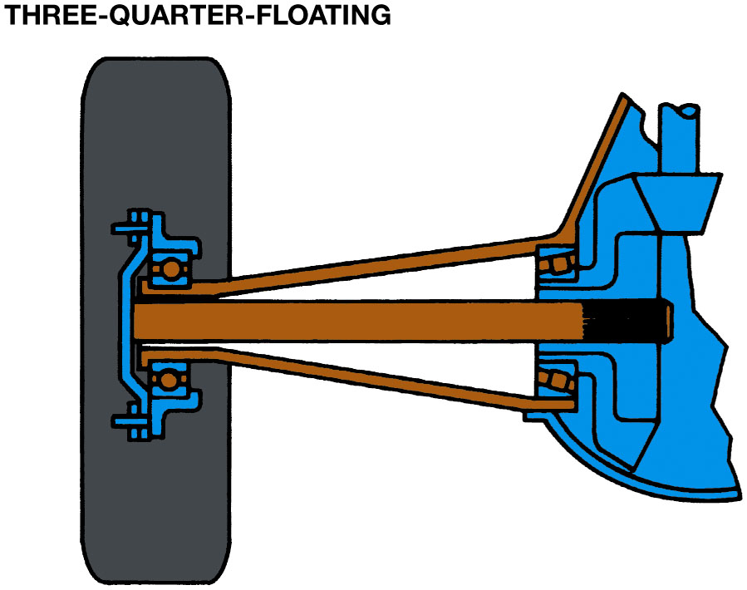
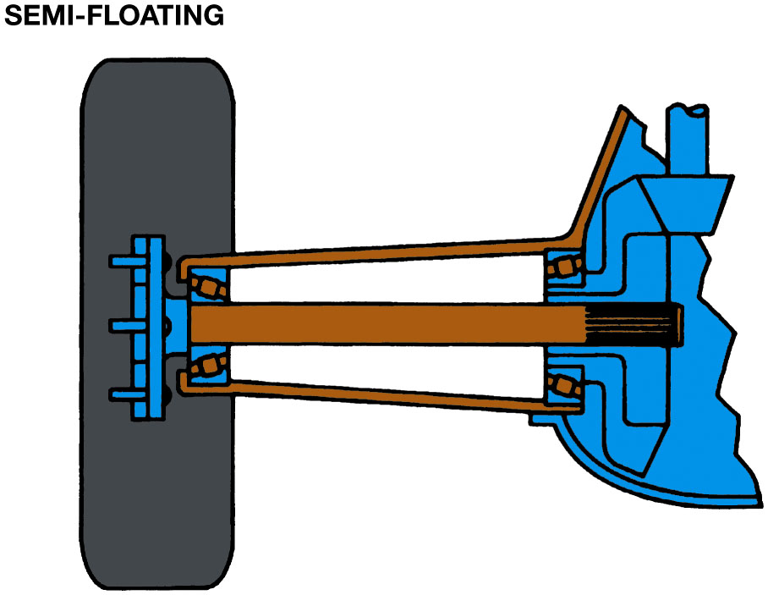
Rear Drive Axle Types
Figure 11.26 A three-quarter-floating rear axle.
Figure 11.27 A semi-floating rear axle housing is the most commonly used in light rear-wheel-drive vehicles.
Notes:
The bearings in a three-quarter-floating axle are mounted and retained in the brake drum or rotor hub, which mounts onto the axle housing. The outer extension of the hub fits onto the end of the axle, which is usually splined and tapered, and a nut and cotter pin secure the hub to the axle. The axle shaft splines to the side gears inside the differential. The wheels are mounted on the hub and retained by lug bolts or nuts. As in the full-floating axle, the axle housing and bearings in the hub support the weight in a three-quarter-floating axle. Because of the construction of a ¾ -floating axle, the wheel must be removed before removing the axle shaft from the vehicle. Figure 11.26.
Wheel bearings in semi-floating axle either press onto the axle shaft or are installed in the outer end of the axle
housing. A retainer plate at the outer end of the axle shaft or a C-clip inside the differential at the other end keeps the axle shaft in the housing. The brake drum or rotor fits onto the end of the axle, and lug bolts or nuts fasten the wheel to the drum or rotor and to the axle. These axles are called “semi-floating” because only the inboard ends of axle shaft “float” in housing.

Slide 31
Rear Axle Bearing and Seal Replacement
There are 2 basic types of axle retaining methods:
Retainer plate-type
Uses 4 fasteners that retain axle in axle housing.
C-lock
Straight roller bearing supporting a semi-floating axle shaft
Inside axle housing
Notes:
Retainer Plate-type Rear Axles The retainer plate-type rear axle uses four fasteners that retain the axle in the axle housing. To remove axle shaft and the rear axle bearing and seal, the retainer bolts or nuts must be removed.
NOTE: If the axle flange has an access hole, then a retainer plate-type axle is used.
The hole or holes in the wheel flange permit a socket wrench access to the fasteners. After the fasteners have been removed, the axle shaft must be removed from the rear axle housing. With the retainer plate-type rear axle, the bearing and the retaining ring are press fit onto the axle and the bearing cup (outer race) is also tightly fitted into the axle housing tube. ● FIGURE 11.28.
● SEE FIGURE 11.29 for the method to remove the axle shaft using a rear axle puller.
C-Lock-type Axles Vehicles that use C-locks (clips) use a straight roller bearing supporting a semi-floating axle shaft inside the axle housing. The straight rollers do not have an rollers ride on the axle itself. If a bearing fails, both the axle and the bearing usually need to be replaced. The outer bearing race holding rollers is pressed into the rear axle housing. The axle bearing is usually lubricated by rear-end lubricant and a grease seal is located on the outside of the bearing.
NOTE: Some replacement bearings are available that are designed to ride on a fresh, unworn section of the old axle. These bearings allow the use of the original axle, saving the cost of a replacement axle.
The C-lock-type rear axle retaining method requires that differential cover plate be removed.
After removal of the cover, the differential pinion shaft has to be removed before the C-lock that retains the axle can be removed. ● SEE
FIGURES 11.31 AND 11.32.

Slide 32
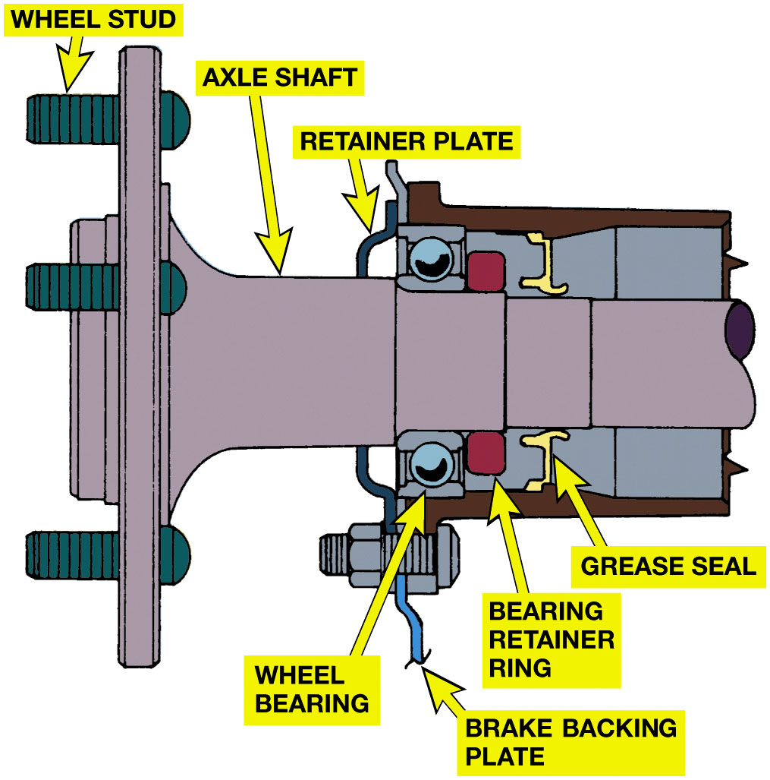
Figure 11.28
Retainer Plate-type
A retainer plate-type rear axle bearing. Access to the fasteners is through a hole in the axle flange.
Notes:
Long Description:
The illustration comprises various parts of a retainer plate-type axle bearing. They are labelled wheel stud, axle shaft, brake backing plate, and retainer plates, wheel bearings, bearing retainer rings, and grease seal attached on both ends of the axle shaft.

Slide 33
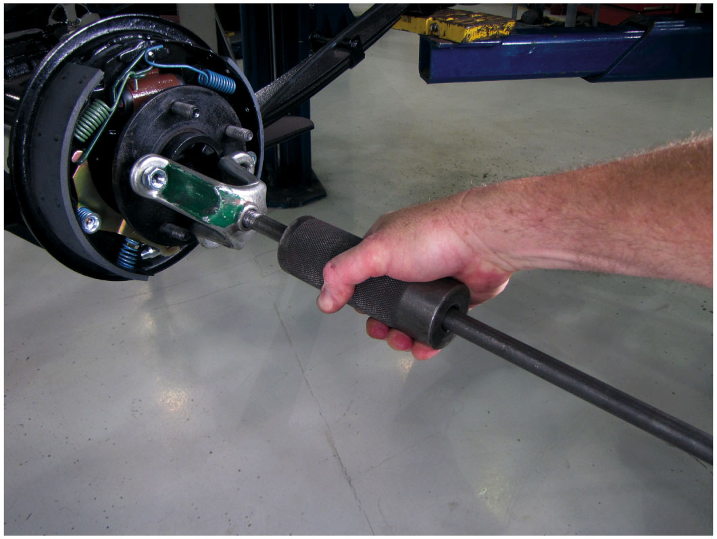
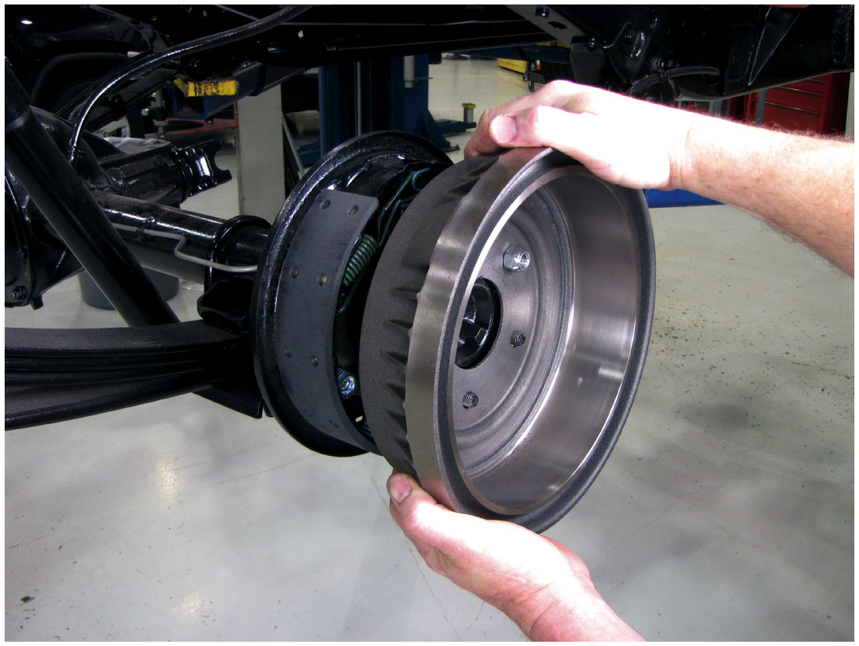
Removing Rear Axle
Figure 11.29 A slide-hammer-type axle puller can be used to remove an axle.
Figure 11.30 To remove axle equipped with a retainer-plate rear axle, brake drum placed back onto axle studs backward so that drum itself can be used as a slide hammer to pull axle out of axle housing.
Notes:
Tech Tip” The Brake Drum Slide Hammer Trick
To remove the axle from a vehicle equipped with a retainer plate-type rear axle, simply use the brake drum as a slide hammer to remove the axle from the axle housing. ● SEE FIGURE 11.30. If the brake drum does not provide enough force, a slide hammer can also be used to remove the axle shaft.
Long Description:
The close-up view has a circular part that is a brake drum attached at the end, to remove the axle. The drum is being pulled to pull out the rear axle from the axle housing.

Slide 34
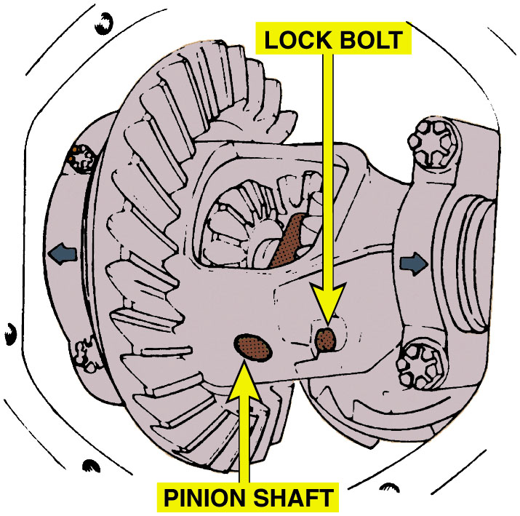
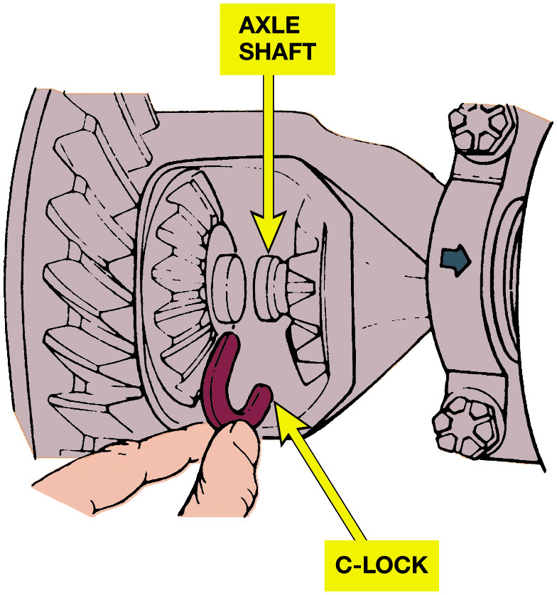
C-Lock Axle Removal
Figure 11.31 To remove the C-lock (clip), the lock bolt must be removed before the pinion shaft is taken out.
Figure 11.32 The axle must be pushed inward slightly to allow the C-lock to be removed. After the C-lock has been removed, the axle can be easily pulled out of the axle housing.

Slide 35
Animation: Remove and Replace Axle Shaft, C-Lock (Animation will automatically start)

Slide 36
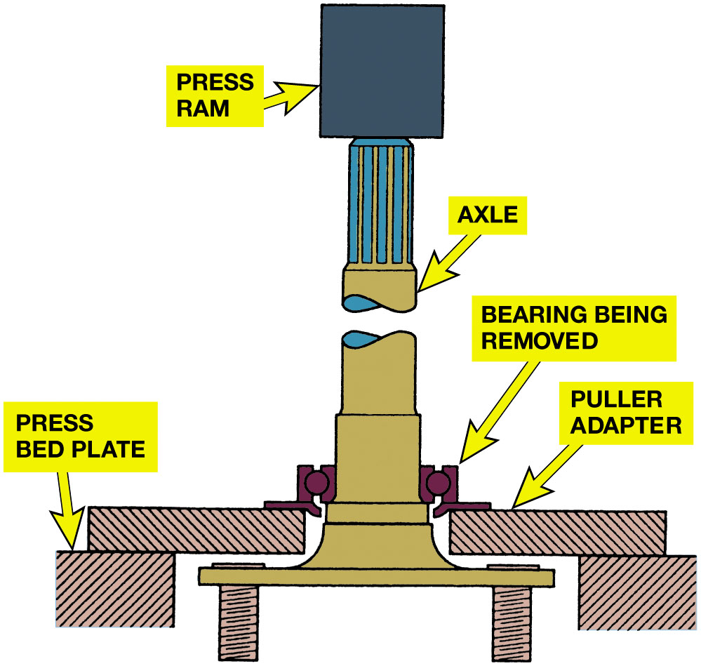
Figure 11.33
Removing Bearing
Using a hydraulic press to press an axle bearing from the axle. When pressing a new bearing back onto the axle, pressure should only be on the inner bearing race to prevent damaging the bearing.
Notes:
NOTE: Some replacement bearings are available that are designed to ride on a fresh, unworn section of the old axle. These bearings allow the use of the original axle, saving the cost of a replacement axle.
Long Description:
The illustration of the pressure being put on the inner bearing of the axle using a hydraulic press. Arrows indicate a press bed plate, a puller adapter, and a bearing being removed on both sides. The axle is placed in the middle of the hydraulic press and a press ram is indicated at the top of the illustration.

Slide 37
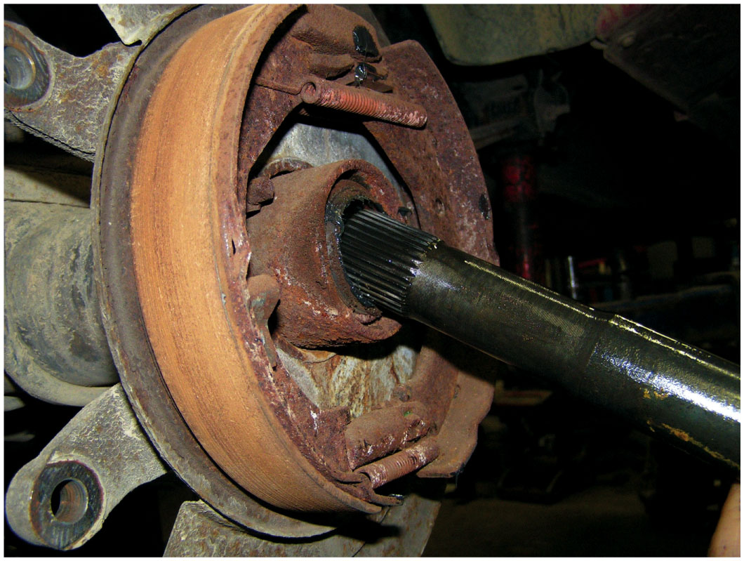
Figure 11.34
Removing Axle Seal
Removing an axle seal using the axle shaft as the tool. While this procedure is done in some shops, the preferred and specified procedure is to use a seal puller.

Slide 38
Animation: Remove and Replace Axle Shaft, Bearing Retained (Animation will automatically start)

Slide 39
Bearing Failure Analysis
Whenever A bearing is replaced, old bearing
Must be inspected and cause of failure eliminated.
Metal fatigue: long vehicle usage
Electrical arcing
Shock loading
Notes:
Metal Fatigue
Long vehicle usage, even under normal driving conditions, causes metal to fatigue. Cracks often appear, and eventually these cracks expand downward into the metal from the surface. The metal between the cracks can break out into small chips, slabs, or scales of metal. This process of breaking up is called spalling.
Case Study: The Noisy Toyota
A customer complained that a noise was heard from the rear of a Toyota Highlander S U V. During a test drive, the service technician did notice a slight noise and thought it might be due to a tire.
Driving over various types of road surfaces did not change the level or the pitch (frequency) of the noise indicating that the noise was due to a bearing rather than a tire. As a double check that a tire was not the issue, the technician rotated tires placing the front tires in the rear and the rear tires on the front. Another test drive resulted in the same results.
The technician then recommended that right rear wheel bearing (bearing hub assembly) be replaced and the customer agreed to the estimate. When the hub bearing was removed and checked for any roughness, the technician did not feel or hear any noise from the old bearing. However, once the new bearing was replaced, the noise was gone during a test drive.
Summary
Complaint—Customer complained of a noise from the right rear of the S U V.
Cause—Defective wheel bearing.
Correction—Replacing the right rear bearing/hub assembly fixed the noise concern.
Tech Tip: Bearing Overload
It is not uncommon for vehicles to be overloaded. This is particularly common with pickup trucks and vans. Whenever there is a heavy load, the axle bearings must support the entire weight of the vehicle, including its cargo. If a bump is hit while driving with a heavy load, the balls of a ball bearing or the rollers of a roller bearing can make an indent in the race of the bearing. This dent or imprint is called Brinelling, named after Johann A. Brinell, a Swedish engineer who developed
a process of testing for surface hardness by pressing a hard ball with a standard force into a sample material to be tested. Once this imprint is made, the bearing will make noise whenever the roller or ball rolls over the indent. Continued use causes wear to occur on all of the balls or rollers and eventual failure.
While this may take months to fail, the cause of the bearing failure is often overloading of the vehicle. Avoid shock loads and overloading for safety and for longer vehicle life.

Slide 40
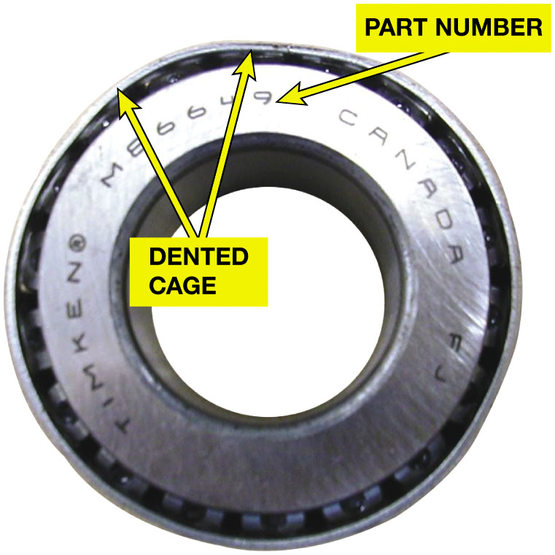
Figure 11.35
Bent Cage
This bearing has a bent cage and must be replaced.

Slide 41
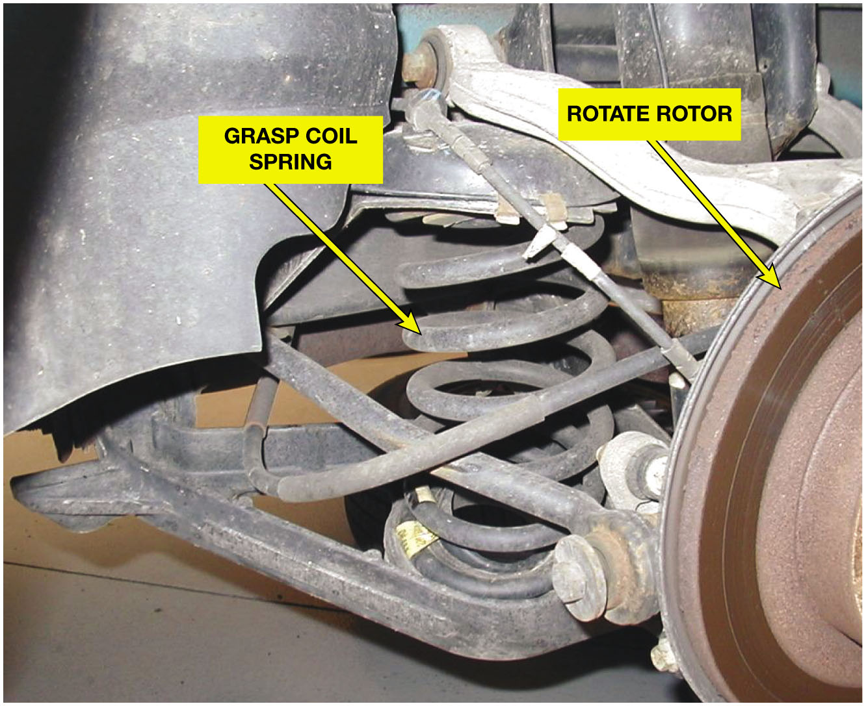
Figure 11.36
Feeling Spring Vibration
To detect a possible defective wheel bearing, grasp the coil spring and then rotate the wheel. If there is roughness in the bearing, a vibration will be felt in the spring.
Notes:
Tech Tip: Touch the Spring When Checking for Bearing Noise
Wheel bearing noises are often hard to pin down because the noise can be transmitted throughout the vehicle. Whenever diagnosing a possible defective wheel bearing, use one hand to grasp the spring while using the other hand to rotate the wheel. The roughness of a defective wheel bearing is easily detected by feeling a vibration in the coil spring. ● SEE FIGURE 11–36.

Slide 42
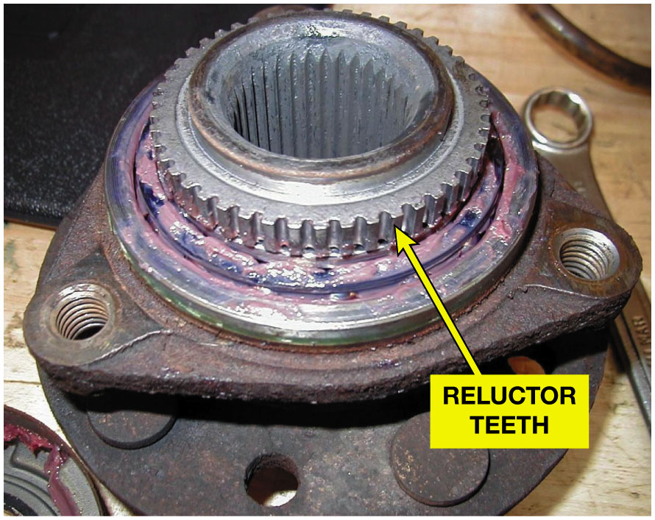
Figure 11.37
Reluctor Wheel A B S
A bearing/hub assembly that shows the reluctor (tone wheel) teeth used by the wheel speed sensor.
Notes:
Tech Tip: Double-Check the Bearing Part Number
Most wheel bearing/hub assemblies include the tone wheel (reluctor ring), which is used by the wheel speed sensor for use by the electronic brake control unit for electronic stability control and antilock brake operation. The number of notches or teeth on the bearing hub can and do vary. If the incorrect bearing is installed, it can cause the amber A B S warning lamp to come on and a wheel speed sensor diagnostic trouble code to be set. Figure 11.37.

Slide 43
Question 1
What type of wheel bearings are mostly used on the front wheels of front-wheel-drive vehicles?
A. Roller bearing
B. Single tapered roller bearing
C. Double-row ball bearing
D. Needle roller bearing

Slide 44
Answer 1
What type of wheel bearings are mostly used on the front wheels of front-wheel-drive vehicles?
C. Double-row ball bearing

Slide 45
Summary
A defective bearing can be caused by metal fatigue that leads to
Spalling, shock loads cause brinelling, or damage from electrical arcing.
Noisy while driving straight, and noise increases with wheel speed
All bearings must be serviced, replaced, and/or adjusted
Using vehicle manufacturer’s recommended procedures.
Notes:
9 Step Rear Axle Bearing Replacement found on Pages 161-162

Slide 46
Rear Axle Bearing Replacement Photo Sequence

Slide 47
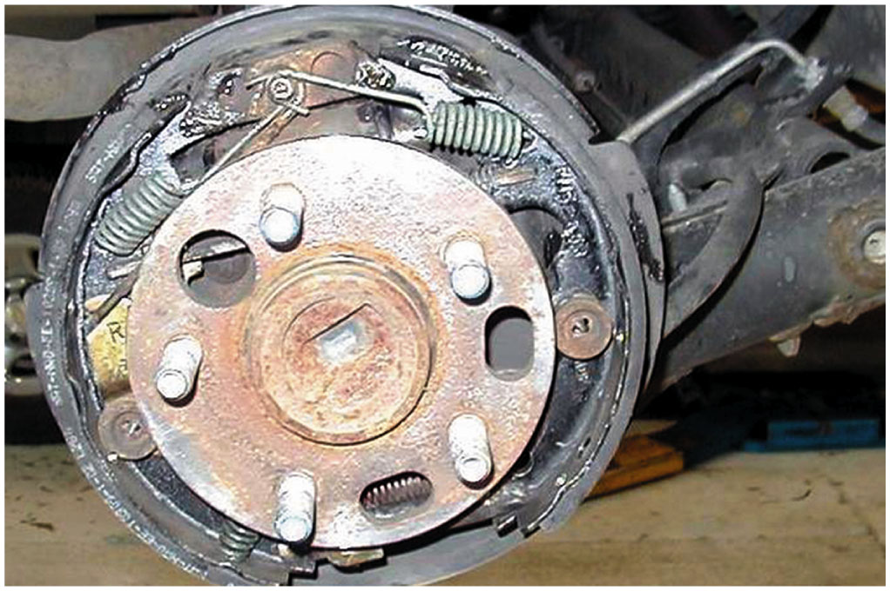
1. After safely hoisting the vehicle, remove the rear wheels and brake drums

Slide 48
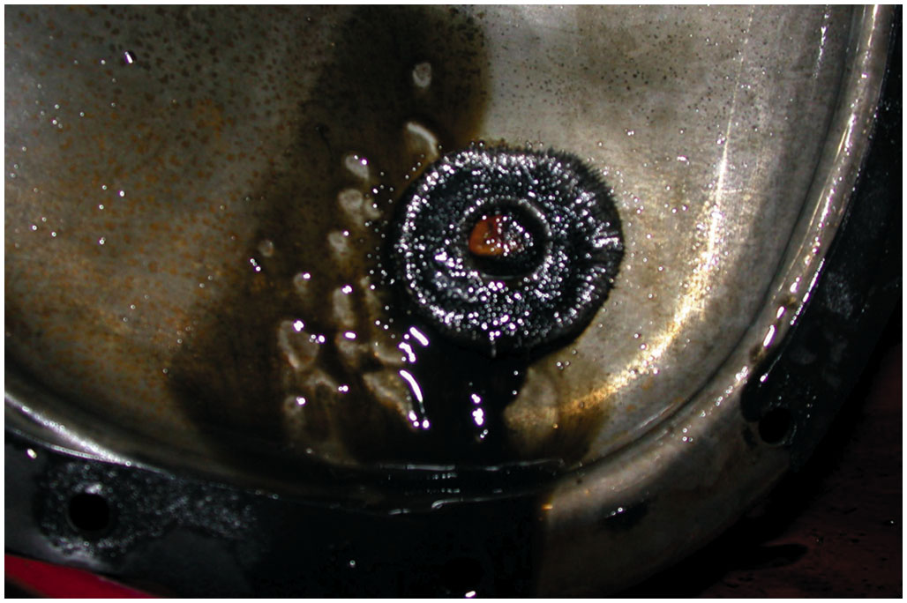
2. Remove the rear differential cover and inspect the magnet for metal particles that would indicate serious wear or damage

Slide 49
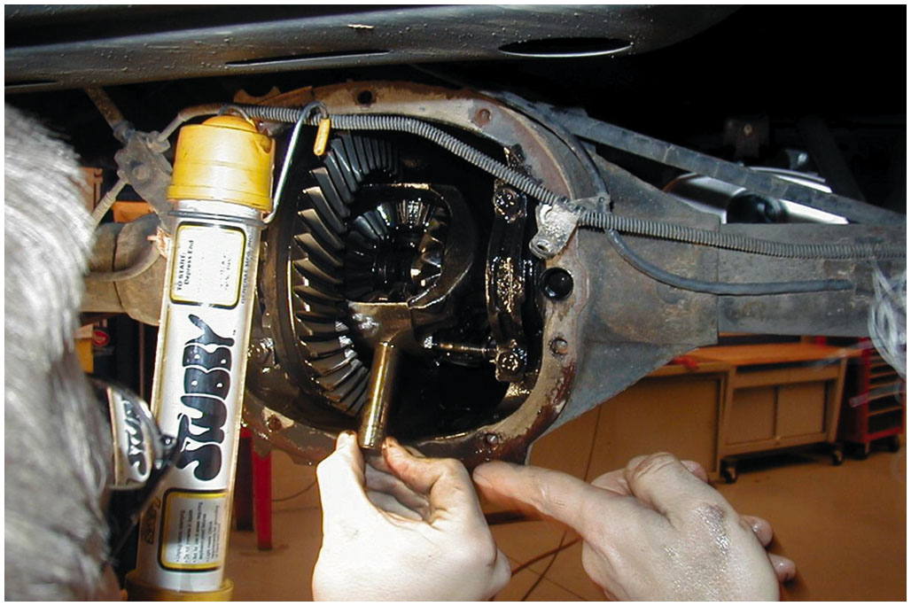
3. Remove the retaining bolt and allow the pinion shaft to be removed

Slide 50
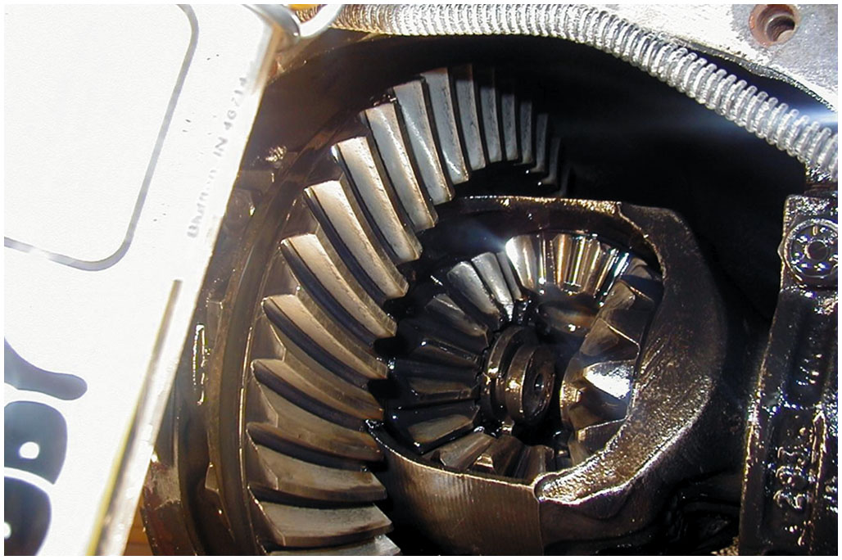
4. Push the axle inward toward the center of the vehicle to free the axle clip

Slide 51
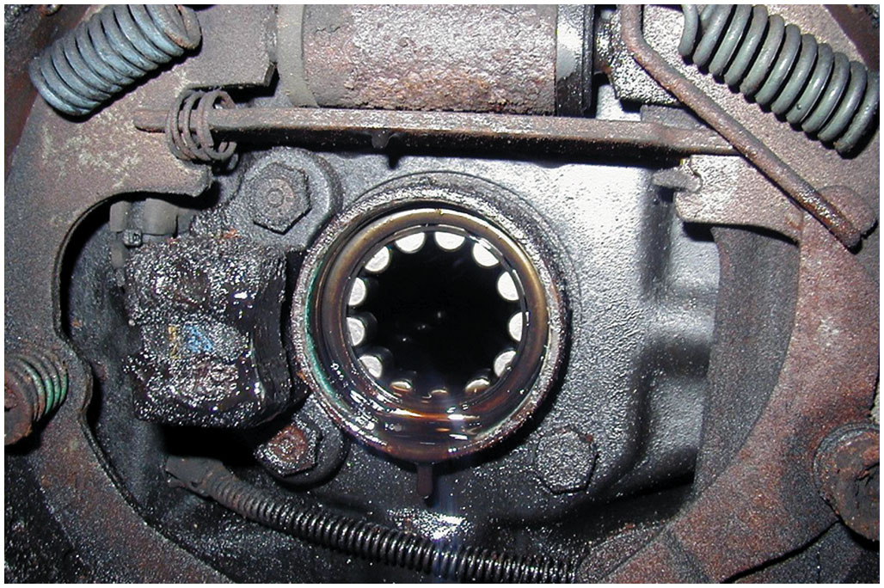
5. After removing the clip, the axle can then be removed. Note that the backing plate is wet, indicating that the axle seal has been leaking

Slide 52
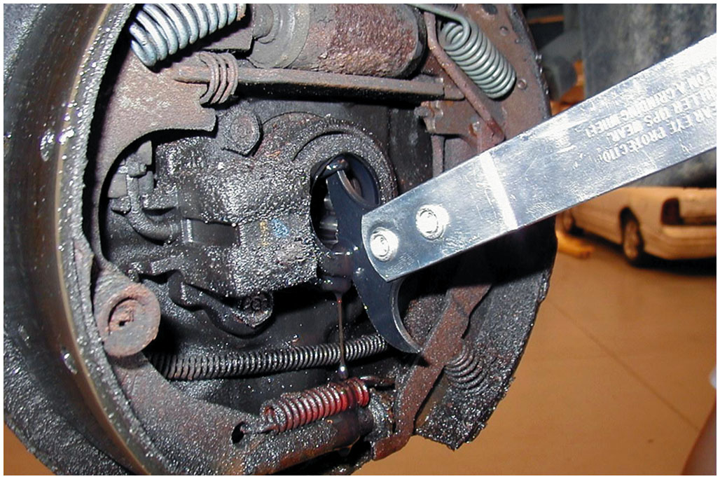
6. A seal removal tool being used to remove the axle seal

Slide 53
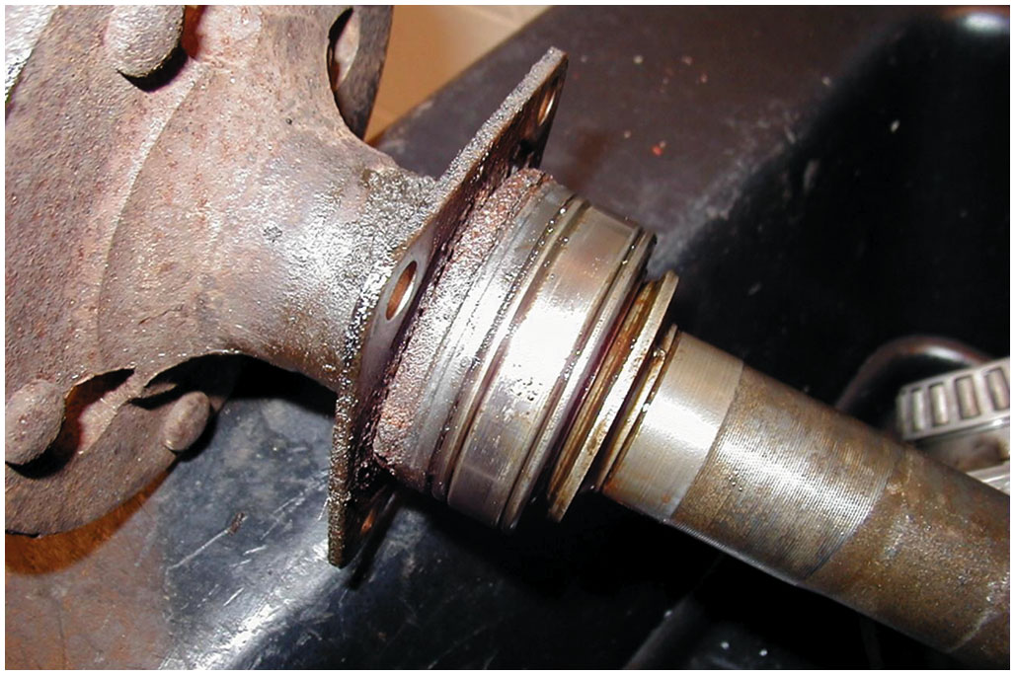
7. If a retainer-type axle is being serviced, the bearing and seal need to be pressed off of the axle

Slide 54
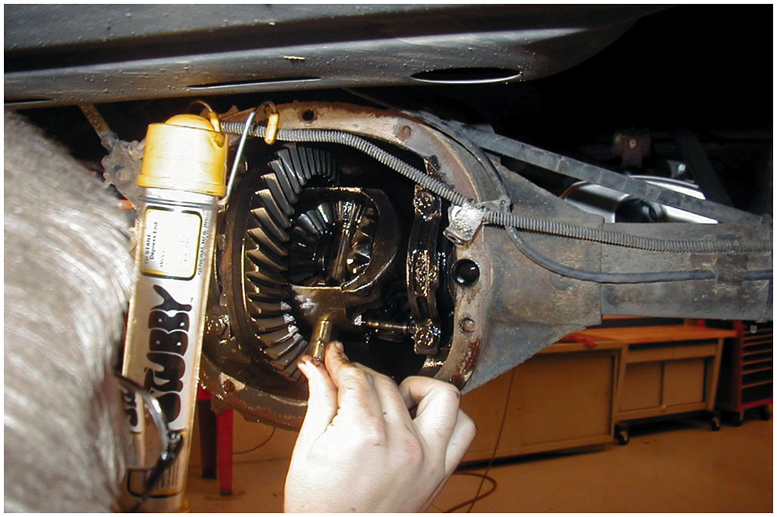
8. After installing a new bearing and seal, insert the axle and install the clip, then the pinion shaft

Slide 55
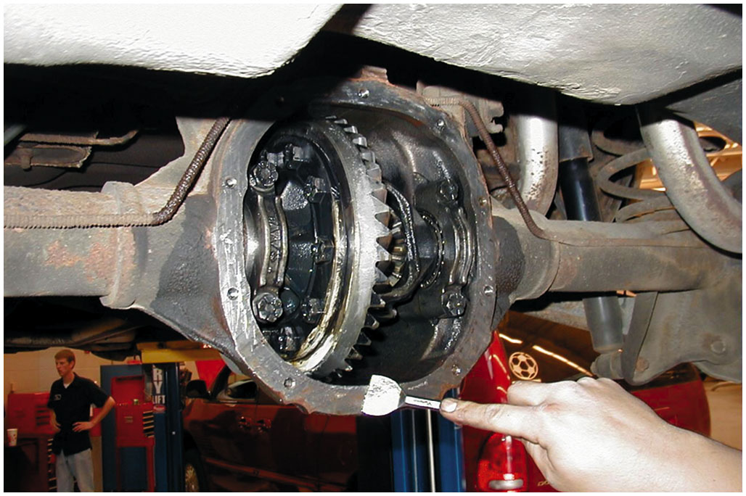
9. Clean the differential housing before installing the cover gasket and cover. Refill the differential with the specified fluid

Slide 56
Animation: Wheel Bearing & Hub Replacement (Animation will automatically start)

Slide 57
Automotive Fundamentals Videos and Animations
Videos Link: (A3) Manual Drive Train Axles Videos
Animations Link: (A3) Manual Drive Train Axles Animations

Slide 58
Copyright
This work is protected by United States copyright laws and is provided solely for the use of instructors in teaching their courses and assessing student learning. Dissemination or sale of any part of this work (including on the World Wide Web) will destroy the integrity of the work and is not permitted. The work and materials from it should never be made available to students except by instructors using the accompanying text in their classes. All recipients of this work are expected to abide by these restrictions and to honor the intended pedagogical purposes and the needs of other instructors who rely on these materials.

