Slide 1
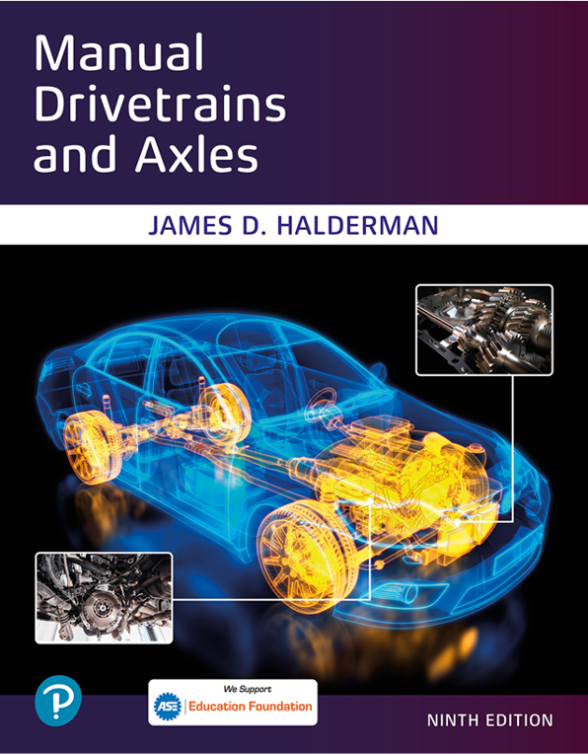
Manual Drivetrains and Axles
Ninth Edition
Chapter 10
Driveshaft and Half Shaft Service
Copyright © 2024, 2018, 2015 Pearson Education, Inc. All Rights Reserved
Notes:
If this PowerPoint presentation contains mathematical equations, you may need to check that your computer has the following installed:
1) Math Type Plugin
2) Math Player (free versions available)
3) NVDA Reader (free versions available)
INSTRUCTOR NOTE: This presentation includes text explanation notes, you can use to teach the course. When in SLIDE SHOW mode, you RIGHT CLICK and select SHOW PRESENTER VIEW, to use the notes.

Slide 2
Learning Objectives
10.1 Explain how to diagnose and inspect a U-joint.
10.2 List the steps necessary to replace a U-joint.
10.3 Explain how to perform a measurement of the working angles of a U-joint.
10.4 Diagnose problems with C V joints and describe the service procedures for replacing C V joints.

Slide 3
U-Joint Diagnosis
What is some background on driveshaft of a rear-wheel-drive vehicle?
Symptoms of Defective U-Joints
Vibration or harshness at highway speed
Clicking sound vehicle moving either forward or in reverse
Clunking sound whenever changing gears
Such as moving from drive to reverse
Notes:
The driveshaft of a typical R W D vehicle rotates about three times faster than wheels. This is due to the gear reduction that occurs in the drive axle. The drive axle not only provides gear reduction but also allows for a difference in the speed of the rear wheels that
is necessary whenever turning a corner. The driveshaft rotates at the same speed as the engine if the transmission ratio is 1 to 1 (1:1).
The engine speed, in revolutions per minute (R P M), is transmitted through the transmission at the same speed. In lower gears, the engine speed is many times faster than the output of the transmission. Most transmissions today, both manual and automatic, have an overdrive gear. This means that at highway speeds, the driveshaft is rotating faster than the engine.

Slide 4
Driveshaft and U-Joint Inspection
U-joints should be inspected every time
Vehicle chassis lubricated, or four times a year.
Driveshaft must be removed to do this.
Check driveshaft for movement of u-joints
Movement means u-joint must be replaced.
Notes:
CAUTION: A dented or creased driveshaft can collapse, especially when the vehicle is under load.
This collapse of the driveshaft can cause severe damage to the vehicle and may cause an accident.
Case Study: The Squeaking Pickup Truck
The owner of a pickup truck complained that a squeaking noise occurred while driving in reverse. The “eeee epee eeee” sound increased in frequency as the truck increased in speed, yet the noise did not occur when driving forward. Because there was no apparent looseness in the U-joints, the service technician at first thought that the problem was inside either transmission or the rear end. When the driveshaft was removed to further investigate the problem, it became obvious where the noise was coming from. The U-joint needle bearing had worn the cross-shaft bearing surface of the U-joint. ● SEE FIGURE 10.1, Next Slide. The noise occurred only in
reverse because the wear had occurred in the forward direction, and therefore only when the torque was applied in the opposite direction did the needle bearing become bound up and start to make noise. A replacement U-joint solved the squeaking noise in reverse.
Summary:
◼ Complaint—Customer complained of squeaking sound but only while driving in reverse.
◼ Cause—A worn U-joint was found to be the cause.
◼ Correction—The worn U-joint was replaced and the noise issue was corrected.

Slide 5
Figure 10.1
Brinelling Grooves
Notice how the needle bearings have worn grooves, called Brinelling, into the bearing surface of the U-joint.

Slide 6
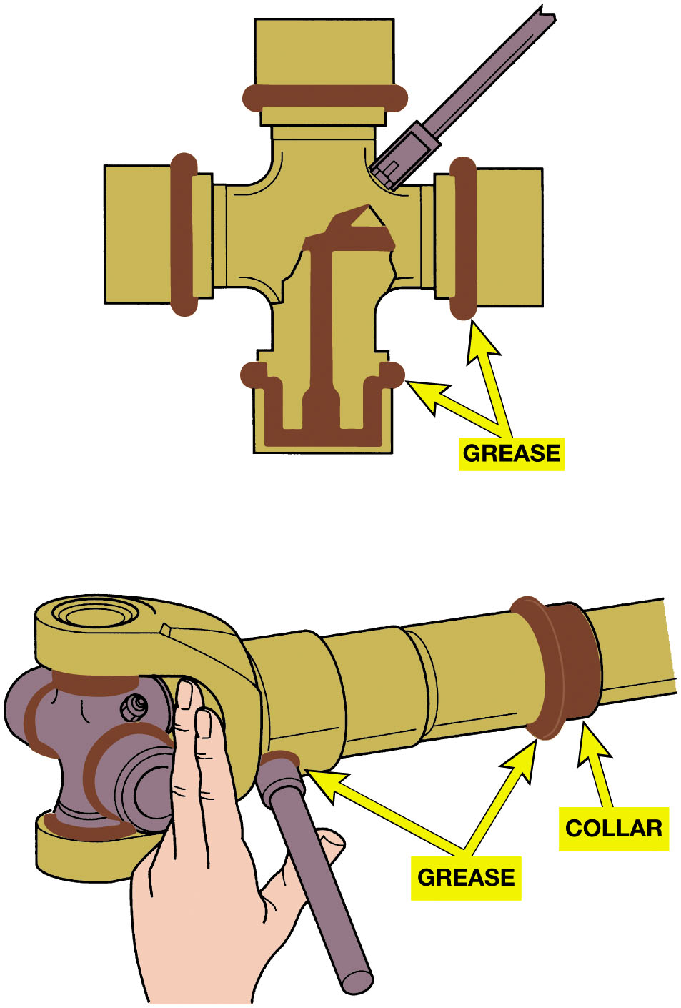
Figure 10.2
Grease Fitting
All U-joints and spline collars equipped with a grease fitting should be greased four times a year as part of a regular lubrication service.
Notes:
U-joints are permanently lubricated and have no provision for greasing. If there is a grease fitting,
the U-joint should be lubricated by applying grease with a grease gun. ● See Figures 10.2 And 10.3.
Long Description:
The illustration on the top is a U-joint that is greased on the inside and at the corners as part of a regular lubrication service. The illustration below is of a spline. A U-joint is affixed to it on the left end. a collar is attached to its right end. The collar and the corners of the U-joint are greased as part of a regular lubrication service.

Slide 7
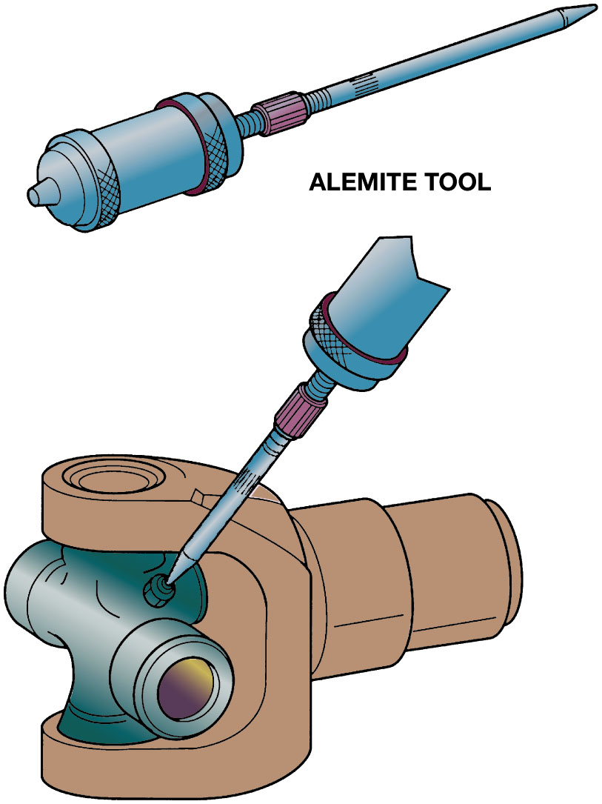
Figure 10.3
Alemite Tool
Many U-joints require a special grease gun tool to reach the grease fittings.
Notes:
Long Description:
The illustration on the top is of a metal rod with a broad barrel-like left end and a pointy tip on the right. The tool is labeled alemite tool. The illustration below is a U-joint affixed to an equipment. The alemite tool is used to reach the grease fittings

Slide 8
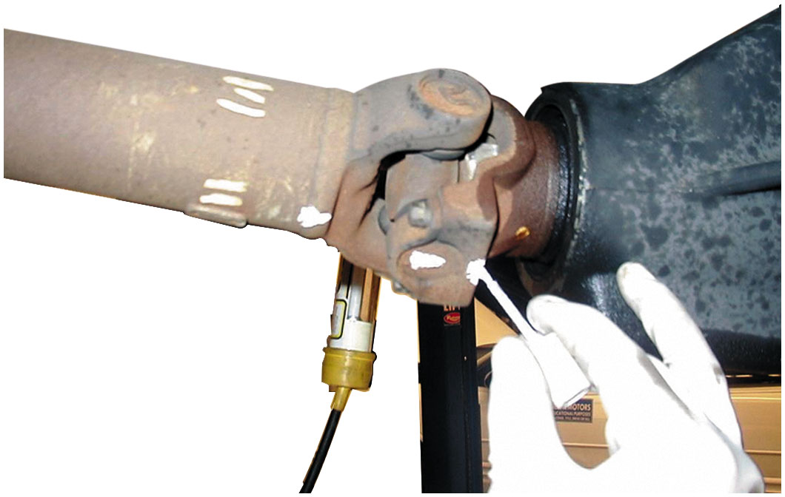
Figure 10.4
Marking Location
Always mark the original location of U-joints before disassembly.

Slide 9
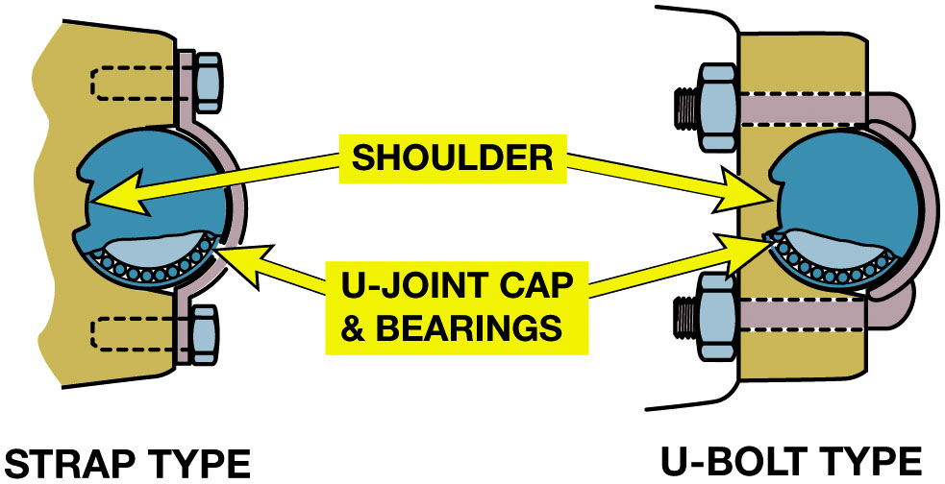
Figure 10.5
Retaining Caps
Two types of retaining methods that are commonly used at the rear U-joint at the differential.
Notes:
Long Description:
The illustration has two types of retention mechanisms. The mechanism on the left is labeled strap type. The mechanism on the right is labeled U-bolt type. Both highlight a shoulder and a U-joint cap and bearing in the center.

Slide 10
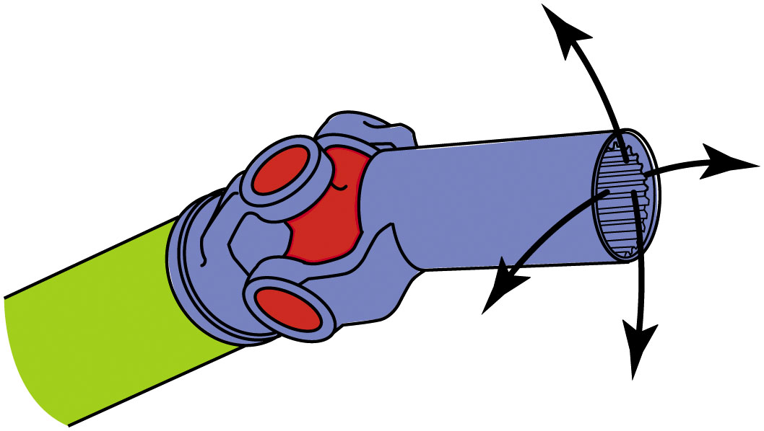
Figure 10.6
Checking U-Joint
The best way to check any U-joint is to remove the driveshaft from the vehicle and move each joint in all directions. A good U-joint should be free to move without binding.

Slide 11
U-Joint Replacement
Remove retainers; use press or a vise to separate U-joint from yoke.
Replacement U-joints use spring clips instead of injected plastic.
Should be forged and use up to 32 needle bearings.
After removing any dirt or burrs from the yoke, press in a new U-joint.
Notes:
All movement in a U-joint should occur between the trunnions and the needle bearings in the end caps. The end caps
are press-fit to the yokes, which are welded to the driveshaft. Three types of retainers are used to keep the bearing caps on
the U-joints: the outside snap ring (● SEE FIGURE 10.7), the inside retaining ring, and injected synthetic (usually nylon).
● SEE FIGURE 10.8. After removing the retainers, use a press or a vise to separate the U-joint from the yoke. ● SEE FIGURE 10.9.
U-joints that use synthetic retainers must be separated using a press and a special tool to press onto both sides of the joint in order to shear the plastic retainer, as shown in ● FIGURE 10.11.

Slide 12
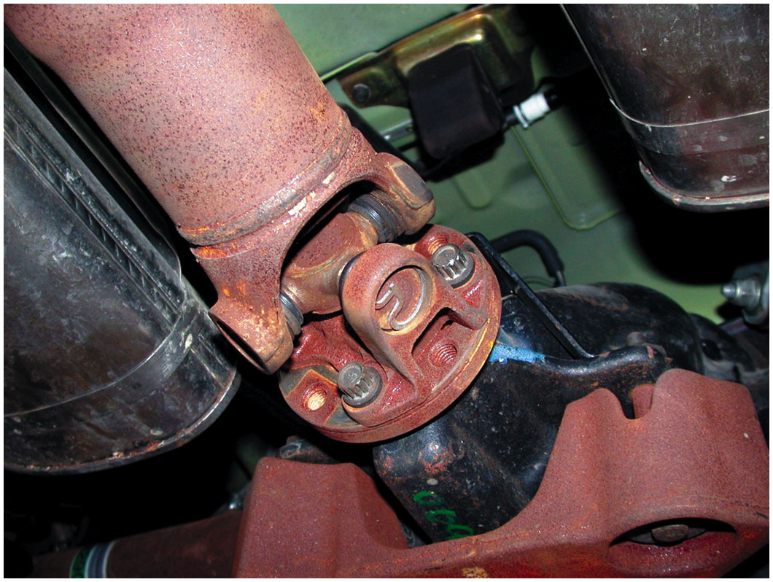
Figure 10.7
Outside Snap Ring
Typical U-joint that uses an outside snap ring. This style of joint bolts directly to the companion flange that is attached to the pinion gear in the differential.

Slide 13
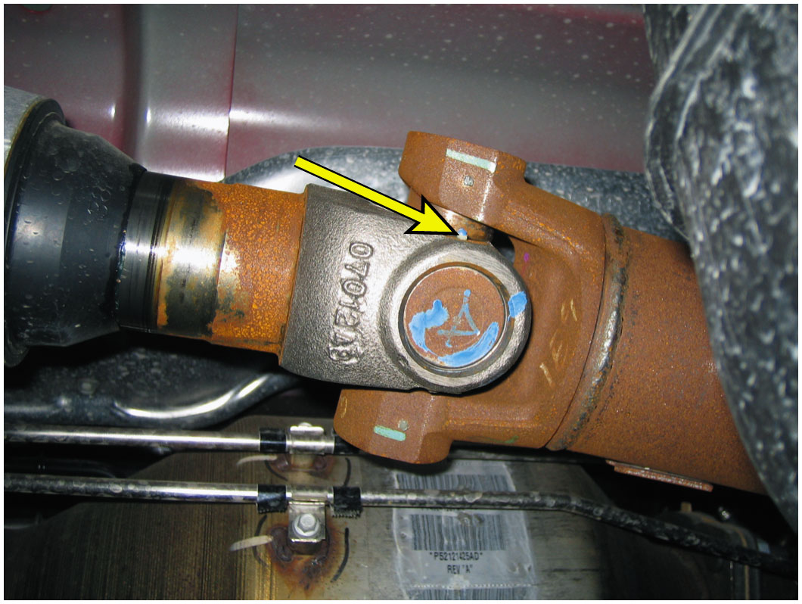
Figure 10.8
Nylon Sealed
A U-joint that is held together by nylon and usually requires that heat be applied to remove from the yoke.

Slide 14
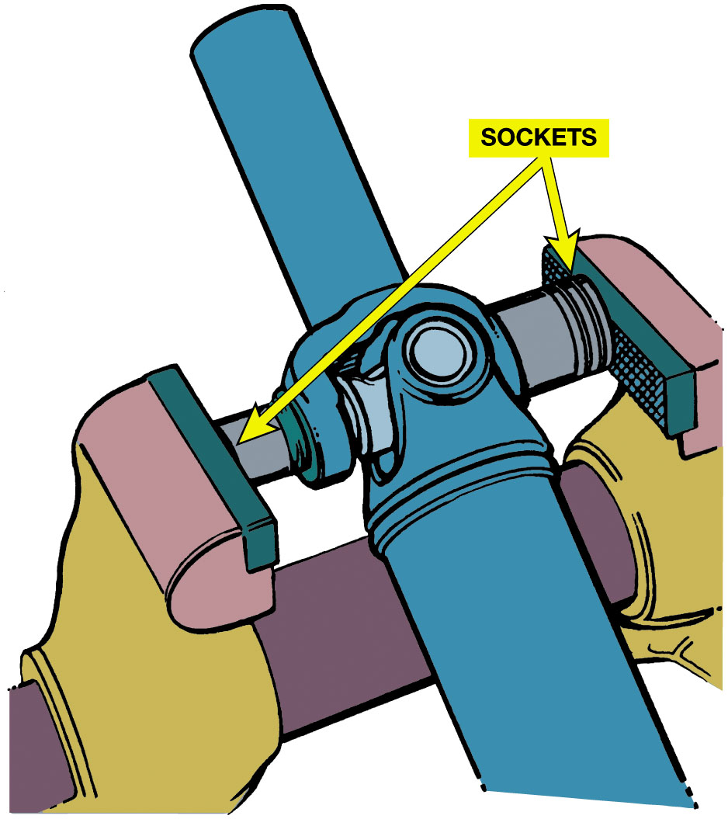
Figure 10.9
Use a vise and two sockets to remove a U-joint. One socket fits over the bearing cup and the other fits on the bearing to press-fit the cups from the crosspiece.
Notes:
Long Description:
The illustration has a U-joint affixed to an instrument. Each end of the instrument has a bearing cup. A socket is placed over the bearing cup, and another socket is placed over the opposite bearing. A vise through the U-joint is used to remove the U-joint.

Slide 15
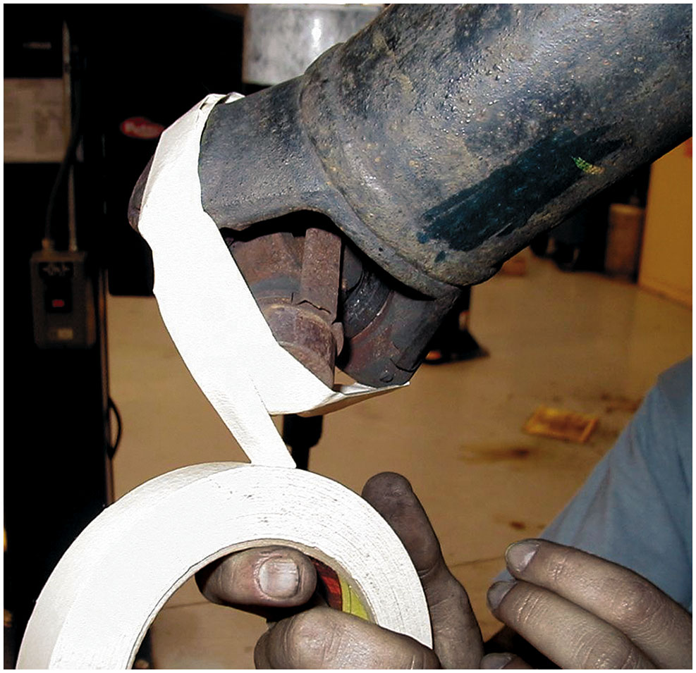
Figure 10.10
Taping the U-joint to prevent the caps from coming off.

Slide 16
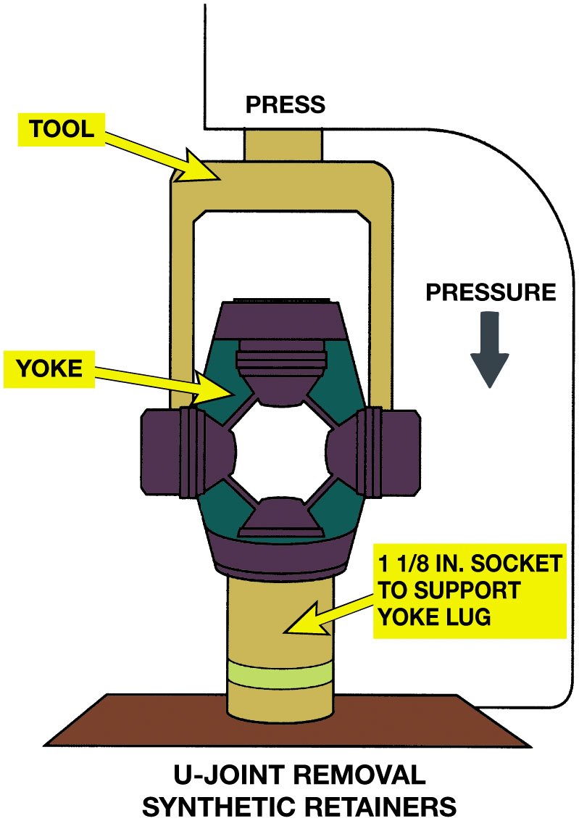
Figure 10.11
Special Tool
A special tool being used to press apart a U-joint that is retained by injected plastic. Heat from a propane torch may be necessary to soften the plastic to avoid exerting too much force on the U-joint.
Notes:
Long Description:
The illustration has an eleven over 8 inches socket that supports the yoke lug. On the socket is a U-joint with a yoke in each of the four corners. The special tool is placed on the U-joint with its ends resting on the left and right sections of the U-joint. The pressure is exerted on the top of the tool.

Slide 17
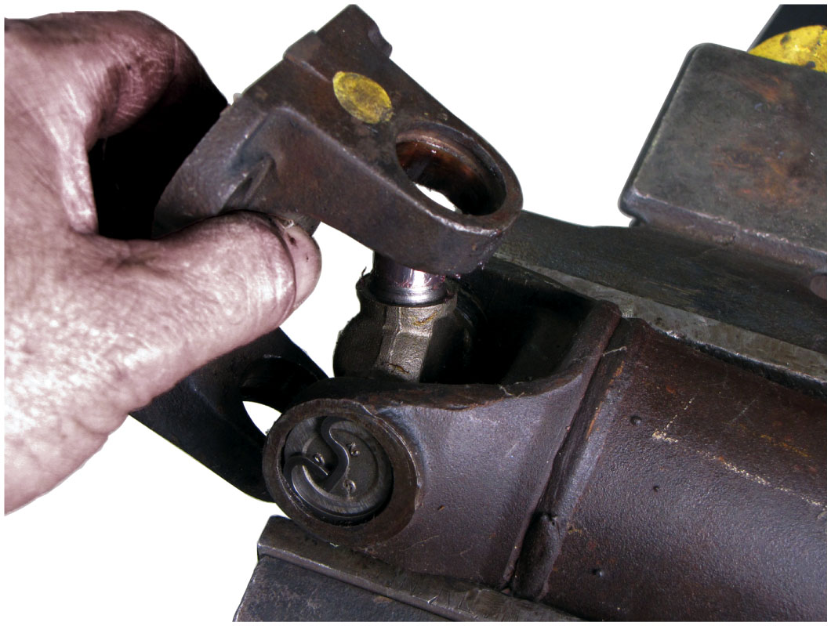
Figure 10.12
Removing the worn cross from the yoke.

Slide 18
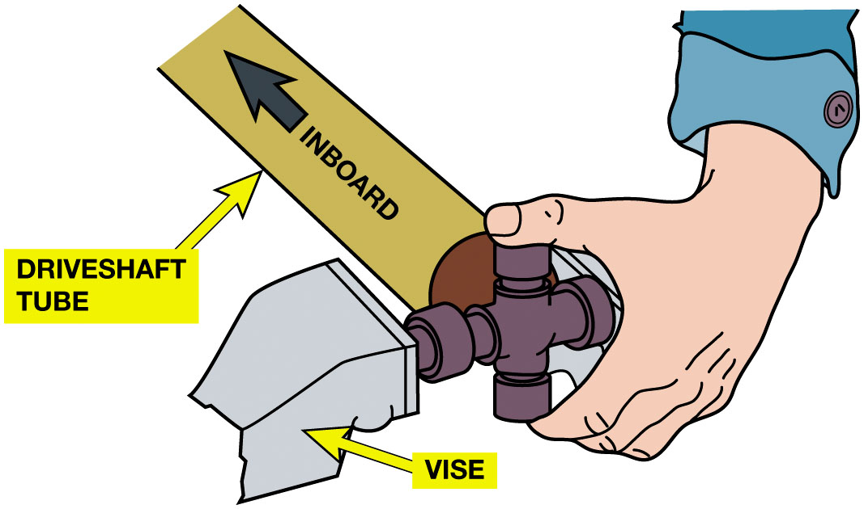
Figure 10.13
Installing U-Joint
When installing a new U-joint, position the grease fitting on the inboard side (toward the driveshaft tube) and in alignment with the grease fitting of the U-joint at the other end.
Notes:
Long Description:
The illustration has a grease fitting positioned on the inboard side of the vehicle towards the driveshaft. A new U-joint is positioned in alignment with the grease fitting. On the left and right end of the U-joint is a vise.

Slide 19
U-Joint Working Angles
Place an inclinometer on rear U-joint bearing cap.
Level bubble and read angle.
Rotate driveshaft 90 degrees, read angle of rear yoke.
Subtract smaller reading from larger reading
To obtain working angle of joint.
Notes:
To measure U-joint and driveshaft angles, the vehicle must be hoisted using an axle contact or drive-on-type lift so
as to maintain the same driveshaft angles as the vehicle has while being driven.
The working angles of the two U-joints on a driveshaft should be within 1/2 degree of each other in order to cancel
out speed changes. ● SEE FIGURE 10.14.

Slide 20
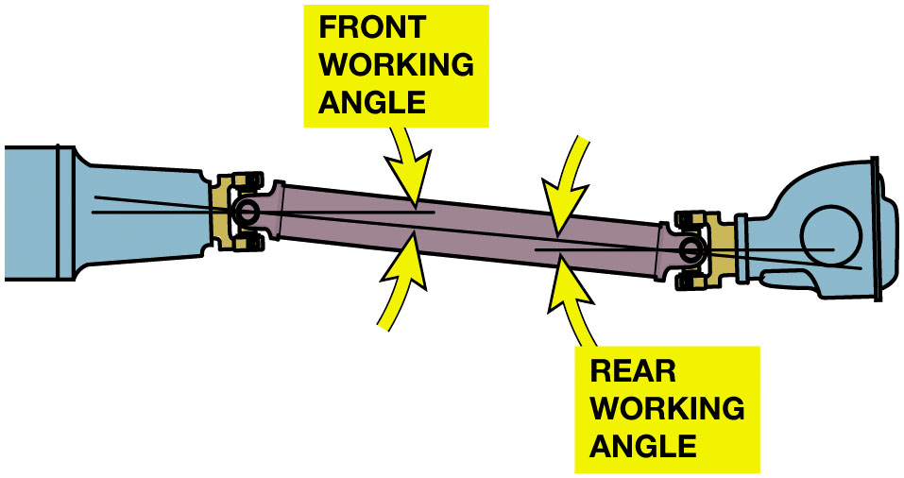
Figure 10.14
Working Angles
Working Angle
At Least
Degree
Not Exceed 3 Degrees
The working angle of most U-joints should be at least
degree
(to permit the needle bearing to rotate in the U-joints) and should
not exceed 3 degrees or a vibration can occur in the driveshaft, especially at higher speeds. The difference between the front and
rear working should be within
degree of each other.
Notes:
Long Description:
The illustration has a driveshaft. A U-joint is located at both ends of the driveshaft. The U-joints and driveshaft are connected by a needle bearing. The angle formed by the axis and the needle bearing on the left end is referred to as the front working angle. The angle formed by the axis and the needle bearing on the right end is referred to as the rear working angle. Most u-joints should have a working angle of at least half a degree.

Slide 21
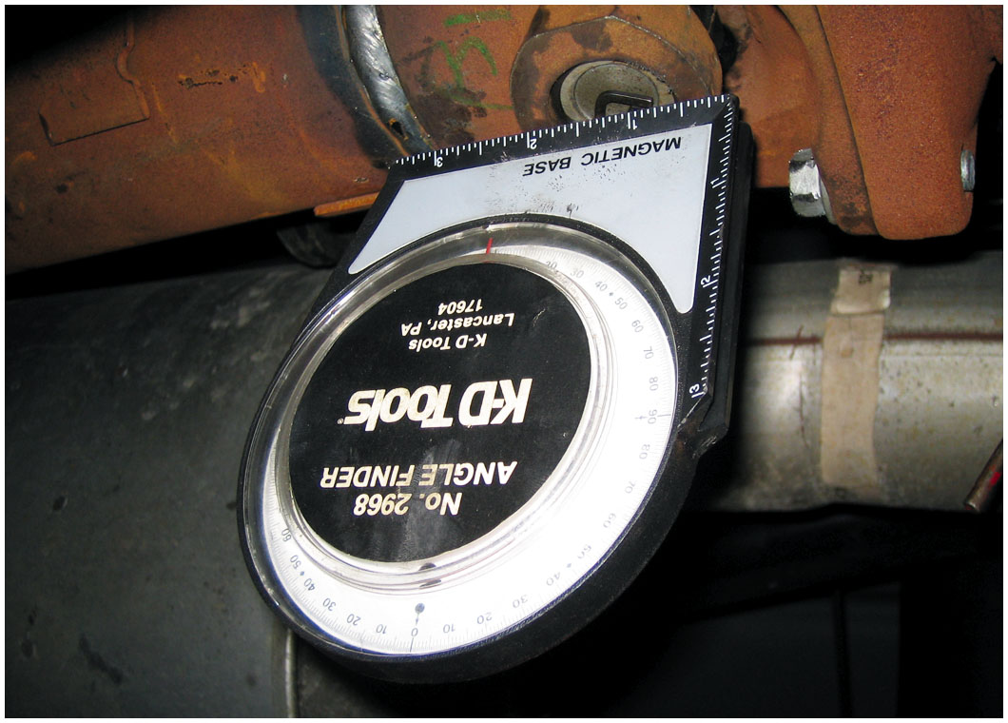
Figure 10.15
Inclinometer
An inclinometer with a magnetic base is being used to measure the angle of the driveshaft at the rear U-joint.

Slide 22
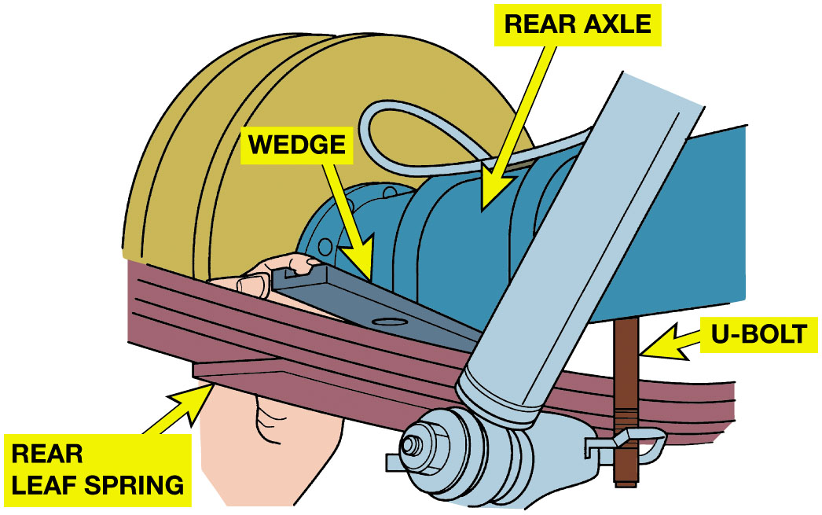
Figure 10.16
Tapered Wedge
Placing a tapered metal wedge between the rear leaf spring and the rear axle pedestal to correct rear U-joint working angles.
Notes:
CAUTION: Use caution whenever using wedges between the differential and the rear leaf spring to restore correct U-joint working angle. Even though wedges are made to raise the front of the differential, the tilt often prevents rear-end lubricant from reaching pinion bearing, resulting in pinion bearing noise and eventual failure.
Long Description:
The illustration has a rear axle on the top. Below the rear axle is the rear leaf spring. They are connected through a U-bolt. A tapered metal wedge is placed between the rear axle and the rear leaf spring to correct the working angles.

Slide 23
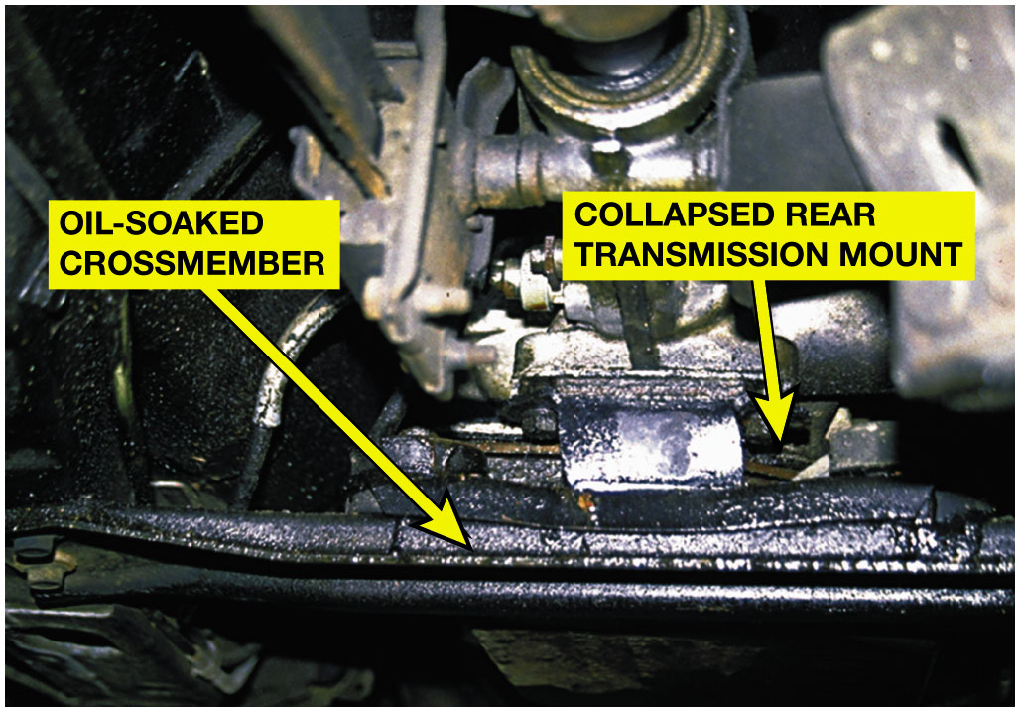
Figure 10.17
Mount Collapse
A transmission oil pan gasket leak allowed automatic transmission fluid (A T F) to saturate the rear transmission mount rubber, causing it to collapse. After replacing the defective mount, proper driveshaft angles were restored and the driveline vibration was corrected.

Slide 24
C V Joint Diagnosis
Noise while driving could signal that a C V joint is worn or has failed.
Try driving the vehicle in reverse while turning and accelerating.
Notes:
When a C V joint wears or fails, the most common symptom is noise while driving. An outer fixed C V joint will most likely be heard when turning sharply and accelerating at the same time. This noise is usually a clicking sound. While inner joint failure is less common, a defective inner C V joint often creates a loud clunk while accelerating from rest. To help verify a defective joint, drive
the vehicle in reverse while turning and accelerating. This almost always will reveal a defective outer joint.

Slide 25
Replacement Shaft Assemblies
Front-wheel-drive vehicles were widely used in Europe and Japan
Long before they became popular in North America.
Standard repair procedure in those countries
Replace entire drive assembly if there is C V joint failure.

Slide 26
C V Joint Service
Hub nut must be removed whenever servicing a C V joint or shaft assembly
on a front-wheel-drive vehicle.
What are steps to follow after the hub nut is loosened?

Slide 27
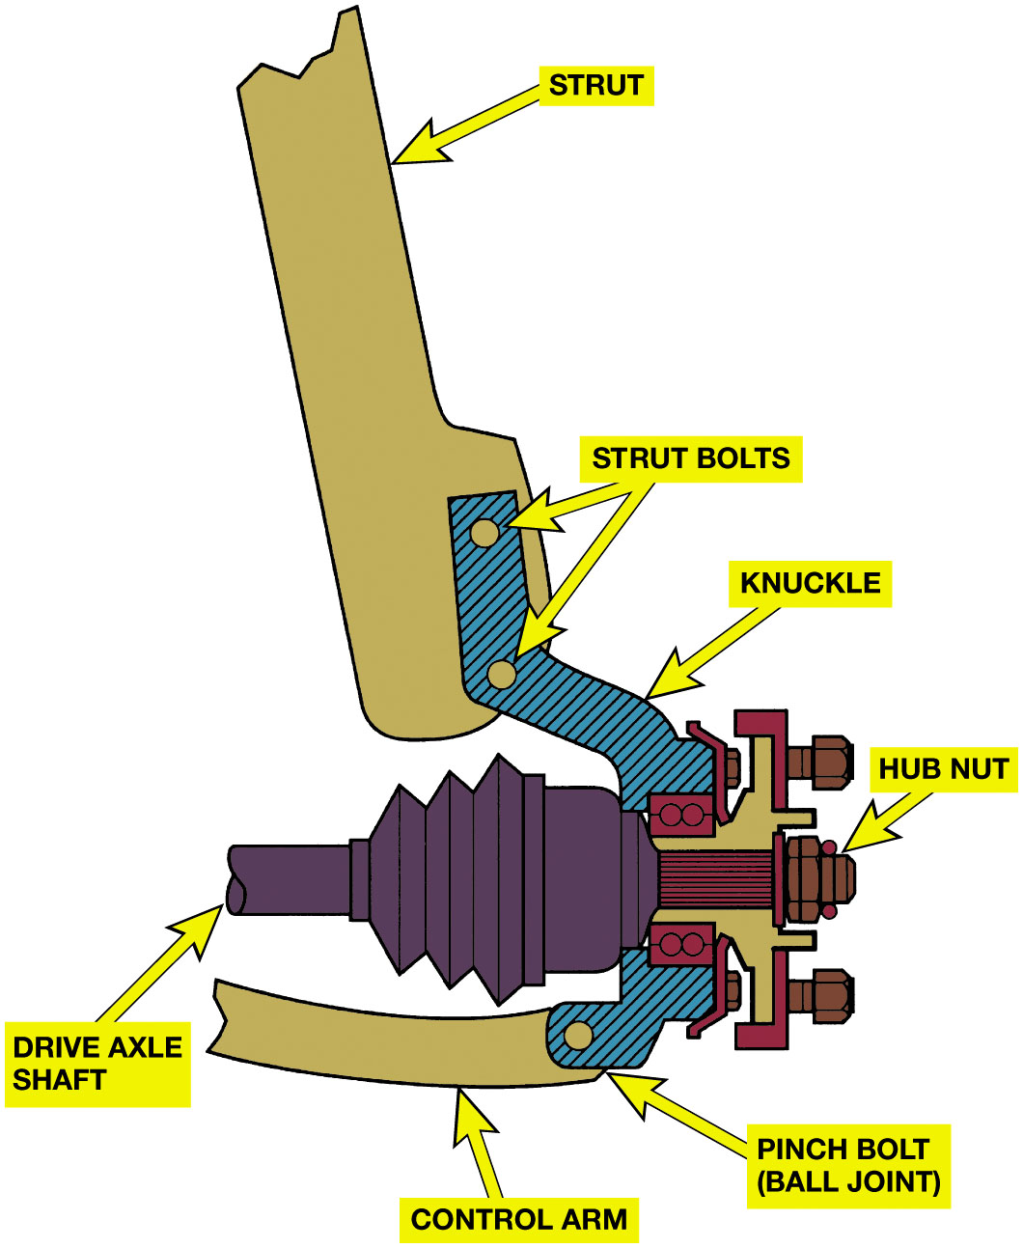
Figure 10.18
Hub Nut
The hub nut must be removed before the hub bearing assembly or drive axle shaft can be removed from the vehicle.
Notes:
Long Description:
The illustration has a drive axle shaft. A hub nut is attached on the right of the drive axle shaft. Above and below, the drive axle shaft on the right is a knuckle. A control arm is attached to the knuckle below the drive axle shaft through a pinch bolt or a ball joint. A strut is attached to the knuckle above the drive axle shaft through two strut bolts.

Slide 28
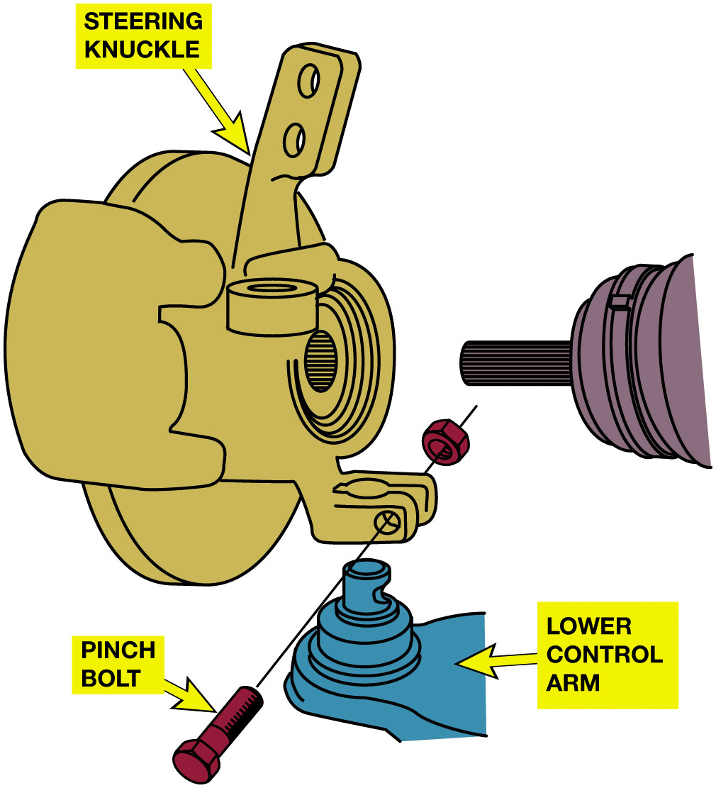
Figure 10.19
Pinch Bolt
Many knuckles are attached to the ball joint on the lower control arm by a pinch bolt.
Notes:
Long Description:
The illustration has a steering knuckle at the top. Below is a lower control arm. A pinch bolt passes through the aperture in the lower control arm and the steering knuckle, connecting the two.

Slide 29
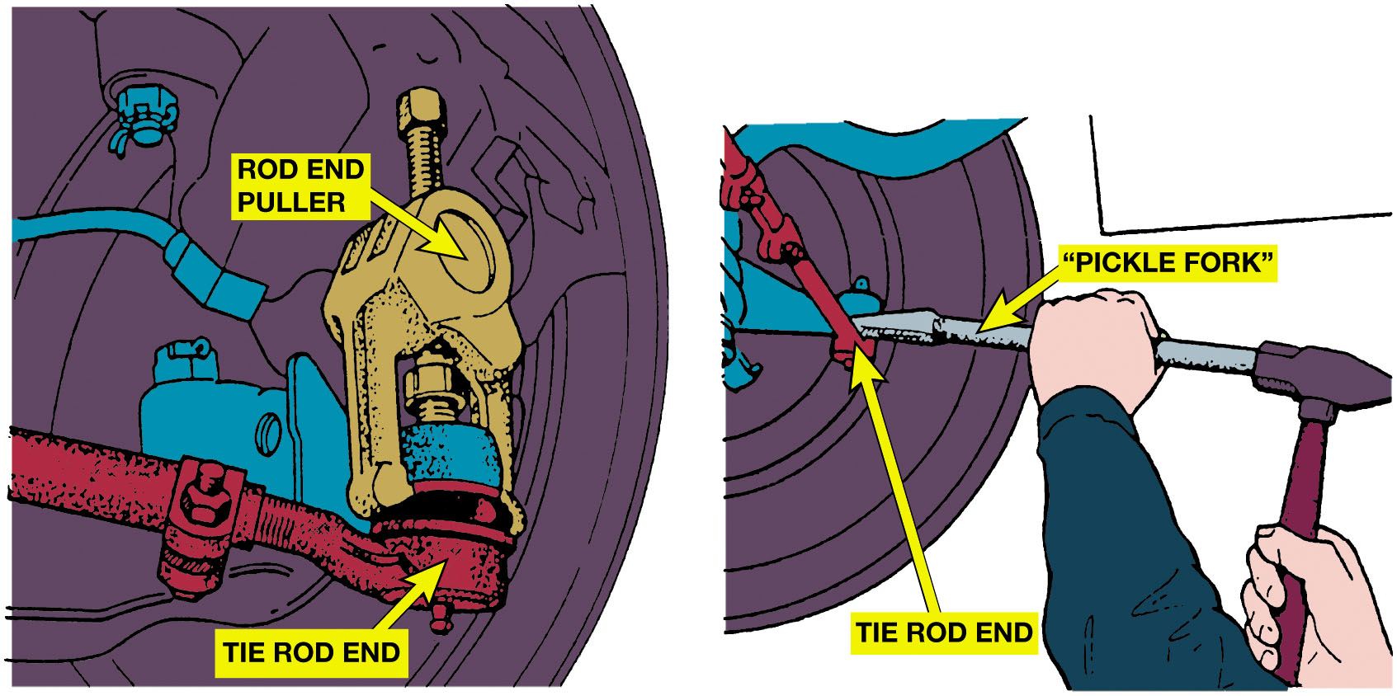
Figure 10.20
Separating Tie Rod
The preferred method for separating the tie rod end from the steering knuckle is to use a puller such as the one shown. A “pickle-fork”-type tool should be used only if the tie rod is going to be replaced. A pickle-fork-type tool can damage or tear the rubber grease boot. Striking the tie rod end with a hammer while holding another hammer behind the joint to shock and break the taper from the steering knuckle can also be used.
Notes:
Long Description:
The illustration on the left has a driveshaft axle. At the bottom is the tie rod end. Above the tie rod end is a knuckle. Above the knuckle is rod end puller. In the illustration on the right, a pickle fork tool is used to separate the knuckle and the tie rod end.

Slide 30
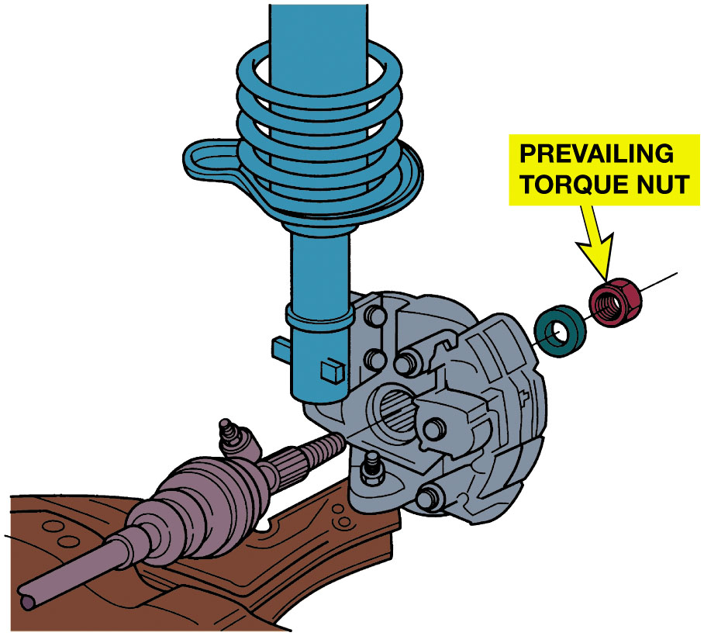
Figure 10.21
Torque Prevailing Nut
Many drive axles are retained by prevailing torque nut that must not be reused. Prevailing torque nuts are slightly deformed or contain a plastic insert that holds the nut tight (retains the torque) to the shaft without loosening.
Notes:
Long Description:
The illustration has a drive axle. On its right is a knuckle. A needle bearing passes through the aperture in the drive axle. On the right is a prevailing torque nut with a plastic insert that is torqued to retain the drive axle.

Slide 31
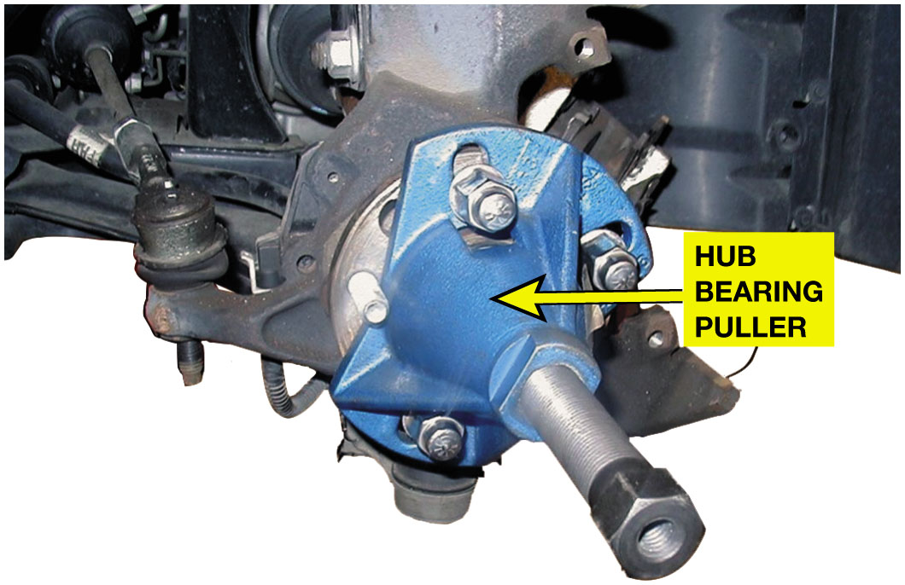
Figure 10.22
Hub Bearing Puller
A special General Motors tool is being used to separate the drive axle shaft from the wheel hub bearing.

Slide 32
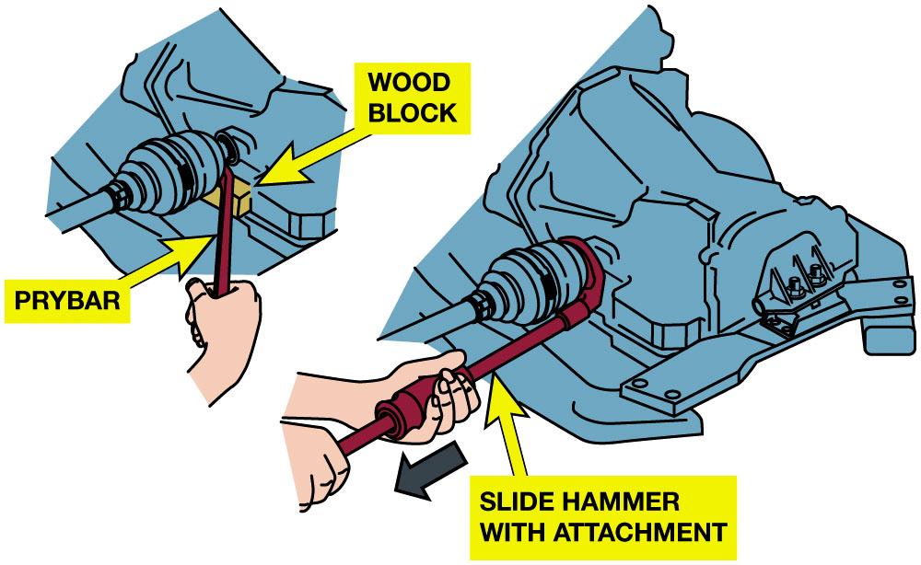
Figure 10.23
Pulling From Transaxle
Most inner C V joints can be separated from the transaxle with a prybar.
Notes:
Long Description:
The illustration on the left has a C V joint connected to a transaxle. Below the joint is a wooden block. The C V joint is separated from the transaxle using a prybar. The illustration on the right has a C V joint connected to a transaxle. The joint is separated from the transaxle using a slide hammer with attachment.

Slide 33
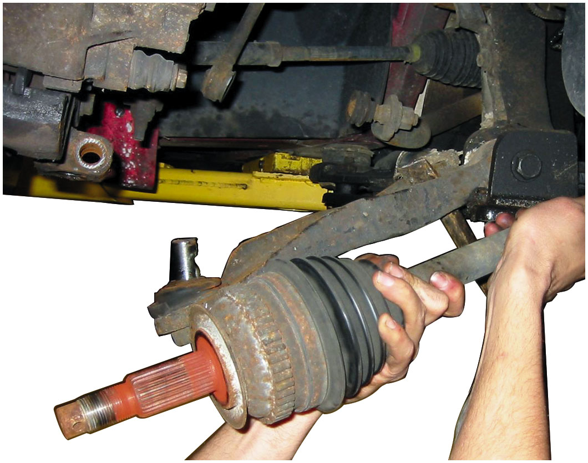
Figure 10.24
Removing Drive Shaft
When removing a drive axle shaft assembly, use care to avoid pulling the plunge joint apart.

Slide 34
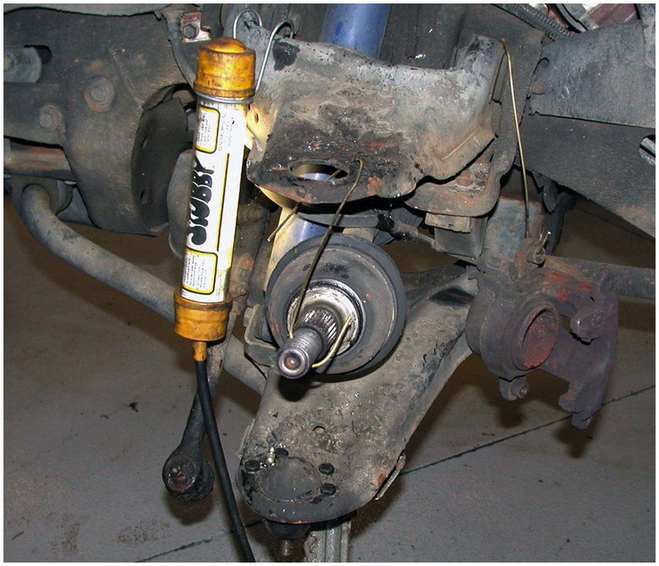
Figure 10.25
Supporting Shaft
If other service work requires that just one end of the drive axle shaft be disconnected from the vehicle, be sure that the free end is supported to prevent damage to the protective boots or allowing the joint to separate.

Slide 35
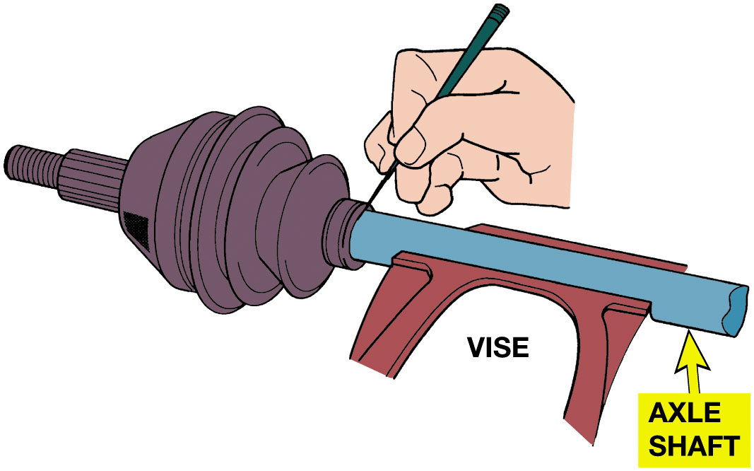
Figure 10.26
Scribe a Line
With a scribe, mark the location of the boots before removal. The replacement boots must be in the same location.
Notes:
Long Description:
The illustration has an axle shaft. The axle shaft is placed in a vise. A C V joint is connected to the shaft on its left end. The location is marked on the right end of the C V joint using a scribe.

Slide 36
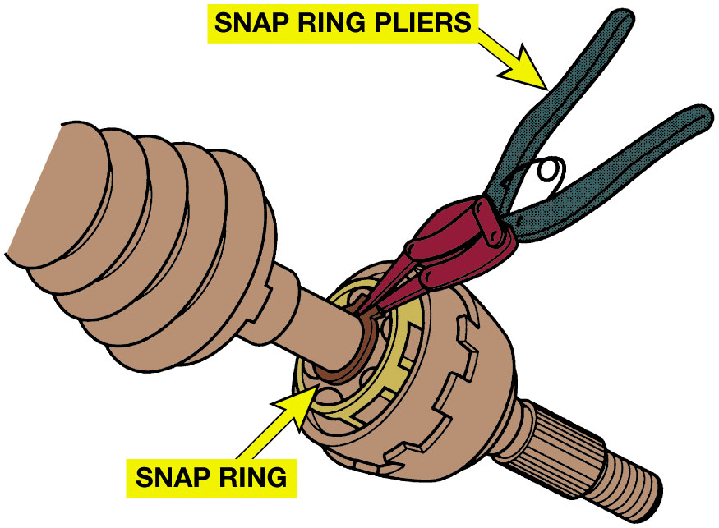
Figure 10.27
Remove Snap Ring
Most C V joints use a snap ring to retain the joint on the drive axle shaft.
Notes:
Long Description:
The illustration has a C V joint. A snap ring piler is used to install the snap ring between the C V joints.

Slide 37
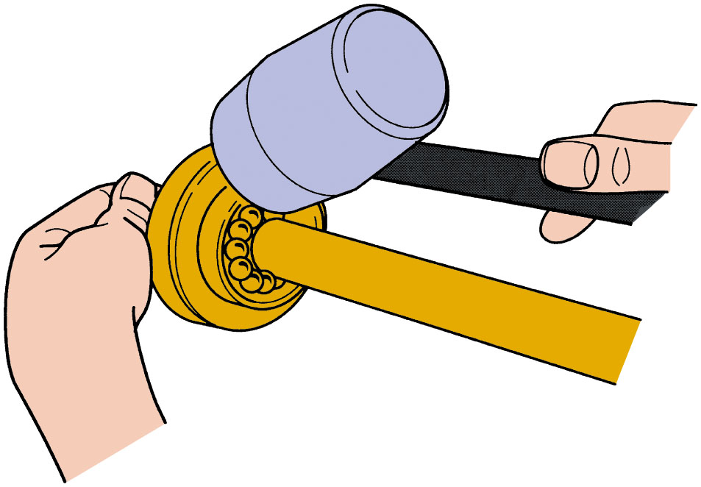
Figure 10.28
Removing Joint
After releasing the snap ring, most C V joints can be tapped off the shaft using a brass or shot-filled plastic (dead-blow) hammer.
Notes:
Long Description:
The illustration has a C V joint. A brass or shot-filled plastic hammer is used to tap off the C V joint after releasing the snap ring.

Slide 38
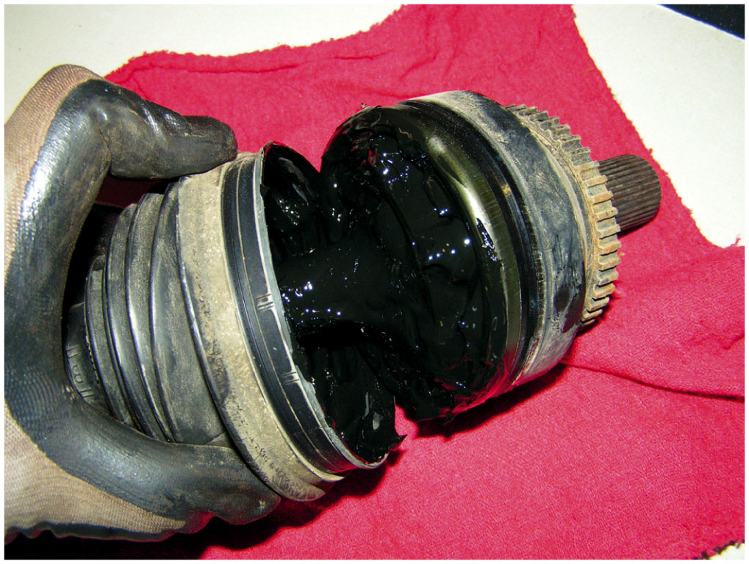
Figure 10.29
Joint was OK
Typical outer C V joint after removing the boot and the joint from the drive axle shaft. This joint was removed from the vehicle because a torn boot was found. After disassembly and cleaning, this joint was found to be OK and was put back into service. Even though the grease looks terrible, there was enough grease in the joint to provide lubrication to prevent any wear from occurring.

Slide 39
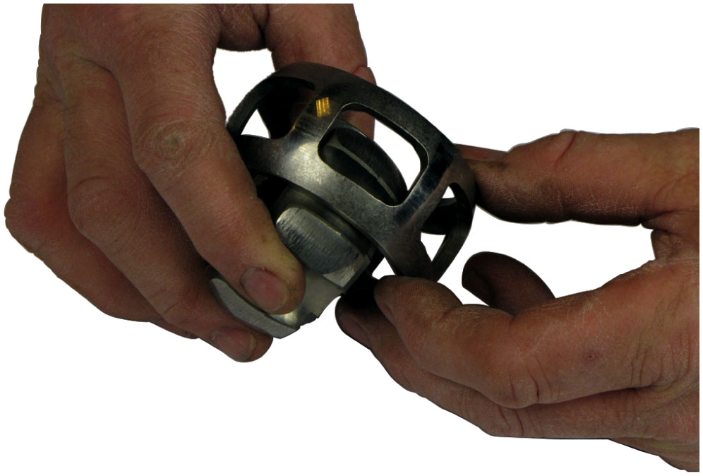
Figure 10.30
Inspecting Cage
The cage of this Rzeppa-type C V joint is being carefully inspected before being reassembled.

Slide 40
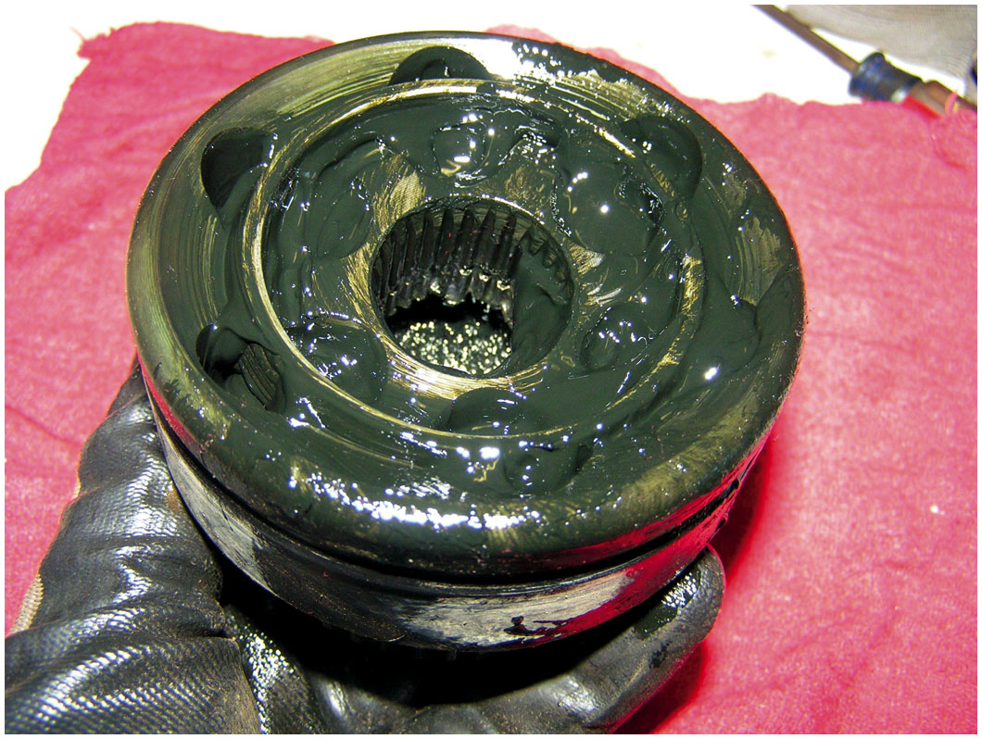
Figure 10.31
Use All Grease
Be sure to use all of the grease supplied with the replacement joint or boot kit. Use only the grease supplied and do not use substitute grease.

Slide 41
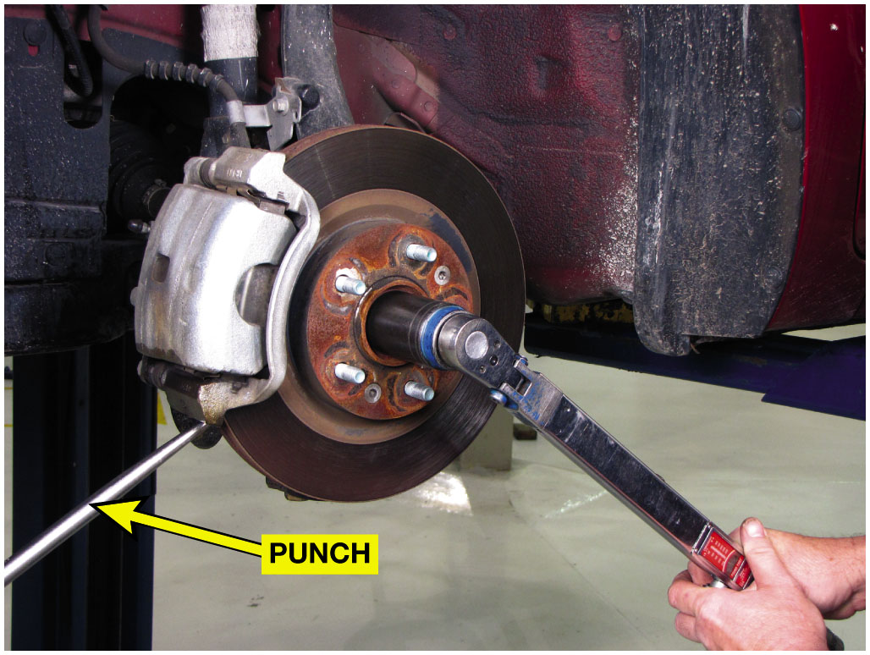
Figure 10.32
Spindle Nut Torqued
A punch being used to keep the rotor from rotating while torquing the axle shaft spindle nut.

Slide 42
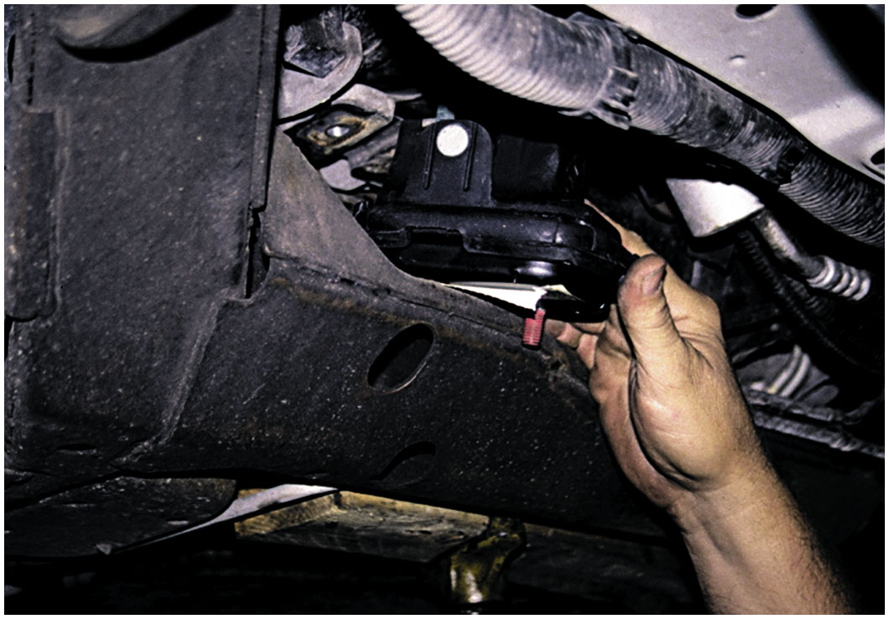
Figure 10.33
Engine Mount
The engine had to be raised higher to get the new (non-collapsed) engine mount installed.
Notes:
Case Study: The Vibrating Buick
The owner of a F W D Buick complained that it vibrated during acceleration only. The vehicle would also pull toward one side
during acceleration. An inspection discovered a worn (cracked) engine mount. After replacing the mount, the C V joint angles were restored and both the vibration and the pulling to one side during acceleration were solved. ● Figure 10.33.
Summary:
◼ Complaint—Owner complained about a vibration and a pull to one side during acceleration.
◼ Cause—defective engine mount caused C V joint angles to be unequal causing vibration and pulling during acceleration.
◼ Correction—The engine mount was replaced and the customer concern was solved.

Slide 43
Question 1
A defective outer C V joint will usually make a __________.
A. rumbling noise
B. growling noise
C. clicking noise
D. clunking noise

Slide 44
Answer 1
A defective outer C V joint will usually make a __________.
C. clicking noise

Slide 45
Summary
Defective U-joint often makes clicking sound in reverse.
Driveline clunk noise can often be corrected by applying
High-temperature chassis grease to splines of front yoke
Defective outer fixed C V joint will make a clicking sound
Defective inner C V joint often creates a loud clunk while accelerating
Drive in reverse while turning and accelerating to find defective joint
C V joints require careful cleaning, inspection, lubrication
With specific C V joint grease.
Notes:
9 Step Drive Axle Shaft Replacement found on Pages 143-144

Slide 46
Drive Axle Shaft Replacement Photo Sequence

Slide 47
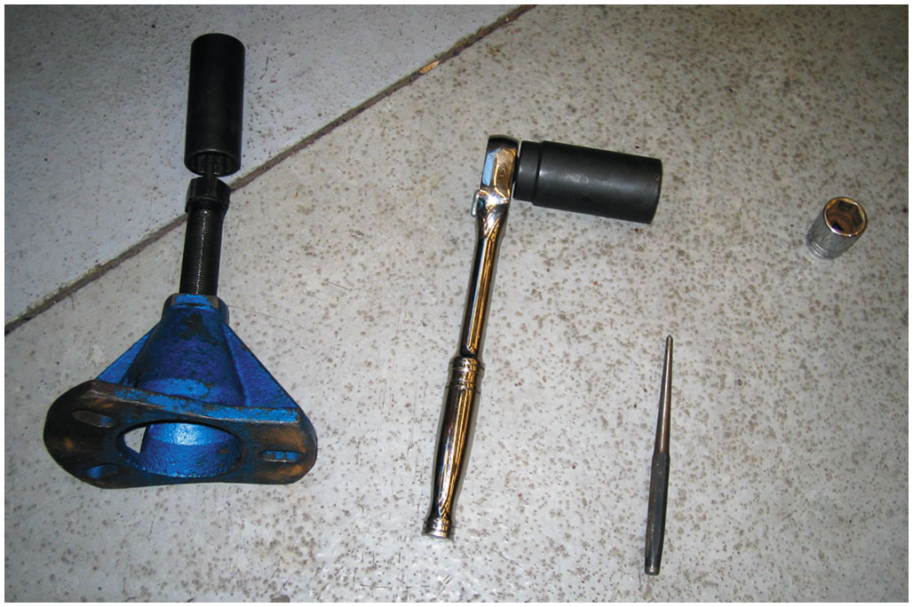
1. Tools needed to replace a drive axle shaft on a General Motors vehicle include a drift, sockets, plus a prybar bearing/axle shaft special tool

Slide 48
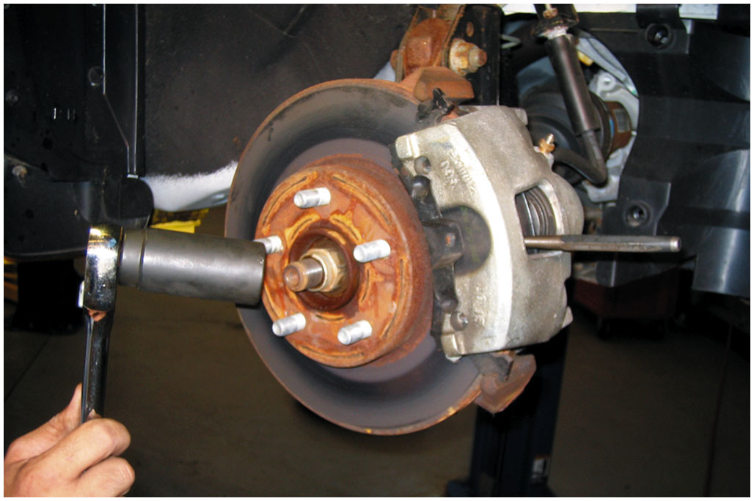
2. The drive axle shaft retaining nut can be loosened with the tire on the ground, or use a drift inserted into the rotor cooling fins before removing the nut

Slide 49
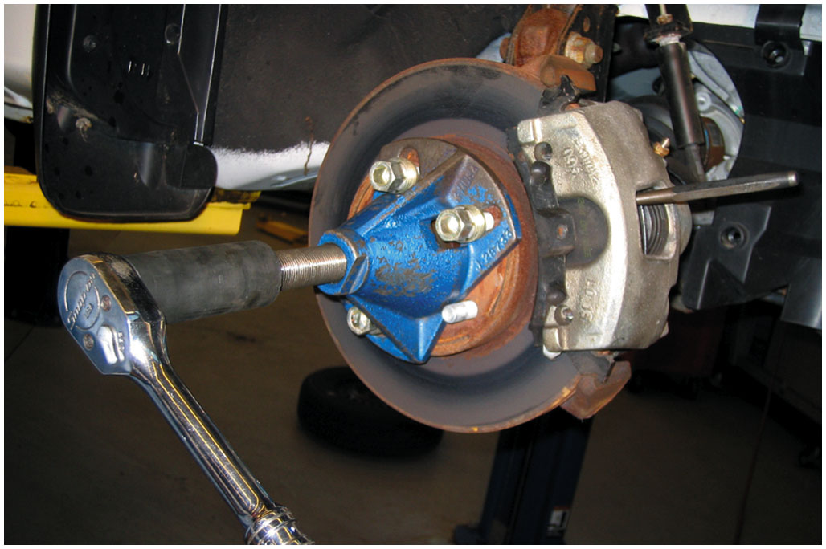
3. Using a special tool to push the drive axle splines from the bearing assembly

Slide 50
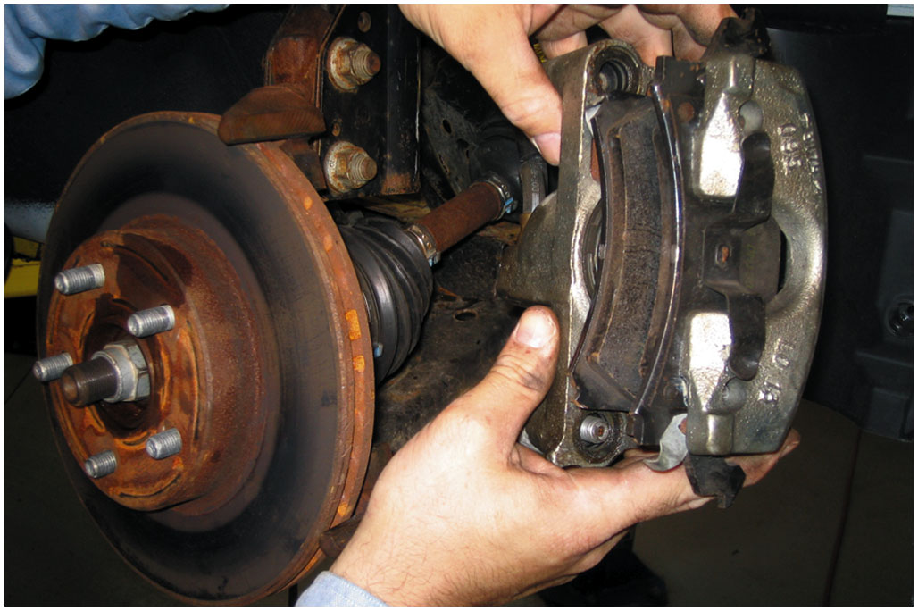
4. Remove the disc brake caliper and support it out of the way. Then, remove the disc brake rotor

Slide 51
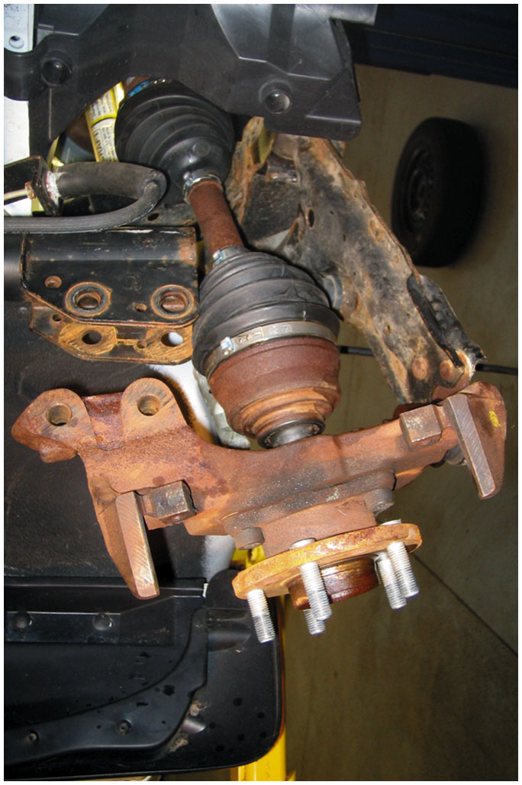
5. The lower ball joint could have been removed instead of disconnecting the strut from the knuckle so that the alignment could be retained

Slide 52
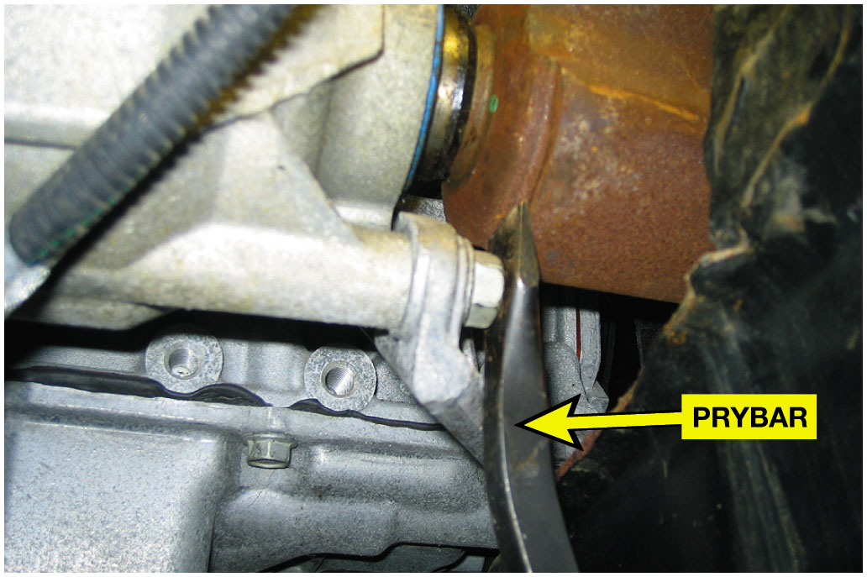
6. A prybar is used to separate the inner drive axle shaft joint from the transaxle

Slide 53
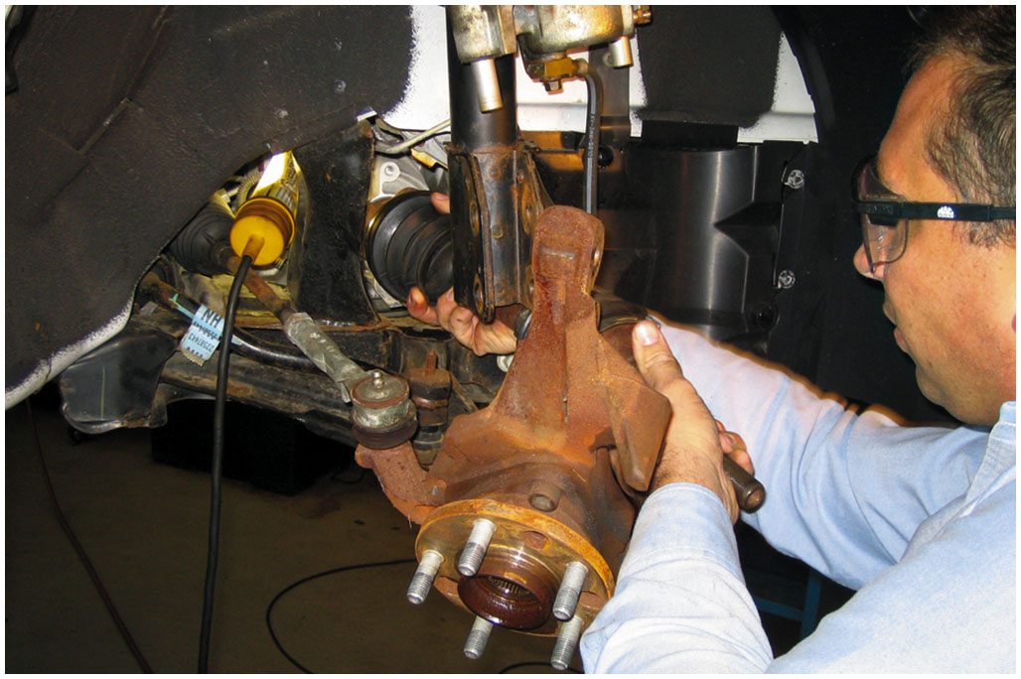
7. After the inner joint splines have been released from the transaxle, carefully remove the drive axle shaft assembly from the vehicle

Slide 54
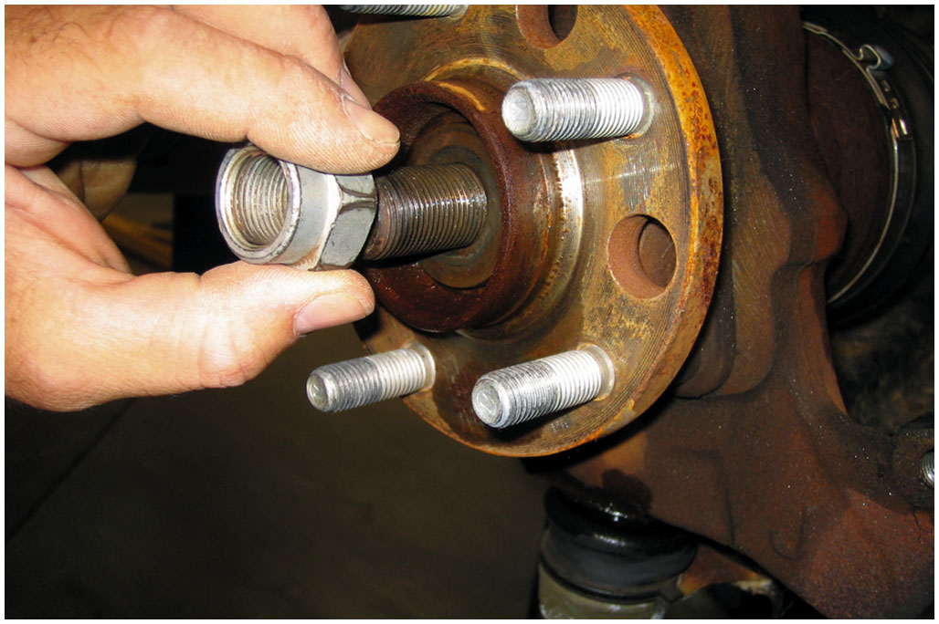
8. To install, reverse the disassembly procedure and be sure to install the washer under the retainer-nut, and always use a new prevailing torque nut

Slide 55
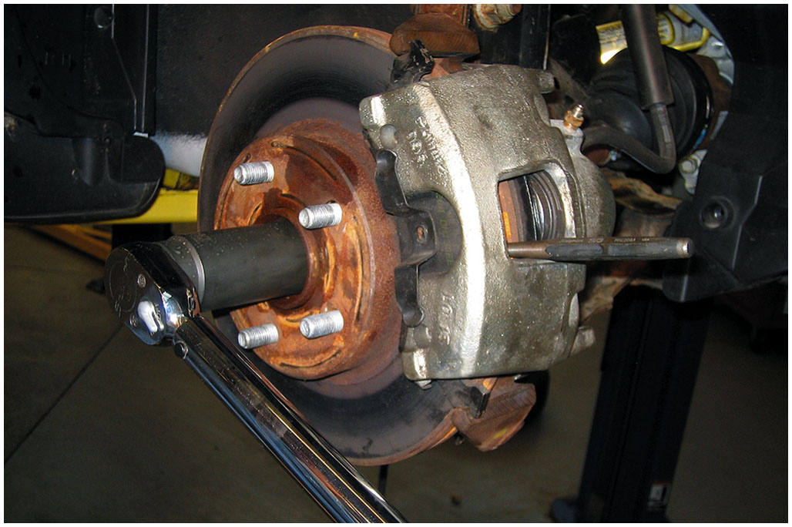
9. Reinstall the disc brake rotor and caliper and then torque the drive axle shaft retaining nut to factory specifications

Slide 56
Automotive Fundamentals Videos and Animations
Videos Link: (A3) Manual Drive Train Axles Videos
Animations Link: (A3) Manual Drive Train Axles Animations

Slide 57
Copyright
This work is protected by United States copyright laws and is provided solely for the use of instructors in teaching their courses and assessing student learning. Dissemination or sale of any part of this work (including on the World Wide Web) will destroy the integrity of the work and is not permitted. The work and materials from it should never be made available to students except by instructors using the accompanying text in their classes. All recipients of this work are expected to abide by these restrictions and to honor the intended pedagogical purposes and the needs of other instructors who rely on these materials.

