Slide 1
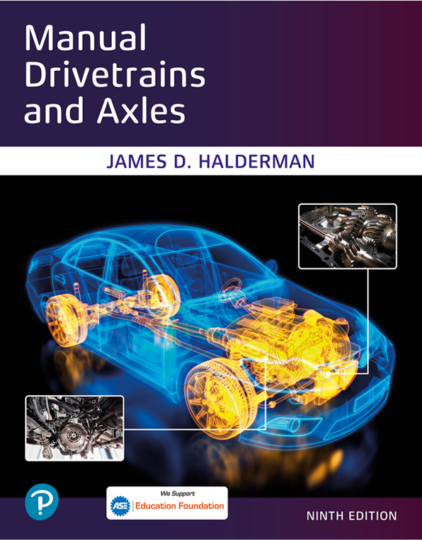
Manual Drivetrains and Axles
Ninth Edition
Chapter 9
Driveshafts and Half Shafts
Copyright © 2024, 2018, 2015 Pearson Education, Inc. All Rights Reserved
Notes:
If this PowerPoint presentation contains mathematical equations, you may need to check that your computer has the following installed:
1) Math Type Plugin
2) Math Player (free versions available)
3) NVDA Reader (free versions available)
INSTRUCTOR NOTE: This presentation includes text explanation notes, you can use to teach the course. When in SLIDE SHOW mode, you RIGHT CLICK and select SHOW PRESENTER VIEW, to use the notes.

Slide 2
Learning Objectives
9.1 Describe driveshaft design and balance.
9.2 Describe the function and operation of U-joints.
9.3 Discuss the two types of C V joints and how they work.

Slide 3
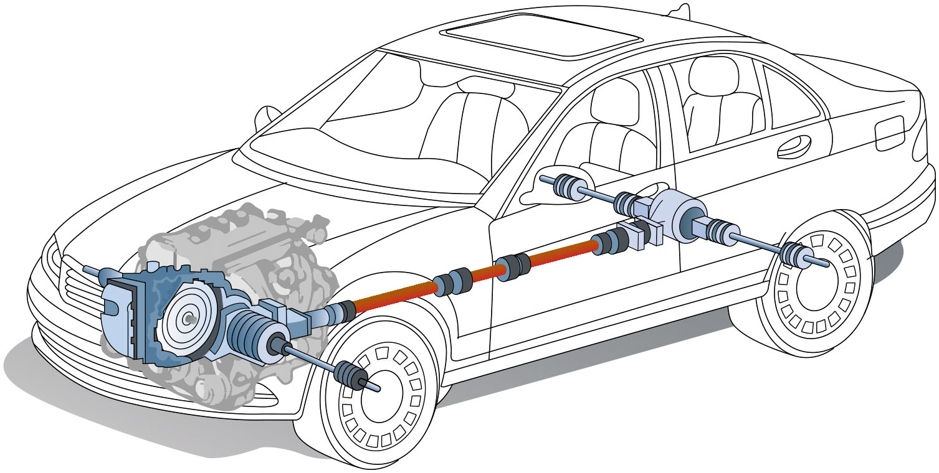
Figure 9.1
A W D Vehicle
A vehicle equipped with all-wheel drive using a transaxle uses many different driveshafts. From the transaxle to the front wheels, two “half shafts” are used. In this example, the multi-piece driveshaft is used to transmit engine torque to the drive axle at the rear of the vehicle. From the drive axle, two more half-shafts (drive axle shafts) are used to transmit torque to the rear wheels.
Notes:
A driveshaft transmits engine torque from the transmission or transaxle (if front-wheel drive) to
the rear axle assembly or drive wheels. ● SEE FIGURES 9.1 AND 9.2.
Driveshaft is the term used by the Society of Automotive Engineers (S A E) to describe the shaft between the transmission and the rear axle assembly on a rear-wheel-drive vehicle. General Motors and some other manufacturers use the term propeller shaft or prop shaft to describe this same part. The S A E term will be used throughout this textbook. A typical driveshaft is a hollow steel tube. A splined end yoke is welded onto one end that slips over the splines of the output shaft of the transmission. ● SEE FIGURE 9.3. An end yoke is welded onto the other end of the driveshaft. Some driveshafts use a center support bearing.
Long Description:
The wheels of the vehicle are connected with drive shafts. The drive shafts of the front wheels are connected to the transaxle with the front differential. The drive shafts of the rear wheels are connected to the rear differential with viscous coupling. The front and rear differentials are connected by a prop shaft.

Slide 4
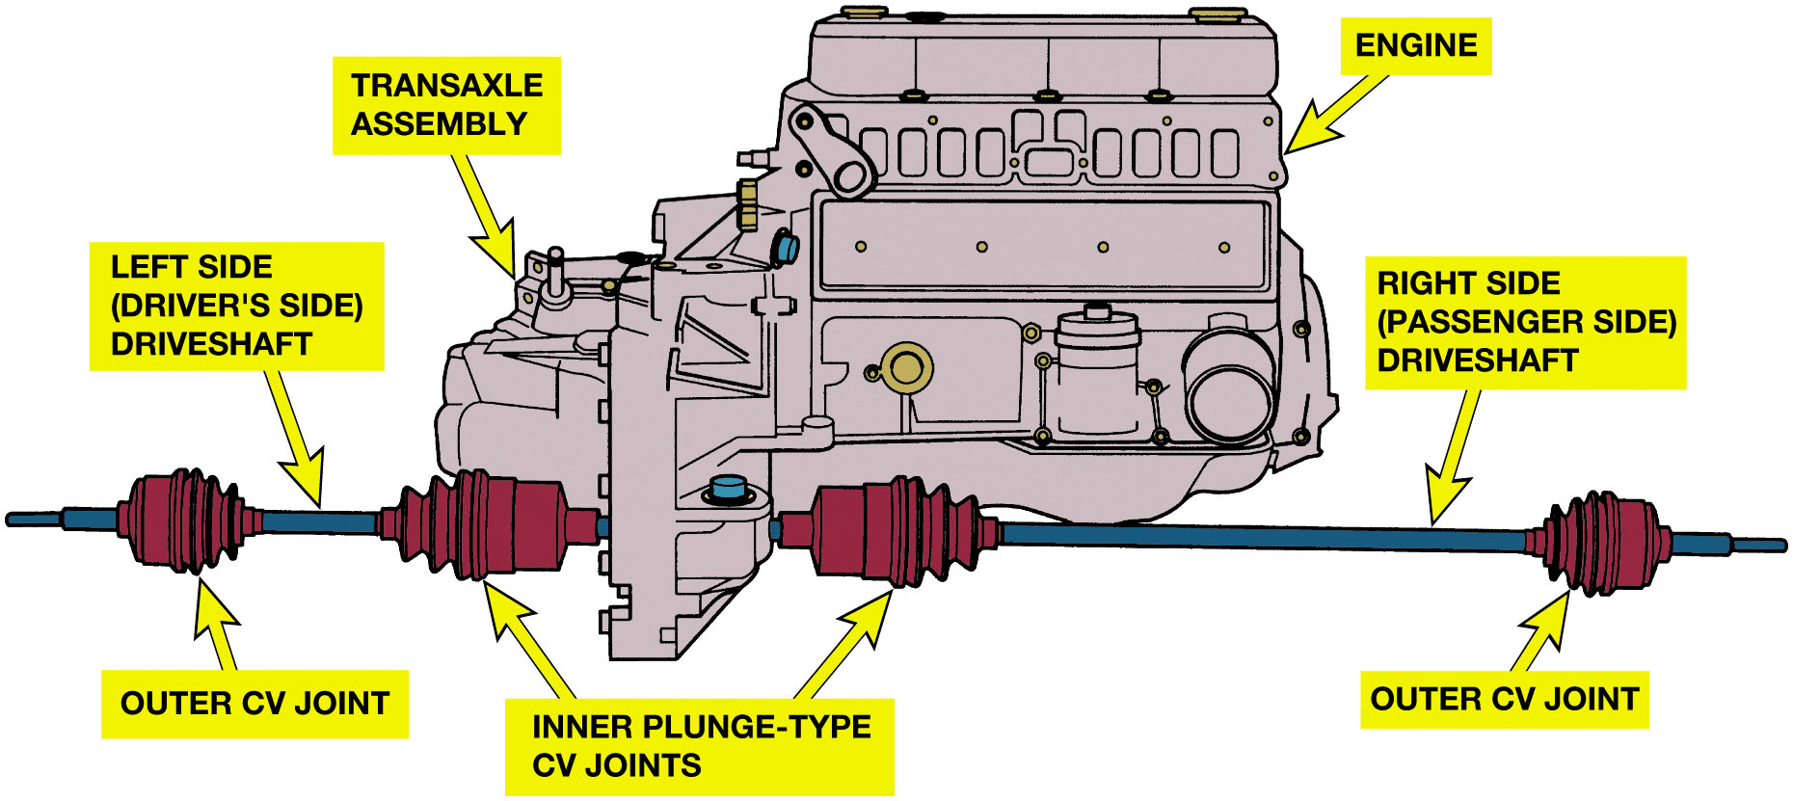
Figure 9.2
F W D Vehicle Setup
In a rear-wheel-drive vehicle, the driveshaft transmits engine torque from the transmission to the rear axle assembly and drive wheels. In a front-wheel-drive vehicle driveshafts (also called axle shafts) transmit torque from the transaxle to each of the front drive wheels.
Notes:
Long Description:
The illustration depicts the outer C V joints and the inner plunge-type C V joints connected with drive shafts. The drive shaft on the left labeled left side (driver’s side) drive shaft is short and the drive shaft on the right labeled right side (passenger side) drive shaft is long. The inner plunge-type C V joints are connected to the engine with a transaxle assembly.

Slide 5
Animation: FWD Drivetrain (Animation will automatically start)

Slide 6
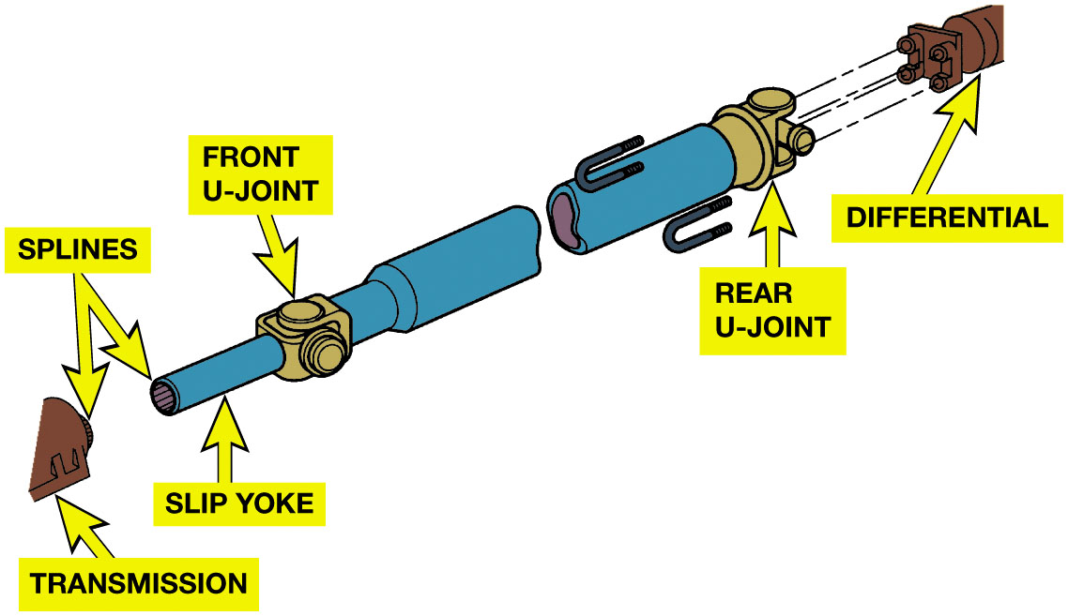
Figure 9.3
Driveshaft
What is purpose and function of driveshafts?
Driveshaft Design
One- or two-piece driveshaft
Aluminum driveshafts
Typical driveshaft (also called a propeller shaft). The driveshaft transfers engine power from the transmission to the differential.
Notes:
Page 121 answers the question What is purpose and function of driveshafts?
Most driveshafts are constructed of hollow steel tubing. The forces are transmitted through surface of the driveshaft tubing. The surface is therefore in tension, and cracks can develop on outside surface of the driveshaft due to metal fatigue. Driveshaft tubing can bend and, if dented, can collapse. A dented driveshaft should be replaced and no attempt should be made to repair the dent.
● See Figure 9.4.
Most rear-wheel-drive cars and light trucks use a one- or two-piece driveshaft. A steel tube driveshaft has a maximum length of about 65 inches (165 c m). Beyond this critical length, a center support bearing must be used, as shown in FIGURE 9.5. A center support bearing is also called a steady bearing or hanger bearing. Some vehicle manufacturers use aluminum driveshafts; these can be as long as 90 inches (230 c m) with no problem. Many extended-cab pickup trucks and certain vans use aluminum driveshafts to eliminate the need (and expense) of a center support bearing. Composite-material driveshafts are also used in some vehicles. These carbon-fiber-plastic driveshafts are very strong yet lightweight, and can be made in extended lengths without the need for a center support bearing.

Slide 7
Animation: FWD Driveshaft (Animation will automatically start)

Slide 8
Animation: RWD Driveshaft Operation (Animation will automatically start)

Slide 9
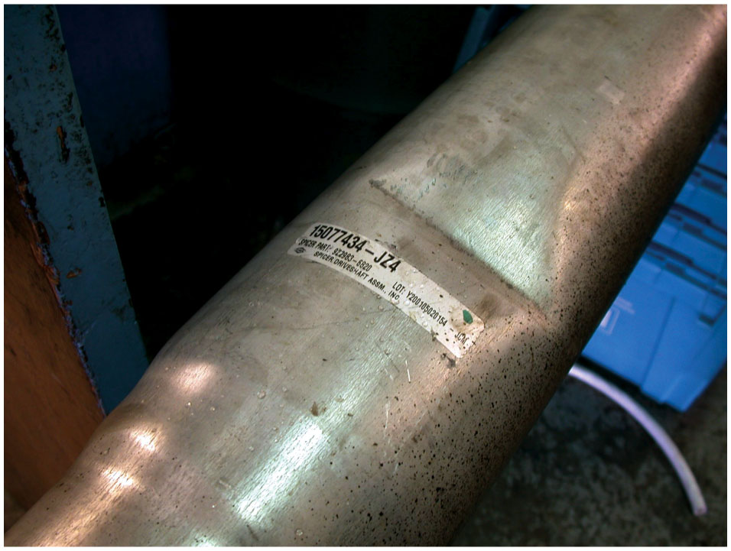
Figure 9.4
Dented Driveshaft
This driveshaft was found to be dented during a visual inspection and has to be replaced.

Slide 10
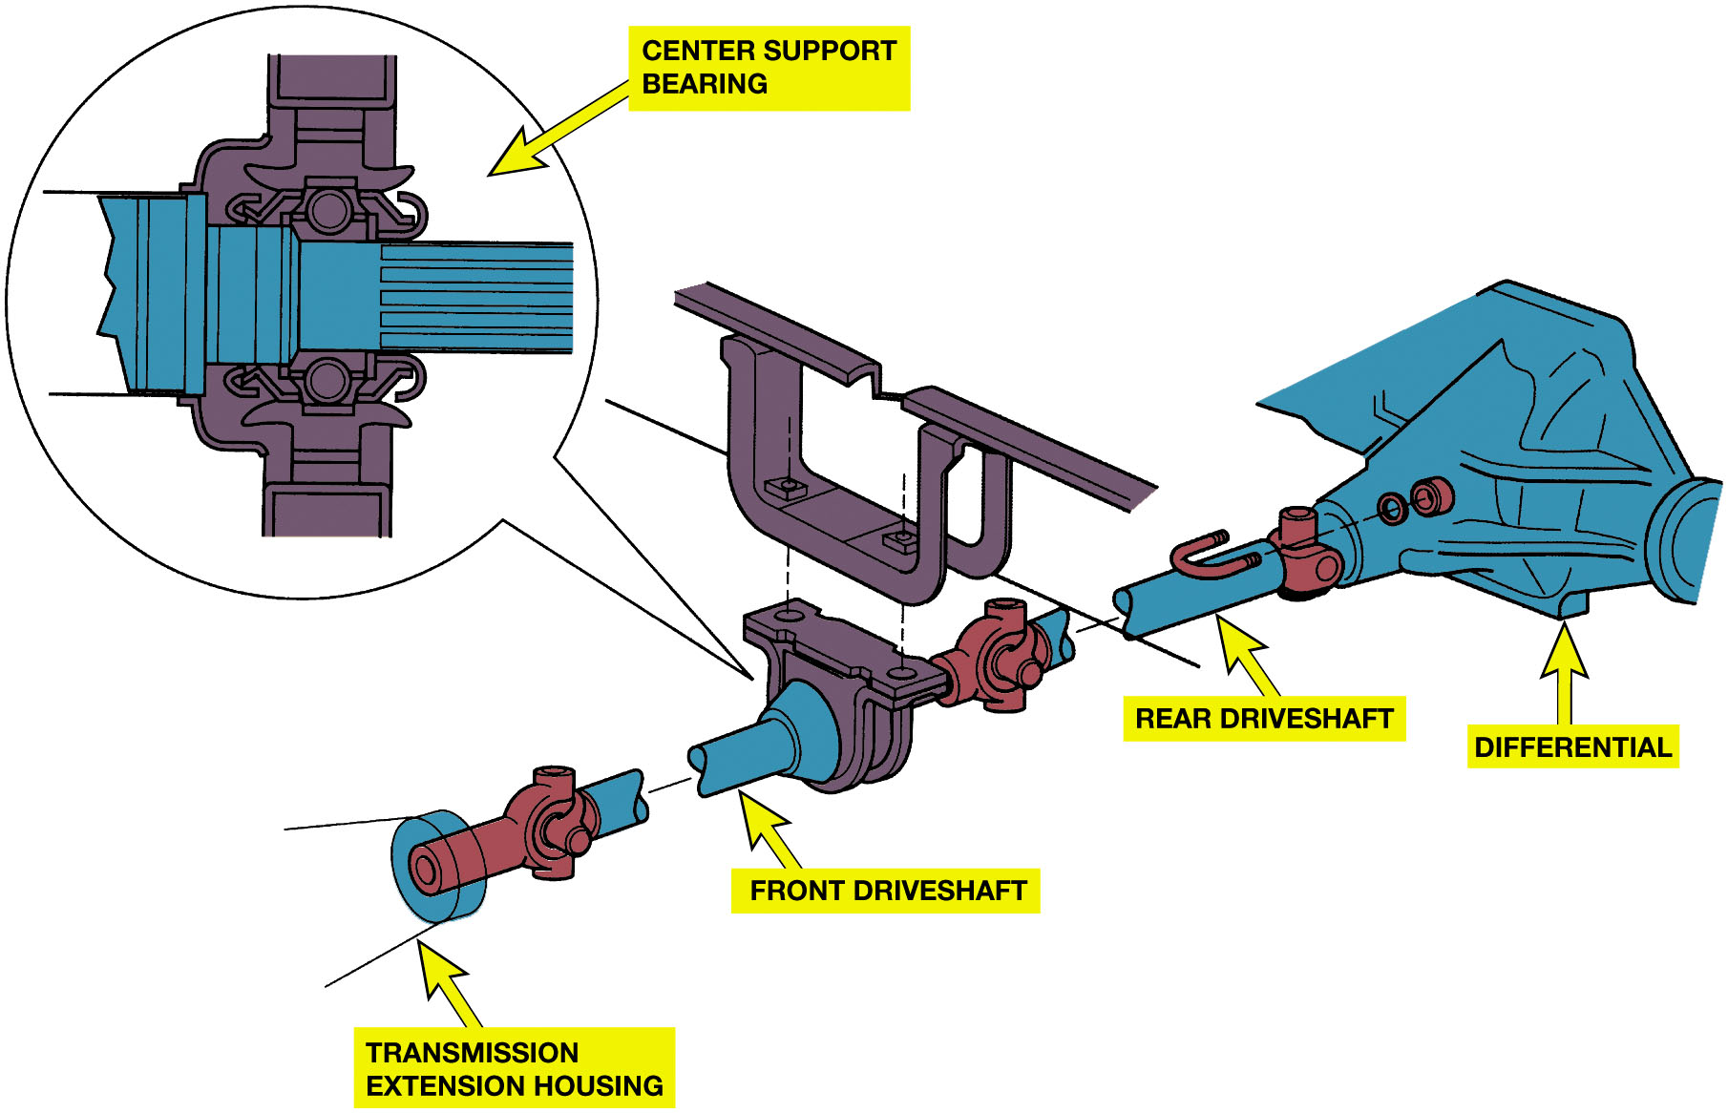
Figure 9.5
Center Support Bearing
A center support bearing is used on many vehicles with long two-part driveshafts.
Notes:
Long Description:
The labeled parts from the left are the transmission extension housing, front drive shaft, center support bearing, rear drive shaft, and differential. An enlarged cross-sectional view of the center support bearing is at the top. The cross-sectional view depicts a horizontal drive shaft between a center support bearing.

Slide 11
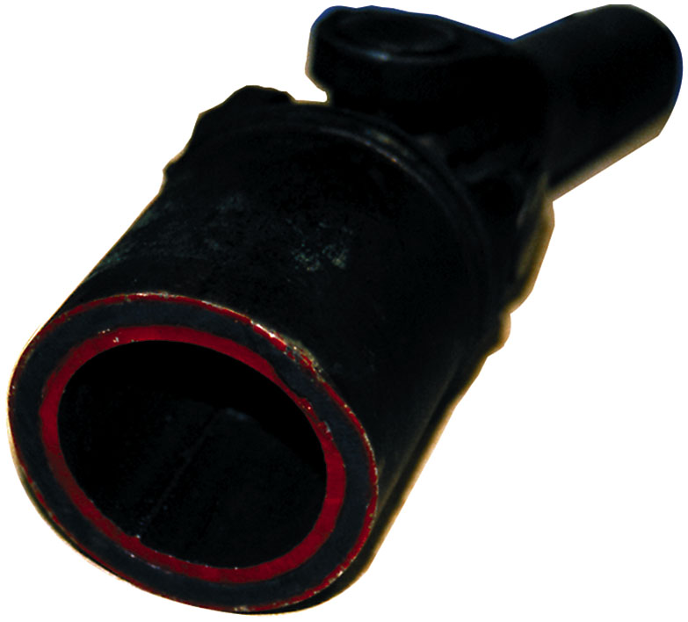
Figure 9.6
Inner & Outer Housing
Some driveshafts use rubber between an inner and outer housing to absorb vibrations and shocks to the driveline.

Slide 12
Driveshaft Balance
Any driveshaft whose rotational speed is greater than 1000 R P M
Must be balanced.
Driveshaft balance should be within 0.5% of the driveshaft weight.
Notes:
All driveshafts are balanced. Generally, any driveshaft whose rotational speed is greater than 1000 R P M must be balanced.
Driveshaft balance should be within 0.5% of the driveshaft weight. (This is one of the biggest reasons why aluminum or
composite driveshafts can be longer because of their light weight.)

Slide 13
U-Joint Design and Operation
U-joints allow wheels and the rear axle to move up and down
Remain flexible, and still transfer torque to drive wheels.
Working angle of
to 3 degrees
If angles differ by more than a
between front and rear joint
Vibration is usually produced that is torque sensitive.

Slide 14
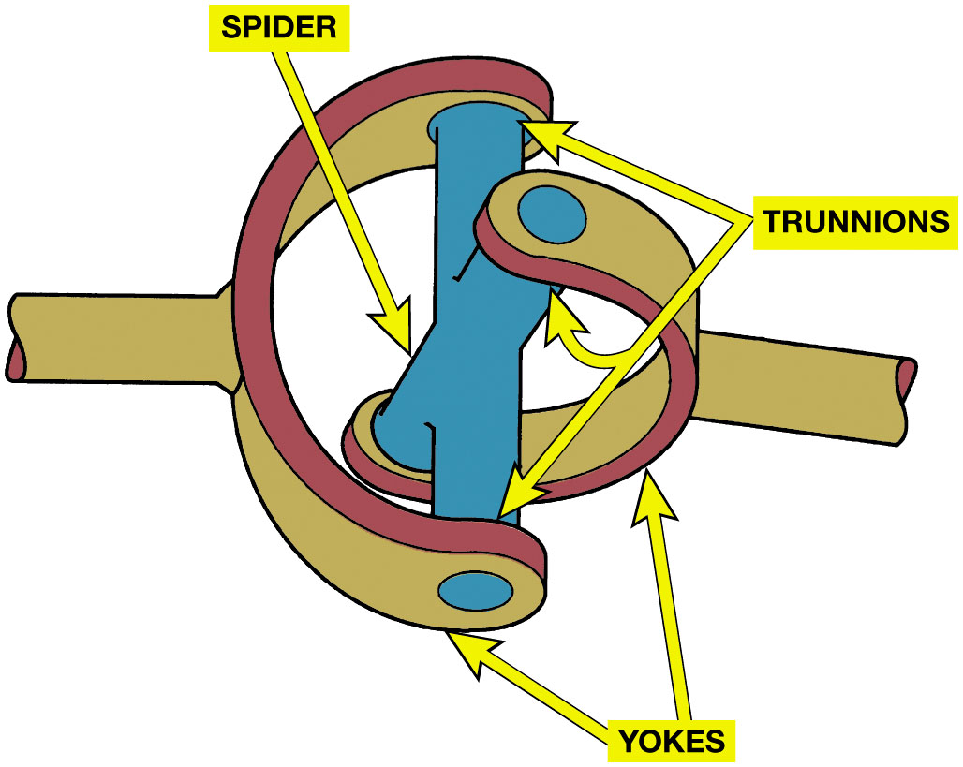
Figure 9.7
U-Joint Components
A simple universal joint (U-joint).

Slide 15
Animation: Universal Joint Operation (Animation will automatically start)

Slide 16
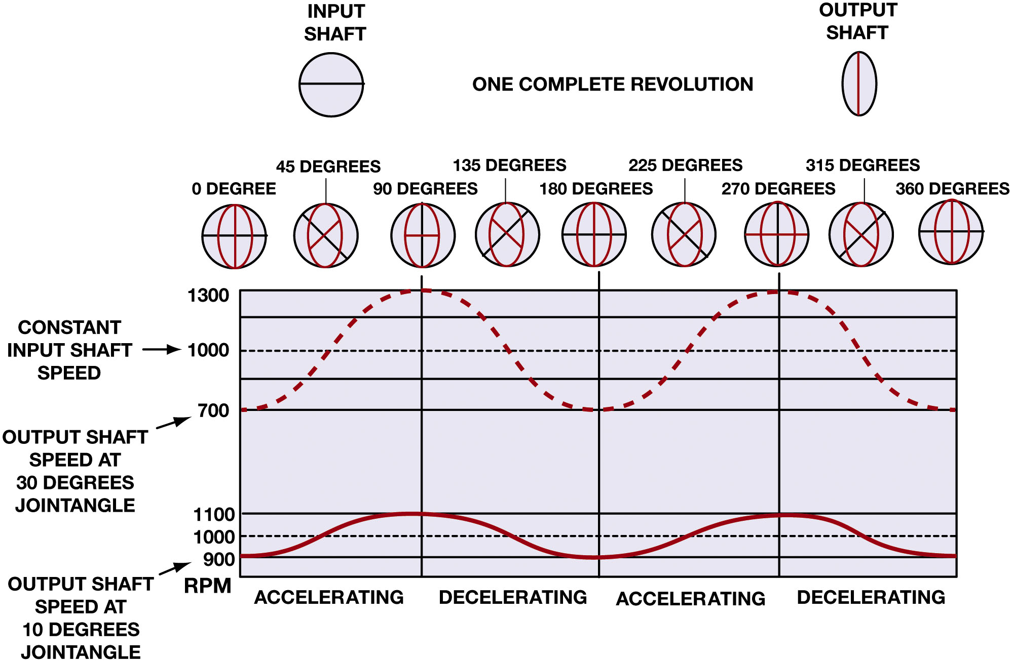
Figure 9.8
U-Joint Speed & Angle
Notes:
Figure 9-8 How the speed difference on the output of a typical U-joint varies with the speed and the angle of the U-joint.
At the bottom of the chart, the input speed is a constant 1000 R P M, while the output speed varies from 900 to 1100 R P M when the angle difference in the joint is only 10 degrees. At the top of the chart, the input speed is a constant 1000 R P M, yet the output speed varies from 700 to 1200 R P M when the angle difference in the joint is changed to 30 degrees.
Long Description:
The graph’s horizontal axis represents acceleration and deceleration and the vertical axis represents R P M and ranges from 900 to 1100 in increments of 100 units at the bottom and 700 to 1300 in increments of 300 units at the top. The data in the graph at the bottom are as follows. Accelerating from 900 to 1100, decelerating from 1100 to 900, accelerating from 900 to 1100, and decelerating from 1100 to 900. The data in the graph at the top are as follows. Accelerating from 700 to 1300, decelerating from 1300 to 700, accelerating from 700 to 1300, and decelerating from 1300 to 700. R P M 900 in the bottom graph is labeled output shaft at 10 degrees joint angle. R P M 700 in the top graph is labeled output shaft speed at 30 degrees joint angle. R P M 1000 is labeled constant input shaft speed. A circle with a horizontal line at the center is labeled input shaft and an oval with a vertical line at the center is labeled output labeled. The angle of the input shaft and output shaft above the graph from left to right are labeled as follows. 0 degree, 45 degrees, 90 degrees, 135 degrees, 180 degrees, 225 degrees, 270 degrees, 315 degrees, and 360 degrees.

Slide 17
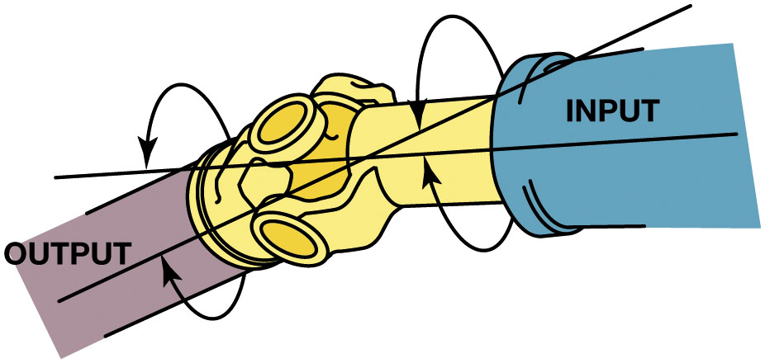
Figure 9.9
Joint Angle
The joint angle is the difference between the angles of the joint.
Notes:
Long Description:
Two angled pipes labeled output on the left and input on the right are connected by an angled U-joint. A line extends from the center of the input and output pipes which intersects at the joint. Two circular arrows point at the lines on either side.

Slide 18
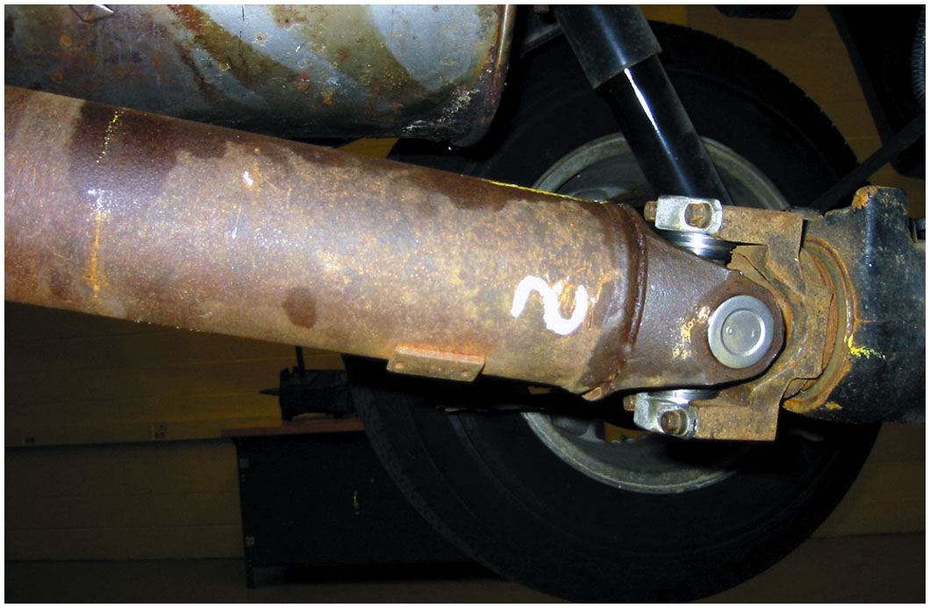
Figure 9.10
Cardan U-Joint
The angle of this rear-Cardan U-joint is noticeable.

Slide 19
Double-Cardan Joints
Regular U-joints are usually designed to work up to 12 degrees of angularity.
If two Cardan-style U-joints are joined together, the angle at which this double-Cardan joint can function is about 18 to 20 degrees.

Slide 20
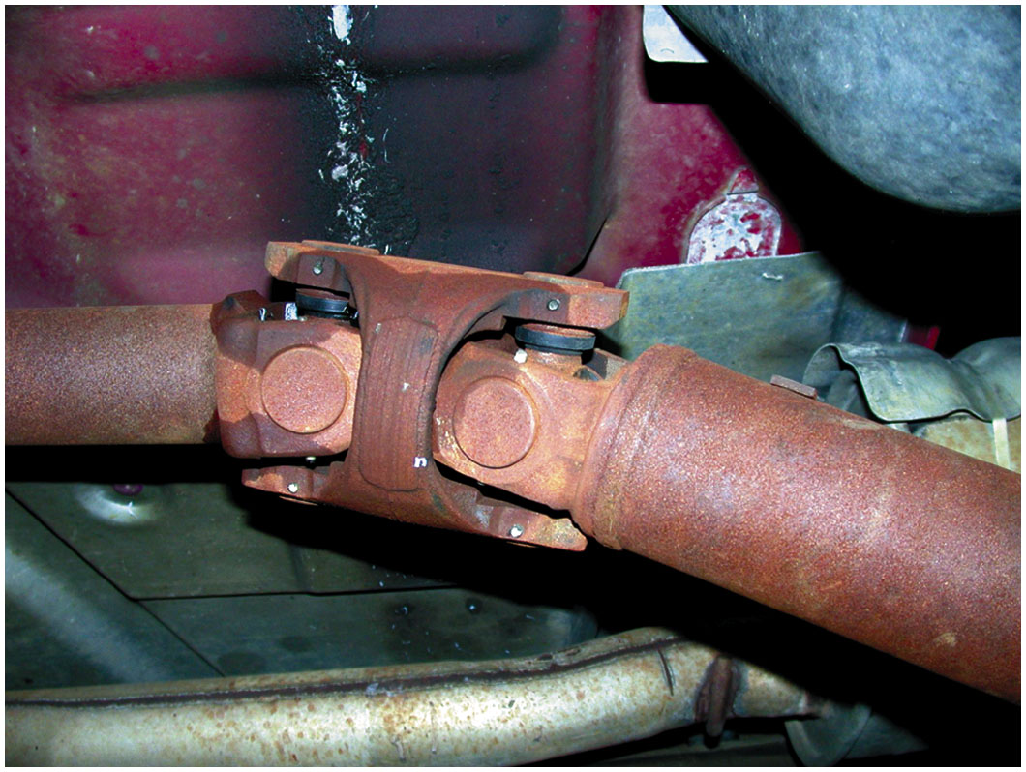
Figure 9.11
A double-Cardan U-joint.

Slide 21
Constant Velocity Joints (1 of 2)
Designed to rotate without changing speed
Regular U-joints are usually designed to work up to 12 degrees of angularity
Double-Cardan U-joints were first used on large rear-wheel drive vehicles to help reduce drive line-induced vibrations

Slide 22
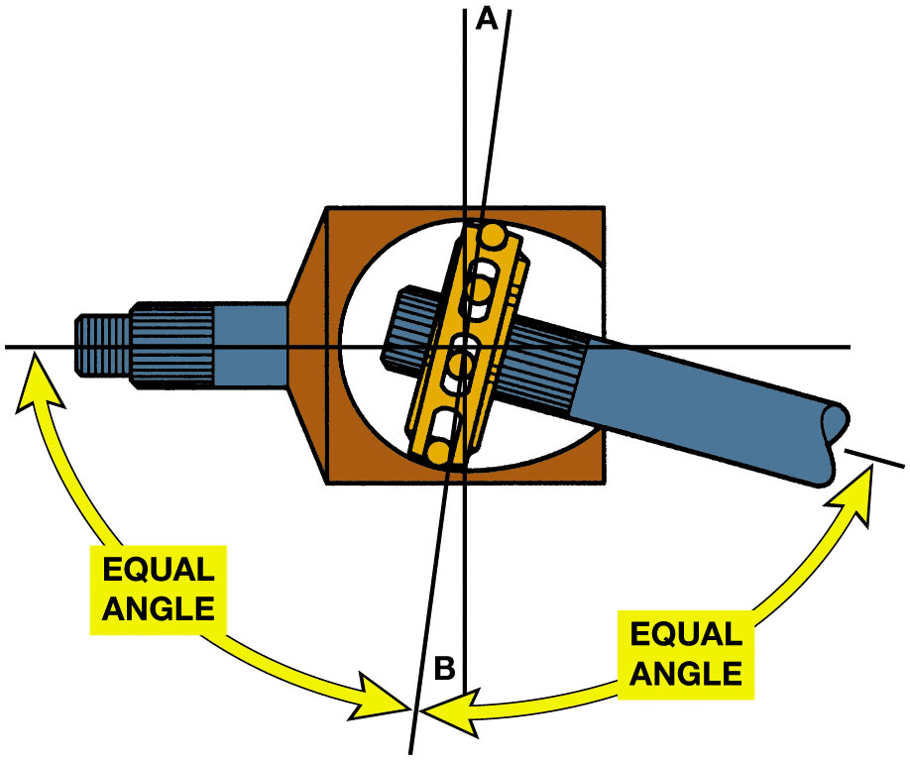
Figure 9.12
C V Joint
A constant-velocity (C V) joint can operate at high angles without a change in velocity (speed) because the joint design results in equal angles between input and output.
Notes:
Long Description:
The illustration depicts an angled shaft on the right and a horizontal shaft on the left connected by a constant-velocity joint. Two intersecting lines labeled A at the top and labeled B at the bottom. Two double-headed arrows labeled equal angle point to the left and right ends of the shafts, and to point B.

Slide 23
Animation: CV Joint (Animation will automatically start)

Slide 24
Constant Velocity Joints (2 of 2)
Outer C V Joints
Rzeppa Joints: commonly used joint as outer joints
Transfers torque through six round balls that are held in position midway between the two shafts
Inner C V Joints
Attach output of transaxle to drive axle shaft

Slide 25
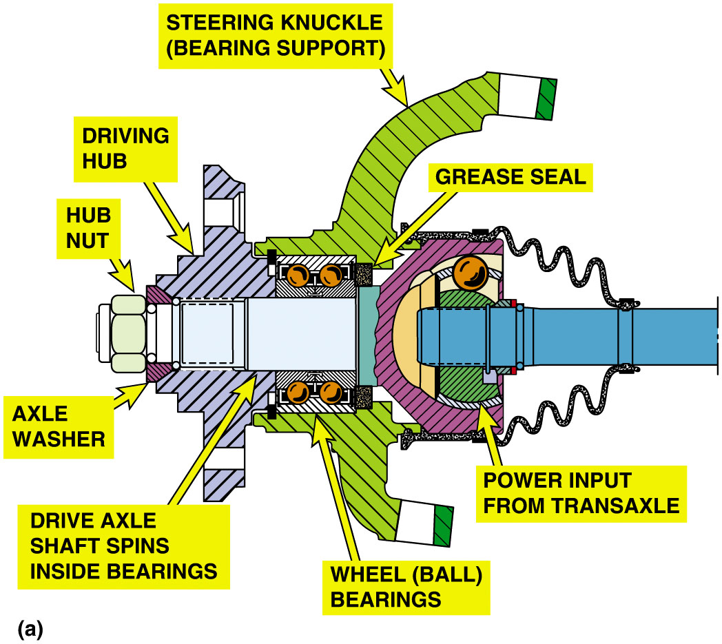
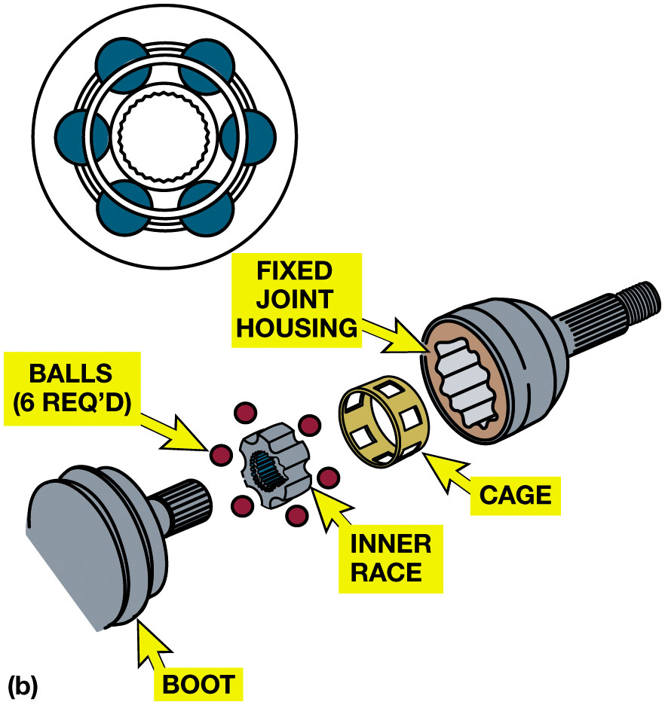
Figure 9.13
Rzeppa Fixed Joint
(a) A cutaway view of the outer C V joint with a double-row ball bearing assembly that shows the relations of the parts involved. (b) A Rzeppa fixed joint. This type of C V joint is commonly used at the wheel side of the drive axle shaft. This joint can operate at high angles to compensate for suspension travel and steering angle changes.
Notes:
Long Description 1:
The parts of the outer C V joints from left to right are labeled as follows. Hub nut, axle washer, driving hub, drive axle shaft spins inside bearing, grease seal, wheel (ball) bearing, and power input from transaxle.
Long Description 2:
The parts of the Rzeppa fixed joint from left to right are labeled as follows. Boot, ball’s (req’d), inner race, cage, and fixed joint housing. A schematic of the balls with inner rece is at the top.

Slide 26
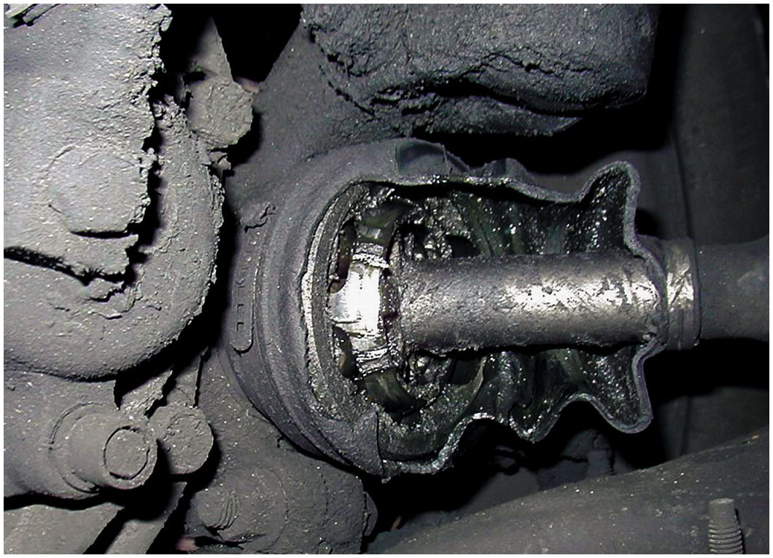
Figure 9.14
Torn Joint Boot
The protective C V joint boot has been torn away on this vehicle and all of the grease has been thrown outward onto the brake and suspension parts. The driver of this vehicle noticed a “clicking” noise, especially when turning.

Slide 27
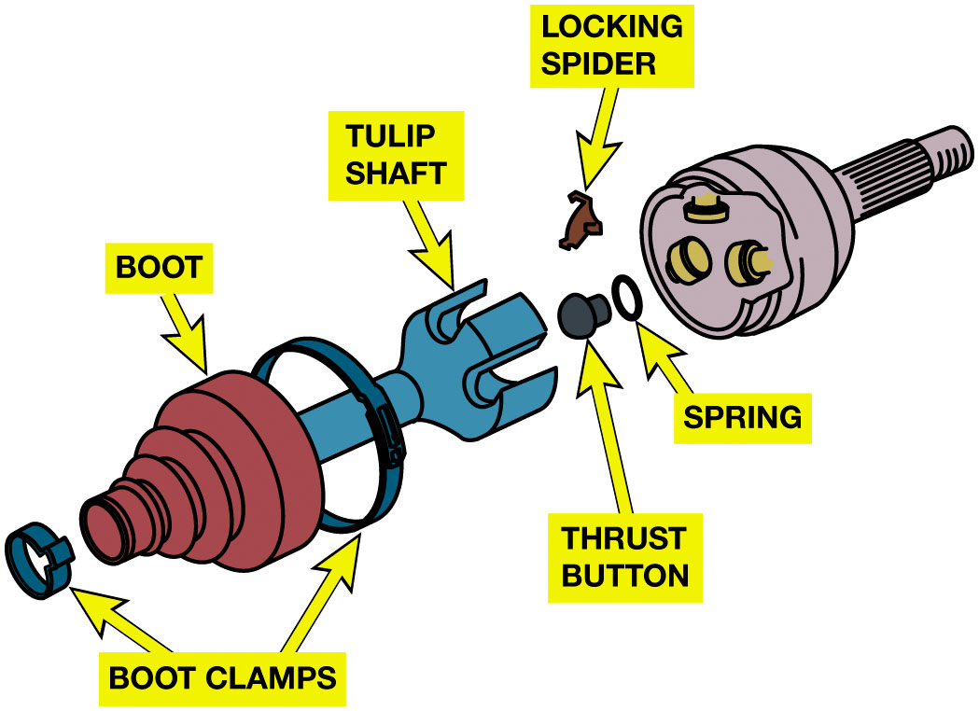
Figure 9.15
Tripod Fixed Joint
A tripod fixed joint. This type of joint is found on some Japanese vehicles. If the joint wears out, it is to be replaced with an entire drive axle shaft assembly.

Slide 28
Figure 9.16
Fixed Outer Joint
The fixed outer joint is required to move in all directions because the wheels must turn for steering as well as move up and down during suspension movement. The inner joint has to be able to not only move up and down but also plunge in and out as the suspension moves up and down.
Notes:
Long Description:
The inner joint is connected to the outer joint by a pipe-like structure. The inner joint is labeled plunging and the outer joint is labeled fixed. An arrow points from the outer to the inner joint. An upward arrow above and a downward arrow below the outer joint.

Slide 29
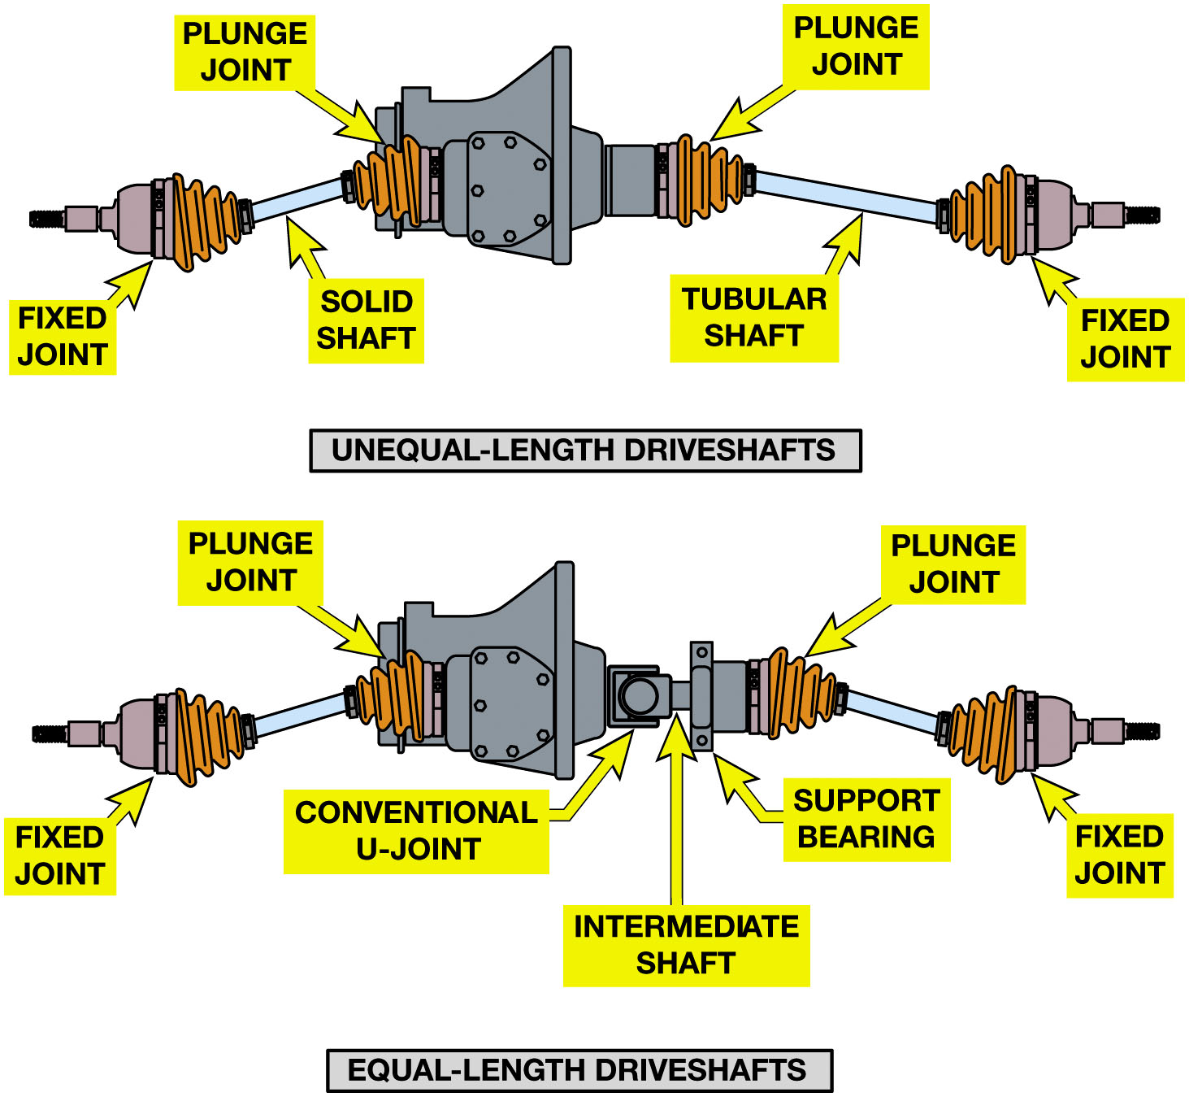
Figure 9.17
Torque Steer
Unequal-length driveshafts result in unequal drive axle shaft angles to the front drive wheels. This unequal angle side to side often results in a steering of the vehicle during acceleration called torque steer. By using an intermediate shaft, both drive axles are the same angle and the torque steer effect is reduced.
Notes:
Unequal-length drive axle shafts (also called half shafts) result in unequal drive axle shaft
angles to the front drive wheels. ● SEE FIGURE 9.17. This unequal angle often results in a pull on
the steering wheel during acceleration. This pulling to one side during acceleration due to unequal engine torque
being applied to the front drive wheels is called torque steer. To help reduce the effect of torque
steer, some vehicles are manufactured with an intermediate shaft that results in equal drive axle shaft angles. Both designs use fixed
outer C V joints with plunge-type inner joints.
Typical types of inner C V joints that are designed to move axially, or plunge, include the following:
1. Tripod. ● SEE FIGURE 9.19.
2. Cross groove. ● SEE FIGURE 9.20.
3. Double offset. ● SEE FIGURE 9.21.
CV joints are also used in rear-wheel-drive vehicles and in many four-wheel-drive vehicles.
Long Description:
The unequal-length drive shaft at the top has the fixed joint connected to the plunge joint by a solid shaft on the left and on the right, the fixed joint is connected to the plunge joint by a tubular shaft. The equal-length drive shaft at the bottom has the fixed joint connected to the plunge joint by a solid shaft on the left and on the right, the fixed joint is connected to the plunge joint by a tubular shaft. The left drive shaft and the right drive shaft are connected by a conventional U-joint, intermediate shaft, and support bearing.

Slide 30
Frequently Asked Question: What is That Weight for on the Drive Axle Shaft?
? Frequently Asked Question
What is that Weight for on the Drive Axle Shaft? Some drive axle shafts are equipped with what looks like a balance weight. Figure 9.18. It is actually a dampener weight used to dampen out certain drive line vibrations. The weight is not used on all vehicles and may or may not appear on the same vehicle depending on engine, transmission, and other options. The service technician should always try to replace a defective or worn drive axle shaft with the exact replacement. When replacing an entire drive axle shaft, the technician should always follow the manufacturer’s instructions regarding either transferring or not transferring the weight to the new shaft.

Slide 31
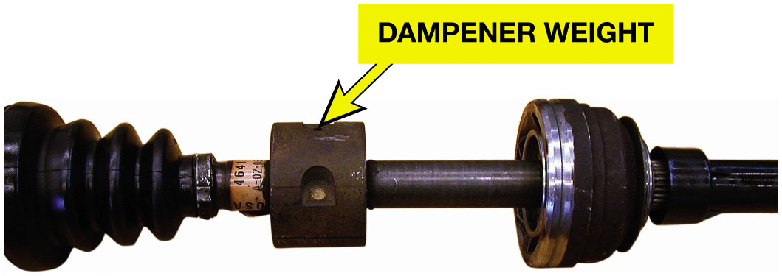
Figure 9.18
Dampener Weight
A typical drive axle shaft with dampener weight.
Notes:
Figure mentioned in Frequently Asked Question

Slide 32
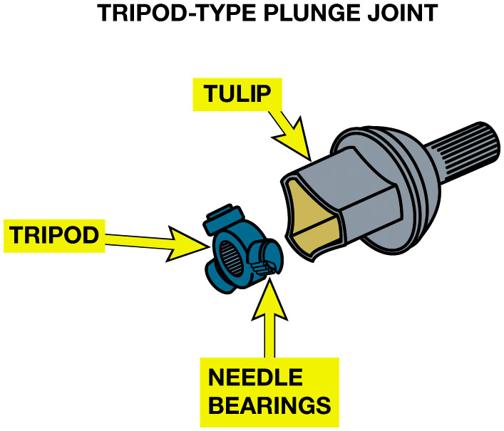
Figure 9.19
Tripod Joint
A tripod joint is also called a tripot, tripode, or tulip design.

Slide 33
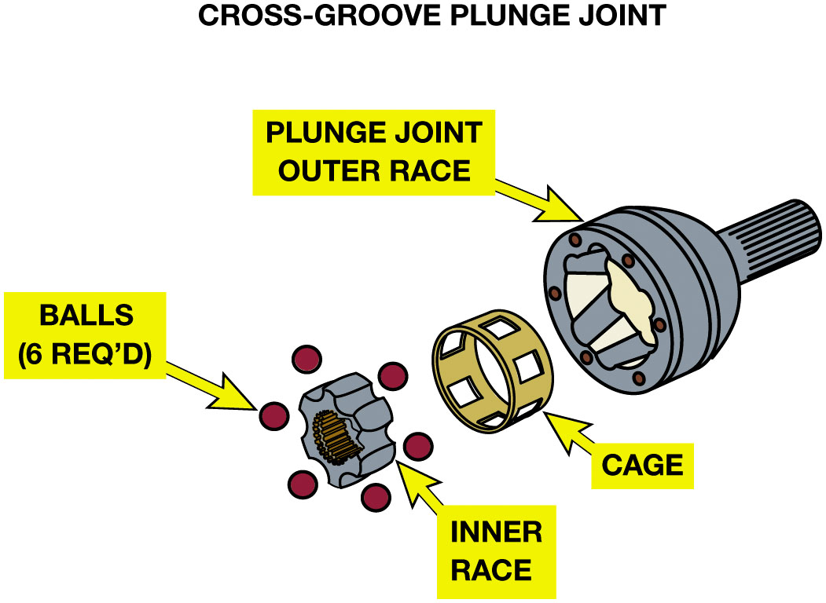
Figure 9.20
Cross-Groove Joint
A cross-groove plunge joint is used on many German front-wheel-drive vehicles and as both inner and outer joints on the rear of vehicles that use an independent-type rear suspension.

Slide 34
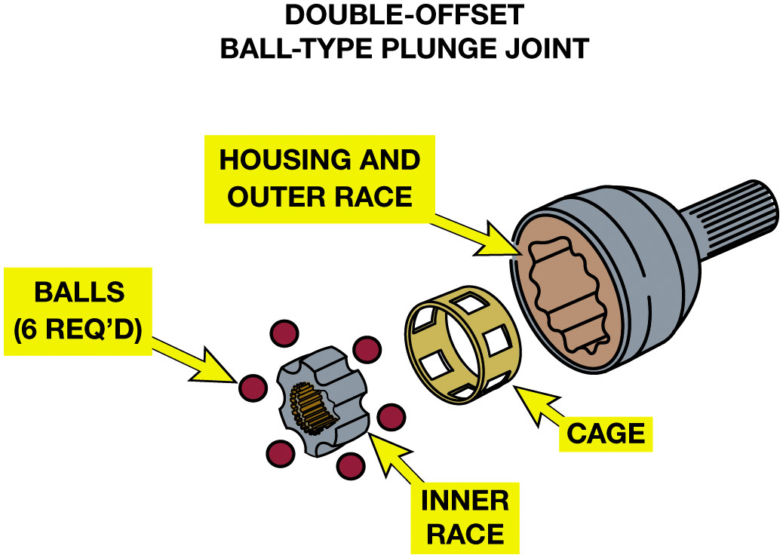
Figure 9.21
Double-Offset Ball Type
Double-offset ball-type plunge joint.

Slide 35
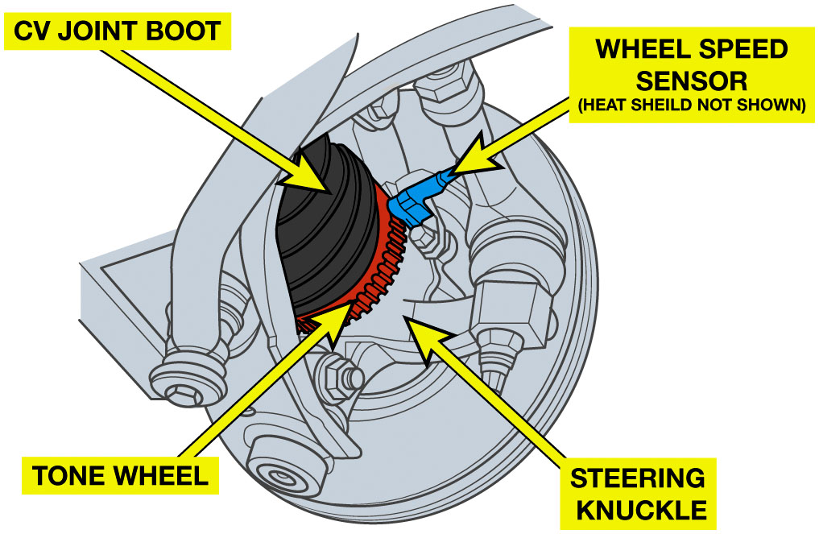
Figure 9.22
Wheel Speed Sensor
Many outer C V joints include the tone wheel for the wheel speed sensor used by the anti-lock and stability control systems.

Slide 36
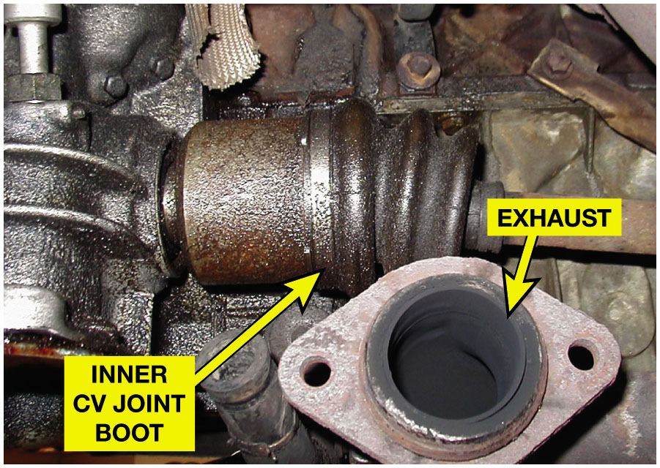
Figure 9.23
Tech Tip
Tech Tip:
C V Joint Boots Are in Hot Place
Many C V joints are close to the exhaust system where they are exposed to higher than normal temperatures.
Notes:
Tech Tip: C V Joint Boots Are in a Hot Place
While the outer C V boots move when the front wheels are steered, the inner boots are also subjected to possible damage because they are often near the exhaust system where the high temperatures can damage the boot material. Then, if there is an engine oil leak, the engine oil could harm the C V boot too. Try to fix all leaks to help prevent premature C V boot failure. ● Figure 9.23.

Slide 37
Question 1
The proper grease to use with a C V joint is
A. Black chassis grease
B. Dark blue E P grease
C. Red moly grease
D. Grease supplied with boot kit

Slide 38
Answer 1
The proper grease to use with a C V joint is
D. Grease supplied with boot kit

Slide 39
Summary
R W D driveshaft transmits engine torque from transmission to differential.
U-joints allow driveshaft to transmit engine torque While suspension and the rear axle assembly are moving Up and down during normal driving conditions.
C V joints provide a smooth transmission of torque to drive wheels Regardless of angularity of the wheel or joint.
Outer or fixed C V joints commonly use a Rzeppa design
Inner C V joints are plunging or tripod type.

Slide 40
Automotive Fundamentals Videos and Animations
Videos Link: (A3) Manual Drive Train Axles Videos
Animations Link: (A3) Manual Drive Train Axles Animations

Slide 41
Copyright
This work is protected by United States copyright laws and is provided solely for the use of instructors in teaching their courses and assessing student learning. Dissemination or sale of any part of this work (including on the World Wide Web) will destroy the integrity of the work and is not permitted. The work and materials from it should never be made available to students except by instructors using the accompanying text in their classes. All recipients of this work are expected to abide by these restrictions and to honor the intended pedagogical purposes and the needs of other instructors who rely on these materials.

