Slide 1
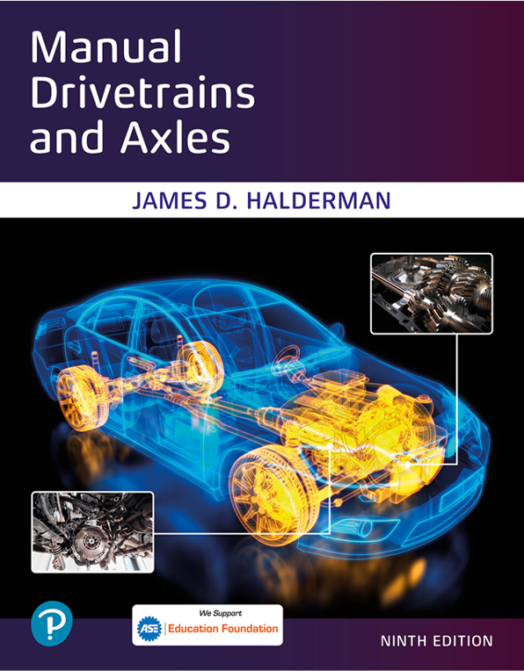
Manual Drivetrains and Axles
Ninth Edition
Chapter 8
Manual Transmission/Transaxle Diagnosis and Service
Copyright © 2024, 2018, 2015 Pearson Education, Inc. All Rights Reserved
Notes:
If this PowerPoint presentation contains mathematical equations, you may need to check that your computer has the following installed:
1) Math Type Plugin
2) Math Player (free versions available)
3) NVDA Reader (free versions available)
INSTRUCTOR NOTE: This presentation includes text explanation notes, you can use to teach the course. When in SLIDE SHOW mode, you RIGHT CLICK and select SHOW PRESENTER VIEW, to use the notes.

Slide 2
Learning Objectives
8.1 Explain how to perform transaxle/transmission maintenance operations.
8.2 Explain manual transaxle/transmission diagnosis.
8.3 Discuss the procedure for transaxle/ transmission removal and replacement..
8.4 Discuss the procedure for transaxle/ transmission overhaul.

Slide 3
Preventive Maintenance (1 of 2)
Normal Maintenance Operation Includes:
Periodic check of the lubricant level
Linkage/shifter adjustment
Mount inspection or replacement as needed
Visual inspection for leaks and other abnormal conditions
Lubricant check
What are some things to check for?
Notes:
In-vehicle service, also called on-vehicle service, in most cases is a normal maintenance operation
and includes the following:
Periodic check of the lubricant level
Linkage/shifter adjustment
Mount inspection or replacement as needed
Visual inspection for leaks and other abnormal conditions When a problem such as hard shifting occurs, the shift linkage is also be checked and readjusted, if necessary.
If possible, service and repair operations are done with the transaxle/transmission in the vehicle. Transmission removal and replacement (R&R) takes about 2.5 hours and transaxle removal and replacement may take up to 5 hours. This varies greatly depending on the vehicle and the experience of the technician, but in any case, transmission/transaxle removal and replacement is time consuming.

Slide 4
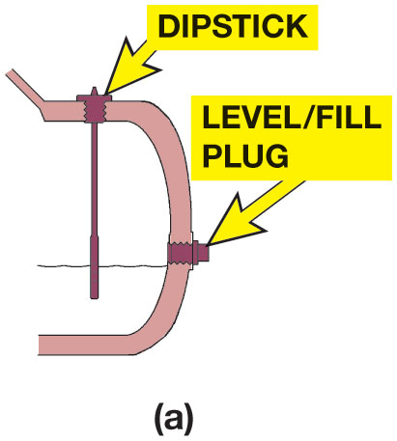
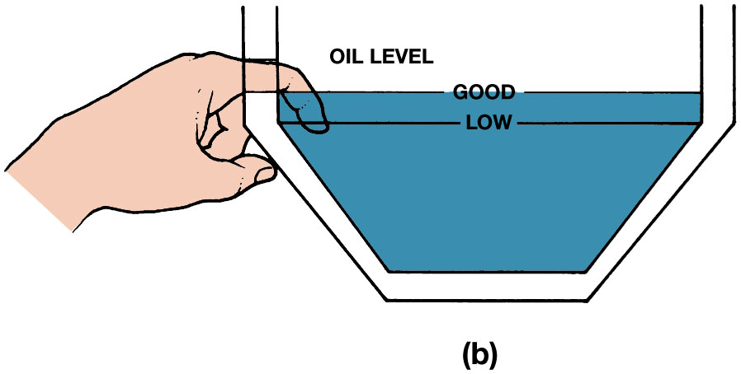
Figure 8.1
Fluid Level Check
(a) Transaxles and transmissions use either a dipstick or level plug to check the oil level. (b) To determine the fluid level, insert a finger into the opening and feel for the fluid level. Some vehicle manufacturers specify that the fluid level be 1 inch (25 m m) below the fill plug opening.
Notes:
Long Description 1:
The illustration has a curved structure. The structure has a wave at the bottom that highlights the level of oil. A vertical dipstick is attached from the top. The lower end of the dipstick is immersed in oil. A level slash fill plug is attached on the bottom right at the level of oil.
Long Description 2:
The illustration has a container filled with oil. Two horizontal lines are marked at the top. The text below oil reads oil level. The upper line is labeled good. The lower line is labeled low. From the left, an index finger is dipped into oil to check the level of oil.

Slide 5
Preventive Maintenance (2 of 2)
Transmission Lubricant replacement steps
How should the transaxle linkage get adjusted?
How can an alignment check get accomplished?
Notes:
Step 1 bring lubricant up to operating temperature.
Step 2 raise and securely support the vehicle.
Step 3 check service information for the exact location of the fill and drain plugs.
Step 4 locate the drain plug at the bottom of the transaxle/transmission, place a drain pan under it, remove the drain plug.
Step 5 allow the lubricant to drain out completely before replacing the plug. Check for any steel particles on the magnetic drain plug
Step 6 inspect the old lubricant for any contamination
Step 7 check the owner’s manual or service information to determine correct lubricant type and refill
Step 8 refill the transaxle/transmission to the correct level.

Slide 6
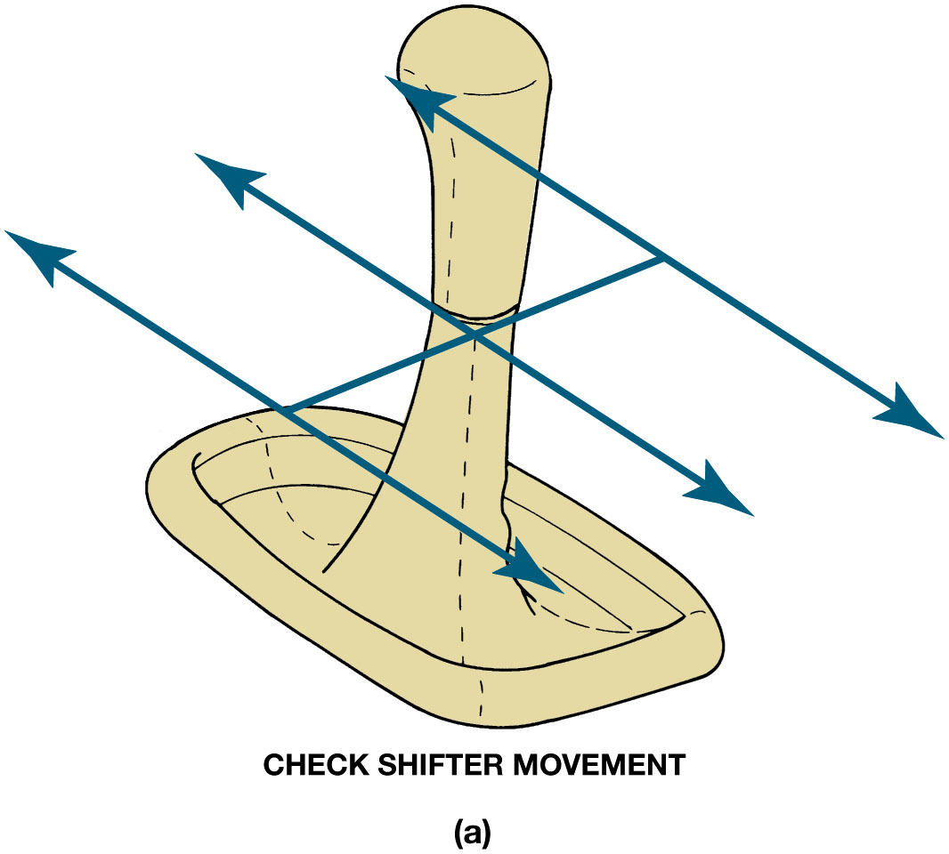
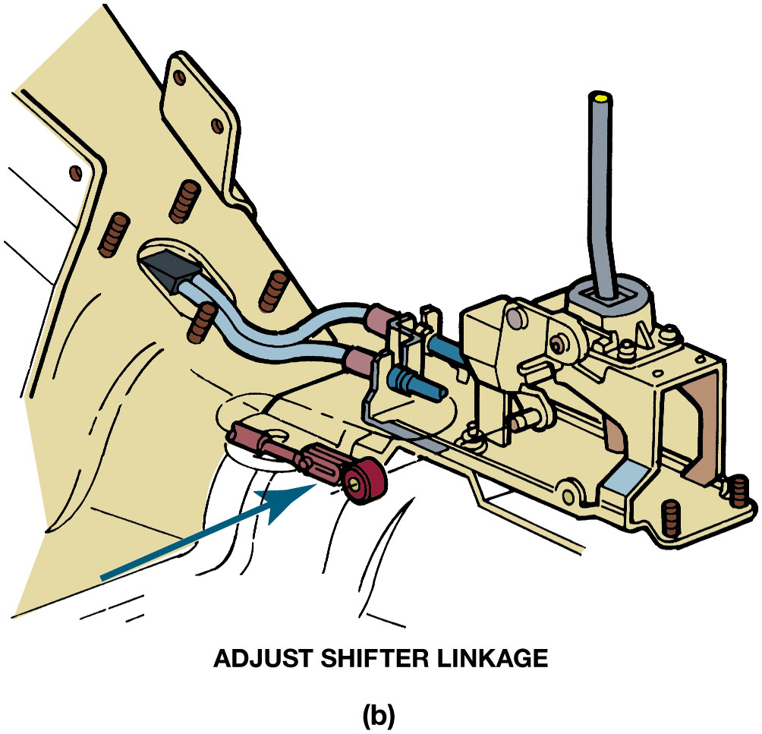
Figure 8.2
Linkage Adjustment
(a) Operate the shift levers through all of the gears with the engine off and again with it running. (b) If necessary, adjust the shift linkage following the vehicle manufacturer’s specified procedure.
Notes:
Long Description 1:
The shifter is broad and flat from the bottom and tube-like structure from the top. Three horizontal double-headed arrows are marked on the shifter. A vertical line passes through the center of the horizontal arrows. The text below reads as (a) check shifter movement.
Long Description 2:
From the left to right, the illustration has a selectable cable, crossover cable, cable clips, adjustment screw, and shift lever. A horizontal arrow points toward the adjustment screw. A text below the illustration reads (b) adjust shifter linkage.

Slide 7
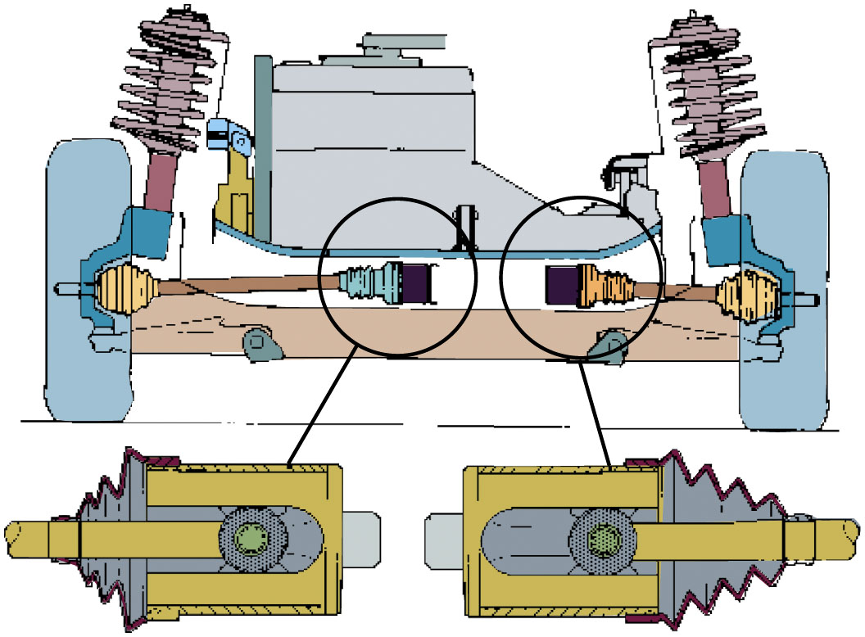
Figure 8.3
F W D Alignment
The enlarged views of the inner C V joints show that the engine and transaxle are misaligned; they should be moved toward the right.
Notes:
Long Description:
The illustration has axle shafts, two wheels, a driveshaft, a transaxle, an engine, two coil springs, two inner joints, two outer joints, and C V joints in the center. The inner C V joints in the center are encircled and point to their enlarged view at the bottom. The inner C V joints have axle shafts, splines, outer sockets, stub axles, and steel balls.

Slide 8
Manual Transmission/Transaxle Diagnosis
Verify customer concern by performing a road test.
Perform visual inspection.
Follow service information and follow pinpoint tests to determine root cause.
Perform needed repair and verify repair.
Notes:
Case Study: Worn Shift Fork Mystery
A vehicle equipped with a manual transmission had to be repaired several times for worn shift forks. Even though the vehicle warranty paid for the repair, both the customer and the service department personnel were concerned about repeated failures. All technical service bulletins (T S B s) were checked to see if there was an updated, improved shift fork. No luck. After third repair, the service technician rode with the customer to see if the cause could be determined. As the woman driver got into the driver’s seat, she
placed the handle of her purse over the shifter on the floor and allowed the purse to hang from shifter. The technician asked the owner if she always placed her purse on the shifter and when she said yes, the technician knew immediately cause of the worn shift forks. The purse exerted a force on the shifter all the time. This force pushed the shift forks against the synchronizer sleeve. Because the sleeve rotates all the time the vehicle is in motion, the shift forks were quickly worn. The customer agreed to find another location for her
purse so that the transmission problem would not reoccur.
Summary:
Complaint—Repeated manual transmission shift fork failures.
Cause—Driver hung her purse over the shifter which exerted a force on the shift forks.
Correction—Driver agreed to find another location for her purse.
Tech Tip: Take the Owner on the Test Drive Everyone drives differently. By having the vehicle owner along, he or she can better point out when the fault occurs and under what conditions. Sometimes, the owner should drive so the technician can verify the concern.

Slide 9
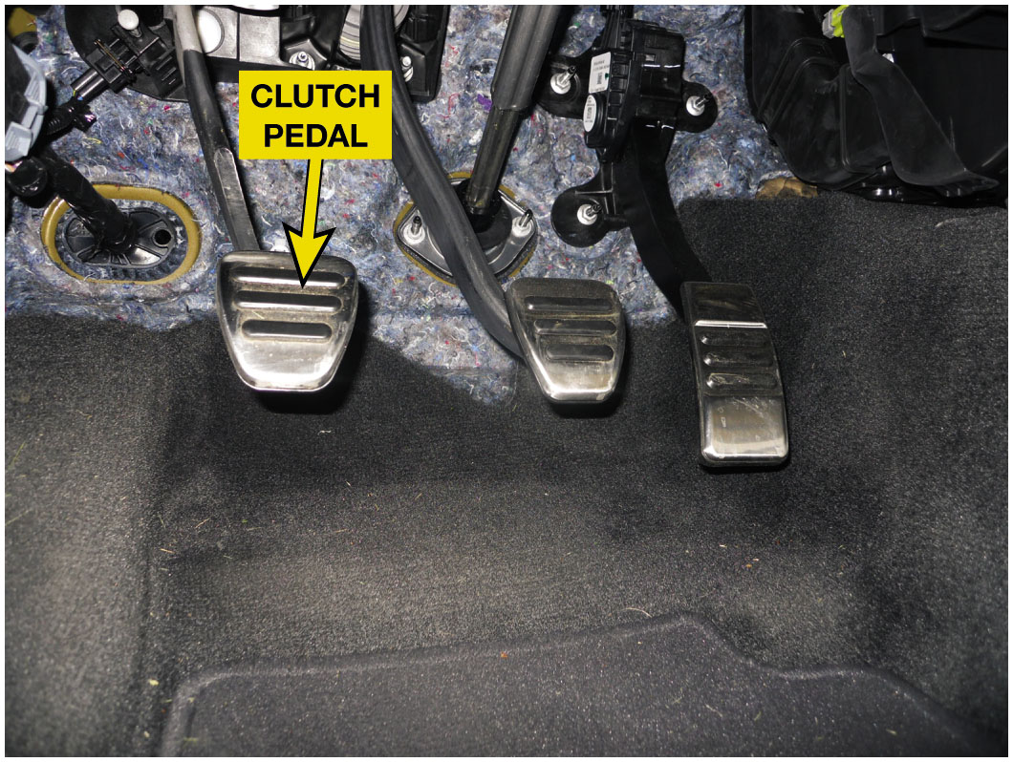
Figure 8.4
Clutch Pedal Free Play
Test drive procedure includes:
Check clutch pedal free play.
Check the clutch pedal for proper operation and be sure that the floor mat or carpet is not interfering with the operation of the clutch.
Notes:
Long Description:
The lower view of a vehicle has a floor mat at the bottom. Above the floor, three pedals such as clutch, brake, and accelerator are attached. The left pedal is labeled clutch pedal.

Slide 10
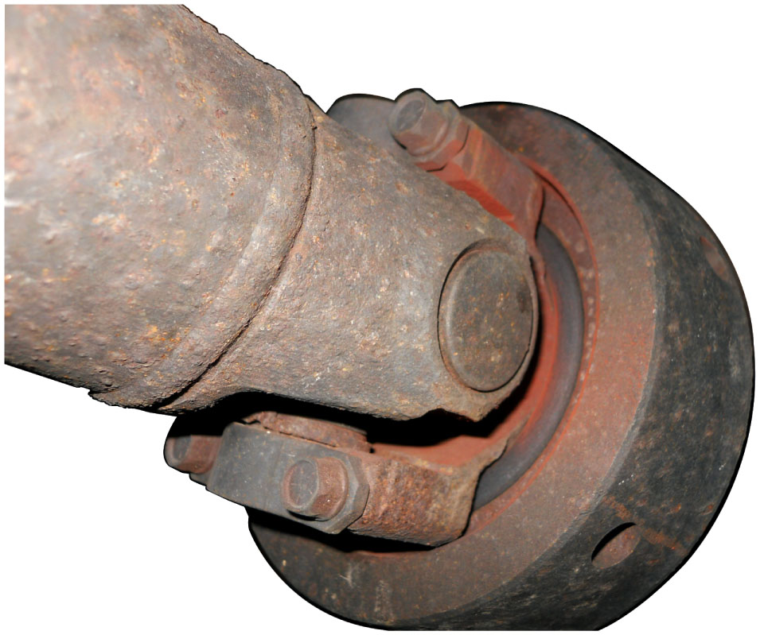
Figure 8.5
Rust Dust Checking
Rust Dust
Reddish Dust Found Around Areas That Rusted
Likely Location For Wear
When performing a visual inspection, check for “rust dust,” which is evidence of worn components such as universal joints.
Notes:
Examine the driveshaft for damage or mud that could affect its balance.
Examine U-joints for damage or looseness. Check for “rust dust,” which is a reddish dust found around areas that have rusted and is a likely location where wear has occurred. ● FIGURE 8.5.
Long Description:
The universal joint has a shaft, circlip. Needle roller bearings, spider, and yoked shaft end. The universal joint is covered with rust dust.

Slide 11
Chart 8.1
Transmission/Transaxle Faults
Transmission/ Transaxle Fault | Description Of Fault | Possible Cause(s)
Leaks | Fluid escapes from the transaxle/ transmission | Leaking gaskets or seals
Hard shifts | Requires an abnormally high amount of force to shift into gear | Possible incorrect lubricant in the transmission and/or shifter/linkage/shift fork problems
Shift block-out | Will not shift into one or more gears | Possible shift linkage and/or interlock concerns. Can be caused by the “shift skip” system which forces a shift to 4th instead of 2nd at lower vehicle speeds to improve fuel economy
Locked into gear | Transmission/transaxle will not shift out of a gear | Shifter/linkage/shift fork problems
Jumps out of gear | Will shift into neutral on its own | Often caused by worn synchronizer assemblies
Clash/grinding during a shift | Gear clash/grinding noise occurs as shift is made | Often caused by worn synchronizer assemblies
Noisy | A grinding, growling noise while in neutral | Worn or defective bearings
No gear at all | Sometimes the teeth are sheared and there is no gear at all (usually second gear) | Usually caused by driver abuse
Notes:
SEE CHART 8.1 for a list and possible causes of most transaxle/transmission problems.
Tech Tip: Too High Viscosity Oil Can Hurt Shifting During a shift, the synchronizer ring must cut through the lubricant to contact the speed gear cone. Hard shifts can result from a lubricant that is too thick or from worn synchronizer rings (the threadlike grooves are no longer sharp).

Slide 12
Chart 8.2
Typical Noises
Commonly Heard Noises | Usually Heard When | Possible Causes
Gear rattle | Most noticeable while accelerating at low RPM and lugging the engine | Possible defective clutch disc (broken damper springs) or a defective dual mass flywheel, if equipped
Neutral rattle | Occurs with the engine running in neutral with the clutch engaged | These vibrations can occur in the engine with balance shafts and dual-mass flywheels, and proper clutch-disc hub damper springs
Backlash | Occurs when the driveline load or direction is changed, for example, when the throttle is changed abruptly or when the vehicle is brought to a stop and shifted into reverse | Often caused by worn U-joints or lack of lubrication on the splines on the output shaft of a rear-wheel-drive transmission
Gear clash | The grinding that occurs if the clutch is released too quickly while making a shift or a shift is made too quickly with non-synchronized gears | Clash can be the result of improper shifts (rushed too quickly), wrong gear oil, worn synchronizers, or a misadjusted clutch
Notes:
CHART 8.2 for some of the more common noise problems to look for when the transmission/transaxle is disassembled.
Manual transmission noises will vary greatly between makes and models. Some older transmission models normally were
noisy, especially in reverse or first gear. The Muncie “Rock Crusher” four-speed transmission is an example where the transmission was very noisy because it used spur gears instead of the quieter helical-cut gears. The variations in noise levels are due to manufacturing variations, transmission type (heavy duty trucks are usually noisier), clutch disc damper, flywheel type, and amount of vehicle noise insulation. Some transmission noises are caused by the uneven power flow pulses from the engine.
■ A bearing noise problem while in neutral with the clutch disengaged is related to clutch bearing noises.
■ Noises can travel. For example, the driveshaft can transmit rear drive axle noises so they seem to be coming from the transmission.
Tech Tip: How to Pin Down the Source of a Vibration
A noise concern that occurs with the vehicle at idle speed in neutral can be caused by harmonic vibrations. Slowly increase engine speed to about 2500 R P M. If the noise goes away, it is engine harmonics. The problem is not in the transmission and it could be caused by a faulty clutch disc damper, bad dual-mass flywheel, or an engine fault.
Tech Tip: Drips Run Downhill
If a leak is noted and the source cannot be seen, remember that a fluid normally runs downward and that the wind under the vehicle will move the fluid to the rear, so the point of leakage is normally above and forward of the fluid drips.

Slide 13
Transaxle/Transmission Removal (1 of 3)
Transaxle Removal
Disconnect negative (−) battery cable.
Disconnect shift cables or rods, clutch linkage, backup light switch, wires. speedometer cable speed sensor connections, hose, etc.
Installation of an engine support tool.
Remove upper clutch housing bolts
Install guide pin into 1 or 2 of bolt holes
Notes:
See Pages 98-99 for transaxle removal and installation

Slide 14
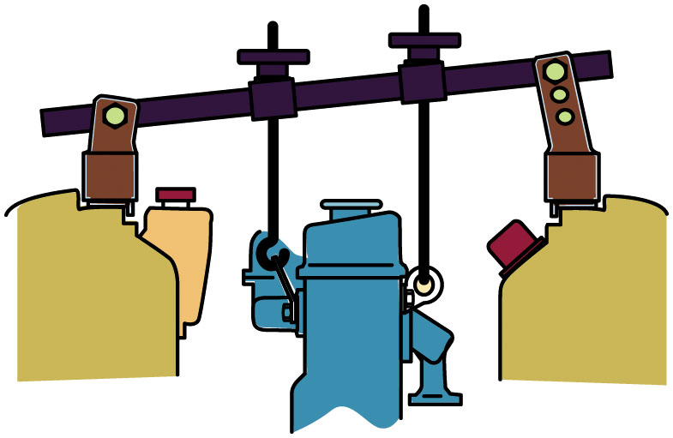
Figure 8.6
F W D Engine Support
Tools Needed
Transmission jack
Tall safety stand to support vehicle or engine
Engine support fixture must be used to support and move unit in and out
Most front-wheel-drive (F W D) vehicles require the use of a fixture to support the engine before removing the transaxle.
Notes:
Long Description:
The illustration has a horizontal stand at the top. An engine support tool is attached to the stand in the center with the help of bolts.

Slide 15
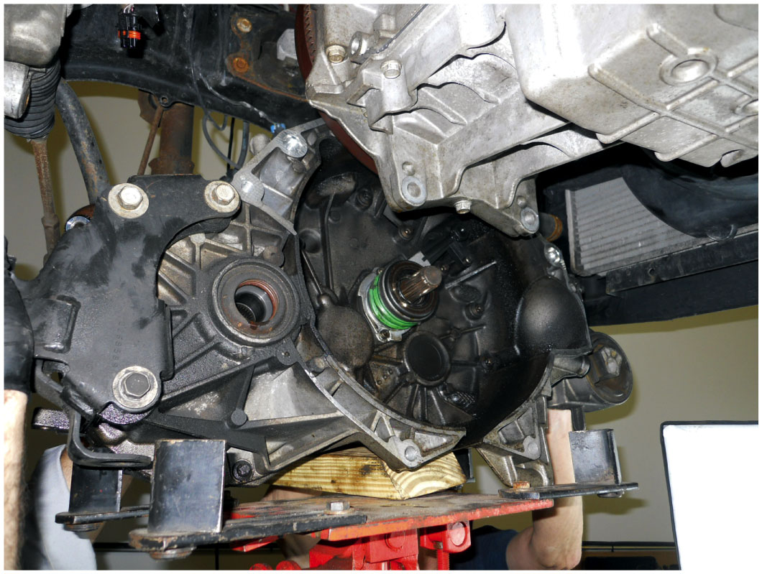
Figure 8.7
Transaxle Removal
Position A Transmission Jack
Support transaxle,
Remove any mounts or supports,
Carefully lower it from vehicle.
A transaxle being removed from underneath a vehicle and being supported by a transmission jack.

Slide 16
Transaxle/Transmission Removal (2 of 3)
Raise, securely support vehicle on hoist or jack stands
Drain transaxle oil and install second guide pin.
How does transaxle get installed?
Transmission Removal/Replacement
Disconnect negative (−) battery cable.
Raise and securely support vehicle.
Drain fluid.
Notes:
See pages 98-99 of the text for the answer

Slide 17
Transaxle/Transmission Removal (3 of 3)
Remove:
Backup light wires, speedo cable or speed sensor
Hose or cable brackets attached to the vehicle, and the shift linkage.
Remove transmission bolts.
Remove transmission-to-clutch housing or transmission-to-engine bolts.
Lower unit out of vehicle
Notes:
See Pages 99-100 for transmission removal and installation

Slide 18
Animation: Manual Transmission, Remove & Replace (Animation will automatically start)

Slide 19
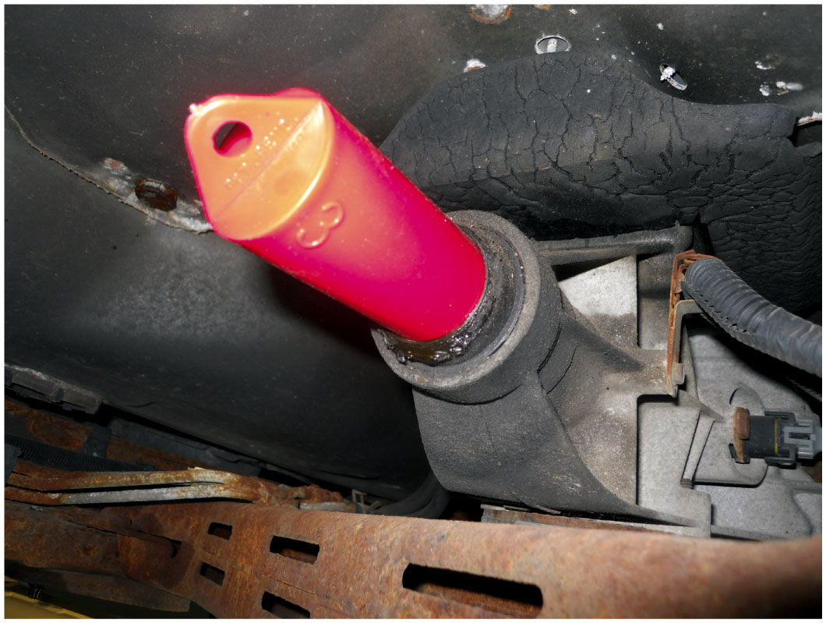
Figure 8.8
Tail Shaft Plug
A tail shaft housing plug is being used to help keep the transmission fluid from leaking as the transmission is being removed from the vehicle.

Slide 20
Transaxle/Transmission Overhaul (1 of 3)
Typical Procedure
Disassembly of unit
Clean and identify unit
Gear and bearing inspection
Reconditioning of subassemblies
Checking gear end float
Unit is reassembled
What wear items should be checked? Page 99
Notes:
The exact procedure for carrying out each of these steps will vary depending on the make and model. It is highly recommended that the procedure specified in service information be followed along with the clearances and torque specifications.
The following wear items are normally checked during disassembly:
■ The internal shift linkages for rough operation and wear
■ Clearance between all shift forks and sleeves
■ All shafts for excessive end play and rough operation
■ All floating gears for excess end float or rough rotation
■ All blocker rings for free motion and excessive or insufficient clearance or damaged lining
■ broken teeth

Slide 21
Transaxle/Transmission Overhaul (2 of 3)
What is included in a typical transmission/transaxle kit?
See Page 100 of the text & next slide
Transaxle Disassembly
Install holding fixture
Remove drain plug and check fluid
On some transaxles, differential bearing retainer, extension housing, and differential are removed first.
On some transaxles, disassembly begins with removal of left side case cover, fifth-gear synchronizer assembly, and fifth counter gear.

Slide 22
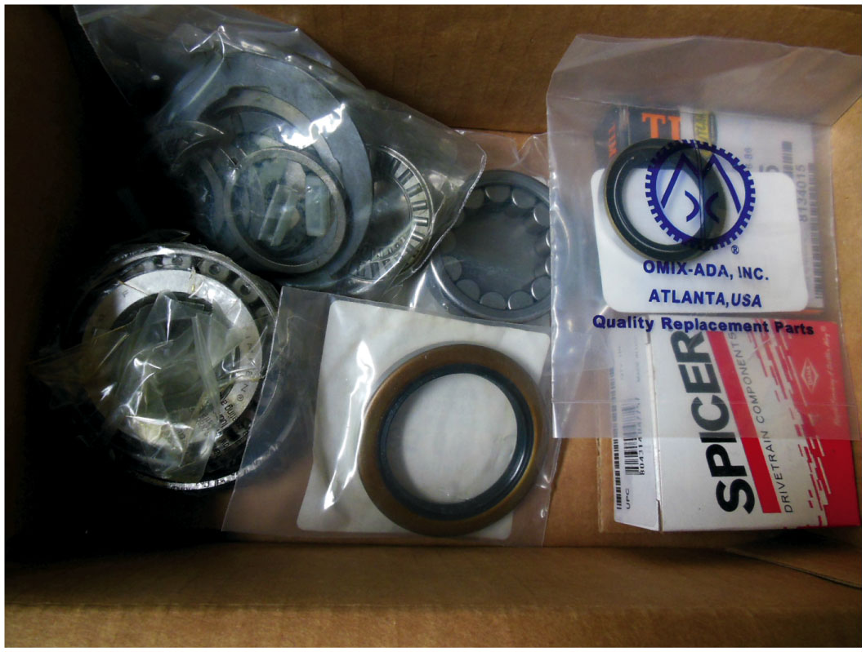
Figure 8.9
Service Parts Kit
A service parts kit for a Borg-Warner T 5 manual transmission which includes bearings, seals, and snap rings.
Notes:
A transmission/transaxle kit is recommended for every transmission/transaxle overhaul. These kits contain most of the normal wear items but not any hard parts. A typical kit includes the following items:
■ New snap rings
■ Thrust washers
■ Slingers
■ Synchronizer rings
■ Synchronizer springs
■ Special clips
■ Bushings
■ Roller bearings
■ Gaskets and seals
■ Strut keys
Long Description:
The kit includes circular bearings, rings, and various seals. Some parts are labeled Omix-Ada, Incorporated, Atlanta, U S A, quality replacement parts.

Slide 23
Transaxle/Transmission Overhaul (3 of 3)
Service Information Specifies Disassembly Begin With
Removal of backup light switch, reverse idler shaft retaining bolt, detent plunger retaining screw, interlock sleeve retaining pin, and fill plug.
Remove case-to-clutch housing or end-cover-to-case attachment bolts.
Remove shift mechanism, reverse idler gear, shaft
Remove input and main shaft
Remove ring gear and differential assembly

Slide 24
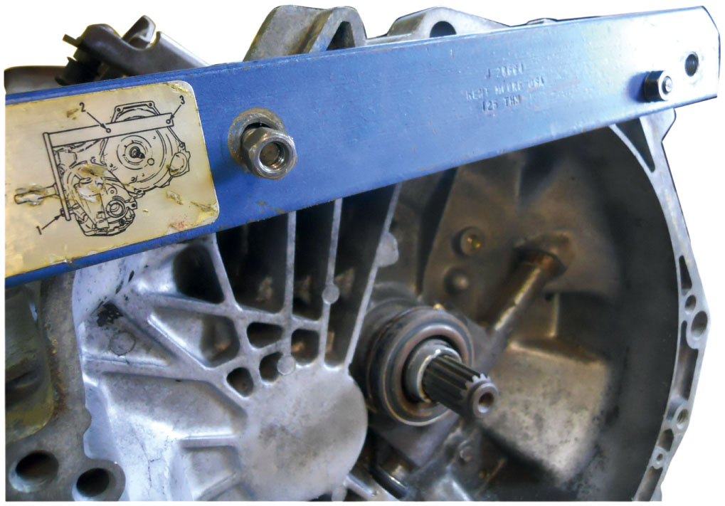
Figure 8.10
Holding Fixture
Step 1 Install Holding Fixture
Step 2, Page 100
Step 3, Page 100
Step 4, Page 100
Using a holding fixture is a great way to support the transaxle during disassembly and reassembly.
Notes:
STEP 2 Remove the drain plug, and check the quantity and condition of the fluid. Also, remove the fill plug to ensure that it is not seized or has damaged threads.
STEP 3 In some transaxles, the differential bearing retainer, extension housing, and differential are removed first. In some others, the disassembly begins with the removal of the left-side case cover, fifth-gear synchronizer assembly, and the fifth counter gear. Sometimes service information specifies that the disassembly begin with the removal of the backup light switch, reverse idler shaft retaining bolt, detent plunger retaining screw, interlock sleeve retaining pin, and fill plug.
STEP 4 Remove the case-to-clutch housing or end-cover-to- case attachment bolts. As these bolts are removed, note their length so that they can be replaced in the proper location. It will usually be necessary to tap the case with a plastic hammer or pry upward using a small prybar to break the seal between the two parts. If using a prying tool, try not to scratch the sealing surfaces, Figure 8.11.

Slide 25
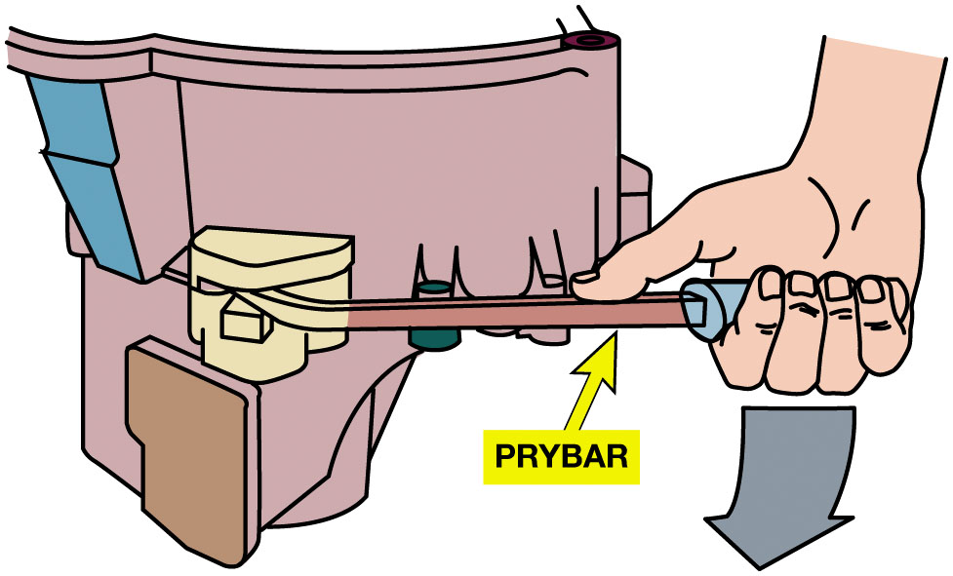
Figure 8.11
Case Pry Points
It will be necessary to tap
Case with plastic hammer or pry upward
With Small prybar to break seal between two parts
If using prying tool, try not to scratch sealing surfaces.
Most transaxles use formed-in-place gaskets that tend to glue the case and covers together. This unit has a slot to allow prying without damaging the gasket surfaces.
Notes:
STEP 5 After removing the cover, remove the shift mechanism, the reverse idler gear, and its shaft, if necessary.
STEP 6 Remove the input and main shaft assemblies together, holding them so that the gears stay in mesh until the shafts leave their bearings.
STEP 7 Remove the ring gear and differential assembly, See Figure 8.12
Long Description:
The illustration has a case on the left. On the right, a right hand holds a pry bar from the right to the left. The front end of the pry bar is fixed in the case to break the seal between the two parts.

Slide 26
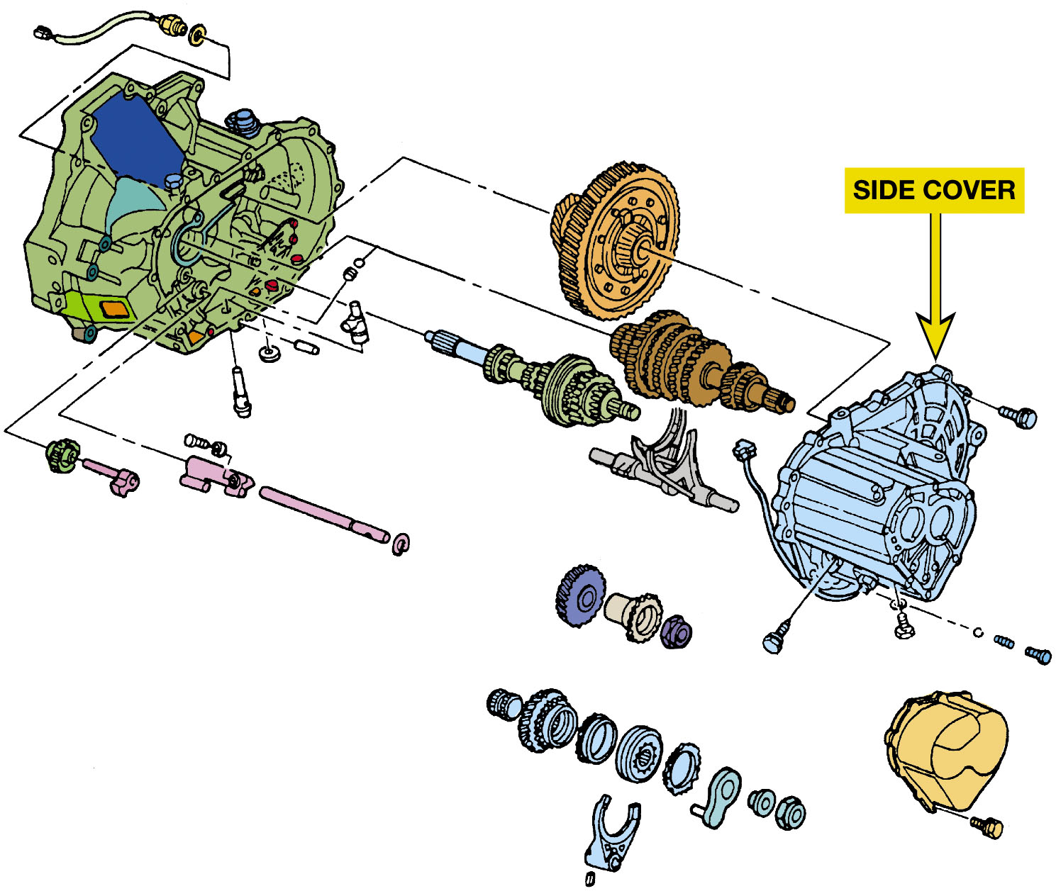
Figure 8.12
Removing Side Cover
Removing the side cover allows access to the shift forks and differential assembly.
Notes:
Long Description:
The illustration has the assembly on the left and a side cover on the right. In the center, it has shift forks, bearings, and various ring gears.

Slide 27
Transmission Disassembly (1 of 3)
What is procedure to disassemble a typical transmission?
See Page 101 to 103
Parts cleaning
Check debris attached to magnet
Cleanup
Gear inspection
Sometimes damage is easy to locate; a close inspection is necessary
Notes:
STEP 1 Clean and identify the unit so that the correct parts and specifications can be found. Figure 8.13.
STEP 2 Remove drain plug and check quantity and condition of fluid. See Figure 8.14
STEP 3 Remove case cover or case cover with shift mechanism. On some units, it is necessary to disconnect the shift shaft in the extension housing, remove the extension housing, and then remove the case cover and shift mechanism.
STEP 4 On units that use tapered roller bearings, remove shims and bearing cup. The input shaft/main drive gear can now be removed.
STEP 5 Remove extension housing. Countershaft extension with the fifth and sixth drive gears and the synchronizer assembly along with the shift fork can now be removed.
STEP 6 Remove the rear bearing and then remove the main shaft assembly. This usually involves using a puller to remove a ball bearing or sliding the cup of a tapered roller bearing out of the case and then moving the main shaft forward, upward, and out of the case.
STEP 7 Remove the cluster gear and countershaft. On one-piece tapered roller bearing units, remove the rear bearing retainer and slide the countershaft to the rear of the case to remove the rear bearing cup, then move the shafts forward and upward for removal see Figure 8.15.
STEP 8 Locate and remove the reverse idler gear shaft locking device, and remove the shaft, gear, and any thrust washers or O-rings. In some units, the idler gear shaft must be driven out using a long tapered punch. In other units, the idler gear shaft must be
pressed out.

Slide 28
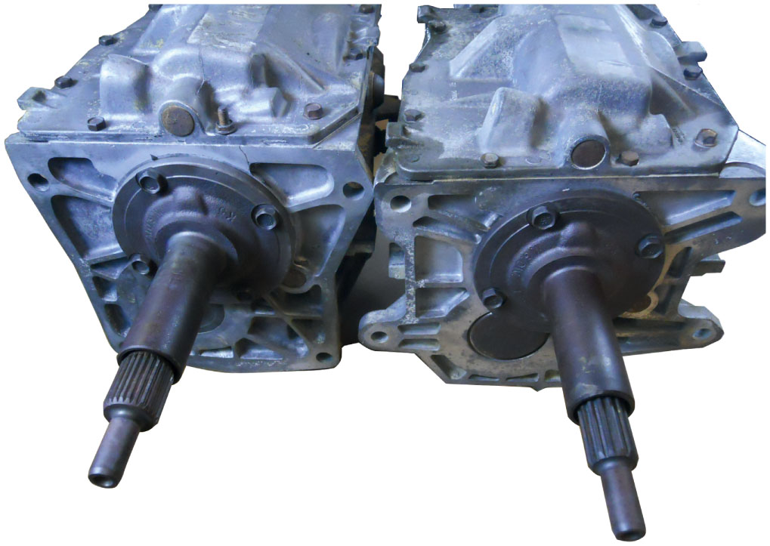
Figure 8.13
Unit Identification
The Borg-Warner T 5 five-speed manual transmission is used in many makes and models of vehicles and they vary with the number of splines for either the input shaft or output shaft or both.

Slide 29
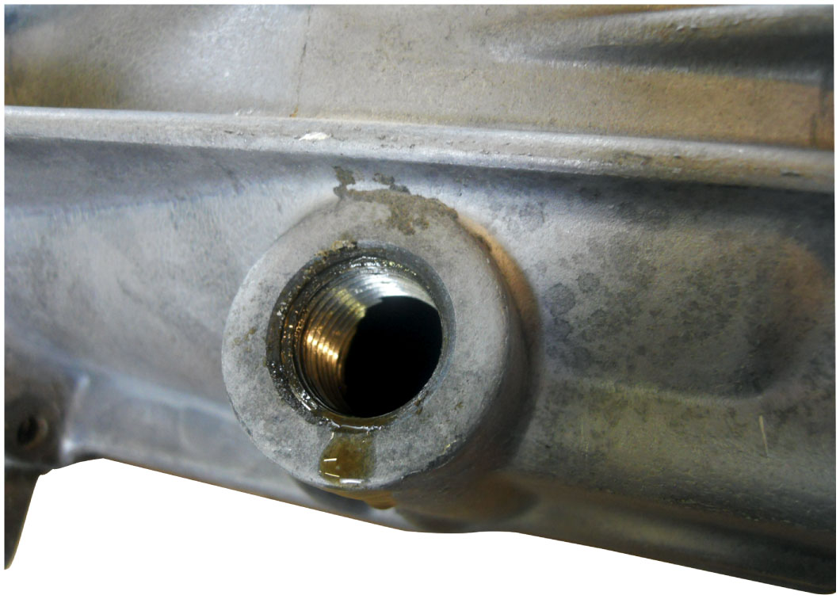
Figure 8.14
Draining Fluid
Drain the fluid into a suitable container and dispose of the old fluid according to local, state, and federal regulations.

Slide 30
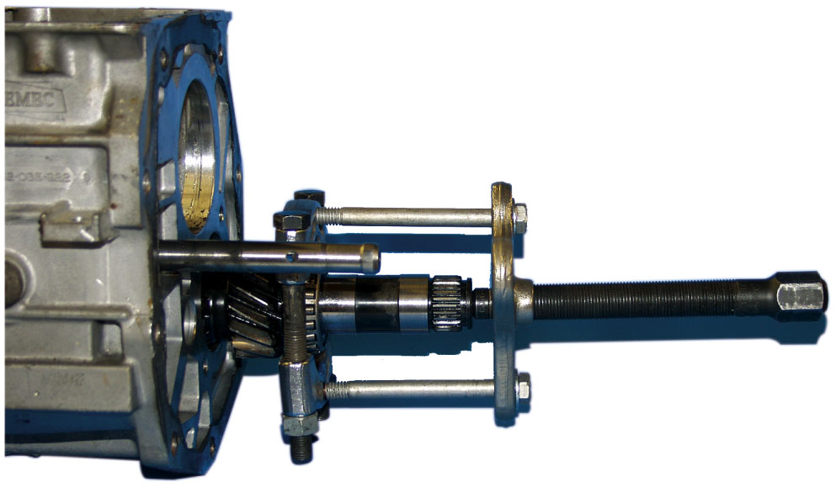
Figure 8.15
Bearing/Gear Puller
A rear bearing being removed using a gear/bearing puller.

Slide 31
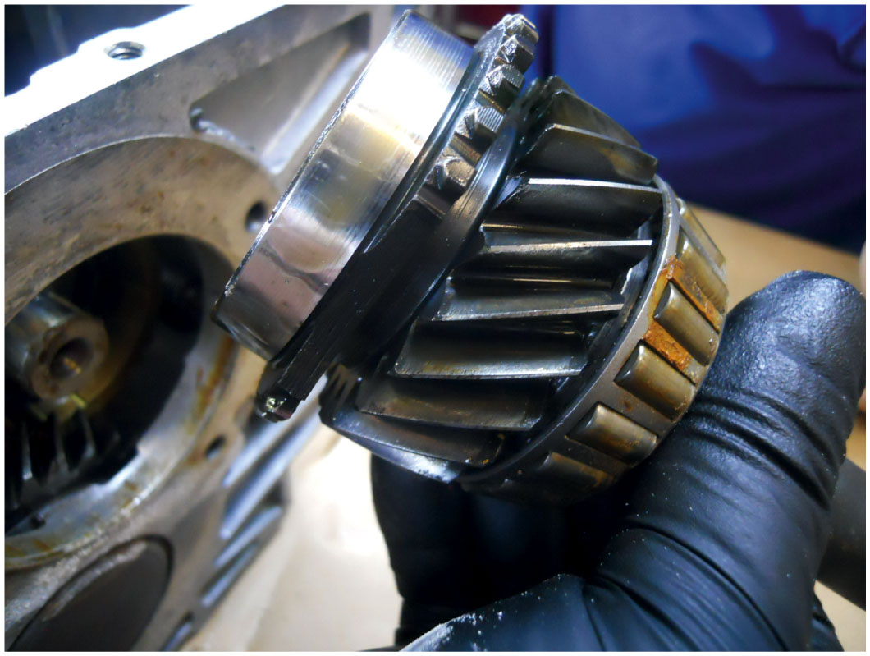
Figure 8.16
Gear Inspection
Visually check the condition of all gears and bearings.
Notes:
Gear Inspection
In some cases, gear damage is quite obvious and easy to locate. With other gears, however, a close
inspection is necessary to determine if there is a problem with the teeth or thrust or bearing
surfaces. See Figure 8.16.

Slide 32
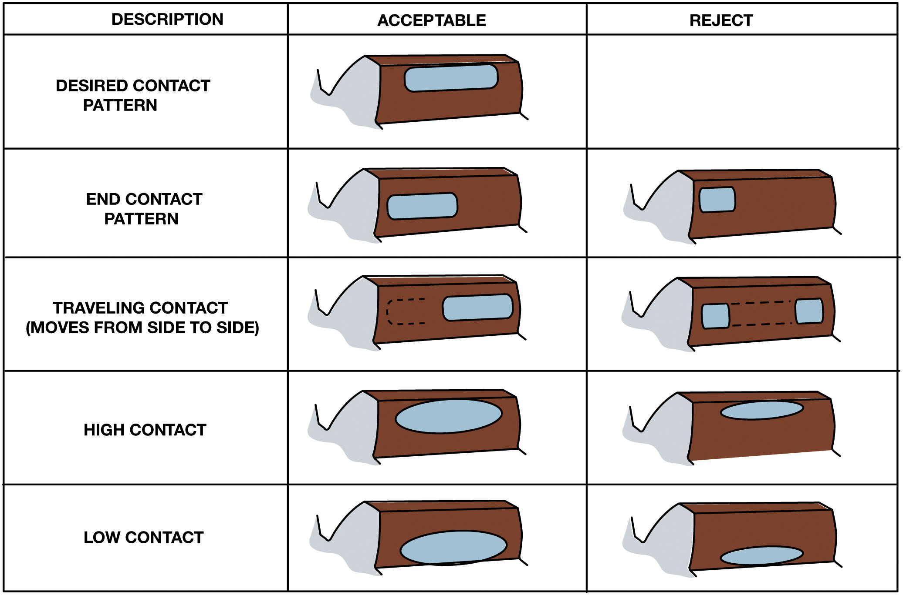
Figure 8.17
Gear Wear Patterns
Worn gears will often show a contact pattern on close inspection. Good and bad patterns are shown.
Notes:
NOTE: If one gear of a set has a broken tooth, be aware that a tooth on the mating gear encountered
the same load and is probably damaged. The broken gear and its mate are replaced as a set.
Tech Tip: Reuse Old or Replace?
A technician often has to decide whether to reuse or replace slightly worn or damaged parts. Some cluster gears, for example, are very expensive, and replacement can raise the cost of a rebuild significantly. Normally, chips that do not extend into contact area do not require gear replacement. They can, however, cause a slight noise or be the base of a stress crack or further chipping. Small burrs and chips can be removed or blended into gear surface using a high-speed grinder with a small abrasive stone. Worn, rounded, or burred clutching teeth can also be corrected by grinding.
Long Description:
The table has three columns and five rows. The column headers from the left to the right are as follows: description, acceptable, and reject. All the patterns have a toe at the bottom, a heel on the top, and drive and coast on the sides. The row entries from the left to the right are as follows. Row 1: description, desired contact pattern; acceptable. Row 2: description, end contact pattern; acceptable; reject. Row 3: description, traveling contact (moves from side to side); acceptable; reject. Row 4: description, high contact; acceptable; reject. Row 5: description, low contact; acceptable; reject.

Slide 33
Transmission Disassembly (2 of 3)
Bearing Inspection
Normally done by sight, feel, and sound
Brinelling; Contamination; Electric arcing; Fretting; Misalignment; Peeling; Seizing; Spalling
Bearing Removal & Installation
Inner races of bearing are often pressed onto shaft
Pressing force should be transmitted to inner race.
Main shaft disassembly
What are steps to disassemble a main shaft?
Pages 101-102
Notes:
Bearing Inspection
Immediately after cleaning an antifriction (ball, roller, or needle) bearing, it should be dipped in a clean, lightweight lubricant and covered to keep it clean and dust free. Inspection of a bearing is normally done by sight, feel, and sound. Visual inspection of a worn bearing can reveal a broken cage or pitted races. ● Figure 8.18.
Bearing damage occurs in many forms. The terms commonly used to describe bearing damage are as follows:
■ Brinelling: a series of indentations pressed or worn into a race
■ Contamination: scratches, pitting, or scoring in a scattered pattern on the ball or roller surfaces
■ Electric arcing: a series of small burn marks or grooves across the raceways
■ Fretting: small particles that decay and break off the bearing races
■ Seizing: caused when balls or rollers fail to roll and this causes damage to cage and end of rollers with evidence of excessive heat
■ Spalling: an advanced stage of decay with flaking away from the bearing race

Slide 34
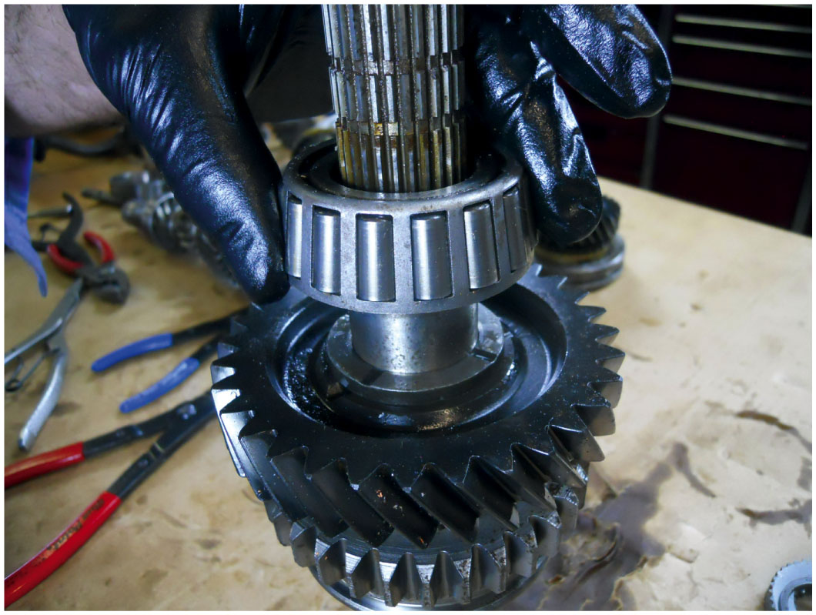
Figure 8.18
Bearing Inspection
Carefully inspect all bearings before reassembling the unit. If one is worn or damaged, then many experts recommend that all of the bearings be replaced because they all share the same lubricating oil and any wear metal will be thrown throughout the assembly.
Notes:
Tech Tip: Bearing Checks
Holding the bearing in a vertical position by the outer race while spinning the inner race by hand allows damage to be felt or heard. Many technicians place the shaft inside the inner race, giving it a slight load and a much better turning handle. The weight of the shaft also makes any bearing problem more evident.
Tech Tip: Bearing Failure? Check the Body Grounds
Premature bearing failure that results in a pitted bearing can be caused by poor electrical grounds. The pits are often completely around the bearing races. Current flow for the electrical systems must return to battery ground. Poor engine ground straps will force this current to pass through the transmission and across the bearings, and this can cause an arc at the bearing races. If arcing of bearings is discovered, check and repair the factory ground wiring and connections at the body, engine block, and the transmission/transaxle itself.

Slide 35
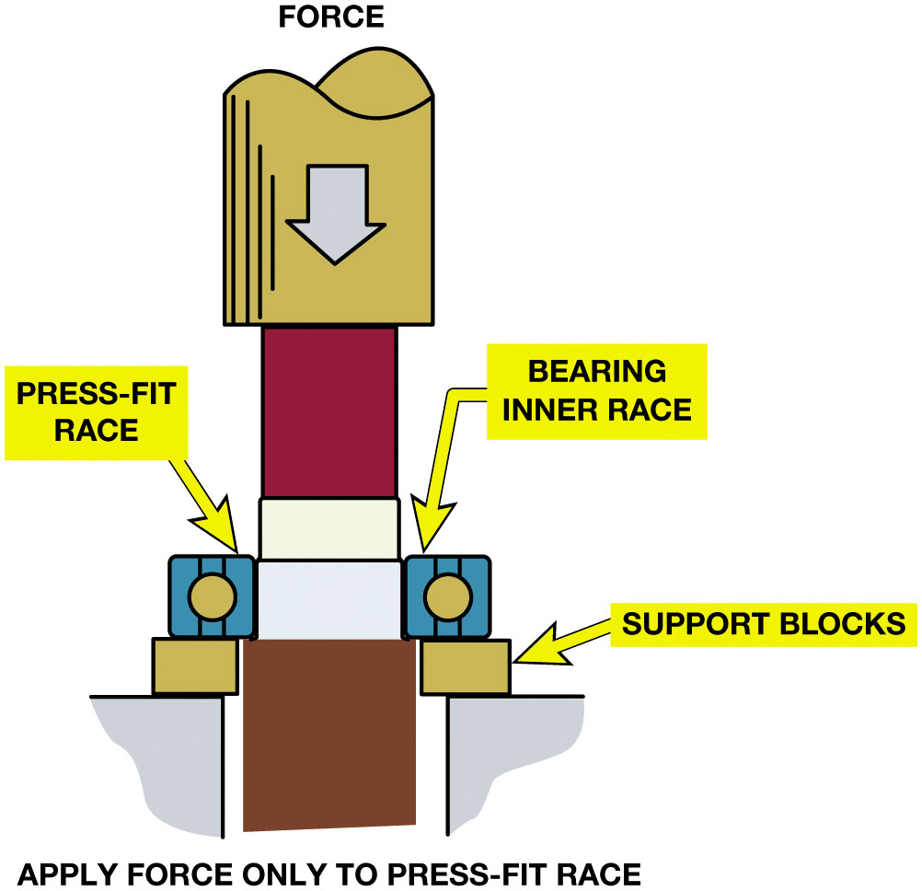
Figure 8.19
Bearing Installation
Pressing Force
Transmitted
Only To Inner Race
When a ball bearing is pressed off a shaft, the bearing should be supported by the inner race (if possible) so the force is not exerted on the outer race by the balls.
Notes:
Bearing Installation
The inner races of bearing are often pressed onto the shaft and the pressing force should be transmitted only to the inner race. Figure 8.19.
Tech Tip: Heat or Cool for Best Results
When installing a tight-fitting bearing over a shaft, heat the bearing in an oven or hot oil. A temperature of 300° to 400°F (150° to 200°C)
will expand the bearing about 0.001 inch per inch of bearing diameter. If the external part cannot be heated, sometimes the internal part can be cooled to make it smaller. Parts can be chilled by placing them in a freezer or immersing them in a container with dry ice and acetone. Either of these methods can change a press fit into a slip fit.
Long Description:
The illustration has a vertical shaft in the center. The shaft has a force with a downward arrow on the top. On both sides, two structures are at the bottom. Above the structures are the support blocks. On the left, a block labeled press-fit race is attached above the support block. On the right, a block labeled bearing inner race is attached above the support block. At the bottom of the illustration, the text reads apply force only to press-fit race.

Slide 36
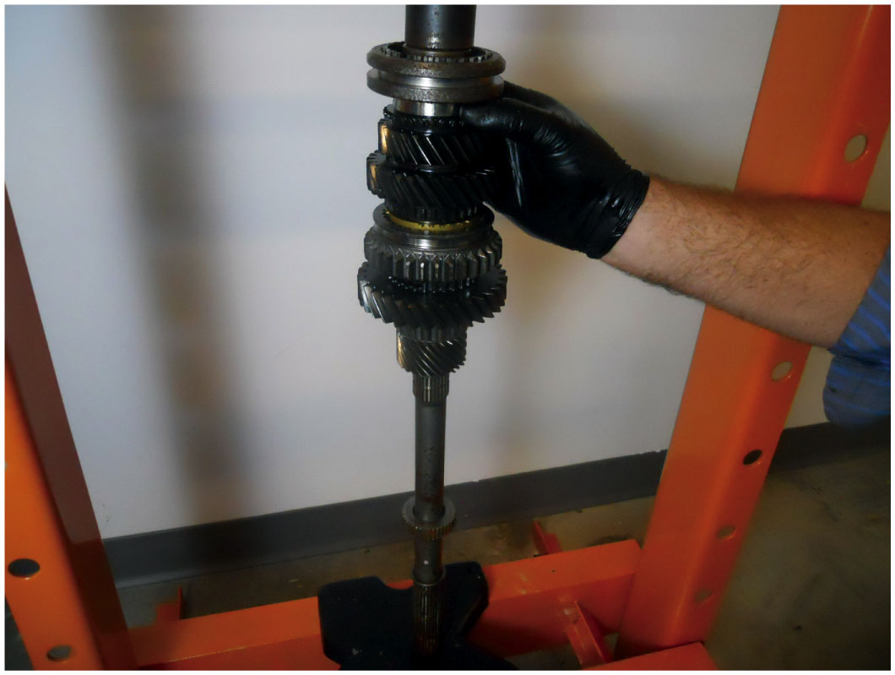
Figure 8.20
Main Shaft Assembly
Use caution when pressing parts onto the main shaft. Always follow the specified assembly procedures as found in service information.

Slide 37
Transmission Disassembly (3 of 3)
Synchronizer disassembly, inspection, and reassembly
What are steps for reassembling a synchronizer?
See Pages 105-106 of text
Blocker Ring Inspection
Cone surface should be smooth and polished
Main Shaft Reassembly
What are steps to reassemble a main shaft?
Page 106-107 of text
Notes:
Tech Tip: Take a Photo Before Disassembling
Many technicians have learned that it is helpful to have a photo available of a part that is together before it is disassembled. Take a photo of the main shaft with a phone or camera to use just in case it is needed to insure proper assembly.

Slide 38
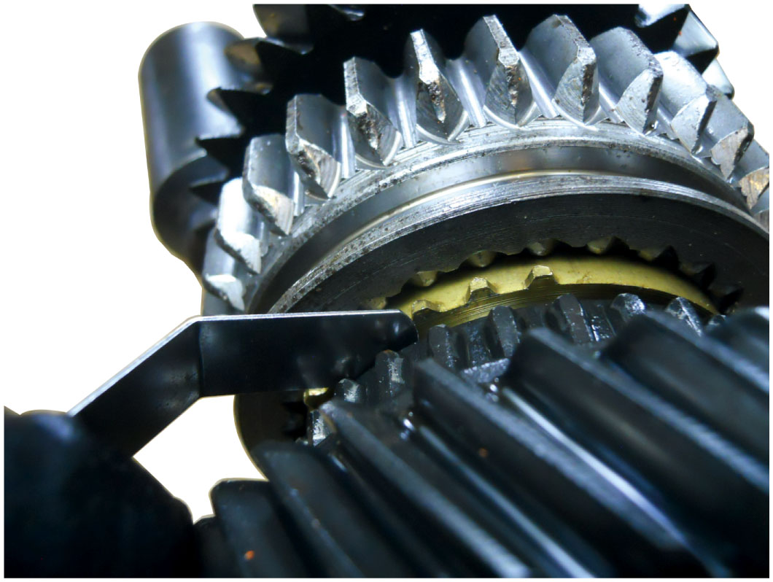
Figure 8.21
Blocker Ring Clearance
When the cone is pushed against the gear, there should be a minimum amount of clearance between the blocker ring and gear clutching teeth. Use a feeler gauge to determine this measurement.

Slide 39
Animation: Check Blocker Ring Clearance (Animation will automatically start)

Slide 40
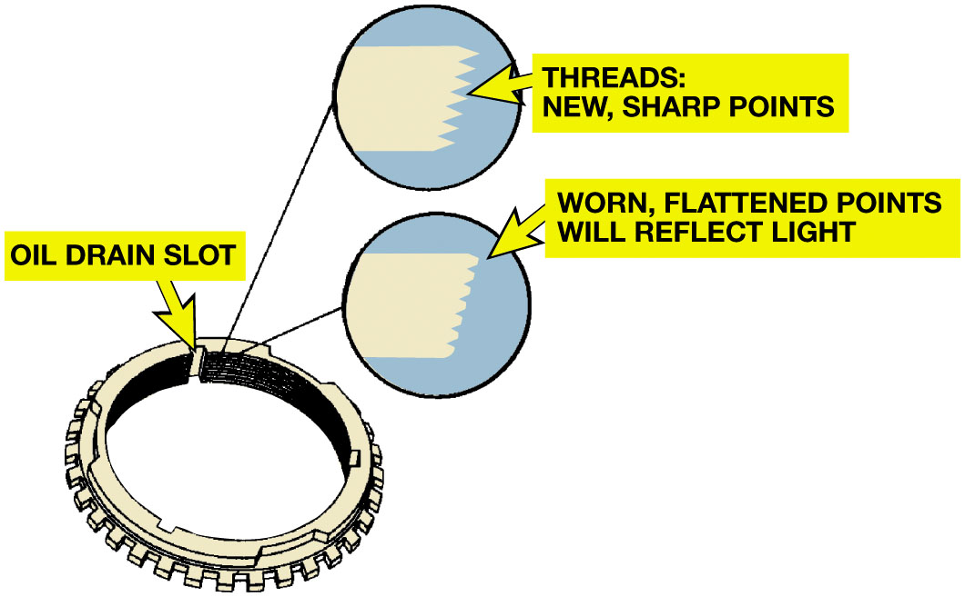
Figure 8.22
Checking Grooves
The thread-like grooves of a new blocker ring are sharp so that they cut through the lubrication film. They become flattened as they wear, and the flat edges will reflect light.
Notes:
Tech Tip: Blocker Ring Inspection Tips
A good metal blocker ring will have a thread-like inner surface with the threads coming to a sharp point; the edges will not reflect light. A worn blocker ring will have flattened rings around the inner surface.
Figure 8.22.
After a quick visual check for damage, a technician will drop a metal blocker ring onto a bench top from a short distance. A good blocker ring will make a bell-like ringing noise, whereas a cracked or broken ring will make a dull, flat sound. Paper-lined and composite blocker rings should be checked for glazing of the friction surface and discoloration, which often indicates glazing.
Long Description:
The ring is circular and has teeth on the outer boundary. On the inner side are oil drain slots. Beside the drain slot are horizontal threads. The top right side has two enlarged illustrations of the threads. The upper illustration has a circle in which the right ends of the thread are conical. The threads are new and have sharp points. The lower illustration has a circle in which the ends of the thread are worn and flattened points. The points will reflect light.

Slide 41
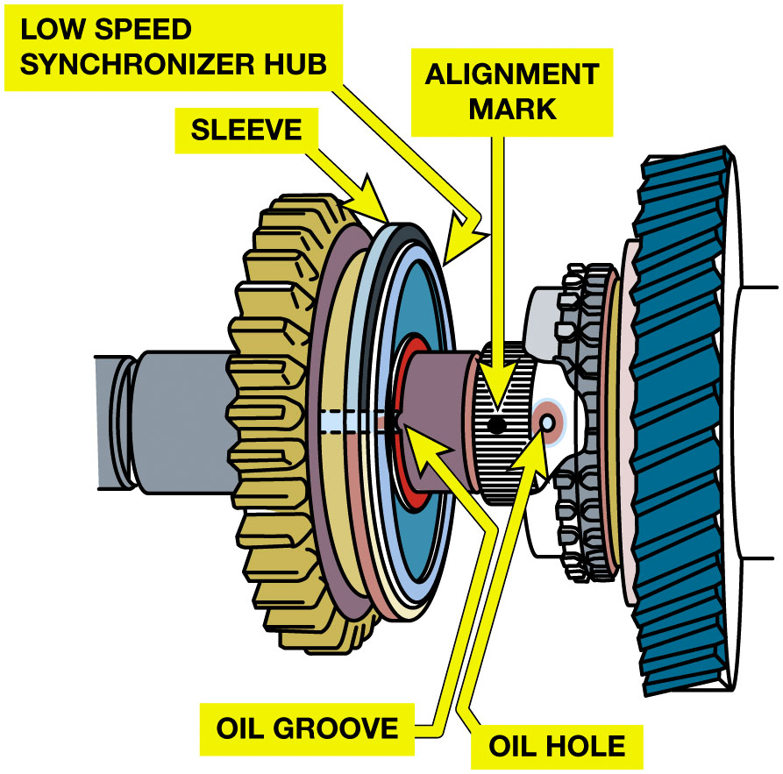
Figure 8.23
Main Shaft Assembly
Some synchronizer hubs
Have oiling grooves
Must be aligned with
Oil hole in shaft
This synchronizer hub has an oil groove that must be aligned with the oil hole in the main shaft during assembly.
Notes:
To reassemble a main shaft, perform the following steps:
STEP 1 Place the first gear to be installed (with its sleeve, bushing, or bearing, if used) onto main shaft along with its blocker ring. Set the synchronizer assembly in place, making sure that it is facing the proper direction. Turn the main shaft so that the gear is above the
synchronizer, align the blocker ring so that its notches engage the inserts, and shift the synchronizer sleeve to engage the gear’s clutching teeth to keep the blocker ring aligned. Some synchronizer hubs have oiling grooves that must be aligned with an oil hole in the shaft. Figure 8.23.

Slide 42
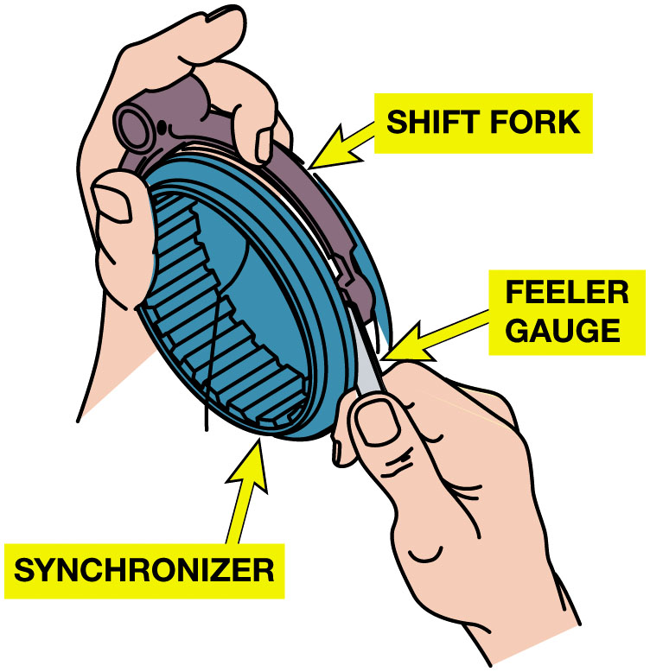
Figure 8.24
Fork Clearance
Shift Forks:
inspect for
Distortion, bends, cracks, broken or worn inserts, step wear
Both sleeve
Cam contact areas
There should be a specified clearance, usually about 0.030 inch (0.8 mm), between the fork and the groove in the sleeve. Excess clearance indicates a worn fork or groove.
Notes:
Long Description:
The illustration has a circular synchronizer in the front and a shift fork at the back. From the top, the left hand holds the shift fork and synchronizer. From the bottom, right hand holds the feeler gauge and insert the gauge between the fork and the groove.

Slide 43
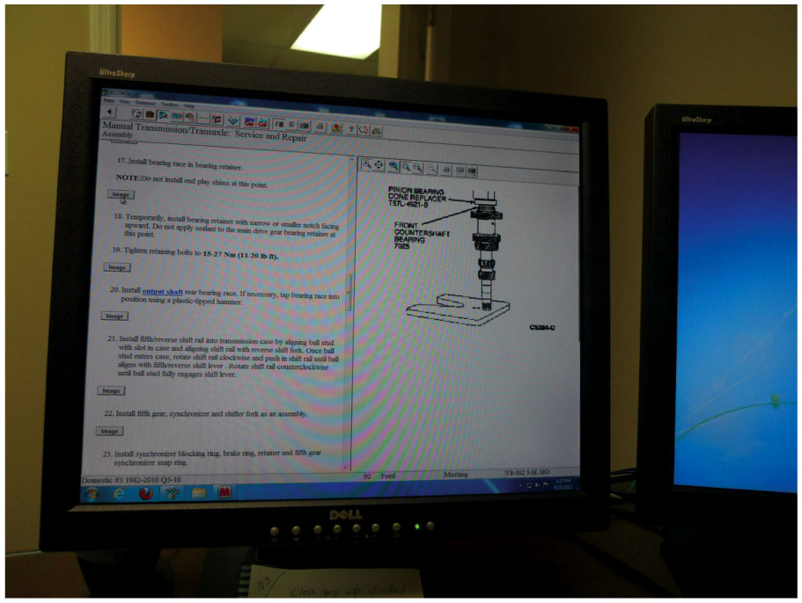
Figure 8.25
Service Information
Having service information readily available is important so that each step can be checked as the unit is being reassembled.
Notes:
Long Description:
The screen has an all data window with minimize, maximize, and close buttons on the top right. At the top, the bar has options for data, view, database, toolbar, and help. Below the bar is a heading, manual transmission or transaxle service and repair assembly. Below the heading, the points from top to bottom are as follows. 17. Install bearing race in bearing retainer. Note: do not install end play shims at this point. Image button. 18. Temporarily, install bearing retainer with narrow or smaller notch facing upward. Do not apply sealant to the main drive gear bearing retainer at this point. 19. Tighten retaining bolts to 15-27 N m. Image button. 20. Install output shaft rear bearing race. If necessary, tap bearing race into position using a plastic-tipped hammer. Image button. 21. Install fifth slash reverse shift rail into transmission case by aligning shift rail with reverse shift fork. Once ball stud enters case, rotate shift rail clockwise and push in shift rail until ball aligns with fifth slash reverse shift lever. Rotate shift rail counterclockwise until ball stud fully engages shift lever. Image button. 22. Install fifth gear, synchronizer, and shifter fork as an assembly. Image button. 23. Install synchronizer blocking ring, brake ring, retainer, and fifth gear synchronizer snap ring. On the right, a schematic of a shaft is given. The shaft has a pinion bearing cone replacer T S T L- 4621 B on the top and front countershaft bearing 7025 below it.

Slide 44
Shift Mechanism
Check Following During Visual Inspection:
Shift forks
Shift rails
Detent springs
Detent cam
Interlock plates
Selector plates
Reverse lockout mechanism/solenoid
Notes:
Each mechanism set contains a fork for each synchronizer sleeve or gear to be shifted, and each fork is mounted on a rail or lever that moves it through its travel. Each shifter includes one or more spring loaded detent balls or cams and some form of interlock that allows only one shift fork to move at a time.

Slide 45
Case and Covers (1 of 2)
Cleaning & Inspection
Should Be Thoroughly Cleaned And Carefully Checked
Seal Installation
Each shift shaft that passes through the case
1 or 2 output shaft seals and input shaft seal
End Play/Preload Checks
Steps to check and adjust bearing clearance/preload
On transaxle? See Pages 108-109
Notes:
Case Study: The Case of the Worn Shift Fork
A 2007 B M W 325 i (113,000 m i) had a problem of first-gear jump-out. The transmission was removed and rebuilt, and a new 1–2 guide sleeve and first gear was installed along with new transmission mounts and rubber shifter mounts. But, this did not fix the problem.
When the transmission was disassembled again, the shift fork was measured for wear. The shift fork measured at 0.145 to 0.170 inch, and the dimension of a new fork was 0.190 inch. Replacement of the fork fixed this transmission.
Summary:
Complaint—Customer complained that the transmission would jump out of first gear.
Cause—Worn shift fork.
Correction—A replacement shift fork corrected the customer concern.
Case Study: Find the Root Cause
The transmission in a Ford Explorer (150,000 m i) was rebuilt 5,000 miles ago. A damaged input shaft and all of the bearings were replaced using original equipment parts. The end play was adjusted as shown in Ford service information. This transmission was repaired before for same problem, a seized front bearing. It came back because of same problem. It was determined that the damage was caused by a fluid loss. The leak was through three loose rubber plugs at the back of the top cover. Replacement of the damaged input shaft bearing and the three rubber sealing plugs fixed this
problem.
Summary:
Complaint—Repeated bearing failure.
Cause—Leaking seals.
Correction—Replacement bearings and new seals corrected the root cause.

Slide 46
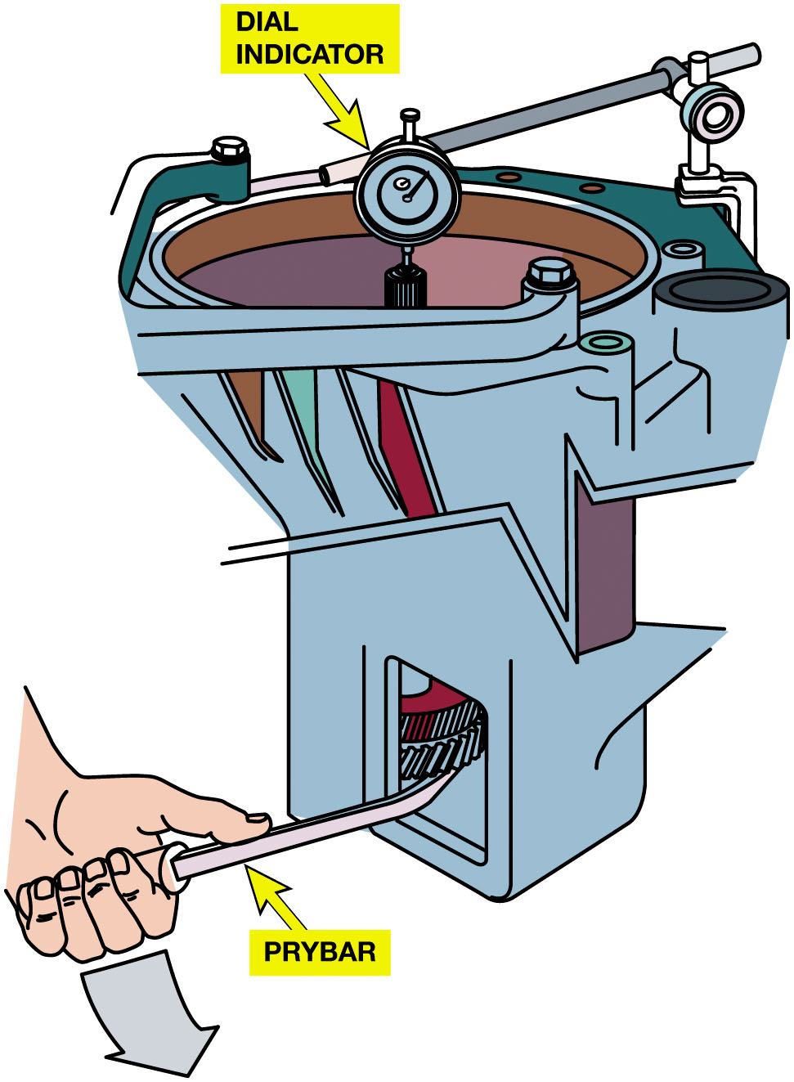
Figure 8.26
End Play
End Play
Free, lengthwise movement of shaft
Measured using dial indicator
or feeler gauge.
The dial indicator is set up to measure input shaft endplay as it is lifted and dropped using the prybar.
Notes:
Long Description:
The illustration has a transmission case with various parts. The case has a dial indicator, input shaft, shims, gears, and bearings. From the bottom, left hand holds a pry bar and insert into the machine. The hand lifts and drops the shaft with the help of a pry bar. The dial indicator displays the results.

Slide 47
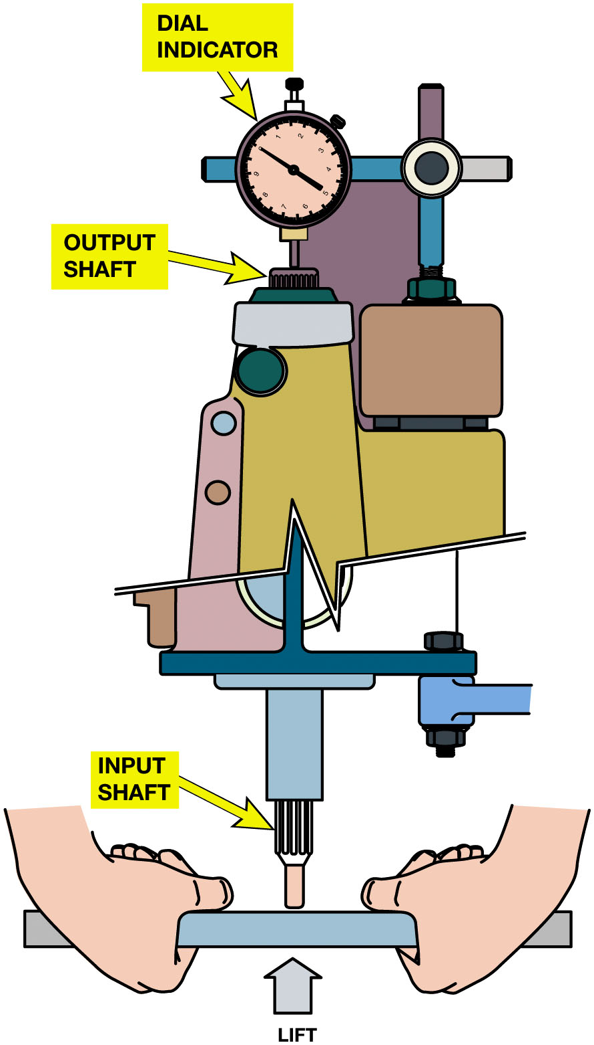
Figure 8.27
End Play Check
End Play
Cluster Gear
Lifted & Dropped
A dial indicator has been set up to measure the endplay that occurs as the cluster gear is lifted and dropped.
Notes:
Install a dial indicator with the indicating stylus at the end of and parallel to the shaft. Move the shaft up and down through its free travel several times while reading the end play or clearance on the dial indicator. Figure 8.27.
Long Description:
From the top to bottom, the illustration has a dial indicator, output shaft, and input shaft. At the bottom, two hands hold the cluster gear. Below the gear, an arrow labeled lift points upwards.

Slide 48
Case and Covers (2 of 2)
Case Sealants
Room-temperature vulcanizing (R T V)
Anaerobic sealants
Final Checks

Slide 49
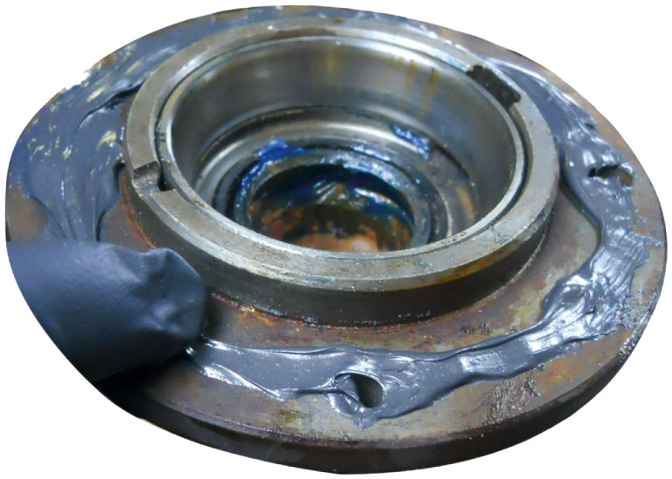
Figure 8.28
Anaerobic Sealant
When using R T V to seal a transmission/transaxle case, be sure to surround each bolt hole to help prevent leakage.
Notes:
Sealants
Most transaxles use formed-in-place gaskets (F I P G). These are usually of the following two types:
■ Room-temperature vulcanizing (R T V) liquid sealant. R T V is thick and very viscous as it comes out of the tube. Depending on temperature and humidity, it will set up to a rubber-like material in about 15 minutes.
■ Anaerobic sealants. Anaerobic sealants are quite fluid and set up after the parts are assembled. Anaerobic sealants cure in the absence of air. R T V sealants are commonly used on covers that are less than perfectly flat, or on slightly flexible materials that do not necessarily make perfect joints. To make a good seal, an anaerobic sealant requires a wider, flatter, more perfect surface
because it cures to a much thinner thickness than that of R T V. To make a good seal, both types of sealants require surfaces
that are clean and oil-free when they are applied. See Figure 8.28.

Slide 50
Question 1
“Rust dust” is an indication of what fault?
A. Broken blocker rings
B. Worn steel parts such as U-joints
C. A slipping clutch
D. Fluid leak

Slide 51
Answer 1
“Rust dust” is an indication of what fault?
B. Worn steel parts such as U-joints

Slide 52
Summary
Transmissions must have clean gear oil at proper level and type.
Improper operation determined using several diagnostic steps.
Internal transmission problems require that transmission
Be removed from vehicle.
Transmission and transaxle disassembly and reassembly
Varies between different makes and models.
Gears, bearings, synchronizer assemblies
Shift forks, and transaxle differentials are major wear components.
Notes:
Pages 111 to 116 contains a 16 step process for the overhaul of a manual transmission
Pages 117 to 119 contains an 18 step process for the overhaul of a manual transaxle

Slide 53
N V-1500 Transmission Removal & Installation Photo Sequence

Slide 54
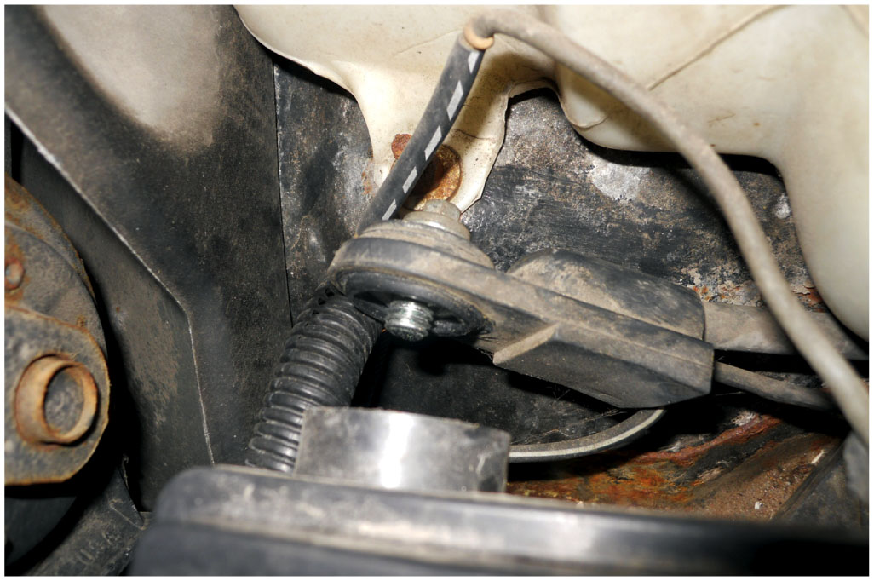
1. Start any transmission/transaxle removal procedure by disconnecting the negative battery cable

Slide 55
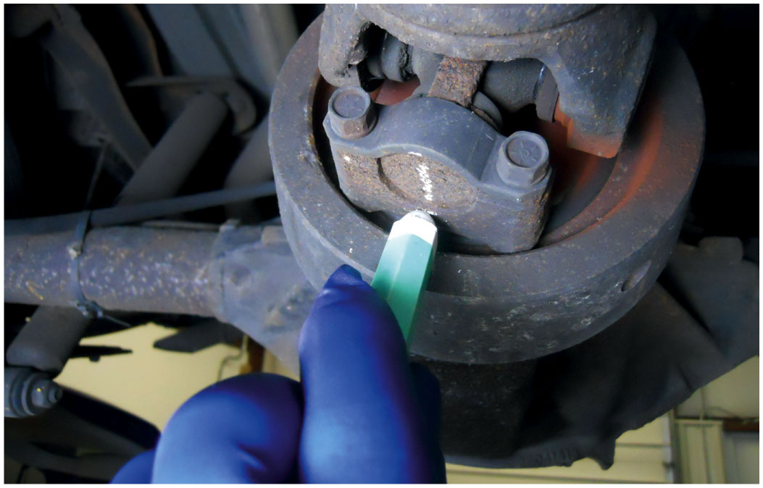
2. Mark the position of the driveshaft, then remove the driveshaft from underneath the vehicle

Slide 56
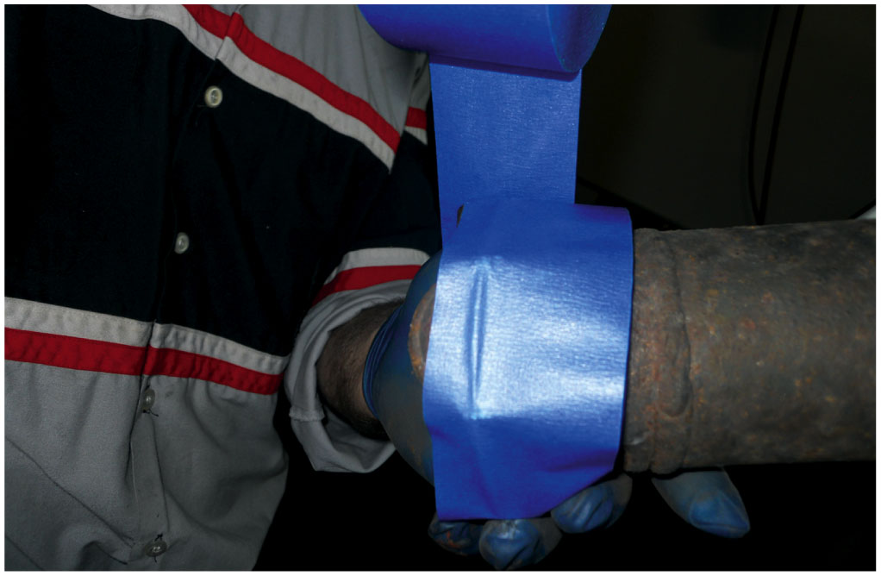
3. Use to tape or a rubber glove over the U-joint to keep the end caps from falling off and use a plug at the extension housing of the transmission to help keep transmission fluid from leaking

Slide 57
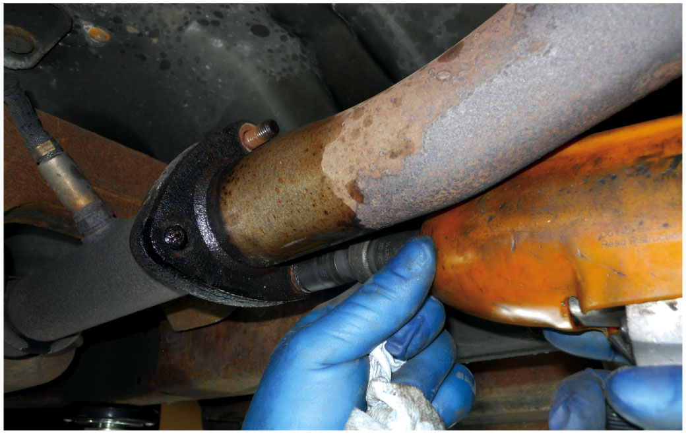
4. Removing the exhaust system was needed to be done to provide the clearance to remove the transmission

Slide 58
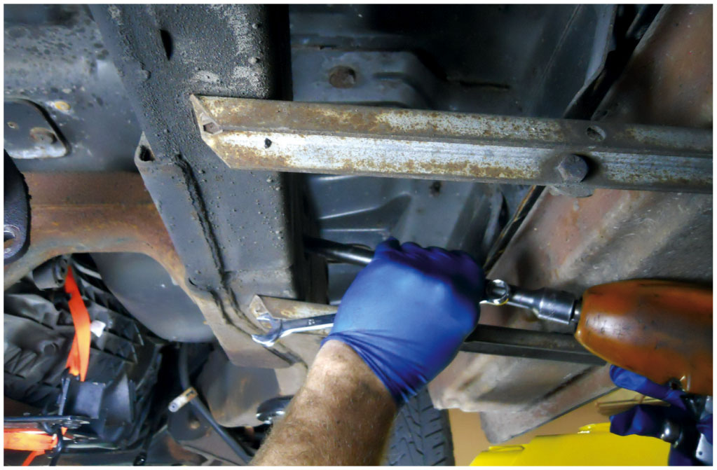
5. Removing the bolts for the rear cross member by using an impact and extension to get to the fasteners inside the frame rail

Slide 59
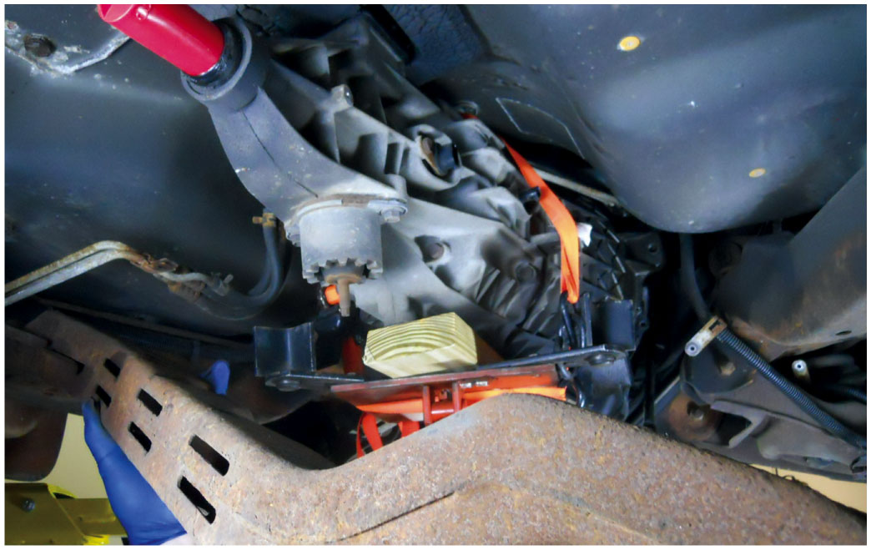
6. Removing the rear cross member but not before supporting the transmission with a transmission jack

Slide 60
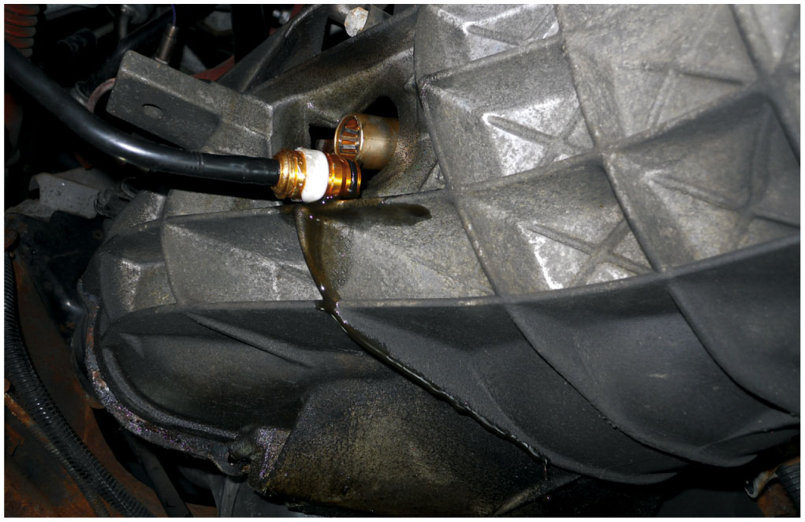
7. When the hydraulic clutch line was removed, hydraulic fluid (brake fluid) leaked out and into a catch pan

Slide 61
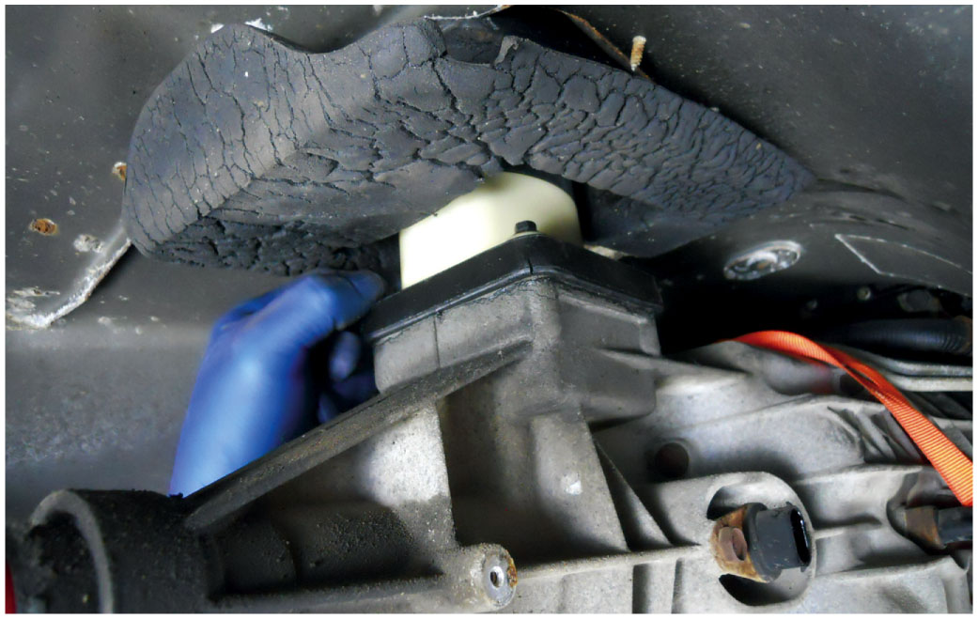
8. The transmission was lowered enough to disconnect the shifter from the transmission. This step helps save time by eliminating the need to remove the shifter and boot from inside the vehicle

Slide 62
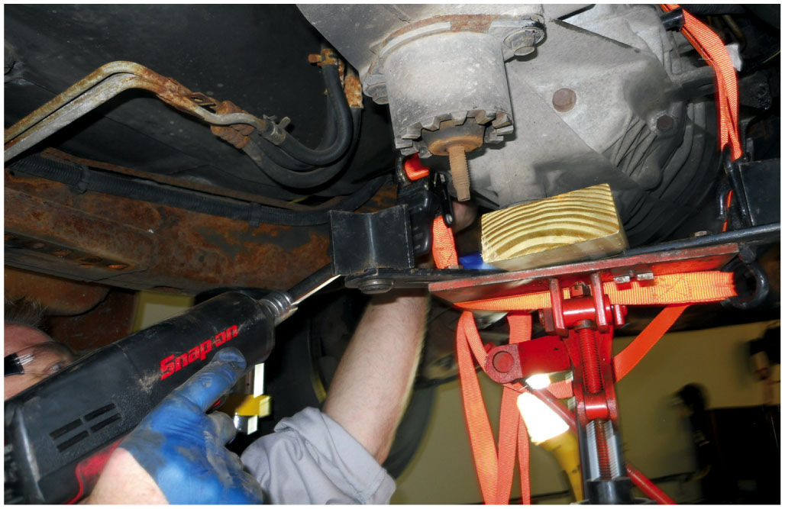
9. The bell housing bolts are removed using a long extension on the impact wrench

Slide 63
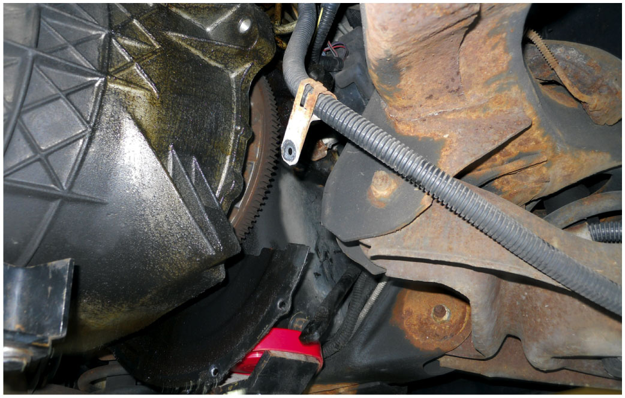
10. The engine is being supported by a tall safety stand as the transmission is being removed

Slide 64
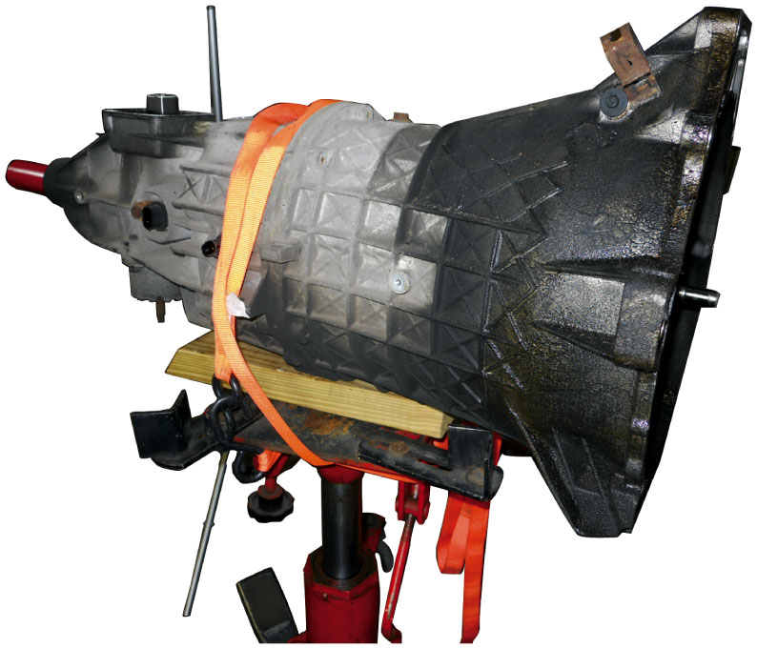
11. The transmission is lowered using the transmission jack and safety strap to help prevent it from falling off the jack

Slide 65
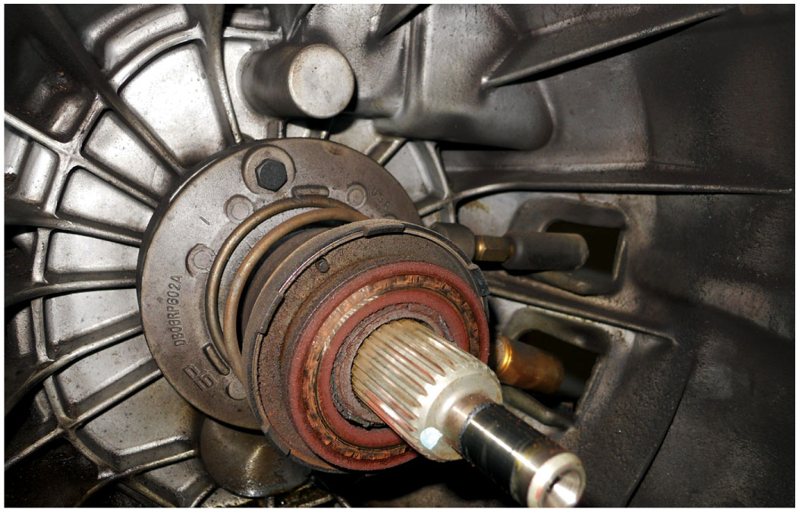
12. The original release bearing and clutch assembly is going to be replaced

Slide 66
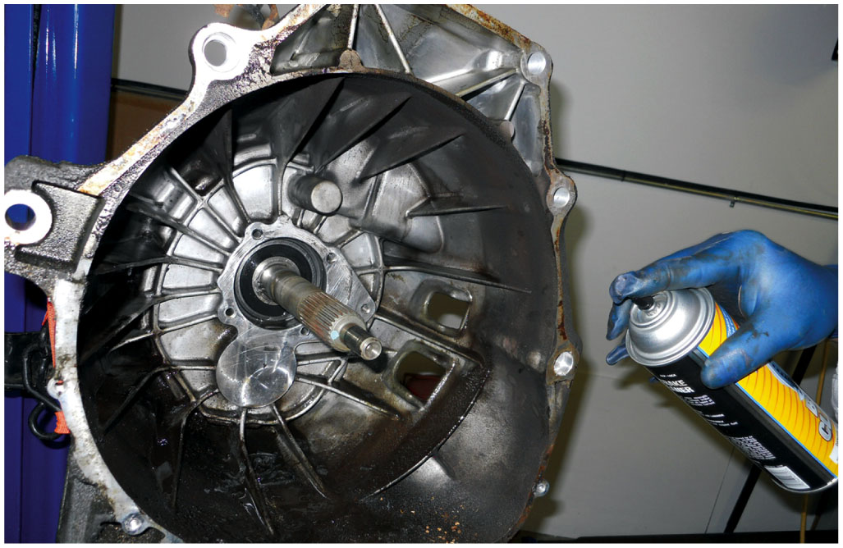
13. The bell housing area was cleaned after removing the release bearing

Slide 67
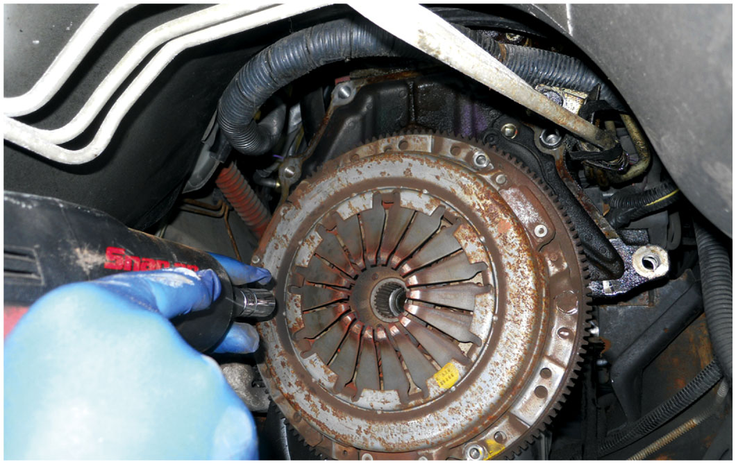
14. The old pressure plate being removed from the flywheel

Slide 68
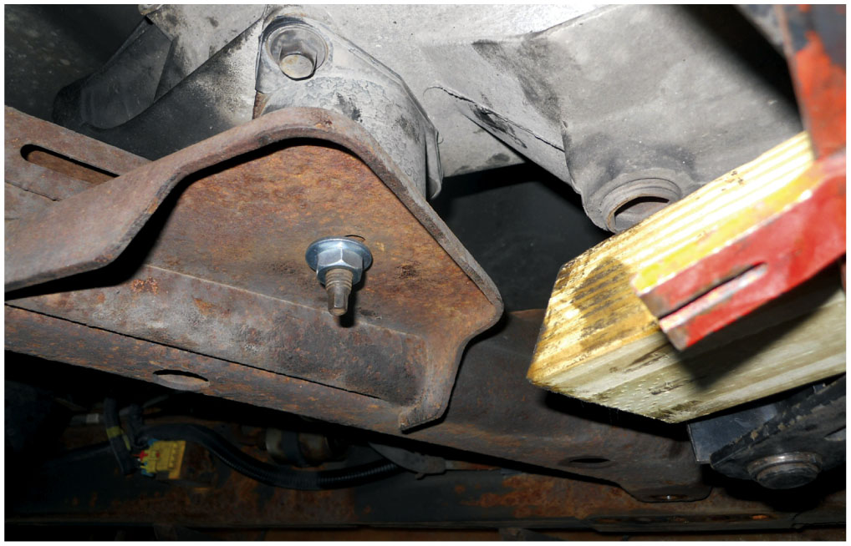
15. After installing the new clutch assembly, the transmission was reinstalled and all of the fasteners tightened to factory specifications

Slide 69
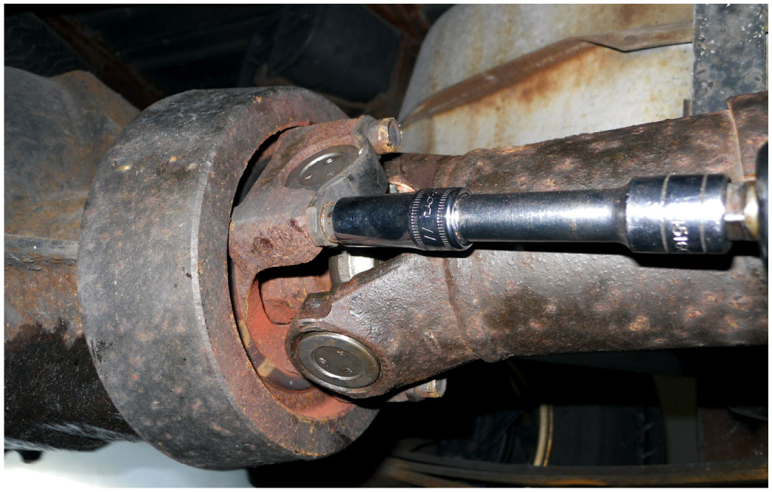
16. The worn rear U-joint was replaced and then the driveshaft was installed

Slide 70
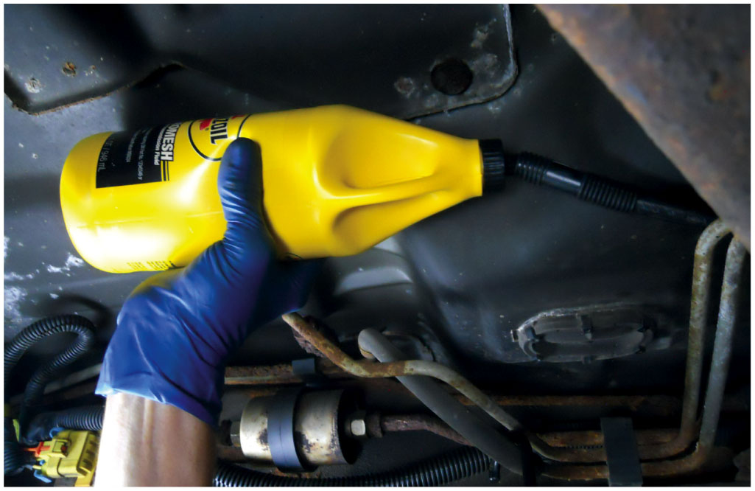
17. The specified gear lube was added to the manual transmission after it was fully installed

Slide 71
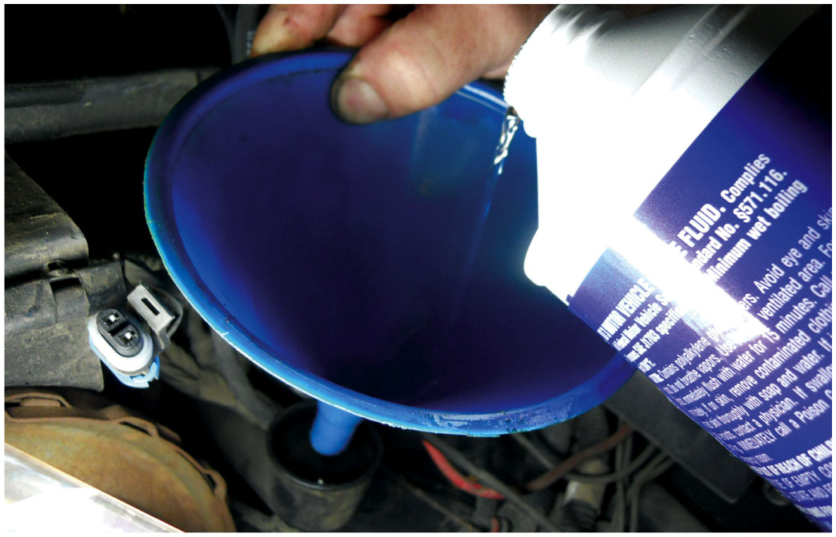
18. The clutch fluid is being added, then the system bled and the truck was test-driven to verify proper operation

Slide 72
N V-1500 Transmission Service Photo Sequence

Slide 73
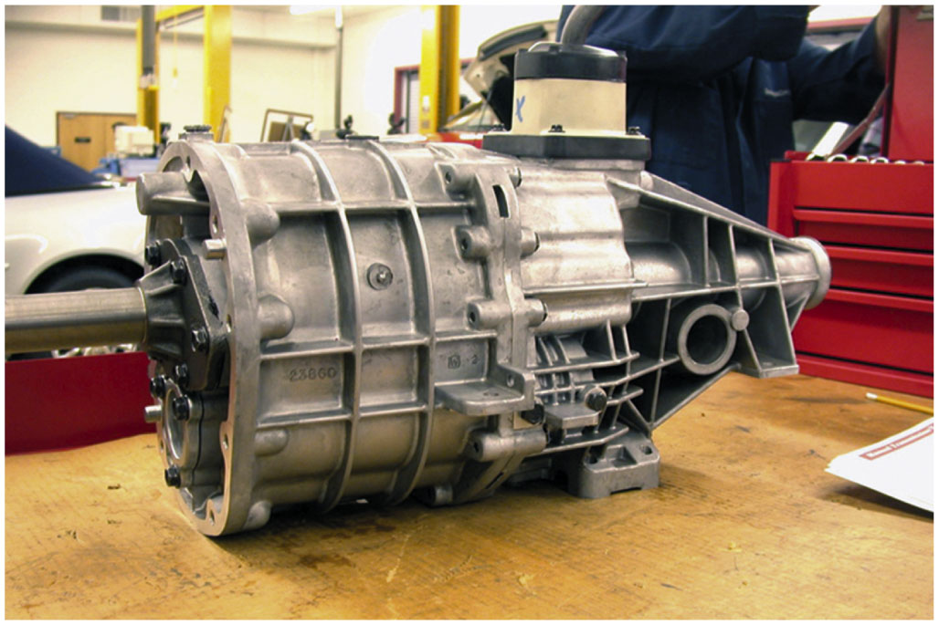
1. N V-1500 five-speed manual transmission is used in two-wheel drive applications only

Slide 74
2. The shifter assembly has been removed. Note the roll pin in the center of the shift lever socket

Slide 75
3. Snap-ring pliers are being used to remove the snap ring retaining the input shaft bearing

Slide 76
4. The upside down case is being separated showing the countershaft (top) and shift forks

Slide 77
5. Before further disassembly can be accomplished, the shift lever socket roll pin must be driven out using a punch and a hammer

Slide 78
6. The shift shaft and forks can now be removed

Slide 79
7. The reverse idle gear is unbolted from the case and removed

Slide 80
8. The output shaft assembly fifth gear (far left) and the synchronizer assemblies

Slide 81
9. The bearing is being removed using a bearing splitter and a hydraulic press

Slide 82
10. A speed gear (bottom) along with the double row needle bearing used between the shaft and the speed gear. The hub (center) is splined & rotates with output shaft

Slide 83
11. A synchronizer assembly being reassembled. It often takes several hands to hold the hub (center) and the sleeve (outer ring)

Slide 84
12. A hydraulic press is used to reassemble output shaft and bearing

Slide 85
13. The assembled output shaft is held against the counter shaft to double check that all of the gears have been correctly assembled

Slide 86
14. The assembled output shaft and counter shaft are being reinstalled in the transmission case

Slide 87
15. The case halves are bolted together

Slide 88
16. The last step is to assembly the shift lever and check for proper operation in all gear positions

Slide 89
N V-350 Transaxle Service Photo Sequence

Slide 90
1. After transaxle has been removed from the vehicle and fluid drained, place the transaxle on a work surface

Slide 91
2. The bell housing case half containing the large output shaft front bearing (center) and the input shaft front bearing (smaller bearing on left)

Slide 92
3. The differential assembly is simply lifted out of half of the case

Slide 93
4. The input and output shafts are a press fit into the bearings and are also retained with a snap ring, which must be removed

Slide 94
5. Using a special tool, the input and output shafts are pressed out of the housing using a hydraulic press

Slide 95
6. The input shaft can be disassembled using a bearing splitter and a press, or two screwdrivers to pry gears off the shaft

Slide 96
7. This transaxle uses both brass and powdered metal synchronizer rings with a fiber (paper) inner cone surface

Slide 97
8. Synchronizer ring gaps are being measured using a feeler (thickness) gauge. The factory specifications are usually 0.040 to 0.069 inches

Slide 98
9. The gear clutch teeth should be inspected for wear

Slide 99
10. An assembled synchronizer assembly containing a sleeve, keys, springs, and detent

Slide 100
11. The input shaft (left) and the output shaft (right) are checked for proper assembly before being installed into the case

Slide 101
12. The differential bearing preload is determined by measuring for zero end play; then adding the thickness shim under the bearing cup

Slide 102
13. The bearing cup is being installed using an installation tool and a hammer

Slide 103
14. All of the shift forks and shift arms must be aligned properly before installing the components into the case

Slide 104
15. All of the components, including the differential (upper right), the output shaft (center), and the input shaft (left), plus the shift linkage are installed and checked for proper positioning.

Slide 105
16. The case halves being reinstalled. The bearings (top) must be pressed back onto the input and output shafts using a press.

Slide 106
17. The bell housing case being reattached

Slide 107
18. The completed assembly. Notice the bearing cover (top) has already been installed.

Slide 108
Automotive Fundamentals Videos and Animations
Videos Link: (A3) Manual Drive Train Axles Videos
Animations Link: (A3) Manual Drive Train Axles Animations

Slide 109
Copyright
This work is protected by United States copyright laws and is provided solely for the use of instructors in teaching their courses and assessing student learning. Dissemination or sale of any part of this work (including on the World Wide Web) will destroy the integrity of the work and is not permitted. The work and materials from it should never be made available to students except by instructors using the accompanying text in their classes. All recipients of this work are expected to abide by these restrictions and to honor the intended pedagogical purposes and the needs of other instructors who rely on these materials.

