Slide 1
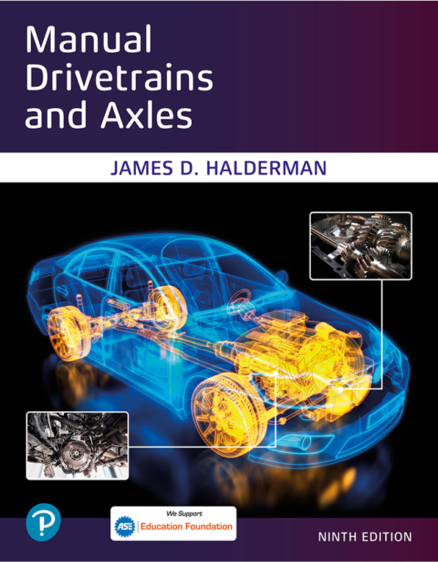
Manual Drivetrains and Axles
Ninth Edition
Chapter 7
Electronically Controlled Manual Transmission/Transaxle
Copyright © 2024, 2018, 2015 Pearson Education, Inc. All Rights Reserved
Notes:
If this PowerPoint presentation contains mathematical equations, you may need to check that your computer has the following installed:
1) Math Type Plugin
2) Math Player (free versions available)
3) NVDA Reader (free versions available)
INSTRUCTOR NOTE: This presentation includes text explanation notes, you can use to teach the course. When in SLIDE SHOW mode, you RIGHT CLICK and select SHOW PRESENTER VIEW, to use the notes.

Slide 2
Learning Objectives
7.1 Discuss parts and operation of a dual clutch transmission/transaxle.
7.2 Explain the construction of a GETRAG D C T 450 transaxle.
7.3 Describe the diagnostic and service procedures for a dual clutch transmission/transaxle system

Slide 3
Electronically Controlled Manual Transmissions/ Transaxle (1 of 2)
Manual Transmission/Transaxle Framework
Hydraulic Actuators Make Shifts
Controlled by Electronic Control Module
Single or Dual Clutch Design
Notes:
A dual clutch transaxle is essentially two transmissions built into one case. Each portion is driven by one of the clutches, and these
clutches are applied, one at a time, to transfer power. A dual clutch transmission is essentially an automatic transmission that uses manual transmission-style gear layout and synchronizers with two countershafts. The shifts can occur vary rapidly, being controlled by how fast each clutch can be applied and with partially engaging one clutch while slipping the other during shifts.
DESCRIPTION An electronically controlled manual transmission/transaxle uses a manual transmission or transaxle as the basic framework and then uses hydraulic actuators to make the shifts all controlled by an electronic control module. While some use a single clutch disc like the RAM M40MTA, most use a dual clutch design.
PURPOSE AND FUNCTION A dual clutch automatic transmission or transaxle uses a manual-type transmission and two clutches that engage either the inner or outer transmission shaft. This type of transmission is designed to achieve ls, compared to a conventional automatic

Slide 4
Electronically Controlled Manual Transmissions/ Transaxle (2 of 2)
Dual Clutch Design
2 clutches engage inner or outer transmission shaft
Like conventional automatic
Improve fuel economy.
Reduce cost of assembly
Improve speed of gear changes.
Provide smoother operation.
Notes:
A dual clutch transaxle is essentially two transmissions built into one case. Each portion is driven by one of the clutches, and these
clutches are applied, one at a time, to transfer power. A dual clutch transmission is essentially an automatic transmission that uses manual transmission-style gear layout and synchronizers with two countershafts. The shifts can occur vary rapidly, being controlled by how fast each clutch can be applied and with partially engaging one clutch while slipping the other during shifts.
DESCRIPTION An electronically controlled manual transmission/transaxle uses a manual transmission or transaxle as the basic framework and then uses hydraulic actuators to make the shifts all controlled by an electronic control module. While some use a single clutch disc like the RAM M40MTA, most use a dual clutch design.
PURPOSE AND FUNCTION A dual clutch automatic transmission or transaxle uses a manual-type transmission and two clutches that engage either the inner or outer transmission shaft. This type of transmission is designed to achieve ls, compared to a conventional automatic

Slide 5
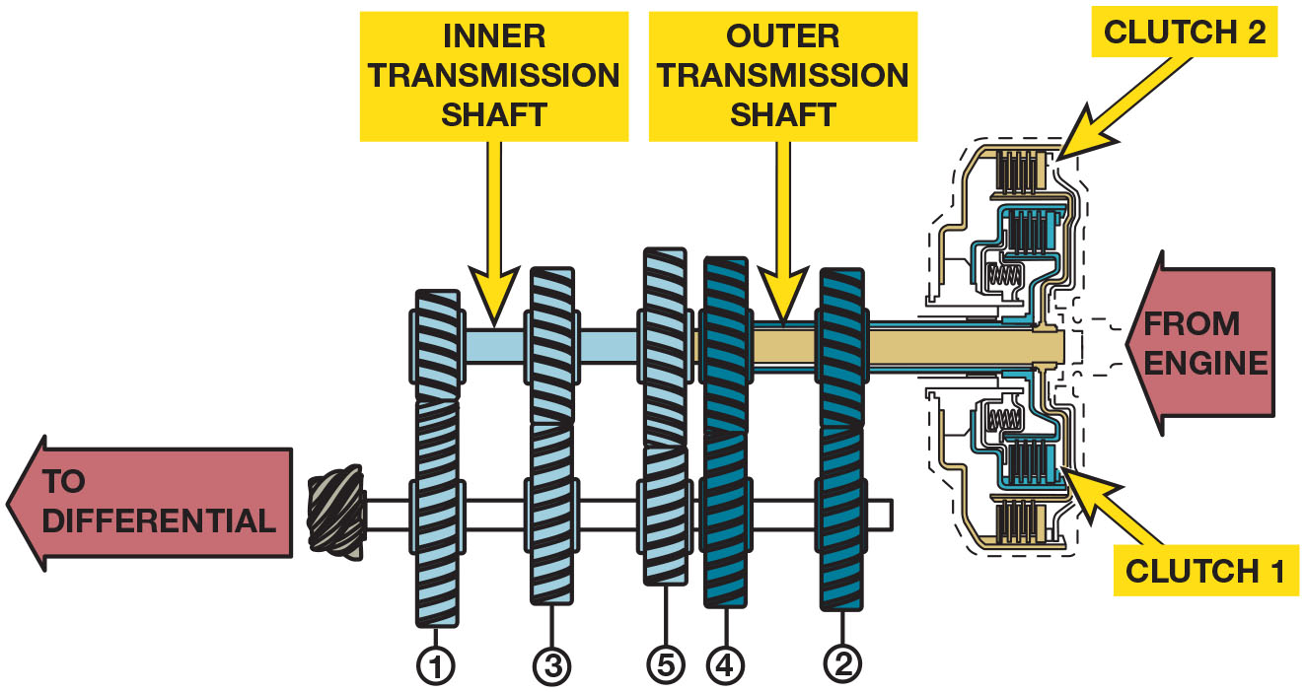
Figure 7.1
Dual-Clutch Automatic
A dual clutch automatic uses the best features of an automatic transmission without the power loss of a torque converter.
Notes:
Dual clutch automatic transmission/ transaxle can also be referred to as
■ Direct shift gearbox (D S G). Most commonly used by the V W/Audi Group (V A G) of vehicles.
■ Porsche Doppelkupplung (P D K). The Porsche term used to describe their dual clutch automatic.
■ Automated manual transmission (A M T). Original term no longer commonly used.
■ Twin clutch transmission. Another variation of the term used for a dual clutch automatic transmission.
Long Description:
The cross-section has a horizontal shaft on the bottom attached to the gear with a small diameter on its left end. A left arrow on the left side of that gear is labeled to differential. Two similar adjacent horizontal shafts on top are labeled inner transmission shaft on the left and outer transmission shaft on the right. Three sets of gears labeled 1, 3, and 5 from the left, are attached to the inner transmission shaft on top and the bottom horizontal shaft on the bottom. Two similar sets of gears labeled 4 and 2 from the left are attached to the outer transmission shaft on top and the bottom horizontal shaft on the bottom. The right end of the outer transmission shaft is attached to a circuit of micro parts labeled clutch 2 on top and clutch 1 on the bottom. A left arrowhead on the right end of the outer transmission shaft is labeled from engine.

Slide 6
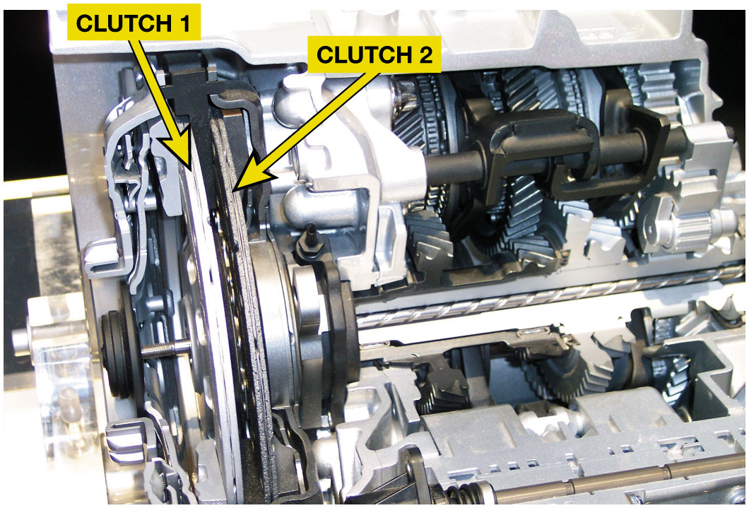
Figure 7.2
Parts & Operation
2 Types Dual Clutch
Dual Dry Clutches used in low powered vehicles, such as small front-wheel-drive vehicles..
Dual Wet Clutches used in higher powered vehicles.
Dual clutch automatic transaxles that use two dry clutches. The larger clutch drives the odd number gear ratios (first, third, and fifth) and the smaller clutch drives the even numbered gear ratios (second, fourth, and sixth).
Notes:
PARTS AND OPERATION
A dual clutch automatic transmission/transaxle uses two clutches that are mounted together. One clutch drives the
odd number gears (first, third, fifth, and seventh). The other clutch drives the even number gears (second, fourth, and
sixth). ● Figure 7.1.
The shifts occur without interrupting the torque from the engine by applying torque to the clutch while at the same
time disconnecting the other clutch. These actions result in a rapid shift without the slight delay usually associated with an
automatic transmission.
There are two types of clutches used depending on application.
1. Dual dry clutches are used in low powered vehicles, such as small front-wheel-drive vehicles. ● Figure 7.2.
2. Dual wet clutches are often used in higher powered vehicles.

Slide 7
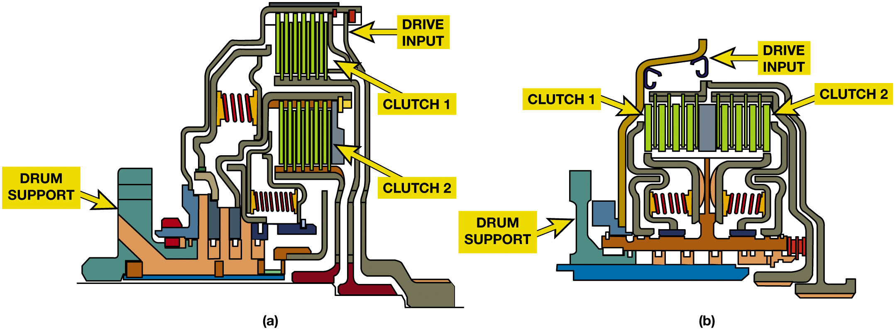
Figure 7.3
Dual Clutch Transaxle: Concentric & Parallel Wet Clutches
(a) A concentric (nested) clutch design, the assembly is shorter in length but taller in height. (b) A parallel clutch design is longer but has a smaller diameter drum assembly.
Notes:
There are two basic Wet Clutch Designs used in dual clutch automatic transmissions.
(a) Concentric clutch (also called a nested-type clutch) is a design where both plates share the same vertical plane and provides a shorter assembly.
(b) Parallel clutch design is used in a side-by-side arrangement.

Slide 8
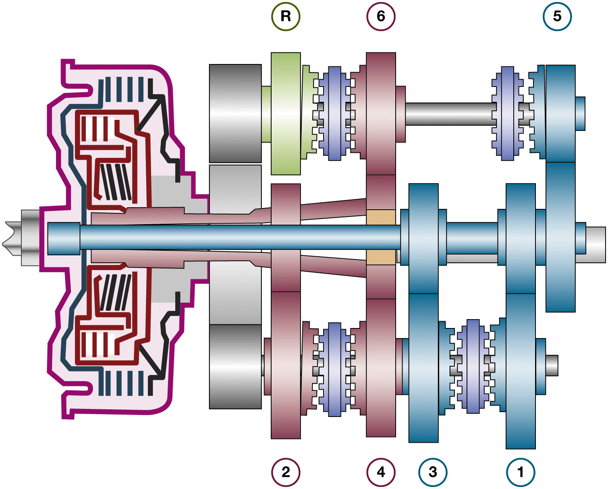
Figure 7.4
1–3 & 5 synchronizer assemblies driven by clutch 1
2–4 & 6-reverse synchronizers driven by clutch 2.
Movement begins 1–3 synchronizer shifted to first gear and clutch 1 applied.
2–4 synchronizer then shifted into
gear by hydraulic servo
1–2 upshift occurs when clutch 1 is released clutch 2 applied
Notice the two concentric input shafts. Each shaft is splined to a clutch.
Notes:
Gear Arrangements
The 1–3 and 5 synchronizer assemblies are driven by clutch 1 and the 2–4 and 6-reverse synchronizers are driven by clutch 2. Vehicle movement begins with the 1–3 synchronizer shifted to first gear and clutch 1 applied. The 2–4 synchronizer is then shifted into second gear by a hydraulic servo, and the 1–2 upshift will occur when clutch 1 is released and clutch 2 is applied.
The remaining upshifts occur in the same manner, with the synchronizer pre-shifted or shifted early, and the actual shift occurring when the clutches are cycled. ● Figure 14.4.
The driver can control the transmission/transaxle using a floor-mounted shift lever or one of a pair of paddles mounted on the steering wheel.
■ Clutches 1 and 2 are applied by hydraulic pressure, similar to automatic transmission clutches.
■ The hydraulic flow to the clutches and servos is controlled electronically by a control module.
Long Description:
The cross-section has two concentric cylindrical shafts splined from the center of the circuit of clutches on the left and attached to the gear cluster on the right. The inner shaft has a length longer than the outer one. Moving from left to right the outer shaft divides into two parts on the top and bottom of the inner one. The outer shaft is attached to three sets of gears labeled 6 on top and 2 and 4 on the bottom. A detached gear labeled R is on the left side of 6. The inner cylindrical shaft is attached to three sets of gears labeled 5 on top and 3 and 1 on the bottom.

Slide 9
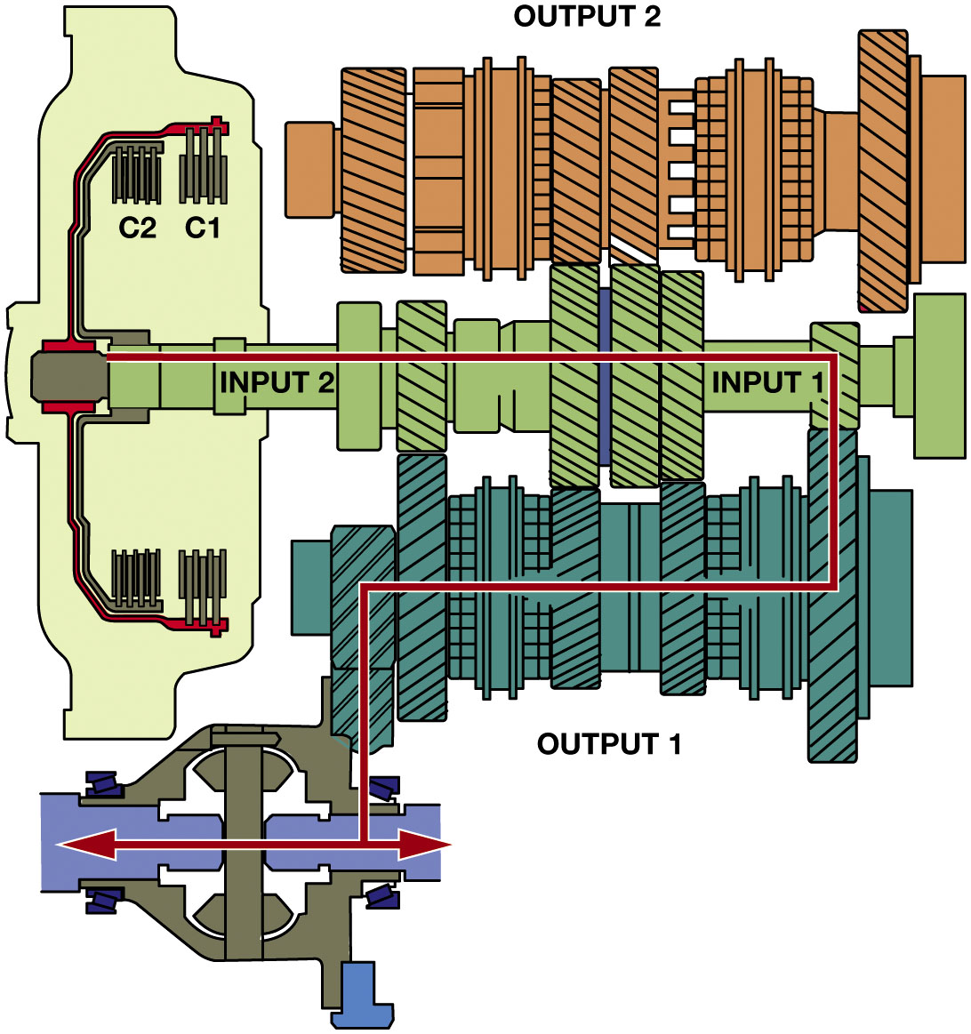
Figure 7.5
GETRAG D C T 450
Clutch 1 on drives inner shaft.
gear control device
pressurized to shift to
gear.
Clutch 2 filled with hydraulic pressure
gear torque delivery
through clutch 1 is being reduced as clutch 2 is being applied and starting to transmit engine torque.
First gear engaged using clutch 1 (C 1) to transmit engine torque.
Notes:
A Getrag D C T 450 transaxle is a dual clutch automatic trans-axle commonly used in a number of Ford and Volvo vehicles starting in 2008. This is a six-speed unit and uses clutch 1 for the odd-numbered gears (1, 3, 5) and clutch 2 for the even-numbered gears (2, 4, 6).
Gear Change Example
Using the D C T 450 as the example, the shift from the first to the second includes the following actions:
STEP 1 Clutch 1 is on and drives the inner shaft. ● Figure 7.5.
STEP 2 Second gear control device is pressurized to get ready to shift to second gear.
STEP 3 Clutch 2 is starting to be filled with hydraulic pressure (both clutches work at same time during shifting).
STEP 4 First gear torque delivery through clutch 1 is being reduced as clutch 2 is being applied and starting to transmit engine torque.
Long Description:
The illustration has a circuit of clutches on the left. It has two concentric C-shaped structures attached to four clutch configurations, two on top and two on the bottom. The clutches secured to the inner C-shaped structure are labeled C 2. The clutches secured to the outer C-shaped structure are labeled C 1. The vertical microparts in C 1 have a length longer than those in c 2. A cylindrical shaft labeled input 2 on the left and input 1 on the right is splined from the center of the circuit of clutches. The shaft is attached to a set of three cluster gears. The top is labeled output 2 and the bottom is labeled output 1. The bottom-left margin of the bottom cluster gear is attached to the engine torque. A horizontal line from the left end of the shaft labeled input 2 travels towards the first gears near input 1. It further extends vertically downwards in the countershaft, travels horizontally leftwards, and extends vertically to the engine torque. It then extends horizontally as a double-sided arrow in the centerline of the engine torque.

Slide 10
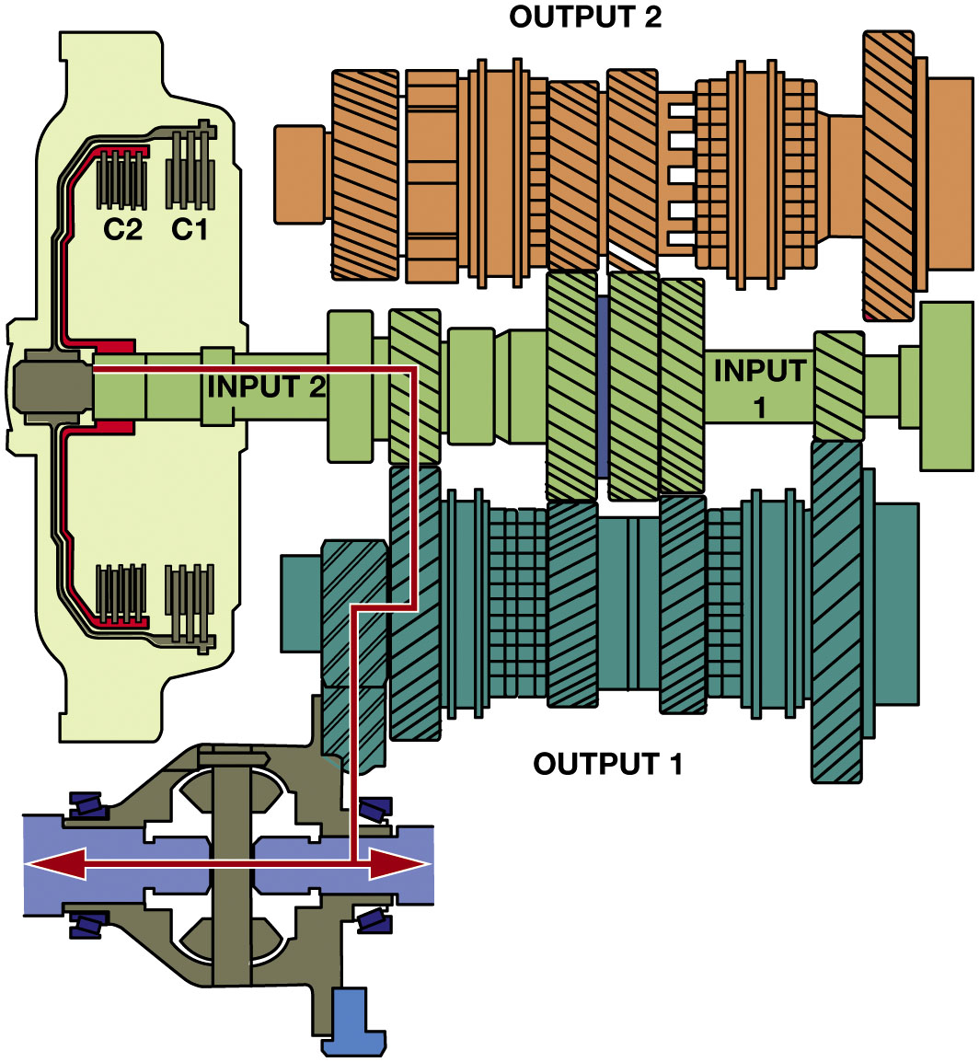
Figure 7.6
GETRAG D C T 450
Engine torque through clutch 1 is zero & full engine torque being transmitted through clutch 2.
Second gear engaged using clutch 2 (C 2) to transmit engine torque.
Notes:
Step 5 of Operation
Long Description:
The illustration has a circuit of clutches on the left. It has two concentric C-shaped structures attached to four clutch configurations, two on top and two on the bottom. The clutches secured to the inner C-shaped structure are labeled C 2. The clutches secured to the outer C-shaped structure are labeled C 1. The vertical microparts in C 1 have a length longer than those in c 2. A cylindrical shaft labeled input 2 on the left and input 1 on the right is splined from the center of the circuit of clutches. The shaft is attached to a set of three cluster gears. The top is labeled output 2 and the bottom is labeled output 1. The bottom-left margin of the bottom cluster gear is attached to the engine torque. A horizontal line from the left end of the shaft labeled input 2 travels downward through the second gear and extends as a double-sided arrow in the centerline of the engine torque.

Slide 11
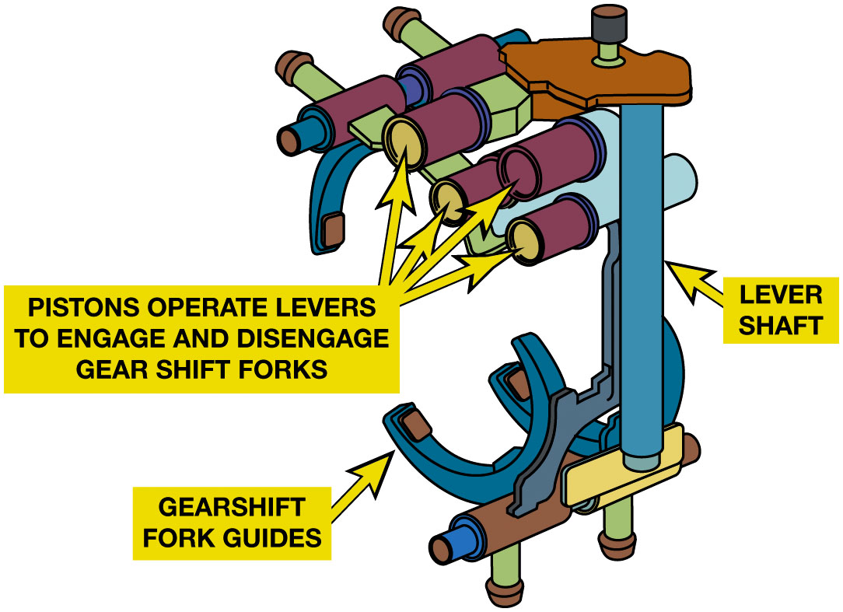
Figure 7.7
GETRAG D C T 450 Shift Forks
Gearshift fork 1 (odd): R-N-5
Gearshift fork 2 (odd): 3-N-1
Gearshift fork 3 (even): 2-N-4
Gearshift fork 4 (even): P-N-6
The shift forks are similar to those used in a manual transmission but are moved using hydraulic pistons.
Notes:
SHIFT FORKS
There are four gearshift forks in this Getrag D C T 450 transaxle. The gear positions per gearshift fork include the following:
■ Gearshift fork 1 (odd): R-N-5
■ Gearshift fork 2 (odd): 3-N-1
■ Gearshift fork 3 (even): 2-N-4
■ Gearshift fork 4 (even): P-N-6
The gearshift forks mechanically engage the gears. The forks are moved by hydraulic pistons, which
are controlled by shift solenoids. The transmission control module (T C M) operates shift solenoids.
The solenoids move pistons, which in turn apply force to the shift forks through lever points to
help in- crease the force applied. Both an even and an odd gear can be commanded at the same time
in parallel.
■ Fifth gear and neutral are blocked if the reverse gear is engaged.
■ Neutral and first gear are blocked if third gear is engaged. FIGURE 7.7.
Long Description:
The cross-section of the transaxle shift fork has a vertical cylindrical component labeled lever shaft on the rear side of the configuration. The lever shaft is attached to U-shaped components labeled gearshift fork guides, two each on the bottom and top. The gearshift fork guides on the bottom are attached to horizontal cylindrical shafts on their bottom. Similarly, the gearshift fork guides on the top are attached to horizontal cylindrical shafts on their top. The lever shaft and the gearshift forks on the top have small horizontal cylindrical components clustered in between labeled pistons operate levers to engage and disengage gear shift forks.

Slide 12
GETRAG D C T 450 Speed Sensors
Engine Speed Sensor
Inputs engine speed to T C M from clutch housing sensor
Speed Sensor Input Shaft Odd Gears.
Gives T C M information on input shaft R P M
(after C 1 clutch) for odd gears, 1, 3, 5, and R.
Speed Sensor Input Shaft Even Gears.
Gives T C M information on input shaft R P M
(after the C 2 clutch) for even gears, 2, 4, and 6
Notes:
SPEED SENSORS Speed sensors include the following:
Engine speed sensor. Inputs the engine speed to the T C M from the sensor located on the clutch drum housing.
Speed sensor input shaft odd gears. Gives the T C M information on input shaft R P M (after the C 1 clutch) for odd gears, 1, 3, 5, and R.
Speed sensor input shaft even gears. Gives the T C M information on input shaft R P M (after the C 2 clutch) for even gears, 2, 4, and 6.

Slide 13
Frequently Asked Question: How Does Dual Clutch Achieve Better Fuel Economy?
? Frequently Asked Question
How Does a Dual Clutch Type Transmission Achieve Better Fuel Economy? One of advantages of a dual clutch automatic is that it is able to provide improved fuel economy over a conventional torque converter-type automatic. One strategy is to have the unit go into neutral when the vehicle is stopped by disengaging the clutches. This allows the engine to remain running but reduces the load on the engine, which improves fuel economy and reduces vibrations. The clutch is engaged when driver releases the brake.

Slide 14
GETRAG D C T 450 Temperature Sensors
Clutch Fluid Temperature
Measure temperature of fluid leaving clutches
Transmission Fluid Temperature
Measure temperature of fluid in transmission
Oil Temperature Sensor
Located on T C M
Provides information on transmission oil temperature
Notes:
TEMPERATURE SENSORS The T C M uses temperature information to determine correct system pressure, for controlling the
clutch, for cold starts, and for overheating protection.

Slide 15
Frequently Asked Question: Why is T C M Using Position of Steering Wheel?
? Frequently Asked Question
Why is the T C M Using the Position of the Steering Wheel? The steering wheel position (S W P) sensor information is sent to the transmission control module (T C M) over the network to prevent the transmission from upshifting when cornering. This helps the driver by allowing the vehicle to be accelerated when exiting a corner. If the steering wheel position was not part of the shift program, the transmission might likely upshift to a higher gear as the vehicle slows then the transmission may have to downshift again when the vehicle exits the corner.

Slide 16
GETRAG D C T 450 Pressure & Position Sensors
Pressure Sensors
T C M information on hydraulic pressure of clutches.
T C M supplies sensors with 5 V.
Register pressure to control clutch pressure
T C M controls solenoids to provide correct clutch pressure
Position Sensors
Fork Position Sensors
Give T C M information on position of 4 gear shift forks
Handle shifting in transmission includes 1-R; 3-5; 2-4; & 6-N
Transmissions Range Sensor (T R S)
Sensor provides the actual P R N D gear selection
Notes:
Pressure sensors give the T C M information on hydraulic pressure of clutches. The T C M sup- plies the sensors with 5 V. The sensors register the oil pressure to control clutch pressure so that the T C M can control the solenoids to provide correct clutch pressure for each clutch.
Position sensors include the following:
Fork position sensors—sensors give T C M information on position of 4 gear shift forks that handle shifting 1-R; 3-5; 2-4; and 6-N.
Transmissions Range Sensor (T R S)—This sensor provides the actual P R N D gear selection.
The transmission electronic control module uses information from the sensors to determine proper clutch and shift servo operation. Once the T C M determines the required gear range and driving conditions, actuators are turned on or off to control hydraulic pressure, gear selection, clutch control shift lock.

Slide 17
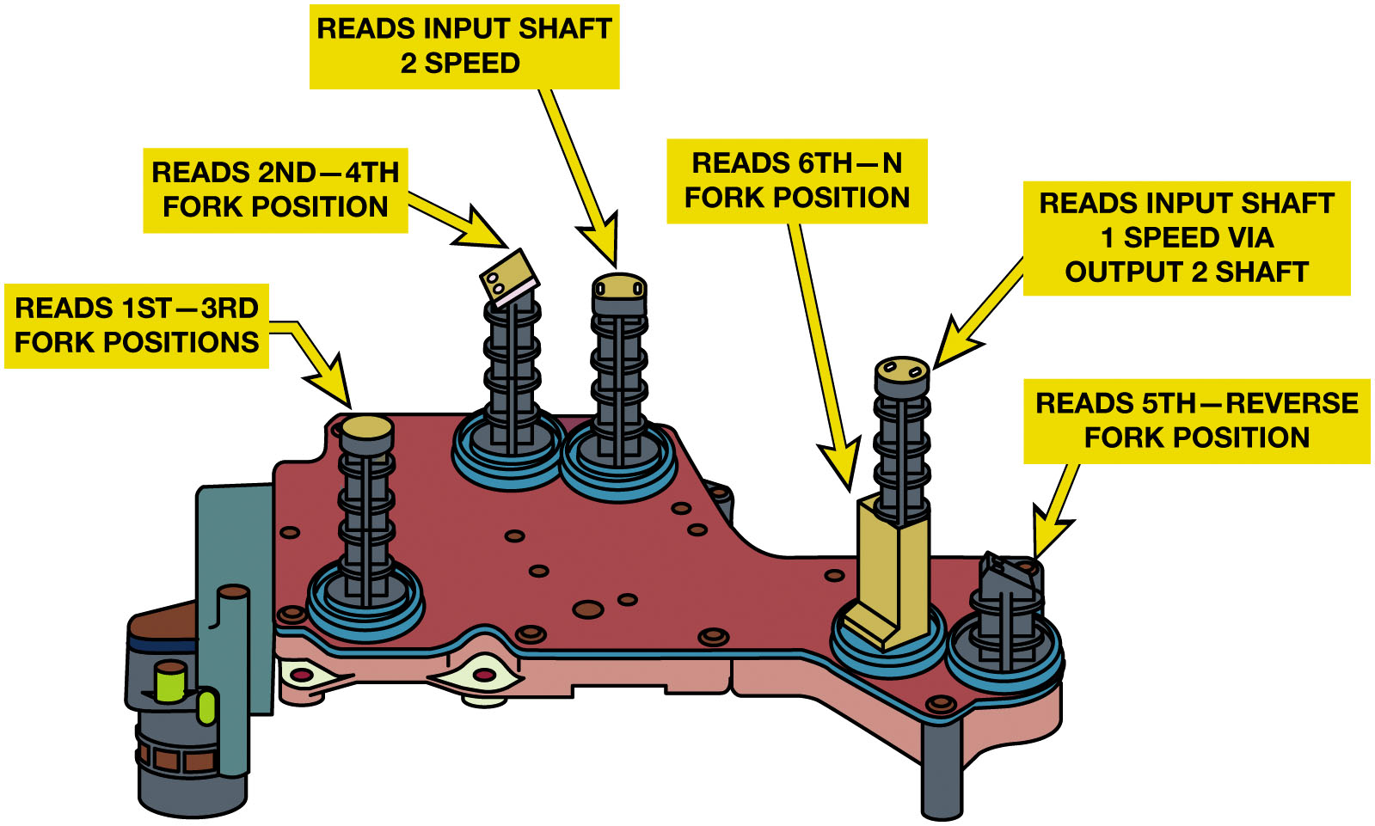
Figure 7.8
Solenoids
Fork position and shaft speed sensors are used as inputs to the T C M.
Notes:
The transmission control module (T C M) operates shift solenoids. These pistons apply force to the shift forks through lever points to help increase the force applied. Both an even and an odd gear can be commanded at the same time in parallel. Position sensors are located inside the case and this information is used by the T C M to determine the actual position of each shift fork. See Figure 7.8
Long Description:
The cross-section is a flat and irregularly-shaped structure attached to five vertical spring-like position sensors. The bottom-left position sensor is labeled reads first to third fork positions. The top-left position sensor is labeled reads second to fourth fork positions. The top-right position sensor is labeled reads input shaft 2 speed. The bottom-right surface has two position sensors. The one on the left has a partial covering labeled reads sixth to N fork positions and the one on the right is half the usual height. The position sensor with a partial covering is labeled reads input shaft 1 speed via output 2 shaft. The shortest sensor on the extreme bottom-right surface is labeled reads fifth to reverse fork positions.

Slide 18
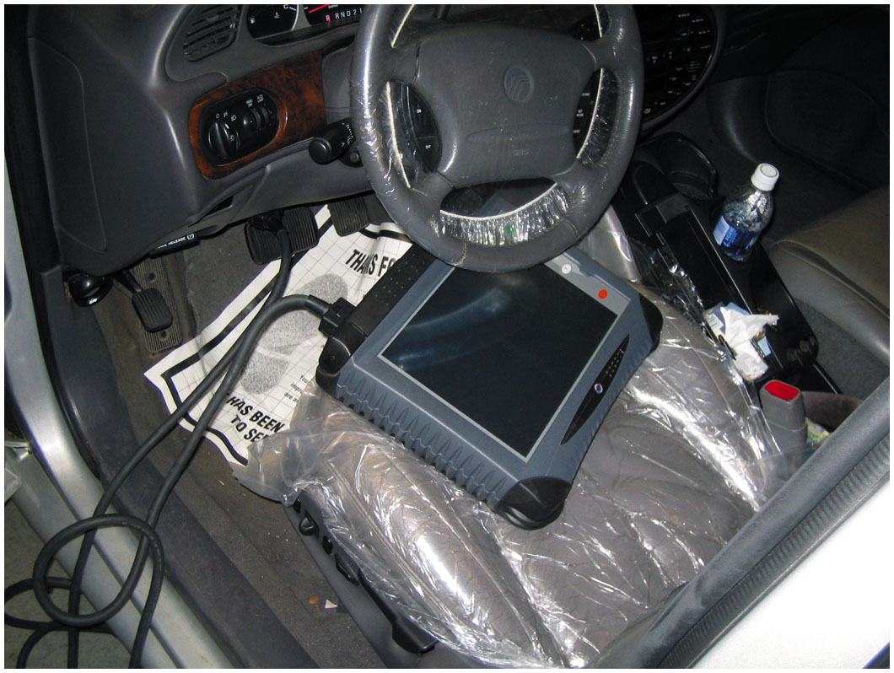
Figure 7.9
Diagnosis & Service
Verify concern
Perform thorough visual inspection, including:
Checking fluid level and condition and drivetrain mounts
Check for procedure
Follow it
Repair & Road Test
The use of a factory or a factory-level aftermarket scan tool is often used to diagnose the dual clutch transmission system.
Notes:
STEP 1 Verify the customer concern (complaint). This step includes trying to duplicate what the customer or driver is concerned about.
STEP 2 Perform a thorough visual inspection, including the following:
Checking level and condition of the fluid
Checking drivetrain mounts for damage or faults
STEP 3 Check service information for the specified procedure to follow. Most vehicles require the use of a factory-brand scan tool.
STEP 4 Follow the troubleshooting procedure as specified to fix the root cause of the problem. This means following the instructions displayed on the scan tool or service information.
STEP 5 Repair the fault.
STEP 6 Road test the vehicle under the same conditions that were performed to verify the fault to ensure that the repair is completed.
Fluid Maintenance
The transmission fluid is usually high-quality synthetic oil, which is unique for this type of transmission. Dual clutch transmission fluid is usually green to help identify it as a unique fluid and to help prevent someone from using conventional automatic transmission fluid. Always use the specified fluid. For example, the Ford dry dual clutch fluid is specifically formulated for use in the D P S 6 power shift twin dry clutch transmission. This fluid is manufactured with synthetic base oils and performance additives, providing improved shifting at all ambient temperatures. This fluid is used only in transmissions requiring a fluid meeting W S S-M 2 C 2 0 0-D 2.
Most dual clutch automatic transmissions/transaxles use an external filter that is serviceable and an internal filter that is a non serviceable part unless the unit is totally disassembled. Always follow the vehicle manufacturer’s recommended fluid and filter service intervals.

Slide 19
Diagnostic Trouble Codes
P0715 | Input shaft 1 (odd number gear axle) speed sensor system (output high range out)
P0716 | Input shaft 1 (odd number gear axle) speed sensor system (poor performance)
P0717 | Input shaft 1 (odd number gear axle) speed sensor system (output low range out)
P0746 | Line pressure solenoid system (drive current range out)
P0753 | Shift select solenoid 1 system (open circuit) P0758 Shift select solenoid 2 system (open circuit)
P0776 | Clutch cooling flow solenoid system (drive current range out)
P0842 | Clutch 1 pressure sensor system (output low range out)
P0960 | Line pressure solenoid system (open circuit)
Chart 7.1 Found on Page 90 of the text showing some common D T C s
Notes:
D T C s
As part of any diagnostics, checking for diagnostic trouble codes is one of the first steps. See Chart 7.1

Slide 20
Question 1
A concentric clutch ______________
A. Has a smaller drum diameter
B. Type of dry clutch
C. Shorter in length
D. Taller in height

Slide 21
Answer 1
A concentric clutch ______________
C. Shorter in length

Slide 22
Summary (1 of 2)
Dual clutch automatic transmission/transaxle uses a manual-type transmission
2 clutches that engage either inner or outer transmission shaft.
Dual dry clutch system used for
Lower- powered front-wheel-drive vehicles,
Dual wet clutches used for most
High-powered vehicles. 2 types used:
Concentric Design
Parallel Design.
Notes:
A dual clutch automatic transmission or transaxle uses a manual-type transmission and two clutches that engage either the inner or outer transmission shaft.
A dual clutch automatic transmission can also be referred to as direct shift gearbox (D S G), Porsche Doppelkupplung (P D K), automated manual transmission (A M T), or a twin clutch transmission.
A dual dry clutch system is mostly used for lower- powered front-wheel-drive vehicles, whereas dual wet clutches are used for most high-powered front-and rear-wheel-drive vehicles. 2 basic wet clutch designs used in dual clutch automatic transmissions.
A concentric clutch (also called a nested-type clutch) is a design where both plates share the same vertical plane and provides a shorter assembly.
A parallel clutch design is used in a side-by-side arrangement.
Speed sensors are used to measure the speed of the odd gear shaft and the even gear shaft.
Position sensors are used to detect the positions of the shift forks.
Solenoids are used to make the actual shifts by moving the shift forks.
Dual clutch automatic transmissions use a unique fluid.

Slide 23
Summary (2 of 2)
Speed sensors used to measure speed
Of odd gear shaft and even gear shaft
Position sensors used to detect positions of shift forks
Solenoids used to make actual shifts by
Moving shift forks
Dual clutch automatic transmissions use a unique fluid
Notes:
A dual clutch automatic transmission or transaxle uses a manual-type transmission and two clutches that engage either the inner or outer transmission shaft.
A dual clutch automatic transmission can also be referred to as direct shift gearbox (D S G), Porsche Doppelkupplung (P D K), automated manual trans- mission (A M T), or a twin clutch transmission.
A dual dry clutch system is mostly used for lower- powered front-wheel-drive vehicles, whereas dual wet clutches are used for most high-powered front-and rear-wheel-drive vehicles. 2 basic wet clutch designs used in dual clutch automatic transmissions.
A concentric clutch (also called a nested-type clutch) is a design where both plates share the same vertical plane and provides a shorter assembly.
A parallel clutch design is used in a side-by-side arrangement.
Speed sensors are used to measure the speed of the odd gear shaft and the even gear shaft.
Position sensors are used to detect the positions of the shift forks.
Solenoids are used to make the actual shifts by moving the shift forks.
Dual clutch automatic transmissions use a unique fluid.

Slide 24
Automotive Fundamentals Videos and Animations
Videos Link: (A3) Manual Drive Train Axles Videos
Animations Link: (A3) Manual Drive Train Axles Animations

Slide 25
Copyright
This work is protected by United States copyright laws and is provided solely for the use of instructors in teaching their courses and assessing student learning. Dissemination or sale of any part of this work (including on the World Wide Web) will destroy the integrity of the work and is not permitted. The work and materials from it should never be made available to students except by instructors using the accompanying text in their classes. All recipients of this work are expected to abide by these restrictions and to honor the intended pedagogical purposes and the needs of other instructors who rely on these materials.

