Slide 1
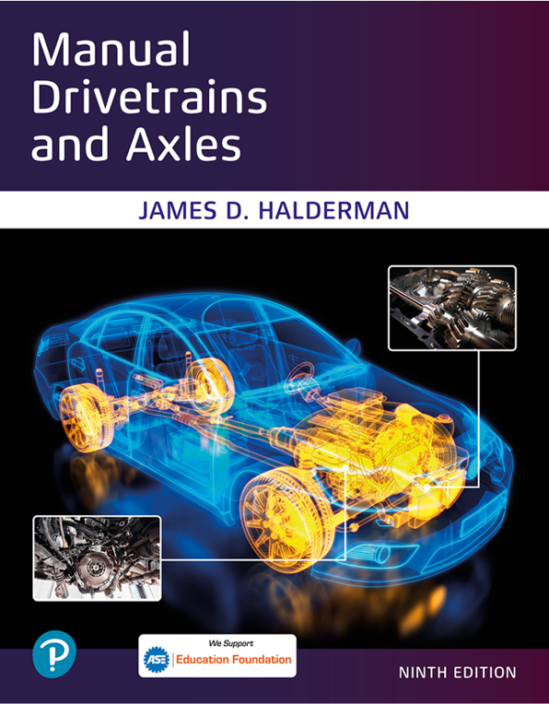
Manual Drivetrains and Axles
Ninth Edition
Chapter 6
Manual Transaxle Parts And Operation
Copyright © 2024, 2018, 2015 Pearson Education, Inc. All Rights Reserved
Notes:
If this PowerPoint presentation contains mathematical equations, you may need to check that your computer has the following installed:
1) Math Type Plugin
2) Math Player (free versions available)
3) NVDA Reader (free versions available)
INSTRUCTOR NOTE: This presentation includes text explanation notes, you can use to teach the course. When in SLIDE SHOW mode, you RIGHT CLICK and select SHOW PRESENTER VIEW, to use the notes.

Slide 2
Learning Objectives
6.1 Explain the parts of a standard transaxle.
6.2 Discuss transaxle operation.

Slide 3
Purpose & Function
Large majority of vehicles sold today are F W D.
Engine & transaxle either transverse or longitudinally
Transverse engine points across vehicle
Longitudinal engine commonly used in R W D
Pull to one side during acceleration (torque steer) caused by:
Unequal C V Joint Angles
Unequal Length Of The Shafts
Tendency For Longer Shaft To Twist
Notes:
Large majority of vehicles sold today are F W D. The engine and transaxle are either transverse or longitudinally mounted.
Transverse engine points across the vehicle also called east-west positioning.
Longitudinal engine is commonly used in rear-wheel-drive vehicles and is often called north-south positioning.
Many features of the transmission part of a transaxle are similar to those of a R W D transmission. There are differences, however, in the number of shafts and the power flow. There is also the addition of the final drive gears and the differential.
F W D vehicles have transverse-mounted engines, and engine-transmission package must fit in the vehicle between the suspension components. Many transaxles have the differential mounted off center which results in unequal-length drive shafts. FIGURE 6.1.
Unequal-length drive shafts can cause the vehicle to pull to one side during acceleration, which is
called torque steer. Torque steer is caused by
Unequal C V Joint Angles
Unequal Length Of The Shafts
Tendency For Longer Shaft To Twist

Slide 4
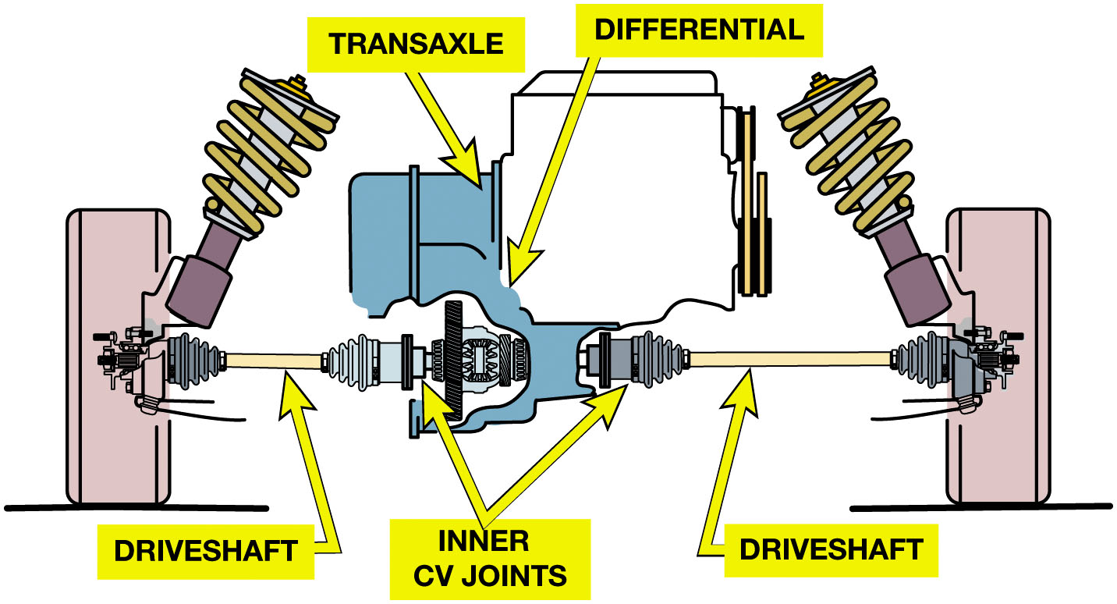
Figure 6.1
Transaxle
A transaxle is a transmission plus the final drive and differential. The inner C V joints of the front drive shafts connect to the side gears in the transaxle differential.
Notes:
Long Description:
The illustration has two vertical engines on either side. A rod surrounded by spirals is at the inner side at the top of the engine. In the center of the engines is dumbbell-shaped structures labeled driveshaft. The driveshafts are connected to vertically aligned joints labeled inner C V joints. The C V joints are encapsulated within an inverted C-shaped structure labeled differential. Elongated from the differential is a device labeled transaxle.

Slide 5
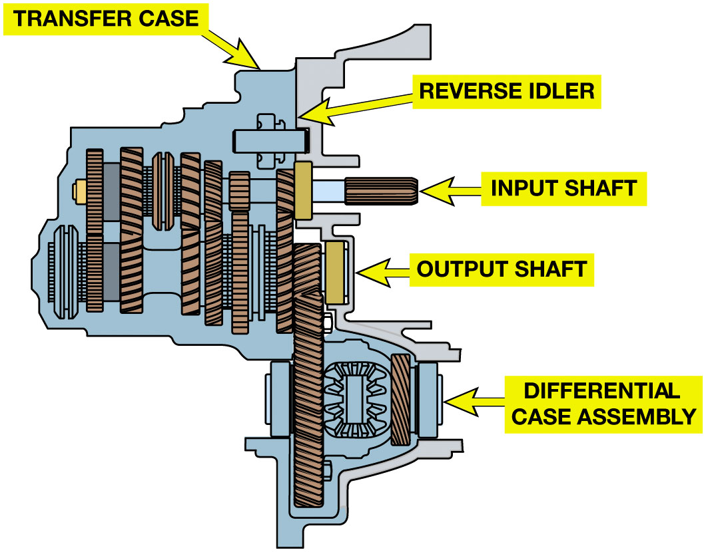
Figure 6.2
Transaxle Construction
Input shaft
Sometimes called clutch shaft.
Main shaft
Sometimes called countershaft or intermediate shaft.
Includes drive pinion gear
Note the four shafts being used in this transaxle; input shaft, output shaft, the final drive (bottom), and the reverse idle gear (top).
Notes:
PARTS INVOLVED Most transaxles are made with four parallel shafts:
1. Input shaft—The input shaft is sometimes called the clutch shaft because it is splined to the
clutch disc. The driving gears are positioned on the input shaft, and there is one for each forward
speed.
2. Main shaft—The main shaft, also called a countershaft or an intermediate shaft, also includes a
gear for each forward speed and these are the driven gears. The main shaft also includes the drive
pinion gear. The drive pinion gear is the transmission output and the input for the final drive.
3. Final drive ring gear—The final drive ring gear is mounted on the differential case. The
differential divides the power flow between the two C V joints coupled to the drive shafts and on to
the wheels. The differential pinion gears and side (axle) gears in the differential allow for
speed differences when the vehicle turns a corner. This gear arrangement also splits the power from
a single source to two sources with, typically, 50/50 torque distribution.
4. Reverse idler shaft—All of the gears in a transaxle, with the exception of the reverse idler,
are in constant mesh, and each of the gear pairs on the input shaft and main shaft represents the
power paths for a particular gear ratio. ● SEE FIGURE 6.2.
Long Description:
The parts of a transaxle consists of four different shafts aligned parallel. The first shaft is a rectangle aligned horizontally and is labeled reverse idler. Below the reverse idler is the second shaft labeled input shaft. The shaft consists of vertically aligned rectangles, placed closely and connected to the rectangles of the third shaft labeled output shaft. The second rectangle on the right of the output shaft is connected to the rectangle of the fourth shaft. The rectangle of the fourth shaft has a circle with spirals towards its right. A rectangle is on the right of the circle, followed by another rectangle labeled differential case assembly. All the shafts are encased inside an irregular case labeled transfer case.

Slide 6
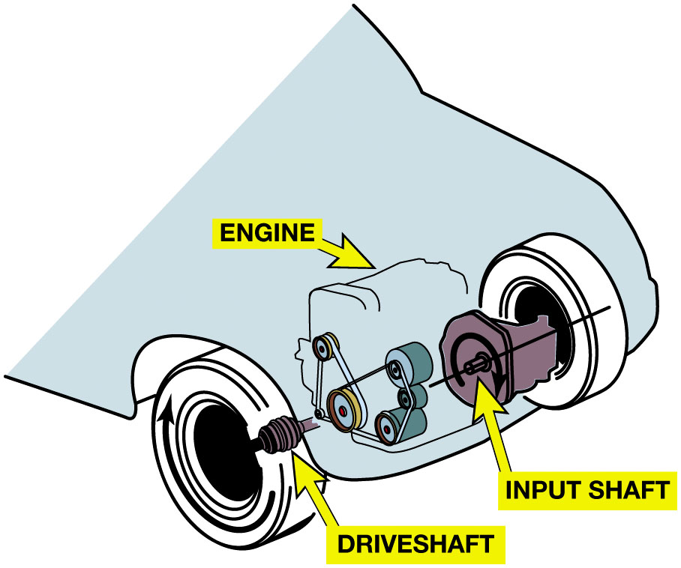
Figure 6.3
Transaxle Construction Position
Most engines rotate in C W direction (viewing rotation from right, or passenger, side
Input shaft rotates C W, main shaft rotates C C W in forward gears, & differential rotates C W to drive wheels in C W direction
The engine and the transaxle input shaft rotate in a clockwise direction in most F W D vehicles (viewed from the right side).
Notes:
At each gear pair, one gear is secured solidly to the shaft and the other floats on the shaft, right next to a synchronizer assembly. Some transaxles secure all gears on the input shaft to form a cluster gear. These can be either a single cluster gear or a group of gears pressed onto a splined shaft. Other designs float all or some of driving gears on the input shaft and secure the driven gears onto the main shaft. Most engines rotate in a clockwise direction (viewing the drive rotation from the right, or passenger, side of the vehicle). The input shaft rotates clockwise, the main shaft rotates counterclockwise in forward gears, and the differential rotates clockwise to drive the wheels in a clockwise direction. Figure 6.3.
Long Description:
The illustration has the right view of a car with wheels on both sides. The clockwise direction of the wheel is depicted by an arrow. Connected to the anterior wheel is a dumbbell-shaped structure labeled driveshaft. The driveshaft is connected to an engine that consists of a wheel connected to three horizontal cylinders aligned vertically. Next to the cylinders is a circle labeled input shaft. The input shaft has a hole in the center through which passes a rod and is connected to the posterior wheel. The clockwise direction of rotation of the shaft is marked by an arrow.

Slide 7
Animation: FWD Drivetrain (Animation will automatically start)

Slide 8
Transaxle Operation
Power Flow
The power passes from the driving gear to the driven gear on the main shaft and through the synchronizer and the power leaves through the drive pinion.
Gear Ratios
Reverse idler shifted into mesh; idler gear rotates counterclockwise; 1-2 synchronizer rotates clockwise; differential and drive wheels rotates counterclockwise
Notes:
Powerflow
The power flow through the transmission section of a transaxle is essentially the same in all the
Forward gears. The power (torque) passes:
From driving gear on input shaft
To driven gear on main shaft and then
Through synchronizer assembly to main shaft itself;
Power leaves transaxle main shaft through drive pinion, which drives final drive ring gear because the power passes through only one set of gears, the ratio for that gear speed is determined by that pair of gears. The smallest gear on input shaft drives largest gear on main shaft for first gear, and largest gear on input shaft drives smallest gear on main shaft for highest gear. For example, the power
Flow through a commonly used five-speed transaxle is shown in FIGURE 6.4.

Slide 9
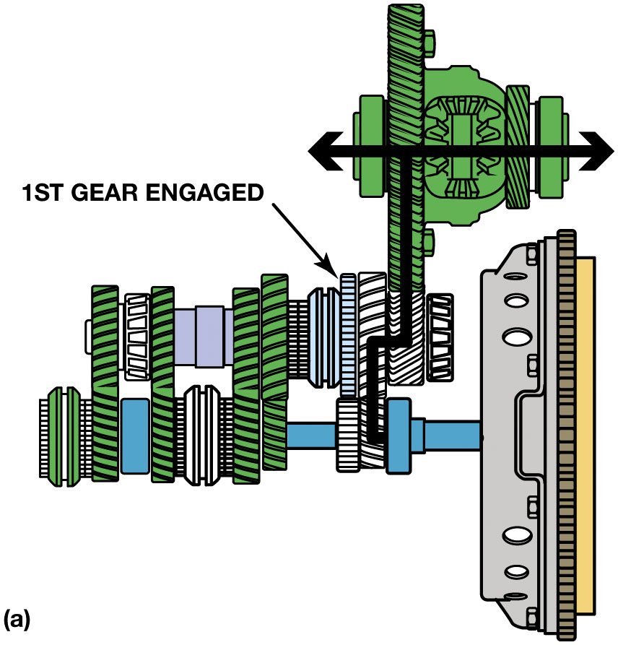
Figure 6.4 (1 of 6)
First Gear (a)
(a) First gear power flow through a Mitsubishi K M M 5 A F 3 five-speed transaxle.
Notes:
GEAR RATIOS
The synchronizers are the same as those used in a rear-wheel-drive transmission and their parts and
operation are identical.
The power flow for reverse gear is also similar to that of a rear-wheel-drive transmission. In most
cases, the reverse idler is shifted into mesh with the reverse gear on the in- put shaft and the
sleeve of the 1–2 synchronizer assembly, which has the spur gear teeth for reverse on the outer
diameter. The idler gear will rotate in a counterclockwise direction viewed from the right side,
the 1–2 synchronizer assembly will rotate clockwise, and the differential and drive wheels will
rotate counterclockwise to drive the vehicle backward. SEE FIGURE 6.5.
Long Description:
The illustration has a transaxle on the right. A rod is connected to the transaxle and marks the beginning of the input shaft on the left. Above the input shaft is the output shaft. Connected to the output shaft is the differential case assembly. The second rectangle from the right of the output shaft is labeled first gear engaged. An arrow emerges from the rod, goes to the first rectangle of the output shaft, turns right, and moves upward to the differential case assembly, and splits into a double-headed arrow.

Slide 10
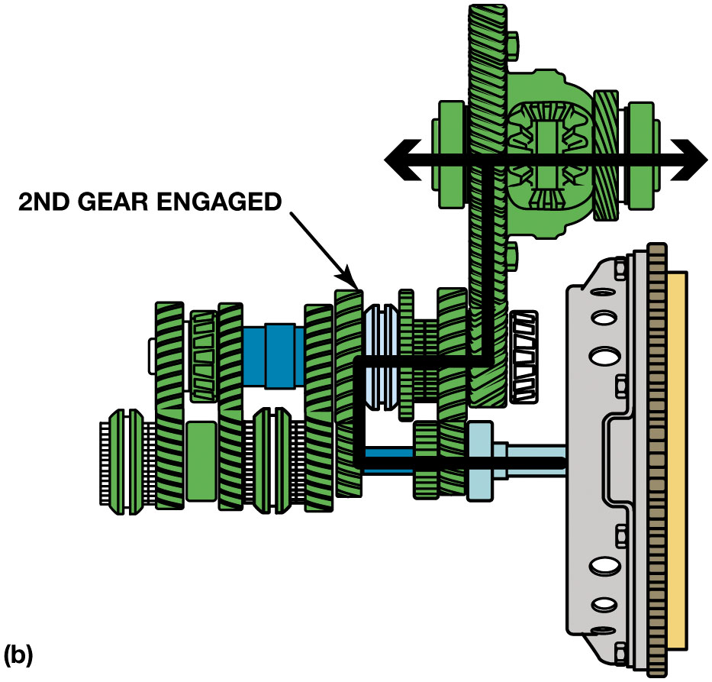
Figure 6.4 (2 of 6)
Second Gear (b)
(b) Second gear powerflow
Notes:
Long Description:
The illustration has a transaxle on the right. A rod is connected to the transaxle and marks the beginning of the input shaft on the left. Above the input shaft is the output shaft. Connected to the output shaft is the differential case assembly. The third rectangle from the right of the output shaft is labeled second gear engaged. An arrow emerges from the rod, reaches the third rectangle of the input shaft, moves upward to the output shaft, turns right to the endpoint of the differential case assembly, and moves upward. The arrow then splits into a double-headed arrow in the differential case assembly.

Slide 11
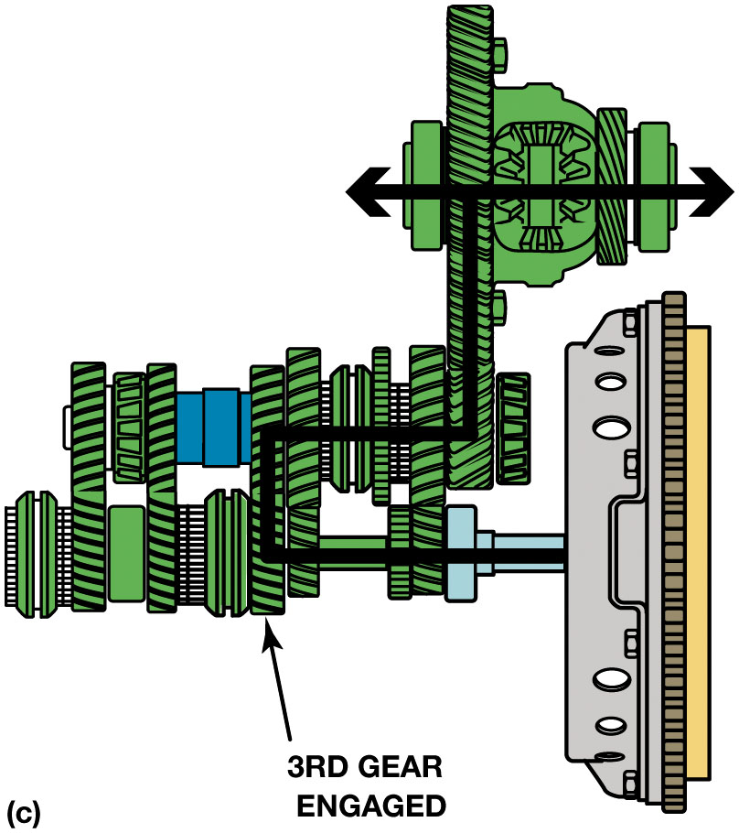
Figure 6.4 (3 of 6)
Third Gear (c)
(c) Third gear powerflow
Notes:
GEAR RATIOS
The synchronizers are the same as those used in a rear-wheel-drive transmission and their parts and
operation are identical.
The power flow for reverse gear is also similar to that of a rear-wheel-drive transmission. In most
cases, the reverse idler is shifted into mesh with the reverse gear on the in- put shaft and the
sleeve of the 1–2 synchronizer assembly, which has the spur gear teeth for reverse on the outer
diameter. The idler gear will rotate in a counterclockwise direction viewed from the right side,
the 1–2 synchronizer assembly will rotate clockwise, and the differential and drive wheels will
rotate counterclockwise to drive the vehicle backward. SEE FIGURE 6.5.
Long Description:
The illustration has a transaxle on the right. A rod is connected to the transaxle and marks the beginning of the input shaft on the left. Above the input shaft is the output shaft. Connected to the output shaft is the differential case assembly. The fourth rectangle from the right of the input shaft is labeled third gear engaged. An arrow emerges from the rod, reaches the fourth rectangle of the input shaft, moves upward to the output shaft, turns right to the endpoint of the differential case assembly, and moves upward. The arrow then splits into a double-headed arrow in the differential case assembly.

Slide 12
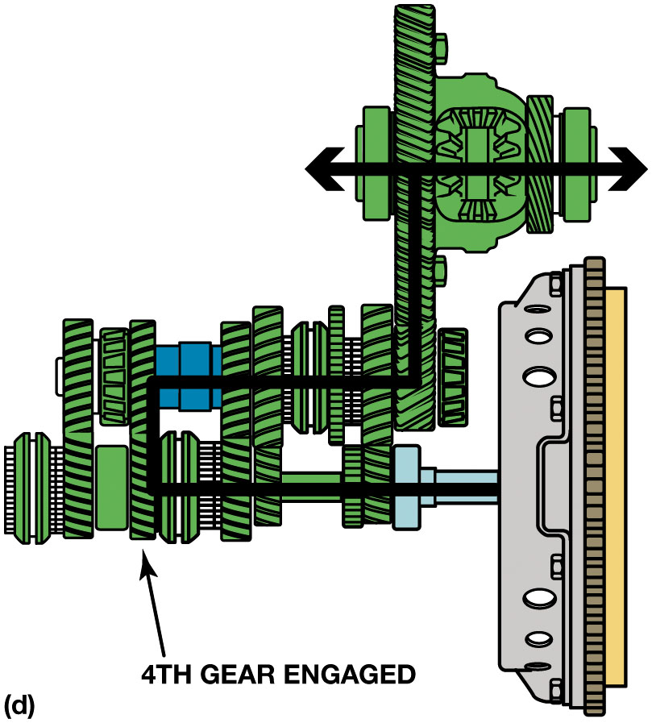
Figure 6.4 (4 of 6)
Fourth Gear (d)
(d) Fourth gear powerflow
Notes:
GEAR RATIOS
The synchronizers are the same as those used in a rear-wheel-drive transmission and their parts and
operation are identical.
The power flow for reverse gear is also similar to that of a rear-wheel-drive transmission. In most
cases, the reverse idler is shifted into mesh with the reverse gear on the in- put shaft and the
sleeve of the 1–2 synchronizer assembly, which has the spur gear teeth for reverse on the outer
diameter. The idler gear will rotate in a counterclockwise direction viewed from the right side,
the 1–2 synchronizer assembly will rotate clockwise, and the differential and drive wheels will
rotate counterclockwise to drive the vehicle backward. SEE FIGURE 6.5.
Long Description:
The illustration has a transaxle on the right. A rod is connected to the transaxle and marks the beginning of the input shaft on the left. Above the input shaft is the output shaft. Connected to the output shaft is the differential case assembly. The fifth rectangle from the right of the input shaft is labeled fourth gear engaged. An arrow emerges from the rod, reaches the fifth rectangle of the input shaft, moves upward to the output shaft, turns right to the endpoint of the differential case assembly, and moves upward. The arrow then splits into a double-headed arrow in the differential case assembly.

Slide 13
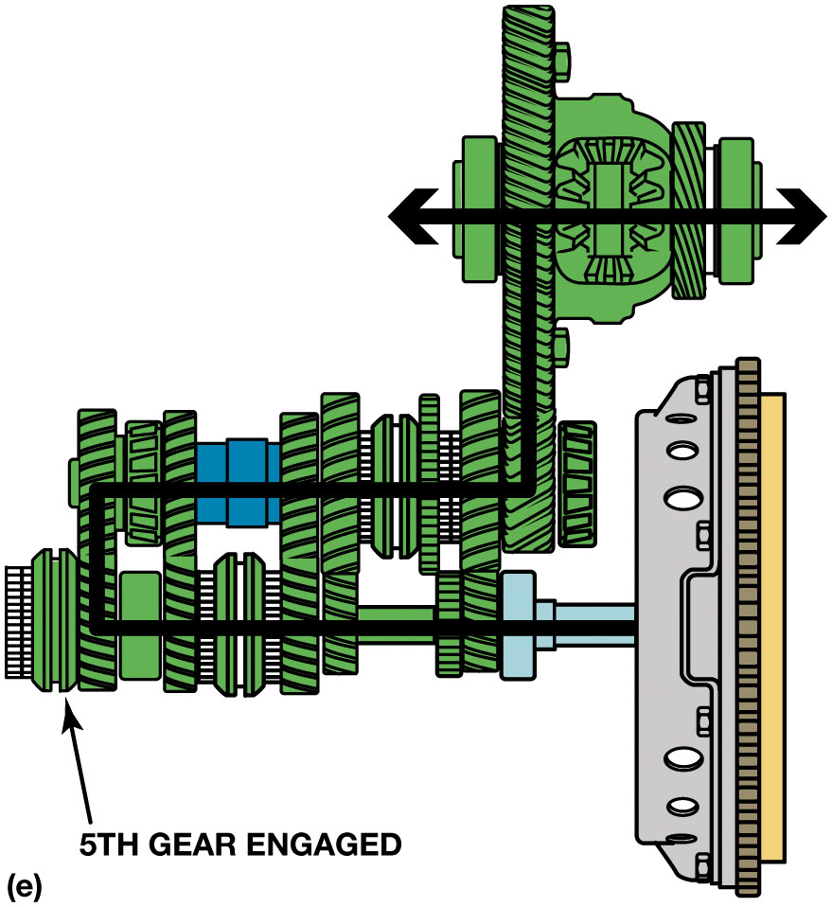
Figure 6.4 (5 of 6)
Fifth Gear (e)
(e) Fifth gear powerflow
Notes:
GEAR RATIOS
The synchronizers are the same as those used in a rear-wheel-drive transmission and their parts and
operation are identical.
The power flow for reverse gear is also similar to that of a rear-wheel-drive transmission. In most
cases, the reverse idler is shifted into mesh with the reverse gear on the in- put shaft and the
sleeve of the 1–2 synchronizer assembly, which has the spur gear teeth for reverse on the outer
diameter. The idler gear will rotate in a counterclockwise direction viewed from the right side,
the 1–2 synchronizer assembly will rotate clockwise, and the differential and drive wheels will
rotate counterclockwise to drive the vehicle backward. SEE FIGURE 6.5.
Long Description:
The illustration has a transaxle on the right. A rod is connected to the transaxle and marks the beginning of the input shaft on the left. Above the input shaft is the output shaft. Connected to the output shaft is the differential case assembly. The sixth rectangle from the right of the input shaft is labeled fifth gear engaged. An arrow emerges from the rod, reaches the sixth rectangle of the input shaft, moves upward to the output shaft, turns right to the endpoint of the differential case assembly, and moves upward. The arrow then splits into a double-headed arrow in the differential case assembly.

Slide 14
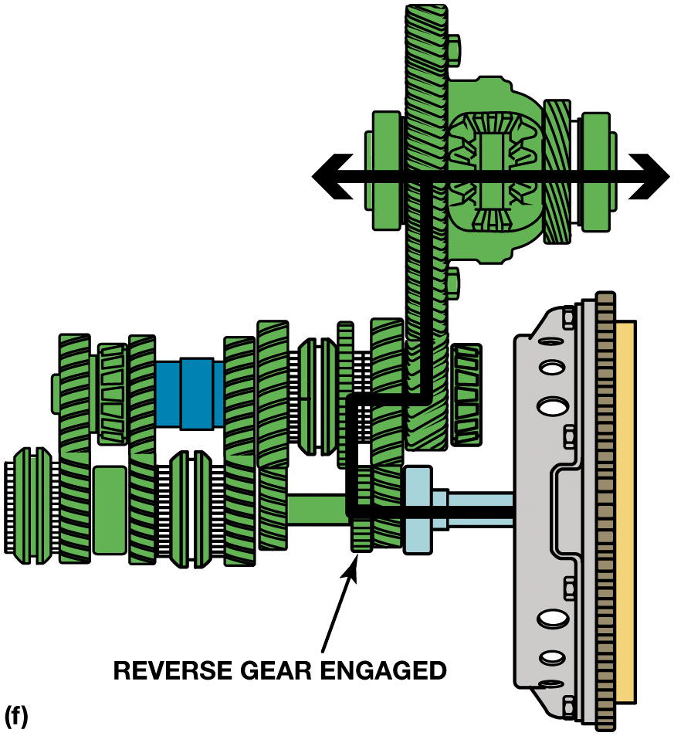
Figure 6.4 (6 of 6)
Reverse (f)
(f) Reverse powerflow (idler not shown)
Notes:
GEAR RATIOS
The synchronizers are the same as those used in a rear-wheel-drive transmission and their parts and
operation are identical.
The power flow for reverse gear is also similar to that of a rear-wheel-drive transmission. In most
cases, the reverse idler is shifted into mesh with the reverse gear on the in- put shaft and the
sleeve of the 1–2 synchronizer assembly, which has the spur gear teeth for reverse on the outer
diameter. The idler gear will rotate in a counterclockwise direction viewed from the right side,
the 1–2 synchronizer assembly will rotate clockwise, and the differential and drive wheels will
rotate counterclockwise to drive the vehicle backward. SEE FIGURE 6.5.
Long Description:
The illustration has a transaxle on the right. A rod is connected to the transaxle and marks the beginning of the input shaft on the left. Above the input shaft is the output shaft. Connected to the output shaft is the differential case assembly. The second rectangle from the right of the input shaft is labeled reverse gear engaged. An arrow emerges from the rod, reaches the reverse gear of the input shaft, moves upward to the output shaft, turns right to the endpoint of the differential case assembly, and moves upward. The arrow then splits into a double-headed arrow in the differential case assembly.

Slide 15
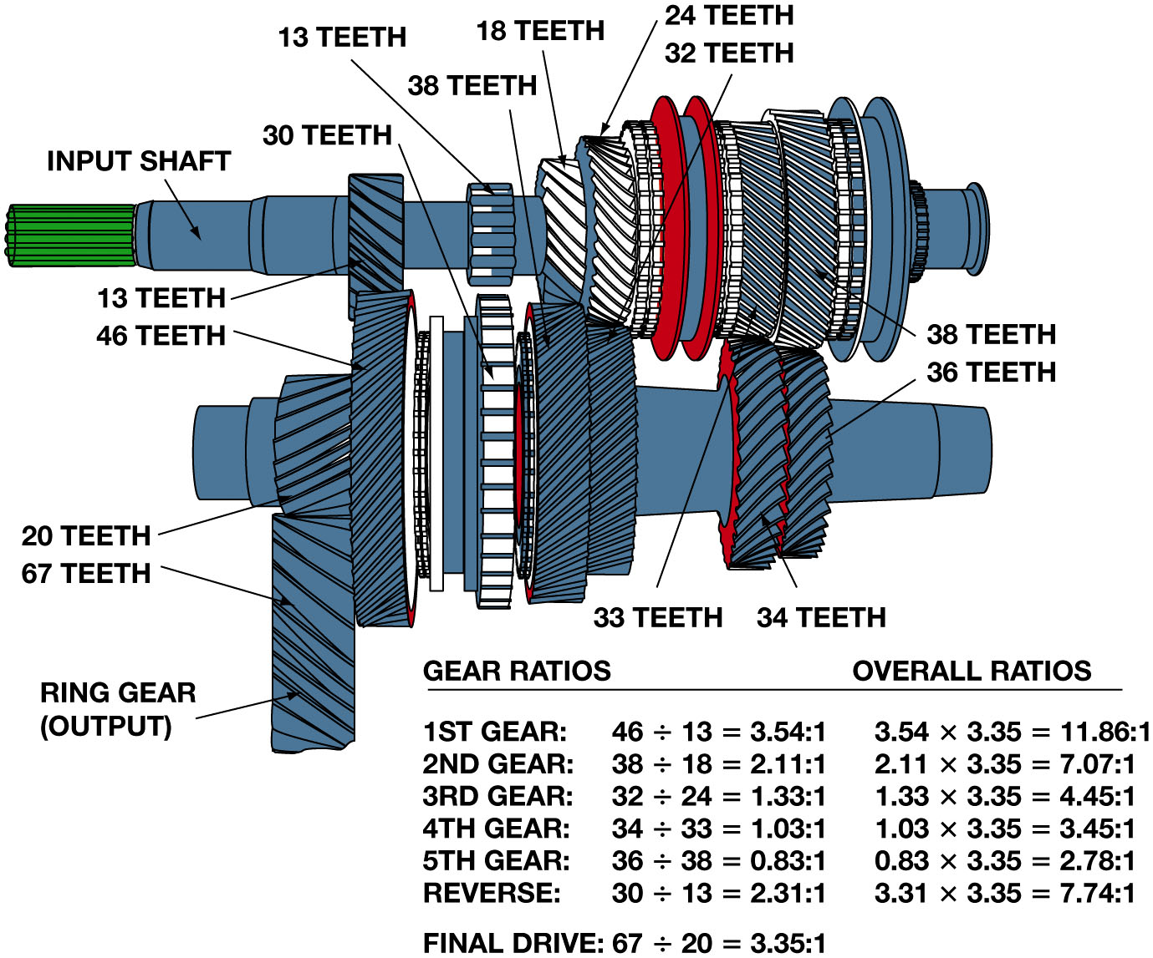
Figure 6.5
Transaxle Operation Gear Ratios
The gear ratios of a transaxle are determined by dividing the tooth count of the driven gear by that of the driving gear. Multiplying the transaxle gear ratio by the final drive ratio gives us the overall ratio.
Notes:
GEAR RATIOS
The synchronizers are the same as those used in a rear-wheel-drive transmission and their parts and
operation are identical.
The power flow for reverse gear is also similar to that of a rear-wheel-drive transmission. In most
cases, the reverse idler is shifted into mesh with the reverse gear on the in- put shaft and the
sleeve of the 1–2 synchronizer assembly, which has the spur gear teeth for reverse on the outer
diameter. The idler gear will rotate in a counterclockwise direction viewed from the right side,
the 1–2 synchronizer assembly will rotate clockwise, and the differential and drive wheels will
rotate counterclockwise to drive the vehicle backward. SEE FIGURE 6.5.
Long Description:
The illustration has an input shaft at the top and an output shaft below. Starting from the left, the input shaft has a gear with 13 teeth, followed by a circular gear with 13 teeth, 18 teeth, 24 teeth, and 38 teeth. Starting from the left, the output shaft has a vertical gear with 67 teeth and a gear with 20 teeth above. Next to the gear with 20 teeth is a circular gear with 46 teeth, 30 teeth, 32 teeth, 33 teeth, 34 teeth, and 36 teeth. A chart for gear ratios and overall ratios is provided below the illustration. Gear ratios for the gears are as follows. First gear: 46 divided by 13 equals 3 point 5 4 colon 1. Second gear: 38 divided by 18 equals 2 point 11 colon 1. Third gear: 32 divided by 24 equals 1 point 3 3 colon 1. Fourth gear: 34 divided by 33 equals 1 point 0 3 colon 1. Fifth gear: 36 divided by 38 equals 0 point 8 3 colon 1. Reverse: 30 divided by 13 equals 2 point 3 1 colon 1. Final drive: 67 divided by 20 equals 3 point 3 5 colon 1. Overall ratios for the gears are as follows. 3 point 5 4 times 3 point 3 5 equals 11 point 8 6 colon 1. 2 point 1 1 times 3 point 3 5 equals 7 point 0 7 colon 1. 1 point 3 3 times 3 point 3 5 equals 4 point 4 5 colon 1. 1 point 0 3 times 3 point 3 5 equals 3 point 4 5 colon 1. 0 point 8 3 times 3 point 3 5 equals 2 point 7 8 colon 1. 3 point 3 1 times 3 point 3 5 equals 7 point 7 4 colon 1.

Slide 16
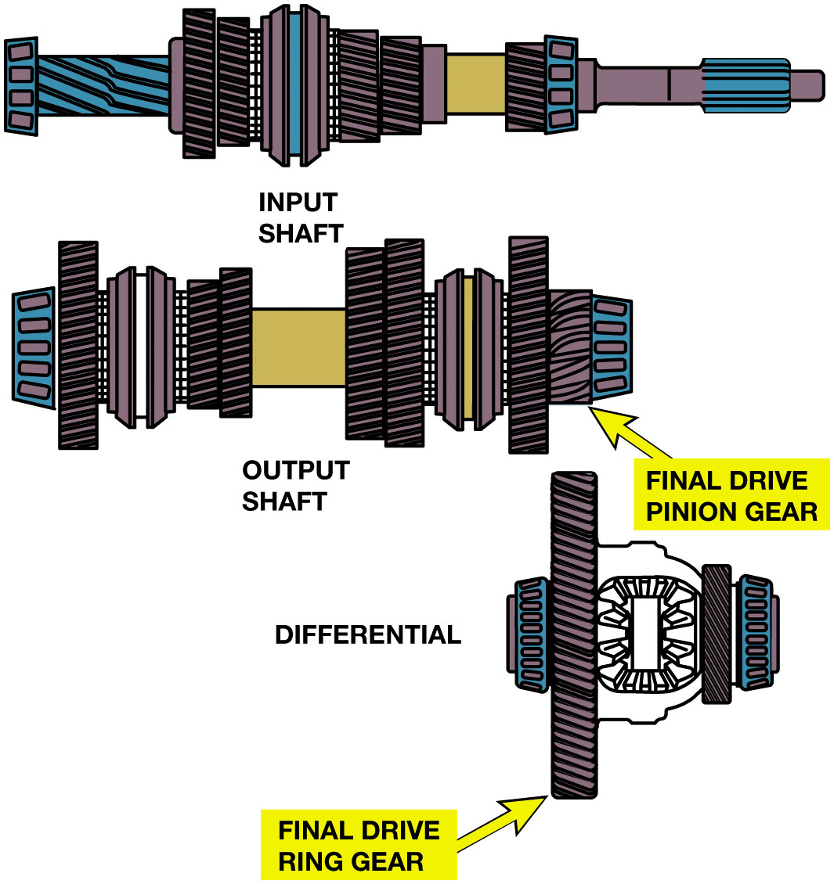
Figure 6.6
Transaxle Operation Final Drive
Power Leaves Transaxle Main Shaft
Through drive pinion
Drives final drive ring gear.
Drive pinion & ring gear
In pair of helical gears
Gear set operates quietly
Does not require critical adjustments like a hypoid gear set.
The final drive pinion gear drives the ring gear, which is mounted on the differential case.
Notes:
Long Description:
The illustration has an input shaft at the top, an output shaft in the middle, and a differential shaft at the bottom. Starting from the right of the output shaft is a rectangle aligned vertically and labeled final drive pinion gear. Starting from the left, the differential shaft has a circular gear followed by a rectangle aligned vertically and labeled final drive ring gear.

Slide 17
Animation: Transmission Power Flow (Animation will automatically start)

Slide 18
Animation: Transaxle: 1st Gear (Animation will automatically start)

Slide 19
Animation: Transaxle, 2nd Gear (Animation will automatically start)

Slide 20
Animation: Transaxle, 3rd Gear (Animation will automatically start)

Slide 21
Animation: Transaxle, 4th Gear (Animation will automatically start)

Slide 22
Animation: Transaxle, 5th Gear (Animation will automatically start)

Slide 23
Animation: Transaxle, Final Drive (Animation will automatically start)

Slide 24
Animation: Transaxle, Reverse (Animation will automatically start)

Slide 25
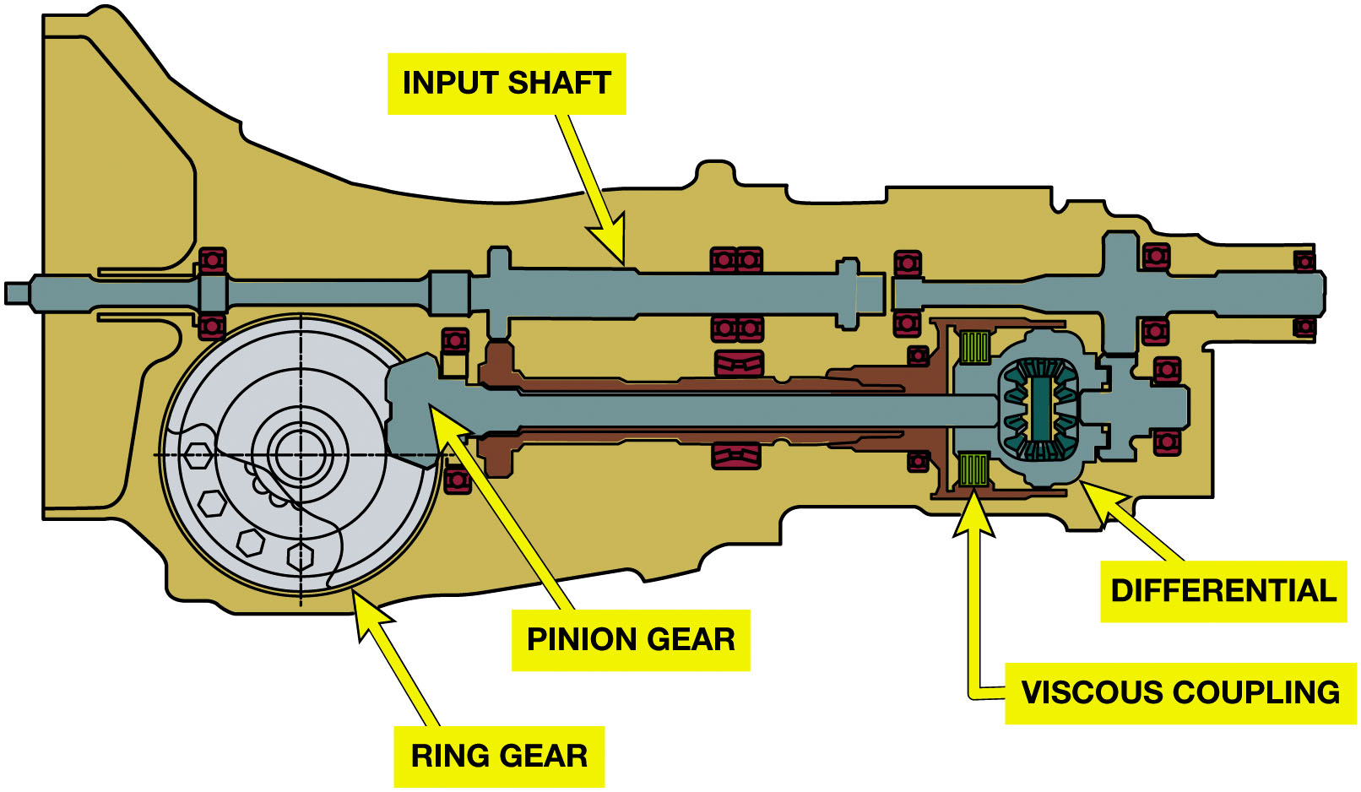
Figure 6.7
Transaxle Operation Longitudinal Transaxle
Final Drive & Differential
Power leaves through drive pinion.
Power must turn
to align with front drive.
Hypoid gears require adjustments for proper ring and pinion gear positioning
This Subaru transaxle is used with an engine that is mounted lengthwise in the vehicle. Note how the final drive is through a ring and pinion gear set. Also note the center differential and extension to drive the rear wheels of an all-wheel-drive vehicle.
Notes:
Longitudinal Transaxle
Some front-wheel-drive vehicle manufacturers place the engine longitudinally (lengthwise) rather
than placing transversally. This requires a major change in the transaxle. In these units, the
power must turn 90 degrees to align with the front drive. Some units use a hypoid gear set that
mounts the drive pinion above or below the center of the ring gear. This gear set turns the power
flow as it produces the necessary final drive reduction. The power flow from the ring gear through
the differential to the C V joints is the same as described previously.
Hypoid gears require adjustments for proper ring and
pinion gear positioning during assembly procedures. This transaxle lends itself to A W D or 4 W D
because of the longitudinal position of the main shaft. It is a fairly simple matter for the
manufacturer to install a clutch at the rear end of the main shaft and extend an output shaft to
connect to a drive- shaft for the rear wheels. FIGURE 6.7.
Long Description:
Starting from the right, the transaxle has an input shaft at the top and a differential below. The differential is held together with the viscous coupling at the top and bottom, just next to the differential coil. The endpoint of the differential on the left has a bulge and is labeled pinion gear. Followed by the pinion gear is a wheel labeled ring gear.

Slide 26
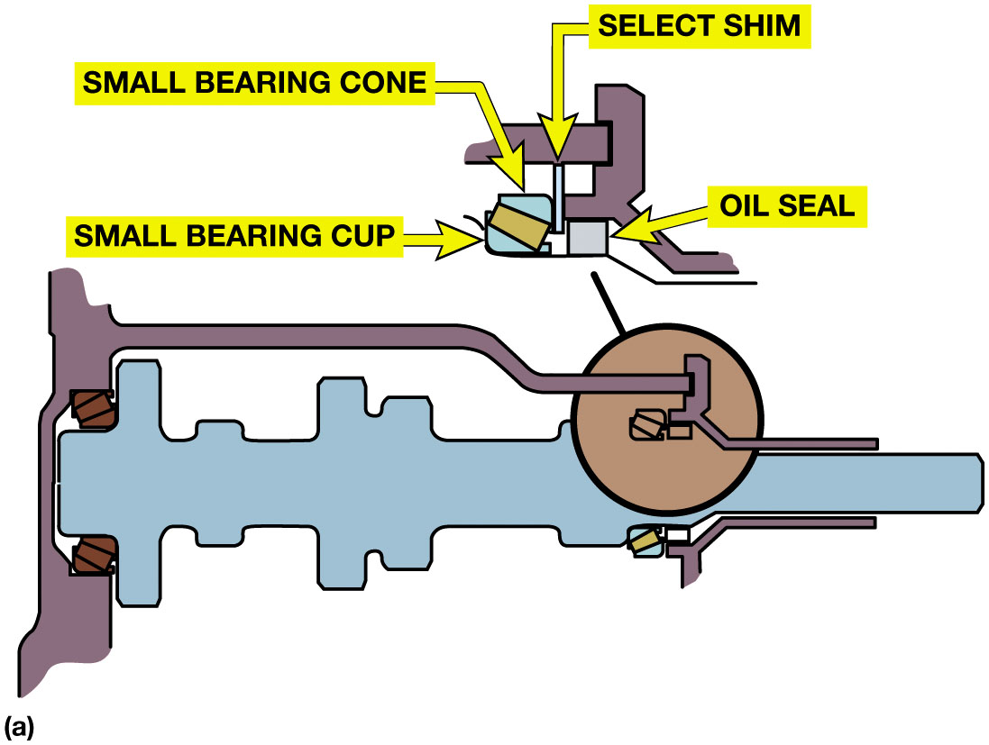
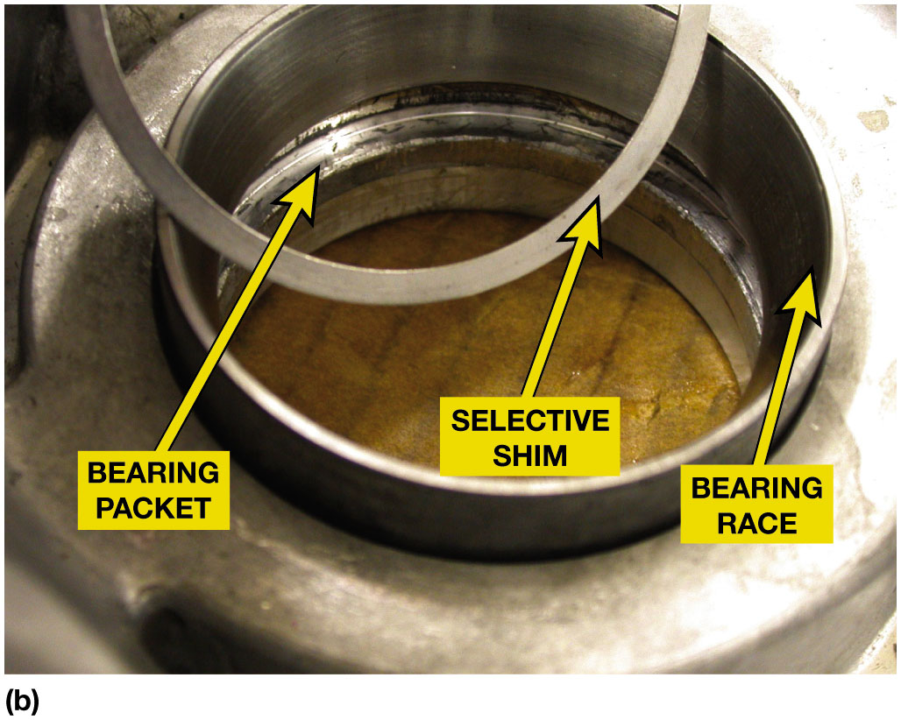
Figure 6.8
Transaxle Operation Bearings & Shims
(a) This transaxle uses tapered roller bearings at the input shaft. To adjust these bearings, the selective shim is located at each bearing set. (b) The selective shim is used under the bearing race and placed into the bearing pocket (bearing counter-bore) before the race is pressed into the transaxle case.
Notes:
TRANSAXLE GEARS Like manual transmissions, manual transaxles use helical gears for all the forward
speeds and spur gears for reverse. To allow for engine length in the cramped width of the engine
compartment, the speed gears, synchronizer assemblies, and bearings are kept as narrow and compact
as practical. This design factor is much more critical with transaxles than with transmissions.
TRANSAXLE BEARINGS The bearing surfaces on many transaxles are made with lubrication slots to
compensate for the reduced gear width, whereas on other units the speed gears are mounted on roller
or needle bearings. These features also improve the efficiency of the transaxle and fuel economy.
Some transaxles use a roller bearing at the engine end of the input shaft and main shaft and a ball
bearing at the other end of the shaft.
The ball bearing supports one end and also positions the shaft to the case as the roller bearing
supports the end with the greater side loading from the final drive. This feature makes for easy
servicing, as the roller bearing can slide through the openings when the cover is removed or
installed.
On transaxles that use tapered roller bearings, bearing clearance or preload is adjusted by
selecting the correct size of shim to place at the bearing or bearing cup. The selective shim is
positioned under the bearing cup in the case. A selective shim means that there are several
different thickness shims available that can be inserted behind the bearing to tied bearing preload.
In loaded areas whereshaft movement can create a problem, the bearings are ad-
justed to a slight preload. ● SEE FIGURE 6.8.
Long Description 1:
The illustration has an asymmetrical rod with a circle at its tapering end. A shaft with its base on the left holds the circle and the rod together on either side. A close-up view of the tapered roller bearings is provided at the top. Two horizontal bars, one on top and one below, are joined by a vertical bar. A block with the label oil seal lies immediately below the horizontal bar at the bottom. Next to the oil seal and close to the horizontal bar is a cup-shaped structure labeled small bearing cup. The opening of the cup is labeled small bearing cone. In between the block and the cup is a vertical strip that connects the two horizontal bars.
Long Description 2:
The image has a circular, bearing race. The inner layer of the bearing race is labeled the bearing packet. At the rim of the bearing packet, is another ring towards the edge labeled selective shim.

Slide 27
Transaxle Operation: Case & Lubrication
Transaxle Case Design
Made from cast aluminum.
Separate side case or side cover.
Splash Lubrication
Oil is directed to critical areas by troughs and oiling funnels
Notes:
Transaxle Case Design
Transaxle cases are made from cast aluminum. Many cases use a two-part assembly with a right-hand
case or cover that also forms the clutch housing and a left-hand or main case that contains the
gears. Some units have a separate side case or side cover that encloses the fifth gear set and the
synchronizer or just the left-side bearings. Some units have a bottom or differential cover that
provides access to the differential assembly.
SPLASH LUBRICATION Like transmissions, transaxles use a supply of oil in the sump at the bottom of
the case that is circulated by gear rotation. This type of lubrication is called splash
lubrication. The oil is directed to critical areas by troughs and oiling funnels. The fluid level
is normally checked at a fill-level plug or with a dipstick.
Most transaxles have a common case, so the transmission and final drive share the same lubricant.
Some units separate two and different oils may be used for each gear set, and there will be 2 fluid-level plugs.

Slide 28
Question 1
All of these can cause torque steer, EXCEPT:
A. Unequal C V joint angles
B. Unequal length of the shafts
C. The tendency for the longer drive shaft to twist
D. Defective C V Joint

Slide 29
Answer 1
All of these can cause torque steer, EXCEPT:
D. Defective C V Joint

Slide 30
Summary
Transaxles combine a transmission with the final drive gear set and differential.
Some transaxles are mounted in a longitudinal position
Use a hypoid final drive gear set.
Transaxles use helical cut gears except for reverse
Where straight cut spur gears are often used.

Slide 31
Automotive Fundamentals Videos and Animations
Videos Link: (A3) Manual Drive Train Axles Videos
Animations Link: (A3) Manual Drive Train Axles Animations

Slide 32
Copyright
This work is protected by United States copyright laws and is provided solely for the use of instructors in teaching their courses and assessing student learning. Dissemination or sale of any part of this work (including on the World Wide Web) will destroy the integrity of the work and is not permitted. The work and materials from it should never be made available to students except by instructors using the accompanying text in their classes. All recipients of this work are expected to abide by these restrictions and to honor the intended pedagogical purposes and the needs of other instructors who rely on these materials.

